Slide 1
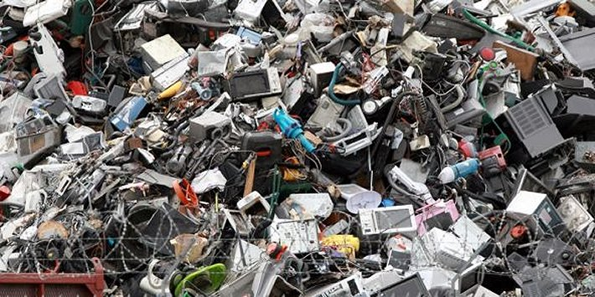
The Mad Hedge Fund Trader “Tech is Trashed”
With John Thomas Incline Village, NV, January 19, 2022 www.madhedgefundtrader.com
Notes:
*

Slide 2
Trade Alert Performance New All Time Highs!
*January 3.12% MTD *July +0.61% Final *February +13.28% Final *August +9.36% Final *March +20.60% Final *September 1.03% Final *April +15.67% Final *October +8.91% MTD *May +8.13% Final *November -11.79% Final *June +0.71% Final *December +11.26% Final *2021 FINAL +90.02% compared to +18.75% for the Dow Average 2022 YTD: 3.12% Dow Average 2022 YTD -3.8% *+515.11% since inception *Average annualized return of 42.62% for 12 years

Slide 3
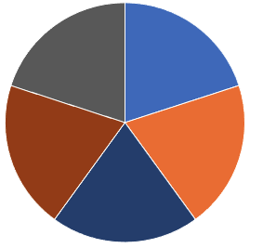
Portfolio Review 30% cash-70% invested Long Term Bull Market
Current Capital at Risk
Risk On
World is Getting Better
(TLT) 2/$149-$152 put spread | 10.00%
(TLT) 2/$147-$150 put spread | 10.00%
Risk Off
World is Getting Worse
(MSFT) 2/$340-$350 puts spread | -10.00%
(SPY) 2/$480-$500 put spread | -10.00%
(SPY) 2/$477-$487 put spread | -10.00%
(TLT) 2/$130-$133 call spread | -10.00%
Total Net Position | -20.00%
Total Aggregate Position | 60.00%
Expiration Value 9.02%

Slide 4
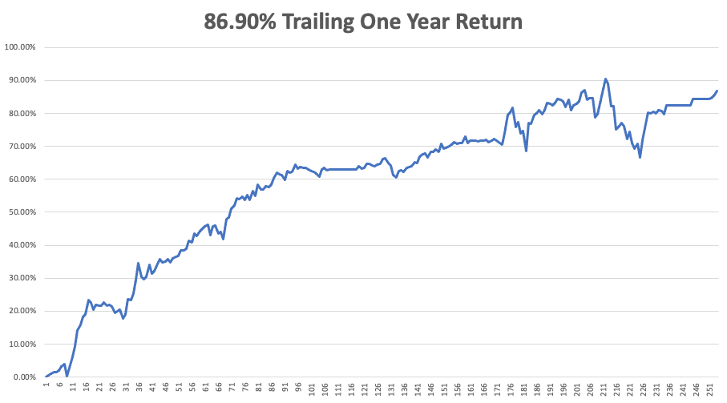

Slide 5
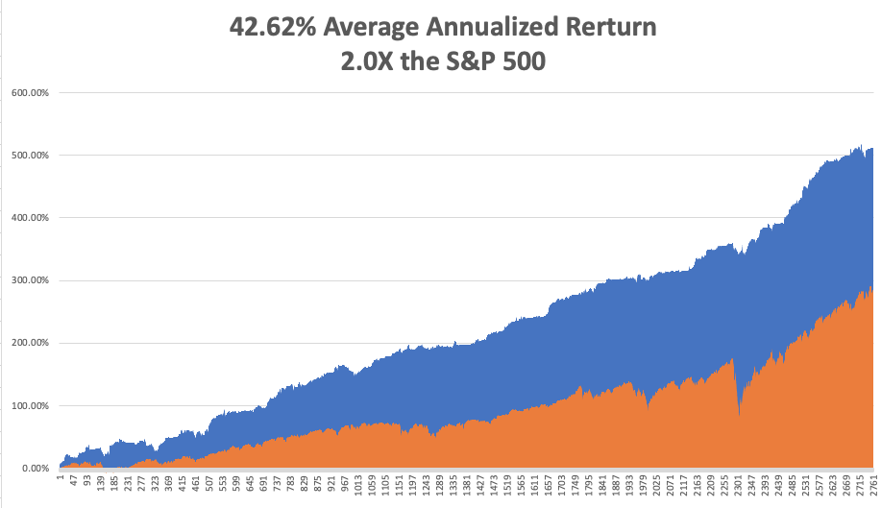
GTD 12 Year Daily Audited Performance

Slide 6
The Method to My Madness The Roaring Twenties are Here
*Interest rates have moved to the fore as the main market driver *Rapidly tightening Fed policy has triggered a global “RISK OFF” *It not the next four rate hikes that I’m worried about, which are already in the market, the the 8 following *A core short in bonds will be key, but trade this too *Bonds SAW another repeat of the January 2021 crash with a $15.00 dive since early December *Omicron is slowing growth everywhere, but a quick bounce back is expected *VIX over $30 is the ideal entry point for new positions

Slide 7
Corona Update – Explosive Growth
*Omicron ravages the US, taking cases to a multiple of past peak *500 million rapid covid tests going out to the public for free with online application at https://www.covidtests.gov *A year ago, hospitalizations hit 1450,000/day. Now it’s 1 million/day *Testing for under fives is underway, wit three mini shots the most likely candidate *Fatalities are a fifth less that year ago peak *Hospitalizations are 80% from the unvaccinated *Pandemic is still going to zero by summer, book those cruises *US cases top 68 million, deaths topping 854,000 and deaths are limited to 1,000 a day, and could soon top 1 million

Slide 8
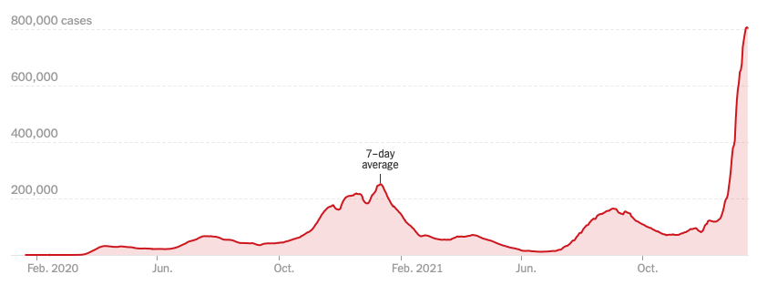
Bump on the Way to Zero

Slide 9
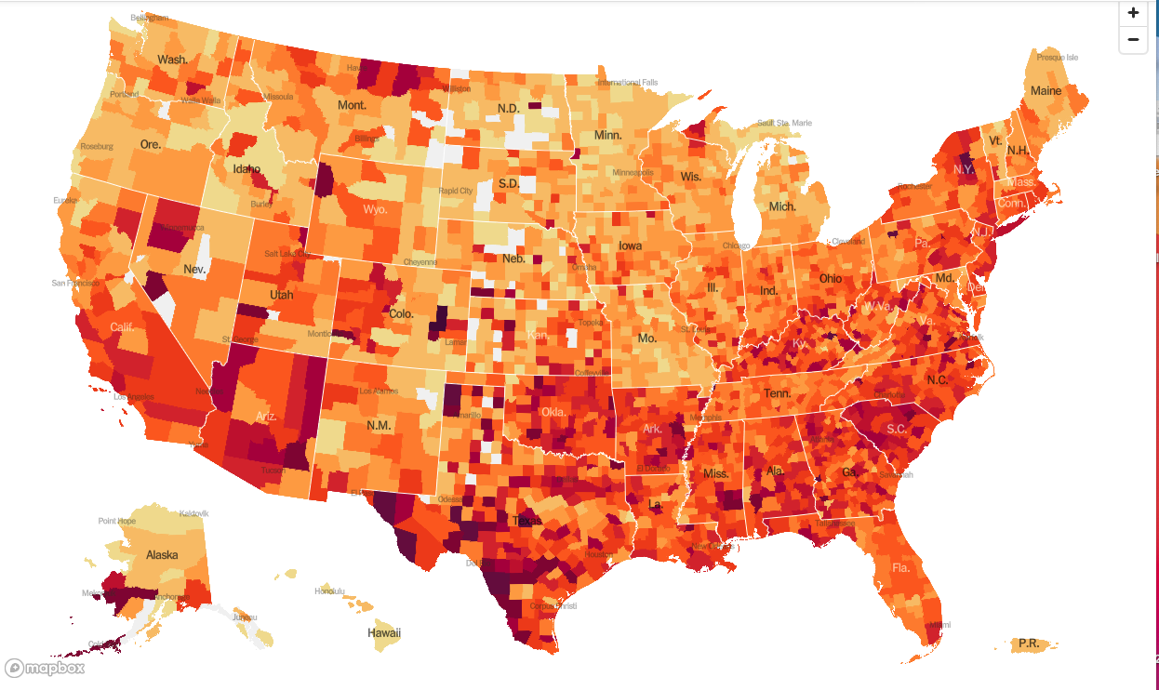
January 20 2021 Infection Rate

Slide 10
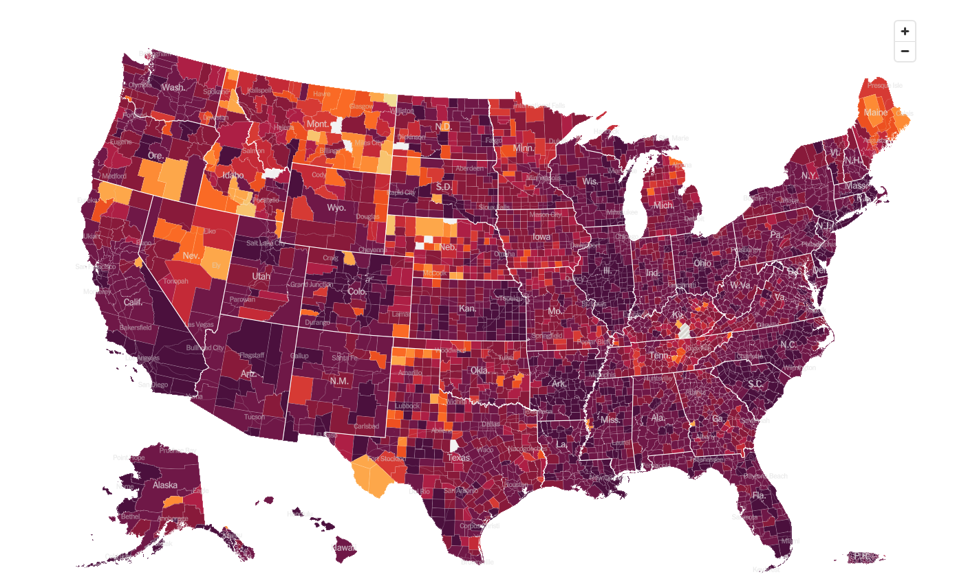
January 19 2022 Infection Rate

Slide 11
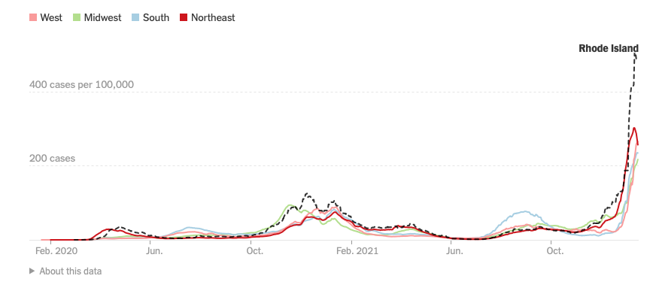

Slide 12
The Global Economy – Still Breathing
*The Fed Minutes Were a Bombshell, released yesterday indicating a serious acceleration of interest rate hikes are in the cards this year. *Nonfarm Payroll Report Disappoints at 199,000. But the Headline Unemployment Rate plunged from 4.2% to 3.9%, *The Economy is the Strongest in Decades, according to JP Morgan CEO Jamie Diamond. *Quantitative Tightening to Start in July, says Goldman Sachs. That’s when the Fed starts selling its vast holdings of US Treasury bonds, about $8.5 trillion worth. *Inflation Hits 7.0%, with the Consumer Price Index hitting a 39 year high. *Wholesale Prices Soar 9.7% YOY, the most in 11 years *US Retail Sales Take 10% Dive, down 1.9% in December, as omicron takes its pound of flesh

Slide 13
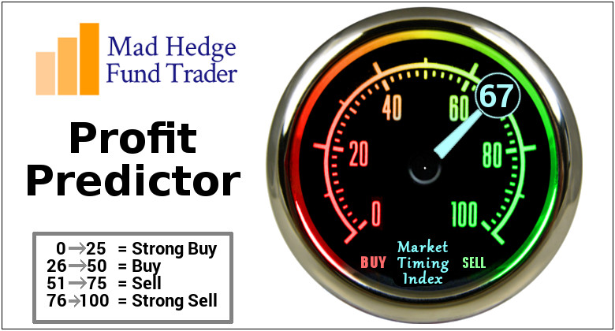
The Mad Hedge Profit Predictor Market Timing Index – SELL Territory An artificial intelligence driven algorithm that analyzes 30 different economic, technical, and momentum driven indicators

Slide 14
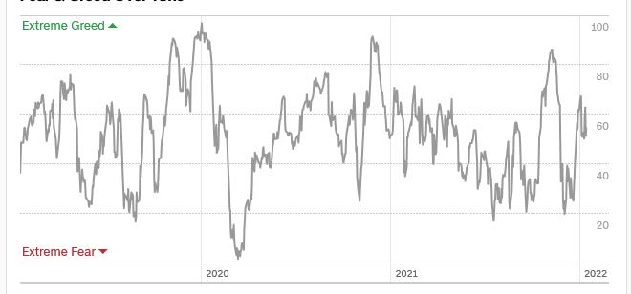
The Mad Hedge Profit Predictor From Extreme “BUY” to Neutral
SELL
Do Nothing
BUY

Slide 15
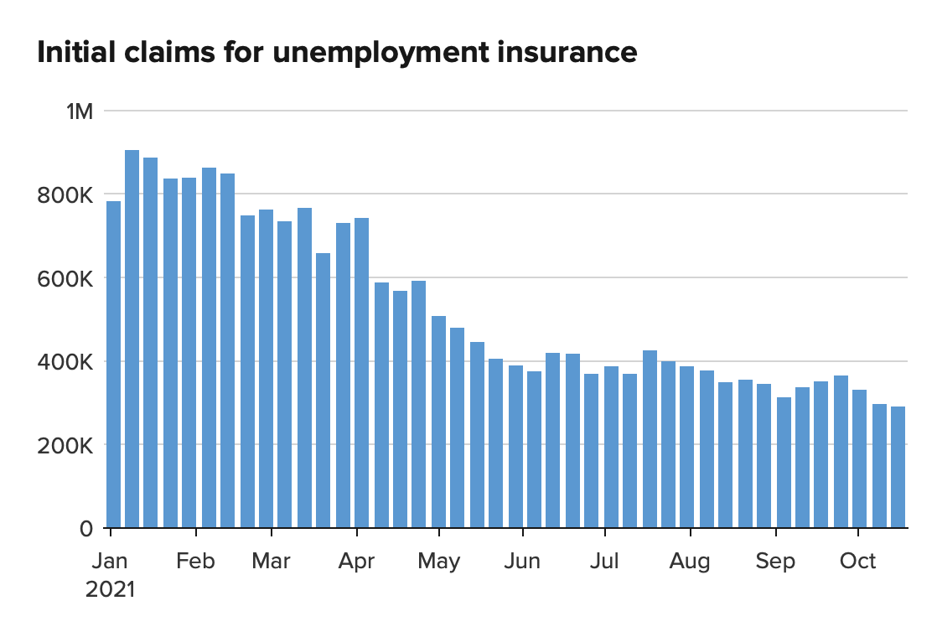
Weekly Jobless Claims – New Lows 230,000 – 2 Month High

Slide 17
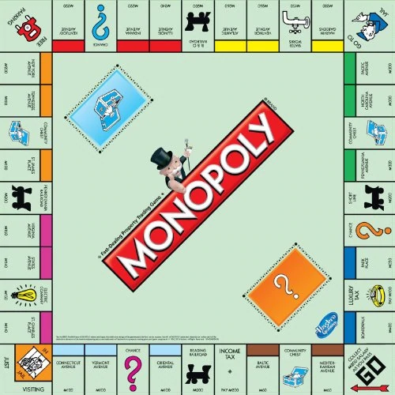
Stocks – Game Changer
*A Major sectoral rotation out of tech and into value recovery stocks is underway *Interest sensitives will be leaders for the next six months, like banks, brokers, and fund managers *NASDAQ Stocks Down 50% Hits Record, from one-year highs. It’s a Dotcom bust echo. Had worth month since 2007 *What is the Cheapest Sector in the Market? Biotech and Health Care, which are at valuation lows not seen since the 2009 and 2000 lows *Goldman Sachs disappoints, taking all brokers down on bear market fears *Auto Stocks Will Be Top Performers, in 2022, says value legend Mario Gabelli. *S&P 500 Profits Jump 22.4% in Q4, possibly taking the full year figure up an incredible 49%.

Slide 18
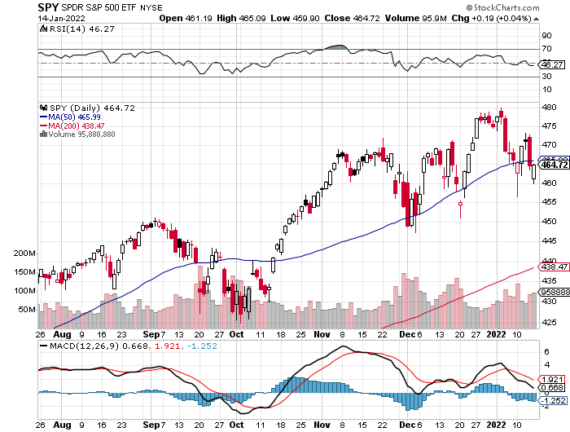
S&P 500 – Year End Melt Up! long 2/$480-$500 bull call spread Took profits on long 10/$410-$420 bull call spread stopped out of long 10/$419-$429 bull call spread
New Highs Yearend Target $475 Achieved
First Support $448 -6.7%
The Bottom 422 Down 12.5%

Slide 19
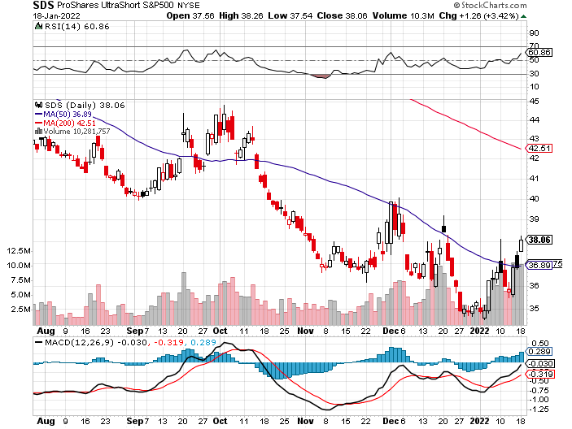
ProShares Ultra Short S&P 500 (SDS)- a great hedge for long stocks and bonds long 2X position has a hedge against longs and bond shorts a reprieve after 20 months

Slide 20
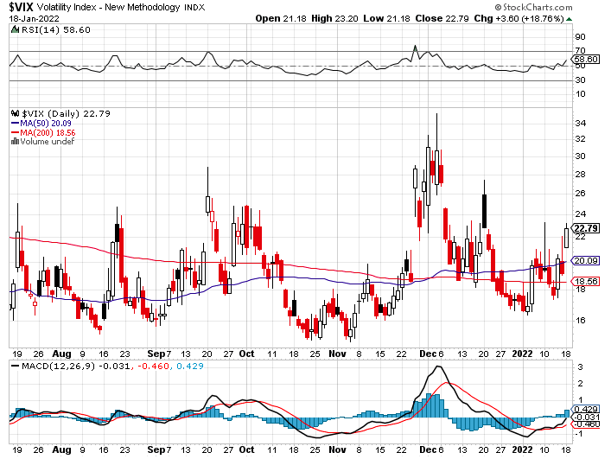
(VIX) – Dying a Slow Death classic summer market

Slide 21
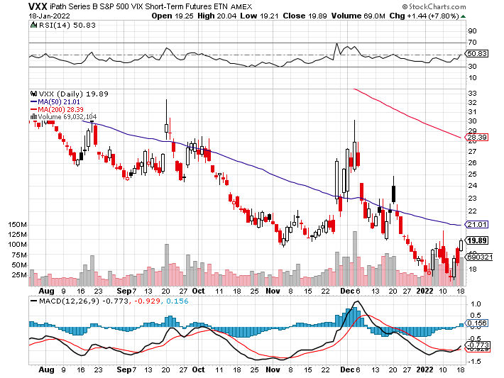
(VXX)-

Slide 22
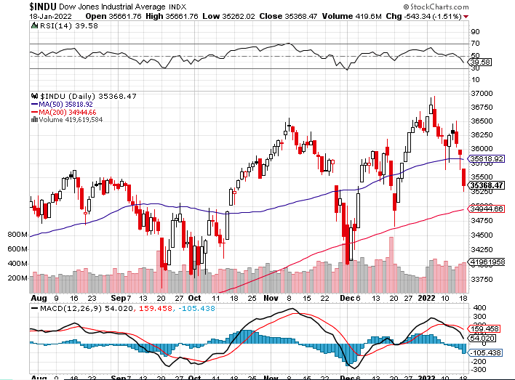
Dow Average ($INDU)-

Slide 23
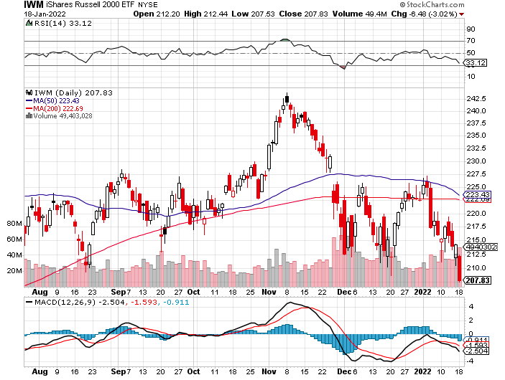
Russell 2000 (IWM)- took profits on Long 10/$137-$142 vertical bull call spread took profits on Long 10/$153-$156 vertical bear put spread

Slide 24
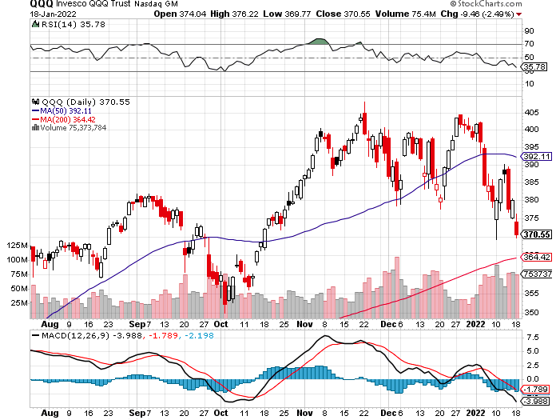
NASDAQ (QQQ) – long (QQQ) 4/$330-$335 put spread took profits on long (QQQ) 3/$340-$345 put spread covered long (QQQ) $325-$330 put spread

Slide 25
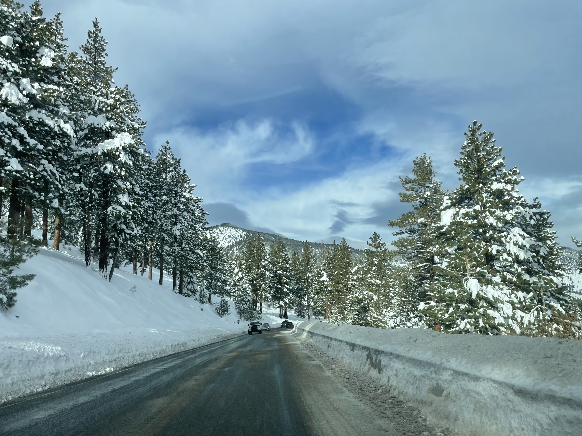

Slide 26
The Barbell Portfolio
*50% Big Tech - 2% of US Employment but 27% of Market Cap and 38% of Profits 50% Domestic Recovery, including: Railroads Couriers Banks Construction Credit Cards Event organizers Ticket sales Retailers

Slide 27
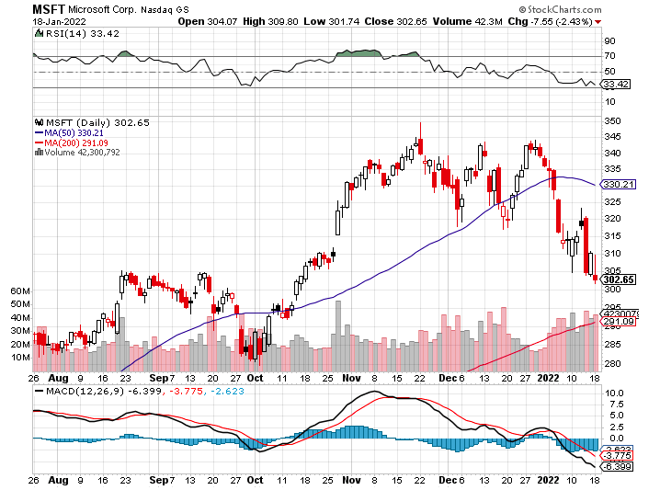
Microsoft (MSFT)- long 2/$340-$350 put spread took profits on long 12/$220-$230 call spread stop loss on long 12/$170-$180 call spread

Slide 28
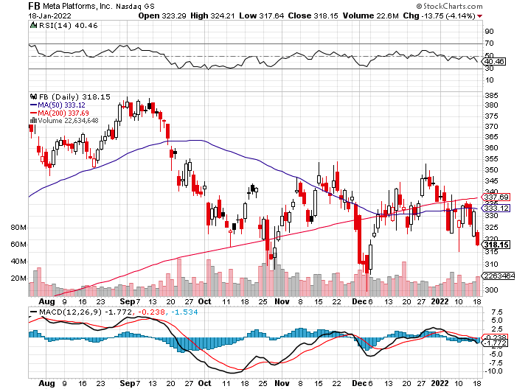
Facebook (FB)- Changes Name to “Meta” took profits on Long 9/$290-$300 vertical bear put spread stopped out of Long 9/$190-$200 vertical bear put spread

Slide 29
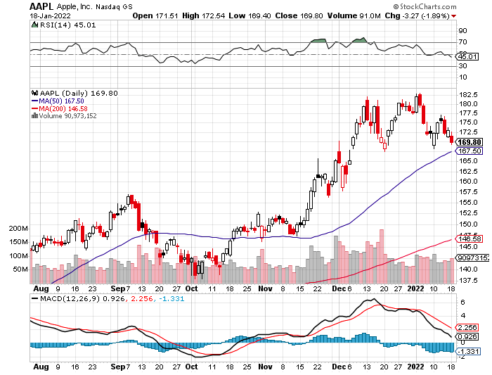
Apple (AAPL)- the First $3 Trillion Market Cap took profits on long 7/$320-$330 call spread took profits on long 4/24/$250-$260 call spread took profits on long 5/$250-$260 call spread

Slide 30
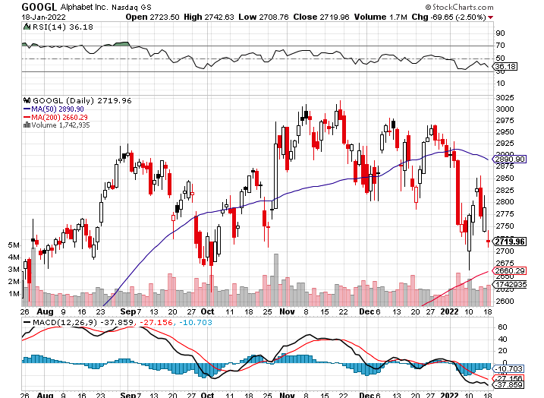
Alphabet (GOOGL) – Ad king on economic recovery 15% of search is travel related took profits on long 12/$1,200-$1,230 bull call spread took profits on long 9/$1,030-$1,080 vertical bull call spread

Slide 31
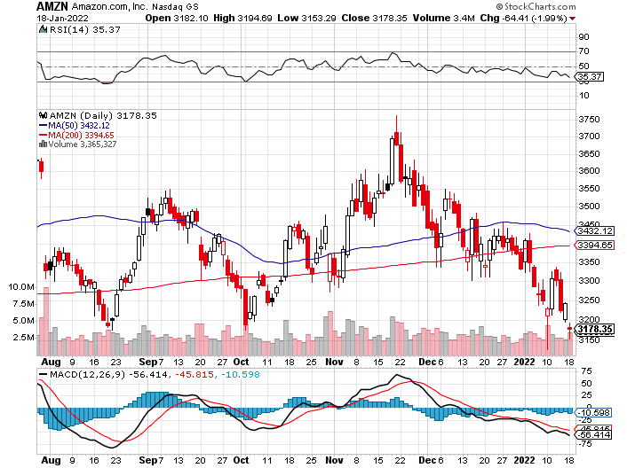
Amazon (AMZN) – took profits on long 9/$2,800-$2,900 bull call spread

Slide 32
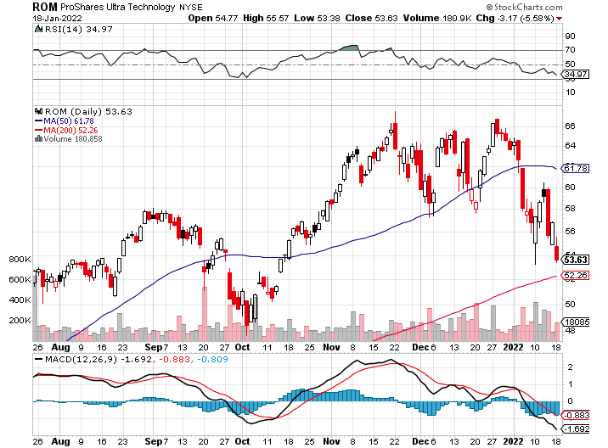
ProShares Ultra Technology (ROM) – New Highs

Slide 33
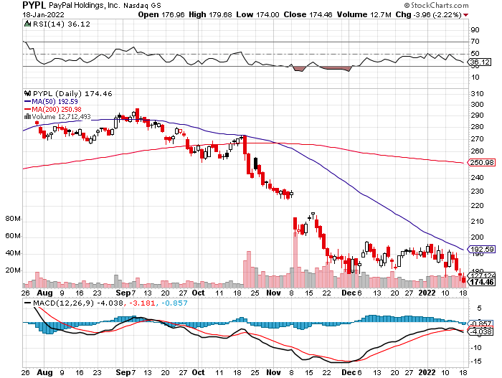
PayPal (PYPL) - Cancels Pinterest Buy took profits on long 4/$90-$95 call spread

Slide 34
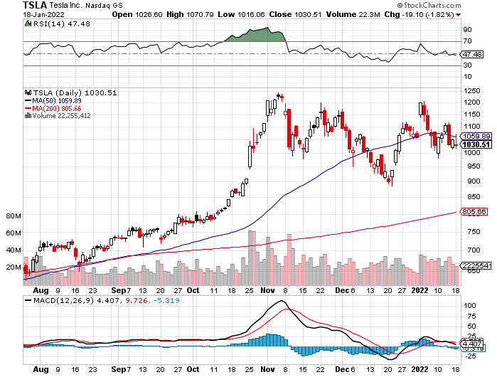
Tesla (TSLA) - Hits $1.2 Trillion in Market Cap 308,000 EV’s delivered in Q4 took profits on long 2X 4/$450-$500 call spread, took profits on long 3/$400-$450 call spread took profits on long 2/$650-$700 call spread-expires, stopped out of long 3/$600-$650 call spread Took profits on long 2/$600-$650 bull call spread, Took profits on long 2/$550-$600 bull call spread

Slide 35
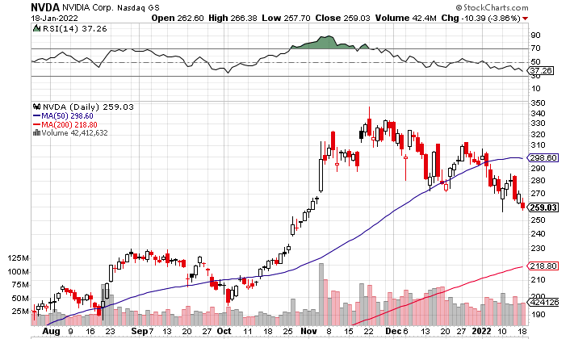
NVIDIA (NVDA) – A Mad Hedge 10 bagger – Global Semiconductor Shortage Slows Auto Industry, Graphic card sales up 87% in Q2

Slide 36
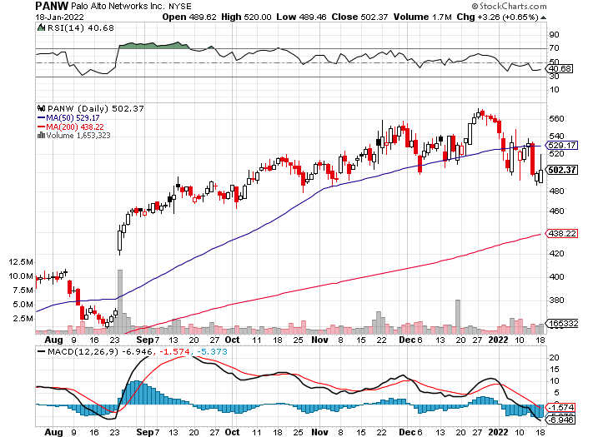
Palo Alto Networks (PANW)- Hacking never goes out of fashion

Slide 37
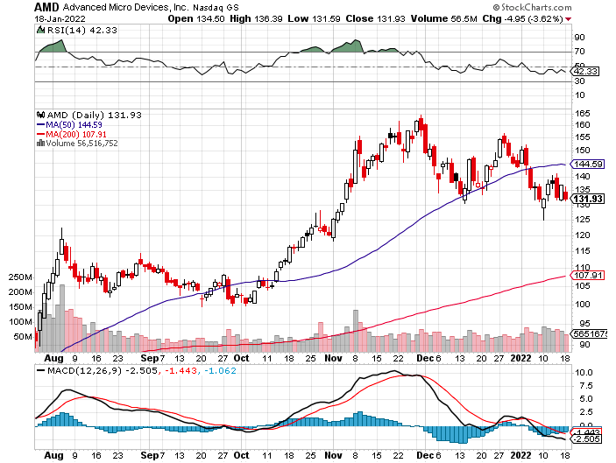
Advanced Micro Devices (AMD)- programable logic devices took profits on long 2/$75-$80 call spread

Slide 38
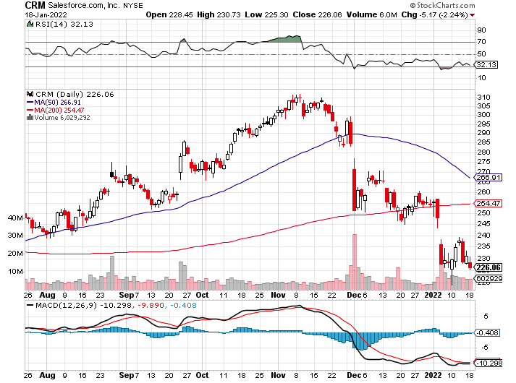
Salesforce (CRM)- Massive Online Migration took profits on long 9/$125-$130 vertical bull call spread took profits on long 8/$125-$130 vertical bull call spread took profits on long 2/$105-$115 call spread

Slide 39
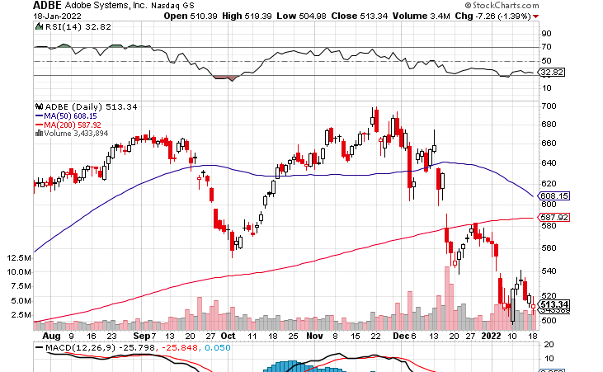
Adobe (ADBE)- Cloud play The Quality Non-China tech play

Slide 40
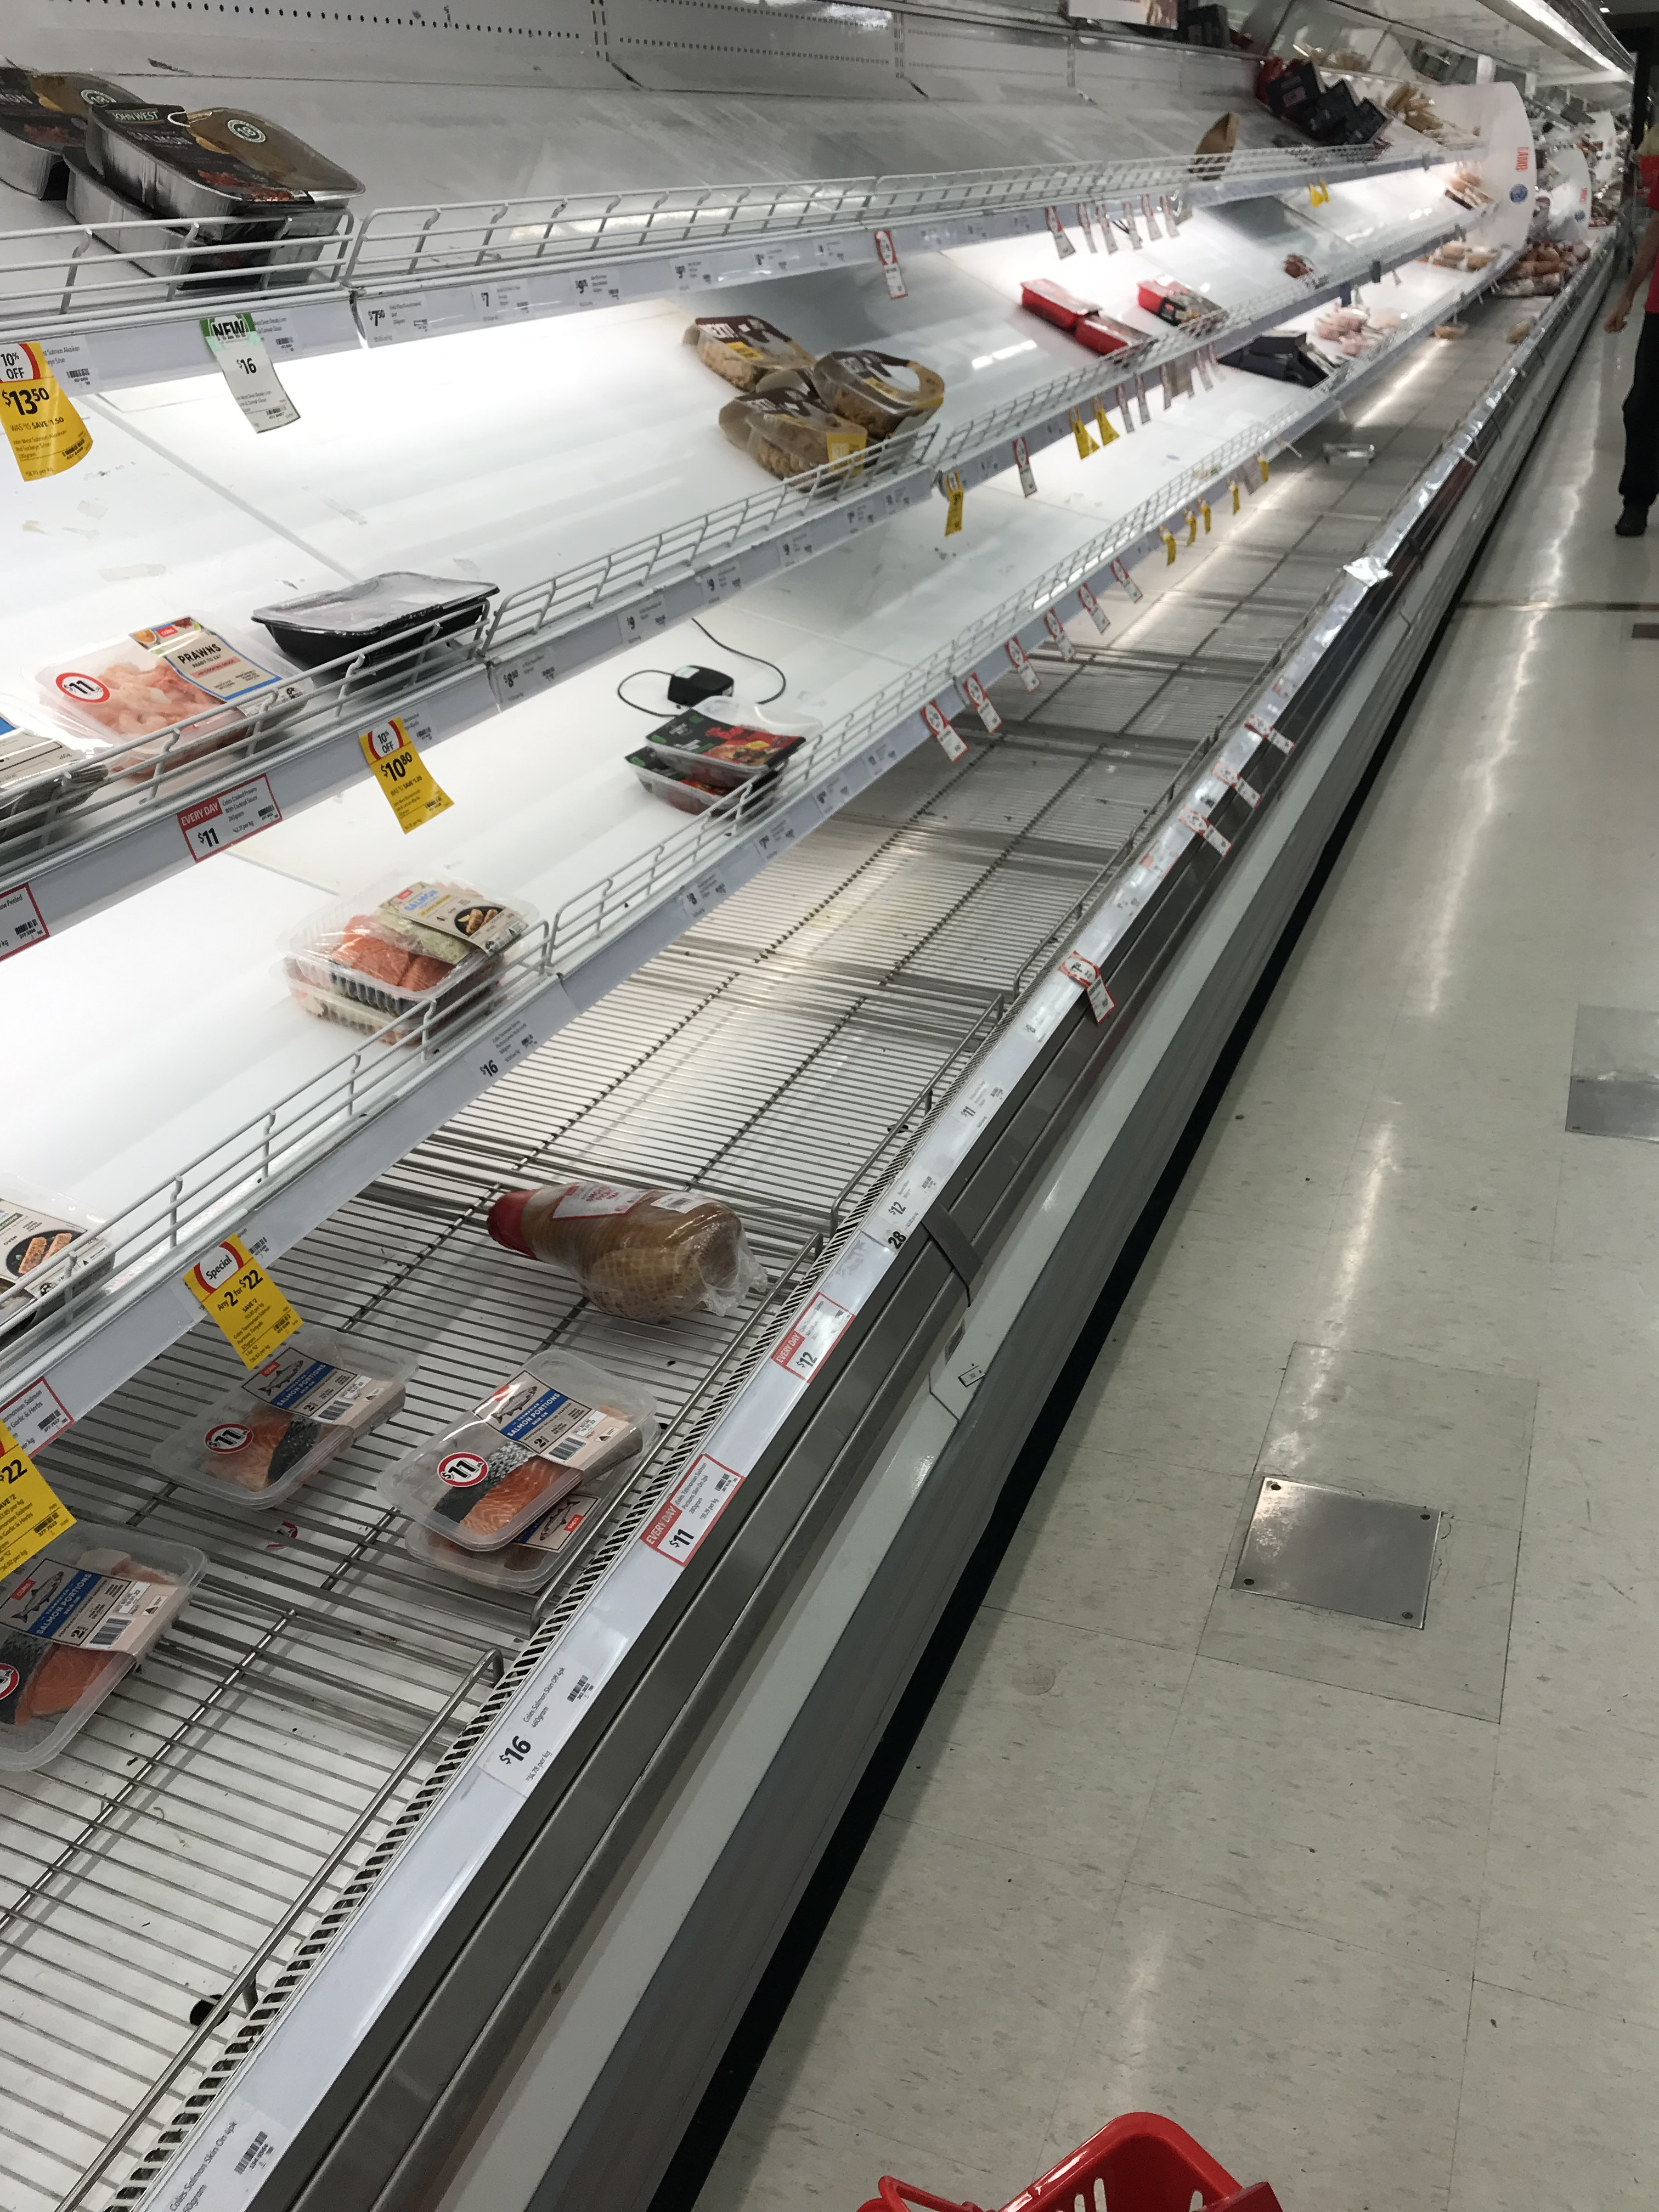

Slide 41
The Second Half of the Barbell
*Bets on a domestic recovery in 2022 Q4 *Upside potential in 2022 far greater than tech *Some of these have not moved for 5 or 10 years *Focuses on economically sensitive cyclical industries *Makes a great counterweight to high-growth technology *We could spend all of next year rotating between the two groups

Slide 42
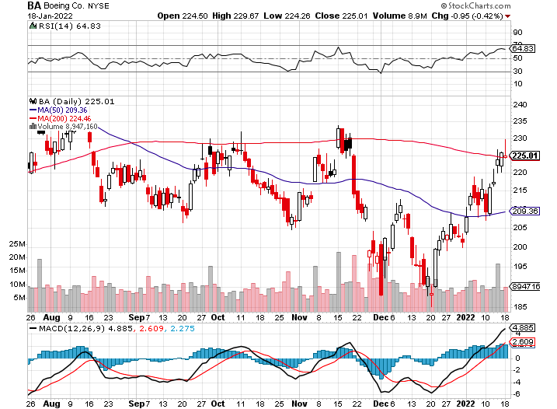
Boeing (BA) –LEAP Candidate China Orders Boeing 737 Max Back into the Air Boeing Wins a Major Order, for 30 737 MAX’s long 3/$146-$149 call spread took profits on long 2/$150-$160 call spread

Slide 43
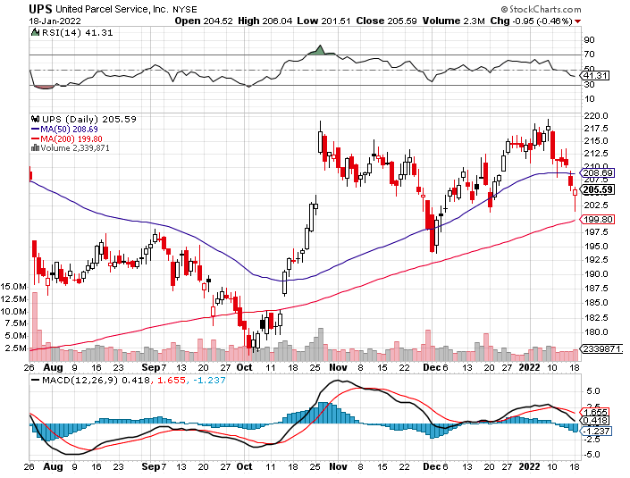
Package Delivery- United Parcel Service (UPS) - Package Delivery massive increase in overnight deliveries, announces blowout earnings, vaccine deliveries took profits on long 11/$130-$140 call spread

Slide 44
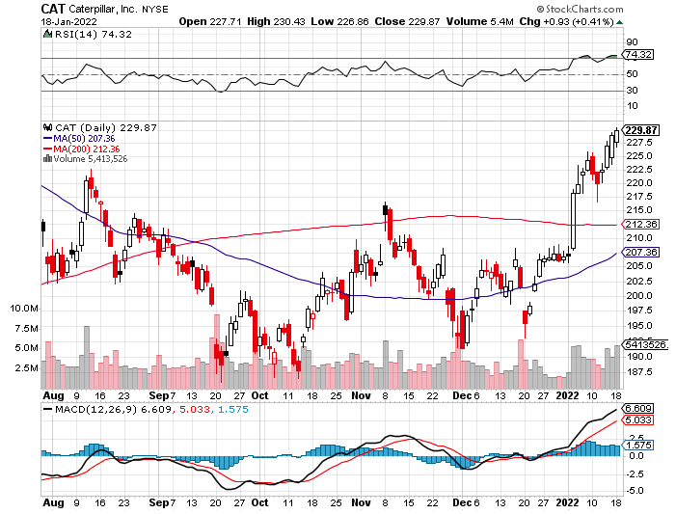
Caterpillar (CAT)- Ag + Infrastructure + Housing took profits on long 12/$145-$150 call spread took profits on long 11/$125-$135 call spread

Slide 45
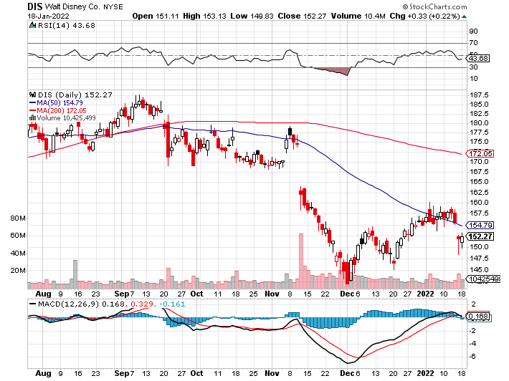
Walt Disney (DIS)- Earnings fail Streaming Growth Shortfall stopped out of long 10/$165-$175 call spread took profits on long 3/$170-$180 call spread

Slide 46
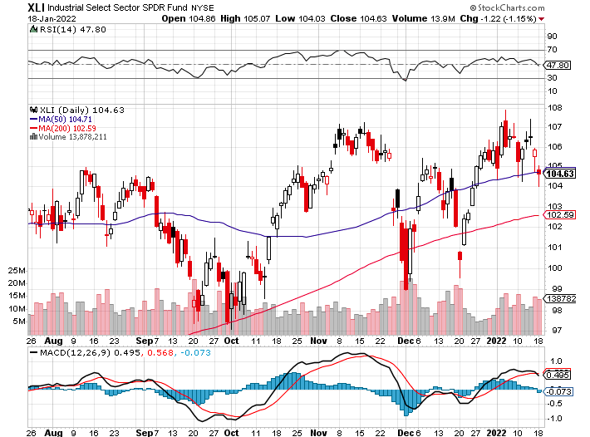
Industrials Sector SPDR (XLI)- (GE), (MMM), (UNP), (UTX), (BA), (HON)

Slide 47
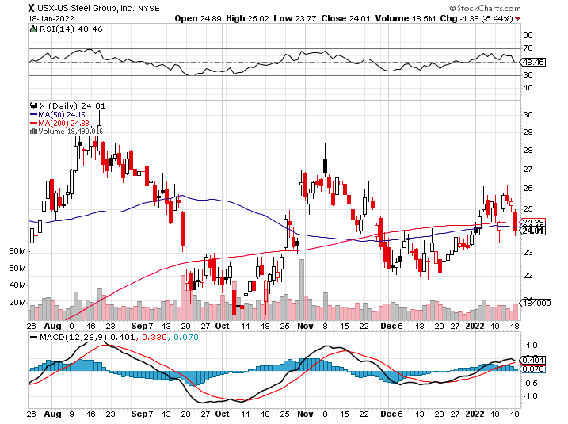
US Steel (X) – Commodity Drag

Slide 48
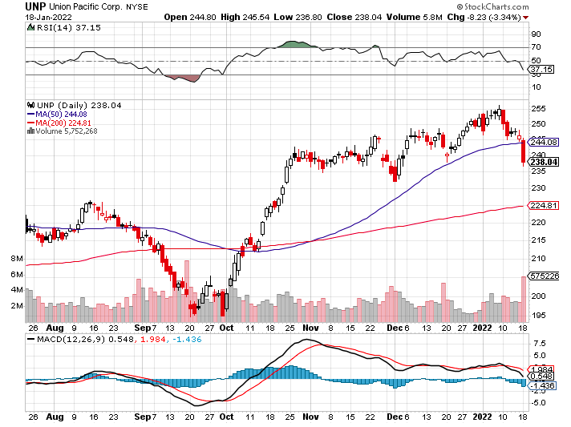
Union Pacific RR (UNP)- Big Stuff to Ship near record earnings announced took profits on long 5/$200-$210 call spread took profits on 11/$150-$160 call spread

Slide 49
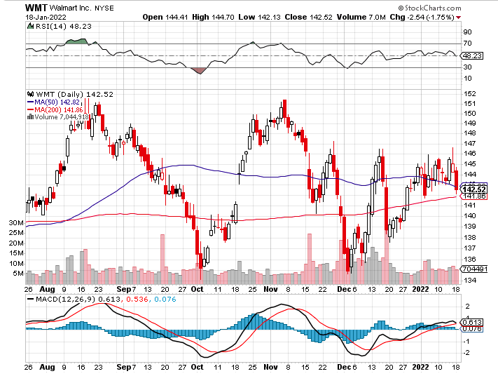
Wal-Mart (WMT)- took profit on Long 11/$125-$130 bear put spread took profit on Long 10/$119-$121 bear put spread took profits on Long 8/$114-$117 bear put spread

Slide 50
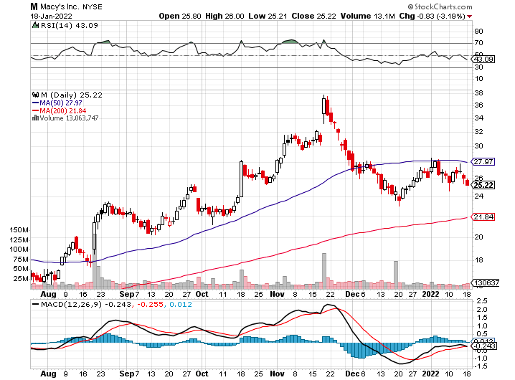
Macys’ (M) – Retail Punished took profits on Long 8/$23-$25 bear put spread

Slide 51
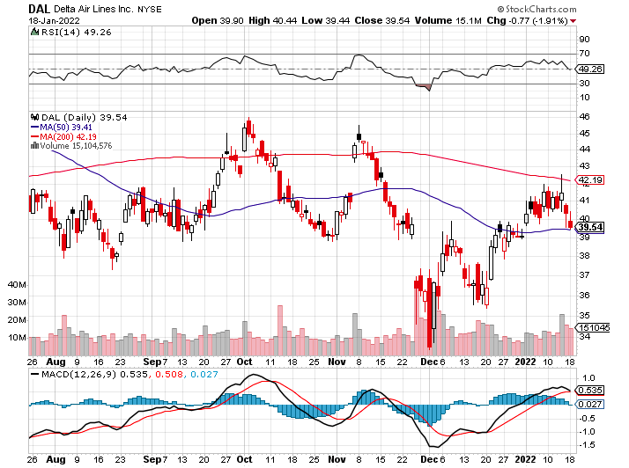
Delta Airlines (DAL) –

Slide 52
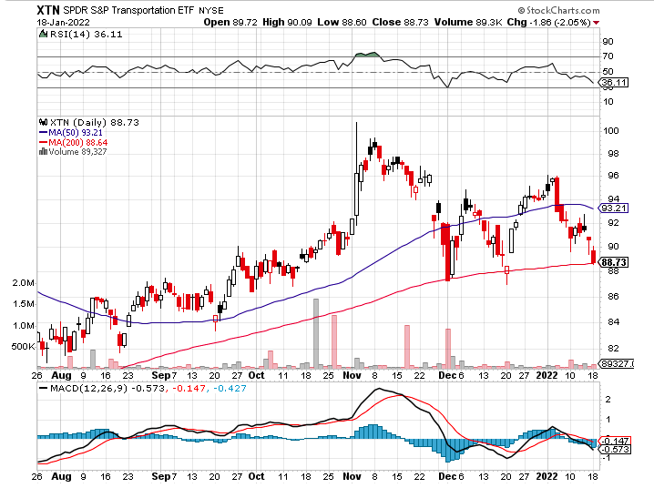
Transports Sector SPDR (XTN)- Worst Hit Sector (ALGT), (ALK), (JBLU), (LUV), (CHRW), (DAL)

Slide 53
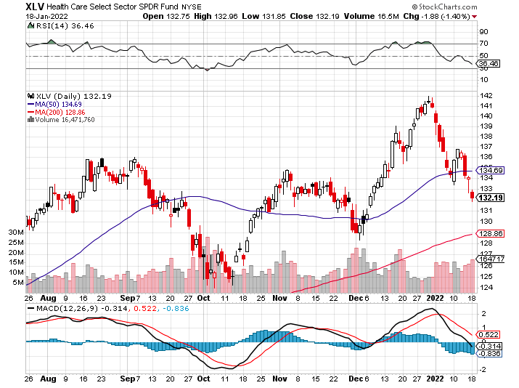
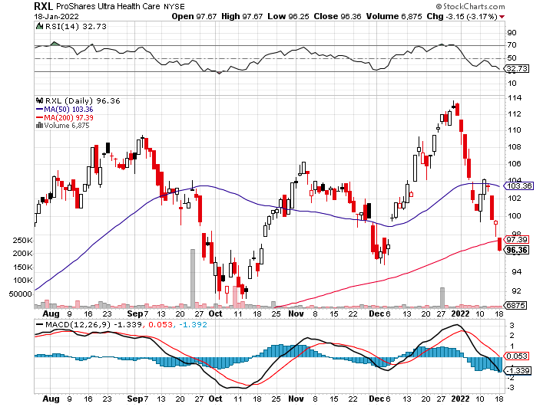
Health Care Sector (XLV), (RXL) (JNJ), (PFE), (MRK), (GILD), (ACT), (AMGN)

Slide 54
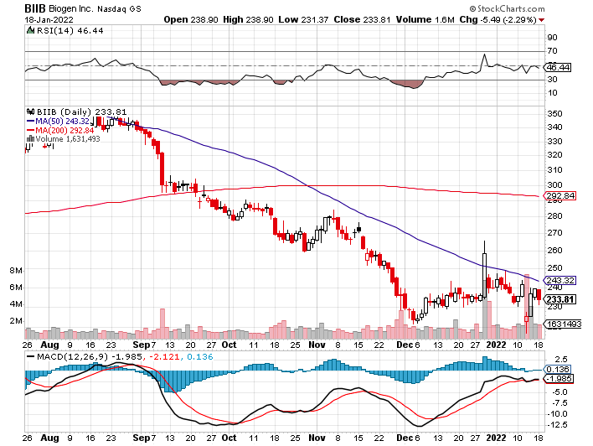
Biogen (BIIB) Why you invest in Biotech

Slide 55
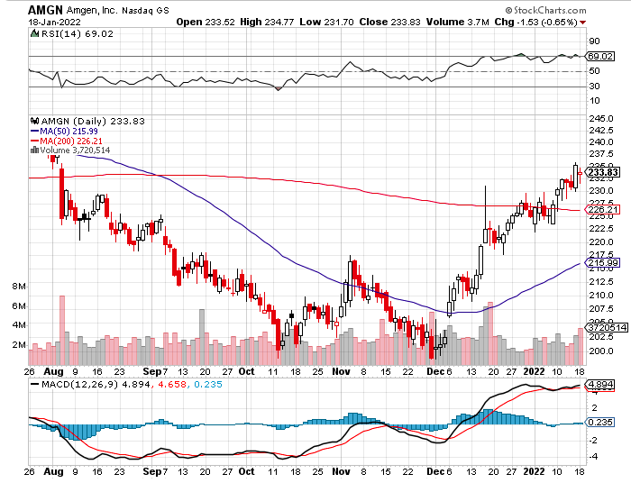
Amgen (AMGN) took profits on long 11/$185-$200 bull call spread

Slide 56
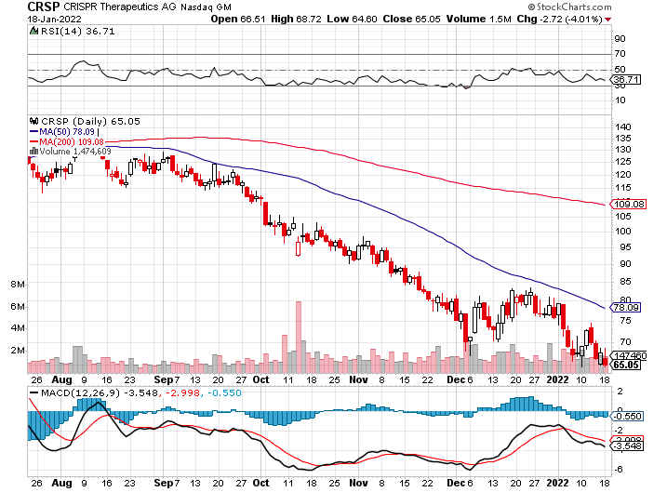
CRISPR Therapeutics (CRSP)

Slide 57
Goldman Sachs (GS) – took profits 12/$330-$350 call spread took profits 11/$330-$350 call spread stop loss on long 11/$385-$395 call spreads

Slide 58
Morgan Stanley (MS) – Doubled Dividend took profits on long 11/$85-$90 call spread stop loss on long 11/$95-$98 call spread took profits on long 10/$85-$90 call spread profits on long 2/$55-$60 call spread

Slide 59
JP Morgan Chase (JPM)-Back to Life took profits 12/$148-$152.50 call spread took profits on long 10/$130-$140 call spread took profits on long 8/$140-$145 call spread took profits on long 7/$140-$145 call spread

Slide 60
ProShares Ultra Technology ETF (ROM) – 2X Long Technology ETF took profits on long 10/$62-65 call spread

Slide 61
Bank of America (BAC) – took profits long 12/$39-$42 call spread stop loss on long 11/$43-$45 call spread took profits on 11/$37-$40 call spread took profits on long 2/$28-$30 call spread

Slide 62
SPDR Metals & Mining ETF (XME) – long 2/$28-$30 call spread

Slide 63
Blackrock (BLK)-Asset Collection Boom took profits on long 3/$770-$790 call spread took profits on long 3/$310-$340 call spread

Slide 64
Visa (V) – “Touchless” Bitcoin Drag took profits on long 5/$220-$225 bull call spread took profits on long long 5/$195-$205 bull call spread took profits on long 9/$180-$185 bull call spread

Slide 65
Consumer Discretionary SPDR (XLY) (DIS), (AMZN), (HD), (CMCSA), (MCD), (SBUX)

Slide 66
Berkshire Hathaway (BRKB)- Natural Barbell New All-Time High long 10/$275-$280 call spread long 10/$272.50-$277.50 call spread took profits on long 10/$255-$265 call spread took profits on long 3/$230-$240 call spread

Slide 67
Europe Hedged Equity (HEDJ)-

Slide 68
Japan (DXJ)-

Slide 69
Emerging Markets (EEM) - Pro trade, Weak Dollar, Long Recovery Play

Slide 71
Bonds – Collapse!
*Interest rates hit new two year high taking ten –year US Treasury to 1.84% *Bond collapse goes global with German Bunds going positive for the first time in four years *Fed is fanning the flames by ending QE and promising four interest rate hikes, with another eight to follow over three years *Fed minutes indicate that the worst is yet to come *Sell any six-point rally in the (TLT) *In a year, yield on the ten-year US Treasury bond will be at 2.50% or higher *US Treasury bond fund (TLT) could plunge from $180 in 2020 to $105 by 2023

Slide 73
Treasury ETF (TLT) – Levitating took profits on long 12/$152-$155 put spread, took profits on 11/$150-$153 put spread took profits on long 10/$154-$157 put spread, took profits on long 10/$137-$140 call spread profits on long 10/$155-$158 put spread, took profits on 9/$155-$158 put spread took profits on long 8/$157-$160 put spread, took profits on long 8/$156-$159 put spread,

Slide 74
Ten Year Treasury Yield ($TNX) – 1.51%

Slide 75
Junk Bonds (HYG) 4.32% Yield to Maturity

Slide 76
2X Short Treasuries (TBT)-Another run at highs

Slide 77
Emerging Market Debt (ELD) 5.81% Yield-

Slide 78
Emerging Market Debt (ELD) 5.81% Yield- Mix of AAA, AA, and A rated bonds

Slide 80
Foreign Currencies – Dollar Fades
*Soaring European inflation, up to 5%, has lit a fire under all currencies, as their interest rates are rising faster than ours. *”Buy the Rumor, Sell the News” profit taking hits US Dollar *As long as US interest rates keep rising the greenback will remain strong *China Posts Record Trade Surplus in 2021, at $676 billion, on global economic recovery, further undermining the buck *Currency with the fastest appreciating interest rates always does best *Long-term fundamentals are still poor, a dollar short could be the new ten-year trade, but not yet *Stand aside from forex for now, there are getting fish to fry

Slide 81
Japanese Yen (FXY), (YCS)

Slide 82
Euro ($XEU), (FXE), (EUO)-

Slide 83
British Pound (FXB)-

Slide 84
Australian Dollar (FXA)- The Global Recovery Play took profits on long 8/$67-$69 call spread

Slide 85
Emerging Market Currencies (CEW)

Slide 86
Chinese Yuan- (CYB)-

Slide 88
Bitcoin – Rising Rate Hit Buy the Mad Hedge Bitcoin Letter at https://www.madhedgefundtrader.com/store/
*Bitcoin Gets Crushed, approaching a one year low at $40,000, and will continue to do so *Ethereum off a perfect 50% from summer high *Any noninterest bearing instrument gets punished when rates rise and crypto is no exception *Omicron variant delivered a new mini recession and crypto is no place to hide *Will this be a 50% correction or and 80% one, as in years past *Long term “BUY” signal for Bitcoin still intact *Buy Bitcoin and Ethereum on the bigger dip

Slide 89
Bitcoin ($BTCUSD) – Wake Up Time

Slide 90
Ethereum (ETHE) –

Slide 91
MicroStrategy (MSTR) –

Slide 92
Amplify Transformational Data Sharing ETF (BLOK) – Cross Imminent

Slide 94
Energy – Higher Highs
*Lofty US GDP forecasts are sending oil to new highs *Hot 8.1% growth from China, the world’s largest consumer, is another major factor *The risk/reward for a new oil trade here is terrible *$100/barrel oil is possible, but with rising volatility *The Saudis want to keep Texas tea under $100 a barrel, the price that causes recessions and less long-term consumption *The end of oil is upon us, but it may take 30 years to unwind existing infrastructure *Avoid all energy plays like the plague, it’s the new buggy whip industry as the US de-carbonizes

Slide 95
Oil-($WTIC)

Slide 96
United States Oil Fund (USO) long 10/$9.50-$10 Vertical bull call spread

Slide 97
Energy Select Sector SPDR (XLE)-No Performance! (XOM), (CVX), (SLB), (KMI), (EOG), (COP)

Slide 98
Halliburton (HAL)-

Slide 99
Natural Gas (UNG) -

Slide 101
Precious Metals – Still No Pulse
*Not a hint of downside protection offered by gold in this global selloff *Gold has been the worst performing asset of 2021 *Gold provided absolutely no downside protection during the recent pandemic crash *If $9 trillion of investment demand decamps for the crypto world, leaving only jewelry demand, $9 trillion could go into Bitcoin. *Rising interest rates bode poorly for precious metals as it raises the opportunity cost for non-yielding assets *Bitcoin is clearly sucking capital out of precious metals *Stay away until this plays out *Silver is still the bigger and better long-term play

Slide 102
Gold (GLD)- Meltdown

Slide 103
Market Vectors Gold Miners ETF- (GDX) –

Slide 104
Barrick Gold (GOLD) took profits on long 1/$21-$23 call spread took profits on long 11/$22-$24 call spread

Slide 105
Newmont Mining- (NEM)- took profits on long $55-60 call spread

Slide 106
Silver- (SLV)- took profits on long 11/$19-$20 call spread

Slide 107
Silver Miners - (SIL)-

Slide 108
Wheaton Precious Metals - (WPM)- took profits on long 2/$39-41 call spread

Slide 109
Copper (COPX)-Uptrend Resumes Copper Unions Vote to Strike in Chile, cutting off 33% of the global supply

Slide 110
Real Estate – Still Hot
*Apartment Occupancy Hits All Time High, as growing numbers are priced out of home ownership. As a result, rental rates are now rising faster than home prices. Occupancy is now at 97.5%. *Lumber Prices are Soaring Again. *The Big Apple is Back, with Manhattan rents hitting all-time highs, up 16% YOY. *Prices will continue to appreciate but at a third the 2021 18% rate *Homebuilder Sentiment falls in December, from 84 to 83 *Rents now soaring faster than home prices and low earnings are priced out *US Home Prices Soar 18.4%, in October according to S&P Case Shiller

Slide 111
S&P Case Shiller Up 19.5% for September Phoenix (33.1%), Tampa (27.2%), Miami 25.2% lead

Slide 112
Crown Castle International (CCI) – 2.70% yielding cell phone tower REIT

Slide 113
US Home Construction Index (ITB) (DHI), (LEN), (PHM), (TOL), (NVR)

Slide 115
Trade Sheet- So What Do We Do About All This?
*Stocks – sell rallies *Bonds – sell rallies aggressively *Commodities-stand aside *Currencies- stand aside *Precious Metals – stand aside *Energy – stand aside *Volatility - sell short over $30 *Real estate – stand aside *Bitcoin – stand aside

Slide 116
Next Strategy Webinar 12:00 EST Wednesday, February 2 from Incline Village, NV email me questions at support@madhedgefundtrader.com
Good Luck and Good Trading!
Notes:
*

