Slide 1
The Mad Hedge Fund Trader “Turmoil”
With John Thomas Incline Village, NV, February 2, 2022 www.madhedgefundtrader.com
Notes:
*

Slide 2
Trade Alert Performance New All Time Highs!
*January 14.59% MTD *July +0.61% Final *February +13.28% Final *August +9.36% Final *March +20.60% Final *September 1.03% Final *April +15.67% Final *October +8.91% MTD *May +8.13% Final *November -11.79% Final *June +0.71% Final *December +11.26% Final *2022 YTD +14.59% compared to -3.2% for the Dow Average *+527.15% since inception *Average annualized return of 43.19% for 12 years

Slide 3
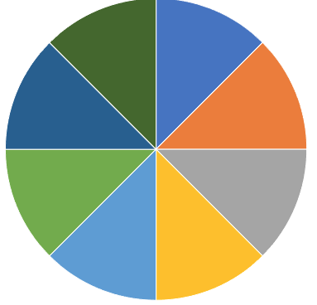
Portfolio Review 60% Long, 30% short, 10% cash Long Term Bull Market
Current Capital at Risk
Risk On
World is Getting Better
(TLT) 2/$149-$152 put spread | 10.00%
(TLT) 2/$147-$150 put spread | 10.00%
(TLT) 3/$150-$153 Put spread | 10.00%
(SPY) 2/$400-$410 call spread | 10.00%
(BRKB) 2/$270-$280 call spread | 10.00%
(TSLA) 2/$600-$650 call spread | 10.00%
Risk Off
World is Getting Worse
(MSFT) 2/$340-$350 puts spread | -10.00%
(AAPL) 2/$180-$190 put spread | -10.00%
(SPY) 2/$465-$475 put spread | -10.00%
Total Net Position | 30.00%
Total Aggregate Position | 90.00%
Expiration Value 21.68%

Slide 4
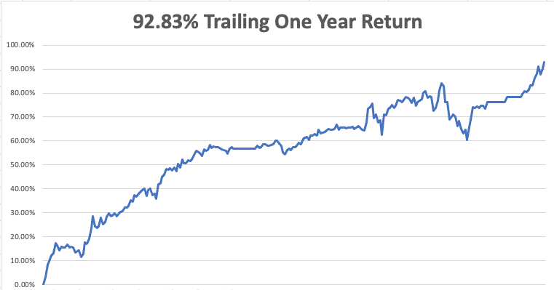

Slide 5
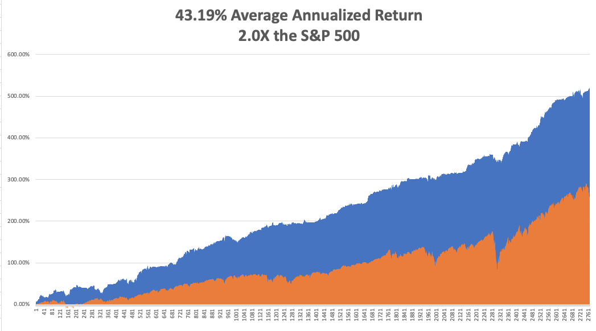
GTD 12 Year Daily Audited Performance

Slide 6
The Method to My Madness The Roaring Twenties are Here
*Keep trading this market. (VIX) in the high $20’s is the sweet spot *The first three interest rate rises are in the market, but not the 9 that follow *Rapidly tightening Fed policy has triggered a global “RISK OFF” *A core short in bonds will be key, but trade this too *Omicron is slowing growth everywhere, but a quick bounce back is expected *VIX over $30 is the ideal entry point for new positions *Ukraine war is all talk and no do. It already succeeded because it got Putin’s oil prices up high

Slide 7
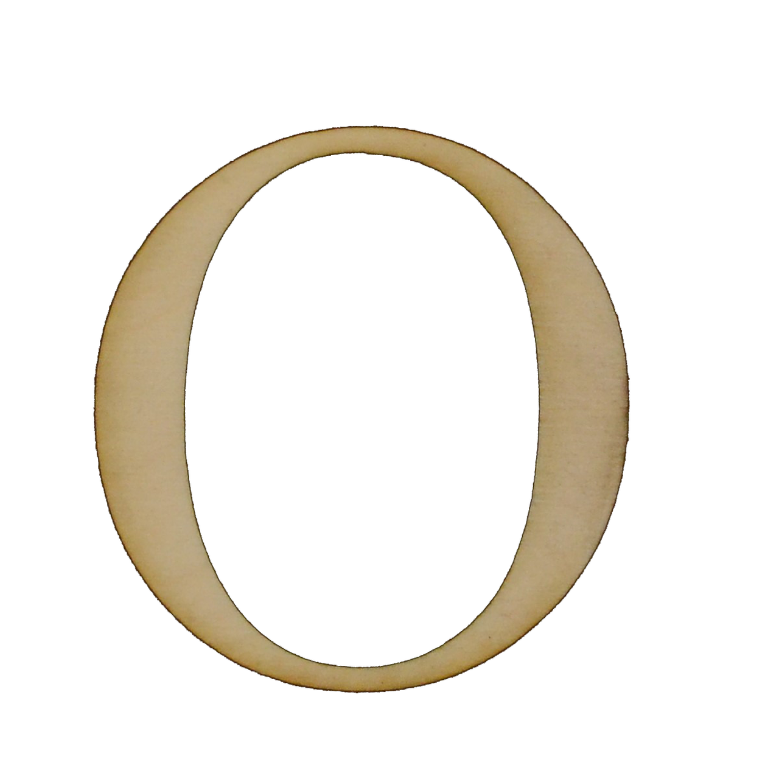
Corona Update – Explosive Growth
*Omicron is now dominating the US economy, but cases have peaked *A year ago, hospitalizations hit 450,000/day. Now it’ 1 million/day. *Vaccines for children under 5 will be out in March *Fatalities are a fifth less than last years peak *Hospitalizations are at 80% from the unvaccinated *Pandemic is still going to be zero by summer, book those cruises *US cases top 90 million, deaths topping 854,000 and deaths are limited to 2,000 a day

Slide 8
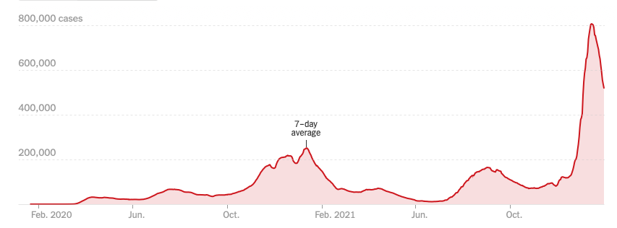
Bump on the Way to Zero

Slide 9
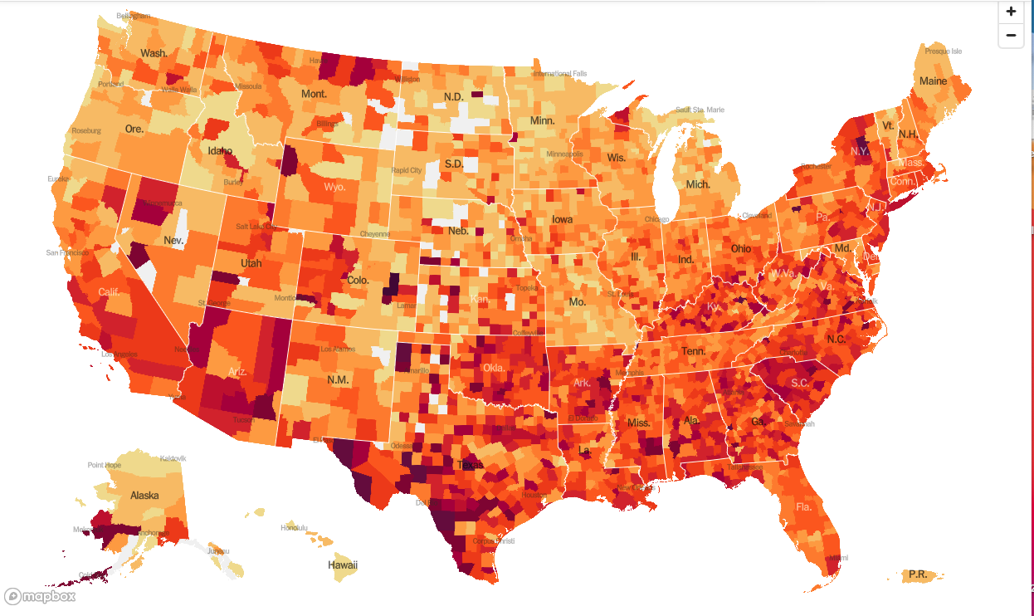
January 20 2021 Infection Rate

Slide 10
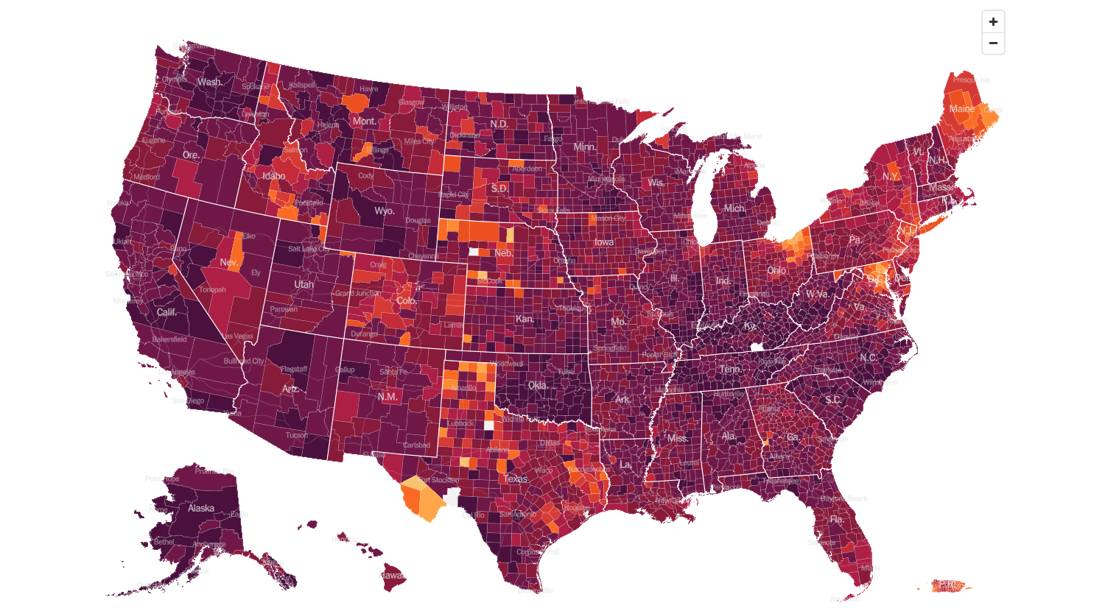
February 2nd 2022 Infection Rate

Slide 11
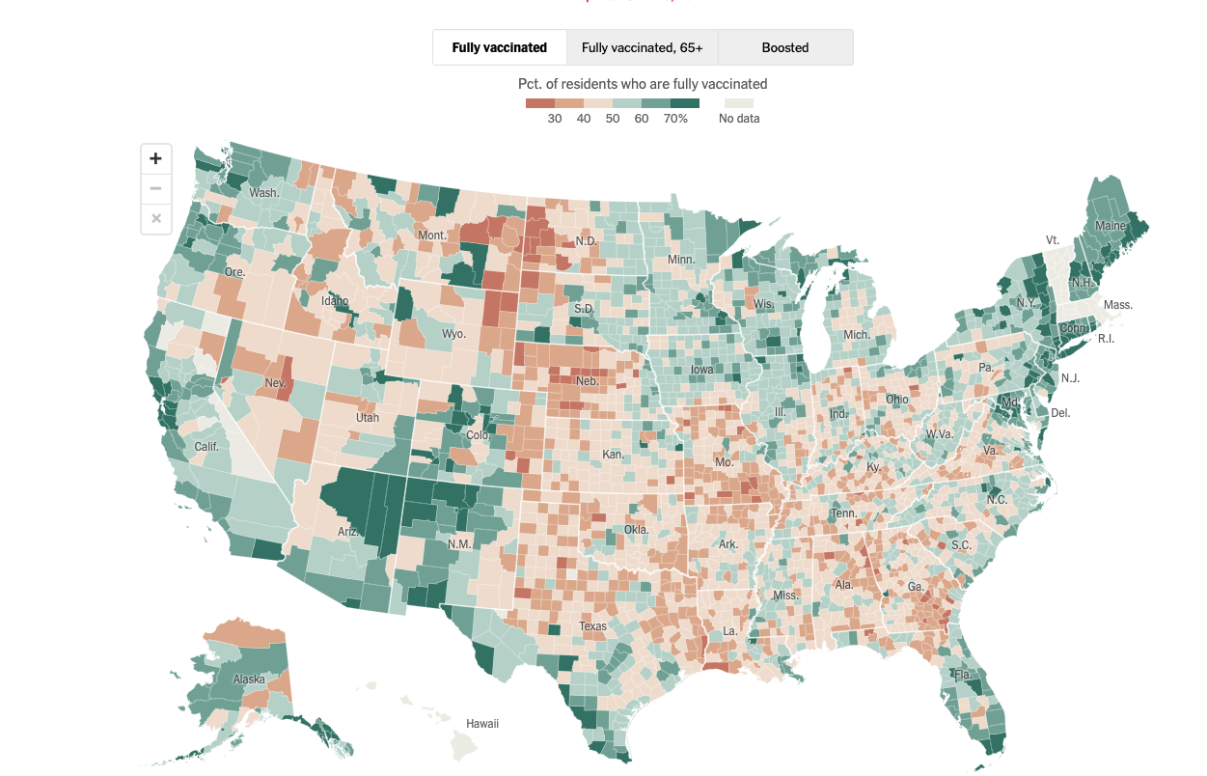

Slide 12
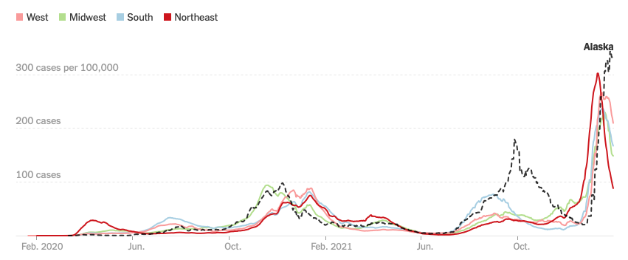

Slide 13
The Global Economy – Powering On
*Fed to Raise Rates Eight Times. That’s what will be needed to curb the current runaway inflation which is now at 7.0% and still rising
*Personally, I think it will be 12 quarter point increments to peak out at a 3 ¼% overnight rate. *The economy is still very strong, but Omicron is a concern *Q4 GDP Explodes at 6.9%, continuing the highest economic growth rate in decades *Watch for growth to slow to 2.0% in Q1 *China’s Zero Covid Policy to Continue Through Fall, and so will our supply chain and inflation problems *China GDP Grows 8.1% YOY but is rapidly slowing now thanks to Omicron

Slide 14
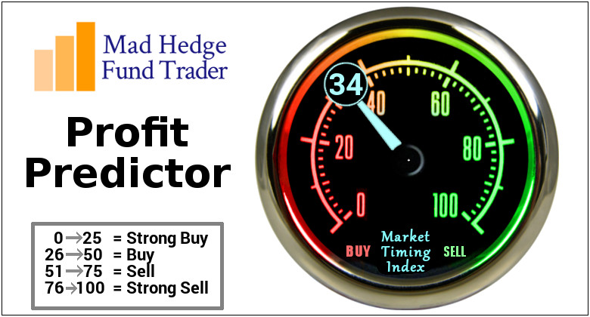
The Mad Hedge Profit Predictor Market Timing Index – Buy Territory An artificial intelligence driven algorithm that analyzes 30 different economic, technical, and momentum driven indicators

Slide 15
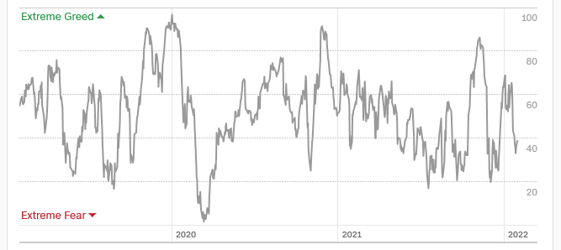
The Mad Hedge Profit Predictor From Extreme “BUY” to Neutral
SELL
Do Nothing
BUY

Slide 16
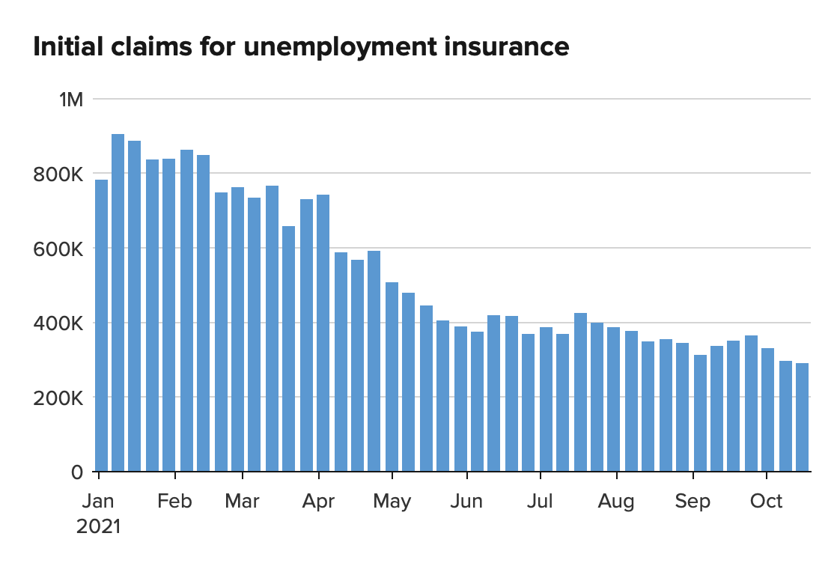
Weekly Jobless Claims – New Lows 260,000 – 4 Month High

Slide 17
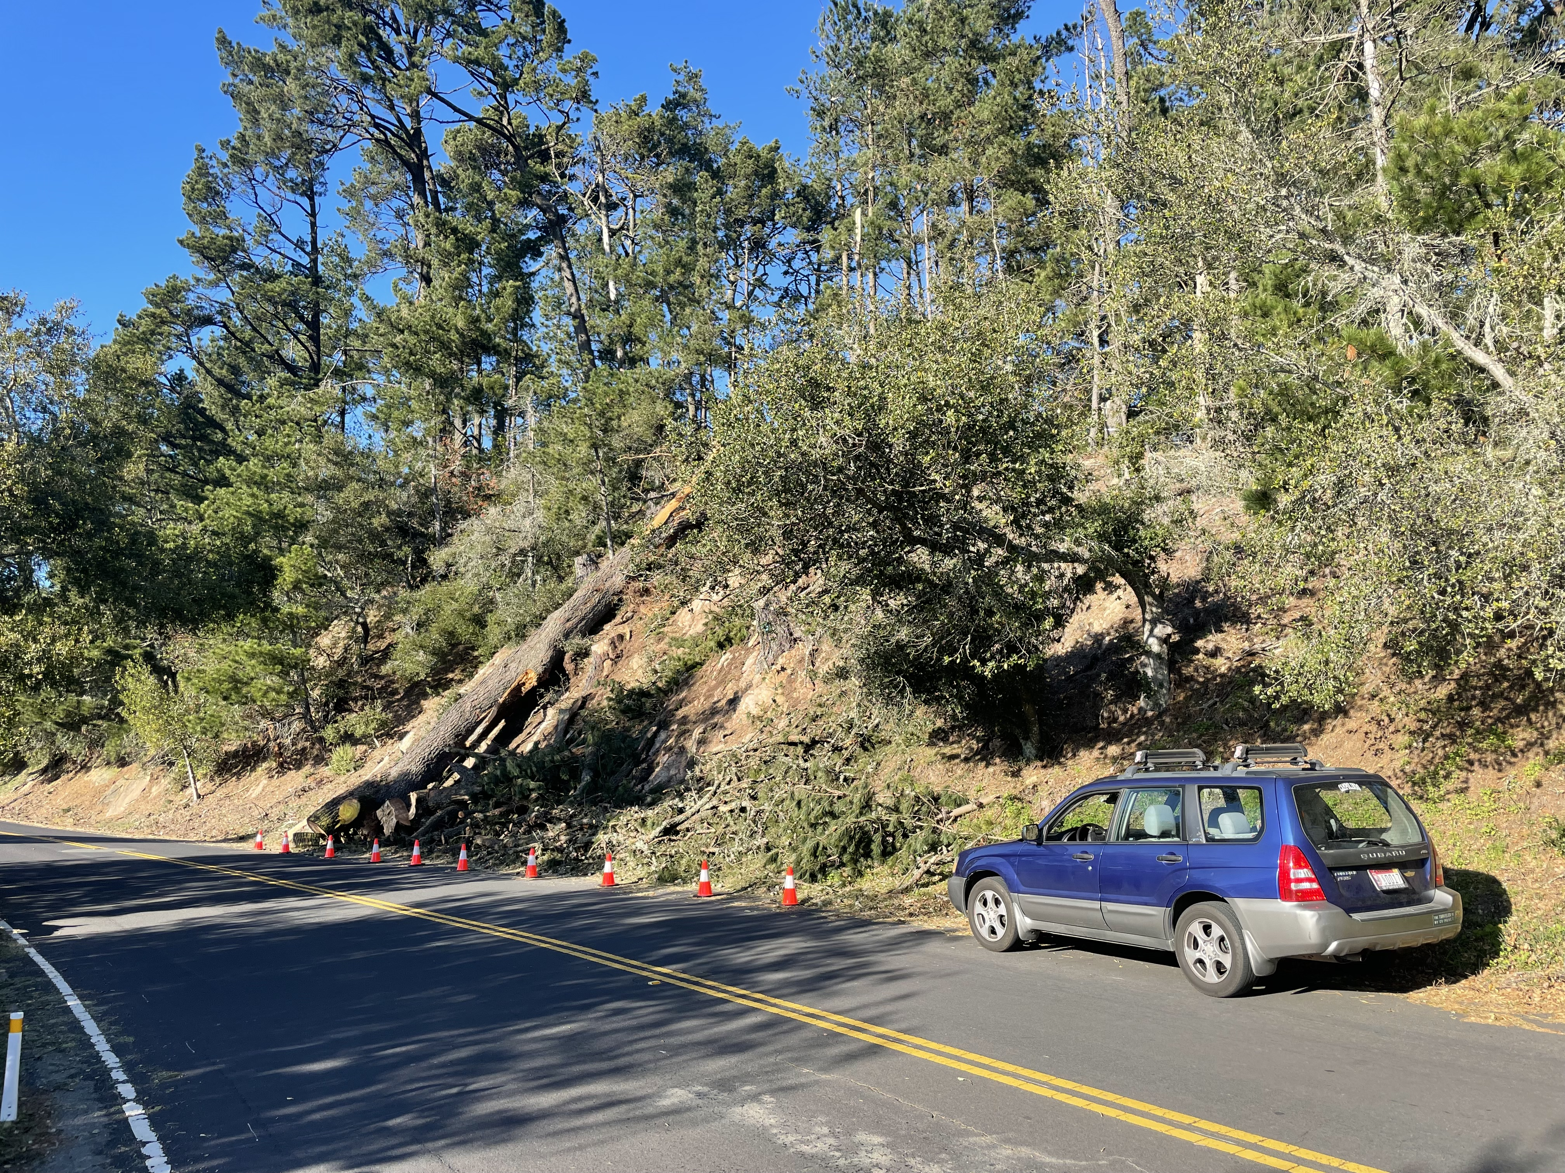

Slide 18
Stocks – Palpitations
*Dow Dives Nearly $4,000 points in 14 days, in the mother of all corrections. *The Market is De-Grossing Big Time. That means cutting total market exposure and selling everything, regardless of stock or sector. *Interest sensitives will be leaders for the next six months, like banks, brokers, and fund managers *NASDAQ Stocks suffer worst January in history *Stocks to Fall Another 10%, says Wharton Prof Jeremy Siegel, who has been uncannily accurate for the past decade. *Volatility to remain high, a money maker for Mad Hedge *S&P 500 Profits Jump 22.4% in Q4, possibly taking the full year figure up an incredible 49%.

Slide 19
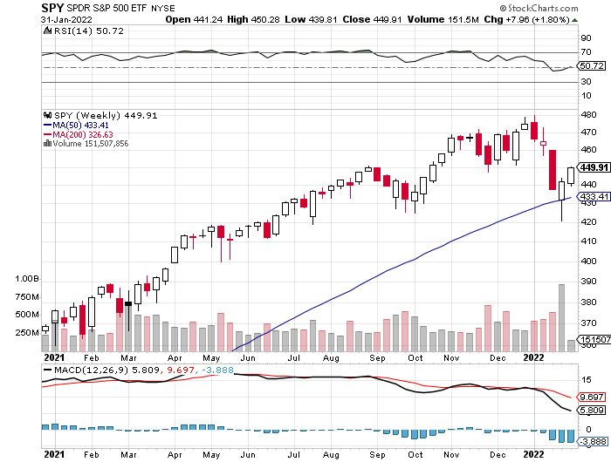
S&P 500 – Year End Melt Up! long 2/$410-$420 bull call spread, long 2/$465-$475 bear put spread Took profits on long 2/$480-$500 bear put spread, Took profits on long 10/$410-$420 bull call spread
First Support $420 -12.5%
The Bottom 395 Down 17.7%

Slide 20
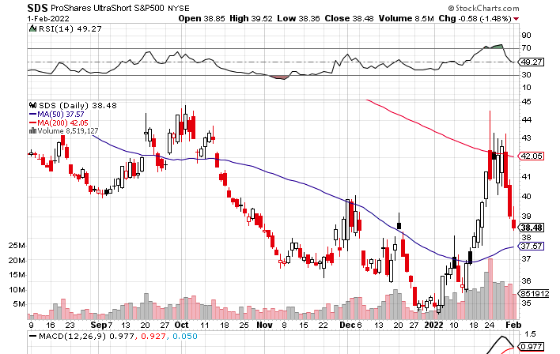
ProShares Ultra Short S&P 500 (SDS)- a great hedge for long stocks and bonds long 2X position has a hedge against longs and bond shorts

Slide 21
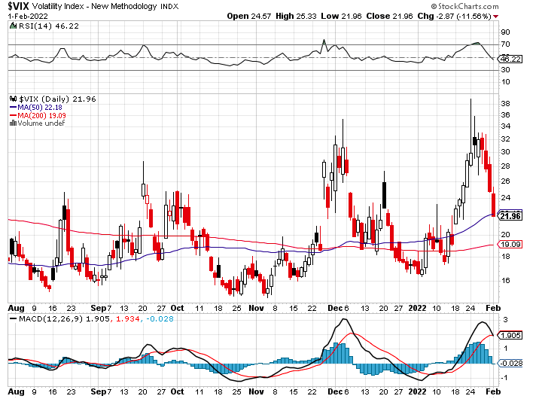
(VIX) – Dying a Slow Death classic summer market

Slide 22
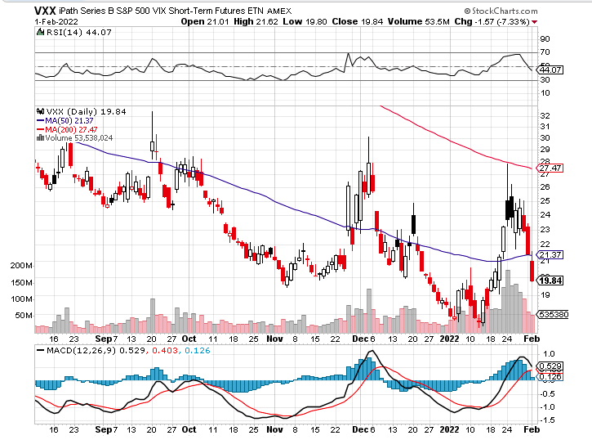
(VXX)-

Slide 23
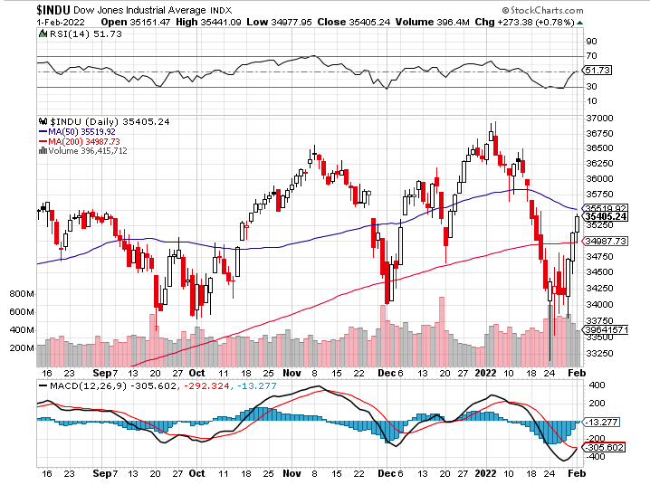
Dow Average ($INDU)-

Slide 24
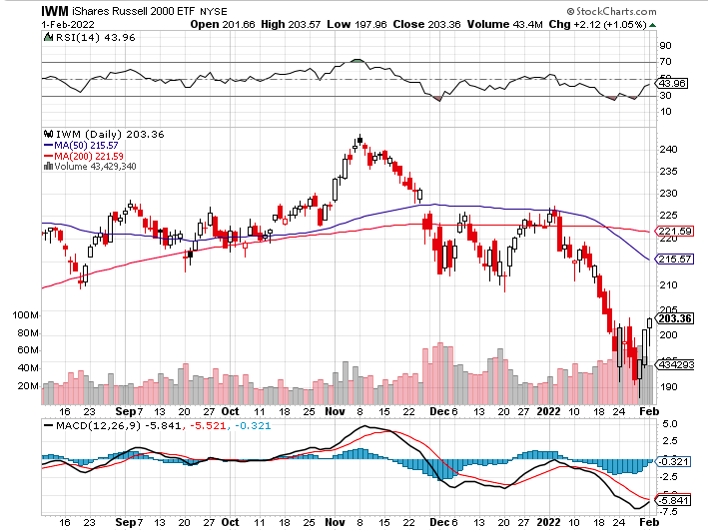
Russell 2000 (IWM)- took profits on Long 10/$137-$142 vertical bull call spread took profits on Long 10/$153-$156 vertical bear put spread

Slide 25
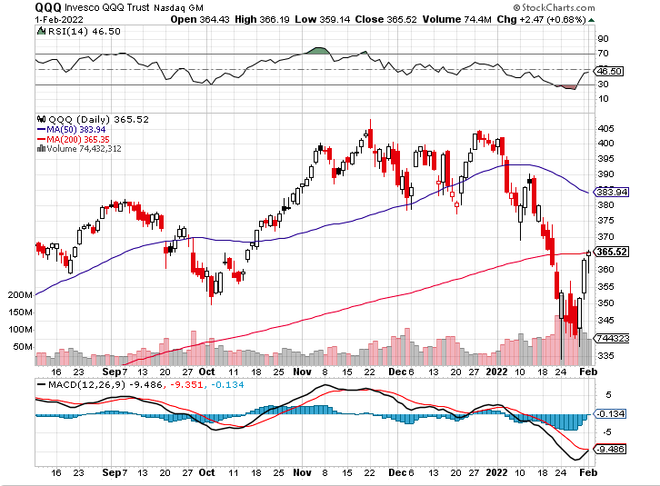
NASDAQ (QQQ) – long (QQQ) 4/$330-$335 put spread took profits on long (QQQ) 3/$340-$345 put spread covered long (QQQ) $325-$330 put spread

Slide 26
The Barbell Portfolio
*50% Big Tech - 2% of US Employment but 27% of Market Cap and 38% of Profits 50% Domestic Recovery, including: Railroads Couriers Banks Construction Credit Cards Event organizers Ticket sales Retailers

Slide 27
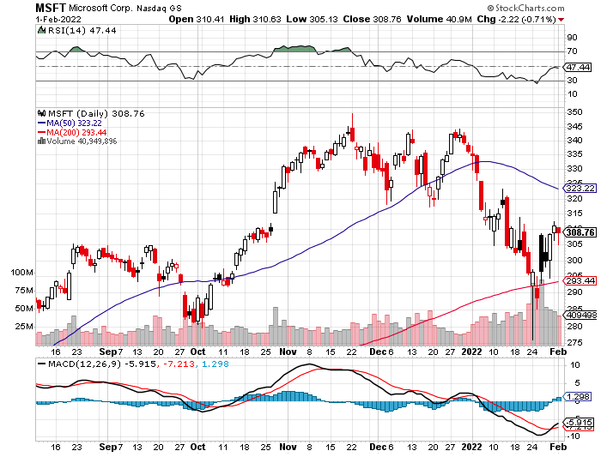
Microsoft (MSFT)- long 2/$340-$350 bear put spread took profits on long 12/$220-$230 call spread stop loss on long 12/$170-$180 call spread

Slide 28
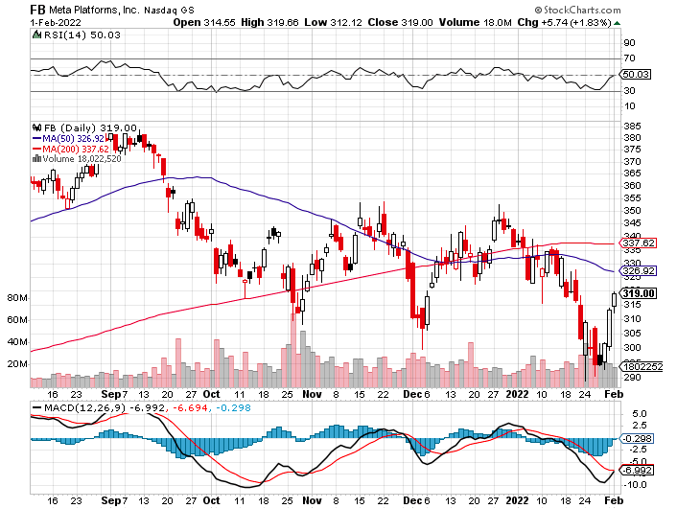
Facebook (FB)- Changes Name to “Meta” took profits on Long 9/$290-$300 vertical bear put spread stopped out of Long 9/$190-$200 vertical bear put spread

Slide 29
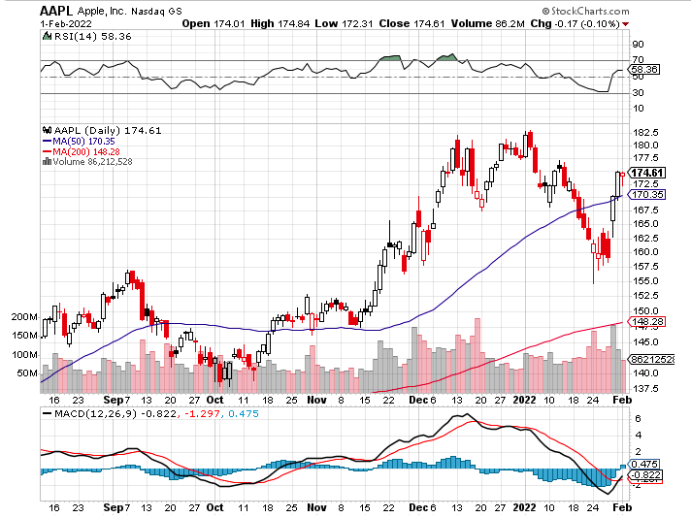
Apple (AAPL)- Apple Blows it Away, with Q4 revenues of an eye popping $124 billion, up 11% YOY. Some $27 billion in dividends and share buy backs was returned to shareholders. long 2/$180-$190 put spread

Slide 30
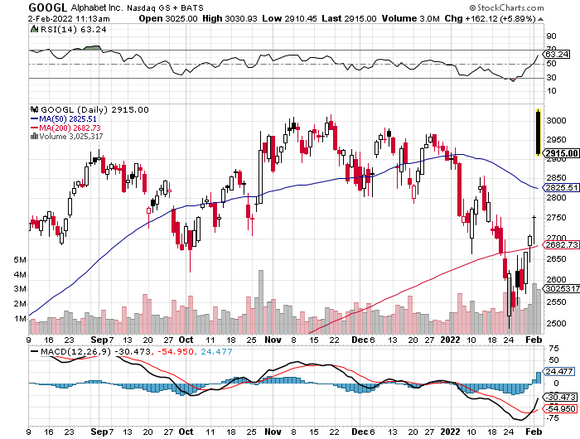
Alphabet (GOOGL) – 20:1 Share Split took profits on long 12/$1,200-$1,230 bull call spread took profits on long 9/$1,030-$1,080 vertical bull call spread

Slide 31
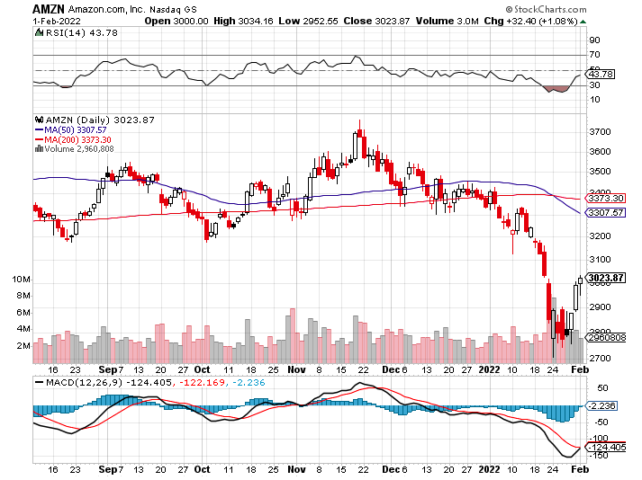
Amazon (AMZN) – took profits on long 9/$2,800-$2,900 bull call spread

Slide 32
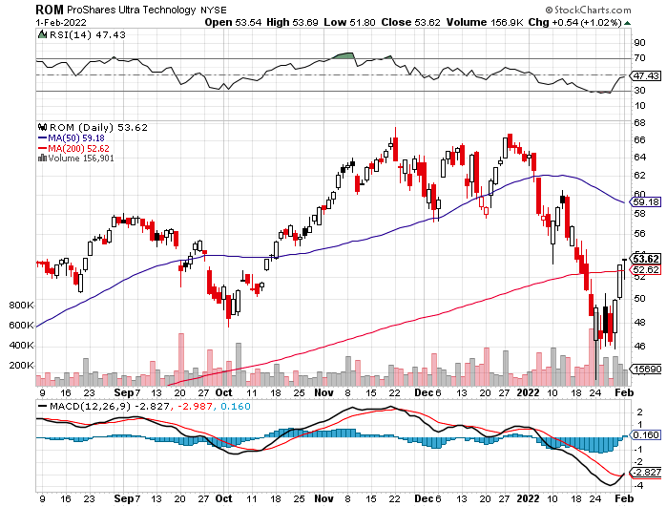
ProShares Ultra Technology (ROM) – New Highs

Slide 33
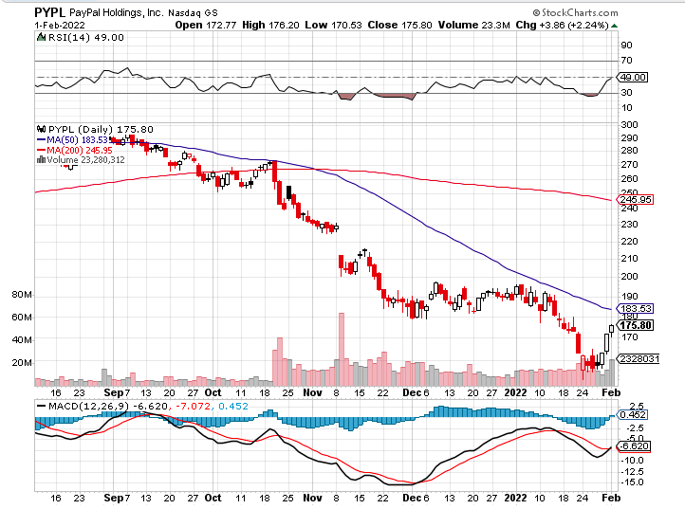
PayPal (PYPL) - Cancels Pinterest Buy took profits on long 4/$90-$95 call spread

Slide 34
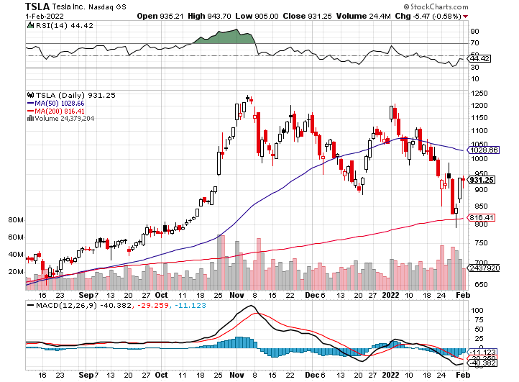
Tesla (TSLA) –Aiming for 1.5 million cars in 2022 long 2/$600-$650 call spread

Slide 35
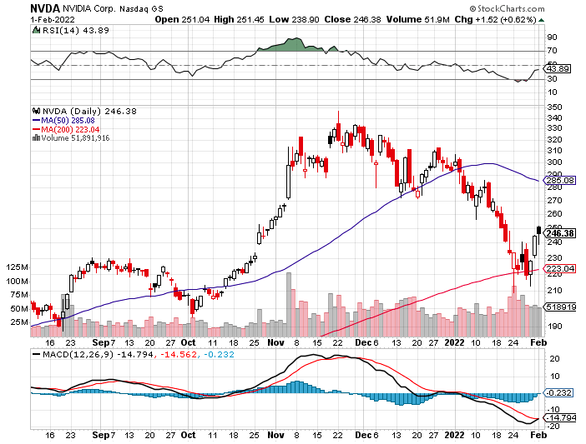
NVIDIA (NVDA) – A Mad Hedge 10 bagger – Global Semiconductor Shortage Slows Auto Industry, Graphic card sales up 87% in Q2

Slide 36
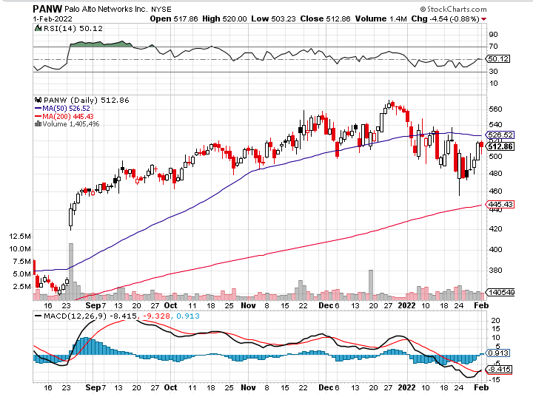
Palo Alto Networks (PANW)- Hacking never goes out of fashion

Slide 37
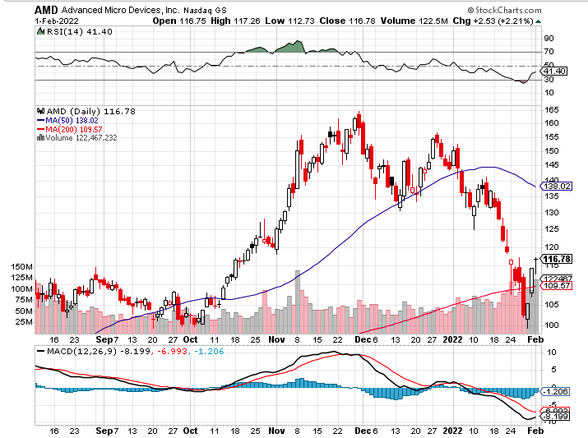
Advanced Micro Devices (AMD)- programable logic devices took profits on long 2/$75-$80 call spread

Slide 38
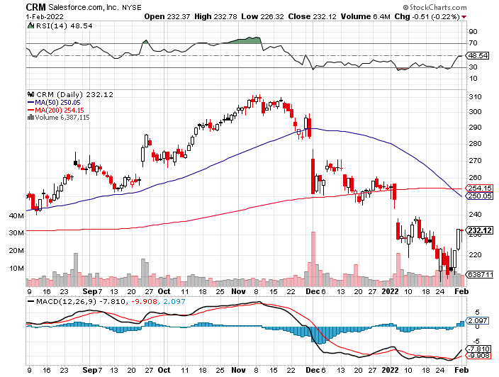
Salesforce (CRM)- Massive Online Migration took profits on long 9/$125-$130 vertical bull call spread took profits on long 8/$125-$130 vertical bull call spread took profits on long 2/$105-$115 call spread

Slide 39
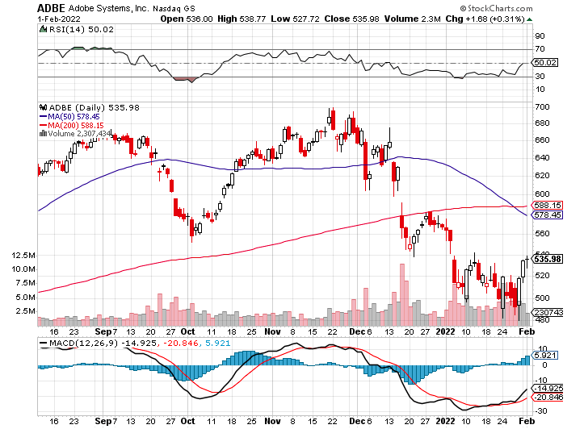
Adobe (ADBE)- Cloud play The Quality Non-China tech play

Slide 41
The Second Half of the Barbell
*Bets on a domestic recovery in 2022 Q4 *Upside potential in 2022 far greater than tech *Some of these have not moved for 5 or 10 years *Focuses on economically sensitive cyclical industries *Makes a great counterweight to high-growth technology *We could spend all of next year rotating between the two groups

Slide 42
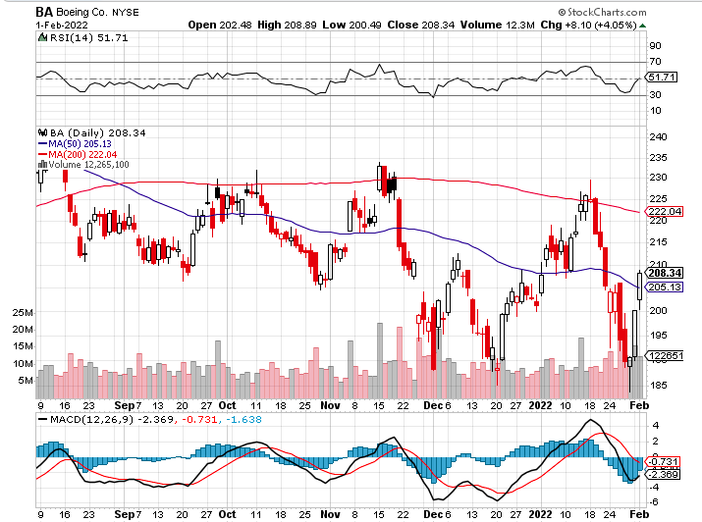
Boeing (BA) –LEAP Candidate China Orders Boeing 737 Max Back into the Air Boeing Wins a Major Order, for 30 737 MAX’s long 3/$146-$149 call spread took profits on long 2/$150-$160 call spread

Slide 43
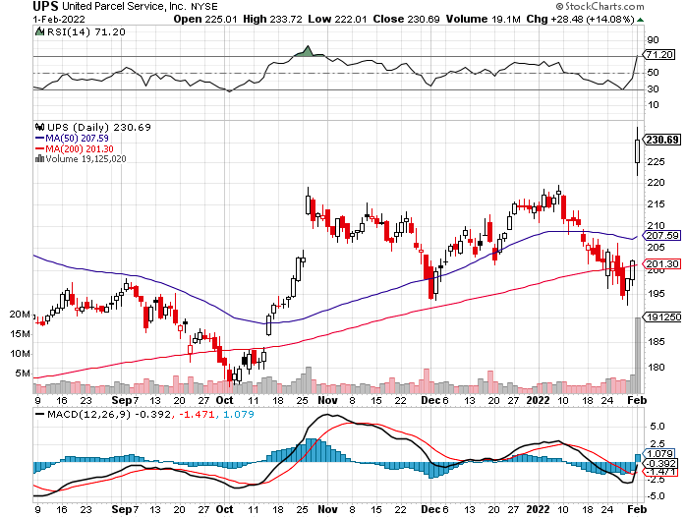
Package Delivery- United Parcel Service (UPS) - Package Delivery record profits took profits on long 11/$130-$140 call spread

Slide 44
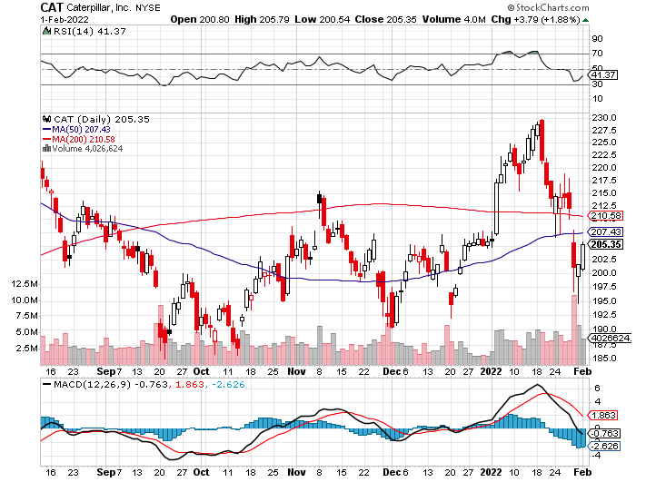
Caterpillar (CAT)- Ag + Infrastructure + Housing took profits on long 12/$145-$150 call spread took profits on long 11/$125-$135 call spread

Slide 45
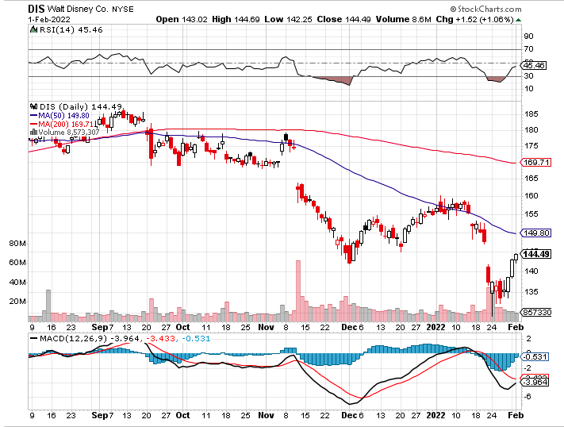
Walt Disney (DIS)- Earnings fail Streaming Growth Shortfall stopped out of long 10/$165-$175 call spread took profits on long 3/$170-$180 call spread

Slide 46
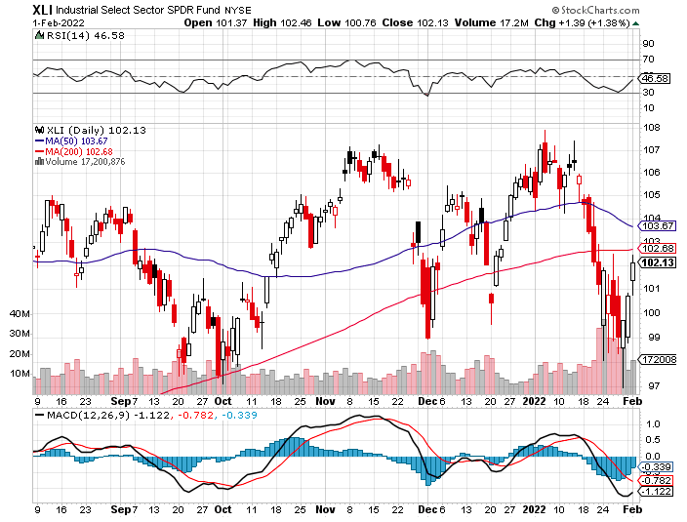
Industrials Sector SPDR (XLI)- (GE), (MMM), (UNP), (UTX), (BA), (HON)

Slide 47
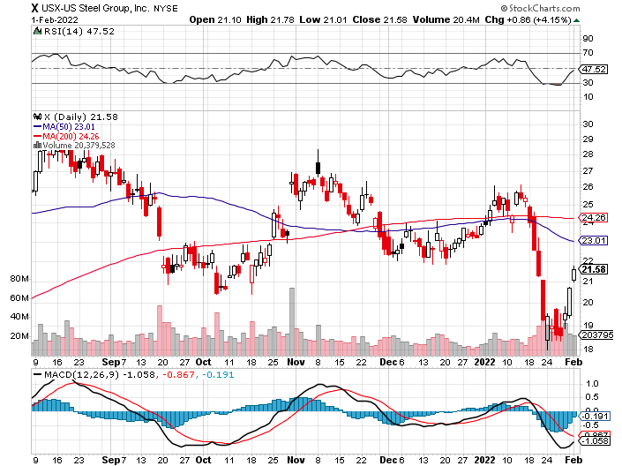
US Steel (X) – Commodity Drag

Slide 48
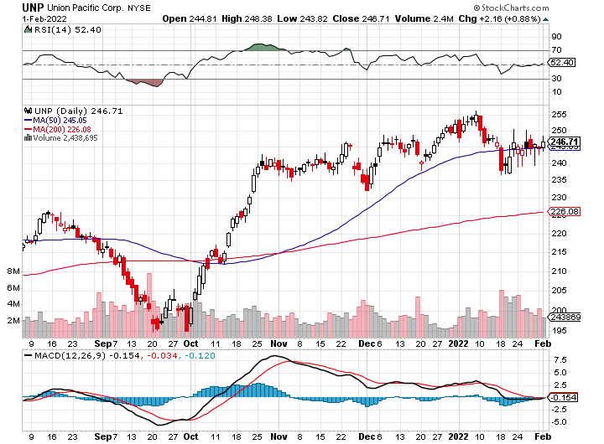
Union Pacific RR (UNP)- Big Stuff to Ship near record earnings announced took profits on long 5/$200-$210 call spread took profits on 11/$150-$160 call spread

Slide 49
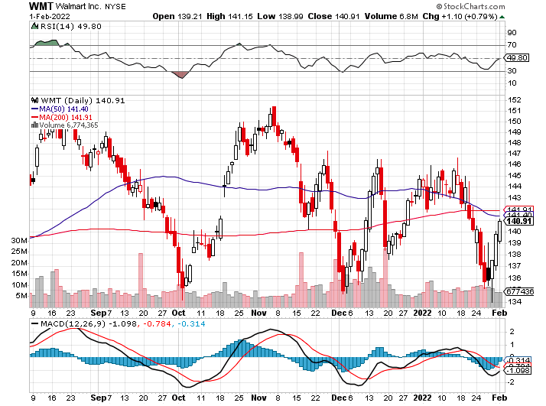
Wal-Mart (WMT)- took profit on Long 11/$125-$130 bear put spread took profit on Long 10/$119-$121 bear put spread took profits on Long 8/$114-$117 bear put spread

Slide 50
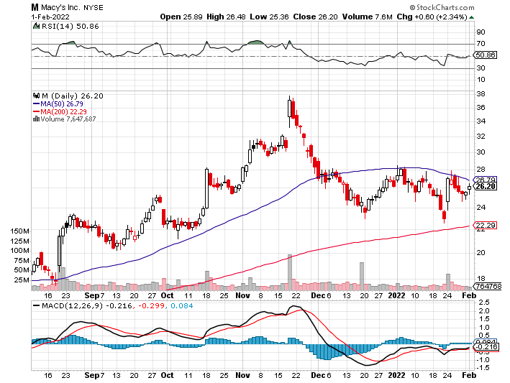
Macys’ (M) – Retail Punished took profits on Long 8/$23-$25 bear put spread

Slide 51
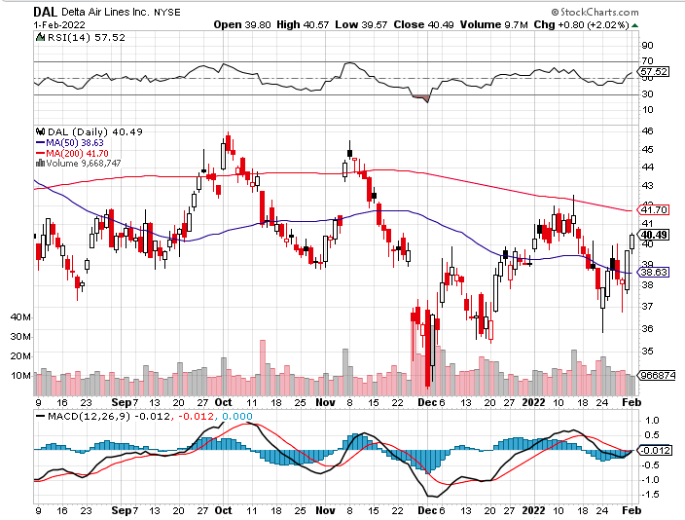
Delta Airlines (DAL) –

Slide 52
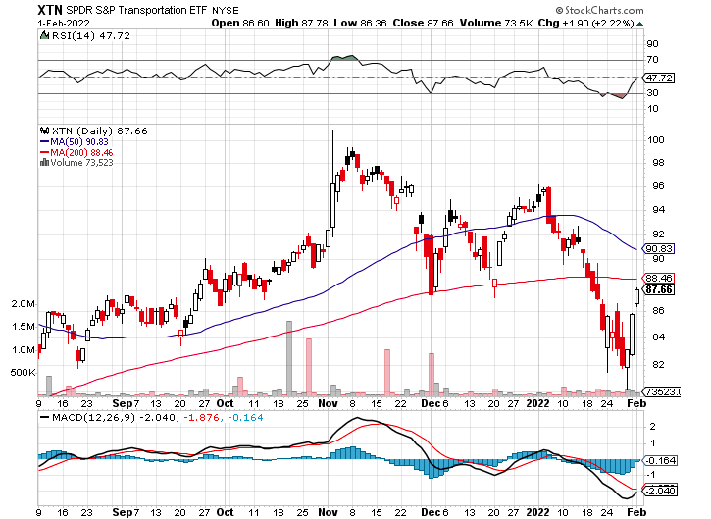
Transports Sector SPDR (XTN)- Worst Hit Sector (ALGT), (ALK), (JBLU), (LUV), (CHRW), (DAL)

Slide 53
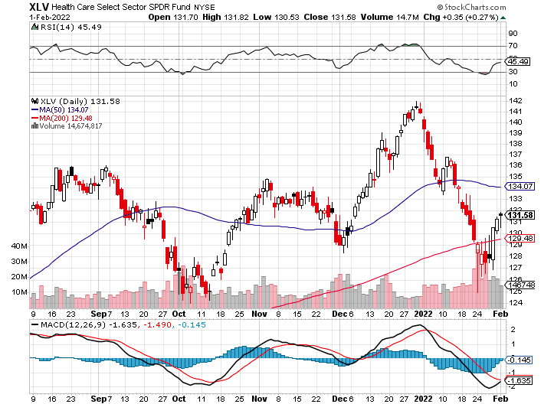
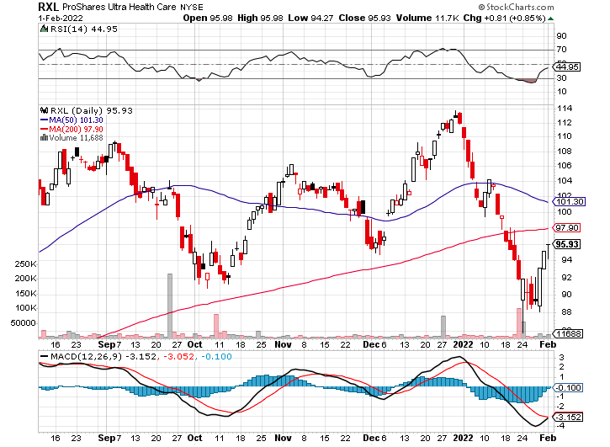
Health Care Sector (XLV), (RXL) (JNJ), (PFE), (MRK), (GILD), (ACT), (AMGN)

Slide 54
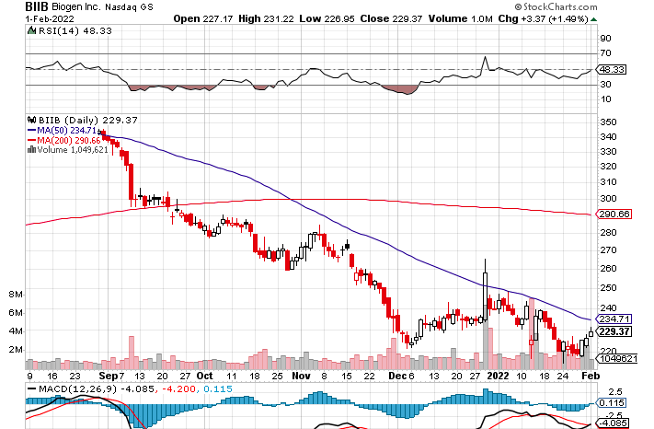
Biogen (BIIB) Why you invest in Biotech

Slide 55
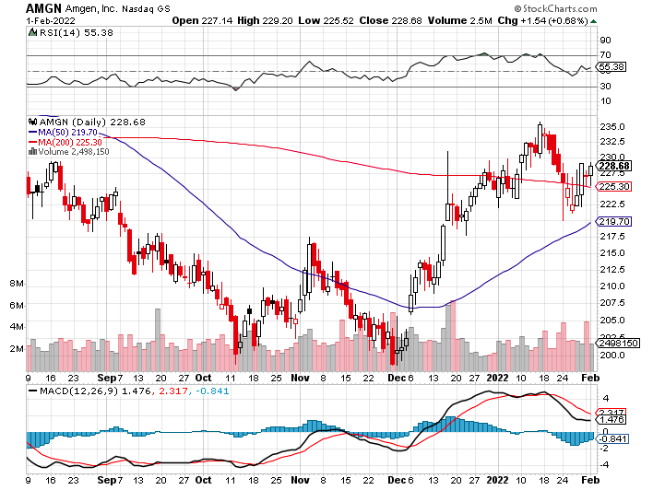
Amgen (AMGN) took profits on long 11/$185-$200 bull call spread

Slide 56
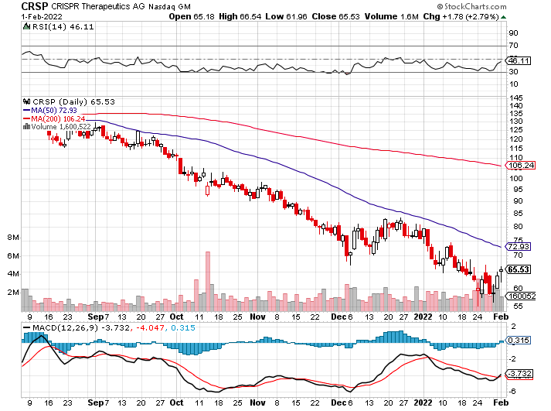
CRISPR Therapeutics (CRSP)

Slide 57
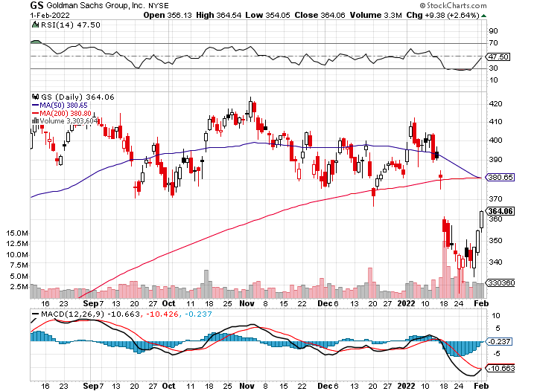
Goldman Sachs (GS) – took profits 12/$330-$350 call spread took profits 11/$330-$350 call spread stop loss on long 11/$385-$395 call spreads

Slide 58
Morgan Stanley (MS) – Doubled Dividend took profits on long 11/$85-$90 call spread stop loss on long 11/$95-$98 call spread took profits on long 10/$85-$90 call spread profits on long 2/$55-$60 call spread

Slide 59
JP Morgan Chase (JPM)-Back to Life took profits 12/$148-$152.50 call spread took profits on long 10/$130-$140 call spread took profits on long 8/$140-$145 call spread took profits on long 7/$140-$145 call spread

Slide 60
ProShares Ultra Technology ETF (ROM) – 2X Long Technology ETF took profits on long 10/$62-65 call spread

Slide 61
Bank of America (BAC) – took profits long 12/$39-$42 call spread stop loss on long 11/$43-$45 call spread took profits on 11/$37-$40 call spread took profits on long 2/$28-$30 call spread

Slide 62
SPDR Metals & Mining ETF (XME) – long 2/$28-$30 call spread

Slide 63
Blackrock (BLK)-Asset Collection Boom took profits on long 3/$770-$790 call spread took profits on long 3/$310-$340 call spread

Slide 64
Visa (V) – “Touchless” Bitcoin Drag took profits on long 5/$220-$225 bull call spread took profits on long long 5/$195-$205 bull call spread took profits on long 9/$180-$185 bull call spread

Slide 65
Consumer Discretionary SPDR (XLY) (DIS), (AMZN), (HD), (CMCSA), (MCD), (SBUX)

Slide 66
Berkshire Hathaway (BRKB)- Natural Barbell New All-Time High long 2/$270-$280 call spread

Slide 67
Europe Hedged Equity (HEDJ)-

Slide 68
Japan (DXJ)-

Slide 69
Emerging Markets (EEM) - Pro trade, Weak Dollar, Long Recovery Play

Slide 71
Bonds – Pariah
*The Bond Collapse Goes Global, with German 10-year bunds going positive for the first time in three years, up 40 basis points in a month *Interest rates hit new two-year high taking ten – year US Treasury to 1.92% *Is a half point rate hike in store for March? Next week’s inflation rate will tell. *Mortgage Interest Rates Hit 22 Month High, with the 30-year fixed hitting 3.56%. *Sell any six-point rally in the (TLT) *In a year, yield on the ten-year US Treasury bond will be at 2.50% or higher *US Treasury bond fund (TLT) could plunge from $180 in 2020 to $105 by 2023

Slide 72
Treasury ETF (TLT) – Breaking Down long 12/$149-$152 put spread, long 2/$147-$150 put spread long 3/$150-$153 put spread

Slide 73
Ten Year Treasury Yield ($TNX) – 1.81%

Slide 74
Junk Bonds (HYG) 4.32% Yield to Maturity

Slide 75
2X Short Treasuries (TBT)-Another run at highs

Slide 76
Emerging Market Debt (ELD) 5.81% Yield-

Slide 77
Emerging Market Debt (ELD) 5.81% Yield- Mix of AAA, AA, and A rated bonds

Slide 78
Foreign Currencies – Dollar Rebound
*US Dollar shows new signs of life *As long as the US interest rates keep rising the greenback will remain strong *China Posts Record Trade Surplus in 2021, at $676 billion, on global economic recovery, further undermining the buck *Currency with the fastest appreciating interest rates always does best *Long-term fundamentals are still poor, a dollar short could be the new ten-year trade, but not yet *Stand aside from forex for now, they are getting fish to fry

Slide 79
Japanese Yen (FXY), (YCS)

Slide 80
Euro (FXE)-

Slide 81
British Pound (FXB)-

Slide 82
Australian Dollar (FXA)- The Global Recovery Play took profits on long 8/$67-$69 call spread

Slide 83
Emerging Market Currencies (CEW)

Slide 84
Chinese Yuan- (CYB)-

Slide 85
Bitcoin – Rising Rate Hit Buy the Mad Hedge Bitcoin Letter at https://www.madhedgefundtrader.com/store/
*Bitcoin Gets Crushed, approaching a one year low at $31,000, and will continue to do so *Any noninterest bearing instrument gets punished when rates rise and crypto is no exception *Omicron variant delivered a new mini recession and crypto is no place to hide *Will this be a 50% correction or and 80% one, as in years past *Long term “BUY” signal for Bitcoin still intact *Buy Bitcoin and Ethereum on the bigger dip

Slide 86
Bitcoin ($BTCUSD) – Wake Up Time

Slide 87
Ethereum (ETHE) –

Slide 88
MicroStrategy (MSTR) –

Slide 89
Amplify Transformational Data Sharing ETF (BLOK) – Cross Imminent

Slide 90
Energy – Russian Roulette
*Oil Hits Seven Year High *Inventories hit 21-year low *No new capital is entering the industry, crimping supplies as old fields play out *The threat of a Russian invasion of the Ukraine is prompting advance stockpiling *Russia is the world’s second largest oil exporter. *The risk/reward for a new oil trade here is terrible *$100/barrel oil is possible, but with rising volatility *Avoid all energy plays like the plague, it’s the new buggy whip industry as the US de-carbonizes

Slide 91
Oil-($WTIC)

Slide 92
United States Oil Fund (USO) long 10/$9.50-$10 Vertical bull call spread

Slide 93
Energy Select Sector SPDR (XLE)-No Performance! (XOM), (CVX), (SLB), (KMI), (EOG), (COP)

Slide 94
Halliburton (HAL)-

Slide 95
Natural Gas (UNG) -

Slide 96
Precious Metals – Still No Pulse
*Not a hint of downside protection offered by gold in this global selloff *Gold has been the worst performing asset of 2021 *Gold provided absolutely no downside protection during the recent pandemic crash *If $9 trillion of investment demand decamps for the crypto world, leaving only jewelry demand, $9 trillion could go into Bitcoin. *Rising interest rates bode poorly for precious metals as it raises the opportunity cost for non-yielding assets *Bitcoin is clearly sucking capital out of precious metals *Stay away until this plays out *Silver is still the bigger and better long-term play

Slide 97
Gold (GLD)- Meltdown

Slide 98
Market Vectors Gold Miners ETF- (GDX) –

Slide 99
Barrick Gold (GOLD) took profits on long 1/$21-$23 call spread took profits on long 11/$22-$24 call spread

Slide 100
Newmont Mining- (NEM)- took profits on long $55-60 call spread

Slide 101
Silver- (SLV)- took profits on long 11/$19-$20 call spread

Slide 102
Silver Miners - (SIL)-

Slide 103
Wheaton Precious Metals - (WPM)- took profits on long 2/$39-41 call spread

Slide 104
Copper (COPX)-Uptrend Resumes Copper Unions Vote to Strike in Chile, cutting off 33% of the global supply

Slide 105
Real Estate – No Rest
*Existing Homes Sales Hit a 15 Year High, at 6.12 million, the best since 2006 *Extreme inventory shortage is the issue, with only 910,000 homes for sale at the end of the year, an incredibly low 1.8-month supply. *You can’t find anything on the market now, to buy or rent *The medium price of a home sold in December was $358,000, a 15.8% gain YOY *New Home Sales Skyrocket to an eye popping 811,000 in December, up 11.7% YOY *Median sales prices jump to $377,700, up 3% YOY *S&P Case Shiller Rockets 18.8%, in November with its National Home Price Index The real estate boom is years away from a peak.

Slide 106
S&P Case Shiller S&P Case Shiller Rockets 18.8%, in November with its National Home Price Index Phoenix 32.2%, Tampa (29%), and Miami (26.6%) were the big gainers

Slide 107
Crown Castle International (CCI) – 2.70% yielding cell phone tower REIT

Slide 108
US Home Construction Index (ITB) (DHI), (LEN), (PHM), (TOL), (NVR)

Slide 110
Trade Sheet- So What Do We Do About All This?
*Stocks – sell rallies *Bonds – sell rallies aggressively *Commodities-stand aside *Currencies- stand aside *Precious Metals – stand aside *Energy – stand aside *Volatility - sell short over $30 *Real estate – stand aside *Bitcoin – stand aside

Slide 111
Next Strategy Webinar 12:00 EST Wednesday, February 16 from Incline Village, NV email me questions at support@madhedgefundtrader.com
Good Luck and Good Trading!
Notes:
*

