Slide 1
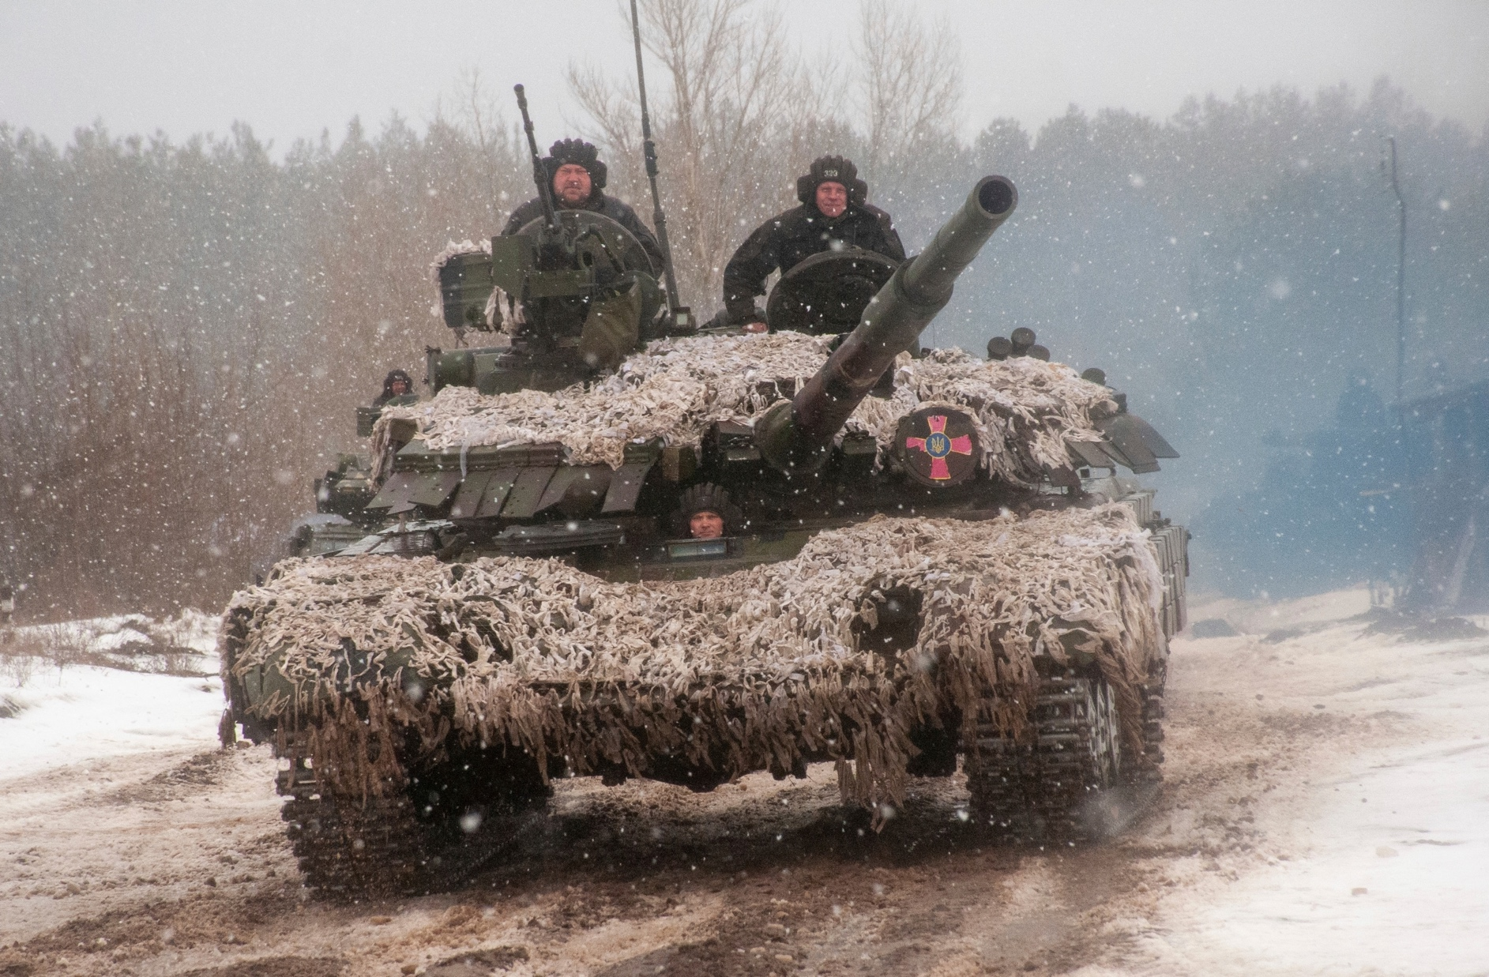
The Mad Hedge Fund Trader “Invasion Fears”
With John Thomas Incline Village, NV, February 16, 2022 www.madhedgefundtrader.com
Notes:
*

Slide 2
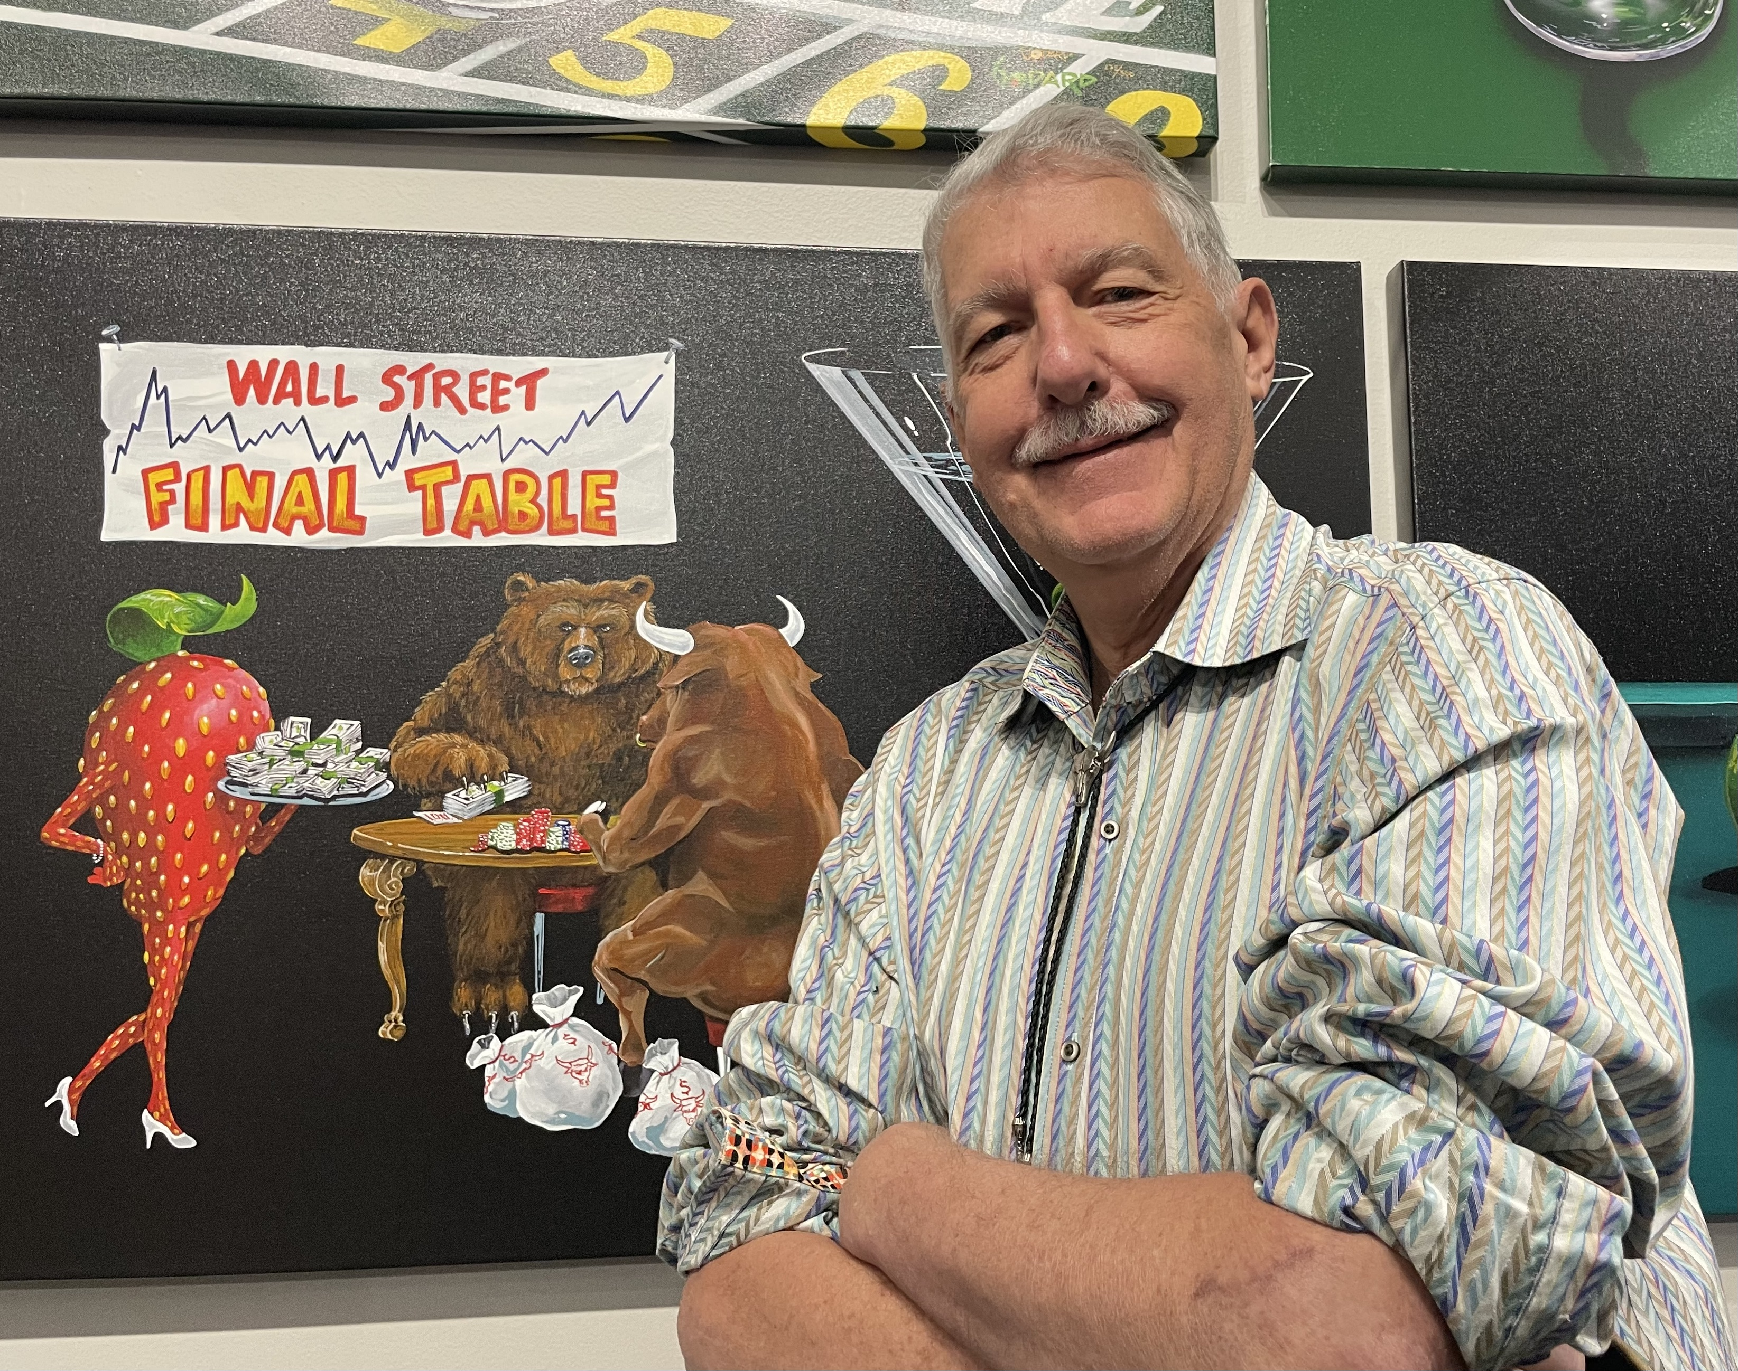

Slide 3
Trade Alert Performance New All Time Highs!
*January 14.59% Final *July +0.61% Final *February +8.07% MTD *August +9.36% Final *March +20.60% Final *September 1.03% Final *April +15.67% Final *October +8.91% MTD *May +8.13% Final *November -11.79% Final *June +0.71% Final *December +11.26% Final *2022 YTD +22.66% compared to -3.8% for the Dow Average *+535.22% since inception *Average annualized return of 44.05% for 12 years

Slide 4
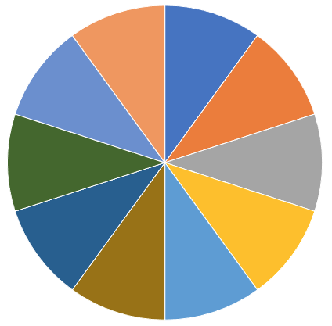
Portfolio Review 40% Long, 50% short, 10% cash Long Term Bull Market
Risk On
World is Getting Better
(TLT) 2/$149-$152 put spread | 10.00%
(TLT) 2/$147-$150 put spread | 10.00%
(BRKB) 2/$270-$280 call spread | 10.00%
(TSLA) 2/$600-$650 call spread | 10.00%
Risk Off
World is Getting Worse
(MSFT) 2/$340-$350 puts spread | -10.00%
(SPY) 2/$465-$475 put spread | -10.00%
(SPY) 3/$470-$480 put spread | -10.00%
(AMZN) 2/$3400-$3500 put spread | -10.00%
(TLT) 2/$127-$130 call spread | -10.00%
Total Net Position | -10.00%
Total Aggregate Position | 90.00%
Expiration Value 26.08%

Slide 5
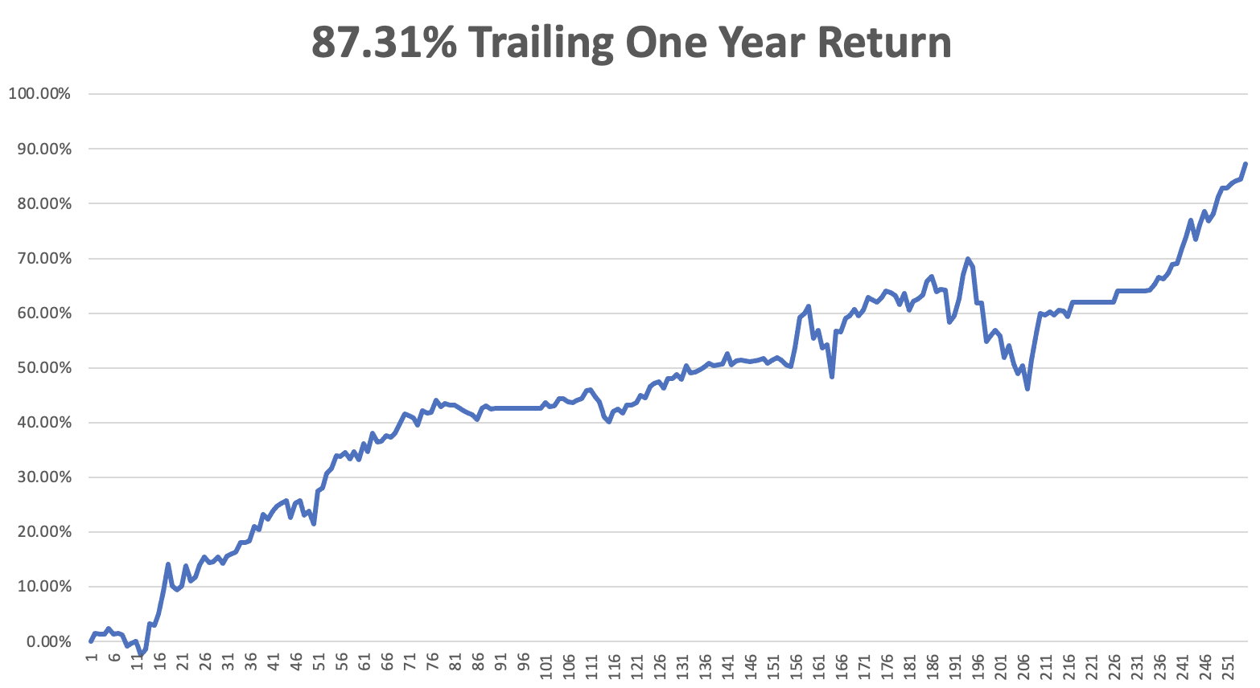

Slide 6
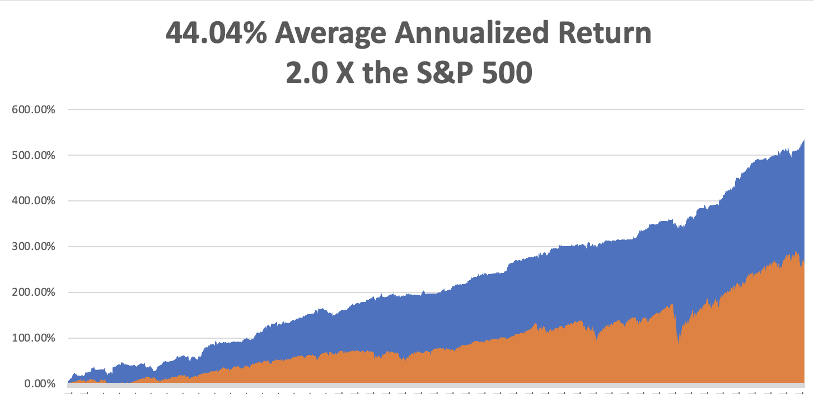
GTD 12 Year Daily Audited Performance

Slide 7
The Method to My Madness The Roaring Twenties are Here
*Ukraine war prospects are the main driver now *The breakout of peace will bring a rally, but not new highs *The first three Interest rate rises are in the market, but not the 9 that follow *When the focus shifts back to interest rates stocks are in trouble *A core short in bonds will be key, but trade this too *Omicron cases collapse, taking this drag off the market *VIX over $30 is the ideal entry point for new positions

Slide 8
Corona Update – Explosive Growth
*Omicron now dominating US economy, but cases have peaked *Under fives vaccine out in delayed until April *Fatalities are a fifth less that year ago peak *Hospitalizations are 80% from the unvaccinated *Pandemic is still going to zero by summer, book those cruises *US cases top 80 million, deaths topping 925,000 and deaths are back up to 2,000 a day

Slide 9
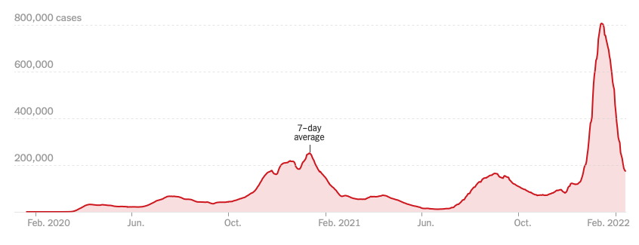
Bump on the Way to Zero

Slide 10
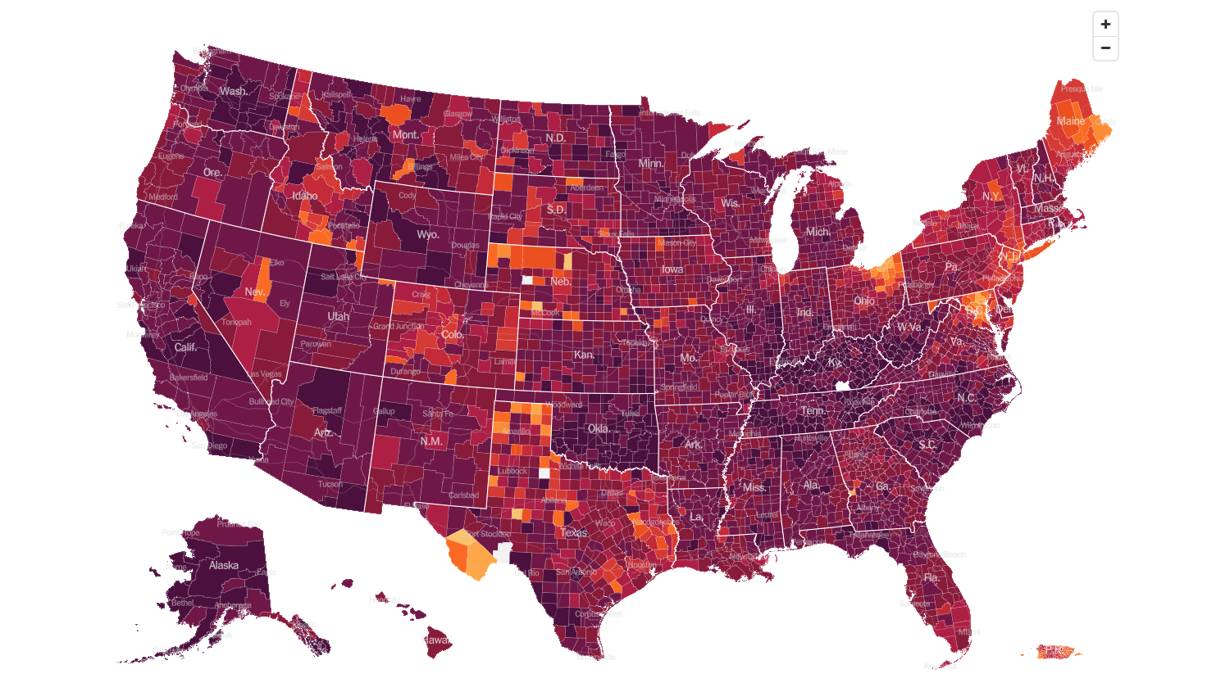
February 2 2022 Infection Rate

Slide 11
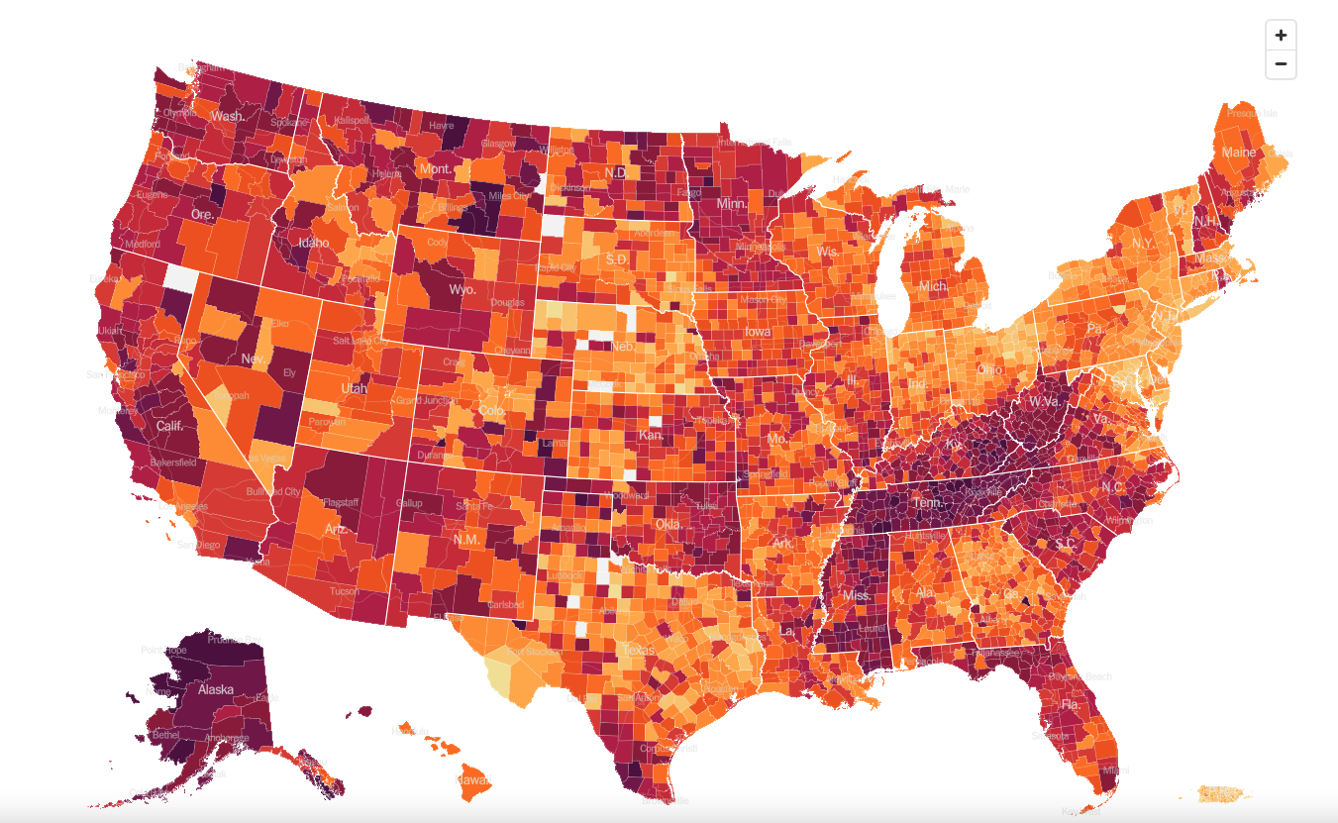
February 16 2022 Infection Rate

Slide 12
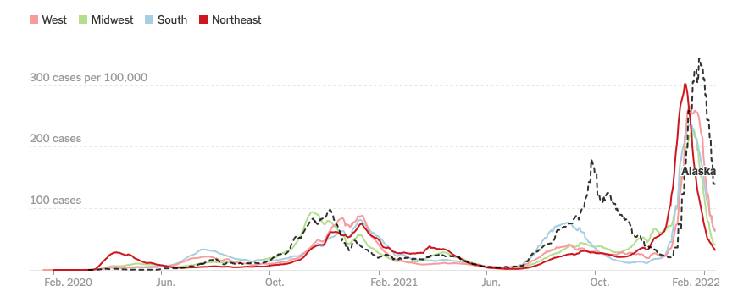

Slide 13
The Global Economy – Mixed Messages
*The Nonfarm Payroll Report Comes in Hot, at 467,000 when many were expecting negative numbers due to omicron *The Headline Unemployment Rate rose to 4.0%. *Core CPI Comes in Hot at 7.5%, the highest since 1982 *Fed Now Pushing a Half Point Hike, tanking the markets, and could deliver 100 basis points by July *Consumer Sentiment Dives, from 67 to 61.7, according to the University of Michigan *Wholesale Prices Rocket 1% in January and are up a nosebleed 9.7% YOY

Slide 14
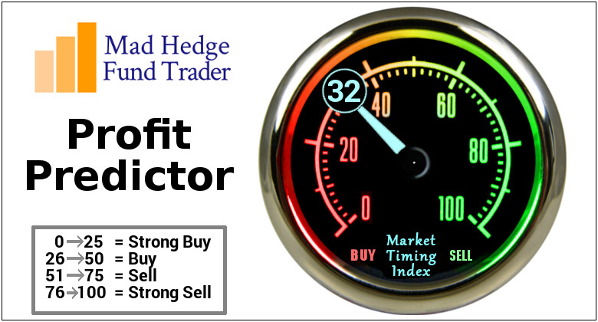
The Mad Hedge Profit Predictor Market Timing Index – Buy Territory An artificial intelligence driven algorithm that analyzes 30 different economic, technical, and momentum driven indicators

Slide 15
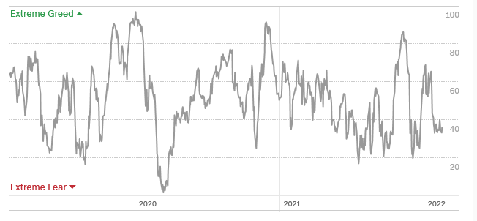
The Mad Hedge Profit Predictor From Extreme “BUY” to Neutral
SELL
Do Nothing
BUY

Slide 16
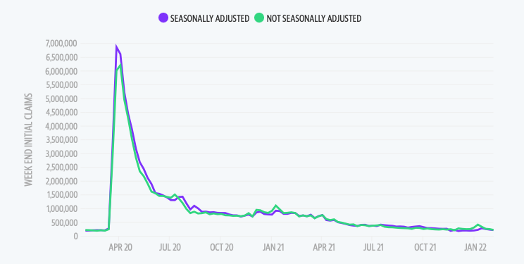
Weekly Jobless Claims – Falling 223,000 –

Slide 17
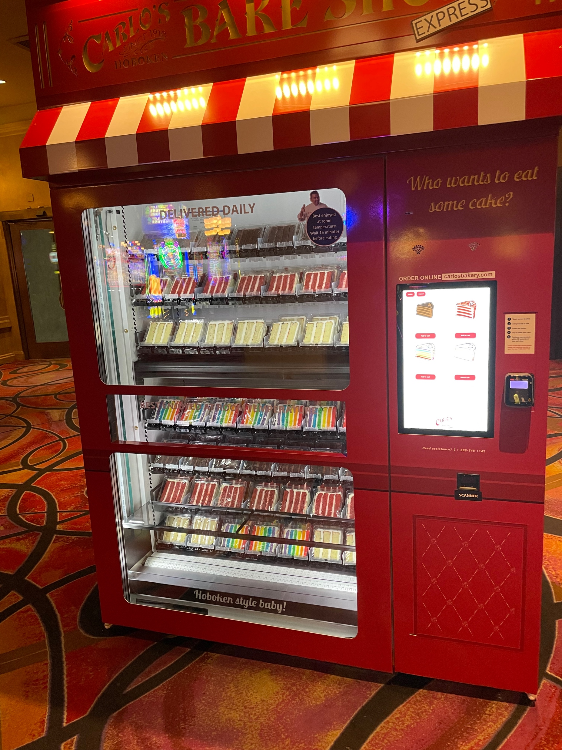

Slide 18
Stocks – Invasion Fears
*Dow Dives Nearly $1,600 points in 3 days on Russian invasion fears *Goldman Sachs Chops 2022 Market Forecast, taking the S&P 500 goal from $5,100 down to $4,900 *Facebook Crashes 30% on Huge Earnings Miss, in Q4 *NVIDIA Cancels ARM Purchase, ending its $66 billion attempt to buy market share *Stocks to Fall Another 10%, says Wharton Prof Jeremy Siegel, who has been uncannily accurate for the past decade. *Volatility to remain high, a money maker for Mad Hedge *George Soros Buys into Rivian *Look for terrible H1 and strong H2 scenario to continue

Slide 19
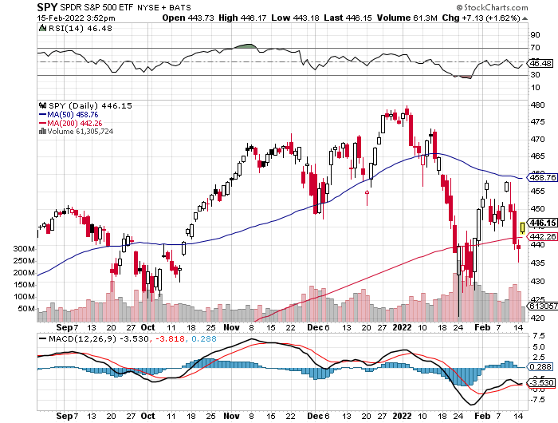
S&P 500 – Year End Melt Up! long 2/$465-$475 bear put spread, long 3/$470-$480 bear put spread Took profits on long 2/$410-$420 bull call spread, Took profits on long 2/$480-$500 bear put spread, Took profits on long 10/$410-$420 bull call spread
The Bottom 425 Down 13.5%

Slide 20
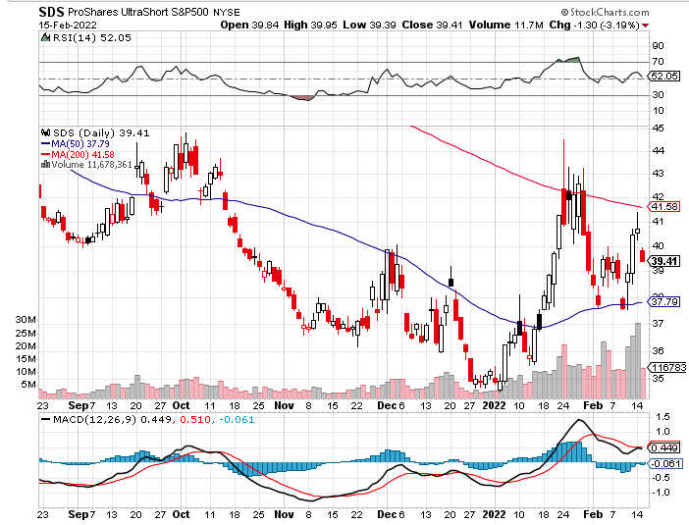
ProShares Ultra Short S&P 500 (SDS)- a great hedge for long stocks and bonds long 2X position has a hedge against longs and bond shorts

Slide 21
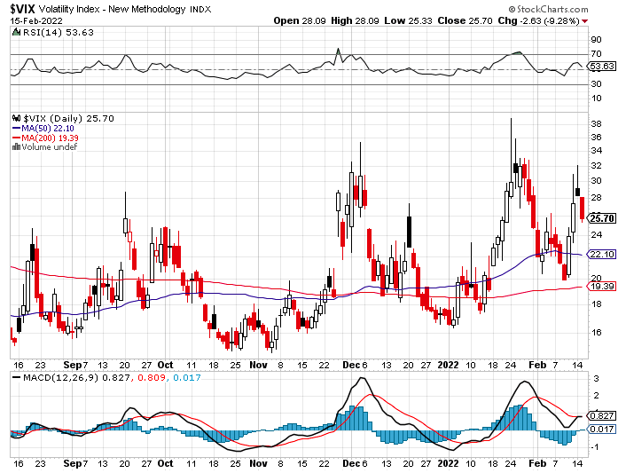
(VIX) – Dying a Slow Death classic summer market

Slide 22
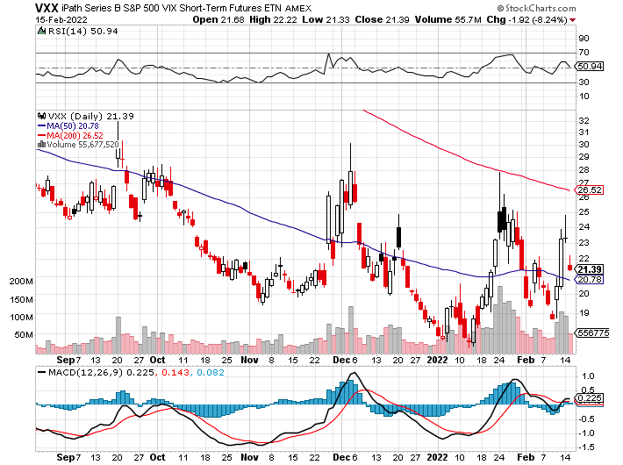
(VXX)-

Slide 23
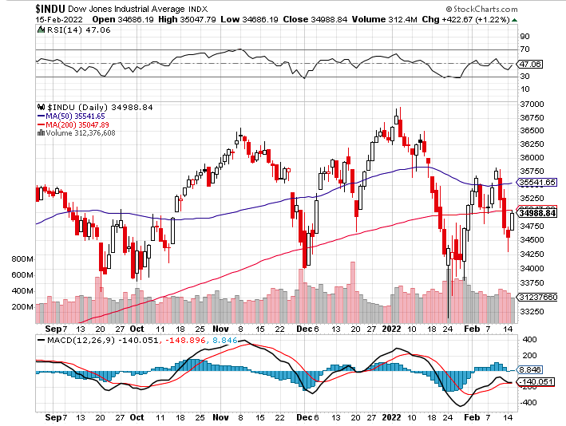
Dow Average ($INDU)-

Slide 24
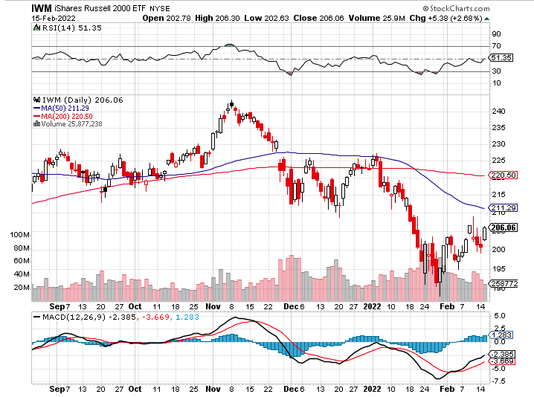
Russell 2000 (IWM)- took profits on Long 10/$137-$142 vertical bull call spread took profits on Long 10/$153-$156 vertical bear put spread

Slide 25
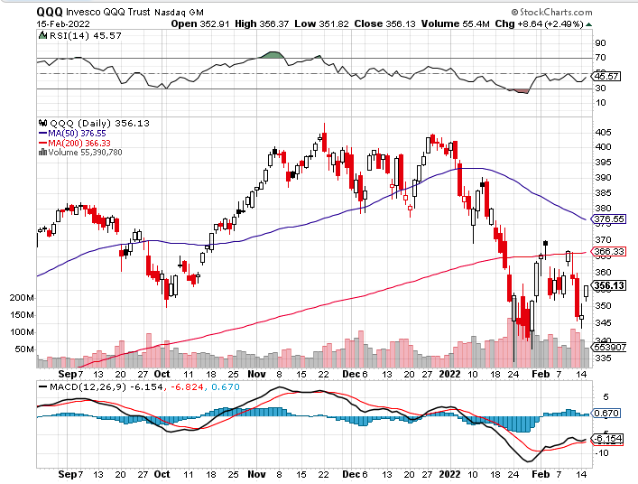
NASDAQ (QQQ) – long (QQQ) 4/$330-$335 put spread took profits on long (QQQ) 3/$340-$345 put spread covered long (QQQ) $325-$330 put spread

Slide 26
The Barbell Portfolio
*50% Big Tech - 2% of US Employment but 27% of Market Cap and 38% of Profits 50% Domestic Recovery, including: Railroads Couriers Banks Construction Credit Cards Event organizers Ticket sales Retailers

Slide 28
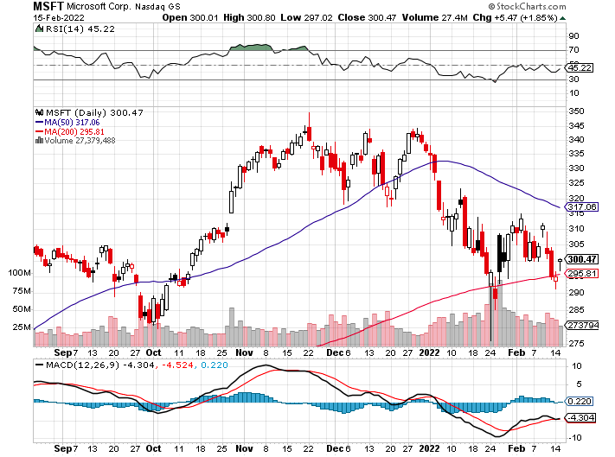
Microsoft (MSFT)- long 2/$340-$350 bear put spread took profits on long 12/$220-$230 call spread stop loss on long 12/$170-$180 call spread

Slide 29
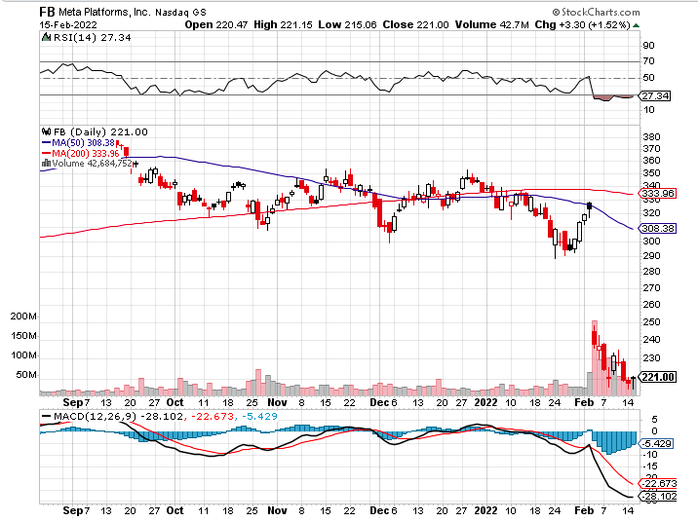
Facebook (FB)- Changes Name to “Meta” took profits on Long 9/$290-$300 vertical bear put spread stopped out of Long 9/$190-$200 vertical bear put spread

Slide 30
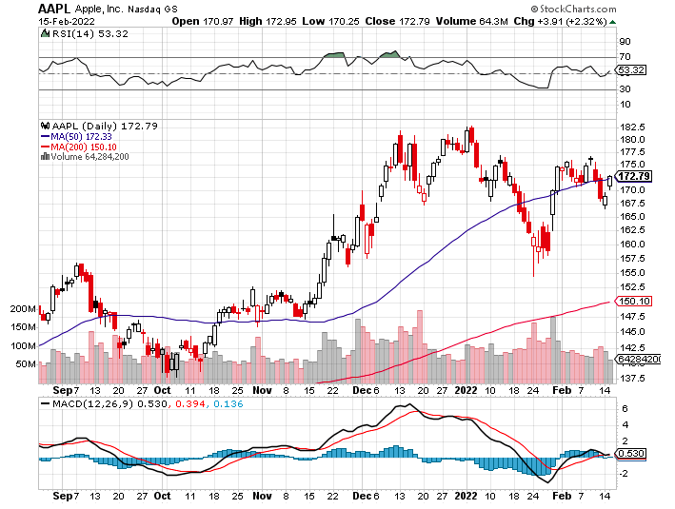
Apple (AAPL)- Apple Blows it Away, with Q4 revenues of an eye popping $124 billion, up 11% YOY. Some $27 billion in dividends and share buy backs was returned to shareholders. Took profits on long 2/$180-$190 put spread

Slide 31
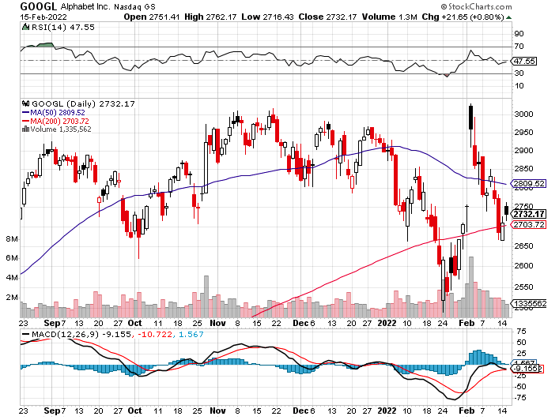
Alphabet (GOOGL) – Ad king on economic recovery 15% of search is travel related took profits on long 12/$1,200-$1,230 bull call spread took profits on long 9/$1,030-$1,080 vertical bull call spread

Slide 32
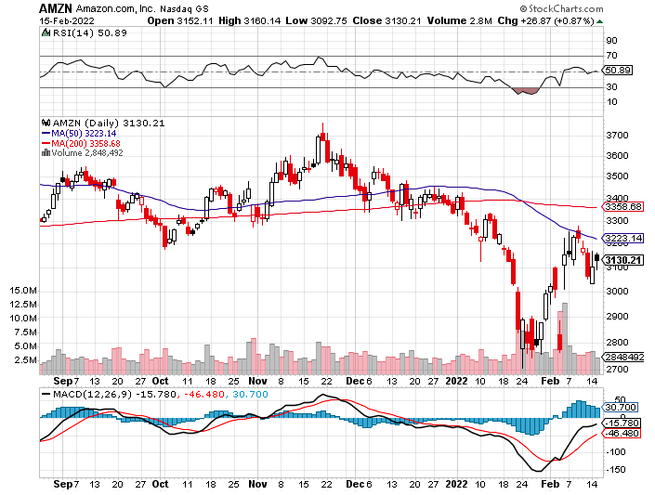
Amazon (AMZN) – long 2/$3,400-$3,500 bear put spread took profits on long 9/$2,800-$2,900 bull call spread

Slide 33
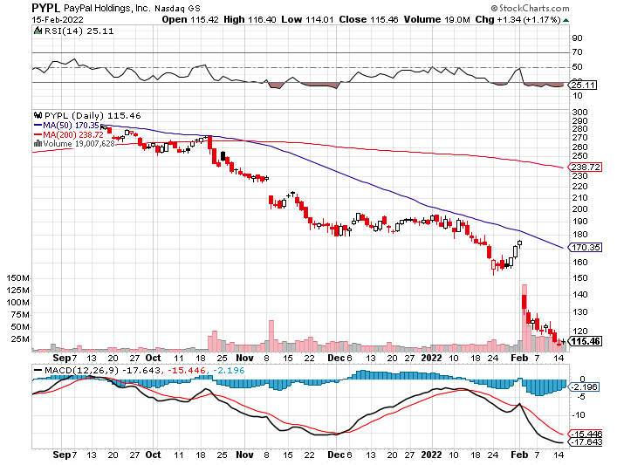
PayPal (PYPL) - Cancels Pinterest Buy took profits on long 4/$90-$95 call spread

Slide 34
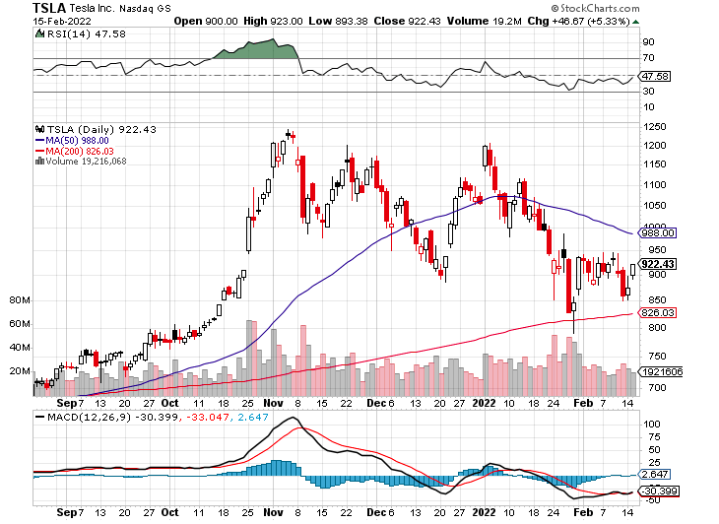
Tesla (TSLA) –Aiming for 1.5 million cars in 2022 long 2/$600-$650 call spread

Slide 35
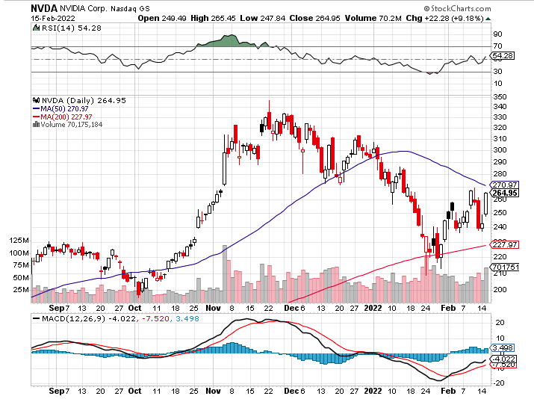
NVIDIA (NVDA) – A Mad Hedge 10 bagger – Global Semiconductor Shortage Slows Auto Industry,

Slide 36
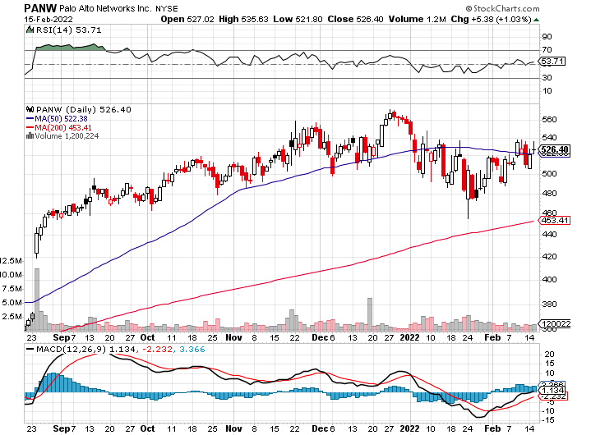
Palo Alto Networks (PANW)- Hacking never goes out of fashion

Slide 37
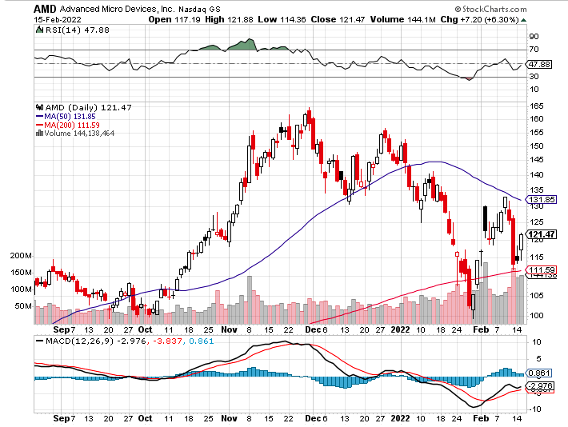
Advanced Micro Devices (AMD)- programable logic devices took profits on long 2/$75-$80 call spread

Slide 38
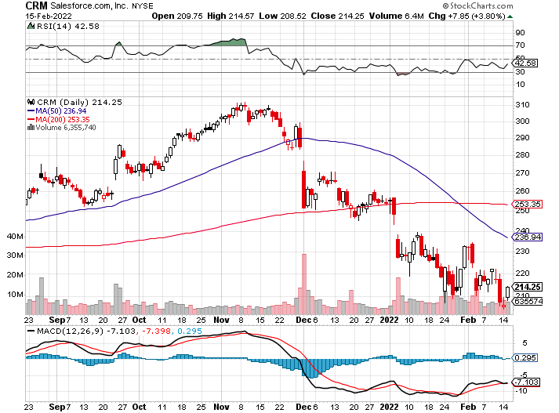
Salesforce (CRM)- Massive Online Migration took profits on long 9/$125-$130 vertical bull call spread took profits on long 8/$125-$130 vertical bull call spread took profits on long 2/$105-$115 call spread

Slide 39
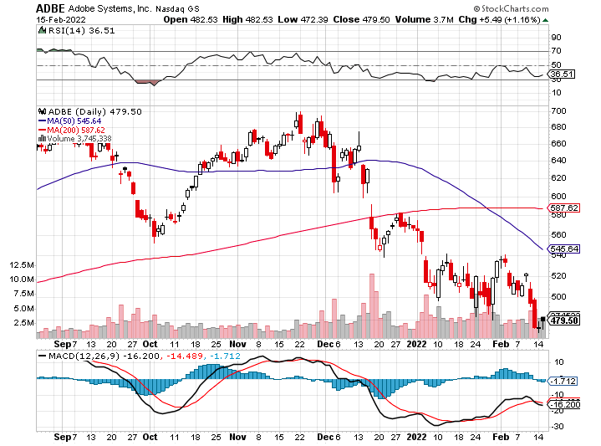
Adobe (ADBE)- Cloud play The Quality Non-China tech play

Slide 40
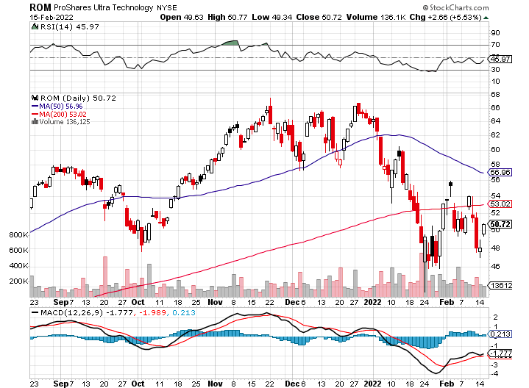
ProShares Ultra Technology ETF (ROM) – 2X Long Technology ETF took profits on long 10/$62-65 call spread

Slide 41
The Second Half of the Barbell
*Bets on a domestic recovery in 2022 Q4 *Upside potential in 2022 far greater than tech *Some of these have not moved for 5 or 10 years *Focuses on economically sensitive cyclical industries *Makes a great counterweight to high-growth technology *We could spend all of next year rotating between the two groups

Slide 42
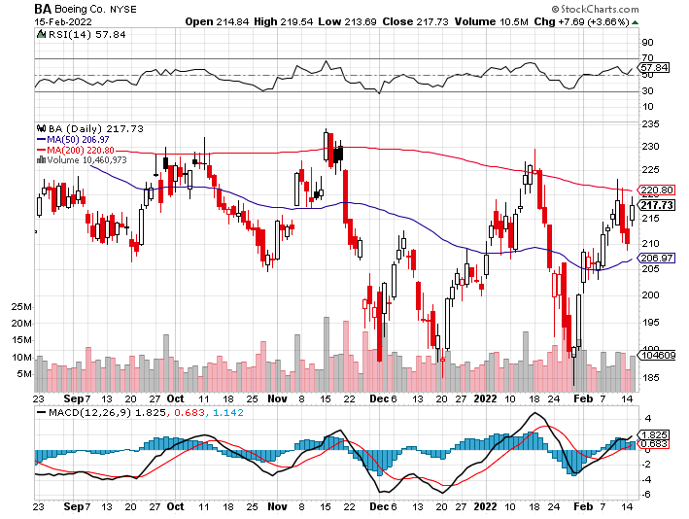
Boeing (BA) –LEAP Candidate Slapped by FAA Banning Self-Certification long 3/$146-$149 call spread took profits on long 2/$150-$160 call spread

Slide 43
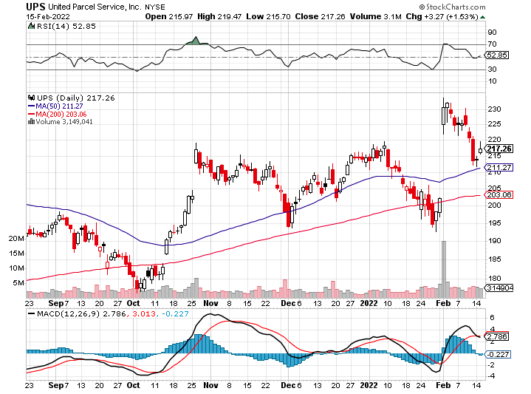
Package Delivery- United Parcel Service (UPS) - Package Delivery record profits took profits on long 11/$130-$140 call spread

Slide 44
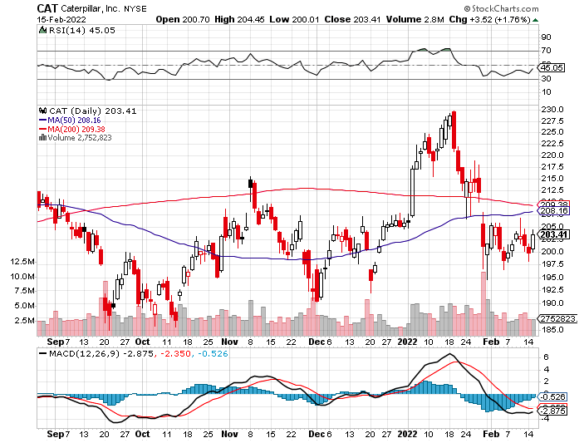
Caterpillar (CAT)- Ag + Infrastructure + Housing took profits on long 12/$145-$150 call spread took profits on long 11/$125-$135 call spread

Slide 45
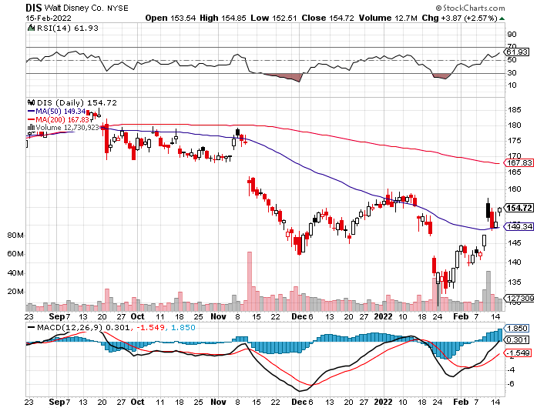
Walt Disney (DIS)- stopped out of long 10/$165-$175 call spread took profits on long 3/$170-$180 call spread

Slide 46
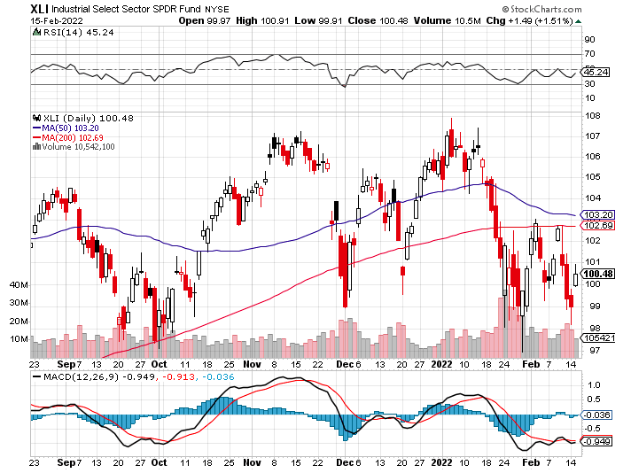
Industrials Sector SPDR (XLI)- (GE), (MMM), (UNP), (UTX), (BA), (HON)

Slide 47
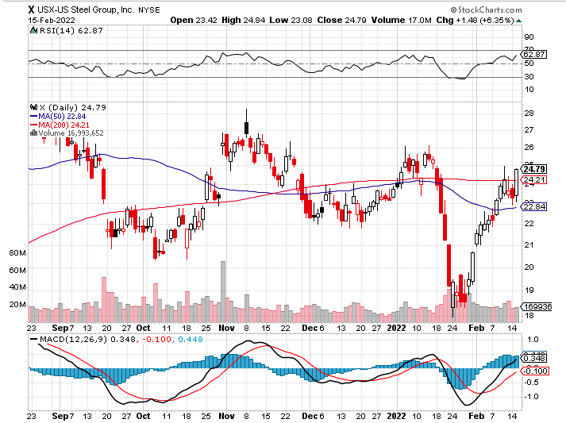
US Steel (X) – Commodity Drag

Slide 48
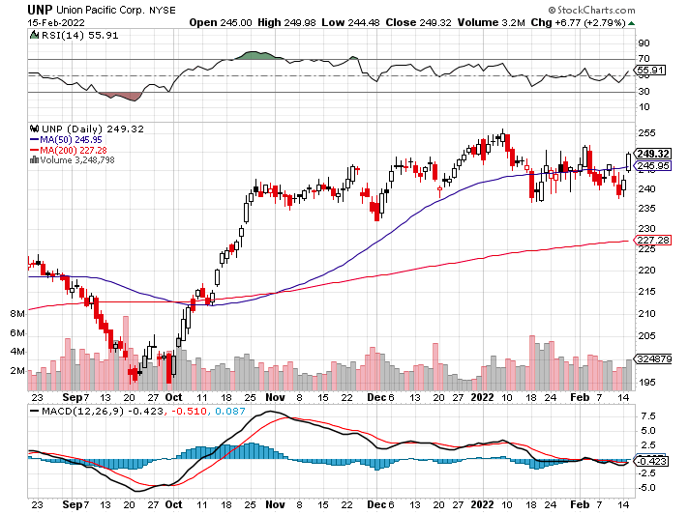
Union Pacific RR (UNP)- Big Stuff to Ship near record earnings announced took profits on long 5/$200-$210 call spread took profits on 11/$150-$160 call spread

Slide 49
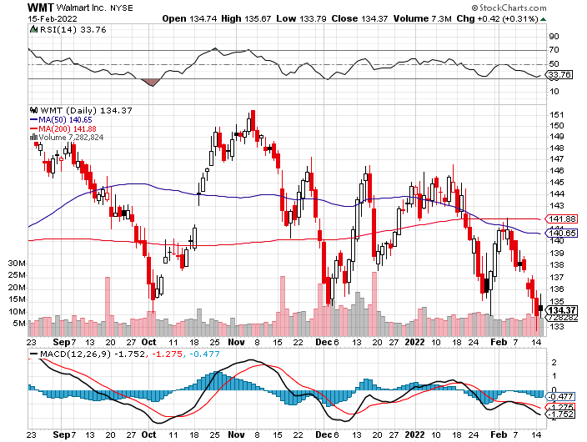
Wal-Mart (WMT)- took profit on Long 11/$125-$130 bear put spread took profit on Long 10/$119-$121 bear put spread took profits on Long 8/$114-$117 bear put spread

Slide 50
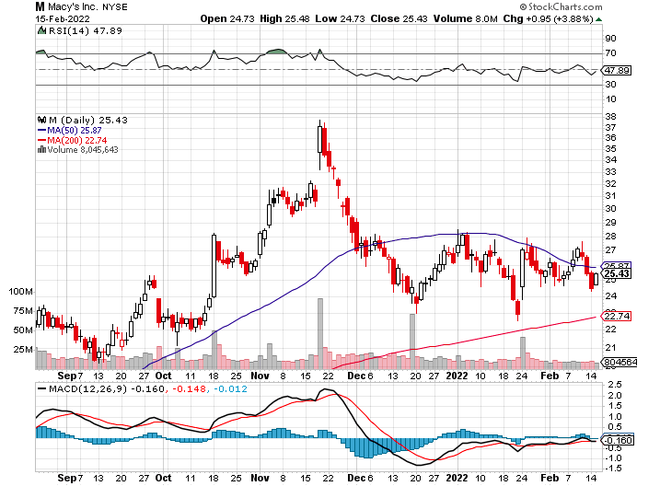
Macys’ (M) – Retail Punished took profits on Long 8/$23-$25 bear put spread

Slide 51
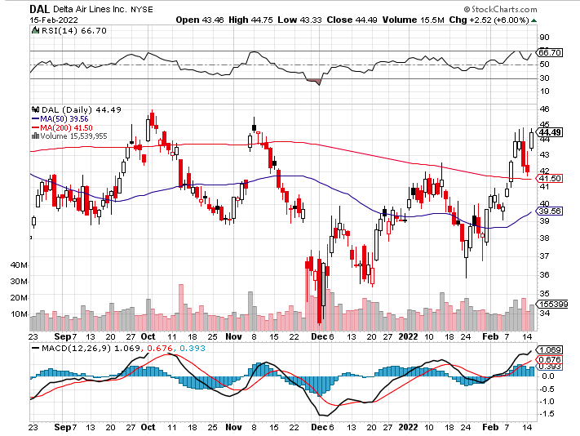
Delta Airlines (DAL) –

Slide 52
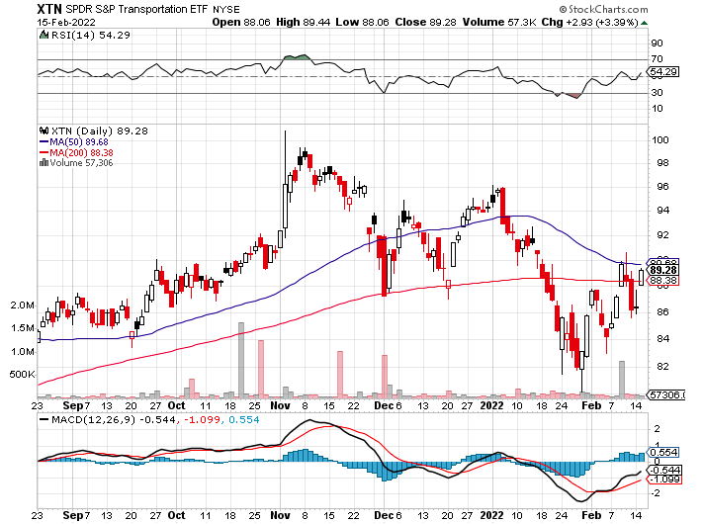
Transports Sector SPDR (XTN)- Worst Hit Sector (ALGT), (ALK), (JBLU), (LUV), (CHRW), (DAL)

Slide 53
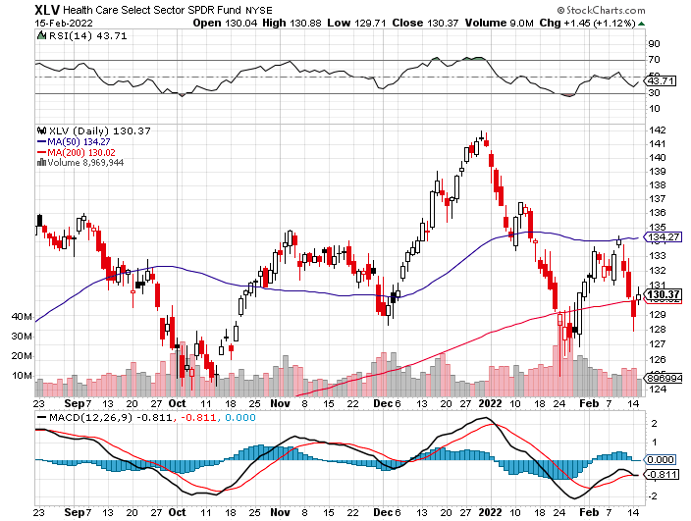
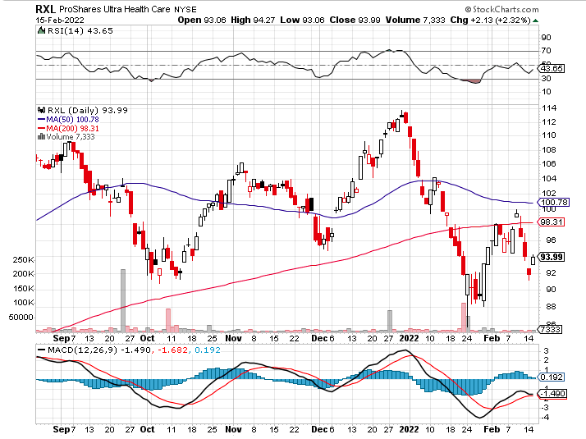
Health Care Sector (XLV), (RXL) (JNJ), (PFE), (MRK), (GILD), (ACT), (AMGN)

Slide 54
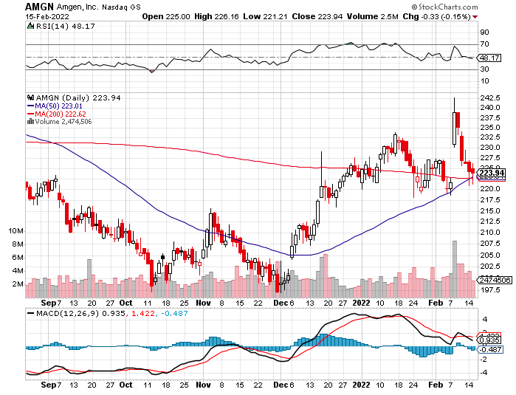
Amgen (AMGN) took profits on long 11/$185-$200 bull call spread

Slide 55
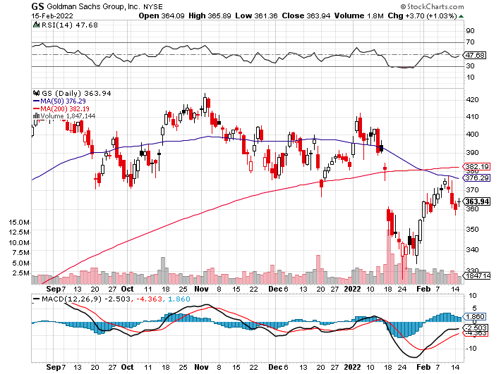
Goldman Sachs (GS) – took profits 12/$330-$350 call spread took profits 11/$330-$350 call spread stop loss on long 11/$385-$395 call spreads

Slide 56
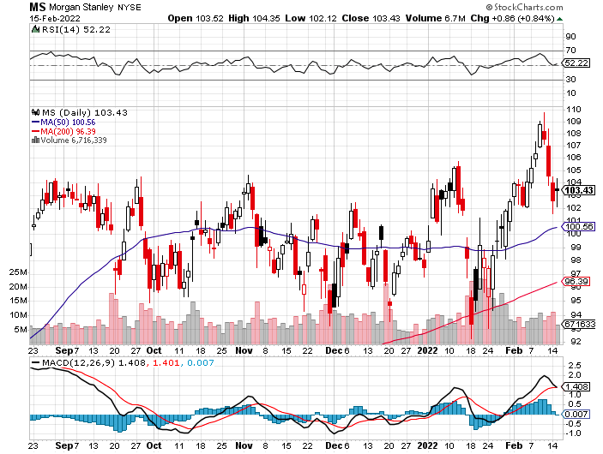
Morgan Stanley (MS) – Doubled Dividend took profits on long 11/$85-$90 call spread stop loss on long 11/$95-$98 call spread took profits on long 10/$85-$90 call spread profits on long 2/$55-$60 call spread

Slide 57
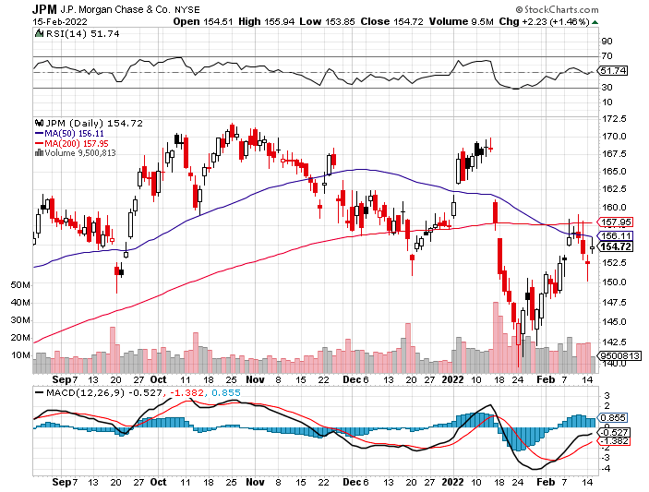
JP Morgan Chase (JPM)-Back to Life took profits 12/$148-$152.50 call spread took profits on long 10/$130-$140 call spread took profits on long 8/$140-$145 call spread took profits on long 7/$140-$145 call spread

Slide 58
Bank of America (BAC) – took profits long 12/$39-$42 call spread stop loss on long 11/$43-$45 call spread took profits on 11/$37-$40 call spread took profits on long 2/$28-$30 call spread

Slide 59
SPDR Metals & Mining ETF (XME) – long 2/$28-$30 call spread

Slide 60
Blackrock (BLK)-Asset Collection Boom took profits on long 3/$770-$790 call spread took profits on long 3/$310-$340 call spread

Slide 61
Visa (V) – “Touchless” Bitcoin Drag took profits on long 5/$220-$225 bull call spread took profits on long long 5/$195-$205 bull call spread took profits on long 9/$180-$185 bull call spread

Slide 62
Consumer Discretionary SPDR (XLY) (DIS), (AMZN), (HD), (CMCSA), (MCD), (SBUX)

Slide 63
Berkshire Hathaway (BRKB)- Natural Barbell New All-Time High long 2/$270-$280 call spread

Slide 64
Europe Hedged Equity (HEDJ)-

Slide 65
Japan (DXJ)-

Slide 66
Emerging Markets (EEM) - Pro trade, Weak Dollar, Long Recovery Play

Slide 68
Bonds – Vigilantes are Back
*The Bond Vigilantes are Back, as the monetary tightening goes global *US National Debt Tops $30 Trillion, the end result of 20 years of deficit spending. *Interest rates hit new two year high taking ten –year US Treasury to 2.05% *Is a half point rate hike in store for March. Next week’s inflation rate will tell *Real Yields Turn Positive, for the first time in a decade, at least for 30-year US treasury bonds *Sell any six-point rally in the (TLT) *In a year, yield on the ten-year US Treasury bond will be at 2.50% or higher *US Treasury bond fund (TLT) could plunge from $180 in 2020 to $105 by 2023

Slide 69
Treasury ETF (TLT) – Breaking Down long 2/$149-$152 put spread, long 2/$147-$150 put spread long 3/$150-$153 put spread, Long 3/$127-$130 call spread

Slide 70
Ten Year Treasury Yield ($TNX) – 2.05%

Slide 71
Junk Bonds (HYG) 4.75% Yield to Maturity

Slide 72
2X Short Treasuries (TBT)-Another run at highs

Slide 74
Foreign Currencies – Flat Lining
*Soaring interest rates fail to give the buck a boost *Ukraine crisis also fails to deliver a bid for the greenback *All major currencies are flat-lining as capital pours into cash *Currency with the fastest appreciating interest rates usually does best *Long-term fundamentals are still poor, a dollar short could be the new ten-year trade, but not yet *Stand aside from forex for now, there are getting fish to fry

Slide 75
Japanese Yen (FXY)

Slide 76
Euro (FXE)-

Slide 77
British Pound (FXB)-

Slide 78
Australian Dollar (FXA)- The Global Recovery Play took profits on long 8/$67-$69 call spread

Slide 79
Emerging Market Currencies (CEW)

Slide 80
Chinese Yuan- (CYB)-

Slide 82
Bitcoin – Rising Rate Hit Buy the Mad Hedge Bitcoin Letter at https://www.madhedgefundtrader.com/store/
*Bitcoin Comes Back from the Dead, rising 42% from the intraday January 24 low to $45,500 *There are still a lot of stale longs above, about a year’s worth, so be careful. *Any noninterest bearing instrument gets punished when rates rise and crypto is no exception *Omicron variant delivered a new mini recession and crypto has no place to hide *Will this be a 50% correction or an 80% one, as in years past *Long term “BUY” signal for Bitcoin still intact *Buy Bitcoin and Ethereum on the bigger dip

Slide 83
Bitcoin ($BTCUSD) – Finding a bid

Slide 84
Ethereum (ETHE) –

Slide 85
MicroStrategy (MSTR) –

Slide 86
Amplify Transformational Data Sharing ETF (BLOK) –

Slide 88
Energy –
*Oil Hits New Seven Year High *Inventories hit 21-year low *No new capital is entering the industry, crimping supplies as old fields play out *A Russian invasion of the Ukraine would cause a spike to $125 and that’s the point, since oil accounts for 70% of Russian revenues *US oil consumption hits 22 million b/d, a new all time high *The risk/reward for a new oil trade here is terrible *Avoid all energy plays like the plague, it’s the new buggy whip industry as the US de-carbonizes

Slide 89
Oil-($WTIC)

Slide 90
United States Oil Fund (USO) long 10/$9.50-$10 Vertical bull call spread

Slide 91
Energy Select Sector SPDR (XLE)-No Performance! (XOM), (CVX), (SLB), (KMI), (EOG), (COP)

Slide 92
Halliburton (HAL)-

Slide 93
Natural Gas (UNG) -

Slide 95
Precious Metals – Finally a Bid
*Gold Finally gets a bid off the back of the Ukraine crisis *Biden naming the time and date of the invasion finally did it *Lack of decent alternative trading opportunities is also a help *Rising interest rates bode poorly for precious metals as it raises the opportunity cost for non-yielding assets *Bitcoin is clearly sucking capital out of precious metals *Stay away until this plays out *Silver is still the bigger and better long-term play

Slide 96
Gold (GLD)- Meltdown

Slide 97
Market Vectors Gold Miners ETF- (GDX) –

Slide 98
Barrick Gold (GOLD) took profits on long 1/$21-$23 call spread took profits on long 11/$22-$24 call spread

Slide 99
Newmont Mining- (NEM)- took profits on long $55-60 call spread

Slide 100
Silver- (SLV)- took profits on long 11/$19-$20 call spread

Slide 101
Silver Miners - (SIL)-

Slide 102
Wheaton Precious Metals - (WPM)- took profits on long 2/$39-41 call spread

Slide 103
Copper (COPX)-Uptrend Resumes Copper Unions Vote to Strike in Chile, cutting off 33% of the global supply

Slide 105
Real Estate – Severe Shortage
*January Housing Sentiment Hits 20-Month Low, with affordability hitting a 25-year low *Foreclosures are Soaring, now that the pandemic relief is over. They were up 29% in January, double YOY levels. *Soaring lumber prices return as a problem, triple pre pandemic prices, adding $19,000 to cost of new home *Rising mortgage rates becoming a drag *S&P Case Shiller Rockets 18.8%, in November with its National Home Price Index The real estate boom is years away from a peak.

Slide 106
S&P Case Shiller S&P Case Shiller Rockets 18.8%, in November with its National Home Price Index Phoenix 32.2%, Tampa (29%), and Miami (26.6%) were the big gainers

Slide 107
Crown Castle International (CCI) – 2.70% yielding cell phone tower REIT

Slide 108
US Home Construction Index (ITB) (DHI), (LEN), (PHM), (TOL), (NVR)

Slide 110
Trade Sheet- So What Do We Do About All This?
*Stocks – sell rallies *Bonds – sell rallies aggressively *Commodities-buy dips *Currencies- stand aside *Precious Metals – stand aside *Energy – stand aside *Volatility - sell short over $30 *Real estate – stand aside *Bitcoin – stand aside

Slide 111
Next Strategy Webinar 12:00 EST Wednesday, March 2 from Incline Village, NV email me questions at support@madhedgefundtrader.com
Good Luck and Good Trading!
Notes:
*

