Slide 1
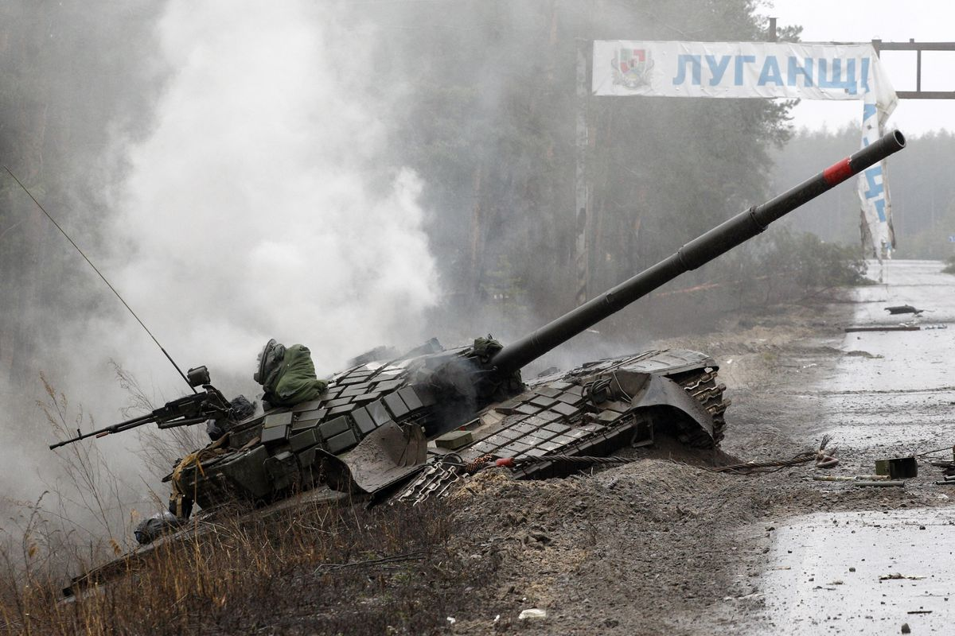
The Mad Hedge Fund Trader “Invasion!”
With John Thomas Incline Village, NV, March 2, 2022 www.madhedgefundtrader.com
Notes:
*

Slide 3
Trade Alert Performance New All Time Highs!
*January 14.59% Final *July +0.61% Final *February +10.51% MTD *August +9.36% Final *March +20.60% Final *September 1.03% Final *April +15.67% Final *October +8.91% MTD *May +8.13% Final *November -11.79% Final *June +0.71% Final *December +11.26% Final *2022 YTD +25.10% compared to -5.9% for the Dow Average *+537.66% since inception *Average annualized return of 43.89% for 12 years

Slide 4
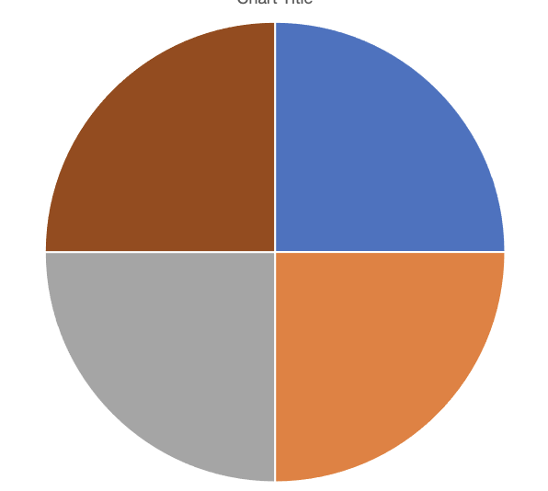
Portfolio Review 60% Long, 30% short, 10% cash Long Term Bull Market
Current Capital at Risk
Risk On
World is Getting Better
(TLT) 3/$144-$147 put spread | 10.00%
(TLT) 3/$145-$148 put spread | 10.00%
(TSLA) 3/$550-$600 call spread | 10.00%
Risk Off
World is Getting Worse
(TLT) 3/$127-$130 call spread | -10.00%
Total Net Position | 20.00%
Total Aggregate Position | 40.00%
Expiration Value 28.42%

Slide 5
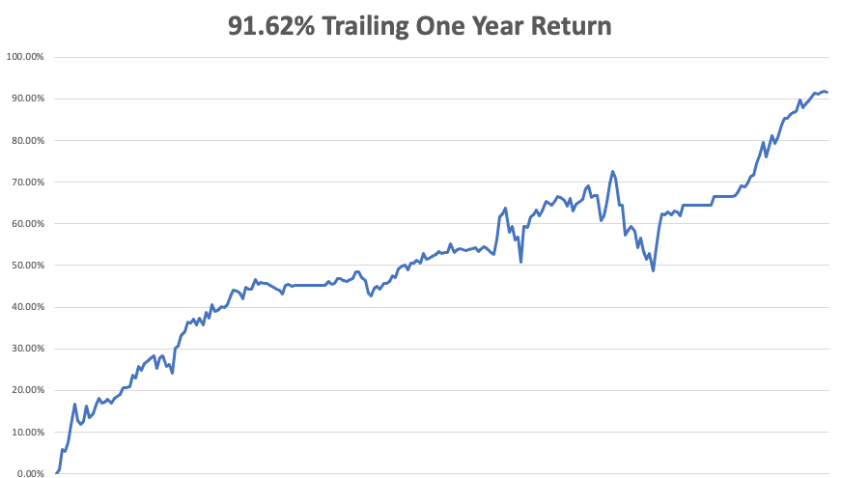

Slide 6
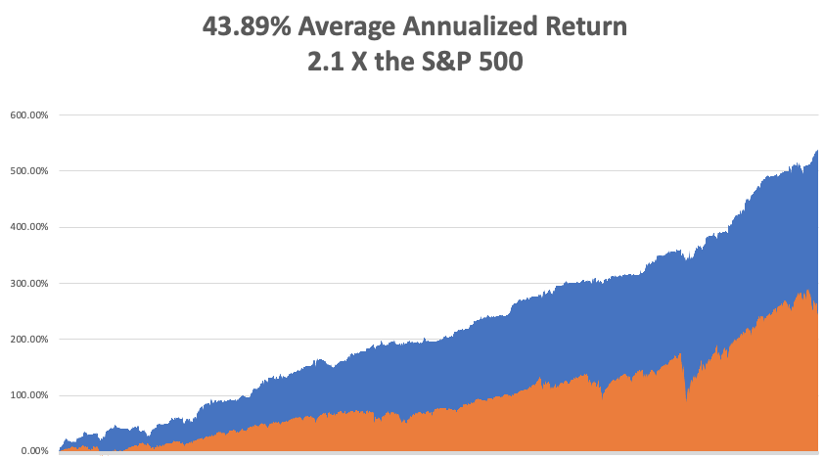
GTD 13 Year Daily Audited Performance

Slide 7
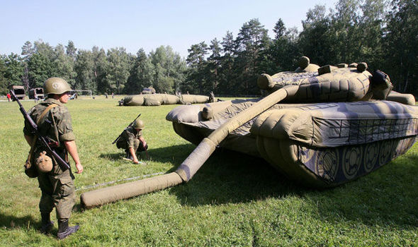
The War In Ukraine
*Second Cold War Began a week ago remaking the global political order overnight *Surprise Ukrainian resistance expends war from days to years, or until Russia gives up *Equally surprising was a massive global support for Ukraine. Germany sent its entire stock of Javelin and Stinger missiles by truck overnight on roads the Russians unwisely left open *The US is backstopping Europe with overnight flights of emergency supplies. All of the infrastructure left over from the last Cold War is still there 30 years later. *Russian planned for a one day invasion so only sent gas and food for one day. As a result, tanks are running out of gas and soldiers are starving and running out of ammo *This is not your grandfather’s Russian Army, troops are untrained, short of supplies, and poorly led. The strategy has been a disaster. Casuatlies have topped 5,000 in a week

Slide 8
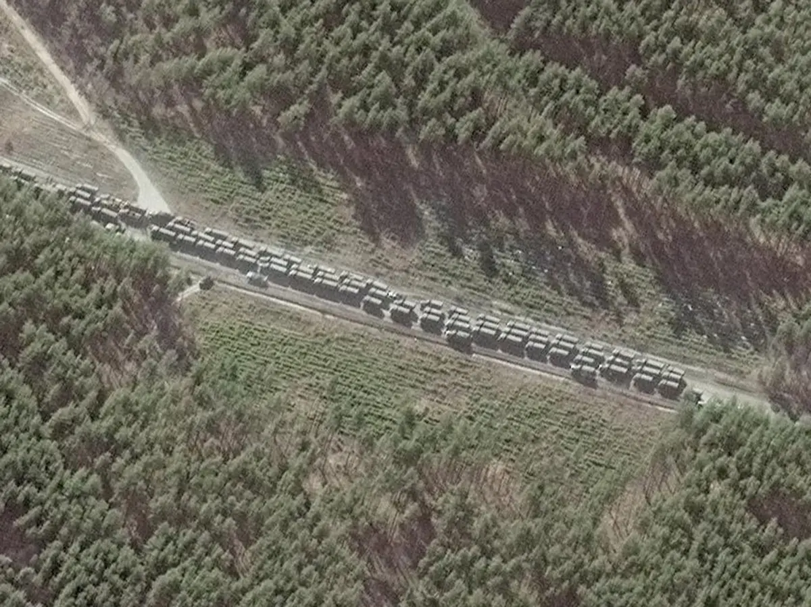

Slide 9
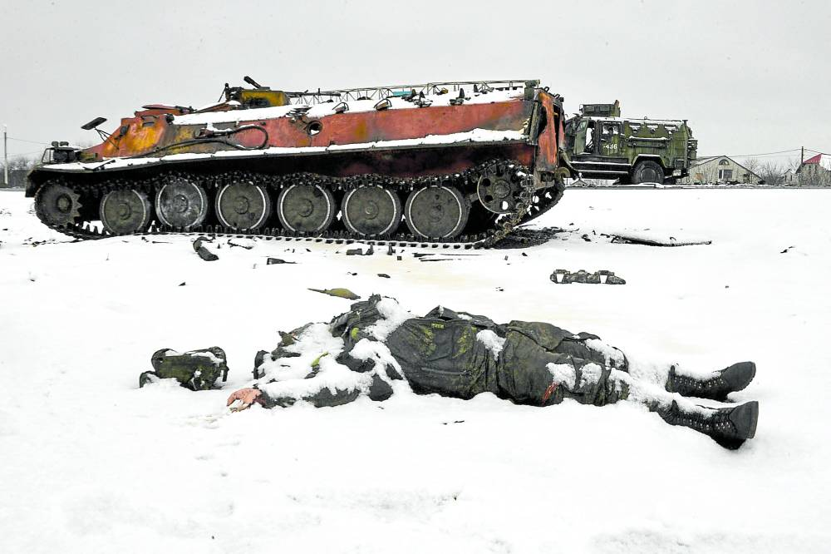
The War In Ukraine and the Markets
*An out of the Blue war takes the (VIX) to $38 and dries up liquidity *But falls have so far been modest, with the Fed tightening already taking stocks down 12% *Russia account for $1.5 trillion of a $100 trillion global economy, about the size of Australia *But has an outsize presence in energy *Complete exclusion of Russia from the global economy will have minimal impact *Wars are a positive for the economy in that they increase spending but are also inflationary *Once the initial shocks are over its back to a bull market

Slide 10
The Method to My Madness The Roaring Twenties are Here
*Ukraine war is the main driver now, stand back on risk until conditions settle *The biggest risk for markets now is that Russia realizes it is over its head and gives up, sparking a $3,000 point rally in the Dow *The first interest rate rise in three years is weeks away, but has been cut from 1.2% to ¼% *The better-quality trade here is in selling short bonds because wars drive interest rates and inflation up, not down *US Dollar will remain strong but it is too late to buy *Same with gold, Bitcoin is the better buy here on dips with Massive Russian buying *Omicron cases collapse, taking this drag off the market, but is being ignored now *VIX over $30 is the ideal entry point for new positions

Slide 11
Corona Update – Almost Gone
*Stunning 97% Decline in cases in a month to 42,000 cases a day *Under fives vaccine out in delayed until April *Most states dropping mask mandates, including California *Pandemic is close to no longer being a factor for the economy *Pandemic is still going to zero by summer, book those cruises *US cases top 80.7 million, deaths topping 977,000 and deaths are down to to 1,000 a day

Slide 12
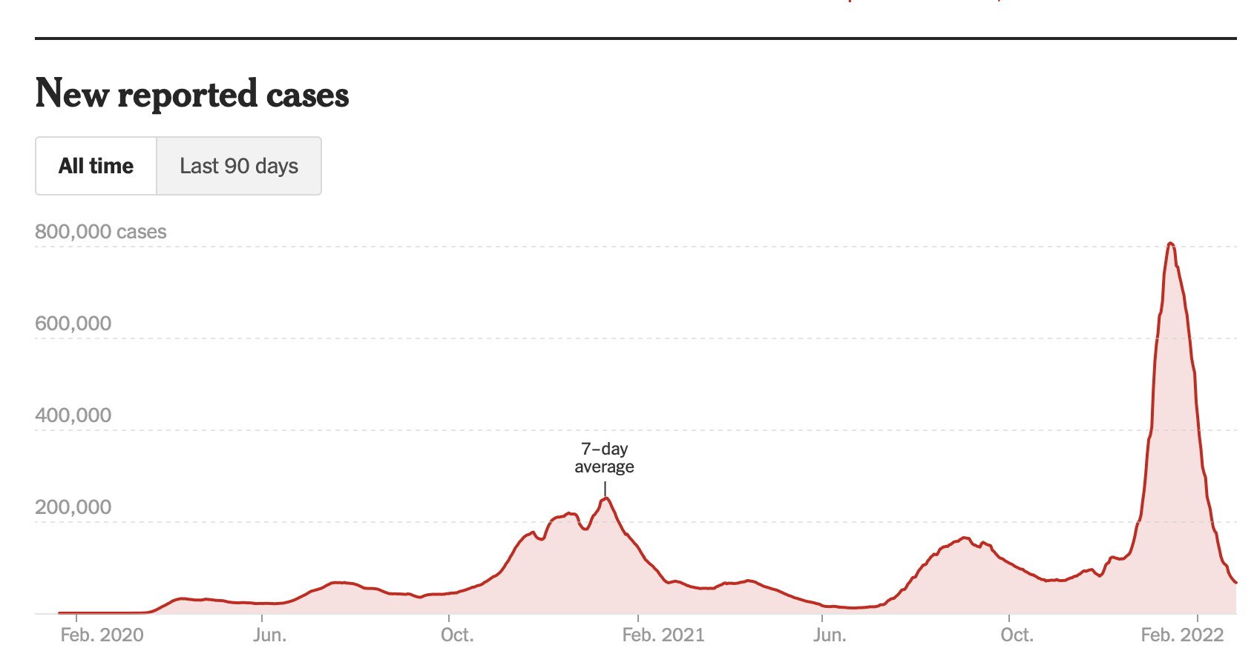
Bump on the Way to Zero

Slide 13
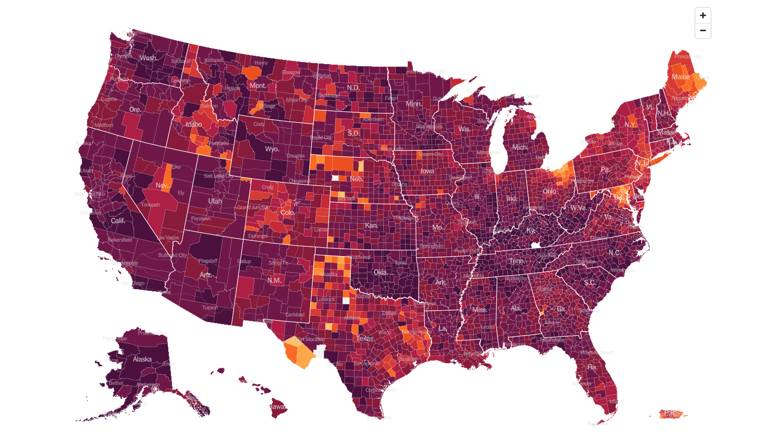
February 2 2022 Infection Rate

Slide 14
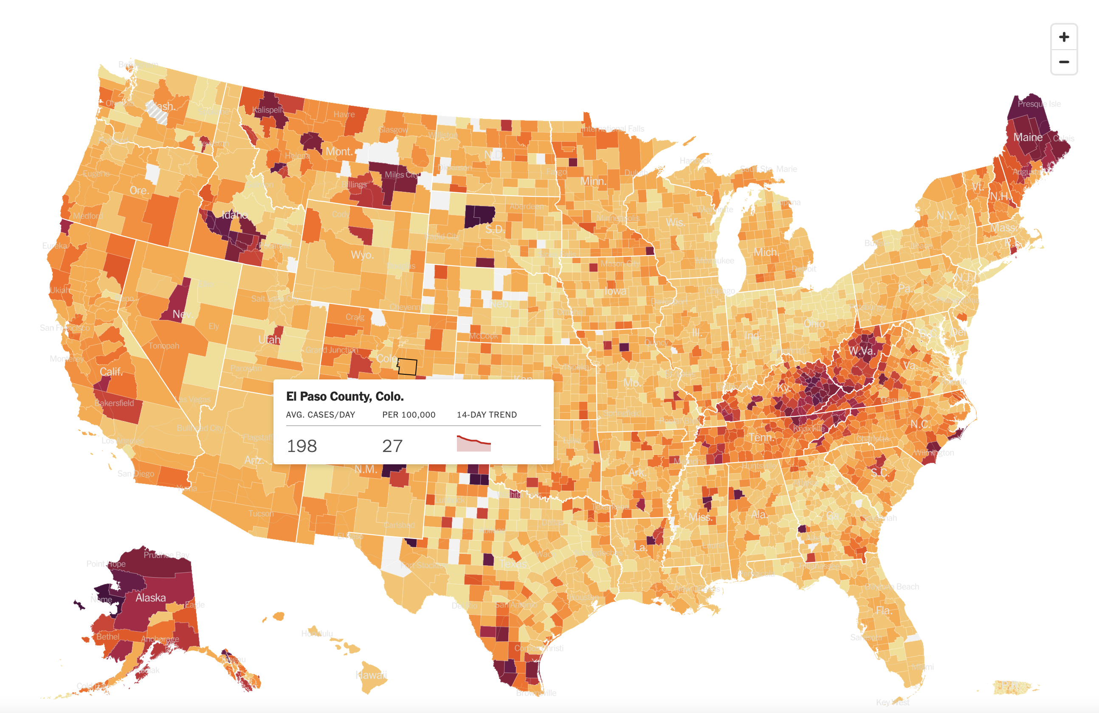
March 2 2022 Infection Rate

Slide 15
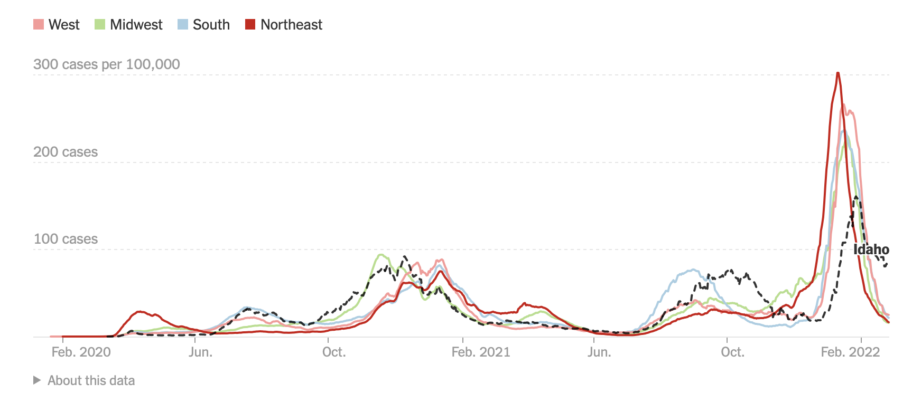

Slide 16
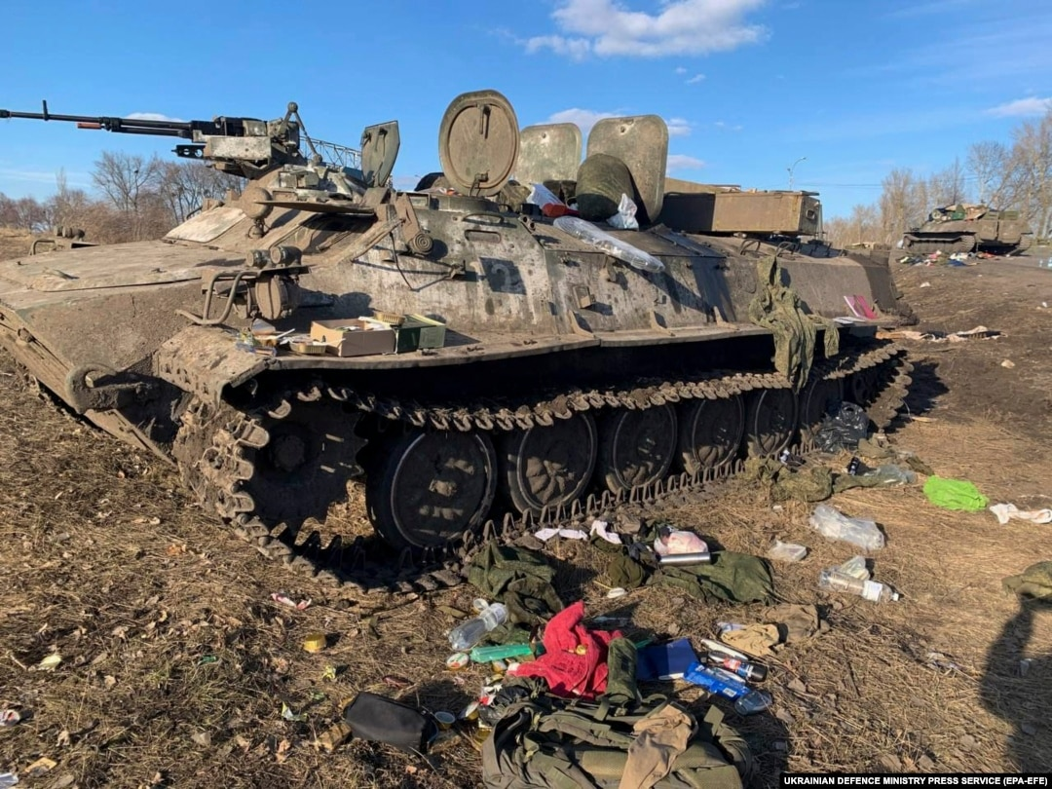
The Global Economy – War Takes Over
*Russia Becomes the New North Korea, with Biden taking the nuclear option on sanctions *Russians Sanctions are now the dominant factor for the global economy , going from less than expected to much worse than expected and taking the markets with them *The Half Point Fed Rate Hike is Off the Table, but we will still see an increase, nonetheless *Weekly Jobless Claims Hit 232,000 *Consumer Confidence Drops, to a five-month low *Leading Economic Indicators Drop, down 0.3% *Retail Sales Soar by 3.8%, in January *US GDP Jumped by 6.9% in Q4,

Slide 17
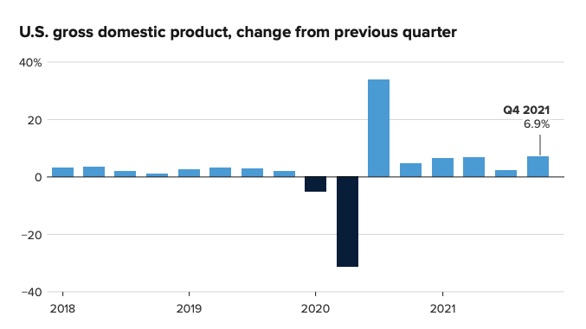

Slide 18
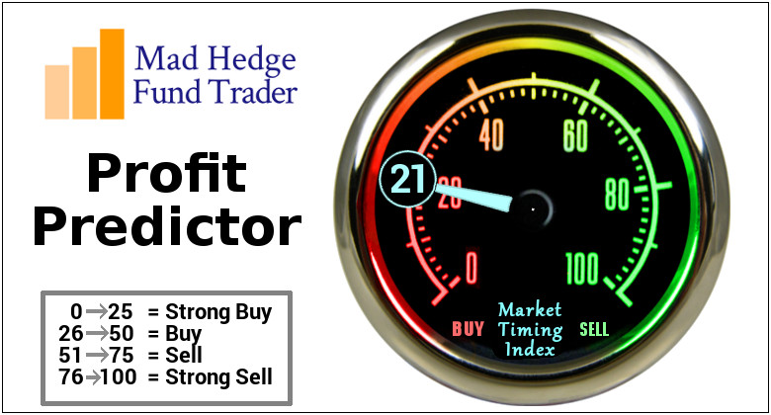
The Mad Hedge Profit Predictor Market Timing Index – Buy Territory An artificial intelligence driven algorithm that analyzes 30 different economic, technical, and momentum driven indicators

Slide 19
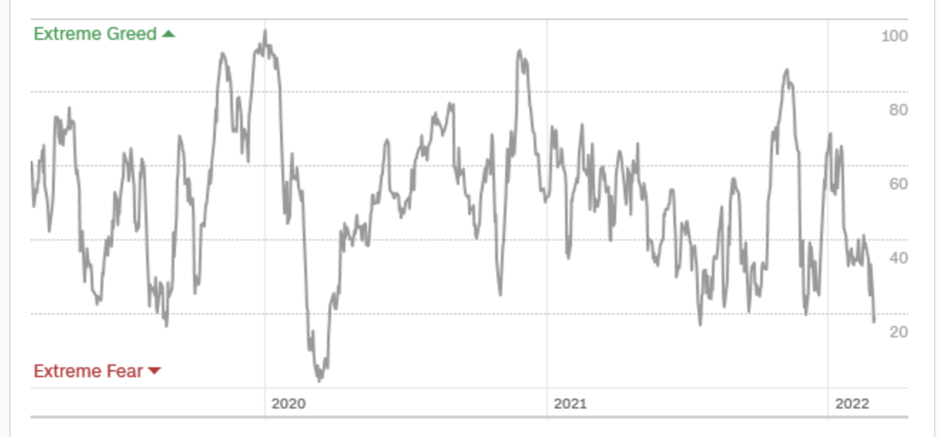
The Mad Hedge Profit Predictor From Extreme “SELL” to Extreme “BUY”
SELL
Do Nothing
BUY

Slide 20
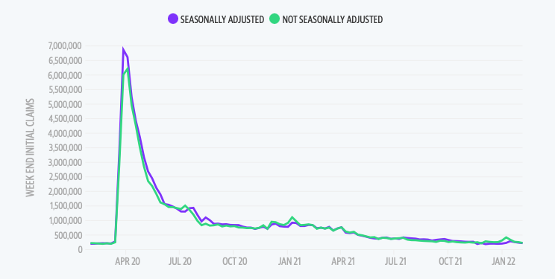
Weekly Jobless Claims – Falling 223,000 –

Slide 21
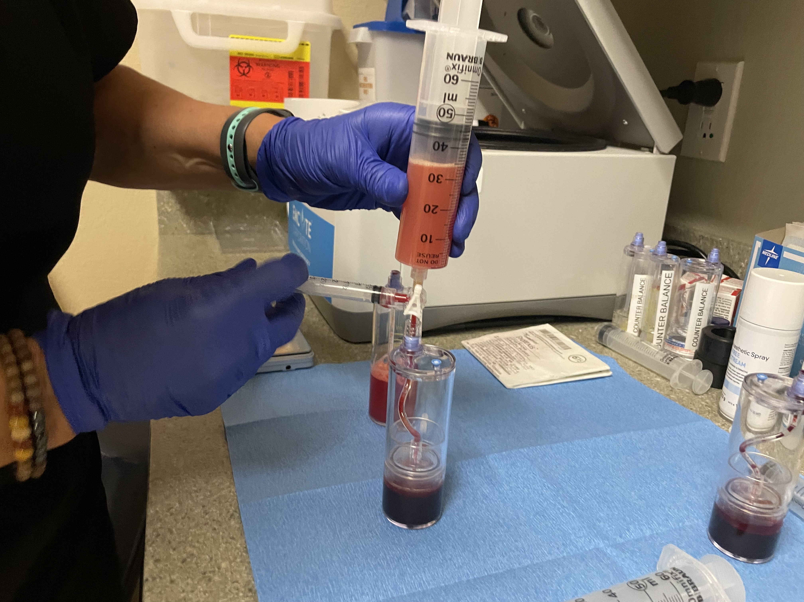

Slide 22
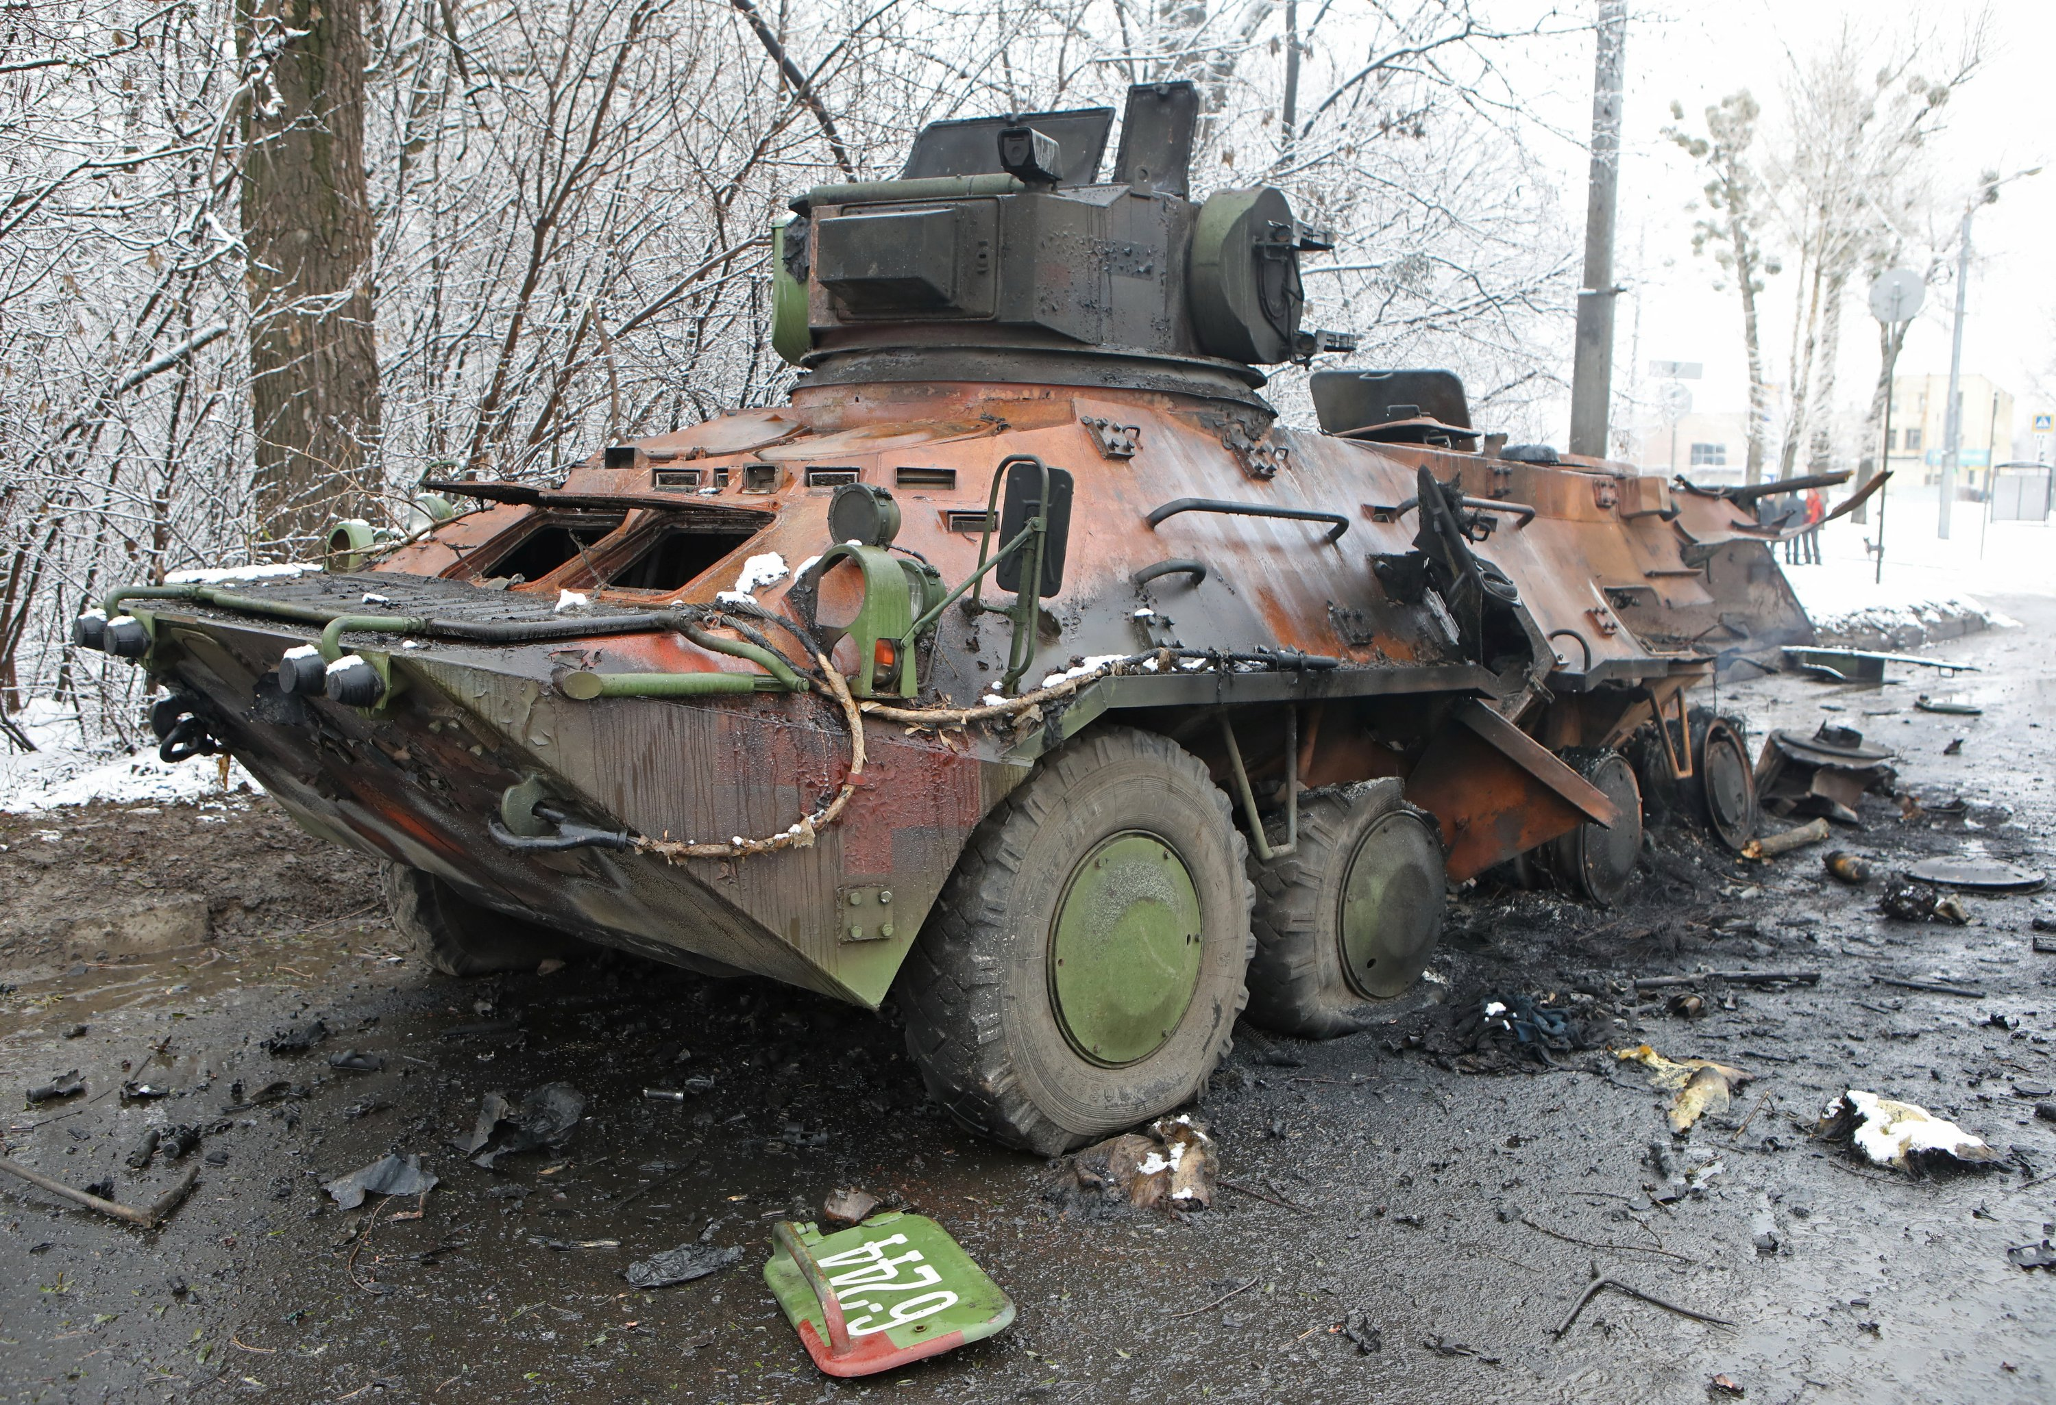
Stocks – A Wartime Market
*The Market Only Sees the Ukraine Right Now, fundamentals are irrelevant *Banks are crushed because of slower interest rate rises, slowing economy, rising default rates, and losses on Russian investments, with Citigroup taking the biggest hit *Commodities explode to the upside on loss of Russian supplies and greater war demand *Defense shares rocket on the second Cold War, with US defense spending going from 3.5% to 4% of GDP. Germany doubles from 1% to 2%, or $100 billion. Buy (LMT), (RTN), (GD) on dips *Volatility will remain, but we are making a multi-month bottom. Use visits to $40 to buy *Oil companies are writing off hundreds of millions of dollars in Russian investments, but are making aa fortune on oil at $110 *Boeing ceased maintenance of Russian planes, grounding them *Another opportunity of the decade is setting up *Look for terrible H1 and strong H2 scenario to continue

Slide 23
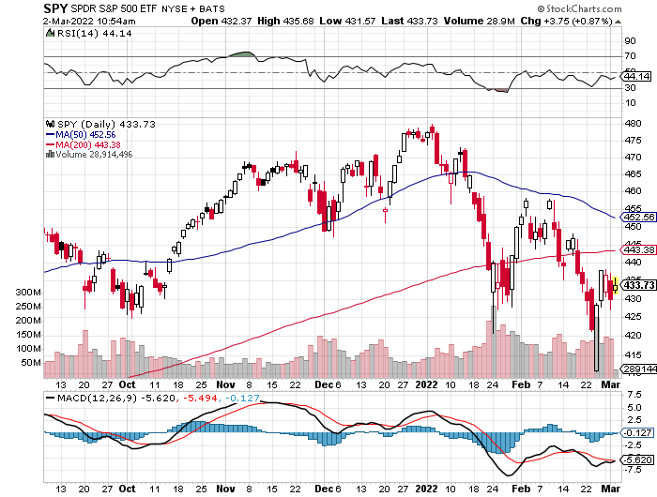
S&P 500 – Year End Melt Up! long 2/$465-$475 bear put spread, long 3/$470-$480 bear put spread Took profits on long 2/$410-$420 bull call spread, Took profits on long 2/$480-$500 bear put spread, Took profits on long 10/$410-$420 bull call spread
New High By end 2022
The Bottom 384 Down 20%

Slide 24
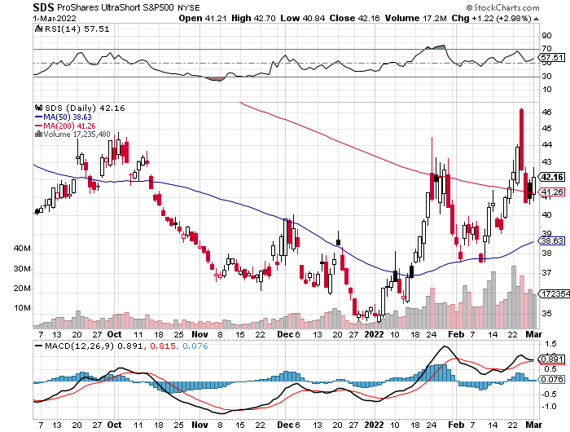
ProShares Ultra Short S&P 500 (SDS)- a great hedge for long stocks and bonds long 2X position has a hedge against longs and bond shorts

Slide 25
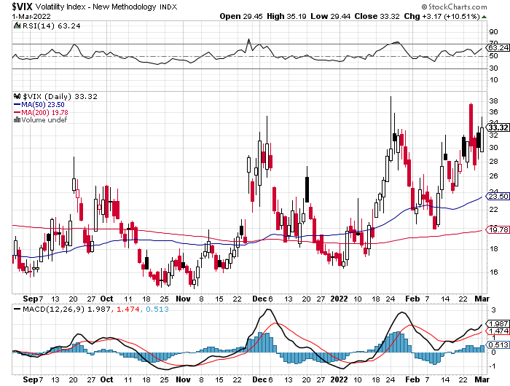
(VIX) – Continuing Spikes classic summer market

Slide 26
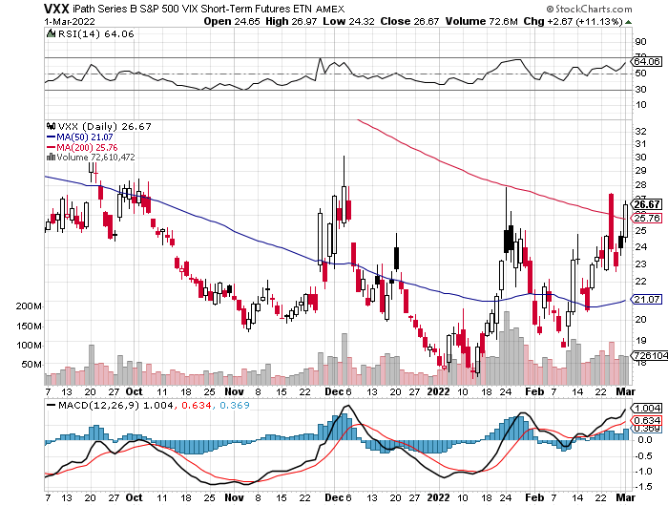
(VXX)-

Slide 27
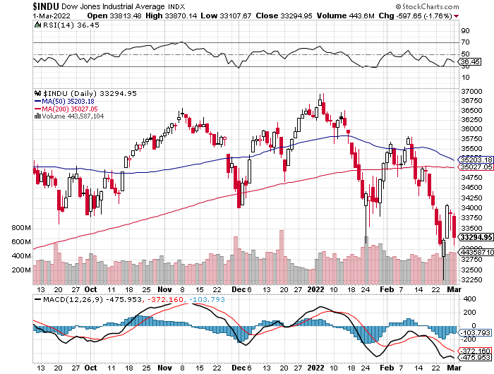
Dow Average ($INDU)-

Slide 28
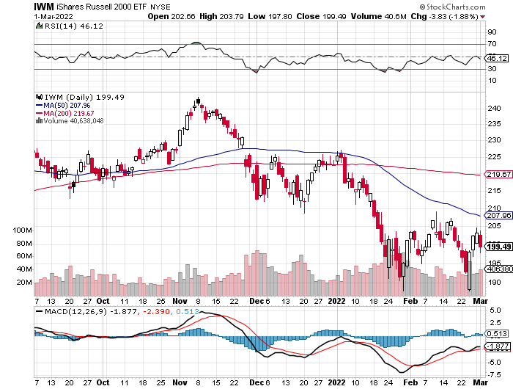
Russell 2000 (IWM)- took profits on Long 10/$137-$142 vertical bull call spread took profits on Long 10/$153-$156 vertical bear put spread

Slide 29
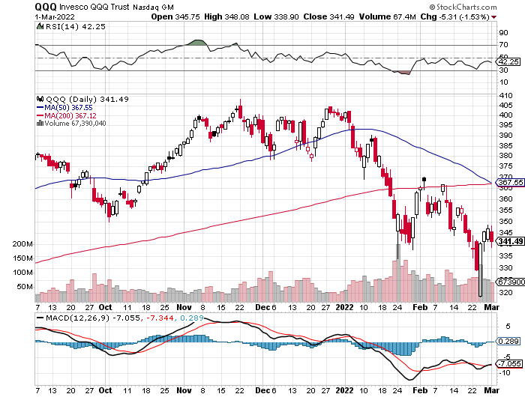
NASDAQ (QQQ) – long (QQQ) 4/$330-$335 put spread took profits on long (QQQ) 3/$340-$345 put spread covered long (QQQ) $325-$330 put spread

Slide 30
The Barbell Portfolio
*50% Big Tech - 2% of US Employment but 27% of Market Cap and 38% of Profits 50% Domestic Recovery, including: Railroads Couriers Banks Construction Credit Cards Event organizers Ticket sales Retailers

Slide 31
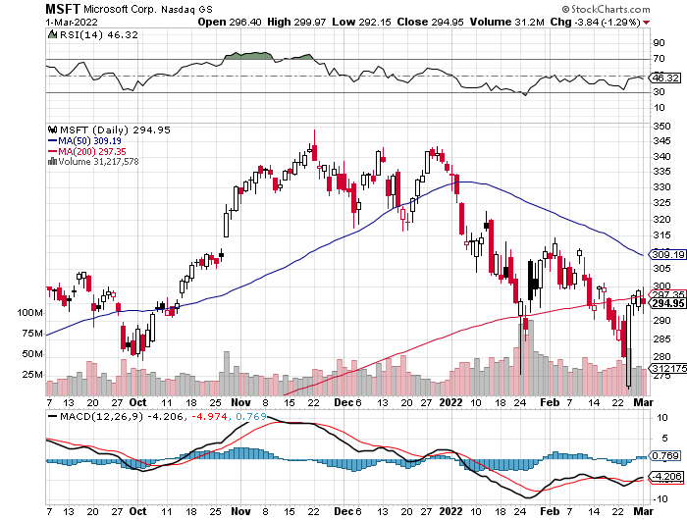
Microsoft (MSFT)- long 2/$340-$350 bear put spread took profits on long 12/$220-$230 call spread stop loss on long 12/$170-$180 call spread

Slide 32
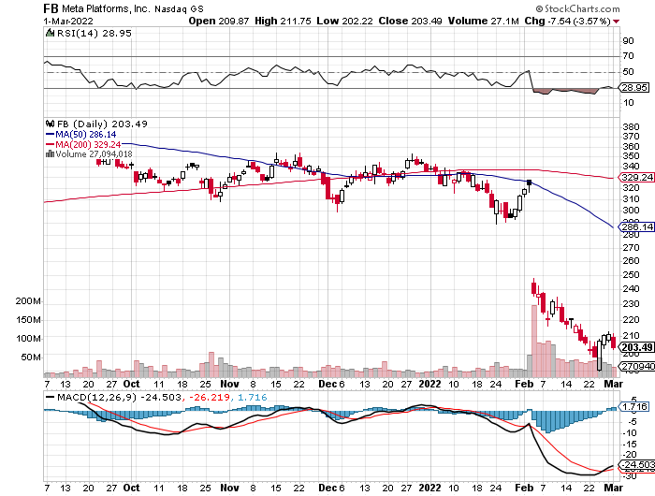
Facebook (FB)- Changes Name to “Meta” took profits on Long 9/$290-$300 vertical bear put spread stopped out of Long 9/$190-$200 vertical bear put spread

Slide 33
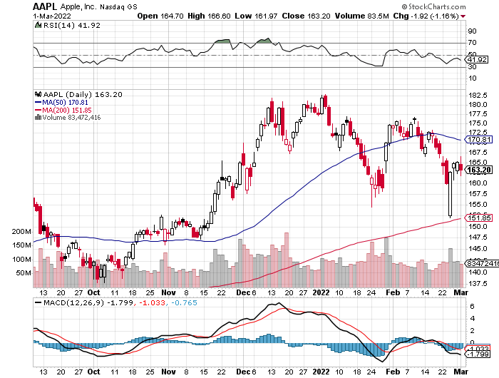
Apple (AAPL)- Apple Blows it Away, with Q4 revenues of an eye popping $124 billion, up 11% YOY Stopped out of 3/$150-$155 call spread, Took profits on long 2/$180-$190 put spread

Slide 34
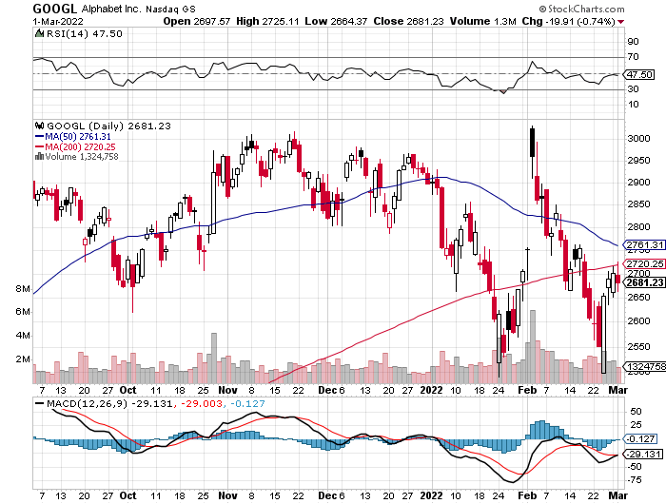
Alphabet (GOOGL) – Ad king on economic recovery 15% of search is travel related took profits on long 12/$1,200-$1,230 bull call spread took profits on long 9/$1,030-$1,080 vertical bull call spread

Slide 35
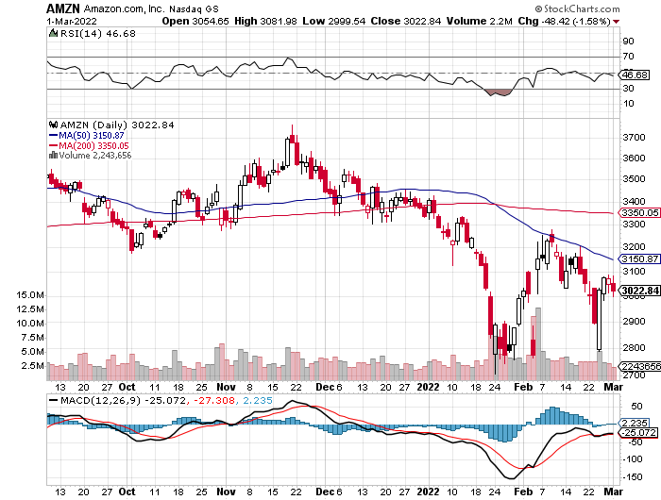
Amazon (AMZN) – long 2/$3,400-$3,500 bear put spread took profits on long 9/$2,800-$2,900 bull call spread

Slide 36
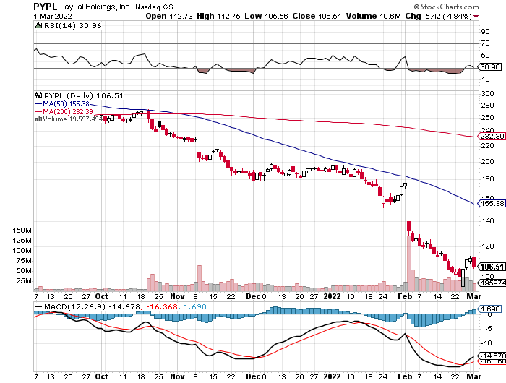
PayPal (PYPL) - Cancels Pinterest Buy took profits on long 4/$90-$95 call spread

Slide 37
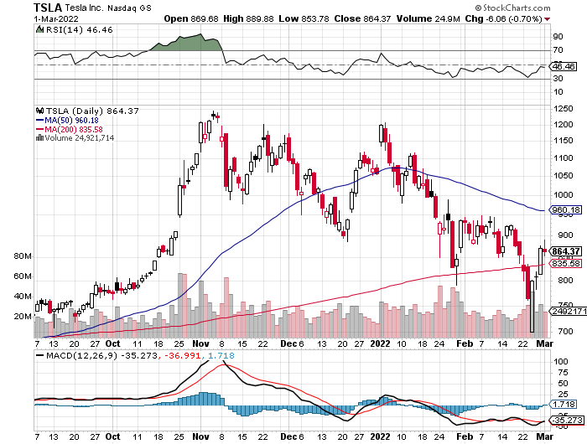
Tesla (TSLA) –Aiming for 1.5 million cars in 2022 long 3/$550-$600 call spread, took profits on long 2/$600-$650 call spread

Slide 38
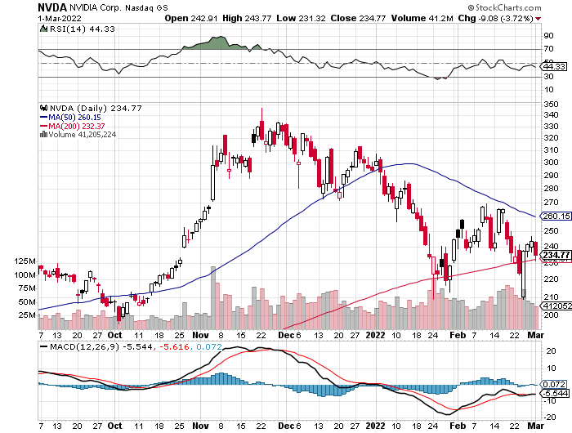
NVIDIA (NVDA) – A Mad Hedge 10 bagger – Global Semiconductor Shortage Slows Auto Industry,

Slide 39
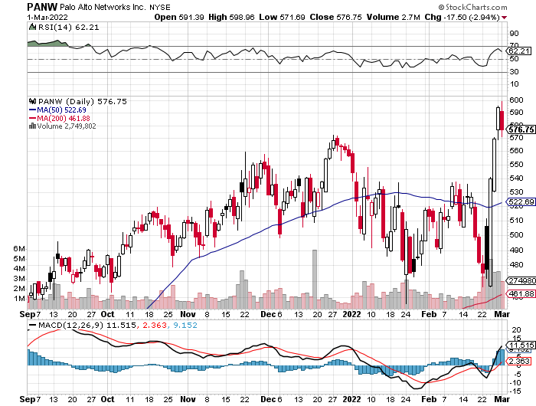
Palo Alto Networks (PANW)- Hacking never goes out of fashion

Slide 40
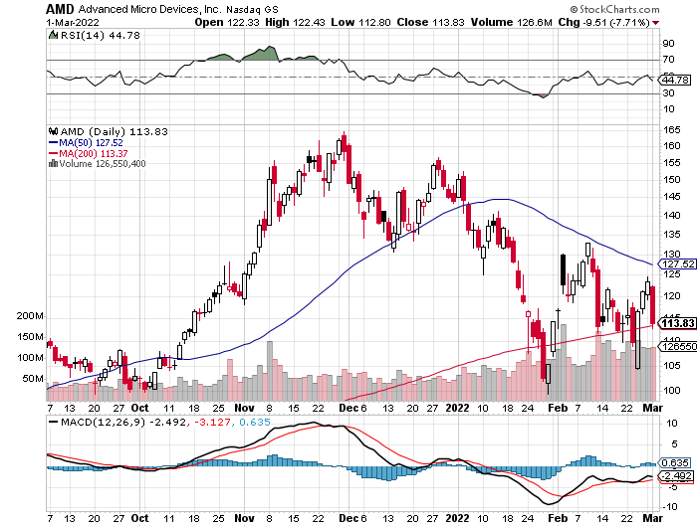
Advanced Micro Devices (AMD)- programable logic devices took profits on long 2/$75-$80 call spread

Slide 41
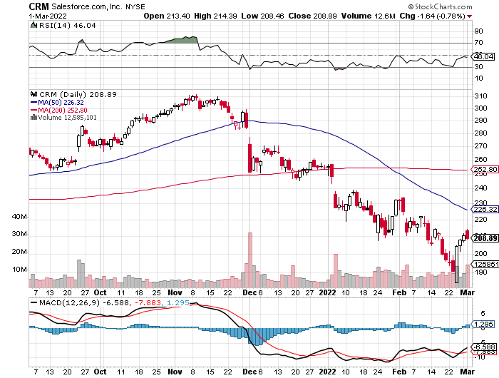
Salesforce (CRM)- Massive Online Migration took profits on long 9/$125-$130 vertical bull call spread took profits on long 8/$125-$130 vertical bull call spread took profits on long 2/$105-$115 call spread

Slide 42
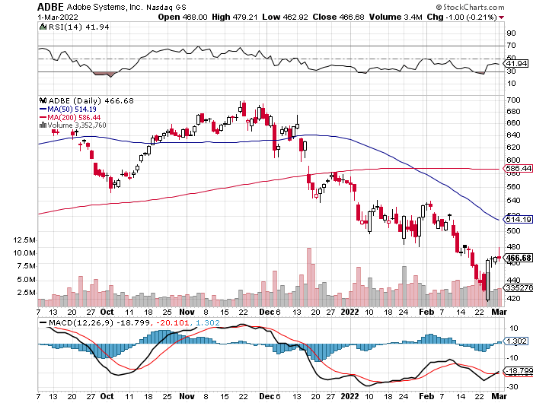
Adobe (ADBE)- Cloud play The Quality Non-China tech play

Slide 43
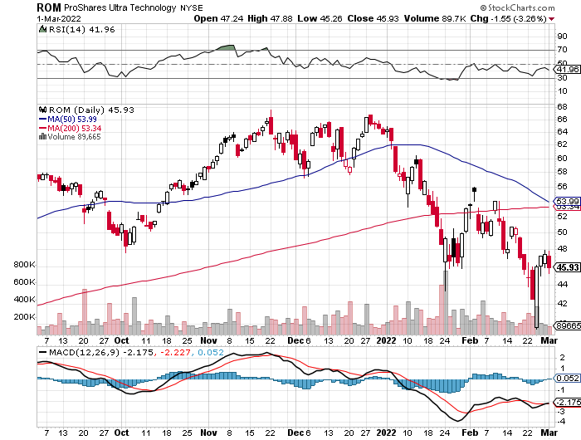
ProShares Ultra Technology ETF (ROM) – 2X Long Technology ETF took profits on long 10/$62-65 call spread

Slide 44
The Second Half of the Barbell
*Bets on a domestic recovery in 2022 Q4 *Upside potential in 2022 far greater than tech *Some of these have not moved for 5 or 10 years *Focuses on economically sensitive cyclical industries *Makes a great counterweight to high-growth technology *We could spend all of next year rotating between the two groups

Slide 45
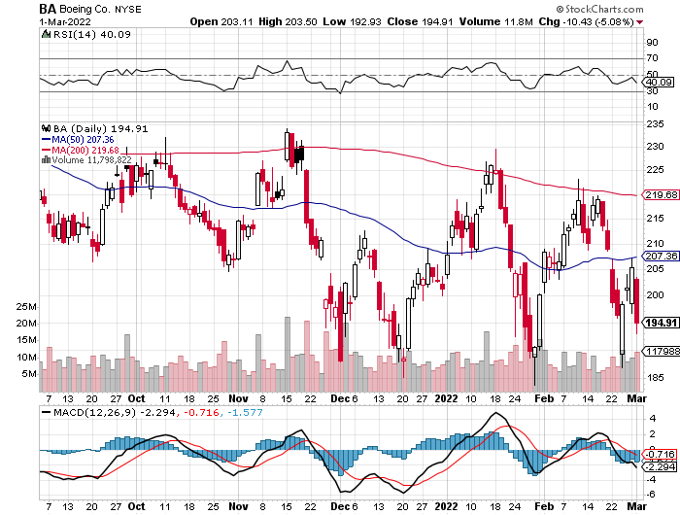
Boeing (BA) –LEAP Candidate Slapped by FAA Banning Self-Certification long 3/$146-$149 call spread, took profits on long 2/$150-$160 call spread

Slide 46
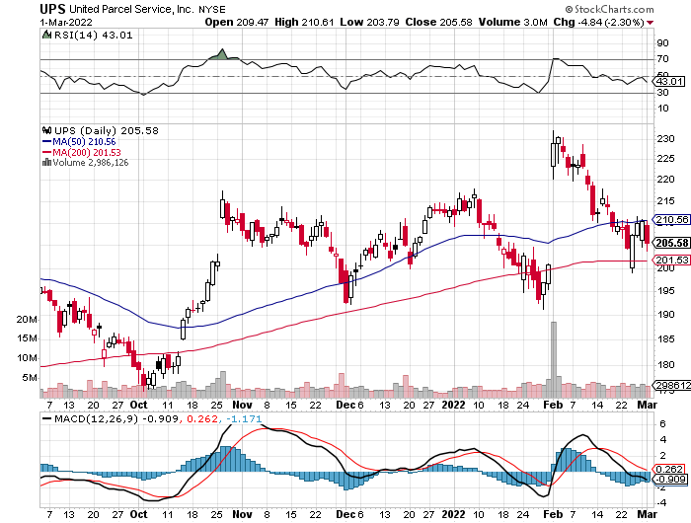
Package Delivery- United Parcel Service (UPS) - Package Delivery record profits took profits on long 11/$130-$140 call spread

Slide 47
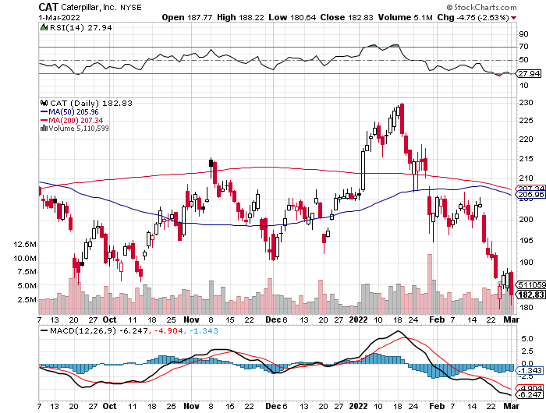
Caterpillar (CAT)- Ag + Infrastructure + Housing took profits on long 12/$145-$150 call spread took profits on long 11/$125-$135 call spread

Slide 48
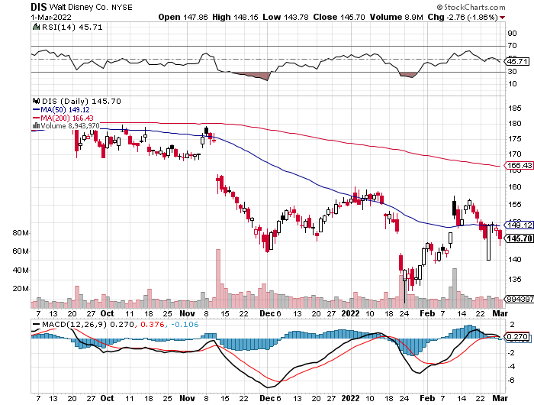
Walt Disney (DIS)- stopped out of long 10/$165-$175 call spread took profits on long 3/$170-$180 call spread

Slide 49
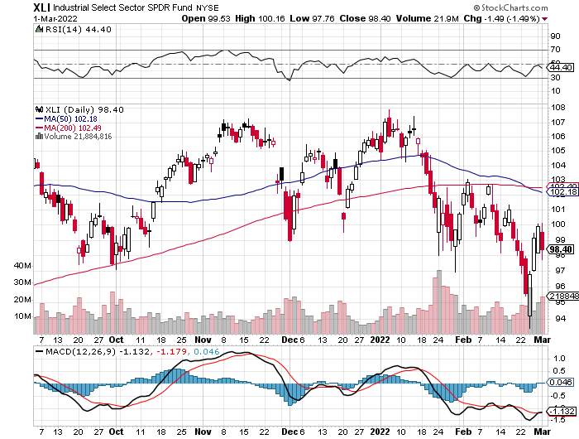
Industrials Sector SPDR (XLI)- (GE), (MMM), (UNP), (UTX), (BA), (HON)

Slide 50
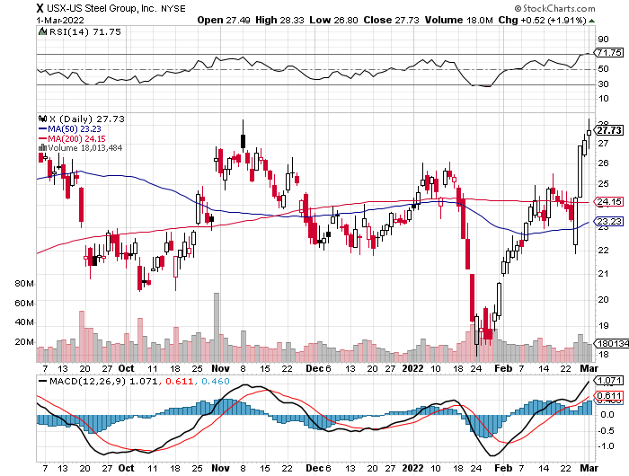
US Steel (X) – Commodity Drag

Slide 51
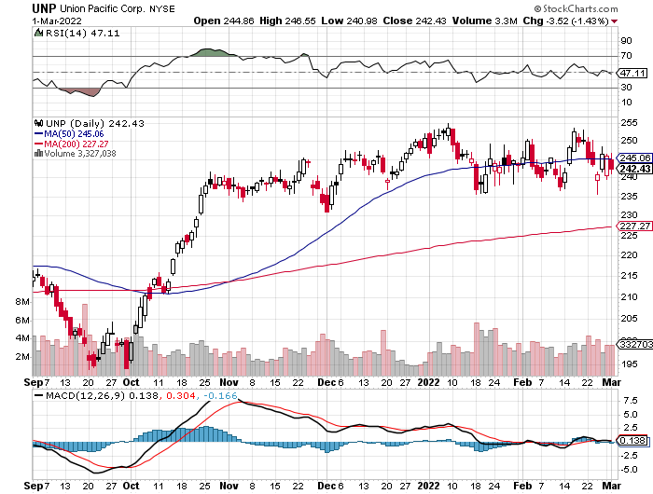
Union Pacific RR (UNP)- Big Stuff to Ship near record earnings announced took profits on long 5/$200-$210 call spread took profits on 11/$150-$160 call spread

Slide 52
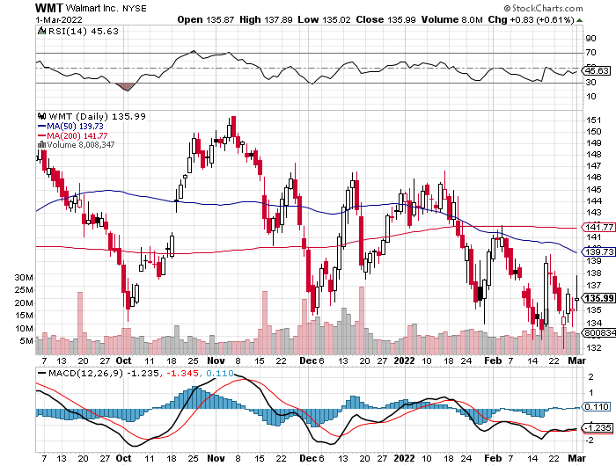
Wal-Mart (WMT)- took profit on Long 11/$125-$130 bear put spread took profit on Long 10/$119-$121 bear put spread took profits on Long 8/$114-$117 bear put spread

Slide 53
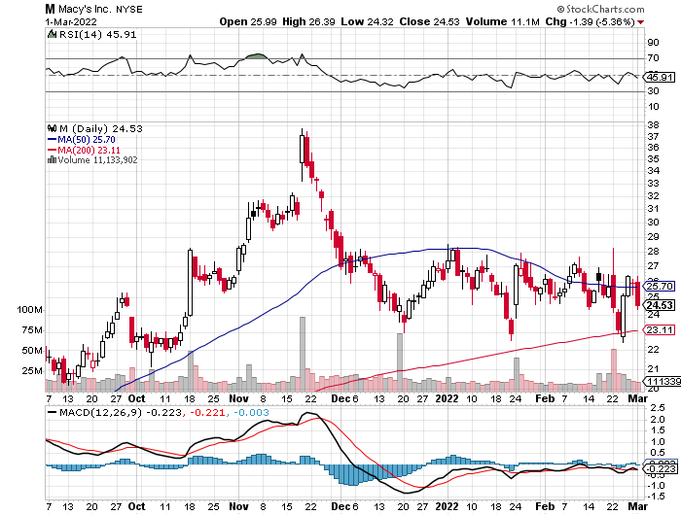
Macys’ (M) – Retail Punished took profits on Long 8/$23-$25 bear put spread

Slide 54
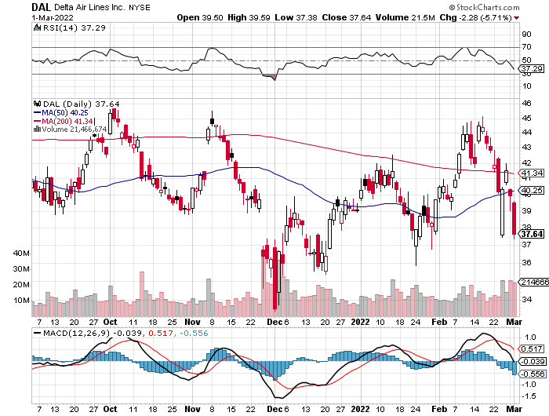
Delta Airlines (DAL) –

Slide 55
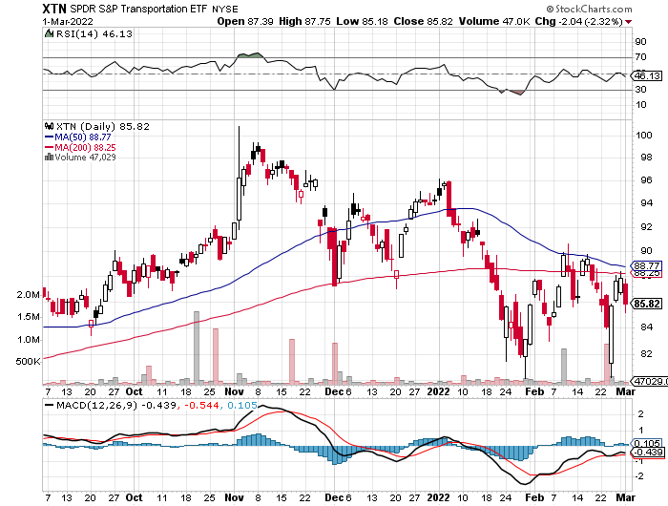
Transports Sector SPDR (XTN)- Worst Hit Sector (ALGT), (ALK), (JBLU), (LUV), (CHRW), (DAL)

Slide 56
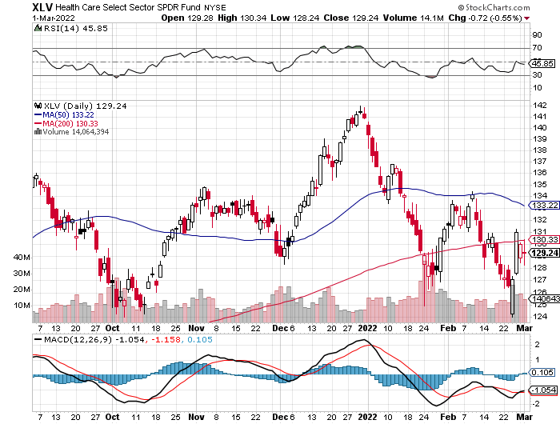
Health Care Sector (XLV) (JNJ), (PFE), (MRK), (GILD), (ACT), (AMGN)

Slide 57
Amgen (AMGN) took profits on long 11/$185-$200 bull call spread

Slide 58
Goldman Sachs (GS) – took profits 12/$330-$350 call spread took profits 11/$330-$350 call spread stop loss on long 11/$385-$395 call spreads

Slide 59
Morgan Stanley (MS) – Doubled Dividend took profits on long 11/$85-$90 call spread stop loss on long 11/$95-$98 call spread took profits on long 10/$85-$90 call spread profits on long 2/$55-$60 call spread

Slide 60
JP Morgan Chase (JPM)-Back to Life took profits 12/$148-$152.50 call spread, took profits on long 10/$130-$140 call spread took profits on long 8/$140-$145 call spread, took profits on long 7/$140-$145 call spread

Slide 61
Bank of America (BAC) – took profits long 12/$39-$42 call spread, stop loss on long 11/$43-$45 call spread took profits on 11/$37-$40 call spread , took profits on long 2/$28-$30 call spread

Slide 62
SPDR Metals & Mining ETF (XME) – long 2/$28-$30 call spread

Slide 63
Blackrock (BLK)-Asset Collection Boom took profits on long 3/$770-$790 call spread took profits on long 3/$310-$340 call spread

Slide 64
Visa (V) – “Touchless” Bitcoin Drag took profits on long 5/$220-$225 bull call spread took profits on long long 5/$195-$205 bull call spread took profits on long 9/$180-$185 bull call spread

Slide 65
Consumer Discretionary SPDR (XLY) (DIS), (AMZN), (HD), (CMCSA), (MCD), (SBUX)

Slide 66
Berkshire Hathaway (BRKB)- Natural Barbell Berkshire Hathaway Profits Soar, as Warren Buffet boosts share buybacks to a record $27 billion took profits on long 2/$270-$280 call spread

Slide 67
Europe Hedged Equity (HEDJ)-

Slide 68
Japan (DXJ)-

Slide 69
Emerging Markets (EEM) - Pro trade, Weak Dollar, Long Recovery Play

Slide 71
Bonds – Flight to Safety
*War brings immediate flight to safety and bond melt up *But the reality is that wars always bring higher interest rates and inflation, especially during a Fed tightening *Wars also brings greater government borrowing, this time for the whole world at once *Interest rates dive, falling to an incredible 1.70% fir the ten year *A half point rate hike is off the table, but Powell says a quarter point is a sure thing *Sell any six-point rally in the (TLT) *In a year, yield on the ten-year US Treasury bond will be at 2.50% or higher *US Treasury bond fund (TLT) could plunge from $180 in 2020 to $105 by 2023

Slide 72
Treasury ETF (TLT) – Breaking Down Long 3/$127-$130 call spread, Long 3/$144-$147 put spread, Long 3/$145-$148 put spread took profits on long 2/$149-$152 put spread, took profits on long 2/$147-$150 put spread too profits on long 3/$150-$153 put spread

Slide 73
Ten Year Treasury Yield ($TNX) – 2.05%

Slide 74
Junk Bonds (HYG) 4.75% Yield to Maturity

Slide 75
2X Short Treasuries (TBT)-Another run at highs

Slide 77
Foreign Currencies – Panic Buying
*Flight to safety bid sends buck to two year high *European currencies are dumped in the face of real war *Russian Ruble crashes 50% *European interest rates plunging on recession fears *Currency with the fastest appreciating interest rates usually does best *Long-term fundamentals are still poor, a dollar short could be the new ten-year trade, but not yet *Stand aside from forex for now, there are getting fish to fry

Slide 78
Japanese Yen (FXY)

Slide 79
Euro (FXE)-

Slide 80
British Pound (FXB)-

Slide 81
Australian Dollar (FXA)- The Global Recovery Play took profits on long 8/$67-$69 call spread

Slide 82
Emerging Market Currencies (CEW)

Slide 83
Chinese Yuan- (CYB)-

Slide 85
Bitcoin – Back from the Dead Buy the Mad Hedge Bitcoin Letter at https://www.madhedgefundtrader.com/store/
*Flight to safety find Bitcoin, pops 12% in a day on massive Russian buying *Russia has move to Bitcoin in a big way as it is kicked out of the western financial system *Is a double bottom on the charts in the works *Mad Hedge Bitcoin Letter is now buying Bitcoin plays on dips *There are still a lot of stale longs above, about a year’s worth, so be careful. *Long term “BUY” signal for Bitcoin still intact *Buy Bitcoin and Ethereum on the bigger dip

Slide 86
Bitcoin ($BTCUSD) – Finding a bid

Slide 87
Ethereum (ETHE) –

Slide 88
MicroStrategy (MSTR) –

Slide 89
Amplify Transformational Data Sharing ETF (BLOK) –

Slide 90
Energy –New Golden Age
*Oil Breaks $110, and some analysts are targeting $125 in a week *US and other countries rush to release reserves but can only have a token effect at best *The big problem is natural gas for Germany, Replacement with US gas would require a decade long buildout *How much do you want to invest in a resource that is going to zero in 20 years? *The irony is that the war will accelerate the move out of carbon into alternatives *The risk/reward for a new oil trade here is terrible, the is the last chance to sell all your holdings *Avoid all energy plays like the plague, it’s the new buggy whip industry as the US de-carbonizes

Slide 92
Oil-($WTIC)

Slide 93
United States Oil Fund (USO) long 10/$9.50-$10 Vertical bull call spread

Slide 94
Energy Select Sector SPDR (XLE)-No Performance! (XOM), (CVX), (SLB), (KMI), (EOG), (COP)

Slide 95
Halliburton (HAL)-

Slide 96
Natural Gas (UNG) -

Slide 97
Precious Metals – Finally a Bid
*Gold Catches a Bid, off the back of the unrelenting Ukraine crisis. All that Russian buying of gold for the last several years suddenly makes sence *Is Gold the New Bitcoin? The yellow metal is now just short of $1,900 an ounce *Many analysts are now raising their targets for the barbarous relic now that Bitcoin has utterly failed to provide protection against absolutely anything. Wars, inflation, economic, slowdown, pandemic, Bitcoin has fallen in every case. *Rising interest rates bode poorly for precious metals as it raises the opportunity cost for non-yielding assets *Bitcoin is clearly sucking capital out of precious metals *Stay away until this plays out *Silver is still the bigger and better long-term play

Slide 98
Gold (GLD)- Meltdown

Slide 99
Market Vectors Gold Miners ETF- (GDX) –

Slide 100
Barrick Gold (GOLD) took profits on long 1/$21-$23 call spread took profits on long 11/$22-$24 call spread

Slide 101
Newmont Mining- (NEM)- took profits on long $55-60 call spread

Slide 102
Silver- (SLV)- took profits on long 11/$19-$20 call spread

Slide 103
Silver Miners - (SIL)-

Slide 104
Wheaton Precious Metals - (WPM)- took profits on long 2/$39-41 call spread

Slide 105
Copper (COPX)-Uptrend Resumes Copper Unions Vote to Strike in Chile, cutting off 33% of the global supply

Slide 106
Real Estate – Hotter than Hot
*Existing Home Sales Jump 6.7%, to 6.5 million units, far better than expected. inventory is down to yet another record low, an incredibly short 1.6-month supply *Pending Home Sales Dive 5.7%, the biggest decline in 11 months *The Median Home Price has risen to $350,300, with the bulk of sales on the high end *Million dollar plus homes are up 39% YOY. *Home Loan Applications Hit Two Year Low, thanks to soaring interest rates which took the 30-year fixed to 3.95%. *New Home Sales down 4.5% in January, and off 19.3% YOY. Some 806,000 units were sold *S&P Case Shiller Rockets 18.6%, in December with its National Home Price Index The real estate boom is years away from a peak.

Slide 107
S&P Case Shiller S&P Case Shiller Rockets 18.8%, in November with its National Home Price Index Phoenix 32.5%, Tampa (29%), and Miami (27%) were the big gainers

Slide 109
Crown Castle International (CCI) – 2.70% yielding cell phone tower REIT

Slide 110
US Home Construction Index (ITB) (DHI), (LEN), (PHM), (TOL), (NVR)

Slide 112
Trade Sheet- So What Do We Do About All This?
*Stocks – sell rallies *Bonds – sell rallies aggressively *Commodities-buy dips *Currencies- stand aside *Precious Metals – stand aside *Energy – stand aside *Volatility - sell short over $30 *Real estate – stand aside *Bitcoin – stand aside

Slide 113
Next Strategy Webinar 12:00 EST Wednesday, March 16 from Incline Village, NV email me questions at support@madhedgefundtrader.com
Good Luck and Good Trading!
Notes:
*

