Slide 1
The Mad Hedge Fund Trader “Rate Shock”
With John Thomas Incline Village, NV, March 23, 2022 www.madhedgefundtrader.com
Notes:
*

Slide 2
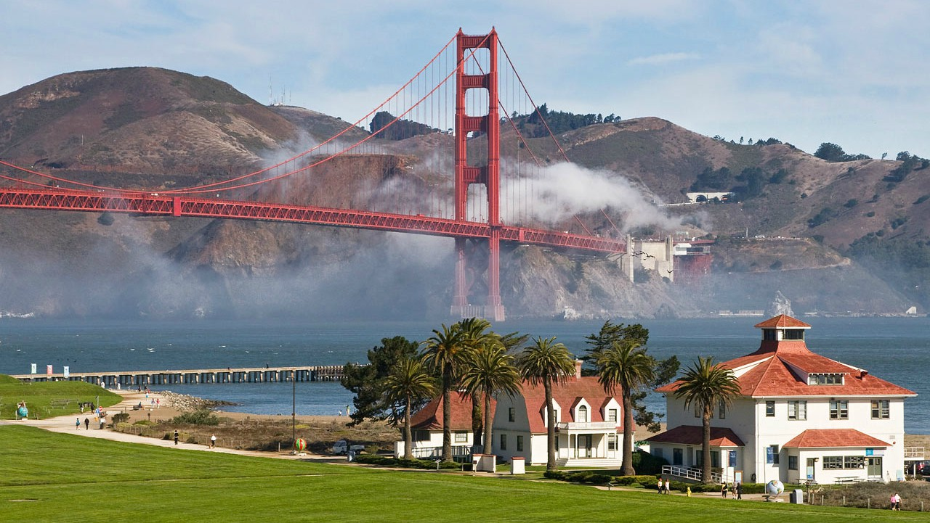

Slide 3
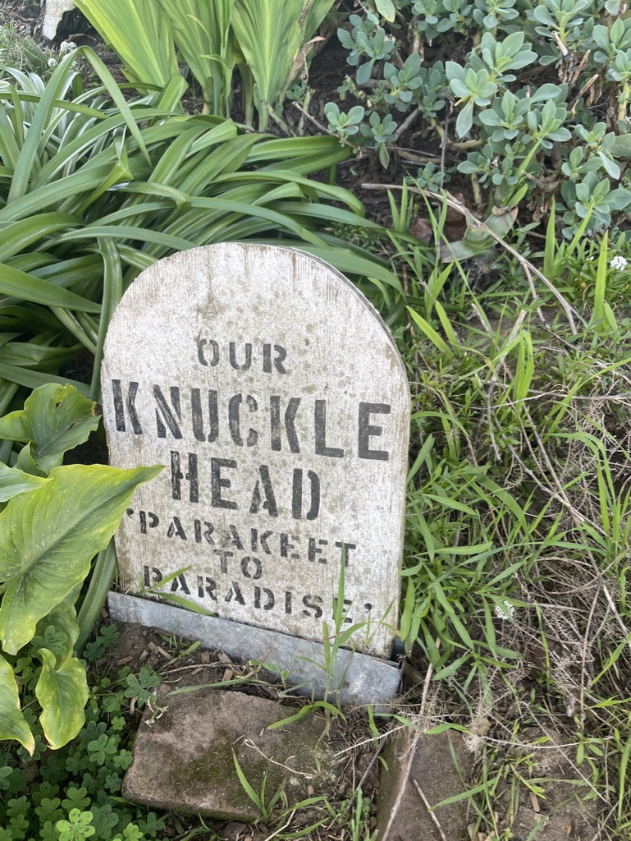

Slide 4
Trade Alert Performance New All Time Highs!
*January 14.59% Final *July +0.61% Final *February +10.51% MTD *August +9.36% Final *March +15.23% Final *September 1.03% Final *April +15.67% Final *October +8.91% MTD *May +8.13% Final *November -11.79% Final *June +0.71% Final *December +11.26% Final *2022 YTD +29.82% compared to -5.9% for the Dow Average *+542.38% since inception *Average annualized return of 44.88% for 12 years

Slide 5
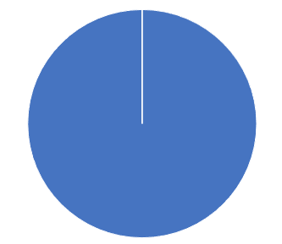
Portfolio Review 60% Long, 30% short, 10% cash Long Term Bull Market
Risk On
World is Getting Better
NO POSITIONS
Risk Off
World is Getting Worse
(SPY) 4/$470-$480 put sread | -10.00%
Total Net Position | -10.00%
Total Aggregate Position | 10.00%
Expiration Value 27.92%

Slide 6
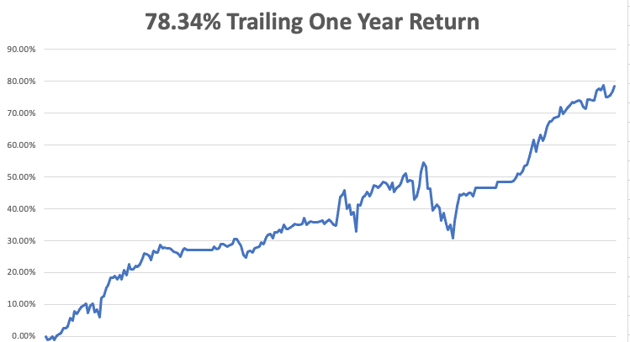

Slide 7
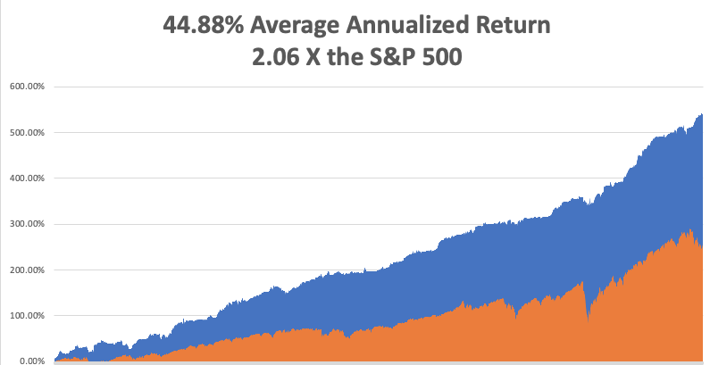
GTD 13 Year Daily Audited Performance

Slide 8
The Method to My Madness The Roaring Twenties are Here
*Ukraine war prospects are the main driver now *Half point rate hikes take us out of the frying pan into the fire *The first three Interest rate rises are in the market, but not the 9 that follow *When the focus shifts back to interest rates stocks are in trouble *A core short in bonds will be key, but trade this too *Omicron cases collapse, taking this drag off the market *VIX over $30 is the ideal entry point for new positions *Bitcoin is attempting an upside breakout *Watch out for the headline “Putin Assassinated” which reverses anything and take stocks up $2,000 in a week

Slide 9
Corona Update – Explosive Growth
*Stunning 92% Decline in cases in a month to 78,000 cases a day *Under fives may be able to get Moderna shots by summer *Most states dropping mask mandates, including California *Pandemic is close to no longer being a factor for the economy *Pandemic is still going to zero by summer, book those cruises *US cases top 80 million, deaths topping 972,000 and deaths are down to to 500 a day

Slide 10
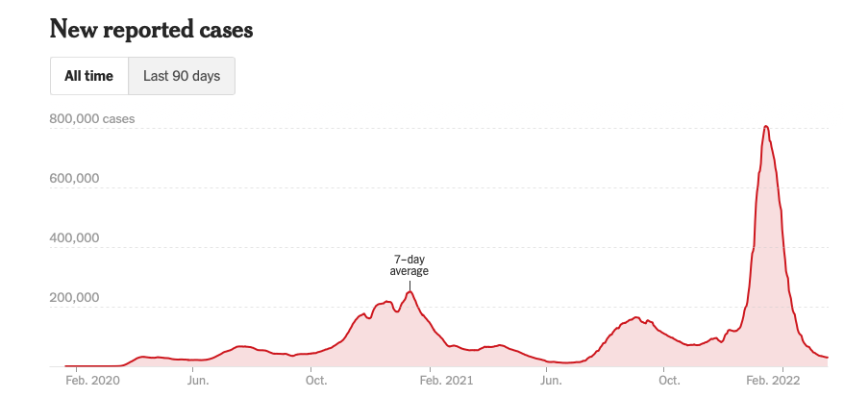
The Pandemic is Over

Slide 11
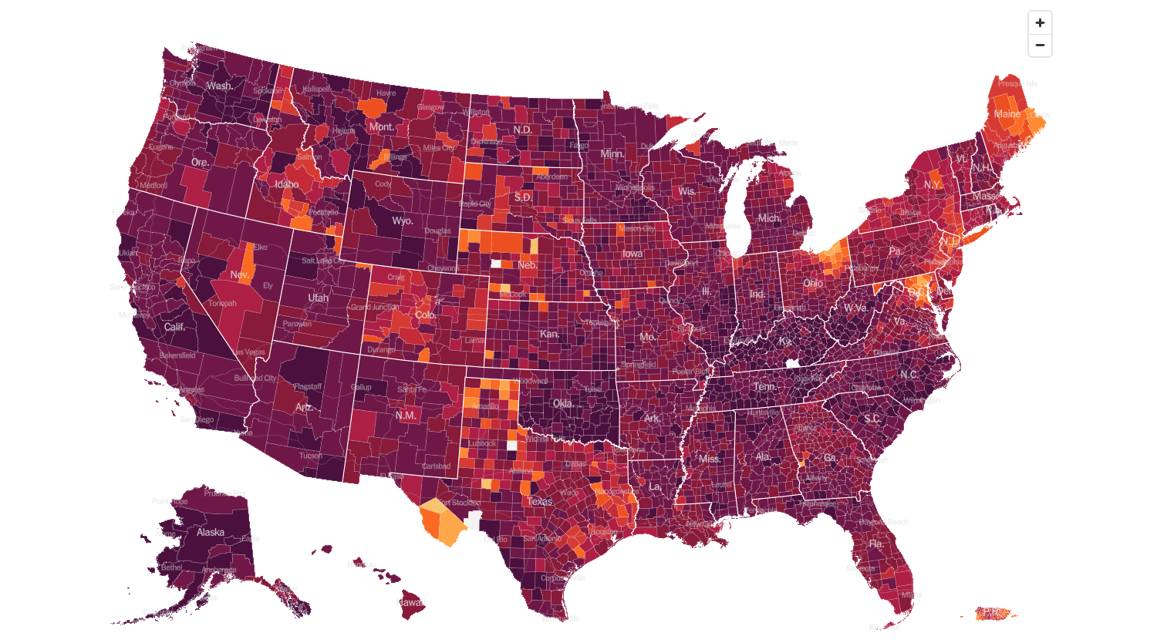
February 2 2022 Infection Rate

Slide 12
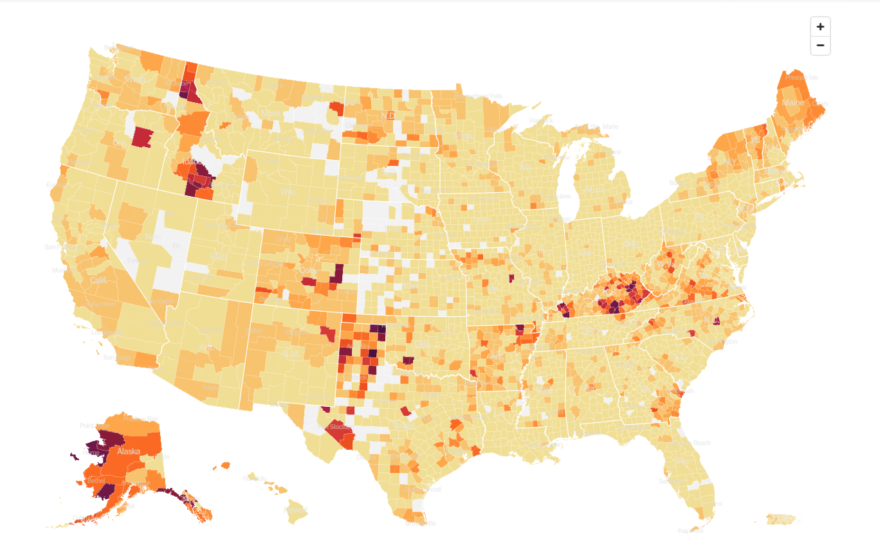
March 23 2022 Infection Rate

Slide 13
The Global Economy – Uncertainty
*The Fed Raises Interest Rates by a quarter point. The futures markets are already discounting seven rate hikes this year, but not he six in 2023 *Nonfarm Payroll Blows it Away, up an eye popping 678,000 in February. The Headline Unemployment rate fell to 3.8% *Janet Yellen Says Inflation to Persist for Another Year *Q1 is now Looking Like a Write Off , from 5% GDP growth to zero *CPI Inflation Data Comes in at a Red Hot 7.9% YOY, a new cycle high and a new 40 year high *The Producer Price Index is Up a Hot 10% YOY, and 0.8% in February *Retail Sales Fade, up only 0.3% in February and up 17.6% YOY *US Consumer Sentiment Dives to 59.7

Slide 14
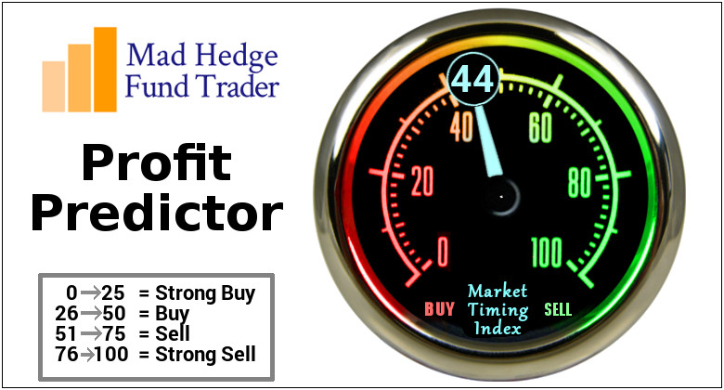
The Mad Hedge Profit Predictor Market Timing Index – Buy Territory An artificial intelligence driven algorithm that analyzes 30 different economic, technical, and momentum driven indicators

Slide 15
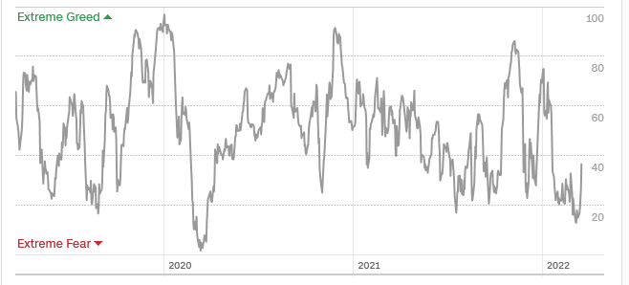
The Mad Hedge Profit Predictor From Extreme “BUY” to Neutral
SELL
Do Nothing
BUY

Slide 16
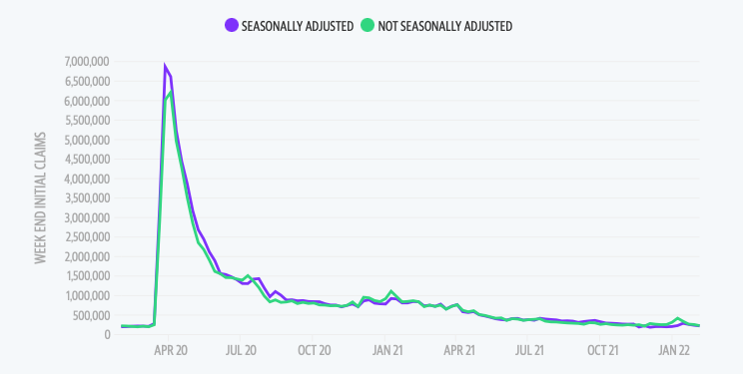
Weekly Jobless Claims – Falling 214,000 – and falling

Slide 17
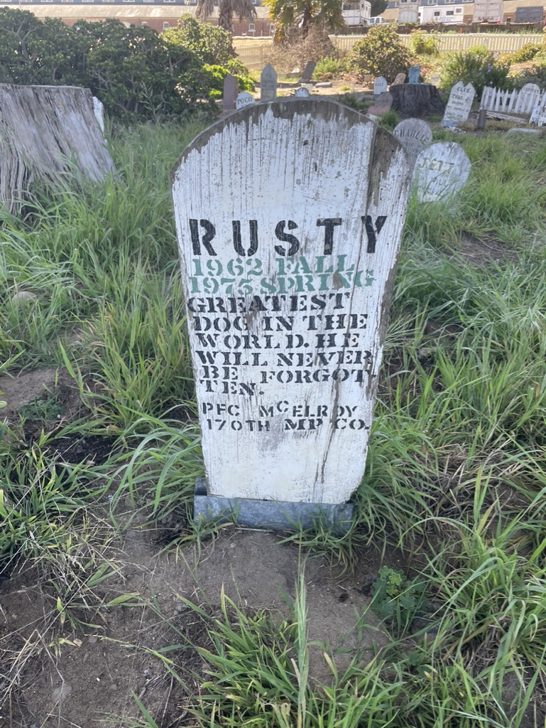

Slide 18
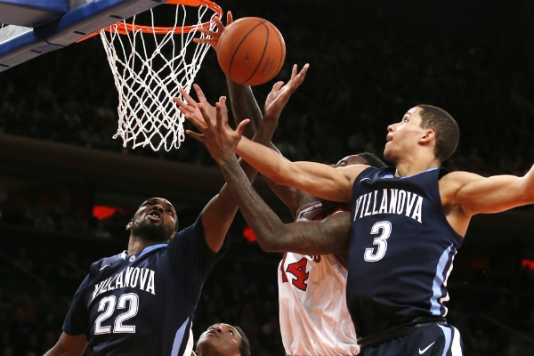
Stocks – Rebound
*The Market Only Sees the Ukraine Right Now, fundamentals are irrelevant *short covering rally prompts a massive one-week rally focusing on the highest quality stocks, like (NVDA), (MSFT), (GOOGL), and (TSLA). These will lead the next bull market and are now in strong Buy on Dips Territory *Banks also in strong Buy on Dips Territory *Russia has $350 Billion of US stock for Sale at Market *China Crashes, on fears they may get dragged into the Ukraine war by Russia. *The War is Roiling the EV Market, as high energy prices send demand rocketing, but materials like nickel, aluminum, and lithium through the roof *Look for terrible H1 and strong H2 scenario to continue

Slide 19
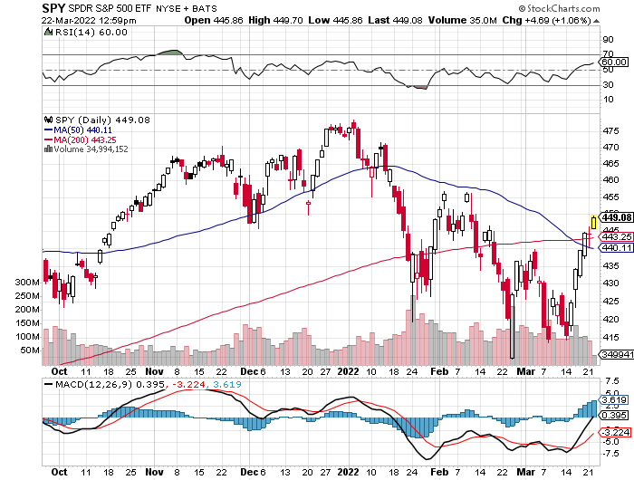
S&P 500 – Year End Melt Up! long 2/$465-$475 bear put spread, long 3/$470-$480 bear put spread Took profits on long 2/$410-$420 bull call spread, Took profits on long 2/$480-$500 bear put spread, Took profits on long 10/$410-$420 bull call spread
The Bottom 410 Down -17%

Slide 20
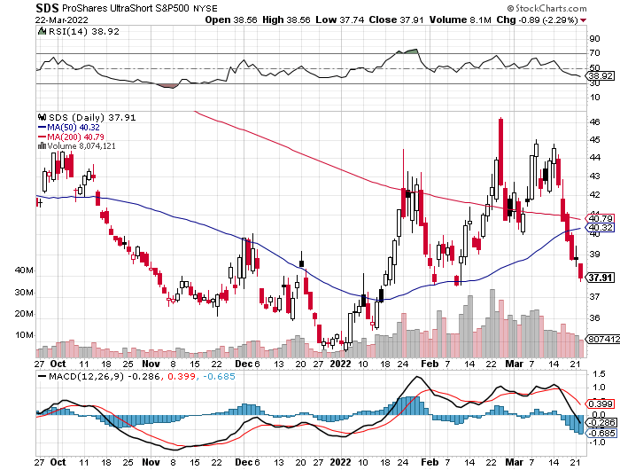
ProShares Ultra Short S&P 500 (SDS)- a great hedge for long stocks and bonds long 2X position has a hedge against longs and bond shorts

Slide 21
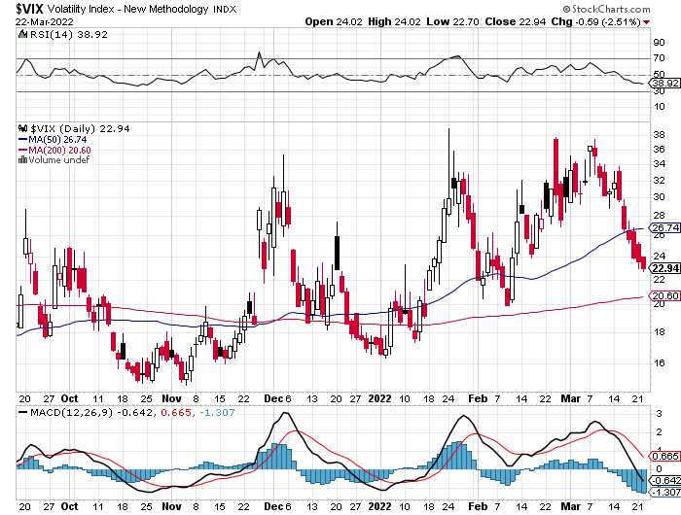
(VIX) – Dying a Slow Death classic summer market

Slide 22
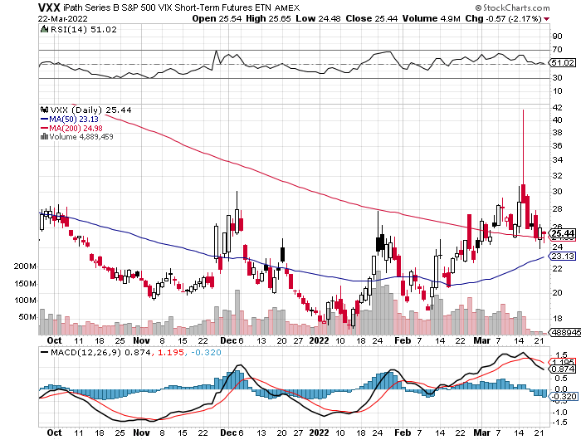
(VXX)-

Slide 23
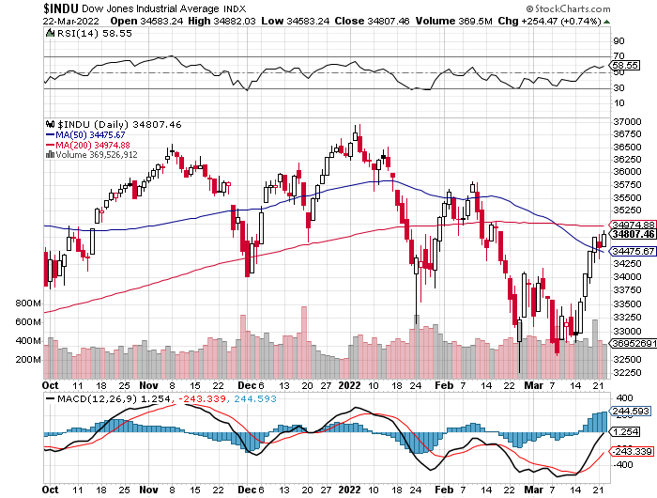
Dow Average ($INDU)-

Slide 24
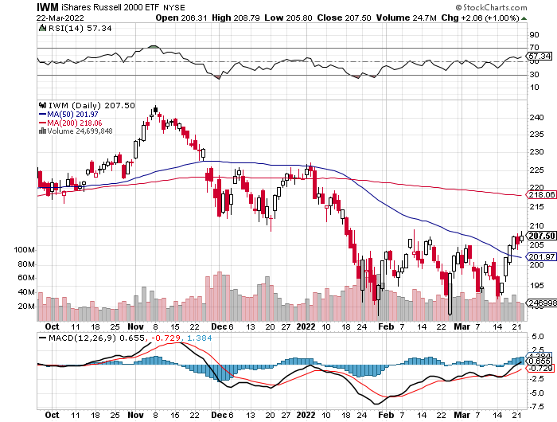
Russell 2000 (IWM)- took profits on Long 10/$137-$142 vertical bull call spread took profits on Long 10/$153-$156 vertical bear put spread

Slide 25
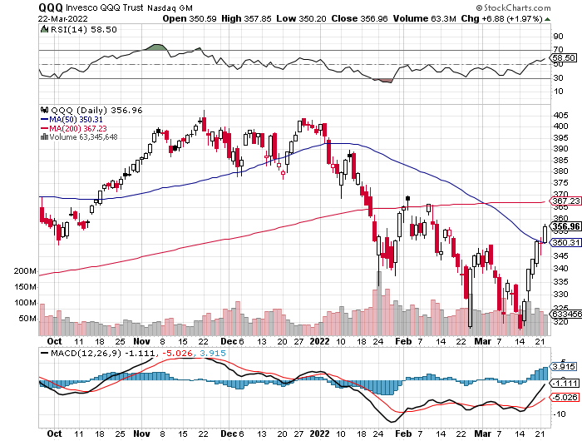
NASDAQ (QQQ) – long (QQQ) 4/$330-$335 put spread took profits on long (QQQ) 3/$340-$345 put spread covered long (QQQ) $325-$330 put spread

Slide 26
The Barbell Portfolio
*50% Big Tech - 2% of US Employment but 27% of Market Cap and 38% of Profits 50% Domestic Recovery, including: Railroads Couriers Banks Construction Credit Cards Event organizers Ticket sales Retailers

Slide 27
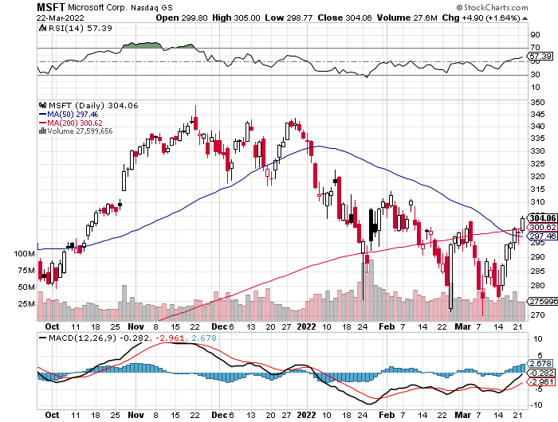
Microsoft (MSFT)- took profits on long 2/$340-$350 bear put spread took profits on long 12/$220-$230 call spread stop loss on long 12/$170-$180 call spread

Slide 28
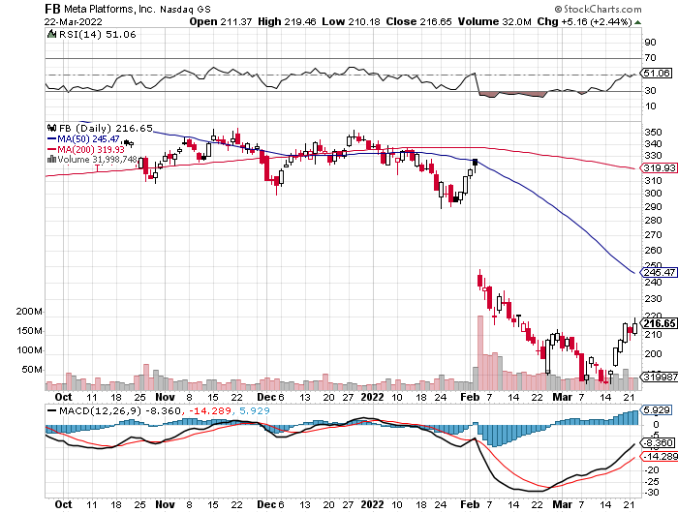
Facebook (FB)- Changes Name to “Meta” took profits on Long 9/$290-$300 vertical bear put spread stopped out of Long 9/$190-$200 vertical bear put spread

Slide 29
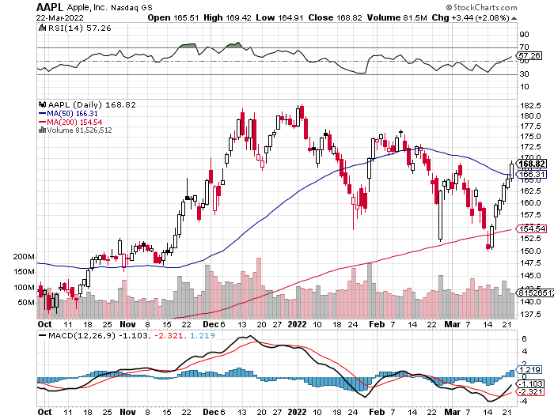
Apple (AAPL)- Launches new low-end $429 5G iPhone SE. Took profits on long 2/$180-$190 put spread

Slide 30
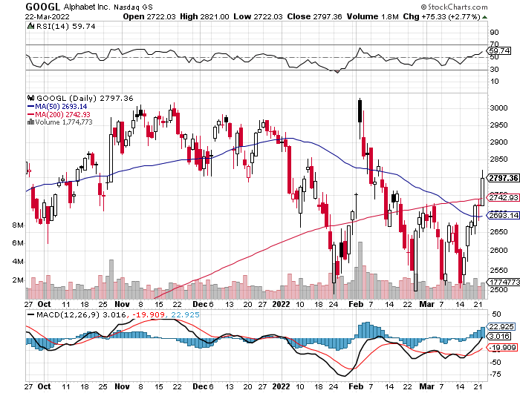
Alphabet (GOOGL) – Ad king on economic recovery 20:1 share split in July took profits on long 12/$1,200-$1,230 bull call spread took profits on long 9/$1,030-$1,080 vertical bull call spread

Slide 31
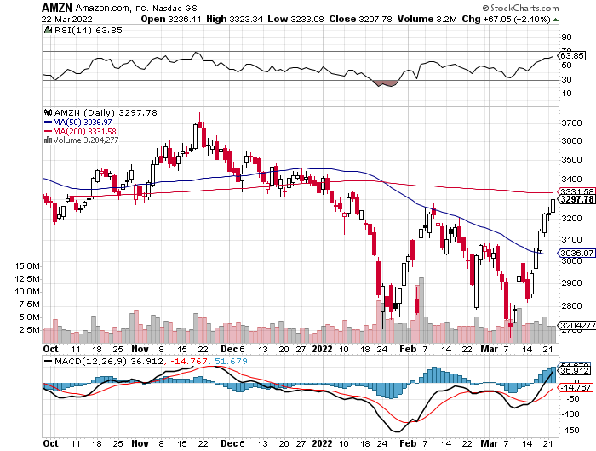
Amazon (AMZN) – long 2/$3,400-$3,500 bear put spread took profits on long 9/$2,800-$2,900 bull call spread

Slide 32
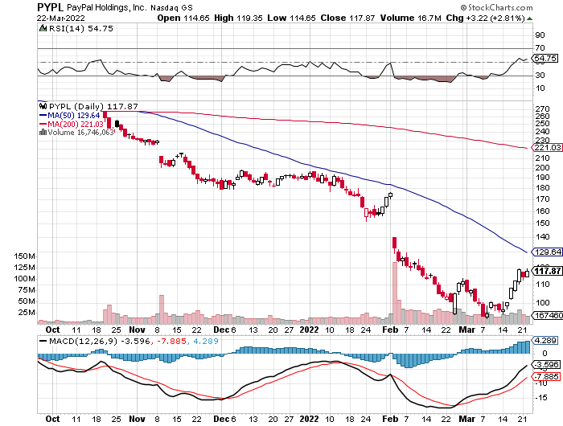
PayPal (PYPL) - Cancels Pinterest Buy took profits on long 4/$90-$95 call spread

Slide 33
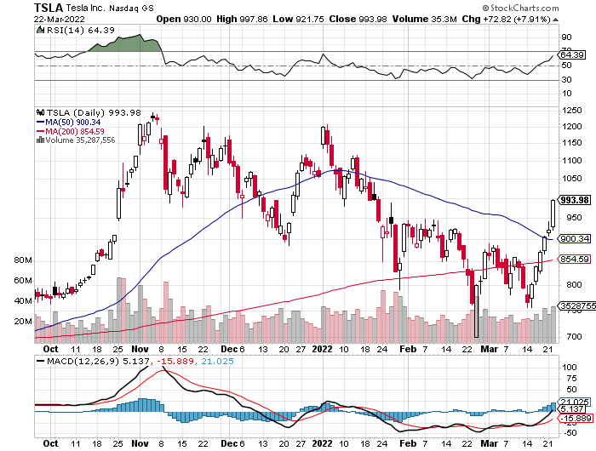
Tesla (TSLA) –Aiming for 1.5 million cars in 2022 Jeffries Raises Tesla Target, from $1,250 to $1,400, Germany Model Y starts deliveries took profits on long 2/$550-$600 call spread took profits on long 2/$600-$650 call spread

Slide 34
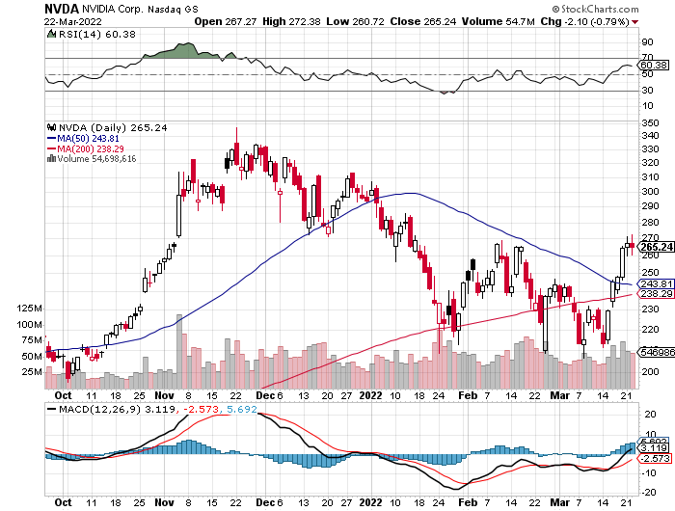
NVIDIA (NVDA) – A Mad Hedge 20 bagger – Global Semiconductor Shortage Slows Auto Industry,

Slide 35
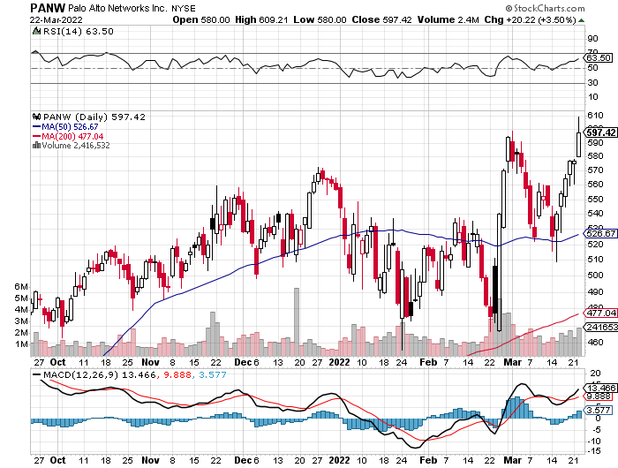
Palo Alto Networks (PANW)- Hacking never goes out of fashion

Slide 36
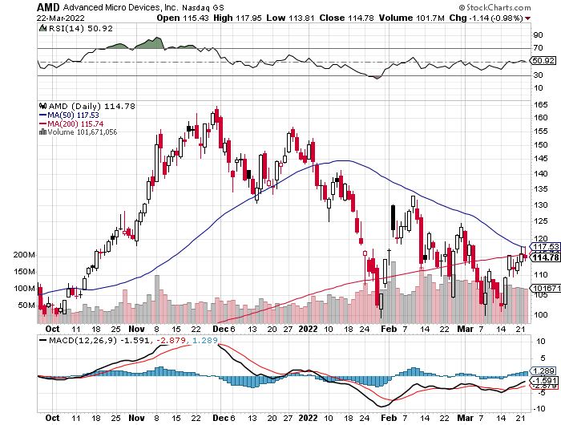
Advanced Micro Devices (AMD)- programable logic devices took profits on long 2/$75-$80 call spread

Slide 37
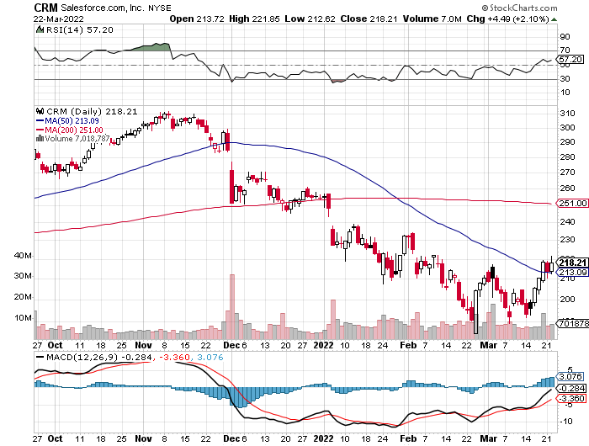
Salesforce (CRM)- Massive Online Migration took profits on long 9/$125-$130 vertical bull call spread took profits on long 8/$125-$130 vertical bull call spread took profits on long 2/$105-$115 call spread

Slide 38
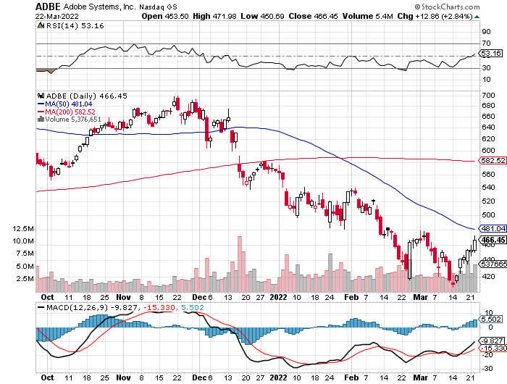
Adobe (ADBE)- Cloud play The Quality Non-China tech play

Slide 39
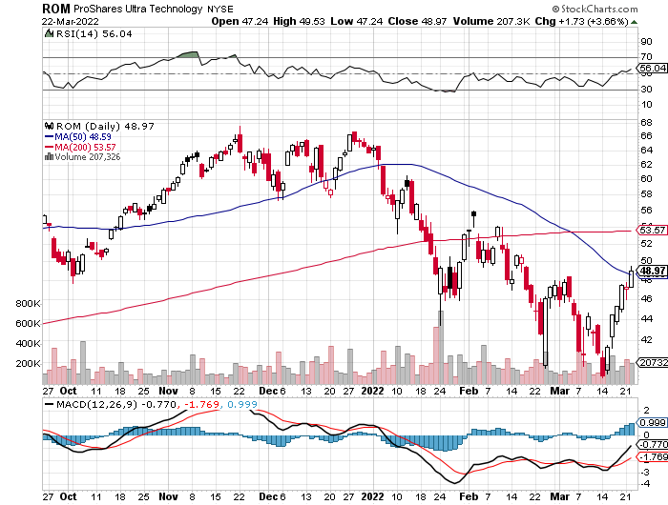
ProShares Ultra Technology ETF (ROM) – 2X Long Technology ETF took profits on long 10/$62-65 call spread

Slide 40
The Second Half of the Barbell
*Bets on a domestic recovery in 2022 Q4 *Upside potential in 2022 far greater than tech *Some of these have not moved for 5 or 10 years *Focuses on economically sensitive cyclical industries *Makes a great counterweight to high-growth technology *We could spend all of next year rotating between the two groups

Slide 41
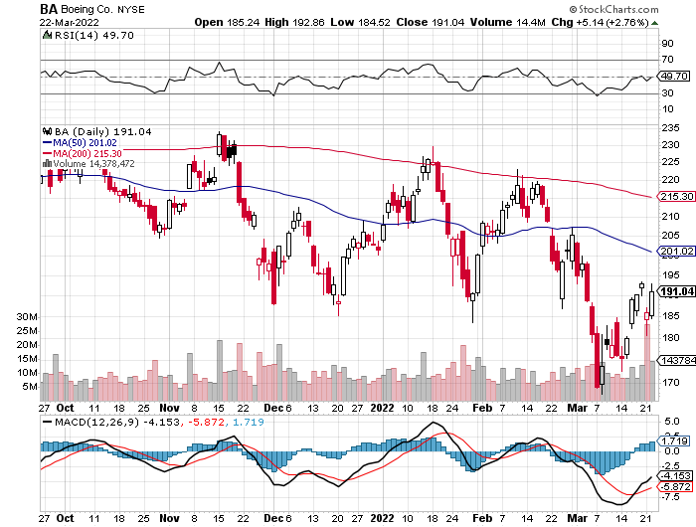
Boeing (BA) –LEAP Candidate Boeing Crashes in China, with a 737 killing 132 passengers long 3/$146-$149 call spread took profits on long 2/$150-$160 call spread

Slide 42
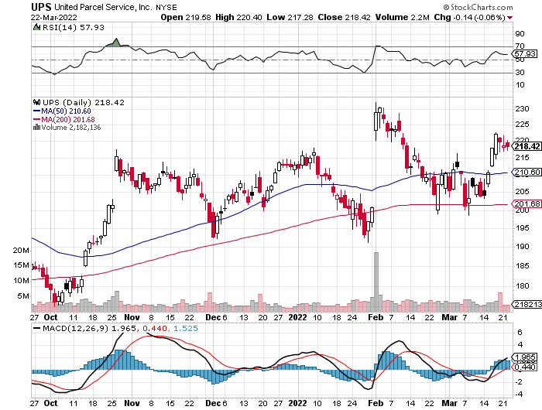
Package Delivery- United Parcel Service (UPS) - Package Delivery record profits took profits on long 11/$130-$140 call spread

Slide 43
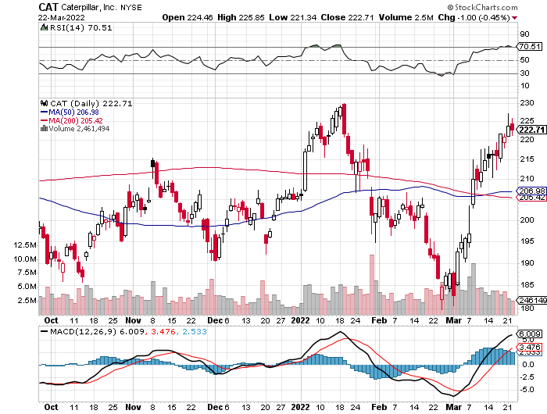
Caterpillar (CAT)- Ag + Infrastructure + Housing took profits on long 12/$145-$150 call spread took profits on long 11/$125-$135 call spread

Slide 44
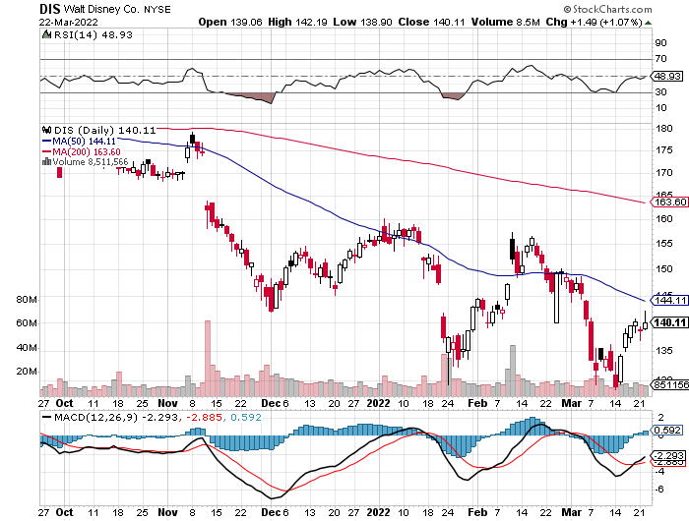
Walt Disney (DIS)- stopped out of long 10/$165-$175 call spread took profits on long 3/$170-$180 call spread

Slide 45
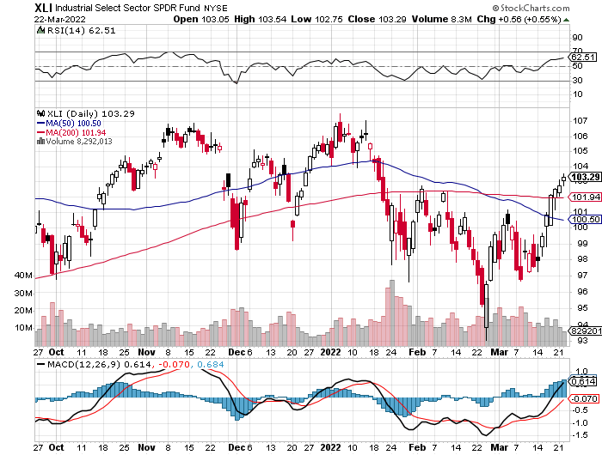
Industrials Sector SPDR (XLI)- (GE), (MMM), (UNP), (UTX), (BA), (HON)

Slide 46
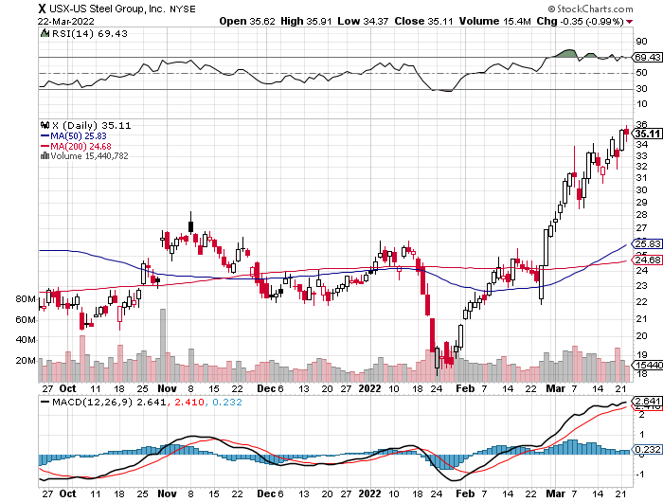
US Steel (X) – Commodity Bubble

Slide 47
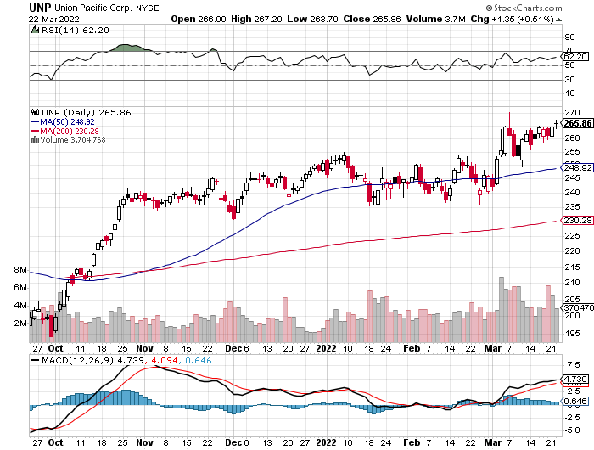
Union Pacific RR (UNP)- Big Stuff to Ship near record earnings announced took profits on long 5/$200-$210 call spread took profits on 11/$150-$160 call spread

Slide 48
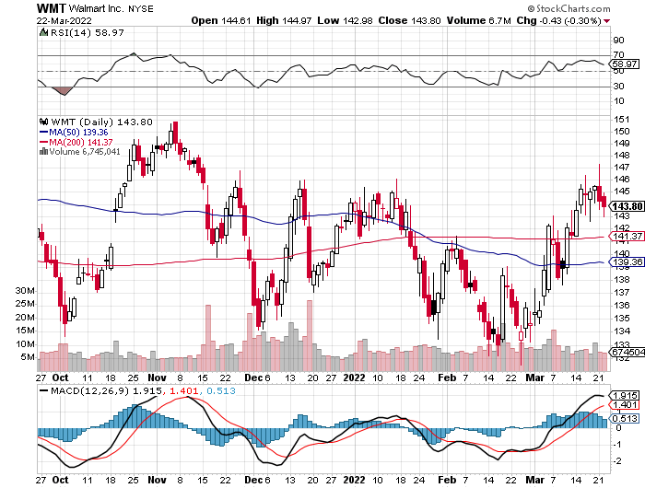
Wal-Mart (WMT)- took profit on Long 11/$125-$130 bear put spread took profit on Long 10/$119-$121 bear put spread took profits on Long 8/$114-$117 bear put spread

Slide 49
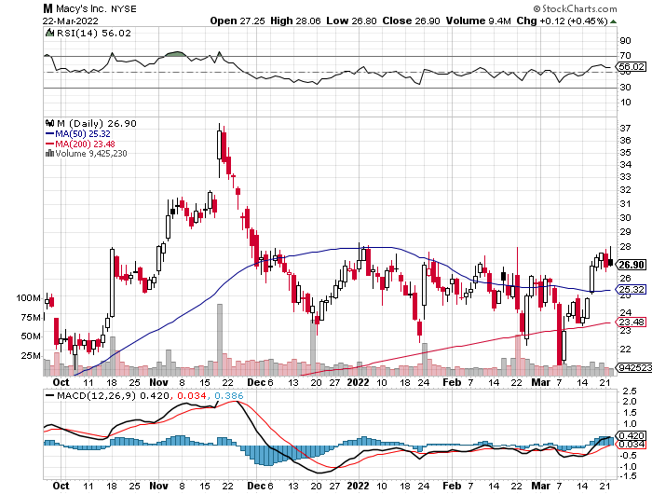
Macys’ (M) – Retail Punished took profits on Long 8/$23-$25 bear put spread

Slide 50
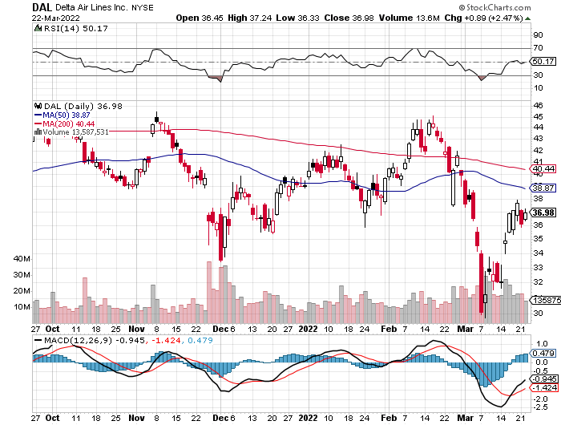
Delta Airlines (DAL) –

Slide 51
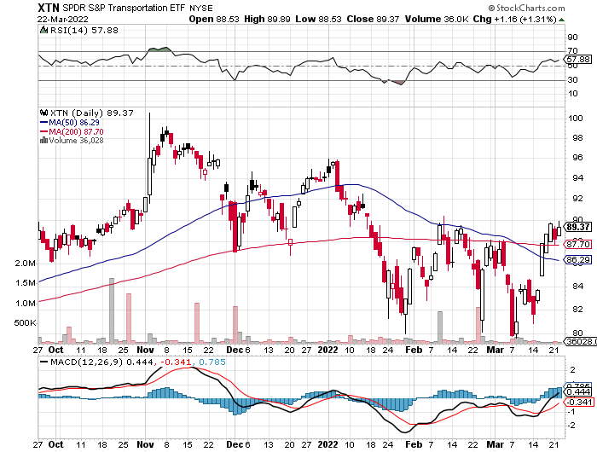
Transports Sector SPDR (XTN)- Worst Hit Sector (ALGT), (ALK), (JBLU), (LUV), (CHRW), (DAL)

Slide 52
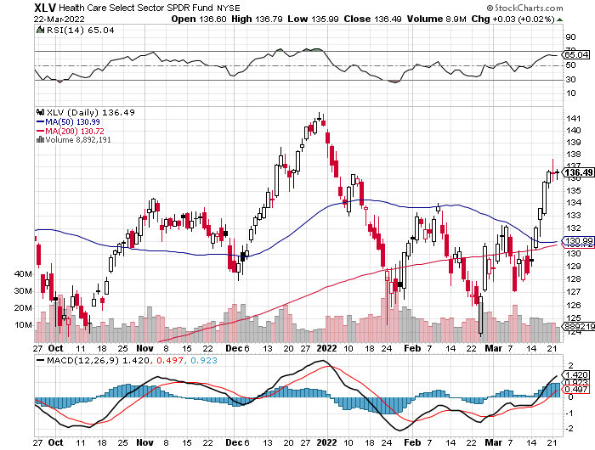
Health Care Sector (XLV), (RXL) (JNJ), (PFE), (MRK), (GILD), (ACT), (AMGN)

Slide 53
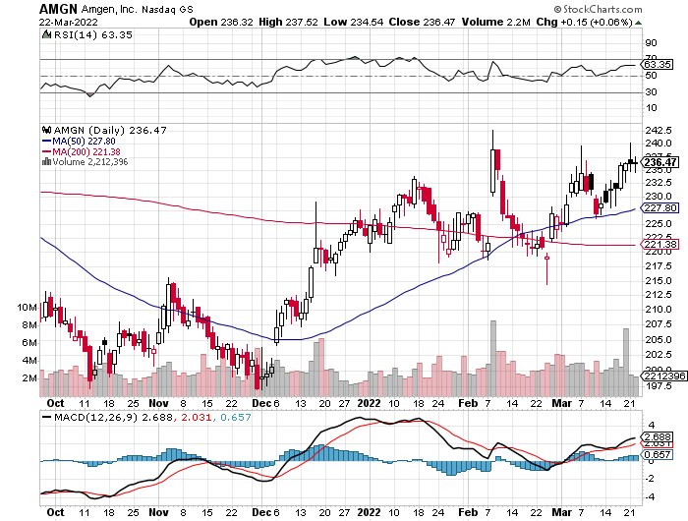
Amgen (AMGN) took profits on long 11/$185-$200 bull call spread

Slide 54
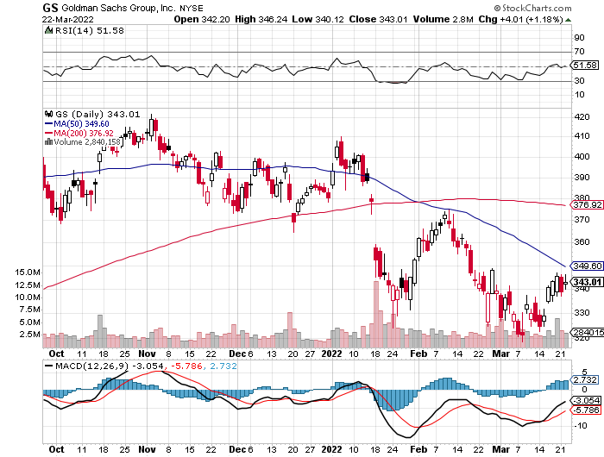
Goldman Sachs (GS) – took profits 12/$330-$350 call spread took profits 11/$330-$350 call spread stop loss on long 11/$385-$395 call spreads

Slide 55
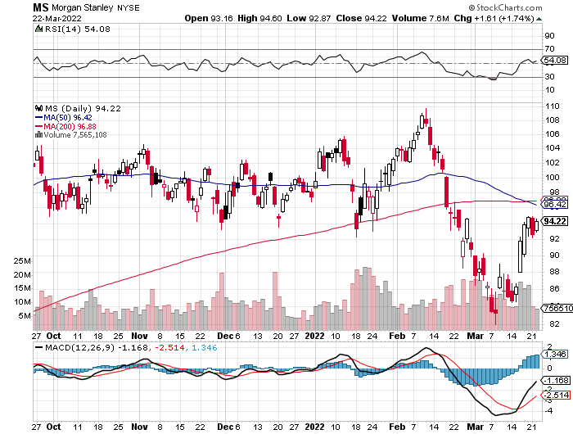
Morgan Stanley (MS) – Doubled Dividend took profits on long 11/$85-$90 call spread stop loss on long 11/$95-$98 call spread took profits on long 10/$85-$90 call spread profits on long 2/$55-$60 call spread

Slide 56
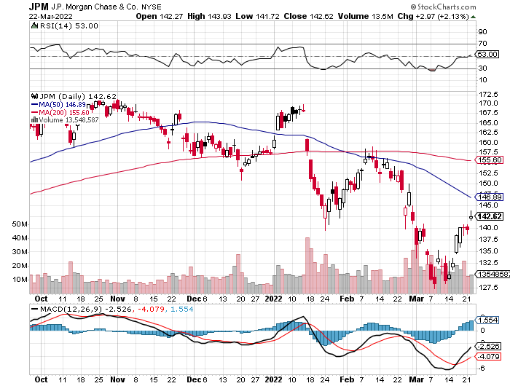
JP Morgan Chase (JPM)-Back to Life took profits 12/$148-$152.50 call spread took profits on long 10/$130-$140 call spread took profits on long 8/$140-$145 call spread took profits on long 7/$140-$145 call spread

Slide 57
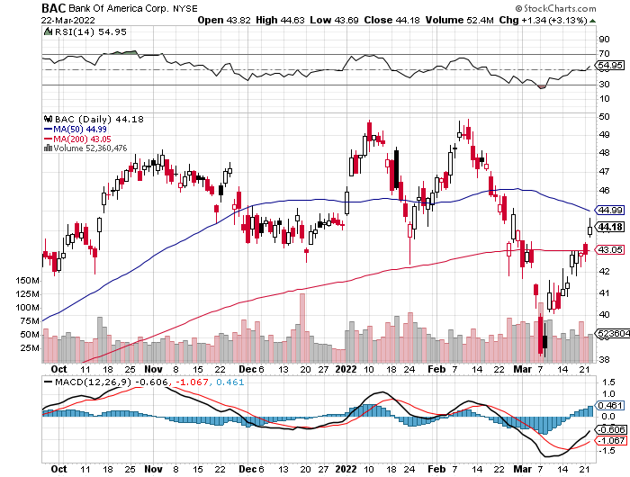
Bank of America (BAC) – took profits long 12/$39-$42 call spread stop loss on long 11/$43-$45 call spread took profits on 11/$37-$40 call spread took profits on long 2/$28-$30 call spread

Slide 58
SPDR Metals & Mining ETF (XME) – long 2/$28-$30 call spread

Slide 59
Blackrock (BLK)-Asset Collection Boom took profits on long 3/$770-$790 call spread took profits on long 3/$310-$340 call spread

Slide 60
Visa (V) – “Touchless” Bitcoin Drag took profits on long 5/$220-$225 bull call spread took profits on long long 5/$195-$205 bull call spread took profits on long 9/$180-$185 bull call spread

Slide 61
Consumer Discretionary SPDR (XLY) (DIS), (AMZN), (HD), (CMCSA), (MCD), (SBUX)

Slide 62
Berkshire Hathaway (BRKB)- Natural Barbell Buys Alleghany Insurance, for $11.6 billion took profits on long 2/$270-$280 call spread

Slide 63
Europe Hedged Equity (HEDJ)-

Slide 64
Japan (DXJ)-

Slide 65
Emerging Markets (EEM) - Pro trade, Weak Dollar, Long Recovery Play

Slide 67
Bonds – Defining the New Range
*Bonds Collapse on happy talks about Russia/Ukraine talks, making my shorts look even better *Russian Credit Default Swaps Hit 34% Yields, indicating an extremely high probability of default *The first seven rate hikes are in the market, but the following five aren’t *Final target is a 3.00% overnight rate *US National Debt Tops $30 Trillion, the end result of 20 years of deficit spending. *Interest rates hit new two year high taking ten –year US Treasury to 2.18% *Real Yields Turn Positive, for the first time in a decade, at least for 30-year US treasury bonds *Sell any six-point rally in the (TLT) *US Treasury bond fund (TLT) could plunge from $180 in 2020 to $105 by 2023

Slide 68
Treasury ETF (TLT) – Breaking Down stopped out of long 4/$127-$130 call spread took profits on long 2/$149-$152 put spread, took profits on long 2/$147-$150 put spread took profits on long 3/$150-$153 put spread, took profits on long 3/$127-$130 call spread

Slide 69
Ten Year Treasury Yield ($TNX) – 2.42% yearend end target nearly met

Slide 70
Junk Bonds (HYG) 5.33% Yield to Maturity

Slide 71
2X Short Treasuries (TBT)-Another run at highs

Slide 73
Foreign Currencies – Dollar Pop
*Soaring interest rates and flights to safety turbocharge the buck *Ukraine war crushes the Euro *Commodity currencies like (FXA) and (FXC) soar. *Currency with the fastest appreciating interest rates usually does best and that’s the US *Long-term fundamentals are still poor, a dollar short could be the new ten-year trade, but not yet *Stand aside from forex for now, they are getting fish to fry

Slide 74
Japanese Yen (FXY)

Slide 75
Euro (FXE)-

Slide 76
British Pound (FXB)-

Slide 77
Australian Dollar (FXA)- The Global Recovery Play took profits on long 8/$67-$69 call spread

Slide 78
Emerging Market Currencies (CEW)

Slide 79
Chinese Yuan- (CYB)-

Slide 81
Bitcoin – Rising Rate Hit Buy the Mad Hedge Bitcoin Letter at https://www.madhedgefundtrader.com/store/
*Bitcoin Comes Back from the Dead, rising 32% from the intraday January 24 low to $42,500 *Upside breakout may be at hand *Any noninterest bearing instrument gets punished when rates rise and crypto is no exception *Bitcoin Soars 9% on Biden Executive Order to explore regulations *Will this be a 50% correction or and 80% one, as in years past? *Long term “BUY” signal for Bitcoin still intact *Buy Bitcoin and Ethereum on the bigger dip

Slide 82
Bitcoin ($BTCUSD) – Finding a bid

Slide 83
Ethereum (ETHE) –

Slide 84
MicroStrategy (MSTR) –

Slide 85
Amplify Transformational Data Sharing ETF (BLOK) –

Slide 87
Energy – Third Oil Shock
*Oil Plunges to $95 a Barrel, down $37 from the recent high, as the panic short covering dries up *Rumors of increased OPEC oil production and deals with Iran and Venezuela weigh on prices *Margin Increases Hit Oil Land, with brokers demanding more cash up front for derivatives increasing in volatility * Europe to Cut by Two Thirds This Year, some 45% of their current gas supply Russian Gas Purchases *The US and Saudi Arabia can boost production *The risk/reward for a new oil trade here is terrible and now volatility is extreme *US to Ban Russian Oil Imports, and the rush is on to see how fast we can replace German imports *Avoid all energy plays like the plague, it’s the new buggy whip industry as the US de-carbonizes

Slide 88
Oil-($WTIC)

Slide 89
United States Oil Fund (USO) long 10/$9.50-$10 Vertical bull call spread

Slide 90
Energy Select Sector SPDR (XLE)-No Performance! (XOM), (CVX), (SLB), (KMI), (EOG), (COP)

Slide 91
Halliburton (HAL)-

Slide 92
Natural Gas (UNG) -

Slide 94
Precious Metals – Cooling Off
*Gold gives up recent gains on bond market collapse and soaring interest rates *Successive half point rate cuts that Powell has been threatening absolutely do not work for gold *Many analysts are now raising their targets for the barbarous relic now that Bitcoin has utterly failed to provide protection against absolutely anything. Wars, inflation, economic, slowdown, pandemic, Bitcoin has fallen in every case. *Rising interest rates bode poorly for precious metals as it raises the opportunity cost for non-yielding assets *Bitcoin is clearly sucking capital out of precious metals *Stay away until this plays out *Silver is still the bigger and better long-term play

Slide 95
Gold (GLD)- Meltdown

Slide 96
Market Vectors Gold Miners ETF- (GDX) –

Slide 97
Barrick Gold (GOLD) took profits on long 1/$21-$23 call spread took profits on long 11/$22-$24 call spread

Slide 98
Newmont Mining- (NEM)- took profits on long $55-60 call spread

Slide 99
Silver- (SLV)- took profits on long 11/$19-$20 call spread

Slide 100
Silver Miners - (SIL)-

Slide 101
Wheaton Precious Metals - (WPM)- took profits on long 2/$39-41 call spread

Slide 102
Copper (COPX)-Uptrend Resumes Copper Unions Vote to Strike in Chile, cutting off 33% of the global supply

Slide 104
Real Estate – Hotter than Hot
*Existing Home Sales Plunge by 7.2% to 6.02 million units in February *New Home Sales Dive, down 2% to 772,000 in February *Inventories still a very light at 6 months compared to a scant 2-month supply for existing homes *Interest rates are starting to bite, and prices are still soaring, taking the median national price to a new high of $406,600, up 10.6% YOY. *Rents Rise at Fastest Rate in 30 Years *Even teardowns are now selling in a week *Remodel boom continues, you can’t hire anyone for anything *S&P Case Shiller Rockets 18.6%, in December with its National Home Price Index The real estate boom is years away from a peak.

Slide 105
S&P Case Shiller S&P Case Shiller Rockets 18.8%, in November with its National Home Price Index Phoenix 32.5%, Tampa (29%), and Miami (27%) were the big gainers

Slide 106
Crown Castle International (CCI) – 2.70% yielding cell phone tower REIT

Slide 107
US Home Construction Index (ITB) (DHI), (LEN), (PHM), (TOL), (NVR)

Slide 109
Trade Sheet- So What Do We Do About All This?
*Stocks – sell rallies *Bonds – sell rallies aggressively *Commodities-buy dips *Currencies- stand aside *Precious Metals – stand aside *Energy – stand aside *Volatility - sell short over $30 *Real estate – stand aside *Bitcoin – stand aside

Slide 110
Next Strategy Webinar 12:00 EST Wednesday, April 6 from Incline Village, NV email me questions at support@madhedgefundtrader.com
Good Luck and Good Trading!
Notes:
*

