Slide 1
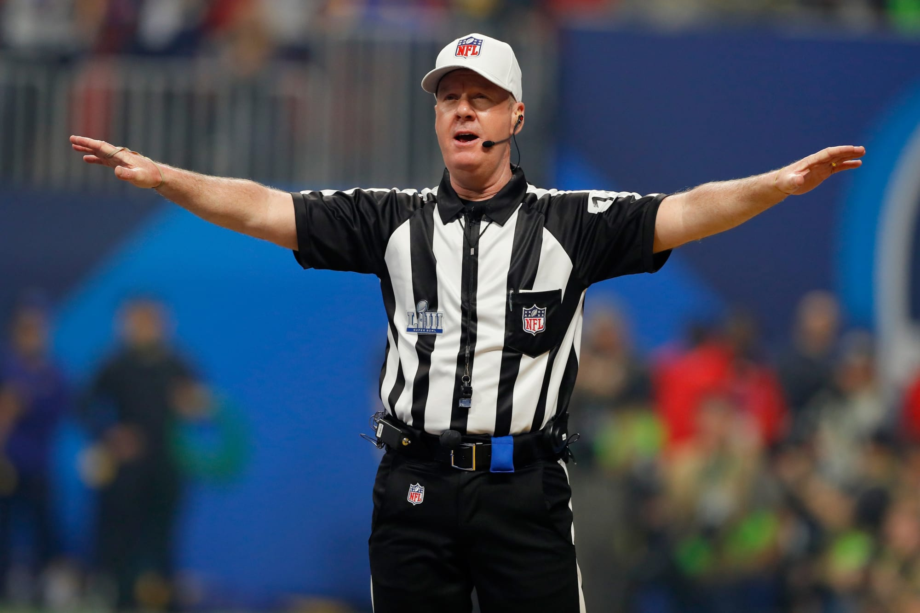
The Mad Hedge Fund Trader “No Trade”
With John Thomas Incline Village, NV, April 20, 2022 www.madhedgefundtrader.com
Notes:
*

Slide 3
Trade Alert Performance New All Time Highs!
*January 14.59% Final *July +0.61% Final *February +8.78% MTD *August +9.36% Final *March +3.43% Final *September 1.03% Final *April +0.38% Final *October +8.91% MTD *May +8.13% Final *November -11.79% Final *June +0.71% Final *December +11.26% Final *2022 YTD +27.33% compared to -5.2% for the Dow Average *+539.79% since inception *Average annualized return of 44.37% for 13 years

Slide 4
Portfolio Review 0% Long, 0% short, 100% cash All cash in a no trade market
Expiration Value 27.23%
NO POSITIONS

Slide 5
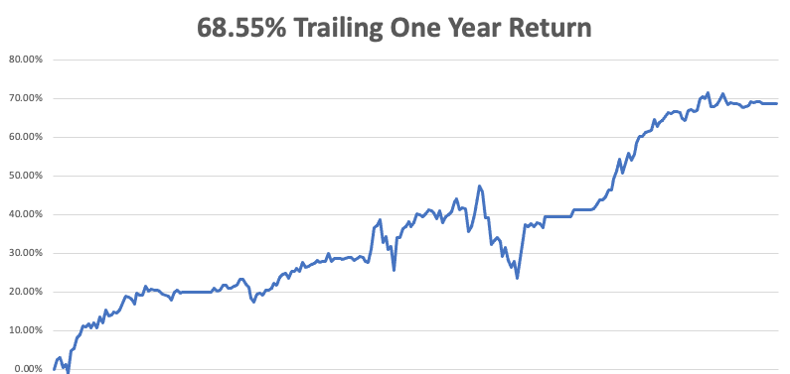

Slide 7
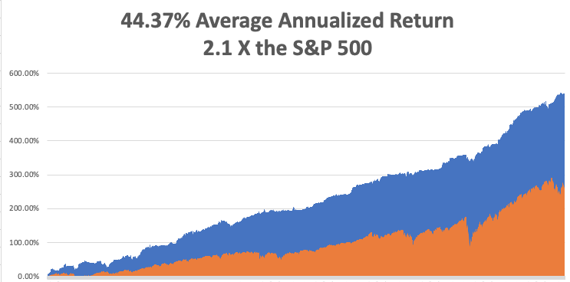
GTD 13 Year Daily Audited Performance

Slide 8
The Method to My Madness The Roaring Twenties are Here
*Main market driver has flipped from the Ukraine War to Interest rates, cutting stocks off at the knees *Half point rate hikes take us out of the frying pan into the fire, and we could get four in a row *The first seven Interest rate rises are in the market, but not the 5 that follow *A core short in bonds will be key, but trade this too *The pandemic is over and new variant is unlikely to affect the US as immunity is so high *VIX over $30 is the ideal entry point for new long positions *Watch out for the headline “Putin Assassinated” or :Putin resigns” which reverses anything and take stocks up $2,000 in a week

Slide 9
Corona Update – The Pandemic is Over
*Corona virus cases at 80.6 million, up only 300,000 in a week, but lifting mask requirement on airplanes will bring a new spike * Deaths topping 988,000 and have only increased by 3,000 in the past week *China is Dramatically Under Counting Covid Cases, according to Dr. Scott Gottlieb *That because the country’s CoronaVac and Sinopharm vaccines are only 30% effective and not RNA based *Biden offered our own RNA based Pfizer and Moderna vaccines for sale but they refused out of national pride. In the meantime, the 26 million people of Shanghai are starving, unable to go outside to buy food. *Second boosters approved by CDC will prevent a recurrence *Under fives vaccine out in delayed until summer *Pandemic is still going to near zero by summer, book those cruises

Slide 10
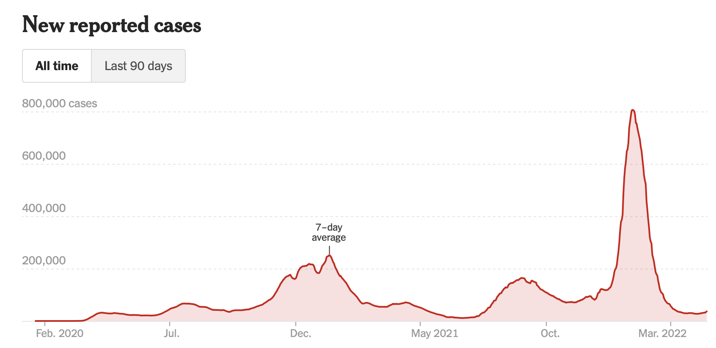
The Pandemic is Over

Slide 11
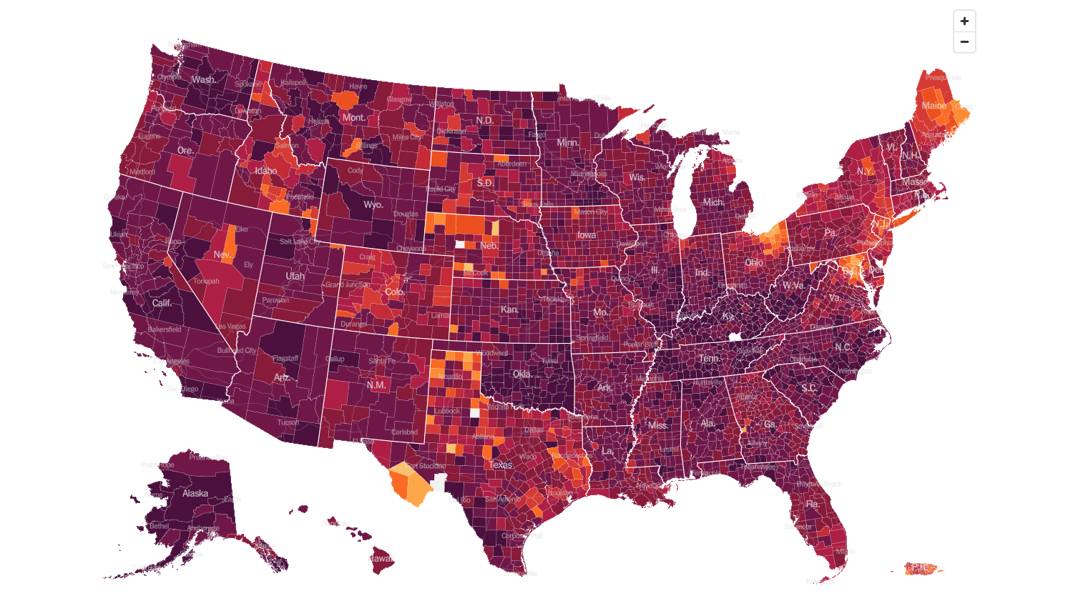
February 2 2022 Infection Rate

Slide 12
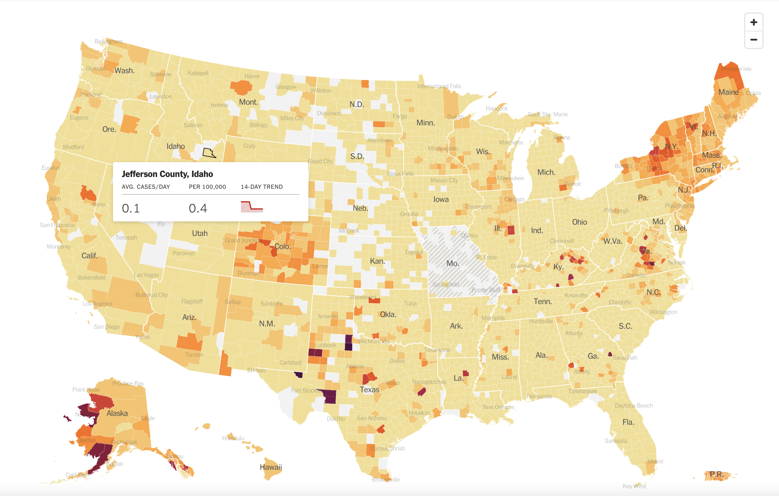
April 20 2022 Infection Rate

Slide 13
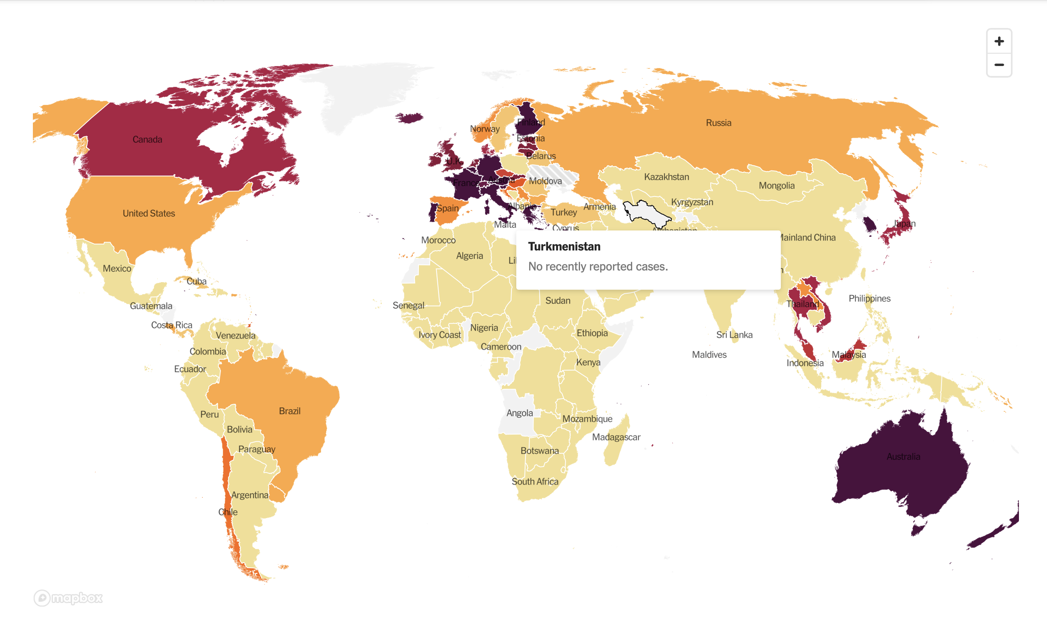

Slide 14
The Global Economy – It’s an Inflation Game
*Inflation Soars to 8.5%, a 40-year high *The Fed Just Declared War on the Stock Market, buy threatening multiple back-to-back 50 basis point rate cuts AND accelerated QT (quantitative tightening). *Used Car Sales Take a Hit, as affordability becomes a major issue. CarMax just reported a 6.5% plunge in Q4 *Producer Price Index Rockets by 11.2%, an 11-year high *Retail Sales Jumped 0.5% in March, and up 6.9% YOY, while import prices hit an 11-year high *Weekly Jobless Claims Hit 185,000, up 18,000 from the previous week. The stock market may be worried about a coming recession but the jobs market sure isn’t

Slide 15
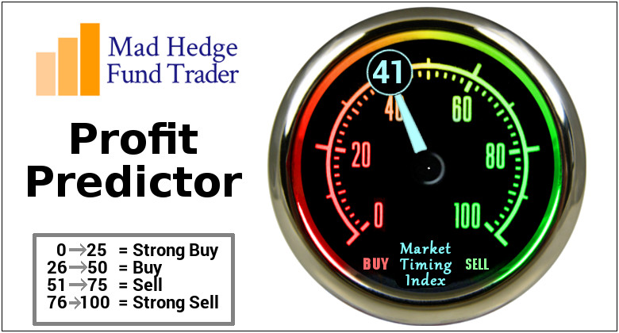
The Mad Hedge Profit Predictor Market Timing Index – Buy Territory An artificial intelligence driven algorithm that analyzes 30 different economic, technical, and momentum driven indicators

Slide 16
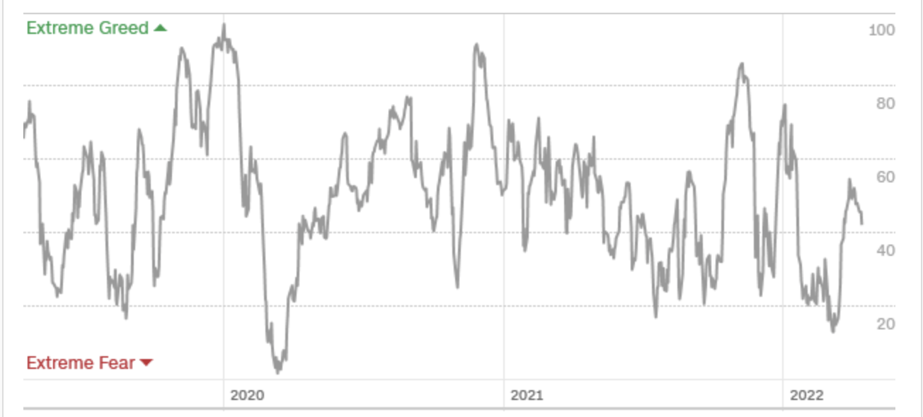
The Mad Hedge Profit Predictor From Extreme “BUY” to Neutral
SELL
Do Nothing
BUY

Slide 17
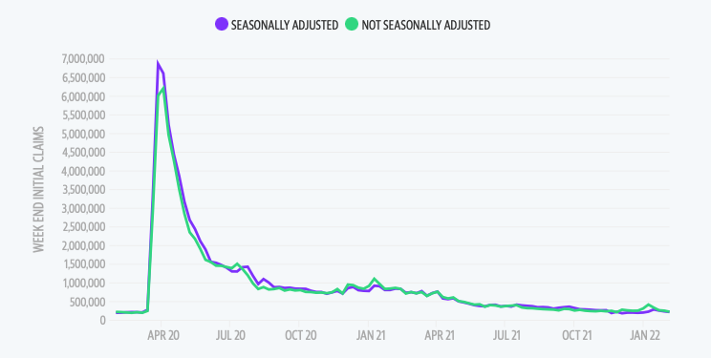
Weekly Jobless Claims – Falling 185,000 – up 18,000

Slide 18
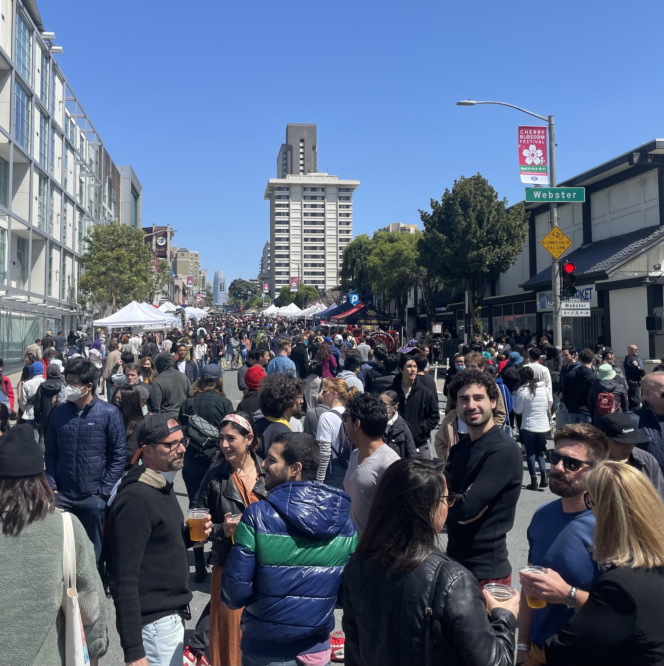

Slide 19
Stocks – Chop
*Indexes are failing at top of new ranges and are going to retest the lows *Leadership by defensive sectors like utilities and consumer staples show that the worst is yet to come *Reopening stocks get a one-day spike on lifting of mask mandate for aircraft *Elon Musk makes a bid for Twitter which fought back with a poison pill *Tech stocks are right on verge of breaking down to new lows *Defense stocks still on a tear thanks to long term increase in demand for weapons *Look for terrible H1 and strong H2 scenario to continue

Slide 20
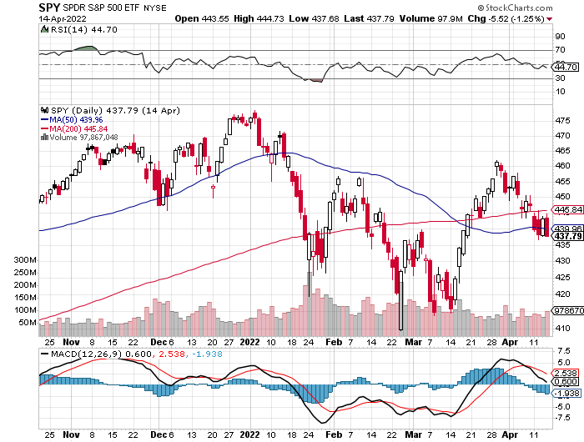
S&P 500 – Back to the Bottom of the Range took profits on long 4/$470-$480 bear put spread Took profits on long 2/$465-$475 bear put spread Took profits on long 2/$410-$420 bull call spread, Took profits on long 2/$480-$500 bear put spread, Took profits on long 10/$410-$420 bull call spread
The Bottom 410 Down -17%

Slide 21
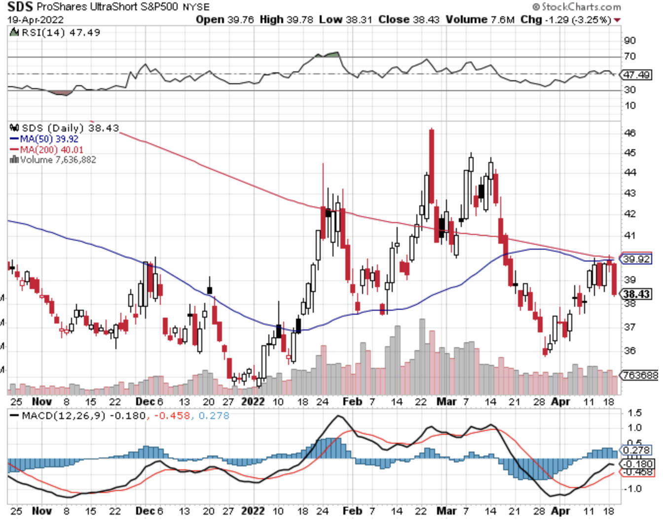
ProShares Ultra Short S&P 500 (SDS)- a great hedge for long stocks and bonds long 2X position has a hedge against longs and bond shorts

Slide 22
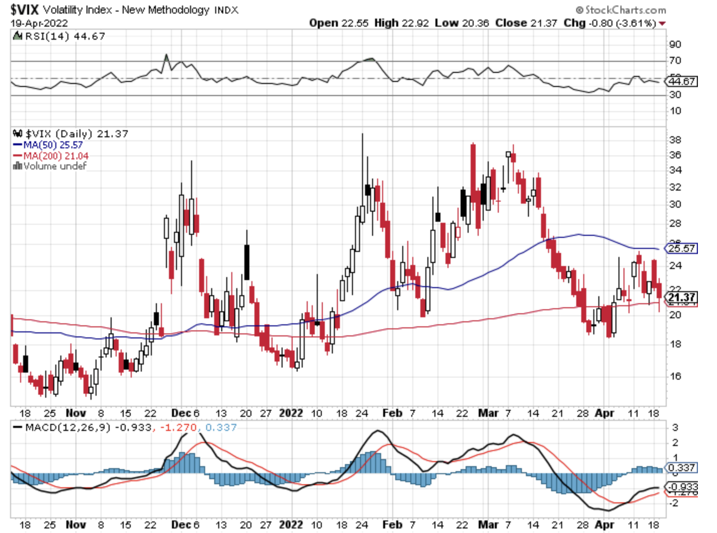
(VIX) – Dying a Slow Death classic summer market

Slide 23
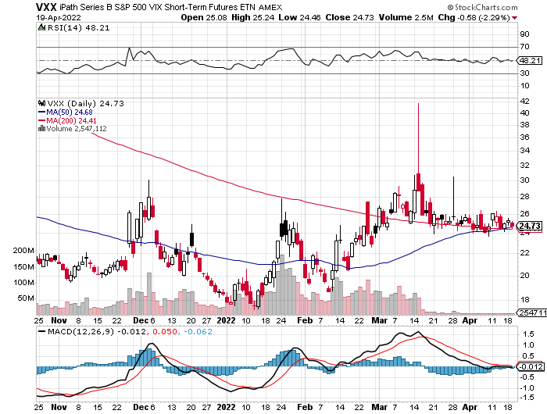
(VXX)-

Slide 24
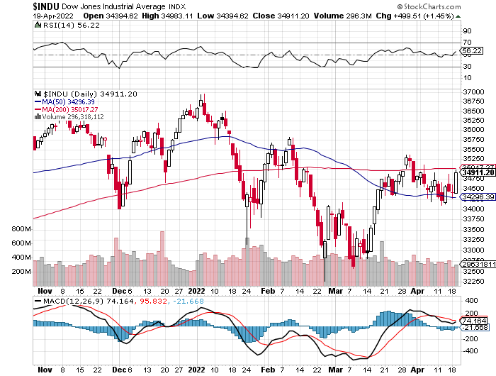
Dow Average ($INDU)-

Slide 25
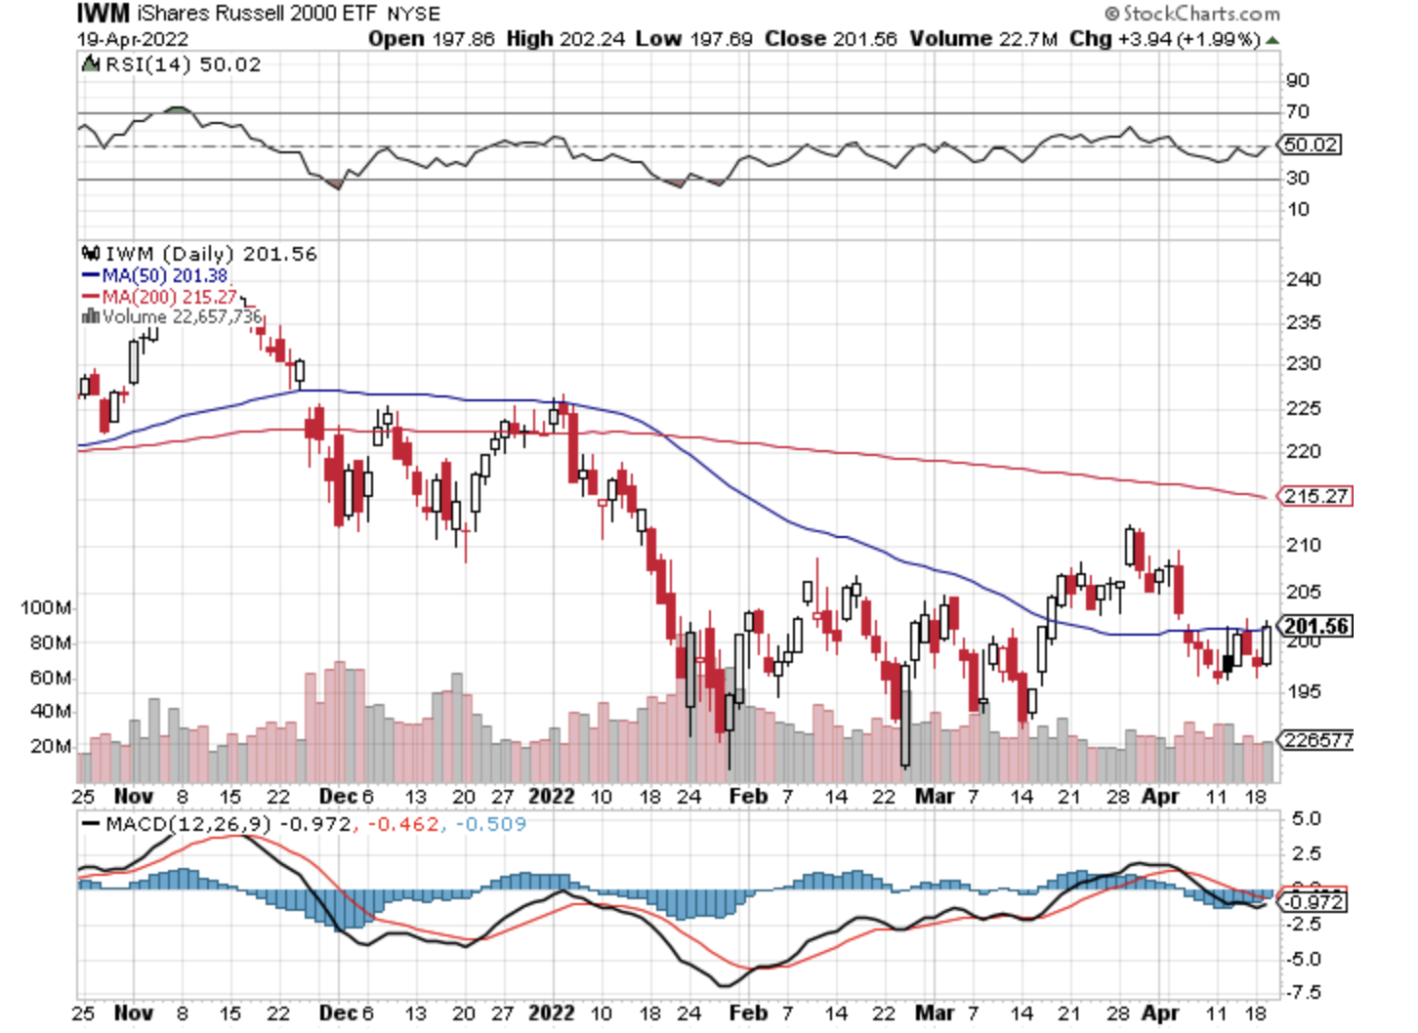
Russell 2000 (IWM)- took profits on Long 10/$137-$142 vertical bull call spread took profits on Long 10/$153-$156 vertical bear put spread

Slide 26
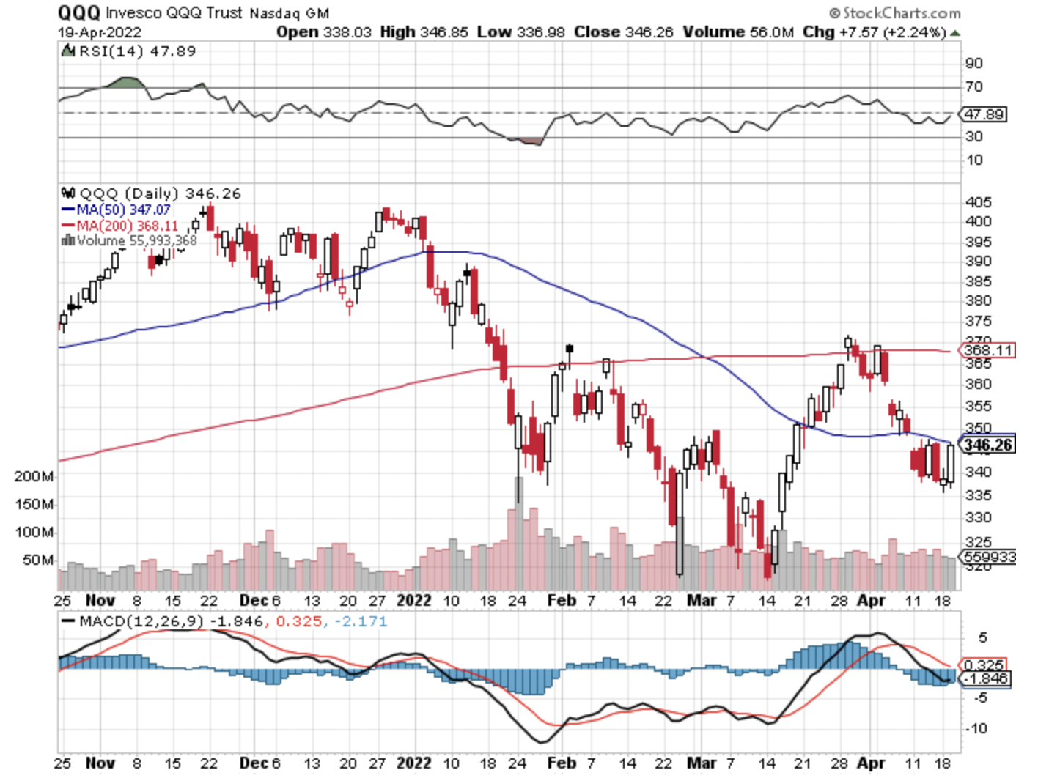
NASDAQ (QQQ) – long (QQQ) 4/$330-$335 put spread took profits on long (QQQ) 3/$340-$345 put spread covered long (QQQ) $325-$330 put spread

Slide 28
The Barbell Portfolio
*50% Big Tech - 2% of US Employment but 27% of Market Cap and 38% of Profits 50% Domestic Recovery, including: Railroads Couriers Banks Construction Credit Cards Event organizers Ticket sales Retailers

Slide 29
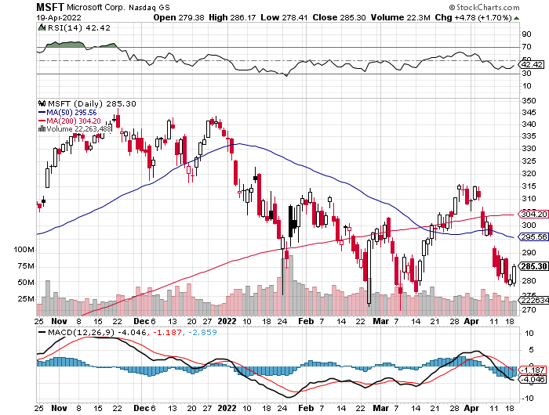
Microsoft (MSFT)- took profits on long 2/$340-$350 bear put spread took profits on long 12/$220-$230 call spread stop loss on long 12/$170-$180 call spread

Slide 30
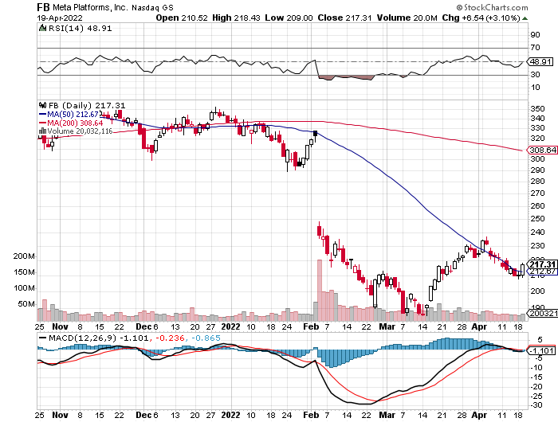
Facebook (FB)- Changes Name to “Meta” took profits on Long 9/$290-$300 vertical bear put spread stopped out of Long 9/$190-$200 vertical bear put spread

Slide 31
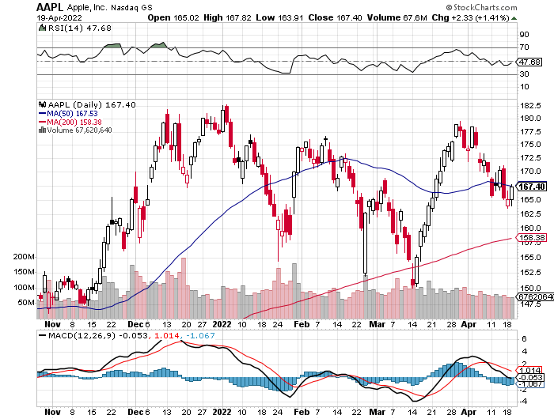
Apple (AAPL)- Launches new low-end $429 5G iPhone SE. Took profits on long 2/$180-$190 put spread

Slide 32
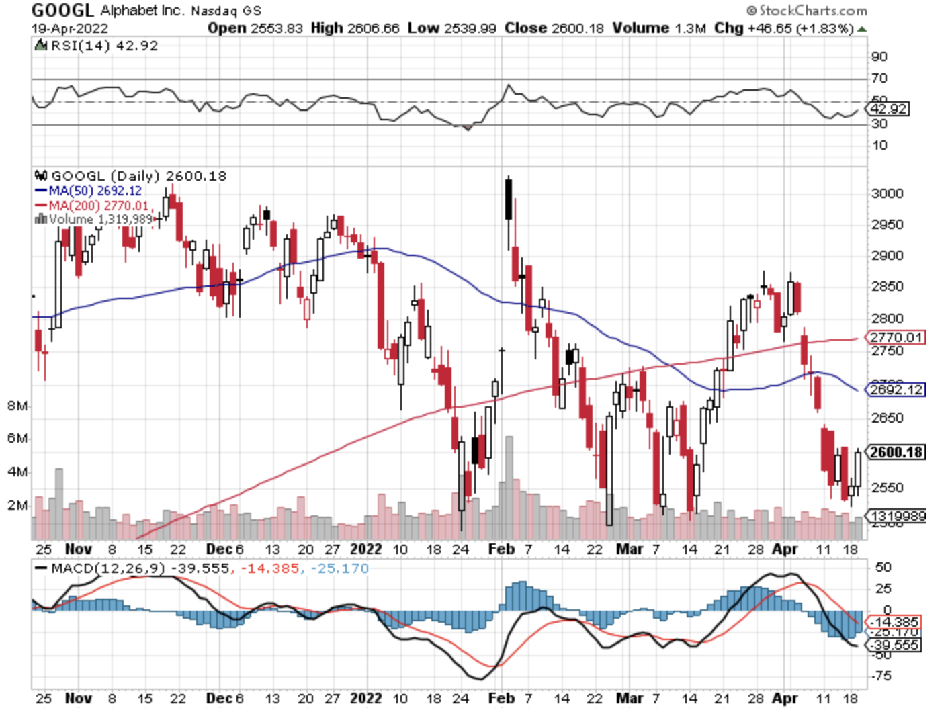
Alphabet (GOOGL) – Ad king on economic recovery 20:1 share split in July, to Invest $9.5 Billion in Infrastructure this Year. took profits on long 12/$1,200-$1,230 bull call spread took profits on long 9/$1,030-$1,080 vertical bull call spread

Slide 33
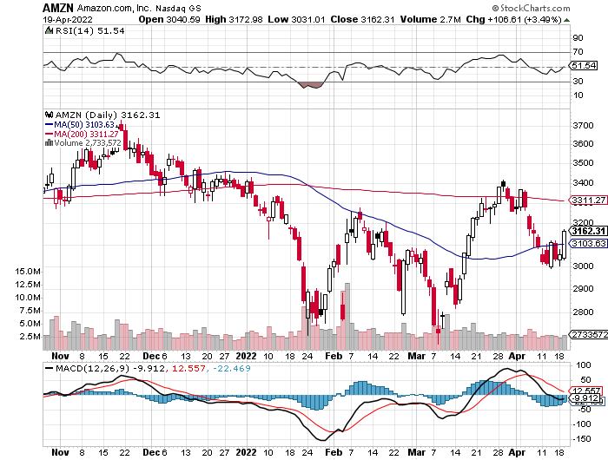
Amazon (AMZN) – took profits on long 2/$3,400-$3,500 bear put spread took profits on long 9/$2,800-$2,900 bull call spread

Slide 34
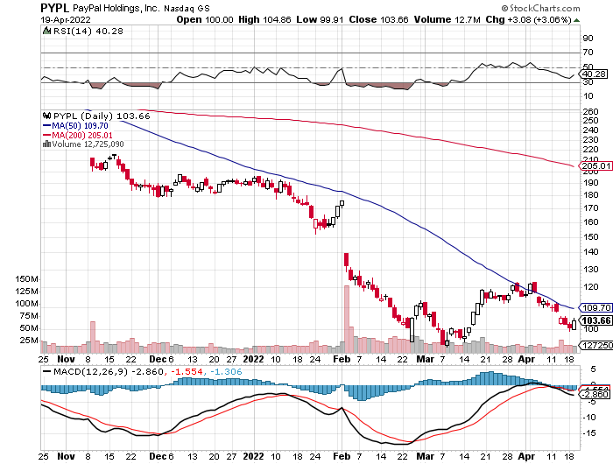
PayPal (PYPL) - took profits on long 4/$90-$95 call spread

Slide 35
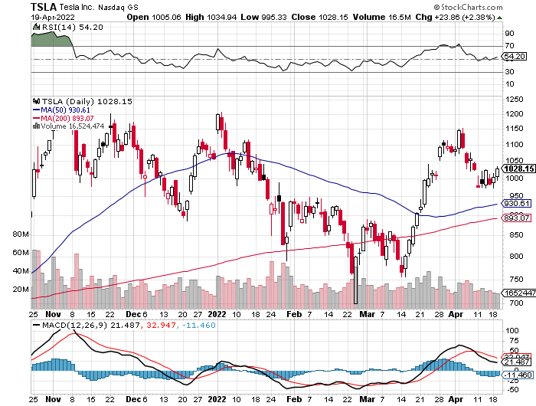
Tesla (TSLA) –Aiming for 1.5 million cars in 2022 Tesla Blows Away Q1 Sales, shipping 310,000 vehicles Tesla to Split Shares and Pay Dividend Elon Musk Makes $53 Billion Takeover Bid for Twitter took profits on long 2/$550-$600 call spread took profits on long 2/$600-$650 call spread

Slide 36
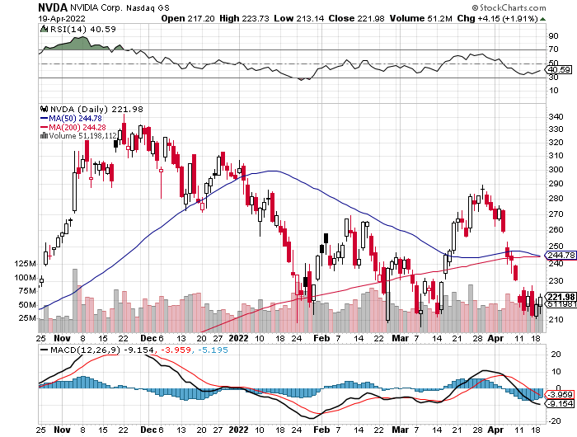
NVIDIA (NVDA) – A Mad Hedge 50 bagger – Global Semiconductor Shortage Slows Auto Industry,

Slide 37
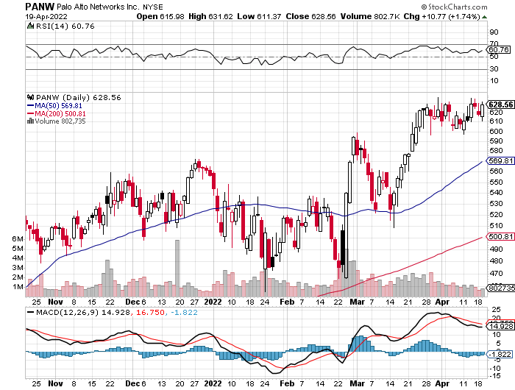
Palo Alto Networks (PANW)- Hacking never goes out of fashion

Slide 38
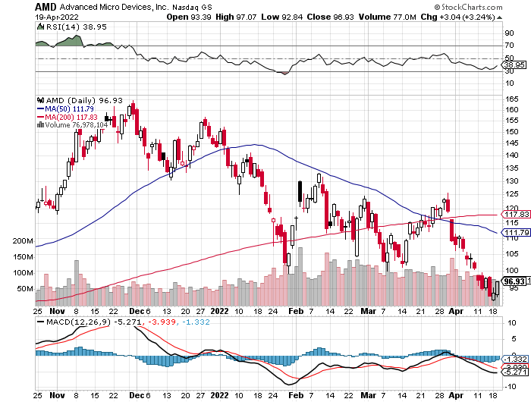
Advanced Micro Devices (AMD)- Recession fears programable logic devices took profits on long 2/$75-$80 call spread

Slide 39
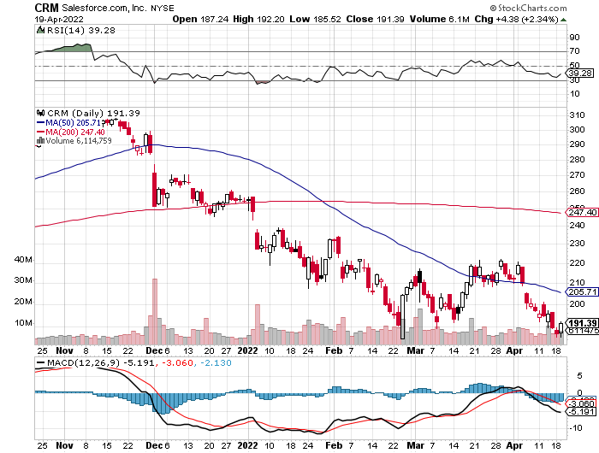
Salesforce (CRM)- Massive Online Migration took profits on long 9/$125-$130 vertical bull call spread took profits on long 8/$125-$130 vertical bull call spread took profits on long 2/$105-$115 call spread

Slide 40
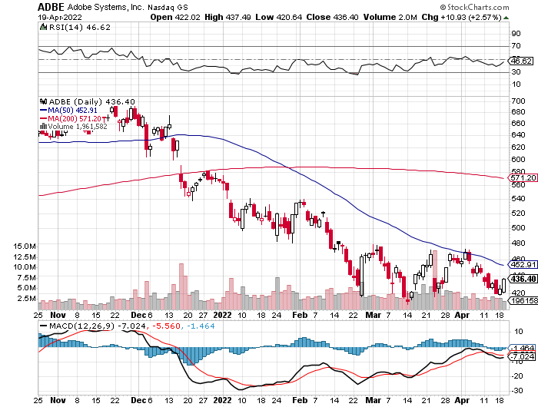
Adobe (ADBE)- Cloud play The Quality Non-China tech play

Slide 41
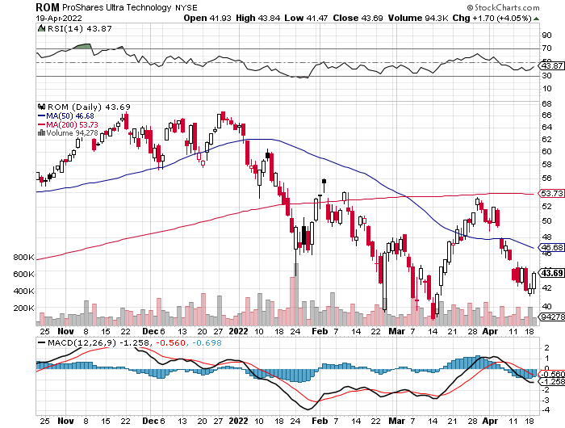
ProShares Ultra Technology ETF (ROM) – 2X Long Technology ETF took profits on long 10/$62-65 call spread

Slide 42
The Second Half of the Barbell
*Bets on a domestic recovery in 2022 Q4 *Upside potential in 2022 far greater than tech *Some of these have not moved for 5 or 10 years *Focuses on economically sensitive cyclical industries *Makes a great counterweight to high-growth technology *We could spend all of next year rotating between the two groups

Slide 44
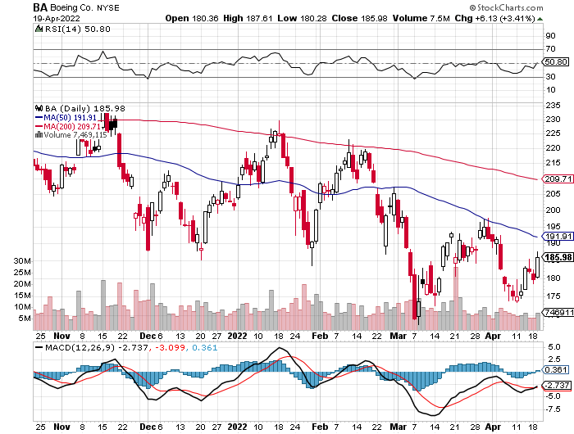
Boeing (BA) –LEAP Candidate Boeing Crashes in China, with a 737 killing 132 passengers long 3/$146-$149 call spread took profits on long 2/$150-$160 call spread

Slide 45
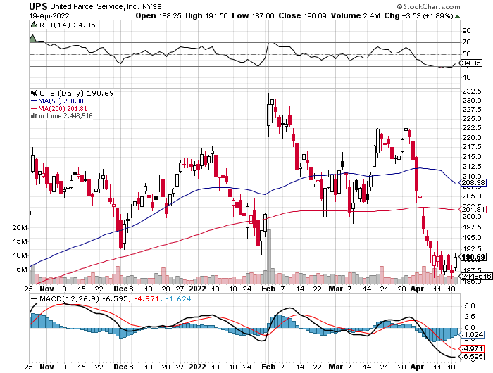
Package Delivery- United Parcel Service (UPS) - Package Delivery record profits took profits on long 11/$130-$140 call spread

Slide 46
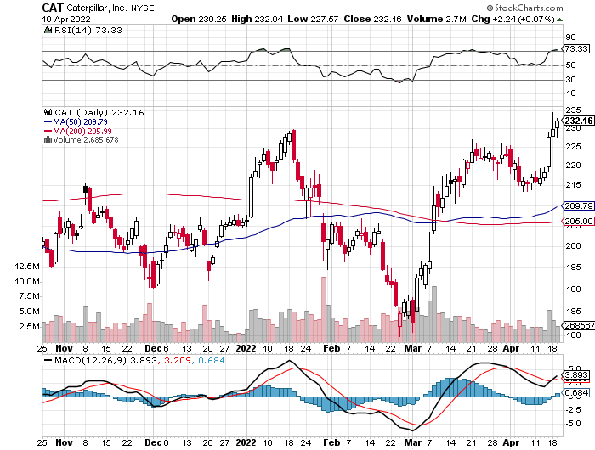
Caterpillar (CAT)- Ag + Infrastructure + Housing took profits on long 12/$145-$150 call spread took profits on long 11/$125-$135 call spread

Slide 47
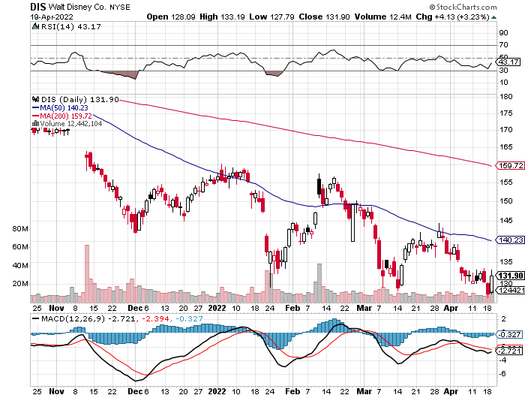
Walt Disney (DIS)- stopped out of long 10/$165-$175 call spread took profits on long 3/$170-$180 call spread

Slide 48
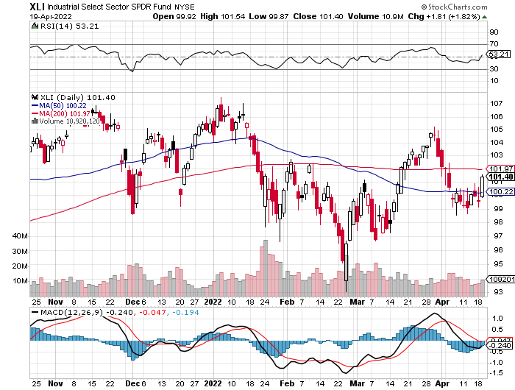
Industrials Sector SPDR (XLI)- (GE), (MMM), (UNP), (UTX), (BA), (HON)

Slide 49
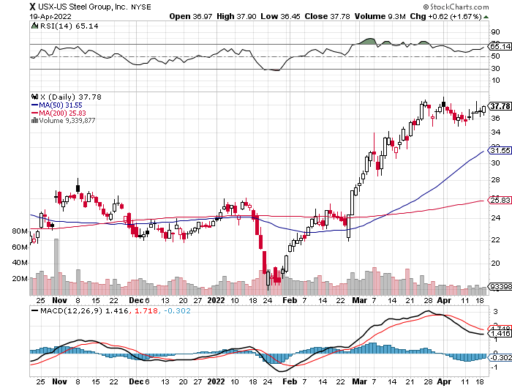
US Steel (X) – Commodity Boom and Wartime boost

Slide 50
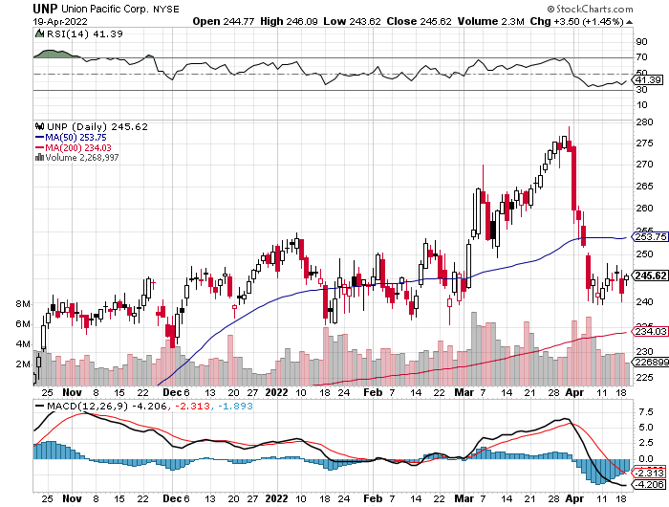
Union Pacific RR (UNP)- Big Stuff to Ship near record earnings announced took profits on long 5/$200-$210 call spread took profits on 11/$150-$160 call spread

Slide 51
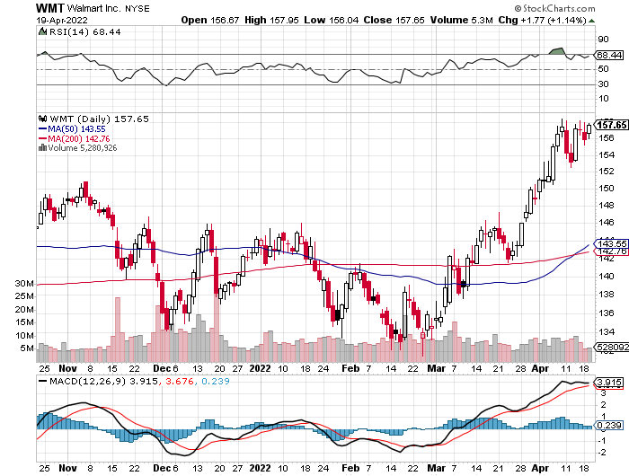
Wal-Mart (WMT)- took profit on Long 11/$125-$130 bear put spread took profit on Long 10/$119-$121 bear put spread took profits on Long 8/$114-$117 bear put spread

Slide 52
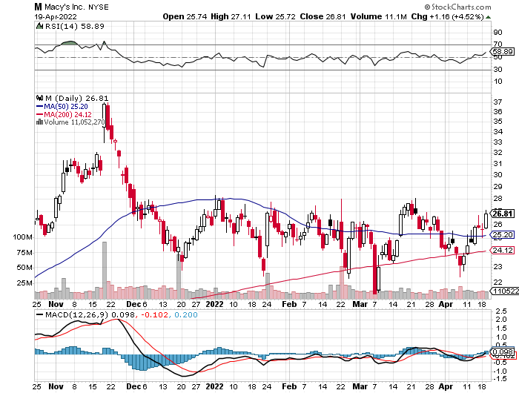
Macys’ (M) – Retail Punished took profits on Long 8/$23-$25 bear put spread

Slide 53
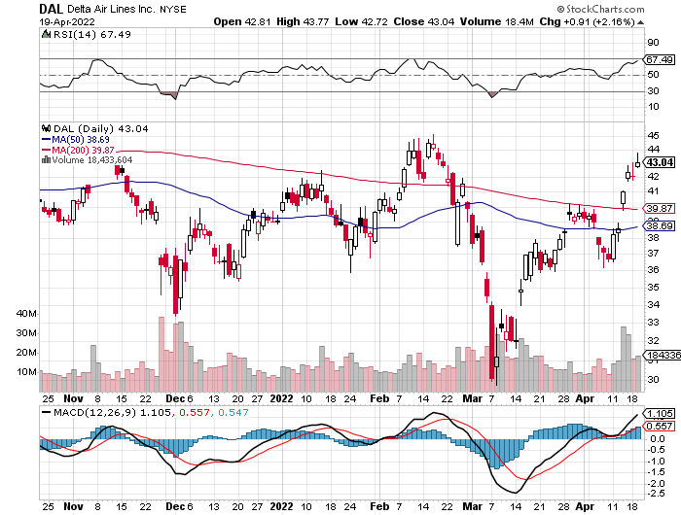
Delta Airlines (DAL) – Travel is Back!

Slide 54
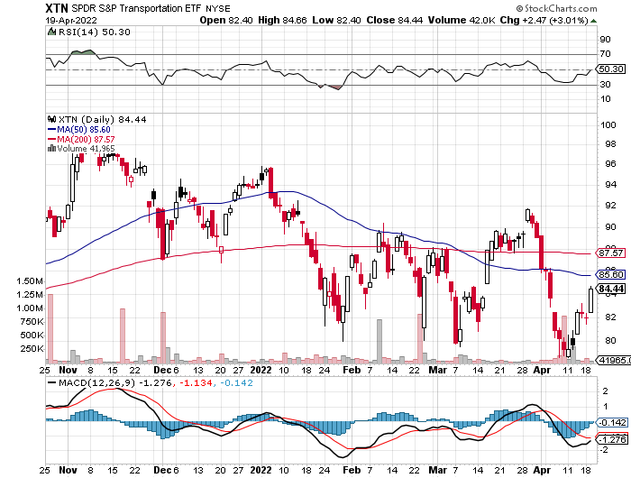
Transports Sector SPDR (XTN)- Worst Hit Sector (ALGT), (ALK), (JBLU), (LUV), (CHRW), (DAL)

Slide 55
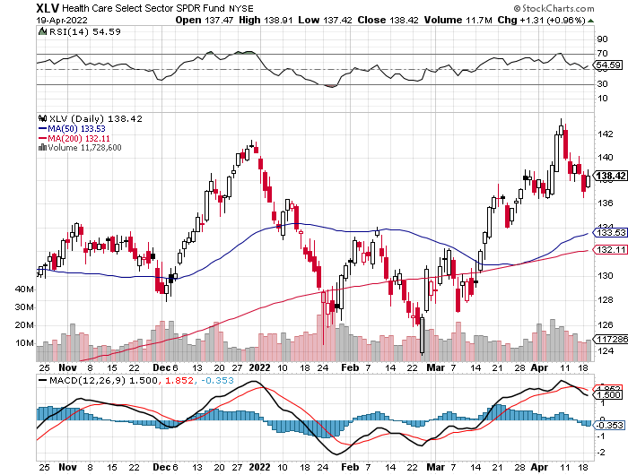
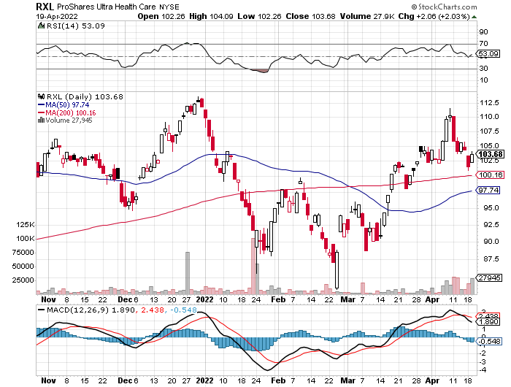
Health Care Sector (XLV), (RXL) (JNJ), (PFE), (MRK), (GILD), (ACT), (AMGN)

Slide 56
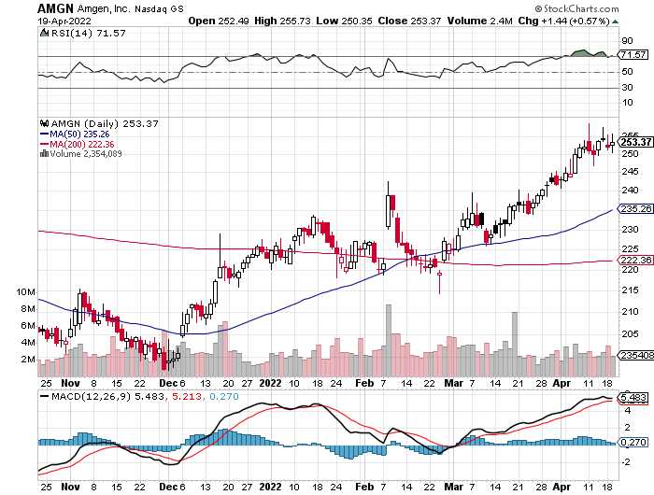
Amgen (AMGN) took profits on long 11/$185-$200 bull call spread

Slide 57
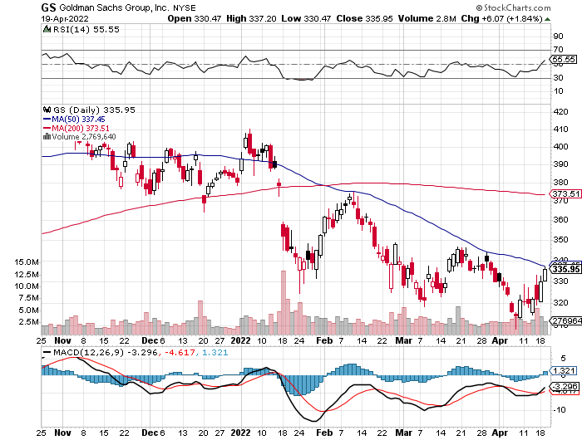
Goldman Sachs (GS) – took profits 12/$330-$350 call spread took profits 11/$330-$350 call spread stop loss on long 11/$385-$395 call spreads

Slide 58
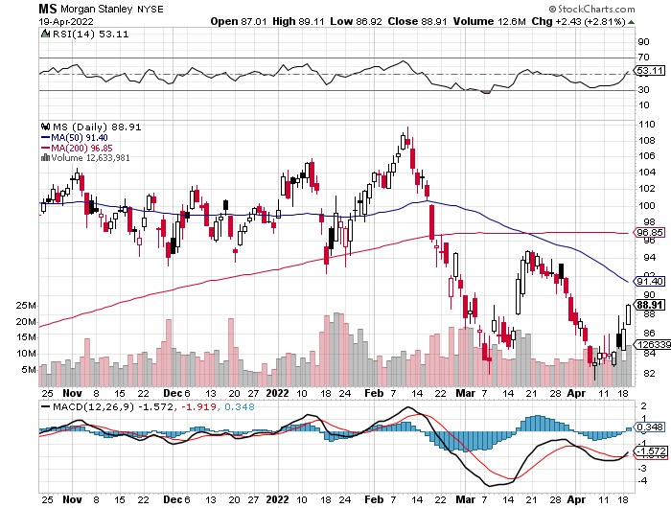
Morgan Stanley (MS) – Blows Away Earnings took profits on long 11/$85-$90 call spread stop loss on long 11/$95-$98 call spread took profits on long 10/$85-$90 call spread profits on long 2/$55-$60 call spread

Slide 59
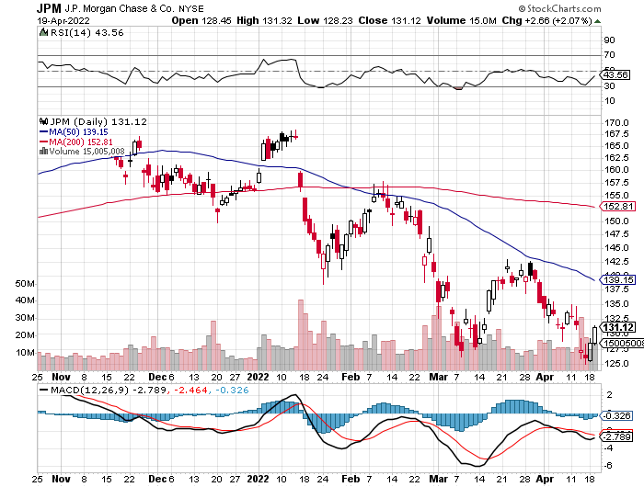
JP Morgan Chase (JPM)- Takes a Russia Hit, losing $524 billion on its exposure there. took profits 12/$148-$152.50 call spread took profits on long 10/$130-$140 call spread took profits on long 8/$140-$145 call spread took profits on long 7/$140-$145 call spread

Slide 60
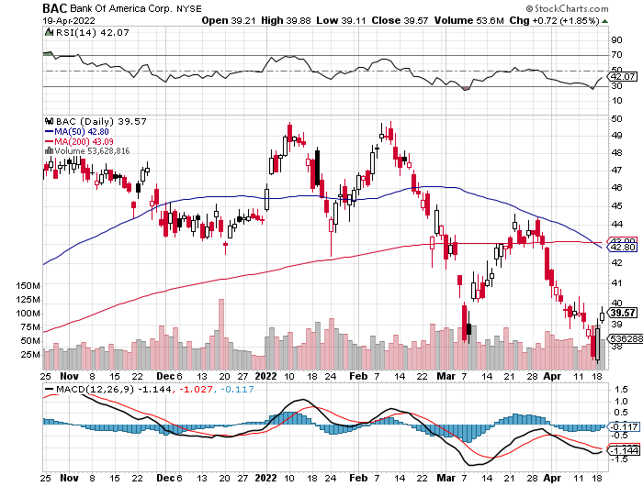
Bank of America (BAC) – took profits long 12/$39-$42 call spread stop loss on long 11/$43-$45 call spread took profits on 11/$37-$40 call spread took profits on long 2/$28-$30 call spread

Slide 61
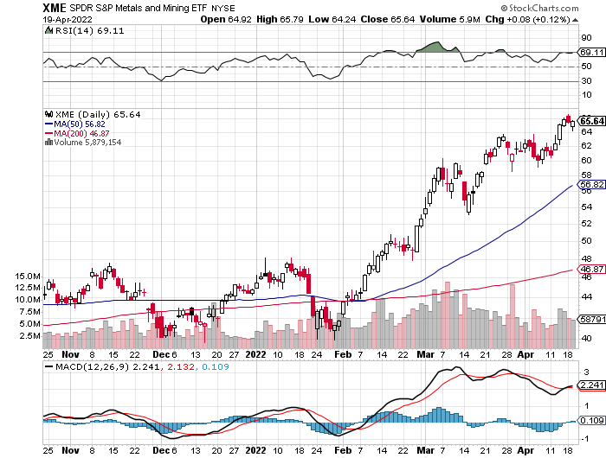
SPDR Metals & Mining ETF (XME) – long 2/$28-$30 call spread

Slide 62
Blackrock (BLK)-Asset Collection Boom took profits on long 3/$770-$790 call spread took profits on long 3/$310-$340 call spread

Slide 63
Visa (V) – “Touchless” Bitcoin Drag took profits on long 5/$220-$225 bull call spread took profits on long long 5/$195-$205 bull call spread took profits on long 9/$180-$185 bull call spread

Slide 64
Consumer Discretionary SPDR (XLY) (DIS), (AMZN), (HD), (CMCSA), (MCD), (SBUX)

Slide 65
Berkshire Hathaway (BRKB)- Natural Barbell Buys Alleghany Insurance, for $11.6 billion took profits on long 2/$270-$280 call spread

Slide 66
Europe Hedged Equity (HEDJ)-

Slide 67
Japan (DXJ)-

Slide 68
Emerging Markets (EEM) - Pro trade, Weak Dollar, Long Recovery Play

Slide 70
Bonds – Free Fall
*Bonds Hit New Three-Year Lows, with yields soaring to 2.93% overnight *Mortgage Refi’s Down 67% YOY, thanks to a 30-year fixed rate mortgage that has topped 5.0% *The first seven rate hikes are in the market, but the following five aren’t *Final target is a 3.00% overnight rate *US National Debt Tops $30 Trillion, the end result of 20 years of deficit spending. *Sell any six-point rally in the (TLT) *US Treasury bond fund (TLT) could plunge from $180 in 2020 to $105 by 2023

Slide 71
Treasury ETF (TLT) – Breaking Down stopped out of long 4/$127-$130 call spread took profits on long 2/$149-$152 put spread, took profits on long 2/$147-$150 put spread took profits on long 3/$150-$153 put spread, took profits on long 3/$127-$130 call spread

Slide 72
Ten Year Treasury Yield ($TNX) – 2.56%

Slide 73
Junk Bonds (HYG) 5.49% Yield to Maturity

Slide 74
2X Short Treasuries (TBT)-Another run at highs

Slide 76
Foreign Currencies – Dollar on Fire
*Soaring interest rates and flight to safety turbocharge the buck *Ukraine war crushes the Euro *Commodity currencies like (FXA) and (FXC) take a break on commodities selloff *Russian ruble bounced back on oil pricing, capital exports bans *Currency with the fastest appreciating interest rates usually does best and that’s the US *Long-term fundamentals are still poor, a dollar short could be the new ten-year trade, but not yet *Stand aside from forex for now, there are getting fish to fry

Slide 77
Japanese Yen (FXY)

Slide 78
Euro (FXE)-

Slide 79
British Pound (FXB)-

Slide 80
Australian Dollar (FXA)- The Global Recovery Play took profits on long 8/$67-$69 call spread

Slide 81
Emerging Market Currencies (CEW)

Slide 82
Chinese Yuan- (CYB)-

Slide 84
Bitcoin – Buy the Mad Hedge Bitcoin Letter at https://www.madhedgefundtrader.com/store/
*Bitcoin backs off, from $48,000 to $39,000, or 18.75% *Soaring energy costs have greatly raised the cost of mining, raising breakeven costs *Higher costs have also reduced the hashtag rate, or the rate of new Bitcoin mining *No 2 Miner Kazakhstan bans Bitcoin mining to conserve energy *If Elon Musk likes Bitcoin maybe you should too. *Long term “BUY” signal for Bitcoin still intact *Buy Bitcoin and Ethereum on the bigger dip

Slide 85
Bitcoin ($BTCUSD) – Finding a bid

Slide 86
Ethereum (ETHE) –

Slide 87
MicroStrategy (MSTR) –

Slide 88
Amplify Transformational Data Sharing ETF (BLOK) –

Slide 90
Energy –
*Biden Waives Ethanol Rules to Cut Gas Prices. Refiners had been limited to selling 15% ethanol blends to cut carbon emissions. * *But the Ukraine War will keep prices high as long as the war continues *Watch for the “Putin Resigns” headline, which could take oil down $50 overnight *Avoid all energy plays like the plague, it’s the new buggy whip industry as the US de-carbonizes

Slide 92
Oil-($WTIC)

Slide 93
United States Oil Fund (USO) long 10/$9.50-$10 Vertical bull call spread

Slide 94
Energy Select Sector SPDR (XLE)-No Performance! (XOM), (CVX), (SLB), (KMI), (EOG), (COP)

Slide 95
Halliburton (HAL)-

Slide 96
Natural Gas (UNG) -

Slide 98
Precious Metals –
*Gold gives up recent gains on bond market collapse and soaring interest rates *Successive half point rate cuts that Powell has been threatening absolutely do not work for gold *Many analysts are now raising their targets for the barbarous relic now that Bitcoin has utterly failed to provide protection against absolutely anything. Wars, inflation, economic, slowdown, pandemic, Bitcoin has fallen in every case. *Rising interest rates bode poorly for precious metals as it raises the opportunity cost for non-yielding assets *Stay away until this plays out *Silver is still the bigger and better long-term play

Slide 99
Gold (GLD)-

Slide 100
Market Vectors Gold Miners ETF- (GDX) –

Slide 101
Barrick Gold (GOLD) took profits on long 1/$21-$23 call spread took profits on long 11/$22-$24 call spread

Slide 102
Newmont Mining- (NEM)- took profits on long $55-60 call spread

Slide 103
Silver- (SLV)- took profits on long 11/$19-$20 call spread

Slide 104
Silver Miners - (SIL)-

Slide 105
Wheaton Precious Metals - (WPM)- took profits on long 2/$39-41 call spread

Slide 106
Copper (COPX)-Uptrend Resumes Copper Unions Vote to Strike in Chile, cutting off 33% of the global supply

Slide 108
Real Estate – High Prices
*S&P Case Shiller Up 19.2% in January, yet another new all-time high *US Housing Starts Hit 15 Year High, up 0.3% in March to 1.79 million *Applications to build top 1.87 million *The US has a structural shortage of 10 million homes caused by the large number of small builders that went under during the financial crisis and never came back. *Mortgage interest rates started to rise sharply, with the 30-year fixed at 4.50% *Home prices should keep rising for the rest of the decade, although at a slower rate *Pending Homes Sales Sink, down 4.1% in February, the fourth straight month of declines * New Home Sales Dive, down 2% to 772,000 in February *S&P Case Shiller Rockets 19.2%, in January with its National Home Price Index

Slide 109
S&P Case Shiller S&P Case Shiller Rockets 19.2%, in November with its National Home Price Index Phoenix (33%), Tampa (31%), and Miami (28%)

Slide 110
Crown Castle International (CCI) – 3.04% yielding cell phone tower REIT

Slide 111
US Home Construction Index (ITB) (DHI), (LEN), (PHM), (TOL), (NVR)

Slide 113
Trade Sheet- So What Do We Do About All This?
*Stocks – sell rallies *Bonds – sell rallies aggressively *Commodities-buy dips *Currencies- stand aside *Precious Metals – buy dips *Energy – stand aside *Volatility - sell short over $30 *Real estate – stand aside *Bitcoin – buy dips

Slide 115
Next Strategy Webinar 12:00 EST Wednesday, May 4 from Incline Village, NV email me questions at support@madhedgefundtrader.com
Good Luck and Good Trading!
Notes:
*

