Slide 1
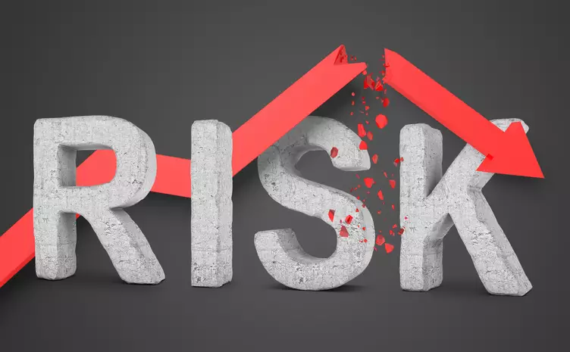
The Mad Hedge Fund Trader “RISK OFF”
With John Thomas Silicon Valley, CA, May 4, 2022 www.madhedgefundtrader.com
Notes:
*

Slide 3
Trade Alert Performance New All Time Highs!
*January 14.59% Final *July +0.61% Final *February +8.78% MTD *August +9.36% Final *March +3.43% Final *September 1.03% Final *April +3.33% Final *October +8.91% MTD *May +8.13% MTD *November -11.79% Final *June +0.71% Final *December +11.26% Final *2022 YTD +30.18% compared to -9.2% for the Dow Average *+$542.74% since inception *Average annualized return of 43.71% for 13 years

Slide 4
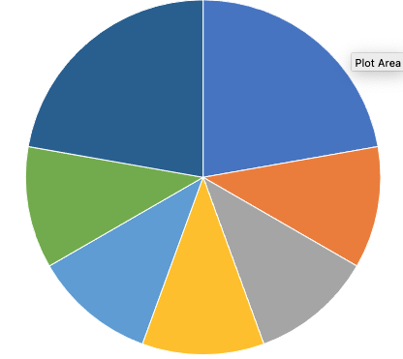
Portfolio Review 70% Long, 20% short, 10% cash Bullish at the bottom of the range
Current Capital at Risk
Risk On
World is Getting Better
(TLT) 5/$127-$130 put spread | 20.00%
(TLT) 5/$128-$131 put spread | 10.00%
(BRKB) 5/$300-$310 call spread | 10.00%
(SPY) 5/$370-$380 call spread | 10.00%
(CCJ) 5/$$20-$23 call spread | 10.00%
(GLD) 5/$165-$170 call spread | 10.00%
Risk Off
World is Getting Worse
(TLT) 5/$110-$113 call spread | -20.00%
Total Net Position | 50.00%
Total Aggregate Position | 90.00%
Expiration Value 40.55%

Slide 7
GTD 13 Year Daily Audited Performance

Slide 8
The Method to My Madness The Roaring Twenties are Here
*The Ukraine War stalls, putting the focus back on rising interest rates *That is prompting investors to dump growth tech and buy value and inflation plays, like commodities *Uranium has entered structural long term bull market *Half point rate hikes take us out of the frying pan into the fire, and we could get four in a row *The first seven Interest rate rises are in the market, but not the 5 that follow *A core short in bonds will be key, but trade this too *The pandemic is over and new variant is unlikely to affect the US as immunity is so high *VIX over $30 is the ideal entry point for new long positions

Slide 9
Corona Update –
*Corona virus cases at 80.6 million, up only 300,000 in a week, but lifting mask requirement on airplanes will bring a new spike * Deaths topping 988,000 and have only increased by 3,000 in the past week *Moderna has applied for under fives vaccine using two micro doses, FDA may approve both Moderna and Pfizer vaccine by the summer at the same time *Second boosters approved by CDC for over 50’s will prevent a recurrence *Pandemic is still going to near zero by summer, book those cruises *Covid is with us for good and big pharma will offer combined annual covid and flu shots by the fall

Slide 10
The Pandemic is Over

Slide 11
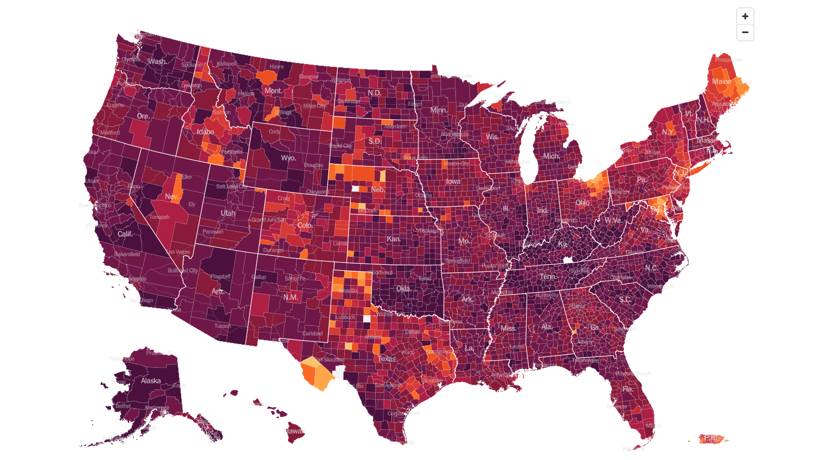
February 2 2022 Infection Rate

Slide 12
May 4 2022 Infection Rate

Slide 13
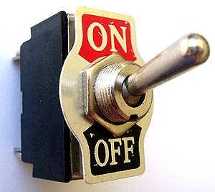
The Global Economy – On or Off
*US economy leads the world by a huge margin, with Europe and Asia lagging *Q1 GDP plunges -1.4%, with exports a major drag *World Bank Cuts Global Growth Outlook on Russian War, from 4.1% in January to 3.2%. *Retail Sales Jumped 0.5% in March, and up 6.9% YOY, while import prices hit an 11-year high *Producer Price Index Rockets by 11.2%, an 11-year high. * * *

Slide 14
The Mad Hedge Profit Predictor Market Timing Index – Buy Territory An artificial intelligence driven algorithm that analyzes 30 different economic, technical, and momentum driven indicators

Slide 15
The Mad Hedge Profit Predictor From Extreme “BUY” to Neutral
SELL
Do Nothing
BUY

Slide 16
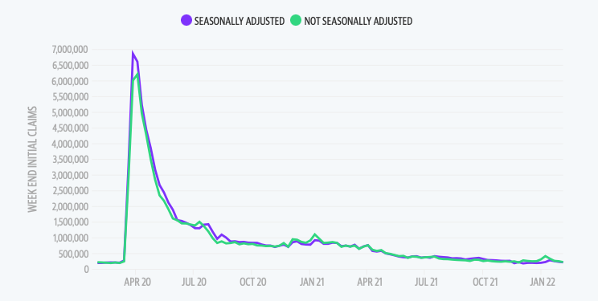
Weekly Jobless Claims – Falling 180,000 – down 5,000

Slide 18
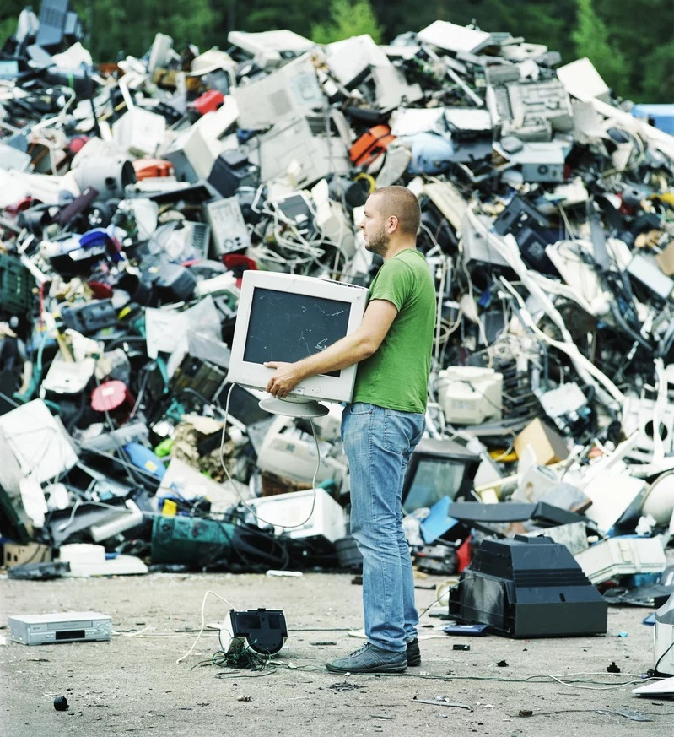
Stocks – Tech is Trash
*Tech is trash as traders flee interest sensitive growth stocks *Story stocks are dead, like Teladoc (TDOC) and Robinhood (HOOD) *Investor Optimism Hits 30-Year Low, according to the Association of Individual Investors. Now only 15.8% of investors are bullish *New interest is is cheap value stocks with consistent earnings *Everything went down in the last selloff as funds “de-grossed” cut risk, and raised cash *Commodities sold off too, creating a great entry point, as they will come back the fastest as long as inflation is hot *Netflix melts down, from $700 to $185 on streaming competition *Defense stocks still on a tear thanks to long term increase in demand for weapons *Look for terrible H1 and strong H2 scenario to continue

Slide 19
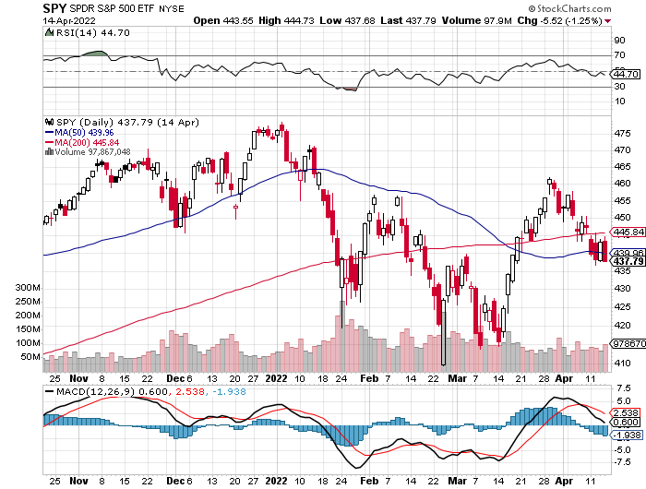
S&P 500 – Back to the Bottom of the Range-April 20 long 5/$370-$380 bull call spread, took profits on long 4/$470-$480 bear put spread Took profits on long 2/$465-$475 bear put spread Took profits on long 2/$410-$420 bull call spread, Took profits on long 2/$480-$500 bear put spread, Took profits on long 10/$410-$420 bull call spread
The Bottom 410 Down -17%

Slide 20
S&P 500 – Back to the Bottom of the Range-May 4 took profits on long 4/$470-$480 bear put spread Took profits on long 2/$465-$475 bear put spread Took profits on long 2/$410-$420 bull call spread, Took profits on long 2/$480-$500 bear put spread, Took profits on long 10/$410-$420 bull call spread
The Bottom 410 Down -17%

Slide 21
ProShares Ultra Short S&P 500 (SDS)- a great hedge for long stocks and bonds long 2X position has a hedge against longs and bond shorts

Slide 22
(VIX) – Dying a Slow Death classic summer market

Slide 23
(VXX)-

Slide 24
Dow Average ($INDU)-

Slide 25
Russell 2000 (IWM)- took profits on Long 10/$137-$142 vertical bull call spread took profits on Long 10/$153-$156 vertical bear put spread

Slide 26
NASDAQ (QQQ) – long (QQQ) 4/$330-$335 put spread took profits on long (QQQ) 3/$340-$345 put spread covered long (QQQ) $325-$330 put spread

Slide 28
The Barbell Portfolio
*50% Big Tech - 2% of US Employment but 27% of Market Cap and 38% of Profits 50% Domestic Recovery, including: Railroads Couriers Banks Construction Credit Cards Event organizers Ticket sales Retailers

Slide 29
Microsoft (MSFT)- took profits on long 2/$340-$350 bear put spread took profits on long 12/$220-$230 call spread stop loss on long 12/$170-$180 call spread

Slide 30
Facebook (FB)- Changes Name to “Meta” took profits on Long 9/$290-$300 vertical bear put spread stopped out of Long 9/$190-$200 vertical bear put spread

Slide 31
Apple (AAPL)- Earnings Beat share buyback program jumped by an eye popping $90 billion Took profits on long 2/$180-$190 put spread

Slide 32
Alphabet (GOOGL) – Ad king on economic recovery Alphabet Misses on Top and Bottom took profits on long 12/$1,200-$1,230 bull call spread took profits on long 9/$1,030-$1,080 vertical bull call spread

Slide 33
Amazon (AMZN) – took profits on long 2/$3,400-$3,500 bear put spread took profits on long 9/$2,800-$2,900 bull call spread

Slide 34
PayPal (PYPL) - took profits on long 4/$90-$95 call spread

Slide 35
Tesla (TSLA) –Earnings Soar by 87% YOY Aiming for 1.5 million cars in 2022 but Elon’s stock was put up for margin loan to buy Twitter, tanking the stock Tesla to Split Shares and Pay Dividend took profits on long 2/$550-$600 call spread took profits on long 2/$600-$650 call spread

Slide 36
NVIDIA (NVDA) – A Mad Hedge 50 bagger – Global Semiconductor Shortage Slows Auto Industry,

Slide 37
Palo Alto Networks (PANW)- Hacking never goes out of fashion

Slide 38
Advanced Micro Devices (AMD)- Recession fears programable logic devices took profits on long 2/$75-$80 call spread

Slide 39
Salesforce (CRM)- Massive Online Migration took profits on long 9/$125-$130 vertical bull call spread took profits on long 8/$125-$130 vertical bull call spread took profits on long 2/$105-$115 call spread

Slide 40
Adobe (ADBE)- Cloud play The Quality Non-China tech play

Slide 41
ProShares Ultra Technology ETF (ROM) – 2X Long Technology ETF took profits on long 10/$62-65 call spread

Slide 42
The Second Half of the Barbell
*Bets on a domestic recovery in 2022 Q4 *Upside potential in 2022 far greater than tech *Some of these have not moved for 5 or 10 years *Focuses on economically sensitive cyclical industries *Makes a great counterweight to high-growth technology *We could spend all of next year rotating between the two groups

Slide 44
Boeing (BA) –Disastrous Earnings $2.7 loss booked in Q1 long 3/$146-$149 call spread took profits on long 2/$150-$160 call spread

Slide 45
Package Delivery- United Parcel Service (UPS) - Package Delivery record profits took profits on long 11/$130-$140 call spread

Slide 46
Caterpillar (CAT)- Ag + Infrastructure + Housing took profits on long 12/$145-$150 call spread took profits on long 11/$125-$135 call spread

Slide 47
Walt Disney (DIS)- Florida Declres War stopped out of long 10/$165-$175 call spread took profits on long 3/$170-$180 call spread

Slide 48
Industrials Sector SPDR (XLI)- (GE), (MMM), (UNP), (UTX), (BA), (HON)

Slide 49
US Steel (X) – Commodity Boom and Wartime boost

Slide 50
Union Pacific RR (UNP)- Big Stuff to Ship near record earnings announced took profits on long 5/$200-$210 call spread took profits on 11/$150-$160 call spread

Slide 51
Wal-Mart (WMT)- took profit on Long 11/$125-$130 bear put spread took profit on Long 10/$119-$121 bear put spread took profits on Long 8/$114-$117 bear put spread

Slide 52
Macys’ (M) – Retail Punished took profits on Long 8/$23-$25 bear put spread

Slide 53
Delta Airlines (DAL) – Travel is Back!

Slide 54
Transports Sector SPDR (XTN)- Worst Hit Sector (ALGT), (ALK), (JBLU), (LUV), (CHRW), (DAL)

Slide 55
Health Care Sector (XLV), (RXL) (JNJ), (PFE), (MRK), (GILD), (ACT), (AMGN)

Slide 56
Amgen (AMGN) took profits on long 11/$185-$200 bull call spread

Slide 57
Goldman Sachs (GS) – took profits 12/$330-$350 call spread took profits 11/$330-$350 call spread stop loss on long 11/$385-$395 call spreads

Slide 58
Morgan Stanley (MS) – Blows Away Earnings Equity trading came in a hot $3.2 billion and bond trading $2.9 billion took profits on long 11/$85-$90 call spread stop loss on long 11/$95-$98 call spread took profits on long 10/$85-$90 call spread profits on long 2/$55-$60 call spread

Slide 59
JP Morgan Chase (JPM)- Takes a Russia Hit, losing $524 billion on its exposure there. took profits 12/$148-$152.50 call spread took profits on long 10/$130-$140 call spread took profits on long 8/$140-$145 call spread took profits on long 7/$140-$145 call spread

Slide 60
Bank of America (BAC) – took profits long 12/$39-$42 call spread stop loss on long 11/$43-$45 call spread took profits on 11/$37-$40 call spread took profits on long 2/$28-$30 call spread

Slide 61
SPDR Metals & Mining ETF (XME) – long 2/$28-$30 call spread

Slide 62
Blackrock (BLK)-Asset Collection Boom took profits on long 3/$770-$790 call spread took profits on long 3/$310-$340 call spread

Slide 63
Visa (V) – “Touchless” Bitcoin Drag took profits on long 5/$220-$225 bull call spread took profits on long long 5/$195-$205 bull call spread took profits on long 9/$180-$185 bull call spread

Slide 64
Consumer Discretionary SPDR (XLY) (DIS), (AMZN), (HD), (CMCSA), (MCD), (SBUX)

Slide 65
Berkshire Hathaway (BRKB)- Natural Barbell Buys Alleghany Insurance, for $11.6 billion long 5/$300-$310 call spread, took profits on long 2/$270-$280 call spread

Slide 66
Europe Hedged Equity (HEDJ)-

Slide 67
Japan (DXJ)-

Slide 68
Emerging Markets (EEM) - Pro trade, Weak Dollar, Long Recovery Play

Slide 70
Bonds – Bottom Fishing
*Bonds Hit New Three-Year Lows, with yields soaring to 3.02% overnight *Mortgage Refi’s Down 67% YOY, thanks to a 30-year fixed rate mortgage that has topped 5.0% *Half of all new mortgages are now 5/1 ARMS *Final target is a 3.50% overnight rate *US National Debt Tops $30 Trillion, the end result of 20 years of deficit spending. *Sell any six-point rally in the (TLT) *US Treasury bond fund (TLT) could plunge from $180 in 2020 to $105 by 2023

Slide 71
Treasury ETF (TLT) – Breaking Down long 5/$128-$131 put spread, long 2X 5/$127-$130 put spread long 2X 5/$110-$113 put spread, stopped out of long 4/$127-$130 call spread took profits on long 2/$149-$152 put spread, took profits on long 2/$147-$150 put spread took profits on long 3/$150-$153 put spread, took profits on long 3/$127-$130 call spread

Slide 72
Ten Year Treasury Yield ($TNX) – 2.56%

Slide 73
Junk Bonds (HYG) 5.89% Yield to Maturity

Slide 74
2X Short Treasuries (TBT)-Another run at highs

Slide 76
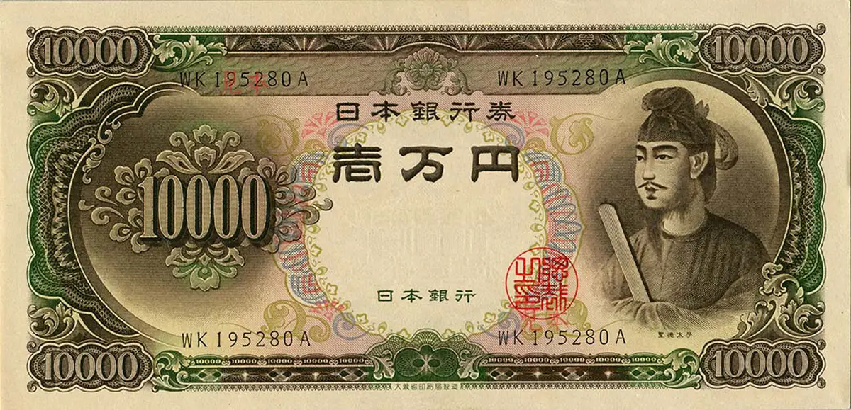
Foreign Currencies – Yen Collapse
*Failure of the Bank of Japan to raise interest along with the rest of the world crushes the yen *Soaring interest rates and flight to safety turbocharge the buck *Ukraine war crushes the Euro *Commodity currencies like (FXA) and (FXC) take a break on commodities selloff *Currency with the fastest appreciating interest rates usually does best and that’s the US *Long-term fundamentals are still poor, a dollar short could be the new ten-year trade, but not yet *Stand aside from forex for now, there are getting fish to fry

Slide 77
Japanese Yen (FXY)

Slide 78
Euro (FXE)-

Slide 79
British Pound (FXB)-

Slide 80
Australian Dollar (FXA)- The Global Recovery Play took profits on long 8/$67-$69 call spread

Slide 81
Emerging Market Currencies (CEW)

Slide 82
Chinese Yuan- (CYB)-

Slide 84
Bitcoin – Churning Buy the Mad Hedge Bitcoin Letter at https://www.madhedgefundtrader.com/store/
*Bitcoin backs off, from $48,000 to $39,000, or 18.75% *A second country makes Bitcoin its national currency, the Central African Republic, joining El Salvador *Secret Service Seizes $102 Million in Crypto, in 254 cases since 2015. Crooks go where the money is. *But Dogecoin is up on the Musk takeover of Twitter. *No 2 Miner Kazakhstan bans Bitcoin mining to conserve energy *Long term “BUY” signal for Bitcoin still intact *Buy Bitcoin and Ethereum on the bigger dip

Slide 85
Bitcoin ($BTCUSD) – Finding a bid

Slide 86
Ethereum (ETHE) –

Slide 87
MicroStrategy (MSTR) –

Slide 88
Amplify Transformational Data Sharing ETF (BLOK) –

Slide 90
Energy & Commodities –
*Russia cuts gas exports to Poland and Bulgaria, sending European gas up 17% overnight *Germany may be next, go long heavy sweaters in German for next winter *In the end, it will be price, not politics, that cuts the German-Russian energy link *Watch for the “Putin Resigns” headline, which could take oil down $50 overnight *Massive short squeeze for copper has begun *New bull market in uranium will continue for years as energy hungry nations look for new non-carbon sources to replace Russia *Avoid all energy plays like the plague, it’s the new buggy whip industry as the US de-carbonizes

Slide 91
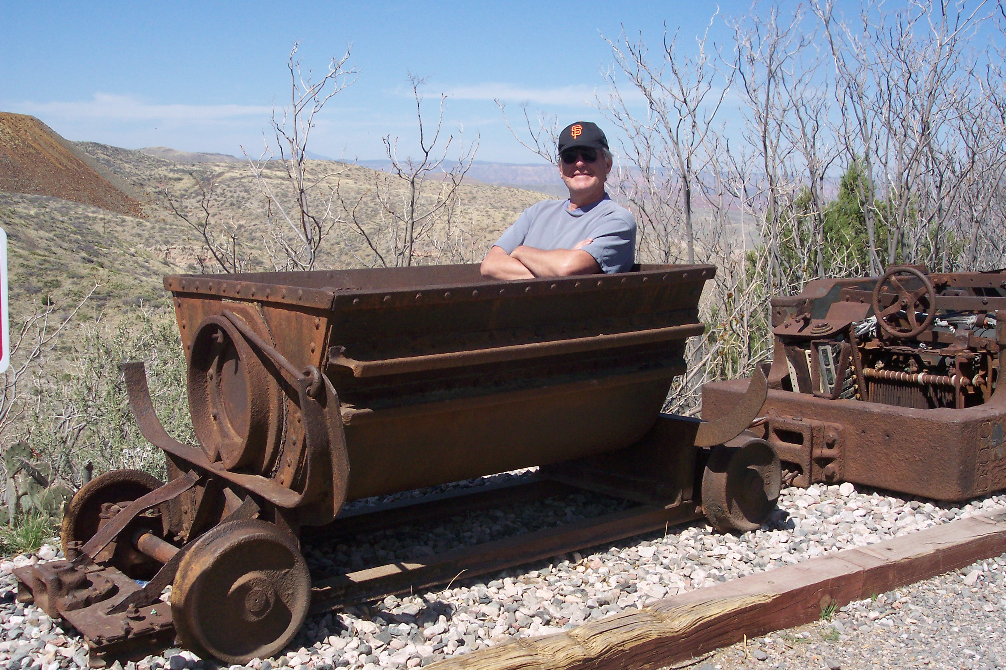
The Commodities Story
*Inflation and the Ukraine War have turbocharged the commodity space *Even if inflation peaks, commodities will keep rising because they’re not making them anymore *Paper assets like stocks and bonds can be created with a spreadsheet entry *Commodities can take a decade to bring on new supply *Regulation, harsh conditions, huge capital requirement, financing, infrastructure all conspire to delay new supply *The Ukraine War really poured gasoline on the fire, squeezing already short supplies of nickel, corn, wheat, and soybean oil *In 2021 Ukraine produced 13% of the world’s calories *if Tesla meets 20 million unit a year target, demand for lithium, nickel, and cobalt will triple

Slide 93
Oil-($WTIC)

Slide 94
United States Oil Fund (USO) long 10/$9.50-$10 Vertical bull call spread

Slide 95
Energy Select Sector SPDR (XLE)-No Performance! (XOM), (CVX), (SLB), (KMI), (EOG), (COP)

Slide 96
Halliburton (HAL)-

Slide 97
Natural Gas (UNG) -

Slide 98
Freeport McMoRan (FCX) -

Slide 99
Cameco (CCJ) - long 5/$20-$23 bull call spread

Slide 101
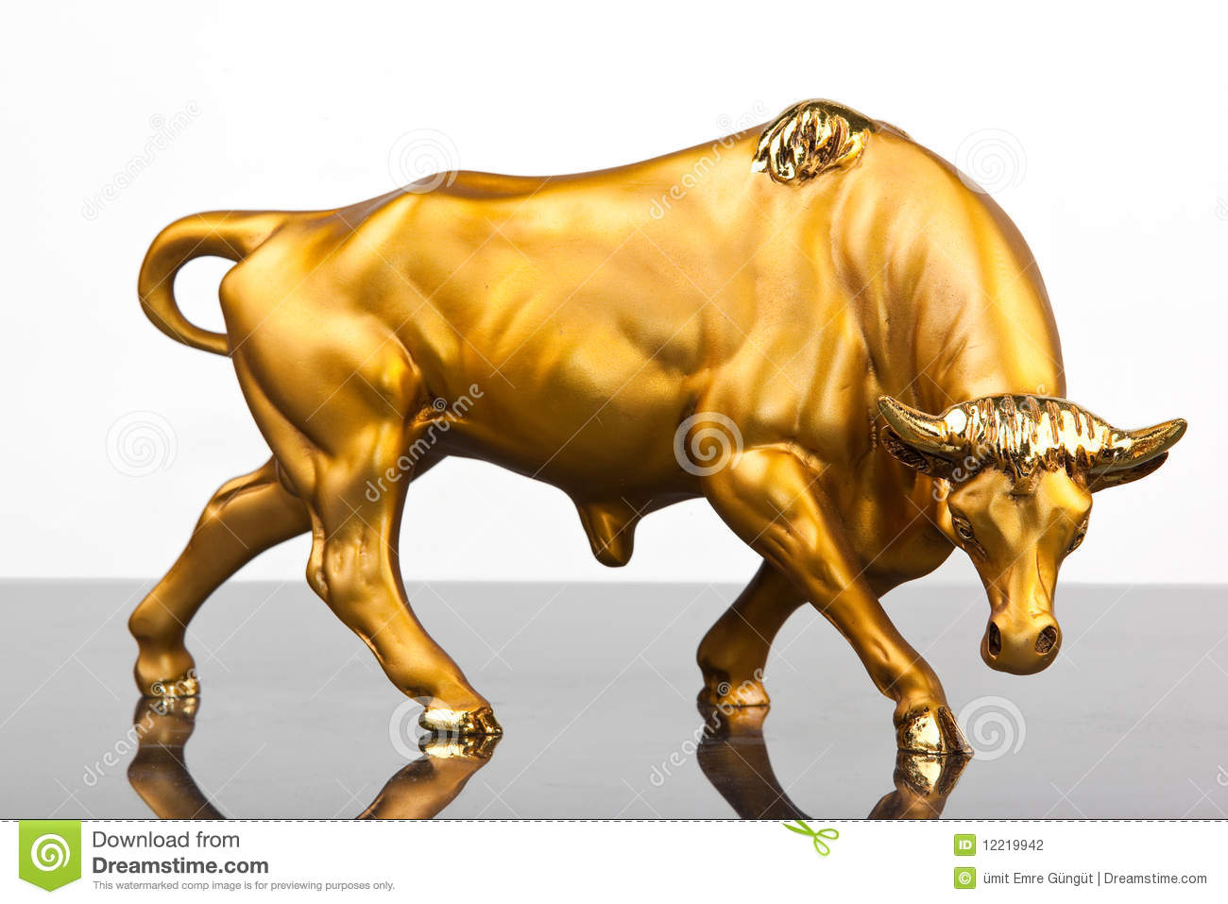
Precious Metals – Secular New Gold Bull
*Gold maintains strength on new long term structural buyers of gold *Russia is moving as many assets as possible into gold to avoid US sanctions *So are other sanction prone countries, like China and Iran *Many analysts are now raising their targets for the barbarous relic now that Bitcoin has utterly failed to provide protection against absolutely anything. Wars, inflation, economic, slowdown, pandemic, Bitcoin has fallen in every case. *Recently falling interest rates give gold and additional boost *It is after all a classic inflation play, which will rise before it falls *Silver is still the bigger and better long-term play

Slide 102
Gold (GLD)- long 5/$165-$170 bull call spread

Slide 103
Market Vectors Gold Miners ETF- (GDX) –

Slide 104
Barrick Gold (GOLD) took profits on long 1/$21-$23 call spread took profits on long 11/$22-$24 call spread

Slide 105
Newmont Mining- (NEM)- took profits on long $55-60 call spread

Slide 106
Silver- (SLV)- took profits on long 11/$19-$20 call spread

Slide 107
Silver Miners - (SIL)-

Slide 108
Wheaton Precious Metals - (WPM)- took profits on long 2/$39-41 call spread

Slide 110
Real Estate – Moving to ARMS
*Pending Homes Sales Fell 1.2% in March, down 8.2% YOY. Only the northeast was up *Mortgage Interest Rates Hit 14 Year High, doubling from 2.75% to 5.20% *New Mortgage demand has hit a 13-year low. *Demand Doubles for Adjustable-Rate Mortgages, thanks to rocketing 30-year rates *New York Real Estate Sees Record Sales, up 33% in Q1 *US Housing Starts Hit 15 Year High, up 0.3% in March to 1.79 million *S&P Case-Shiller hits new all-time highs at 19.8% YOY

Slide 111
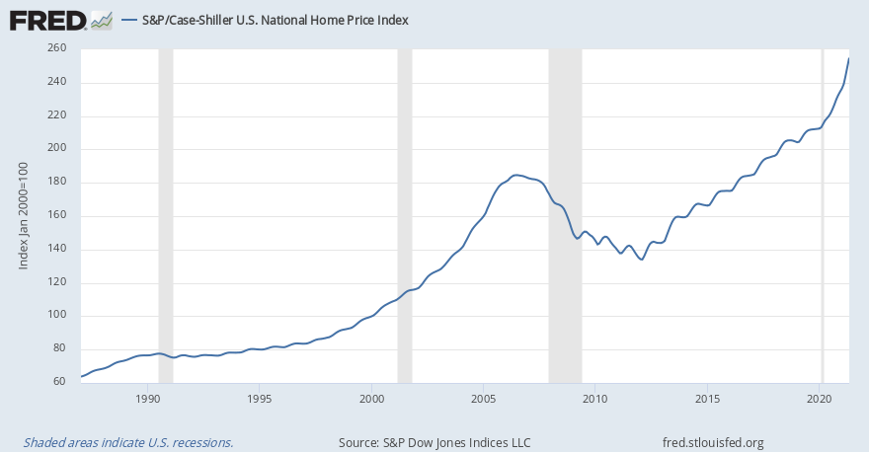
S&P Case Shiller S&P Case Shiller Rockets 19.8%, in November with its National Home Price Index Phoenix (32.9%), Tampa (32.6%), and Miami (29.7%)

Slide 112
Crown Castle International (CCI) – 3.12% yielding cell phone tower REIT

Slide 113
US Home Construction Index (ITB) (DHI), (LEN), (PHM), (TOL), (NVR)

Slide 115
Trade Sheet- So What Do We Do About All This?
*Stocks – buy the big dips *Bonds – sell rallies aggressively *Commodities-buy dips *Currencies- stand aside *Precious Metals – buy dips *Energy – stand aside *Commodities – Buy dips *Volatility - sell short over $30 *Real estate – stand aside *Bitcoin – buy dips

Slide 116
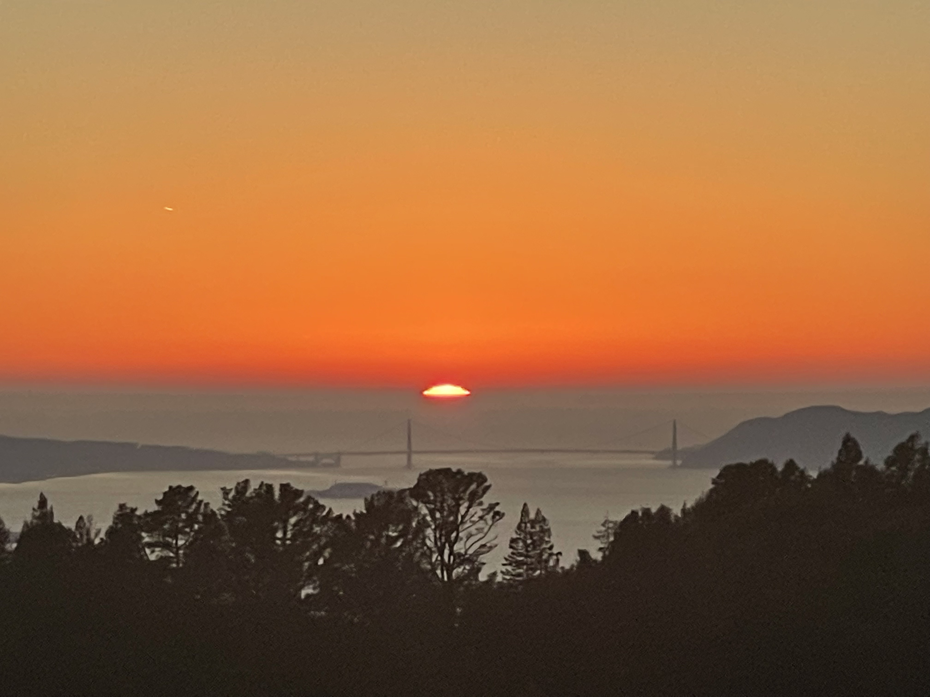

Slide 117
Next Strategy Webinar 12:00 EST Wednesday, May 18 from Silicon Valley, CA email me questions at support@madhedgefundtrader.com
Good Luck and Good Trading!
Notes:
*

