Slide 1
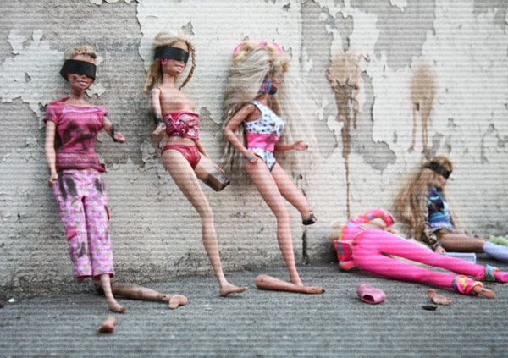
The Mad Hedge Fund Trader “Shooting the Generals”
With John Thomas Silicon Valley, CA, May 18, 2022 www.madhedgefundtrader.com
Notes:
*

Slide 2
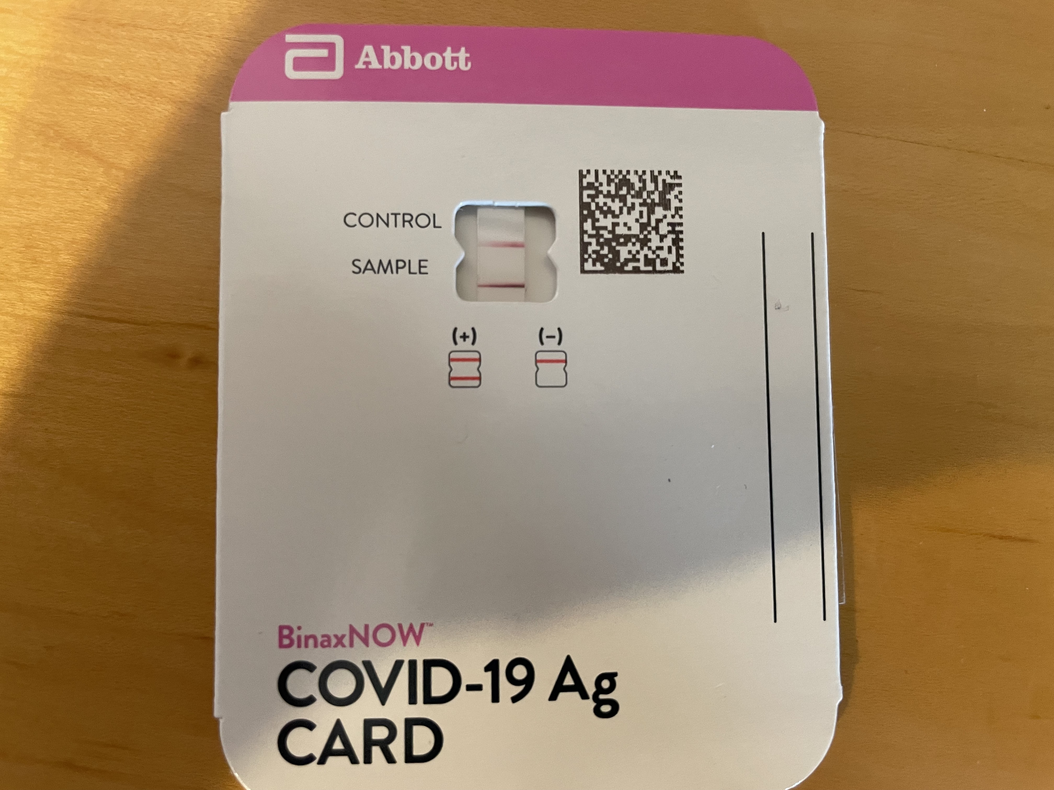

Slide 3
Trade Alert Performance New All Time Highs!
*January 14.59% Final *July +0.61% Final *February +8.78% MTD *August +9.36% Final *March +3.43% Final *September 1.03% Final *April +3.33% Final *October +8.91% MTD *May +6.08% MTD *November -11.79% Final *June +0.71% Final *December +11.26% Final *2022 YTD +36.26% compared to -12.7% for the Dow Average *+$548.82% since inception *Average annualized return of 43.78% for 14 years

Slide 4
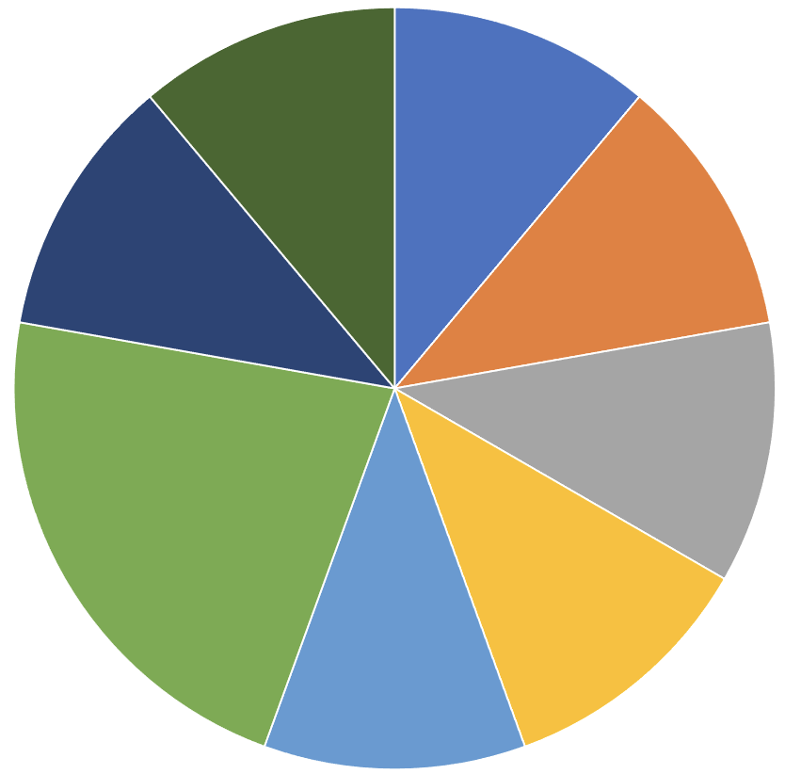
Portfolio Review 80% Long, 20% short, 0% cash-up 13% in 3 Days!!! Bullish at the bottom of the range, with a huge long stock/short (VIX) position
Risk On
World is Getting Better
(TLT) 6/$124-$127 put spread | 10.00%
(SPY) 5/$365-$375 call spread | 10.00%
(NVDA) 6/$120-$130 call spread | 10.00%
(AAPL) 6/$135-$135 call spread | 10.00%
(AAPL) 6/$110-$120 call spread | 20.00%
(BRKB) 6/$260-$270 call spread | 10.00%
(V) 6/$150-$160 call spread | 10.00%
Risk Off
World is Getting Worse
(AAPL) 6/$155-$1365 put spread | -10.00%
(SPY) 6$435-$445 put spread | -10.00%
Total Net Position | 60.00%
Total Aggregate Position | 100.00%
Expiration Value +43.58%

Slide 5
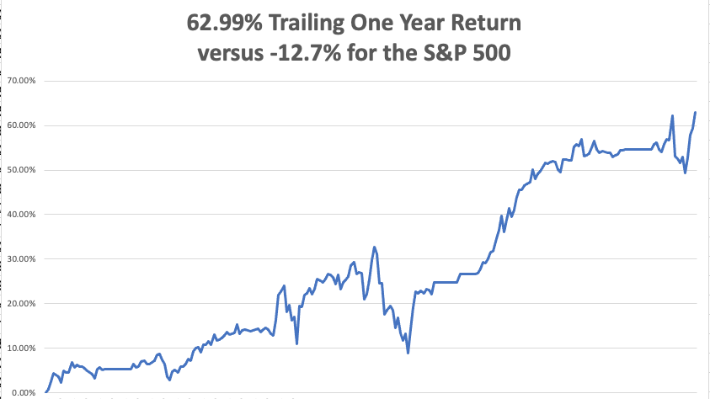

Slide 6
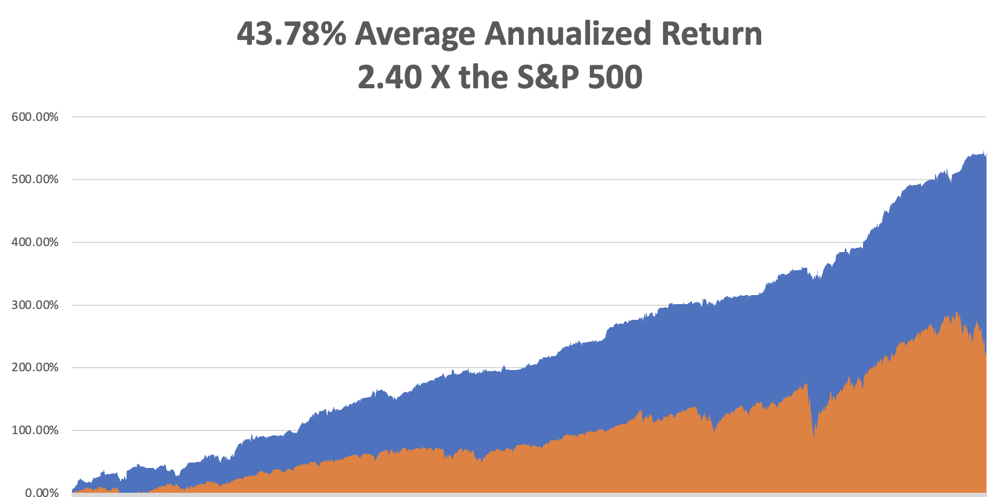

Slide 7
The Method to My Madness Searching of a Risk Bottom
*”Sell Everything” panic reached a crescendo *Traders piled into technology stocks that capitulated earlier in the week *Market is raising recession risks, even though the data is not *Half point rate hikes take us out of the frying pan into the fire, and we could get three more *The first 200 basis points of Interest rate rises are in the market, but 300 are not *Bonds may be reaching the last ten points of their move down *Pandemic cases are increasing modestly but are no longer a factor for the economy *VIX over $30 is the ideal entry point for new long positions

Slide 8
Corona Update –
* US Deaths top 1 million, 3% of those over 85 died *Corona virus cases at 82.5 million, up 1,000,000 in a week, but lifting mask requirement on airplanes will bring a new spike * Deaths topping 1,000 and have only increased by 2,000 in the past week *Vaccine for under fives due this summer *Pandemic is still going to near zero by summer, book those cruises *Covid is with us for good and big pharma will offer combined annual covid and flu shots by the fall

Slide 9
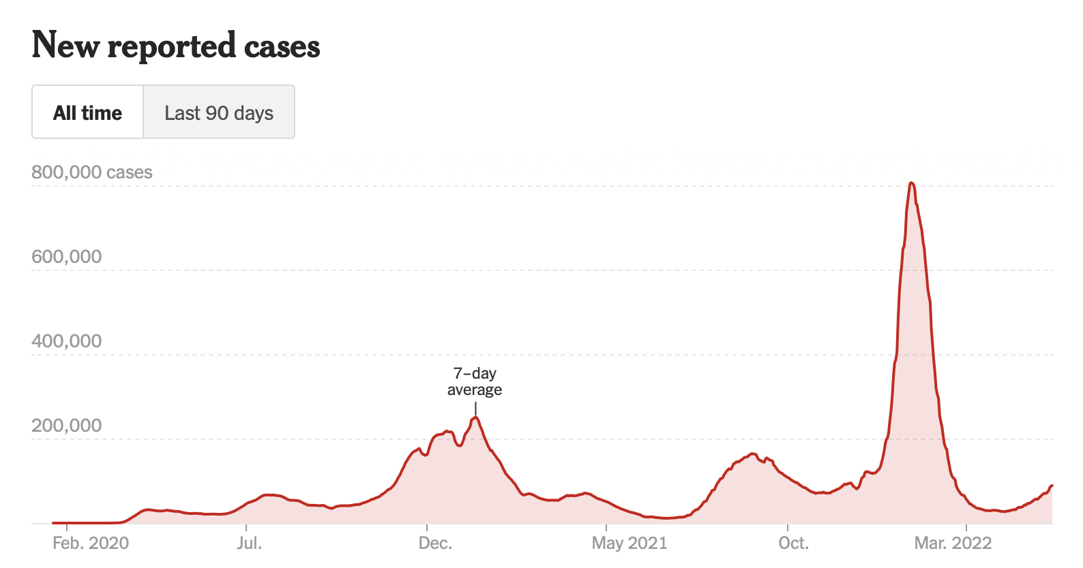
The Pandemic is Over

Slide 10
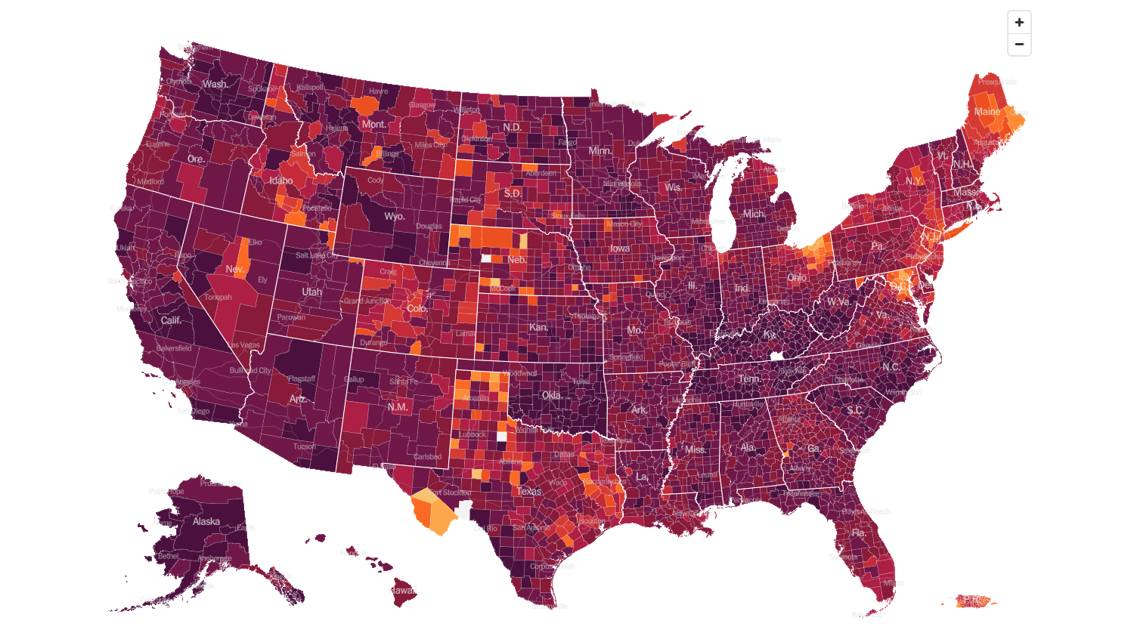
February 2 2022 Infection Rate

Slide 11
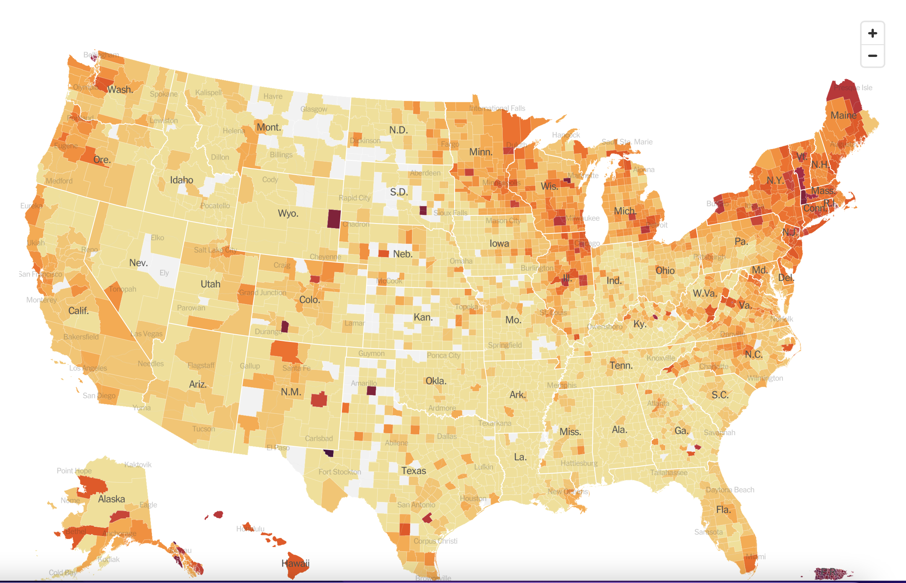
May 18 2022 Infection Rate

Slide 12
The Global Economy – Stronger than it Looks
*Jay Powell Warns of More 50 Basis Point Rate Rises, if the economic conditions justify it *Core Inflation Moderates Slightly, down from 8.5% to 8.3% *JOLTS Hits a Record High, with 11.55 million job opening in March, up 205,000 on the month *China’s Industrial Production Collapses by 2.9%, and Retail Sales fell by a shocking 11.1% *Consumer Sentiment Hits 11-Year Low according to the University of Michigan *Producer Price Index Soars 11.0% YOY and 0.5% in April alone *Air Tickets Prices Have Through the Roof and were the biggest single factor keeping the CPI inflation figure high *Inflation Expectations Fall to 6.3%

Slide 13
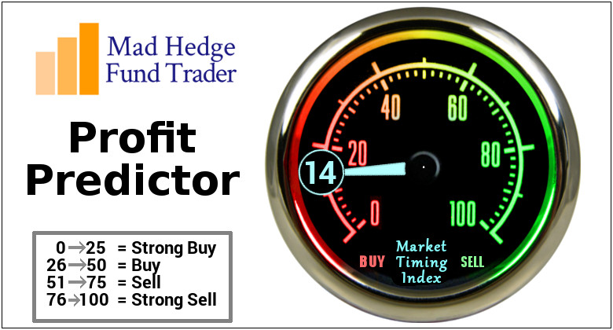
The Mad Hedge Profit Predictor Market Timing Index – Buy Territory An artificial intelligence driven algorithm that analyzes 30 different economic, technical, and momentum driven indicators

Slide 14
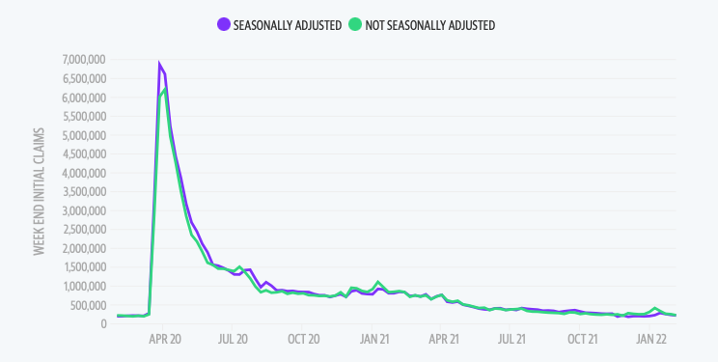
Weekly Jobless Claims – Falling 203,000 – up 1,000

Slide 15
Stocks – Shooting the Generals
*Shooting the lead tech stocks usually means a market bottom *Warren Buffet is Buying Stocks, some $51 billion in Q1, moving big into (CVX), and (OXY) *Elon Musk Crashes His Own Stock, selling $8.4 billion of Tesla *Goldman Sachs Quit the SPAC Market, citing unmanageable liability *Elon Musk Cools on Twitter, causing the stock to dive 20%. *Softbank Suffers $27 Billion Loss in 2021, and their Vision Fund looking at far greater losses this year *MacDonald’s is Selling its Russian Operations *Look for terrible H1 and strong H2 scenario to continue

Slide 16
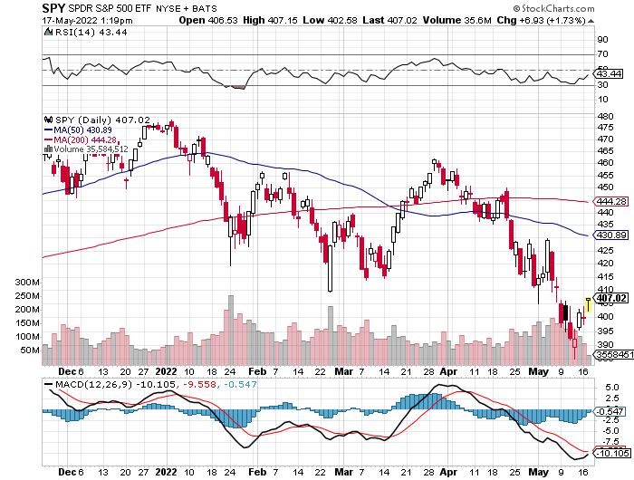
S&P 500 – Back to the Bottom of the Range long $435-$445 put spread, long $365-$375 call spread, took profits on long $370-$380 put spread Took profits on long 2/$465-$475 bear put spread Took profits on long 2/$410-$420 bull call spread,
$460
The Bottom 387 Down -17.3%

Slide 17
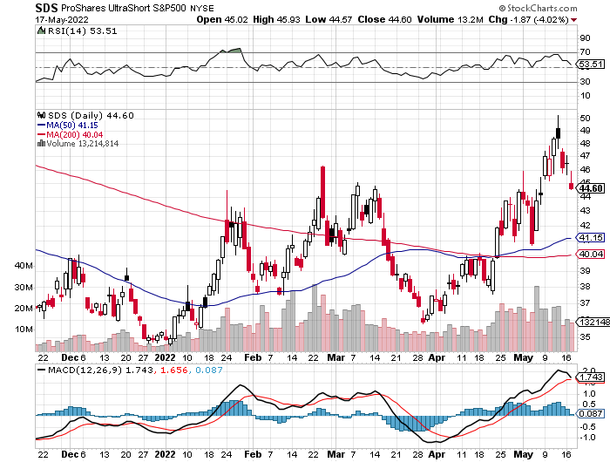
ProShares Ultra Short S&P 500 (SDS)- a great hedge for long stocks and bonds long 2X position has a hedge against longs and bond shorts

Slide 18
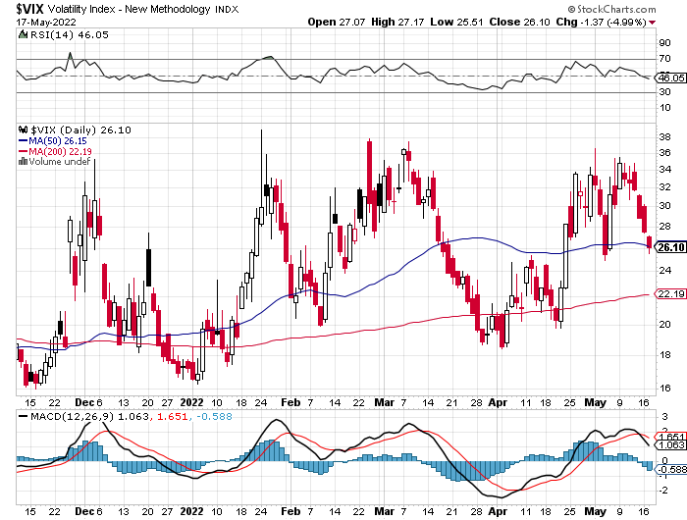
(VIX) – Unable to Make a New High

Slide 19
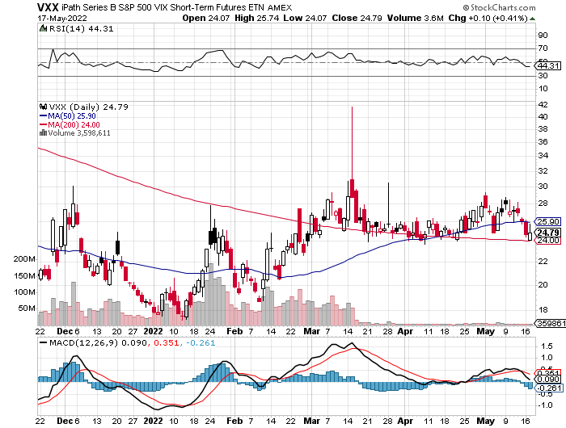
(VXX)-

Slide 20
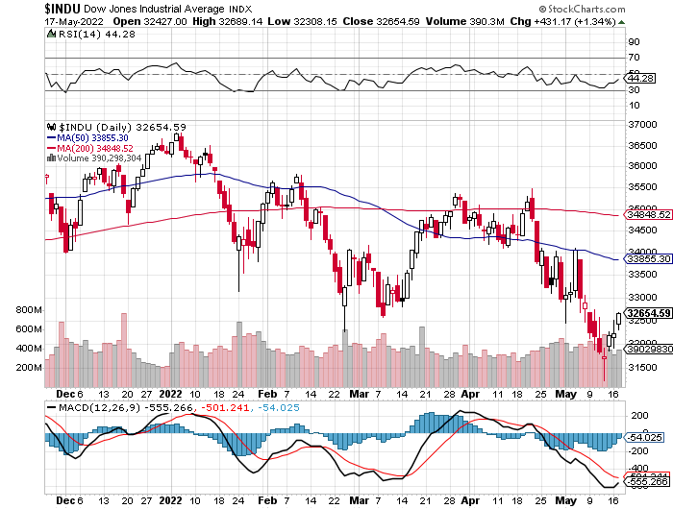
Dow Average ($INDU)-

Slide 21
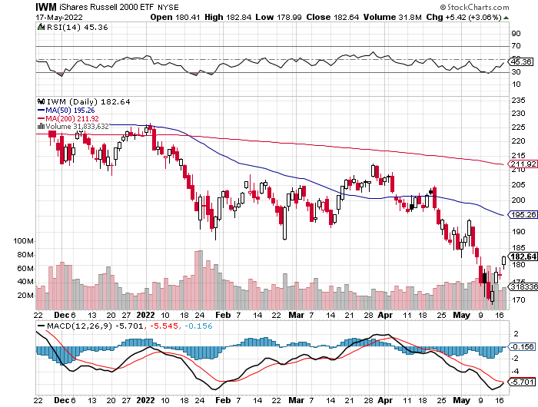
Russell 2000 (IWM)- took profits on Long 10/$137-$142 vertical bull call spread took profits on Long 10/$153-$156 vertical bear put spread

Slide 22
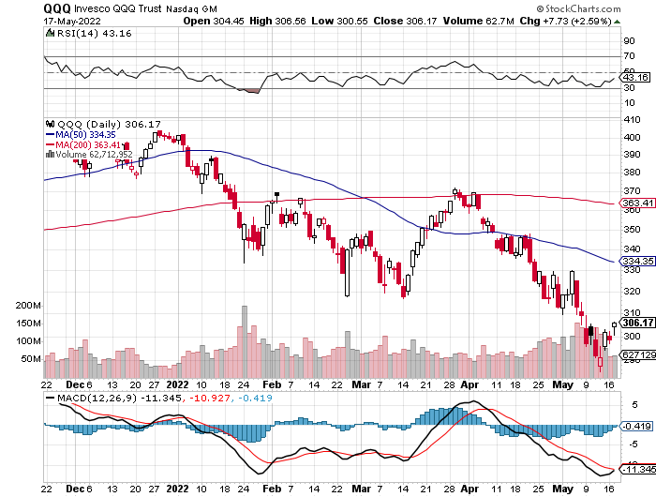
NASDAQ (QQQ) – long (QQQ) 4/$330-$335 put spread took profits on long (QQQ) 3/$340-$345 put spread covered long (QQQ) $325-$330 put spread

Slide 23
The Barbell Portfolio
*50% Big Tech - 2% of US Employment but 27% of Market Cap and 38% of Profits 50% Domestic Recovery, including: Railroads Couriers Banks Construction Credit Cards Event organizers Ticket sales Retailers

Slide 24
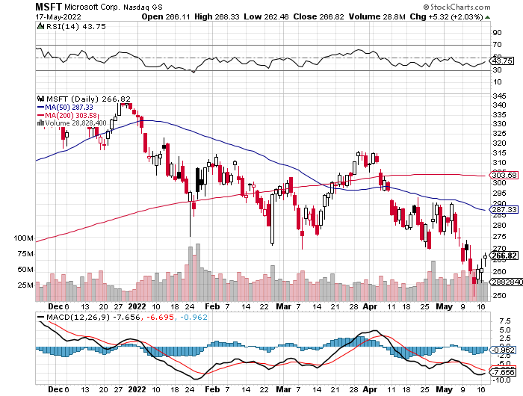
Microsoft (MSFT)- took profits on long 2/$340-$350 bear put spread took profits on long 12/$220-$230 call spread stop loss on long 12/$170-$180 call spread

Slide 25
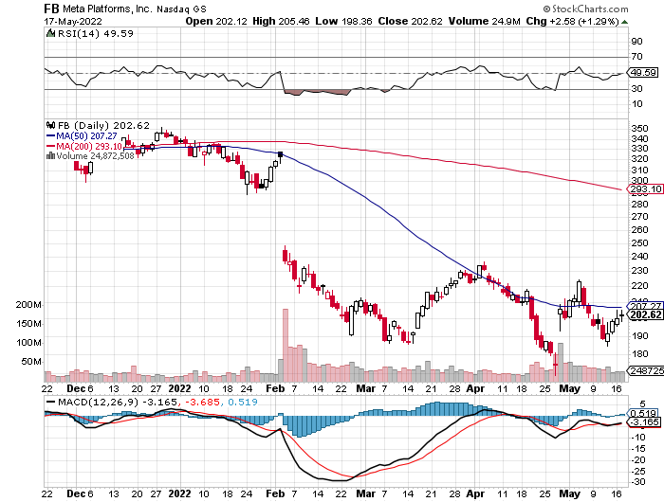
Facebook (FB)- Changes Name to “Meta” took profits on Long 9/$290-$300 vertical bear put spread stopped out of Long 9/$190-$200 vertical bear put spread

Slide 26
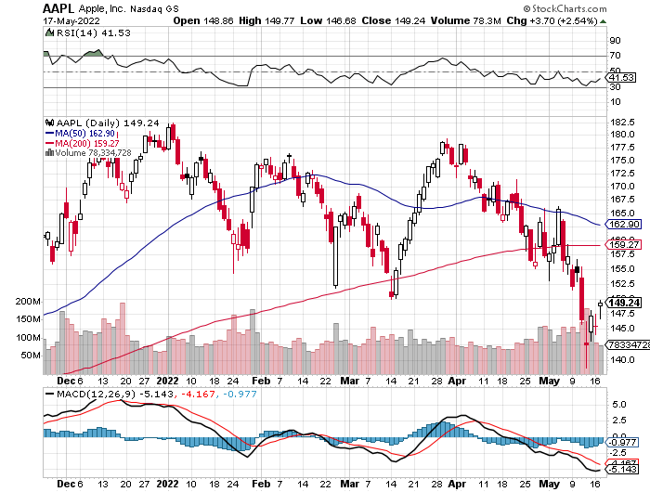
Apple (AAPL)- Quadruple Position share buyback program jumped by an eye popping $90 billion long 6/$155-$165 put spread, long 6/$125-135 call spread, long 6/$110-$120 call spread, took profits on long 2/$180-$190 put spread

Slide 27
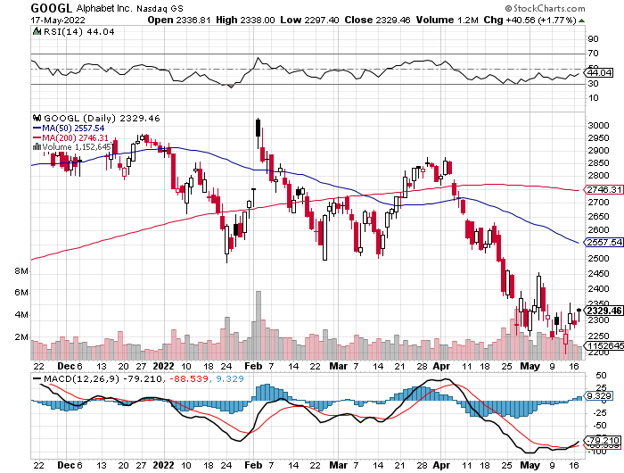
Alphabet (GOOGL) – Ad king on economic recovery Alphabet Misses on Top and Bottom took profits on long 12/$1,200-$1,230 bull call spread took profits on long 9/$1,030-$1,080 vertical bull call spread

Slide 28
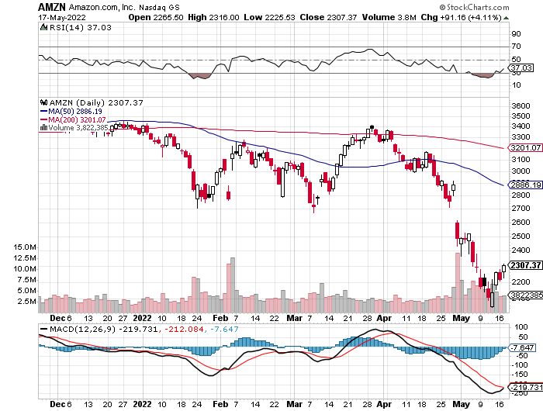
Amazon (AMZN) – took profits on long 2/$3,400-$3,500 bear put spread took profits on long 9/$2,800-$2,900 bull call spread

Slide 29
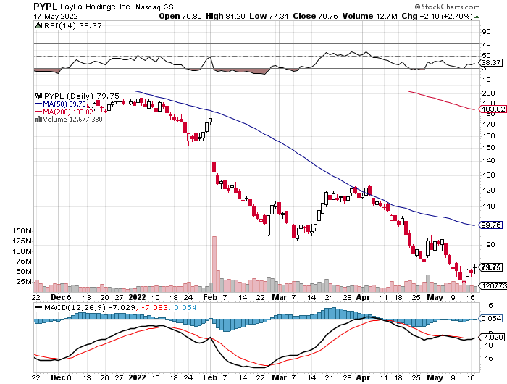
PayPal (PYPL) - took profits on long 4/$90-$95 call spread

Slide 30
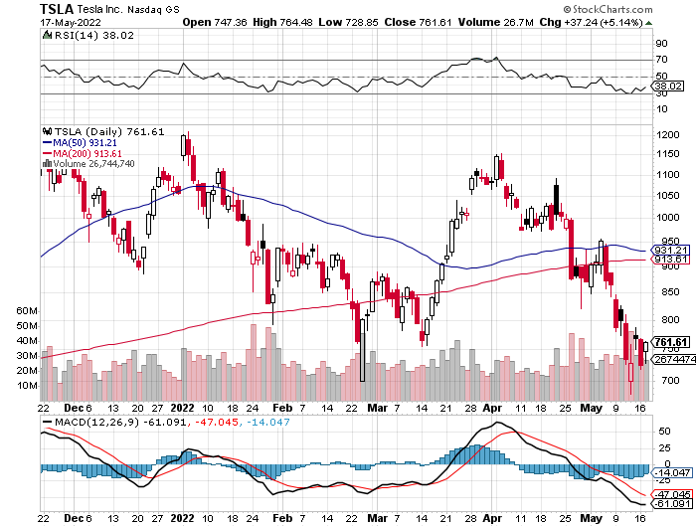
Tesla (TSLA) –Twitter Drag Aiming for 1.5 million cars in 2022 but Elon’s stock was put up for margin loan to buy Twitter, tanking the stock Tesla to Split Shares and Pay Dividend took profits on long 2/$550-$600 call spread took profits on long 2/$600-$650 call spread

Slide 31
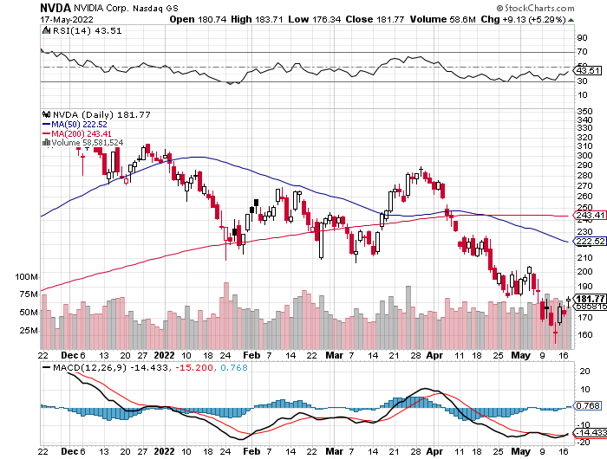
NVIDIA (NVDA) – A Mad Hedge 50 bagger – Global Semiconductor Shortage Slows Auto Industry, long 6/$120-$130 call spread

Slide 32
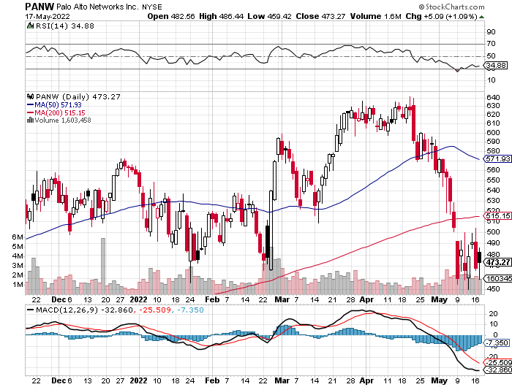
Palo Alto Networks (PANW)- Hacking never goes out of fashion

Slide 33
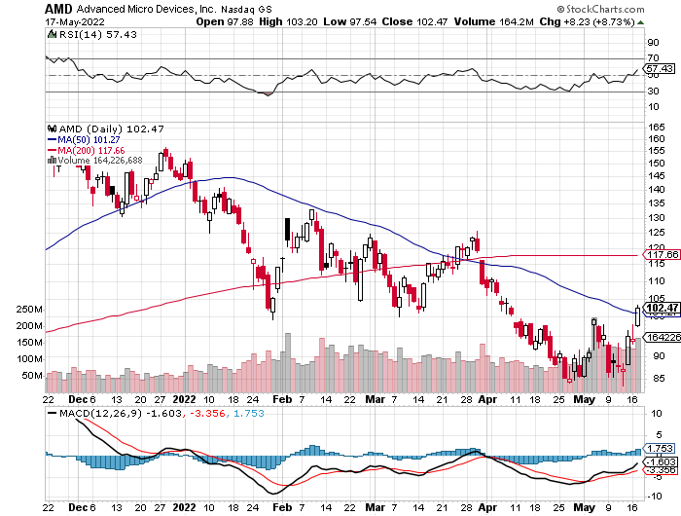
Advanced Micro Devices (AMD)- Recession fears programable logic devices took profits on long 2/$75-$80 call spread

Slide 34
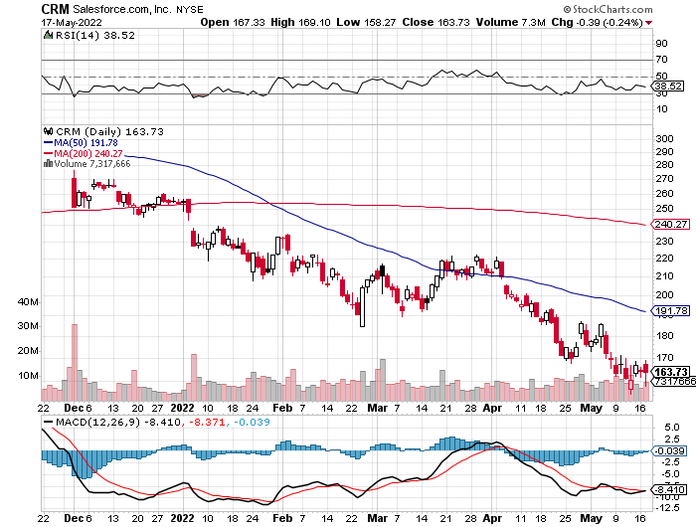
Salesforce (CRM)- Massive Online Migration took profits on long 9/$125-$130 vertical bull call spread took profits on long 8/$125-$130 vertical bull call spread took profits on long 2/$105-$115 call spread

Slide 35
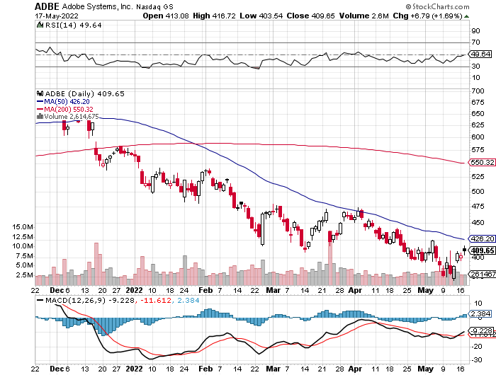
Adobe (ADBE)- Cloud play The Quality Non-China tech play

Slide 36
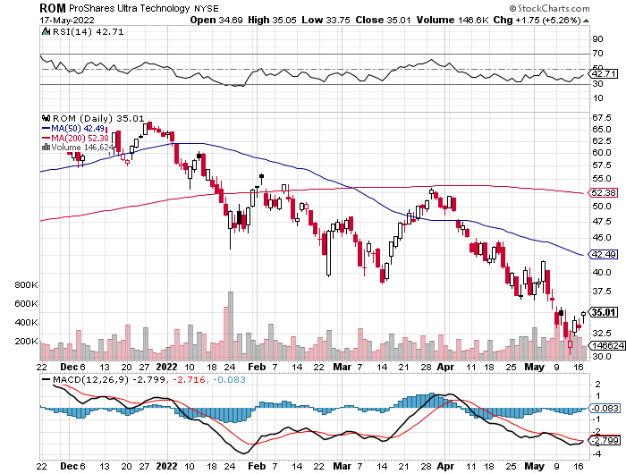
ProShares Ultra Technology ETF (ROM) – 2X Long Technology ETF took profits on long 10/$62-65 call spread

Slide 37
The Second Half of the Barbell
*Bets on a domestic recovery in 2022 Q4 *Upside potential in 2022 far greater than tech *Some of these have not moved for 5 or 10 years *Focuses on economically sensitive cyclical industries *Makes a great counterweight to high-growth technology *We could spend all of next year rotating between the two groups

Slide 38
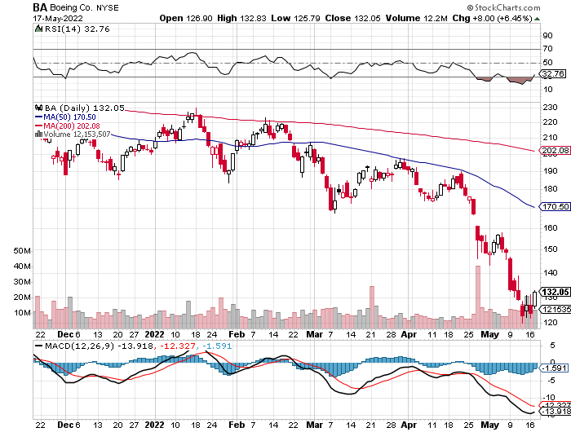
Boeing (BA) –Disastrous Earnings $2.7 loss booked in Q1 long 3/$146-$149 call spread took profits on long 2/$150-$160 call spread

Slide 39
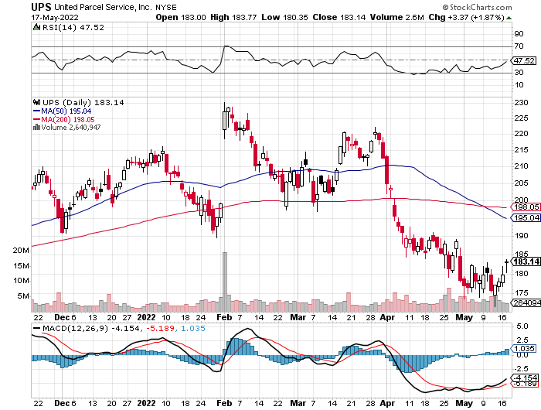
Package Delivery- United Parcel Service (UPS) - Package Delivery record profits took profits on long 11/$130-$140 call spread

Slide 40
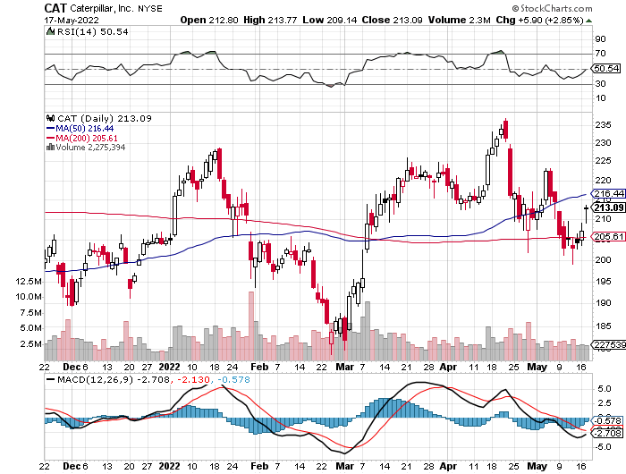
Caterpillar (CAT)- Ag + Infrastructure + Housing took profits on long 12/$145-$150 call spread took profits on long 11/$125-$135 call spread

Slide 41
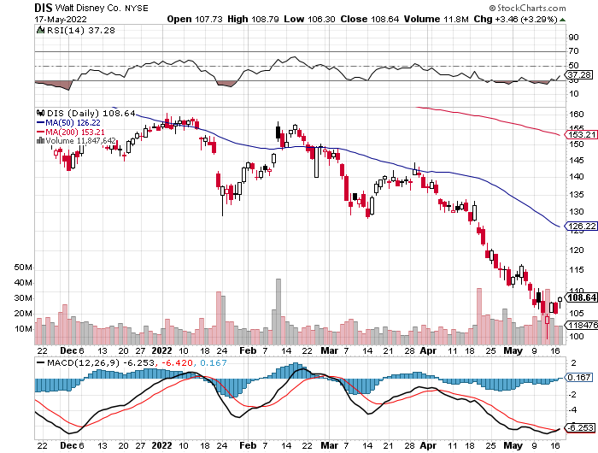
Walt Disney (DIS)- Florida Declares War stopped out of long 10/$165-$175 call spread took profits on long 3/$170-$180 call spread

Slide 42
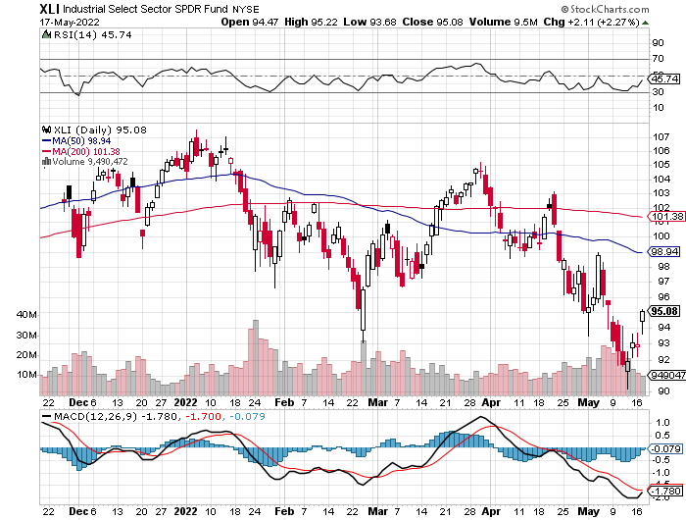
Industrials Sector SPDR (XLI)- (GE), (MMM), (UNP), (UTX), (BA), (HON)

Slide 43
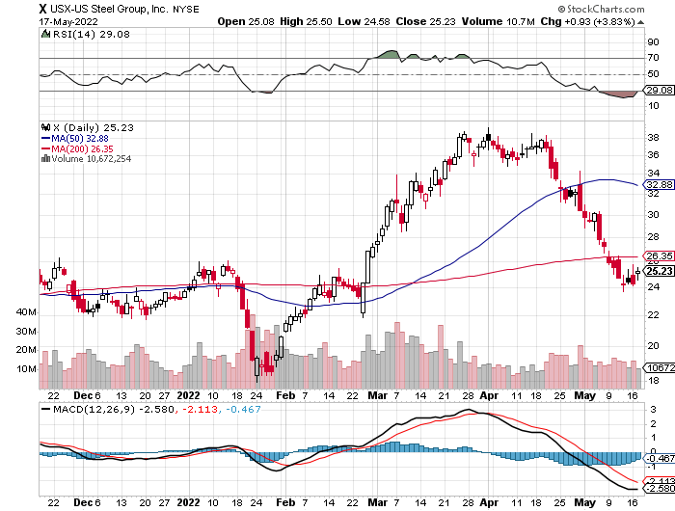
US Steel (X) – Commodity Boom and Wartime boost

Slide 44
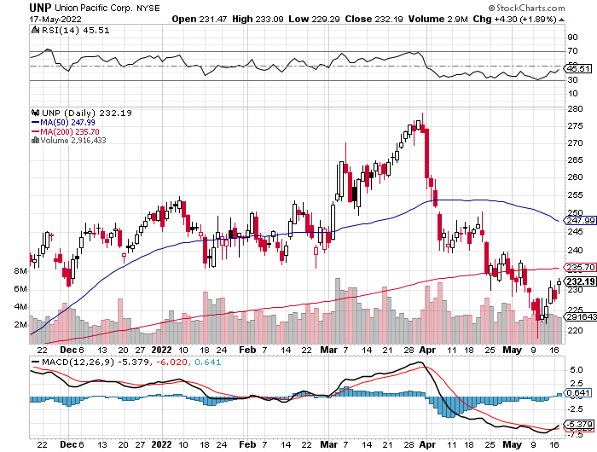
Union Pacific RR (UNP)- Big Stuff to Ship near record earnings announced took profits on long 5/$200-$210 call spread took profits on 11/$150-$160 call spread

Slide 45
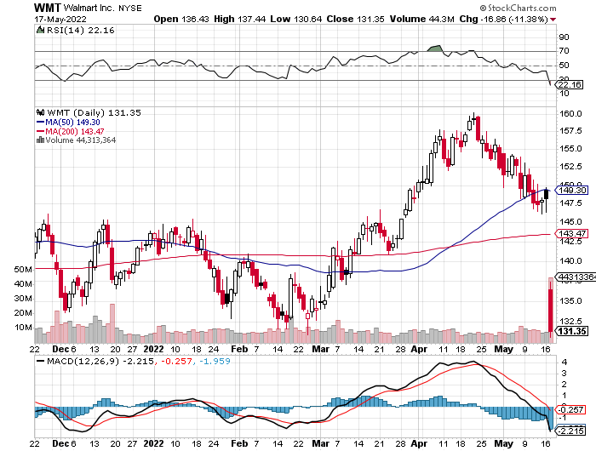
Wal-Mart (WMT)- took profit on Long 11/$125-$130 bear put spread took profit on Long 10/$119-$121 bear put spread took profits on Long 8/$114-$117 bear put spread

Slide 46
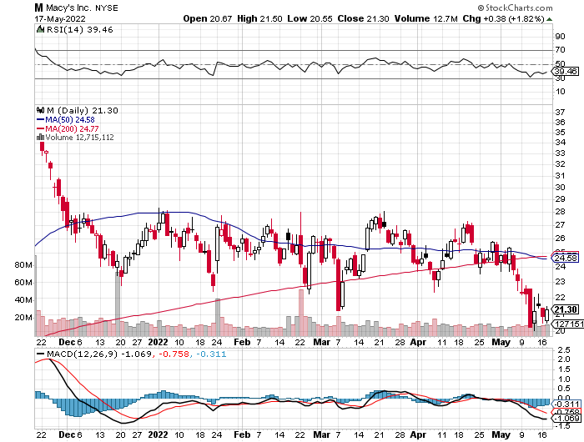
Macys’ (M) – Retail Punished took profits on Long 8/$23-$25 bear put spread

Slide 47
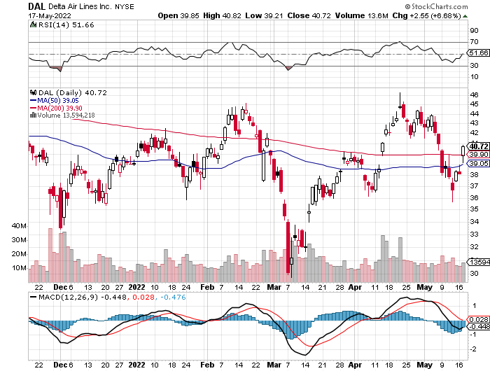
Delta Airlines (DAL) – Travel is Back!

Slide 48
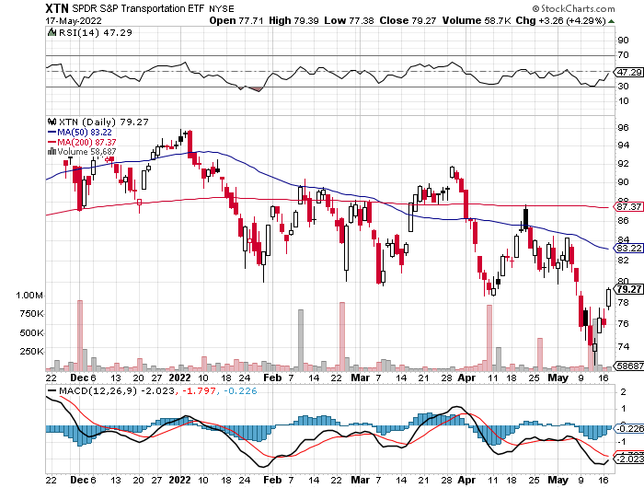
Transports Sector SPDR (XTN)- Worst Hit Sector (ALGT), (ALK), (JBLU), (LUV), (CHRW), (DAL)

Slide 49
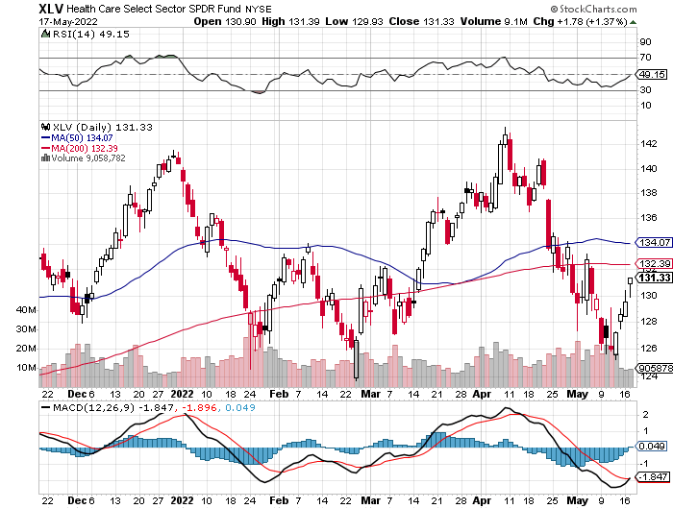
Health Care Sector (XLV) (JNJ), (PFE), (MRK), (GILD), (ACT), (AMGN)

Slide 50
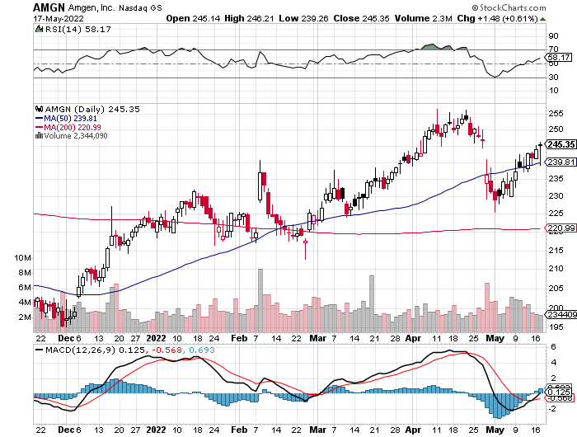
Amgen (AMGN) took profits on long 11/$185-$200 bull call spread

Slide 51
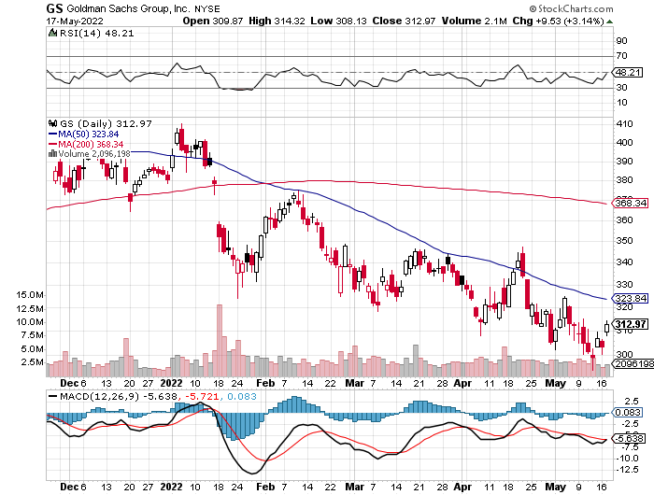
Goldman Sachs (GS) – took profits 12/$330-$350 call spread took profits 11/$330-$350 call spread stop loss on long 11/$385-$395 call spreads

Slide 52
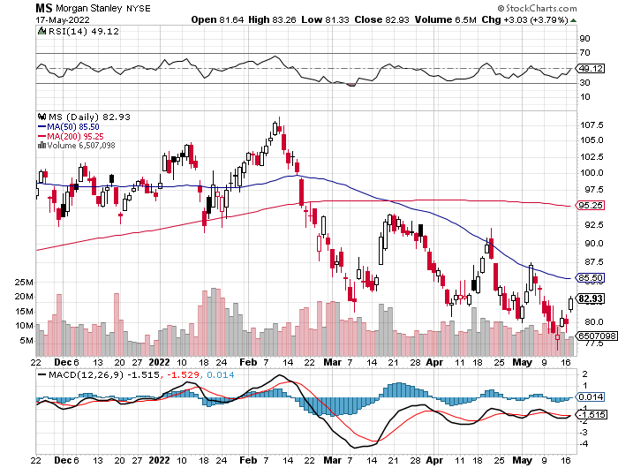
Morgan Stanley (MS) – Blows Away Earnings Equity trading came in a hot $3.2 billion and bond trading $2.9 billion took profits on long 11/$85-$90 call spread stop loss on long 11/$95-$98 call spread took profits on long 10/$85-$90 call spread profits on long 2/$55-$60 call spread

Slide 53
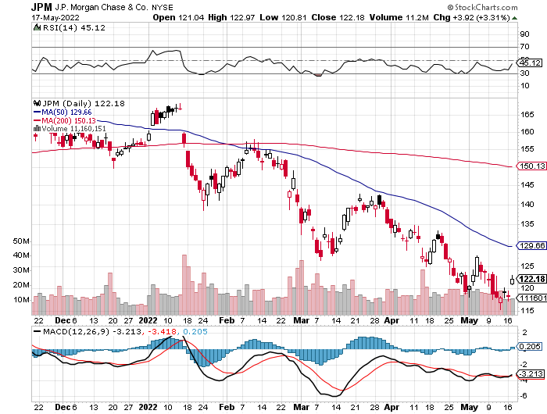
JP Morgan Chase (JPM)- Takes a Russia Hit, losing $524 billion on its exposure there. took profits 12/$148-$152.50 call spread

Slide 54
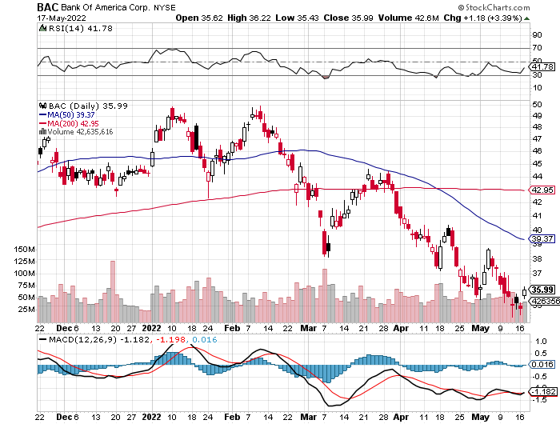
Bank of America (BAC) – took profits long 12/$39-$42 call spread

Slide 55
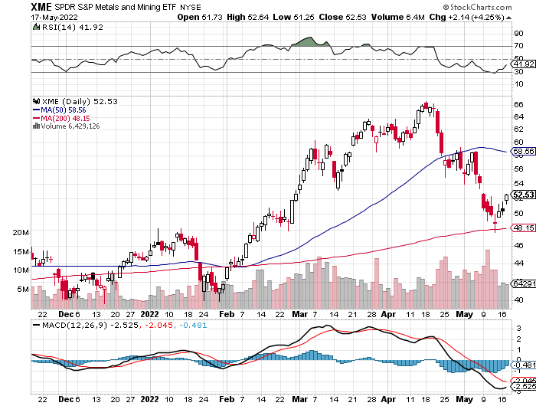
SPDR Metals & Mining ETF (XME) – long 2/$28-$30 call spread

Slide 56
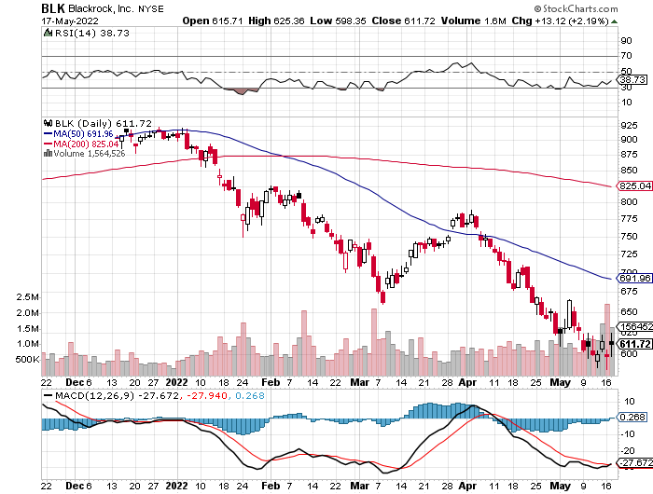
Blackrock (BLK)-Asset Collection Boom took profits on long 3/$770-$790 call spread took profits on long 3/$310-$340 call spread

Slide 57
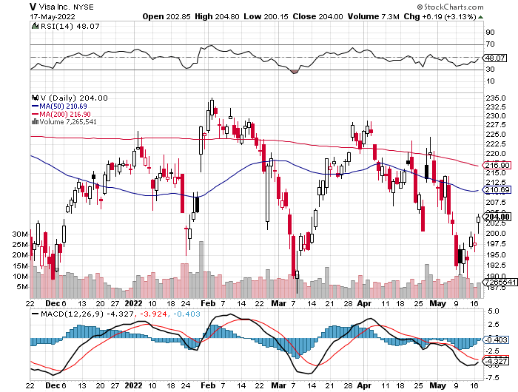
Visa (V) – “Touchless” Bitcoin Drag long 6/$150-$160 bull call spread

Slide 58
Consumer Discretionary SPDR (XLY) (DIS), (AMZN), (HD), (CMCSA), (MCD), (SBUX)

Slide 59
Berkshire Hathaway (BRKB)- Natural Barbell Buys Alleghany Insurance, for $11.6 billion long 6/$260-$270 call spread, stopped out of long 5/$300-$310 call spread, took profits on long 2/$270-$280 call spread

Slide 60
Europe Hedged Equity (HEDJ)-

Slide 61
Japan (DXJ)-

Slide 62
Emerging Markets (EEM) - Pro trade, Weak Dollar, Long Recovery Play

Slide 63
Bonds – End of the Game?
*Bonds Hit New Three-Year Lows, with yields soaring to 3.12% overnight *The US Budget Deficit is in Free Fall, putting our hefty bond shorts at risk *While Trump was president the national debt exploded by $4 trillion, a dream come true for bond shorts *Since Biden became president, the annual budget deficit has plunged from $3.1 trillion to $360 billion for the first seven months of fiscal 2022, and we could approach zero by yearend *An exploding economy has sent tax revenues soaring, and taxpayers still have to pay a gigantic bill for last year’s monster capital gains in the stock market *Biden has also been unable to get many spending bills through the Senate, where he lacks a clear majority. *US Treasury bond fund (TLT) could plunge from $180 in 2020 to $100 by 2023

Slide 64
Treasury ETF (TLT) – Breaking Down took profits on long 5/$128-$131 put spread, look profits on long 5/$127-$130 put spread took profits on long 5/$110-$113 call spread, stopped out of long 4/$127-$130 call spread

Slide 65
Ten Year Treasury Yield ($TNX) – 2.92%

Slide 66
Junk Bonds (HYG) 6.10% Yield to Maturity

Slide 67
2X Short Treasuries (TBT)-Another run at highs

Slide 68
Foreign Currencies – Dollar High
*US Dollar Blasts Through to 20-Year High *Soaring US interest rates and flight to safety turbocharge the buck *Ukraine war crushes the Euro *Shanghai shutdown crushes the Chinese Yuan *Commodity currencies like (FXA) and (FXC) take a break on commodities selloff *Long-term US dollar fundamentals are still poor, a dollar short could be the new ten-year trade, but not yet *Stand aside from forex for now, there are getting fish to fry

Slide 69
Japanese Yen (FXY)

Slide 70
Euro (FXE)-

Slide 71
British Pound (FXB)-

Slide 72
Australian Dollar (FXA)- The Global Recovery Play took profits on long 8/$67-$69 call spread

Slide 73
Emerging Market Currencies (CEW)

Slide 74
Chinese Yuan- (CYB)- Shanghai Shutdown

Slide 75
Bitcoin – Breakdown Buy the Mad Hedge Bitcoin Letter at https://www.madhedgefundtrader.com/store/
*Bitcoin backs off, from $69,000 to $28,000, or 60% *Disappearing global liquidity is not the time to be in Bitcoin *Tether, a stablecoin tied to the US dollar, has fallen to 69% of its face value, but later recovers *Luna Crashes to Earth, the crypto diving from $75 to $1 *Coinbase Crashes on Earnings Miss, taking the stock down 19% *Buy Bitcoin and Ethereum on the bigger dip, but not now

Slide 76
Bitcoin ($BTCUSD) – Finding a bid

Slide 77
Ethereum (ETHE) –

Slide 78
MicroStrategy (MSTR) –

Slide 79
Amplify Transformational Data Sharing ETF (BLOK) –

Slide 80
Energy & Commodities –
*Russia cuts electricity exports to Finland as it joins NATO *Natural Gas Soars by 9% in Europe as the continent tries to wean itself off Russian supplies *The average household is spending $5,000 a year on gasoline, except the 2 million EV owners *It’s a race against time as Germany races to wean itself of Russian Oil by next winter *Watch for the “Putin Resigns” or “Putin Declares Victory” headline, which could take oil down $50 overnight *Russian invasion highlights the risk of relying on oil as an energy source. *New bull market in uranium will continue for years as energy hungry nations look for new non-carbon sources to replace Russia *Avoid all energy plays like the plague, it’s the new buggy whip industry as the US de-carbonizes

Slide 81
Oil-($WTIC)

Slide 82
United States Oil Fund (USO) long 10/$9.50-$10 Vertical bull call spread

Slide 83
Energy Select Sector SPDR (XLE)-No Performance! (XOM), (CVX), (SLB), (KMI), (EOG), (COP)

Slide 84
Halliburton (HAL)-

Slide 85
Natural Gas (UNG) -

Slide 86
Freeport McMoRan (FCX) -

Slide 87
Cameco (CCJ) - long 5/$20-$23 bull call spread

Slide 88
Precious Metals – Gold Takes a Break
*Gold takes a break on global “RISK OFF” move *Gold is more of a commodity play now than a risk hedge *Recently falling interest rates give gold and additional boost *It is after all a classic inflation play, which will rise before it falls *Silver is still the bigger and better long-term play

Slide 89
Gold (GLD)- took profits on long 5/$165-$170 bull call spread

Slide 90
Market Vectors Gold Miners ETF- (GDX) –

Slide 91
Barrick Gold (GOLD) took profits on long 1/$21-$23 call spread took profits on long 11/$22-$24 call spread

Slide 92
Newmont Mining- (NEM)- took profits on long $55-60 call spread

Slide 93
Silver- (SLV)- took profits on long 11/$19-$20 call spread

Slide 94
Silver Miners - (SIL)-

Slide 95
Wheaton Precious Metals - (WPM)- took profits on long 2/$39-41 call spread

Slide 96
Real Estate – Weakness!
*30-Year Fixed Rate Mortgages Top 5.5% in the fastest rate rise in history *Housing Supply Improves for the first time in three years *Homebuilder Sentiment Hits Two Year Low, down from 77 to 69 *New home materials costs up 19% YOY *Mortgage Demand Plunges 12%,

Slide 97
S&P Case Shiller S&P Case Shiller Rockets 19.8%, in November with its National Home Price Index Phoenix (32.9%), Tampa (32.6%), and Miami (29.7%)

Slide 98
Crown Castle International (CCI) – 3.33% yielding cell phone tower REIT

Slide 99
US Home Construction Index (ITB) (DHI), (LEN), (PHM), (TOL), (NVR)

Slide 100
Trade Sheet- So What Do We Do About All This?
*Stocks – buy the big dips *Bonds – sell rallies aggressively *Commodities-buy dips *Currencies- stand aside *Precious Metals – buy dips *Energy – stand aside *Commodities – Buy dips *Volatility - sell short over $30 *Real estate – stand aside *Bitcoin – stand aside

Slide 102
Next Strategy Webinar 12:00 EST Wednesday, June 1 from Silicon Valley, CA email me questions at support@madhedgefundtrader.com
Good Luck and Good Trading!
Notes:
*

