Slide 1
The Mad Hedge Fund Trader “The Post Recession Trade”
With John Thomas Silicon Valley, CA, June 22, 2022 www.madhedgefundtrader.com
Notes:
*

Slide 3
Trade Alert Performance New All Time Highs!
*January 14.59% Final *July +0.61% Final *February +8.78% MTD *August +9.36% Final *March +3.43% Final *September 1.03% Final *April +3.33% Final *October +8.91% MTD *May +8.80% Final *November -11.79% Final *June +8.73% MTD *December +11.26% Final *2022 YTD +50.60% compared to -17.78% for the Dow Average *+$563.16% since inception *Average annualized return of +44.23% for 14 years

Slide 4
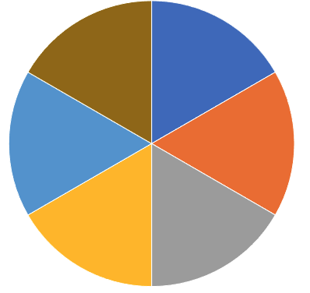
Portfolio Review 50% Long, 10% short, 40% cash- Bullish at the bottom of the range
Current Capital at Risk
Risk On
World is Getting Better
(MSFT) 7/$200-$210 call spread | 10.00%
(NVDA) 7/$120-$130 call spread | 10.00%
(TSLA) 7/$500-$550 call spread | 10.00%
(BRKB) 7/$220-$230 call spread | 10.00%
(TLT) 7/$119-$122 put spread | 10.00%
Risk Off
World is Getting Worse
(SPY) 7/$410-$420 put spread | -10.00%
Total Net Position | 40.00%
Expiration Value +54.29%

Slide 5
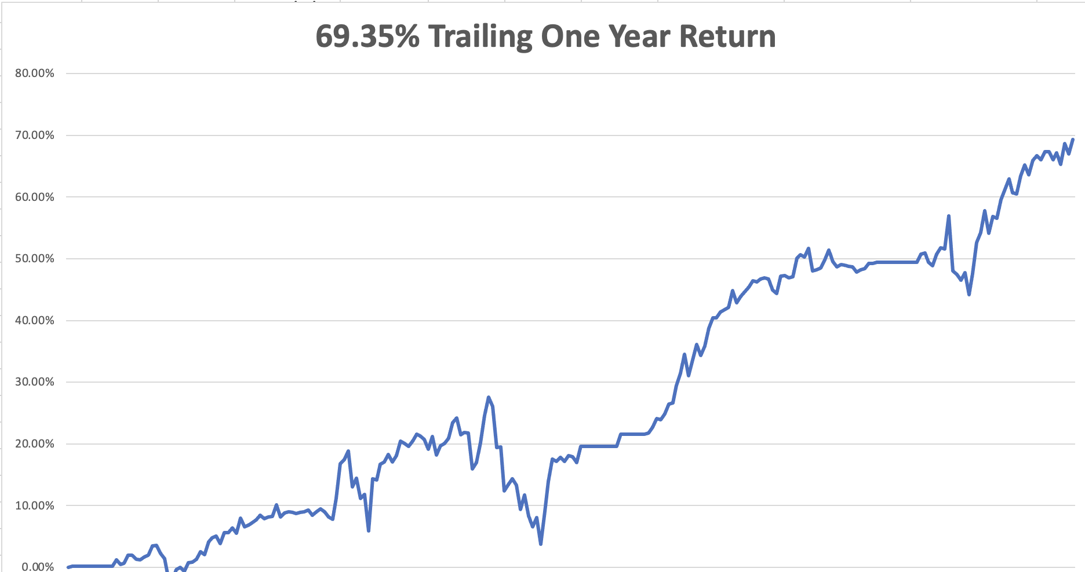

Slide 6
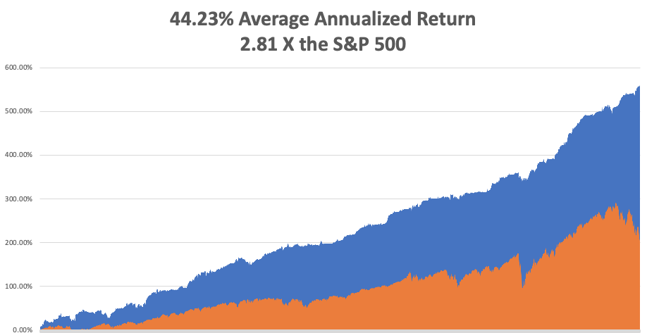

Slide 7
The Method to My Madness Searching of a Risk Bottom
*Downtrend remains intact, but new lows are becoming increasing marginal *Rollover of the energy sector could mark the final low *US Dollar also starting to show topping signs *The first 200 basis points of Interest rate rises are in the market, but 300 are not *Bear market in bonds has stalled, keep short positions small *Pandemic cases are increasing modestly but are no longer a factor for the economy or the stock market *VIX hanging around over $30 sets up great options positions

Slide 8
Corona Update –
*Most Americans have some covid immunity now, even through vaccination, getting the disease, or like me, through both! *Five and under Pfizer vaccine is now available *The US drops covid testing requirements for international travelers *Corona virus cases up 2 million to 86.5 million *Deaths up 2,000 to 1,005,000 in 2 weeks, *Pandemic is still going to near zero by summer, book those cruises *But a lot of “long covid” cases are hidden below the surface *Covid is with us for good and big pharma will offer combined annual covid and flu shots by the fall

Slide 9
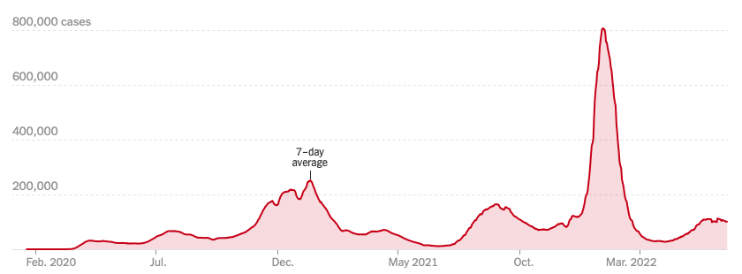
The Pandemic is Over

Slide 10
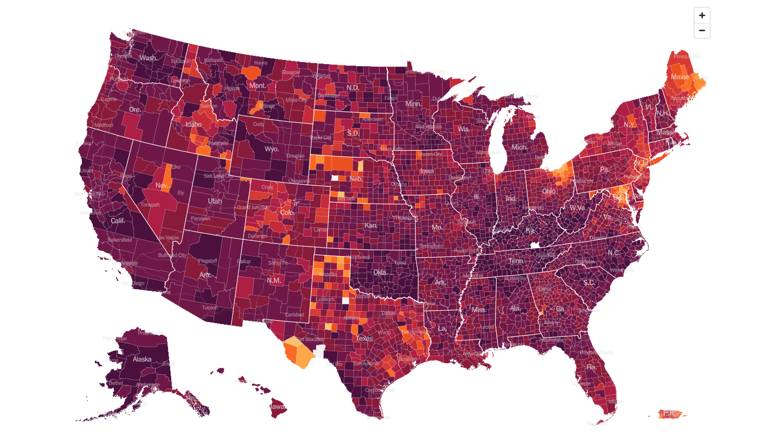
February 2 2022 Infection Rate

Slide 11
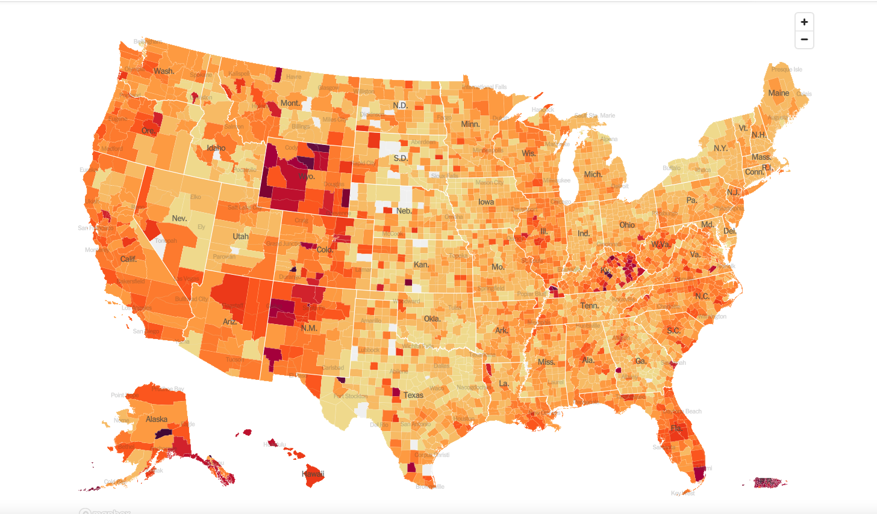
June 22 2022 Infection Rate

Slide 12
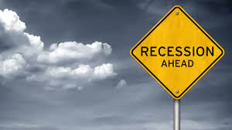
The Global Economy – Recession Fears
*Fed Raises Rates by 75 Basis Points, the most in 28 years *May inflation hit 8.6%, a new 40 year high *Nonfarm Payroll Report Comes in at 390,000, better than expected * Weekly Jobless Claims Come in at 229,000, down 3,000 *Retail Sales Drop 0.3%, much worse than expected *Producer Price Index Jumps 10.8% YOY, fanning the flames of inflation *Consumer Sentiment is in Free Fall, diving from 58.50 to 50.2 *US Consumer Credit Surges, up 10.1% in April

Slide 13
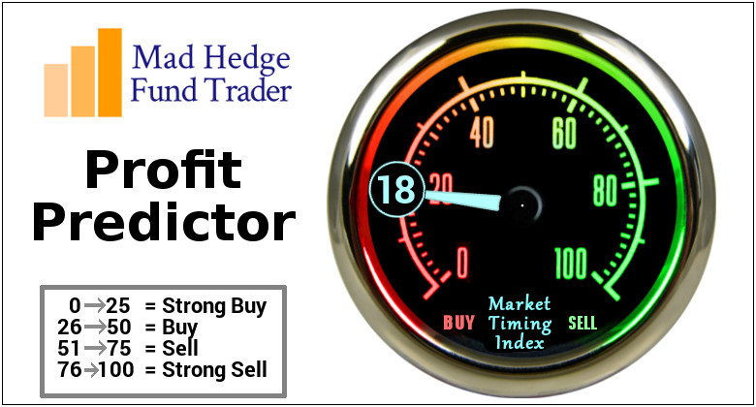
The Mad Hedge Profit Predictor Market Timing Index – Buy Territory An artificial intelligence driven algorithm that analyzes 30 different economic, technical, and momentum driven indicators

Slide 14
The Mad Hedge Profit Predictor From Extreme “BUY” to Neutral
SELL
Do Nothing
BUY

Slide 15
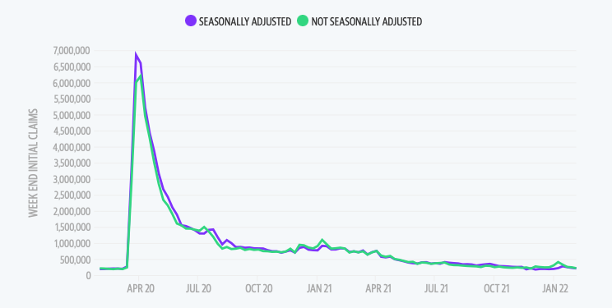
Weekly Jobless Claims – Falling 229,000 – down 3,000

Slide 16
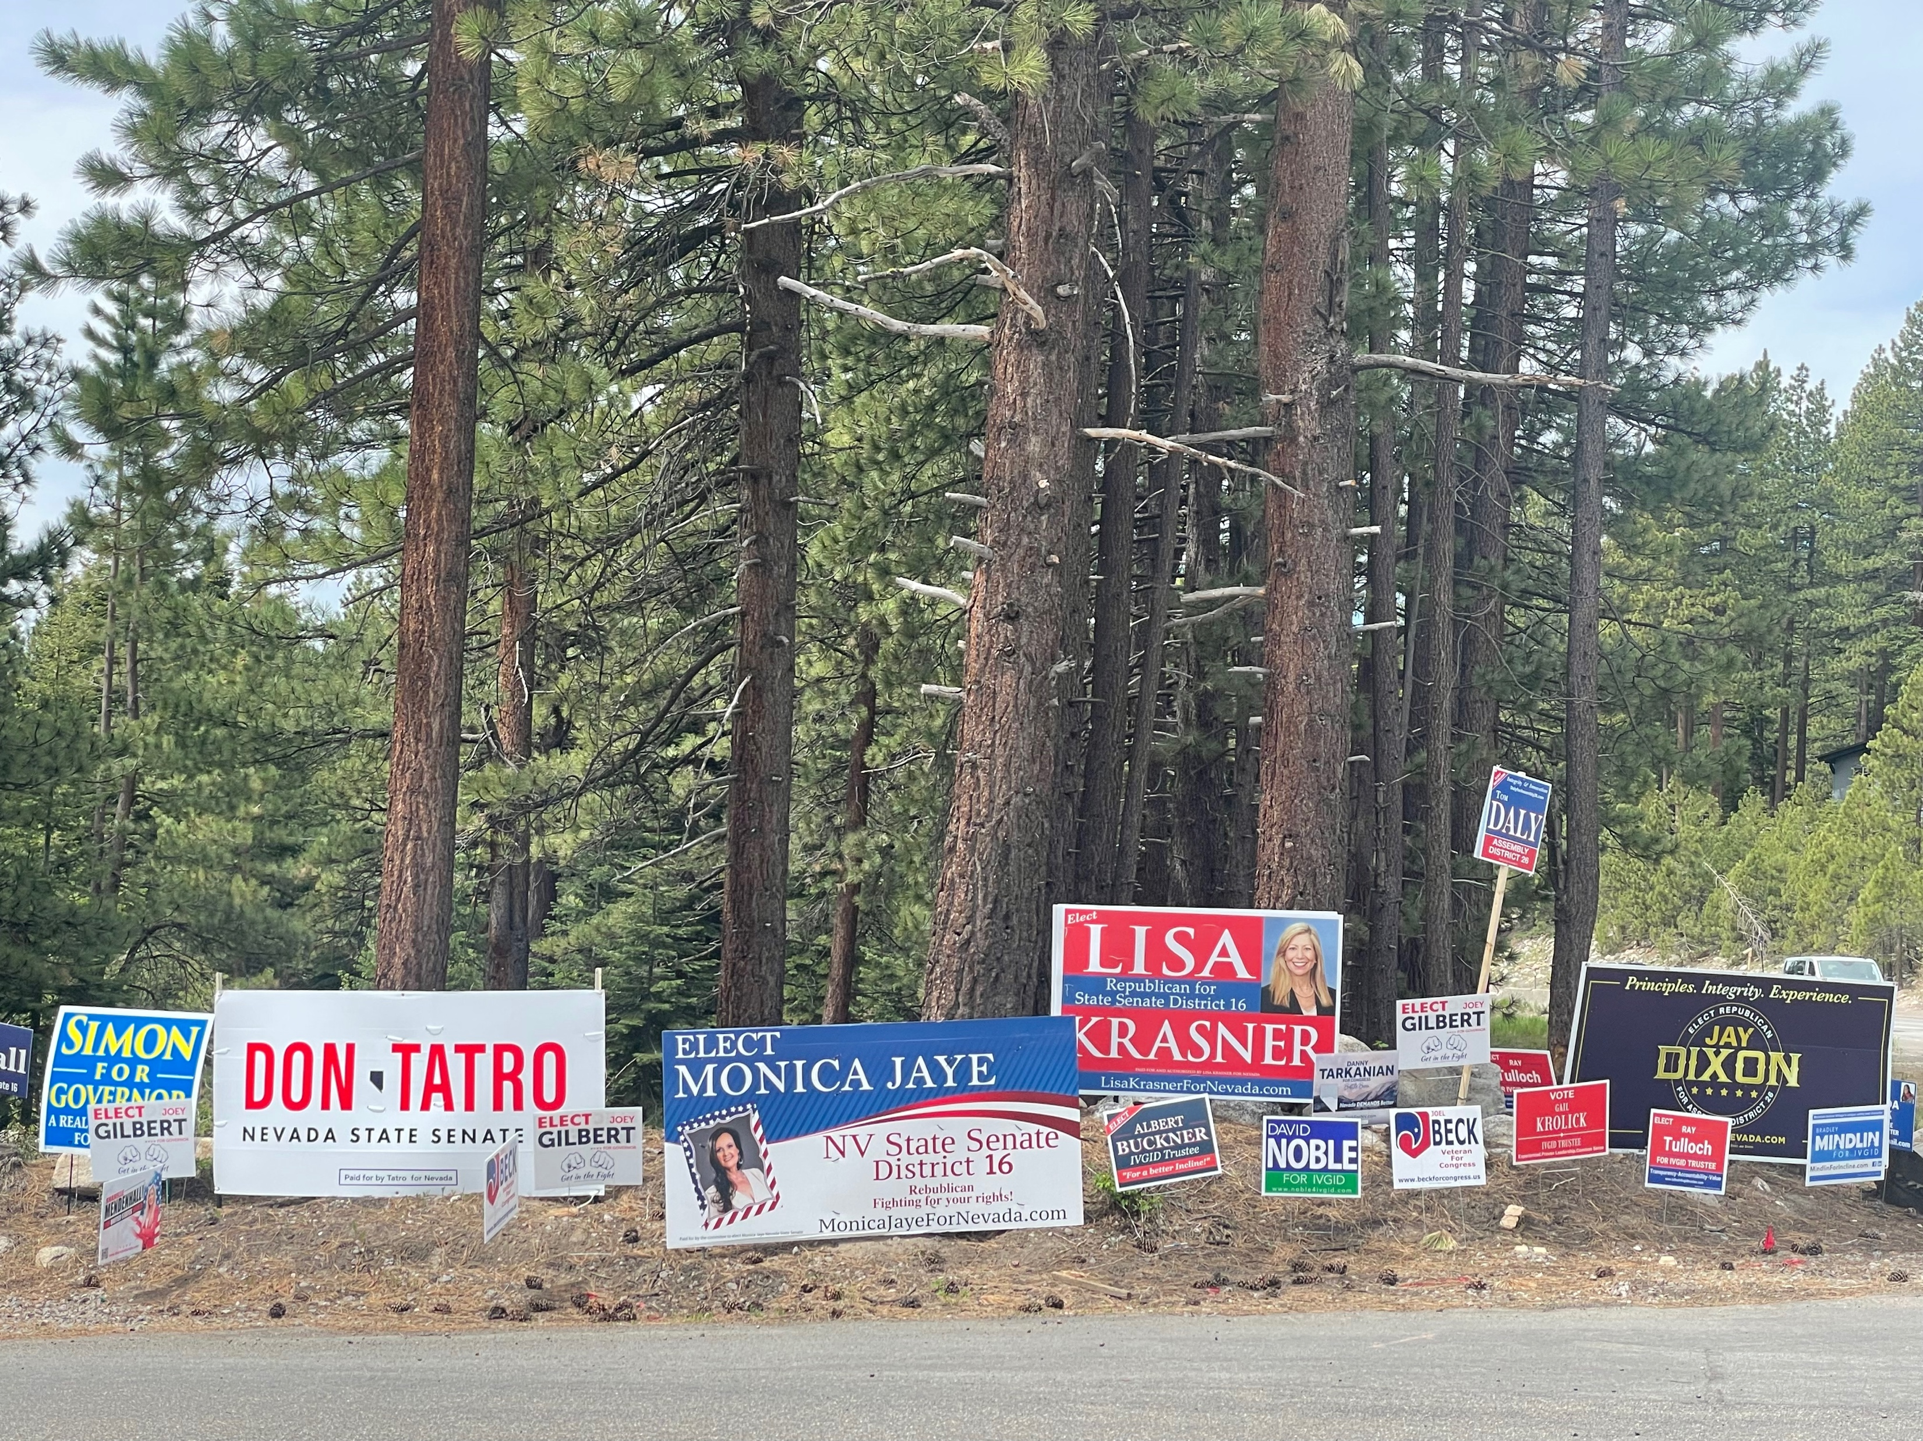

Slide 17
Stocks – Back from the Dead
*Dow Average Breaks 30,000, for the first time in a year, down 8,000 in less than six months, or 21% *Stocks to Hit New Highs in 2022, even if oil hits $150 a barrel, says JP Morgan’s Marko Kolanovic *Strong Dollar is Demolishing US Corporate Profits *Expect the market to continue range trading for the next several months, and possible the rest of the year *DocuSign Crashes 24% on an earnings fail. It’s further proof that money losing small tech has a long bumpy road ahead of it *Target Warns of More Margin Squeeze, with too much inventory and flagging demand *Look for terrible H1 and strong H2 scenario to continue

Slide 18
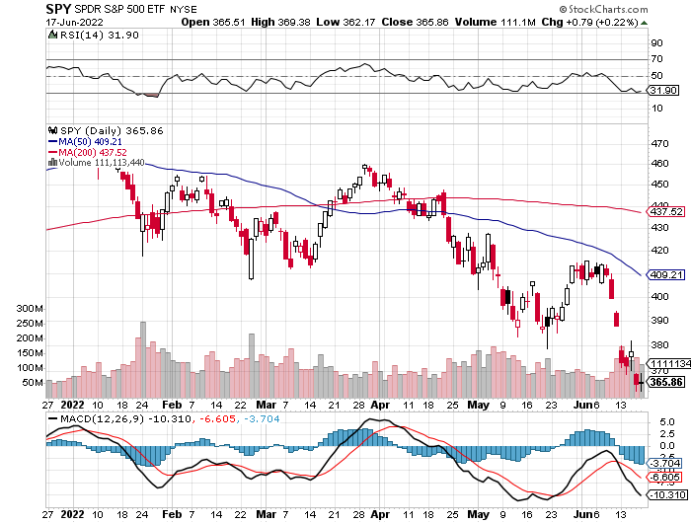
S&P 500 – Back to the Bottom of the Range long 6/$430-$440 put spread, long $440-$450 put spread, ,
$409
The Bottom 350 Down -27%

Slide 19
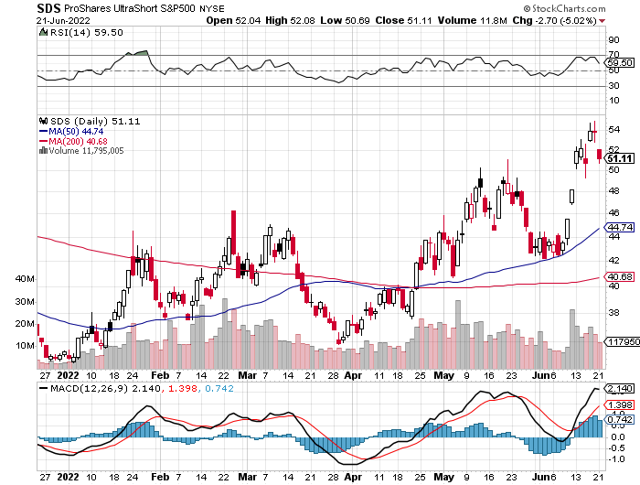
ProShares Ultra Short S&P 500 (SDS)- a great hedge for long stocks and bonds long 2X position has a hedge against longs and bond shorts

Slide 20
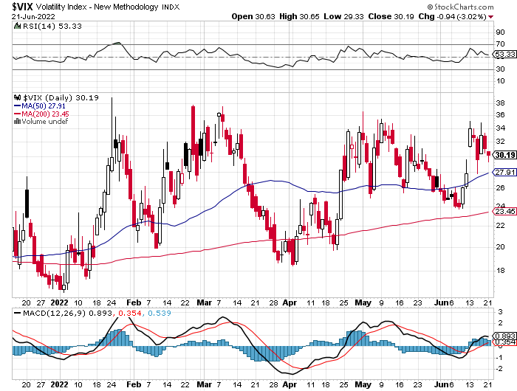
(VIX) – Unable to Make a New High

Slide 21
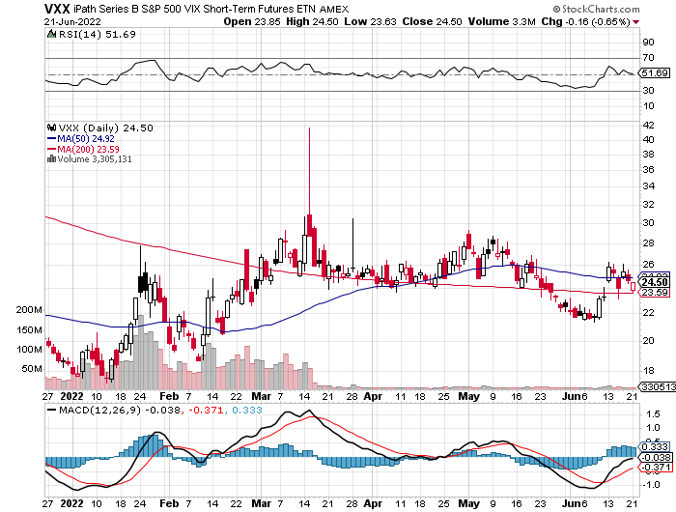
(VXX)-

Slide 22
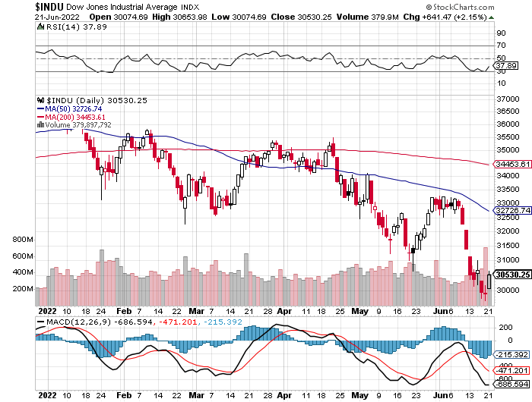
Dow Average ($INDU)-

Slide 23
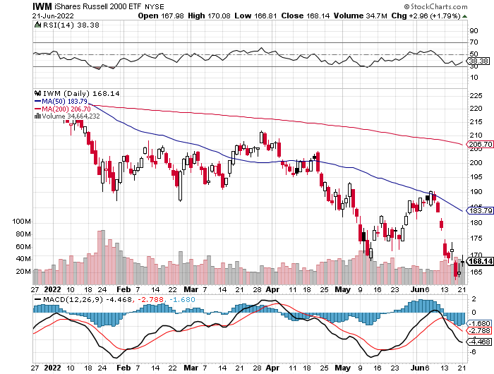
Russell 2000 (IWM)- took profits on Long 10/$137-$142 vertical bull call spread took profits on Long 10/$153-$156 vertical bear put spread

Slide 24
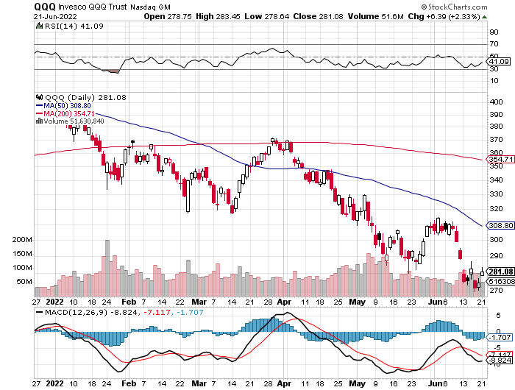
NASDAQ (QQQ) – long (QQQ) 4/$330-$335 put spread took profits on long (QQQ) 3/$340-$345 put spread covered long (QQQ) $325-$330 put spread

Slide 25
The Barbell Portfolio
*50% Big Tech - 2% of US Employment but 27% of Market Cap and 38% of Profits 50% Domestic Recovery, including: Railroads Couriers Banks Construction Credit Cards Event organizers Ticket sales Retailers

Slide 26
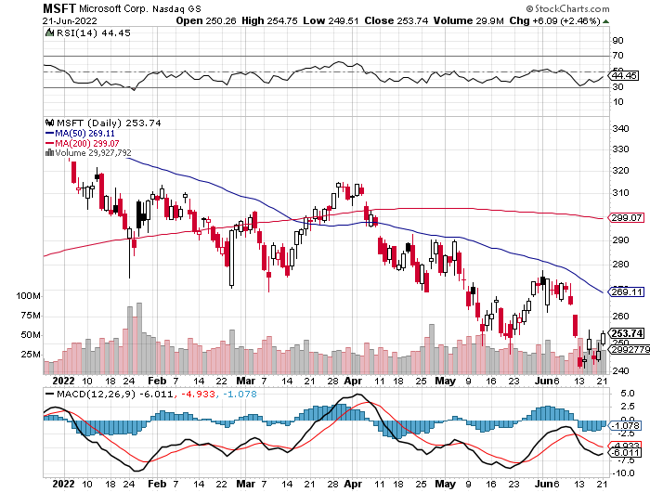
Microsoft (MSFT)- long 7/$220-$210 call spread, took profits on long 6/$220-$230 call spread took profits on long 2/$200-$210 bear put spread

Slide 27
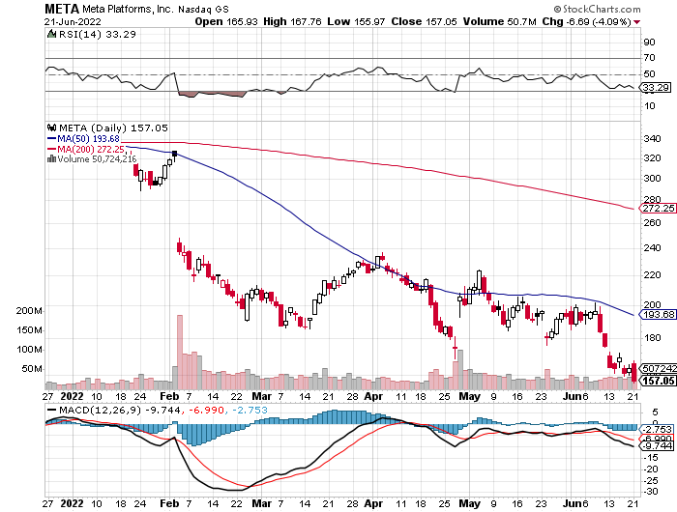
Facebook (FB)- Changes Name to “Meta” took profits on Long 9/$290-$300 vertical bear put spread stopped out of Long 9/$190-$200 vertical bear put spread

Slide 28
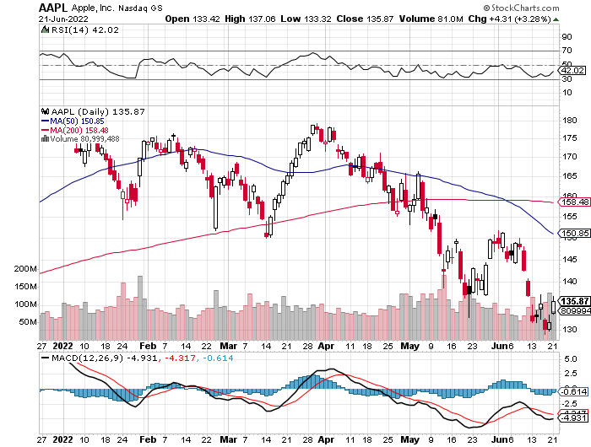
Apple (AAPL)- Apple is Moving into the Loan Business long 6/$155-$165 put spread, stopped out of long 6/$125-135 call spread, took profits on long 6/$110-$120 call spread, took profits on long 2/$180-$190 put spread

Slide 29
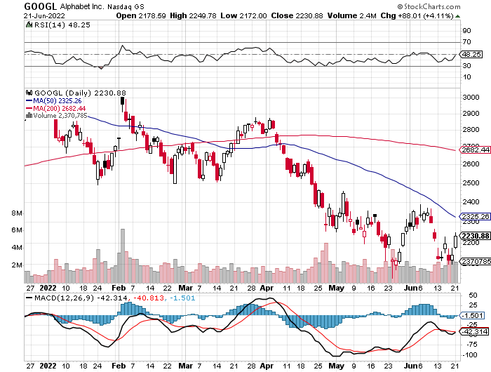
Alphabet (GOOGL) – Ad king on economic recovery Alphabet Misses on Top and Bottom took profits on long 12/$1,200-$1,230 bull call spread took profits on long 9/$1,030-$1,080 vertical bull call spread

Slide 30
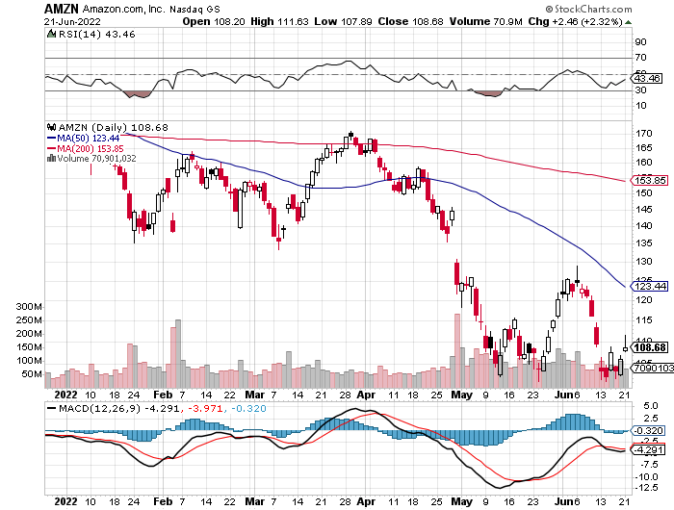
Amazon (AMZN) – Amazon Splits 20:1, triggering an avalanche of new retail buyers took profits on long 2/$3,400-$3,500 bear put spread took profits on long 9/$2,800-$2,900 bull call spread

Slide 31
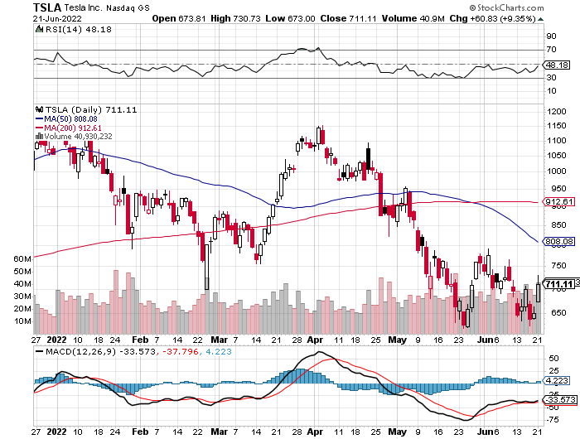
Tesla (TSLA) –Twitter Drag Aiming for 1.4 million cars in 2022, Proposes 3:1 Stock Split Tesla is Raising Prices on its Cars, passing on rising commodity prices directly to customer because they can long 2/$500-$550 call spread profits on long 2/$550-$600 call spread took profits on long 2/$600-$650 call spread

Slide 32
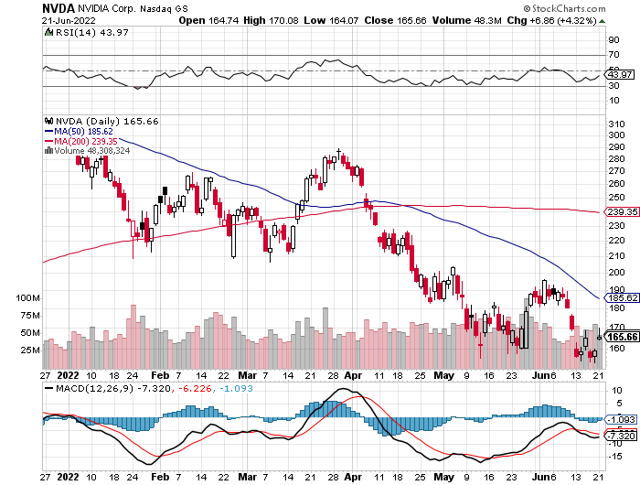
NVIDIA (NVDA) – Surprising to the upside on almost every front, sending the stock up $30, or 18.75% long 7/$120-$130 call spread took profits on long 6/$120-$130 call spread

Slide 33
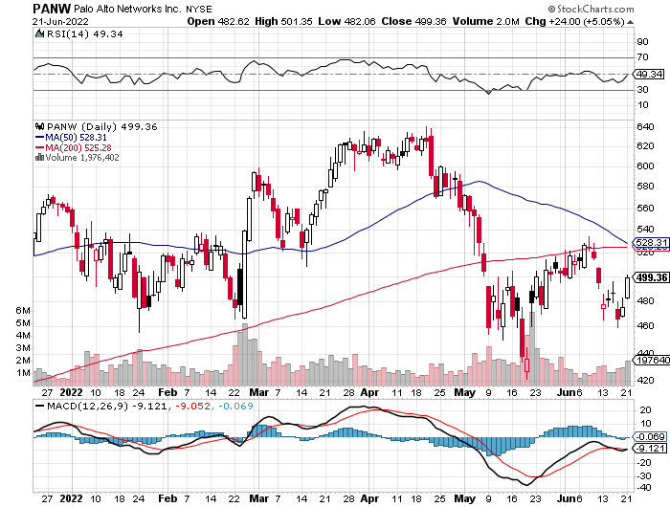
Palo Alto Networks (PANW)- Hacking never goes out of fashion

Slide 34
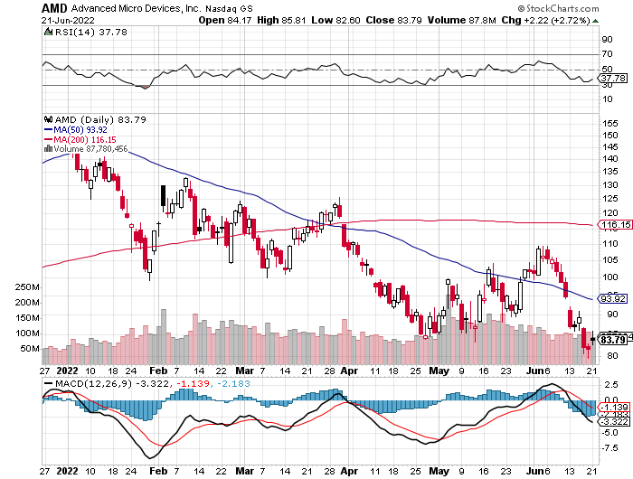
Advanced Micro Devices (AMD)- Recession fears programable logic devices took profits on long 2/$75-$80 call spread

Slide 35
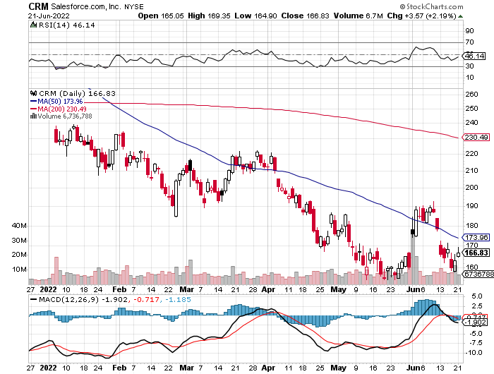
Salesforce (CRM)- Massive Online Migration took profits on long 9/$125-$130 vertical bull call spread took profits on long 8/$125-$130 vertical bull call spread took profits on long 2/$105-$115 call spread

Slide 36
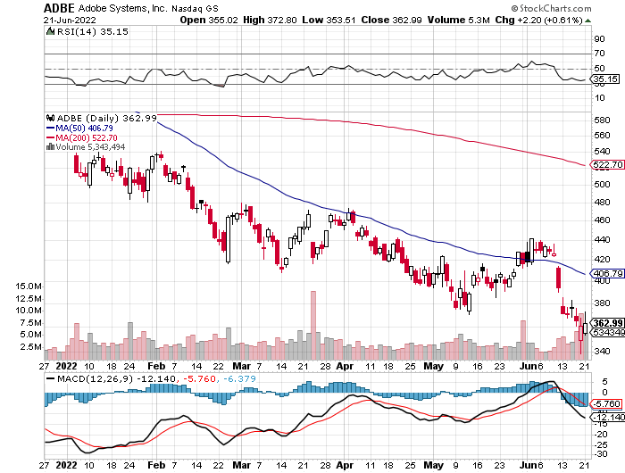
Adobe (ADBE)- Cloud play The Quality Non-China tech play

Slide 37
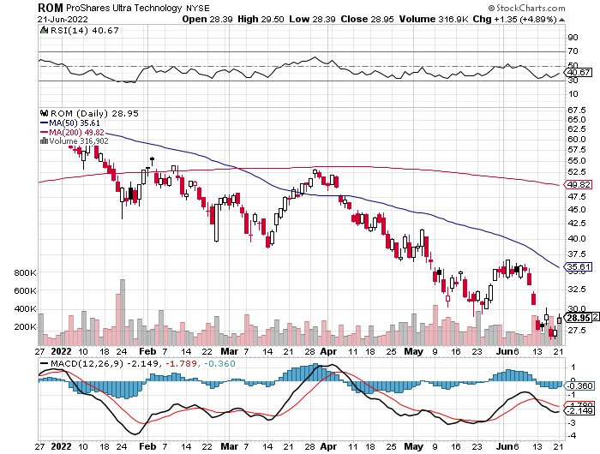
ProShares Ultra Technology ETF (ROM) – 2X Long Technology ETF took profits on long 10/$62-65 call spread

Slide 38
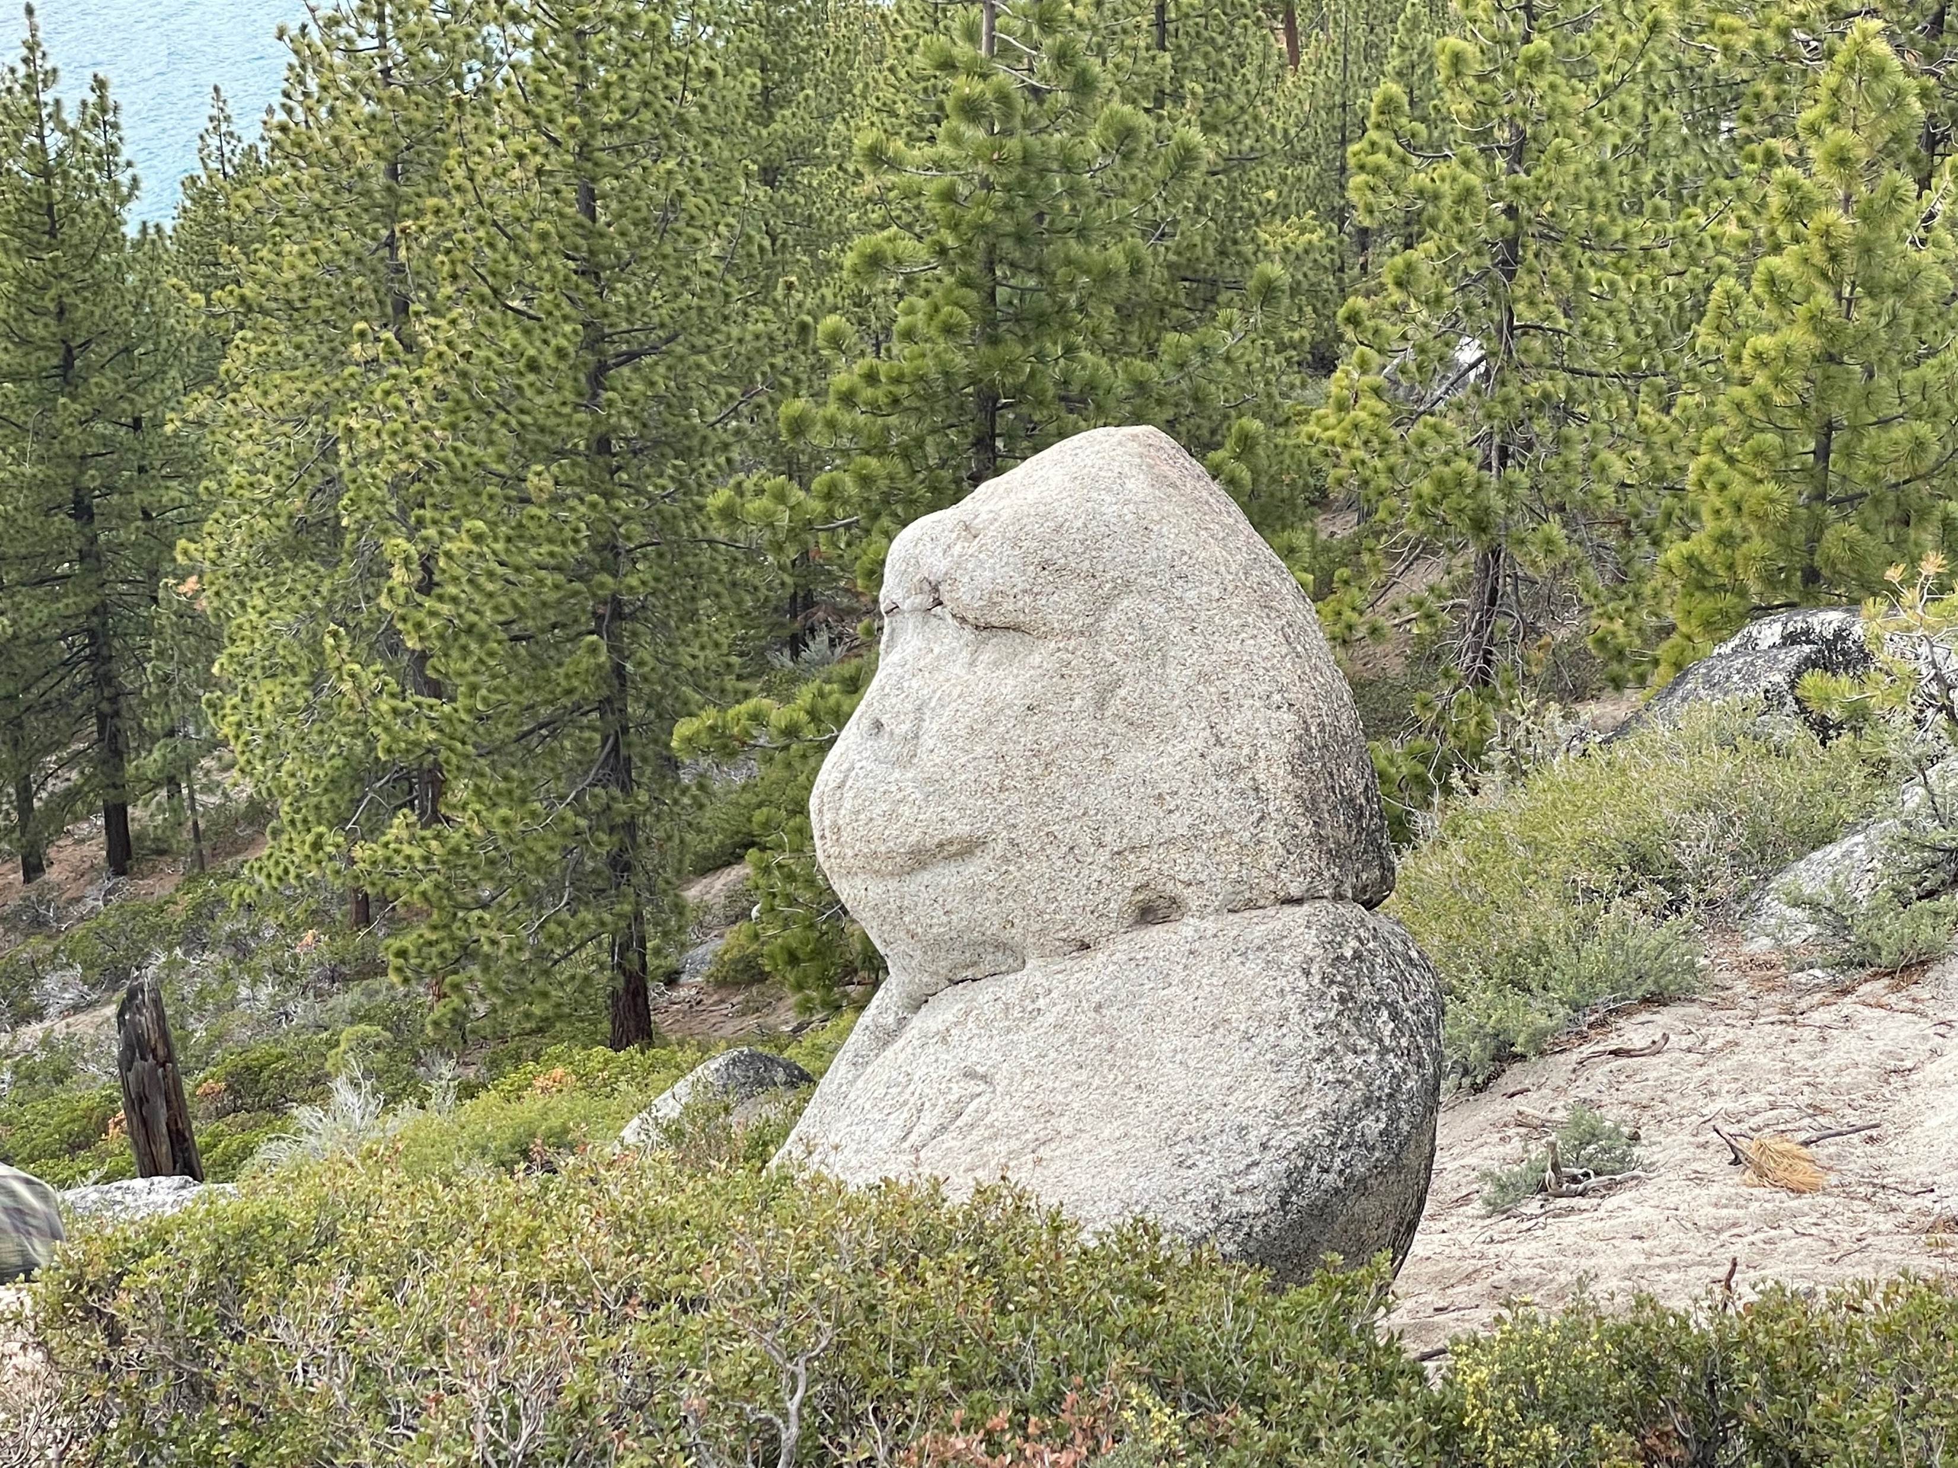

Slide 39
The Second Half of the Barbell
*Bets on a domestic recovery in 2022 Q4 *Upside potential in 2022 far greater than tech *Some of these have not moved for 5 or 10 years *Focuses on economically sensitive cyclical industries *Makes a great counterweight to high-growth technology *We could spend all of next year rotating between the two groups

Slide 40
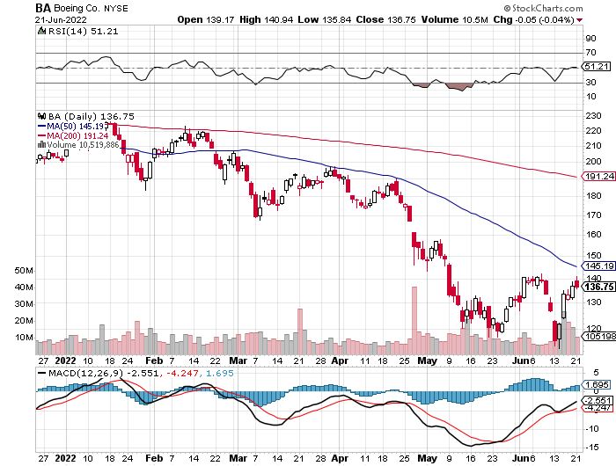
Boeing (BA) –Disastrous Earnings $2.7 loss booked in Q1 long 3/$146-$149 call spread took profits on long 2/$150-$160 call spread

Slide 41
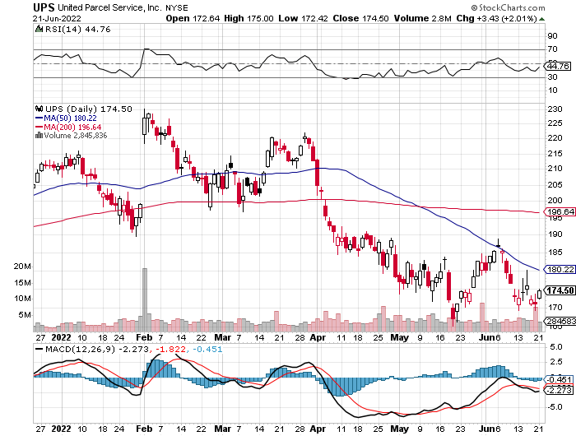
Package Delivery- United Parcel Service (UPS) - Package Delivery record profits took profits on long 11/$130-$140 call spread

Slide 42
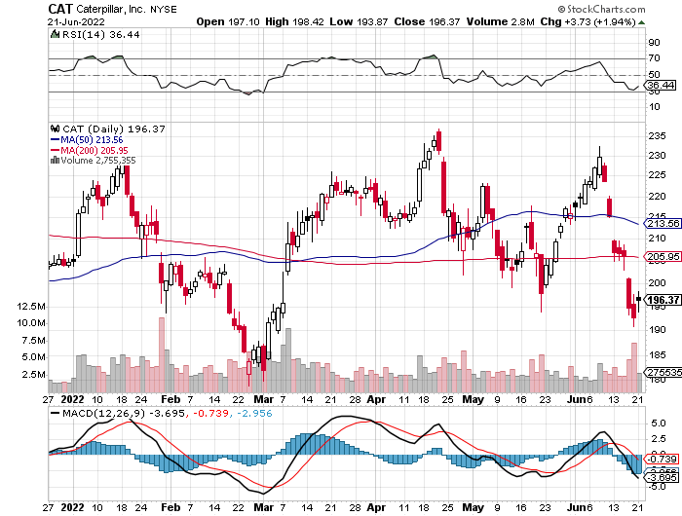
Caterpillar (CAT)- Ag + Infrastructure + Housing Raises Dividend by 50% took profits on long 12/$145-$150 call spread took profits on long 11/$125-$135 call spread

Slide 43
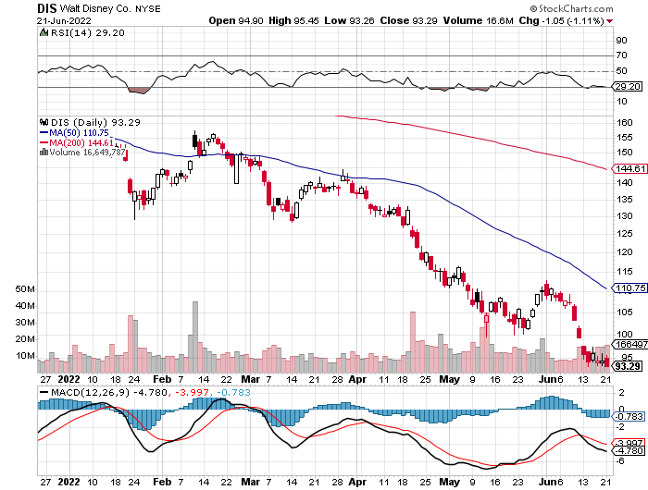
Walt Disney (DIS)- Florida Declares War stopped out of long 10/$165-$175 call spread took profits on long 3/$170-$180 call spread

Slide 44
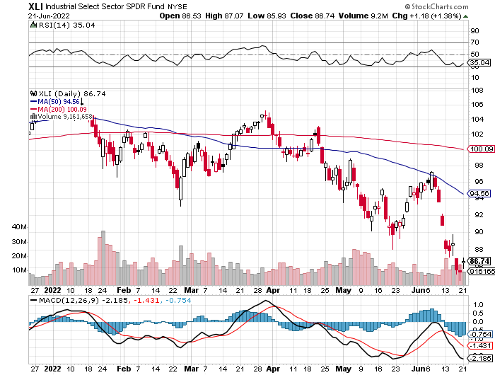
Industrials Sector SPDR (XLI)- (GE), (MMM), (UNP), (UTX), (BA), (HON)

Slide 45
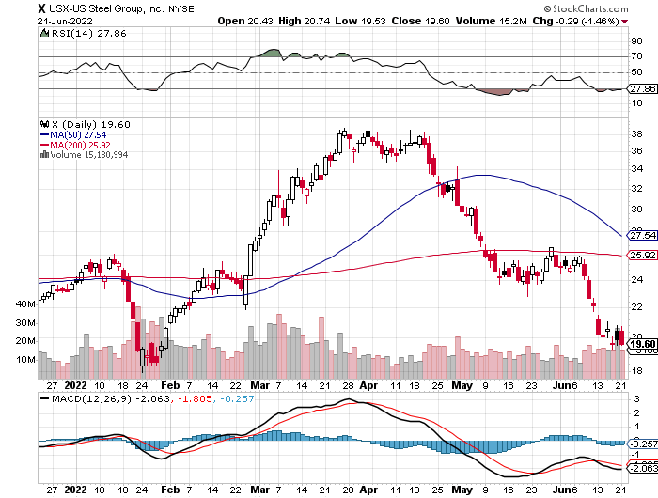
US Steel (X) – Commodity Boom and Wartime boost

Slide 46
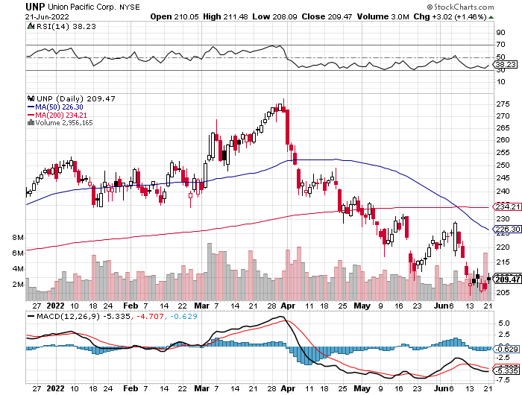
Union Pacific RR (UNP)- Big Stuff to Ship near record earnings announced took profits on long 5/$200-$210 call spread took profits on 11/$150-$160 call spread

Slide 47
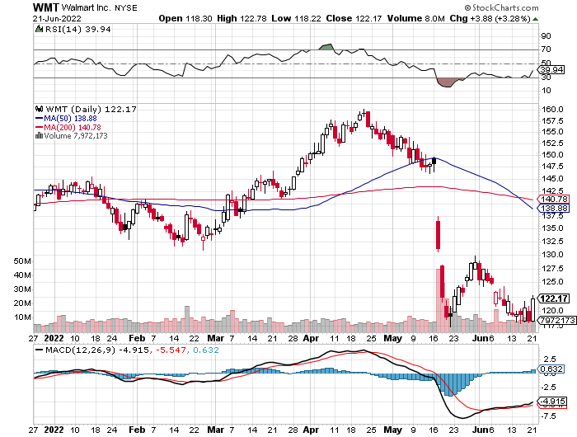
Wal-Mart (WMT)- took profit on Long 11/$125-$130 bear put spread took profit on Long 10/$119-$121 bear put spread took profits on Long 8/$114-$117 bear put spread

Slide 48
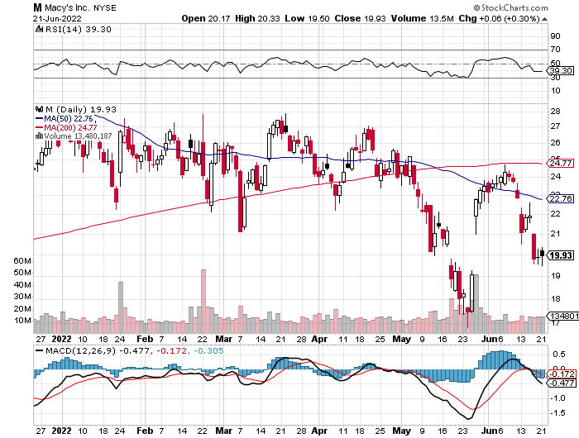
Macys’ (M) – Retail Punished Macy’s Surprises to the Upside took profits on Long 8/$23-$25 bear put spread

Slide 49
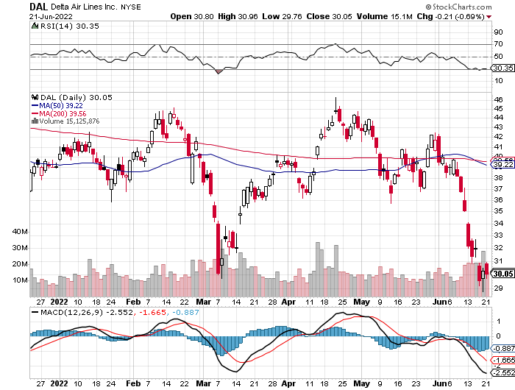
Delta Airlines (DAL) – Travel is Back!

Slide 50
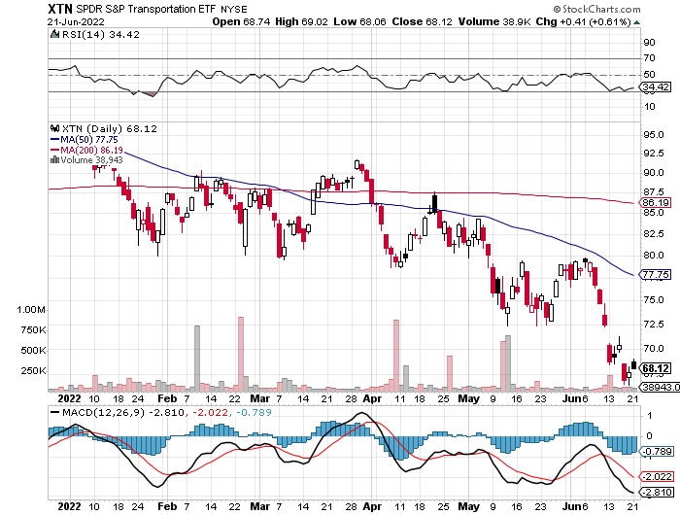
Transports Sector SPDR (XTN)- Worst Hit Sector (ALGT), (ALK), (JBLU), (LUV), (CHRW), (DAL)

Slide 51
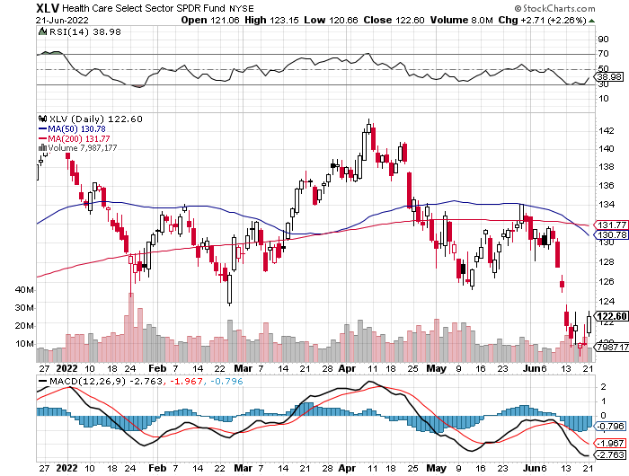
Health Care Sector (XLV) (JNJ), (PFE), (MRK), (GILD), (ACT), (AMGN)

Slide 52
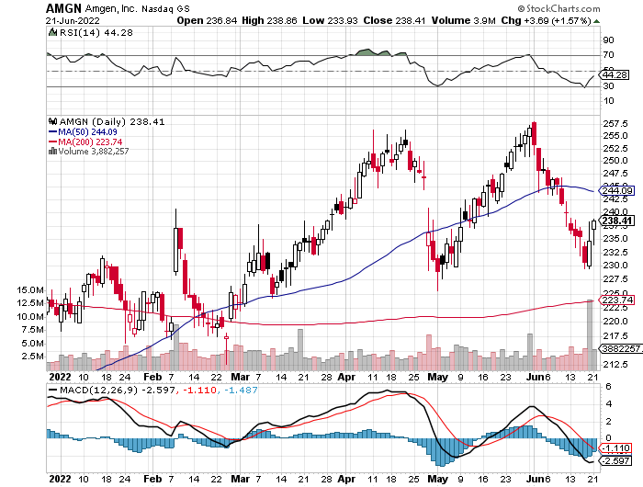
Amgen (AMGN) took profits on long 11/$185-$200 bull call spread

Slide 53
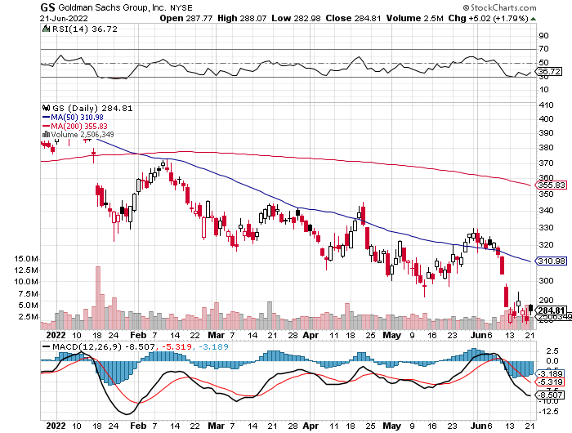
Goldman Sachs (GS) – took profits 12/$330-$350 call spread took profits 11/$330-$350 call spread stop loss on long 11/$385-$395 call spreads

Slide 54
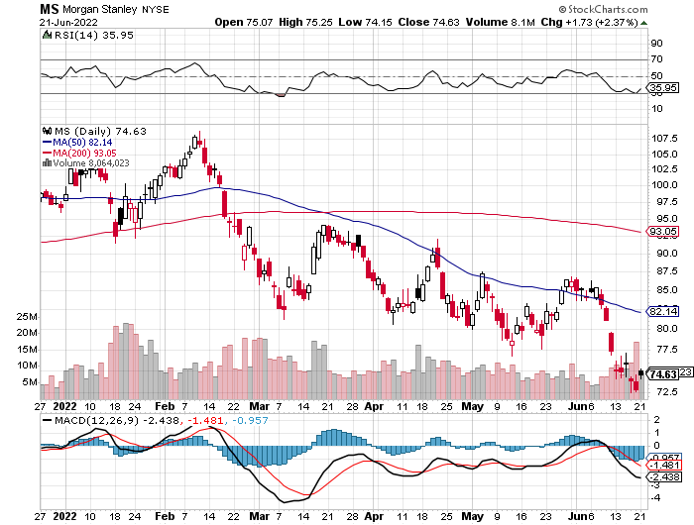
Morgan Stanley (MS) – Blows Away Earnings Equity trading came in a hot $3.2 billion and bond trading $2.9 billion took profits on long 11/$85-$90 call spread

Slide 55
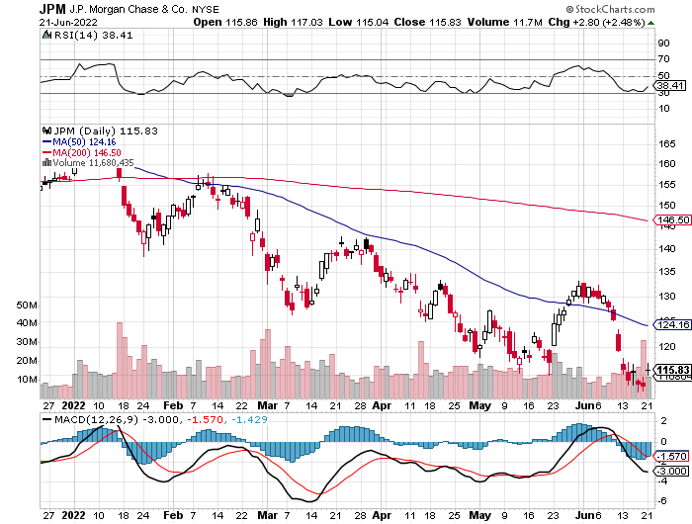
JP Morgan Chase (JPM)- Shares Pop 7.5%, on news that a 17% return on equity is achievable took profits 12/$148-$152.50 call spread

Slide 56
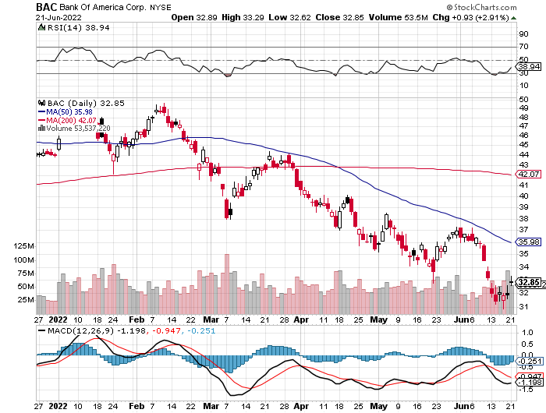
Bank of America (BAC) – took profits long 12/$39-$42 call spread

Slide 57
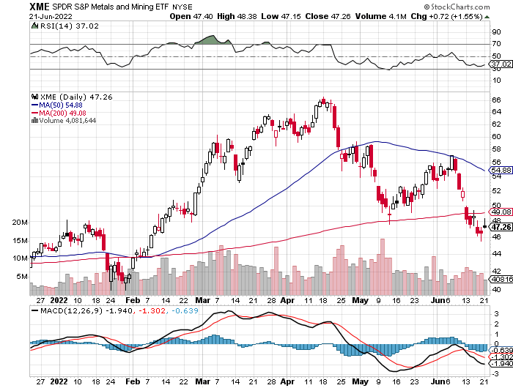
SPDR Metals & Mining ETF (XME) – long 2/$28-$30 call spread

Slide 58
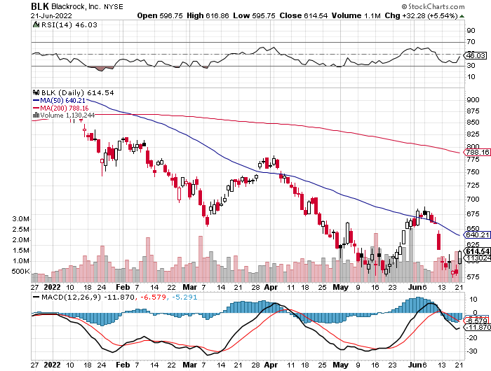
Blackrock (BLK)-Asset Collection Boom took profits on long 3/$770-$790 call spread took profits on long 3/$310-$340 call spread

Slide 59
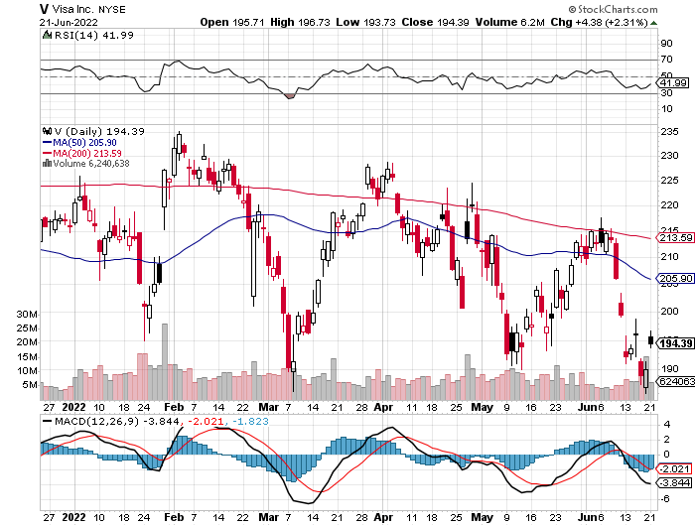
Visa (V) – “Touchless” Bitcoin Drag long 6/$150-$160 bull call spread

Slide 60
Consumer Discretionary SPDR (XLY) (DIS), (AMZN), (HD), (CMCSA), (MCD), (SBUX)

Slide 61
Berkshire Hathaway (BRKB)- Natural Barbell Buys Alleghany Insurance, for $11.6 billion long 7/$220-$230 call spread took profits on long 6/$260-$270 call spread, stopped out of long 5/$300-$310 call spread, took profits on long 2/$270-$280 call spread

Slide 62
Europe Hedged Equity (HEDJ)-

Slide 63
Japan (DXJ)-

Slide 64
Emerging Markets (EEM) - Pro trade, Weak Dollar, Long Recovery Play

Slide 66
Bonds – End of the Road
*Ten Year Treasuries yields Hit 11-Year High, at a 3.48% yield, then plunge 30 basis points *Short covering of massive short positions is a factor *The bulk of the move down in bond prices is done *US Treasury Bans Purchase of Russian Debt, so if you were looking for those 20%-30% junk yields you are out of luck *US Treasury bond fund (TLT) could plunge from $180 in 2020 to $100 by 2023

Slide 67
Treasury ETF (v) – Bottoming-No Positions took profits on long 6/$124-$127 put spread, took profits on long long 7/$128-$131 put spread took profits on long 5/$128-$131 put spread, look profits on long 5/$127-$130 put spread took profits on long 5/$110-$113 call spread

Slide 68
Ten Year Treasury Yield ($TNX) – 3.24%

Slide 69
Junk Bonds (HYG) 7.52% Yield to Maturity

Slide 70
2X Short Treasuries (TBT)-Another run at highs

Slide 72
Foreign Currencies – Dollar Takes a Break
*US Dollar takes a break from 20-Year High thanks to falling interest rates *Euro pops on dollar weakness *Shanghai shutdown end boosts the Yuan *Commodity currencies like (FXA) and (FXC) go ballistic on rising oil prices *Long-term US dollar fundamentals are still poor, a dollar short could be the new ten-year trade, but not yet *Stand aside from forex for now, there are getting fish to fry

Slide 73
Japanese Yen (FXY)

Slide 74
Euro (FXE)-

Slide 75
British Pound (FXB)-

Slide 76
Australian Dollar (FXA)- The Global Recovery Play took profits on long 8/$67-$69 call spread

Slide 77
Emerging Market Currencies (CEW)

Slide 78
Chinese Yuan- (CYB)- Shanghai Shutdown

Slide 80
Bitcoin – Breakdown Buy the Mad Hedge Bitcoin Letter at https://www.madhedgefundtrader.com/store/
*Bitcoin is Still in Free Fall, down 75% from the top *There are no buyers anywhere, and margin calls are running rampant *WE are now at cost of production so further falls may be limited as miners shut down *Soaring electricity costs have increased cost of production in a major way *Disappearing global liquidity is not the time to be in Bitcoin *Coinbase Lays Off 18%, as the crypto nuclear winter continues *Buy Bitcoin and Ethereum on the bigger dip, but not now

Slide 81
Bitcoin ($BTCUSD) – Finding a bid

Slide 82
Ethereum (ETHE) –

Slide 83
MicroStrategy (MSTR) –

Slide 84
Amplify Transformational Data Sharing ETF (BLOK) –

Slide 86
Energy & Commodities – Rolling Over
*OPEC+ Raises Oil Output, to meet surging energy demand caused by the Ukraine War *Oil Companies are Under Attack over price gouging *A windfall profits tax may be in the works, the last one running from 1980-1988 during the second oil shock *Gasoline Prices Skyrocket, hitting $7.29 a gallon in California and $5.00 everywhere else *Natural Gas Crashes, down 17% in a day *Uranium Stocks Soar on Biden’s plan to buy $4.3 billion worth of enriched uranium *Americans Will Spend an Extra $730 Billion on Energy this Year *Avoid all energy plays like the plague, it’s the new buggy whip industry as the US de-carbonizes

Slide 88
Oil-($WTIC)

Slide 89
United States Oil Fund (USO) long 10/$9.50-$10 Vertical bull call spread

Slide 90
Energy Select Sector SPDR (XLE)-No Performance! (XOM), (CVX), (SLB), (KMI), (EOG), (COP)

Slide 91
Halliburton (HAL)-

Slide 92
Natural Gas (UNG) -

Slide 93
Freeport McMoRan (FCX) -

Slide 94
Cameco (CCJ) - took profits on long 5/$20-$23 bull call spread

Slide 96
Precious Metals – Dead in the Water
*Gold takes a break on global “RISK OFF” move *Gold is more of a commodity play now than a risk hedge *Recently falling interest rates give gold and additional boost *It is after all a classic inflation play, which will rise before it falls *Silver is still the bigger and better long-term play

Slide 97
Gold (GLD)- took profits on long 5/$165-$170 bull call spread

Slide 98
Market Vectors Gold Miners ETF- (GDX) –

Slide 99
Barrick Gold (GOLD) took profits on long 1/$21-$23 call spread took profits on long 11/$22-$24 call spread

Slide 100
Newmont Mining- (NEM)- took profits on long $55-60 call spread

Slide 101
Silver- (SLV)- took profits on long 11/$19-$20 call spread

Slide 102
Silver Miners - (SIL)-

Slide 103
Wheaton Precious Metals - (WPM)- took profits on long 2/$39-41 call spread

Slide 105
Real Estate – Price Peak
*Home purchases reliant on debt have dropped by half *Soaring Interest Rates Demolish New Home Construction, down 14.42% in May *Homebuilder Sentiment Hits Two Year Low, from 69 to 67, and is now down six months in a row *30-Year Fixed Rate Mortgages Rocket to 6.28% *Lumber Crashes, down 50% from the highs in months *Luxury Home Sales are Plunging in New York, in numbers, but not in prices *New Home Mortgages Hit 22 Year Low *Look for prices to flat line until rates drop

Slide 106
S&P Case Shiller S&P Case Shiller Rockets 20.6%, in March with its National Home Price Index Tampa (34.8%), Phoenix (32.4%), and Miami (32.0%)

Slide 107
Crown Castle International (CCI) – 3.77% yielding cell phone tower REIT

Slide 108
US Home Construction Index (ITB) (DHI), (LEN), (PHM), (TOL), (NVR)

Slide 110
Trade Sheet- So What Do We Do About All This?
*Stocks – buy the big dips at bottom of range *Bonds – sell big rallies *Commodities-buy dips *Currencies- stand aside *Precious Metals – stand aside *Energy – stand aside *Volatility - sell short over $30 *Real estate – stand aside *Bitcoin – stand aside

Slide 112
Next Strategy Webinar 12:00 EST Wednesday, August 10 from Lake Tahoe, NV email me questions at support@madhedgefundtrader.com
Good Luck and Good Trading!
Notes:
*

