Slide 1
The Mad Hedge Fund Trader “The Bottom is In”
With John Thomas Silicon Valley, CA, August 10, 2022 www.madhedgefundtrader.com
Notes:
*

Slide 3
Trade Alert Performance New All Time Highs!
*January 14.59% Final *July +3.98% Final *February +8.78% MTD *August +0.46% MTD *March +3.43% Final *September 1.03% Final *April +3.33% Final *October +8.91% MTD *May +8.80% Final *November -11.79% Final *June +5.91% Final *December +11.26% Final *2022 YTD +55.29% compared to -10.19% for the Dow Average *+$567.85% since inception *Average annualized return of +44.83% for 14 years

Slide 4
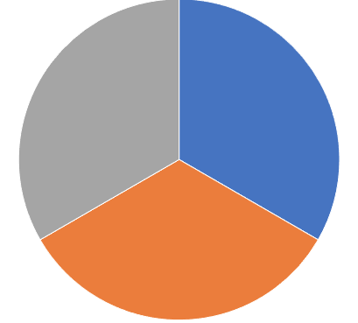
Portfolio Review 30% Long, 0% short, 70% cash- Neutral at the top of the range
Current Capital at Risk
Risk On
World is Getting Better
(TSLA) 8/$500 puts | 10.00%
(TLT) 8/123-$126 put spread | 10.00%
(TLT) 9/$125-$128 put spread | 10.00%
Risk Off
World is Getting Worse
NO POSITIONS
Total Net Position | 30.00%
Total Aggregate Position | 30.00%
Expiration Value +57.59%

Slide 5
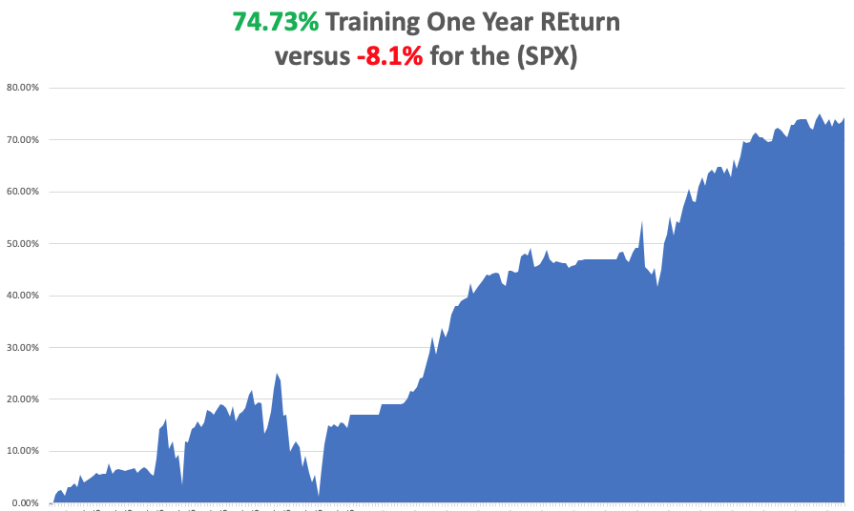

Slide 6
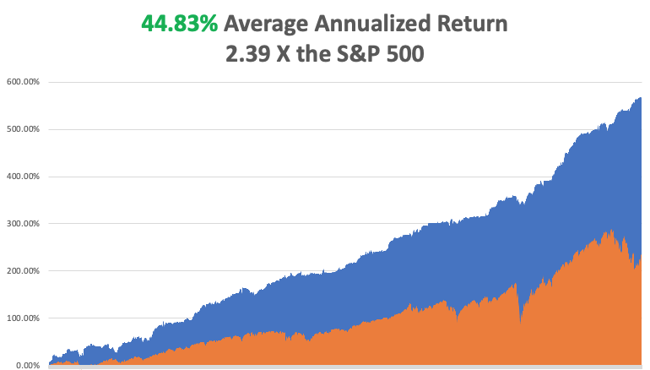

Slide 7
The Method to My Madness The Bottom is In
*All of the factors that prompted the bear market are reversing *Q2 Earnings came in much better than expected, with big tech leading *Energy has peaked and has entered a sharp decline *Inflation has peaked, with only wages and rents remaining strong *Strong dollar and QT have already added the next 100 basis point rate rise *Bear market in bonds has stalled, keep short positions small *Yearend (SPX) of 4,800 is on the table *Hiring is much stronger than expected because much is now online and overseas *VIX at $20 means trading opportunities are few

Slide 8
Corona Update –
*Most Americans have some covid immunity now, even through vaccination, getting the disease, or like me, both! *Five and under Pfizer vaccine is now available *BA.5 is the dominant variant now, highly contagious but very weak *Corona virus cases up 1 million to 92.1 million *Deaths up 5,000 to 1,033,000 in 2 weeks, *But a lot of “long covid” cases are hidden below the surface *Covid is no longer a major factor for the economy

Slide 9
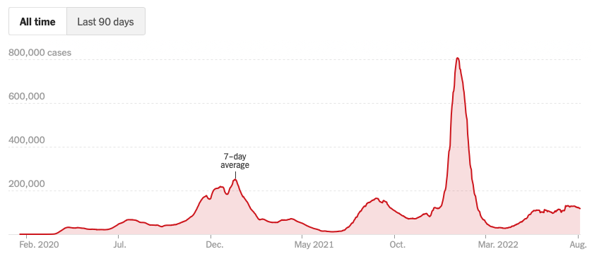
The Pandemic is Over But we may have a permanent low level

Slide 10
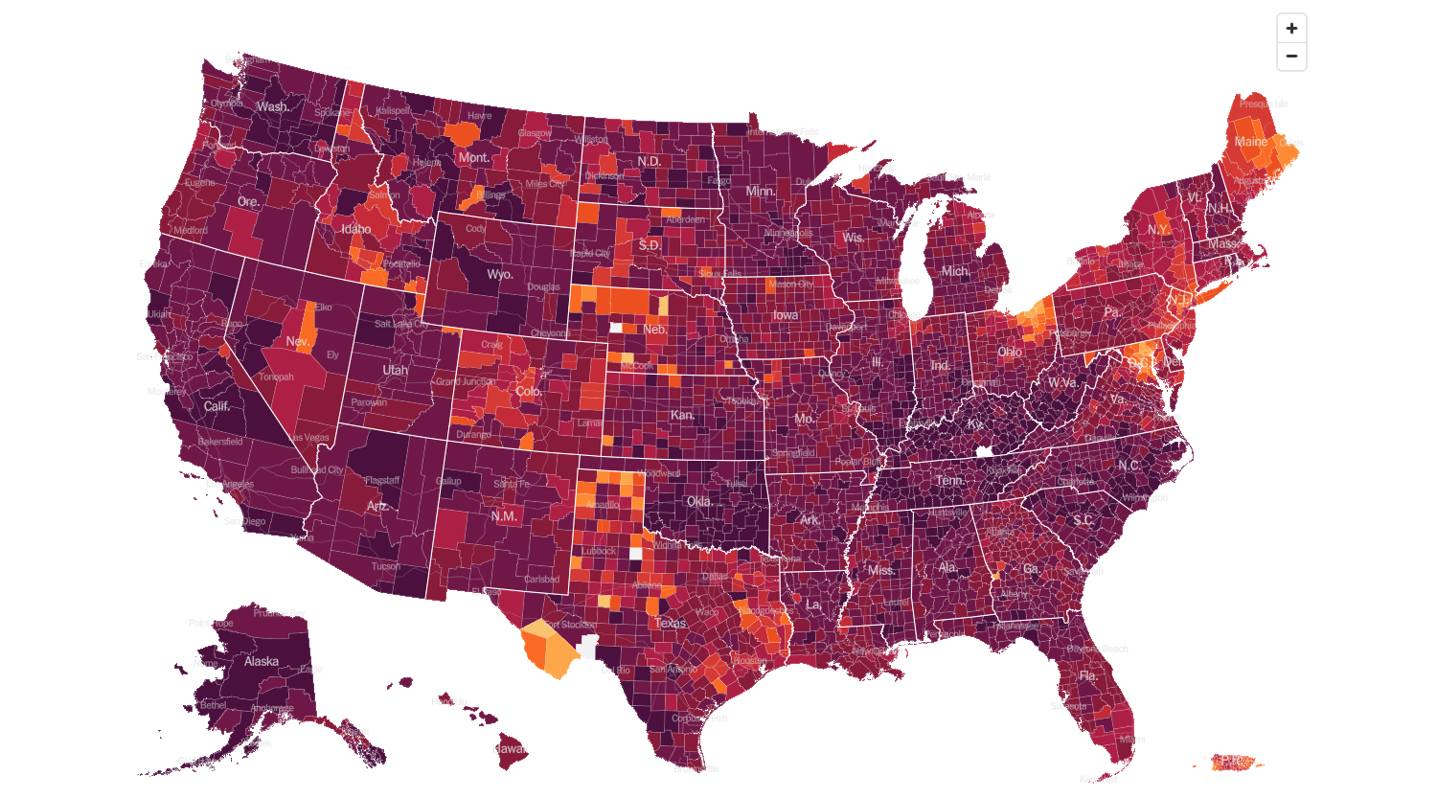
February 2 2022 Infection Rate

Slide 11
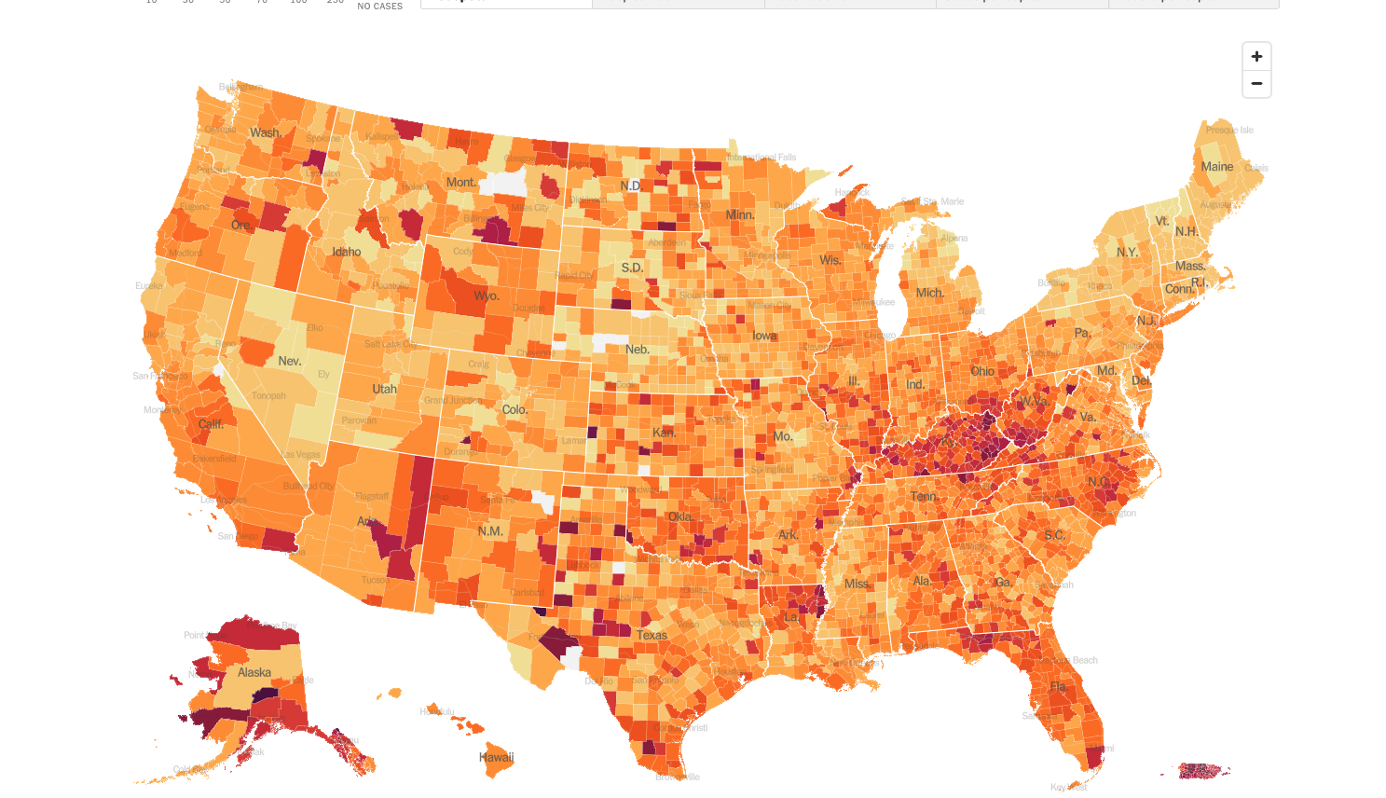
August 10 2022 Infection Rate

Slide 12
The Global Economy – Recession?
*The US is Officially in Recession, after reporting a slight 0.9% decline in Q2 *That makes two back-to-back quarters following the 1.6% decline in Q1 *Biden $740 billion package to the rescue will head off deeper recession, if there is one *July Nonfarm Payroll Hits a Blockbuster 528,000, double expectations *The Headline Unemployment rate fell to 3.5%, a new post pandemic low *Weekly Jobless Claims hit 260,000, an 8- month high *Fed Says More Rate Hikes Coming But No Recession *CPI Plunges to 8.5% in July from 9.1%, August to decline again *England Predicts Major Recession after hiking interest rates by 0.50% to 1.75%

Slide 13
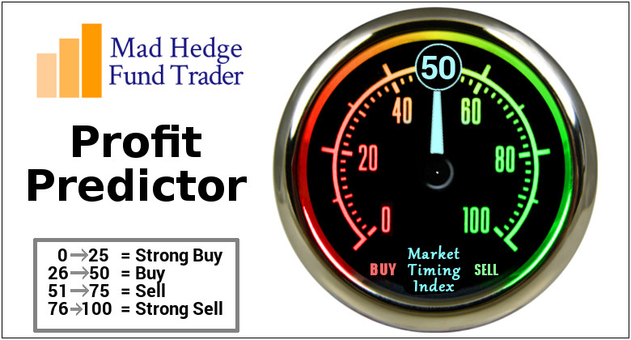
The Mad Hedge Profit Predictor Market Timing Index – Buy Territory An artificial intelligence driven algorithm that analyzes 30 different economic, technical, and momentum driven indicators

Slide 14
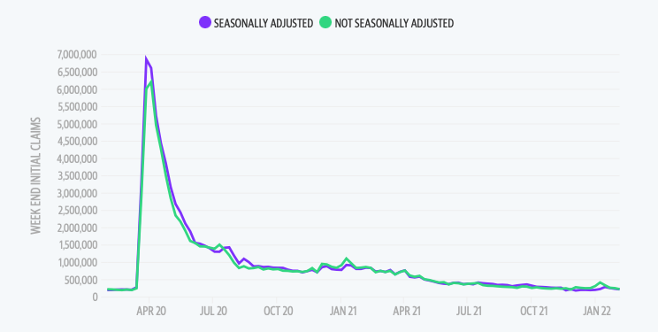
Weekly Jobless Claims – Falling 260,000 – up 5,000

Slide 15
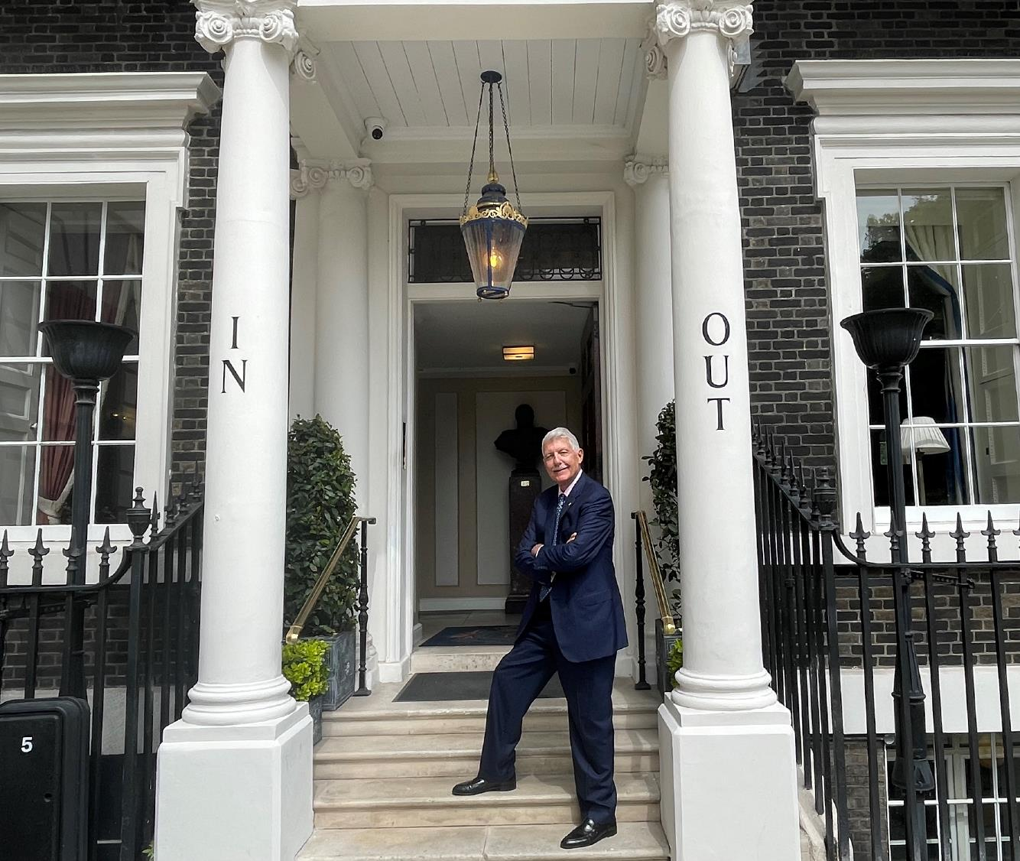

Slide 16
Stocks – The Bottom is in
*Stocks have moved from the bottom to the top of a three months range in 7 weeks *Worst case, we give up 1/3 to ½ of the recent 3,000 gains in August *A massive yearend rally will ensue in September to (SPY) 4,800 *Tech was the big leader. That continues *Commodities may begin a big move as the real economy recovers *EV’s and alternative energy plays have come ballistic off of the $374 billion Biden Climate package *Look for terrible H1 and strong H2 scenario to continue

Slide 17
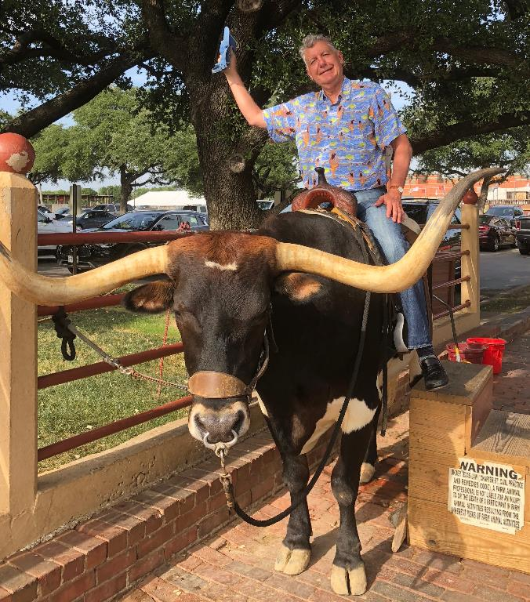
Stocks – The Bull Case
What’s In the Market *High Inflation *Oil Shock *Covid spike *Labor shortage *Supply chain headaches *Fed interest rate rises *Quantitative Tightening *Poor Earnings
What’s Not In the Market *Plunging gas prices *Plunging commodity prices *Falling inflation *$750 billion stimulus package *Record low 3.5% Unemployment *Better than expected earnings

Slide 18
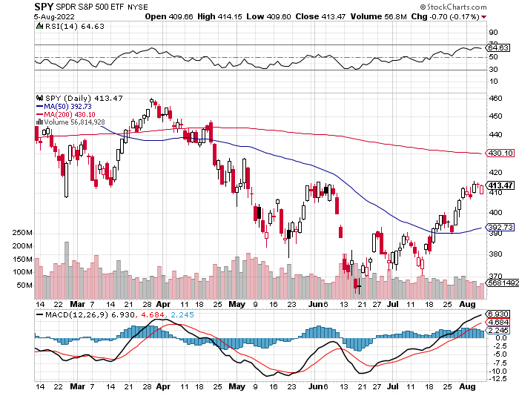
S&P 500 – The Most Likely Case-Mild Recession took profits on long 6/$430-$440 put spread, took profits on long $440-$450 put spread ,
$480 Yearend
$415 +15.3%
The Bottom 360 Down -25%

Slide 19
S&P 500 – Less Likely Case-Double Bottom-High Inflation Number took profits on long 6/$430-$440 put spread, took profits on long $440-$450 put spread ,
$480 Yearend
$415 +15.3%
The Bottom 360 Down -25%

Slide 20
S&P 500 – Worst Case-High Inflation Continues-New Lows took profits on long 6/$430-$440 put spread, took profits on long $440-$450 put spread ,
$480 in 2023
The Bottom 320 Down -33%

Slide 21
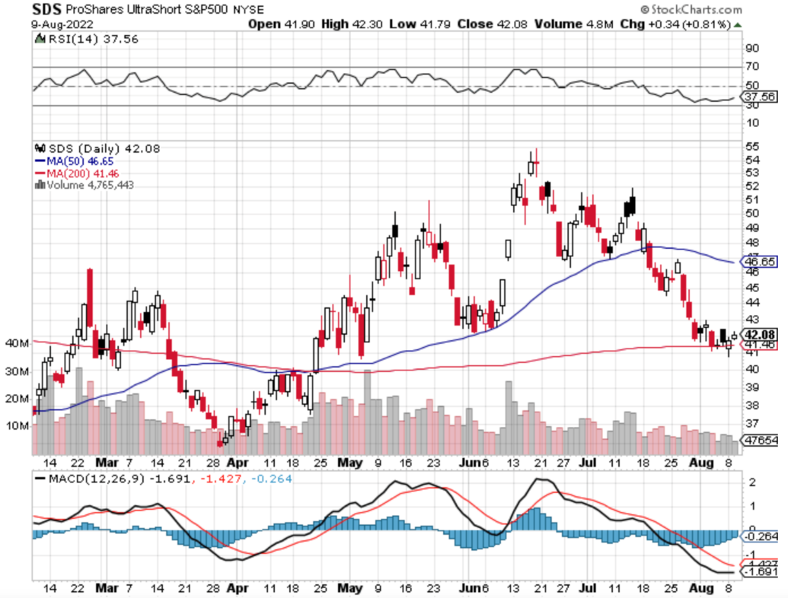
ProShares Ultra Short S&P 500 (SDS)- a great hedge for long stocks and bonds long 2X position has a hedge against longs and bond shorts

Slide 22
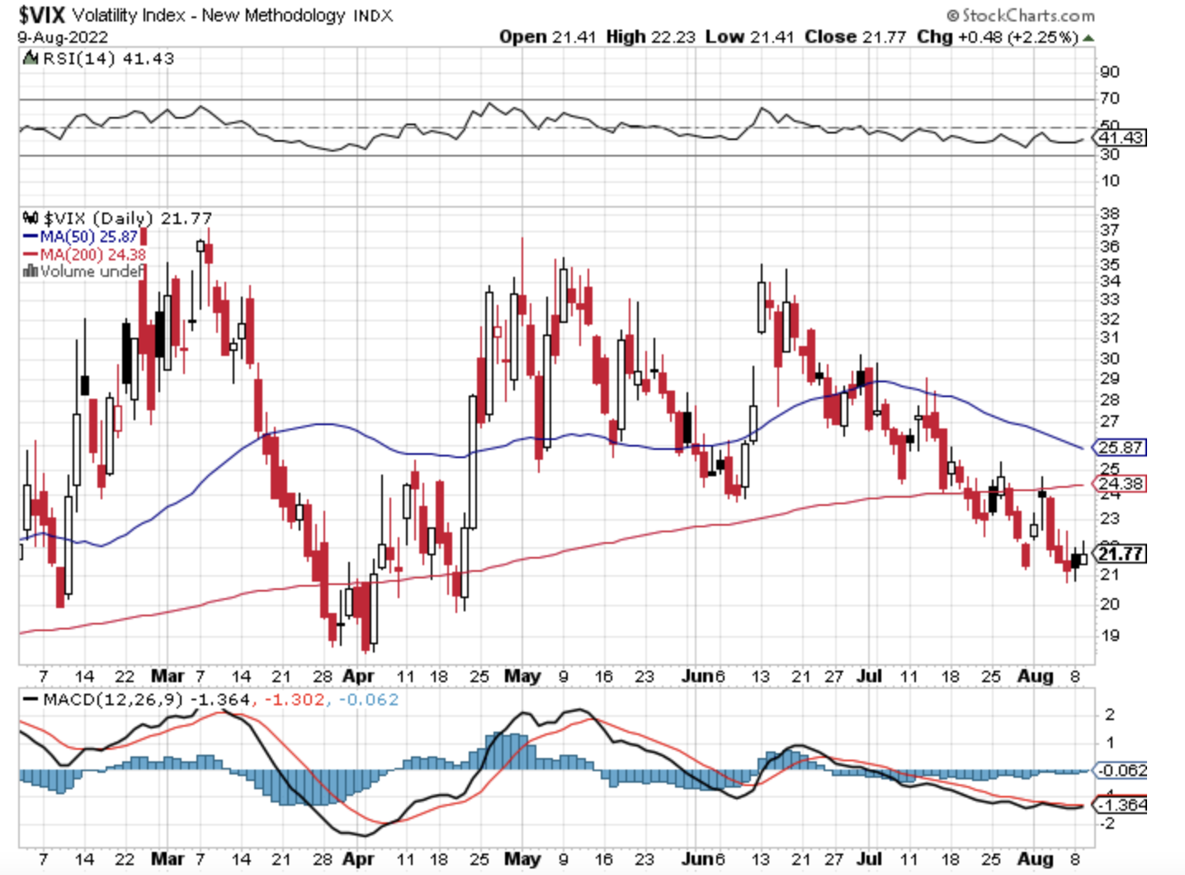
(VIX) – Unable to Make a New High

Slide 23
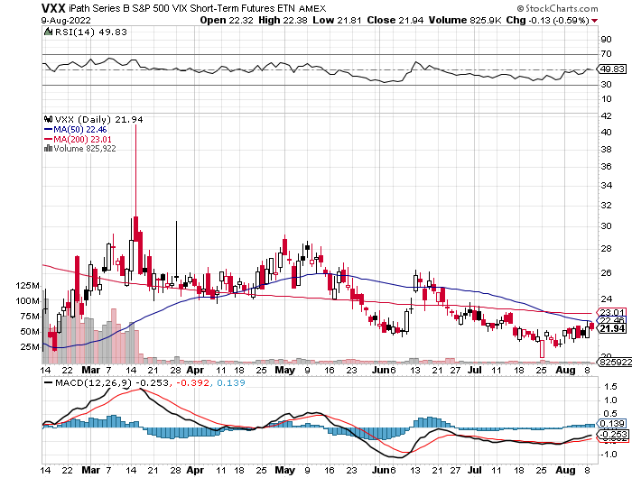
(VXX)-

Slide 24
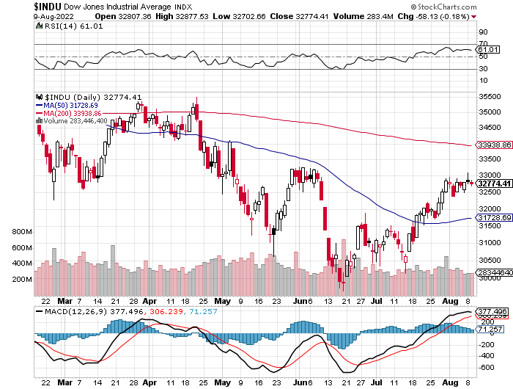
Dow Average ($INDU)-

Slide 25
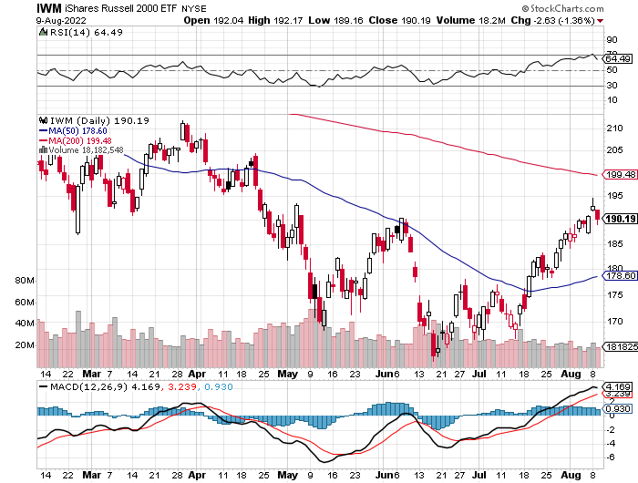
Russell 2000 (IWM)- took profits on Long 10/$137-$142 vertical bull call spread took profits on Long 10/$153-$156 vertical bear put spread

Slide 26
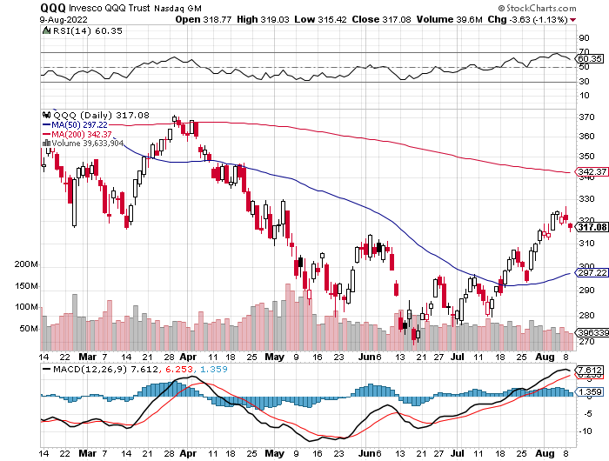
NASDAQ (QQQ) – long (QQQ) 4/$330-$335 put spread took profits on long (QQQ) 3/$340-$345 put spread covered long (QQQ) $325-$330 put spread

Slide 27
The Barbell Portfolio
*50% Big Tech - 2% of US Employment but 27% of Market Cap and 38% of Profits 50% Domestic Recovery, including: Railroads Couriers Banks Construction Credit Cards Event organizers Ticket sales Retailers

Slide 28
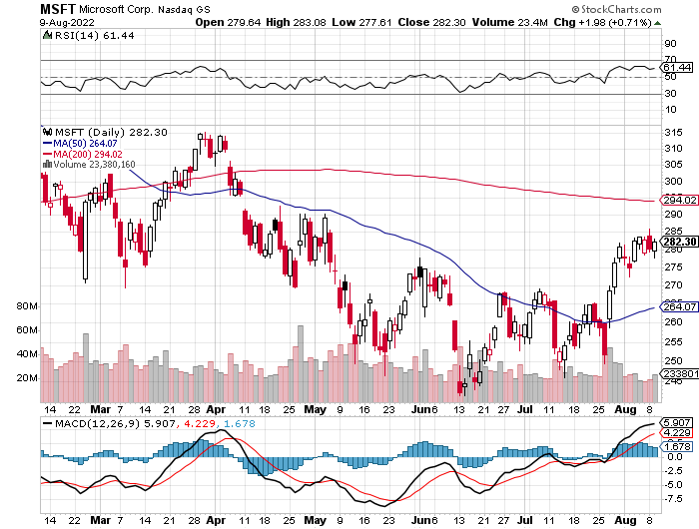
Microsoft (MSFT)- long 7/$220-$210 call spread, took profits on long 6/$220-$230 call spread took profits on long 2/$200-$210 bear put spread

Slide 29
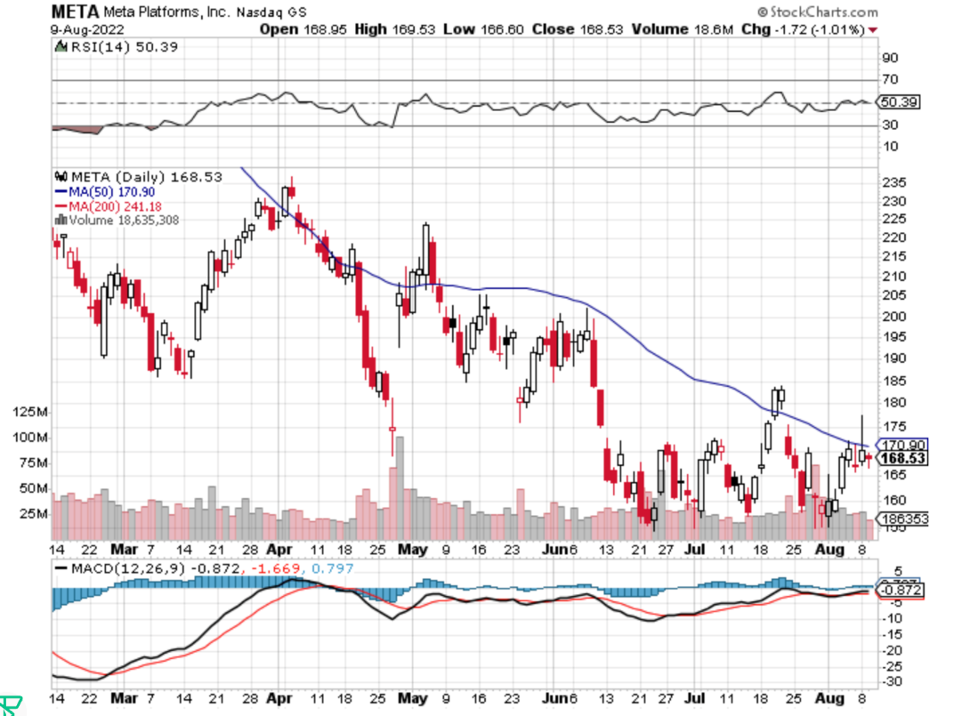
Facebook (FB)- Changes Name to “Meta” took profits on Long 9/$290-$300 vertical bear put spread stopped out of Long 9/$190-$200 vertical bear put spread

Slide 30
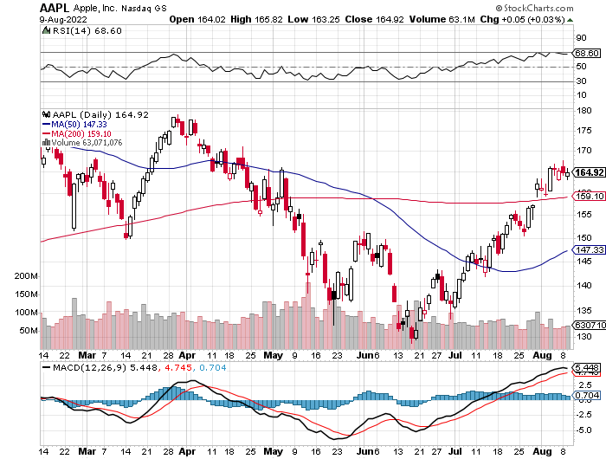
Apple (AAPL)- Apple is Moving into the Loan Business long 6/$155-$165 put spread, stopped out of long 6/$125-135 call spread, took profits on long 6/$110-$120 call spread, took profits on long 2/$180-$190 put spread

Slide 31
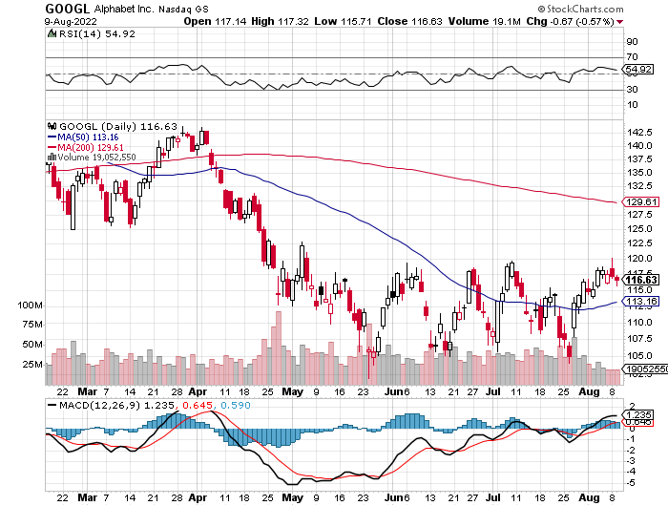
Alphabet (GOOGL) – Ad king on economic recovery Alphabet Misses on Top and Bottom took profits on long 12/$1,200-$1,230 bull call spread took profits on long 9/$1,030-$1,080 vertical bull call spread

Slide 32
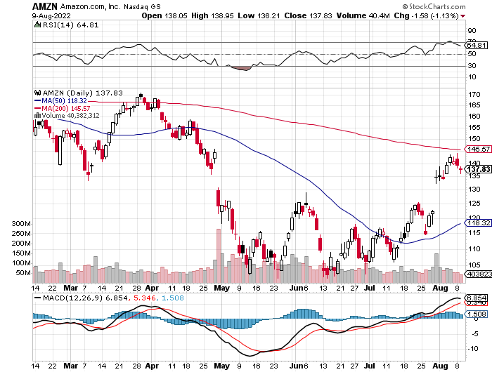
Amazon (AMZN) – Amazon Splits 20:1, triggering an avalanche of new retail buyers took profits on long 2/$3,400-$3,500 bear put spread took profits on long 9/$2,800-$2,900 bull call spread

Slide 33
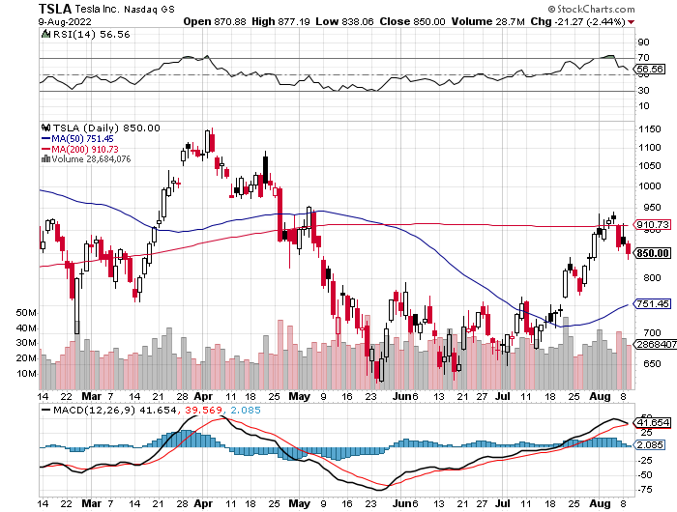
Tesla (TSLA) –Gone Ballistic Aiming for 1.4 million cars in 2022, 100 Million by 2030, 3:1 Stock Split Approved Commodity costs are trending down short 8/$500 calls took profits on long 2/$500-$550 call spread, profits on long 2/$550-$600 call spread took profits on long 2/$600-$650 call spread

Slide 34
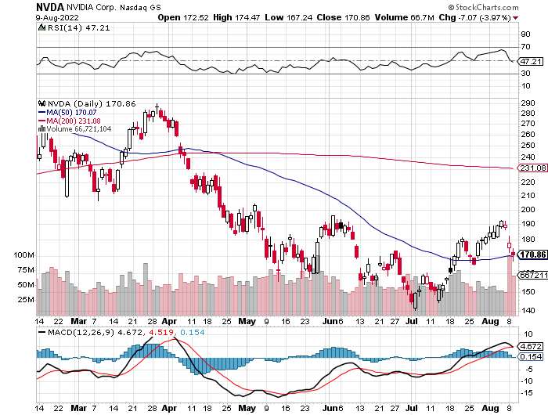
NVIDIA (NVDA) – Surprising to the upside on almost every front, sending the stock up $30, or 18.75% long 7/$120-$130 call spread took profits on long 6/$120-$130 call spread

Slide 35
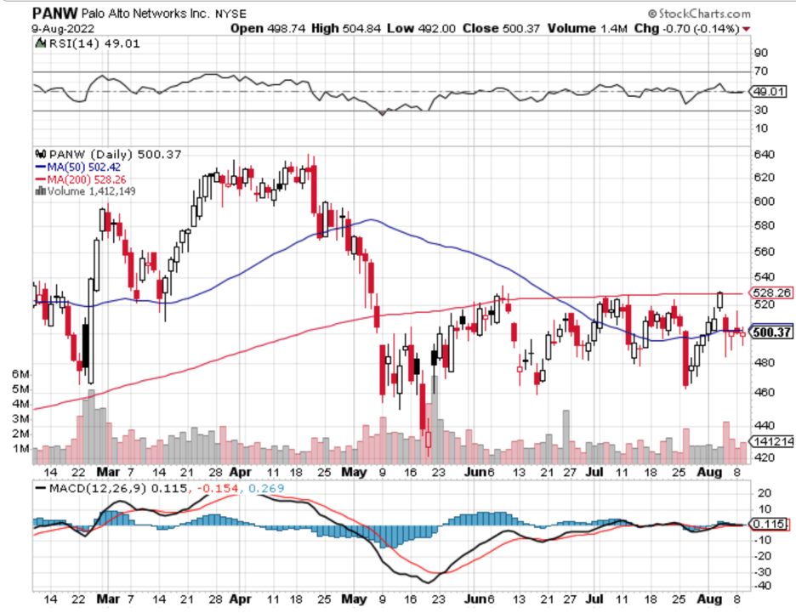
Palo Alto Networks (PANW)- Hacking never goes out of fashion

Slide 36
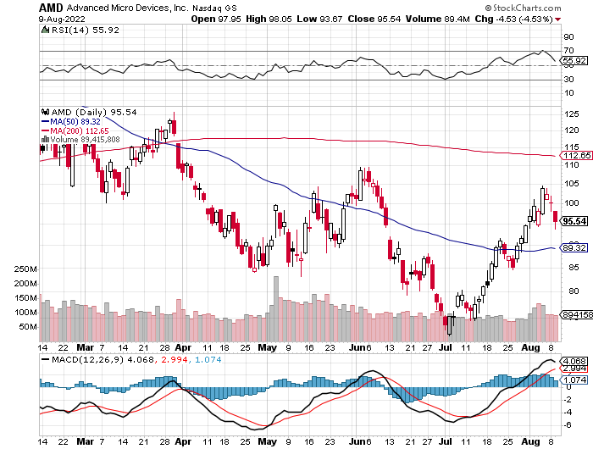
Advanced Micro Devices (AMD)- Recession fears programable logic devices took profits on long 2/$75-$80 call spread

Slide 37
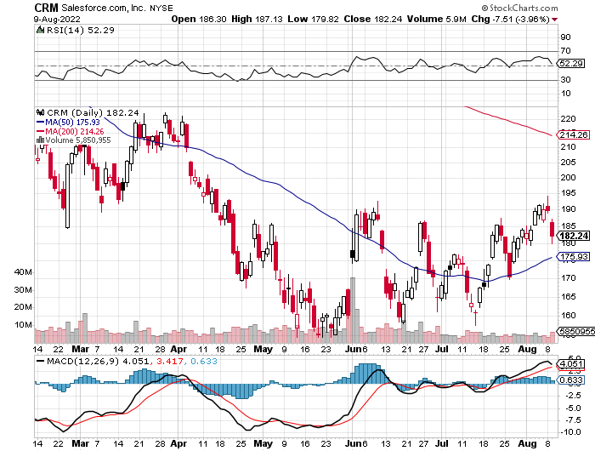
Salesforce (CRM)- Massive Online Migration took profits on long 9/$125-$130 vertical bull call spread took profits on long 8/$125-$130 vertical bull call spread took profits on long 2/$105-$115 call spread

Slide 38
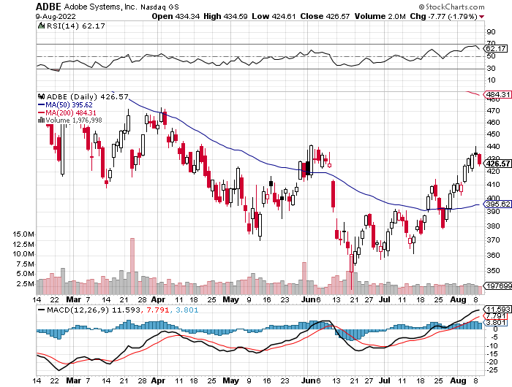
Adobe (ADBE)- Cloud play The Quality Non-China tech play

Slide 39
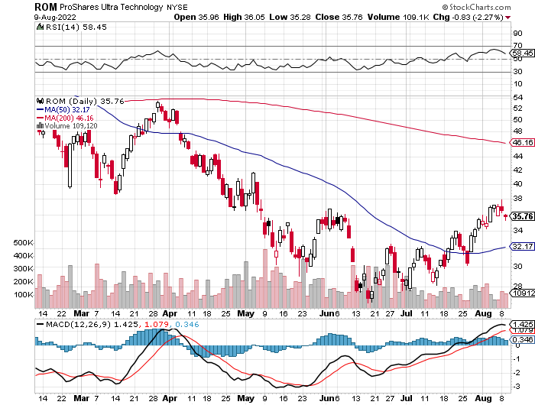
ProShares Ultra Technology ETF (ROM) – 2X Long Technology ETF took profits on long 10/$62-65 call spread

Slide 41
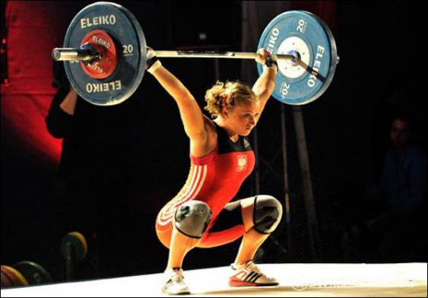
The Second Half of the Barbell
*Bets on a domestic recovery in 2022 Q4 *Upside potential in 2022 far greater than tech *Some of these have not moved for 5 or 10 years *Focuses on economically sensitive cyclical industries *Makes a great counterweight to high-growth technology *We could spend all of next year rotating between the two groups

Slide 42
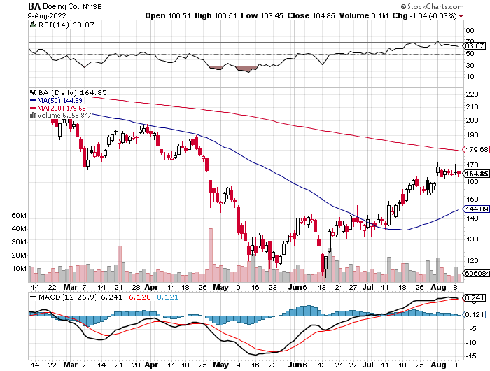
Boeing (BA) –Disastrous Earnings $2.7 loss booked in Q1 long 3/$146-$149 call spread took profits on long 2/$150-$160 call spread

Slide 43
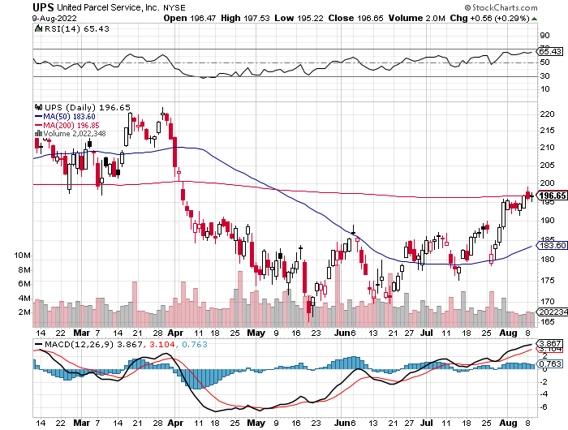
Package Delivery- United Parcel Service (UPS) - Package Delivery record profits took profits on long 11/$130-$140 call spread

Slide 44
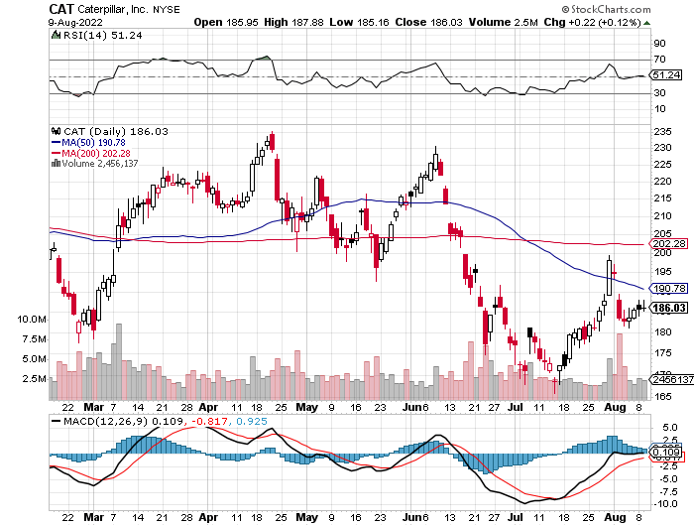
Caterpillar (CAT)- Ag + Infrastructure + Housing Raises Dividend by 50% took profits on long 12/$145-$150 call spread took profits on long 11/$125-$135 call spread

Slide 45
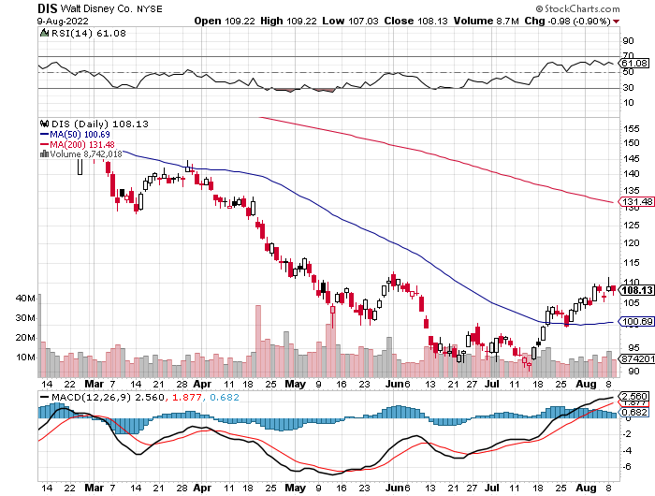
Walt Disney (DIS)- Florida Declares War stopped out of long 10/$165-$175 call spread took profits on long 3/$170-$180 call spread

Slide 46
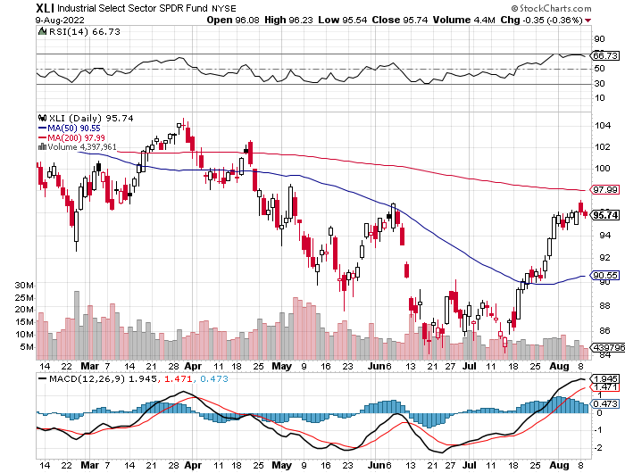
Industrials Sector SPDR (XLI)- (GE), (MMM), (UNP), (UTX), (BA), (HON)

Slide 47
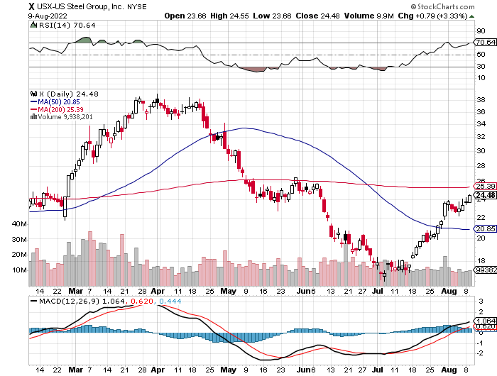
US Steel (X) – Commodity Boom and Wartime boost

Slide 48
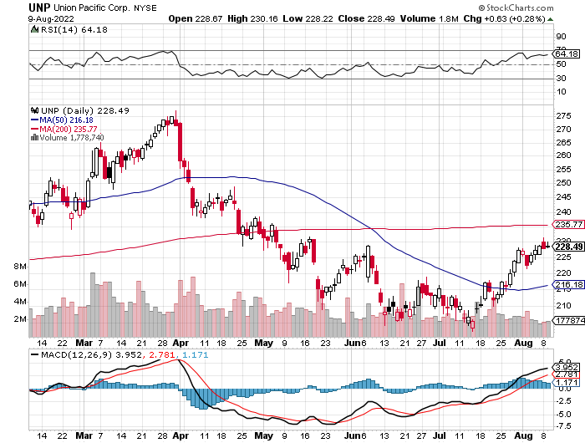
Union Pacific RR (UNP)- Big Stuff to Ship near record earnings announced took profits on long 5/$200-$210 call spread took profits on 11/$150-$160 call spread

Slide 49
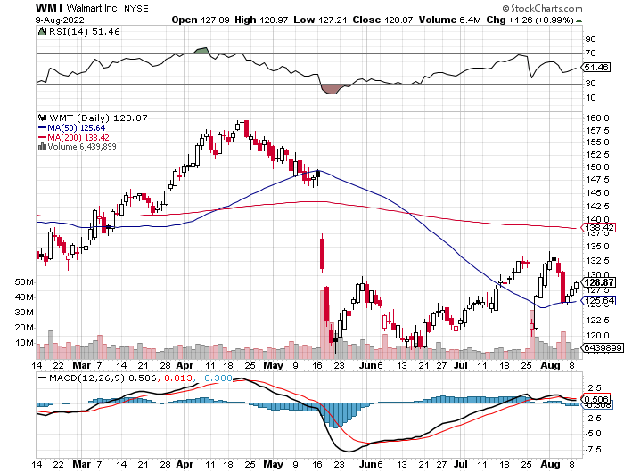
Wal-Mart (WMT)- took profit on Long 11/$125-$130 bear put spread took profit on Long 10/$119-$121 bear put spread took profits on Long 8/$114-$117 bear put spread

Slide 50
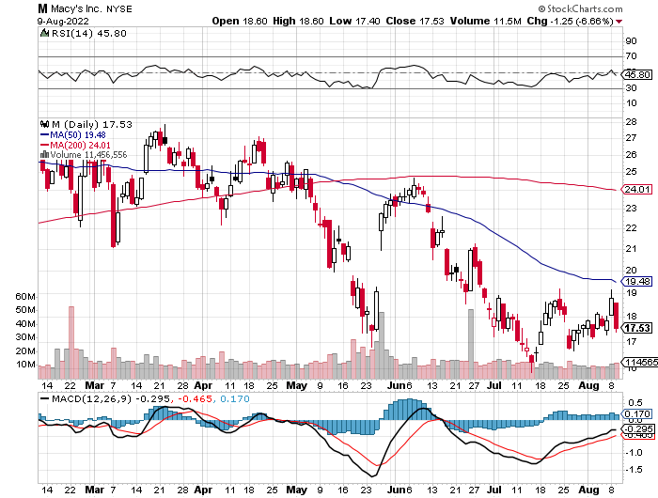
Macys’ (M) – Retail Punished Macy’s Surprises to the Upside took profits on Long 8/$23-$25 bear put spread

Slide 51
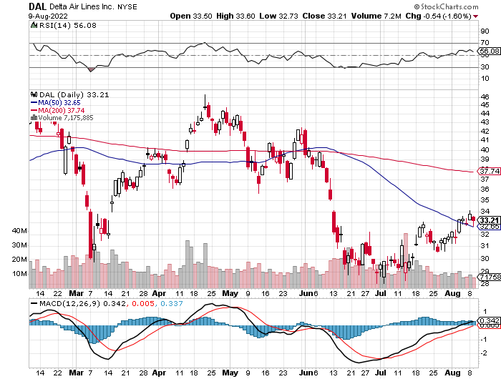
Delta Airlines (DAL) – Travel is Back!

Slide 52
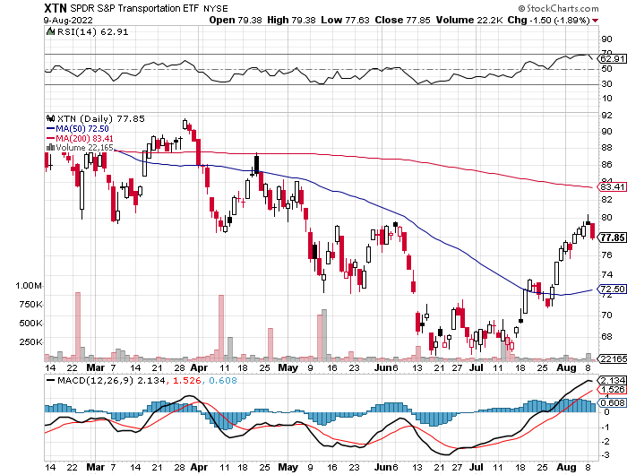
Transports Sector SPDR (XTN)- Worst Hit Sector (ALGT), (ALK), (JBLU), (LUV), (CHRW), (DAL)

Slide 53
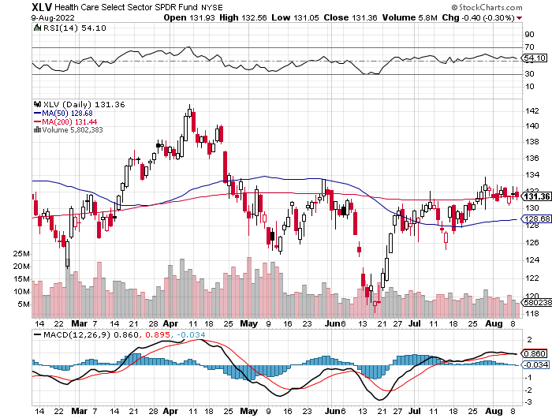
Health Care Sector (XLV) (JNJ), (PFE), (MRK), (GILD), (ACT), (AMGN)

Slide 54
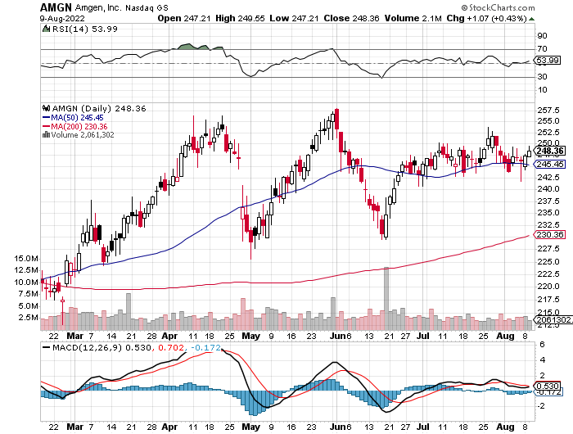
Amgen (AMGN) took profits on long 11/$185-$200 bull call spread

Slide 55
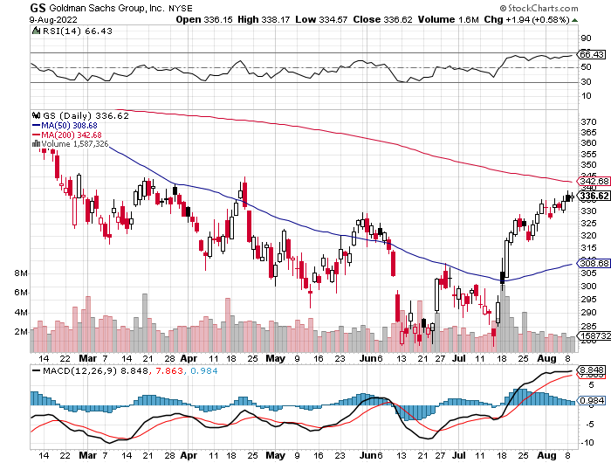
Goldman Sachs (GS) – took profits 12/$330-$350 call spread took profits 11/$330-$350 call spread stop loss on long 11/$385-$395 call spreads

Slide 56
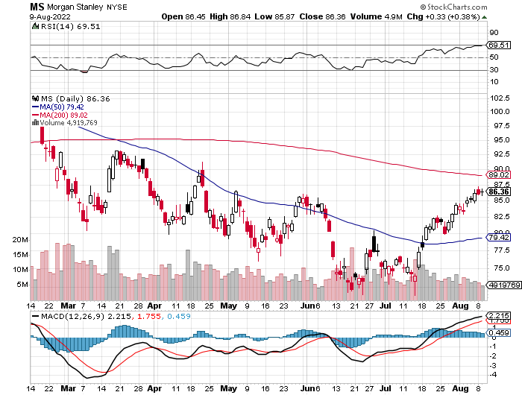
Morgan Stanley (MS) – Blows Away Earnings Equity trading came in a hot $3.2 billion and bond trading $2.9 billion took profits on long 11/$85-$90 call spread

Slide 57
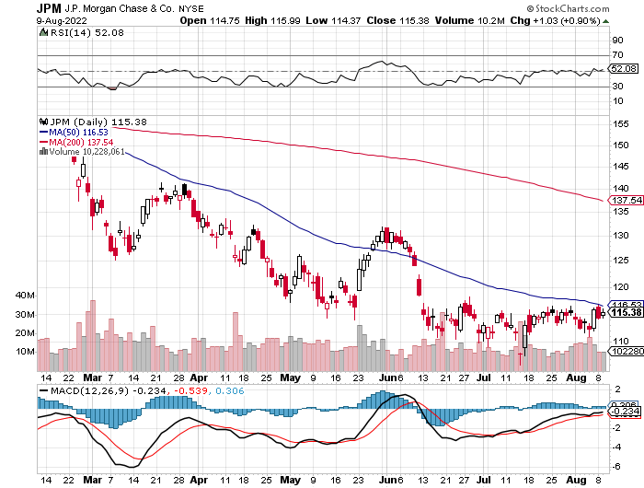
JP Morgan Chase (JPM)- Shares Pop 7.5%, on news that a 17% return on equity is achievable took profits 12/$148-$152.50 call spread

Slide 58
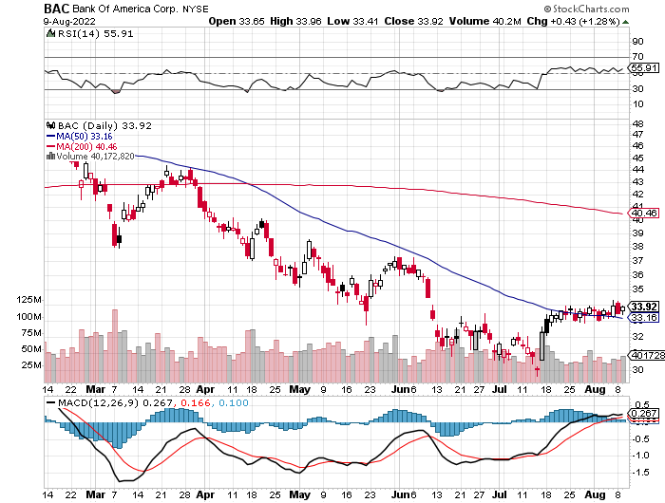
Bank of America (BAC) – took profits long 12/$39-$42 call spread

Slide 59
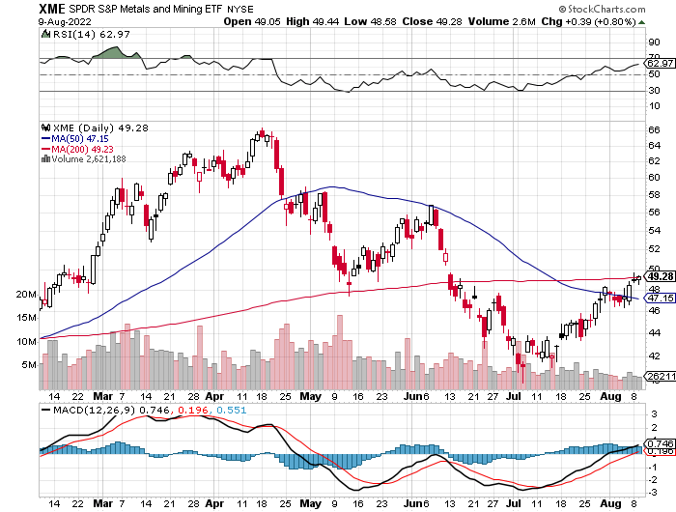
SPDR Metals & Mining ETF (XME) – long 2/$28-$30 call spread

Slide 60
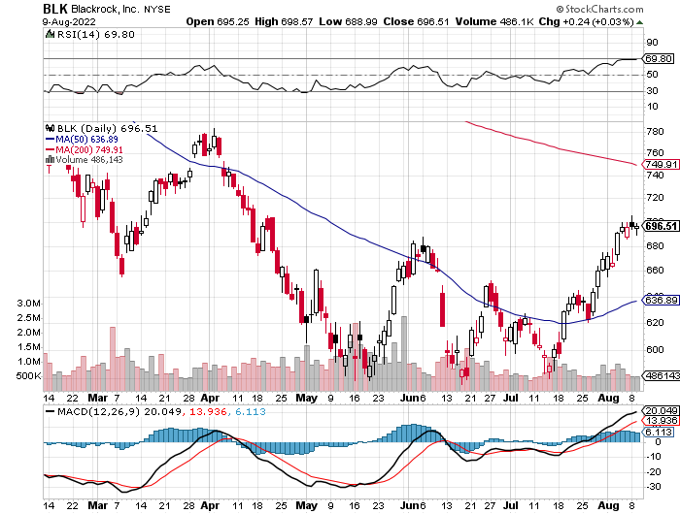
Blackrock (BLK)-Asset Collection Boom took profits on long 3/$770-$790 call spread took profits on long 3/$310-$340 call spread

Slide 61
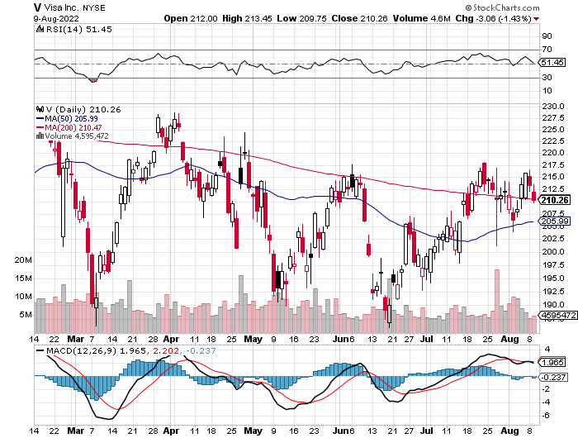
Visa (V) – “Touchless” Bitcoin Drag long 6/$150-$160 bull call spread

Slide 62
Consumer Discretionary SPDR (XLY) (DIS), (AMZN), (HD), (CMCSA), (MCD), (SBUX)

Slide 63
Berkshire Hathaway (BRKB)- Natural Barbell Buys Alleghany Insurance, for $11.6 billion long 7/$220-$230 call spread took profits on long 6/$260-$270 call spread, stopped out of long 5/$300-$310 call spread, took profits on long 2/$270-$280 call spread

Slide 64
Europe Hedged Equity (HEDJ)-

Slide 65
Japan (DXJ)-

Slide 66
Emerging Markets (EEM) - Pro trade, Weak Dollar, Long Recovery Play

Slide 68
Bonds – Trapped in a Range
*A seven-week counter trend rally in bonds is ending now as the economy reheats up *Massive repayment of US budget deficits this year will support the (TLT) at $108 *BUT Quantitative Tightening at $120 billion a month will continue to pressure bonds from above *So will another 1.50% in Fed rate rises through 2023 *Until economy reaccelerates a $108-$121 range will prevail *US Treasury bond fund (TLT) could plunge from $180 in 2020 to $100 by 2023

Slide 69
Treasury ETF (TLT) – Bottoming-No Positions took profits on long 6/$124-$127 put spread, took profits on long long 7/$128-$131 put spread took profits on long 5/$128-$131 put spread, look profits on long 5/$127-$130 put spread took profits on long 5/$110-$113 call spread

Slide 70
Ten Year Treasury Yield ($TNX) – 2.78%

Slide 71
Junk Bonds (HYG) 7.75% Yield to Maturity

Slide 72
2X Short Treasuries (TBT)-Another run at highs

Slide 74
Foreign Currencies – Dollar Takes a Break
*US Dollar takes a break from 20-Year High thanks to falling interest rates *Euro bouncing along the bottom *Weak Chinese economy flatlines the Yuan *Commodity currencies like (FXA) and (FXC)take it on the nose from falling commodity prices *Long-term US dollar fundamentals are still poor, a dollar short could be the new ten-year trade, but not yet *Stand aside from forex for now, there are getting fish to fry

Slide 75
Japanese Yen (FXY)

Slide 76
Euro (FXE)-

Slide 77
British Pound (FXB)-

Slide 78
Australian Dollar (FXA)- The Global Recovery Play took profits on long 8/$67-$69 call spread

Slide 79
Emerging Market Currencies (CEW)

Slide 80
Chinese Yuan- (CYB)- Shanghai Shutdown

Slide 82
Bitcoin – Breakdown Buy the Mad Hedge Bitcoin Letter at https://www.madhedgefundtrader.com/store/
*Bitcoin is Still in Free Fall, down 75% from the top *There are no buyers anywhere, and margin calls are running rampant *WE are now at cost of production so further falls may be limited as miners shut down *Soaring electricity costs have increased cost of production in a major way *Disappearing global liquidity is not the time to be in Bitcoin *Coinbase Lays Off 18%, as the crypto nuclear winter continues *Buy Bitcoin and Ethereum on the bigger dip, but not now

Slide 83
Bitcoin ($BTCUSD) – Finding a bid

Slide 84
Ethereum (ETHE) –

Slide 85
MicroStrategy (MSTR) –

Slide 86
Amplify Transformational Data Sharing ETF (BLOK) –

Slide 88
Energy & Commodities – Rolling Over
*Watch the Ukraine War, the sooner Russia loses, the sooner 10 million barrels a day of Russian oil gets dumped on the market. Casualties now at 80,000. They are fighting a 21st century war with Cold War weapons *OPEC+ Raises Oil Output by 100,000, a token amount *Gasoline Futures are in Freefall, down 30% from the February peak down to $3.95 a gallon, and down every day for 2 months. *Weak Chinese Data Torpedo's Oil *Tesla Costs are Plunging, with more than half of input prices trending down *Avoid all energy plays like the plague, it’s the new buggy whip industry as the US de-carbonizes

Slide 89
Oil-($WTIC)

Slide 90
United States Oil Fund (USO) long 10/$9.50-$10 Vertical bull call spread

Slide 91
Energy Select Sector SPDR (XLE)-No Performance! (XOM), (CVX), (SLB), (KMI), (EOG), (COP)

Slide 92
Halliburton (HAL)-

Slide 93
Natural Gas (UNG) -

Slide 94
Freeport McMoRan (FCX) -

Slide 95
Cameco (CCJ) - took profits on long 5/$20-$23 bull call spread

Slide 97
Precious Metals – Still Not a Player
*Gold Plunges on Jobs Data *Gold is more of a commodity play now than a risk hedge *Recently falling interest rates give gold and additional boost *Speculative interest has faded to a few hard-core gold bugs *Silver is still the bigger and better long-term play

Slide 98
Gold (GLD)- took profits on long 5/$165-$170 bull call spread

Slide 99
Market Vectors Gold Miners ETF- (GDX) –

Slide 100
Barrick Gold (GOLD) took profits on long 1/$21-$23 call spread took profits on long 11/$22-$24 call spread

Slide 101
Newmont Mining- (NEM)- took profits on long $55-60 call spread

Slide 102
Silver- (SLV)- took profits on long 11/$19-$20 call spread

Slide 103
Silver Miners - (SIL)-

Slide 104
Wheaton Precious Metals - (WPM)- took profits on long 2/$39-41 call spread

Slide 106
Real Estate – Peak Prices
*The S&P Case Shiller National Home Price Index Sees Another Drop, from 20.6% to 19.7% in May *The US is still short 10 million homes as Millennials trade up *30-Year Fixed Rate Mortgages fall below 5.00% *Half of US Homes are Equity Rich, indicating homeowner equity is more than 50% of market value *Home Prices fall at a Record Pace, down from a 19.3% annual gain to 17.3% in June *Pending Home Sales Fell a Staggering 20% in June *Lumber Prices are Still in Free-Fall, with lumber sales down 25% in June *Real Estate Prices Peaked Simultaneously all Over the World. The frothiest market in New Zealand and Australia have already seen 13% falls.

Slide 107
S&P Case Shiller S&P Case Shiller Rockets 20.6%, in March with its National Home Price Index Tampa (34.8%), Phoenix (32.4%), and Miami (32.0%)

Slide 108
Crown Castle International (CCI) – 3.29% yielding cell phone tower REIT

Slide 109
US Home Construction Index (ITB) (DHI), (LEN), (PHM), (TOL), (NVR)

Slide 111
Trade Sheet- So What Do We Do About All This?
*Stocks – buy the big dips at bottom of range *Bonds – sell big rallies *Commodities-buy dips *Currencies- stand aside *Precious Metals – stand aside *Energy – stand aside *Volatility - sell short over $30 *Real estate – stand aside *Bitcoin – stand aside

Slide 113
Next Strategy Webinar 12:00 EST Wednesday, August 24 from Lake Tahoe, NV email me questions at support@madhedgefundtrader.com
Good Luck and Good Trading!
Notes:
*

