Slide 1
The Mad Hedge Fund Trader “Panic Attack”
With John Thomas Silicon Valley, CA, September 7, 2022 www.madhedgefundtrader.com
Notes:
*

Slide 2
Mad Hedge Traders & Investors Summit September 13-15
*A collection of the 28 best traders and managers in the world, or 8 a day *Back-to-back One-hour presentations followed by an interactive Q&A *It’s a smorgasbord of trading strategies, pick the one that is right for you *Covering all stocks, bonds, commodities, foreign exchange, precious metals, and real estate *It’s the best look at the rest of 2022’s money making opportunities you will get anywhere *An invitation will be sent to you shortly and it is FREE to attend

Slide 3
Trade Alert Performance New All Time Highs! 22 out of 23 trade alerts profitable
*January 14.59% Final *July +3.98% Final *February +8.78% MTD *August +5.13% Final *March +3.43% Final *September -0.21% MTD *April +3.33% Final *October +8.91% MTD *May +8.80% Final *November -11.79% Final *June +5.91% Final *December +11.26% Final *2022 YTD +59.96% compared to -13% for the Dow Average *+$572.52% since inception *Average annualized return of +44.90% for 14 years

Slide 4
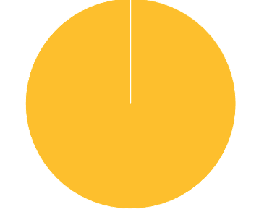
Portfolio Review 10% Long, 0% short, 90% cash- Cash in middle of the range
Current Capital at Risk
Risk On
(MSFT) 9/$235-$245 call spread | 10.00%
NO POSITIONS
Risk Off
NO POSITIONS
Total Net Position | 0.00%
Total Aggregate Position | 10.00%
Expiration Value +61.10%

Slide 5
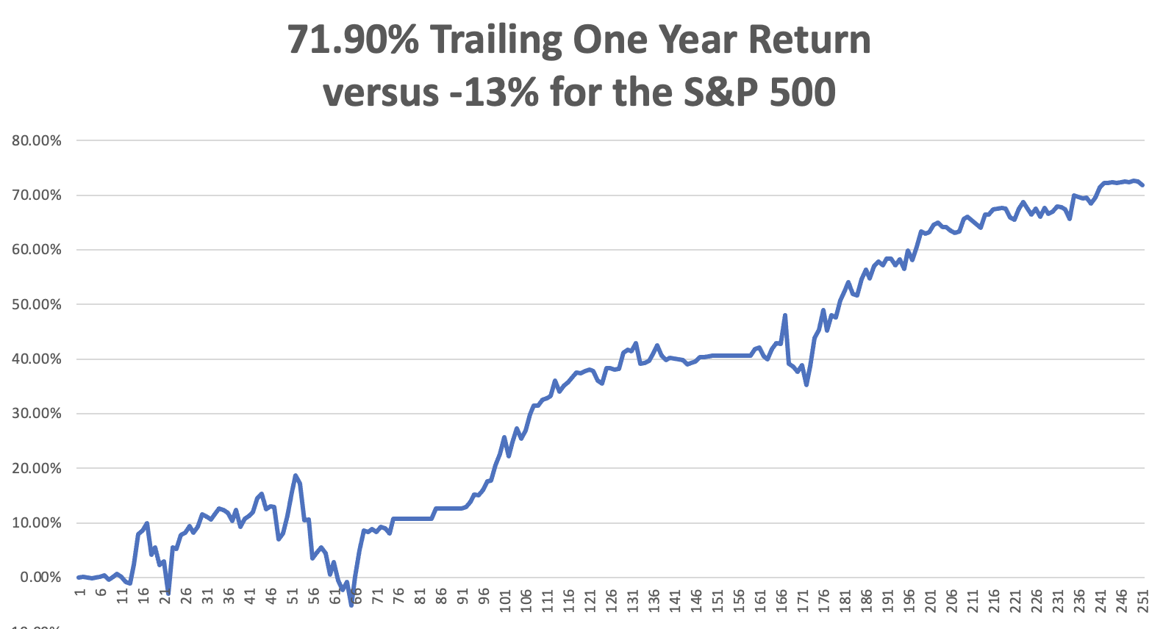

Slide 6
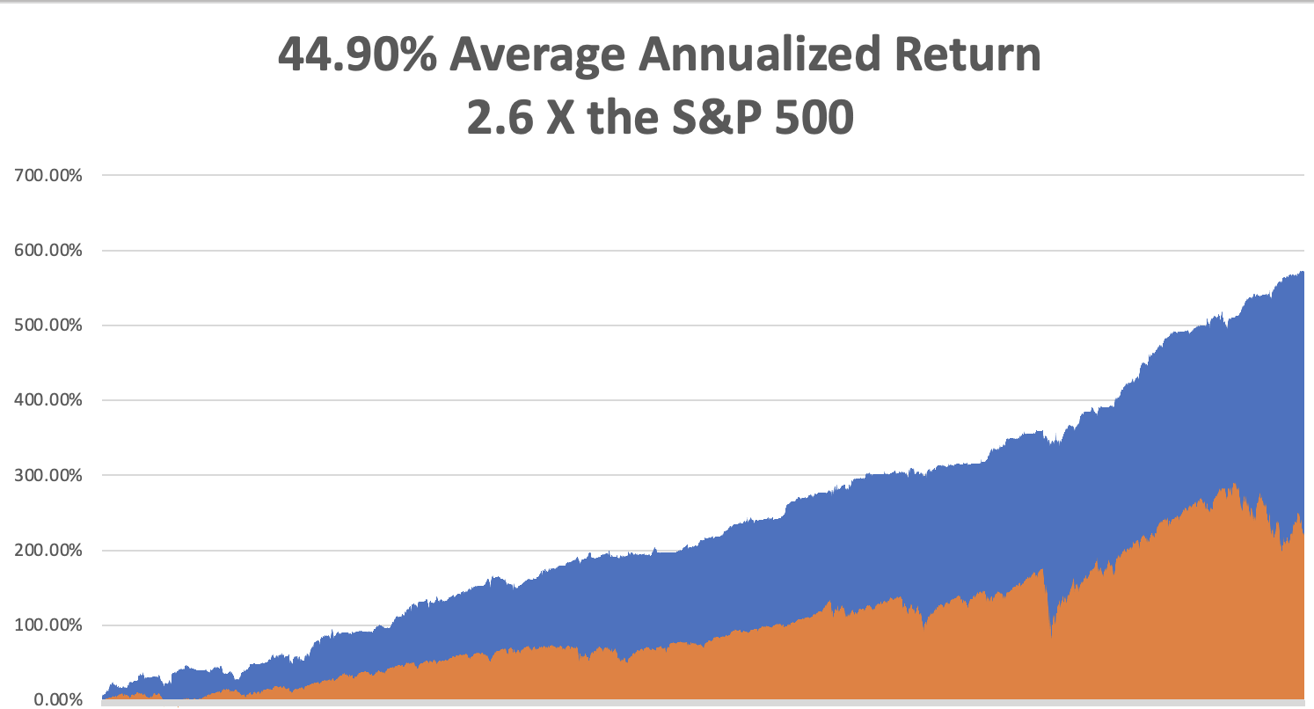

Slide 7
The Method to My Madness The Bottom is In
*RISK generally is selling off from an extremely overbought position *We are now three weeks into a 1–2-month correction *Oil prices continue in free fall, hitting new 8-month lows *Inflation is plunging but it may not show up yet in the September 13 number *Coming interest rate rises have put the wind back behind the US dollar *Bear market in bonds has resumed on rate rise fears *Yearend (SPX) of 4,800 is still on the table *VIX pops from $19 to $27

Slide 8
Corona Update –
*New omicron covid booster is now available, which may turn into an annual shot like the flu *It’s all part of a massive fall booster campaign. I’ll be the first in line *Five and under Pfizer vaccine is now available *BA.5 is the dominant variant now, highly contagious but very weak *Corona virus cases up 1 million a week to 94.8 million *Deaths up 2,000 a week to 1,050,000, *But a lot of “long covid” cases are hidden below the surface *Covid is no longer a major factor for the economy

Slide 9
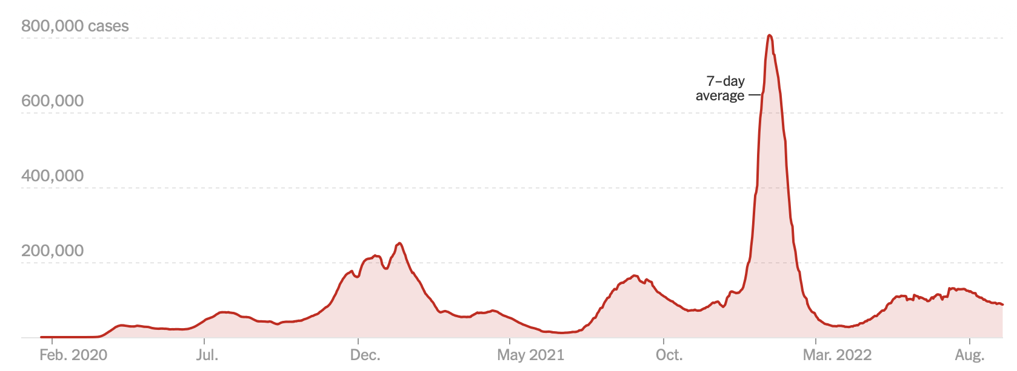
The Pandemic is Over But we may have a permanent low level

Slide 10
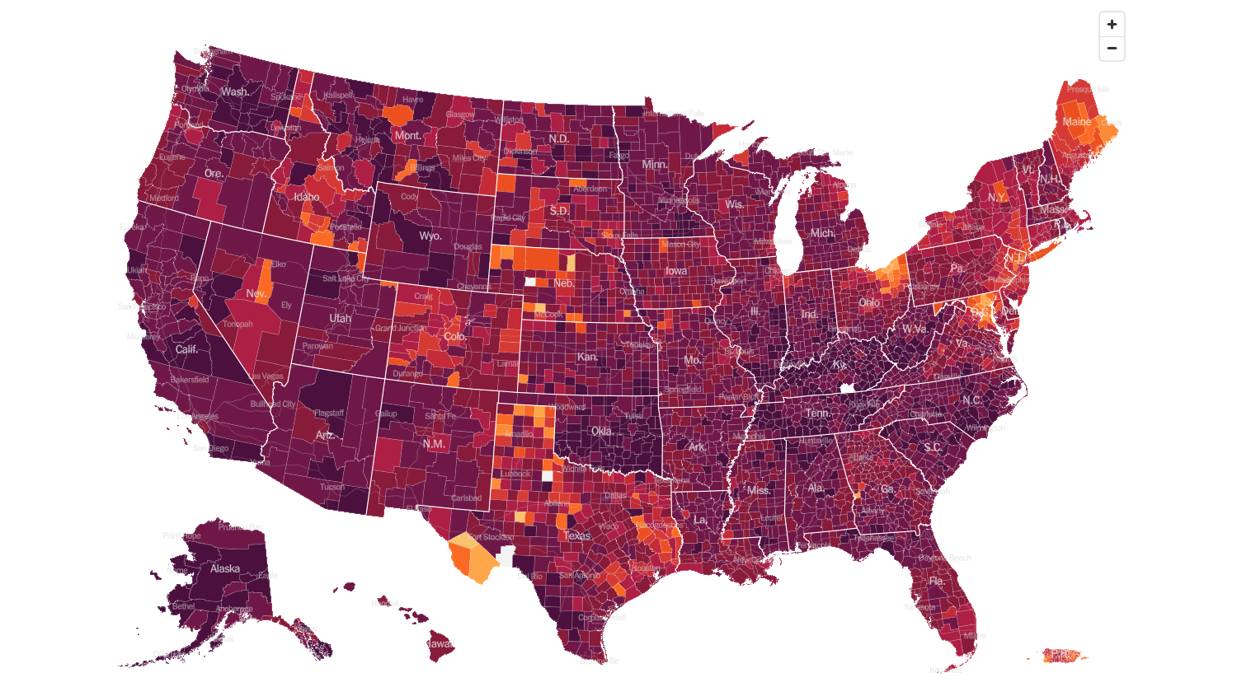
February 2 2022 Infection Rate

Slide 11
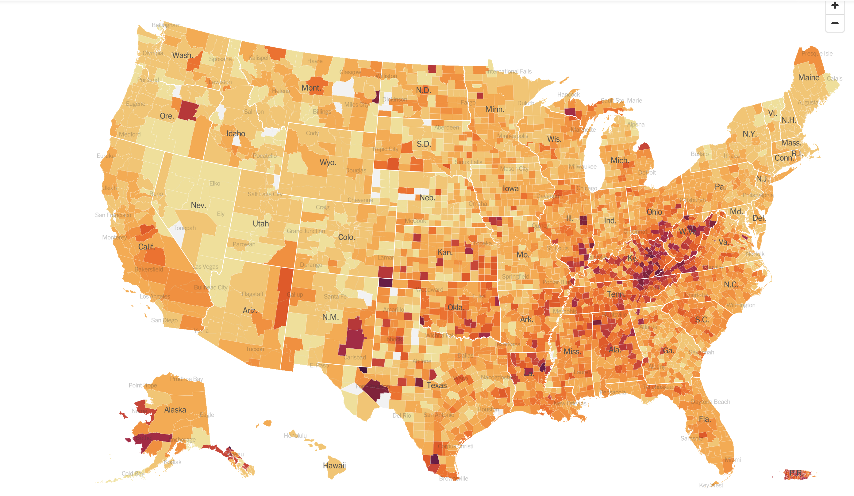
August 24 2022 Infection Rate

Slide 12
The Global Economy – Jittery
* Nonfarm Payroll Report Drops to 315,000 in August, a big decline *Headline Unemployment Rate jumps to 3.7% *It makes a 75-basis point in September a sure thing *QT Accelerates Next Thursday to $95 billion a month *The Money Supply is Collapsing, down for four consecutive months
*Manufacturing PMI Hits Two Year Low at 51.5. Things are definitely slowing here. * US Consumer Sentiment Improves, from 55.1 to 58.2 *S&P Global Services PMI Dives, from 49.0 to 44

Slide 13
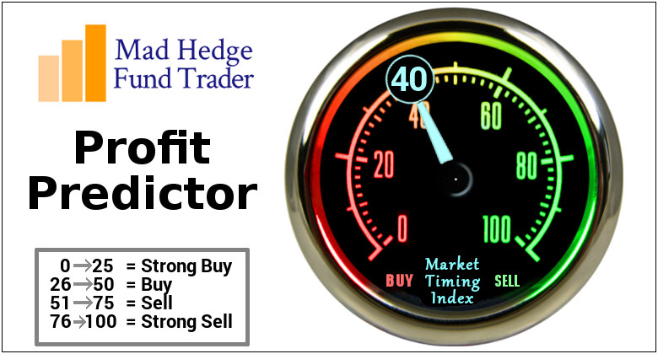
The Mad Hedge Profit Predictor Market Timing Index – Buy Territory An artificial intelligence driven algorithm that analyzes 30 different economic, technical, and momentum driven indicators

Slide 14
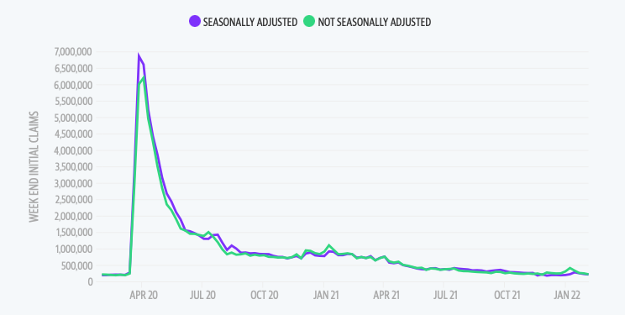
Weekly Jobless Claims – Falling 232,000 – down 18,000

Slide 15
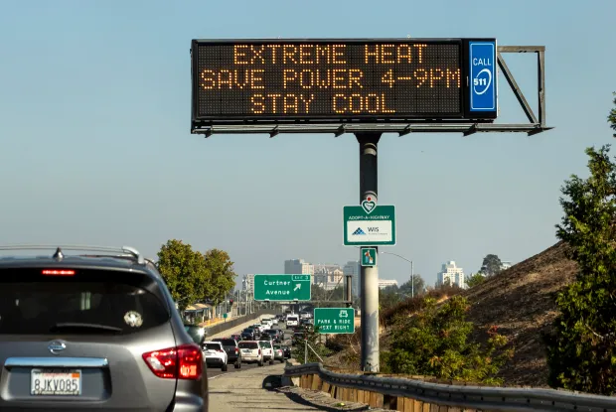

Slide 16
Stocks – Panic Attack!
*Powell warns in hawkish speech at Jackson Hole of “Some Pain” is ahead, especially for stocks *Where are the Biggest Buyers on the Dip? Microsoft (MSFT), Salesforce (CRM), and Disney (DIS), followed by Visa (V), *Stocks rallied hard for two months, then stalled *Best case, we give up 1/3 to ½ of the recent 4,000 gains in August *Worst case, we bounce along a $362 bottom for a few more months with minimal risk and then go ballistic after the midterm elections. It make no difference who wins *The chip sector Guides Down, in the face of new US export restrictions to China *Toyota Invests $3.8 Billion in US Battery Plant to qualify as “American Made” *Look for terrible H1 and strong H2 scenario to continue

Slide 17
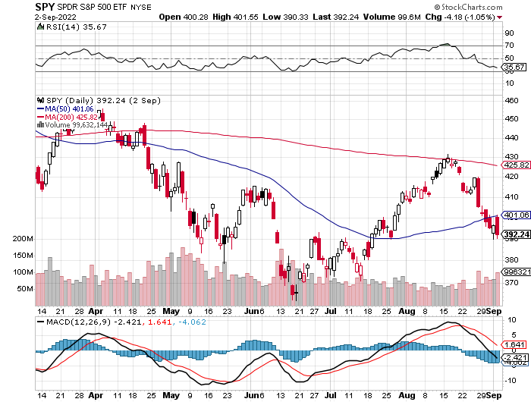
S&P 500 – The Worst Case-Mild Recession took profits on long 6/$445-$455 put spread took profits on long 6/$430-$440 put spread, took profits on long $440-$450 put spread
$480 Yearend
$432 +19.3% Rally
The Bottom 362 Down -25%

Slide 18
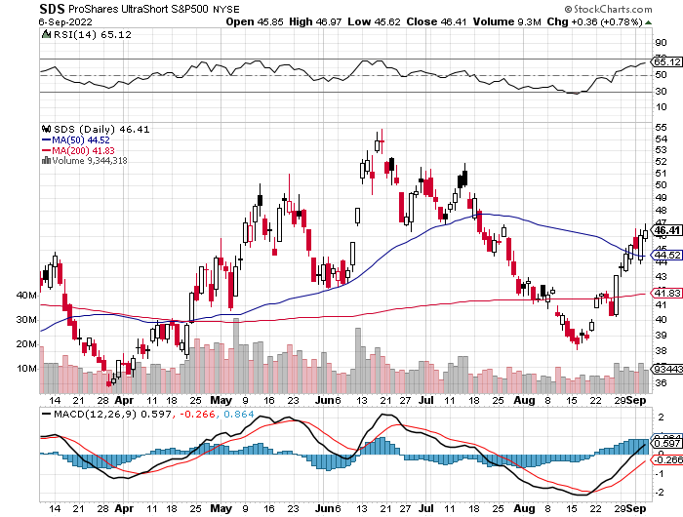
ProShares Ultra Short S&P 500 (SDS)- a great hedge for long stocks and bonds long 2X position has a hedge against longs and bond shorts

Slide 19
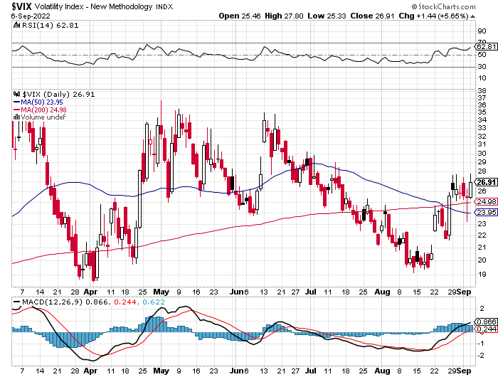
(VIX) – Unable to Make a New High

Slide 20
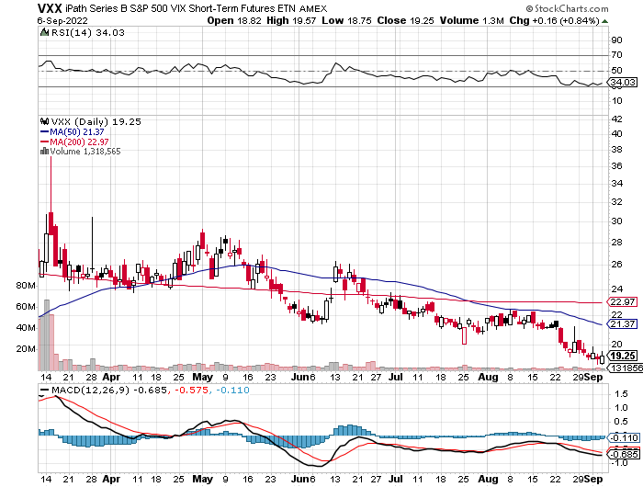
(VXX)-

Slide 21
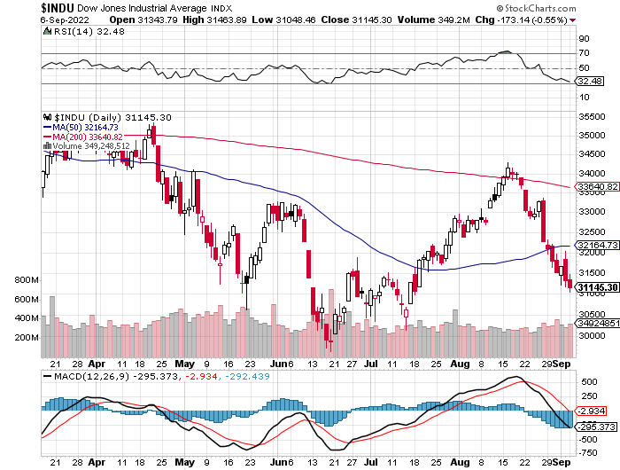
Dow Average ($INDU)-

Slide 22
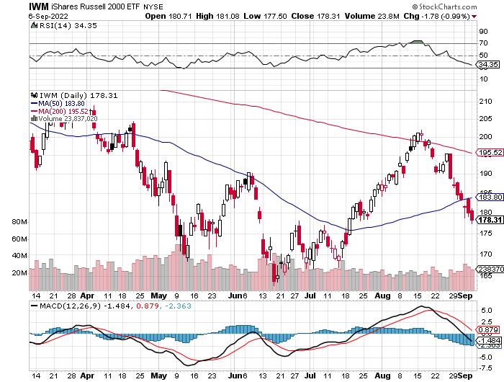
Russell 2000 (IWM)- took profits on Long 10/$137-$142 vertical bull call spread took profits on Long 10/$153-$156 vertical bear put spread

Slide 23
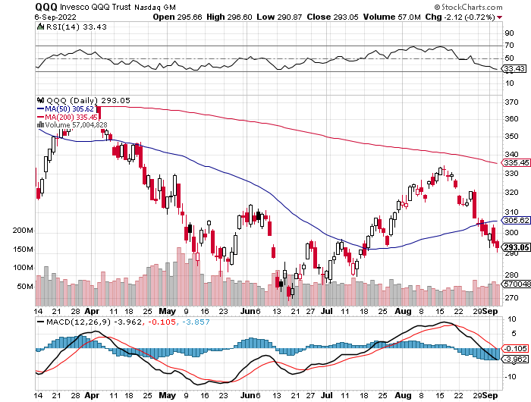
NASDAQ (QQQ) – took profits on long (QQQ) 4/$330-$335 put spread took profits on long (QQQ) 3/$340-$345 put spread covered long (QQQ) $325-$330 put spread

Slide 24
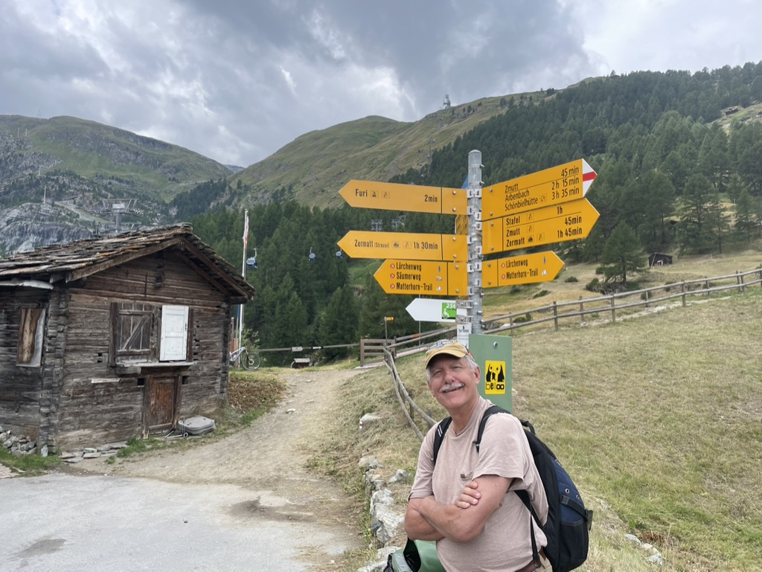

Slide 25
The Barbell Portfolio
*50% Big Tech - 2% of US Employment but 27% of Market Cap and 38% of Profits 50% Domestic Recovery, including: Railroads Couriers Banks Construction Credit Cards Event organizers Ticket sales Retailers

Slide 26
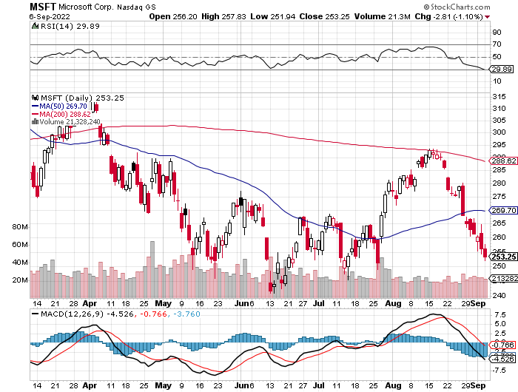
Microsoft (MSFT)- 9/$235-$245 call spread-expires in 7 trading days took profits on long 7/$220-$210 call spread, took profits on long 6/$220-$230 call spread, took profits on long 2/$200-$210 bear put spread

Slide 27
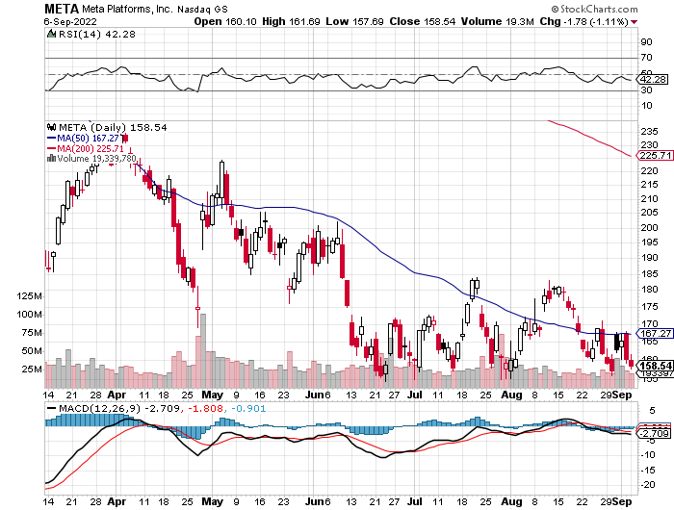
Facebook (FB)- Changes Name to “Meta” took profits on Long 9/$290-$300 vertical bear put spread stopped out of Long 9/$190-$200 vertical bear put spread

Slide 28
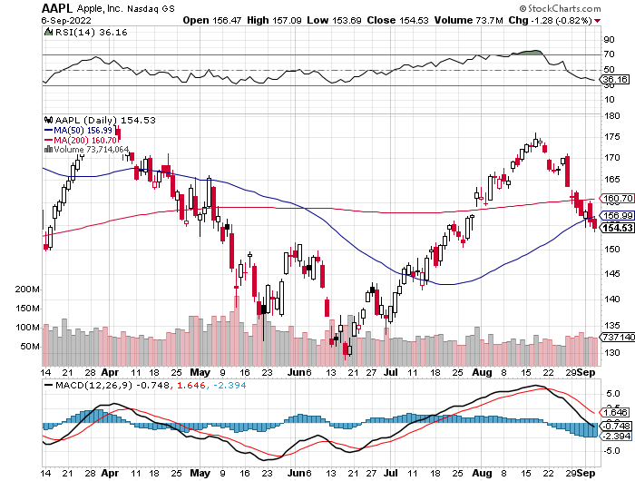
Apple (AAPL)- iPhone 14 launched! took profits on long 6/$155-$165 put spread, stopped out of long 6/$125-135 call spread, took profits on long 6/$110-$120 call spread, took profits on long 2/$180-$190 put spread

Slide 29
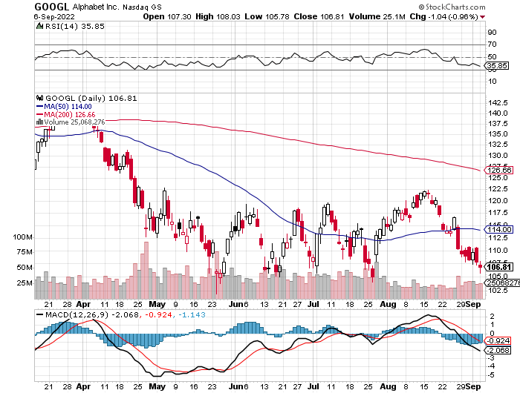
Alphabet (GOOGL) – Ad king on economic recovery Alphabet Misses on Top and Bottom took profits on long 12/$1,200-$1,230 bull call spread took profits on long 9/$1,030-$1,080 vertical bull call spread

Slide 30
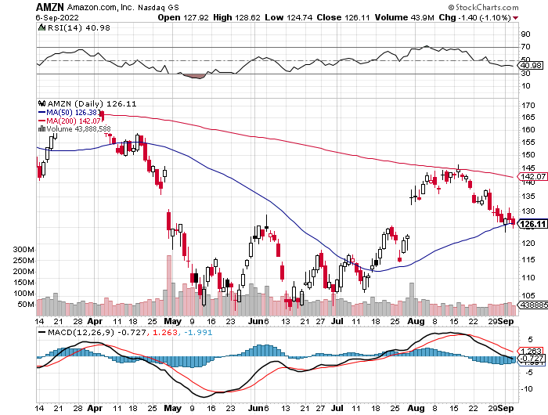
Amazon (AMZN) – Amazon Splits 20:1, triggering an avalanche of new retail buyers took profits on long 2/$3,400-$3,500 bear put spread took profits on long 9/$2,800-$2,900 bull call spread

Slide 31
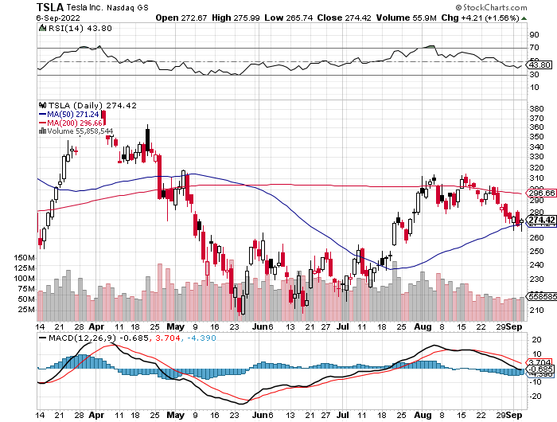
Tesla (TSLA) – Taking a break Tesla Needs $400 Billion to build 8 more factories to meet Musk’s 20 million unit a year target took profits on short 8/$500 puts, stopped out of short 8/$950 calls took profits on long 2/$500-$550 call spread, profits on long 2/$550-$600 call spread

Slide 32
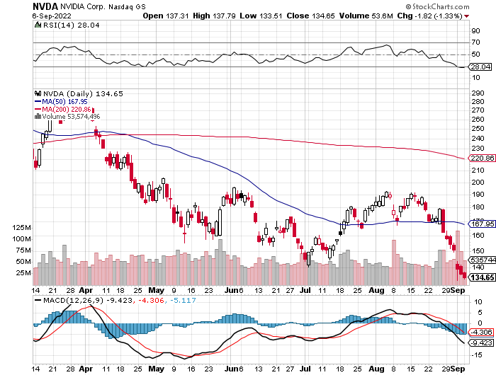
NVIDIA (NVDA) – Downgrade on US ban of highest end AI chips to China took profits on long 7/$120-$130 call spread, took profits on long 6/$120-$130 call spread

Slide 33
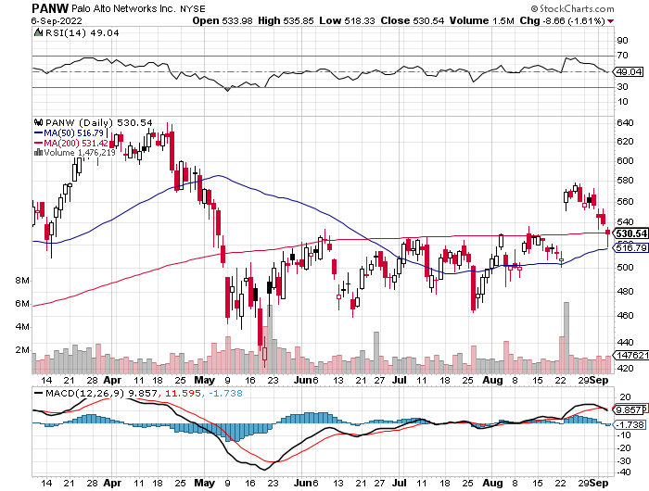
Palo Alto Networks (PANW)- Hacking never goes out of fashion

Slide 34
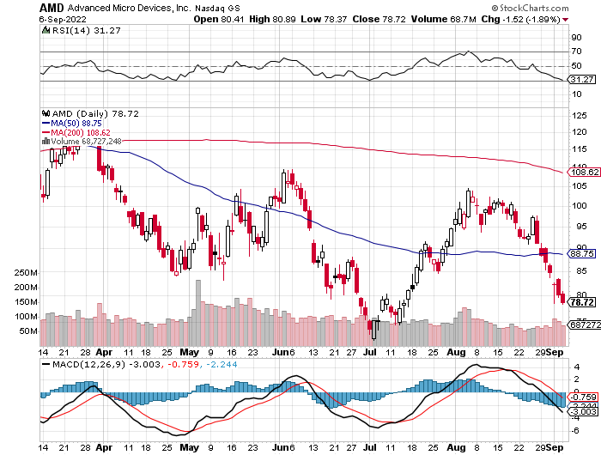
Advanced Micro Devices (AMD)- Recession fears programable logic devices took profits on long 2/$75-$80 call spread

Slide 35
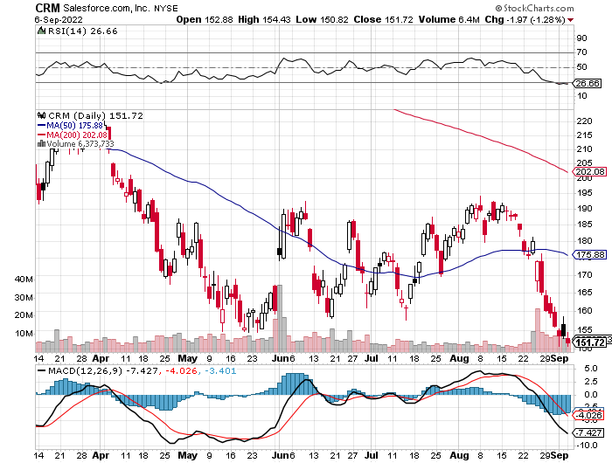
Salesforce (CRM)- Massive Online Migration took profits on long 9/$125-$130 vertical bull call spread took profits on long 8/$125-$130 vertical bull call spread took profits on long 2/$105-$115 call spread

Slide 36
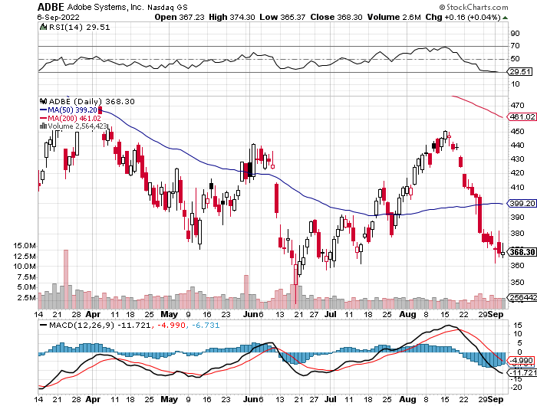
Adobe (ADBE)- Cloud play The Quality Non-China tech play

Slide 37
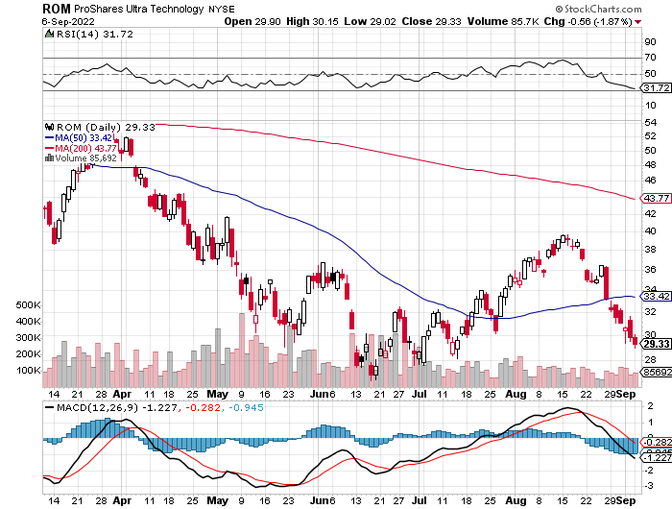
ProShares Ultra Technology ETF (ROM) – 2X Long Technology ETF took profits on long 10/$62-65 call spread

Slide 38
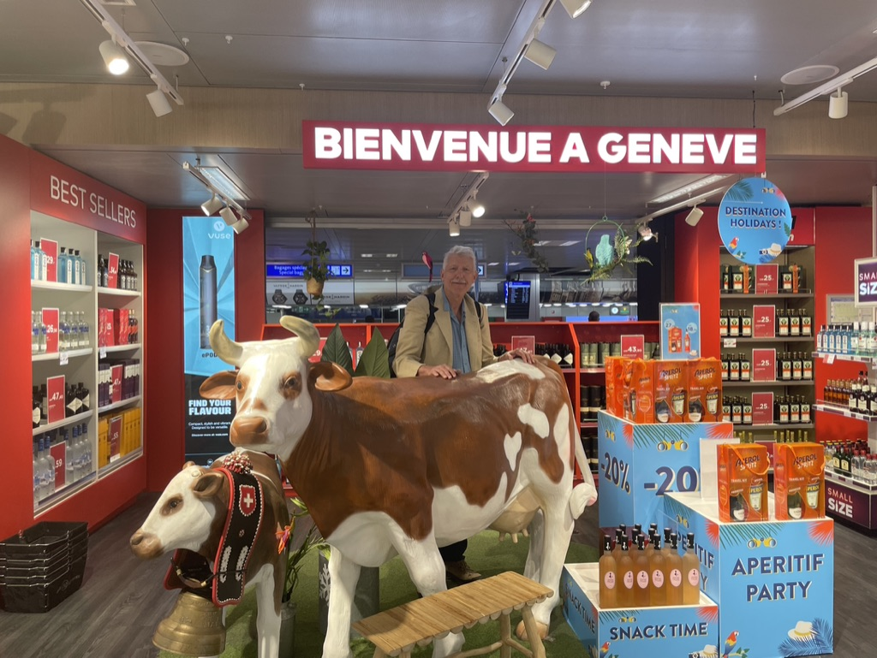

Slide 39
The Second Half of the Barbell
*Bets on a domestic recovery in 2022 Q4 *Upside potential in 2022 far greater than tech *Some of these have not moved for 5 or 10 years *Focuses on economically sensitive cyclical industries *Makes a great counterweight to high-growth technology *We could spend all of next year rotating between the two groups

Slide 40
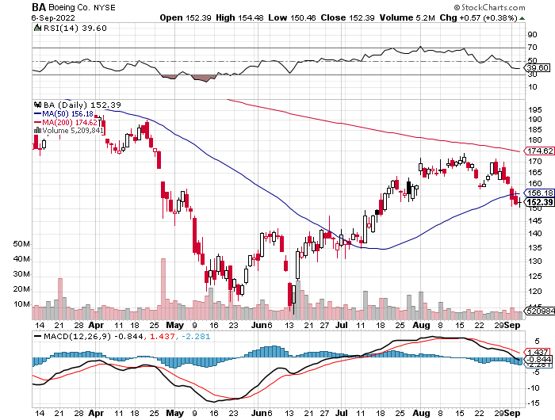
Boeing (BA) –Disastrous Earnings Boeing Delivered its First 787 Dreamliner in a year long 3/$146-$149 call spread took profits on long 2/$150-$160 call spread

Slide 41
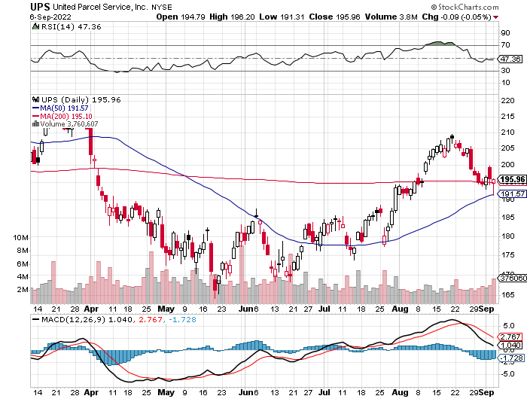
Package Delivery- United Parcel Service (UPS) - Package Delivery record profits took profits on long 11/$130-$140 call spread

Slide 42
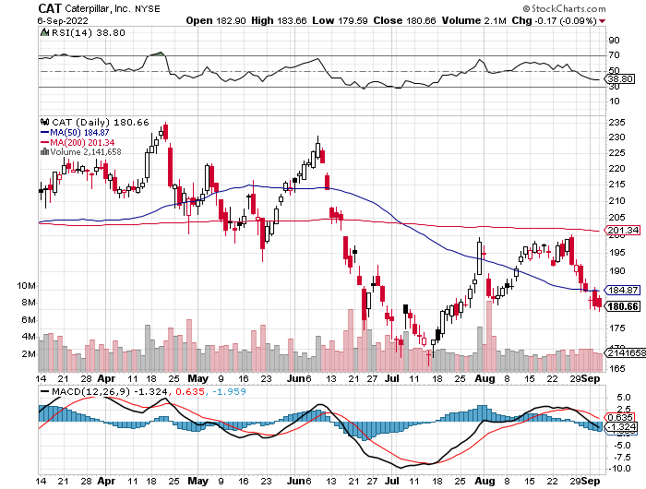
Caterpillar (CAT)- Ag + Infrastructure + Housing Raises Dividend by 50% took profits on long 12/$145-$150 call spread took profits on long 11/$125-$135 call spread

Slide 43
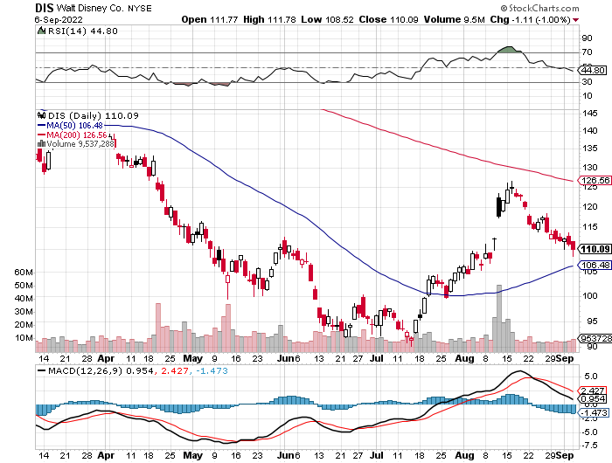
Walt Disney (DIS) - Genie+ stopped out of long 10/$165-$175 call spread took profits on long 3/$170-$180 call spread

Slide 44
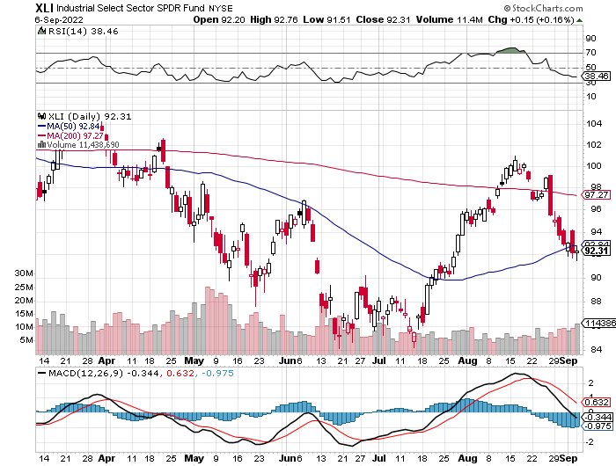
Industrials Sector SPDR (XLI)- (GE), (MMM), (UNP), (UTX), (BA), (HON)

Slide 45
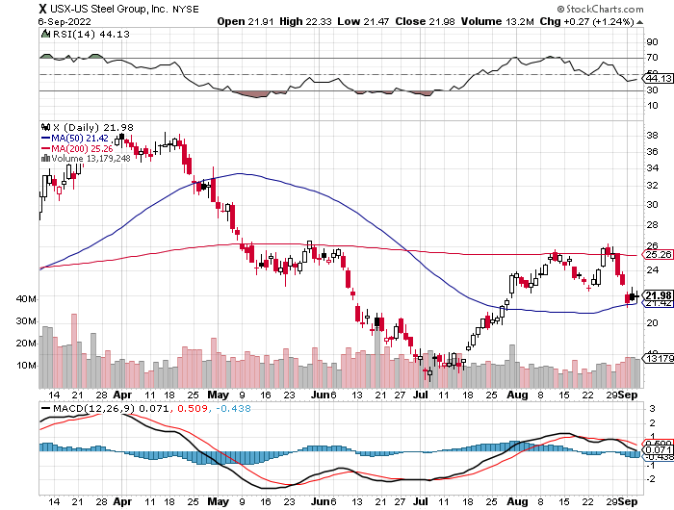
US Steel (X) – Commodity Boom and Wartime boost

Slide 46
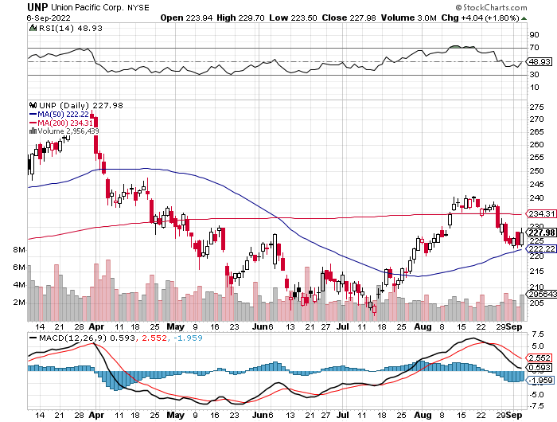
Union Pacific RR (UNP)- Big Stuff to Ship near record earnings announced took profits on long 5/$200-$210 call spread took profits on 11/$150-$160 call spread

Slide 47
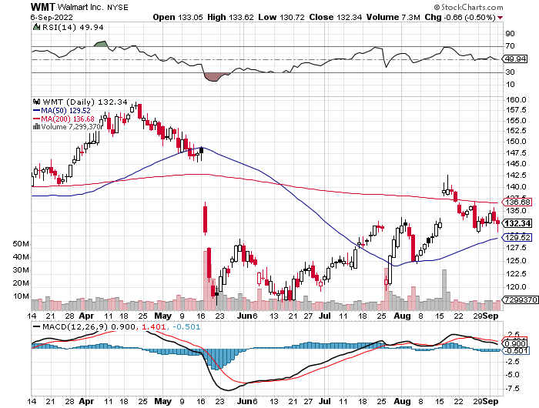
Wal-Mart (WMT)- took profit on Long 11/$125-$130 bear put spread took profit on Long 10/$119-$121 bear put spread took profits on Long 8/$114-$117 bear put spread

Slide 48
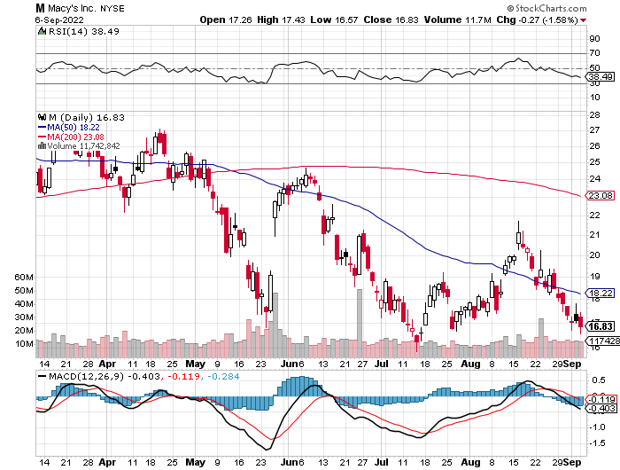
Macys’ (M) – Retail Punished Macy’s Surprises to the Upside took profits on Long 8/$23-$25 bear put spread

Slide 49
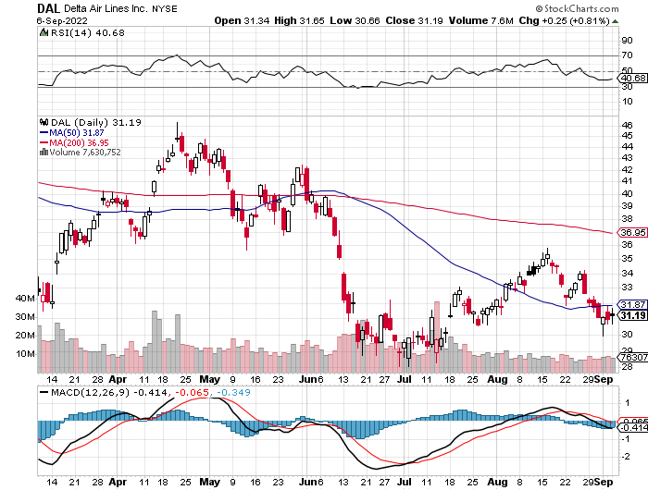
Delta Airlines (DAL) – Travel is Back!

Slide 50
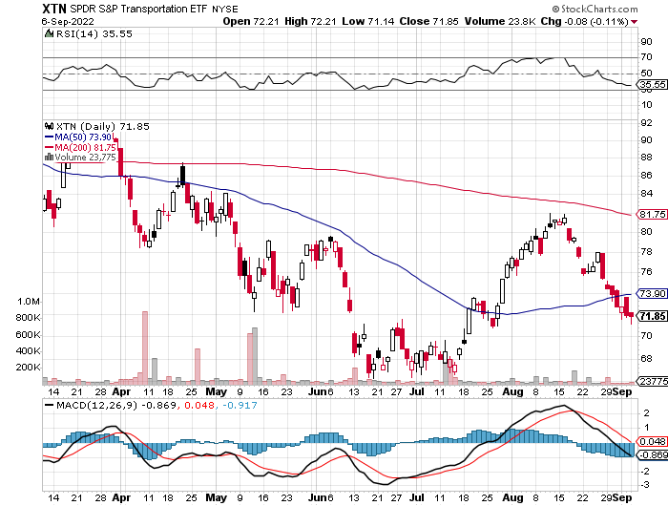
Transports Sector SPDR (XTN)- Worst Hit Sector (ALGT), (ALK), (JBLU), (LUV), (CHRW), (DAL)

Slide 51
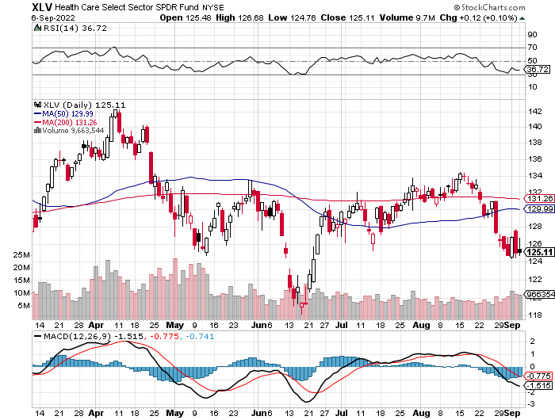
Health Care Sector (XLV) (JNJ), (PFE), (MRK), (GILD), (ACT), (AMGN)

Slide 52
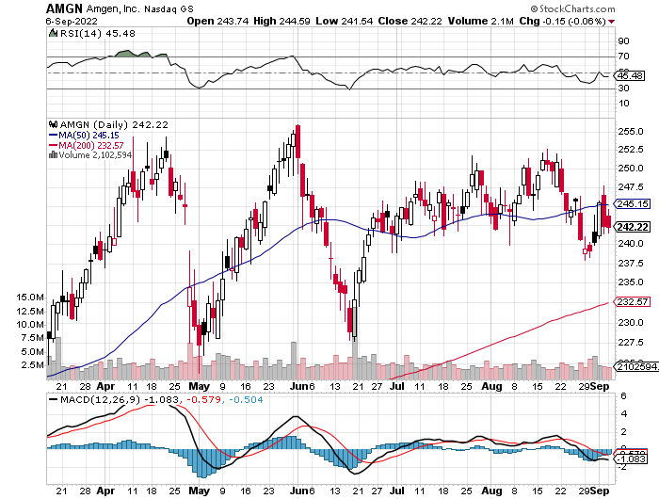
Amgen (AMGN) took profits on long 11/$185-$200 bull call spread

Slide 53
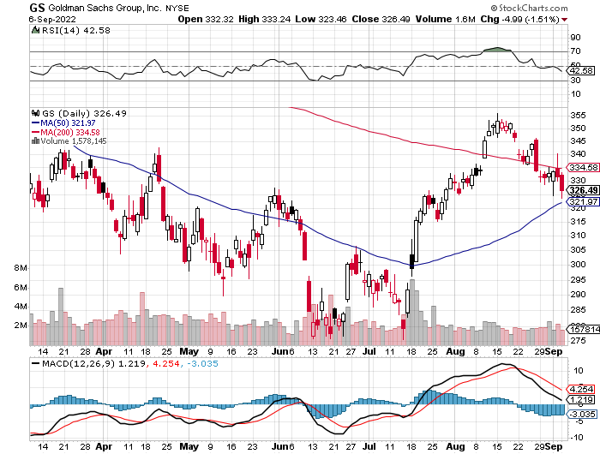
Goldman Sachs (GS) – took profits 12/$330-$350 call spread took profits 11/$330-$350 call spread stop loss on long 11/$385-$395 call spreads

Slide 54
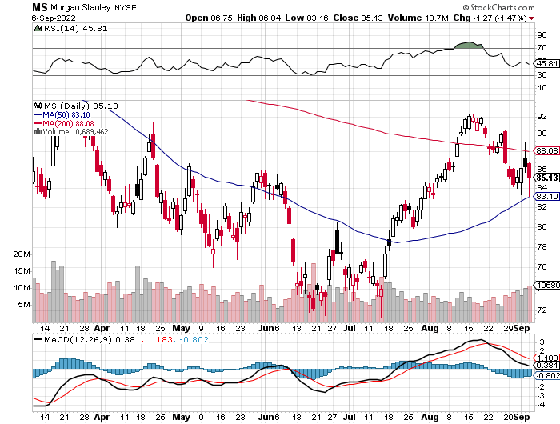
Morgan Stanley (MS) – Blows Away Earnings Equity trading came in a hot $3.2 billion and bond trading $2.9 billion took profits on long 11/$85-$90 call spread

Slide 55
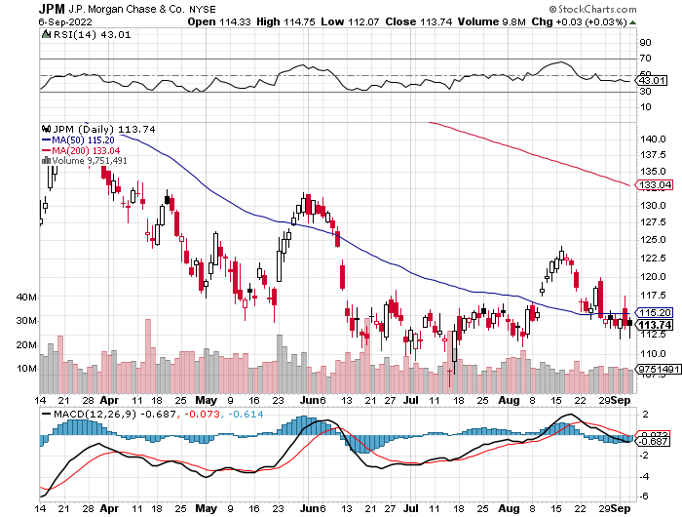
JP Morgan Chase (JPM)- Shares Pop 7.5%, on news that a 17% return on equity is achievable took profits 12/$148-$152.50 call spread

Slide 56
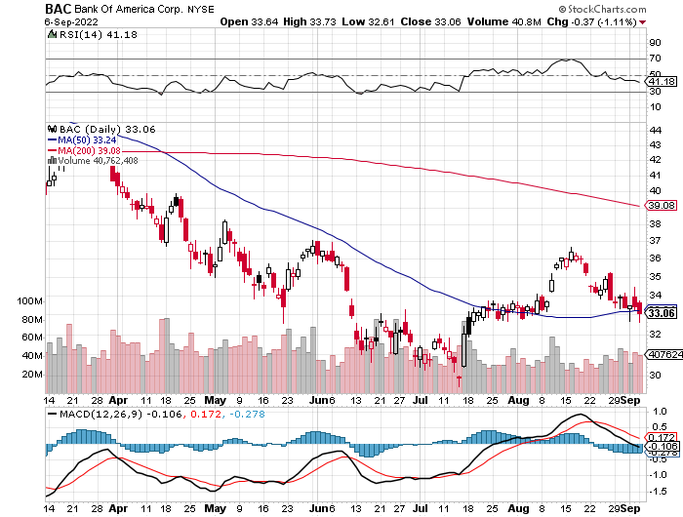
Bank of America (BAC) – took profits long 12/$39-$42 call spread

Slide 57
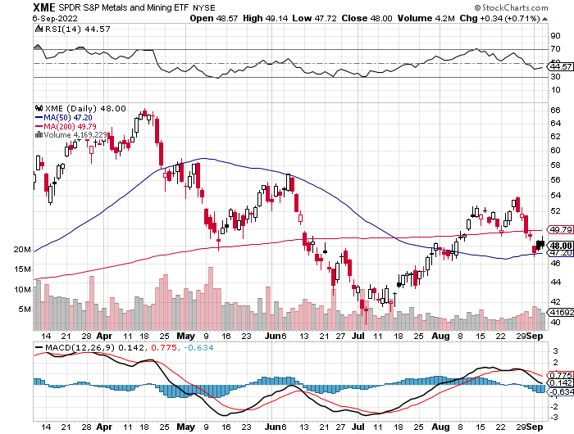
SPDR Metals & Mining ETF (XME) – long 2/$28-$30 call spread

Slide 58
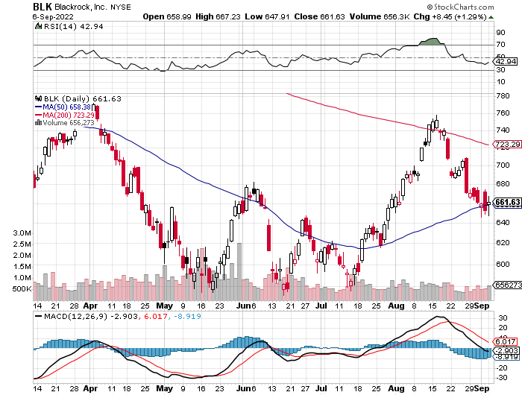
Blackrock (BLK)-Asset Collection Boom took profits on long 3/$770-$790 call spread took profits on long 3/$310-$340 call spread

Slide 59
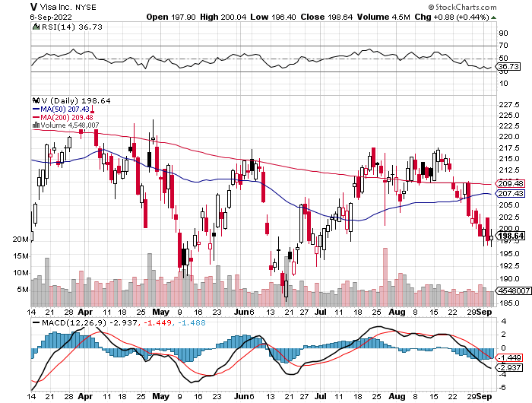
Visa (V) – “Touchless” Bitcoin Drag long 6/$150-$160 bull call spread

Slide 60
Consumer Discretionary SPDR (XLY) (DIS), (AMZN), (HD), (CMCSA), (MCD), (SBUX)

Slide 61
Berkshire Hathaway (BRKB)- Natural Barbell Warren Buffet Turns 92 long 7/$220-$230 call spread took profits on long 6/$260-$270 call spread, stopped out of long 5/$300-$310 call spread, took profits on long 2/$270-$280 call spread

Slide 62
Europe Hedged Equity (HEDJ)-

Slide 63
Japan (DXJ)-

Slide 64
Emerging Markets (EEM) - Pro trade, Weak Dollar, Long Recovery Play

Slide 66
Bonds – New Low for the Year
*A two-month counter trend rally in bonds ends as the economy reheats up *We are now have broken the bottom of the range at $108 *BUT Quantitative Tightening at $95 billion a month will continue to pressure bonds from above at $121 *So will another 1.50% in Fed rate rises through 2023 *US Treasury bond fund (TLT) could plunge from $180 in 2020 to $100 by 2023 *But a one month LONG trade may be setting up at a 10-year yield of 3.60%

Slide 67
Treasury ETF (TLT) – Bottoming-No Positions took profits on long 6/$123-$126 put spread took profits on long 6/$125-$128 put spread took profits on long 6/$124-$127 put spread, took profits on long long 7/$128-$131 put spread took profits on long 5/$128-$131 put spread, look profits on long 5/$127-$130 put spread

Slide 68
Ten Year Treasury Yield ($TNX) – 3.34%

Slide 69
Junk Bonds (HYG) 6.81% Yield to Maturity

Slide 70
2X Short Treasuries (TBT)-Another run at highs

Slide 72
Foreign Currencies – Dollar Surge
*Strong Dollar is Crushing Inflation, thanks to cheaper imports *It’s one of the biggest moves since Nixon took the US off the gold standard in 1971. *Euro hits new lows, those European vacations are getting cheaper *Weak Chinese economy crushes the Yuan, government attempting to stabilize *Commodity currencies like (FXA) and (FXC) take it on the nose from falling commodity prices *Long-term US dollar fundamentals are still poor, a dollar short could be the new ten-year trade, but not yet *Stand aside from forex for now, there are getting fish to fry

Slide 73
Japanese Yen (FXY)

Slide 74
Euro (FXE)-

Slide 75
British Pound (FXB)-

Slide 76
Australian Dollar (FXA)- The Global Recovery Play took profits on long 8/$67-$69 call spread

Slide 77
Emerging Market Currencies (CEW)

Slide 78
Chinese Yuan- (CYB)- Shanghai Shutdown

Slide 80
Bitcoin – Breakdown Buy the Mad Hedge Bitcoin Letter at https://www.madhedgefundtrader.com/store/
*Bitcoin is Headed Back to Cost of $17,000, after breaking $20,000 on Friday, top is capped at $25,000. But with soaring electricity price cost might be $20,000 now *Ether is the big play with the merge taking place this week, it's the only crypto that has gone up this summer *Mt Gox bankruptcy resolution could dump 137,000 Bitcoin on the market ten years later *Crypto has provided no downside protection, cratering along with everything else after Powell’s hawkish speech *Most speculators have returned to the stock market and not crypto *Avoid all crypto for now with better trades elsewhere

Slide 81
Bitcoin ($BTCUSD) – Finding a bid

Slide 82
Ethereum (ETHE) –

Slide 83
MicroStrategy (MSTR) –

Slide 84
Amplify Transformational Data Sharing ETF (BLOK) –

Slide 86
Energy & Commodities –Probing Lows
*Oil pops on OPEC+ token production cut of only 100,000 to boost prices *But Spreading China lockdowns still a major drag, Taking the world’s largest consumer offline * California Heads for a Heat Emergency last Weekend, took temperatures up to 116, increases political pressure to get off oil sooner *California Bans Internal Combustion Engine Sales, from 2035 as peak energy hits 51 MW/day *There’s another 50-cent decline in gasoline prices in the cards *Russia Is China’s Top Oil Supplier, for the third month in a row *Gasoline Futures one year out are trading at enormous discounts *Avoid all energy plays like the plague, it’s the new buggy whip industry as the US de-carbonizes

Slide 87
Oil-($WTIC)

Slide 88
United States Oil Fund (USO) long 10/$9.50-$10 Vertical bull call spread

Slide 89
Energy Select Sector SPDR (XLE)-No Performance! (XOM), (CVX), (SLB), (KMI), (EOG), (COP)

Slide 90
Halliburton (HAL)-

Slide 91
Natural Gas (UNG) -

Slide 92
Freeport McMoRan (FCX) -

Slide 93
Cameco (CCJ) - took profits on long 5/$20-$23 bull call spread

Slide 95
Precious Metals –Putin is Still Selling
*Double bottom or new lows? *Gold Plunges on massive Russian selling as reserves dry up *Gold is more of a commodity play now than a risk hedge *As long as commodities are weak, gold will be weak,
Pulled down by recession fears *Recently rising interest rates are a drag on gold *Speculative interest has faded to a few hard-core gold bugs *Silver is still the bigger and better long-term play

Slide 96
Gold (GLD) - Deflation call took profits on long 5/$165-$170 bull call spread

Slide 97
Market Vectors Gold Miners ETF- (GDX) –

Slide 98
Barrick Gold (GOLD) took profits on long 1/$21-$23 call spread took profits on long 11/$22-$24 call spread

Slide 99
Newmont Mining- (NEM)- took profits on long $55-60 call spread

Slide 100
Silver- (SLV)- took profits on long 11/$19-$20 call spread

Slide 101
Silver Miners - (SIL)-

Slide 102
Wheaton Precious Metals - (WPM)- took profits on long 2/$39-41 call spread

Slide 104
Real Estate – More Recession
*Home Prices Retreat, in June to an 18% YOY gain *Pending Home Sales Dive 1% in July on a signed contract basis and are of 19.9% YOY *Toll Brothers Orders Plunge 60% in Q2, as demand for luxury homes vaporize. It expects to be down 15% for the full year *New Home Sales Crash 12.6%, in July, the worst number since the Great Recession 2008 level

Slide 105
S&P Case Shiller-Still Going Up in the Rear View Mirror S&P Case Shiller Rockets 19.7%, in May with its National Home Price Index Tampa (35%), Miami (33.0%), Dallas (28.2%)

Slide 106
Crown Castle International (CCI) – 3.26% yielding cell phone tower REIT

Slide 107
US Home Construction Index (ITB) (DHI), (LEN), (PHM), (TOL), (NVR)

Slide 109
Trade Sheet- So What Do We Do About All This?
*Stocks – buy the big dips at bottom of range *Bonds – sell big rallies *Commodities-buy dips *Currencies- stand aside *Precious Metals – stand aside *Energy – stand aside *Volatility - sell short over $30 *Real estate – stand aside *Bitcoin – stand aside

Slide 111
Next Strategy Webinar 12:00 EST Wednesday, September 21 from Silicon Valley, CA email me questions at support@madhedgefundtrader.com
Good Luck and Good Trading!
Notes:
*

