Slide 1
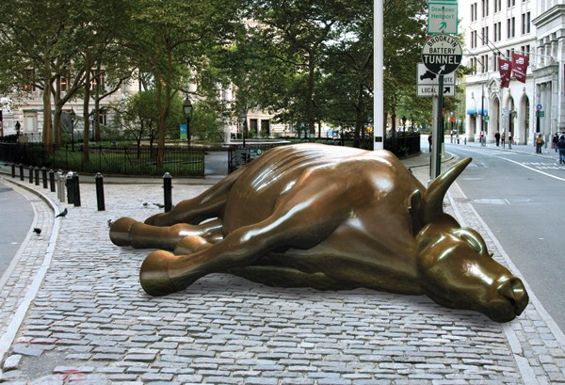
The Mad Hedge Fund Trader “Bull Market Postponed”
With John Thomas Silicon Valley, CA, September 7, 2022 www.madhedgefundtrader.com
Notes:
*

Slide 2
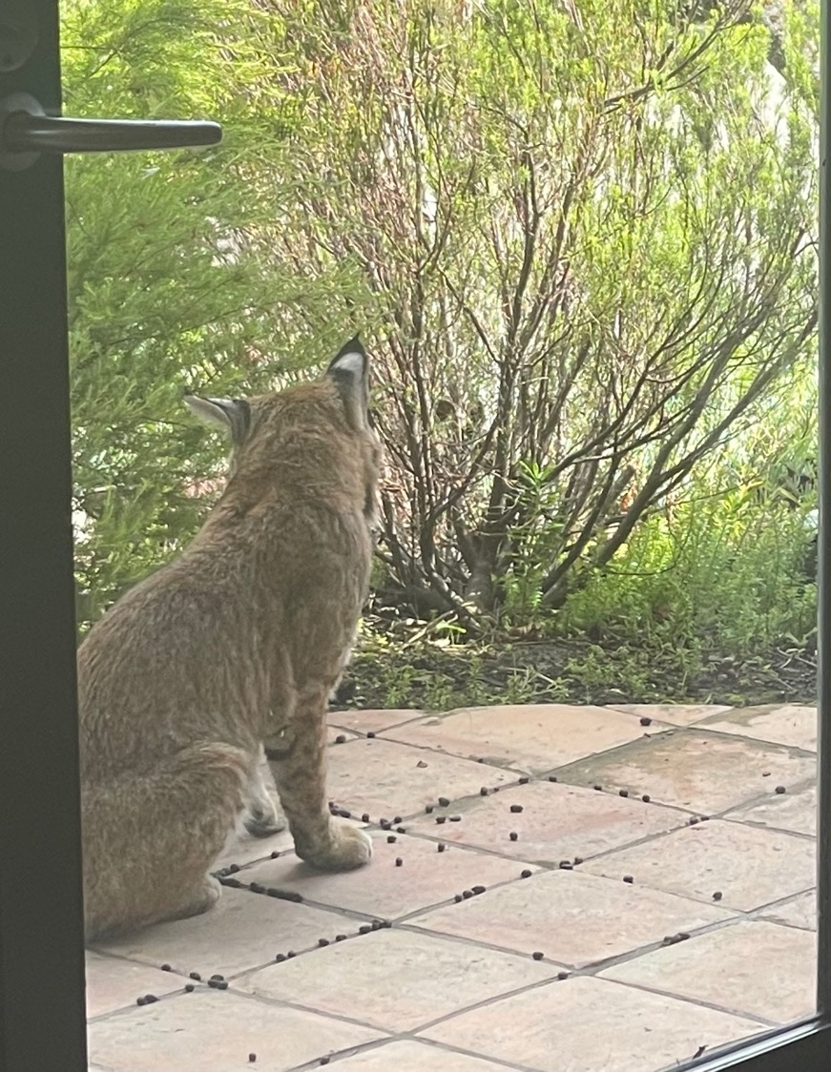

Slide 3
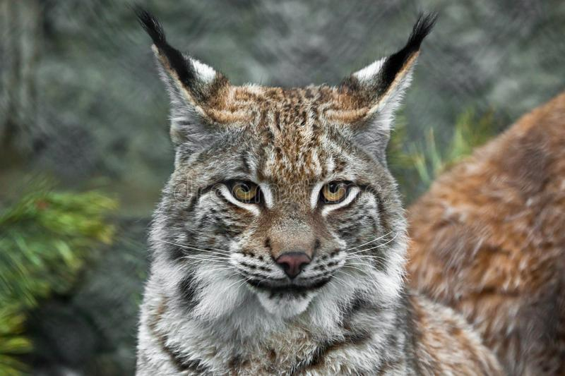

Slide 4
Mad Hedge Traders & Investors Summit September 13-15 The Recordings are Up go to www.madhedge.com
*A collection of the 28 best traders and managers in the world *Back-to-back One-hour presentations followed by an interactive Q&A *It’s a smorgasbord of trading strategies, pick the one that is right for you *Covering all stocks, bonds, commodities, foreign exchange, precious metals, and real estate *It’s the best look at the rest of 2022’s money making opportunities you will get anywhere *An invitation will be sent to you shortly and it is FREE to attend

Slide 5
Trade Alert Performance New All Time Highs! 29 out of 30 trade alerts profitable
*January 14.59% Final *July +3.98% Final *February +8.78% Final *August +5.13% Final *March +3.43% Final *September +3.19% MTD *April +3.33% Final *October +8.91% MTD *May +8.80% Final *November -11.79% Final *June +5.91% Final *December +11.26% Final *2022 YTD +63.15% compared to -18% for the Dow Average *+$575.71% since inception *Average annualized return of +44.80% for 14 years

Slide 6
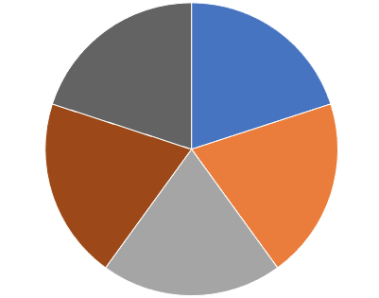
Portfolio Review 30% Long, 20% short, 50% cash- Cash at the lower end of the range
Current Capital at Risk
Risk On
(TLT) 10/$98-$101 call spread | 10.00%
(TSLA) 10/$230-$240 call spread | 10.00%
(RIVN) 10/$25-$30 call spread | 10.00%
Risk Off
(AAPL) 10/$165-$175 call spread | -10.00%
(SPY) 10/$410-$420 put spread | -10.00%
Total Net Position | -20.00%
Total Aggregate Position | 50.00%
Expiration Value +71.70%

Slide 7
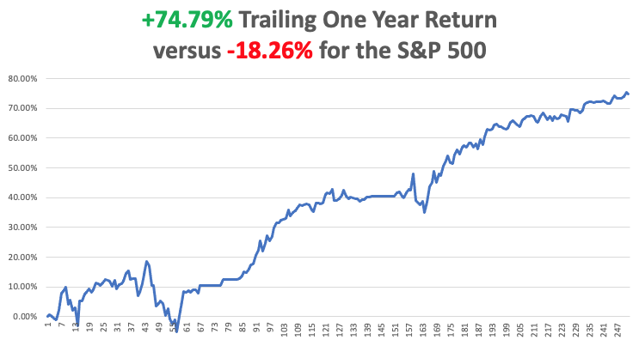

Slide 8
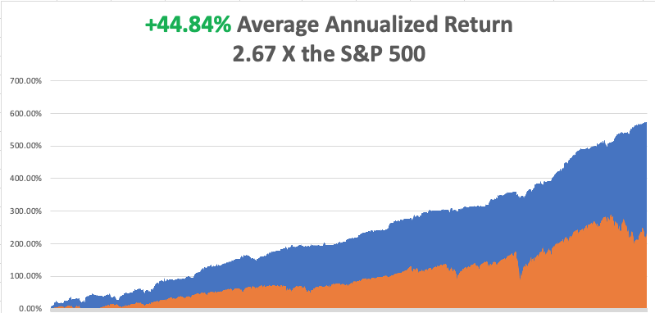

Slide 9
The Method to My Madness The Bottom is In
*Terrible CPI delays the next bull market by one or two months *We are now five weeks into a 2–3-month correction *Q4 could be the best entry point for stocks in a decade *Oil prices continue in free fall, hitting new 9-month lows *Inflation is plunging but it may not show up until the October 13 number *Coming interest rate rises have put the wind back behind the US dollar *Bear market in bonds may be ending with 10-year rates topping 3.50% *(SPX) 4,800 is postposed until 2023 *VIX pops from $19 to $28

Slide 10
Corona Update –
*The pandemic is over and is no longer a factor in the economy *Covid will continue at a low 500 deaths a week forever *Covid boosters will be an annual chore for the rest of our lives *I am ending weekly Covid coverage with this issue unless we get another big spike

Slide 11
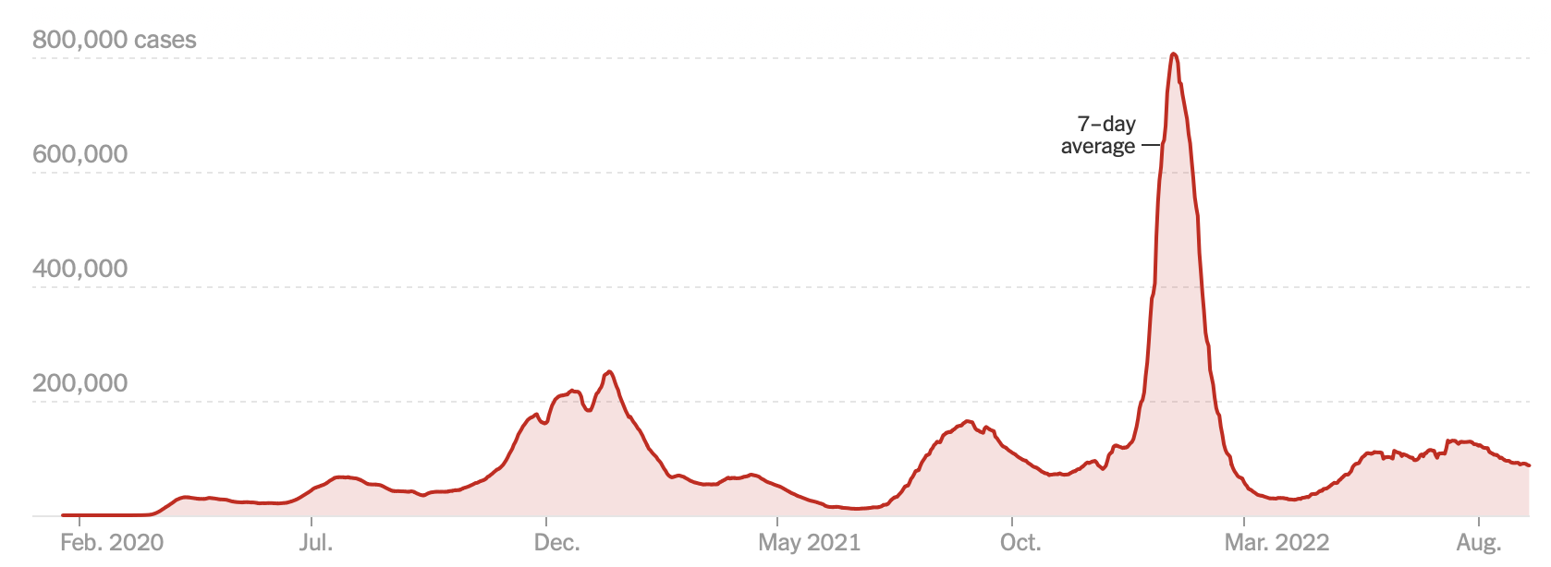
The Pandemic is Over But we may have a permanent low level

Slide 12
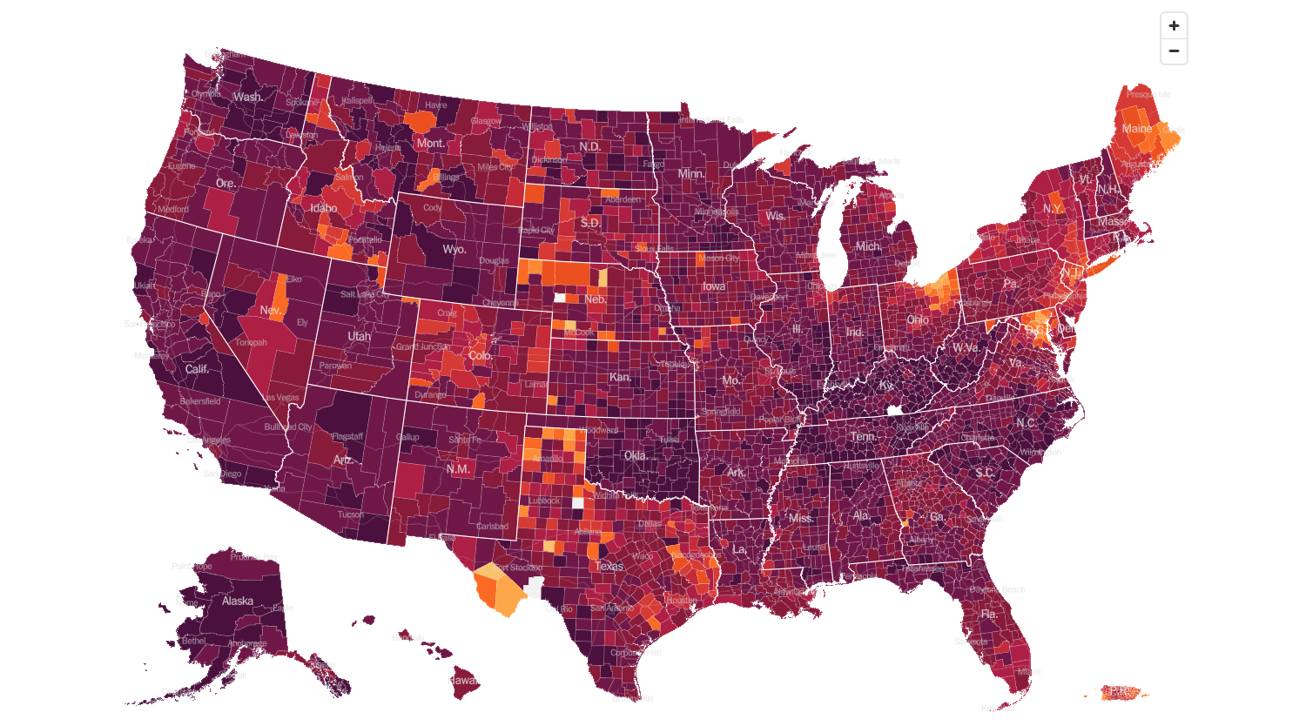
February 2 2022 Infection Rate

Slide 13
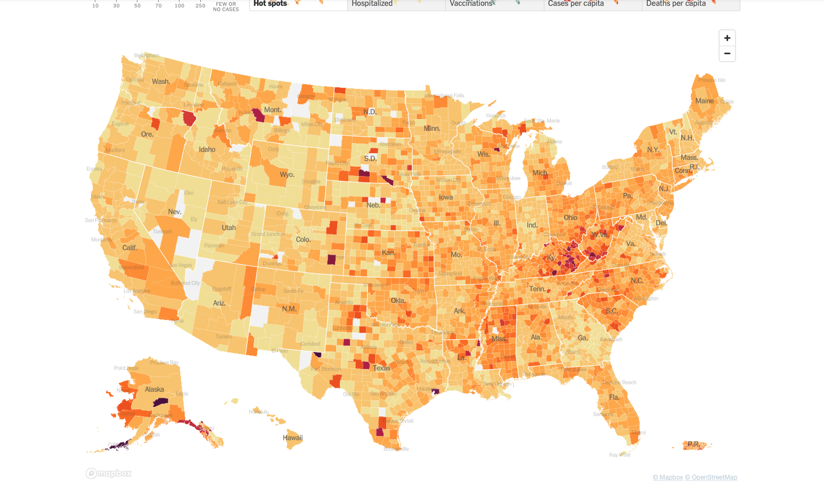
September 21 2022 Infection Rate

Slide 14
The Global Economy – Rolling Over
*75 basis point Fed interest rate rise comes today *European Inflation Hits 9.6%. *Weekly Jobless Claims Come in at 213,000, down 5,000 and lower for the fifth consecutive week *Rail Strike Averted at the last possible minute after an all-night session. *US Retails Sales Rise, by 0.3% in August *California Sets $22 Minimum Wage for fast food workers starting from 2023

Slide 15
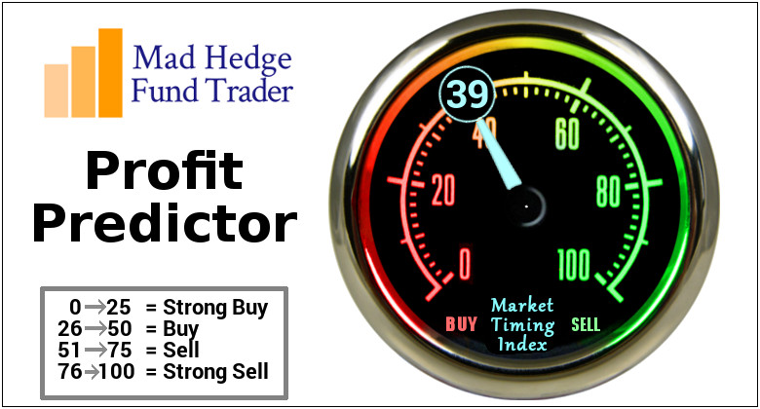
The Mad Hedge Profit Predictor Market Timing Index – Buy Territory An artificial intelligence driven algorithm that analyzes 30 different economic, technical, and momentum driven indicators

Slide 16
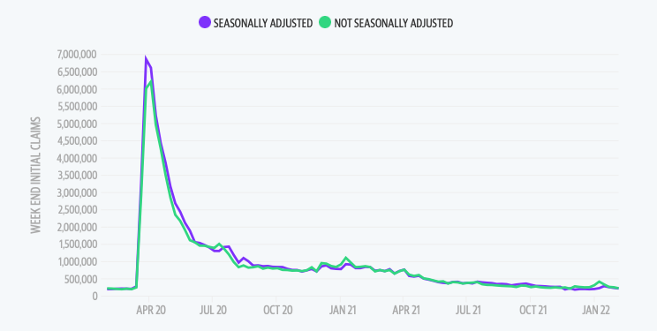
Weekly Jobless Claims – Falling 213,000 – down 5,000

Slide 18
Stocks – Double Bottoming
*Q4 could be the best entry point for stocks in a decade *Consumer Price Index Came in at a Hot 8.3%, in August, much higher than expected *A sweet spot for long term LEAPS is opening up, with Concierge clients getting enhanced coverage *The entry market could be shifting towards climate change with a huge focus on EV’s *That includes commodity plays like (FCX) and (CCJ) *US Announces $900 million for EV Charging *JP Morgan Says M&A Revenues are Off 50% *Look for terrible H1 and strong H2 scenario to continue

Slide 19
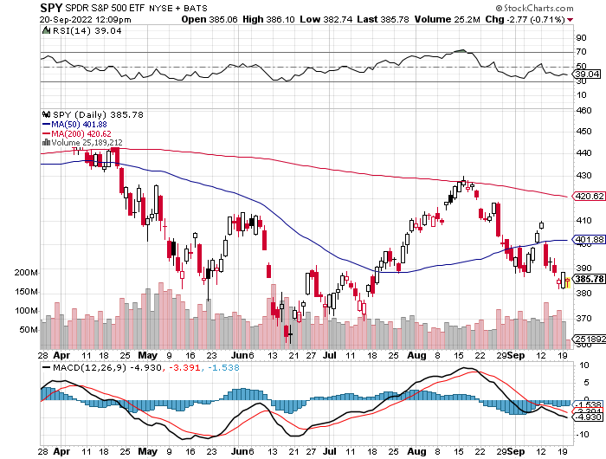
S&P 500 – The Worst Case-Mild Recession long 10/$410-$420 put spread, took profits on long 6/$445-$455 put spread took profits on long 6/$430-$440 put spread, took profits on long $440-$450 put spread
$420 2023
$432 +19.3% Rally
The Bottom 362 Down -25%

Slide 20
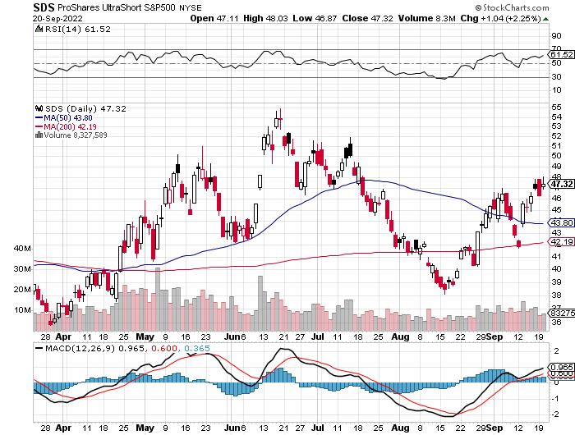
ProShares Ultra Short S&P 500 (SDS)- a great hedge for long stocks and bonds long 2X position has a hedge against longs and bond shorts

Slide 21
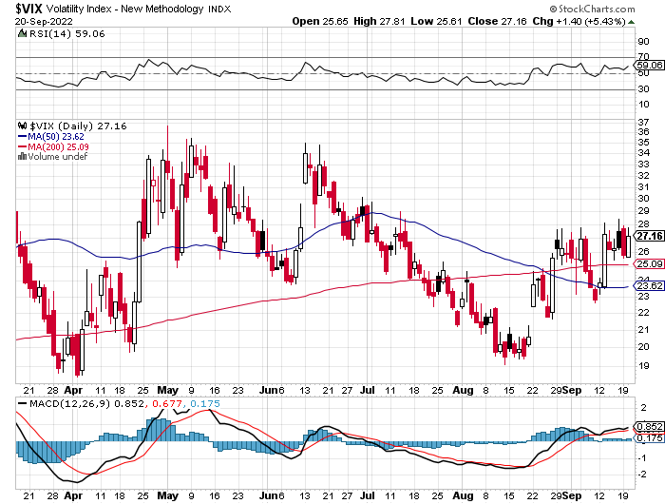
(VIX) – Unable to Make a New High

Slide 22
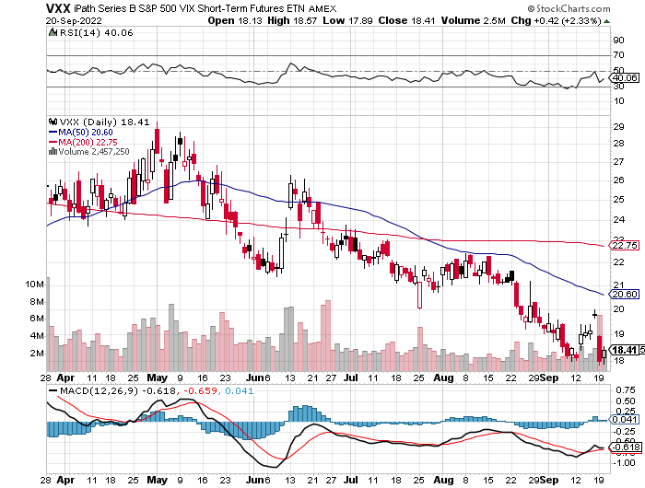
(VXX)-

Slide 23
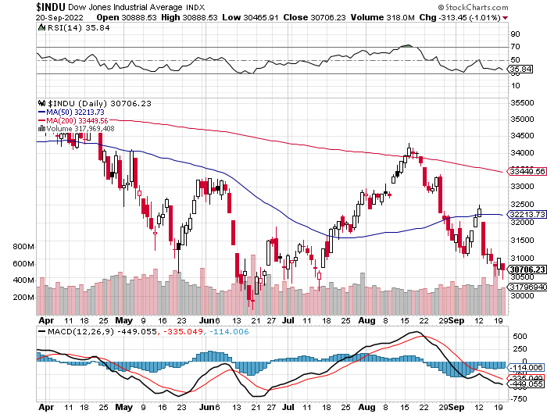
Dow Average ($INDU)-

Slide 24
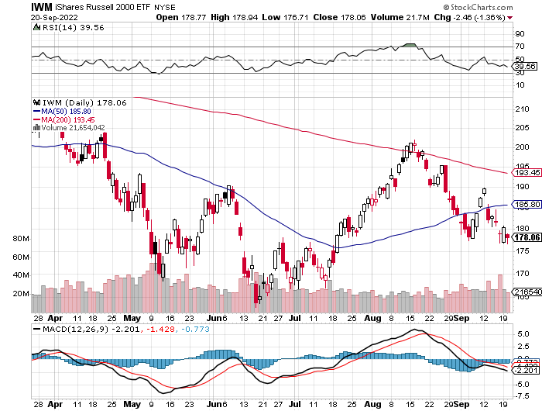
Russell 2000 (IWM)- took profits on Long 10/$137-$142 vertical bull call spread took profits on Long 10/$153-$156 vertical bear put spread

Slide 25
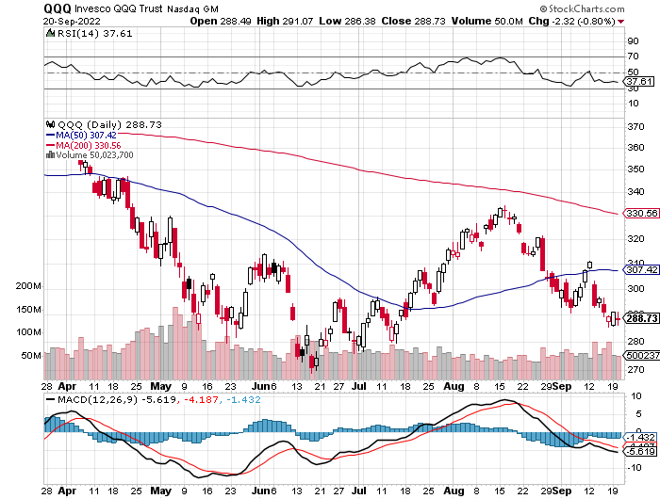
NASDAQ (QQQ) – took profits on long (QQQ) 4/$330-$335 put spread took profits on long (QQQ) 3/$340-$345 put spread covered long (QQQ) $325-$330 put spread

Slide 26
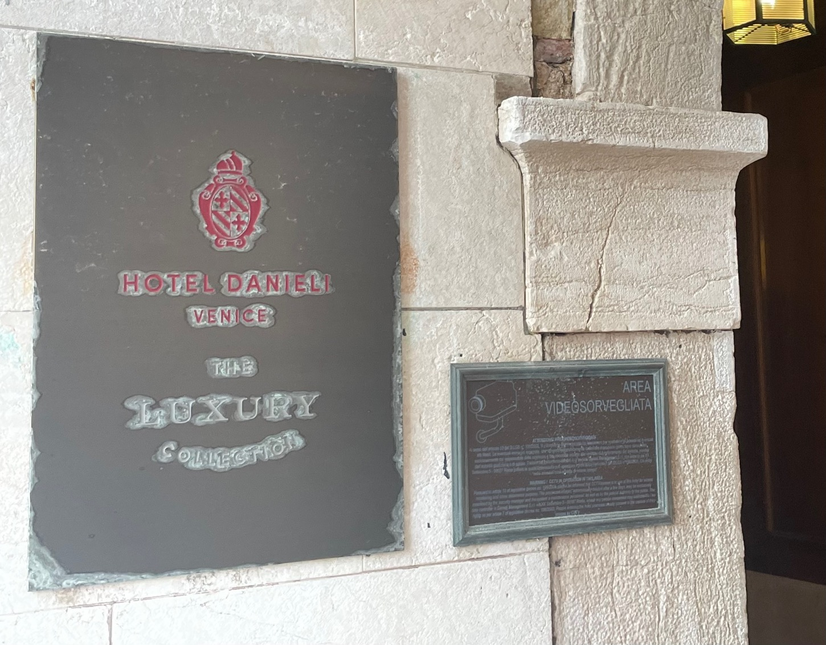

Slide 27
The Barbell Portfolio
*50% Big Tech - 2% of US Employment but 27% of Market Cap and 38% of Profits 50% Domestic Recovery, including: Railroads Couriers Banks Construction Credit Cards Event organizers Ticket sales Retailers

Slide 28
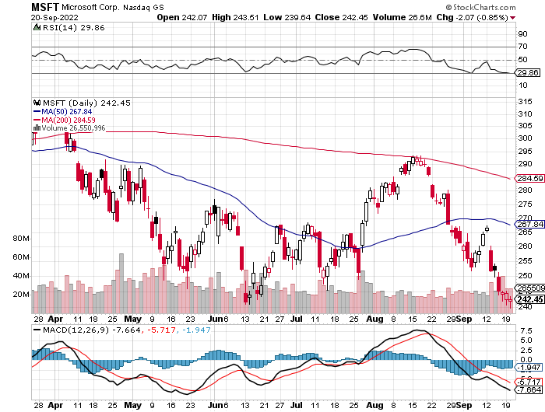
Microsoft (MSFT)- 9/$235-$245 call spread-expires in 7 trading days took profits on long 7/$220-$210 call spread, took profits on long 6/$220-$230 call spread, took profits on long 2/$200-$210 bear put spread

Slide 29
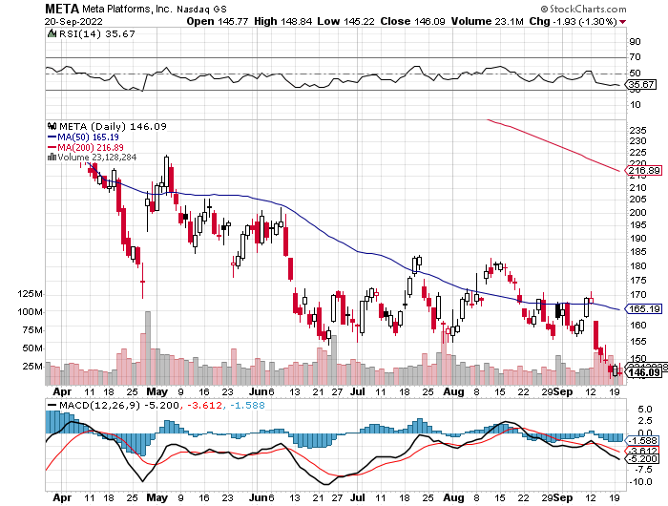
Meta (META)- Looking for the Metaverse took profits on Long 9/$290-$300 vertical bear put spread stopped out of Long 9/$190-$200 vertical bear put spread

Slide 30
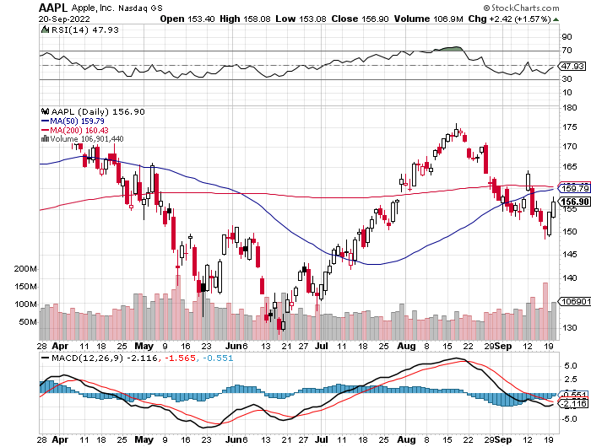
Apple (AAPL)-iPhone 14 launched! long 10/$165-$175 put spread took profits on long 6/$155-$165 put spread, stopped out of long 6/$125-135 call spread, took profits on long 6/$110-$120 call spread, took profits on long 2/$180-$190 put spread

Slide 31
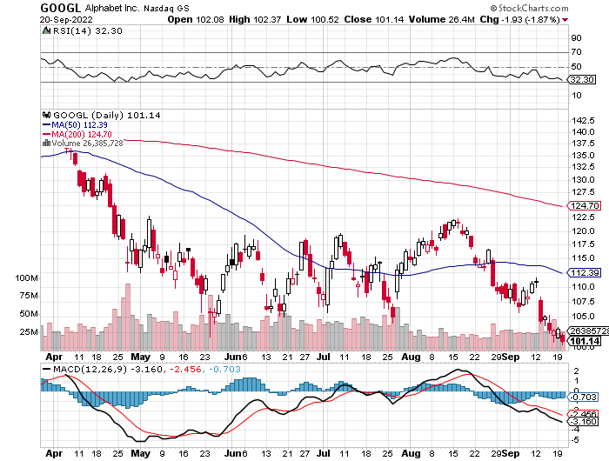
Alphabet (GOOGL) – Ad king on economic recovery $4.1 Billion fine for European antitrust took profits on long 12/$1,200-$1,230 bull call spread took profits on long 9/$1,030-$1,080 vertical bull call spread

Slide 32
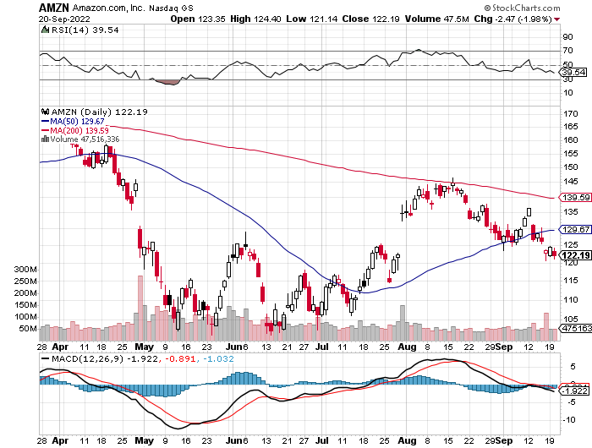
Amazon (AMZN) – Amazon Splits 20:1, triggering an avalanche of new retail buyers took profits on long 2/$3,400-$3,500 bear put spread took profits on long 9/$2,800-$2,900 bull call spread

Slide 33
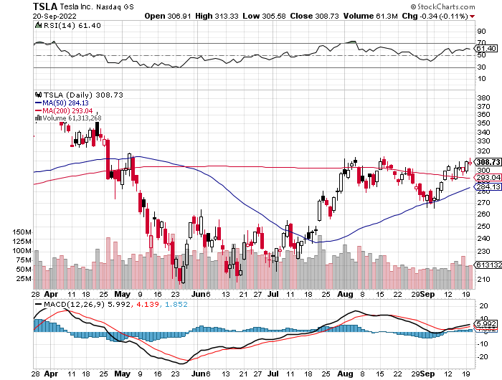
Tesla (TSLA) – Taking a break Tesla Triples China Deliveries after expanding the Shanghai factory long 10/$220-$230 call spread took profits on short 8/$500 puts, stopped out of short 8/$950 calls took profits on long 2/$500-$550 call spread, profits on long 2/$550-$600 call spread

Slide 34
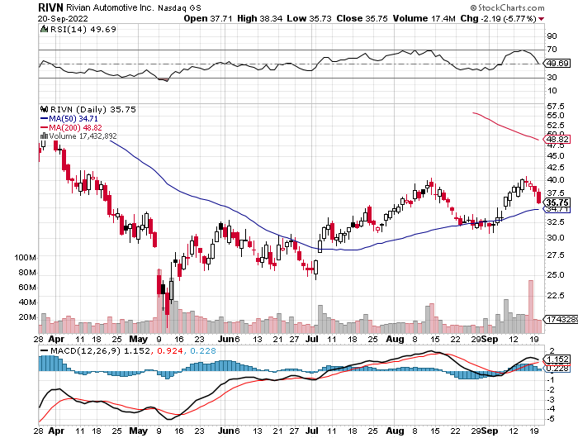
Rivian (RIVN) – Amazon Backed Electric Trucks 2022 production of 20,000 long 10/$25-$30 call spread

Slide 35
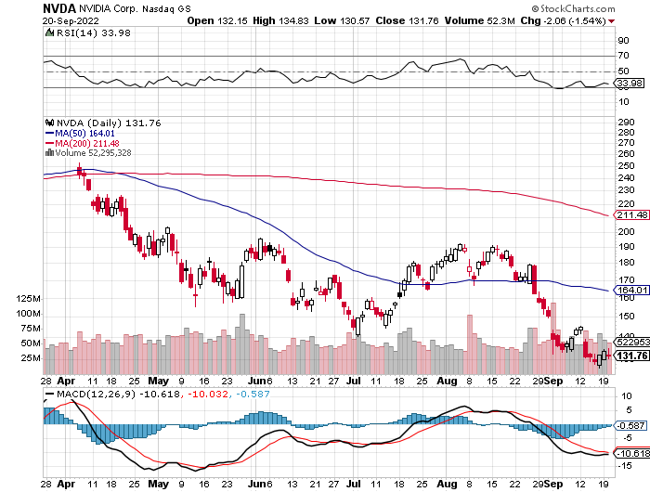
NVIDIA (NVDA) – Downgrade on US ban of highest end AI chips to China took profits on long 7/$120-$130 call spread, took profits on long 6/$120-$130 call spread

Slide 36
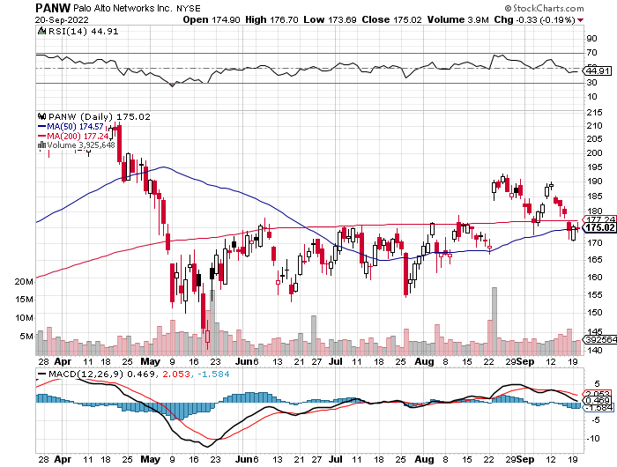
Palo Alto Networks (PANW)- Hacking never goes out of fashion

Slide 37
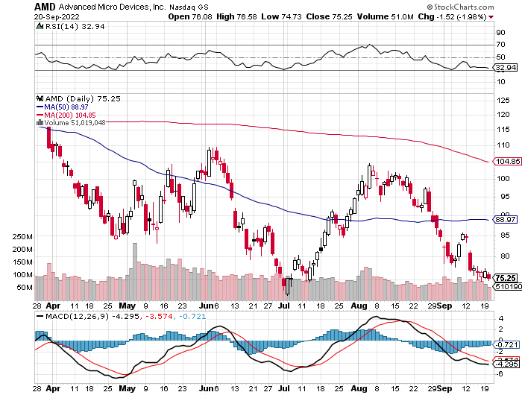
Advanced Micro Devices (AMD)- Recession fears programable logic devices took profits on long 2/$75-$80 call spread

Slide 38
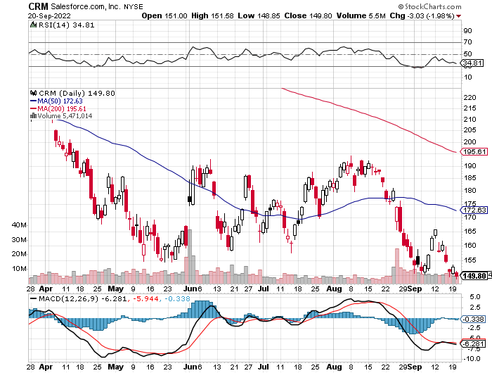
Salesforce (CRM)- Massive Online Migration took profits on long 9/$125-$130 vertical bull call spread took profits on long 8/$125-$130 vertical bull call spread took profits on long 2/$105-$115 call spread

Slide 39
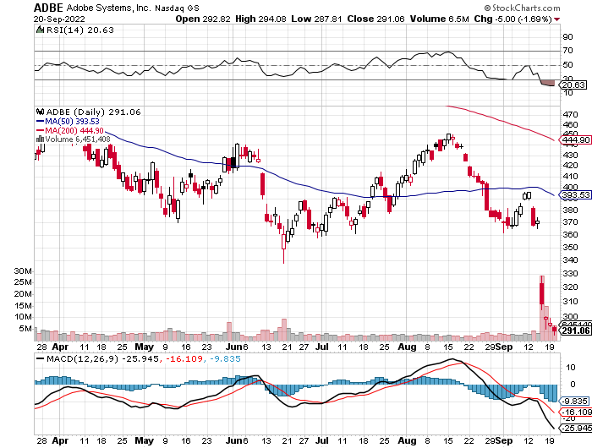
Adobe (ADBE)- Cloud play The Quality Non-China tech play

Slide 40
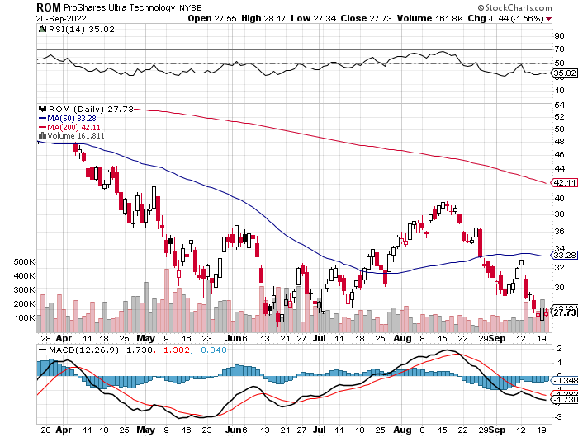
ProShares Ultra Technology ETF (ROM) – 2X Long Technology ETF took profits on long 10/$62-65 call spread

Slide 42
The Second Half of the Barbell
*Bets on a domestic recovery in 2022 Q4 *Upside potential in 2022 far greater than tech *Some of these have not moved for 5 or 10 years *Focuses on economically sensitive cyclical industries *Makes a great counterweight to high-growth technology *We could spend all of next year rotating between the two groups

Slide 43
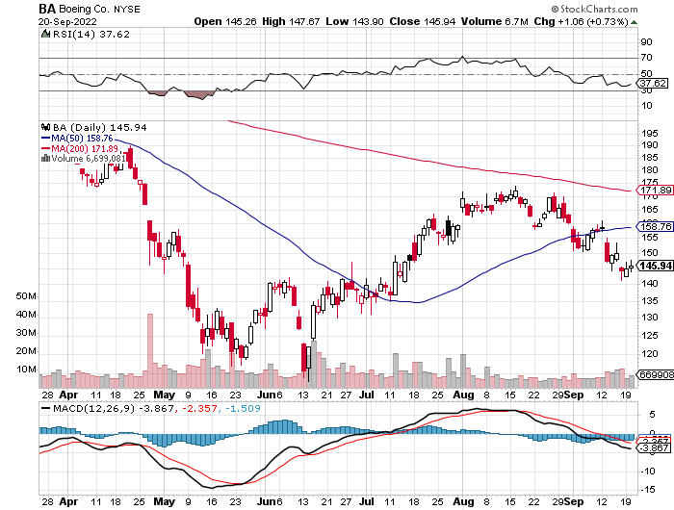
Boeing (BA) –Disastrous Earnings Boeing Delivered its First 787 Dreamliner in a year long 3/$146-$149 call spread took profits on long 2/$150-$160 call spread

Slide 44
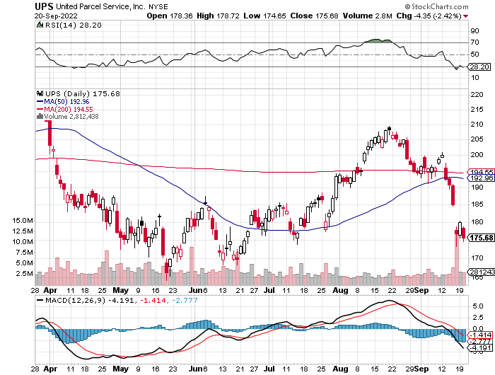
Package Delivery- United Parcel Service (UPS) - Package Delivery record profits took profits on long 11/$130-$140 call spread

Slide 45
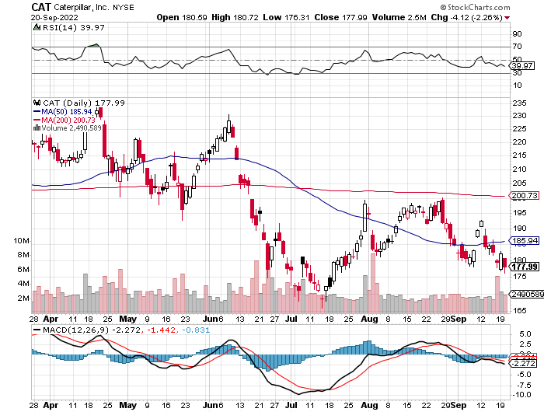
Caterpillar (CAT)- Ag + Infrastructure + Housing Raises Dividend by 50% took profits on long 12/$145-$150 call spread took profits on long 11/$125-$135 call spread

Slide 46
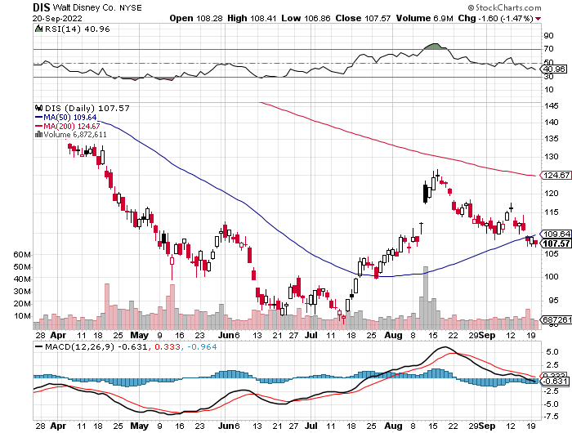
Walt Disney (DIS) - Genie+ stopped out of long 10/$165-$175 call spread took profits on long 3/$170-$180 call spread

Slide 47
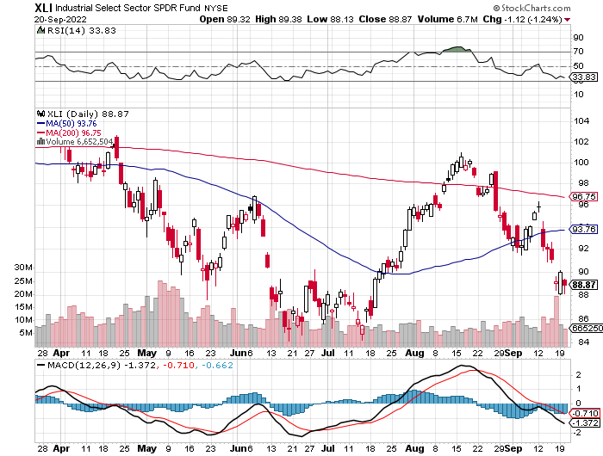
Industrials Sector SPDR (XLI)- (GE), (MMM), (UNP), (UTX), (BA), (HON)

Slide 48
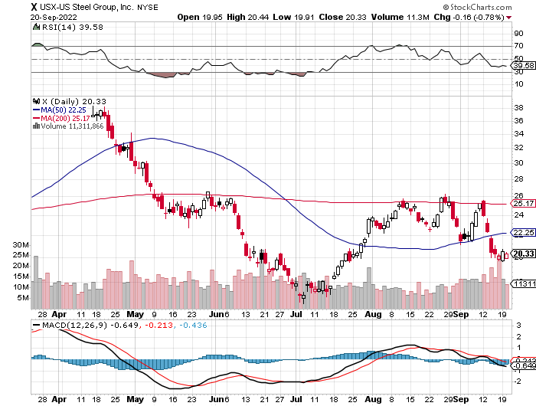
US Steel (X) – Commodity Boom and Wartime boost

Slide 49
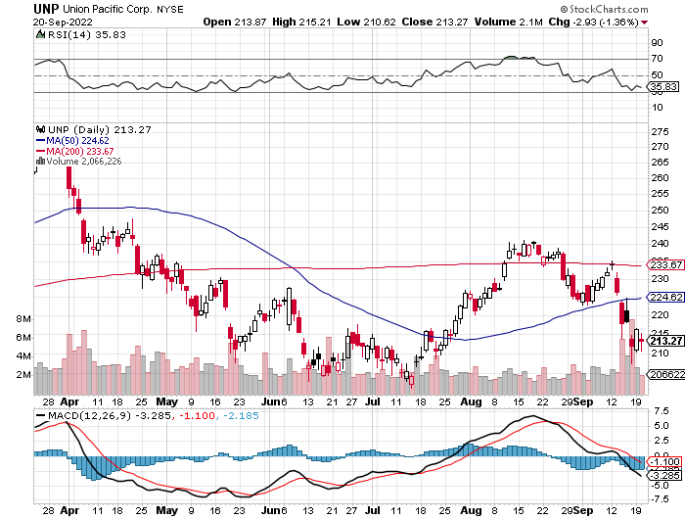
Union Pacific RR (UNP)- Big Stuff to Ship near record earnings announced took profits on long 5/$200-$210 call spread took profits on 11/$150-$160 call spread

Slide 50
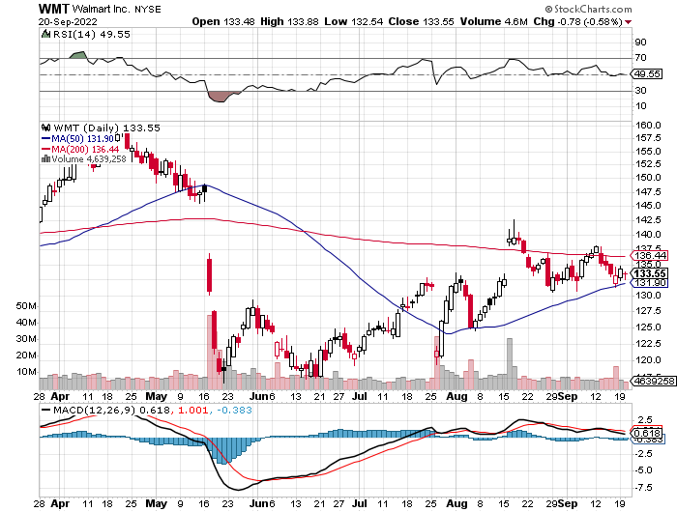
Wal-Mart (WMT)- took profit on Long 11/$125-$130 bear put spread took profit on Long 10/$119-$121 bear put spread took profits on Long 8/$114-$117 bear put spread

Slide 51
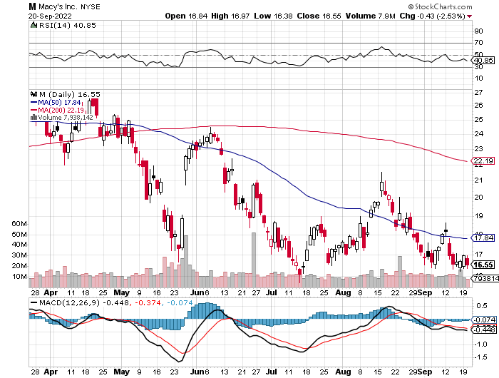
Macys’ (M) – Retail Punished Macy’s Surprises to the Upside took profits on Long 8/$23-$25 bear put spread

Slide 52
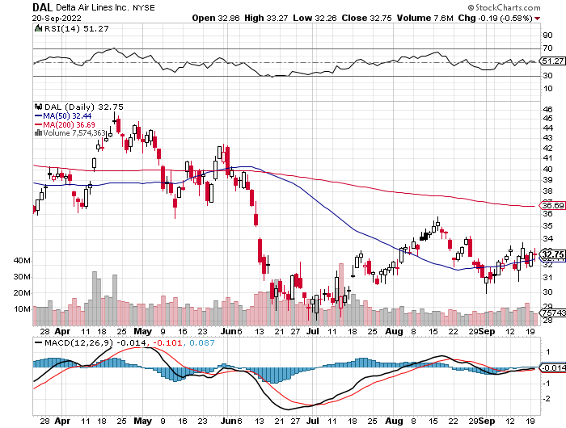
Delta Airlines (DAL) – Travel is Back!

Slide 53
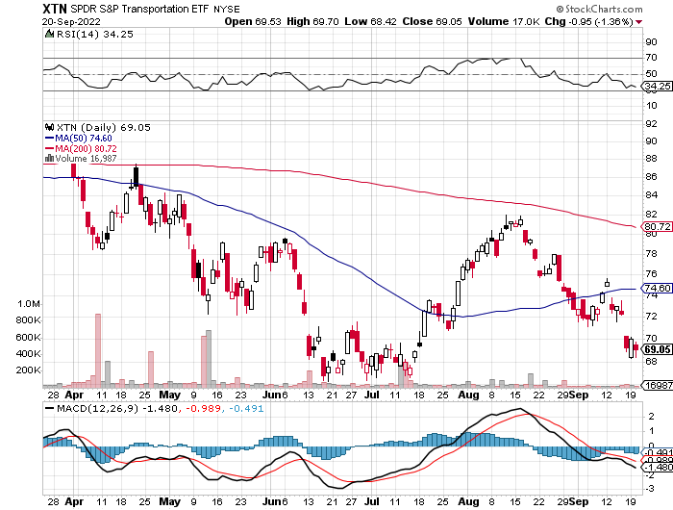
Transports Sector SPDR (XTN)- Worst Hit Sector (ALGT), (ALK), (JBLU), (LUV), (CHRW), (DAL)

Slide 54
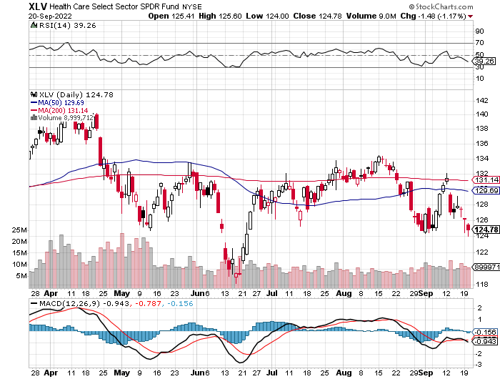
Health Care Sector (XLV) (JNJ), (PFE), (MRK), (GILD), (ACT), (AMGN)

Slide 55
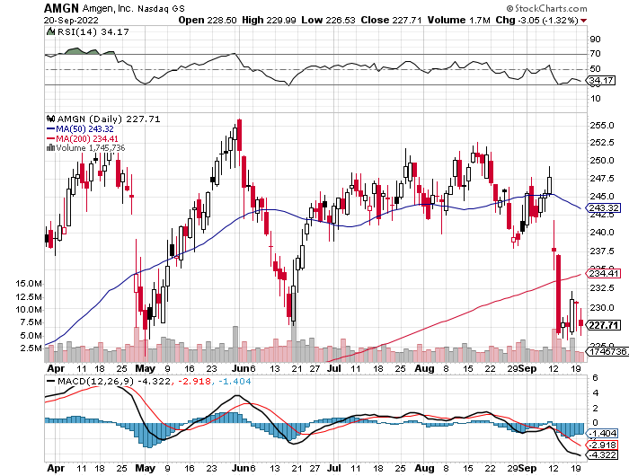
Amgen (AMGN) took profits on long 11/$185-$200 bull call spread

Slide 56
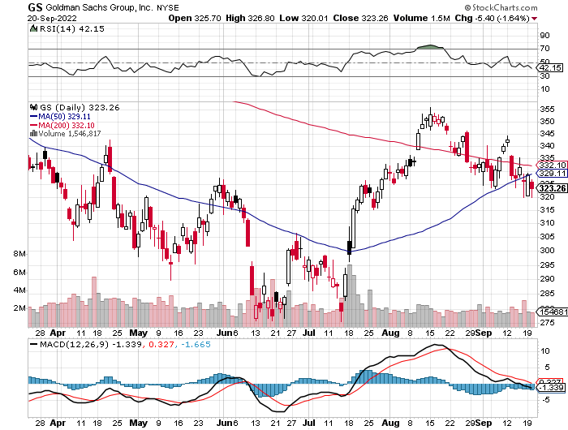
Goldman Sachs (GS) – took profits 12/$330-$350 call spread took profits 11/$330-$350 call spread stop loss on long 11/$385-$395 call spreads

Slide 57
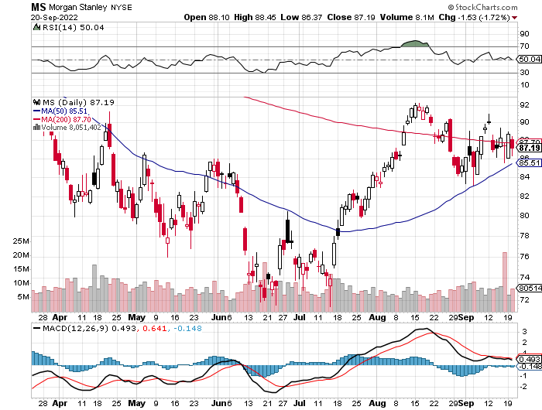
Morgan Stanley (MS) – Blows Away Earnings Equity trading came in a hot $3.2 billion and bond trading $2.9 billion took profits on long 11/$85-$90 call spread

Slide 58
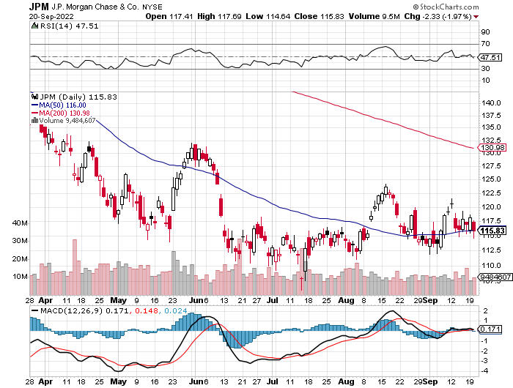
JP Morgan Chase (JPM)- Shares Pop 7.5%, on news that a 17% return on equity is achievable took profits 12/$148-$152.50 call spread

Slide 59
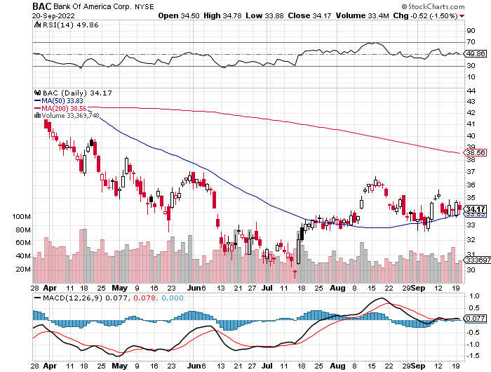
Bank of America (BAC) – took profits long 12/$39-$42 call spread

Slide 60
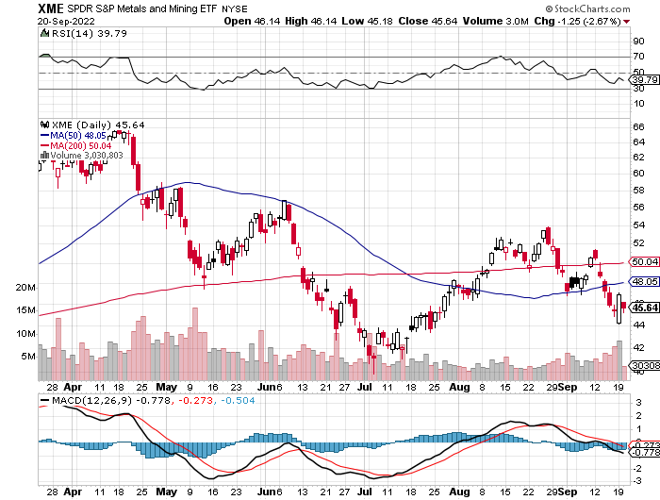
SPDR Metals & Mining ETF (XME) – long 2/$28-$30 call spread

Slide 61
Blackrock (BLK)-Asset Collection Boom took profits on long 3/$770-$790 call spread took profits on long 3/$310-$340 call spread

Slide 62
Visa (V) – “Touchless” Bitcoin Drag long 6/$150-$160 bull call spread

Slide 63
Consumer Discretionary SPDR (XLY) (DIS), (AMZN), (HD), (CMCSA), (MCD), (SBUX)

Slide 64
Berkshire Hathaway (BRKB)- Natural Barbell Warren Buffet Turns 92 long 7/$220-$230 call spread took profits on long 6/$260-$270 call spread, stopped out of long 5/$300-$310 call spread, took profits on long 2/$270-$280 call spread

Slide 65
Europe Hedged Equity (HEDJ)-

Slide 66
Japan (DXJ)-

Slide 67
Emerging Markets (EEM) - Pro trade, Weak Dollar, Long Recovery Play

Slide 69
Bonds – Bottoming?
*10 Year Yields Hit 11 Year High, at a 3.57% yield *A one-month selloff ends as the bear market in stocks extends *We now have broken the bottom of the range at $108 *BUT Quantitative Tightening at $95 billion a month will continue to pressure bonds from above *So will another 1.50% in Fed rate rises through 2023 *US Treasury bond fund (TLT) could plunge from $180 in 2020 to $100 by 2023 *But a one-month LONG trade may be setting up at a 10-year yield of 3.60%

Slide 70
Treasury ETF (TLT) – Bottoming-No Positions long 10/$98-$101 call spread took profits on long 6/$123-$126 put spread, took profits on long 6/$125-$128 put spread took profits on long 6/$124-$127 put spread, took profits on long long 7/$128-$131 put spread took profits on long 5/$128-$131 put spread, look profits on long 5/$127-$130 put spread

Slide 71
Ten Year Treasury Yield ($TNX) – 3.57%

Slide 72
Junk Bonds (HYG) 6.81% Yield to Maturity

Slide 73
2X Short Treasuries (TBT)-Another run at highs

Slide 75
Foreign Currencies – Dollar Surge
*British Pound Hits 37-Year Low, at $1.14 to the US dollar *Traders cite a lack of confidence in the new prime minister Liz Truss *The real reason is the structural toll taken by Brexit, the consequences of which will take a half century to play out *It means a weak economy, falling standards of living, and a much lower British pound. *Euro hits new lows, those European vacations are getting cheaper *Weak Chinese economy crushes the Yuan, government attempting to stabilize *Stand aside from forex for now, there are better fish to fry

Slide 76
Japanese Yen (FXY) - Weakest

Slide 77
Euro (FXE)-

Slide 78
British Pound (FXB)-

Slide 79
Australian Dollar (FXA)- The Global Recovery Play took profits on long 8/$67-$69 call spread

Slide 80
Emerging Market Currencies (CEW)

Slide 81
Chinese Yuan- (CYB)- Shanghai Shutdown

Slide 83
Bitcoin – Breakdown Buy the Mad Hedge Bitcoin Letter at https://www.madhedgefundtrader.com/store/
*Bitcoin Hits 3 Month Low, at $18,400 *$10,000 is now at risk. *IF Bitcoin failed to protect against inflation and did not serve as a store of value what’s the ownership case where insiders have a huge advantage? *Maybe in El Salvador where the local currency is worthless *Bitcoin is Headed Back to Cost of $17,000, after breaking $20,000 on Friday, top is capped at $25,000. But with soaring electricity price cost might be $20,000 now *Ether peaks out with Merge, plunged 15% *Avoid all crypto for now with better trades elsewhere

Slide 84
Bitcoin ($BTCUSD) – Finding a bid

Slide 85
Ethereum (ETHE) –

Slide 86
MicroStrategy (MSTR) –

Slide 87
Amplify Transformational Data Sharing ETF (BLOK) –

Slide 89
Energy & Commodities –
*US Oil Reserves hit 38 Year Low, at 434 million barrels, down 39% from maximum capacity *That is about 22 days worth of US consumption *Capping oil prices to save consumers has its price *California Hits Record Power Consumption, at 51 megawatts, as San Francisco Bay Area temperatures reach 116 degrees *Germany Fights Russia with Coal *Russia Cuts Gas Supplies to Europe until Ukraine sanctions are lifted *Avoid all energy plays like the plague, it’s the new buggy whip industry as the US de-carbonizes

Slide 90
Oil-($WTIC)

Slide 91
United States Oil Fund (USO) long 10/$9.50-$10 Vertical bull call spread

Slide 92
Energy Select Sector SPDR (XLE)-No Performance! (XOM), (CVX), (SLB), (KMI), (EOG), (COP)

Slide 93
Halliburton (HAL)-

Slide 94
Natural Gas (UNG) -

Slide 95
Freeport McMoRan (FCX) -

Slide 96
Cameco (CCJ) - took profits on long 5/$20-$23 bull call spread

Slide 98
Precious Metals –No Protection
*New lows show there is no downside protection, no flight to safety bid *Gold Plunges on massive Russian selling as reserves dry up *Gold is more of a commodity play now than a risk hedge, and you don’t own commodities in a recession *As long as commodities are weak, gold will be weak,
Pulled down by recession fears *Recently rising interest rates are a drag on gold *Speculative interest has faded to a few hard-core gold bugs *Silver is still the bigger and better long-term play

Slide 99
Gold (GLD) - Deflation call took profits on long 5/$165-$170 bull call spread

Slide 100
Market Vectors Gold Miners ETF- (GDX) –

Slide 101
Barrick Gold (GOLD) took profits on long 1/$21-$23 call spread took profits on long 11/$22-$24 call spread

Slide 102
Newmont Mining- (NEM)- took profits on long $55-60 call spread

Slide 103
Silver- (SLV)- took profits on long 11/$19-$20 call spread

Slide 104
Silver Miners - (SIL)-

Slide 105
Wheaton Precious Metals - (WPM)- took profits on long 2/$39-41 call spread

Slide 107
Real Estate – Lights Out
*It’s Like They Shut the Lights Out in the real estate market, which flipped from the offer to the bid side of the market in weeks *Housing Starts Blast Off, at 1,575,000 and up 12.2% in August, much better than expected *Homebuilder Sentiment Dives 3 Points, to 46 according to the National Association of Homebuilders *Home Mortgage Applications Dive 27% YOY, thanks to a mortgage interest rate over 6.0%, a multiyear high *Refi’s have also fallen off a cliff. Only 452,000 borrowers would benefit from a refi at these levels *Expect this to continue for another year *Home Equity is Shrinking, down $500 billion from the $11.5 trillion peak

Slide 108
S&P Case Shiller-Still Going Up in the Rear View Mirror S&P Case Shiller Rockets 18%, in June with its National Home Price Index Tampa (35%), Miami (33.0%), Dallas (28.2%)

Slide 109
Crown Castle International (CCI) – 3.26% yielding cell phone tower REIT

Slide 110
US Home Construction Index (ITB) (DHI), (LEN), (PHM), (TOL), (NVR)

Slide 112
Trade Sheet- So What Do We Do About All This?
*Stocks – buy the big dips at bottom of range *Bonds – sell big rallies, buy big dips *Commodities-buy dips *Currencies- stand aside *Precious Metals – stand aside *Energy – stand aside *Volatility - sell short over $30 *Real estate – stand aside *Bitcoin – stand aside

Slide 114
Next Strategy Webinar 12:00 EST Wednesday, October 5 from Silicon Valley, CA email me questions at support@madhedgefundtrader.com
Good Luck and Good Trading!
Notes:
*

