Slide 1
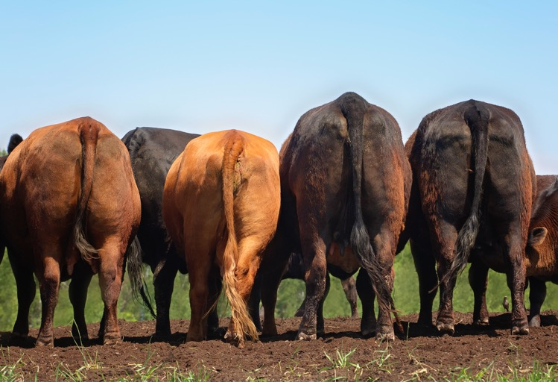
The Mad Hedge Fund Trader “Betting the Ranch”
With John Thomas Incline Village, NV, October 5, 2022 www.madhedgefundtrader.com
Notes:
*

Slide 2
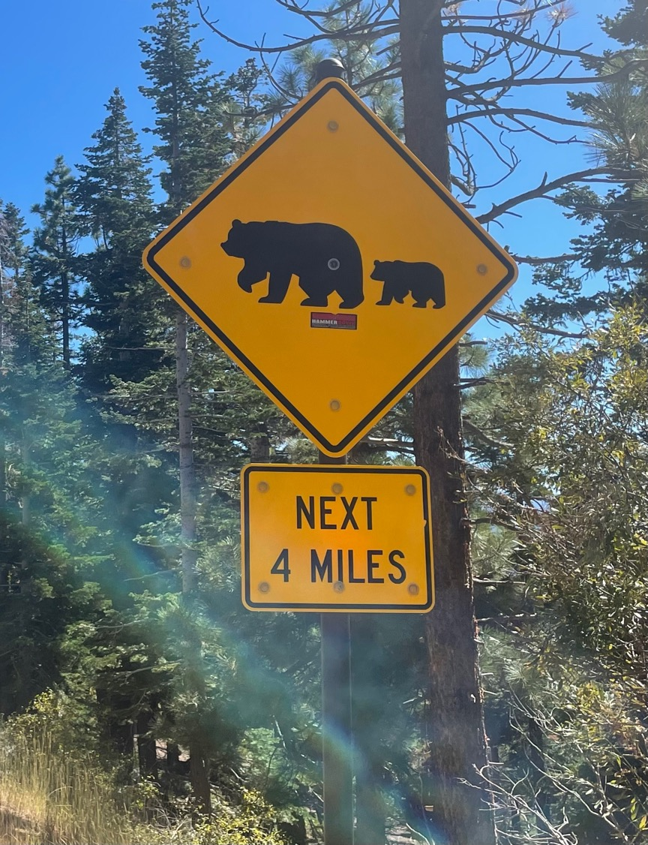

Slide 3
Mad Hedge Traders & Investors Summit September 13-15 The Recordings are Up go to www.madhedge.com
*A collection of the 28 best traders and managers in the world *Back-to-back One-hour presentations followed by an interactive Q&A *It’s a smorgasbord of trading strategies, pick the one that is right for you *Covering all stocks, bonds, commodities, foreign exchange, precious metals, and real estate *It’s the best look at the rest of 2022’s money-making opportunities you will get anywhere *An invitation will be sent to you shortly and it is FREE to attend

Slide 4
Trade Alert Performance New All Time Highs! 22 out of 23 trade alerts profitable
*January 14.59% Final *July +3.98% Final *February +8.78% MTD *August +5.13% Final *March +3.43% Final *September +9.72% Final *April +3.33% Final *October +0.50% MTD *May +8.80% Final *November -11.79% Final *June +5.91% Final *December +11.26% Final *2022 YTD +70.18% compared to -20.7% for the Dow Average *+$582.74% since inception *Average annualized return of +45.36% for 14 years

Slide 5
Portfolio Review 70% Long, 20% short, 10% cash- Aggressively long at new lows
Current Capital at Risk
Risk On
(RIVN) 10/$25-$30 call spread | 10.00%
(PANW) 10/$120-$130 call spread | 10.00%
(SPY) 10/$320-$330 call spread | 10.00%
(BRKB) 10/$220-$230 call spread | 10.00%
(TSLA) 10/$200-$210 call spread | 10.00%
Risk Off
(TLT) 10/$110-$103 put spread | -10.00%
(SPY) 10/$390-$400 put spread | -10.00%
(SPY) 10/$385-$395 put spread | -10.00%
Total Net Position | 20.00%
Total Aggregate Position | 80.00%
Expiration Value +80.00%

Slide 6
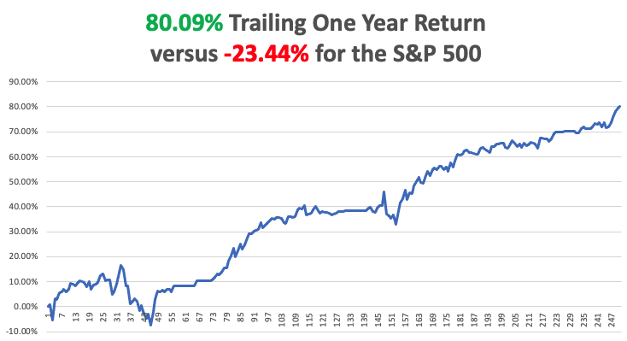

Slide 7
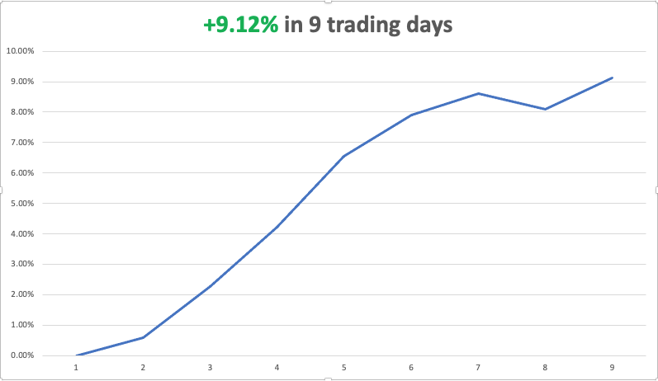

Slide 8
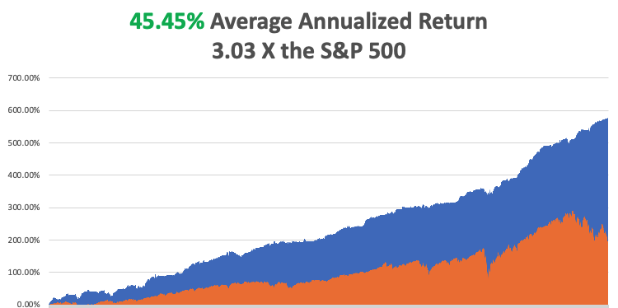

Slide 9
The Method to My Madness The Bottom is In
*Bear market is now in full force, taking out double bottom, but we only got a marginal new low of 800 Dow Points in 4 months *Major trading rally launched with onset of Q4 may be discounting the end of interest rate rises in as early as two months *US dollar may have peaked with bonds bottoming at 4.00% yield *We are now 9 months into a 12–15-month bear market *Q4 could be the best entry point for stocks in a decade, time to look at those LEAPS - Concierge All-LEAPS portfolio *Oil prices continue in free fall, hitting new 9-month lows *Inflation is plunging but it may not show up until the October 13 number *VIX pops to $34

Slide 10
The Global Economy – Unstable
*The Fed Raises by 75 Basis Points, and the statement suggested rates will be higher for longer. *Consumer Sentiment Hits Record Low, at 59.1 according to the University of Michigan. That’s worse than the pandemic low and the 2009 Great Recession low. *Rail Strike Averted at the last possible minute after an all-night session. *2021 GDP Revised Up, from 5.7% to 5.9%. The post covid recovery was stronger than expected. *The Money Supply is in Free Fall, showing the sharpest 5-Month decline in history *European Inflation Hits 9.6%. Yes, prices are higher in Europe than here because they have to pay in ever more expensive dollars, as well as premium prices for marginal energy. *US Retails Sales Rise, by 0.3% in August

Slide 11
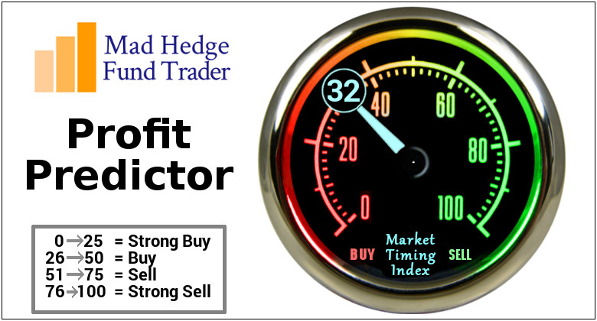
The Mad Hedge Profit Predictor Market Timing Index – Buy Territory An artificial intelligence driven algorithm that analyzes 30 different economic, technical, and momentum driven indicators

Slide 12
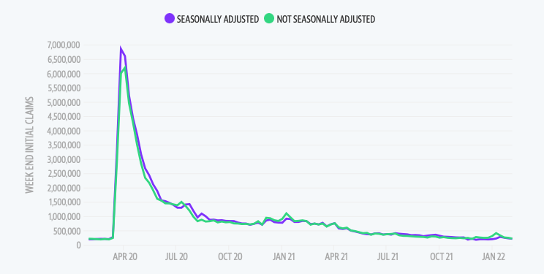
Weekly Jobless Claims – Falling 195,000 – down 18,000

Slide 13
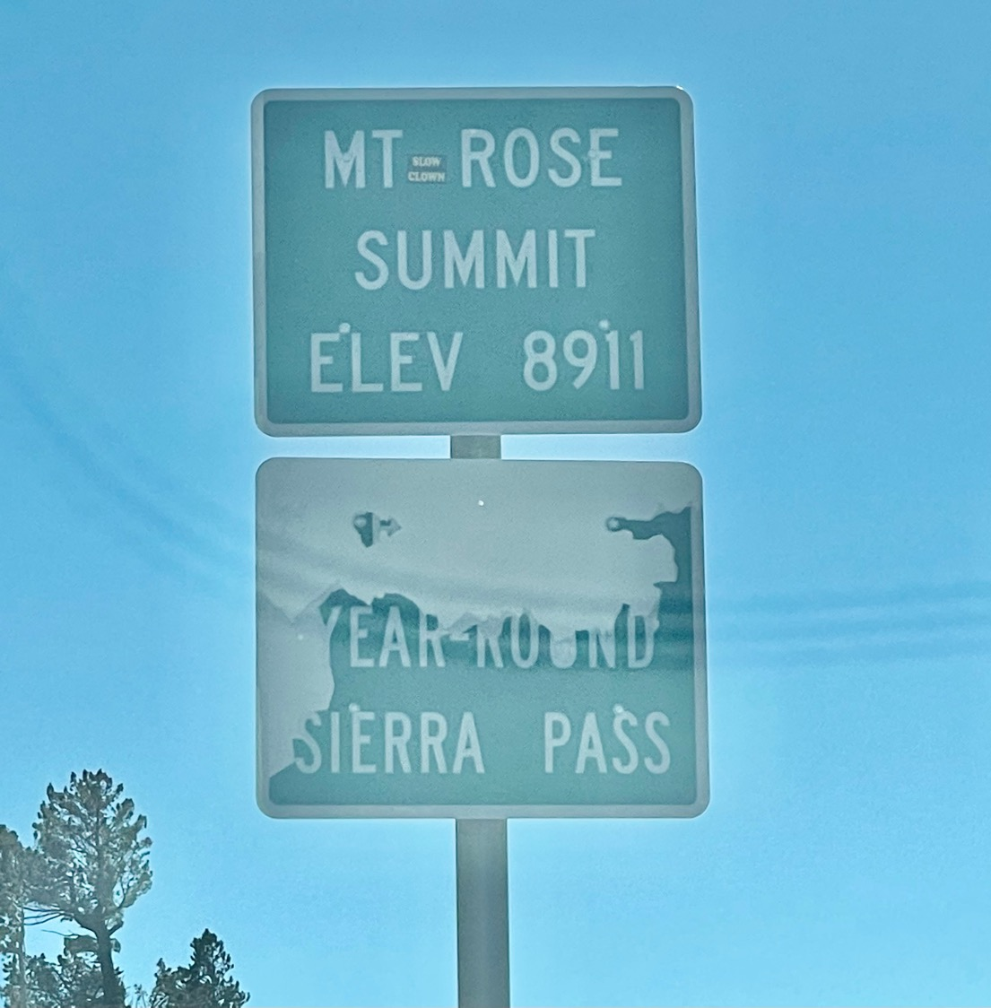

Slide 14
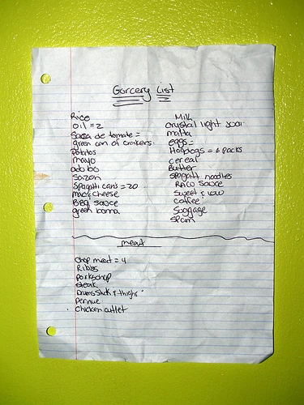
Stocks – Everything is on Sale
*Q4 could be the best entry point for stocks in a decade *All Capitulation Indicators Flashed red on Friday *Cash levels at mutual funds are at all time highs *The Bank of America Investors Survey shows the high number of managers expecting a recession since the 2020 pandemic low, the last great buying and LEAPS opportunity *Commercial hedgers are showing the largest short positions since 2020. The Volatility Index (VIX) hit $34.00 on Tuesday *The risks of NOT being invested are rising. *A sweet spot for long term LEAPS is opening up for first time in years, with Concierge clients getting enhanced coverage *Look for terrible H1 and strong H2 scenario to continue

Slide 15
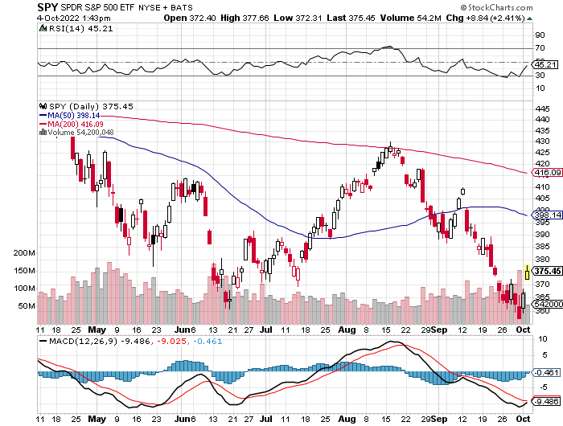
S&P 500 – The Worst Case-Severe Recession long 10/$385-$395 put spread, long 10/$390-$400 put spread, long 10/$320-$330 call spread took profits on long 6/$445-$455 put spread took profits on long 6/$430-$440 put spread, took profits on long $440-$450 put spread
$420 2023
$432 +31% Rally
The Bottom $350 Down -27%

Slide 16
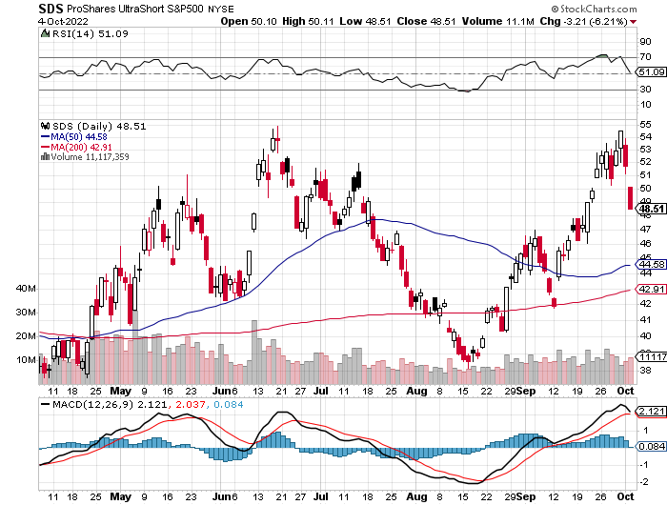
ProShares Ultra Short S&P 500 (SDS)- a great hedge for long stocks and bonds long 2X position has a hedge against longs and bond shorts

Slide 17
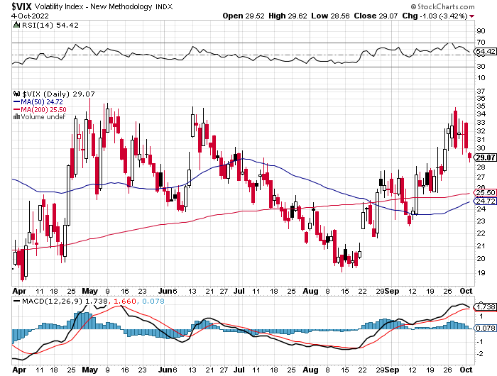
(VIX) – Triple Top at $35

Slide 18
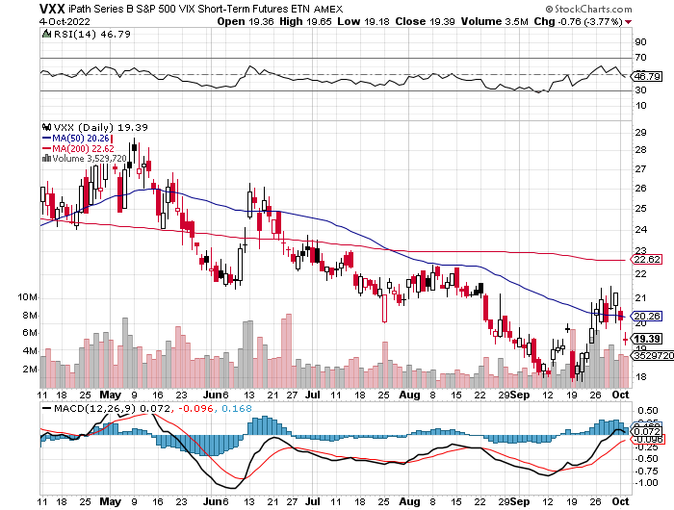
(VXX)-

Slide 19
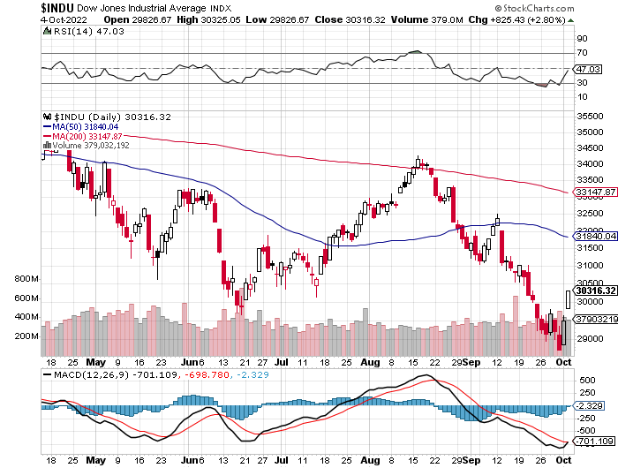
Dow Average ($INDU)-

Slide 20
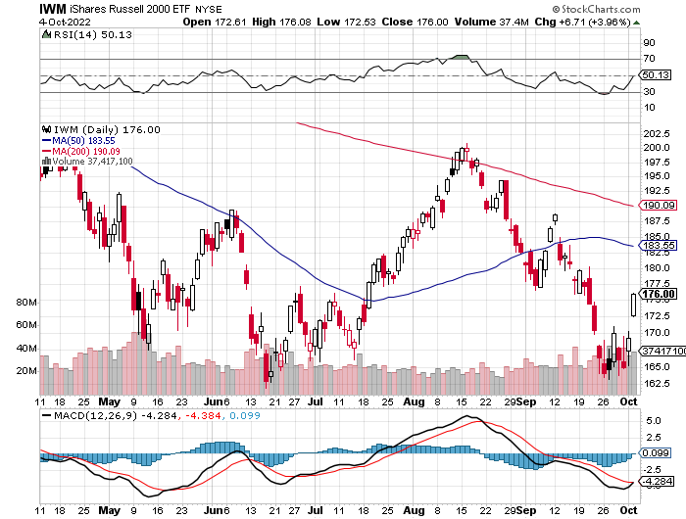
Russell 2000 (IWM)- took profits on Long 10/$137-$142 vertical bull call spread took profits on Long 10/$153-$156 vertical bear put spread

Slide 21
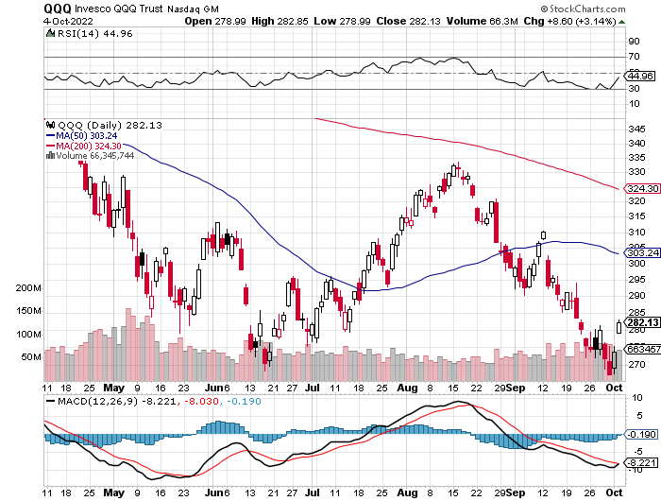
NASDAQ (QQQ) – took profits on long (QQQ) 4/$330-$335 put spread took profits on long (QQQ) 3/$340-$345 put spread covered long (QQQ) $325-$330 put spread

Slide 23
The Barbell Portfolio
*50% Big Tech - 2% of US Employment but 27% of Market Cap and 38% of Profits 50% Domestic Recovery, including: Railroads Couriers Banks Construction Credit Cards Event organizers Ticket sales Retailers

Slide 24
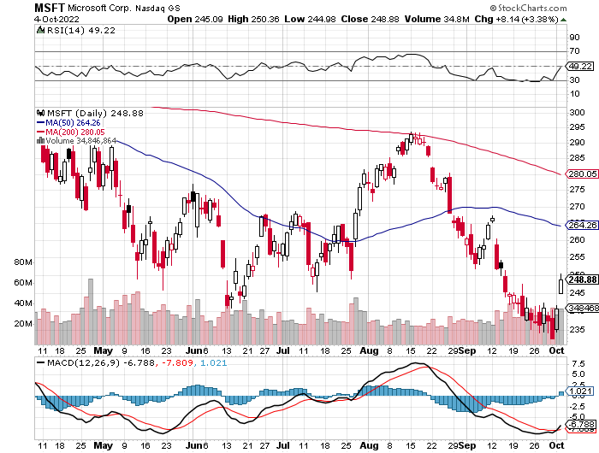
Microsoft (MSFT)- took profits on 9/$235-$245 call spread, took profits on long 7/$220-$210 call spread, took profits on long 6/$220-$230 call spread, took profits on long 2/$200-$210 bear put spread

Slide 25
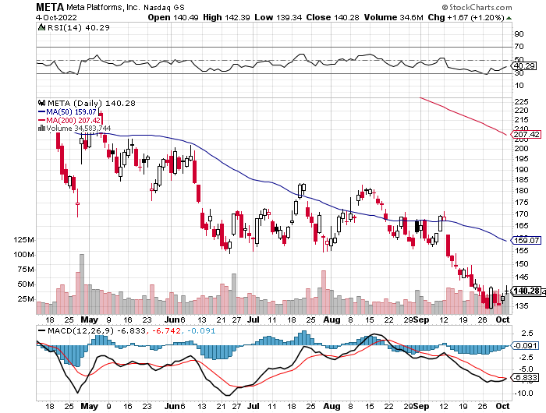
Meta (META)- Looking for the Metaverse took profits on Long 9/$290-$300 vertical bear put spread stopped out of Long 9/$190-$200 vertical bear put spread

Slide 26
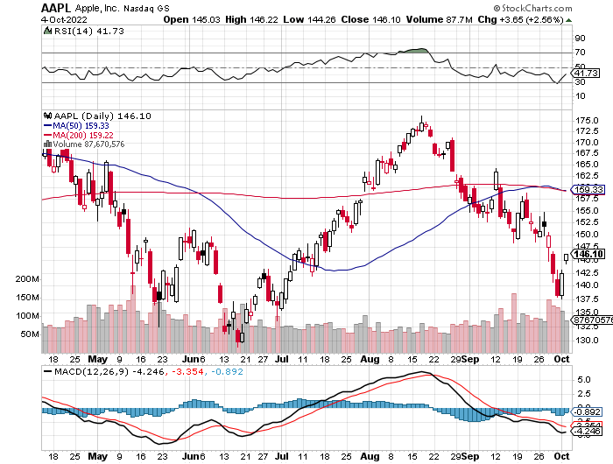
Apple (AAPL)-iPhone 14 launched! Took profits on long 10/$165-$175 put spread took profits on long 6/$155-$165 put spread, stopped out of long 6/$125-135 call spread, took profits on long 6/$110-$120 call spread, took profits on long 2/$180-$190 put spread

Slide 27
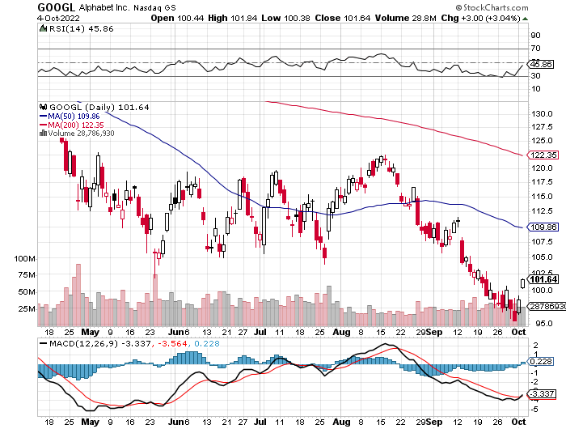
Alphabet (GOOGL) – Ad king on economic recovery $4.1 Billion fine for European antitrust took profits on long 12/$1,200-$1,230 bull call spread took profits on long 9/$1,030-$1,080 vertical bull call spread

Slide 28
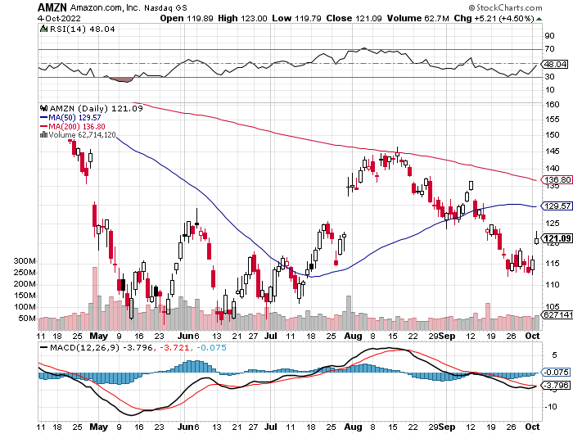
Amazon (AMZN) – Amazon Splits 20:1, triggering an avalanche of new retail buyers took profits on long 2/$3,400-$3,500 bear put spread took profits on long 9/$2,800-$2,900 bull call spread

Slide 29
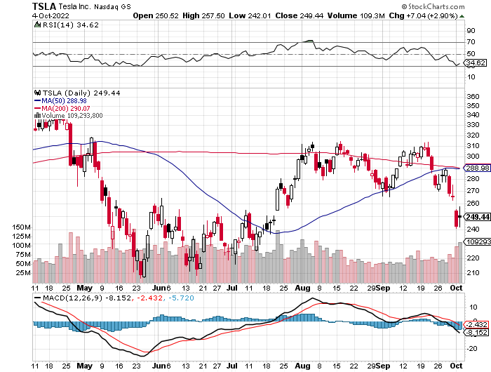
Tesla (TSLA) – Twitter Disaster EV Sales to Hit New All Time High in 2022, to 13% of global new vehicle sales, up from 9% last year long 10/$200-$210 call spread, stopped out of long 10/$220-$230 call spread took profits on short 8/$500 puts, stopped out of short 8/$950 calls took profits on long 2/$500-$550 call spread, profits on long 2/$550-$600 call spread

Slide 30
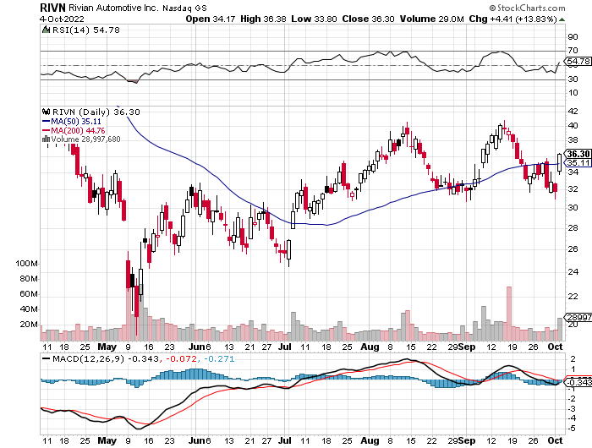
Rivian (RIVN) – Amazon Backed Electric Trucks 2022 production jumps from 20,000 to 25,000 long 10/$25-$30 call spread - expires in 12 days

Slide 31
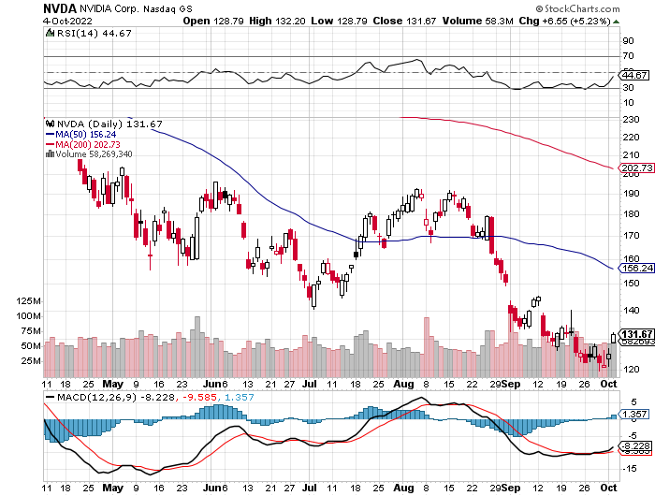
NVIDIA (NVDA) – Downgrade on US ban of highest end AI chips to China took profits on long 10/$95-$100 call spread took profits on long 7/$120-$130 call spread, took profits on long 6/$120-$130 call spread

Slide 32
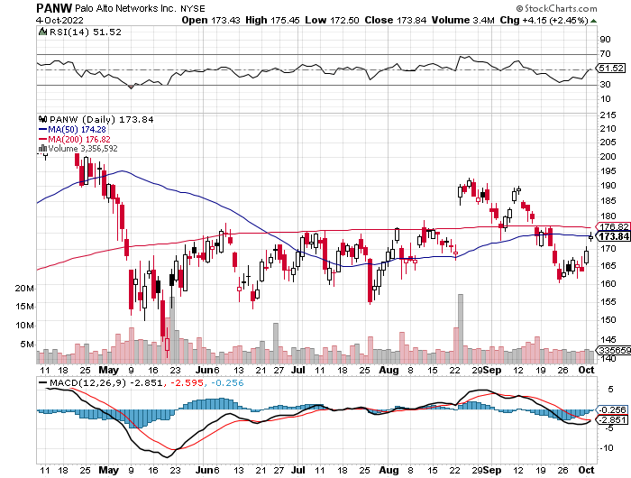
Palo Alto Networks (PANW)- Hacking never goes out of fashion long 10/$130-$140 call spread - expires in 12 days

Slide 33
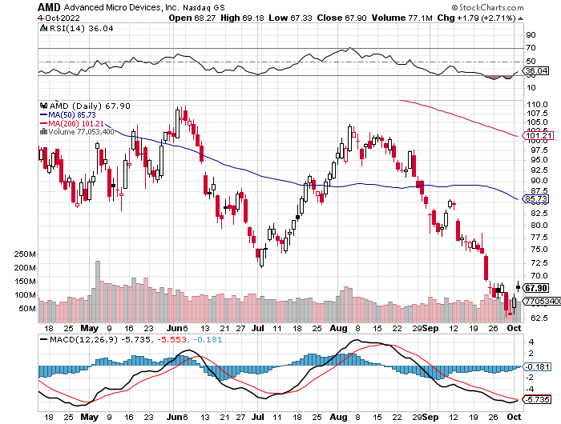
Advanced Micro Devices (AMD)- Recession fears programable logic devices- took profits on long 2/$75-$80 call spread

Slide 34
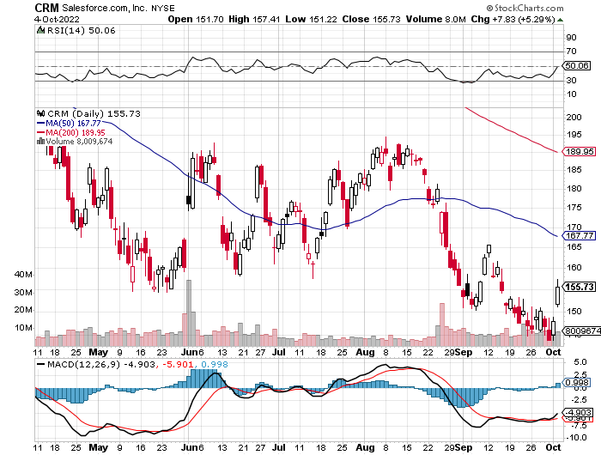
Salesforce (CRM)- Massive Online Migration took profits on long 9/$125-$130 vertical bull call spread took profits on long 8/$125-$130 vertical bull call spread took profits on long 2/$105-$115 call spread

Slide 35
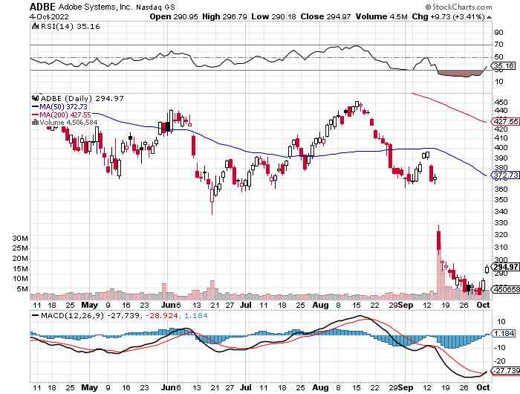
Adobe (ADBE)- Cloud play The Quality Non-China tech play

Slide 36
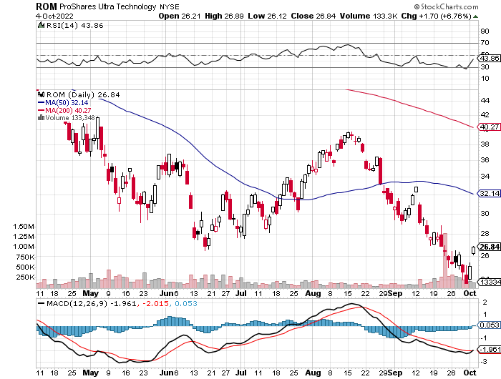
ProShares Ultra Technology ETF (ROM) – 2X Long Technology ETF took profits on long 10/$62-65 call spread

Slide 37
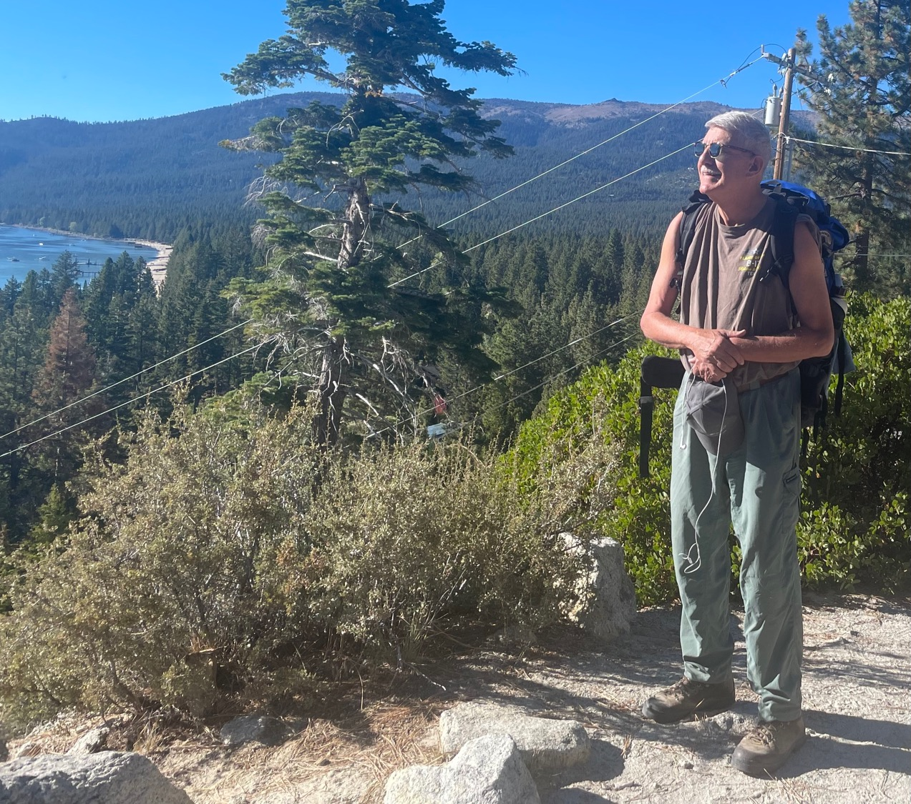

Slide 38
The Second Half of the Barbell
*Bets on a domestic recovery in 2022 Q4 *Upside potential in 2022 far greater than tech *Some of these have not moved for 5 or 10 years *Focuses on economically sensitive cyclical industries *Makes a great counterweight to high-growth technology *We could spend all of next year rotating between the two groups

Slide 39
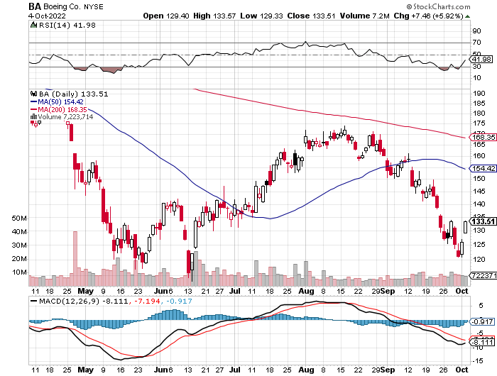
Boeing (BA) –Disastrous Earnings Boeing Delivered its First 787 Dreamliner in a year long 3/$146-$149 call spread

Slide 40
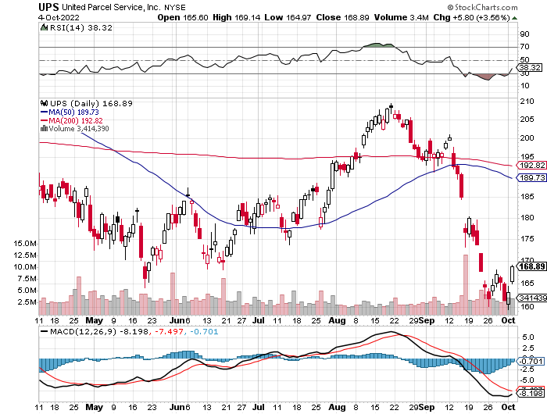
Package Delivery- United Parcel Service (UPS) - Package Delivery record profits took profits on long 11/$130-$140 call spread

Slide 41
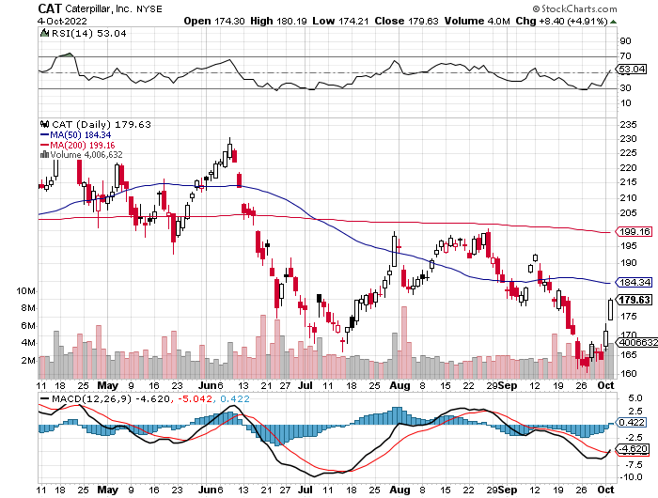
Caterpillar (CAT)- Ag + Infrastructure + Housing Raises Dividend by 50% took profits on long 12/$145-$150 call spread took profits on long 11/$125-$135 call spread

Slide 42
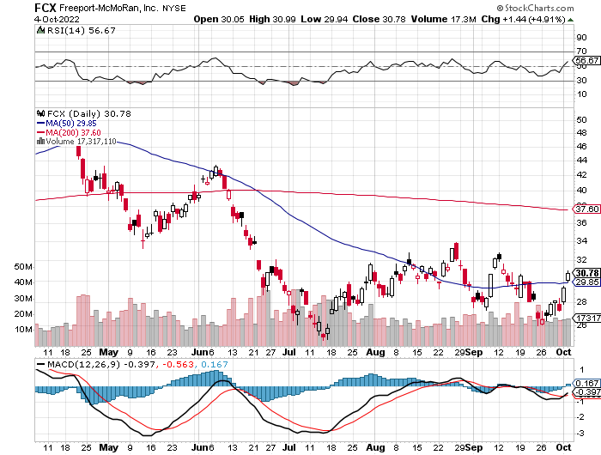
Freeport McMoRan - (FCX)- Copper Play took profits on long 12/$20-$23 call spread

Slide 43
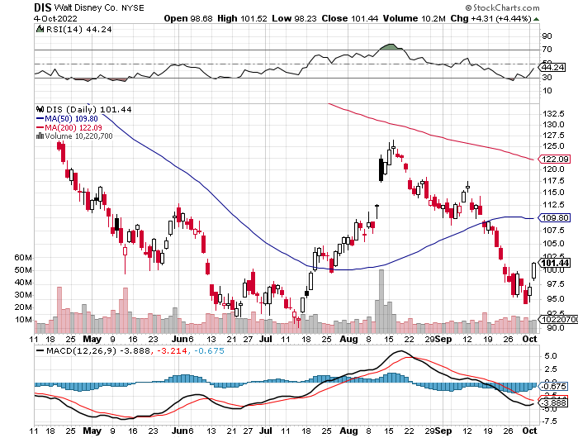
Walt Disney (DIS) - Genie+ stopped out of long 10/$165-$175 call spread took profits on long 3/$170-$180 call spread

Slide 44
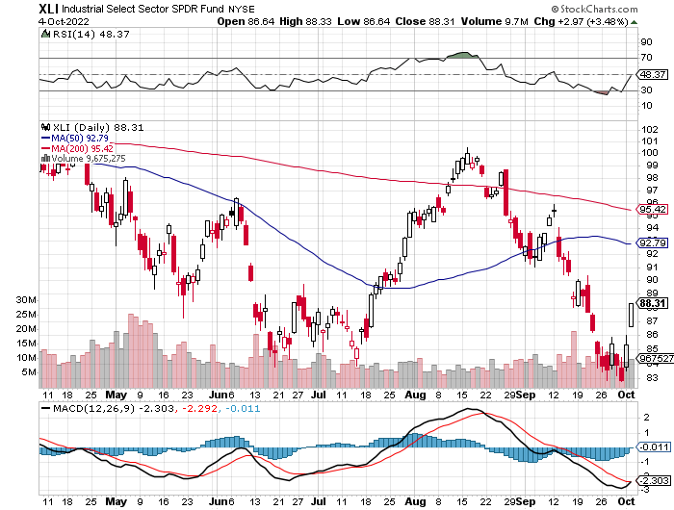
Industrials Sector SPDR (XLI)- (GE), (MMM), (UNP), (UTX), (BA), (HON)

Slide 45
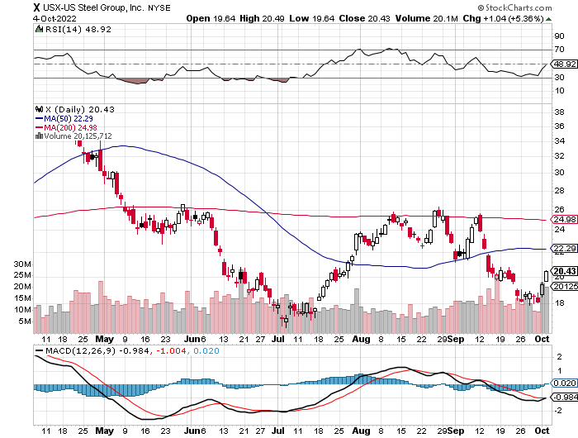
US Steel (X) – Commodity Boom and Wartime boost

Slide 46
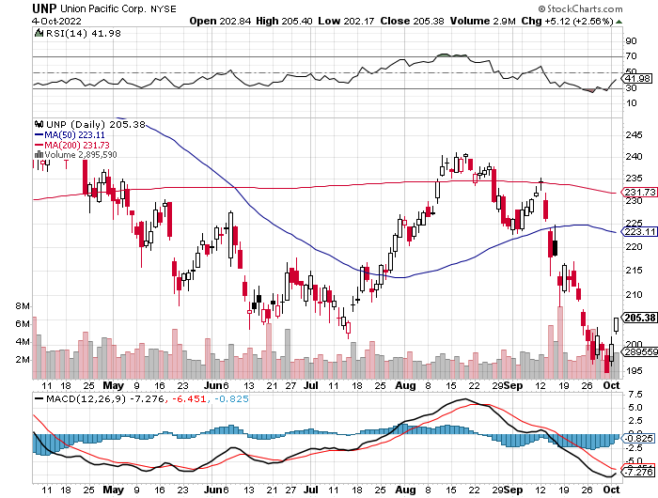
Union Pacific RR (UNP)- Big Stuff to Ship near record earnings announced took profits on long 5/$200-$210 call spread took profits on 11/$150-$160 call spread

Slide 47
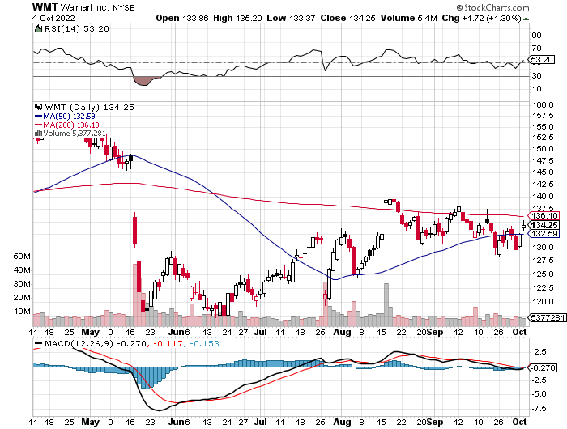
Wal-Mart (WMT)- took profit on Long 11/$125-$130 bear put spread took profit on Long 10/$119-$121 bear put spread took profits on Long 8/$114-$117 bear put spread

Slide 48
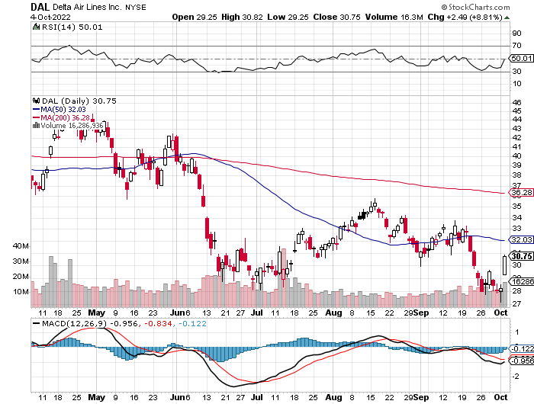
Delta Airlines (DAL) – Travel is Back!

Slide 49
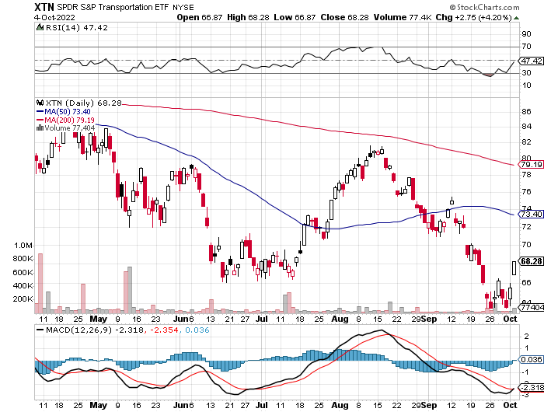
Transports Sector SPDR (XTN)- Worst Hit Sector (ALGT), (ALK), (JBLU), (LUV), (CHRW), (DAL)

Slide 50
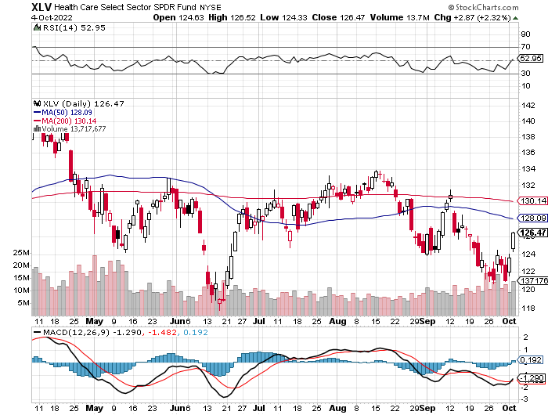
Health Care Sector (XLV) (JNJ), (PFE), (MRK), (GILD), (ACT), (AMGN)

Slide 51
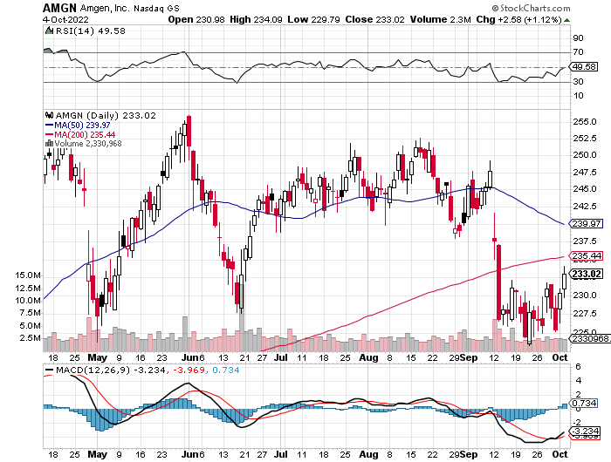
Amgen (AMGN) took profits on long 11/$185-$200 bull call spread

Slide 52
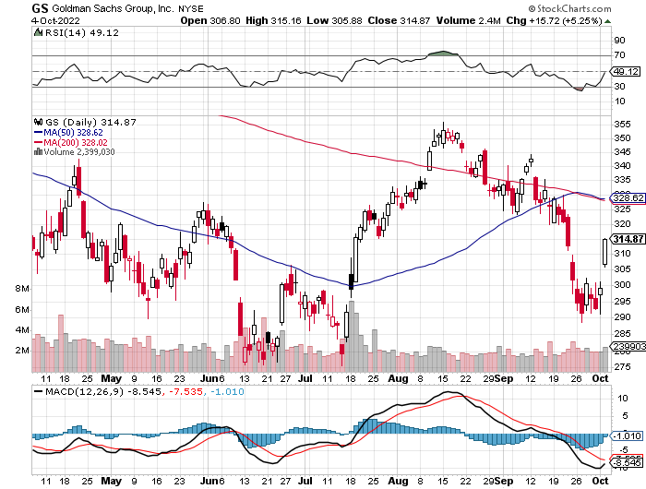
Goldman Sachs (GS) – took profits 12/$330-$350 call spread took profits 11/$330-$350 call spread stop loss on long 11/$385-$395 call spreads

Slide 53
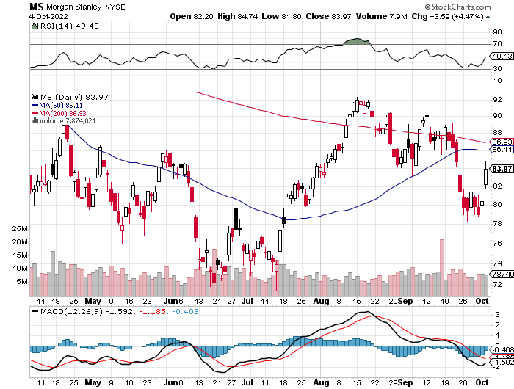
Morgan Stanley (MS) – Blows Away Earnings Equity trading came in a hot $3.2 billion and bond trading $2.9 billion took profits on long 11/$85-$90 call spread

Slide 54
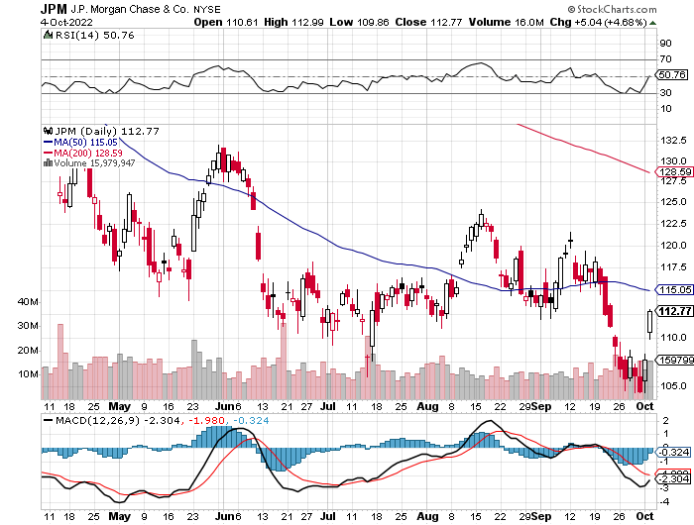
JP Morgan Chase (JPM)- Shares Pop 7.5%, on news that a 17% return on equity is achievable took profits 12/$148-$152.50 call spread

Slide 55
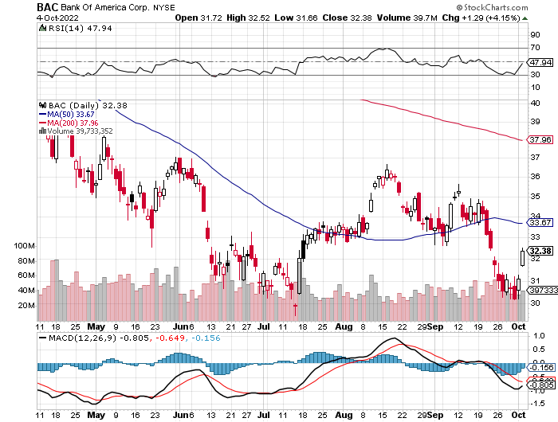
Bank of America (BAC) – took profits long 12/$39-$42 call spread

Slide 56
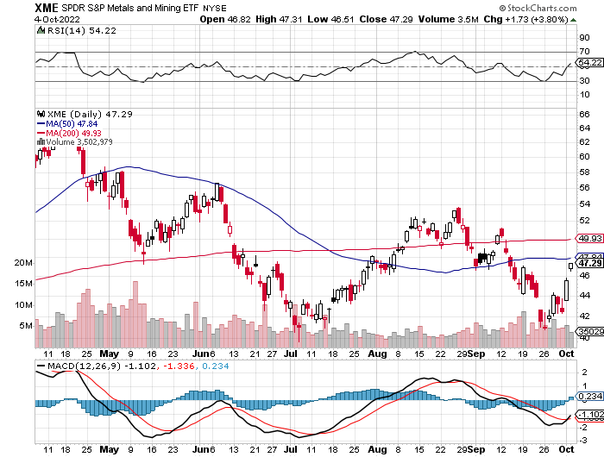
SPDR Metals & Mining ETF (XME) – long 2/$28-$30 call spread

Slide 57
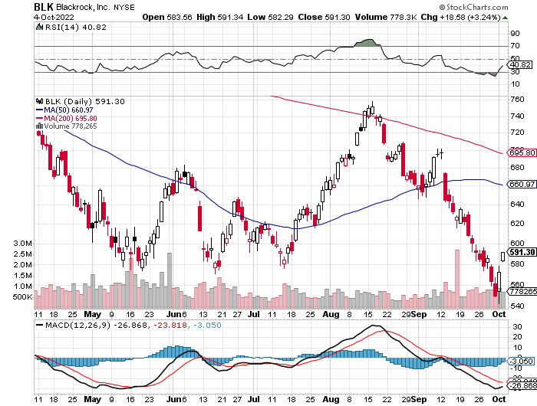
Blackrock (BLK)-Asset Collection Boom took profits on long 3/$770-$790 call spread took profits on long 3/$310-$340 call spread

Slide 58
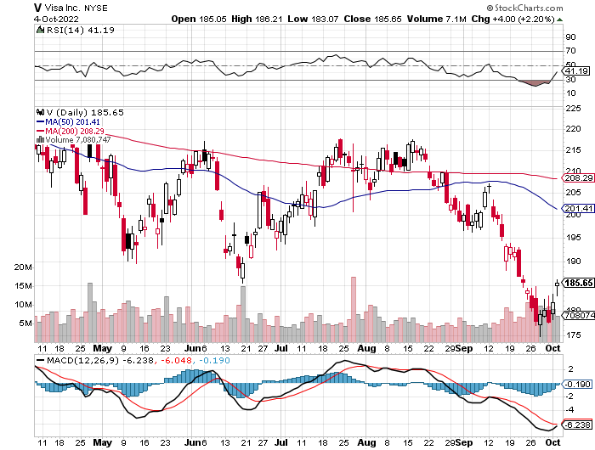
Visa (V) – “Touchless” Bitcoin Drag long 6/$150-$160 bull call spread

Slide 59
Consumer Discretionary SPDR (XLY) (DIS), (AMZN), (HD), (CMCSA), (MCD), (SBUX)

Slide 60
Berkshire Hathaway (BRKB)- Natural Barbell Warren Buffet Turns 92 long 10/$220-$230 call spread - expires in 12 days took profits on long 7/$220-$230 call spread, took profits on long 7/$220-$230 call spread took profits on long 6/$260-$270 call spread, stopped out of long 5/$300-$310 call spread,

Slide 61
Europe Hedged Equity (HEDJ)-

Slide 62
Japan (DXJ)-

Slide 63
Emerging Markets (EEM) - Pro trade, Weak Dollar, Long Recovery Play

Slide 65
Bonds – 4.00% Ten Year Yields
*Here’s the Next Financial Crisis, massive unrealized losses in the bond market. Onset could mark the bottom of the stock market *The (TLT) alone has lost 43% in 2 ½ years *Apply those losses to a global $150 trillion bond market and it adds up to a lot of money *Anybody who used leverage is now gone. How many investors without swimsuits will be discovered when the tide goes out? *We are now have broken the bottom of the range going down to $101 *US Treasury bond fund (TLT) could plunge from $180 in 2020 to $100 by 2023-TARGET ACHIEVED! *The Government Loves Inflation, even if you hate it, for the purchasing power of the bonds it issued is now shrinking at a 9% annual rate. *But a LONG trade may be setting up at a 10-year yield of 4.00%

Slide 66
Treasury ETF (TLT) – Bottoming long 10/$110-$113 put spread, stopped out of long 10/$98-$101 call spread took profits on long 6/$123-$126 put spread, took profits on long 6/$125-$128 put spread took profits on long 6/$124-$127 put spread, took profits on long long 7/$128-$131 put spread took profits on long 5/$128-$131 put spread, look profits on long 5/$127-$130 put spread

Slide 67
Ten Year Treasury Yield ($TNX) – 3.62%

Slide 68
Junk Bonds (HYG) 8.13% Yield to Maturity

Slide 69
2X Short Treasuries (TBT)-Another run at highs

Slide 71
Foreign Currencies – Panic in Britain
*Bank of England Moves to Support a Crashing Pound, by flipping from a seller to a buyer in the long-dated bond market, thus dropping interest rates *The moves are designed to offset the new Truss government’s plan to cut taxes and boost deficit spending *The BOE also indicated that interest rate hikes are coming. *Euro hits new lows, those European vacations are getting cheaper *Weak Chinese economy crushes the Yuan, government attempting to stabilize *Stand aside from forex for now, they are getting fish to fry

Slide 72
Japanese Yen (FXY)

Slide 73
Euro (FXE)-

Slide 74
British Pound (FXB)-

Slide 75
Australian Dollar (FXA)- The Global Recovery Play took profits on long 8/$67-$69 call spread

Slide 76
Emerging Market Currencies (CEW)

Slide 77
Chinese Yuan- (CYB)- Shanghai Shutdown

Slide 79
Bitcoin – Breakdown Buy the Mad Hedge Bitcoin Letter at https://www.madhedgefundtrader.com/store/
*High Interest Rates are Destroying Bitcoin, possibly taking it down to $10,000 this year *All non-yielding instruments, like gold, are getting slaughtered in the face of the Fed’s record rate rises *Liquidity is also drying up. Avoid crypto like the plague. *Bitcoin Hits 3 Month Low, at $18,000 *$10,000 is now at risk. *It could take year to recover, or until we reach another extreme liquidity event from the Fed like we had a year ago. We have the exact opposite now *Avoid all crypto for now with better trades elsewhere

Slide 80
Bitcoin ($BTCUSD) – Finding a bid

Slide 81
Ethereum (ETHE) –

Slide 82
MicroStrategy (MSTR) –

Slide 83
Amplify Transformational Data Sharing ETF (BLOK) –

Slide 85
Energy & Commodities – The Cartel Moves
Oil Hits New 2022 Low at $78 a Barrel, cheaper than pre–Ukraine War prices, thanks to exploding recession fears *OPEC+ attempts to put in a floor with a 2 million barrel a quota cut, 1 million net production cut without Russia *Is Jay Powell the most effective weapon against Russia with his most rapid interest rate rises in history destroying oil demand? *Putin blows up the Nordstream pipeline to prevent future Russian governments from resuming energy supplies to Europe? *Or was it all about an insurance claim? *Germany Fights Russia with Coal *Avoid all energy plays like the plague, it’s the new buggy whip industry as the US de-carbonizes

Slide 86
Oil-($WTIC)

Slide 87
United States Oil Fund (USO) long 10/$9.50-$10 Vertical bull call spread

Slide 88
Energy Select Sector SPDR (XLE)-No Performance! (XOM), (CVX), (SLB), (KMI), (EOG), (COP)

Slide 89
Halliburton (HAL)-

Slide 90
Natural Gas (UNG) -

Slide 91
Freeport McMoRan (FCX) -

Slide 92
Cameco (CCJ) - took profits on long 5/$20-$23 bull call spread

Slide 94
Precious Metals – Finally, a Bid!
*Gold finally gets a bid with Q4 onset *Destruction of crypto is bringing back gold as a non-correlated asset *Prospect of an end to Fed interest rates rises in two months is also helping *Gold is more of a commodity play now than a risk hedge *Recently rising interest rates were a drag on gold *Speculative interest has faded to a few hard-core gold bugs *Silver is still the bigger and better long-term play

Slide 95
Gold (GLD) - Deflation call took profits on long 5/$165-$170 bull call spread

Slide 96
Market Vectors Gold Miners ETF- (GDX) –

Slide 97
Barrick Gold (GOLD) took profits on long 1/$21-$23 call spread took profits on long 11/$22-$24 call spread

Slide 98
Newmont Mining- (NEM)- took profits on long $55-60 call spread

Slide 99
Silver- (SLV)- Exploding EV Demand took profits on long 11/$19-$20 call spread

Slide 100
Silver Miners - (SIL)-

Slide 101
Wheaton Precious Metals - (WPM)- took profits on long 2/$39-41 call spread

Slide 103
Real Estate – Free Fall
*Pending Home Sales Drop, down 2.0% in August on a signed contract basis *Sales are down for the third month in a row and are off 24% YOY. Only the west gained *Mortgage interest rates are now at 20-year highs *Buyers catching recession fears are breaking contracts and walking away from deposits. *Case Shiller Delivers a Shocking Fall, down from 18.7% to 16.1% in June. *New Home Sales Soar, in August, some 685,000, or 20% higher than expected. *The median home price rose to $436,800. Inventory shot up to 8.1 months, up from the 2.5 month low six months ago. *Prices are now up only 8% YOY compared to 20% a few months ago *30-Year Fixed Rate Mortgage Hits 7.08%

Slide 104
S&P Case Shiller-Still Going Up in the Rear View Mirror S&P Case Shiller Rockets 18%, in June with its National Home Price Index Tampa (31.8%), Miami (31.7%), Dallas (24.7%)

Slide 105
Crown Castle International (CCI) – 3.26% yielding cell phone tower REIT

Slide 106
US Home Construction Index (ITB) (DHI), (LEN), (PHM), (TOL), (NVR)

Slide 108
Trade Sheet- So What Do We Do About All This?
*Stocks – buy the big dips at bottom of range *Bonds – sell big rallies *Commodities-buy dips *Currencies- stand aside *Precious Metals – stand aside *Energy – stand aside *Volatility - sell short over $30 *Real estate – stand aside *Bitcoin – stand aside

Slide 110
Next Strategy Webinar 12:00 EST Wednesday, October 19 from Silicon Valley, CA email me questions at support@madhedgefundtrader.com
Good Luck and Good Trading!
Notes:
*

