Slide 1
The Mad Hedge Fund Trader “Whiplash Market”
With John Thomas Incline Village, NV, October 19, 2022 www.madhedgefundtrader.com
Notes:
*

Slide 2
October 28 Incline Village Strategy Luncheon
*An excellent meal will be followed by a wide-ranging discussion and an extended question and answer period *The lunch will be held at the premier restaurant in Incline Village, Nevada on the sparkling shores of Lake Tahoe *please go to my online store at http://www.madhedgefundtrader.com/store and click on “luncheons.”

Slide 3
February 17 Honolulu, Hawaii Strategy Luncheon
*An excellent meal will be followed by a wide-ranging discussion and an extended question and answer period *The lunch will be held at the premier restaurant in Incline Village, Nevada on the sparkling shores of Lake Tahoe *please go to my online store at http://www.madhedgefundtrader.com/store and click on “luncheons.”

Slide 4
Mad Hedge Traders & Investors Summit September 13-15 The Recordings are Up go to www.madhedge.com
*A collection of the 28 best traders and managers in the world *Back-to-back One-hour presentations followed by an interactive Q&A *It’s a smorgasbord of trading strategies, pick the one that is right for you *Covering all stocks, bonds, commodities, foreign exchange, precious metals, and real estate *It’s the best look at the rest of 2022’s money making opportunities you will get anywhere *An invitation will be sent to you shortly and it is FREE to attend

Slide 5
Trade Alert Performance New All Time Highs! 22 out of 23 trade alerts profitable
*January 14.59% Final *July +3.98% Final *February +8.78% MTD *August +5.13% Final *March +3.43% Final *September +9.72% Final *April +3.33% Final *October +6.20% MTD *May +8.80% Final *November -11.79% Final *June +5.91% Final *December +11.26% Final *2022 YTD +75.88% compared to -18.36% for the Dow Average *+$567.62% since inception *Average annualized return of +44.23% for 14 years

Slide 6
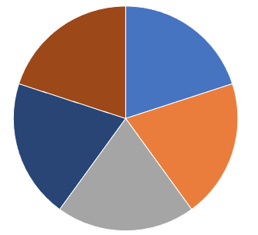
Portfolio Review 30% Long, 20% short, 50% cash Modest long in historically volatile market
Current Capital at Risk
Risk On
(V) 10/$160-$170 call spread | 10.00%
(TSLA) 10$170-$180 call spread | 10.00%
(JPM) 10/$85-$90 call spread | 10.00%
Risk Off
(SPY) 10/$385-$395 put spread | -10.00%
(SPY) 10/$385-$395 put spread | -10.00%
Total Net Position | 10.00%
Total Aggregate Position | 50.00%
Expiration Value +77.93%

Slide 7
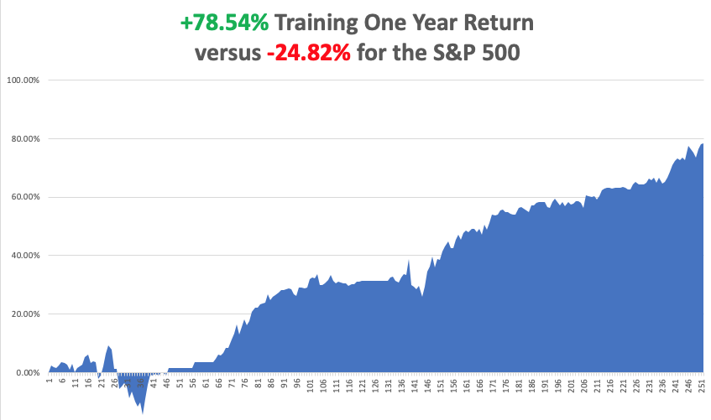

Slide 8
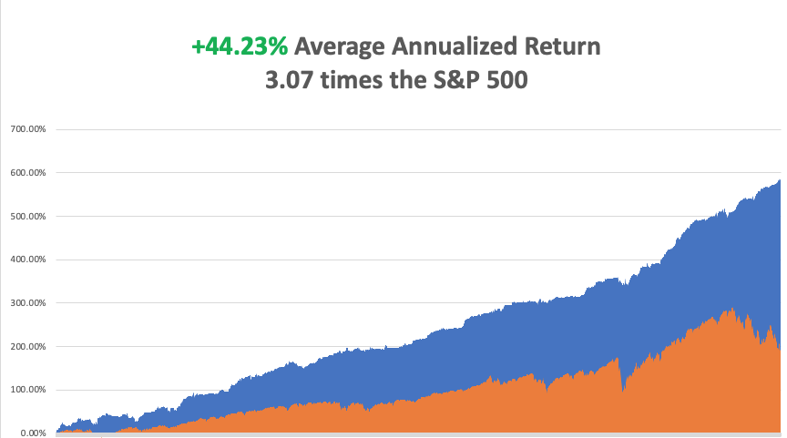

Slide 9
The Method to My Madness The Bottom is In
*Blunder 3.0 means keeping rates too low, then too high, then next is too low again *Midterm election 800-pound gorilla on the market’s back is about to depart *We are now 9 months into a 12–18-month bear market *Q4 could be the best entry point for stocks in a decade *Oil prices continue in free fall, hitting new 9-month lows *Inflation is plunging but it may not show up until the November 10 number *Coming interest rate rises have put the wind back behind the US dollar *Bear market in bonds may be ending with 10-year rates topping 4.00% *(SPX) 4,800 is postposed until 2023 *VIX pops to $35

Slide 10
The Global Economy – Recessionary
*Consumer Price Index Rockets Up to 8.6%, up 0.4% on the month and a new 40-year high *PPI Comes in Hot, at 0.4% in September. Services and food were the big gainers *Nonfarm Payroll Falls Short at 263,000, in September *The headline unemployment rate matched a 2022 low at 3.5% *Weekly Jobless Claim Rise to 228,000, up 9,000 on the week. *The long-term unemployment rate, the U-6 also matched this year’s low at 6.7%. The report keeps the Fed on its current interest raising schedule *JP Morgan Sees Recession in 6-9 Months, according to CEO Jamie Diamond. *PC Sales Dive 19.5% in Q3, reaching only 68 million units.
*Supply Chain Problems are Disappearing, as two years of port congestion ease

Slide 11
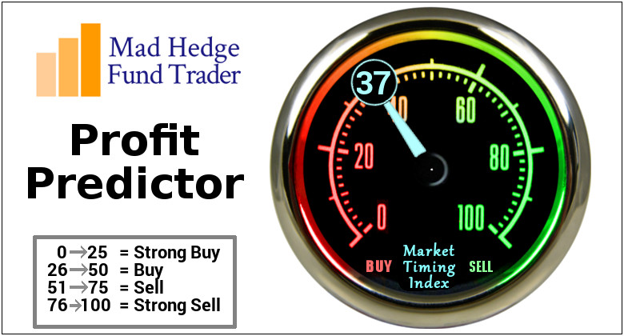
The Mad Hedge Profit Predictor Market Timing Index – Buy Territory An artificial intelligence driven algorithm that analyzes 30 different economic, technical, and momentum driven indicators

Slide 12
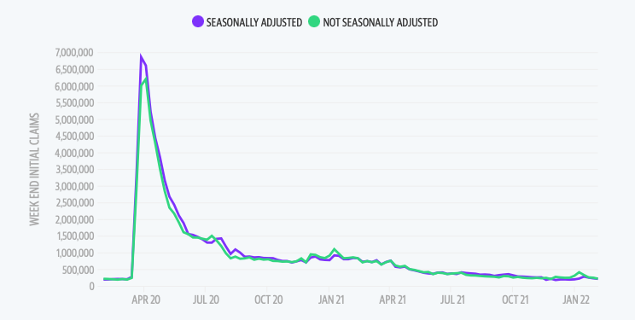
Weekly Jobless Claims – Falling 229,000 – Up 9,000

Slide 14
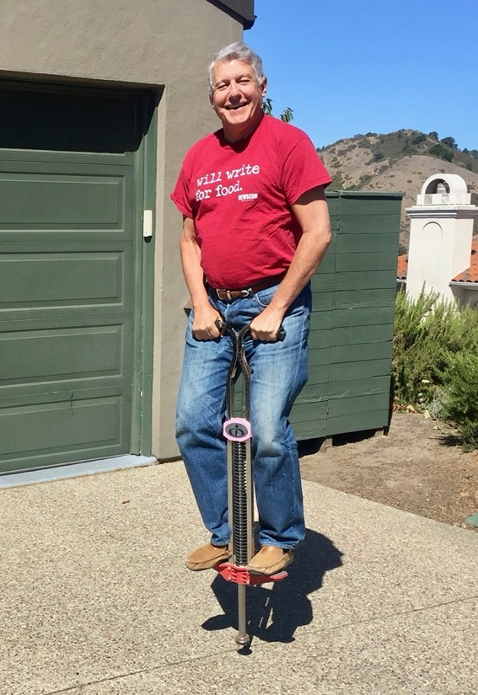
Stocks – Extreme Volatility
*Stocks Mount Historic Rally, gaining $1,420 points, or 5% of the intraday low *NASDAQ hit Two Year Low, at 10,542. Growth is being thrown out with the bathwater, while value is the port in the storm *All Capitulation Indicators Flashed red constantly now *Cash levels at mutual funds are at all time highs *Banks led the charge on UP days, suggesting they may be the new lead sector in a rising market *The risks of NOT being invested are rising. *A sweet spot for long term LEAPS is opening up for first time in years, with Concierge clients getting enhanced coverage *Look for terrible H1 and strong H2 scenario to continue

Slide 15
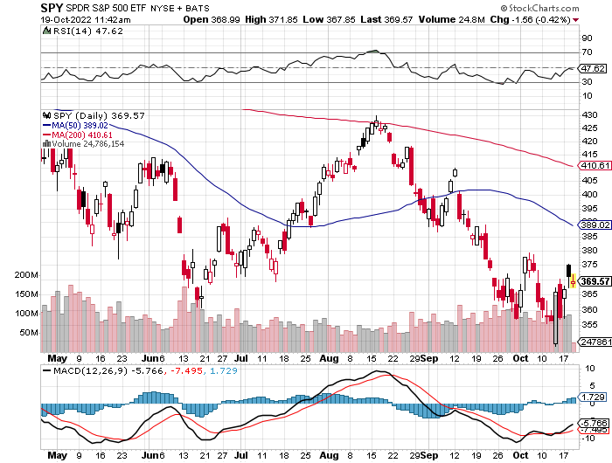
S&P 500 – The Worst Case-Severe Recession long 10/$385-$395 put spread-expires in 2 days, long 11/$410-$400 put spread took profit on long 10/$390-$400 put spread, took profit on long 10/$320-$330 call spread took profits on long 6/$445-$455 put spread
$480 2023
$430 +31% Rally
The Bottom $350 Down -27%

Slide 16
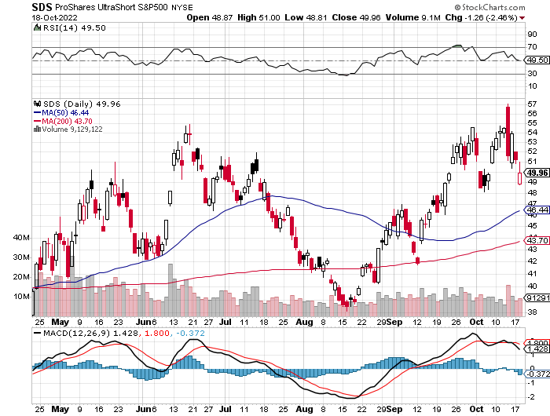
ProShares Ultra Short S&P 500 (SDS)- a great hedge for long stocks and bonds long 2X position has a hedge against longs and bond shorts

Slide 17
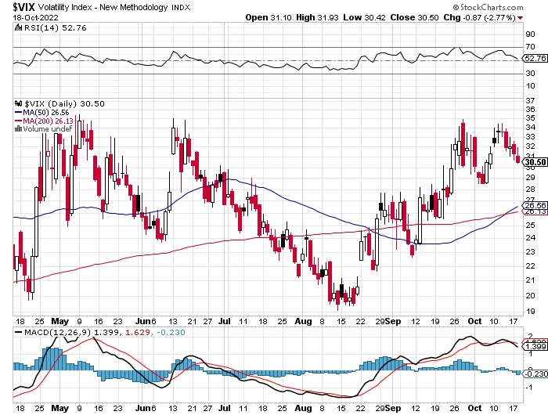
(VIX) – Unable to Make a New High

Slide 18
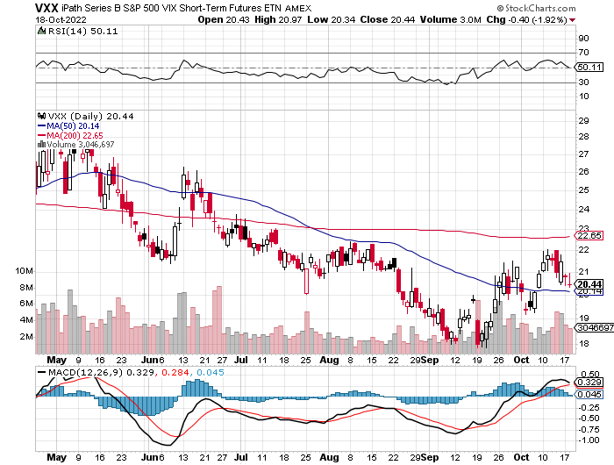
(VXX)-

Slide 19
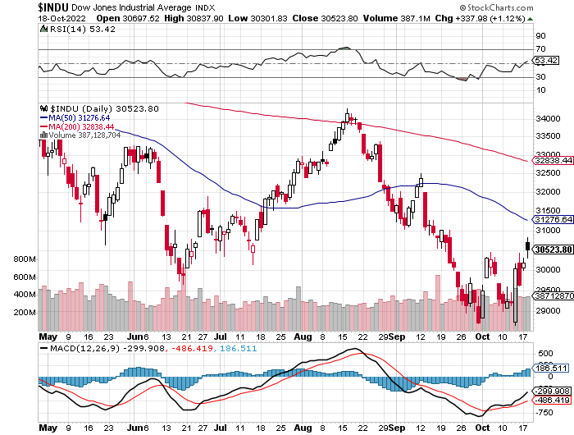
Dow Average ($INDU)-

Slide 20
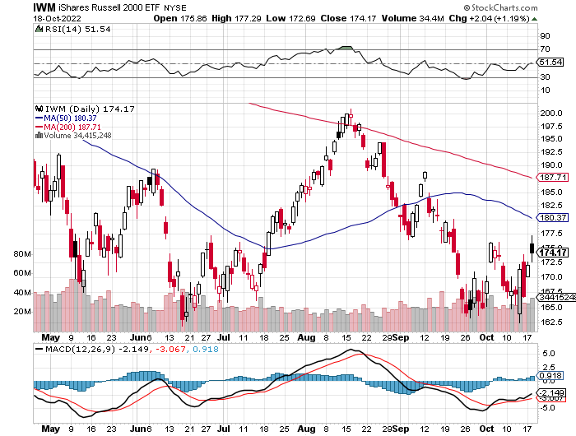
Russell 2000 (IWM)- took profits on Long 10/$137-$142 vertical bull call spread took profits on Long 10/$153-$156 vertical bear put spread

Slide 21
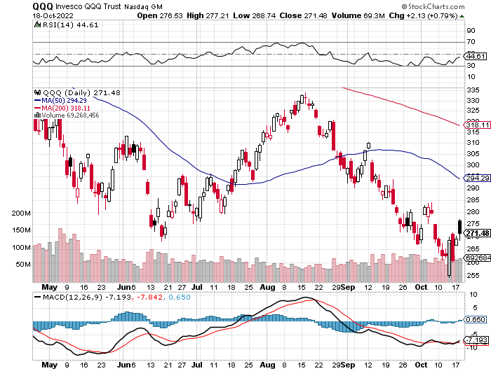
NASDAQ (QQQ) – took profits on long (QQQ) 4/$330-$335 put spread took profits on long (QQQ) 3/$340-$345 put spread covered long (QQQ) $325-$330 put spread

Slide 22
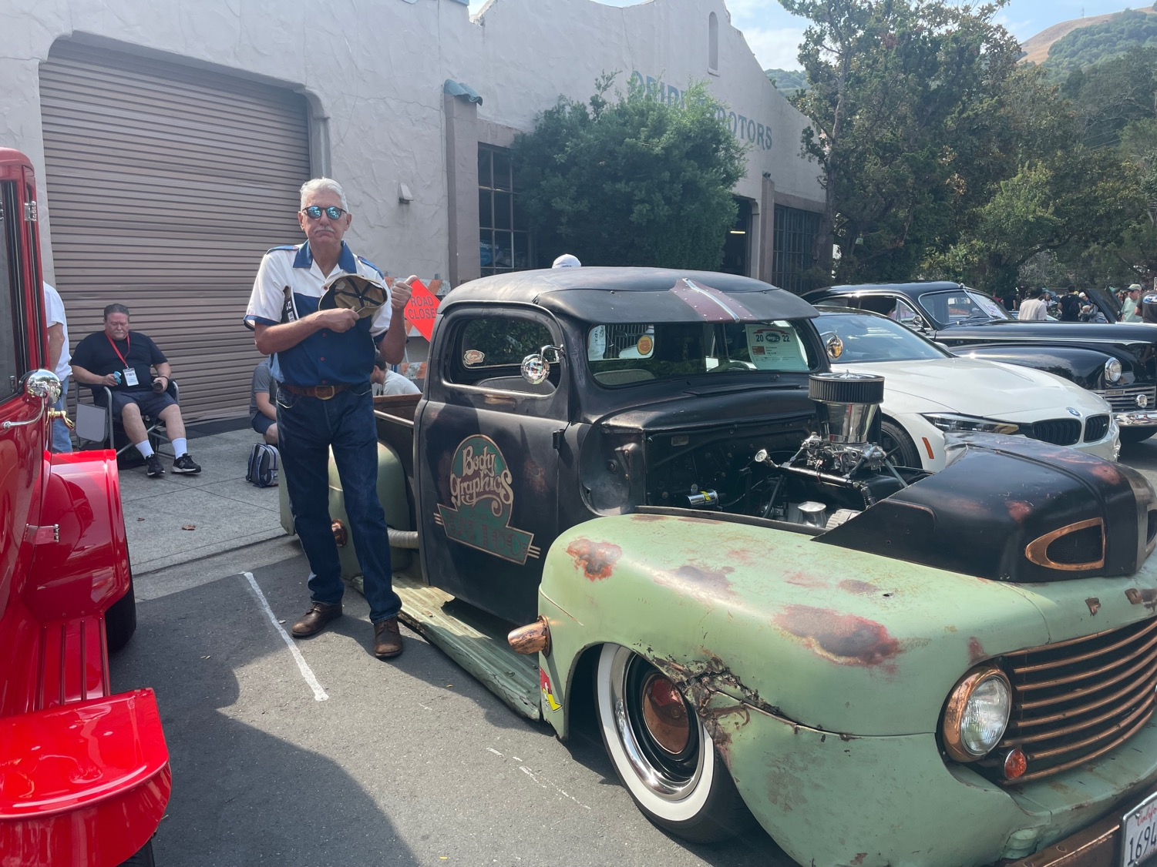

Slide 23
The Barbell Portfolio
*50% Big Tech - 2% of US Employment but 27% of Market Cap and 38% of Profits 50% Domestic Recovery, including: Railroads Couriers Banks Construction Credit Cards Event organizers Ticket sales Retailers

Slide 24
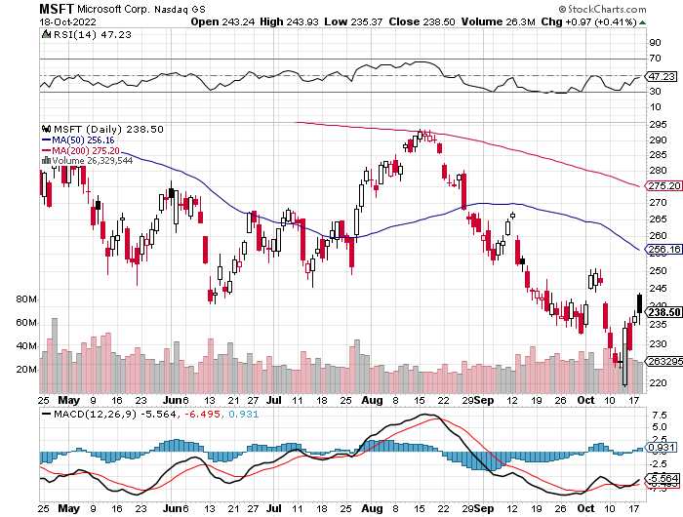
Microsoft (MSFT)- took profits on 9/$235-$245 call spread, took profits on long 7/$220-$210 call spread, took profits on long 6/$220-$230 call spread, took profits on long 2/$200-$210 bear put spread

Slide 25
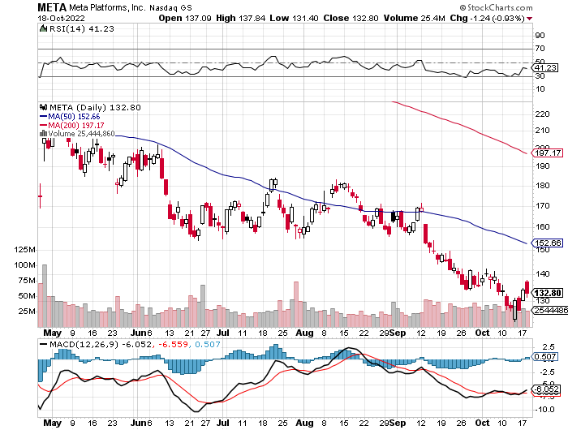
Meta (META)- Looking for the Metaverse took profits on Long 9/$290-$300 vertical bear put spread stopped out of Long 9/$190-$200 vertical bear put spread

Slide 26
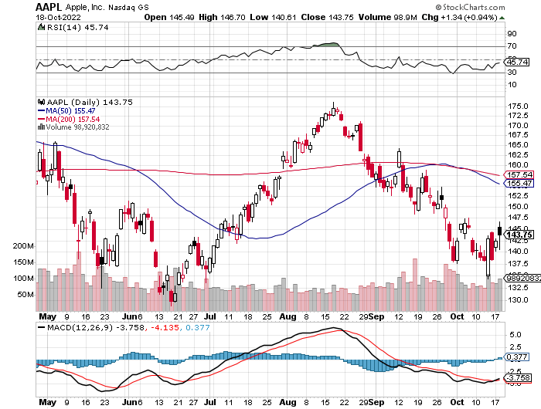
Apple (AAPL)-iPhone 14 launched! Took profits on long 10/$165-$175 put spread took profits on long 6/$155-$165 put spread, stopped out of long 6/$125-135 call spread, took profits on long 6/$110-$120 call spread, took profits on long 2/$180-$190 put spread

Slide 27
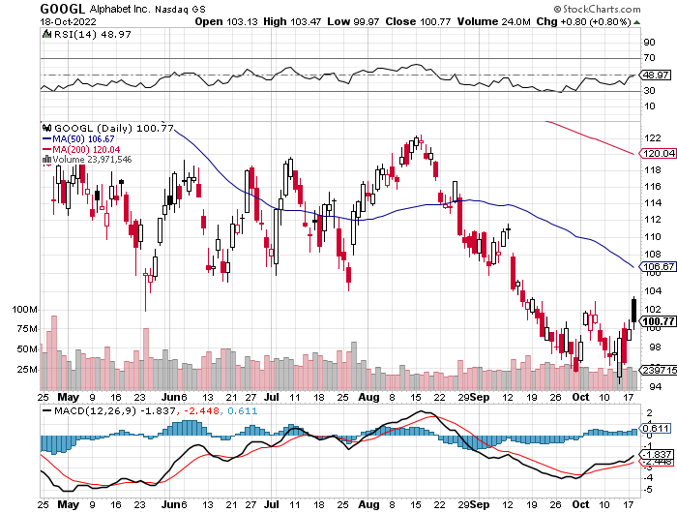
Alphabet (GOOGL) – Ad king on economic recovery $4.1 Billion fine for European antitrust took profits on long 12/$1,200-$1,230 bull call spread took profits on long 9/$1,030-$1,080 vertical bull call spread

Slide 28
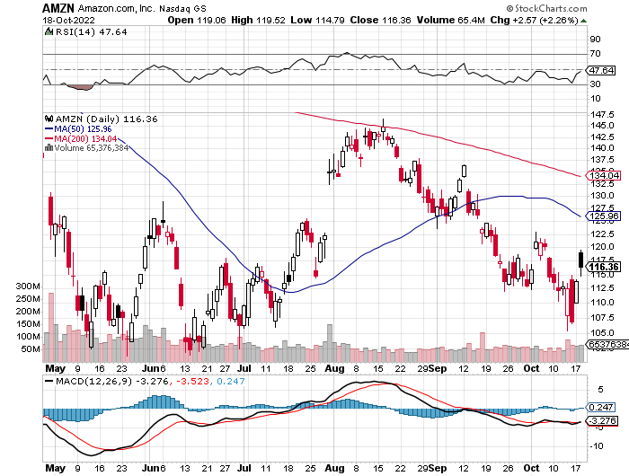
Amazon (AMZN) – Amazon Splits 20:1, triggering an avalanche of new retail buyers took profits on long 2/$3,400-$3,500 bear put spread took profits on long 9/$2,800-$2,900 bull call spread

Slide 29
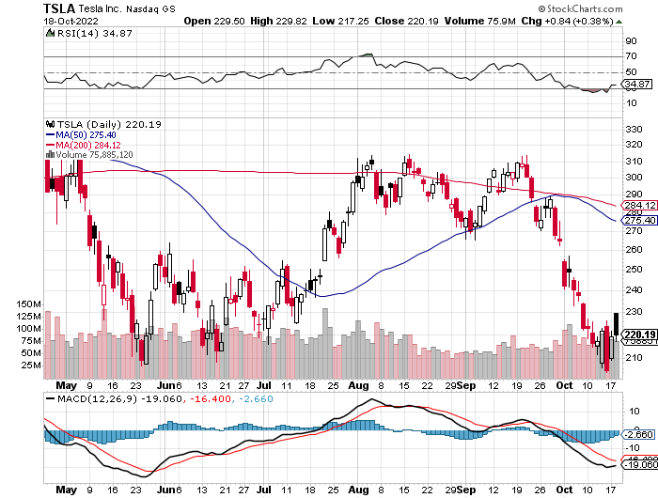
Tesla (TSLA) – Twitter Disaster Elon Musk Pays Full Price for Twitter, at $54.20 a share, Tesla loses $333 billion in market cap on $16 billion purchase long 10/$170-$180 call spread stopped out of long 10/$200-$210 call spread, stopped out of long 10/$220-$230 call spread

Slide 30
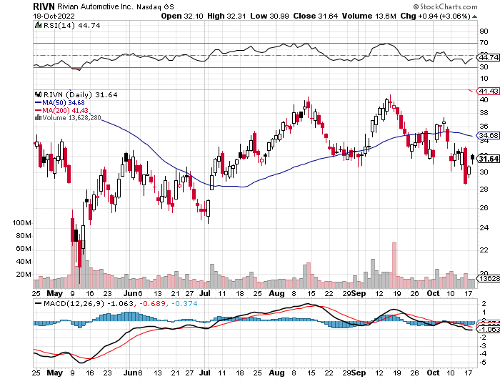
Rivian (RIVN) – Amazon Backed Electric Trucks recall of five cent bolt costs 25% of market cap took profits on long 10/$25-$30 call spread

Slide 31
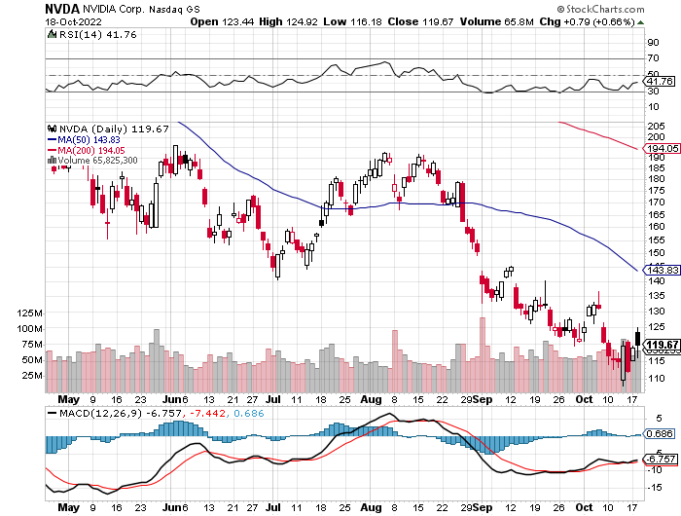
NVIDIA (NVDA) – Downgrade on US ban of highest end AI chips to China took profits on long 10/$95-$100 call spread took profits on long 7/$120-$130 call spread, took profits on long 6/$120-$130 call spread

Slide 32
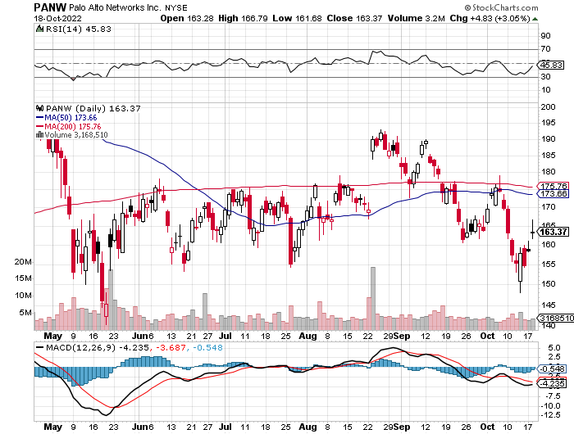
Palo Alto Networks (PANW)- Hacking never goes out of fashion took profits on long 10/$130-$140 call spread

Slide 33
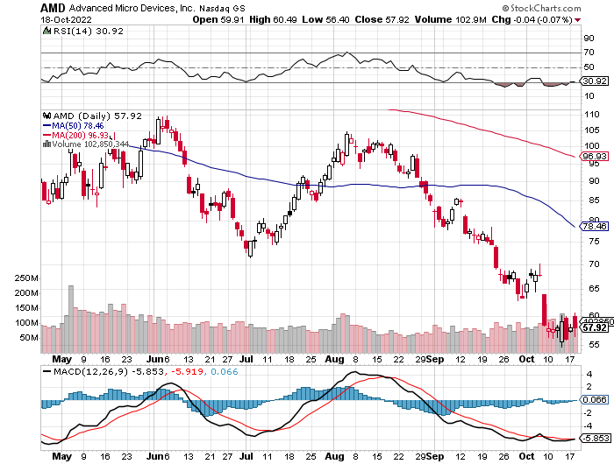
Advanced Micro Devices (AMD)- Recession fears programable logic devices took profits on long 2/$75-$80 call spread

Slide 34
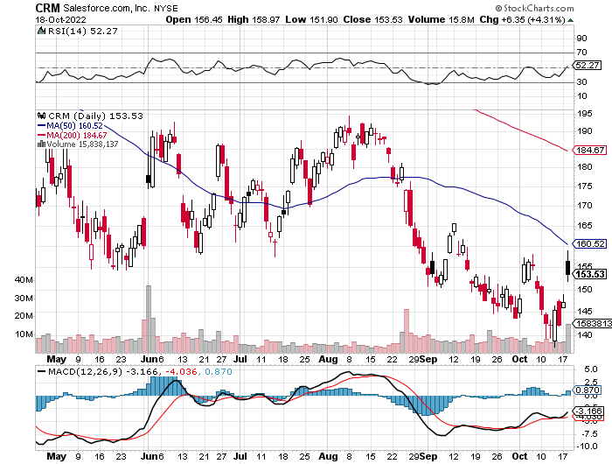
Salesforce (CRM)- Massive Online Migration took profits on long 9/$125-$130 vertical bull call spread took profits on long 8/$125-$130 vertical bull call spread took profits on long 2/$105-$115 call spread

Slide 35
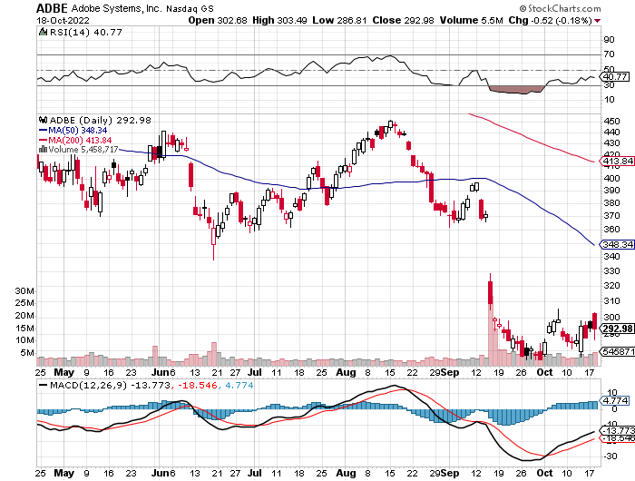
Adobe (ADBE)- Cloud play The Quality Non-China tech play

Slide 36
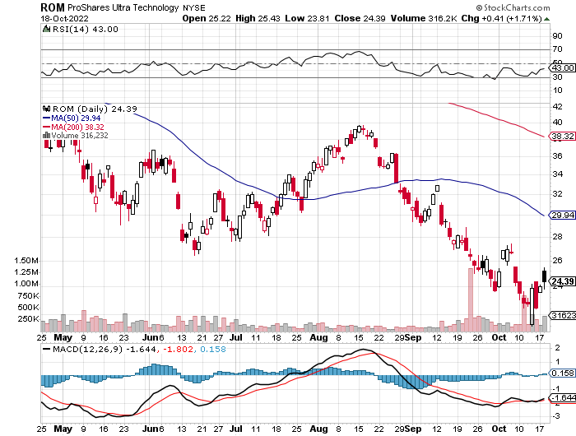
ProShares Ultra Technology ETF (ROM) – 2X Long Technology ETF took profits on long 10/$62-65 call spread

Slide 37
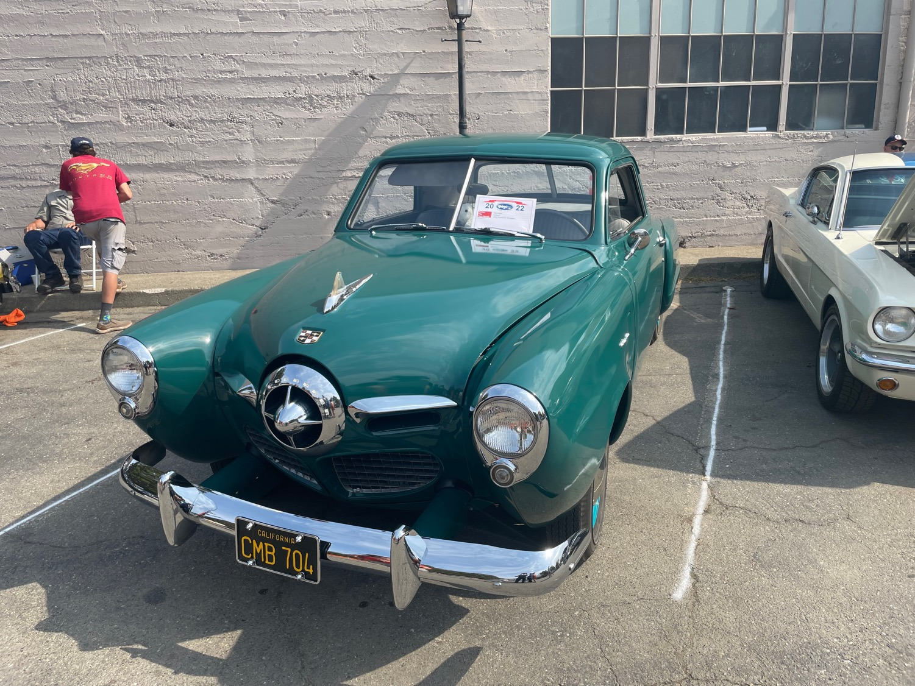

Slide 38
The Second Half of the Barbell
*Bets on a domestic recovery in 2022 Q4 *Upside potential in 2022 far greater than tech *Some of these have not moved for 5 or 10 years *Focuses on economically sensitive cyclical industries *Makes a great counterweight to high-growth technology *We could spend all of next year rotating between the two groups

Slide 39
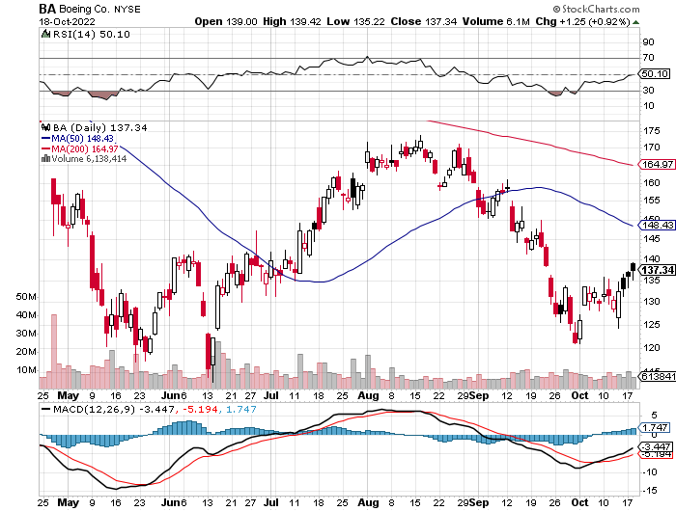
Boeing (BA) –Disastrous Earnings Boeing Delivered its First 787 Dreamliner in a year long 3/$146-$149 call spread

Slide 40
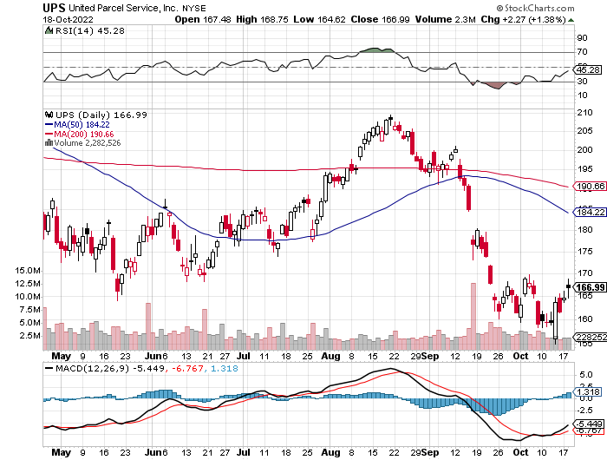
Package Delivery- United Parcel Service (UPS) - Package Delivery record profits took profits on long 11/$130-$140 call spread

Slide 41
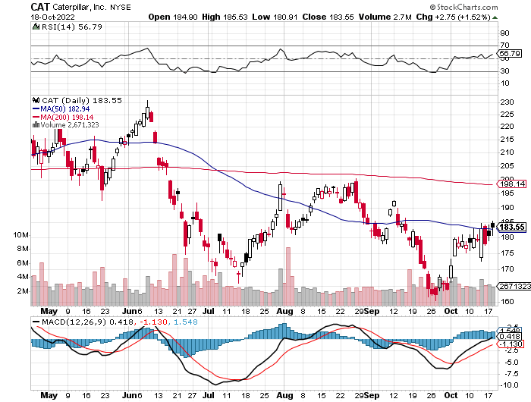
Caterpillar (CAT)- Ag + Infrastructure + Housing Raises Dividend by 50% took profits on long 12/$145-$150 call spread took profits on long 11/$125-$135 call spread

Slide 42
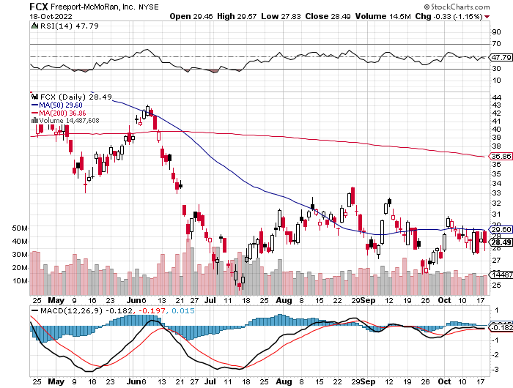
Freeport McMoRan - (FCX)- Copper Play took profits on long 10/$20-$23 call spread

Slide 43
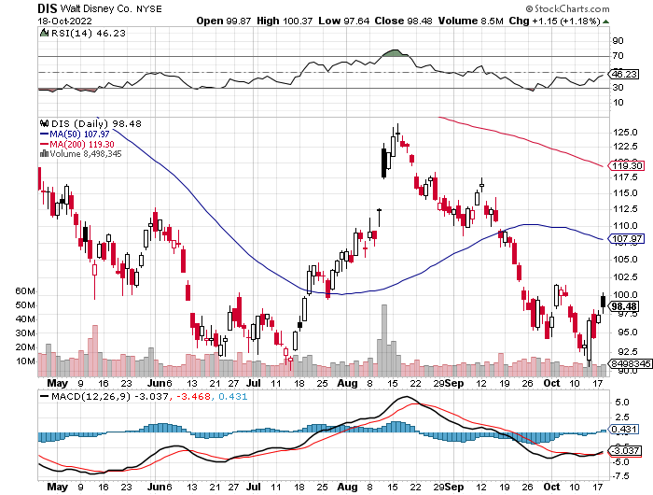
Walt Disney (DIS) - Genie+ stopped out of long 10/$165-$175 call spread took profits on long 3/$170-$180 call spread

Slide 44
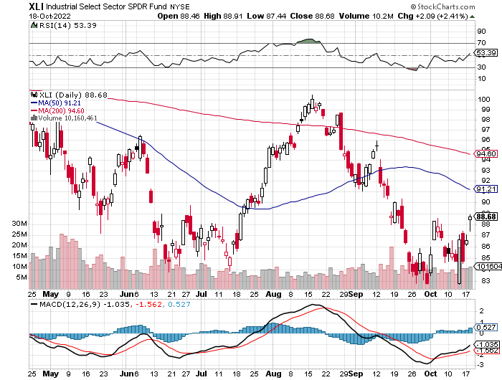
Industrials Sector SPDR (XLI)- (GE), (MMM), (UNP), (UTX), (BA), (HON)

Slide 45
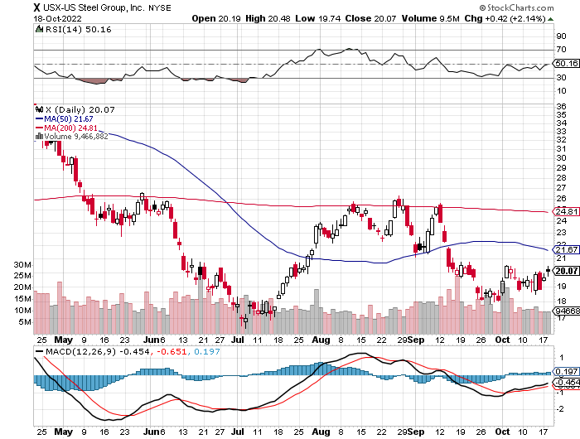
US Steel (X) – Commodity Boom and Wartime boost

Slide 46
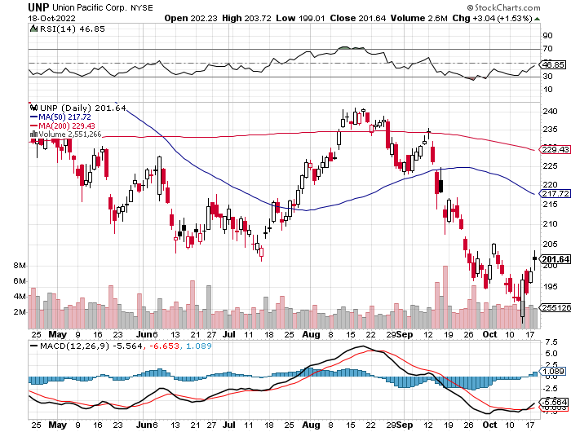
Union Pacific RR (UNP)- Big Stuff to Ship near record earnings announced took profits on long 5/$200-$210 call spread took profits on 11/$150-$160 call spread

Slide 47
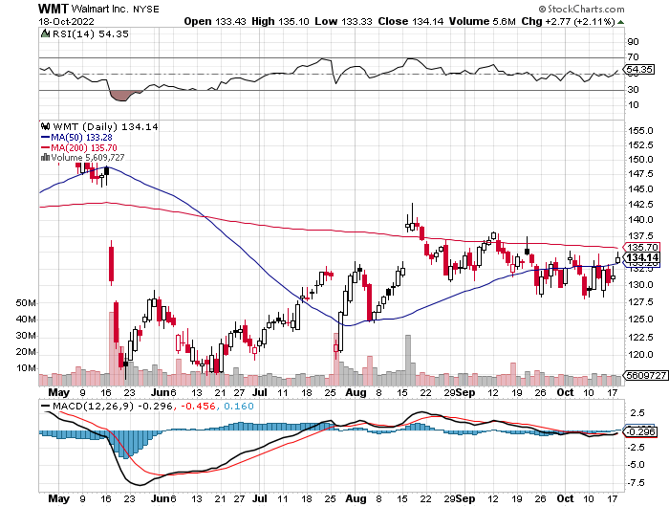
Wal-Mart (WMT)- took profit on Long 11/$125-$130 bear put spread took profit on Long 10/$119-$121 bear put spread took profits on Long 8/$114-$117 bear put spread

Slide 48
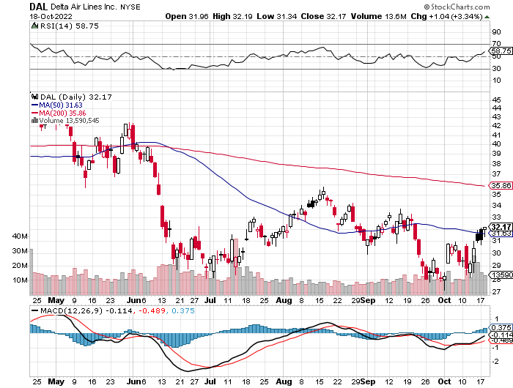
Delta Airlines (DAL) – Travel is Back! Every weekend is a holiday weekend

Slide 49
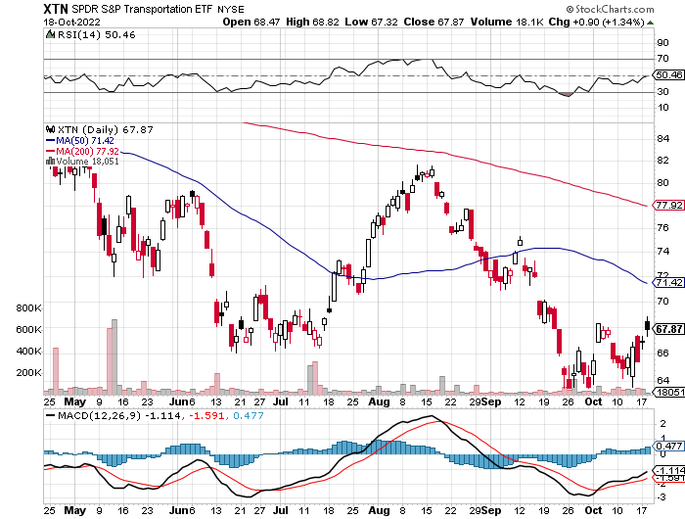
Transports Sector SPDR (XTN)- Worst Hit Sector (ALGT), (ALK), (JBLU), (LUV), (CHRW), (DAL)

Slide 50
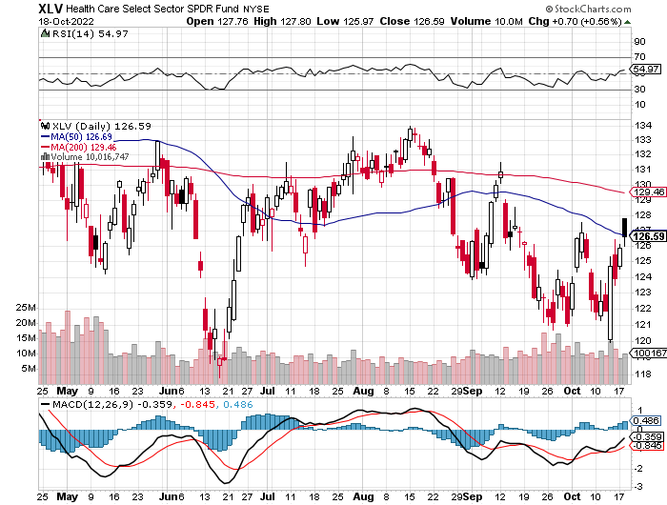
Health Care Sector (XLV) (JNJ), (PFE), (MRK), (GILD), (ACT), (AMGN)

Slide 51
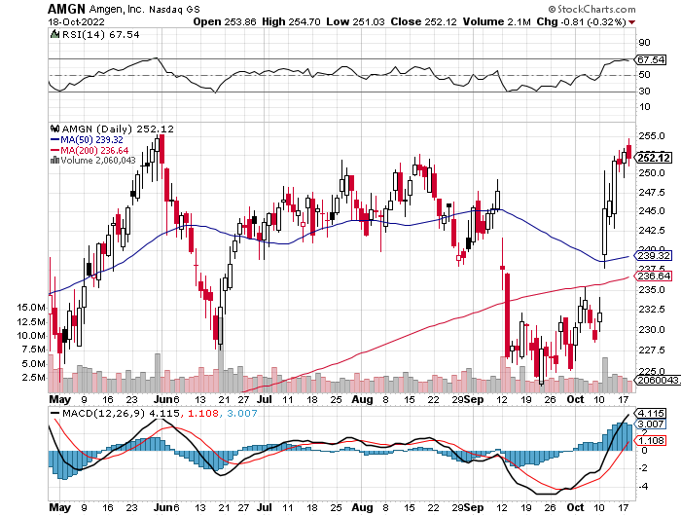
Amgen (AMGN) took profits on long 11/$185-$200 bull call spread

Slide 52
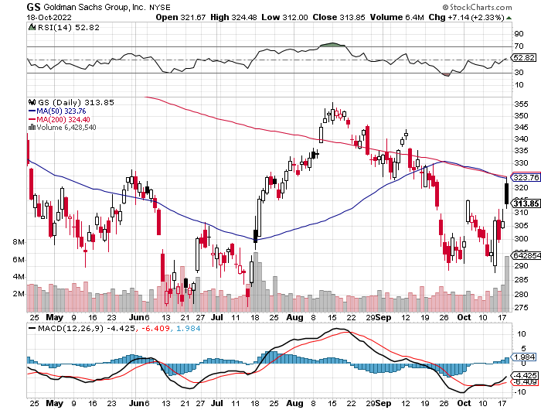
Goldman Sachs (GS) – took profits 12/$330-$350 call spread took profits 11/$330-$350 call spread stop loss on long 11/$385-$395 call spreads

Slide 53
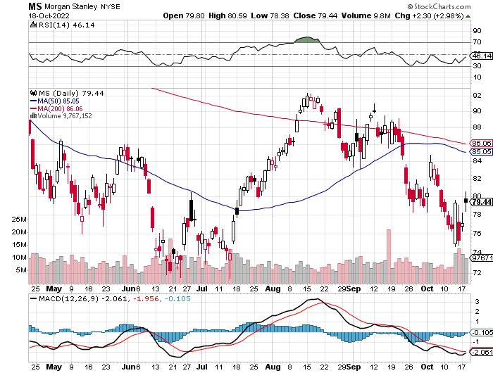
Morgan Stanley (MS) – Equity trading came in a hot $3.2 billion and bond trading $2.9 billion stopped out of long 11/$85-$90 call spread

Slide 54
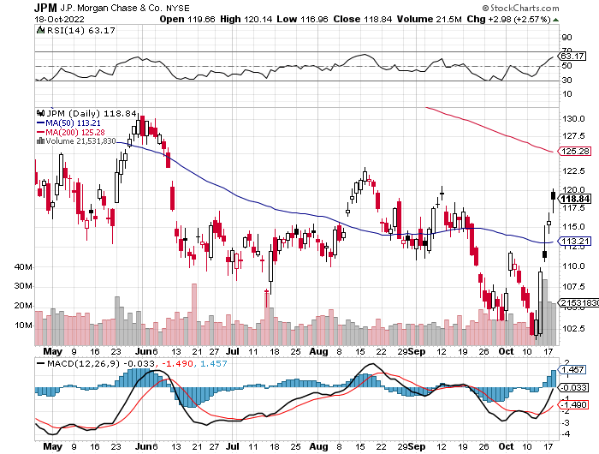
JP Morgan Chase (JPM)-New Lead Sector long 10/$85-$90 call spread-expires in 2 days, stopped out of long 10/$95-$100 call spread took profits long 12/$148-$152.50 call spread

Slide 55
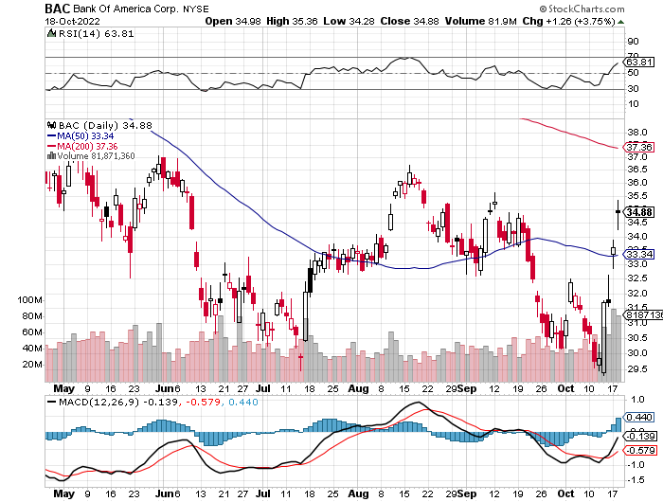
Bank of America (BAC) – New Lead Sector took profits long 12/$39-$42 call spread

Slide 56
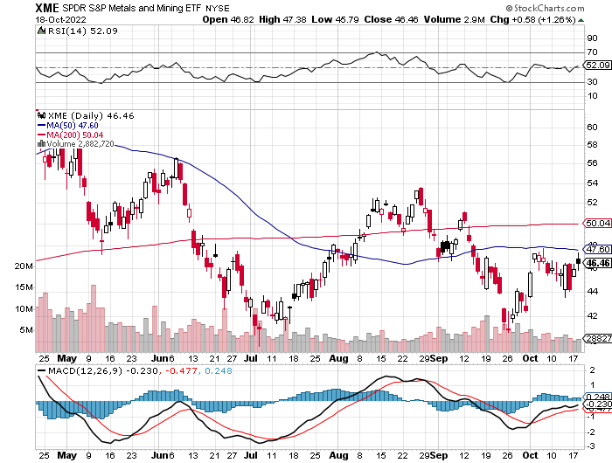
SPDR Metals & Mining ETF (XME) – long 2/$28-$30 call spread

Slide 57
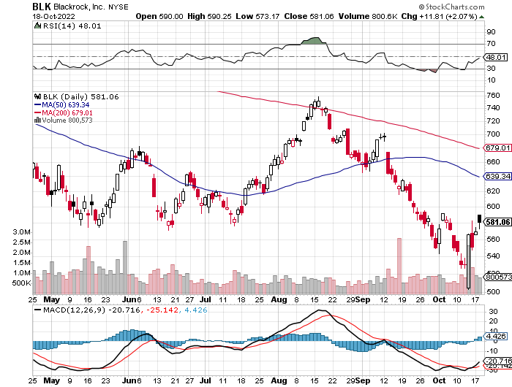
Blackrock (BLK)-Asset Collection Boom took profits on long 3/$770-$790 call spread took profits on long 3/$310-$340 call spread

Slide 58
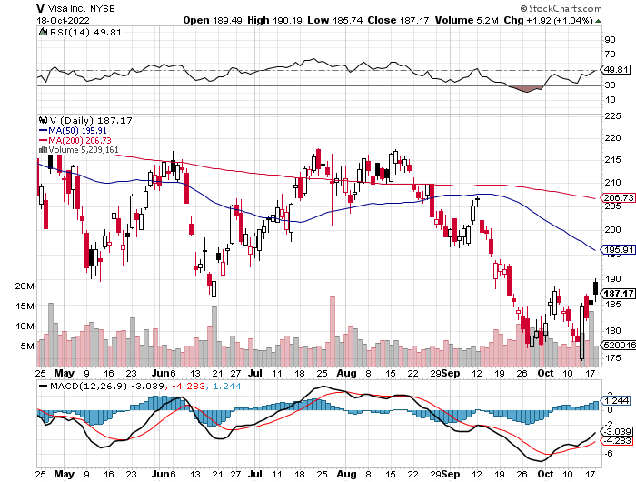
Visa (V) – “Touchless” Bitcoin Drag long 10/$160-$170 bull call spread-expires in 2 days took profits on long 6/$150-$160 bull call spread

Slide 59
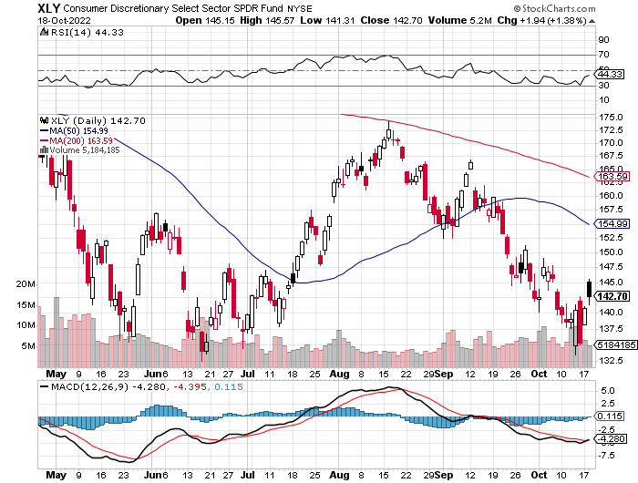
Consumer Discretionary SPDR (XLY) (DIS), (AMZN), (HD), (CMCSA), (MCD), (SBUX)

Slide 60
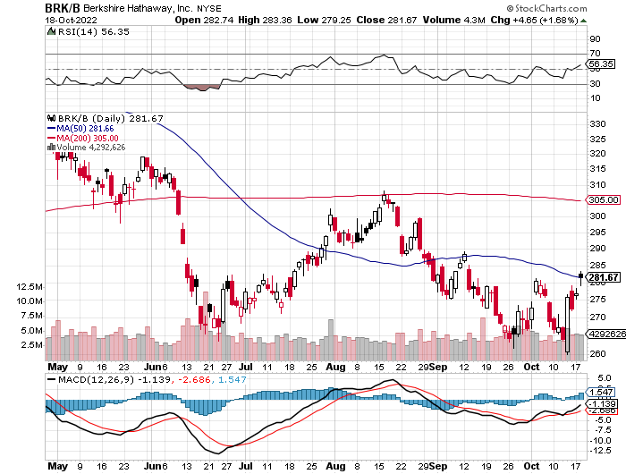
Berkshire Hathaway (BRKB)- Natural Barbell New Lead Sector took profits on long 10/$220-$230 call spread, took profits on long 7/$220-$230 call spread, took profits on long 7/$220-$230 call spread took profits on long 6/$260-$270 call spread, stopped out of long 5/$300-$310 call spread,

Slide 61
Europe Hedged Equity (HEDJ)-

Slide 62
Japan (DXJ)-

Slide 63
Emerging Markets (EEM) - Pro trade, Weak Dollar, Long Recovery Play

Slide 65
Bonds – One Way Market
*Bond Liquidity Issues Haunting the Fed, and bids dry up in an endlessly falling market *The (TLT) alone has lost 43% in 2 ½ years *We are now have broken the bottom of the range going down to $95 *US Treasury bond fund (TLT) could plunge from $180 in 2020 to $100 by 2023-TARGET ACHIEVED! *The Government Loves Inflation, even if you hate it, for the purchasing power of the bonds it issued is now shrinking at a 9% annual rate. *Japanese ten-year bonds haven’t traded in three days *But a LONG trade may be setting up at a 10-year yield of 4.00%

Slide 66
Treasury ETF (TLT) – No Position took profits on long 10/$110-$113 put spread, stopped out of long 10/$98-$101 call spread took profits on long 6/$123-$126 put spread, took profits on long 6/$125-$128 put spread took profits on long 6/$124-$127 put spread, took profits on long long 7/$128-$131 put spread took profits on long 5/$128-$131 put spread, look profits on long 5/$127-$130 put spread

Slide 67
Ten Year Treasury Yield ($TNX) – 4.05%

Slide 68
Junk Bonds (HYG) 8.42% Yield to Maturity

Slide 69
2X Short Treasuries (TBT)-Another run at highs

Slide 71
Foreign Currencies – Dollar Double top?
*If US interest rate rises end in two months, the US dollar could be topping out here *Complete reversal of Truss policies bring major rally in British pound *New Lows for yen as Japanese interest remain at zero with the rest of the world raising *Americans pouring into Europe to buy vacation homes with dollars at 20-year highs *Weak Chinese economy and covid lockdowns crushes the Yuan, government attempting to stabilize *Stand aside from forex for now, there are getting fish to fry

Slide 72
Japanese Yen (FXY)

Slide 73
Euro (FXE)-

Slide 74
British Pound (FXB)-

Slide 75
Australian Dollar (FXA)- The Global Recovery Play took profits on long 8/$67-$69 call spread

Slide 76
Emerging Market Currencies (CEW)

Slide 77
Chinese Yuan- (CYB)- Shanghai Shutdown

Slide 80
Energy & Commodities – OPEC Move
*OPEC+ Cuts Quotas by 2 million, and production by 1 million, in one of the largest reductions in history. *Biden administration matched 2 million barrel a day OPEC+ quota cut with a further release of 10 million barrels from the Strategic Petroleum Reserve. *Biden administration may be negotiating with Venezuela to lift sanctions and free up 1 million barrels a day, which has been a Russian ally up until now *Russia Loses 60% of Seaborn European Oil Traffic, and it’s going to zero when sanctions escalate by yearend. *Biden May be Negotiating with Venezuela to lift Sanctions and free up 1 million barrels of oil a day *Germany Fights Russia with Coal *Avoid all energy plays like the plague, it’s the new buggy whip industry as the US de-carbonizes

Slide 81
Oil-($WTIC)

Slide 82
United States Oil Fund (USO) long 10/$9.50-$10 Vertical bull call spread

Slide 83
Energy Select Sector SPDR (XLE)-No Performance! (XOM), (CVX), (SLB), (KMI), (EOG), (COP)

Slide 84
Halliburton (HAL)-

Slide 85
Natural Gas (UNG) -

Slide 86
Freeport McMoRan (FCX) -

Slide 87
Cameco (CCJ) - took profits on long 5/$20-$23 bull call spread

Slide 89
Precious Metals – Going Nowhere
*Gold give up recent gains on continuing interest rate rise *Destruction of crypto is bringing back gold as a non-correlated asset *Prospect of an end to Fed interest rates rises in two months is also helping *Gold is more of a commodity play now than a risk hedge, and commodities do poorly going into recession *Speculative interest has faded to a few hard-core gold bugs *Silver is still the bigger and better long-term play

Slide 90
Gold (GLD) - Deflation call took profits on long 5/$165-$170 bull call spread

Slide 91
Market Vectors Gold Miners ETF- (GDX) –

Slide 92
Barrick Gold (GOLD) took profits on long 1/$21-$23 call spread took profits on long 11/$22-$24 call spread

Slide 93
Newmont Mining- (NEM)- took profits on long $55-60 call spread

Slide 94
Silver- (SLV)- took profits on long 11/$19-$20 call spread

Slide 95
Silver Miners - (SIL)-

Slide 96
Wheaton Precious Metals - (WPM)- took profits on long 2/$39-41 call spread

Slide 98
Real Estate – Waiting for the Second Shoe
*30-Year Fixed Rate Mortgage Hits an Eye-popping 7.4%, in a clear Fed effort to shut down the real estate market * Homebuilder Sentiment Collapses, for single family homes, a mind blowing 8 points to 38 in October. *It’s the lowest reading since 2012. Anything below 50 is recessionary. *The west took the biggest hit. *Home Financing Pours into 5/1 ARMS, which can be had for a doable 5.56%. *REITS are Still Getting Slaughtered, with the plunge in the bond market today to multidecade lows. The REIT Index is down 30% this year *Manhattan Apartment Sales Collapse, down 18% in Q3 *Market is shutting down from lack of turnover

Slide 99
S&P Case Shiller-Still Going Up in the Rear View Mirror S&P Case Shiller Rockets 18%, in June with its National Home Price Index Tampa (31.8%), Miami (31.7%), Dallas (24.7%)

Slide 100
Crown Castle International (CCI) – 4.61% yielding cell phone tower REIT

Slide 101
US Home Construction Index (ITB) (DHI), (LEN), (PHM), (TOL), (NVR)

Slide 103
Trade Sheet- So What Do We Do About All This?
*Stocks – buy the big dips at bottom of range *Bonds – sell big rallies *Commodities-stand aside *Currencies- stand aside *Precious Metals – stand aside *Energy – stand aside *Volatility - sell short over $30 *Real estate – stand aside *Bitcoin – stand aside

Slide 105
Next Strategy Webinar 12:00 EST Wednesday, November 2 from Silicon Valley, CA email me questions at support@madhedgefundtrader.com
Good Luck and Good Trading!
Notes:
*

