Slide 1
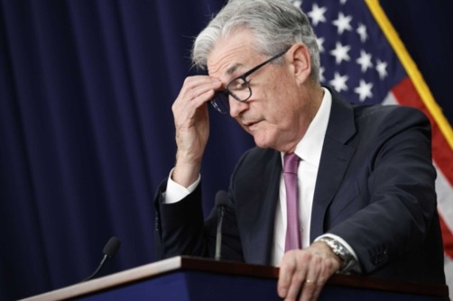
The Mad Hedge Fund Trader “All Eyes on the Fed”
With John Thomas Incline Village, NV, November 2, 2022 www.madhedgefundtrader.com
Notes:
*

Slide 2
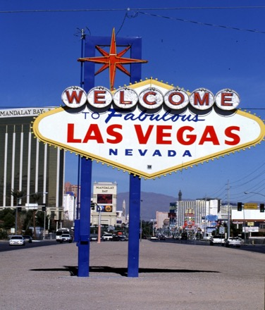
November 4 Las Vegas Strategy Luncheon
*An excellent meal will be followed by a wide-ranging discussion and an extended question and answer period *The lunch will be held at the premier restaurant in Incline Village, Nevada on the sparkling shores of Lake Tahoe *please go to my online store at http://www.madhedgefundtrader.com/store and click on “luncheons.”

Slide 3
February 17 Honolulu, Hawaii Strategy Luncheon
*An excellent meal will be followed by a wide-ranging discussion and an extended question and answer period *The lunch will be held at the premier restaurant in Incline Village, Nevada on the sparkling shores of Lake Tahoe *please go to my online store at http://www.madhedgefundtrader.com/store and click on “luncheons.”

Slide 4
July 13, 2023 Seminar at Sea
*Cunard Line’s flagship, the elegant and spacious Queen Mary II, on an eastbound transatlantic cruise *The Ship departs New York at 12:00 AM on July 7, 2023, and arrives at Southampton on July 14 *Guests will be responsible for booking their own cabin through Cunard *Every dinner during the voyage will be black tie *Customers are required to book their own cabins and return flights from England *The Cunard cruise number is M319.

Slide 5
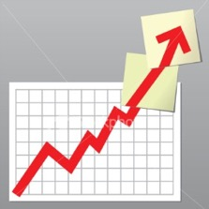
Trade Alert Performance New All Time Highs! 22 out of 23 trade alerts profitable
*January 14.59% Final *July +3.98% Final *February +8.78% MTD *August +5.13% Final *March +3.43% Final *September +9.72% Final *April +3.33% Final *October +5.69% Final *May +8.80% Final *November +0.57 MTD *June +5.91% Final *December +11.26% Final *2022 YTD +75.37% compared to -9.86% for the Dow Average *+587.93% since inception *Average annualized return of +45.60% for 14 years

Slide 6
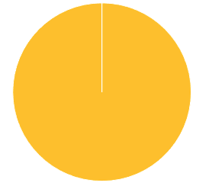
Portfolio Review 0% Long, 10% short, 90% cash At the top of the move
Current Capital at Risk
Risk On
NO POSITIONS
Risk Off
(SPY) 10/$385-$395 put spread | -10.00%
Total Net Position | -10.00%
Total Aggregate Position | 10.00%
Expiration Value +77.93%

Slide 7
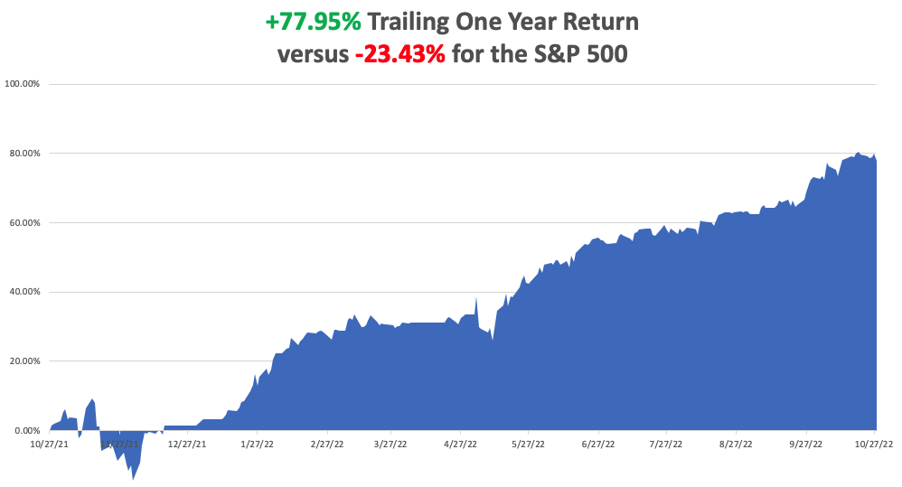

Slide 8
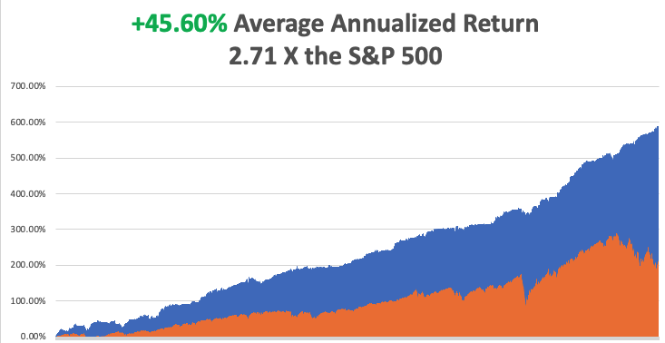

Slide 9
The Method to My Madness The Bottom is In
*The post election may have just happened *Midterm election 800-pound gorilla on the market’s back is about to depart in 5 days *We are now 10 months into a 12–18-month bear market *Q4 could be the best entry point for stocks in a decade *Oil prices flat lining on recession fears *Inflation is plunging but it may not show up until the November 10 number *Coming interest rate top will top the US dollar *Bear market in bonds may be ending with 10-year rates topping 4.43% *(SPX) 4,800 is postponed until 2023 *VIX dives to $25

Slide 10
The Global Economy – The Disappearing Money Syndrome
*A 75 Basis Point Rate Hike is a Sure Thing on Wednesday *If Jay Powell remains hawkish in his statement, stocks and bonds will sell off and the dollar will rally *Don’t forget next week’s midterm election to further add to the noise
*M2 Growth has slowed from 13% to 1.2% YOY, and is about to turn negative, but its purchasing power is declining at an 8.4% rate *M2 and the Case-Shiller National Home Price Index have both risen exactly 43% in the last three years *US GDP Grows 2.6% in Q3 *Chicago PMI is Still Falling, from a 47 estimated to 45.2 in October *US Consumer Confidence Fades, in October, according to the Conference Board, from 107.8 to 102.5 *

Slide 11
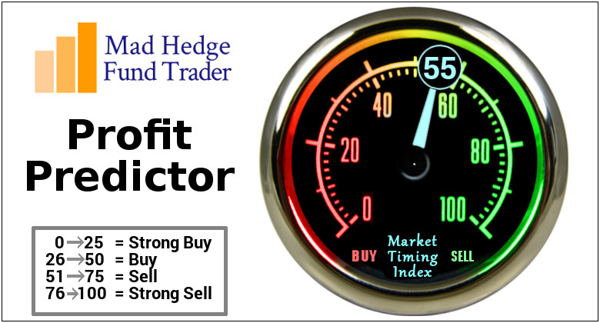
The Mad Hedge Profit Predictor Market Timing Index – Dead in the Middle-Do Nothing An artificial intelligence driven algorithm that analyzes 30 different economic, technical, and momentum driven indicators

Slide 12
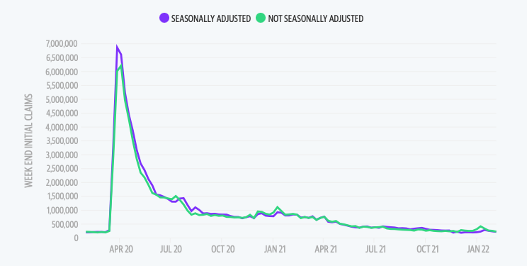
Weekly Jobless Claims – Falling 229,000 – Up 9,000

Slide 13
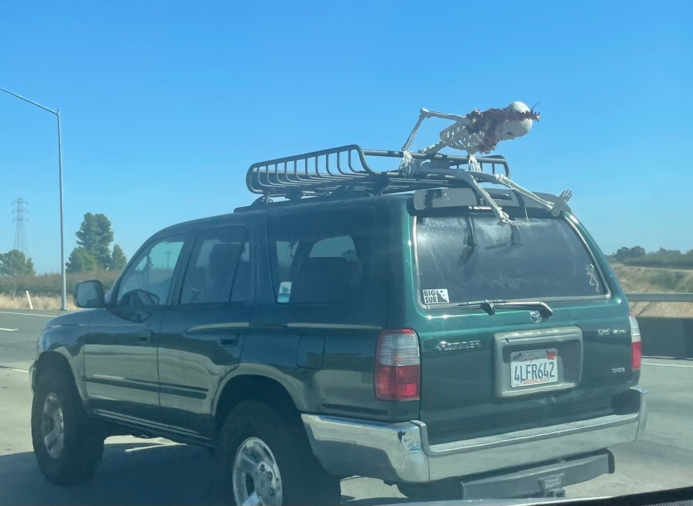

Slide 14
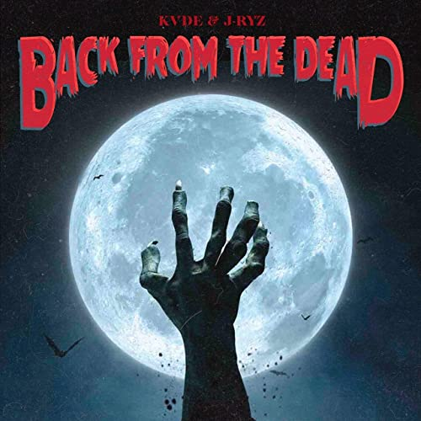
Stocks – Back from the Dead
*All the negatives have gone, the seasonals, earnings reports, strong dollar, and in 8 days, the election *The put/call spread is the biggest in history, about 1:4, showing that investors are piling in, or at least covering shorts as fast as they can *Stock buy backs to hit record $1.25 trillion in 2022 *Old value industrials have been overwhelmingly trouncing bog tech *Banks led the charge on UP days, suggesting they may be the new lead sector in a rising market-the golden age is just beginning *No surprise that investors sold what was expensive (tech) and what was bought what was cheap (banks). It’s basic investing 101 * Tech is still trading at a big premium to the market and double the price earnings of banks *Look for terrible H1 and strong H2 scenario to continue

Slide 15
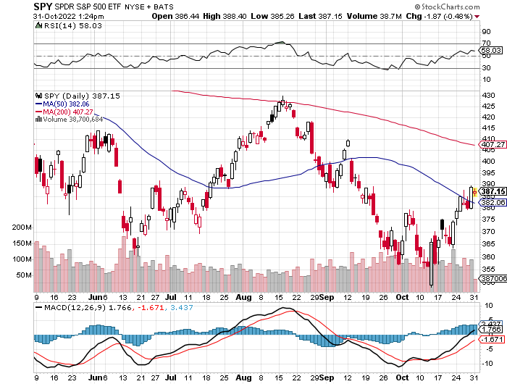
S&P 500 – The Worst Case-Severe Recession took profits on long 10/$385-$395 put spread, long 11/$410-$400 put spread took profit on long 10/$390-$400 put spread, took profit on long 10/$320-$330 call spread took profits on long 6/$445-$455 put spread
$410 +17% Rally
The Bottom $350 Down -27%

Slide 16
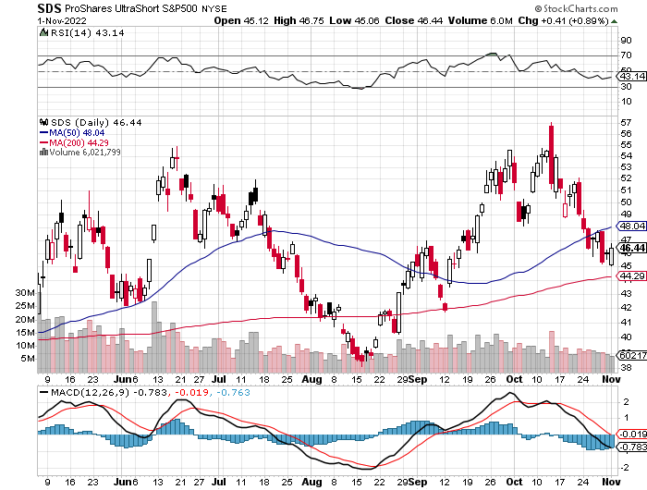
ProShares Ultra Short S&P 500 (SDS)- a great hedge for long stocks and bonds long 2X position has a hedge against longs and bond shorts

Slide 17
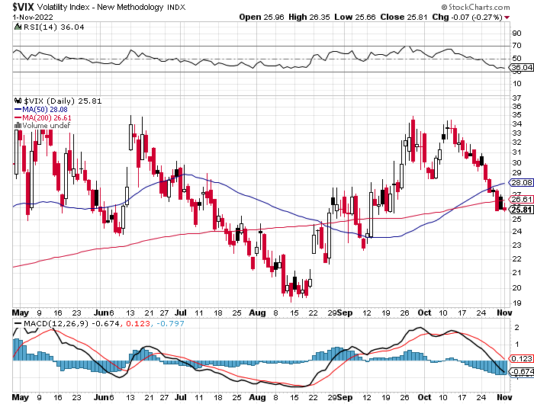
(VIX) – Unable to Make a New High

Slide 18
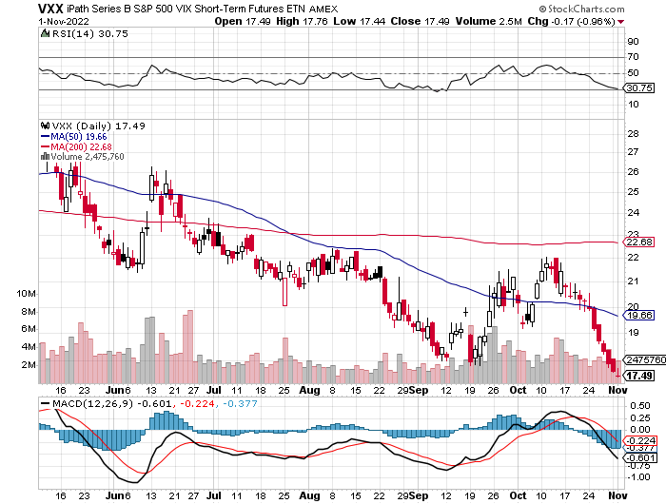
(VXX)-

Slide 19
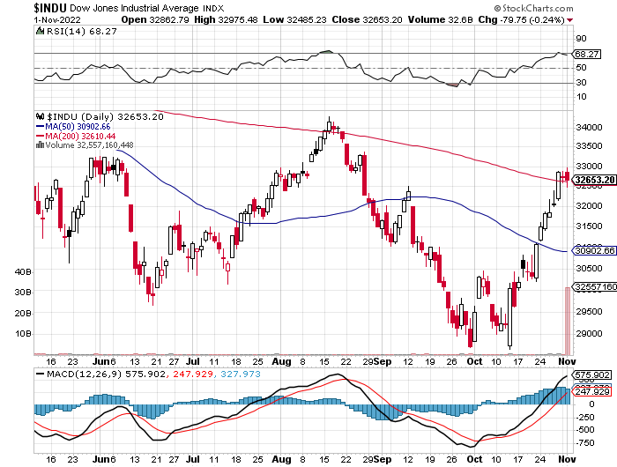
Dow Average ($INDU)-

Slide 20
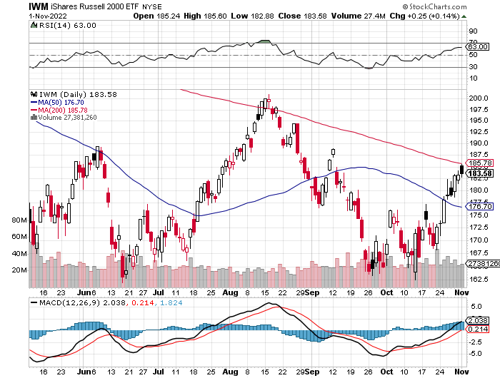
Russell 2000 (IWM)- took profits on Long 10/$137-$142 vertical bull call spread took profits on Long 10/$153-$156 vertical bear put spread

Slide 21
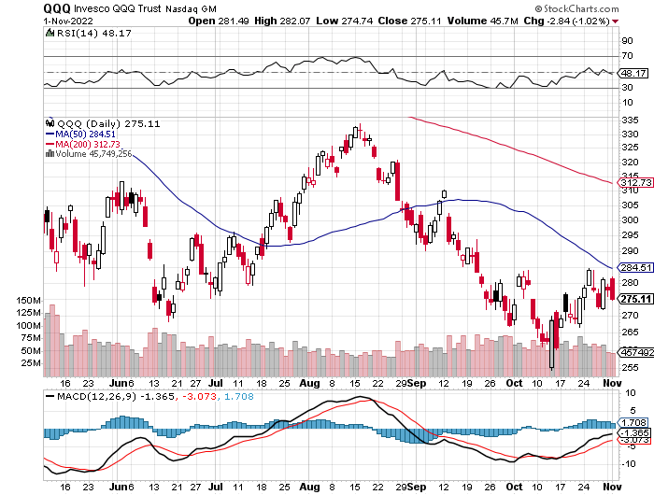
NASDAQ (QQQ) – Lagging took profits on long (QQQ) 4/$330-$335 put spread took profits on long (QQQ) 3/$340-$345 put spread covered long (QQQ) $325-$330 put spread

Slide 23
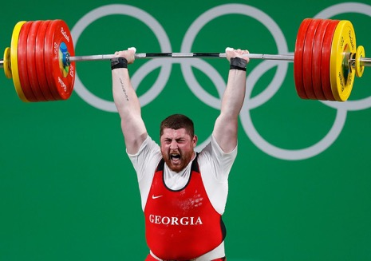
The Barbell Portfolio
*50% Big Tech - 2% of US Employment but 27% of Market Cap and 38% of Profits 50% Domestic Recovery, including: Railroads Couriers Banks Construction Credit Cards Event organizers Ticket sales Retailers

Slide 24
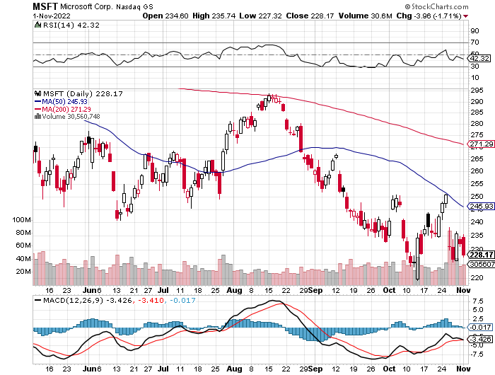
Microsoft (MSFT)- took profits on 9/$235-$245 call spread, took profits on long 7/$220-$210 call spread, took profits on long 6/$220-$230 call spread, took profits on long 2/$200-$210 bear put spread

Slide 25
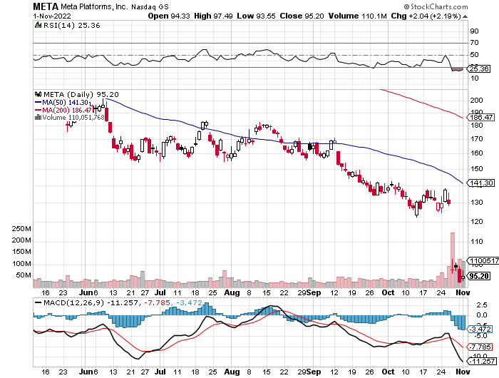
Meta (META)- Looking for the Metaverse took profits on Long 9/$290-$300 vertical bear put spread stopped out of Long 9/$190-$200 vertical bear put spread

Slide 26
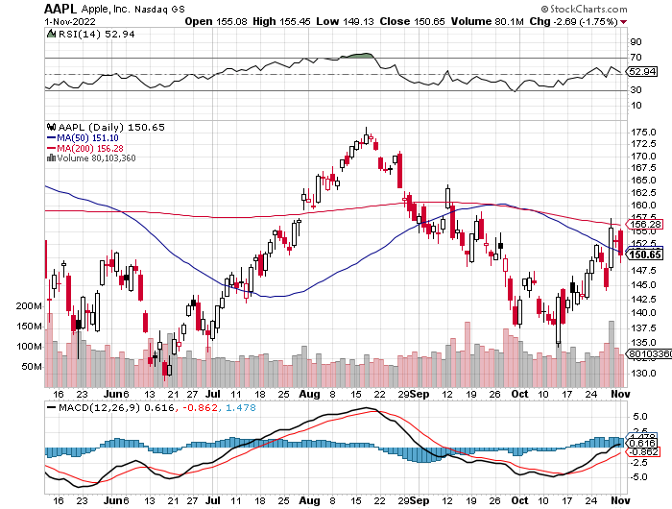
Apple (AAPL)- Apple Cuts iPhone Production in China Took profits on long 10/$165-$175 put spread took profits on long 6/$155-$165 put spread, stopped out of long 6/$125-135 call spread, took profits on long 6/$110-$120 call spread, took profits on long 2/$180-$190 put spread

Slide 27
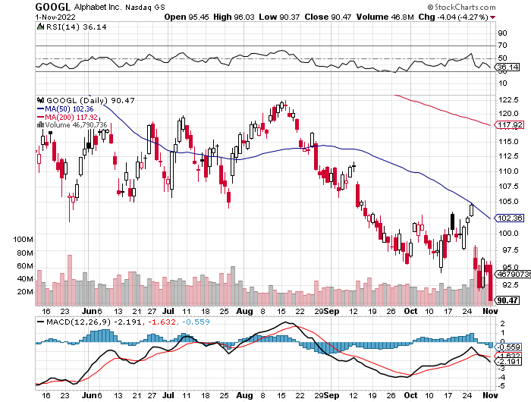
Alphabet (GOOGL) – Ad king on economic recovery Lost $1 Trillion valuation took profits on long 12/$1,200-$1,230 bull call spread took profits on long 9/$1,030-$1,080 vertical bull call spread

Slide 28
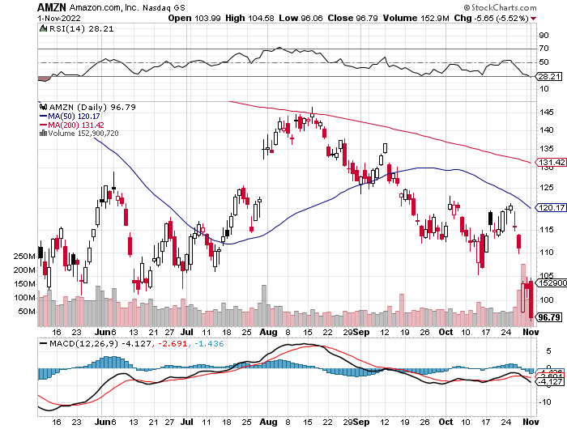
Amazon (AMZN) – Amazon Splits 20:1, triggering an avalanche of new retail buyers took profits on long 2/$3,400-$3,500 bear put spread took profits on long 9/$2,800-$2,900 bull call spread

Slide 29
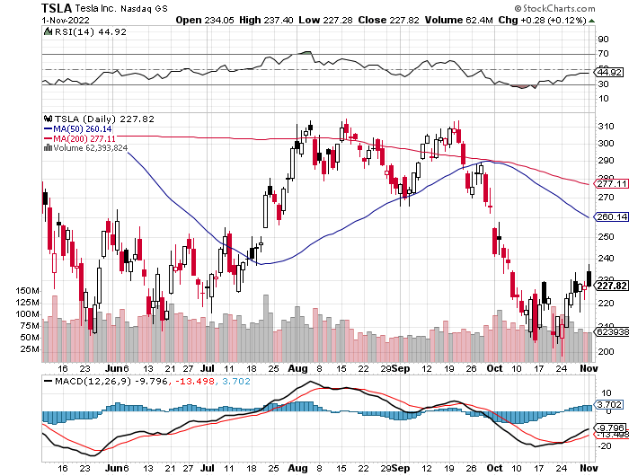
Tesla (TSLA) – Twitter Disaster Elon Musk Pays Full Price for Twitter, at $54.20 a share, Tesla loses $333 billion in market cap on $16 billion purchase took profits on long 10/$170-$180 call spread stopped out of long 10/$200-$210 call spread, stopped out of long 10/$220-$230 call spread

Slide 30
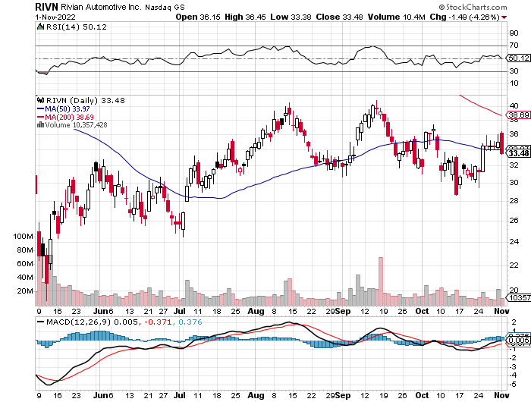
Rivian (RIVN) – Amazon Backed Electric Trucks recall of five cent bolt costs 25% of market cap took profits on long 10/$25-$30 call spread

Slide 31
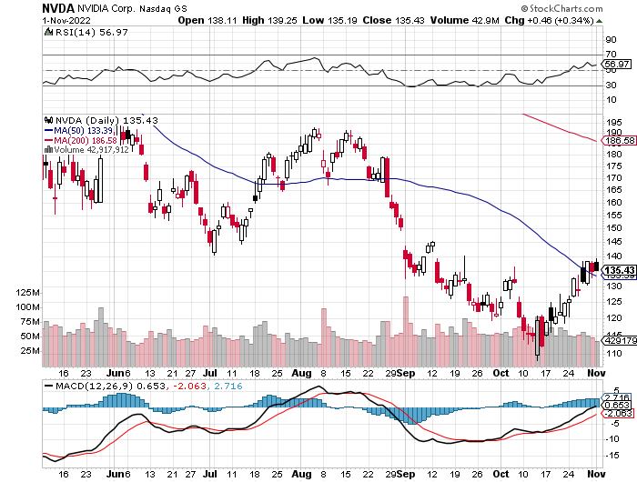
NVIDIA (NVDA) – Downgrade on US ban of highest end AI chips to China took profits on long 10/$95-$100 call spread took profits on long 7/$120-$130 call spread, took profits on long 6/$120-$130 call spread

Slide 32
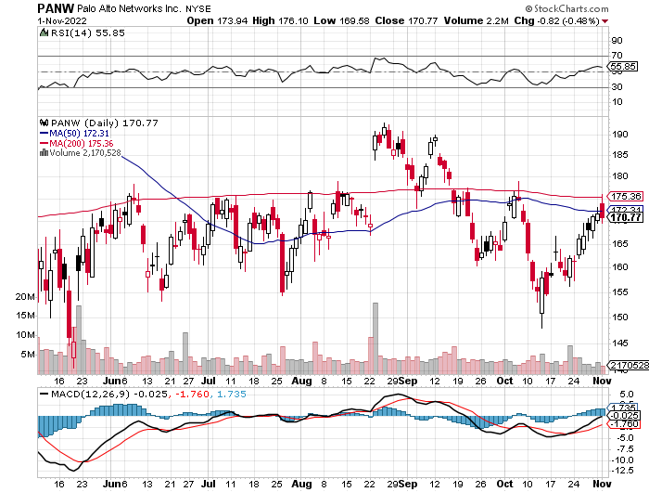
Palo Alto Networks (PANW)- Hacking never goes out of fashion took profits on long 10/$130-$140 call spread

Slide 33
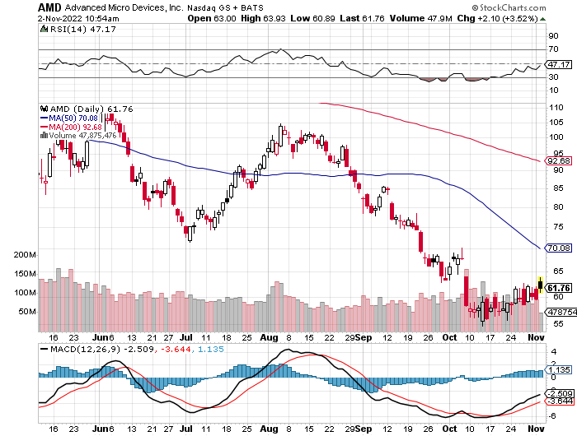
Advanced Micro Devices (AMD)- Recession fears programable logic devices took profits on long 2/$75-$80 call spread

Slide 34
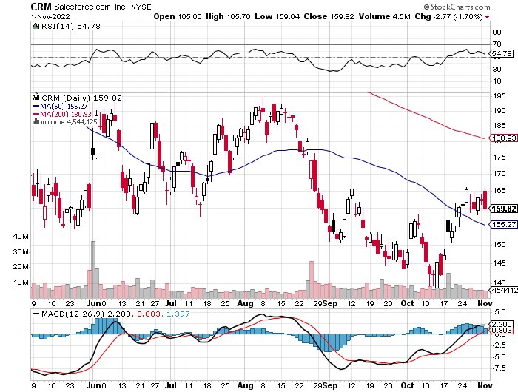
Salesforce (CRM)- Massive Online Migration took profits on long 9/$125-$130 vertical bull call spread took profits on long 8/$125-$130 vertical bull call spread took profits on long 2/$105-$115 call spread

Slide 35
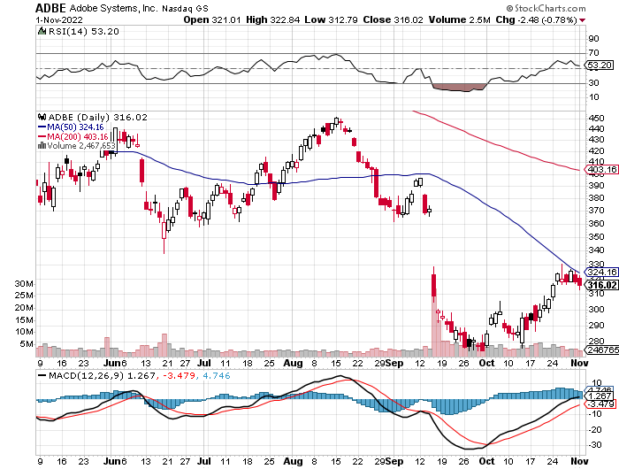
Adobe (ADBE)- Cloud play The Quality Non-China tech play

Slide 36
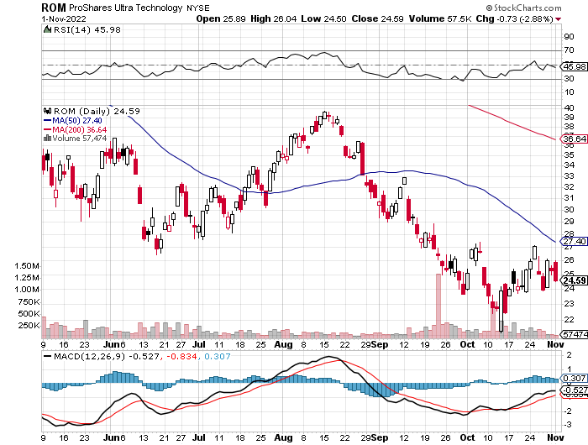
ProShares Ultra Technology ETF (ROM) – 2X Long Technology ETF took profits on long 10/$62-65 call spread

Slide 37
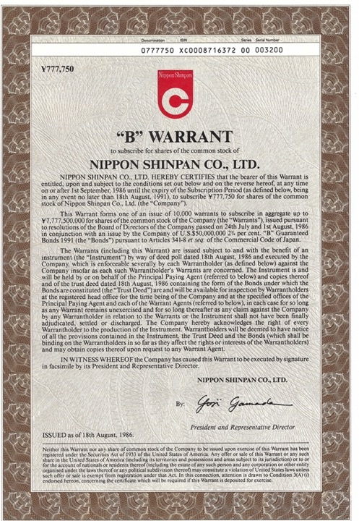

Slide 38
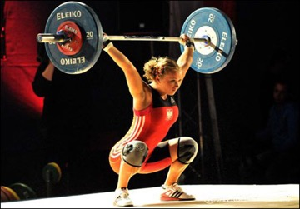
The Second Half of the Barbell
*Bets on a domestic recovery in 2022 Q4 *Upside potential in 2022 far greater than tech *Some of these have not moved for 5 or 10 years *Focuses on economically sensitive cyclical industries *Makes a great counterweight to high-growth technology *We could spend all of next year rotating between the two groups

Slide 39
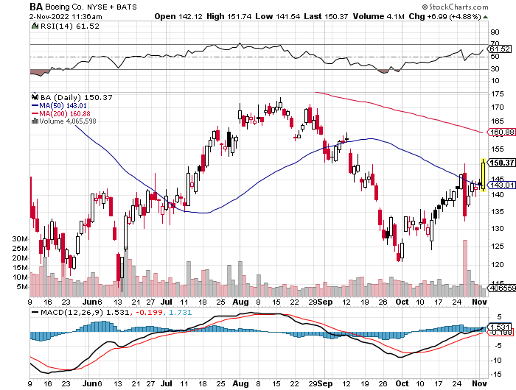
Boeing (BA) –Disastrous Earnings Company to turn cash flow positive in 2023 long 3/$146-$149 call spread

Slide 40
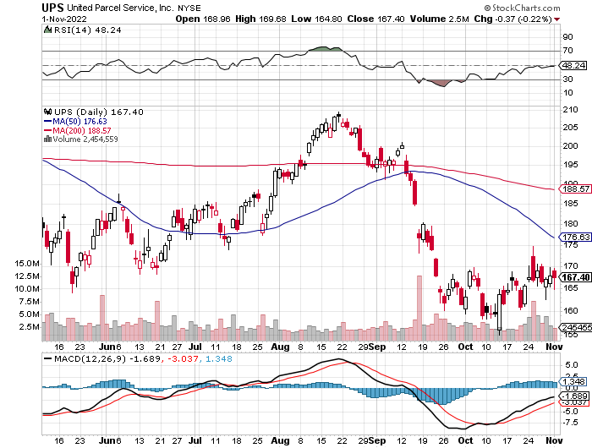
Package Delivery- United Parcel Service (UPS) - Package Delivery record profits took profits on long 11/$130-$140 call spread

Slide 41
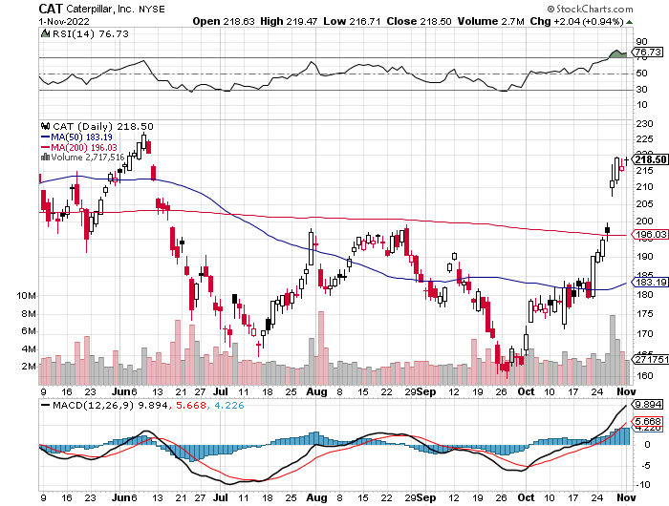
Caterpillar (CAT)- Ag + Infrastructure + Housing Perfect Upside Storm took profits on long 12/$145-$150 call spread took profits on long 11/$125-$135 call spread

Slide 42
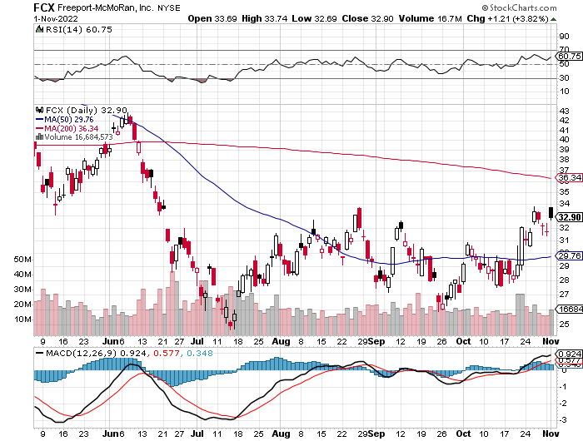
Freeport McMoRan - (FCX)- Copper Play took profits on long 10/$20-$23 call spread

Slide 43
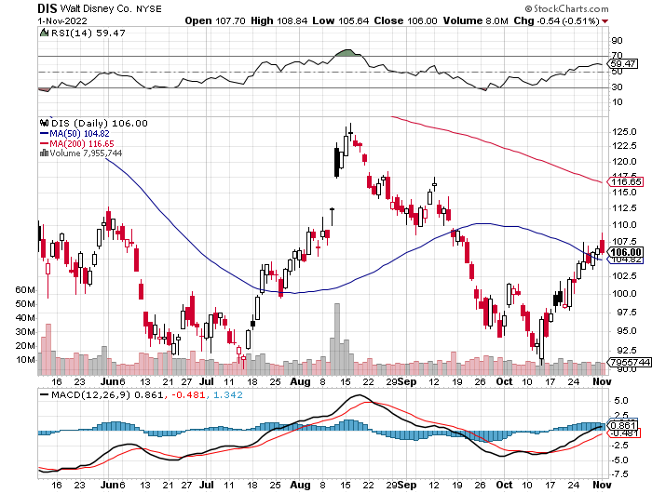
Walt Disney (DIS) - Genie+ stopped out of long 10/$165-$175 call spread took profits on long 3/$170-$180 call spread

Slide 44
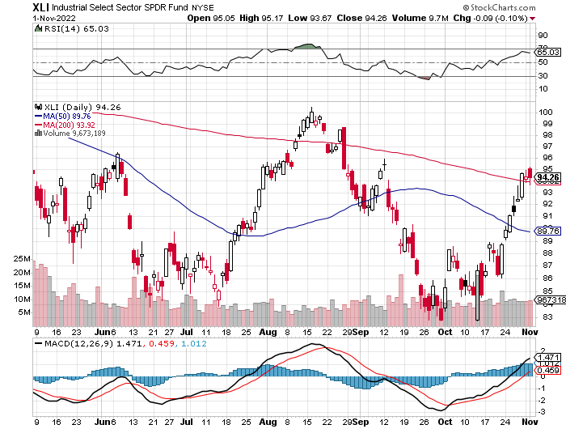
Industrials Sector SPDR (XLI)- No Doubt Who's Leading (GE), (MMM), (UNP), (UTX), (BA), (HON)

Slide 45
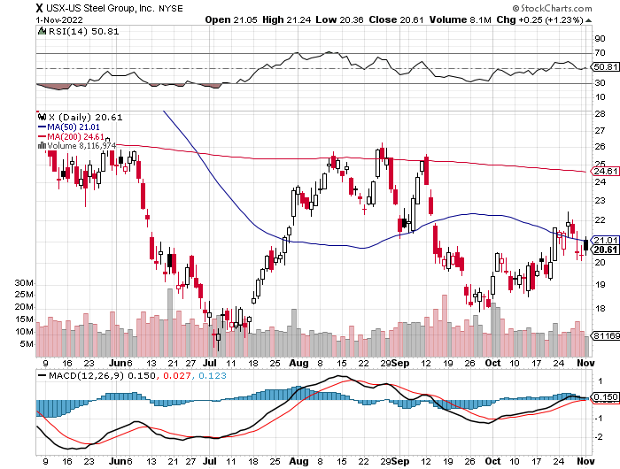
US Steel (X) – Commodity Boom and Wartime boost

Slide 46
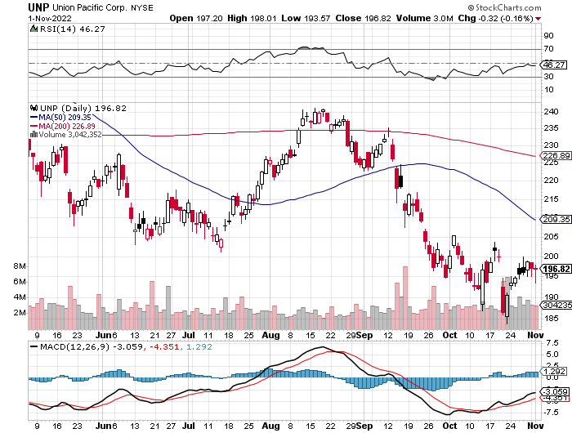
Union Pacific RR (UNP)- Big Stuff to Ship near record earnings announced took profits on long 5/$200-$210 call spread took profits on 11/$150-$160 call spread

Slide 47
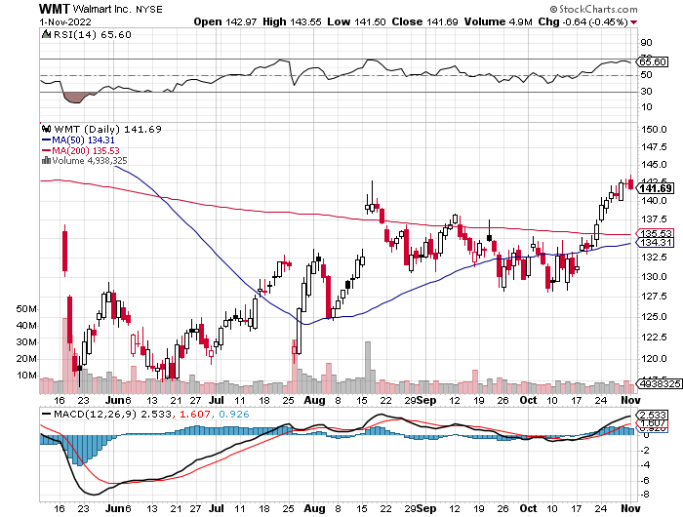
Wal-Mart (WMT)- Low end retail took profit on Long 11/$125-$130 bear put spread took profit on Long 10/$119-$121 bear put spread took profits on Long 8/$114-$117 bear put spread

Slide 48
Delta Airlines (DAL) – Travel is Back!

Slide 49
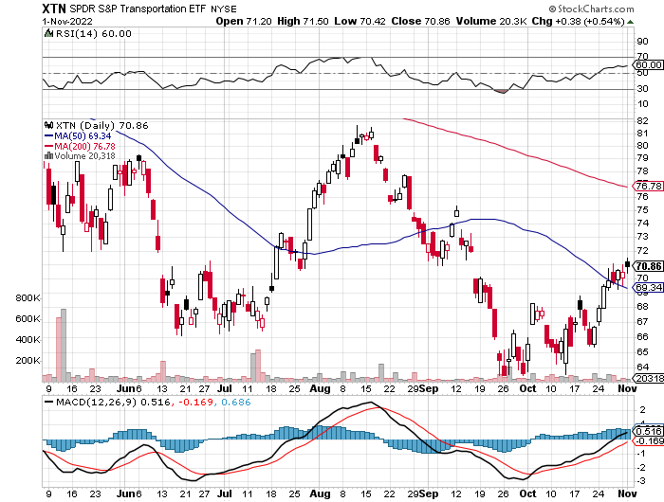
Transports Sector SPDR (XTN)- Worst Hit Sector (ALGT), (ALK), (JBLU), (LUV), (CHRW), (DAL)

Slide 50
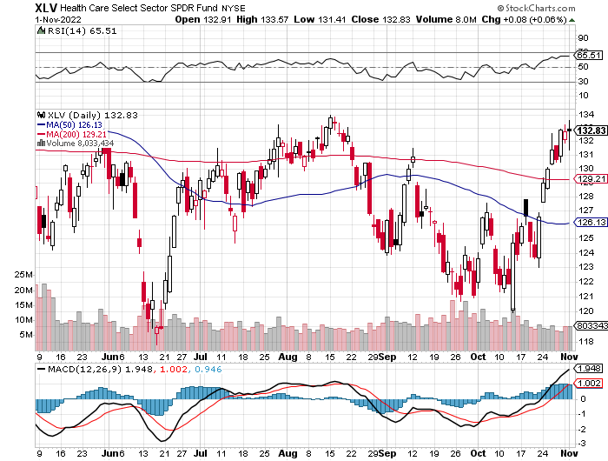
Health Care Sector (XLV) – On Fire (JNJ), (PFE), (MRK), (GILD), (ACT), (AMGN) buy the Mad Hedge Biotech & Health Care Letter

Slide 51
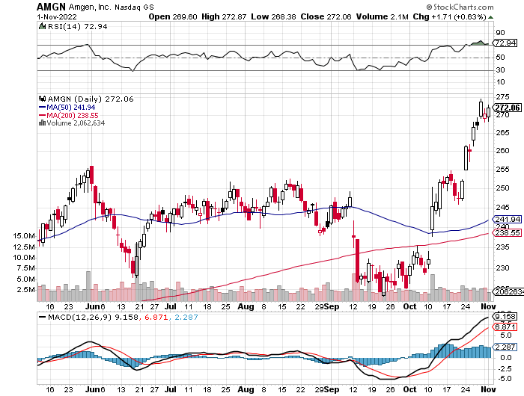
Amgen (AMGN) – Our Number One Pick took profits on long 11/$185-$200 bull call spread

Slide 52
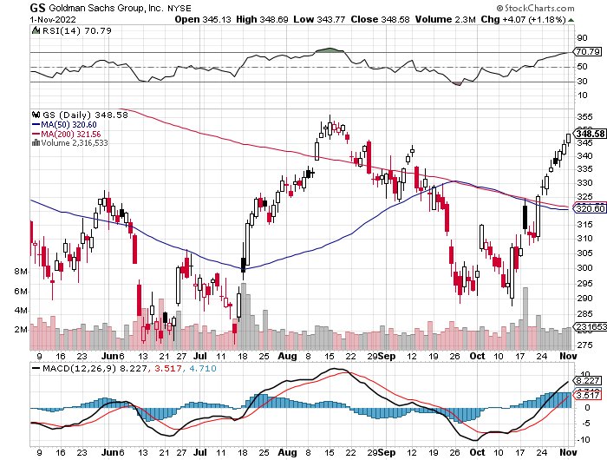
Goldman Sachs (GS) – Another Lead Sector took profits 12/$330-$350 call spread took profits 11/$330-$350 call spread stop loss on long 11/$385-$395 call spreads

Slide 53
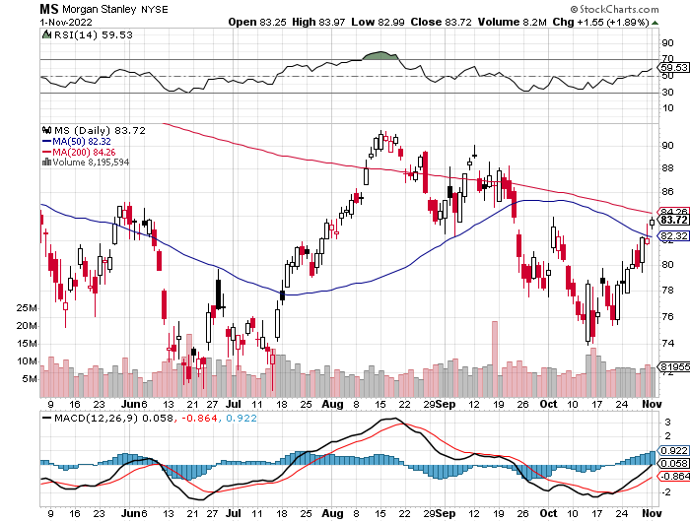
Morgan Stanley (MS) – Another Lead Sector Equity trading came in a hot $3.2 billion and bond trading $2.9 billion took profits on long 10/$85-$90 call spread

Slide 54
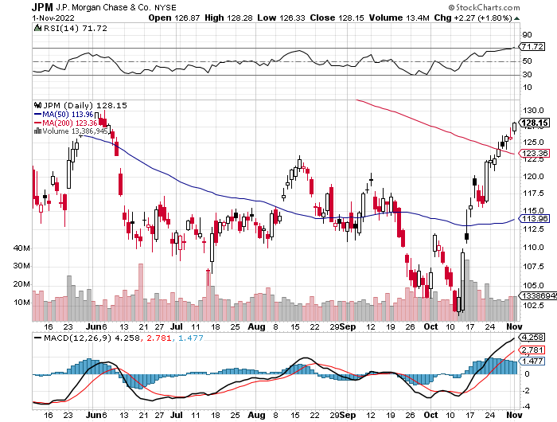
JP Morgan Chase (JPM)- Another Lead Sector took profits on long 10/$85-$90 call spread, stopped out of long 10/$95-$100 call spread took profits long 12/$148-$152.50 call spread

Slide 55
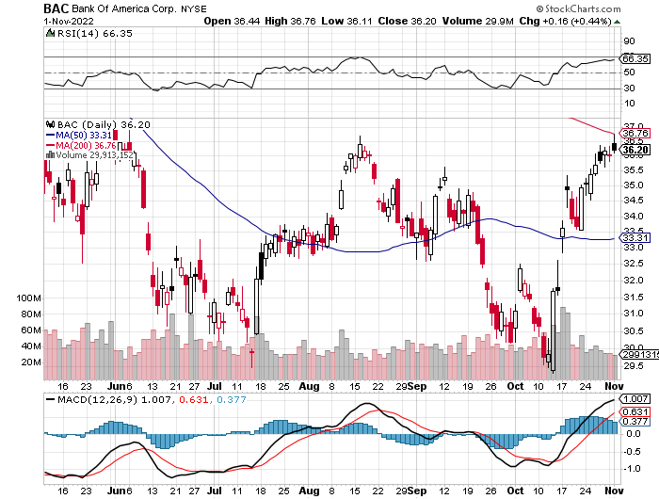
Bank of America (BAC) – Another Lead Sector took profits long 12/$39-$42 call spread

Slide 56
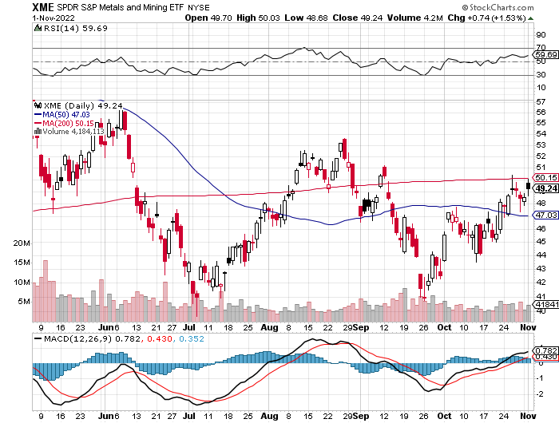
SPDR Metals & Mining ETF (XME) – long 2/$28-$30 call spread

Slide 57
Blackrock (BLK)- Another Lead Sector took profits on long 3/$770-$790 call spread took profits on long 3/$310-$340 call spread

Slide 58
Visa (V) – Another Lead Sector Inflation play, Double digit grower, 50% profit margin, and big buyer of its own stock took profits on long 10/$160-$170 bull call spread took profits on long 6/$150-$160 bull call spread

Slide 59
Consumer Discretionary SPDR (XLY) (DIS), (AMZN), (HD), (CMCSA), (MCD), (SBUX)

Slide 60
Berkshire Hathaway (BRKB)- Natural Barbell Another Lead Sector took profits on long 10/$220-$230 call spread, took profits on long 7/$220-$230 call spread, took profits on long 7/$220-$230 call spread took profits on long 6/$260-$270 call spread, stopped out of long 5/$300-$310 call spread,

Slide 61
Europe Hedged Equity (HEDJ)-

Slide 62
Japan (DXJ)-

Slide 63
Emerging Markets (EEM) - Pro trade, Weak Dollar, Long Recovery Play

Slide 65
Bonds – A Bottom in Sight?
*US Budget Deficit Drops by Half, after the sharpest decline in government spending in history *Less government borrowing is building a floor under bond prices *The (TLT) alone has lost 48% in 2 ½ years *We are now have broken the bottom of the range going down to $92 *The Government Loves Inflation, even if you hate it, for the purchasing power of the bonds it issued is now shrinking at a 9% annual rate. *But a LONG trade may be setting up at a 10-year yield of 4.50%

Slide 66
Treasury ETF (TLT) – No Position took profits on long 10/$110-$113 put spread, stopped out of long 10/$98-$101 call spread took profits on long 6/$123-$126 put spread, took profits on long 6/$125-$128 put spread took profits on long 6/$124-$127 put spread, took profits on long long 7/$128-$131 put spread took profits on long 5/$128-$131 put spread, look profits on long 5/$127-$130 put spread

Slide 67
Ten Year Treasury Yield ($TNX) – 4.05%

Slide 68
Junk Bonds (HYG) 8.42% Yield to Maturity

Slide 69
2X Short Treasuries (TBT)- Topping Out

Slide 71
Foreign Currencies – Topping Dollar?
*Yen to Fall More, from 2009 low, since the Bank of Japan refuses to raise interest rates. Sell short the (FXY) on rallies *Bank of Japan Intervenes, to support the yen from this year’s catastrophic fall *US dollar becomes a petro-currency as a net energy exporter *If US interest rate rises end in six weeks, the US dollar could be topping out here * British Pound Rockets, on news that Boris Johnson Pulled Out of UK PM Race. *Weak Chinese economy and covid lockdowns crushes the Yuan, government attempting to stabilize *Stand aside from forex for now, there are getting fish to fry

Slide 72
Japanese Yen (FXY)

Slide 73
Euro (FXE)-

Slide 74
British Pound (FXB)-

Slide 75
Australian Dollar (FXA)- The Global Recovery Play took profits on long 8/$67-$69 call spread

Slide 76
Emerging Market Currencies (CEW)

Slide 77
Chinese Yuan- (CYB)- Shanghai Shutdown

Slide 79
Energy & Commodities –
*Natural gas glut arrives *60 ships offshore in Europe waiting to unload natural gas in Europe costing $500,000 a day per ship *Biden attacks oil companies on price gouging, proposes windfall profits tax *Russia Loses ability to insure oil cargoes at yearend *Germany Fights Russia with Coal *Avoid all energy plays like the plague, it’s the new buggy whip industry as the US de-carbonizes *I’m not recommending energy because there is no long term growth story here

Slide 80
Oil-($WTIC)

Slide 81
United States Oil Fund (USO) long 10/$9.50-$10 Vertical bull call spread

Slide 82
Energy Select Sector SPDR (XLE)-No Performance! (XOM), (CVX), (SLB), (KMI), (EOG), (COP)

Slide 83
Halliburton (HAL)-

Slide 84
Natural Gas (UNG) -

Slide 85
Freeport McMoRan (FCX) -

Slide 86
Cameco (CCJ) – Uranium Play took profits on long 5/$20-$23 bull call spread

Slide 88
Precious Metals – Dead as a Doorknob
*Not even a bull market in stocks can bring gold back to life *Interest rates are so high now that gold has become a no-go *Gold is more of a commodity play now than a risk hedge, and commodities do poorly going into recession *Speculative interest has faded to a few hard-core gold bugs *Silver is still the bigger and better long-term play

Slide 89
Gold (GLD) - Deflation call took profits on long 5/$165-$170 bull call spread

Slide 90
Market Vectors Gold Miners ETF- (GDX) –

Slide 91
Barrick Gold (GOLD) took profits on long 1/$21-$23 call spread took profits on long 11/$22-$24 call spread

Slide 92
Newmont Mining- (NEM)- took profits on long $55-60 call spread

Slide 93
Silver- (SLV)- took profits on long 11/$19-$20 call spread

Slide 94
Silver Miners - (SIL)-

Slide 95
Wheaton Precious Metals - (WPM)- took profits on long 2/$39-41 call spread

Slide 96
Real Estate – Trapped
*S&P Case Shiller Dives at Record Rate, with its National Home Price Index, up only 13% YOY in July, the steepest YOY decline in a year *That is off from a 15.6% annual rate in June and a 21% rate in March *Declines will be limited from here, as there are now 85 million Millennials looking to buy from only 65 million Gen Xers. Most baby boomers are already in their assisted living facilities and the Greatest Generation is gone *Pending sales are the lowest since 2015. *Touring activity is down 27% YOY *Mortgage rates now at 20 year high *Homeowners are now trapped by their 2.75% mortgages….forever *Home price falls will be more muted than many expect and will reaccelerate once interest rates start to fall again next year

Slide 97
S&P Case Shiller-Still Going Up in the Rear View Mirror S&P Case Shiller Rises 13%, in July with its National Home Price Index Miami (+28.6%), Tampa (+28.0%), Charlotte NC (+21.3%)…San Francisco (-4.3%), Seattle (-3.9%)

Slide 98
Crown Castle International (CCI) – 4.61% yielding cell phone tower REIT

Slide 99
US Home Construction Index (ITB) (DHI), (LEN), (PHM), (TOL), (NVR)

Slide 100
Trade Sheet- So What Do We Do About All This?
*Stocks – buy the big dips at bottom of range *Bonds – sell big rallies *Commodities-buy dips *Currencies- stand aside *Precious Metals – stand aside *Energy – stand aside *Volatility - sell short over $30 *Real estate – stand aside

Slide 102
Next Strategy Webinar 12:00 EST Wednesday, November 16 from Silicon Valley, CA email me questions at support@madhedgefundtrader.com
Good Luck and Good Trading!
Notes:
*

