Slide 1
The Mad Hedge Fund Trader “Flip Flop”
With John Thomas Incline Village, NV, November 16, 2022 www.madhedgefundtrader.com
Notes:
*

Slide 2
Trade Sheet- So What Do We Do About All This?
*Stocks – buy the big dips at bottom of range *Bonds – buy dips *Commodities-buy dips *Currencies- sell dollar rallies *Precious Metals – buy dips *Energy – stand aside *Volatility - sell short over $30 *Real estate – buy dips

Slide 3
February 17 Honolulu, Hawaii Strategy Luncheon
*An excellent meal will be followed by a wide-ranging discussion and an extended question and answer period *The lunch will be held at the premier restaurant in Incline Village, Nevada on the sparkling shores of Lake Tahoe *please go to my online store at http://www.madhedgefundtrader.com/store and click on “luncheons.”

Slide 4
July 13, 2023 Seminar at Sea
*Cunard Line’s flagship, the elegant and spacious Queen Mary II, on an eastbound transatlantic cruise *The Ship departs New York at 12:00 AM on July 7, 2023, and arrives at Southampton on July 14 *Guests will be responsible for booking their own cabin through Cunard *Every dinner during the voyage will be black tie *Customers are required to book their own cabins and return flights from England *The Cunard cruise number is M319.

Slide 5
Trade Alert Performance New All Time Highs! 22 out of 23 trade alerts profitable
*January 14.59% Final *July +3.98% Final *February +8.78% MTD *August +5.13% Final *March +3.43% Final *September +9.72% Final *April +3.33% Final *October +5.69% Final *May +8.80% Final *November +2.20 MTD *June +5.91% Final *December +11.26% Final *2022 YTD +77.57% compared to -9.86% for the Dow Average *+590.13% since inception *Average annualized return of +45.60% for 14 years

Slide 7
Portfolio Review 0% Long, 0% short, 100% cash In the Middle of the Range
NO POSITIONS
Expiration Value +77.93%

Slide 8
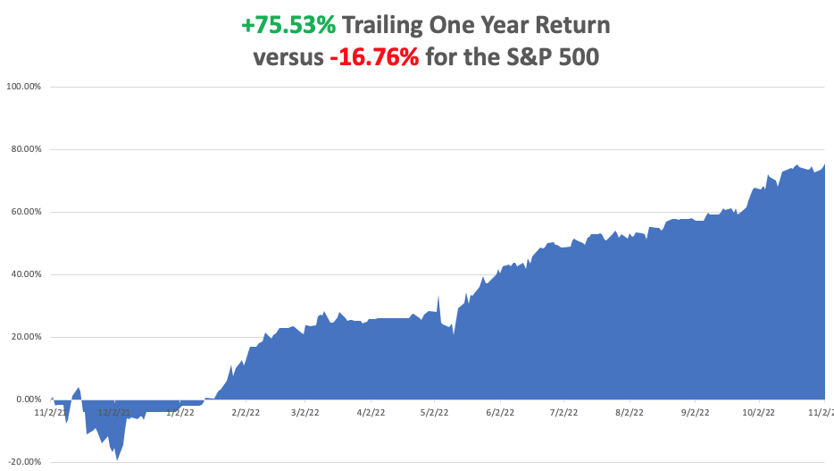

Slide 9
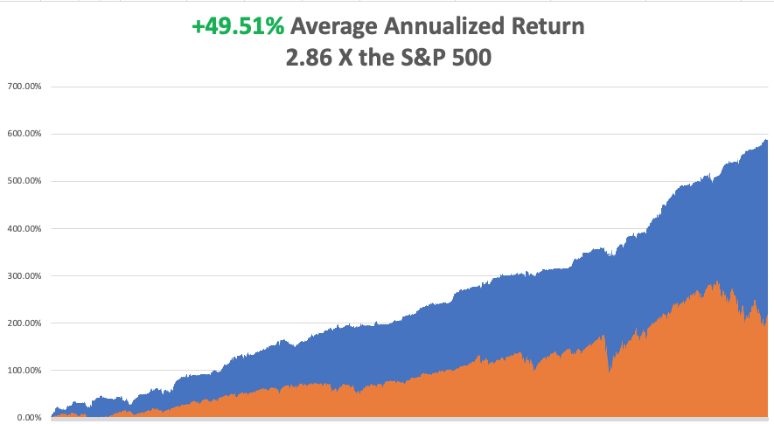

Slide 10
The Method to My Madness The Bottom is In
*The post election may have just happened, we could flat line until the next CPI report on December 13 *The Democratic Midterm election produced a one-day 1,000-point selloff *We are now 11 months into a 12–18-month bear market *Q4 is the best entry point for stocks in a decade *Oil prices flat lining on recession fears *Inflation is plunging but the Fed needs to see several deflationary data points to ease up *The US dollar has topped *Bull market in bonds will be the top trade of 2023 *(SPX) 4,800 is postponed until 2023 *VIX dives to $22 – NO TRADE

Slide 11
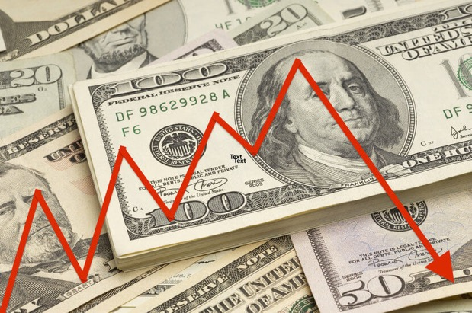
The Global Economy – Weak
*Consumer Price Index Dives to 7.7%, a full 1% decline from the previous month *Fed Raises Interest Rates by 75 Basis Points but changed their language to be slightly more accommodative *Nonfarm Payroll Comes in at a hot 261,000 in October *The Headline Unemployment Rate crawled up to 3.7%, the highest since February *Consumer Confidence Dives, according to the University of Michigan. *Auto Loan Delinquencies Soaring *Weekly Jobless Claims Rise to 225,000, up 5,000 on the week *Russian Economy Shrinks by 5% YOY in September *FTX Becomes an Epic Bankruptcy, with $9.5 billion missing

Slide 12
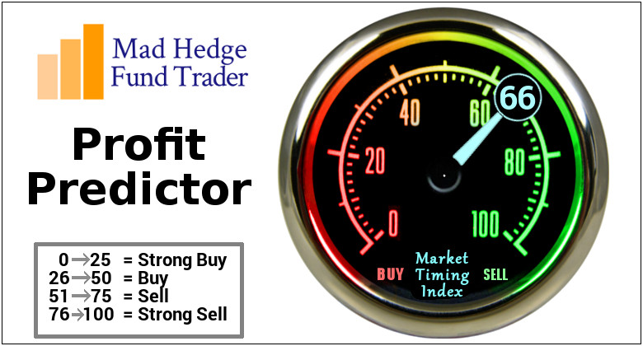
The Mad Hedge Profit Predictor Market Timing Index – Buy Territory An artificial intelligence driven algorithm that analyzes 30 different economic, technical, and momentum driven indicators

Slide 13
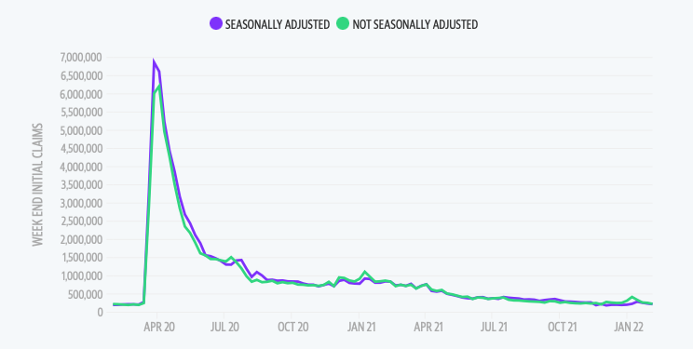
Weekly Jobless Claims – Falling 229,000 – Up 9,000

Slide 15
Stocks – 2023 Preview
*Big tech, which gets a major share from overseas sales, rocketed. Apple alone was up $12. Cathy Wood’s Ark Innovation Fund (ARKK) was up an incredible 14% *All the negatives have gone, the seasonals, earnings reports, strong dollar, and the election *Fed Says Financial System Healthy, ruling out any 2009 style 52% stock market crash *Old value industrials have been overwhelmingly trouncing big tech *Banks led the charge on UP days, suggesting they may be the new lead sector in a rising market-the golden age is just beginning *Tech is still trading at a big premium to the market and double the price earnings of banks, may be dead money *Look for terrible H1 and strong H2 scenario to continue

Slide 16
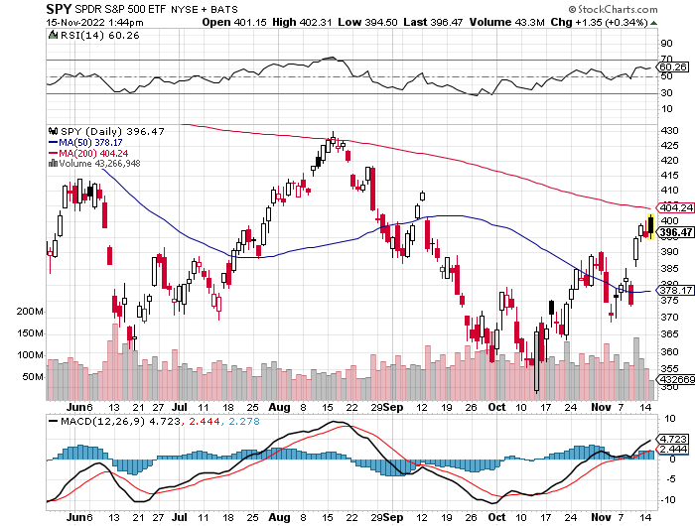
S&P 500 – The Worst Case-Severe Recession took profits on long 10/$385-$395 put spread, long 11/$410-$400 put spread took profit on long 10/$390-$400 put spread, took profit on long 10/$320-$330 call spread took profits on long 6/$445-$455 put spread
$410 +17% Rally
The Bottom $350 Down -27%

Slide 17
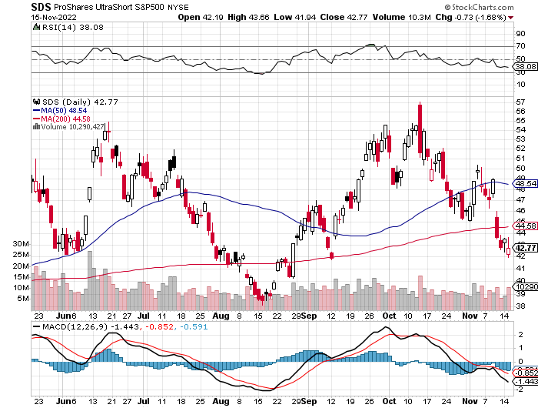
ProShares Ultra Short S&P 500 (SDS)- a great hedge for long stocks and bonds long 2X position has a hedge against longs and bond shorts

Slide 18
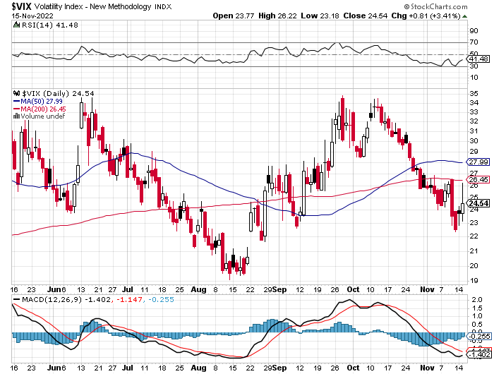
(VIX) – Unable to Make a New High

Slide 19
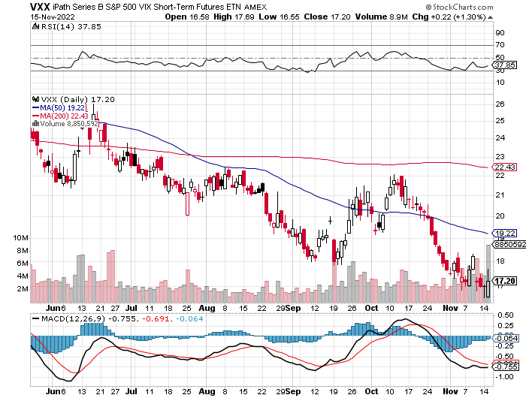
(VXX)-

Slide 20
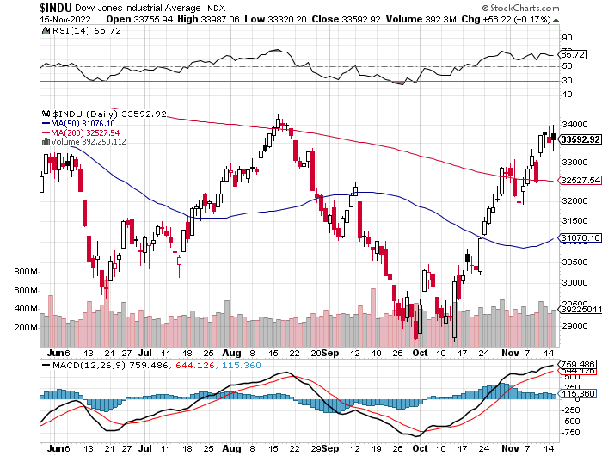
Dow Average ($INDU)-

Slide 21
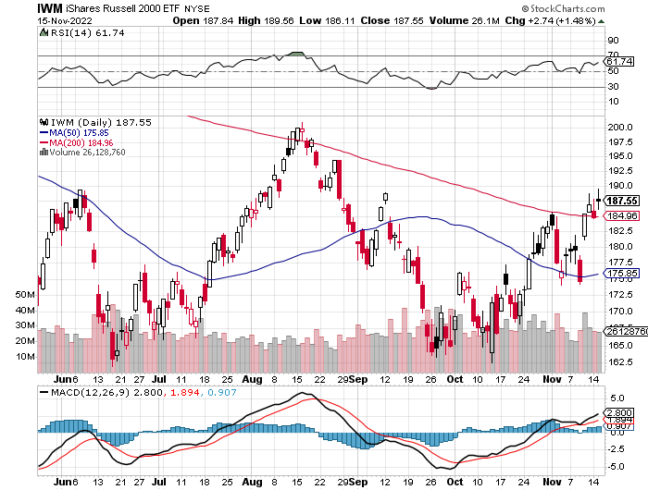
Russell 2000 (IWM)- took profits on Long 10/$137-$142 vertical bull call spread took profits on Long 10/$153-$156 vertical bear put spread

Slide 22
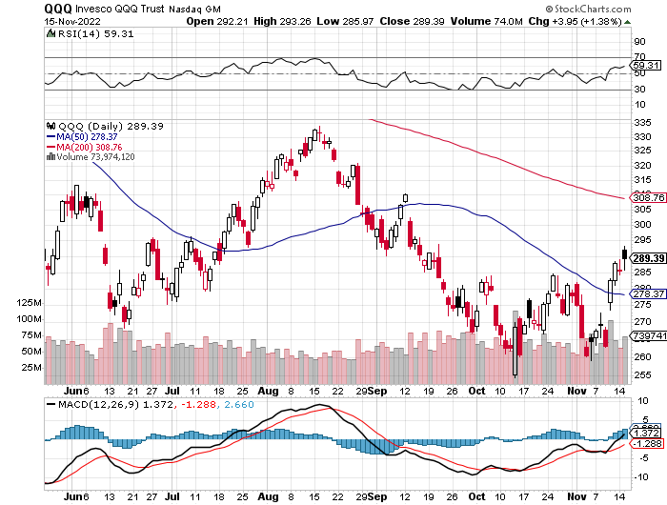
NASDAQ (QQQ) – took profits on long (QQQ) 4/$330-$335 put spread took profits on long (QQQ) 3/$340-$345 put spread covered long (QQQ) $325-$330 put spread

Slide 23
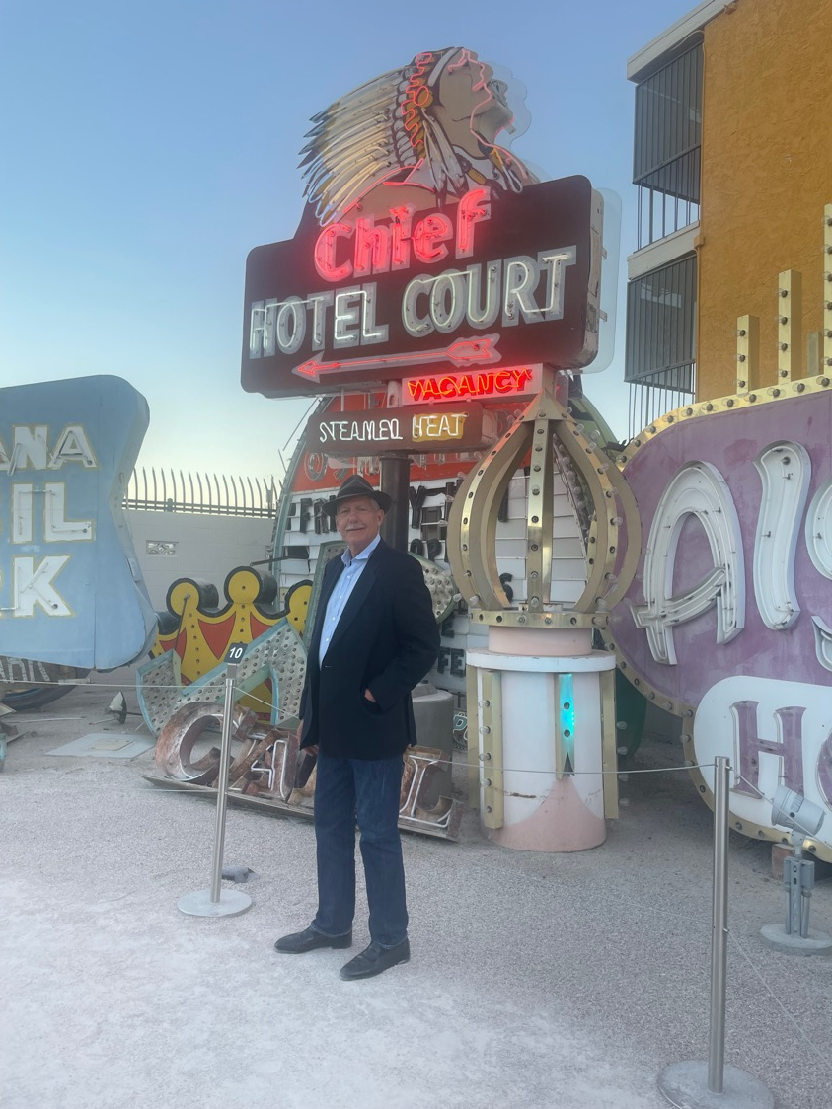

Slide 24
The Barbell Portfolio
*50% Big Tech - 2% of US Employment but 27% of Market Cap and 38% of Profits 50% Domestic Recovery, including: Railroads Couriers Banks Construction Credit Cards Event organizers Ticket sales Retailers

Slide 25
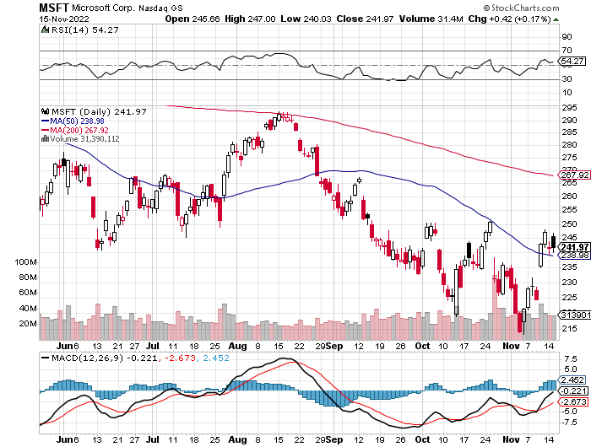
Microsoft (MSFT)- took profits on 9/$235-$245 call spread, took profits on long 7/$220-$210 call spread, took profits on long 6/$220-$230 call spread, took profits on long 2/$200-$210 bear put spread

Slide 26
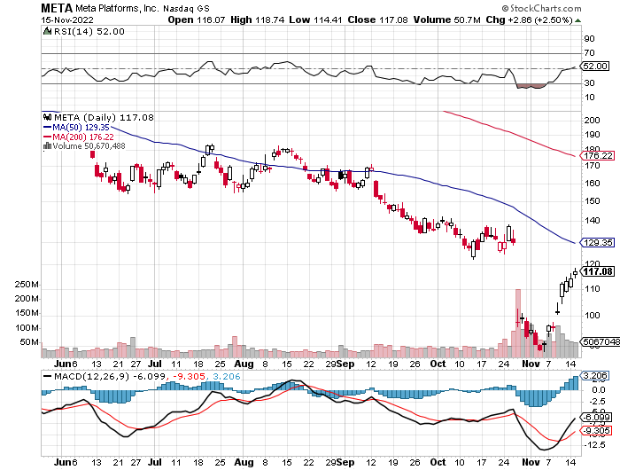
Meta (META)- Looking for the Metaverse took profits on Long 9/$290-$300 vertical bear put spread stopped out of Long 9/$190-$200 vertical bear put spread

Slide 27
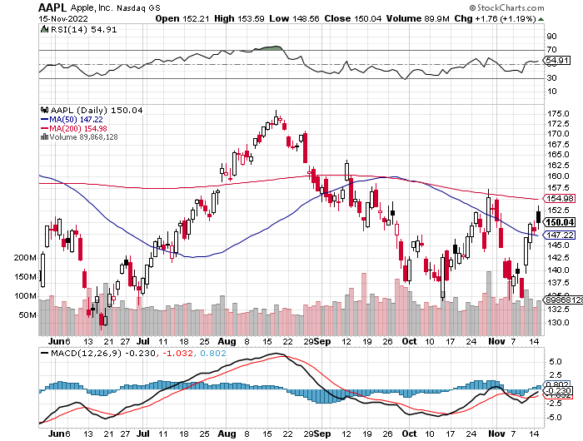
Apple (AAPL)- Apple Cuts iPhone Production in China Took profits on long 10/$165-$175 put spread took profits on long 6/$155-$165 put spread, stopped out of long 6/$125-135 call spread, took profits on long 6/$110-$120 call spread, took profits on long 2/$180-$190 put spread

Slide 28
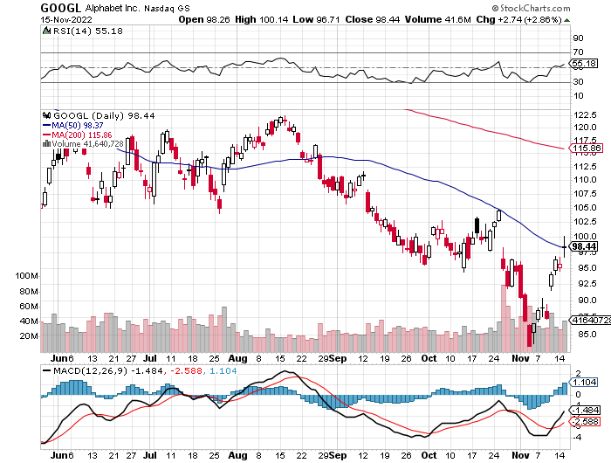
Alphabet (GOOGL) – Ad king on economic recovery $4.1 Billion fine for European antitrust took profits on long 12/$1,200-$1,230 bull call spread took profits on long 9/$1,030-$1,080 vertical bull call spread

Slide 29
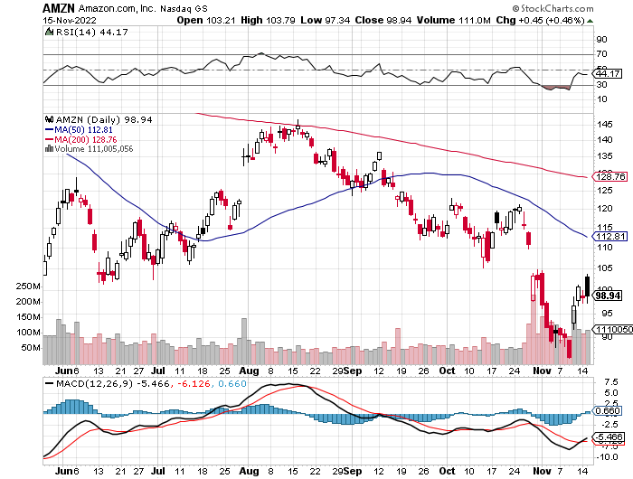
Amazon (AMZN) – Amazon Splits 20:1, triggering an avalanche of new retail buyers took profits on long 2/$3,400-$3,500 bear put spread took profits on long 9/$2,800-$2,900 bull call spread

Slide 30
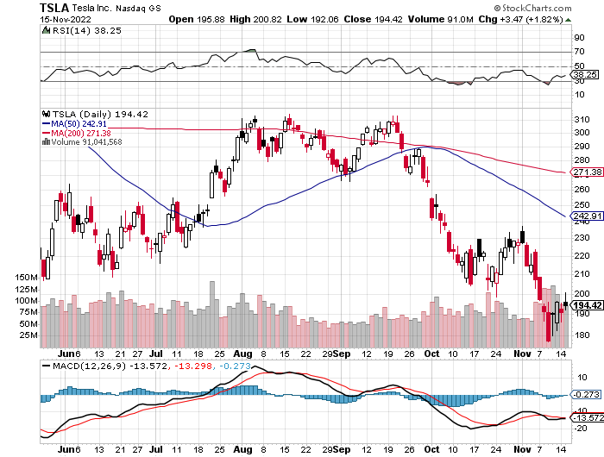
Tesla (TSLA) – Twitter Disaster Elon Musk Sells More Tesla Shares, some $3.9 billion worth Musk Warns of Twitter Bankruptcy took profits on long 10/$170-$180 call spread stopped out of long 10/$200-$210 call spread, stopped out of long 10/$220-$230 call spread

Slide 31
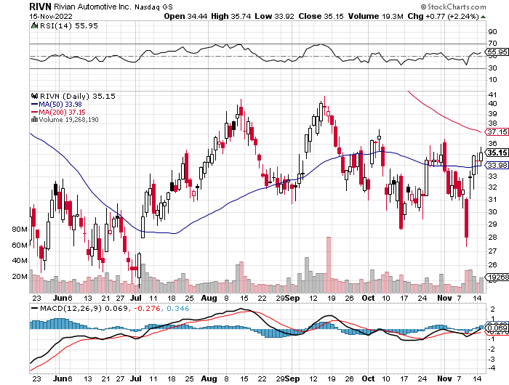
Rivian (RIVN) – Amazon Backed Electric Trucks recall of five cent bolt costs 25% of market cap took profits on long 10/$25-$30 call spread

Slide 32
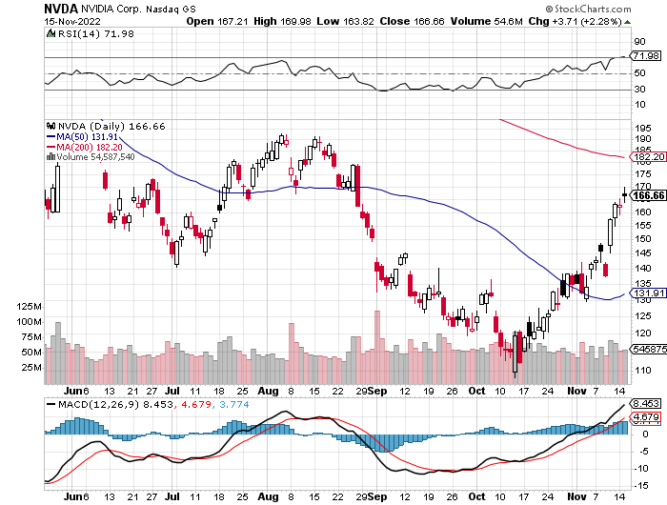
NVIDIA (NVDA) – Downgrade on US ban of highest end AI chips to China took profits on long 10/$95-$100 call spread took profits on long 7/$120-$130 call spread, took profits on long 6/$120-$130 call spread

Slide 33
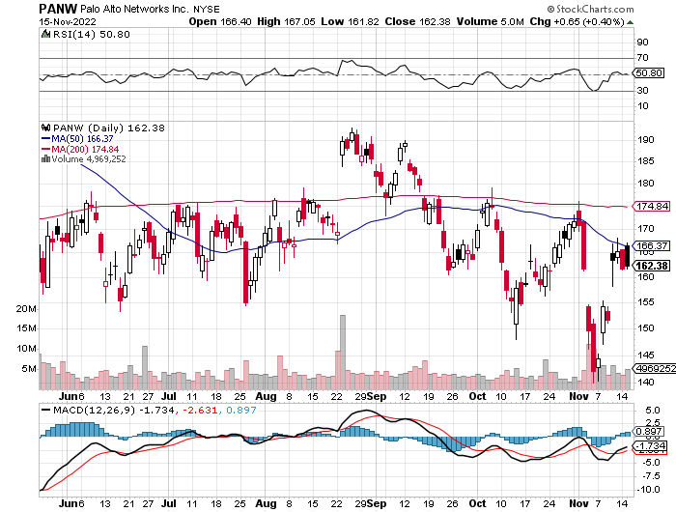
Palo Alto Networks (PANW)- Hacking never goes out of fashion took profits on long 10/$130-$140 call spread

Slide 34
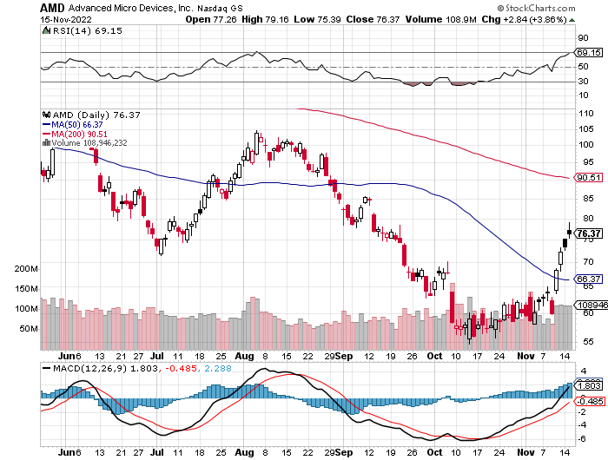
Advanced Micro Devices (AMD)- Recession fears programable logic devices took profits on long 2/$75-$80 call spread

Slide 35
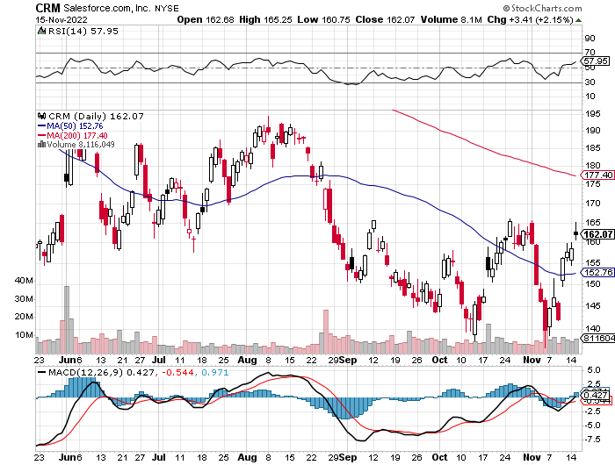
Salesforce (CRM)- Massive Online Migration took profits on long 9/$125-$130 vertical bull call spread took profits on long 8/$125-$130 vertical bull call spread took profits on long 2/$105-$115 call spread

Slide 36
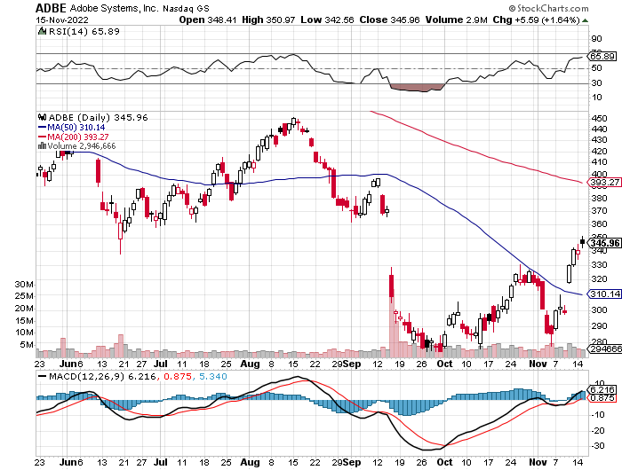
Adobe (ADBE)- Cloud play The Quality Non-China tech play

Slide 37
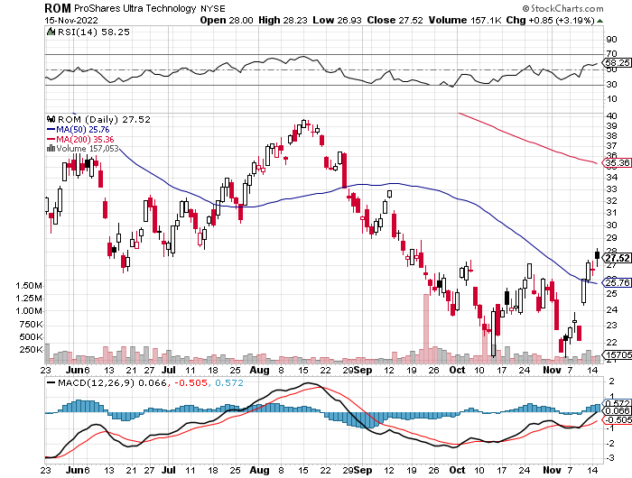
ProShares Ultra Technology ETF (ROM) – 2X Long Technology ETF took profits on long 10/$62-65 call spread

Slide 39
The Second Half of the Barbell
*Bets on a domestic recovery in 2022 Q4 *Upside potential in 2022 far greater than tech *Some of these have not moved for 5 or 10 years *Focuses on economically sensitive cyclical industries *Makes a great counterweight to high-growth technology *We could spend all of next year rotating between the two groups

Slide 40
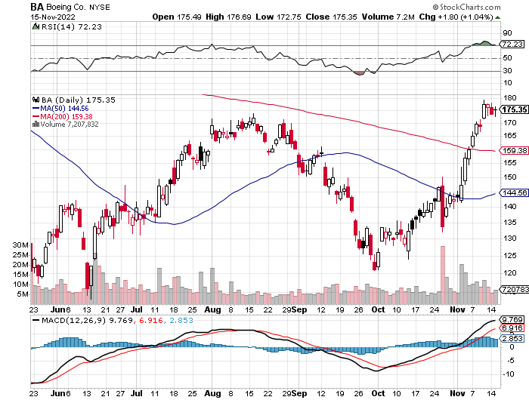
Boeing (BA) –Boeing Orders Rise in October Boeing Delivered its First 787 Dreamliner in a year long 3/$146-$149 call spread

Slide 41
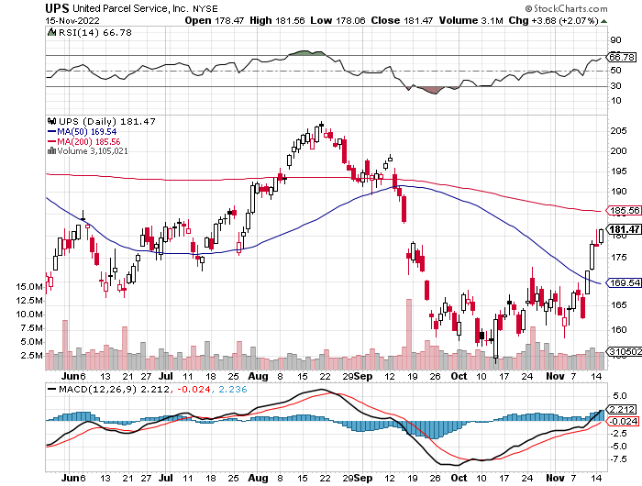
Package Delivery- United Parcel Service (UPS) - Package Delivery record profits took profits on long 11/$130-$140 call spread

Slide 42
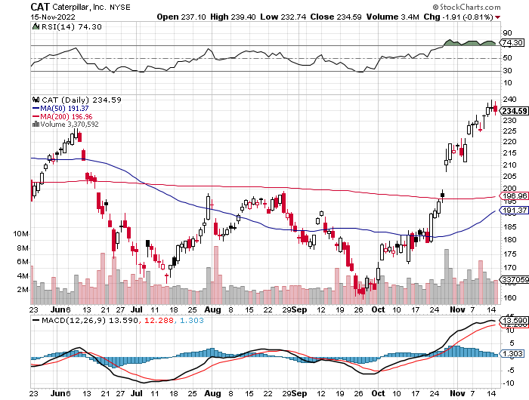
Caterpillar (CAT)- Ag + Infrastructure + Housing Raises Dividend by 50% took profits on long 12/$145-$150 call spread took profits on long 11/$125-$135 call spread

Slide 43
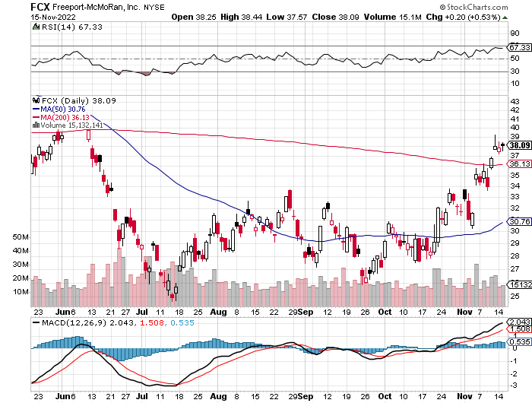
Freeport McMoRan - (FCX)- Copper Play took profits on long 10/$20-$23 call spread

Slide 44
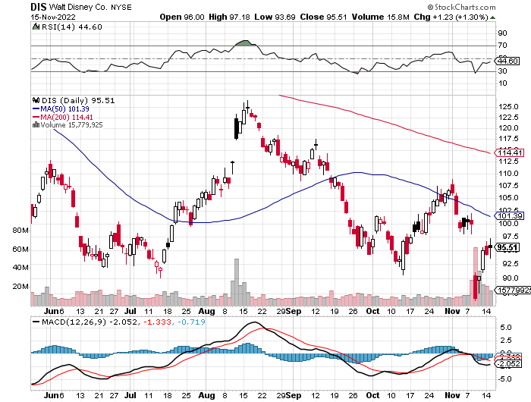
Walt Disney (DIS) - Genie+ Disney Bombs, on a profit miss, taking the stock down 10% stopped out of long 10/$165-$175 call spread took profits on long 3/$170-$180 call spread

Slide 45
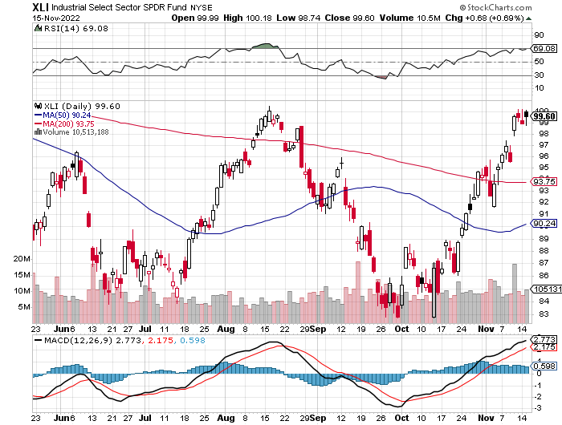
Industrials Sector SPDR (XLI)- (GE), (MMM), (UNP), (UTX), (BA), (HON)

Slide 46
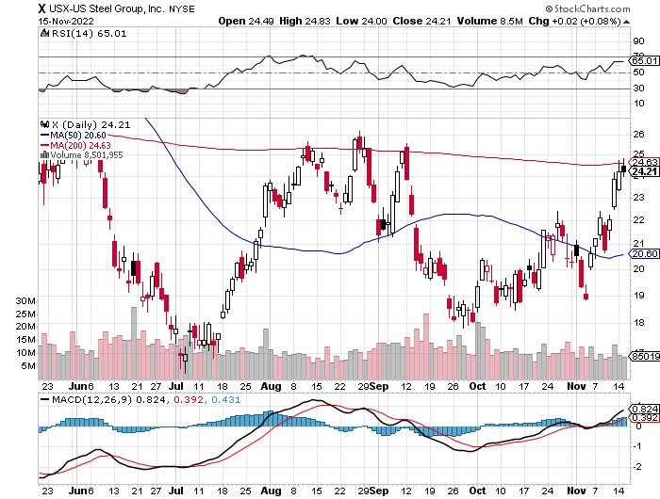
US Steel (X) – Commodity Boom and Wartime boost

Slide 47
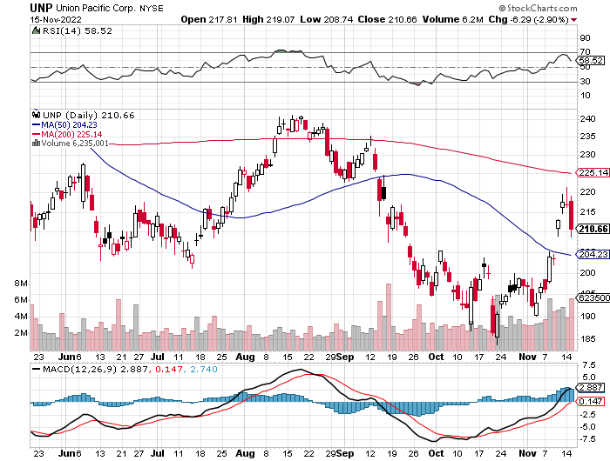
Union Pacific RR (UNP)- Big Stuff to Ship near record earnings announced took profits on long 5/$200-$210 call spread took profits on 11/$150-$160 call spread

Slide 48
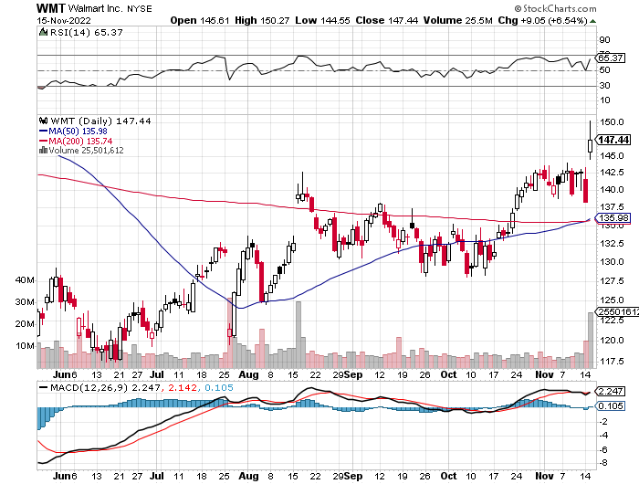
Wal-Mart (WMT)- took profit on Long 11/$125-$130 bear put spread took profit on Long 10/$119-$121 bear put spread took profits on Long 8/$114-$117 bear put spread

Slide 49
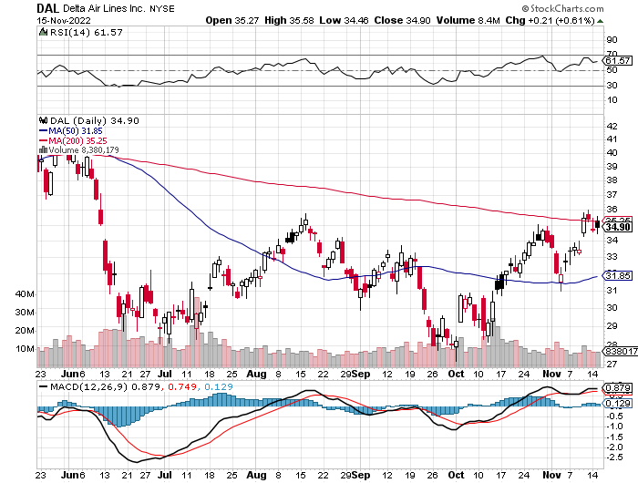
Delta Airlines (DAL) – Travel is Back!

Slide 50
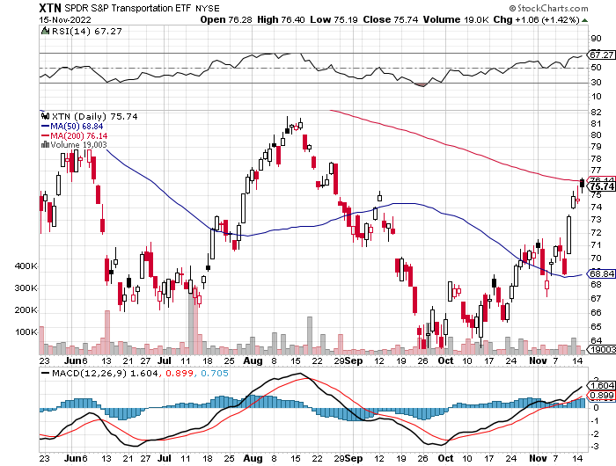
Transports Sector SPDR (XTN)- Worst Hit Sector (ALGT), (ALK), (JBLU), (LUV), (CHRW), (DAL)

Slide 51
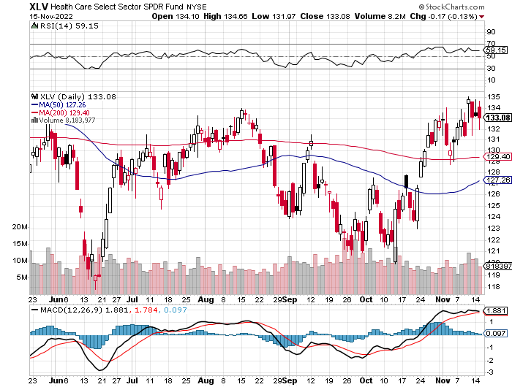
Health Care Sector (XLV) (JNJ), (PFE), (MRK), (GILD), (ACT), (AMGN)

Slide 52
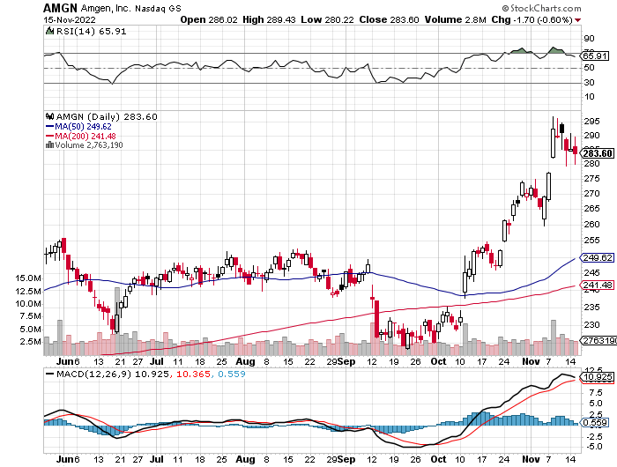
Amgen (AMGN) took profits on long 11/$185-$200 bull call spread

Slide 53
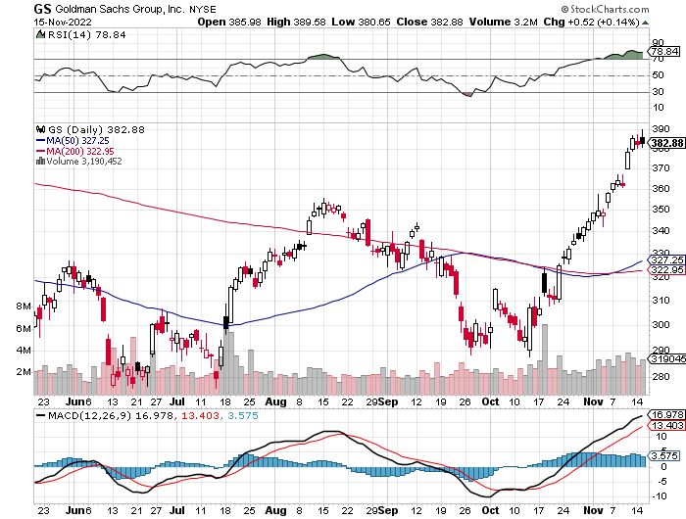
Goldman Sachs (GS) – took profits 12/$330-$350 call spread took profits 11/$330-$350 call spread stop loss on long 11/$385-$395 call spreads

Slide 54
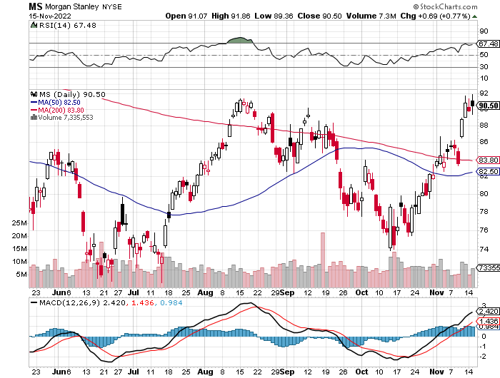
Morgan Stanley (MS) – Blows Away Earnings Equity trading came in a hot $3.2 billion and bond trading $2.9 billion took profits on long 10/$85-$90 call spread

Slide 55
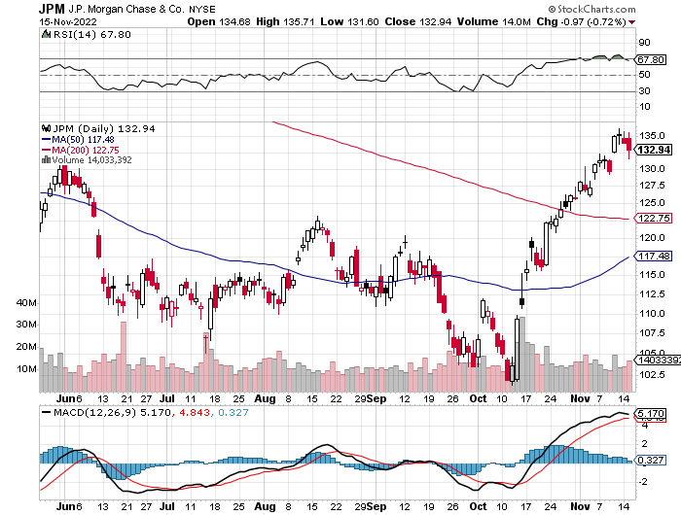
JP Morgan Chase (JPM)- took profits on long 10/$85-$90 call spread, stopped out of long 10/$95-$100 call spread took profits long 12/$148-$152.50 call spread

Slide 56
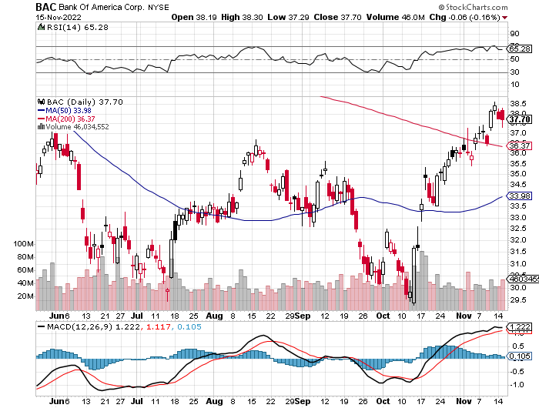
Bank of America (BAC) – took profits long 12/$39-$42 call spread

Slide 57
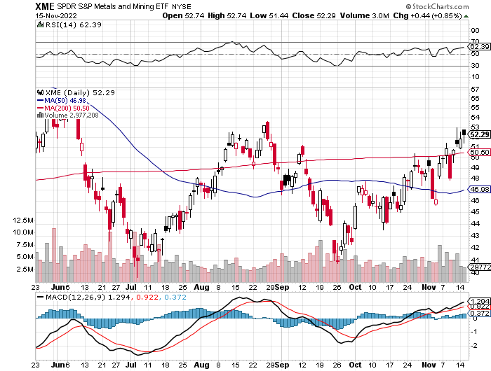
SPDR Metals & Mining ETF (XME) – long 2/$28-$30 call spread

Slide 58
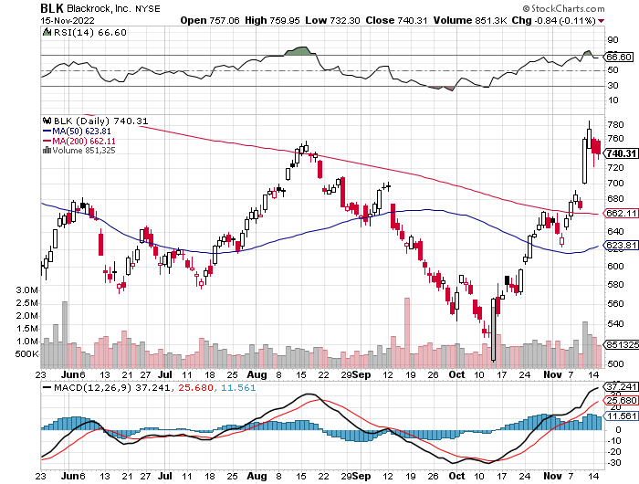
Blackrock (BLK)-Asset Collection Boom took profits on long 3/$770-$790 call spread took profits on long 3/$310-$340 call spread

Slide 59
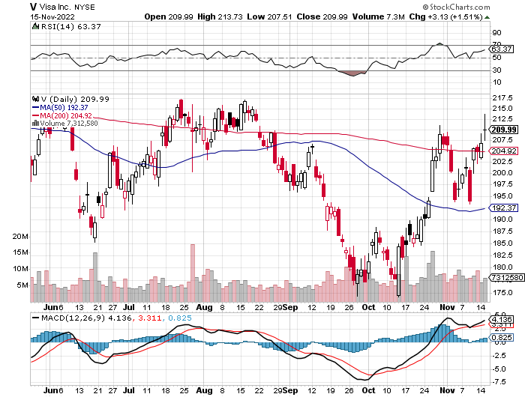
Visa (V) – “Touchless” Bitcoin Drag Inflation play, Double digit grower, 50% profit margin, and big buyer of its own stock took profits on long 10/$160-$170 bull call spread took profits on long 6/$150-$160 bull call spread

Slide 60
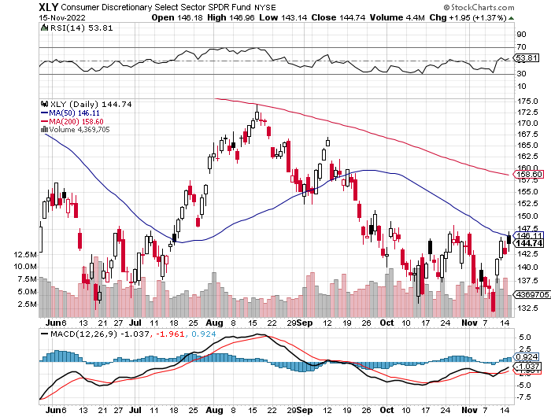
Consumer Discretionary SPDR (XLY) (DIS), (AMZN), (HD), (CMCSA), (MCD), (SBUX)

Slide 61
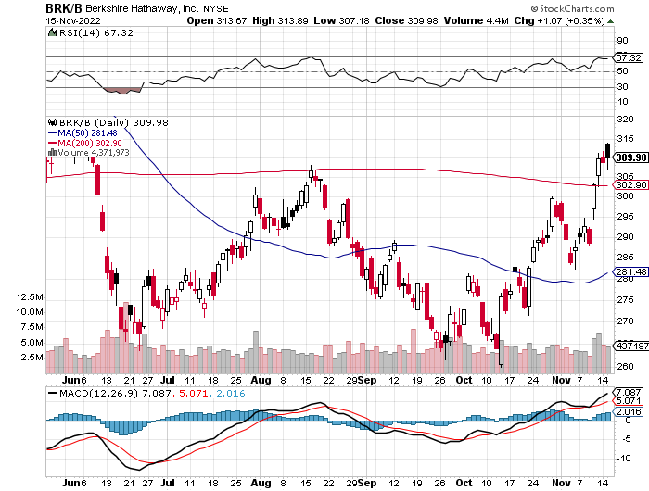
Berkshire Hathaway (BRKB)- Natural Barbell 20% Profit Increase YOY took profits on long 10/$220-$230 call spread, took profits on long 7/$220-$230 call spread, took profits on long 7/$220-$230 call spread took profits on long 6/$260-$270 call spread, stopped out of long 5/$300-$310 call spread,

Slide 62
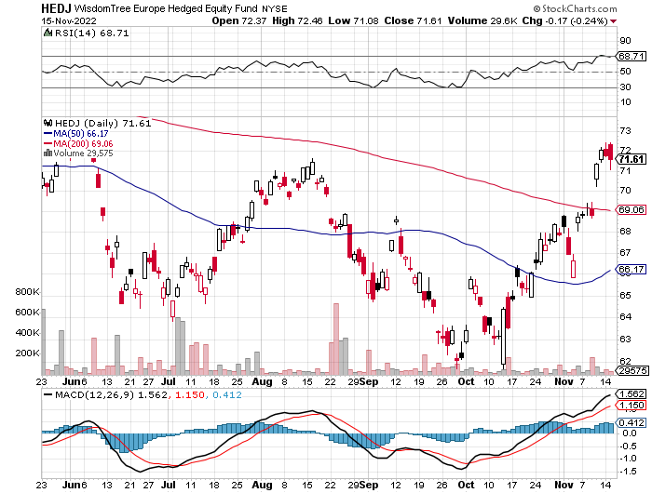
Europe Hedged Equity (HEDJ)-

Slide 63
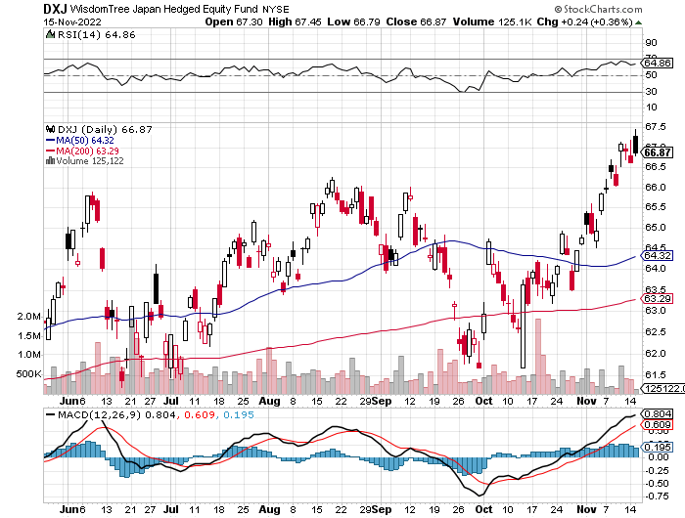
Japan (DXJ)-

Slide 64
Emerging Markets (EEM) - Pro trade, Weak Dollar, Long Recovery Play

Slide 67
Bonds – THE big trade of 2023.
*Bonds Clock Best Day in Years, taking the ten-year US Treasury bond fund up $3.64 *All low interest rate plays had monster days *Junk bond ETF’s (JNK) and (HYG) were up two points *30-year fixed rate mortgages dropped 60 basis points to 6.60%
US Budget Deficit Drops by Half, after the sharpest decline in government spending in history *Less government borrowing is building a floor under bond prices *The (TLT) alone has lost 48% in 2 ½ years *The Government Loves Inflation, even if you hate it, for the purchasing power of the bonds it issued is now shrinking at a 9% annual rate.

Slide 68
Treasury ETF (TLT) – No Position took profits on long 10/$110-$113 put spread, stopped out of long 10/$98-$101 call spread took profits on long 6/$123-$126 put spread, took profits on long 6/$125-$128 put spread took profits on long 6/$124-$127 put spread, took profits on long long 7/$128-$131 put spread took profits on long 5/$128-$131 put spread, look profits on long 5/$127-$130 put spread

Slide 69
Ten Year Treasury Yield ($TNX) – 3.78%

Slide 70
Junk Bonds (HYG) 8.42% Yield to Maturity

Slide 71
2X Short Treasuries (TBT)-Another run at highs

Slide 73
Foreign Currencies – Dollar Top
*Sharply falling US interest rates bring a crashing US dollar *All foreign currencies will rally strongly *Buy the Euro (FXE), Australian dollar (FXA), British Pound (FXB), and Japanese yen (FXY) *Weak Chinese economy will keep the Yuan relatively weak as long as pandemic lockdown continue *Strong currencies will also deliver major bull markets in emerging market stocks (EEM) and (CEW)

Slide 74
THE MAD HEDGE FUND TRADER
Australian Dollar (FXA) - Major Long-Term Bottom is In Targeting Parity – A call option on a global synchronized recovery
1:1
BUY

Slide 75
Japanese Yen (FXY)
2023 Target 25%

Slide 76
Euro (FXE)-
2023 Target 25%

Slide 77
British Pound (FXB)-
2023 Target 15%

Slide 78
Emerging Market Currencies (CEW)
2023 Target 40%

Slide 80
Energy & Commodities –
*Energy was the worst performing sector because they aren’t getting the air cover they paid for with a red wave *60 ships offshore in Europe waiting to unload natural gas in Europe costing $500,000 a day per ship *Biden attacks oil companies on price gouging, proposes windfall profits tax *Russia Loses ability to insure oil cargoes at yearend *Germany Fights Russia with Coal *Avoid all energy plays like the plague, it’s the new buggy whip industry as the US de-carbonizes *I’m not recommending energy because there is no long term growth story here *Oil companies refuse to make 30-year investments in infrastructure that will become useless in ten years

Slide 81
Oil-($WTIC)

Slide 82
United States Oil Fund (USO) long 10/$9.50-$10 Vertical bull call spread

Slide 83
Energy Select Sector SPDR (XLE)-No Performance! (XOM), (CVX), (SLB), (KMI), (EOG), (COP)

Slide 84
Halliburton (HAL)-

Slide 85
Natural Gas (UNG) -

Slide 86
Freeport McMoRan (FCX) -

Slide 87
Cameco (CCJ) - took profits on long 5/$20-$23 bull call spread

Slide 89
Precious Metals – Finally, a Bid!
*Gold will be a good performer in 2023 *Collapsing interest rates next year will be the big story here *Destruction of crypto is bringing back gold as a non-correlated asset *Gold is more of a commodity play now than a risk hedge *Recently rising interest rates delivered a terrible 2022 for gold *Silver is still the bigger and better long-term play because of EV and solar panel demand

Slide 90
Gold (GLD) - Deflation call took profits on long 5/$165-$170 bull call spread

Slide 91
Market Vectors Gold Miners ETF- (GDX) –

Slide 92
Barrick Gold (GOLD) took profits on long 1/$21-$23 call spread took profits on long 11/$22-$24 call spread

Slide 93
Newmont Mining- (NEM)- took profits on long $55-60 call spread

Slide 94
Silver- (SLV)- took profits on long 11/$19-$20 call spread

Slide 95
Silver Miners - (SIL)-

Slide 96
Wheaton Precious Metals - (WPM)- took profits on long 2/$39-41 call spread

Slide 98
Real Estate – Stumbling
*Homebuilder DR Horton reports sales off 30% *$1.5 Trillion in Homeowners Equity Lost Since May *Since July, the median home price has dropped by $11,560 *The average borrower has lost $30,000 in equity *Residential housing could remain weak for another 12-24 months, compared to the six-year drawdown we had from 2006 *Homebuilder Sentiment collapses, from 83 a year ago to 33 in November *China taking measures to stimulate its own real estate market, copper investors please take note

Slide 99
S&P Case Shiller-Still Going Up in the Rear View Mirror S&P Case Shiller Rises 13%, in July with its National Home Price Index Miami (+28.6%), Tampa (+28.0%), Charlotte NC (+21.3%)…San Francisco (-4.3%), Seattle (-3.9%)

Slide 100
Crown Castle International (CCI) – 4.46% yielding cell phone tower REIT

Slide 101
US Home Construction Index (ITB) (DHI), (LEN), (PHM), (TOL), (NVR)

Slide 103
Trade Sheet- So What Do We Do About All This?
*Stocks – buy the big dips at bottom of range *Bonds – buy dips *Commodities-buy dips *Currencies- sell dollar rallies *Precious Metals – buy dips *Energy – stand aside *Volatility - sell short over $30 *Real estate – buy dips

Slide 105
Next Strategy Webinar 12:00 EST Wednesday, November 30 from Silicon Valley, CA email me questions at support@madhedgefundtrader.com
Good Luck and Good Trading!
Notes:
*

