Slide 1
The Mad Hedge Fund Trader “Looking for Big Foot”
With John Thomas Incline Village, NV, November 30, 2022 www.madhedgefundtrader.com
Notes:
*

Slide 2
February 17 Honolulu, Hawaii Strategy Luncheon
*An excellent meal will be followed by a wide-ranging discussion and an extended question and answer period *The lunch will be held at the premier restaurant in Incline Village, Nevada on the sparkling shores of Lake Tahoe *please go to my online store at http://www.madhedgefundtrader.com/store and click on “luncheons.”

Slide 3
July 13, 2023 Seminar at Sea Tickets are Selling Fast!
*Cunard Line’s flagship, the elegant and spacious Queen Mary II, on an eastbound transatlantic cruise *The Ship departs New York at 12:00 AM on July 7, 2023, and arrives at Southampton on July 14 *Guests will be responsible for booking their own cabin through Cunard *Every dinner during the voyage will be black tie *Customers are required to book their own cabins and return flights from England *The Cunard cruise number is M319.

Slide 4
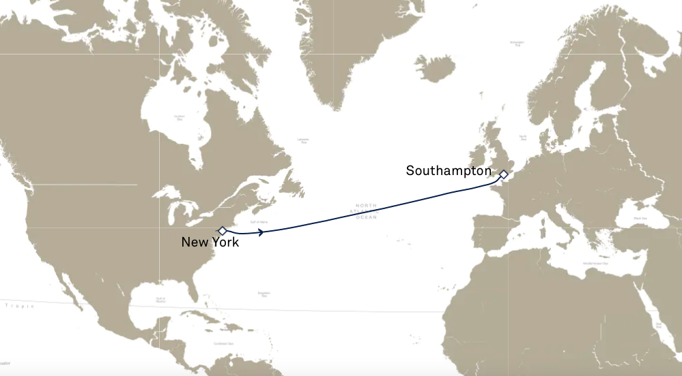

Slide 5
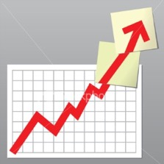
Trade Alert Performance New All Time Highs! 22 out of 23 trade alerts profitable
*January 14.59% Final *July +3.98% Final *February +8.78% MTD *August +5.13% Final *March +3.43% Final *September +9.72% Final *April +3.33% Final *October +5.69% Final *May +8.80% Final *November +11.27 MTD *June +5.91% Final *December +11.26% Final *2022 YTD +86.64% compared to -16% for the S&P 500 *+599.20% since inception *Average annualized return of +45.76% for 14 years

Slide 6
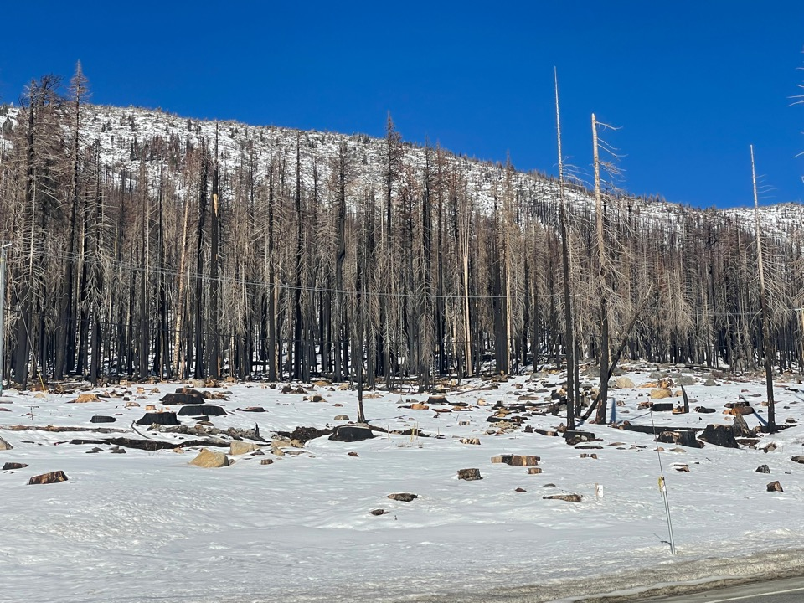

Slide 7
Portfolio Review 40% Long, 40% short, 20% cash getting expensive
Risk Adjusted Basis
Current Capital at Risk
Risk On
(TLT) 12/$91-$94 call spread | 10.00%
(TLT) 12/$92-$95 call spread | 10.00%
(TLT) 12/$93-$96 call spread | 10.00%
(TSLA) 12/$93-$96 call spread | 10.00%
Risk Off
(XOM) 12/120-$125 put spread | -10.00%
(SPY) 12/$420-$430 put spread | -10.00%
(OXY) 12/$77.50-$82.50 put spread | -10.00%
(TSLA) 12/$225-$230 put spread | -10.00%
Total Net Position | 0.00%
Expiration Value +90.01%

Slide 8
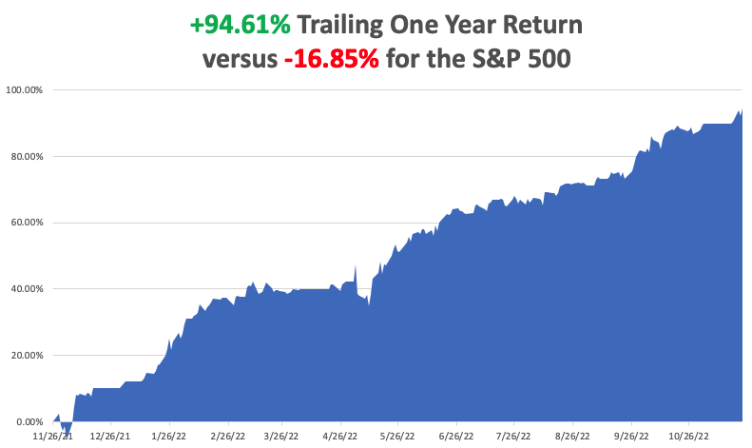

Slide 9
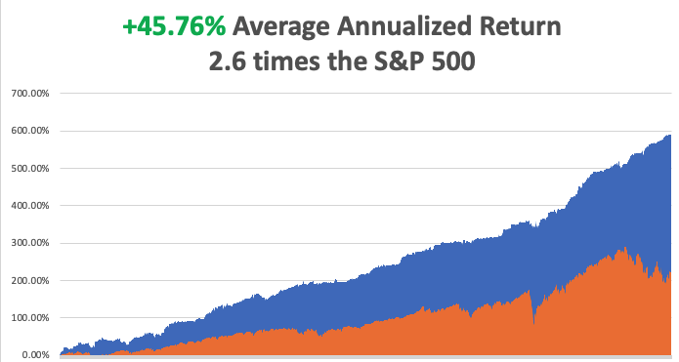

Slide 10
The Method to My Madness The Bottom is In
*The Fed gives the signal for risk assets to rise for the rest of the year with slowing interest rate rises *The move is catching investors short stock with too much cash *We are now 11 months into a 12–18-month bear market *Q4 is the best entry point for stocks and bonds in a decade *Oil prices in free fall on recession fears *Inflation is plunging but the Fed needs to see several deflationary data points to ease up *The US dollar has topped and will be weak for a decade *Look for S&P 500 at 4,800 by end 2023 *VIX dives to $20 – NO TRADE

Slide 11
The Global Economy – Weak
*Fed Favors the Slowing of Rate Hikes, making a December increase of only 50 basis points a sure thing *S&P Global Manufacturing PMI Takes a Hit, in November, down to 47.6 from an estimate of 50 *Consumer Sentiment Holds Up Well, at 56.8 versus an estimated 54.9 in October *Leading Economic Indicators Dive, off 0.8% in October *Retail Sales Rise 1.3% in October, causing analysts to raise Q4 GDP forecasts *Producer Price Index Dives, from 8.3% to 8.0% YOY

Slide 12
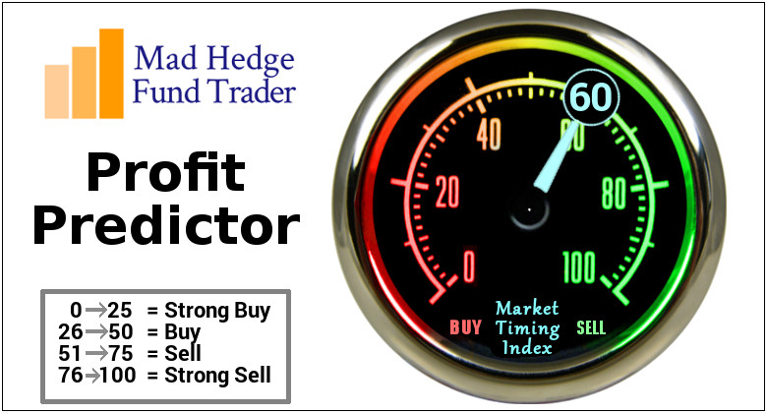
The Mad Hedge Profit Predictor Market Timing Index – Buy Territory An artificial intelligence driven algorithm that analyzes 30 different economic, technical, and momentum driven indicators

Slide 13
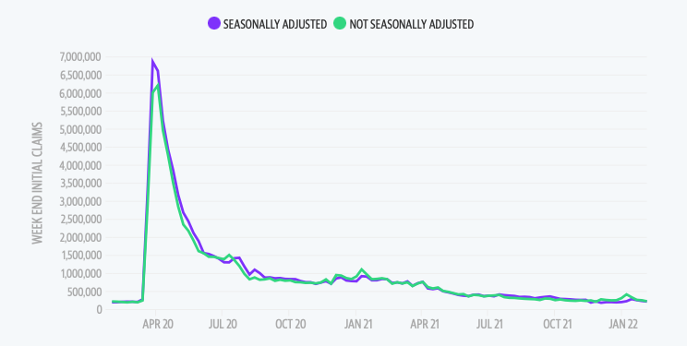
Weekly Jobless Claims – Falling 240,000 – Up 17,000

Slide 14
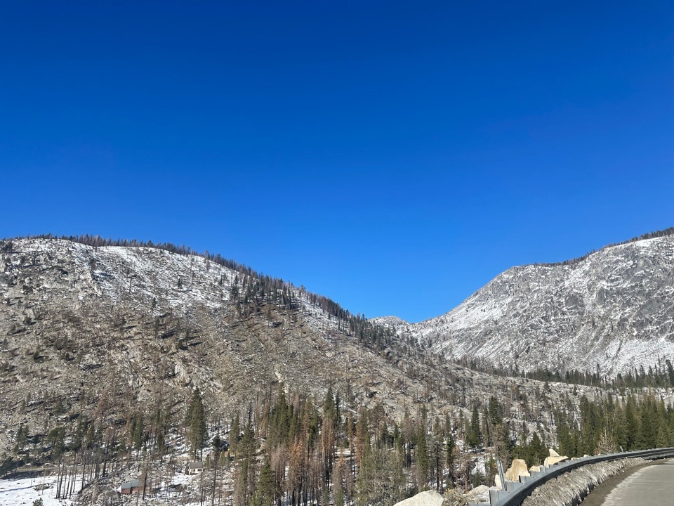

Slide 15
Stocks – In the Doghouse
*Equities See Monster Inflows, some $23 billion in 35 weeks according to the Bank of America (BAC) flow of funds survey *(SPY) 200-day moving average at $402.11 is proving formidable resistance *Tech is still in the doghouse and will remain there until the Fed starts to CUT interest rates *Until then, stocks sensitive to falling interest rates will lead, like banks, REITS, bonds *Fed Says Financial System Healthy, ruling out any 2009 style 52% stock market crash *Look for terrible H1 and strong H2 scenario to continue

Slide 16
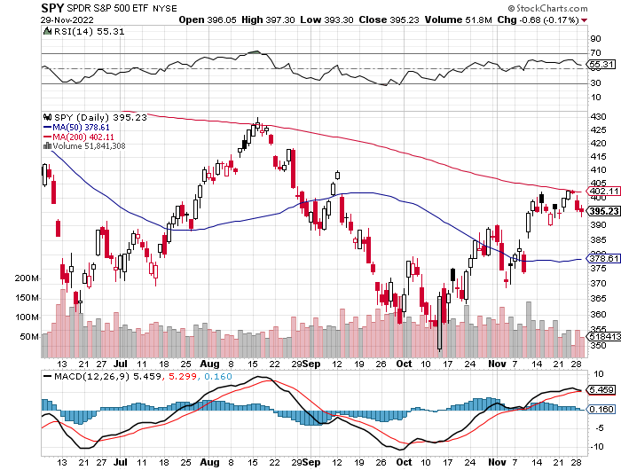
S&P 500 – The Worst Case-Severe Recession long 11/$420-$430 put spread took profits on long 10/$385-$395 put spread, took profits on long 11/$410-$400 put spread took profit on long 10/$390-$400 put spread, took profit on long 10/$320-$330 call spread
$428 +20% Rally
The Bottom $355 Down -26%

Slide 17
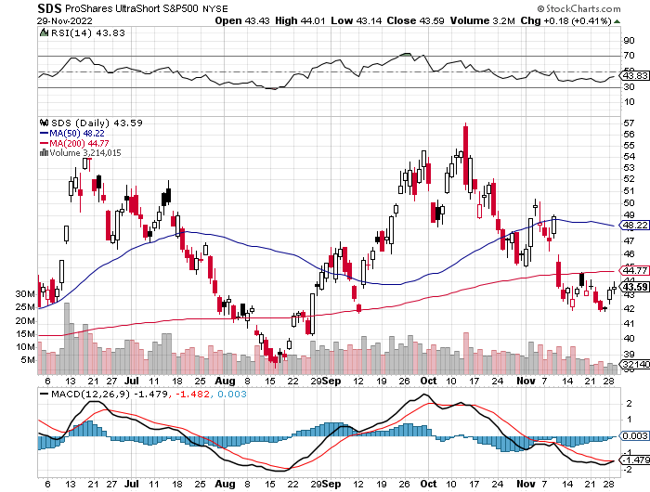
ProShares Ultra Short S&P 500 (SDS)- a great hedge for long stocks and bonds long 2X position has a hedge against longs and bond shorts

Slide 18
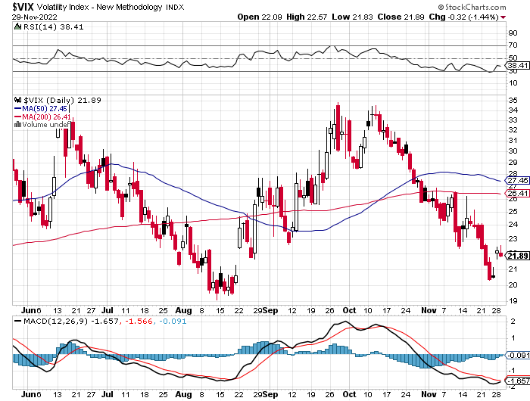
(VIX) – Unable to Make a New High

Slide 19
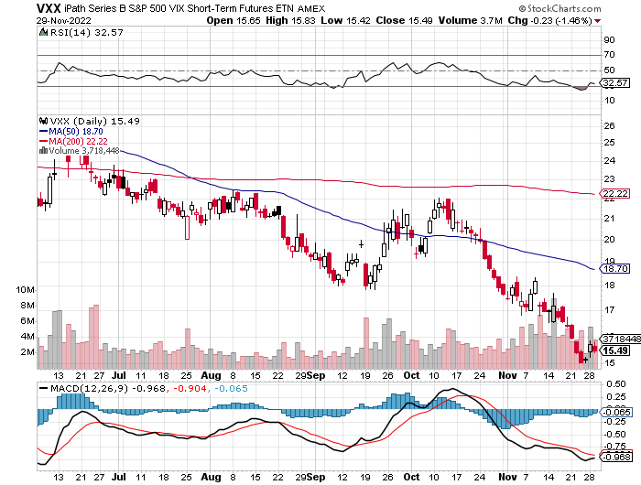
(VXX)-

Slide 20
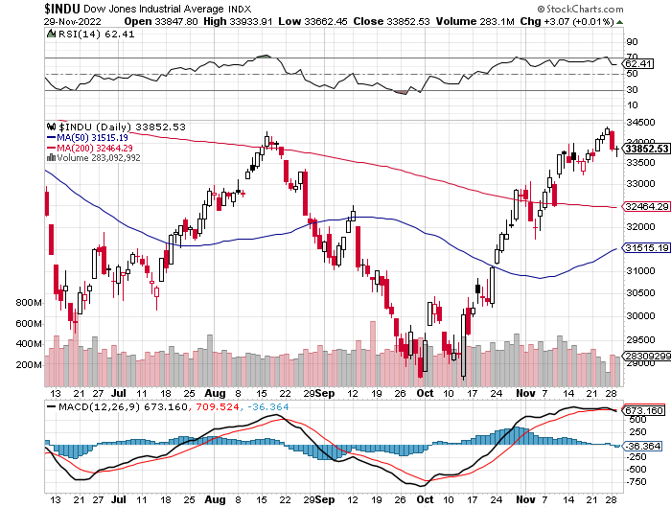
Dow Average ($INDU)-

Slide 21
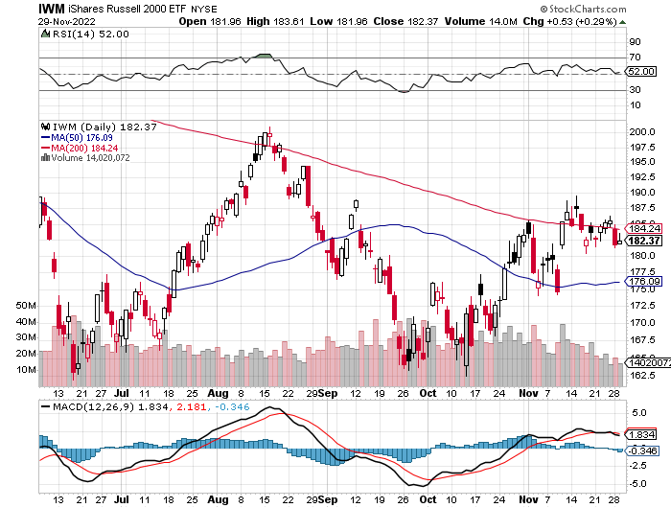
Russell 2000 (IWM)- took profits on Long 10/$137-$142 vertical bull call spread took profits on Long 10/$153-$156 vertical bear put spread

Slide 22
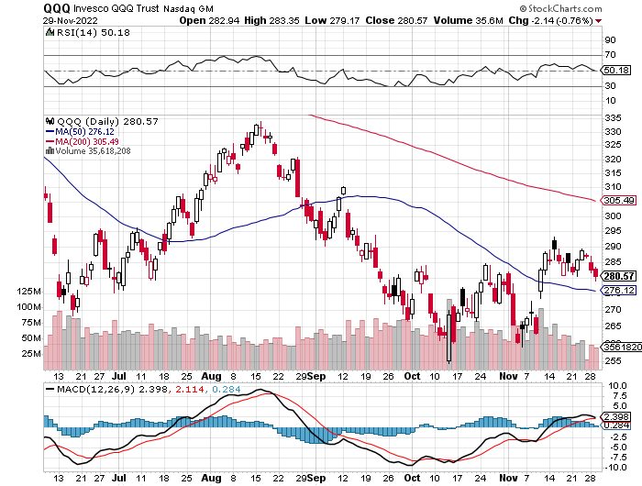
NASDAQ (QQQ) – took profits on long (QQQ) 4/$330-$335 put spread took profits on long (QQQ) 3/$340-$345 put spread covered long (QQQ) $325-$330 put spread

Slide 23
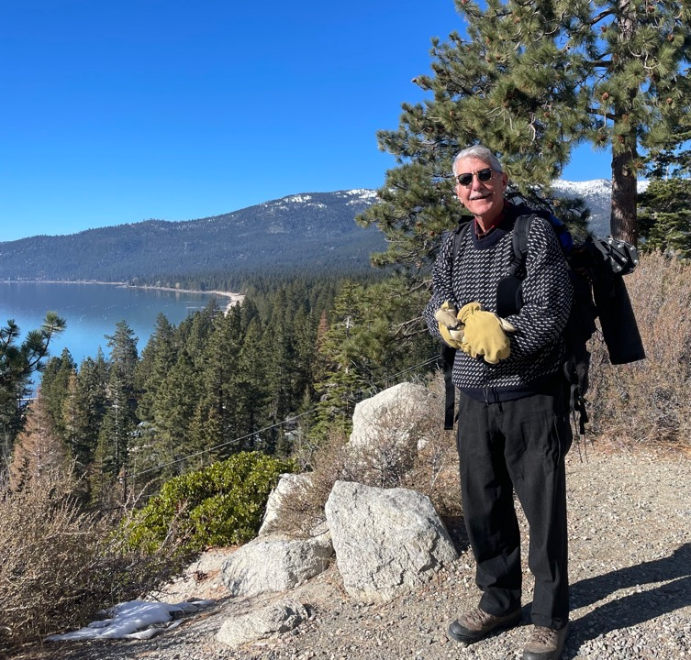

Slide 24
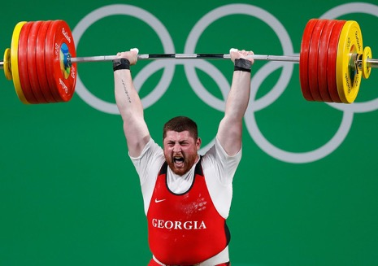
The Barbell Portfolio
*50% Big Tech - 2% of US Employment but 27% of Market Cap and 38% of Profits 50% Domestic Recovery, including: Railroads Couriers Banks Construction Credit Cards Event organizers Ticket sales Retailers

Slide 25
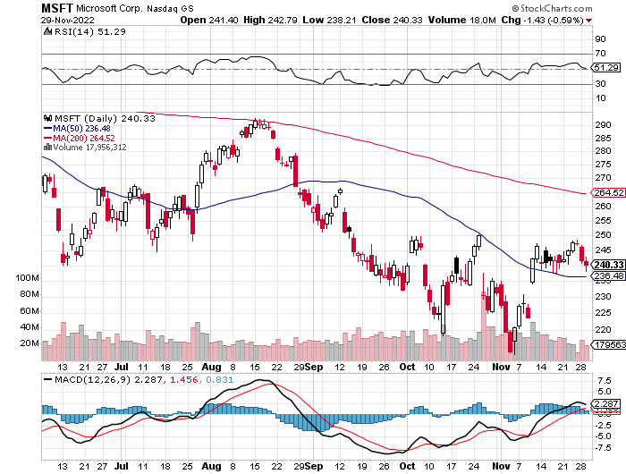
Microsoft (MSFT)- took profits on 9/$235-$245 call spread, took profits on long 7/$220-$210 call spread, took profits on long 6/$220-$230 call spread, took profits on long 2/$200-$210 bear put spread

Slide 26
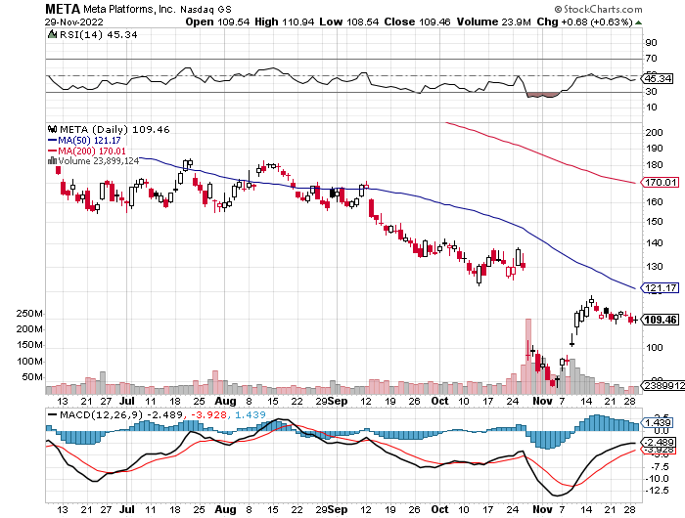
Meta (META)- Looking for the Metaverse took profits on Long 9/$290-$300 vertical bear put spread stopped out of Long 9/$190-$200 vertical bear put spread

Slide 27
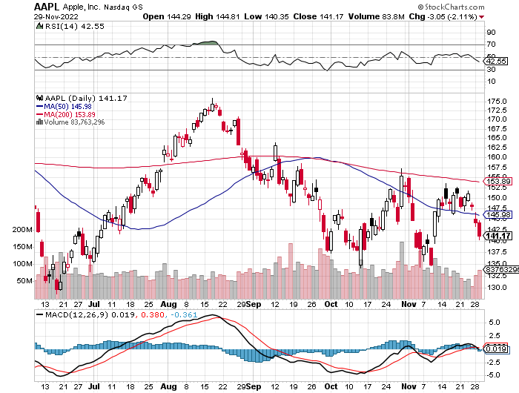
Apple (AAPL)- Apple Cuts iPhone Production in China Took profits on long 10/$165-$175 put spread took profits on long 6/$155-$165 put spread, stopped out of long 6/$125-135 call spread, took profits on long 6/$110-$120 call spread, took profits on long 2/$180-$190 put spread

Slide 28
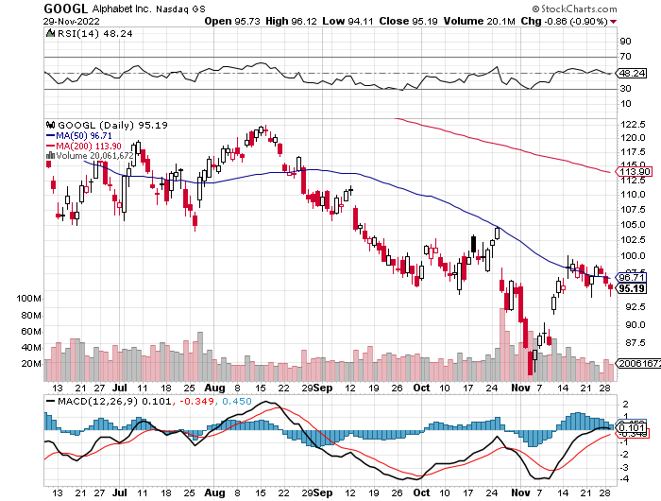
Alphabet (GOOGL) – Ad king on economic recovery $4.1 Billion fine for European antitrust took profits on long 12/$1,200-$1,230 bull call spread took profits on long 9/$1,030-$1,080 vertical bull call spread

Slide 29
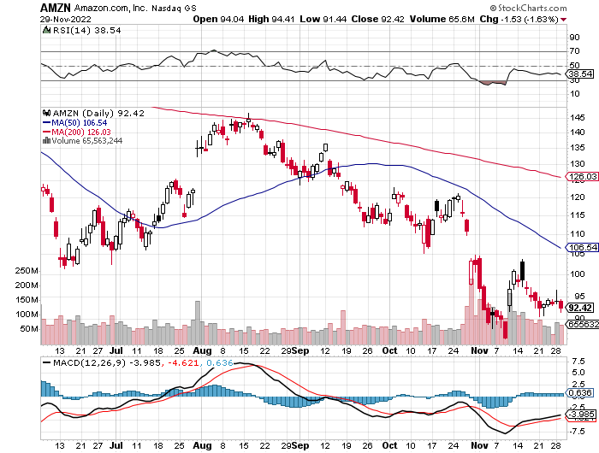
Amazon (AMZN) – Amazon to Lay Off 10,000 took profits on long 2/$3,400-$3,500 bear put spread took profits on long 9/$2,800-$2,900 bull call spread

Slide 30
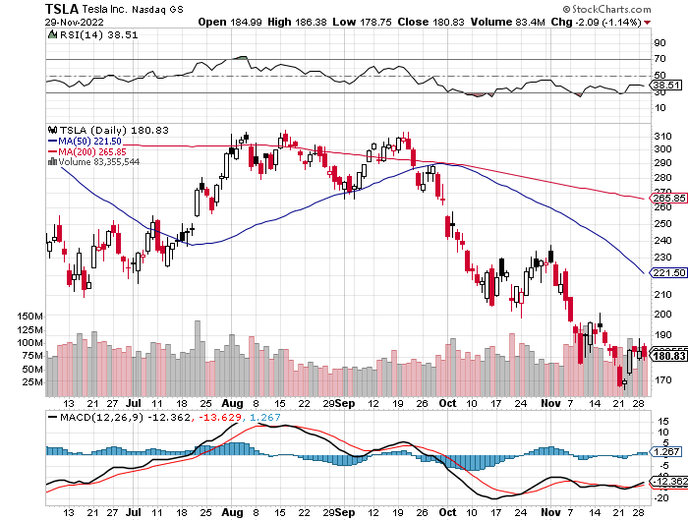
Tesla (TSLA) – Twitter Disaster Recall of 325,000 Takes Tesla to Two Year Low Musk Warns of Twitter Bankruptcy long 12/$140-$150 call spread, long 12/$225-$230 put spread took profits on long 10/$170-$180 call spread

Slide 31
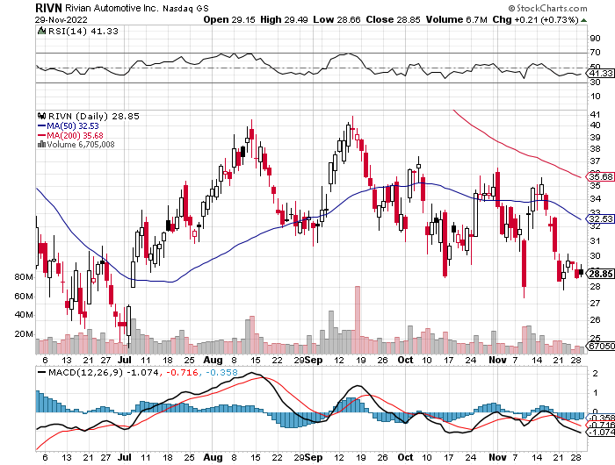
Rivian (RIVN) – Amazon Backed Electric Trucks recall of five cent bolt costs 25% of market cap took profits on long 10/$25-$30 call spread

Slide 32
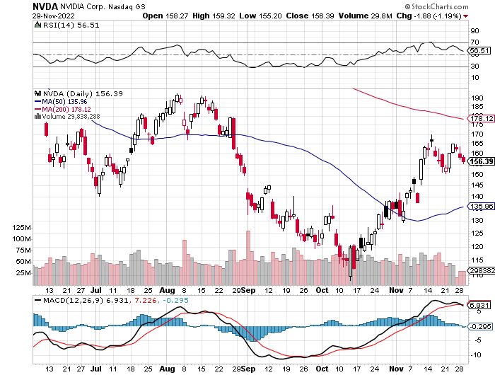
NVIDIA (NVDA) – Downgrade on US ban of highest end AI chips to China took profits on long 10/$95-$100 call spread took profits on long 7/$120-$130 call spread, took profits on long 6/$120-$130 call spread

Slide 33
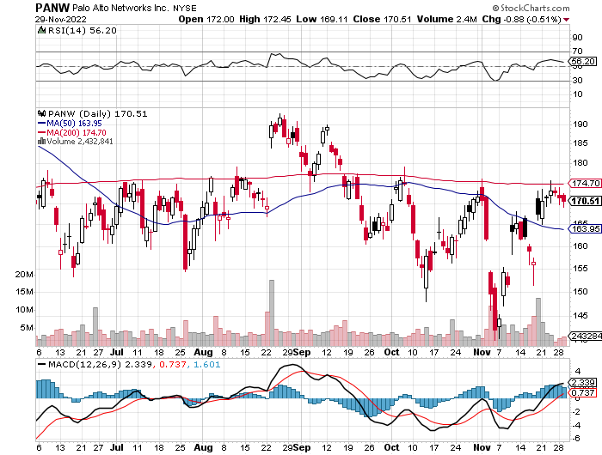
Palo Alto Networks (PANW)- Hacking never goes out of fashion took profits on long 10/$130-$140 call spread

Slide 34
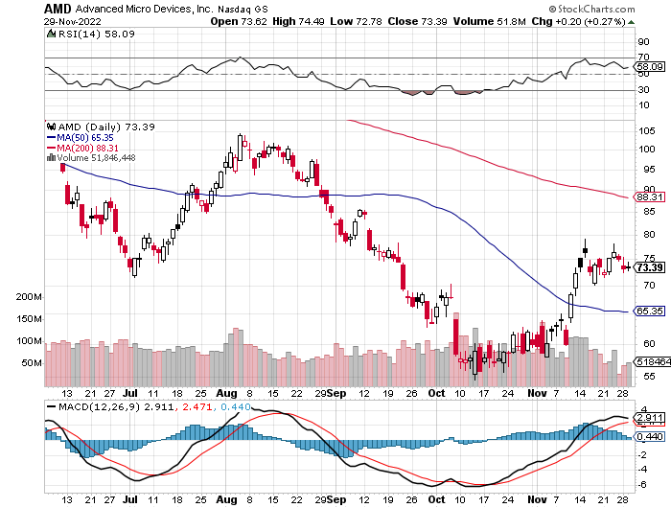
Advanced Micro Devices (AMD)- Recession fears programable logic devices took profits on long 2/$75-$80 call spread

Slide 35
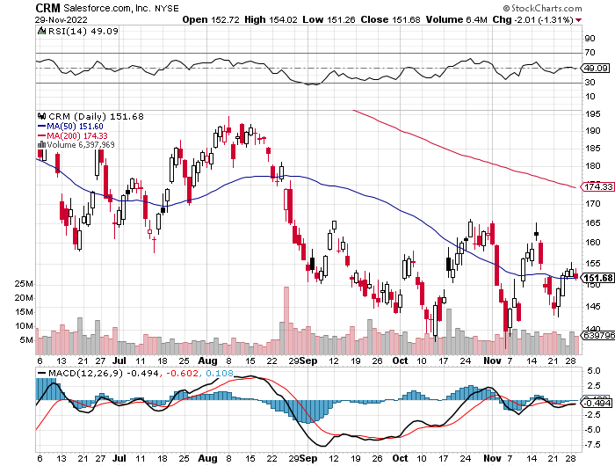
Salesforce (CRM)- Massive Online Migration took profits on long 9/$125-$130 vertical bull call spread took profits on long 8/$125-$130 vertical bull call spread took profits on long 2/$105-$115 call spread

Slide 36
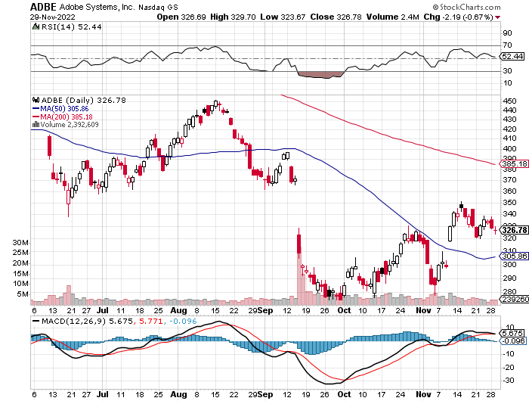
Adobe (ADBE)- Cloud play The Quality Non-China tech play

Slide 37
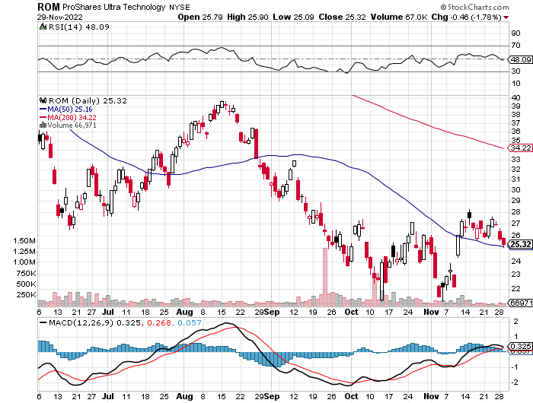
ProShares Ultra Technology ETF (ROM) – 2X Long Technology ETF took profits on long 10/$62-65 call spread

Slide 38
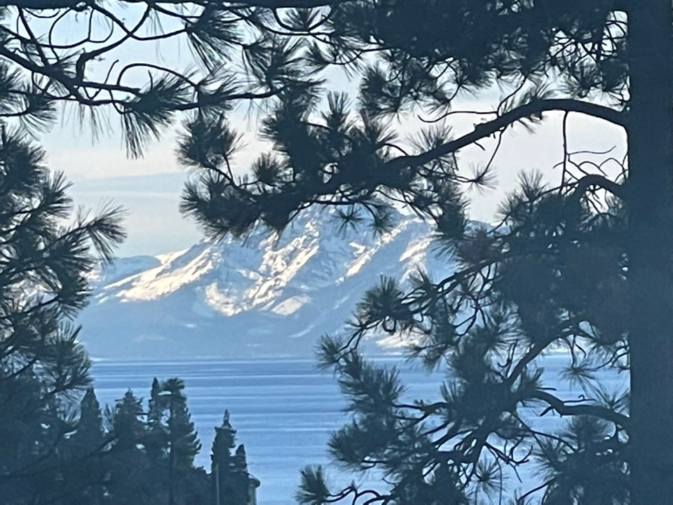

Slide 39
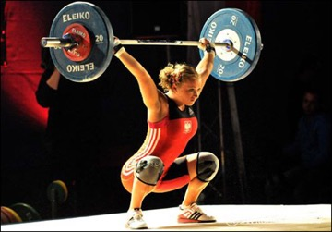
The Second Half of the Barbell
*Bets on a domestic recovery in 2022 Q4 *Upside potential in 2022 far greater than tech *Some of these have not moved for 5 or 10 years *Focuses on economically sensitive cyclical industries *Makes a great counterweight to high-growth technology *We could spend all of next year rotating between the two groups

Slide 40
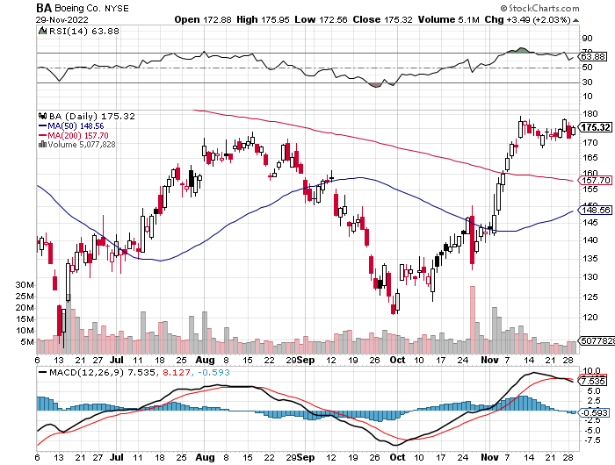
Boeing (BA) –Boeing Orders Rise in October Boeing Delivered its First 787 Dreamliner in a year long 3/$146-$149 call spread

Slide 41
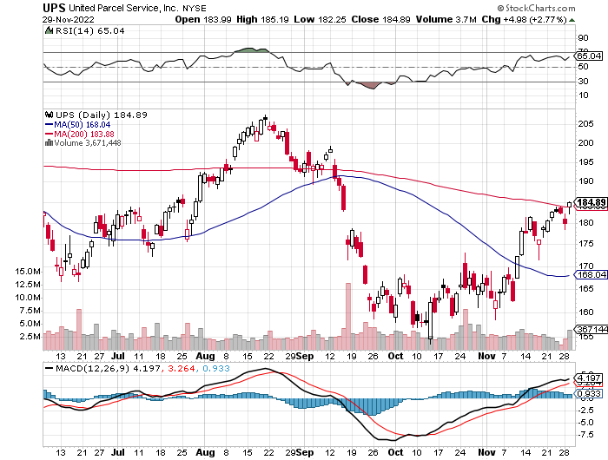
Package Delivery- United Parcel Service (UPS) - Package Delivery record profits took profits on long 11/$130-$140 call spread

Slide 42
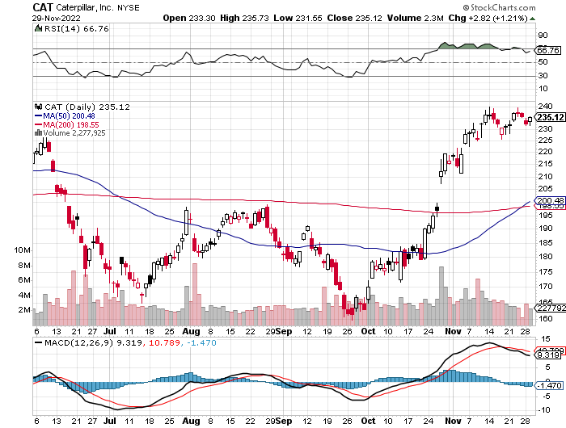
Caterpillar (CAT)- Ag + Infrastructure + Housing Raises Dividend by 50% took profits on long 12/$145-$150 call spread took profits on long 11/$125-$135 call spread

Slide 43
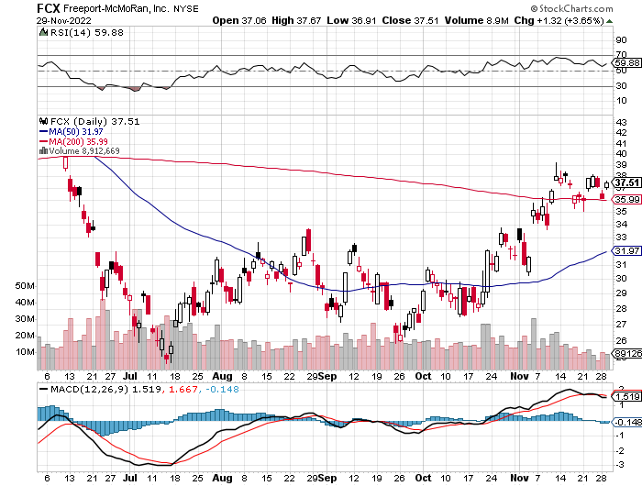
Freeport McMoRan - (FCX)- Copper Play took profits on long 10/$20-$23 call spread

Slide 44
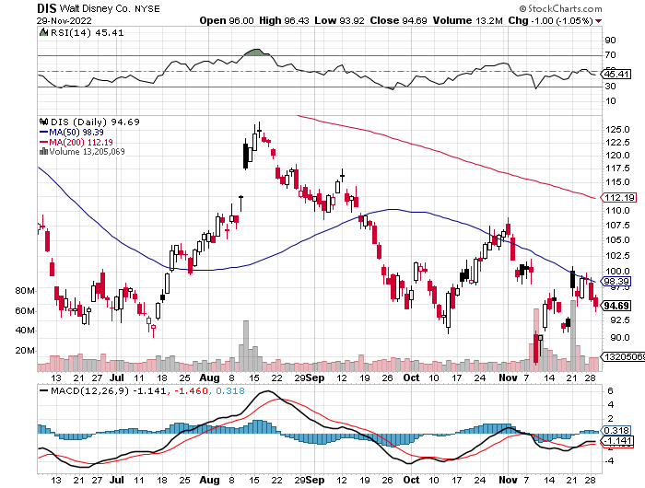
Walt Disney (DIS) - Genie+ Disney Axes Chairman, bringing back Bob Iger from retirement stopped out of long 10/$165-$175 call spread took profits on long 3/$170-$180 call spread

Slide 45
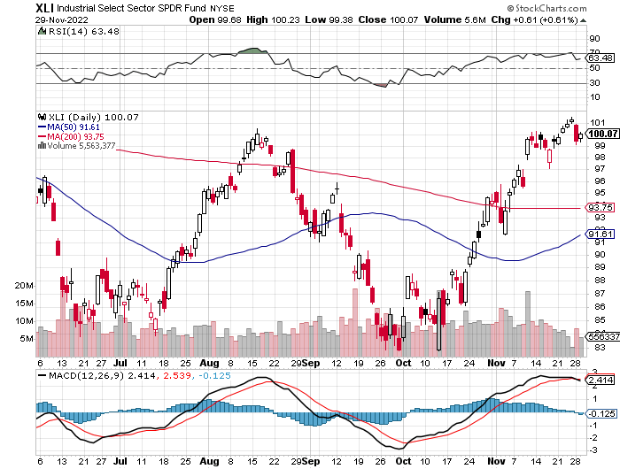
Industrials Sector SPDR (XLI)- (GE), (MMM), (UNP), (UTX), (BA), (HON)

Slide 46
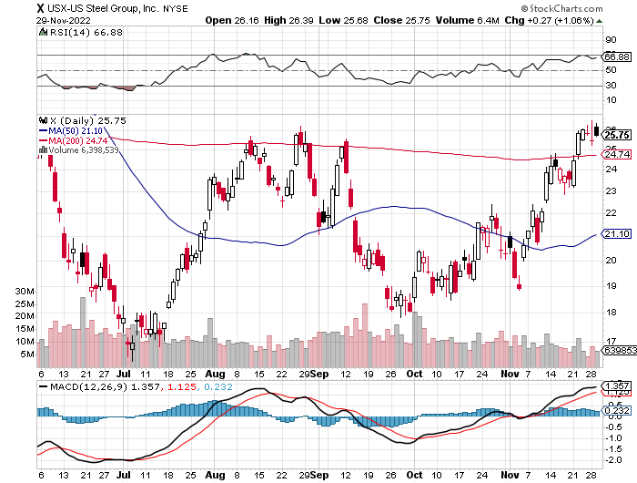
US Steel (X) – Commodity Boom and Wartime boost

Slide 47
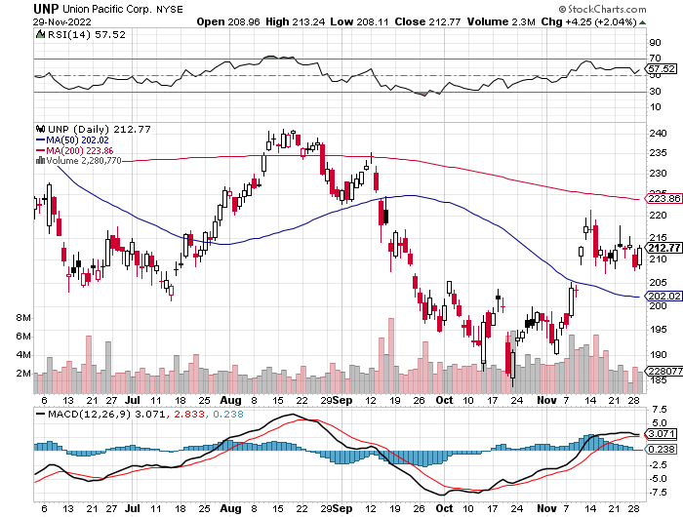
Union Pacific RR (UNP)- Big Stuff to Ship near record earnings announced took profits on long 5/$200-$210 call spread took profits on 11/$150-$160 call spread

Slide 48
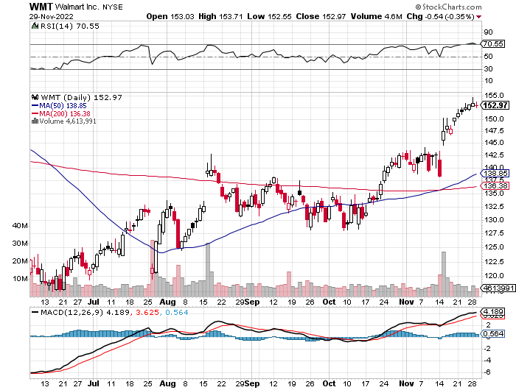
Wal-Mart (WMT)- took profit on Long 11/$125-$130 bear put spread took profit on Long 10/$119-$121 bear put spread took profits on Long 8/$114-$117 bear put spread

Slide 49
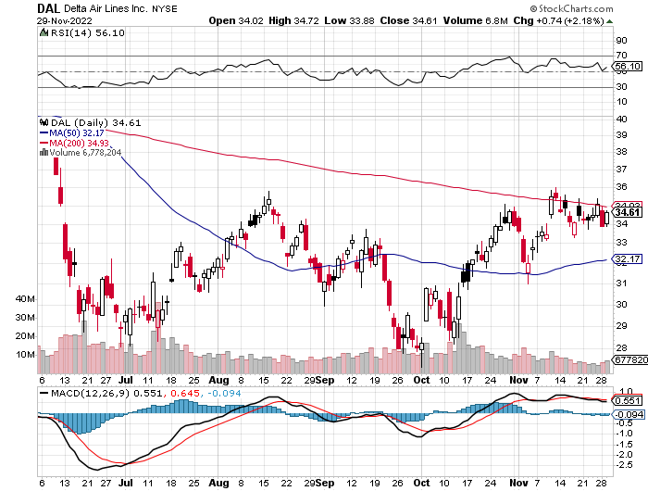
Delta Airlines (DAL) – Travel is Back!

Slide 50
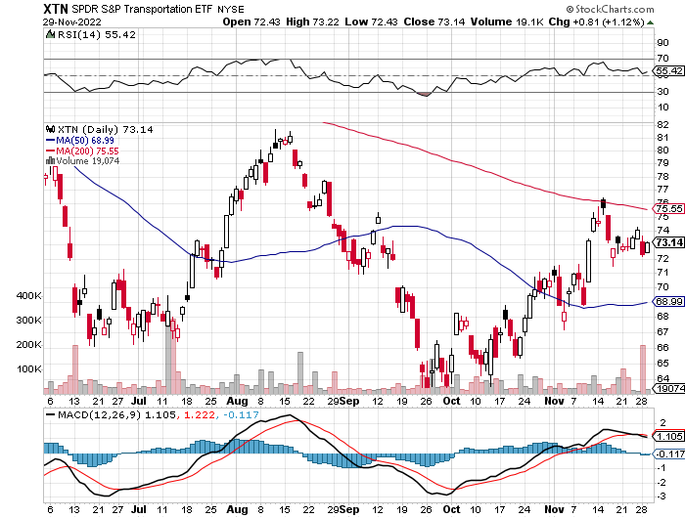
Transports Sector SPDR (XTN)- Worst Hit Sector (ALGT), (ALK), (JBLU), (LUV), (CHRW), (DAL)

Slide 51
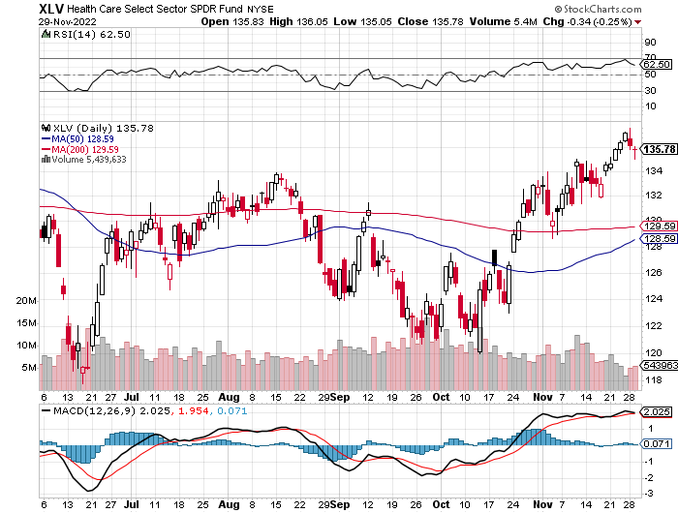
Health Care Sector (XLV) (JNJ), (PFE), (MRK), (GILD), (ACT), (AMGN)

Slide 52
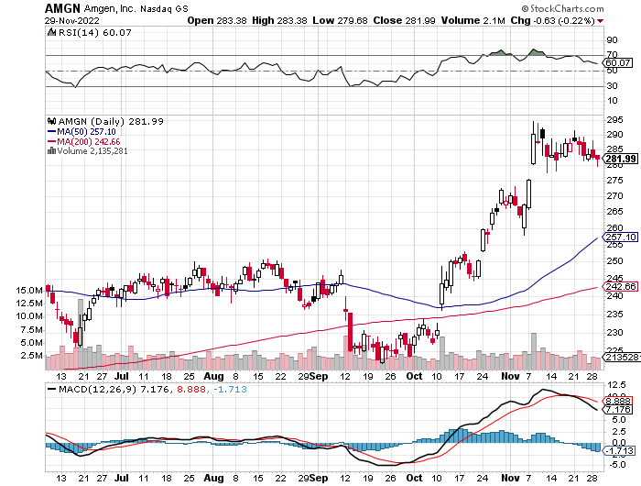
Amgen (AMGN) took profits on long 11/$185-$200 bull call spread

Slide 53
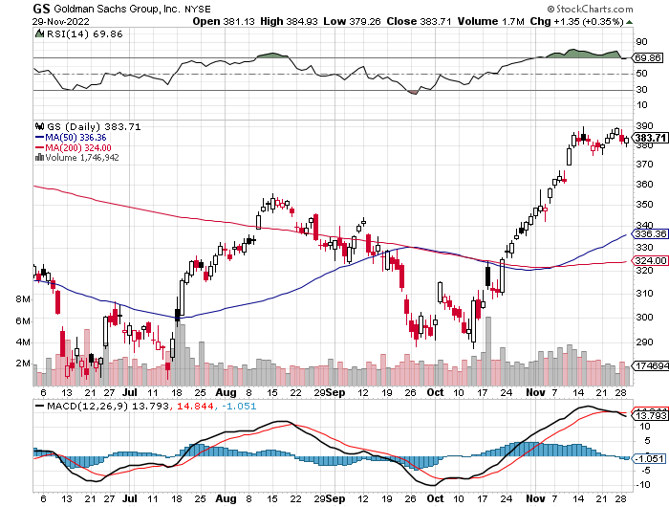
Goldman Sachs (GS) – took profits 12/$330-$350 call spread took profits 11/$330-$350 call spread stop loss on long 11/$385-$395 call spreads

Slide 54
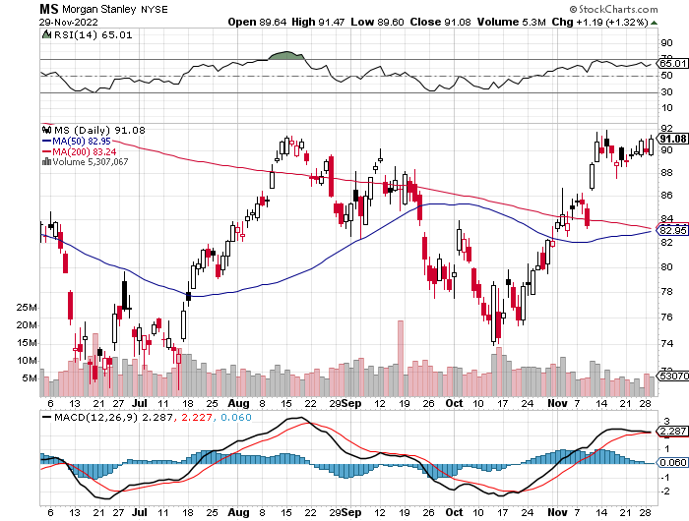
Morgan Stanley (MS) – Blows Away Earnings Equity trading came in a hot $3.2 billion and bond trading $2.9 billion took profits on long 10/$85-$90 call spread

Slide 55
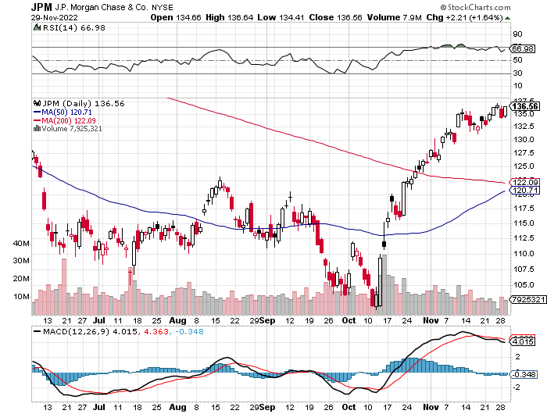
JP Morgan Chase (JPM)- took profits on long 10/$85-$90 call spread, stopped out of long 10/$95-$100 call spread took profits long 12/$148-$152.50 call spread

Slide 56
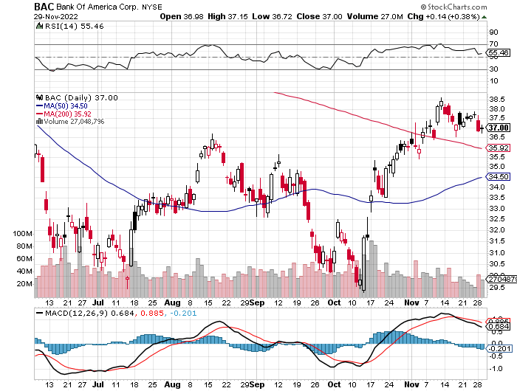
Bank of America (BAC) – took profits long 12/$39-$42 call spread

Slide 57
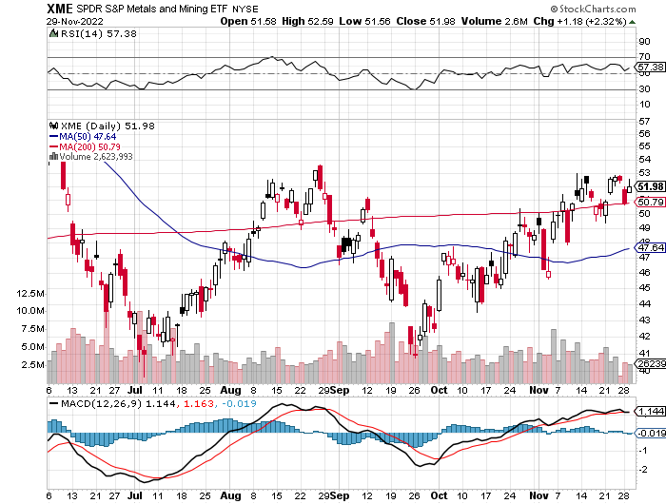
SPDR Metals & Mining ETF (XME) – long 2/$28-$30 call spread

Slide 58
Blackrock (BLK)-Asset Collection Boom took profits on long 3/$770-$790 call spread took profits on long 3/$310-$340 call spread

Slide 59
Visa (V) – “Touchless” Bitcoin Drag Inflation play, Double digit grower, 50% profit margin, and big buyer of its own stock took profits on long 10/$160-$170 bull call spread took profits on long 6/$150-$160 bull call spread

Slide 60
Consumer Discretionary SPDR (XLY) (DIS), (AMZN), (HD), (CMCSA), (MCD), (SBUX)

Slide 61
Berkshire Hathaway (BRKB)- Natural Barbell 20% Profit Increase YOY took profits on long 10/$220-$230 call spread, took profits on long 7/$220-$230 call spread, took profits on long 7/$220-$230 call spread took profits on long 6/$260-$270 call spread, stopped out of long 5/$300-$310 call spread,

Slide 62
Europe Hedged Equity (HEDJ)-

Slide 63
Japan (DXJ)-

Slide 64
Emerging Markets (EEM) - Pro trade, Weak Dollar, Long Recovery Play

Slide 66
Bonds – THE big trade of 2023.
*Bonds Continue on a Tear, with the (TLT) up a breathtaking $12 from the October low *(TLT) could reach $120 in 2023. Keep buying (TLT) calls, calls spreads and LEAPS on dips *Junk bond ETF’s (JNK) and (HYG) were up two points *30-year fixed rate mortgages dropped 60 basis points to 6.60%
*US Budget Deficit Drops by Half, after the sharpest decline in government spending in history *Less government borrowing is building a strong floor under bond prices as all Covid stimulus programs expire

Slide 67
Treasury ETF (TLT) – Triple Long long 12/$91-$94 call spread, long 12/$92-$95 call spread, long 12/$93-$96 call spread took profits on long 10/$110-$113 put spread, stopped out of long 10/$98-$101 call spread took profits on long 6/$123-$126 put spread, took profits on long 6/$125-$128 put spread took profits on long 6/$124-$127 put spread, took profits on long long 7/$128-$131 put spread took profits on long 5/$128-$131 put spread, look profits on long 5/$127-$130 put spread

Slide 68
Ten Year Treasury Yield ($TNX) – 3.78%

Slide 69
Junk Bonds (HYG) 8.42% Yield to Maturity

Slide 70
2X Short Treasuries (TBT)-Another run at highs

Slide 72
Foreign Currencies – Dollar Stall
*Sharply falling US interest rates bring a crashing US dollar *All foreign currencies will rally strongly *Buy the Euro (FXE), Australian dollar (FXA), British Pound (FXB), and Japanese yen (FXY) *China lockdowns will keep the Yuan relatively weak *Strong currencies will also deliver major bull markets in emerging market stocks (EEM) and (CEW)

Slide 73
THE MAD HEDGE FUND TRADER
Australian Dollar (FXA) - Major Long-Term Bottom is In Targeting Parity – A call option on a global synchronized recovery
1:1
BUY

Slide 74
Japanese Yen (FXY)
2023 Target 25%

Slide 75
Euro (FXE)-
2023 Target 25%

Slide 76
British Pound (FXB)-
2023 Target 15%

Slide 77
Emerging Market Currencies (CEW)
2023 Target 40%

Slide 79
Energy & Commodities – Short Play
*OPEC Plus Considering 500,000 Barrel a Day Increase, a disastrous move ahead of a recession *But it’s tough to beat a coming recession, which every other hard asset class and commodity is now confirming *European Sanctions Shutting in Russian Oil, forcing them to cap wells and damage reserves *What is sold will be capped at 30% below the market *China and India are the sole remaining buyers *Delivery to the later will be tough when insuring Russian cargoes is banned at yearend *Avoid all energy plays like the plague, it’s the new buggy whip industry as the US de-carbonizes *I’m not recommending energy because there is no long term growth story here

Slide 80
Oil-($WTIC)

Slide 81
United States Oil Fund (USO) long 10/$9.50-$10 Vertical bull call spread

Slide 82
Energy Select Sector SPDR (XLE)-No Performance! (XOM), (CVX), (SLB), (KMI), (EOG), (COP)

Slide 83
ExxonMobile (XOM)- long 12/$120-$125 put spread-expires in 12 trading days

Slide 84
Occidental Petroleum (OXY)- long 12/$77.50-$82.50 put spread-expires in 12 trading days

Slide 85
Natural Gas (UNG) -

Slide 86
Freeport McMoRan (FCX) -

Slide 87
Cameco (CCJ) - took profits on long 5/$20-$23 bull call spread

Slide 88
Precious Metals – New Bull Market
*A Massive Silver Shortage is Developing, with demand up 16% in 2023 to 1.21 million ounces *With EV production increasing from 1.5 million to 20 million units a year within the decade, its share of the market will rise from 5% to 75% *Solar panel demand is also rising. Buy (SLV) and (WPM) on dips, and my next LEAPS will be for silver on the next dip. *Gold will be a good performer in 2023 *Collapsing interest rates next year will be the big story here

Slide 89
Gold (GLD) - Deflation call took profits on long 5/$165-$170 bull call spread

Slide 90
Market Vectors Gold Miners ETF- (GDX) –

Slide 91
Barrick Gold (GOLD) took profits on long 1/$21-$23 call spread took profits on long 11/$22-$24 call spread

Slide 92
Newmont Mining- (NEM)- took profits on long $55-60 call spread

Slide 93
Silver- (SLV)- took profits on long 11/$19-$20 call spread

Slide 94
Silver Miners - (SIL)-

Slide 95
Wheaton Precious Metals - (WPM)- took profits on long 2/$39-41 call spread

Slide 97
Real Estate – Prices Holding
*New Home Sales Come in Hot, at 632,000, a real shocker with the 30-year fixed rate at 7.4% *Low ball Seller financing incentives have to be a factor where they buy down rates to lower levels. Free upgrades, like those cherry wood cabinets, bonus rooms, and marble kitchen counters, also help. *Prices are still up 15% YOY and inventories rose to a once unbelievable 8.9 months *Existing Home Sales Plunge, 5.9% in October, to an annualized rate of 4.43 million units *It is the slowest sales pace in 11 years *It is not as bad as expected but is still down a horrific 28.4% YOY *Inventory fell to just 1.22 million units, only a 3.3-month supply, supporting prices in a major way *Housing accounts for about 20% of the US economy, so here is your recession threat right here.

Slide 98
S&P Case Shiller-Still Going Up in the Rear View Mirror S&P Case Shiller Rises 10.60%, in July with its National Home Price Index Miami (+24.6%), Tampa (+23.8%), Charlotte NC (+17.8%)

Slide 99
Crown Castle International (CCI) – 4.46% yielding cell phone tower REIT

Slide 100
US Home Construction Index (ITB) (DHI), (LEN), (PHM), (TOL), (NVR)

Slide 102
Trade Sheet- So What Do We Do About All This?
*Stocks – buy the big dips at bottom of range *Bonds – buy dips *Commodities-buy dips *Currencies- sell dollar rallies *Precious Metals – buy dips *Energy – stand aside *Volatility - sell short over $30 *Real estate – buy dips

Slide 104
Next Strategy Webinar 12:00 EST Wednesday, December 14 from Silicon Valley, CA email me questions at support@madhedgefundtrader.com
Good Luck and Good Trading!
Notes:
*

