Slide 1

The Mad Hedge Fund Trader
“January Surprise”
With John Thomas
Silicon Valley, CA, January 11, 2023
www.madhedgefundtrader.com
Notes:
*

Slide 2
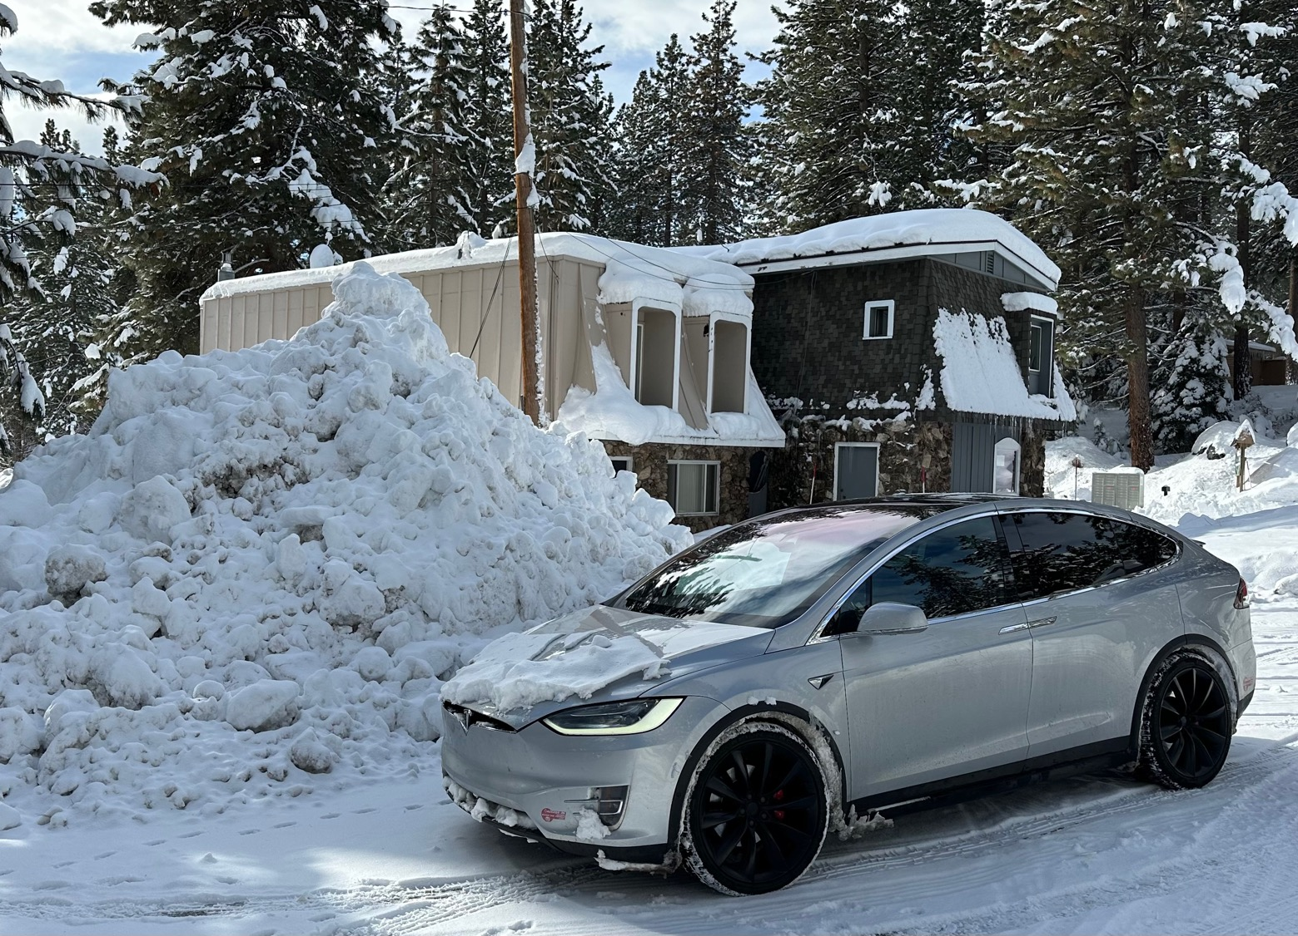

Slide 3

February 17 Honolulu, Hawaii Strategy Luncheon
*An excellent meal will be followed by a wide-ranging discussion
and an extended question and answer period
*The lunch will be held at the premier restaurant in
Incline Village, Nevada on the sparkling shores of Lake Tahoe
*please go to my online store at
http://www.madhedgefundtrader.com/store
and click on “luncheons.”

Slide 4

July 13, 2023 Seminar at Sea
Tickets are Selling Fast!
*Cunard Line’s flagship, the elegant and spacious Queen Mary II, on an eastbound transatlantic cruise
*The Ship departs New York at 12:00 AM on July 7, 2023, and arrives at Southampton on July 14
*Guests will be responsible for booking their own cabin
through Cunard
*Three dinners during the voyage will be black tie
*Customers are required to book their own cabins
and return flights from England
*The Cunard cruise number is M319.

Slide 5
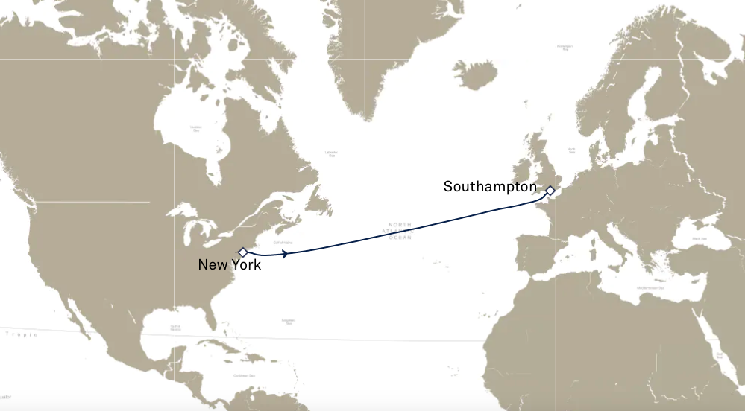

Slide 6

Trade Alert Performance
New All Time Highs!
22 out of 23 trade alerts profitable
*January +13.89% MTD *July +3.98% Final
*February +8.78% Final *August +5.13% Final
*March +3.43% Final *September +9.72% Final
*April +3.33% Final *October +5.69% Final
*May +8.80% Final *November +8.31 Final
*June +5.91% Final *December +0.95% Final
*2022 Final +84.63%
compared to -18.63% for the S&P 500
*2023 Year to Date +13.89%, +610.58% since inception
*Average annualized return of +46.67% for 15 years

Slide 7
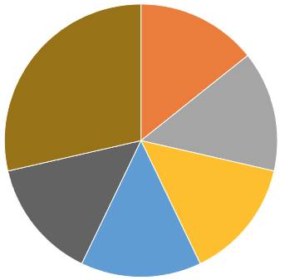
Portfolio Review
20% Long, 80% short, 0% cash
aggressively short tech
Current Capital at Risk
Risk On
(TSLA) 1/$75-$80 call spread | 10.00%
(GOLD) 1/$15.50-$16.50 call spread | 10.00%
(WPM) 1/$$36-$39 call spread | 10.00%
(BRKB) 1/$290-$300 call spread | 10.00%
Risk Off
(TLT) 1/$96-$99 call spread | -10.00%
(TLT) 1/$96-$99 call spread | -20.00%
(TLT) 2/$95-$98 call spread | -20.00%
Total Net Position | -10.00%
Total Aggregate Position | 90.00%
Expiration Value
+17.96%

Slide 8
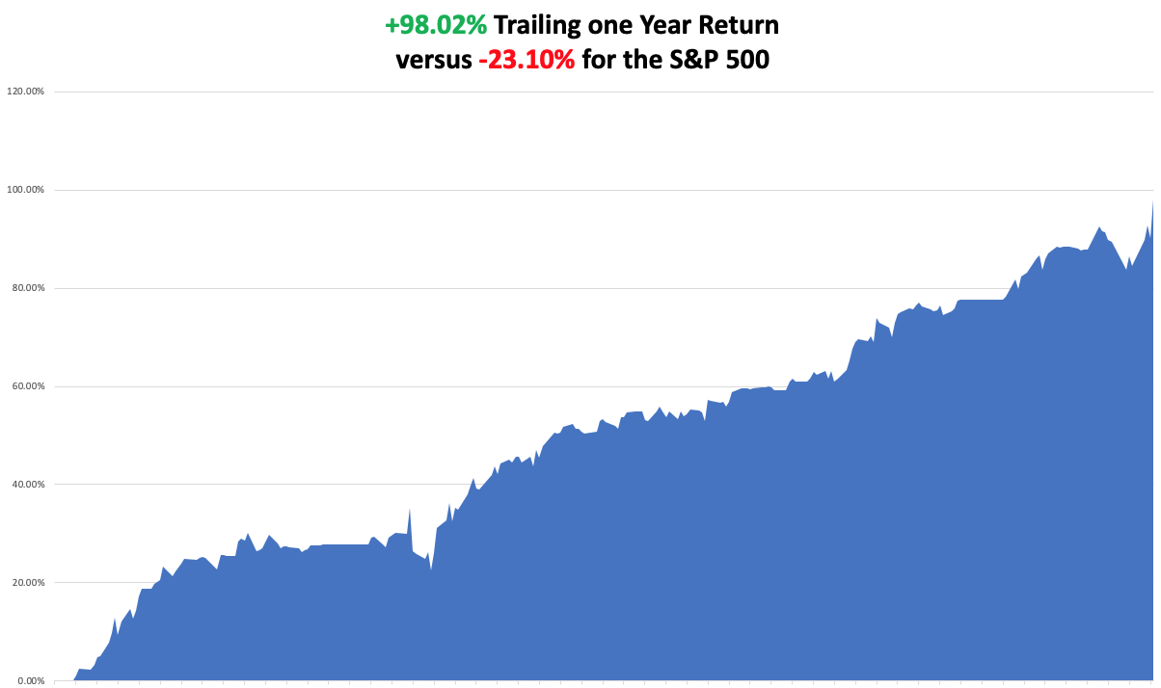

Slide 9
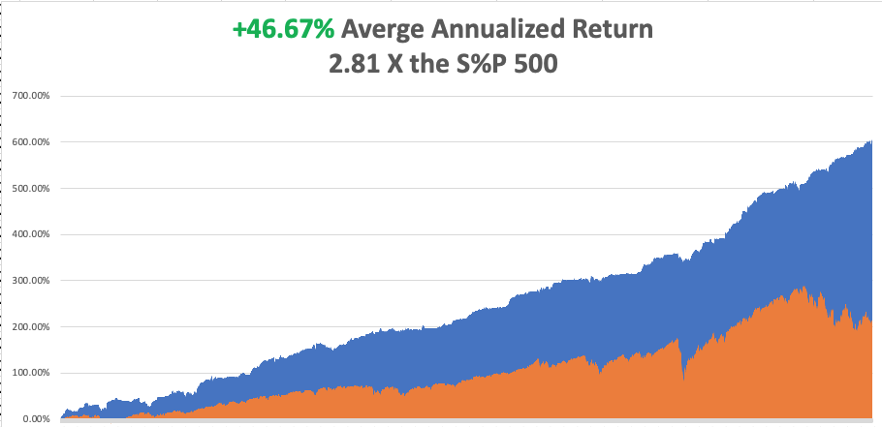

Slide 10
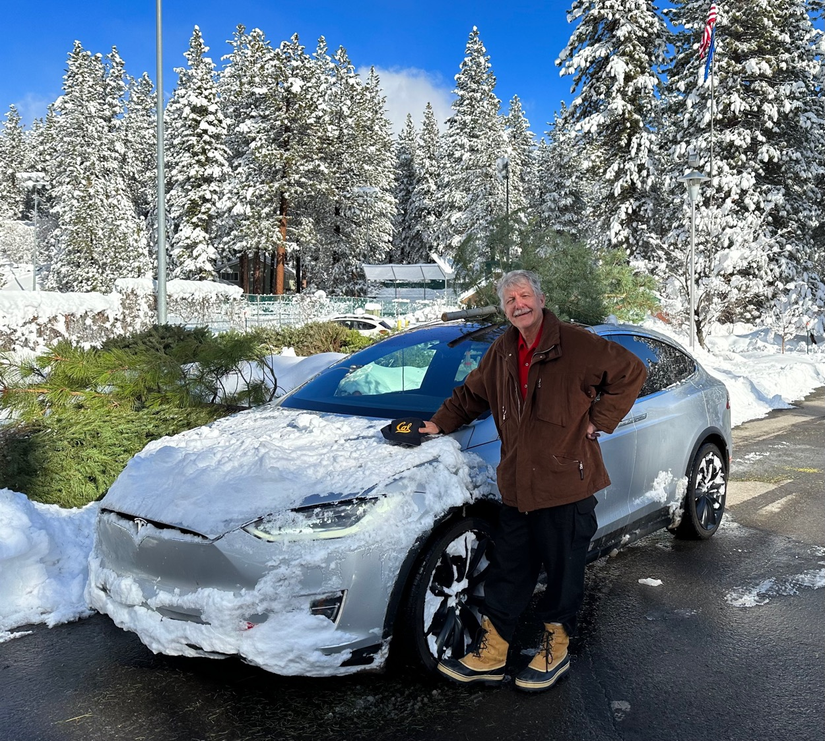

Slide 11

The Method to My Madness
The Bottom is In
*The market went into the New Year heavily short, we will flat line until the inflation report tomorrow, expect chop in a range for six months
*A House intent on debt default puts a cloud over the Treasury trade
*Energy plumbing new lows on Russia failures, warm weather, and supply glut
*Gold and Silver deliver major upside breakout
*2023 could be the year of commodities
*The US dollar has topped and will be weak for a decade
*Look for S&P 500 at 4,800 by end 2023
*VIX dives to $22 – NO TRADE

Slide 12
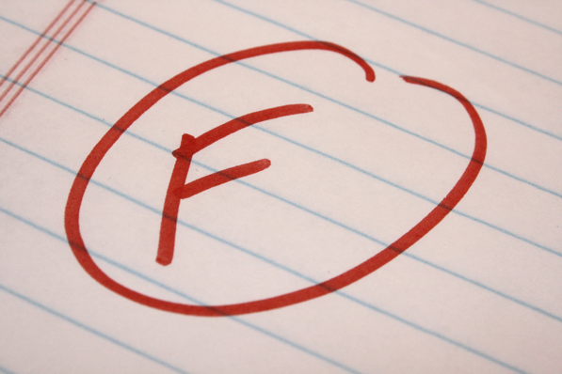
The Global Economy – Failing
*Nonfarm Payroll Report Comes in Warm, at 223,000 for November, not hot enough, popping the stock market
*The Headline Unemployment Rate fell to an eye popping 3.5%, a post covid low
*Average hourly earnings dropped by half to 0.3% and up 4.6% YOY.
*JOLTS Stays Strong, in November at 10.4 million, proving that hiring remains strong.
*Fed Minutes Remain Restrictive, at the December 12 meeting, with inflation cited as the greatest threat to the economy
*Leading Economic Indicators Fall Far Short, down 0.3% in December.
*Shipping Costs Dive 40%, as supply chain problems end.
*IMF Sees a Slow Decade, with global growth slowing from 6%
in 2021 to 3.2% in 2022 and 2.7% in 2023

Slide 13
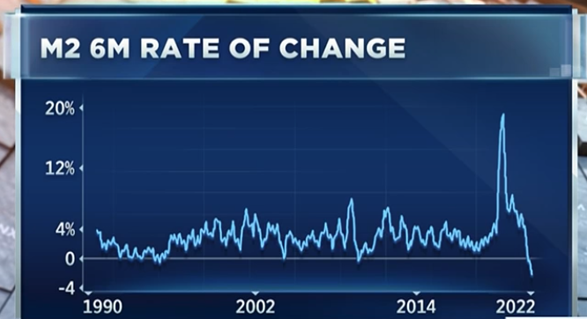

Slide 14
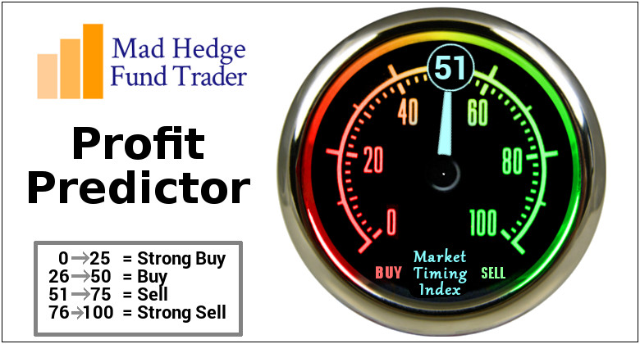
The Mad Hedge Profit Predictor
Market Timing Index – Neutral
An artificial intelligence driven algorithm that analyzes 30 different economic, technical, and momentum driven indicators

Slide 15
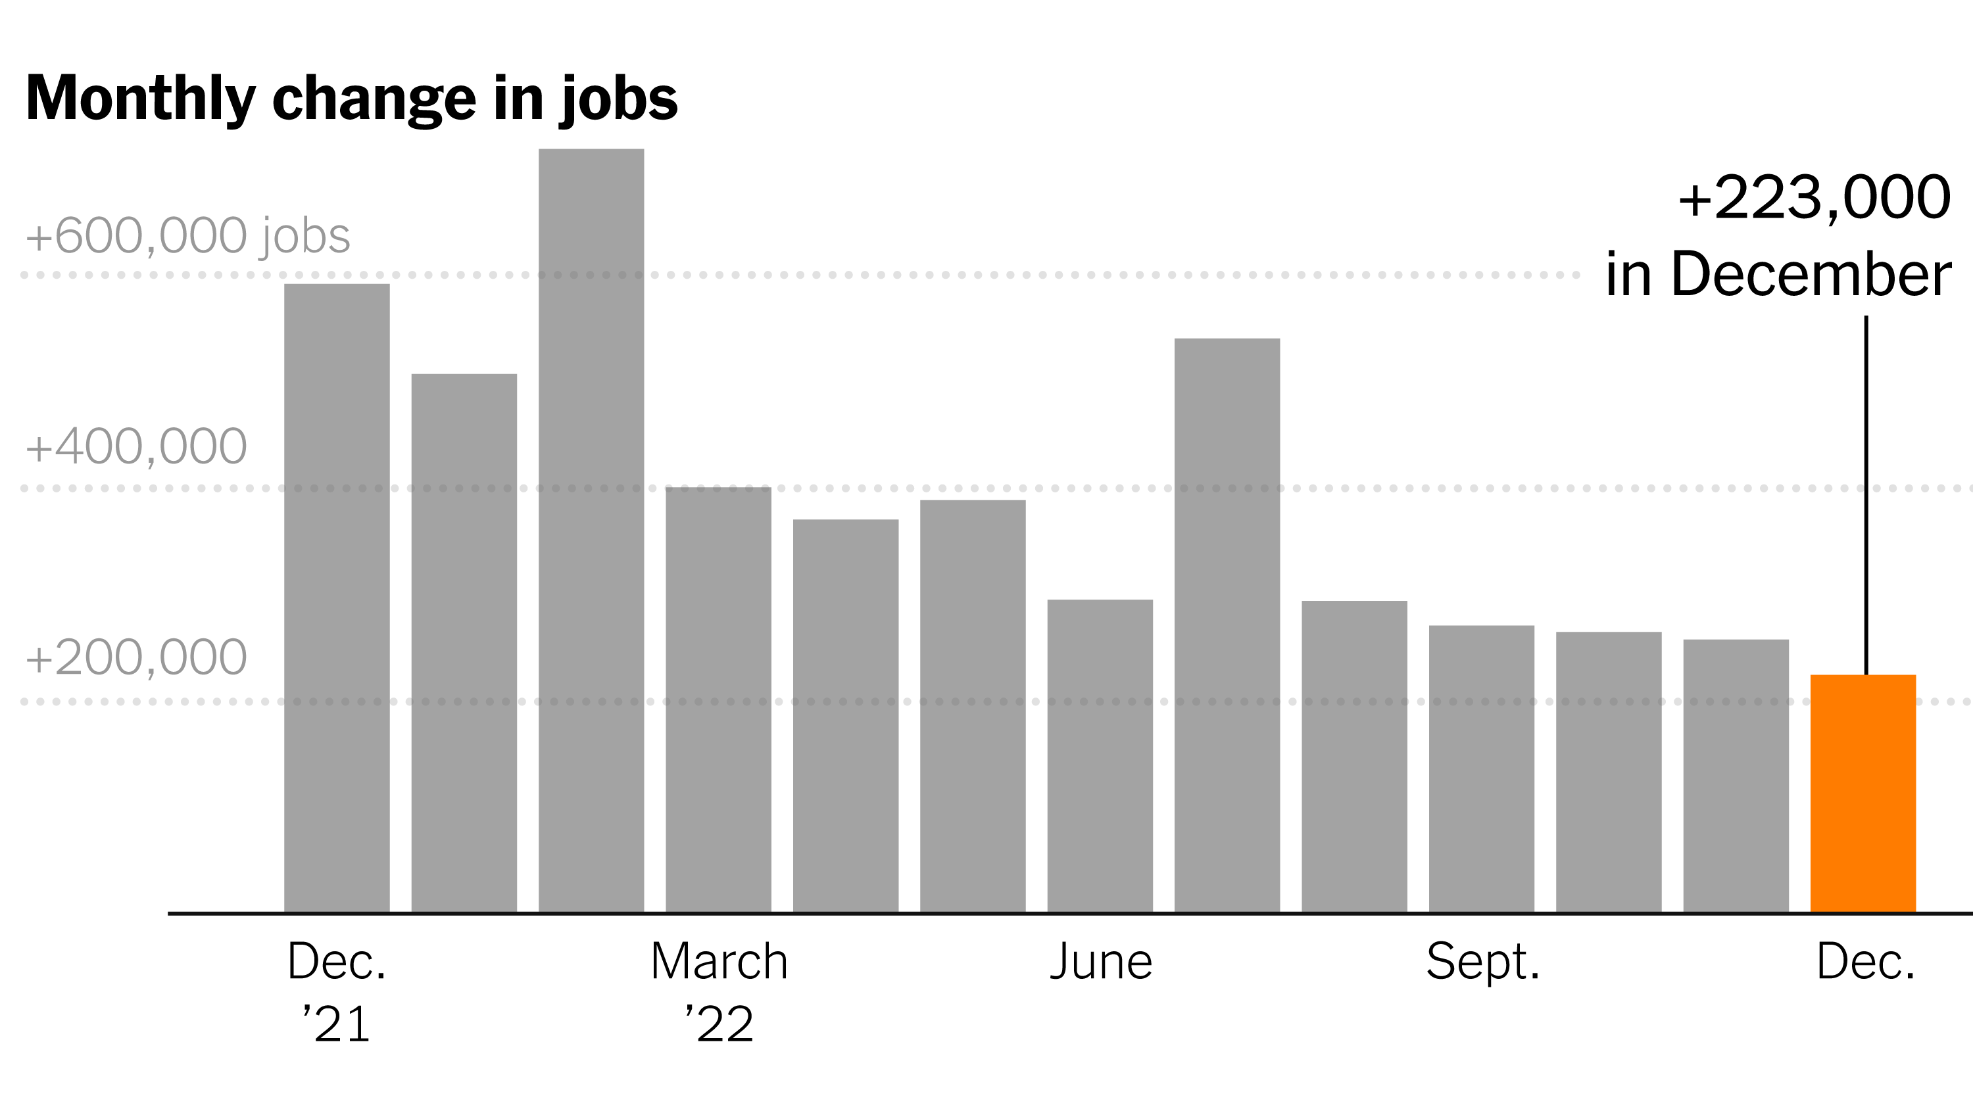
Weekly Jobless Claims – Falling
223,000 – Down 10,000

Slide 16
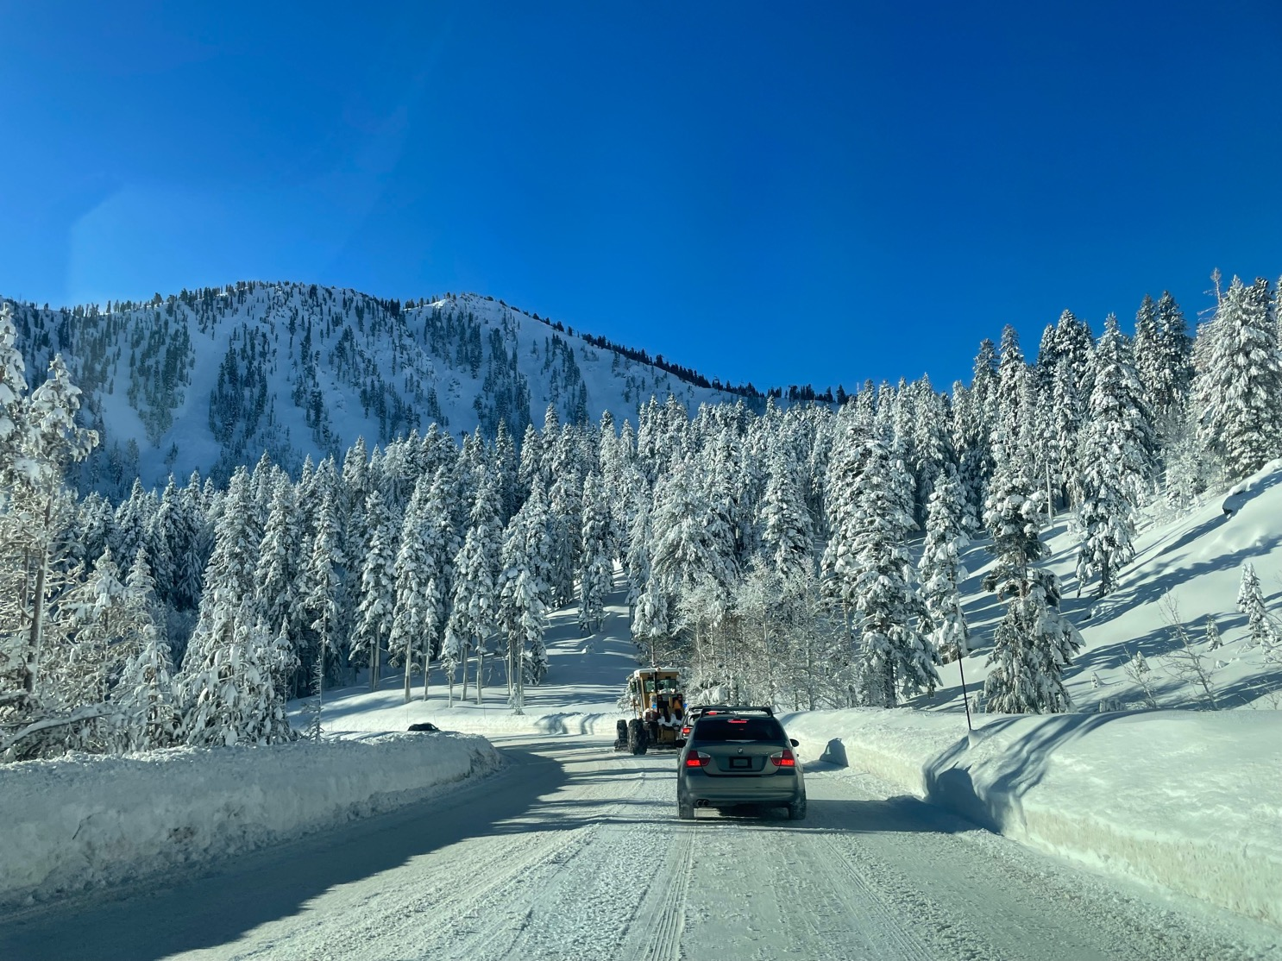

Slide 17
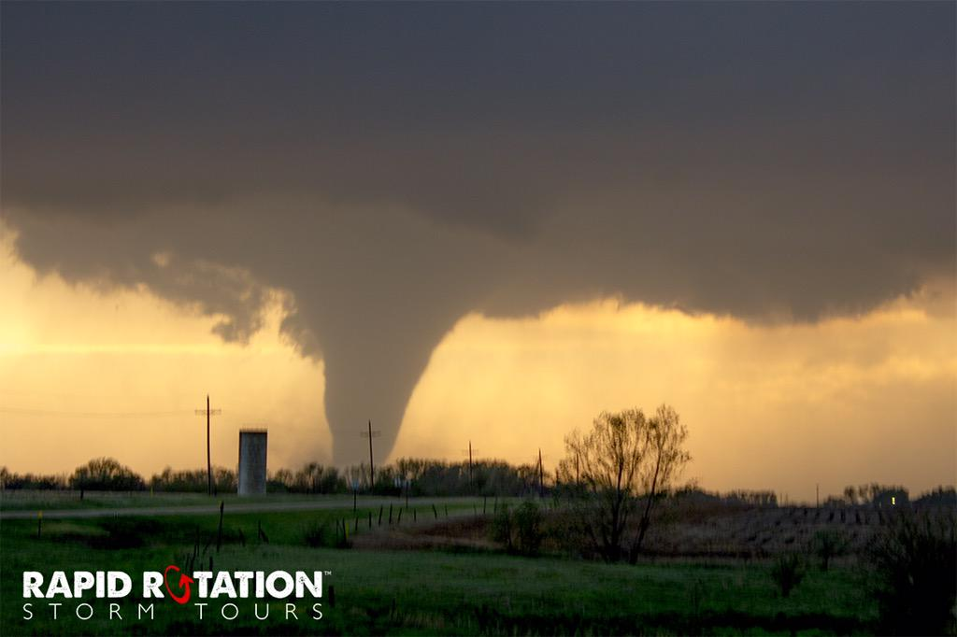
Stocks – Rapid Rotation
*2023 starts with a massive short cover, but are still stuck in the range
*2023 will be all about value in H1 and growth in H2
*Commodity plays will lead, oil plays will lag
*Financials will also be a strong sector with Biotech
as the safety trade
*Use the panic days to load up on tech stocks for an H2 rally
*Boeing goes ballistic on rapidly recovering orders
helped by aircraft shortage
*Tesla is now the most widely owned and traded stock
in the market beating Apple, is now a leading market indicator
*Look for terrible H1 and strong H2 scenario to replay in 2023

Slide 18
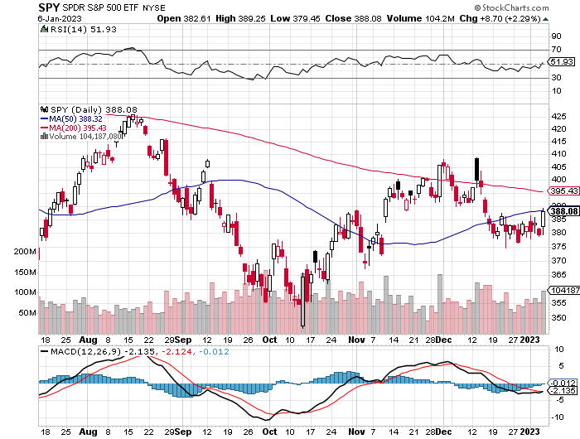
S&P 500 – The Worst Case-Severe Recession took profits on long 1/$420-$430 put spread, took profits on long 11/$420-$430 put spread took profits on long 10/$385-$395 put spread, took profits on long 11/$410-$400 put spread took profit on long 10/$390-$400 put spread, took profit on long 10/$320-$330 call spread
$410
+15%
Rally
The Bottom
$355
Down -26%

Slide 19
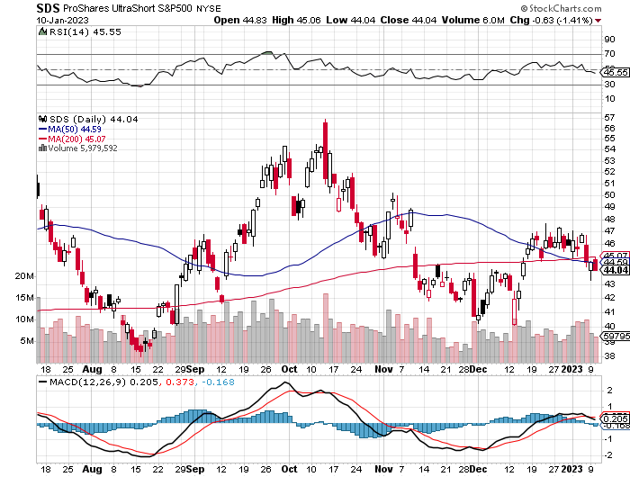
ProShares Ultra Short S&P 500 (SDS)- a great hedge for long stocks and bonds long 2X position has a hedge against longs and bond shorts

Slide 20
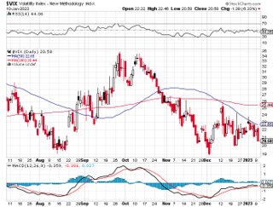
(VIX) – Bargain of the Century

Slide 21
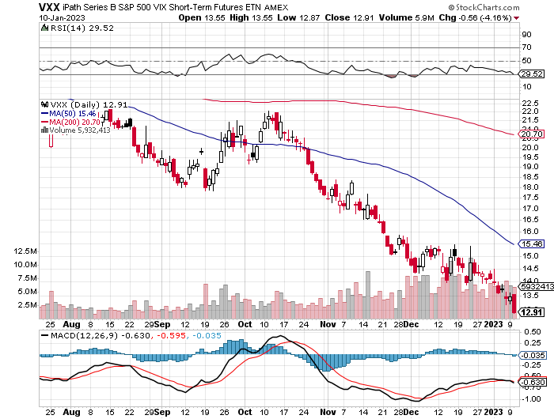
(VXX)-

Slide 22
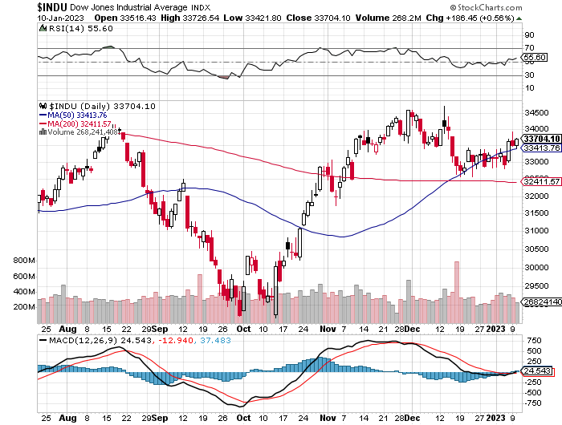
Dow Average ($INDU)-

Slide 23
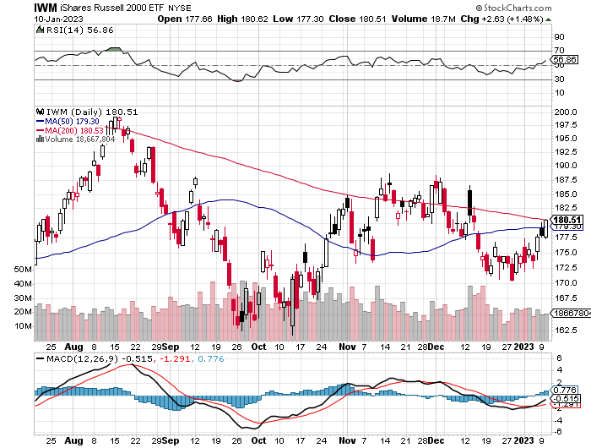
Russell 2000 (IWM)- took profits on Long 10/$137-$142 vertical bull call spread took profits on Long 10/$153-$156 vertical bear put spread

Slide 24
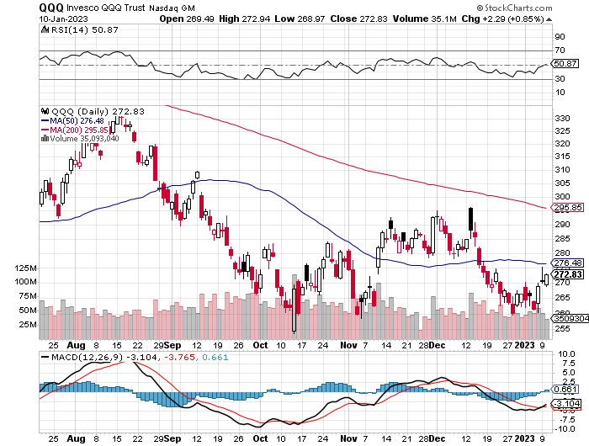
NASDAQ (QQQ) – took profits on long (QQQ) 1/$290-$300 put spread, took profits on long (QQQ) 4/$330-$335 put spread took profits on long (QQQ) 3/$340-$345 put spread, covered long (QQQ) $325-$330 put spread

Slide 25
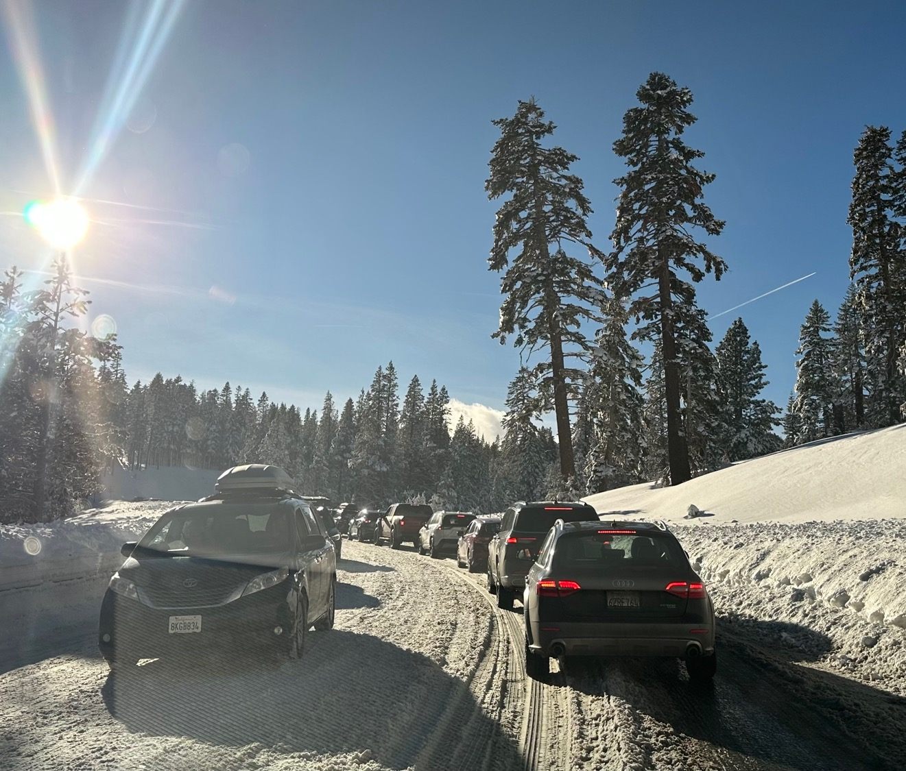

Slide 26
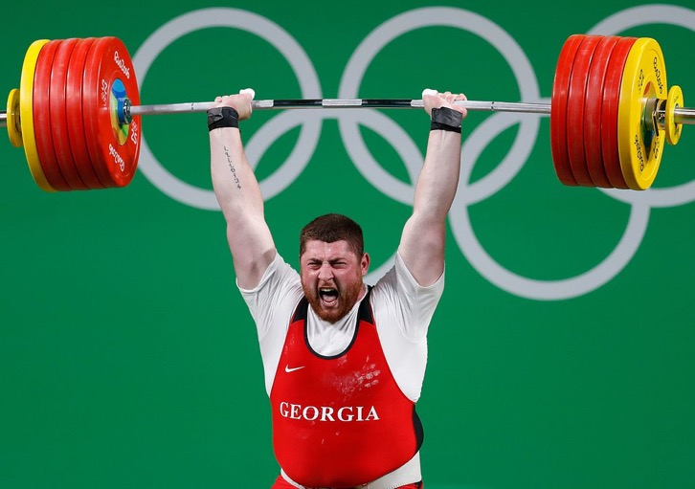
The Barbell Portfolio
*50% Big Tech - 2% of US Employment but 27% of Market Cap and 38% of Profits
50% Domestic Recovery, including:
Railroads
Couriers
Banks
Construction
Credit Cards
Event organizers
Ticket sales
Retailers

Slide 27
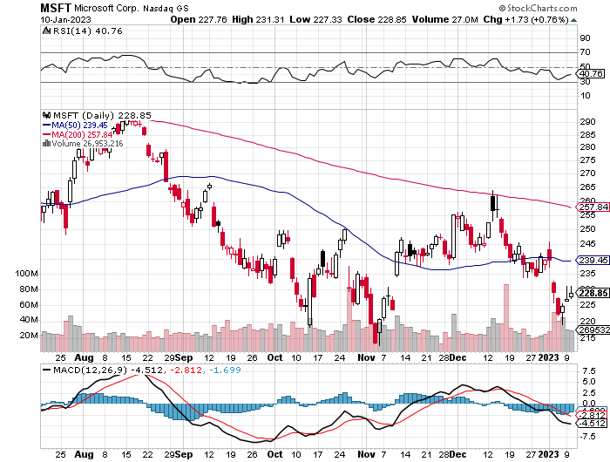
Microsoft (MSFT)- took profits on 9/$235-$245 call spread, took profits on long 7/$220-$210 call spread, took profits on long 6/$220-$230 call spread, took profits on long 2/$200-$210 bear put spread

Slide 28
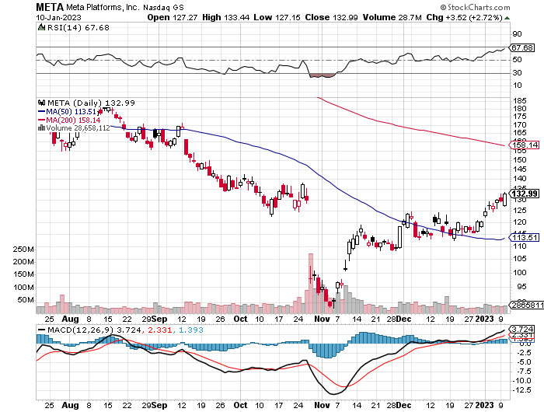
Meta (META)- Looking for the Metaverse took profits on Long 9/$290-$300 vertical bear put spread stopped out of Long 9/$190-$200 vertical bear put spread

Slide 29
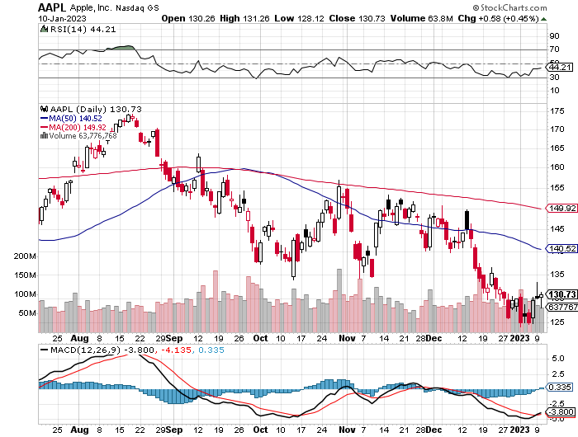
Apple (AAPL)-Cash Balance Falls from $175 billion to $25 billion took profits on long 1/$145-$155 put spread, Took profits on long 10/$165-$175 put spread took profits on long 6/$155-$165 put spread, stopped out of long 6/$125-135 call spread, took profits on long 6/$110-$120 call spread, took profits on long 2/$180-$190 put spread

Slide 30
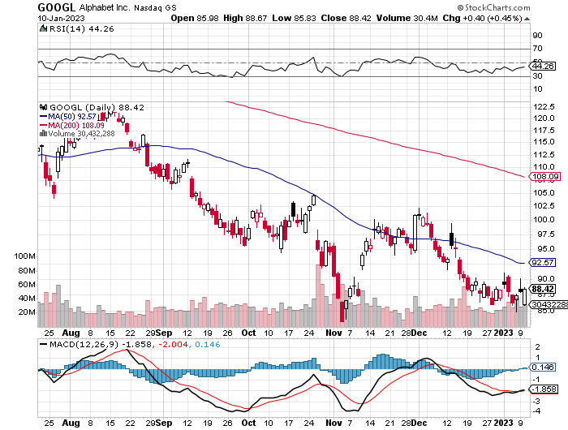
Alphabet (GOOGL) – Ad king on economic recovery
$4.1 Billion fine for European antitrust took profits on long 12/$1,200-$1,230 bull call spread took profits on long 9/$1,030-$1,080 vertical bull call spread

Slide 31
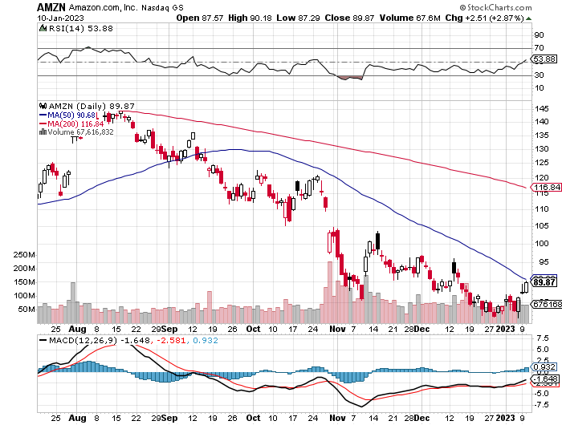
Amazon (AMZN) – Amazon to Lay Off 100,000 took profits on long 2/$3,400-$3,500 bear put spread took profits on long 9/$2,800-$2,900 bull call spread

Slide 32
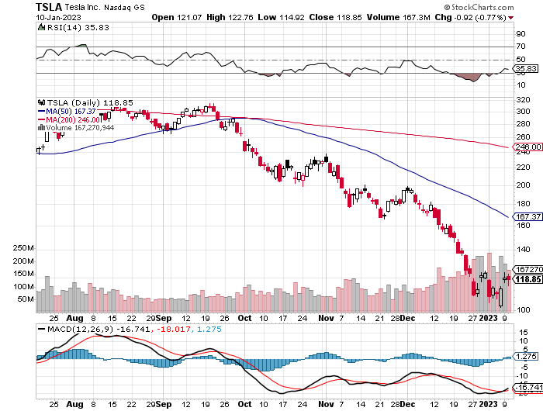
Tesla (TSLA) – Shanghai Shutdown
To Announce Fifth Factory in Mexico
Q4 Sales Come in Short, delivering 405,278 and 1.3 million for all of 2023 long 1/$75-$80 call spread-Expires in 6 Trading days stopped out of long 12/$100-$110 call spread-worst trade of the year, took profits on long 12/$140-$150 call spread, too profits on long 12/$225-$230 put spread took profits on long 10/$170-$180 call spread

Slide 33
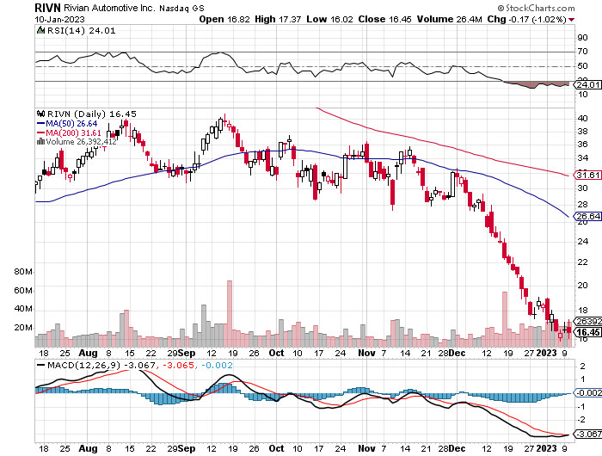
Rivian (RIVN) – Amazon Backed Electric Trucks
Joint Venture with Mercedes Put on Hold took profits on long 10/$25-$30 call spread

Slide 34
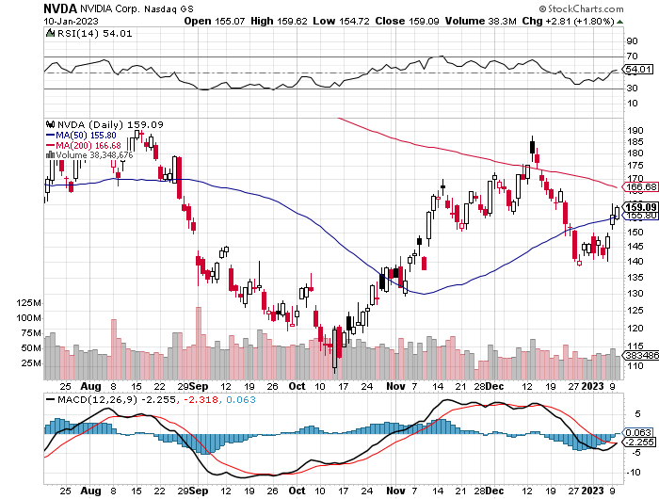
NVIDIA (NVDA) – Downgrade on US ban of highest end AI chips to China took profits on long 10/$95-$100 call spread took profits on long 7/$120-$130 call spread, took profits on long 6/$120-$130 call spread

Slide 35
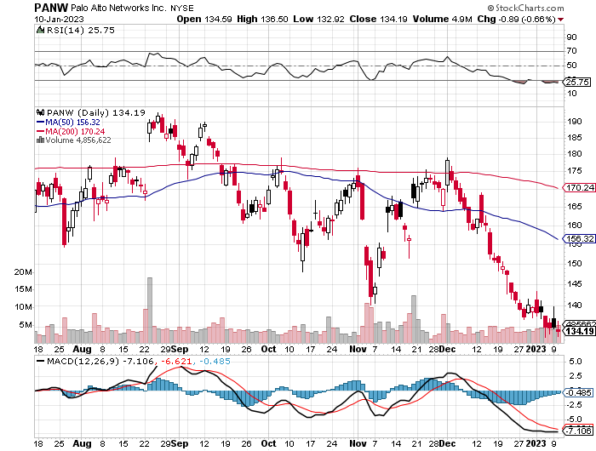
Palo Alto Networks (PANW)- Hacking never goes out of fashion took profits on long 10/$130-$140 call spread

Slide 36
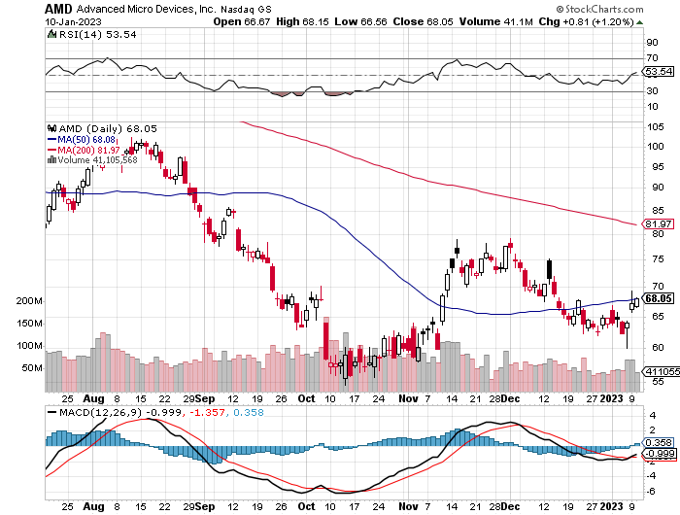
Advanced Micro Devices (AMD)- Recession fears programable logic devices took profits on long 2/$75-$80 call spread

Slide 37
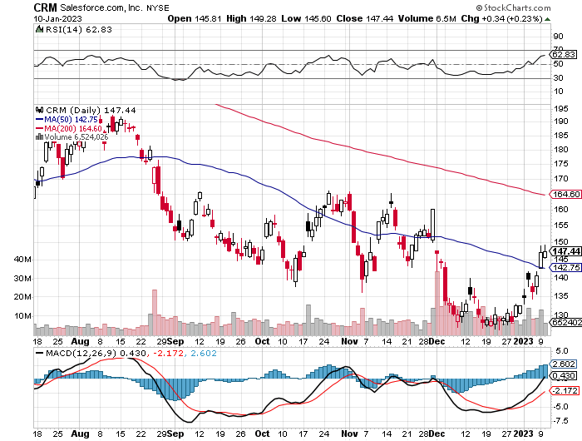
Salesforce (CRM)- Massive Online Migration took profits on long 9/$125-$130 vertical bull call spread took profits on long 8/$125-$130 vertical bull call spread took profits on long 2/$105-$115 call spread

Slide 38
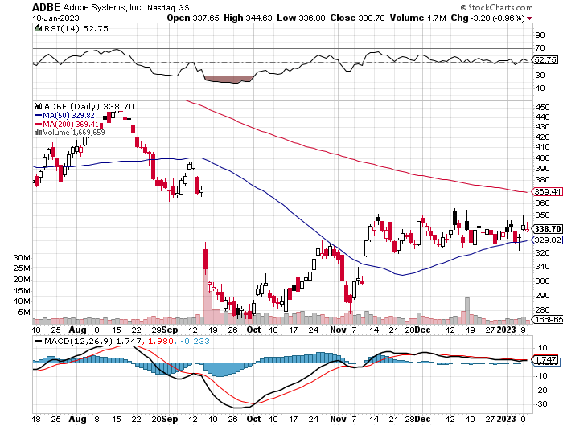
Adobe (ADBE)- Cloud play
The Quality Non-China tech play

Slide 39
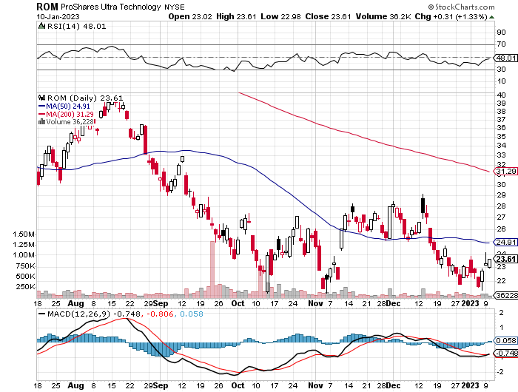
ProShares Ultra Technology ETF (ROM) – 2X Long Technology ETF took profits on long 10/$62-65 call spread

Slide 40
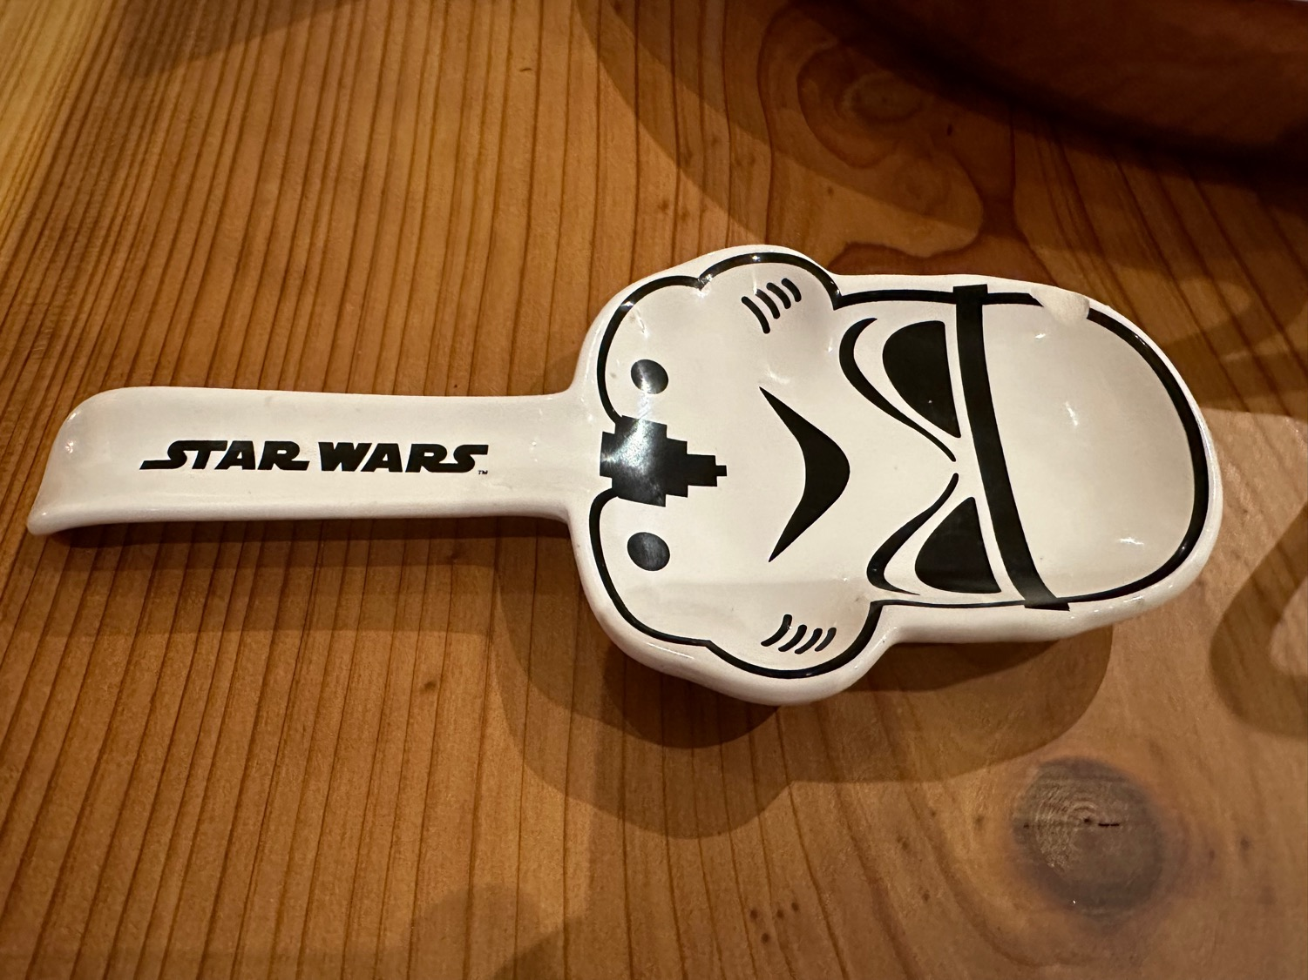

Slide 41
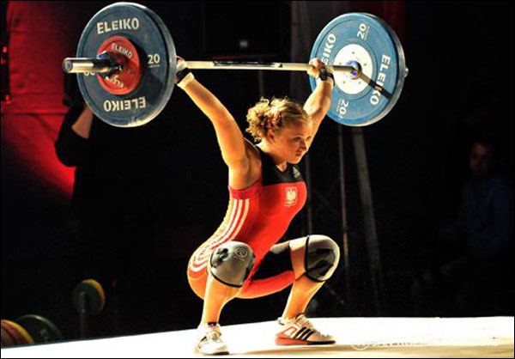
The Second Half of the Barbell
*Bets on a domestic recovery in 2022 Q4
*Upside potential in 2022 far greater than tech
*Some of these have not moved for 5 or 10 years
*Focuses on economically sensitive cyclical industries
*Makes a great counterweight to
high-growth technology
*We could spend all of next year rotating
between the two groups

Slide 42
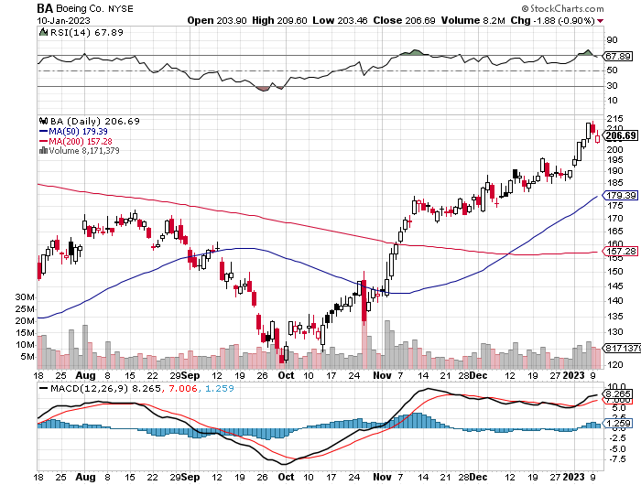
Boeing (BA) –United orders 100 787 Dreamliner's other airlines will have to follow to stay competitive
Boeing Delivered its First 787 Dreamliner in a year long 3/$146-$149 call spread

Slide 43
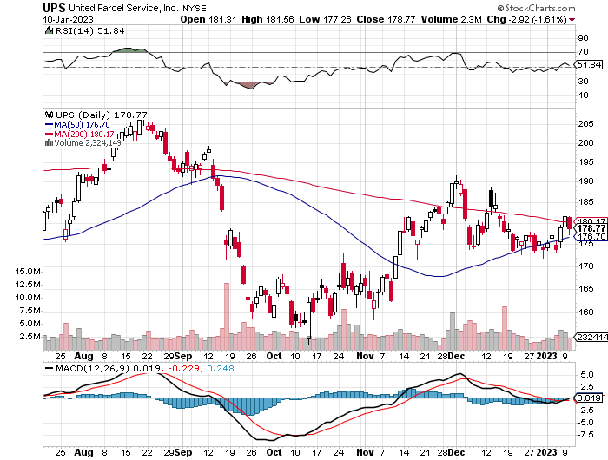
Package Delivery- United Parcel Service (UPS) - took profits on long 11/$130-$140 call spread

Slide 44
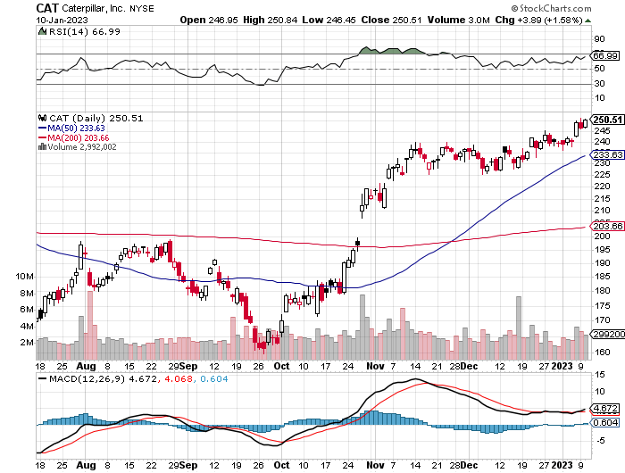
Caterpillar (CAT)- Ag + Infrastructure + Housing
Raises Dividend by 50% took profits on long 12/$145-$150 call spread took profits on long 11/$125-$135 call spread

Slide 45
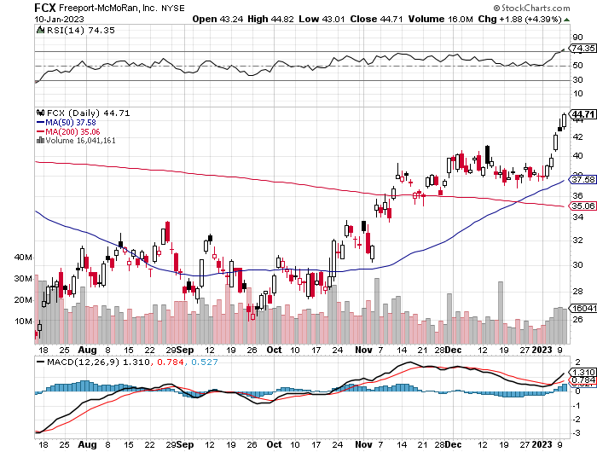
Freeport McMoRan - (FCX)- Copper Play took profits on long 10/$20-$23 call spread

Slide 46
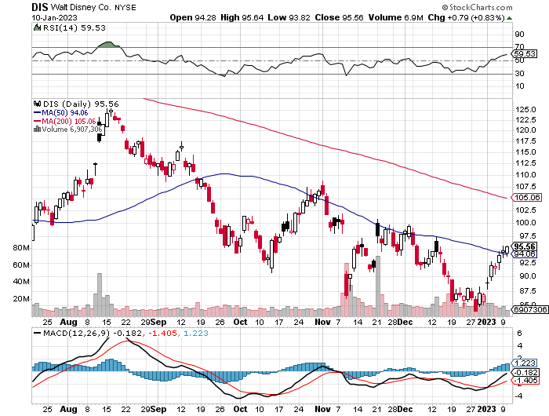
Walt Disney (DIS) - Not a recession play stopped out of long 10/$165-$175 call spread took profits on long 3/$170-$180 call spread

Slide 47
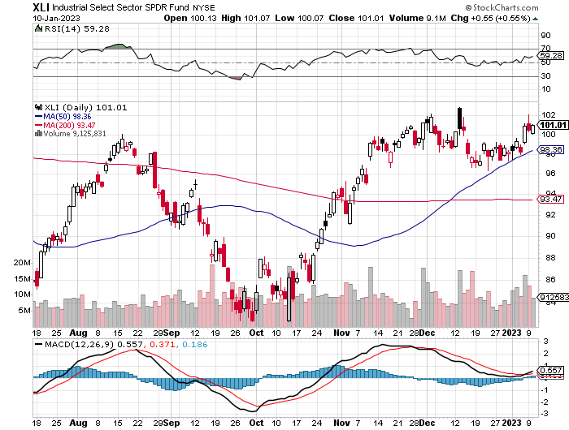
Industrials Sector SPDR (XLI)-
(GE), (MMM), (UNP), (UTX), (BA), (HON)

Slide 48
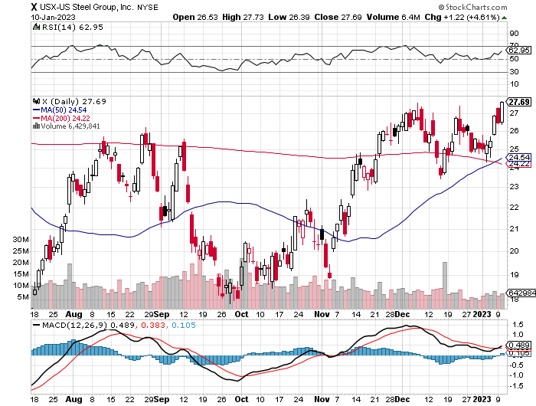
US Steel (X) – Commodity Boom and Wartime boost

Slide 49
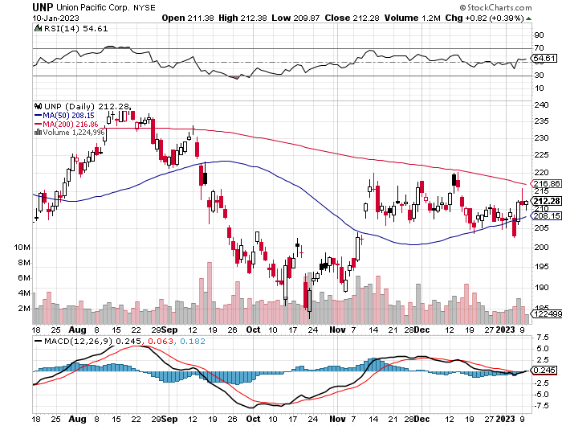
Union Pacific RR (UNP)- Big Stuff to Ship took profits on long 5/$200-$210 call spread took profits on 11/$150-$160 call spread

Slide 50
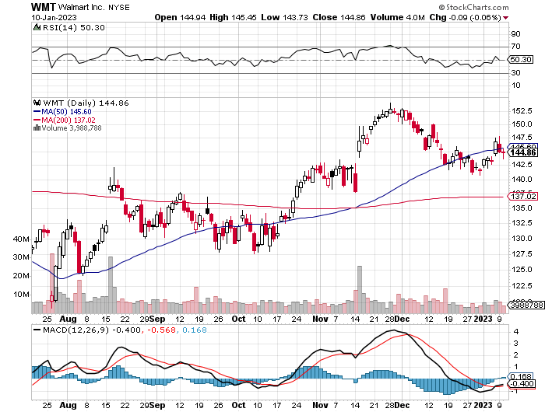
Wal-Mart (WMT)- took profit on Long 11/$125-$130 bear put spread took profit on Long 10/$119-$121 bear put spread took profits on Long 8/$114-$117 bear put spread

Slide 51
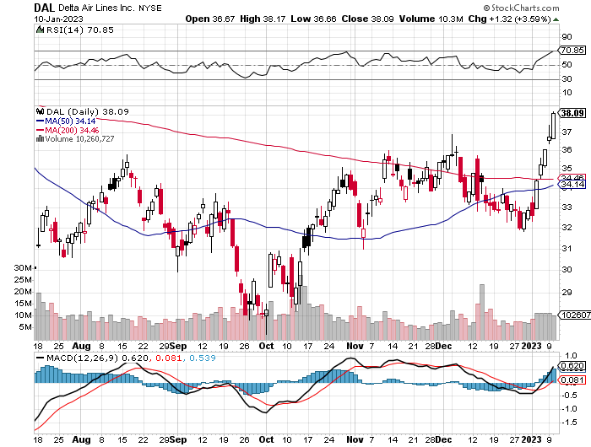
Delta Airlines (DAL) – Travel is Back!

Slide 52
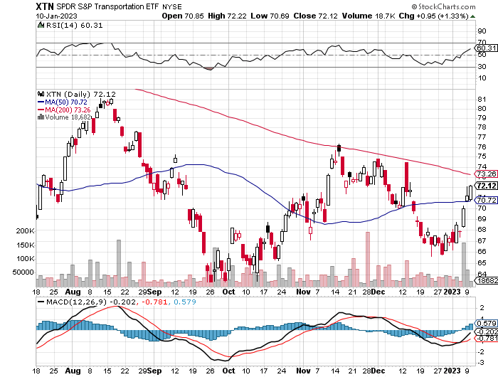
Transports Sector SPDR (XTN)- Worst Hit Sector
(ALGT), (ALK), (JBLU), (LUV), (CHRW), (DAL)

Slide 53
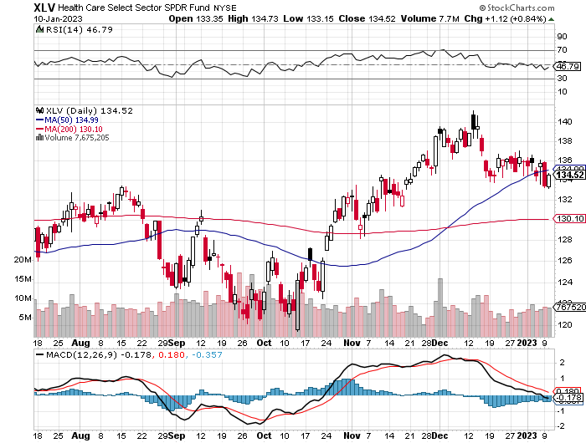
Health Care Sector (XLV)
(JNJ), (PFE), (MRK), (GILD), (ACT), (AMGN)

Slide 54
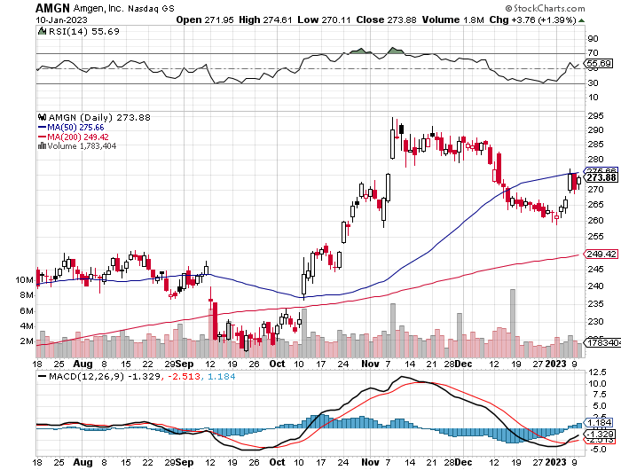
Amgen (AMGN) took profits on long 11/$185-$200 bull call spread

Slide 55
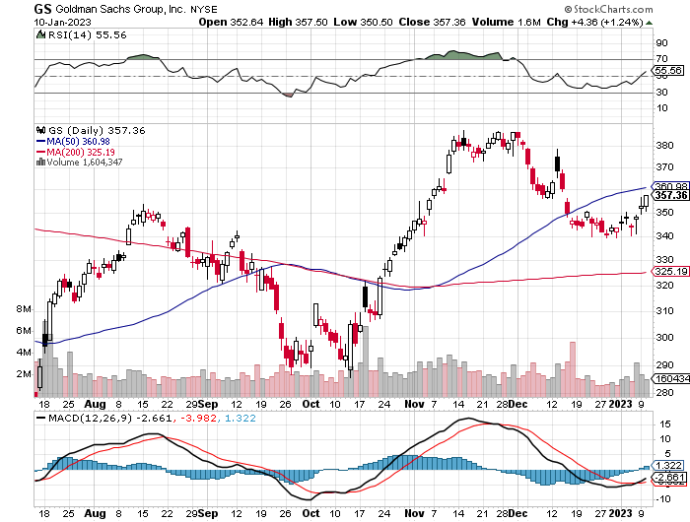
Goldman Sachs (GS) – took profits 12/$330-$350 call spread took profits 11/$330-$350 call spread stop loss on long 11/$385-$395 call spreads

Slide 56

Morgan Stanley (MS) – took profits on long 10/$85-$90 call spread

Slide 57

JP Morgan Chase (JPM)- took profits on long 10/$85-$90 call spread, stopped out of long 10/$95-$100 call spread took profits long 12/$148-$152.50 call spread

Slide 58

Bank of America (BAC) – took profits long 12/$39-$42 call spread

Slide 59

SPDR Metals & Mining ETF (XME) – long 2/$28-$30 call spread

Slide 60

Blackrock (BLK)-Asset Collection Boom took profits on long 3/$770-$790 call spread took profits on long 3/$310-$340 call spread

Slide 61

Visa (V) – “Touchless” Bitcoin Drag
Inflation play, Double digit grower, 50% profit margin, and big buyer of its own stock took profits on long 10/$160-$170 bull call spread took profits on long 6/$150-$160 bull call spread

Slide 62

Consumer Discretionary SPDR (XLY)
(DIS), (AMZN), (HD), (CMCSA), (MCD), (SBUX)

Slide 63

Berkshire Hathaway (BRKB)- Natural Barbell long 1/$290-$300 call spread, took profits on long 10/$220-$230 call spread, took profits on long 7/$220-$230 call spread, took profits on long 7/$220-$230 call spread took profits on long 6/$260-$270 call spread

Slide 64

Europe Hedged Equity (HEDJ)-

Slide 65

Japan (DXJ)-

Slide 66

Emerging Markets (EEM) - Pro trade, Weak Dollar, Long Recovery Play

Slide 67


Slide 68

Bonds – A New Default Risk
*A new cloud overhangs the bond market as a government shutdown and default looms over the market this summer as chaos reigns in the House of Representatives
*The House controls all spending in the US government with a majority
of 4, soon to be an unmanageable 3.
*(TLT) should reach $120 in 2023 without political interreference
*Keep buying (TLT) calls, calls spreads and LEAPS on dips
*Junk bond ETF’s (JNK) and (HYG) were up two points
*30-year fixed rate mortgages dropped 80 basis points to 6.48%
*US Budget Deficit Drops by Half, after the sharpest
decline in government spending in history
*Buy (TLT), (JNK), (HYG) on dips

Slide 69

Treasury ETF (TLT) – Triple Long long 1/$96-$99 call spread, long 1/$95-$98 call spread, long 2/$95-$98 call spread, took profits on long 11/$96-$99 call spread, took profits on long 12/$94-$97 call spread took profits on long 12/$91-$94 call spread, took profits on long 12/$92-$95 call spread, took profits on long 12/$93-$96 call spread

Slide 70

Ten Year Treasury Yield ($TNX) – 3.46%

Slide 71

Junk Bonds (HYG) 5.04% Yield to Maturity

Slide 72

Municipal Bonds (MUB) 2.02% Yield-
Strong dollar disease

Slide 73

Emerging Market Debt (ELD) 5.37% Yield-
Strong dollar disease

Slide 74

2X Short Treasuries (TBT)-Another run at highs

Slide 75


Slide 76

Foreign Currencies – Robust Yen
*Japan Reverses 30 Year Easy Money Policy, allowing interest rates to float up from 0.25% to 0.50%.
*The Japanese yen soared 4% on the move, the world most shorted currency, which hedge funds used to fund all positions
*Swiss National Bank Posts Record Losses, at $143 billion after supporting a falling Swiss franc against a strong dollar in 2022
*Buy the Euro (FXE), Australian dollar (FXA),
British Pound (FXB), and Japanese yen (FXY)
*China lockdowns will keep the Yuan relatively weak
*Strong currencies will also deliver major bull markets in
emerging market stocks (EEM) and (CEW)

Slide 77



THE MAD HEDGE FUND TRADER
Australian Dollar (FXA) - Major Long-Term Bottom is In Targeting Parity – A call option on a global synchronized recovery
1:1
BUY

Slide 78

Japanese Yen (FXY)
2023
Target
25%

Slide 79

Euro (FXE)-
2023
Target
25%

Slide 80

British Pound (FXB)-
2023
Target
15%

Slide 81


Emerging Market Currencies (CEW)
2023
Target
40%

Slide 82


Slide 83

Energy & Commodities – The Death of OPEC
*The $60 Cap on oil purchases from Russia is succeeding
*It amounts to a de facto, oil buyers cartel led by the International Energy Agency
*The west is not short of oil, it’s just in the wrong places
*The US is now in world’s top oil producer,
followed by Saudi Arabia and Russia
*Massive supplies from the US headed
off Europe’s energy crisis
*As a result, natural gas has crashed, and oil is
hitting one-year lows
*Avoid all energy plays like the plague
*It’s the last asset to own going into a recession

Slide 84


Slide 85

Oil-($WTIC)

Slide 86

United States Oil Fund (USO)

Slide 87

Energy Select Sector SPDR (XLE)-No Performance!
(XOM), (CVX), (SLB), (KMI), (EOG), (COP)

Slide 88

ExxonMobile (XOM)- took profits on long 12/$120-$125 put spread

Slide 89

Occidental Petroleum (OXY)- took profits on long 12/$77.50-$82.50 put spread

Slide 90

Natural Gas (UNG) -

Slide 91
Freeport McMoRan (FCX) -

Slide 92

Cameco (CCJ) - took profits on long 5/$20-$23 bull call spread

Slide 93


Slide 94

Precious Metals – Major Breakout
*Gold and silver deliver a major upside breakout, hitting seven-month highs
*With interest rates certain to plummet in 2023 as the Fed reacts to a recession, Precious metals could be one of the big trades for next year
*Gold turned out to be a far better diversification
than crypto
*The demise of crypto puts a new focus on gold
*Buy (GLD), (GDX), and (GOLD) on dips.

Slide 95

Gold (GLD) - Deflation call took profits on long 5/$165-$170 bull call spread

Slide 96

Market Vectors Gold Miners ETF- (GDX) –

Slide 97

Barrick Gold (GOLD) long 1/$15.50-$16.50 call spread

Slide 98

Newmont Mining- (NEM)- took profits on long $55-60 call spread

Slide 99

Silver- (SLV)- took profits on long 11/$19-$20 call spread

Slide 100

Silver Miners - (SIL)-

Slide 101

Wheaton Precious Metals - (WPM)- long 1/$36-$39 call spread

Slide 102


Slide 103

Real Estate – Still in Recession
*Existing Home Sales Collapse, down 7.7% in November to a seasonally adjusted 4.09 million units. They are off 35.4% YOY
*Case Shiller Drops to 9.24% Annual Gain, in October with its National Home Price Index, the fourth consecutive monthly decline
*Homebuilder Sentiment is Still Dropping, from 34 to 31
in December, compared to 84 a year ago
*Manhattan Apartment Sales Plunge, as brokers fear a frozen market
*Consumer Confidence in Housing is Recovering,
according to data from Fannie Mae. Thank falling
prices and interest rates

Slide 104

S&P Case Shiller Plunges
S&P Case Shiller Drops 9.24%, in September with its National Home Price Index
Miami (+21.0%), Tampa (+20.5%), Charlotte NC (+15.0%)

Slide 105

Crown Castle International (CCI) – 4.30% yielding cell phone tower REIT

Slide 106

US Home Construction Index (ITB)
(DHI), (LEN), (PHM), (TOL), (NVR)

Slide 107


Slide 108

Trade Sheet-
So What Do We Do About All This?
*Stocks – buy the big dips at bottom of range,
………………sell rallied to hedge
*Bonds – buy dips
*Commodities-buy dips
*Currencies- sell dollar rallies
*Precious Metals – buy dips
*Energy – stand aside
*Volatility - sell short over $30
*Real estate – buy dips

Slide 109


Slide 110

Next Strategy Webinar
12:00 EST Wednesday, January 25 from Silicon Valley, CA email me questions at support@madhedgefundtrader.com
Good Luck and Good Trading!
Notes:
*

Slide 111


Slide 112


