Slide 1
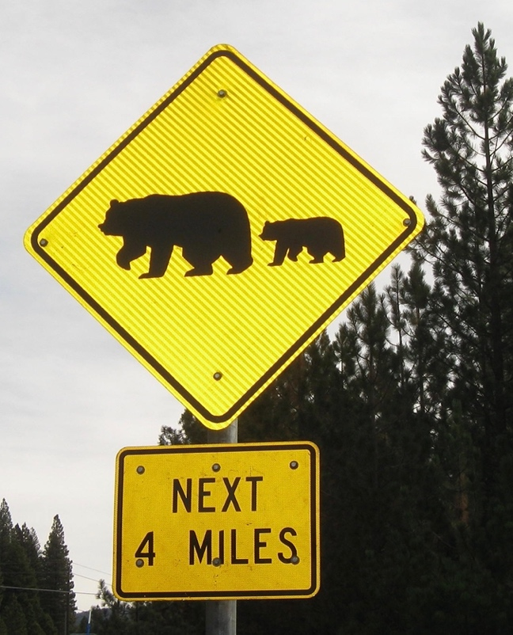
The Mad Hedge Fund Trader “Where’s the Bear?””
With John Thomas Silicon Valley, CA, January 25, 2023 www.madhedgefundtrader.com
Notes:
*

Slide 3
February 17 Honolulu, Hawaii Strategy Luncheon
*An excellent meal will be followed by a wide-ranging discussion and an extended question and answer period *The lunch will be held at a private club in Honolulu *please go to my online store at http://www.madhedgefundtrader.com/store and click on “luncheons.”

Slide 4
July 13, 2023 Seminar at Sea
*Cunard Line’s flagship, the elegant and spacious Queen Mary II, on an eastbound transatlantic cruise *The Ship departs New York at 12:00 AM on July 7, 2023, and arrives at Southampton on July 14 *Guests will be responsible for booking their own cabin through Cunard *Three dinners during the voyage will be black tie *Customers are required to book their own cabins and return flights from England *The Cunard cruise number is M319

Slide 5
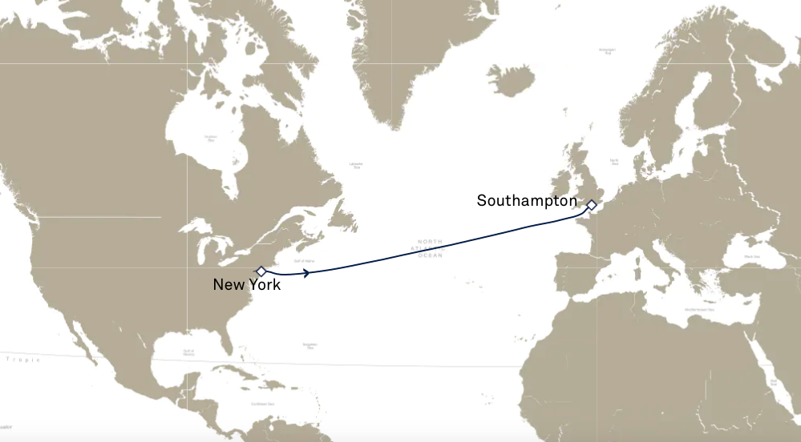

Slide 6
Trade Alert Performance New All Time Highs! 22 out of 23 trade alerts profitable
*January +20.65% MTD *July +3.98% Final *February +8.78% Final *August +5.13% Final *March +3.43% Final *September +9.72% Final *April +3.33% Final *October +5.69% Final *May +8.80% Final *November +8.31 Final *June +5.91% Final *December +0.95% Final *2022 Final +84.63% compared to -18.63% for the S&P 500 *2023 Year to Date +20.65%, +617.84% since inception *Average annualized return of +47.22% for 15 years

Slide 7
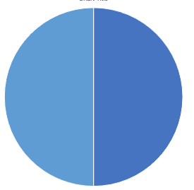
Portfolio Review 20% Long, 80% cash modestly long
Current Capital at Risk
Risk On
(OXY) 2/$55-$60 call spread | 10.00%
Risk Off
(QQQ) 2/$305-$315 put spread | -10.00%
Total Net Position | 0.00%
Total Aggregate Position | 20.00%
Expiration Value +23.79%

Slide 8
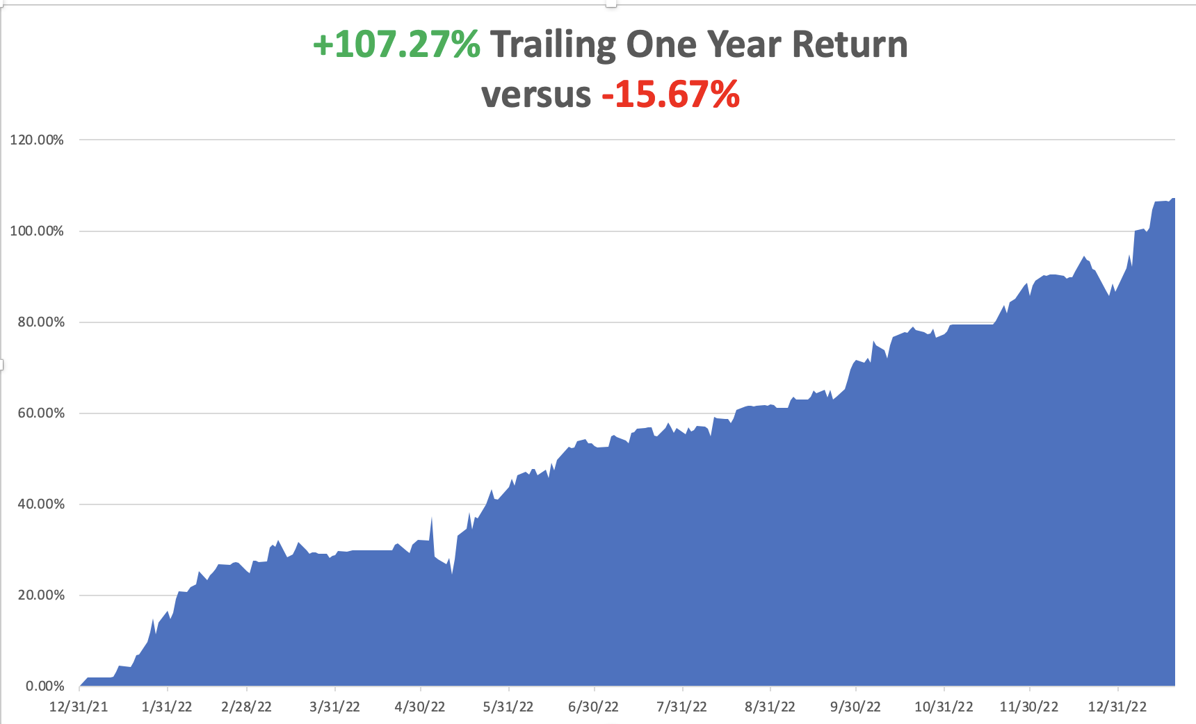

Slide 9
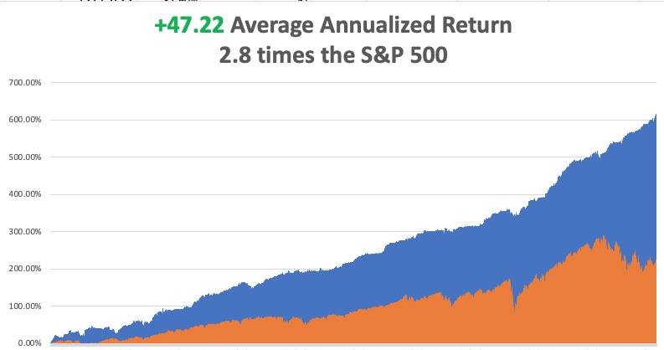

Slide 10
The Method to My Madness The Bottom is In
*The market is now pricing in only a 25-basis point rate hike on February 1, driving stocks higher, especially interest rate sensitive tech *A House intent on debt default has capped bonds for now *Energy is plumbing new lows on Russia military failures, warm weather, and a supply glut. Only a China post Covid recovery can save it *Gold and Silver deliver major upside breakouts that continue *2023 could be the year of commodities *The US dollar has topped and will be weak for a decade *Look for S&P 500 at $4,800 by end 2023 *VIX dives to $18 – NO TRADE

Slide 11
The Global Economy – Struggling
*Recession Risk Falls, from a 98% probability to only 73% according to an advanced model from JP Morgan Bank *Tech Layoffs Top 70,000, or 2% of the tech workforce *Fed May Retreat to 25 Basis Point, in their February 1 rate hike *China is Back, with a 3% GDP print for 2022 *China Reopening Accelerates, and may well head off a global recession *Wholesale Prices Drop 0.5% in December versus an expected 0.1% in another big step toward the unwind of inflation. *US Consumer Inflation Expectations are Falling, the one-year view slipping from 4.4% to 4.0%, *Inflation to Drop to 5% in a Year, according to a survey taken by the New York Fed

Slide 12
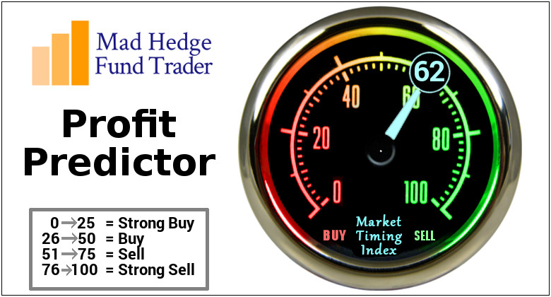
The Mad Hedge Profit Predictor Market Timing Index – Neutral An artificial intelligence driven algorithm that analyzes 30 different economic, technical, and momentum driven indicators

Slide 13
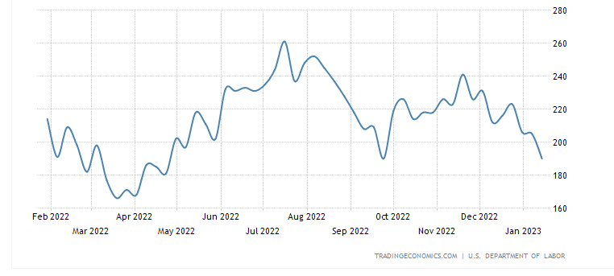
Weekly Jobless Claims – Falling 190,000 – Down 15,000

Slide 14
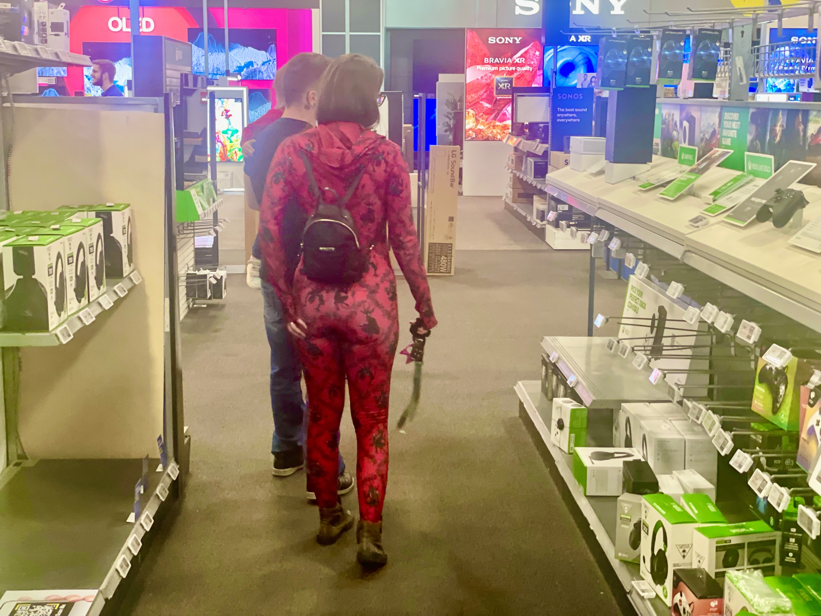

Slide 15
Stocks – Things are better than they appear
*This Year Won’t Be as Bad as Last, or so hope the bulls that have been piling into stocks since January 3 *The weakness in tech stocks actually understate the ballistic moves in value, metals, and financial stocks, which Mad Hedge is long *Banks Disappoint on Earnings, smacking stocks *2023 is still seeing a massive short cover, but are still stuck in the range *Commodity plays will lead, oil plays will lag *Financials will also be a strong sector with Biotech as the safety trade *Netflix Blows it Away, with 6.7 new subscribers, taking the stock up 7%, and 125% from the May low. *Look for terrible H1 and strong H2 scenario to replay in 2023

Slide 16
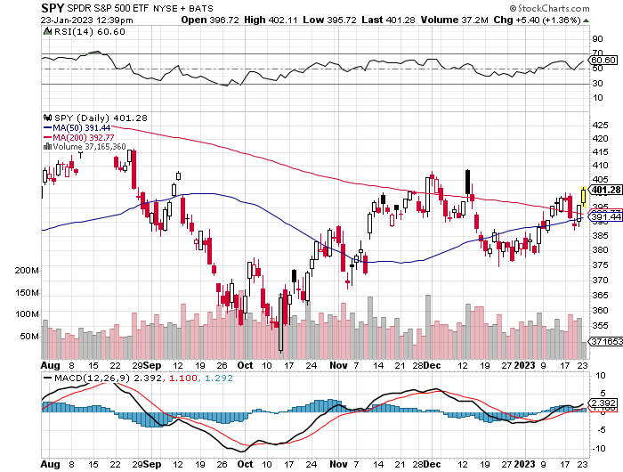
S&P 500 – The Worst Case-Severe Recession-Best-No Recession took profits on long 1/$420-$430 put spread, took profits on long 11/$420-$430 put spread took profits on long 10/$385-$395 put spread, took profits on long 11/$410-$400 put spread took profit on long 10/$390-$400 put spread, took profit on long 10/$320-$330 call spread
$410 +15% Rally
The Bottom $355 Down -26%

Slide 17
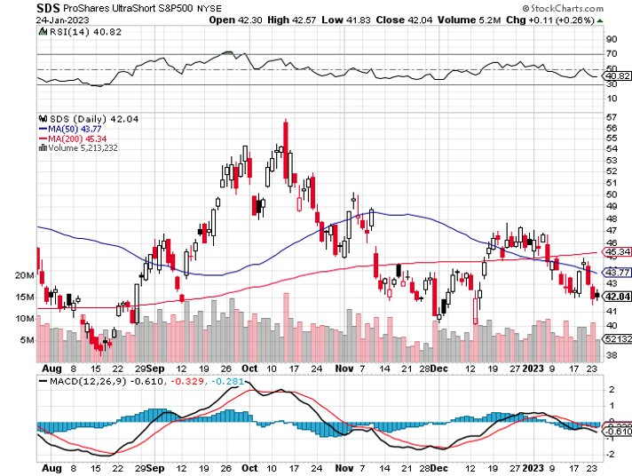
ProShares Ultra Short S&P 500 (SDS)- a great hedge for long stocks and bonds long 2X position has a hedge against longs and bond shorts

Slide 18
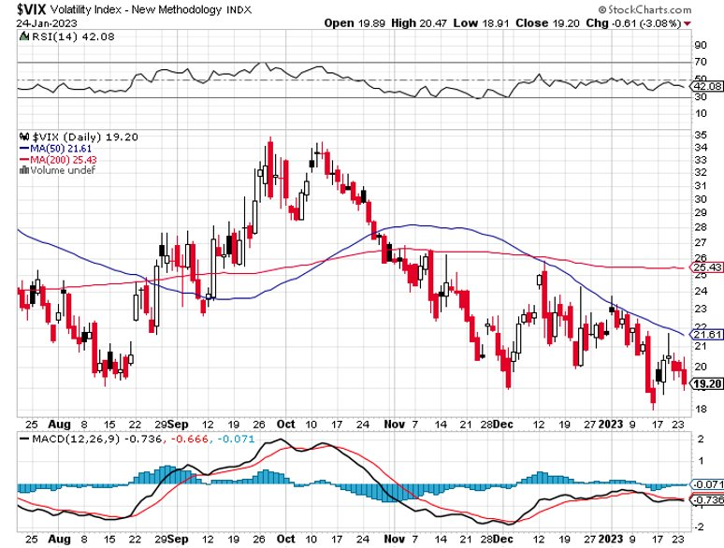
(VIX) – Bargain of the Century

Slide 19
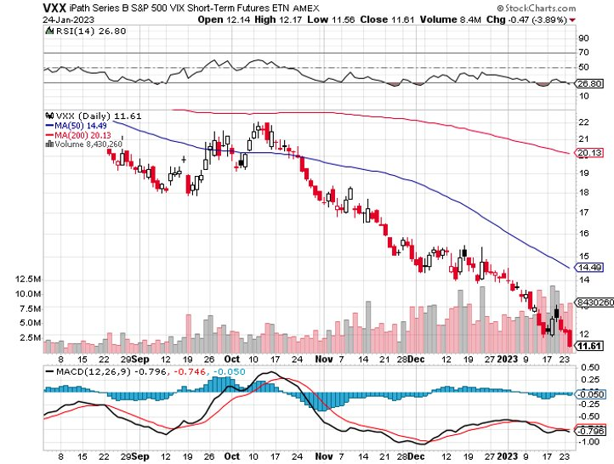
(VXX)-

Slide 20
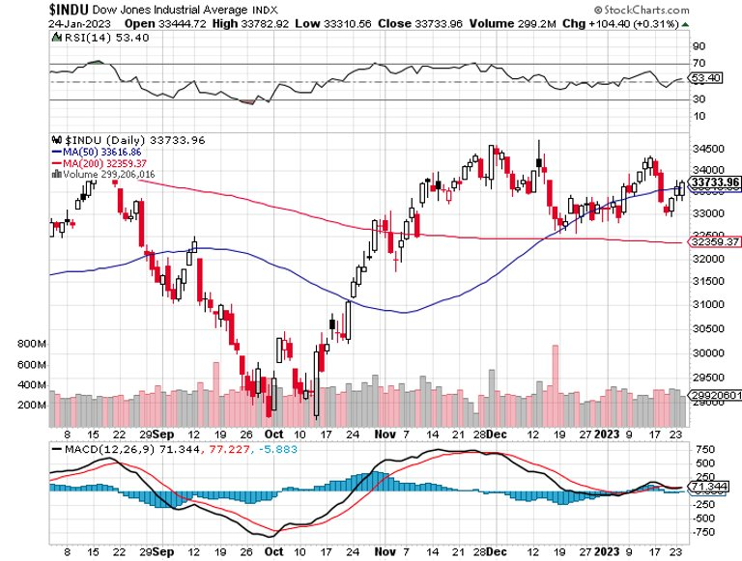
Dow Average ($INDU)-

Slide 21
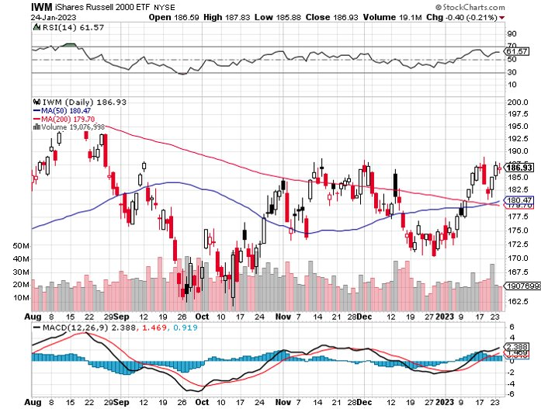
Russell 2000 (IWM)- took profits on Long 10/$137-$142 vertical bull call spread took profits on Long 10/$153-$156 vertical bear put spread

Slide 22
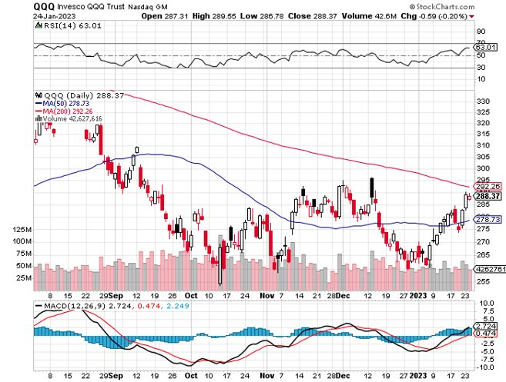
NASDAQ (QQQ) – took profits on long (QQQ) 1/$290-$300 put spread, took profits on long (QQQ) 4/$330-$335 put spread took profits on long (QQQ) 3/$340-$345 put spread, covered long (QQQ) $325-$330 put spread

Slide 23
The Barbell Portfolio
*50% Big Tech - 2% of US Employment but 27% of Market Cap and 38% of Profits 50% Domestic Recovery, including: Railroads Couriers Banks Construction Credit Cards Event organizers Ticket sales Retailers

Slide 24
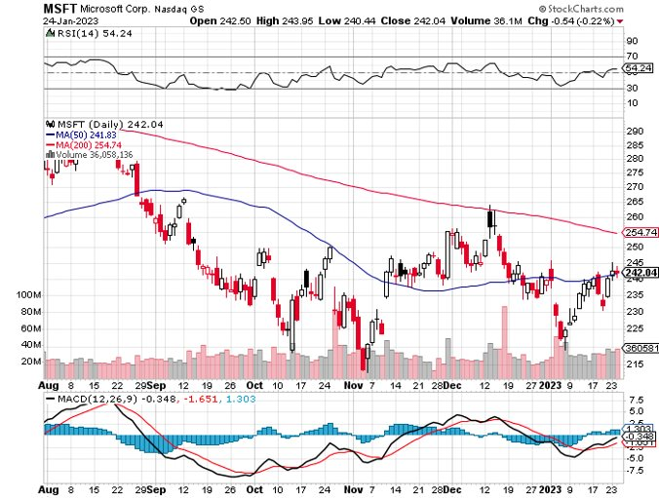
Microsoft (MSFT)- took profits on 9/$235-$245 call spread, took profits on long 7/$220-$210 call spread, took profits on long 6/$220-$230 call spread, took profits on long 2/$200-$210 bear put spread

Slide 25
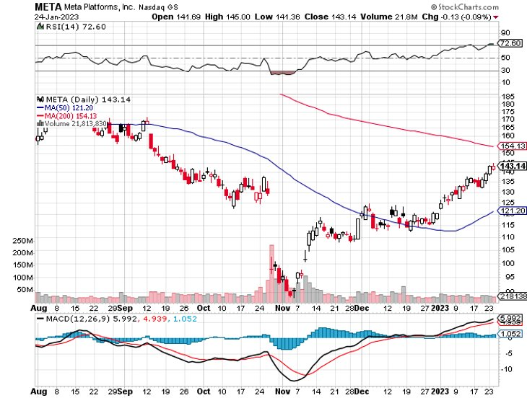
Meta (META)- Looking for the Metaverse took profits on Long 9/$290-$300 vertical bear put spread stopped out of Long 9/$190-$200 vertical bear put spread

Slide 26
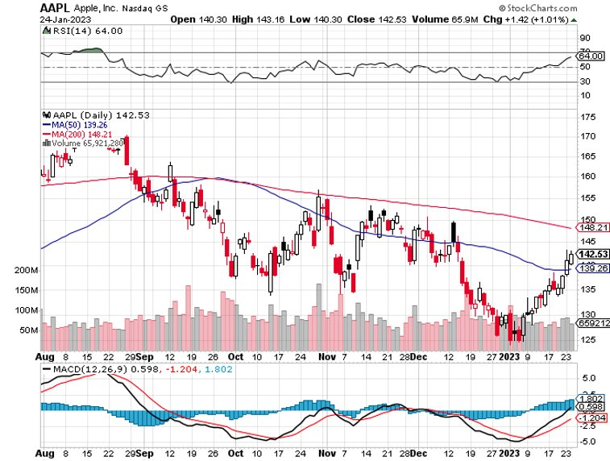
Apple (AAPL)-Cash Balance Falls from $175 billion to $25 billion took profits on long 1/$145-$155 put spread, Took profits on long 10/$165-$175 put spread took profits on long 6/$155-$165 put spread, stopped out of long 6/$125-135 call spread, took profits on long 6/$110-$120 call spread, took profits on long 2/$180-$190 put spread

Slide 27
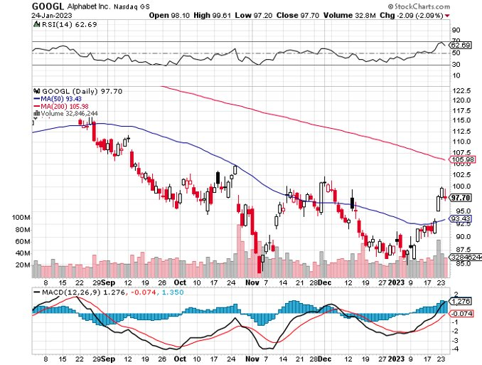
Alphabet (GOOGL) – Ad king on economic recovery $4.1 Billion fine for European antitrust took profits on long 12/$1,200-$1,230 bull call spread took profits on long 9/$1,030-$1,080 vertical bull call spread

Slide 28
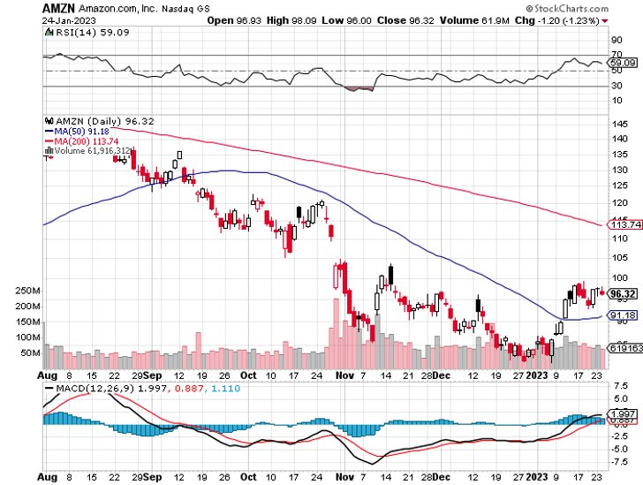
Amazon (AMZN) – Amazon to Lay Off 100,000 took profits on long 2/$3,400-$3,500 bear put spread took profits on long 9/$2,800-$2,900 bull call spread

Slide 29
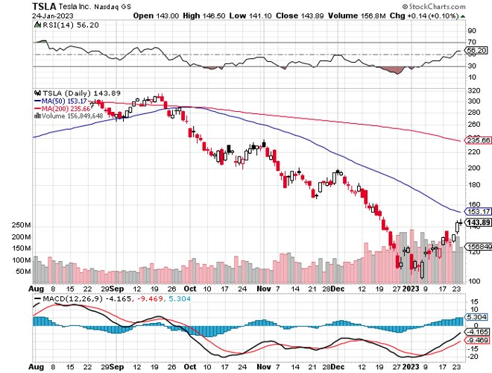
Tesla (TSLA) – Musk on Trial Tesla Cuts US Prices, up to 20% for the model 3 and 35% with subsidy long 2/$95-$100 call spread, took profits on long 1/$75-$80 call spread stopped out of long 12/$100-$110 call spread-worst trade of the year, took profits on long 12/$140-$150 call spread, too profits on long 12/$225-$230 put spread

Slide 30
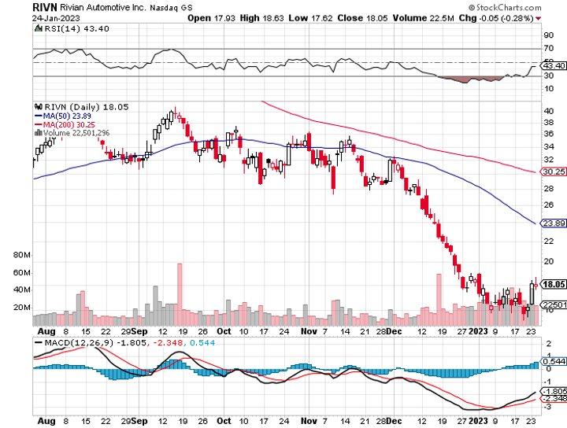
Rivian (RIVN) – Amazon Backed Electric Trucks Joint Venture with Mercedes Put on Hold took profits on long 10/$25-$30 call spread

Slide 31
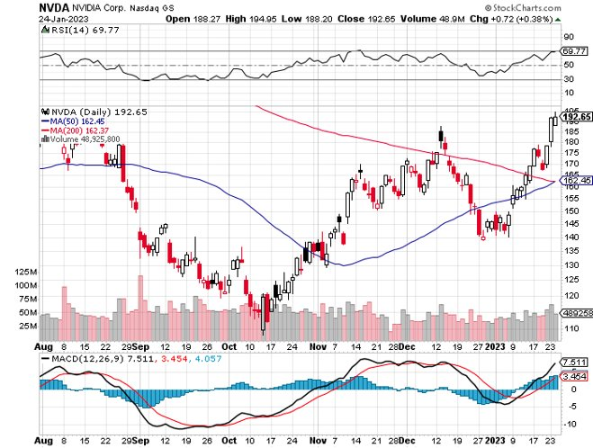
NVIDIA (NVDA) – Downgrade on US ban of highest end AI chips to China took profits on long 10/$95-$100 call spread took profits on long 7/$120-$130 call spread, took profits on long 6/$120-$130 call spread

Slide 32
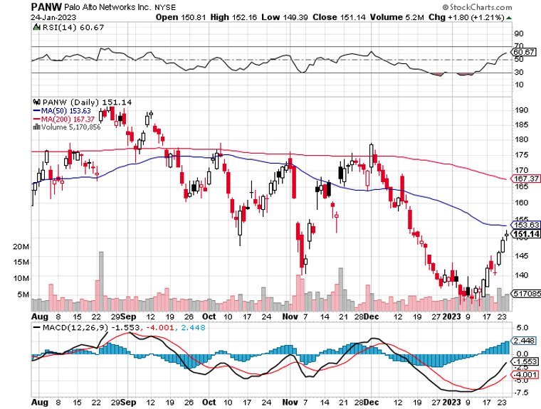
Palo Alto Networks (PANW)- Hacking never goes out of fashion took profits on long 10/$130-$140 call spread

Slide 33
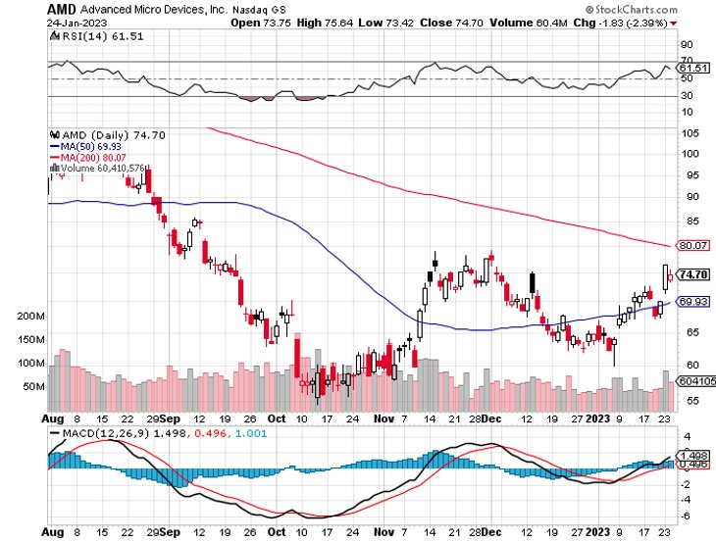
Advanced Micro Devices (AMD)- Recession fears programable logic devices took profits on long 2/$75-$80 call spread

Slide 34
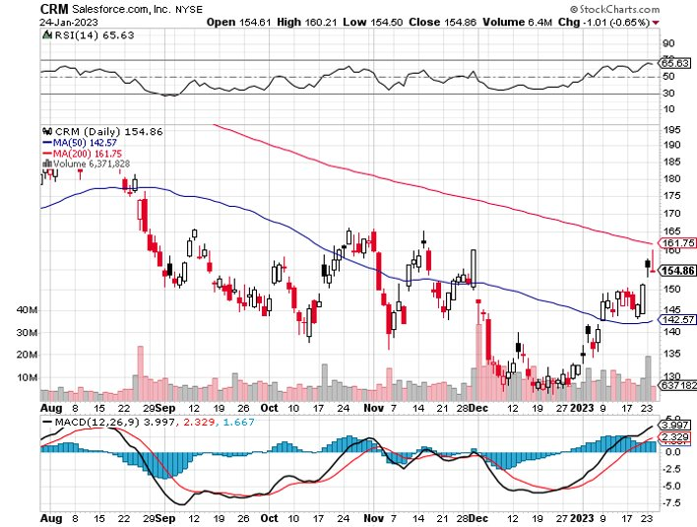
Salesforce (CRM)- Massive Online Migration took profits on long 9/$125-$130 vertical bull call spread took profits on long 8/$125-$130 vertical bull call spread took profits on long 2/$105-$115 call spread

Slide 35
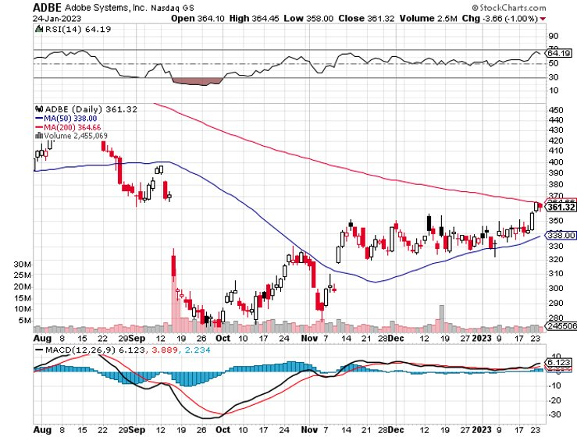
Adobe (ADBE)- Cloud play The Quality Non-China tech play

Slide 36
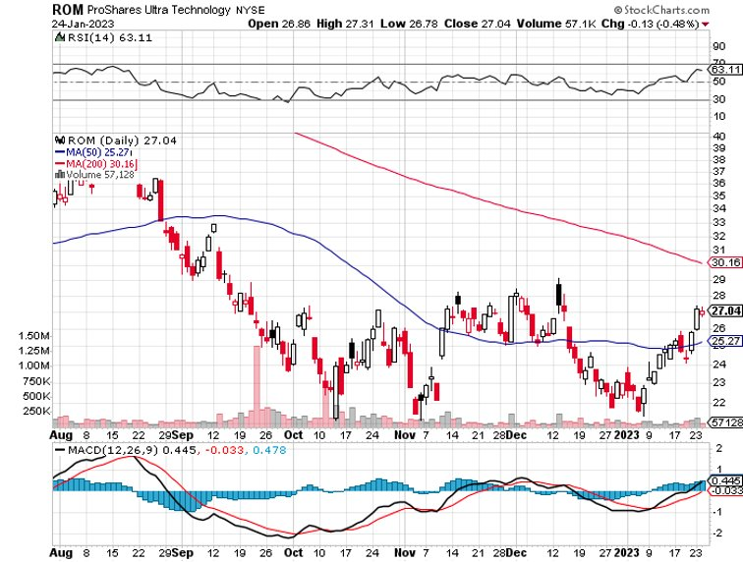
ProShares Ultra Technology ETF (ROM) – 2X Long Technology ETF took profits on long 10/$62-65 call spread

Slide 37
The Second Half of the Barbell
*Bets on a domestic recovery in 2022 Q4 *Upside potential in 2022 far greater than tech *Some of these have not moved for 5 or 10 years *Focuses on economically sensitive cyclical industries *Makes a great counterweight to high-growth technology *We could spend all of next year rotating between the two groups

Slide 38
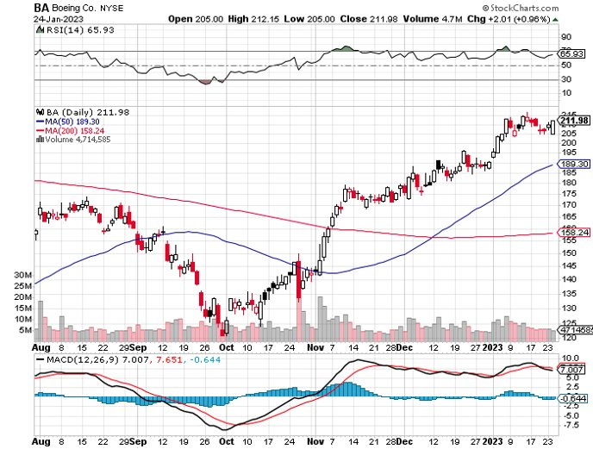
Boeing (BA) –Deliveries Soar from 340 to 480 in 2022, and 479 new orders Boeing Scores $425 Million NASA Contract to enhance engine fuel efficiencies long 3/$146-$149 call spread

Slide 39
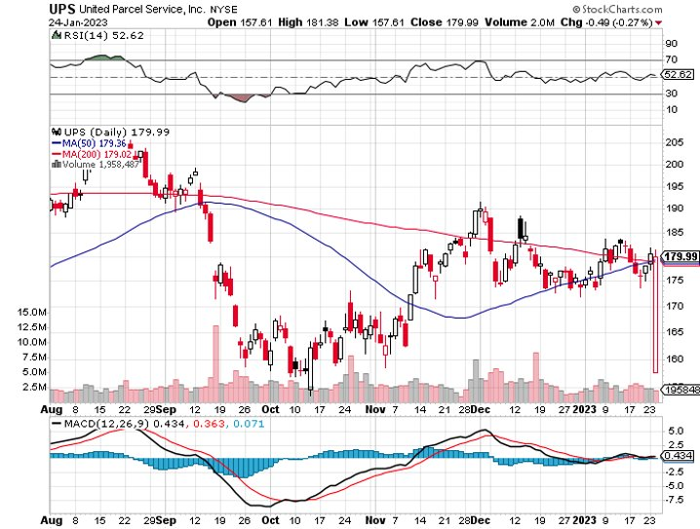
Package Delivery- United Parcel Service (UPS) - took profits on long 11/$130-$140 call spread

Slide 40
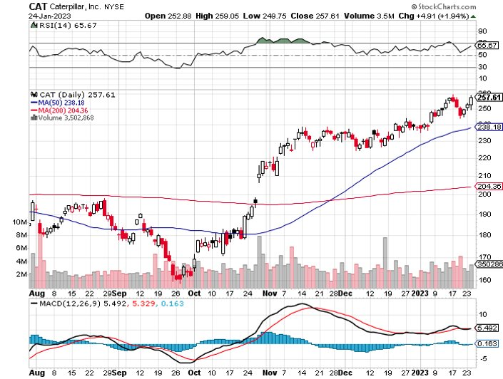
Caterpillar (CAT)- Ag + Infrastructure + Housing Raises Dividend by 50% took profits on long 12/$145-$150 call spread took profits on long 11/$125-$135 call spread

Slide 41
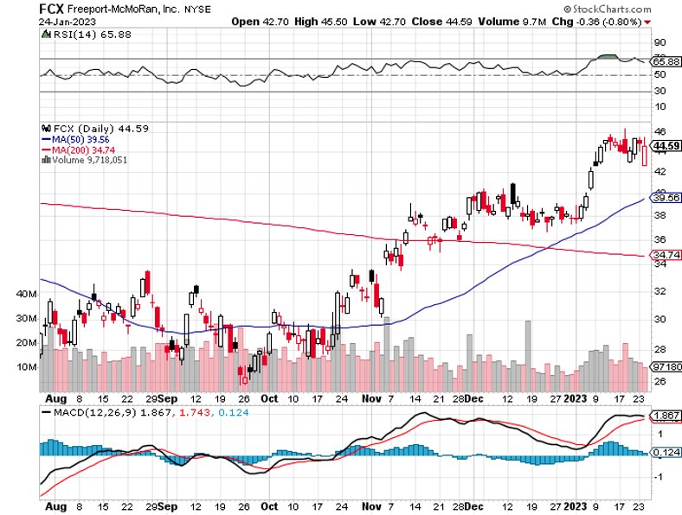
Freeport McMoRan - (FCX)- Copper Play took profits on long 10/$20-$23 call spread

Slide 42
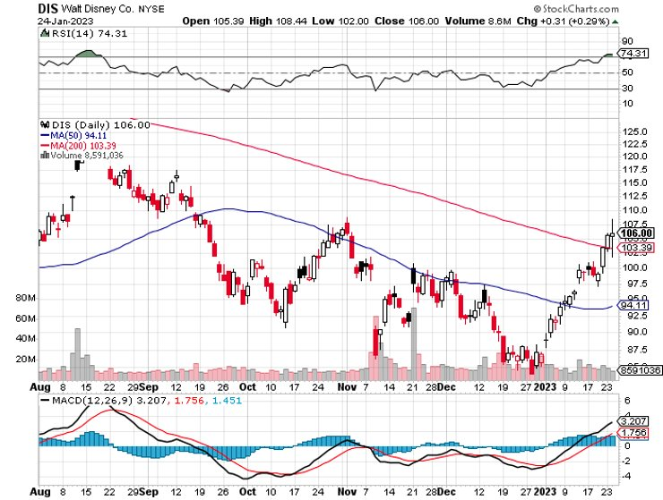
Walt Disney (DIS) - Not a recession play stopped out of long 10/$165-$175 call spread took profits on long 3/$170-$180 call spread

Slide 43
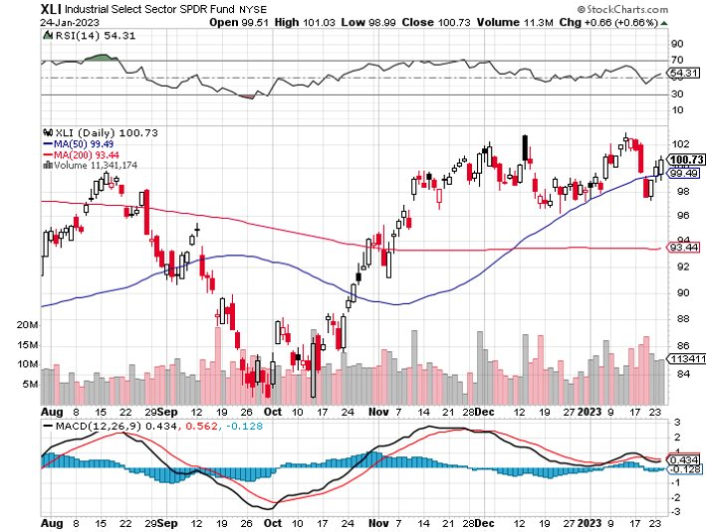
Industrials Sector SPDR (XLI)- (GE), (MMM), (UNP), (UTX), (BA), (HON)

Slide 44
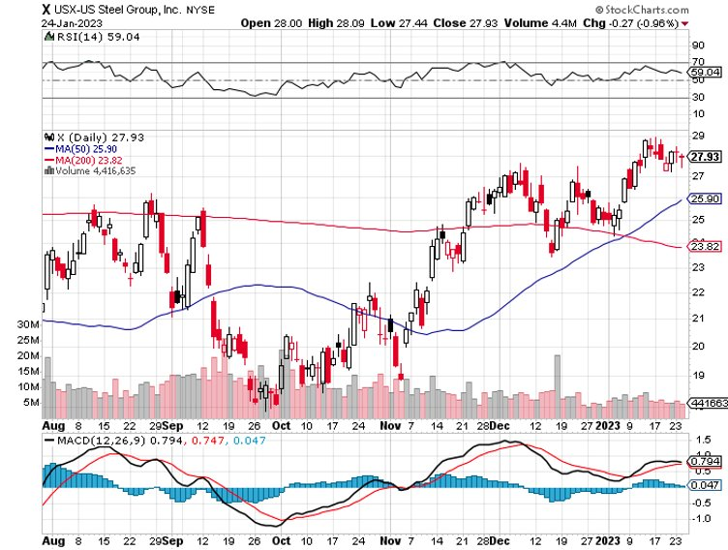
US Steel (X) – Commodity Boom and Wartime boost

Slide 45
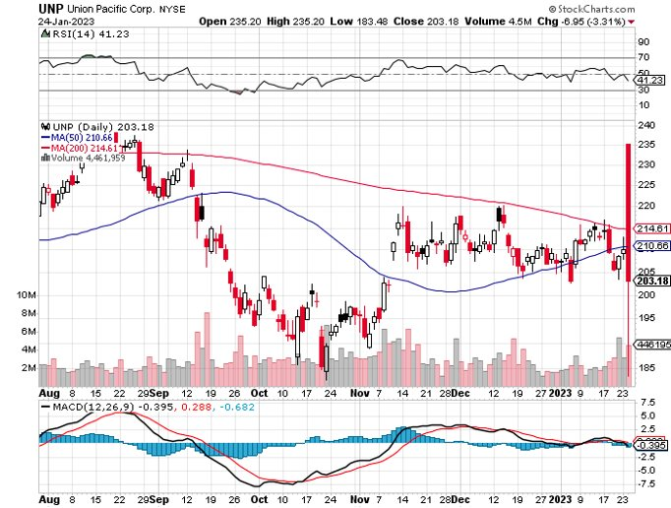
Union Pacific RR (UNP)- Big Stuff to Ship took profits on long 5/$200-$210 call spread took profits on 11/$150-$160 call spread

Slide 46
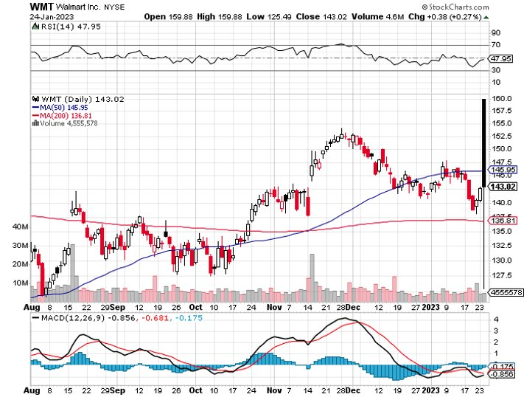
Wal-Mart (WMT)- took profit on Long 11/$125-$130 bear put spread took profit on Long 10/$119-$121 bear put spread took profits on Long 8/$114-$117 bear put spread

Slide 47
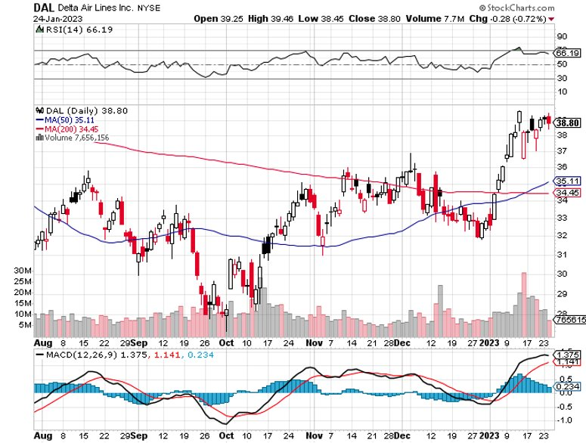
Delta Airlines (DAL) – Travel is Back!

Slide 48
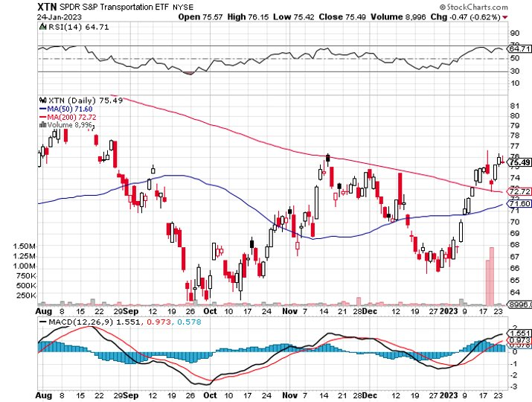
Transports Sector SPDR (XTN)- Worst Hit Sector (ALGT), (ALK), (JBLU), (LUV), (CHRW), (DAL)

Slide 49
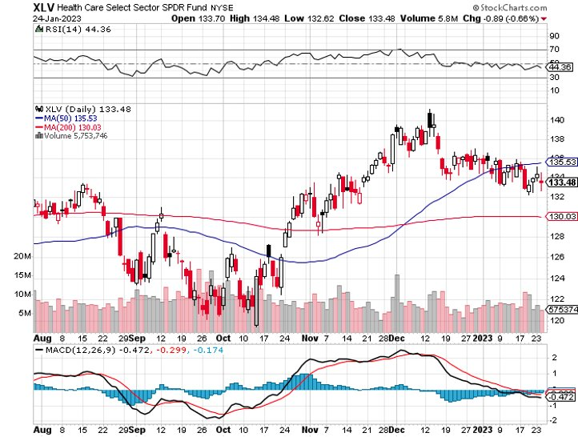
Health Care Sector (XLV) (JNJ), (PFE), (MRK), (GILD), (ACT), (AMGN)

Slide 50
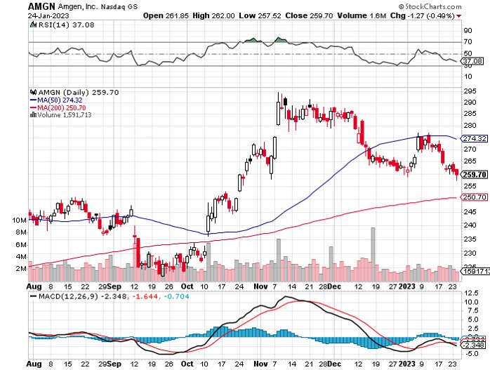
Amgen (AMGN) took profits on long 11/$185-$200 bull call spread

Slide 51
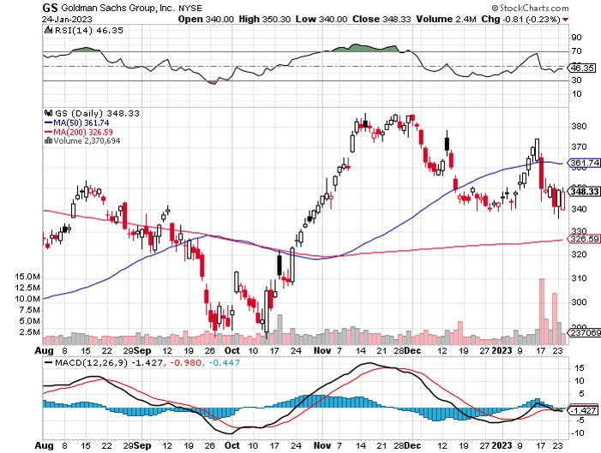
Goldman Sachs (GS) – took profits 12/$330-$350 call spread took profits 11/$330-$350 call spread stop loss on long 11/$385-$395 call spreads

Slide 52
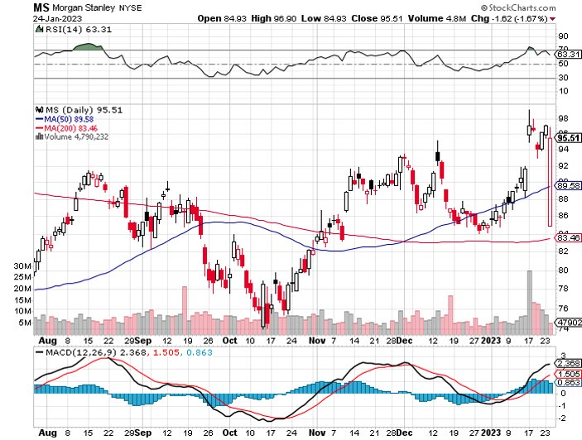
Morgan Stanley (MS) – took profits on long 10/$85-$90 call spread

Slide 53
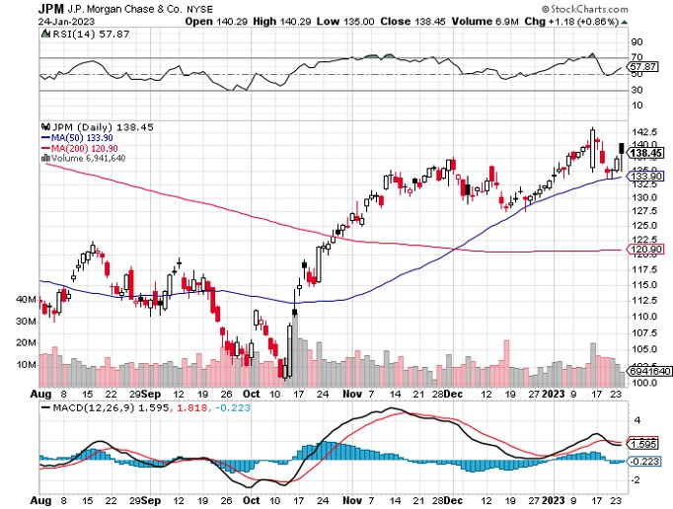
JP Morgan Chase (JPM)- took profits on long 10/$85-$90 call spread, stopped out of long 10/$95-$100 call spread took profits long 12/$148-$152.50 call spread

Slide 54
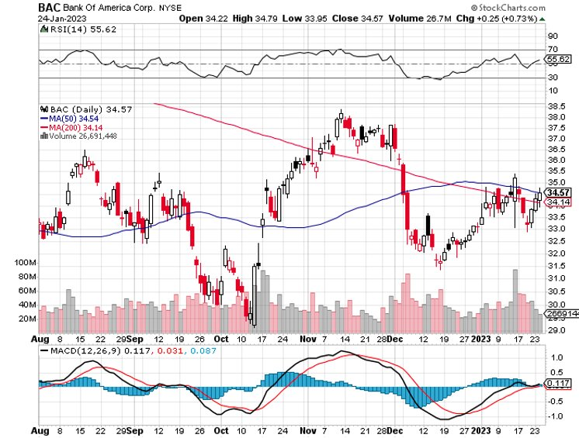
Bank of America (BAC) – took profits long 12/$39-$42 call spread

Slide 55
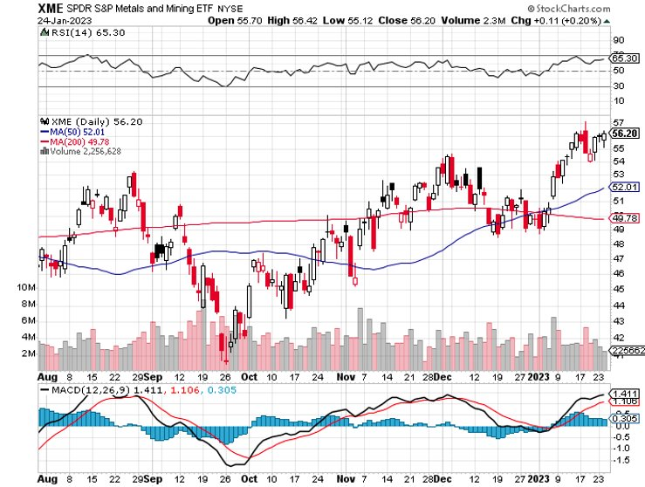
SPDR Metals & Mining ETF (XME) – long 2/$28-$30 call spread

Slide 56
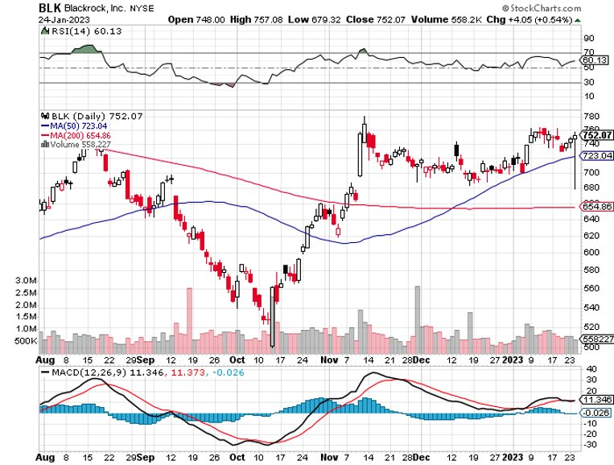
Blackrock (BLK)-Asset Collection Boom took profits on long 3/$770-$790 call spread took profits on long 3/$310-$340 call spread

Slide 57
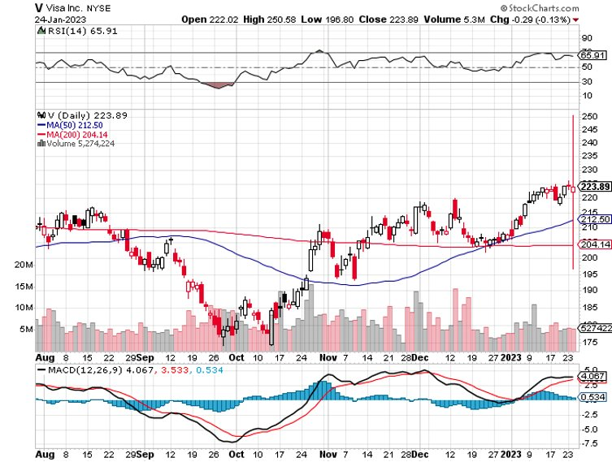
Visa (V) – “Touchless” Bitcoin Drag Inflation play, Double digit grower, 50% profit margin, and big buyer of its own stock took profits on long 10/$160-$170 bull call spread took profits on long 6/$150-$160 bull call spread

Slide 58
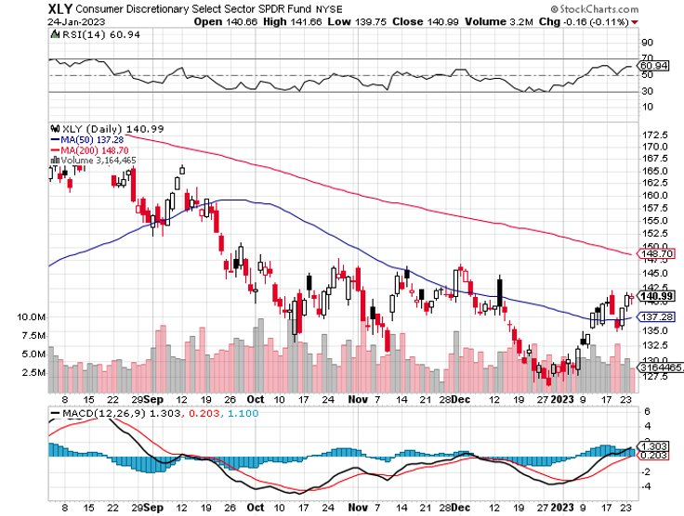
Consumer Discretionary SPDR (XLY) (DIS), (AMZN), (HD), (CMCSA), (MCD), (SBUX)

Slide 59
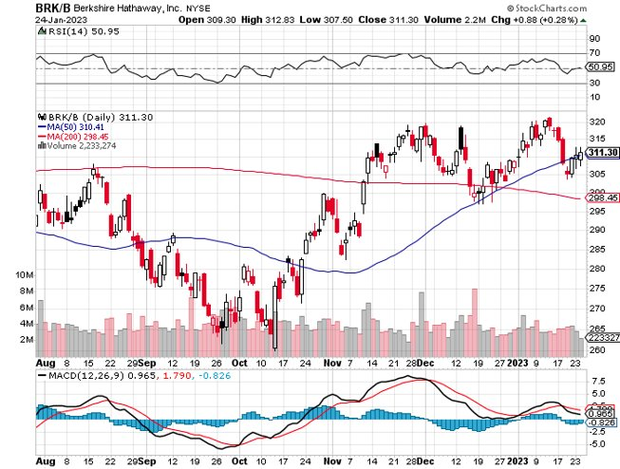
Berkshire Hathaway (BRKB)- Natural Barbell took profits on long 1/$290-$300 call spread, took profits on long 10/$220-$230 call spread, took profits on long 7/$220-$230 call spread, took profits on long 7/$220-$230 call spread took profits on long 6/$260-$270 call spread

Slide 60
Europe Hedged Equity (HEDJ)-

Slide 61
Japan (DXJ)-

Slide 62
Emerging Markets (EEM) - Pro trade, Weak Dollar, Long Recovery Play

Slide 64
Bonds – Political Chaos
*Treasury Secretary Warns of Coming US Bond Default, saying the government runs out of money by June, capping bond prices for the foreseeable future *Overweight Bonds at 60% of a balanced portfolio says bond guru Jeffrey Gundlach of DoubleLine *(TLT) should reach $120 in 2023 without political interreference *Keep buying (TLT) calls, calls spreads and LEAPS on dips *Junk bond ETF’s (JNK) and (HYG) were up two points
*US Budget Deficit Drops by Half, after the sharpest decline in government spending in history

Slide 65
Treasury ETF (TLT) – Triple Long took profits on long 1/$96-$99 call spread, took profits on long 1/$95-$98 call spread, took profits on long 2/$95-$98 call spread, took profits on long 11/$96-$99 call spread, took profits on long 12/$94-$97 call spread took profits on long 12/$91-$94 call spread, took profits on long 12/$92-$95 call spread, took profits on long 12/$93-$96 call spread

Slide 66
Ten Year Treasury Yield ($TNX) – 3.33%

Slide 67
Junk Bonds (HYG) 7.55% Yield to Maturity

Slide 68
Municipal Bonds (MUB) 2.06% Yield-

Slide 69
Emerging Market Debt (ELD) 6.72% Yield-

Slide 70
2X Short Treasuries (TBT)-Out of Favor

Slide 72
Foreign Currencies – Dollar Fade
*Japan Inflation Hits 41-Year High, exceeding the central bank’s target for nine consecutive months. *Expecting another interest rate rise, the Japanese yen spiked to a new four month high at ¥128.5. Japan Reverses 30 Year Easy Money Policy, allowing interest rates to float up from 0.25% to 0.50%. *Buy the Euro (FXE), Australian dollar (FXA), British Pound (FXB), and Japanese yen (FXY) *China lockdowns will keep the Yuan relatively weak *Strong currencies will also deliver major bull markets in emerging market stocks (EEM) and (CEW)

Slide 73
THE MAD HEDGE FUND TRADER
Australian Dollar (FXA) - Major Long-Term Bottom is In Targeting Parity – A call option on a global synchronized recovery
1:1
BUY

Slide 74
Japanese Yen (FXY)
2023 Target 25%

Slide 75
Euro (FXE)-
2023 Target 25%

Slide 76
British Pound (FXB)-
2023 Target 15%

Slide 77
Emerging Market Currencies (CEW)
2023 Target 40%

Slide 79
Energy & Commodities – China Play
*Sudden Chinese economic recovery is boosting oil prices on the back of Covid herd immunity, which they started only three months ago *Russian Oil Hits Two-Year Low, when priced in rubles, setting off a budget crisis *The $60 Cap on oil purchases from Russia is succeeding *Russia is Losing $170 Million a Day from $60 a barrel price cap, or $62 billion a year, *There is a short-term play here in oil equities for a bounce from the bottom of the range *The US is now the world’s top oil producer, followed by Saudi Arabia and Russia *Massive supplies from the US headed off Europe’s energy crisis

Slide 80
Oil-($WTIC)

Slide 81
United States Oil Fund (USO)

Slide 82
Energy Select Sector SPDR (XLE)-No Performance! (XOM), (CVX), (SLB), (KMI), (EOG), (COP)

Slide 83
ExxonMobile (XOM)- took profits on long 12/$120-$125 put spread

Slide 84
Occidental Petroleum (OXY)- long 2/$55-$60 call spread, took profits on long 12/$77.50-$82.50 put spread

Slide 85
Natural Gas (UNG) -

Slide 86
Freeport McMoRan (FCX) -

Slide 87
Cameco (CCJ) - took profits on long 5/$20-$23 bull call spread

Slide 89
Precious Metals – From Strength to Strength
*Australian Metals Exports Soar, as the new supercycle in commodities gains steam. Shipments topped $9 billion in November, 20% higher than the most optimistic forecasts. Keep buying copper (FCX), aluminium (AA), iron ore (BHP), gold (GLD) and silver (SLV) on dips *Gold and silver deliver major upside breakout, hitting seven-month highs *With interest rates certain to plummet in 2023 as the Fed reacts to a recession, Precious metals could be one of the big trades for next year *Gold turned out to be a far better diversification than crypto *The demise of crypto puts a new focus on gold *Buy (GLD), (GDX), and (GOLD) on dips

Slide 90
Gold (GLD) - Deflation call took profits on long 5/$165-$170 bull call spread

Slide 91
Market Vectors Gold Miners ETF- (GDX) –

Slide 92
Barrick Gold (GOLD) took profit on long 1/$15.50-$16.50 call spread

Slide 93
Newmont Mining- (NEM)- took profits on long $55-60 call spread

Slide 94
Silver- (SLV)- took profits on long 11/$19-$20 call spread

Slide 95
Silver Miners - (SIL)-

Slide 96
Wheaton Precious Metals - (WPM)- took profits on long 1/$36-$39 call spread

Slide 97
Real Estate – Falling Rates
*Existing Home Sales Fall by 1.5% in December to a 14-year low *Mortgage Rates Plunge to 6.04% for the 30-year fixed, sparking a 28% gain week to week. *A massive rally in the bond market is the big incentive, taking ten-year Treasury bonds to 6.33%, a new five month low *Inventory remains low. Mortgage rates could easily shed another 100 basis points by summer just on falling to the traditional premium over Treasuries *Builder Sentiment Rose 4 Points in December according to the National Association of Homebuilders

Slide 98
Sales Volume is Falling at 12-Year Low but Not Price

Slide 99
S&P Case Shiller Plunges S&P Case Shiller Drops 9.24%, in September with its National Home Price Index Miami (+21.0%), Tampa (+20.5%), Charlotte NC (+15.0%)

Slide 100
Crown Castle International (CCI) – 4.30% yielding cell phone tower REIT

Slide 101
US Home Construction Index (ITB) (DHI), (LEN), (PHM), (TOL), (NVR)

Slide 102
Trade Sheet- So What Do We Do About All This?
*Stocks – buy the big dips at bottom of range, ………………sell big rallies to hedge holdings *Bonds – buy dips *Commodities-buy dips *Currencies- sell dollar rallies, buy currencies *Precious Metals – buy dips *Energy – buy dips *Volatility - sell short over $30 *Real estate – buy dips

Slide 103
Next Strategy Webinar 12:00 EST Wednesday, February 8 from Silicon Valley, CA email me questions at support@madhedgefundtrader.com
Good Luck and Good Trading!
Notes:
*

