Slide 1
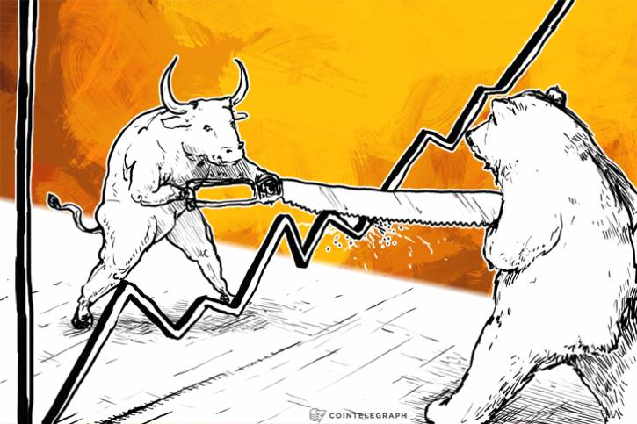
The Mad Hedge Fund Trader
“Whipsawed”
With John Thomas
Silicon Valley, CA, February 8, 2023
www.madhedgefundtrader.com
Notes:
*

Slide 2
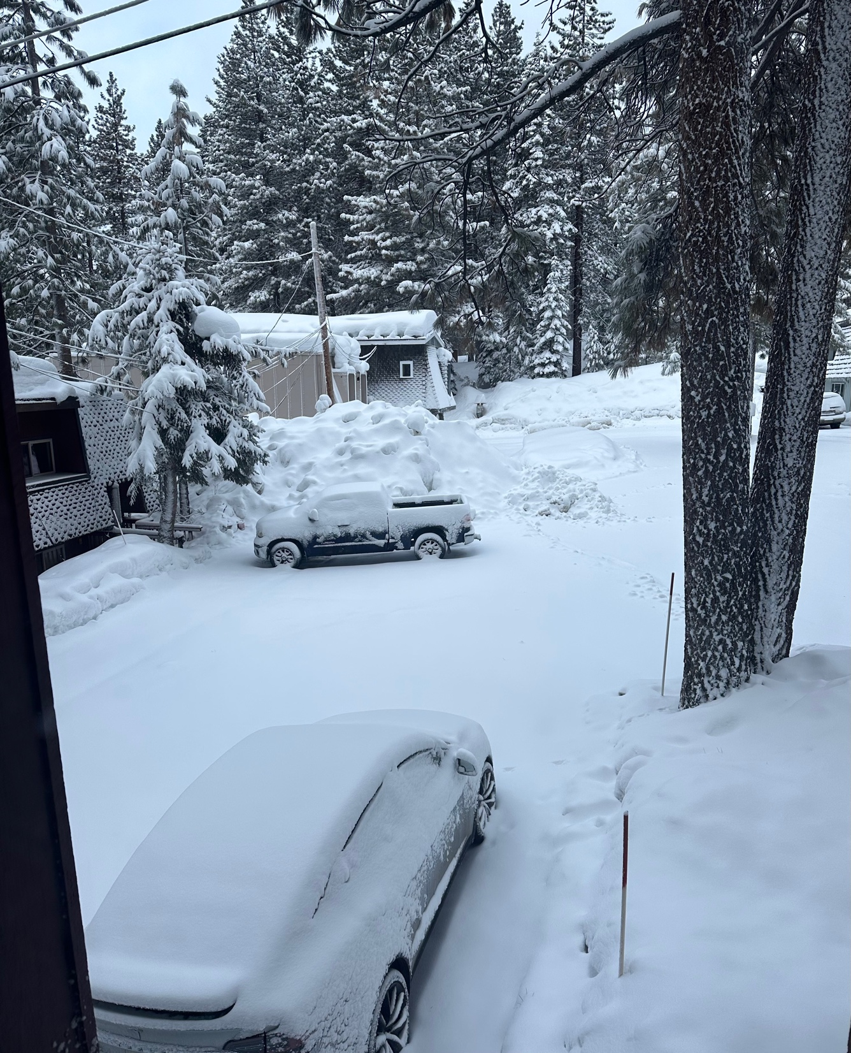

Slide 3

February 17 Honolulu, Hawaii Strategy Luncheon
*An excellent meal will be followed by a wide-ranging discussion
and an extended question and answer period
*The lunch will be held at a private club in Honolulu
*please go to my online store at
http://www.madhedgefundtrader.com/store
and click on “luncheons.”

Slide 4

July 13, 2023 Seminar at Sea
*Cunard Line’s flagship, the elegant and spacious Queen Mary II, on an eastbound transatlantic cruise
*The Ship departs New York at 12:00 AM on July 7, 2023, and arrives at Southampton on July 14
*Guests will be responsible for booking their own cabin
through Cunard
*Three dinners during the voyage will be black tie
*Customers are required to book their own cabins
and return flights from England
*The Cunard cruise number is M319

Slide 5
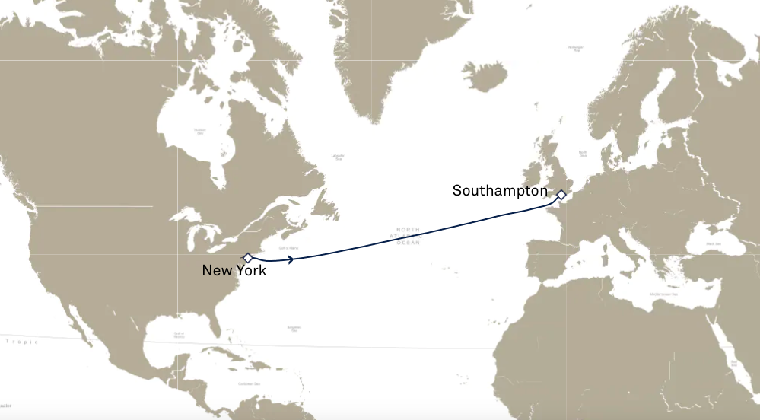

Slide 6
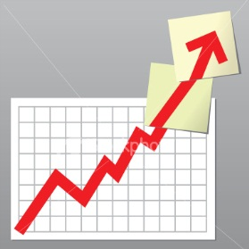
Trade Alert Performance
New All Time Highs!
22 out of 23 trade alerts profitable
*January +22.35% Final *July +3.98% Final
*February -5.70% MTD *August +5.13% Final
*March +3.43% Final *September +9.72% Final
*April +3.33% Final *October +5.69% Final
*May +8.80% Final *November +8.31 Final
*June +5.91% Final *December +0.95% Final
*2022 Final +84.63%
compared to -18.63% for the S&P 500
*2023 Year to Date +16.65%, versus +9.2% for the S&P 500
+613.84% since inception
*Average annualized return of +46.62% for 15 years

Slide 7
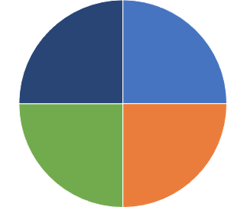
Portfolio Review
20% Long, 80% cash
modestly long
Current Capital at Risk
Risk On
(TSLA) 2/$150-$160 call spread | 10.00%
(TSLA) 2/$155-$165 call spread | 10.00%
Risk Off
(TSLA) 2/$220-$230 put spread | -10.00%
(TSLA) 2/$210-$220 put spread | -10.00%
Total Net Position | 0.00%
Total Aggregate Position | 40.00%
Expiration Value
+21.90%

Slide 8
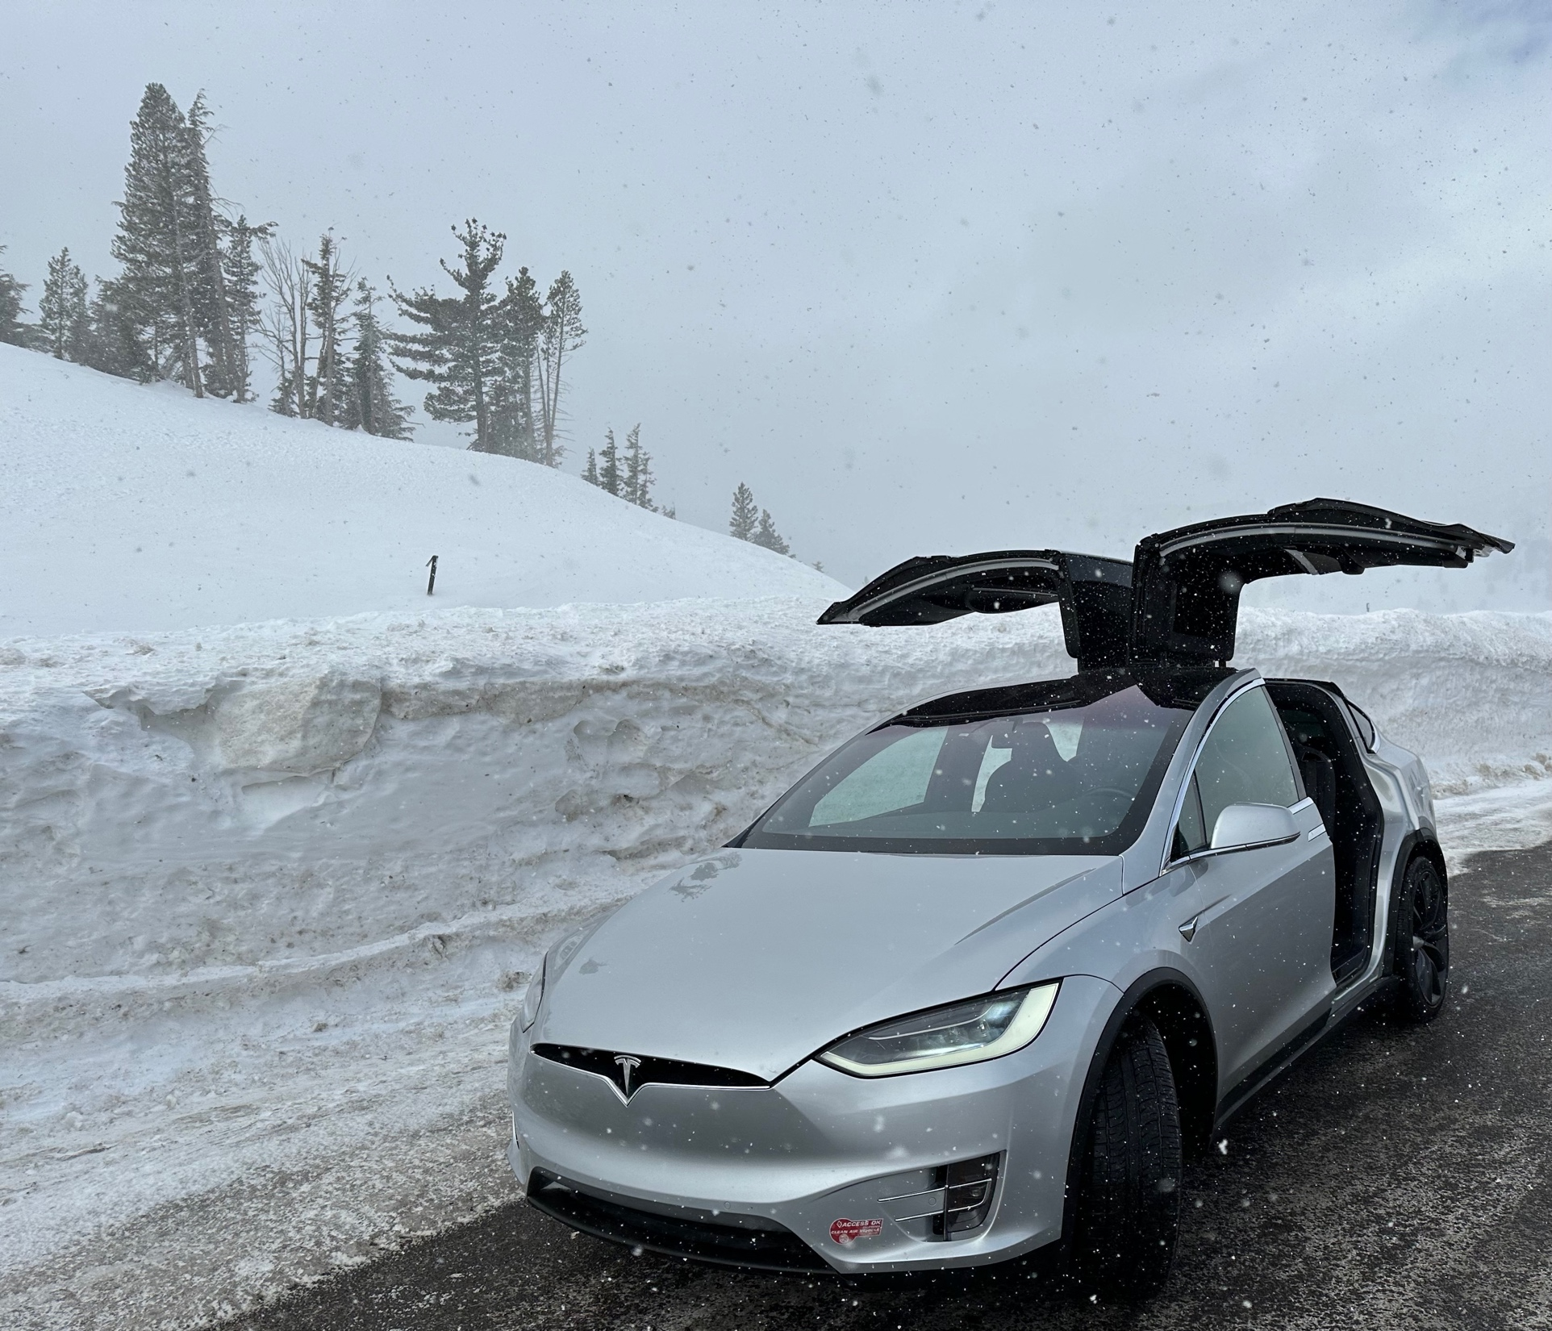

Slide 9

The Method to My Madness whipsaw
*Markets rallied big on Powell’s comment that inflation is declining, which we already knew
*Aggressive growth tech and small caps led the gains, all bull market indicators
*A House intent on debt default still capping bonds and the range is too small to trade
*Energy is plumbing new lows on Russia military failures, warm weather, and a supply glut
*Gold, Silver, and commodities take a hit on higher interest rates,
but is temporary
*The US dollar gets a small pop off of one year low
*Look for S&P 500 at $4,800 by end 2023
*VIX dives to $19 – NO TRADE, cash is king

Slide 10

The Global Economy – Goodbye Recession
*Fed Raises Rates 25 basis points to overnight rate of 4.50% to 4.75%
*Nonfarm Payroll Report at 513,000 Blows Away Estimates, more than double expectations
*The Headline Unemployment Rate fell to a new 53 year low at 3.4%
*JOLTS Surges Past 11 Million Job Openings in December to a five-month high
*Weekly Jobless Claims Hit New 9 Month Low, at 183,000, down 3,000, and is close to a multi-generational low
* Europe Delivers Surprising Q4 Growth, despite WWIII
playing out on its doorstep
*IMF Upgrades Global Growth Forecast for 2023 to 2.9%
*Q4 GDP is Up 2.9%, far higher than expected

Slide 11
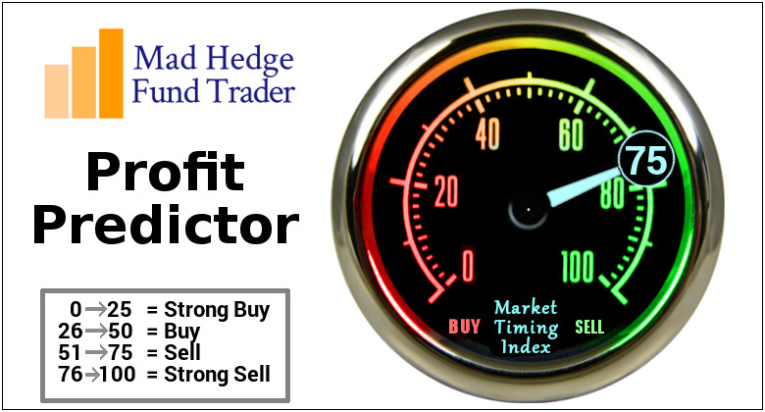
The Mad Hedge Profit Predictor
Market Timing Index – Neutral
An artificial intelligence driven algorithm that analyzes 30 different economic, technical, and momentum driven indicators

Slide 12
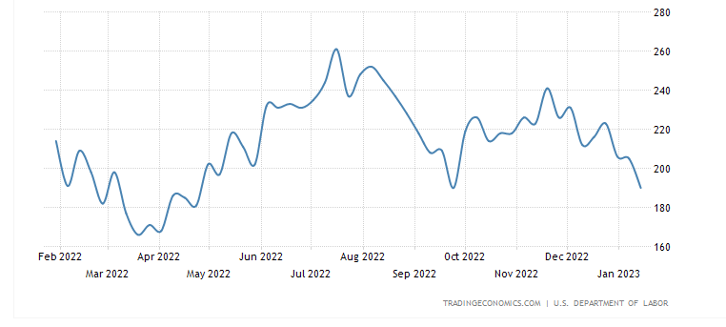
Weekly Jobless Claims – Falling
187,000 – Down 3,000

Slide 13
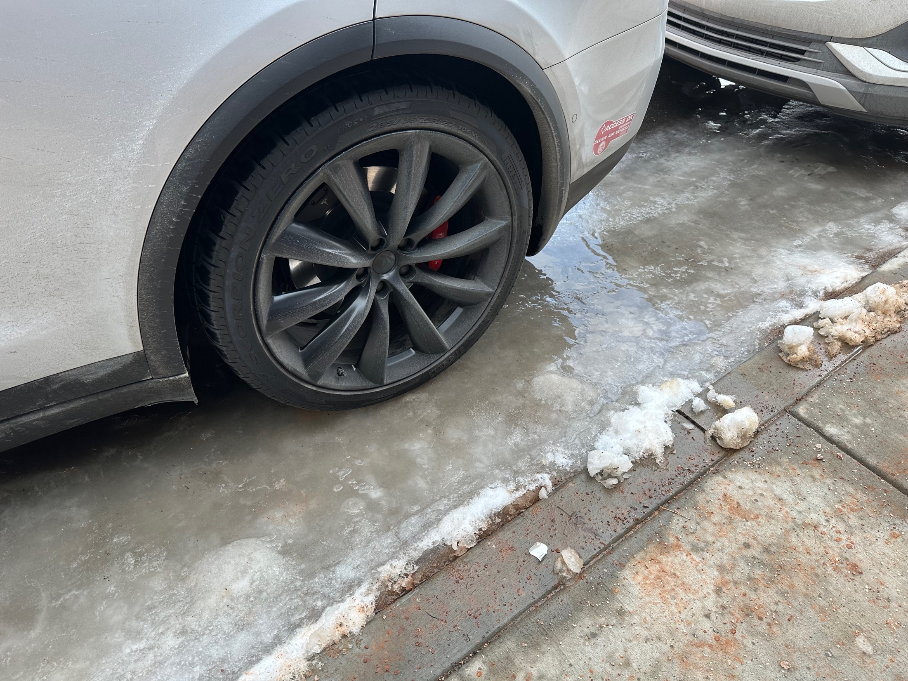

Slide 14
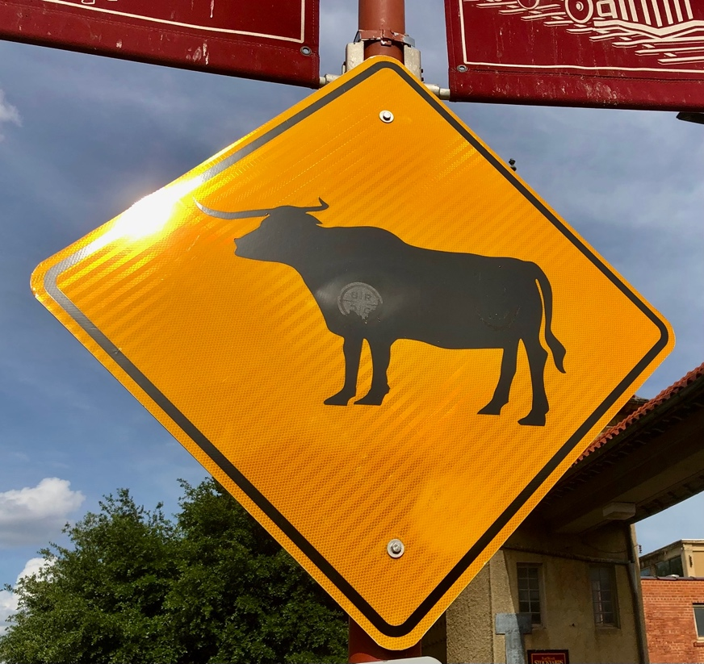
Stocks – The Bull is Back
*Powell delivers major upside breakout in stocks, even if he didn’t want him
*All the bull market indicators are flashing “GREEN”, with tech and small caps leading
*Panic short covering by hedge funds as stock go from zero bid to zero offered
*Rising rate fears set back every commodity and energy play
*Financials holding up remarkably well awaiting the next upside breakout
*Has the 2023 scenario reversed, with a strong first half and
a weak second half, or will the market be strong all year?
*It’s what traders and investors are least prepared and positioned for
*Tesla has become the top trading stock in the market

Slide 15
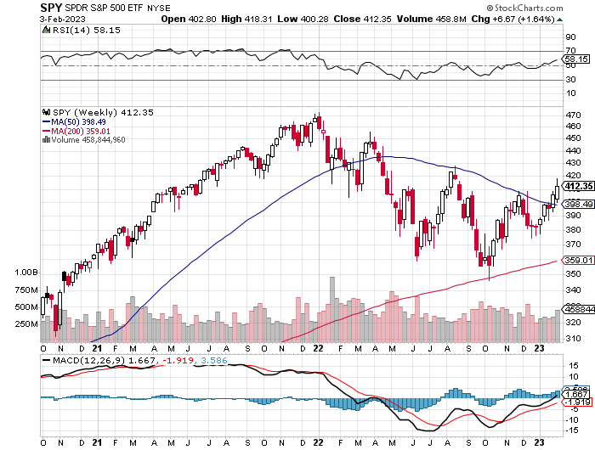
S&P 500 – A Bull Market is Developing – Weekly - June took profits on long 1/$420-$430 put spread, took profits on long 11/$420-$430 put spread took profits on long 10/$385-$395 put spread, took profits on long 11/$410-$400 put spread took profit on long 10/$390-$400 put spread, took profit on long 10/$320-$330 call spread
$480
Target
$430
+21%
Rally
$375
-12.8%
Pull Back
The Bottom
$355
Down -26%

Slide 16
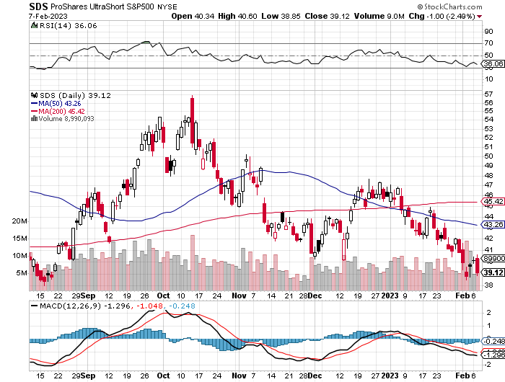
ProShares Ultra Short S&P 500 (SDS)- a great hedge for long stocks and bonds long 2X position has a hedge against longs and bond shorts

Slide 17
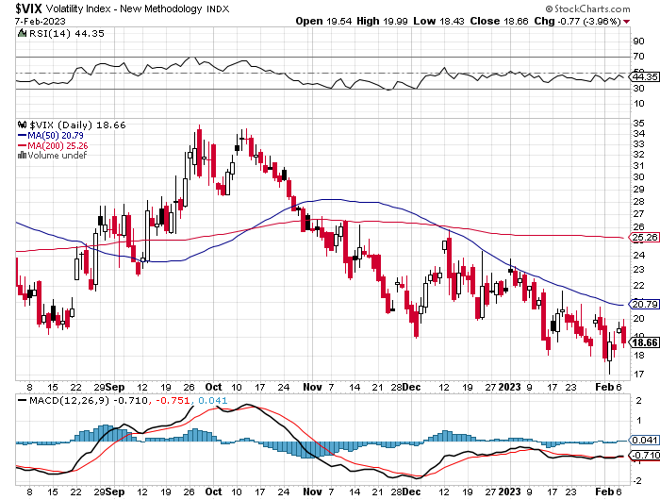
(VIX) – Bargain of the Century

Slide 18
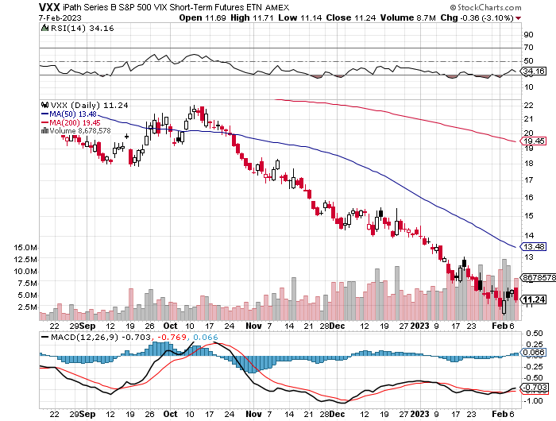
(VXX)-

Slide 19
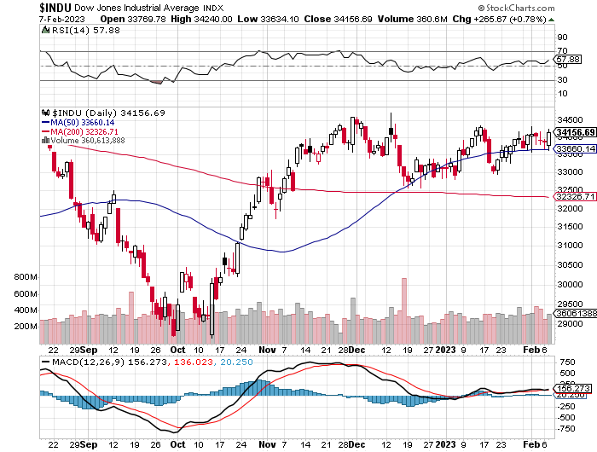
Dow Average ($INDU)-

Slide 20
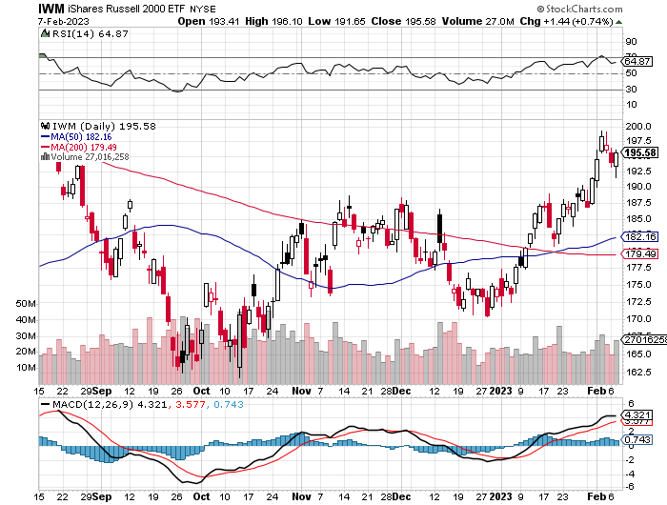
Russell 2000 (IWM)- took profits on Long 10/$137-$142 vertical bull call spread took profits on Long 10/$153-$156 vertical bear put spread

Slide 21
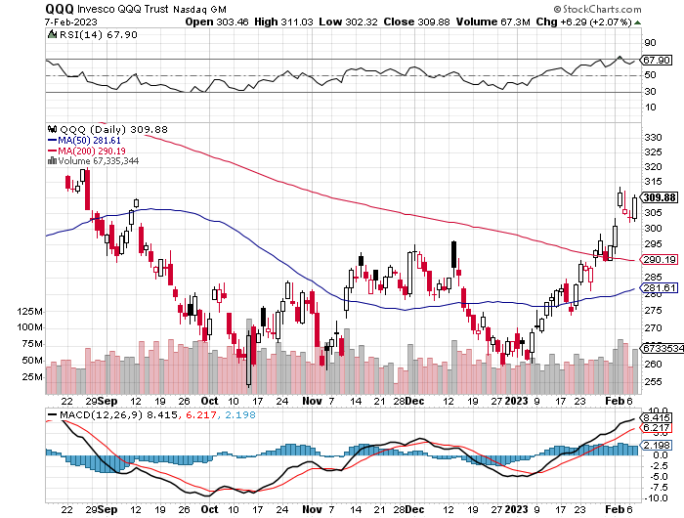
NASDAQ (QQQ) – stopped out of long (QQQ) 1/$305-$315 put spread took profits on long (QQQ) 1/$290-$300 put spread, took profits on long (QQQ) 4/$330-$335 put spread took profits on long (QQQ) 3/$340-$345 put spread, covered long (QQQ) $325-$330 put spread

Slide 22
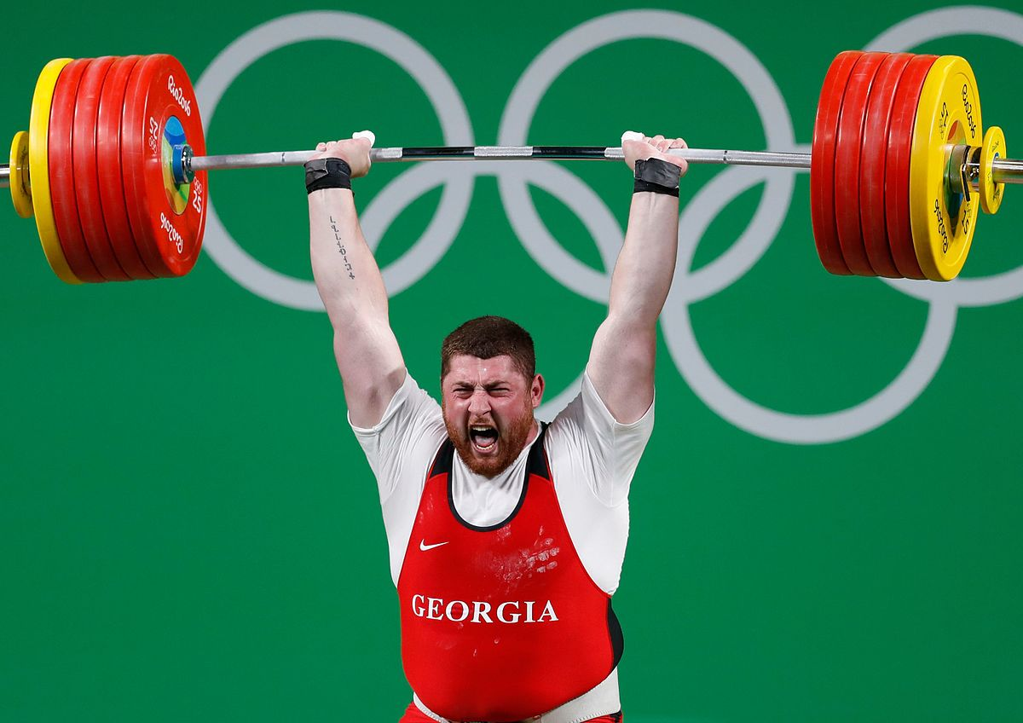
The Barbell Portfolio
*50% Big Tech - 2% of US Employment but 27% of Market Cap and 38% of Profits
50% Domestic Recovery, including:
Railroads
Couriers
Banks
Construction
Credit Cards
Event organizers
Ticket sales
Retailers

Slide 23
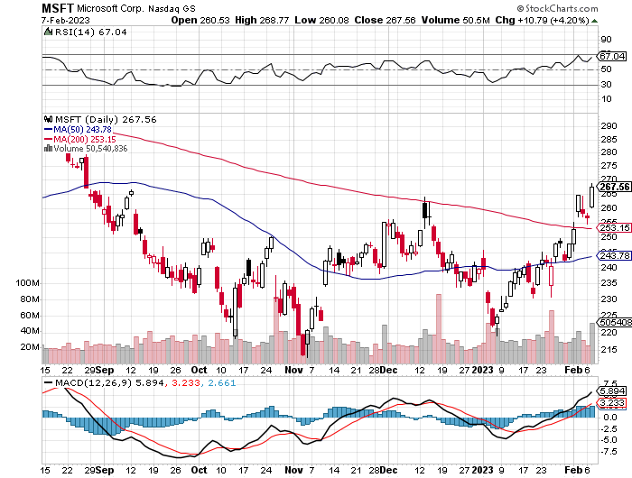
Microsoft (MSFT)- Grim Forward Guidance took profits on 9/$235-$245 call spread, took profits on long 7/$220-$210 call spread, took profits on long 6/$220-$230 call spread, took profits on long 2/$200-$210 bear put spread

Slide 24
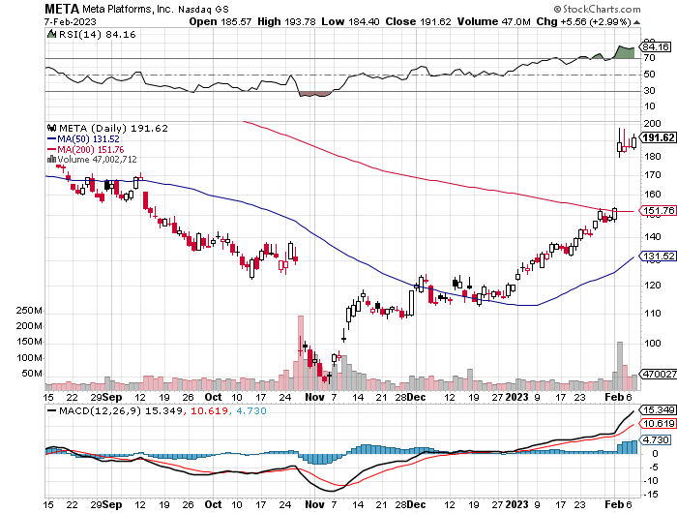
Meta (META)- Soars an Incredible 20% took profits on Long 9/$290-$300 vertical bear put spread stopped out of Long 9/$190-$200 vertical bear put spread

Slide 25
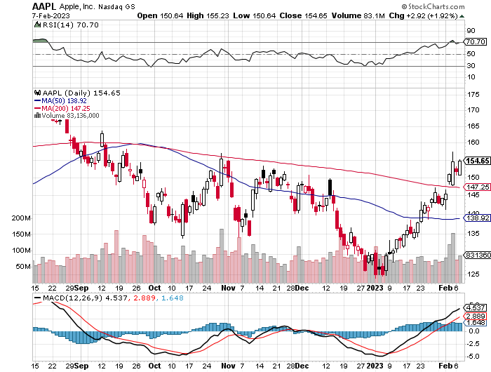
Apple (AAPL)- Disappoints on parts shortfalls in China took profits on long 1/$155-$165 put spread took profits on long 1/$145-$155 put spread, Took profits on long 10/$165-$175 put spread took profits on long 6/$155-$165 put spread, stopped out of long 6/$125-135 call spread, took profits on long 6/$110-$120 call spread, took profits on long 2/$180-$190 put spread

Slide 26
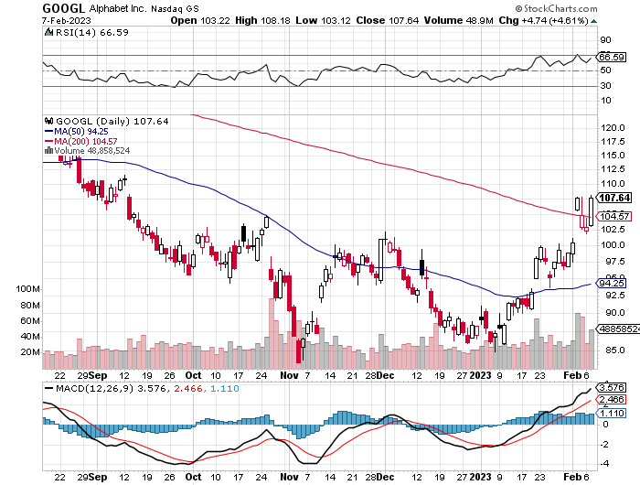
Alphabet (GOOGL) – Disappoints on a major advertising shortfall
Government Sues Google on Antitrust took profits on long 12/$1,200-$1,230 bull call spread took profits on long 9/$1,030-$1,080 vertical bull call spread

Slide 27
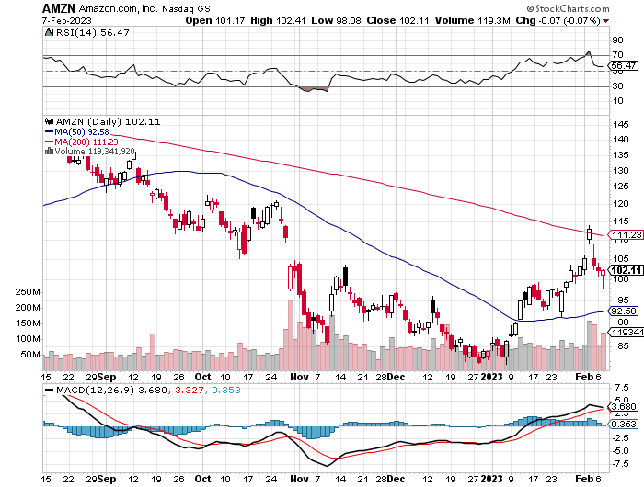
Amazon (AMZN) – US Preparing Antitrust Against Amazon took profits on long 2/$3,400-$3,500 bear put spread took profits on long 9/$2,800-$2,900 bull call spread

Slide 28
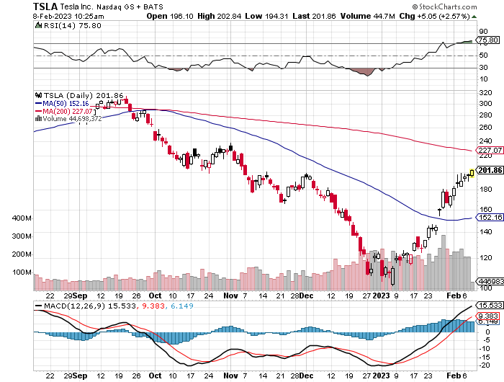
Tesla (TSLA) – Top Trader With Implied Volatility at 90%
Elon Musk Wins “Funding Secured” Suit – Investor Day March 1 long 2/$220-$230 put spread, long 2/$210-$220 put spread – expires in 7 trading days long 2/$150-$160 call spread, long 2/$155-$165 call spread – expires in 7 trading days took profits on long 2/$95-$100 call spread, took profits on long 1/$75-$80 call spread

Slide 29
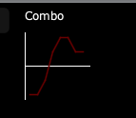
Tesla 2/$150-$155-$160-$165-$210-$220 Short Strangle expires in 7 trading days
Stop out at $210 to the upside and $165 on the downside
Max Profit
$165-$210
Max P

Slide 30
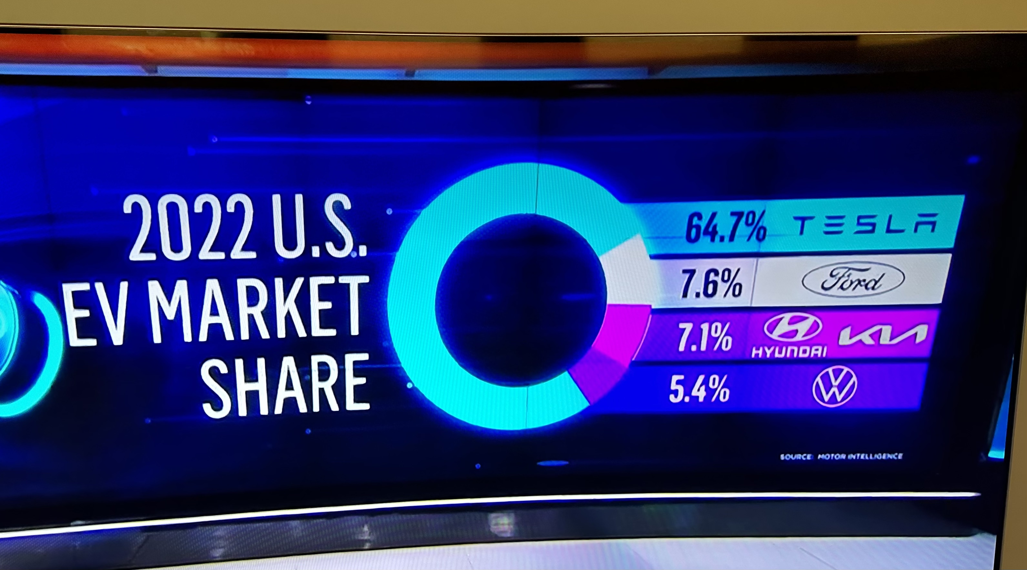

Slide 31
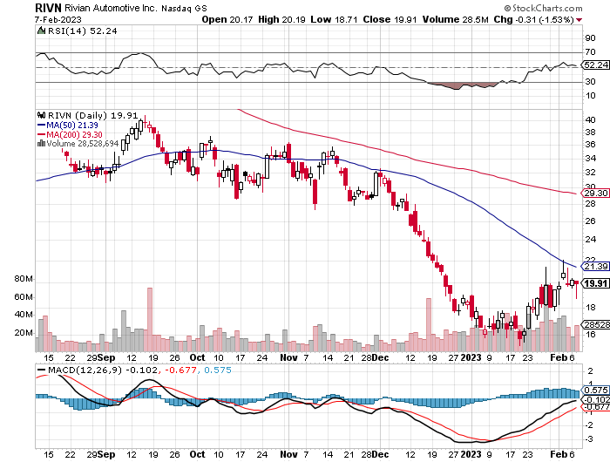
Rivian (RIVN) – Amazon Backed Electric Trucks
Joint Venture with Mercedes Put on Hold took profits on long 10/$25-$30 call spread

Slide 32
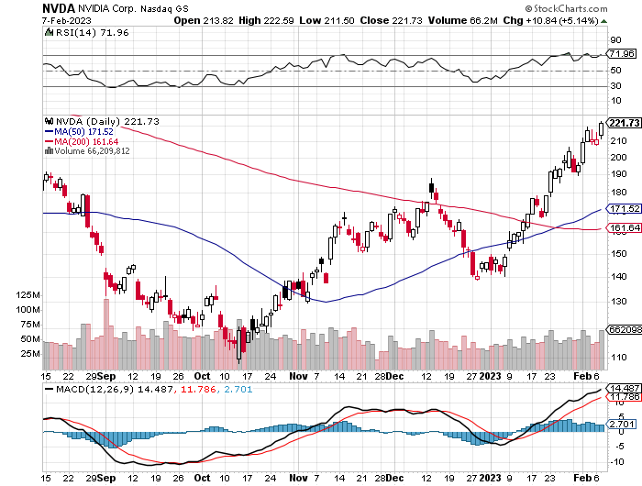
NVIDIA (NVDA) – Downgrade on US ban of highest end AI chips to China took profits on long 10/$95-$100 call spread took profits on long 7/$120-$130 call spread, took profits on long 6/$120-$130 call spread

Slide 33
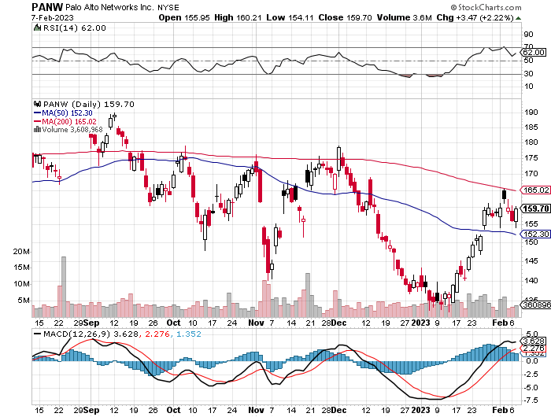
Palo Alto Networks (PANW)- Hacking never goes out of fashion took profits on long 10/$130-$140 call spread

Slide 34
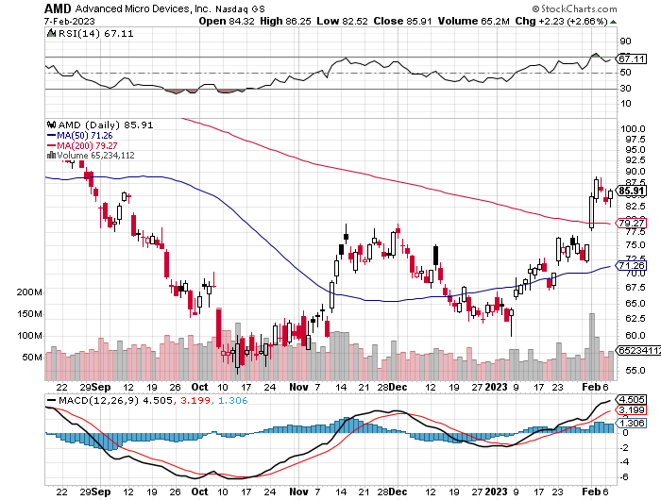
Advanced Micro Devices (AMD)- Recession fears programable logic devices took profits on long 2/$75-$80 call spread

Slide 35
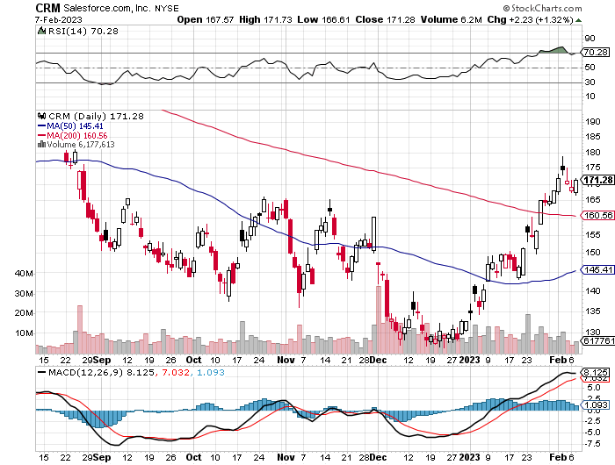
Salesforce (CRM)- Massive Online Migration took profits on long 9/$125-$130 vertical bull call spread took profits on long 8/$125-$130 vertical bull call spread took profits on long 2/$105-$115 call spread

Slide 36
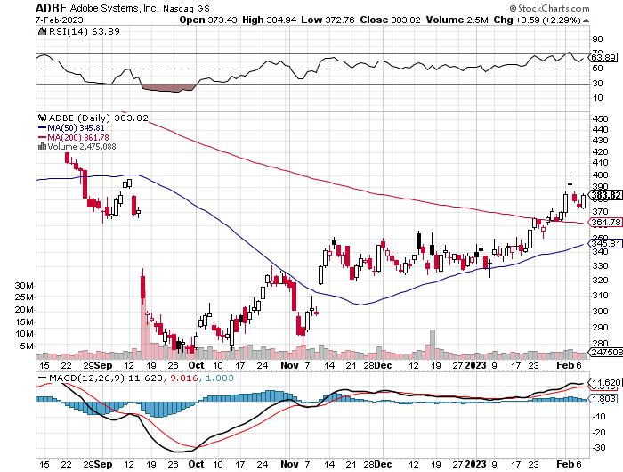
Adobe (ADBE)- Cloud play
The Quality Non-China tech play

Slide 37
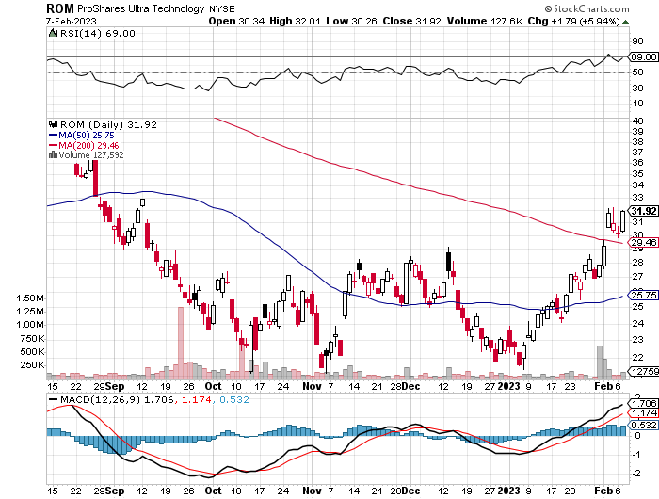
ProShares Ultra Technology ETF (ROM) – 2X Long Technology ETF took profits on long 10/$62-65 call spread

Slide 38
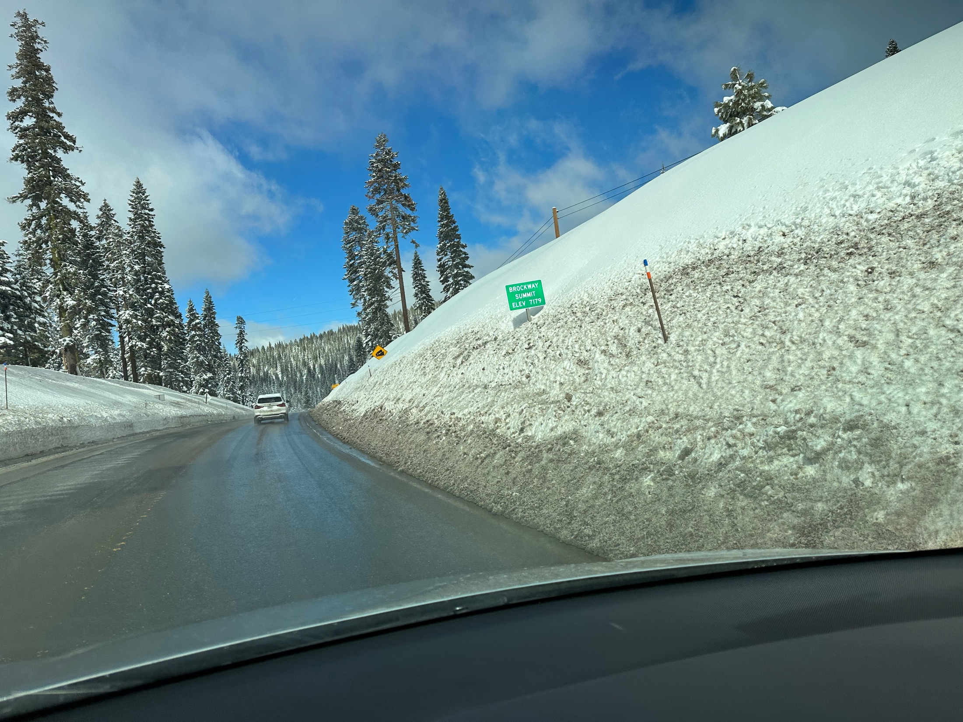

Slide 39
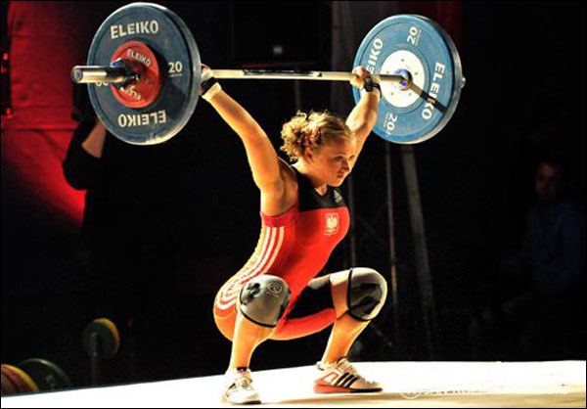
The Second Half of the Barbell
*Bets on a domestic recovery in 2022 Q4
*Upside potential in 2022 far greater than tech
*Some of these have not moved for 5 or 10 years
*Focuses on economically sensitive cyclical industries
*Makes a great counterweight to
high-growth technology
*We could spend all of next year rotating
between the two groups

Slide 40
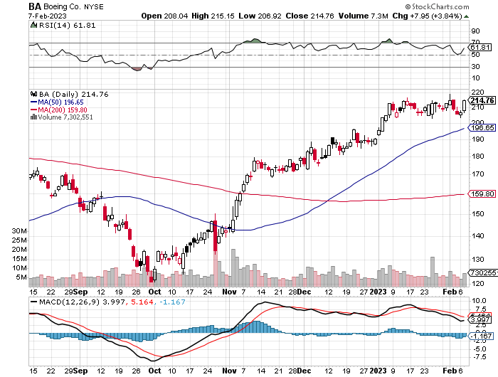
Boeing (BA) –Deliveries Soar from 340 to 480 in 2022, and 479 new orders
To Hire 10,000 in 2023

Slide 41
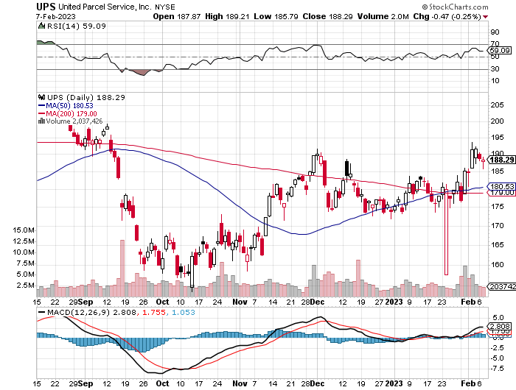
Package Delivery- United Parcel Service (UPS) - took profits on long 11/$130-$140 call spread

Slide 42
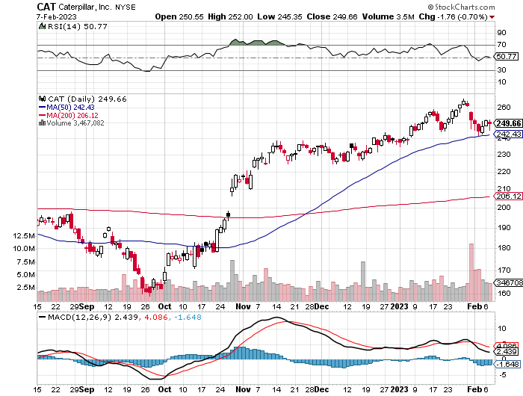
Caterpillar (CAT)- Ag + Infrastructure + Housing
Raises Dividend by 50% took profits on long 12/$145-$150 call spread took profits on long 11/$125-$135 call spread

Slide 43
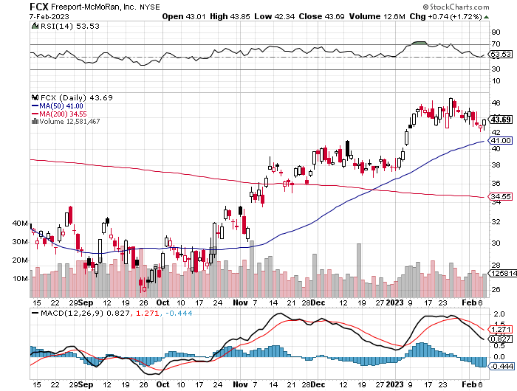
Freeport McMoRan - (FCX)- Copper Play took profits on long 10/$20-$23 call spread

Slide 44
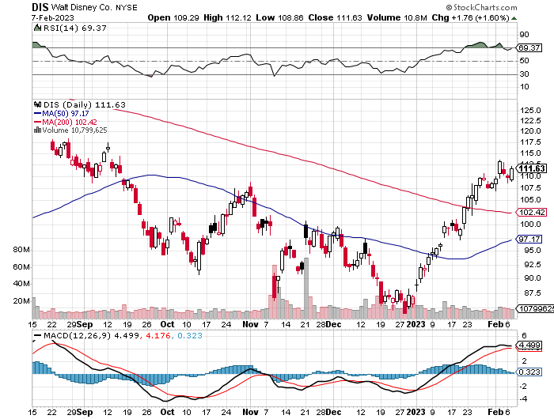
Walt Disney (DIS) - Not a recession play stopped out of long 10/$165-$175 call spread took profits on long 3/$170-$180 call spread

Slide 45
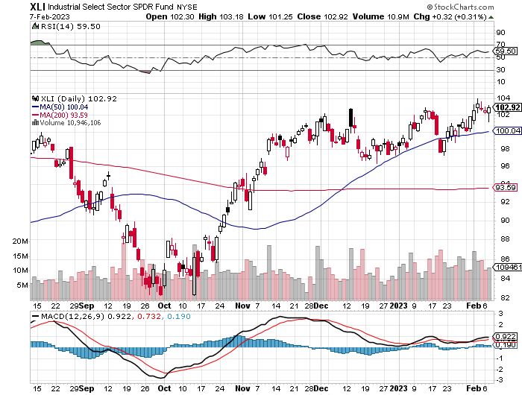
Industrials Sector SPDR (XLI)-
(GE), (MMM), (UNP), (UTX), (BA), (HON)

Slide 46
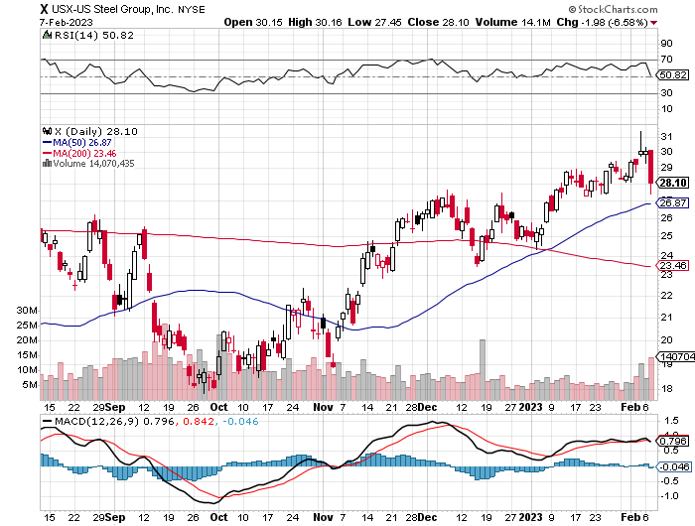
US Steel (X) – Commodity Boom and Wartime boost

Slide 47
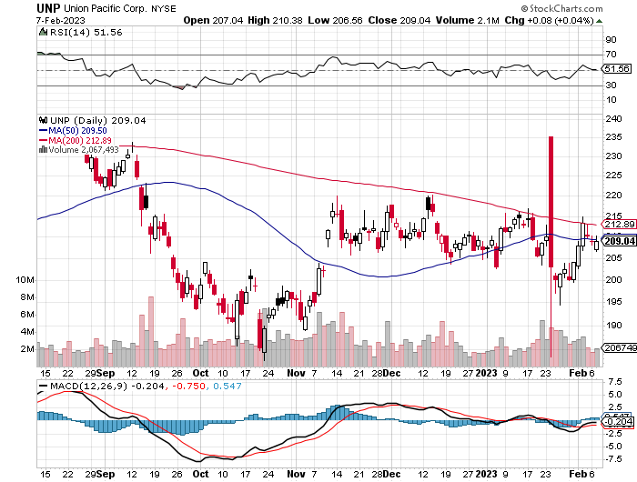
Union Pacific RR (UNP)- Big Stuff to Ship took profits on long 5/$200-$210 call spread took profits on 11/$150-$160 call spread

Slide 48
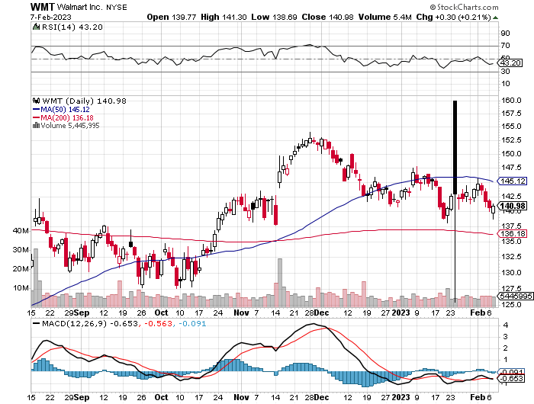
Wal-Mart (WMT)- took profit on Long 11/$125-$130 bear put spread took profit on Long 10/$119-$121 bear put spread took profits on Long 8/$114-$117 bear put spread

Slide 49
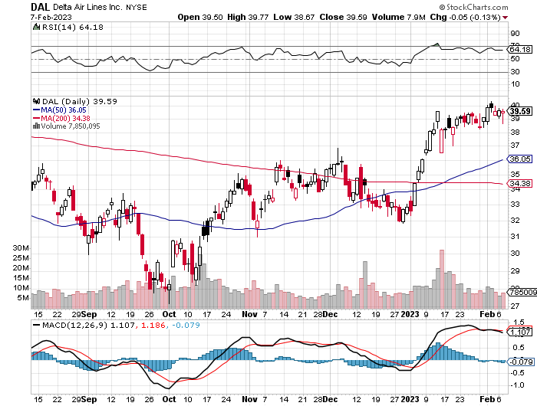
Delta Airlines (DAL) – Travel is Back!

Slide 50
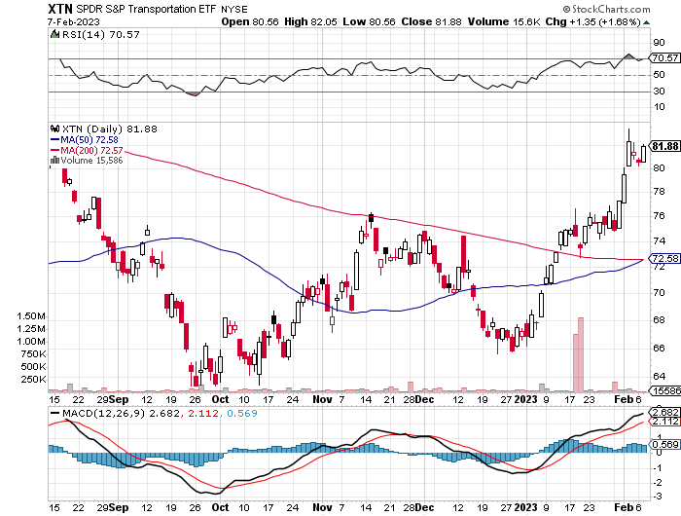
Transports Sector SPDR (XTN)- Worst Hit Sector
(ALGT), (ALK), (JBLU), (LUV), (CHRW), (DAL)

Slide 51
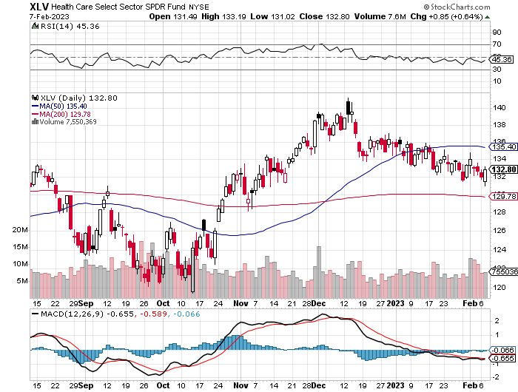
Health Care Sector (XLV)
(JNJ), (PFE), (MRK), (GILD), (ACT), (AMGN)

Slide 52
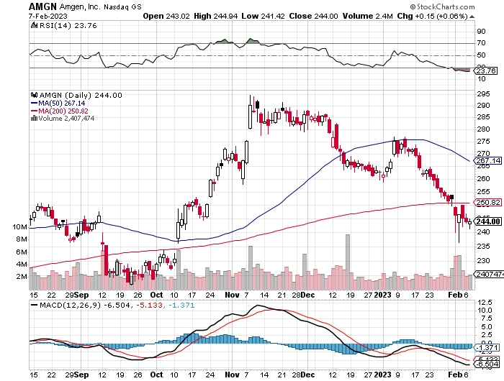
Amgen (AMGN) took profits on long 11/$185-$200 bull call spread

Slide 53
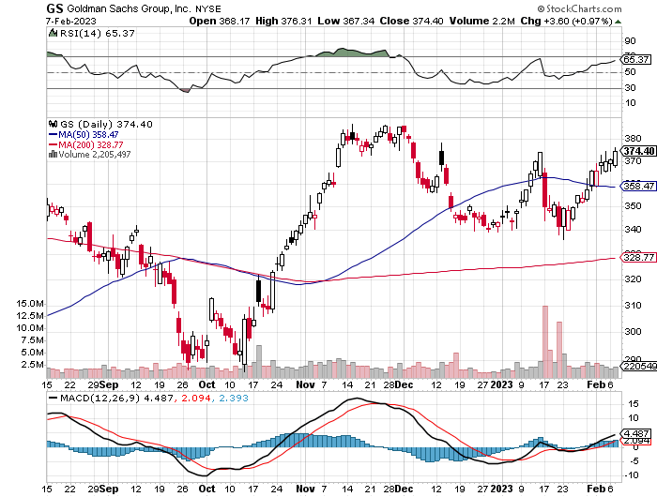
Goldman Sachs (GS) – took profits 12/$330-$350 call spread took profits 11/$330-$350 call spread stop loss on long 11/$385-$395 call spreads

Slide 54
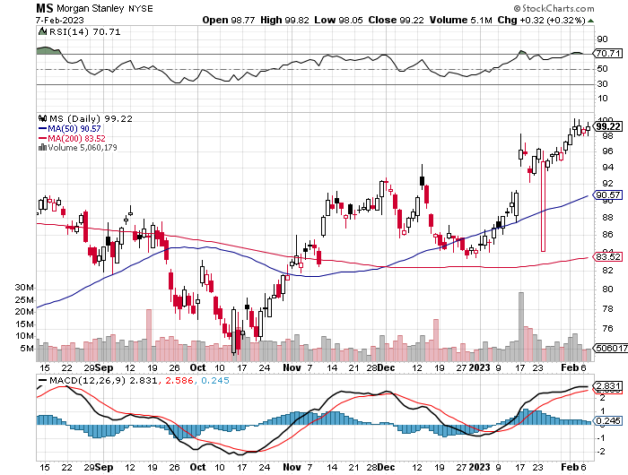
Morgan Stanley (MS) – took profits on long 10/$85-$90 call spread

Slide 55
JP Morgan Chase (JPM)- took profits on long 10/$85-$90 call spread, stopped out of long 10/$95-$100 call spread took profits long 12/$148-$152.50 call spread

Slide 56

Bank of America (BAC) – took profits long 12/$39-$42 call spread

Slide 57

SPDR Metals & Mining ETF (XME) – long 2/$28-$30 call spread

Slide 58

Blackrock (BLK)-Asset Collection Boom took profits on long 3/$770-$790 call spread took profits on long 3/$310-$340 call spread

Slide 59

Visa (V) – “Touchless” Bitcoin Drag
Transaction grew by an inflationary 10% back to pre-pandemic levels took profits on long 10/$160-$170 bull call spread took profits on long 6/$150-$160 bull call spread

Slide 60

Consumer Discretionary SPDR (XLY)
(DIS), (AMZN), (HD), (CMCSA), (MCD), (SBUX)

Slide 61

Berkshire Hathaway (BRKB)- Natural Barbell took profits on long 1/$290-$300 call spread, took profits on long 10/$220-$230 call spread, took profits on long 7/$220-$230 call spread, took profits on long 7/$220-$230 call spread took profits on long 6/$260-$270 call spread

Slide 62

Europe Hedged Equity (HEDJ)-

Slide 63

Japan (DXJ)-

Slide 64

Emerging Markets (EEM) - Pro trade, Weak Dollar, Long Recovery Play

Slide 65


Slide 66

Bonds – Still Trapped
*While stocks read Powell’s comments as hugely bullish, bonds saw them as negative
*But even bonds recovered half of a $3 loss on a recovering liquidity argument
*That leaves us with a bond range to narrow to trade
*(TLT) should reach $120 in 2023 without political interreference
*Keep buying (TLT) calls, calls spreads and LEAPS
on dips but only on dips
*Junk bond ETF’s (JNK) and (HYG) are a great
high yield play

Slide 67

Treasury ETF (TLT) – Triple Long took profits on long 1/$96-$99 call spread, took profits on long 1/$95-$98 call spread, took profits on long 2/$95-$98 call spread, took profits on long 11/$96-$99 call spread, took profits on long 12/$94-$97 call spread took profits on long 12/$91-$94 call spread, took profits on long 12/$92-$95 call spread, took profits on long 12/$93-$96 call spread

Slide 68

Ten Year Treasury Yield ($TNX) – 3.33%

Slide 69

Junk Bonds (HYG) 7.55% Yield to Maturity

Slide 70

Municipal Bonds (MUB) 2.06% Yield-

Slide 71

Emerging Market Debt (ELD) 6.72% Yield-

Slide 72

2X Short Treasuries (TBT)-Out of Favor

Slide 73


Slide 74

Foreign Currencies – Powell Boost
*Prospects of higher rates for longer give new life to the US Dollar
*After a great four month run all currencies were overdue and in need of a rest
*China lockdowns will still keep the Yuan relatively weak
*Any strength in the dollar will be temporary
*Buy (FXE), (FXY), (FXB) on dips

Slide 75

Australian Dollar (FXA) - Major Long-Term Bottom is In Targeting Parity – A call option on a global synchronized recovery
1:1
BUY

Slide 76

Japanese Yen (FXY)
2023
Target
25%

Slide 77

Euro (FXE)-
2023
Target
25%

Slide 78

British Pound (FXB)-
2023
Target
15%

Slide 79


Emerging Market Currencies (CEW)
2023
Target
40%

Slide 80


Slide 81

Energy & Commodities – Bad News
*Ukraine War is Accelerating Move to Green Energy, or so thinks British Petroleum, cutting its ten-year energy demand forecast
*Chevron Announces $75 Billion Share Buy Back, a record for the industry, inviting a political backlash
*Energy Hits 17 Year Low in M&A. It’s not amazing that
no one wants to buy into an industry that is eating its seed
corn and going to zero in our lifetimes
*There is a short-term play here in oil equities for a
bounce from the bottom of the range
*The US is now the world’s top oil producer,
followed by Saudi Arabia and Russia
*Massive supplies from the US headed
off Europe’s energy crisis

Slide 82

Oil-($WTIC)

Slide 83

United States Oil Fund (USO)

Slide 84

Energy Select Sector SPDR (XLE)-No Performance!
(XOM), (CVX), (SLB), (KMI), (EOG), (COP)

Slide 85

ExxonMobile (XOM)- took profits on long 12/$120-$125 put spread

Slide 86

Occidental Petroleum (OXY)- took profits on long 2/$55-$60 call spread, took profits on long 12/$77.50-$82.50 put spread

Slide 87

Natural Gas (UNG) -

Slide 88
Freeport McMoRan (FCX) -

Slide 89

Cameco (CCJ) - took profits on long 5/$20-$23 bull call spread

Slide 90


Slide 91

Precious Metals – Fed Correction
*Powell comments about interest rates higher for longer give precious metals a long-needed correction, it's been straight up for four months
*Silver is beating gold as massive new industrial demand kicks in from several sources, including solar and EV’s and is also a China recovery play
*Silver is is now an industrial commodity while gold is still a
precious metal used for jewelry, investment, and central bank reserves
*It all makes silver the better play on the eve of an economy recovery
*Many pension funds that abandoned precious metals a decade ago
are starting to crawl bank in in size
*With interest rates certain to plummet later in 2023 as the Fed reacts
to a recession, Precious metals could be one of the big trades for next year
*Buy (GLD), (GDX), and (GOLD) on dips

Slide 92

Gold (GLD) - Deflation call took profits on long 5/$165-$170 bull call spread

Slide 93

Market Vectors Gold Miners ETF- (GDX) –

Slide 94

Barrick Gold (GOLD) took profit on long 1/$15.50-$16.50 call spread

Slide 95

Newmont Mining- (NEM)- took profits on long $55-60 call spread

Slide 96

Silver- (SLV)- took profits on long 11/$19-$20 call spread

Slide 97

Silver Miners - (SIL)-

Slide 98

Wheaton Precious Metals - (WPM)- took profits on long 1/$36-$39 call spread

Slide 99


Slide 100

Real Estate – Rate Hit
*Pending Home Sales Jump in December, up 2.5%
*Existing Home Sales Fall by 1.5% in December
*Construction Spending is Down 0.4%, the weakest since August
*Pulte Homes Beats, on recovering home prices,
with sales up a shocking 19% in Q4
*Office Occupancy Recovers to 50%
*
*S&P Case Shiller Drops to an 8.6% Annual Gain

Slide 101

S&P Case Shiller Plunges
S&P Case Shiller Drops 8.6%, in November with its National Home Price Index
Miami (+18.4%), Tampa (+16.9%), Atlanta (+12.7%)

Slide 102

Crown Castle International (CCI) – 4.30% yielding cell phone tower REIT

Slide 103

US Home Construction Index (ITB)
(DHI), (LEN), (PHM), (TOL), (NVR)

Slide 104

Trade Sheet-
So What Do We Do About All This?
*Stocks – buy the big dips at bottom of range,
………………sell big rallies to hedge holdings
*Bonds – buy dips
*Commodities-buy dips
*Currencies- sell dollar rallies, buy currencies
*Precious Metals – buy dips
*Energy – buy dips
*Volatility - sell short over $30
*Real estate – buy dips

Slide 105

Next Strategy Webinar
12:00 EST Wednesday, February 22 from Silicon Valley, CA email me questions at support@madhedgefundtrader.com
Good Luck and Good Trading!
Notes:
*

Slide 106


