Slide 1
The Mad Hedge Fund Trader “Topping Out”
With John Thomas Silicon Valley, CA, February 22, 2023 www.madhedgefundtrader.com
Notes:
*

Slide 3
July 13, 2023 Seminar at Sea
*Cunard Line’s flagship, the elegant and spacious Queen Mary II, on an eastbound transatlantic cruise *The Ship departs New York at 12:00 AM on July 7, 2023, and arrives at Southampton on July 14 *Guests will be responsible for booking their own cabin through Cunard *Three dinners during the voyage will be black tie *Customers are required to book their own cabins and return flights from England *The Cunard cruise number is M319

Slide 4
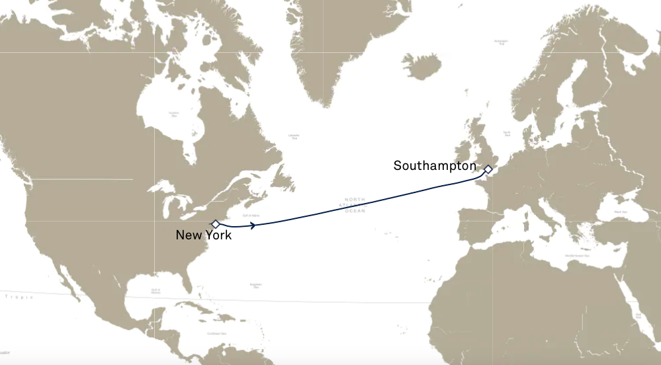

Slide 5
Trade Alert Performance New All Time Highs! 22 out of 23 trade alerts profitable
*January +22.35% Final *July +3.98% Final *February -1.02% MTD *August +5.13% Final *March +3.43% Final *September +9.72% Final *April +3.33% Final *October +5.69% Final *May +8.80% Final *November +8.31 Final *June +5.91% Final *December +0.95% Final *2022 Final +84.63% compared to -18.63% for the S&P 500 *2023 Year to Date +21.83%, versus +7.1% for the S&P 500 +618.52% since inception *Average annualized return of +46.83% for 15 years

Slide 6
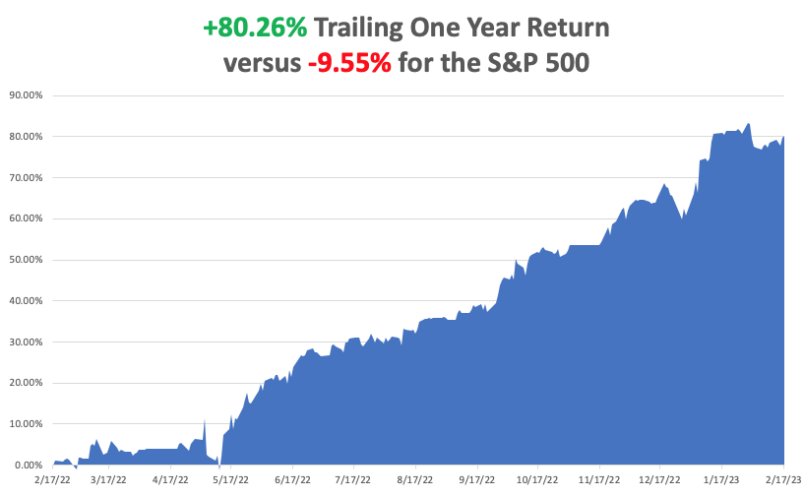

Slide 7
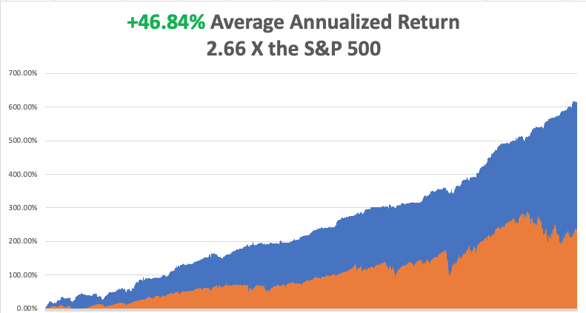

Slide 8
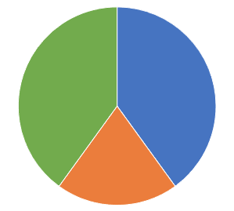
Portfolio Review 0% Long, 100% cash
Current Capital at Risk
Risk On
(TSLA) 3/$145-$155 call spread | 20.00%
(TLT) 3/$92-$95 call spread | 10.00%
Risk Off
(TSLA) 3/$250-$260 put spread | 20.00%
Total Net Position | 50.00%
Total Aggregate Position | 50.00%
Expiration Value +26.60%

Slide 10
The Method to My Madness whipsaw
*Risk markets showing exhaustion after a great four month run *Aggressive growth tech and small caps are taking a break, all bull market indicators *A House intent on debt default still capping bonds, sending yield back to 3.90% *Energy is plumbing new lows on Russia military failures, warm weather, and a supply glut *Gold, Silver, and commodities take a hit on higher interest rates, but is temporary *The US dollar gets a small pop off of one year low *Look for S&P 500 at $4,800 by end 2023 *VIX dives to $20 – NO TRADE, cash is king

Slide 11
The Global Economy – Chopping Away
*Choppy and contradictory economic data are bedeviling traders *Fed’s Bullard Signals a Doubling of Next Rate Hike to 0.50%. Higher inflation expectations are back! *Consumer Price Pop 0.7% in January, hotter than expected. That takes the YOY figure to 6.0% *CPI Misses at 6.4% YOY after rising 0.5% in January *Consumer Debt Hits $16.9 Trillion, a new all-time high, up $1.3 trillion YOY *US remains the strongest economy in the world and will keep a strong stock market

Slide 12
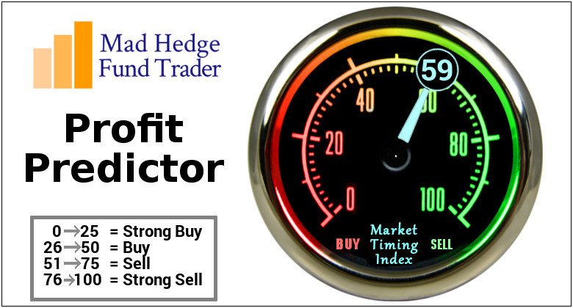
The Mad Hedge Profit Predictor Market Timing Index – Neutral An artificial intelligence driven algorithm that analyzes 30 different economic, technical, and momentum driven indicators

Slide 13
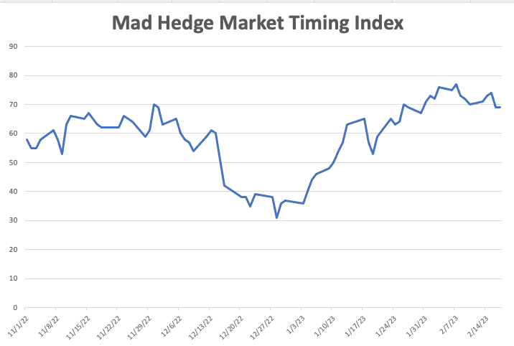
SELL
BUY

Slide 14
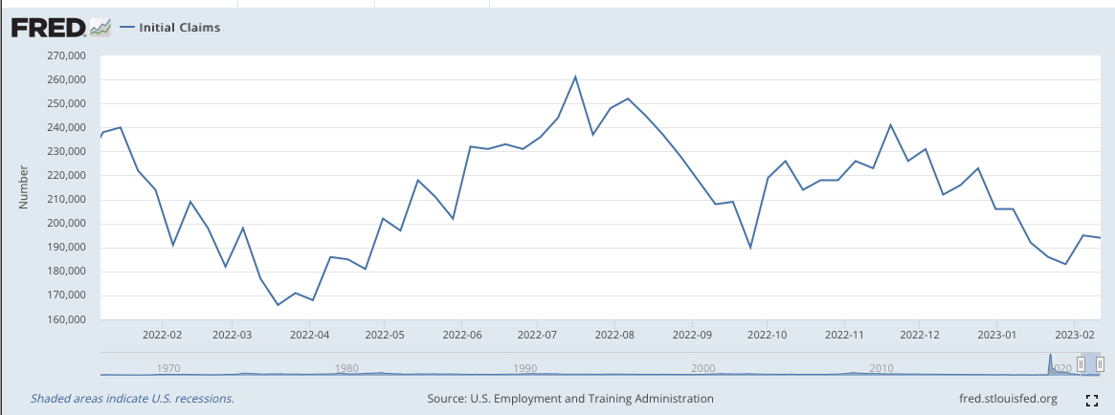
Weekly Jobless Claims – Falling 193,000 – Down 3,000

Slide 16
Stocks – Topping Out
*Stocks hit top of what will be a multi month range *Paramount+ Surpasses 56 Million Subs *Dropbox Takes Big Loss on SF Real Estate *Great Quarter for Roblox, with gross bookings rose by 17% year over year *Robot Purchases Going Mainstream, American corporations added 44,100 robots in 2022, an 11% increase over the previous year *Uber is clearly winning the taxi wars as competitor Lyft report bombs *Meta Pulls The Trigger On More Staff Cuts *Disney Beats, on better park performance and smaller streaming losses

Slide 17
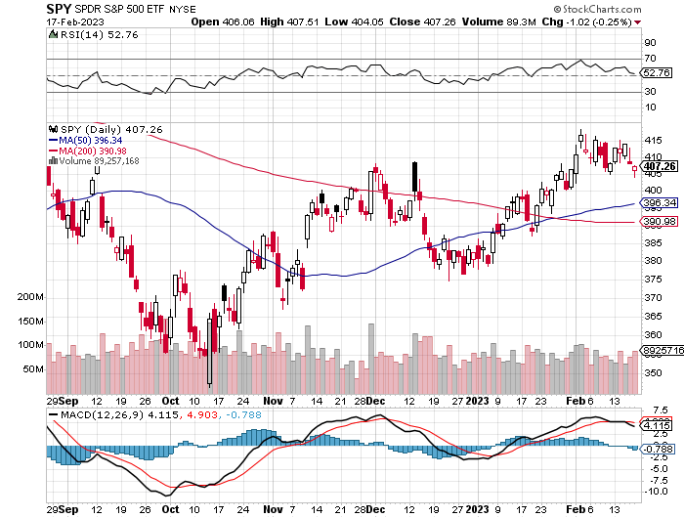
S&P 500 – A Bull Market is Developing – Weekly - June took profits on long 1/$420-$430 put spread, took profits on long 11/$420-$430 put spread took profits on long 10/$385-$395 put spread, took profits on long 11/$410-$400 put spread took profit on long 10/$390-$400 put spread, took profit on long 10/$320-$330 call spread
$480 Target
$430 +21% Rally
$375 -12.8% Pull Back
The Bottom $355 Down -26%

Slide 18
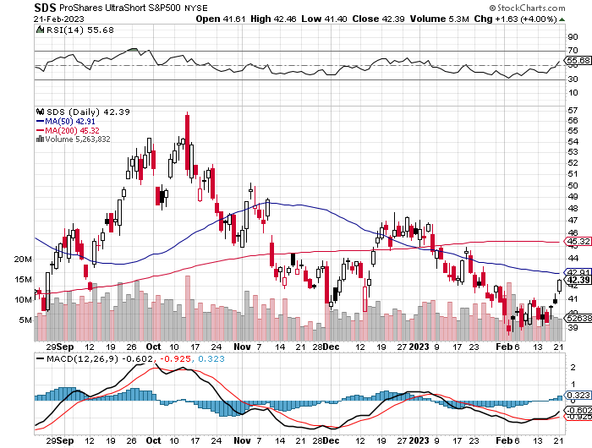
ProShares Ultra Short S&P 500 (SDS)- a great hedge for long stocks and bonds long 2X position has a hedge against longs and bond shorts

Slide 19
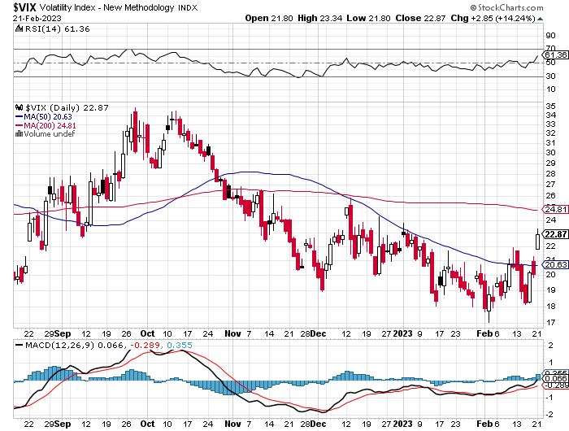
(VIX) – Bargain of the Century

Slide 20
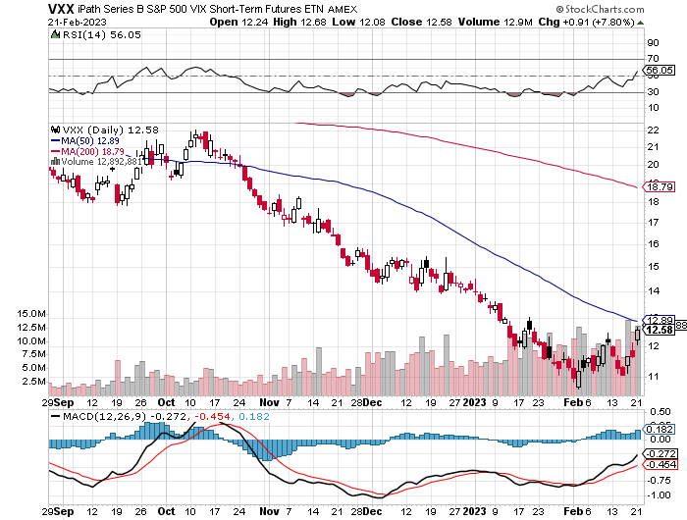
(VXX)-

Slide 21
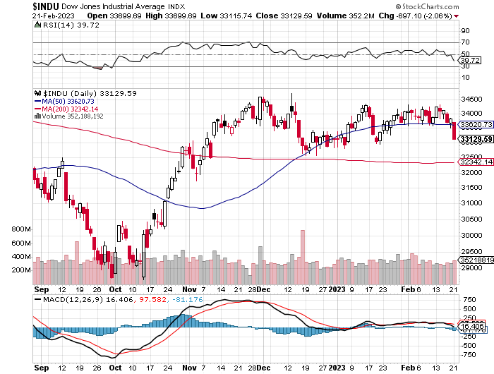
Dow Average ($INDU)-

Slide 22
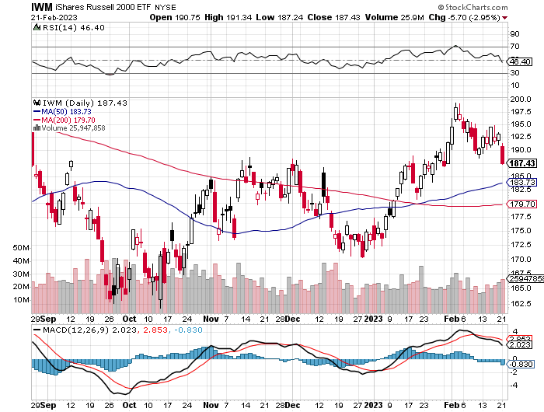
Russell 2000 (IWM)- took profits on Long 10/$137-$142 vertical bull call spread took profits on Long 10/$153-$156 vertical bear put spread

Slide 23
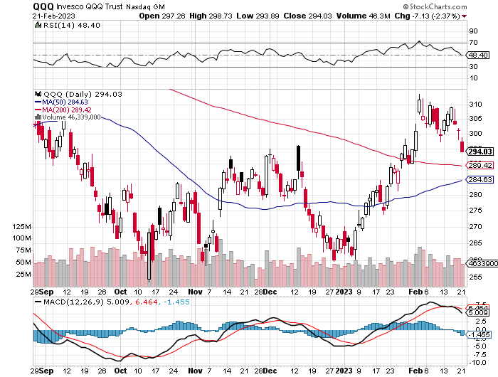
NASDAQ (QQQ) – took profits on long (QQQ) 1/$290-$300 put spread, took profits on long (QQQ) 4/$330-$335 put spread took profits on long (QQQ) 3/$340-$345 put spread, covered long (QQQ) $325-$330 put spread

Slide 24
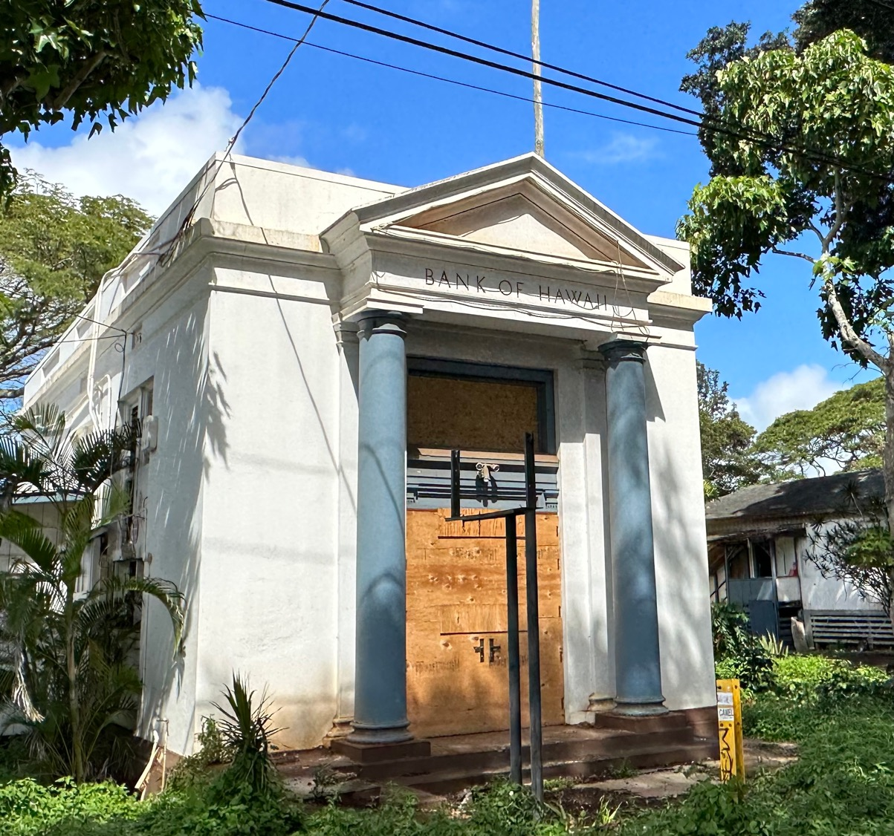

Slide 25
The Barbell Portfolio
*50% Big Tech - 2% of US Employment but 27% of Market Cap and 38% of Profits 50% Domestic Recovery, including: Railroads Couriers Banks Construction Credit Cards Event organizers Ticket sales Retailers

Slide 26
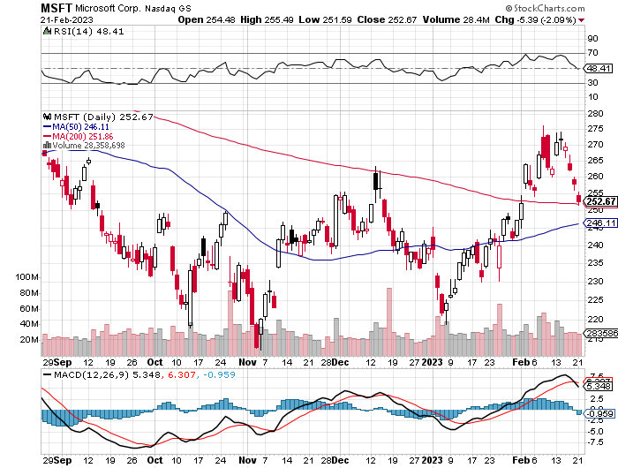
Microsoft (MSFT)- Grim Forward Guidance took profits on 9/$235-$245 call spread, took profits on long 7/$220-$210 call spread, took profits on long 6/$220-$230 call spread, took profits on long 2/$200-$210 bear put spread

Slide 27
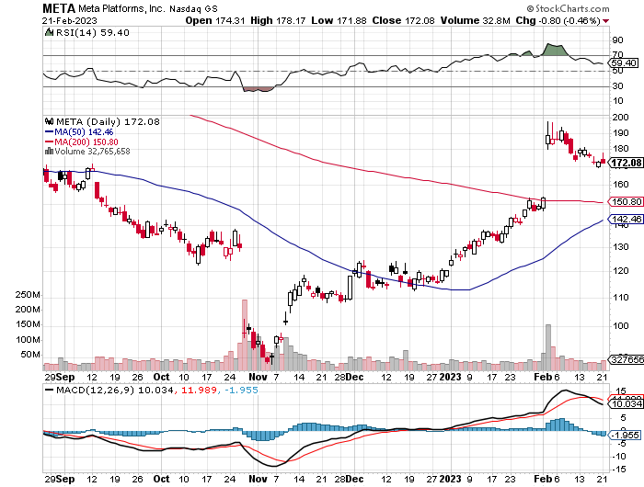
Meta (META)- Soars an Incredible 20% took profits on Long 9/$290-$300 vertical bear put spread stopped out of Long 9/$190-$200 vertical bear put spread

Slide 28
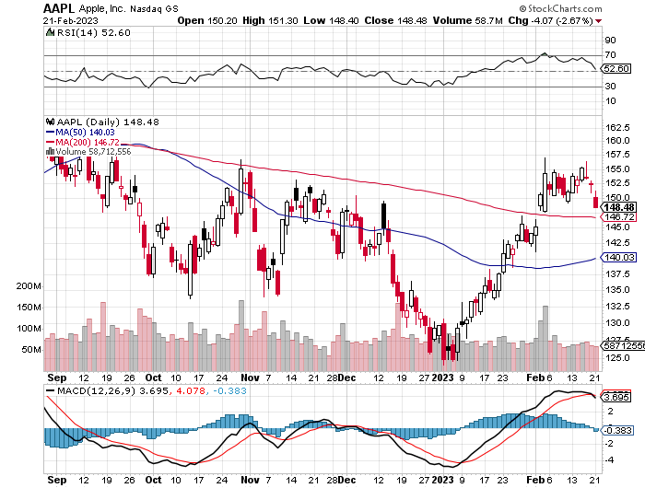
Apple (AAPL)- Disappoints on parts shortfalls in China took profits on long 1/$145-$155 put spread, Took profits on long 10/$165-$175 put spread took profits on long 6/$155-$165 put spread, stopped out of long 6/$125-135 call spread, took profits on long 6/$110-$120 call spread, took profits on long 2/$180-$190 put spread

Slide 29
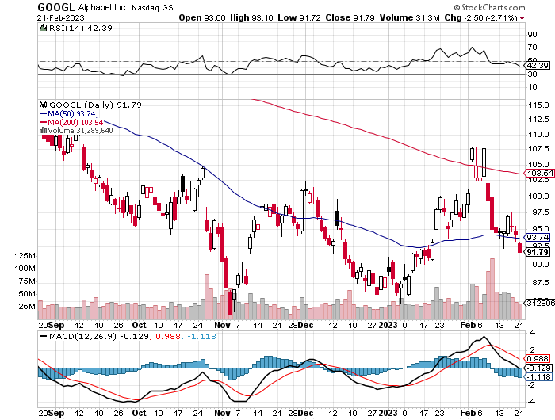
Alphabet (GOOGL) – Disappoints on a major advertising shortfall Government Sues Google on Antitrust took profits on long 12/$1,200-$1,230 bull call spread took profits on long 9/$1,030-$1,080 vertical bull call spread

Slide 30
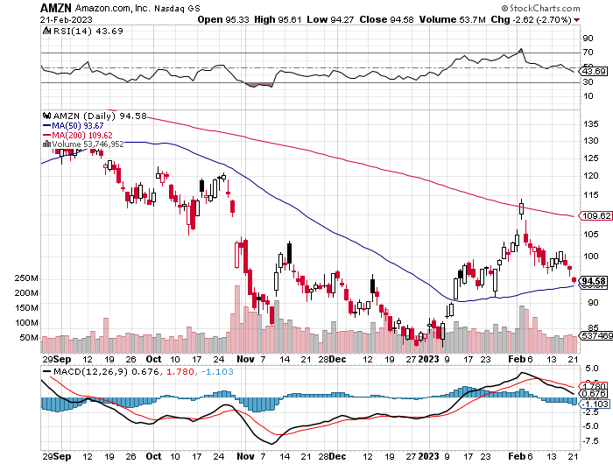
Amazon (AMZN) – US Preparing Antitrust Against Amazon took profits on long 2/$3,400-$3,500 bear put spread took profits on long 9/$2,800-$2,900 bull call spread

Slide 31
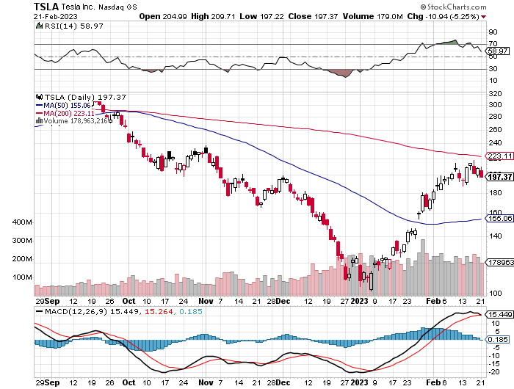
Tesla (TSLA) – Top Trader With Implied Volatility at 90% 360,000 recall on Self driving, Ford F-150 Lightening halts production Tesla Model Y Now the Top Selling Car in California long 2/$145-$155 call spread, long 2/$250-$260 put spread took profits on long 2/$150-$160 call spread, took profits on long 2/$155-$165 put spread took profits on long 2/$220-$230 call spread, stopped out of long 2/$210-$220 put spread took profits on long 2/$95-$100 call spread, took profits on long 1/$75-$80 call spread

Slide 32
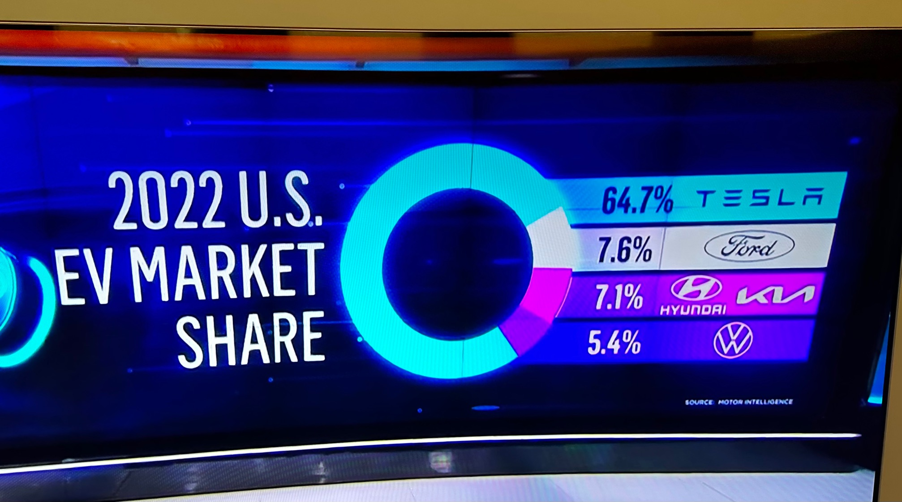

Slide 33
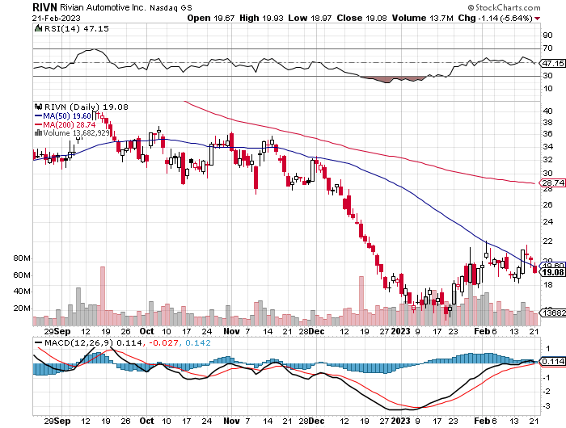
Rivian (RIVN) – Amazon Backed Electric Trucks Joint Venture with Mercedes Put on Hold took profits on long 10/$25-$30 call spread

Slide 34
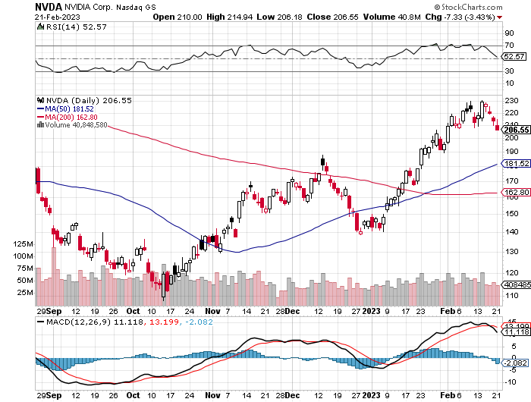
NVIDIA (NVDA) – Downgrade on US ban of highest end AI chips to China took profits on long 10/$95-$100 call spread took profits on long 7/$120-$130 call spread, took profits on long 6/$120-$130 call spread

Slide 35
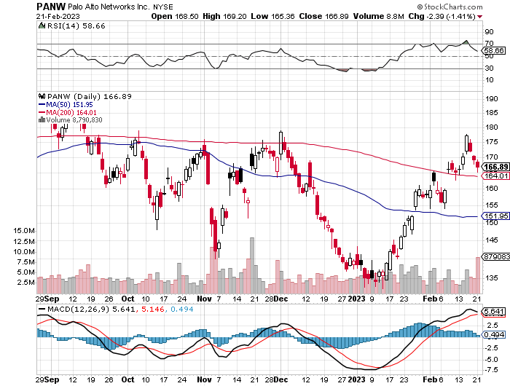
Palo Alto Networks (PANW)- Hacking never goes out of fashion took profits on long 10/$130-$140 call spread

Slide 36
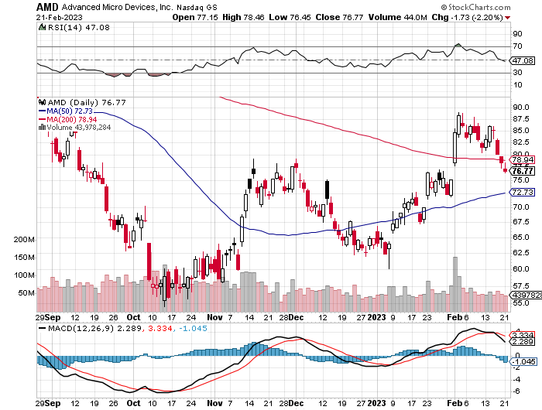
Advanced Micro Devices (AMD)- Recession fears programable logic devices took profits on long 2/$75-$80 call spread

Slide 37
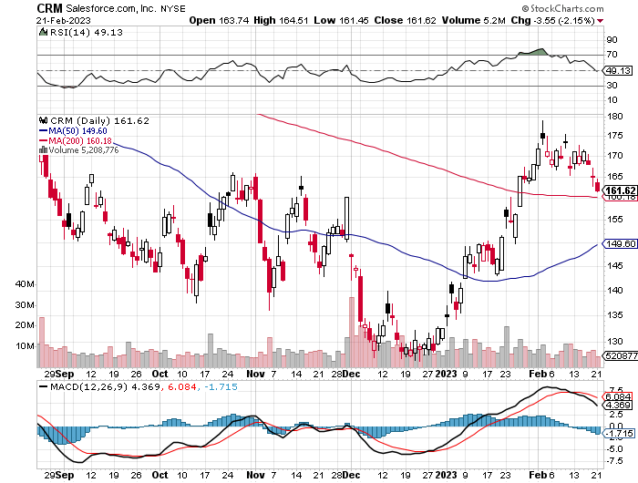
Salesforce (CRM)- Massive Online Migration took profits on long 9/$125-$130 vertical bull call spread took profits on long 8/$125-$130 vertical bull call spread took profits on long 2/$105-$115 call spread

Slide 38
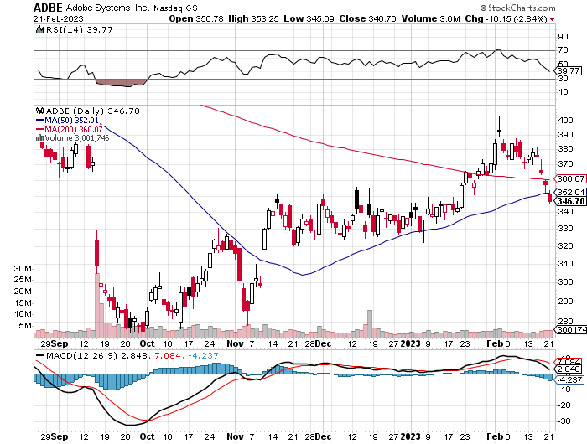
Adobe (ADBE)- Cloud play The Quality Non-China tech play

Slide 39
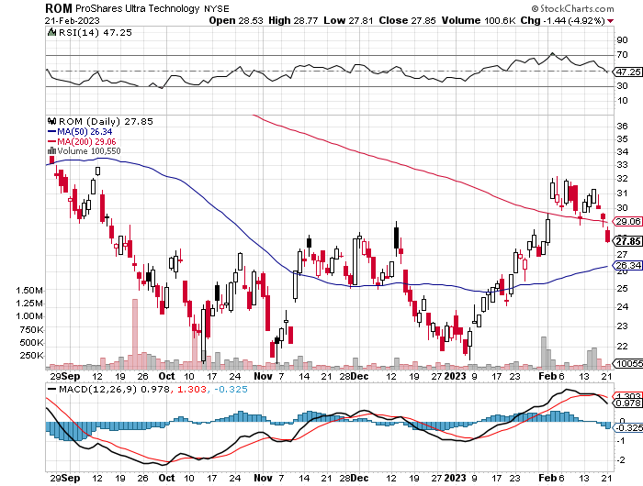
ProShares Ultra Technology ETF (ROM) – 2X Long Technology ETF took profits on long 10/$62-65 call spread

Slide 41
The Second Half of the Barbell
*Bets on a domestic recovery in 2022 Q4 *Upside potential in 2022 far greater than tech *Some of these have not moved for 5 or 10 years *Focuses on economically sensitive cyclical industries *Makes a great counterweight to high-growth technology *We could spend all of next year rotating between the two groups

Slide 42
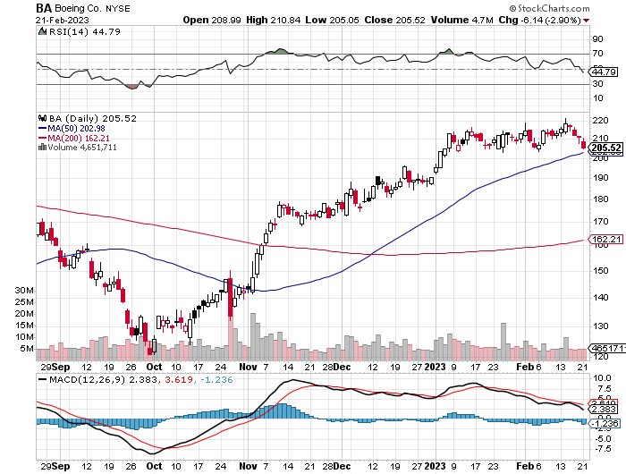
Boeing (BA) –Deliveries Soar from 340 to 480 in 2022, and 479 new orders To Hire 10,000 in 2023

Slide 43
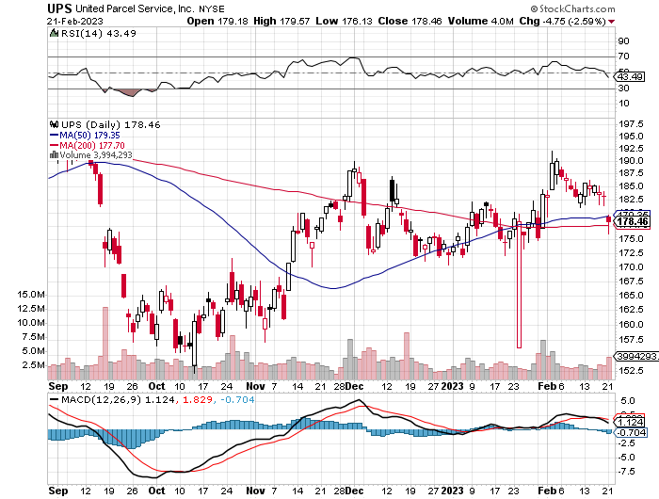
Package Delivery- United Parcel Service (UPS) - took profits on long 11/$130-$140 call spread

Slide 44
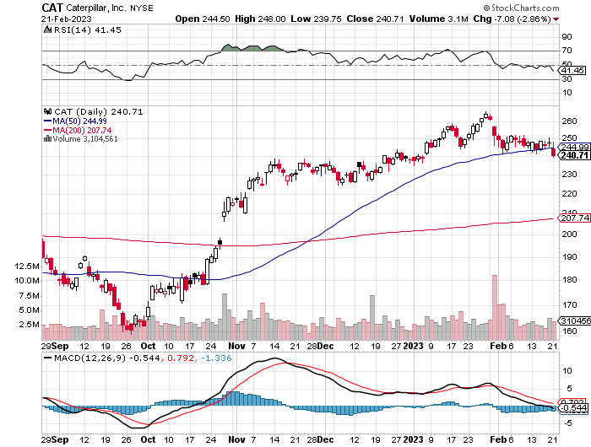
Caterpillar (CAT)- Ag + Infrastructure + Housing Raises Dividend by 50% took profits on long 12/$145-$150 call spread took profits on long 11/$125-$135 call spread

Slide 45
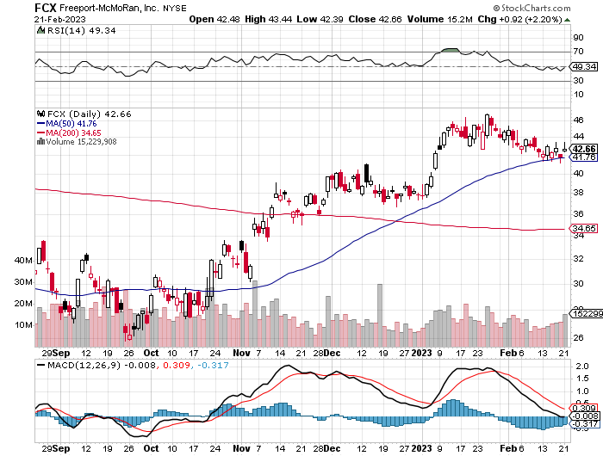
Freeport McMoRan - (FCX)- Copper Play took profits on long 10/$20-$23 call spread

Slide 46
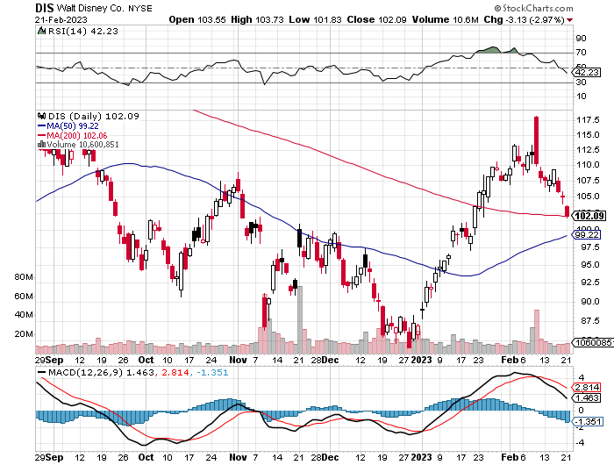
Walt Disney (DIS) - Not a recession play stopped out of long 10/$165-$175 call spread took profits on long 3/$170-$180 call spread

Slide 47
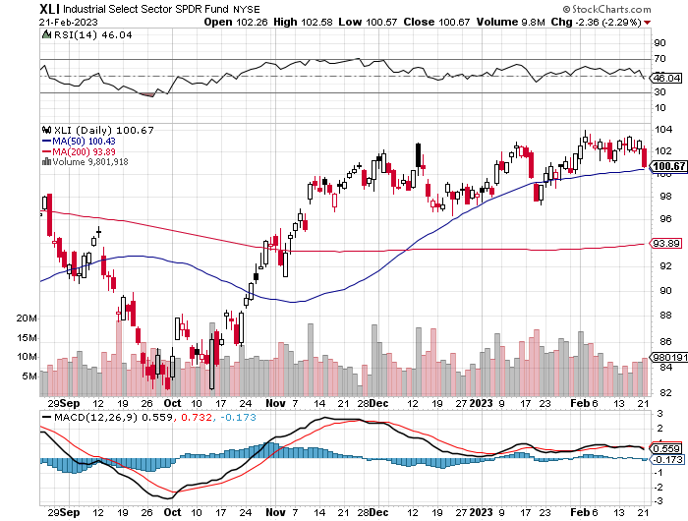
Industrials Sector SPDR (XLI)- (GE), (MMM), (UNP), (UTX), (BA), (HON)

Slide 48
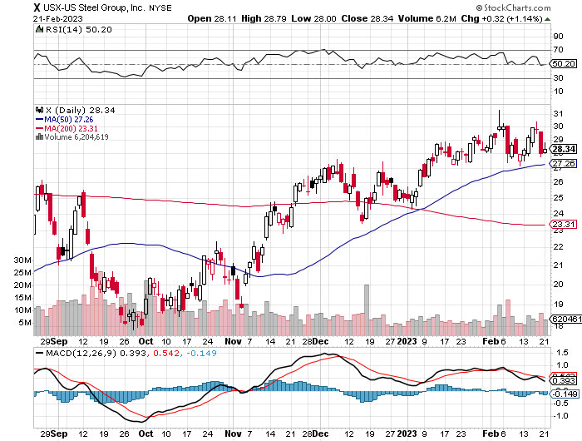
US Steel (X) – Commodity Boom and Wartime boost

Slide 49
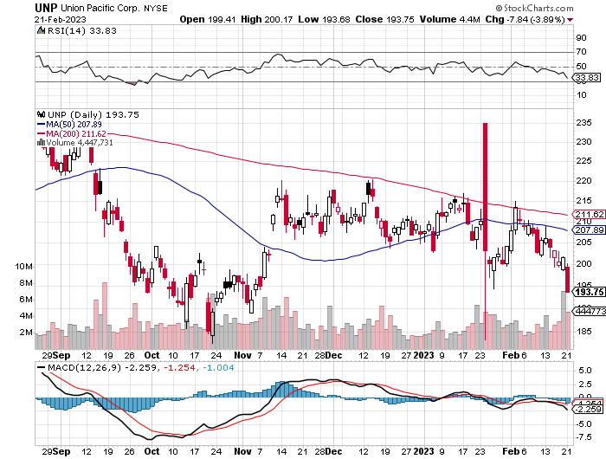
Union Pacific RR (UNP)- Big Stuff to Ship took profits on long 5/$200-$210 call spread took profits on 11/$150-$160 call spread

Slide 51
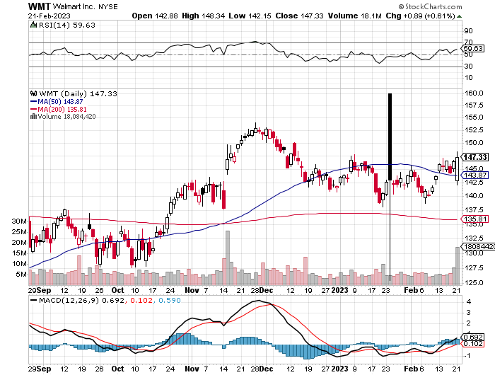
Wal-Mart (WMT)- took profit on Long 11/$125-$130 bear put spread took profit on Long 10/$119-$121 bear put spread took profits on Long 8/$114-$117 bear put spread

Slide 52
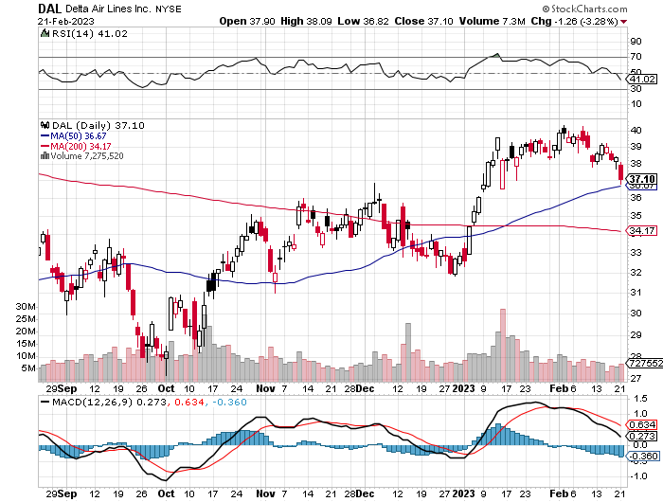
Delta Airlines (DAL) – Travel is Back!

Slide 53
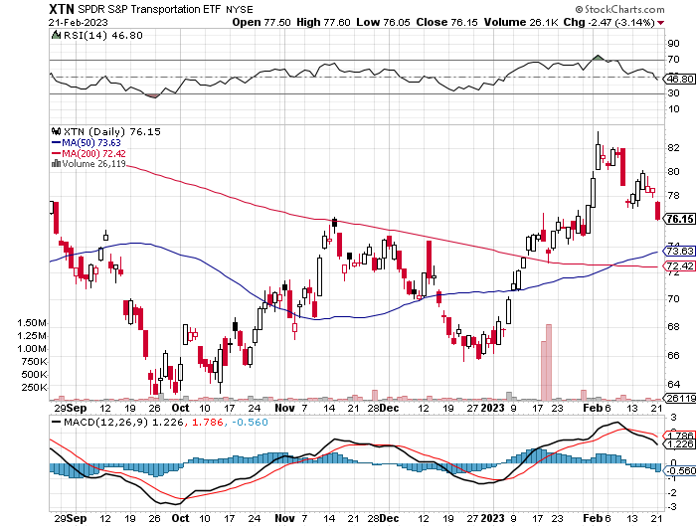
Transports Sector SPDR (XTN)- Worst Hit Sector (ALGT), (ALK), (JBLU), (LUV), (CHRW), (DAL)

Slide 54
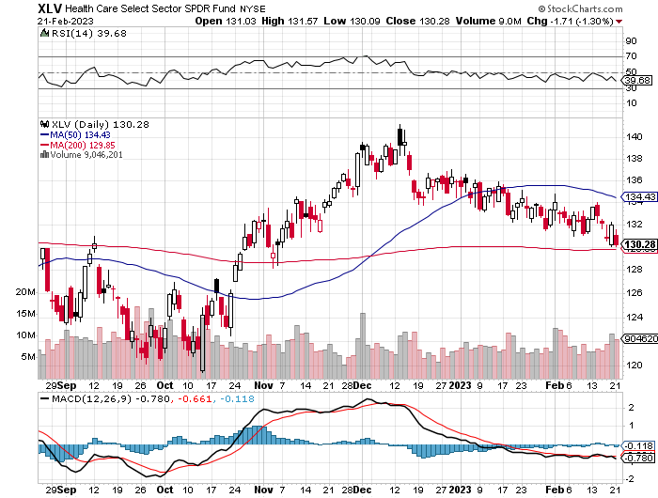
Health Care Sector (XLV) (JNJ), (PFE), (MRK), (GILD), (ACT), (AMGN)

Slide 55
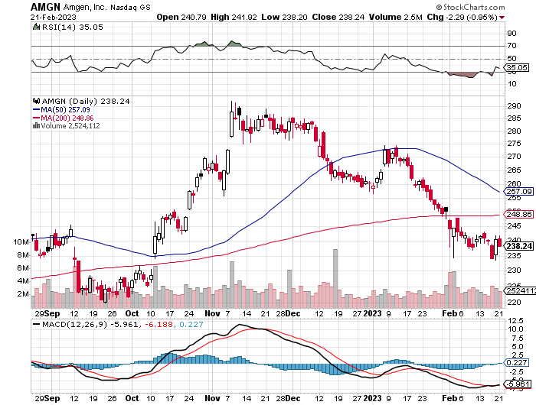
Amgen (AMGN) took profits on long 11/$185-$200 bull call spread

Slide 56
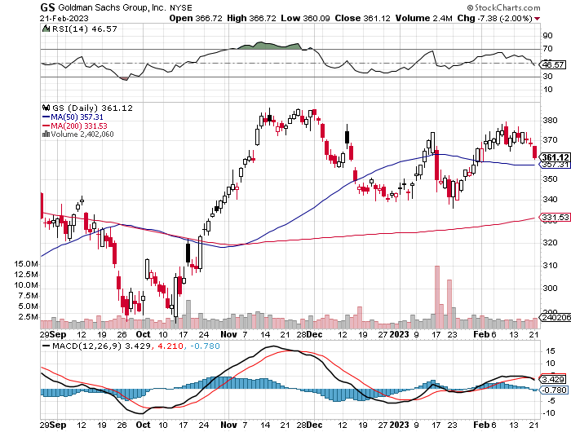
Goldman Sachs (GS) – took profits 12/$330-$350 call spread took profits 11/$330-$350 call spread stop loss on long 11/$385-$395 call spreads

Slide 57
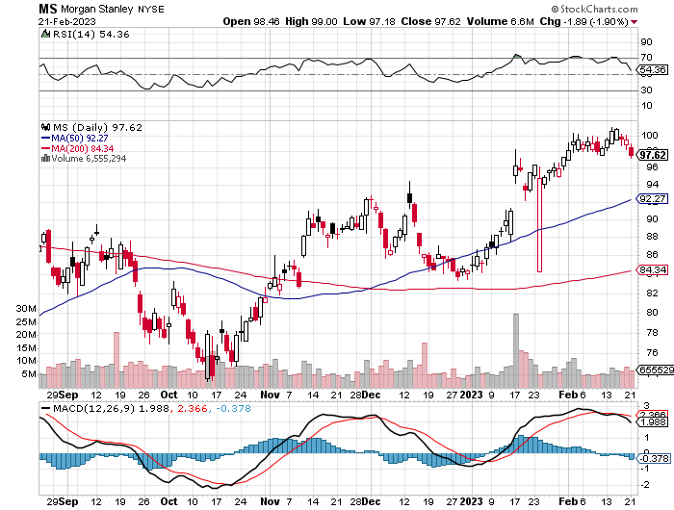
Morgan Stanley (MS) – took profits on long 10/$85-$90 call spread

Slide 58
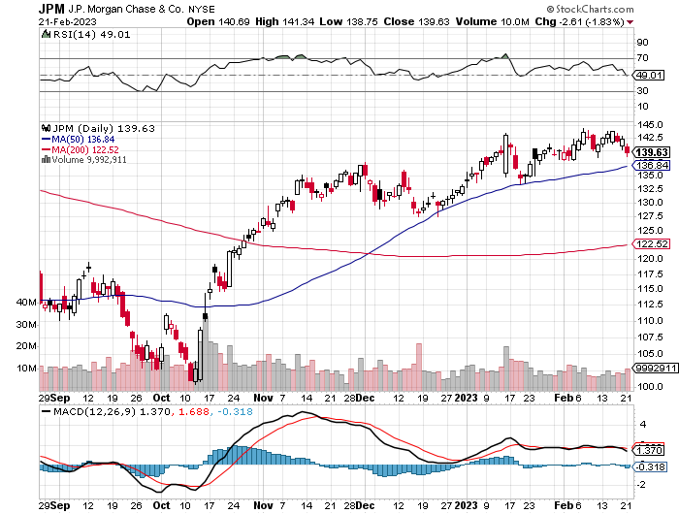
JP Morgan Chase (JPM)- took profits on long 10/$85-$90 call spread, stopped out of long 10/$95-$100 call spread took profits long 12/$148-$152.50 call spread

Slide 59
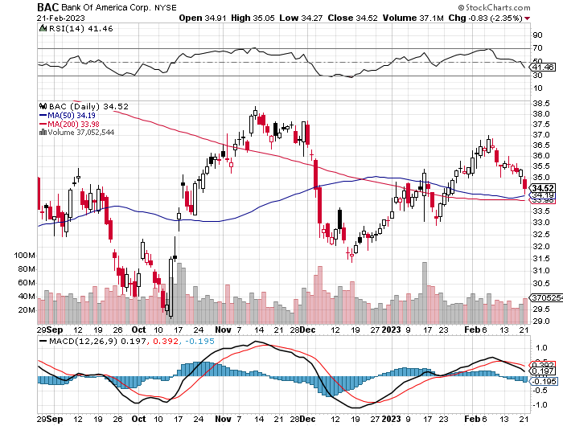
Bank of America (BAC) – took profits long 12/$39-$42 call spread

Slide 60
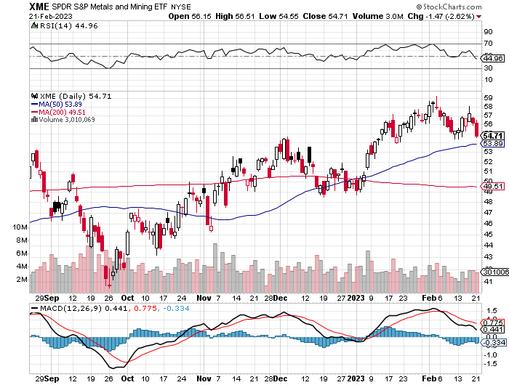
SPDR Metals & Mining ETF (XME) – long 2/$28-$30 call spread

Slide 61
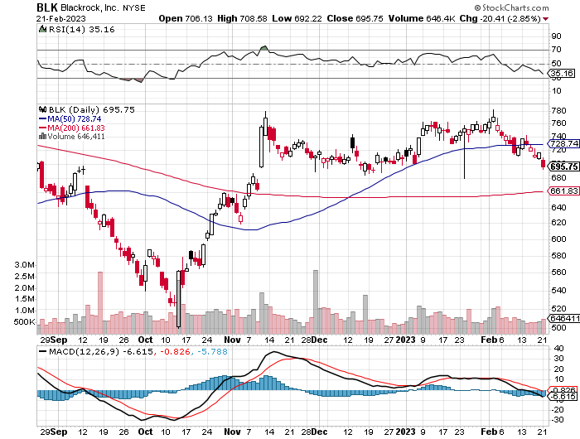
Blackrock (BLK)-Asset Collection Boom took profits on long 3/$770-$790 call spread took profits on long 3/$310-$340 call spread

Slide 62
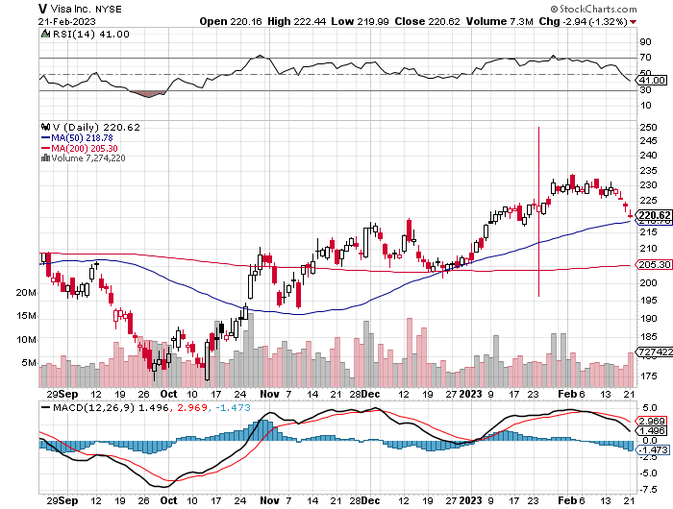
Visa (V) – “Touchless” Bitcoin Drag Transaction grew by an inflationary 10% back to pre-pandemic levels took profits on long 10/$160-$170 bull call spread took profits on long 6/$150-$160 bull call spread

Slide 63
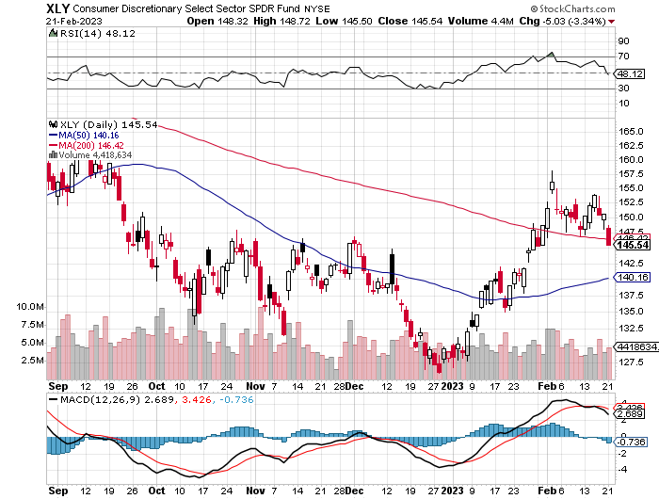
Consumer Discretionary SPDR (XLY) (DIS), (AMZN), (HD), (CMCSA), (MCD), (SBUX)

Slide 64
Berkshire Hathaway (BRKB)- Natural Barbell took profits on long 1/$290-$300 call spread, took profits on long 10/$220-$230 call spread, took profits on long 7/$220-$230 call spread, took profits on long 7/$220-$230 call spread took profits on long 6/$260-$270 call spread

Slide 65
Europe Hedged Equity (HEDJ)-

Slide 66
Japan (DXJ)-

Slide 67
Emerging Markets (EEM) - Pro trade, Weak Dollar, Long Recovery Play

Slide 69
Bonds – Double Top
*Bonds entering “BUY” territory at bottom of the range, driven down by warnings of government debt defaults *Ten-year US Treasury yields jump from 3.30% to 3.9% *Still looking like 2.50% yield by end 2023 *(TLT) should reach $120 in 2023 after political interreference ends this summer *Keep buying (TLT) calls, calls spreads and LEAPS on dips but only on dips *Junk bond ETF’s (JNK) and (HYG) are a great high yield play

Slide 70
Treasury ETF (TLT) – Triple Long took profits on long 1/$96-$99 call spread, took profits on long 1/$95-$98 call spread, took profits on long 2/$95-$98 call spread

Slide 71
Ten Year Treasury Yield ($TNX) – 3.82%

Slide 72
Junk Bonds (HYG) 7.55% Yield to Maturity

Slide 73
Municipal Bonds (MUB) 2.06% Yield-

Slide 74
Emerging Market Debt (ELD) 6.72% Yield-

Slide 75
2X Short Treasuries (TBT)-Out of Favor

Slide 77
Foreign Currencies – New Dollar Strength
* Prospects of higher rates for longer give new life to the US Dollar * Kazuo Ueda, former Bank of Japan board member, to take the helm of the BOJ from April. The yen takes a hit on the news *After a great four month run all currencies were overdue and in need of a rest *China going to Covid heard immunity will still keep the Yuan relatively weak *Any strength in the dollar will be temporary *Look for new dollar lows by end 2023 *Buy (FXE), (FXY), (FXB) on dips

Slide 78
THE MAD HEDGE FUND TRADER
Australian Dollar (FXA) - Major Long-Term Bottom is In Targeting Parity – A call option on a global synchronized recovery
1:1
BUY

Slide 79
Japanese Yen (FXY)
2023 Target 25%

Slide 80
Euro (FXE)-
2023 Target 25%

Slide 81
British Pound (FXB)-
2023 Target 15%

Slide 82
Emerging Market Currencies (CEW)
2023 Target 40%

Slide 84
Energy & Commodities – Head & Shoulders Top?
*Russia cuts production by 500,000 barrels a day due to sanctions and falling demand *Natural Gas breaks down to new two year low on warm European winter and US supplies *Biden Ukraine Visit Tanks Gas and Oil Prices, cutting Russia’s chances of a win and eventually leading to a flood of oil on the market. *Energy is getting so cheap it might be worth a trade. *Germany Accelerates Move Towards Alternatives, permanently cutting all ties with Russia energy *Europe’s biggest economy, and the fourth largest in the world, hopes to get 80% of its electricity from solar and wind by 2030 *Massive supplies from the US headed off Europe’s energy crisis

Slide 85
Oil-($WTIC)

Slide 86
United States Oil Fund (USO)

Slide 87
Energy Select Sector SPDR (XLE)-No Performance! (XOM), (CVX), (SLB), (KMI), (EOG), (COP)

Slide 88
ExxonMobile (XOM)- took profits on long 12/$120-$125 put spread

Slide 89
Occidental Petroleum (OXY)- long 2/$55-$60 call spread, took profits on long 12/$77.50-$82.50 put spread

Slide 90
Natural Gas (UNG) -

Slide 91
Freeport McMoRan (FCX) -

Slide 92
Cameco (CCJ) - took profits on long 5/$20-$23 bull call spread

Slide 94
Precious Metals – Entry Point
*Gold gets a correction, opening up a great entry point *Silver is beating gold as massive new industrial demand kicks in from several sources, including solar and EV’s and is also a China recovery play *Silver is now an industrial commodity while gold is still a precious metal used for jewelry, investment, and central bank reserves *It all makes silver the better play on the eve of an economy recovery *Many pension funds that abandoned precious metals a decade ago are starting to crawl bank in size *With interest rates certain to plummet later in 2023 as the Fed reacts to a recession, Precious metals could be one of the big trades for next year *Buy (GLD), (GDX), (GOLD), (SLV), and (WPM) on dips

Slide 95
Gold (GLD) - Deflation call took profits on long 5/$165-$170 bull call spread

Slide 96
Market Vectors Gold Miners ETF- (GDX) –

Slide 97
Barrick Gold (GOLD) took profit on long 1/$15.50-$16.50 call spread

Slide 98
Newmont Mining- (NEM)- took profits on long $55-60 call spread

Slide 99
Silver- (SLV)- took profits on long 11/$19-$20 call spread

Slide 100
Silver Miners - (SIL)-

Slide 101
Wheaton Precious Metals - (WPM)- took profits on long 1/$36-$39 call spread

Slide 103
Real Estate – Rate Surge
*Housing starts dive 4.5%, and 21% YOY *Housing Permits down 1.6% *Housing inventory still at half pre pandemic levels as regional bidding ways still persist and no one wants to sell *Mortgage application volume fell 7.7% as mortgage rates jumped higher to 6.39% *S&P Case Shiller Drops to an 8.6% Annual Gain *Look for new bull market in housing to start by end 2023, driven by plunging mortgage rates to 4.0%

Slide 104
S&P Case Shiller Plunges S&P Case Shiller Drops 8.6%, in November with its National Home Price Index Miami (+18.4%), Tampa (+16.9%), Atlanta (+12.7%)

Slide 105
Crown Castle International (CCI) – 4.30% yielding cell phone tower REIT

Slide 106
US Home Construction Index (ITB) (DHI), (LEN), (PHM), (TOL), (NVR)

Slide 108
Trade Sheet- So What Do We Do About All This?
*Stocks – buy the big dips at bottom of range, ………………sell big rallies to hedge holdings *Bonds – buy dips *Commodities-buy dips *Currencies- sell dollar rallies, buy currencies *Precious Metals – buy dips *Energy – buy dips *Volatility - sell short over $30 *Real estate – buy dips

Slide 110
Next Strategy Webinar 12:00 EST Wednesday, February 22 from Silicon Valley, CA email me questions at support@madhedgefundtrader.com
Good Luck and Good Trading!
Notes:
*

