Slide 1
The Mad Hedge Fund Trader “Confused Economy….Confused Market”
With John Thomas Silicon Valley, CA, March 8, 2023 www.madhedgefundtrader.com
Notes:
*

Slide 2
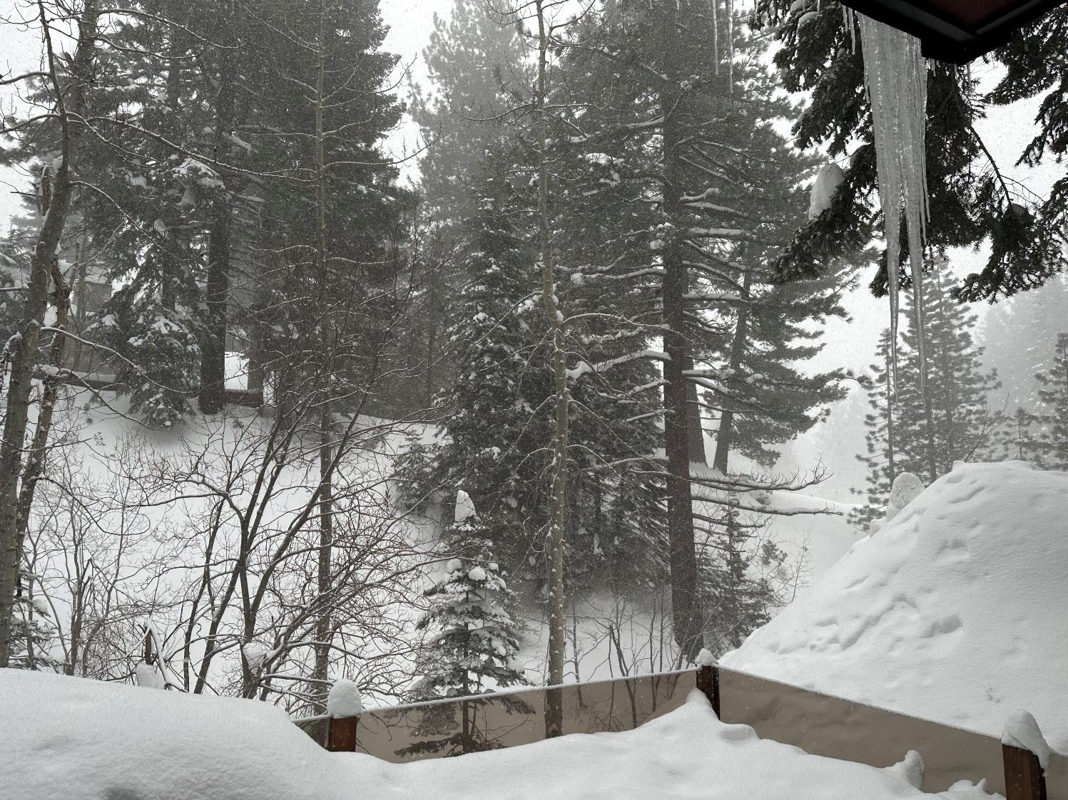

Slide 4
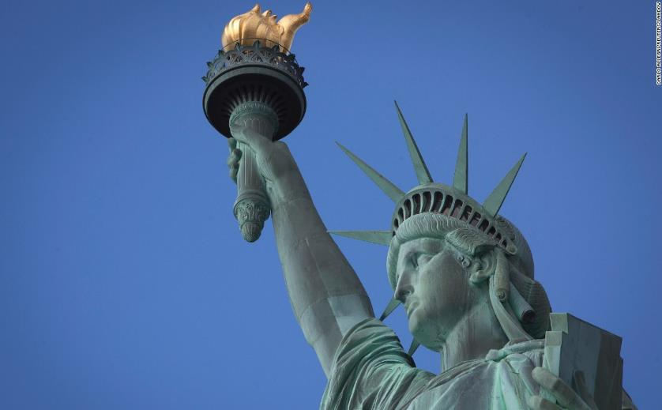
THURSDAY, JULY 6 NEW YORK STRATEGY LUNCHEON
*An excellent meal will be followed by a wide-ranging discussion and an extended question and answer period *The lunch will be held in an exclusive private club in Midtown Manhattan with a strict dress code *please go to my online store at http://www.madhedgefundtrader.com/store and click on “luncheons.” Tickets are available for $299

Slide 5
Friday July 13, 2023 Seminar at Sea
*Cunard Line’s flagship, the elegant and spacious Queen Mary II, on an eastbound transatlantic cruise *The Ship departs New York at 12:00 AM on July 7, 2023, and arrives at Southampton on July 14 *Guests will be responsible for booking their own cabin through Cunard *Three dinners during the voyage will be black tie *Customers are required to book their own cabins and return flights from England *The Cunard cruise number is M319

Slide 6
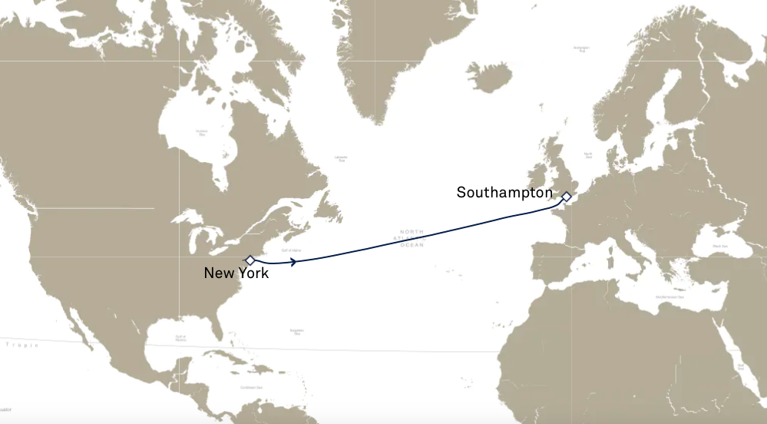

Slide 7
Trade Alert Performance New All Time Highs! 22 out of 24 trade alerts profitable in 2023
*January +22.35% Final *July +3.98% Final *February +3.41% Final *August +5.13% Final *March +2.86% MTD *September +9.72% Final *April +3.33% Final *October +5.69% Final *May +8.80% Final *November +8.31 Final *June +5.91% Final *December +0.95% Final *2022 Final +84.63% compared to -18.63% for the S&P 500 *2023 Year to Date +28.62%, versus +4.74% for the S&P 500 +625.81% since inception *Average annualized return of +46.83% for 15 years

Slide 8
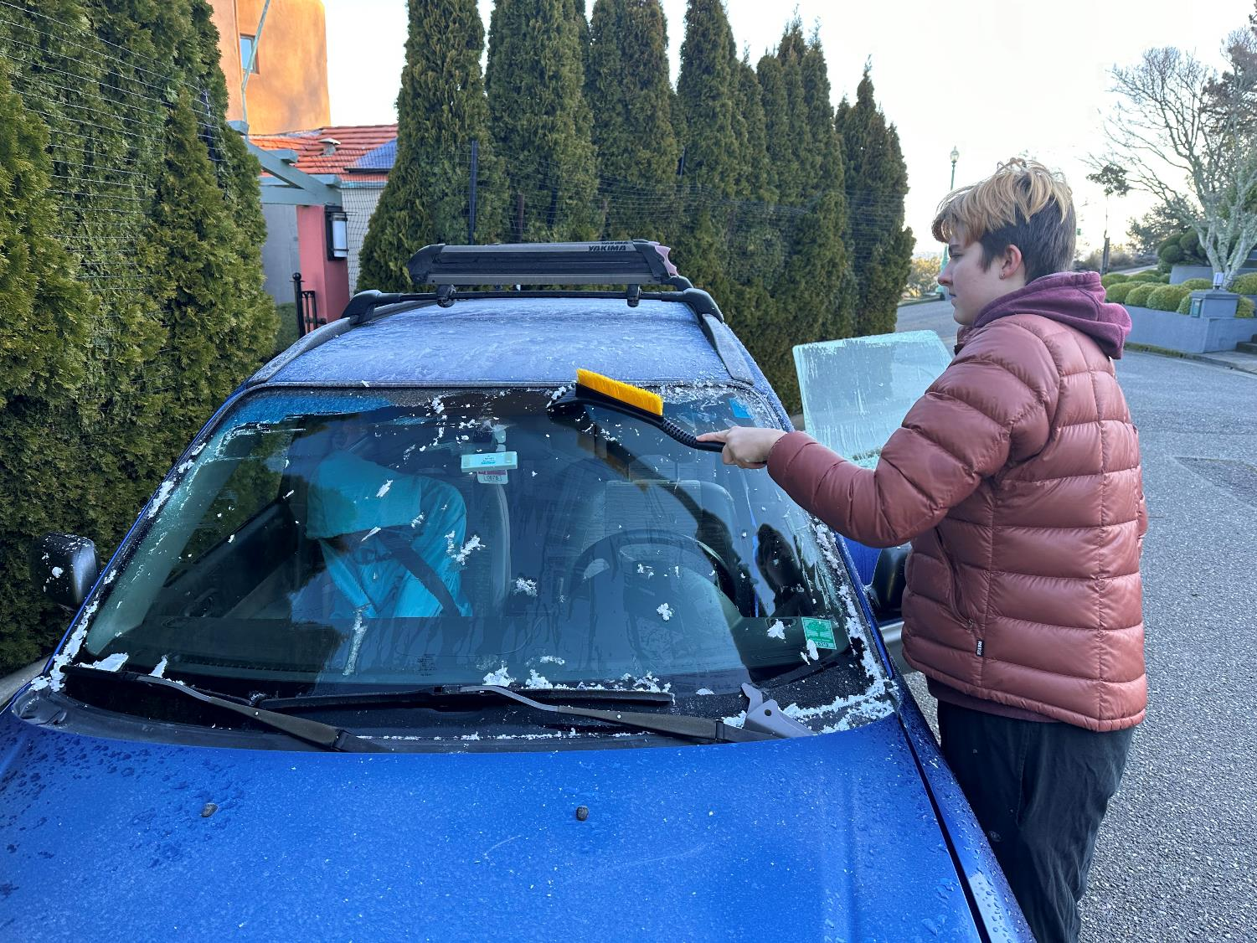

Slide 9
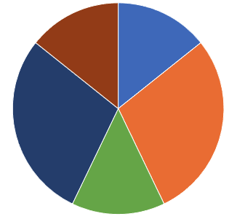
Portfolio Review 30% Long, 40% Short, 30% cash
Current Capital at Risk
Risk On
(TLT) 3/$92-$95 call spread | 10.00%
(TSLA) 4/$130-$140 call spread | 20.00%
Risk Off
(NVDA) 3/$260-$270 puts spread | -10.00%
(TSLA) 4/$150-$160 call spread | -20.00%
(NVDA) 4/$270-$280 put spread | -10.00%
Total Net Position | -10.00%
Total Aggregate Position | 70.00%
Expiration Value +35.34%

Slide 10
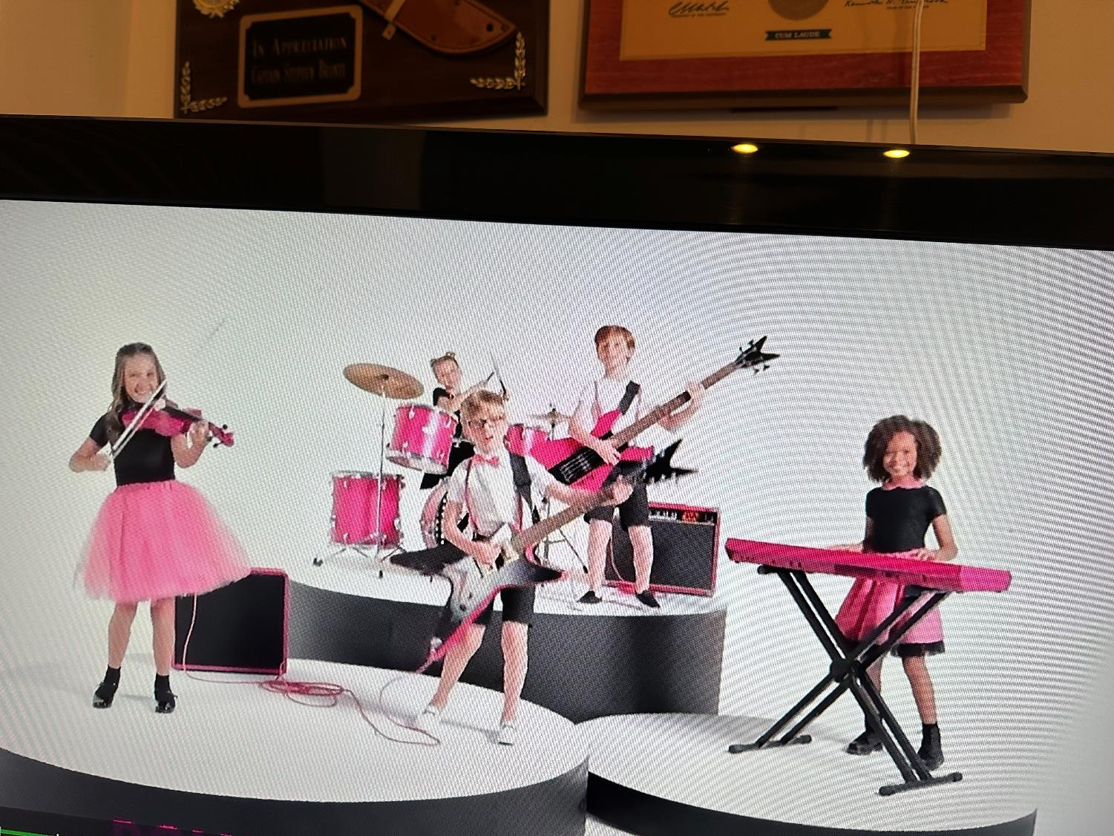

Slide 11
The Method to My Madness whipsaw
*Risk markets will be trapped in a range for months until the economic data breaks out *Aggressive growth tech and small caps will lead the next bull market *A House intent on debt default still capping bonds, sending yield back to 4.00% *Energy is plumbing new lows on Russia military failures, warm weather, and a supply glut *Gold, Silver, and commodities take a hit on higher interest rates, but is temporary *The US dollar gets a small pop off of a one year low as interest rates stay higher for longer *Look for S&P 500 at $4,800 by end 2023 *VIX dives to $20 – NO TRADE, cash is king

Slide 12
The Global Economy – Confused
*Fed Minutes Show More Hikes to Come, with the emphasis on the plural. That could take the overnight borrowing rate to a 6.00% high *Nothing Happens Until March 14, at 8:30 AM EST the next big inflation read, the Core CPI comes out. *Q4 GDP Dips, from 3.9% to 2.7% in the October-December quarter *Consumption took a dive, which is amazing over the holidays *Consumer Price Pop 0.7% in January, hotter than expected *China Manufacturing PMI Hits 11-Year High, at 52.6
*China Set’s Hot 5% Growth Target for 2023, as “zero covid” ends and herd immunity takes over

Slide 13
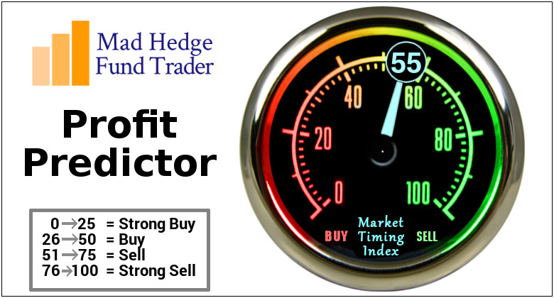
The Mad Hedge Profit Predictor Market Timing Index – Neutral An artificial intelligence driven algorithm that analyzes 30 different economic, technical, and momentum driven indicators

Slide 14
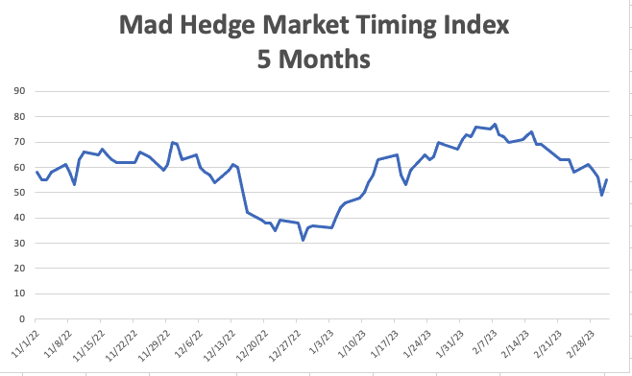
SELL
BUY

Slide 15
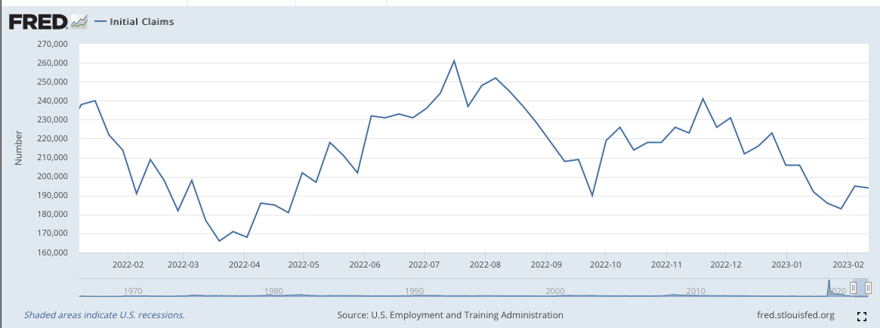
Weekly Jobless Claims – Falling 190,000 – Down 3,000

Slide 16
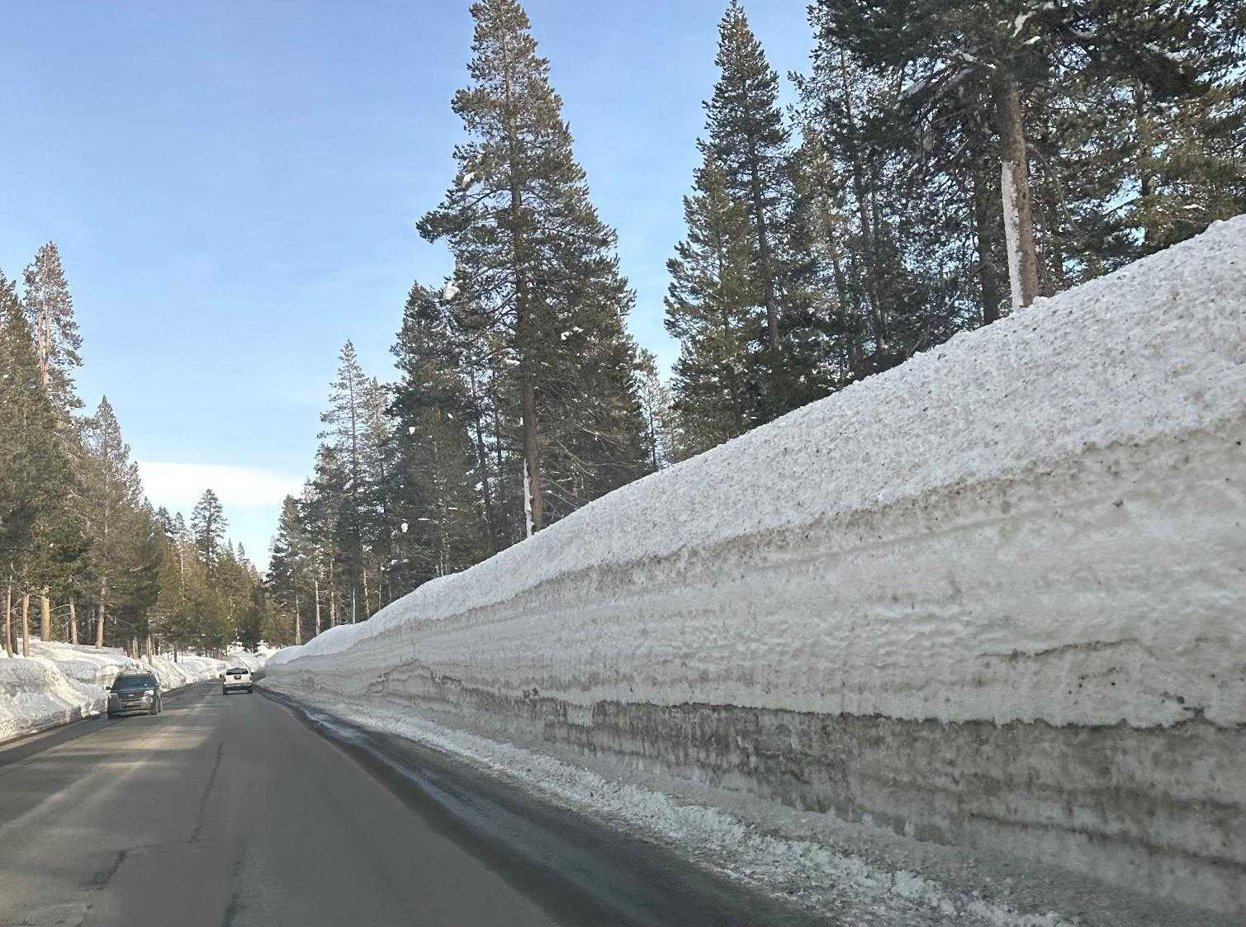

Slide 17
Stocks – Looking for the Next Trade
*Looking for flat first half, strong second half to take us to S&P 500 4,800 by yearend *Stocks will start to discount collapsing interest rates from this summer *US Equity Funds See Biggest Outflow in Seven Weeks, putting a retest of the lows on the table *If you don’t know what to do keep cash so you can buy at the next market bottom *Individual 401k’s Lost 23% in 2022, according to a study from Fidelity *High inflation is shrinking the remaining purchasing power even faster *Market neutral strategies will be big winners in a low Volatility Index ($VIX) world

Slide 18
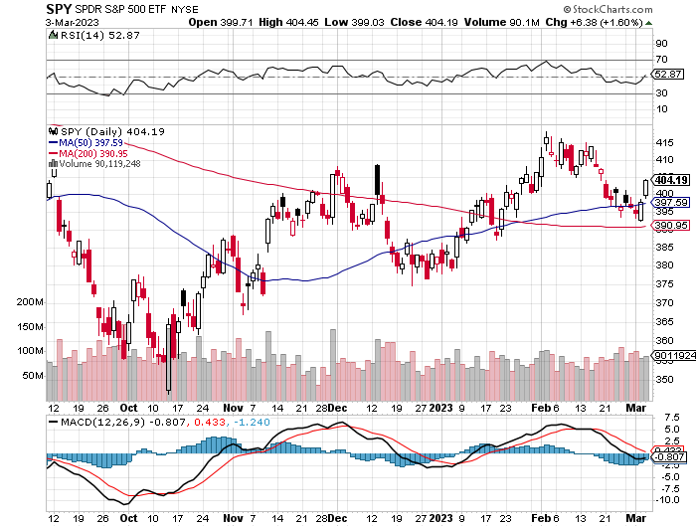
S&P 500 – Higher Lows and Lower Highs took profits on long 1/$420-$430 put spread, took profits on long 11/$420-$430 put spread took profits on long 10/$385-$395 put spread, took profits on long 11/$410-$400 put spread took profit on long 10/$390-$400 put spread, took profit on long 10/$320-$330 call spread
2023 $480 Target
$430 +21% Rally
$375 -12.8% Pull Back
The Bottom $355 Down -26%

Slide 19
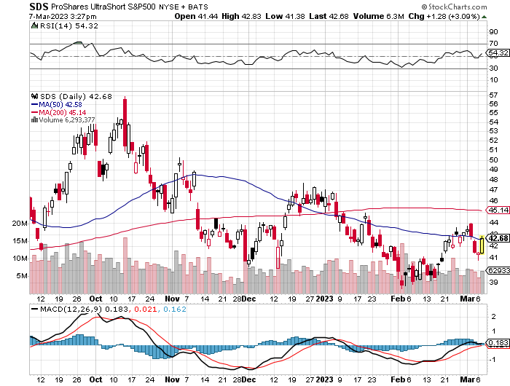
ProShares Ultra Short S&P 500 (SDS)- a great hedge for long stocks and bonds long 2X position has a hedge against longs and bond shorts

Slide 20
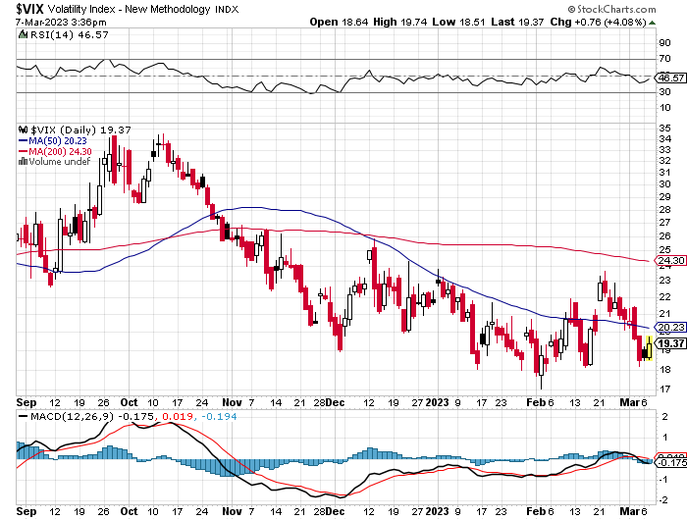
(VIX) – Bargain of the Century

Slide 21
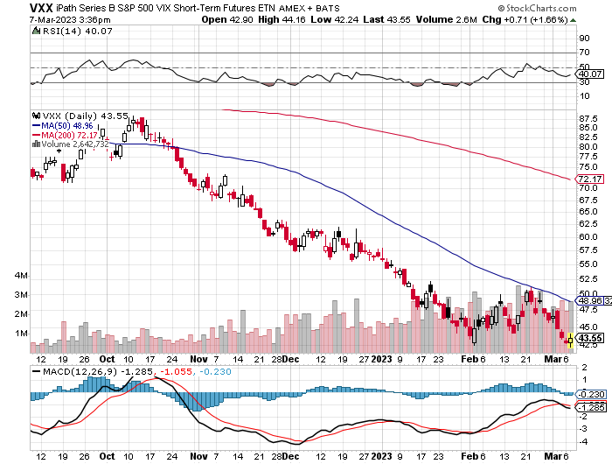
(VXX)-

Slide 22
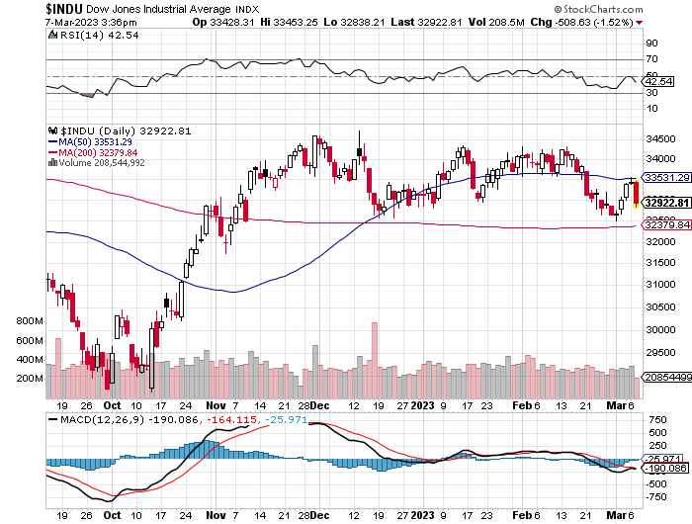
Dow Average ($INDU)-

Slide 23
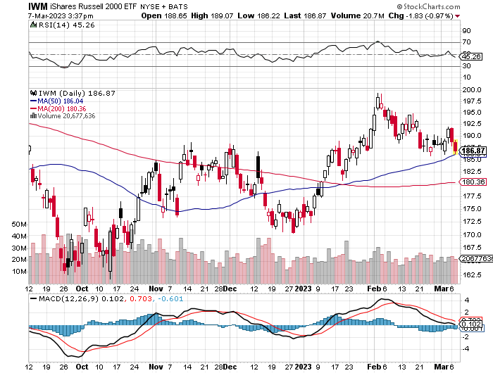
Russell 2000 (IWM)- took profits on Long 10/$137-$142 vertical bull call spread took profits on Long 10/$153-$156 vertical bear put spread

Slide 24
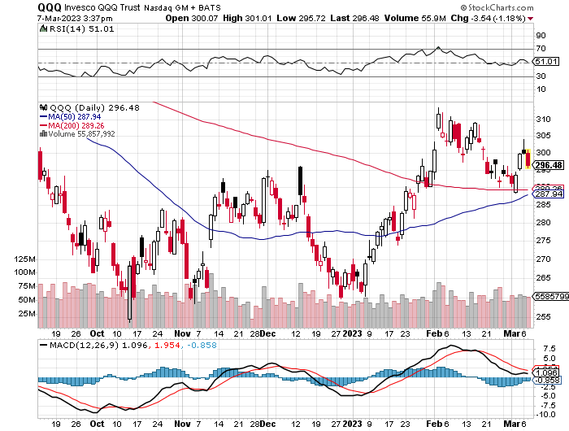
NASDAQ (QQQ) – took profits on long (QQQ) 1/$290-$300 put spread, took profits on long (QQQ) 4/$330-$335 put spread took profits on long (QQQ) 3/$340-$345 put spread, covered long (QQQ) $325-$330 put spread

Slide 26
The Barbell Portfolio
*50% Big Tech - 2% of US Employment but 27% of Market Cap and 38% of Profits 50% Domestic Recovery, including: Railroads Couriers Banks Construction Credit Cards Event organizers Ticket sales Retailers

Slide 27
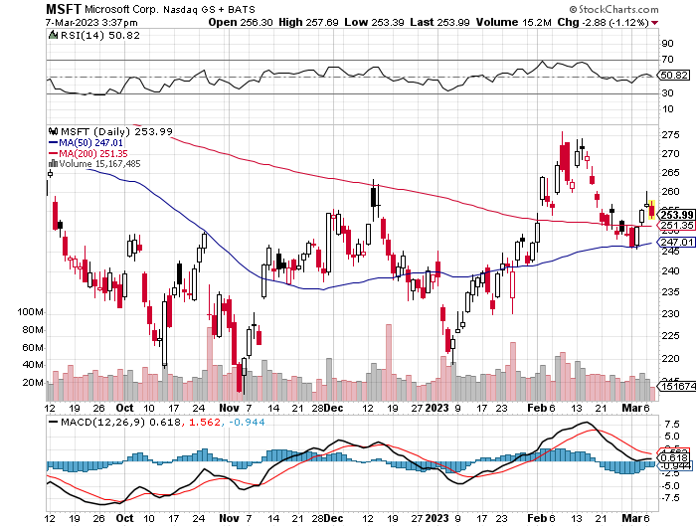
Microsoft (MSFT)- Grim Forward Guidance took profits on 9/$235-$245 call spread, took profits on long 7/$220-$210 call spread, took profits on long 6/$220-$230 call spread, took profits on long 2/$200-$210 bear put spread

Slide 28
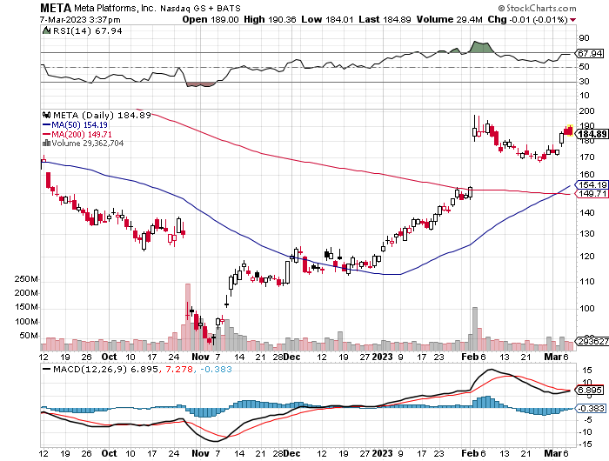
Meta (META)- Double Top? took profits on Long 9/$290-$300 vertical bear put spread stopped out of Long 9/$190-$200 vertical bear put spread

Slide 29
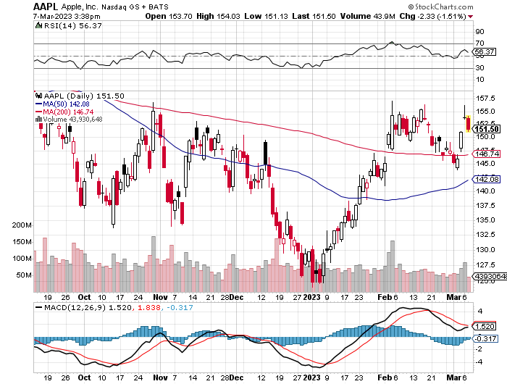
Apple (AAPL)-) Apple to Add Glucose Monitor on its Watches took profits on long 1/$145-$155 put spread, Took profits on long 10/$165-$175 put spread took profits on long 6/$155-$165 put spread, stopped out of long 6/$125-135 call spread, took profits on long 6/$110-$120 call spread, took profits on long 2/$180-$190 put spread

Slide 30
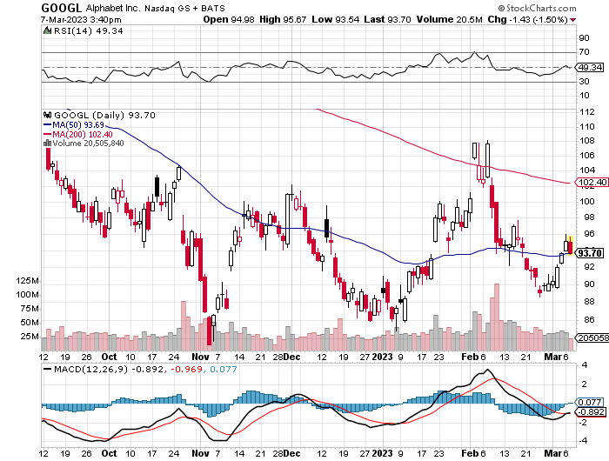
Alphabet (GOOGL) – Disappoints on a major advertising shortfall Government Sues Google on Antitrust took profits on long 12/$1,200-$1,230 bull call spread took profits on long 9/$1,030-$1,080 vertical bull call spread

Slide 31
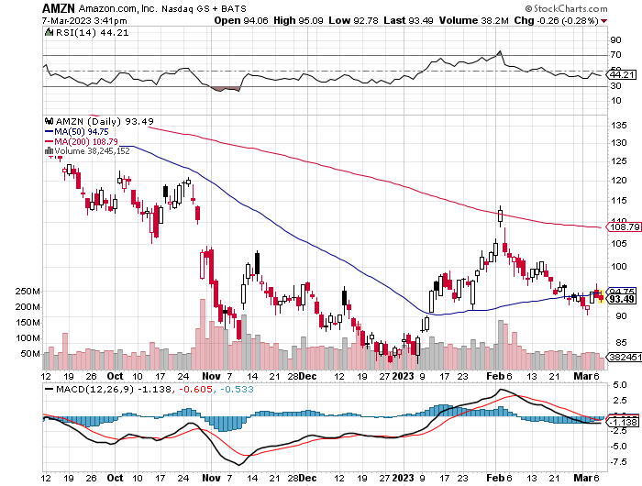
Amazon (AMZN) – US Preparing Antitrust Against Amazon took profits on long 2/$3,400-$3,500 bear put spread took profits on long 9/$2,800-$2,900 bull call spread

Slide 32
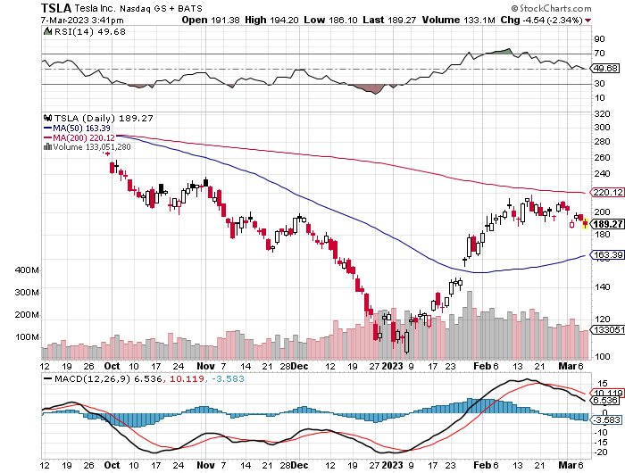
Tesla (TSLA) – Top Trader With Implied Volatility at 90% Tesla Day Offers No Surprises, Moves Engineering HQ to Silicon Valley long 4/$130-$140 call spread, long 4/$250-$260 put spread took profits on long 3/$145-$165 call spread, took profits on long 3/$250-$260 put spread took profits on long 2/$150-$160 call spread, took profits on long 2/$155-$165 put spread

Slide 33
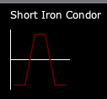
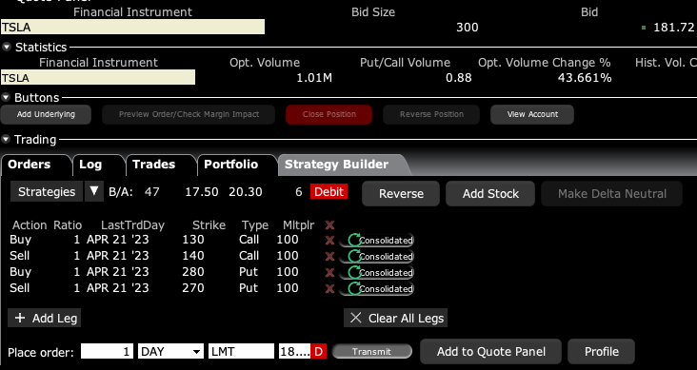
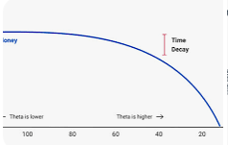
The Short Strangle Strategy Profits from a market that doesn’t move, but must buy at highest implied volatility, is a great time decay play

Slide 34
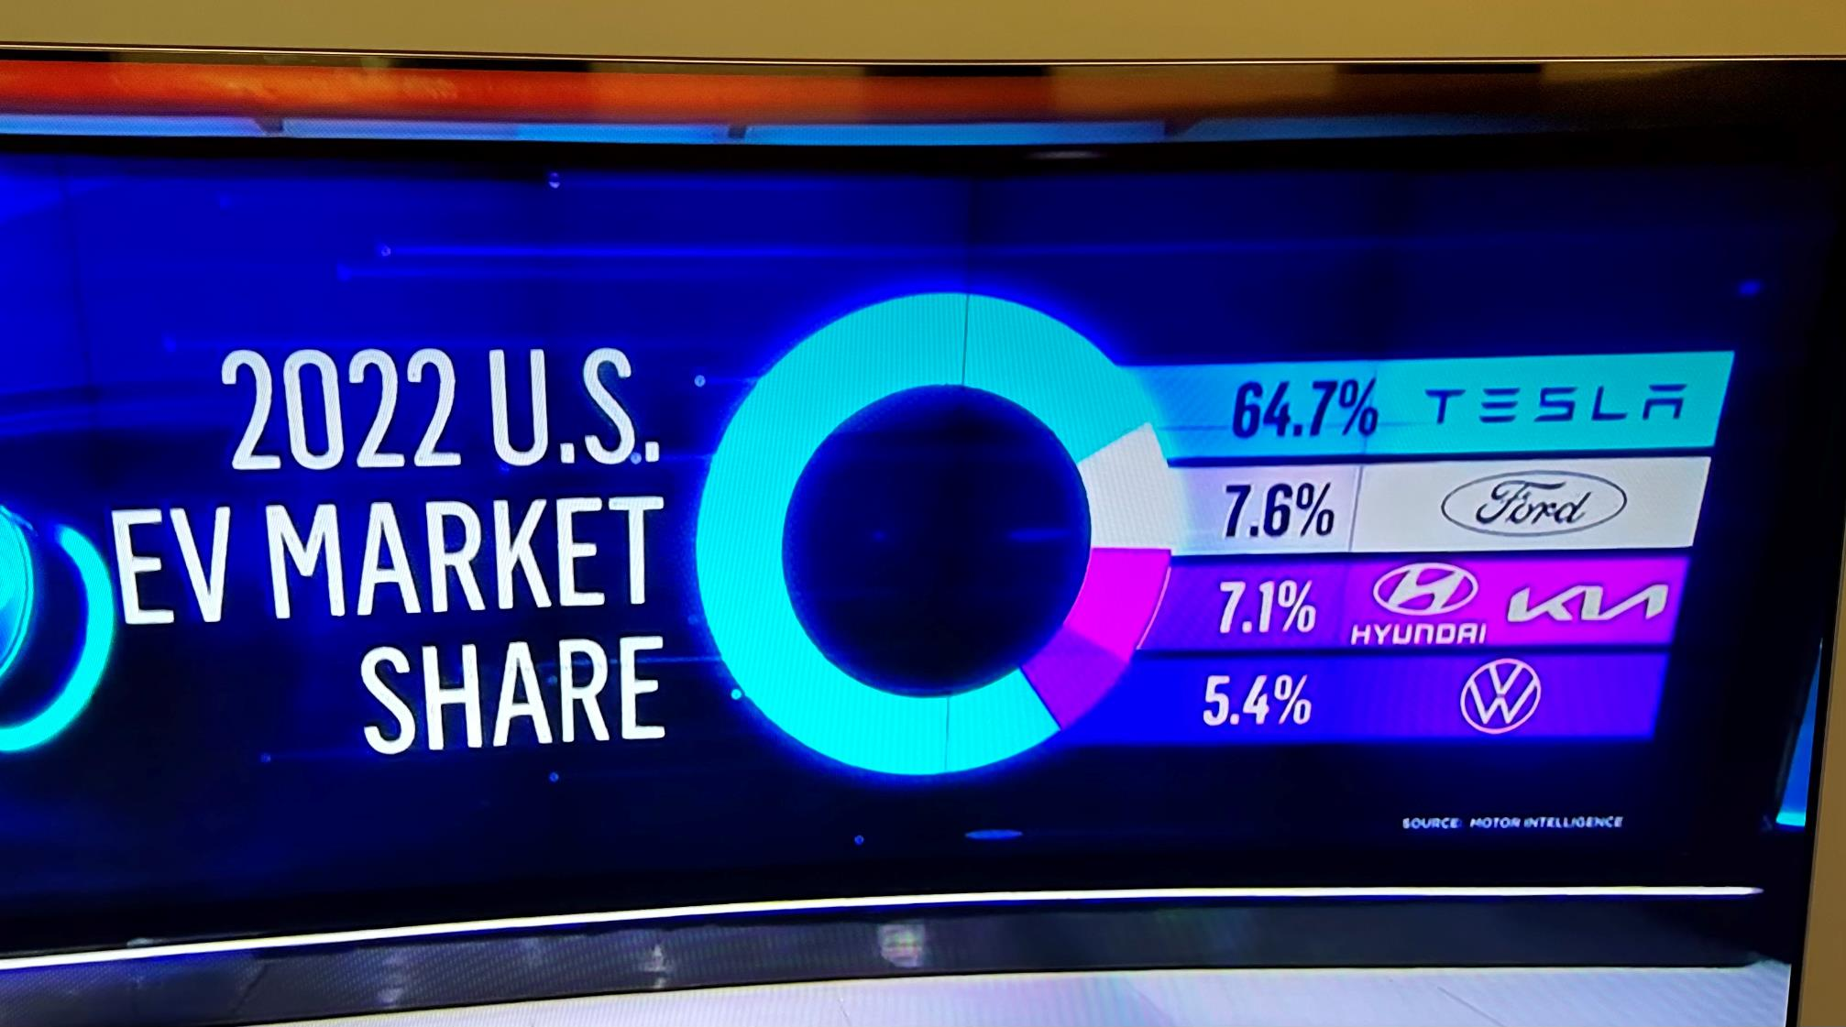

Slide 35
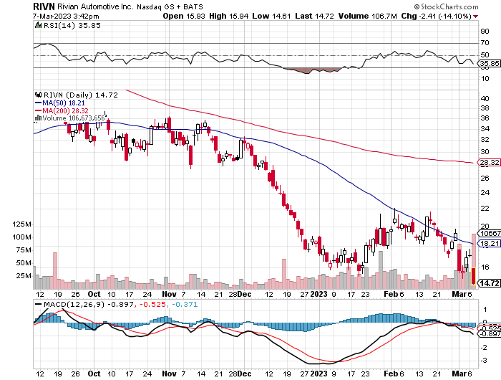
Rivian (RIVN) – Amazon Backed Electric Trucks Rivian Reports $5.4 Billion Loss, less than expected – But $1.3 billion capital raise will weigh on stock took profits on long 10/$25-$30 call spread

Slide 36
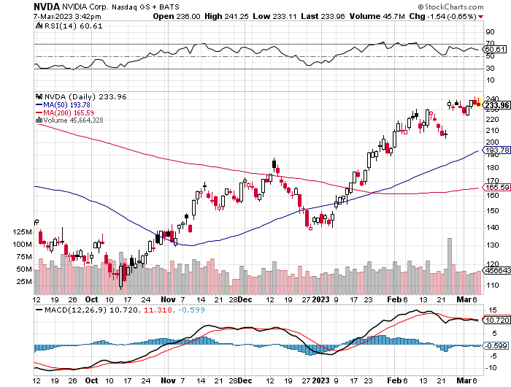
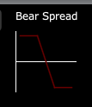
NVIDIA (NVDA) – NVIDIA Beats, sending the stock up 7% on a 41% YOY growth in data center sales long 3/$260-$270 put spread, long 3/$270-$280 put spread took profits on long 10/$95-$100 call spread took profits on long 7/$120-$130 call spread, took profits on long 6/$120-$130 call spread

Slide 37
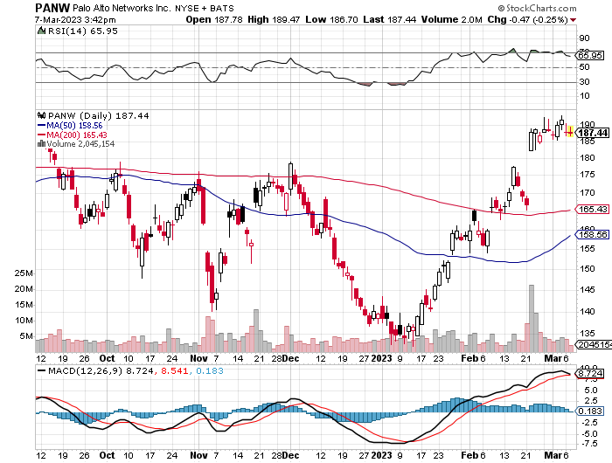
Palo Alto Networks (PANW)- Hacking never goes out of fashion Palo Alto Networks Beats took profits on long 10/$130-$140 call spread

Slide 38
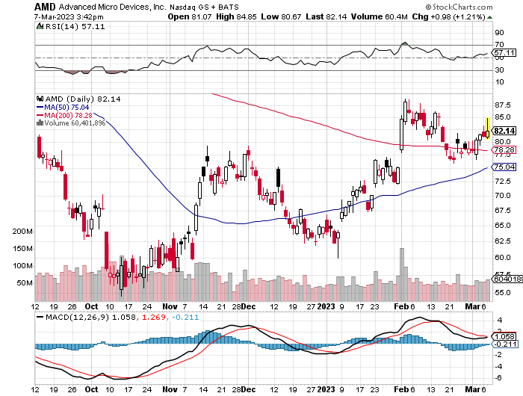
Advanced Micro Devices (AMD)- Recession fears programable logic devices took profits on long 2/$75-$80 call spread

Slide 39
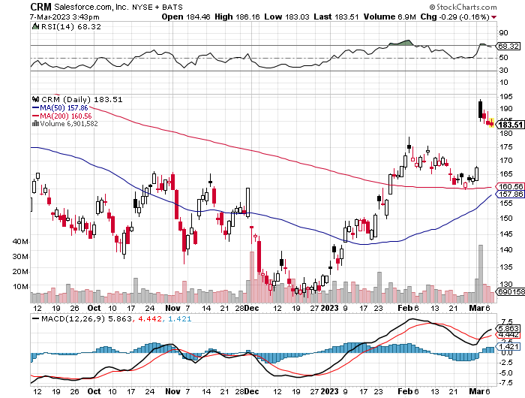
Salesforce (CRM)- Massive Online Migration Salesforce Soars 16%, on better than expected guidance took profits on long 9/$125-$130 vertical bull call spread took profits on long 8/$125-$130 vertical bull call spread took profits on long 2/$105-$115 call spread

Slide 40
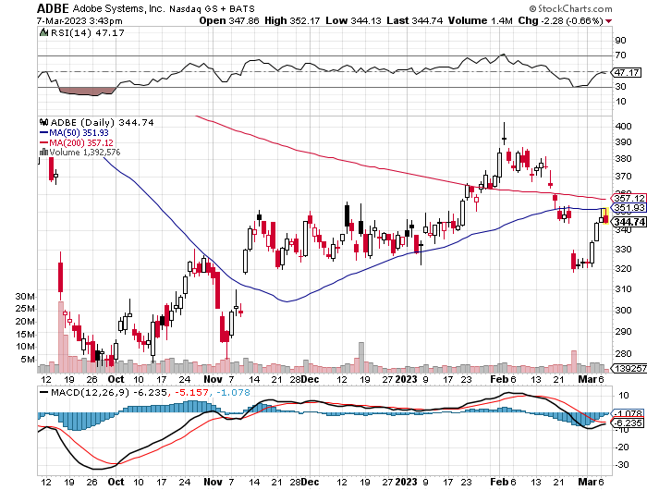
Adobe (ADBE)- Cloud play The Quality Non-China tech play

Slide 41
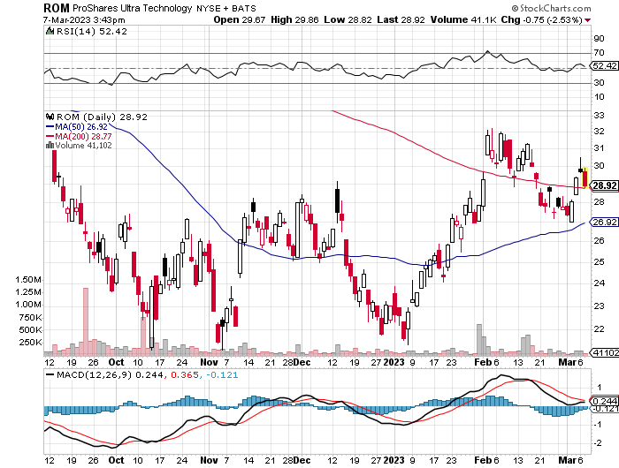
ProShares Ultra Technology ETF (ROM) – 2X Long Technology ETF took profits on long 10/$62-65 call spread

Slide 43
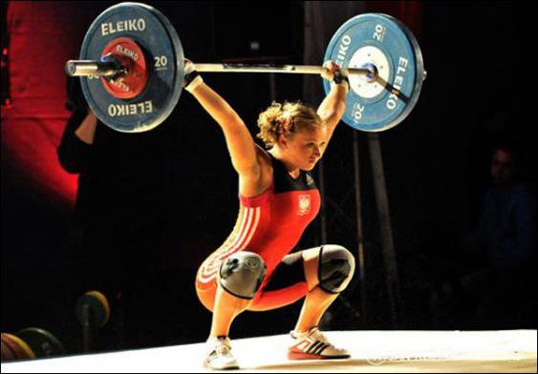
The Second Half of the Barbell
*Bets on a domestic recovery in 2022 Q4 *Upside potential in 2022 far greater than tech *Some of these have not moved for 5 or 10 years *Focuses on economically sensitive cyclical industries *Makes a great counterweight to high-growth technology *We could spend all of next year rotating between the two groups

Slide 44
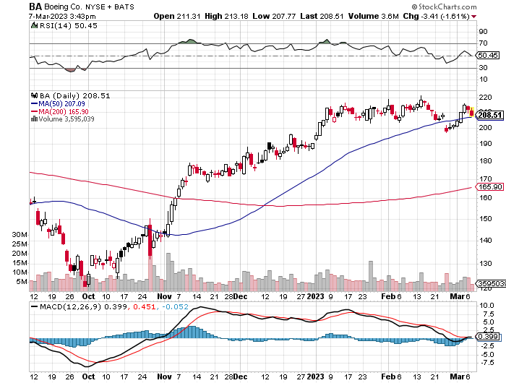
Boeing (BA) – 787 Deliveries halted on bulkhead flaw from 340 to 480 in 2022, and 479 new orders

Slide 45
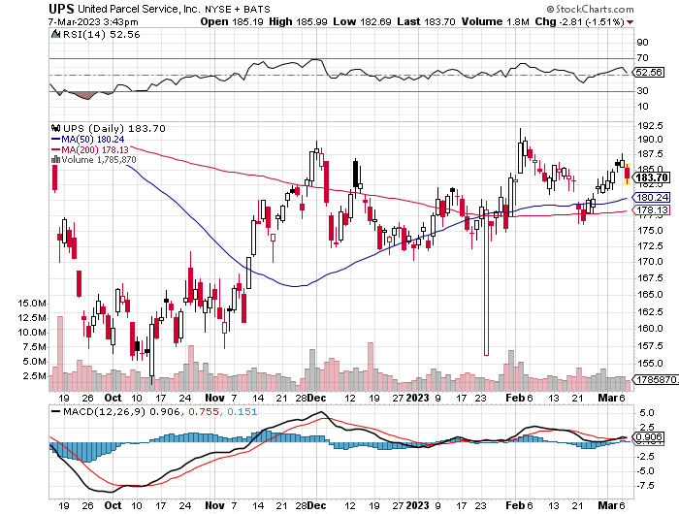
Package Delivery- United Parcel Service (UPS) - took profits on long 11/$130-$140 call spread

Slide 46
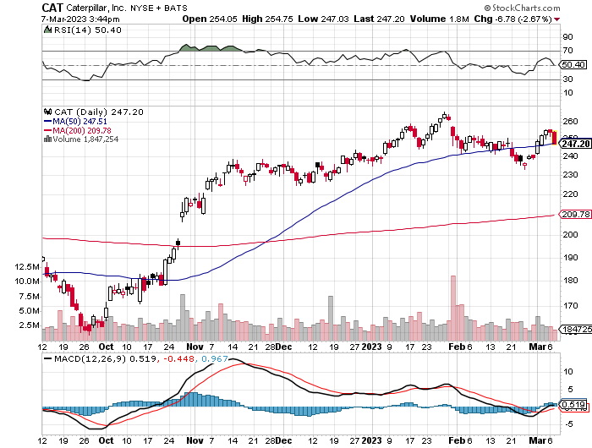
Caterpillar (CAT)- Ag + Infrastructure + Housing Raises Dividend by 50% took profits on long 12/$145-$150 call spread took profits on long 11/$125-$135 call spread

Slide 47
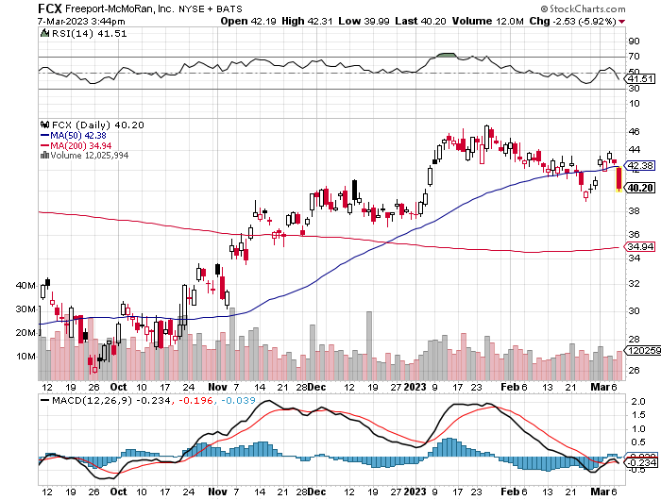
Freeport McMoRan - (FCX)- Copper Play took profits on long 10/$20-$23 call spread

Slide 48
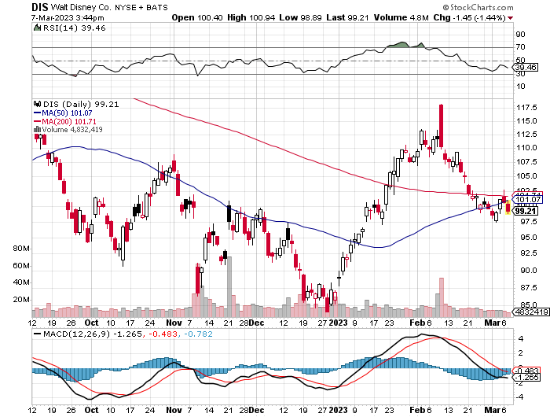
Walt Disney (DIS) - Not a recession play stopped out of long 10/$165-$175 call spread took profits on long 3/$170-$180 call spread

Slide 49
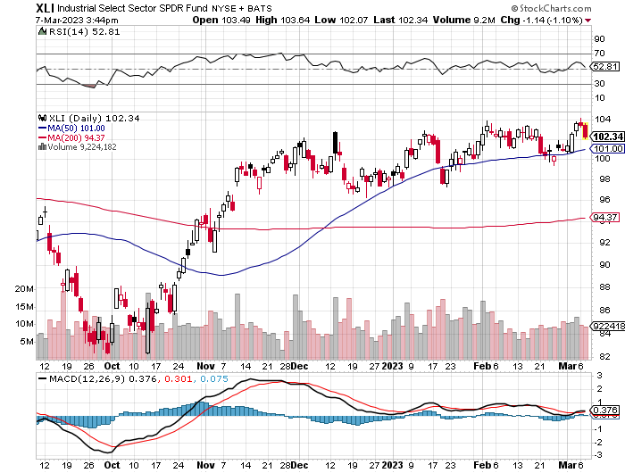
Industrials Sector SPDR (XLI)- (GE), (MMM), (UNP), (UTX), (BA), (HON)

Slide 50
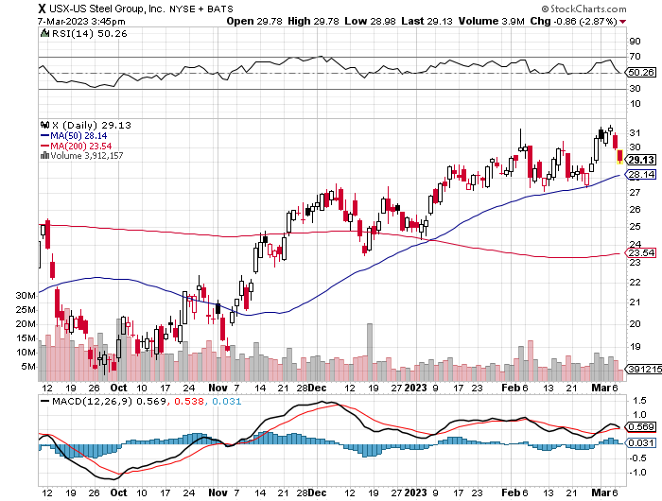
US Steel (X) – Commodity Boom and Wartime boost

Slide 51
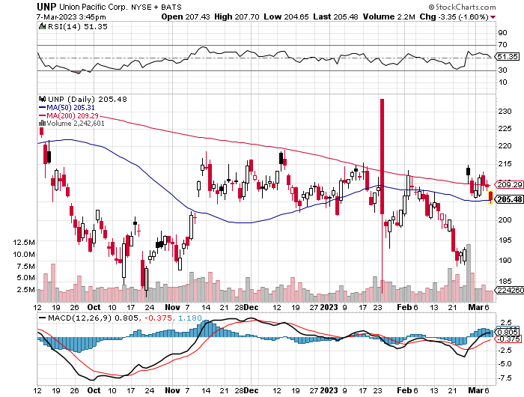
Union Pacific RR (UNP)- Big Stuff to Ship took profits on long 5/$200-$210 call spread took profits on 11/$150-$160 call spread

Slide 52
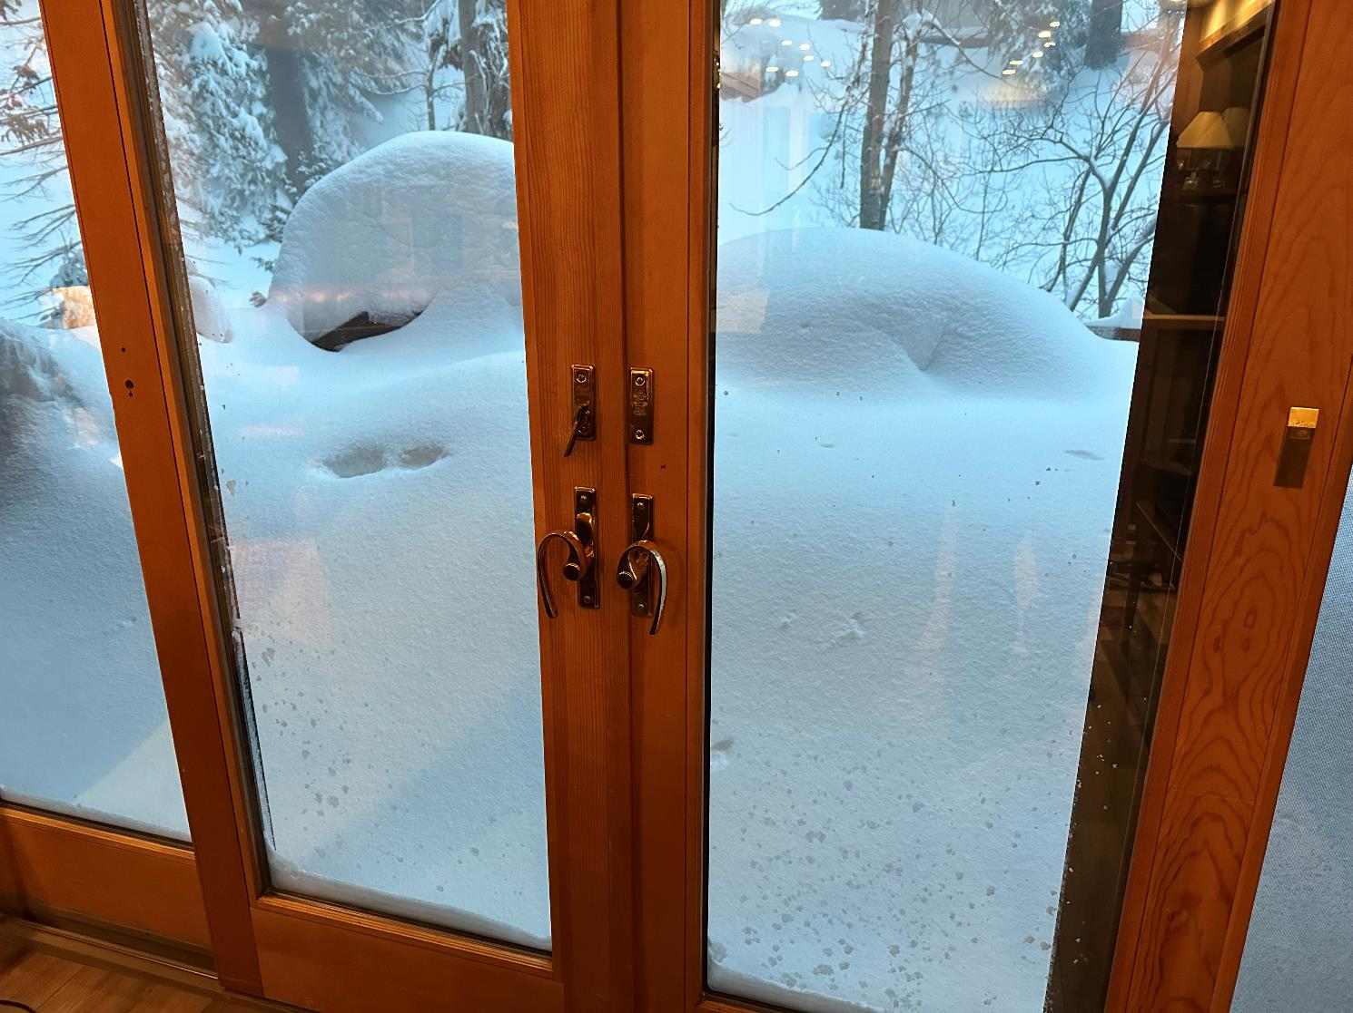

Slide 53
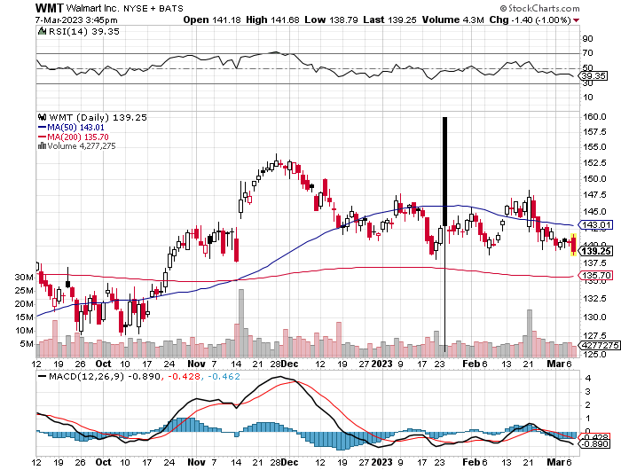
Wal-Mart (WMT)- took profit on Long 11/$125-$130 bear put spread took profit on Long 10/$119-$121 bear put spread took profits on Long 8/$114-$117 bear put spread

Slide 54
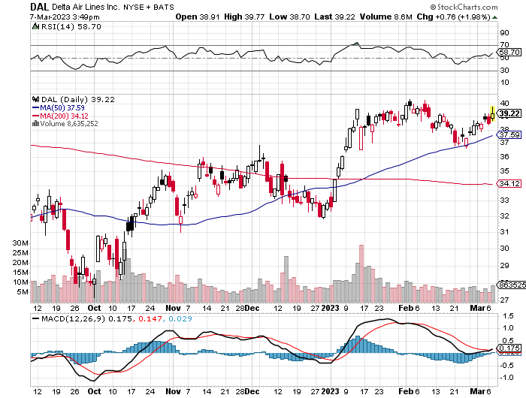
Delta Airlines (DAL) – Travel is Back!

Slide 55
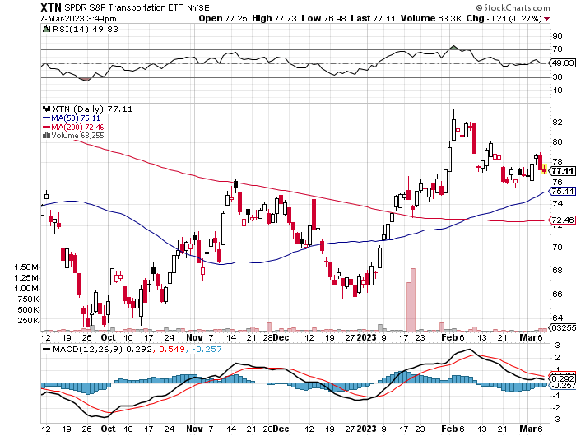
Transports Sector SPDR (XTN)- Worst Hit Sector (ALGT), (ALK), (JBLU), (LUV), (CHRW), (DAL)

Slide 56
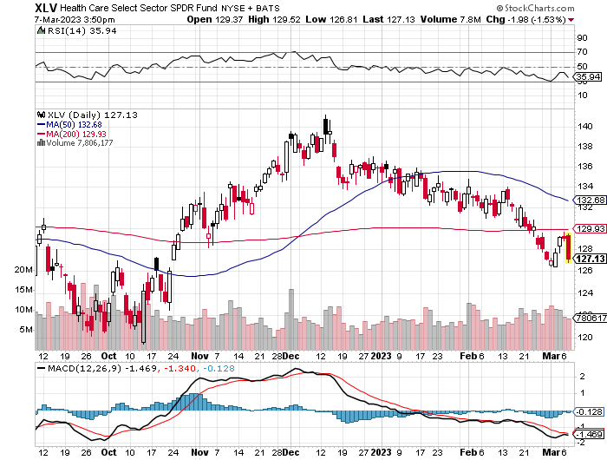
Health Care Sector (XLV) (JNJ), (PFE), (MRK), (GILD), (ACT), (AMGN)

Slide 57
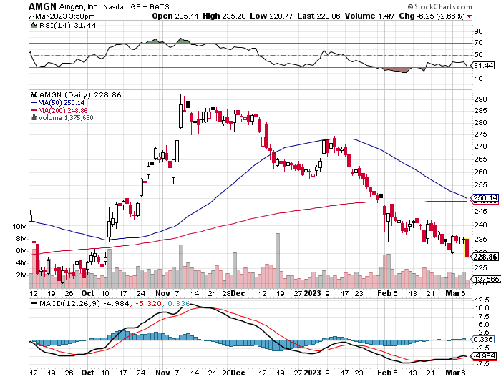
Amgen (AMGN) took profits on long 11/$185-$200 bull call spread

Slide 58
Goldman Sachs (GS) – took profits 12/$330-$350 call spread took profits 11/$330-$350 call spread stop loss on long 11/$385-$395 call spreads

Slide 59
Morgan Stanley (MS) – took profits on long 10/$85-$90 call spread

Slide 60
JP Morgan Chase (JPM)- took profits on long 10/$85-$90 call spread, stopped out of long 10/$95-$100 call spread took profits long 12/$148-$152.50 call spread

Slide 61
Bank of America (BAC) – took profits long 12/$39-$42 call spread

Slide 62
SPDR Metals & Mining ETF (XME) – long 2/$28-$30 call spread

Slide 63
Blackrock (BLK)-Asset Collection Boom took profits on long 3/$770-$790 call spread took profits on long 3/$310-$340 call spread

Slide 64
Visa (V) – “Touchless” Bitcoin Drag Transaction grew by an inflationary 10% back to pre-pandemic levels took profits on long 10/$160-$170 bull call spread took profits on long 6/$150-$160 bull call spread

Slide 65
Consumer Discretionary SPDR (XLY) (DIS), (AMZN), (HD), (CMCSA), (MCD), (SBUX)

Slide 66
Berkshire Hathaway (BRKB)- Natural Barbell 2022 $30.2 billion profit on unchanged stock, Warren Buffet’s Annual Letter is Out took profits on long 1/$290-$300 call spread, took profits on long 10/$220-$230 call spread, took profits on long 7/$220-$230 call spread, took profits on long 7/$220-$230 call spread took profits on long 6/$260-$270 call spread

Slide 67
Europe Hedged Equity (HEDJ)-

Slide 68
Japan (DXJ)-

Slide 69
Emerging Markets (EEM) - Pro trade, Weak Dollar, Long Recovery Play

Slide 71
Bonds – Bottom Fishing
*Bonds entering “BUY” territory at bottom of the range, driven down by warnings of government debt defaults *Ten-year US Treasury yields jump from 3.30% to 4.05% *Still looking like 2.50% yield by end 2023 *(TLT) should reach $120 in 2023 after political interreference ends this summer *Keep buying (TLT) calls, calls spreads and LEAPS on dips but only on dips *Junk bond ETF’s (JNK) and (HYG) are a great high yield play

Slide 72
Treasury ETF (TLT) – long 1/$92-$95 call spread, took profits on long 1/$96-$99 call spread, took profits on long 1/$95-$98 call spread, took profits on long 2/$95-$98 call spread

Slide 73
Ten Year Treasury Yield ($TNX) – 3.95%

Slide 74
Junk Bonds (HYG) 8.10% Yield to Maturity

Slide 75
Municipal Bonds (MUB) 3.20% Yield-

Slide 76
Emerging Market Debt (ELD) 6.81% Yield-

Slide 77
2X Short Treasuries (TBT)-Out of Favor

Slide 79
Foreign Currencies – High Rates for Longer
* Prospects of 0.50% Fed rate rise giving new life for the dollar *But dead cat bounce could be peaking here *After a great four month run all currencies were overdue and in need of a rest *Dollar selloff may resume after March 22 Fed meeting *Any strength in the dollar will be temporary *Look for new dollar lows by end 2023 *Buy (FXE), (FXY), (FXB) on dips

Slide 80
THE MAD HEDGE FUND TRADER
Australian Dollar (FXA) - Major Long-Term Bottom is In Targeting Parity – A call option on a global synchronized recovery
1:1
BUY

Slide 81
Japanese Yen (FXY)
2023 Target 25%

Slide 82
Euro (FXE)-
2023 Target 25%

Slide 83
British Pound (FXB)-
2023 Target 15%

Slide 84
Emerging Market Currencies (CEW)
2023 Target 40%

Slide 86
Energy & Commodities –A Trade is Here
*Oil Companies are Playing the Short Game, milking their companies for all the profits they can get at the expense of long-term capital investment, and ignoring massive tax subsidies to do so *Last year oil companies reaped a stunning $128 billion in profits, juiced by the Ukraine War which took Texas tea prices to $132 a barrel. *That’s what you do when your industry may disappear in a decade. *But if there is no US recession and China’s reopening accelerates, we may have to visit $100 a barrel. *Buy (UNG) on dips, up 40% in two weeks *Germany Accelerates Move Towards Alternatives, hopes to get 80% of its electricity from solar and wind by 2030

Slide 87
Oil-($WTIC)

Slide 88
United States Oil Fund (USO)

Slide 89
Energy Select Sector SPDR (XLE)-No Performance! (XOM), (CVX), (SLB), (KMI), (EOG), (COP)

Slide 90
ExxonMobile (XOM)- took profits on long 12/$120-$125 put spread

Slide 91
Occidental Petroleum (OXY)- long 2/$55-$60 call spread, took profits on long 12/$77.50-$82.50 put spread

Slide 92
Natural Gas (UNG) – Huge Buy as China Comes Back online Long January 2025 $14 - $15 Call Spread LEAPS

Slide 93
Freeport McMoRan (FCX) -

Slide 94
Cameco (CCJ) - took profits on long 5/$20-$23 bull call spread

Slide 96
Precious Metals – Rate Shock
*Gold may have found its bottom here, prompting another round of bottom fishing *Silver is beating gold as massive new industrial demand kicks in from several sources, including solar and EVs, and is also a China recovery play *Silver is now an industrial commodity while gold is still a precious metal used for jewelry, investment, and central bank reserves *EV Makers Running Up Against Supply Shortages. To meet ambitious production forecasts metals production has to triple quickly *I’m talking copper, aluminum, silver, chromium, and lithium. *With interest rates certain to plummet later in 2023 as the Fed reacts to a recession, Precious metals could be one of the big trades for next year *Buy (GLD), (GDX), (GOLD), (SLV), and (WPM) on dips

Slide 97
Gold (GLD) - Deflation call took profits on long 5/$165-$170 bull call spread

Slide 98
Market Vectors Gold Miners ETF- (GDX) –

Slide 99
Barrick Gold (GOLD) took profit on long 1/$15.50-$16.50 call spread

Slide 100
Newmont Mining- (NEM)- took profits on long $55-60 call spread

Slide 101
Silver- (SLV)- took profits on long 11/$19-$20 call spread

Slide 102
Silver Miners - (SIL)-

Slide 103
Wheaton Precious Metals - (WPM)- took profits on long 1/$36-$39 call spread

Slide 105
Real Estate – Rate Surge
*Mortgage Rates Jump to 6.65%, snuffing out the green shoots that briefly appeared in January *Pending Home Sales Soar 8.7% in January on a signed contract basis *Existing Home Sales Dive 0.7% in January, to a 4 million annualized rate *Mortgage Demand Hits 28 Year Low, down 6% in a week, *Homebuilder Sentiment hits Four Month High, at 7 points to 42, and up from the 31 low *S&P Case Shiller Gains 5.7% in December, YOY

Slide 106
S&P Case Shiller Plunges S&P Case Shiller Drops to +5.7%, in November with its National Home Price Index Miami (+15.9%), Tampa (+13.9%), Atlanta (+10.4%)

Slide 107
Crown Castle International (CCI) – 4.85% yielding cell phone tower REIT

Slide 108
US Home Construction Index (ITB) (DHI), (LEN), (PHM), (TOL), (NVR)

Slide 110
Trade Sheet- So What Do We Do About All This?
*Stocks – buy the big dips at bottom of range, ………………sell big rallies to hedge holdings *Bonds – buy dips *Commodities-buy dips *Currencies- sell dollar rallies, buy currencies *Precious Metals – buy dips *Energy – buy dips *Volatility - sell short over $30 *Real estate – buy dips

Slide 112
Next Strategy Webinar 12:00 EST Wednesday, March 22 from Silicon Valley, CA email me questions at support@madhedgefundtrader.com
Good Luck and Good Trading!
Notes:
*

