Slide 1
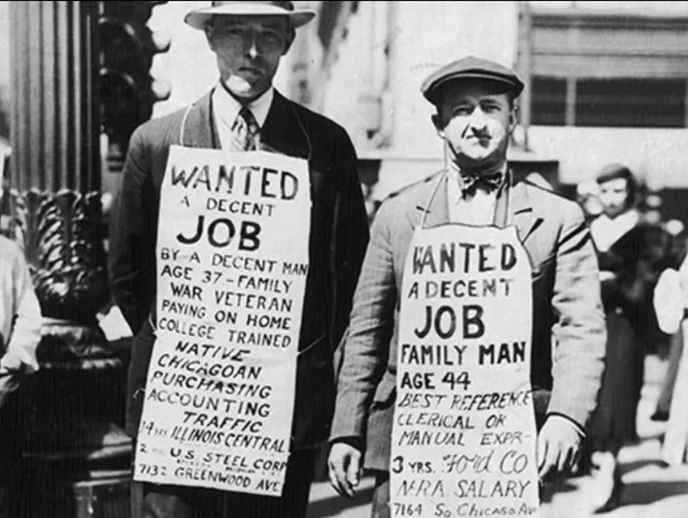
The Mad Hedge Fund Trader “Banking Crisis!”
With John Thomas Silicon Valley, CA, March 22, 2023 www.madhedgefundtrader.com
Notes:
*

Slide 2
The Great Depression
*All banks close for a week and 9,000 banks failed. Without deposit insurance $7 billion in individual deposits were lost *Safe deposit holdings of failed banks were not auctioned off until 60 years later *All modern financial regulation followed *Regulation roll backs inevitably bring a new crisis, like 1987, the S&L crisis and the 2008 Financial crisis *It’s a rolling wave that hits every 15 years and presents great opportunities to get into financial stocks at huge discounts

Slide 3
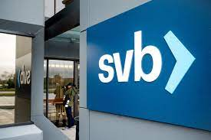
Why This is Not the Great Depression, nor the 1987 crash, the S&L Crisis, 2008 Financial Crisis
*Dodd Frank has required banks with over $250 billion in capital to be massively over capitalized *The top 20 banks could handle double the 2008 amount of defaults *In 2008 Morgan Stanley had leverage of 40X and Lehman Brothers 100X. Today, Morgan Stanley is at 7.5X and Lehman Brother is gone *Treasury has proved aggressive in putting out fires quickly *Goal is to protect all depositors *No management walk aways with $100 million bonuses as in 2008 *This time will be punished with firings, claw backs of bonuses and recent share sales, and lifetime bans from the industry *Emphasis is in private sector rescues, such as the $30 billion in deposits into First Republic Bank (FRC) by 11 healthy banks

Slide 4
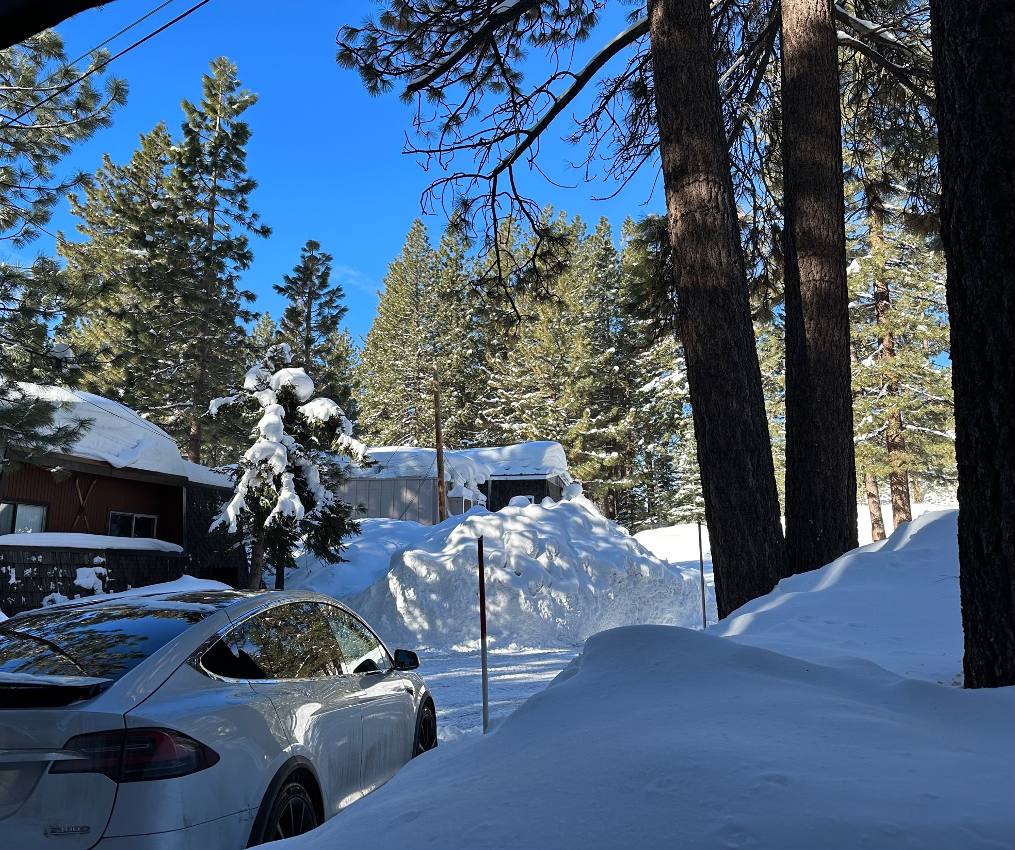

Slide 5
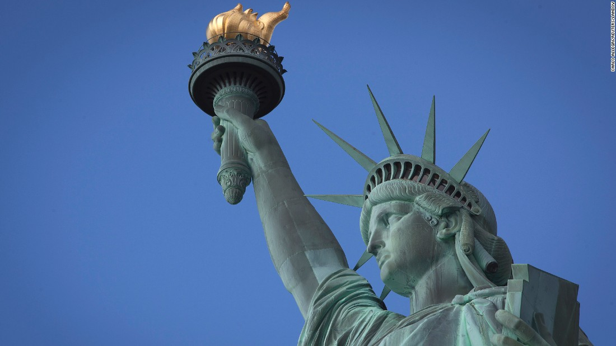
THURSDAY, JULY 6 NEW YORK STRATEGY LUNCHEON
*An excellent meal will be followed by a wide-ranging discussion and an extended question and answer period *The lunch will be held in an exclusive private club in Midtown Manhattan with a strict dress code *please go to my online store at http://www.madhedgefundtrader.com/store and click on “luncheons.” Tickets are available for $299

Slide 6
Friday July 13, 2023 Seminar at Sea
*Cunard Line’s flagship, the elegant and spacious Queen Mary II, on an eastbound transatlantic cruise *The Ship departs New York at 12:00 AM on July 7, 2023, and arrives at Southampton on July 14 *Guests will be responsible for booking their own cabin through Cunard *Three dinners during the voyage will be black tie *Customers are required to book their own cabins and return flights from England *The Cunard cruise number is M319

Slide 7
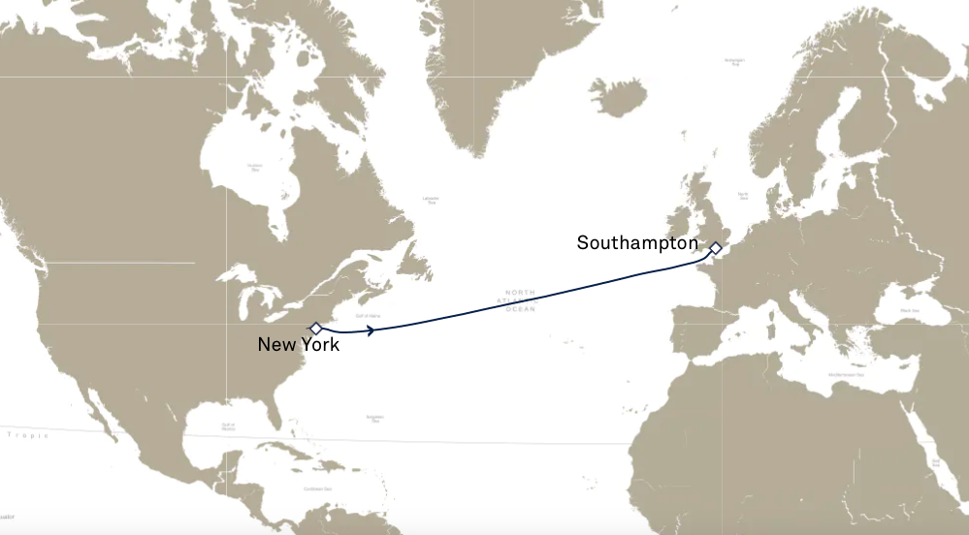

Slide 8
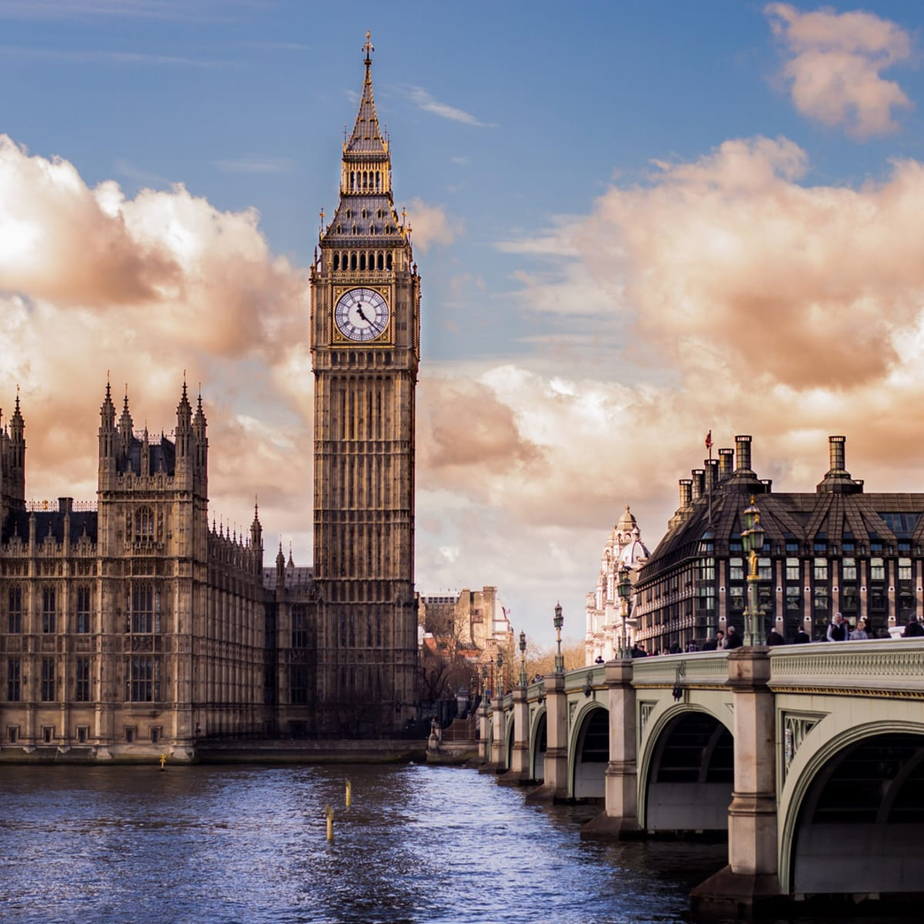
THURSDAY, JULY 19 LONDON STRATEGY LUNCHEON
*An excellent meal will be followed by a wide-ranging discussion and an extended question and answer period *The lunch will be held in an exclusive private club in Midtown Manhattan with a strict dress code *please go to my online store at http://www.madhedgefundtrader.com/store and click on “luncheons.” Tickets are available for $298

Slide 9
Trade Alert Performance New All Time Highs! 31 out of 33 trade alerts profitable
*January +22.35% Final *July +3.98% Final *February +3.41% Final *August +5.13% Final *March +5.61% MTD *September +9.72% Final *April +3.33% Final *October +5.69% Final *May +8.80% Final *November +8.31 Final *June +5.91% Final *December +0.95% Final *2022 Final +84.63% compared to -18.63% for the S&P 500 *2023 Year to Date +31.37%, versus +2.2% for the S&P 500 +616.69% since inception *Average annualized return of +47.74% for 15 years

Slide 10
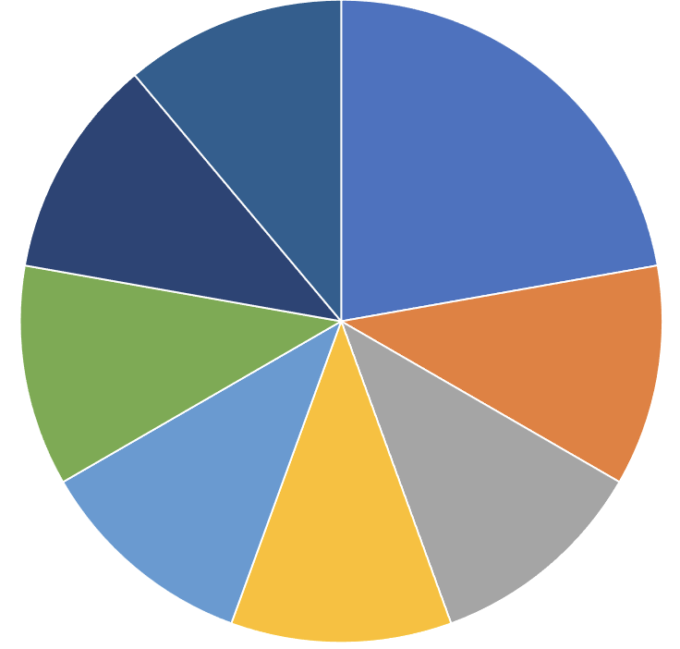
Portfolio Review 80% Long, 20% Short, 20% cash with VIX at $30 its time to be fully invested
Current Capital at Risk
Risk On
(TSLA) 4/$130-$140 call spread | 20.00%
(BAC) 4/$20-$23 call spread | 10.00%
(SCHW) 4/$30-$35 call spread | 10.00%
(C) 4/$30-$35 call spread | 10.00%
(JPM) 4/$105-$115 call spread | 10.00%
(IBKR) 4/$60-$65 call spread | 10.00%
(MS) 4/$65-$70 call spread | 10.00%
Risk Off
(TLT) 4/$114-$117 put spread | -10.00%
Total Net Position | 70.00%
Total Aggregate Position | 90.00%
Expiration Value +44.18%

Slide 11
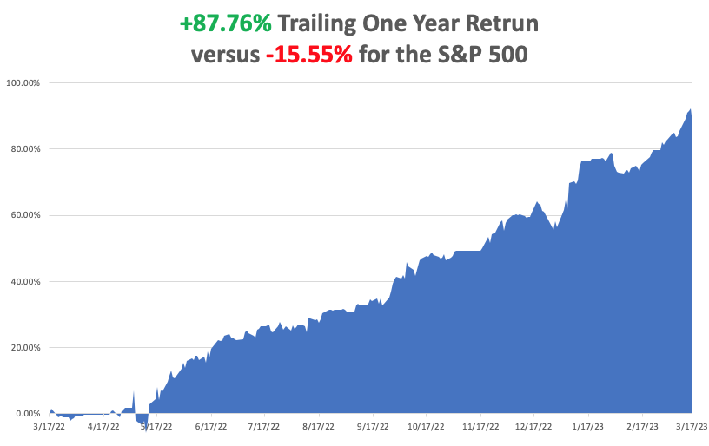

Slide 12
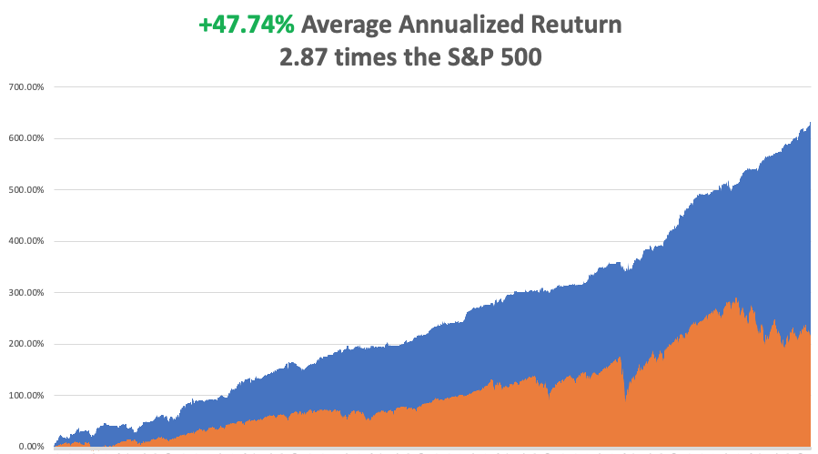

Slide 13
The Method to My Madness Fed Reversal
*Ranges for months but volatility has nearly doubled – a dream come true for traders *Fed has to prioritize saving the financial system over controlling inflation – QE is back! *Flight to safety takes bond yields back to bottom of range *Energy is plumbing new lows on new recession fears *Gold, Silver upside breakout on lower interest rates sooner *The US dollar gets a small pop off of a one year low as interest rates stay higher for longer *Look for S&P 500 at $4,800 by end 2023 *VIX rockets to $31 – Everything is now tradable

Slide 14
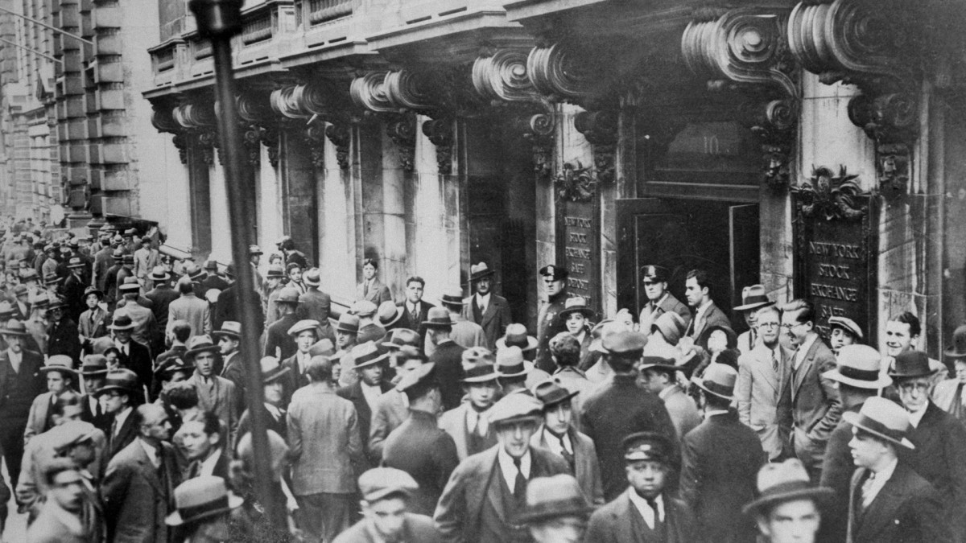
The Global Economy – Recession Fears
* Fed Spends $297 to Bail Out the Financial System *Europe Raises Interest Rates by 50 Basis Points, catching up with the US Europe has inflation at 2% higher than the US *Core Inflation Comes in Moderate, at a 6.0% YOY rate * Swiss National Bank Steps in to Bail Out Credit Suisse, taking pressure off US market * PPI Down 0.1%, for February, showing that prices are actually falling. A big rise was expected *Nonfarm Payroll Report hot at 311,000. The Headline Unemployment Rate rose from 3.5% to 3.6%, still at a 53-year low

Slide 15
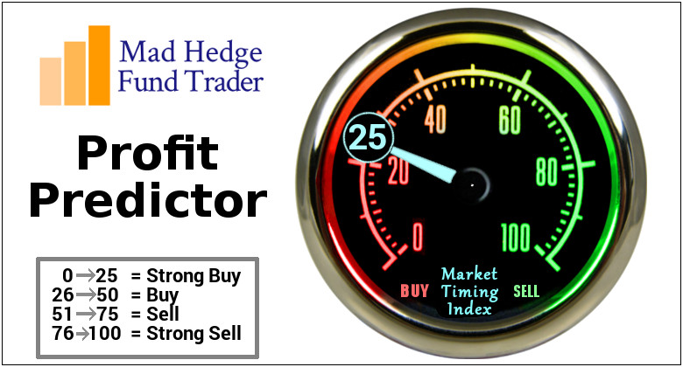
The Mad Hedge Profit Predictor Market Timing Index – Neutral An artificial intelligence driven algorithm that analyzes 30 different economic, technical, and momentum driven indicators

Slide 16
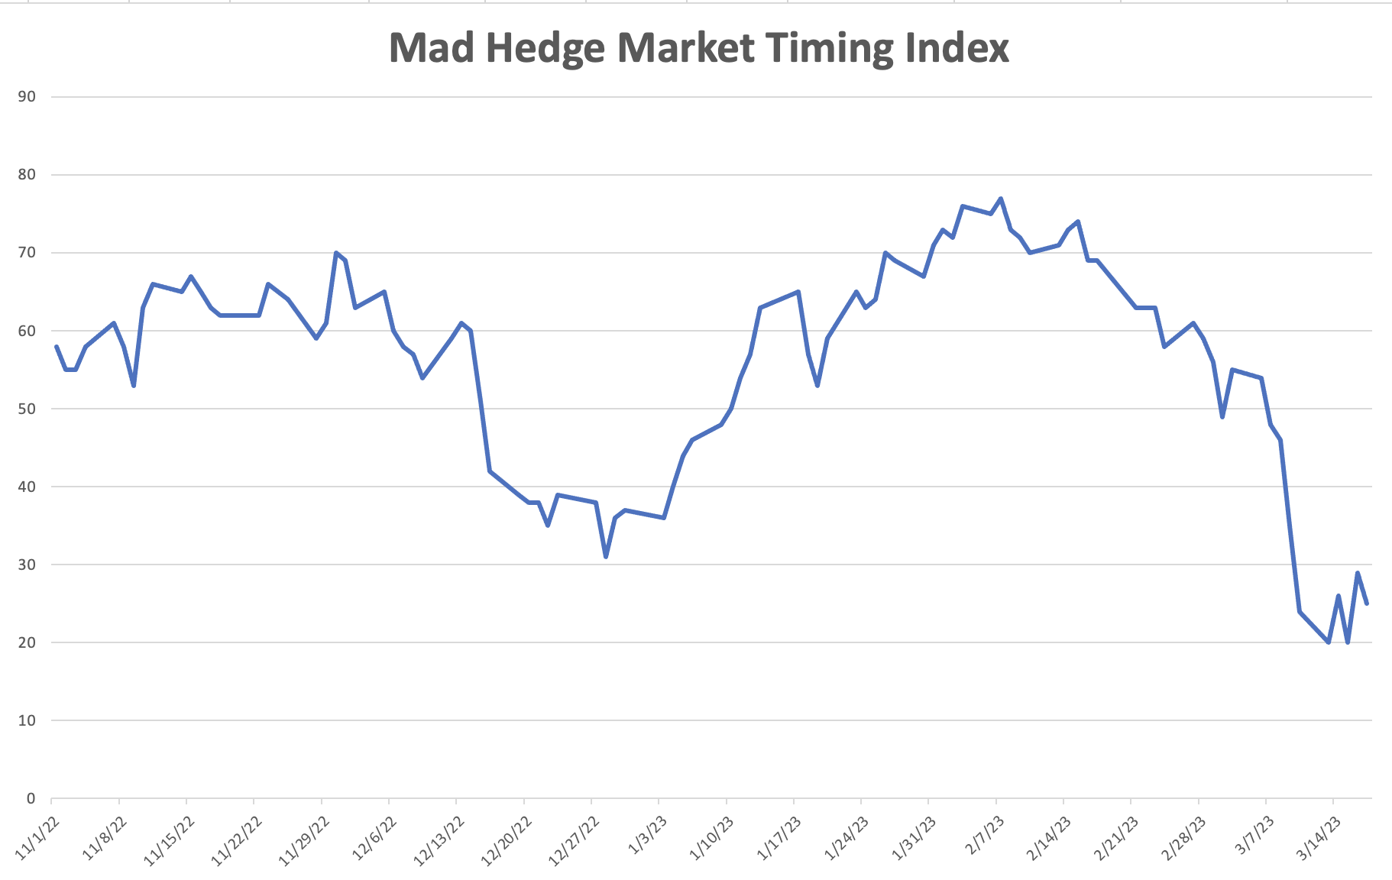
SELL
BUY

Slide 17
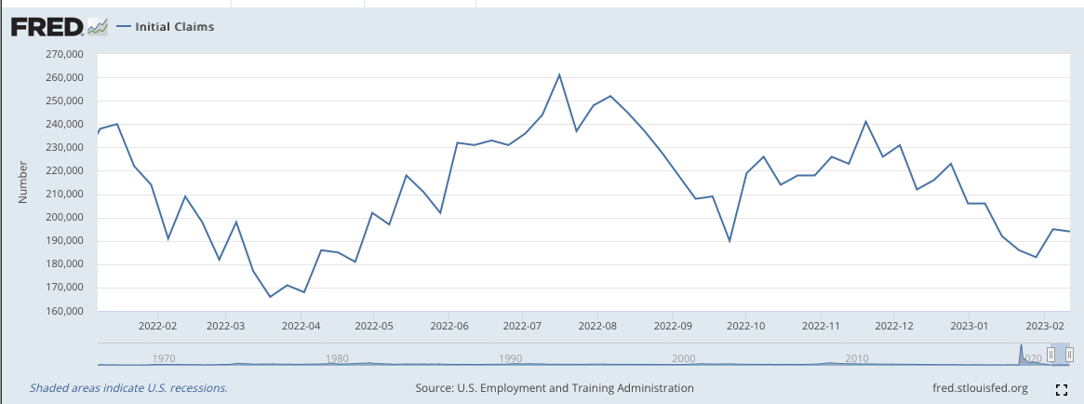
Weekly Jobless Claims – Falling 190,000 – Down 3,000

Slide 18
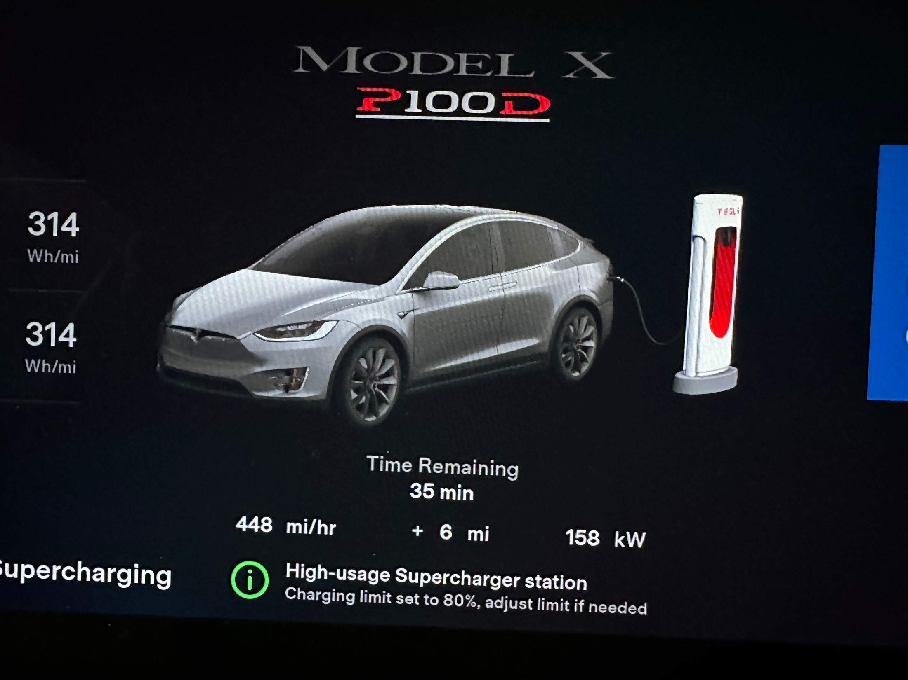

Slide 19
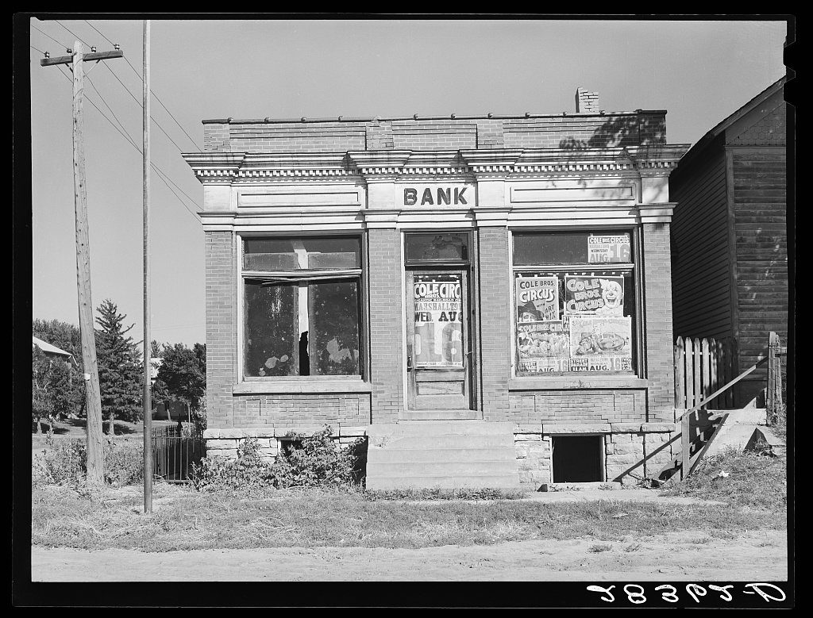
Stocks – Crisis
*Banks take it on the the nose, delivering biggest selloff in a decade *Money is flowing out of small banks into big, from the heartland to the coasts. (JPM) is now turning down new applications they have been flooded with *Smallest banks like First Republic (FRH) and Fifth Third (FITB) take biggest hits, but even big safe ones are down 20% *Microsoft Adds AI to Word and Excel, called AI Copilot for Microsoft 365 *META Lays Off Another 10,000, citing a changing global outlook and heightened efficiencies of in office workers *Volatility spikes to $31 opening countless options trades *Add one-year LEAPS for highest quality banks like (JPM), (MS), and (GS) *Looking for flat first half, strong second half to take us to S&P 500 4,800 by yearend

Slide 20
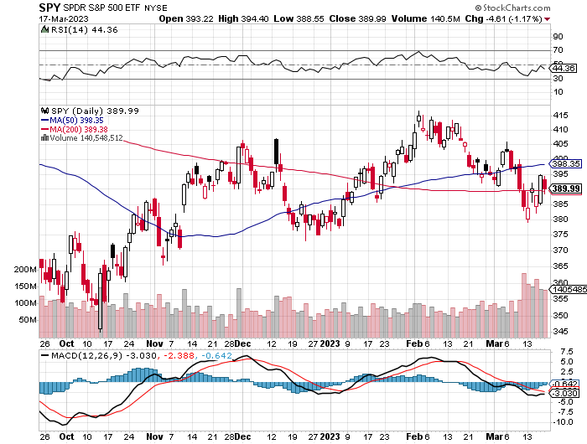
S&P 500 – Higher Lows and Lower Highs took profits on long 1/$420-$430 put spread, took profits on long 11/$420-$430 put spread took profits on long 10/$385-$395 put spread, took profits on long 11/$410-$400 put spread took profit on long 10/$390-$400 put spread, took profit on long 10/$320-$330 call spread
2023 $480 Target
$430 +21% Rally
$375 -12.8% Pull Back
The Bottom $355 Down -26%

Slide 21
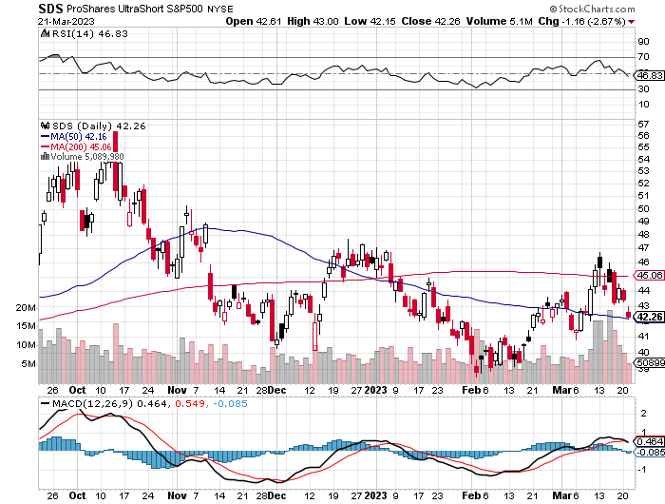
ProShares Ultra Short S&P 500 (SDS)- a great hedge for long stocks and bonds long 2X position has a hedge against longs and bond shorts

Slide 22
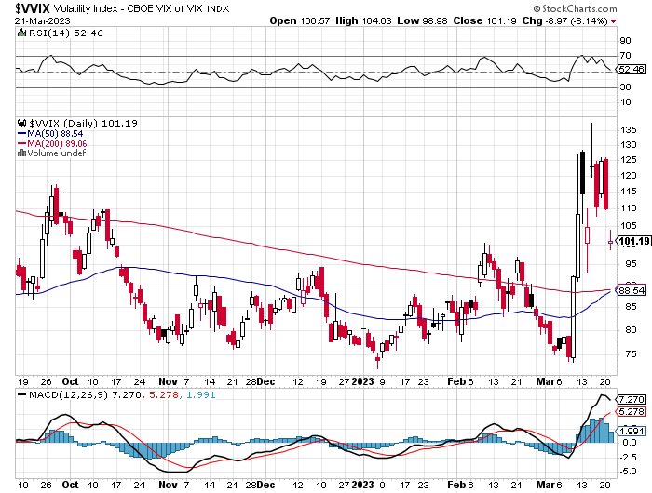
(VIX) – Bargain of the Century

Slide 23
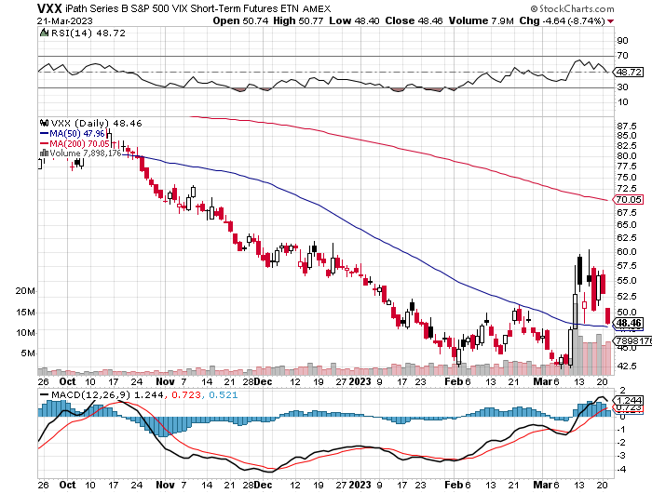
(VXX)-

Slide 24
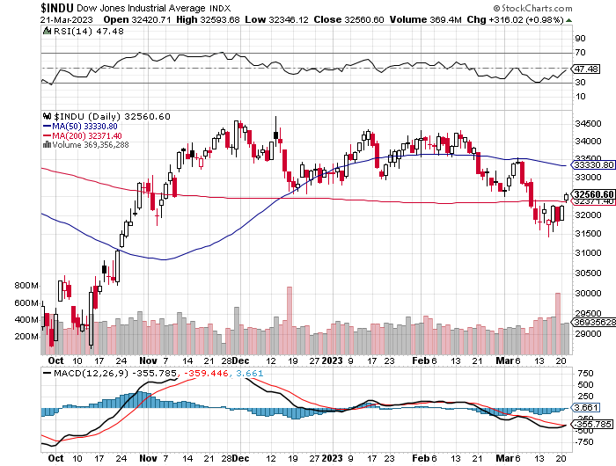
Dow Average ($INDU)-

Slide 25
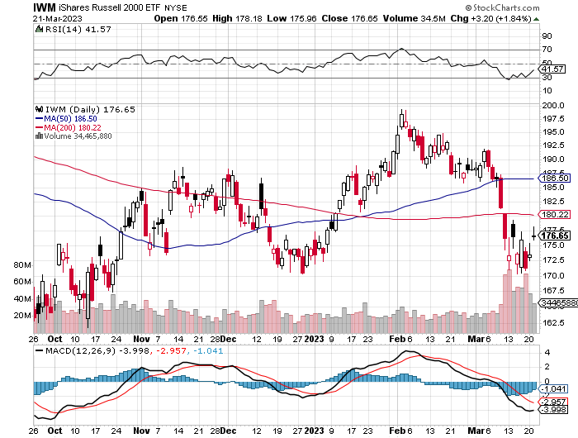
Russell 2000 (IWM)- took profits on Long 10/$137-$142 vertical bull call spread took profits on Long 10/$153-$156 vertical bear put spread

Slide 26
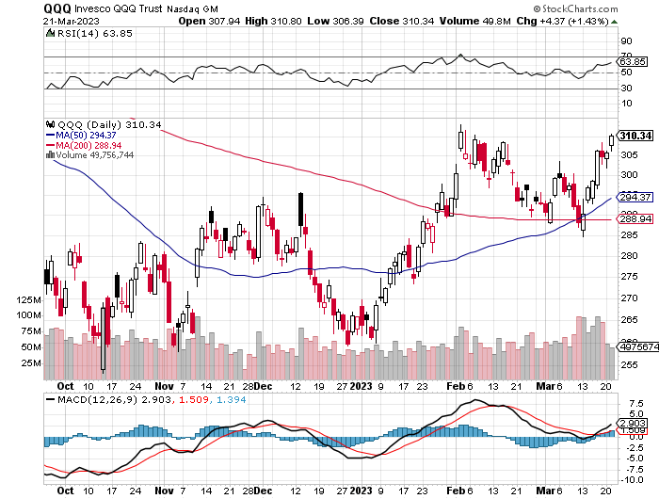
NASDAQ (QQQ) – took profits on long (QQQ) 1/$290-$300 put spread, took profits on long (QQQ) 4/$330-$335 put spread took profits on long (QQQ) 3/$340-$345 put spread, covered long (QQQ) $325-$330 put spread

Slide 27
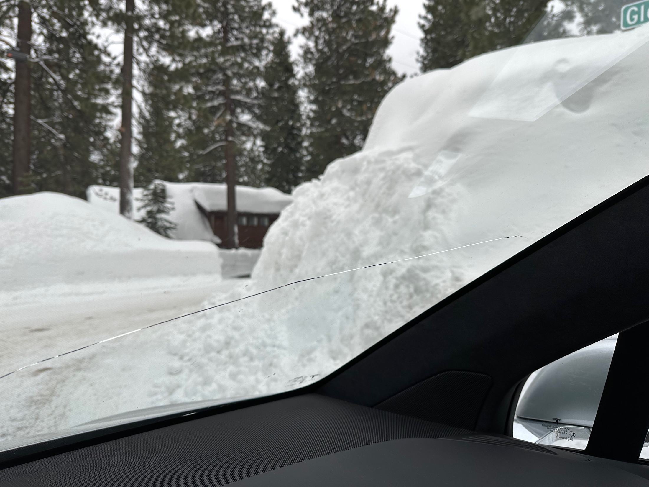

Slide 28
The Barbell Portfolio
*50% Big Tech - 2% of US Employment but 27% of Market Cap and 38% of Profits 50% Domestic Recovery, including: Railroads Couriers Banks Construction Credit Cards Event organizers Ticket sales Retailers

Slide 29
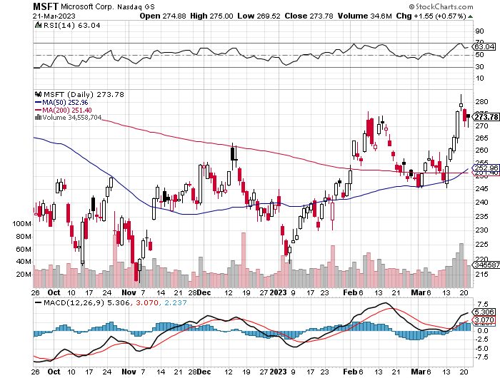
Microsoft (MSFT)- Grim Forward Guidance took profits on 9/$235-$245 call spread, took profits on long 7/$220-$210 call spread, took profits on long 6/$220-$230 call spread, took profits on long 2/$200-$210 bear put spread

Slide 30
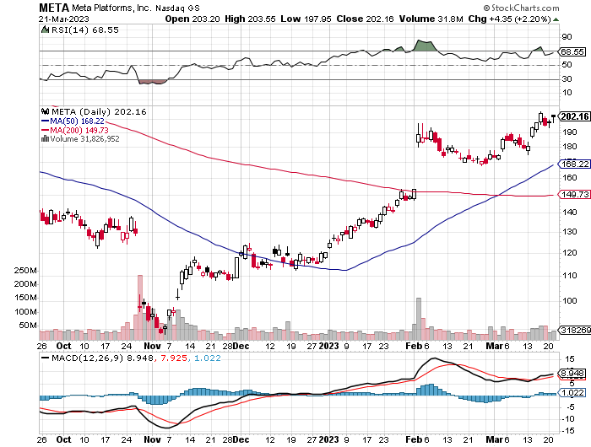
Meta (META)- Soars an Incredible 20% took profits on Long 9/$290-$300 vertical bear put spread stopped out of Long 9/$190-$200 vertical bear put spread

Slide 31
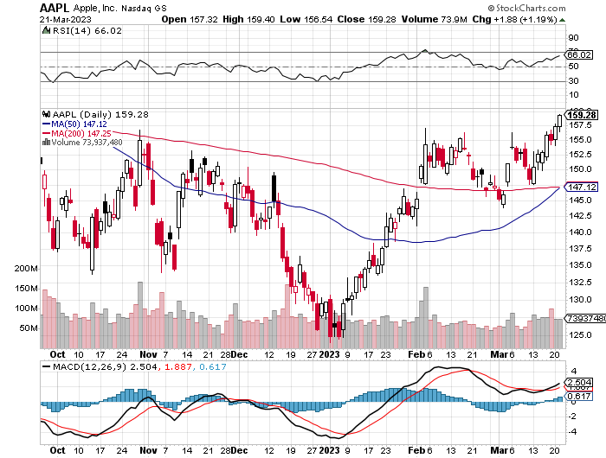
Apple (AAPL)-) Apple to Add Glucose Monitor on its Watches took profits on long 1/$145-$155 put spread, Took profits on long 10/$165-$175 put spread took profits on long 6/$155-$165 put spread, stopped out of long 6/$125-135 call spread, took profits on long 6/$110-$120 call spread, took profits on long 2/$180-$190 put spread

Slide 32
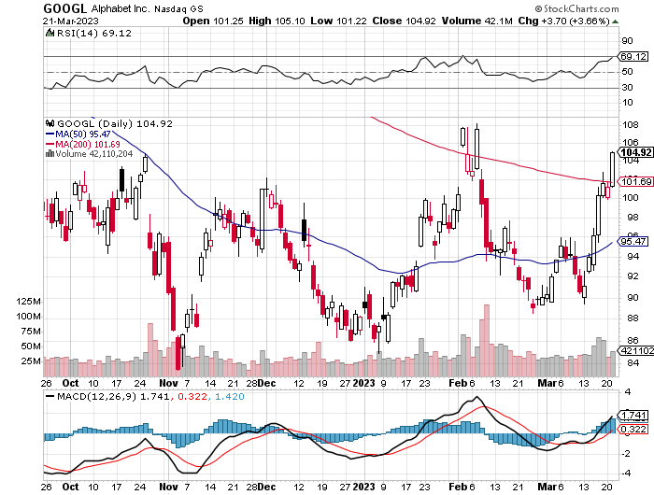
Alphabet (GOOGL) – Disappoints on a major advertising shortfall Government Sues Google on Antitrust took profits on long 12/$1,200-$1,230 bull call spread took profits on long 9/$1,030-$1,080 vertical bull call spread

Slide 33
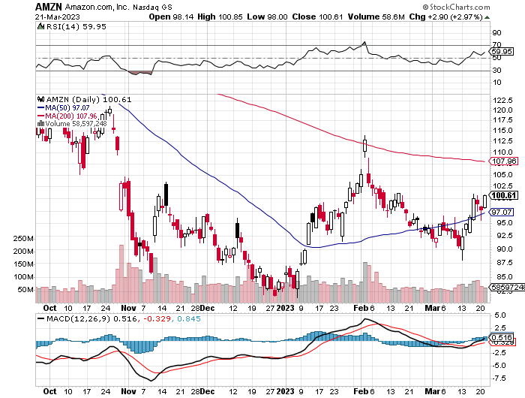
Amazon (AMZN) – US Preparing Antitrust Against Amazon took profits on long 2/$3,400-$3,500 bear put spread took profits on long 9/$2,800-$2,900 bull call spread

Slide 34
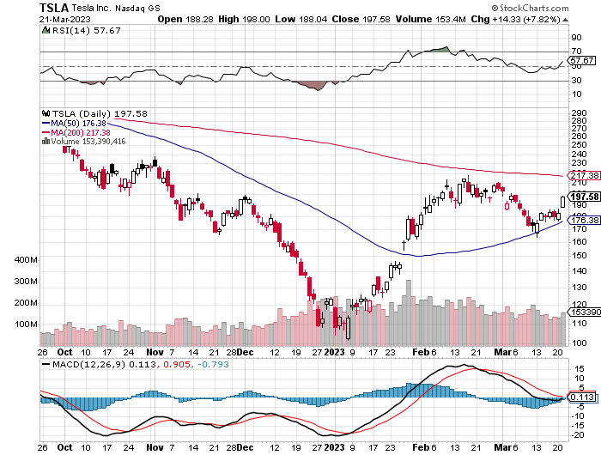
Tesla (TSLA) – Top Trader With Implied Volatility at 78% long 4/$130-$140 call spread - expires in 17 trading days, took profits on long 4/$250-$260 put spread took profits on long 3/$145-$165 call spread, took profits on long 3/$250-$260 put spread took profits on long 2/$150-$160 call spread, took profits on long 2/$155-$165 put spread

Slide 35
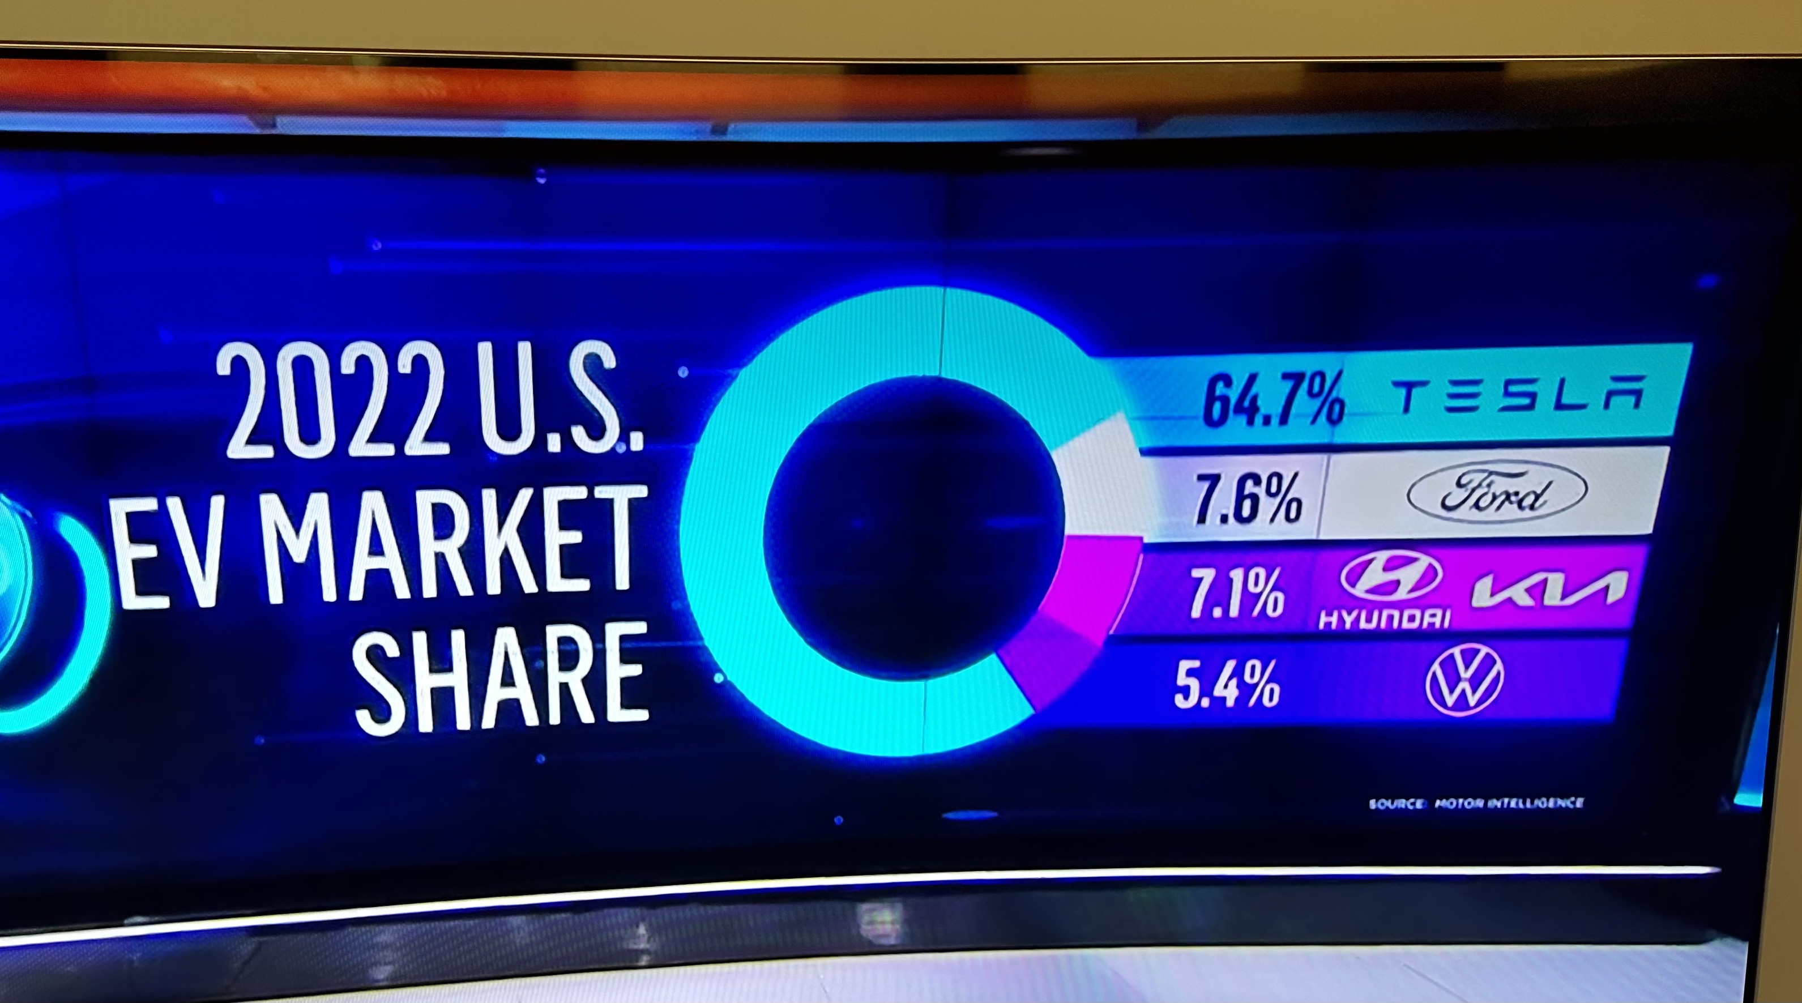

Slide 36
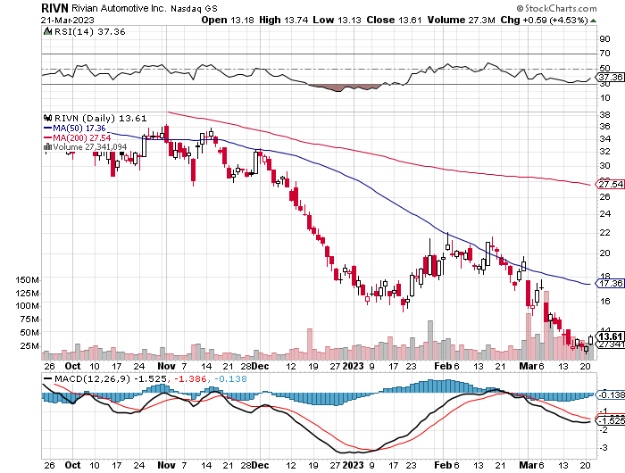
Rivian (RIVN) – Amazon Backed Electric Trucks $1.3 billion capital raise tanks stocks took profits on long 10/$25-$30 call spread

Slide 37
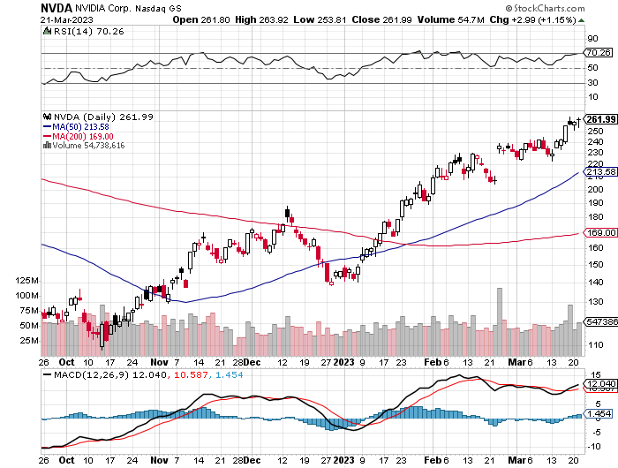
NVIDIA (NVDA) – NVIDIA Beats, sending the stock up 7% on a 41% YOY growth in data center sales – flight to big balance sheets long 3/$260-$270 put spread, took profits on long 10/$95-$100 call spread took profits on long 7/$120-$130 call spread, took profits on long 6/$120-$130 call spread

Slide 38
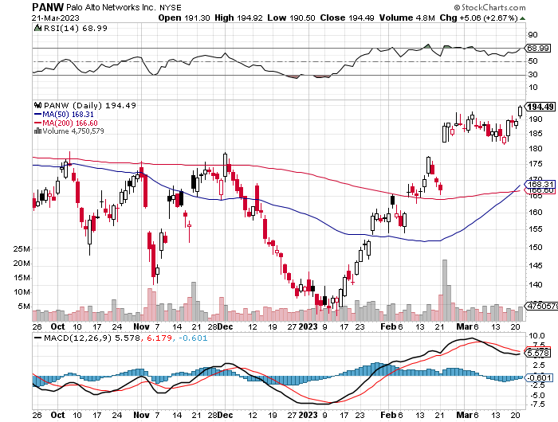
Palo Alto Networks (PANW)- Hacking never goes out of fashion Palo Alto Networks Beats took profits on long 10/$130-$140 call spread

Slide 39
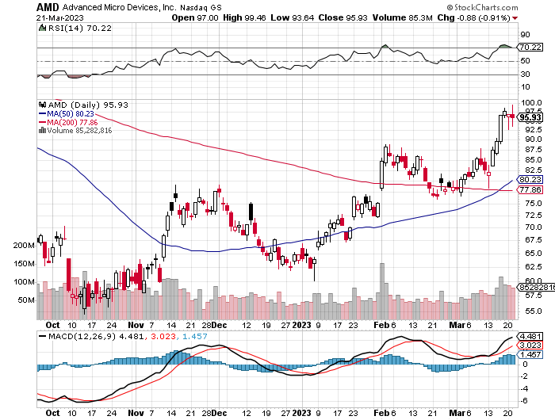
Advanced Micro Devices (AMD)- Recession fears programable logic devices took profits on long 2/$75-$80 call spread

Slide 40
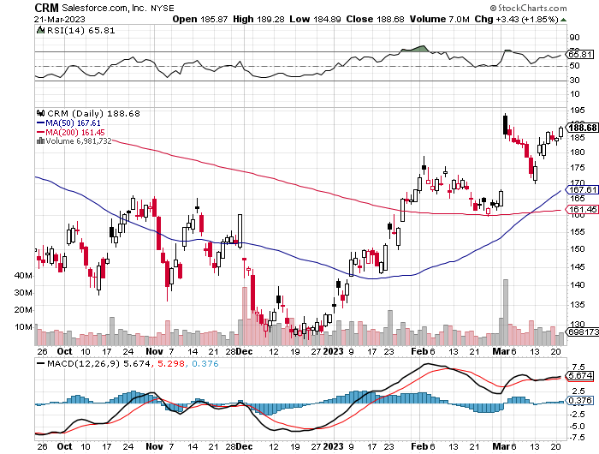
Salesforce (CRM)- Massive Online Migration Salesforce Soars 16%, on better than expected guidance took profits on long 9/$125-$130 vertical bull call spread took profits on long 8/$125-$130 vertical bull call spread took profits on long 2/$105-$115 call spread

Slide 41
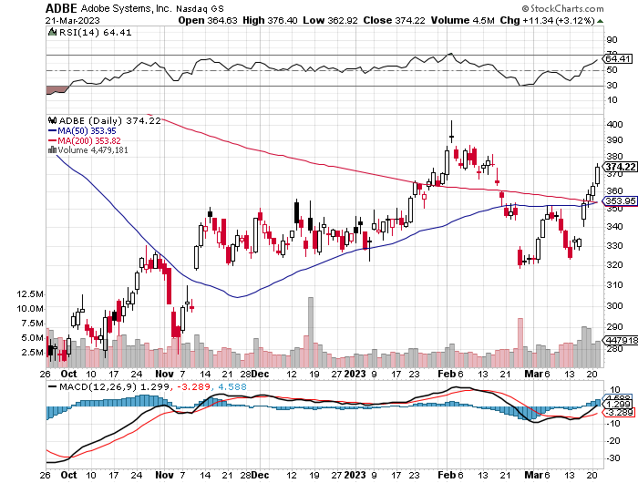
Adobe (ADBE)- Cloud play The Quality Non-China tech play

Slide 42
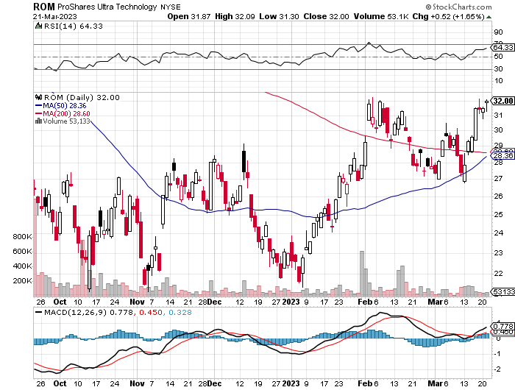
ProShares Ultra Technology ETF (ROM) – 2X Long Technology ETF took profits on long 10/$62-65 call spread

Slide 43
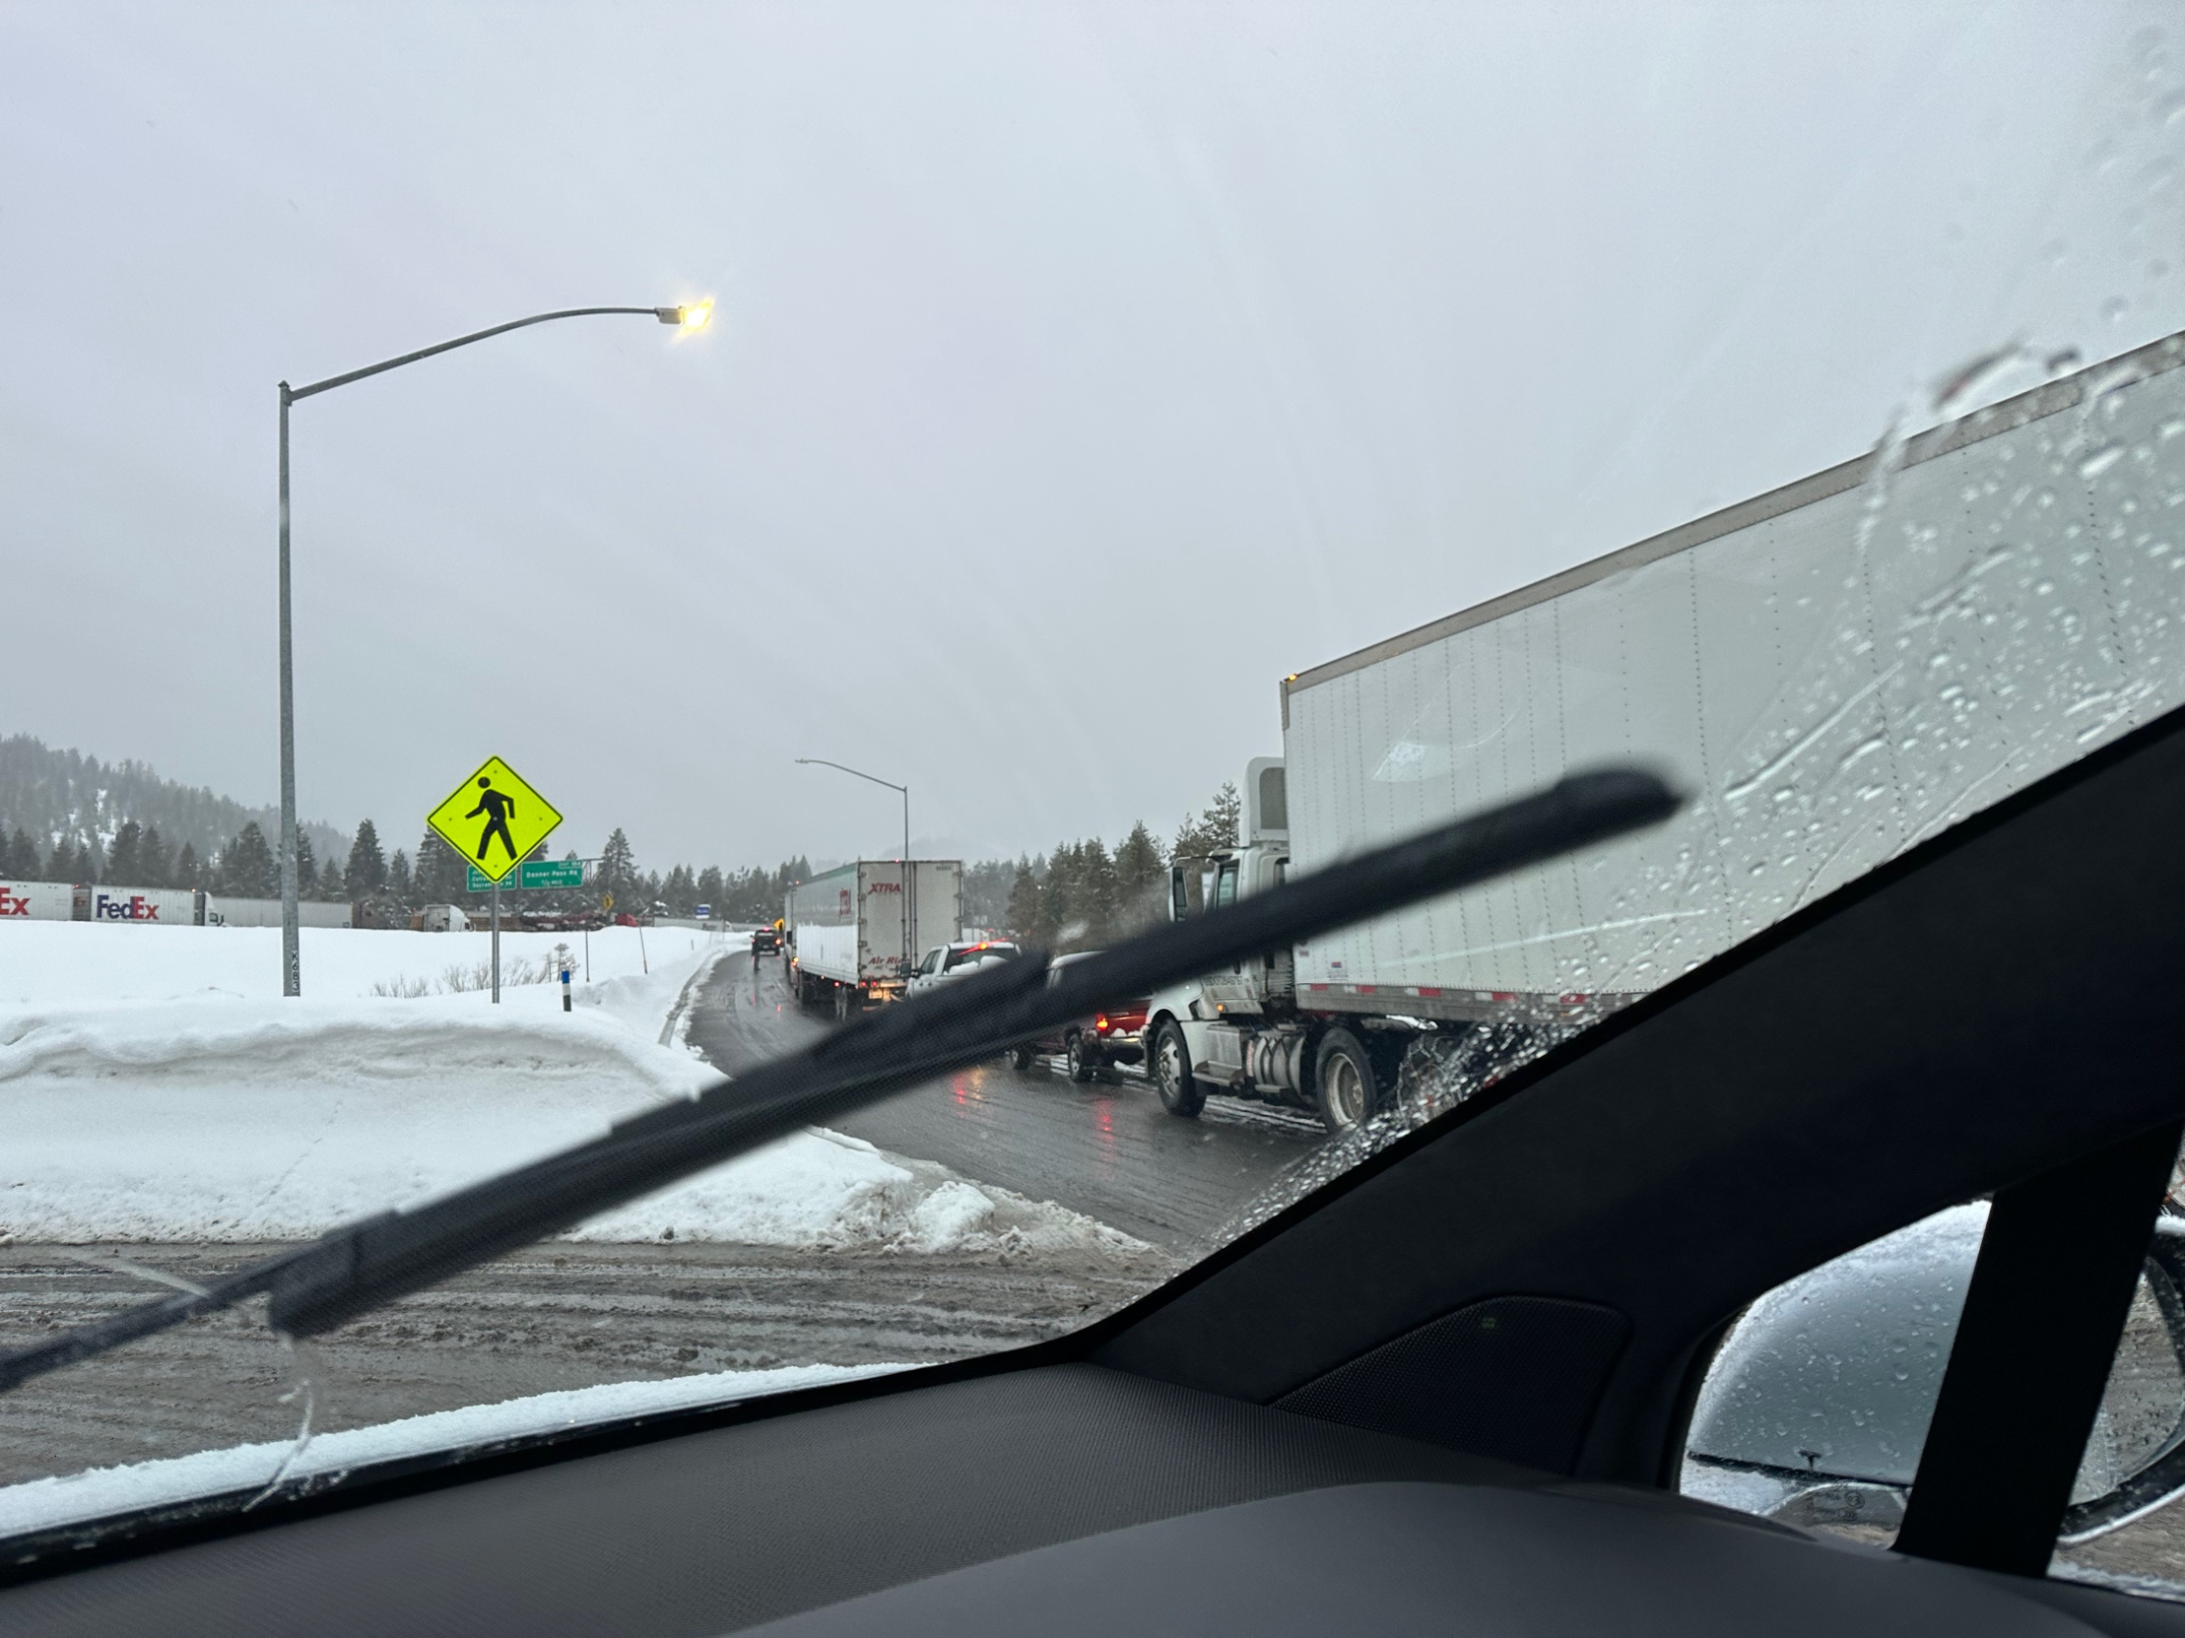

Slide 44
The Second Half of the Barbell
*Bets on a domestic recovery in 2022 Q4 *Upside potential in 2022 far greater than tech *Some of these have not moved for 5 or 10 years *Focuses on economically sensitive cyclical industries *Makes a great counterweight to high-growth technology *We could spend all of next year rotating between the two groups

Slide 45
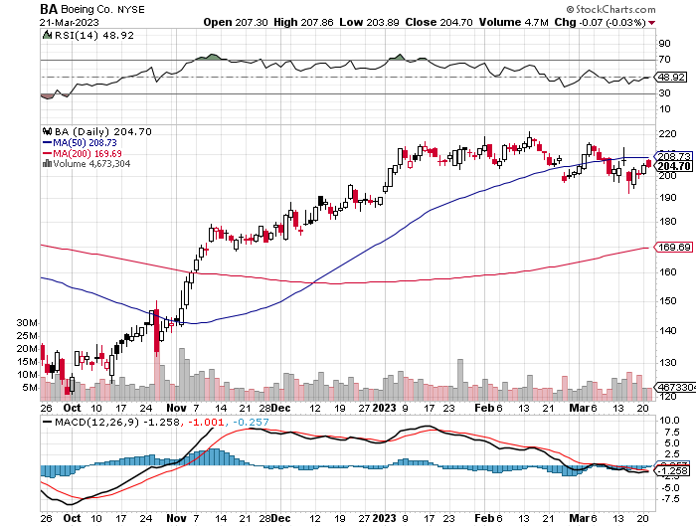
Boeing (BA) – Boeing Resume 787 Dreamliner Deliveries after a data analysis error is resolved.

Slide 46
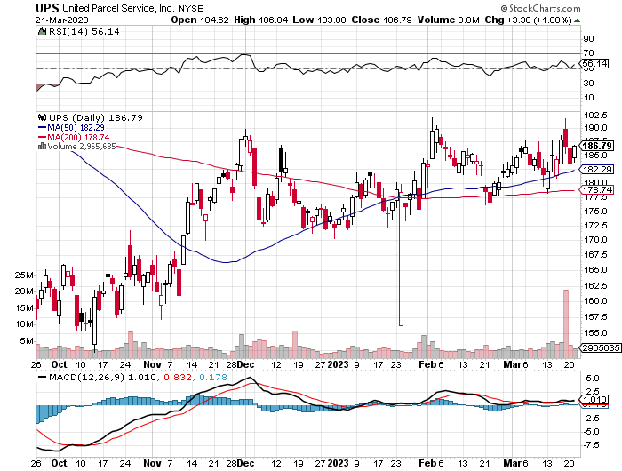
Package Delivery- United Parcel Service (UPS) - took profits on long 11/$130-$140 call spread

Slide 47
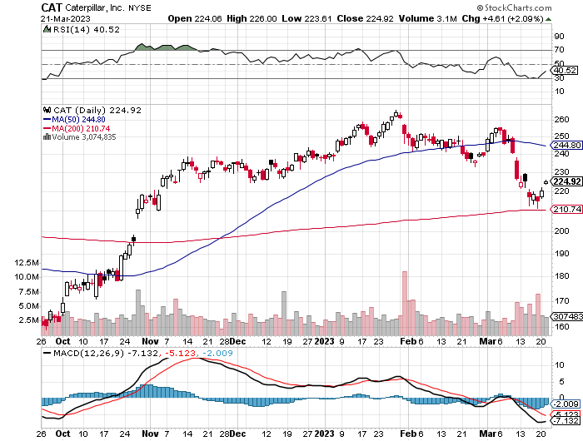
Caterpillar (CAT)- Ag + Infrastructure + Housing Raises Dividend by 50% took profits on long 12/$145-$150 call spread took profits on long 11/$125-$135 call spread

Slide 48
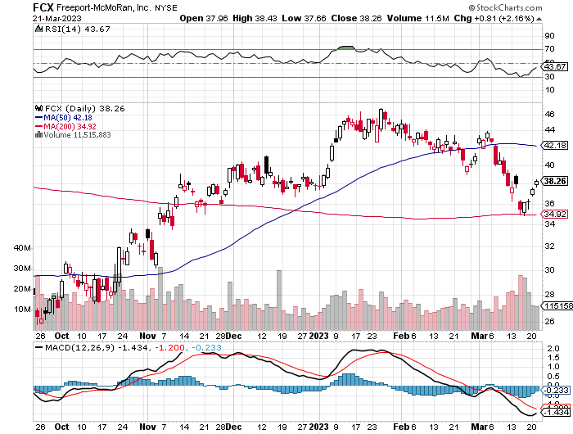
Freeport McMoRan - (FCX)- Copper Play took profits on long 10/$20-$23 call spread

Slide 49
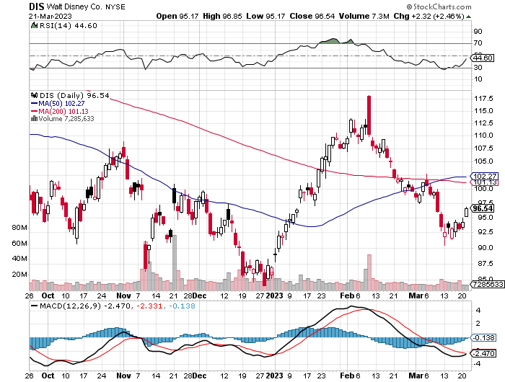
Walt Disney (DIS) - Not a recession play stopped out of long 10/$165-$175 call spread took profits on long 3/$170-$180 call spread

Slide 50
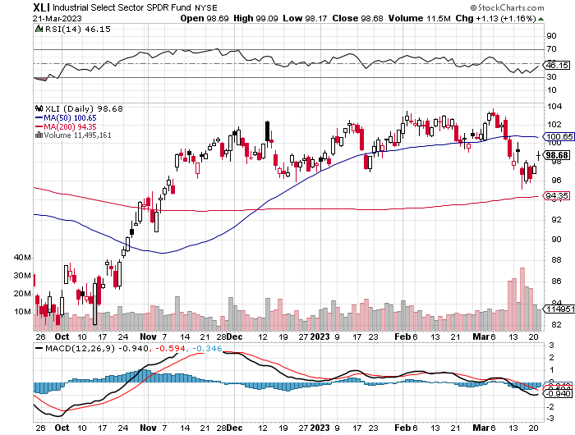
Industrials Sector SPDR (XLI)- (GE), (MMM), (UNP), (UTX), (BA), (HON)

Slide 51
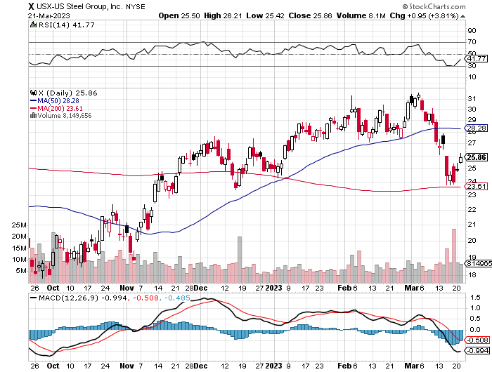
US Steel (X) – Commodity Boom and Wartime boost

Slide 52
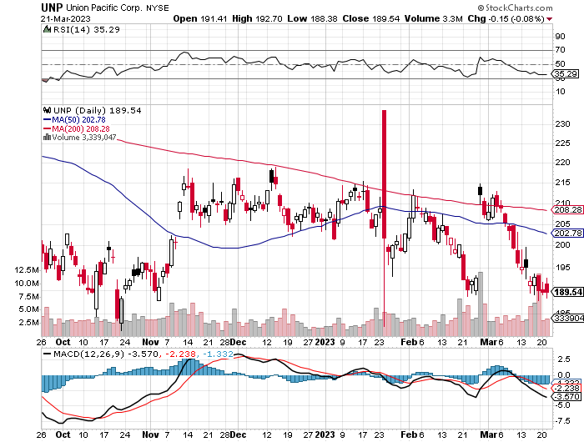
Union Pacific RR (UNP)- Big Stuff to Ship took profits on long 5/$200-$210 call spread took profits on 11/$150-$160 call spread

Slide 53
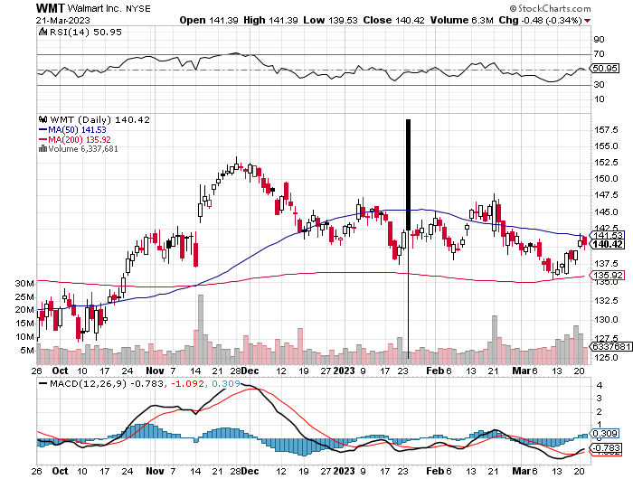
Wal-Mart (WMT)- took profit on Long 11/$125-$130 bear put spread took profit on Long 10/$119-$121 bear put spread took profits on Long 8/$114-$117 bear put spread

Slide 54
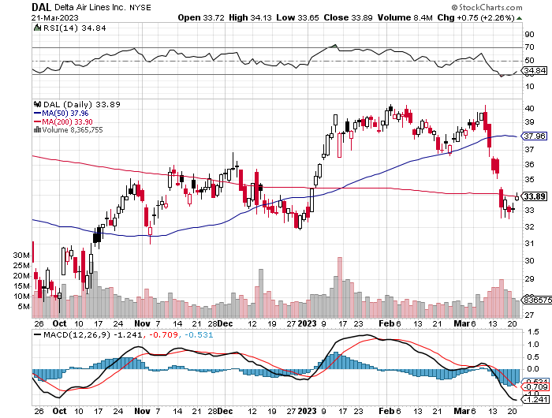
Delta Airlines (DAL) – Travel is Back!

Slide 55
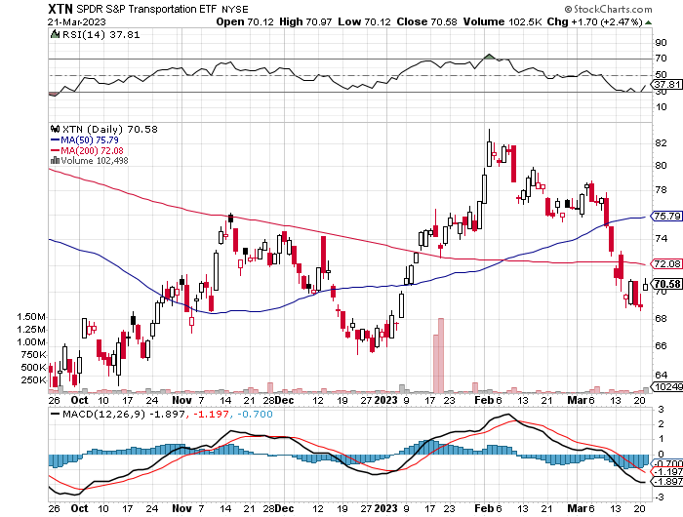
Transports Sector SPDR (XTN)- Worst Hit Sector (ALGT), (ALK), (JBLU), (LUV), (CHRW), (DAL)

Slide 56
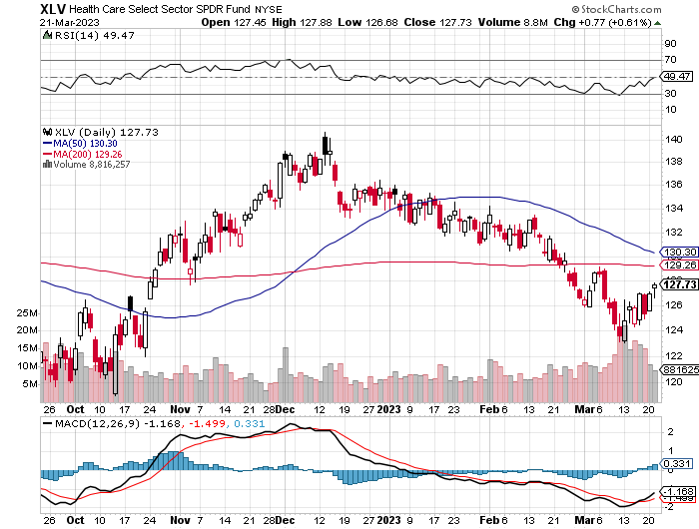
Health Care Sector (XLV) (JNJ), (PFE), (MRK), (GILD), (ACT), (AMGN)

Slide 57
Amgen (AMGN) took profits on long 11/$185-$200 bull call spread

Slide 58
Goldman Sachs (GS) – Highest Capital ration net of mark to market took profits 12/$330-$350 call spread took profits 11/$330-$350 call spread stop loss on long 11/$385-$395 call spreads

Slide 59
Morgan Stanley (MS) – Highest Capital ration net of mark to market long 4/$65-$70 call spread - expires in 17 trading days

Slide 60
JP Morgan Chase (JPM) - Highest Capital ration net of mark to market long 4/$105-$115 call spread - expires in 17 trading days

Slide 61
Bank of America (BAC) – Most Low interest rate mortgage exposure long 4/$20-$23 call spread - expires in 17 trading days

Slide 62
Citigroup (C) – long 4/$30-$35 call spread - expires in 17 trading days

Slide 63
Charles Schwab (SCHW) – No Risk Taking – is all fee business long 4/$30-$35 call spread - expires in 17 trading days

Slide 64
Interactive Brokers (IBKR) – Best Risk Control long 4/$60-$65 call spread - expires in 17 trading days

Slide 65
First Republic (FRC) – High ratio of uninsured deposits, 65% of loans are ARMs, mitigating risk, large share of jumbo loans to high-net-worth individuals, stock down 80% from California exposure

Slide 66
SPDR Metals & Mining ETF (XME) – long 2/$28-$30 call spread

Slide 67
Blackrock (BLK)-Asset Collection Boom took profits on long 3/$770-$790 call spread took profits on long 3/$310-$340 call spread

Slide 68
Visa (V) – “Touchless” Bitcoin Drag Transaction grew by an inflationary 10% back to pre-pandemic levels took profits on long 10/$160-$170 bull call spread took profits on long 6/$150-$160 bull call spread

Slide 69
Consumer Discretionary SPDR (XLY) (DIS), (AMZN), (HD), (CMCSA), (MCD), (SBUX)

Slide 70
Berkshire Hathaway (BRKB)- Natural Barbell 2022 $30.2 billion profit on unchanged stock, Warren Buffet’s Annual Letter is Out took profits on long 1/$290-$300 call spread, took profits on long 10/$220-$230 call spread, took profits on long 7/$220-$230 call spread, took profits on long 7/$220-$230 call spread took profits on long 6/$260-$270 call spread

Slide 71
Europe Hedged Equity (HEDJ)-

Slide 72
Japan (DXJ)-

Slide 73
Emerging Markets (EEM) - Pro trade, Weak Dollar, Long Recovery Play

Slide 75
Bonds – Flight to Safety
*Bank crisis brings record peak in bond prices, drop in yields, which may accelerate a Fed interest rate cutting policy *Ten-year US Treasury yields plunge from 3.90% to 3.30% in days *Crash of (TLT) from $180 to $92 over 2 1.2 years brought bankruptcy of Silicon Valley Bank *There is never just one cockroach *Still looking like 2.50% yield by end 2023 *(TLT) should reach $120 in 2023 after political interreference ends this summer *Keep buying (TLT) calls, calls spreads and LEAPS on dips but only on dips *Junk bond ETF’s (JNK) and (HYG) are a great high yield play

Slide 76
Treasury ETF (TLT) – long 4/$113-$116 put spread, long 4/$114-$117 put spread-expires in 17 trading days, took profits on long 1/$92-$95 call spread, took profits on long 1/$96-$99 call spread, took profits on long 1/$95-$98 call spread, took profits on long 2/$95-$98 call spread

Slide 77
Ten Year Treasury Yield ($TNX) – 3.60%

Slide 78
Junk Bonds (HYG) 8.30% Yield to Maturity

Slide 79
Municipal Bonds (MUB) 3.27% Yield-

Slide 80
Emerging Market Debt (ELD) 6.83% Yield-

Slide 81
2X Short Treasuries (TBT)-Out of Favor

Slide 82
Foreign Currencies – Dollar Stall
* Prospects of 0.25% Fed rate rise knocking the wind out of the dollar *Dollar could be peaking here *After a great dollar run all currencies were overdue and in need of a rest *Dollar selloff may resume after March 22 Fed meeting *Any strength in the dollar will be temporary *Look for new dollar lows by end 2023 *Buy (FXE), (FXY), (FXB) on dips

Slide 83
THE MAD HEDGE FUND TRADER
Australian Dollar (FXA) - Major Long-Term Bottom is In Targeting Parity – A call option on a global synchronized recovery
1:1
BUY

Slide 84
Japanese Yen (FXY)
2023 Target 25%

Slide 85
Euro (FXE)-
2023 Target 25%

Slide 86
British Pound (FXB)-
2023 Target 15%

Slide 87
Emerging Market Currencies (CEW)
2023 Target 40%

Slide 89
Energy & Commodities –Free Fall
*Recession fears spur price collapse *Market is now oversupplied with 300,000 barrels/day *120 million barrels have gone into storage in 9 months *Only an OPEC Plus production cut can arrest the fall *China is coming back on stream too slowly to come to the rescue *Expect a long delay until we see lower gasoline prices *Joe Biden is the only buyer of 400 million barrel to refill the Strategic Petroleum Reserve

Slide 90
Oil-($WTIC)

Slide 91
United States Oil Fund (USO)

Slide 92
Energy Select Sector SPDR (XLE)-No Performance! (XOM), (CVX), (SLB), (KMI), (EOG), (COP)

Slide 93
ExxonMobile (XOM)- took profits on long 12/$120-$125 put spread

Slide 94
Occidental Petroleum (OXY)- Buffet’s a Buyer long 2/$55-$60 call spread, took profits on long 12/$77.50-$82.50 put spread

Slide 95
Natural Gas (UNG) - Long January 2025 $14 - $15 Call Spread LEAPS

Slide 96
Freeport McMoRan (FCX) -

Slide 97
Cameco (CCJ) - took profits on long 5/$20-$23 bull call spread

Slide 99
Precious Metals – New Bull Market
*Gold Breaks Out, crossing a key technical level and setting the options market on fire. Some gold minders saw options volume up 400% *Flight to safety bid finally kicks in *Imminent recession means lower interest rates sooner and less yield competition for gold *Is Platinum the Precious Metals Play of 2023? *There is rising demand from hydrogen fuel cells and the green hydrogen movement *The world’s second largest producer of platinum is Russia, who’s supplies have been cut off. *Buy (GLD), (GDX), (GOLD), (SLV), (PPLT) and (WPM) on dips

Slide 100
Gold (GLD) - Deflation call took profits on long 5/$165-$170 bull call spread

Slide 101
Market Vectors Gold Miners ETF- (GDX) –

Slide 102
Barrick Gold (GOLD) took profit on long 1/$15.50-$16.50 call spread

Slide 103
Newmont Mining- (NEM)- took profits on long $55-60 call spread

Slide 104
Silver- (SLV)- took profits on long 11/$19-$20 call spread

Slide 105
Silver Miners - (SIL)-

Slide 106
Wheaton Precious Metals - (WPM)- took profits on long 1/$36-$39 call spread

Slide 107
Platinum- (PPLT)- 556,000-ounce shortage this year took profits on long 1/$36-$39 call spread

Slide 108
Real Estate – Rates Dive
* Builder Sentiment Rises, in February two points for the third consecutive monthly gain, thanks to overwhelming demand from first time Millennial buyers *Mortgage Rates Dive, off the back of a three-day, $8.00 rally in the bond market. Mortgage rates plunged by 50 basis points to 6.50% and may have more to go *Mortgage rate crash may ignite the spring selling season *Housing inventories still very short after cleanout in January the last time rates fell sharply *Existing Home Sales Soar 14.5%, in February, a three-year high *The median home prices fell 0.2% to $363,000, the first decline in 11 years *Cash sales were 28% of total sales

Slide 109
S&P Case Shiller Plunges S&P Case Shiller Drops to +5.7%, in November with its National Home Price Index Miami (+15.9%), Tampa (+13.9%), Atlanta (+10.4%)

Slide 110
Crown Castle International (CCI) – 4.72% yielding cell phone tower REIT

Slide 111
US Home Construction Index (ITB) (DHI), (LEN), (PHM), (TOL), (NVR)

Slide 113
Trade Sheet- So What Do We Do About All This?
*Stocks – buy the big dips at bottom of range, ………………sell big rallies to hedge holdings *Bonds – buy dips, sell extreme rallies *Commodities-buy dips *Currencies- sell dollar rallies, buy currencies *Precious Metals – buy dips *Energy – stand aside *Volatility - sell short over $30 *Real estate – buy dips

Slide 115
Next Strategy Webinar 12:00 EST Wednesday, April 12 from Incline Village, NV email me questions at support@madhedgefundtrader.com
Good Luck and Good Trading!
Notes:
*

