Slide 1
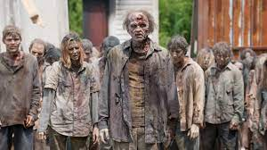
The Mad Hedge Fund Trader “The Stock Market That Won’t Die”
With John Thomas Incline Village, NV, April 12, 2023 www.madhedgefundtrader.com
Notes:
*

Slide 2
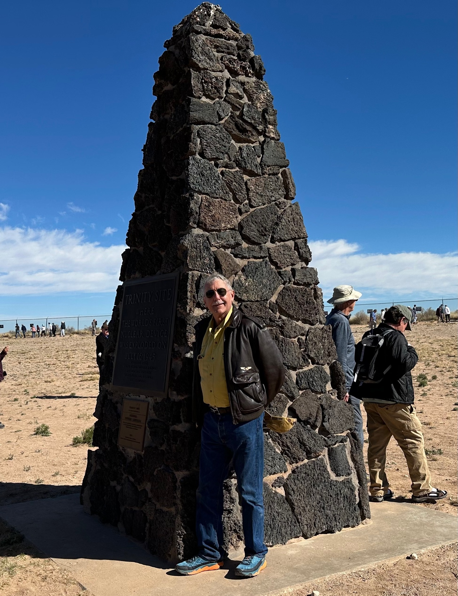

Slide 3
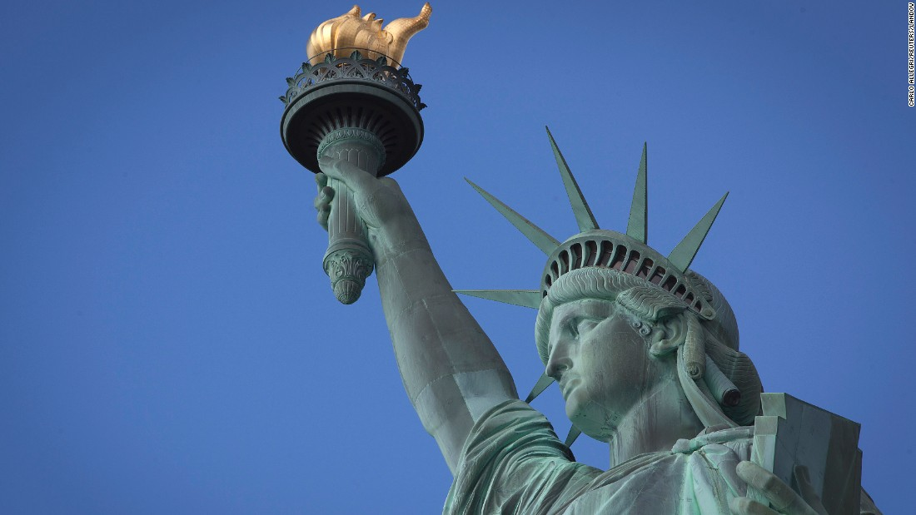
THURSDAY, JULY 6 NEW YORK STRATEGY LUNCHEON
*An excellent meal will be followed by a wide-ranging discussion and an extended question and answer period *The lunch will be held in an exclusive private club in Midtown Manhattan with a strict dress code *please go to my online store at http://www.madhedgefundtrader.com/store and click on “luncheons.” Tickets are available for $299

Slide 4
Friday July 13, 2023 Seminar at Sea
*Cunard Line’s flagship, the elegant and spacious Queen Mary II, on an eastbound transatlantic cruise *The Ship departs New York at 12:00 AM on July 7, 2023, and arrives at Southampton on July 14 *Guests will be responsible for booking their own cabin through Cunard *Three dinners during the voyage will be black tie *Customers are required to book their own cabins and return flights from England *The Cunard cruise number is M319

Slide 5
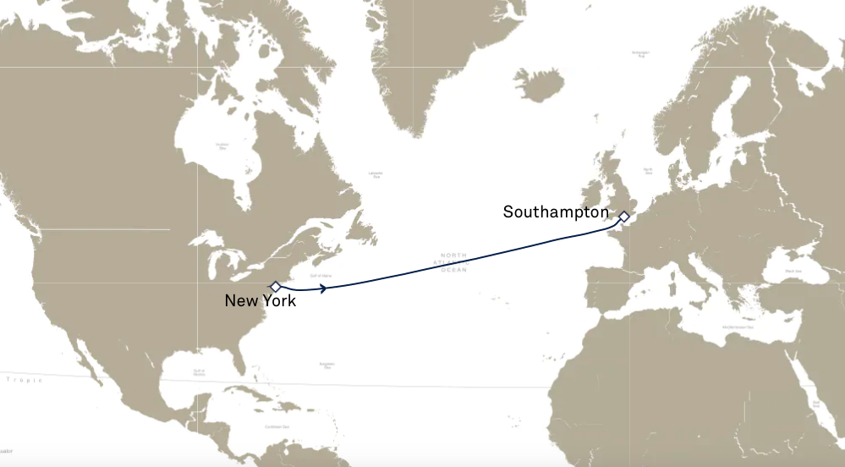

Slide 6
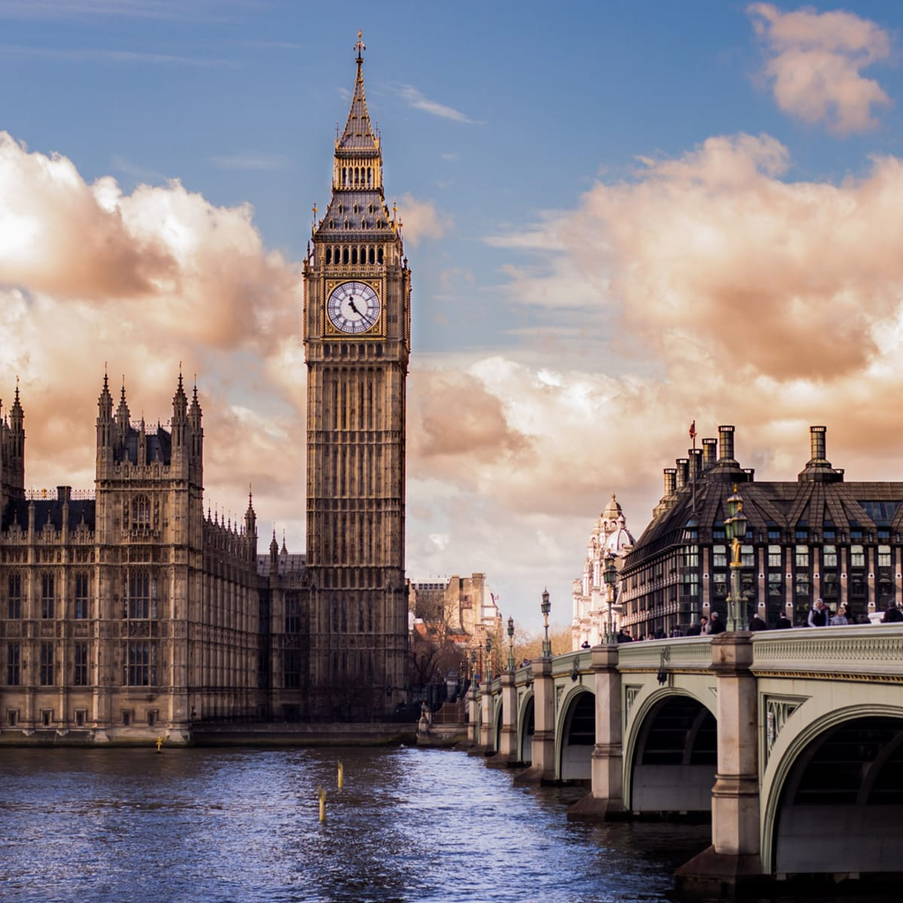
THURSDAY, JULY 19 LONDON STRATEGY LUNCHEON
*An excellent meal will be followed by a wide-ranging discussion and an extended question and answer period *The lunch will be held in an exclusive private club in Midtown Manhattan with a strict dress code *please go to my online store at http://www.madhedgefundtrader.com/store and click on “luncheons.” Tickets are available for $298

Slide 7
Trade Alert Performance Best Quarter in the History of the Mad Hedge Fund Trader! 33 out of 36 trade alerts profitable
*January +22.35% Final *July +3.98% Final *February +3.41% Final *August +5.13% Final *March +20.85% Final *September +9.72% Final *April +1.03% MTD *October +5.69% Final *May +8.80% Final *November +8.31 Final *June +5.91% Final *December +0.95% Final *2022 Final +84.63% compared to -18.63% for the S&P 500 *2023 Year to Date +47.57%, versus +7.00% for the S&P 500 +643.57% since inception *Average annualized return of +48.26% for 15 years

Slide 8
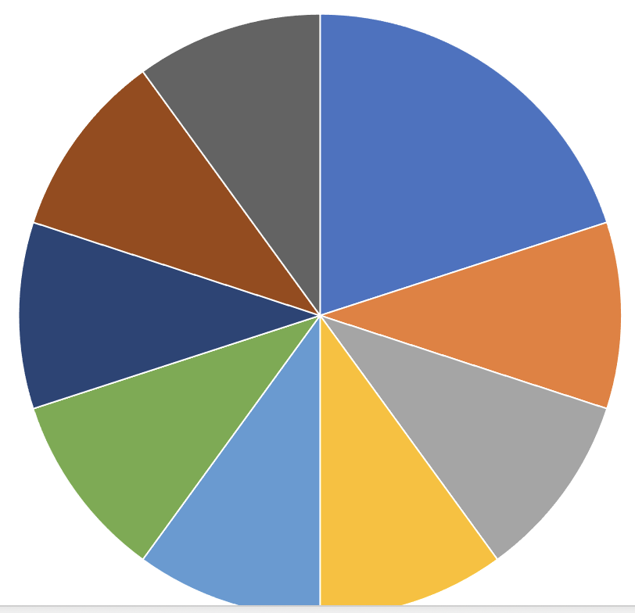
Portfolio Review 100% Long, 0% Short, 0% cash – All expire in 7 trading days with VIX at $20 its time to be fully invested
Current Capital at Risk
Risk On
(TSLA) 4/$130-$140 call spread | 20.00%
(BAC) 4/$20-$23 call spread | 10.00%
(C) 4/$30-$35 call spread | 10.00%
(JPM) 4/$105-$115 call spread | 10.00%
(IBKR) 4/$60-$65 call spread | 10.00%
(MS) 4/$65-$70 call spread | 10.00%
(BRK/B) 4/$260-$270 call spread | 10.00%
(FCX) 4/$30-$33 call spread | 10.00%
(TLT) 4/$96-$99 call spread | 10.00%
Expiration Value +49.21%

Slide 9
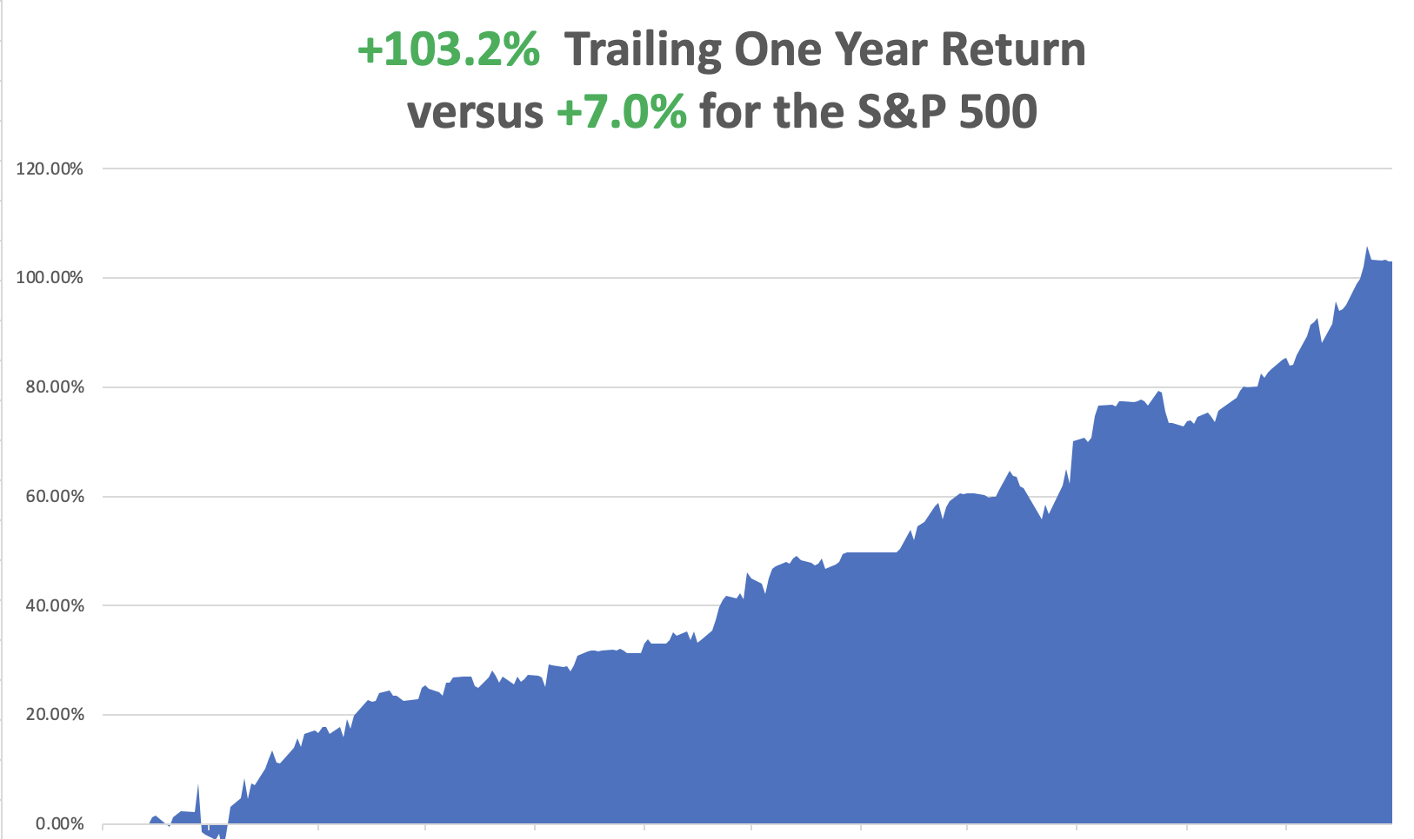

Slide 10
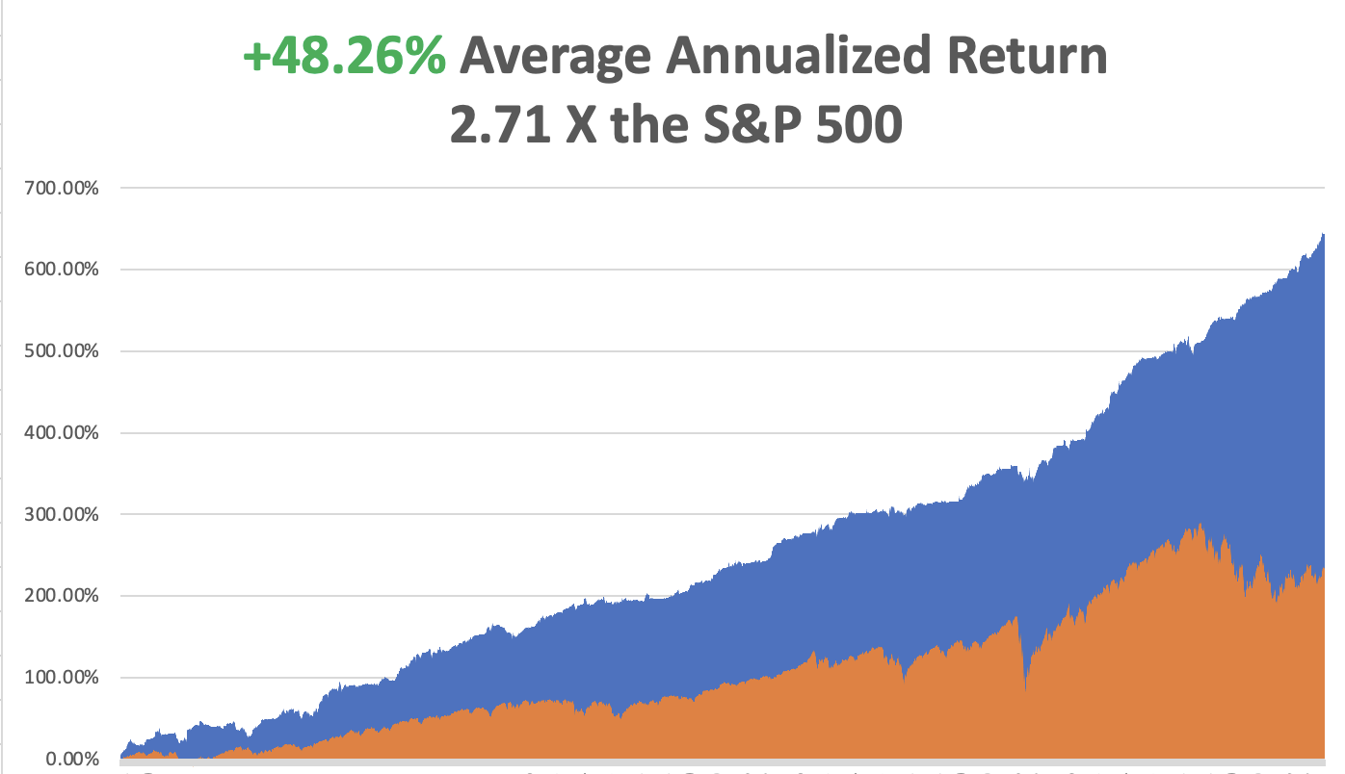

Slide 11
The Method to My Madness
*5.6% YOY Inflation rate underlines the long-term bull case for stocks, will be under 4% by yearend *Stock Markets have done a big pull forward of performance, bringing normally strong April performance into January-March *We are now at the top end of a high-risk range, with asset classes diverging sharply in outlooks *Bonds, foreign currencies, precious metals, and energy now discounting a recession, while stocks at these prices are discounting a soft landing *OPEC production cut halted oil meltdown *Gold, Silver upside breakout on lower interest rates sooner *The US dollar fails on recession prospect *Look for S&P 500 at $4,800 by end 2023 *VIX plunges under $20 – Nothing is now tradable

Slide 12
The Global Economy – Holding Up
*5.6% inflation rate announced April 12 is the 9th consecutive month of decline *Nonfarm Payroll Report Holds Up, at 236,000 in March, the lowest since December 2020 *It shows that high interest rates still have not impacted the jobs market. February was revised up to 326,000 *The headline Unemployment Rate dropped back to a 50 year low at 3.5% *June JOLTS survey of job openings fell to 10.698 million, down from 11.3 million last month *Q4 GDP Comes in at 2.6% *Used Car Prices are Soaring Again frustrating the Fed’s inflation fighting effort. *Supply Chain Problems Just Took a Step Backwards, with the close of the Ports of Los Angeles and Long Beach over worker shortages

Slide 13
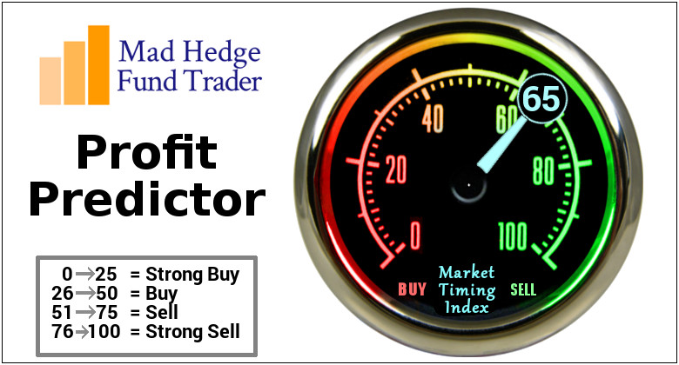
The Mad Hedge Profit Predictor Market Timing Index – Getting High An artificial intelligence driven algorithm that analyzes 30 different economic, technical, and momentum driven indicators

Slide 14
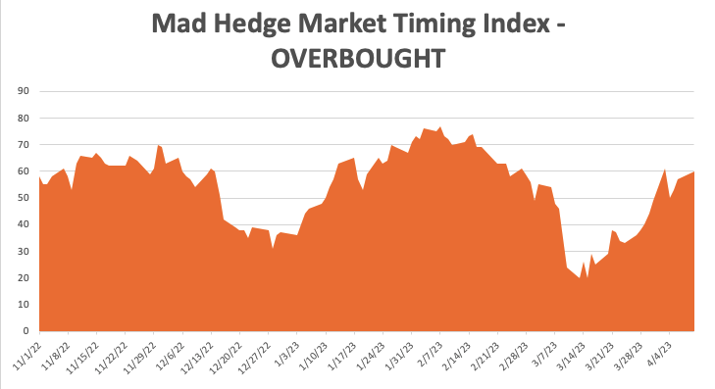
SELL
BUY

Slide 15
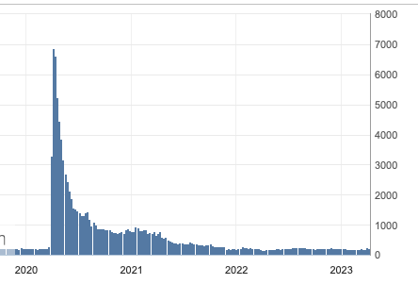
Weekly Jobless Claims – Falling 228,000 – Down 18,000

Slide 16
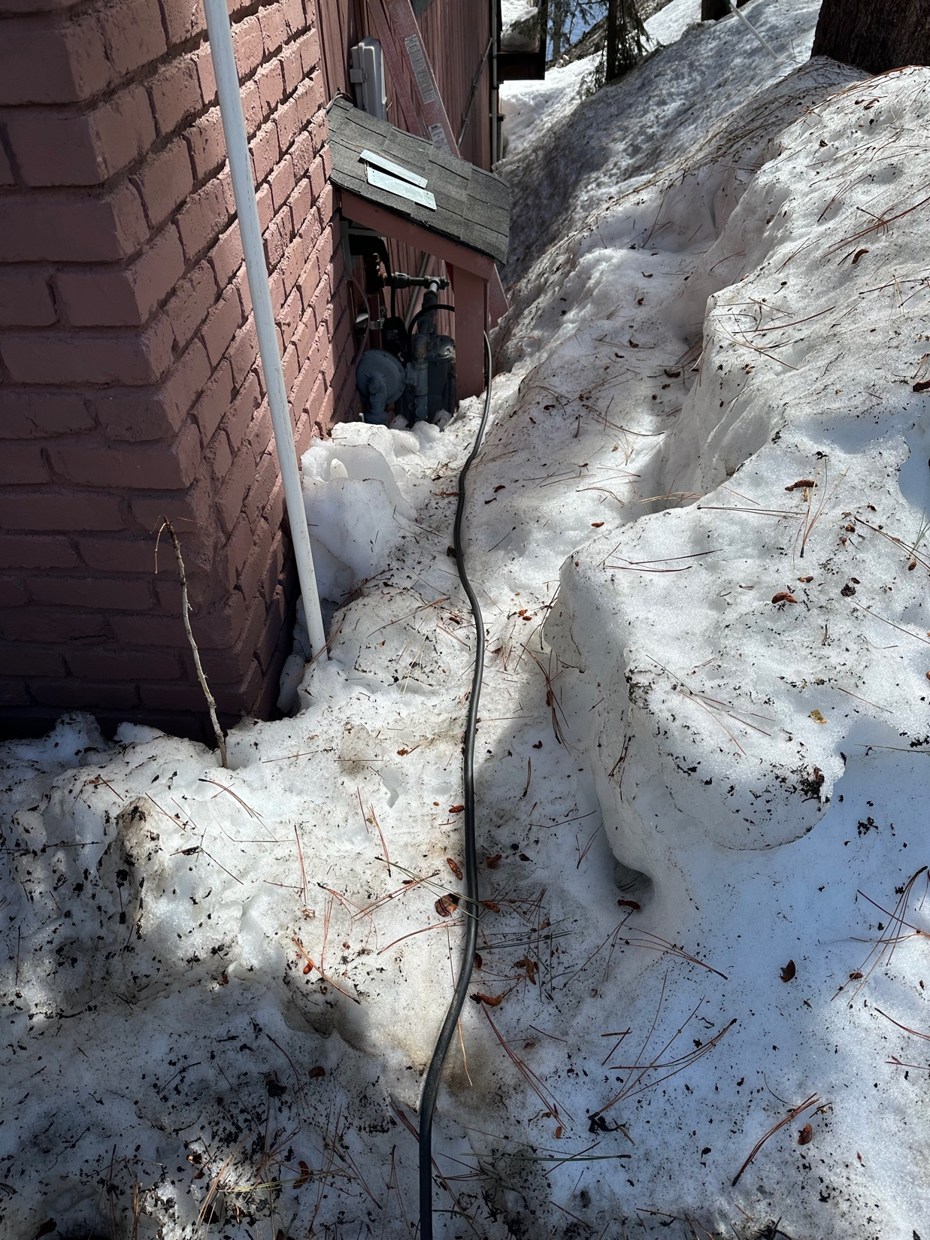

Slide 17
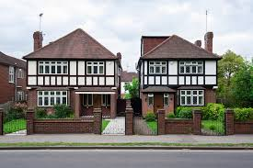
Stocks – Detached
*Boeing Ramps Up 737 MAX Production, from 31 to 37 planes a month due to unprecedented demand *Chip Stocks are On Fire, clocking the best sector of any in Q1 *Stock Dividends Hit New All-Time Highs, at $146.8 billion, up 7% YOY *Alibaba to Break Up, into six different companies *AI Could be a $7 Trillion Business in ten years, according to Goldman Sachs *Volatility plunges to $19 putting the market asleep *Ford Loses $2 Billion on EV’s in 2022, compared to a Tesla profit of $12.6 billion *Looking for flat first half, strong second half to take us to S&P 500 4,800 by yearend

Slide 18
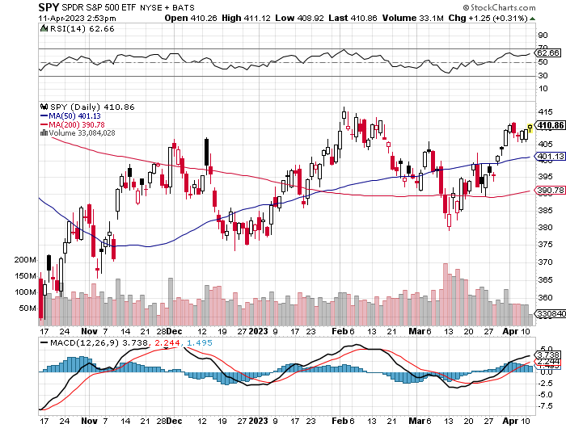
S&P 500 – Sell in May took profits on long 1/$420-$430 put spread, took profits on long 11/$420-$430 put spread took profits on long 10/$385-$395 put spread, took profits on long 11/$410-$400 put spread took profit on long 10/$390-$400 put spread, took profit on long 10/$320-$330 call spread
2023 $480 Target
$430 +21% Rally
$375 -12.8% Pull Back
The Bottom $355 Down -26%

Slide 19
SELL
BUY

Slide 20
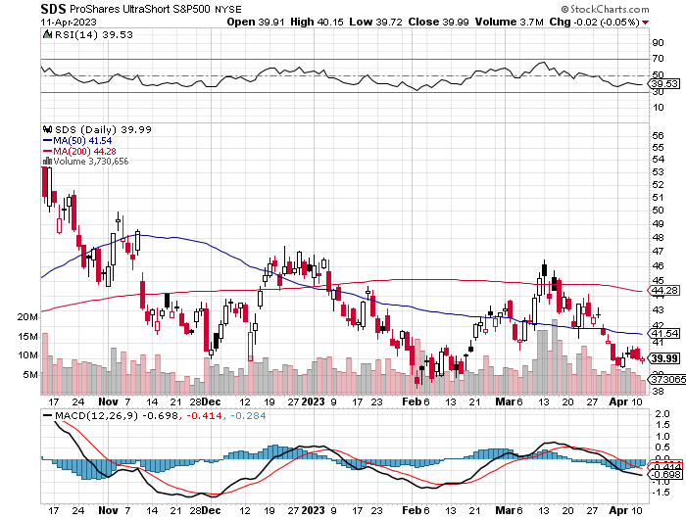
ProShares Ultra Short S&P 500 (SDS)- a great hedge for long stocks and bonds long 2X position has a hedge against longs and bond shorts

Slide 21
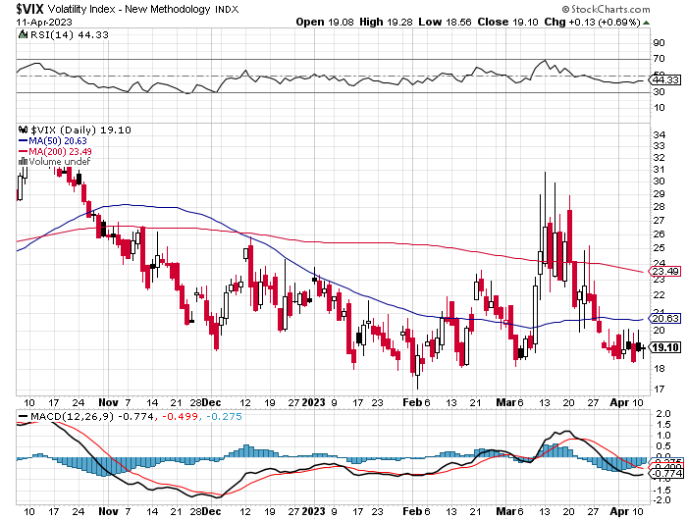
(VIX) – Bargain of the Century

Slide 22
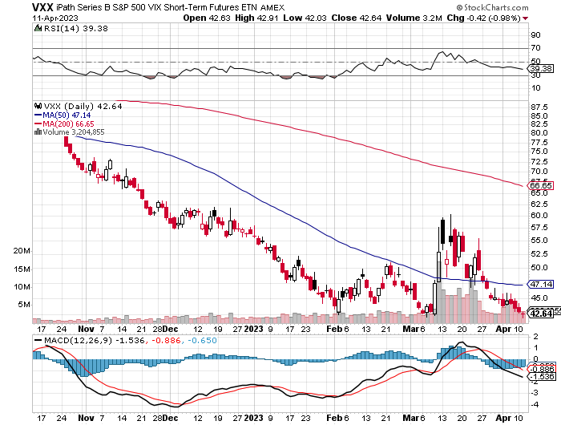
(VXX)-

Slide 23
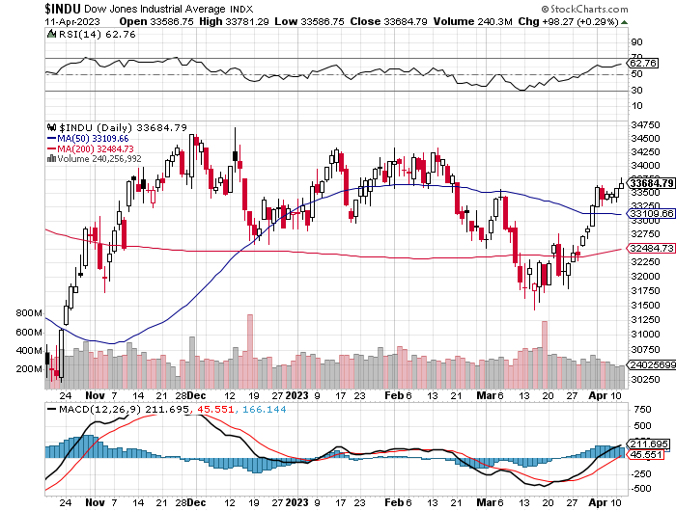
Dow Average ($INDU)-

Slide 24
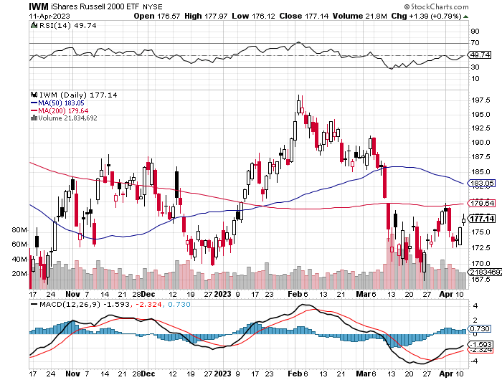
Russell 2000 (IWM)- took profits on Long 10/$137-$142 vertical bull call spread took profits on Long 10/$153-$156 vertical bear put spread

Slide 25
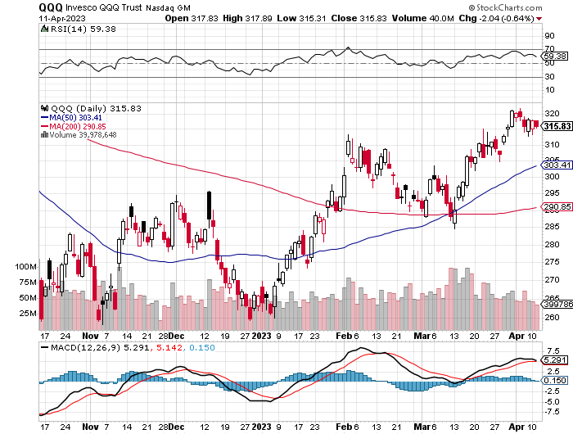
NASDAQ (QQQ) – took profits on long (QQQ) 1/$290-$300 put spread, took profits on long (QQQ) 4/$330-$335 put spread took profits on long (QQQ) 3/$340-$345 put spread, covered long (QQQ) $325-$330 put spread

Slide 27
The Barbell Portfolio
*50% Big Tech - 2% of US Employment but 27% of Market Cap and 38% of Profits 50% Domestic Recovery, including: Railroads Couriers Banks Construction Credit Cards Event organizers Ticket sales Retailers

Slide 28
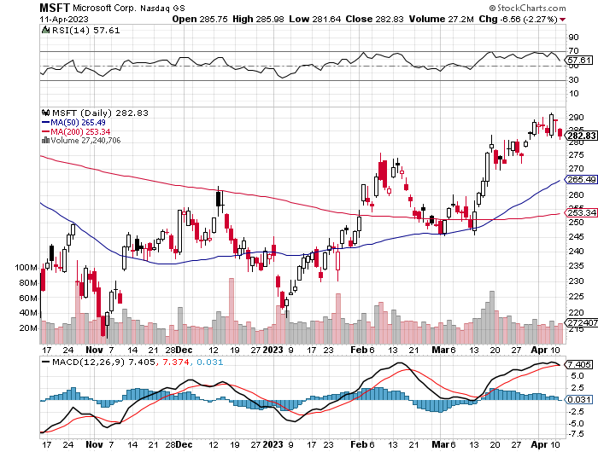
Microsoft (MSFT)- Grim Forward Guidance took profits on 9/$235-$245 call spread, took profits on long 7/$220-$210 call spread, took profits on long 6/$220-$230 call spread, took profits on long 2/$200-$210 bear put spread

Slide 29
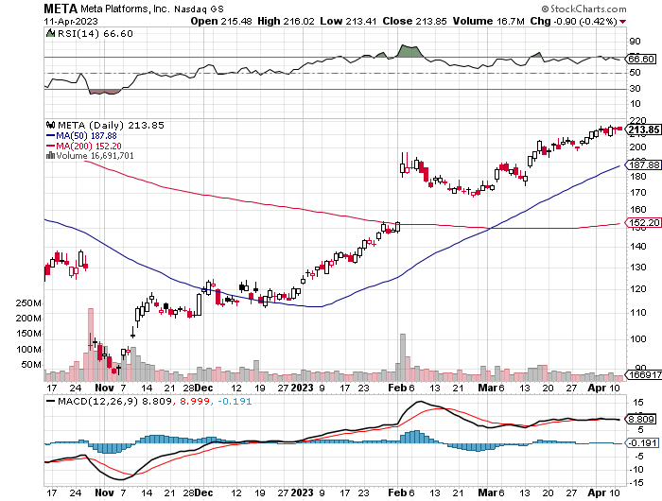
Meta (META)- Soars an Incredible 20% took profits on Long 9/$290-$300 vertical bear put spread stopped out of Long 9/$190-$200 vertical bear put spread

Slide 30
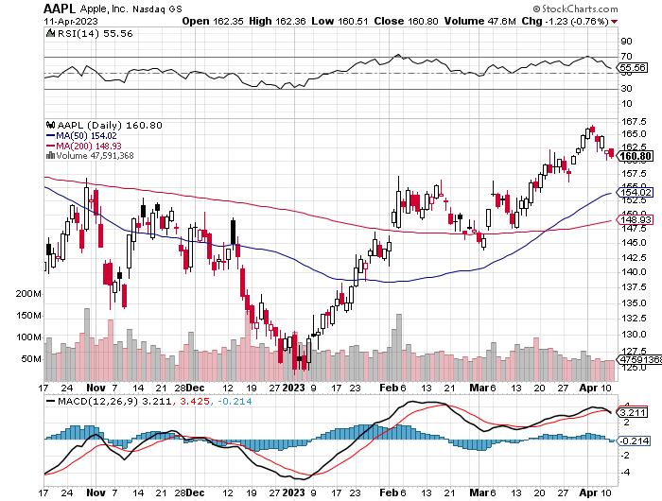
Apple (AAPL)-Apple Cash Hoard Soars to $165 Billion took profits on long 1/$145-$155 put spread, Took profits on long 10/$165-$175 put spread took profits on long 6/$155-$165 put spread, stopped out of long 6/$125-135 call spread, took profits on long 6/$110-$120 call spread, took profits on long 2/$180-$190 put spread

Slide 31
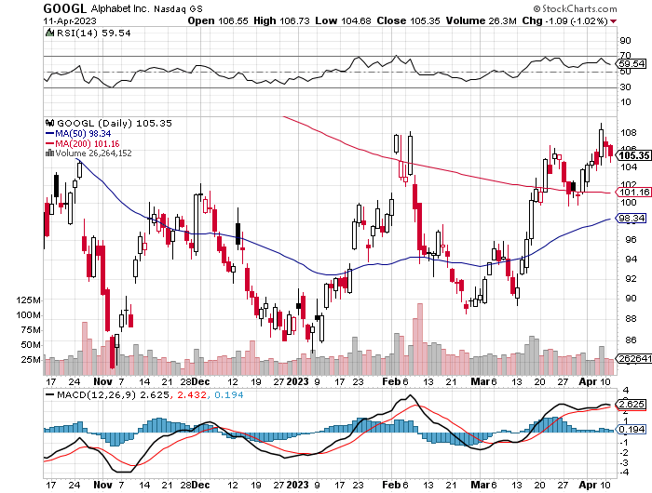
Alphabet (GOOGL) – Google Delivers Supercomputer, Google’s new A.I. supercomputer is 1.7x faster & 1.9x more efficient than NVIDIA a100 took profits on long 12/$1,200-$1,230 bull call spread took profits on long 9/$1,030-$1,080 vertical bull call spread

Slide 32
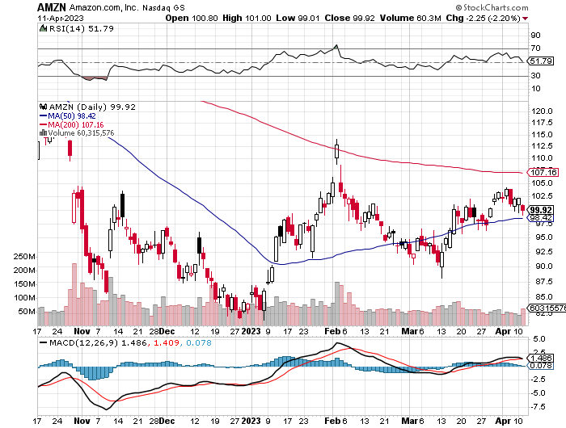
Amazon (AMZN) – US Preparing Antitrust Against Amazon took profits on long 2/$3,400-$3,500 bear put spread took profits on long 9/$2,800-$2,900 bull call spread

Slide 33
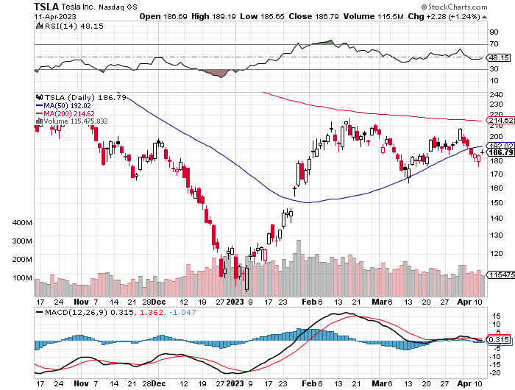
Tesla (TSLA) – Top Trader With Implied Volatility at 78% Tesla Cuts Prices Again, Tesla Posts Record EV Deliveries, Deliveries grew 36% from a year ago long 4/$130-$140 call spread - expires in 7 trading days, took profits on long 4/$250-$260 put spread took profits on long 3/$145-$165 call spread, took profits on long 3/$250-$260 put spread took profits on long 2/$150-$160 call spread, took profits on long 2/$155-$165 put spread

Slide 34
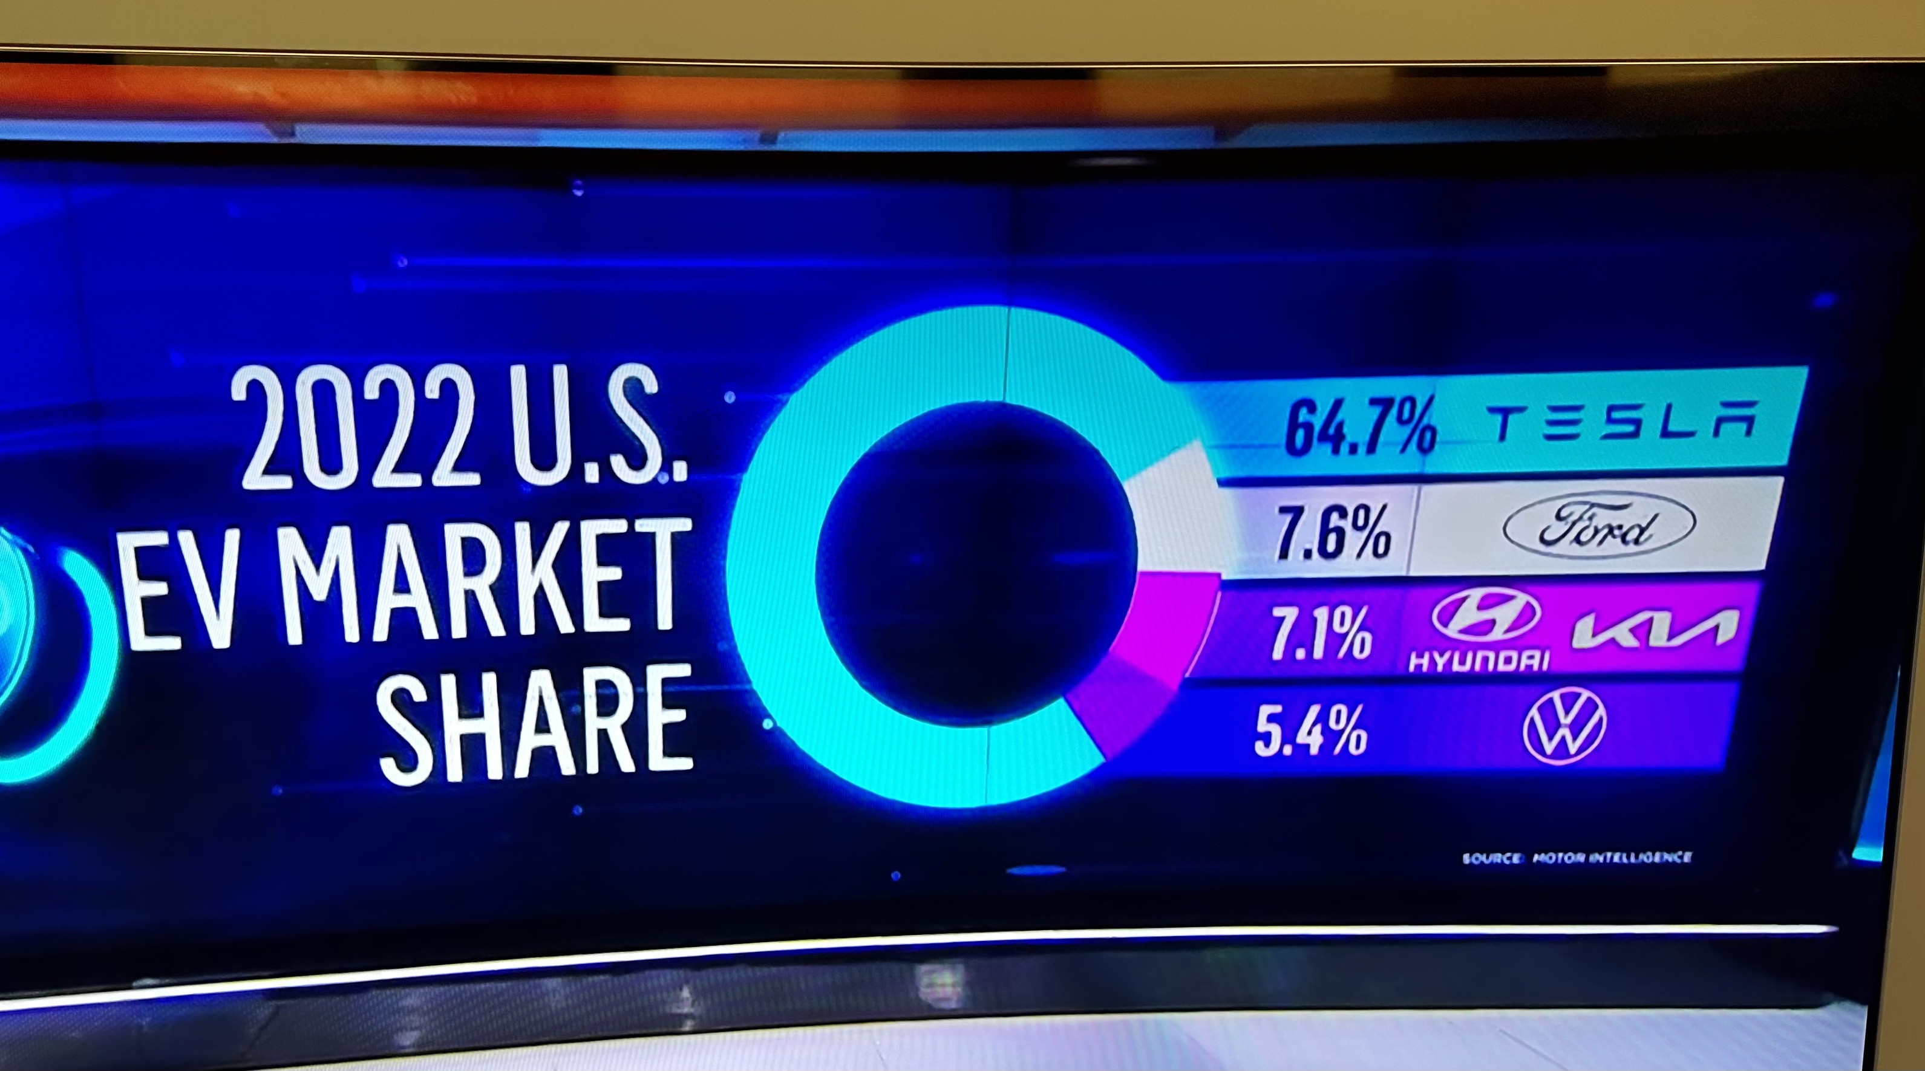

Slide 35
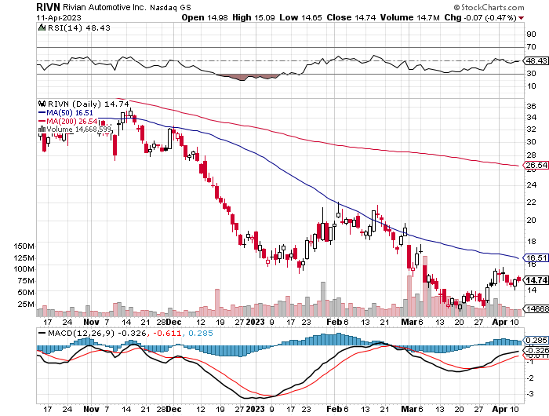
Rivian (RIVN) – Amazon Backed Electric Trucks $1.3 billion capital raise tanks stocks took profits on long 10/$25-$30 call spread

Slide 36
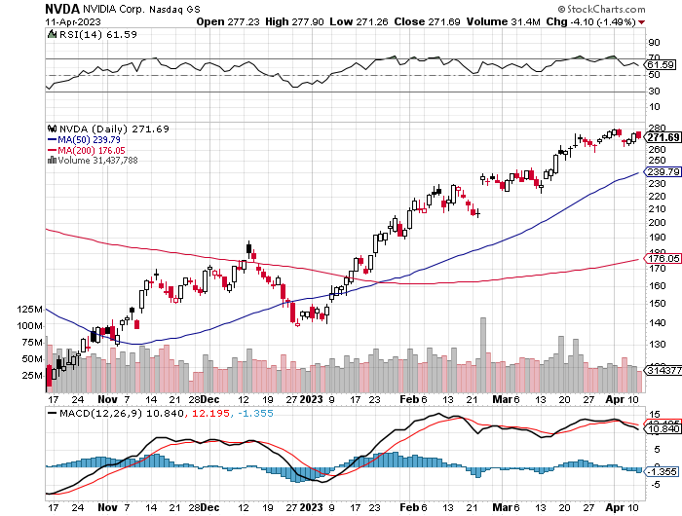
NVIDIA (NVDA) – NVIDIA ties up with Adobe, to develop a new generation of AI generative chips long 3/$260-$270 put spread, took profits on long 10/$95-$100 call spread took profits on long 7/$120-$130 call spread, took profits on long 6/$120-$130 call spread

Slide 37
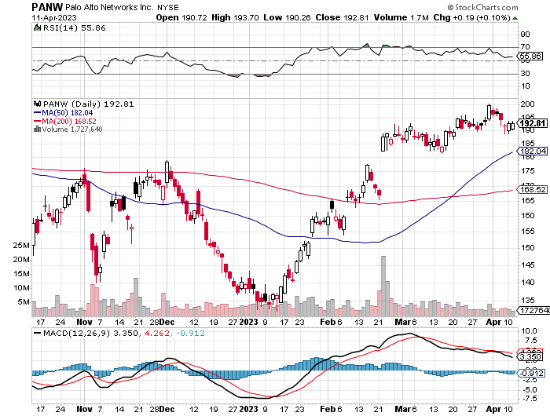
Palo Alto Networks (PANW)- Hacking never goes out of fashion Palo Alto Networks Beats took profits on long 10/$130-$140 call spread

Slide 38
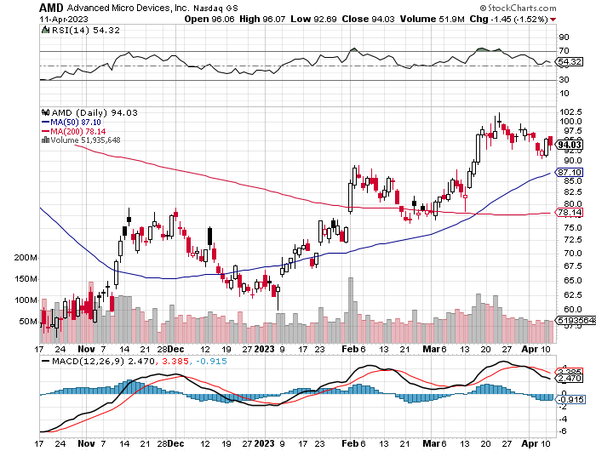
Advanced Micro Devices (AMD)- Recession fears programable logic devices took profits on long 2/$75-$80 call spread

Slide 39
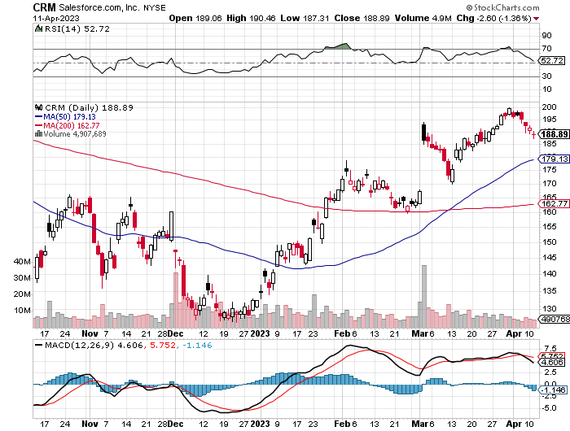
Salesforce (CRM)- Massive Online Migration Salesforce Soars 16%, on better than expected guidance took profits on long 9/$125-$130 vertical bull call spread took profits on long 8/$125-$130 vertical bull call spread took profits on long 2/$105-$115 call spread

Slide 40
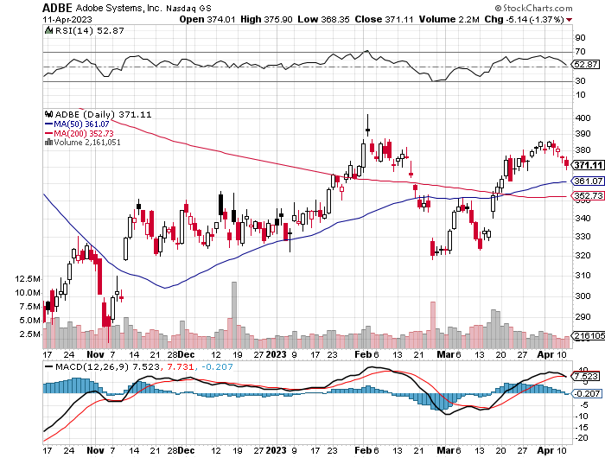
Adobe (ADBE)- Cloud play The Quality Non-China tech play

Slide 41
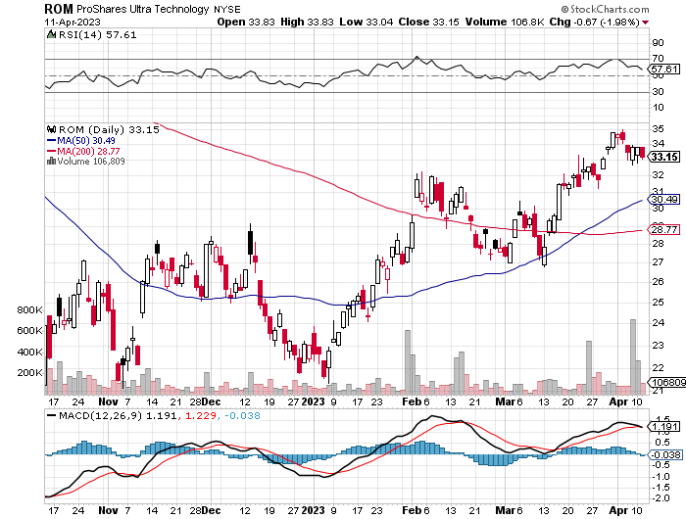
ProShares Ultra Technology ETF (ROM) – 2X Long Technology ETF took profits on long 10/$62-65 call spread

Slide 43
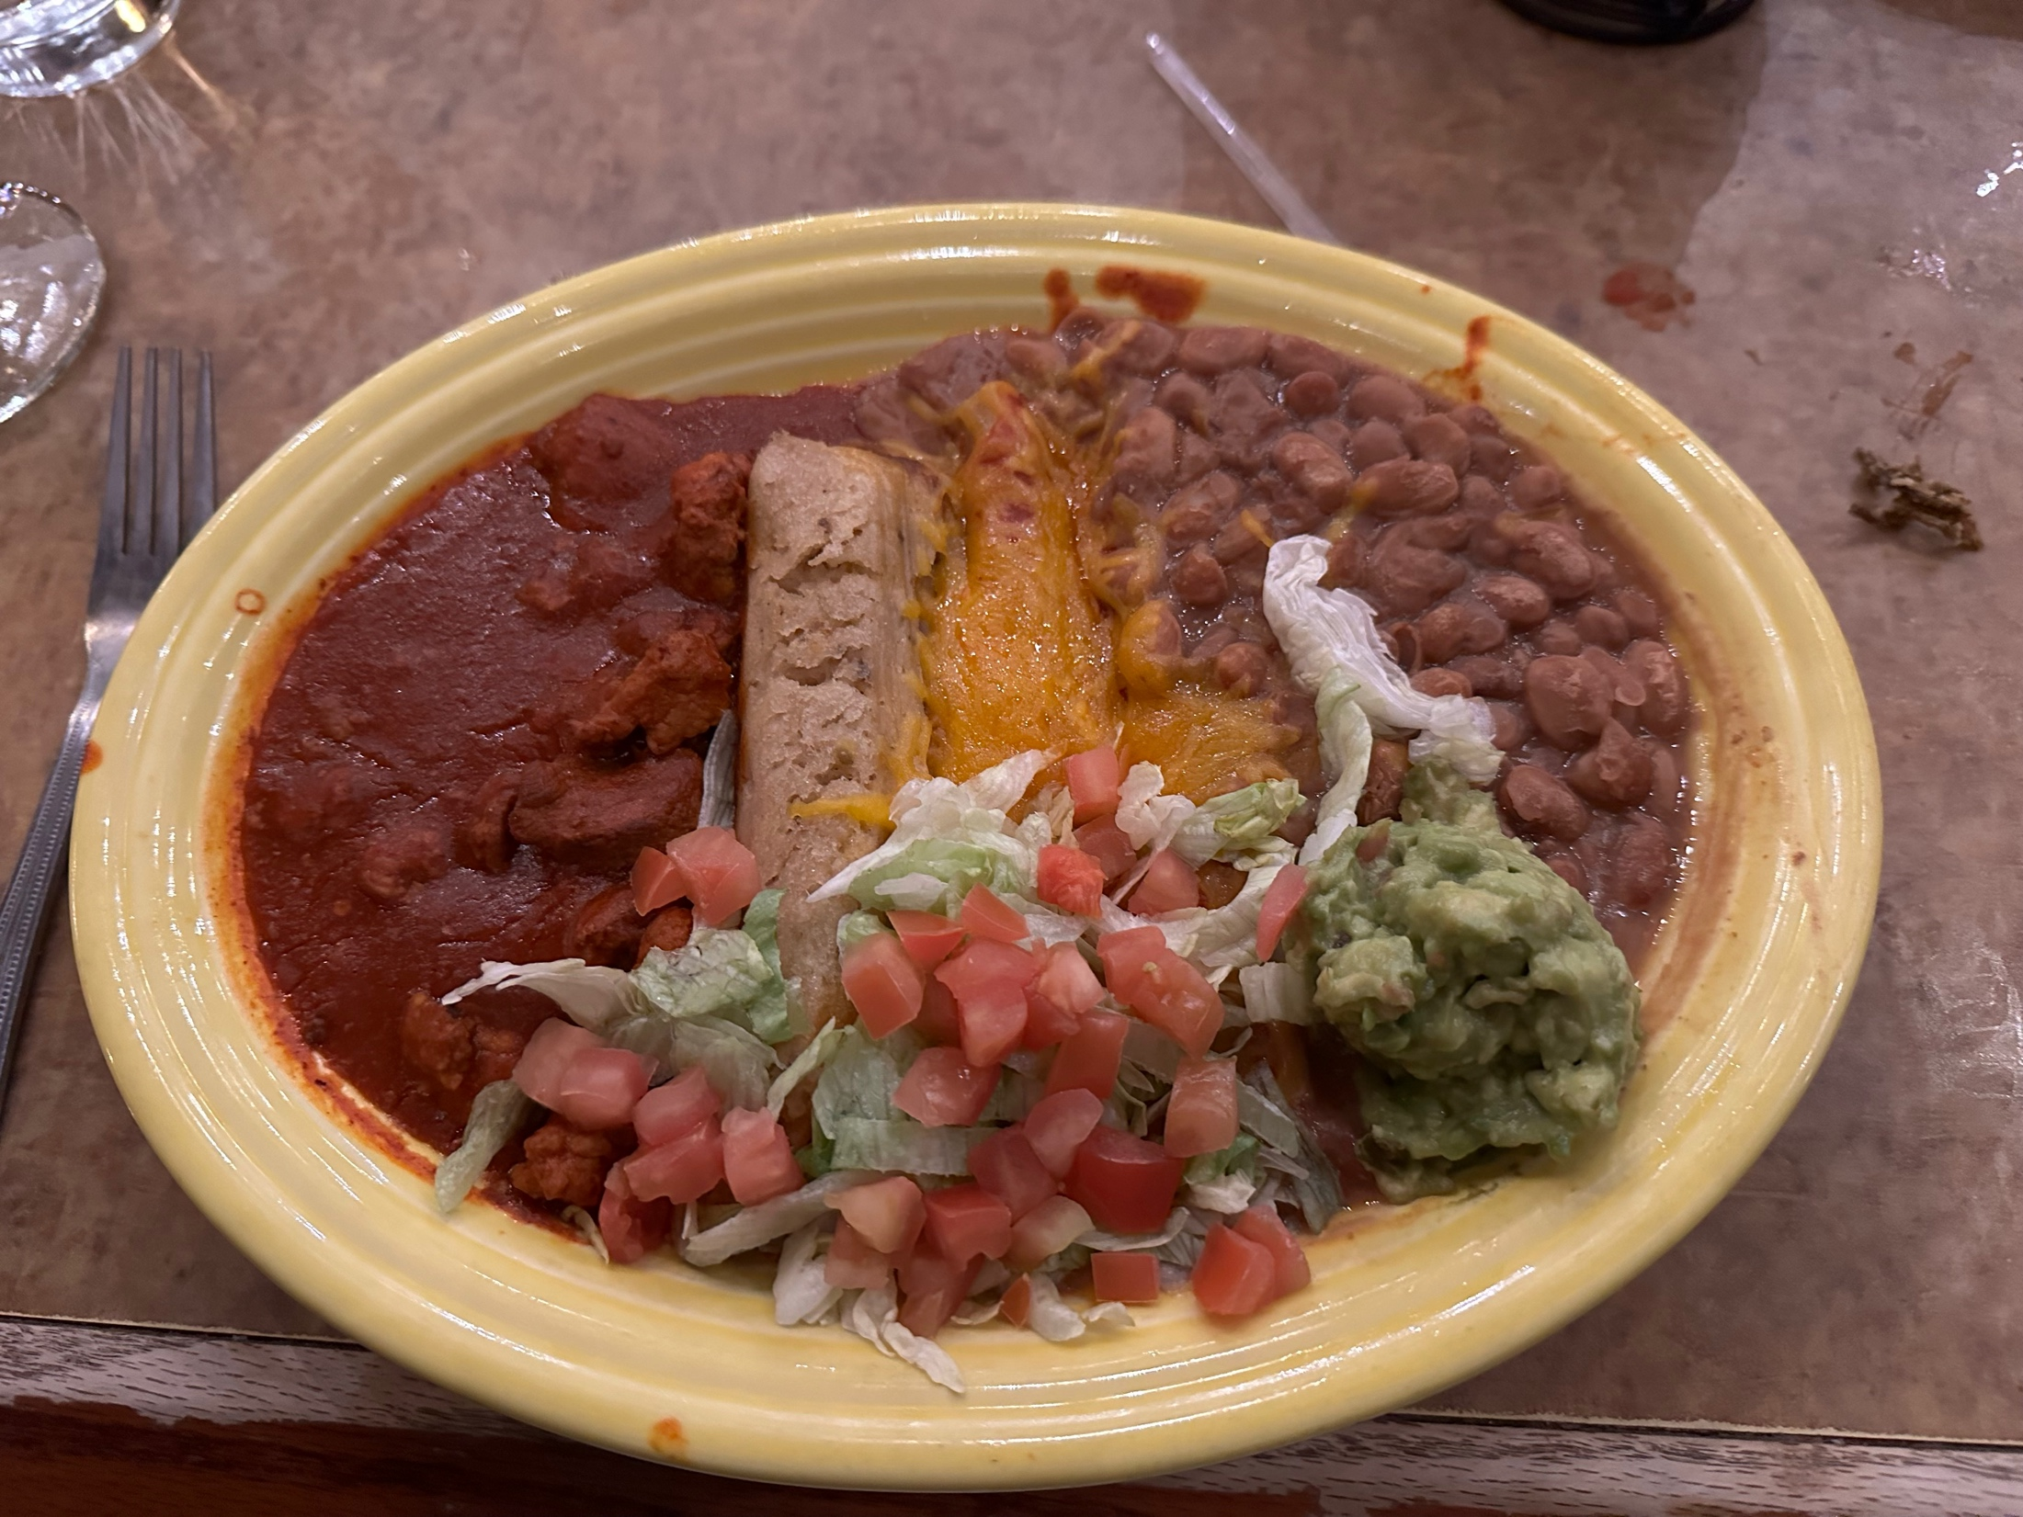

Slide 44
The Second Half of the Barbell
*Bets on a domestic recovery in 2022 Q4 *Upside potential in 2022 far greater than tech *Some of these have not moved for 5 or 10 years *Focuses on economically sensitive cyclical industries *Makes a great counterweight to high-growth technology *We could spend all of next year rotating between the two groups

Slide 45
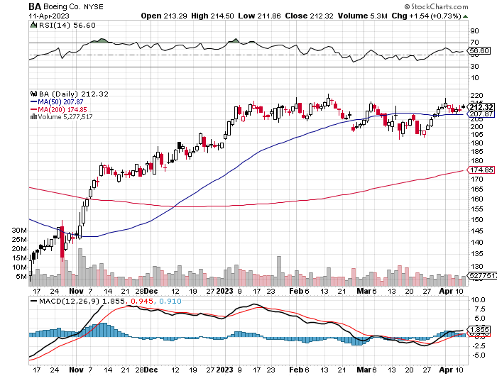
Boeing (BA) – 737 MAX Production Increases from 31 to 37

Slide 46
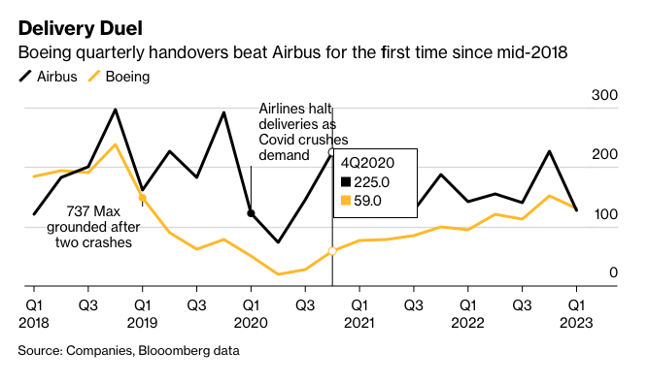

Slide 47
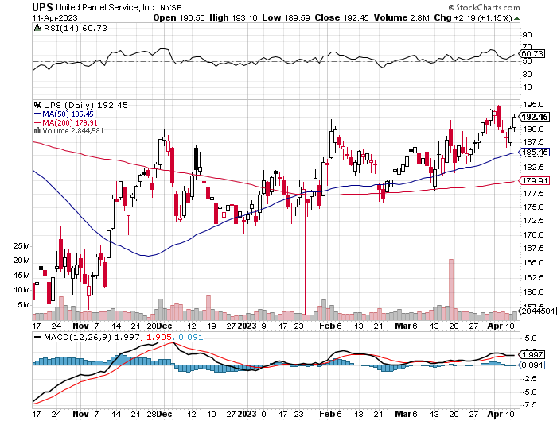
Package Delivery- United Parcel Service (UPS) - took profits on long 11/$130-$140 call spread

Slide 48
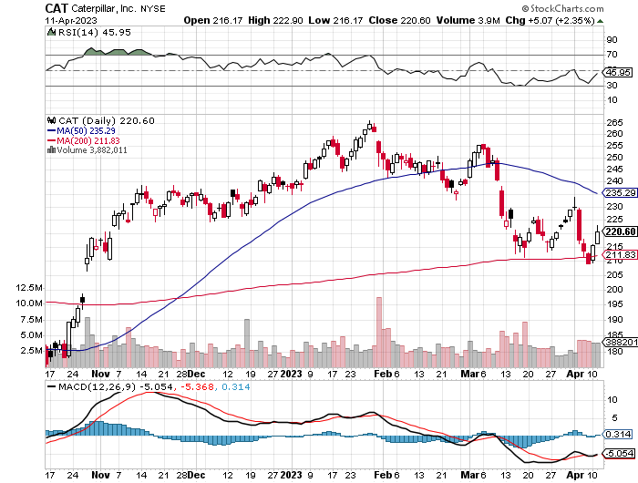
Caterpillar (CAT)- Ag + Infrastructure + Housing Raises Dividend by 50% took profits on long 12/$145-$150 call spread took profits on long 11/$125-$135 call spread

Slide 49
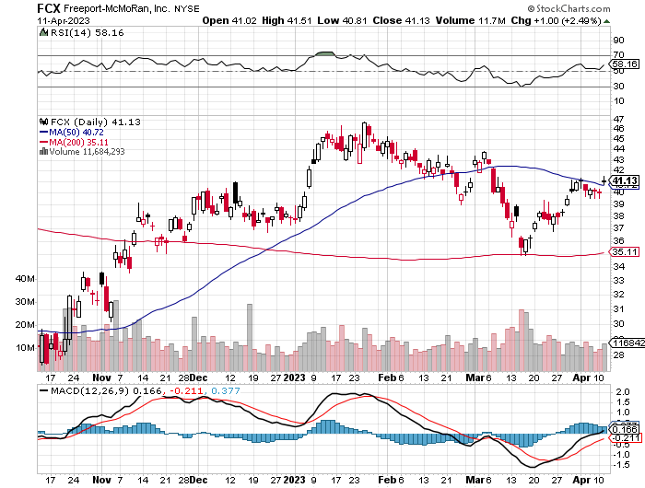
Freeport McMoRan - (FCX)- Coming Copper Crisis long 4/$30-$33 call spread – expires in 7 trading days took profits on long 10/$20-$23 call spread
We Bought

Slide 50
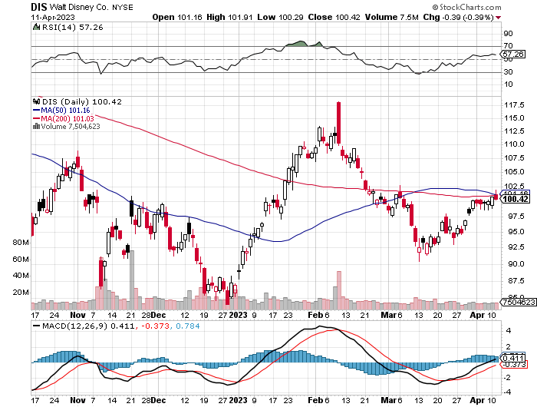
Walt Disney (DIS) - Not a recession play stopped out of long 10/$165-$175 call spread took profits on long 3/$170-$180 call spread

Slide 51
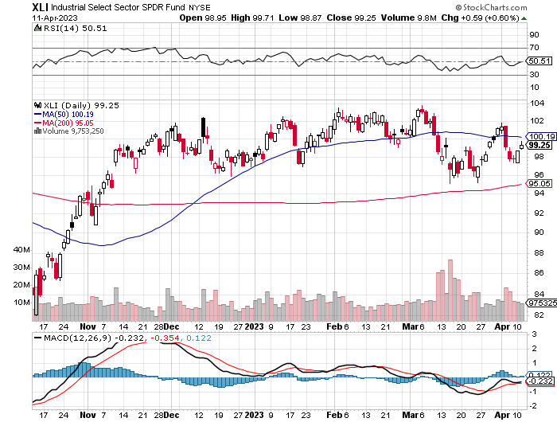
Industrials Sector SPDR (XLI)- (GE), (MMM), (UNP), (UTX), (BA), (HON)

Slide 52
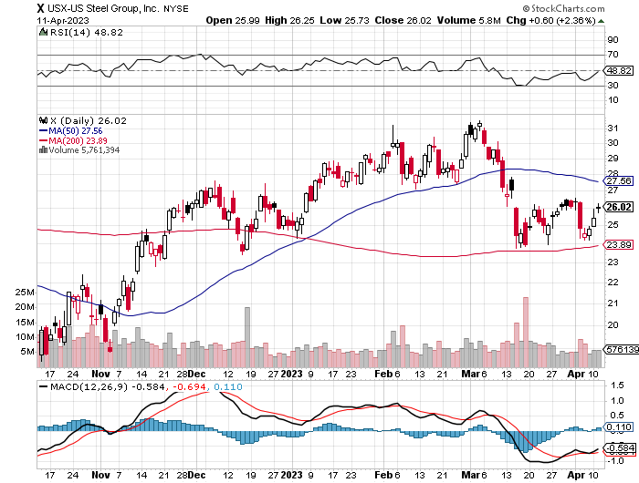
US Steel (X) – Commodity Boom and Wartime boost

Slide 53
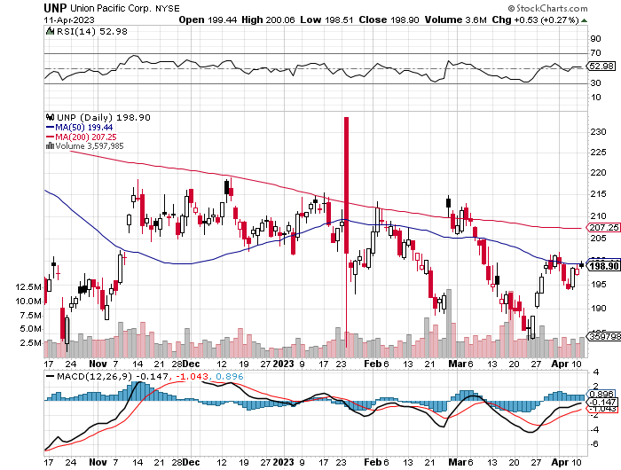
Union Pacific RR (UNP)- Big Stuff to Ship took profits on long 5/$200-$210 call spread took profits on 11/$150-$160 call spread

Slide 54
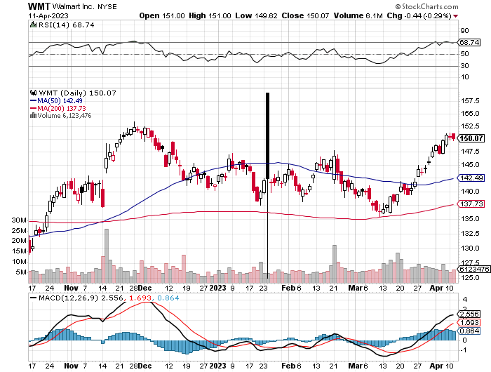
Wal-Mart (WMT)- took profit on Long 11/$125-$130 bear put spread took profit on Long 10/$119-$121 bear put spread took profits on Long 8/$114-$117 bear put spread

Slide 55
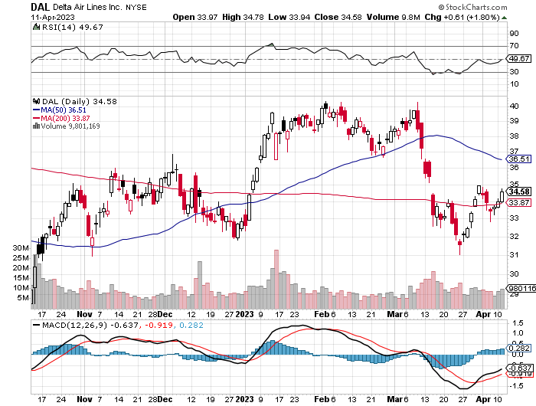
Delta Airlines (DAL) – Travel is Back!

Slide 56
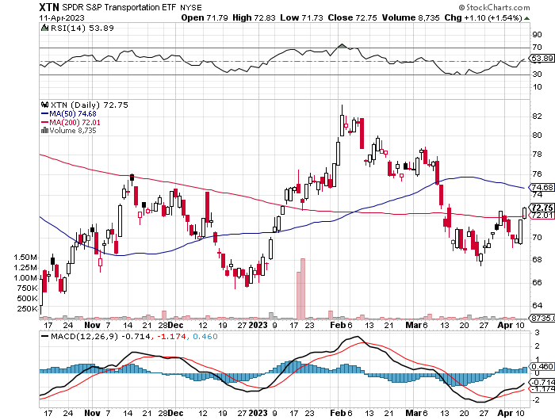
Transports Sector SPDR (XTN)- Worst Hit Sector (ALGT), (ALK), (JBLU), (LUV), (CHRW), (DAL)

Slide 57
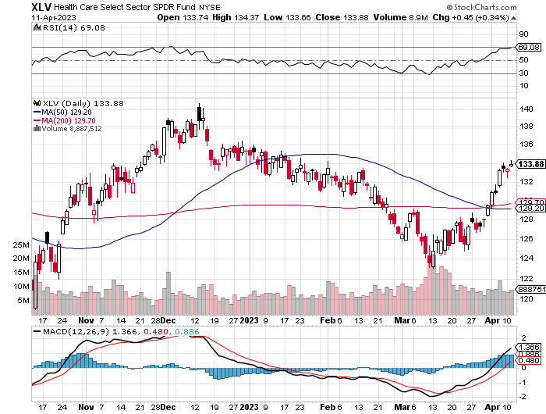
Health Care Sector (XLV) (JNJ), (PFE), (MRK), (GILD), (ACT), (AMGN)

Slide 58
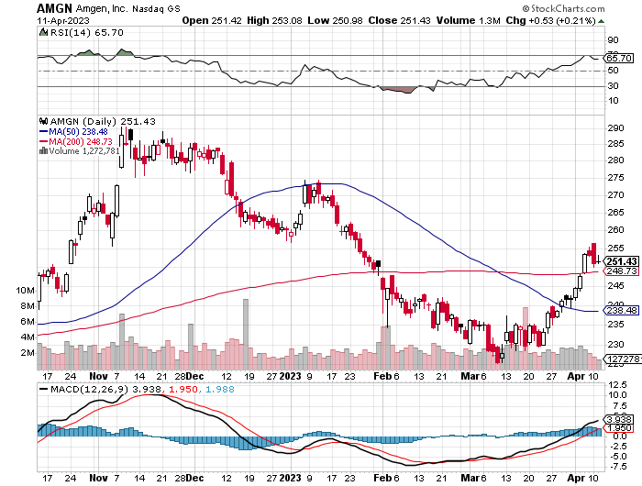
Amgen (AMGN) took profits on long 11/$185-$200 bull call spread

Slide 59
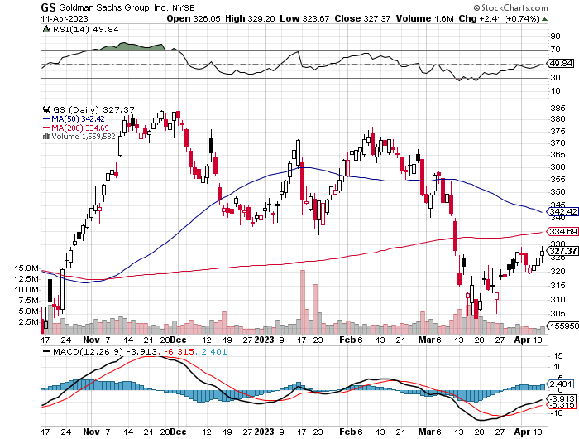
Goldman Sachs (GS) – Highest Capital ration net of mark to market took profits 12/$330-$350 call spread took profits 11/$330-$350 call spread stop loss on long 11/$385-$395 call spreads

Slide 60
Morgan Stanley (MS) – Highest Capital ration net of mark to market long 4/$65-$70 call spread - expires in 7 trading days

Slide 61
JP Morgan Chase (JPM) - Highest Capital ration net of mark to market long 4/$105-$115 call spread - expires in 7 trading days

Slide 62
Bank of America (BAC) – Most Low interest rate mortgage exposure long 4/$20-$23 call spread - expires in 7 trading days

Slide 63
Citigroup (C) – long 4/$30-$35 call spread - expires in 7 trading days

Slide 64
Charles Schwab (SCHW) – No Risk Taking – is all fee business took profits on long 4/$30-$35 call spread

Slide 65
Interactive Brokers (IBKR) – Best Risk Control long 4/$60-$65 call spread - expires in 7 trading days

Slide 66
First Republic (FRC) – High ratio of uninsured deposits, 65% of loans are ARMs, mitigating risk, large share of jumbo loans to high-net-worth individuals, stock down 80% from California exposure

Slide 67
SPDR Metals & Mining ETF (XME) – long 2/$28-$30 call spread

Slide 68
Blackrock (BLK)-Asset Collection Boom took profits on long 3/$770-$790 call spread took profits on long 3/$310-$340 call spread

Slide 69
Visa (V) – “Touchless” Bitcoin Drag Transaction grew by an inflationary 10% back to pre-pandemic levels took profits on long 10/$160-$170 bull call spread took profits on long 6/$150-$160 bull call spread

Slide 70
Consumer Discretionary SPDR (XLY) (DIS), (AMZN), (HD), (CMCSA), (MCD), (SBUX)

Slide 71
Berkshire Hathaway (BRKB)- Natural Barbell 2022 $30.2 billion profit on unchanged stock, Warren Buffet’s Annual Letter is Out long 4/$260-$270 call spread - – expires in 7 trading days took profits on long 1/$290-$300 call spread, took profits on long 10/$220-$230 call spread, took profits on long 7/$220-$230 call spread, took profits on long 7/$220-$230 call spread took profits on long 6/$260-$270 call spread

Slide 72
Europe Hedged Equity (HEDJ)-

Slide 73
Japan (DXJ)-

Slide 74
Emerging Markets (EEM) - Pro trade, Weak Dollar, Long Recovery Play

Slide 76
Bonds – Recession Fears
*Soaring bond prices and collapsing yields are discounting a coming recession *Ten-year US Treasury yields plunge from 3.60% to 3.30% *Keep Buying 90-Day T-Bills, now pushing a 5% risk free yield. *Still looking like 2.50% yield by end 2023 *(TLT) should reach $120 in 2023 after political interreference ends this summer *Keep buying (TLT) calls, calls spreads and LEAPS on dips but only on dips *Junk bond ETF’s (JNK) and (HYG) are a great high yield play

Slide 77
Treasury ETF (TLT) – long 4/$96-$99 call spread took profits on long 4/$113-$116 put spread, took profits on long 4/$114-$117 put spread took profits on long 1/$92-$95 call spread, took profits on long 1/$96-$99 call spread, took profits on long 1/$95-$98 call spread, took profits on long 2/$95-$98 call spread
We Bought

Slide 78
Ten Year Treasury Yield ($TNX) – 3.39%

Slide 79
Junk Bonds (HYG) 8.30% Yield to Maturity

Slide 80
Municipal Bonds (MUB) 3.27% Yield-

Slide 81
Emerging Market Debt (ELD) 6.83% Yield-

Slide 82
2X Short Treasuries (TBT)-Out of Favor

Slide 84
Foreign Currencies – Yen slide
*New Bank of Japan governor holds to ultra easy interest rate strategy, crushing the yen *Dollar has peaked, undercut by recession fears *Dollar selloff may accelerate after May 2-3 Fed meeting *Any strength in the dollar will be temporary *Look for new dollar lows by end 2023 *Buy (FXE), (FXY), (FXB) on dips

Slide 85
THE MAD HEDGE FUND TRADER
Australian Dollar (FXA) - Major Long-Term Bottom is In Targeting Parity A call option on a global synchronized recovery
1:1
BUY

Slide 86
Japanese Yen (FXY)
2023 Target 25%

Slide 87
Euro (FXE)-
2023 Target 25%

Slide 88
British Pound (FXB)-
2023 Target 15%

Slide 89
Emerging Market Currencies (CEW)
2023 Target 40%

Slide 91
Energy & Commodities –Production Cut
*OPEC Plus cuts production by 500,000 barrels a day to prevent price crash to $50/barrel *Recession fears were taking oil to new lows *Natural Gas Explodes to the Upside, bouncing hard off a multiyear lows *Uranium Demand is Surging with the Nuclear Renaissance. And now the US is restarting plutonium production for the first time in 20 years, a uranium derivative *Expect a long delay until we see lower gasoline prices *Big oil move will have to wait for global economic recovery *Buy oil and gas on dips for a trade

Slide 92
Oil-($WTIC)

Slide 93
United States Oil Fund (USO)

Slide 94
Energy Select Sector SPDR (XLE)-No Performance! (XOM), (CVX), (SLB), (KMI), (EOG), (COP)

Slide 95
ExxonMobile (XOM)- took profits on long 12/$120-$125 put spread

Slide 96
Occidental Petroleum (OXY)- Buffet’s a Buyer long 2/$55-$60 call spread, took profits on long 12/$77.50-$82.50 put spread

Slide 97
Natural Gas (UNG) - Long January 2025 $14 - $15 Call Spread LEAPS

Slide 98
Cameco (CCJ) - took profits on long 5/$20-$23 bull call spread

Slide 100
Precious Metals – New Bull Market
*Gold moves within 2% of new all-time highs, driven by the prospect of falling interest rates and the demise of crypto *Gold (GDX) and Silver miners (SIL) catch on fire *Russia and China still stockpiling gold to avoid western sanctions *Lithium Prices Have Dropped by Half *A Severe Short Squeeze in Copper is Developing, leading to a massive price spike later in 2023 *A Chinese economic recovery and exploding EV growth are the reasons

Slide 101
Global Lithium Production

Slide 102
Gold (GLD) - Deflation call took profits on long 5/$165-$170 bull call spread

Slide 103
Market Vectors Gold Miners ETF- (GDX) –

Slide 104
Barrick Gold (GOLD) took profit on long 1/$15.50-$16.50 call spread

Slide 105
Newmont Mining- (NEM)- took profits on long $55-60 call spread

Slide 106
Silver- (SLV)- took profits on long 11/$19-$20 call spread

Slide 107
Silver Miners - (SIL)-

Slide 108
Wheaton Precious Metals - (WPM)- took profits on long 1/$36-$39 call spread

Slide 109
Platinum- (PPLT)- Green Hydrogen Play 556,000-ounce shortage this year took profits on long 1/$36-$39 call spread

Slide 111
Real Estate – Commercial Crisis
*$1.5 Trillion in Commercial Real Estate Debt coming due is a Threat to all asset classes *Manhattan Office Vacancies Hit Record High *New Home Sales Grew 1.1%, in February, Existing Home Sales Soar 14.5% *Pending Homes Sales are Flat in February, rising by just 0.8% on a signed contracts basis *S&P Case Shiller Loses Gains in in January in their National Home Price Index, dropping from a 5.6% annual gain to only 3.8%. Prices have been dropping for seven straight months *REIT’s are getting demolished by refi fears, with rates tripling from zero rate era *Home Ownership Premium Highest Since 2006, when compared to rentals

Slide 112
S&P Case Shiller Plunges S&P Case Shiller Drops to +3.8%, in January with its National Home Price Index San Francisco was down -8% YOY, while -Seattle gave up 5%. Miami gained +14%, Tampa +11%, and Atlanta +8%.

Slide 113
Crown Castle International (CCI) – 4.72% yielding cell phone tower REIT

Slide 114
US Home Construction Index (ITB) (DHI), (LEN), (PHM), (TOL), (NVR)

Slide 116
Trade Sheet- So What Do We Do About All This?
*Stocks – buy the big dips at bottom of range, ………………sell big rallies to hedge holdings *Bonds – buy dips, sell extreme rallies *Commodities-buy dips *Currencies- sell dollar rallies, buy currencies *Precious Metals – buy dips *Energy – buy dips *Volatility - sell short over $30 *Real estate – buy dips

Slide 119
Next Strategy Webinar 12:00 EST Wednesday, April 26 from Silicon Valley, CA email me questions at support@madhedgefundtrader.com
Good Luck and Good Trading!
Notes:
*

