Slide 1
The Mad Hedge Fund Trader “Man the Lifeboats”
With John Thomas Incline Village, NV, April 26, 2023 www.madhedgefundtrader.com
Notes:
*

Slide 2
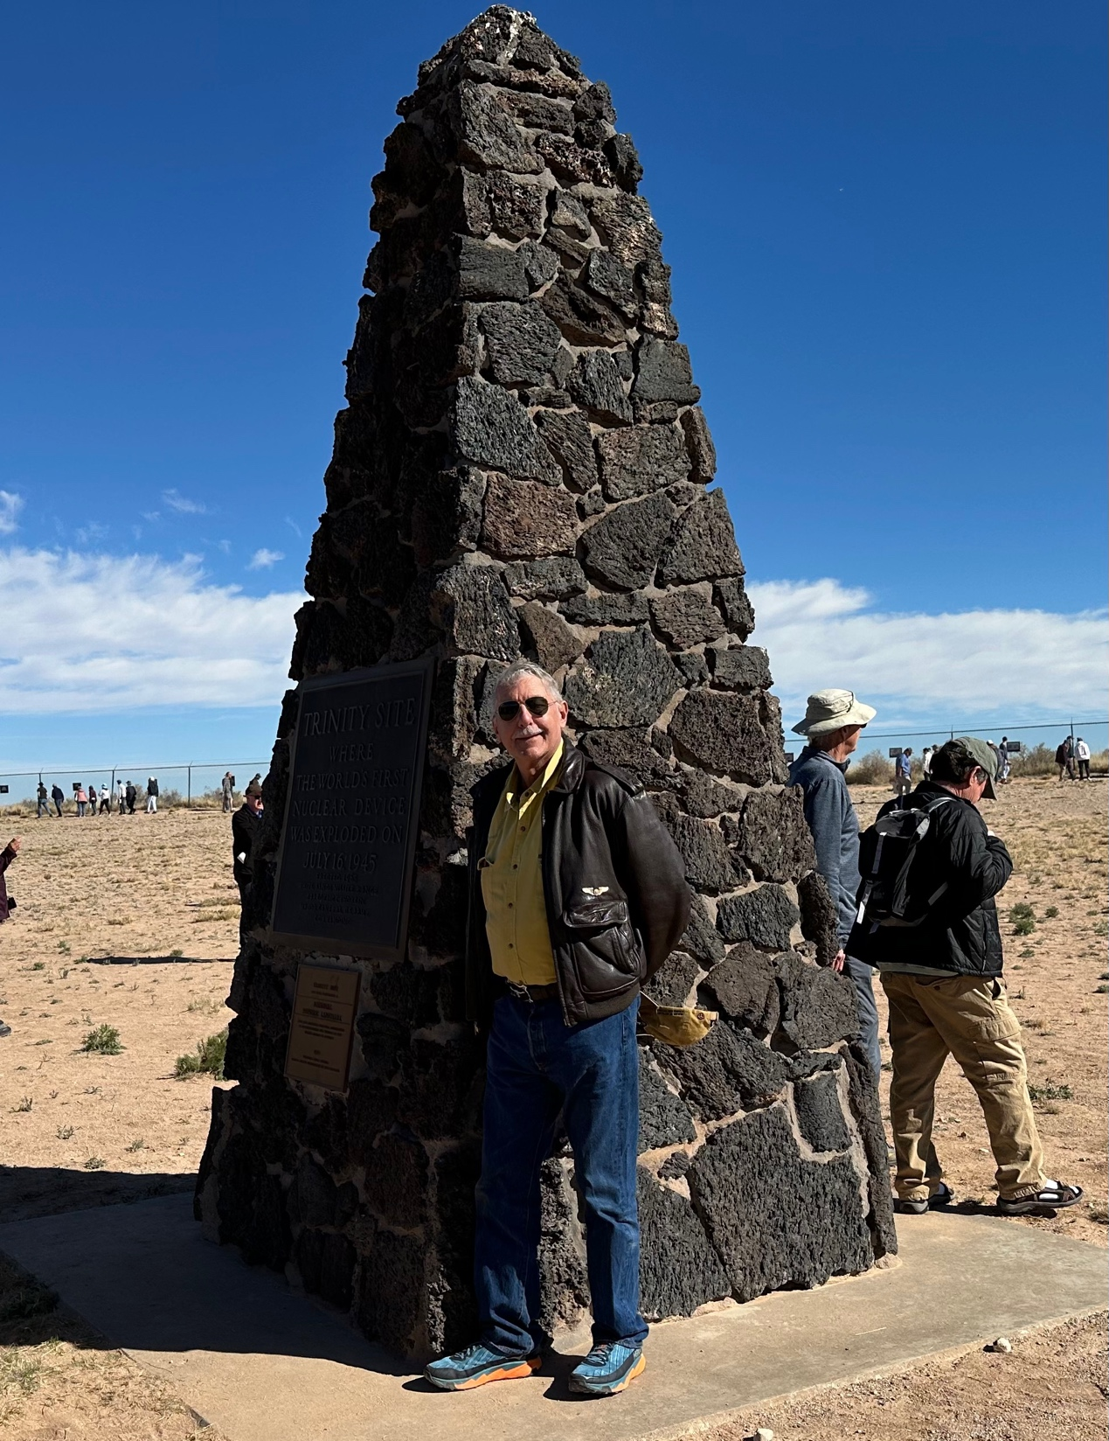

Slide 3
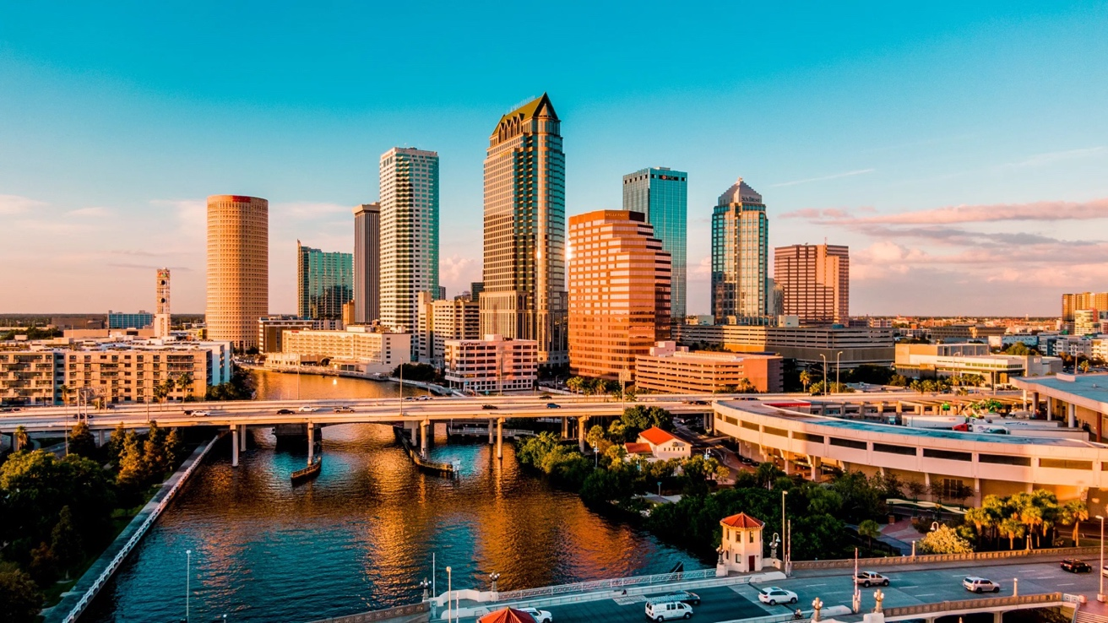
THURSDAY, MAY 18 TAMPA STRATEGY LUNCHEON
*An excellent meal will be followed by a wide-ranging discussion and an extended question and answer period *The lunch will be held in an exclusive private club in Midtown Manhattan with a strict dress code *please go to my online store at http://www.madhedgefundtrader.com/store and click on “luncheons.” Tickets are available for $289

Slide 4
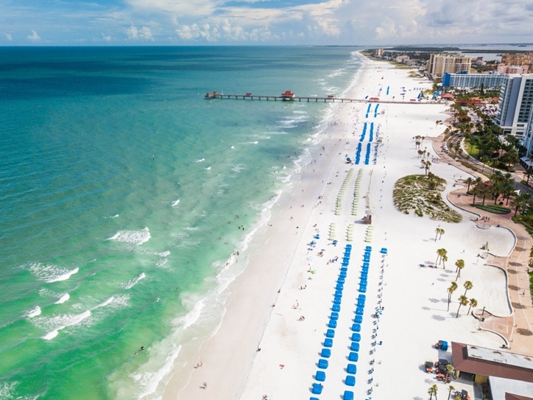
THURSDAY, MAY 19 BOCA RATON STRATEGY LUNCHEON
*An excellent meal will be followed by a wide-ranging discussion and an extended question and answer period *The lunch will be held in an exclusive private club in Midtown Manhattan with a strict dress code *please go to my online store at http://www.madhedgefundtrader.com/store and click on “luncheons.” Tickets are available for $295

Slide 5
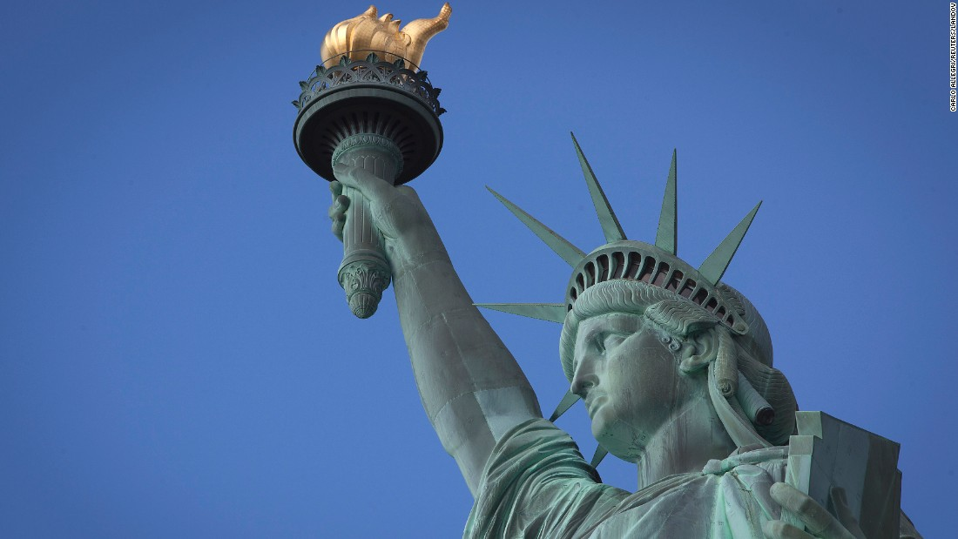
THURSDAY, JULY 6 NEW YORK STRATEGY LUNCHEON
*An excellent meal will be followed by a wide-ranging discussion and an extended question and answer period *The lunch will be held in an exclusive private club in Midtown Manhattan with a strict dress code *please go to my online store at http://www.madhedgefundtrader.com/store and click on “luncheons.” Tickets are available for $299

Slide 6
Friday July 13, 2023 Seminar at Sea
*Cunard Line’s flagship, the elegant and spacious Queen Mary II, on an eastbound transatlantic cruise *The Ship departs New York at 12:00 AM on July 7, 2023, and arrives at Southampton on July 14 *Guests will be responsible for booking their own cabin through Cunard *Three dinners during the voyage will be black tie *Customers are required to book their own cabins and return flights from England *The Cunard cruise number is M319

Slide 7
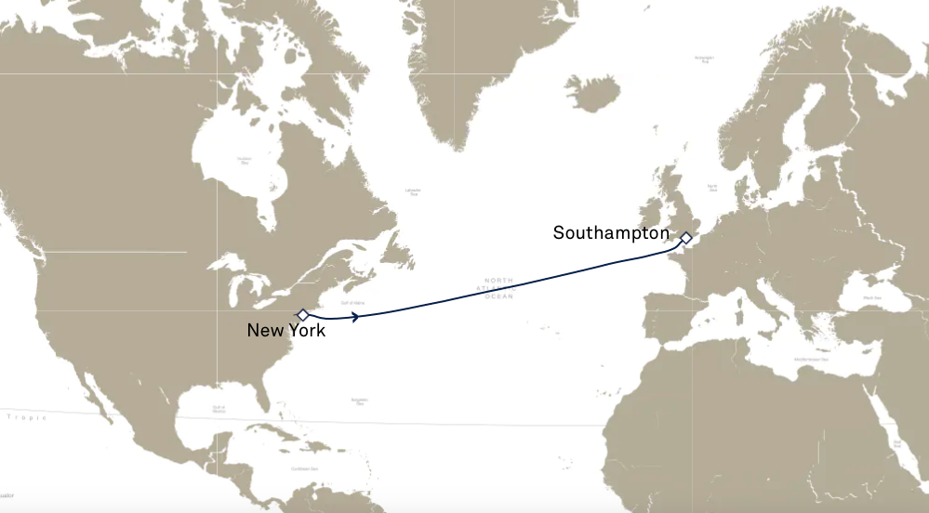

Slide 8
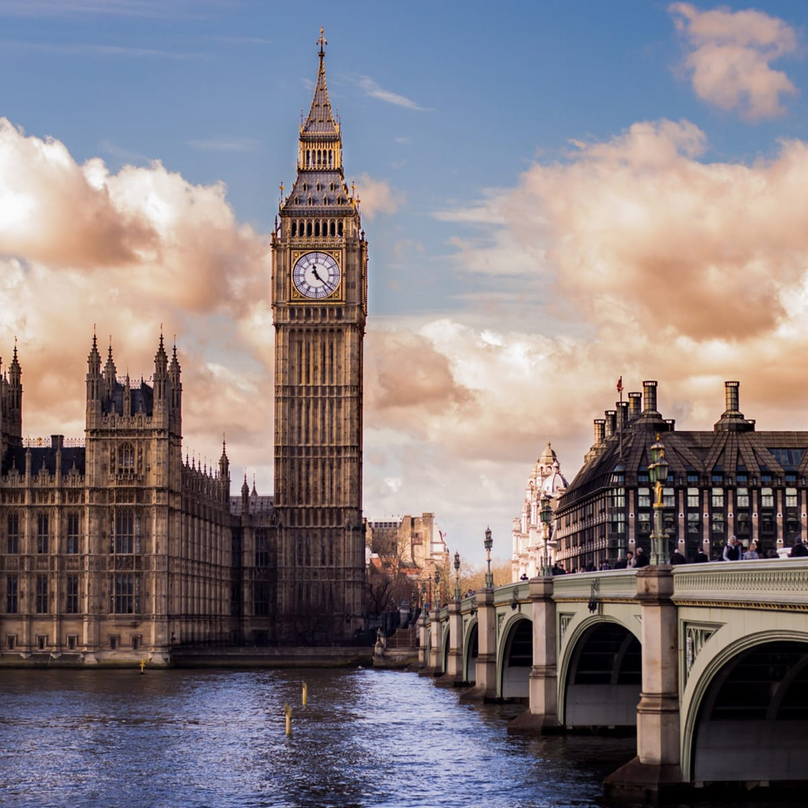
THURSDAY, JULY 19 LONDON STRATEGY LUNCHEON
*An excellent meal will be followed by a wide-ranging discussion and an extended question and answer period *The lunch will be held in an exclusive private club in Midtown Manhattan with a strict dress code *please go to my online store at http://www.madhedgefundtrader.com/store and click on “luncheons.” Tickets are available for $298

Slide 9
Trade Alert Performance New All Time Highs! 31 out of 33 trade alerts profitable
*January +22.35% Final *July +3.98% Final *February +3.41% Final *August +5.13% Final *March +20.85% Final *September +9.72% Final *April +10.52% MTD *October +5.69% Final *May +8.80% Final *November +8.31 Final *June +5.91% Final *December +0.95% Final *2022 Final +84.63% compared to -18.63% for the S&P 500 *2023 Year to Date +57.14%, versus +11.05% for the S&P 500 +654.33% since inception *Average annualized return of +49.07% for 15 years

Slide 10
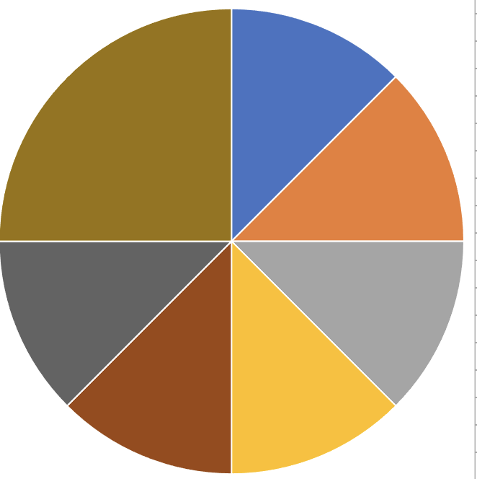
Portfolio Review 100% Long, 0% Short, 0% cash with VIX at $20 its time to be fully invested
Current Capital at Risk
Risk On
(TLT) 5/$98-$101 call spread | 10.00%
(TLT) 5/$97-$100 call spread | 10.00%
(BA) 5/$170-$175 call spread | 10.00%
(TSLA) 5/$110-$120 call spread | 10.00%
Risk Off
(SPY) 5/$220-$230 pit spread | -10.00%
(QQQ) 5/$335-$345 put spread | -10.00%
(TSLA) 5/$220-$230 put spread | -20.00%
Total Net Position | 0.00%
Total Aggregate Position | 80.00%
Expiration Value +66.39%

Slide 11
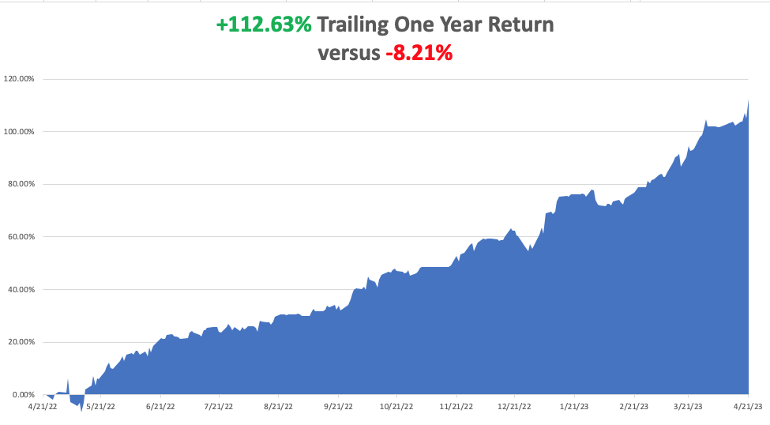

Slide 12
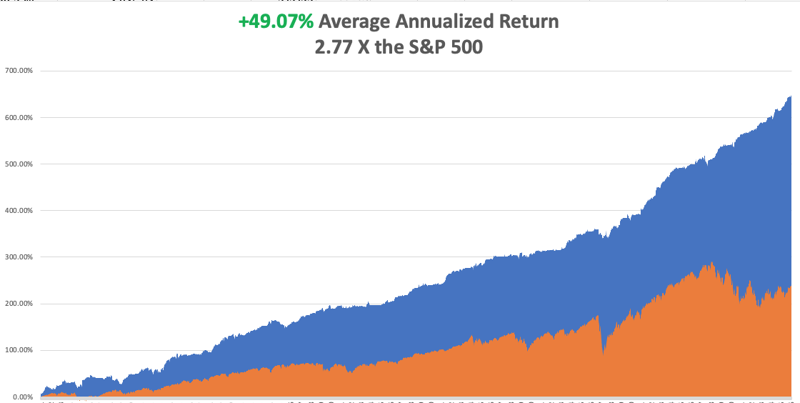

Slide 13
The Method to My Madness
*Markets have gone from very low risk to very high risk in a month *We are now at the top end of a high-risk range, with asset classes diverging sharply in outlooks *Bonds, foreign currencies, precious metals, and energy now discounting a recession, while stocks at these prices are discounting a soft landing *Oil gave up OPEC production cut spike *Gold, Silver upside breakout fades *The US dollar is dead in the water on recession prospects *Look for S&P 500 10% correction, the $4,800 by end 2023 *VIX plunges to $16 – Nothing is now tradable

Slide 14
The Global Economy – Fading
*The Fed is Looking for “One and Done”, with the next 25-basis rate hike on May 3 *$1 Trillion Boosts Asset Prices in Q1 to bail out banks is about to go away *S&P Global Flash PMI Hits 11 Month High, up from 52.3 to 53.5 in April. *Short Sellers Take Billion Dollar Hit, betting that European bank shares would collapse in the aftermath of the US regional banking crisis. *Inflation Takes a Dive, dropping to a 5.6% YOY rate, the ninth consecutive month of decline. *Cash is Pouring into Money Market Funds, as fears of a stock market correction mount *PPI Gives Another Deflation Hint, dropping a shocking 0.5% in March to only a 2.7% YOY rate

Slide 15
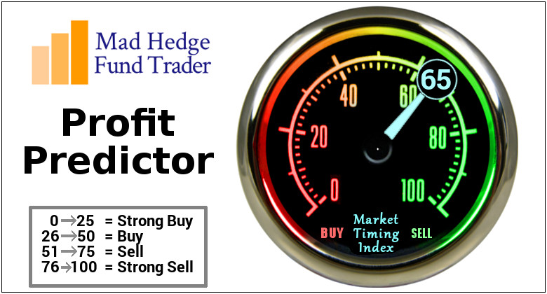
The Mad Hedge Profit Predictor Market Timing Index – Neutral to Rich An artificial intelligence driven algorithm that analyzes 30 different economic, technical, and momentum driven indicators

Slide 16
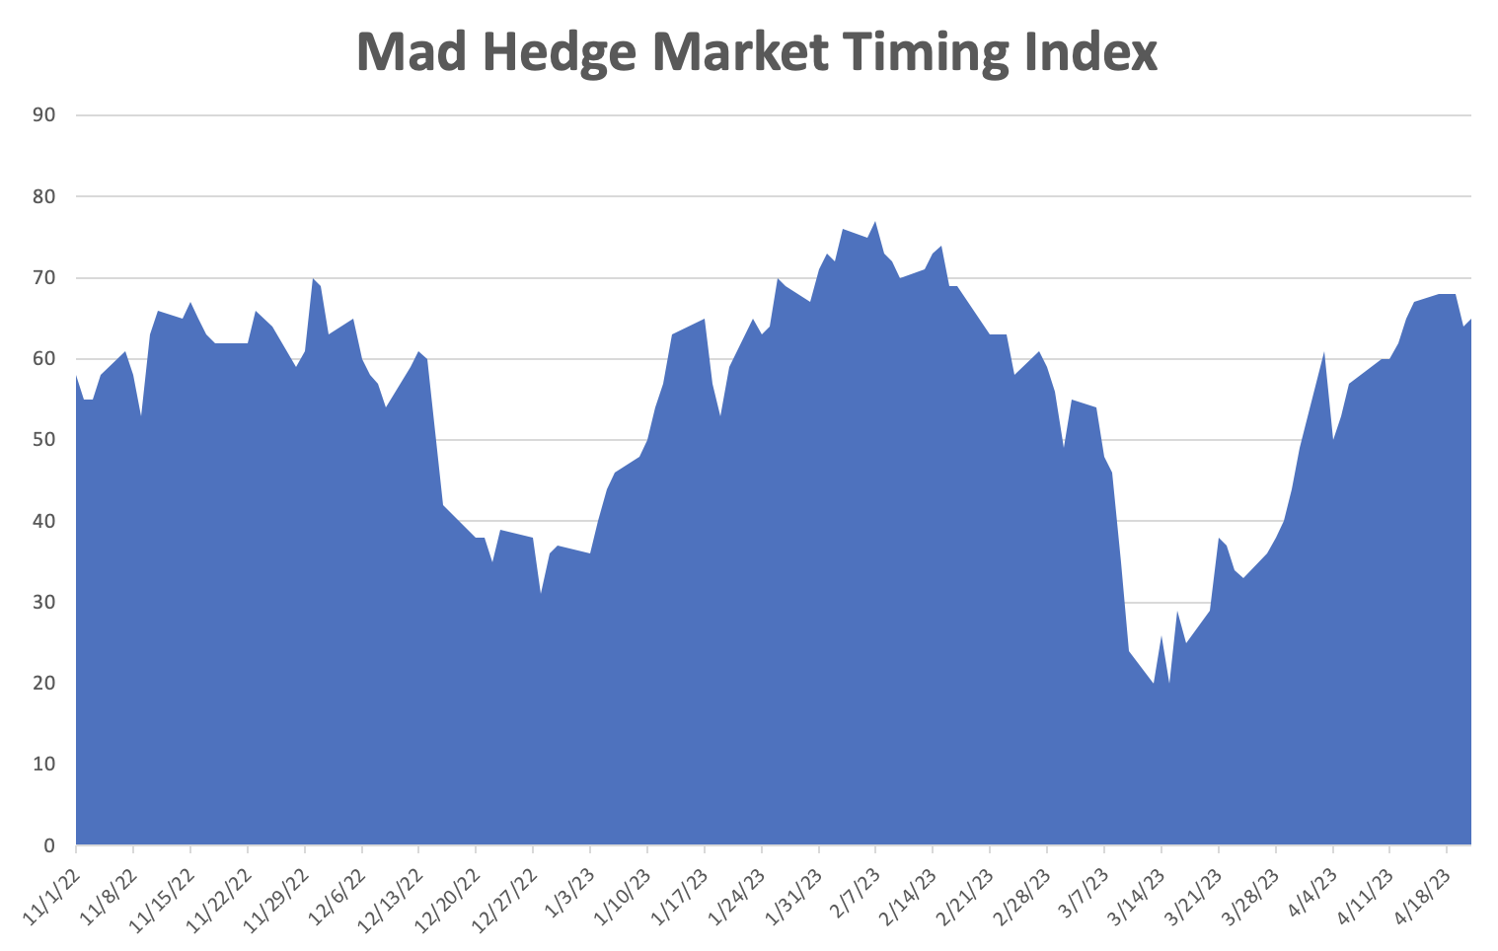
SELL
BUY

Slide 17
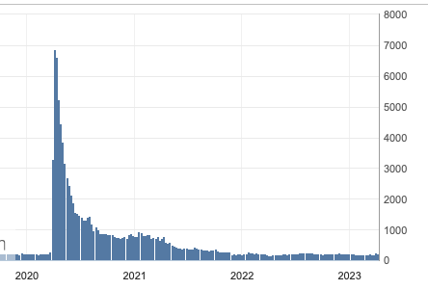
Weekly Jobless Claims – Falling 239,000 – UP 11,000 – One Year High

Slide 18
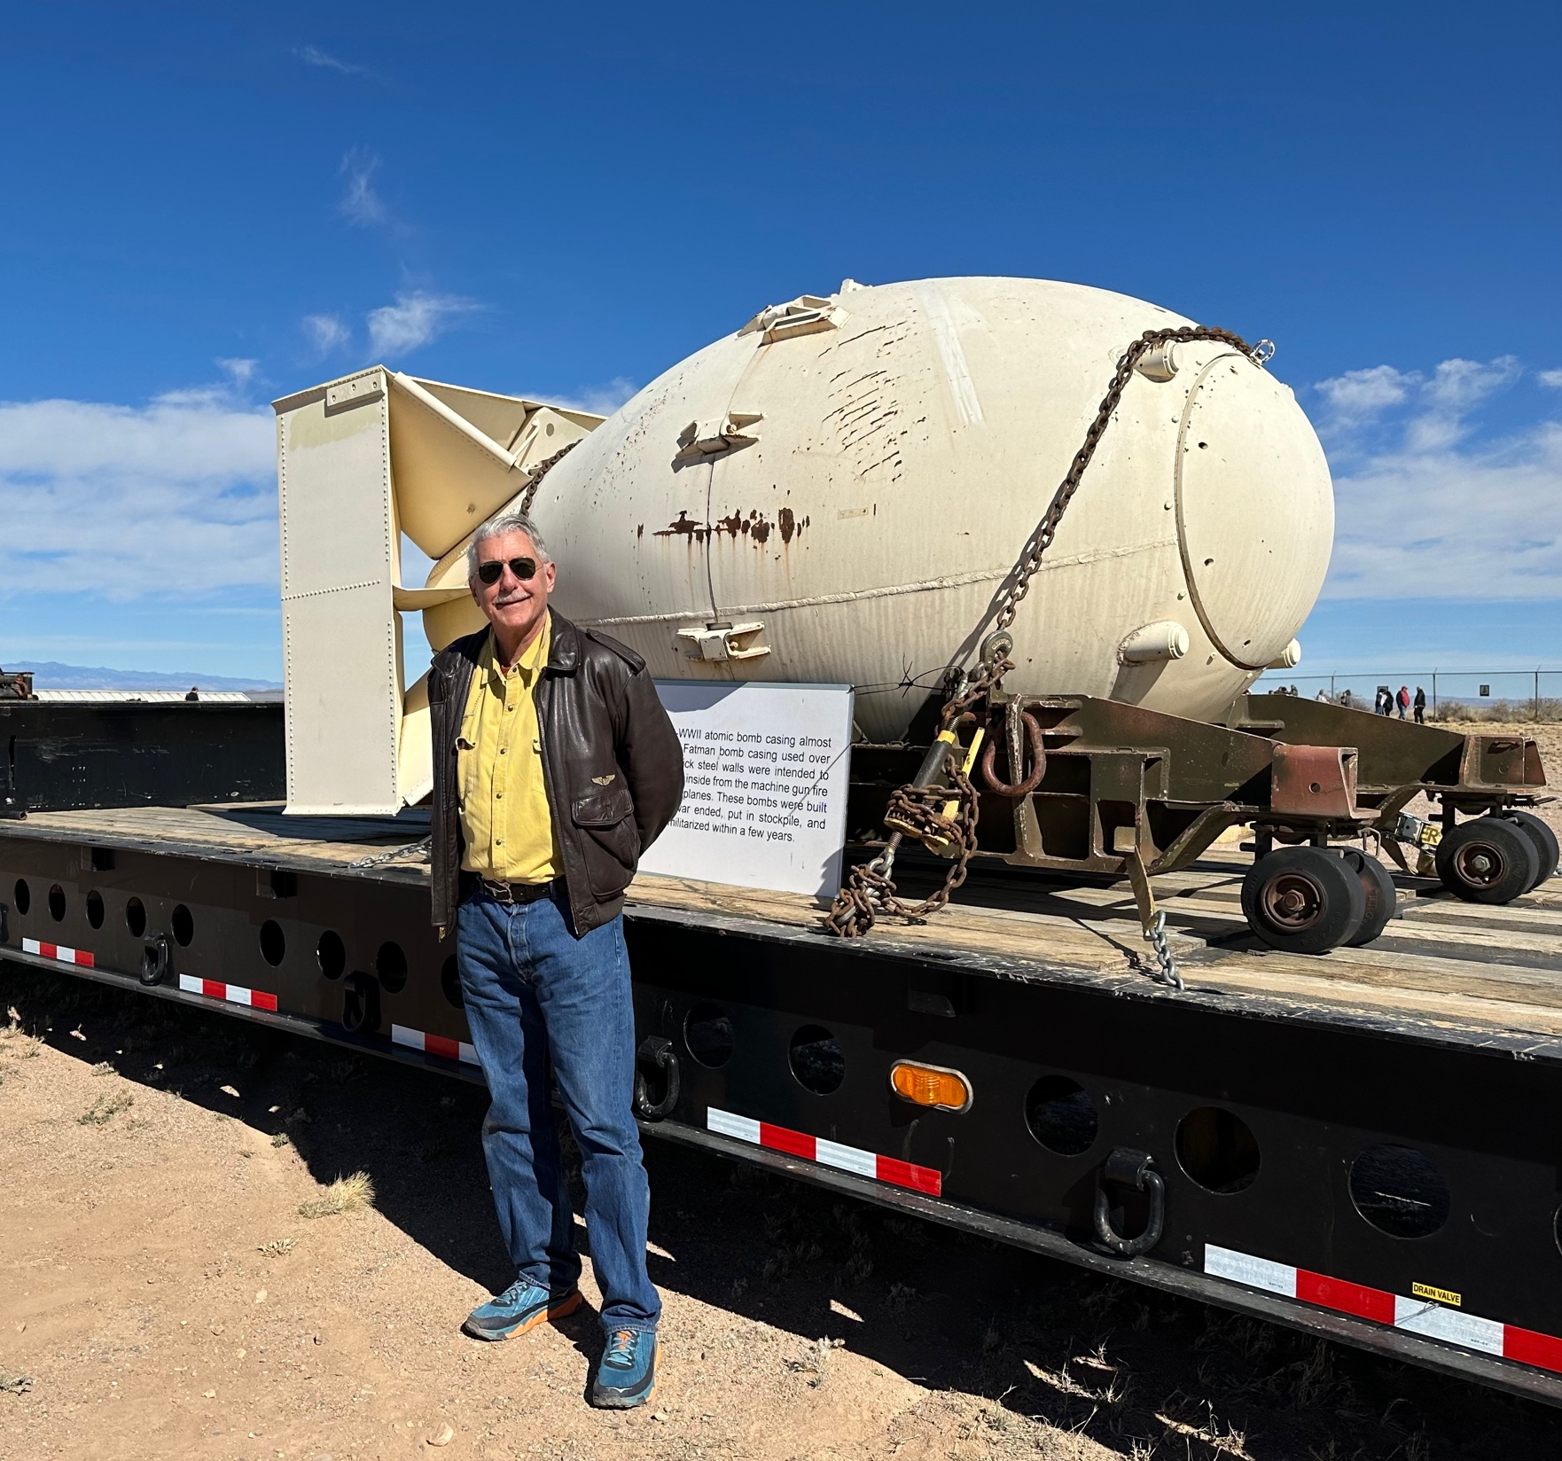

Slide 19
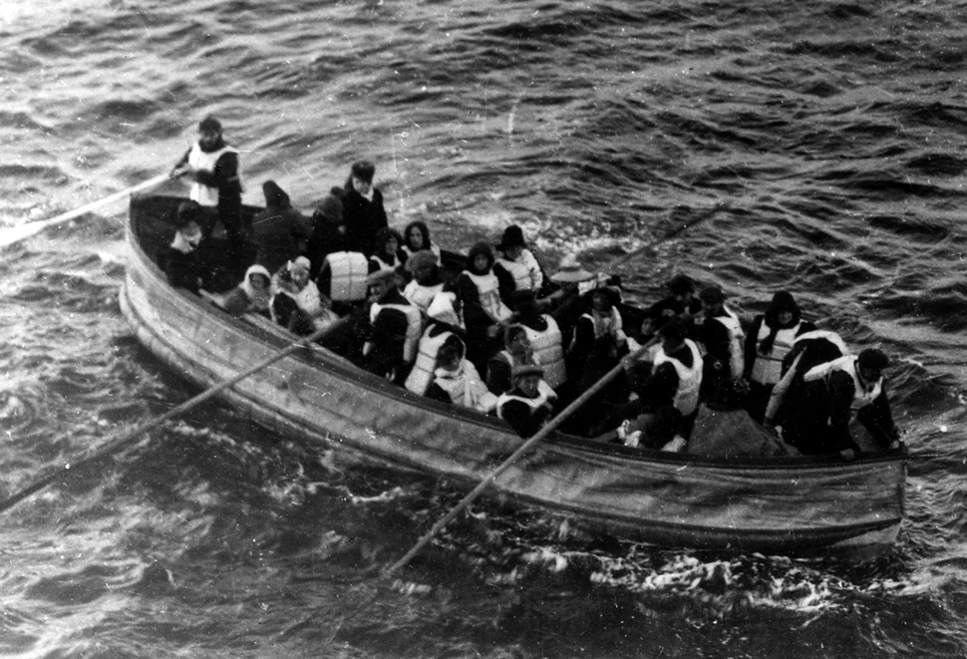
Stocks – Man the Lifeboats!
*Earnings Season Sees Best Start in a Decade, with 90% beating estimates, albeit low ones *Only 20% (SPY) companies have reported so far with (JPM), out biggest long, leading the charge *Consensus (SPY) earnings are currently $220 a share giving a moderate price/earnings multiple of 18.77X. *All technical indicators are now flashing red *Seasonals are now turning strongly against stocks *Volatility plunges to $15 putting the market asleep *Goldman Sachs Bombs, with an earnings shortfall due to disastrous foray into retail banking *Looking for flat first half, strong second half to take us to S&P 500 4,800 by yearend

Slide 20
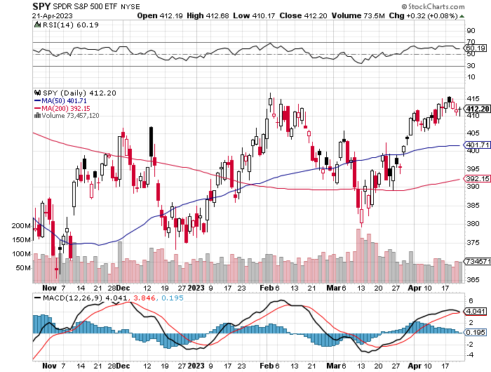
S&P 500 – Sell in May long 5/$420-$430 put spread, took profits on long 1/$420-$430 put spread, took profits on long 11/$420-$430 put spread
2023 $480 Target
$430 +21% Rally
$375 -12.8% Pull Back
The Bottom $355 Down -26%

Slide 21
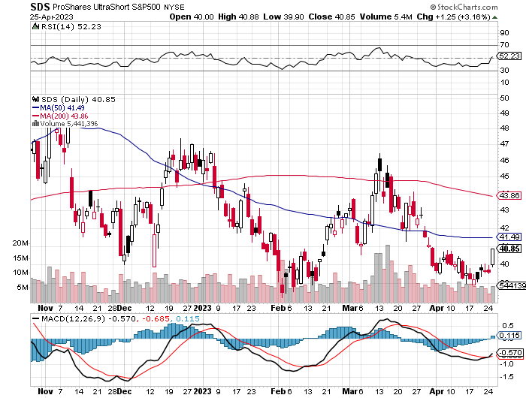
ProShares Ultra Short S&P 500 (SDS)- a great hedge for long stocks and bonds long 2X position has a hedge against longs and bond shorts

Slide 22
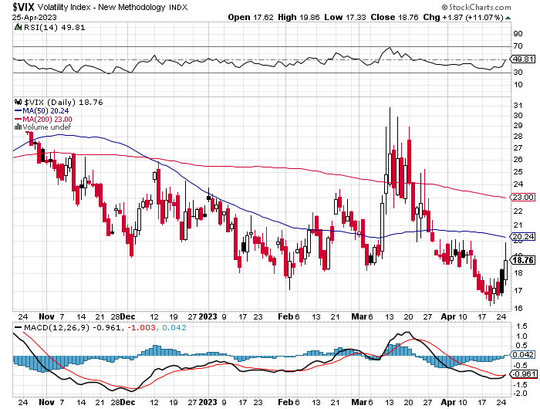
(VIX) – Bargain of the Century

Slide 23
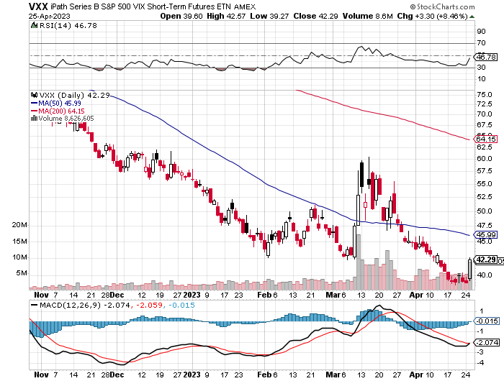
(VXX)-

Slide 24
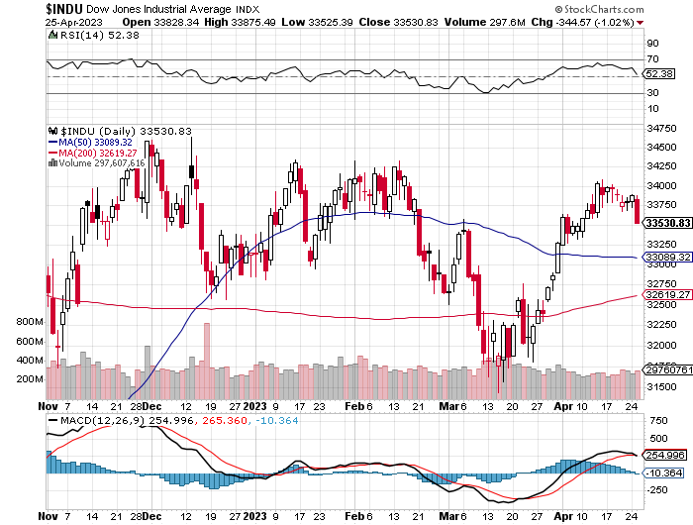
Dow Average ($INDU)-

Slide 25
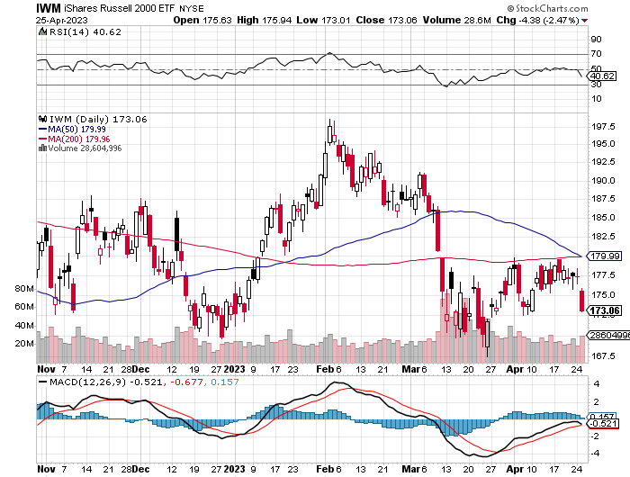
Russell 2000 (IWM)- took profits on Long 10/$137-$142 vertical bull call spread took profits on Long 10/$153-$156 vertical bear put spread

Slide 26
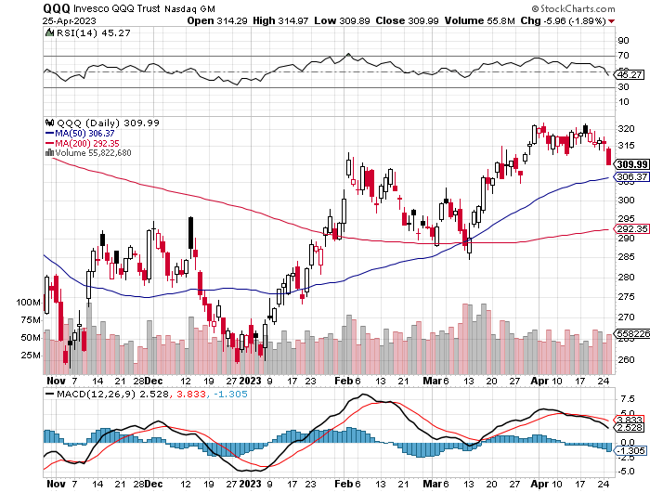
NASDAQ (QQQ) – Long 5/$335-$345 put spread took profits on long (QQQ) 1/$290-$300 put spread, took profits on long (QQQ) 4/$330-$335 put spread took profits on long (QQQ) 3/$340-$345 put spread, covered long (QQQ) $325-$330 put spread

Slide 27
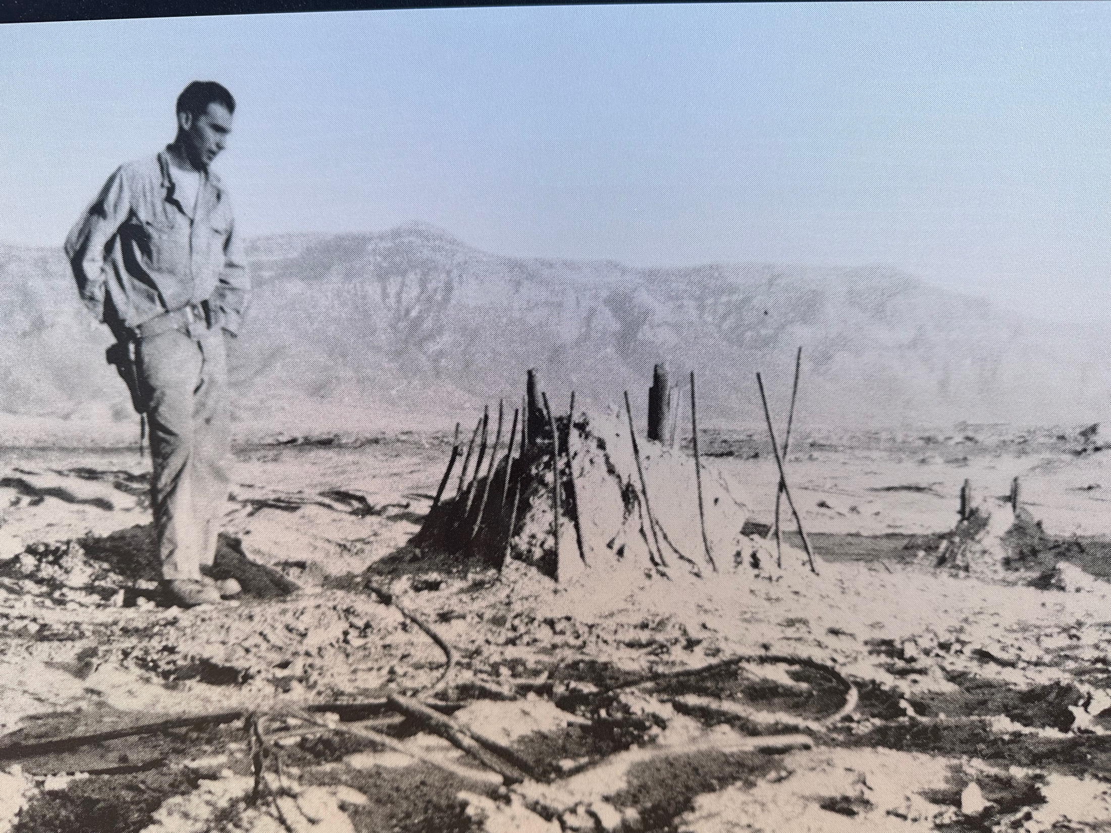

Slide 28
The Barbell Portfolio
*50% Big Tech - 2% of US Employment but 27% of Market Cap and 38% of Profits 50% Domestic Recovery, including: Railroads Couriers Banks Construction Credit Cards Event organizers Ticket sales Retailers

Slide 29
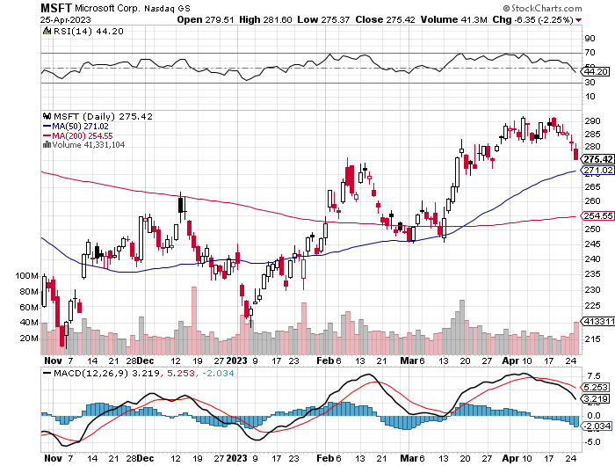
Microsoft (MSFT)- Grim Forward Guidance took profits on 9/$235-$245 call spread, took profits on long 7/$220-$210 call spread, took profits on long 6/$220-$230 call spread, took profits on long 2/$200-$210 bear put spread

Slide 30
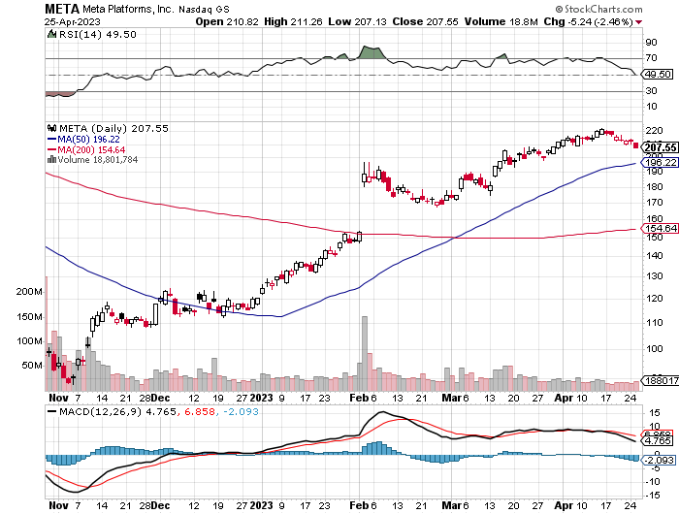
Meta (META)- Soars an Incredible 20% took profits on Long 9/$290-$300 vertical bear put spread stopped out of Long 9/$190-$200 vertical bear put spread

Slide 31
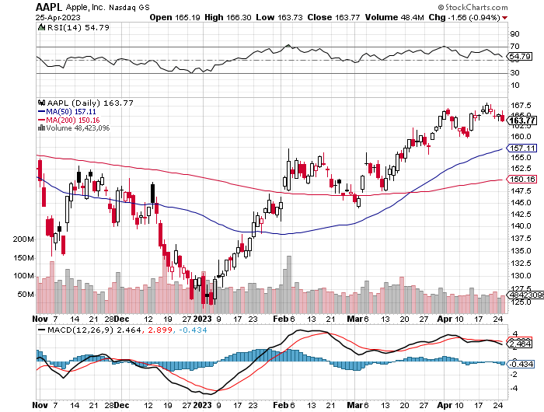
Apple (AAPL) Apple Goes into the Banking Business, offering a 4.15% interest rate on overnight deposits took profits on long 1/$145-$155 put spread, Took profits on long 10/$165-$175 put spread took profits on long 6/$155-$165 put spread, stopped out of long 6/$125-135 call spread, took profits on long 6/$110-$120 call spread, took profits on long 2/$180-$190 put spread

Slide 32
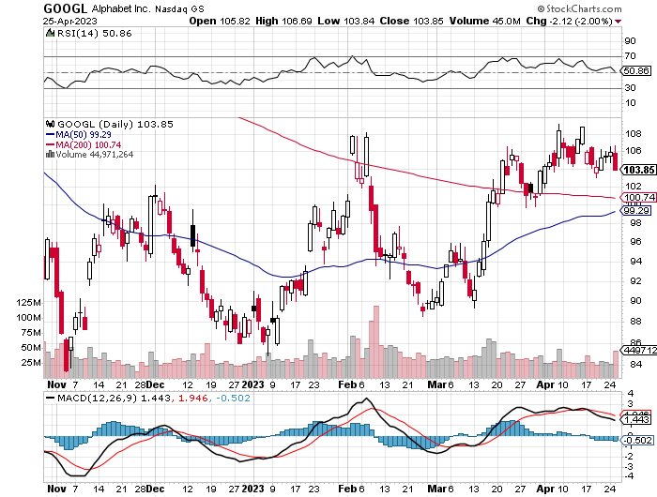
Alphabet (GOOGL) –Google Calls a Halt to Massive San Jose Campus took profits on long 12/$1,200-$1,230 bull call spread took profits on long 9/$1,030-$1,080 vertical bull call spread

Slide 33
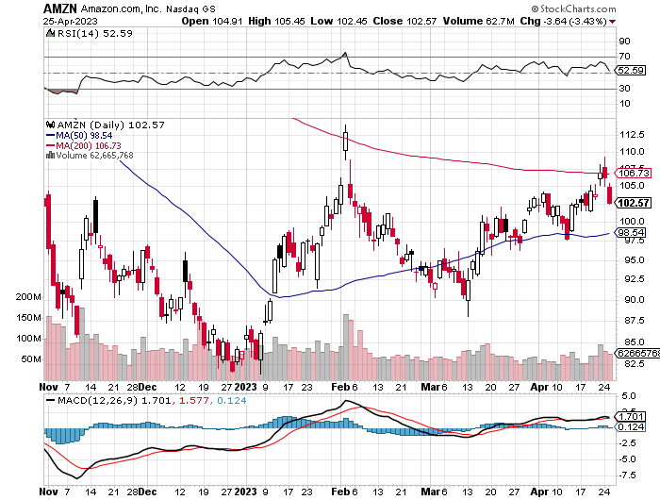
Amazon (AMZN) – US Preparing Antitrust Against Amazon took profits on long 2/$3,400-$3,500 bear put spread took profits on long 9/$2,800-$2,900 bull call spread

Slide 34
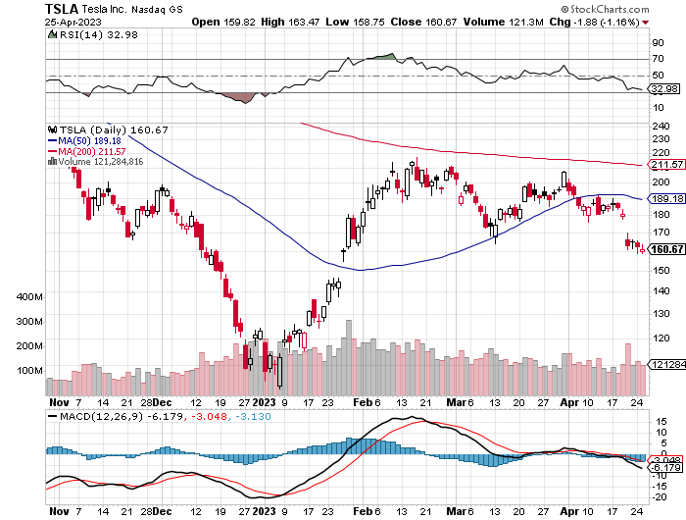
Tesla (TSLA) – Volatility Collapse to 50% Tesla Earnings Disappoint, taking the profit margin down to a two-year low long 4/$110-$120 call spread, long 4/$220-$230 put spread took profits on long 4/$130-$140 call spread, took profits on long 4/$250-$260 put spread

Slide 35
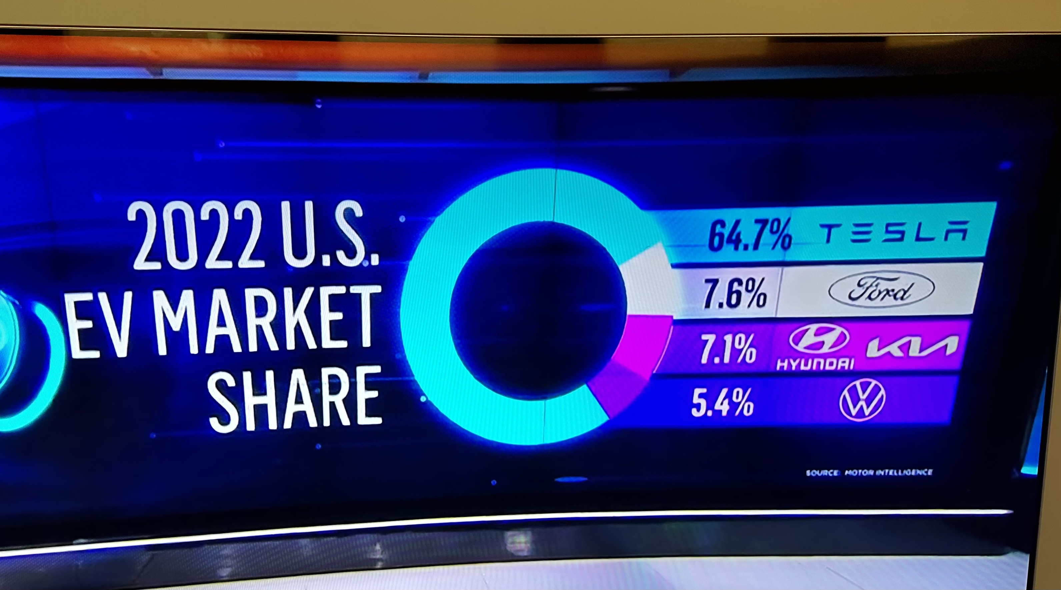

Slide 36
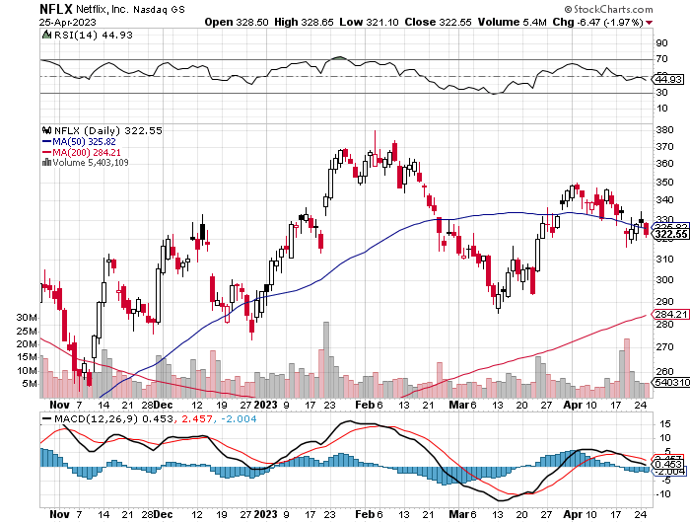
Netflix (NFLX) – Netflix Earnings are Flat, after a delay in password sharing ban.

Slide 37
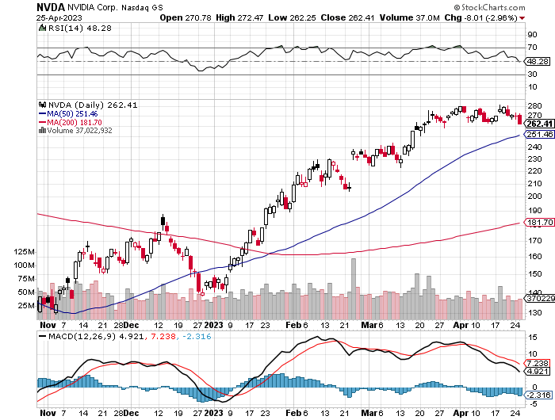
NVIDIA (NVDA) – NVIDIA ties up with Adobe, to develop a new generation of AI generative chips long 3/$260-$270 put spread, took profits on long 10/$95-$100 call spread took profits on long 7/$120-$130 call spread, took profits on long 6/$120-$130 call spread

Slide 38
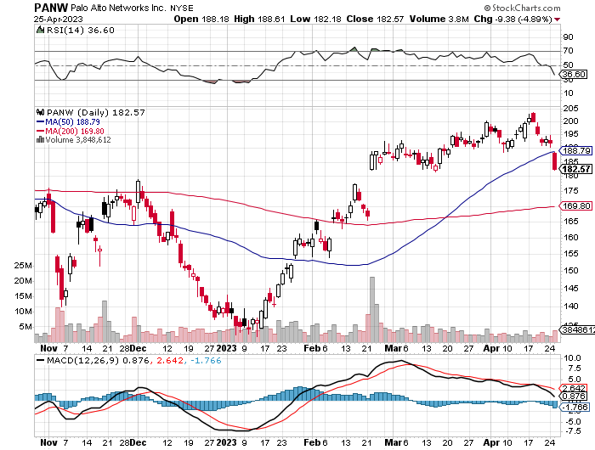
Palo Alto Networks (PANW)- Hacking never goes out of fashion Palo Alto Networks Beats took profits on long 10/$130-$140 call spread

Slide 39
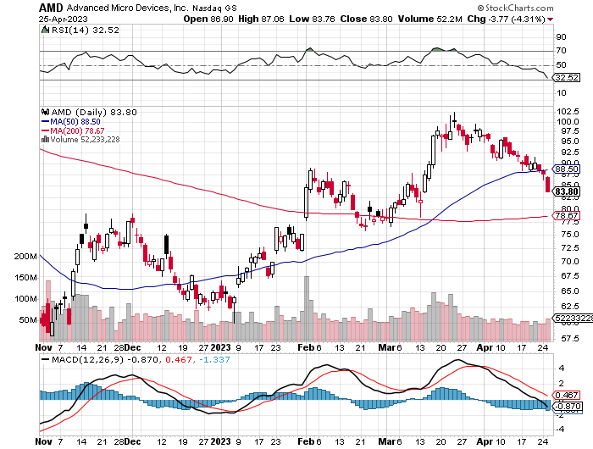
Advanced Micro Devices (AMD)- Recession fears programable logic devices took profits on long 2/$75-$80 call spread

Slide 40
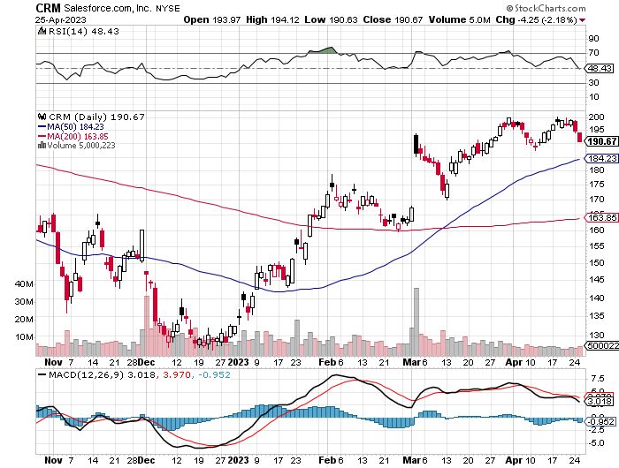
Salesforce (CRM)- Massive Online Migration Salesforce Soars 16%, on better than expected guidance took profits on long 9/$125-$130 vertical bull call spread took profits on long 8/$125-$130 vertical bull call spread took profits on long 2/$105-$115 call spread

Slide 41
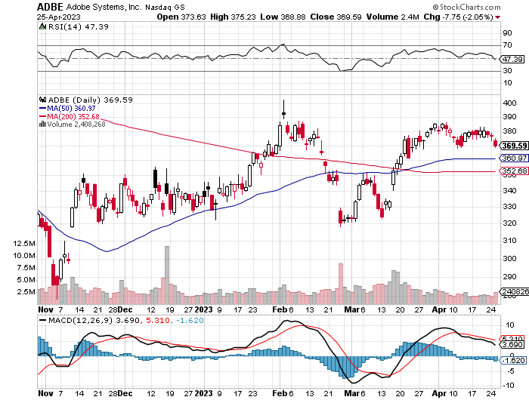
Adobe (ADBE)- Cloud play The Quality Non-China tech play

Slide 42
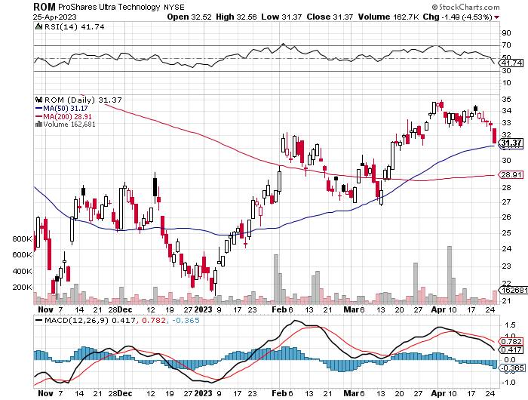
ProShares Ultra Technology ETF (ROM) – 2X Long Technology ETF took profits on long 10/$62-65 call spread

Slide 43
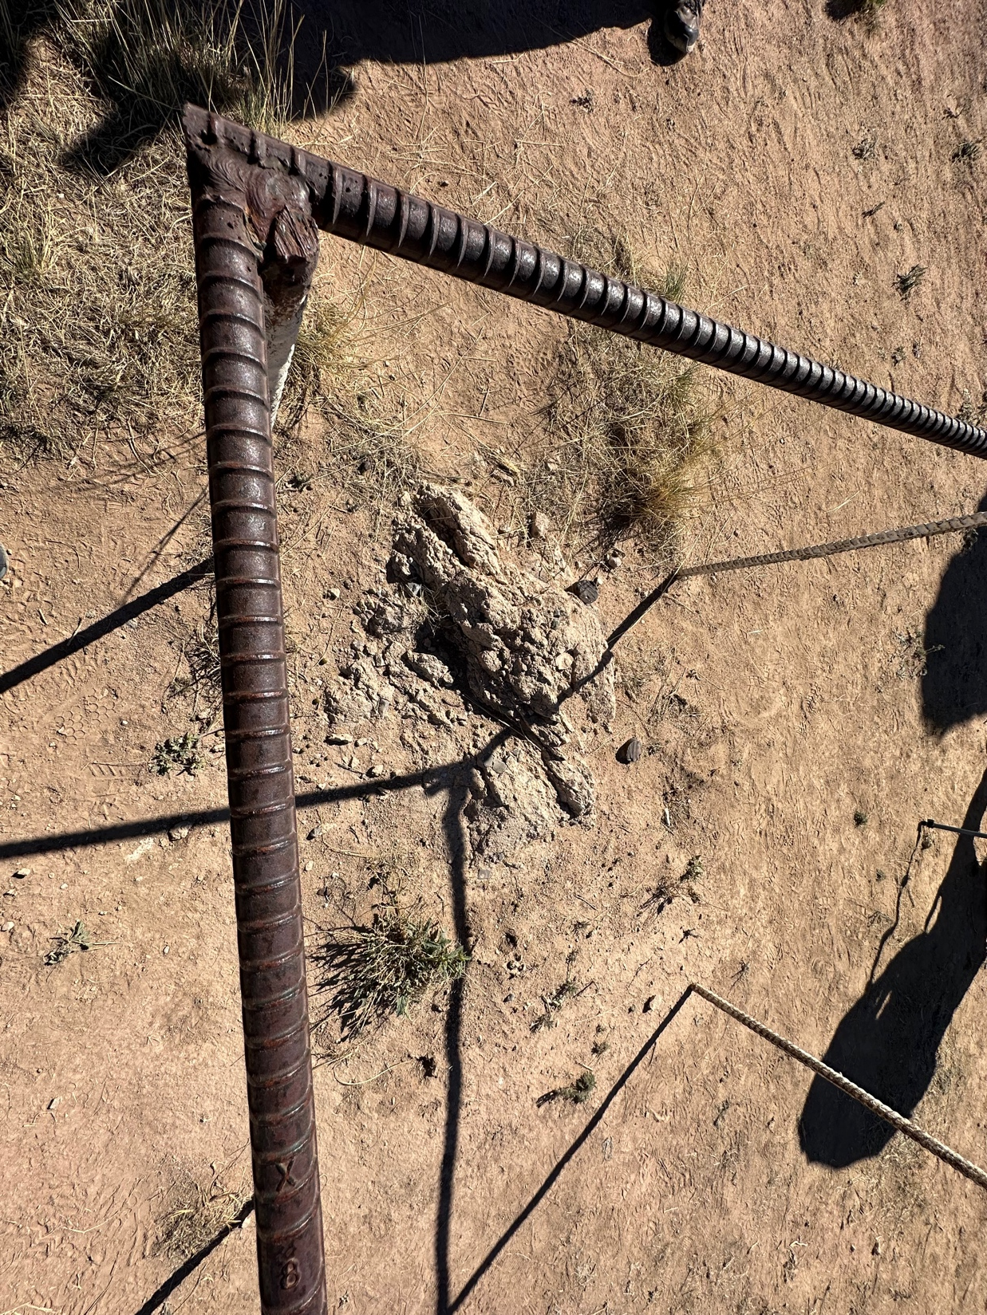

Slide 44
The Second Half of the Barbell
*Bets on a domestic recovery in 2022 Q4 *Upside potential in 2022 far greater than tech *Some of these have not moved for 5 or 10 years *Focuses on economically sensitive cyclical industries *Makes a great counterweight to high-growth technology *We could spend all of next year rotating between the two groups

Slide 45
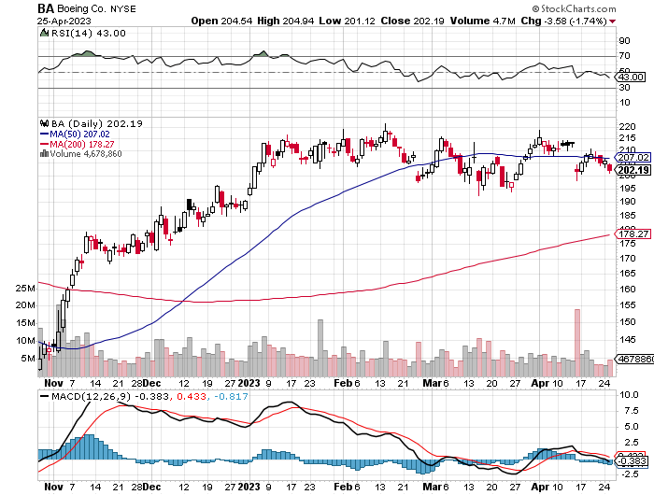
Boeing (BA) – 737 MAX Production Increases from 31 to 37 Boeing Goes Back in the Penalty Box, with a recurring bulkhead problem halting 737 MAX production long 5/$17-$175 call spread

Slide 46
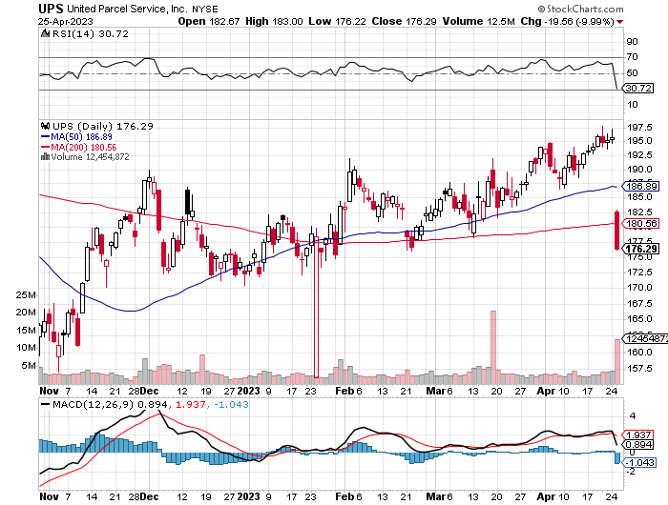
Package Delivery- United Parcel Service (UPS) - took profits on long 11/$130-$140 call spread

Slide 47
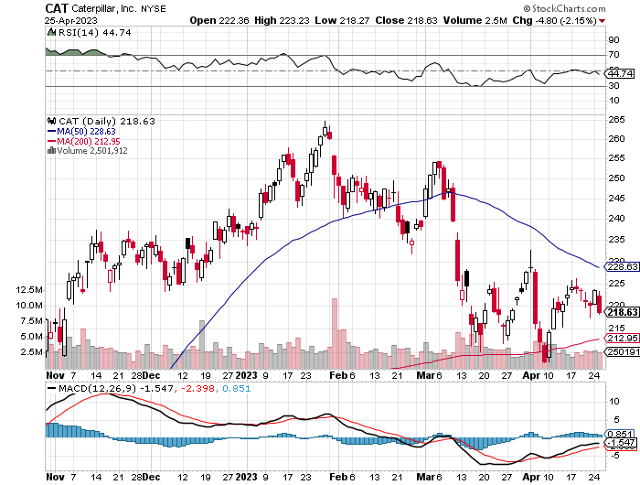
Caterpillar (CAT)- Ag + Infrastructure + Housing Raises Dividend by 50% took profits on long 12/$145-$150 call spread took profits on long 11/$125-$135 call spread

Slide 48
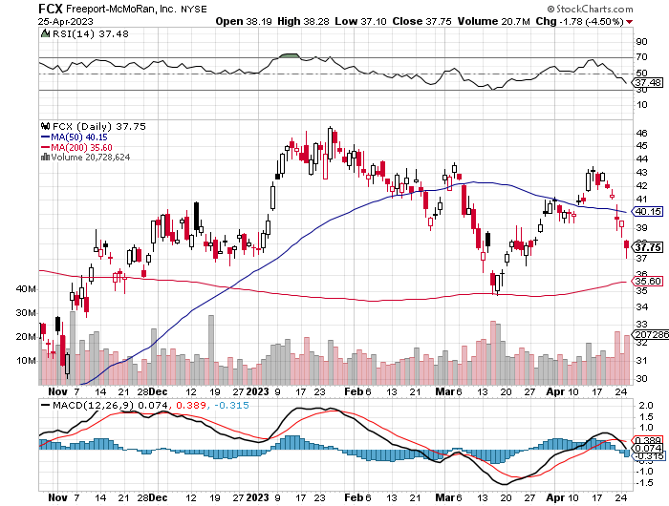
Freeport McMoRan - (FCX)- Coming Copper Crisis took profits on long 4/$30-$33 call spread took profits on long 10/$20-$23 call spread

Slide 49
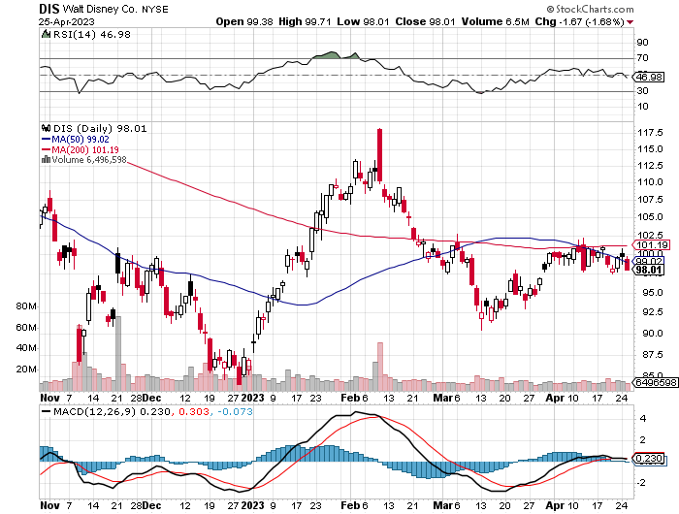
Walt Disney (DIS) - Not a recession play stopped out of long 10/$165-$175 call spread took profits on long 3/$170-$180 call spread

Slide 50
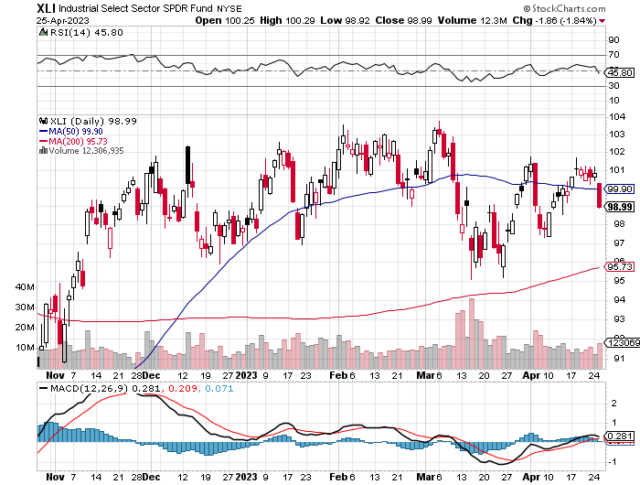
Industrials Sector SPDR (XLI)- (GE), (MMM), (UNP), (UTX), (BA), (HON)

Slide 51
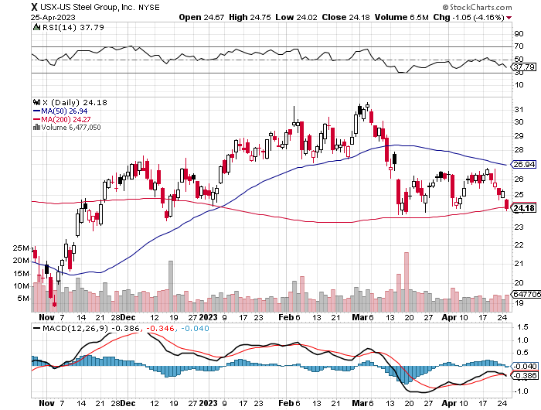
US Steel (X) – Commodity Boom and Wartime boost

Slide 52
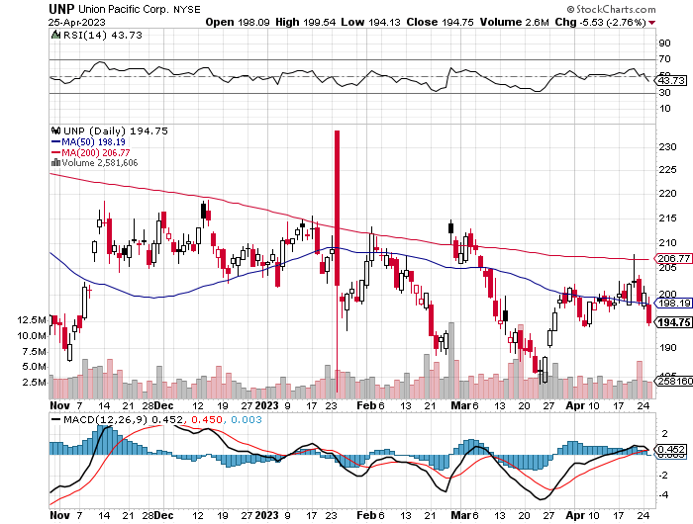
Union Pacific RR (UNP)- Big Stuff to Ship took profits on long 5/$200-$210 call spread took profits on 11/$150-$160 call spread

Slide 53
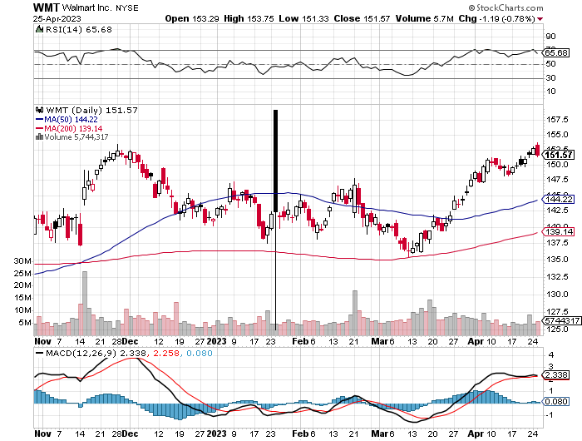
Wal-Mart (WMT)- took profit on Long 11/$125-$130 bear put spread took profit on Long 10/$119-$121 bear put spread took profits on Long 8/$114-$117 bear put spread

Slide 54
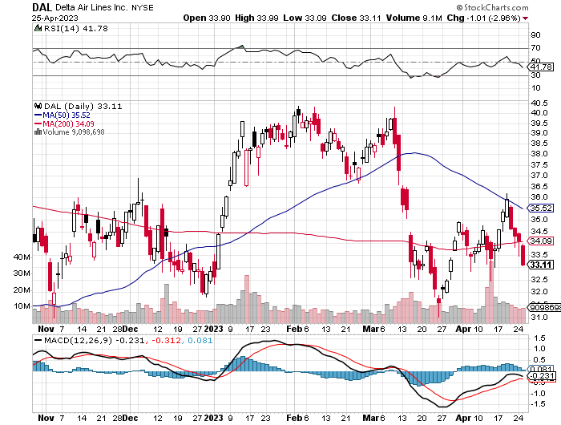
Delta Airlines (DAL) – Travel is Back!

Slide 55
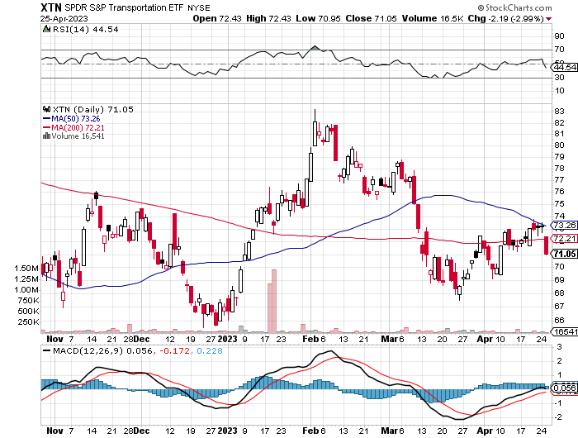
Transports Sector SPDR (XTN)- Worst Hit Sector (ALGT), (ALK), (JBLU), (LUV), (CHRW), (DAL)

Slide 56
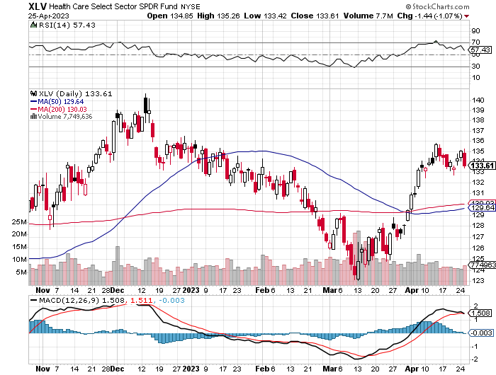
Health Care Sector (XLV) (JNJ), (PFE), (MRK), (GILD), (ACT), (AMGN)

Slide 57
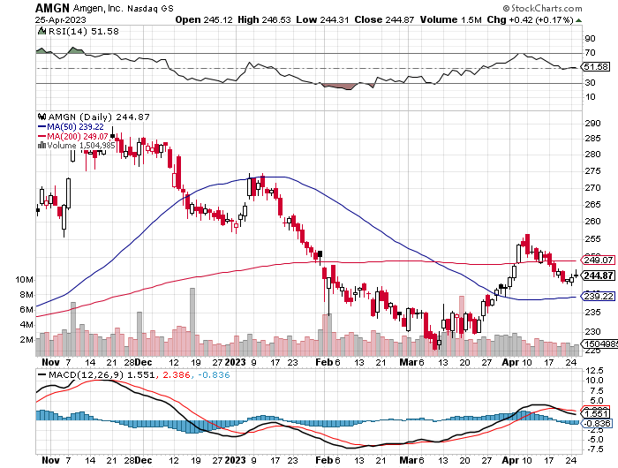
Amgen (AMGN) took profits on long 11/$185-$200 bull call spread

Slide 58
Goldman Sachs (GS) – Highest Capital ration net of mark to market took profits 12/$330-$350 call spread took profits 11/$330-$350 call spread stop loss on long 11/$385-$395 call spreads

Slide 59
Morgan Stanley (MS) – Highest Capital ration net of mark to market took profits on long 4/$65-$70 call spread

Slide 60
JP Morgan Chase (JPM) - Highest Capital ration net of mark to market took profits on long 4/$105-$115 call spread

Slide 61
Bank of America (BAC) – Bank of America Rips, on a great earnings report took profits on long 4/$20-$23 call spread

Slide 62
Citigroup (C) – took profits on long 4/$30-$35 call spread

Slide 63
Charles Schwab (SCHW) – No Risk Taking – is all fee business took profits on long 4/$30-$35 call spread

Slide 64
Interactive Brokers (IBKR) – Best Risk Control took profits on long 4/$60-$65 call spread

Slide 65
First Republic (FRC) – High ratio of uninsured deposits, 65% of loans are ARMs, mitigating risk, large share of jumbo loans to high-net-worth individuals, stock down 80% from California exposure

Slide 66
SPDR Metals & Mining ETF (XME) – long 2/$28-$30 call spread

Slide 67
Blackrock (BLK)-Asset Collection Boom took profits on long 3/$770-$790 call spread took profits on long 3/$310-$340 call spread

Slide 68
Visa (V) – “Touchless” Bitcoin Drag Transaction grew by an inflationary 10% back to pre-pandemic levels took profits on long 10/$160-$170 bull call spread took profits on long 6/$150-$160 bull call spread

Slide 69
Consumer Discretionary SPDR (XLY) (DIS), (AMZN), (HD), (CMCSA), (MCD), (SBUX)

Slide 70
Berkshire Hathaway (BRKB)- Natural Barbell 2022 $30.2 billion profit on unchanged stock, Warren Buffet’s Annual Letter is Out took profits on long 4/$260-$270 call spread took profits on long 1/$290-$300 call spread, took profits on long 10/$220-$230 call spread, took profits on long 7/$220-$230 call spread, took profits on long 7/$220-$230 call spread took profits on long 6/$260-$270 call spread

Slide 71
Europe Hedged Equity (HEDJ)-

Slide 72
Japan (DXJ)-

Slide 73
Emerging Markets (EEM) - Pro trade, Weak Dollar, Long Recovery Play

Slide 75
Bonds – Default Fears
*Credit Default Swaps Prices Hit 12 Year High, as fears of a US government default this summer exact an ever higher prices *These are insurance policies for bonds *Confidence in the House leadership caving is at zero, who prefers an economic debacle as a path to winning the 2024 election *Ten-year US Treasury yields back up to from 3.65% *Keep Buying 90-Day T-Bills, now pushing a 5.2% risk free yield. *Still looking like 2.50% yield by end 2023 *Keep buying (TLT) calls, calls spreads and LEAPS on dips but only on dips *Junk bond ETF’s (JNK) and (HYG) are a great high yield play

Slide 76
Treasury ETF (TLT) – long 5/$97-$100 call spread, long 2/$98-$101 call spread took profits on long 4/$96-$99 call spread took profits on long 4/$113-$116 put spread, took profits on long 4/$114-$117 put spread

Slide 77
Ten Year Treasury Yield ($TNX) – 3.65%

Slide 78
Junk Bonds (HYG) 8.30% Yield to Maturity

Slide 79
Municipal Bonds (MUB) 3.27% Yield-

Slide 80
Emerging Market Debt (ELD) 6.83% Yield-

Slide 81
2X Short Treasuries (TBT)-Out of Favor

Slide 83
Foreign Currencies – Yen slide
*New Bank of Japan governor holds to ultra easy interest rate strategy, crushing the yen *Dollar has peaked, undercut by recession fears *Dollar selloff may accelerate after May 2-3 Fed meeting *Any strength in the dollar will be temporary *Look for new dollar lows by end 2023 *Buy (FXE), (FXY), (FXB) on dips

Slide 84
THE MAD HEDGE FUND TRADER
Australian Dollar (FXA) - Major Long-Term Bottom is In Targeting Parity – A call option on a global synchronized recovery
1:1
BUY

Slide 85
Japanese Yen (FXY)
2023 Target 25%

Slide 86
Euro (FXE)-
2023 Target 25%

Slide 87
British Pound (FXB)-
2023 Target 15%

Slide 88
Emerging Market Currencies (CEW)
2023 Target 40%

Slide 90
Energy & Commodities –Production Cut
*OPEC Plus cuts production by 500,000 barrels a day to prevent price crash to $50/barrel *Recession fears were taking oil to new lows *Natural Gas Explodes to the Upside, bouncing hard off a multiyear lows *Uranium Demand is Surging with the Nuclear Renaissance. And now the US is restarting plutonium production for the first time in 20 years, a uranium derivative *Expect a long delay until we see lower gasoline prices *Big oil move will have to wait for global economic recovery *Buy oil and gas on dips for a trade

Slide 91
Oil-($WTIC)

Slide 92
United States Oil Fund (USO)

Slide 93
Energy Select Sector SPDR (XLE)-No Performance! (XOM), (CVX), (SLB), (KMI), (EOG), (COP)

Slide 94
ExxonMobile (XOM)- took profits on long 12/$120-$125 put spread

Slide 95
Occidental Petroleum (OXY)- Buffet’s a Buyer long 2/$55-$60 call spread, took profits on long 12/$77.50-$82.50 put spread

Slide 96
Natural Gas (UNG) - Long January 2025 $14 - $15 Call Spread LEAPS

Slide 97
Freeport McMoRan (FCX) -

Slide 98
Cameco (CCJ) - took profits on long 5/$20-$23 bull call spread

Slide 100
Precious Metals – Lithium Shock
*Chile Nationalizes the Lithium Industry, sending (SQM) and ALB) into a tailspin *The official reason is to make the industry more efficient *The real reason is so the government can skim off more profits in this exploding industry *Chile is the world’s second largest producer of lithium essential for EV batteries. *Gold back off from new all-time highs, driven by the prospect of falling interest rates and the demise of crypto *A Severe Short Squeeze in Copper is Developing, leading to a massive price spike later in 2023

Slide 101
Gold (GLD) - Deflation call took profits on long 5/$165-$170 bull call spread

Slide 102
Market Vectors Gold Miners ETF- (GDX) –

Slide 103
Barrick Gold (GOLD) took profit on long 1/$15.50-$16.50 call spread

Slide 104
Newmont Mining- (NEM)- took profits on long $55-60 call spread

Slide 105
Silver- (SLV)- took profits on long 11/$19-$20 call spread

Slide 106
Silver Miners - (SIL)-

Slide 107
Wheaton Precious Metals - (WPM)- took profits on long 1/$36-$39 call spread

Slide 108
Platinum- (PPLT)- 556,000-ounce shortage this year took profits on long 1/$36-$39 call spread

Slide 110
Real Estate – Back from the Dead
*Existing Home Sales Slide in March, down 2.4% to a 4.44 million annual rate *Some 28% of sales were above the asking price *Inventories remain extremely short at 980,000. *Builders Sentiment Improves Slightly, by one point to 45, the best since June *Prices are now picking up with extreme inventory shortage *The market will take off like a rocket when rates drop at yearend

Slide 111
S&P Case Shiller Plunges S&P Case Shiller Drops to +3.8%, in January with its National Home Price Index San Francisco was down -8% YOY, while -Seattle gave up 5%. Miami gained +14%, Tampa +11%, and Atlanta +8%.

Slide 112
Crown Castle International (CCI) – 4.95% yielding cell phone tower REIT

Slide 113
US Home Construction Index (ITB) (DHI), (LEN), (PHM), (TOL), (NVR)

Slide 115
Trade Sheet- So What Do We Do About All This?
*Stocks – buy the big dips at bottom of range, ………………sell big rallies to hedge holdings *Bonds – buy dips, sell extreme rallies *Commodities-buy dips *Currencies- sell dollar rallies, buy currencies *Precious Metals – buy dips *Energy – buy dips *Volatility - sell short over $30 *Real estate – buy dips

Slide 116
Next Strategy Webinar 12:00 EST Wednesday, May 10 from Silicon Valley, CA email me questions at support@madhedgefundtrader.com
Good Luck and Good Trading!
Notes:
*

