Slide 1
The Mad Hedge Fund Trader “Debt Ceiling Debacle”
With John Thomas Incline Village, NV, April 10, 2023 www.madhedgefundtrader.com
Notes:
*

Slide 3
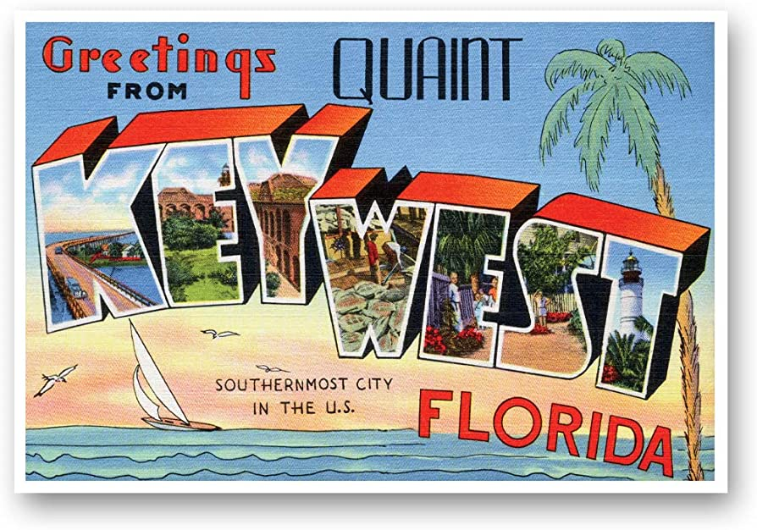
THURSDAY, MAY 16 KEY WEST STRATEGY LUNCHEON
*An excellent meal will be followed by a wide-ranging discussion and an extended question and answer period *The lunch will be held in a sleazy bar in old Key West *please go to my online store at http://www.madhedgefundtrader.com/store and click on “luncheons.” Tickets are available for $285

Slide 4
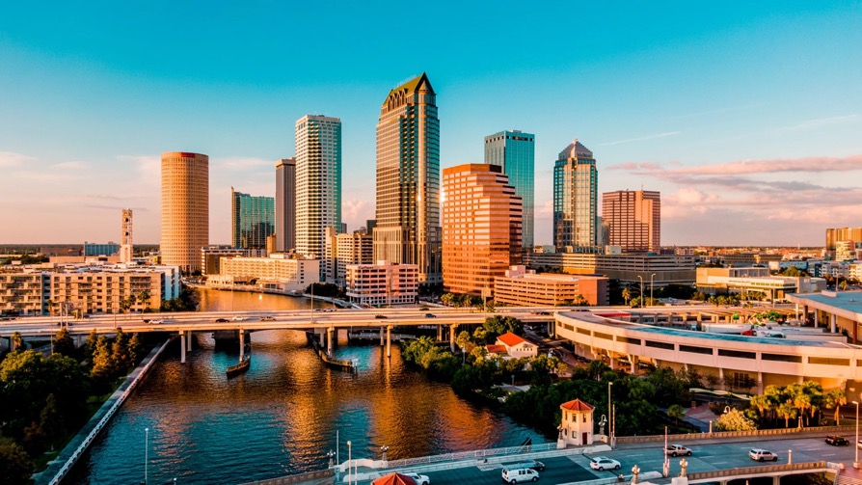
THURSDAY, MAY 18 TAMPA STRATEGY LUNCHEON
*An excellent meal will be followed by a wide-ranging discussion and an extended question and answer period *The lunch will be held in an exclusive private club in Midtown Manhattan with a strict dress code *please go to my online store at http://www.madhedgefundtrader.com/store and click on “luncheons.” Tickets are available for $289

Slide 5
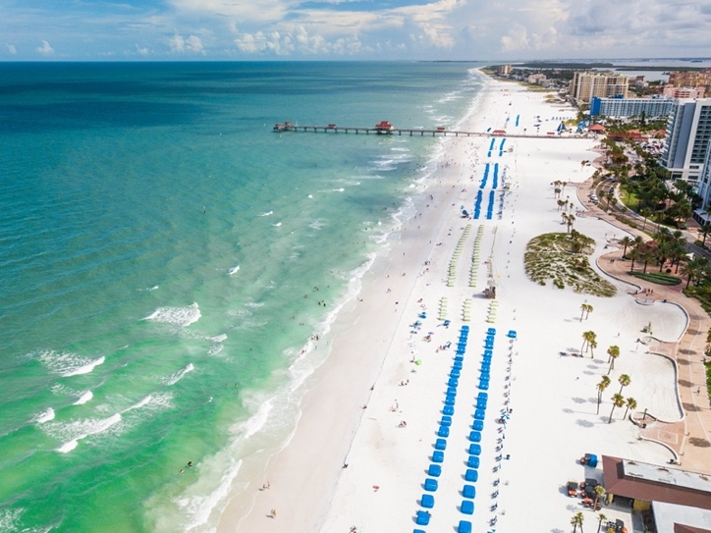
THURSDAY, MAY 19 BOCA RATON STRATEGY LUNCHEON
*An excellent meal will be followed by a wide-ranging discussion and an extended question and answer period *The lunch will be held in an exclusive private club in Midtown Manhattan with a strict dress code *please go to my online store at http://www.madhedgefundtrader.com/store and click on “luncheons.” Tickets are available for $295

Slide 6
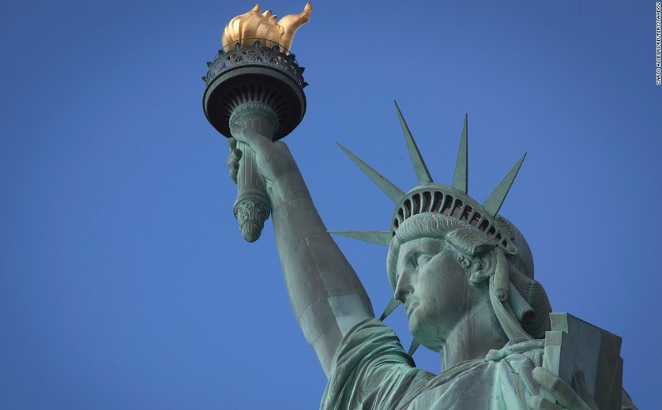
THURSDAY, JULY 6 NEW YORK STRATEGY LUNCHEON
*An excellent meal will be followed by a wide-ranging discussion and an extended question and answer period *The lunch will be held in an exclusive private club in Midtown Manhattan with a strict dress code *please go to my online store at http://www.madhedgefundtrader.com/store and click on “luncheons.” Tickets are available for $299

Slide 7
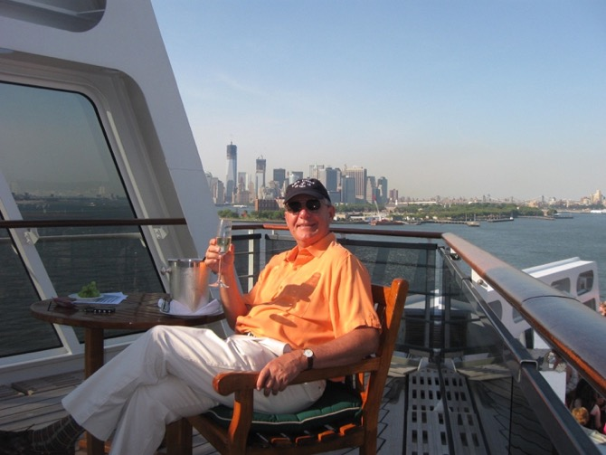
Friday July 13, 2023 Seminar at Sea
*Cunard Line’s flagship, the elegant and spacious Queen Mary II, on an eastbound transatlantic cruise *The Ship departs New York at 12:00 AM on July 7, 2023, and arrives at Southampton on July 14 *Guests will be responsible for booking their own cabin through Cunard *Three dinners during the voyage will be black tie *Customers are required to book their own cabins and return flights from England *The Cunard cruise number is M319

Slide 8
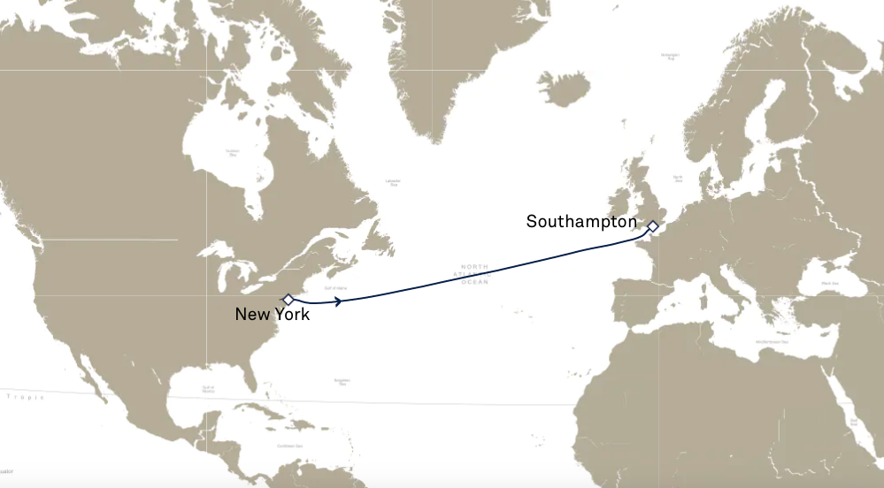

Slide 9
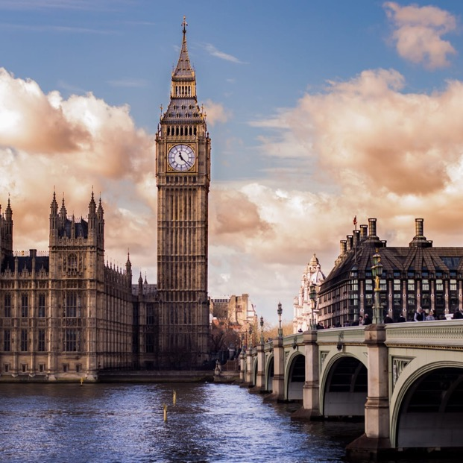
THURSDAY, JULY 19 LONDON STRATEGY LUNCHEON
*An excellent meal will be followed by a wide-ranging discussion and an extended question and answer period *The lunch will be held in an exclusive private club in Midtown Manhattan with a strict dress code *please go to my online store at http://www.madhedgefundtrader.com/store and click on “luncheons.” Tickets are available for $298

Slide 10
Trade Alert Performance New All Time Highs! 31 out of 33 trade alerts profitable
*January +22.35% Final *July +3.98% Final *February +3.41% Final *August +5.13% Final *March +20.85% Final *September +9.72% Final *April +15.13% Final *October +5.69% Final *May +0.75% MTD *November +8.31 Final *June +5.91% Final *December +0.95% Final *2022 Final +84.63% compared to -18.63% for the S&P 500 *2023 Year to Date +61.76%, versus +8.16% for the S&P 500 +658.95% since inception *Average annualized return of +48.86% for 15 years

Slide 11
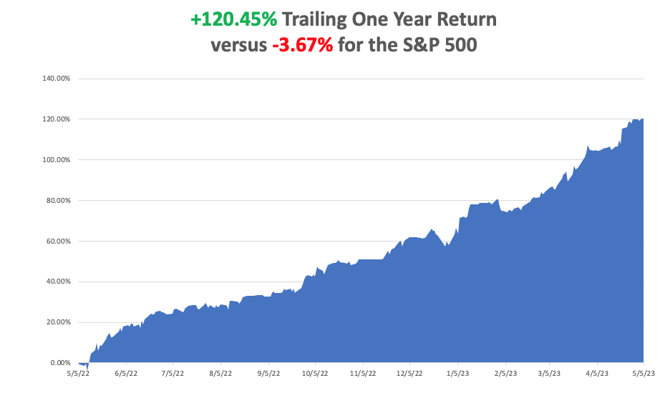

Slide 12
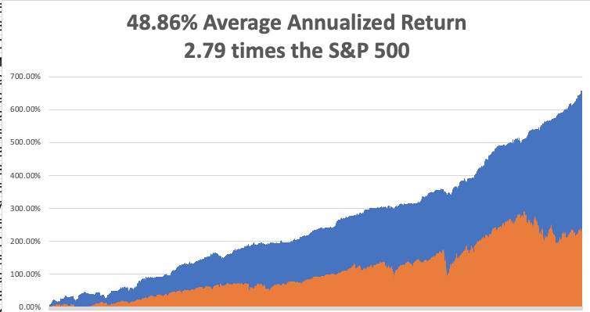

Slide 13
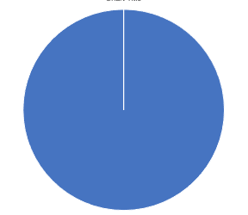
Portfolio Review 10% Long, 0% Short, 90% cash with VIX at $17no new positions
Current Capital at Risk
Risk On
(TLT) 5/$98-$101 call spread | 10.00%
Risk Off
NO POSITIONS
Total Net Position | 10.00%
Expiration Value +63.00%

Slide 14
The Method to My Madness
*Debt Ceiling debacle has frozen all markets, driving volatility to two-year lows at $15 *Even bonds have narrowed to a range too narrow to trade 3.35%-3.55% *This could go on for a month….or more *In the meantime, seasonals have turned sharply against all risk taking *Trading volumes are shrinking by the day *Summer will present the best buying opportunities of the year *Precious metals and commodities should be at the top of and “BUY” list to cash in on an economic recovery *In this market patience is a virtue, let the market come to you

Slide 15
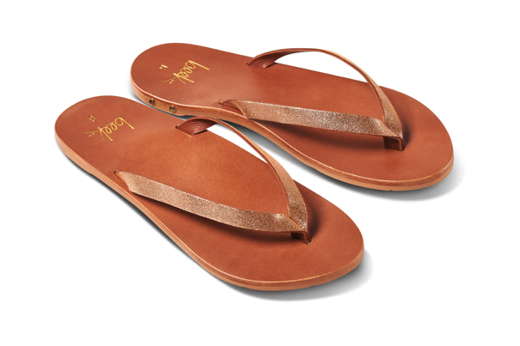
The Global Economy – Hard – Soft - Hard - Soft
*Fed Raises Rates 0.25%, likely the last such move in this cycle. Futures * Nonfarm Payroll Jumps by 253,000, another hot number. The headline Unemployment Rate dropped to a half century low of 3.4%. These figures suggest for rate hikes to come. *Fed Financial Stability Report Highlights Risk to the Economy, warning of recession risks *Tightening of bank lending is a concern, so is commercial real estate with elevated valuations *Consumer Inflation Expectations Dropped, in April by 5.2% YOY. It’s part of the recent cavalcade of softening economic data.
*Europe Ekes Out 0.1% Growth in Q1, versus a 1.1% rate for the US *New Car Loans are in Free Fall, and car sales can’t be far behind. It is collateral damage from the regional bank crisis, hastening a coming recession.

Slide 16
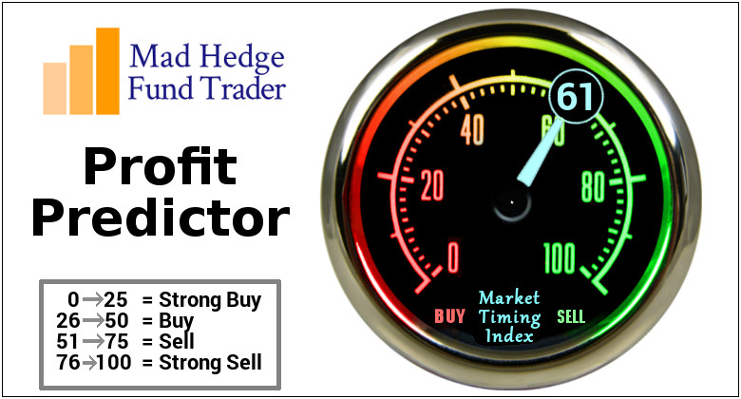
The Mad Hedge Profit Predictor Market Timing Index – Neutral to Rich An artificial intelligence driven algorithm that analyzes 30 different economic, technical, and momentum driven indicators

Slide 17
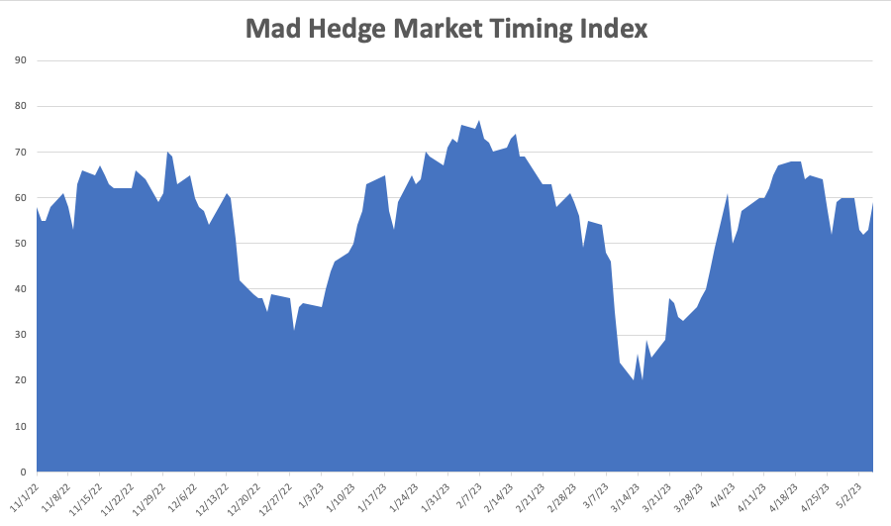
SELL
BUY

Slide 18
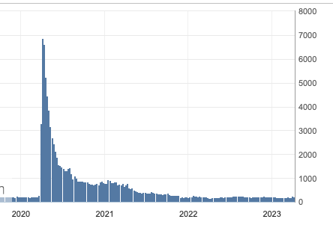
Weekly Jobless Claims – Falling 255,000 – UP 5,000 – One Year High

Slide 20
Stocks – Dead Weight Debt Ceiling
*The Feds could bar hedge funds from launching raids on small regional bank shares with the aim of taking them to zero. Such a ban was enforced for all hanks in 2009. * The Regional Bank Crisis Spreads, with Phoenix based Western Alliance Bankcorp (WAL) down a staggering 65% on the week. *Consensus (SPY) earnings are currently $220 a share giving an expensive price/earnings multiple of 18.77X *You Only Need to Buy Seven Stocks This Year, as the rest are going nowhere. That include (AAPL), (GOOGL), (META), (AMZN), (TSLA), (NVDA), (CRM). Watch out when the next rotation broadens out to the rest of the market. *All technical indicators are now flashing red. Seasonals
are now turning strongly against stocks *Volatility plunges to $15 putting the market asleep *Looking for flat first half, strong second half to take us to S&P 500 4,800 by yearend

Slide 21
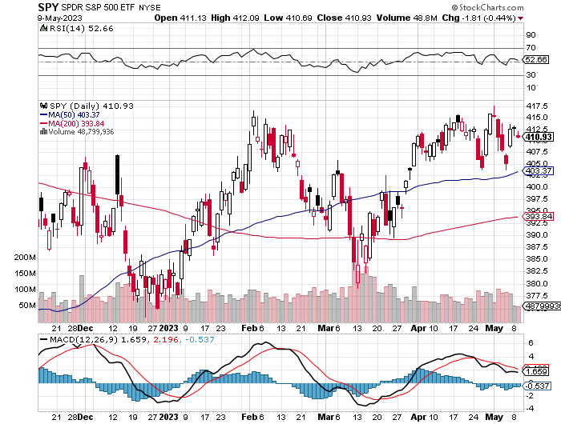
S&P 500 – Sell in May took profits on long 5/$420-$430 put spread, took profits on long 1/$420-$430 put spread, took profits on long 11/$420-$430 put spread
2023 $480 Target
$430 +21% Rally
$375 -12.8% Pull Back
The Bottom $355 Down -26%

Slide 22
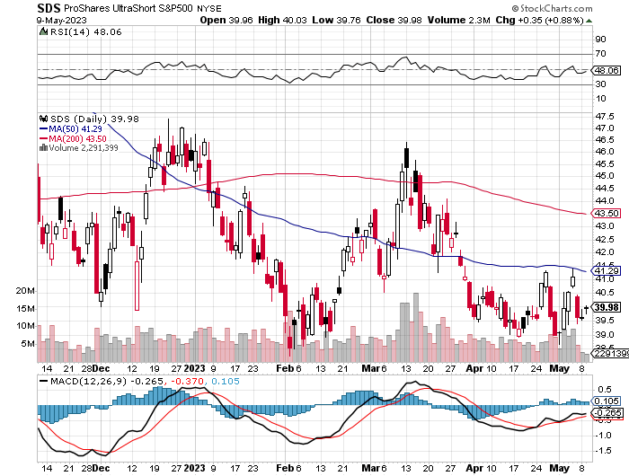
ProShares Ultra Short S&P 500 (SDS)- a great hedge for long stocks and bonds long 2X position has a hedge against longs and bond shorts

Slide 23
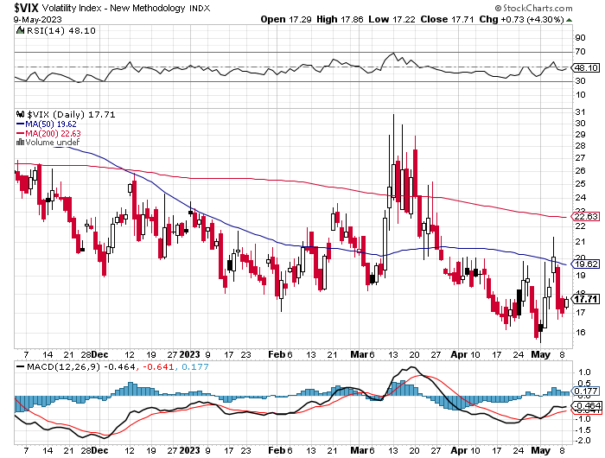
(VIX) – Bargain of the Century

Slide 24
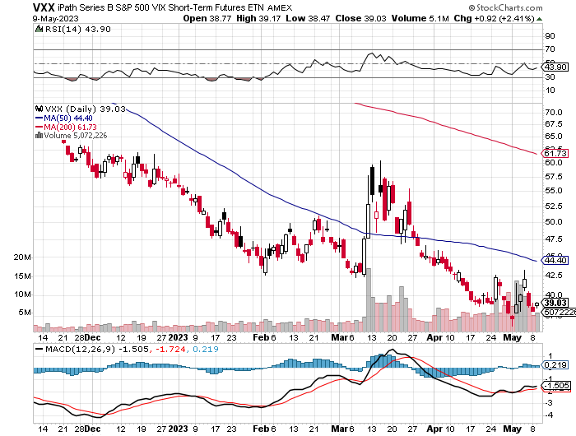
(VXX)-

Slide 25
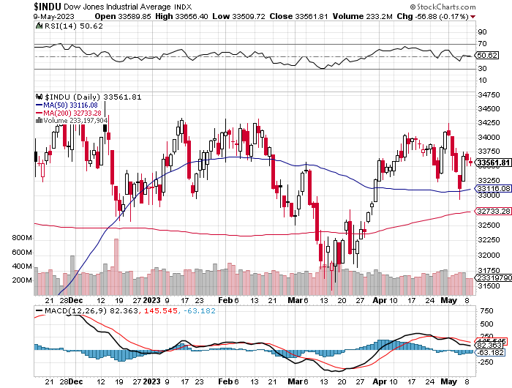
Dow Average ($INDU)-

Slide 26
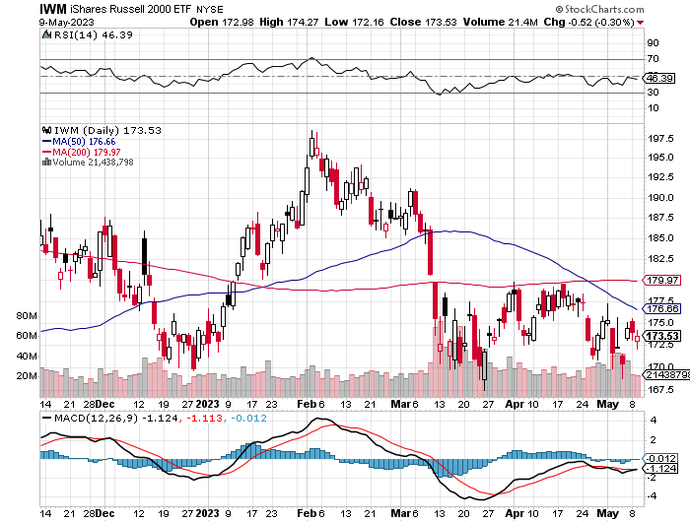
Russell 2000 (IWM)- took profits on Long 10/$137-$142 vertical bull call spread took profits on Long 10/$153-$156 vertical bear put spread

Slide 27
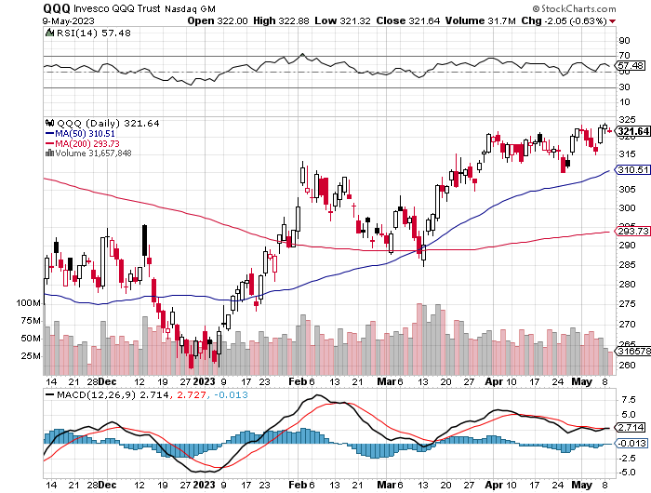
NASDAQ (QQQ) – took profits on Long 5/$335-$345 put spread took profits on long (QQQ) 1/$290-$300 put spread, took profits on long (QQQ) 4/$330-$335 put spread took profits on long (QQQ) 3/$340-$345 put spread, covered long (QQQ) $325-$330 put spread

Slide 28
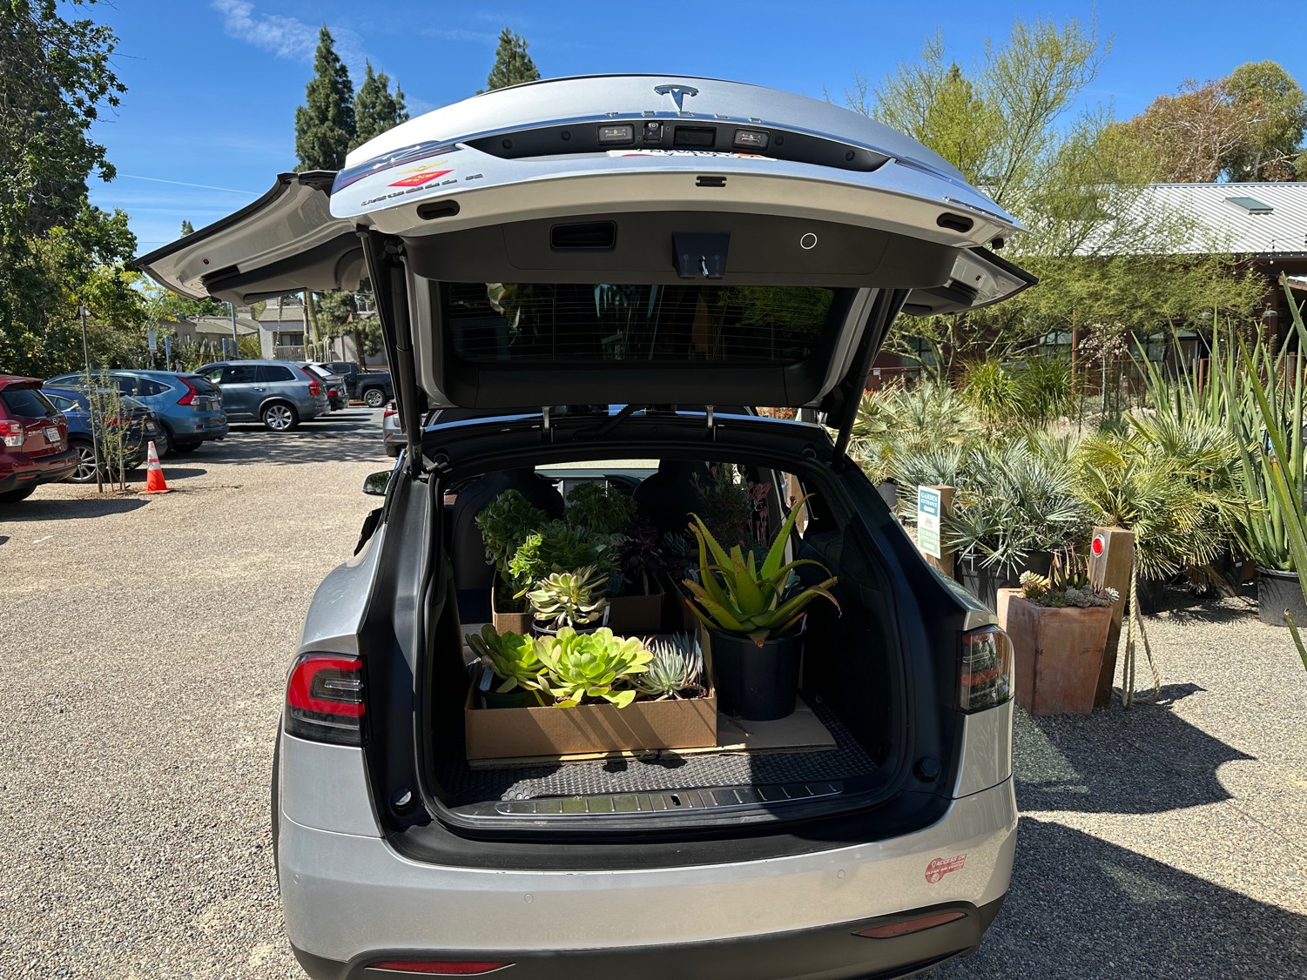

Slide 29
The Barbell Portfolio
*50% Big Tech - 2% of US Employment but 27% of Market Cap and 38% of Profits 50% Domestic Recovery, including: Railroads Couriers Banks Construction Credit Cards Event organizers Ticket sales Retailers

Slide 30
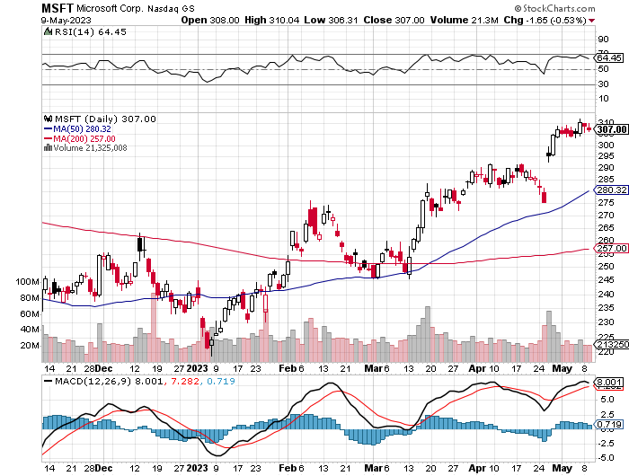
Microsoft (MSFT)- Earnings Beat took profits on 9/$235-$245 call spread, took profits on long 7/$220-$210 call spread, took profits on long 6/$220-$230 call spread, took profits on long 2/$200-$210 bear put spread

Slide 31
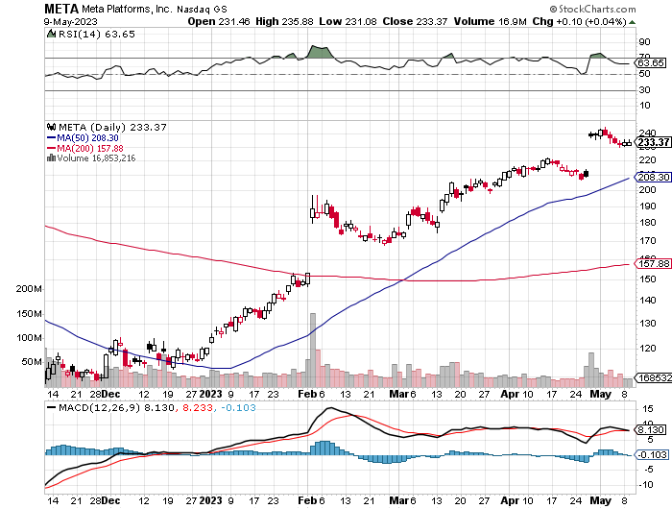
Meta (META)- Soars an Incredible 20% took profits on Long 9/$290-$300 vertical bear put spread stopped out of Long 9/$190-$200 vertical bear put spread

Slide 32
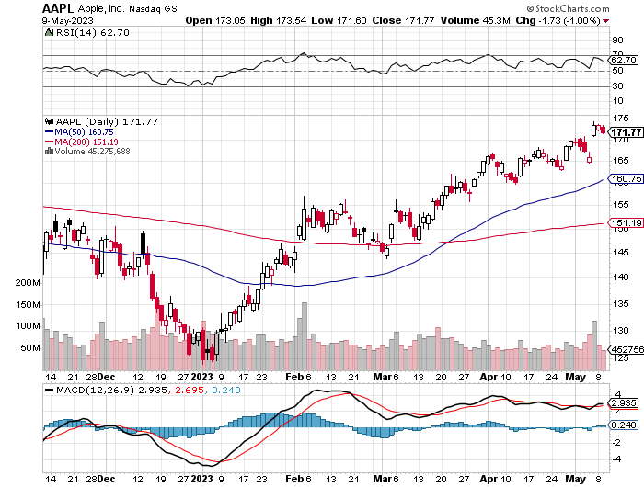
Apple (AAPL) Better earnings on iPhone growth, $90 billion share buy back took profits on long 1/$145-$155 put spread, Took profits on long 10/$165-$175 put spread took profits on long 6/$155-$165 put spread, stopped out of long 6/$125-135 call spread, took profits on long 6/$110-$120 call spread, took profits on long 2/$180-$190 put spread

Slide 33
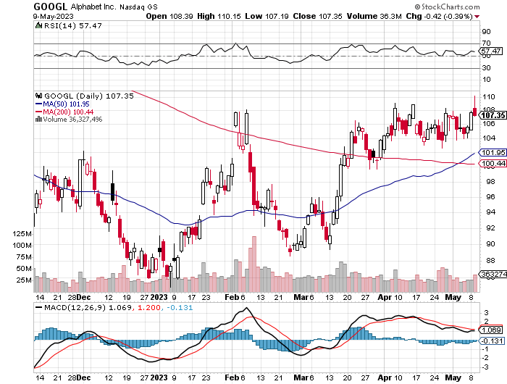
Alphabet (GOOGL) –Google Calls a Halt to Massive San Jose Campus took profits on long 12/$1,200-$1,230 bull call spread took profits on long 9/$1,030-$1,080 vertical bull call spread

Slide 34
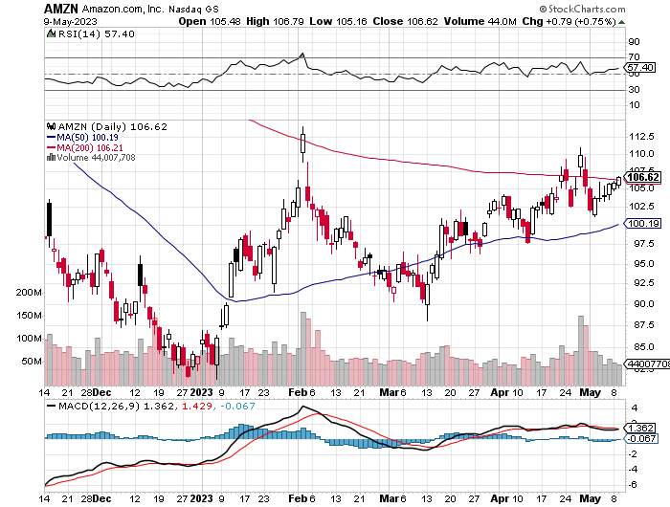
Amazon (AMZN) – took profits on long 2/$3,400-$3,500 bear put spread took profits on long 9/$2,800-$2,900 bull call spread

Slide 35
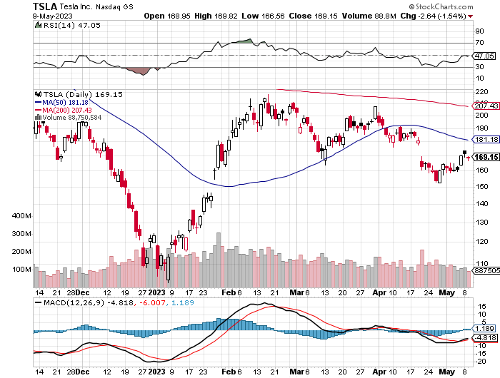
Tesla (TSLA) – Volatility Collapse to 44% Tesla Breaks Ground on Massive Lithium Processing factory in Texas More Tesla Price Cuts to Come, with swelling inventories forcing Musk’s hand took profits on long 4/$110-$120 call spread, took profits on long 4/$220-$230 put spread took profits on long 4/$130-$140 call spread, took profits on long 4/$250-$260 put spread

Slide 36
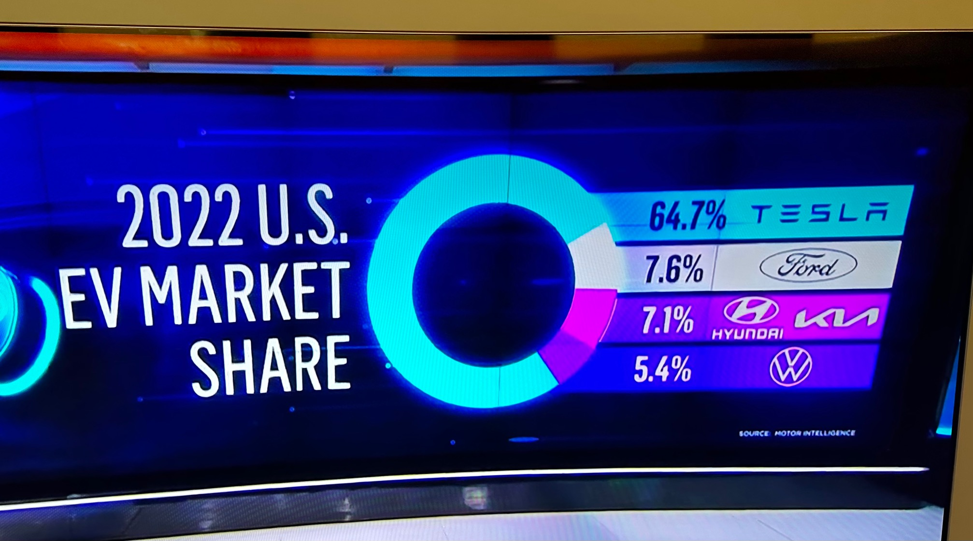

Slide 37
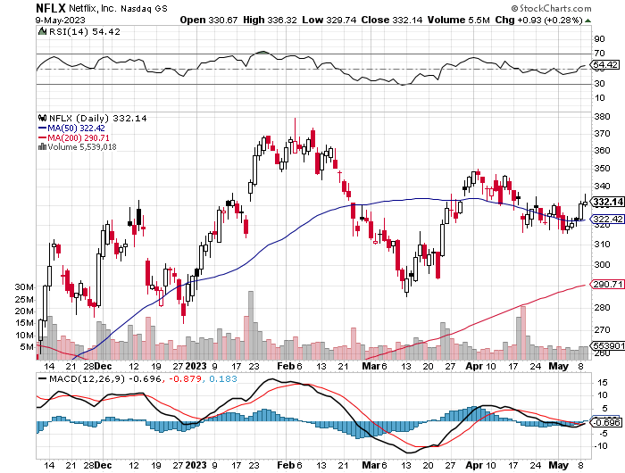
Netflix (NFLX) – Netflix subscribers beat, after a delay in password sharing ban.

Slide 38
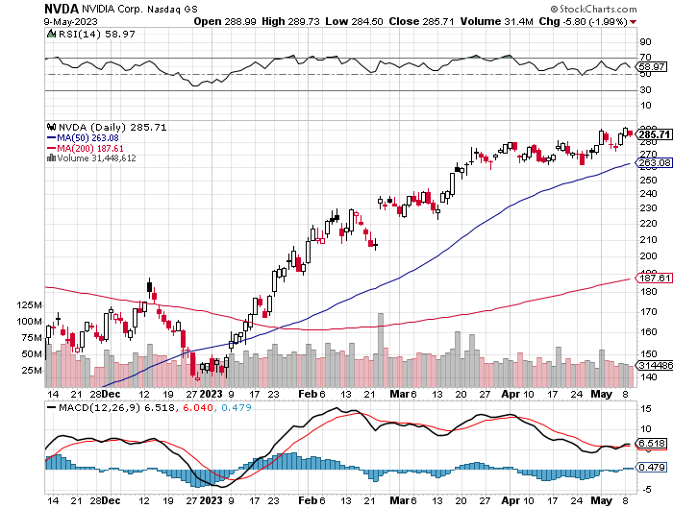
NVIDIA (NVDA) – NVIDIA ties up with Adobe, to develop a new generation of AI generative chips took profits on long 3/$260-$270 put spread, took profits on long 10/$95-$100 call spread took profits on long 7/$120-$130 call spread, took profits on long 6/$120-$130 call spread

Slide 39
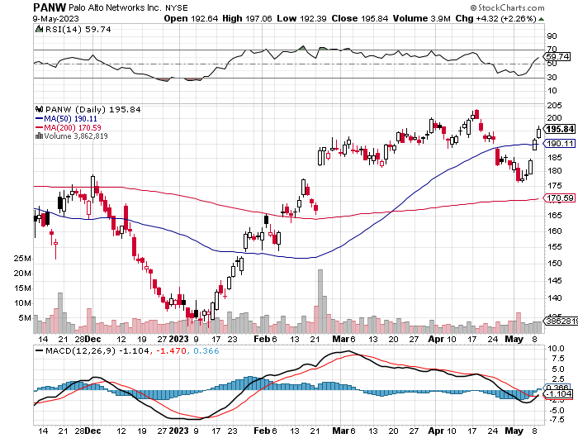
Palo Alto Networks (PANW)- Hacking never goes out of fashion Palo Alto Networks Beats took profits on long 10/$130-$140 call spread

Slide 40
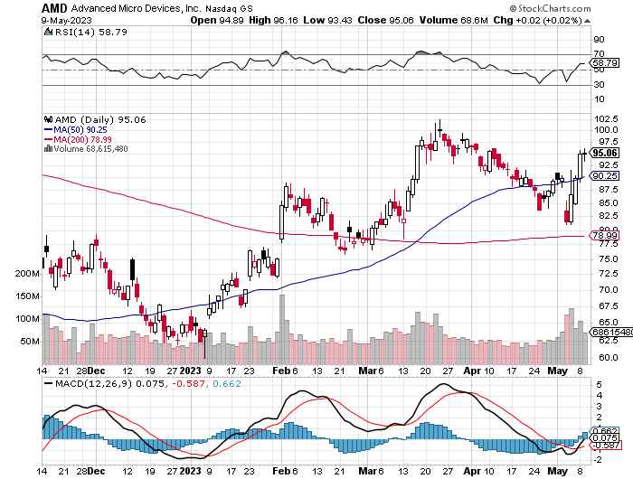
Advanced Micro Devices (AMD)- Recession fears programable logic devices took profits on long 2/$75-$80 call spread

Slide 41
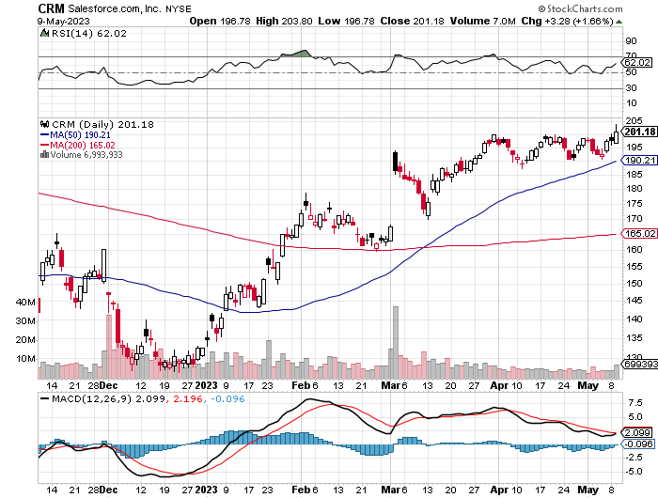
Salesforce (CRM)- Massive Online Migration Salesforce Soars 16%, on better-than-expected guidance took profits on long 9/$125-$130 vertical bull call spread took profits on long 8/$125-$130 vertical bull call spread took profits on long 2/$105-$115 call spread

Slide 42
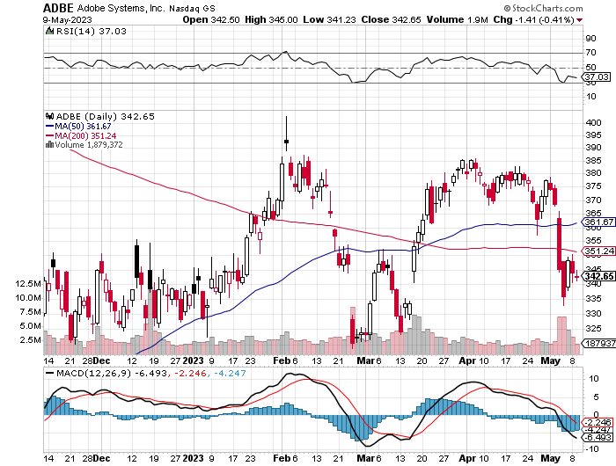
Adobe (ADBE)- Cloud play The Quality Non-China tech play

Slide 43
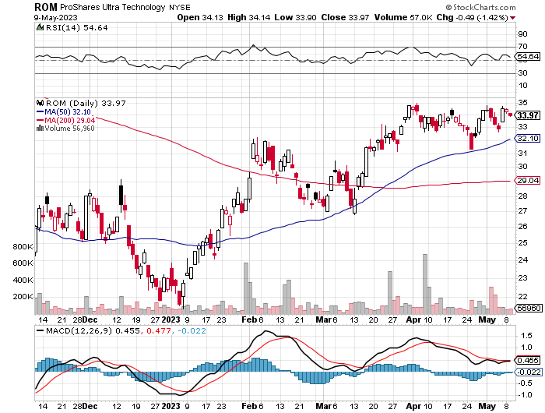
ProShares Ultra Technology ETF (ROM) – 2X Long Technology ETF took profits on long 10/$62-65 call spread

Slide 44
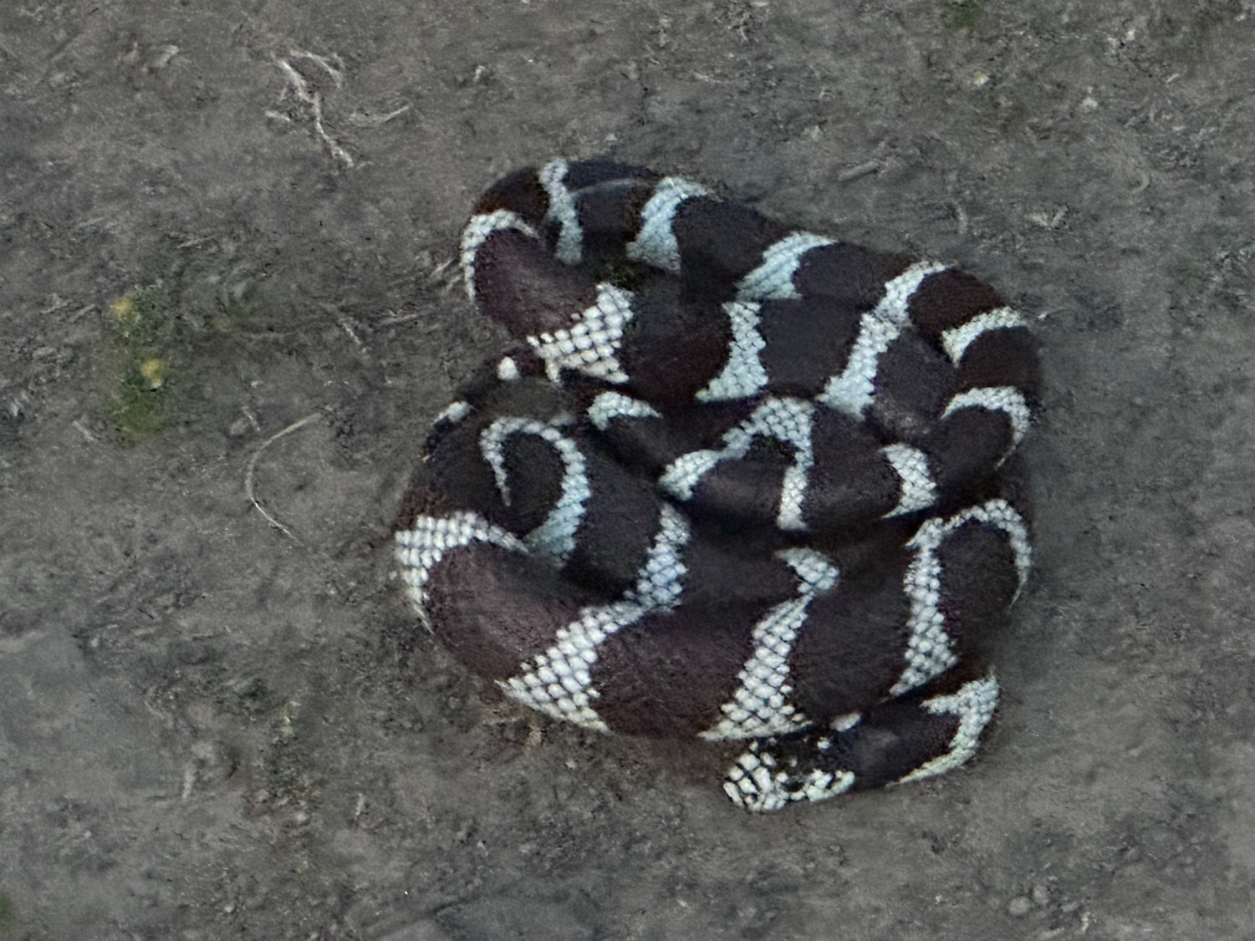

Slide 45
The Second Half of the Barbell
*Bets on a domestic recovery in 2022 Q4 *Upside potential in 2022 far greater than tech *Some of these have not moved for 5 or 10 years *Focuses on economically sensitive cyclical industries *Makes a great counterweight to high-growth technology *We could spend all of next year rotating between the two groups

Slide 46
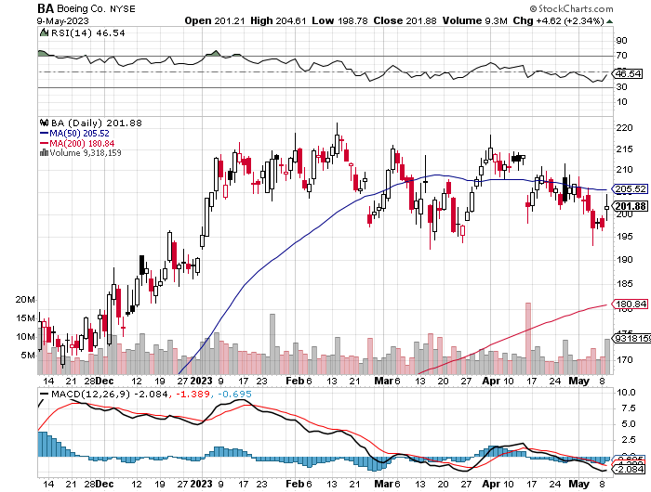
Boeing (BA) – 737 MAX Production Increases from 31 to 37 Boeing Lands Blockbuster 300 Plane Order, from Ireland’s Ryan Air worth $40 billion took profits on long 5/$17-$175 call spread

Slide 47
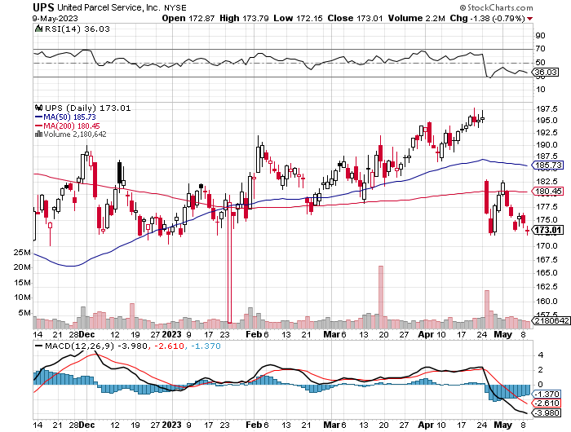
Package Delivery- United Parcel Service (UPS) - took profits on long 11/$130-$140 call spread

Slide 48
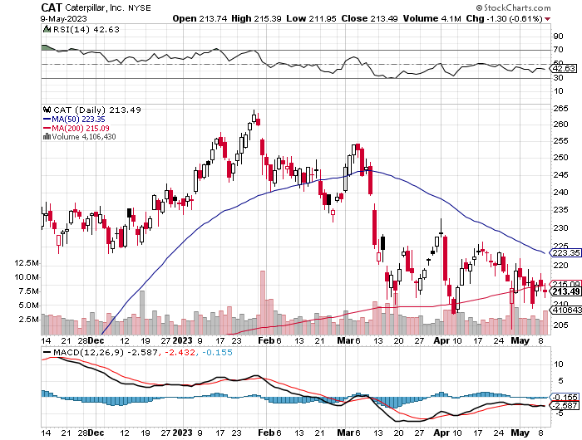
Caterpillar (CAT)- Ag + Infrastructure + Housing Raises Dividend by 50% took profits on long 12/$145-$150 call spread took profits on long 11/$125-$135 call spread

Slide 49
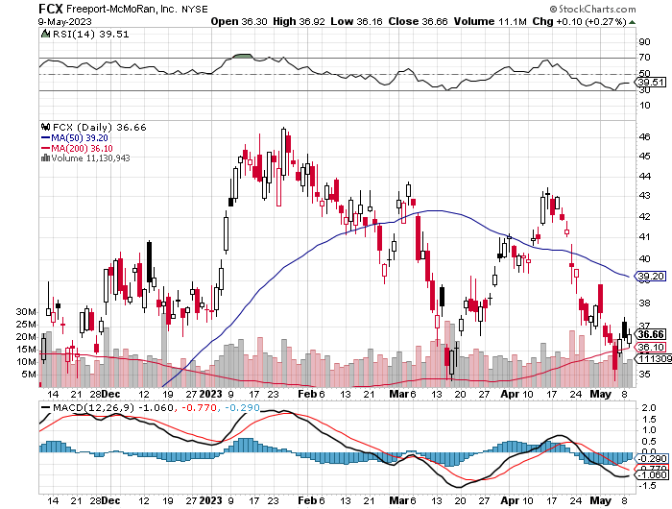
Freeport McMoRan - (FCX)- Coming Copper Crisis took profits on long 4/$30-$33 call spread took profits on long 10/$20-$23 call spread

Slide 50
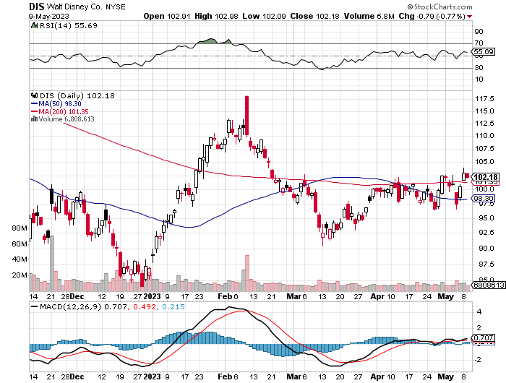
Walt Disney (DIS) - Not a recession play stopped out of long 10/$165-$175 call spread took profits on long 3/$170-$180 call spread

Slide 51
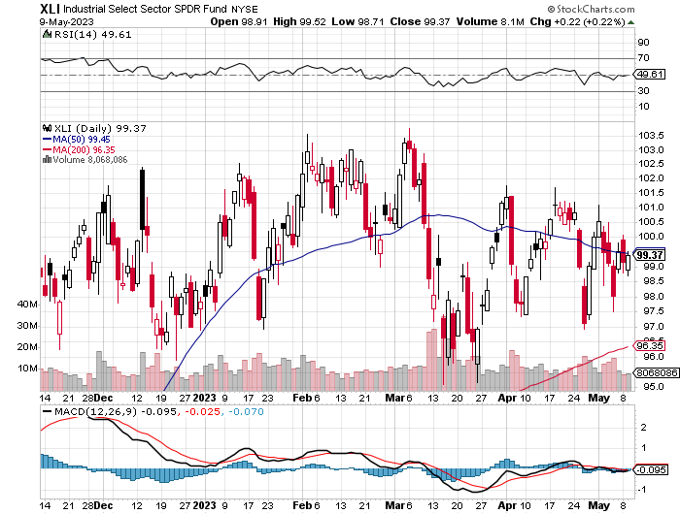
Industrials Sector SPDR (XLI)- (GE), (MMM), (UNP), (UTX), (BA), (HON)

Slide 52
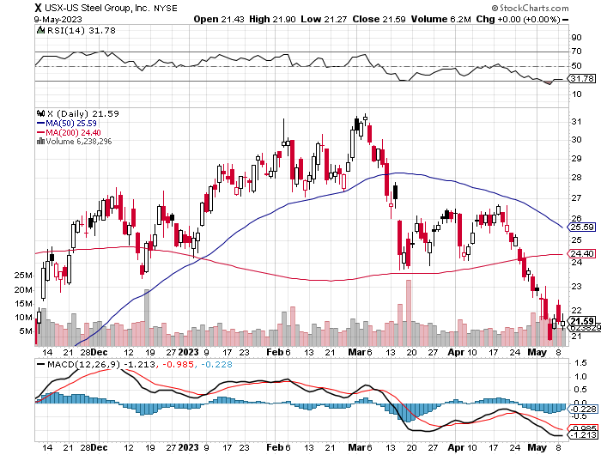
US Steel (X) – Commodity Boom and Wartime boost

Slide 53
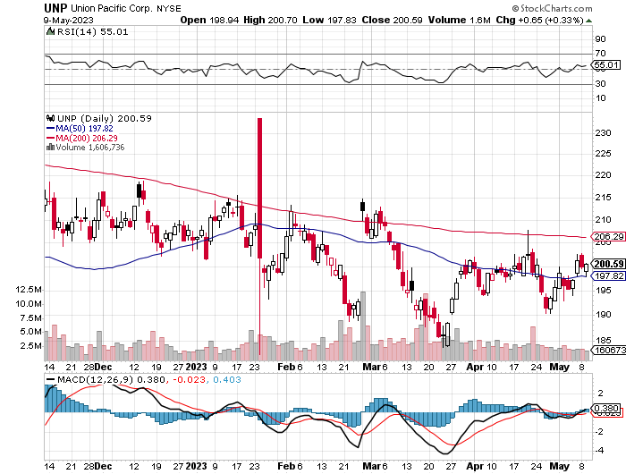
Union Pacific RR (UNP)- Big Stuff to Ship took profits on long 5/$200-$210 call spread took profits on 11/$150-$160 call spread

Slide 54
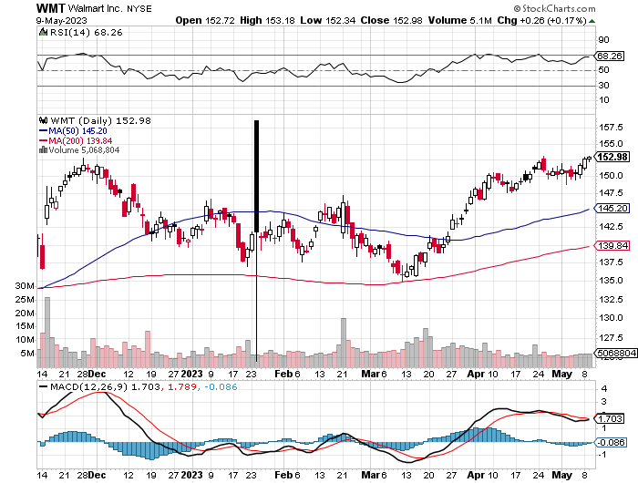
Wal-Mart (WMT)- took profit on Long 11/$125-$130 bear put spread took profit on Long 10/$119-$121 bear put spread took profits on Long 8/$114-$117 bear put spread

Slide 55
Delta Airlines (DAL) – Travel is Back!

Slide 56
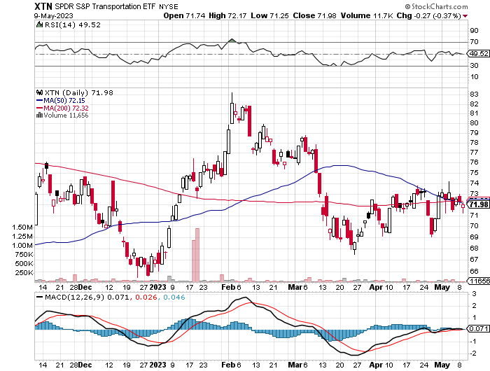
Transports Sector SPDR (XTN)- Worst Hit Sector (ALGT), (ALK), (JBLU), (LUV), (CHRW), (DAL)

Slide 57
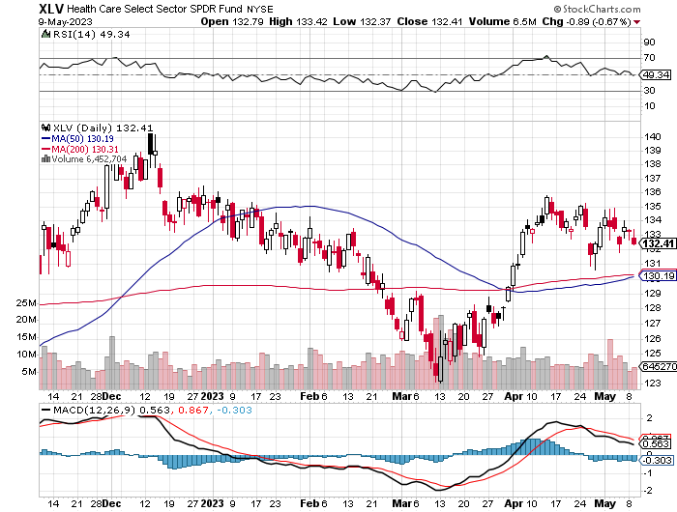
Health Care Sector (XLV) (JNJ), (PFE), (MRK), (GILD), (ACT), (AMGN)

Slide 58
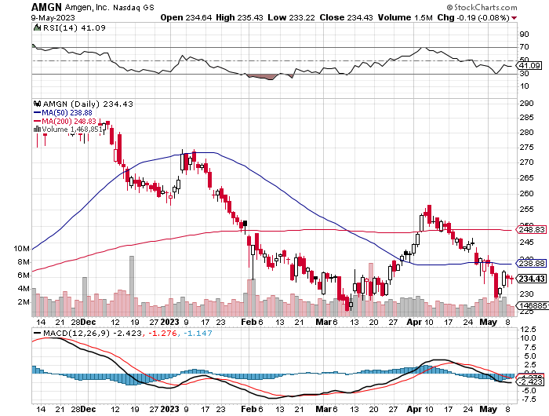
Amgen (AMGN) took profits on long 11/$185-$200 bull call spread

Slide 59
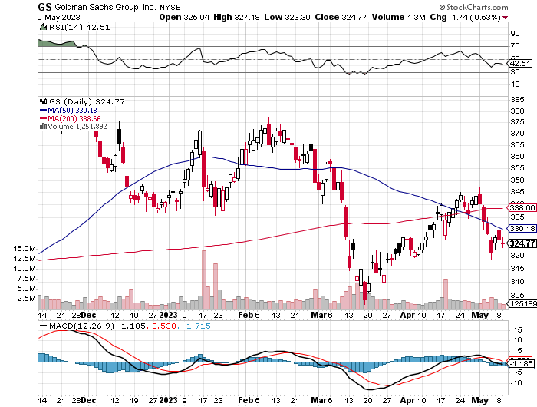
Goldman Sachs (GS) – Highest Capital ration net of mark to market took profits 12/$330-$350 call spread took profits 11/$330-$350 call spread stop loss on long 11/$385-$395 call spreads

Slide 60
Morgan Stanley (MS) – Highest Capital ration net of mark to market took profits on long 4/$65-$70 call spread

Slide 61
JP Morgan Chase (JPM) - Highest Capital ration net of mark to market took profits on long 4/$105-$115 call spread

Slide 62
Bank of America (BAC) – Bank of America Rips, on a great earnings report took profits on long 4/$20-$23 call spread

Slide 63
Citigroup (C) – took profits on long 4/$30-$35 call spread

Slide 64
Charles Schwab (SCHW) – No Risk Taking – is all fee business took profits on long 4/$30-$35 call spread

Slide 65
Interactive Brokers (IBKR) – Best Risk Control took profits on long 4/$60-$65 call spread

Slide 66
SPDR Metals & Mining ETF (XME) – long 2/$28-$30 call spread

Slide 67
Blackrock (BLK)-Asset Collection Boom took profits on long 3/$770-$790 call spread took profits on long 3/$310-$340 call spread

Slide 68
Visa (V) – “Touchless” Bitcoin Drag Transaction grew by an inflationary 10% back to pre-pandemic levels took profits on long 10/$160-$170 bull call spread took profits on long 6/$150-$160 bull call spread

Slide 69
Consumer Discretionary SPDR (XLY) (DIS), (AMZN), (HD), (CMCSA), (MCD), (SBUX)

Slide 70
Berkshire Hathaway (BRKB)- Natural Barbell operating earnings up 12.6% in Q1 took profits on long 4/$260-$270 call spread took profits on long 1/$290-$300 call spread, took profits on long 10/$220-$230 call spread, took profits on long 7/$220-$230 call spread, took profits on long 7/$220-$230 call spread took profits on long 6/$260-$270 call spread

Slide 71
Europe Hedged Equity (HEDJ)-

Slide 72
Japan (DXJ)-

Slide 73
Emerging Markets (EEM) - Pro trade, Weak Dollar, Long Recovery Play

Slide 75
Bonds – More Default Fears
*Yellen Warns of Economic Catastrophe, if the debt ceiling is not raised *Congress has raised the debt ceiling 98 times in 106 years, meaning there really isn’t a debt ceiling *It’s really and antiquated housekeeping measure which has been turned into a political tool to pay for spending that has already been completed *Ten-year US Treasury yields back up to 3.55% *Keep Buying 90-Day T-Bills, now pushing a 5.2% risk free yield *Still looking like 2.50% yield by end 2023 *Keep buying (TLT) calls, calls spreads and LEAPS on dips but only on dips *Junk bond ETF’s (JNK) and (HYG) are a great high yield play

Slide 76
Treasury ETF (TLT) – long 5/$98-$101 call spread took profits on long 5/$97-$100 call spread, long 2/$98-$101 call spread, took profits on long 4/$96-$99 call spread took profits on long 4/$113-$116 put spread, took profits on long 4/$114-$117 put spread

Slide 77
Ten Year Treasury Yield ($TNX) – 3.37%

Slide 78
Junk Bonds (HYG) 8.30% Yield to Maturity

Slide 79
Municipal Bonds (MUB) 3.27% Yield-

Slide 80
Emerging Market Debt (ELD) 6.83% Yield-

Slide 81
2X Short Treasuries (TBT)-Out of Favor

Slide 83
Foreign Currencies – Weak Dollar
*Dollar has peaked, undercut by recession fears *Dollar selloff will accelerate on any debt default *Any strength in the dollar will be temporary *Look for new dollar lows by end 2023 *Buy (FXE), (FXY), (FXB), (FXA) on dips

Slide 84
THE MAD HEDGE FUND TRADER
Australian Dollar (FXA) - Major Long-Term Bottom is In Targeting Parity – A call option on a global synchronized recovery
1:1
BUY

Slide 85
Japanese Yen (FXY)
2023 Target 25%

Slide 86
Euro (FXE)-
2023 Target 25%

Slide 87
British Pound (FXB)-
2023 Target 15%

Slide 88
Emerging Market Currencies (CEW)
2023 Target 40%

Slide 90
Energy & Commodities –New Lows
*The Oil Collapse is Signaling a Recession, as is weakness in all other commodities, even lithium *Texas tea has plunged 22% in three weeks to a new two year low at $62 *It’s one of the worst performing asset classes of 2023 *Widespread EV adoption is finally making a big dent, as are the price wars there *OPEC Plus production cuts were unable to stem the decline *Buy (USO) on dips as an economic recovery play * China Expects LNG Price Spike Later this Year, due to coming supply shortages and a recovering economy

Slide 91
Oil-($WTIC)

Slide 92
United States Oil Fund (USO)

Slide 93
Energy Select Sector SPDR (XLE)-No Performance! (XOM), (CVX), (SLB), (KMI), (EOG), (COP)

Slide 94
ExxonMobile (XOM)- took profits on long 12/$120-$125 put spread

Slide 95
Occidental Petroleum (OXY)- Buffet’s a Buyer long 2/$55-$60 call spread, took profits on long 12/$77.50-$82.50 put spread

Slide 96
Natural Gas (UNG) - Long January 2025 $14 - $15 Call Spread LEAPS

Slide 97
Freeport McMoRan (FCX) - Codelco Sees Profit Slump, the world’s largest copper producer based in Chile

Slide 98
Cameco (CCJ) - took profits on long 5/$20-$23 bull call spread

Slide 100
Precious Metals – Lithium Shock
*Chile Nationalizes the Lithium Industry, sending (SQM) and ALB) into a tailspin *The official reason is to make the industry more efficient *The real reason is so the government can skim off more profits in this exploding industry *Chile is the world’s second largest producer of lithium essential for EV batteries. *Gold headed for $3,000 by 2024, but back off from new all-time highs *The new drivers are soon to fall interest rates and the demise of crypto *Russia and China are also stockpiling gold to sidestep international sanctions *A Severe Short Squeeze in Copper is Developing, leading to a massive price spike later in 2023

Slide 101
Gold (GLD) - Deflation call took profits on long 5/$165-$170 bull call spread

Slide 102
Market Vectors Gold Miners ETF- (GDX) –

Slide 103
Barrick Gold (GOLD) took profit on long 1/$15.50-$16.50 call spread

Slide 104
Newmont Mining- (NEM)- took profits on long $55-60 call spread

Slide 105
Silver- (SLV)- took profits on long 11/$19-$20 call spread

Slide 106
Silver Miners - (SIL)-

Slide 107
Wheaton Precious Metals - (WPM)- took profits on long 1/$36-$39 call spread

Slide 108
Platinum- (PPLT)- 556,000-ounce shortage this year took profits on long 1/$36-$39 call spread

Slide 110
Real Estate – Signs of Life
* Home Prices are Still Rising, even in the worst hit markets, like San Francisco *Notice that the Case Shiller National Home Index YOY numbers never turned negative *Extreme inventory shortages make this easy because of homeowners trapped by their ultra-low mortgage interest rates *Investors are trying to front run the next leg of the bull market in residential real estate, which should start when interest rates plunge at yearend. * Pending Home Sales Plunge 5.2% * New Home Sales Pop, to 683,000 * S&P Case Shiller Rises 2%, in February, the first time in nine months *At a 2.6% YOY rate we are seeing the slowest price growth in 11 years.

Slide 111
S&P Case Shiller Plunges S&P Case Shiller Drops to +2.0%, in February with its National Home Price Index Miami gained +10.6%, Tampa +7.7%, and Atlanta +6.6%.

Slide 112
Crown Castle International (CCI) – 4.95% yielding cell phone tower REIT

Slide 113
US Home Construction Index (ITB) (DHI), (LEN), (PHM), (TOL), (NVR)

Slide 115
Trade Sheet- So What Do We Do About All This?
*Stocks – buy the big dips at bottom of range, ………………sell big rallies to hedge holdings *Bonds – buy dips, sell extreme rallies *Commodities-buy dips *Currencies- sell dollar rallies, buy currencies *Precious Metals – buy dips *Energy – buy dips *Volatility - sell short over $30 *Real estate – buy dips

Slide 116
Next Strategy Webinar 12:00 EST Wednesday, May 24 from Silicon Valley, CA email me questions at support@madhedgefundtrader.com
Good Luck and Good Trading!
Notes:
*

