Slide 1
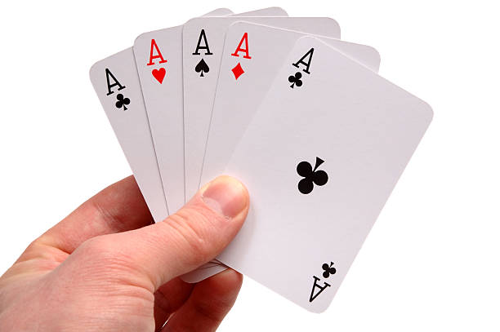
The Mad Hedge Fund Trader “Big Tech Melt up”
With John Thomas Silicon Valley, CA, May 22, 2023 www.madhedgefundtrader.com
Notes:
*

Slide 3
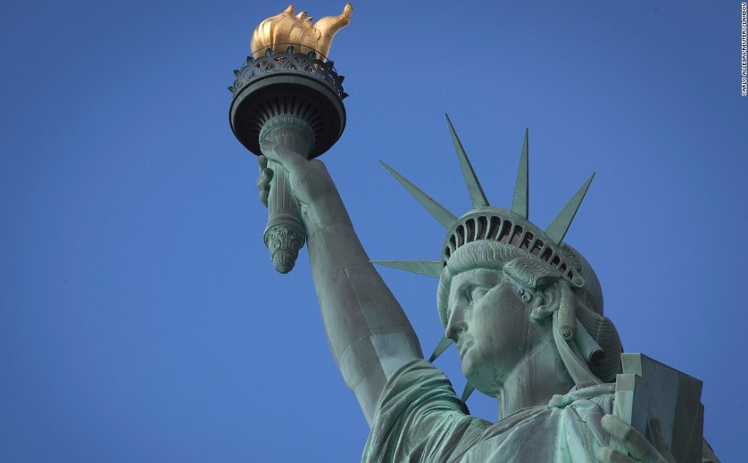
THURSDAY, JULY 6 NEW YORK STRATEGY LUNCHEON
*An excellent meal will be followed by a wide-ranging discussion and an extended question and answer period *The lunch will be held in an exclusive private club in Midtown Manhattan with a strict dress code *please go to my online store at http://www.madhedgefundtrader.com/store and click on “luncheons.” Tickets are available for $299

Slide 4
Friday July 13, 2023 Seminar at Sea
*Cunard Line’s flagship, the elegant and spacious Queen Mary II, on an eastbound transatlantic cruise *The Ship departs New York at 12:00 AM on July 7, 2023, and arrives at Southampton on July 14 *Guests will be responsible for booking their own cabin through Cunard *Three dinners during the voyage will be black tie *Customers are required to book their own cabins and return flights from England *The Cunard cruise number is M319

Slide 5
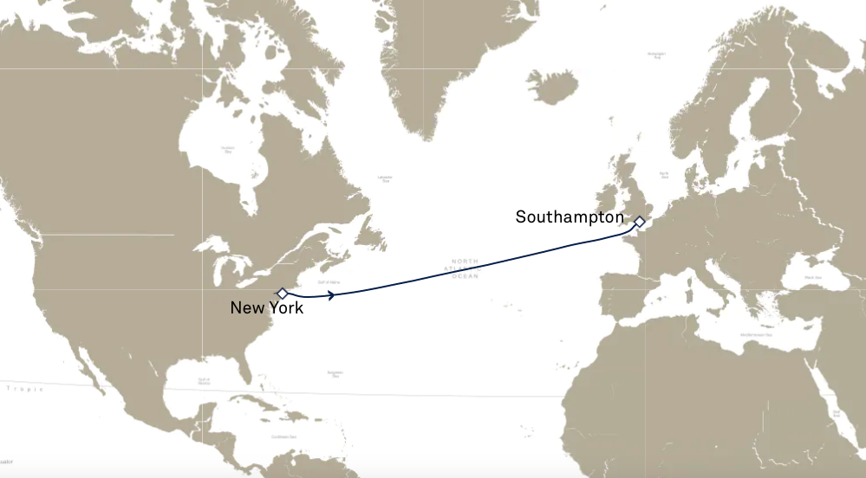

Slide 6
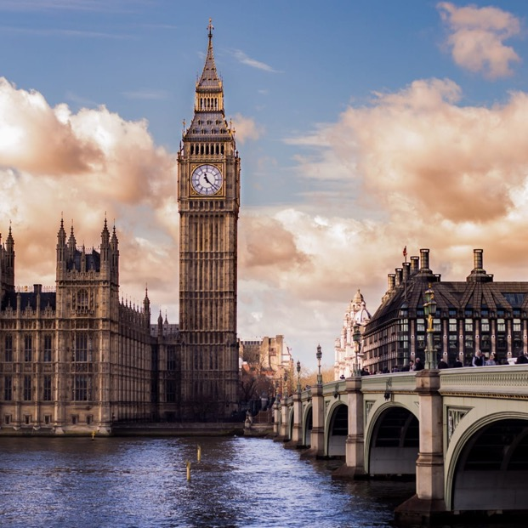
THURSDAY, JULY 19 LONDON STRATEGY LUNCHEON
*An excellent meal will be followed by a wide-ranging discussion and an extended question and answer period *The lunch will be held in an exclusive private club in Midtown Manhattan with a strict dress code *please go to my online store at http://www.madhedgefundtrader.com/store and click on “luncheons.” Tickets are available for $298

Slide 7
Trade Alert Performance New All Time Highs! 31 out of 33 trade alerts profitable
*January +22.35% Final *July +3.98% Final *February +3.41% Final *August +5.13% Final *March +20.85% Final *September +9.72% Final *April +15.13% Final *October +5.69% Final *May +2.70% MTD *November +8.31 Final *June +5.91% Final *December +0.95% Final *2022 Final +84.63% compared to -18.63% for the S&P 500 *2023 Year to Date +64.24%, versus +10.86% for the S&P 500 +661.43% since inception *Average annualized return of +661.43% for 15 years

Slide 8
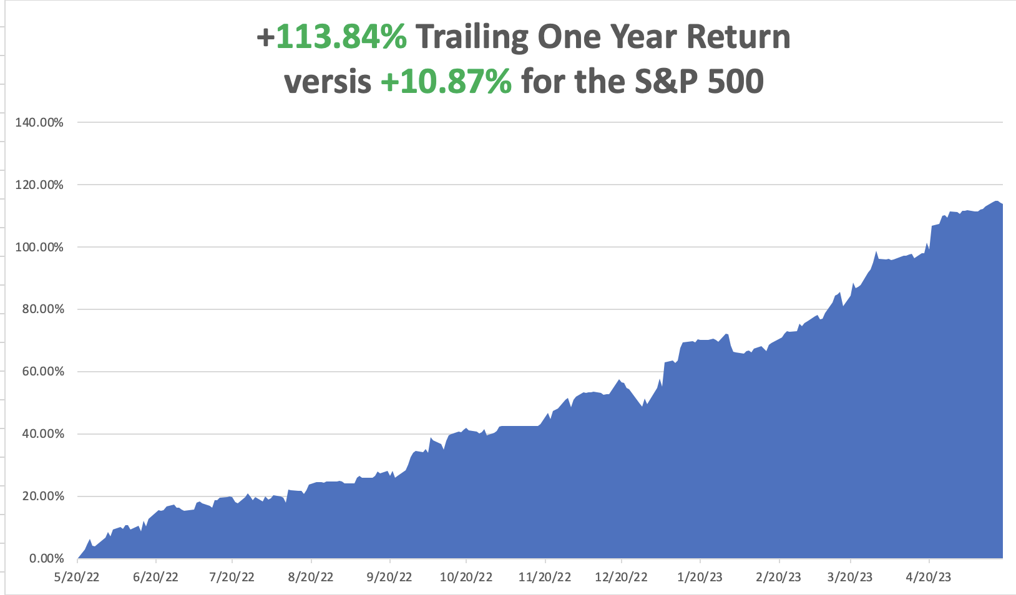

Slide 9
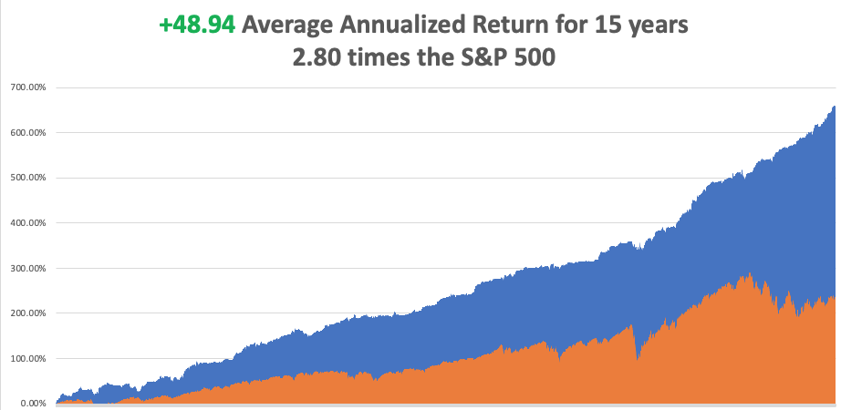

Slide 10
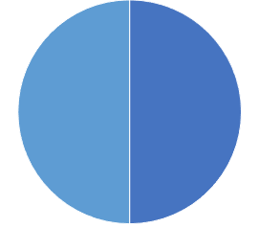
Portfolio Review 10% Long, 10% Short, 80% cash with VIX at $17 no new positions
Current Capital at Risk
Risk On
(TSLA) 6/$120-$130 calll spread | 10.00%
Risk Off
(TSLA) 6/$210-$220 put spread | -10.00%
Total Net Position | 0.00%
Total Aggregate Position | 20.00%
Expiration Value +65.68%

Slide 11
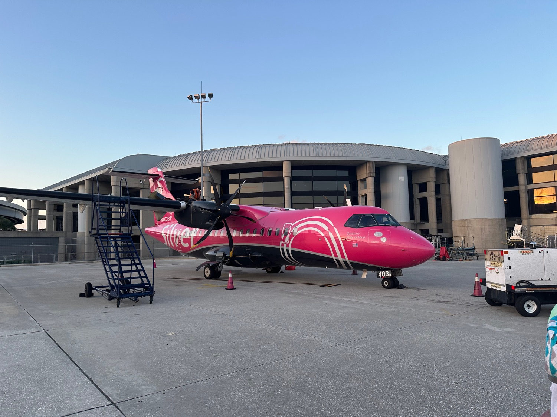

Slide 12
The Method to My Madness
*Debt Ceiling debacle has frozen all markets, but volatility recovers to $21 *Bonds have given up all 2023 gains taking yields back up from 3.30% to 3.75% *Markets are out of synch with risk, worse case scenario is a 50% probability but is in no way discounted *In the meantime, seasonals have turned sharply against all risk taking *Trading volumes are shrinking by the day *Summer will present the best buying opportunities of the year *Precious metals and commodities should be at the top of and “BUY” list to cash in on an economic recovery on any dip *In this market patience is a virtue, let the market come to you

Slide 13
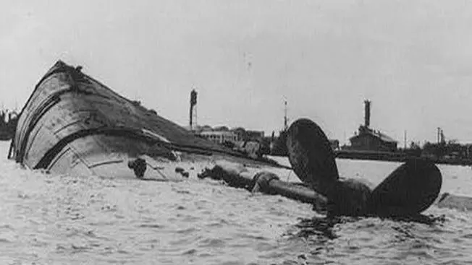
The Global Economy – Rolling Over
* CPI Hits 4.9% YOY, after the 0.40% report for April. * Leading Economic Indicators Gave up 0.6% in April, to 107.5 (2016 is the baseline at 100) as rolling over economic data heighten recession risks * Philadelphia Fed Manufacturing Index Collapses, down from 20 to 10.5, approaching a three-year low * Retail Sales Drop 0.4% in April *University of Michigan Consumer Sentiment Index Falls, down 1.2% to a new six month low * Wholesale Prices Rise a Weak 0.2% in April, as shown by the Producer Price Index, another nail in inflation’s coffin *US Business Activity Hits 13 Month High, according to S&P Global and its Flash PMI Index, up from 53.4 to 54.5

Slide 14
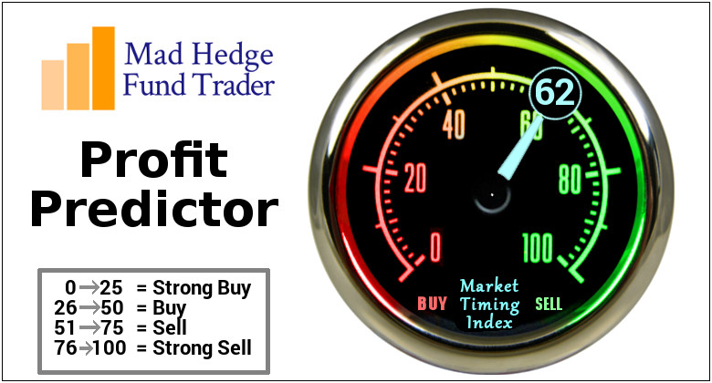
The Mad Hedge Profit Predictor Market Timing Index – Neutral to Rich An artificial intelligence driven algorithm that analyzes 30 different economic, technical, and momentum driven indicators

Slide 15
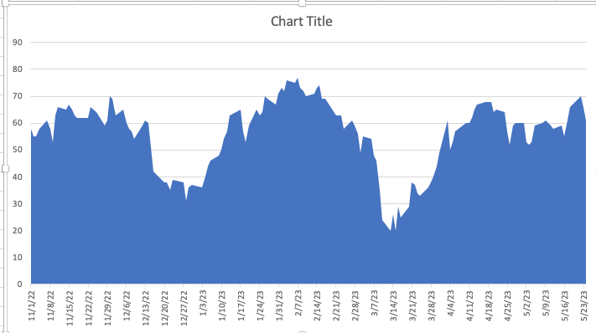
Risk at 7 Month High
SELL
BUY

Slide 16
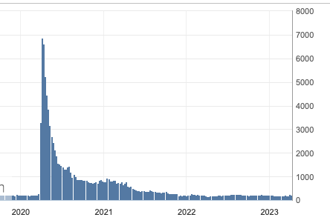
Weekly Jobless Claims – Falling 242,000 – DOWN 22,000 – 22,000 fraudulent claims last week

Slide 17
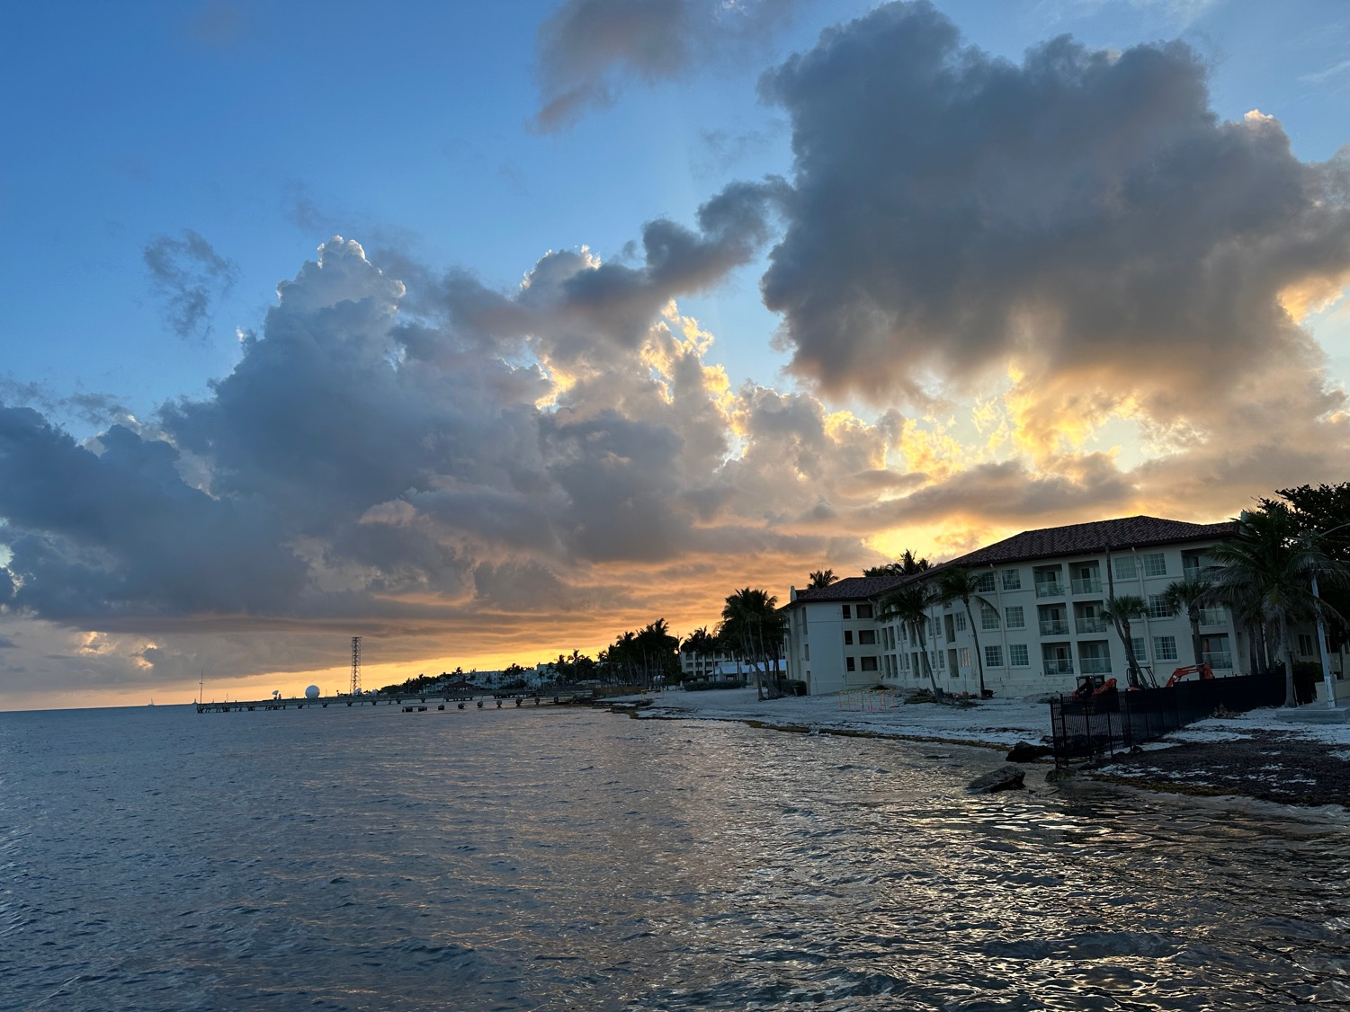

Slide 18
Stocks – The Five Stock Market
*There’s a 1,000 Drop in the Market Waiting to Happen. That’s what happens when the market rallies on a Biden McCarthy debt ceiling deal, which McCarthy’s own party then votes down. *Equity Allocations are at 15 Year Low, with massive amounts of cash in 90-day T-bills. Look for money to pour into stocks in the second half, as per the Mad Hedge 2023 Playbook * Insiders Loading the Boat with Regional Bank Stocks. If the SEC bans short selling of bank stock, which they should, then raids on these shares by hedge funds end. Small bank shares then double. * First Solar Rockets 26%, on an easing of US Treasury rules on what defines “Made in America.” *Consensus (SPY) earnings are currently $220 a share giving a moderate price/earnings multiple of 18.77X *FANGS to Rise 50% by Yearend, says Fundstrat’s ultra-bull Tom Lee *All technical indicators are now flashing red. Seasonals
are now turning strongly against stocks *Looking for flat first half, strong second half to take us to S&P 500 4,800 by yearend

Slide 19
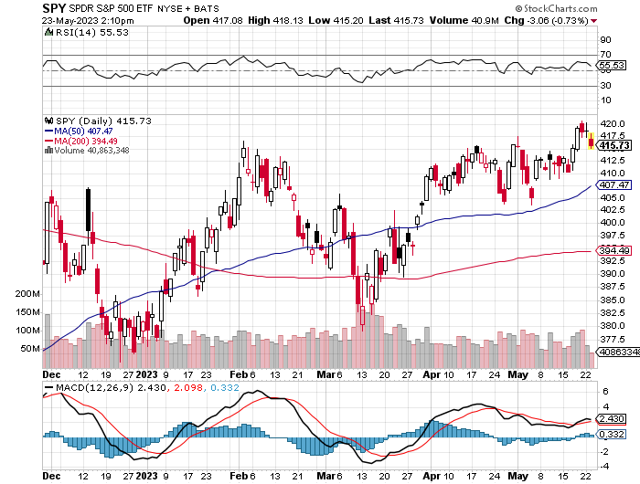
S&P 500 – Sell in May took profits on long 5/$420-$430 put spread, took profits on long 1/$420-$430 put spread, took profits on long 11/$420-$430 put spread
$480 2023 Target
$430 +21% Rally
$375 -12.8% Pull Back
The Bottom $355 Down -26%

Slide 20
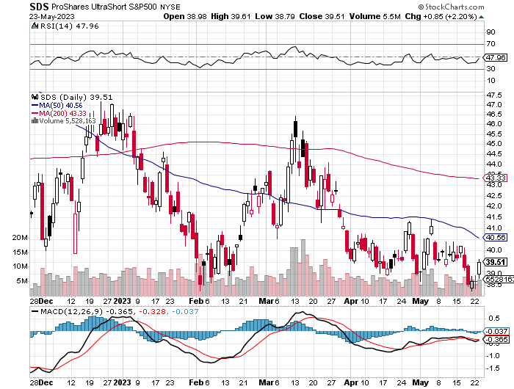
ProShares Ultra Short S&P 500 (SDS)- a great hedge for long stocks and bonds long 2X position has a hedge against longs and bond shorts

Slide 21
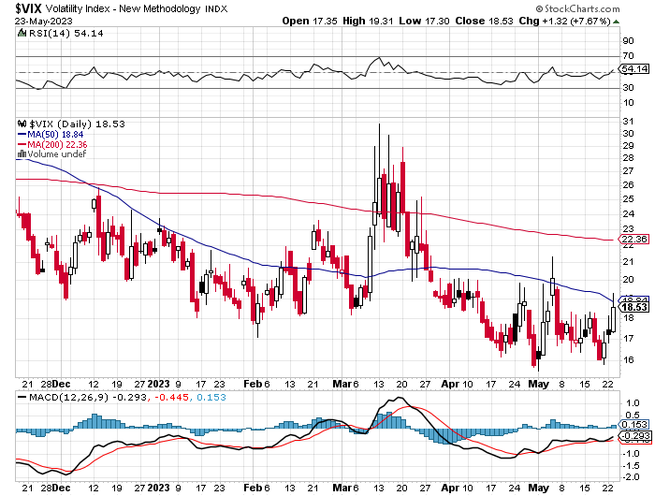
($VIX) – Bargain of the Century

Slide 22
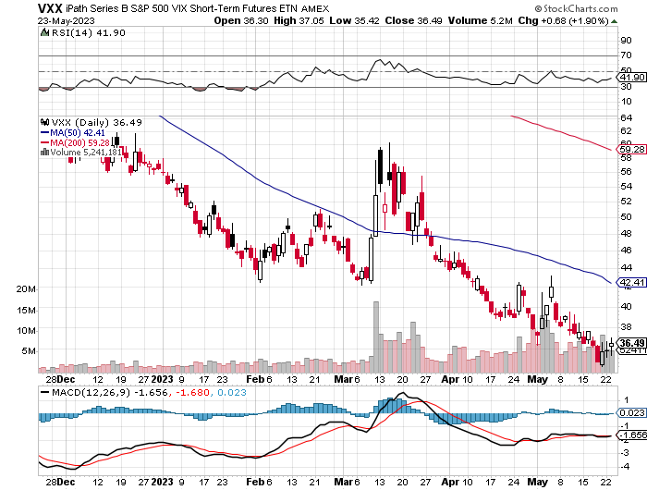
(VXX)-

Slide 23
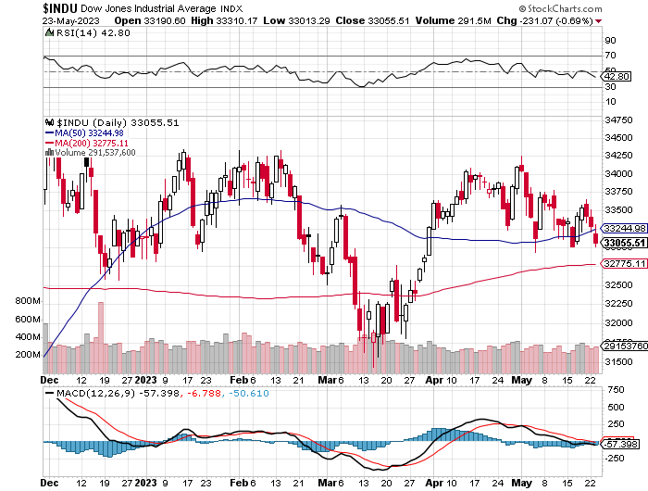
Dow Average ($INDU)-

Slide 24
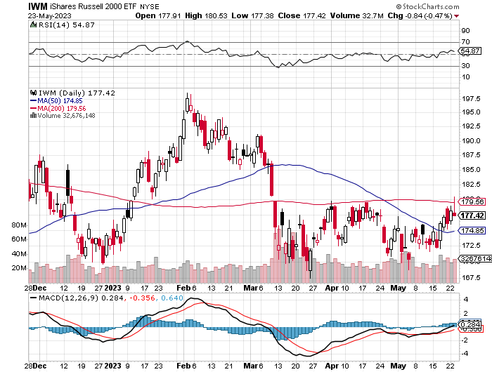
Russell 2000 (IWM)- took profits on Long 10/$137-$142 vertical bull call spread took profits on Long 10/$153-$156 vertical bear put spread

Slide 25
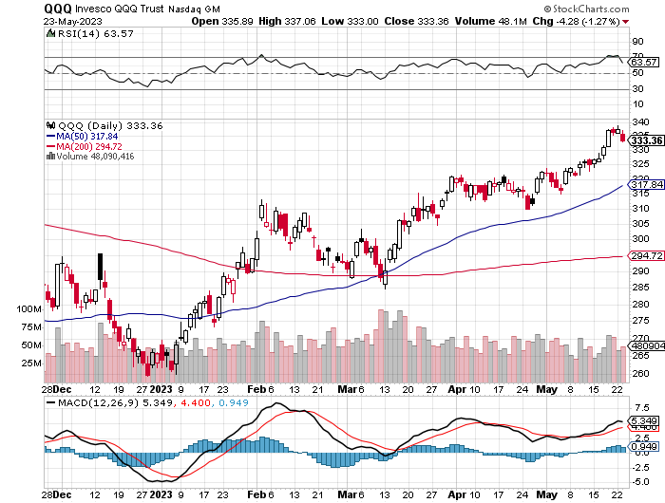
NASDAQ (QQQ) – took profits on Long 5/$335-$345 put spread took profits on long (QQQ) 1/$290-$300 put spread, took profits on long (QQQ) 4/$330-$335 put spread took profits on long (QQQ) 3/$340-$345 put spread, covered long (QQQ) $325-$330 put spread

Slide 26
THE MAD HEDGE FUND TRADER
The Barbell Portfolio
*75% Big Tech – 2% of US workforce, 25% of market cap and 25% of US earnings 25% Domestic Recovery, including: Railroads, airlines, cruise lines, Couriers, steel companies Banks, commodities Construction Credit Card Companies Hotels, casinos Online Ticket Sales

Slide 27
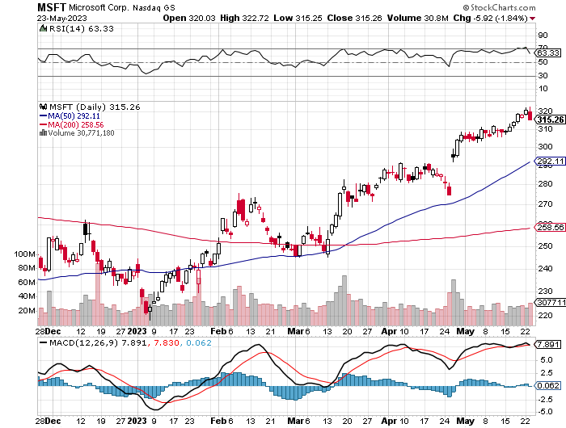
Microsoft (MSFT)- Earnings Beat took profits on 9/$235-$245 call spread, took profits on long 7/$220-$210 call spread, took profits on long 6/$220-$230 call spread, took profits on long 2/$200-$210 bear put spread

Slide 28
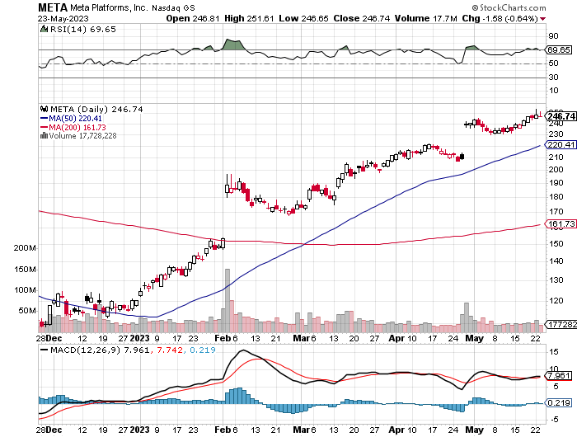
Meta (META)- Soars an Incredible 20% took profits on Long 9/$290-$300 vertical bear put spread stopped out of Long 9/$190-$200 vertical bear put spread

Slide 29
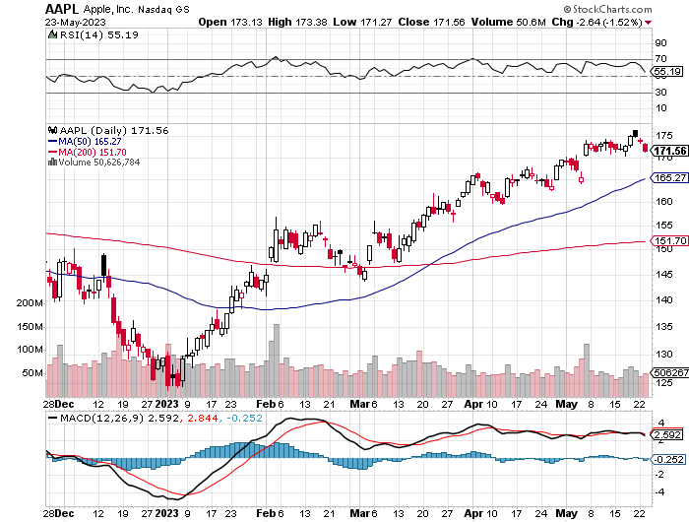
Apple (AAPL) India’s Tata to Build iPhones for Apple took profits on long 1/$145-$155 put spread, Took profits on long 10/$165-$175 put spread took profits on long 6/$155-$165 put spread, stopped out of long 6/$125-135 call spread, took profits on long 6/$110-$120 call spread, took profits on long 2/$180-$190 put spread

Slide 30
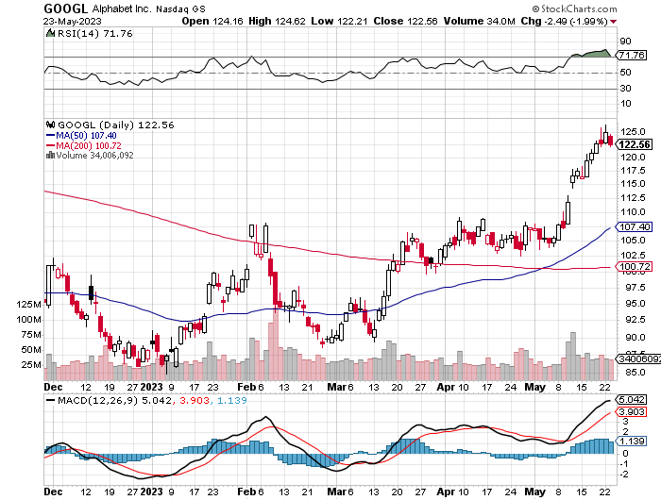
Alphabet (GOOGL) – Google Ramps Up AI Effort took profits on long 12/$1,200-$1,230 bull call spread took profits on long 9/$1,030-$1,080 vertical bull call spread

Slide 31
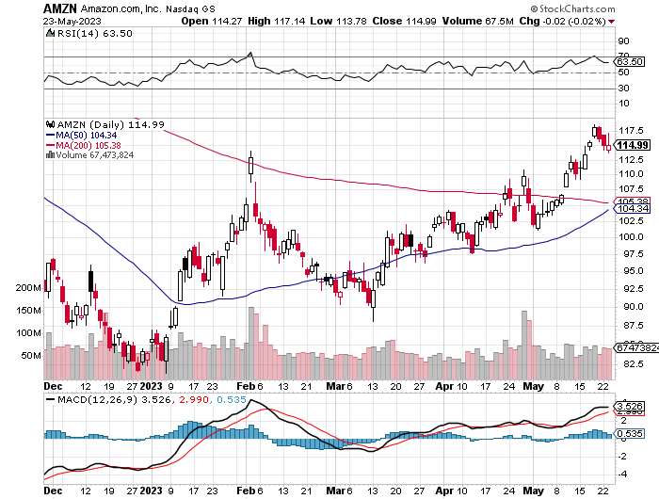
Amazon (AMZN) – took profits on long 2/$3,400-$3,500 bear put spread took profits on long 9/$2,800-$2,900 bull call spread

Slide 32
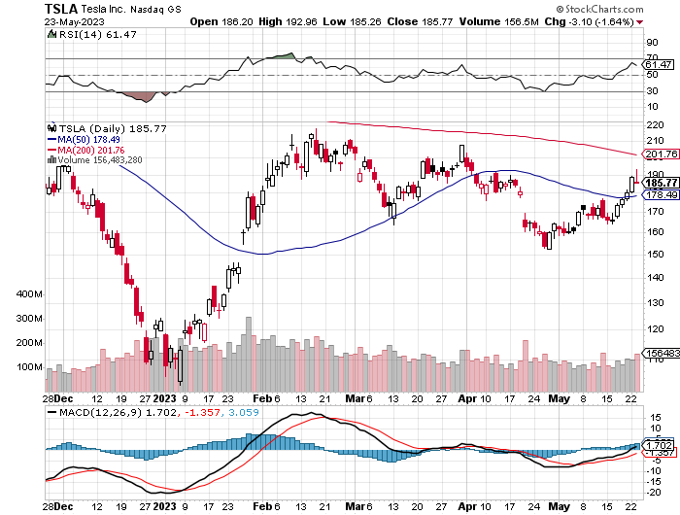
Tesla (TSLA) – Volatility Collapse to 43% Considering an India Factory More Tesla Price Cuts to Come, with swelling inventories forcing Musk’s hand long 6/$120-$130 call spread, long 6/$210-$220 put spread took profits on long 5/$110-$120 call spread, took profits on long 5/$220-$230 put spread took profits on long 4/$130-$140 call spread, took profits on long 4/$250-$260 put spread

Slide 33
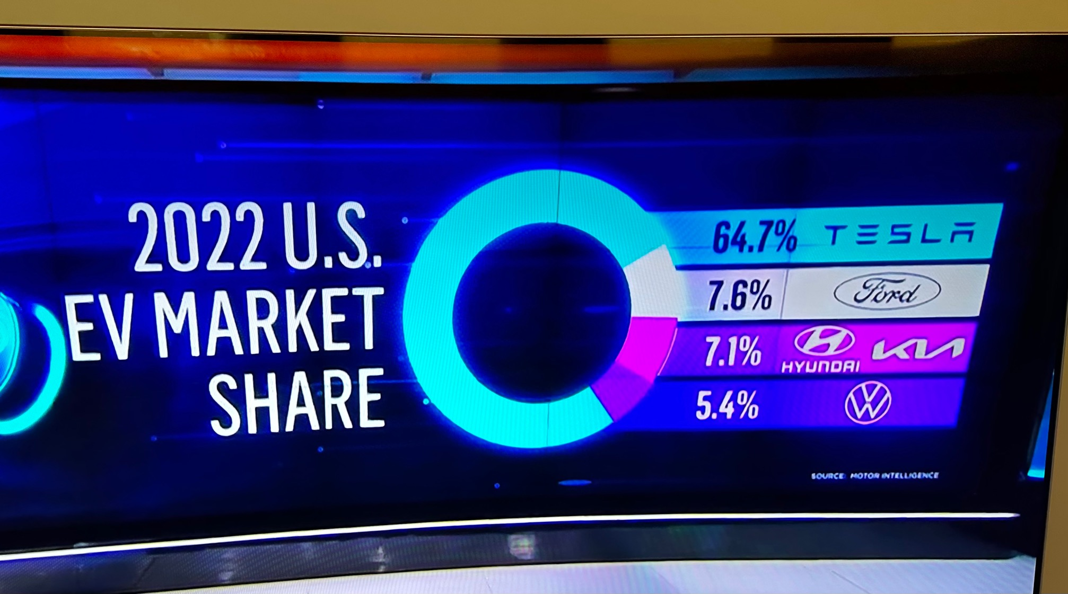

Slide 34
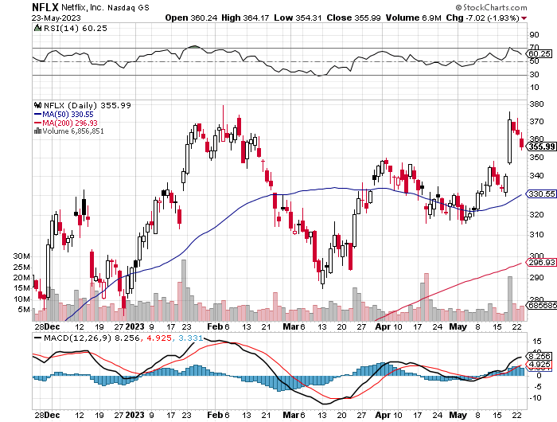
Netflix (NFLX) – Netflix subscribers beat, after a delay in password sharing ban.

Slide 35
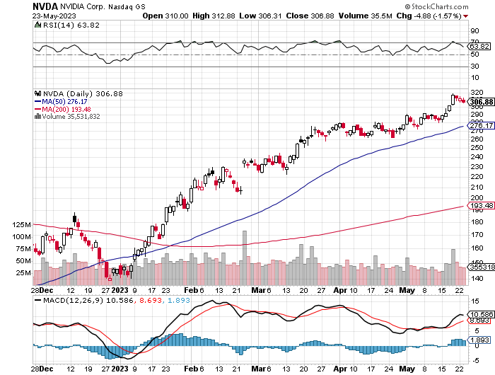
NVIDIA (NVDA) – NVIDIA Could Rise Fivefold in Ten years, say fund managers took profits on long 3/$260-$270 put spread, took profits on long 10/$95-$100 call spread took profits on long 7/$120-$130 call spread, took profits on long 6/$120-$130 call spread

Slide 36
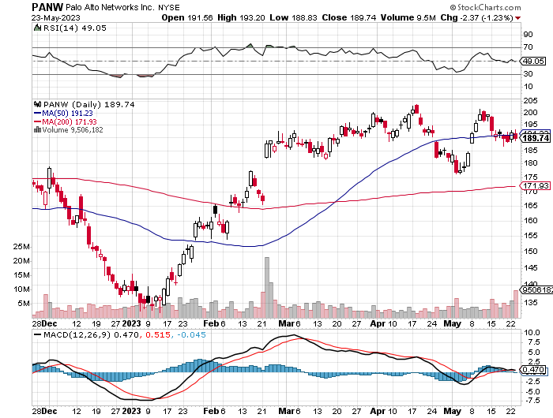
Palo Alto Networks (PANW)- Hacking never goes out of fashion Palo Alto Networks Beats took profits on long 10/$130-$140 call spread

Slide 37
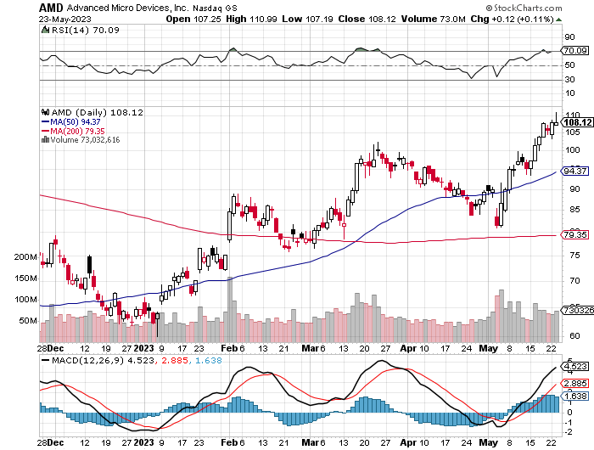
Advanced Micro Devices (AMD)- Recession fears programable logic devices took profits on long 2/$75-$80 call spread

Slide 38
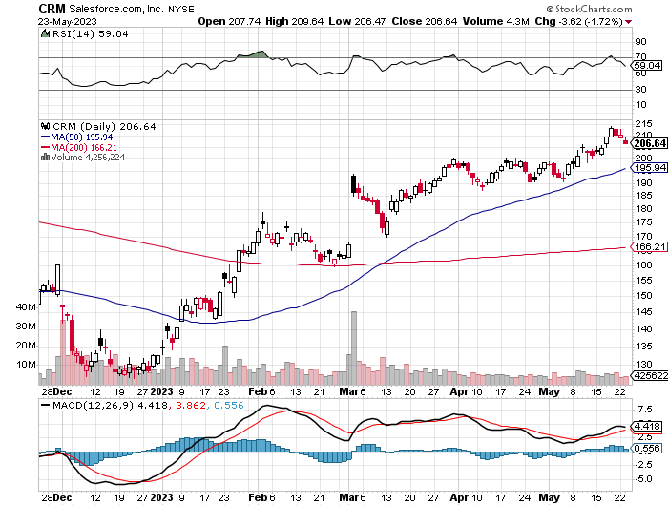
Salesforce (CRM)- Massive Online Migration Salesforce Soars 16%, on better-than-expected guidance took profits on long 9/$125-$130 vertical bull call spread took profits on long 8/$125-$130 vertical bull call spread took profits on long 2/$105-$115 call spread

Slide 39
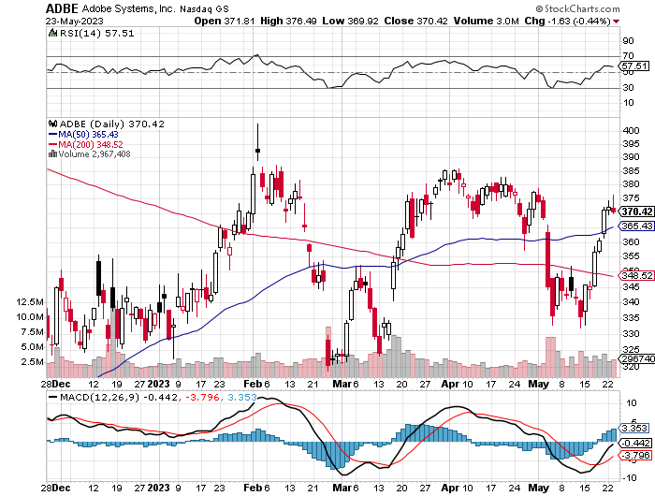
Adobe (ADBE)- Cloud play The Quality Non-China tech play

Slide 40
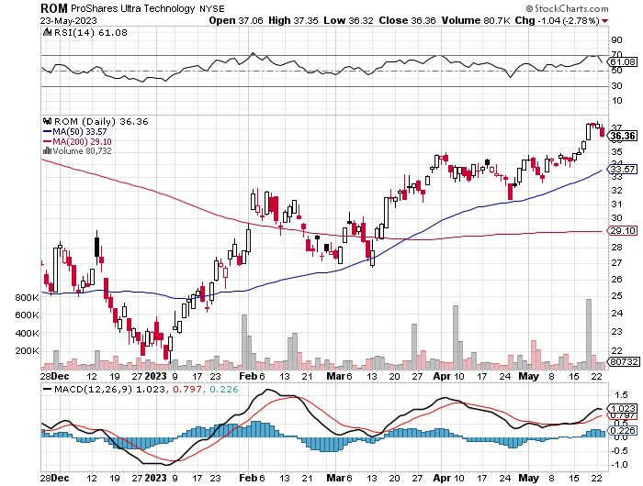
ProShares Ultra Technology ETF (ROM) – 2X Long Technology ETF took profits on long 10/$62-65 call spread

Slide 42
The Second Half of the Barbell
*Bets on a domestic recovery in 2022 Q4 *Upside potential in 2022 far greater than tech *Some of these have not moved for 5 or 10 years *Focuses on economically sensitive cyclical industries *Makes a great counterweight to high-growth technology *We could spend all of next year rotating between the two groups

Slide 43
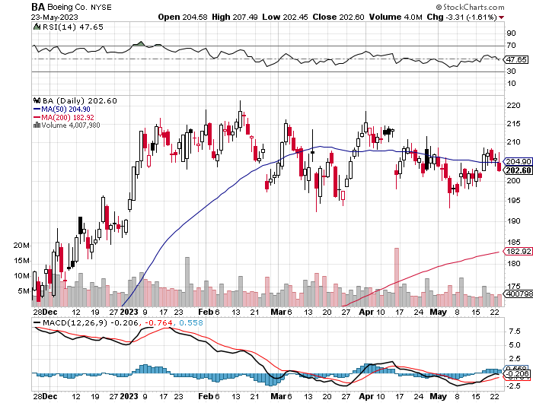
Boeing (BA) – 737 MAX Production Increases from 31 to 37 Boeing Lands Blockbuster 300 Plane Order, from Ireland’s Ryan Air worth $40 billion took profits on long 5/$17-$175 call spread

Slide 44
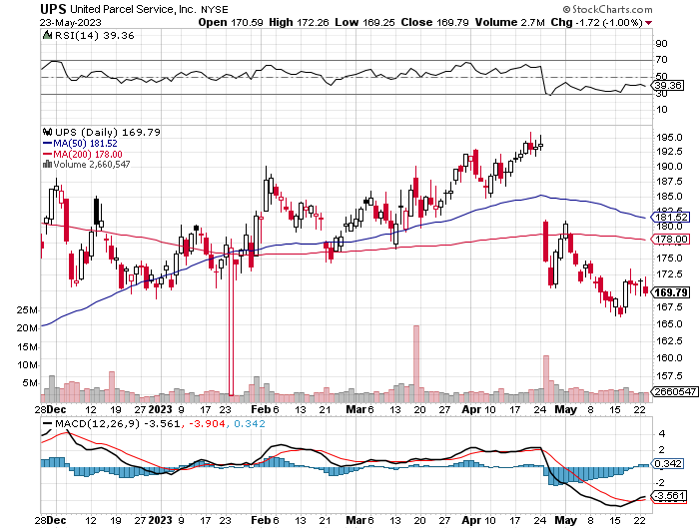
Package Delivery- United Parcel Service (UPS) - took profits on long 11/$130-$140 call spread

Slide 45
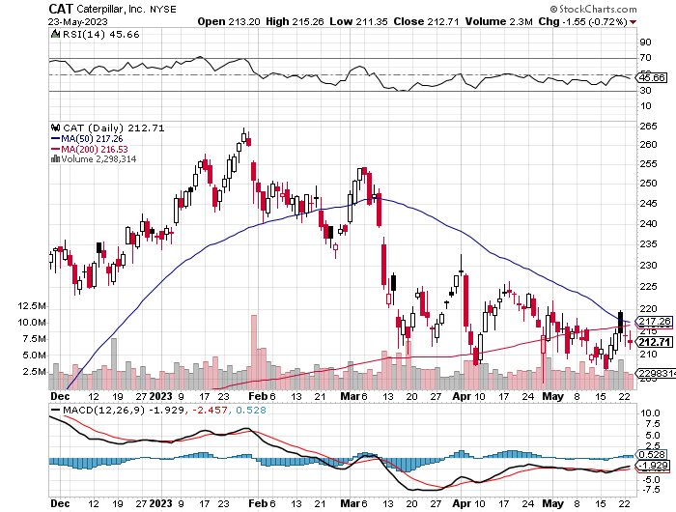
Caterpillar (CAT)- Ag + Infrastructure + Housing took profits on long 12/$145-$150 call spread took profits on long 11/$125-$135 call spread

Slide 46
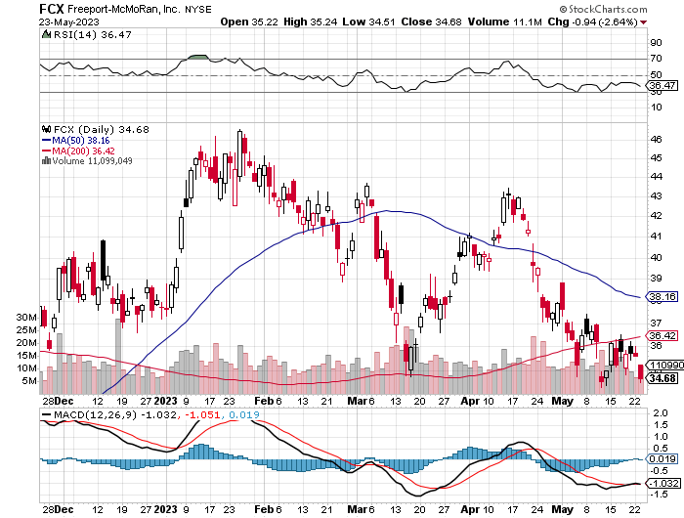
Freeport McMoRan - (FCX)- Coming Copper Crisis took profits on long 4/$30-$33 call spread took profits on long 10/$20-$23 call spread

Slide 47
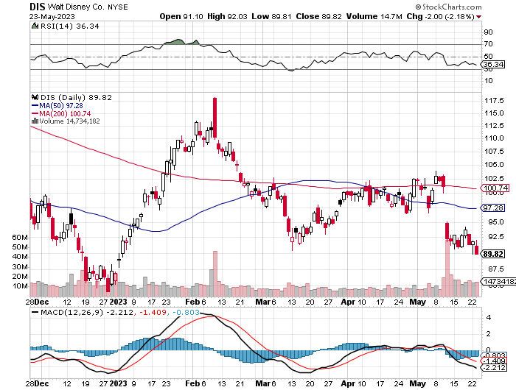
Walt Disney (DIS) - Disney Earnings are Flat, with parks jam packed and maxed out. But streaming in a nosedive, down 4 million subscribers in Q1 at 157.8 million

Slide 48
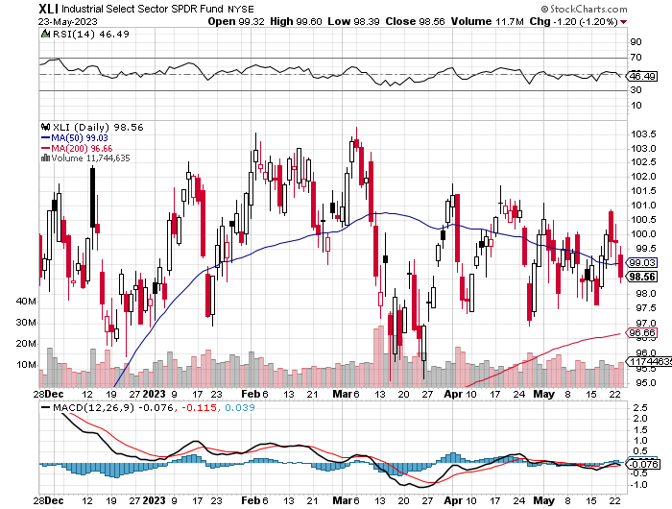
Industrials Sector SPDR (XLI)- (GE), (MMM), (UNP), (UTX), (BA), (HON)

Slide 49
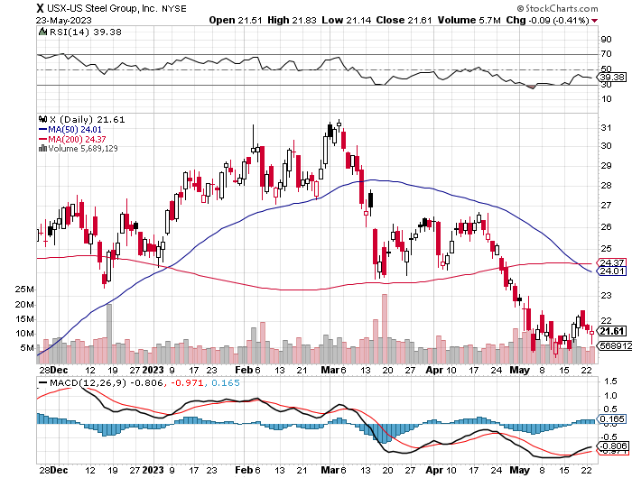
US Steel (X) – Commodity Boom and Wartime boost

Slide 50
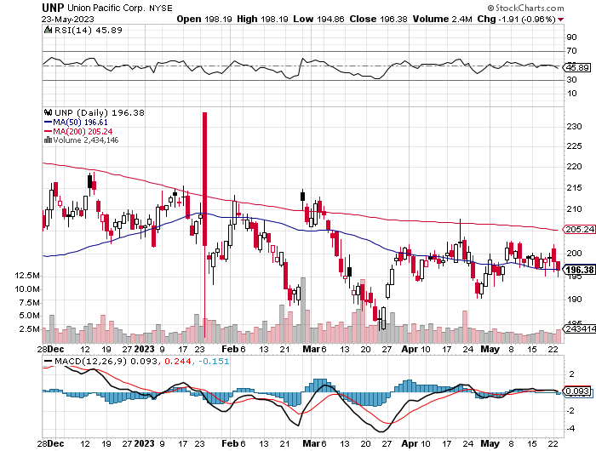
Union Pacific RR (UNP)- Big Stuff to Ship took profits on long 5/$200-$210 call spread took profits on 11/$150-$160 call spread

Slide 51
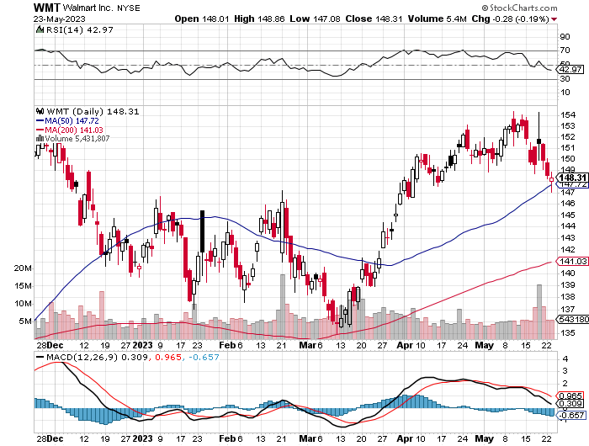
Wal-Mart (WMT)- took profit on Long 11/$125-$130 bear put spread took profit on Long 10/$119-$121 bear put spread took profits on Long 8/$114-$117 bear put spread

Slide 52
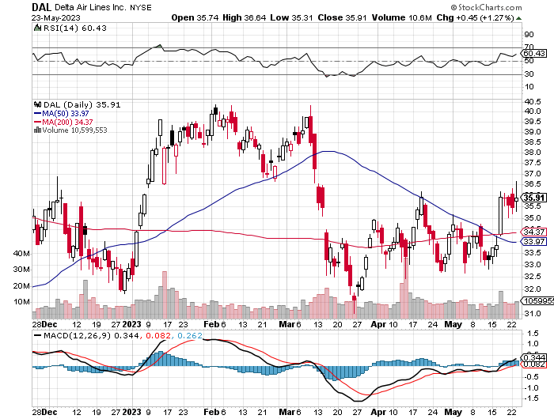
Delta Airlines (DAL) – Travel is Back!

Slide 53
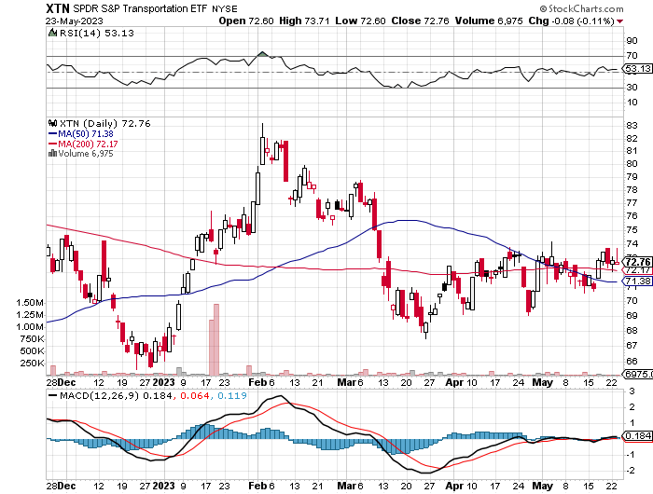
Transports Sector SPDR (XTN)- Worst Hit Sector (ALGT), (ALK), (JBLU), (LUV), (CHRW), (DAL)

Slide 54
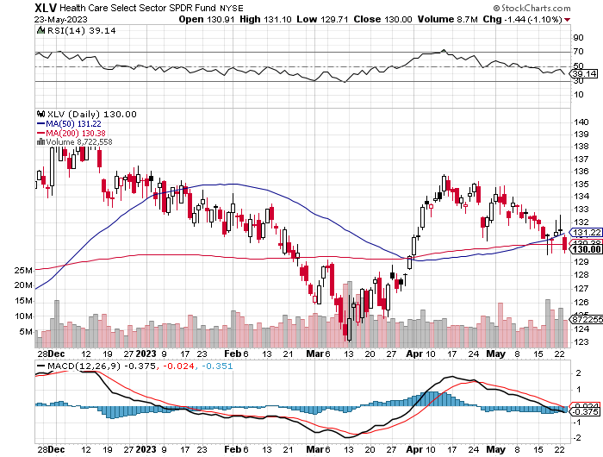
Health Care Sector (XLV) (JNJ), (PFE), (MRK), (GILD), (ACT), (AMGN)

Slide 55
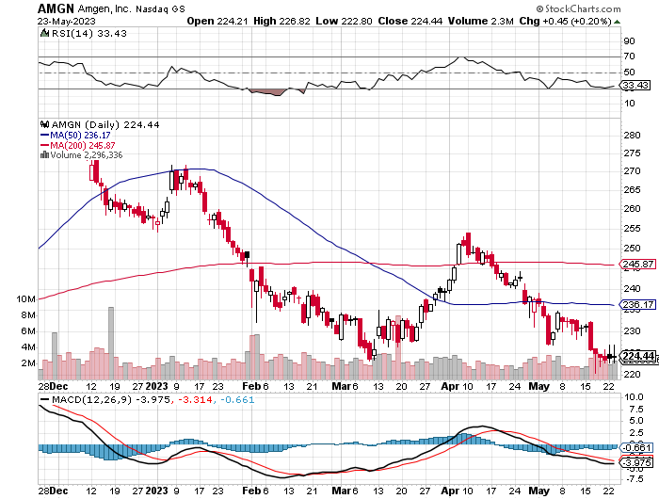
Amgen (AMGN) took profits on long 11/$185-$200 bull call spread

Slide 56
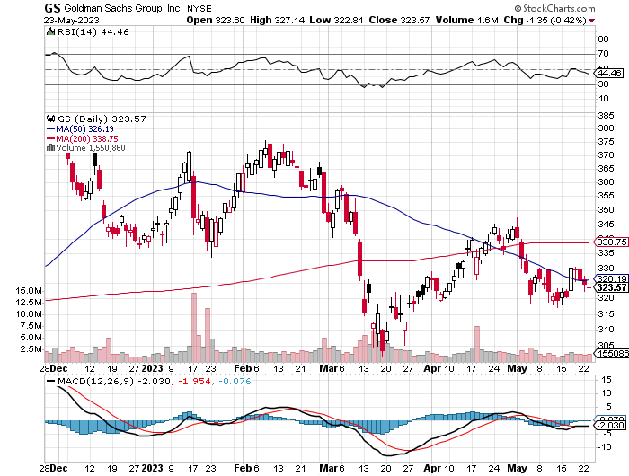
Goldman Sachs (GS) – Highest Capital ration net of mark to market took profits 12/$330-$350 call spread took profits 11/$330-$350 call spread stop loss on long 11/$385-$395 call spreads

Slide 57
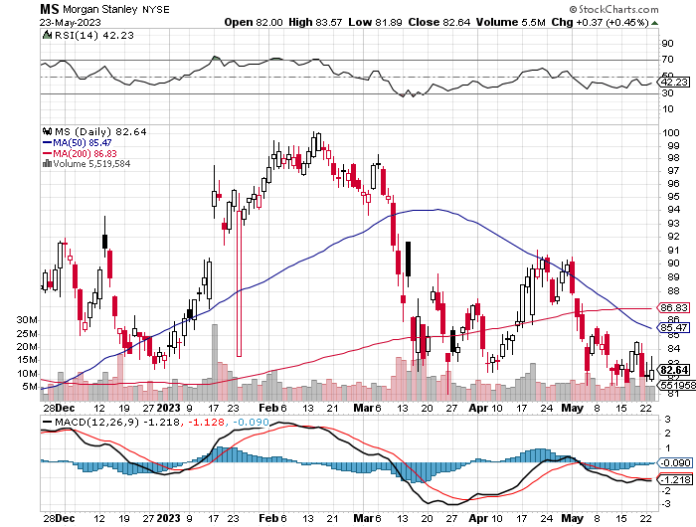
Morgan Stanley (MS) – Highest Capital ratio net of mark to market CEO to Step Down in a Year took profits on long 4/$65-$70 call spread

Slide 58
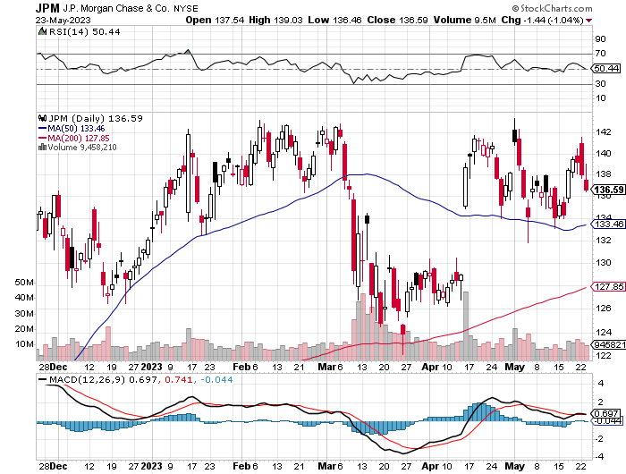
JP Morgan Chase (JPM) - Highest Capital ratio net of mark to market JP Morgan Picks Up an Annual $3 Billion, in interest income on the First Republic deal took profits on long 4/$105-$115 call spread

Slide 59
Bank of America (BAC) – Bank of America Rips, on a great earnings report took profits on long 4/$20-$23 call spread

Slide 60
Citigroup (C) – took profits on long 4/$30-$35 call spread

Slide 61
Charles Schwab (SCHW) – No Risk Taking – is all fee business took profits on long 4/$30-$35 call spread

Slide 62
Interactive Brokers (IBKR) – Best Risk Control took profits on long 4/$60-$65 call spread

Slide 63
SPDR Metals & Mining ETF (XME) – long 2/$28-$30 call spread

Slide 64
Blackrock (BLK)-Asset Collection Boom took profits on long 3/$770-$790 call spread took profits on long 3/$310-$340 call spread

Slide 65
Visa (V) – “Touchless” Bitcoin Drag Transaction grew by an inflationary 10% back to pre-pandemic levels took profits on long 10/$160-$170 bull call spread took profits on long 6/$150-$160 bull call spread

Slide 66
Consumer Discretionary SPDR (XLY) (DIS), (AMZN), (HD), (CMCSA), (MCD), (SBUX)

Slide 67
Berkshire Hathaway (BRKB)- Natural Barbell operating earnings up 12.6% in Q1 took profits on long 4/$260-$270 call spread took profits on long 1/$290-$300 call spread, took profits on long 10/$220-$230 call spread, took profits on long 7/$220-$230 call spread, took profits on long 7/$220-$230 call spread took profits on long 6/$260-$270 call spread

Slide 68
Europe Hedged Equity (HEDJ)-

Slide 69
Japan (DXJ)-

Slide 70
Emerging Markets (EEM) - Pro trade, Weak Dollar, Long Recovery Play

Slide 72
Bonds – Approaching New Lows
*(TLT) Approaches 2023 Low, taking yields up to 3.72%, and the closer we get to a debt ceiling deal, the lower we go. 30-Year mortgages hit 7.0% *When a deal is done, it unleashes a new onslaught of bond selling by the Treasury now limited by the old debt ceiling, and lower lows on bonds *Rising interest payments by Treasury mean less money to pay other bills and and earlier debt ceiling deadline. *In the dream scenario we fall all the way to $95 in the (TLT) where we will be issuing recommendations for call spreads and LEAPS by the boatload *Treasury to Issue $700 Billion in T-Bills within weeks of a debt ceiling deal, pushing short term yields up. The question is with a (TLT) at the $100 handle, a 2023 low, how much is already in the price? *Keep Buying 90-Day T-Bills, now pushing a 5.2% risk free yield *Still looking like 2.50% yield by end 2023 *Junk bond ETF’s (JNK) and (HYG) are a great high yield play

Slide 73
Treasury ETF (TLT) – took profits on long 5/$98-$101 call spread took profits on long 5/$97-$100 call spread, long 2/$98-$101 call spread, took profits on long 4/$96-$99 call spread took profits on long 4/$113-$116 put spread, took profits on long 4/$114-$117 put spread

Slide 74
Ten Year Treasury Yield ($TNX) – 3.75%

Slide 75
Junk Bonds (HYG) 8.30% Yield to Maturity

Slide 76
Municipal Bonds (MUB) 3.27% Yield-

Slide 77
Emerging Market Debt (ELD) 6.83% Yield-

Slide 78
2X Short Treasuries (TBT)-Out of Favor

Slide 80
Foreign Currencies – Fading Dollar
* US Dollar Soars to Three Month High, as investors flee to safe haven short term investments *Rapidly worsening economic data is sparking recession fears. Ten consecutive months of falling inflation is another indicator of a slowdown. *Dollar has peaked, undercut by recession fears *Dollar selloff will accelerate on any debt default *Any strength in the dollar will be temporary *Look for new dollar lows by end 2023 *Buy (FXE), (FXY), (FXB), (FXA) on dips

Slide 81
Australian Dollar (FXA) - Major Long-Term Bottom is In Targeting Parity – A call option on a global synchronized recovery
1:1
BUY

Slide 82
Japanese Yen (FXY)
2023 Target 25%

Slide 83
Euro (FXE)-
2023 Target 25%

Slide 84
British Pound (FXB)-
2023 Target 15%

Slide 85
Emerging Market Currencies (CEW)
2023 Target 40%

Slide 88
Energy & Commodities – Recovery Play
*Saudi threats of a short squeeze has put a short term bottom in for oil *The Oil Collapse is Signaling a Recession, as is weakness in all other commodities, even lithium *Texas tea has plunged 22% in three weeks to a new two year low at $62 *It’s one of the worst performing asset classes of 2023 *Widespread EV adoption is finally making a big dent, as are the price wars there *Vale Announces $2.7 Billion Mining Expansion, in the Amazon to increase iron ore production *Buy (USO) on dips as an economic recovery play *China Expects LNG Price Spike Later this Year, due to coming supply shortages and a recovering economy

Slide 89
Oil-($WTIC)

Slide 90
United States Oil Fund (USO)

Slide 91
Energy Select Sector SPDR (XLE)-No Performance! (XOM), (CVX), (SLB), (KMI), (EOG), (COP)

Slide 92
ExxonMobile (XOM)- took profits on long 12/$120-$125 put spread

Slide 93
Occidental Petroleum (OXY)- Buffet’s a Buyer long 2/$55-$60 call spread, took profits on long 12/$77.50-$82.50 put spread

Slide 94
Natural Gas (UNG) - Long January 2025 $14 - $15 Call Spread LEAPS

Slide 95
Freeport McMoRan (FCX) - Codelco Sees Profit Slump, the world’s largest copper producer based in Chile

Slide 96
Cameco (CCJ) - took profits on long 5/$20-$23 bull call spread

Slide 98
Precious Metals – Taking a Break
*Gold sells off from potential double top *Gold headed for $3,000 by 2024, but back off from new all-time highs *The new drivers are soon to fall interest rates and the demise of crypto *Silver is the better play with a higher beta *Russia and China are also stockpiling gold to sidestep international sanctions *A Severe Short Squeeze in Copper is Developing, leading to a massive price spike later in 2023

Slide 99
Gold (GLD) - Deflation call took profits on long 5/$165-$170 bull call spread

Slide 100
Market Vectors Gold Miners ETF- (GDX) –

Slide 101
Barrick Gold (GOLD) took profit on long 1/$15.50-$16.50 call spread

Slide 102
Newmont Mining- (NEM)- took profits on long $55-60 call spread

Slide 103
Silver- (SLV)- took profits on long 11/$19-$20 call spread

Slide 104
Silver Miners - (SIL)-

Slide 105
Wheaton Precious Metals - (WPM)- took profits on long 1/$36-$39 call spread

Slide 106
Platinum- (PPLT)- 556,000-ounce shortage this year took profits on long 1/$36-$39 call spread

Slide 109
Real Estate – Signs of Life
*Worst case, home prices go sideways from here until lower interest rates launch a new bull market in residential housing, especially with 30-year mortgages at 7.0% *Existing Home Sales Plunge 3.4%, in April, as buyers contends with prices that won’t fall and high prices *There is a tidal wave of Millennial buyers under the market. *Homebuilder Sentiment Up for 10th Straight Month, as it will be for the next decade *Mortgage Applications Jump, 10% last week on a WOW basis. They are still down 32% YOY. *Some borrowers are moving to 40-year mortgages to lower monthly payments. *New Home Sales Hit 13 Month High, up 4.1% in April *Median Home Prices are down 8.2% YOY.

Slide 110
S&P Case Shiller Plunges S&P Case Shiller Drops to +2.0%, in February with its National Home Price Index Miami gained +10.6%, Tampa +7.7%, and Atlanta +6.6%.

Slide 111
Crown Castle International (CCI) – 5.44% yielding cell phone tower REIT

Slide 112
US Home Construction Index (ITB) (DHI), (LEN), (PHM), (TOL), (NVR) Toll Brothers sells out of homes at high process, announced blowout earnings

Slide 116
Trade Sheet- So What Do We Do About All This?
*Stocks – buy the big dips at bottom of range, ………………sell big rallies to hedge holdings *Bonds – buy dips, sell extreme rallies *Commodities-buy dips *Currencies- sell dollar rallies, buy currencies *Precious Metals – buy dips *Energy – buy dips *Volatility - sell short over $30 *Real estate – buy dips

Slide 117
Next Strategy Webinar 12:00 EST Wednesday, June 7 from Silicon Valley, CA email me questions at support@madhedgefundtrader.com
Good Luck and Good Trading!
Notes:
*

