Slide 1
The Mad Hedge Fund Trader “The Next Rotation is Here”
With John Thomas Lake Tahoe, CA, June 7, 2023 www.madhedgefundtrader.com
Notes:
*

Slide 3
*A gathering of 28 of the best trading minds in the world *It’s a smorgasbord of trading strategies in all asset classes, including Stocks, bonds, foreign exchange, commodities, precious metals, and energy *$100,000 in free prizes awarded to those who register *Sign up at https://www.madhedge.com/?source=jtmhft or respond to the link we will send you shortly *Best of all, attendance is FREE!

Slide 4
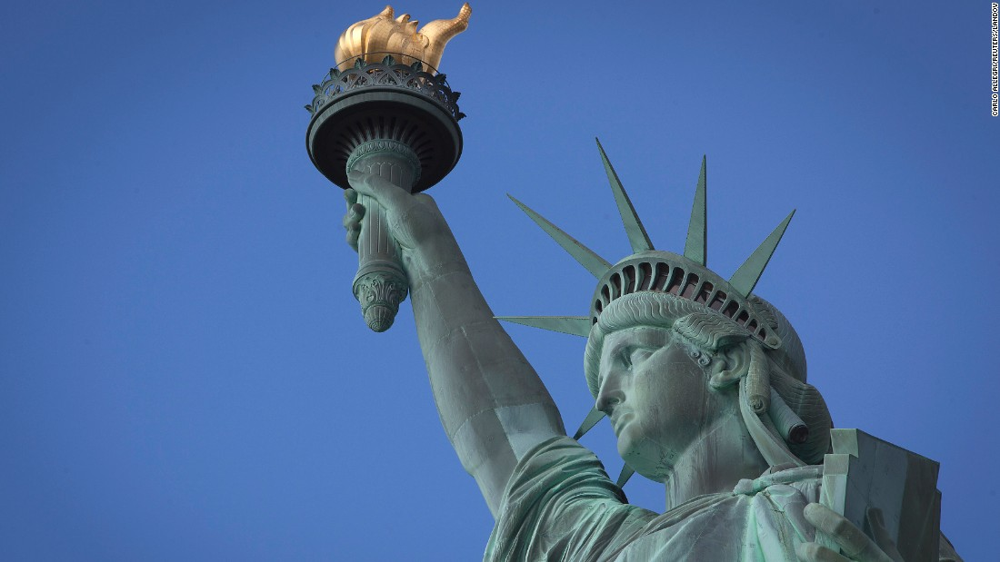
THURSDAY, JULY 6 NEW YORK STRATEGY LUNCHEON
*An excellent meal will be followed by a wide-ranging discussion and an extended question and answer period *The lunch will be held in an exclusive private club in Midtown Manhattan with a strict dress code *please go to my online store at http://www.madhedgefundtrader.com/store and click on “luncheons.” Tickets are available for $299

Slide 5
Friday July 13, 2023 Seminar at Sea
*Cunard Line’s flagship, the elegant and spacious Queen Mary II, on an eastbound transatlantic cruise *The Ship departs New York at 12:00 AM on July 7, 2023, and arrives at Southampton on July 14 *Guests will be responsible for booking their own cabin through Cunard *Three dinners during the voyage will be black tie *Customers are required to book their own cabins and return flights from England *The Cunard cruise number is M319

Slide 6
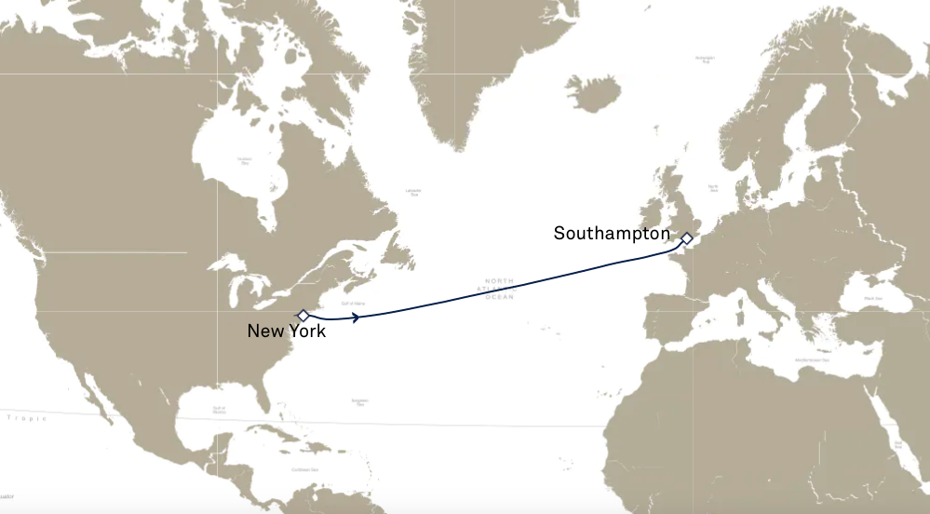

Slide 7
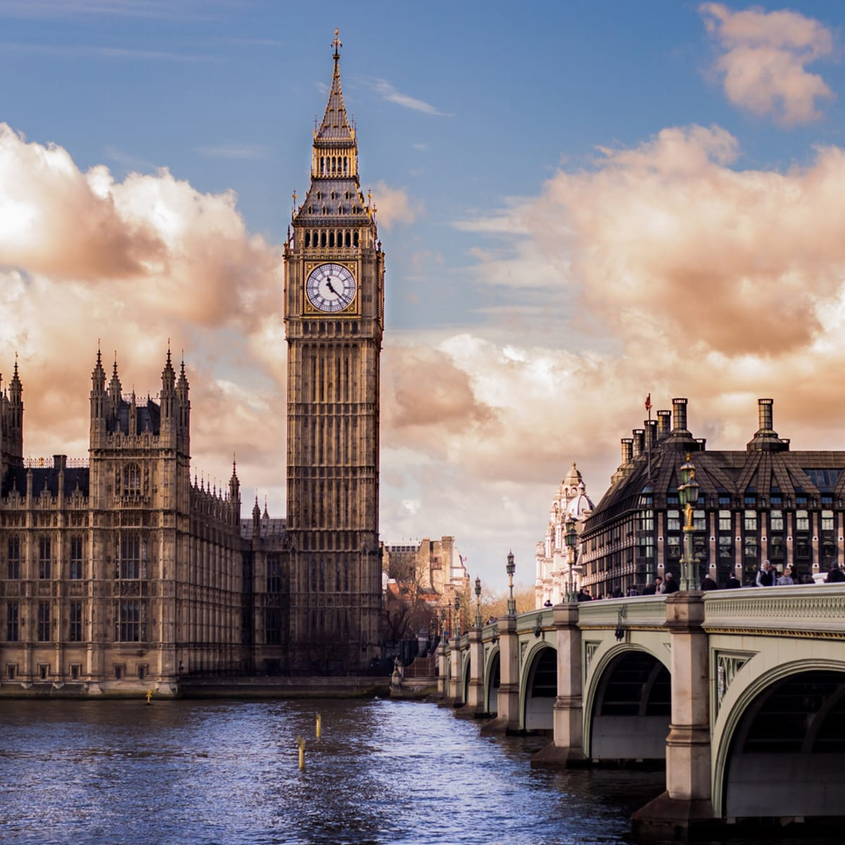
THURSDAY, JULY 19 LONDON STRATEGY LUNCHEON
*An excellent meal will be followed by a wide-ranging discussion and an extended question and answer period *The lunch will be held in an exclusive private club in Midtown Manhattan with a strict dress code *please go to my online store at http://www.madhedgefundtrader.com/store and click on “luncheons.” Tickets are available for $298

Slide 8
Trade Alert Performance New All Time Highs! 40 out of 44 trade alerts profitable
*January +22.35% Final *July +3.98% Final *February +3.41% Final *August +5.13% Final *March +20.85% Final *September +9.72% Final *April +15.13% Final *October +5.69% Final *May +0.30%% Final *November +8.31 Final *June -0.01% MTD *December +0.95% Final *2022 Final +84.63% compared to -18.63% for the S&P 500 *2023 Year to Date +61.74%, versus +12.17% for the S&P 500 +658.93% since inception *Average annualized return of +48.77% for 15 years

Slide 9
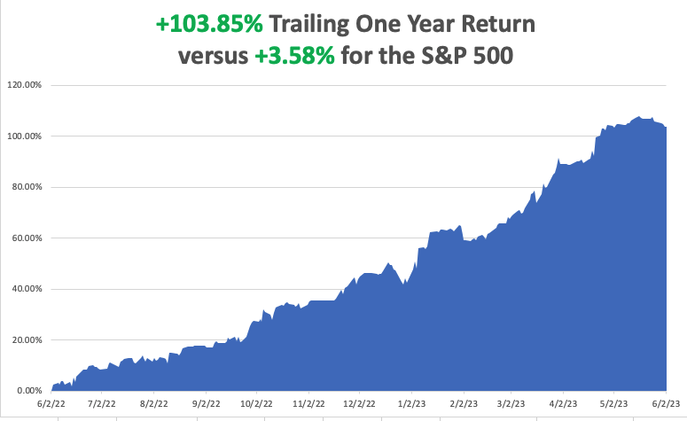

Slide 10
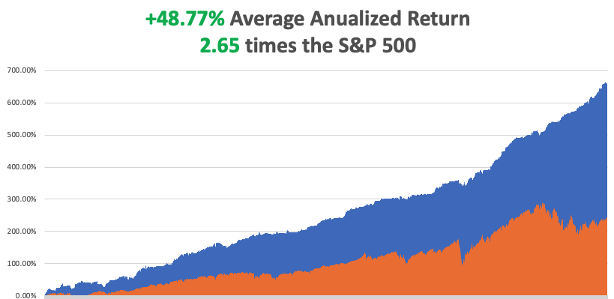

Slide 11
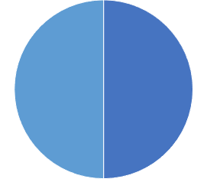
Portfolio Review 10% Long, 10% Short, 80% cash with VIX at $17 no new positions
Current Capital at Risk
Risk On
(TSLA) 6/$120-$130 calll spread | 10.00%
(FCX) 6/$32-$35 call spread | 10.00%
Risk Off
Total Net Position | 20.00%
Total Aggregate Position | 20.00%
Expiration Value +62.52%

Slide 13
The Method to My Madness Still a Bipolar Market
*Equity Allocations are at a 15 Year Low, with massive amounts of cash in 90-day T-bills *Look for money to pour into stocks in the second half, as per the Mad Hedge 2023 Playbook *Big rotation out of cash into Industrials, commodities, and energy is near *Debt Ceiling crisis end is a weight off the market’s back *Bonds weaken looking for another 0.25% rise June 14th *Summer will present the best buying opportunities of the year *Precious metals and commodities should be at the top of and “BUY” list to cash in on an economic recovery *In this market patience is a virtue, let the market come to you

Slide 14
The Global Economy – Confused
*Nonfarm Payroll Soars by 339,000, in May for the tenth consecutive month of increases *Oddly, the headline Unemployment Rate jumped 0.3% to 3.7%, which the Fed must love. *More importantly, wages increased by only 4.3%. It’s the biggest rise in unemployment in three years. Professional & Business Services led by 64,000 and the Government with 56,000. It’s a Goldilocks report. *Inflation Continues to Fall, down 0.4% in April. Food prices rose 6.9% from a year ago while energy fell 6.3% *Business Borrowing for Capital Goods Dives, by 8% in April *China’s PMI Dives, telling us that an economic recovery there may be next year’s business

Slide 15
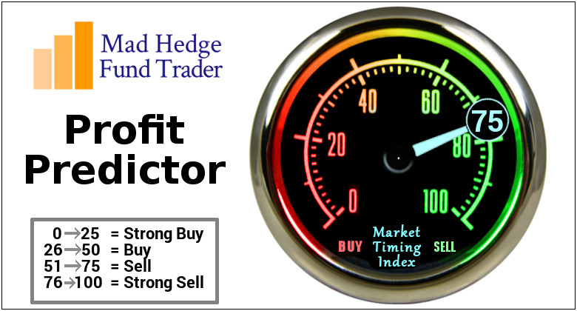
The Mad Hedge AI Market Timing Index – Neutral to Rich An artificial intelligence driven algorithm that analyzes 30 different economic, technical, and momentum driven indicators

Slide 16
Mad Hedge AI Market Timing Index
SELL
BUY

Slide 17
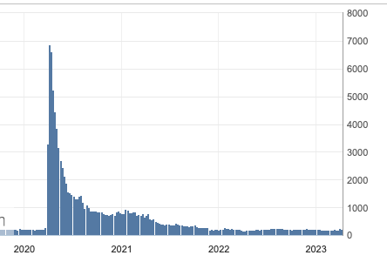
Weekly Jobless Claims – Falling 232,000 – Up 2,000

Slide 18
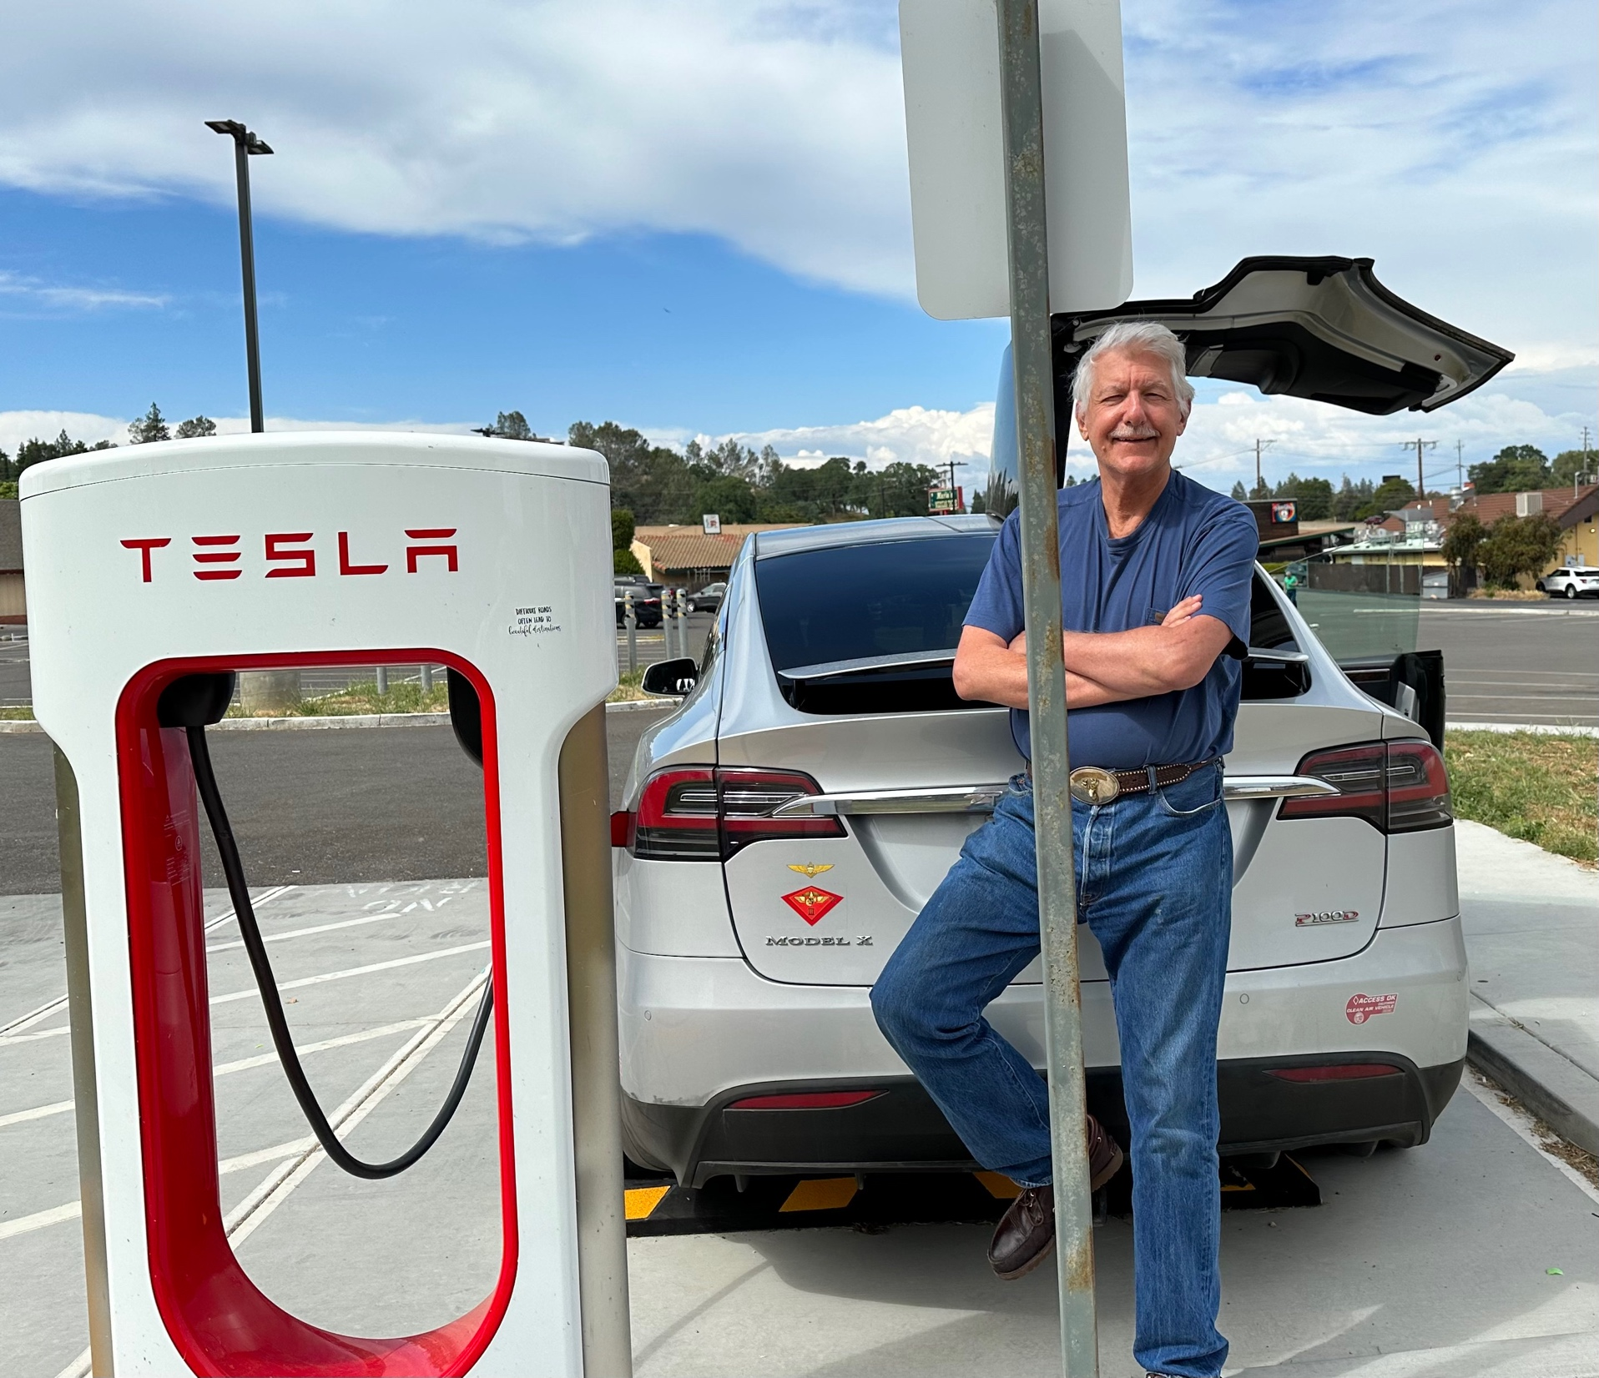

Slide 19
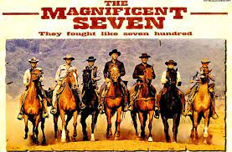
Stocks – The Magnificent Seven
*Stocks in no way reflecting the massive increase in earnings and the large multiple expansion, creating of “hockey stick” effect upward on stock prices. *A Record $8.5 Billion Poured into Tech Stocks Last Week, into what has been known as “The Magnificent Seven” *Is Big Tech Peaking? The urge to take big profits is becoming overwhelming *Best case, they move sideways for a while before the next leg up *Time to rotate into the big laggards of the year, industrials, commodities, and energy? *The Volatility Index Hits New 2023 Low, at $13, and it could be headed to $12. I recall a 1998 low of $8 just before the Long Term Capital Management blow up *S&P 500 Earnings were Unchanged YOY, in Q1 when a crash was expected. Surging technology earnings take the credit *Looking for flat first half, strong second half to take us to S&P 500 4,800 by yearend

Slide 20
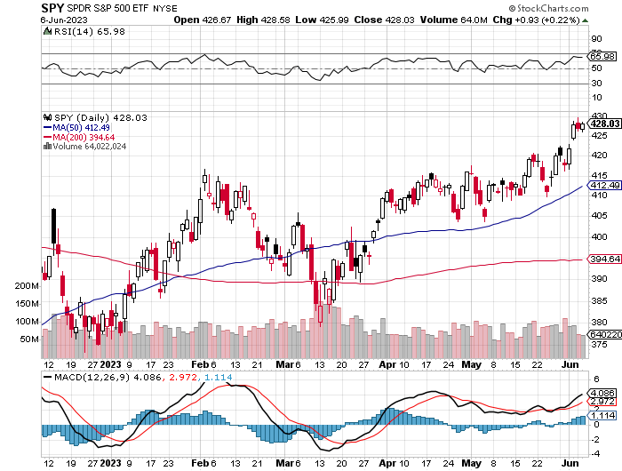
S&P 500 – Taking a Break took profits on long 5/$420-$430 put spread, took profits on long 1/$420-$430 put spread, took profits on long 11/$420-$430 put spread
$480 2023 Target +11.6%
$405 -5.8% Pull Back
The Bottom $355 Down -17.4%

Slide 21
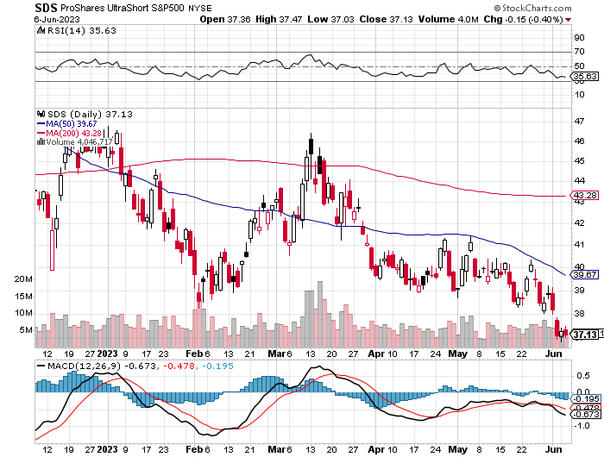
ProShares Ultra Short S&P 500 (SDS)- a great hedge for long stocks and bonds long 2X position has a hedge against longs and bond shorts

Slide 22
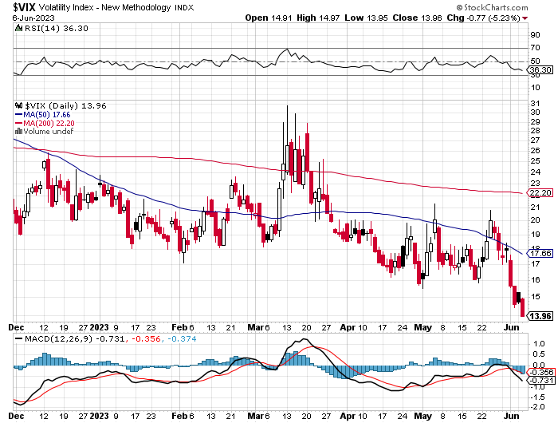
(VIX) – Bargain of the Century

Slide 23
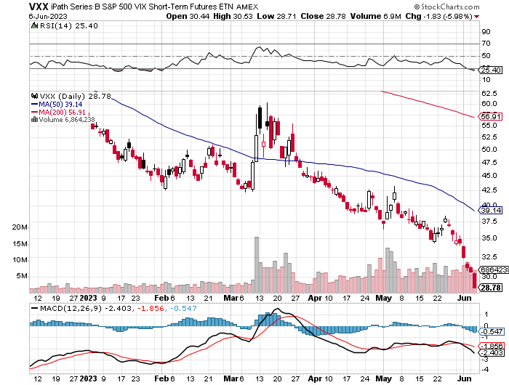
(VXX)-

Slide 24
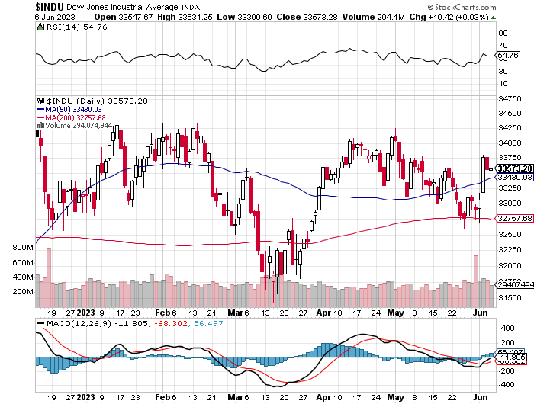
Dow Average ($INDU)-

Slide 25
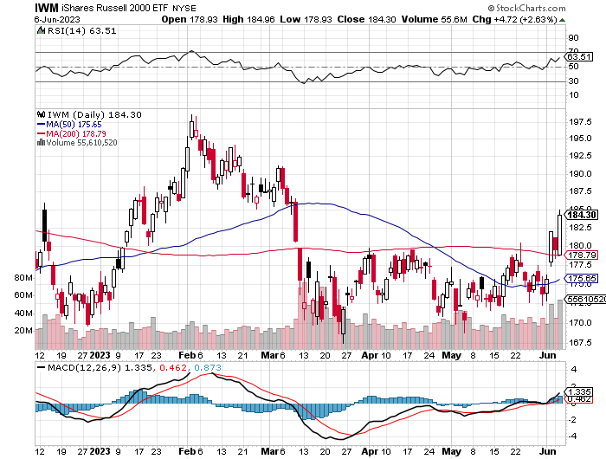
Russell 2000 (IWM)- took profits on Long 10/$137-$142 vertical bull call spread took profits on Long 10/$153-$156 vertical bear put spread

Slide 26
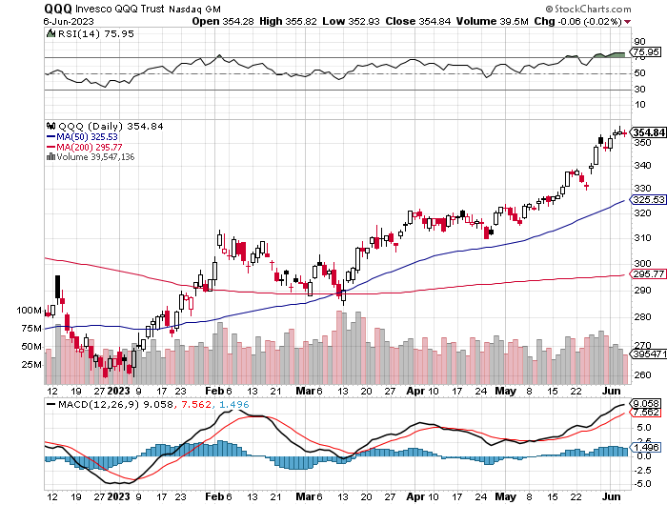
NASDAQ (QQQ) – took profits on Long 5/$335-$345 put spread took profits on long (QQQ) 1/$290-$300 put spread, took profits on long (QQQ) 4/$330-$335 put spread took profits on long (QQQ) 3/$340-$345 put spread, covered long (QQQ) $325-$330 put spread

Slide 27
THE MAD HEDGE FUND TRADER
The Barbell Portfolio – Time for a Flip?
*75% Big Tech – 2% of US workforce, 25% of market cap and 25% of US earnings 25% Domestic Recovery, including: Railroads, airlines, cruise lines, Couriers, steel companies Banks, commodities Construction Credit Card Companies Hotels, casinos Online Ticket Sales

Slide 28
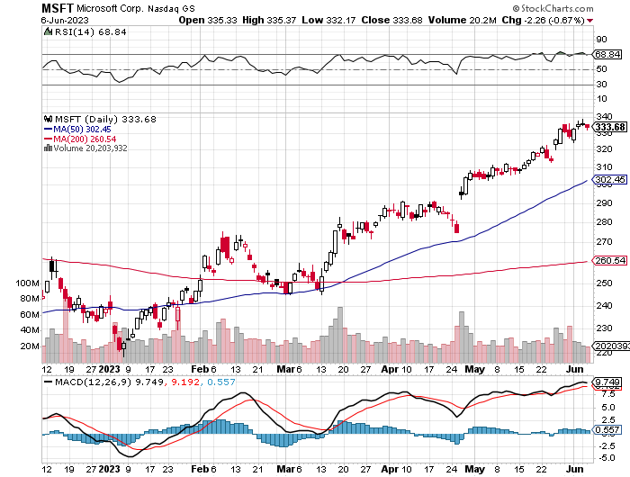
Microsoft (MSFT)- Earnings Beat took profits on 9/$235-$245 call spread, took profits on long 7/$220-$210 call spread, took profits on long 6/$220-$230 call spread, took profits on long 2/$200-$210 bear put spread

Slide 29
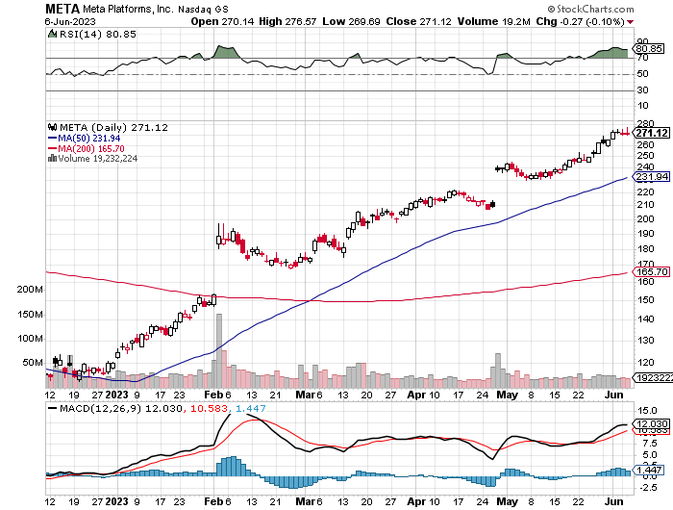
Meta (META)- Soars an Incredible 20% took profits on Long 9/$290-$300 vertical bear put spread stopped out of Long 9/$190-$200 vertical bear put spread

Slide 30
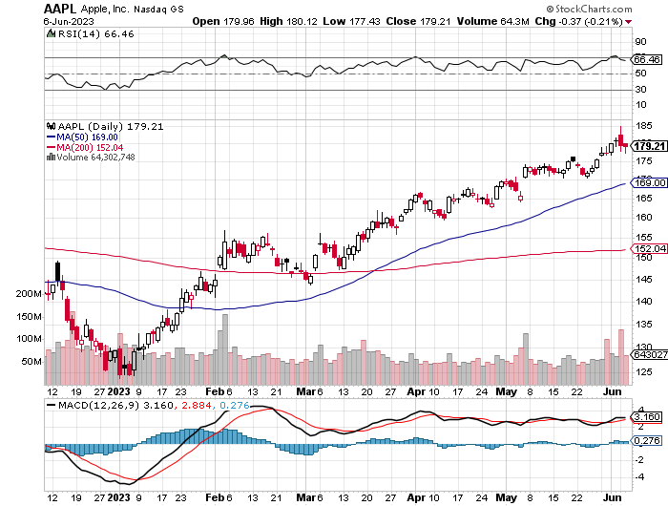
Apple (AAPL) Vision Pro Headset will soon account for 10% of Apple Earnings, biggest launch since iPhone took profits on long 1/$145-$155 put spread, Took profits on long 10/$165-$175 put spread took profits on long 6/$155-$165 put spread, stopped out of long 6/$125-135 call spread, took profits on long 6/$110-$120 call spread, took profits on long 2/$180-$190 put spread

Slide 31
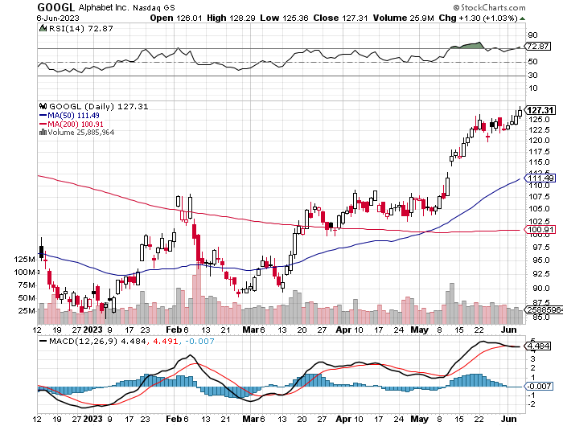
Alphabet (GOOGL) – Google Ramps Up AI Effort took profits on long 12/$1,200-$1,230 bull call spread took profits on long 9/$1,030-$1,080 vertical bull call spread

Slide 32
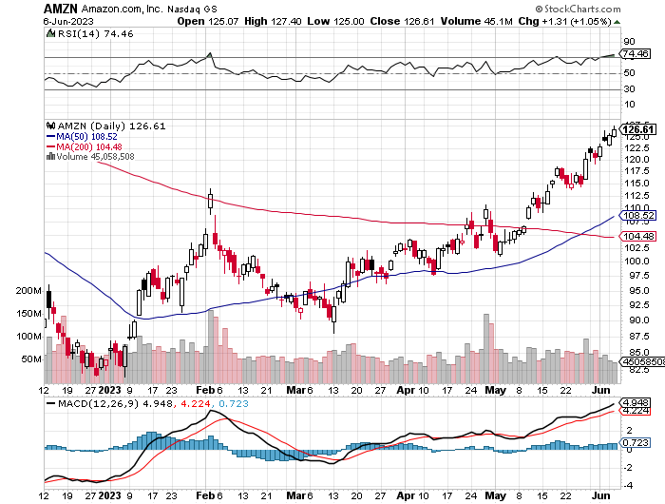
Amazon (AMZN) – Amazon to Offer Free Mobile Service to Prime members took profits on long 2/$3,400-$3,500 bear put spread took profits on long 9/$2,800-$2,900 bull call spread

Slide 33
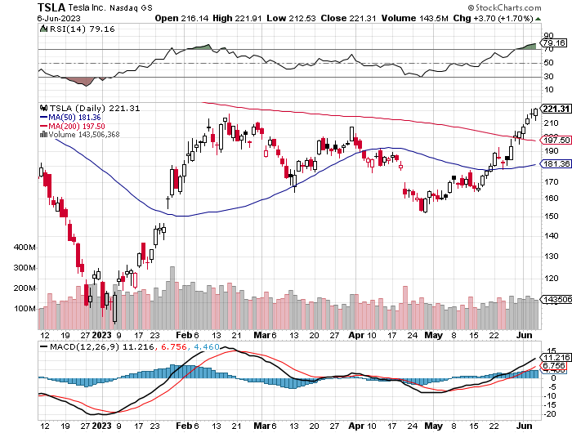
Tesla (TSLA) – Volatility Collapse to 43% Tesla Model Y Became World’s Top Selling Car in Q1, Ford Cuts Deal with Tesla to Share National Charger Network long 6/$120-$130 call spread, stopped out of long 6/$210-$220 put spread took profits on long 5/$110-$120 call spread, took profits on long 5/$220-$230 put spread took profits on long 4/$130-$140 call spread, took profits on long 4/$250-$260 put spread

Slide 34
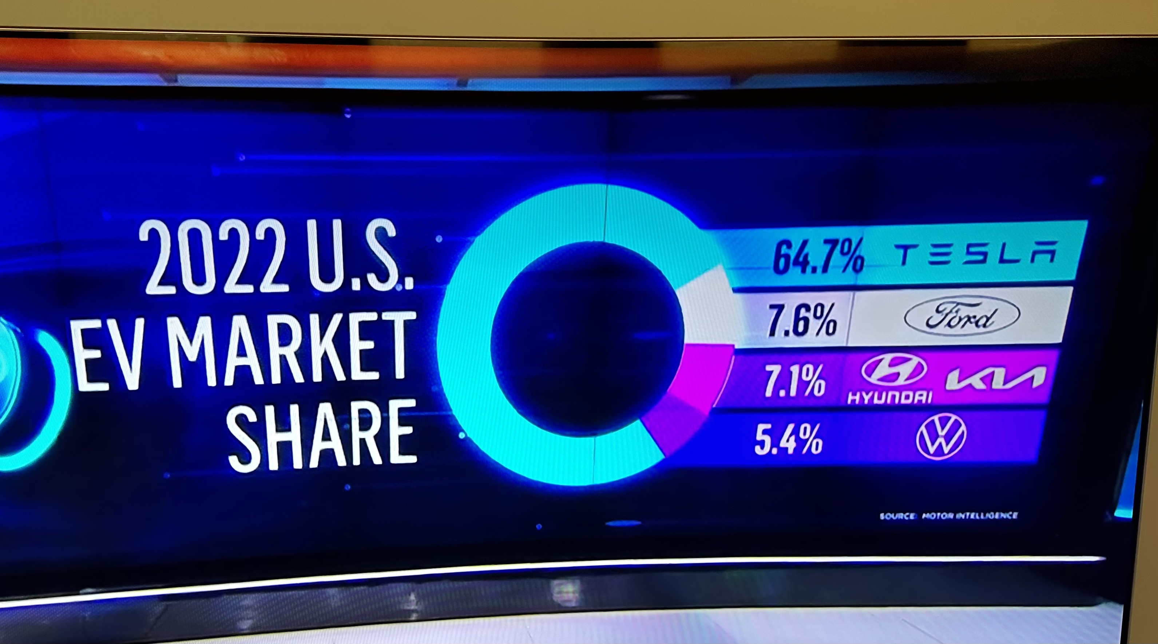

Slide 35
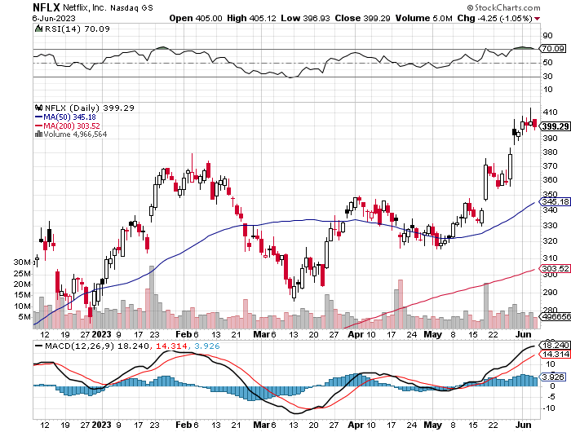
Netflix (NFLX) – Netflix subscribers beat - Netflix Password Sharing Crackdown Goes Global

Slide 36
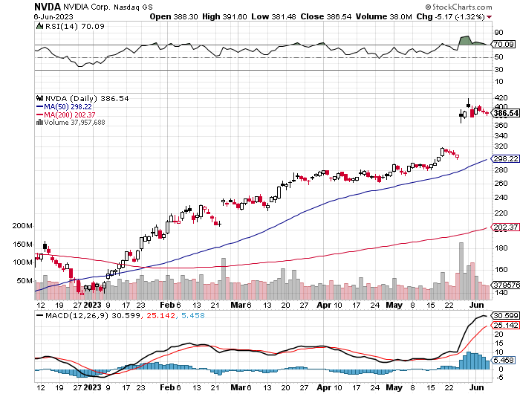
NVIDIA (NVDA) – Blowout Profits Hits $1 trillion Market Cap, with the shares hitting a high of $420 took profits on long 3/$260-$270 put spread, took profits on long 10/$95-$100 call spread took profits on long 7/$120-$130 call spread, took profits on long 6/$120-$130 call spread

Slide 37
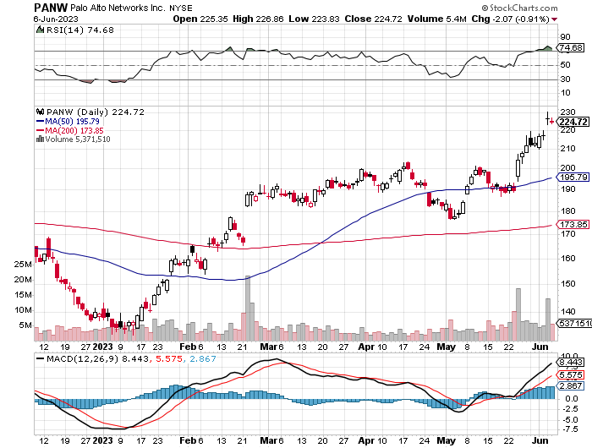
Palo Alto Networks (PANW)- Hacking never goes out of fashion Palo Alto Networks Beats took profits on long 10/$130-$140 call spread

Slide 38
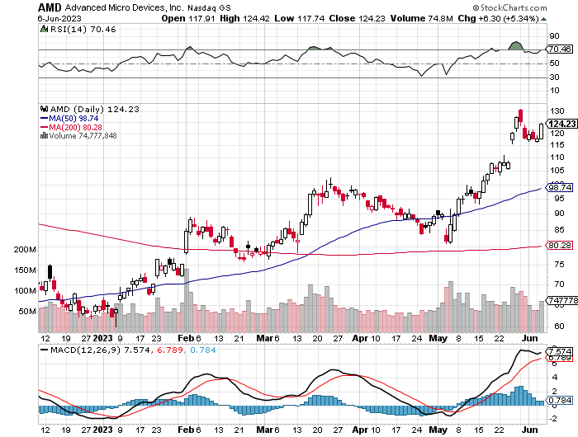
Advanced Micro Devices (AMD)- Recession fears programable logic devices took profits on long 2/$75-$80 call spread

Slide 39
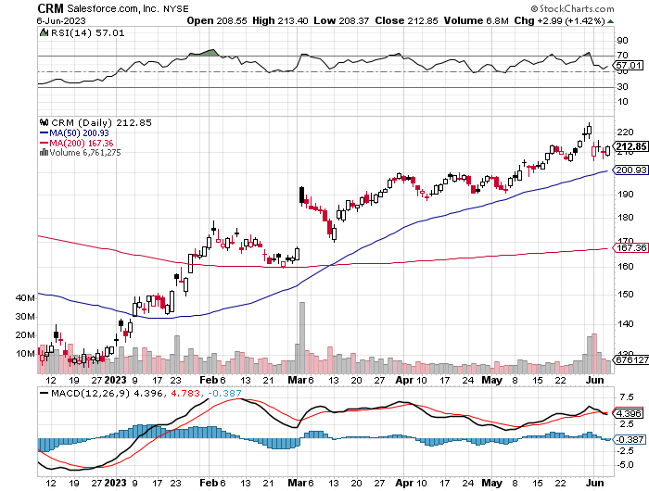
Salesforce (CRM)- Massive Online Migration Salesforce Soars 16%, on better-than-expected guidance took profits on long 9/$125-$130 vertical bull call spread took profits on long 8/$125-$130 vertical bull call spread took profits on long 2/$105-$115 call spread

Slide 40
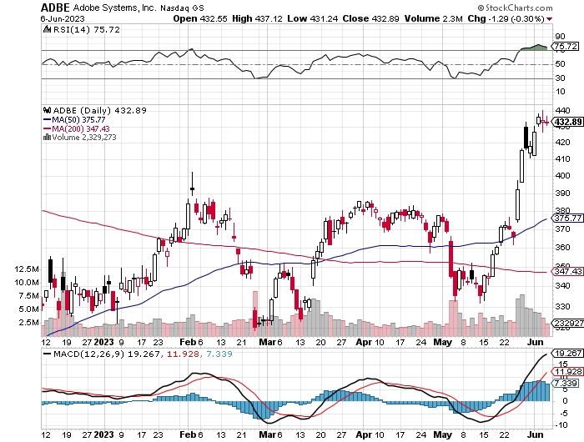
Adobe (ADBE)- Cloud play The Quality Non-China tech play

Slide 41
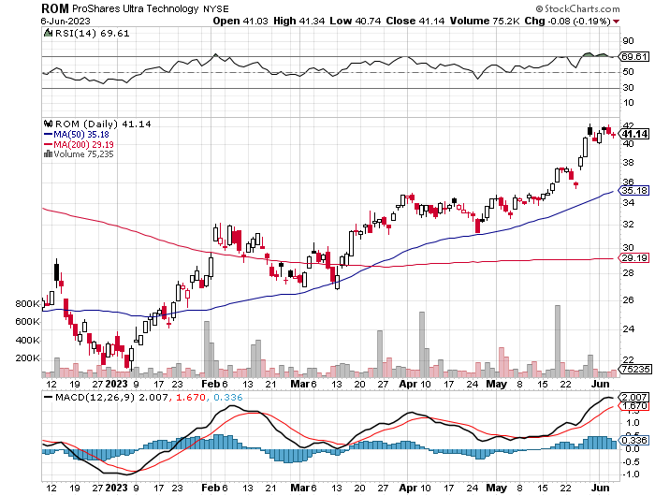
ProShares Ultra Technology ETF (ROM) – 2X Long Technology ETF took profits on long 10/$62-65 call spread

Slide 43
The Second Half of the Barbell
*Bets on a domestic recovery in 2022 Q4 *Upside potential in 2022 far greater than tech *Some of these have not moved for 5 or 10 years *Focuses on economically sensitive cyclical industries *Makes a great counterweight to high-growth technology *We could spend all of next year rotating between the two groups

Slide 44
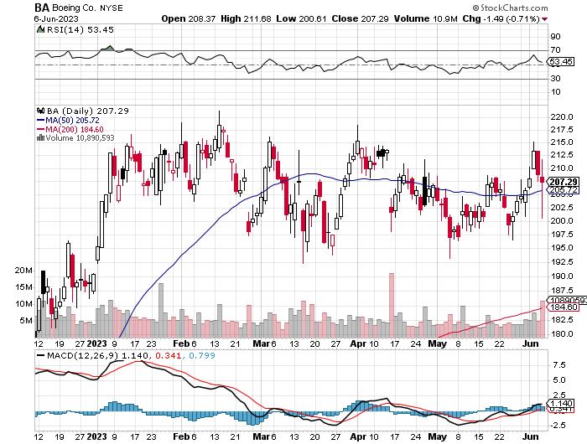
Boeing (BA) – Increases Dreamliner Production for the Fourth Time in 2023 took profits on long 5/$17-$175 call spread

Slide 45
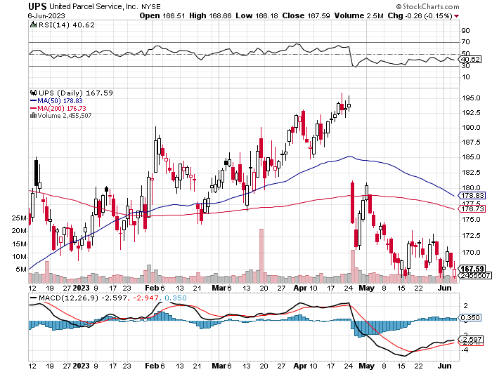
Package Delivery- United Parcel Service (UPS) - took profits on long 11/$130-$140 call spread

Slide 46
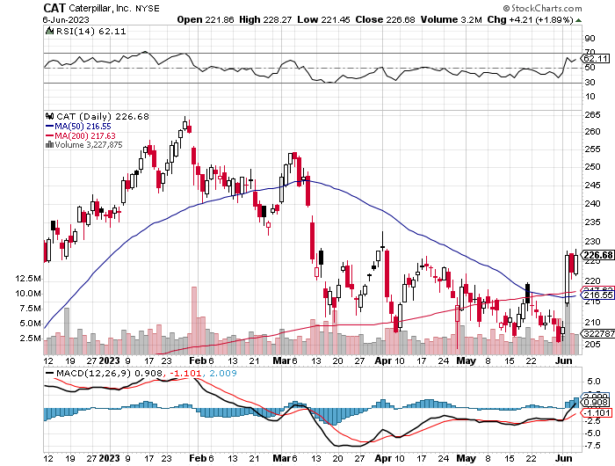
Caterpillar (CAT)- Ag + Infrastructure + Housing Raises Dividend by 50% took profits on long 12/$145-$150 call spread took profits on long 11/$125-$135 call spread

Slide 47
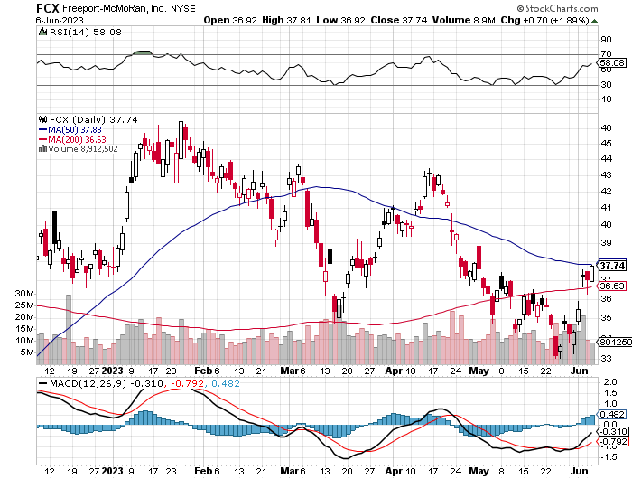
Freeport McMoRan - (FCX)- Coming Copper Crisis took profits on long 4/$30-$33 call spread took profits on long 10/$20-$23 call spread

Slide 48
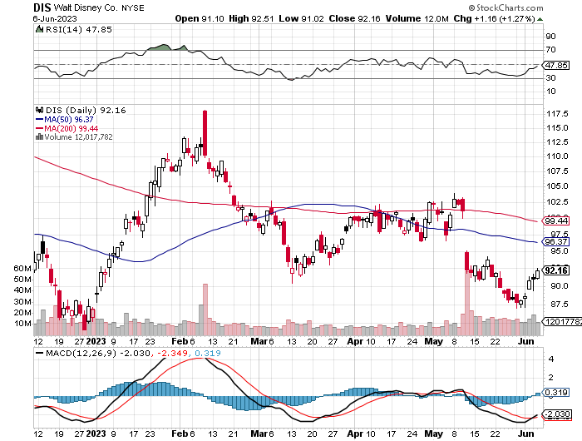
Walt Disney (DIS) - Disney Earnings are Flat, with parks jam packed and maxed out. But streaming in a nosedive, down 4 million subscribers in Q1 at 157.8 million

Slide 49
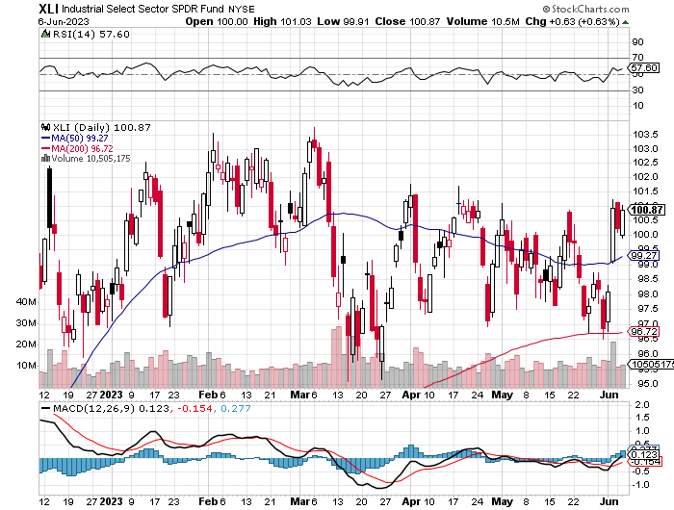
Industrials Sector SPDR (XLI)- (GE), (MMM), (UNP), (UTX), (BA), (HON)

Slide 50
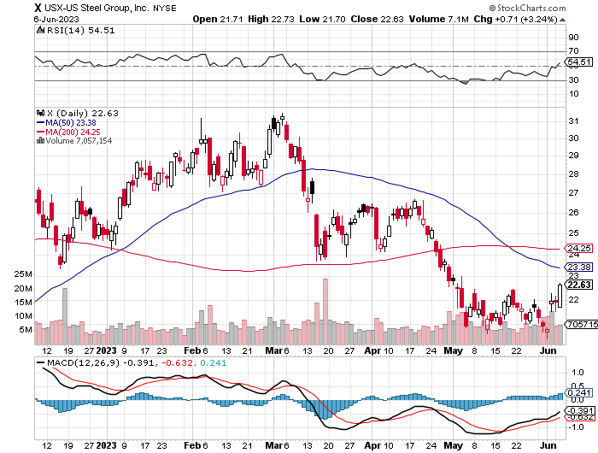
US Steel (X) – Commodity Boom and Wartime boost

Slide 51
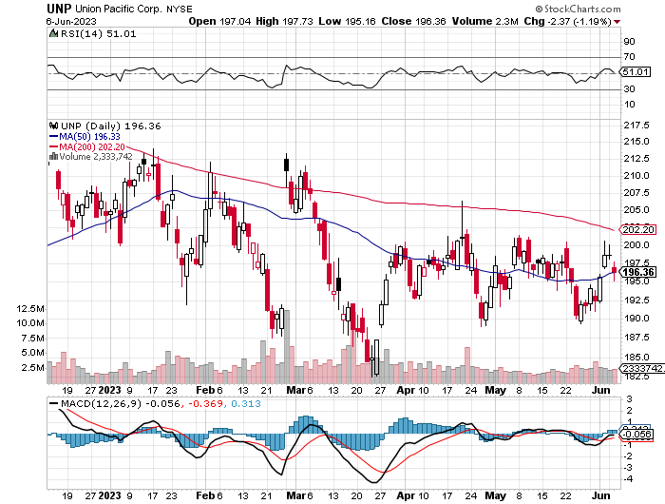
Union Pacific RR (UNP)- Big Stuff to Ship took profits on long 5/$200-$210 call spread took profits on 11/$150-$160 call spread

Slide 52
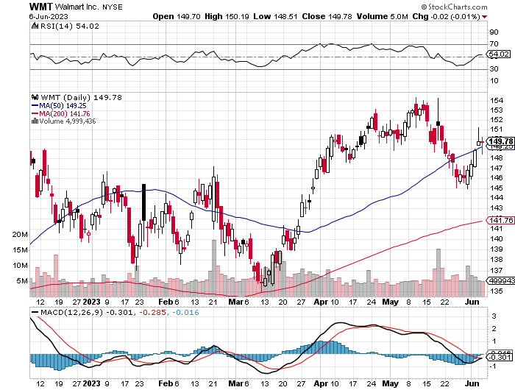
Wal-Mart (WMT)- took profit on Long 11/$125-$130 bear put spread took profit on Long 10/$119-$121 bear put spread took profits on Long 8/$114-$117 bear put spread

Slide 53
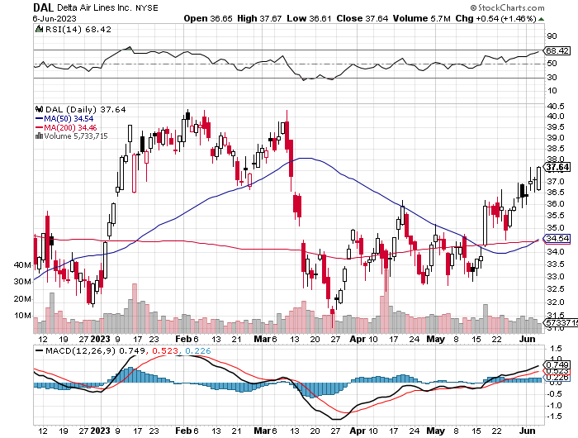
Delta Airlines (DAL) – Travel is Back!

Slide 54
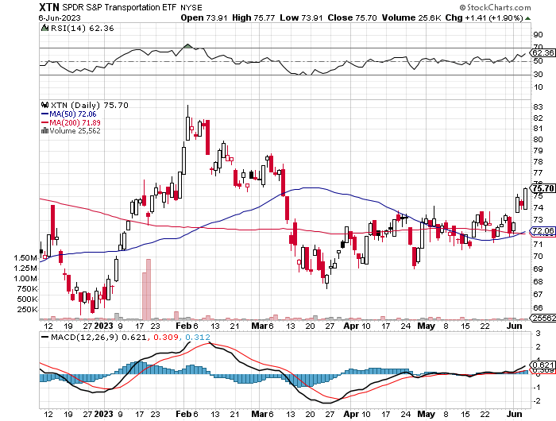
Transports Sector SPDR (XTN)- Worst Hit Sector (ALGT), (ALK), (JBLU), (LUV), (CHRW), (DAL)

Slide 55
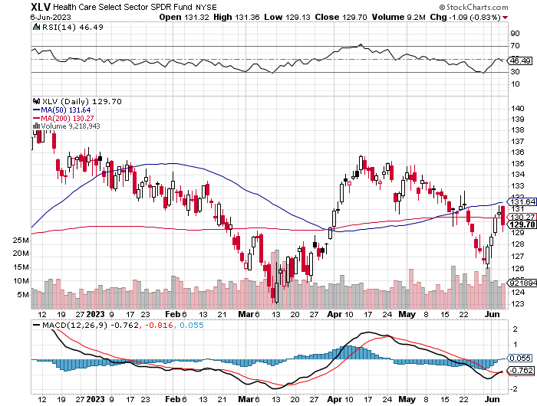
Health Care Sector (XLV) (JNJ), (PFE), (MRK), (GILD), (ACT), (AMGN)

Slide 56
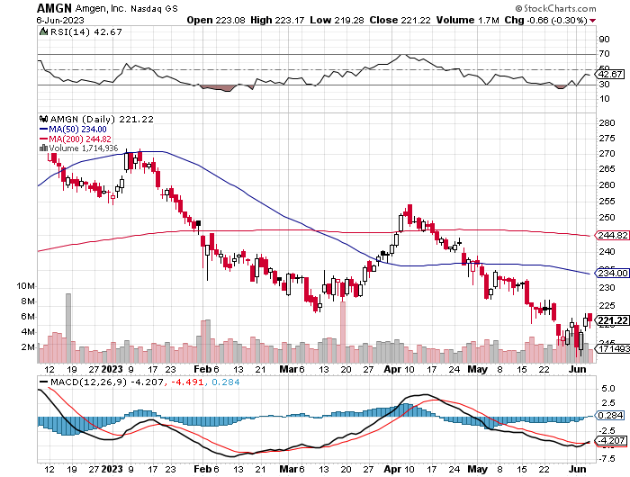
Amgen (AMGN) took profits on long 11/$185-$200 bull call spread

Slide 57
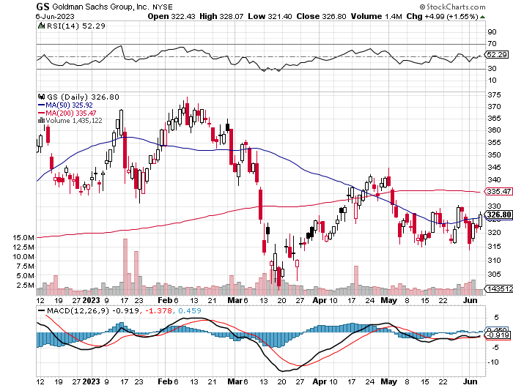
Goldman Sachs (GS) – Highest Capital ration net of mark to market took profits 12/$330-$350 call spread took profits 11/$330-$350 call spread stop loss on long 11/$385-$395 call spreads

Slide 58
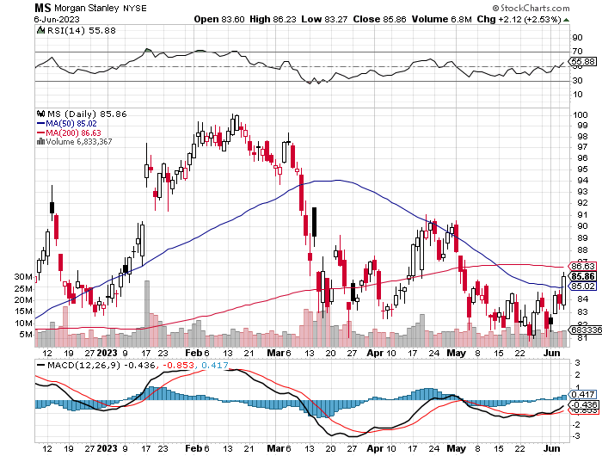
Morgan Stanley (MS) – Highest Capital ratio net of mark to market CEO to Step Down in a Year took profits on long 4/$65-$70 call spread

Slide 59
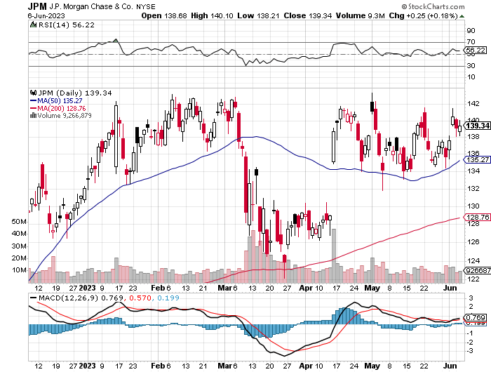
JP Morgan Chase (JPM) - Highest Capital ratio net of mark to market JP Morgan Picks Up an Annual $3 Billion, in interest income on the First Republic deal took profits on long 4/$105-$115 call spread

Slide 60
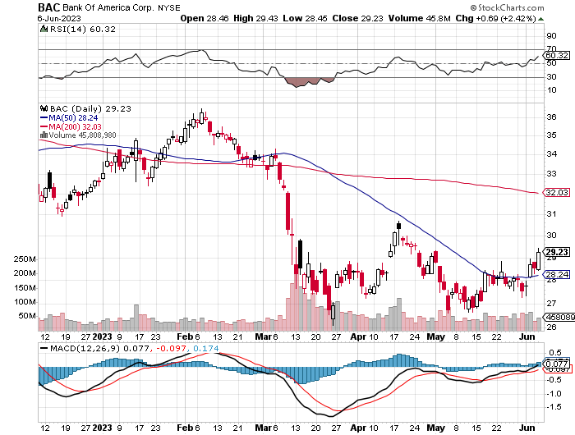
Bank of America (BAC) – Bank of America Rips, on a great earnings report took profits on long 4/$20-$23 call spread

Slide 61
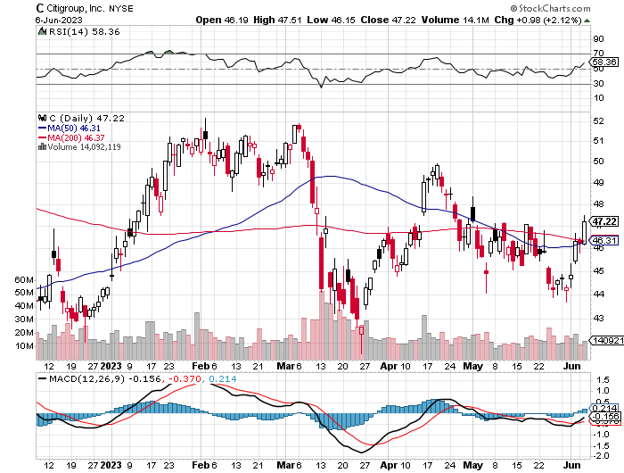
Citigroup (C) – took profits on long 4/$30-$35 call spread

Slide 62
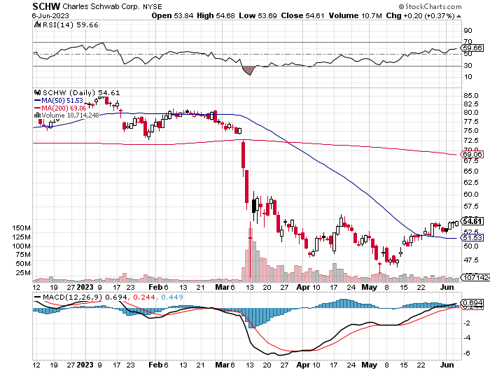
Charles Schwab (SCHW) – No Risk Taking – is all fee business took profits on long 4/$30-$35 call spread

Slide 63
Interactive Brokers (IBKR) – Best Risk Control took profits on long 4/$60-$65 call spread

Slide 64
SPDR Metals & Mining ETF (XME) – long 2/$28-$30 call spread

Slide 65
Blackrock (BLK)-Asset Collection Boom took profits on long 3/$770-$790 call spread took profits on long 3/$310-$340 call spread

Slide 66
Visa (V) – “Touchless” Bitcoin Drag Transaction grew by an inflationary 10% back to pre-pandemic levels took profits on long 10/$160-$170 bull call spread took profits on long 6/$150-$160 bull call spread

Slide 67
Consumer Discretionary SPDR (XLY) (DIS), (AMZN), (HD), (CMCSA), (MCD), (SBUX)

Slide 68
Berkshire Hathaway (BRKB)- Natural Barbell operating earnings up 12.6% in Q1 took profits on long 4/$260-$270 call spread took profits on long 1/$290-$300 call spread, took profits on long 10/$220-$230 call spread, took profits on long 7/$220-$230 call spread, took profits on long 7/$220-$230 call spread took profits on long 6/$260-$270 call spread

Slide 69
Europe Hedged Equity (HEDJ)-

Slide 70
Japan (DXJ)-

Slide 71
Emerging Markets (EEM) - Pro trade, Weak Dollar, Long Recovery Play

Slide 73
Bonds – Plunge!
*Bonds plunge on a red hot May Nonfarm Payroll, which suggests another quarter point interest rates rise from the Fed at the June or July meeting *That’s why bond prices took a bath, taking another run at the 2023 lows *Fitch Puts US Debt on Credit Watch, meaning that it is due for a downgrade. It’s the first time since the 2011 Moody’s downgrade from AAA to AA+ *Treasury to Issue $1 trillion in T-Bills within weeks after debt ceiling deal, pushing short term yields up. The question is with a (TLT) at the $100 handle, a 2023 low, how much is already in the price? *Keep Buying 90-Day T-Bills, now pushing a 5.2% risk free yield *Still looking like 2.50% yield by end 2023 *Junk bond ETF’s (JNK) and (HYG) are a great high yield play

Slide 74
Treasury ETF (TLT) – took profits on long 5/$98-$101 call spread took profits on long 5/$97-$100 call spread, long 2/$98-$101 call spread, took profits on long 4/$96-$99 call spread took profits on long 4/$113-$116 put spread, took profits on long 4/$114-$117 put spread

Slide 75
Ten Year Treasury Yield ($TNX) – 3.69%

Slide 76
Junk Bonds (HYG) 8.30% Yield to Maturity

Slide 77
Municipal Bonds (MUB) 3.27% Yield-

Slide 78
Emerging Market Debt (ELD) 6.83% Yield-

Slide 79
2X Short Treasuries (TBT)-Out of Favor

Slide 81
Foreign Currencies – Dollar Reprieve
*Dollar Jumps on a May Nonfarm Payroll, which suggests another quarter point interest rates rise from the Fed at the June 13-14 meeting *That’s why prices took a bath on Friday, taking another run at the 2023 lows. *Investors flee to safe haven short term investments *Rapidly worsening economic data is sparking recession fears. Ten consecutive months of falling inflation is another indicator of a slowdown. *Any strength in the dollar will be temporary *Look for new dollar lows by end 2023 *Buy (FXE), (FXY), (FXB), (FXA) on dips

Slide 82
THE MAD HEDGE FUND TRADER
1:1
Australian Dollar (FXA) - Major Long-Term Bottom is In Targeting Parity – A call option on a global synchronized recovery
BUY
BUY

Slide 83
Euro (FXE)-
2023 Target 25%
BUY

Slide 84
Emerging Market Currencies (CEW)
2023 Target 40%
BUY

Slide 85
Australian Dollar (FXA) - Major Long-Term Bottom is In Targeting Parity – A call option on a global synchronized recovery
1:1
BUY

Slide 86
Japanese Yen (FXY)
2023 Target 25%

Slide 87
Euro (FXE)-
2023 Target 25%

Slide 88
British Pound (FXB)-
2023 Target 15%

Slide 89
Emerging Market Currencies (CEW)
2023 Target 40%

Slide 91
Energy & Commodities – Saudi Folds
*Saudi Arabia Cuts Again, adding another 1 million barrel a day reduction to the existing 2 million one *The goal is to prevent a price collapse in the face of a slowing global economy. Prices rose $3.00 on the rumor *The Oil Collapse is Signaling a Recession, as is weakness in all other commodities, even lithium *Alterative Energy Hits 20% in New York State, a new all-time high *Tesla becoming world’s largest selling car may be the writing on the wall *Buy (USO) on dips as an economic recovery play *China Expects LNG Price Spike Later this Year, due to coming supply shortages and a recovering economy

Slide 92
Oil-($WTIC)

Slide 93
United States Oil Fund (USO)

Slide 94
Energy Select Sector SPDR (XLE)-No Performance! (XOM), (CVX), (SLB), (KMI), (EOG), (COP)

Slide 95
ExxonMobile (XOM)- took profits on long 12/$120-$125 put spread

Slide 96
Occidental Petroleum (OXY)- Buffet’s a Buyer long 2/$55-$60 call spread, took profits on long 12/$77.50-$82.50 put spread

Slide 97
Natural Gas (UNG) - Long January 2025 $14 - $15 Call Spread LEAPS

Slide 98
Freeport McMoRan (FCX) - Codelco Sees Profit Slump, the world’s largest copper producer based in Chile

Slide 99
Cameco (CCJ) - took profits on long 5/$20-$23 bull call spread

Slide 101
Precious Metals – Fading Fast
*Fear of rising interest rates cause the metals to take a break *Gold sells off from potential double top *JP Morgan Recommends Adding Cash and Gold, *Gold headed for $3,000 by 2025, but back off from new all-time highs *The new drivers are soon to fall interest rates and the demise of crypto *Silver is the better play with a higher beta *Russia and China are also stockpiling gold to sidestep international sanctions *A Severe Short Squeeze in Copper is Developing, leading to a massive price spike later in 2023

Slide 102
Gold (GLD) - Deflation call took profits on long 5/$165-$170 bull call spread

Slide 103
Market Vectors Gold Miners ETF- (GDX) –

Slide 104
Barrick Gold (GOLD) took profit on long 1/$15.50-$16.50 call spread

Slide 105
Newmont Mining- (NEM)- took profits on long $55-60 call spread

Slide 106
Silver- (SLV)- took profits on long 11/$19-$20 call spread

Slide 107
Silver Miners - (SIL)-

Slide 108
Wheaton Precious Metals - (WPM)- took profits on long 1/$36-$39 call spread

Slide 109
Platinum- (PPLT)- 556,000-ounce shortage this year took profits on long 1/$36-$39 call spread

Slide 111
Real Estate – Signs of Life
*30-Year Fixed Rate Mortgages Jump Back to 7.0%, on the impasse in Washington and default fears. The residential real estate recovery goes back on hold *Worst case, home prices go sideways from here until lower interest rates launch a new bull market in residential housing. *Pending Home Sales Collapse, unchanged from March, but down 20% YOY on a signed contract basis *There is a tidal wave of Millennial buyers under the market. *Homebuilder Sentiment Up for 10th Straight Month, as it will be for the next decade *Mortgage Applications Jump, 10% last week on a WOW basis. They are still down 32% YOY

Slide 112
S&P Case Shiller Plunges S&P Case Shiller Drops to +2.0%, in February with its National Home Price Index Miami gained +10.6%, Tampa +7.7%, and Atlanta +6.6%.

Slide 113
Crown Castle International (CCI) – 5.50% yielding cell phone tower REIT

Slide 114
US Home Construction Index (ITB) (DHI), (LEN), (PHM), (TOL), (NVR)

Slide 115
Trade Sheet- So What Do We Do About All This?
*Stocks – buy the big dips at bottom of range, ………………sell big rallies to hedge holdings *Bonds – buy dips, sell extreme rallies *Commodities-buy dips *Currencies- sell dollar rallies, buy currencies *Precious Metals – buy dips *Energy – buy dips *Volatility - sell short over $30 *Real estate – buy dips

Slide 116
Next Strategy Webinar 12:00 EST Wednesday, June 21 from Silicon Valley, CA email me questions at support@madhedgefundtrader.com
Good Luck and Good Trading!
Notes:
*

