Slide 1

The Mad Hedge Fund Trader
“The Great Rotation”
With John Thomas
Lake Tahoe, CA, June 21, 2023
www.madhedgefundtrader.com
Notes:
*

Slide 2


Slide 3
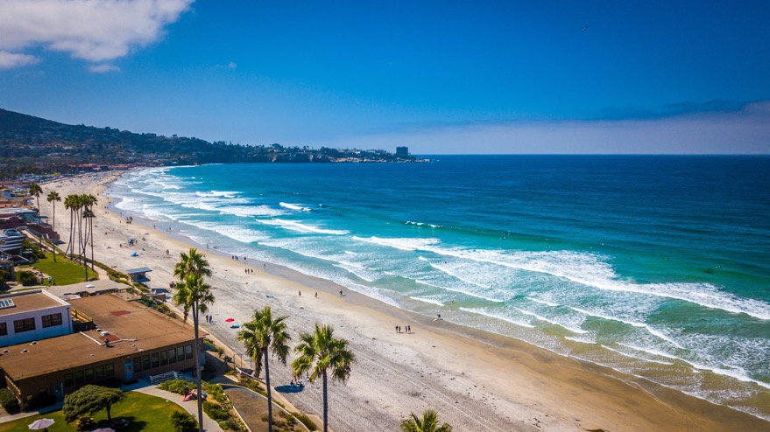
THURSDAY, SEPTEMBER 6 SAN DIEGO
STRATEGY LUNCHEON
*An excellent meal will be followed by a wide-ranging discussion
and an extended question and answer period
*The lunch will be held in an exclusive restaurant
on the waterfront
*please go to my online store at
http://www.madhedgefundtrader.com/store
and click on “luncheons.”
Tickets are available for $279

Slide 4

Trade Alert Performance
Summer Doldrums
40 out of 46 trade alerts profitable
*January +22.35% Final *July +0.44% Final
*February +3.41% Final *August -4.70% MTD
*March +20.85% Final *September +9.72% Final
*April +15.13% Final *October +5.69% Final
*May +0.30%% Final *November +8.31 Final
*June +3.01% Final *December +0.95% Final
*2022 Final +84.63%
compared to -18.63% for the S&P 500
*2023 Year to Date +60.80%, versus +8.51% for the S&P 500
+657.99% since inception
*Average annualized return of +48.15% for 15 years

Slide 5
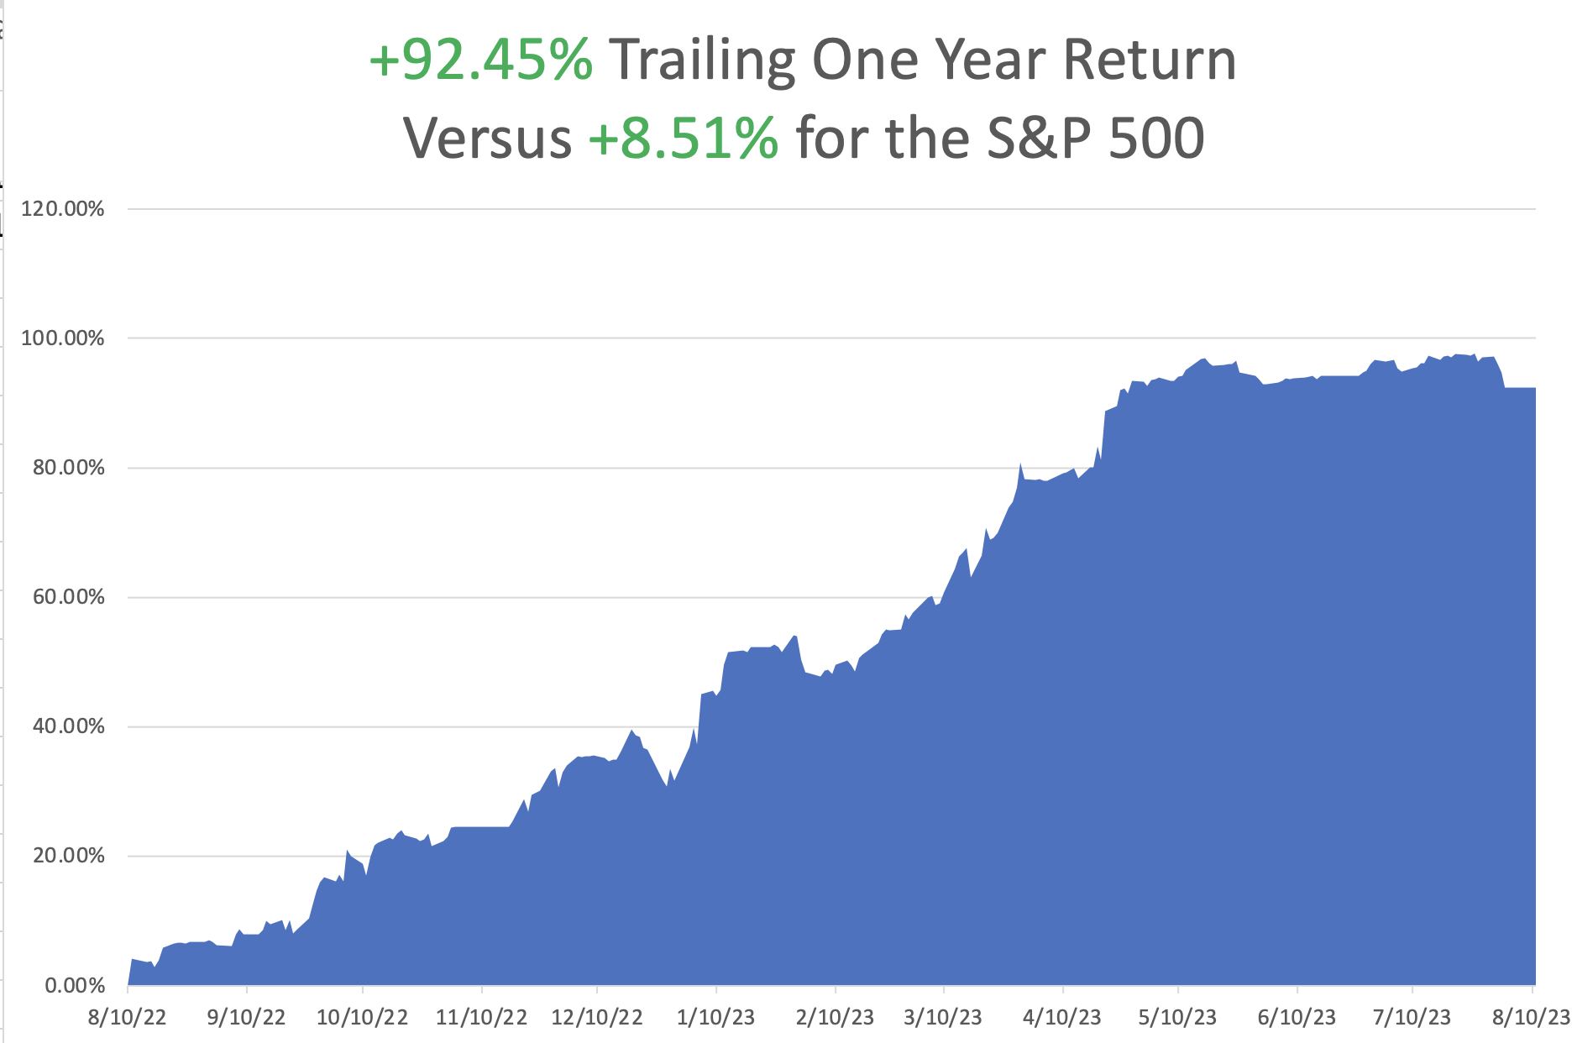

Slide 6
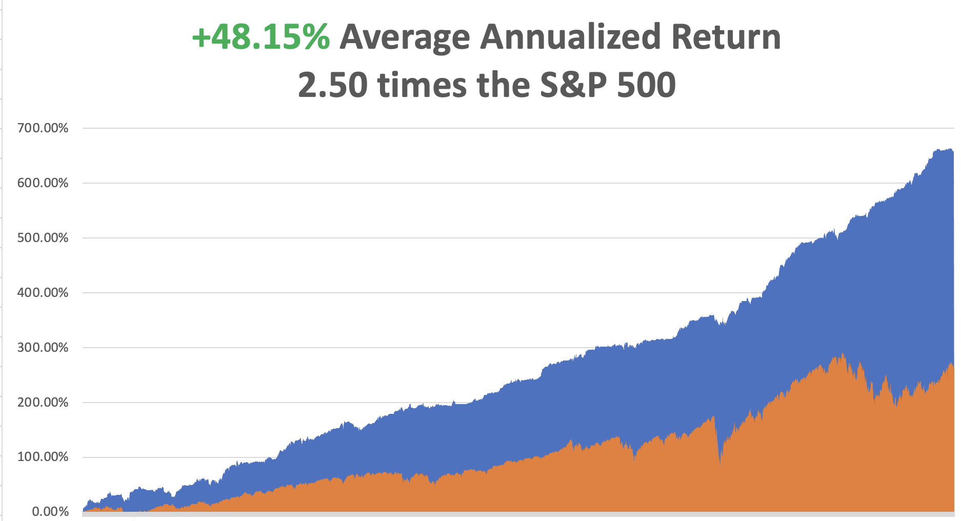

Slide 7
Portfolio Review
0% Long, 0% Short, 100% cash
with VIX at $15 no new positions
NO POSITIONS
Expiration Value
+60.80%

Slide 8


Slide 9

The Method to My Madness
*Big rotation underway out of Big Tech into industrials, commodities, and energy
*But the tech selloff will be brief. Too many people are trying to get into accelerating earnings
*Bonds probing lows in rising interest rate fears
*Fall will present the best buying opportunities of the year
*Precious metals and commodities should be at the top of
and “BUY” list to cash in on an economic recovery
*In this market patience is a virtue, let the market come to you

Slide 10

The Global Economy – Bouncing
*The Nonfarm Payroll Drops to 187,000 in July, a one year low, less than expectations
*The Headline Unemployment Rate returned to 3.5%, a 50-year low. The soft-landing scenario lives!
*That’s supposed to be impossible in the face of 5.25% interest rates.
*Average hourly earnings grew at a restrained 3.6% annual rate. Half of the new jobs were in health care. At the rate we are aging that is no surprise.
* Inflation Jumps, 0.2% in July and 3.2% YOY. Rents, education, and insurance
(climate change) were higher while used cars were down 1.3% and air fares plunged by 8.1%
* PPI Rose 0.3% in July, in line with yesterday’s inflation read.
On a year-over-year basis, headline PPI was up just 0.8%.
* Deflation Hits China, as the post Covid recovery continues to lag.
Their Consumer Price Index fell 0.3% YOY

Slide 11
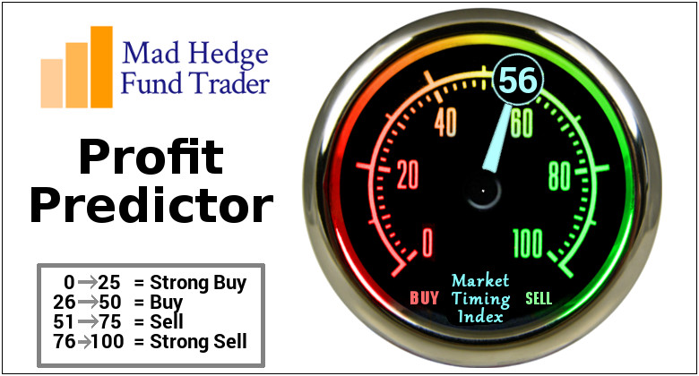
The Mad Hedge Profit Predictor
Market Timing Index – Overpriced
An artificial intelligence driven algorithm that analyzes 30 different economic, technical, and momentum driven indicators

Slide 12
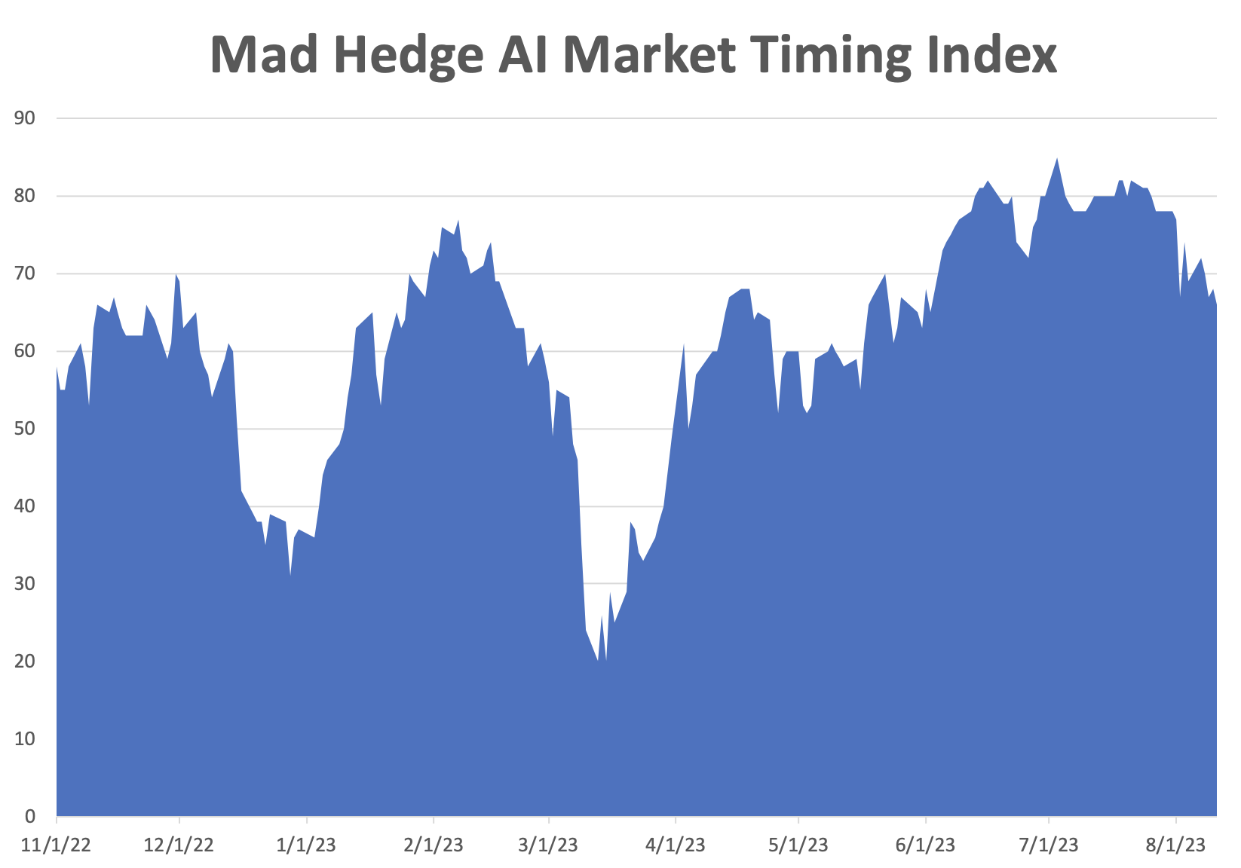
SELL
BUY

Slide 13
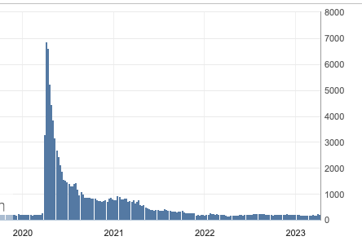
Weekly Jobless Claims – Rising
278,000 – Up 1,000

Slide 14


Slide 15
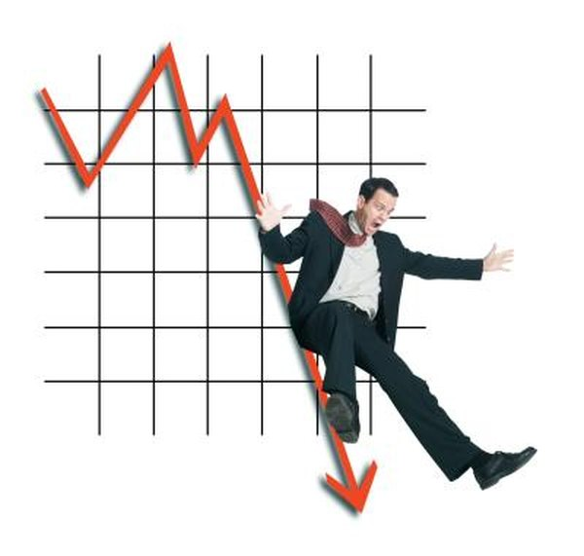
Stocks – Correction Time
* US Sees Biggest Equity Outflow in Seven Weeks, with some $15 billion fleeing the market last week. Some believe that the party is over for 2023 and now begins the hangover.
*Rating Agencies Strike Again, with Moody’s threatened downgrade of a dozed regional banks
*Money Market Inflows Hit Four Month High, at $58.56 billion as
risk makes a big comeback. What they really should be buying is 90-Day T-bills
with 5.27% yields today. Equity fund inflows have gone flat
*Albermarle (ALB) to Boost Lithium Production with a new filtering
technology at an Arkansas plant to meet exploding demand from EV makers
* Berkshire Hathaway (BRK/B) Post Record Profit, with profits up 38%
* Rivian (RIVN) Beats, losing only $1.08 a share versus an expected $1.41
* Biden Cracks Down on Technology Investment in China

Slide 16
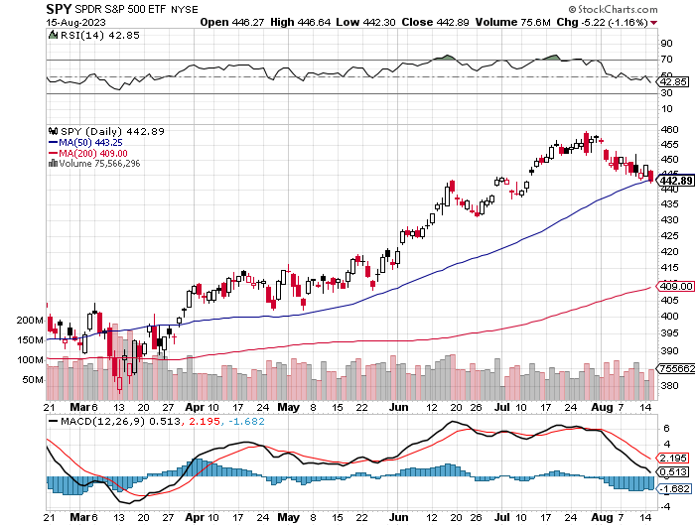
S&P 500 – Back to support took profits on long 5/$420-$430 put spread, took profits on long 1/$420-$430 put spread, took profits on long 11/$420-$430 put spread
$480
2023
Target
$442
-3.9%
1st support
$430
-6.50%
2nd support
The Bottom
$380
Down –17.4%

Slide 17
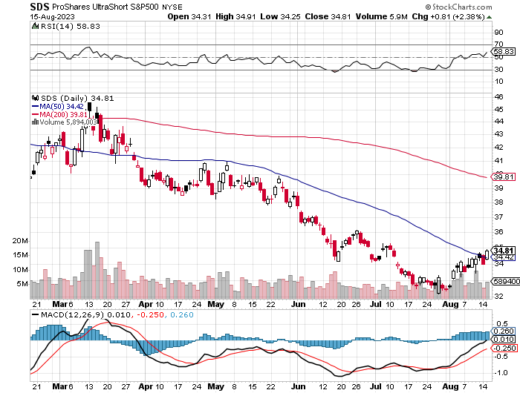
ProShares Ultra Short S&P 500 (SDS)- a great hedge for long stocks and bonds long 2X position has a hedge against longs and bond shorts

Slide 18
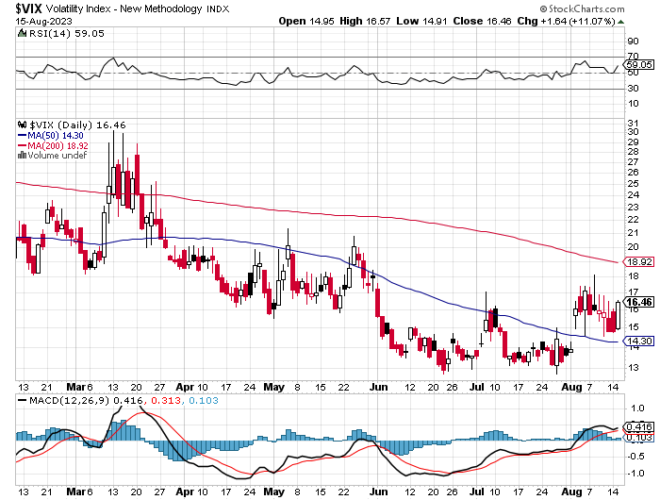
(VIX) – Bargain of the Century

Slide 19
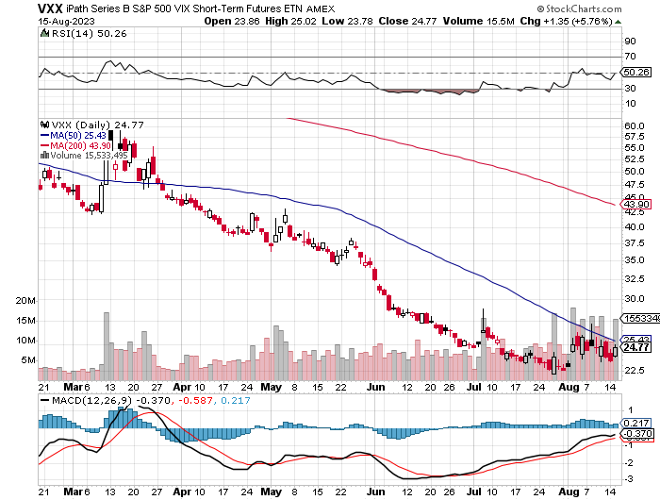
(VXX)-

Slide 20
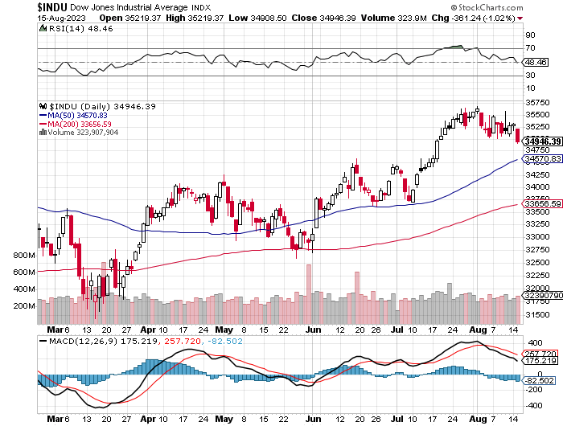
Dow Average ($INDU)-

Slide 21
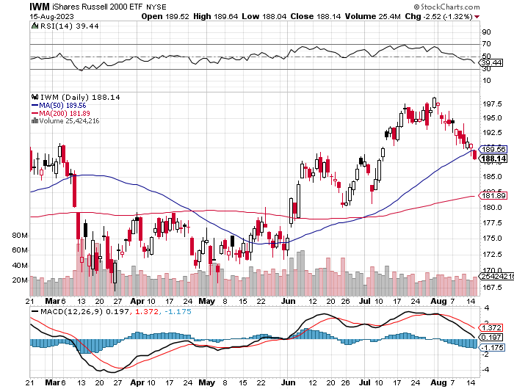
Russell 2000 (IWM)- took profits on Long 10/$137-$142 vertical bull call spread took profits on Long 10/$153-$156 vertical bear put spread

Slide 22
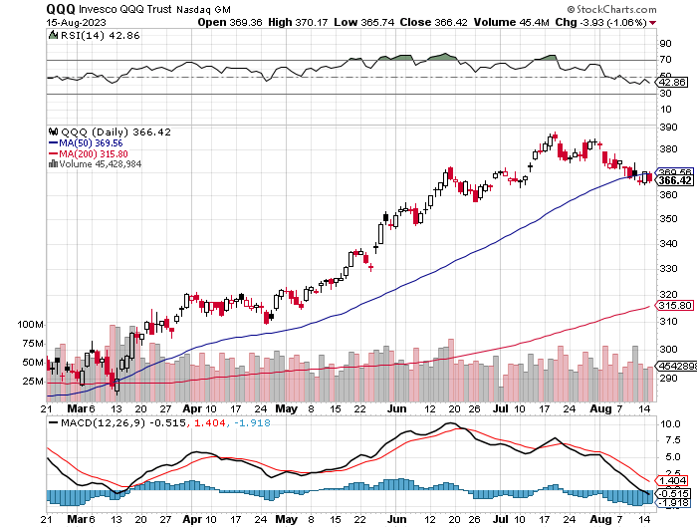
NASDAQ (QQQ) – took profits on Long 5/$335-$345 put spread took profits on long (QQQ) 1/$290-$300 put spread, took profits on long (QQQ) 4/$330-$335 put spread took profits on long (QQQ) 3/$340-$345 put spread, covered long (QQQ) $325-$330 put spread

Slide 23


Slide 24



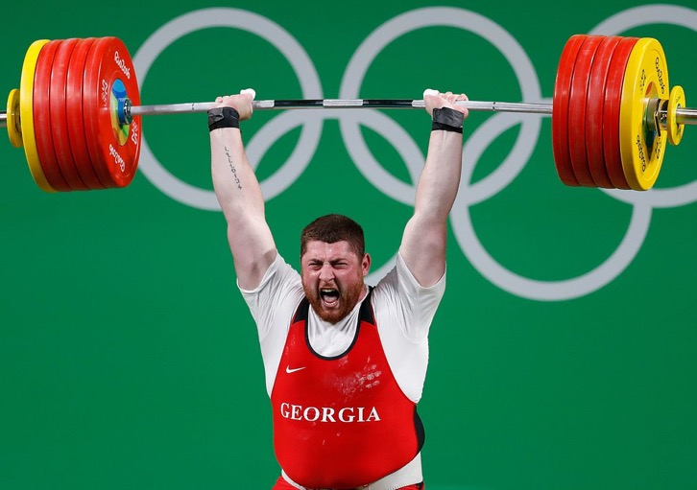
THE MAD HEDGE FUND TRADER
The Barbell Portfolio
*75% Big Tech – 2% of US workforce, 25% of market cap and 25% of US earnings
25% Domestic Recovery, including:
Railroads, airlines, cruise lines,
Couriers, steel companies
Banks, commodities
Construction
Credit Card Companies
Hotels, casinos
Online Ticket Sales

Slide 25
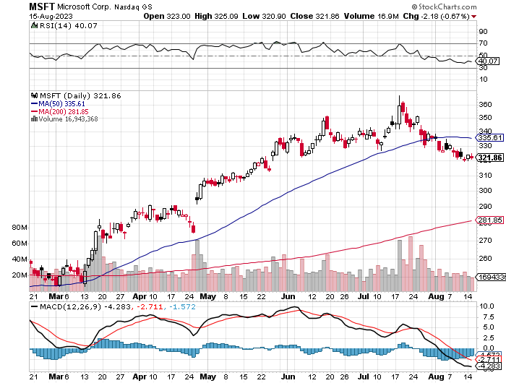
Microsoft (MSFT)- Earnings Beat took profits on 9/$235-$245 call spread, took profits on long 7/$220-$210 call spread, took profits on long 6/$220-$230 call spread, took profits on long 2/$200-$210 bear put spread

Slide 26
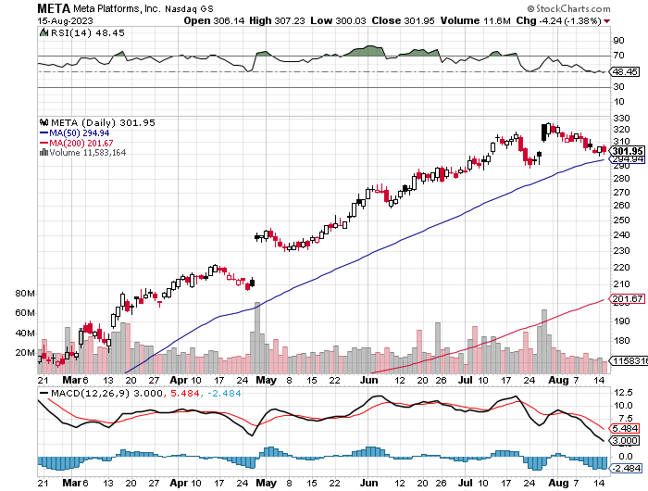
Meta (META)- Soars an Incredible 20% took profits on Long 9/$290-$300 vertical bear put spread stopped out of Long 9/$190-$200 vertical bear put spread

Slide 27
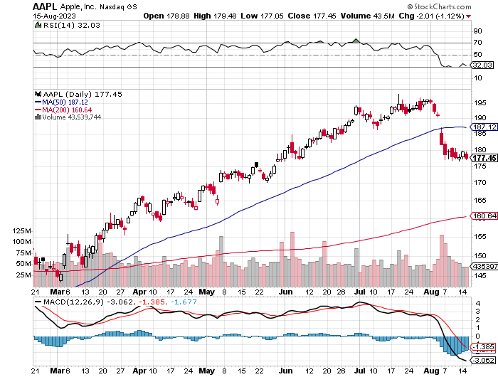
Apple (AAPL)
Apple Reports Earnings Decline, down 1.4% in its Q3, and expects the same in Q4 took profits on long 1/$145-$155 put spread, Took profits on long 10/$165-$175 put spread took profits on long 6/$155-$165 put spread, stopped out of long 6/$125-135 call spread, took profits on long 6/$110-$120 call spread, took profits on long 2/$180-$190 put spread

Slide 28
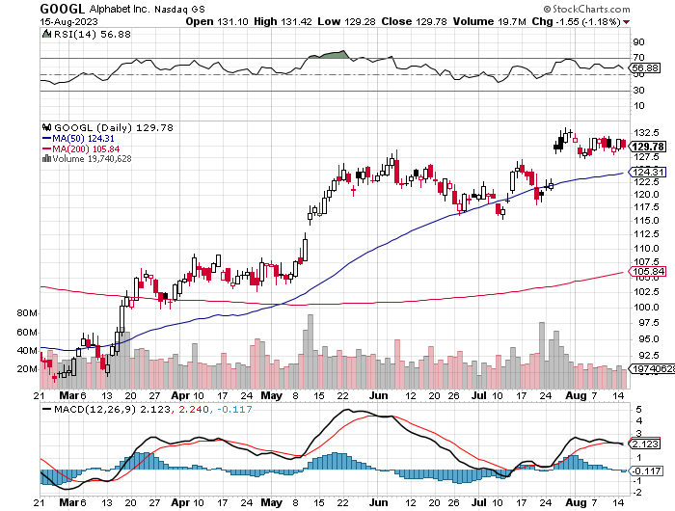
Alphabet (GOOGL) – Google Ramps Up AI Effort
EU Accuses Google of Abusing Monopoly Power took profits on long 12/$1,200-$1,230 bull call spread took profits on long 9/$1,030-$1,080 vertical bull call spread

Slide 29
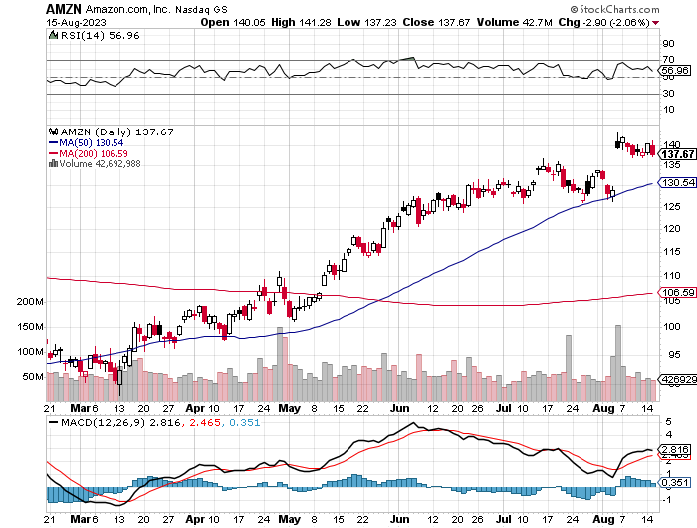
Amazon (AMZN) –
Amazon Soars on Earnings Beat, nearly double Wall Street estimates as its massive bet on AI pays off bigtime took profits on long 2/$3,400-$3,500 bear put spread took profits on long 9/$2,800-$2,900 bull call spread

Slide 30
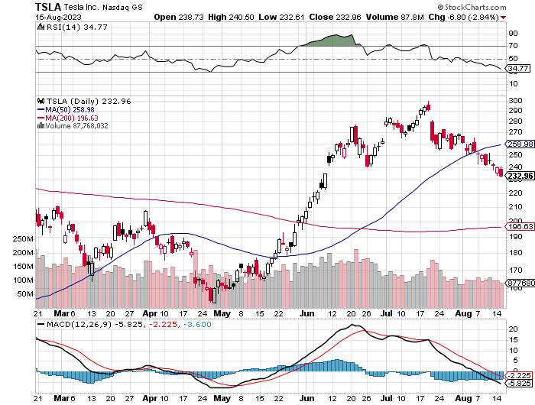
Tesla (TSLA) – Volatility Collapse to 43%
Tesla Model Y Became World’s Top Selling Car in Q1,
Price war continues took profits on long 6/$120-$130 call spread, stopped out of long 6/$210-$220 put spread took profits on long 5/$110-$120 call spread, took profits on long 5/$220-$230 put spread took profits on long 4/$130-$140 call spread, took profits on long 4/$250-$260 put spread

Slide 31
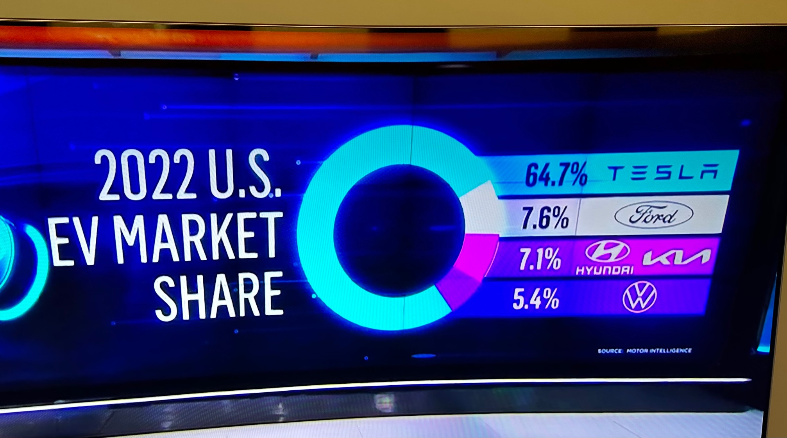

Slide 32
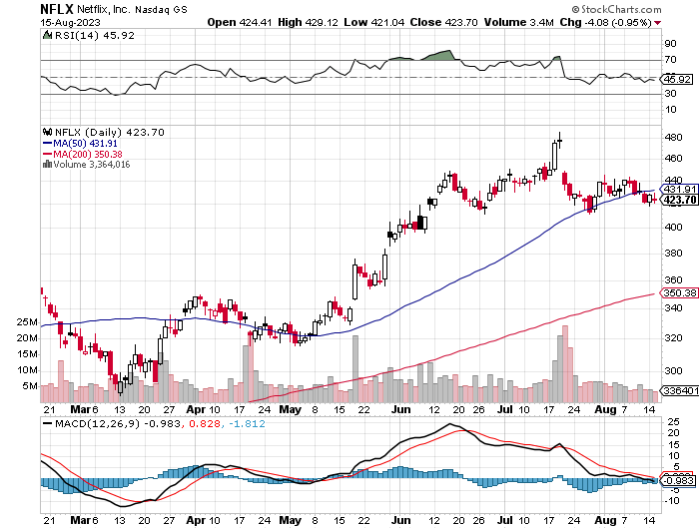
Netflix (NFLX) – Netflix subscribers beat - Netflix Password Sharing Crackdown Goes Global

Slide 33
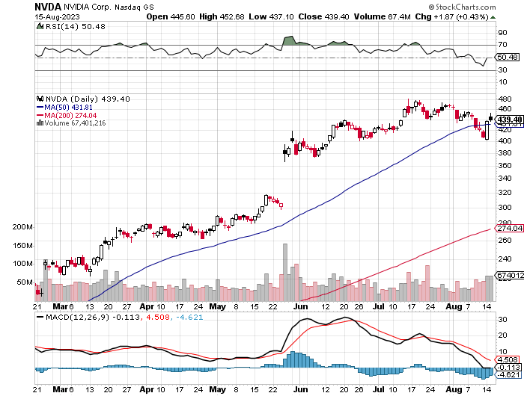
NVIDIA (NVDA) – Blowout Profits
EPS to triple in 2024, up another 50% in 2024 took profits on long 3/$260-$270 put spread, took profits on long 10/$95-$100 call spread took profits on long 7/$120-$130 call spread, took profits on long 6/$120-$130 call spread

Slide 34
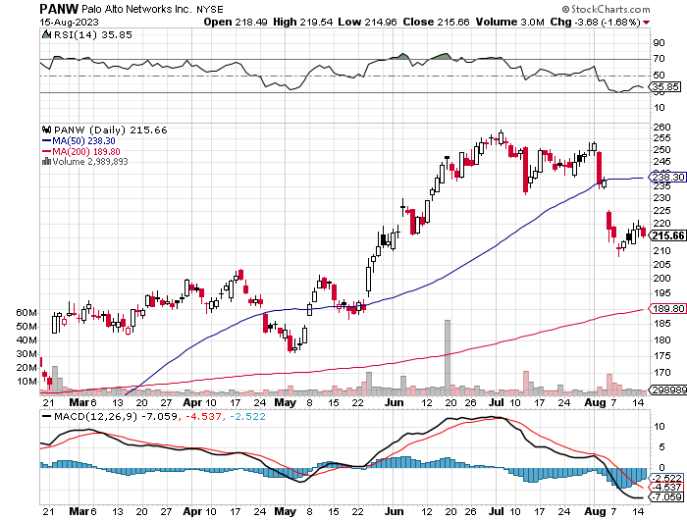
Palo Alto Networks (PANW)- Hacking never goes out of fashion
Palo Alto Networks (PANW) Goes into the S&P 500 took profits on long 10/$130-$140 call spread

Slide 35
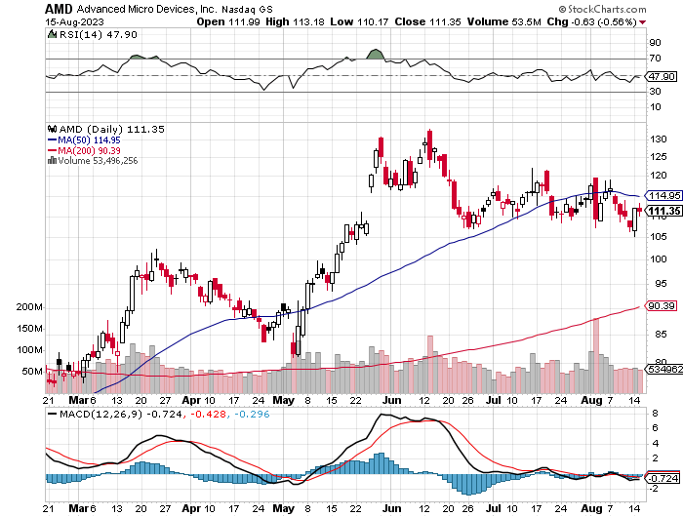
Advanced Micro Devices (AMD)- Recession fears programable logic devices took profits on long 2/$75-$80 call spread

Slide 36
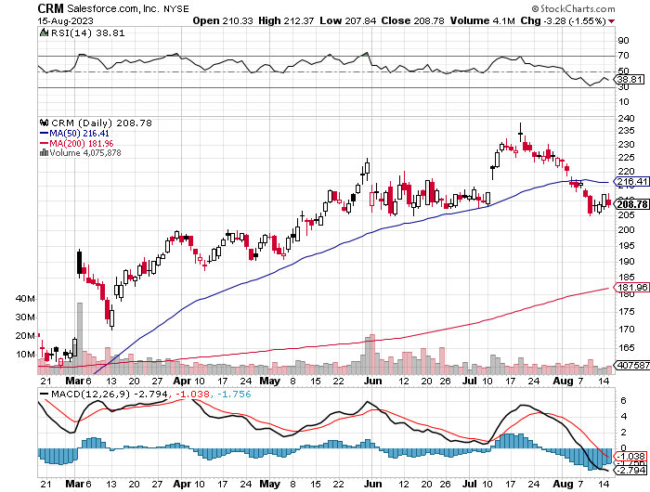
Salesforce (CRM)- Massive Online Migration
Salesforce Soars 16%, on better-than-expected guidance took profits on long 9/$125-$130 vertical bull call spread took profits on long 8/$125-$130 vertical bull call spread took profits on long 2/$105-$115 call spread

Slide 37
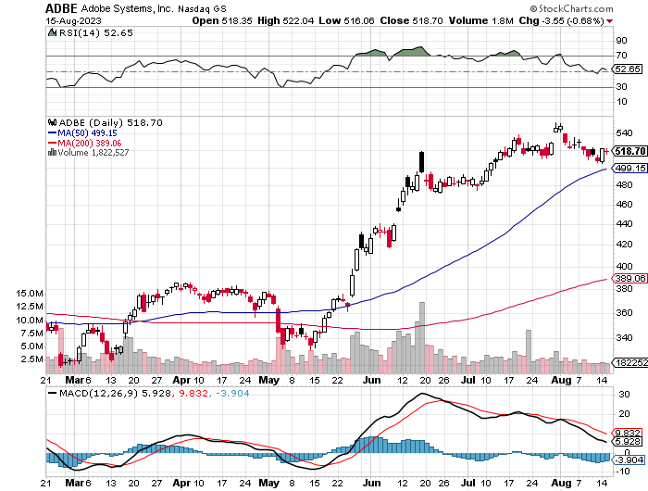
Adobe (ADBE)- Cloud play
The Quality Non-China tech play

Slide 38
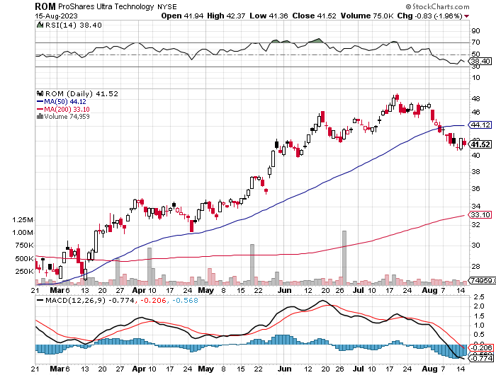
ProShares Ultra Technology ETF (ROM) – 2X Long Technology ETF took profits on long 10/$62-65 call spread

Slide 39
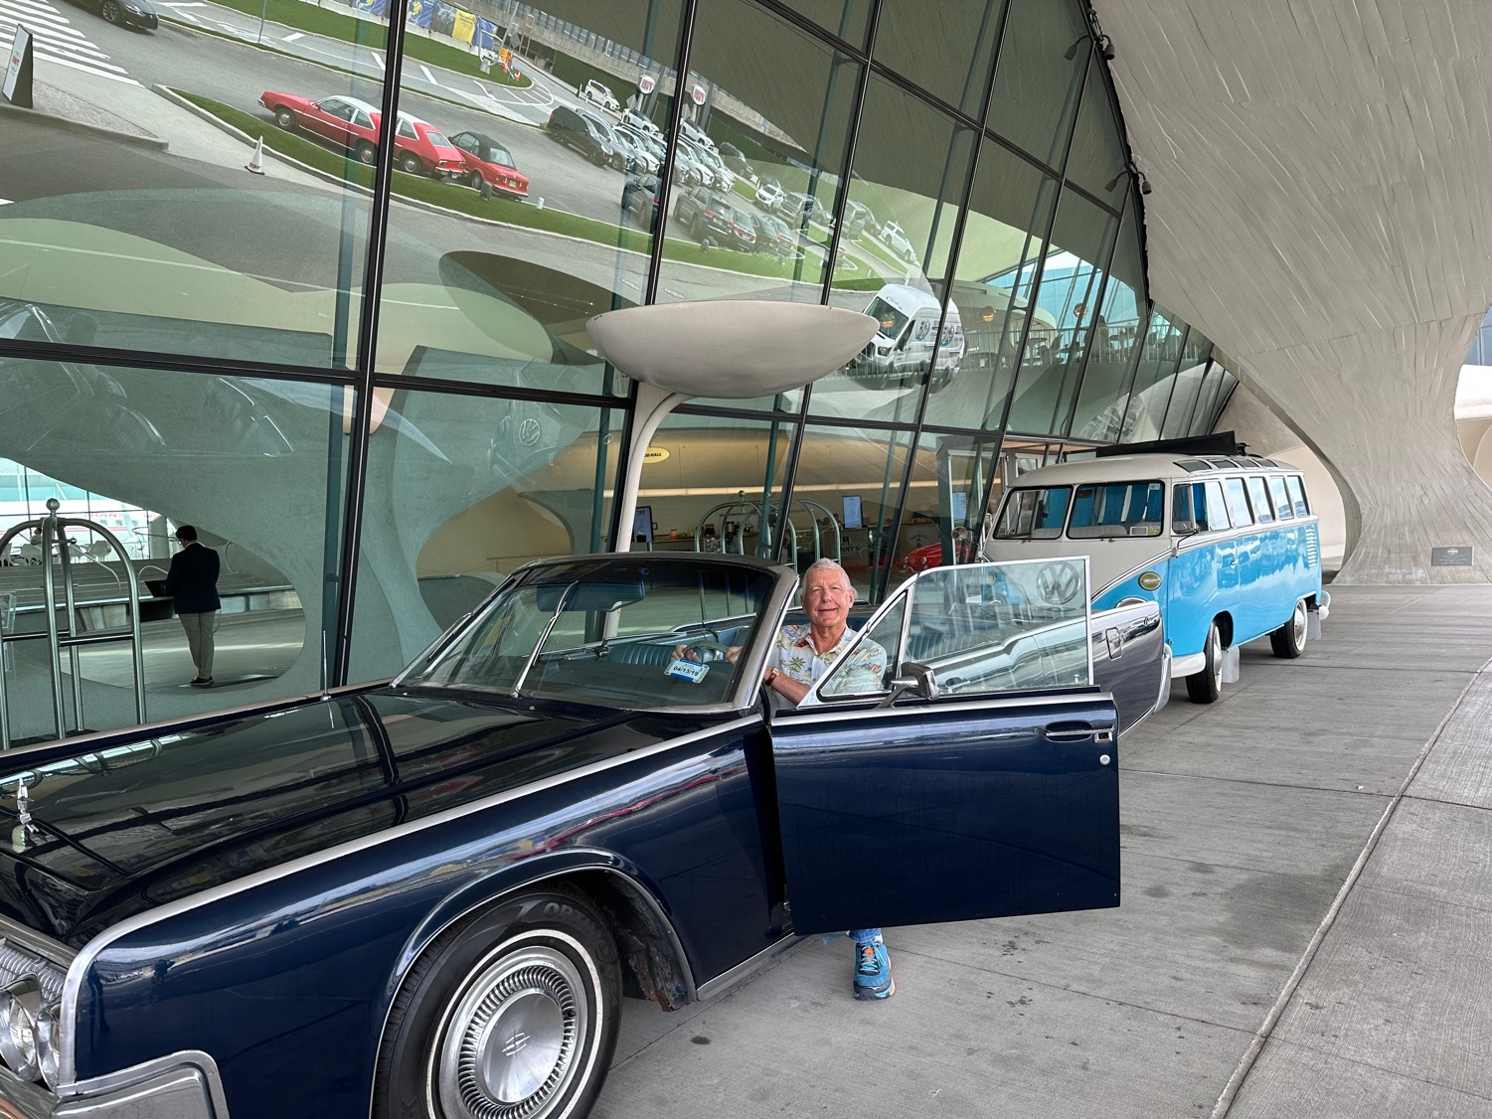

Slide 40
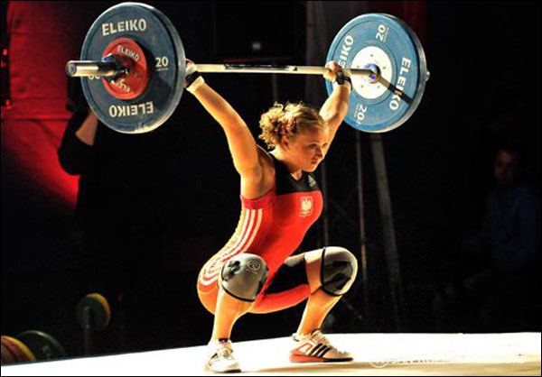
The Second Half of the Barbell
*Bets on a domestic recovery in 2022 Q4
*Upside potential in 2022 far greater than tech
*Some of these have not moved for 5 or 10 years
*Focuses on economically sensitive cyclical industries
*Makes a great counterweight to
high-growth technology
*We could spend all of next year rotating
between the two groups

Slide 41
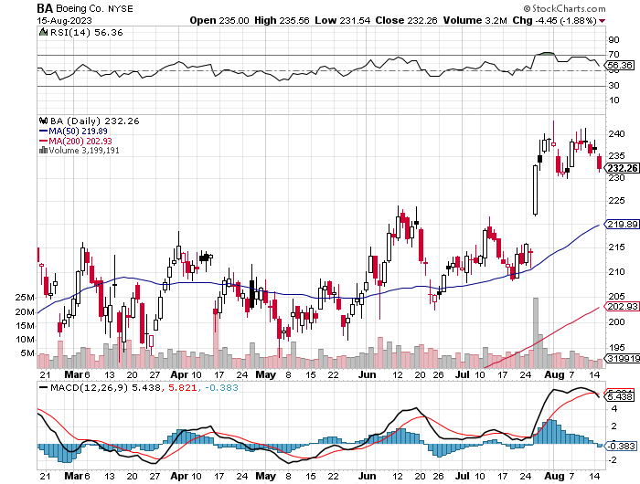
Boeing (BA) –
Increases Dreamliner Production for the Fourth Time in 2023 took profits on long 5/$17-$175 call spread

Slide 42
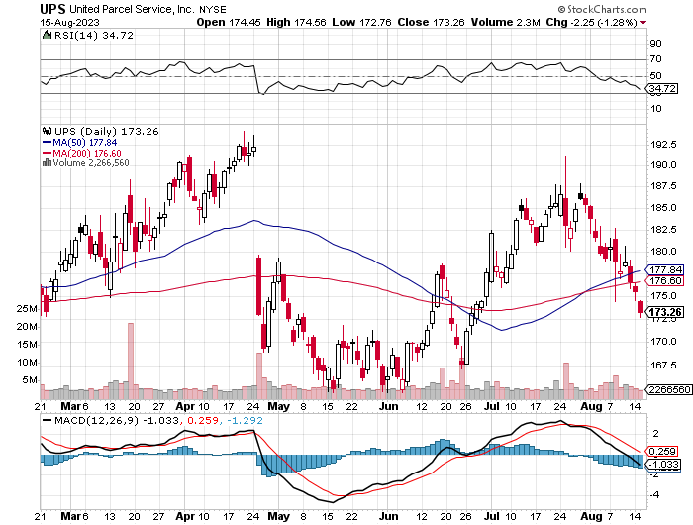
Package Delivery- United Parcel Service (UPS) – strike averted took profits on long 11/$130-$140 call spread

Slide 43
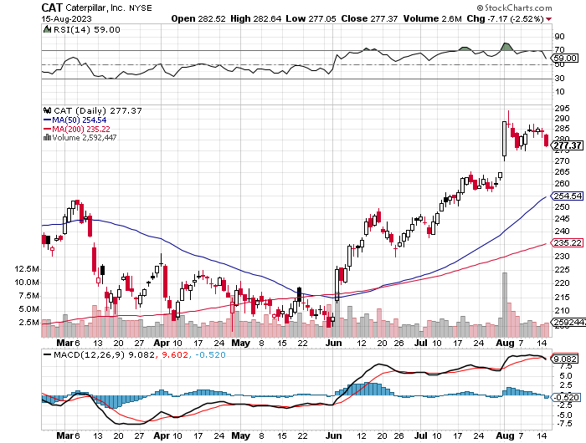
Caterpillar (CAT)- Ag + Infrastructure + Housing
Raises Dividend by 50% took profits on long 12/$145-$150 call spread took profits on long 11/$125-$135 call spread

Slide 44
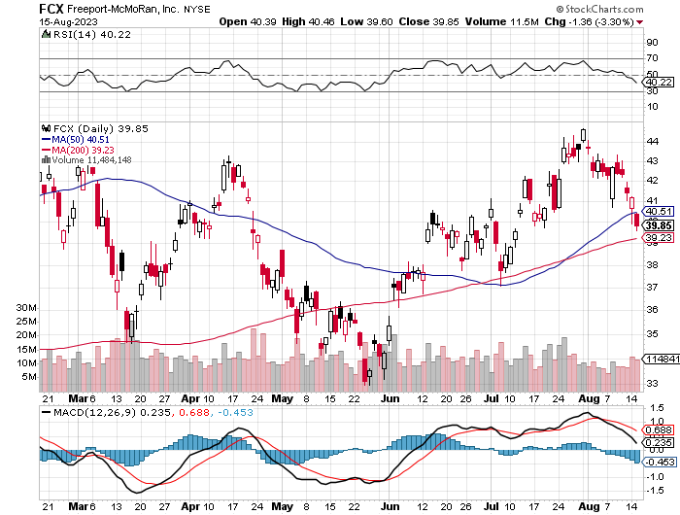
Freeport McMoRan - (FCX)- Coming Copper Crisis took profits on long 6/$32-$35 call spread took profits on long 4/$30-$33 call spread, took profits on long 10/$20-$23 call spread

Slide 45
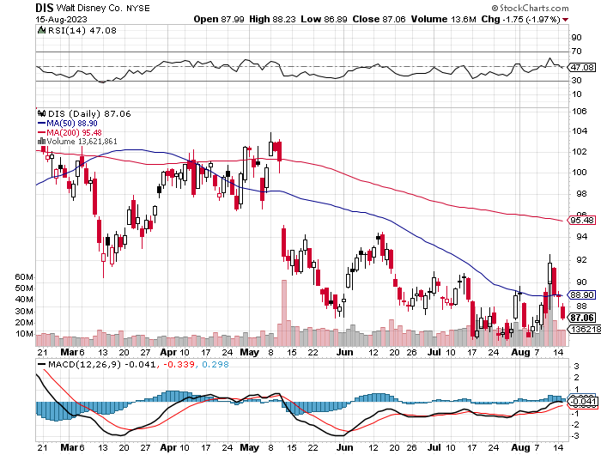
Walt Disney (DIS) - Disney Earnings are Flat, with parks jam packed and maxed out.
But streaming in a nosedive, down 4 million subscribers in Q1 at 157.8 million

Slide 46
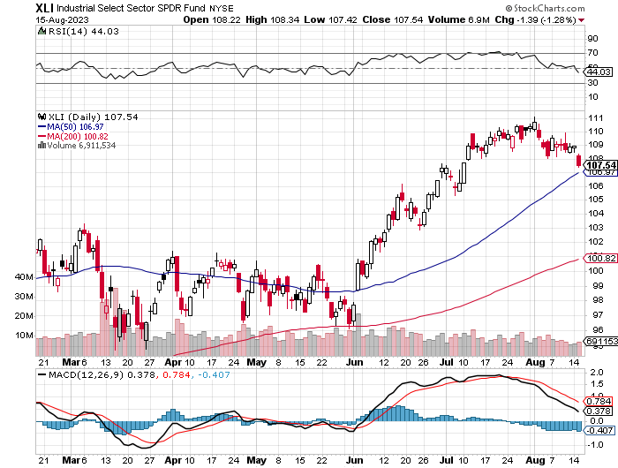
Industrials Sector SPDR (XLI)-
(GE), (MMM), (UNP), (UTX), (BA), (HON)

Slide 47
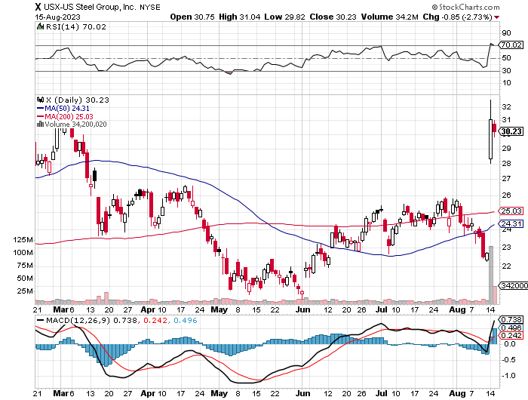
US Steel (X) – Commodity Boom and commodity
Bidding war breaks out, taking stock up 50% and LEAPS up 101%

Slide 48
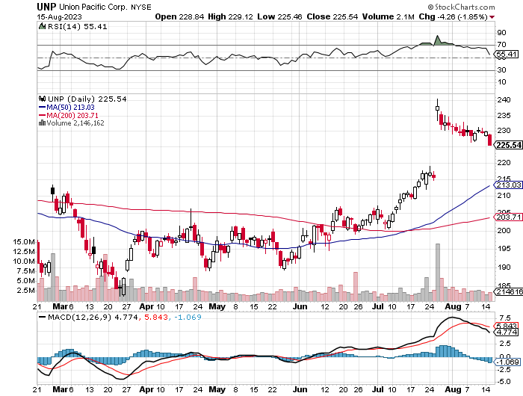
Union Pacific RR (UNP)- Big Stuff to Ship took profits on long 5/$200-$210 call spread took profits on 11/$150-$160 call spread

Slide 49
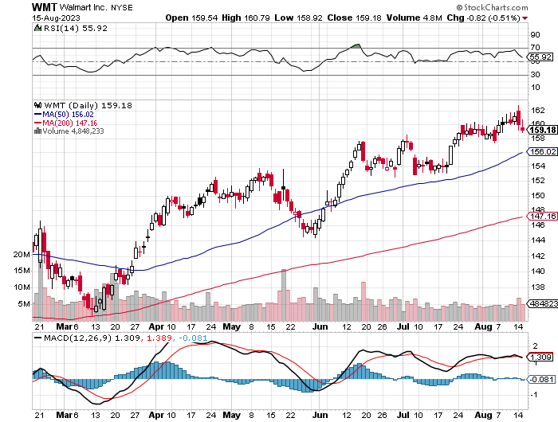
Wal-Mart (WMT)- took profit on Long 11/$125-$130 bear put spread took profit on Long 10/$119-$121 bear put spread took profits on Long 8/$114-$117 bear put spread

Slide 50
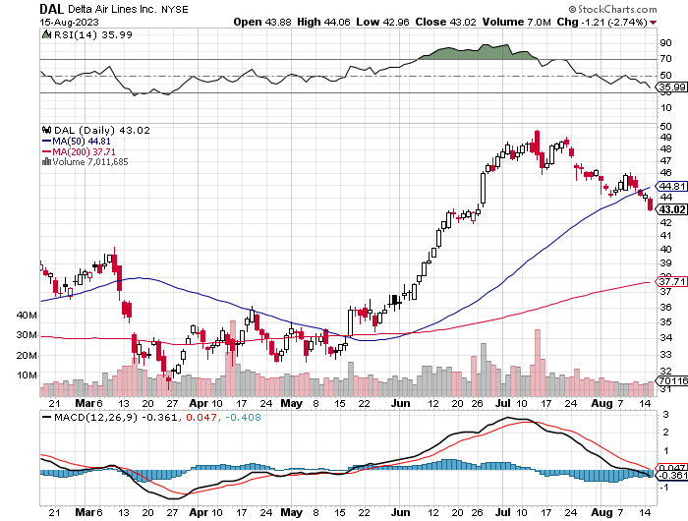
Delta Airlines (DAL) – Travel is Back!
Returns dividend for first time in 3 years entering a summer perfect storm of profits

Slide 51
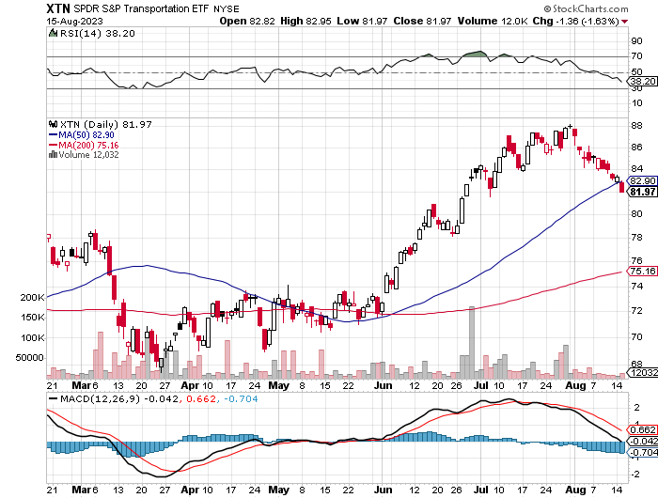
Transports Sector SPDR (XTN)- Worst Hit Sector
(ALGT), (ALK), (JBLU), (LUV), (CHRW), (DAL)

Slide 52
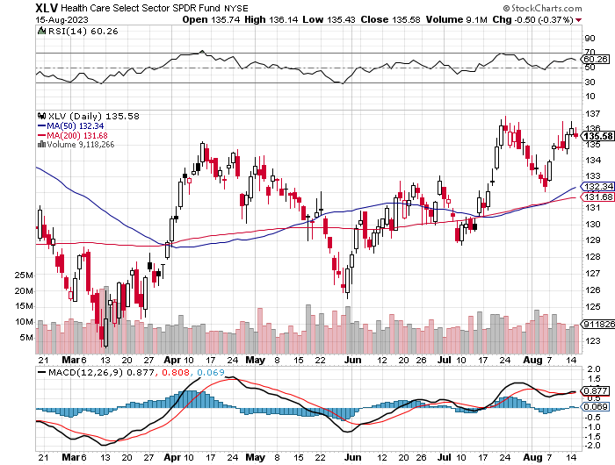
Health Care Sector (XLV)
(JNJ), (PFE), (MRK), (GILD), (ACT), (AMGN)

Slide 53
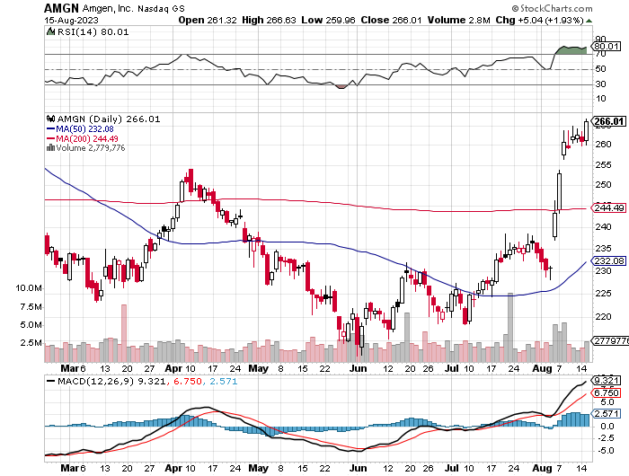
Amgen (AMGN) took profits on long 11/$185-$200 bull call spread

Slide 54
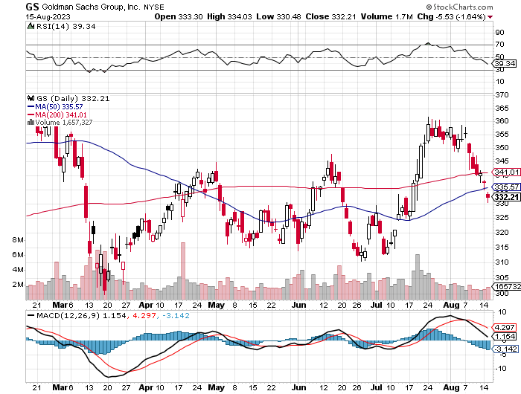
Goldman Sachs (GS) – Highest Capital ratio net of mark to market took profits 12/$330-$350 call spread took profits 11/$330-$350 call spread stop loss on long 11/$385-$395 call spreads

Slide 55
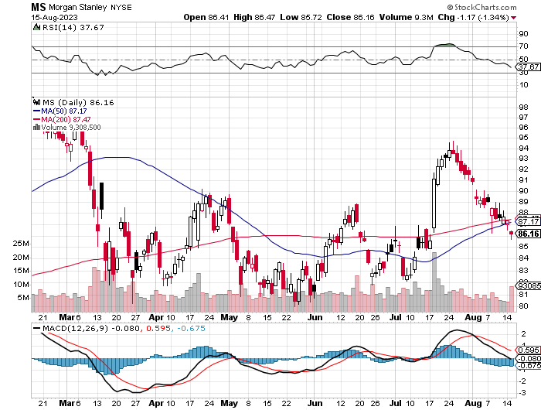
Morgan Stanley (MS) – Highest Capital ratio net of mark to market
CEO to Step Down in a Year took profits on long 4/$65-$70 call spread

Slide 56
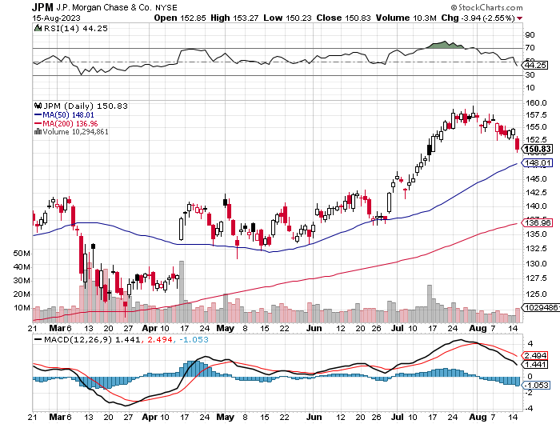
JP Morgan Chase (JPM) - Highest Capital ratio net of mark to market
JP Morgan Picks Up an Annual $3 Billion, in interest income on the First Republic deal took profits on long 4/$105-$115 call spread

Slide 57
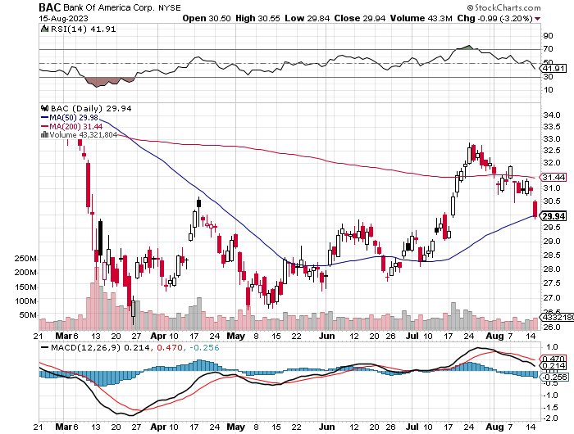
Bank of America (BAC) – Bank of America Rips, on a great earnings report took profits on long 4/$20-$23 call spread

Slide 58
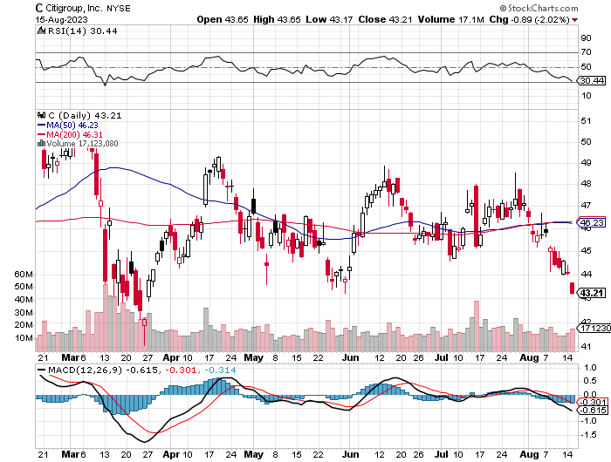
Citigroup (C) – took profits on long 4/$30-$35 call spread

Slide 59
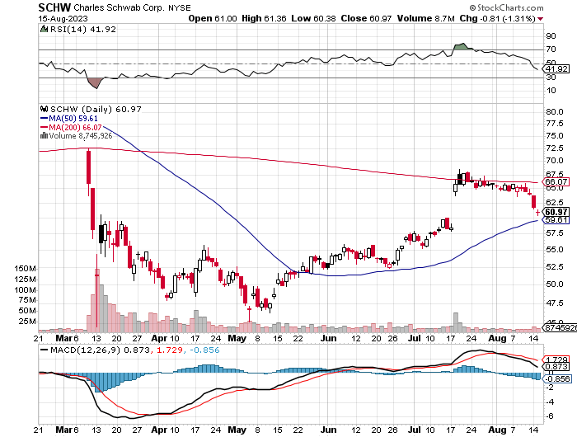
Charles Schwab (SCHW) – LEAPS up 67% in three months took profits on long 4/$30-$35 call spread

Slide 60

Interactive Brokers (IBKR) – Best Risk Control took profits on long 4/$60-$65 call spread

Slide 61

SPDR Metals & Mining ETF (XME) – long 2/$28-$30 call spread

Slide 62

Blackrock (BLK)-Asset Collection Boom took profits on long 3/$770-$790 call spread took profits on long 3/$310-$340 call spread

Slide 63

Visa (V) – Inflation boost
Transaction grew by an inflationary 10% back to pre-pandemic levels took profits on long 10/$160-$170 bull call spread took profits on long 6/$150-$160 bull call spread

Slide 64

Consumer Discretionary SPDR (XLY)
(DIS), (AMZN), (HD), (CMCSA), (MCD), (SBUX)

Slide 65

Berkshire Hathaway (BRKB)- Natural Barbell operating earnings soar in Q2, LEAPS up 350% took profits on long 4/$260-$270 call spread took profits on long 1/$290-$300 call spread, took profits on long 10/$220-$230 call spread, took profits on long 7/$220-$230 call spread, took profits on long 7/$220-$230 call spread took profits on long 6/$260-$270 call spread

Slide 66

Europe Hedged Equity (HEDJ)-

Slide 67

Japan (DXJ)-

Slide 68

Emerging Markets (EEM) - Pro trade, Weak Dollar, Long Recovery Play

Slide 69


Slide 70

Bonds – Probing for a bottom
*The whole falling interest rate, rising bond price trade has been delayed for six months thanks to the Fitch downgrade and hotter than expected economic growth at 2.40% for Q2.
*US Debt Downgraded from AAA to AA+ by the well-known Fitch rating agency for only the second time in history
*Bonds (TLT) took it on the nose. The January 6 attack on the capitol and standoff over the debt ceiling crisis was cited as the reasons. US bonds are still the safest and most liquid investment in the world when held to expiration.
*Keep Buying 90-Day T-Bills, now pushing a 5.2% risk free yield
*Still looking like 3.50% yield by end 2023
*Junk bond ETF’s (JNK) and (HYG) are holding up extremely
well with a 6.5% yield
*Bonds still likely to hit $110 by yearend

Slide 71

Treasury ETF (TLT) – took profits on long 5/$98-$101 call spread took profits on long 5/$97-$100 call spread, long 2/$98-$101 call spread, took profits on long 4/$96-$99 call spread took profits on long 4/$113-$116 put spread, took profits on long 4/$114-$117 put spread

Slide 72

Ten Year Treasury Yield ($TNX) – 4.26%

Slide 73

Junk Bonds (JNK) 6.50% Yield to Maturity

Slide 74

Municipal Bonds (MUB) 3.27% Yield-

Slide 75

Emerging Market Debt (ELD) 6.83% Yield-

Slide 76

2X Short Treasuries (TBT)-Out of Favor

Slide 77


Slide 78

Foreign Currencies – Dollar Fading
*Dollar dumps On Fed decision of no interest rate rise and only quarter points to go
*Japanese yen is headed for new multiyear lows at $150
*Investors flee to safe haven short term investments
*Falling inflation rate at 3.2% is accelerating first rate cut to March
*Any strength in the dollar will be temporary
*Look for new dollar lows by end 2023
*Buy (FXE), (FXB), (FXA) on dips, avoid (FXY)

Slide 79

Australian Dollar (FXA) - Major Long-Term Bottom is In Targeting Parity – A call option on a global synchronized recovery
1:1
BUY

Slide 80

Japanese Yen (FXY)

Slide 81

Euro (FXE)-
2023
Target
25%

Slide 82

British Pound (FXB)-
2023
Target
15%

Slide 83


Emerging Market Currencies (CEW)
2023
Target
40%

Slide 84


Slide 85

Energy & Commodities – Reborn Again
* Natural Gas Soars to a new 2023 High and accomplished an upside breakout on all charts
*European gas prices have just jumped 40%
* An Australian strike shut down an LNG export facilities
*Russian output down 800,000 b/d since January due to sanctions and sinking tankers
*Unilateral Saudi 1 million b/d cut in June worked
*Oil traded back to top of 2023 range and may break out to $100
*China Expects LNG Price Spike Later this Year,
due to coming supply shortages and a recovering economy
*Buy all energy on dips

Slide 86

Oil-($WTIC)

Slide 87

United States Oil Fund (USO)

Slide 88

Energy Select Sector SPDR (XLE)-No Performance!
(XOM), (CVX), (SLB), (KMI), (EOG), (COP)

Slide 89

ExxonMobile (XOM)- took profits on long 12/$120-$125 put spread

Slide 90

Occidental Petroleum (OXY)- Buffet’s a Buyer long 2/$55-$60 call spread, took profits on long 12/$77.50-$82.50 put spread

Slide 91

Natural Gas (UNG) -
Long January 2025 $14 - $15 Call Spread LEAPS

Slide 92
Freeport McMoRan (FCX) -
Codelco Sees Profit Slump, the world’s largest copper producer based in Chile

Slide 93

Cameco (CCJ) - took profits on long 5/$20-$23 bull call spread

Slide 94


Slide 95

Precious Metals – Take a Hit
*No Fed action to lower rates undercuts precious metals
*Interest rate rises in Europe and Australia aren’t helping either
*Gold headed for $3,000 by 2025, but back off first from new all-time highs
*The new drivers are soon to fall interest rates and the demise of crypto
*Silver is the better play with a higher beta
*Russia and China are also stockpiling gold to sidestep
international sanctions
*A Severe Short Squeeze in Copper is Developing,
leading to a massive price spike later in 2023

Slide 96

Gold (GLD) - Deflation call took profits on long 5/$165-$170 bull call spread

Slide 97

Market Vectors Gold Miners ETF- (GDX) –

Slide 98

Barrick Gold (GOLD) took profit on long 1/$15.50-$16.50 call spread

Slide 99

Newmont Mining- (NEM)- took profits on long $55-60 call spread

Slide 100

Silver- (SLV)- took profits on long 11/$19-$20 call spread

Slide 101

Silver Miners - (SIL)-

Slide 102

Wheaton Precious Metals - (WPM)- took profits on long 1/$36-$39 call spread

Slide 103

Platinum- (PPLT)- 556,000-ounce shortage this year took profits on long 1/$36-$39 call spread

Slide 104


Slide 105

Real Estate – Coming Back
*Home Mortgage Rates Hit a 22-Year High, at 7.08%.
*But the existing home market is heating up and the new home market is absolutely on fire in anticipating of a coming rate fall.
*You can’t beat a gale force demographic tailwind
*Rustbelt prices are rising for the First time in five years,
the cheapest homes in the country
*Homebuilder Sentiment dives on record mortgage highs
*Rising rents are still the big input into the Fed’s inflation calculation
*Case-Shiller Rose by 0.7% in May
*We are on the eve of another decade long demographic
driven bull market in residential real estate

Slide 106

S&P Case Shiller Plunges
S&P Case Shiller Rises to +0.70%, with its National Home Price Index
Chicago gained +4.6%, Cleveland +3.9%, and New York +3.5%.
Seattle down -11.3%, San Francisco -11.0%

Slide 107

Crown Castle International (CCI) – 6.26% yielding cell phone tower REIT loses Verizon as major customer

Slide 108

US Home Construction Index (ITB)
(DHI), (LEN), (PHM), (TOL), (NVR)

Slide 109


Slide 110

Trade Sheet-
So What Do We Do About All This?
*Stocks – buy the big dips at bottom of range,
………………sell big rallies to hedge holdings
*Bonds – buy dips
*Commodities-buy dips
*Currencies- sell dollar rallies, buy currencies
*Precious Metals – buy dips
*Energy – buy dips
*Volatility - sell short over $30
*Real estate – buy dips

Slide 111

Next Strategy Webinar
12:00 EST Wednesday, August 30 from Silicon Valley, CA email me questions at support@madhedgefundtrader.com
Good Luck and Good Trading!
Notes:
*

Slide 112


