Slide 1
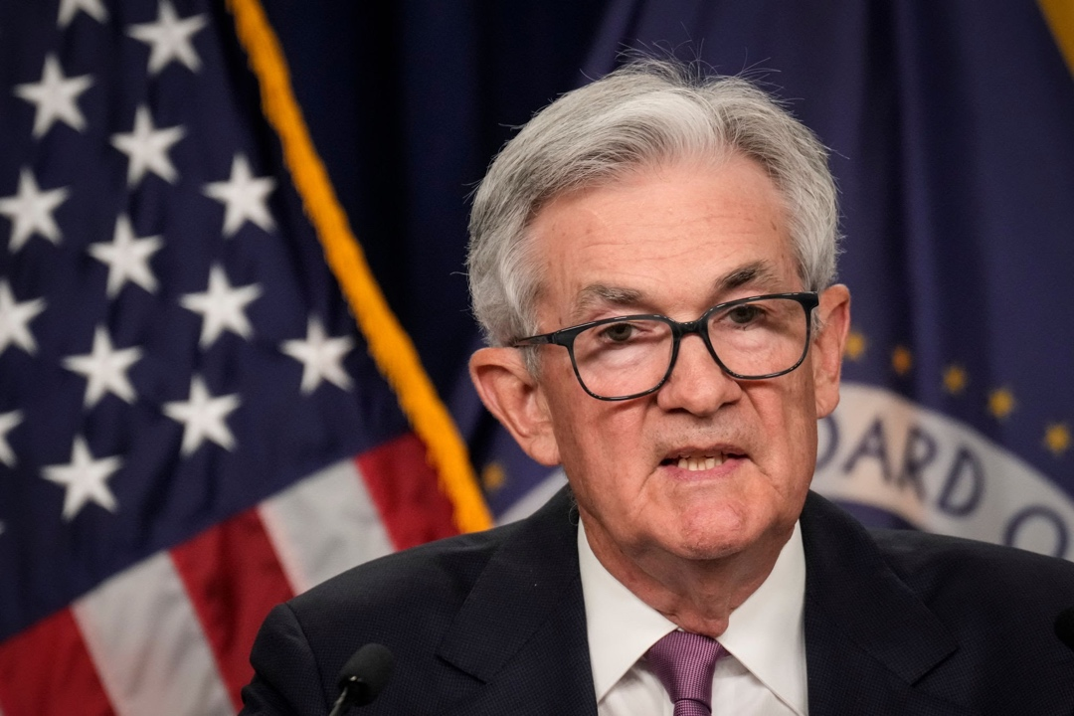
The Mad Hedge Fund Trader
“Higher for Longer”
With John Thomas
Lake Tahoe, CA, August 30, 2023
www.madhedgefundtrader.com
Notes:
*

Slide 2


*A gathering of 28 of the best trading minds in the world
*It’s a smorgasbord of trading strategies in all asset classes, including Stocks, bonds, foreign exchange, commodities, precious metals, and energy
*$100,000 in free prizes awarded to those who register
*Sign up at https://www.madhedge.com/?source=jtmhft or
respond to the link we will send you shortly
*Best of all, attendance is FREE!

Slide 3
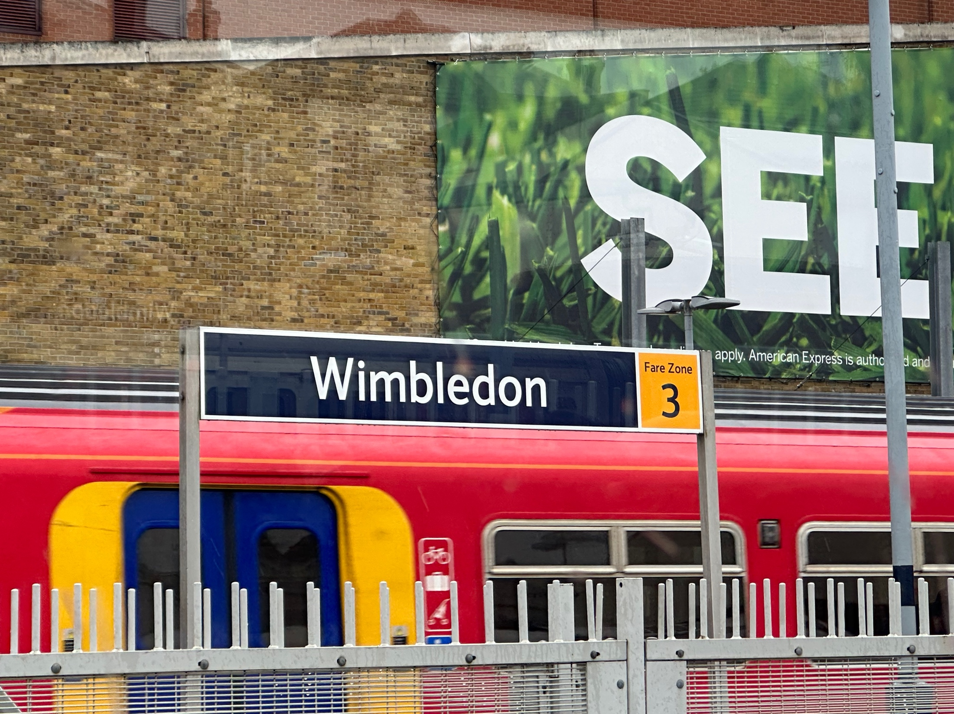

Slide 4
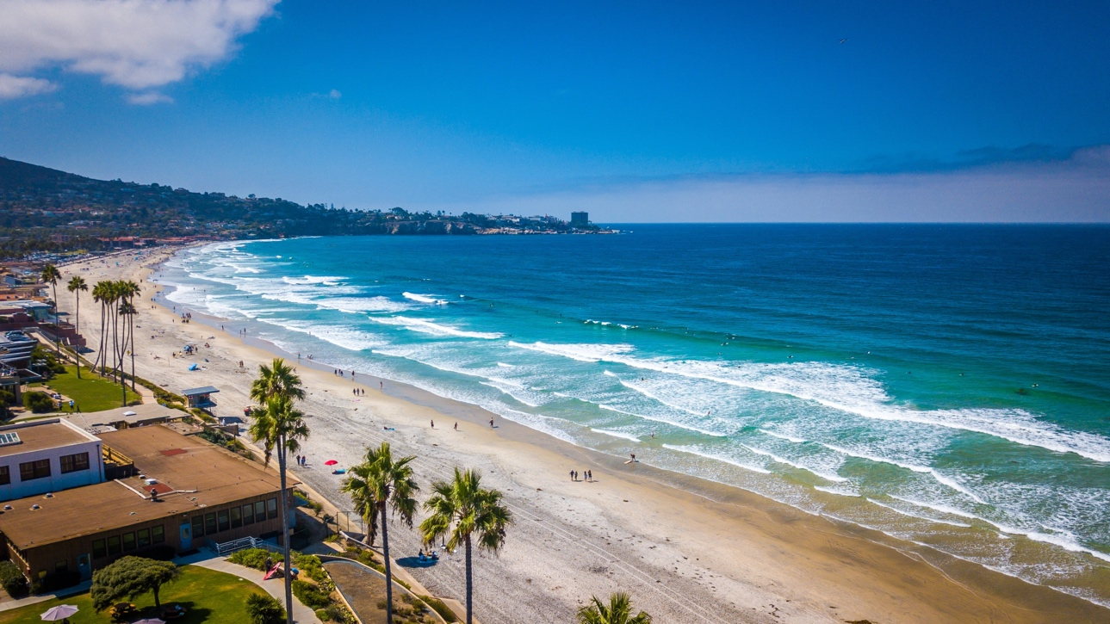
THURSDAY, SEPTEMBER 6 SAN DIEGO
STRATEGY LUNCHEON
*An excellent meal will be followed by a wide-ranging discussion
and an extended question and answer period
*The lunch will be held in an exclusive restaurant
on the waterfront
*please go to my online store at
http://www.madhedgefundtrader.com/store
and click on “luncheons.”
Tickets are available for $279

Slide 5

Trade Alert Performance
Summer Doldrums
40 out of 46 trade alerts profitable
*January +22.35% Final *July +0.44% Final
*February +3.41% Final *August -4.70% MTD
*March +20.85% Final *September +9.72% Final
*April +15.13% Final *October +5.69% Final
*May +0.30%% Final *November +8.31 Final
*June +3.01% Final *December +0.95% Final
*2022 Final +84.63%
compared to -18.63% for the S&P 500
*2023 Year to Date +60.80%, versus +8.51% for the S&P 500
+657.99% since inception
*Average annualized return of +48.15% for 15 years

Slide 6
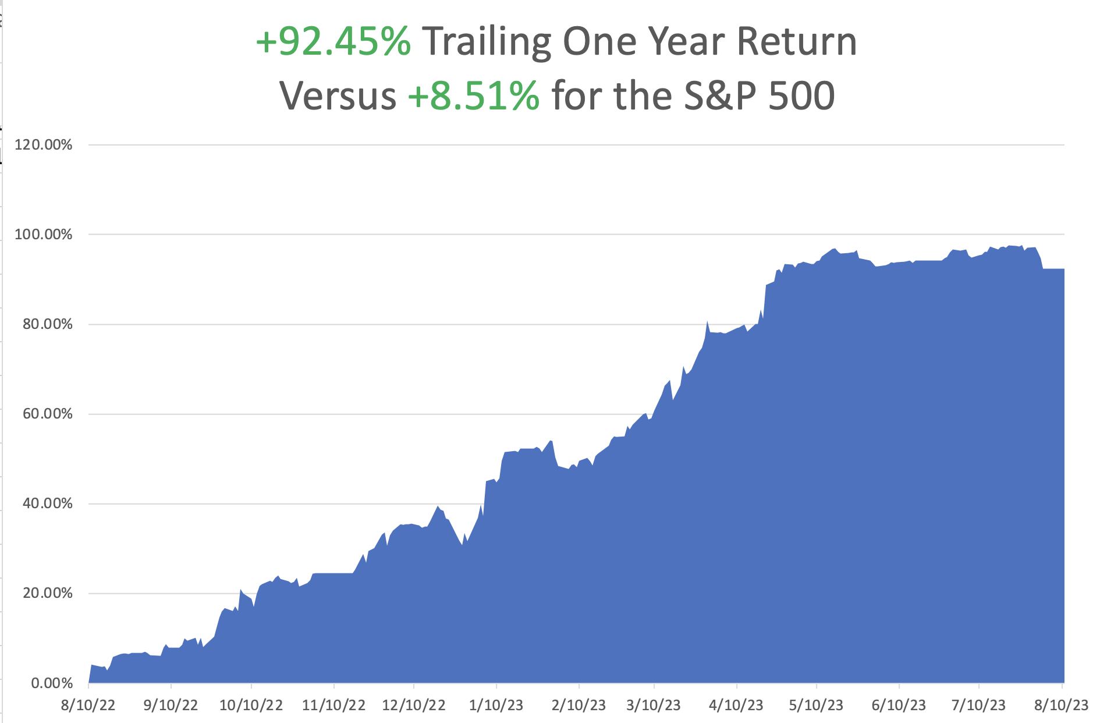

Slide 7
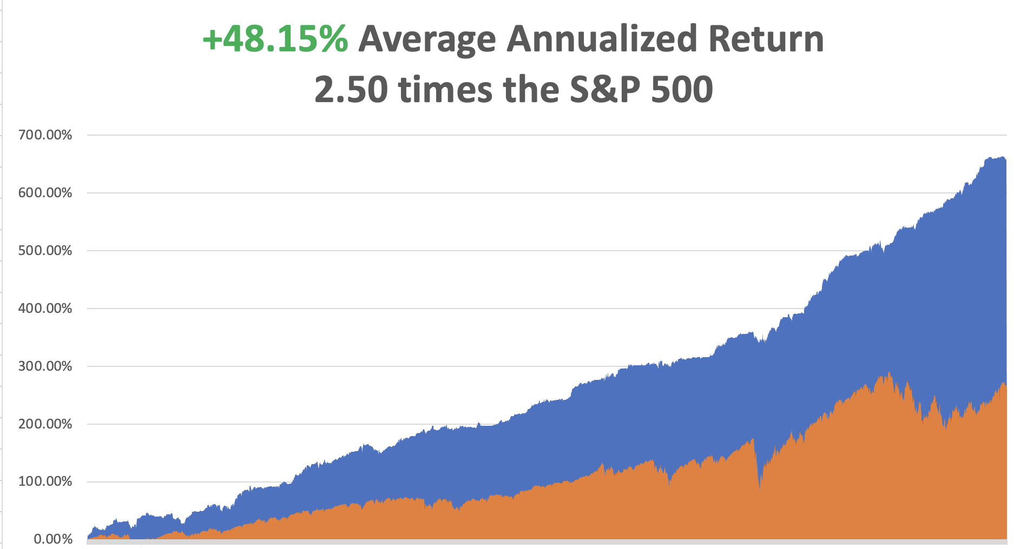

Slide 8
Portfolio Review
0% Long, 0% Short, 100% cash
with VIX at $15 no new positions
NO POSITIONS
Expiration Value
+60.80%

Slide 9
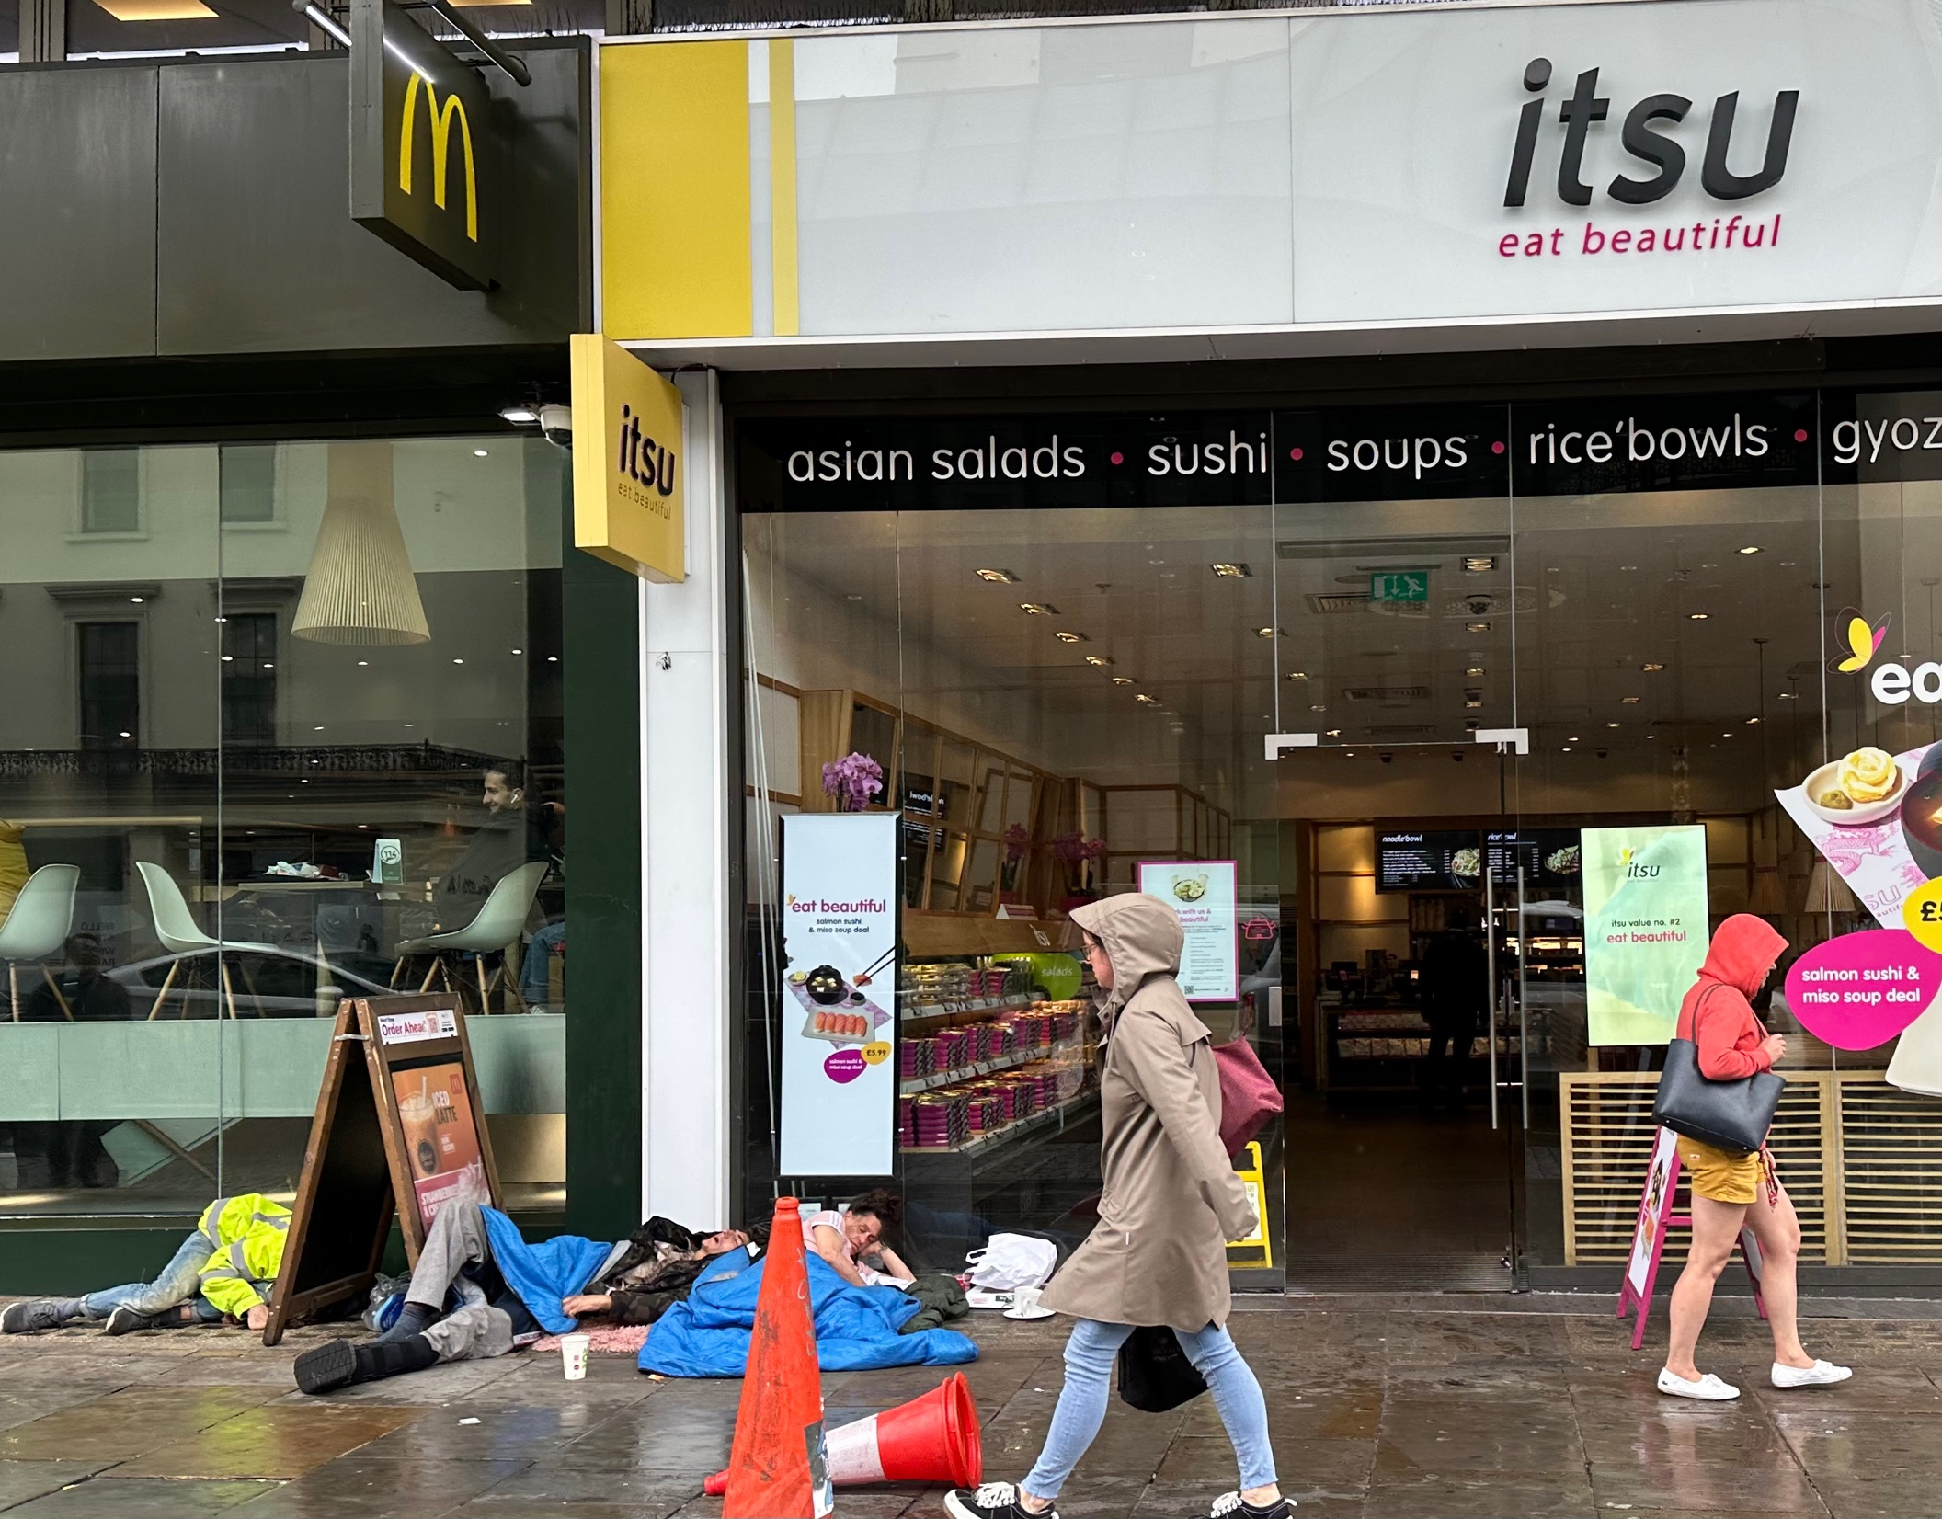

Slide 10

The Method to My Madness
*The next dip is the one you buy, with $5.6 trillion in cash sitting on the sidelines.
*Stocks could rally for 6-9 months after that
*Tech is completing a sideways “time” correction, will lead the next leg of the bull market, now 10 months old
*Bonds may have bottomed. Buy LEAPS on the next dip
*Precious metals and commodities should be at the top of
and “BUY” list to cash in on an economic recovery
*Housing is starting a comeback, 20% of the US economy
*Oil getting ready for an upside breakout to $100/barrel
*In this market patience is a virtue, let the market come to you

Slide 11

The Global Economy – Heating Up
*The Oracle Speaks! “Interest rates may have to stay higher for longer,” says Fed governor Jay Powell
*Markets Will Snore Until September 1 Jobs Report. The August Nonfarm Payroll report is expected to come in at a weak 175,000. Enjoy the last week of summer.
*Will the Next Fed Move Bring a Rise in Rates? Economic data over the past month has strongly improved
*Things are Looking Great in Atlanta, with the Fed there forecasting a 5.5% GDP growth rate
*Industrial Production Rises a Hot 1.0% in July, the second best read since January
*Strikes Threatening Detroit, as the United Auto Workers call for a vote, demanding
a 40% wage increase over four years.
*Chinese Profits Continue Slump, down 6.7% YOY in July
Youth Unemployment exceeds 20%.

Slide 12
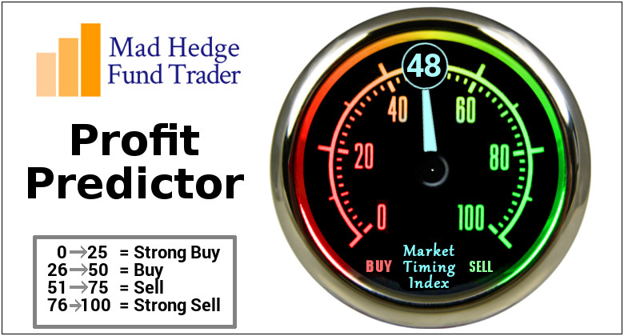
The Mad Hedge Profit Predictor
Market Timing Index – Drops Below 50, for the first time since April
An artificial intelligence driven algorithm that analyzes 30 different economic, technical, and momentum driven indicators

Slide 13
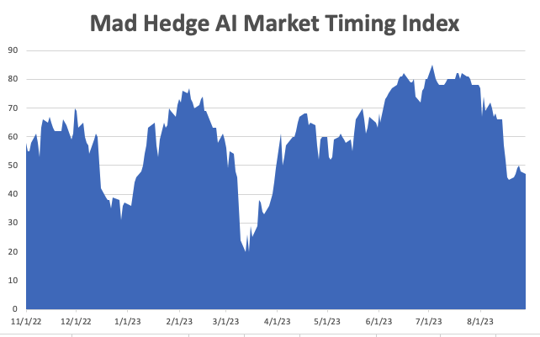
Do Nothing!!
SELL
BUY

Slide 14
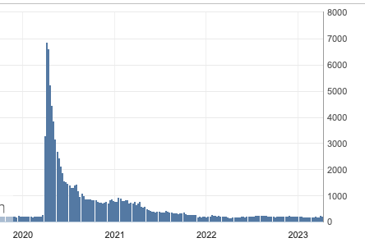
Weekly Jobless Claims – Falling
230,000 – Down 10,000

Slide 15
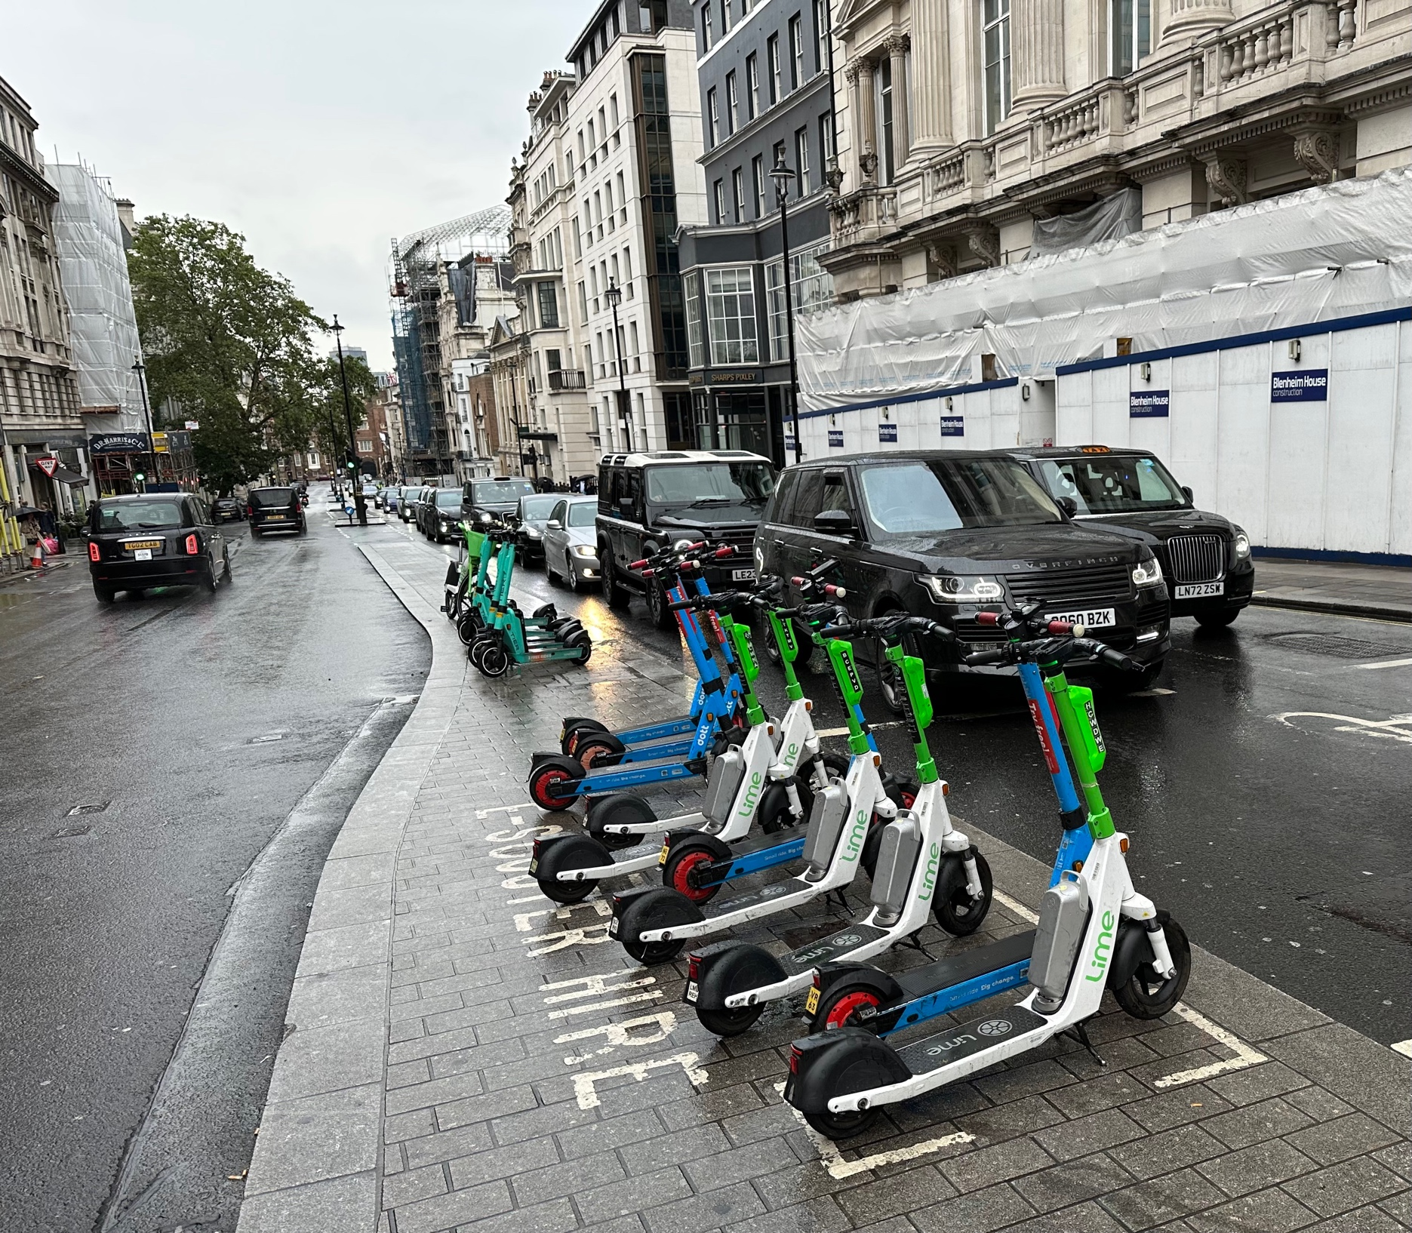

Slide 16

Stocks – Summer Doldrums
*Stocks are chopping around in a narrow range on low volume with a slight downward tilt wait for the Fed to make its move
*No short term or long term trade here. Keep you powder dry
*Bank Earnings Forecasts Cut, by Wells Fargo’s Mike Mayo, a noted bank analyst
*Will the Next Fed Move Bring a Rise in Rates? Economic data over the past month has strongly improved
*Battle over US Steel Contuses, up 50% in shares
* Berkshire Hathaway (BRK/B) Post Record Profit, with profits up 38%
* Rivian (RIVN) Beats, losing only $1.08 a share versus an expected $1.41
*DOT cracks down on airline delays

Slide 17
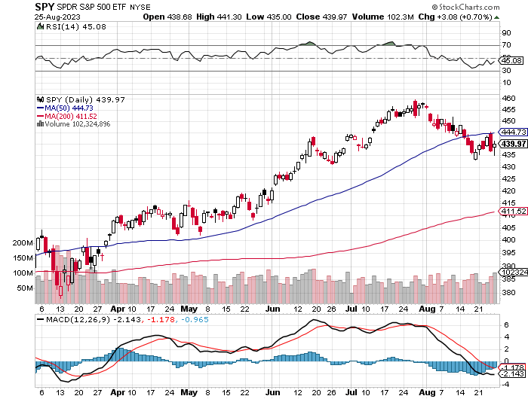
S&P 500 – Back to support took profits on long 5/$420-$430 put spread, took profits on long 1/$420-$430 put spread, took profits on long 11/$420-$430 put spread
$480
2023
Target
$411
-10.65%
2nd support
The Bottom
$380
Down –17.4%

Slide 18
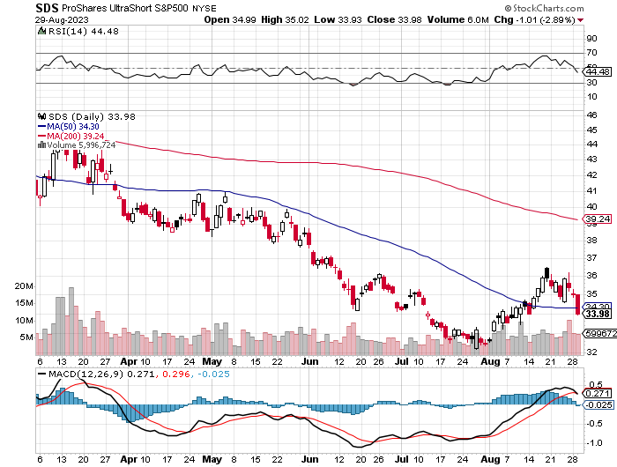
ProShares Ultra Short S&P 500 (SDS)- a great hedge for long stocks and bonds long 2X position has a hedge against longs and bond shorts

Slide 19
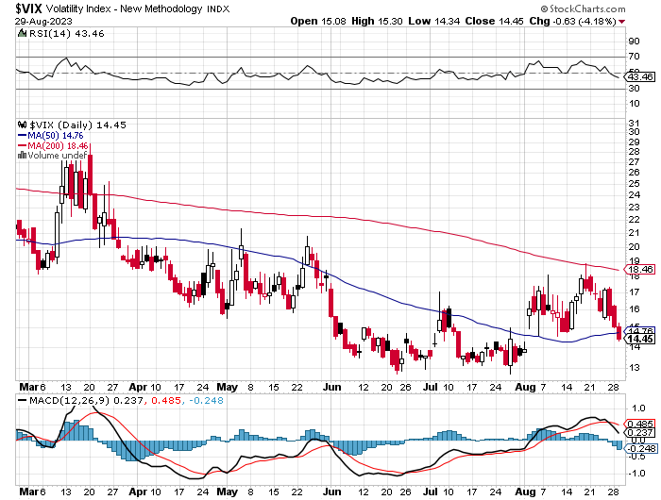
(VIX) – Bargain of the Century

Slide 20
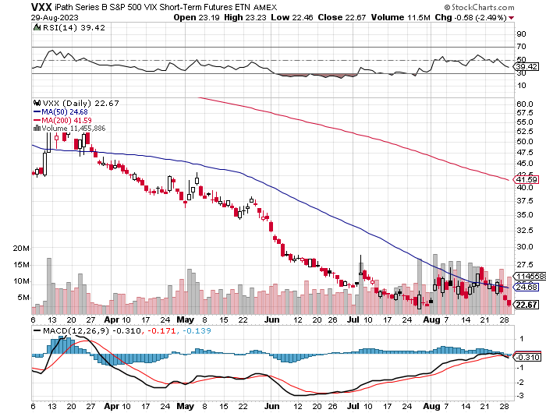
(VXX)-

Slide 21
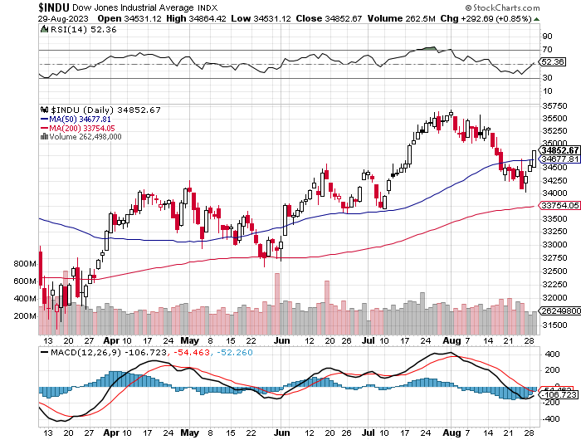
Dow Average ($INDU)-

Slide 22
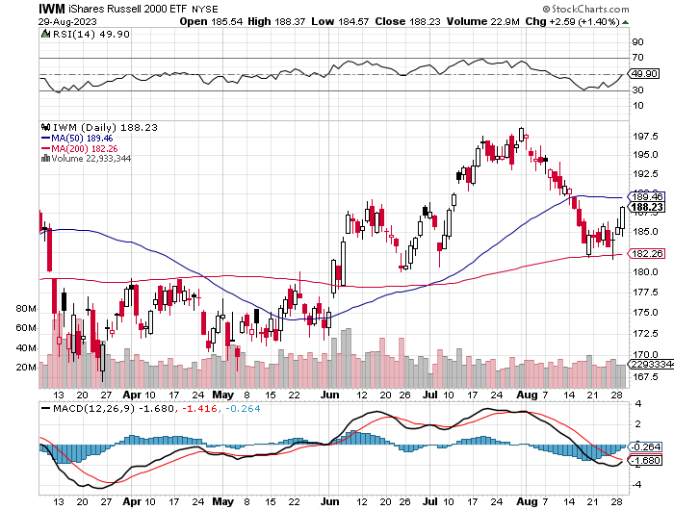
Russell 2000 (IWM)- took profits on Long 10/$137-$142 vertical bull call spread took profits on Long 10/$153-$156 vertical bear put spread

Slide 23
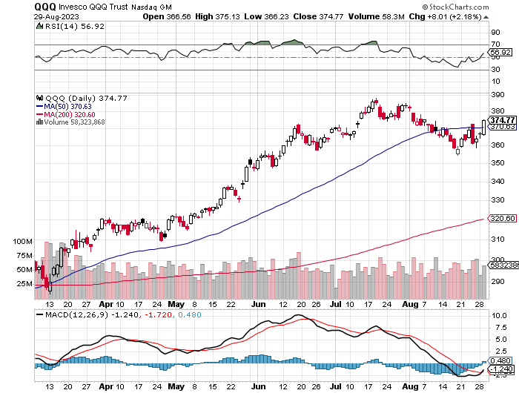
NASDAQ (QQQ) – took profits on Long 5/$335-$345 put spread took profits on long (QQQ) 1/$290-$300 put spread, took profits on long (QQQ) 4/$330-$335 put spread took profits on long (QQQ) 3/$340-$345 put spread, covered long (QQQ) $325-$330 put spread

Slide 24


Slide 25



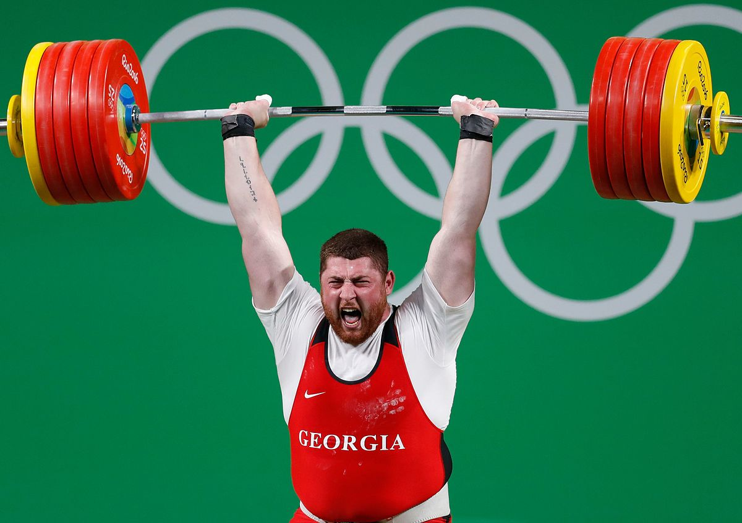
THE MAD HEDGE FUND TRADER
The Barbell Portfolio
*75% Big Tech – 2% of US workforce, 25% of market cap and 25% of US earnings
25% Domestic Recovery, including:
Railroads, airlines, cruise lines,
Couriers, steel companies
Banks, commodities
Construction
Credit Card Companies
Hotels, casinos
Online Ticket Sales

Slide 26
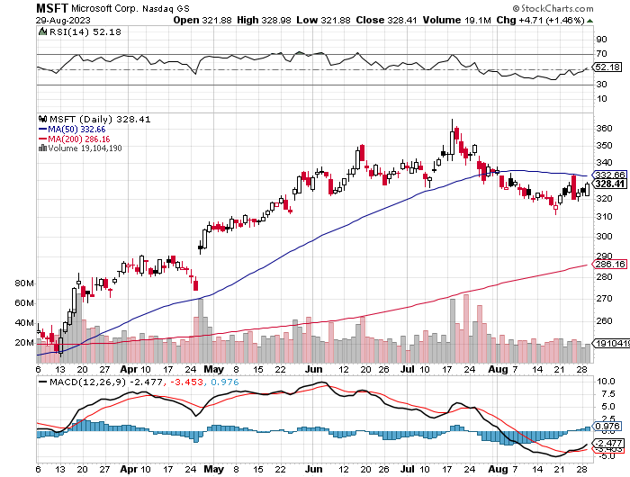
Microsoft (MSFT)- Earnings Beat took profits on 9/$235-$245 call spread, took profits on long 7/$220-$210 call spread, took profits on long 6/$220-$230 call spread, took profits on long 2/$200-$210 bear put spread

Slide 27
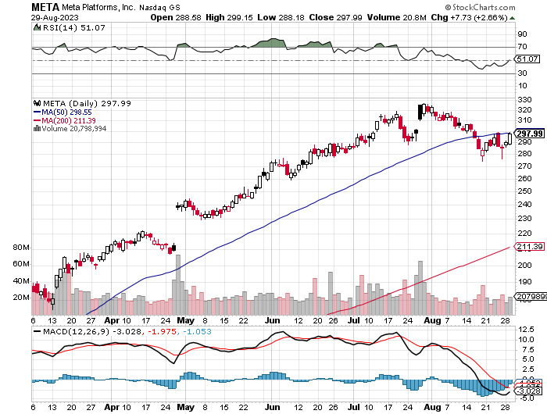
Meta (META)- Soars an Incredible 20% took profits on Long 9/$290-$300 vertical bear put spread stopped out of Long 9/$190-$200 vertical bear put spread

Slide 28
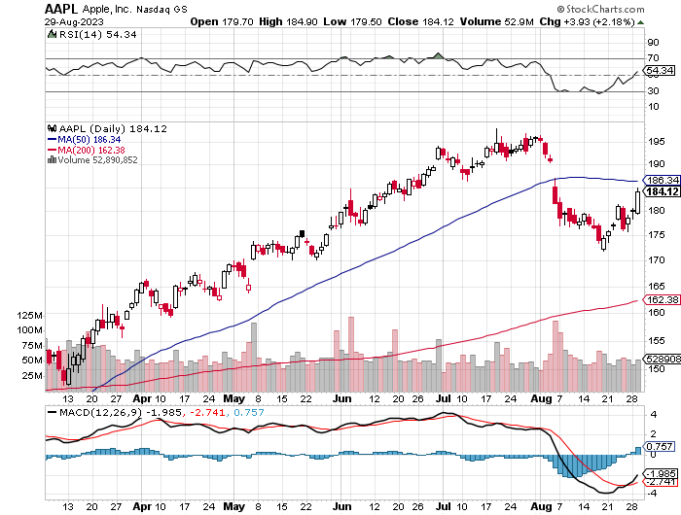
Apple (AAPL)
Apple Topped Out? With no new products on the horizon and interest rates rising took profits on long 1/$145-$155 put spread, Took profits on long 10/$165-$175 put spread took profits on long 6/$155-$165 put spread, stopped out of long 6/$125-135 call spread, took profits on long 6/$110-$120 call spread, took profits on long 2/$180-$190 put spread

Slide 29
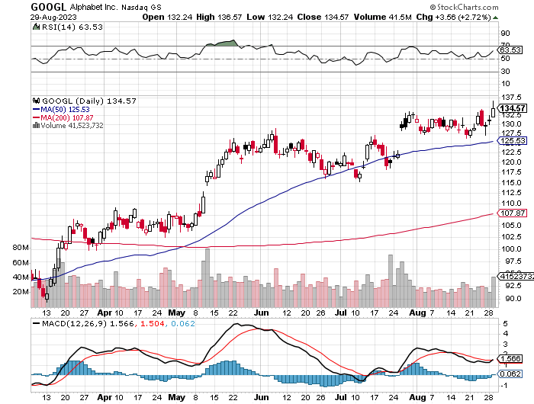
Alphabet (GOOGL) – Google Ramps Up AI Effort
EU Accuses Google of Abusing Monopoly Power took profits on long 12/$1,200-$1,230 bull call spread took profits on long 9/$1,030-$1,080 vertical bull call spread

Slide 30
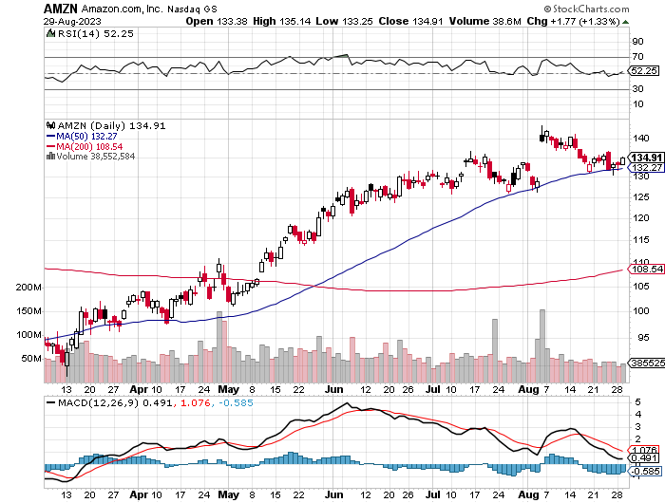
Amazon (AMZN) –
Amazon Soars on Earnings Beat, nearly double Wall Street estimates as its massive bet on AI pays off bigtime took profits on long 2/$3,400-$3,500 bear put spread took profits on long 9/$2,800-$2,900 bull call spread

Slide 31
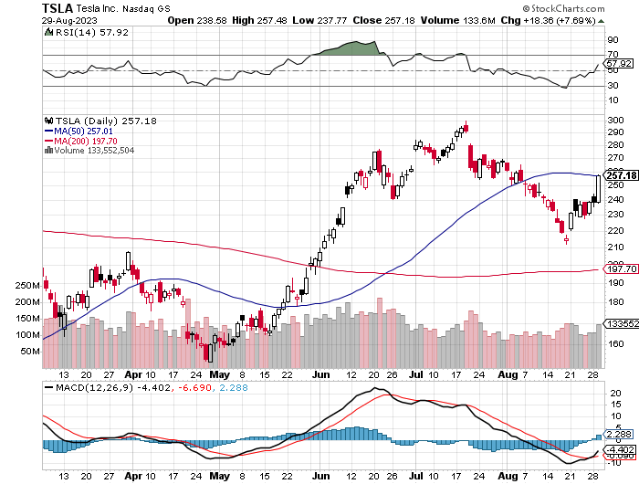
Tesla (TSLA) – Volatility Collapse to 43%
India Attempts to Win the Next Tesla Factory
Tesla Cuts Prices on Models “S” and “X” by $10,000 each took profits on long 6/$120-$130 call spread, stopped out of long 6/$210-$220 put spread took profits on long 5/$110-$120 call spread, took profits on long 5/$220-$230 put spread took profits on long 4/$130-$140 call spread, took profits on long 4/$250-$260 put spread

Slide 32
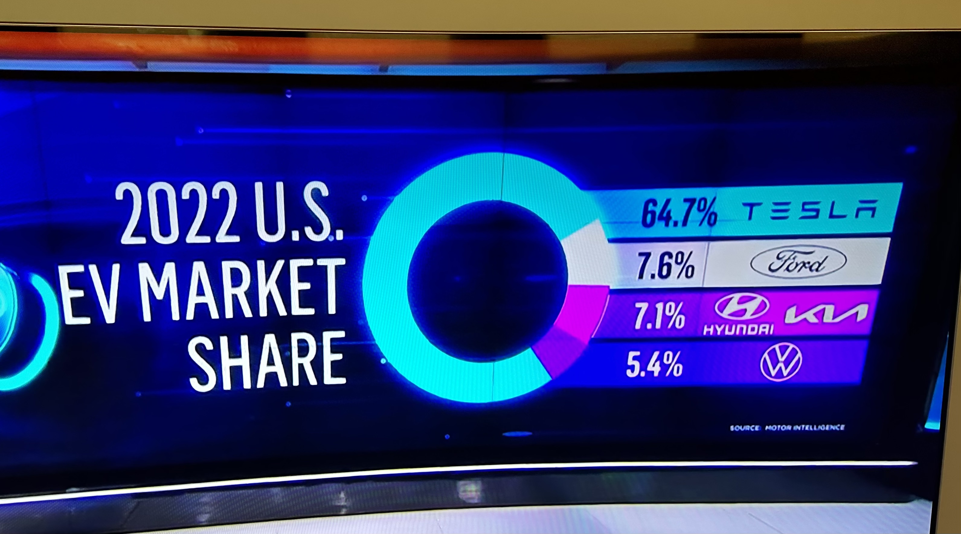

Slide 33
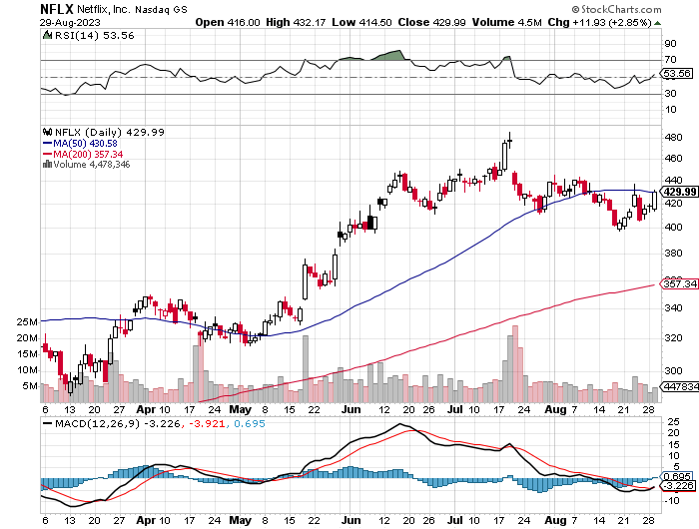
Netflix (NFLX) – Netflix subscribers beat - Netflix Password Sharing Crackdown Goes Global

Slide 34
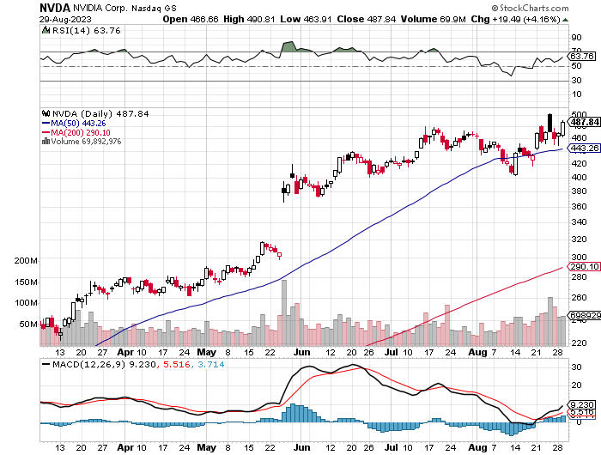
NVIDIA (NVDA) – Blowout Profits
NVIDIA Blows Away Earnings, taking its shares up an astonishing 10% in the after-market to an eye-popping $517 took profits on long 3/$260-$270 put spread, took profits on long 10/$95-$100 call spread took profits on long 7/$120-$130 call spread, took profits on long 6/$120-$130 call spread

Slide 35
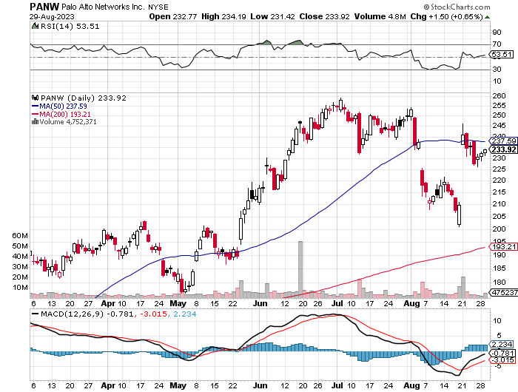
Palo Alto Networks (PANW)- Hacking never goes out of fashion
Palo Alto Networks (PANW) Goes into the S&P 500 took profits on long 10/$130-$140 call spread

Slide 36
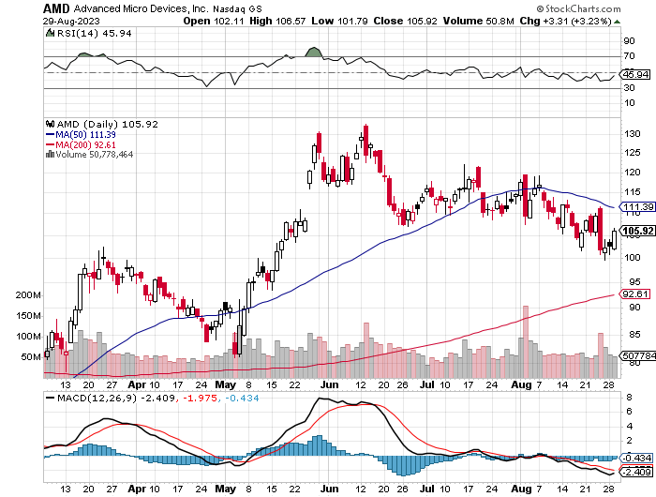
Advanced Micro Devices (AMD)- Recession fears programable logic devices took profits on long 2/$75-$80 call spread

Slide 37
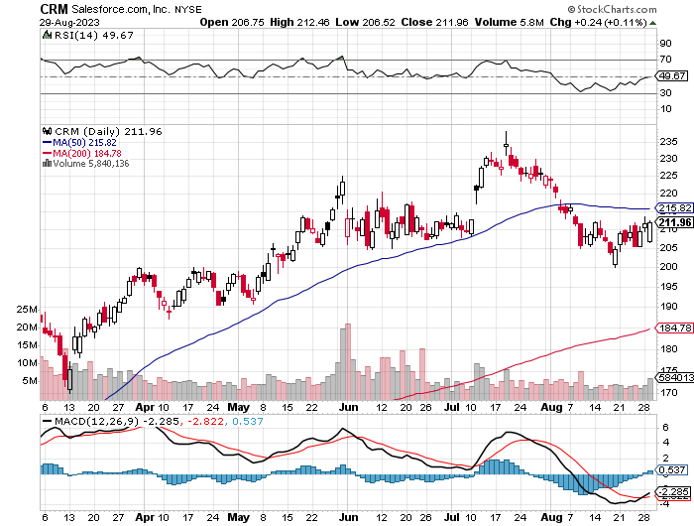
Salesforce (CRM)- Massive Online Migration
Salesforce Soars 16%, on better-than-expected guidance took profits on long 9/$125-$130 vertical bull call spread took profits on long 8/$125-$130 vertical bull call spread took profits on long 2/$105-$115 call spread

Slide 38
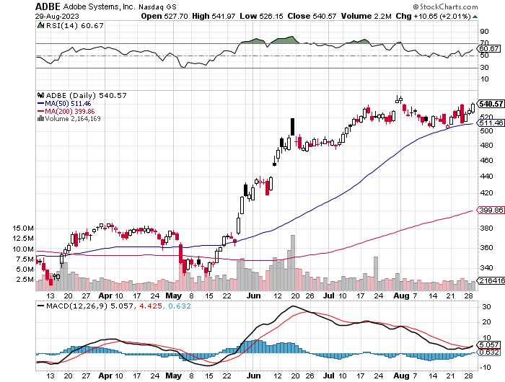
Adobe (ADBE)- Cloud play
The Quality Non-China tech play

Slide 39
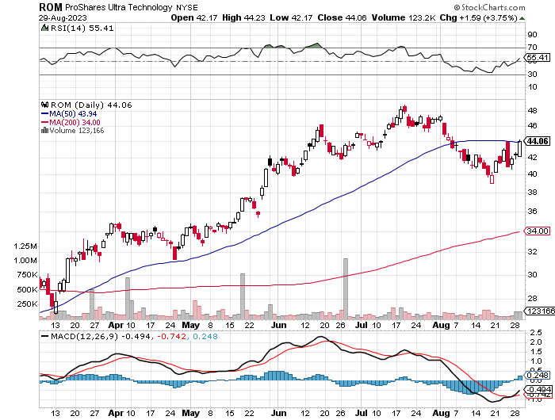
ProShares Ultra Technology ETF (ROM) – 2X Long Technology ETF took profits on long 10/$62-65 call spread

Slide 40


Slide 41
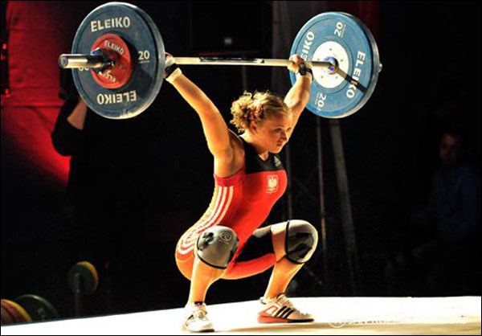
The Second Half of the Barbell
*Bets on a domestic recovery in 2022 Q4
*Upside potential in 2022 far greater than tech
*Some of these have not moved for 5 or 10 years
*Focuses on economically sensitive cyclical industries
*Makes a great counterweight to
high-growth technology
*We could spend all of next year rotating
between the two groups

Slide 42
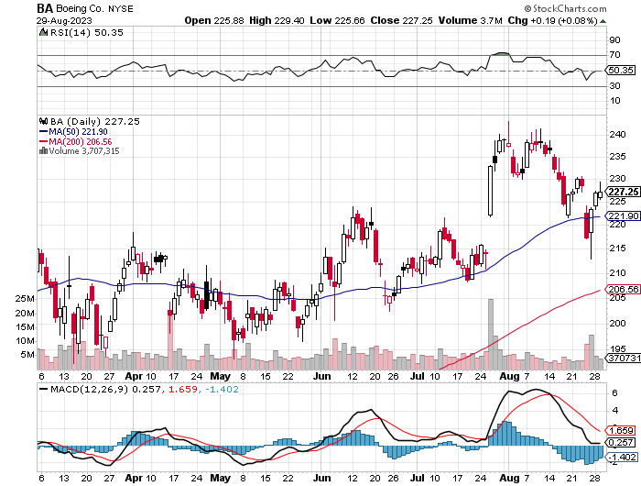
Boeing (BA) –
Another Recall took profits on long 5/$17-$175 call spread

Slide 43
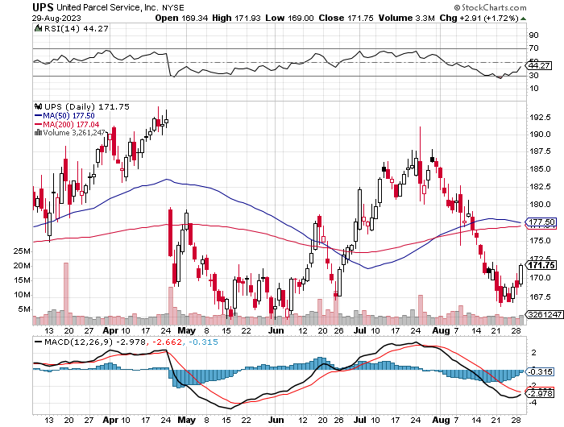
Package Delivery- United Parcel Service (UPS) – strike averted took profits on long 11/$130-$140 call spread

Slide 44
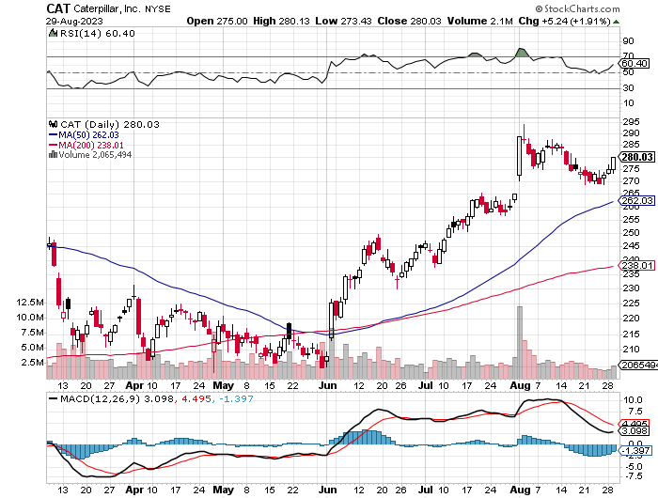
Caterpillar (CAT)- Ag + Infrastructure + Housing
Raises Dividend by 50% took profits on long 12/$145-$150 call spread took profits on long 11/$125-$135 call spread

Slide 45
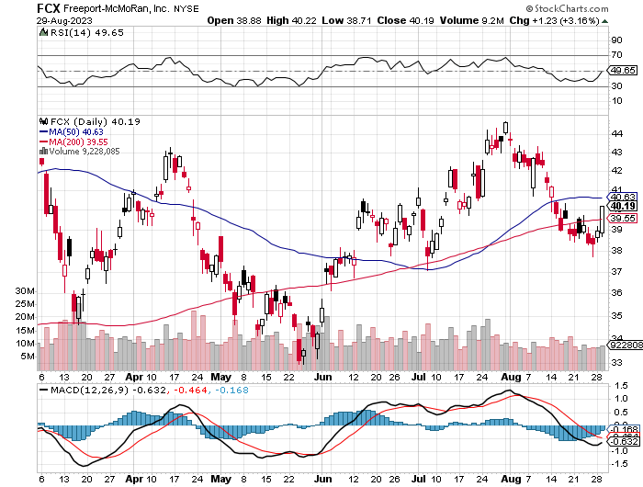
Freeport McMoRan - (FCX)- Coming Copper Crisis took profits on long 6/$32-$35 call spread took profits on long 4/$30-$33 call spread, took profits on long 10/$20-$23 call spread

Slide 46
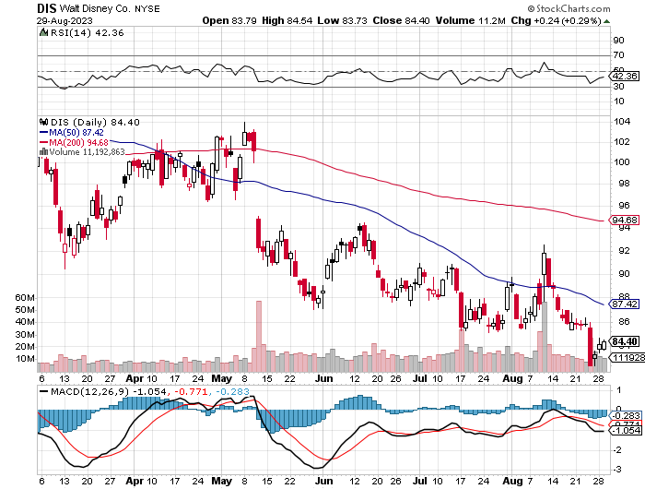
Walt Disney (DIS) - Disney Earnings are Flat, with parks jam packed and maxed out.
But streaming in a nosedive, down 4 million subscribers in Q1 at 157.8 million

Slide 47
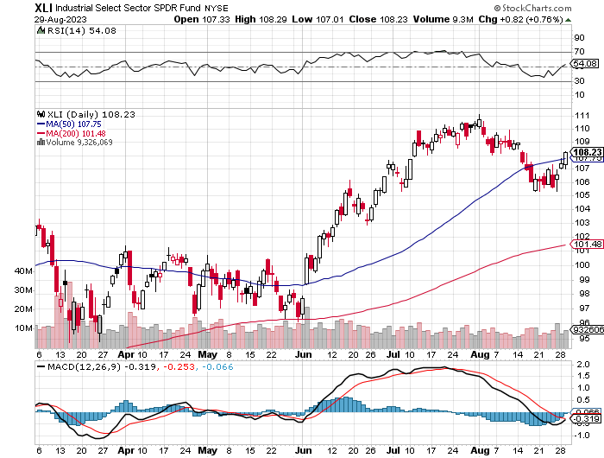
Industrials Sector SPDR (XLI)-
(GE), (MMM), (UNP), (UTX), (BA), (HON)

Slide 48
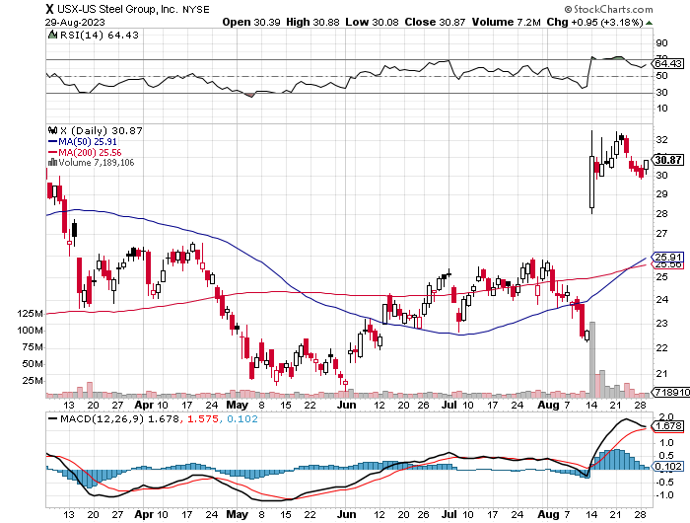
US Steel (X) – Commodity Boom and commodity
Bidding war breaks out, taking stock up 50% and LEAPS up 101%

Slide 49
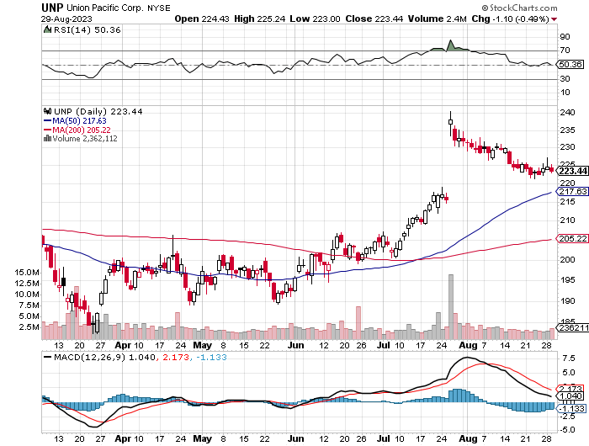
Union Pacific RR (UNP)- Big Stuff to Ship took profits on long 5/$200-$210 call spread took profits on 11/$150-$160 call spread

Slide 50
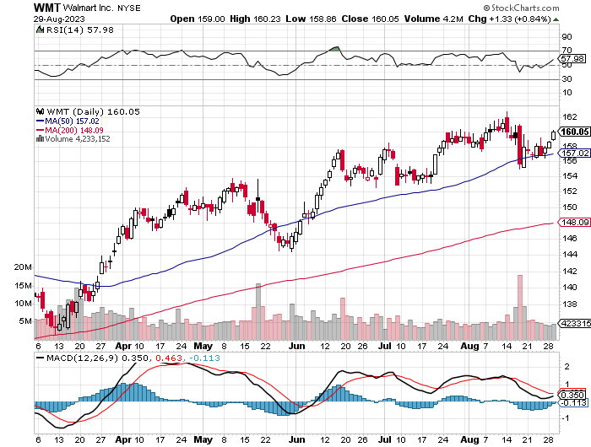
Wal-Mart (WMT)- took profit on Long 11/$125-$130 bear put spread took profit on Long 10/$119-$121 bear put spread took profits on Long 8/$114-$117 bear put spread

Slide 51
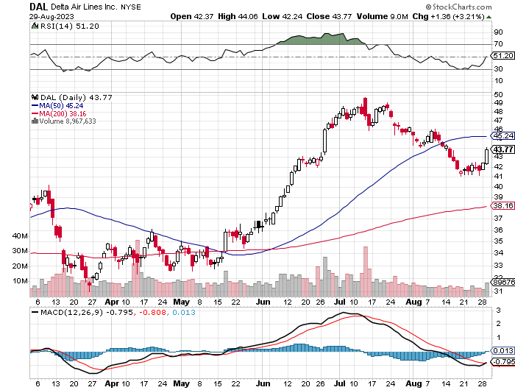
Delta Airlines (DAL) – Travel is Back!
Returns dividend for first time in 3 years entering a summer perfect storm of profits

Slide 52
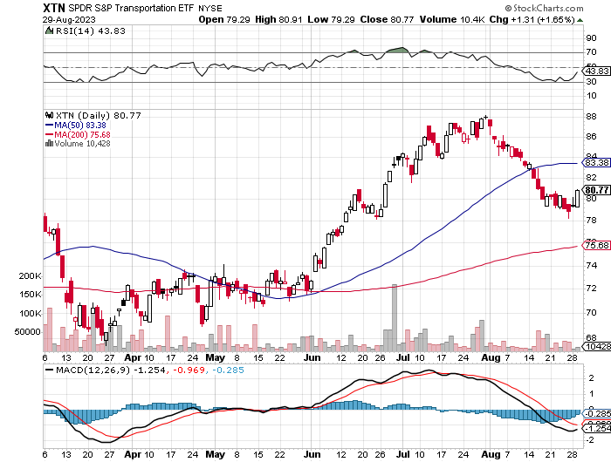
Transports Sector SPDR (XTN)- Worst Hit Sector
(ALGT), (ALK), (JBLU), (LUV), (CHRW), (DAL)

Slide 53
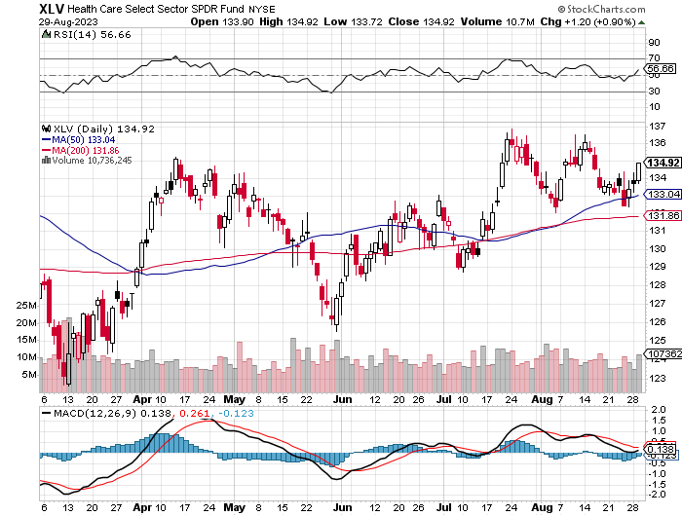
Health Care Sector (XLV)
(JNJ), (PFE), (MRK), (GILD), (ACT), (AMGN)

Slide 54
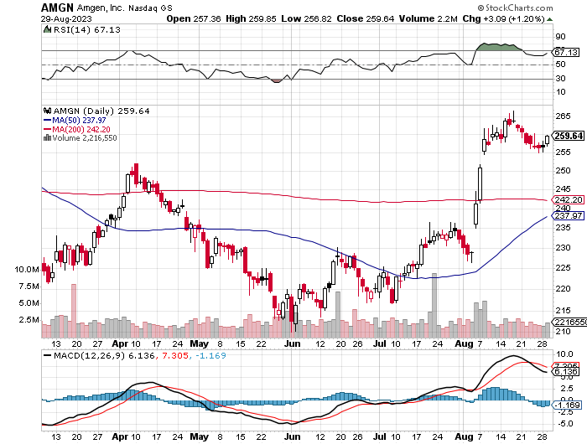
Amgen (AMGN) took profits on long 11/$185-$200 bull call spread

Slide 55
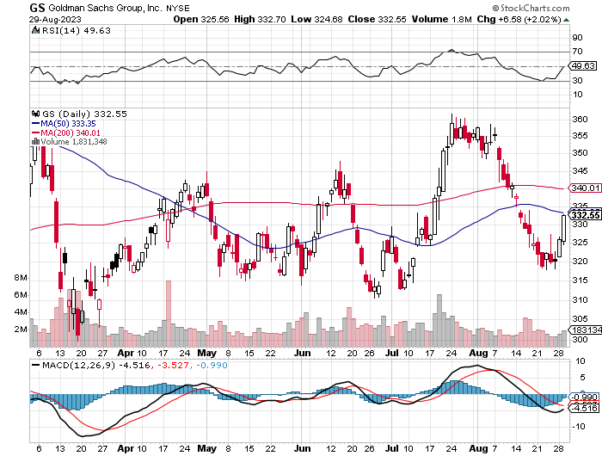
Goldman Sachs (GS) – Highest Capital ratio net of mark to market took profits 12/$330-$350 call spread took profits 11/$330-$350 call spread stop loss on long 11/$385-$395 call spreads

Slide 56
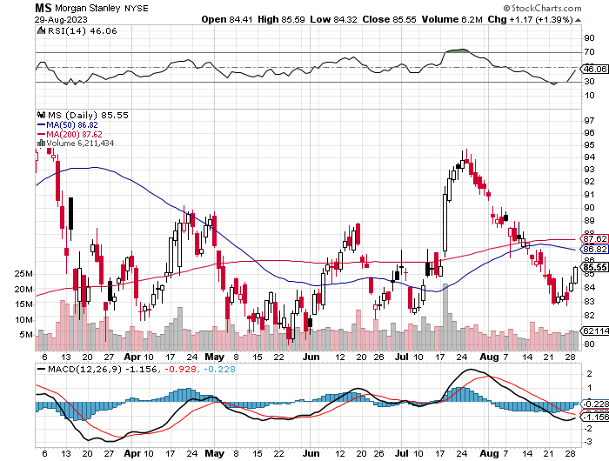
Morgan Stanley (MS) – Highest Capital ratio net of mark to market
CEO to Step Down in a Year took profits on long 4/$65-$70 call spread

Slide 57
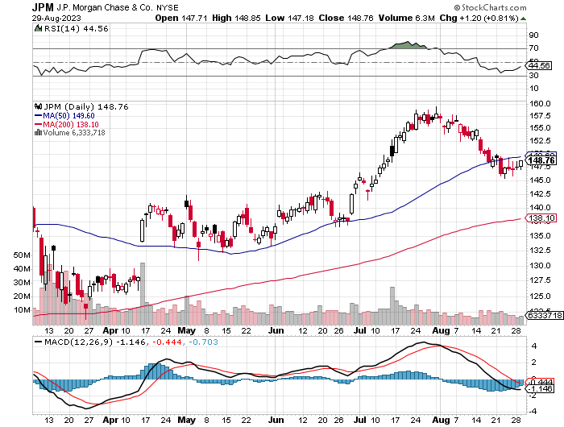
JP Morgan Chase (JPM) - Highest Capital ratio net of mark to market
JP Morgan Picks Up an Annual $3 Billion, in interest income on the First Republic deal took profits on long 4/$105-$115 call spread

Slide 58
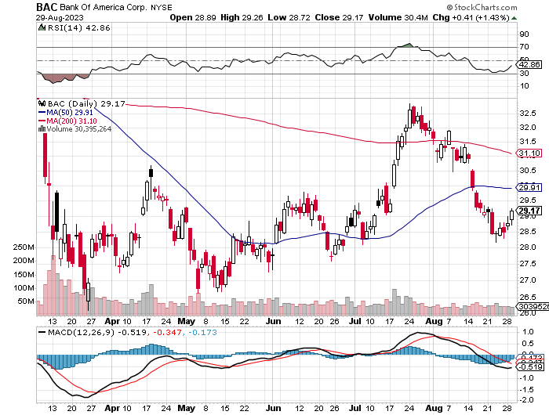
Bank of America (BAC) – Bank of America Rips, on a great earnings report took profits on long 4/$20-$23 call spread

Slide 59

Citigroup (C) – took profits on long 4/$30-$35 call spread

Slide 60

Charles Schwab (SCHW) – LEAPS up 67% in three months took profits on long 4/$30-$35 call spread

Slide 61

Interactive Brokers (IBKR) – Best Risk Control took profits on long 4/$60-$65 call spread

Slide 62

SPDR Metals & Mining ETF (XME) – long 2/$28-$30 call spread

Slide 63

Blackrock (BLK)-Asset Collection Boom took profits on long 3/$770-$790 call spread took profits on long 3/$310-$340 call spread

Slide 64

Visa (V) – Inflation boost
Transaction grew by an inflationary 10% back to pre-pandemic levels took profits on long 10/$160-$170 bull call spread took profits on long 6/$150-$160 bull call spread

Slide 65

Consumer Discretionary SPDR (XLY)
(DIS), (AMZN), (HD), (CMCSA), (MCD), (SBUX)

Slide 66

Berkshire Hathaway (BRKB)- Natural Barbell operating earnings soar in Q2, LEAPS up 350% took profits on long 4/$260-$270 call spread took profits on long 1/$290-$300 call spread, took profits on long 10/$220-$230 call spread, took profits on long 7/$220-$230 call spread, took profits on long 7/$220-$230 call spread took profits on long 6/$260-$270 call spread

Slide 67

Europe Hedged Equity (HEDJ)-

Slide 68

Japan (DXJ)-

Slide 69

Emerging Markets (EEM) - Pro trade, Weak Dollar, Long Recovery Play

Slide 70


Slide 71

Bonds – Looking for the Double Bottom
*Ten Year Treasury yields Hit New 16-year High, at 4.38%.
*The US Budget Deficit is Climbing Once Again increasing Treasury bond sales
*The whole falling interest rate, rising bond price trade has been delayed for six months thanks to the Fitch downgrade and hotter than expected economic growth at 2.40% for Q2.
*Keep Buying 90-Day T-Bills, now pushing a 3.31% risk free yield
*Still looking like 3.50% ten year yield by end 2023
*Junk bond ETF’s (JNK) and (HYG) are holding up extremely
well with a 6.5% yield
*Bonds (TLT) still likely to hit $110 by yearend

Slide 72

Treasury ETF (TLT) – took profits on long 5/$98-$101 call spread took profits on long 5/$97-$100 call spread, long 2/$98-$101 call spread, took profits on long 4/$96-$99 call spread took profits on long 4/$113-$116 put spread, took profits on long 4/$114-$117 put spread

Slide 73

Ten Year Treasury Yield ($TNX) – 4.38%

Slide 74

Junk Bonds (JNK) 6.50% Yield to Maturity

Slide 75

Municipal Bonds (MUB) 2.50% Yield-

Slide 76

Emerging Market Debt (ELD) 6.83% Yield-

Slide 77

2X Short Treasuries (TBT)-Out of Favor

Slide 78


Slide 79

Foreign Currencies – New Strength
*”Higher for Longer” gives an adrenaline shot for the US dollar taking it to new 2023 highs
*Japanese yen is headed for new multiyear lows at $150
*Investors flee to safe haven short term investments
*”Higher for Longer” delays first rate cut to March or even June
*Collapse of dollar is now a 2024 story
*Aussie dollar collapse prompted by slowing Chinese economy
no buying their energy or commodities
*Buy (FXE), (FXB), (FXA) on big dips, avoid (FXY)

Slide 80

THE MAD HEDGE FUND TRADER
Australian Dollar (FXA) - Major Long-Term Bottom is In Targeting Parity – A call option on a global synchronized recovery
1:1
BUY

Slide 81

Japanese Yen (FXY)

Slide 82

Euro (FXE)-
2023
Target
25%

Slide 83

British Pound (FXB)-
2023
Target
15%

Slide 84


Emerging Market Currencies (CEW)
2023
Target
40%

Slide 85


Slide 86

Energy & Commodities – On a Roll
*Natural Gas is now trading in new higher range awaiting a breakout
* An Australian strike shut down an LNG export facilities still looming
*Russian output down 800,000 b/d since January due to sanctions and sinking tankers
*Unilateral Saudi 1 million b/d cut in June worked
*Oil trading at new higher range at $78-%85
*China Expects LNG Price Spike Later this Year,
due to coming supply shortages and a recovering economy
*Buy all energy on dips

Slide 87

Oil-($WTIC)

Slide 88

United States Oil Fund (USO)

Slide 89

Energy Select Sector SPDR (XLE)-No Performance!
(XOM), (CVX), (SLB), (KMI), (EOG), (COP)

Slide 90

ExxonMobile (XOM)- took profits on long 12/$120-$125 put spread

Slide 91

Occidental Petroleum (OXY)- Buffet’s a Buyer long 2/$55-$60 call spread, took profits on long 12/$77.50-$82.50 put spread

Slide 92

Natural Gas (UNG) -
Long January 2025 $14 - $15 Call Spread LEAPS

Slide 93
Freeport McMoRan (FCX) -
Codelco Sees Profit Slump, the world’s largest copper producer based in Chile

Slide 94

Cameco (CCJ) - took profits on long 5/$20-$23 bull call spread

Slide 95


Slide 96

Precious Metals – Correction Time
*”Higher for Longer” on interest rates knocks the wind out of precious metals
*Interest rate rises in Europe and Australia aren’t helping either
*Gold headed for $3,000 by 2025, but back off first from new all-time highs
*The new drivers are soon to fall interest rates and the demise of crypto
*Silver is the better play with a higher beta
*Russia and China are also stockpiling gold to sidestep
international sanctions
*A Severe Short Squeeze in Copper is Developing,
leading to a massive price spike later in 2023
once the Chinese economy comes back on line

Slide 97

Gold (GLD) - Deflation call took profits on long 5/$165-$170 bull call spread

Slide 98

Market Vectors Gold Miners ETF- (GDX) –

Slide 99

Barrick Gold (GOLD) took profit on long 1/$15.50-$16.50 call spread

Slide 100

Newmont Mining- (NEM)- took profits on long $55-60 call spread

Slide 101

Silver- (SLV)- took profits on long 11/$19-$20 call spread

Slide 102

Silver Miners - (SIL)-

Slide 103

Wheaton Precious Metals - (WPM)- took profits on long 1/$36-$39 call spread

Slide 104

Platinum- (PPLT)- 556,000-ounce shortage this year took profits on long 1/$36-$39 call spread

Slide 105


Slide 106

Real Estate – Another Slap
*Existing Home Sales Drop Again, demolished by record high mortgage rates
*July saw sales decline by 2.2% to a six-month low on sales of 4.15 million units.
*Home resales, which account for a big chunk of U.S. housing sales, fell 16.6% on a year-on-year basis in July.
*China’s Largest Real Estate Developer Goes Bankrupt, crushing Asian stock markets along with it
*July Housing Starts at Come in Steady at Up 4.0%, at 1.45 million.
Building Permits were unchanged. June numbers were revised down big
*Homebuilder Sentiment Dives on record mortgage highs,
down 6 points to 50 in August

Slide 107

S&P Case Shiller Plunges
S&P Case Shiller Rises to +0.70%, with its National Home Price Index
Chicago gained +4.6%, Cleveland +3.9%, and New York +3.5%.
Seattle down -11.3%, San Francisco -11.0%

Slide 108

Crown Castle International (CCI) – 6.26% yielding cell phone tower REIT loses Verizon as major customer

Slide 109

US Home Construction Index (ITB)
(DHI), (LEN), (PHM), (TOL), (NVR)

Slide 110


Slide 111

Trade Sheet-
So What Do We Do About All This?
*Stocks – buy the big dips at bottom of range,
………………sell big rallies to hedge holdings
*Bonds – buy dips
*Commodities-buy dips
*Currencies- sell dollar rallies, buy currencies
*Precious Metals – buy dips
*Energy – buy dips
*Volatility - sell short over $30
*Real estate – buy dips

Slide 112


Slide 113

Next Strategy Webinar
12:00 EST Wednesday, September 20 from Silicon Valley, CA email me questions at support@madhedgefundtrader.com
Good Luck and Good Trading!
Notes:
*

Slide 114


