Slide 1
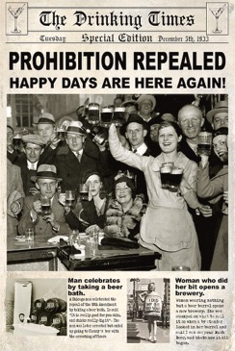
The Mad Hedge Fund Trader “Happy Days are Here Again”
With John Thomas Incline Village, NV November 15, 2023 www.madhedgefundtrader.com
Notes:
*

Slide 3
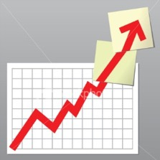
Trade Alert Performance Summer Doldrums 40 out of 46 trade alerts profitable
*January +22.35% Final *July +0.44% Final *February +3.41% Final *August -4.70% Final *March +20.85% Final *September +00% Final *April +15.13% Final *October -5.37% MTD *May +0.30%% Final *November +10.97 Final *June +3.01% Final *December +0.95% Final *2023 Year to Date +77.14%, versus +18.42% for the S&P 500 +663.36% since inception *Average annualized return of +51.26% for 15 years

Slide 4
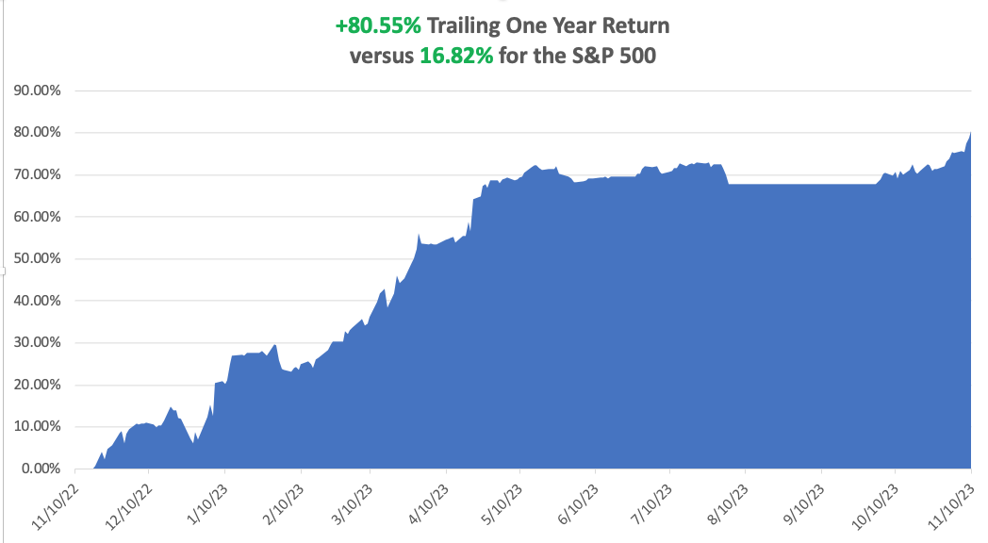

Slide 5
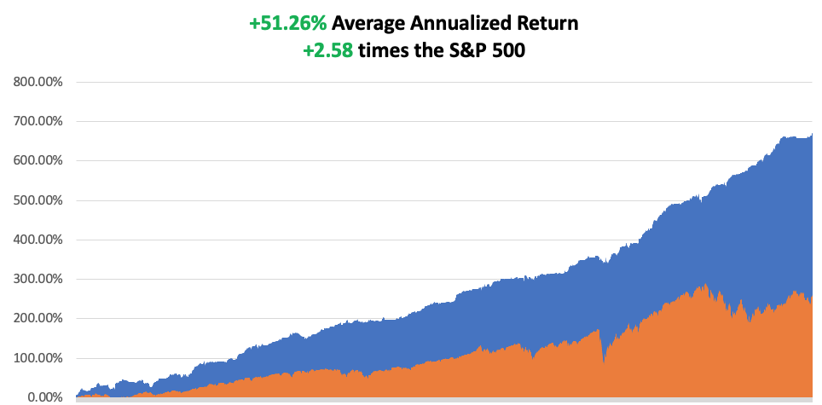

Slide 6
Portfolio Review – Big Tech Bet 70% Long, 10% Short, 20% cash
Expiration Value +82.87%
NO POSITIONS
Risk On
(MSFT) 12/$320-$330 call spread | 10.00%
(NLY) 12/$15-$16 call spread | 10.00%
(BRK/B) 12/$320-$330 call spread | 10.00%
(CCJ) 12/$35-$38 call spread | 10.00%
(CRM) 12/$185-$195 call spread | 10.00%
(GOOGL) 12/$110-$120 call spread | 10.00%
(SNOW) 12/$135-$140 call spread | 10.00%
Risk Off
(TLT) 12/$95-$98 call spread | -10.00%
Total Net Position | 60.00%

Slide 8
The Method to My Madness
*Fed is done raising interest rates, markets are now discounting first cut in May *All interest rate plays go wild, including bonds, REIT’s, precious metals, and financials *The yearend rally is on, but what happens in January? *Government shutdown is on, but markets don’t care *Oil prices and commodities are now trading as one, selling off on slowing economy *The tech bull market is back and will continue for years *Time to go aggressively long stocks and bonds *Commodities and industrials are a second half play

Slide 9
The Global Economy – Cooling
*CPI unchanged at a cool 3.2% *Nonfarm Payroll Report Fades to 150,000 in October, well below expectations *It’s just what markets wanted to hear. The unemployment rate rose to 3.9%, the highest level since January 2022 *A Soft Landing is Now More Likely. Inflation is falling and could lead to Fed interest rate cuts in H2 2024. Stocks and bond will love it *Fed Leaves Rates Unchanged *Weekly Jobless Claims Drop 3,000 to 217,000. It’s still unusually low. Hiring slowed in October as the economy slowed *We’re All Getting a Tax Cut, thanks to inflation driving bracket creep for deductions * China Lends $1.34 Trillion for Belt and Road Initiative, from 2000 to 2001 in an effort to dominate Asian and African infrastructure.

Slide 10
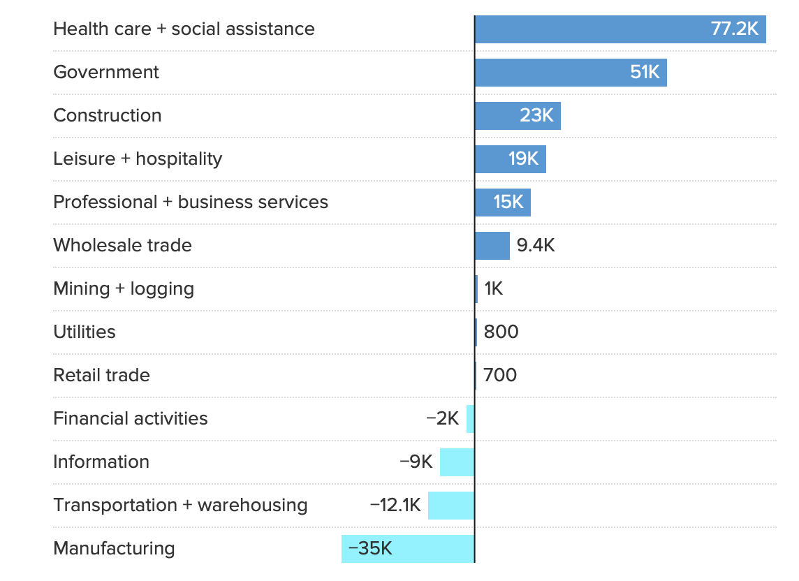

Slide 11
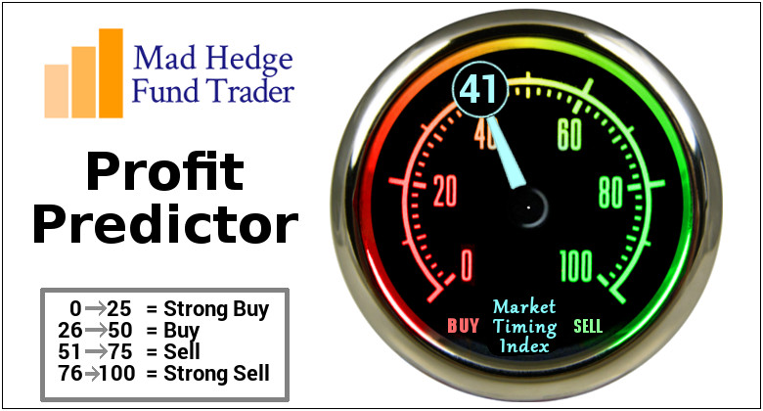
The Mad Hedge Profit Predictor Market Timing Index – Drops Below 50, for the first time since April An artificial intelligence driven algorithm that analyzes 30 different economic, technical, and momentum driven indicators

Slide 12
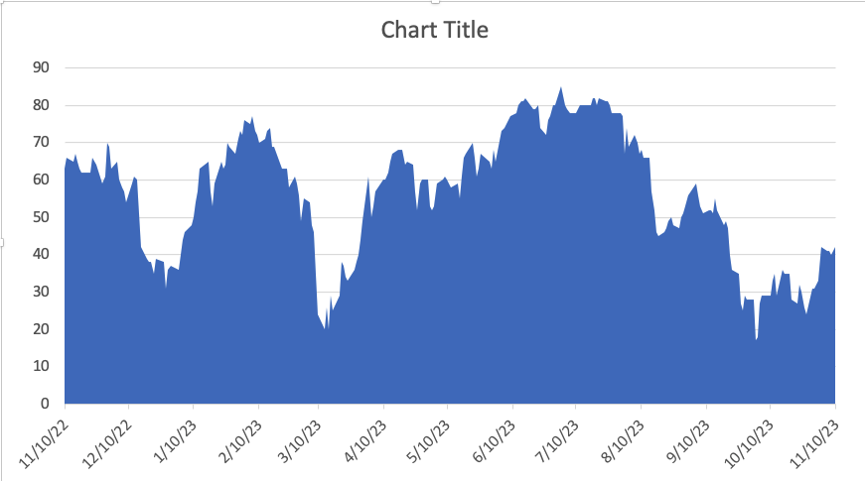
Buy Territory!! – The Bottom is In
SELL
BUY

Slide 13
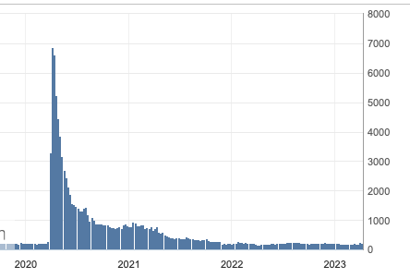
Weekly Jobless Claims – Falling 217,000 – -3,000

Slide 14
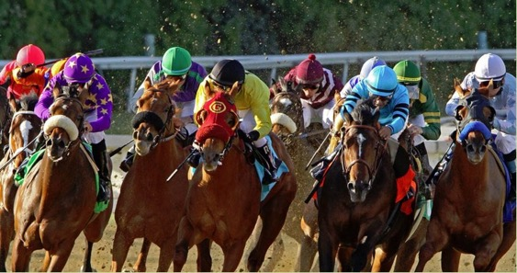
Stocks – Of to the Races
*Most 2023 Stock Gains Happened in 8 Days, up some 14% since January 1 *If you are a day trader, you most likely missed all of this. *This is despite stocks going up 113 day versus 102 down days *Making matters more difficult is that only seven stocks accounted for most of the increase. Talk about a narrow market! *Hedge Funds Were Crushed in Last Week’s Monster Rally, the biggest in 3 ½ years *Government shutdown on November 17 will continue to cap prices and risk taking

Slide 15
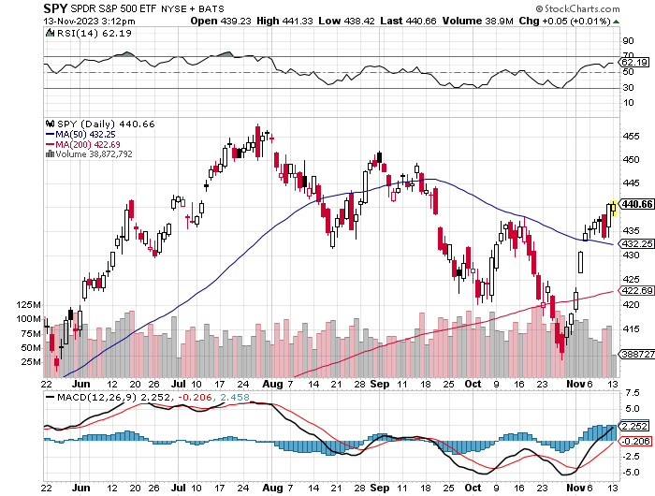
S&P 500 – New Uptrend has Begun took profits on long 5/$420-$430 put spread, took profits on long 1/$420-$430 put spread, took profits on long 11/$420-$430 put spread
$480 2024 Target
$435 -4.34% 1st support
The Bottom $420 Down –8.69%

Slide 16
S&P 500 – Classic Head and Shoulders Bottom on big volume Rally could last until March
$480 2023 Target

Slide 17
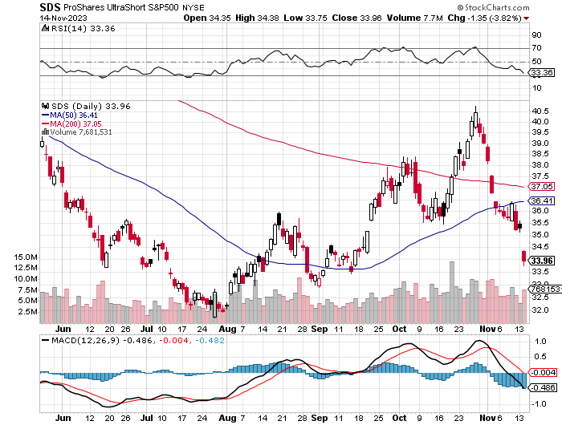
ProShares Ultra Short S&P 500 (SDS)- a great hedge for long stocks and bonds long 2X position has a hedge against longs and bond shorts

Slide 18
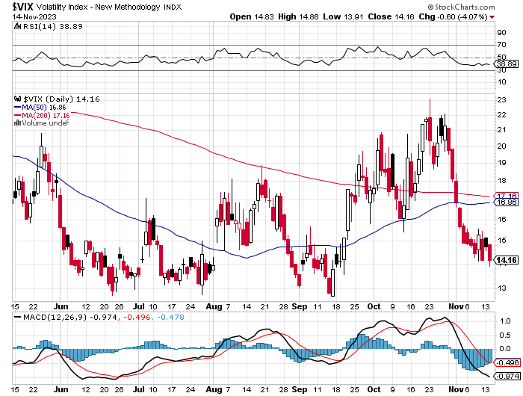
(VIX) – Bargain of the Century

Slide 19
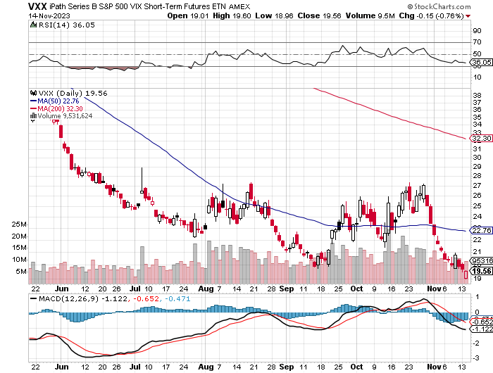
(VXX)-

Slide 20
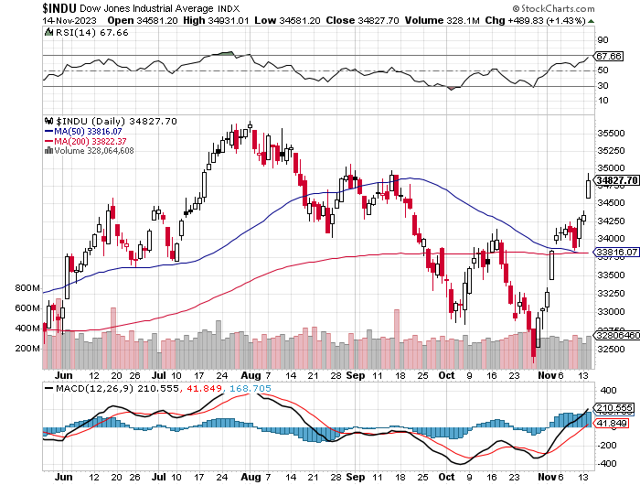
Dow Average ($INDU)-

Slide 21
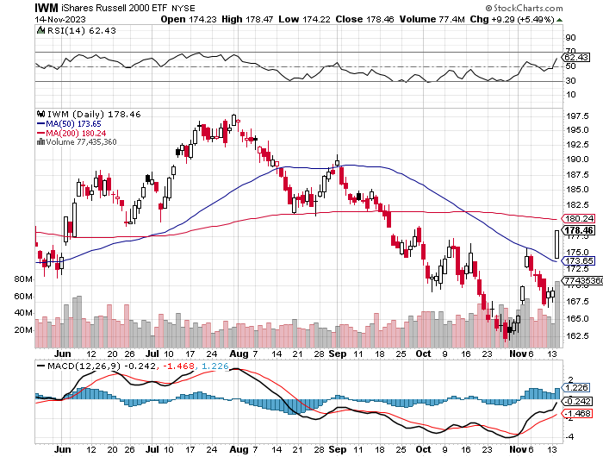
Russell 2000 (IWM)- took profits on Long 10/$137-$142 vertical bull call spread took profits on Long 10/$153-$156 vertical bear put spread

Slide 22
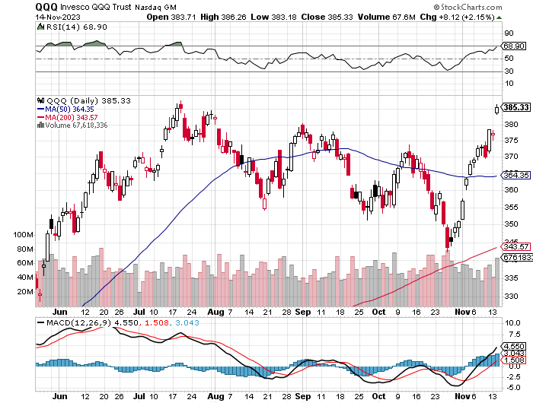
NASDAQ (QQQ) – took profits on Long 5/$335-$345 put spread took profits on long (QQQ) 1/$290-$300 put spread, took profits on long (QQQ) 4/$330-$335 put spread took profits on long (QQQ) 3/$340-$345 put spread, covered long (QQQ) $325-$330 put spread

Slide 23
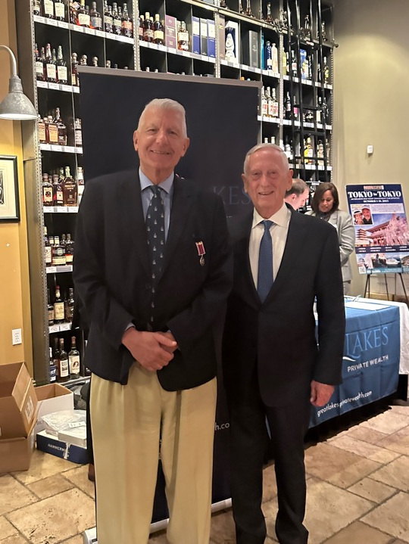

Slide 24
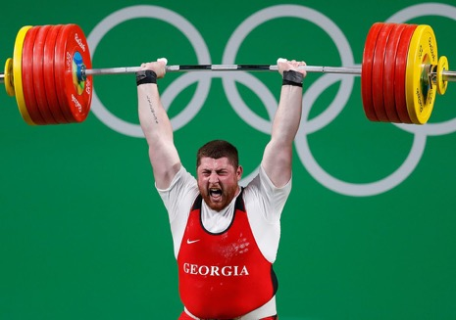
THE MAD HEDGE FUND TRADER
The Barbell Portfolio
*75% Big Tech – 2% of US workforce, 25% of market cap and 25% of US earnings 25% Domestic Recovery, including: Railroads, airlines, cruise lines, Couriers, steel companies Banks, commodities Construction Credit Card Companies Hotels, casinos Online Ticket Sales

Slide 25
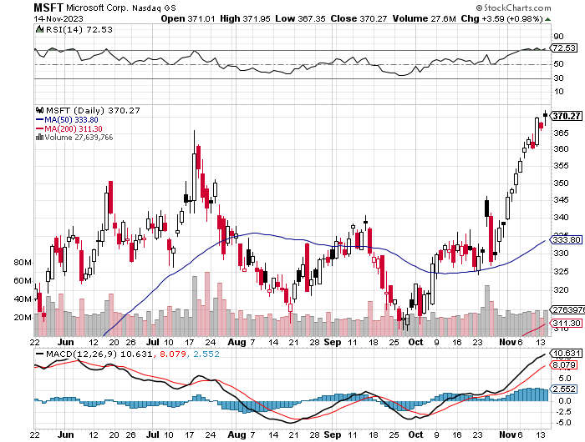
Microsoft (MSFT)- Earnings Beat Bags Activision for $69 Billion long 12/$320-$330 call spread took profits on long 9/$235-$245 call spread, took profits on long 7/$220-$210 call spread, took profits on long 6/$220-$230 call spread, took profits on long 2/$200-$210 bear put spread

Slide 26
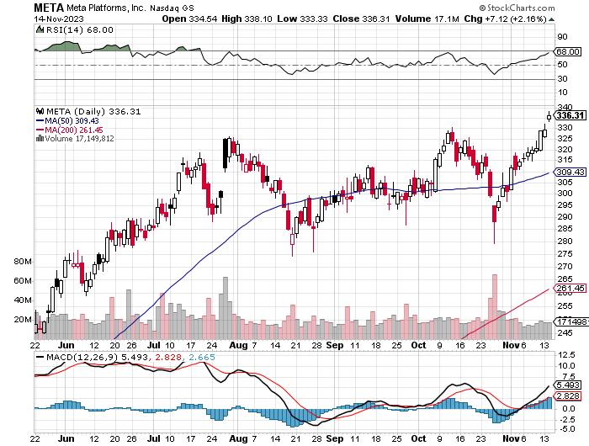
Meta (META)- Soars an Incredible 20% took profits on Long 9/$290-$300 vertical bear put spread stopped out of Long 9/$190-$200 vertical bear put spread

Slide 27
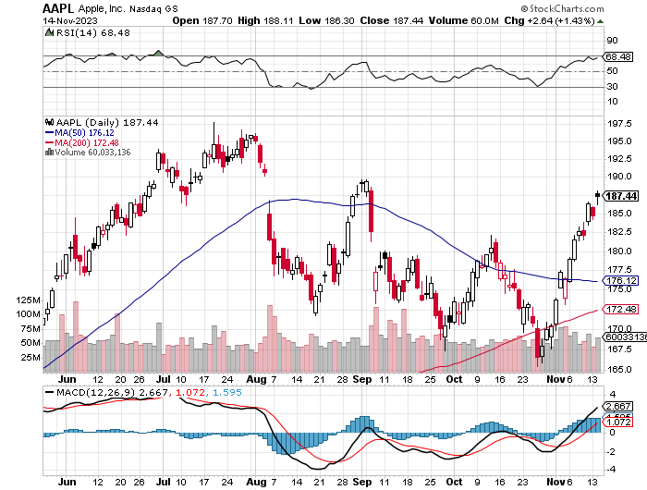
Apple (AAPL) Apple Upgrades New iPhone 15, to deal with overheating from third party gaming took profits on long 1/$145-$155 put spread, Took profits on long 10/$165-$175 put spread took profits on long 6/$155-$165 put spread, stopped out of long 6/$125-135 call spread, took profits on long 6/$110-$120 call spread, took profits on long 2/$180-$190 put spread

Slide 28
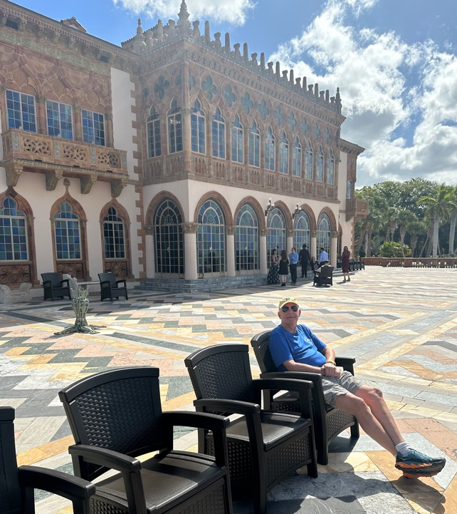

Slide 29
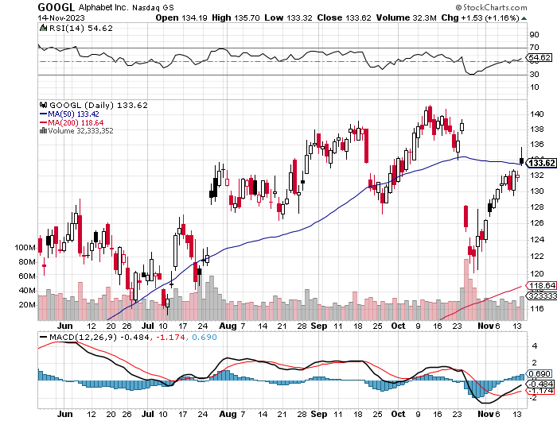
Alphabet (GOOGL) – Google Ramps Up AI Effort Alphabet’s Deep Mind Cut Labor Costs by 40% long 12/$110-$120 call spread took profits on long 12/$1,200-$1,230 bull call spread, took profits on long 9/$1,030-$1,080 vertical bull call spread

Slide 30
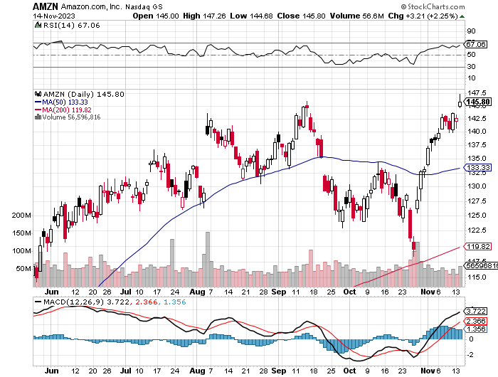
Amazon (AMZN) – FTC Files Antitrust Lawsuit Against Amazon took profits on long 2/$3,400-$3,500 bear put spread took profits on long 9/$2,800-$2,900 bull call spread

Slide 31
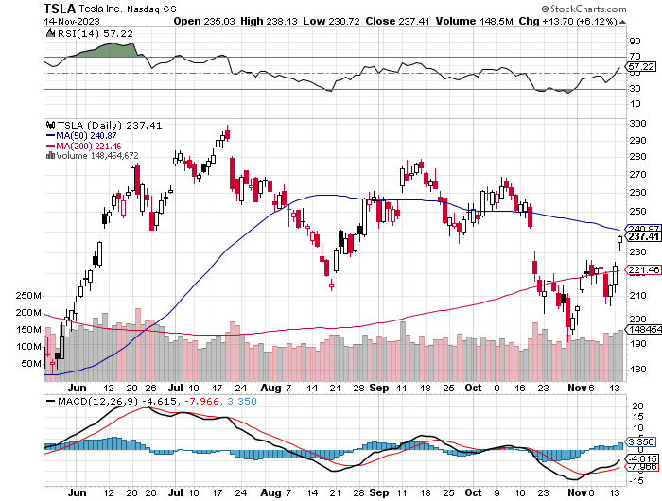
Tesla (TSLA) – The Price War Continues BP Buys Access to Tesla Superchargers for $100 Million New Cybertruck resales banned for one year Chinese EV Maker Nio to Enter the US, and give Tesla a run for its money took profits on long 10/$200-$210 call spread took profits on long 6/$120-$130 call spread, stopped out of long 6/$210-$220 put spread took profits on long 5/$110-$120 call spread, took profits on long 5/$220-$230 put spread

Slide 32
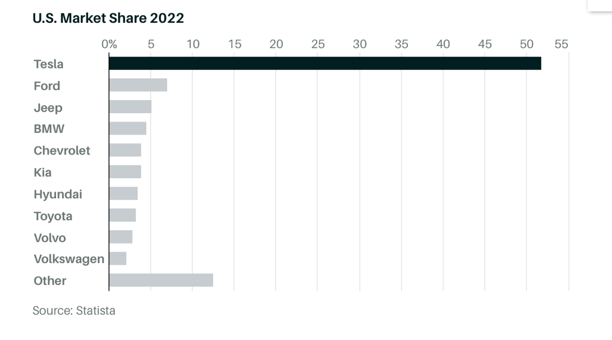

Slide 33
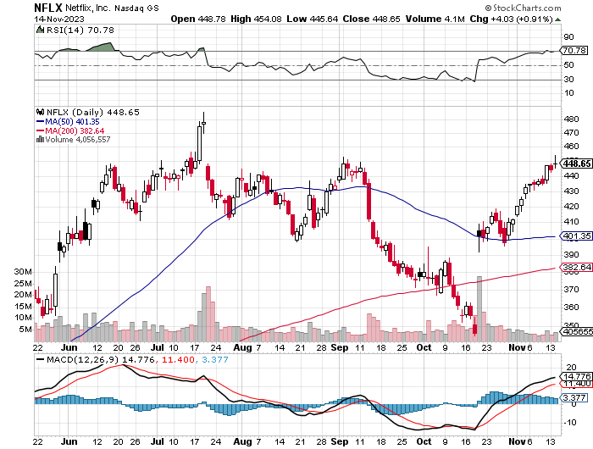
Netflix (NFLX) – Netflix subscribers beat - Netflix Password Sharing Crackdown Goes Global

Slide 34
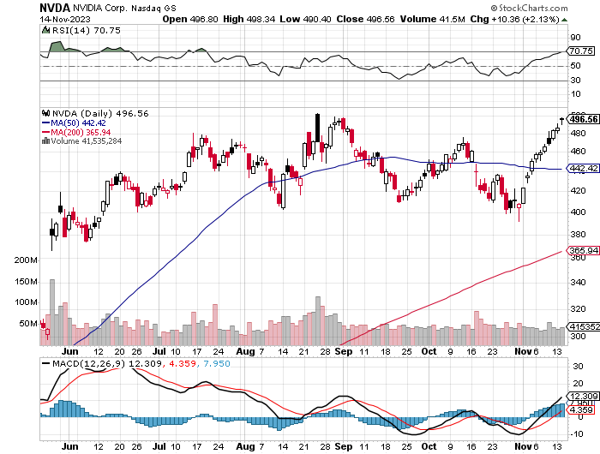
NVIDIA (NVDA) – Blowout Profits – NVIDIA is Designing Dumbed Down Chips for China, to bypass government sanctions took profits on long 10/$370-$380 call spread – took profits on long 11/$370-$380 call spread took profits on long 3/$260-$270 put spread, took profits on long 10/$95-$100 call spread took profits on long 7/$120-$130 call spread, took profits on long 6/$120-$130 call spread

Slide 35
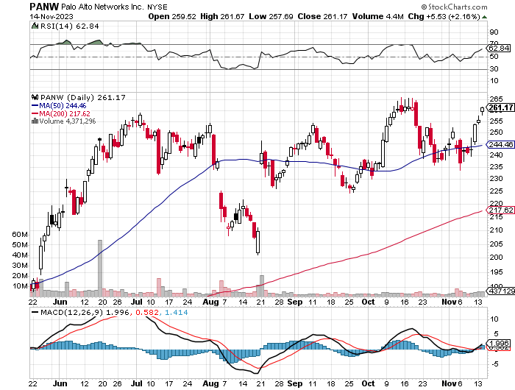
Palo Alto Networks (PANW)- Hacking never goes out of fashion Palo Alto Networks (PANW) Goes into the S&P 500 took profits on long 10/$130-$140 call spread

Slide 36
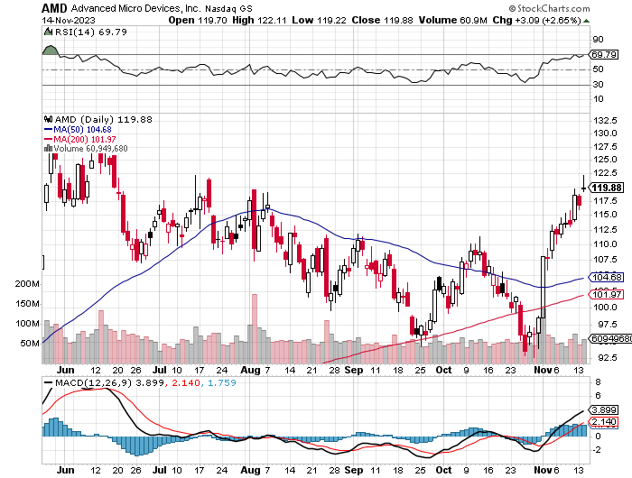
Advanced Micro Devices (AMD)- Recession fears programable logic devices took profits on long 2/$75-$80 call spread

Slide 37
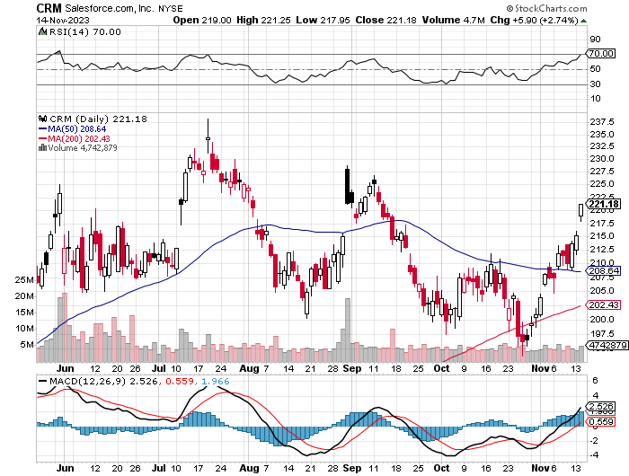
Salesforce (CRM)- Massive Online Migration long 12/$185-$195 call spread took profits on long 9/$125-$130 vertical bull call spread took profits on long 8/$125-$130 vertical bull call spread

Slide 38
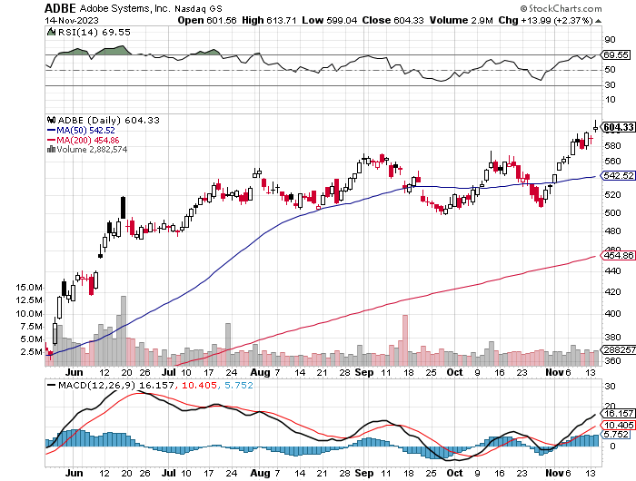
Adobe (ADBE)- Cloud play The Quality Non-China tech play

Slide 39
Snowflake (SNOW)- AI Cloud play long 12/$135-$140 call spread

Slide 40
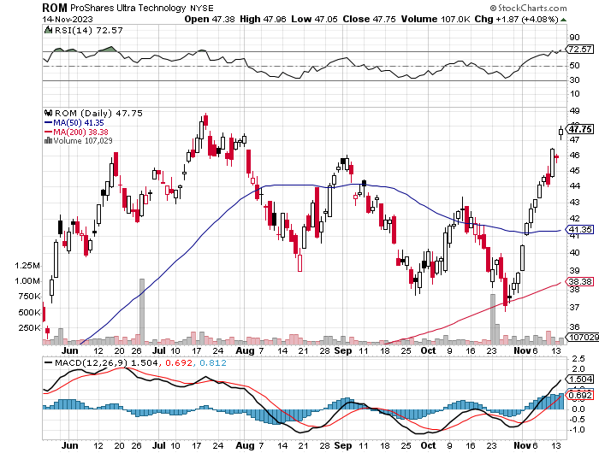
ProShares Ultra Technology ETF (ROM) – 2X Long Technology ETF took profits on long 10/$62-65 call spread

Slide 41
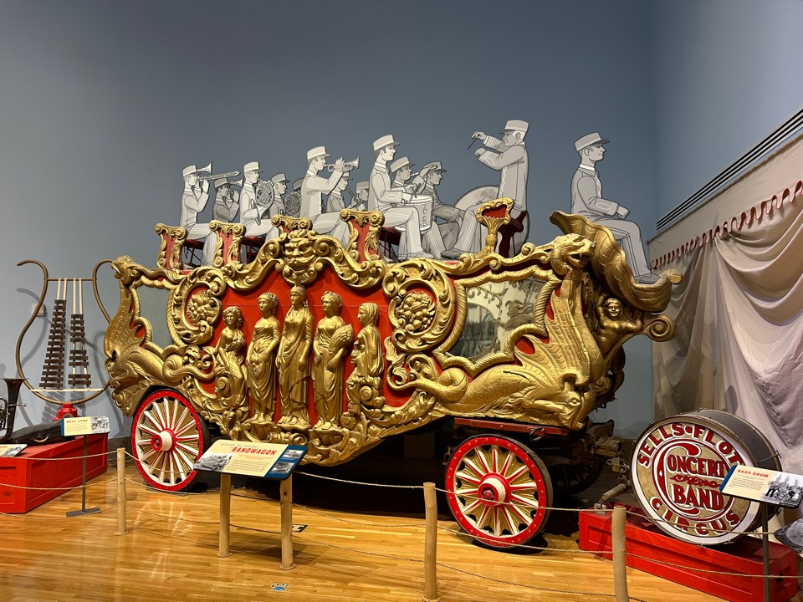

Slide 42
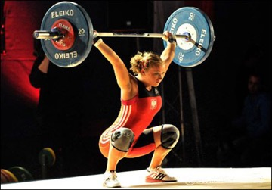
The Second Half of the Barbell
*Bets on a domestic recovery in 2022 Q4 *Upside potential in 2022 far greater than tech *Some of these have not moved for 5 or 10 years *Focuses on economically sensitive cyclical industries *Makes a great counterweight to high-growth technology *We could spend all of next year rotating between the two groups

Slide 43
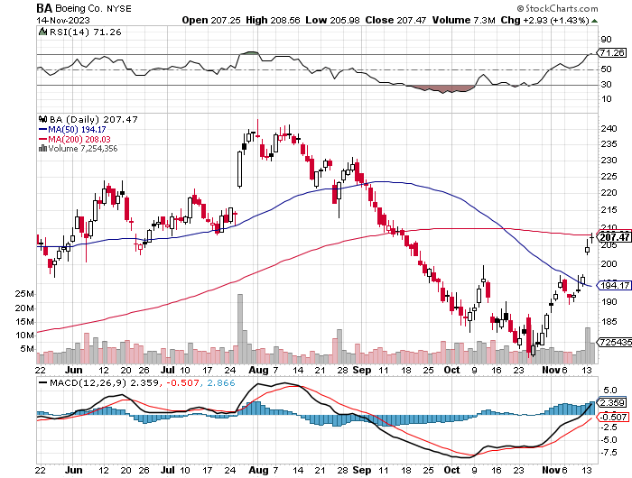
Boeing (BA) – Boeing Lands Monster Order, some $52 billion from Emirates Airlines for 90 new 777x’s and five 787’s took profits on long 5/$17-$175 call spread

Slide 44
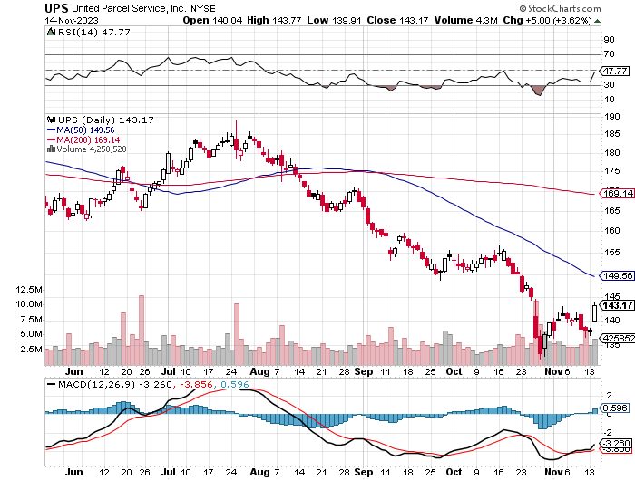
Package Delivery- United Parcel Service (UPS) – strike averted took profits on long 11/$130-$140 call spread

Slide 45
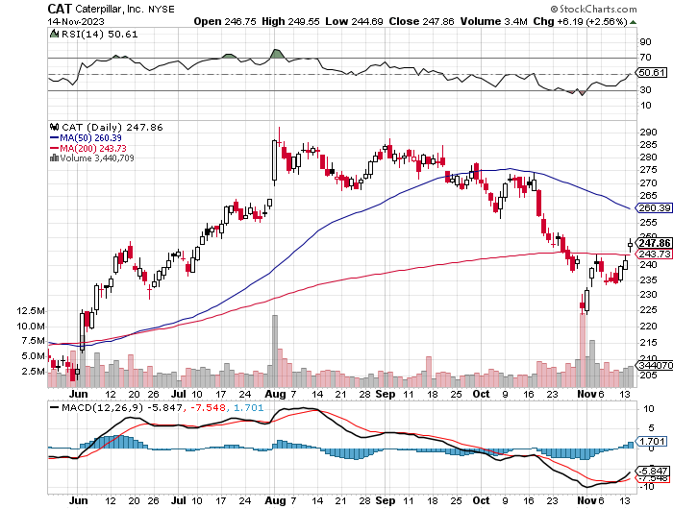
Caterpillar (CAT)- Ag + Infrastructure + Housing Raises Dividend by 50% took profits on long 12/$145-$150 call spread took profits on long 11/$125-$135 call spread

Slide 46
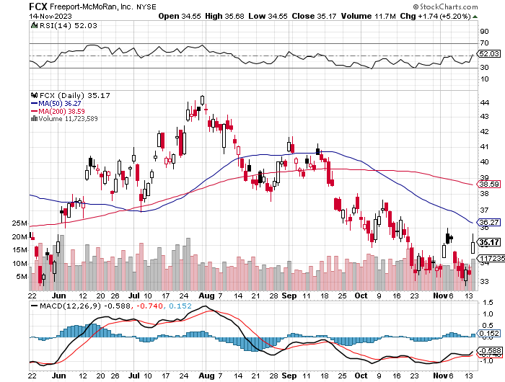
Freeport McMoRan - (FCX)- Coming Copper Crisis took profits on long 6/$32-$35 call spread took profits on long 4/$30-$33 call spread, took profits on long 10/$20-$23 call spread

Slide 47
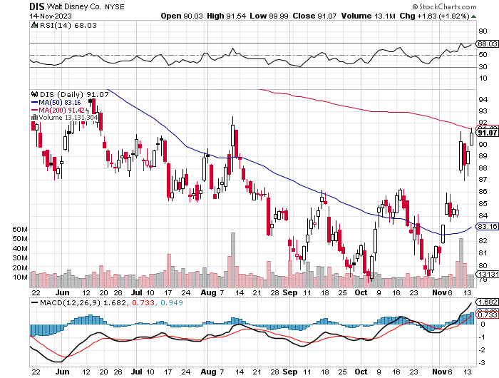
Walt Disney (DIS) -Disney Beats The big profit boost came from the parks

Slide 48
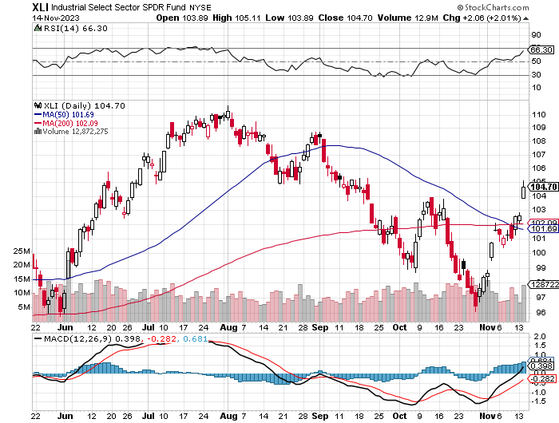
Industrials Sector SPDR (XLI)- (GE), (MMM), (UNP), (UTX), (BA), (HON)

Slide 49
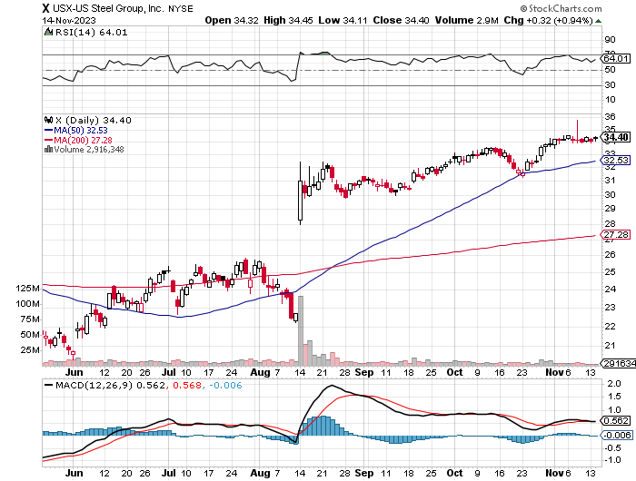
US Steel (X) – Commodity Boom and commodity Bidding war breaks out, taking stock up 50% and LEAPS up 101%

Slide 50
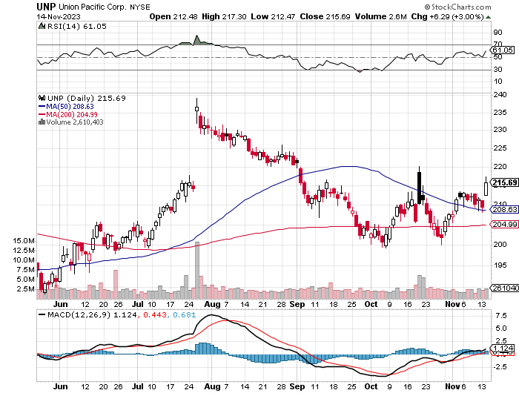
Union Pacific RR (UNP)- Big Stuff to Ship took profits on long 5/$200-$210 call spread took profits on 11/$150-$160 call spread

Slide 51
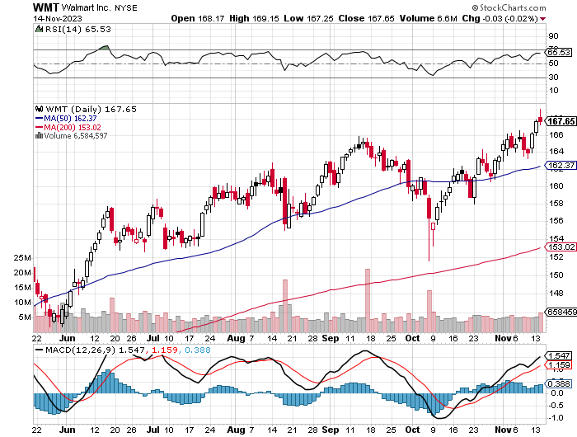
Wal-Mart (WMT)- took profit on Long 11/$125-$130 bear put spread took profit on Long 10/$119-$121 bear put spread took profits on Long 8/$114-$117 bear put spread

Slide 52
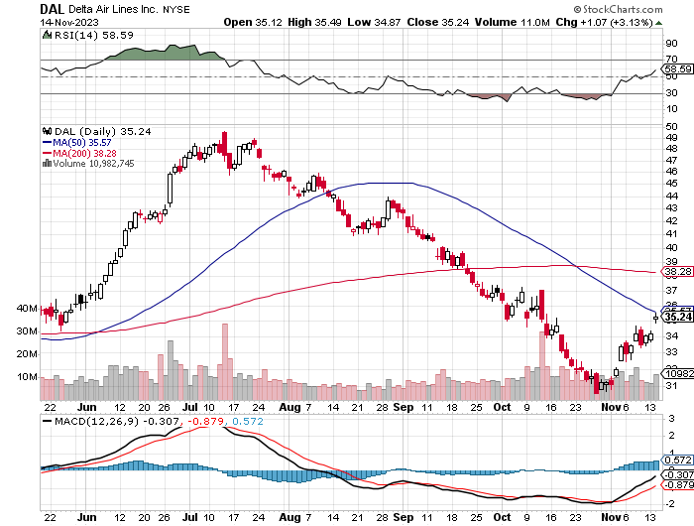
Delta Airlines (DAL) – Travel is Back! Delta Posts Strong Earnings on Robust international travel

Slide 53
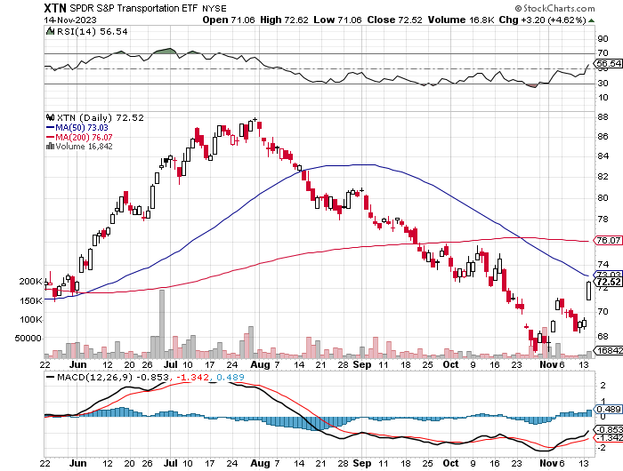
Transports Sector SPDR (XTN)- Worst Hit Sector (ALGT), (ALK), (JBLU), (LUV), (CHRW), (DAL)

Slide 54
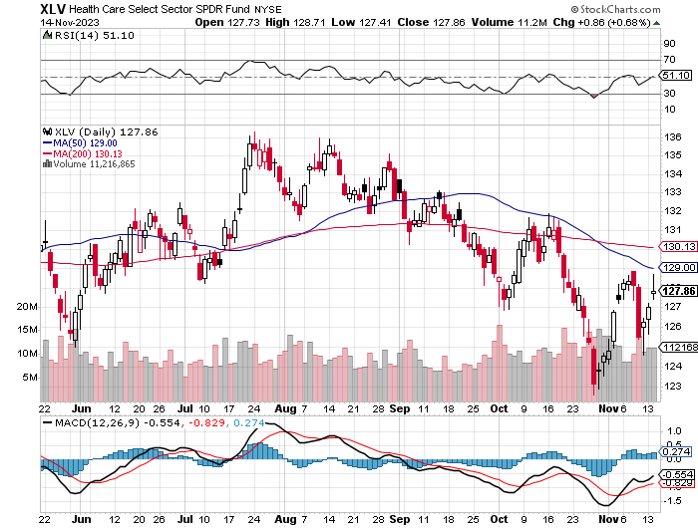
Health Care Sector (XLV) (JNJ), (PFE), (MRK), (GILD), (ACT), (AMGN)

Slide 55
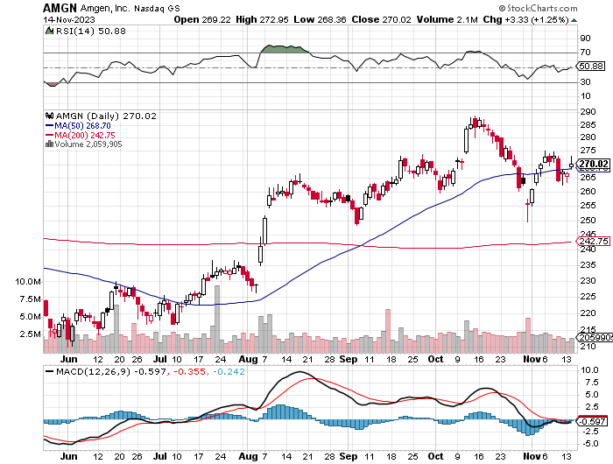
Amgen (AMGN) took profits on long 11/$185-$200 bull call spread

Slide 56
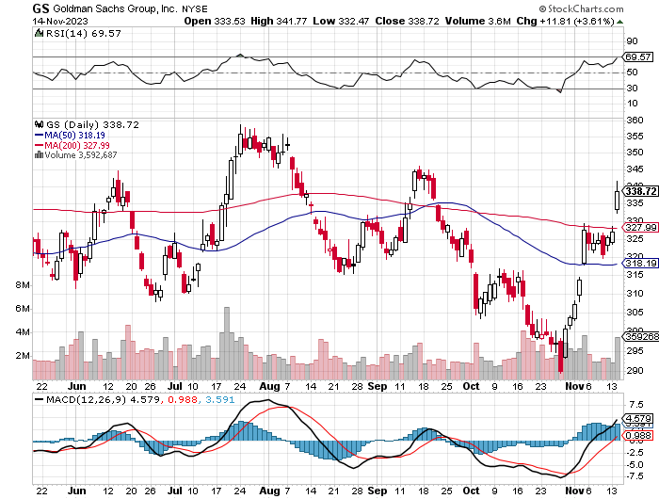
Goldman Sachs (GS) – Earnings Down but Less than Expected took profits 12/$330-$350 call spread took profits 11/$330-$350 call spread stop loss on long 11/$385-$395 call spreads

Slide 57
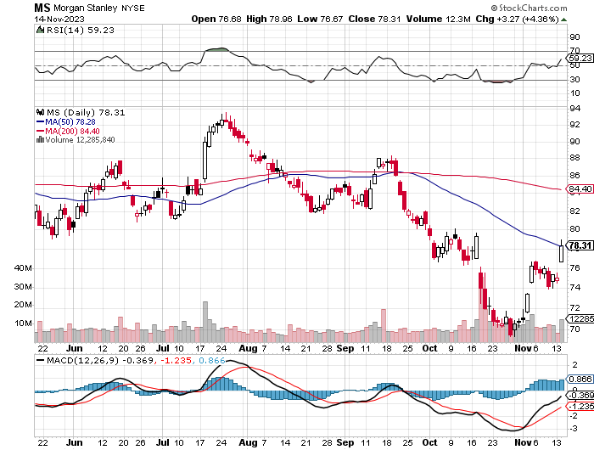
Morgan Stanley (MS) – Highest Capital ratio net of mark to market CEO to Step Down in a Year took profits on long 4/$65-$70 call spread

Slide 58
JP Morgan Chase (JPM) – Monster Earnings Surprise took profits on long 4/$105-$115 call spread

Slide 59
Bank of America (BAC) – Bank of America Rips, on a great earnings report took profits on long 4/$20-$23 call spread

Slide 60
Citigroup (C) – took profits on long 4/$30-$35 call spread

Slide 61
Charles Schwab (SCHW) – LEAPS up 67% in three months took profits on long 4/$30-$35 call spread

Slide 62
Interactive Brokers (IBKR) – Best Risk Control took profits on long 4/$60-$65 call spread

Slide 63
SPDR Metals & Mining ETF (XME) – long 2/$28-$30 call spread

Slide 64
Blackrock (BLK)-Asset Collection Boom took profits on long 3/$770-$790 call spread took profits on long 3/$310-$340 call spread

Slide 65
Visa (V) – Inflation boost Transaction grew by an inflationary 10% back to pre-pandemic levels took profits on long 10/$160-$170 bull call spread took profits on long 6/$150-$160 bull call spread

Slide 66
Consumer Discretionary SPDR (XLY) (DIS), (AMZN), (HD), (CMCSA), (MCD), (SBUX)

Slide 67
Berkshire Hathaway (BRKB)- Natural Barbell Berkshire Hathaway Knocks it Out of the Park, with a 41% gain in operating earnings long 12/$320-$330 call spread took profits on long 4/$260-$270 call spread took profits on long 1/$290-$300 call spread, took profits on long 10/$220-$230 call spread, took profits on long 7/$220-$230 call spread, took profits on long 7/$220-$230 call spread took profits on long 6/$260-$270 call spread

Slide 68
Europe Hedged Equity (HEDJ)-

Slide 69
Japan (DXJ)-

Slide 70
Emerging Markets (EEM) - Pro trade, Weak Dollar, Long Recovery Play

Slide 72
Bonds – The Bottom is In
*Moody’s Rating Service Downgrades the US, citing detiorating fiscal conditions and worsening chaos in Washington *However, it maintained its AAA Rating. *Oh, and the government shuts down on Friday *But Where else are investors going to go for quality? *Investors Poured $5 Billion into Bond ETF’s in October *Ten Year Treasury yields Hit New 16-year High, at 5.0%, then retreat to 4.45% *The whole falling interest rate, rising bond price trade has been delayed for three months hotter than expected economic growth at 4.9% for Q3 and more Fed rate rises *Junk bond ETF’s (JNK) and (HYG) are holding up extremely well with a 8.74% yield and 18 month high *Buy (TLT) on the dip.

Slide 73
Treasury ETF (TLT) – A Short Strangle took profits on long 12/$79-$82 call spread, long 12/$95-$98 put spread took profits on long 11/$76-79 call spread, took profits on long 10/$89-92 put spread, took profits on long 5/$98-$101 call spread took profits on long 5/$97-$100 call spread, long 2/$98-$101 call spread, took profits on long 4/$96-$99 call spread

Slide 74
Ten Year Treasury Yield ($TNX) – 4.45%

Slide 75
Junk Bonds (JNK) 8.74% Yield

Slide 76
Municipal Bonds (MUB) 2.63% Yield-

Slide 77
Emerging Market Debt (ELD) 5.03% Yield-

Slide 78
2X Short Treasuries (TBT)-Out of Favor

Slide 79
Anally Capital Management (NLY) – Leveraged REIT Play long 12/$15-$16 call spread

Slide 81
Foreign Currencies – Leveling Off at the Highs
*Bank of Japan Eases Grip on Bond Yields, ending its unlimited buying operation to keep interest rates down *Japan is the last country to allow rates to rise. Expect the Japanese yen to take off like a rocket. *Dollar Hits New Highs, as “high for longer” interest rates keep powering the greenback *The buck is also catching a flight to safety bid from the imminent government shutdown. It should be topping soon *Collapse of dollar is now a 2024 story *Aussie dollar (FXA) improving on slowly recovering Chinese economy *Buy (FXE), (FXB), (FXA), (FXY)

Slide 82
THE MAD HEDGE FUND TRADER
Australian Dollar (FXA) - Major Long-Term Bottom is In Targeting Parity – A call option on a global synchronized recovery
1:1
BUY

Slide 83
Japanese Yen (FXY)

Slide 84
Euro (FXE)-
2024 Target 25%

Slide 85
British Pound (FXB)-
2024 Target 15%

Slide 86
Emerging Market Currencies (CEW)
2024 Target 40%

Slide 88
Energy & Commodities – Plunge
*Oil Hits Four Month Low at $75 a Barrel, down 4% as the shine comes off the energy sector *The Gaza boost is gone, which never delivered a supply cut off despite many threats *Fears of a global economic slowdown are mounting *China’s oil imports have fallen for six consecutive months, the world’s largest importer *Biden is back in the oil business, provided a floor bid from the Strategic Petroleum Reserve at $79 *Warm weather is capping rallies in natural gas (UNG) *Copper Bull Predicts 80% Gain in the Coming Decade, to $15,000 per metric tonne, up from $8,277

Slide 89
Oil-($WTIC)

Slide 90
United States Oil Fund (USO)

Slide 91
Energy Select Sector SPDR (XLE)-No Performance! (XOM), (CVX), (SLB), (KMI), (EOG), (COP)

Slide 92
ExxonMobile (XOM)- Exxon Buys Pioneer Resources for $60 Billion took profits on long 12/$120-$125 put spread

Slide 93
Occidental Petroleum (OXY)- Buffet’s a Buyer took profits on long 2/$55-$60 call spread, took profits on long 12/$77.50-$82.50 put spread

Slide 94
Natural Gas (UNG) – Warm weather is the killer Long January 2025 $14 - $15 Call Spread LEAPS

Slide 95
Freeport McMoRan (FCX) - Codelco Sees Profit Slump, the world’s largest copper producer based in Chile

Slide 96
Cameco (CCJ) – Global Uranium Renaissance long 12/$35-$38 call spread took profits on long 5/$20-$23 bull call spread

Slide 98
Precious Metals – The New Hedge
*Investors are picking up gold as a hedge for 2024 volatility *Goldman Sachs bets on 21% gain in gold for 2024 *Gold headed for $3,000 by 2025, but back off first from new all-time highs *The new drivers are soon to fall interest rates and the demise of crypto *Silver is the better play with a higher beta *Russia and China are also stockpiling gold to sidestep international sanctions

Slide 99
Gold (GLD) - Deflation call took profits on long 5/$165-$170 bull call spread

Slide 100
Market Vectors Gold Miners ETF- (GDX) –

Slide 101
Barrick Gold (GOLD) took profit on long 1/$15.50-$16.50 call spread

Slide 102
Newmont Mining- (NEM)- took profits on long $55-60 call spread

Slide 103
Silver- (SLV)- took profits on long 11/$19-$20 call spread

Slide 104
Silver Miners - (SIL)-

Slide 105
Wheaton Precious Metals - (WPM)- took profits on long 1/$36-$39 call spread

Slide 106
Platinum- (PPLT)- 556,000-ounce shortage this year took profits on long 1/$36-$39 call spread

Slide 108
Real Estate – Still Stalled
*Real Estate Commissions are About to Drop Sharply, the outcome of a Court Decision against the National Association of Realtors *This is the last undisrupted industry in the country. *An estimated that the $100 billion paid in real-estate commissions annually could be cut by 30%, with as many as 1.6 million agents losing their source of income. It could be years before consumers see actual commission drops. * Homebuyers are Pouring into ARMs, or adjustable-rate mortgages, shunning 30-year fixed rates at a mind numbing 8.0%. ARMs could be had at 6.77% last week *The median home price for existing homes rose to 1.9% to $406,700 according to the National Association of Realtors (NAR) *The robust housing market suggests that while some buyers pulled back due to high borrowing costs, demand continues to outweigh supply.

Slide 109
S&P Case Shiller Plunges S&P Case Shiller Rises to +3.00% in August, with its National Home Price Index Atlanta gained +3.4%, Boston +3.1%, and Charlotte +3.0%.

Slide 111
Crown Castle International (CCI) – 6.26% yielding cell phone tower REIT loses Verizon as major customer

Slide 112
US Home Construction Index (ITB) (DHI), (LEN), (PHM), (TOL), (NVR)

Slide 114
Trade Sheet- So What Do We Do About All This?
*Stocks – buy any dips *Bonds – buy dips *Commodities-buy dips *Currencies- sell dollar rallies, buy currencies *Precious Metals – buy dips *Energy – stand aside *Volatility –stand aside *Real estate – buy dips

Slide 115
Next Strategy Webinar 12:00 EST Wednesday, November 29 from Silicon Valley email me questions at support@madhedgefundtrader.com
Good Luck and Good Trading!
Notes:
*

