Slide 1
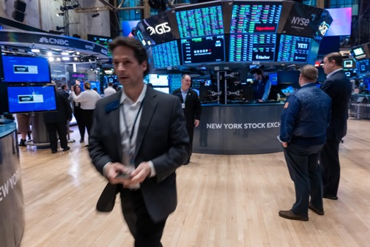
The Mad Hedge Fund Trader
“New All-Time Highs”
With John Thomas
Silicon Valley January 24, 2024
www.madhedgefundtrader.com
Notes:
*

Slide 2


Slide 3
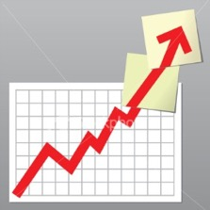
Trade Alert Performance
Beating 2022 – Best in 15 years
60 out of 66 trade alerts profitable – No losers since August 4
*January -3.88% MTD *July +0.44% Final
*February +3.41% Final *August -4.70% Final
*March +20.85% Final *September +00% Final
*April +15.13% Final *October -5.37% FINAL
*May +0.30%% Final *November +15.37 Final
*June +3.01% Final *December -2.27% Final
*2024 YTD +0%, versus +1.50% for the S&P 500 and
+670.74% since inception
*Versus 84.63% for all of 2022
*Versus 79.79% for all of 2023
*Average annualized return of +51.27% for 15 years

Slide 4
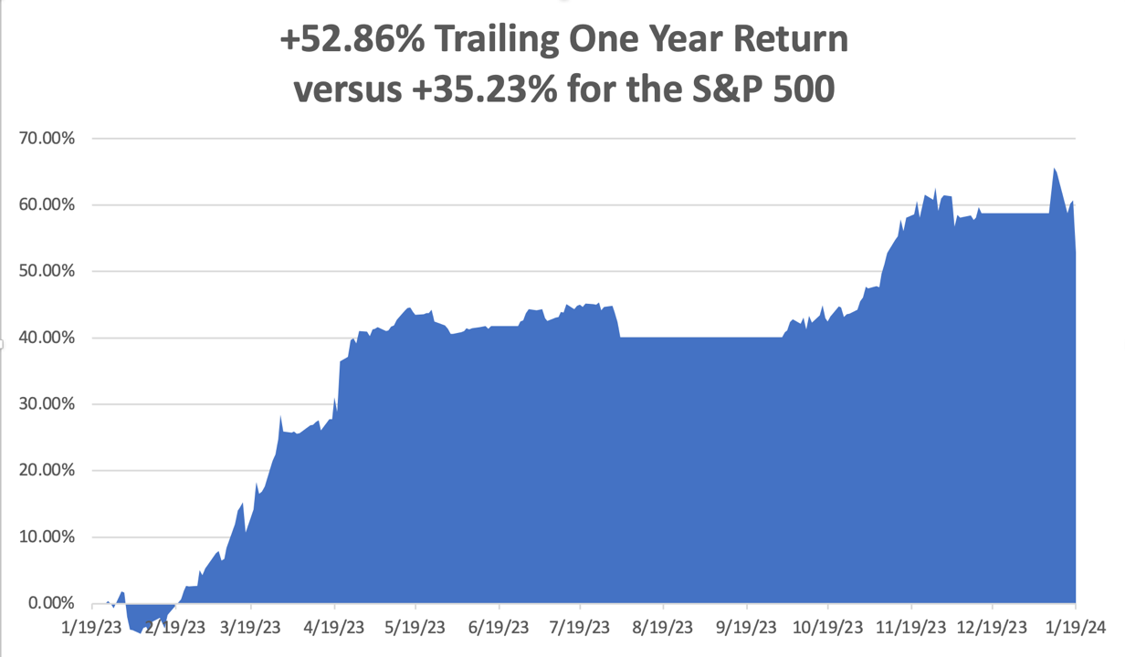

Slide 5
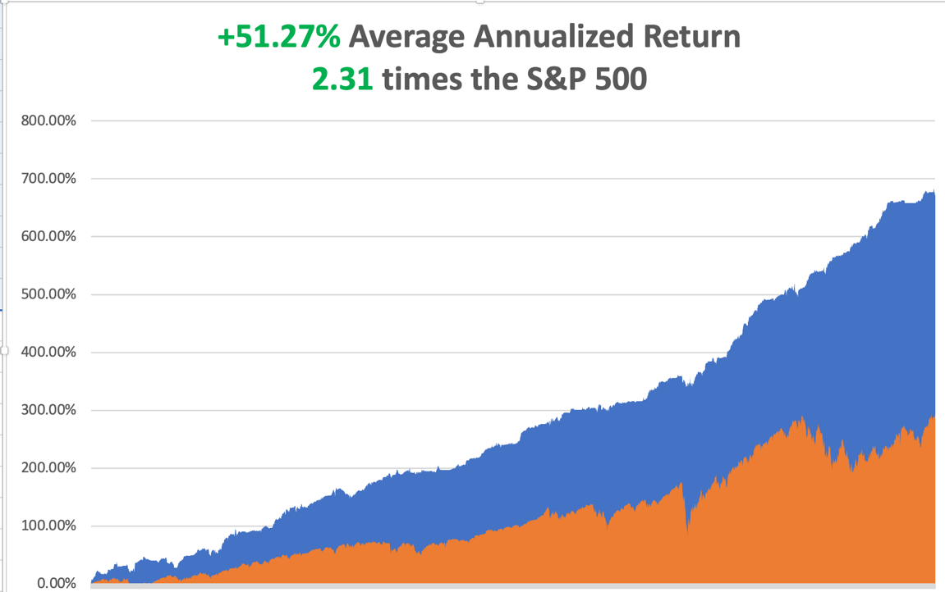

Slide 6
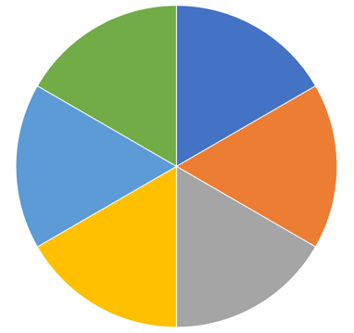
Portfolio Review – Aggressive Long
60% Long, 40% Short, 0% cash
Expiration Value
+0.74%
Current Capital at Risk
Risk On
(MSFT) 2/$330-$340 call spread | 10.00%
(AMZN) 2/$130-$135 call spread | 10.00%
(V) 2/$240-$250 call spread | 10.00%
(PANW) 2/$260-$270 call spread | 10.00%
(CCJ) 2/$38-$41 call spread | 10.00%
(TLT) 2/$90-$90 call spread | 10.00%
Risk Off
NO POSITIONS
Total Net Position | 60.00%
Total Aggregate Position | 60.00%

Slide 7

The Method to My Madness
*Markets are going from overbought to more overbought
*Mag 7 has shrunk to the Mag 5, ex Apple and Tesla
*All economic data is globally slowing, except for the US, with the only good economy in the world
*Oil still pulled down by a collapsing China
*Domestic plays have gone back to sleep on rates
*Buy stocks and bonds but only after substantial dips
*Commodities and industrials are a second half play

Slide 8

The Global Economy – Choppy
*University of Michigan Consumer Sentiment Index Surges, up to 78.8 for January, its highest level since July 2021
*US Retail Sales Come in Best in Three Months, up 0.6% in December, as analysts continue to underestimate the American consumer.
*Weekly Jobless Claims Plunge to 187,000, a 17-month low, underlining the “soft landing” scenario
*PPI Falls 0.1% in December, putting the interest rate
cutting scenario back on
*Consumer Price Index Flies, coming in at 0.3% for December
instead of the anticipated 0.2%, a 3.4% annual rate
*Fed rate cuts just got pushed back from March to June

Slide 9
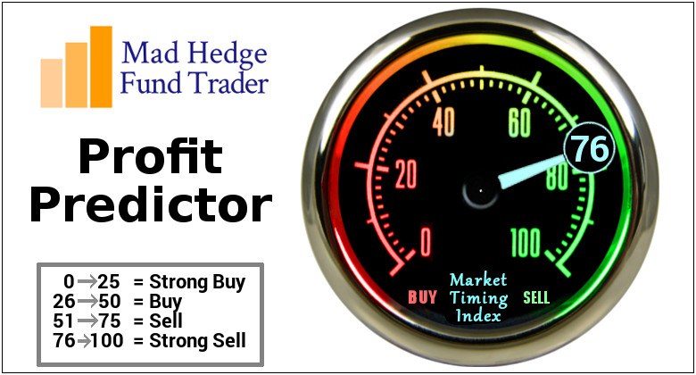
The Mad Hedge Profit Predictor
Market Timing Index – At top end of historic range
An artificial intelligence driven algorithm that analyzes 30 different economic, technical, and momentum driven indicators

Slide 10
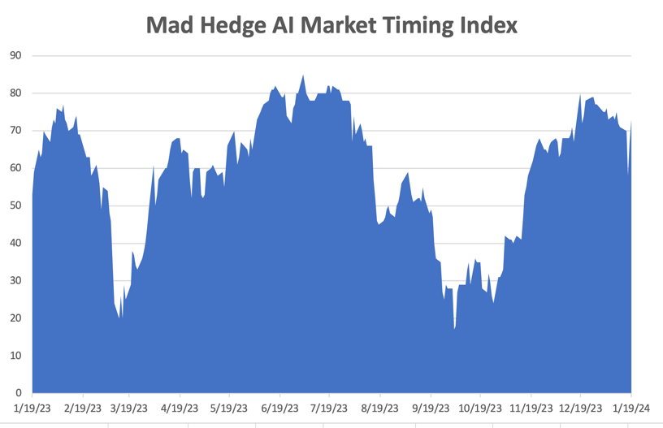
Sell Territory!! – Severe Overbought Territory
SELL
BUY

Slide 11
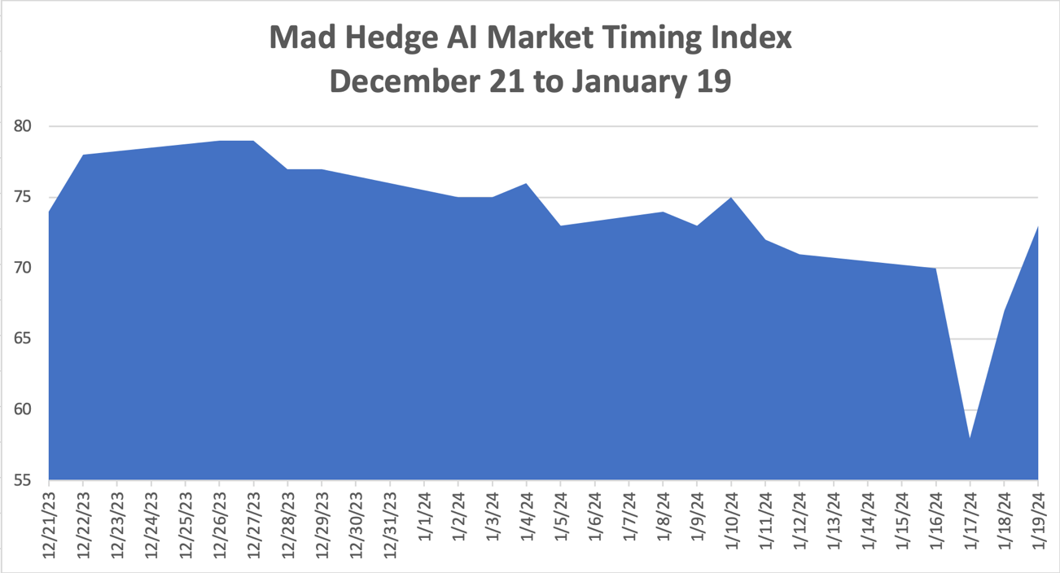

Slide 12
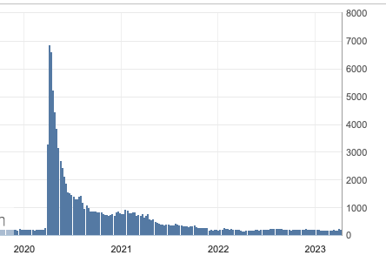
Weekly Jobless Claims – Falling
187,000 – -16,000

Slide 13

Stocks – New All Time High!
*SPY breaks to new high on strong consumer sentiment
*Big tech continues to dominate
*Market will continue to revalue all AI plays
*Bull move could continue into February as investors are under invested, or even short
*Analysts are vastly underestimating technology earnings,
only upgrading in 5% increments creating constant upside
surprises
*Domestic plays have gone back to sleep on rising rates
*The flip flop continues between tech and domestics

Slide 14
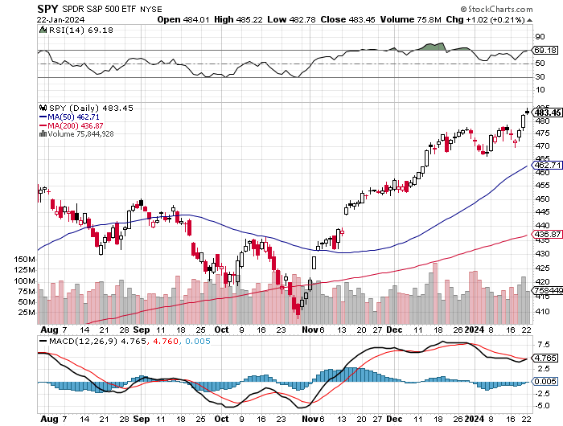
S&P 500 – New High stopped out of short 2/$485-$490 put spread,
Yearend
Target
$550 +15%
$455
-5.80%
1st support
NEVER BET AGAINST THE TREND!!!

Slide 15
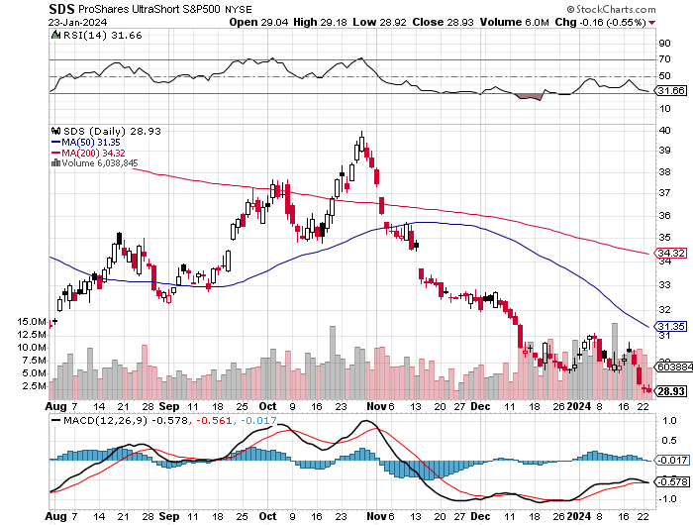
ProShares Ultra Short S&P 500 (SDS)- a great hedge for long stocks and bonds long 2X position has a hedge against longs and bond shorts

Slide 16
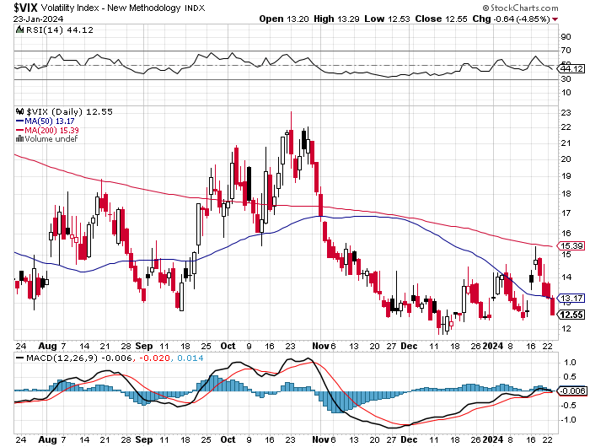
(VIX) – Bargain of the Century

Slide 17
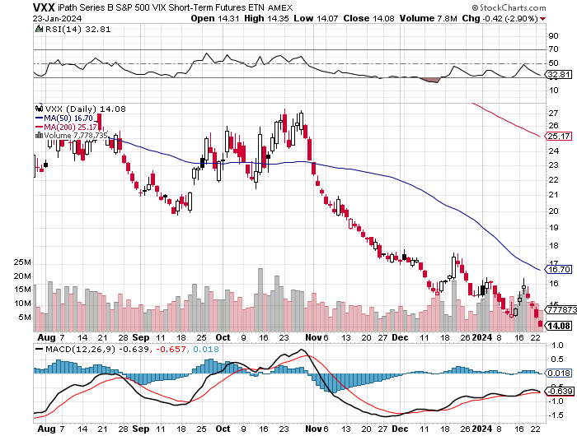
(VXX)-

Slide 18
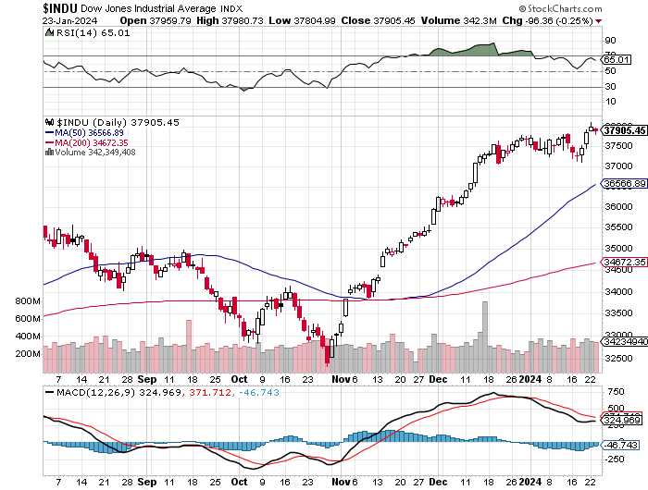
Dow Average ($INDU)-

Slide 19
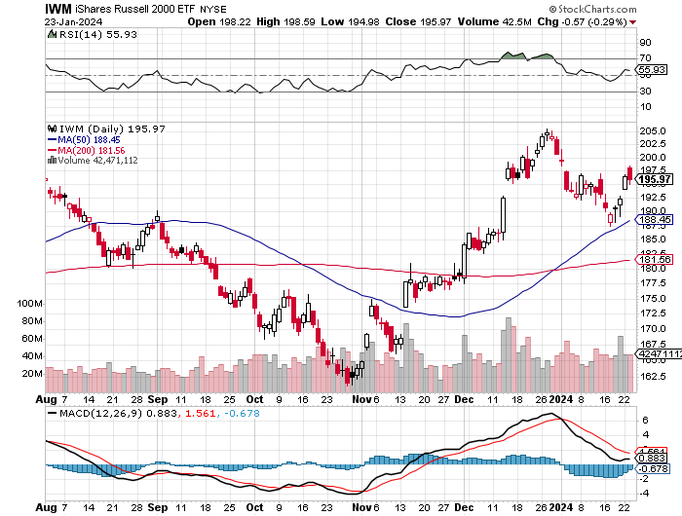
Russell 2000 (IWM)- took profits on Long 10/$137-$142 vertical bull call spread took profits on Long 10/$153-$156 vertical bear put spread

Slide 20
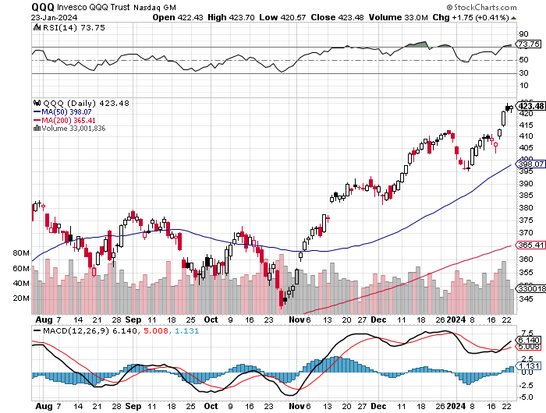
NASDAQ (QQQ) – YIKES! took profits on Long 5/$335-$345 put spread took profits on long (QQQ) 1/$290-$300 put spread, took profits on long (QQQ) 4/$330-$335 put spread took profits on long (QQQ) 3/$340-$345 put spread, covered long (QQQ) $325-$330 put spread

Slide 21
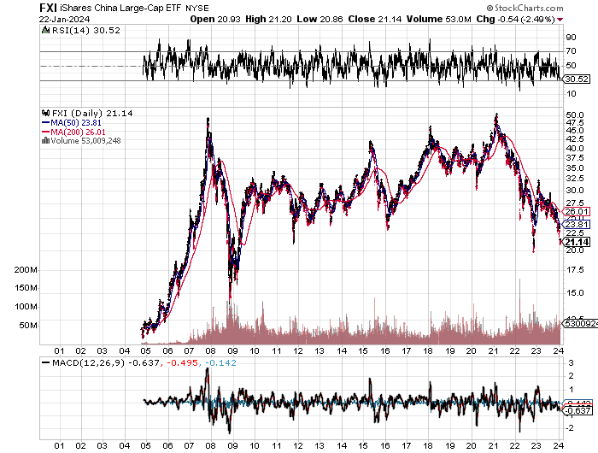
China: 15 Year Low
40 Years of One Child Policy Comes Home to Bite

Slide 22
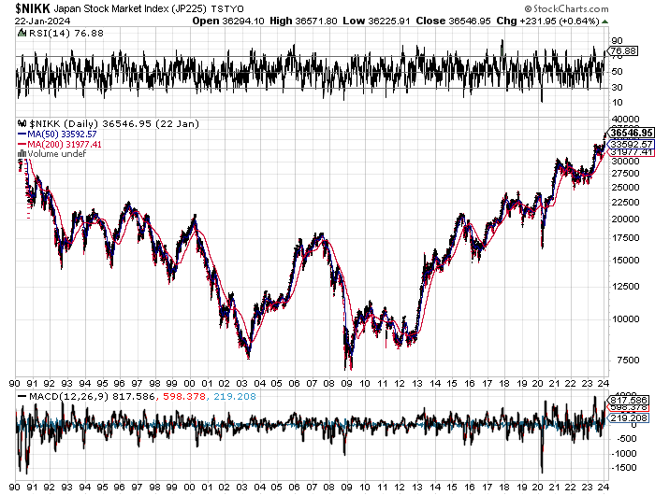
Japan: A 34 Year Round Trip

Slide 23


Slide 24



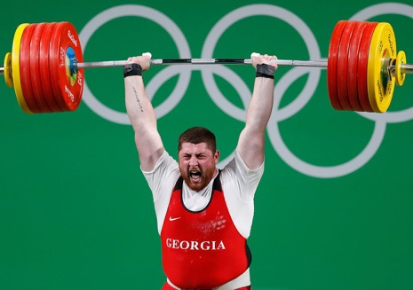
THE MAD HEDGE FUND TRADER
The Barbell Portfolio
*75% Big Tech – 2% of US workforce, 25% of market cap and 25% of US earnings
25% Domestic Recovery, including:
Railroads, airlines, cruise lines,
Couriers, steel companies
Banks, commodities
Construction
Credit Card Companies
Hotels, casinos
Online Ticket Sales

Slide 25
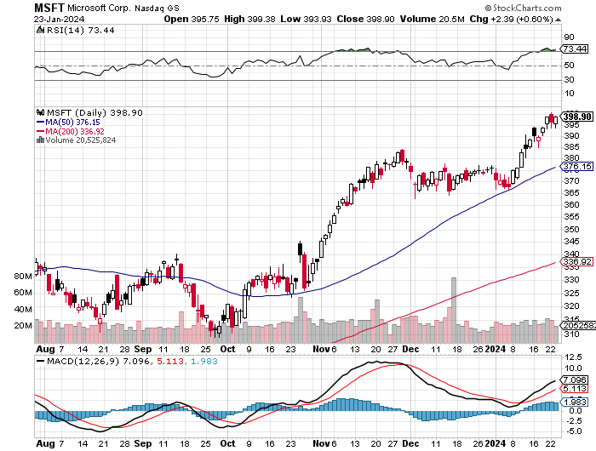
Microsoft (MSFT)- Earnings Beat
The AI Wars Continue, with the entire Open AI staff going to Microsoft (MSFT) long 12/$330-$340 call spread, took profits on long 12/$320-$330 call spread took profits on long 9/$235-$245 call spread, took profits on long 7/$220-$210 call spread, took profits on long 6/$220-$230 call spread, took profits on long 2/$200-$210 bear put spread

Slide 26
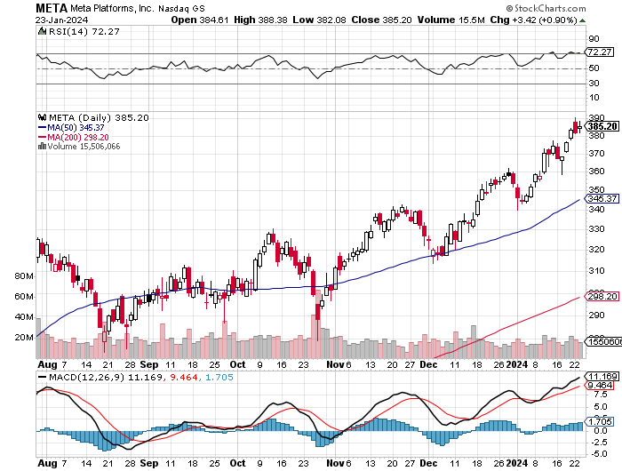
Meta (META)- Soars an Incredible 20% took profits on Long 9/$290-$300 vertical bear put spread stopped out of Long 9/$190-$200 vertical bear put spread

Slide 27
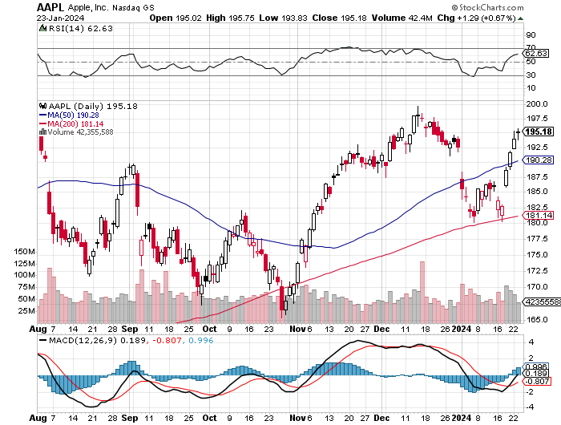
Apple (AAPL)
Apple Beats Samsung, to become the world’s top seller of smart phones with a 20% market share took profits on long 1/$145-$155 put spread, Took profits on long 10/$165-$175 put spread took profits on long 6/$155-$165 put spread, stopped out of long 6/$125-135 call spread, took profits on long 6/$110-$120 call spread, took profits on long 2/$180-$190 put spread

Slide 28
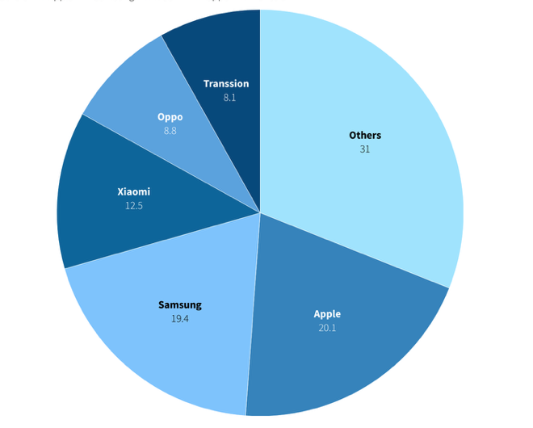

Slide 29
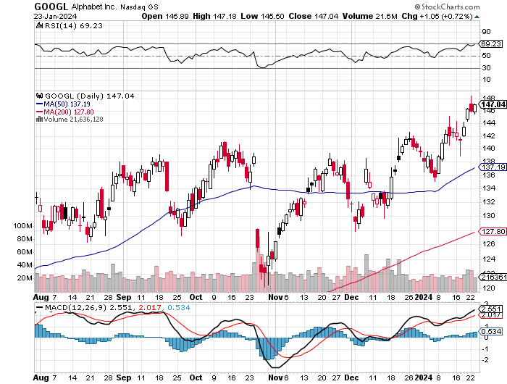
Alphabet (GOOGL) – Google Ramps Up AI Effort
Alphabet Unveils New Gemini AI Model took profits on long 12/$110-$120 call spread took profits on long 12/$1,200-$1,230 bull call spread, took profits on long 9/$1,030-$1,080 vertical bull call spread

Slide 30
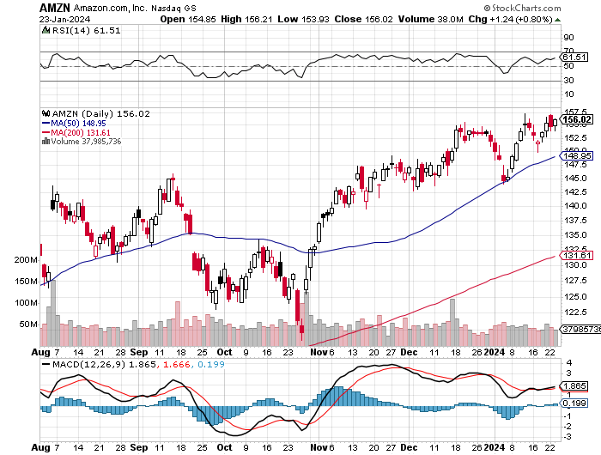
Amazon (AMZN) –
Jeff Bezos Sells Amazon, some 1.673 million shares worth $244 million. He still has 988 million shares left worth $144 billion long 2/$130-$135 bull call spread took profits on long 2/$3,400-$3,500 bear put spread took profits on long 9/$2,800-$2,900 bull call spread

Slide 31
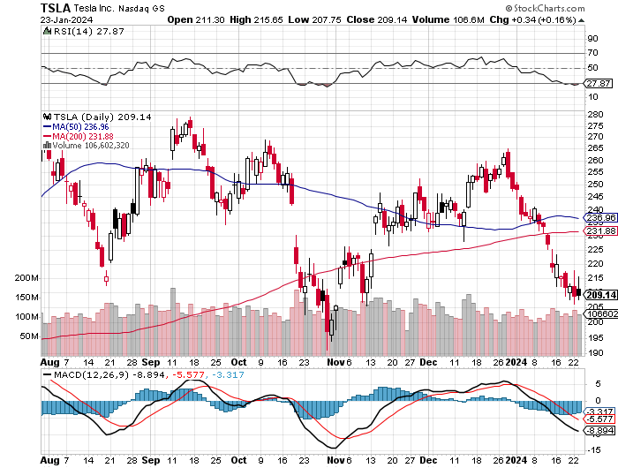
Tesla (TSLA) – The Price War Continues
Tesla to Halt Production in Germany, thanks to soaring shipping costs in the Red Sea
took profits on long 10/$200-$210 call spread
took profits on long 6/$120-$130 call spread, stopped out of long 6/$210-$220 put spread
took profits on long 5/$110-$120 call spread, took profits on long 5/$220-$230 put spread

Slide 32
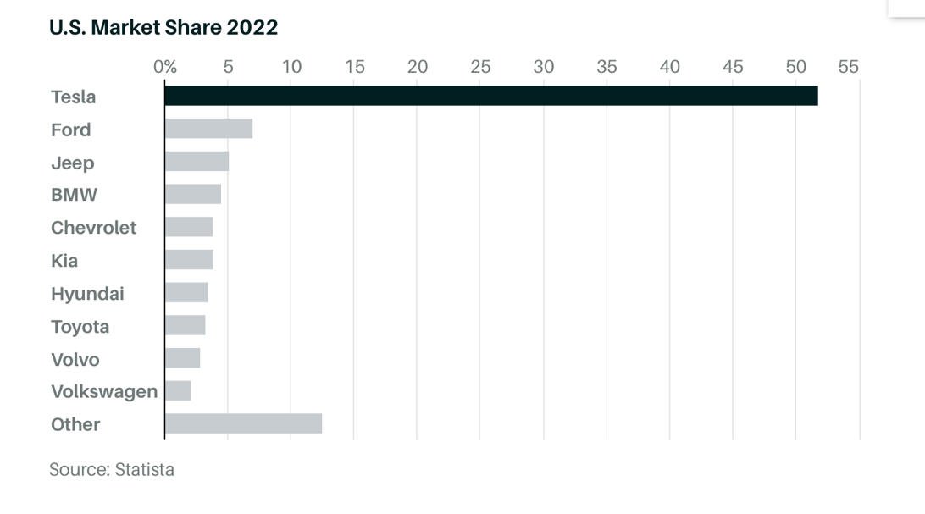

Slide 33
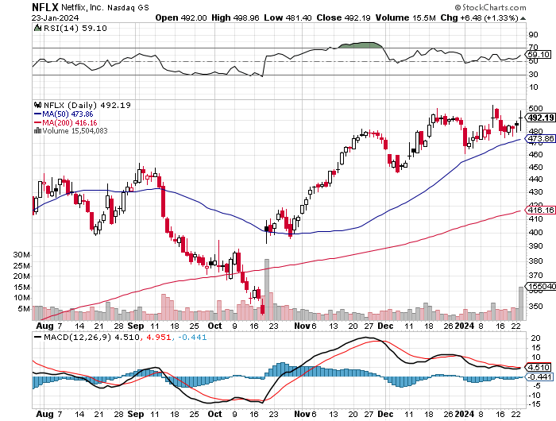
Netflix (NFLX) – Netflix subscribers beat - Netflix Password Sharing Crackdown Goes Global

Slide 34
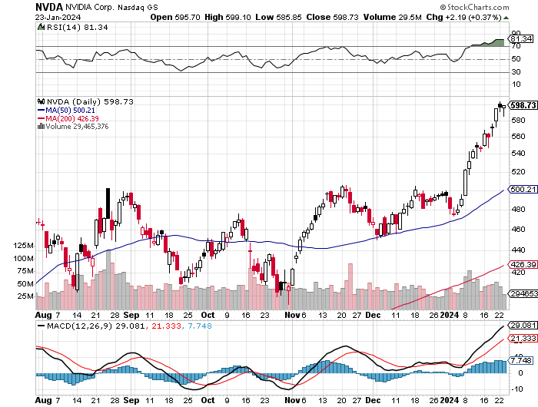
NVIDIA (NVDA) – Double Position took profits on long 2/$350-$360 call spread, took profits on long 2/$360-$370 call spread took profits on long 10/$370-$380 call spread – took profits on long 11/$370-$380 call spread took profits on long 3/$260-$270 put spread, took profits on long 10/$95-$100 call spread took profits on long 7/$120-$130 call spread, took profits on long 6/$120-$130 call spread

Slide 35
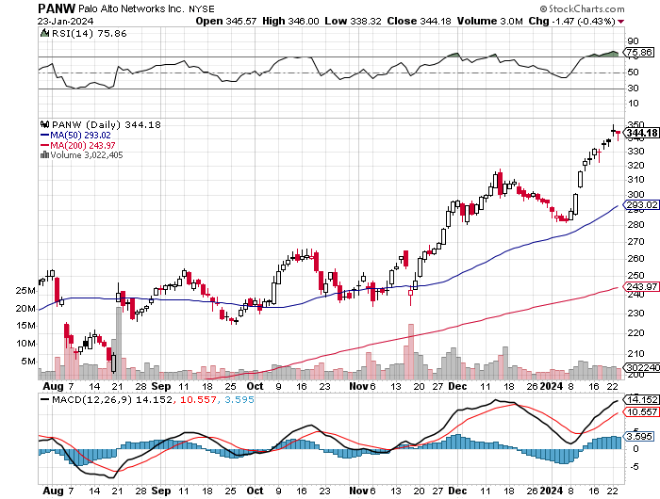
Palo Alto Networks (PANW)- Hacking never goes out of fashion
Palo Alto Networks Dives on Weak Guidance, even though reported earnings were great long 2/$260-$270 call spread, took profits on long 10/$130-$140 call spread

Slide 36
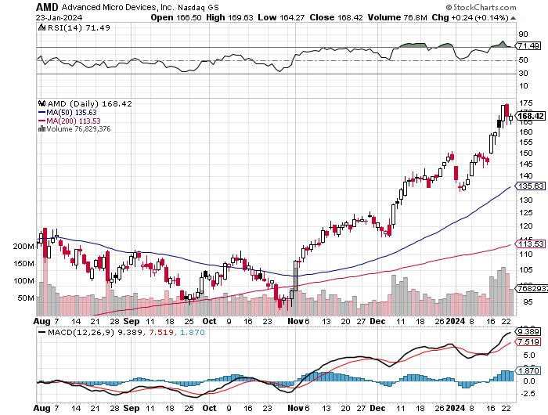
Advanced Micro Devices (AMD)- Recession fears programable logic devices took profits on long 2/$75-$80 call spread

Slide 37
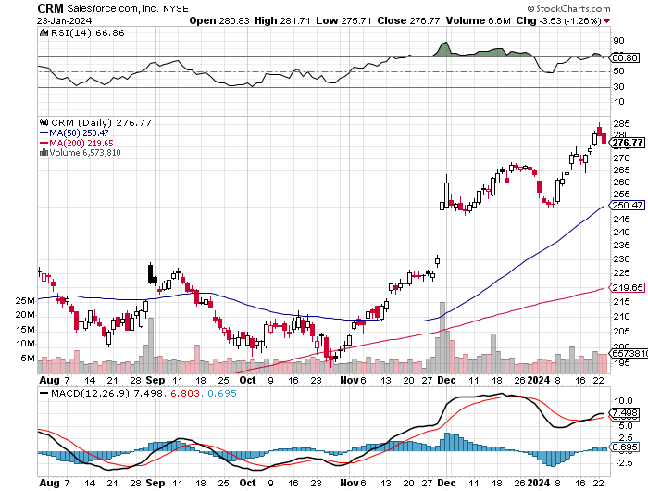
Salesforce (CRM)- Massive Online Migration
Salesforce Soars 16%, on better-than-expected guidance took profits on long 12/$185-$195 call spread took profits on long 9/$125-$130 vertical bull call spread took profits on long 8/$125-$130 vertical bull call spread

Slide 38
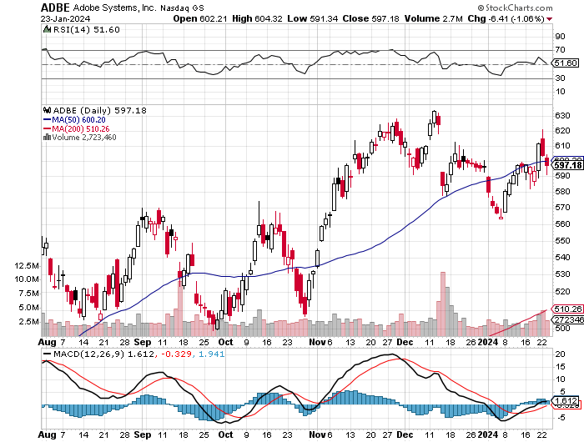
Adobe (ADBE)- Cloud play
The Quality Non-China tech play

Slide 39
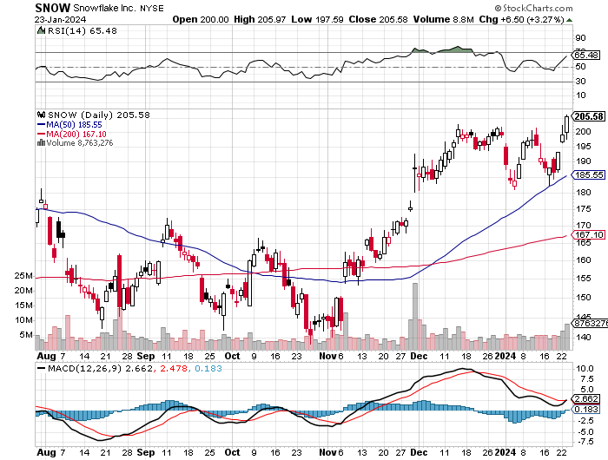
Snowflake (SNOW)- Blockbuster AI Earnings took profits on long 12/$135-$140 call spread

Slide 40
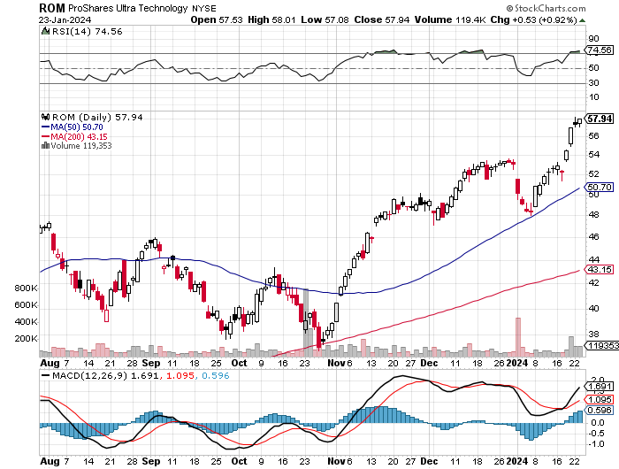
ProShares Ultra Technology ETF (ROM) – 2X Long Technology ETF took profits on long 10/$62-65 call spread

Slide 41
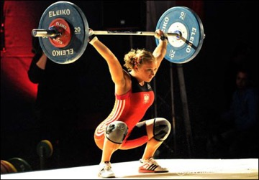
The Second Half of the Barbell
*Bets on a domestic recovery in 2022 Q4
*Upside potential in 2024 far greater than tech
*Some of these have not moved for 5 or 10 years
*Focuses on economically sensitive cyclical industries
*Makes a great counterweight to
high-growth technology
*We could spend all of next ten years rotating
between the two groups

Slide 42
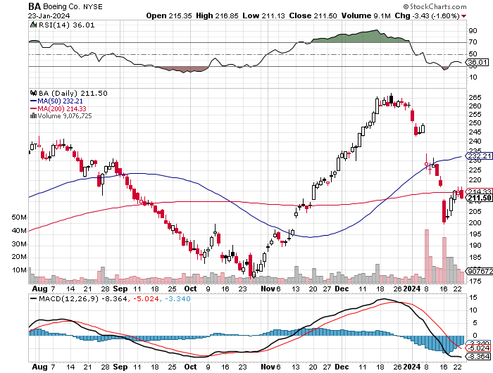
Boeing (BA) –
Boeing's single-aisle deliveries up to 351 units for the year so far stopped out of long 2/$190-$200 call spread, took profits on long 5/$17-$175 call spread

Slide 43
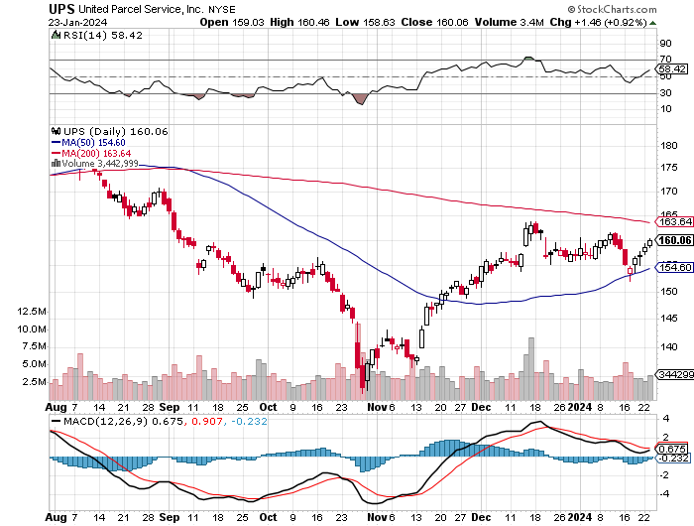
Package Delivery- United Parcel Service (UPS) – strike averted took profits on long 11/$130-$140 call spread

Slide 44
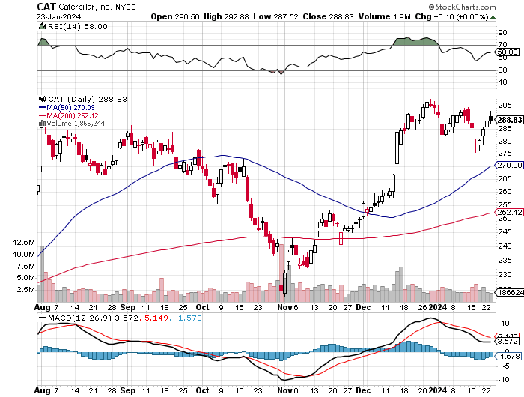
Caterpillar (CAT)- Ag + Infrastructure + Housing long 12/$220-$230 calls – expires in 2 trading days took profits on long 12/$145-$150 call spread took profits on long 11/$125-$135 call spread

Slide 45
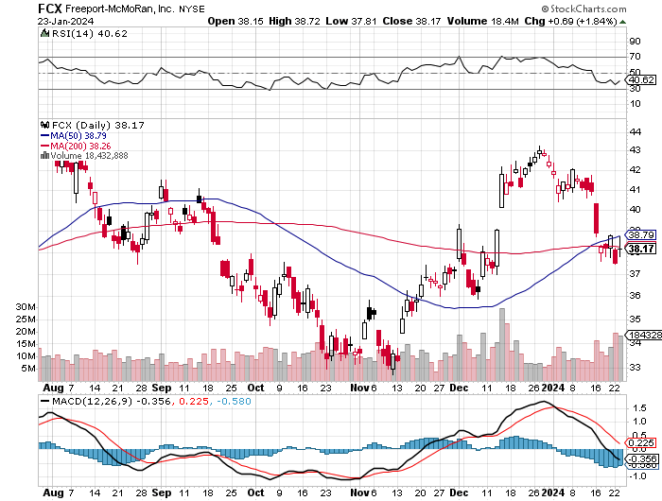
Freeport McMoRan - (FCX)- Coming Copper Crisis took profits on long 6/$32-$35 call spread took profits on long 4/$30-$33 call spread, took profits on long 10/$20-$23 call spread

Slide 46
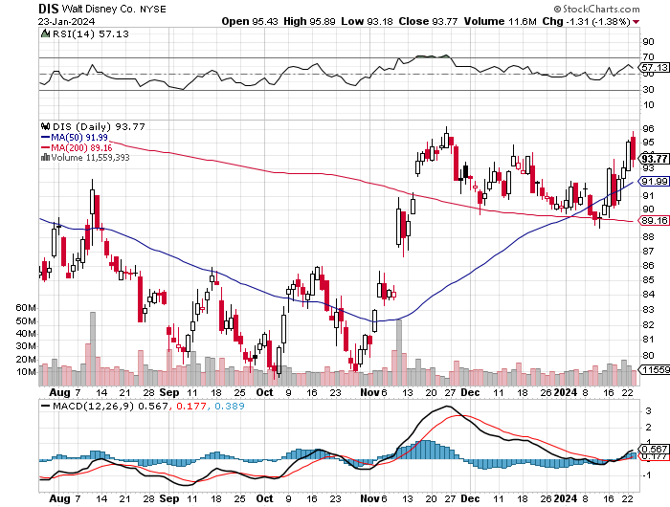
Walt Disney (DIS) -Disney Beats
The big profit boost came from the parks

Slide 47
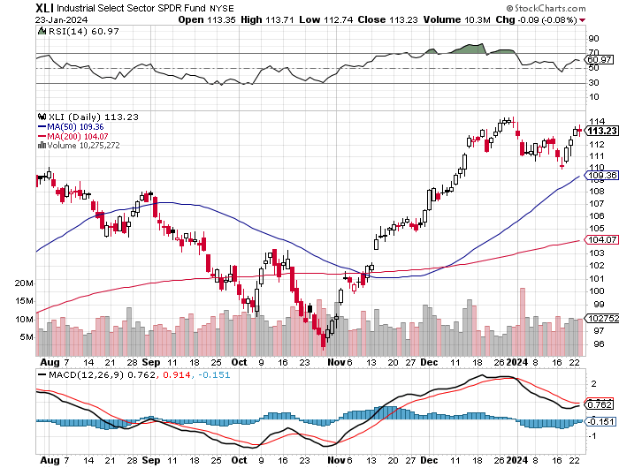
Industrials Sector SPDR (XLI)-
(GE), (MMM), (UNP), (UTX), (BA), (HON)

Slide 48
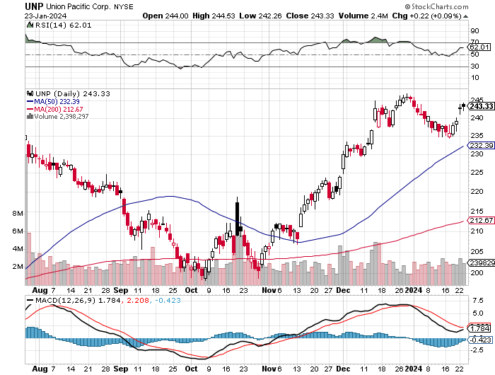
Union Pacific RR (UNP)- Big Stuff to Ship took profits on long 5/$200-$210 call spread took profits on 11/$150-$160 call spread

Slide 49
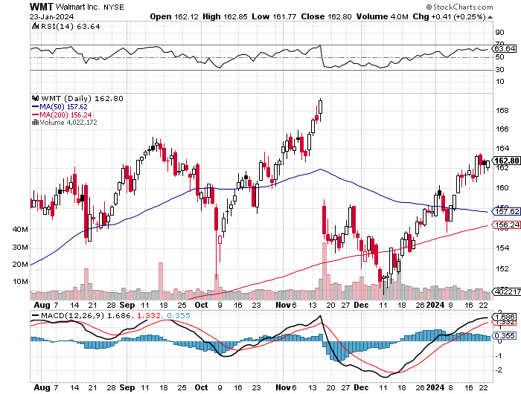
Wal-Mart (WMT)- took profit on Long 11/$125-$130 bear put spread took profit on Long 10/$119-$121 bear put spread took profits on Long 8/$114-$117 bear put spread

Slide 50
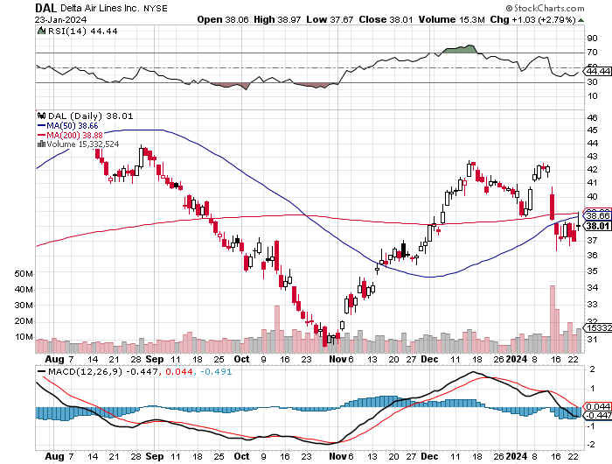
Delta Airlines (DAL) – Travel is Back!
Delta Posts Strong Earnings on Robust international travel stopped out of long 2/$35-$38 call spread

Slide 51
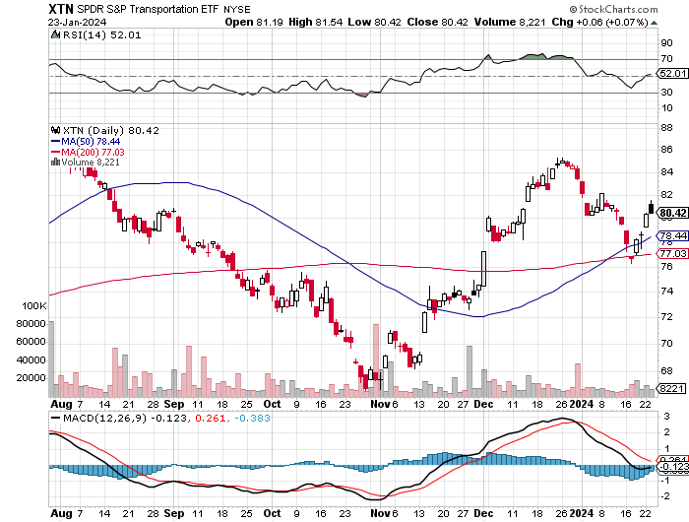
Transports Sector SPDR (XTN)- Worst Hit Sector
(ALGT), (ALK), (JBLU), (LUV), (CHRW), (DAL)

Slide 52
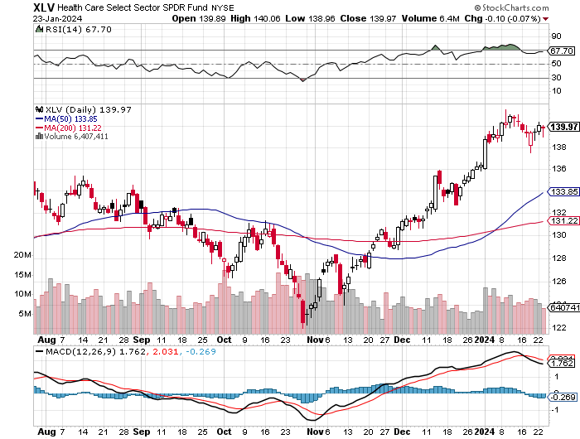
Health Care Sector (XLV)
(JNJ), (PFE), (MRK), (GILD), (ACT), (AMGN)

Slide 53
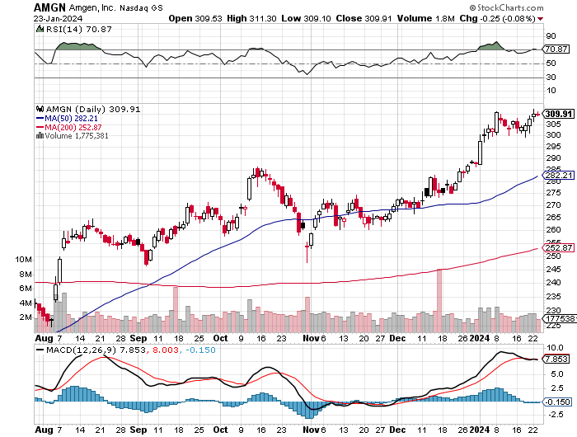
Amgen (AMGN) took profits on long 11/$185-$200 bull call spread

Slide 54
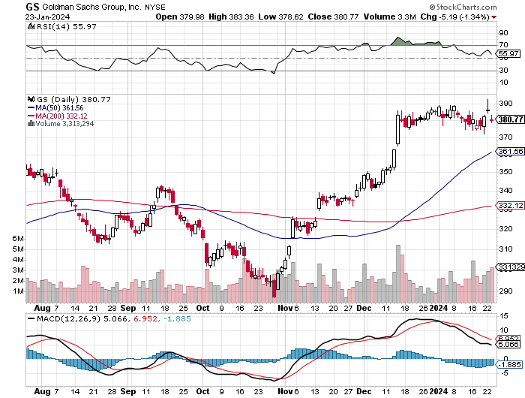
Goldman Sachs (GS) – Earnings Down but Less than Expected took profits 12/$330-$350 call spread took profits 11/$330-$350 call spread stop loss on long 11/$385-$395 call spreads

Slide 55
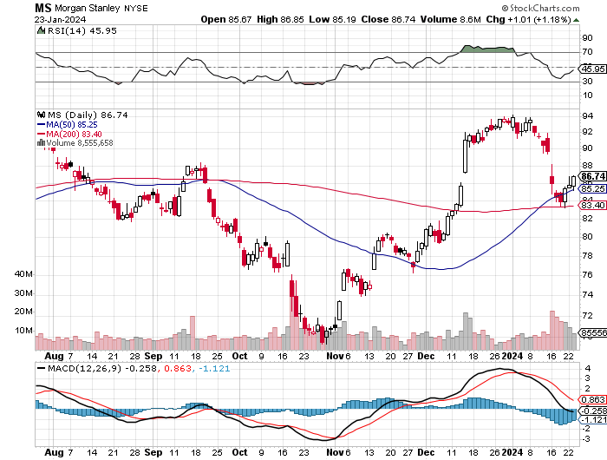
Morgan Stanley (MS) – Highest Capital ratio net of mark to market
CEO to Step Down in a Year took profits on long 4/$65-$70 call spread

Slide 56

JP Morgan Chase (JPM) – Monster Earnings Surprise took profits on long 4/$105-$115 call spread

Slide 57

Bank of America (BAC) – Bank of America Rips, on a great earnings report took profits on long 4/$20-$23 call spread

Slide 58

Citigroup (C) – took profits on long 4/$30-$35 call spread

Slide 59

Charles Schwab (SCHW) – LEAPS up 67% in three months took profits on long 4/$30-$35 call spread

Slide 60

Interactive Brokers (IBKR) – Best Risk Control took profits on long 4/$60-$65 call spread

Slide 61

SPDR Metals & Mining ETF (XME) – long 2/$28-$30 call spread

Slide 62

Blackrock (BLK)-Asset Collection Boom took profits on long 3/$770-$790 call spread took profits on long 3/$310-$340 call spread

Slide 63

Visa (V) – Inflation boost
Transaction grew by an inflationary 10% back to pre-pandemic levels took profits on long 10/$160-$170 bull call spread took profits on long 6/$150-$160 bull call spread

Slide 64

Consumer Discretionary SPDR (XLY)
(DIS), (AMZN), (HD), (CMCSA), (MCD), (SBUX)

Slide 65

Berkshire Hathaway (BRKB)- Natural Barbell
Berkshire Hathaway Knocks it Out of the Park, with a 41% gain in operating earnings took profits on long 12/$320-$330 call spread took profits on long 4/$260-$270 call spread, took profits on long 1/$290-$300 call spread took profits on long 10/$220-$230 call spread, took profits on long 7/$220-$230 call spread took profits on long 7/$220-$230 call spread, took profits on long 6/$260-$270 call spread

Slide 66

Europe Hedged Equity (HEDJ)-

Slide 67

Japan (DXJ)-

Slide 68

Emerging Markets (EEM) - Pro trade, Weak Dollar, Long Recovery Play

Slide 69


Slide 70

Bonds – Still Fading
*US Budget Funded for Two More Months, kicking the can down to March 8
*US Budget Deficit Tops $500 Billion in Q1
*Bonds Could be the Big Trade of 2024
*After the sharpest 19-point two month rise in market history, markets are taking a break
*Markets are discounting three cuts starting in
May in 2024 more likely
*Junk bond ETF’s (JNK) and (HYG) are holding up extremely
well with a 6.50% yield and 18 month high
*I’m looking for an $18-$28 point gain in 2024 with interest
*Buy (TLT) on the dip.

Slide 71

Treasury ETF (TLT) – On Fire
Long 2/$90-$93 call spread, took profits on long 12/$95-$98 put spread took profits on long 12/$79-$82 call spread, took profits on long 11/$76-79 call spread,

Slide 72

Ten Year Treasury Yield ($TNX) – 4.10%

Slide 73

Junk Bonds (JNK) 7.33% Yield

Slide 74

Municipal Bonds (MUB) 3.07% Yield-

Slide 75

Emerging Market Debt (ELD) 6.35% Yield-

Slide 76

2X Short Treasuries (TBT)-Out of Favor

Slide 77

Anally Capital Management (NLY) – Leveraged REIT Play
Yield 13.63% took profits on long 12/$15-$16 call spread

Slide 78


Slide 79

Foreign Currencies – Giving Up Gains
*Foreign currencies give up 2024 gains because of the return of higher US interest rates
*A dollar rally could last a couple of months so a new currency entry point is approaching
*However, Falling interest rates guarantee a falling dollar for 2024
*Bank of Japan Eases Grip on Bond Yields, ending its unlimited buying operation to keep interest rates down
*China Markets Dive, on news that the central bank was
forced into the currency markets to support the yuan
*(FXA) is rally on coming bull markets in
commodities
*Buy (FXY) on dips

Slide 80

Australian Dollar (FXA) - Major Long-Term Bottom is In Targeting Parity – A call option on a global synchronized recovery
1:1
BUY

Slide 81

Japanese Yen (FXY)

Slide 82

Euro (FXE)-
2023
Target
25%

Slide 83

British Pound (FXB)-
2023
Target
15%

Slide 84


Emerging Market Currencies (CEW)
2023
Target
40%

Slide 85


Slide 86

Energy & Commodities –It’s All About China
*China in free fall is destroying the oil market, the world’s largest energy consumer
*Libya returns 300,000 b/d of production to the market
*US Big freeze takes 400,000 b/d off the market from North Dakota
*If you throw good news on a commodity and it fails to rally you get rid of it
*This is despite the US government coming in to buy 1-3 million barrels daily for the SPR
*Copper to Rise 75% in 2024, say industry analysts
*There is a “BUY” setting up here in energy when the global economy
reaccelerates on a lower interest rates world. Watch (XOM) and (OXY).
*Natural Gas gives up much of 2024 gains

Slide 87

Oil-($WTIC)

Slide 88

United States Oil Fund (USO)

Slide 89

Energy Select Sector SPDR (XLE)-No Performance!
(XOM), (CVX), (SLB), (KMI), (EOG), (COP)

Slide 90

ExxonMobile (XOM)-
Exxon Moves Big into Lithium, with the construction of a major mining operation in Arkansas stopped out of Long 12/$97-$100 call spread took profits on long 12/$120-$125 put spread

Slide 91

Occidental Petroleum (OXY)- Buffet’s a Buyer took profits on long 2/$55-$60 call spread took profits on long 12/$77.50-$82.50 put spread

Slide 92

Natural Gas (UNG) – Free Fall on Warm Winter took profits on Long January 2025 $7-8 Call Spread LEAPS

Slide 93
Freeport McMoRan (FCX) – China Drag
Codelco Sees Profit Slump, the world’s largest copper producer based in Chile

Slide 94

Cameco (CCJ) – Global Uranium Renaissance
Uranium Goes Nuclear, with yellow cake prices up 45% since May long 12/$35-$38 call spread – expires in 12 trading days took profits on long 5/$20-$23 bull call spread

Slide 95


Slide 96

Precious Metals – Interest Rate Hit
*Gold takes a hit on rising US interest rates
*Gold needs a return of falling interest rates to resume rally
*Investors are picking up gold as a hedge for 2024 volatility
*Gold headed for $3,000 by 2025, but back off first from new all-time highs
*Silver is the better play with a higher beta
*Russia and China are also stockpiling gold to sidestep
international sanctions

Slide 97

Gold (GLD) - Deflation call took profits on long 5/$165-$170 bull call spread

Slide 98

Market Vectors Gold Miners ETF- (GDX) –

Slide 99

Barrick Gold (GOLD) took profit on long 1/$15.50-$16.50 call spread

Slide 100

Newmont Mining- (NEM)- took profits on long $55-60 call spread

Slide 101

Silver- (SLV)- took profits on long 11/$19-$20 call spread

Slide 102

Silver Miners - (SIL)-

Slide 103

Wheaton Precious Metals - (WPM)- took profits on long 1/$36-$39 call spread

Slide 104

Platinum- (PPLT)- 556,000-ounce shortage this year took profits on long 1/$36-$39 call spread

Slide 105

Real Estate – Ready for Blastoff
*Existing Homes Sales Come in Weak in December MOM, according to the National Association of Realtors
*Sales were 6.2% lower than in December 2022, marking the lowest level since August 2010
*Inventory fell 11.5% from November to December, but it was up 4.2% from December 2022
*There were 1 million homes for sale at the end of December, making
for a 3.2-month supply at the current sales pace
*A six-month supply is considered balanced between buyer and seller
*Real estate is far stronger than people realize
*Refi Demand Rockets, as interest rates plunge to four-month lows
*Tight supply and still-strong demand have kept pressure on home
prices, which not only continue to hit new highs

Slide 106

S&P Case Shiller Turns Hot
S&P Case Shiller Rises to +4.60% YOY in October, with its National Home Price Index
Detroit gained +8.1%, San Diego +7.2%, and New York +7.1%.

Slide 107

Crown Castle International (CCI) – 5.45% yielding 5G cell phone tower REIT
Eliot Management Pushes up stock with activist bid

Slide 108

US Home Construction Index (ITB)
(DHI), (LEN), (PHM), (TOL), (NVR)

Slide 109

Trade Sheet-
So What Do We Do About All This?
*Stocks – buy any dips
*Bonds – buy dips
*Commodities-buy dips
*Currencies- sell dollar rallies, buy currencies
*Precious Metals – buy dips
*Energy – buy dips
*Volatility - buy $12
*Real estate – buy dips

Slide 110

Next Strategy Webinar
12:00 EST Wednesday, February 7 from Silicon Valley email me questions at support@madhedgefundtrader.com
Good Luck and Good Trading!
Notes:
*

Slide 111


Slide 112


