Slide 1
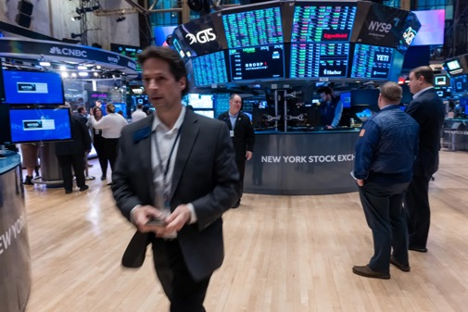
The Mad Hedge Fund Trader
“New All-Time Highs”
With John Thomas
Silicon Valley February 7, 2024
www.madhedgefundtrader.com
Notes:
*

Slide 2


Slide 3
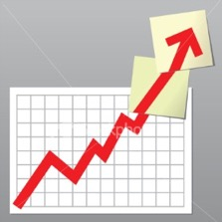
Trade Alert Performance
Beating 2022 – Best in 15 years
60 out of 66 trade alerts profitable – No losers since August 4
*January -4.28% Final *July +0.44% Final
*February +2.04% MTD *August -4.70% Final
*March +20.85% Final *September +00% Final
*April +15.13% Final *October -5.37% Final
*May +0.30%% Final *November +15.37 Final
*June +3.01% Final *December -2.27% Final
*2024 YTD -2.24%, versus +3.56% for the S&P 500 and
+674.39% since inception
*Versus 84.63% for all of 2022
*Versus 79.79% for all of 2023
*Average annualized return of +51.27% for 15 years

Slide 4
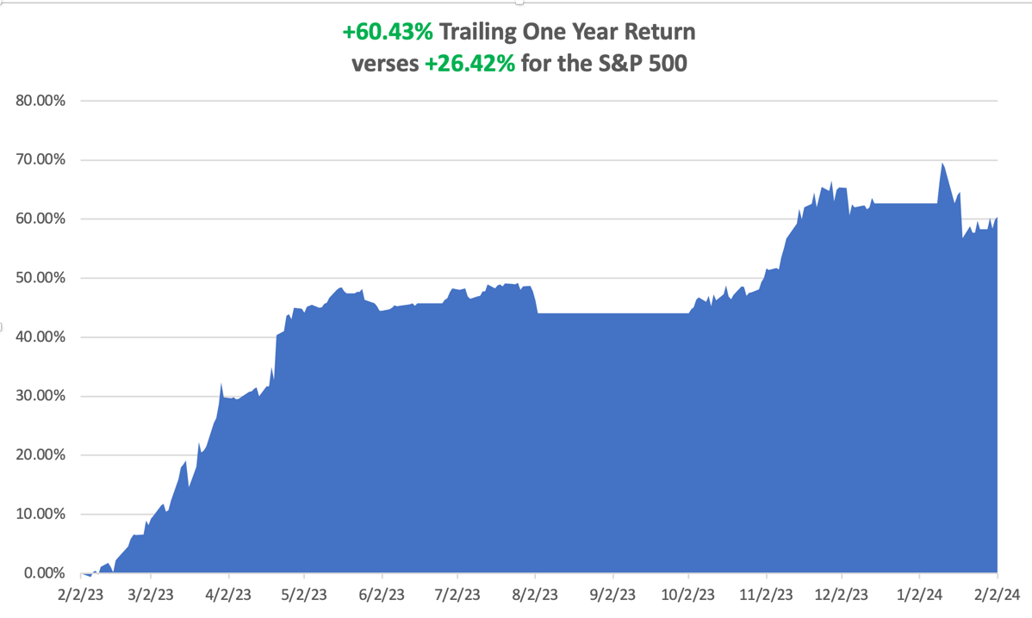

Slide 5
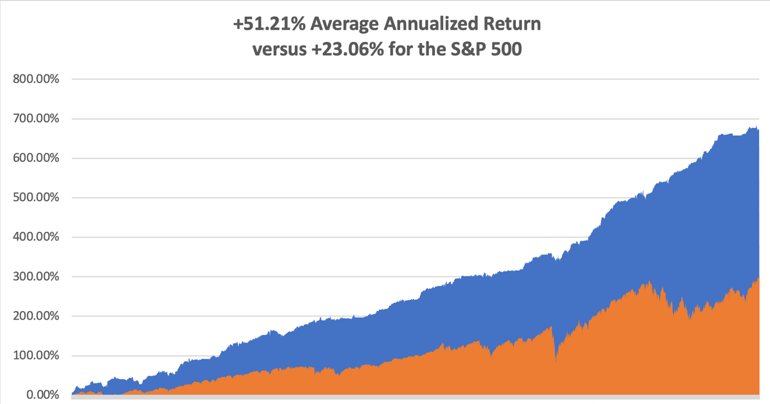

Slide 6
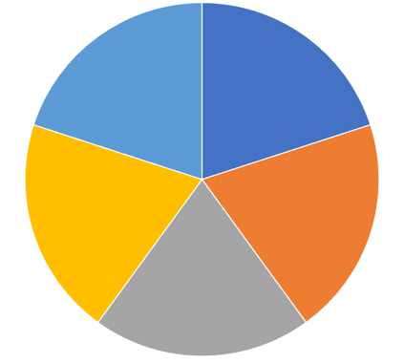
Portfolio Review – Aggressive Long
50% Long, 50% cash
Expiration Value
-2.02%
Current Capital at Risk
Risk On
(MSFT) 2/$330-$340 call spread | 10.00%
(AMZN) 2/$130-$135 call spread | 10.00%
(V) 2/$240-$250 call spread | 10.00%
(PANW) 2/$260-$270 call spread | 10.00%
(CCJ) 2/$38-$41 call spread | 10.00%
Risk Off
NO POSITIONS
Total Net Position | 50.00%
Total Aggregate Position | 50.00%

Slide 7

The Method to My Madness
*The one risk to my hyper bullish scenario is that the economy doesn’t land at all and overheats, forcing the Fed to RAISE interest rates.
*Focus remains on AI 5 with spectacular earnings announced last week
*All economic data is globally slowing, except for the US, with the only good economy in the world
*Saudi Arabia forced to cut oil production goals because of weak
China demand
*Domestic plays have gone silent awaiting actual rate cuts
*Buy stocks and bonds but only after substantial dips
*Commodities and industrials are a second half play,
we will keep rotating back and forth all year with tech

Slide 8
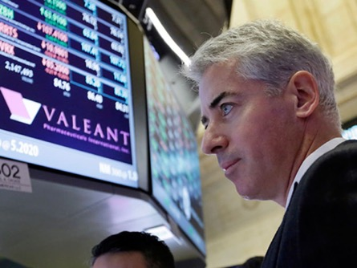
The Traders’ Dilemma
*The choice is now between 5 stocks that have gone up for 3 ½ months, or a dozen interest rate sectors that may be dead money for 4 months
*Avoid the frustration trade, the one you should have done on October 26, look for the next one
*Wait for the ideal AI entry point, no matter how long it takes
*A big chunk of 2024 performance was pulled forward into
2023 and you made that money
*The sole exception is energy, which is driven by
demand from the Chinese economy
*With markets are all time highs 90-day T-bills are still
yielding 5.43%

Slide 9

The Global Economy – Brightening
*Nonfarm Payroll Report Comes in Hot, at 353,000
*The headline Unemployment Rate held at 3.7%.
*The Fed Turns Dovish, with all members expecting the next move to be a rate cut
*Job Openings Hit Three Month High, while fewer Americans quit their jobs
*IMF Upgrades Global Growth Forecast on the strength of the US by 0.2% to 3.1%
*Chinese fiscal stimulus and a strong performance by large emerging market
economies all contributed to the slightly brighter picture.
*US GDP Rocketed by 2.5% in 2023, cementing its position as the strongest
major economy in the world. Q4 came in at a hot 3.3%.

Slide 10
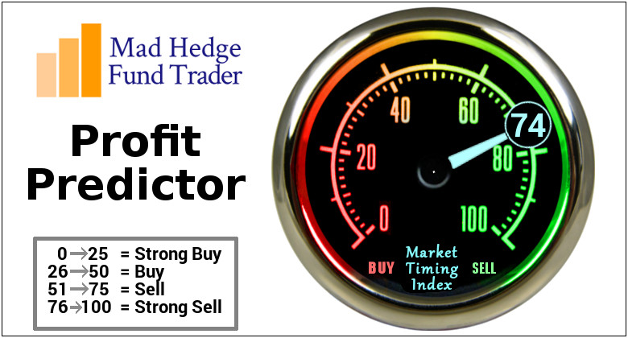
The Mad Hedge Profit Predictor
Market Timing Index – At top end of historic range
An artificial intelligence driven algorithm that analyzes 30 different economic, technical, and momentum driven indicators

Slide 11
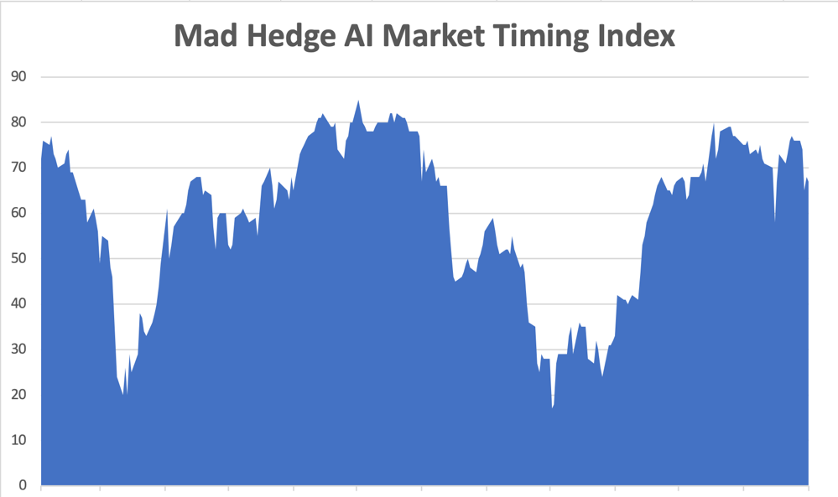
Sell Territory!! – Severe Overbought Territory
SELL
BUY

Slide 12
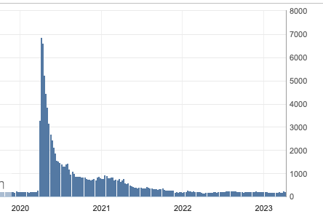
Weekly Jobless Claims – Falling
224,000 – +9,000

Slide 13
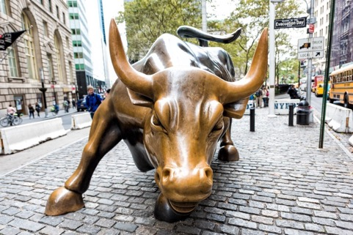
Stocks – New Highs!
*SPY breaks to new high on strong consumer sentiment
*Big tech continues to dominate
*Market will continue to revalue all AI plays
*Biden to Announce Massive Chip Subsidies, to head off a coming shortage driven by AI
*Bull move could continue into February as investors
are under invested, or even short
*Regional Banks Get Another Scare, As New York
Community Bank drops by half
*Domestic plays have gone back to sleep on rising rates
*The flip flop continues between tech and domestics

Slide 14
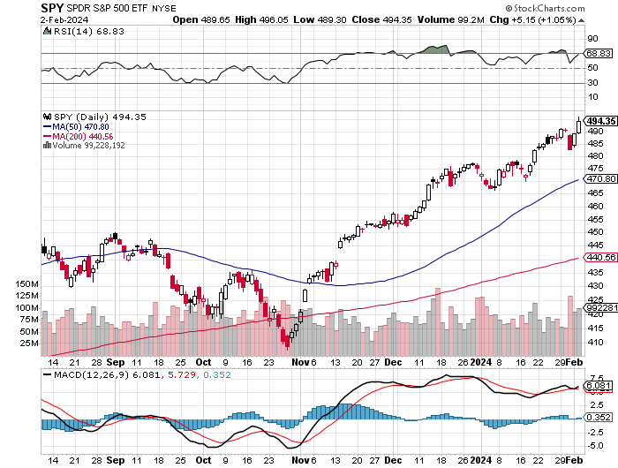
S&P 500 – New High stopped out of short 2/$485-$490 put spread,
Yearend
Target
$550 +15%
$470
-.80%
1st support

Slide 15
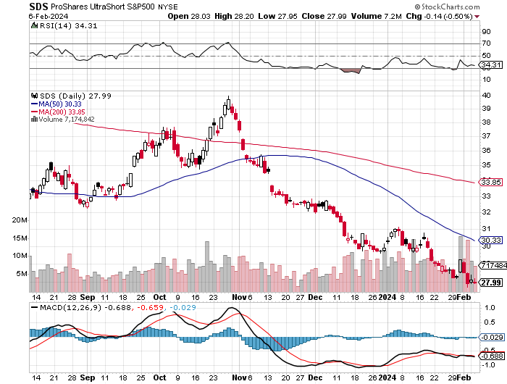
ProShares Ultra Short S&P 500 (SDS)- a great hedge for long stocks and bonds long 2X position has a hedge against longs and bond shorts

Slide 16
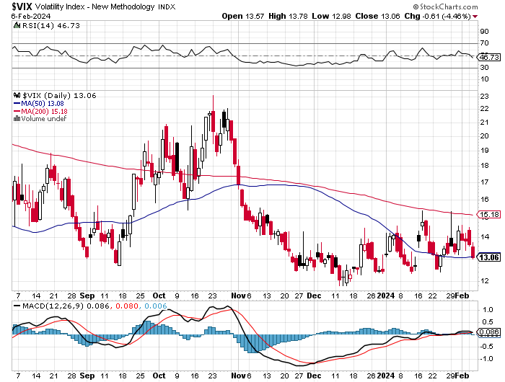
(VIX) – Bargain of the Century

Slide 17
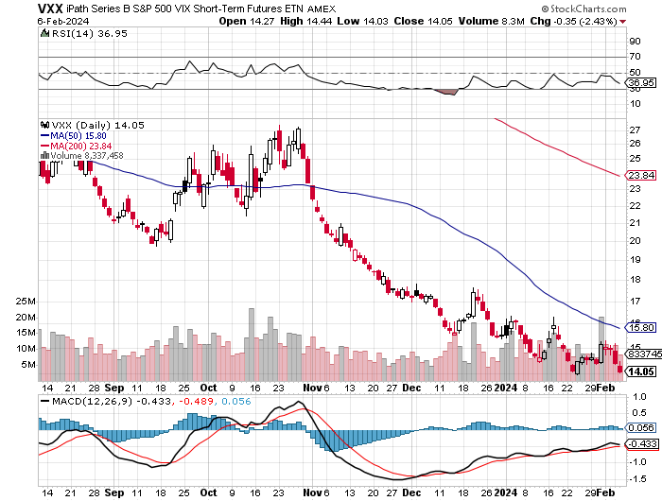
(VXX)-

Slide 18
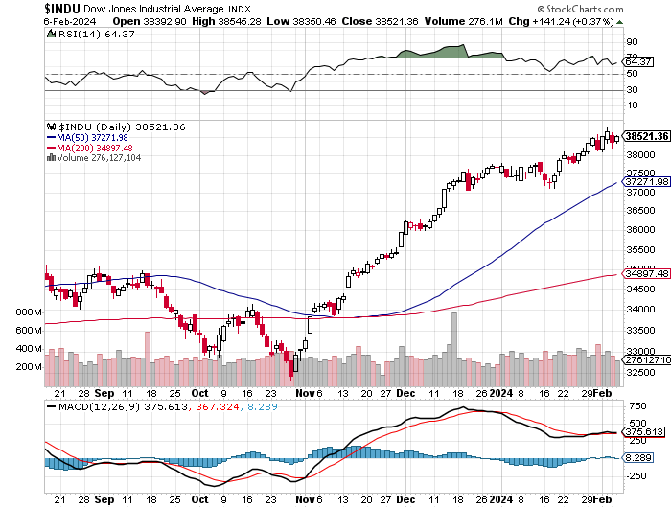
Dow Average ($INDU)-

Slide 19
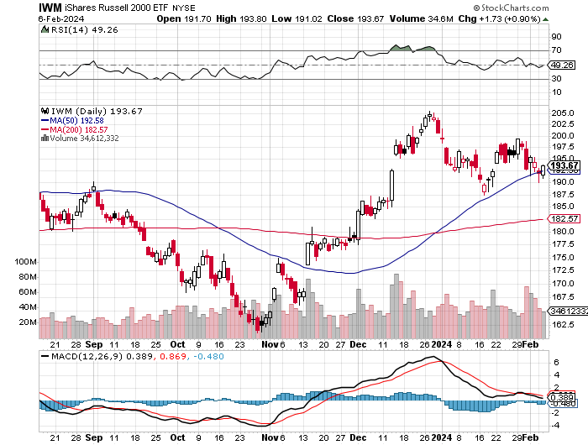
Russell 2000 (IWM)- took profits on Long 10/$137-$142 vertical bull call spread took profits on Long 10/$153-$156 vertical bear put spread

Slide 20
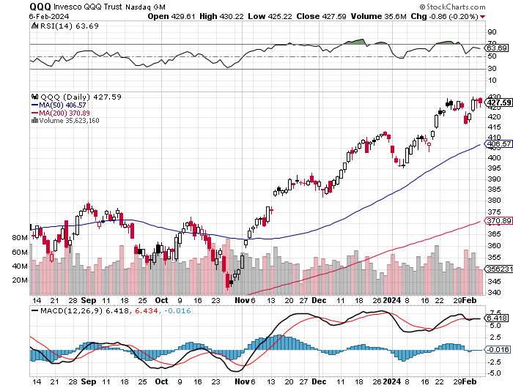
NASDAQ (QQQ) – took profits on Long 5/$335-$345 put spread took profits on long (QQQ) 1/$290-$300 put spread, took profits on long (QQQ) 4/$330-$335 put spread took profits on long (QQQ) 3/$340-$345 put spread, covered long (QQQ) $325-$330 put spread

Slide 21
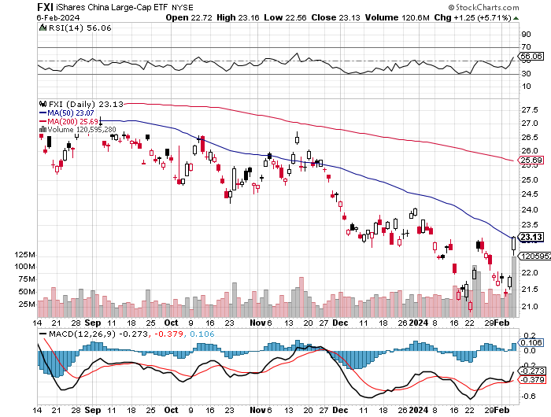
China (FXI)

Slide 22
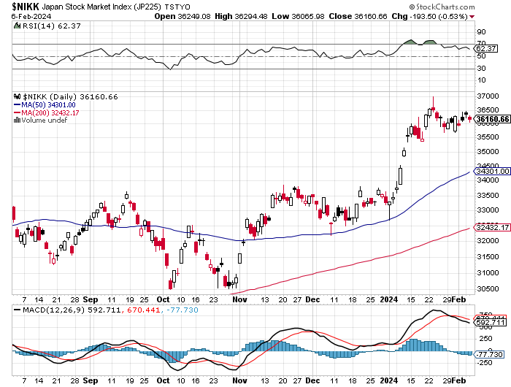
Japan ($NIKK)

Slide 23


Slide 24



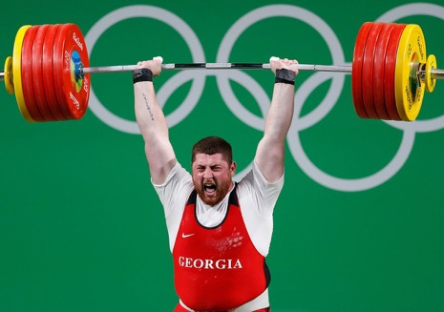
THE MAD HEDGE FUND TRADER
The Barbell Portfolio
*75% Big Tech – 2% of US workforce, 25% of market cap and 25% of US earnings
25% Domestic Recovery, including:
Railroads, airlines, cruise lines,
Couriers, steel companies
Banks, commodities
Construction
Credit Card Companies
Hotels, casinos
Online Ticket Sales

Slide 25
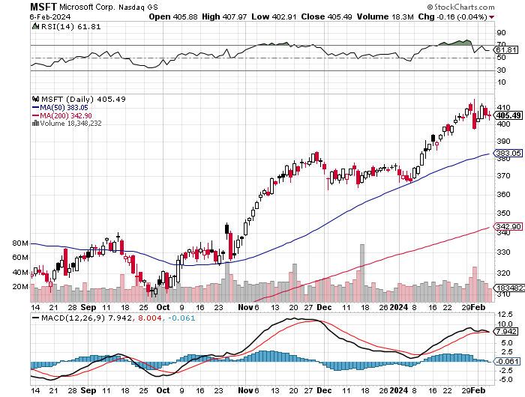
Microsoft (MSFT)- Microsoft Beats Estimates, with the steady growth of its azure cloud business
Microsoft Tops $3 Trillion Valuation, cementing its hold on the AI lead. long 2/$330-$340 call spread – Expires in 8 trading days took profits on long 12/$320-$330 call spread took profits on long 9/$235-$245 call spread, took profits on long 7/$220-$210 call spread, took profits on long 6/$220-$230 call spread, took profits on long 2/$200-$210 bear put spread

Slide 26
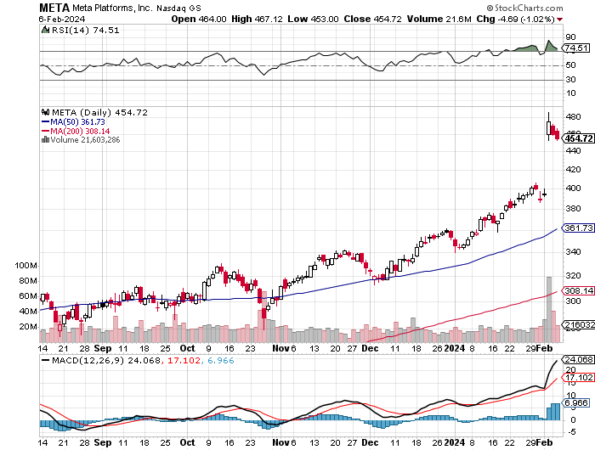
Meta (META)
Meta Rockets 21%, on a $50 billion stock buyback and its first ever dividend took profits on Long 9/$290-$300 vertical bear put spread stopped out of Long 9/$190-$200 vertical bear put spread

Slide 27
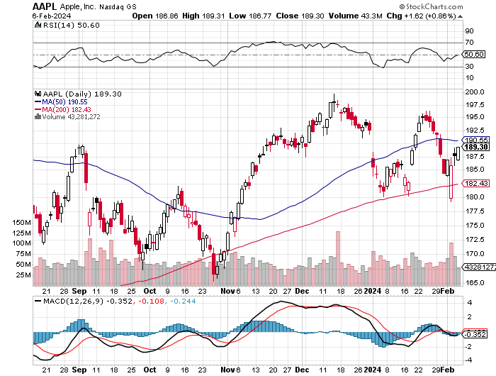
Apple (AAPL)
Apple Beats, But Stock Drops 4% took profits on long 1/$145-$155 put spread, Took profits on long 10/$165-$175 put spread took profits on long 6/$155-$165 put spread, stopped out of long 6/$125-135 call spread, took profits on long 6/$110-$120 call spread, took profits on long 2/$180-$190 put spread

Slide 28
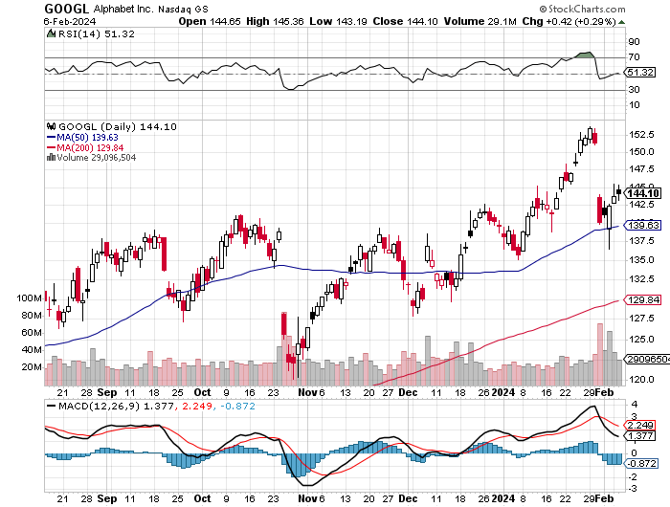
Alphabet (GOOGL) – Google Ramps Up AI Effort
Traders Trash Google, down 7%, on the company’s lack of AI specifics in its earnings report took profits on long 12/$110-$120 call spread took profits on long 12/$1,200-$1,230 bull call spread, took profits on long 9/$1,030-$1,080 vertical bull call spread

Slide 29
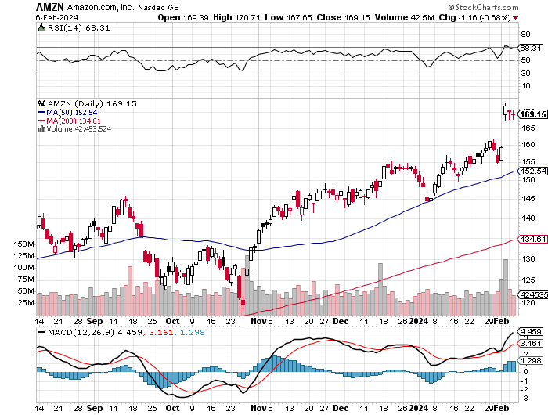
Amazon (AMZN) –
Amazon Soars 8% as Christmas shopping kicked long 2/$130-$135 bull call spread - Expires in 8 trading days took profits on long 2/$3,400-$3,500 bear put spread took profits on long 9/$2,800-$2,900 bull call spread

Slide 30
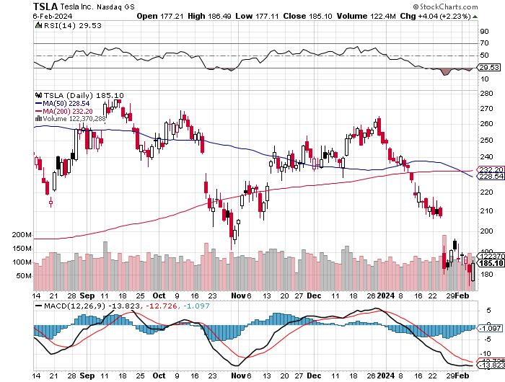
Tesla (TSLA) – The Price War Continues
Elon Musk’s $56 Billion Pay Package Cancelled
took profits on long 10/$200-$210 call spread
took profits on long 6/$120-$130 call spread, stopped out of long 6/$210-$220 put spread
took profits on long 5/$110-$120 call spread, took profits on long 5/$220-$230 put spread

Slide 31
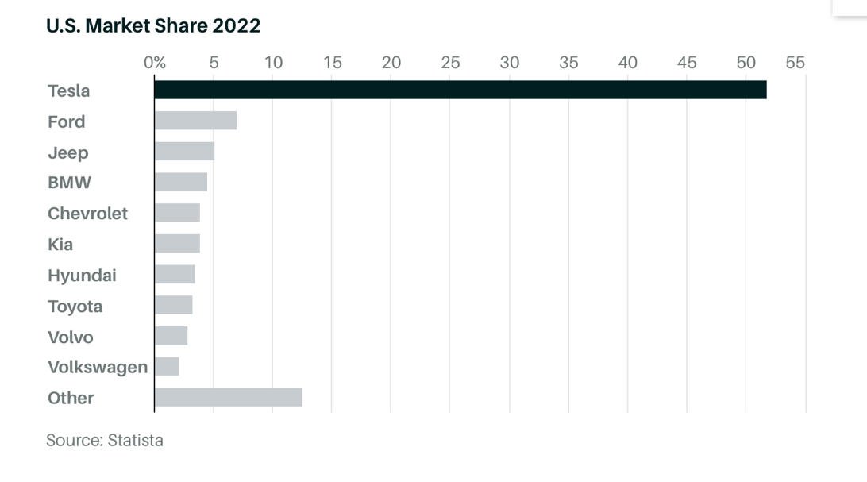

Slide 32
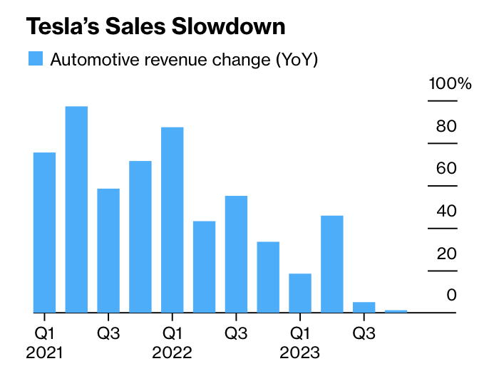

Slide 33
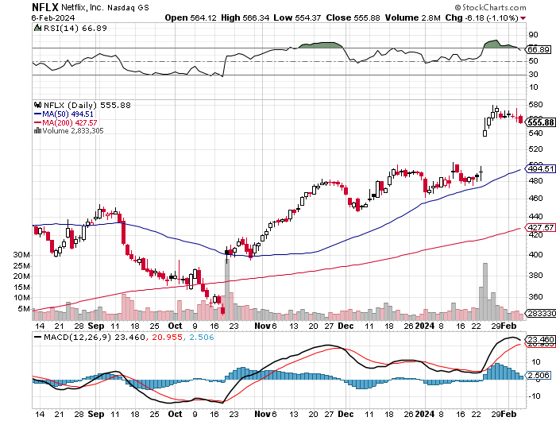
Netflix (NFLX) –
Netflix Soars on Big Subscriber Beat, up 8.6% on an add of 13 million new subscribers

Slide 34
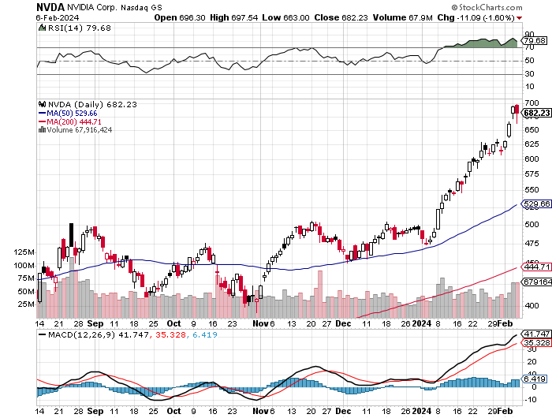
NVIDIA (NVDA) – Double Position took profits on long 2/$350-$360 call spread, took profits on long 2/$360-$370 call spread took profits on long 10/$370-$380 call spread – took profits on long 11/$370-$380 call spread took profits on long 3/$260-$270 put spread, took profits on long 10/$95-$100 call spread took profits on long 7/$120-$130 call spread, took profits on long 6/$120-$130 call spread

Slide 35
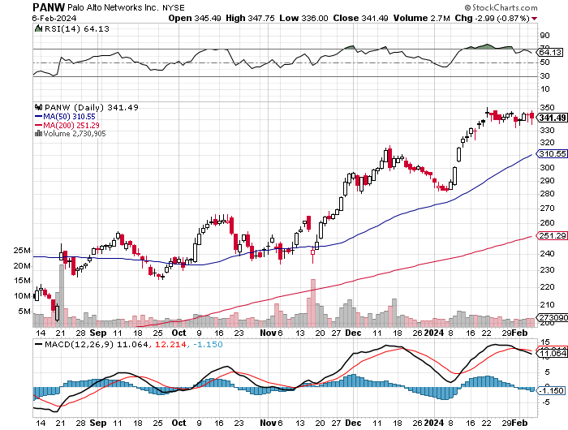
Palo Alto Networks (PANW)- Hacking never goes out of fashion
Palo Alto Networks Dives on Weak Guidance, even though reported earnings were great long 2/$260-$270 call spread - Expires in 8 trading days took profits on long 10/$130-$140 call spread

Slide 36
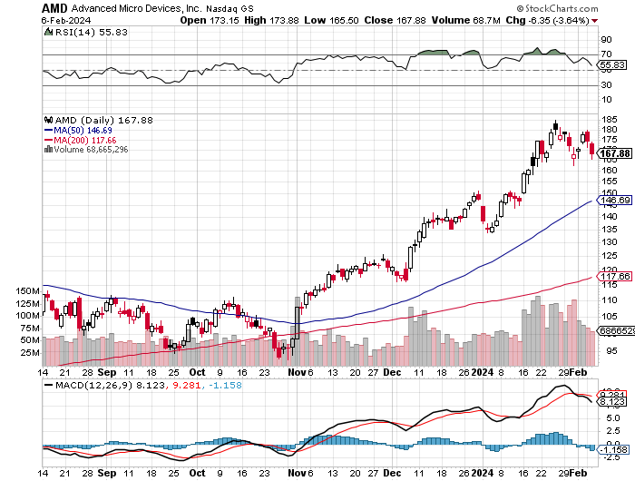
Advanced Micro Devices (AMD)- Recession fears programable logic devices took profits on long 2/$75-$80 call spread

Slide 37
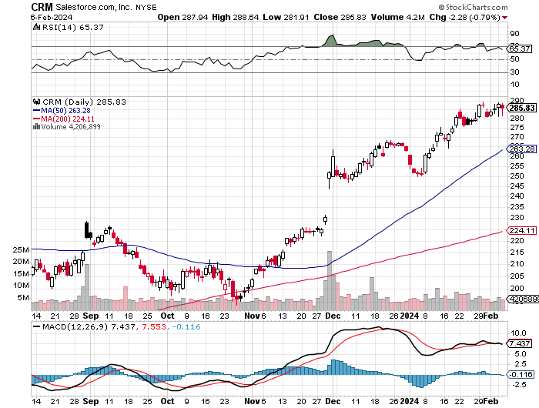
Salesforce (CRM)- Massive Online Migration
Salesforce Soars 16%, on better-than-expected guidance took profits on long 12/$185-$195 call spread took profits on long 9/$125-$130 vertical bull call spread took profits on long 8/$125-$130 vertical bull call spread

Slide 38
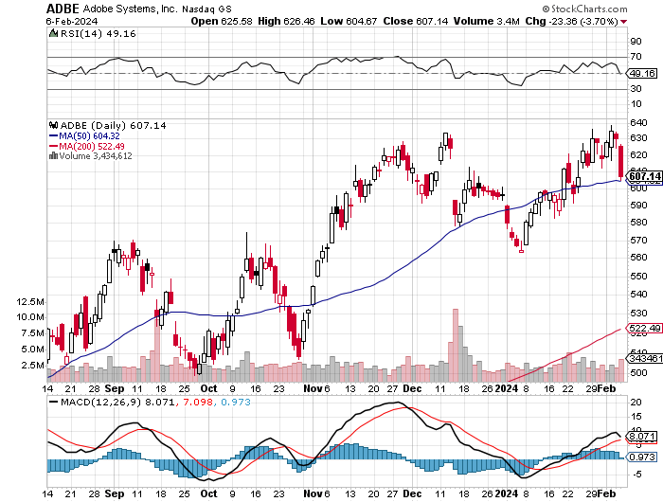
Adobe (ADBE)- Cloud play
The Quality Non-China tech play

Slide 39
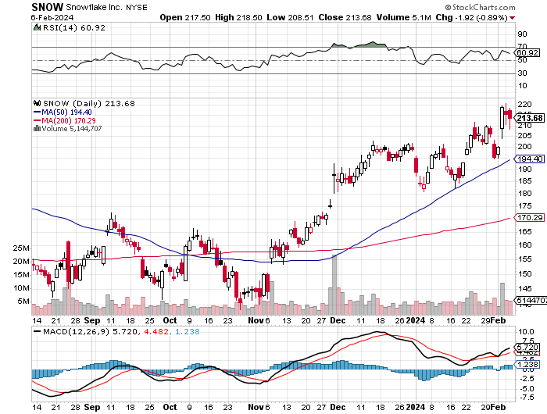
Snowflake (SNOW)- Blockbuster AI Earnings took profits on long 12/$135-$140 call spread

Slide 40
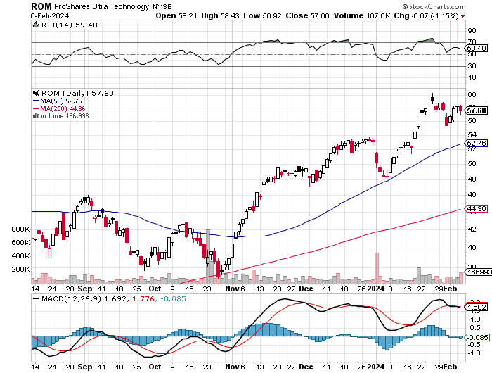
ProShares Ultra Technology ETF (ROM) – 2X Long Technology ETF took profits on long 10/$62-65 call spread

Slide 41
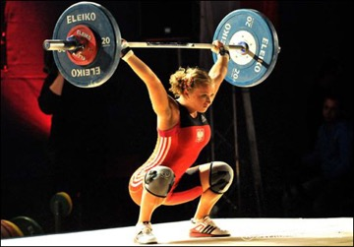
The Second Half of the Barbell
*Bets on a domestic recovery in 2022 Q4
*Upside potential in 2024 far greater than tech
*Some of these have not moved for 5 or 10 years
*Focuses on economically sensitive cyclical industries
*Makes a great counterweight to
high-growth technology
*We could spend all of next ten years rotating
between the two groups

Slide 42
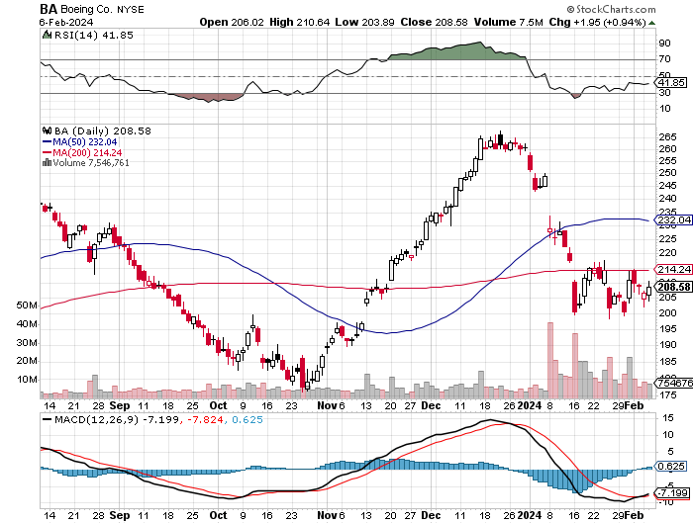
Boeing (BA) –
Boeing is Back in China, its largest customer stopped out of long 2/$190-$200 call spread, took profits on long 5/$17-$175 call spread

Slide 43
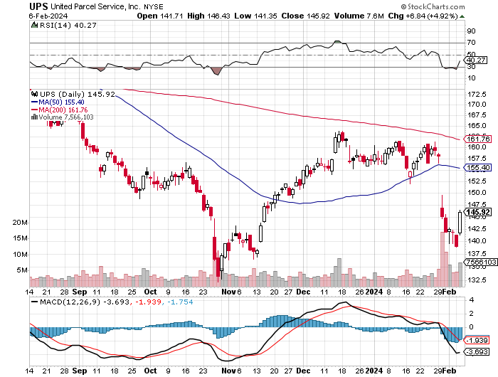
Package Delivery- United Parcel Service (UPS) – strike averted took profits on long 11/$130-$140 call spread

Slide 44
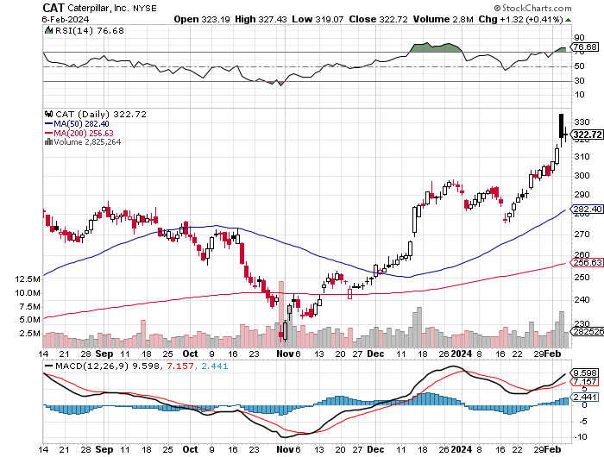
Caterpillar (CAT)- Ag + Infrastructure + Housing long 12/$220-$230 calls – expires in 2 trading days took profits on long 12/$145-$150 call spread took profits on long 11/$125-$135 call spread

Slide 45
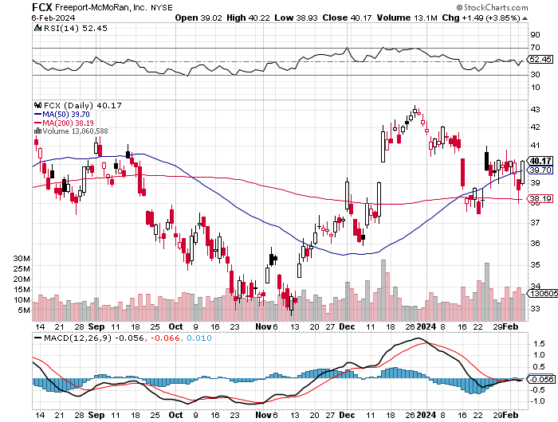
Freeport McMoRan - (FCX)- Coming Copper Crisis took profits on long 6/$32-$35 call spread took profits on long 4/$30-$33 call spread, took profits on long 10/$20-$23 call spread

Slide 46
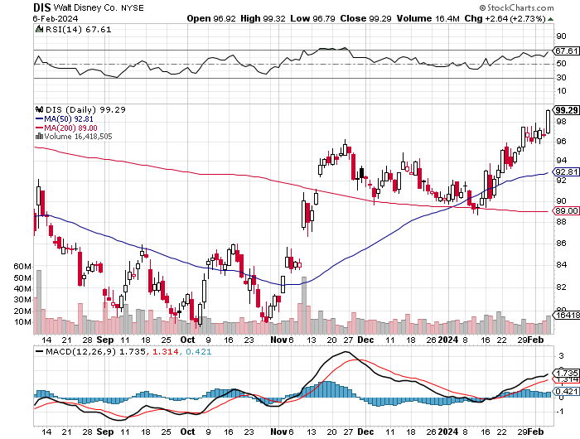
Walt Disney (DIS) -Disney Beats
The big profit boost came from the parks

Slide 47
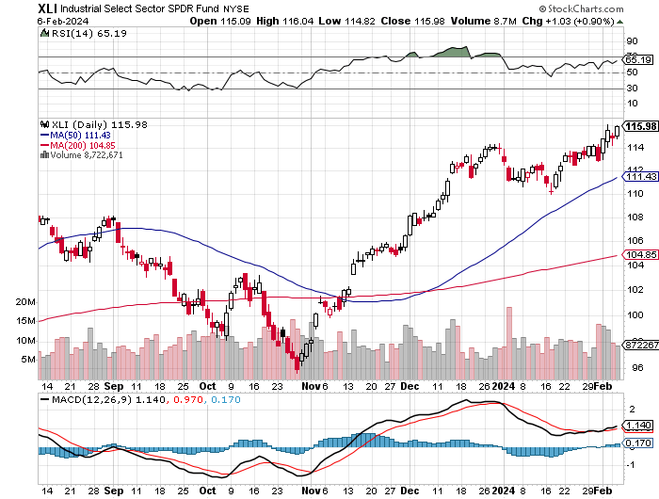
Industrials Sector SPDR (XLI)-
(GE), (MMM), (UNP), (UTX), (BA), (HON)

Slide 48
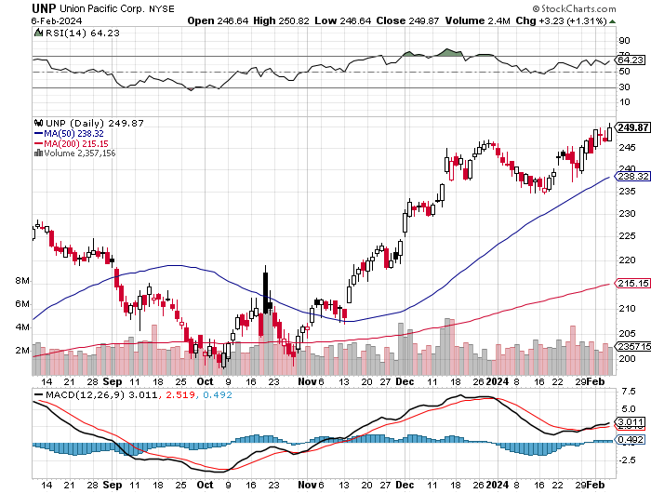
Union Pacific RR (UNP)- Big Stuff to Ship took profits on long 5/$200-$210 call spread took profits on 11/$150-$160 call spread

Slide 49
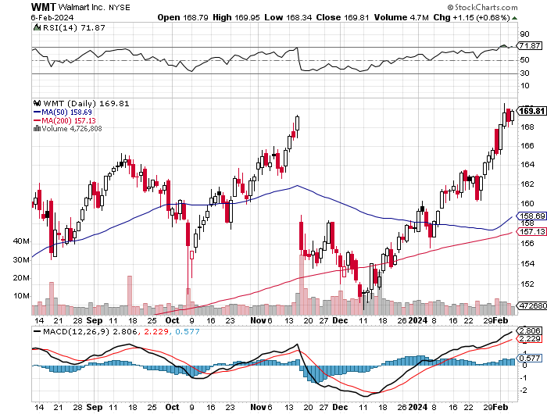
Wal-Mart (WMT)- took profit on Long 11/$125-$130 bear put spread took profit on Long 10/$119-$121 bear put spread took profits on Long 8/$114-$117 bear put spread

Slide 50
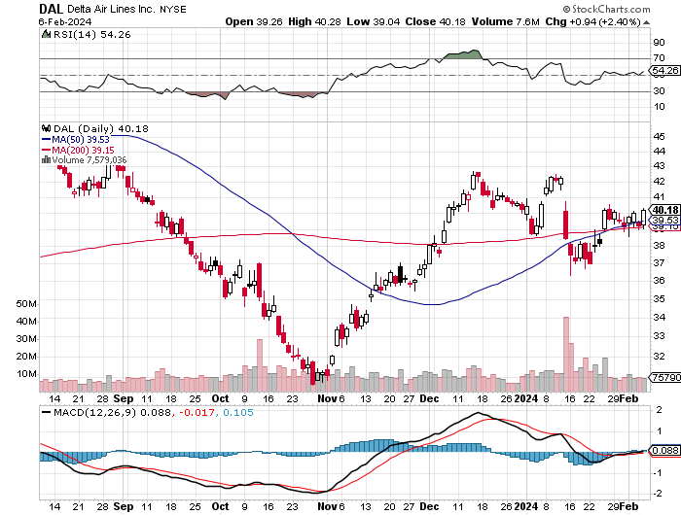
Delta Airlines (DAL) – Travel is Back!
Delta Posts Strong Earnings on Robust international travel stopped out of long 2/$35-$38 call spread

Slide 51
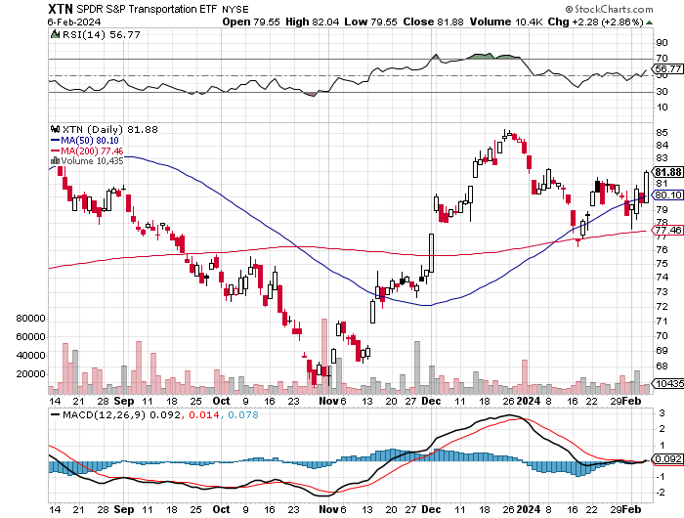
Transports Sector SPDR (XTN)- Worst Hit Sector
(ALGT), (ALK), (JBLU), (LUV), (CHRW), (DAL)

Slide 52
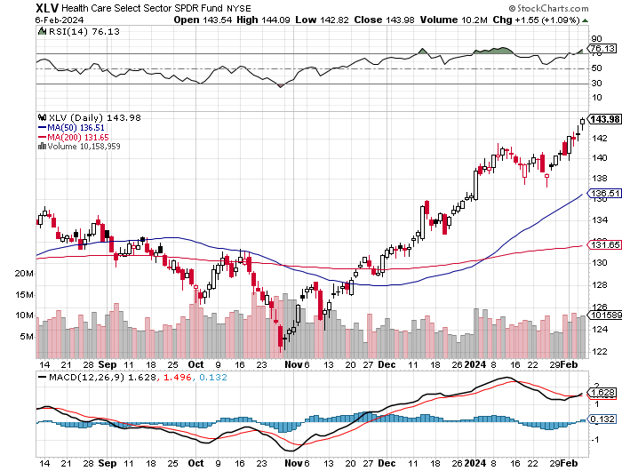
Health Care Sector (XLV)
(JNJ), (PFE), (MRK), (GILD), (ACT), (AMGN)

Slide 53
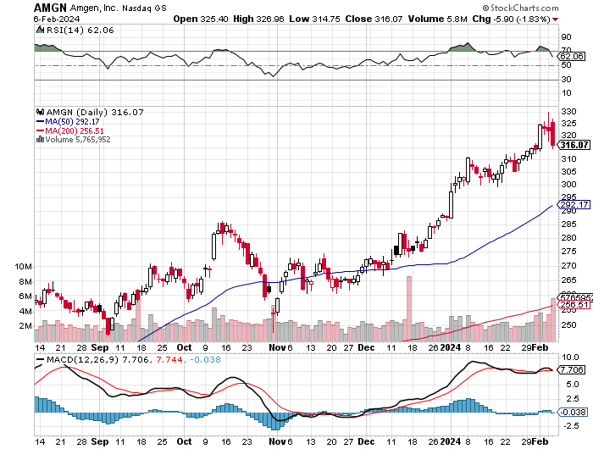
Amgen (AMGN) took profits on long 11/$185-$200 bull call spread

Slide 54
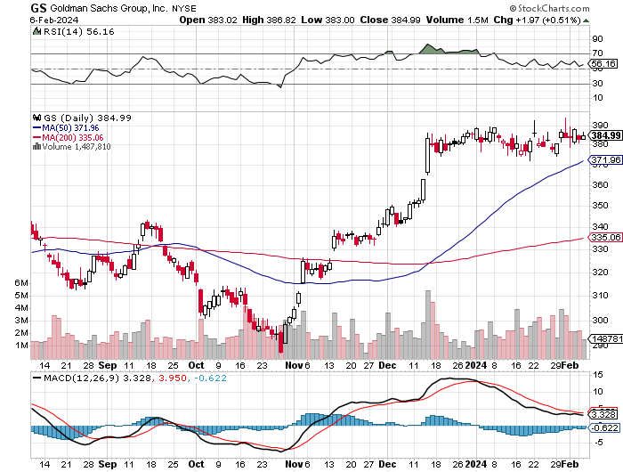
Goldman Sachs (GS) – Earnings Down but Less than Expected took profits 12/$330-$350 call spread took profits 11/$330-$350 call spread stop loss on long 11/$385-$395 call spreads

Slide 55

Morgan Stanley (MS) – Highest Capital ratio net of mark to market
CEO to Step Down in a Year took profits on long 4/$65-$70 call spread

Slide 56

JP Morgan Chase (JPM) – Monster Earnings Surprise took profits on long 4/$105-$115 call spread

Slide 57

Bank of America (BAC) – Bank of America Rips, on a great earnings report took profits on long 4/$20-$23 call spread

Slide 58

Citigroup (C) – took profits on long 4/$30-$35 call spread

Slide 59

Charles Schwab (SCHW) – LEAPS up 67% in three months took profits on long 4/$30-$35 call spread

Slide 60

Interactive Brokers (IBKR) – Best Risk Control took profits on long 4/$60-$65 call spread

Slide 61

SPDR Metals & Mining ETF (XME) – long 2/$28-$30 call spread

Slide 62

Blackrock (BLK)-Asset Collection Boom took profits on long 3/$770-$790 call spread took profits on long 3/$310-$340 call spread

Slide 63

Visa (V) – Inflation boost
Transaction grew by an inflationary 10% back to pre-pandemic levels took profits on long 10/$160-$170 bull call spread took profits on long 6/$150-$160 bull call spread

Slide 64

Consumer Discretionary SPDR (XLY)
(DIS), (AMZN), (HD), (CMCSA), (MCD), (SBUX)

Slide 65

Berkshire Hathaway (BRKB)- Natural Barbell
Berkshire Hathaway Knocks it Out of the Park, with a 41% gain in operating earnings took profits on long 12/$320-$330 call spread took profits on long 4/$260-$270 call spread, took profits on long 1/$290-$300 call spread took profits on long 10/$220-$230 call spread, took profits on long 7/$220-$230 call spread took profits on long 7/$220-$230 call spread, took profits on long 6/$260-$270 call spread

Slide 66

Europe Hedged Equity (HEDJ)-

Slide 67

Japan (DXJ)-

Slide 68

Emerging Markets (EEM) - Pro trade, Weak Dollar, Long Recovery Play
Traders are Lining up for a Big Emerging Market Bet. Falling US interest rates will bring a weak US dollar and runaway bull markets in most emerging markets, which have remained unchanged for more than a decade

Slide 69


Slide 70

Bonds – Back to Life
*US Treasury Borrowing to Hit $760 Billion in Q1, some $55 billion less than expected
*Q2 then drops to only $202 billion
*Bonds rallied on the good news.
*US Budget Funded only until March 8
*Bonds Could be the Big Trade of 2024
*Markets are discounting three cuts Starting in
May in 2024 more likely
*Junk bond ETF’s (JNK) and (HYG) are holding up extremely
well with a 6.50% yield and 18 month high
*I’m looking for an $18-$28 point gain in 2024 with interest
*Buy (TLT) on the dip.

Slide 71

Treasury ETF (TLT) – On Fire
Long 2/$90-$93 call spread, took profits on long 12/$95-$98 put spread took profits on long 12/$79-$82 call spread, took profits on long 11/$76-79 call spread,

Slide 72

Ten Year Treasury Yield ($TNX) – 4.10%

Slide 73

Junk Bonds (JNK) 7.33% Yield

Slide 74

Municipal Bonds (MUB) 3.07% Yield-

Slide 75

Emerging Market Debt (ELD) 6.35% Yield-

Slide 76

2X Short Treasuries (TBT)-Out of Favor

Slide 77

Anally Capital Management (NLY) – Leveraged REIT Play
Yield 13.63% took profits on long 12/$15-$16 call spread

Slide 78


Slide 79

Foreign Currencies – US Dollar Back in Charge
*Foreign currencies give up 2024 gains because of the return of higher US interest rates
*A dollar rally could last a couple of months so a new currency entry point is approaching
*However, eventual falling interest rates guarantee a falling dollar for 2024
*Bank of Japan Eases Grip on Bond Yields, ending its unlimited buying operation to keep interest rates down
*China Markets Dive, on news that the central bank was
forced into the currency markets to support the yuan
*(FXA) is rally on coming bull markets in
commodities
*Buy (FXY) on dips

Slide 80

THE MAD HEDGE FUND TRADER
Australian Dollar (FXA) - Major Long-Term Bottom is In Targeting Parity – A call option on a global synchronized recovery
1:1
BUY

Slide 81

Japanese Yen (FXY)

Slide 82

Euro (FXE)-
2023
Target
25%

Slide 83

British Pound (FXB)-
2023
Target
15%

Slide 84


Emerging Market Currencies (CEW)
2023
Target
40%

Slide 85


Slide 86

Energy & Commodities –Saudi Arabia Cuts
*Saudi Arabia Cuts Oil Production Target, cratering prices and destroying the entire energy sector
*Lack of demand, especially from China, is the reason
*New US output is fuel on the fire
*Production will be throttled back a million barrels to 12 million barrels a day as a long-term goal
*Freeport McMoRan Kills it, with an earnings upside blowout, taking the stock up 5%
*Political problems in Chile and Peru are an issue, which generate
40% of the world’s copper
*Electrification of the US economy will continue to be a driving theme.
China in free fall is destroying the oil market, the world’s largest energy consumer
*There is a “BUY” setting up here in energy when the global economy
reaccelerates on a lower interest rates world. Watch (XOM) and (OXY).

Slide 87

Oil-($WTIC)

Slide 88

United States Oil Fund (USO)

Slide 89

Energy Select Sector SPDR (XLE)-No Performance!
(XOM), (CVX), (SLB), (KMI), (EOG), (COP)

Slide 90

ExxonMobile (XOM)-
3.72% Dividend stopped out of Long 12/$97-$100 call spread took profits on long 12/$120-$125 put spread

Slide 91

Occidental Petroleum (OXY)- Buffet’s a Buyer took profits on long 2/$55-$60 call spread took profits on long 12/$77.50-$82.50 put spread

Slide 92

Natural Gas (UNG) – Free Fall on Warm Winter took profits on Long January 2025 $7-8 Call Spread LEAPS

Slide 93
Freeport McMoRan (FCX) -
Codelco Sees Profit Slump, the world’s largest copper producer based in Chile

Slide 94

Cameco (CCJ) – Global Uranium Renaissance
Uranium Goes Nuclear, with yellow cake prices up 45% since May long 12/$35-$38 call spread – expires in 12 trading days took profits on long 5/$20-$23 bull call spread

Slide 95


Slide 96

Precious Metals – Begging for a Breakout
*Gold trending sideways awaiting decisive breakdown in interest rates
*Gold needs a return of falling interest rates to resume rally
*Miners are lagging gold performance but will play catch up
*Investors are picking up gold as a hedge for 2024 volatility
*Gold headed for $3,000 by 2025, but back off first from new all-time highs
*Silver is the better play with a higher beta
*Russia and China are also stockpiling gold to sidestep
international sanctions

Slide 97

Gold (GLD) - Deflation call took profits on long 5/$165-$170 bull call spread

Slide 98

Market Vectors Gold Miners ETF- (GDX) –

Slide 99

Barrick Gold (GOLD) took profit on long 1/$15.50-$16.50 call spread

Slide 100

Newmont Mining- (NEM)- took profits on long $55-60 call spread

Slide 101

Silver- (SLV)- took profits on long 11/$19-$20 call spread

Slide 102

Silver Miners - (SIL)-

Slide 103

Wheaton Precious Metals - (WPM)- took profits on long 1/$36-$39 call spread

Slide 104

Platinum- (PPLT)- 556,000-ounce shortage this year took profits on long 1/$36-$39 call spread

Slide 105

Real Estate – Gearing up for Spring
*S&P Case Shiller Falls, in November for the first time in nine months
*This was back when mortgage rates was peaking at 8.0%
*New Homes Sales Recover, on a falling interest rate push, up 8.0% to 664,000
*Sales increased 4.4% on a year-on-year basis in December.
*DR Horton Misses, in a rare sign of weakness in the new
home building industry, Taking the shares down 10%. This industry
has a gale force demographic tailwind.
*Tight supply and still-strong demand have kept pressure on home
prices, which not only continue to hit new highs
* Do You Live in Buffalo, New York? If so, you have the good
fortune to occupy the hottest housing market in 2023

Slide 106

S&P Case Shiller Turns Hot
S&P Case Shiller Rises to +4.60% YOY in October, with its National Home Price Index
Detroit gained +8.2%, San Diego +8.0%, and New York +7.1%.

Slide 107

Crown Castle International (CCI) – 5.45% yielding 5G cell phone tower REIT
Eliot Management Pushes up stock with activist bid

Slide 108

US Home Construction Index (ITB)
(DHI), (LEN), (PHM), (TOL), (NVR)

Slide 109


Slide 110

Trade Sheet-
So What Do We Do About All This?
*Stocks – buy any dips
*Bonds – buy dips
*Commodities-buy dips
*Currencies- sell dollar rallies, buy currencies
*Precious Metals – buy dips
*Energy – buy dips
*Volatility - buy $12
*Real estate – buy dips

Slide 111

Next Strategy Webinar
12:00 EST Wednesday, February 21 from Silicon Valley email me questions at support@madhedgefundtrader.com
Good Luck and Good Trading!
Notes:
*

Slide 112


Slide 113


