Slide 1
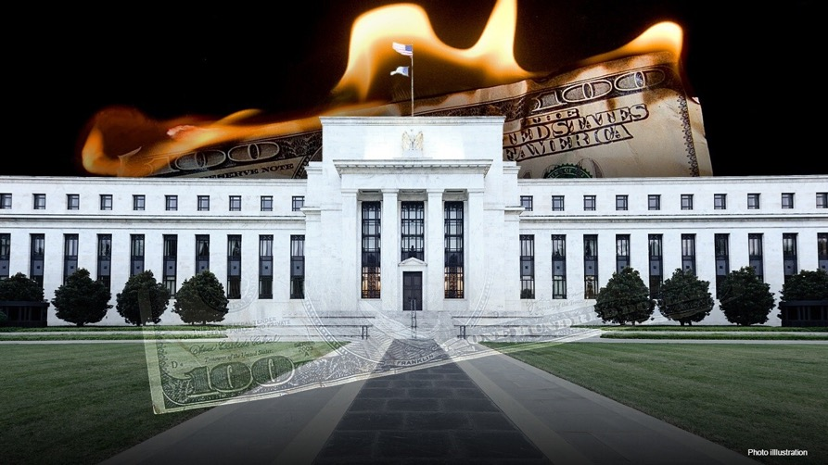
The Mad Hedge Fund Trader
“Who Needs the Fed?”
With John Thomas
Silicon Valley March 6, 2024
www.madhedgefundtrader.com
Notes:
*

Slide 2
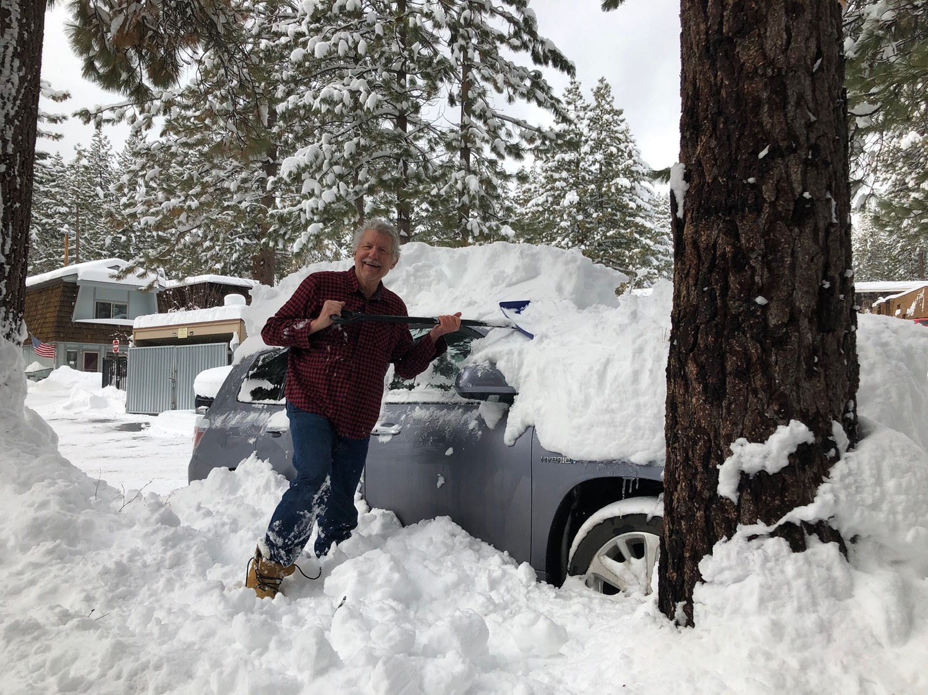

Slide 3
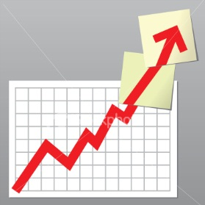
Trade Alert Performance
Beating 2022 – Best in 16 years
60 out of 66 trade alerts profitable
*January -4.28% Final *July +0.44% Final
*February +7.42% Final *August -4.70% Final
*March -0.25% FINAL *September +00% Final
*April +15.13% Final *October -5.37% Final
*May +0.30%% Final *November +15.37 Final
*June +3.01% Final *December -2.27% Final
*2024 YTD +2.89%, versus +6.29% for the S&P 500 and
+679.5
2% since inception
*Versus 84.63% for all of 2022
*Versus 79.79% for all of 2023
*Average annualized return of +51.30% for 16 years

Slide 4
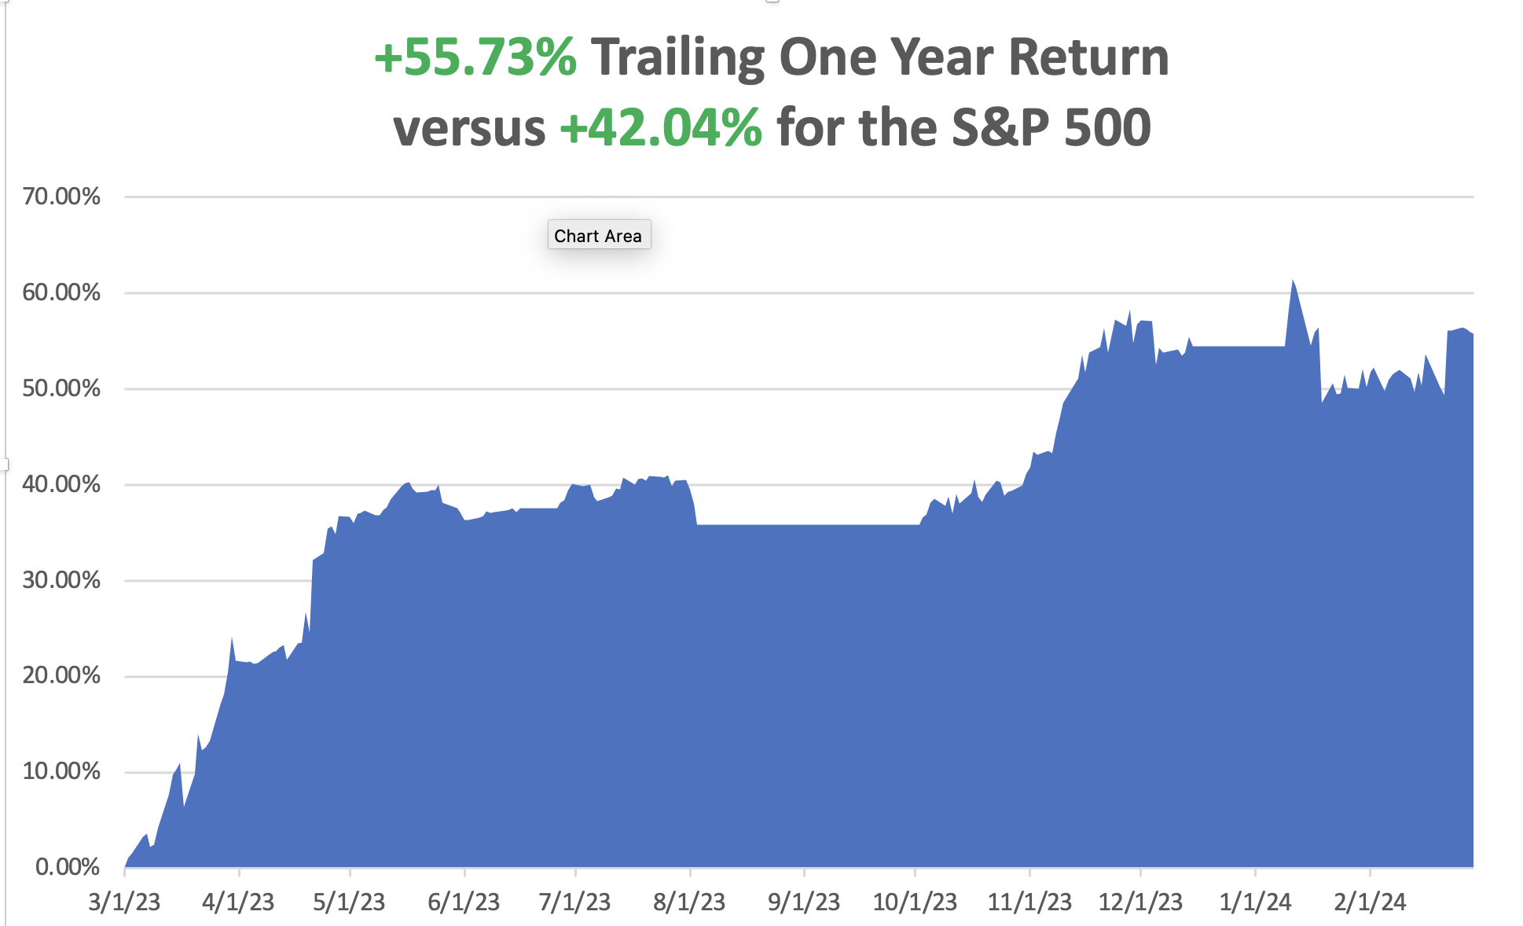

Slide 5
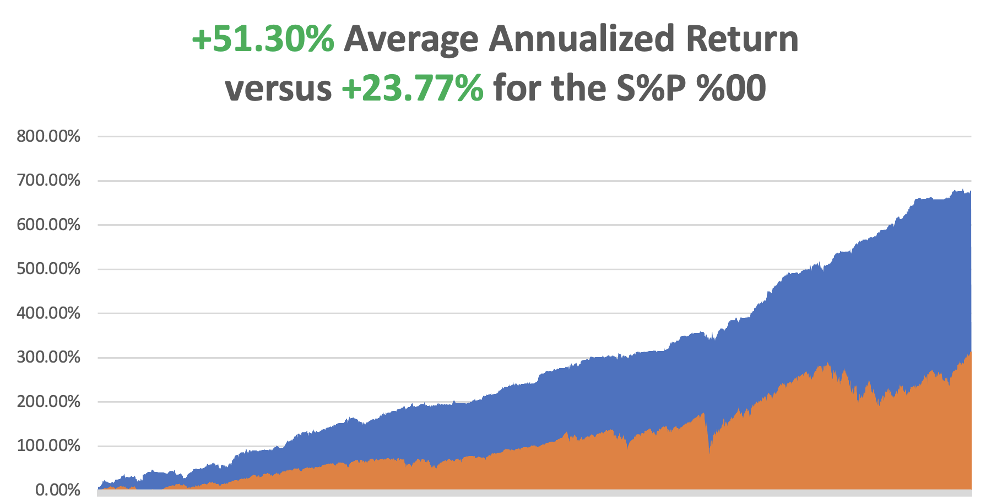

Slide 6
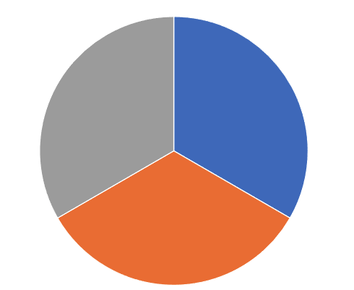
Portfolio Review – Aggressive Long
20% Long, 80% cash
Risk On
(AMZN) 3/$155-$160 call spread | 10.00%
(SNOW) 4/$150-$155 call spread | 10.00%
(TLT) 4/$87-$90 call spread | 10.00%
Risk Off
NO POSITIONS
Total Net Position | 30.00%
Expiration Value
+6.29%

Slide 7

The Method to My Madness
*Overheating risk is rising
*Domestic plays have come back to life, is a major sector rotation at hand? Out of semis and into domestics/
*All falling interest rate plays had a great week, including bonds, precious metals, energy, and even uranium
*All economic data is globally slowing, except for the US,
with the only good economy in the world
*Buy stocks and bonds but only after substantial dips
*Commodities and industrials are a second half play,
we will keep rotating back and forth all year with tech

Slide 8
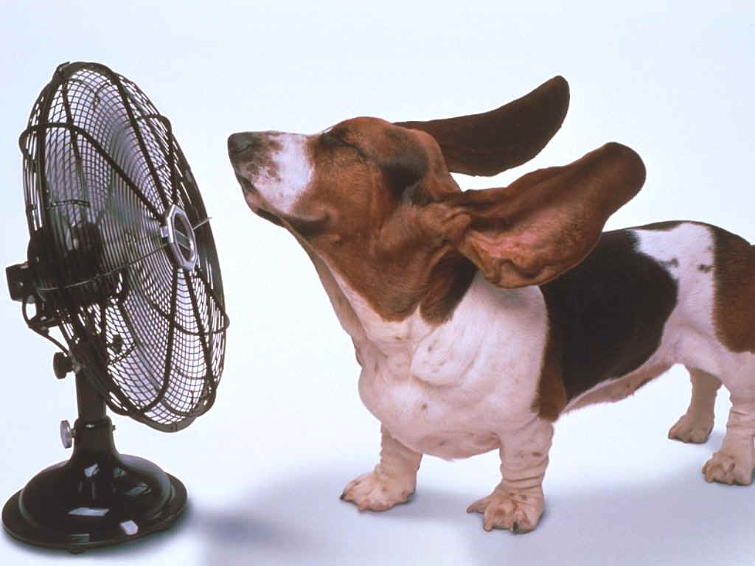
The Global Economy – Heating Up
*Here Comes the Soft Landing, say the G-20 finance ministers in Sao Paulo. Upside risks include faster-than expected disinflation
*Core PCE Comes in Cool, at 2.8%, as expected
*University of Michigan Consumer Sentiment Dips, from 79.6 to 76.9 in February.
*The Fed May Drag Out the end of Quantitative Tightening
*Weekly Jobless Claims Pop, up 13,000 to 215,000
*Q4 GDP is Revised Down from 3.3% to 3.2%
* The Conference Board Bails on Recession Call.

Slide 9
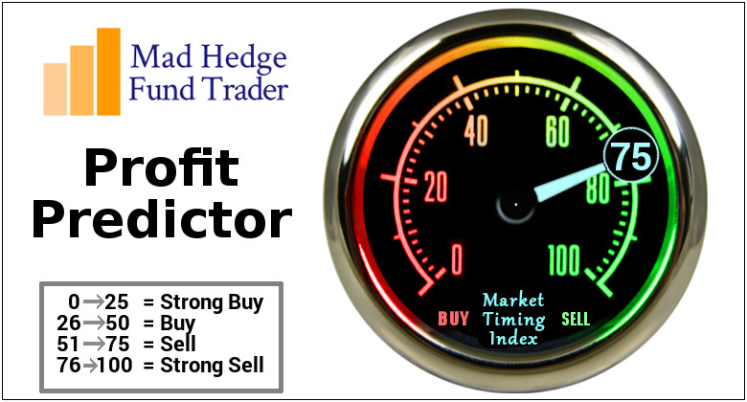
The Mad Hedge Profit Predictor
Market Timing Index – At top end of historic range
An artificial intelligence driven algorithm that analyzes 30 different economic, technical, and momentum driven indicators

Slide 10
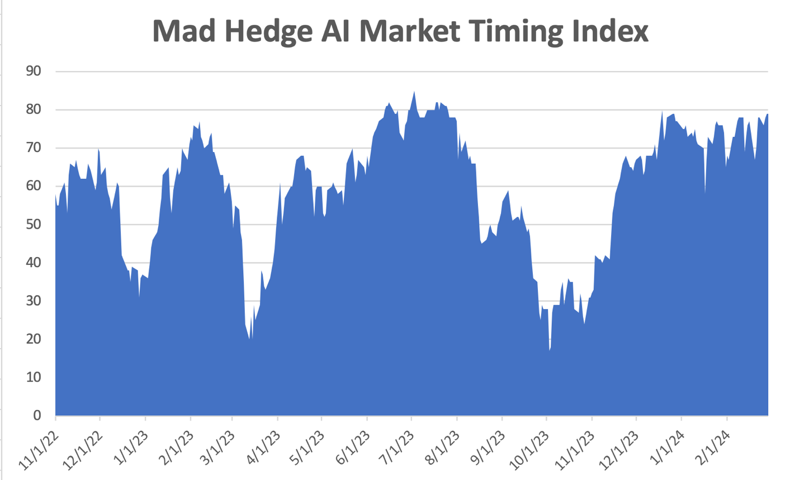
Sell Territory!! – Severe Overbought Territory
SELL
BUY

Slide 11
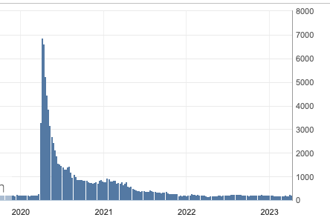
Weekly Jobless Claims – Falling
215,000 – +15,000

Slide 12

Stocks – Is the Rotation at Hand?
*US Stocks Now Account for 70% of Global Stock Market Capitalization, thanks to the ballistic move s in big tech
*Warren Buffet Says There is Nothing to Buy, in his annual letter to shareholders.
*Analysts are ratcheting up yearend targets, with me now at (SPX) 6,000
*Big tech continues to dominate, with NVIDIA earnings at $22 billion YOY, up 225%
*Another Regional Bank is in Trouble. Commercial real estate lender
New York Community Bancorp
*European Companies are Flocking to the US to List.
*The flip flop continues between tech and domestics

Slide 13
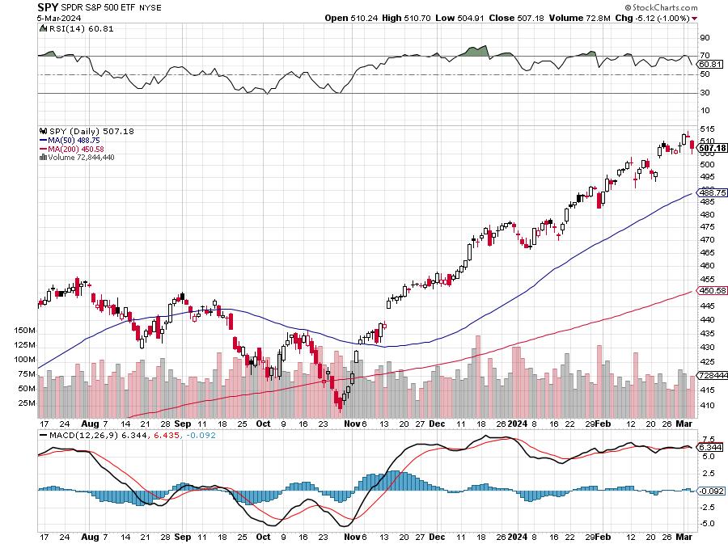
S&P 500 – New High
Yearend
Target
$600 +25%
$465
-7%
1st support

Slide 14
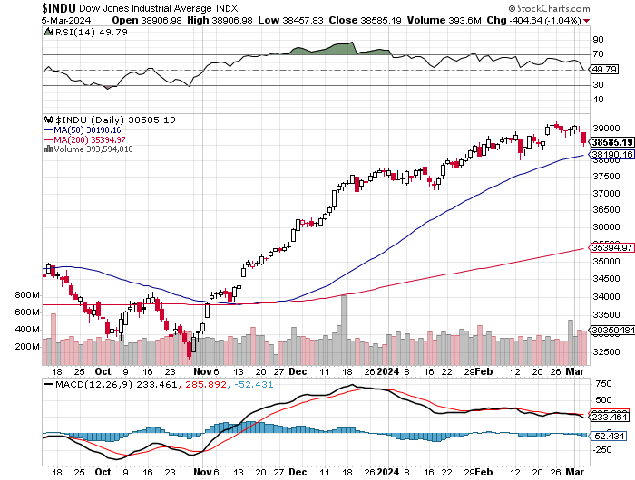
ProShares Ultra Short S&P 500 (SDS)- a great hedge for long stocks and bonds long 2X position has a hedge against longs and bond shorts

Slide 15
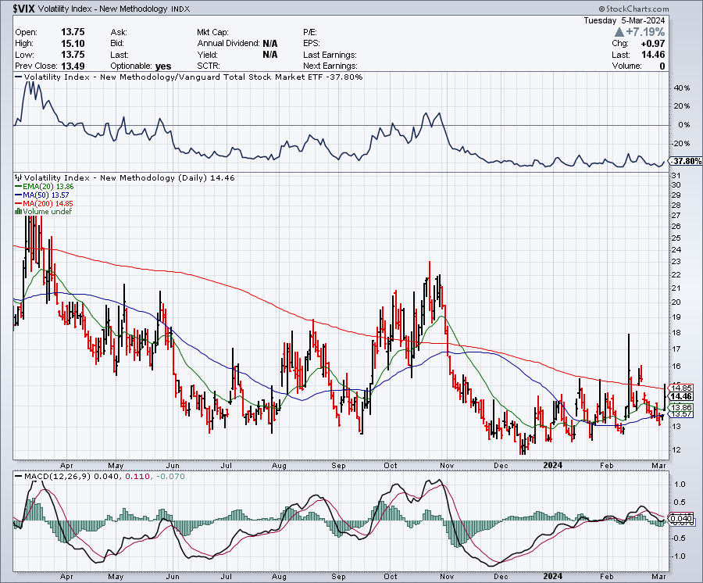
(VIX) – Bargain of the Century

Slide 16
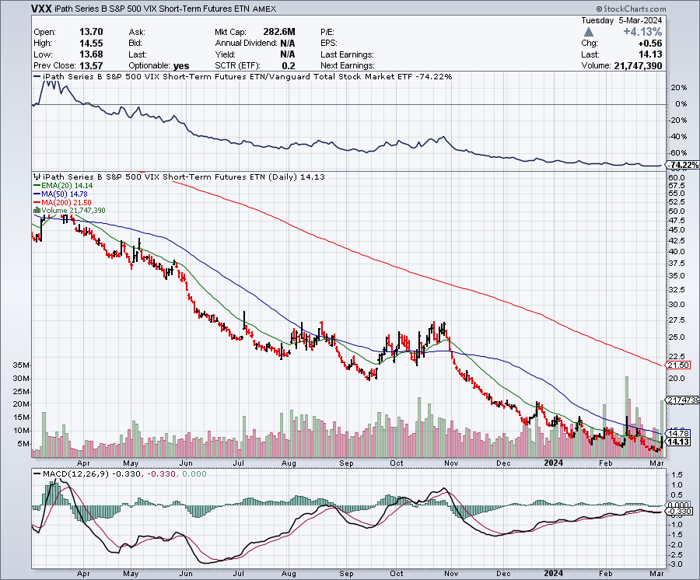
(VXX)-

Slide 17
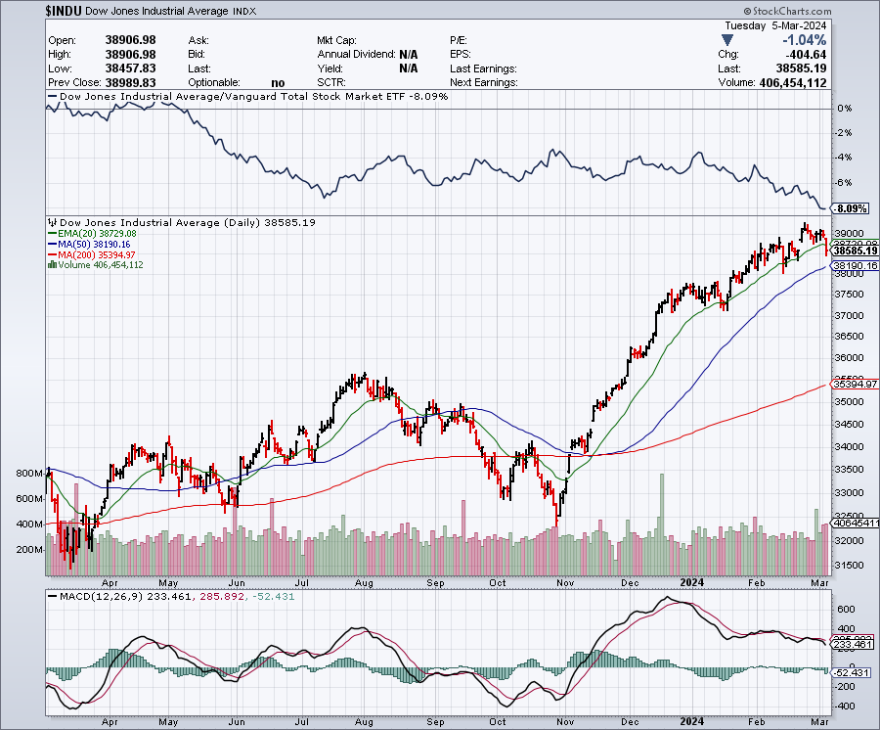
Dow Average ($INDU)-

Slide 18
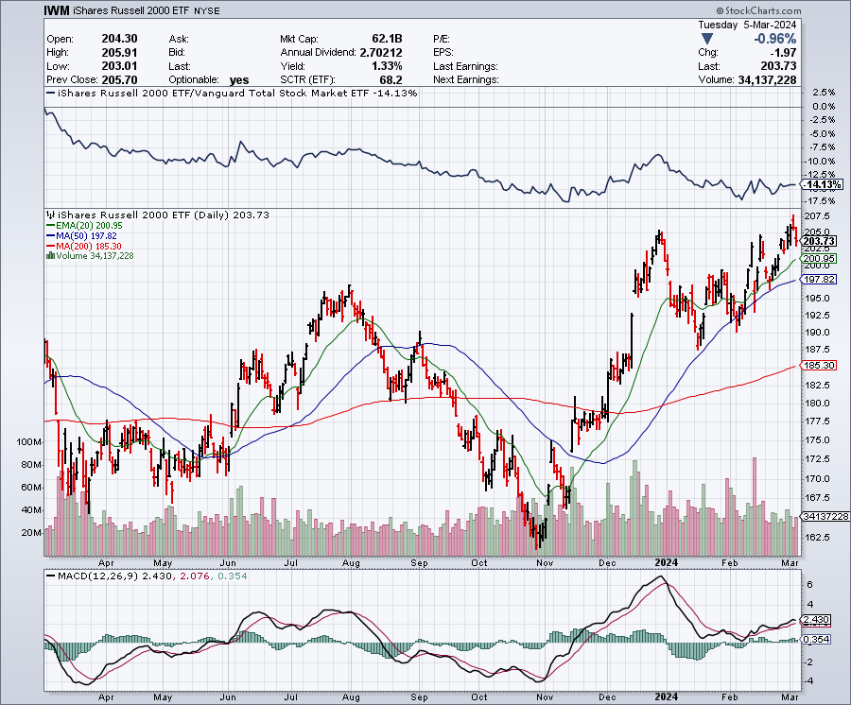
Russell 2000 (IWM)- took profits on Long 10/$137-$142 vertical bull call spread took profits on Long 10/$153-$156 vertical bear put spread

Slide 19
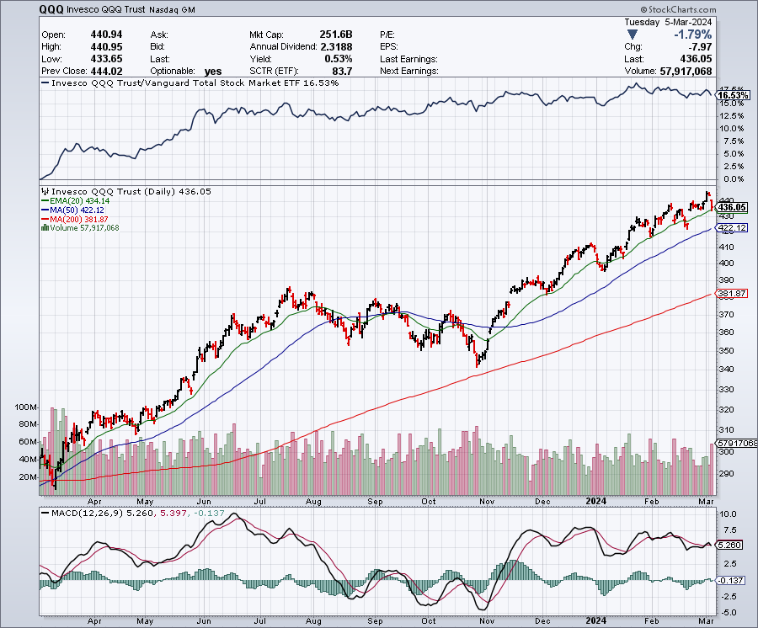
NASDAQ (QQQ) – took profits on Long 5/$335-$345 put spread took profits on long (QQQ) 1/$290-$300 put spread, took profits on long (QQQ) 4/$330-$335 put spread took profits on long (QQQ) 3/$340-$345 put spread, covered long (QQQ) $325-$330 put spread

Slide 20
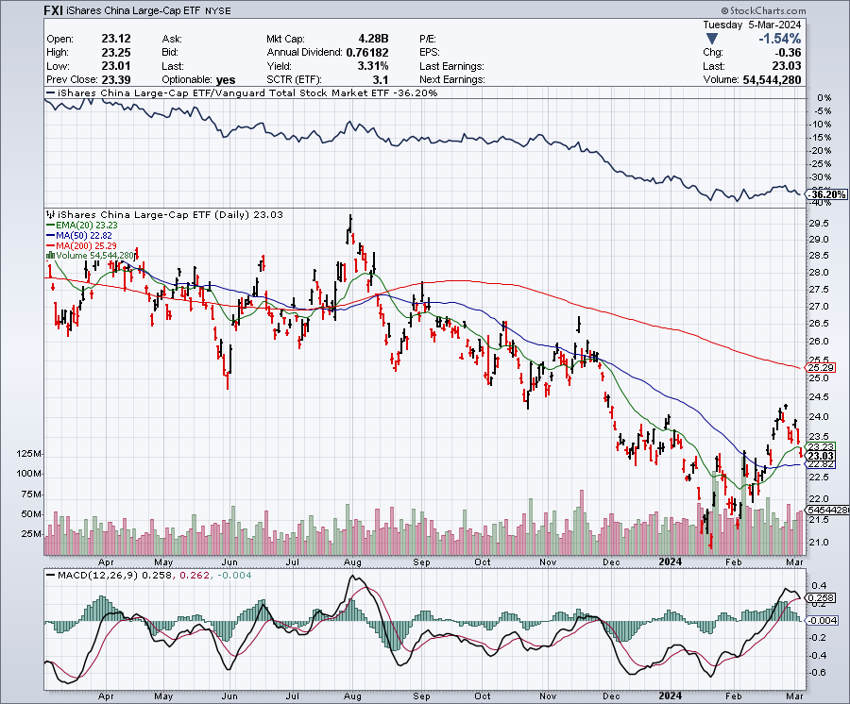
China (FXI) – IN RECESSION-AVOID

Slide 21
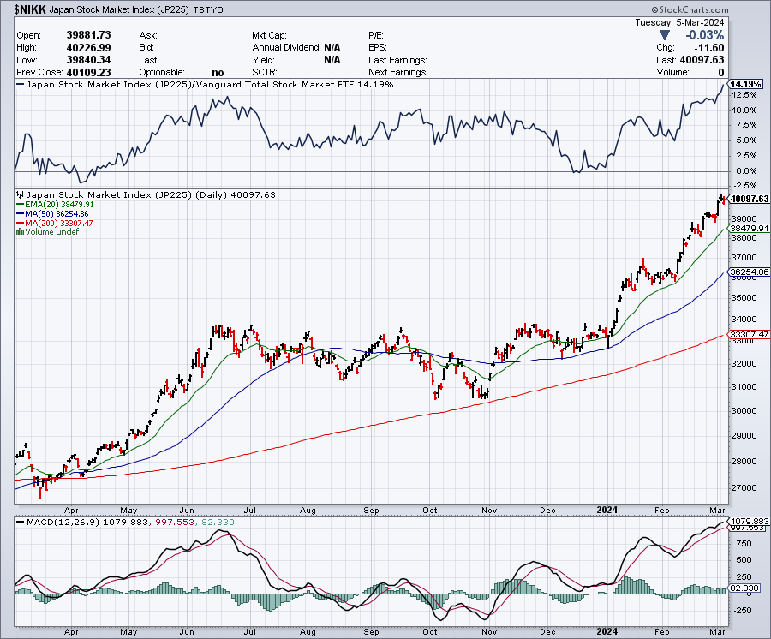
Japan ($NIKK) – New All-Time High powered by weak yen

Slide 22
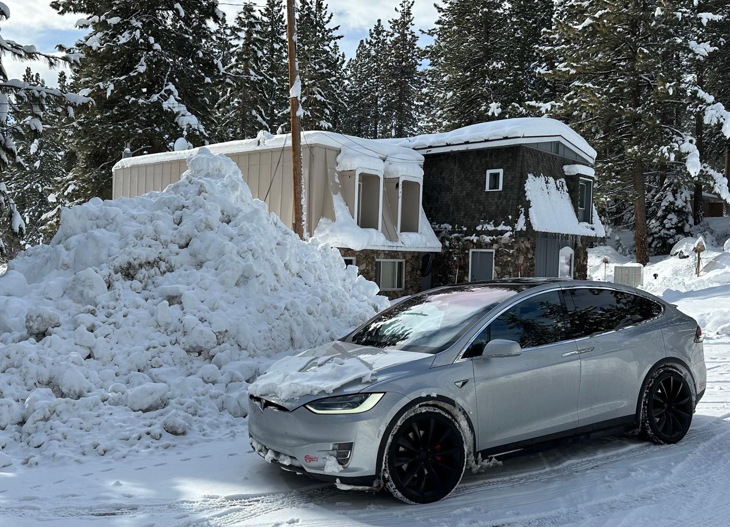

Slide 23



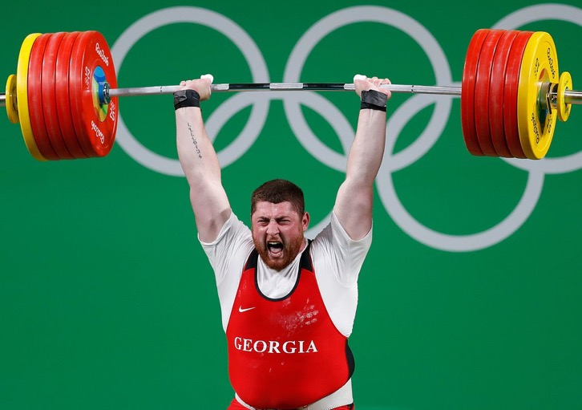
THE MAD HEDGE FUND TRADER
The Barbell Portfolio
*75% Big Tech – 2% of US workforce, 25% of market cap and 25% of US earnings
25% Domestic Recovery, including:
Railroads, airlines, cruise lines,
Couriers, steel companies
Banks, commodities
Construction
Credit Card Companies
Hotels, casinos
Online Ticket Sales

Slide 24
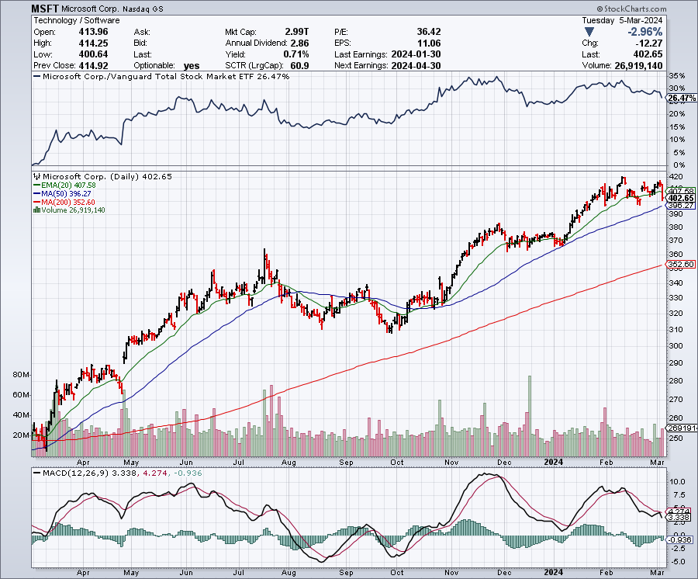
Microsoft (MSFT)- Microsoft Beats Estimates, with the steady growth of its azure cloud business
Microsoft Tops $3 Trillion Valuation, cementing its hold on the AI lead.
Took profits on long 2/$330-$340 call spread, took profits on long 12/$320-$330 call spread took profits on long 9/$235-$245 call spread, took profits on long 7/$220-$210 call spread, took profits on long 6/$220-$230 call spread, took profits on long 2/$200-$210 bear put spread

Slide 25
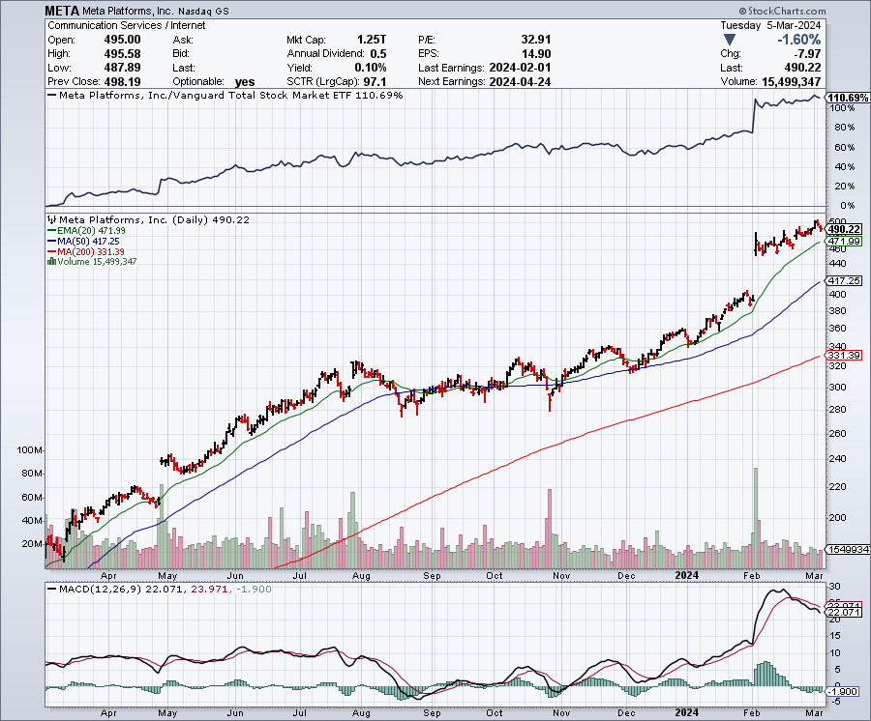
Meta (META)
Meta Rockets 21%, on a $50 billion stock buyback and its first ever dividend took profits on Long 9/$290-$300 vertical bear put spread stopped out of Long 9/$190-$200 vertical bear put spread

Slide 26
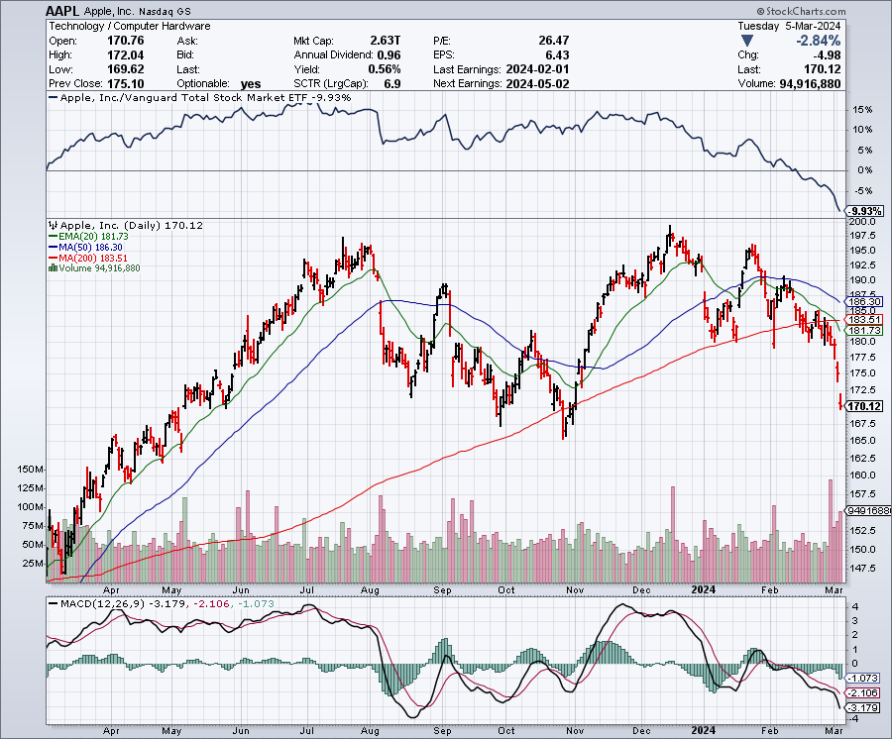
Apple (AAPL)
€2 Billion European antitrust fine took profits on long 1/$145-$155 put spread, Took profits on long 10/$165-$175 put spread took profits on long 6/$155-$165 put spread, stopped out of long 6/$125-135 call spread, took profits on long 6/$110-$120 call spread, took profits on long 2/$180-$190 put spread

Slide 27
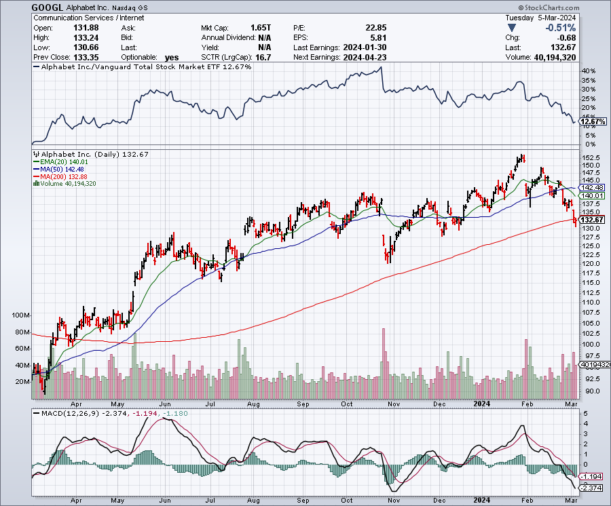
Alphabet (GOOGL) – Disappoints
Google Puts AI on Hold, at least with its Gemini image generator, which created “inaccuracies” in historical pictures took profits on long 12/$110-$120 call spread took profits on long 12/$1,200-$1,230 bull call spread, took profits on long 9/$1,030-$1,080 vertical bull call spread

Slide 28
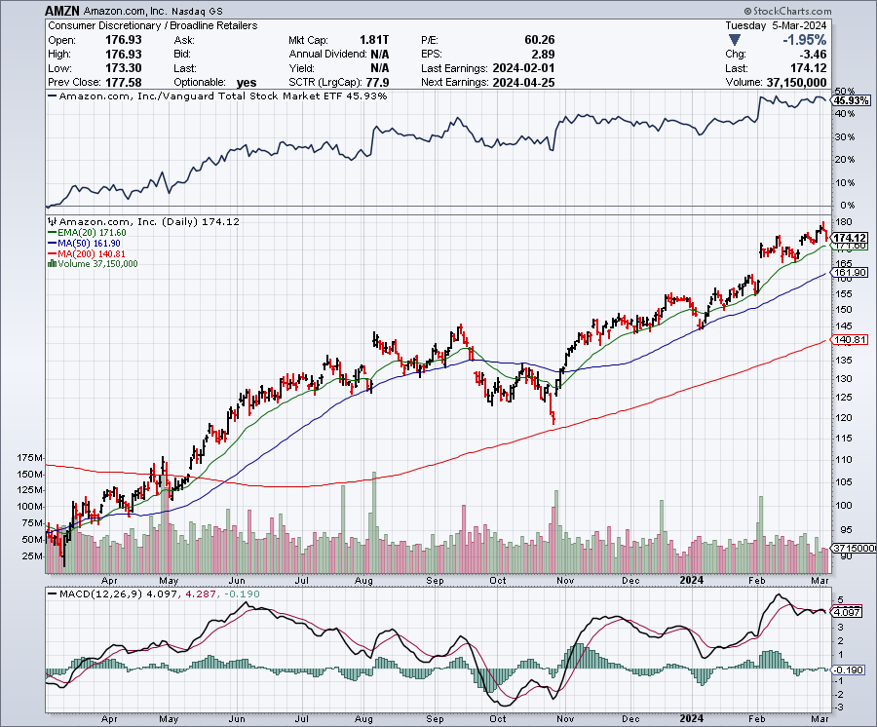
Amazon (AMZN) –
Amazon is getting added to the Dow Average, opening it up to massive index buying long 3/$155-$160 bull call spread-expires in 8 days took profits on long 2/$130-$135 bull call spread

Slide 29
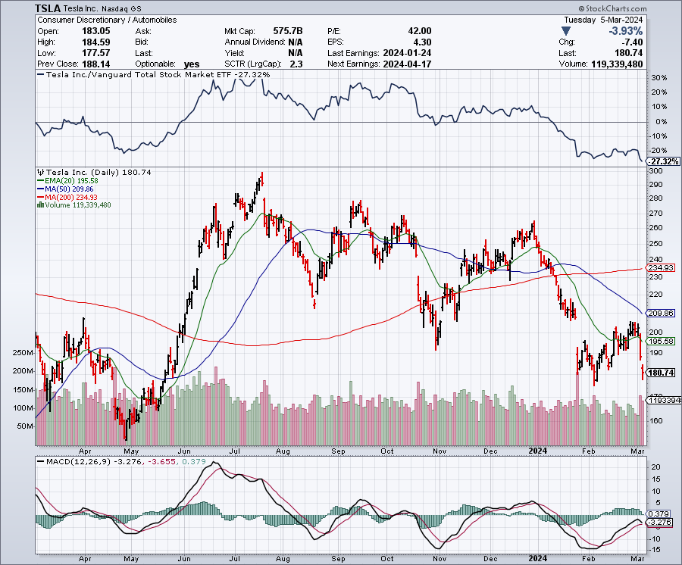
Tesla (TSLA) – The Price War Continues
February car sale in China were disastrous
took profits on long 10/$200-$210 call spread
took profits on long 6/$120-$130 call spread, stopped out of long 6/$210-$220 put spread
took profits on long 5/$110-$120 call spread, took profits on long 5/$220-$230 put spread

Slide 30
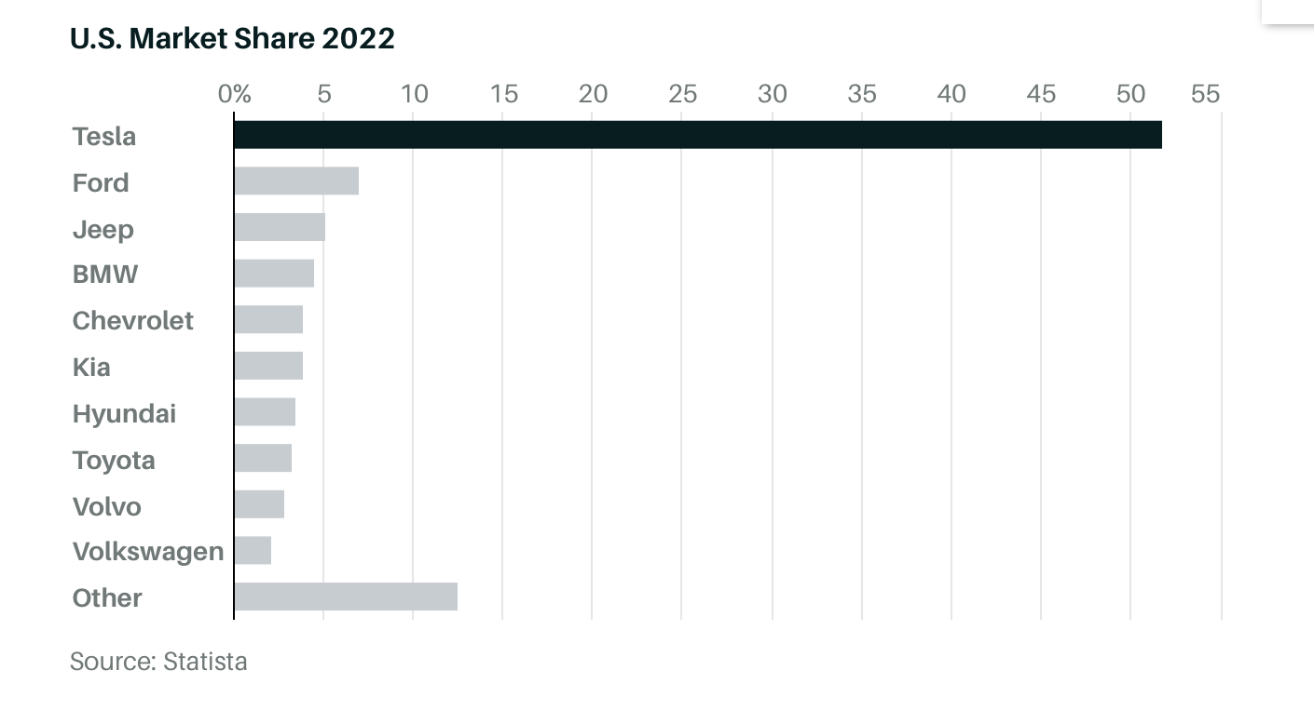

Slide 31
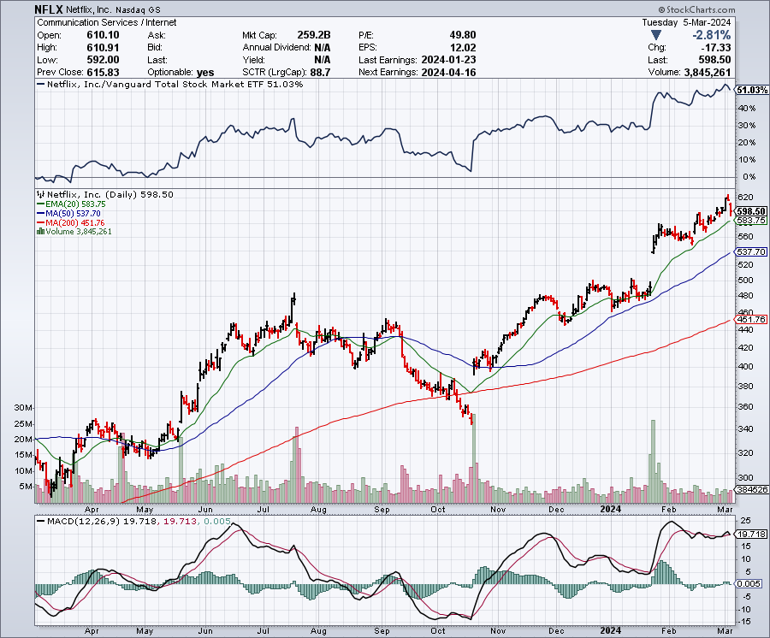
Netflix (NFLX) –
Netflix Soars on Big Subscriber Beat, up 8.6% on an add of 13 million new subscribers

Slide 32
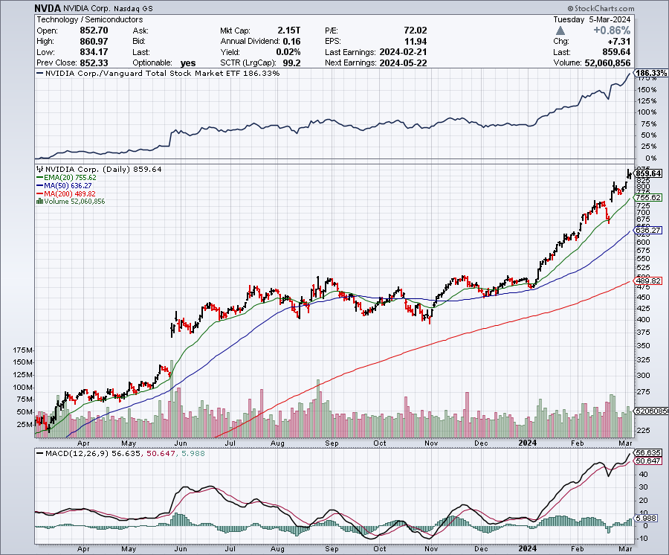
NVIDIA (NVDA) – Double Position-63% Implied on options
Tops $2 trillion now the third most valuable company in the US
Revenues came in at a spectacular $22.1 billion, Earnings were up 225% YOY took profits on long 3/$600-$610, took profits on long 3/$600-$610 took profits on long 2/$350-$360 call spread, took profits on long 2/$360-$370 call spread took profits on long 10/$370-$380 call spread – took profits on long 11/$370-$380 call spread took profits on long 3/$260-$270 put spread, took profits on long 10/$95-$100 call spread took profits on long 7/$120-$130 call spread, took profits on long 6/$120-$130 call spread

Slide 33
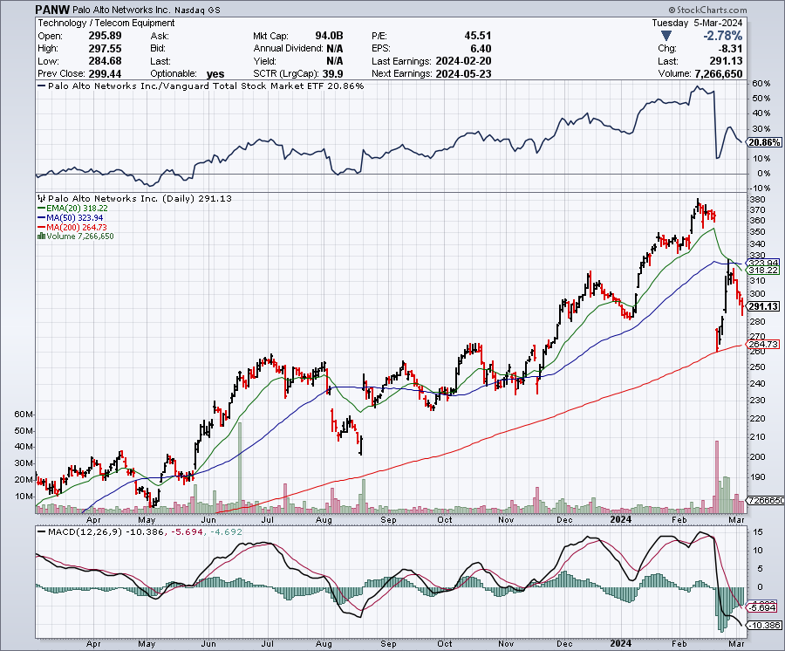
Palo Alto Networks (PANW)- Hacking never goes out of fashion
Palo Alto Networks Disappoints took profits on long 2/$260-$270 call spread, took profits on long 10/$130-$140 call spread

Slide 34
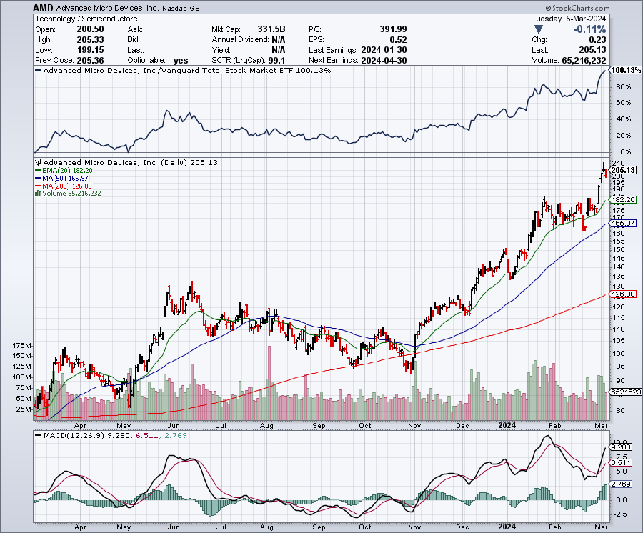
Advanced Micro Devices (AMD)- Recession fears programable logic devices took profits on long 2/$75-$80 call spread

Slide 35
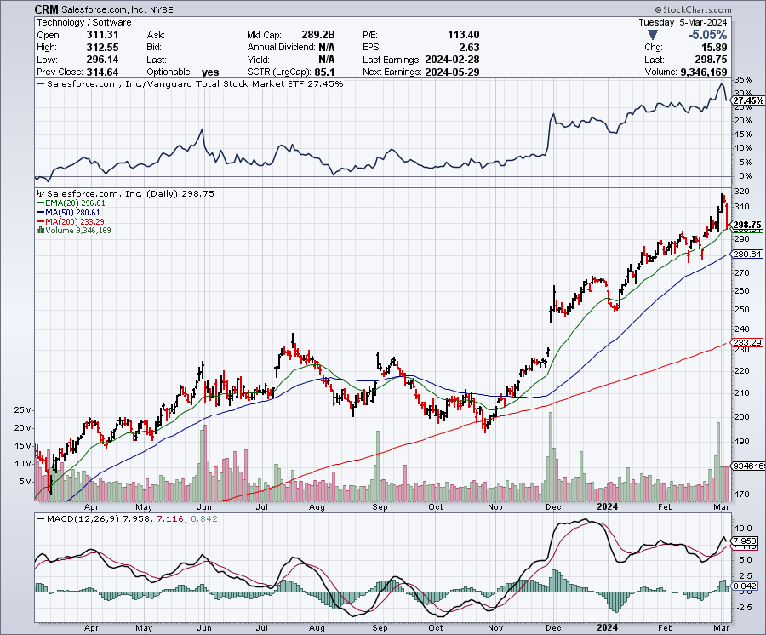
Salesforce (CRM)- Massive Online Migration
Salesforce Soars 16%, on better-than-expected guidance took profits on long 12/$185-$195 call spread took profits on long 9/$125-$130 vertical bull call spread took profits on long 8/$125-$130 vertical bull call spread

Slide 36
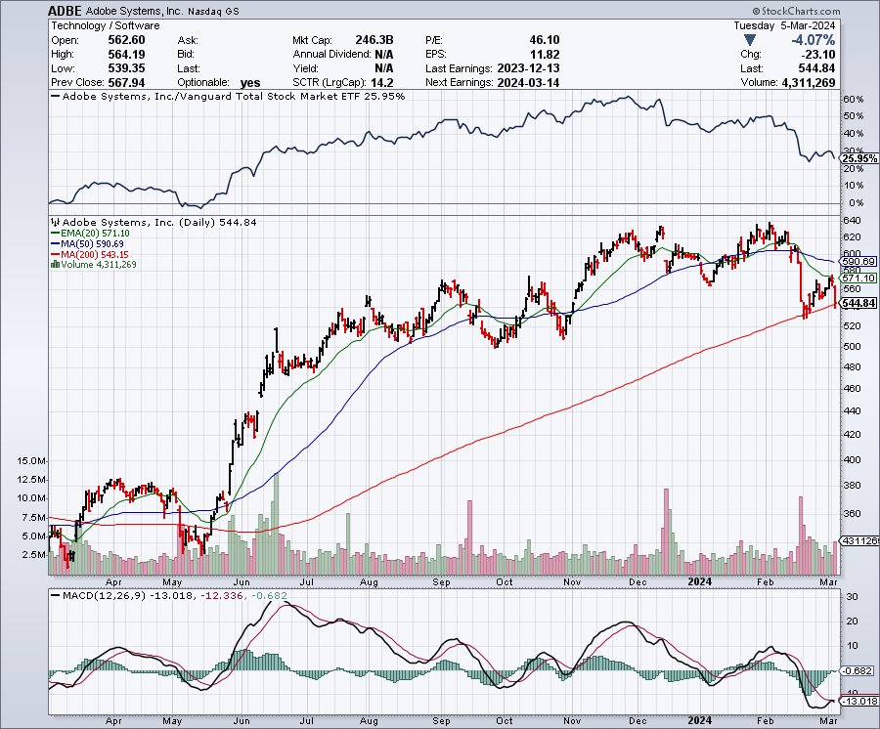
Adobe (ADBE)- Cloud play
The Quality Non-China tech play

Slide 37
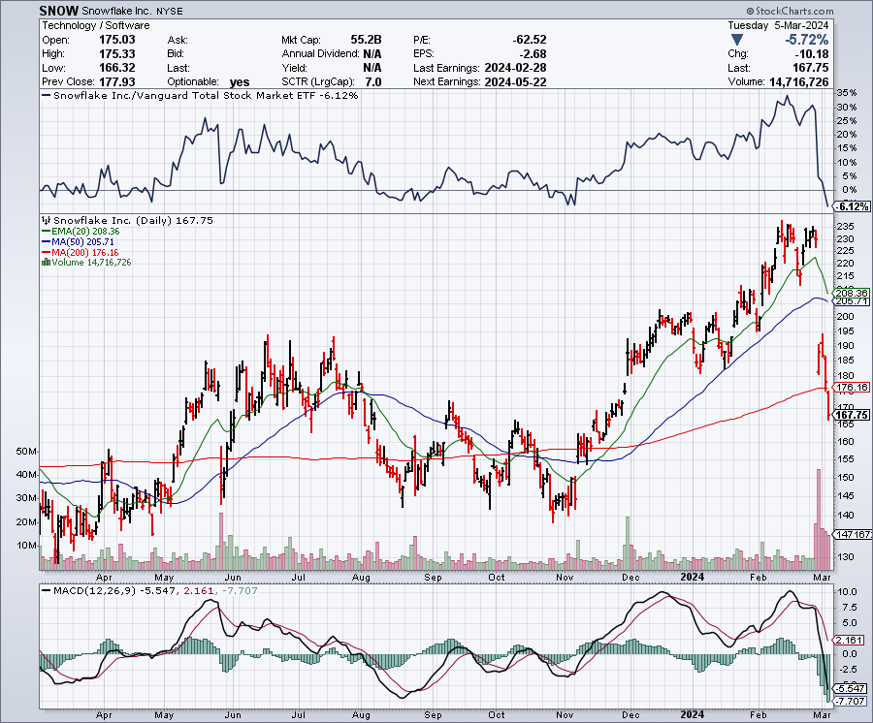
Snowflake (SNOW)- Blockbuster AI Earnings
Snowflake Crashes, down 20%, on weak guidance. CEO Frank Slootman is retiring long 4/$150-$255 call spread took profits on long 12/$135-$140 call spread

Slide 38
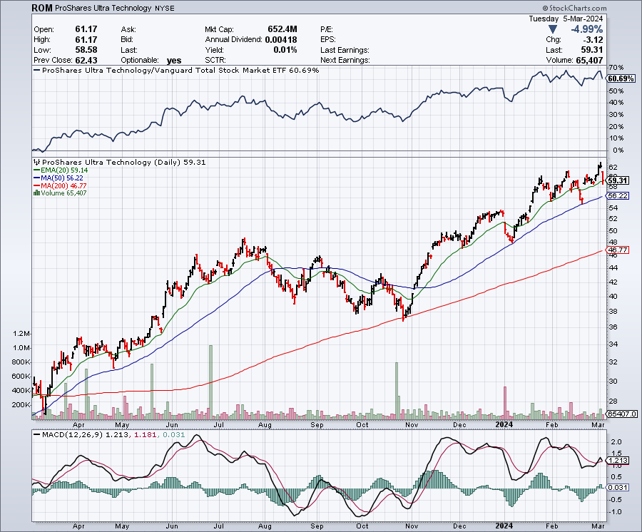
ProShares Ultra Technology ETF (ROM) – 2X Long Technology ETF took profits on long 10/$62-65 call spread

Slide 39
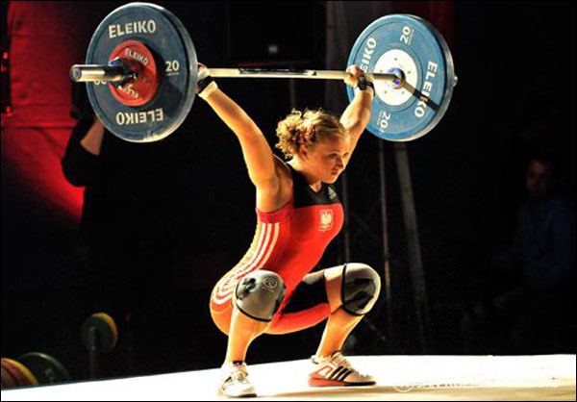
The Second Half of the Barbell
*Bets on a domestic recovery in 2022 Q4
*Upside potential in 2024 far greater than tech
*Some of these have not moved for 5 or 10 years
*Focuses on economically sensitive cyclical industries
*Makes a great counterweight to
high-growth technology
*We could spend all of next ten years rotating
between the two groups

Slide 40
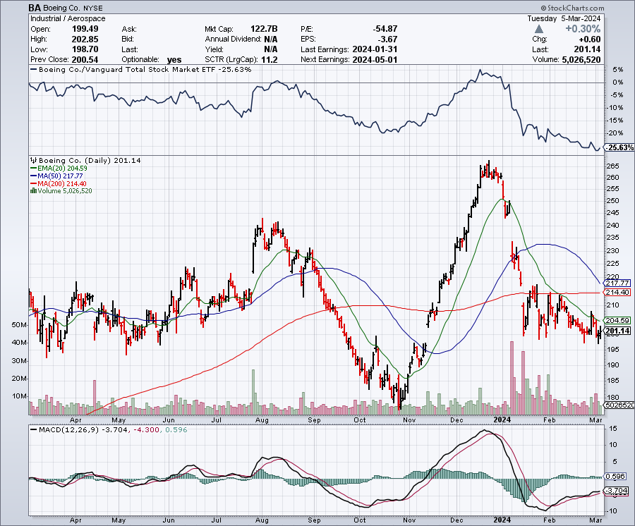
Boeing (BA) –
Boeing Looking to Buy Spirit Aero Systems, in a desperate effort to fix their supply chain problems stopped out of long 2/$190-$200 call spread, took profits on long 5/$17-$175 call spread

Slide 41
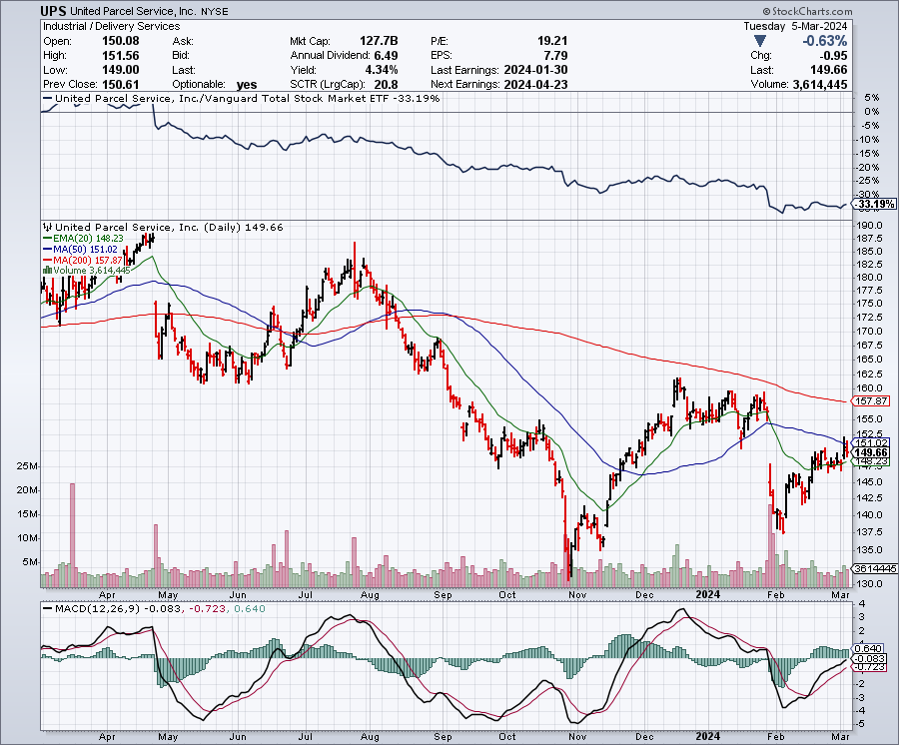
Package Delivery- United Parcel Service (UPS) – strike averted took profits on long 11/$130-$140 call spread

Slide 42
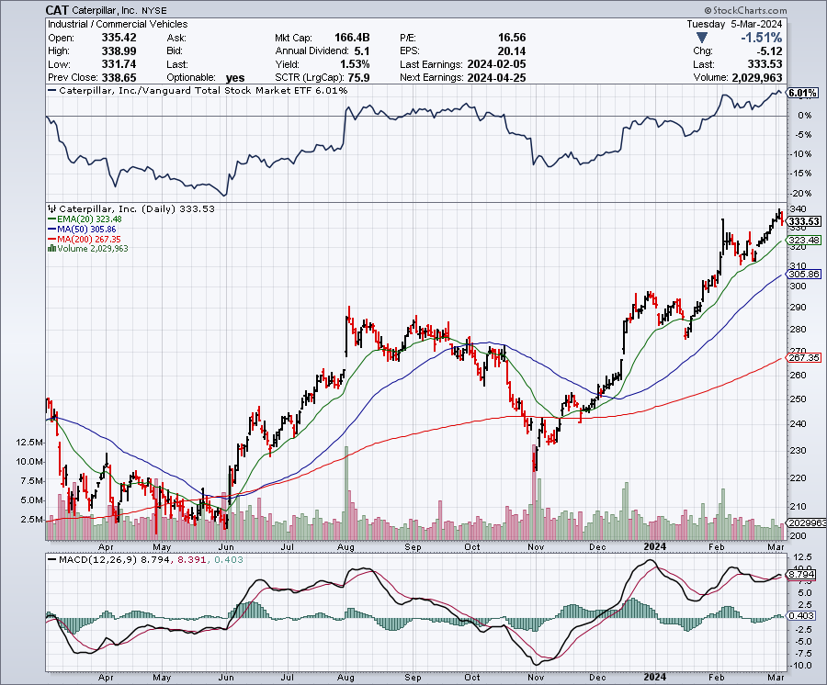
Caterpillar (CAT)- Ag + Infrastructure + Housing long 12/$220-$230 calls – expires in 2 trading days took profits on long 12/$145-$150 call spread took profits on long 11/$125-$135 call spread

Slide 43
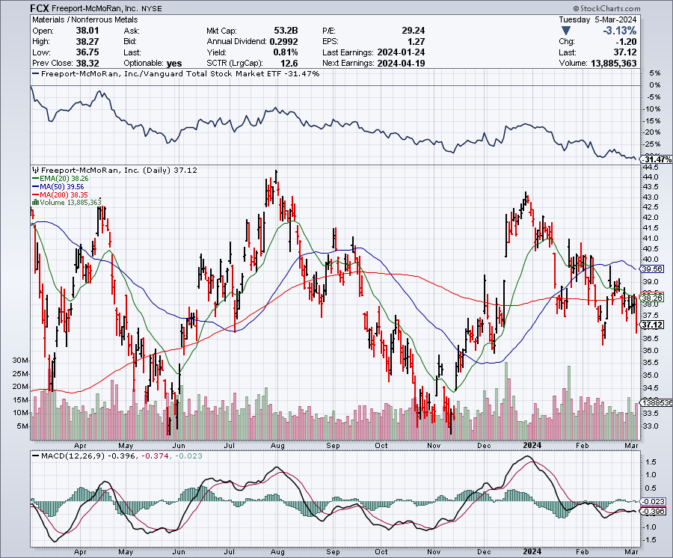
Freeport McMoRan - (FCX)- Coming Copper Crisis took profits on long 6/$32-$35 call spread took profits on long 4/$30-$33 call spread, took profits on long 10/$20-$23 call spread

Slide 44
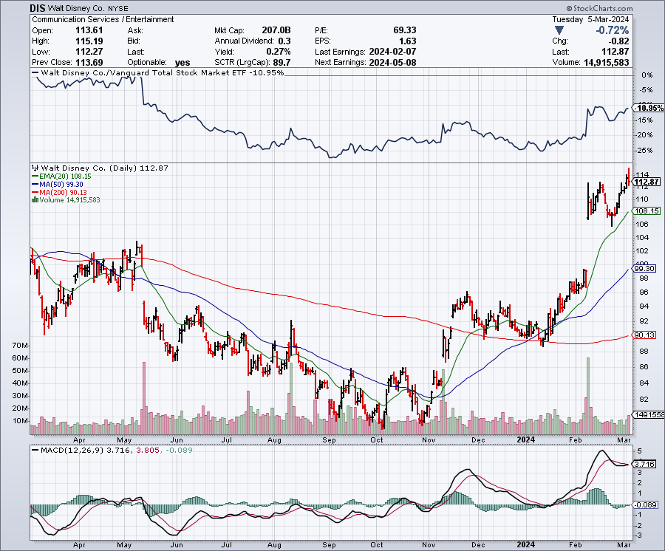
Walt Disney (DIS) -Disney Beats
Disney Buys Stake Fortnight, on of the leading online games

Slide 45
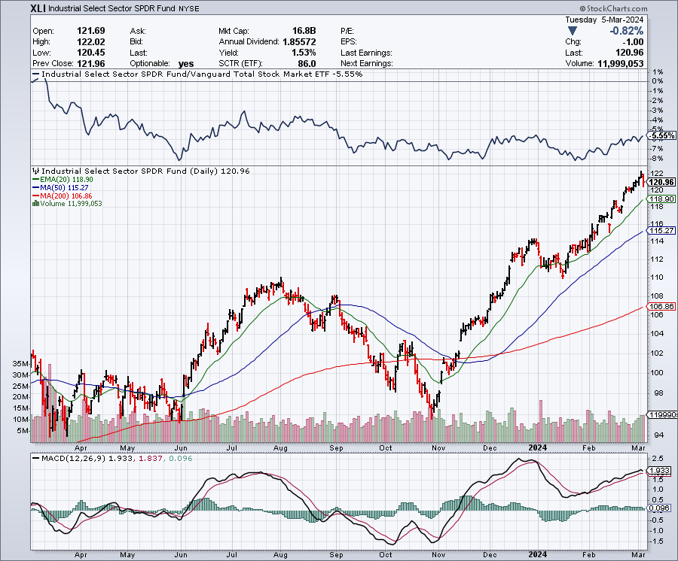
Industrials Sector SPDR (XLI)-
(GE), (MMM), (UNP), (UTX), (BA), (HON)

Slide 46
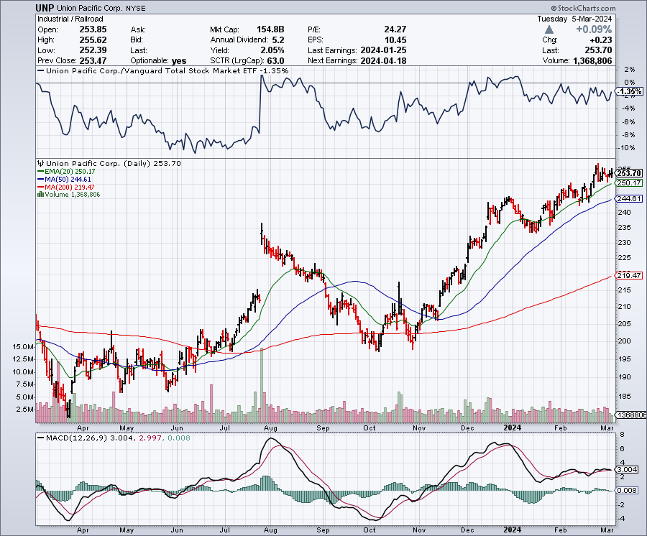
Union Pacific RR (UNP)- Big Stuff to Ship took profits on long 5/$200-$210 call spread took profits on 11/$150-$160 call spread

Slide 47
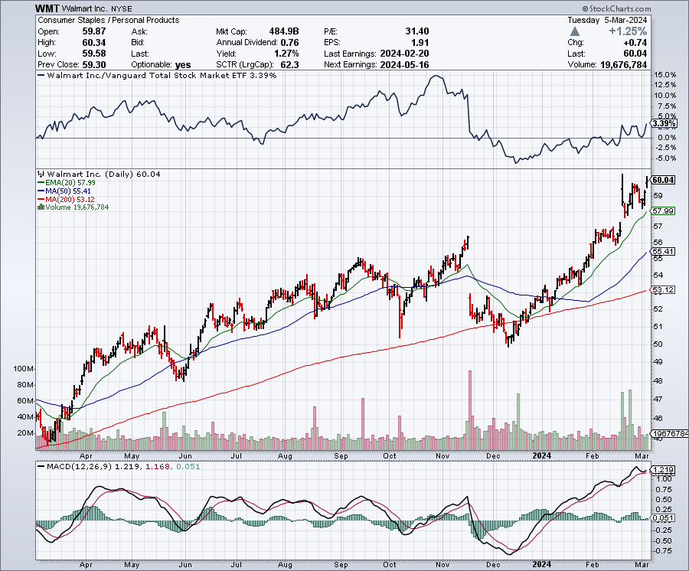
Wal-Mart (WMT)- took profit on Long 11/$125-$130 bear put spread took profit on Long 10/$119-$121 bear put spread took profits on Long 8/$114-$117 bear put spread

Slide 48
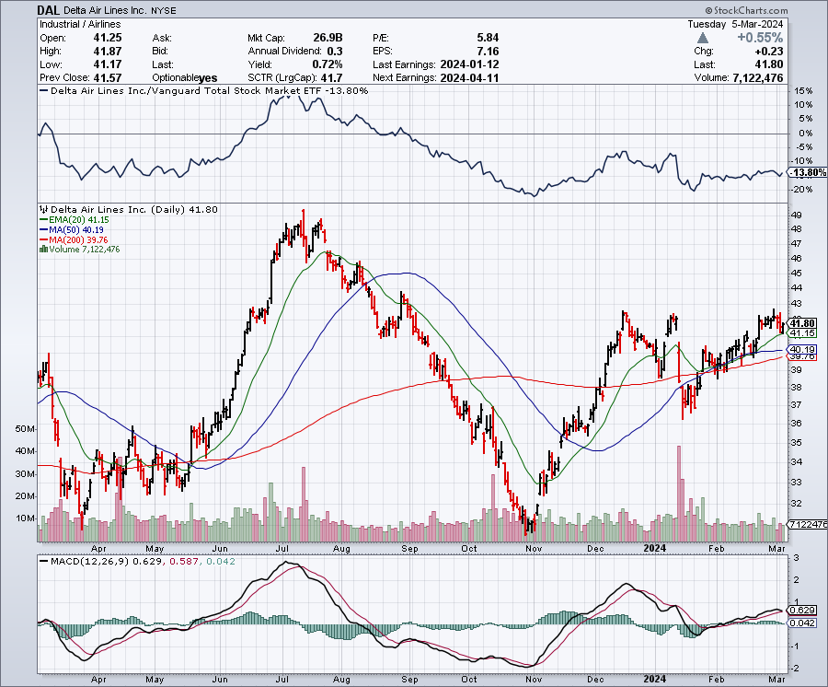
Delta Airlines (DAL) – Travel is Back!
Delta Posts Strong Earnings on Robust international travel stopped out of long 2/$35-$38 call spread

Slide 49
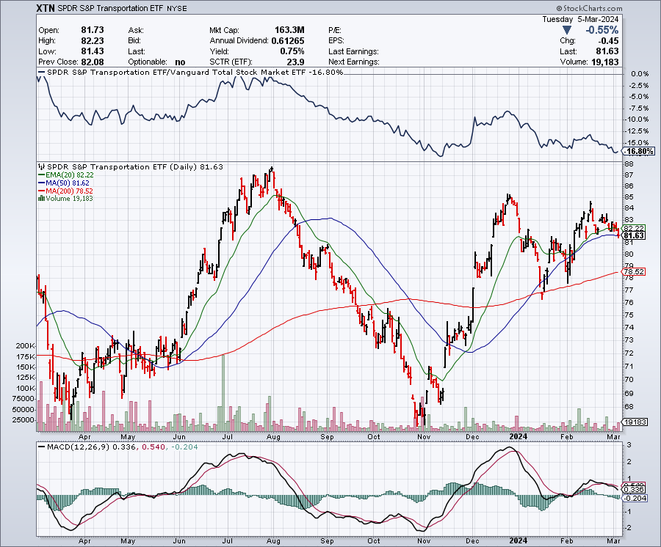
Transports Sector SPDR (XTN)- Worst Hit Sector
(ALGT), (ALK), (JBLU), (LUV), (CHRW), (DAL)

Slide 50
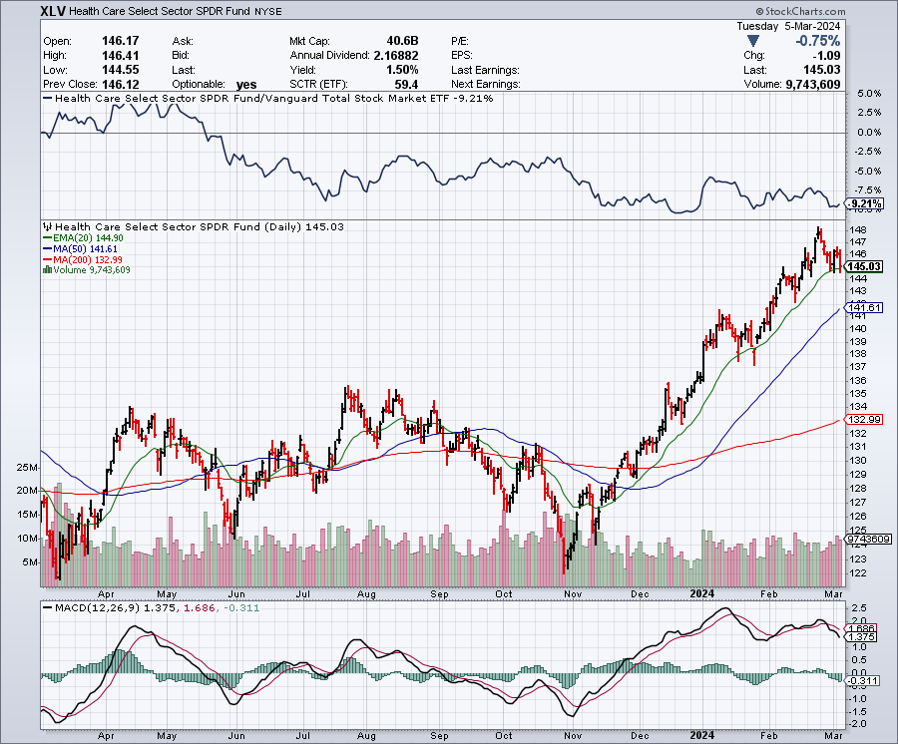
Health Care Sector (XLV)
(JNJ), (PFE), (MRK), (GILD), (ACT), (AMGN)

Slide 51
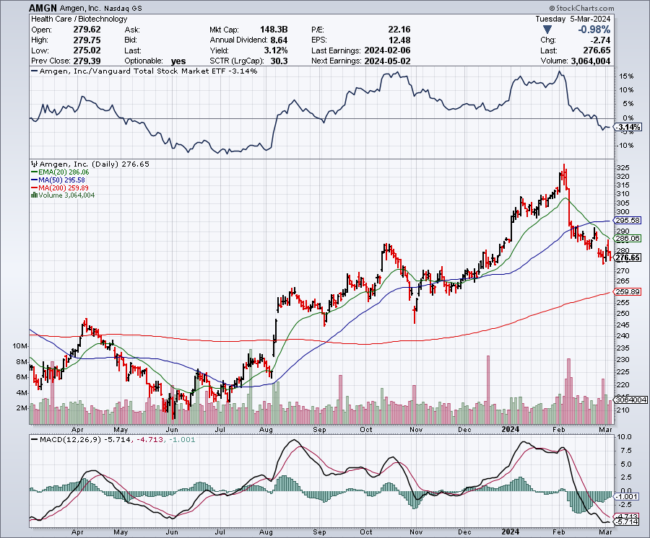
Amgen (AMGN) took profits on long 11/$185-$200 bull call spread

Slide 52
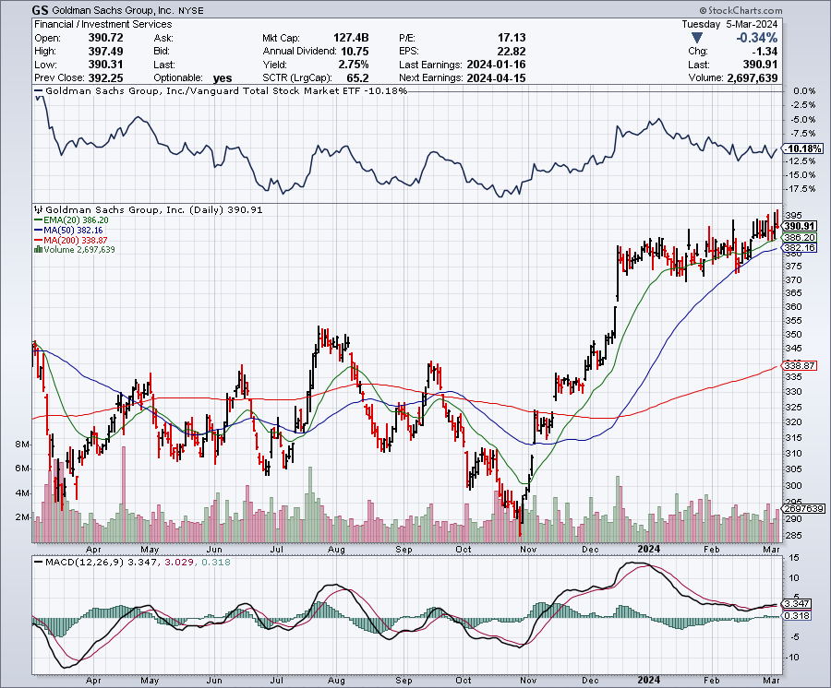
Goldman Sachs (GS) – Earnings Down but Less than Expected took profits 12/$330-$350 call spread took profits 11/$330-$350 call spread stop loss on long 11/$385-$395 call spreads

Slide 53

Morgan Stanley (MS) – Highest Capital ratio net of mark to market
CEO to Step Down in a Year took profits on long 4/$65-$70 call spread

Slide 54

JP Morgan Chase (JPM) – Monster Earnings Surprise
CEO Jamie Diamond Sell $150 Million in (JPM) Shares took profits on long 4/$105-$115 call spread

Slide 55

New York Community Bank (NYCB) – Dividend Cut -62% took profits on long 4/$105-$115 call spread

Slide 56

Bank of America (BAC) – Bank of America Rips, on a great earnings report took profits on long 4/$20-$23 call spread

Slide 57

Citigroup (C) – took profits on long 4/$30-$35 call spread

Slide 58

Charles Schwab (SCHW) – LEAPS up 67% in three months took profits on long 4/$30-$35 call spread

Slide 59

Interactive Brokers (IBKR) – Best Risk Control took profits on long 4/$60-$65 call spread

Slide 60

SPDR Metals & Mining ETF (XME) – long 2/$28-$30 call spread

Slide 61

Blackrock (BLK)-Asset Collection Boom took profits on long 3/$770-$790 call spread took profits on long 3/$310-$340 call spread

Slide 62

Visa (V) – Inflation boost
Transaction grew by an inflationary 10% back to pre-pandemic levels took profits on long 2/$240-$250 bull call spread took profits on long 10/$160-$170 bull call spread, took profits on long 6/$150-$160 bull call spread

Slide 63

Consumer Discretionary SPDR (XLY)
(DIS), (AMZN), (HD), (CMCSA), (MCD), (SBUX)

Slide 64

Berkshire Hathaway (BRKB)- Natural Barbell to Top $1 Trillion in a Year, up from the current $900 billion took profits on long 12/$320-$330 call spread took profits on long 4/$260-$270 call spread, took profits on long 1/$290-$300 call spread took profits on long 10/$220-$230 call spread, took profits on long 7/$220-$230 call spread took profits on long 7/$220-$230 call spread, took profits on long 6/$260-$270 call spread

Slide 65

Europe Hedged Equity (HEDJ)-

Slide 66

Japan (DXJ)-

Slide 67

Emerging Markets (EEM) - Pro trade, Weak Dollar, Long Recovery Play
Traders are Lining up for a Big Emerging Market Bet. Falling US interest rates will bring a weak US dollar and runaway bull markets in most emerging markets, which have remained unchanged for more than a decade

Slide 68


Slide 69

Bonds – A Great Week
*Bonds may have put in a bottom, markets unable to take prices any lower, yields any higher with the current interest rate outlook
*90-Day T-bills at 5.25% still offer attractive alternative
*US Budget Funded only for one extra week to March 15
*Markets are discounting three cuts Starting in
May in 2024 more likely
*Junk bond ETF’s (JNK) and (HYG) are holding up extremely
well with a 6.37% yield and 18 month high
*I’m looking for an $18-$28 point gain in (TLT) during
2024 with interest
*Buy (TLT) on the dip.

Slide 70

Treasury ETF (TLT) – On Fire long 2/$87-$90 call spread stopped out of long 2/$90-$93 call spread, took profits on long 12/$95-$98 put spread took profits on long 12/$79-$82 call spread, took profits on long 11/$76-79 call spread,

Slide 71

Ten Year Treasury Yield ($TNX) – 4.10%

Slide 72

Junk Bonds (JNK) 6.46% Yield

Slide 73

Municipal Bonds (MUB) 2.69% Yield-

Slide 74

Emerging Market Debt (ELD) 6.04% Yield-

Slide 75

2X Short Treasuries (TBT)-Out of Favor

Slide 76

Anally Capital Management (NLY) – Leveraged REIT Play
Yield 13.53% took profits on long 12/$15-$16 call spread

Slide 77


Slide 78

Foreign Currencies – On Top Again
*US Dollar Holds Three Month Highs
*You need a falling interest rates
*A dollar rally could last a couple of months,
so a new currency entry point is approaching
*However, eventual falling interest rates guarantee
a falling dollar for 2024

Slide 79

THE MAD HEDGE FUND TRADER
Australian Dollar (FXA) - Major Long-Term Bottom is In Targeting Parity – A call option on a global synchronized recovery
1:1
BUY

Slide 80

Japanese Yen (FXY)

Slide 81

Euro (FXE)-
2023
Target
25%

Slide 82

British Pound (FXB)-
2023
Target
15%

Slide 83


Emerging Market Currencies (CEW)
2023
Target
40%

Slide 84


Slide 85

Energy & Commodities –Range Bound
*A global commodity rally has dragged oil up
*Slow Chinese growth still drags on the global oil market
*Natural gas rallies 10% on the week
*US continues to dominate markets with 13 million barrels/day production
*Electrification of the US economy will continue
to be a driving theme.
*There is a “BUY” setting up here in energy when
the global economy reaccelerates on a lower interest
rate world. Watch (XOM) and (OXY).

Slide 86

Oil-($WTIC)

Slide 87

United States Oil Fund (USO)

Slide 88

Energy Select Sector SPDR (XLE)-No Performance!
(XOM), (CVX), (SLB), (KMI), (EOG), (COP)

Slide 89

ExxonMobile (XOM)-
Exxon Moves Big into Lithium, with the construction of a major mining operation in Arkansas stopped out of Long 12/$97-$100 call spread took profits on long 12/$120-$125 put spread

Slide 90

Occidental Petroleum (OXY)- Buffet’s a Buyer took profits on long 2/$55-$60 call spread took profits on long 12/$77.50-$82.50 put spread

Slide 91

Natural Gas (UNG) – Free Fall on Warm Winter took profits on Long January 2025 $7-8 Call Spread LEAPS

Slide 92
Freeport McMoRan (FCX) -
Codelco Sees Profit Slump, the world’s largest copper producer based in Chile

Slide 93

Cameco (CCJ) – Global Uranium Renaissance
Uranium Goes Nuclear, with yellow cake prices up 45% since May long 12/$35-$38 call spread – expires in 12 trading days took profits on long 5/$20-$23 bull call spread

Slide 94


Slide 95

Precious Metals – Signs of Life
*Precious metals have a great week on slightly falling rates
*Gold needs a return of falling interest rates to resume rally
*Miners are lagging gold performance but will play catch up
*Investors are picking up gold as a hedge for 2024 volatility
*Gold headed for $3,000 by 2025, but back off first from new all-time highs
*Silver is the better play with a higher beta
*Russia and China are also stockpiling gold to sidestep
international sanctions

Slide 96

Gold (GLD) – This is what an upside breakout looks like took profits on long 5/$165-$170 bull call spread

Slide 97

Market Vectors Gold Miners ETF- (GDX) –

Slide 98

Barrick Gold (GOLD) took profit on long 1/$15.50-$16.50 call spread

Slide 99

Newmont Mining- (NEM)- took profits on long $55-60 call spread

Slide 100

Silver- (SLV) – Silver too took profits on long 11/$19-$20 call spread

Slide 101

Silver Miners - (SIL)-

Slide 102

Wheaton Precious Metals - (WPM)- took profits on long 1/$36-$39 call spread

Slide 103

Platinum- (PPLT)- 556,000-ounce shortage this year took profits on long 1/$36-$39 call spread

Slide 104


Slide 105

Real Estate – Getting Ready for the Spring
*Existing Home Sales Jump 3% YOY,
*Construction Spending Dives in January in a shocking data release, the worst since October 2022
*This is no doubt in response to the sudden jump in mortgage interest rates from 6.40% back up to a restrictive 7.0%
*New Home Sales Weaken, curbed by frigid weather increasing 1.5% to a seasonally adjusted annual rate of 661,000 units in January
*But demand for new construction remains underpinned by a persistent
shortage of previously owned homes
*Toll Brothers Rocks, taking the shares up 6%, with extremely strong
demand for new homes on the horizon. The gale force demographic
tailwind continues.

Slide 106

S&P Case Shiller Turns Hot
S&P Case Shiller Rises to +4.60% YOY in October, with its National Home Price Index
Detroit gained +8.2%, San Diego +8.0%, and New York +7.1%.

Slide 107

Crown Castle International (CCI) – 5.61% yielding 5G cell phone tower REIT
Eliot Management Pushes up stock with activist bid

Slide 108

US Home Construction Index (ITB)
(DHI), (LEN), (PHM), (TOL), (NVR)

Slide 109


Slide 110

Trade Sheet-
So What Do We Do About All This?
*Stocks – buy any dips
*Bonds – buy dips
*Commodities-buy dips
*Currencies- sell dollar rallies, buy currencies
*Precious Metals – buy dips
*Energy – buy dips
*Volatility - buy $12
*Real estate – buy dips

Slide 111

Next Strategy Webinar
12:00 EST Wednesday, March 20 from Silicon Valley email me questions at support@madhedgefundtrader.com
Good Luck and Good Trading!
Notes:
*

Slide 112


