Slide 1

The Mad Hedge Fund Trader
“Commodities are Back!”
With John Thomas
Silicon Valley March 20, 2024
www.madhedgefundtrader.com
Notes:
*

Slide 2
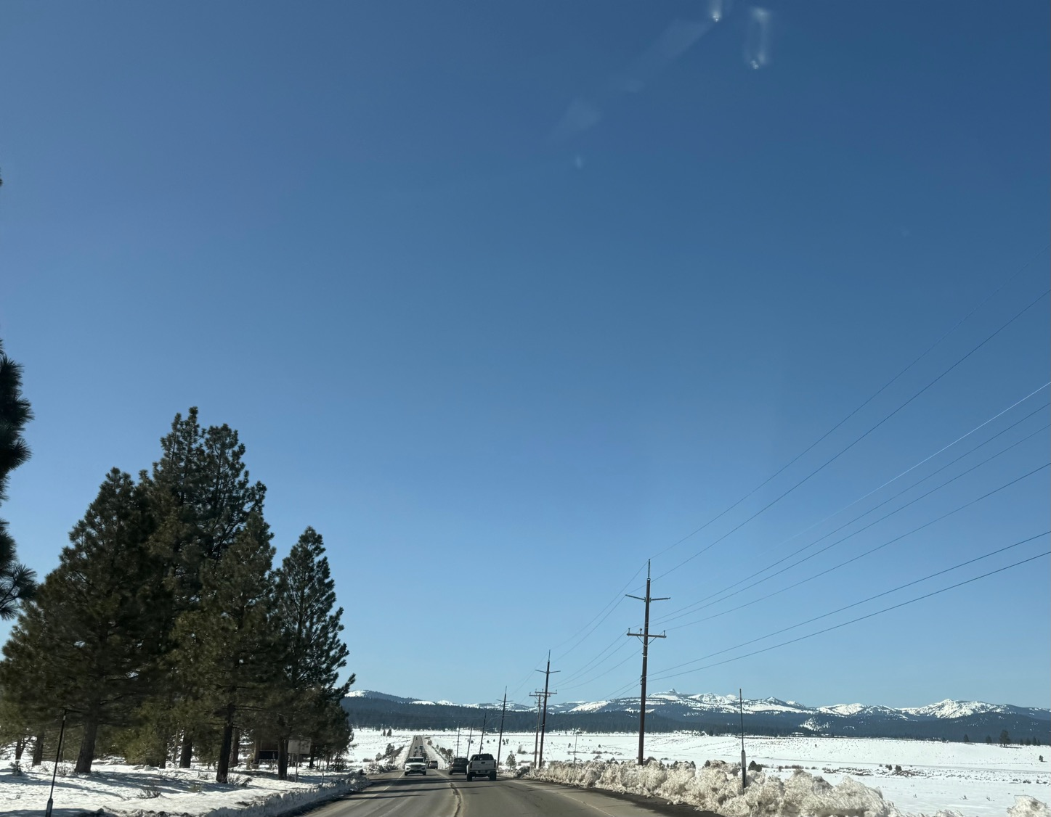

Slide 3

Trade Alert Performance
*January -4.28% Final *July +0.44% Final
*February +7.42% Final *August -4.70% Final
*March +1.34% MTD *September +00% Final
*April +15.13% Final *October -5.37% Final
*May +0.30%% Final *November +15.37 Final
*June +3.01% Final *December -2.27% Final
*2024 YTD +4.48%, versus +6.90% for the S&P 500 and
+681.11% since inception
*Versus 84.63% for all of 2022
*Versus 79.79% for all of 2023
*Average annualized return of +51.40% for 16 years

Slide 4
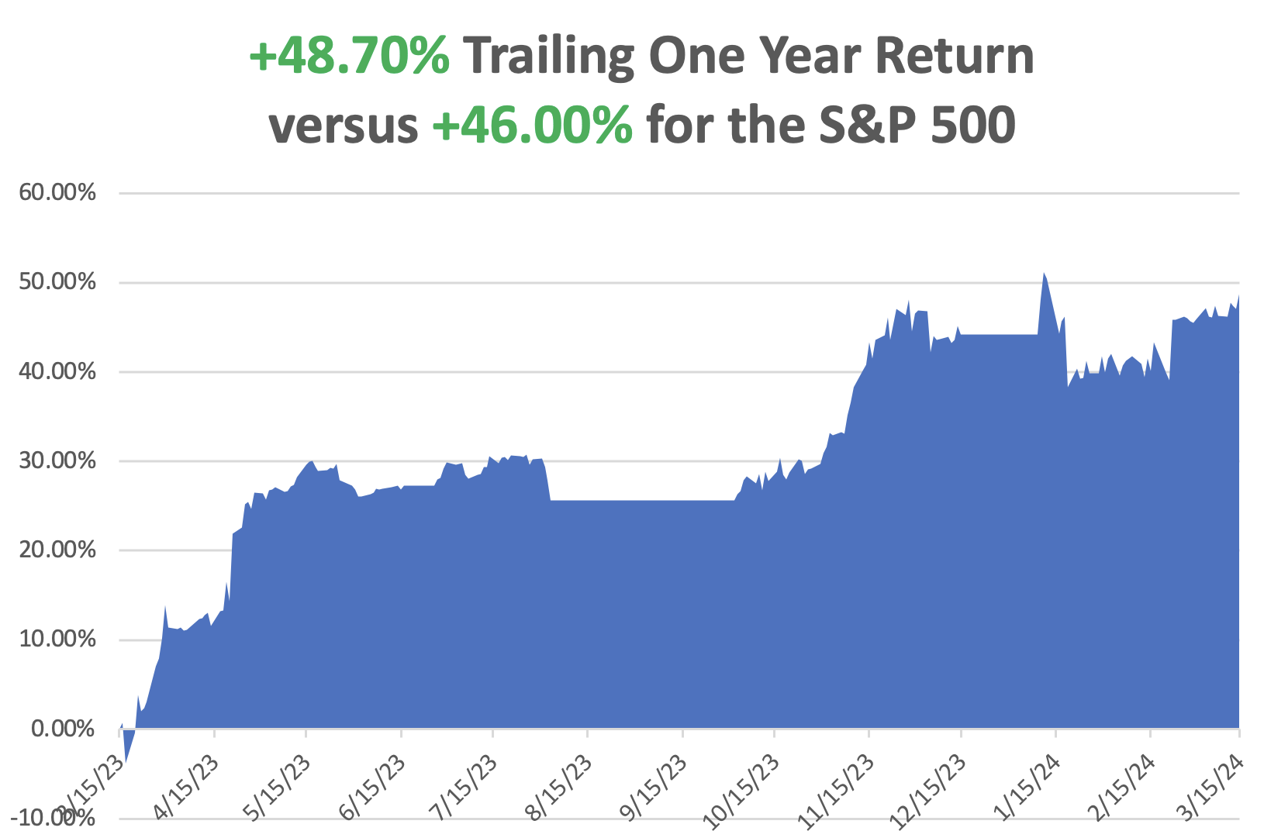

Slide 5
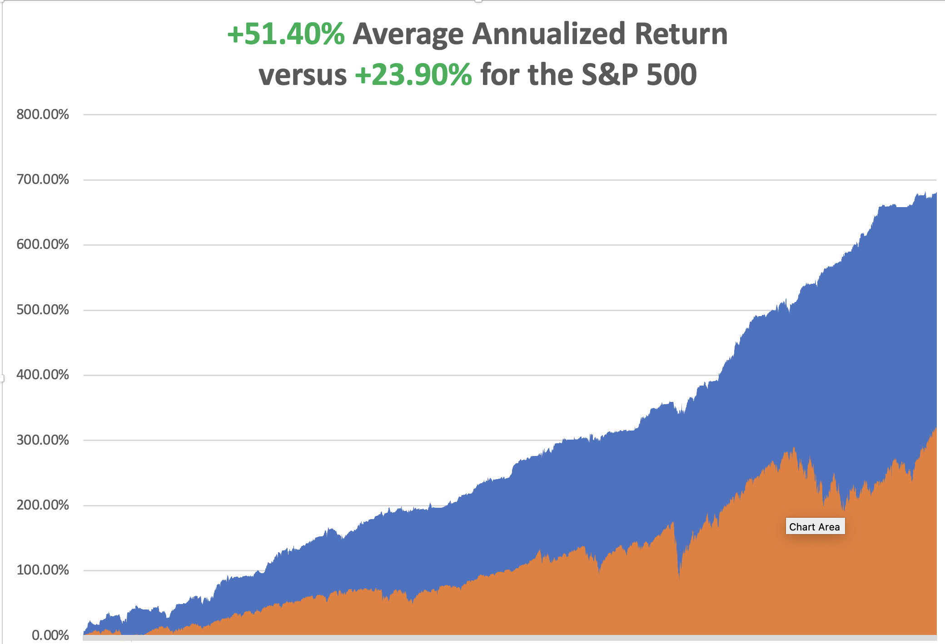

Slide 6
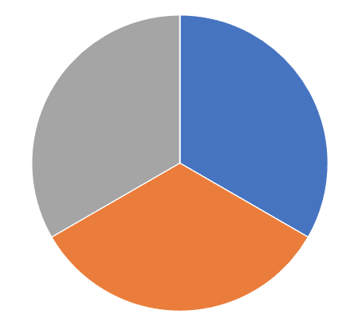
Portfolio Review – Aggressive Long
30% Long, 70% cash
Current Capital at Risk
Risk On
(TLT) 4/$87-$90 call spread | 10.00%
(FCX) 4/$37-$40 call spread | 10.00%
(XOM) 4/$100-$105 call spread | 10.00%
Risk Off
NO POSITIONS | 0.00%
Total Net Position | 30.00%
Total Aggregate Position | 30.00%
Expiration Value
+6.92%

Slide 7

The Method to My Madness
*Overheating risk is rising
*But technology stocks won’t crash, just have a sideways “time” correction
*A major sector rotation is underway Out of big tech and into and into commodities, energy, and precious metals
*All falling interest rate plays had a great week, including bonds,
precious metals, energy, and even uranium
*All economic data is globally slowing, except for the US,
with the only good economy in the world
*Buy stocks and bonds but only after substantial dips

Slide 8

The Global Economy – Even Bad News is Good News
* PPI Comes in Hotter that Hot, at 0.6%. That was higher than the 0.3% forecast from Dow Jones and comes after a 0.3% increase in January.
* CPI Comes in Hot at 0.4% in February. YOY inflation crawled up to 3.2% to 3.1% expected
* Nonfarm Payroll Report Rose 275,000 in February
* The Headline Unemployment Rate rose to 3.9%, a two-year high.
* Beige Book Comes in Moderate, saying "labor market tightness
eased further," in February but noted "difficulties persisted
attracting workers for highly skilled positions."
* JOLTS Job Openings Report Rises by 140,000 to
8,890,000, less than expected
* China Targets 5% Growth for 2024, but nobody buys it for a second.

Slide 9
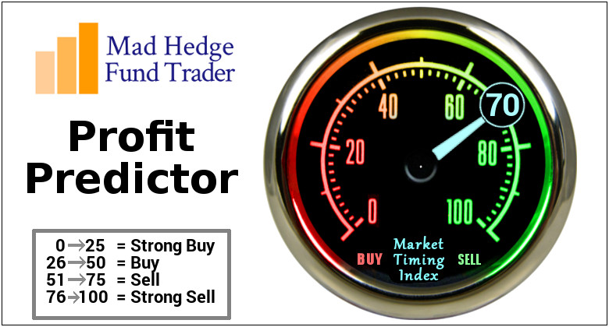
The Mad Hedge Profit Predictor
Market Timing Index – At top end of historic range
An artificial intelligence driven algorithm that analyzes 30 different economic, technical, and momentum driven indicators

Slide 10
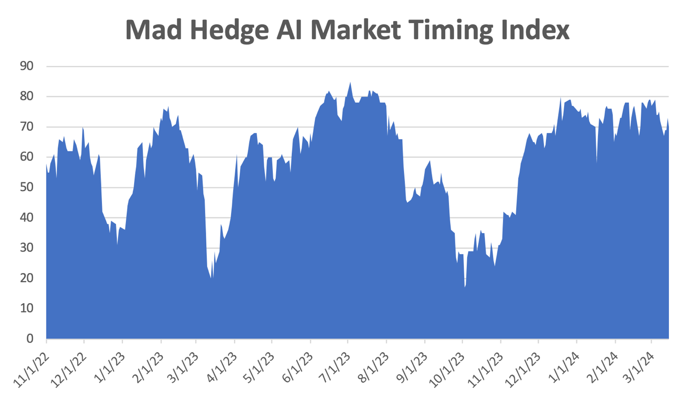
Sell Territory!! – Severe Overbought Territory
SELL
BUY

Slide 11
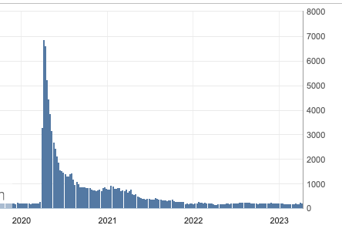
Weekly Jobless Claims – Falling
209,000 – -9,000

Slide 12

Stocks – Commodities are Back!
*NVIDIA Replaces Tesla as Top Traded Stock, with volumes migrating to the options market as well
*Fed to Scale Back Bank Capital Requirements, according to his congressional testimony Wednesday
*Rivian Shares Soar, on news it is halting plans to build a new $2.25 billion factory in Georgia
*New York Community Bancorp Bailed Out, with a cash
infusion led by former Treasury secretary Steve Mnuchin
*Target Rockets 10% on an Earnings Blowout, but the company
said it expects another year of weak sales
* Dell Becomes an AI Stock, sending the shares up 47% in a Day
*Private Equity Targets Macy’s (M), with a $6.6 billion
buyout bid, taking the shares up 16%.

Slide 13
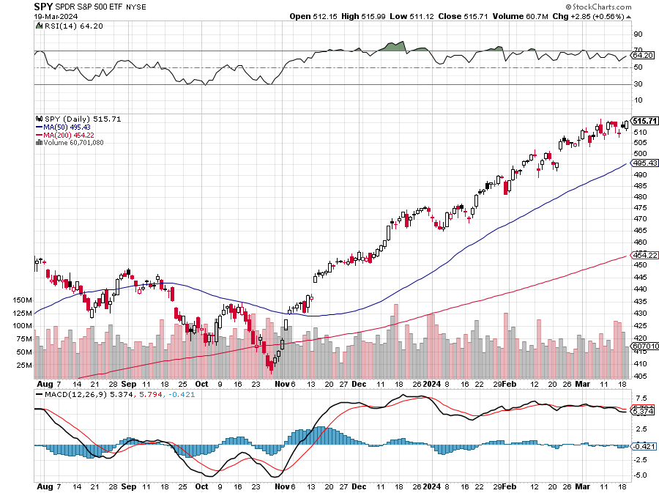
S&P 500 – New High
Yearend
Target
$600 +25%
$490
-5%
1st support

Slide 14
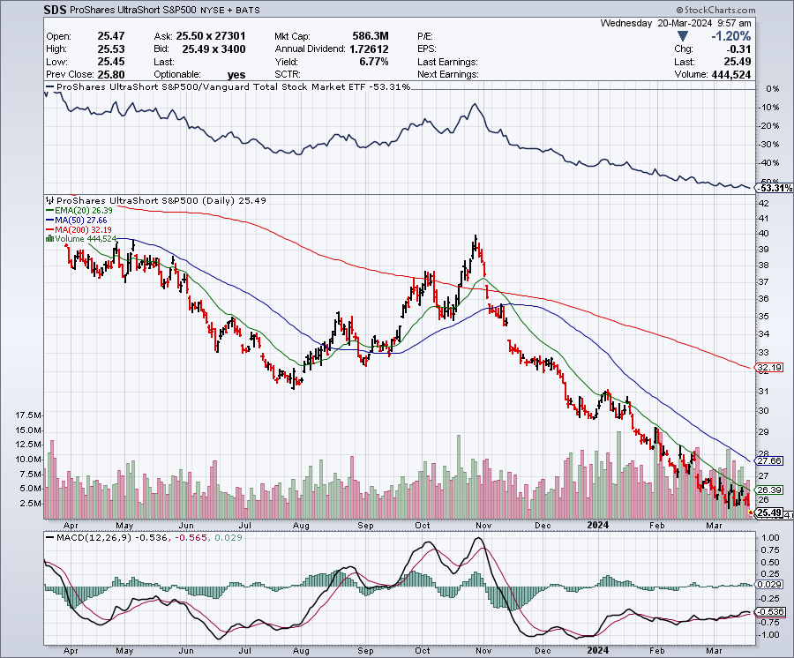
ProShares Ultra Short S&P 500 (SDS)- a great hedge for long stocks and bonds long 2X position has a hedge against longs and bond shorts

Slide 15
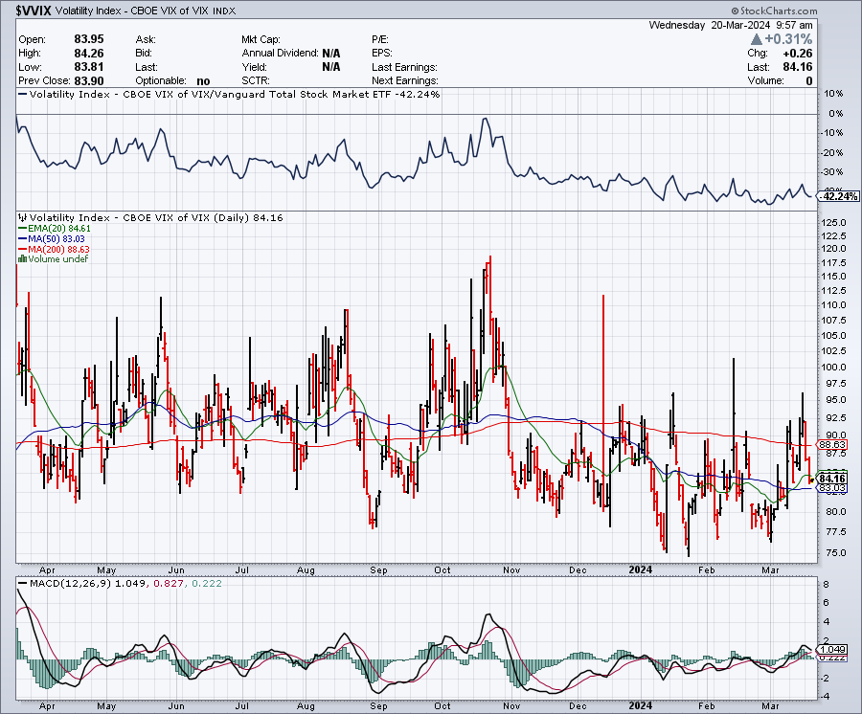
(VIX) – Bargain of the Century

Slide 16
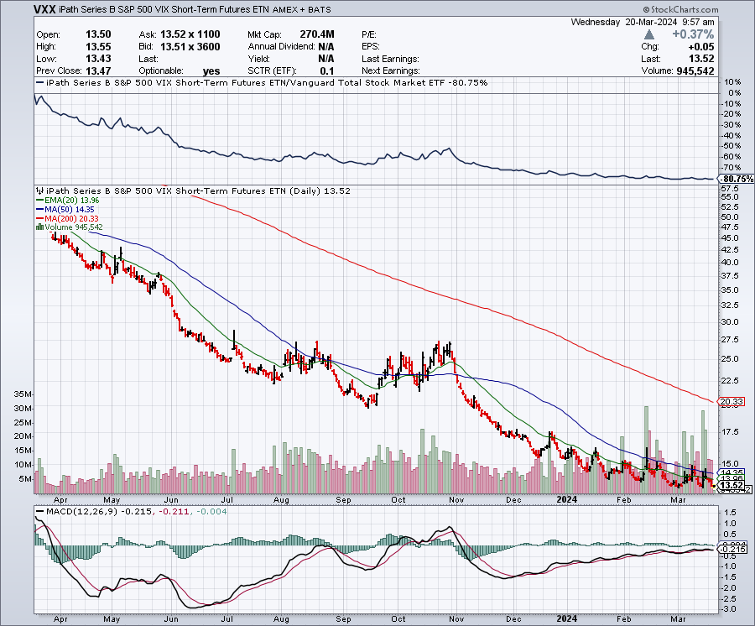
(VXX)-

Slide 17
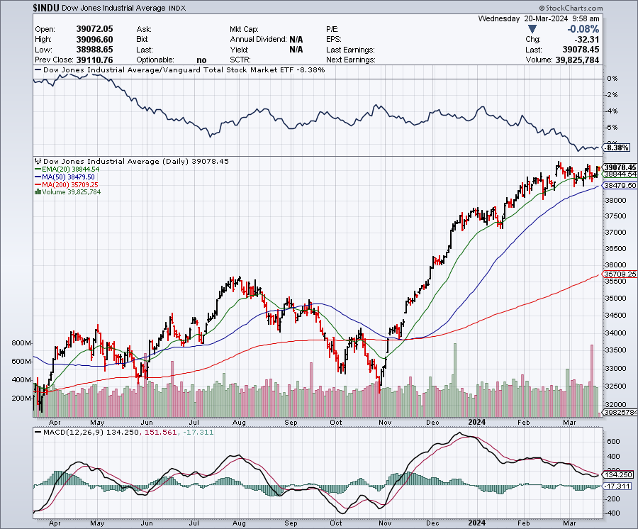
Dow Average ($INDU)-

Slide 18
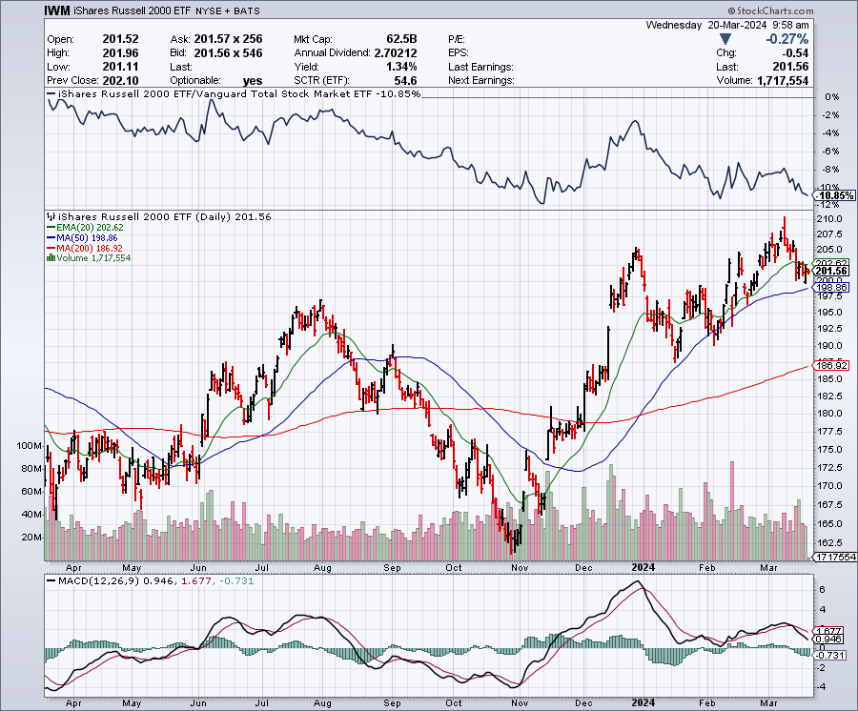
Russell 2000 (IWM)- took profits on Long 10/$137-$142 vertical bull call spread took profits on Long 10/$153-$156 vertical bear put spread

Slide 19
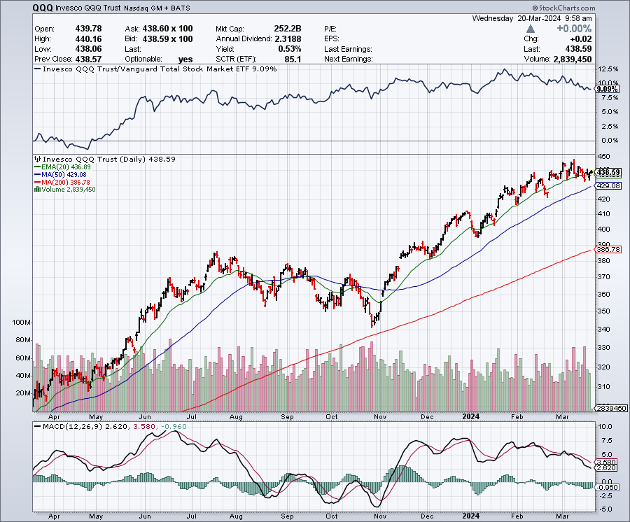
NASDAQ (QQQ) – took profits on Long 5/$335-$345 put spread took profits on long (QQQ) 1/$290-$300 put spread, took profits on long (QQQ) 4/$330-$335 put spread took profits on long (QQQ) 3/$340-$345 put spread, covered long (QQQ) $325-$330 put spread

Slide 20
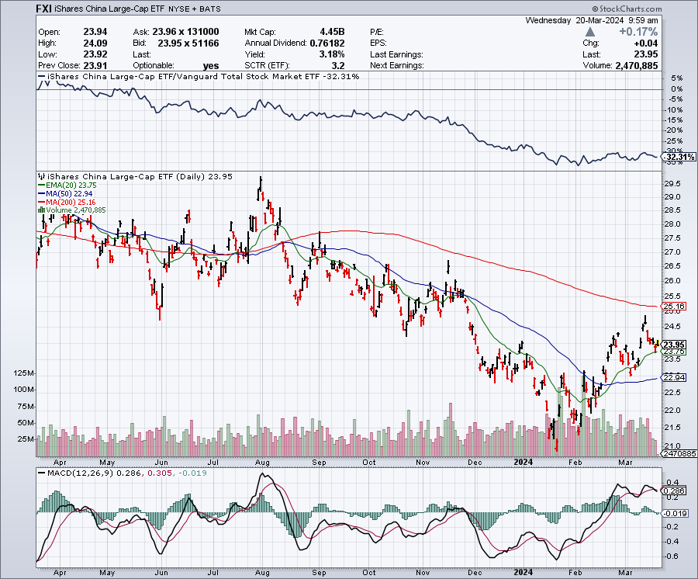
China (FXI)

Slide 21
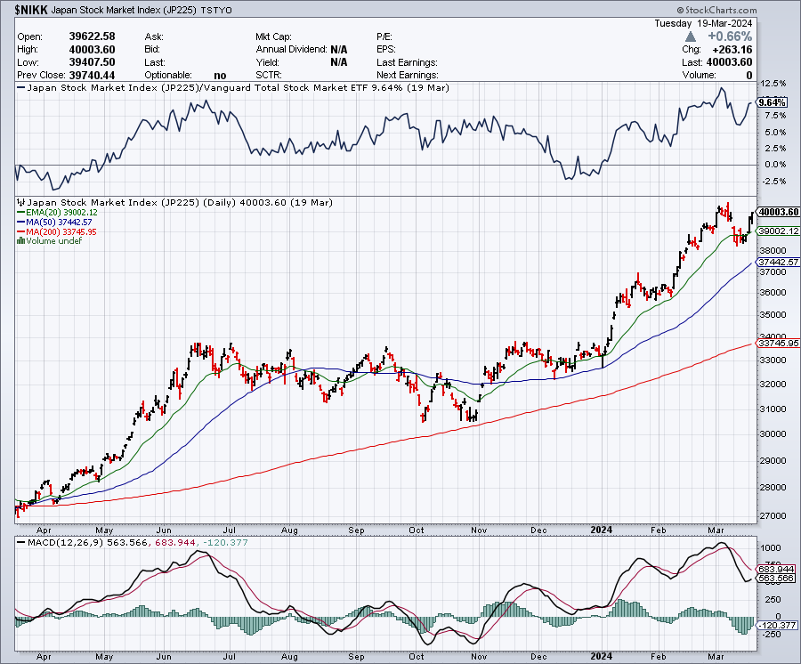
Japan ($NIKK)

Slide 22
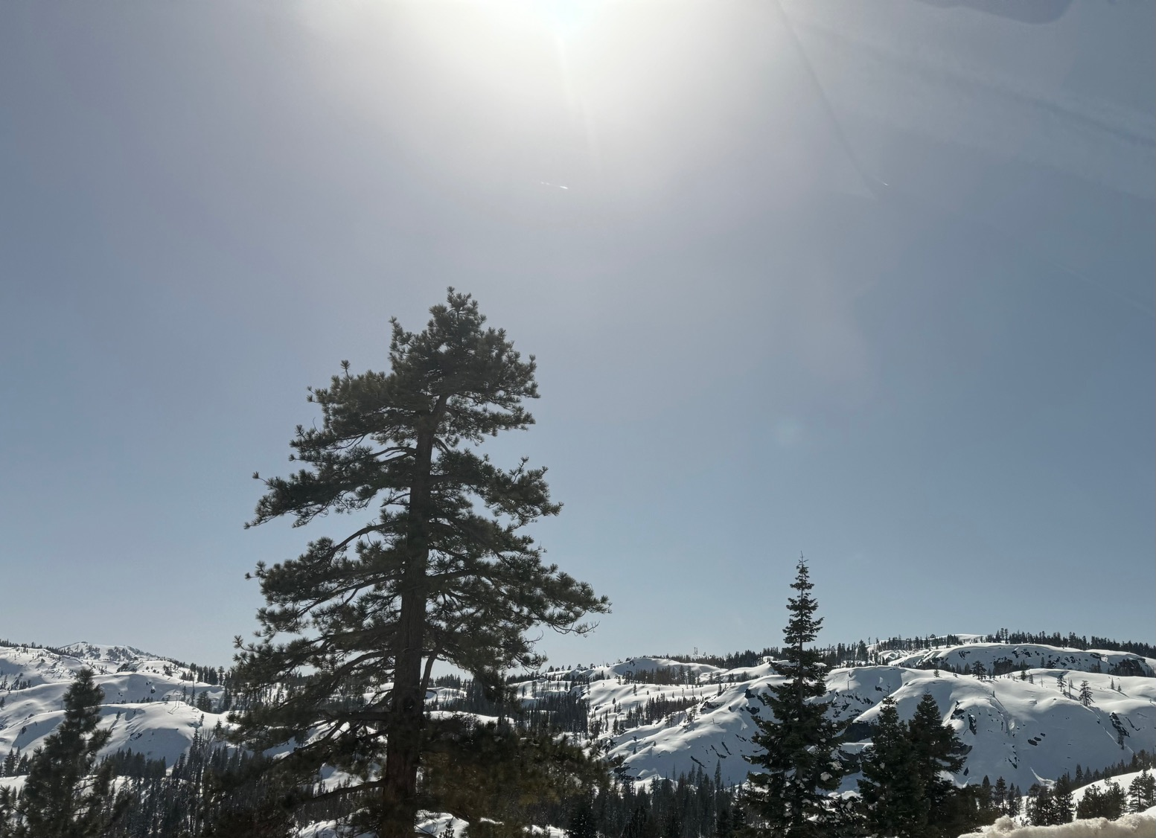

Slide 23



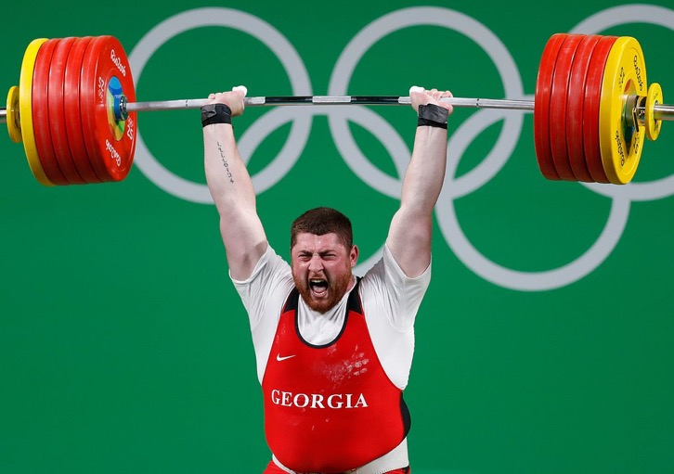
THE MAD HEDGE FUND TRADER
The Barbell Portfolio
*75% Big Tech – 2% of US workforce, 25% of market cap and 25% of US earnings
25% Domestic Recovery, including:
Railroads, airlines, cruise lines,
Couriers, steel companies
Banks, commodities
Construction
Credit Card Companies
Hotels, casinos
Online Ticket Sales

Slide 24
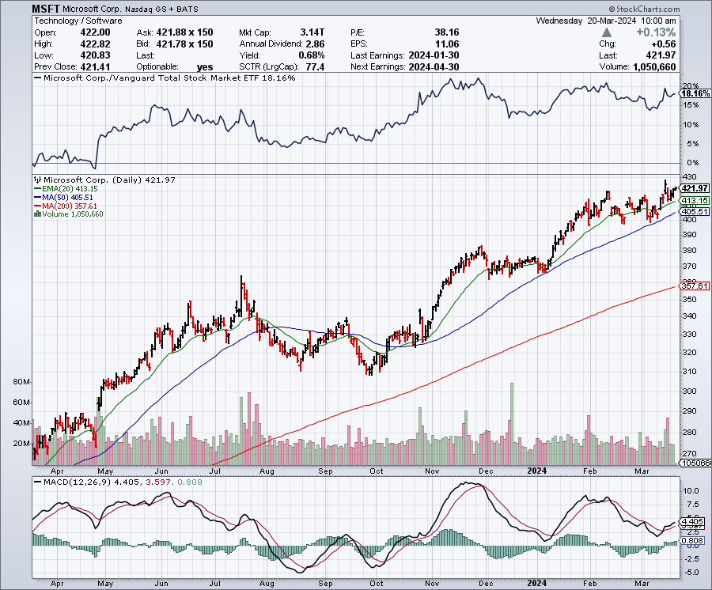
Microsoft (MSFT)- Microsoft Beats Estimates, with the steady growth of its azure cloud business
Microsoft Tops $3 Trillion Valuation, cementing its hold on the AI lead.
Took profits on long 2/$330-$340 call spread, took profits on long 12/$320-$330 call spread took profits on long 9/$235-$245 call spread, took profits on long 7/$220-$210 call spread, took profits on long 6/$220-$230 call spread, took profits on long 2/$200-$210 bear put spread

Slide 25
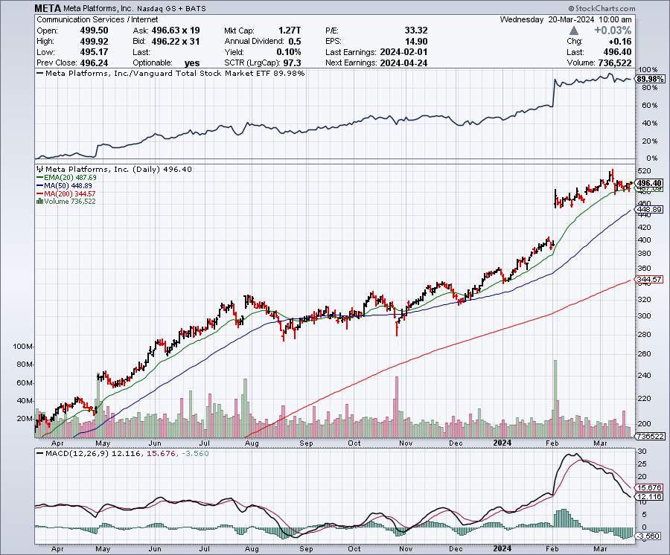
Meta (META)
Meta Rockets 21%, on a $50 billion stock buyback and its first ever dividend took profits on Long 9/$290-$300 vertical bear put spread stopped out of Long 9/$190-$200 vertical bear put spread

Slide 26
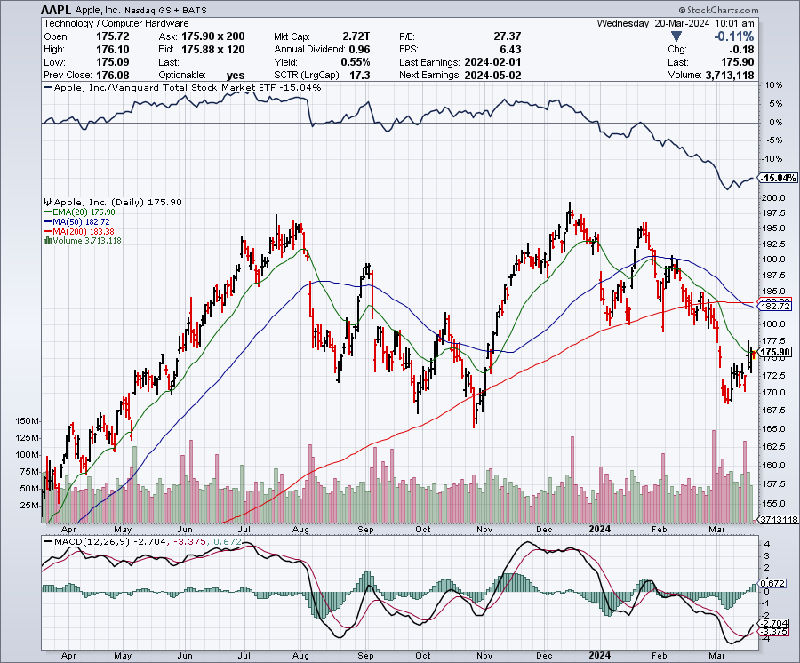
Apple (AAPL)
Google AI to Power Apple’s AI Phones took profits on long 1/$145-$155 put spread, Took profits on long 10/$165-$175 put spread took profits on long 6/$155-$165 put spread, stopped out of long 6/$125-135 call spread, took profits on long 6/$110-$120 call spread, took profits on long 2/$180-$190 put spread

Slide 27
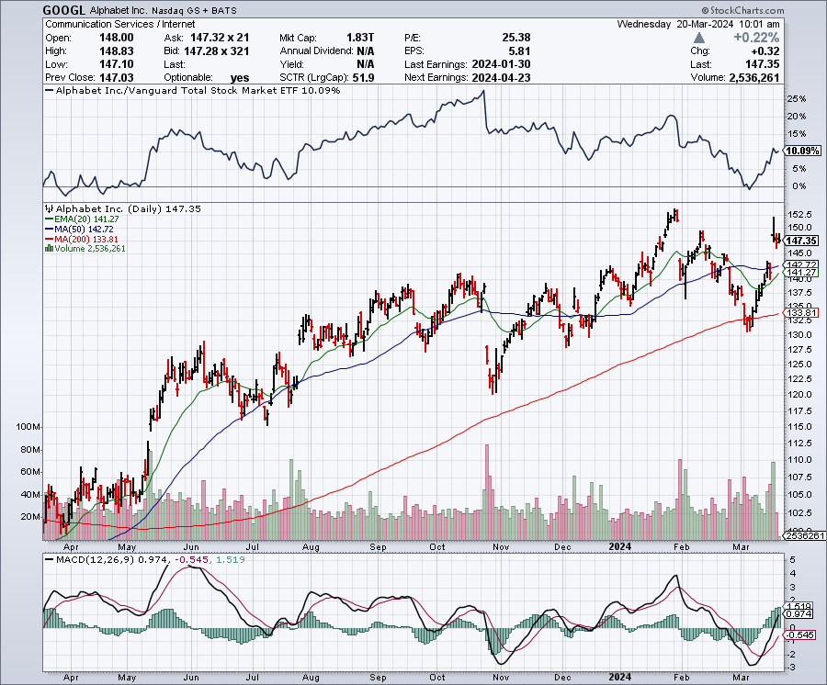
Alphabet (GOOGL) – Back in Play
Google Puts AI on Hold, at least with its Gemini image generator, which created “inaccuracies” in historical pictures took profits on long 12/$110-$120 call spread took profits on long 12/$1,200-$1,230 bull call spread, took profits on long 9/$1,030-$1,080 vertical bull call spread

Slide 28
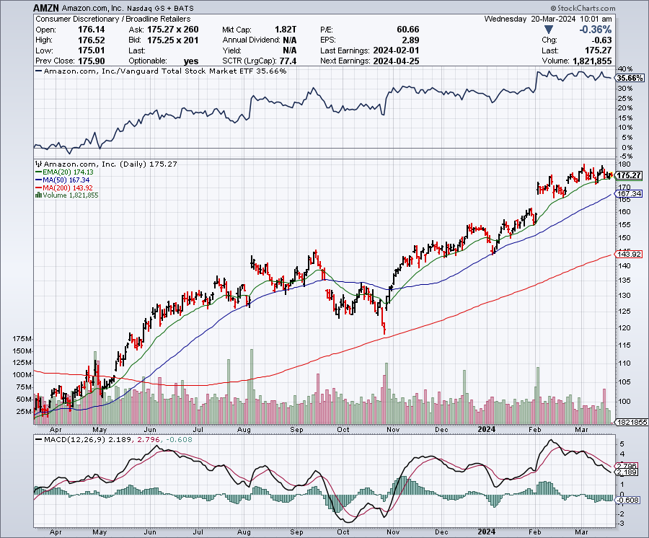
Amazon (AMZN) –
Amazon is getting added to the Dow Average, opening it up to massive index buying long 3/$155-$160 bull call spread , took profits on long 2/$130-$135 bull call spread

Slide 29
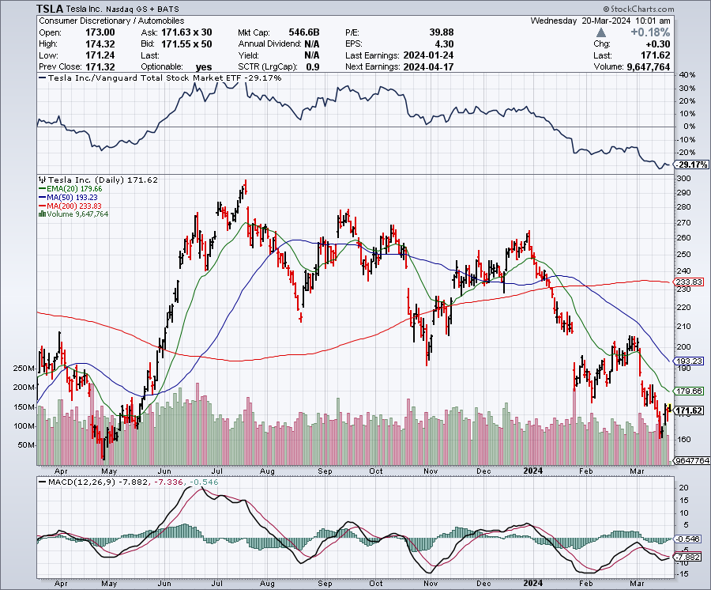
Tesla (TSLA) – The Price War Continues
Biden to Ban Chinese EV Car Imports
took profits on long 10/$200-$210 call spread
took profits on long 6/$120-$130 call spread, stopped out of long 6/$210-$220 put spread
took profits on long 5/$110-$120 call spread, took profits on long 5/$220-$230 put spread

Slide 30
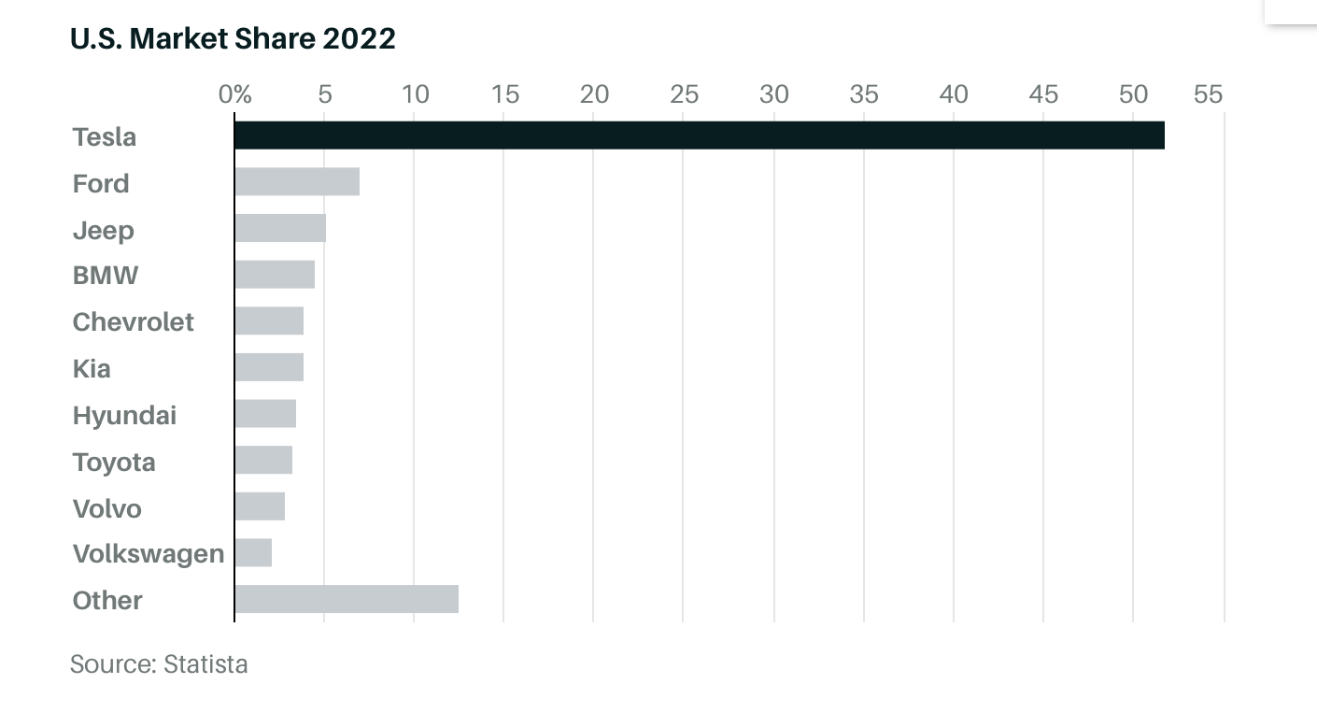

Slide 31
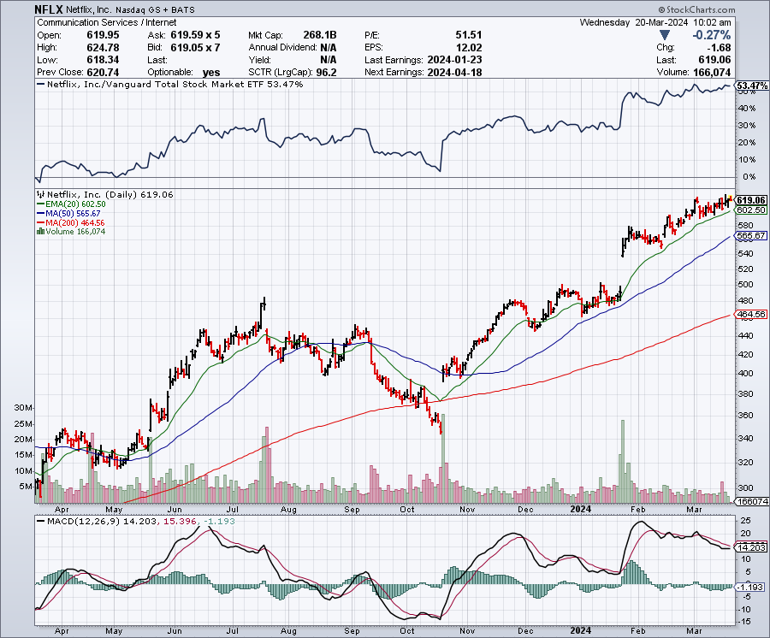
Netflix (NFLX) –
Netflix Soars on Big Subscriber Beat, up 8.6% on an add of 13 million new subscribers

Slide 32
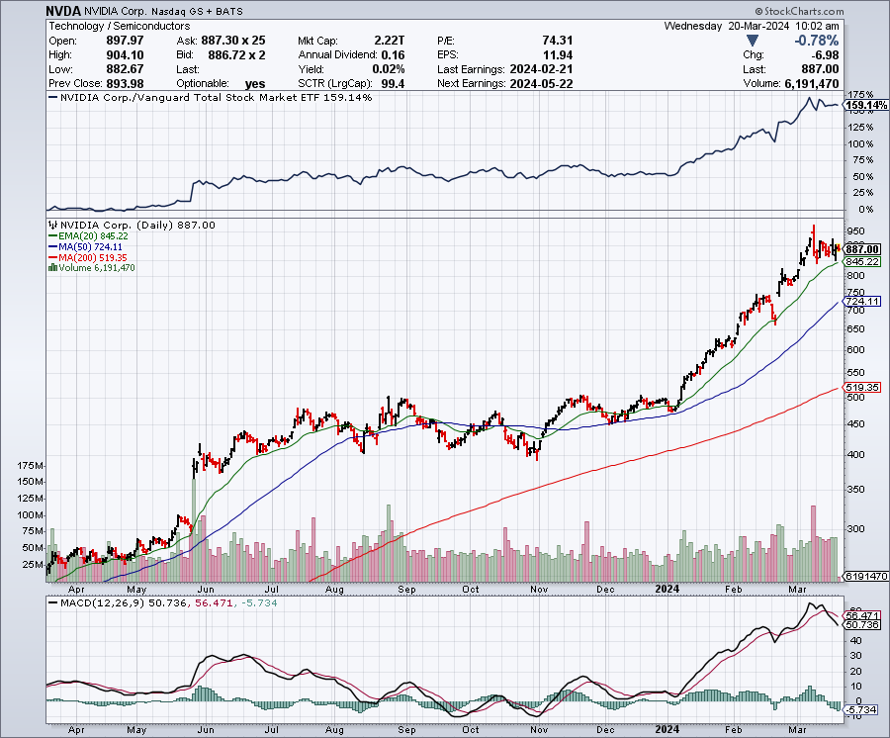
NVIDIA (NVDA) – Double Position-63% Implied on options
The NVIDIA Developer Conference is on this week, in San Jose took profits on long 3/$600-$610, took profits on long 3/$600-$610 took profits on long 2/$350-$360 call spread, took profits on long 2/$360-$370 call spread took profits on long 10/$370-$380 call spread – took profits on long 11/$370-$380 call spread took profits on long 3/$260-$270 put spread, took profits on long 10/$95-$100 call spread took profits on long 7/$120-$130 call spread, took profits on long 6/$120-$130 call spread

Slide 33
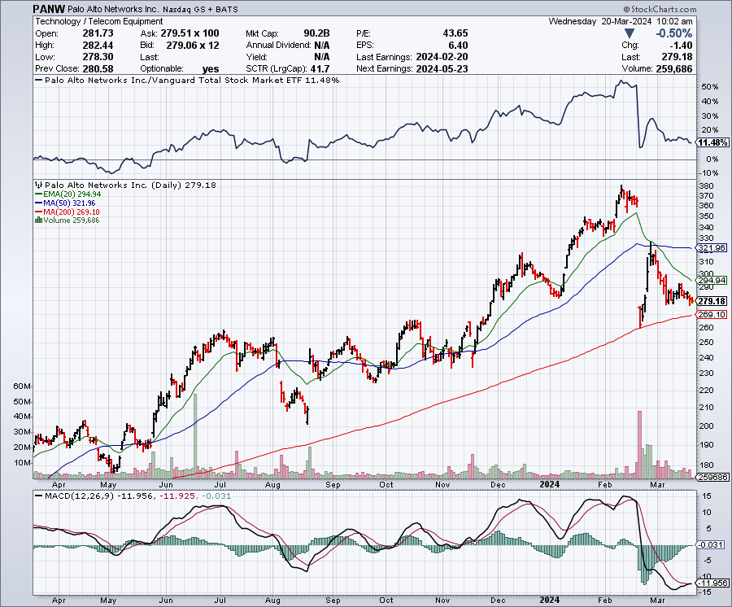
Palo Alto Networks (PANW)- Hacking never goes out of fashion
Palo Alto Networks Disappoints took profits on long 2/$260-$270 call spread, took profits on long 10/$130-$140 call spread

Slide 34
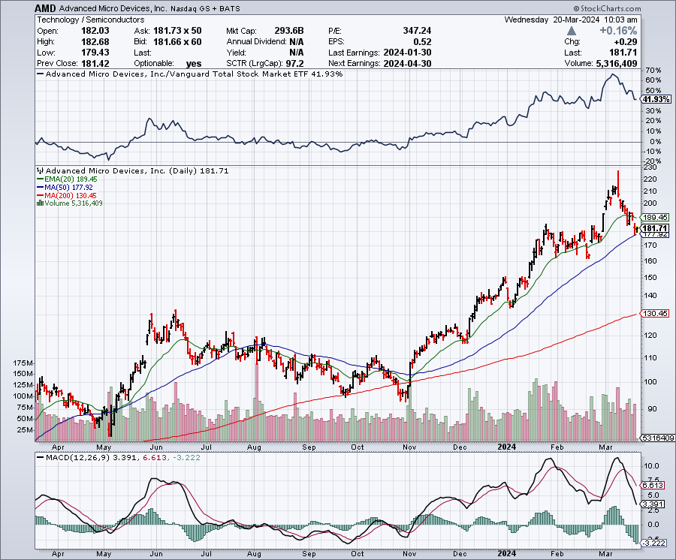
Advanced Micro Devices (AMD)- Recession fears programable logic devices took profits on long 2/$75-$80 call spread

Slide 35
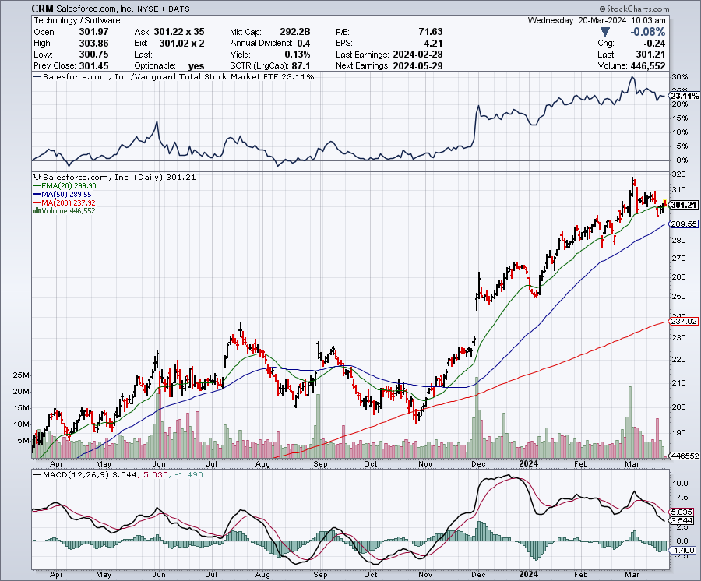
Salesforce (CRM)- Massive Online Migration
Salesforce Soars 16%, on better-than-expected guidance took profits on long 12/$185-$195 call spread took profits on long 9/$125-$130 vertical bull call spread took profits on long 8/$125-$130 vertical bull call spread

Slide 36
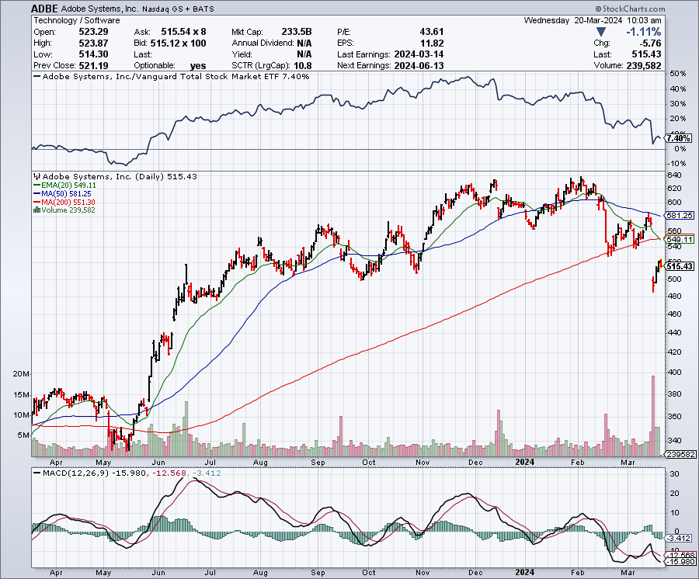
Adobe (ADBE)- Cloud play
The Quality Non-China tech play

Slide 37
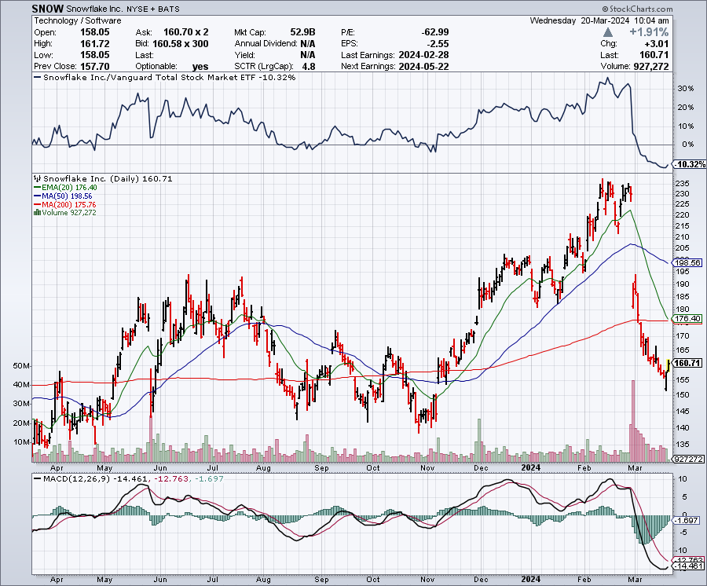
Snowflake (SNOW)- Blockbuster AI Earnings
Snowflake Crashes, down 20%, on weak guidance. CEO Frank Slootman is retiring stopped out of long 4/$150-$255 call spread, took profits on long 12/$135-$140 call spread

Slide 38
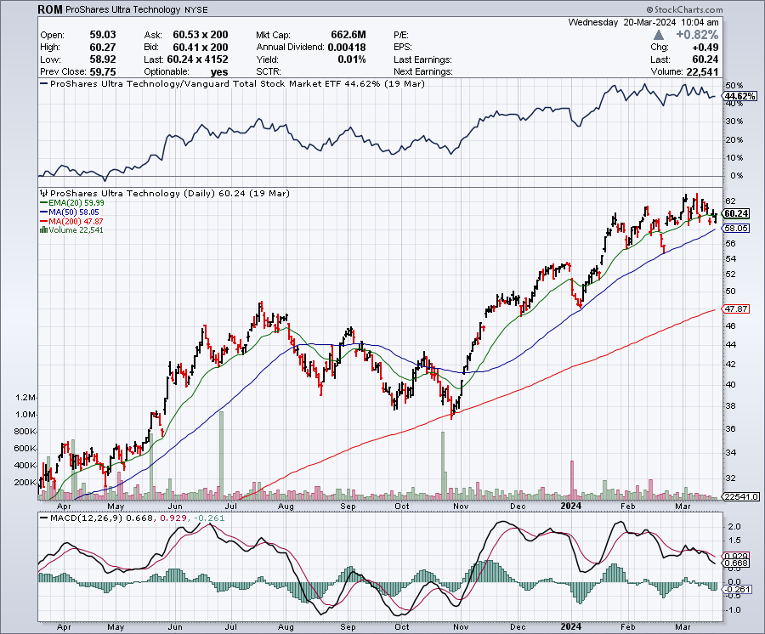
ProShares Ultra Technology ETF (ROM) – 2X Long Technology ETF took profits on long 10/$62-65 call spread

Slide 39
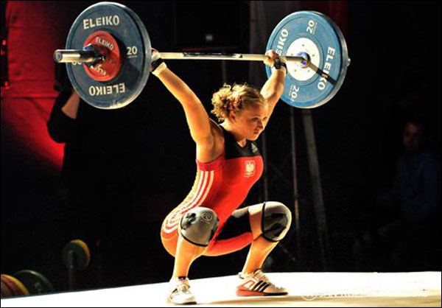
The Second Half of the Barbell
*Bets on a domestic recovery in 2022 Q4
*Upside potential in 2024 far greater than tech
*Some of these have not moved for 5 or 10 years
*Focuses on economically sensitive cyclical industries
*Makes a great counterweight to
high-growth technology
*We could spend all of next ten years rotating
between the two groups

Slide 40
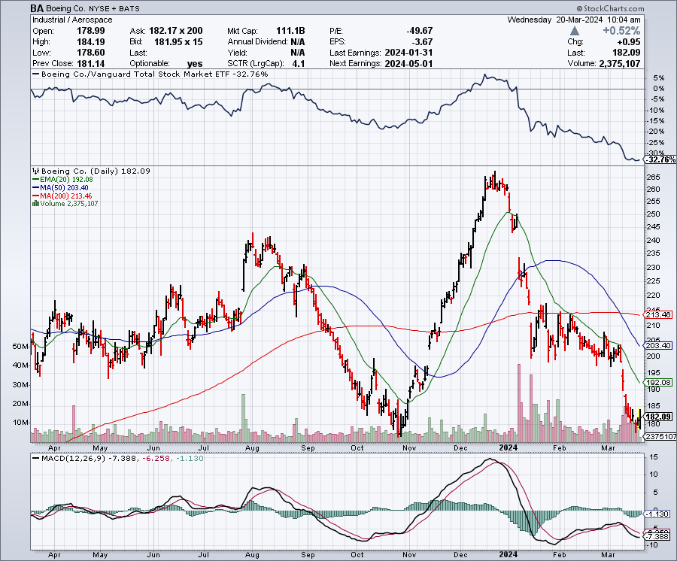
Boeing (BA) –
Boeing is Leasing 36 Airbuses, the meet its own unfilled orders caused by production delays stopped out of long 2/$190-$200 call spread, took profits on long 5/$17-$175 call spread

Slide 41
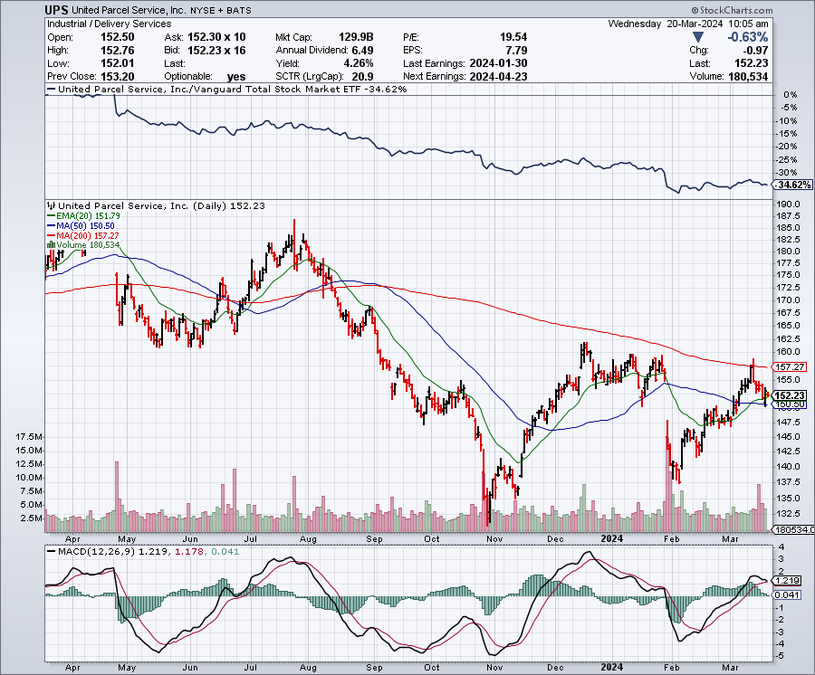
Package Delivery- United Parcel Service (UPS) – strike averted took profits on long 11/$130-$140 call spread

Slide 42
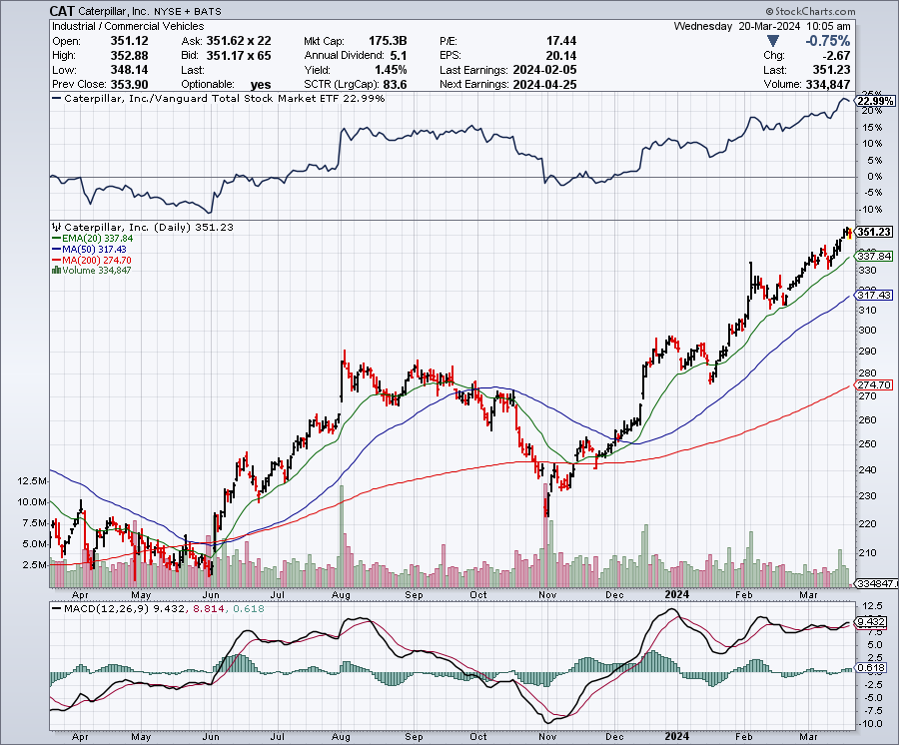
Caterpillar (CAT)- Ag + Infrastructure + Housing long 12/$220-$230 calls – expires in 2 trading days took profits on long 12/$145-$150 call spread took profits on long 11/$125-$135 call spread

Slide 43
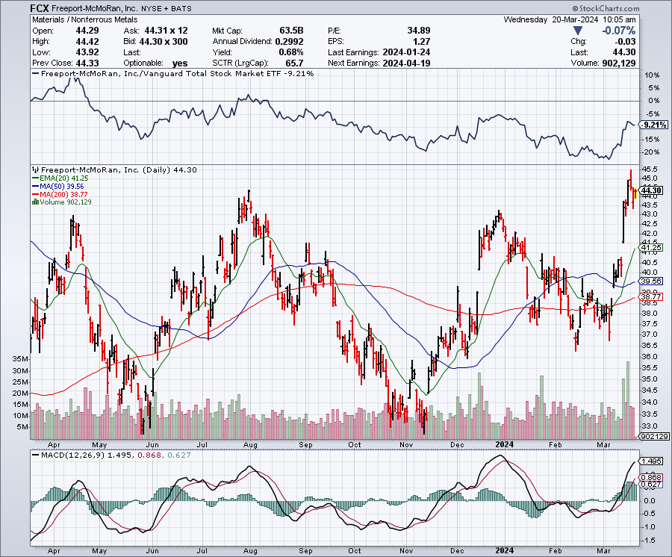
Freeport McMoRan - (FCX)- Coming Copper Crisis long 4/$37-$40 call spread, profits on long 6/$32-$35 call spread took profits on long 4/$30-$33 call spread, took profits on long 10/$20-$23 call spread

Slide 44
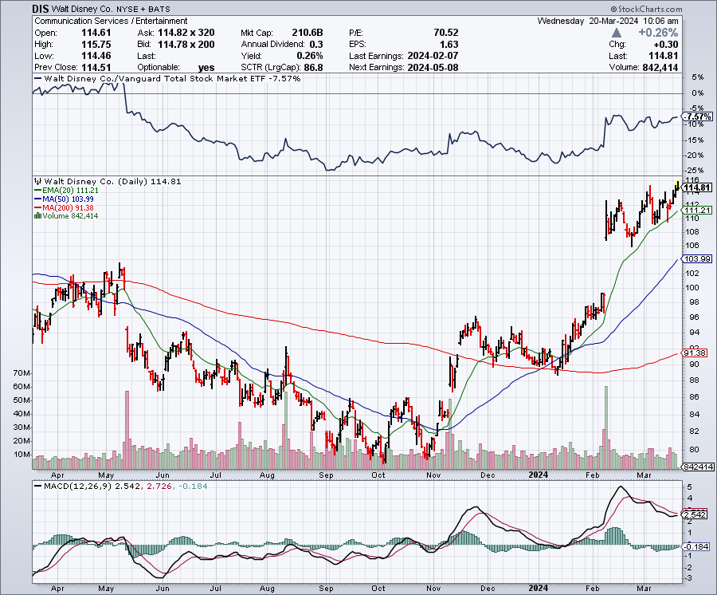
Walt Disney (DIS) -Disney Beats
Disney Buys Stake Fortnight, on of the leading online games

Slide 45
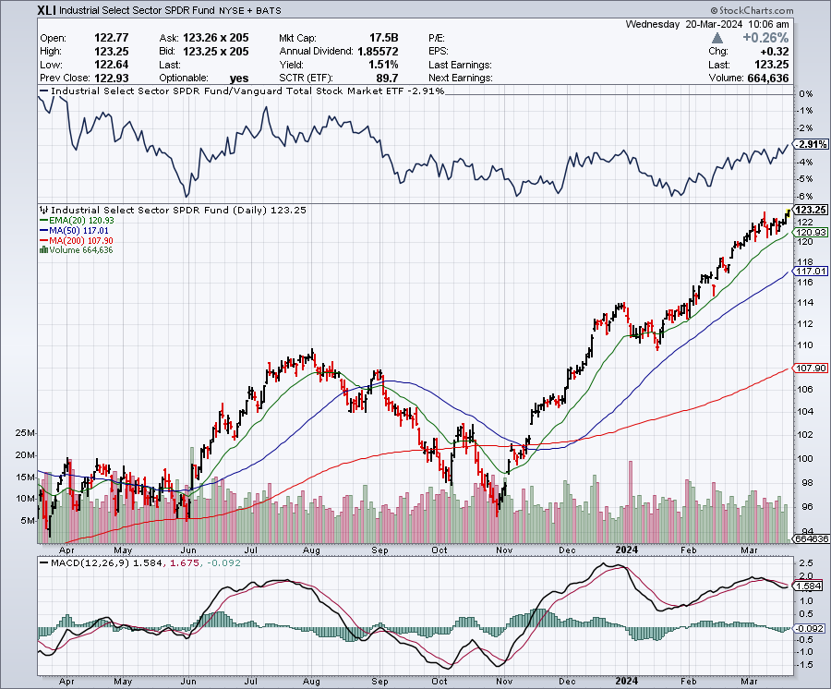
Industrials Sector SPDR (XLI)-
(GE), (MMM), (UNP), (UTX), (BA), (HON)

Slide 46
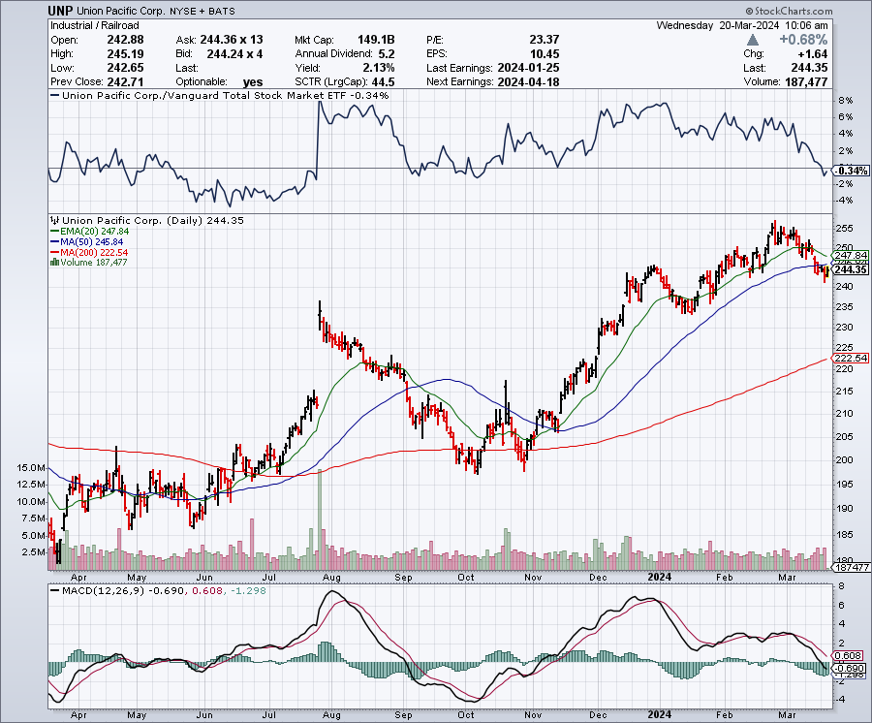
Union Pacific RR (UNP)- Big Stuff to Ship took profits on long 5/$200-$210 call spread took profits on 11/$150-$160 call spread

Slide 47
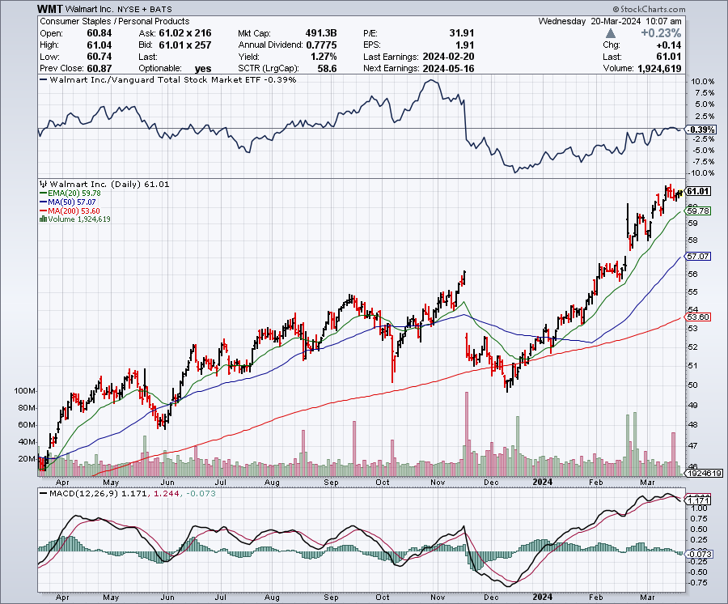
Wal-Mart (WMT)- took profit on Long 11/$125-$130 bear put spread took profit on Long 10/$119-$121 bear put spread took profits on Long 8/$114-$117 bear put spread

Slide 48
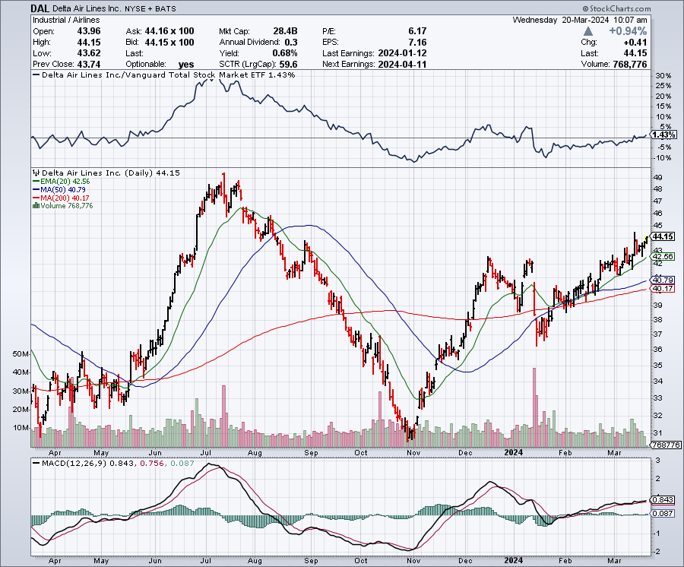
Delta Airlines (DAL) – Travel is Back!
Delta Posts Strong Earnings on Robust international travel stopped out of long 2/$35-$38 call spread

Slide 49
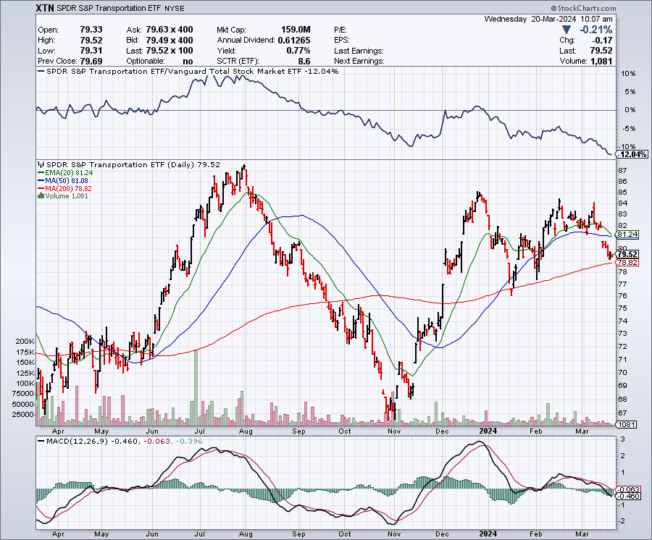
Transports Sector SPDR (XTN)- Worst Hit Sector
(ALGT), (ALK), (JBLU), (LUV), (CHRW), (DAL)

Slide 50
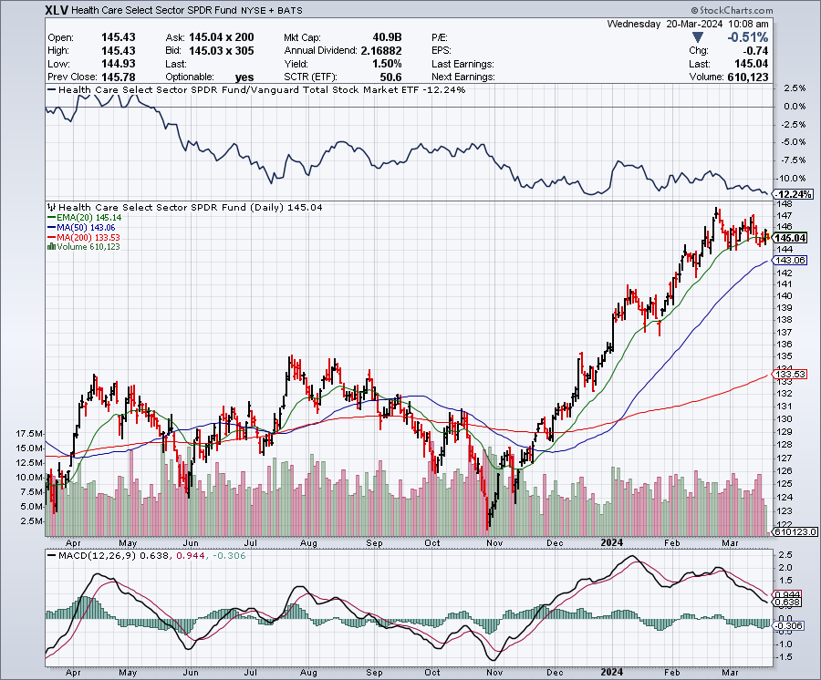
Health Care Sector (XLV)
(JNJ), (PFE), (MRK), (GILD), (ACT), (AMGN)

Slide 51
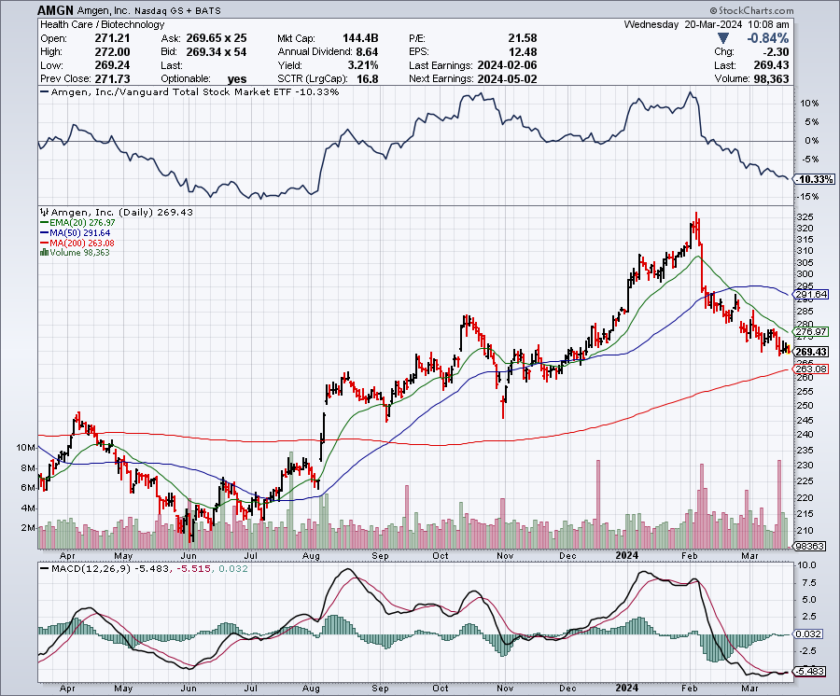
Amgen (AMGN) took profits on long 11/$185-$200 bull call spread

Slide 52
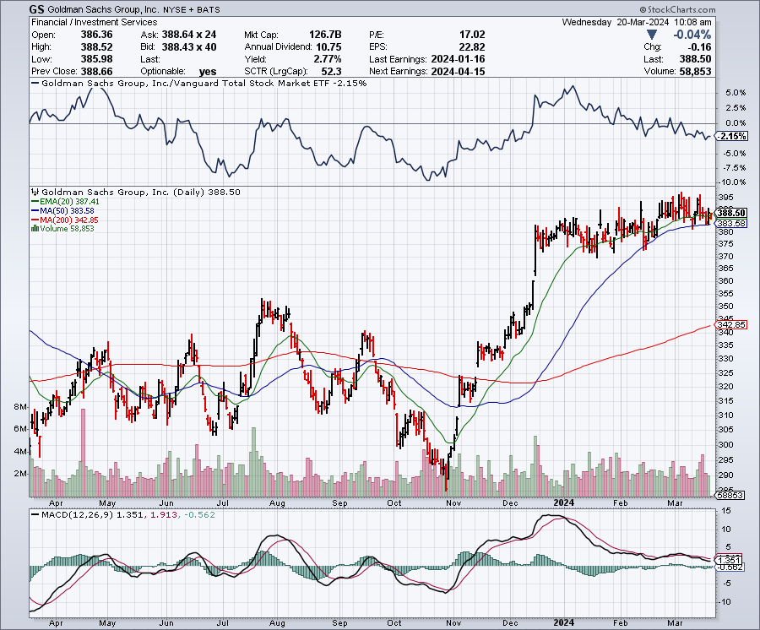
Goldman Sachs (GS) – Earnings Down but Less than Expected took profits 12/$330-$350 call spread took profits 11/$330-$350 call spread stop loss on long 11/$385-$395 call spreads

Slide 53
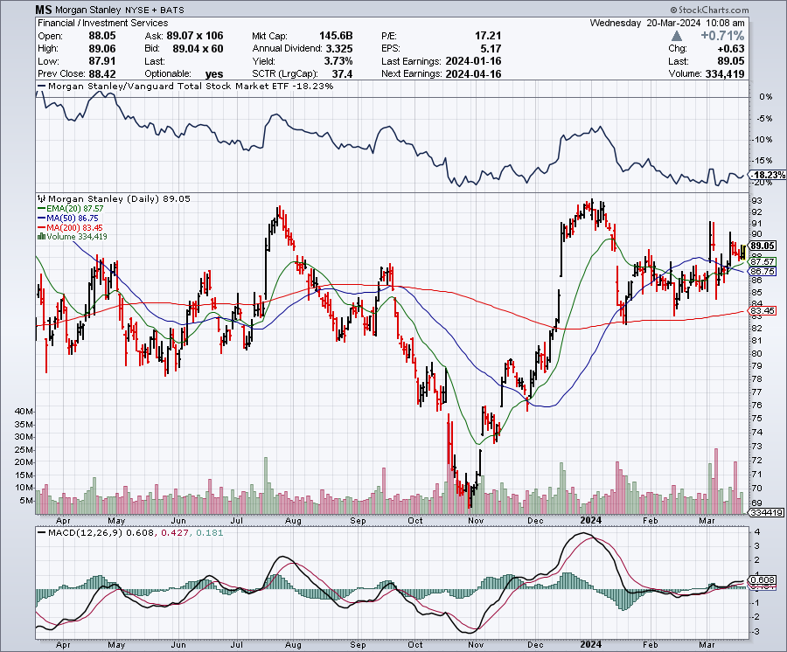
Morgan Stanley (MS) – Highest Capital ratio net of mark to market
CEO to Step Down in a Year took profits on long 4/$65-$70 call spread

Slide 54
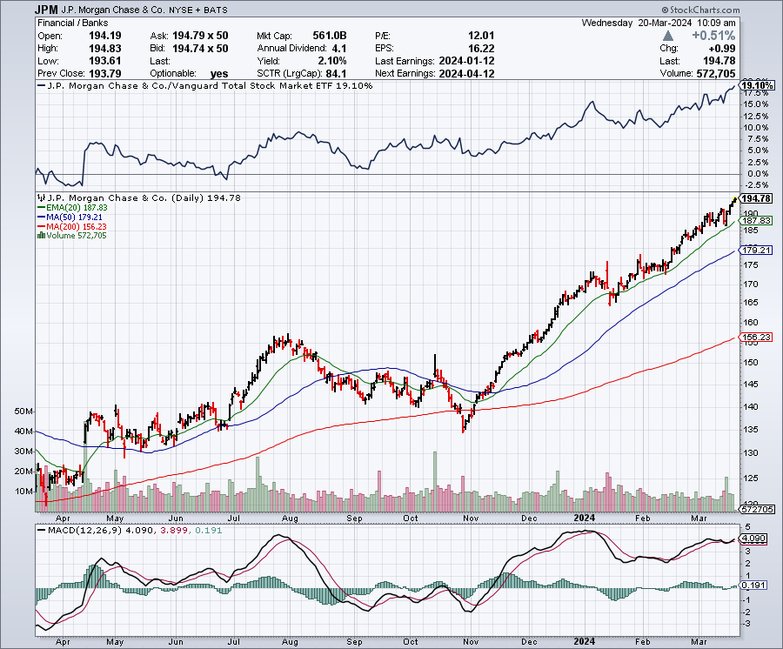
JP Morgan Chase (JPM) – Monster Earnings Surprise
CEO Jamie Diamond Sell $150 Million in (JPM) Shares took profits on long 4/$105-$115 call spread

Slide 55
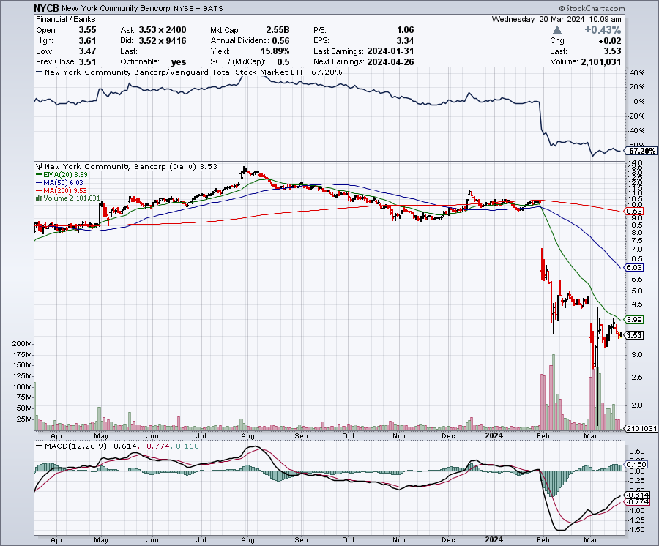
New York Community Bank (NYCB) – Dividend Cut -62% took profits on long 4/$105-$115 call spread

Slide 56

Bank of America (BAC) – Bank of America Rips, on a great earnings report took profits on long 4/$20-$23 call spread

Slide 57

Citigroup (C) – took profits on long 4/$30-$35 call spread

Slide 58

Charles Schwab (SCHW) – LEAPS up 67% in three months took profits on long 4/$30-$35 call spread

Slide 59

Interactive Brokers (IBKR) – Best Risk Control took profits on long 4/$60-$65 call spread

Slide 60

SPDR Metals & Mining ETF (XME) – long 2/$28-$30 call spread

Slide 61

Blackrock (BLK)-Asset Collection Boom took profits on long 3/$770-$790 call spread took profits on long 3/$310-$340 call spread

Slide 62

Visa (V) – Inflation boost
Transaction grew by an inflationary 10% back to pre-pandemic levels took profits on long 2/$240-$250 bull call spread took profits on long 10/$160-$170 bull call spread, took profits on long 6/$150-$160 bull call spread

Slide 63

Consumer Discretionary SPDR (XLY)
(DIS), (AMZN), (HD), (CMCSA), (MCD), (SBUX)

Slide 64

Berkshire Hathaway (BRKB)- Natural Barbell to Top $1 Trillion in a Year, up from the current $900 billion took profits on long 12/$320-$330 call spread took profits on long 4/$260-$270 call spread, took profits on long 1/$290-$300 call spread took profits on long 10/$220-$230 call spread, took profits on long 7/$220-$230 call spread took profits on long 7/$220-$230 call spread, took profits on long 6/$260-$270 call spread

Slide 65

Europe Hedged Equity (HEDJ)-

Slide 66

Japan (DXJ)-

Slide 67

Emerging Markets (EEM) - Pro trade, Weak Dollar, Long Recovery Play
Traders are Lining up for a Big Emerging Market Bet. Falling US interest rates will bring a weak US dollar and runaway bull markets in most emerging markets, which have remained unchanged for more than a decade

Slide 68


Slide 69

Bonds – Doldrums
*Bond Investors are Moving Out the Risk Curve
*The U.S. market for one of the riskiest types of corporate debt is resurging this year, as companies cater to investor demand for assets that can lock in high yields for several years ahead of an expected decline in interest rates.*
*Holders of these bonds, called junior subordinated debt, are among the last to be paid in case of a default and companies can defer interest payments
*The word is out: interest rates are falling
*Europe Moves Towards Interest Rate Cuts, igniting a global bond market rally
*US National Debt is Rising by $1 Trillion Every 100 Days.
A trillion here, a trillion there, sooner or later that adds up to a lot of money.
*Bonds may have put in a bottom, markets unable
to take prices any lower, yields any higher with
the current interest rate outlook

Slide 70

Treasury ETF (TLT) – Dead in the Water
Long 2/$90-$93 call spread,
Took profits in $100-$103 put spread, took profits on long 12/$95-$98 put spread took profits on long 12/$79-$82 call spread, took profits on long 11/$76-79 call spread,

Slide 71

Ten Year Treasury Yield ($TNX) – 4.32%

Slide 72

Junk Bonds (JNK) 7.33% Yield

Slide 73

Municipal Bonds (MUB) 3.07% Yield-

Slide 74

Emerging Market Debt (ELD) 6.35% Yield-

Slide 75

2X Short Treasuries (TBT)-Out of Favor

Slide 76

Anally Capital Management (NLY) – Leveraged REIT Play
Yield 13.63% took profits on long 12/$15-$16 call spread

Slide 77


Slide 78

Foreign Currencies – Another Run at the Dollar Highs
*Higher for Longer Rates means higher for Longer Greenback
*Bank of Japan Cuts Interest Rates, bringing to an end a 34-year stimulus program that was a dismal failure
*The Japanese yen should rocket but collapsed instead.
*US Dollar Holds Three Month Highs
*You need falling interest rates for a weak dollar
*A dollar rally could last a couple of months,
so a new currency entry point is approaching
*However, eventual falling interest rates guarantee
a falling dollar for 2024

Slide 79

THE MAD HEDGE FUND TRADER
Australian Dollar (FXA) - Major Long-Term Bottom is In Targeting Parity – A call option on a global synchronized recovery
1:1
BUY

Slide 80

Japanese Yen (FXY)

Slide 81

Euro (FXE)-
2023
Target
25%

Slide 82

British Pound (FXB)-
2023
Target
15%

Slide 83


Emerging Market Currencies (CEW)
2023
Target
40%

Slide 84


Slide 85

Energy & Commodities –Range Bound
*A global commodity rally has dragged oil up
*US continues to dominate markets with 13 million barrels/day production
*The US has saved Europe’s bacon with 1,300 takers of naturals gas in two years, replacing Russia practically overnight
*In the meantime, coal has plunged from 50% to 19% of US electricity output in 20 years
*Electrification of the US economy will continue
to be a driving theme.
* The Uranium Shortage is Getting Extreme, with yellow cake up 112%
in a year. owners of left-for-dead uranium mines are restarting operations
to capitalize on rising demand for the nuclear fuel.
* AI is Finding New Copper Deposits

Slide 86

Oil-($WTIC)

Slide 87

United States Oil Fund (USO)

Slide 88

Energy Select Sector SPDR (XLE)-No Performance!
(XOM), (CVX), (SLB), (KMI), (EOG), (COP)

Slide 89

ExxonMobile (XOM)-
Exxon Moves Big into Lithium, with the construction of a major mining operation in Arkansas
Long 4/$100-$105 call spread took profits on long 12/$120-$125 put spread

Slide 90

Occidental Petroleum (OXY)- Buffet’s a Buyer took profits on long 2/$55-$60 call spread took profits on long 12/$77.50-$82.50 put spread

Slide 91

Natural Gas (UNG) – Free Fall on Warm Winter took profits on Long January 2025 $7-8 Call Spread LEAPS

Slide 92

Freeport McMoRan (FCX) -
Codelco Sees Profit Slump, the world’s largest copper producer based in Chile

Slide 93

Cameco (CCJ) – Global Uranium Renaissance
Uranium Goes Nuclear, with yellow cake prices up 45% since May long 12/$35-$38 call spread – expires in 12 trading days took profits on long 5/$20-$23 bull call spread

Slide 94


Slide 95

Precious Metals – Signs of Life
*Precious metals have a great week on slightly falling rates
*Gold needs a return of falling interest rates to resume rally
*Miners are lagging gold performance but will play catch up
*Investors are picking up gold as a hedge for 2024 volatility
*Gold headed for $3,000 by 2025, but back off first from new all-time highs
*Silver is the better play with a higher beta
*Russia and China are also stockpiling gold to sidestep
international sanctions

Slide 96

Gold (GLD) - Deflation call took profits on long 5/$165-$170 bull call spread

Slide 97

Market Vectors Gold Miners ETF- (GDX) –

Slide 98

Barrick Gold (GOLD) took profit on long 1/$15.50-$16.50 call spread

Slide 99

Newmont Mining- (NEM)- took profits on long $55-60 call spread

Slide 100

Silver- (SLV)- took profits on long 11/$19-$20 call spread

Slide 101

Silver Miners - (SIL)-

Slide 102

Wheaton Precious Metals - (WPM)- took profits on long 1/$36-$39 call spread

Slide 103

Platinum- (PPLT)- 556,000-ounce shortage this year took profits on long 1/$36-$39 call spread

Slide 104


Slide 105

Real Estate – Demographic Tailwind
*Home prices have risen 2.4 times faster than the inflation rate since 1963.
*Gail force demographic tailwinds are the reason helped by a chronic housing shortage
*New Home Sales Weaken, curbed by frigid weather increasing 1.5% to a seasonally adjusted annual rate of 661,000 units in January
*But demand for new construction remains underpinned by a persistent
shortage of previously owned homes
*Toll Brothers Rocks, taking the shares up 6%, with extremely strong
demand for new homes on the horizon. The gale force demographic
tailwind continues.

Slide 106

S&P Case Shiller Turns Hot
S&P Case Shiller Rises to +4.60% YOY in October, with its National Home Price Index
Detroit gained +8.2%, San Diego +8.0%, and New York +7.1%.

Slide 107

Crown Castle International (CCI) – 5.45% yielding 5G cell phone tower REIT
Eliot Management Pushes up stock with activist bid

Slide 108

US Home Construction Index (ITB)
(DHI), (LEN), (PHM), (TOL), (NVR)

Slide 109


Slide 110

Trade Sheet-
So What Do We Do About All This?
*Stocks – buy any dips
*Bonds – buy dips
*Commodities-buy dips
*Currencies- sell dollar rallies, buy currencies
*Precious Metals – buy dips
*Energy – buy dips
*Volatility - buy $12
*Real estate – buy dips

Slide 111

Next Strategy Webinar
12:00 EST Wednesday, April 3 from Key West, Florida email me questions at support@madhedgefundtrader.com
Good Luck and Good Trading!
Notes:
*

Slide 112


