Slide 1
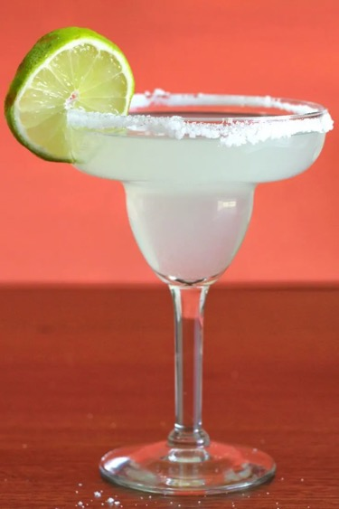
The Mad Hedge Fund Trader
“The Three Margarita Webinar”
With John Thomas
Key West, Florida April 3, 2024
www.madhedgefundtrader.com
Notes:
*

Slide 2
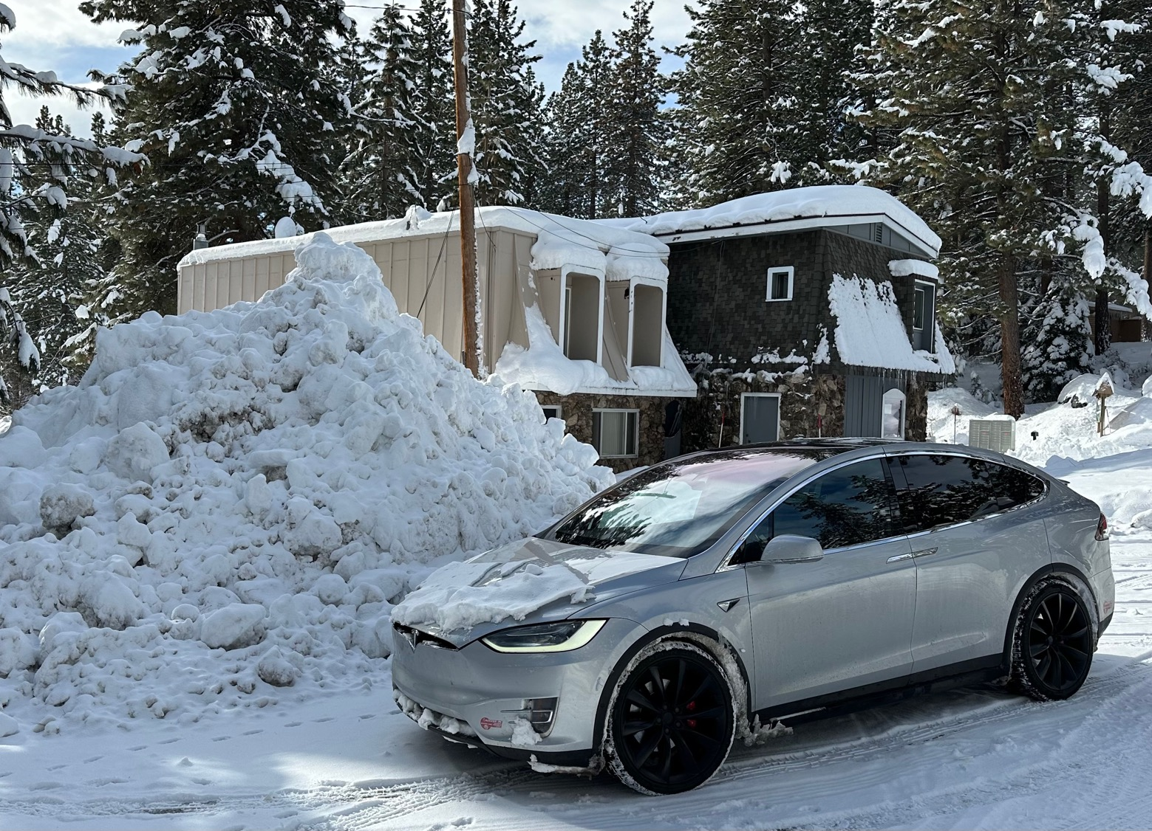

Slide 3


Slide 4
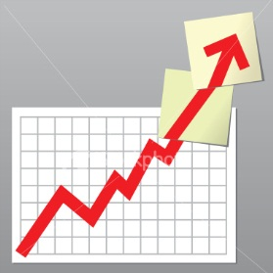
Trade Alert Performance
*January -4.28% Final *July +0.44% Final
*February +7.42% Final *August -4.70% Final
*March +6.23% Final *September +00% Final
*April -2.00% MTD. *October -5.37% Final
*May +0.30%% Final *November +15.37 Final
*June +3.01% Final *December -2.27% Final
*2024 YTD +9.38%, versus +8.59% for the S&P 500 and
+686.00% since inception
*Versus 84.63% for all of 2022
*Versus 79.79% for all of 2023
*Average annualized return of +51.40% for 16 years

Slide 5
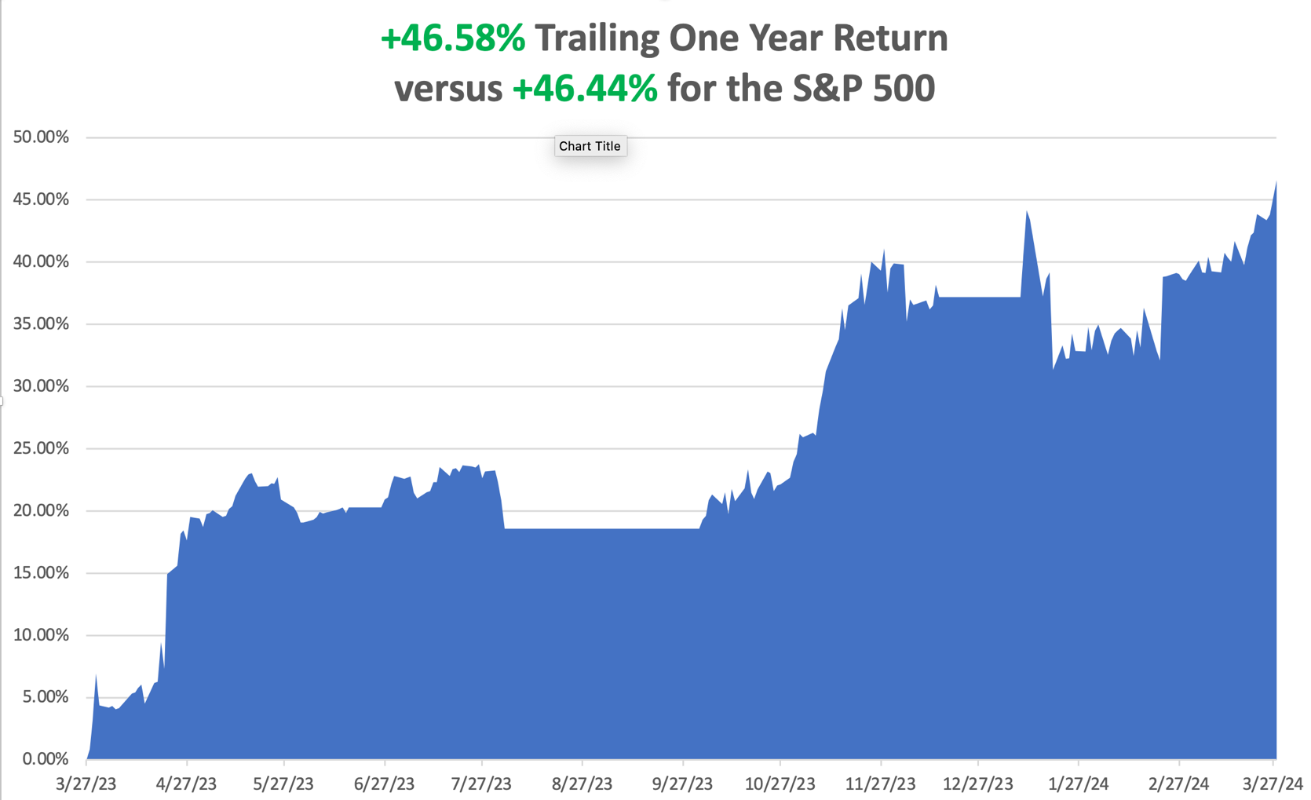

Slide 6
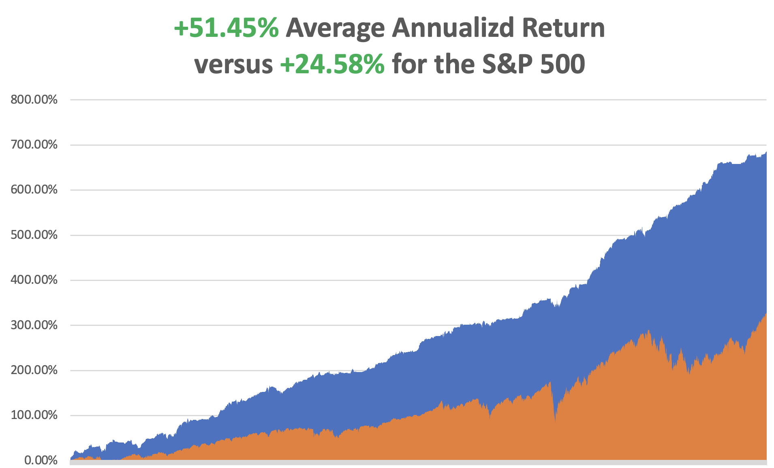

Slide 7
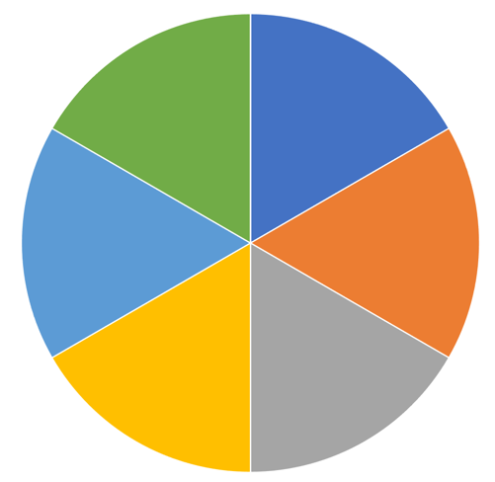
Portfolio Review – Aggressive Long
60% Long, 40% cash
Risk On
(FCX) 4/$37-$40 call spread | 10.00%
(XOM) 4/$100-$105 call spread | 10.00%
(OXY) 4/$59-$62 call spread | 10.00%
(WPM) 4/$39-$42 call spread | 10.00%
(TSLA) 4$140-$150 call spread | 10.00%
(GLD) 4/$194-$197 call spread | 10.00%
Risk Off
NO POSITIONS | 0.00%
Total Net Position | 60.00%
Expiration Value
+9.52%

Slide 8

The Method to My Madness
*The trade is now out of big tech and into commodities, precious metals, and energy
*But technology stocks won’t crash, just have a sideways “time” correction
*If you sell in May and go away, what do you do in April?
*Bonds and other falling interest rate plays go back into the penalty box on a heating economy
*All economic data is globally slowing, except for the US,
with the only good economy in the world
*US dollar approaches multiyear high on rising rates
*Buy stocks and bonds but only after substantial dips

Slide 9

Why are Commodities so Hot?
*Traders are afraid to chase big tech after a huge five month run and are using them to rotate into laggard sectors
*Commodities, precious metals, and energy have not moved for a year
*Traders are willing to bet on falling interest rates, even if they don’t fall until the end of the year
*Commodities, precious metals, and energy
are all great falling interest rates plays
*They are also great plays on a recovering global recovery
*They are also great plays on a falling dollar,
pressured by rising US debt, now at $35 trillion

Slide 10

The Global Economy – A One Hit Wonder
*ADP Show 184,000 private sector job gains in March
*Fed Chair Jay Powell Promises Three Interest Rate Cuts this year, of 25 basis points each
*PCE Comes in Hot at 0.3% for February, and 2.8% YOY
*ISM Manufacturing PMI Soars, reaching at 18 month high
*The final read of the Q2 US GDP is Revised Up, to a 3.4% annual rate
*Leading Economic Indicators Rise, for the first time in
two years according to the Conference Board
*Fed to Dial Back Quantitative Tightening, or QT from the
current $120 billion a month.

Slide 11
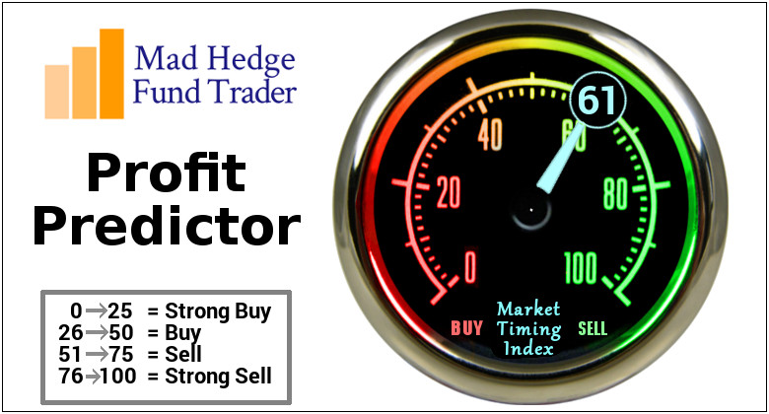
The Mad Hedge Profit Predictor
Market Timing Index – At top end of historic range
An artificial intelligence driven algorithm that analyzes 30 different economic, technical, and momentum driven indicators

Slide 12
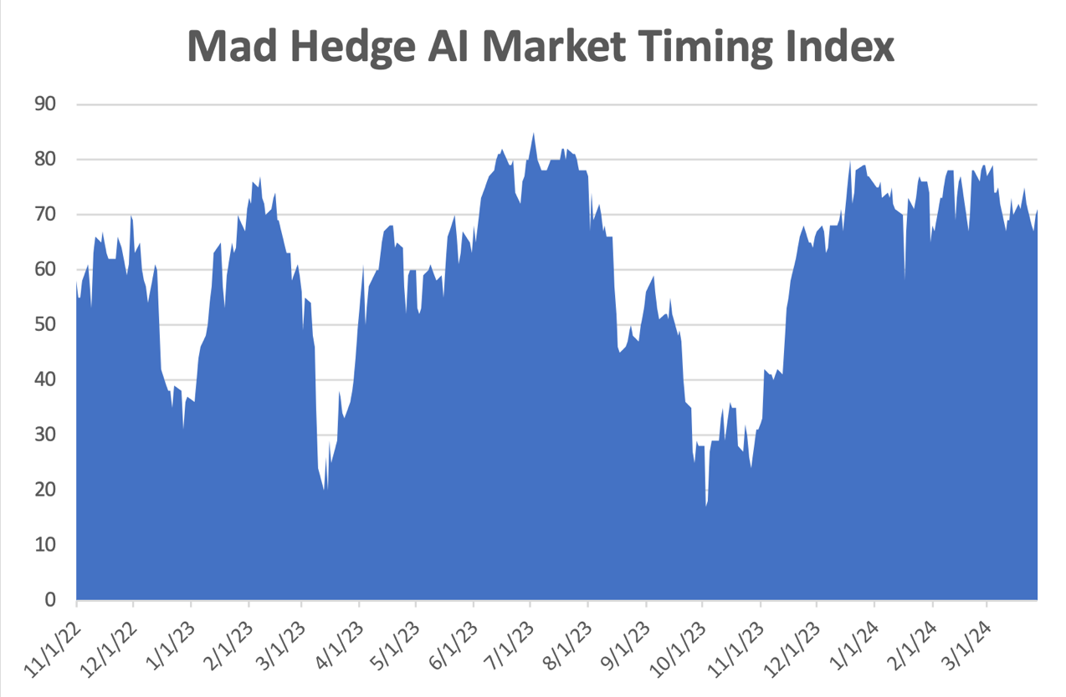
The New Range
SELL
BUY

Slide 13
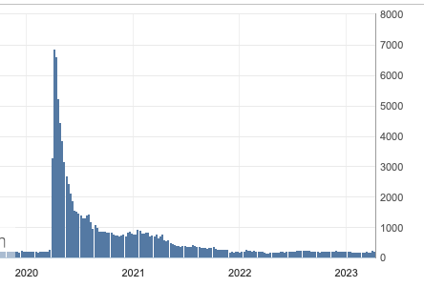
Weekly Jobless Claims – Falling
210,000 – -2,000

Slide 14

Stocks – Commodities Lovefest
*It’s Been Four Years Since the Covid Low, and stocks have averaged a 25% a year return since then
*China Bans AMD and Intel Processors, for government use in retaliation for the ban on high performing NVIDIA chips
*Boeing CEO Resigns. David Calhoun learned the hard way that you can’t cost cut your way to prosperity
*Chipotle Announces 50:1 stock Split, prompting a 3.5% rally in the stock
*Shell is Moving into the Charging Business, which has
much higher margins that selling gasoline
*Reddit Deal Blows Out, in the First Big IPO of 2024,
up 35% at the opening

Slide 15
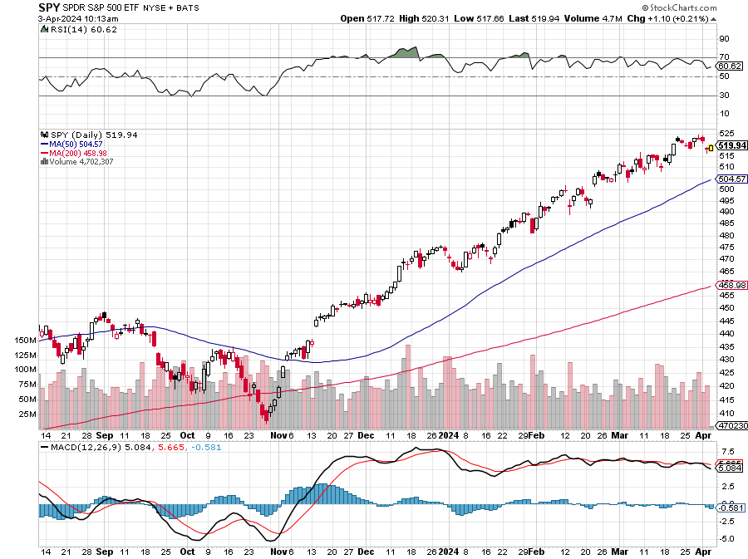
S&P 500 – New High
Yearend
Target
$600 +25%
$504
-4%
1st support

Slide 16
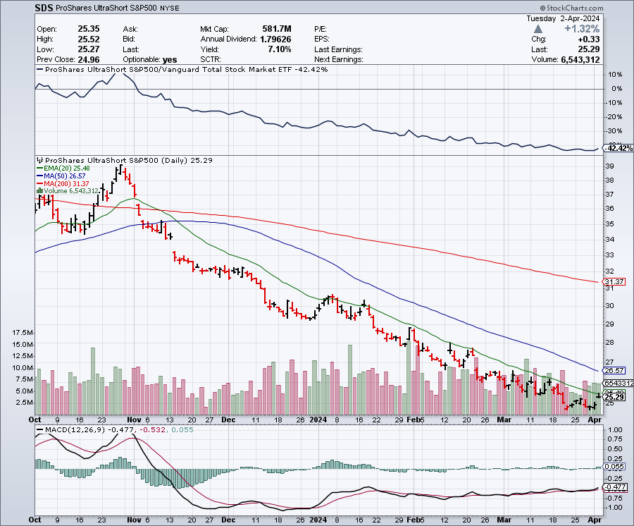
ProShares Ultra Short S&P 500 (SDS)- a great hedge for long stocks and bonds long 2X position has a hedge against longs and bond shorts

Slide 17
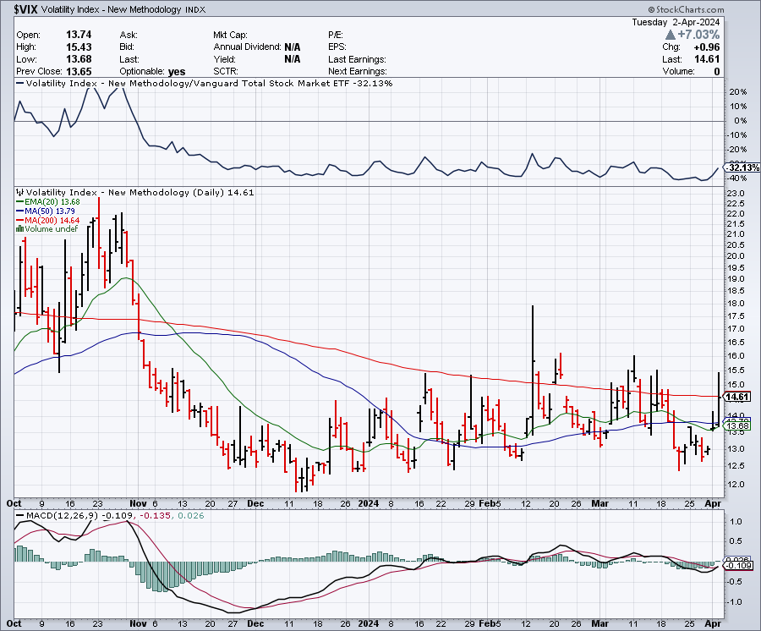
(VIX) – Bargain of the Century

Slide 18
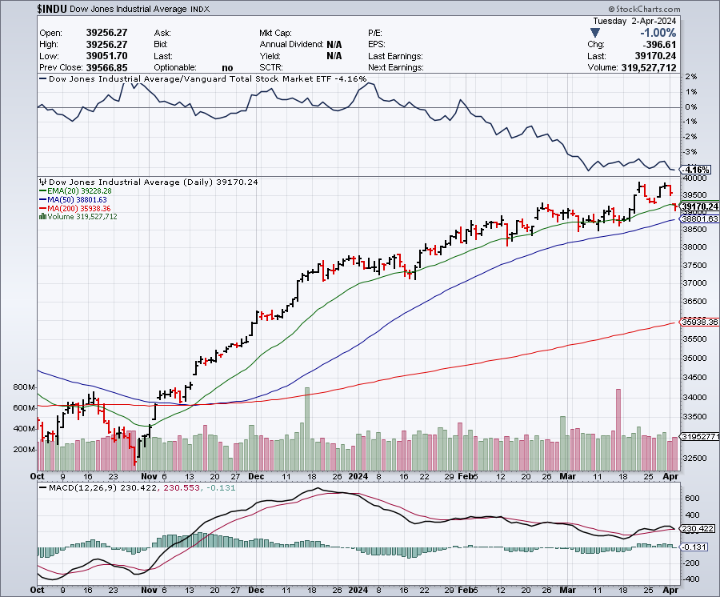
Dow Average ($INDU)-

Slide 19
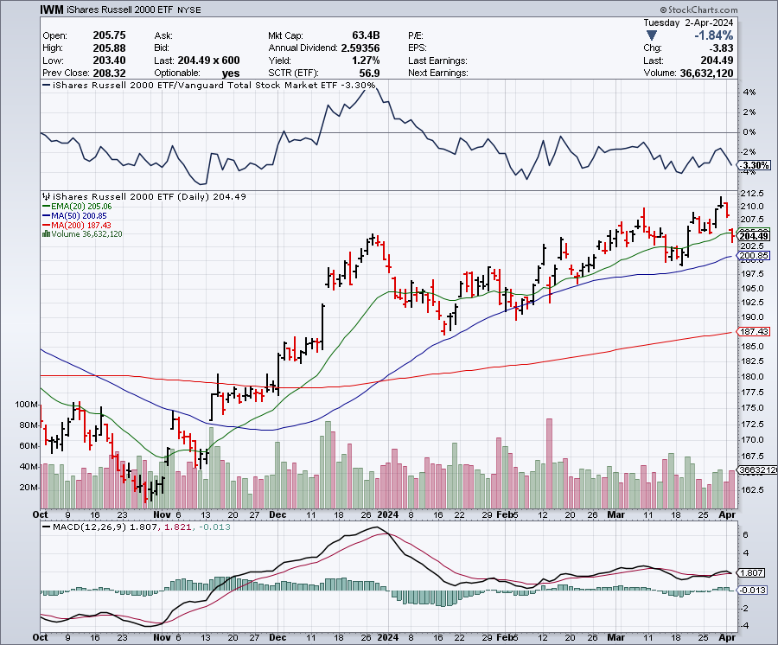
Russell 2000 (IWM)- took profits on Long 10/$137-$142 vertical bull call spread took profits on Long 10/$153-$156 vertical bear put spread

Slide 20
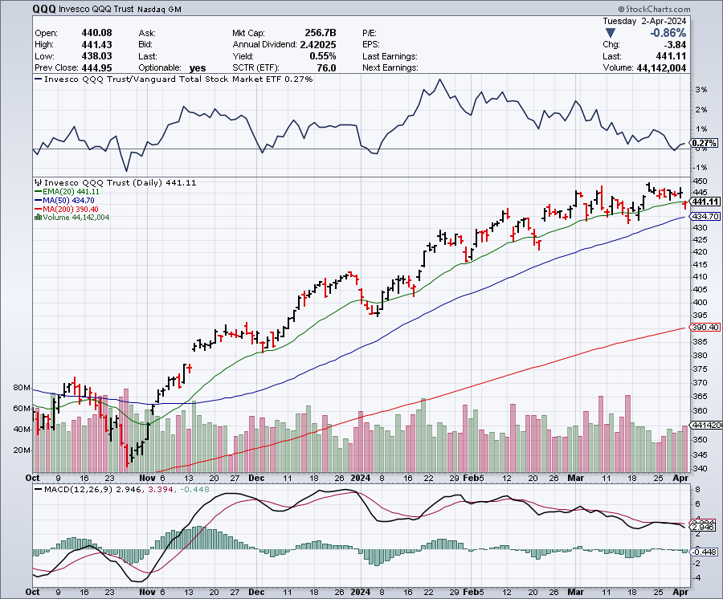
NASDAQ (QQQ) – took profits on Long 5/$335-$345 put spread took profits on long (QQQ) 1/$290-$300 put spread, took profits on long (QQQ) 4/$330-$335 put spread took profits on long (QQQ) 3/$340-$345 put spread, covered long (QQQ) $325-$330 put spread

Slide 21
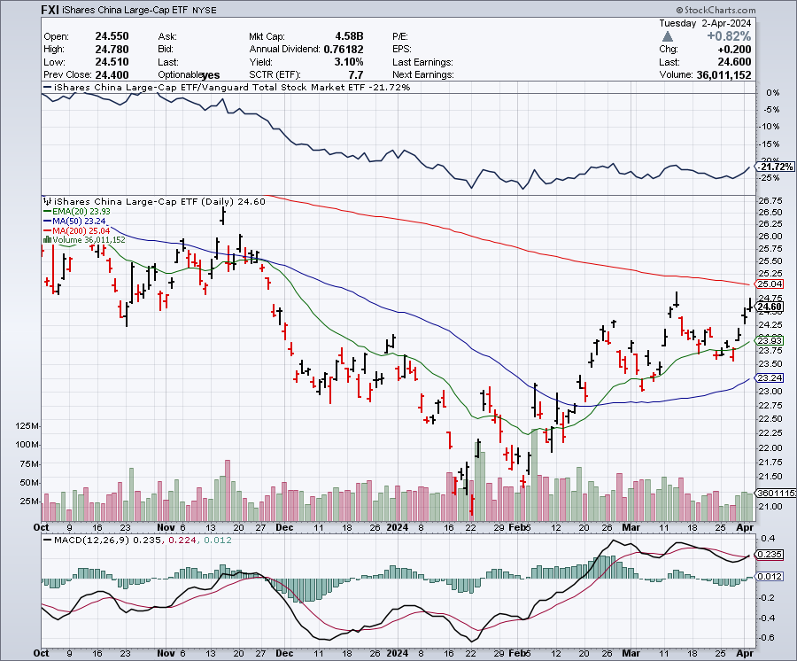
China (FXI)

Slide 22
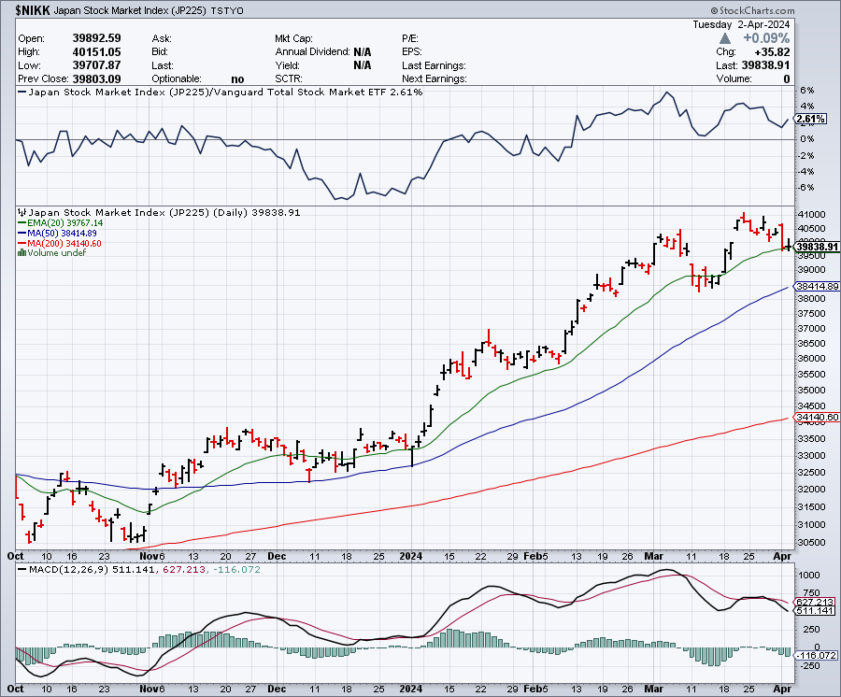
Japan ($NIKK)

Slide 23


Slide 24



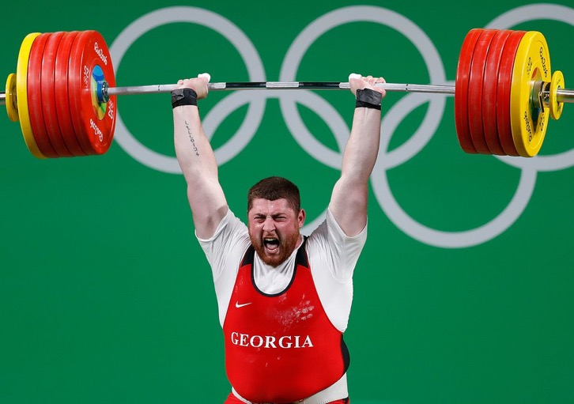
THE MAD HEDGE FUND TRADER
The Barbell Portfolio
*75% Big Tech – 2% of US workforce, 25% of market cap and 25% of US earnings
25% Domestic Recovery, including:
Railroads, airlines, cruise lines,
Couriers, steel companies
Banks, commodities
Construction
Credit Card Companies
Hotels, casinos
Online Ticket Sales

Slide 25
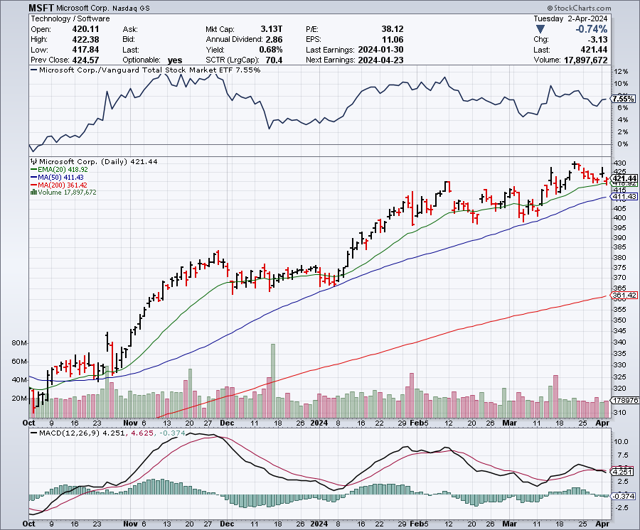
Microsoft (MSFT)- Microsoft Beats Estimates, with the steady growth of its azure cloud business
Microsoft Tops $3 Trillion Valuation, cementing its hold on the AI lead.
Took profits on long 2/$330-$340 call spread, took profits on long 12/$320-$330 call spread took profits on long 9/$235-$245 call spread, took profits on long 7/$220-$210 call spread, took profits on long 6/$220-$230 call spread, took profits on long 2/$200-$210 bear put spread

Slide 26
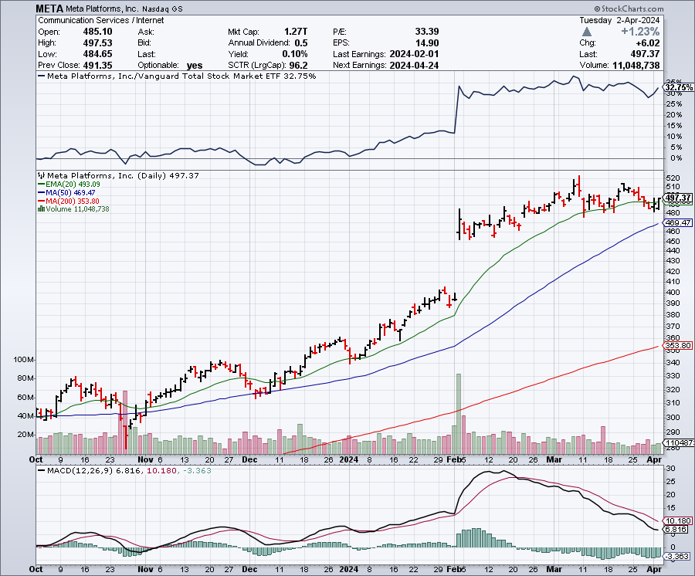
Meta (META)
Meta Rockets 21%, on a $50 billion stock buyback and its first ever dividend took profits on Long 9/$290-$300 vertical bear put spread stopped out of Long 9/$190-$200 vertical bear put spread

Slide 27
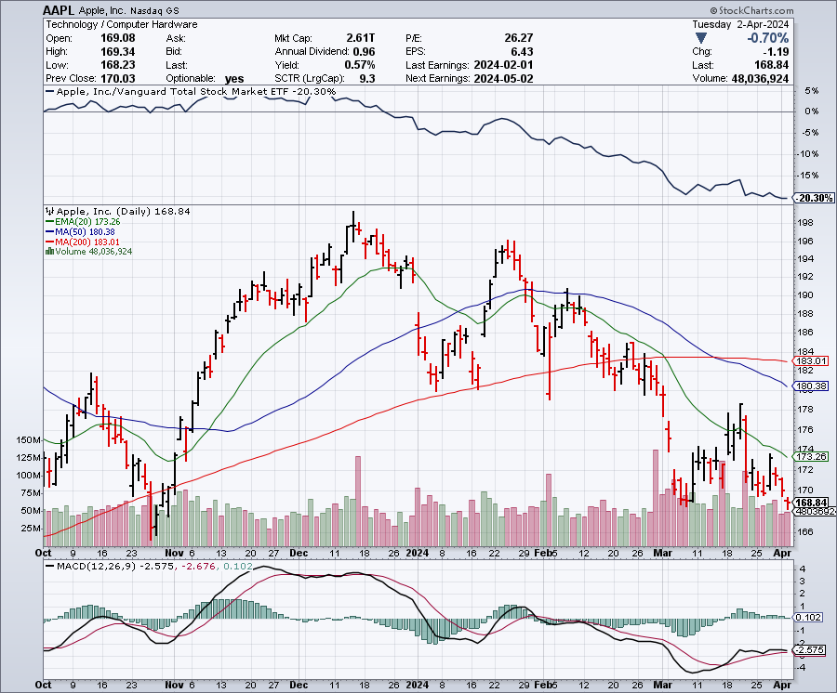
Apple (AAPL)
Apple to Roll Out New AI Strategy, at its June 14 developers conference
The Dept of Justice Goes After Apple on Antitrust, on its 61.3% share of the US smart phone market took profits on long 1/$145-$155 put spread, Took profits on long 10/$165-$175 put spread took profits on long 6/$155-$165 put spread, stopped out of long 6/$125-135 call spread, took profits on long 6/$110-$120 call spread, took profits on long 2/$180-$190 put spread

Slide 28
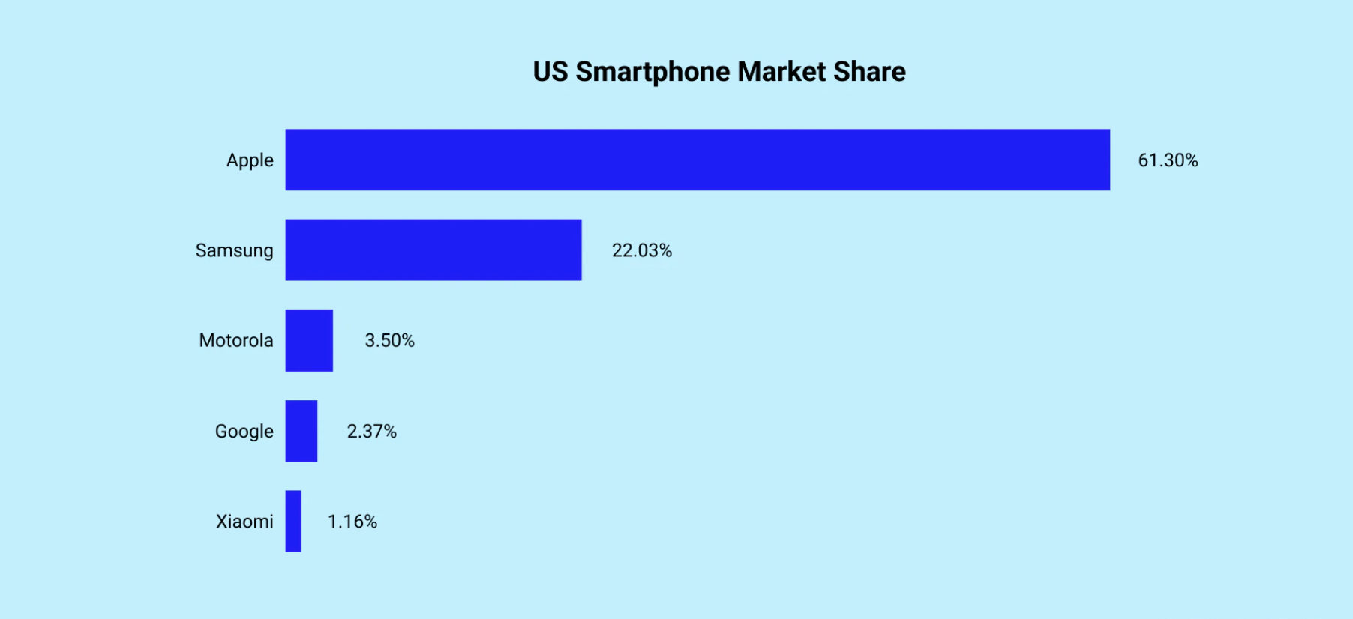

Slide 29
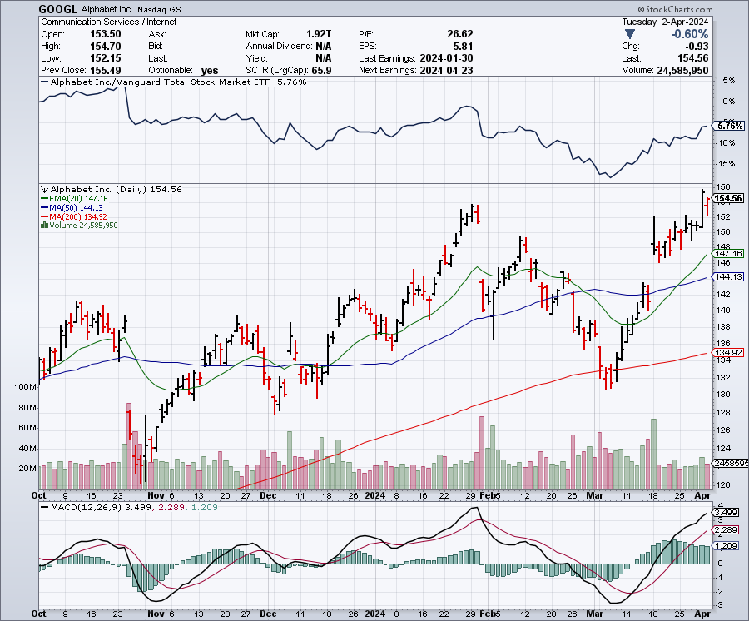
Alphabet (GOOGL) – Back in Play
Google to Delete Browsing Data, after a class action settlement over privacy took profits on long 12/$110-$120 call spread took profits on long 12/$1,200-$1,230 bull call spread, took profits on long 9/$1,030-$1,080 vertical bull call spread

Slide 30
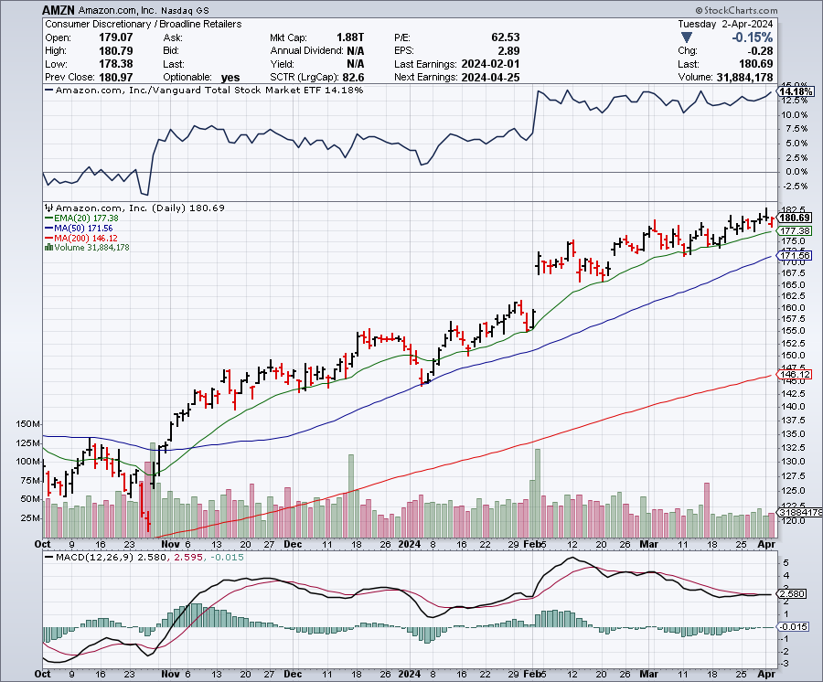
Amazon (AMZN) –
Amazon is getting added to the Dow Average, opening it up to massive index buying long 3/$155-$160 bull call spread , took profits on long 2/$130-$135 bull call spread

Slide 31
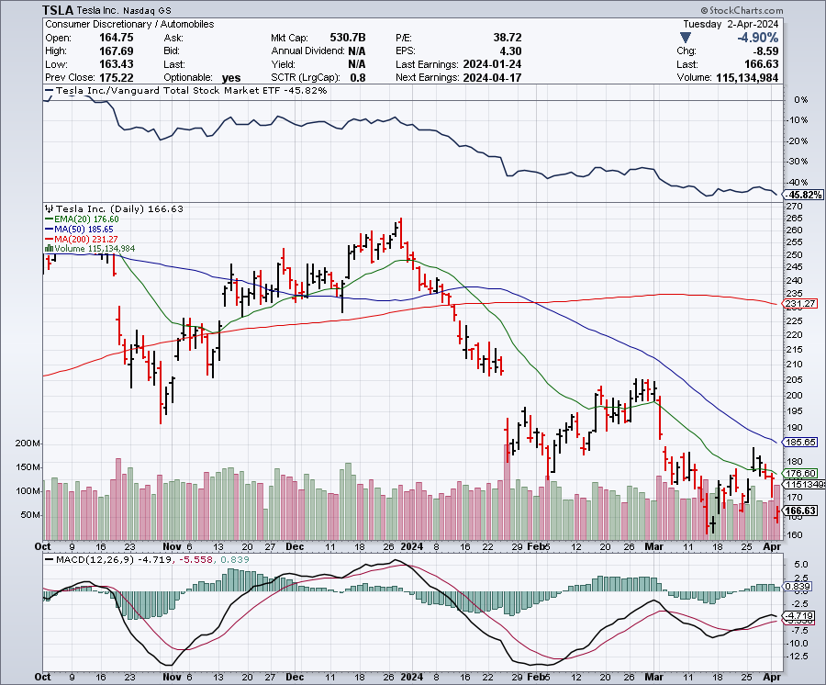
Tesla (TSLA) – Tesla Q1 Sales are Disastrous
long 4/$140-4150 call spread, took profits on long 10/$200-$210 call spread
took profits on long 6/$120-$130 call spread, stopped out of long 6/$210-$220 put spread
took profits on long 5/$110-$120 call spread, took profits on long 5/$220-$230 put spread

Slide 32
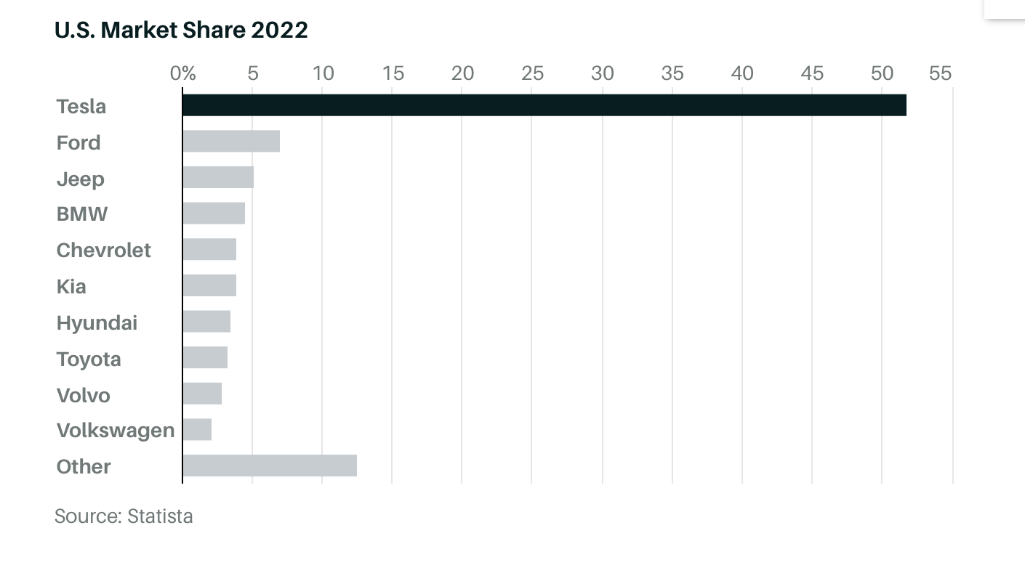

Slide 33
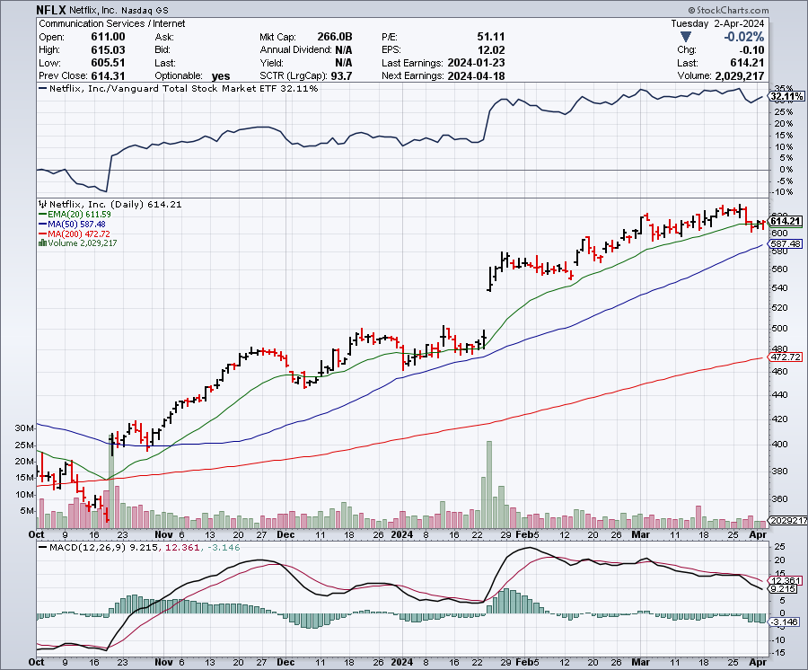
Netflix (NFLX) –
Netflix Soars on Big Subscriber Beat, up 8.6% on an add of 13 million new subscribers

Slide 34
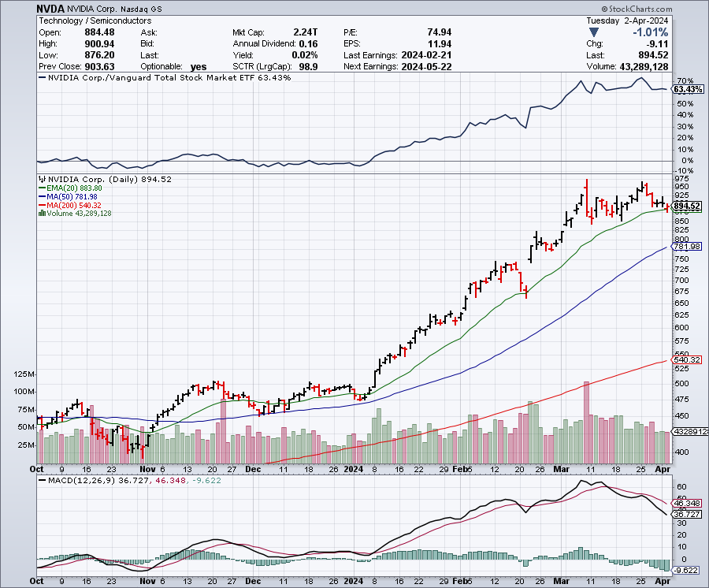
NVIDIA (NVDA) – Double Position-63% Implied on options
The NVIDIA Developer Conference is on this week, in San Jose took profits on long 3/$600-$610, took profits on long 3/$600-$610 took profits on long 2/$350-$360 call spread, took profits on long 2/$360-$370 call spread took profits on long 10/$370-$380 call spread – took profits on long 11/$370-$380 call spread took profits on long 3/$260-$270 put spread, took profits on long 10/$95-$100 call spread took profits on long 7/$120-$130 call spread, took profits on long 6/$120-$130 call spread

Slide 35
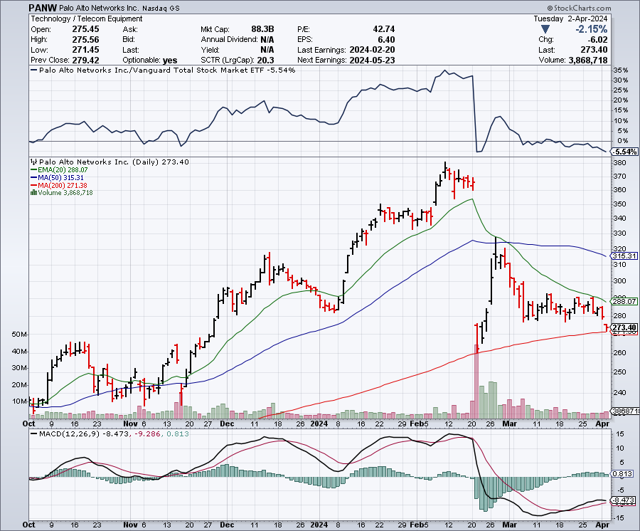
Palo Alto Networks (PANW)- Hacking never goes out of fashion
Palo Alto Networks Disappoints took profits on long 2/$260-$270 call spread, took profits on long 10/$130-$140 call spread

Slide 36
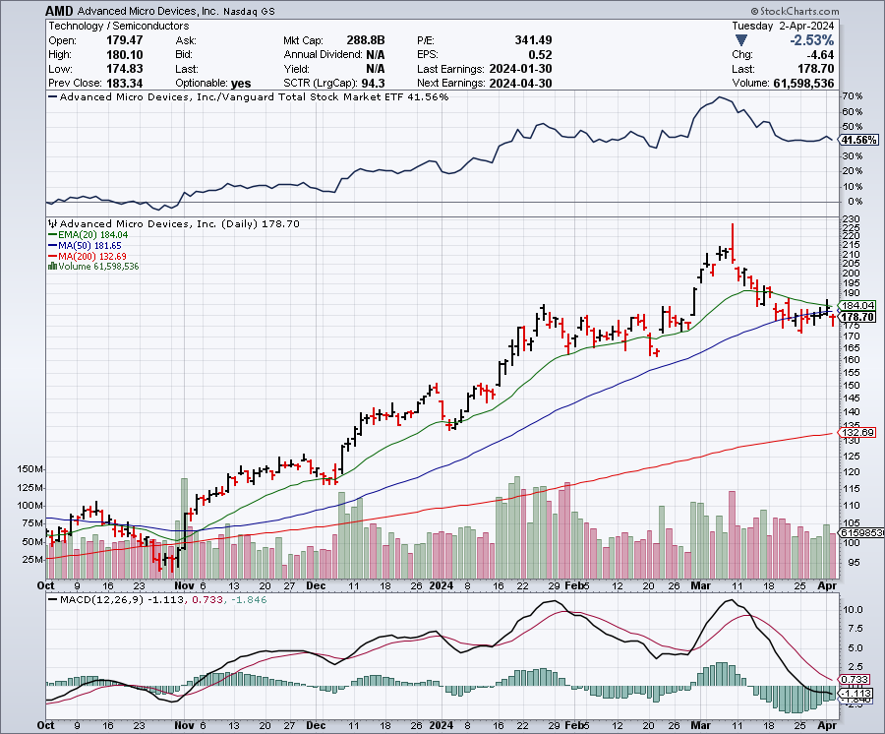
Advanced Micro Devices (AMD)- Recession fears programable logic devices took profits on long 2/$75-$80 call spread

Slide 37
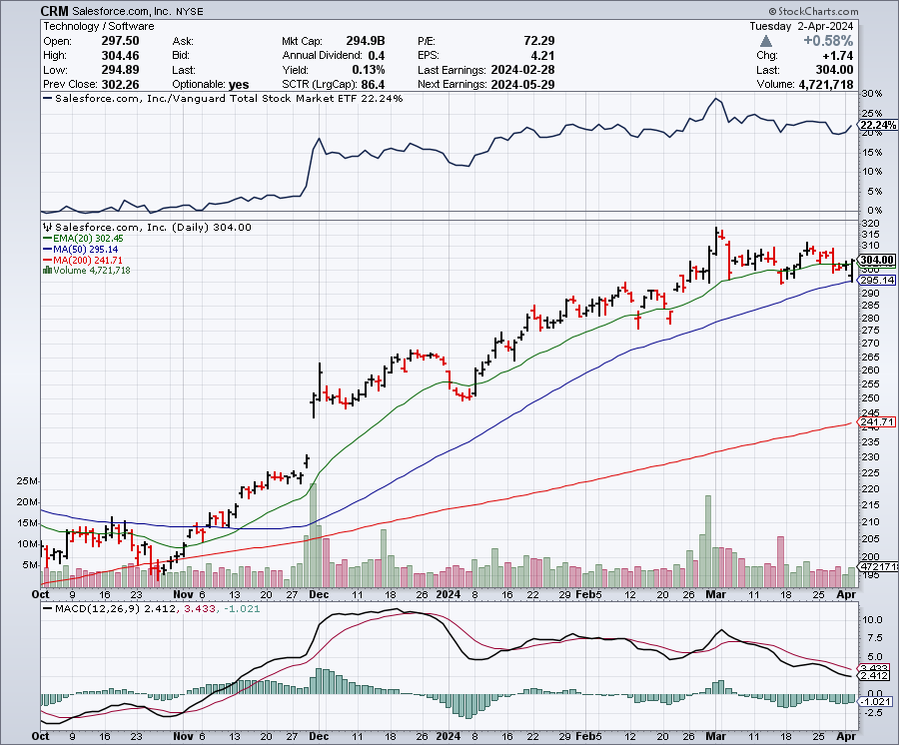
Salesforce (CRM)- Massive Online Migration
Salesforce Soars 16%, on better-than-expected guidance took profits on long 12/$185-$195 call spread took profits on long 9/$125-$130 vertical bull call spread took profits on long 8/$125-$130 vertical bull call spread

Slide 38
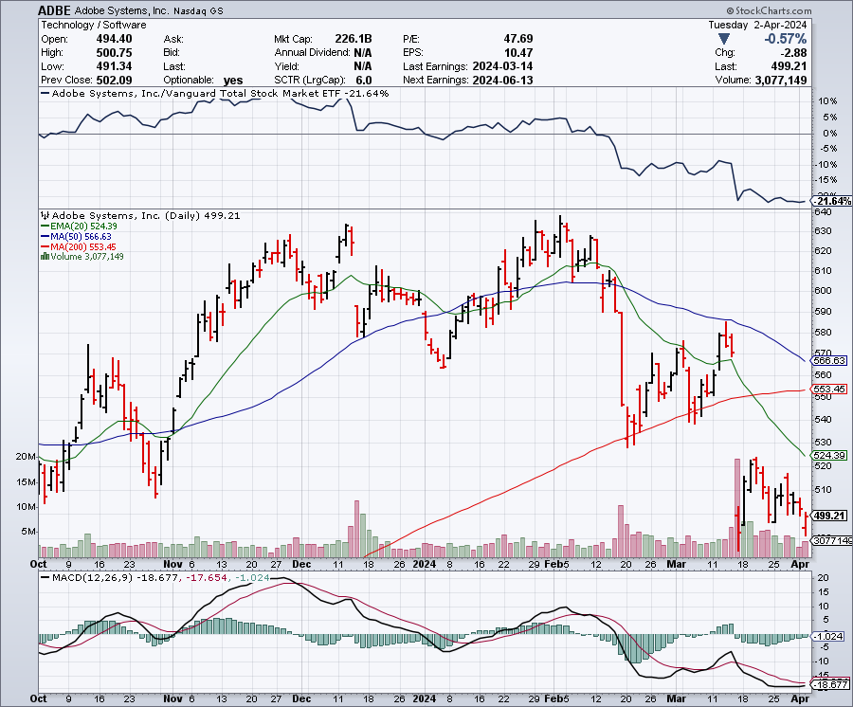
Adobe (ADBE)- Cloud play
The Quality Non-China tech play

Slide 39
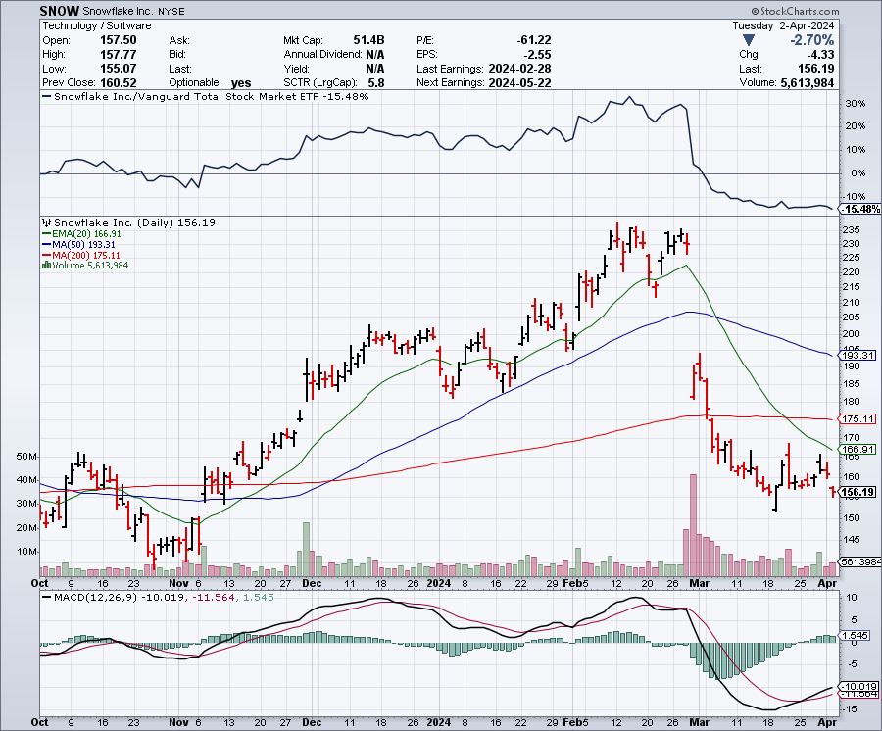
Snowflake (SNOW)- Blockbuster AI Earnings
Snowflake Crashes, down 20%, on weak guidance. CEO Frank Slootman is retiring stopped out of long 4/$150-$255 call spread, took profits on long 12/$135-$140 call spread

Slide 40
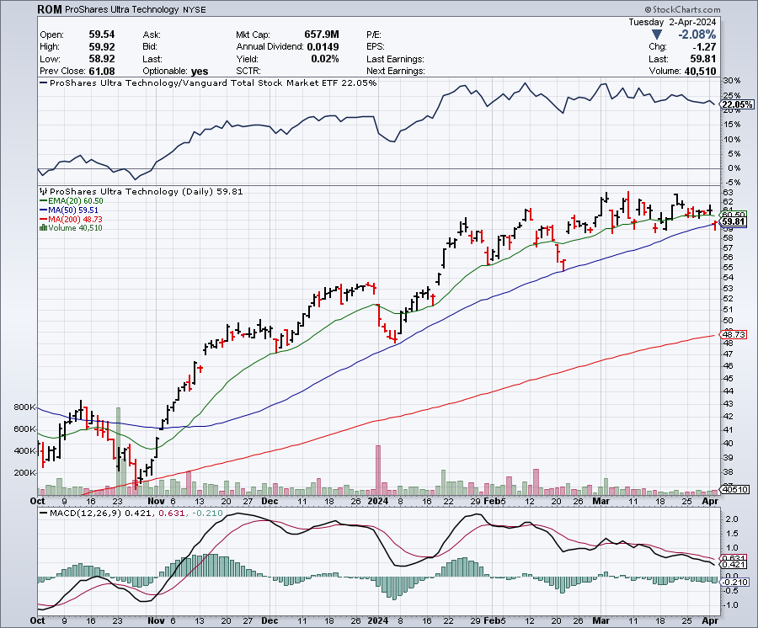
ProShares Ultra Technology ETF (ROM) – 2X Long Technology ETF took profits on long 10/$62-65 call spread

Slide 41
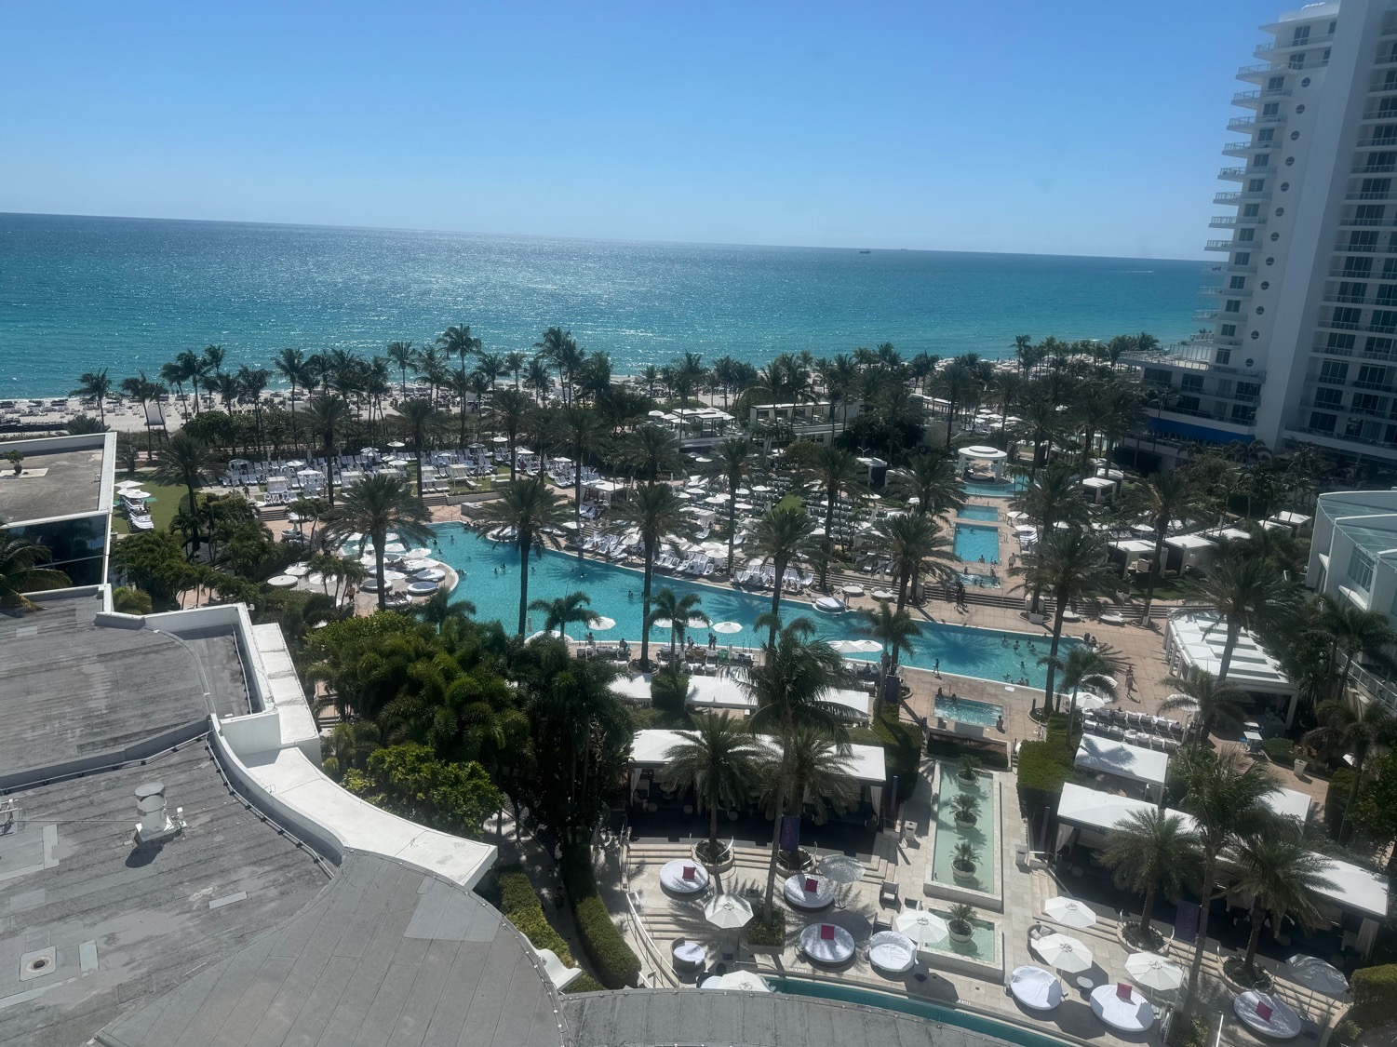

Slide 42
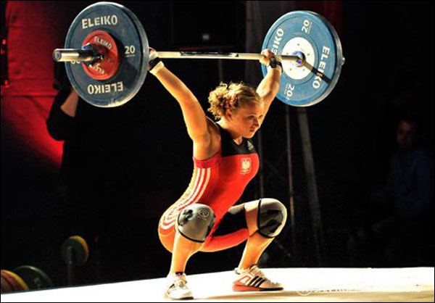
The Second Half of the Barbell
*Bets on a domestic recovery in 2022 Q4
*Upside potential in 2024 far greater than tech
*Some of these have not moved for 5 or 10 years
*Focuses on economically sensitive cyclical industries
*Makes a great counterweight to
high-growth technology
*We could spend all of the next ten years rotating
between the two groups

Slide 43
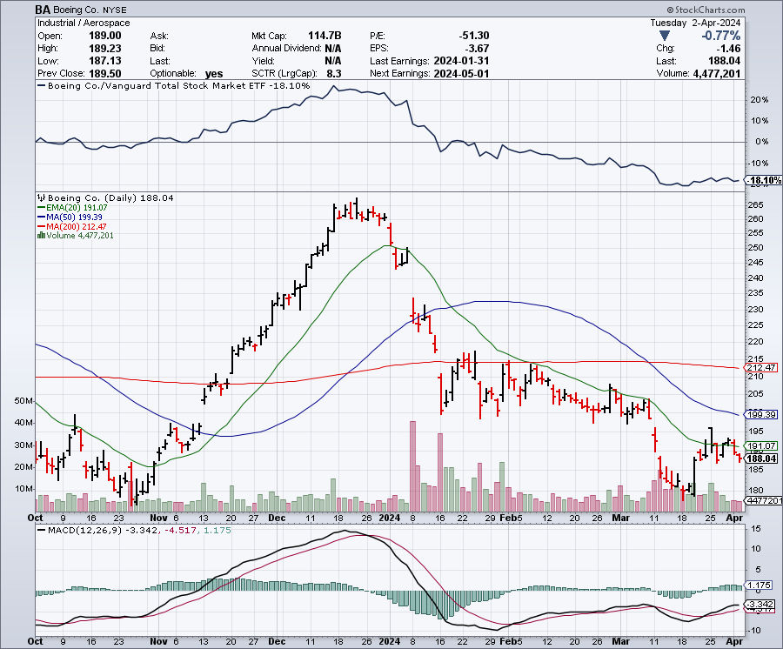
Boeing (BA) –
Boeing is Leasing 36 Airbuses, the meet its own unfilled orders caused by production delays stopped out of long 2/$190-$200 call spread, took profits on long 5/$17-$175 call spread

Slide 44
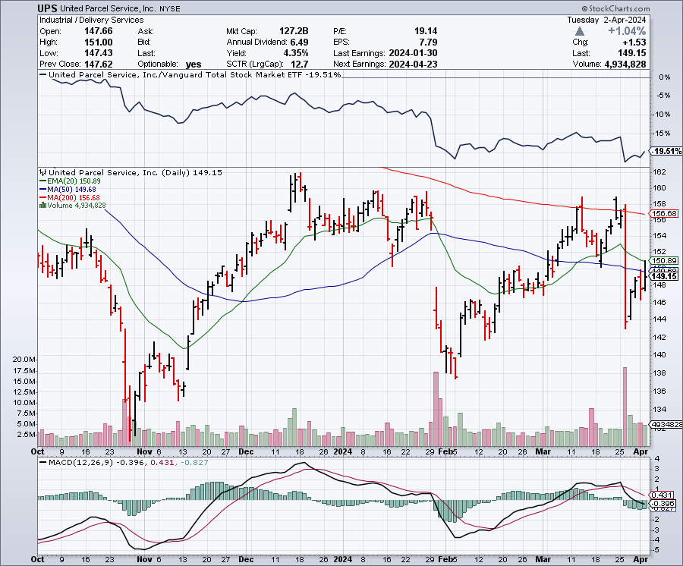
Package Delivery- United Parcel Service (UPS) – strike averted took profits on long 11/$130-$140 call spread

Slide 45
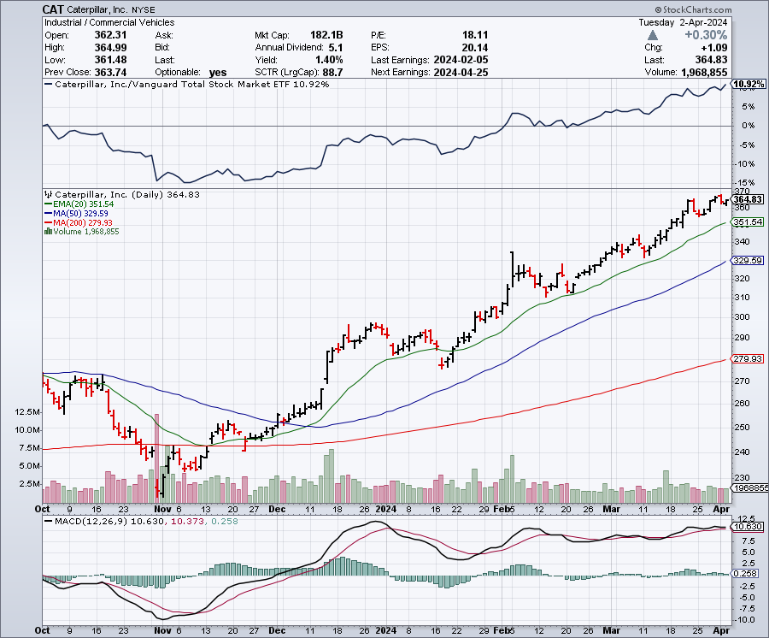
Caterpillar (CAT)- Ag + Infrastructure + Housing long 12/$220-$230 calls – expires in 2 trading days took profits on long 12/$145-$150 call spread took profits on long 11/$125-$135 call spread

Slide 46
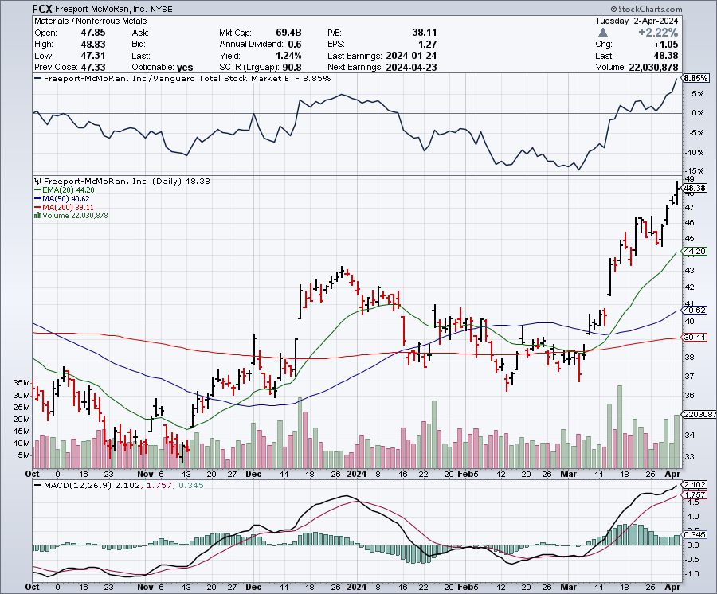
Freeport McMoRan - (FCX)- Coming Copper Crisis long 4/$37-$40 call spread, stopped out of long $48-$51 put spread, profits on long 6/$32-$35 call spread took profits on long 4/$30-$33 call spread, took profits on long 10/$20-$23 call spread

Slide 47
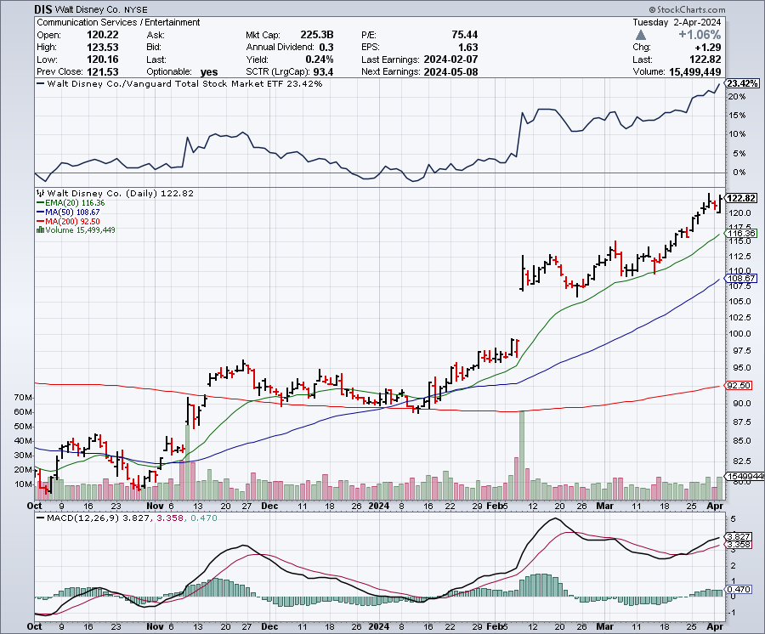
Walt Disney (DIS) -Disney Beats
Disney Settles with Florida

Slide 48
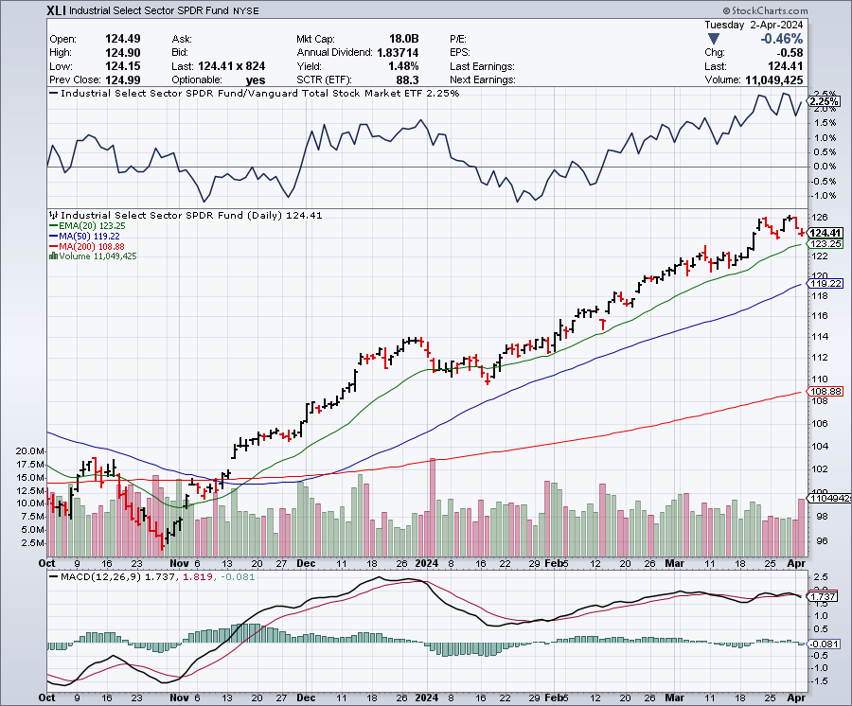
Industrials Sector SPDR (XLI)-
(GE), (MMM), (UNP), (UTX), (BA), (HON)

Slide 49
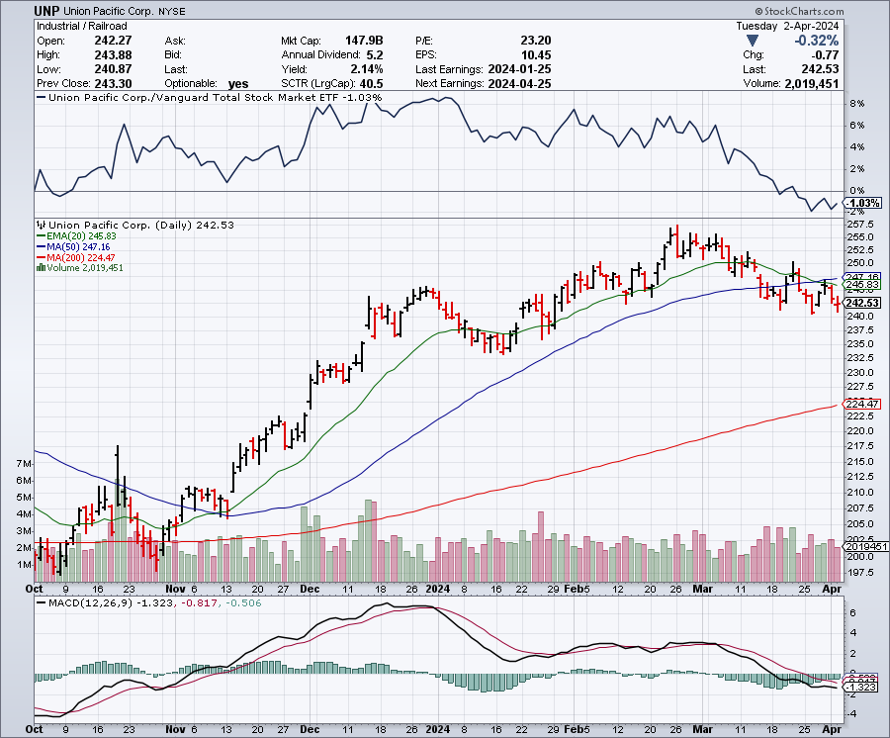
Union Pacific RR (UNP)- Big Stuff to Ship took profits on long 5/$200-$210 call spread took profits on 11/$150-$160 call spread

Slide 50
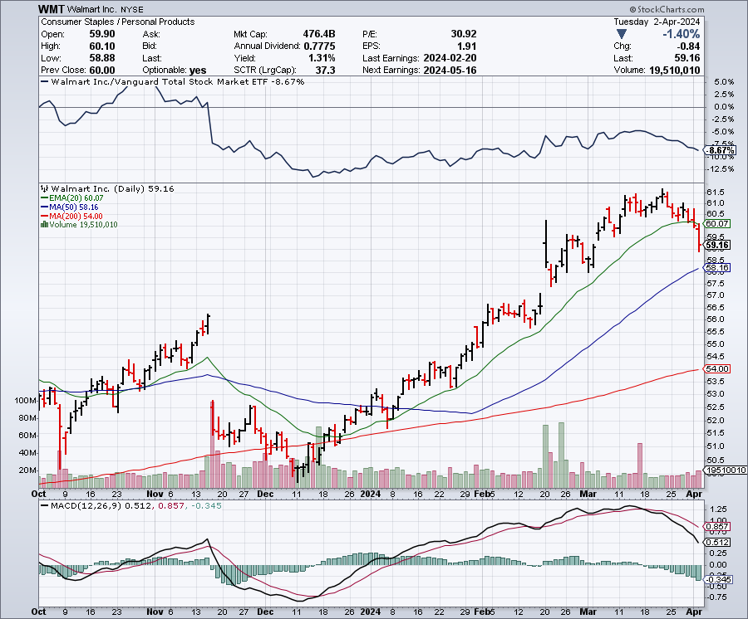
Wal-Mart (WMT)- took profit on Long 11/$125-$130 bear put spread took profit on Long 10/$119-$121 bear put spread took profits on Long 8/$114-$117 bear put spread

Slide 51
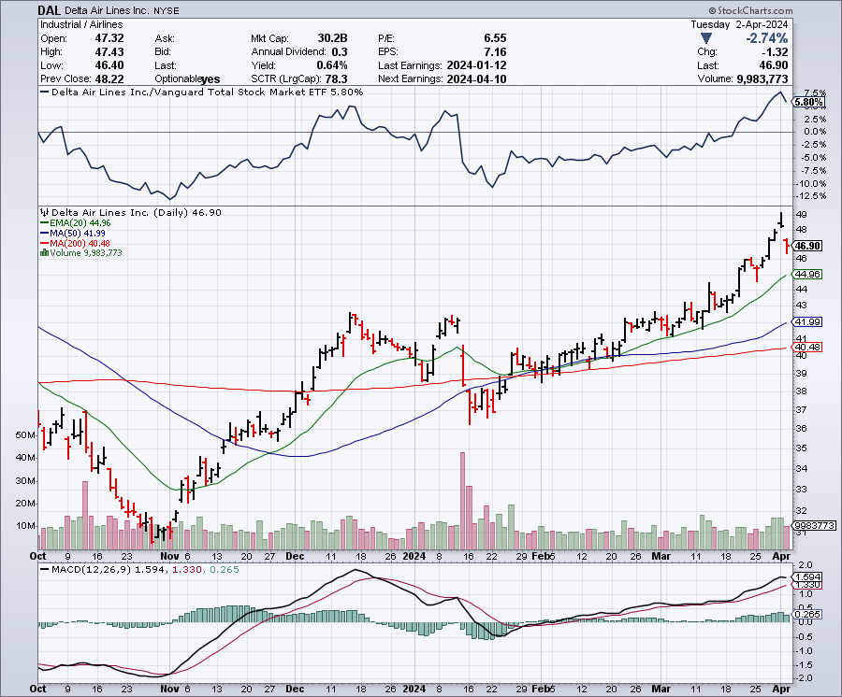
Delta Airlines (DAL) – Travel is Back!
Delta Posts Strong Earnings on Robust international travel stopped out of long 2/$35-$38 call spread

Slide 52
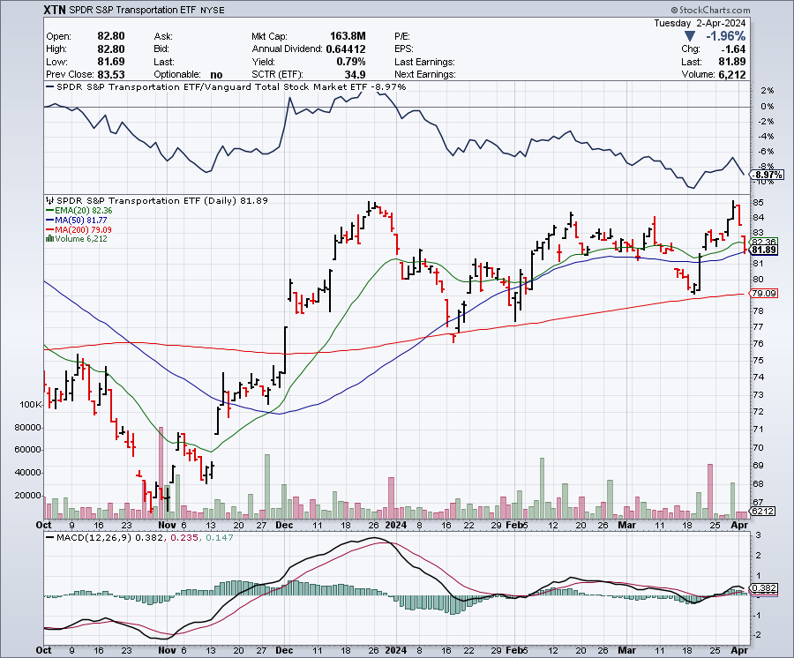
Transports Sector SPDR (XTN)- Worst Hit Sector
(ALGT), (ALK), (JBLU), (LUV), (CHRW), (DAL)

Slide 53
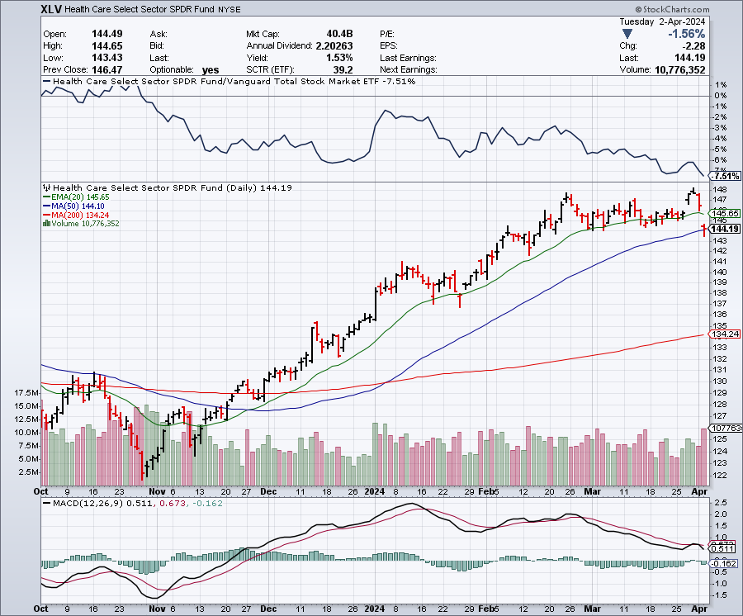
Health Care Sector (XLV)
(JNJ), (PFE), (MRK), (GILD), (ACT), (AMGN)

Slide 54
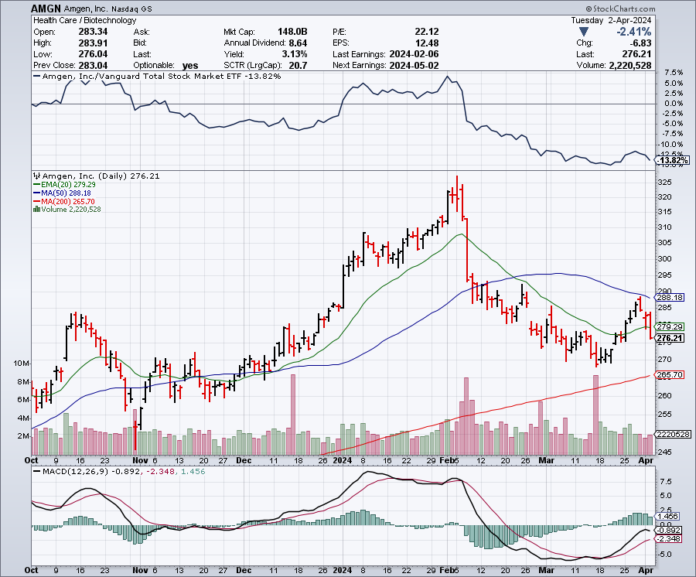
Amgen (AMGN) took profits on long 11/$185-$200 bull call spread

Slide 55
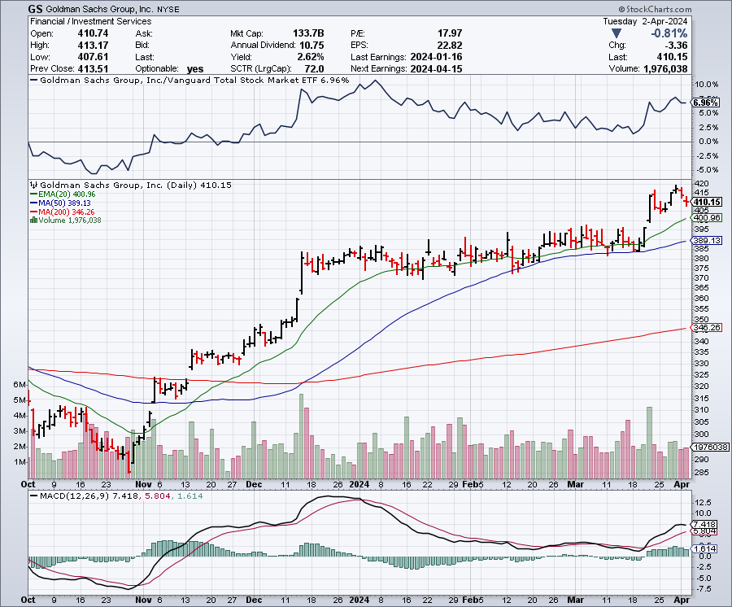
Goldman Sachs (GS) – Earnings Down but Less than Expected took profits 12/$330-$350 call spread took profits 11/$330-$350 call spread stop loss on long 11/$385-$395 call spreads

Slide 56
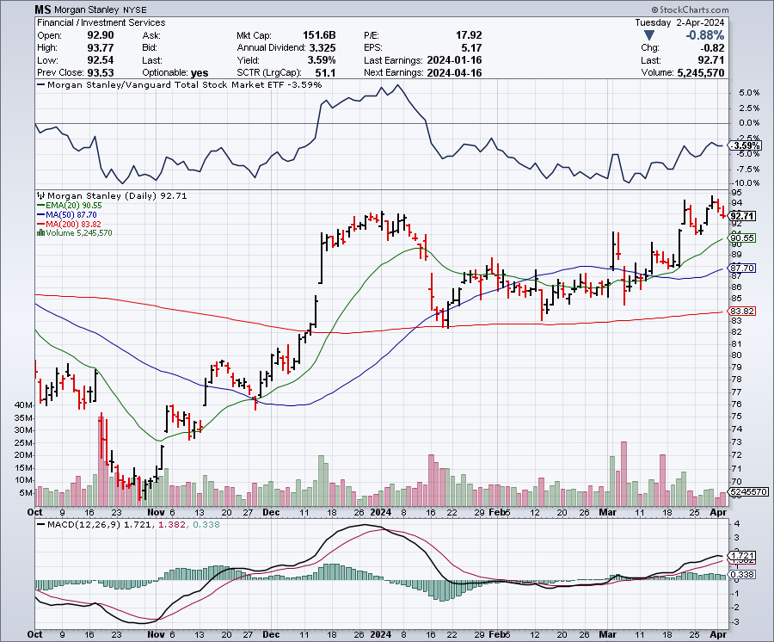
Morgan Stanley (MS) – Highest Capital ratio net of mark to market
CEO to Step Down in a Year took profits on long 4/$65-$70 call spread

Slide 57
JP Morgan Chase (JPM) – Monster Earnings Surprise
CEO Jamie Diamond Sell $150 Million in (JPM) Shares took profits on long 4/$105-$115 call spread

Slide 58

Bank of America (BAC) – Bank of America Rips, on a great earnings report took profits on long 4/$20-$23 call spread

Slide 59

Citigroup (C) – took profits on long 4/$30-$35 call spread

Slide 60

Charles Schwab (SCHW) – LEAPS up 67% in three months took profits on long 4/$30-$35 call spread

Slide 61

Interactive Brokers (IBKR) – Best Risk Control took profits on long 4/$60-$65 call spread

Slide 62

SPDR Metals & Mining ETF (XME) – long 2/$28-$30 call spread

Slide 63

Blackrock (BLK)-Asset Collection Boom took profits on long 3/$770-$790 call spread took profits on long 3/$310-$340 call spread

Slide 64

Visa (V) – Inflation boost
Visa and MasterCard Reach Antitrust Settlement with the US government. took profits on long 2/$240-$250 bull call spread took profits on long 10/$160-$170 bull call spread, took profits on long 6/$150-$160 bull call spread

Slide 65

Consumer Discretionary SPDR (XLY)
(DIS), (AMZN), (HD), (CMCSA), (MCD), (SBUX)

Slide 66

Berkshire Hathaway (BRKB)- Natural Barbell to Top $1 Trillion in a Year, up from the current $900 billion took profits on long 12/$320-$330 call spread took profits on long 4/$260-$270 call spread, took profits on long 1/$290-$300 call spread took profits on long 10/$220-$230 call spread, took profits on long 7/$220-$230 call spread took profits on long 7/$220-$230 call spread, took profits on long 6/$260-$270 call spread

Slide 67

Europe Hedged Equity (HEDJ)-

Slide 68

Japan (DXJ)-

Slide 69

Emerging Markets (EEM) - Pro trade, Weak Dollar, Long Recovery Play
Traders are Lining up for a Big Emerging Market Bet. Falling US interest rates will bring a weak US dollar and runaway bull markets in most emerging markets, which have remained unchanged for more than a decade

Slide 70


Slide 71

Bonds – Slap in the Face
*Rising inflation and heating economy cut bond support off at the knees
*Higher for longer seems to be the new Fed mantra
*However, Jay Powell still promising three rate cuts this year, but they will be at the back end
*So bonds will remain week but may only have $2 of downside left
*A much weaker Europe Moves Towards Interest Rate Cuts
*US National Debt is Rising by $1 Trillion Every 100 Days.
A trillion here, a trillion there, sooner or later tha
t adds up to a lot of money.

Slide 72

Treasury ETF (TLT) – Testing two months Lows took profits on long 4/$87-$90 call spread took profits on long 2/$90-$93 call spread,
Took profits in $100-$103 put spread, took profits on long 12/$95-$98 put spread took profits on long 12/$79-$82 call spread, took profits on long 11/$76-79 call spread,

Slide 73

Ten Year Treasury Yield ($TNX) – 4.42%

Slide 74

Junk Bonds (JNK) 6.35% Yield

Slide 75

Municipal Bonds (MUB) 3.07% Yield-

Slide 76

Emerging Market Debt (ELD) 6.35% Yield-

Slide 77

2X Short Treasuries (TBT)-Out of Favor

Slide 78

Anally Capital Management (NLY) – Leveraged REIT Play
Yield 13.63% took profits on long 12/$15-$16 call spread

Slide 79


Slide 80

Foreign Currencies – US Dollar Powers On
*Japanese Yen Hits New 34-Year Low, at ¥151.97 to the US dollar with the Bank of Japan suggesting that interest rates will stay lower for longer
*Last week the central bank raised rates for the first time in 17 years. Japanese stocks will love it
*Chinese Yuan Crashes, suffering worst day in two months
*Declining exports, collapsing foreign investment,
minimal population growth, it all adds up to a weaker
Chinese currency
*It’s the bitter fruit of 40 years of one child only policy.
Avoid (FXI) like some bad chop suey.
*However, eventual falling interest rates guarantee
a falling dollar for 2024

Slide 81

THE MAD HEDGE FUND TRADER
Australian Dollar (FXA) - Major Long-Term Bottom is In Targeting Parity – A call option on a global synchronized recovery
1:1
BUY

Slide 82

Japanese Yen (FXY)

Slide 83

Euro (FXE)-
2023
Target
25%

Slide 84

British Pound (FXB)-
2023
Target
15%

Slide 85


Emerging Market Currencies (CEW)
2023
Target
40%

Slide 86


Slide 87

Energy & Commodities –New Highs for the Year
*A global commodity rally has dragged oil up
*US continues to dominate markets with 13 million barrels/day production
*In the meantime, coal has plunged from 50% to 19% of US electricity output in 20 years
*Electrification of the US economy will continue
to be a driving theme.
* The Uranium Shortage is Getting Extreme, with yellow cake up 112%
in a year. owners of left-for-dead uranium mines are restarting operations
to capitalize on rising demand for the nuclear fuel.
* AI is Finding New Copper Deposits

Slide 88

Oil-($WTIC)

Slide 89

United States Oil Fund (USO)

Slide 90

Energy Select Sector SPDR (XLE)-No Performance!
(XOM), (CVX), (SLB), (KMI), (EOG), (COP)

Slide 91

ExxonMobile (XOM)-
Exxon Moves Big into Lithium, with the construction of a major mining operation in Arkansas
Long 4/$100-$105 call spread took profits on long 12/$120-$125 put spread

Slide 92

Occidental Petroleum (OXY)- Buffet’s a Buyer long 4/$59-$62 call spread took profits on long 2/$55-$60 call spread, took profits on long 12/$77.50-$82.50 put spread

Slide 93

Natural Gas (UNG) – Free Fall on Warm Winter took profits on Long January 2025 $7-8 Call Spread LEAPS

Slide 94

Cameco (CCJ) – Global Uranium Renaissance
Uranium Goes Nuclear, with yellow cake prices up 45% since May took profits on long 12/$35-$38 call spread, took profits on long 5/$20-$23 bull call spread

Slide 95


Slide 96

Precious Metals – New All-Tme Highs
*Precious metals have a great week on flight to safety
*Gold looking forward to falling interest rates later in 2024
*Miners arel playing catch up
*Investors are picking up gold as a hedge for 2024 volatility
*Gold headed for $3,000 by 2025, but back off first from new all-time highs
*Silver is the better play with a higher beta
*Russia and China are also stockpiling gold to sidestep
international sanctions

Slide 97

Gold (GLD) - Deflation call
Long 4/$194-$197 call spread, took profits on long 5/$165-$170 bull call spread

Slide 98

Market Vectors Gold Miners ETF- (GDX) –

Slide 99

Barrick Gold (GOLD) took profit on long 1/$15.50-$16.50 call spread

Slide 100

Newmont Mining- (NEM)- took profits on long $55-60 call spread

Slide 101

Silver- (SLV)- took profits on long 11/$19-$20 call spread

Slide 102

Silver Miners - (SIL)-

Slide 103

Wheaton Precious Metals - (WPM)- took profits on long 1/$36-$39 call spread

Slide 104

Platinum- (PPLT)- 556,000-ounce shortage this year took profits on long 1/$36-$39 call spread

Slide 105


Slide 106

Real Estate – Hottest Spring in Years
*Existing Homes Sales Soar 9.7% in February to 4.38 million units
*a still low 2.9-month supply at the current sales pace
*Median price higher are up 5.7% from the year before to $384,500.
*US Construction Spending Falls, 0.3% in February according to the Commerce Department.
*Construction spending increased 10.7% year-on-year in February
*New Home Sales Drop, 0.3% in February in a surprising
decline at a 662,000 annual rate on a signed contract basis.
*A spike in mortgage rates to 7.0% gets the blame
*There was a 7.5% drop in prices of new homes sold to $405,000

Slide 107

S&P Case Shiller Turns Hot
S&P Case Shiller Rises to +6.60% YOY in January, with its National Home Price Index
San Diego gained +11.1%, Los Angeles +8.6%, and Detroit +8.2%.

Slide 108

Crown Castle International (CCI) – 5.45% yielding 5G cell phone tower REIT
Eliot Management Pushes up stock with activist bid

Slide 109

US Home Construction Index (ITB)
(DHI), (LEN), (PHM), (TOL), (NVR)

Slide 110


Slide 111

Trade Sheet-
So What Do We Do About All This?
*Stocks – buy any dips
*Bonds – buy dips
*Commodities-buy dips
*Currencies- sell dollar rallies, buy currencies
*Precious Metals – buy dips
*Energy – buy dips
*Volatility - buy $12
*Real estate – buy dips

Slide 112


Slide 113

Next Strategy Webinar
12:00 EST Wednesday, April 17 from Key West, Florida email me questions at support@madhedgefundtrader.com
Good Luck and Good Trading!
Notes:
*

Slide 114


