Slide 1
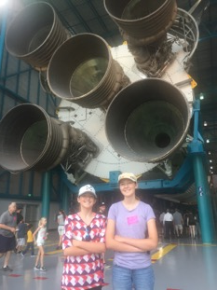
The Mad Hedge Fund Trader “Rocketing Back Up to Zero”
With John Thomas Incline Village, NV May 14, 2025 www.madhedgefundtrader.com
Notes:
*

Slide 5
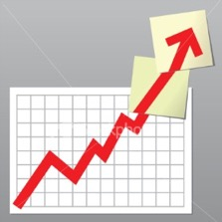
Trade Alert Performance New All-Time Highs!
*January +5.80% Final *July +10.92% Final *February +3.66% Final. *August +3.74% Final *March +4.36% Final *September +10.28% Final *April +0.95% Final *October +7.59% Final *May -4.21% MTD *November +18.96 Final *June +1.94% Final *December +3.26% Final *2025 Year To Date +24.19% +776.08% since inception *Versus 84.63% for all of 2022 *Versus 79.79% for all of 2023 *Versus 75.29% for all of 2024

Slide 6
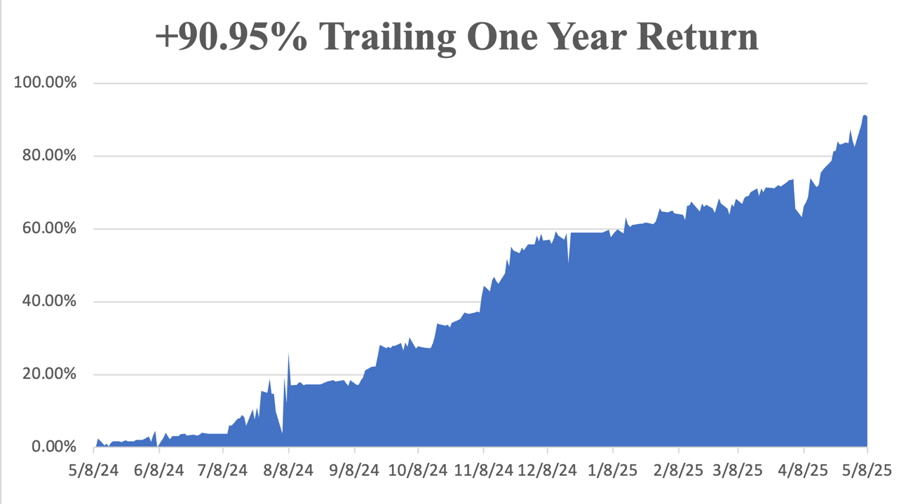

Slide 7
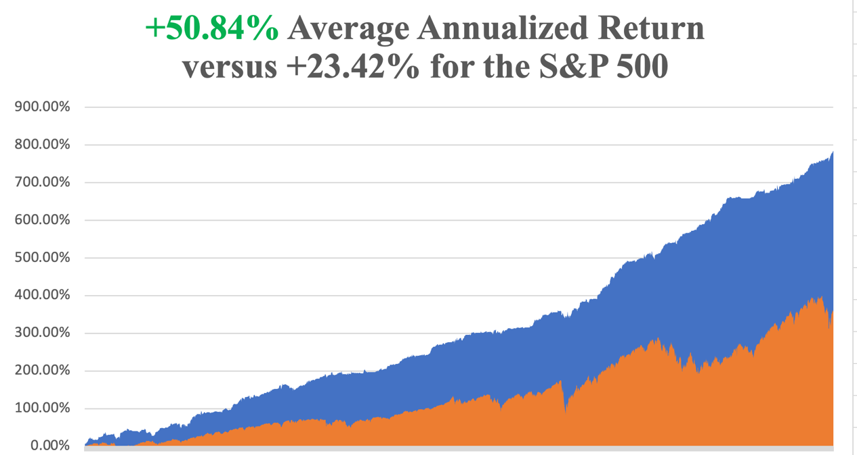

Slide 8
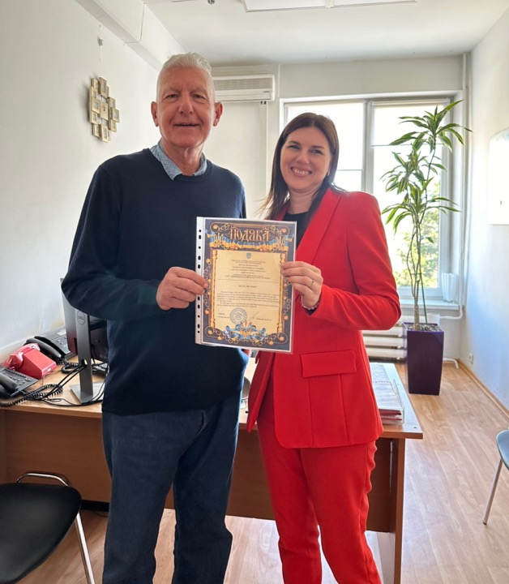

Slide 10
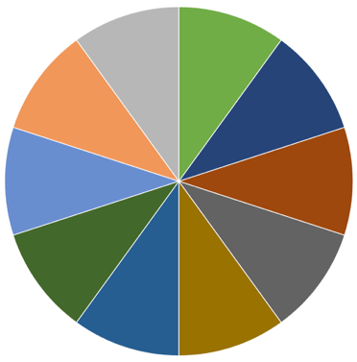
Portfolio Review – Big Bet We Don’t Go to New Highs by June 20 0% risk on, 80% risk off, 20% cash
Risk On
NO POSITIONS | 0.00%
Risk Off
(GLD) 5/$275-$285 call spread | -10.00%
(GLD) 6/$275-$285 call spread | -10.00%
(SPY) 6/$610-$620 call spread | -10.00%
(MSTR) 6/$500-$510 put spread | -10.00%
(NVDA) 6/$140-$145 put spread | -10.00%
(AAPL) 6/$220-$230 put spread | -10.00%
(QQQ) 6/$540-$550 put spread | -10.00%
(TLT) 6/$80-$83 call spread | -10.00%
Total Net Position | -80.00%
Total Gross Position | 80.00%
Expiration Value +37.41%

Slide 11
The Method to My Madness
*Stocks are expensive again, back at century highs in valuations, as administration gives up on trade war with China, but punitive tariffs remain with Mexico and Canada *After retirement funds saw a 20%-30% meltdown in two months, enormous pressure was put of the present to talk stocks back up, which they have been doing every day since. *New money isn’t coming into market, as investors are still scared to death. It’s mostly short covering *That means a recession is still on, but it may take another month to show up in the data *Mag 7 is leading the rally as it always would *Safety assets like gold, bonds, and foreign currency get dumped *Oil rallies big on recovery homes *US Dollar bounces on recovery hopes

Slide 12
The Global Economy – Confusion
*US Q1 GDP Crashes in Q1, down 0.3%, the first installment of a recession *Inflation comes in cool at 2.3% for April, indicating that the recession is still on *Fed Leaves Interest Rates Unchanged, at 4.25%-4.50%, supported by a consistently rising inflation rate *Trump has been Negotiating with Himself, and the stock market, first demanding 145%, then 80%, and 30% by Monday, nearly where they were during the Biden administration *Used Car Prices are Soaring, as tariff fleeing consumers shun expensive new cars *Nearly All US Exports are in Free Fall *ISM Manufacturing Index Says the Recession is Here *Consumer Confidence Collapses, hitting a 15 Year Low *UPS Lays Off 20,000,

Slide 13
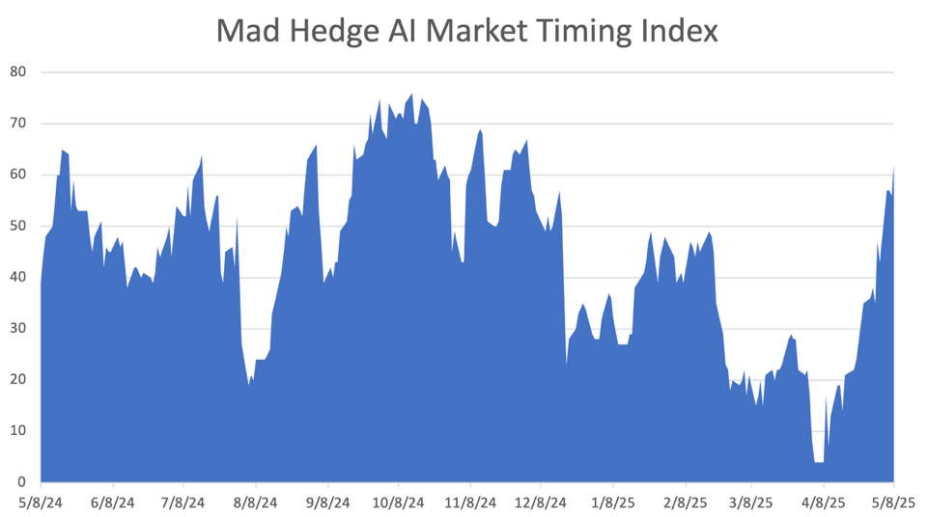
The Mad Hedge Profit Predictor Market Timing Index – From 2 to 71 in a Month! An artificial intelligence driven algorithm that analyzes 30 different economic, technical, and momentum driven indicators
SELL
BUY

Slide 14
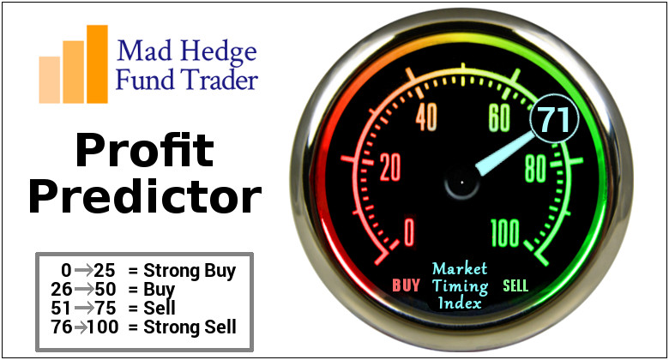

Slide 15
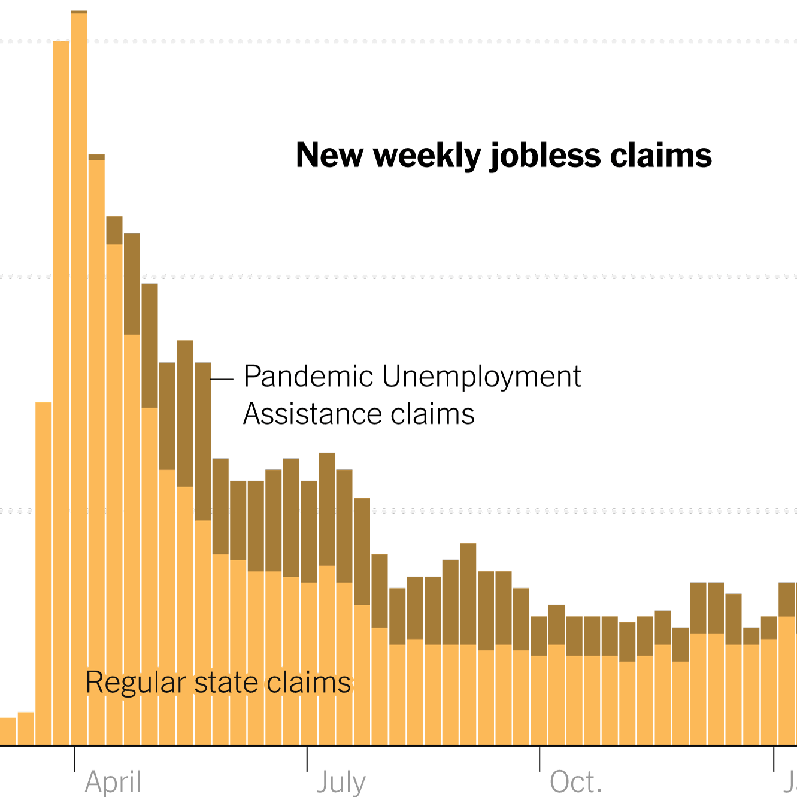
Weekly Jobless Claims – 4 Month Low -13,000 to 228,000

Slide 17
Stocks – China Shock
*Trump whipsaws the market again after folding on most China demands, PE Multiple now at 23 *Shorts rush to cover with most institutions just sitting and watch with their mouths hanging open *Volatility Index ($VIX) craters from $30 to$17 *Warren Buffet Retires, handing over day-to-day management of Berkshire Hathaway (BRK/B) to Greg Abel *Microsoft Goes Ballistic, with the second 10% move in a month. Indications are that AI spending is continuing unabated *General Motors to take $5 Billion Hit on Tariffs *MacDonalds Reports Worst Same Store Sales in Five Years *Bitcoin Recovers $100,000, for the first time since early February *Disney Pops 10% on Surprise Revenue Beat *Palantir (PLTR) Crashes 14%, on fears of collapsing international business

Slide 18
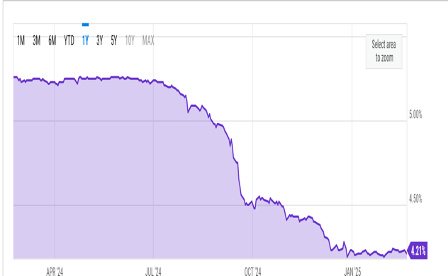
The Ultimate Hedge – Defensive stocks only go down at a slower rate 90 - day US Treasury Bills (Warren Buffet owns $300 billion)
*Government Guaranteed principal *Endless liquidity, trade like water *100% collateral value for margin *Lock in guaranteed income *Can be sold at any time to earn full interest *Will survive any bear market *Ask your broker how to buy

Slide 19
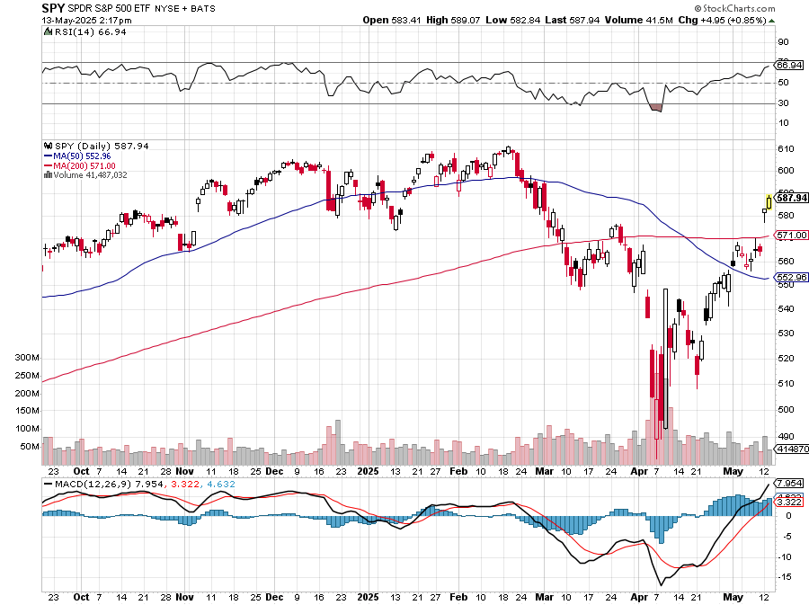
S&P 500 – Downside Targets – down 10% on year long 6/$610-$620 put spread-expires in 26 days
$613 0% 1st resistance
$540 -11.9% 1st support
$480 -21.7% 1st support

Slide 20
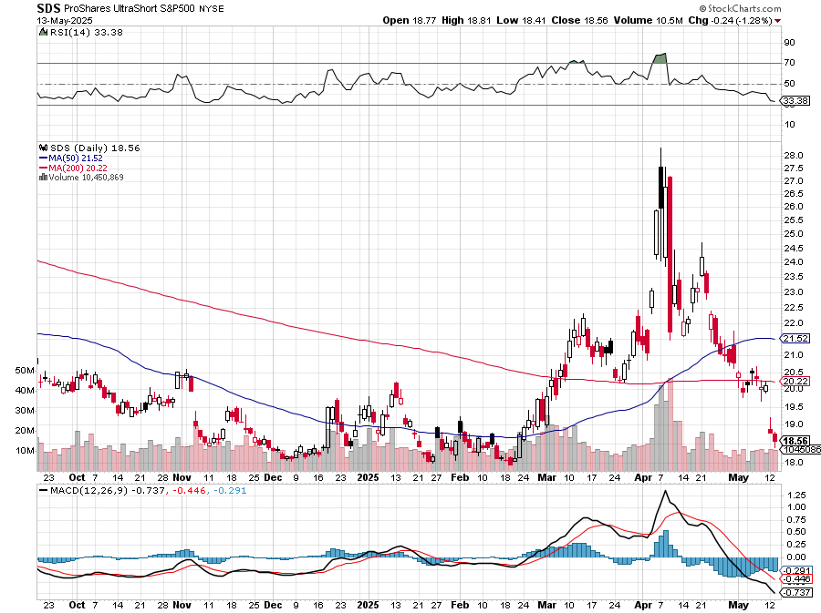
ProShares -2X Short S&P 500 (SDS) - a great 2X hedge for falling long stocks

Slide 21
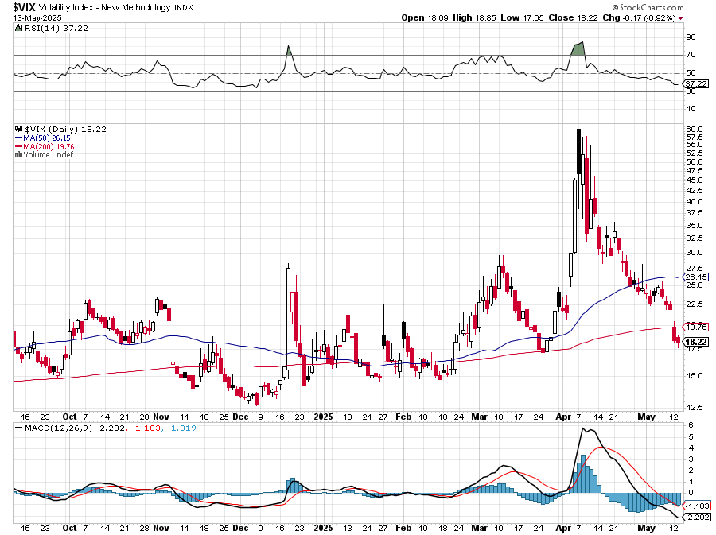
(VIX) – Volatility Index Hits Four Year High at $65, the most since the 2020 pandemic. That implies a 2% move in the S&P 500 (SPX) every day for the next 30 days

Slide 22
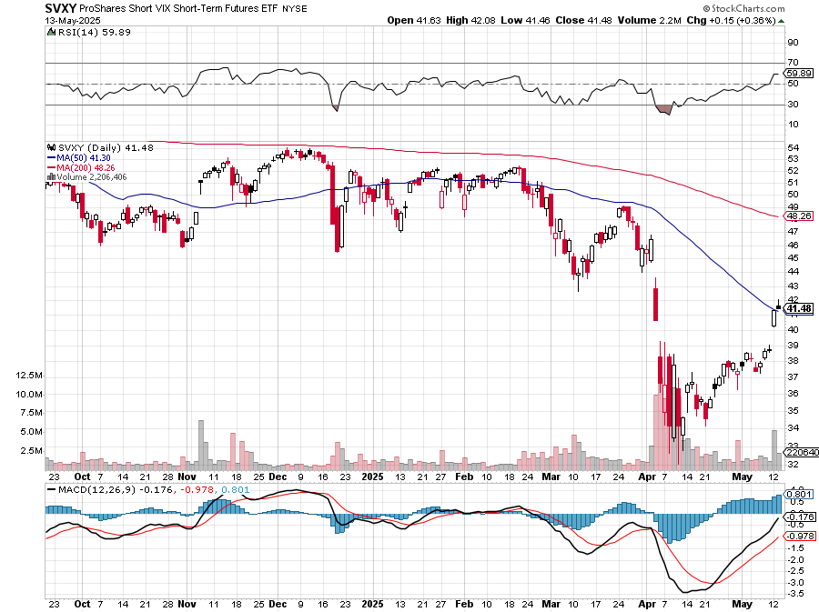
(SVXY) –Short Volatility ETF bought at $36.31 - $32.74 = $3.57

Slide 23
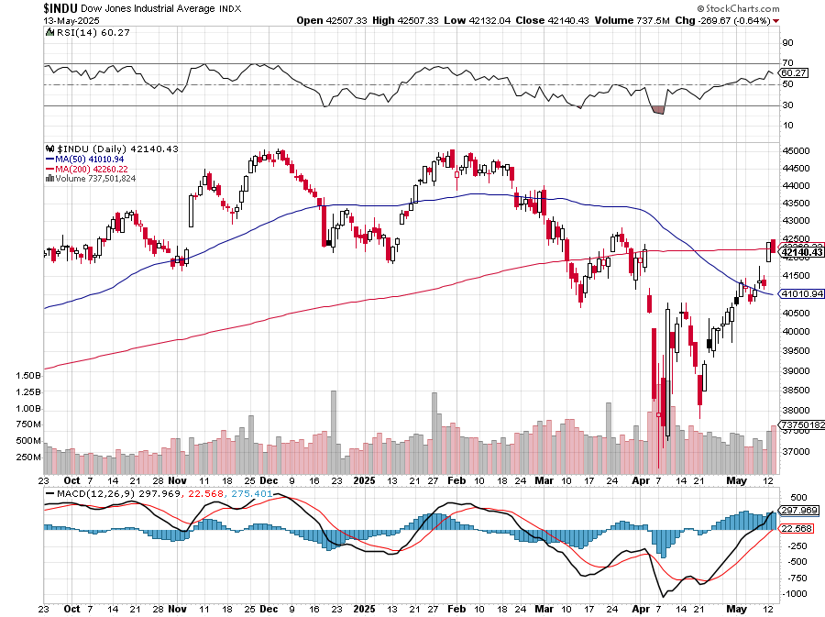
Dow Average ($INDU)-

Slide 24
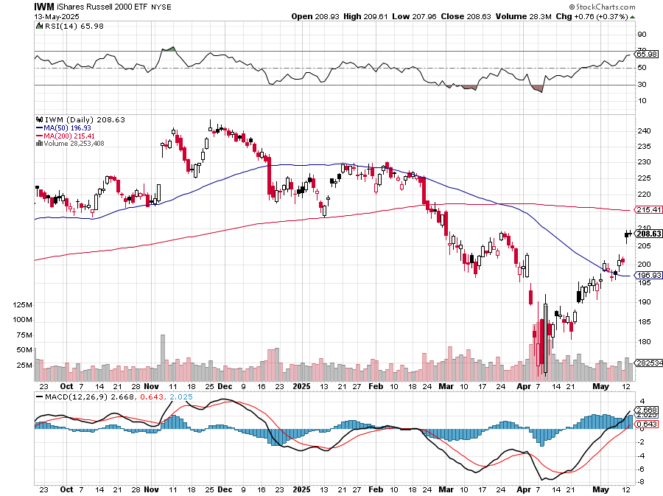
Russell 2000 (IWM)- took profits on Long 10/$137-$142 vertical bull call spread took profits on Long 10/$153-$156 vertical bear put spread

Slide 25
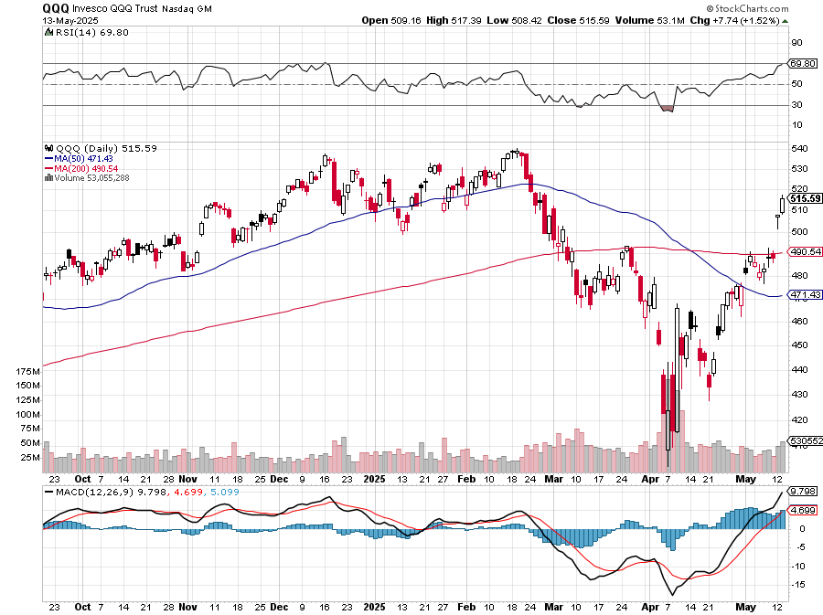
NASDAQ (QQQ) – Down 15% long 6/$540-$550-$345 put spread-expires in 26 days, took profits on Long 5/$335-$345 put spread took profits on long (QQQ) /$540-$550 put spread, took profits on long (QQQ) 4/$330-$335 put spread took profits on long (QQQ) 3/$340-$345 put spread, covered long (QQQ) $325-$330 put spread

Slide 26
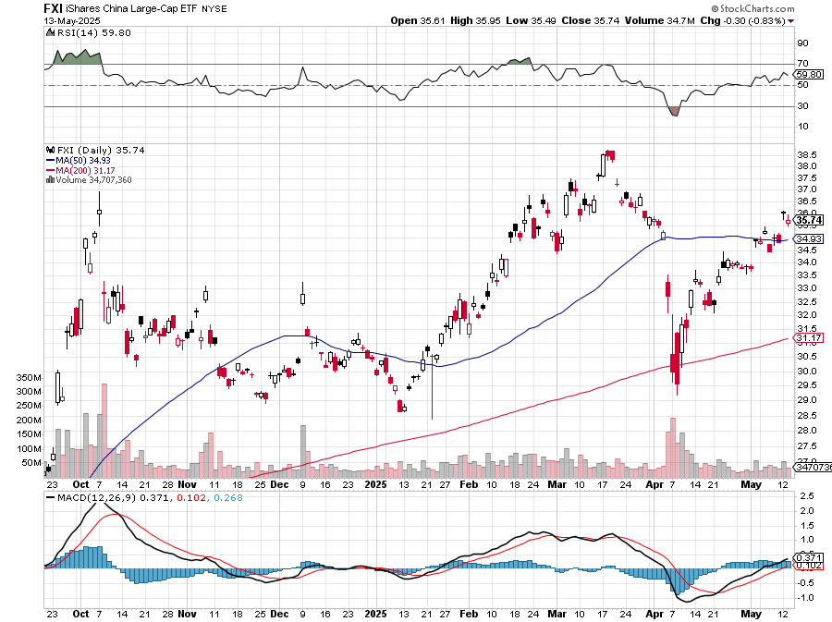
China (FXI) + 36%

Slide 27
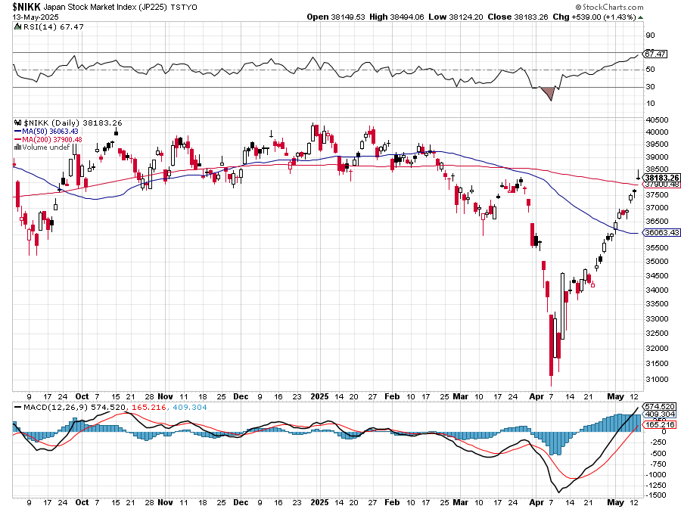
Japan ($NIKK) – down 10%

Slide 28
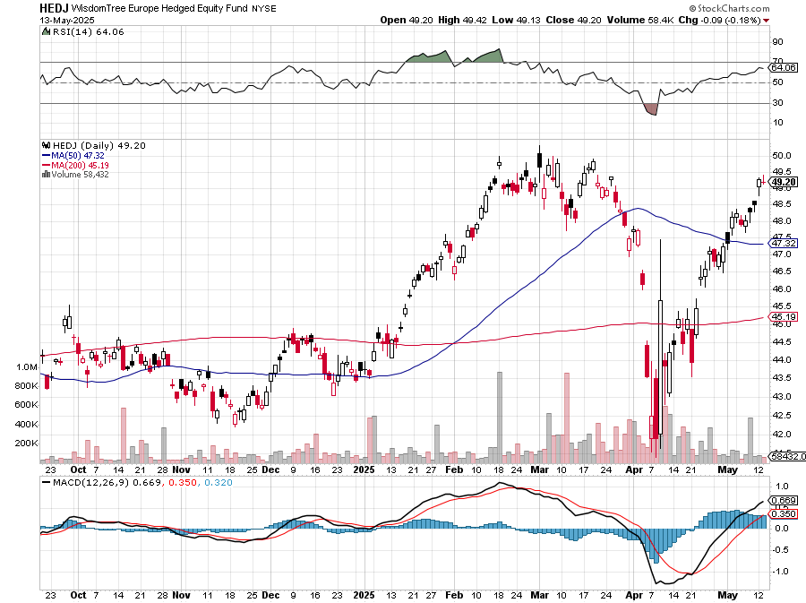
Europe Hedged Equity (HEDJ)- +19%

Slide 29
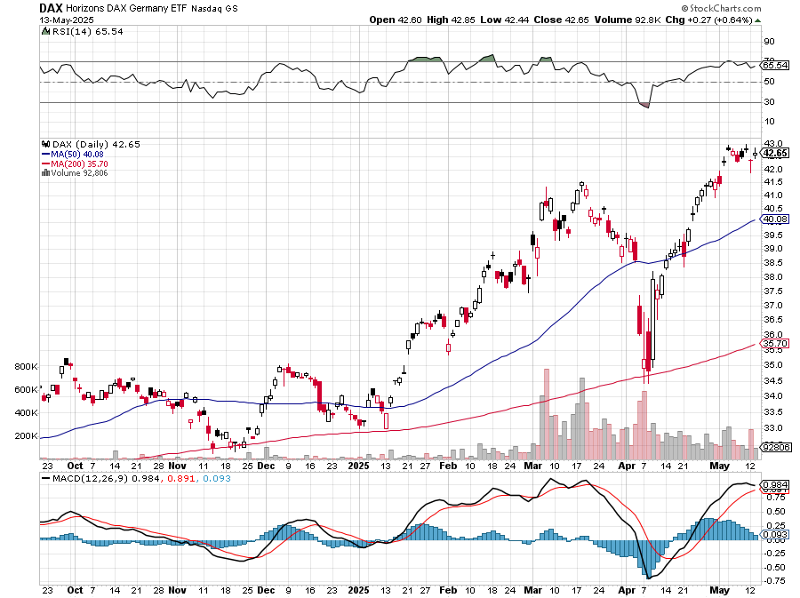
German Dax (DAX)- +30%

Slide 30
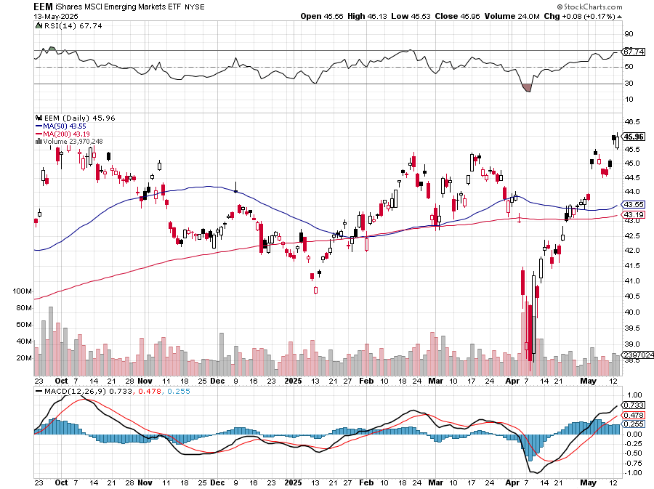
Emerging Markets (EEM) - +8% Weak Dollar, Long Recovery Play

Slide 31
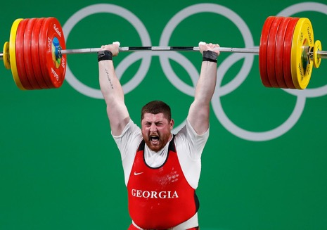
THE MAD HEDGE FUND TRADER
The Barbell Portfolio
*75% Big Tech – 2% of US workforce, 25% of market cap and 25% of US earnings 25% Domestic Recovery, including: Railroads, airlines, cruise lines, Couriers, steel companies Banks, commodities Construction Credit Card Companies Hotels, casinos Online Ticket Sales

Slide 32
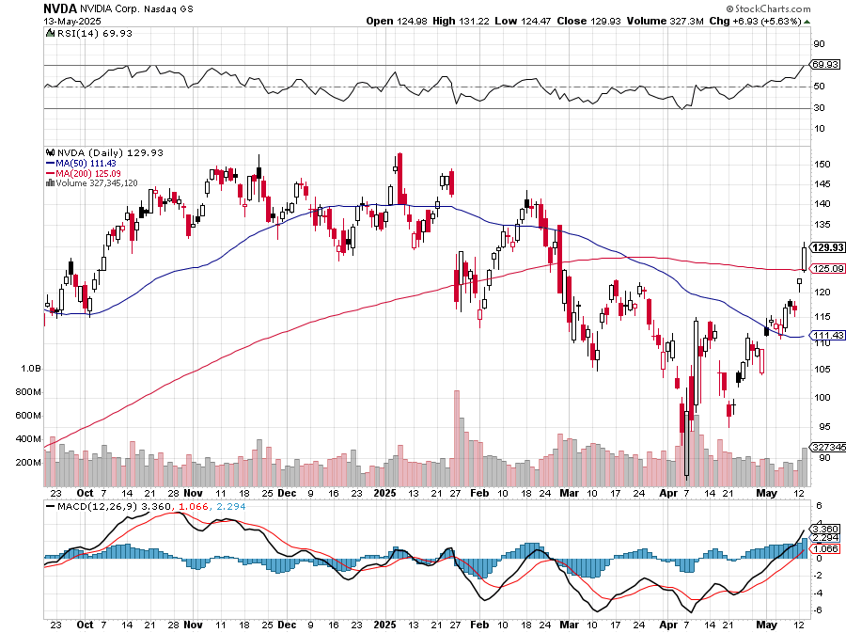
NVIDIA (NVDA) – Blackwell Chips @ $70,000 each Big Deal in Saudi Arabia with sale of 18,000 Blackwells-but not enough to replace China long 6/$140-$145 puts spread, took profits on long 5/$70-$75 call spread took profits on long 3/$88-$90 call spread, took profits on long 4/$140-$145 puts spread took profits on Long 2/$90-$95 call spread, took profits on Long 12/$117-$120 call spread

Slide 33
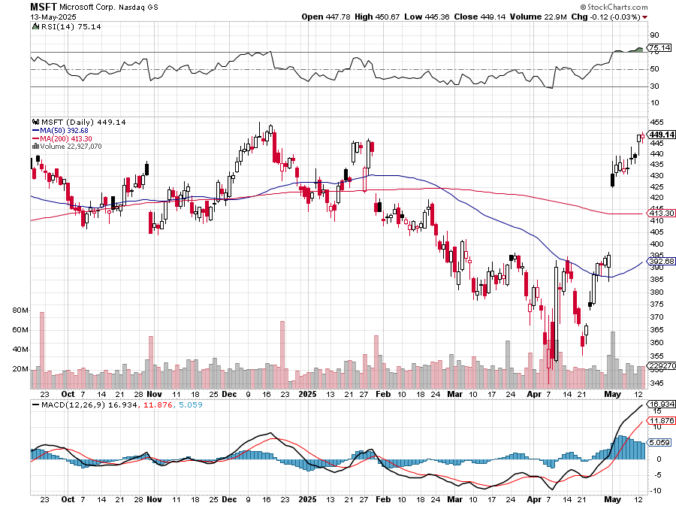
Microsoft (MSFT)-Microsoft Bombs, Microsoft Blows Up on Cloud Guidance took profits on long 5/$430-$440 put spread Took profits on long 2/$330-$340 call spread, took profits on long 12/$320-$330 call spread took profits on long 9/$235-$245 call spread, took profits on long 7/$220-$210 call spread,

Slide 34
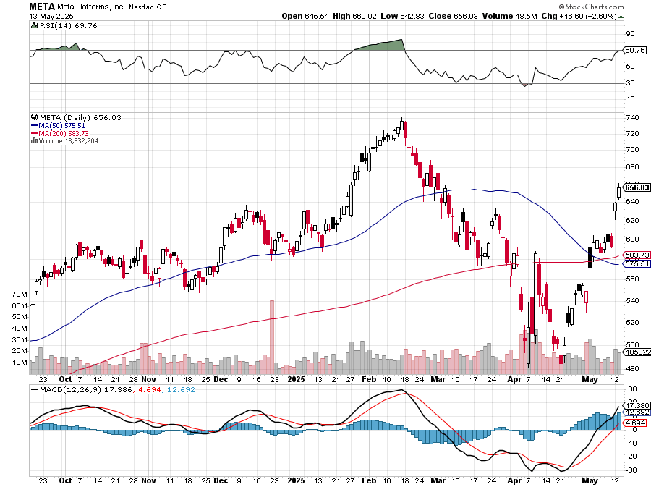
Meta (META) Meta Beats, on improving ad sales, a preeminent AI user took profits on Long 8/$420-$430 call spread took profits on Long 5/$360-$370 vertical bull call spread, took profits on Long 9/$290-$300 vertical bear put spread, stopped out of Long 9/$190-$200 vertical bear put spread

Slide 35
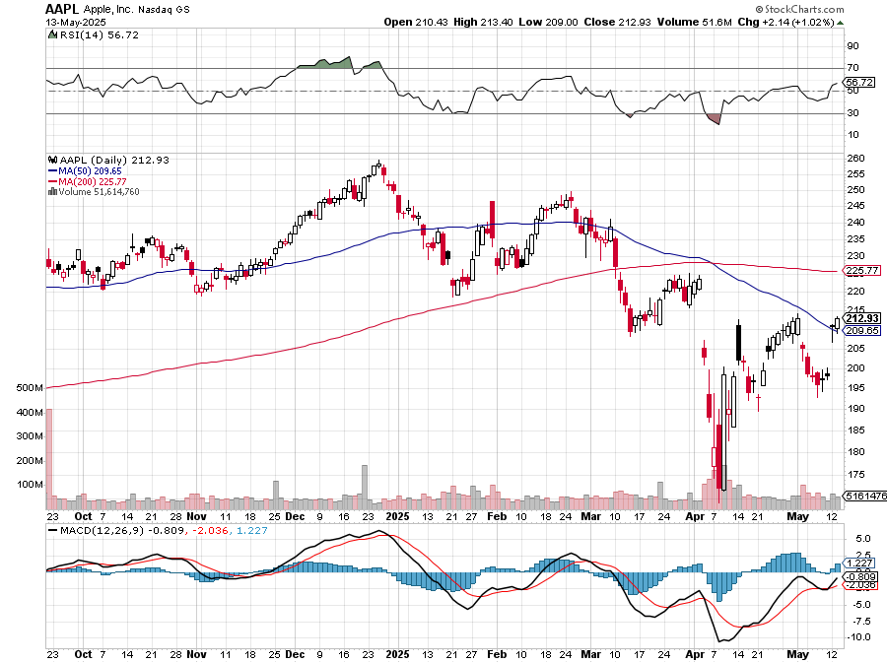
Apple (AAPL) Apple Tanks on Falling Search Revenues long 6/$220-$230 put spread-expires in 26 days, profits on Long 5/$225-$235 vertical bear put spread, took profits on Long 8/$160-$170 call spread took profits on Long 6/$200-$210 bear put spread,

Slide 36
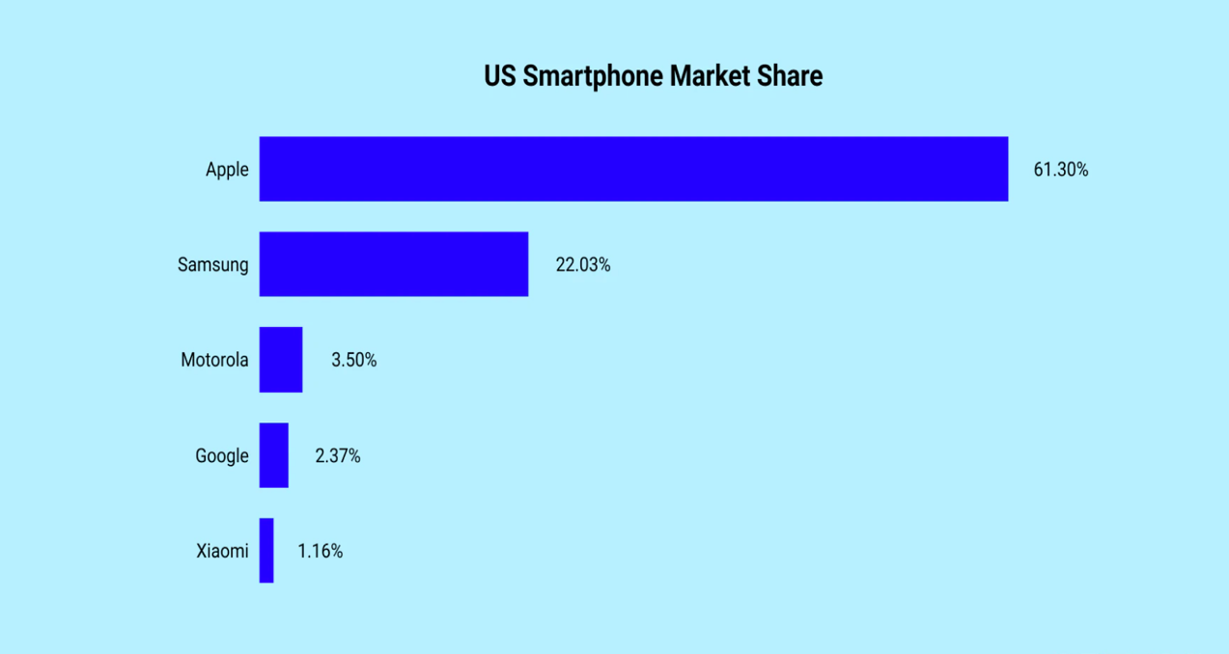

Slide 37
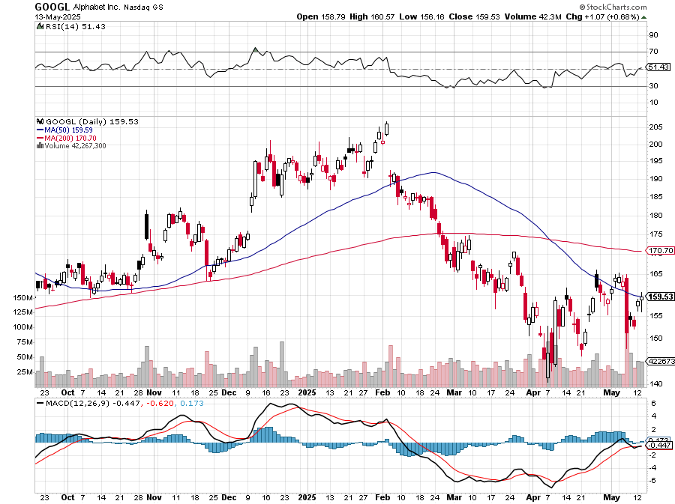
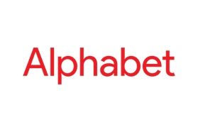
Alphabet (GOOGL) – Breakup Target Trump Administration to Pursue Alphabet Breakup, Alphabet’s Waymo Expands to Washington DC took profits on long 12/$110-$120 call spread took profits on long 12/$1,200-$1,230 bull call spread, took profits on long 9/$1,030-$1,080 vertical bull call spread

Slide 38
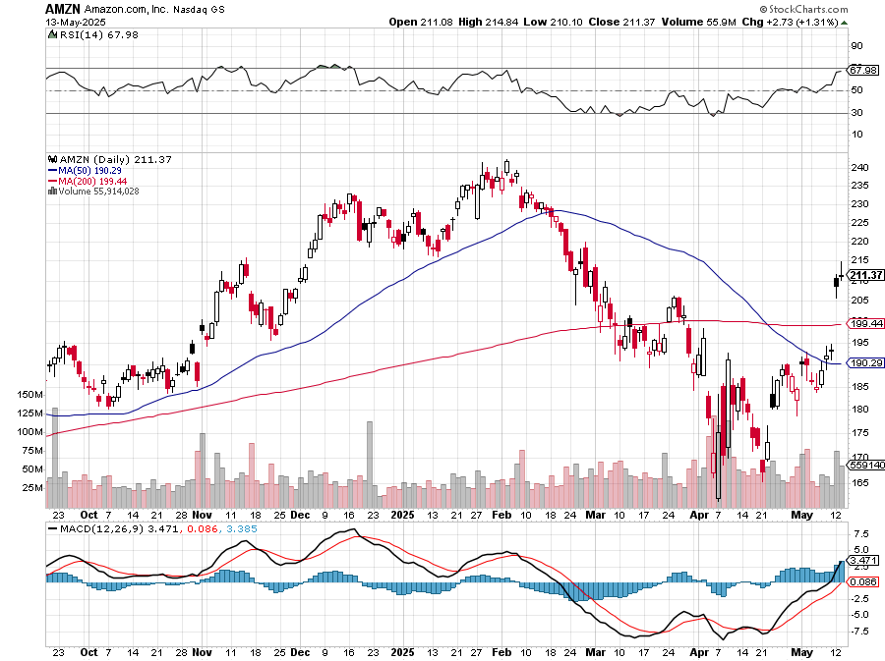
Amazon (AMZN) – Antirust Target Jeff Bezos to Sell $4.7 Billion of Amazon Stock took profits on long 3/$155-$160 bull call spread , took profits on long 2/$130-$135 bull call spread

Slide 39
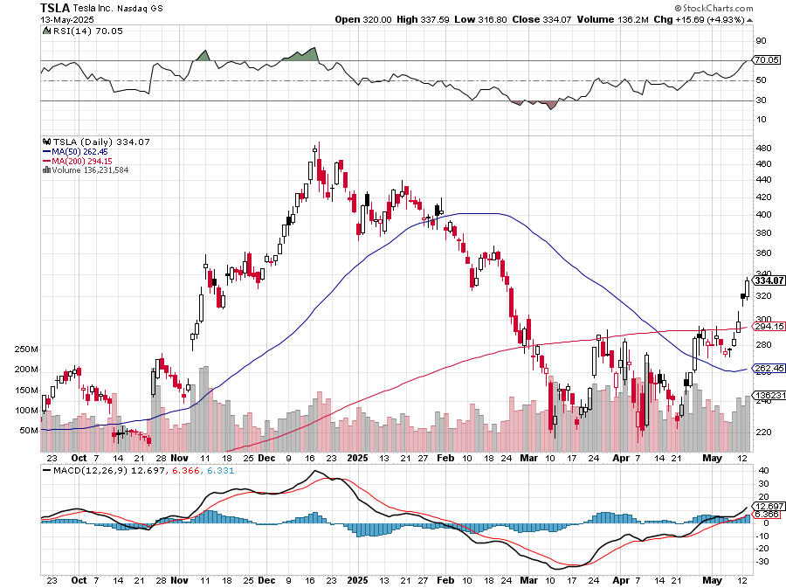
Tesla (TSLA) – Global Brand Destroyed Tesla Supplier Panasonic Lays off 10,000, China Sales Down 6%, stopped out of long 6/$370-$380 put spread, profits on long 4/160-$170 call spread stopped out of long $310-$320 put spread at cost, took profits on long 3/$350-$360 put spread, stopped out of 3/$210-$220 call spread, profits on long 2/$300-$310 call spread, took profits on long 2/$300-$310 call spread,

Slide 40
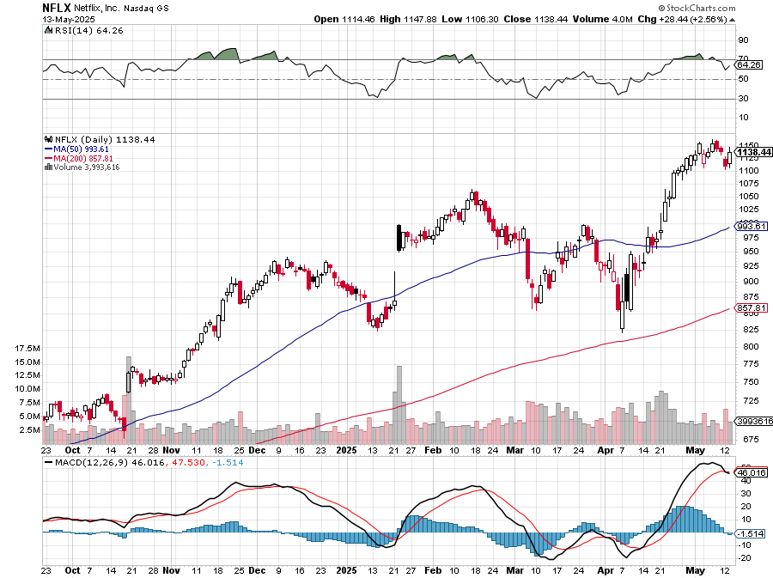
Netflix (NFLX) – Netflix Earnings Rocket, on the back of 19 million new subscriber took profits on long 4/800-$810 call spread

Slide 41
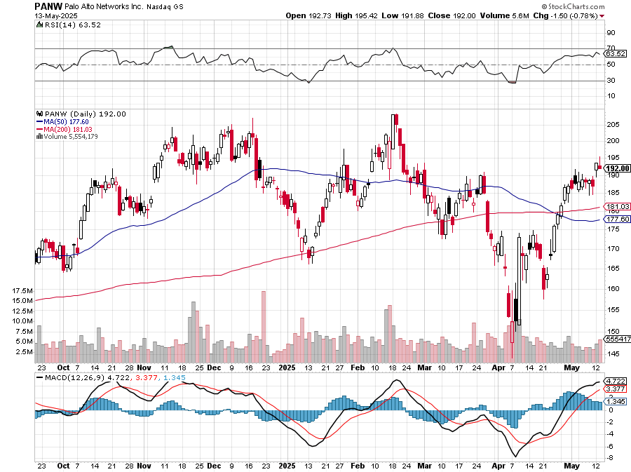
Palo Alto Networks (PANW)- Hacking never goes out of fashion Palo Alto Announced\s 2:1 Split took profits on long 2/$260-$270 call spread, took profits on long 10/$130-$140 call spread

Slide 42
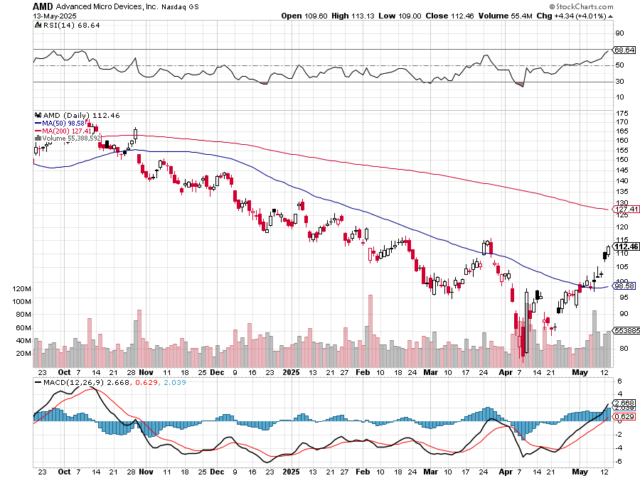
Advanced Micro Devices (AMD)- Recession fears programable logic devices took profits on long 2/$75-$80 call spread

Slide 43
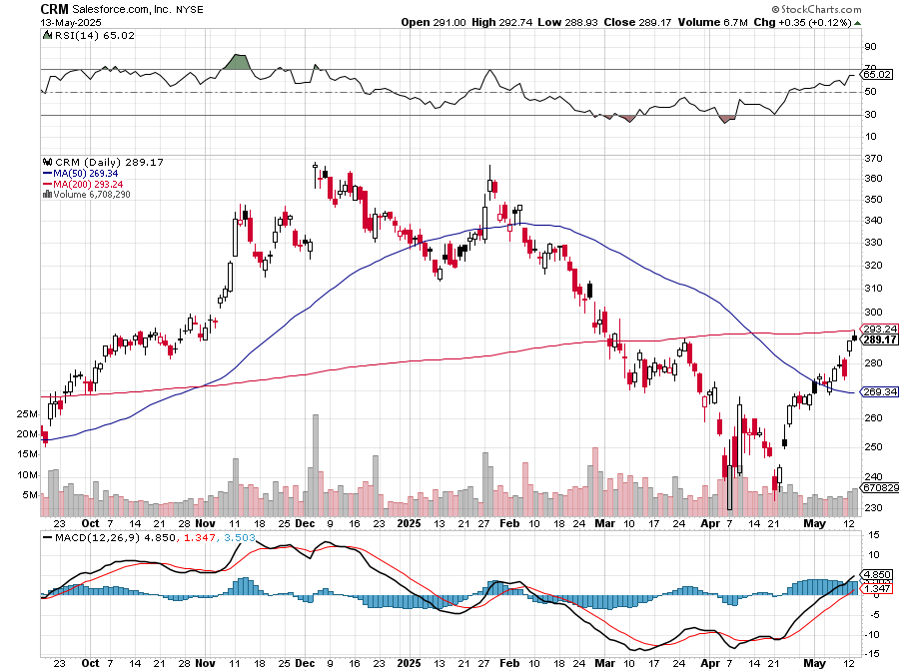
Salesforce (CRM)- Massive Online Migration took profits on long 12/$185-$195 call spread, took profits on long 9/$125-$130 vertical bull call spread took profits on long 8/$125-$130 vertical bull call spread

Slide 44
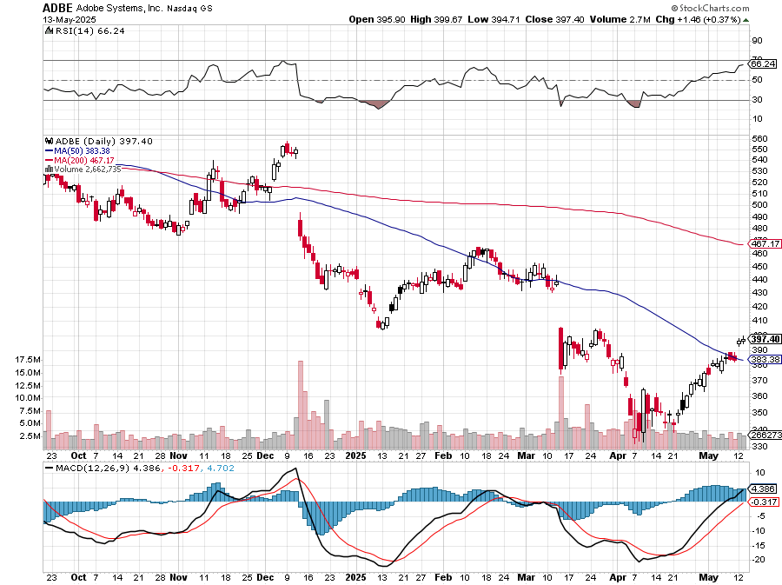
Adobe (ADBE)- Cloud play The Quality Non-China tech play

Slide 45
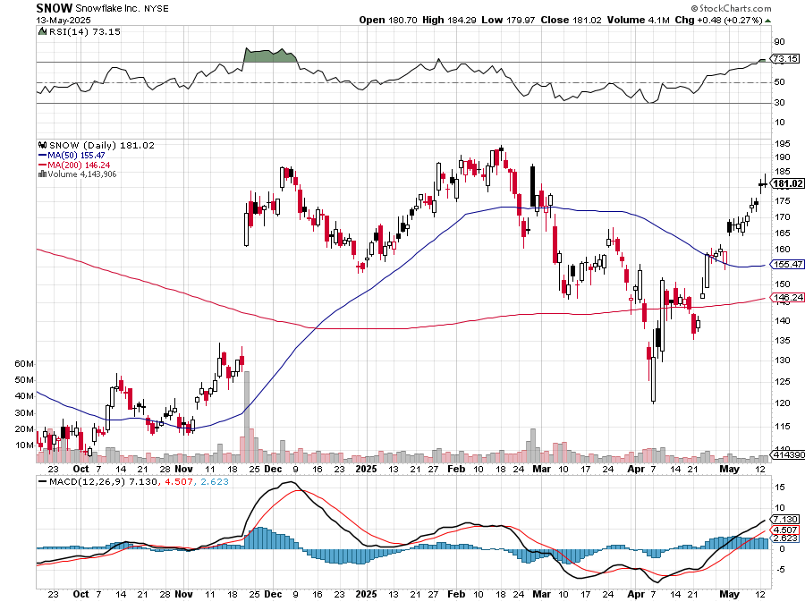
Snowflake (SNOW)- Blockbuster AI Earnings stopped out of long 4/$150-$255 call spread, took profits on long 12/$135-$140 call spread

Slide 46
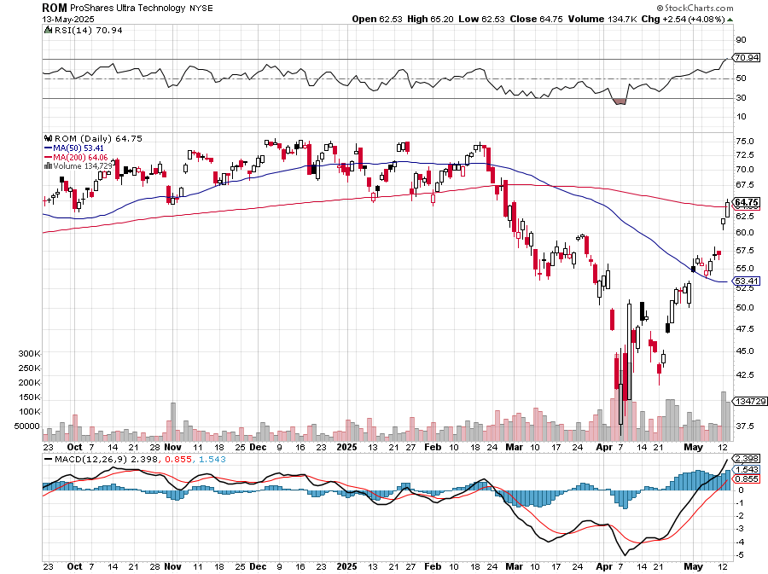
ProShares Ultra Technology ETF (ROM) – 2X Long Technology ETF took profits on long 10/$62-65 call spread

Slide 47
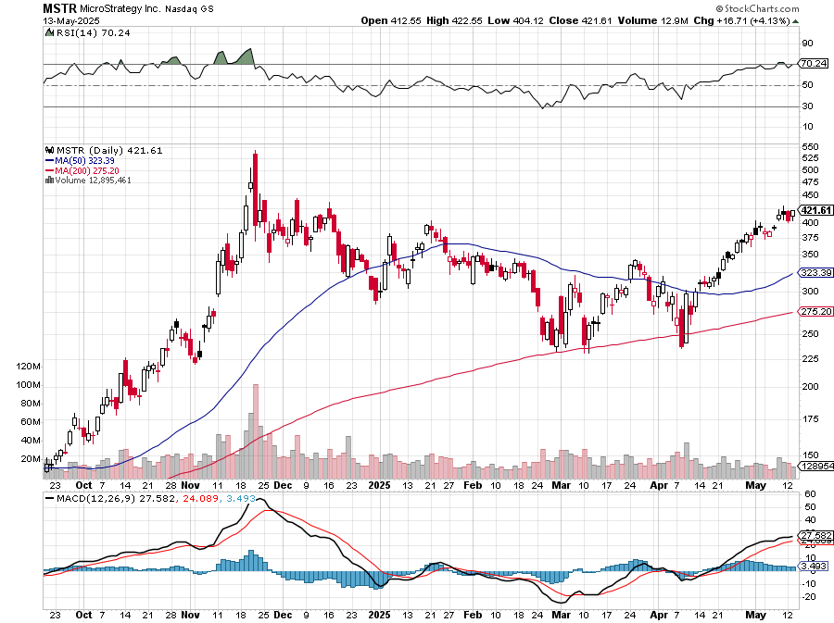
MicroStrategy (MSTR) – Long Bitcoin Play long 6/$500-$510 put spread-expires in 26 trading days took profits on long 5/$400-$410 put spread, took profits on long 5/$220-$230-$230 call spread, took profits on long 5/$400-$410 put spread, took profits on long 5/$400-$410 put spread, took profits on long 4/$340-$350 put spread

Slide 48
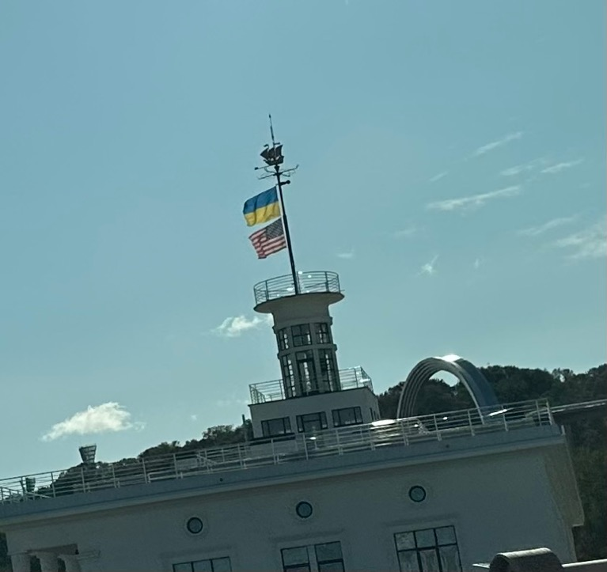

Slide 50
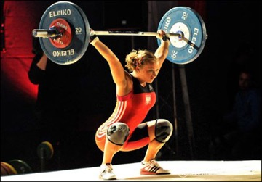
The Second Half of the Barbell
*Bets on a domestic recovery in 2022 Q4 *Upside potential in 2024 far greater than tech *Some of these have not moved for 5 or 10 years *Focuses on economically sensitive cyclical industries *Makes a great counterweight to high-growth technology *We could spend all of next ten years rotating between the two groups

Slide 51
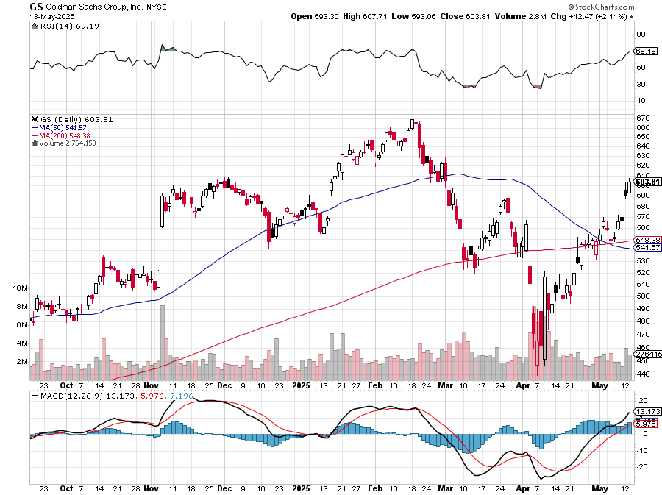
Goldman Sachs (GS) – Goldman Sachs Beats, with Revenues of $12.73 billion vs. $12.46 billion estimate stopped out of 3/$380-$390 call spread, profits on long 12/$330-$350 call spread, took profits on long 11/$330-$350 call spread

Slide 52
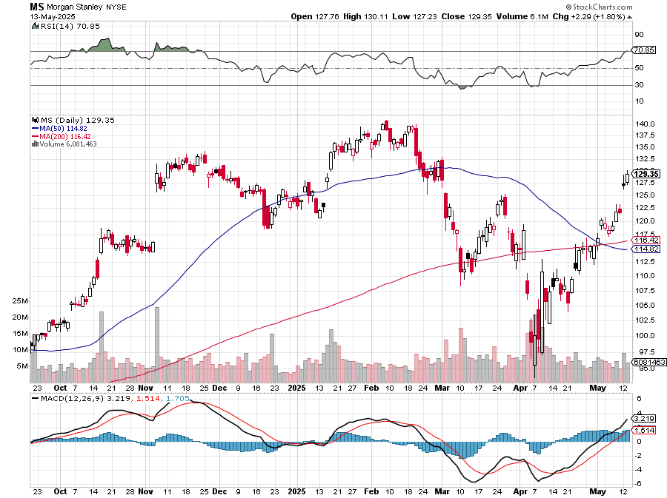
Morgan Stanley (MS) Morgan Stanley Doubles Profits took profits on long $12/210-$220 call spread, Took profits on long $195-$205 call spread, took profits on long 4/$65-$70 call spread

Slide 53
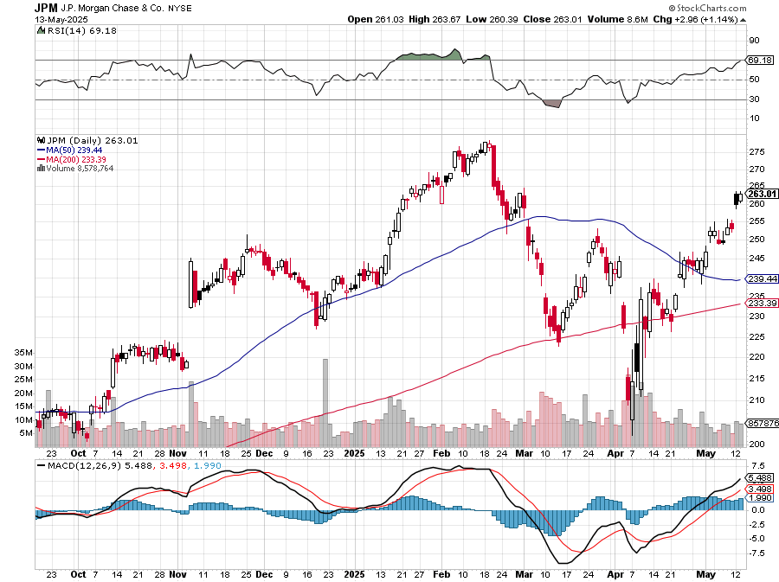
JP Morgan Chase (JPM) – Jamie Diamond Sells 30% of JP Morgan Stock stopped out of 3/$235-$245 calls spread, profits on long 12/$210-$220 call spread, took profits on long 11/$195-$205 call spread, took profits on 4/$215-225 put spread, took profits on long 4/$105-$115 call spread

Slide 54
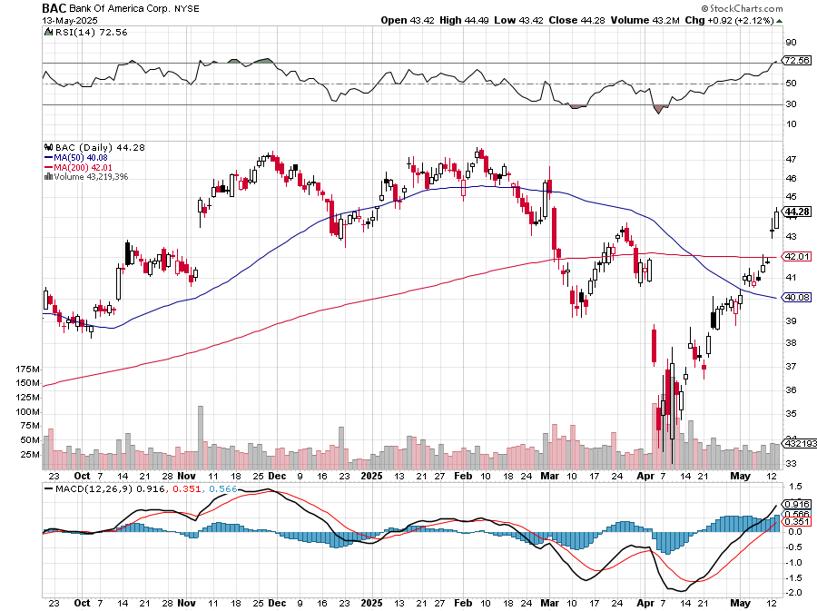
Bank of America (BAC) – Deregulation play took profits on long long 12/$41-$44 call spread, took profits on long 4/$20-$23 call spread

Slide 55
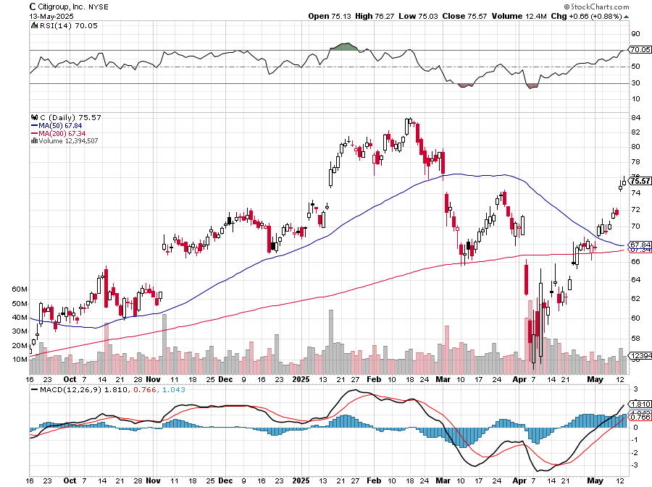
Citigroup (C) – took profits on long long 12/$60-$65 call spread , took profits on long 4/$30-$35 call spread

Slide 56
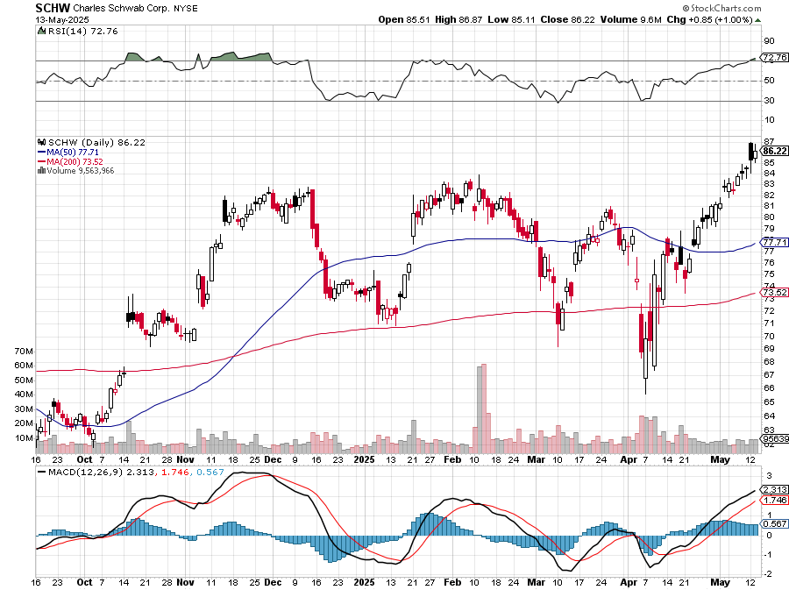
Charles Schwab (SCHW) – LEAPS expire at Max profit took profits on long 4/$30-$35 call spread

Slide 57
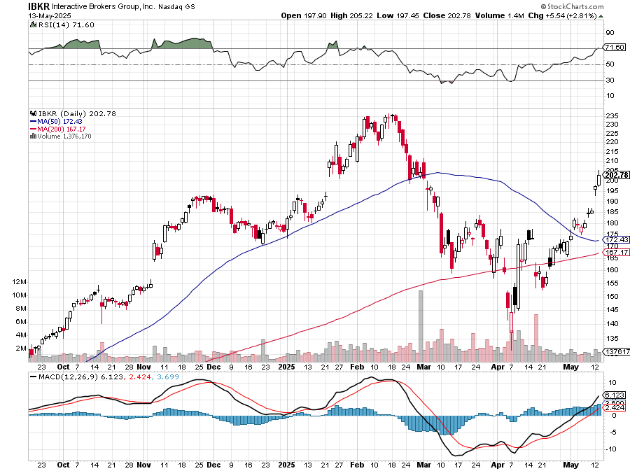
Interactive Brokers (IBKR) – LEAPS expired at Max Profit stopped out of long 3/$160-$170 call spread, out of long 8/$110-$115 call spread , took profits on long 4/$60-$65 call spread

Slide 58
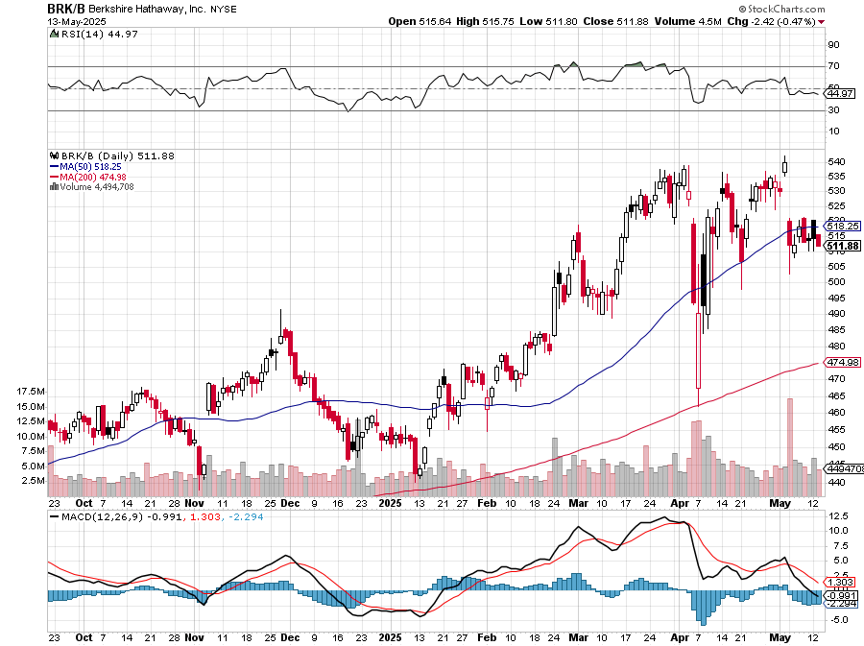
Berkshire Hathaway (BRKB)- Ultimate defensive stock Berkshire Hathaway Builds Record Cash, at $334 billion – Is the new T Bill proxy stopped out of long 12/$405-$415 call spread, took profits on long 12/$320-$330 call spread took profits on long 4/$260-$270 call spread, took profits on long 1/$290-$300 call spread

Slide 59
Blackrock (BLK)-Asset Collection Boom took profits on long 12/$850-$860 call spread took profits on long 3/$770-$790 call spread, took profits on long 3/$310-$340 call spread

Slide 60
SPDR Metals & Mining ETF (XME) – long 2/$28-$30 call spread

Slide 61
Boeing (BA) – Q3 $6 Billion Loss –b Strike Continues Qatar Airways to Buy 100 Boeing Jets “il pesce marcisce dalla testa”

Slide 62
General Motors (GM) – Worst Off Trade War Victim stopped out of long 4/$52.50-$57.50 put spread at cost, long 3/$53-$56 put spread

Slide 63
Package Delivery- United Parcel Service (UPS) – strike averted took profits on long 11/$130-$140 call spread

Slide 64
Caterpillar (CAT)- Ag + Infrastructure + Housing stopped out of long 8/$310-$320 call spread, took profits on long 12/$220-$230 calls spread took profits on long 12/$145-$150 call spread, took profits on long 11/$125-$135 call spread

Slide 65
Deere & Co. (DE)- Ag + Infrastructure + Housing took profits on long 8/$330-$340 put spread stopped out of long 8/$330-$340 calls spread

Slide 66
Freeport McMoRan - (FCX)- Coming Copper Crisis Freeport McMoRan Beats, helped by higher production and easing costs took profits on long 4/$37-$40 call spread, took profits on long 5/$42-$45 call spread, stopped out of long $48-$51 put spread, profits on long 6/$32-$35 call spread took profits on long 4/$30-$33 call spread, took profits on long 10/$20-$23 call spread

Slide 67
Walt Disney (DIS) -Disney Beats Disney Dives on Earnings Bust, although streaming broke even versus an expected loss

Slide 68
Industrials Sector SPDR (XLI)- (GE), (MMM), (UNP), (UTX), (BA), (HON)

Slide 69
Union Pacific RR (UNP)- Big Stuff to Ship took profits on long 5/$200-$210 call spread took profits on 11/$150-$160 call spread

Slide 70
Walmart (WMT) – The New AI Stock took profit on Long 11/$125-$130 bear put spread, took profit on Long 10/$119-$121 bear put spread took profits on Long 8/$114-$117 bear put spread

Slide 71
Costco (COST) – Permanent Compounder took profits on long 4/$840-$850 call spread

Slide 72
Delta Airlines (DAL) – Recession Warning-Travel Collapse The Non-Boeing Airline – uses Airbuses

Slide 73
Transports Sector SPDR (XTN)- Worst Hit Sector (ALGT), (ALK), (JBLU), (LUV), (CHRW), (DAL)

Slide 74
Health Care Sector (XLV) – Defensive Play and Cheap (JNJ), (PFE), (MRK), (GILD), (ACT), (AMGN)

Slide 75
Amgen (AMGN) took profits on long 11/$185-$200 bull call spread

Slide 76
Visa (V) – Inflation boost Justice Hits Visa (V) with Antitrust Suit, with a 47% market share took profits on long 2/$240-$250 bull call spread took profits on long 10/$160-$170 bull call spread, took profits on long 6/$150-$160 bull call spread

Slide 77
Consumer Discretionary SPDR (XLY) (DIS), (AMZN), (HD), (CMCSA), (MCD), (SBUX)

Slide 80
Bonds – Recovery Selloff
*Trump cave on China trade puts recovery hopes back on, along with inflation *Bonds recover sharply to a 4.50% yield *Foreign investors panic sell abates, but but hey still own $38 trillion in US assets *Confidence and the US brand are still permanently damaged *Even just even a 10% selloff generates $3.8 trillion of selling *Why own the US when Germany is doing so much better with no currency risk *US Budget deficit set to double this year to $5 trillion *Avoid (TLT), (JNK), (NLY), (SLRN) and REITS

Slide 81
Treasury ETF (TLT) – long 6/$80-$83 call spread-expires in 26 trading days, took profits on long 4/$84-$87 call spread stopped out of long 1/$82-$85 call spread, took profits on long 10/$103-$106 put spread took profits on long 6/$$94-$97 put spread, took profits on long 5/$82-$85 calls spread

Slide 82
Ten Year Treasury Yield ($TNX) – 4.15%

Slide 83
Junk Bonds (JNK) 6.54% Yield

Slide 84
Municipal Bonds (MUB) 4.21% Yield-

Slide 85
Emerging Market Debt (ELD) 5.62% Yield-

Slide 86
2X Short Treasuries (TBT)-Out of Favor

Slide 87
Anally Capital Management (NLY) – Leveraged REIT Play Yield 13.25% took profits on long 12/$15-$16 call spread

Slide 90
Foreign Currencies – Trade War Relief
*Trump cave in trade war brings US dollar rally *Profit taking hits foreign currencies, which have had massive runs this year *Interest rate differentials are back as the driver of currencies, with the US at a high 4.25%, at least for this week *Next dollar weakness will come with evidence of a recession in weeks *Flight to safety takes a vacation but it will be back *Buy (FXA), (FXE), (FXB), (FXC), and (FXY)

Slide 91
THE MAD HEDGE FUND TRADER
Australian Dollar (FXA) - Major Long-Term Bottom is In Targeting Parity – A call option on a global synchronized recovery

Slide 92
Japanese Yen (FXY)

Slide 93
Euro (FXE)-

Slide 94
British Pound (FXB)-

Slide 95
Emerging Market Currencies (CEW)

Slide 98
Energy & Commodities – Bounce
*Trade war relief give oil a bounce *Oil Production has Peaked, thanks to the collapse in prices triggered by recession fears *Saudi Arabia playing a market share game and increasing production is another factor *We’re headed for $30 a barrel *The U.S.-China trade war is dominating investor sentiment in moving oil prices, superseding nuclear talks between the U.S. and Iran and discord within the OPEC+ coalition *Markets have been rocked by conflicting signals from U.S. over what progress was being made to de-escalate a trade war that threatens to sap global growth.

Slide 99
Oil-($WTIC)

Slide 100
United States Oil Fund (USO)

Slide 101
Energy Select Sector SPDR (XLE)-No Performance! (XOM), (CVX), (SLB), (KMI), (EOG), (COP)

Slide 102
ExxonMobil (XOM)- Exxon Moves Big into Lithium, with the construction of a major mining operation in Arkansas took profits on Long 4/$100-$105 call spread, took profits on long 12/$120-$125 put spread

Slide 103
Occidental Petroleum (OXY)- Buffet’s a Buyer took profits on long 4/$59-$62 call spread took profits on long 2/$55-$60 call spread, took profits on long 12/$77.50-$82.50 put spread

Slide 104
Natural Gas (UNG) – Free Fall on Warm Winter took profits on Long January 2025 $7-8 Call Spread LEAPS

Slide 105
Cameco (CCJ) – Global Uranium Renaissance Microsoft to Reopen Three Mile Island to power AI data centers took profits on long 12/$41-$44 call spread, took profits on long 12/$35-$38 call spread, took profits on long 5/$20-$23 bull call spread

Slide 106
Vistra Corp. (VST) – Global Uranium Renaissance took profits on long 2/$100-$110 call spread

Slide 109
Precious Metals – Profit Taking
*Gold takes a break after a massive 35% rally since the election *My target is still $5,000. *Rising US interest rates have also delivered a hit Q1 Gold Inflows Hit Three Year High, according to the World Gold Council *Gold ETFs saw an inflow of 226.5 metric tonnes worth $21.1 billion in the first quarter, *Central bank buying and Chinese savings demand continues unabated with China devaluing its currency *Keep buying all (GLD) metal dips.

Slide 110
THE MAD HEDGE FUND TRADER
Gold (GLD)-A New Leg long 6/$275-$285 call spread-expires in 26 trading days, took profits on long 5/$275-$285 call spread took profits on profits on long 10/$230-$235 call spread took profits on Long 10/$220-$225 call spread, took profits on Long 8/$210-215 call spread, took profits on Long 7/$200-205 call spread, Long 6/$207.5-$212.5 call spread took profits on Long 4/$194-$197 call spread, took profits on long 5/$165-$170 bull call spread
$5,000 in 2028 +66%
BUY

Slide 111
Gold (GLD) –Falling Rate took profits on Long 10/$230-$235 call spread took profits on Long 10/$220-$225 call spread, took profits on Long 8/$210-215 call spread, took profits on Long 7/$200-205 call spread, Long 6/$207.5-$212.5 call spread took profits on Long 4/$194-$197 call spread, took profits on long 5/$165-$170 bull call spread

Slide 112
Market Vectors Gold Miners ETF- (GDX) – took profit on long 6/$207.50-$212.50 call spread, took profit on long 7/$200-$205 call spread

Slide 113
Barrick Gold (GOLD) took profit on long 1/$15.50-$16.50 call spread

Slide 114
Newmont Mining- (NEM)- Sometimes you Just Get Lucky took profits on long 10/$47-$50 call spread, took profits on long $55-60 call spread

Slide 115
THE MAD HEDGE FUND TRADER
iShares Silver Trust (SLV) - The Better Play Industrial demand, solar panels, electric cars
2025 Target $50 +50%
BUY

Slide 116
Silver Miners - (SIL)-

Slide 117
Wheaton Precious Metals - (WPM)- LEAPS Approaching Max Profit took profits on long 4/$39-$42 call spread , took profits on long 1/$36-$39 call spread

Slide 118
Platinum- (PPLT)- 556,000-ounce shortage this year took profits on long 1/$36-$39 call spread

Slide 121
Real Estate – Dead in the Water
*New Homes are Now Cheaper than Existing Homes, for the first time *A 30% rise in existing inventories has made the difference *New home builders can more easily discount with free upgrades and offer loan buy downs *Some 40% of homes on the market have seen price drops, and time on the market is growing *Existing Homes Sales Hit 16 Year Low *Sales of previously owned US homes fell 5.9% in March to an annualized rate of 4.02 million, the weakest March since 2009 *Trade war has demoloished all confidence in a housing recovery

Slide 122
S&P Case Shiller Slows S&P Case Shiller Rises to +4.1% YOY in February, with its National Home Price Index New York gained +7.7%, Chicago +7.0%, and Cleveland +6.6%. Washington DC was down -1.1%

Slide 123
Crown Castle International (CCI) – 6.62% yielding 5G cell phone tower REIT Eliot Management Pushes up stock with activist bid took profits on Long 8/$90-$95 call spread,

Slide 124
US Home Construction Index (ITB) (DHI), (LEN), (PHM), (TOL), (NVR)

Slide 125
DH Horton (DHI) Horton Bombs, with the stock dropping some 11% in Tuesday morning trading after the U.S.'s largest homebuilder issued its fiscal 2025 guidance took profits on long 11/$165-$175

Slide 128
Trade Sheet- The Recession Trade So What Do We Do About All This?
*Stocks –sell rallies *Bonds – buy dips *Commodities - stand aside *Currencies – buy dips *Precious Metals – buy dips *Energy – stand aside *Volatility – sell over $50 *Real estate – stand aside

Slide 130
Next Strategy Webinar 12:00 EST Wednesday, May 28, 2025 from Incline Village, NV email me questions at support@madhedgefundtrader.com
Good Luck and Good Trading!
Notes:
*

