Slide 1
The Mad Hedge Fund Trader “The Blind Man’s Market”
With John Thomas Incline Village, NV June 11, 2025 www.madhedgefundtrader.com
Notes:
*

Slide 2
Thursday, June 19 is Juneteenth A national holiday All Markets are Closed

Slide 3
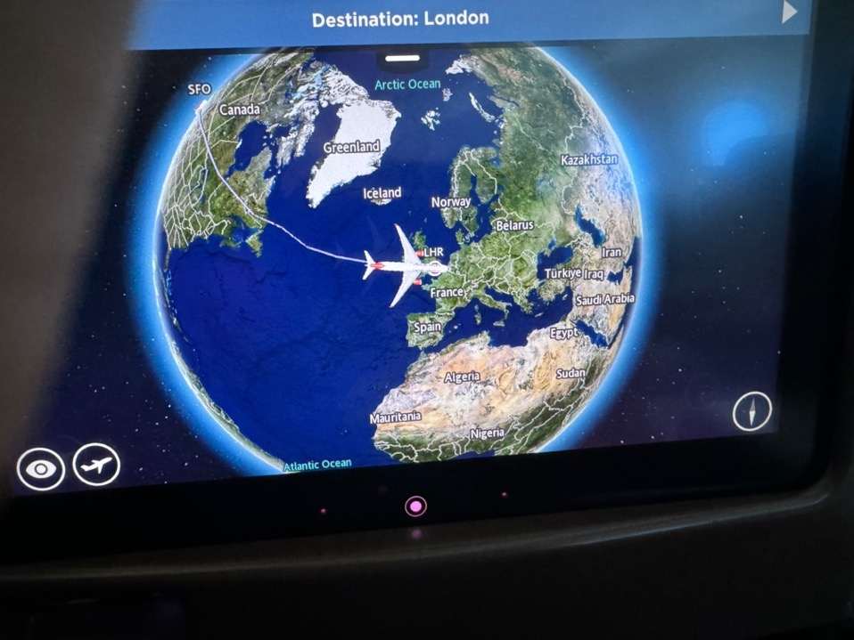

Slide 4
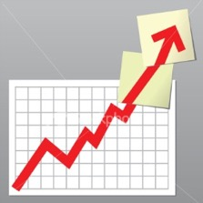
Trade Alert Performance New All-Time Highs-An 11% Week!
*January +5.80% Final *July +10.92% Final *February +3.66% Final. *August +3.74% Final *March +4.36% Final *September +10.28% Final *April +0.95% Final *October +7.59% Final *May +2.51% Final *November +18.96 Final *June +9.94% Final *December +3.26% Final *2025 Year To Date +39.63% +788.17% since inception *Versus 84.63% for all of 2022 *Versus 79.79% for all of 2023 *Versus 75.29% for all of 2024

Slide 5
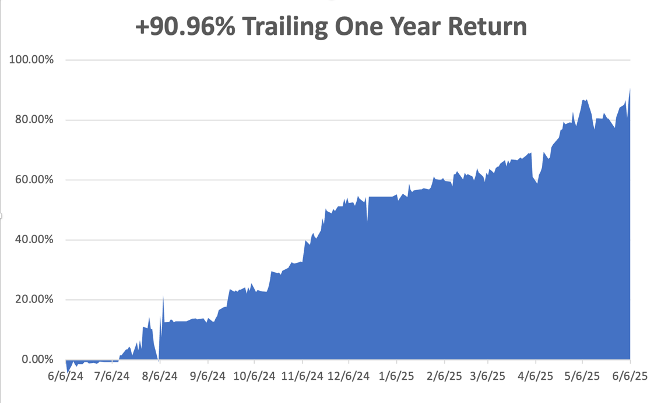

Slide 6
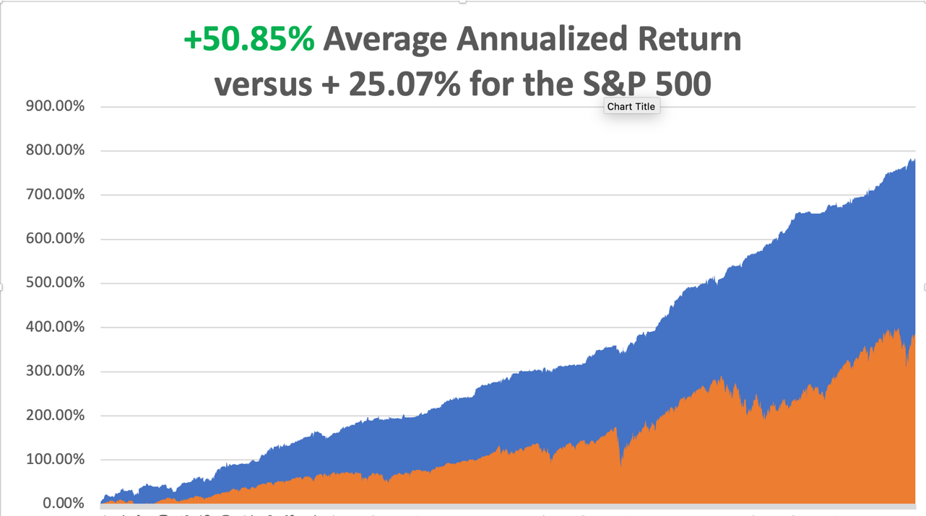

Slide 7
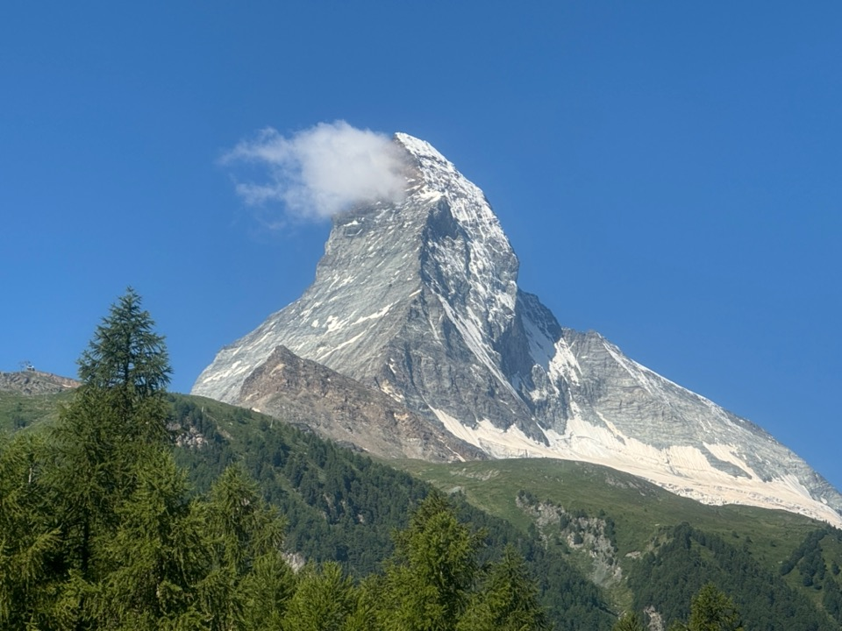

Slide 8
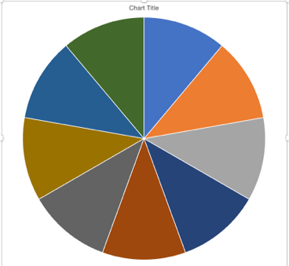
Portfolio Review – Big Bet We Don’t Go to New Highs by June 20 30% risk on, 60% risk off, 10% cash
Portfolio Review – Big Bet We Don’t Go to New Highs by June 20 30% risk on, 60% risk off, 10% cash
Risk On
(MSTR) 6/$330-$340 call spread | 10.00%
(TSLA) 6/$190-$200 call spread | 10.00%
Risk Off
(QQQ) 6/$540-$550 put spread | -10.00%
(TLT) 6/$88-$91 put spread | -10.00%
(WPM) 6/$75-$80 call spread | -10.00%
Total Net Position | -10.00%
Total Gross Position | 50.00%
Expiration Value +43.01%

Slide 9
The Method to My Madness
*Stocks are are now at very high-risk levels due to increasingly unstable world, *Could they go higher? Yes, but not much. The risk/reward here is terrible *US Bond auction failure could be the stick that breaks the camel’s back, and a $22 billion one is due on Thursday *As the National Debt accelerates it is going to present an increasingly difficult ceiling for stock prices *As US credit quality declines, interest rates will rise *The top technology stocks will lead all rallies, awaiting the return of AI as a market these, away from tariffs and debt default. *Safety assets like gold, silver, and T-bills will remain in demand *Oil is still dead on recession fears and OPEC production increase *US Dollar hits new two-year lows

Slide 10
The Global Economy – Slowing
* Nonfarm Payroll Report is Comes in Weak, at 139,000 last month after a combined 95,000 in downward revisions to the prior two months. *The unemployment rate held at 4.2%, * US Trade Deficit Shrinks at the Fastest Rate in History, as imports collapse * Mass Government Firings are Clouding the Economic Data. * U.S. Economic Output will Fall as a Result of New Tariffs on Foreign Goods, said the non-partisan Congressional Budget Office *ADP Hits Two Year Low, as new hiring grinds to a halt *US Factory Orders Dive, *ISM Manufacturing Index Dow for a Fourth Month * The US Economy Contracted at an Annualized Rate of -0.2% in Q1 2025

Slide 11
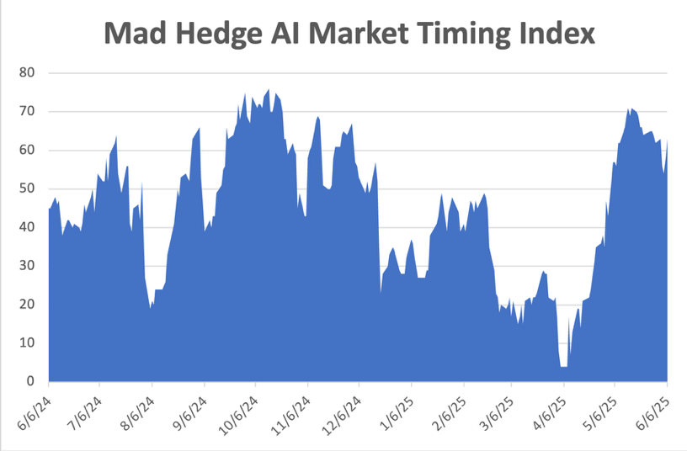
The Mad Hedge Profit Predictor Market Timing Index – New Range? An artificial intelligence driven algorithm that analyzes 30 different economic, technical, and momentum driven indicators
SELL
BUY

Slide 12
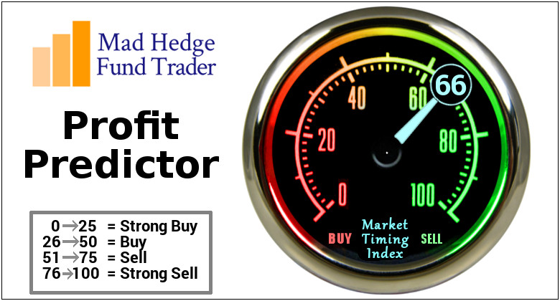

Slide 13
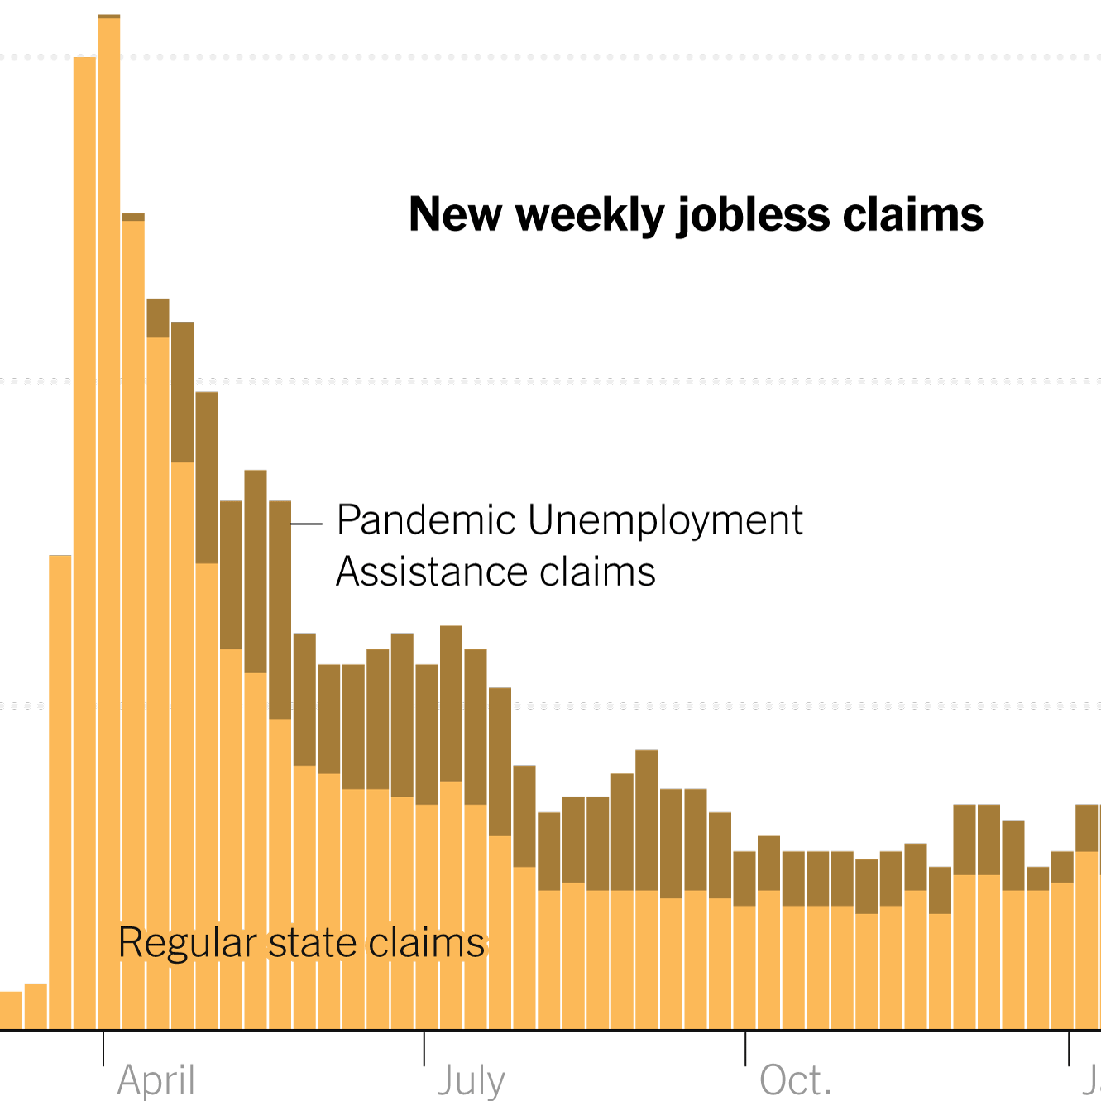
Weekly Jobless Claims – 8 Month High +8,000 to 247,000

Slide 14
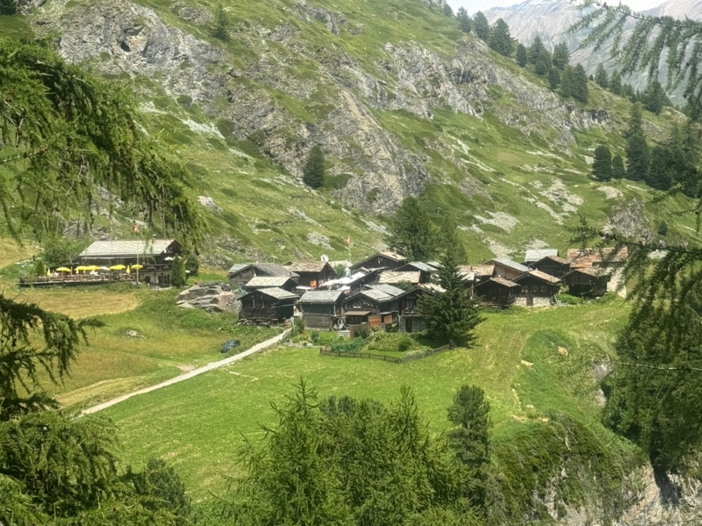

Slide 15
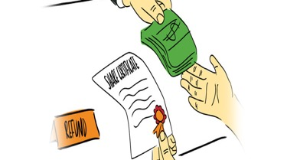
Stocks – A Buyback Game
*A house bill that brings $664 billion in corporate tax cuts and therefor stock buybacks is powering the bull market *That is on top of $1.2 trillion is existing buybacks budgeted for 2025 *US Factories are Shutting Down on Rare Earths Shortages *Sports Betting Stocks Tank, after Illinois imposes a 25% betting tax *Meta to Buy Nuclear Power Plant from Constellation *Money is Fleeing Equity Funds. U.S. equity funds faced a second successive weekly * Best Buy Cuts Earnings Outlook due to Chinese Tariffs *The 60/40 Portfolio is Dead for Now, with both stocks and bonds going down at the same time *US Steel (X) Takeover Goes Through, at $55 a share with Nippon Steel investing $14 billion of investment over the next 14 months to modernize antiquated technology

Slide 16
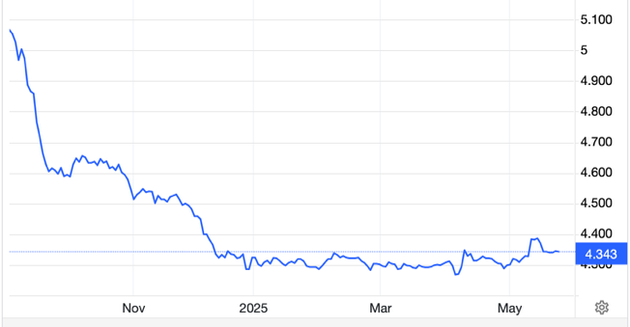
The Ultimate Hedge – Defensive stocks only go down at a slower rate 90 - day US Treasury Bills (Warren Buffet owns $300 billion)
*Government Guaranteed principal *Endless liquidity, trade like water *100% collateral value for margin *Lock in guaranteed income *Can be sold at any time to earn full interest *Will survive any bear market *Ask your broker how to buy
4.40% Yield

Slide 17
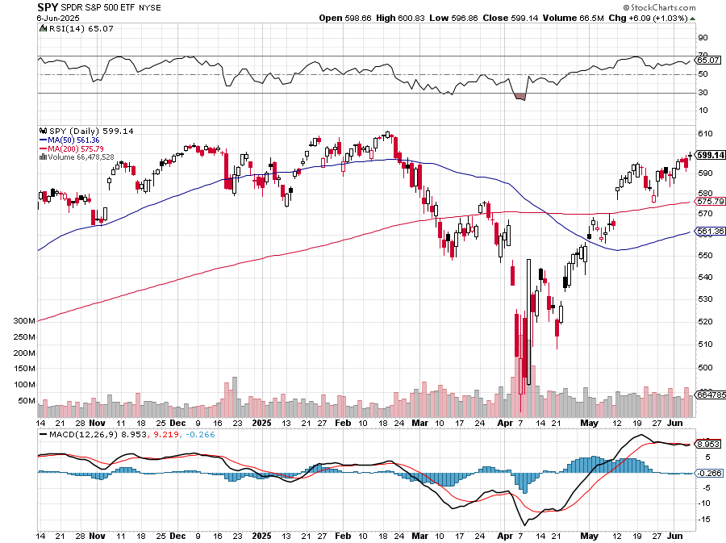
S&P 500 – Downside Targets – down 10% on year long 6/$610-$620 put spread-expires in 6 days, took profits on 6/$610-$620 put spread
$613 -1.3% 1st resistance
$540 -11.9% 1st support
$480 -21.7% 1st support

Slide 18
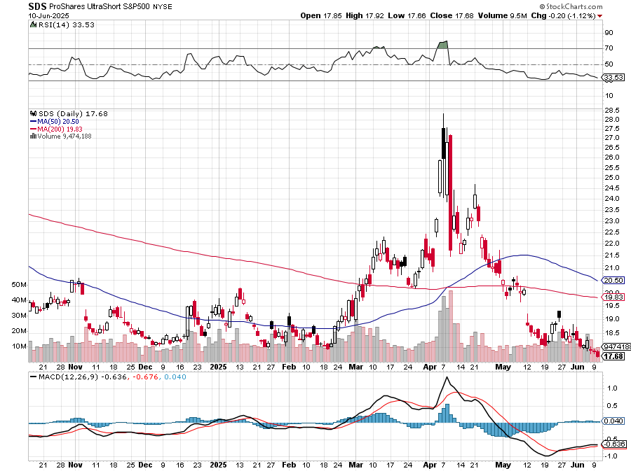
ProShares -2X Short S&P 500 (SDS) - a great 2X hedge for falling long stocks

Slide 19
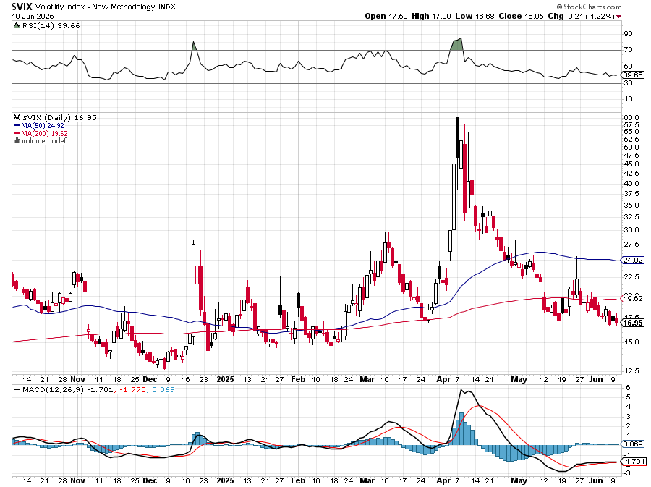
(VIX) – Volatility Index Hits Four Year High at $65, the most since the 2020 pandemic. That implies a 2% move in the S&P 500 (SPX) every day for the next 30 days

Slide 20
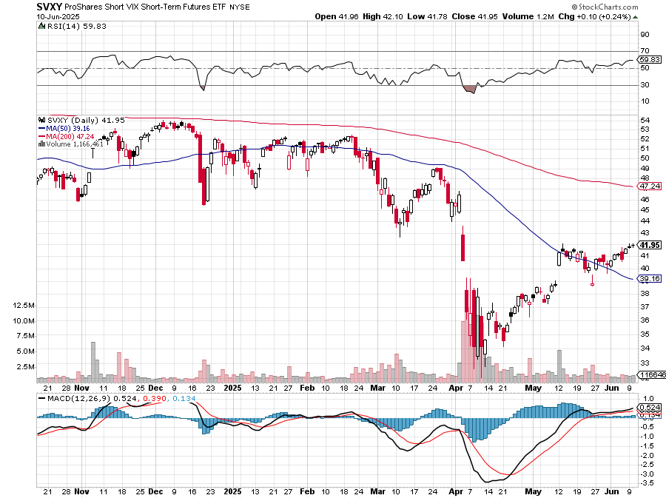
(SVXY) –Short Volatility ETF bought at $36.31 - $32.74 = $3.57

Slide 21
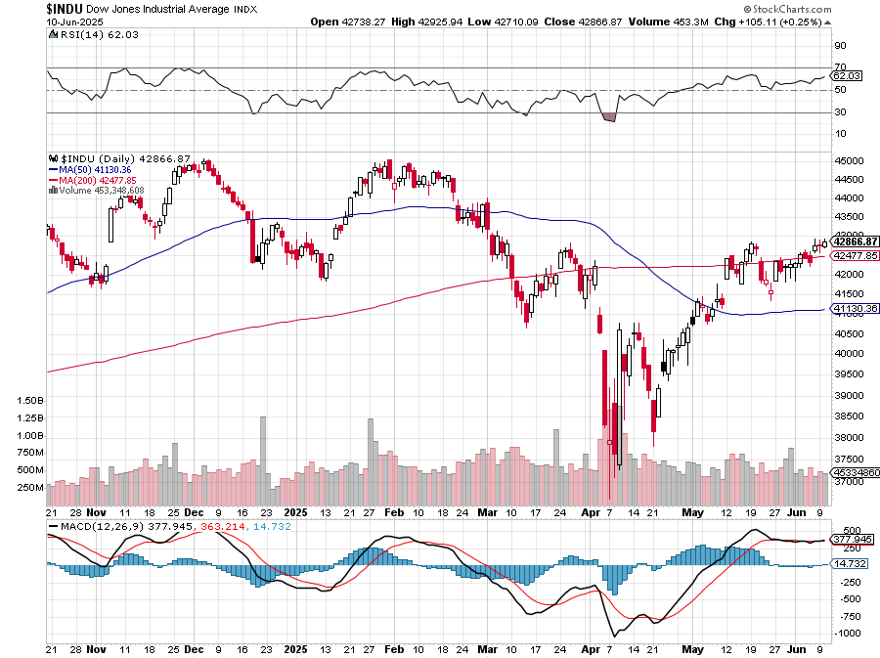
Dow Average ($INDU)-

Slide 22
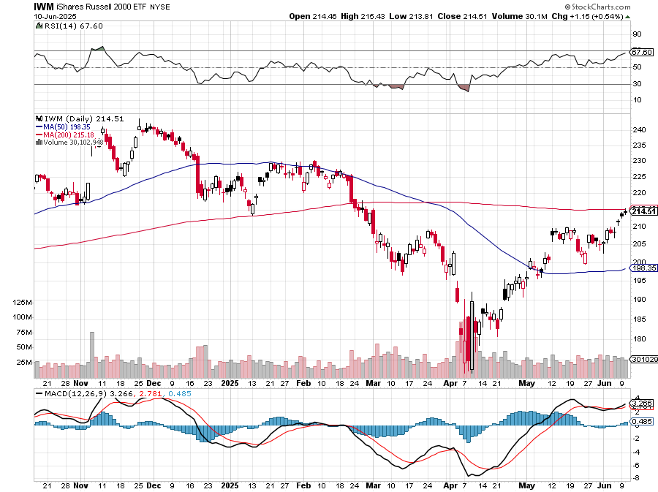
Russell 2000 (IWM)- took profits on Long 10/$137-$142 vertical bull call spread took profits on Long 10/$153-$156 vertical bear put spread

Slide 23
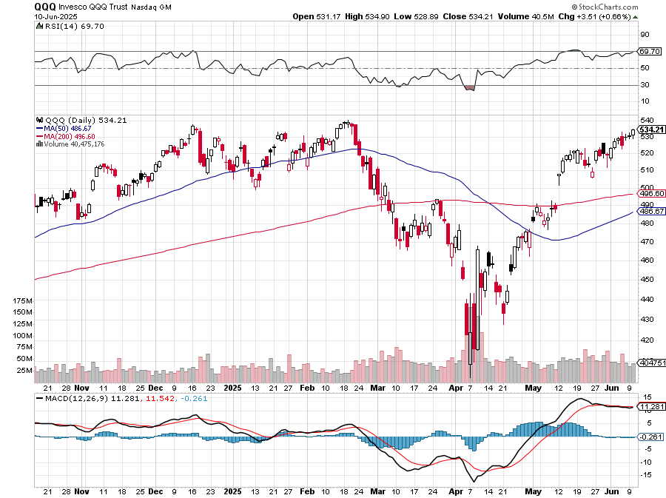
NASDAQ (QQQ) – Down 15% long 6/$540-$550-$345 put spread-expires in 17 days, took profits on Long 5/$335-$345 put spread took profits on long (QQQ) /$540-$550 put spread, took profits on long (QQQ) 4/$330-$335 put spread took profits on long (QQQ) 3/$340-$345 put spread, covered long (QQQ) $325-$330 put spread

Slide 24
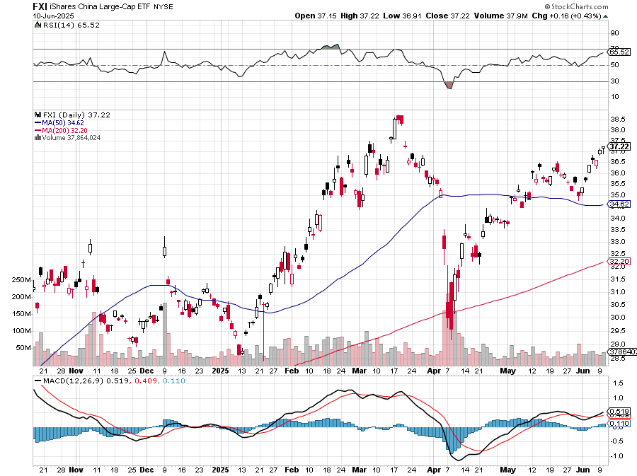
China (FXI) + 36%

Slide 25
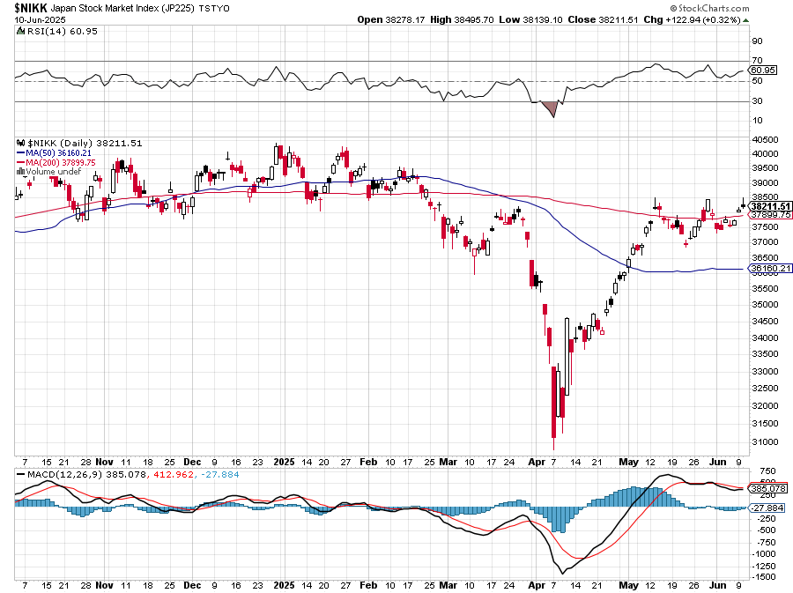
Japan ($NIKK) – down 10%

Slide 26
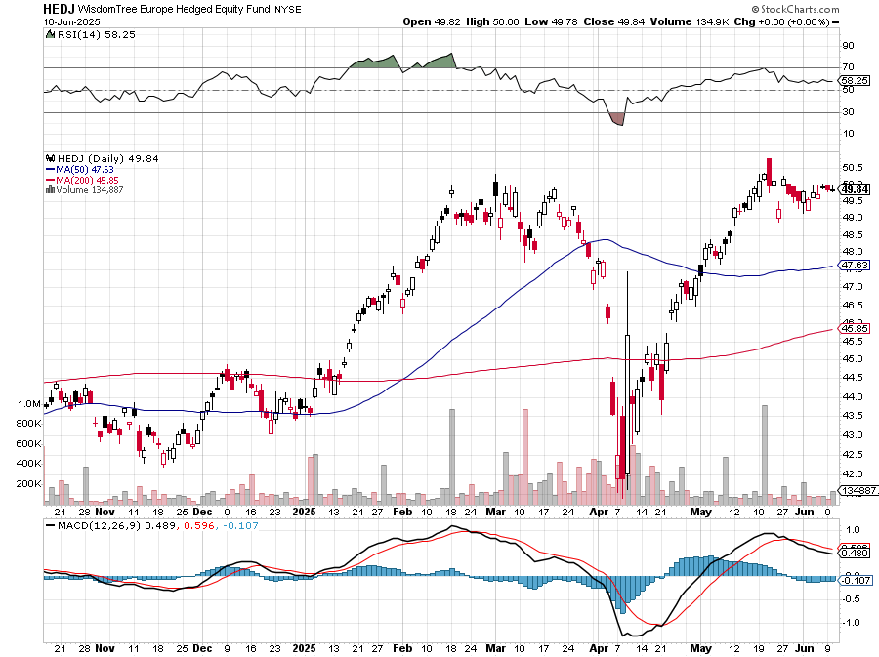
Europe Hedged Equity (HEDJ)- +19%

Slide 27
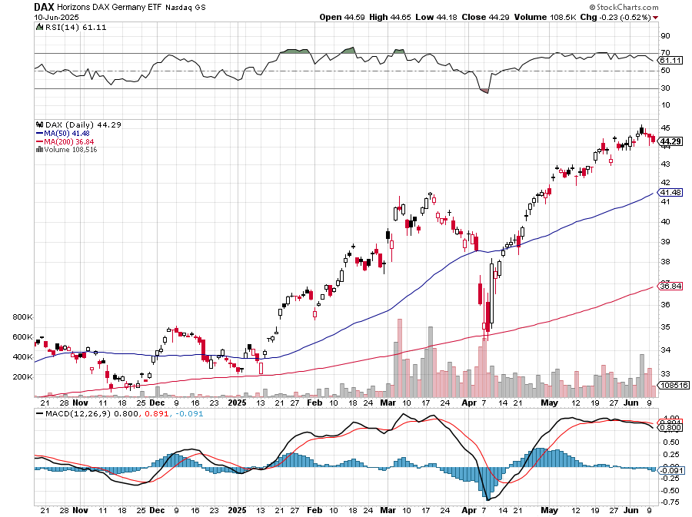
German Dax (DAX)- +30%

Slide 28
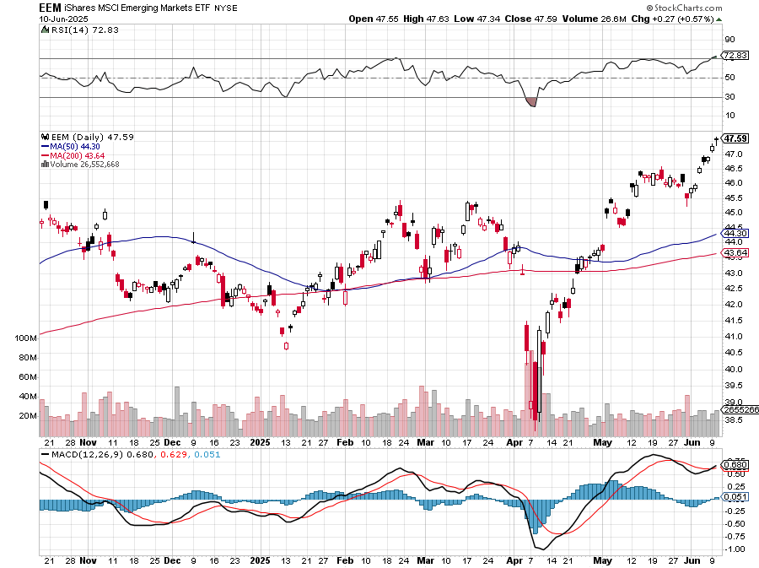
Emerging Markets (EEM) - +8% Weak Dollar, Long Recovery Play

Slide 29
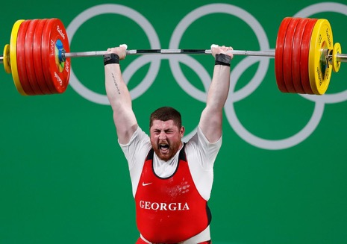
THE MAD HEDGE FUND TRADER
The Barbell Portfolio
*75% Big Tech – 2% of US workforce, 25% of market cap and 25% of US earnings 25% Domestic Recovery, including: Railroads, airlines, cruise lines, Couriers, steel companies Banks, commodities Construction Credit Card Companies Hotels, casinos Online Ticket Sales

Slide 30
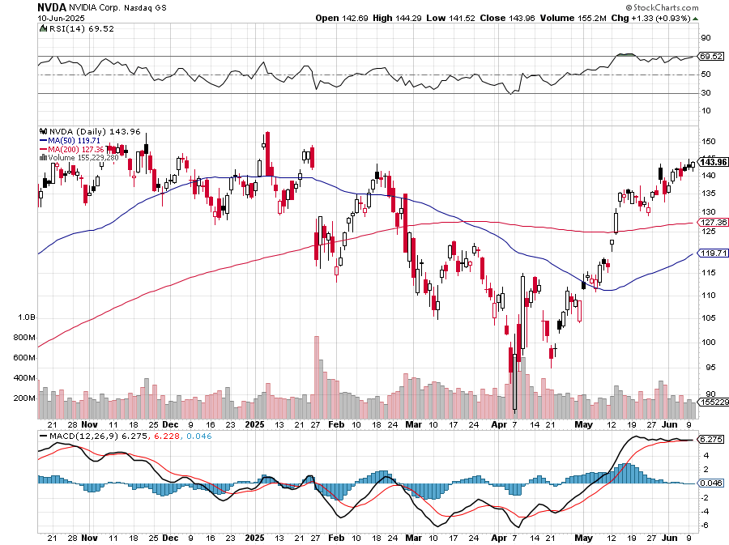
NVIDIA (NVDA) – Blackwell Chips @ $70,000 each Nvidia Comes in Line, with both on sales and profits stopped out of long 6/$140-$145 puts spread, took profits on long 5/$70-$75 call spread took profits on long 3/$88-$90 call spread, took profits on long 4/$140-$145 puts spread took profits on Long 2/$90-$95 call spread, took profits on Long 12/$117-$120 call spread

Slide 31
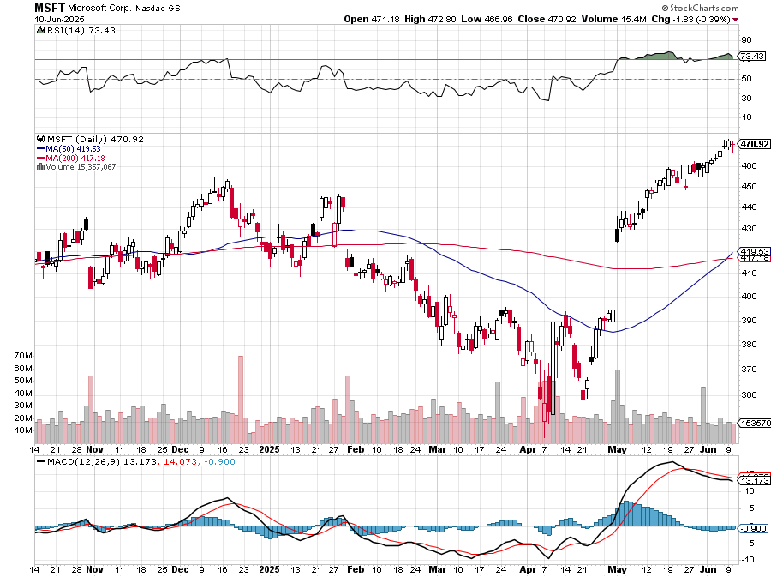
Microsoft (MSFT)-Microsoft Bombs, Microsoft Blows Up on Cloud Guidance took profits on long 5/$430-$440 put spread Took profits on long 2/$330-$340 call spread, took profits on long 12/$320-$330 call spread took profits on long 9/$235-$245 call spread, took profits on long 7/$220-$210 call spread,

Slide 32
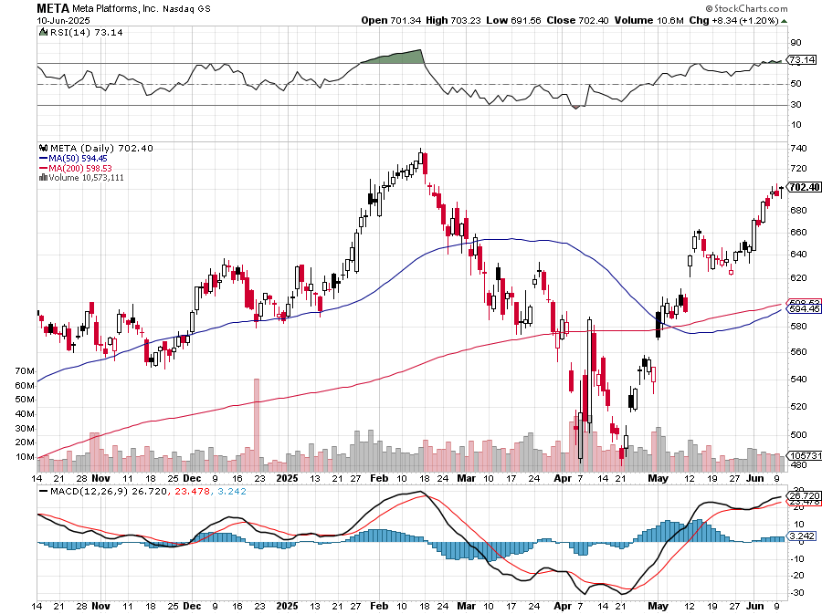
Meta (META) Meta Delays Flagship Behemoth AI Product took profits on Long 8/$420-$430 call spread took profits on Long 5/$360-$370 vertical bull call spread, took profits on Long 9/$290-$300 vertical bear put spread, stopped out of Long 9/$190-$200 vertical bear put spread

Slide 33
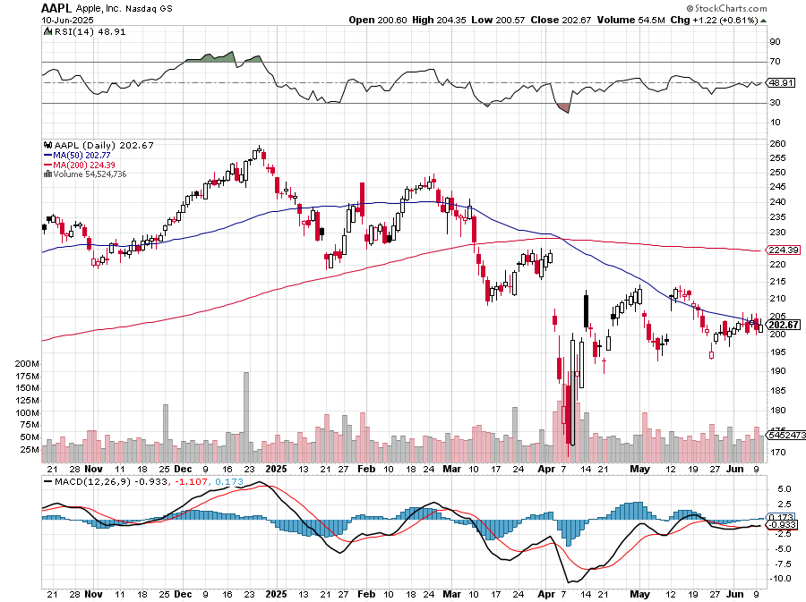
Apple (AAPL) Developers Conference is a Bust took profits on long 6/$220-$230 put spread-expires, profits on Long 5/$225-$235 vertical bear put spread, took profits on Long 8/$160-$170 call spread took profits on Long 6/$200-$210 bear put spread,

Slide 34
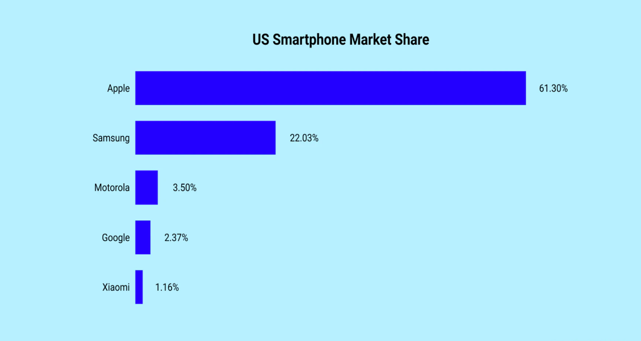

Slide 35
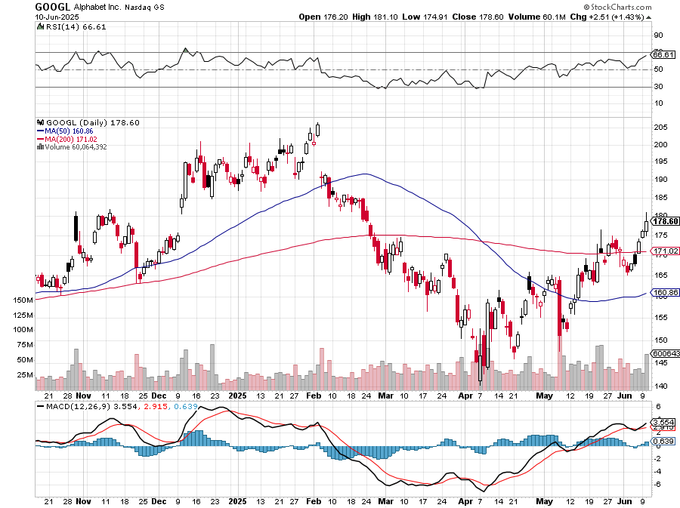
Alphabet (GOOGL) – Breakup Target Trump Administration to Pursue Alphabet Breakup, Alphabet’s Waymo Expands to Washington DC took profits on long 12/$110-$120 call spread took profits on long 12/$1,200-$1,230 bull call spread, took profits on long 9/$1,030-$1,080 vertical bull call spread

Slide 36
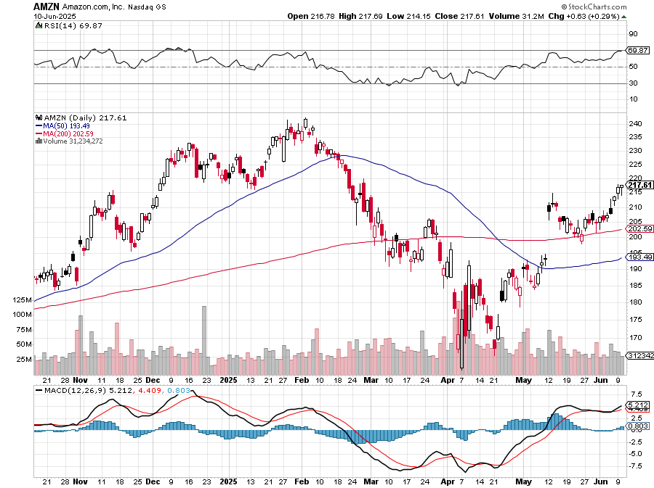
Amazon (AMZN) – Antirust Target Jeff Bezos to Sell $4.7 Billion of Amazon Stock took profits on long 3/$155-$160 bull call spread , took profits on long 2/$130-$135 bull call spread

Slide 37
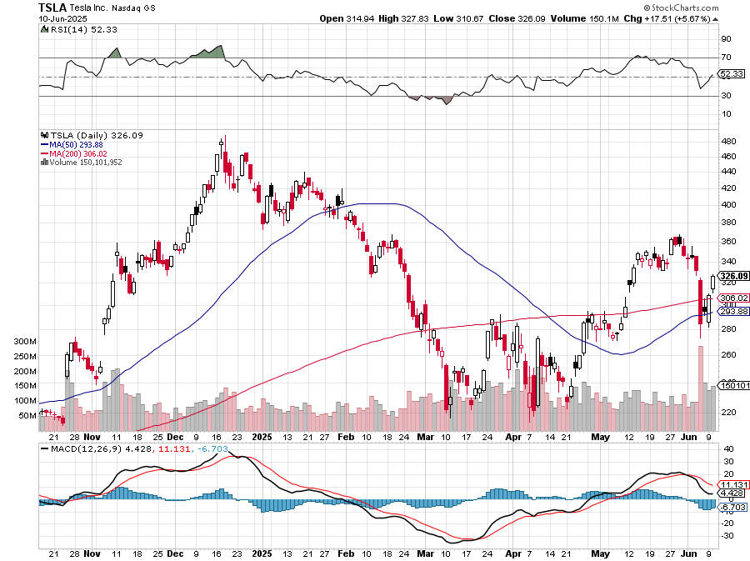
Tesla (TSLA) – Global Brand Destroyed Tesla Sales Aren’t Recovering took profits on long 7/$180-$190 put spread, long 6/190-$200 call spread-expires in 6 trading days took profits on long 6/$430-$440 put spread, took profits on long 4/160-$170 call spread stopped out of long $310-$320 put spread at cost, took profits on long 3/$350-$360 put spread, stopped out of 3/$210-$220 call spread, stopped out of long 6/$370-$380 put spread< profits on long 2/$300-$310 call spread, took profits on long 2/$300-$310 call spread,

Slide 38
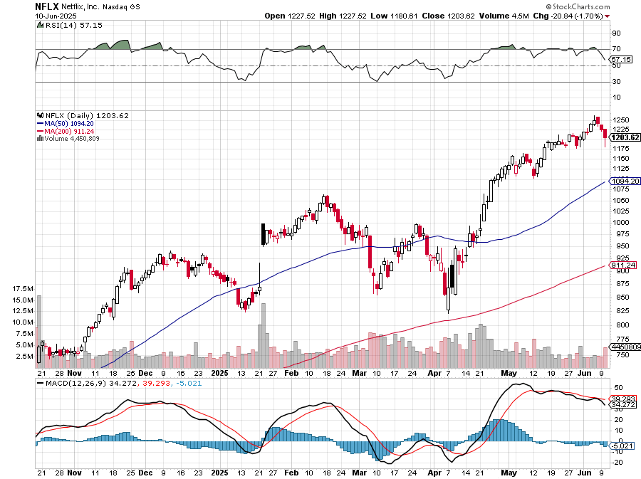
Netflix (NFLX) – Netflix Earnings Rocket, on the back of 19 million new subscriber took profits on long 4/800-$810 call spread

Slide 39
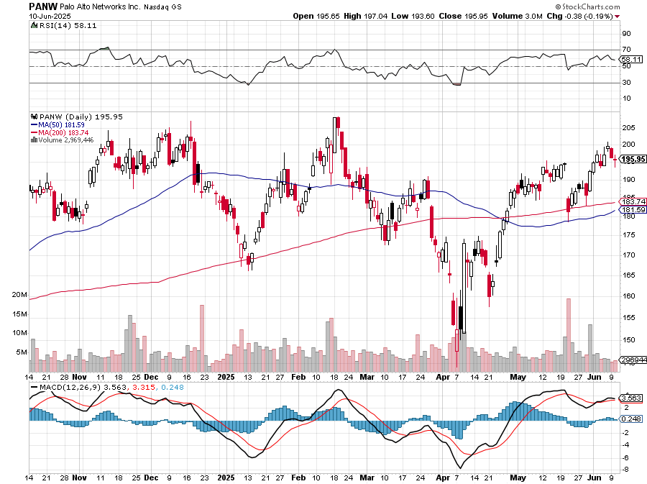
Palo Alto Networks (PANW)- Hacking never goes out of fashion Palo Alto Announced\s 2:1 Split took profits on long 2/$260-$270 call spread, took profits on long 10/$130-$140 call spread

Slide 40
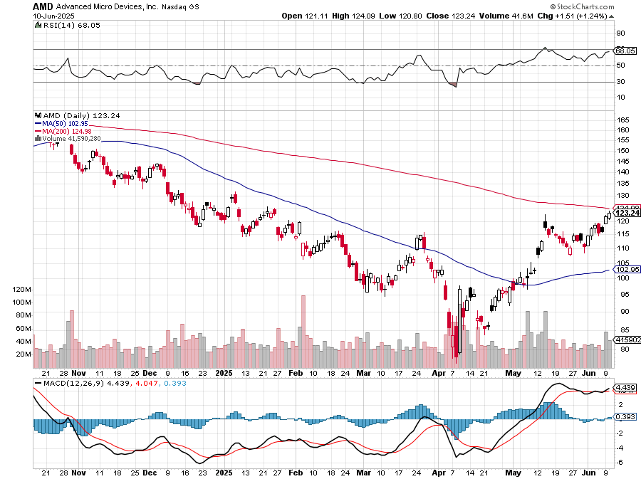
Advanced Micro Devices (AMD)- Recession fears programable logic devices took profits on long 2/$75-$80 call spread

Slide 41
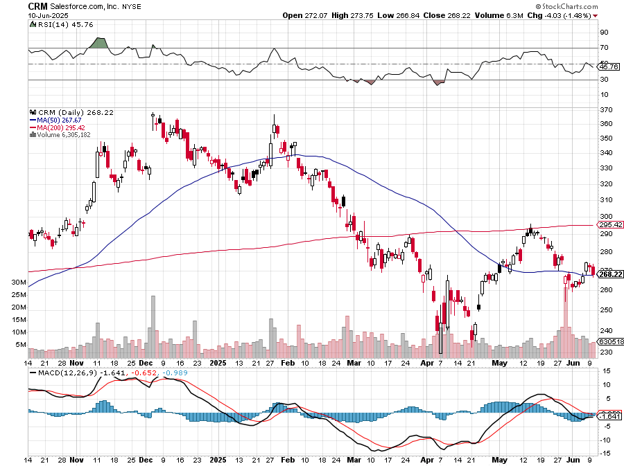
Salesforce (CRM)- Massive Online Migration took profits on long 12/$185-$195 call spread, took profits on long 9/$125-$130 vertical bull call spread took profits on long 8/$125-$130 vertical bull call spread

Slide 42
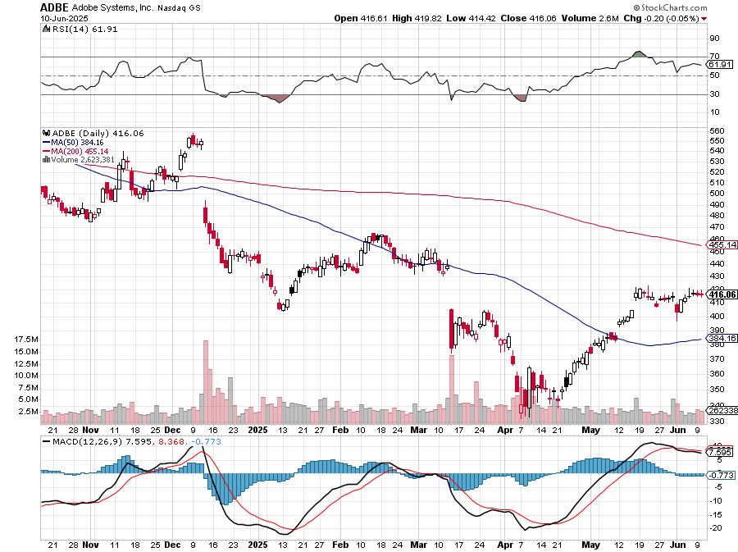
Adobe (ADBE)- Cloud play The Quality Non-China tech play

Slide 43
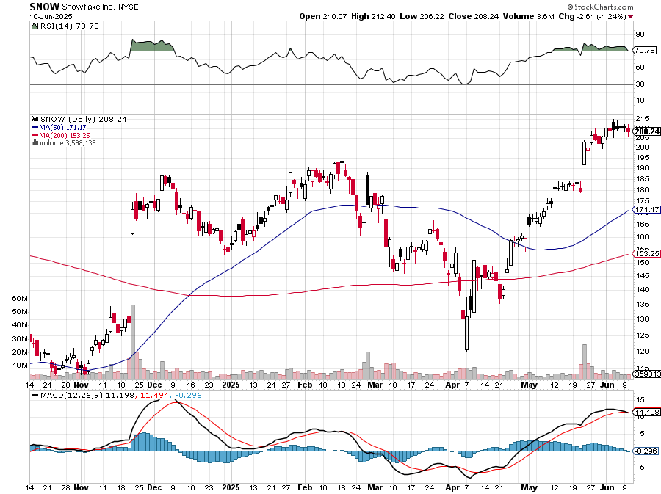
Snowflake (SNOW)- Blockbuster AI Earnings stopped out of long 4/$150-$255 call spread, took profits on long 12/$135-$140 call spread

Slide 44
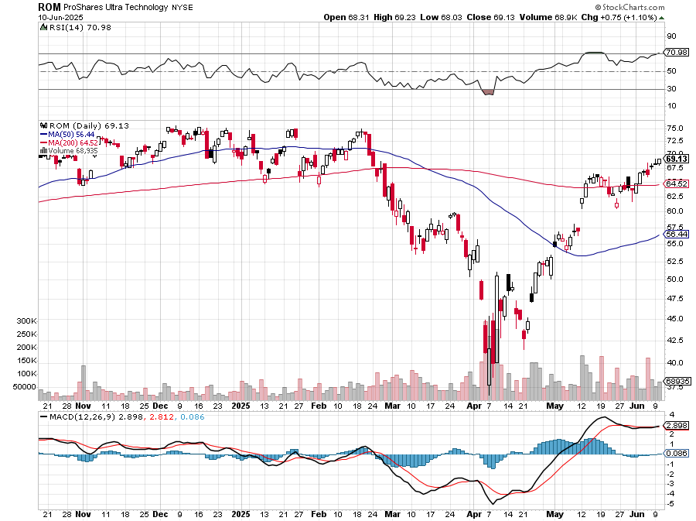
ProShares Ultra Technology ETF (ROM) – 2X Long Technology ETF took profits on long 10/$62-65 call spread

Slide 45
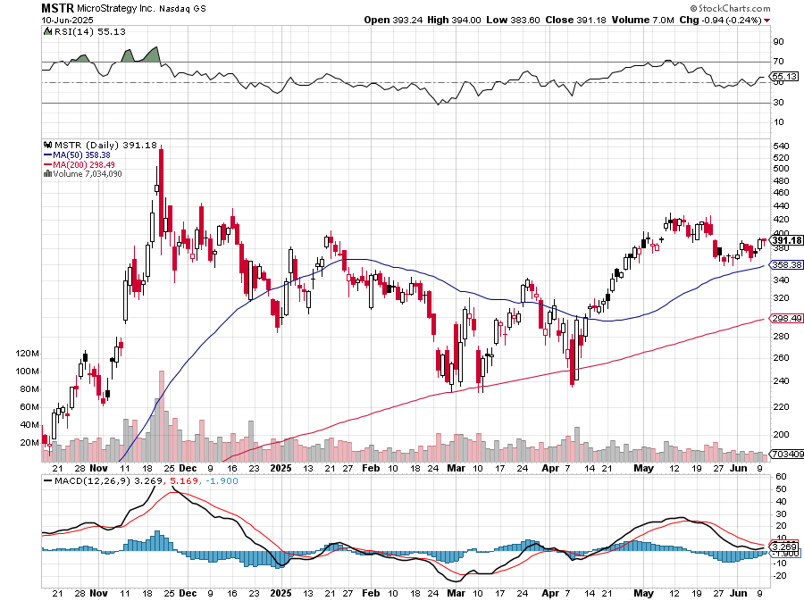
MicroStrategy (MSTR) – Long Bitcoin Play MicroStrategy Copycats are Multiplying Took profits on long 6/$500-$510 put spread, took profits on long 6/$470-$480 put spread long 6/$330-$340 call spread-expires in 7 trading days, stopped out of long 6/$335-$345 put spread took profits on long 5/$400-$410 put spread, took profits on long 5/$220-$230-$230 call spread, took profits on long 5/$400-$410 put spread, took profits on long 5/$400-$410 put spread, took profits on

Slide 47
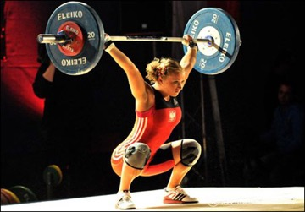
The Second Half of the Barbell
*Bets on a domestic recovery in 2022 Q4 *Upside potential in 2024 far greater than tech *Some of these have not moved for 5 or 10 years *Focuses on economically sensitive cyclical industries *Makes a great counterweight to high-growth technology *We could spend all of next ten years rotating between the two groups

Slide 48
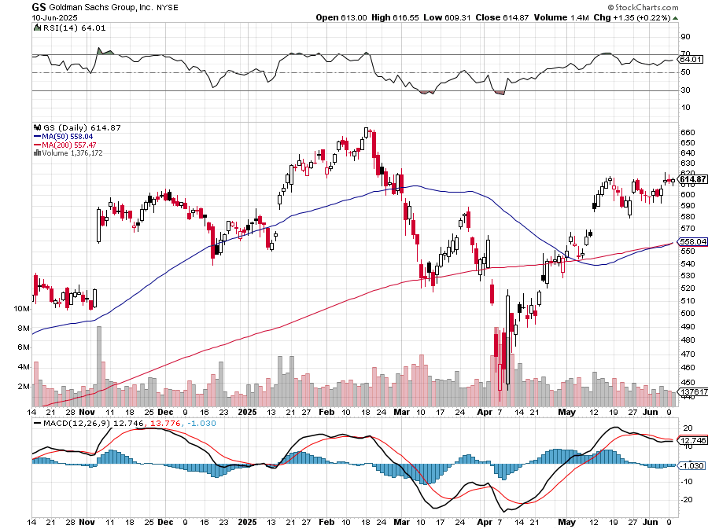
Goldman Sachs (GS) – Goldman Sachs Beats, with Revenues of $12.73 billion vs. $12.46 billion estimate stopped out of 3/$380-$390 call spread, profits on long 12/$330-$350 call spread, took profits on long 11/$330-$350 call spread

Slide 49
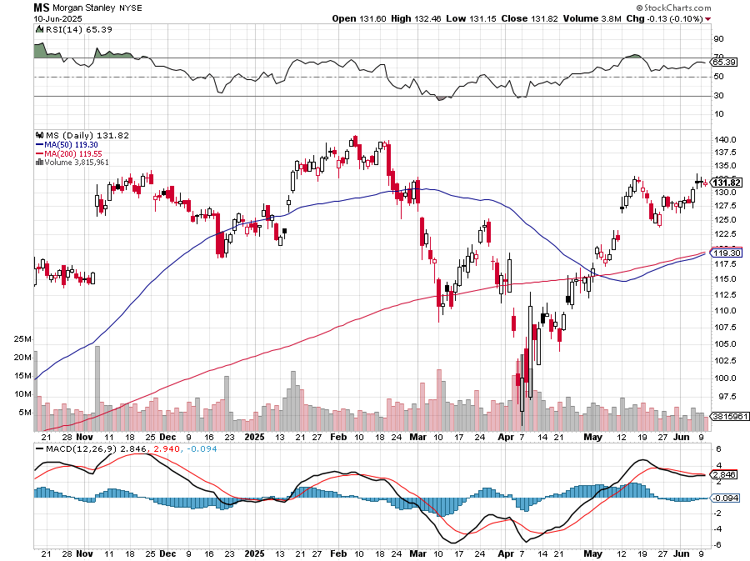
Morgan Stanley (MS) Morgan Stanley Doubles Profits took profits on long $12/210-$220 call spread, Took profits on long $195-$205 call spread, took profits on long 4/$65-$70 call spread

Slide 50
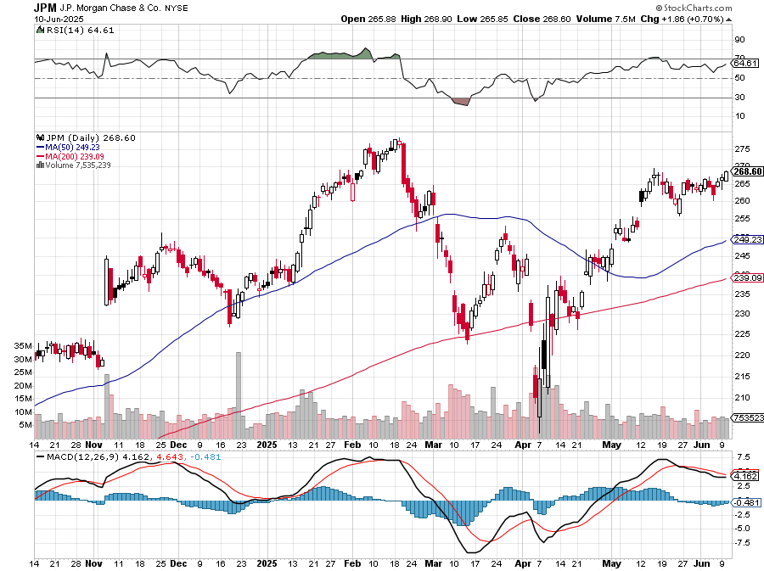
JP Morgan Chase (JPM) – Jamie Diamond Sells 30% of JP Morgan Stock stopped out of 3/$235-$245 calls spread, profits on long 12/$210-$220 call spread, took profits on long 11/$195-$205 call spread, took profits on 4/$215-225 put spread, took profits on long 4/$105-$115 call spread

Slide 51
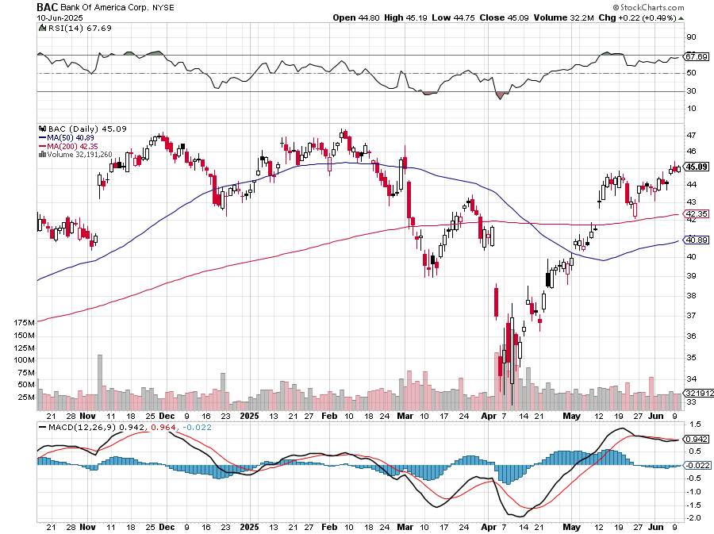
Bank of America (BAC) – Deregulation play took profits on long long 12/$41-$44 call spread, took profits on long 4/$20-$23 call spread

Slide 52
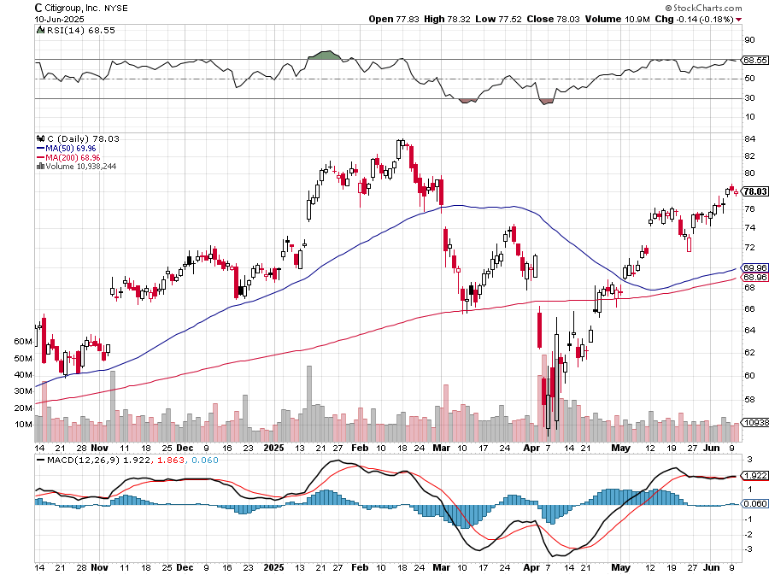
Citigroup (C) – took profits on long long 12/$60-$65 call spread , took profits on long 4/$30-$35 call spread

Slide 53
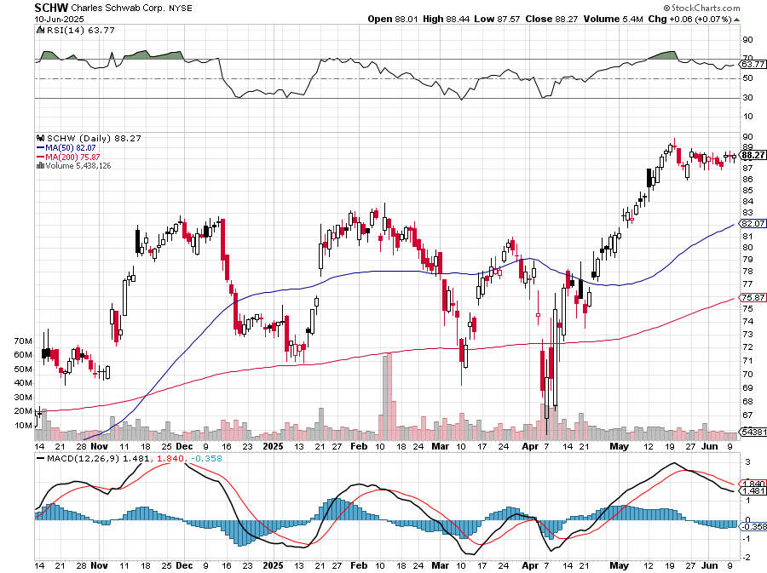
Charles Schwab (SCHW) – LEAPS expire at Max profit took profits on long 4/$30-$35 call spread

Slide 54
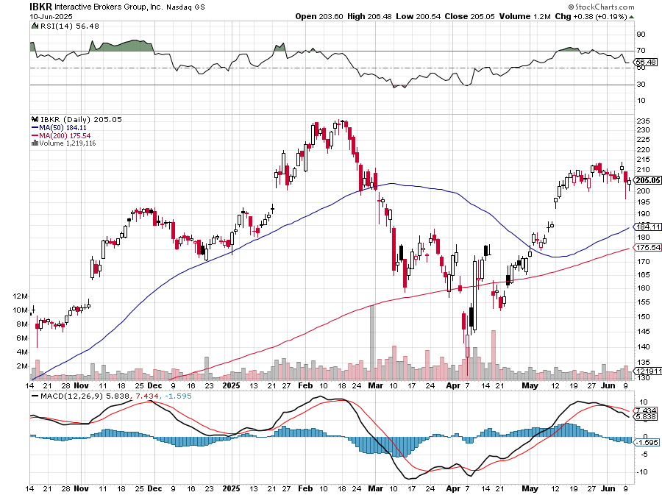
Interactive Brokers (IBKR) – LEAPS expired at Max Profit stopped out of long 3/$160-$170 call spread, out of long 8/$110-$115 call spread , took profits on long 4/$60-$65 call spread

Slide 55
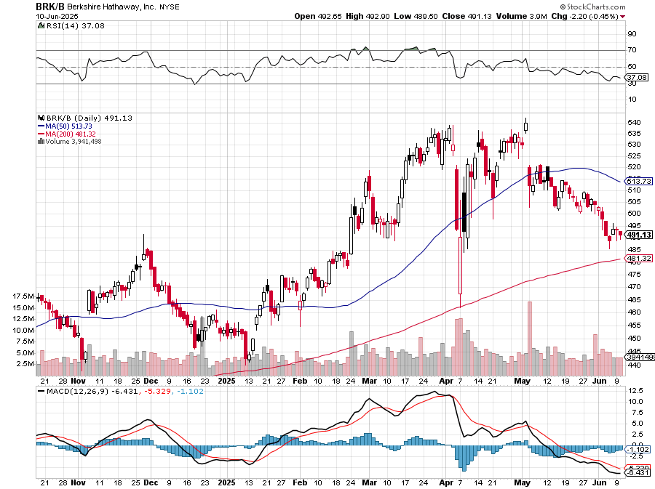
Berkshire Hathaway (BRKB)- Ultimate defensive stock Berkshire Hathaway Builds Record Cash, at $334 billion – Is the new T Bill proxy stopped out of long 12/$405-$415 call spread, took profits on long 12/$320-$330 call spread took profits on long 4/$260-$270 call spread, took profits on long 1/$290-$300 call spread

Slide 56
Blackrock (BLK)-Asset Collection Boom took profits on long 12/$850-$860 call spread took profits on long 3/$770-$790 call spread, took profits on long 3/$310-$340 call spread

Slide 57
SPDR Metals & Mining ETF (XME) – long 2/$28-$30 call spread

Slide 58
Boeing (BA) – Q3 $6 Billion Loss –b Strike Continues Qatar Airways to Buy 100 Boeing Jets “il pesce marcisce dalla testa”

Slide 59
General Motors (GM) – Worst Off Trade War Victim stopped out of long 4/$52.50-$57.50 put spread at cost, long 3/$53-$56 put spread

Slide 60
Package Delivery- United Parcel Service (UPS) – strike averted took profits on long 11/$130-$140 call spread

Slide 61
Caterpillar (CAT)- Ag + Infrastructure + Housing stopped out of long 8/$310-$320 call spread, took profits on long 12/$220-$230 calls spread took profits on long 12/$145-$150 call spread, took profits on long 11/$125-$135 call spread

Slide 62
Deere & Co. (DE)- Ag + Infrastructure + Housing took profits on long 8/$330-$340 put spread stopped out of long 8/$330-$340 calls spread

Slide 63
Freeport McMoRan - (FCX)- Coming Copper Crisis Freeport McMoRan Beats, helped by higher production and easing costs took profits on long 4/$37-$40 call spread, took profits on long 5/$42-$45 call spread, stopped out of long $48-$51 put spread, profits on long 6/$32-$35 call spread took profits on long 4/$30-$33 call spread, took profits on long 10/$20-$23 call spread

Slide 64
Walt Disney (DIS) -Disney Beats Disney Dives on Earnings Bust, although streaming broke even versus an expected loss

Slide 65
Industrials Sector SPDR (XLI)- (GE), (MMM), (UNP), (UTX), (BA), (HON)

Slide 66
Union Pacific RR (UNP)- Big Stuff to Ship took profits on long 5/$200-$210 call spread took profits on 11/$150-$160 call spread

Slide 67
Walmart (WMT) – The New AI Stock took profit on Long 11/$125-$130 bear put spread, took profit on Long 10/$119-$121 bear put spread took profits on Long 8/$114-$117 bear put spread

Slide 68
Costco (COST) – Permanent Compounder took profits on long 4/$840-$850 call spread

Slide 69
Delta Airlines (DAL) – Recession Warning-Travel Collapse The Non-Boeing Airline – uses Airbuses

Slide 70
Transports Sector SPDR (XTN)- Worst Hit Sector (ALGT), (ALK), (JBLU), (LUV), (CHRW), (DAL)

Slide 71
Health Care Sector (XLV) – Defensive Play and Cheap (JNJ), (PFE), (MRK), (GILD), (ACT), (AMGN)

Slide 72
Amgen (AMGN) took profits on long 11/$185-$200 bull call spread

Slide 73
Visa (V) – Inflation boost Justice Hits Visa (V) with Antitrust Suit, with a 47% market share took profits on long 2/$240-$250 bull call spread took profits on long 10/$160-$170 bull call spread, took profits on long 6/$150-$160 bull call spread

Slide 74
Consumer Discretionary SPDR (XLY) (DIS), (AMZN), (HD), (CMCSA), (MCD), (SBUX)

Slide 76
Bonds – Looming Monter Bond Auctions Wiil there be buyers?
*Bonds are trapped at a low range on the “Sell America” trade *June 12 brings the next huge $$2 billion bond auctions for 20-year bonds *A $16 billion Treasury sale of 20-year bonds bombed three weeks ago *A Foreign boycott was a major issue *Japanese Interest Rates are Soaring, part of a worldwide trend, with ultra long 40-year bond yields hitting 3.675%. *A breakout in ten-year US Treasury yields to 5.0% is coming *A $3 trillion rise in the National Debt proposed by the House bill is scaring away long-term bond investors *The Bond Vigilantes are Back, and are not to be taken lightly *Avoid (TLT), (JNK), (NLY), (SLRN) and REITS

Slide 77
Treasury ETF (TLT) – long 6/$88-$91 put spread – expires in 6 trading days stopped out of long 6/$80-$83 call spread, took profits on long 4/$84-$87 call spread stopped out of long 1/$82-$85 call spread, took profits on long 10/$103-$106 put spread took profits on long 6/$$94-$97 put spread, took profits on long 5/$82-$85 calls spread

Slide 78
Ten Year Treasury Yield ($TNX) – 4.51%

Slide 79
Junk Bonds (JNK) 6.54% Yield

Slide 80
Municipal Bonds (MUB) 4.21% Yield-

Slide 81
Emerging Market Debt (ELD) 5.62% Yield-

Slide 82
2X Short Treasuries (TBT)-Out of Favor

Slide 83
Anally Capital Management (NLY) – Leveraged REIT Play Yield 13.25% took profits on long 12/$15-$16 call spread

Slide 85
Foreign Currencies – Dollar Dive
*US dollar Hits Two Year Low, as the “Sell America” trade continues *It’s almost unprecedented for a currency to fall when its interest rates rising *Debt, default, and trade wars are now the larger concern *Next dollar weakness will come with evidence of a recession in days *Buy (FXA), (FXE), (FXB), (FXC), and (FXY)

Slide 86
THE MAD HEDGE FUND TRADER
Australian Dollar (FXA) - Major Long-Term Bottom is In Targeting Parity – A call option on a global synchronized recovery

Slide 87
Japanese Yen (FXY)

Slide 88
Euro (FXE)-

Slide 89
British Pound (FXB)-

Slide 90
Emerging Market Currencies (CEW)

Slide 92
Energy & Commodities – Drowning in Oil
*OPEC Plus is Ramping Up Production *The world’s largest group of oil producers, OPEC+, stuck to its guns at a Saturday meting with another big increase of 411,000 barrels per day for July as it looks to wrestle back market share and punish over-producers *Having spent years curbing production - more than 5 million barrels a day (bpd) or 5% of world demand - eight OPEC+ countries made a modest output increase in April before tripling it for May, June and now July *The Shale Oil Boom is Over, due to tax subsidized US over production, weak Chinese consumption, and recession fears *As a result, oil companies are scaling back capital investment *Texas, Oklahoma, and Louisiana will get hot the hardest.

Slide 93
Oil-($WTIC)

Slide 94
United States Oil Fund (USO)

Slide 95
Energy Select Sector SPDR (XLE)-No Performance! (XOM), (CVX), (SLB), (KMI), (EOG), (COP)

Slide 96
ExxonMobil (XOM)- Exxon Moves Big into Lithium, with the construction of a major mining operation in Arkansas took profits on Long 4/$100-$105 call spread, took profits on long 12/$120-$125 put spread

Slide 97
Occidental Petroleum (OXY)- Buffet’s a Buyer took profits on long 4/$59-$62 call spread took profits on long 2/$55-$60 call spread, took profits on long 12/$77.50-$82.50 put spread

Slide 98
Natural Gas (UNG) – Free Fall on Warm Winter took profits on Long January 2025 $7-8 Call Spread LEAPS

Slide 99
Cameco (CCJ) – Global Uranium Renaissance Microsoft to Reopen Three Mile Island to power AI data centers took profits on long 12/$41-$44 call spread, took profits on long 12/$35-$38 call spread, took profits on long 5/$20-$23 bull call spread

Slide 100
Vistra Corp. (VST) – Global Uranium Renaissance took profits on long 2/$100-$110 call spread

Slide 102
Precious Metals – Profit Taking
*Silver Hits 13 Year High, at $35 an ounce and catching up with gold quickly *Known both as a safe-haven asset and a vital industrial metal, silver has surged 24% so far in 2025 *Industrial uses account for more than half of global silver demand, according to the Silver Institute industry association, so the recession may be a drag *$50 here we come! *Gold is coiling for another move up as soon as stocks fall *Credit downgrades and eventual default have been the dream of gold bugs for the last 50 years *My target is still $5,000.

Slide 103
THE MAD HEDGE FUND TRADER
Gold (GLD) - Coiling took profits in long 6/$275-$285 call spread, took profits on long 5/$275-$285 call spread took profits on profits on long 10/$230-$235 call spread took profits on Long 10/$220-$225 call spread, took profits on Long 8/$210-215 call spread, took profits on Long 7/$200-205 call spread, Long 6/$207.5-$212.5 call spread
$5,000 in 2028 +66%
BUY

Slide 104
Market Vectors Gold Miners ETF- (GDX) – took profit on long 6/$207.50-$212.50 call spread, took profit on long 7/$200-$205 call spread

Slide 105
Barrick Gold (GOLD) took profit on long 1/$15.50-$16.50 call spread

Slide 106
Newmont Mining- (NEM)- Sometimes you Just Get Lucky took profits on long 10/$47-$50 call spread, took profits on long $55-60 call spread

Slide 107
THE MAD HEDGE FUND TRADER
iShares Silver Trust (SLV) - The Better Play Industrial demand, solar panels, electric cars
2025 Target $50 +50%
BUY

Slide 108
Silver Miners - (SIL)-

Slide 109
Wheaton Precious Metals - (WPM)- LEAPS Approaching Max Profit took profits on long 4/$39-$42 call spread long 6/$75-$80 call spread-expires in 7 trading days , took profits on long 1/$36-$39 call spread

Slide 110
Platinum- (PPLT)- 556,000-ounce shortage this year took profits on long 1/$36-$39 call spread

Slide 112
Real Estate – Deader than Dead
*Apartment Rents are Slowing, up only 0.4% in May and down 0.5% YOY, usually a strong period. *The effect on property REITS has been pronounced *The national median monthly rent is now $1,398 a month. Vacancies are at 7%, the highest since 2017. Oversupply is the issue *Housing Stocks Plunge to One Year Lows, on spike in long bond and mortgage rates *Construction spending Collapsed in April, down 0.9%, for both single and multifamily homes. Another red flag for the economy *More Office Space is Disappearing than being Built, for the first time in 25 years * Pending Home Sales Hit Three Year Low

Slide 113
S&P Case Shiller Slows S&P Case Shiller Rises to +4.1% YOY in February, with its National Home Price Index New York gained +7.7%, Chicago +7.0%, and Cleveland +6.6%. Washington DC was down -1.1%

Slide 114
Crown Castle International (CCI) – 6.62% yielding 5G cell phone tower REIT Eliot Management Pushes up stock with activist bid took profits on Long 8/$90-$95 call spread,

Slide 115
US Home Construction Index (ITB) (DHI), (LEN), (PHM), (TOL), (NVR)

Slide 116
DH Horton (DHI) Horton Bombs, with the stock dropping some 11% in Tuesday morning trading after the U.S.'s largest homebuilder issued its fiscal 2025 guidance took profits on long 11/$165-$175

Slide 117
Trade Sheet- The Recession Trade So What Do We Do About All This?
*Stocks –sell rallies *Bonds – sell rallies *Commodities - stand aside *Currencies – buy dips *Precious Metals – buy dips *Energy – stand aside *Volatility – sell over $50 *Real estate – stand aside

Slide 118
Next Strategy Webinar 12:00 EST Wednesday, June 25, 2025 from Incline Village, NV email me questions at support@madhedgefundtrader.com
Good Luck and Good Trading!
Notes:
*

