Slide 1

The Mad Hedge Fund Trader “Uncertainty Rules”
With John Thomas Incline Village, NV July 16, 2025 www.madhedgefundtrader.com
Notes:
*

Slide 2
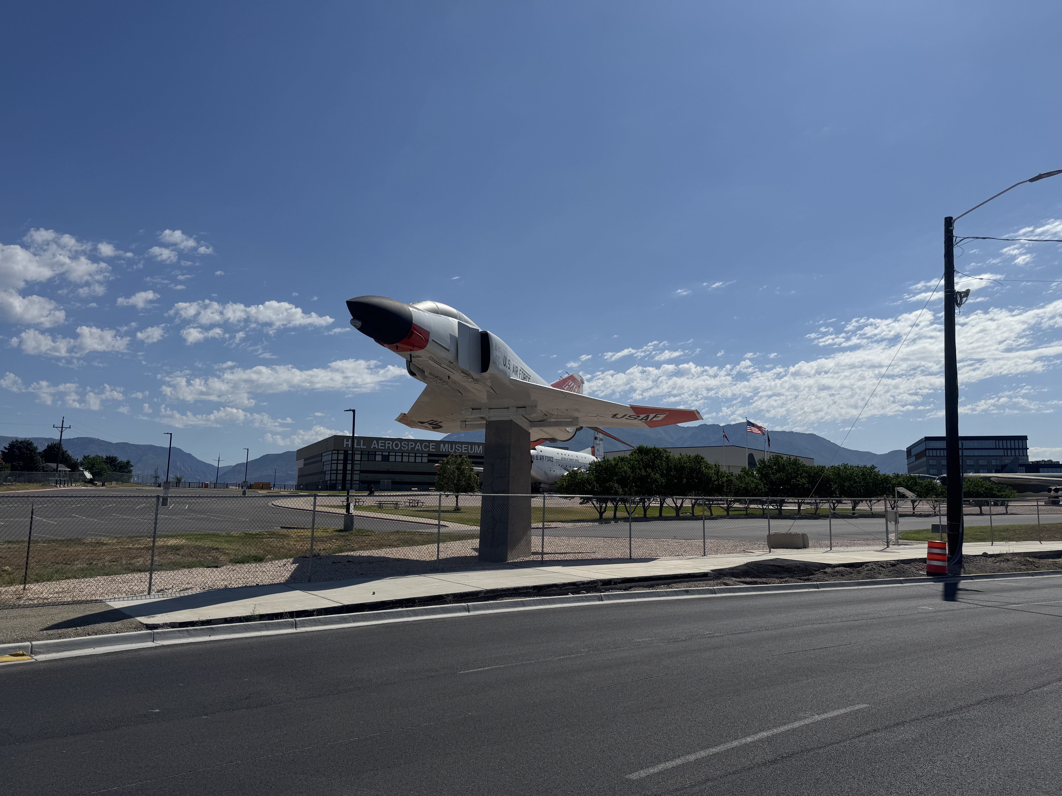

Slide 3

Trade Alert Performance New All-Time Highs-17 Consecutive Positive Months
*January +5.80% Final *July +2.59% MTD *February +3.66% Final. *August +3.74% Final *March +4.36% Final *September +10.28% Final *April +0.95% Final *October +7.59% Final *May +2.51% Final *November +18.96 Final *June +15.48% Final *December +3.26% Final *2025 Year To Date +47.76% +799.65% since inception *Versus 84.63% for all of 2022 *Versus 79.79% for all of 2023 *Versus 75.29% for all of 2024

Slide 4
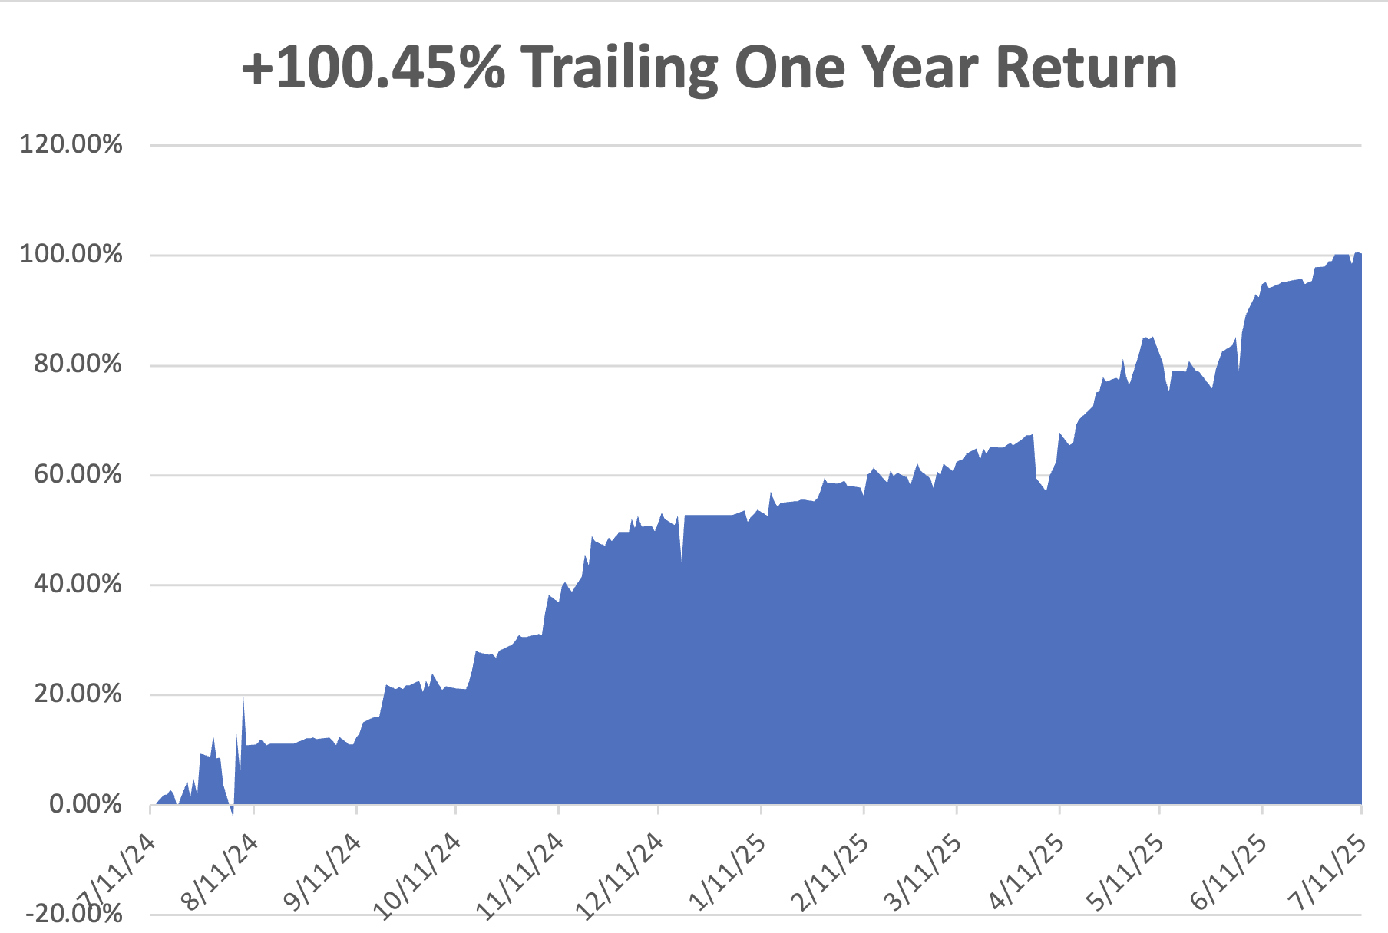

Slide 5
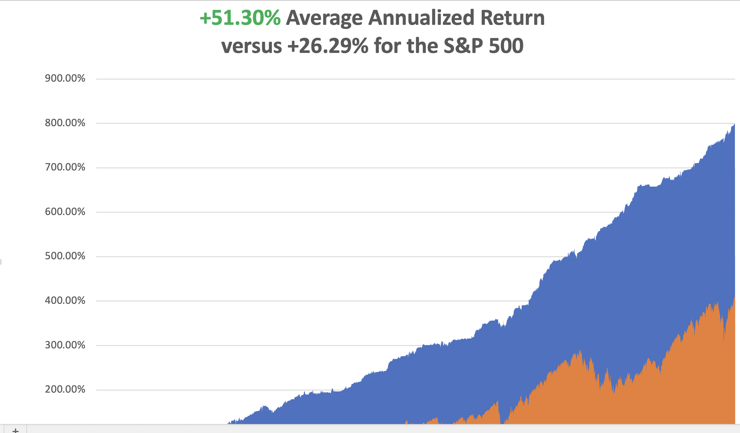

Slide 6


Slide 7
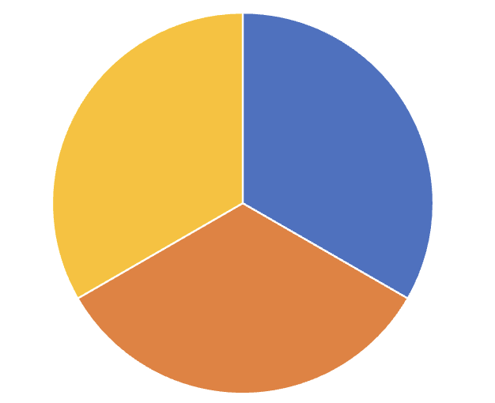
Portfolio Review – High Risk Market Require Maximum Cash 10% risk on, 20% risk off, 70% cash - 100% cash in 2 days
Current Capital at Risk
(AMGN) 7/$260-$270 call spread | 10.00%
Risk Off
(TSLA) 7/$360-$370 put spread | -10.00%
(TSLA) 7/$420-$430 put spread | -10.00%
Total Net Position | -10.00%
Total Gross Position | 30.00%
cash | 70.00%
Expiration Value +47.89%

Slide 8

The Method to My Madness
*Stocks are are now at very high-risk levels due to increasingly unstable world, *AI is the big leader, but The risk/reward here is terrible *Bonds approaching 2025 lows, yields new highs *The new budget bill passed a $5 trillion debt ceiling increase *Safety assets like gold, silver, and T-bills are flat lining with crypto bleeding off speculative capital *Oil is still dead on recession fears and OPEC market share battle *US Dollar hits new four-year lows Bitcoin Hits New All-Time High, at $123.00

Slide 9

The Global Economy – Deflating
*The June Nonfarm Payroll Wasn’t So Hot *Half of the 147,000 gain were government jobs and only 74,000 were from the private sector, a quarter of where they were a year ago *The Headline Unemployment Rate dropped 0.1% to 4.1% *Some 590,000 fill time jobs have been lost since the beginning of 2025. *Immigration Crackdown to Cut US GDP by 1.0%, according to a Federal Reserve study *The Port of Los Angeles Sees Import Surge *Clothing Imports from China Hit 22-Year Low *Used Car Prices Surge, as still Tariffs drive imported car prices through the roof

Slide 10
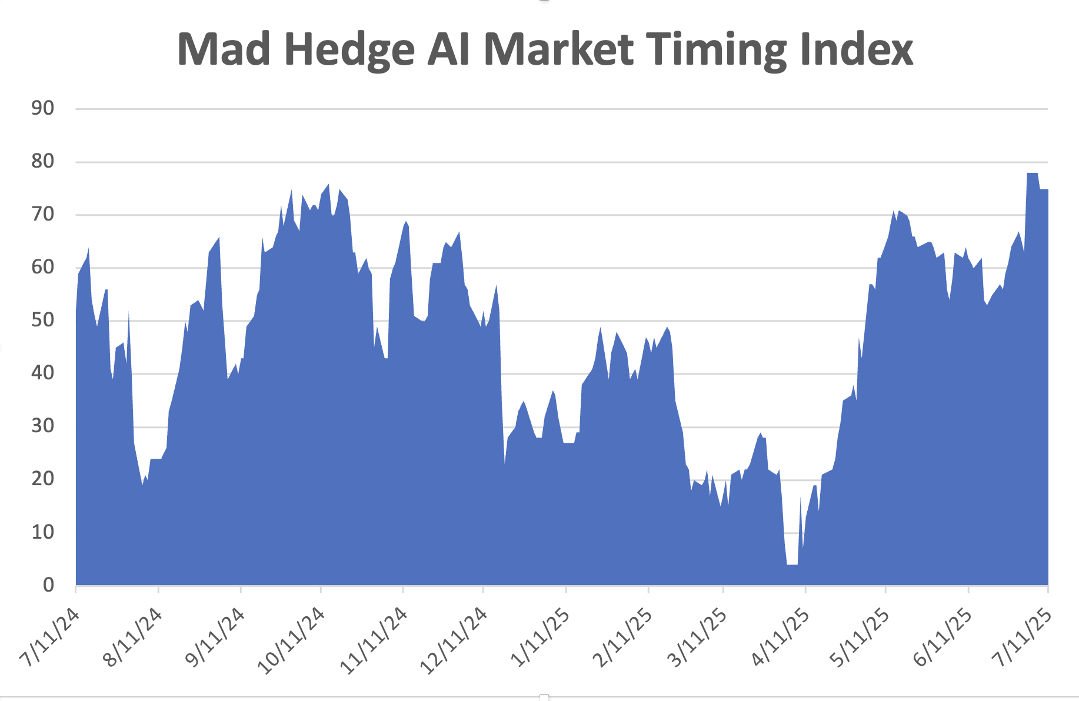
The Mad Hedge Profit Predictor Market Timing Index – New Range? An artificial intelligence driven algorithm that analyzes 30 different economic, technical, and momentum driven indicators
SELL
BUY

Slide 11
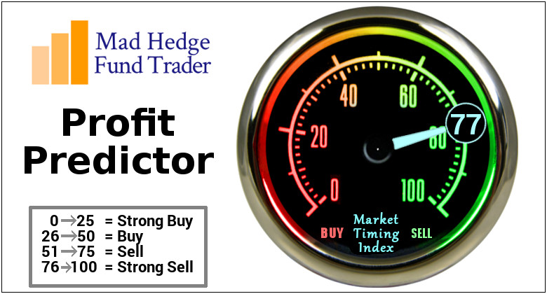

Slide 12
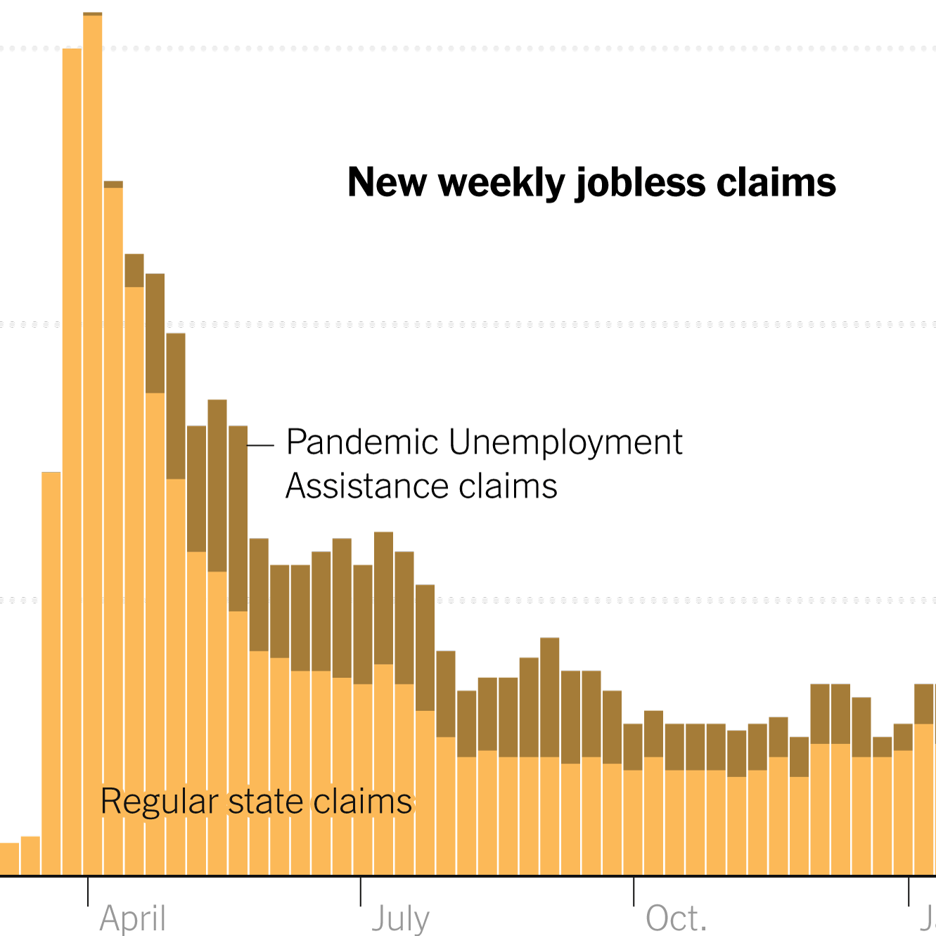
Weekly Jobless Claims – 8 Month High +5,000 to 227,000

Slide 13


Slide 14
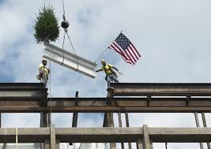
Stocks – Topping out
*Historic Market Concentration Bodes Ill for Future Gains *Since 1972, the S&P 500 has posted below-average returns over the next one, three, six and 12 months when new records were made with fewer than 100 stocks *Bitcoin plays take off on new highs *Hedge Fund Citadel Buys Morgan Stanley’s Option Business *US Military Becomes Largest Shareholder in MP Materials, the largest producer of rare earths in the US *Italy Buys US Corn Flakes. Ferrero International SA is close to acquiring WK Kellogg Co. for about $3 billion *Boeing Ramps Up 737 Production, delivering 60 airplanes last month, the most since December 2023 * Constellation Wiped out by Tariffs on Aluminum

Slide 15
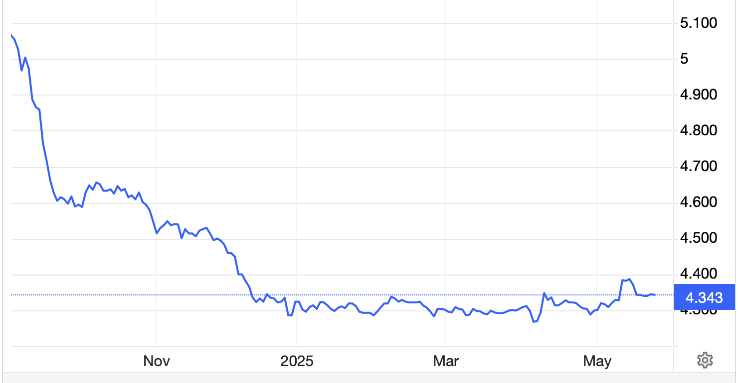
The Ultimate Hedge – Defensive stocks only go down at a slower rate 90 - day US Treasury Bills (Warren Buffet owns $300 billion)
*Government Guaranteed principal *Endless liquidity, trade like water *100% collateral value for margin *Lock in guaranteed income *Can be sold at any time to earn full interest *Will survive any bear market *Ask your broker how to buy
4.40% Yield

Slide 16
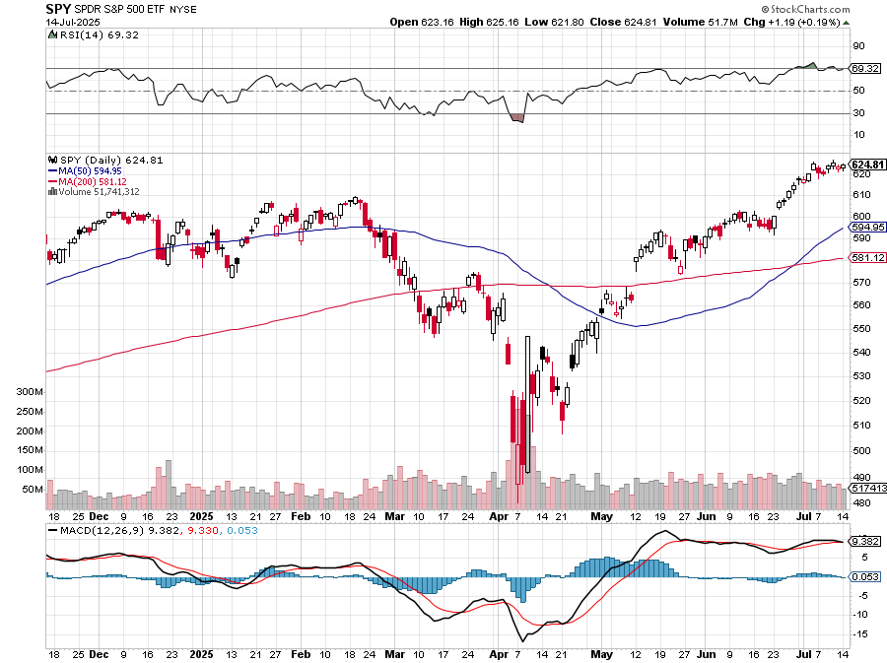
S&P 500 – Downside Targets – Mild Summer Correction took profits on long 6/$660-$640 put spread took profits on 6/$610-$620 put spread
$590 -4.2% 1st resistance
$575 -6.39% 1st support
$560 -9.1% 1st support

Slide 17
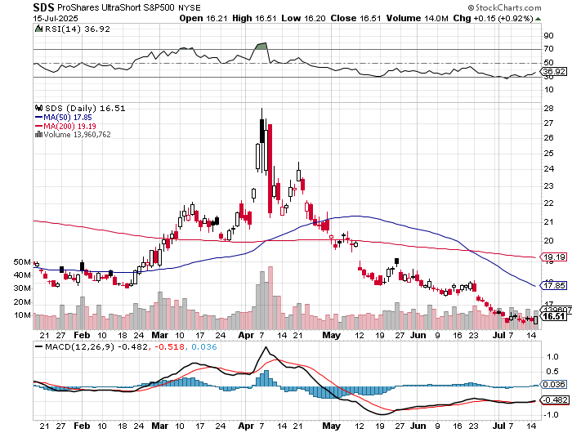
ProShares -2X Short S&P 500 (SDS) - a great 2X hedge for falling long stocks

Slide 18
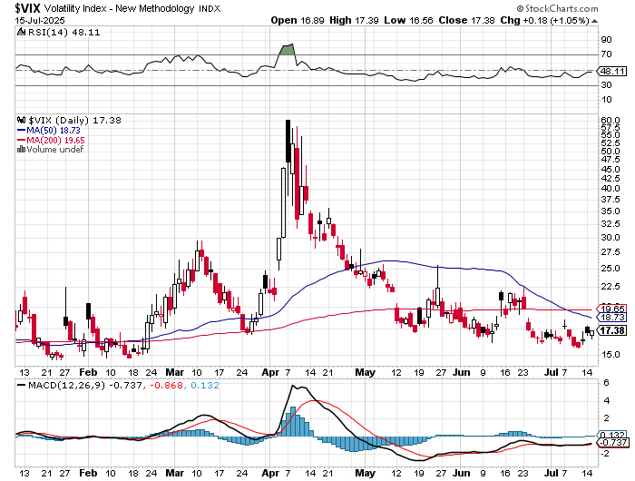
(VIX) – Volatility Index Hits Four Year High at $65, the most since the 2020 pandemic. That implies a 2% move in the S&P 500 (SPX) every day for the next 30 days

Slide 19
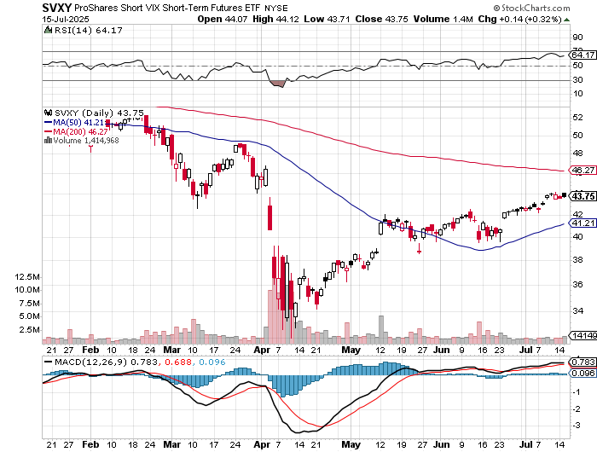
(SVXY) –Short Volatility ETF bought at $36.31 - $32.74 = $3.57

Slide 20
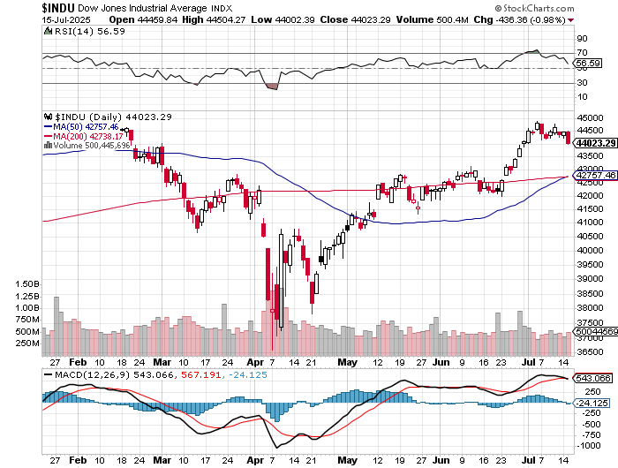
Dow Average ($INDU)-

Slide 21
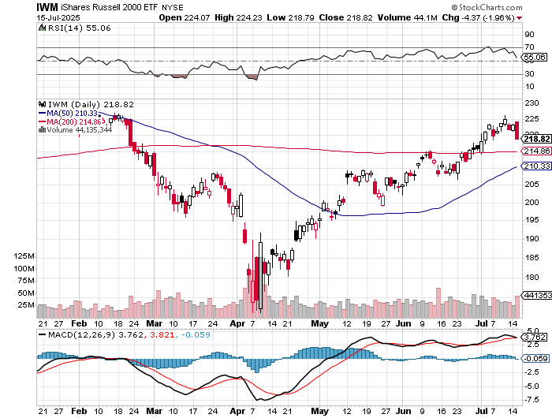
Russell 2000 (IWM)- took profits on Long 10/$137-$142 vertical bull call spread took profits on Long 10/$153-$156 vertical bear put spread

Slide 22
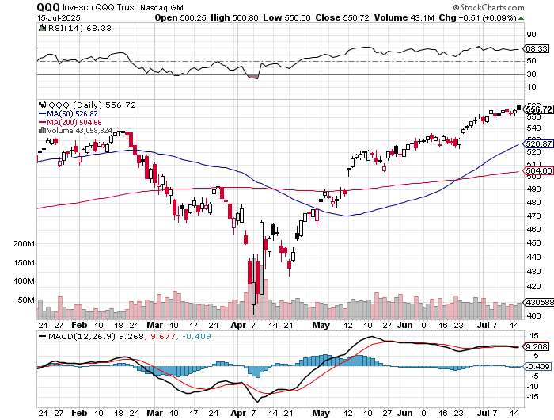
NASDAQ (QQQ) – Down 15% long 6/$540-$550-$345 put spread-expires in 17 days, took profits on Long 5/$335-$345 put spread took profits on long (QQQ) /$540-$550 put spread, took profits on long (QQQ) 4/$330-$335 put spread took profits on long (QQQ) 3/$340-$345 put spread, covered long (QQQ) $325-$330 put spread

Slide 23
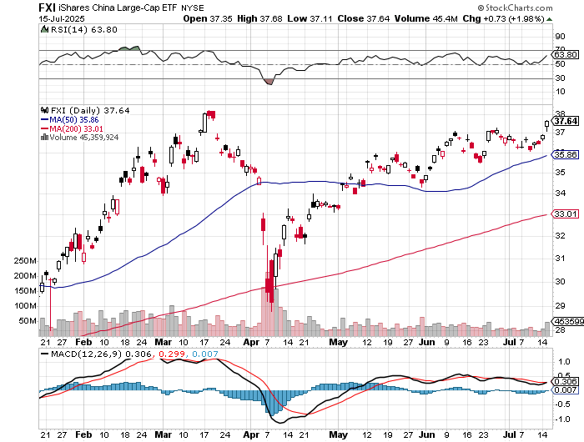
China (FXI) + 36%

Slide 24
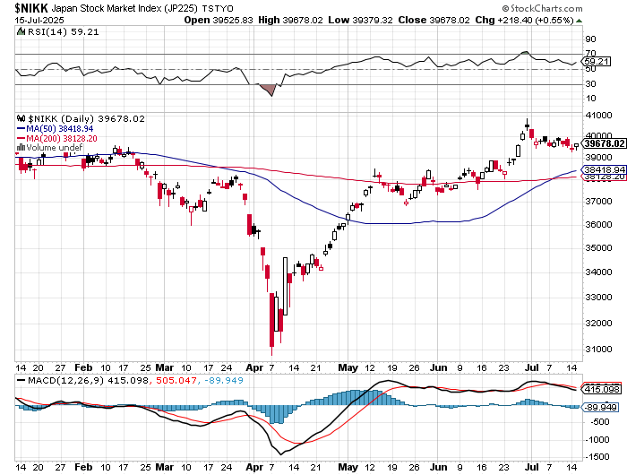
Japan ($NIKK) – down 10%

Slide 25
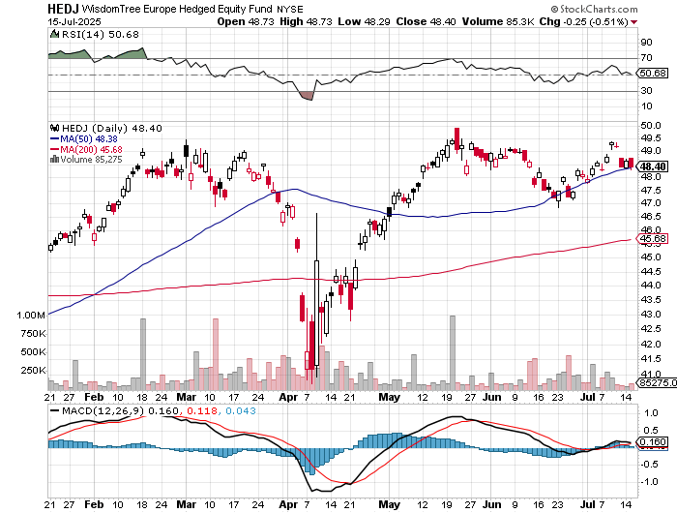
Europe Hedged Equity (HEDJ)- +19%

Slide 26
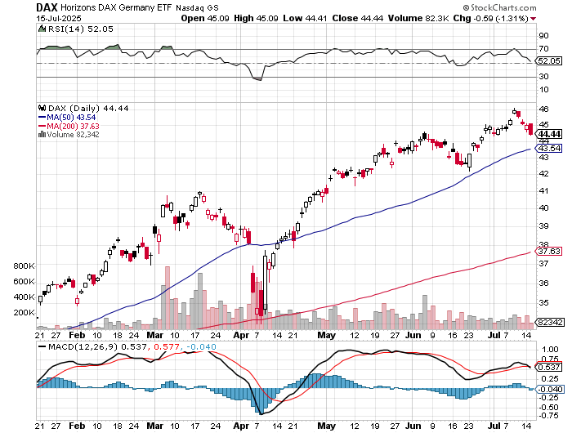
German Dax (DAX)- +30%

Slide 27
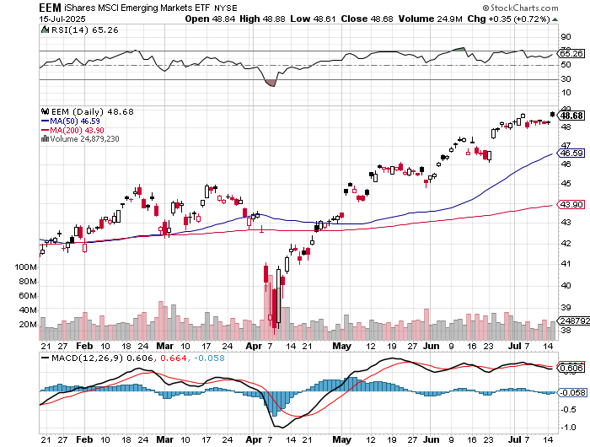
Emerging Markets (EEM) - +8% Weak Dollar, Long Recovery Play

Slide 28


Slide 29



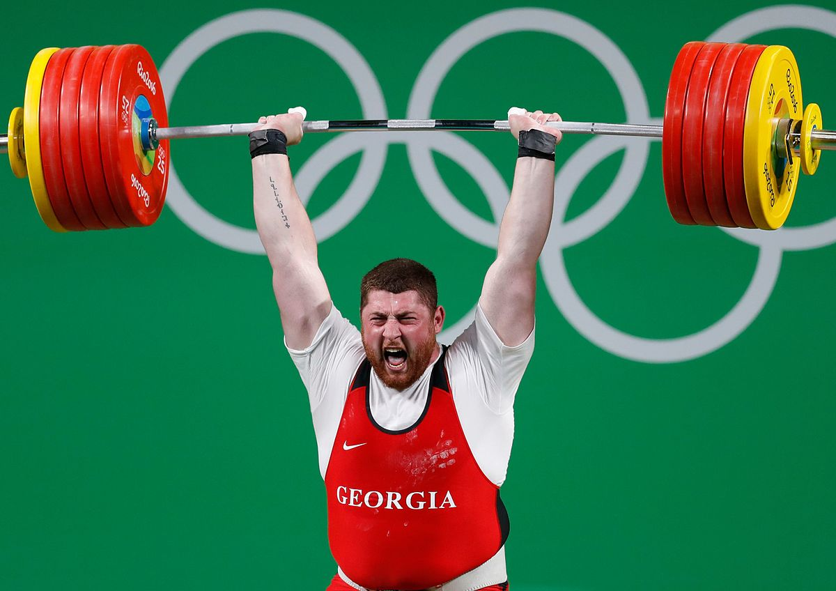
THE MAD HEDGE FUND TRADER
The Barbell Portfolio
*75% Big Tech – 2% of US workforce, 25% of market cap and 25% of US earnings 25% Domestic Recovery, including: Railroads, airlines, cruise lines, Couriers, steel companies Banks, commodities Construction Credit Card Companies Hotels, casinos Online Ticket Sales

Slide 30
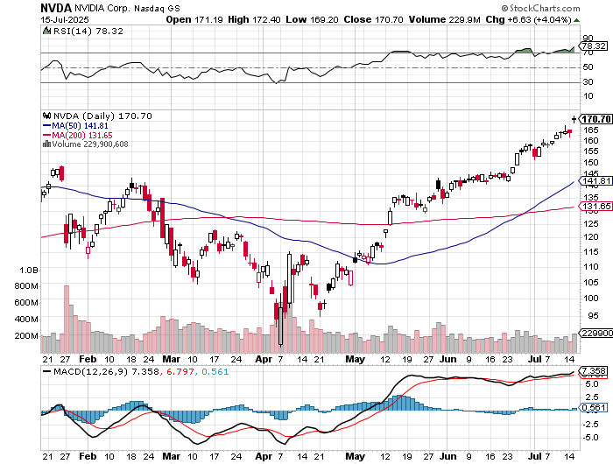

NVIDIA (NVDA) – Blackwell Chips @ $70,000 each Tops $4 Trillion Market Cap stopped out of long 6/$140-$145 puts spread, took profits on long 5/$70-$75 call spread took profits on long 3/$88-$90 call spread, took profits on long 4/$140-$145 puts spread took profits on Long 2/$90-$95 call spread, took profits on Long 12/$117-$120 call spread

Slide 31
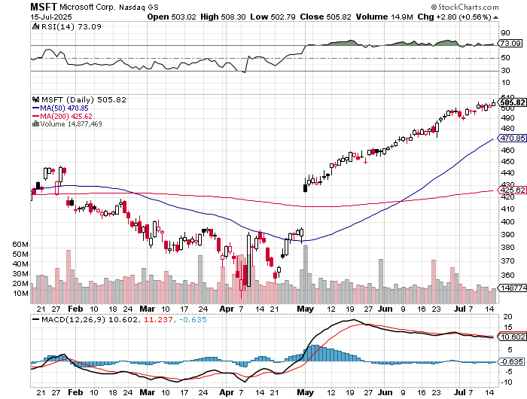

Microsoft (MSFT)-Microsoft Bombs took profits on long 5/$430-$440 put spread Took profits on long 2/$330-$340 call spread, took profits on long 12/$320-$330 call spread took profits on long 9/$235-$245 call spread, took profits on long 7/$220-$210 call spread,

Slide 32
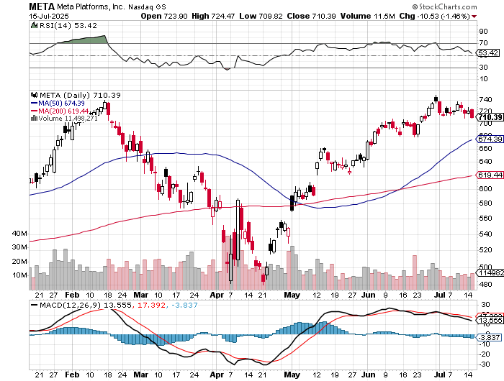

Meta (META) Meta Delays Flagship Behemoth AI Product took profits on Long 8/$420-$430 call spread took profits on Long 5/$360-$370 vertical bull call spread, took profits on Long 9/$290-$300 vertical bear put spread, stopped out of Long 9/$190-$200 vertical bear put spread

Slide 33
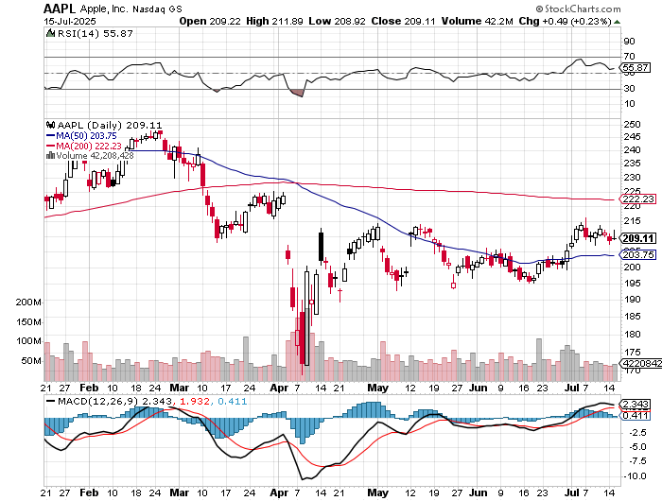

Apple (AAPL) Apple Gets Hit with $62 million EU Fine took profits on long 6/$220-$230 put spread, profits on Long 5/$225-$235 vertical bear put spread, took profits on Long 8/$160-$170 call spread took profits on Long 6/$200-$210 bear put spread,

Slide 34
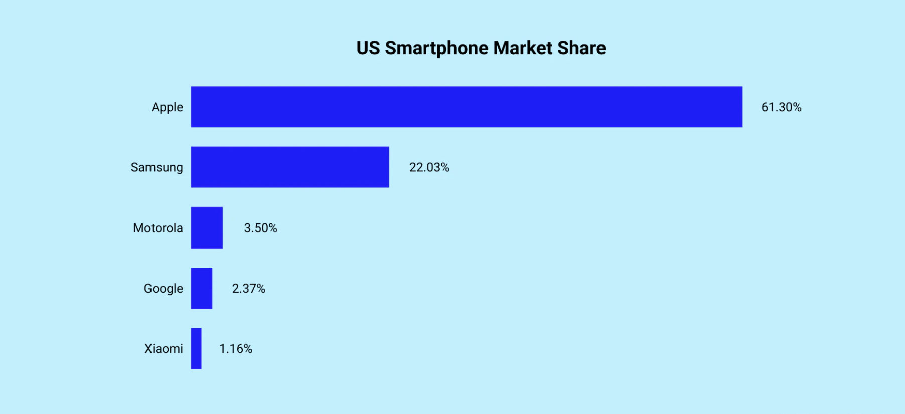

Slide 35
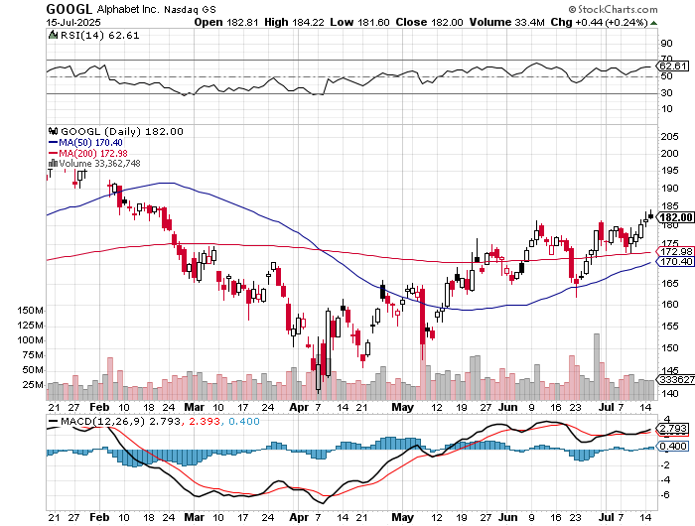
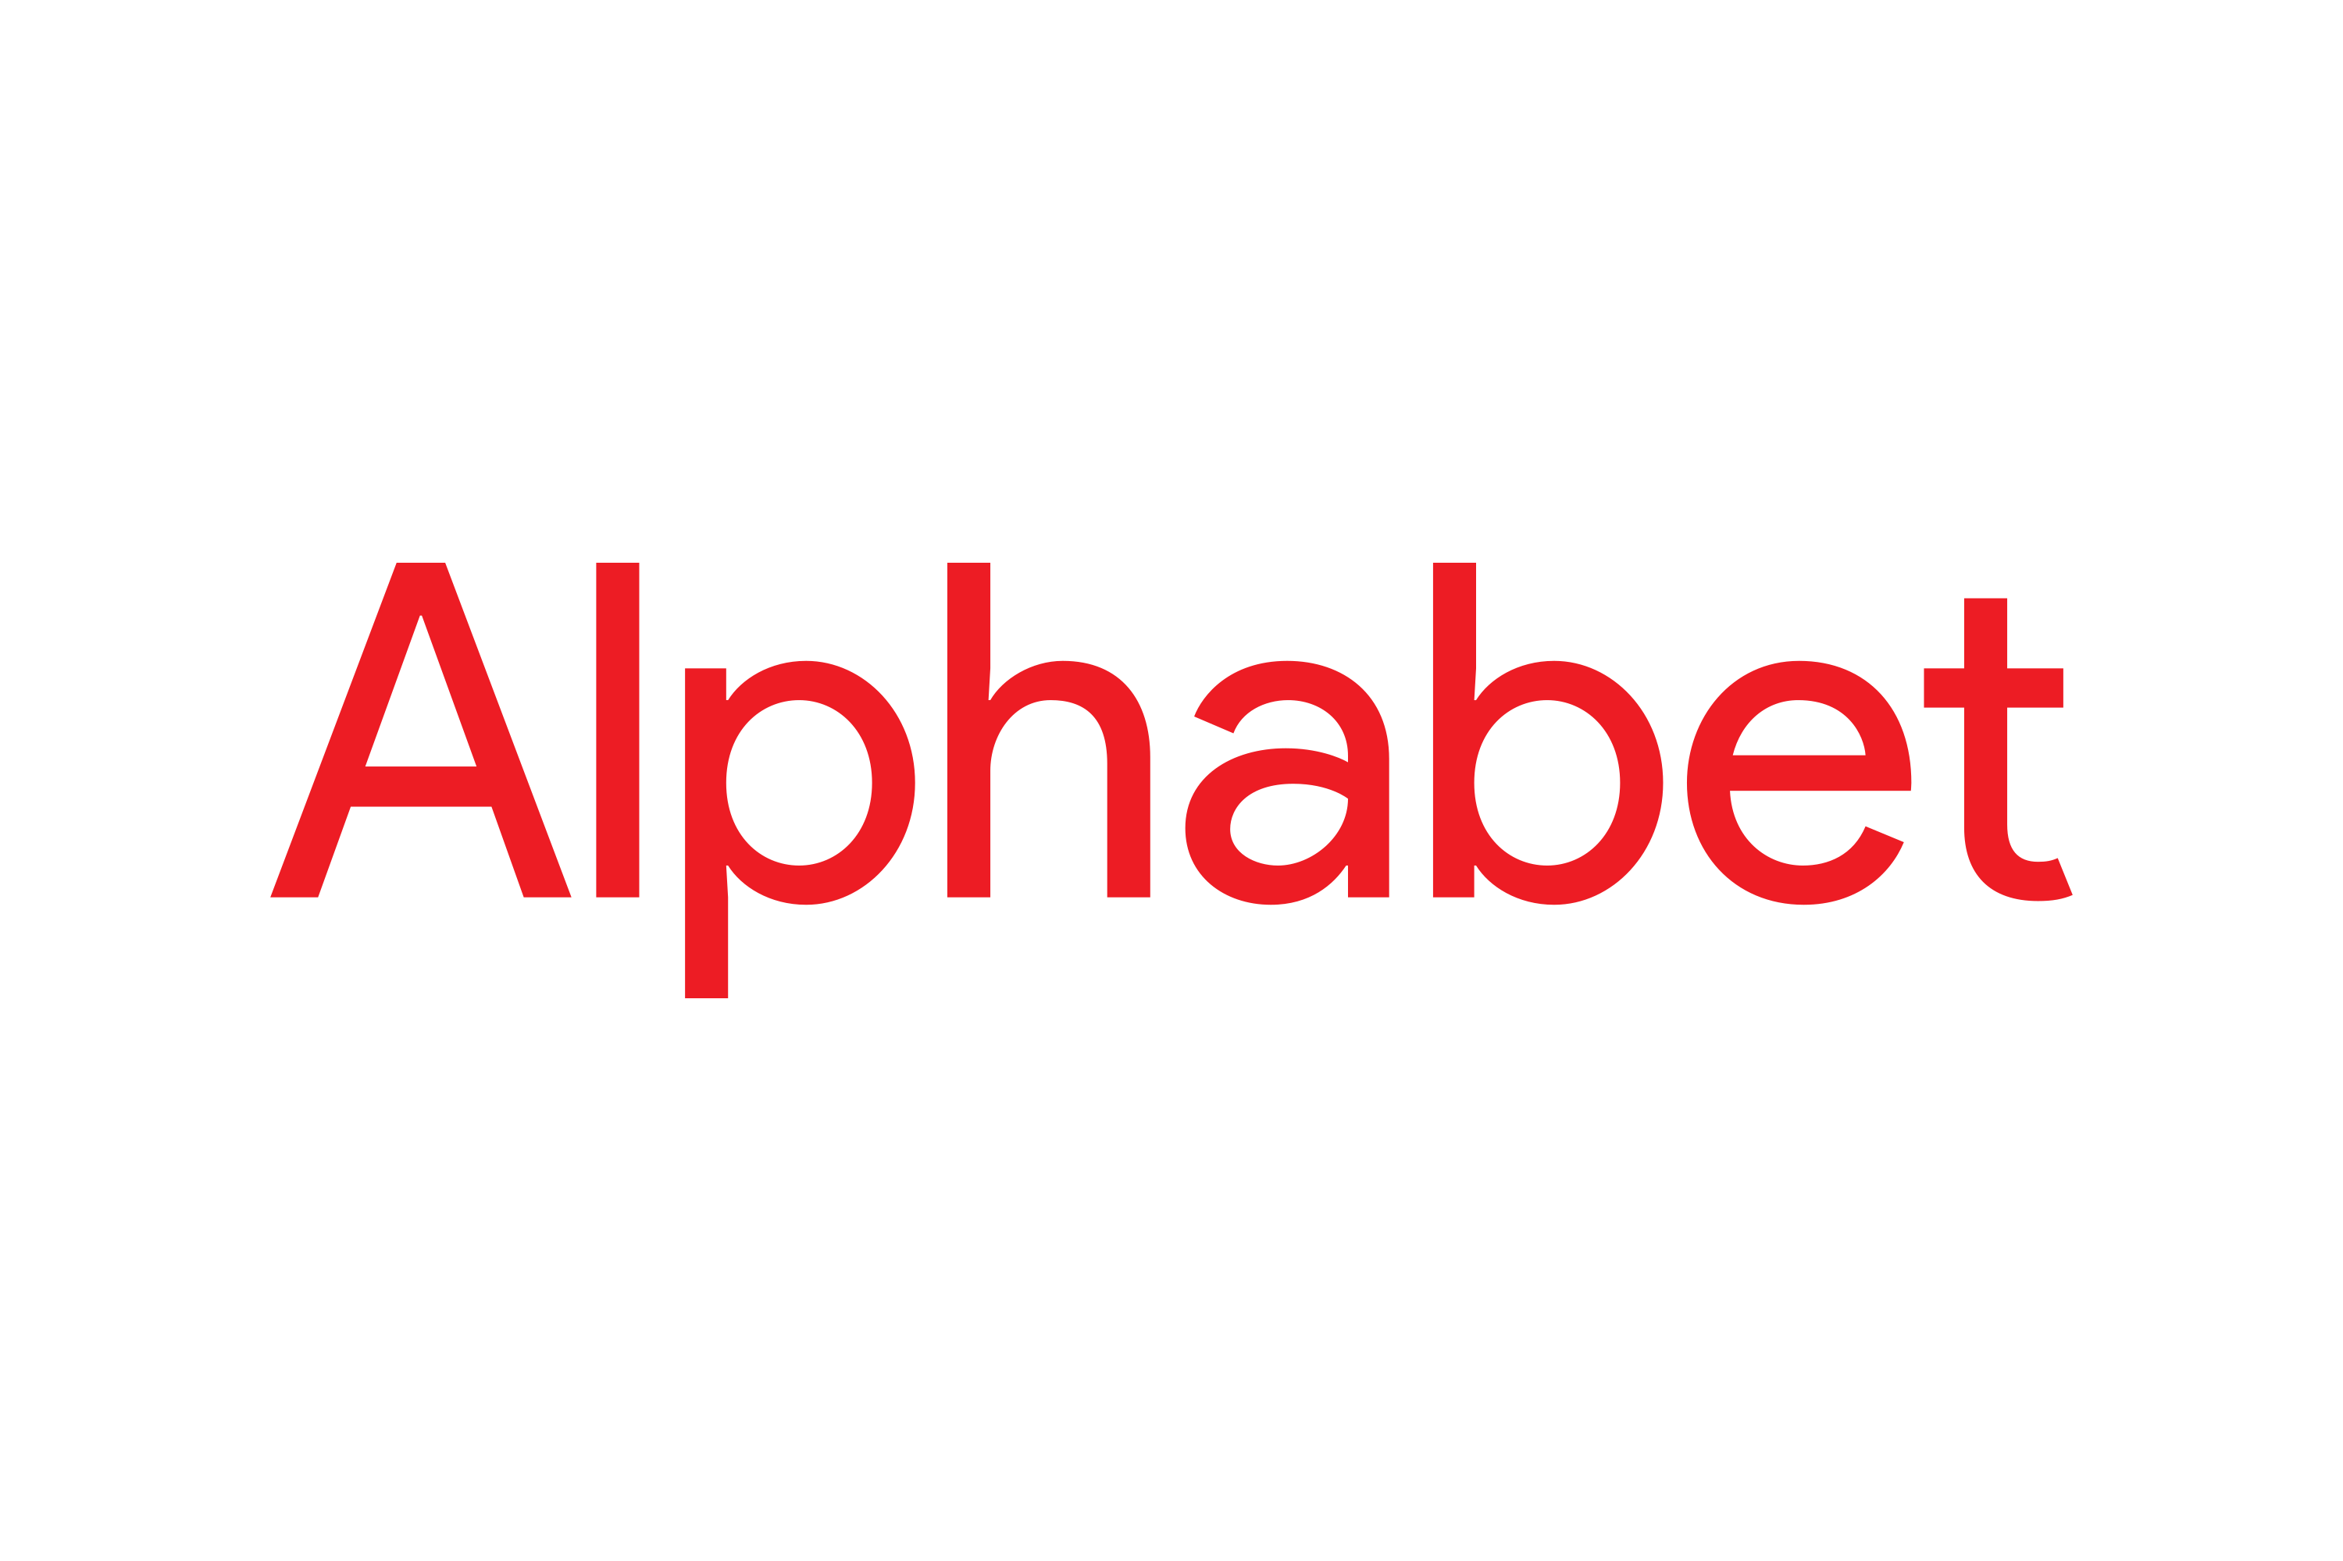
Alphabet (GOOGL) – Breakup Target Waymo Applies for New York City License, for self-driving taxes took profits on long 12/$110-$120 call spread took profits on long 12/$1,200-$1,230 bull call spread, took profits on long 9/$1,030-$1,080 vertical bull call spread

Slide 36
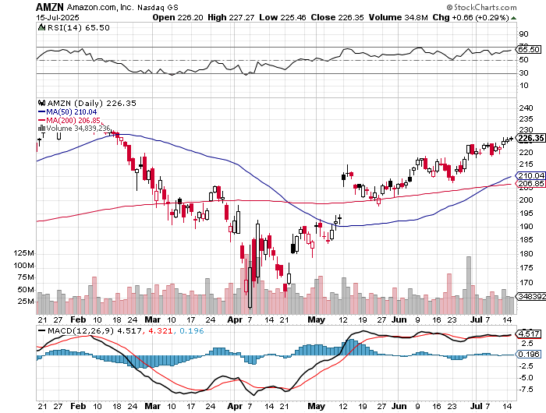

Amazon (AMZN) – Antirust Target Jeff Bezos to Sell $4.7 Billion of Amazon Stock took profits on long 3/$155-$160 bull call spread , took profits on long 2/$130-$135 bull call spread

Slide 37
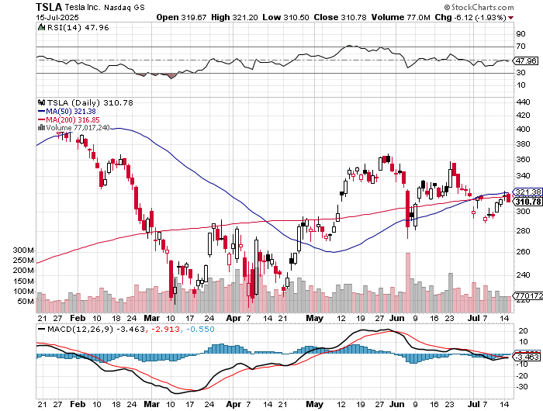

Tesla (TSLA) – Global Brand Destroyed Tesla Dives 10%, as Elon Musk reenters politics long 7/$420-$430 put spread, long 7/$360-$370 put spread-expires in 2 trading days took profits on long 7/$180-$190 put spread, took profits in long 6/190-$200 call took profits on long 6/$430-$440 put spread, took profits on long 4/160-$170 call spread stopped out of long $310-$320 put spread at cost, took profits on long 3/$350-$360 put spread,

Slide 38
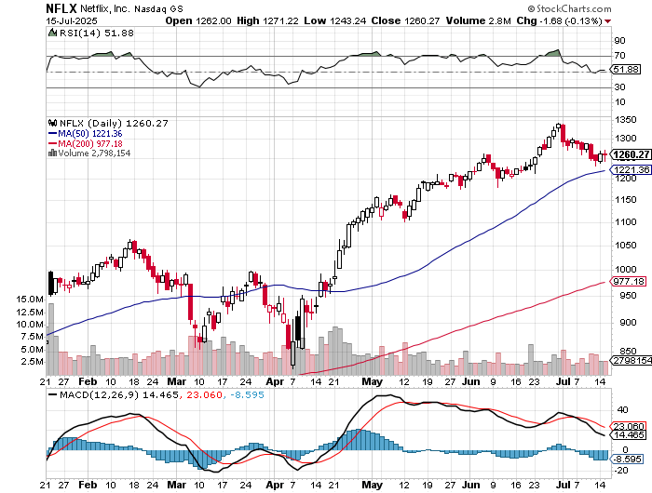

Netflix (NFLX) – Earnings out Tomorrow took profits on long 4/800-$810 call spread

Slide 39
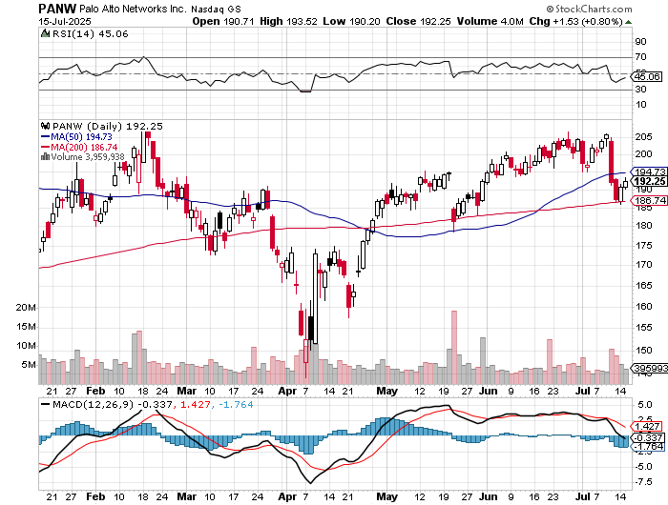

Palo Alto Networks (PANW)- Hacking never goes out of fashion Palo Alto Announced\s 2:1 Split took profits on long 2/$260-$270 call spread, took profits on long 10/$130-$140 call spread

Slide 40
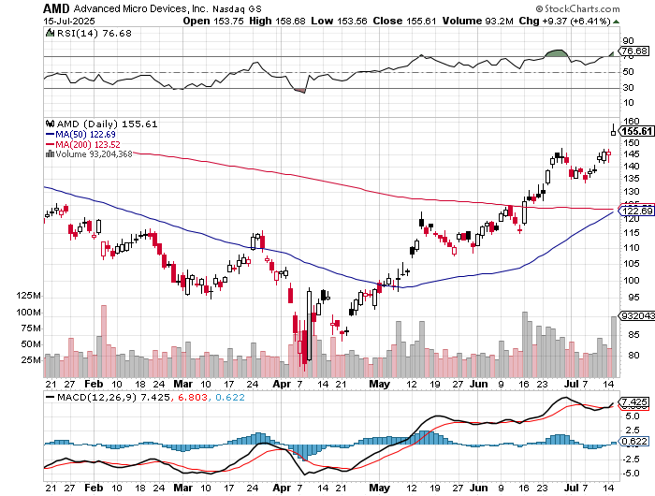

Advanced Micro Devices (AMD)- Recession fears programable logic devices took profits on long 2/$75-$80 call spread

Slide 41
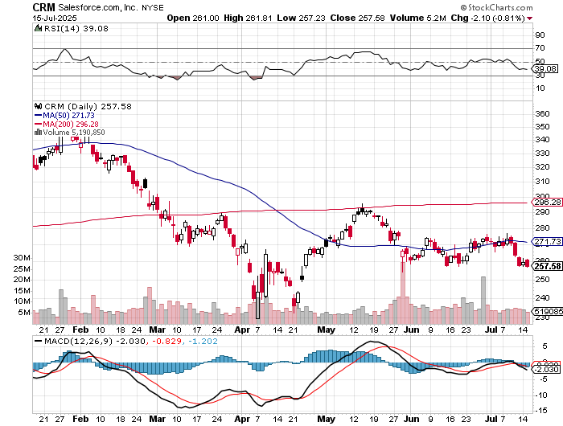

Salesforce (CRM)- Massive Online Migration took profits on long 12/$185-$195 call spread, took profits on long 9/$125-$130 vertical bull call spread took profits on long 8/$125-$130 vertical bull call spread

Slide 42
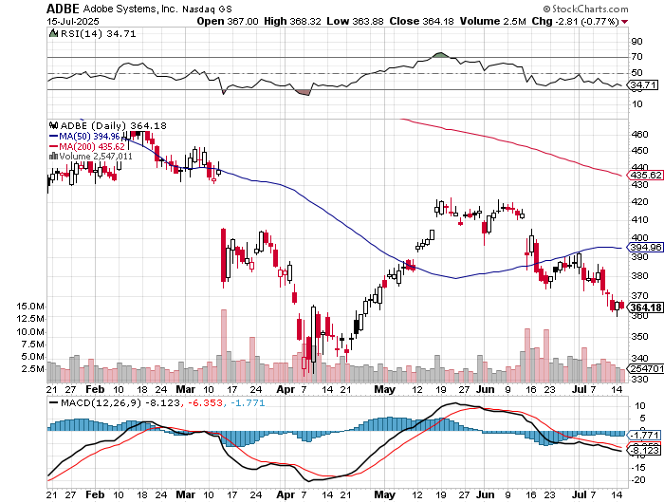

Adobe (ADBE)- Cloud play The Quality Non-China tech play

Slide 43
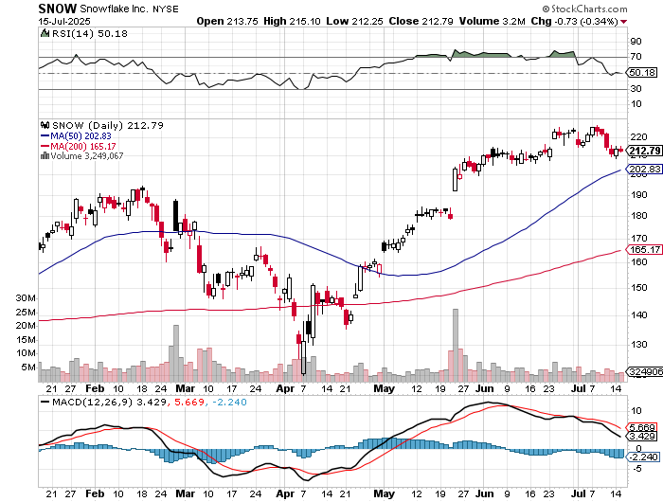

Snowflake (SNOW)- Blockbuster AI Earnings stopped out of long 4/$150-$255 call spread, took profits on long 12/$135-$140 call spread

Slide 44
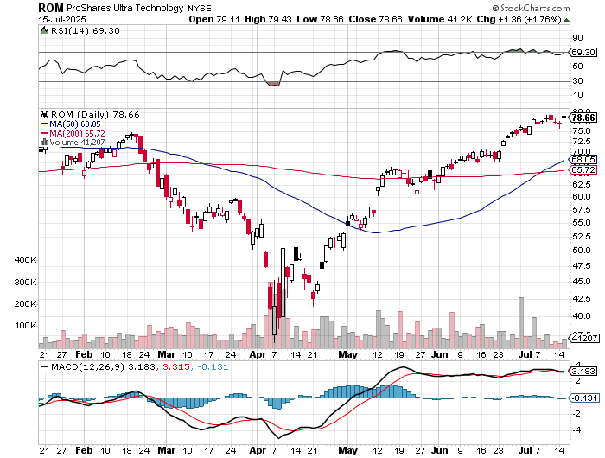
ProShares Ultra Technology ETF (ROM) – 2X Long Technology ETF took profits on long 10/$62-65 call spread

Slide 45
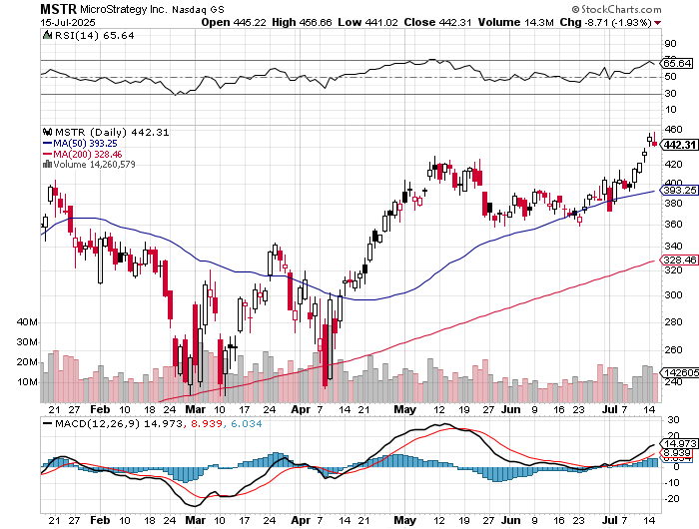

MicroStrategy (MSTR) – Long Bitcoin Play MicroStrategy Copycats are Multiplying Took profits on long 6/$500-$510 put spread, took profits on long 6/$470-$480 put spread took profits on long 6/$330-$340 call spread, stopped out of long 6/$335-$345 put spread took profits on long 5/$400-$410 put spread, took profits on long 5/$220-$230-$230 call spread, took profits on long 5/$400-$410 put spread, took profits on long 5/$400-$410 put spread, took profits on

Slide 46
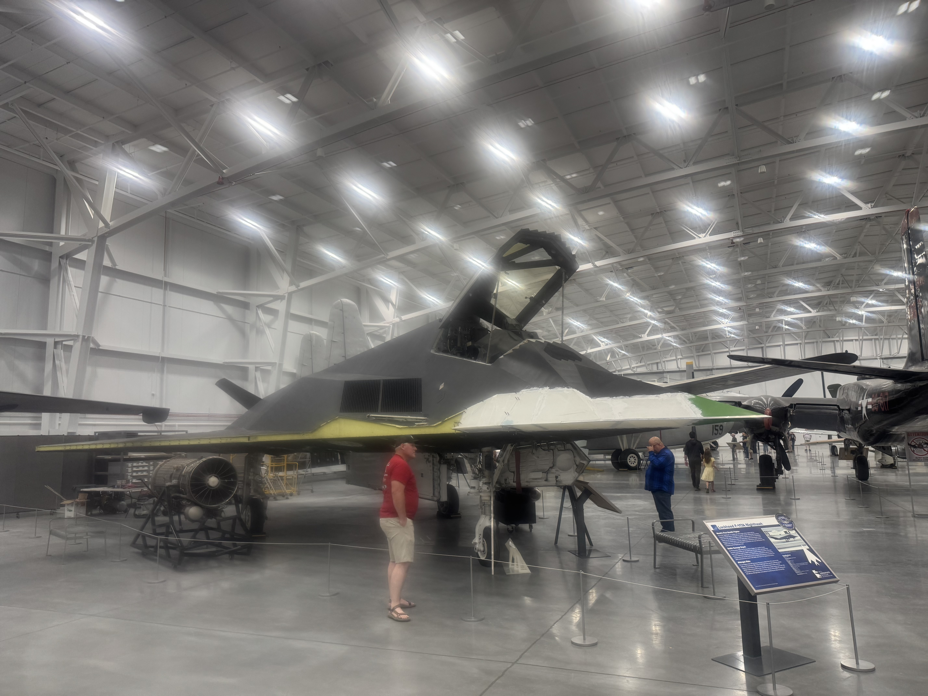

Slide 47
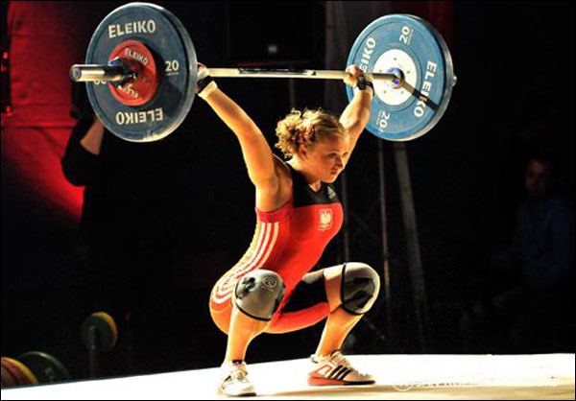
The Second Half of the Barbell
*Bets on a domestic recovery in 2022 Q4 *Upside potential in 2024 far greater than tech *Some of these have not moved for 5 or 10 years *Focuses on economically sensitive cyclical industries *Makes a great counterweight to high-growth technology *We could spend all of next ten years rotating between the two groups

Slide 48
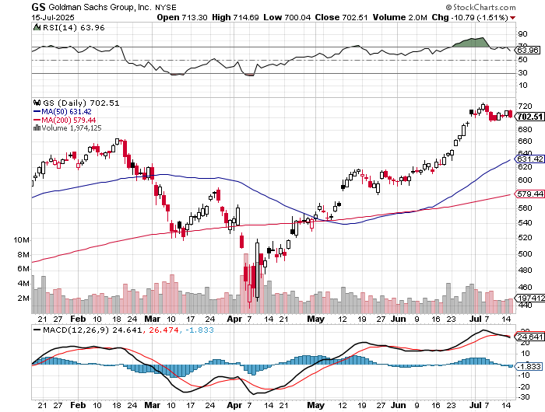

Goldman Sachs (GS) – Goldman Sachs Beats, with Revenues of $12.73 billion vs. $12.46 billion estimate stopped out of 3/$380-$390 call spread, profits on long 12/$330-$350 call spread, took profits on long 11/$330-$350 call spread

Slide 49
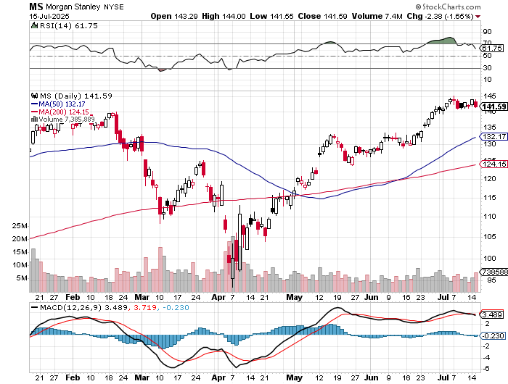

Morgan Stanley (MS) Morgan Stanley Doubles Profits took profits on long $12/210-$220 call spread, Took profits on long $195-$205 call spread, took profits on long 4/$65-$70 call spread

Slide 50
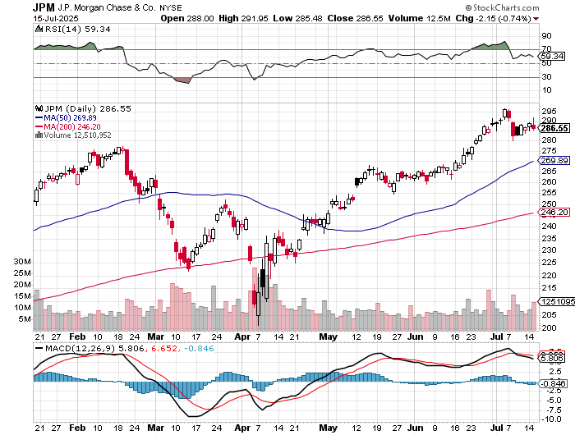

JP Morgan Chase (JPM) – Jamie Diamond Sells 30% of JP Morgan Stock stopped out of 3/$235-$245 calls spread, profits on long 12/$210-$220 call spread, took profits on long 11/$195-$205 call spread, took profits on 4/$215-225 put spread, took profits on long 4/$105-$115 call spread

Slide 51
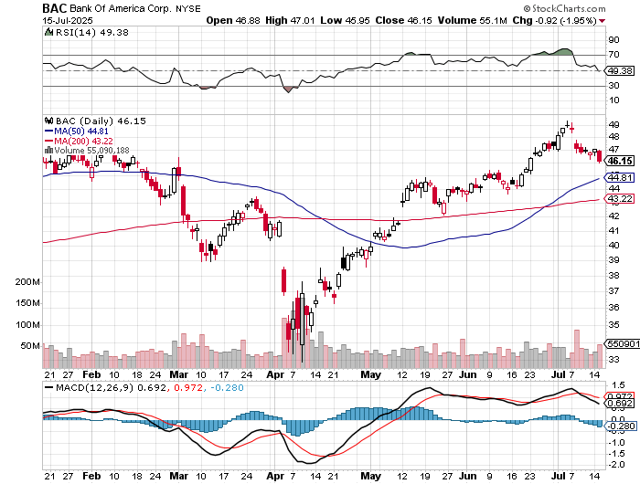

Bank of America (BAC) – Deregulation play took profits on long long 12/$41-$44 call spread, took profits on long 4/$20-$23 call spread

Slide 52
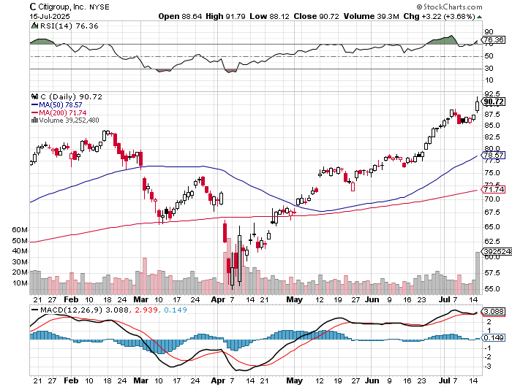

Citigroup (C) – took profits on long long 12/$60-$65 call spread , took profits on long 4/$30-$35 call spread

Slide 53
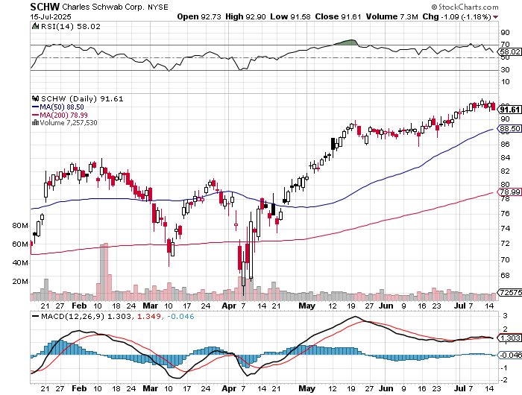

Charles Schwab (SCHW) – LEAPS expire at Max profit took profits on long 4/$30-$35 call spread

Slide 54
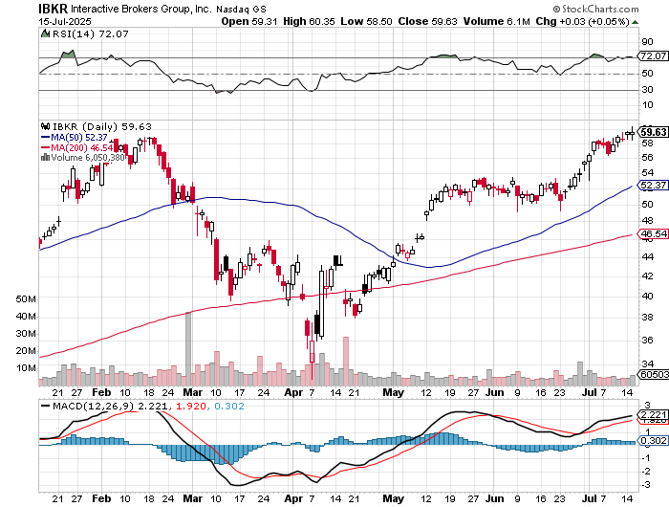

Interactive Brokers (IBKR) – LEAPS expired at Max Profit stopped out of long 3/$160-$170 call spread, out of long 8/$110-$115 call spread , took profits on long 4/$60-$65 call spread

Slide 55
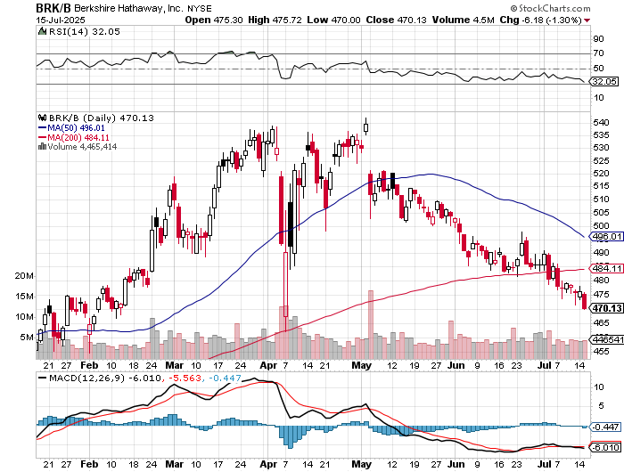

Berkshire Hathaway (BRKB)- Ultimate defensive stock Berkshire Hathaway Builds Record Cash, at $334 billion – Is the new T Bill proxy stopped out of long 12/$405-$415 call spread, took profits on long 12/$320-$330 call spread took profits on long 4/$260-$270 call spread, took profits on long 1/$290-$300 call spread

Slide 56
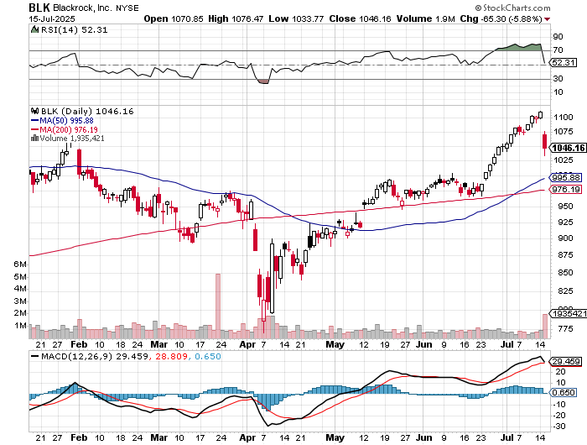

Blackrock (BLK)-Asset Collection Boom took profits on long 12/$850-$860 call spread took profits on long 3/$770-$790 call spread, took profits on long 3/$310-$340 call spread

Slide 57

SPDR Metals & Mining ETF (XME) – long 2/$28-$30 call spread

Slide 58


Boeing (BA) – 300 aircraft order backlog

Slide 59


General Motors (GM) – Worst Off Trade War Victim stopped out of long 4/$52.50-$57.50 put spread at cost, long 3/$53-$56 put spread

Slide 60


Package Delivery- United Parcel Service (UPS) – strike averted took profits on long 11/$130-$140 call spread

Slide 61


Caterpillar (CAT)- Ag + Infrastructure + Housing stopped out of long 8/$310-$320 call spread, took profits on long 12/$220-$230 calls spread took profits on long 12/$145-$150 call spread, took profits on long 11/$125-$135 call spread

Slide 62


Deere & Co. (DE)- Ag + Infrastructure + Housing took profits on long 8/$330-$340 put spread stopped out of long 8/$330-$340 calls spread

Slide 63


Freeport McMoRan - (FCX)- Coming Copper Crisis 50% copper tariff took profits on long 4/$37-$40 call spread, took profits on long 5/$42-$45 call spread, stopped out of long $48-$51 put spread, profits on long 6/$32-$35 call spread took profits on long 4/$30-$33 call spread, took profits on long 10/$20-$23 call spread

Slide 64


Walt Disney (DIS) -Disney Beats Disney Dives on Earnings Bust, although streaming broke even versus an expected loss

Slide 65


Industrials Sector SPDR (XLI)- (GE), (MMM), (UNP), (UTX), (BA), (HON)

Slide 66


Union Pacific RR (UNP)- Big Stuff to Ship took profits on long 5/$200-$210 call spread took profits on 11/$150-$160 call spread

Slide 67


Walmart (WMT) – The New AI Stock took profit on Long 11/$125-$130 bear put spread, took profit on Long 10/$119-$121 bear put spread took profits on Long 8/$114-$117 bear put spread

Slide 68


Costco (COST) – Permanent Compounder took profits on long 4/$840-$850 call spread

Slide 69


Delta Airlines (DAL) – Recession Warning-Travel Collapse The Non-Boeing Airline – uses Airbuses

Slide 70


Transports Sector SPDR (XTN)- Worst Hit Sector (ALGT), (ALK), (JBLU), (LUV), (CHRW), (DAL)

Slide 71


Health Care Sector (XLV) – Defensive Play and Cheap (JNJ), (PFE), (MRK), (GILD), (ACT), (AMGN)

Slide 72


Amgen (AMGN) long 7/$260-$270 bull call spread, took profits on long 11/$185-$200 bull call spread

Slide 73


Visa (V) – Inflation boost took profits on long 2/$240-$250 bull call spread took profits on long 10/$160-$170 bull call spread, took profits on long 6/$150-$160 bull call spread

Slide 74


Consumer Discretionary SPDR (XLY) (DIS), (AMZN), (HD), (CMCSA), (MCD), (SBUX)

Slide 75


Slide 76

Bonds – Pariahs
*Budget bill raises debt ceiling by $5 trillion *We could get there for the end of 2026 *Bonds hate the a national debt at $42 trillion and are approaching 2025 lows in prices, highs in yields *Long Term US Bonds have Become Pariahs *Bond investors are moving away from longer-dated Treasuries *The Bond Vigilantes are Back, and are not to be taken lightly *Government Spending Hit a New All-Time High, in May. Increased spending on Homeland Security is the cause *Avoid (TLT), (JNK), (NLY), (SLRN) and REITS

Slide 77

Treasury ETF (TLT) – took profits on long 6/$88-$91 put spread stopped out of long 6/$80-$83 call spread, took profits on long 4/$84-$87 call spread stopped out of long 1/$82-$85 call spread, took profits on long 10/$103-$106 put spread took profits on long 6/$$94-$97 put spread, took profits on long 5/$82-$85 calls spread

Slide 78

Ten Year Treasury Yield ($TNX) – 4.51%

Slide 79

Junk Bonds (JNK) 6.54% Yield

Slide 80

Municipal Bonds (MUB) 4.21% Yield-

Slide 81

Emerging Market Debt (ELD) 5.62% Yield-

Slide 82

2X Short Treasuries (TBT)-Out of Favor

Slide 83

Anally Capital Management (NLY) – Leveraged REIT Play Yield 13.25% took profits on long 12/$15-$16 call spread

Slide 84


Slide 85

Foreign Currencies – No dollar friends
*US dollar Hits Four Year Low, as the “Sell America” trade continues *Short dollars against long Euros has become the most concentrated trade in global markets *It’s almost unprecedented for a currency to fall when its interest rates rising *Debt, default, and trade wars are now the larger concern *Next dollar weakness will come with evidence of a recession in days *Buy (FXA), (FXE), (FXB), (FXC), and (FXY)

Slide 86


THE MAD HEDGE FUND TRADER
Australian Dollar (FXA) - Major Long-Term Bottom is In Targeting Parity – A call option on a global synchronized recovery

Slide 87


Japanese Yen (FXY)

Slide 88


Euro (FXE)-

Slide 89


British Pound (FXB)-

Slide 90


Emerging Market Currencies (CEW)

Slide 91


Slide 92

Energy & Commodities –
*The Energy Sector is Marking Down Earnings *Exon (XOM) the biggest U.S. energy company, were rising in early trading even after it flagged that second-quarter earnings will take a hit from lower energy prices *US Drillers Cut Rigs for 10th Week, or the first time since July 2020, thanks to a global oil glut *OPEC Increases Production by 550,000 Barrels a Day * Budget Bill Kills Effort to Restore Strategic Petroleum Reserve, cutting the funding by 90%. *US Crude Inventories Hit One Year Low *Look for energy plays to hit new lows *Copper Hits New All-Time High on 50% Tariff

Slide 93

Oil-($WTIC)

Slide 94

United States Oil Fund (USO)

Slide 95

Energy Select Sector SPDR (XLE)-No Performance! (XOM), (CVX), (SLB), (KMI), (EOG), (COP)

Slide 96

ExxonMobil (XOM)- Exxon Moves Big into Lithium, with the construction of a major mining operation in Arkansas took profits on Long 4/$100-$105 call spread, took profits on long 12/$120-$125 put spread

Slide 97

Occidental Petroleum (OXY)- Buffet’s a Buyer took profits on long 4/$59-$62 call spread took profits on long 2/$55-$60 call spread, took profits on long 12/$77.50-$82.50 put spread

Slide 98

Natural Gas (UNG) – Free Fall on Warm Winter took profits on Long January 2025 $7-8 Call Spread LEAPS

Slide 99

Cameco (CCJ) – Global Uranium Renaissance Microsoft to Reopen Three Mile Island to power AI data centers took profits on long 12/$41-$44 call spread, took profits on long 12/$35-$38 call spread, took profits on long 5/$20-$23 bull call spread

Slide 100

Vistra Corp. (VST) – Global Uranium Renaissance took profits on long 2/$100-$110 call spread

Slide 101


Slide 102

Precious Metals – Consolidating
*Bitcoin breakout is stealing gold’s thunder *Speculative money is chasing new highs in crypto plays at the expense of gold *Traders have been rolling out of hedges as stocks rise *Silver hits new High for the year *(AGQ) 2X LEAPS hit max profit *$50 here we come! *My target is still $5,000 for gold

Slide 103


Gold (GLD) –Falling Rate took profits on Long 10/$230-$235 call spread took profits on Long 10/$220-$225 call spread, took profits on Long 8/$210-215 call spread, took profits on Long 7/$200-205 call spread, Long 6/$207.5-$212.5 call spread took profits on Long 4/$194-$197 call spread, took profits on long 5/$165-$170 bull call spread

Slide 104

Market Vectors Gold Miners ETF- (GDX) – took profit on long 6/$207.50-$212.50 call spread, took profit on long 7/$200-$205 call spread

Slide 105


Barrick Gold (GOLD) took profit on long 1/$15.50-$16.50 call spread

Slide 106


Newmont Mining- (NEM)- Sometimes you Just Get Lucky took profits on long 10/$47-$50 call spread, took profits on long $55-60 call spread

Slide 107


THE MAD HEDGE FUND TRADER
iShares Silver Trust (SLV) - The Better Play Industrial demand, solar panels, electric cars
2025 Target $50 +50%
BUY

Slide 108


Silver Miners - (SIL)-

Slide 109


Wheaton Precious Metals - (WPM)- LEAPS Approaching Max Profit took profits on long 4/$39-$42 call spread long 6/$75-$80 call spread-expires in 7 trading days , took profits on long 1/$36-$39 call spread

Slide 110


Platinum- (PPLT)- 556,000-ounce shortage this year took profits on long 1/$36-$39 call spread

Slide 111


Slide 112

Real Estate – No Buyers
*Housing Starts Hit 5 Year Low *Multifamily dropped 30% MOM as a record supply hits the market *Single family home starts fell 7% YOY *All housing related stats are falling off a cliff *Homebuilder Sentiment Hits Pandemic Low *Watch the homebuilders, they will front run any fall in interest rates in 2026 *Apartment Rents are Slowing, up only 0.4% in May and down 0.5% YOY, usually a strong period.

Slide 113

S&P Case Shiller Slows S&P Case Shiller Rises to +2.7% YOY in April, with its National Home Price Index New York gained +7.9%, Chicago +6.0%, and Detroit +5.5%. Tamps and Dallas down -2.2%

Slide 114


Crown Castle International (CCI) – 6.62% yielding 5G cell phone tower REIT Eliot Management Pushes up stock with activist bid took profits on Long 8/$90-$95 call spread,

Slide 115



US Home Construction Index (ITB) (DHI), (LEN), (PHM), (TOL), (NVR)

Slide 116


DH Horton (DHI) Horton Bombs, with the stock dropping some 11% in Tuesday morning trading after the U.S.'s largest homebuilder issued its fiscal 2025 guidance took profits on long 11/$165-$175

Slide 117

Trade Sheet- The Recession Trade So What Do We Do About All This?
*Stocks –stand aside *Bonds – sell rallies *Commodities – buy dips *Currencies – buy dips *Precious Metals – buy dips *Energy – stand aside *Volatility – sell over $30 *Real estate – stand aside

Slide 118

Next Strategy Webinar 12:00 EST Wednesday, July 30, 2025 from Incline Village, NV email me questions at support@madhedgefundtrader.com
Good Luck and Good Trading!
Notes:
*

Slide 119


Slide 120


