Slide 1

The Mad Hedge Fund Trader
“The Dog Days of Summer”
With John Thomas
Incline Village, NV July 20, 2025
www.madhedgefundtrader.com
Notes:
*

Slide 2
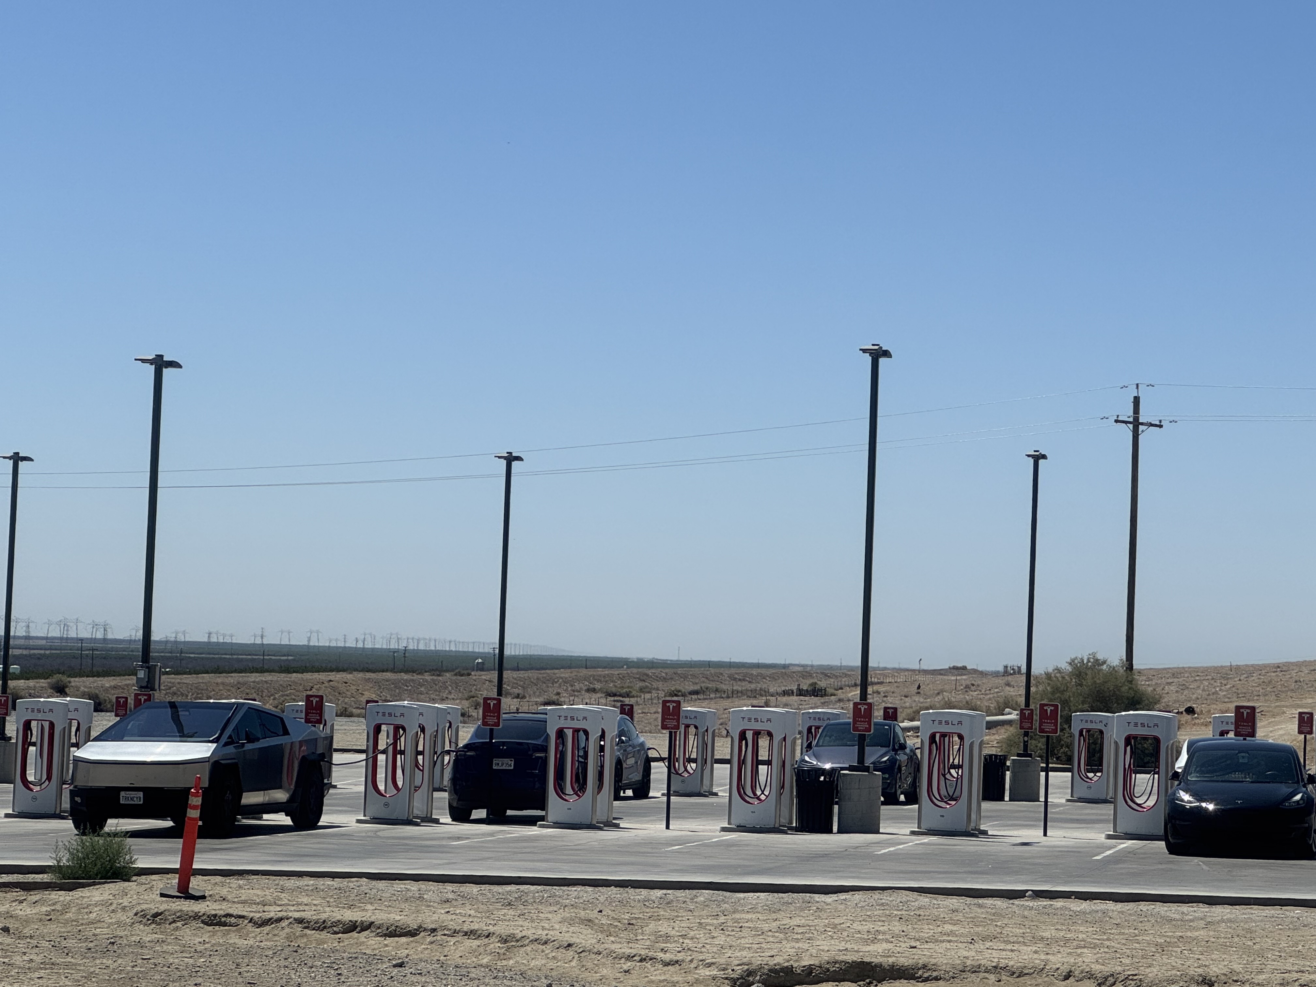

Slide 3
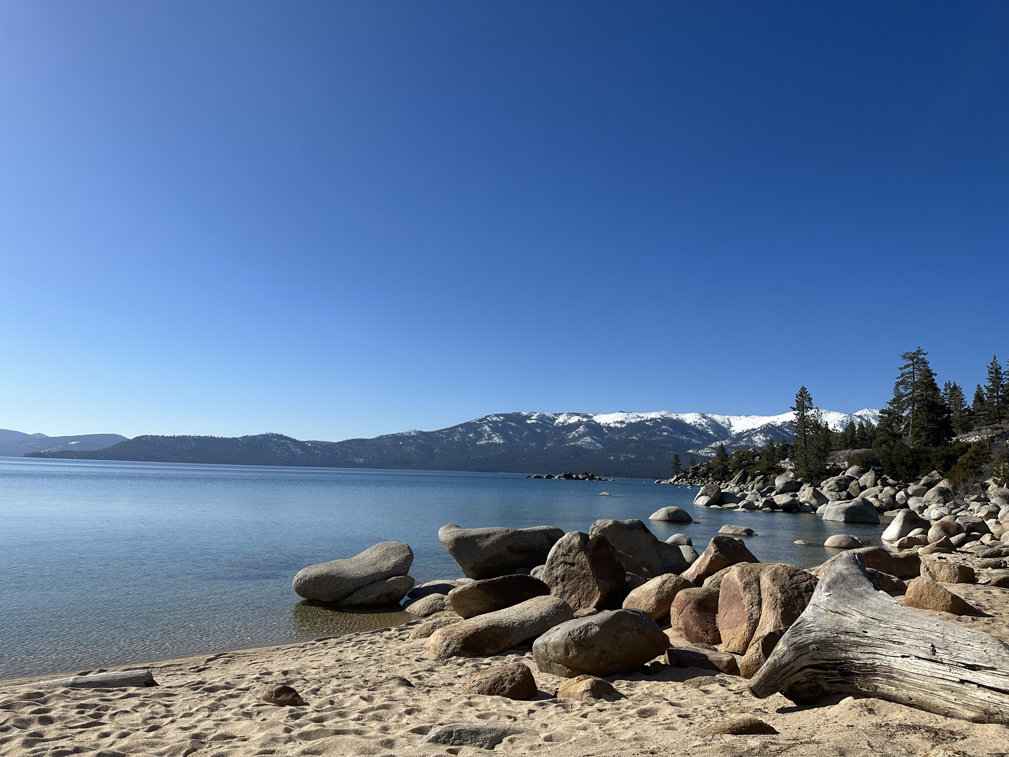
August 22 Lake Tahoe Strategy Dinner
Buy tickets before they sell out
*An excellent meal will be followed by a wide-ranging discussion and an extended question and answer period
*Tickets are available for $249.
*The dinner will be held at the premier restaurant
in Incline Village, Nevada on the sparkling shores
of Lake Tahoe.
*To purchase tickets for the luncheons, please
go to my online store at
http://www.madhedgefundtrader.com/store
and click on “luncheons.”

Slide 4

Trade Alert Performance
New All-Time Highs-17 Consecutive Positive Months
*January +5.80% Final *July +5.21% MTD
*February +3.66% Final. *August +3.74% Final
*March +4.36% Final *September +10.28% Final
*April +0.95% Final *October +7.59% Final
*May +2.51% Final *November +18.96 Final
*June +15.48% Final *December +3.26% Final
*2025 Year To Date +50.38%
+802.27% since inception
*Versus 84.63% for all of 2022
*Versus 79.79% for all of 2023
*Versus 75.29% for all of 2024

Slide 5
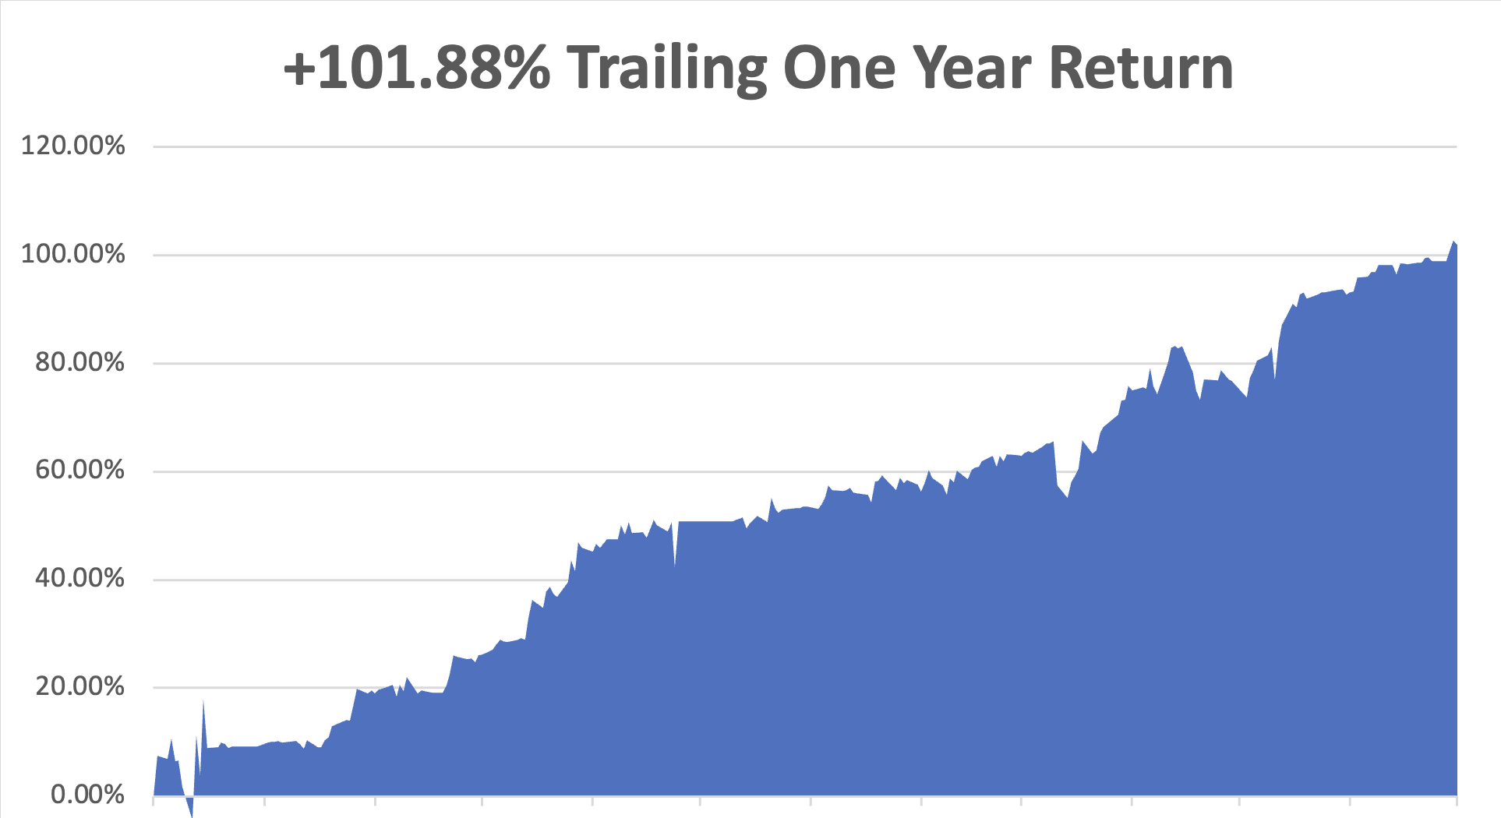

Slide 6
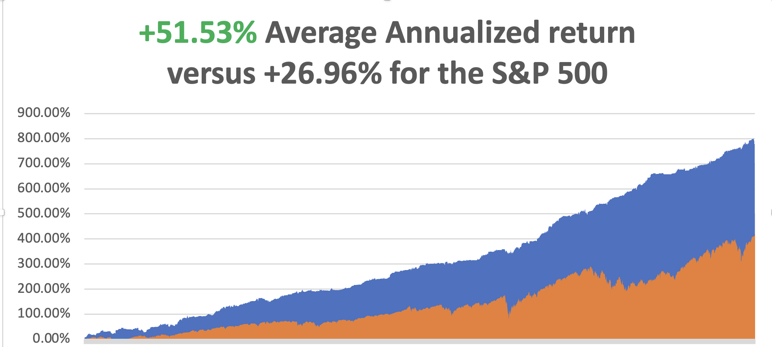

Slide 7
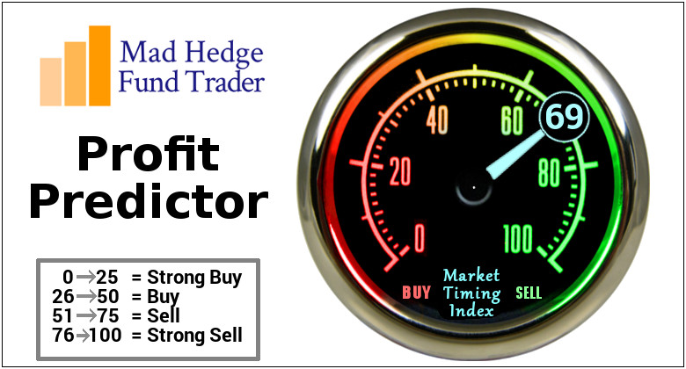

Slide 8
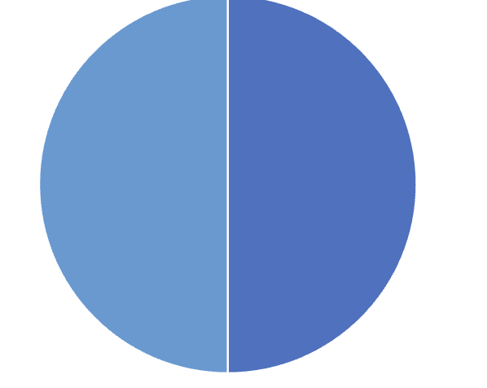
Portfolio Review – High Risk Market Require Maximum Cash
10% risk on, 10% risk off, 80% cash
Entering a very high-risk market
Current Capital at Risk
(WFC) 8/$65-$70 call spread | 10.00%
Risk Off
(TSLA) 8/$370-$380 put spread | -10.00%
Total Net Position | 0.00%
Total Gross Position | 20.00%
cash | 80.00%
Expiration Value
+52.19%

Slide 9

The Method to My Madness
*Stocks are are now at very high-risk levels due to increasingly unstable world,
*AI is the big leader, but The risk/reward here is terrible with Volatility Index at $14
*Bonds approaching 2025 lows, yields new highs
*The new budget bill passed a $5 trillion debt ceiling increase
*Safety assets like gold, silver, and T-bills are flat lining with crypto bleeding off speculative capital
*Oil is still dead on recession fears and OPEC market share battle
*US Dollar hits new four-year lows
Bitcoin Hits New All-Time High, at $123.00

Slide 10

The Global Economy – Flatlining
*US Q2 GDP Growth Rate Grows by 0.75%, with almost all of the growth coming from collapsing imports
*Domestic Demand grew at the slowest rate in 2 ½ years
* Fed Beige Book Turns Pessimistic, with businesses reporting that tariffs caused upward pressure on prices
* Inflation Rises in June, by 0.1% to 0.3%, to a 2.7% annual rate.
* Producer Price Index Comes in Flat, taking the annual rate down to 2.3%
* US Retail Sales Pop, in a rush to beat price increases
* S&P Global Composite PMI Rises, to 54.6, highest since December
* US Fertility Hits All-Time Low, according to the CDC at
1.66 children per couple, well below the 2.18 replacement rate
*China’s Economy Grows by 5.2% in Q2,

Slide 11
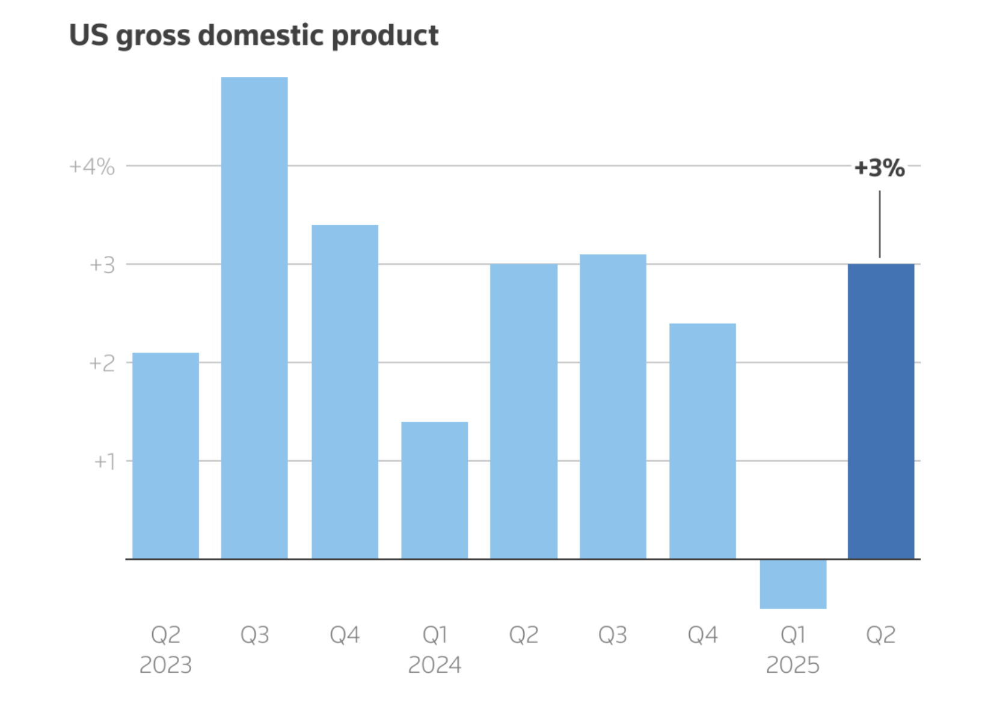

Slide 12
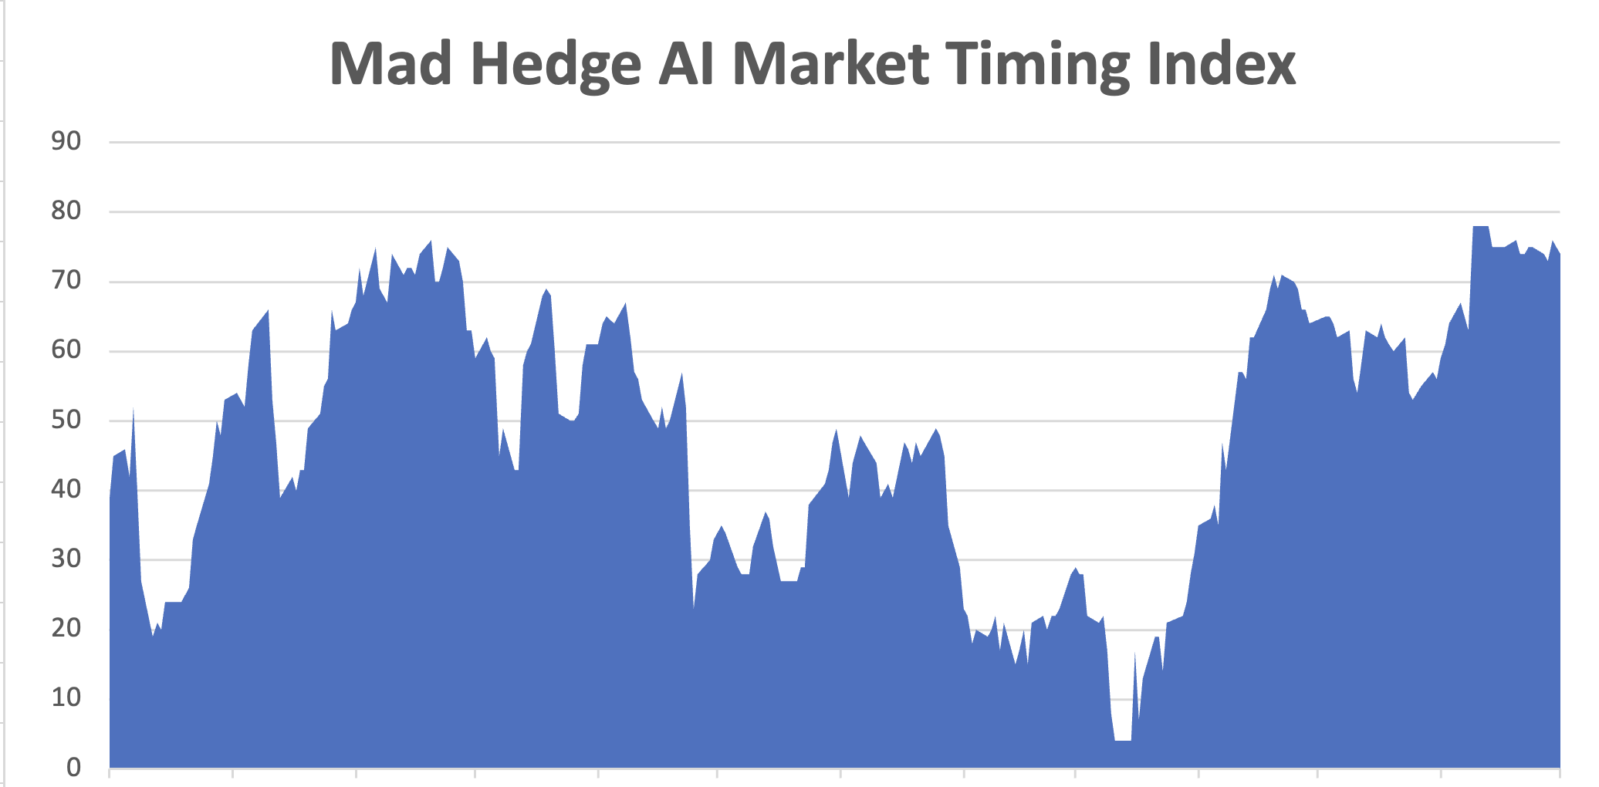
The Mad Hedge Profit Predictor
Market Timing Index – New Range?
An artificial intelligence driven algorithm that analyzes 30 different economic, technical, and momentum driven indicators
SELL
BUY

Slide 13
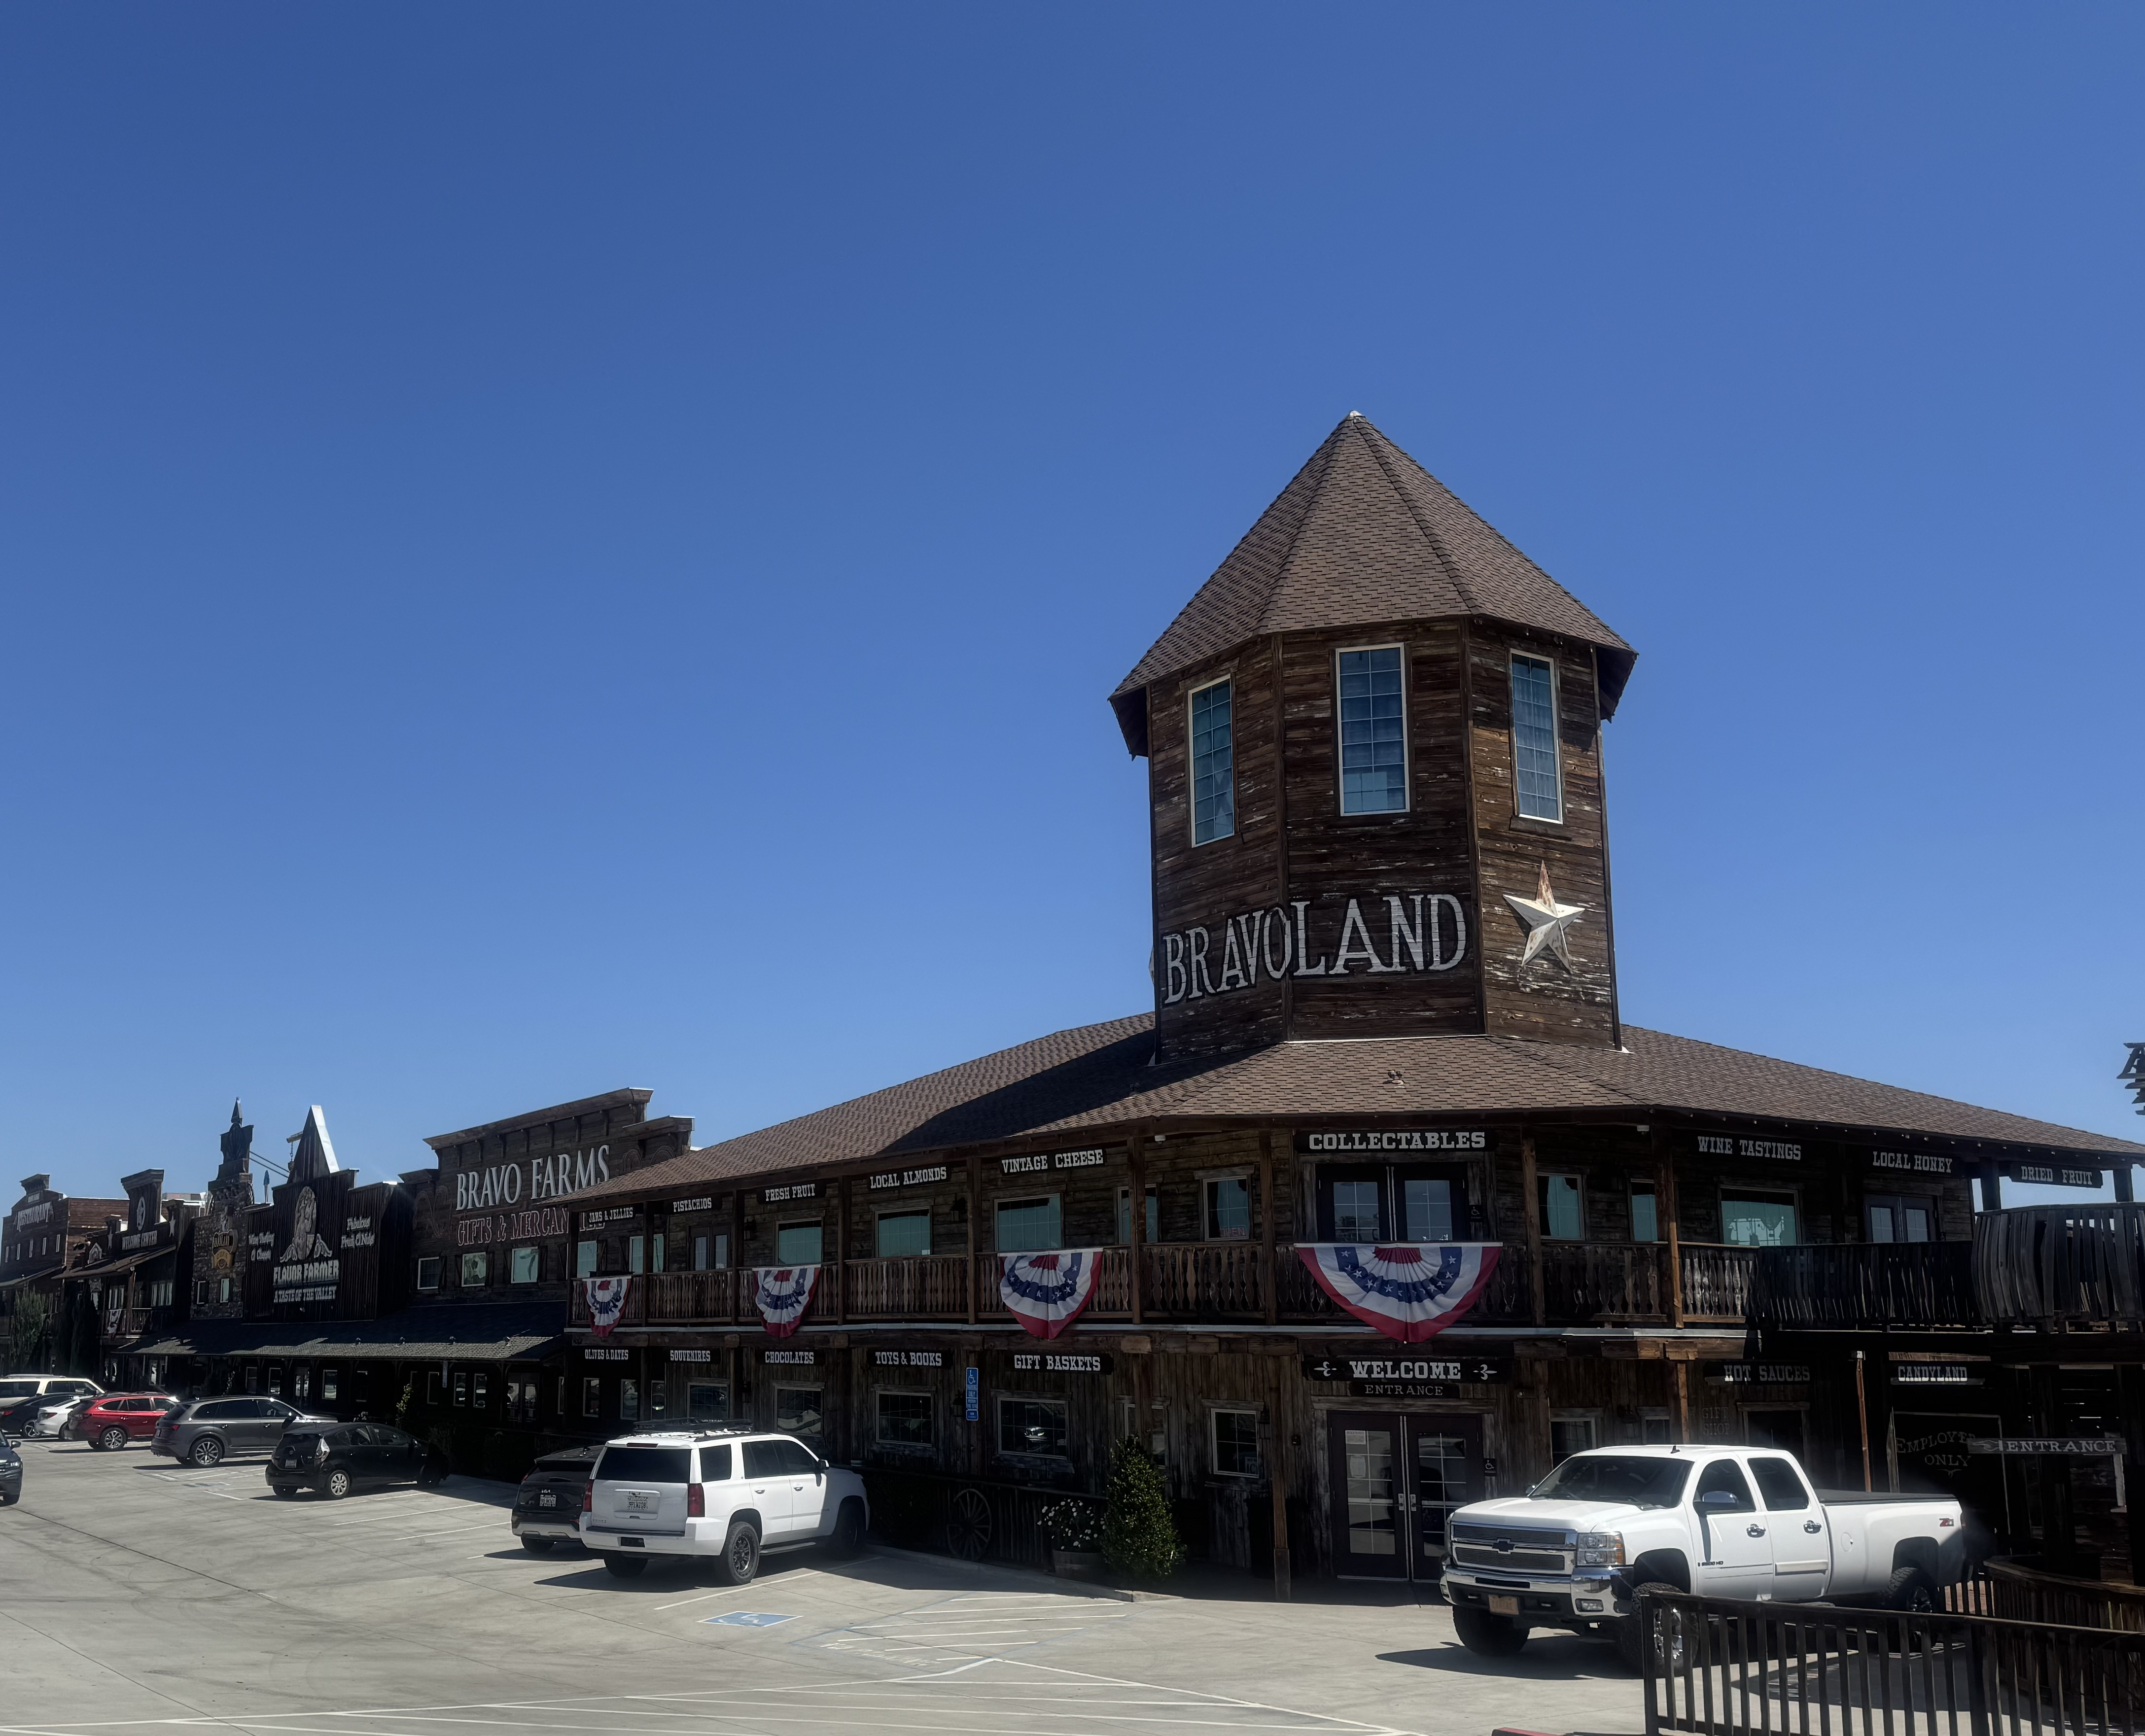

Slide 14
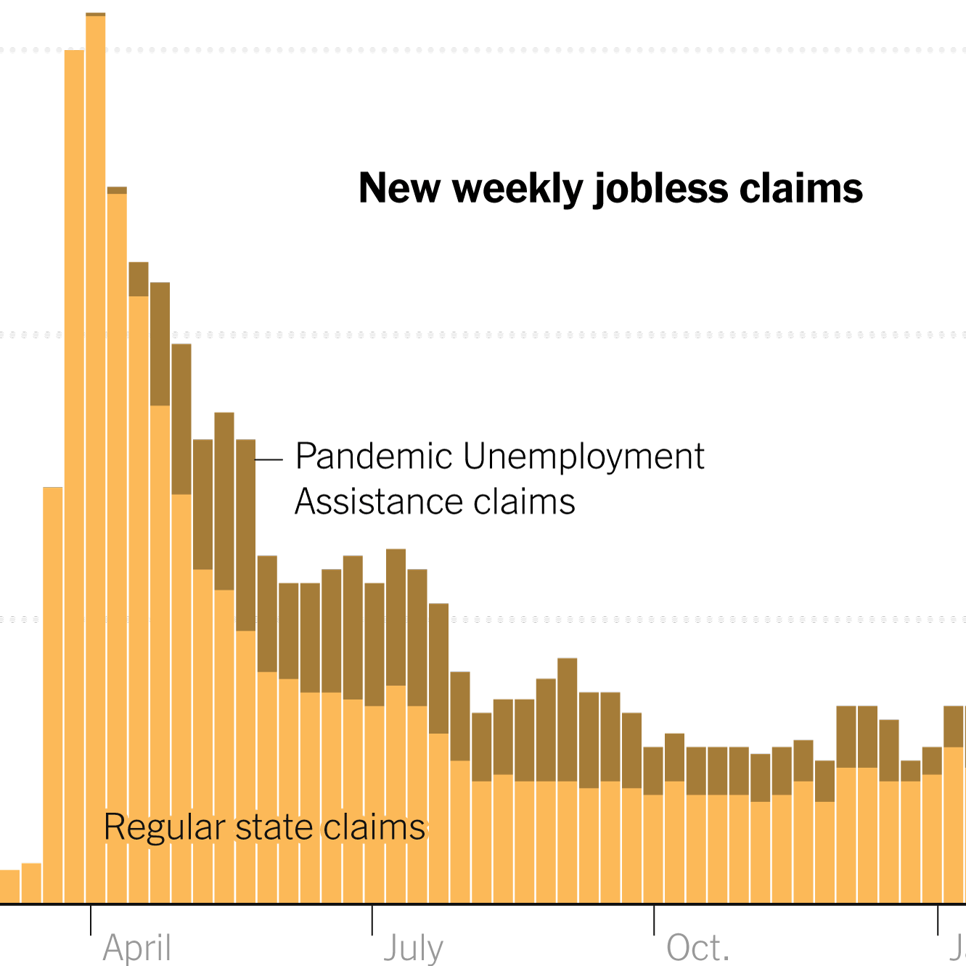
Weekly Jobless Claims – 8 Month High
-4,000 to 218,000

Slide 15
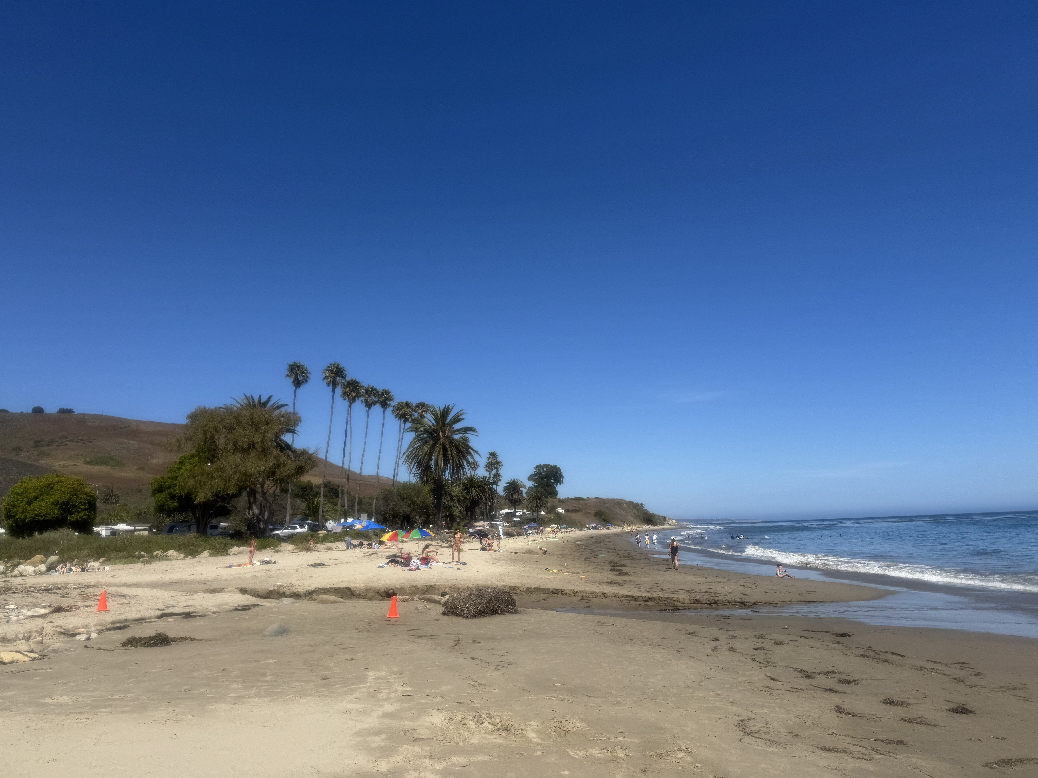

Slide 16

Stocks – No Man’s Land
*Up 26% in 4 months is not a place to buy
*But with trillions of dollars in government money about to hit the market you can’t sell short either
* A Stock Rotation but Not a Selloff? That’s what the Bank of America thinks is happening this summer. Out of tech, into interest sensitives like banks, small caps, homebuilders, bonds, and REIT’s
*Stock Market Momentum is Stalling. U.S. stocks are trading near record highs heading into the thick of the second-quarter earnings season
*But with markets historically expensive and reliant on the performance of tech stocks, some investors are starting to embrace a more cautious outlook
*Speculative Activity Hits the Highest Level in History, greater than the Dotcom Bubble and the pre–Great Financial Crisis crash, says Goldman Sachs.
*Meme Stocks are Back! OpenDoor rocketed 235% in a week and Kohs (KSS) 38% in a day
*Trade war Cuts $1 Billion Out of GM Earnings
*Historic Market Concentration Bodes Ill for Future Gains

Slide 17
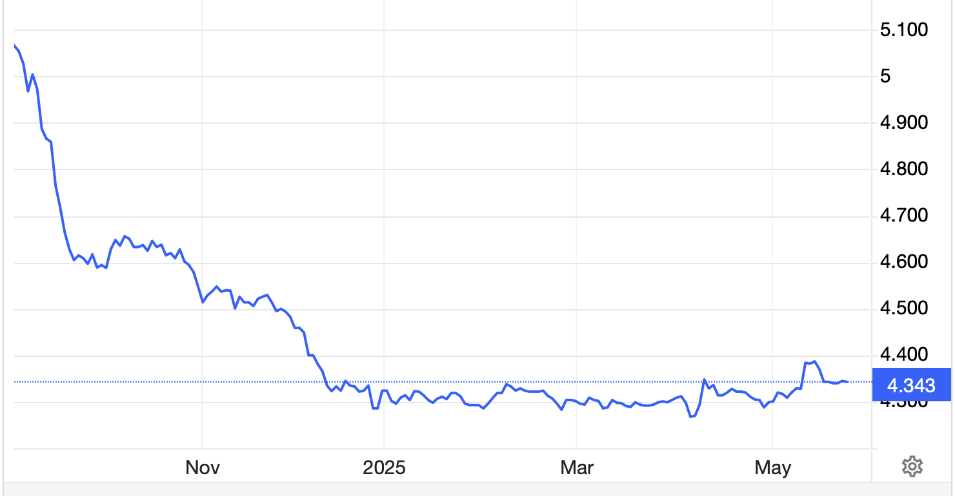
The Ultimate Hedge – Defensive stocks only go down at a slower rate
90 - day US Treasury Bills (Warren Buffet owns $300 billion)
*Government Guaranteed principal
*Endless liquidity,
trade like water
*100% collateral value for margin
*Lock in guaranteed income
*Can be sold at any time to earn
full interest
*Will survive any bear market
*Ask your broker how to buy
4.36% Yield

Slide 18
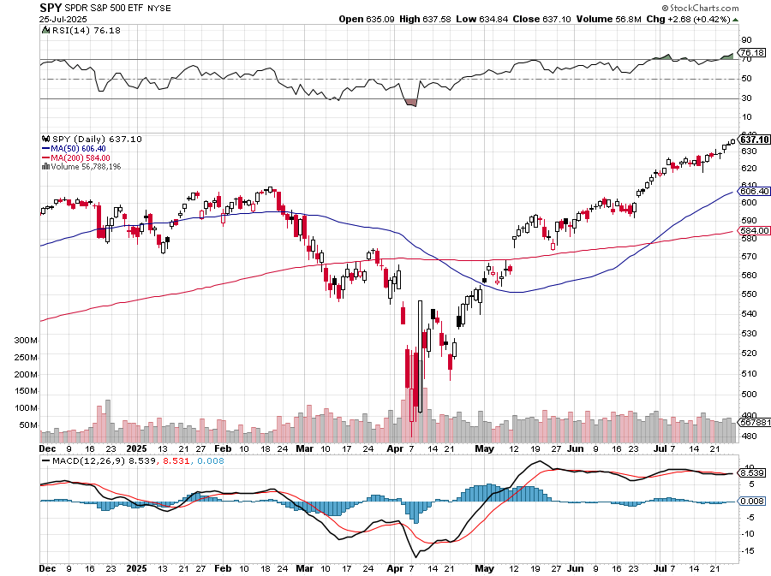
S&P 500 – Downside Targets – Mild Summer Correction took profits on long 6/$660-$640 put spread took profits on 6/$610-$620 put spread
$590
-4.2%
1st resistance
$575
-6.39%
1st support
$560
-9.1%
1st support

Slide 19
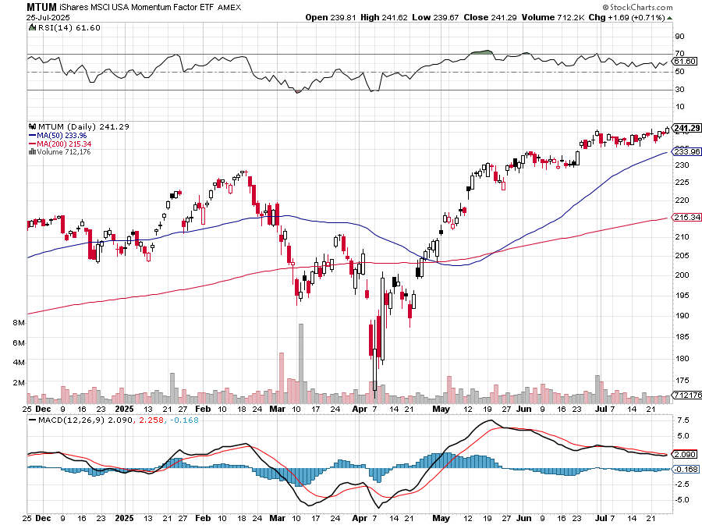
Momentum (MTUM)

Slide 20
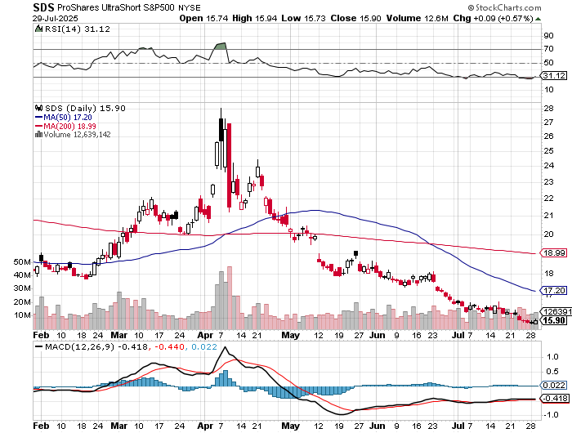
ProShares -2X Short S&P 500 (SDS) - a great 2X hedge for falling long stocks

Slide 21
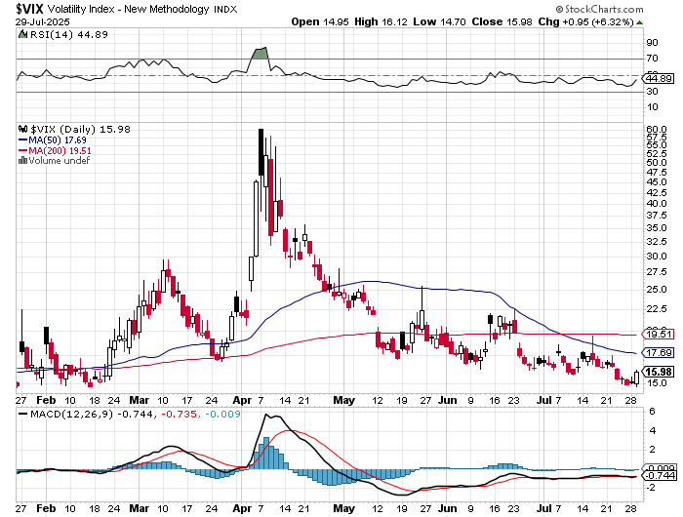
(VIX) –
Volatility Index Hits Four Year High at $65, the most since the 2020 pandemic. That implies a 2% move in the S&P 500 (SPX) every day for the next 30 days

Slide 22
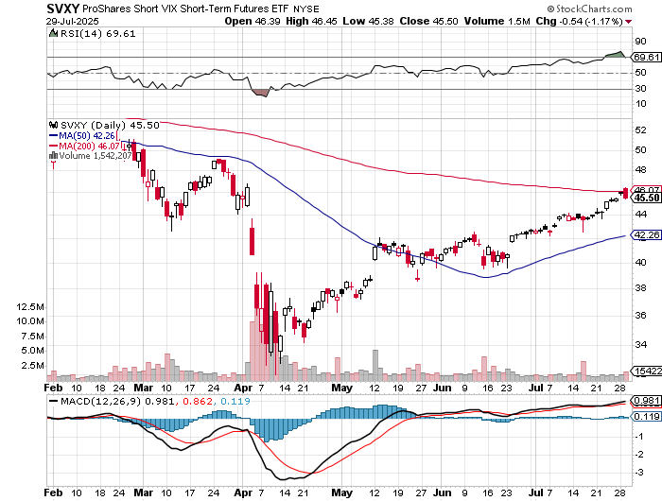
(SVXY) –Short Volatility ETF bought at $36.31 - $32.74 = $3.57

Slide 23
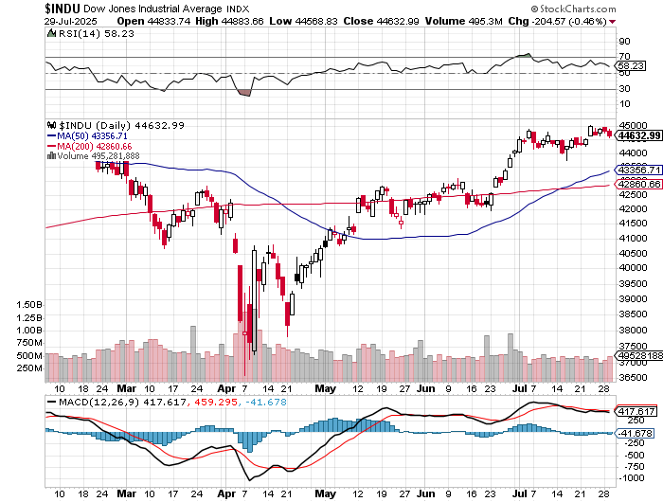
Dow Average ($INDU)-

Slide 24
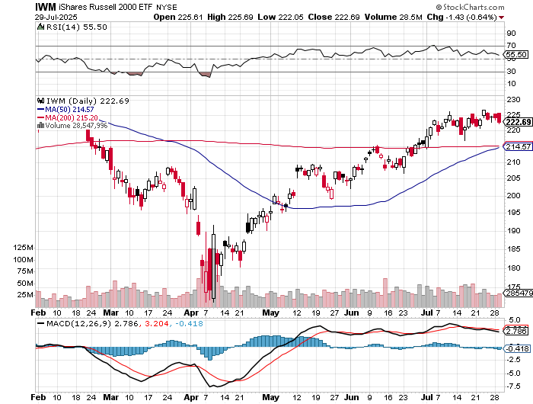
Russell 2000 (IWM)- took profits on Long 10/$137-$142 vertical bull call spread took profits on Long 10/$153-$156 vertical bear put spread

Slide 25
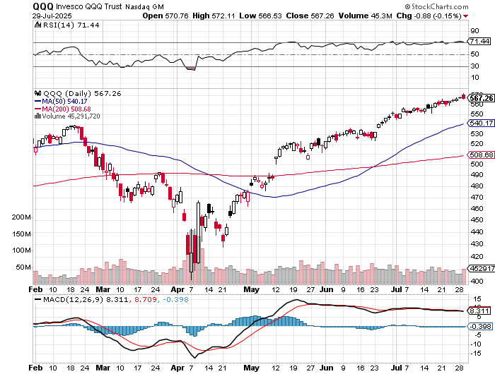
NASDAQ (QQQ) – Down 15% long 6/$540-$550-$345 put spread-expires in 17 days, took profits on Long 5/$335-$345 put spread took profits on long (QQQ) /$540-$550 put spread, took profits on long (QQQ) 4/$330-$335 put spread took profits on long (QQQ) 3/$340-$345 put spread, covered long (QQQ) $325-$330 put spread

Slide 26
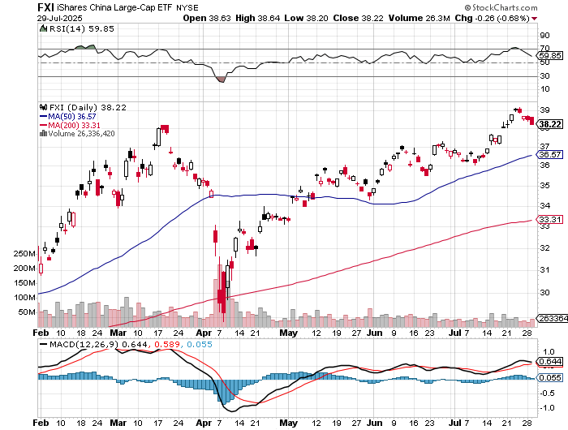
China (FXI) + 36%

Slide 27
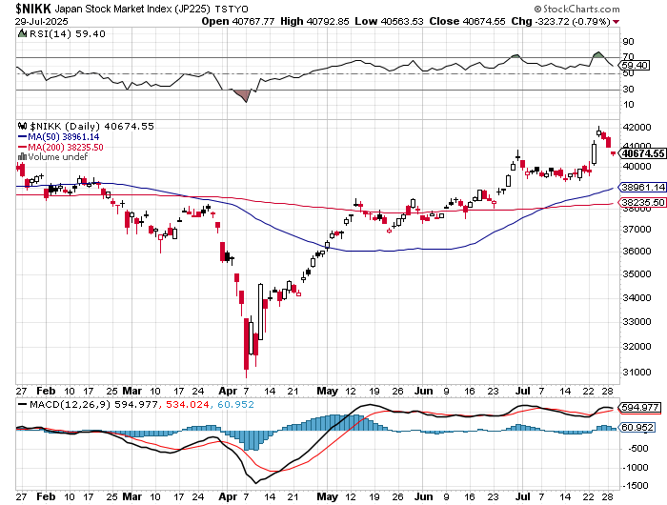
Japan ($NIKK) – down 10%
Nikkei Rockets on Japan Trade Deal, which dropped tariffs on Japanese cars to 15%

Slide 28
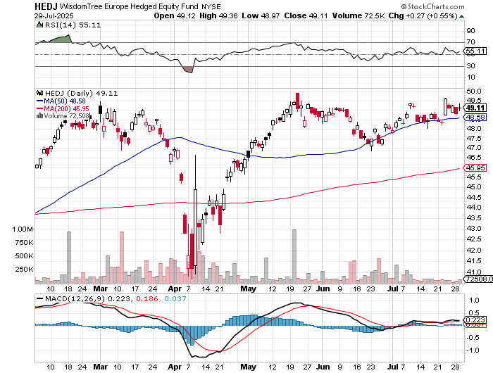
Europe Hedged Equity (HEDJ)- +19%

Slide 29
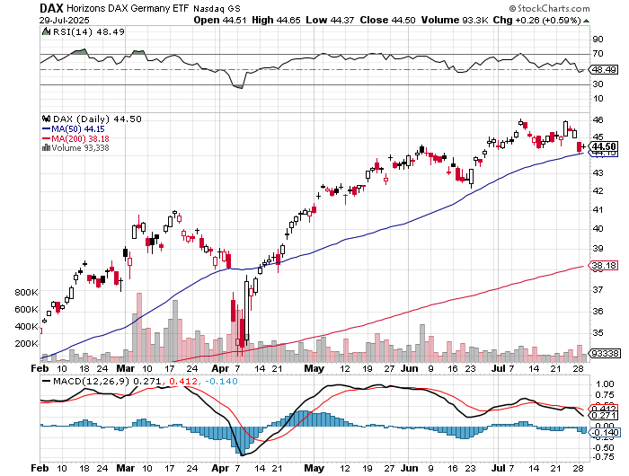
German Dax (DAX)- +30%

Slide 30
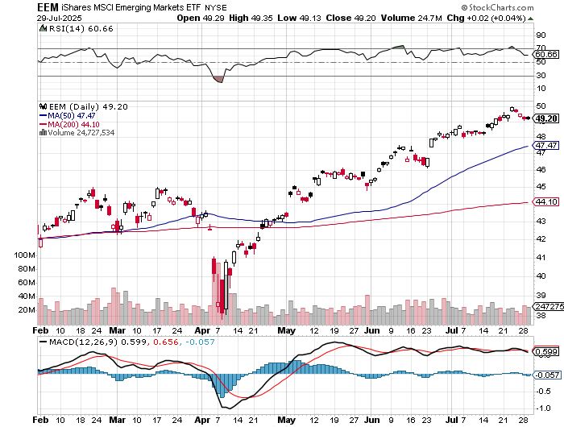
Emerging Markets (EEM) - +8%
Weak Dollar, Long Recovery Play

Slide 31



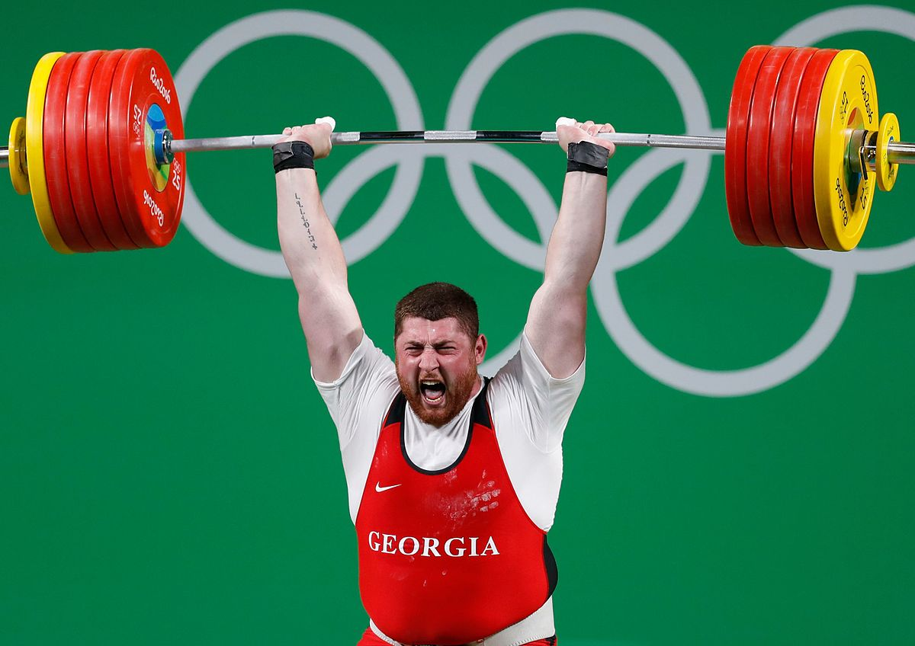
THE MAD HEDGE FUND TRADER
The Barbell Portfolio
*75% Big Tech – 2% of US workforce, 25% of market cap and 25% of US earnings
25% Domestic Recovery, including:
Railroads, airlines, cruise lines,
Couriers, steel companies
Banks, commodities
Construction
Credit Card Companies
Hotels, casinos
Online Ticket Sales

Slide 32
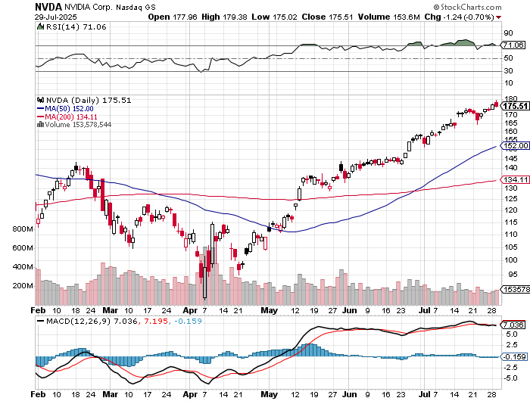

NVIDIA (NVDA) – Blackwell Chips @ $70,000 each
Tops $4 Trillion Market Cap, Nvidia CEO Jenson Huang Sells another $37 million of Stock ,
Government Lifts Nvidia Ban on Chip Sales to China. stopped out of long 6/$140-$145 puts spread, took profits on long 5/$70-$75 call spread took profits on long 3/$88-$90 call spread, took profits on long 4/$140-$145 puts spread took profits on Long 2/$90-$95 call spread, took profits on Long 12/$117-$120 call spread

Slide 33
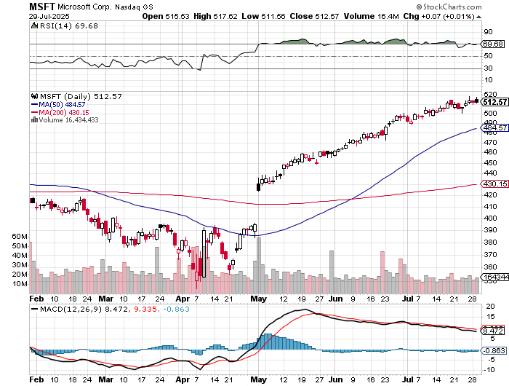

Microsoft (MSFT)-Microsoft Bombs took profits on long 5/$430-$440 put spread
Took profits on long 2/$330-$340 call spread, took profits on long 12/$320-$330 call spread took profits on long 9/$235-$245 call spread, took profits on long 7/$220-$210 call spread,

Slide 34
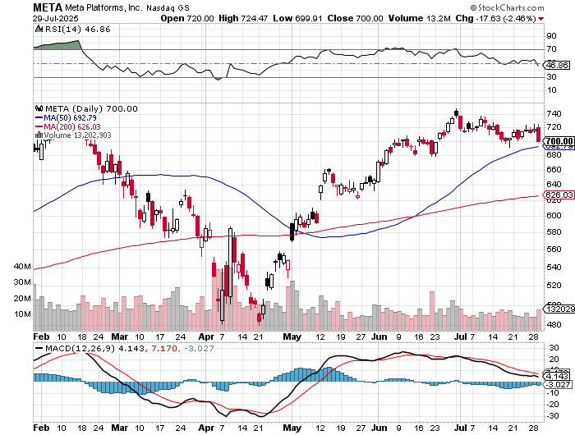

Meta (META)
Meta Delays Flagship Behemoth AI Product took profits on Long 8/$420-$430 call spread took profits on Long 5/$360-$370 vertical bull call spread, took profits on Long 9/$290-$300 vertical bear put spread, stopped out of Long 9/$190-$200 vertical bear put spread

Slide 35
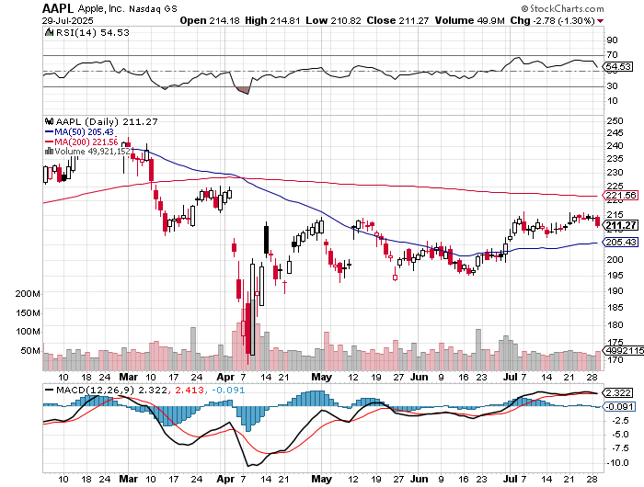

Apple (AAPL)
Apple Gets Hit with $62 million EU Fine took profits on long 6/$220-$230 put spread, profits on Long 5/$225-$235 vertical bear put spread, took profits on Long 8/$160-$170 call spread took profits on Long 6/$200-$210 bear put spread,

Slide 36
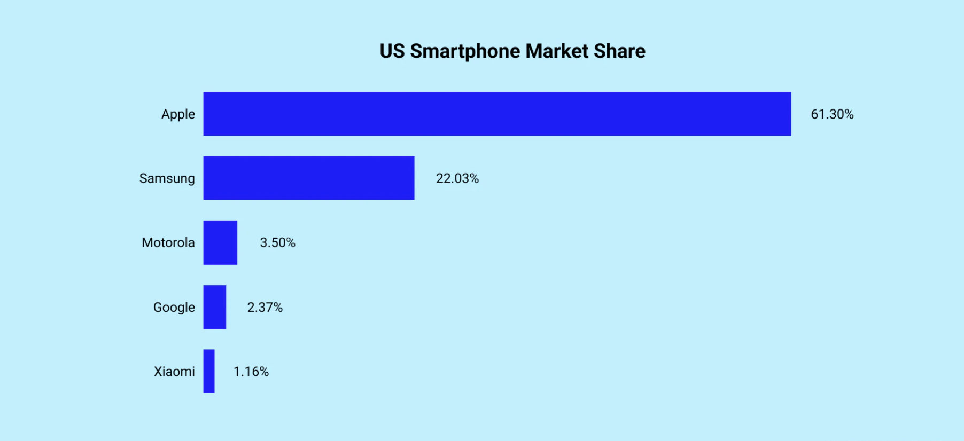

Slide 37
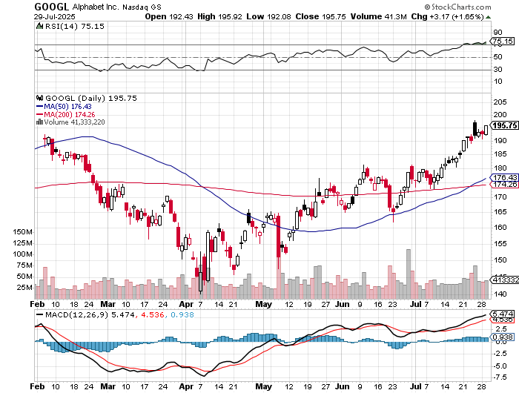
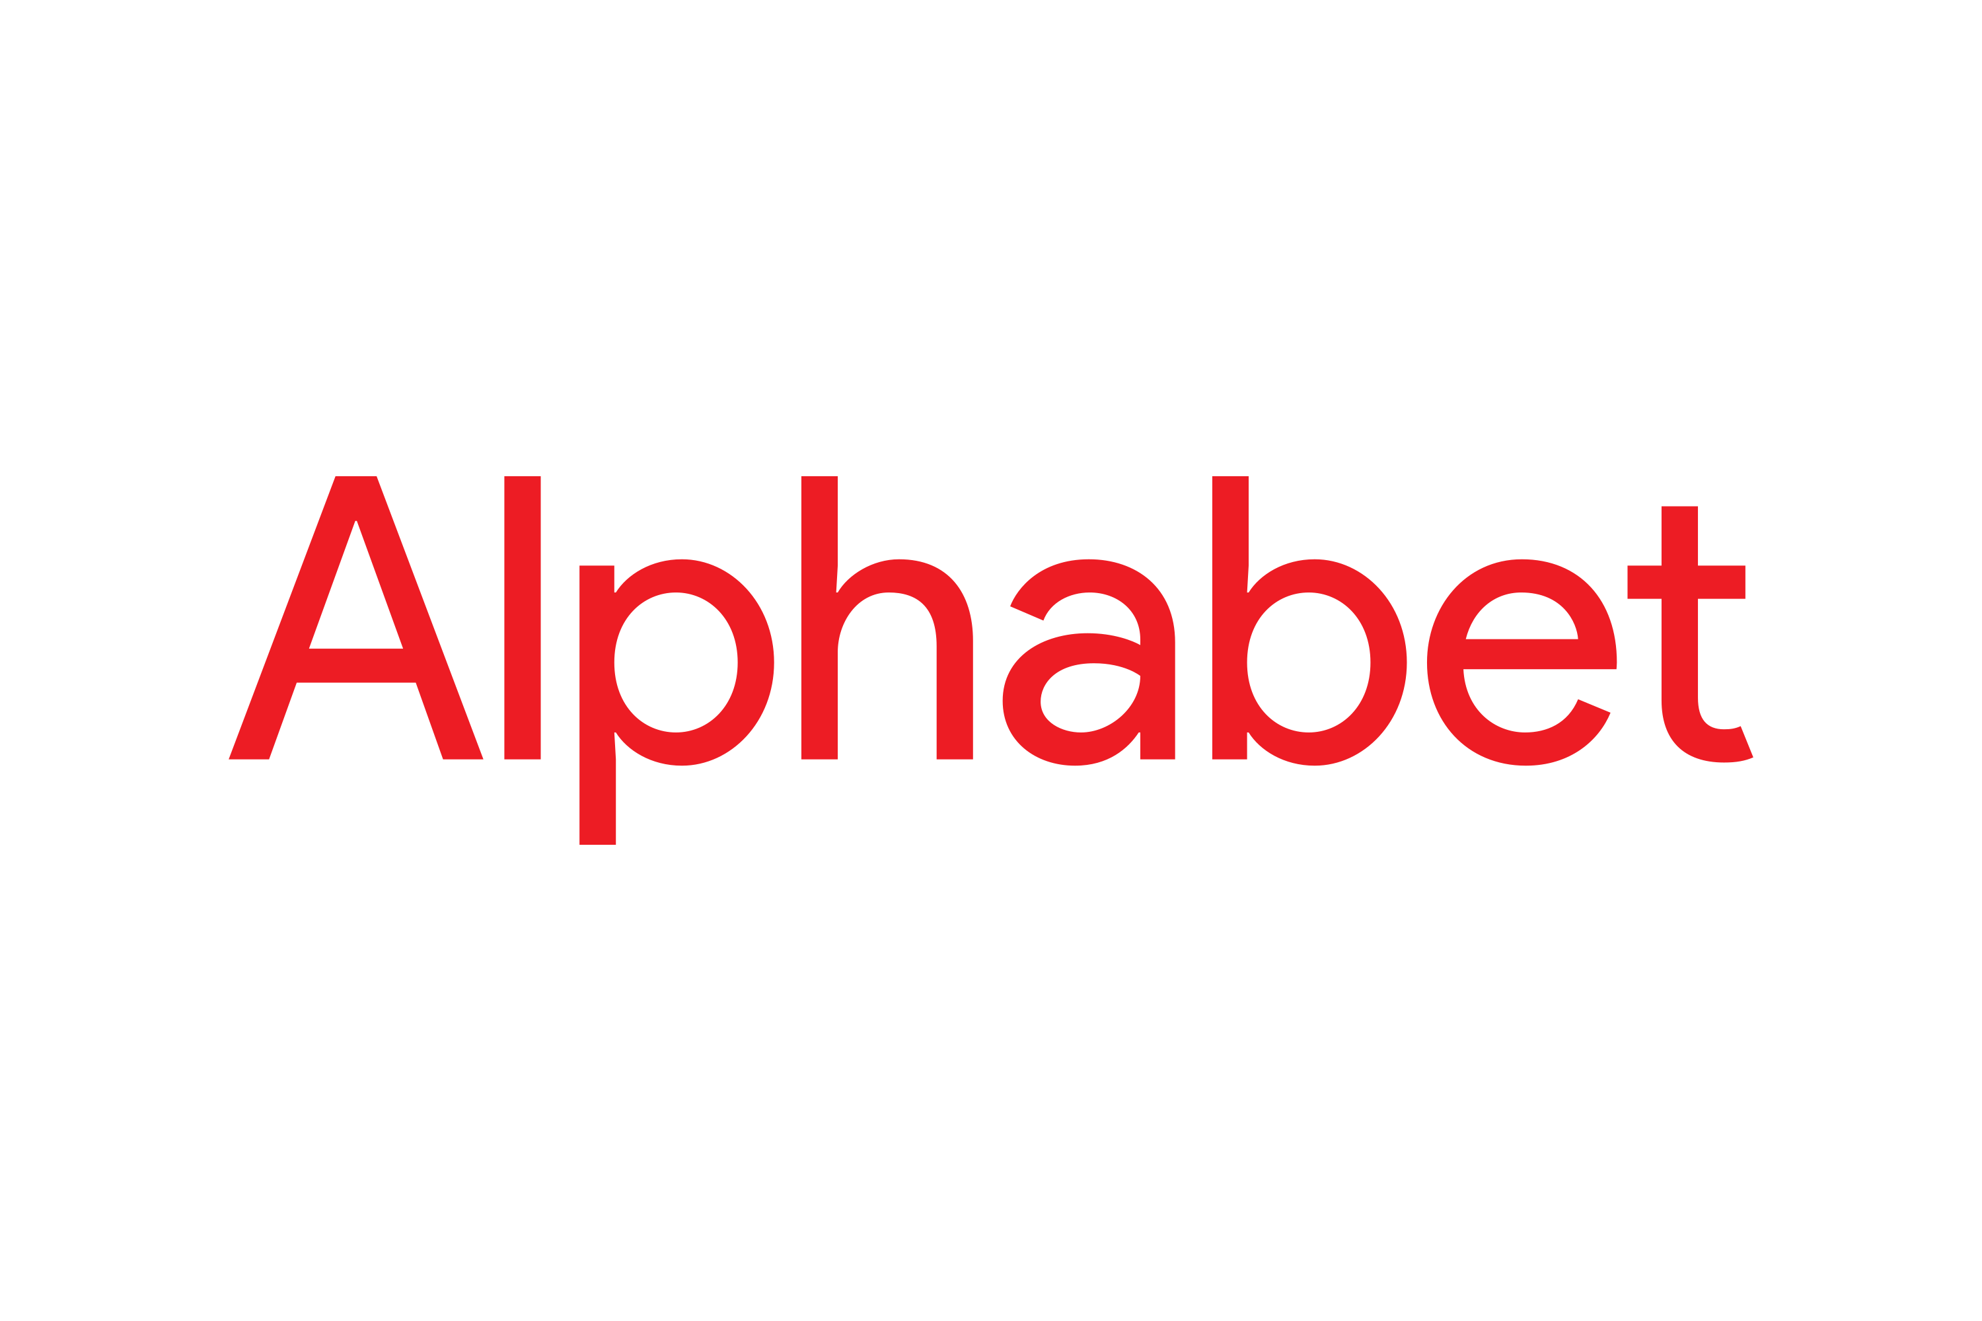
Alphabet (GOOGL) – Google Beats, with Earnings per share up to $2.31
Waymo Applies for New York City License, for self-driving taxes took profits on long 12/$110-$120 call spread took profits on long 12/$1,200-$1,230 bull call spread, took profits on long 9/$1,030-$1,080 vertical bull call spread

Slide 38
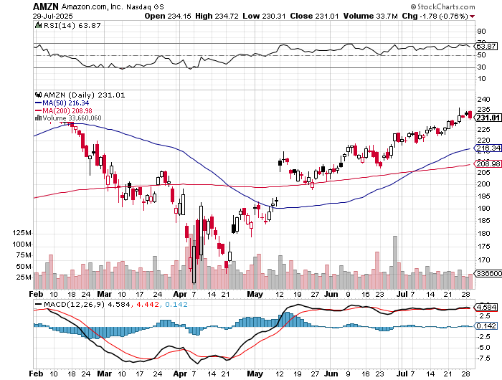

Amazon (AMZN) – Antirust Target
Jeff Bezos to Sell $4.7 Billion of Amazon Stock took profits on long 3/$155-$160 bull call spread , took profits on long 2/$130-$135 bull call spread

Slide 39
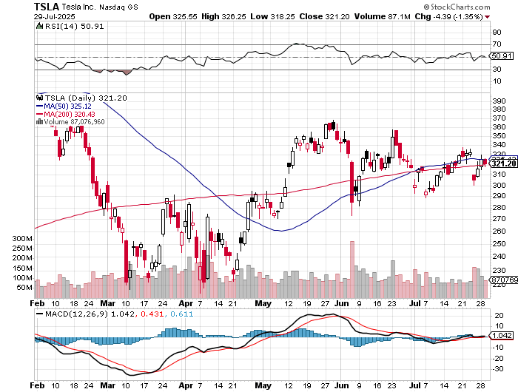

Tesla (TSLA) – Global Brand Destroyed
Announces worst Quarterly earnings in a decade, Tesla to Roll Out Robotaxi’s in San Francisco,
long 8/$370-$380 put spread
took profits on long 7/$420-$430 put spread, took profits on long 7/$360-$370 put spread
took profits on long 7/$180-$190 put spread, took profits in long 6/190-$200 call
took profits on long 6/$430-$440 put spread, took profits on long 4/160-$170 call spread
stopped out of long $310-$320 put spread at cost, took profits on long 3/$350-$360 put spread,

Slide 40
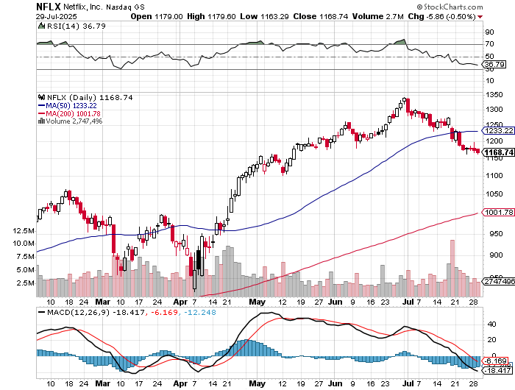

Netflix (NFLX) –
Netflix Beats. It has a very high growth rate for a $542 billion company took profits on long 4/800-$810 call spread

Slide 41
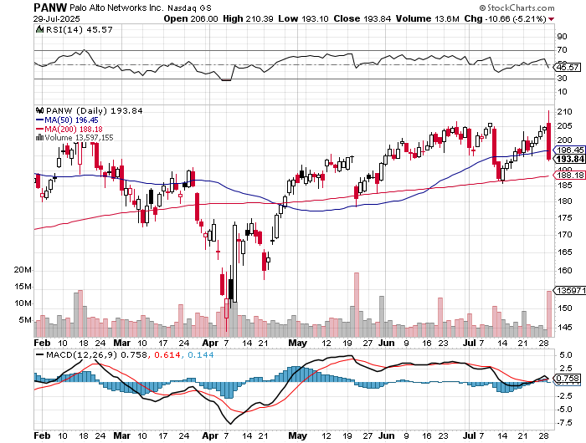

Palo Alto Networks (PANW)- Hacking never goes out of fashion
Palo Alto Announced\s 2:1 Split took profits on long 2/$260-$270 call spread, took profits on long 10/$130-$140 call spread

Slide 42
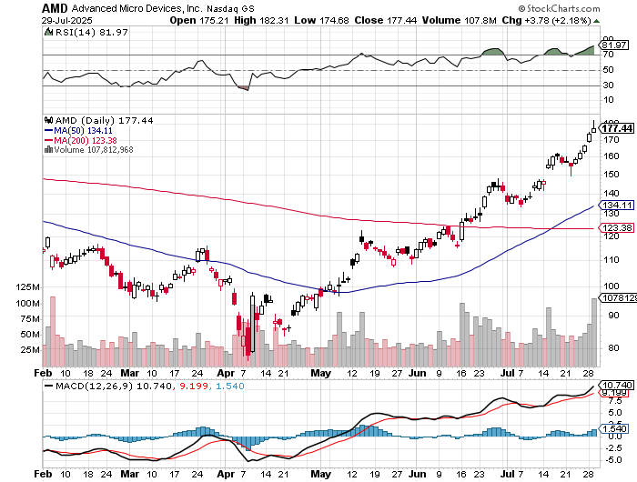

Advanced Micro Devices (AMD)- Recession fears programable logic devices took profits on long 2/$75-$80 call spread

Slide 43
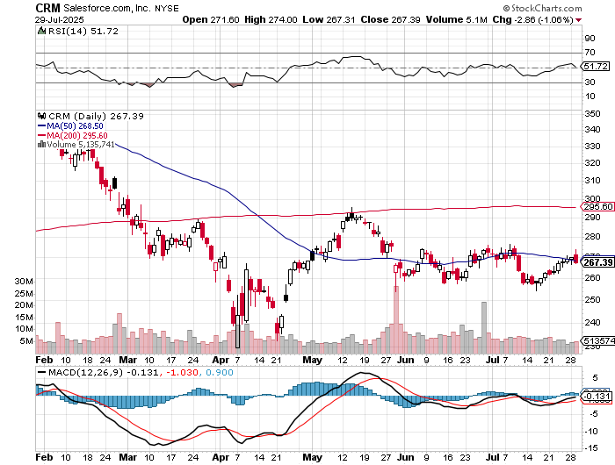

Salesforce (CRM)- Massive Online Migration took profits on long 12/$185-$195 call spread, took profits on long 9/$125-$130 vertical bull call spread took profits on long 8/$125-$130 vertical bull call spread

Slide 44
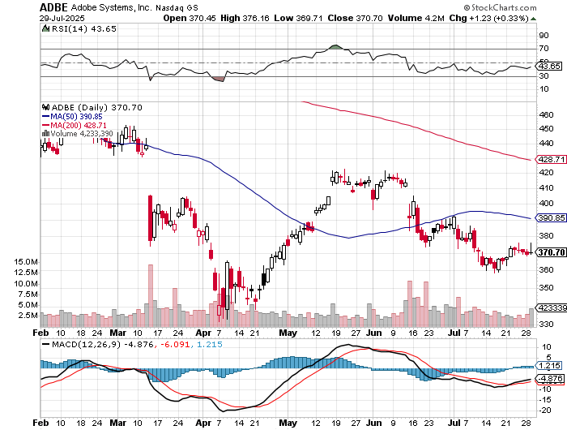

Adobe (ADBE)- Cloud play
The Quality Non-China tech play

Slide 45
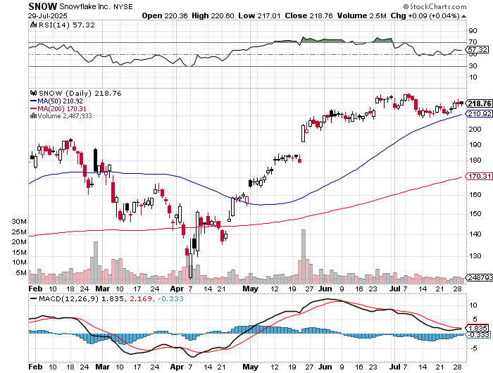

Snowflake (SNOW)- Blockbuster AI Earnings stopped out of long 4/$150-$255 call spread, took profits on long 12/$135-$140 call spread

Slide 46
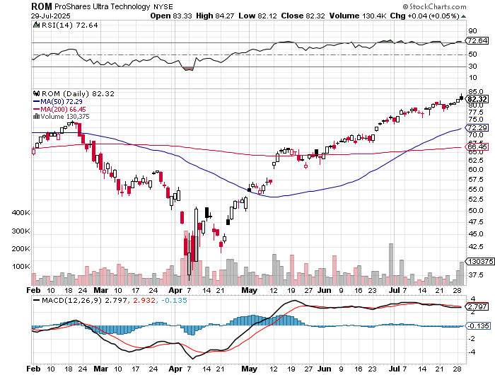
ProShares Ultra Technology ETF (ROM) – 2X Long Technology ETF took profits on long 10/$62-65 call spread

Slide 47
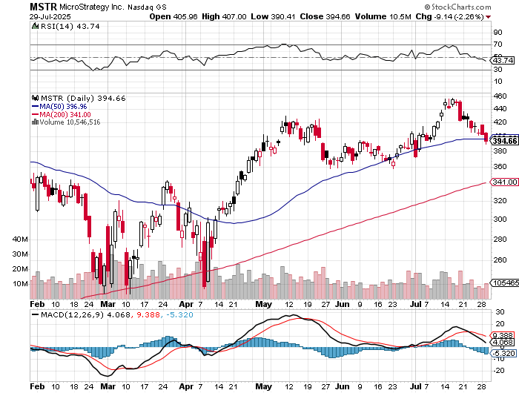

MicroStrategy (MSTR) – Long Bitcoin Play
MicroStrategy Copycats are Multiplying
Took profits on long 6/$500-$510 put spread, took profits on long 6/$470-$480 put spread took profits on long 6/$330-$340 call spread, stopped out of long 6/$335-$345 put spread took profits on long 5/$400-$410 put spread, took profits on long 5/$220-$230-$230 call spread, took profits on long 5/$400-$410 put spread, took profits on long 5/$400-$410 put spread, took profits on

Slide 48
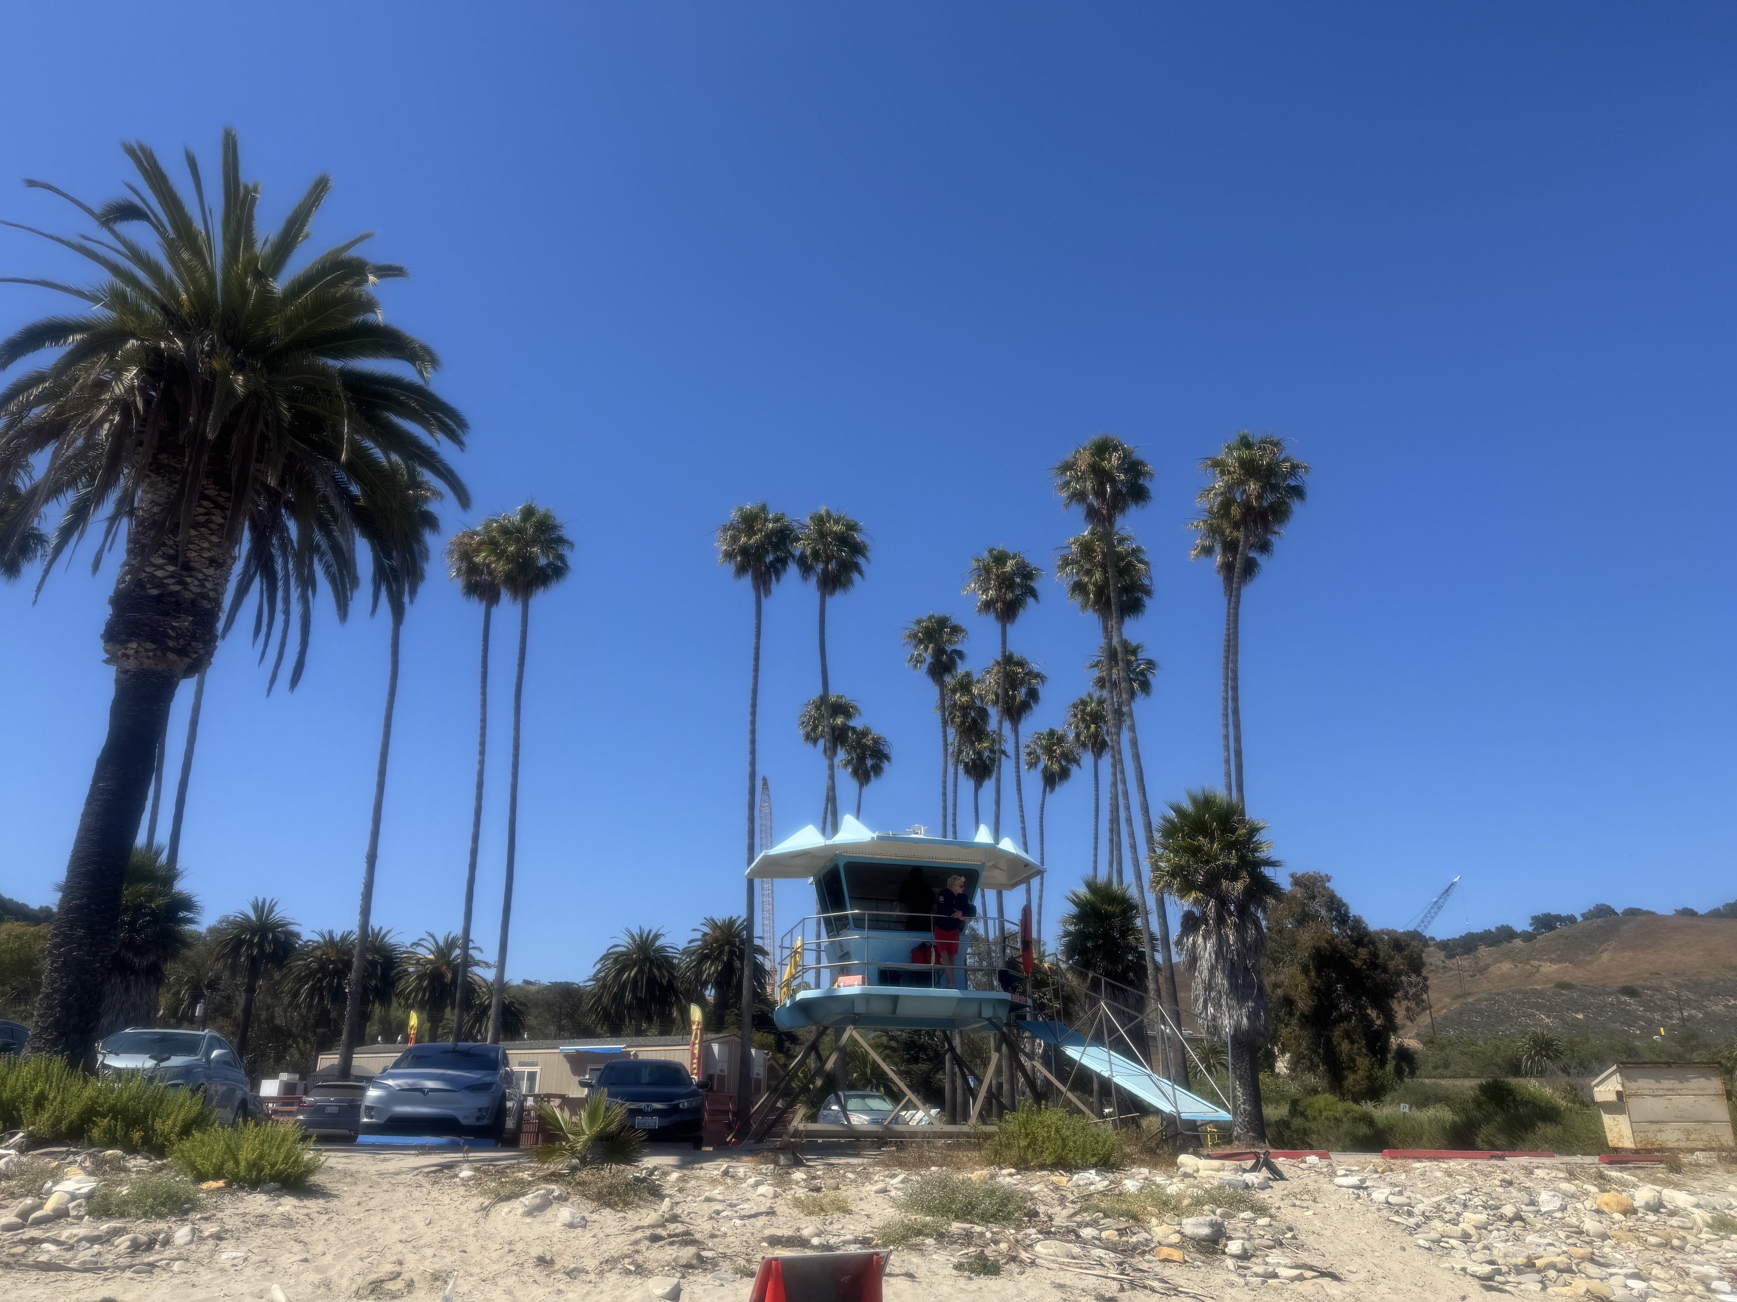

Slide 49
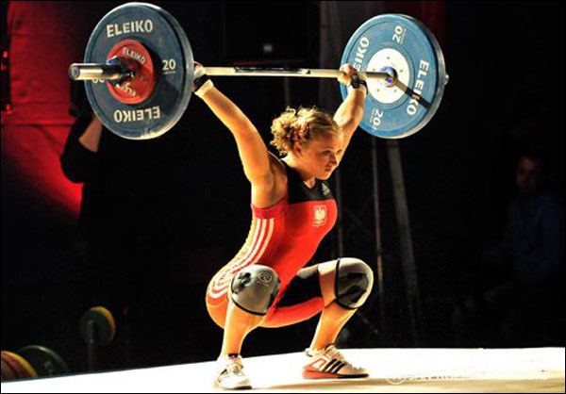
The Second Half of the Barbell
*Bets on a domestic recovery in 2022 Q4
*Upside potential in 2024 far greater than tech
*Some of these have not moved for 5 or 10 years
*Focuses on economically sensitive cyclical industries
*Makes a great counterweight to
high-growth technology
*We could spend all of next ten years rotating
between the two groups

Slide 50
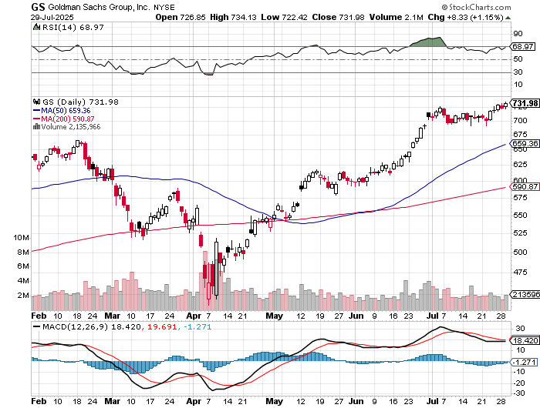

Goldman Sachs (GS) –
Goldman Sachs Beats, with Revenues of $12.73 billion vs. $12.46 billion estimate stopped out of 3/$380-$390 call spread, profits on long 12/$330-$350 call spread, took profits on long 11/$330-$350 call spread

Slide 51
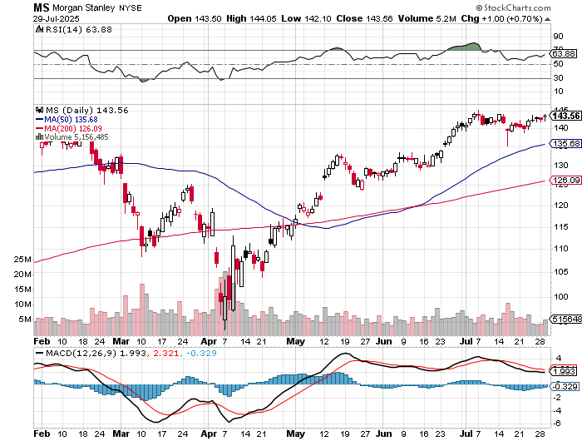
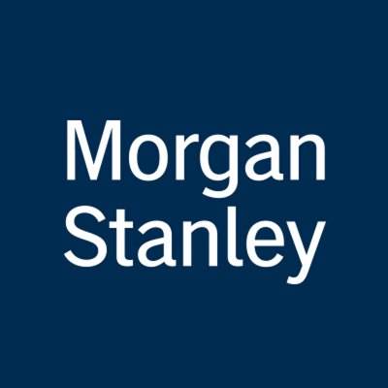
Morgan Stanley (MS)
Morgan Stanely Reports Record Profits, Sells Options Trading Department to Citidel took profits on long $12/210-$220 call spread,
Took profits on long $195-$205 call spread, took profits on long 4/$65-$70 call spread

Slide 52
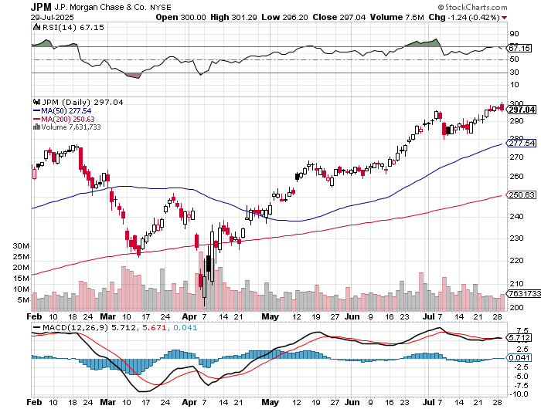
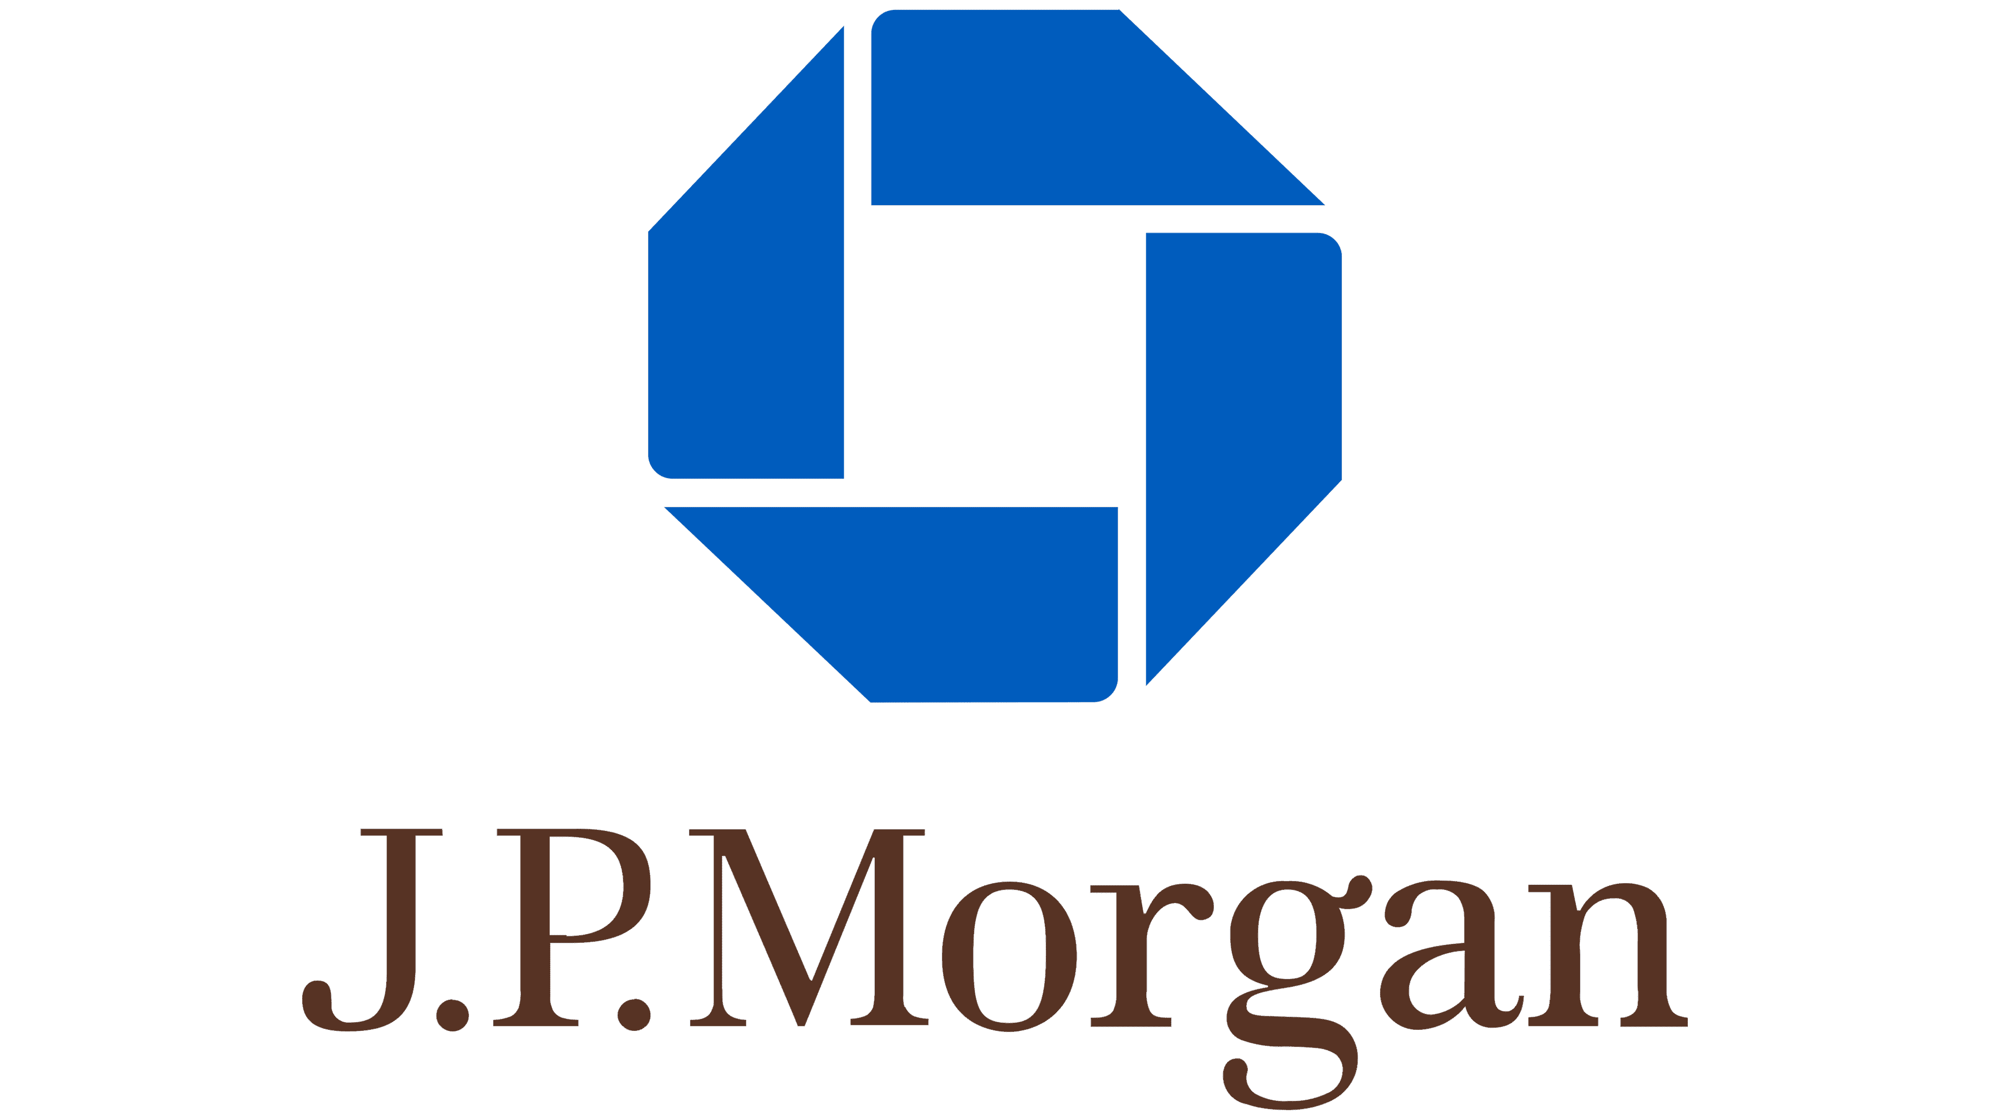
JP Morgan Chase (JPM) – Jamie Diamond Sells 30% of JP Morgan Stock stopped out of 3/$235-$245 calls spread, profits on long 12/$210-$220 call spread, took profits on long 11/$195-$205 call spread, took profits on 4/$215-225 put spread, took profits on long 4/$105-$115 call spread

Slide 53


Bank of America (BAC) – Deregulation play took profits on long long 12/$41-$44 call spread, took profits on long 4/$20-$23 call spread

Slide 54


Citigroup (C) – took profits on long long 12/$60-$65 call spread , took profits on long 4/$30-$35 call spread

Slide 55


Charles Schwab (SCHW) – LEAPS expire at Max profit took profits on long 4/$30-$35 call spread

Slide 56


Interactive Brokers (IBKR) – LEAPS expired at Max Profit stopped out of long 3/$160-$170 call spread, out of long 8/$110-$115 call spread , took profits on long 4/$60-$65 call spread

Slide 57


Berkshire Hathaway (BRKB)- Ultimate defensive stock
Berkshire Hathaway Builds Record Cash, at $334 billion – Is the new T Bill proxy stopped out of long 12/$405-$415 call spread, took profits on long 12/$320-$330 call spread took profits on long 4/$260-$270 call spread, took profits on long 1/$290-$300 call spread

Slide 58


Blackrock (BLK)-Asset Collection Boom
Blackrock Reports Record $12.5 trillion in Assets Under Management took profits on long 12/$850-$860 call spread took profits on long 3/$770-$790 call spread, took profits on long 3/$310-$340 call spread

Slide 59

SPDR Metals & Mining ETF (XME) – long 2/$28-$30 call spread

Slide 60


Boeing (BA) –
300 aircraft order backlog

Slide 61


General Motors (GM) – Worst Off Trade War Victim
Loses $1 Billion on trade wars stopped out of long 4/$52.50-$57.50 put spread at cost, long 3/$53-$56 put spread

Slide 62


Package Delivery- United Parcel Service (UPS) – strike averted took profits on long 11/$130-$140 call spread

Slide 63


Caterpillar (CAT)- Ag + Infrastructure + Housing stopped out of long 8/$310-$320 call spread, took profits on long 12/$220-$230 calls spread took profits on long 12/$145-$150 call spread, took profits on long 11/$125-$135 call spread

Slide 64


Deere & Co. (DE)- Ag + Infrastructure + Housing took profits on long 8/$330-$340 put spread stopped out of long 8/$330-$340 calls spread

Slide 65


Freeport McMoRan - (FCX)- Coming Copper Crisis
50% copper tariff took profits on long 4/$37-$40 call spread, took profits on long 5/$42-$45 call spread, stopped out of long $48-$51 put spread, profits on long 6/$32-$35 call spread took profits on long 4/$30-$33 call spread, took profits on long 10/$20-$23 call spread

Slide 66


Walt Disney (DIS) -Disney Beats
Disney Dives on Earnings Bust, although streaming broke even versus an expected loss

Slide 67


Industrials Sector SPDR (XLI)-
(GE), (MMM), (UNP), (UTX), (BA), (HON)

Slide 68


Union Pacific RR (UNP)- Big Stuff to Ship
The Largest Railroad in History, may be the result of the Union Pacific (UNP)/Norfolk Southern merger worth $87 billion took profits on long 5/$200-$210 call spread took profits on 11/$150-$160 call spread

Slide 69


Walmart (WMT) – The New AI Stock took profit on Long 11/$125-$130 bear put spread, took profit on Long 10/$119-$121 bear put spread took profits on Long 8/$114-$117 bear put spread

Slide 70


Costco (COST) – Permanent Compounder took profits on long 4/$840-$850 call spread

Slide 71


Delta Airlines (DAL) – Recession Warning-Travel Collapse
The Non-Boeing Airline – uses Airbuses

Slide 72


Transports Sector SPDR (XTN)- Worst Hit Sector
(ALGT), (ALK), (JBLU), (LUV), (CHRW), (DAL)

Slide 73


Health Care Sector (XLV) – Defensive Play and Cheap
(JNJ), (PFE), (MRK), (GILD), (ACT), (AMGN)

Slide 74


Amgen (AMGN) long 7/$260-$270 bull call spread, took profits on long 11/$185-$200 bull call spread

Slide 75


Visa (V) – Earnings Beat, Guidance Disappointment took profits on long 2/$240-$250 bull call spread took profits on long 10/$160-$170 bull call spread, took profits on long 6/$150-$160 bull call spread

Slide 76


Consumer Discretionary SPDR (XLY)
(DIS), (AMZN), (HD), (CMCSA), (MCD), (SBUX)

Slide 77


Slide 78

Bonds – Digestion Problem
*Bonds appear stuck on the bottom
*$5 trillion in new government borrowing is overhanging the market
*But future interest rate cuts are beckoning
*No chance for July (out in an hour), but September or December are 50/50 probabilitie
*Bonds hate the a national debt at $42 trillion and are approaching 2025 lows in prices, highs in yields
*Bond investors are moving away from longer-dated Treasuries
*National debt service has topped defense spending
for the first time in history and defense spending just
jumped by 25%
*Avoid (TLT), (JNK), (NLY), (SLRN) and REITS

Slide 79

Treasury ETF (TLT) – took profits on long 6/$88-$91 put spread stopped out of long 6/$80-$83 call spread, took profits on long 4/$84-$87 call spread stopped out of long 1/$82-$85 call spread, took profits on long 10/$103-$106 put spread took profits on long 6/$$94-$97 put spread, took profits on long 5/$82-$85 calls spread

Slide 80

Ten Year Treasury Yield ($TNX) – 4.51%

Slide 81

Junk Bonds (JNK) 6.54% Yield

Slide 82

Municipal Bonds (MUB) 4.21% Yield-

Slide 83

Emerging Market Debt (ELD) 5.62% Yield-

Slide 84

2X Short Treasuries (TBT)-Out of Favor

Slide 85

Anally Capital Management (NLY) – Leveraged REIT Play
Yield 13.25% took profits on long 12/$15-$16 call spread

Slide 86


Slide 87

Foreign Currencies – No dollar friends
*US dollar Hits Four Year Low, as the “Sell America” trade continues
*We may see another 20% move down as Fed interest rates cuts loom
*If rates drop 300 basis points with the next Fed governor as Trump has promised the dollar is toast
*Populist Japanese election win tank Yen
*Next dollar weakness will come with
evidence of a recession in days
*Buy (FXA), (FXE), (FXB), (FXC), and (FXY)

Slide 88


THE MAD HEDGE FUND TRADER
Australian Dollar (FXA) - Major Long-Term Bottom is In Targeting Parity – A call option on a global synchronized recovery

Slide 89


Japanese Yen (FXY)

Slide 90


Euro (FXE)-

Slide 91


British Pound (FXB)-

Slide 92


Emerging Market Currencies (CEW)

Slide 93


Slide 94

Energy & Commodities –Dead in the Water
*Oil is going nowhere on recession fears
*US Drillers Cut Rigs for 10th Week, or the first time since July 2020, thanks to a global oil glut
*OPEC Increases Production by 550,000 Barrels a Day
* Budget Bill Kills Effort to Restore Strategic Petroleum Reserve,
cutting the funding by 90%.
*US Crude Inventories Hit One Year Low
*Look for energy plays to hit new lows
*Copper Hits New All-Time High on 50% Tariff
*Nuclear plays are still hot with with deregulation tailwind

Slide 95

Oil-($WTIC)

Slide 96

United States Oil Fund (USO)

Slide 97

Energy Select Sector SPDR (XLE)-No Performance!
(XOM), (CVX), (SLB), (KMI), (EOG), (COP)

Slide 98

ExxonMobil (XOM)-
Exxon Moves Big into Lithium, with the construction of a major mining operation in Arkansas took profits on Long 4/$100-$105 call spread, took profits on long 12/$120-$125 put spread

Slide 99

Occidental Petroleum (OXY)- Buffet’s a Buyer took profits on long 4/$59-$62 call spread took profits on long 2/$55-$60 call spread, took profits on long 12/$77.50-$82.50 put spread

Slide 100

Natural Gas (UNG) – Free Fall on Warm Winter took profits on Long January 2025 $7-8 Call Spread LEAPS

Slide 101

Cameco (CCJ) – Global Uranium Renaissance
Microsoft to Reopen Three Mile Island to power AI data centers took profits on long 12/$41-$44 call spread, took profits on long 12/$35-$38 call spread, took profits on long 5/$20-$23 bull call spread

Slide 102

Vistra Corp. (VST) – Global Uranium Renaissance took profits on long 2/$100-$110 call spread

Slide 103


Slide 104

Precious Metals – Consolidating
*Bitcoin breakout is stealing gold’s thunder
*Speculative money is chasing new highs in crypto plays at the expense of gold
*Traders have been rolling out of hedges as stocks rise
*Silver hits new High for the year
*(AGQ) 2X LEAPS hit max profit
*$50 here we come!
*My target is still $5,000 for gold

Slide 105


THE MAD HEDGE FUND TRADER
Gold (GLD) – Hedges Dumped
took profits on long 6/$275-$285 call spread, took profits on long 5/$275-$285 call spread
stopped out of long 6/$275-$285 call spread, took profits on profits on long 10/$230-$235 call spread
took profits on Long 10/$220-$225 call spread, took profits on Long 8/$210-215 call spread,
took profits on Long 7/$200-205 call spread, Long 6/$207.5-$212.5 call spread
$5,000
in 2028
+66%
BUY

Slide 106

Market Vectors Gold Miners ETF- (GDX) – took profit on long 6/$207.50-$212.50 call spread, took profit on long 7/$200-$205 call spread

Slide 107


Barrick Mining (B) took profit on long 1/$15.50-$16.50 call spread

Slide 108


Newmont Mining- (NEM)- Sometimes you Just Get Lucky took profits on long 10/$47-$50 call spread, took profits on long $55-60 call spread

Slide 109


THE MAD HEDGE FUND TRADER
iShares Silver Trust (SLV) - The Better Play Industrial demand, solar panels, electric cars
2025
Target
$50
+50%
BUY

Slide 110


Silver Miners - (SIL)-

Slide 111


Wheaton Precious Metals - (WPM)- LEAPS Approaching Max Profit took profits on long 4/$39-$42 call spread long 6/$75-$80 call spread-expires in 7 trading days , took profits on long 1/$36-$39 call spread

Slide 112


Platinum- (PPLT)- 556,000-ounce shortage this year took profits on long 1/$36-$39 call spread

Slide 113


Slide 114

Real Estate – Interest Rate Hopes
*New Home Sales Come in Weak, as builders’ heavier use of sales incentives failed to motivate buyers put off by high costs
*Contract signings on new single-family homes increased 0.6% to an annualized rate of 627,000 last month
*June’s results show US homebuilders are struggling to offset an ugly mix of high prices and borrowing costs by offering incentives and subsidizing customers’ mortgage rates, which risk eroding profit margins.
*Existing Home Sales Drop 2.7%, in June, to an annualized rate of 3.93 million units
*Sales are unchanged YOY on a closing basis
*Some 1.35 million units are for sale, up 15.9% in a year, a 4.7-month supply
*The median price of a home sold is $435,000, up 2% YOY.
*Houses are spending 27 days on the market, with first time buyers at 30%

Slide 115

S&P Case Shiller Slows
S&P Case Shiller Rises to -0.3% YOY in April, with its National Home Price Index
New York gained +7.4%, Chicago +6.1%, and Detroit +54.9%.
Tampa down -2.4%, San Francisco and Dallas -0.6%

Slide 116


Crown Castle International (CCI) – 6.62% yielding 5G cell phone tower REIT
Eliot Management Pushes up stock with activist bid took profits on Long 8/$90-$95 call spread,

Slide 117



US Home Construction Index (ITB)
(DHI), (LEN), (PHM), (TOL), (NVR)

Slide 118


DH Horton (DHI)
DH Horton Rockets 20% on Earnings Beat – Most Important chart of the week took profits on long 11/$165-$175

Slide 119

Trade Sheet- The Recession Trade
So What Do We Do About All This?
*Stocks –stand aside
*Bonds – sell rallies
*Commodities – buy dips
*Currencies – buy dips
*Precious Metals – buy dips
*Energy – stand aside
*Volatility – sell over $30
*Real estate – buy dips

Slide 120

Next Strategy Webinar
12:00 EST Wednesday, July 30, 2025 from Incline Village, NV email me questions at support@madhedgefundtrader.com
Good Luck and Good Trading!
Notes:
*

Slide 121


Slide 122


