Slide 1

The Mad Hedge Fund Trader “Closed for Business”
With John Thomas Incline Village, NV October 1, 2025 www.madhedgefundtrader.com
Notes:
*

Slide 2
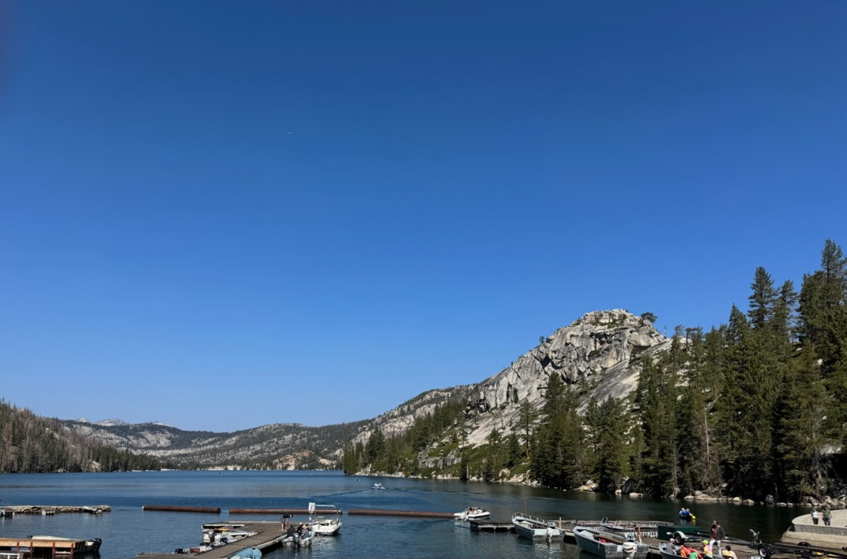

Slide 3


THE REPLAYS ARE UP! *A gathering of 24 of the best trading minds in the world *It’s a smorgasbord of trading strategies in all asset classes, including Stocks, bonds, foreign exchange, commodities, precious metals, and energy *$100,000 in free prizes awarded to those who register *Sign up at by responding to the link we will send you shortly *Best of all, attendance is FREE!

Slide 4
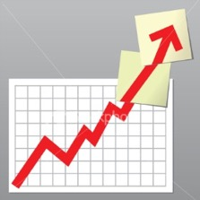
Trade Alert Performance New All-Time Highs-17 Consecutive Positive Months
*January +5.80% Final *July +5.21% Final *February +3.66% Final. *August +1.37% Final *March +4.36% Final *September +2.45% MTD *April +0.95% Final *October +7.59% Final *May +2.51% Final *November +18.96 Final *June +15.48% Final *December +3.26% Final *2025 Year To Date +56.25% +808.14% since inception *Versus 84.63% for all of 2022 *Versus 79.79% for all of 2023 *Versus 75.29% for all of 2024

Slide 5
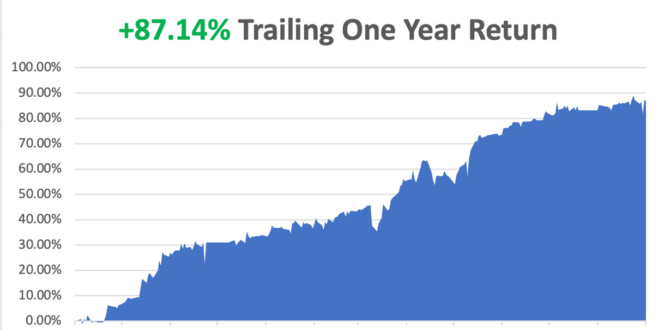

Slide 6
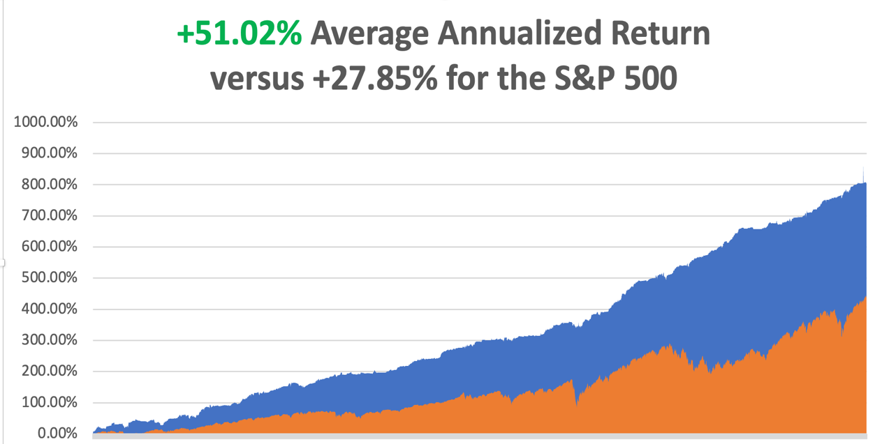

Slide 7
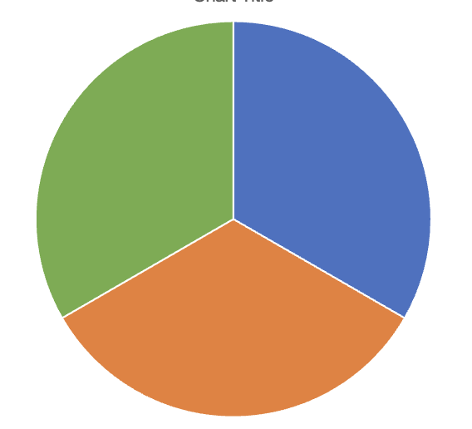
Portfolio Review – High Risk Market Require Maximum Cash 20% risk on, 10% risk off, 70% cash Entering a very high-risk market
Current Capital at Risk
(MSTR) $260-$270 call spread | 10.00%
(GS) $7100-$710 call spread | 10.00%
Risk Off
(TSLA) 10/$510-$520 put spread | -10.00%
Total Net Position | 10.00%
Total Gross Position | 30.00%
cash | 70.00%
Expiration Value +58.47%

Slide 8


Slide 9

The Method to My Madness
*Stocks are are now at very high-risk levels and could still see a “sell the news” on the Fed interest rate cut *There will be no interest rate cuts while the government is closed *A Jobs Crash has steered the Fed towards stimulating the economy *Bonds are going nowhere after what should be massive stimulus *Economic data finally managed a few positive reports *Gold knows no limits but is getting overbought *Oil is still dead, on recession fears and OPEC market share battle *US Dollar is still weakening Bitcoin Hits has lost upside momentum

Slide 10
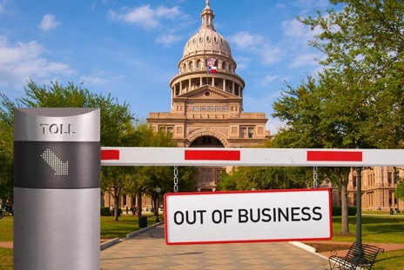
The Global Economy – Shutdown Costs Coming
*Government to Shut Down on Wednesday, sending unemployment soaring and growth into a tailspin, should cut 0.5% off of US GDP *The Jobs crash continues, with ADP down -32,000 for August and big back month downward revisions *Fed Cuts Interest Rates by 25 basis points, rallying all markets. Jobs risk has increased taking priority over inflation concerns, but can they cut without any jobs data *Core Inflation Holds Steady at 2.9% *US Consumer Spending Powers On, increased 0.4% last month *GDP Comes in Hot, showing a gain of 3.8% in the second quarter *Durable Goods Orders Rose by 2.9% month-over-month to $312.1 billion in August 2025, reversing a revised 2.7% slump in July *The Social Security COLA for 2026 Is out At 2.9% *US Retail Sales Rise 0.6%, versus 0.2% expected

Slide 11
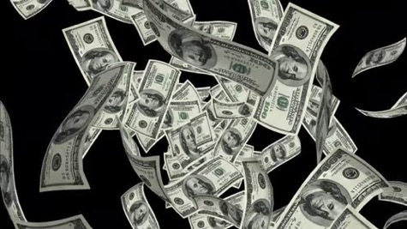
What is Quantitative Easing? The Ultimate Printing Press
*The Fed buys long term bonds and mortgage back securities to drive down long-term interest rates *First initiated in 2008 to stop the real estate crash, driving the Fed balance sheet from near zero to $9.1 trillion *Add to this a cut in federal funds rate from 4.25% to below 3.0% by by a new Fed governor starting in May *The end result will be a recovering in real estate and a super heated stock and crypto market *The end result will be a higher high, then a crash and a lower low *A recession always follows *Don’t forget to sit down when the music stops playing or you will lose everything

Slide 12
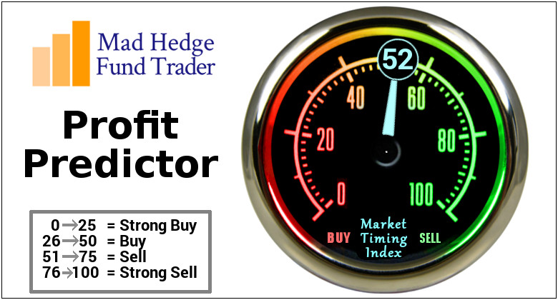

Slide 13
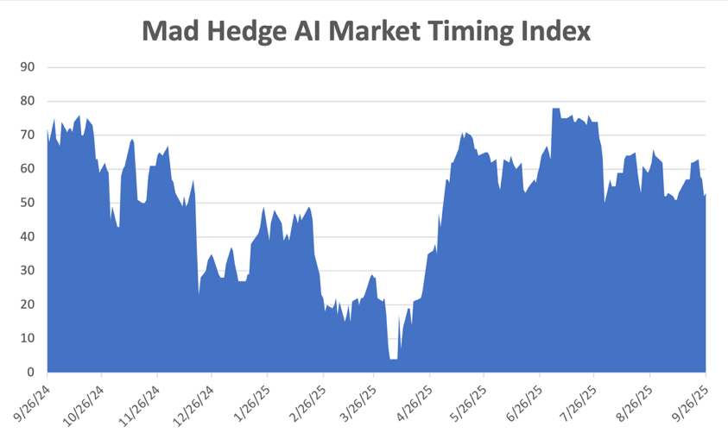
The Mad Hedge Profit Predictor Market Timing Index – New Range? An artificial intelligence driven algorithm that analyzes 30 different economic, technical, and momentum driven indicators
SELL
BUY

Slide 14
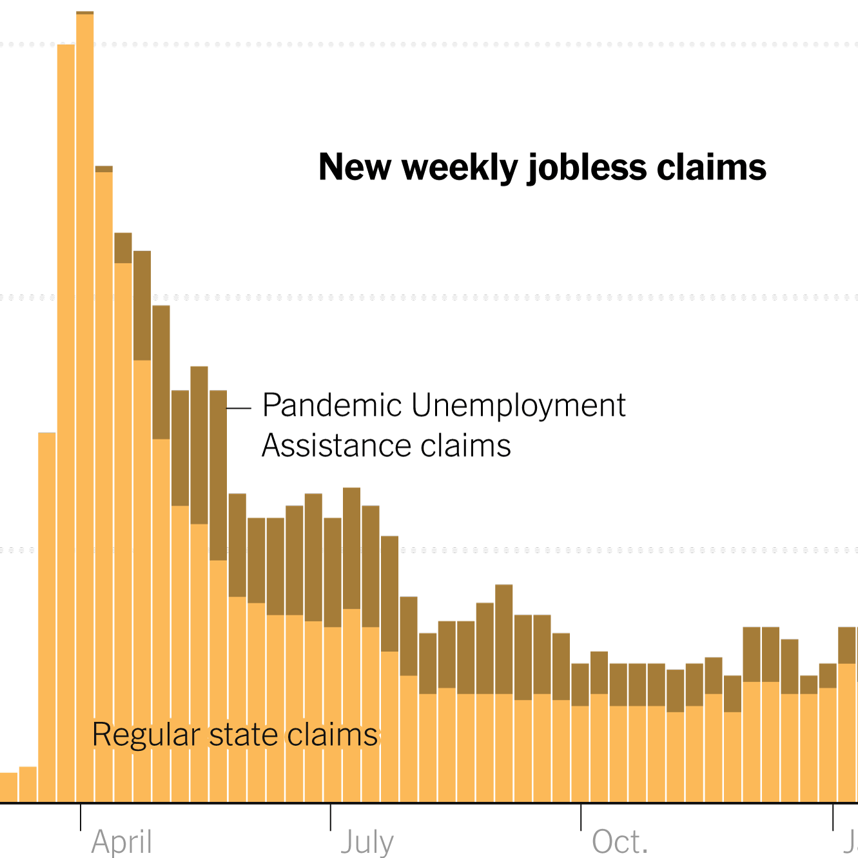
Weekly Jobless Claims – 8 Month High -14,000 to 218,000

Slide 15


Slide 16

Stocks – Shutdown Pause
*A government shutdown will cause the bull market to go on hold but not crash *But the dip, QE is coming *Equity Funds See Record Outflows, as investors rush to book profits *Crypto ETF’s About to Flood the Market, as the SEC's new standards streamline crypto ETF approvals *The Options Market is Turning Hyper Bullish, with trading volume hitting a new all-time high after the Fed meeting *$100,000 H1B Data Fee to Cost US Tech $14 Billion, and causing turmoil in the tech industry *A major rotation took place last week, out of Big tech and into everything else, including financials, energy, pharmaceuticals, and precious metals *If this rotation continues, it could send major stock indexes to new highs well into 2026 *An exploding money supply is hugely stock positive

Slide 17
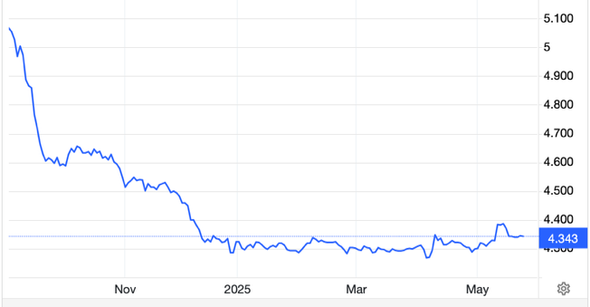
The Ultimate Hedge – Defensive stocks only go down at a slower rate 90 - day US Treasury Bills (Warren Buffet owns $340 billion) Extend to One Year!
*Government Guaranteed principal *Endless liquidity, trade like water *100% collateral value for margin *Lock in guaranteed income *Can be sold at any time to earn full interest *Will survive any bear market *Ask your broker how to buy
3.87% Yield

Slide 18
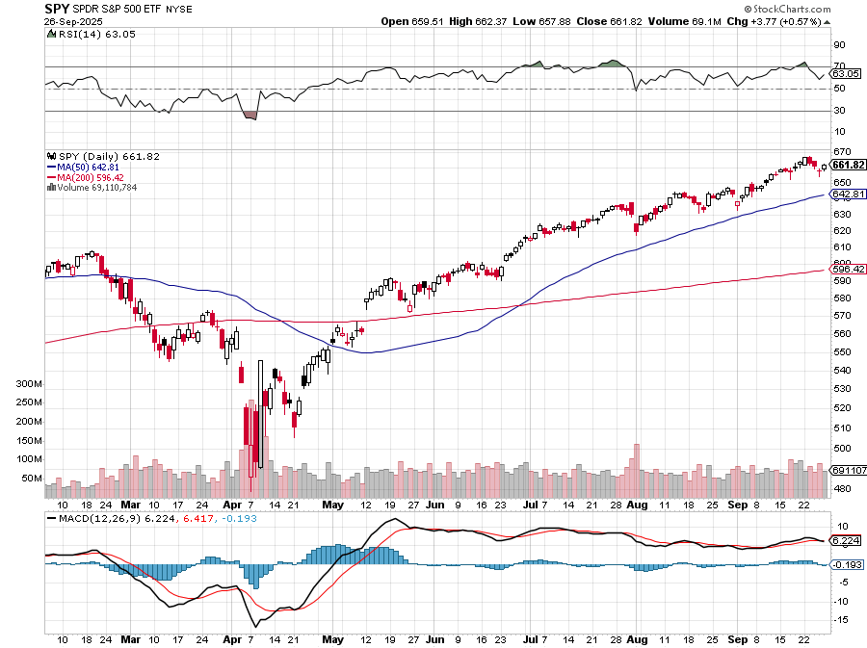
S&P 500 – Downside Targets stopped out of $445-$450 put spread took profits on long 6/$660-$640 put spread took profits on 6/$610-$620 put spread
$650 -2.6% 1st resistance
$630 -7.07% 1st support
$620 -8.70% 1st support

Slide 19
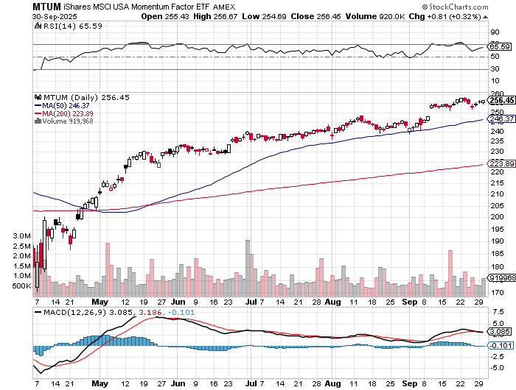
Momentum (MTUM)

Slide 20
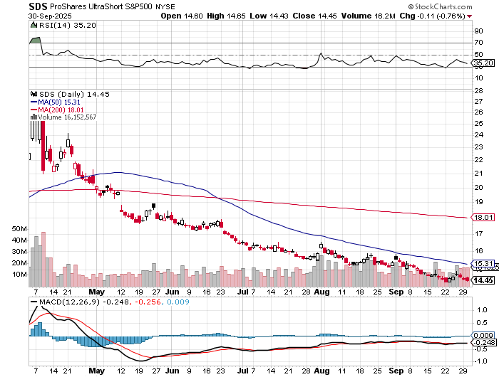
ProShares -2X Short S&P 500 (SDS) - a great 2X hedge for falling long stocks

Slide 21
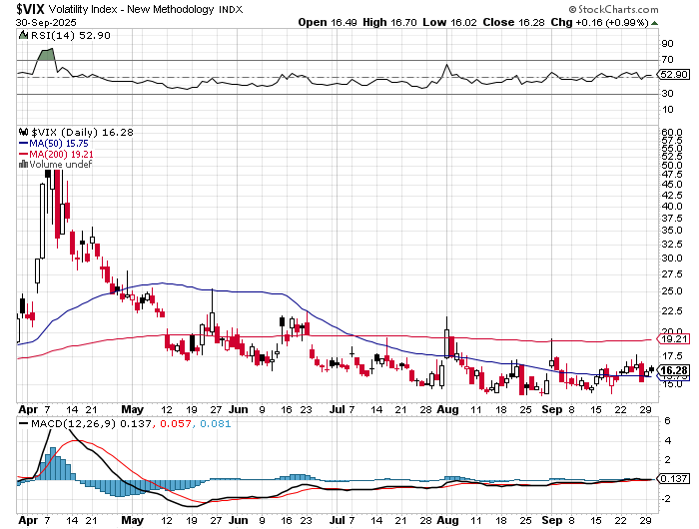
(VIX) – Volatility Index Hits Four Year High at $65, the most since the 2020 pandemic. That implies a 2% move in the S&P 500 (SPX) every day for the next 30 days

Slide 22
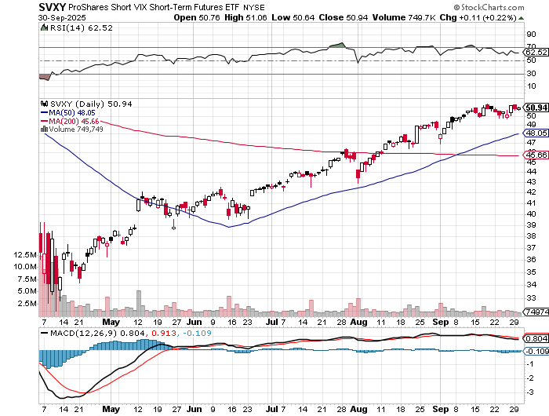
(SVXY) –Short Volatility ETF bought at $36.31 - $32.74 = $3.57

Slide 23
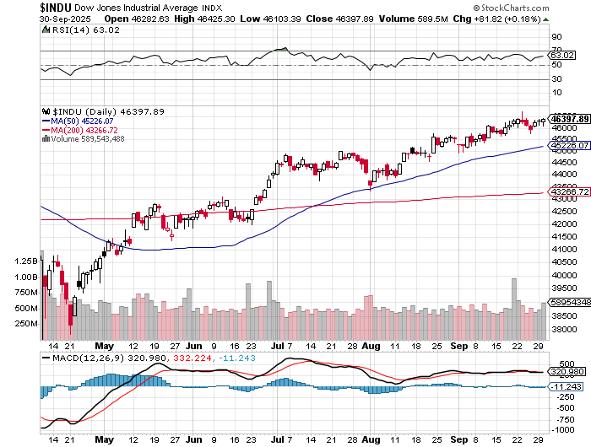
Dow Average ($INDU)-

Slide 24
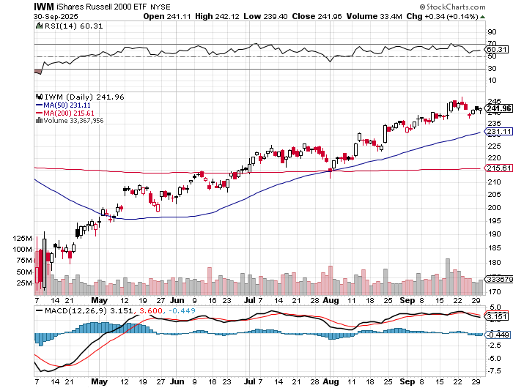
Russell 2000 (IWM)- took profits on Long 10/$137-$142 vertical bull call spread took profits on Long 10/$153-$156 vertical bear put spread

Slide 25
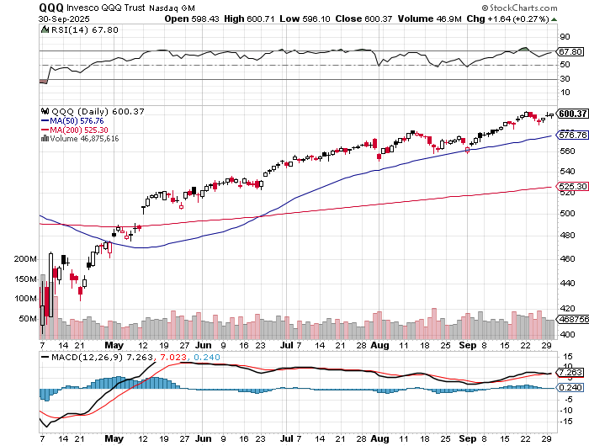
NASDAQ (QQQ) – Down 15% took profits on long 6/$540-$550-$345 put spread, took profits on Long 5/$335-$345 put spread took profits on long (QQQ) /$540-$550 put spread, took profits on long (QQQ) 4/$330-$335 put spread took profits on long (QQQ) 3/$340-$345 put spread, covered long (QQQ) $325-$330 put spread

Slide 26
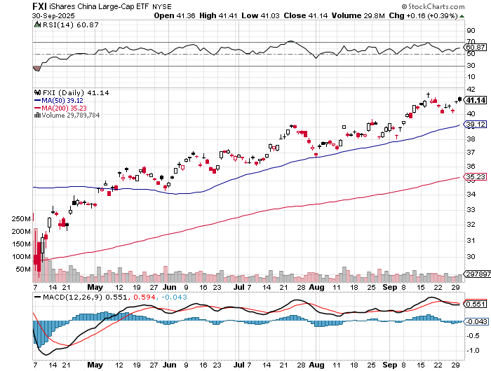
China (FXI) + 36%

Slide 27
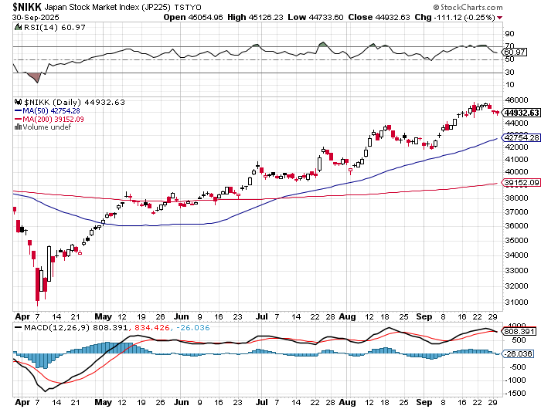
Japan ($NIKK) – down 10% Nikkei Rockets on Japan Trade Deal, which dropped tariffs on Japanese cars to 15%

Slide 28
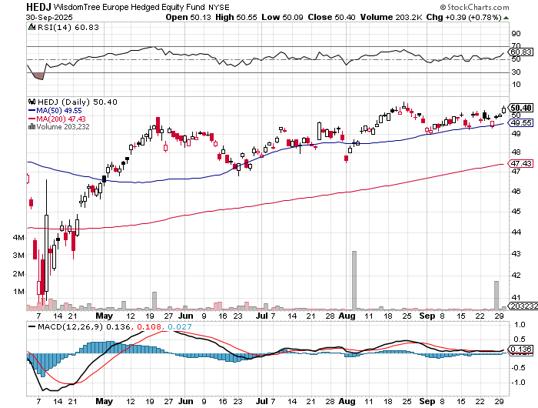
Europe Hedged Equity (HEDJ)- +19%

Slide 29
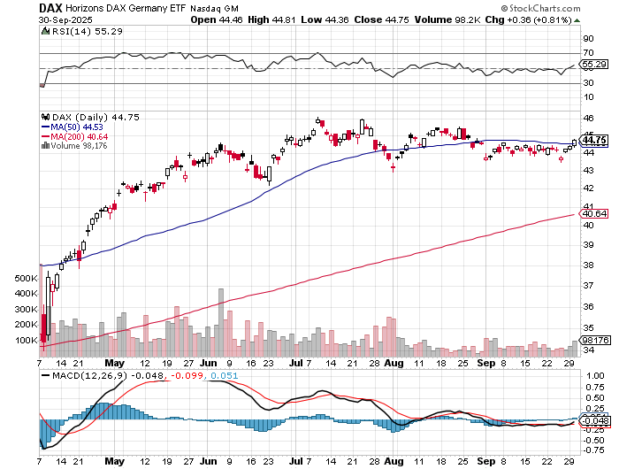
German Dax (DAX)- +30%

Slide 30
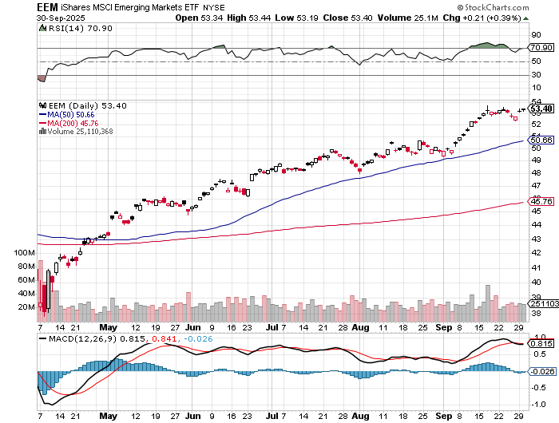
Emerging Markets (EEM) - +8% Weak Dollar, Long Recovery Play

Slide 31



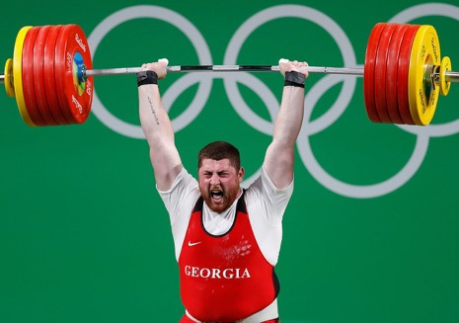
THE MAD HEDGE FUND TRADER
The Barbell Portfolio
*75% Big Tech – 2% of US workforce, 25% of market cap and 25% of US earnings 25% Domestic Recovery, including: Railroads, airlines, cruise lines, Couriers, steel companies Banks, commodities Construction Credit Card Companies Hotels, casinos Online Ticket Sales

Slide 32
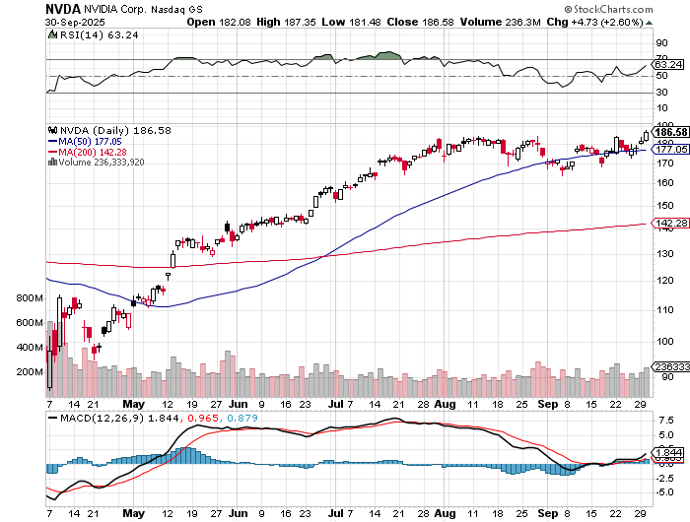

NVIDIA (NVDA) – Blackwell Chips @ $70,000 each Nvidia to Invest $100 Billion in Open AI stopped out of long 6/$140-$145 puts spread, took profits on long 5/$70-$75 call spread took profits on long 3/$88-$90 call spread, took profits on long 4/$140-$145 puts spread took profits on Long 2/$90-$95 call spread, took profits on Long 12/$117-$120 call spread

Slide 33
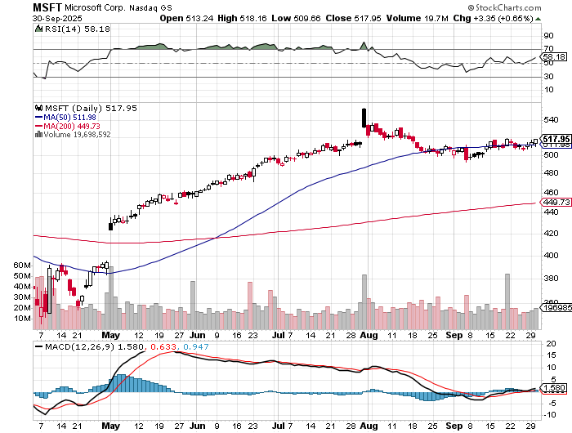

Microsoft (MSFT)- Become the Second $4 trillion Company Microsoft Delivers Blowout Earnings took profits on long 5/$430-$440 put spread Took profits on long 2/$330-$340 call spread, took profits on long 12/$320-$330 call spread took profits on long 9/$235-$245 call spread, took profits on long 7/$220-$210 call spread,

Slide 34
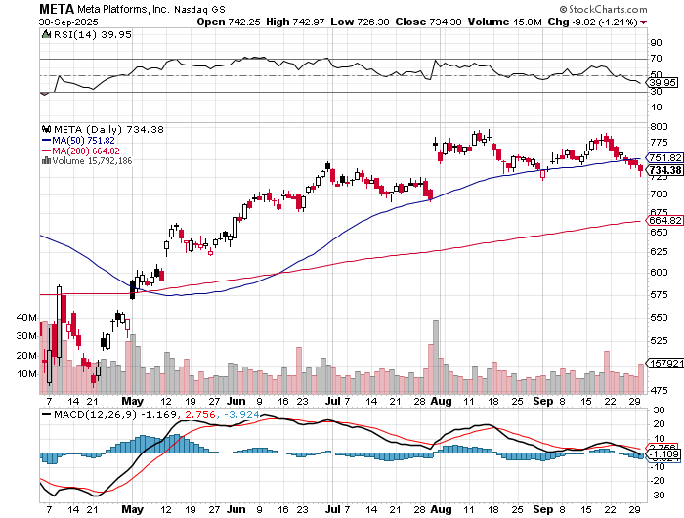

Meta (META) Meta Delays Flagship Behemoth AI Product took profits on Long 8/$420-$430 call spread took profits on Long 5/$360-$370 vertical bull call spread, took profits on Long 9/$290-$300 vertical bear put spread, stopped out of Long 9/$190-$200 vertical bear put spread

Slide 35
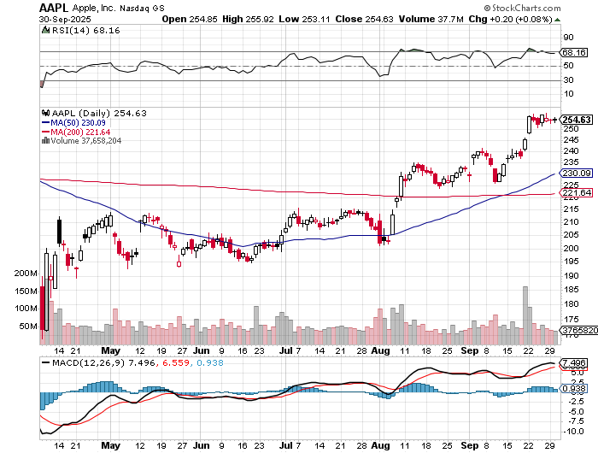

Apple (AAPL) Apple Shares Go Ballistic on spectacular sales of the iPhone 17 sales around the world My Apple LEAPS are Up 60% in Three Weeks took profits on long 6/$220-$230 put spread, profits on Long 5/$225-$235 vertical bear put spread, took profits on Long 8/$160-$170 call spread took profits on Long 6/$200-$210 bear put spread,

Slide 36
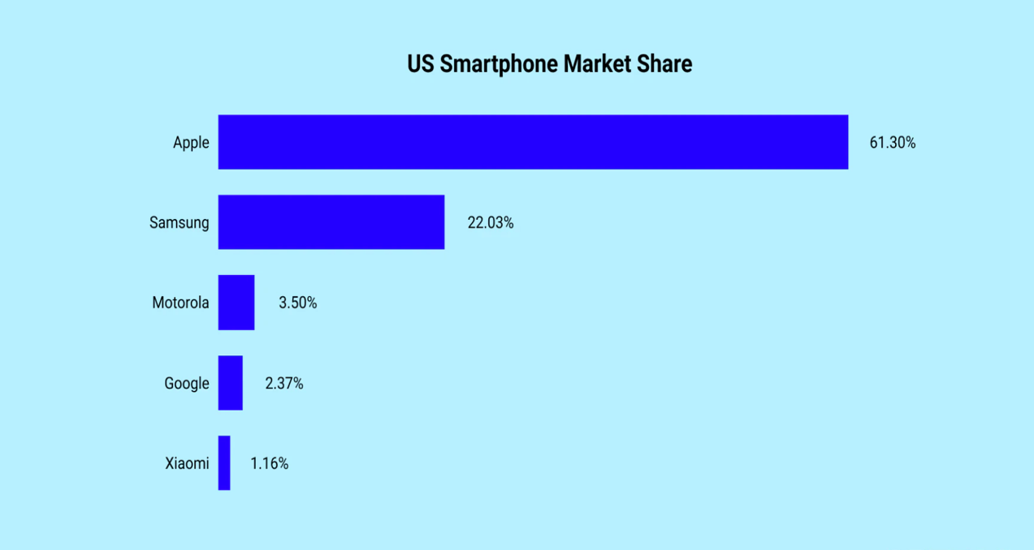

Slide 37
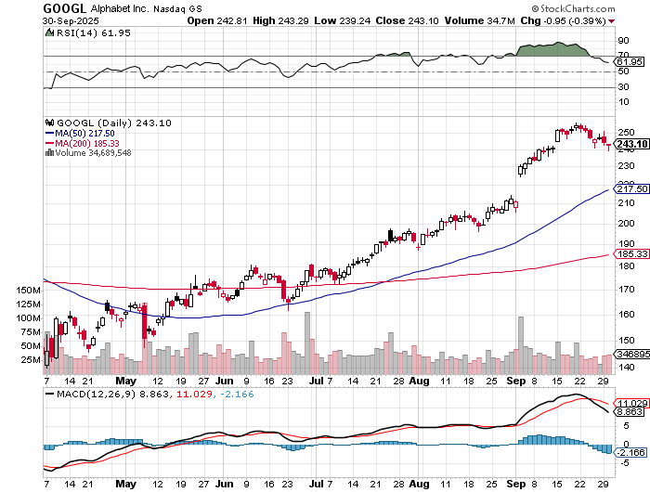
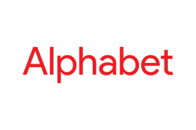
Alphabet (GOOGL) – Google Beats, with Earnings per share up to $2.31 Tops $3 Trillion Market Cap took profits on long 12/$110-$120 call spread took profits on long 12/$1,200-$1,230 bull call spread, took profits on long 9/$1,030-$1,080 vertical bull call spread

Slide 38
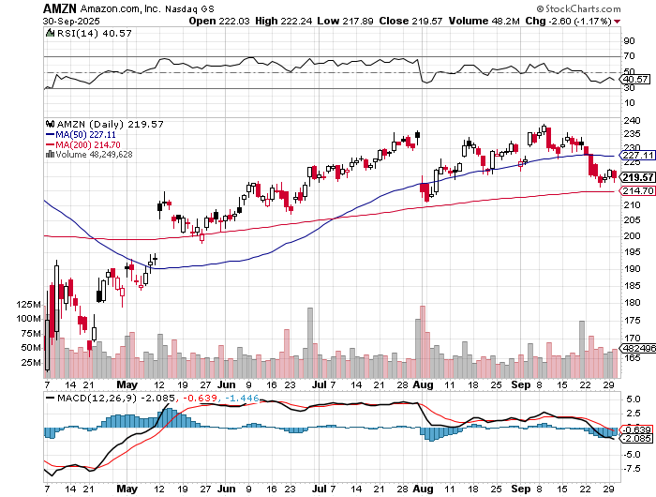

Amazon (AMZN) – Antirust Target Amazon Sells Off on Earnings took profits on long 3/$155-$160 bull call spread , took profits on long 2/$130-$135 bull call spread

Slide 39
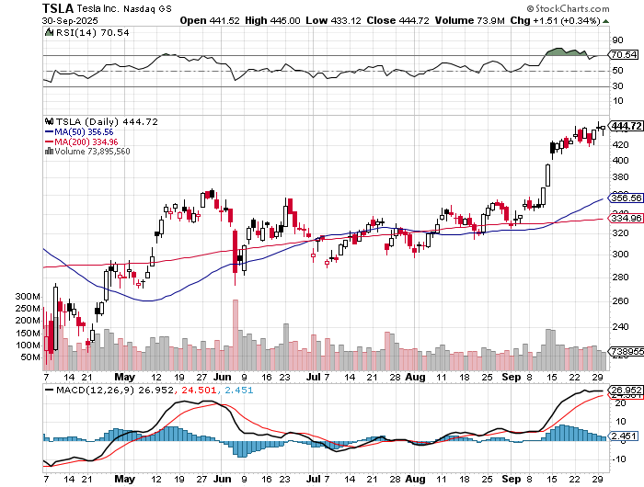

Tesla (TSLA) – Global Brand Destroyed Tesla EV Market Share Falls to 38%, from 80%, BYD Outsells Tesla in Europe Elon Musk Buys $1 Billion in Tesla Stock , Loses $7,500 EV Subsidy on September 30 long 10/$510-$520 put spread, took profits on 8/$370-$380 put spread took profits on long 7/$420-$430 put spread, took profits on long 7/$360-$370 put spread took profits on long 7/$180-$190 put spread, took profits in long 6/190-$200 call

Slide 40
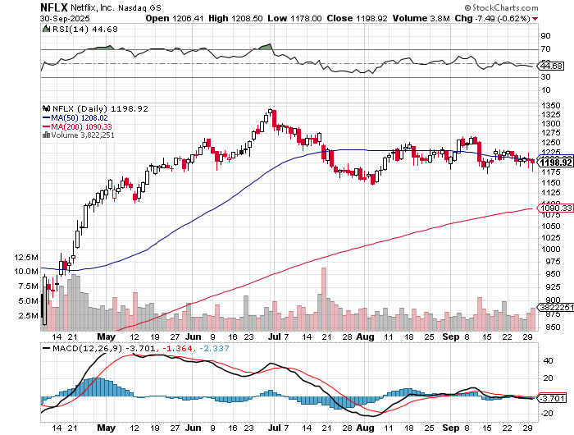

Netflix (NFLX) – Has a Challenger in the form of David Ellison’s Skydance takeover of Paramount and now Warner Brothers Discovery (WBD) took profits on long $1040-$1060 call spread, took profits on long 4/800-$810 call spread

Slide 41
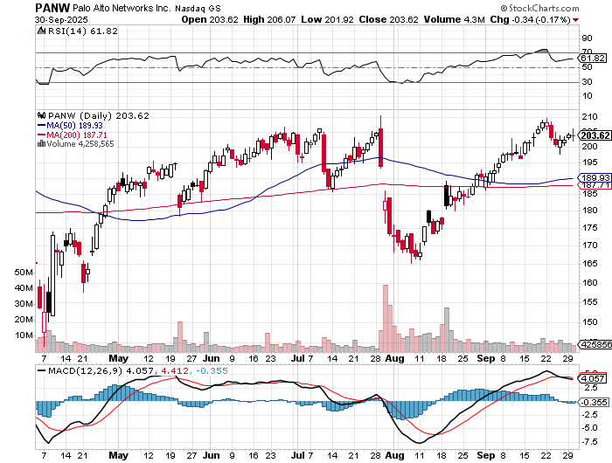

Palo Alto Networks (PANW)- Hacking never goes out of fashion Is AI Putting SaaS Out of Business? took profits on long 2/$260-$270 call spread, took profits on long 10/$130-$140 call spread

Slide 42
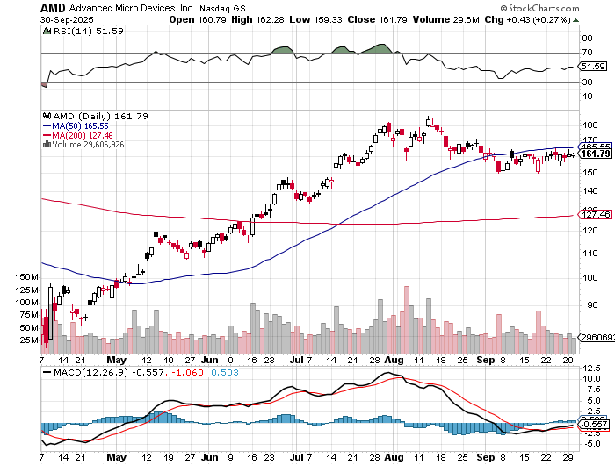

Advanced Micro Devices (AMD)- Recession fears programable logic devices took profits on long 2/$75-$80 call spread

Slide 43
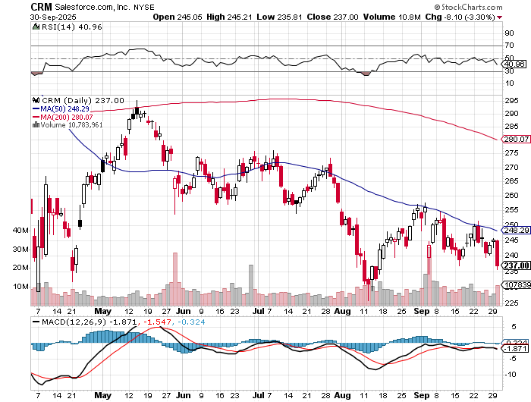

Salesforce (CRM)- Is AI Putting SaaS Out of Business? took profits on long 12/$185-$195 call spread, took profits on long 9/$125-$130 vertical bull call spread took profits on long 8/$125-$130 vertical bull call spread

Slide 44
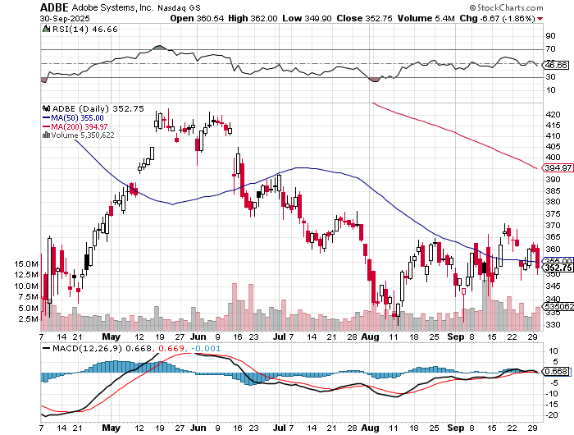

Adobe (ADBE)- Is AI Putting SaaS Out of Business? The Quality Non-China tech play

Slide 45
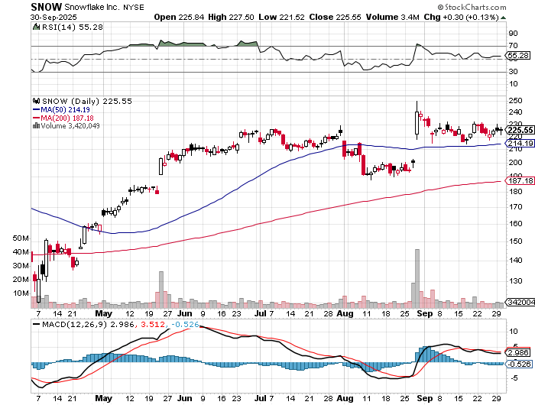

Snowflake (SNOW)- Blockbuster AI Earnings stopped out of long 4/$150-$255 call spread, took profits on long 12/$135-$140 call spread

Slide 46
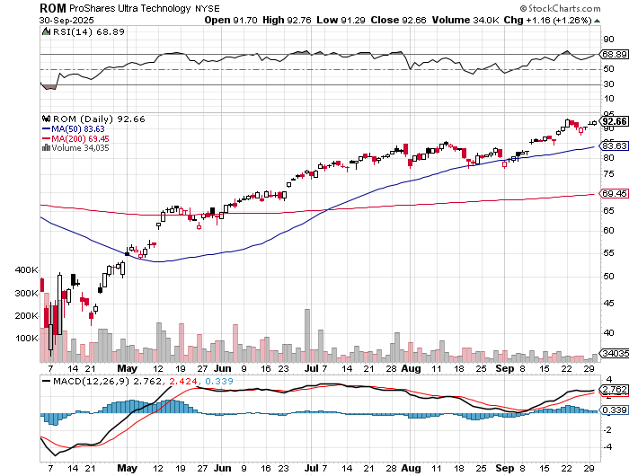
ProShares Ultra Technology ETF (ROM) – 2X Long Technology ETF took profits on long 10/$62-65 call spread

Slide 47
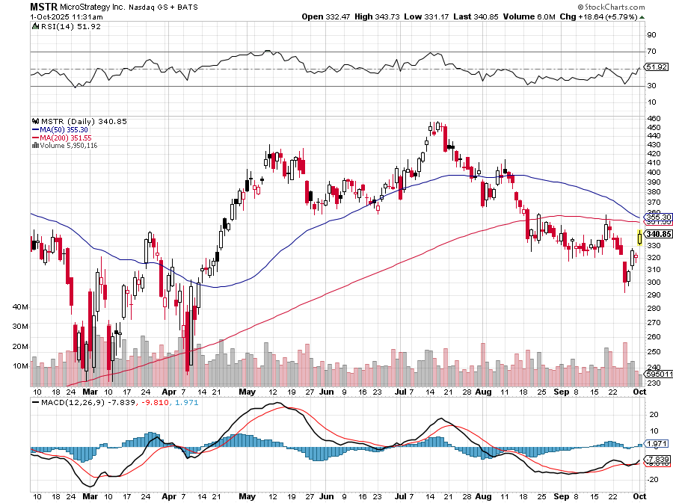

MicroStrategy (MSTR) – Long Bitcoin Play Money is Moving out of Bitcoin Ethereum Long 6/$260-$270 call spread – expires in 12 days Took profits on long 6/$500-$510 put spread, took profits on long 6/$470-$480 put spread took profits on long 6/$330-$340 call spread, stopped out of long 6/$335-$345 put spread

Slide 48
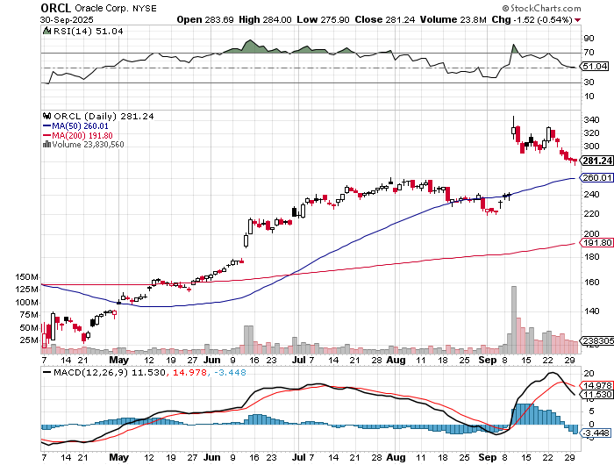

Oracle –(ORCL) – Spectacular Earnings Forecast but $100 billion in debt

Slide 49
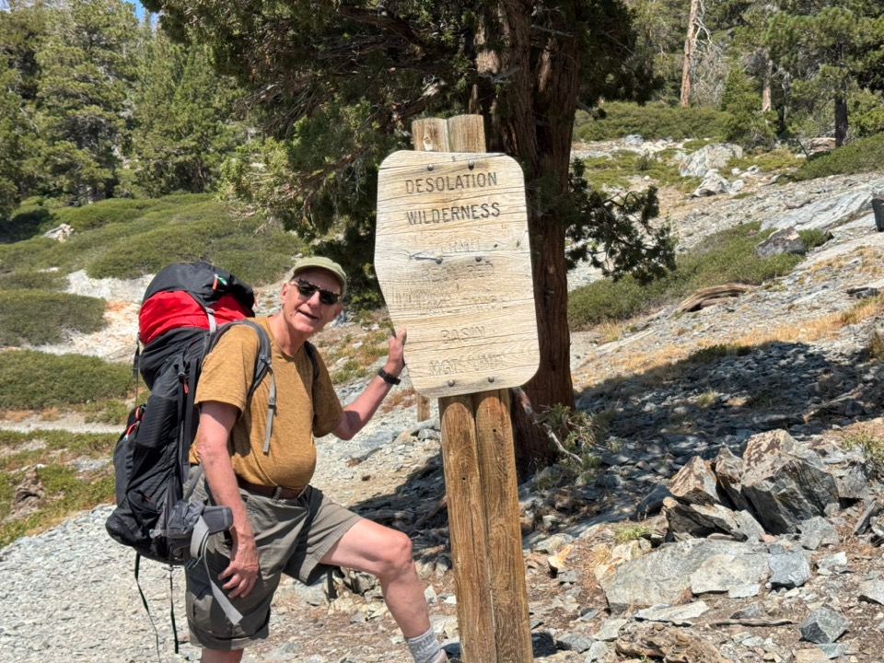

Slide 50
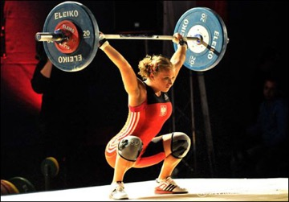
The Second Half of the Barbell
*Bets on a domestic recovery in 2022 Q4 *Upside potential in 2024 far greater than tech *Some of these have not moved for 5 or 10 years *Focuses on economically sensitive cyclical industries *Makes a great counterweight to high-growth technology *We could spend all of next ten years rotating between the two groups

Slide 51
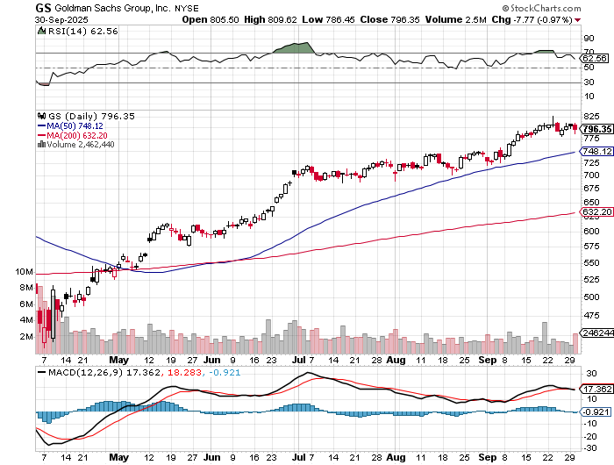

Goldman Sachs (GS) – Upside Breakout! Goldman Sachs Beats, with Revenues of $12.73 billion vs. $12.46 billion estimate long 9/$700-$710 call spread- expires in 12 days, took profits on long 9/$690-$700 call spread, out of 3/$380-$390 call spread, profits on long 12/$330-$350 call spread, took profits on long 11/$330-$350 call spread

Slide 52
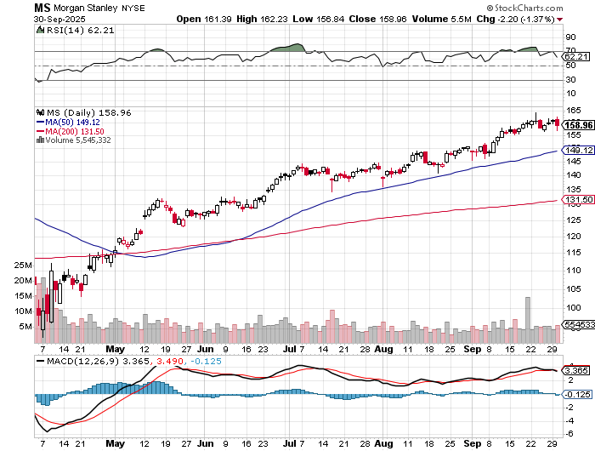

Morgan Stanley (MS) - Upside Breakout! Morgan Stanely Reports Record Profits, Sells Options Trading Department to Citidel took profits on long $12/210-$220 call spread, Took profits on long $195-$205 call spread, took profits on long 4/$65-$70 call spread

Slide 53
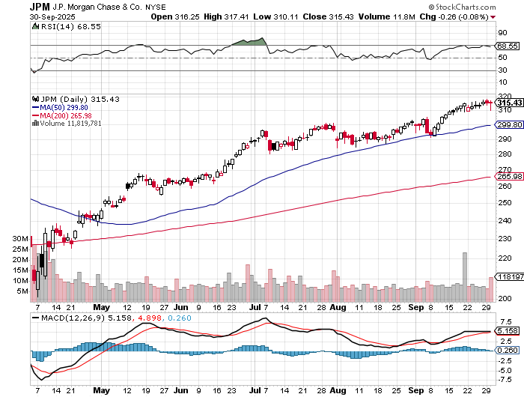

JP Morgan Chase (JPM) – Upside Breakout? long 9/$270-$280 call spread – expires in 2 days, stopped out of 3/$235-$245 calls spread, profits on long 12/$210-$220 call spread, took profits on long 11/$195-$205 call spread, took profits on 4/$215-225 put spread, took profits on long 4/$105-$115 call spread

Slide 54
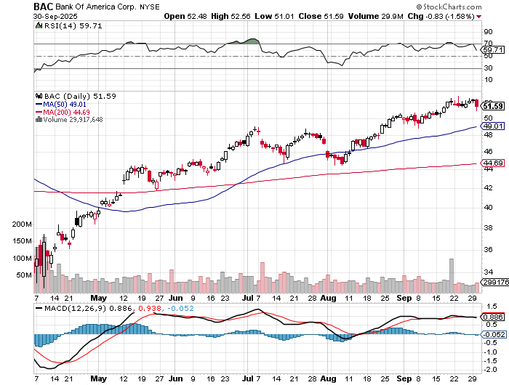

Bank of America (BAC) – Upside Breakout? took profits on long long 12/$41-$44 call spread, took profits on long 4/$20-$23 call spread

Slide 55
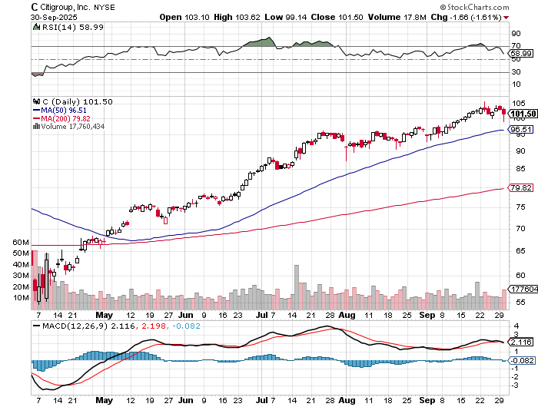

Citigroup (C) – Upside Breakout? took profits on long long 12/$60-$65 call spread , took profits on long 4/$30-$35 call spread

Slide 56


Charles Schwab (SCHW) – Upside Breakout? took profits on long 4/$30-$35 call spread

Slide 57


Interactive Brokers (IBKR) – Upside Breakout? stopped out of long 3/$160-$170 call spread, out of long 8/$110-$115 call spread , took profits on long 4/$60-$65 call spread

Slide 58


Berkshire Hathaway (BRKB)- Ultimate defensive stock Berkshire Hathaway Builds Record Cash, at $334 billion – Is the new T Bill proxy stopped out of long 12/$405-$415 call spread, took profits on long 12/$320-$330 call spread took profits on long 4/$260-$270 call spread, took profits on long 1/$290-$300 call spread

Slide 59


Blackrock (BLK)-Asset Collection Boom Blackrock Reports Record $12.5 trillion in Assets Under Management took profits on long 12/$850-$860 call spread took profits on long 3/$770-$790 call spread, took profits on long 3/$310-$340 call spread

Slide 60

SPDR Metals & Mining ETF (XME) – long 2/$28-$30 call spread

Slide 61


Boeing (BA) – Renaissance Boeing Jet Deliveries are Surging. The company delivered 57 commercial aircraft in August, its best performance for the month since 2018

Slide 62


General Motors (GM) – Worst Off Trade War Victim Loses $1 Billion on trade wars stopped out of long 4/$52.50-$57.50 put spread at cost, long 3/$53-$56 put spread

Slide 63


Package Delivery- United Parcel Service (UPS) – strike averted took profits on long 11/$130-$140 call spread

Slide 64


Caterpillar (CAT)- Ag + Infrastructure + Housing stopped out of long 8/$310-$320 call spread, took profits on long 12/$220-$230 calls spread took profits on long 12/$145-$150 call spread, took profits on long 11/$125-$135 call spread

Slide 65


Deere & Co. (DE)- Ag + Infrastructure + Housing took profits on long 8/$330-$340 put spread stopped out of long 8/$330-$340 calls spread

Slide 66


Freeport McMoRan - (FCX)- Coming Copper Crisis 50% copper tariff-Jan 2027 $35-38 LEAPS at $1.75 up 17% took profits on long 8/$34-$37 call spread took profits on long 4/$37-$40 call spread, took profits on long 5/$42-$45 call spread, stopped out of long $48-$51 put spread, profits on long 6/$32-$35 call spread

Slide 67


Walt Disney (DIS) -Disney Beats Disney Dives on Earnings Bust, although streaming broke even versus an expected loss

Slide 68


Industrials Sector SPDR (XLI)- (GE), (MMM), (UNP), (UTX), (BA), (HON)

Slide 69


Union Pacific RR (UNP)- Big Stuff to Ship The Largest Railroad in History, may be the result of the Union Pacific (UNP)/Norfolk Southern merger worth $200 billion took profits on long 5/$200-$210 call spread took profits on 11/$150-$160 call spread

Slide 70


Walmart (WMT) – Trade War Victim took profit on Long 11/$125-$130 bear put spread, took profit on Long 10/$119-$121 bear put spread took profits on Long 8/$114-$117 bear put spread

Slide 71


Costco (COST) – Trade War Victim took profits on long 4/$840-$850 call spread

Slide 72


Delta Airlines (DAL) – Ticket Price Take Off Delta Maintains Strong Forecast

Slide 73


Transports Sector SPDR (XTN)- Worst Hit Sector (ALGT), (ALK), (JBLU), (LUV), (CHRW), (DAL)

Slide 74


Health Care Sector (XLV) – Defensive Play and Cheap (JNJ), (PFE), (MRK), (GILD), (ACT), (AMGN)

Slide 75


Amgen (AMGN) long 7/$260-$270 bull call spread, took profits on long 11/$185-$200 bull call spread

Slide 76


Visa (V) – Stablecoin Competition took profits on long 2/$240-$250 bull call spread took profits on long 10/$160-$170 bull call spread, took profits on long 6/$150-$160 bull call spread

Slide 77


Consumer Discretionary SPDR (XLY) (DIS), (AMZN), (HD), (CMCSA), (MCD), (SBUX)

Slide 78


Slide 79

Bonds – Stuck in the Mud
*The interest rate on the most popular U.S. home loan dropped last week to its lowest in a year *This has sent homeowners racing to lock in cheaper borrowing costs as slowing jobs growth and expectations for more interest-rate cut drive down yields on benchmark Treasuries *The Mortgage Bankers Association on Wednesday said the contract rate on a 30-year, fixed-rate mortgage dropped 10 basis points in the week ended September 12 to 6.39%. *The US Yield Curve is Steepening *The only thing that can save the bond market is massive Fed buying through quantitative easing *Avoid (TLT), (JNK), (NLY), (SLRN) and REITS

Slide 80

Treasury ETF (TLT) – took profits on long 6/$88-$91 put spread stopped out of long 6/$80-$83 call spread, took profits on long 4/$84-$87 call spread stopped out of long 1/$82-$85 call spread, took profits on long 10/$103-$106 put spread took profits on long 6/$$94-$97 put spread, took profits on long 5/$82-$85 calls spread

Slide 81

Ten Year Treasury Yield ($TNX) – 4.12%

Slide 82

Junk Bonds (JNK) 6.54% Yield

Slide 83

Municipal Bonds (MUB) 4.21% Yield-

Slide 84

Emerging Market Debt (ELD) 5.62% Yield-

Slide 85

2X Short Treasuries (TBT)-Out of Favor

Slide 86

Anally Capital Management (NLY) – Leveraged REIT Play Yield 13.25% took profits on long 12/$15-$16 call spread

Slide 87


Slide 88
Foreign Currencies – Trending Up Again
*Foreign currencies have started to trend up again after Fed interest rate cut *Australian dollar has seen nice gains *We may see another 20% move down as Fed interest rates cuts loom *With the dollar down 15% again the Euro, this effectively doubles imported inflation to a 30% rate, sending prices through the roof and demolishing the US economy *Next dollar weakness will come with evidence of a recession *Buy (FXA), (FXE), (FXB), (FXC), and (FXY)

Slide 89


THE MAD HEDGE FUND TRADER
Australian Dollar (FXA) - Major Long-Term Bottom is In Targeting Parity – A call option on a global synchronized recovery

Slide 90


Japanese Yen (FXY)

Slide 91


Euro (FXE)-

Slide 92


British Pound (FXB)-

Slide 93


Emerging Market Currencies (CEW)

Slide 94



Slide 95

Energy & Commodities – Breakdown Coming
*OPEC+ Oil Production Falling Below Target *OPEC+ has delivered about 75% of the extra oil output it targeted since the group started production hikes in April *The level may fall closer to half later in the year as producers hit capacity limits *OPEC+, which produces 50% of global oil and brings together the OPEC and allies such as Russia, has been pumping almost 500,000 barrels per day below its targets. *The shortfall, equal to 0.5% of global demand, has defied market expectations of a supply glut and supported oil prices. *Freeport McMoRan Halts Exports of Copper from Indonesia, knocking the stock down 20% *China Announces Construction of 17 New Nuclear Power Plants

Slide 96

Oil-($WTIC)

Slide 97

United States Oil Fund (USO)

Slide 98

Energy Select Sector SPDR (XLE)-No Performance! (XOM), (CVX), (SLB), (KMI), (EOG), (COP)

Slide 99

ExxonMobil (XOM)- Exxon Moves Big into Lithium, with the construction of a major mining operation in Arkansas took profits on Long 4/$100-$105 call spread, took profits on long 12/$120-$125 put spread

Slide 100

Occidental Petroleum (OXY)- Buffet’s a Buyer took profits on long 4/$59-$62 call spread took profits on long 2/$55-$60 call spread, took profits on long 12/$77.50-$82.50 put spread

Slide 101

Natural Gas (UNG) – Free Fall on Warm Winter took profits on Long January 2025 $7-8 Call Spread LEAPS

Slide 102

Cameco (CCJ) – Global Uranium Renaissance Microsoft to Reopen Three Mile Island to power AI data centers took profits on long 12/$41-$44 call spread, took profits on long 12/$35-$38 call spread, took profits on long 5/$20-$23 bull call spread

Slide 103

Vistra Corp. (VST) – Global Uranium Renaissance took profits on long 2/$100-$110 call spread

Slide 104


Slide 105

Precious Metals – Big QE Winner
*Coming quantitative easing and interest rate cuts could cause explosive moves up in precious metals prices *Gold is hanging on to new highs very nicely *Gold could hit $4,000 by yearend very easily *Is Gold the New “Safe” Asset? The barbarous relic has rallied in every bear market of the last 50 years *Newmont Sells Orla Mine for $439 Million, popping the stock $3.50 *Gold's rally has been driven by growing anxiety about the US economic trajectory, with investors seeking a hedge against rising prices and weakening currencies, and its price could vault higher if equity markets start to creak.

Slide 106


THE MAD HEDGE FUND TRADER
Gold (GLD) – Headed for $4,000 profits on long 6/$275-$285 call spread, took profits on long 5/$275-$285 call spread stopped out of long 6/$275-$285 call spread, took profits on profits on long 10/$230-$235 call spread
$5,000 in 2028 +66%
BUY

Slide 107

Market Vectors Gold Miners ETF- (GDX) – took profit on long 6/$207.50-$212.50 call spread, took profit on long 7/$200-$205 call spread

Slide 108


Barrick Mining (B) took profit on long 1/$15.50-$16.50 call spread

Slide 109


Newmont Mining- (NEM)- Sometimes you Just Get Lucky took profits on long 10/$47-$50 call spread, took profits on long $55-60 call spread

Slide 110


THE MAD HEDGE FUND TRADER
iShares Silver Trust (SLV) - The Better Play Industrial demand, solar panels, electric cars
2025 Target $50 +50%
BUY

Slide 111


Silver Miners - (SIL)-

Slide 112


Wheaton Precious Metals - (WPM)- LEAPS Approaching Max Profit took profits on long 4/$39-$42 call spread long 6/$75-$80 call spread-expires in 7 trading days , took profits on long 1/$36-$39 call spread

Slide 113


Platinum- (PPLT)- 556,000-ounce shortage this year took profits on long 1/$36-$39 call spread

Slide 114


Slide 115

Real Estate – New Homes on Fire!
*New Home Sales Rocket 20%, in August on falling interest rates, the largest one-month gain since August 2022. *Sales were 15.4% higher than August 2024 *This count is based on people out shopping in August and signing deals, when the average rate on the 30-year fixed mortgage was higher than it is today *That rate started August at 6.63%, according to Mortgage News Daily, and didn't really move much during the month *Existing Home Sales Fall -0.2% in August, and up 1.8% YOY *These figures are based on June and July closing when interest rates were 0.50% higher Inventories are down 1.3% to a 4.6-month supply after rising all year The median price sold is at $422,600, up 2% YOY

Slide 116

S&P Case Shiller Slows S&P Case Shiller Rises to +1.8% YOY in July, with its National Home Price Index New York gained +6.4%, Chicago +6.2%, and Cleveland +4.5%. Tampa -2.5% and Phoenix down -0.9%

Slide 117


Crown Castle International (CCI) – 6.62% yielding 5G cell phone tower REIT Eliot Management Pushes up stock with activist bid took profits on Long 8/$90-$95 call spread,

Slide 118



US Home Construction Index (ITB) (DHI), (LEN), (PHM), (TOL), (NVR)

Slide 119


DH Horton (DHI) DH Horton Rockets 20% on Earnings Beat – Most Important chart of the week took profits on long 11/$165-$175

Slide 120


Slide 121

Trade Sheet- The Recession Trade So What Do We Do About All This?
*Stocks –buy interest rate sensitives *Bonds – stand aside *Commodities – buy dips *Currencies – buy dips *Precious Metals – buy dips *Energy – buy dips *Volatility – sell over $30 *Real estate – buy dips

Slide 122

Next Strategy Webinar 12:00 EST Wednesday, October 15, 2025 from Incline Village, NV email me questions at https://www.madhedgefundtrader.com/jp-ms-0925
Good Luck and Good Trading!
Notes:
*

Slide 123

Notes:
\

Slide 124


