Slide 1
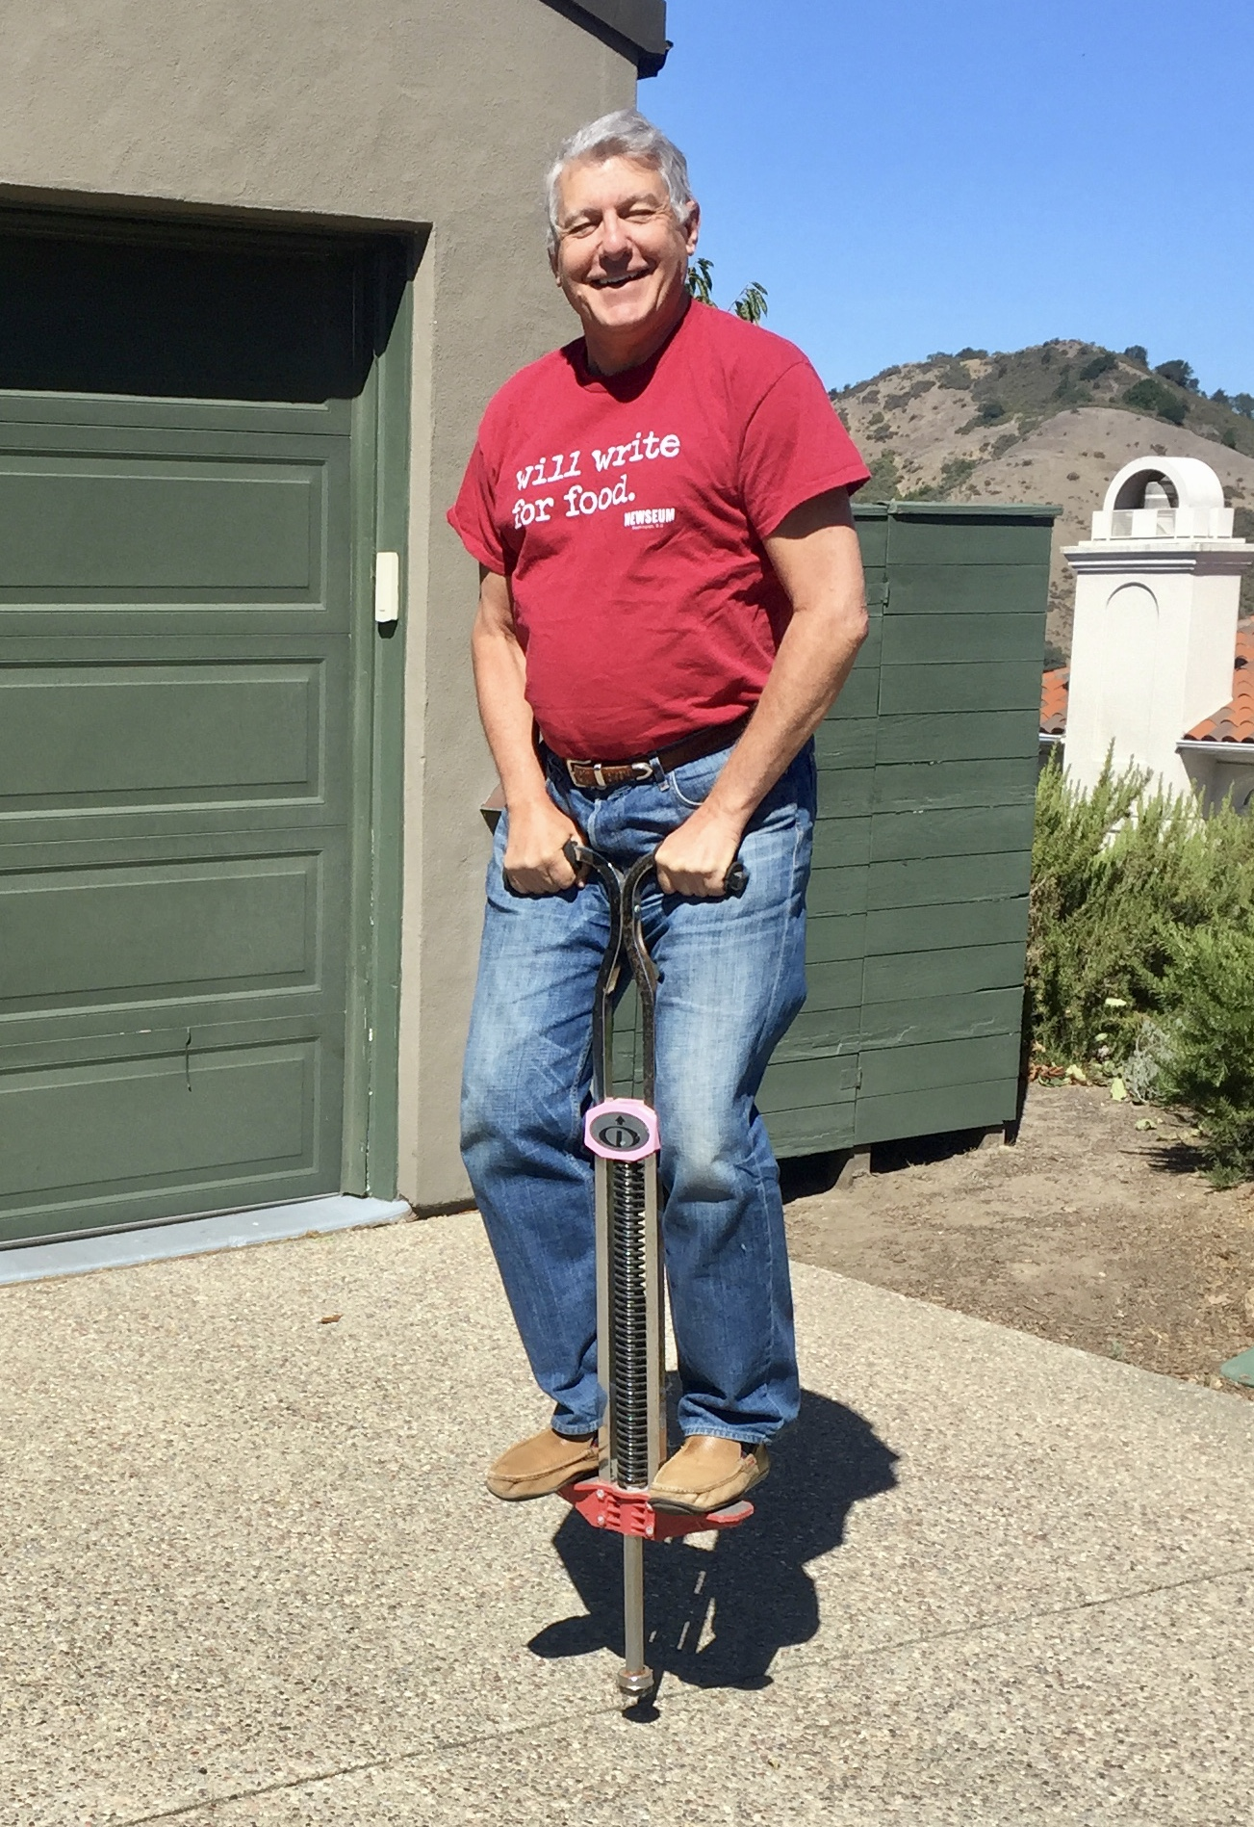
The Mad Hedge Fund Trader “Hard Bounce”
With John Thomas Incline Village, NV November 26, 2025 www.madhedgefundtrader.com
Notes:
*

Slide 2


*A gathering of 24 of the best trading minds in the world *It’s a smorgasbord of trading strategies in all asset classes, including Stocks, bonds, foreign exchange, commodities, precious metals, and energy *$100,000 in free prizes awarded to those who register *Sign up at by responding to the link we will send you shortly *Best of all, attendance is FREE!

Slide 3
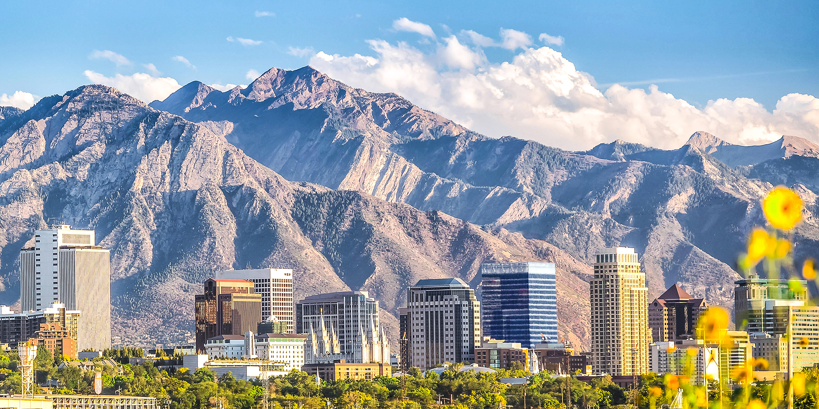
SALT LAKE CITY UTAH STRATEGY LUNCHEON
The event begins at 12:00 noon on Wednesday, December 10, 2025. A three-course meal will be provided and there will be an open discussion on the crucial issues facing investors today We will cover Stocks, bonds, foreign currencies, commodities, precious metals, energy, China, and real estate. Tickets are available for $276. The event will be held in a at a downtown Salt Lake City restaurant To purchase tickets for the luncheons, please go to my online store at https://www.madhedgefundtrader.com/luncheons/

Slide 4

ORLANDO FLORIDA STRATEGY LUNCHEON
The event begins at 12:00 noon on THURSDAY JANUARY 8, 2025. A three-course meal will be provided and there will be an open discussion on the crucial issues facing investors today We will cover Stocks, bonds, foreign currencies, commodities, precious metals, energy, China, and real estate. Tickets are available for $267. The event will be held in a at a major hotel To purchase tickets for the luncheons, please go to my online store at https://www.madhedgefundtrader.com/luncheons/

Slide 5
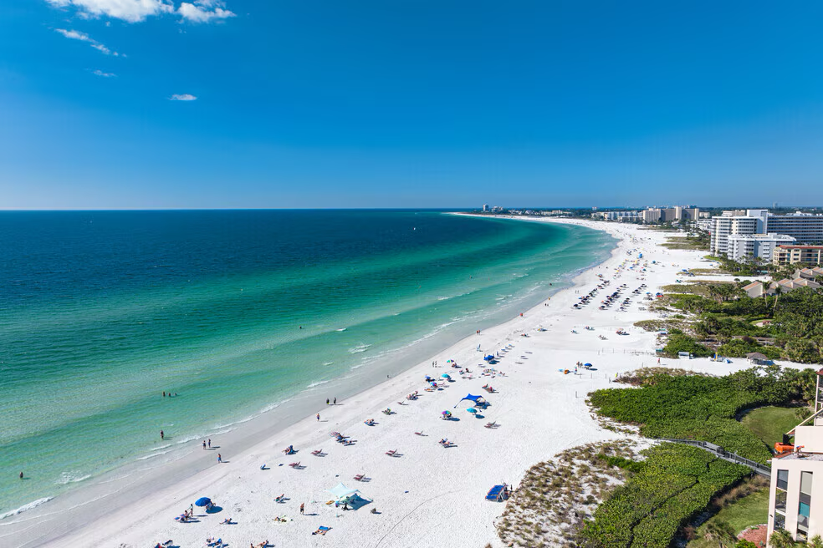
SARASOTA FLORIDA STRATEGY LUNCHEON
The event begins at 12:00 noon on THURSDAY JANUARY 14, 2025. A three-course meal will be provided and there will be an open discussion on the crucial issues facing investors today We will cover Stocks, bonds, foreign currencies, commodities, precious metals, energy, China, and real estate. Tickets are available for $277. The event will be held in a at a major beachfront hotel To purchase tickets for the luncheons, please go to my online store at https://www.madhedgefundtrader.com/luncheons/

Slide 6
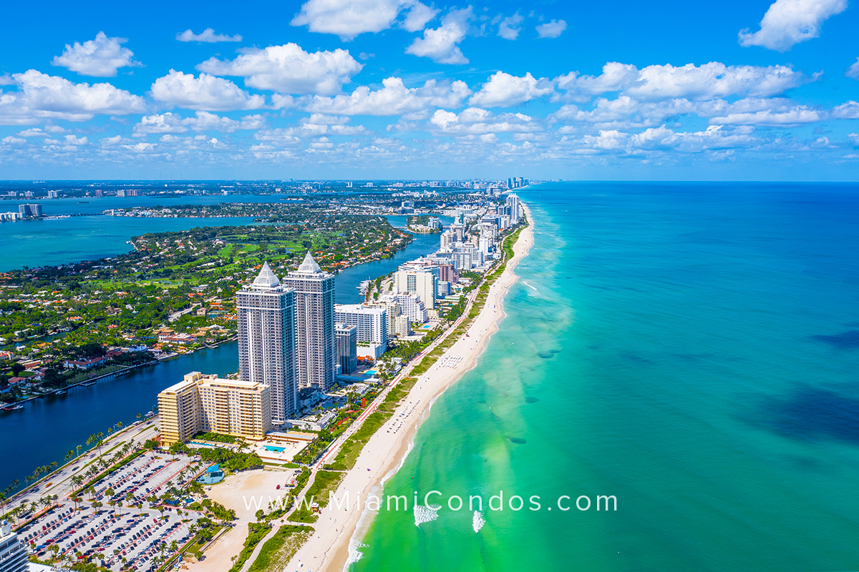
MIAMI FLORIDA STRATEGY LUNCHEON
The event begins at 12:00 noon on THURSDAY JANUARY 16, 2025. A three-course meal will be provided and there will be an open discussion on the crucial issues facing investors today We will cover Stocks, bonds, foreign currencies, commodities, precious metals, energy, China, and real estate. Tickets are available for $297. The event will be held in a at a major beachfront hotel To purchase tickets for the luncheons, please go to my online store at https://www.madhedgefundtrader.com/luncheons/

Slide 7


Slide 8

Trade Alert Performance New All-Time Highs-17 Consecutive Positive Months
*January +5.80% Final *July +5.21% Final *February +3.66% Final. *August +1.37% Final *March +4.36% Final *September +2.21% Final *April +0.95% Final *October +3.11% Final *May +2.51% Final *November +0.25 MTD *June +15.48% Final *December +3.26% Final *2025 Year To Date +59.20% +811.09% since inception *Versus 84.63% for all of 2022 *Versus 79.79% for all of 2023 *Versus 75.29% for all of 2024

Slide 9
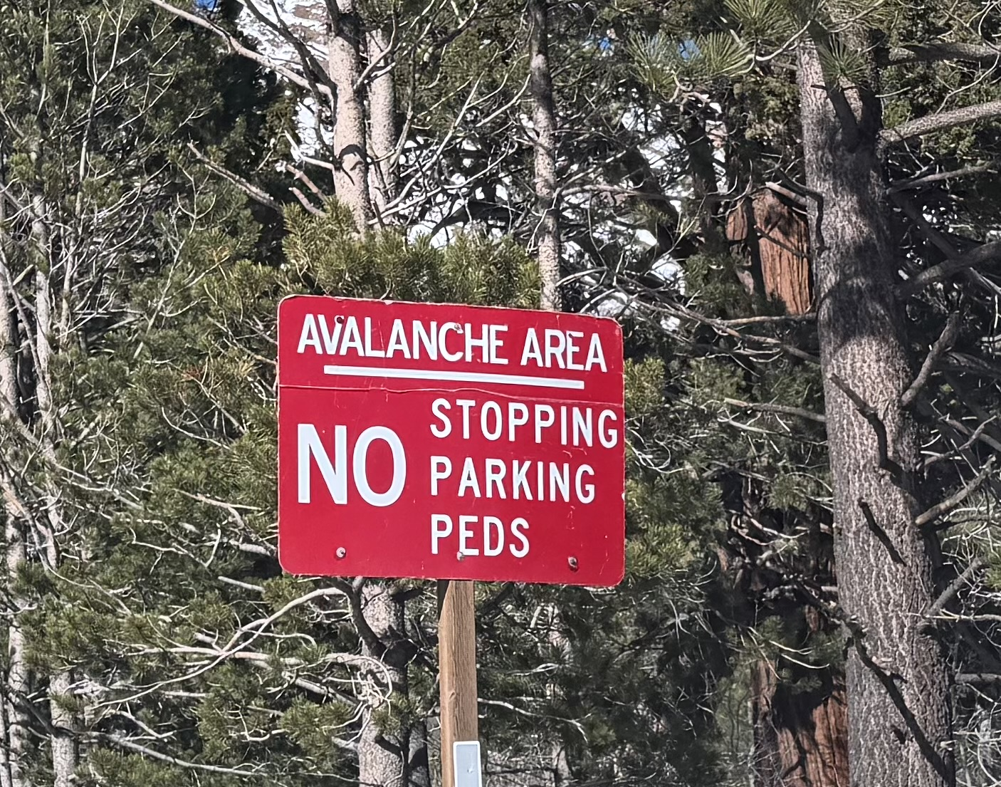

Slide 10
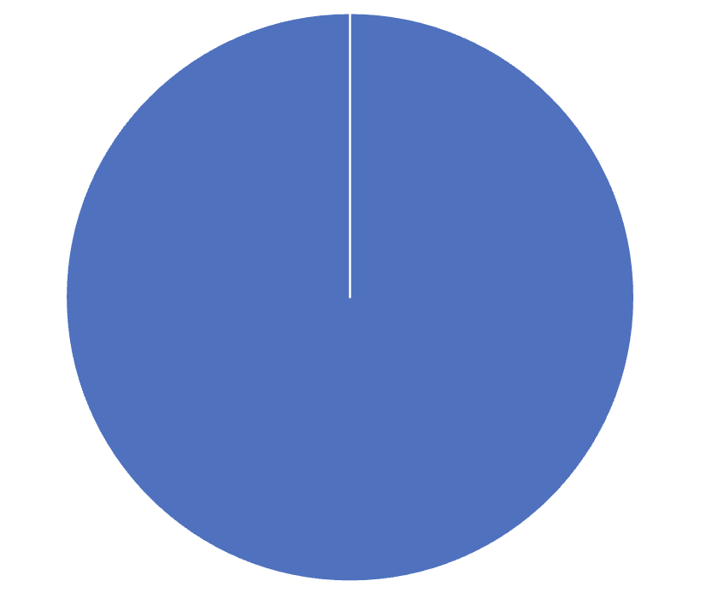
Portfolio Review – High Risk Market Require Maximum Cash 20% risk on, 10% risk off, 70% cash Entering a very high-risk market
Current Capital at Risk
MS 12/$150-$155 call spread | 10.00%
Risk Off
No Positions | 0.00%
Total Net Position | 10.00%
Total Gross Position | 10.00%
cash | 90.00%
Expiration Value +61.07%

Slide 11

The Method to My Madness
*The Yearend rally has begun, with crypto hitting a short-term bottom *The market still have two big overhangs: Fed interest rate decision on December 10 and the Supreme Court Tariff decision *Bonds are dead in the water on $42 trillion National Debt overhang, and $46 trillion without tariffs *The long-term bull arguments of super liquidity, AI, falling interest rates are still the market drivers *Jobs data remains dire *Gold and silver still takes a long overdue rest *New Ukraine peace deal spike oil 5% *US Dollar rallies modestly *Bitcoin plumbs year lows

Slide 12

The Global Economy – The Shutdown Ends
*Some 119,000 Jobs were Gained in September *But the Unemployment Rate rose 0.1% to 4.4%, a 2025 high. August revisions came in at 39,000 downward * Bureau of Labor Statistics Cancels October Jobs Report, * S&P Global US Services Flash PMI Comes in Warm at 54.8, *US Manufacturing is Slowing *Jobless Claims Hit Two Month High *Device Hoarding is Holding Back the Economy *The CPI Rose by 0.3% in October *Auto Loan Defaults Hit Record High

Slide 13
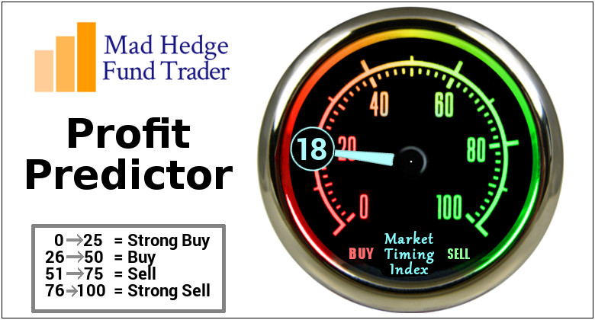

Slide 14
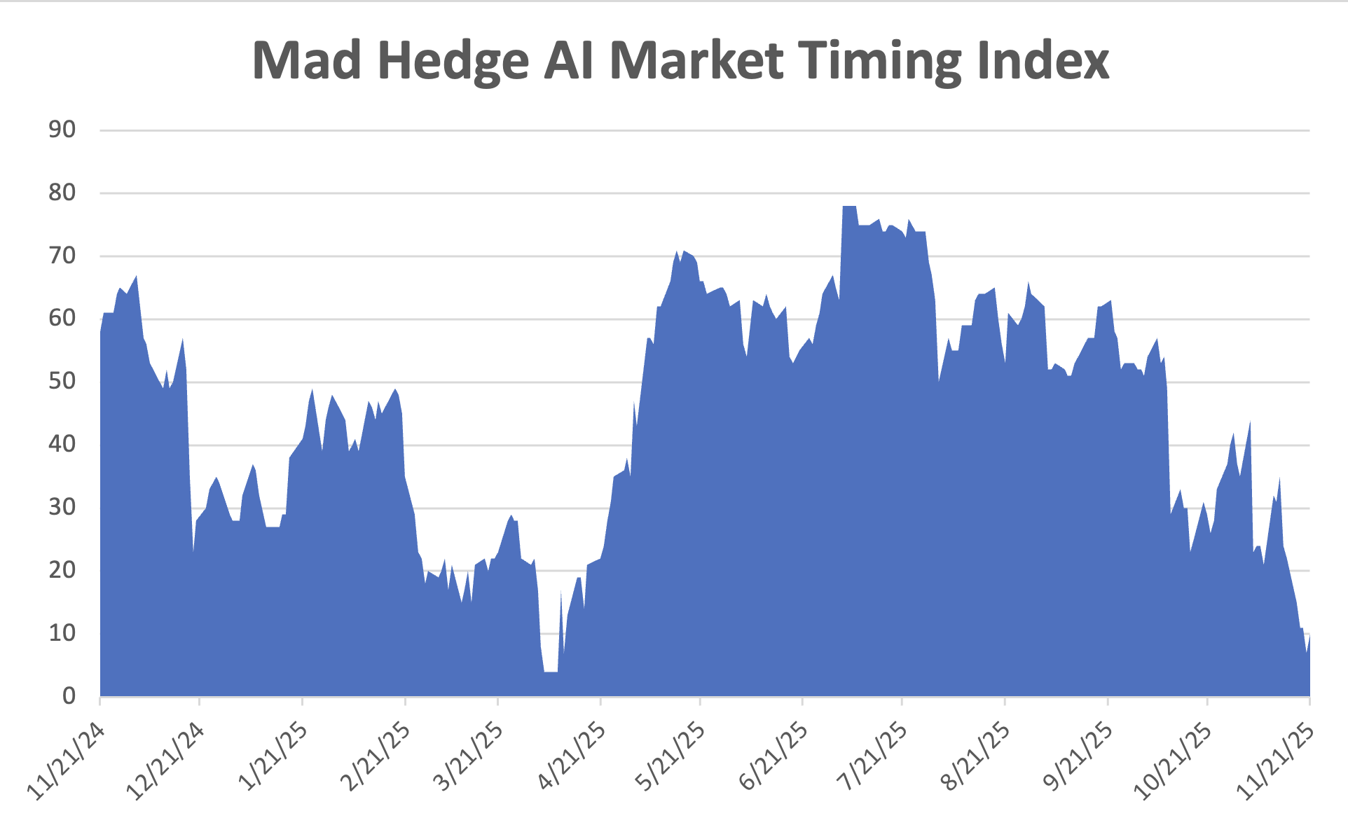
The Mad Hedge Profit Predictor Market Timing Index – Hits Seven month Low at 6, An artificial intelligence driven algorithm that analyzes 30 different economic, technical, and momentum driven indicators
SELL
BUY

Slide 15
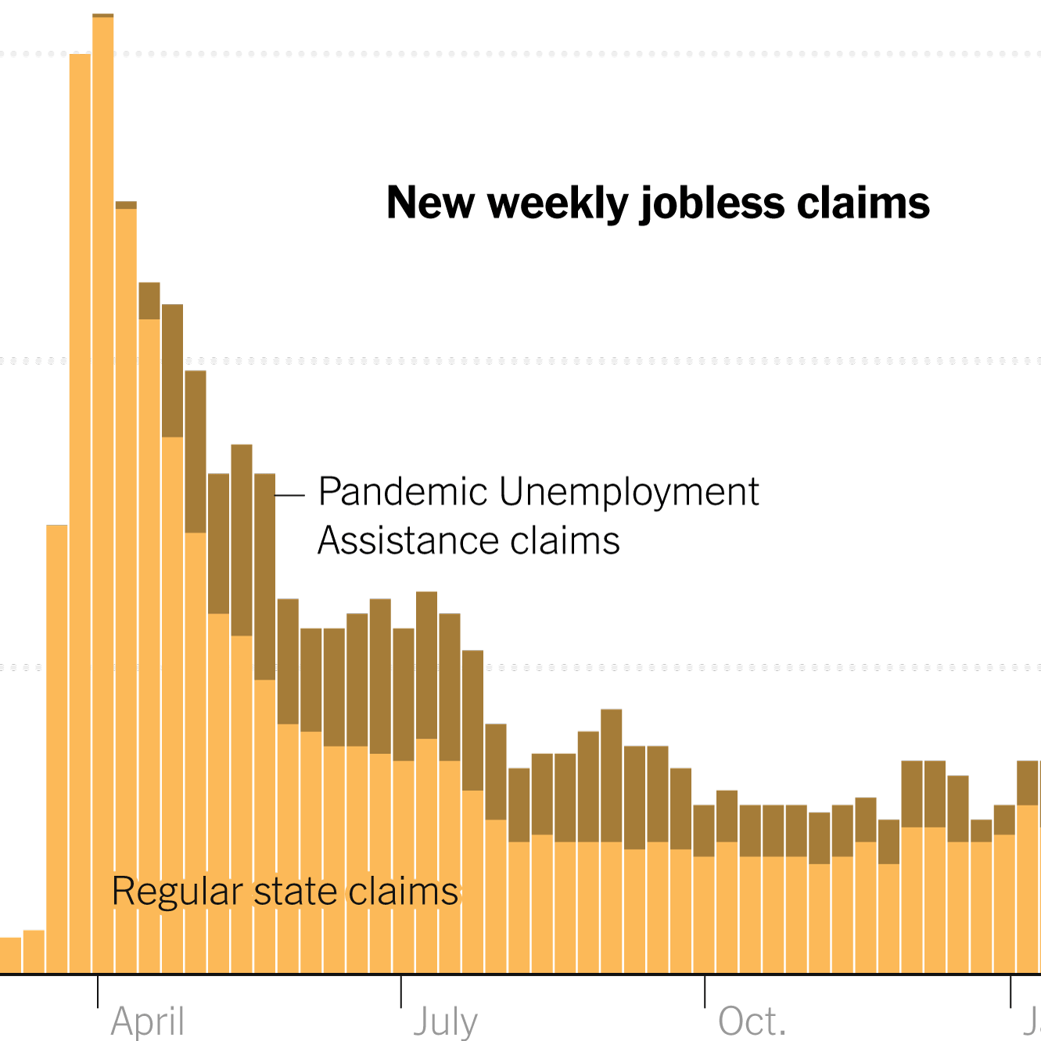
Weekly Jobless Claims – -6,000 to 216,000

Slide 16
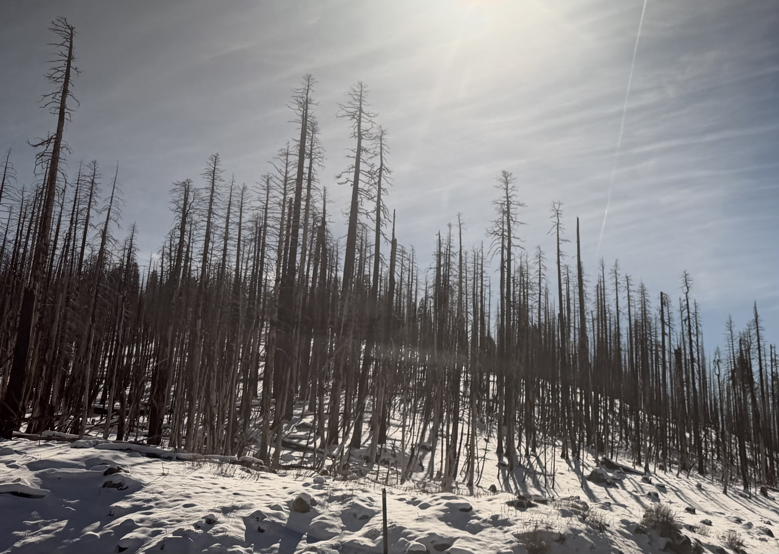

Slide 17
Stocks – Volatility!
*Bitcoin Craters to $80,000 and is Now Down 36% in a month, dragging down stocks with margin calls *Robinhood (HOOD), Coinbase (COIN), and Interactive Brokers (IBKR) are the worst affected *Moderna (MRNA) is the Most Shorted Stock in the S&P 500 *Meta Wins FTC Antitrust Trial, The case, initially filed by the FTC five years ago, centered on Meta’s acquisition of WhatsApp and Instagram. *Major Cloudflare Outage Takes Out Big part of the Internet *Strategy Buys More Bitcoin, taking holdings up to $70 billion *Berkshire Hathaway Takes Major Stake in Amazon *Novo Nordisk dives in Alzheimer's drug failure *Boeing Ends Strike *Is Eli Lily the Next Stock to Split?

Slide 18
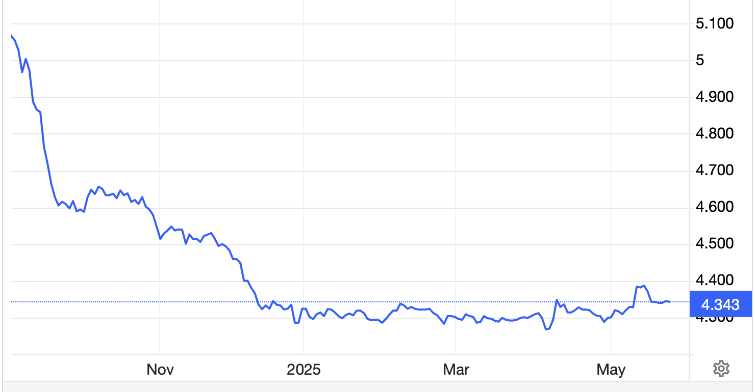
The Ultimate Hedge – Defensive stocks only go down at a slower rate 90 - day US Treasury Bills (Warren Buffet owns $340 billion) Extend to One Year!
*Government Guaranteed principal *Endless liquidity, trade like water *100% collateral value for margin *Lock in guaranteed income *Can be sold at any time to earn full interest *Will survive any bear market *Ask your broker how to buy
3.90% Yield

Slide 19
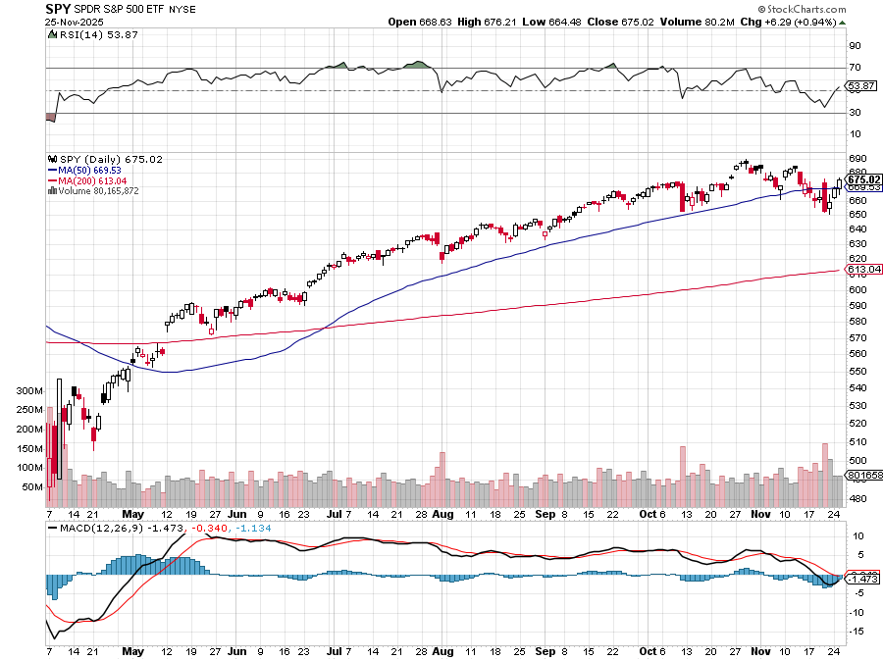
S&P 500 – Breakout! stopped out of $445-$450 put spread took profits on long 6/$660-$640 put spread took profits on 6/$610-$620 put spread
$650 -4.34% 1st support
$630 -6.60% 1st support

Slide 20
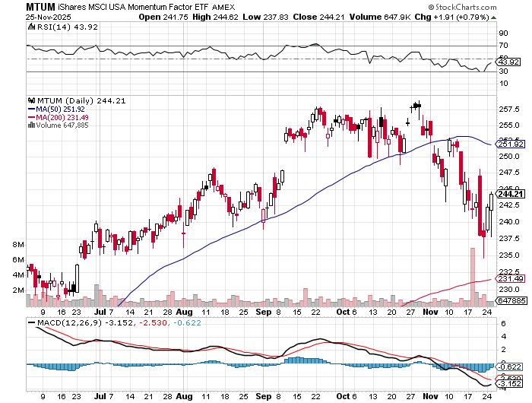
Momentum (MTUM)

Slide 21
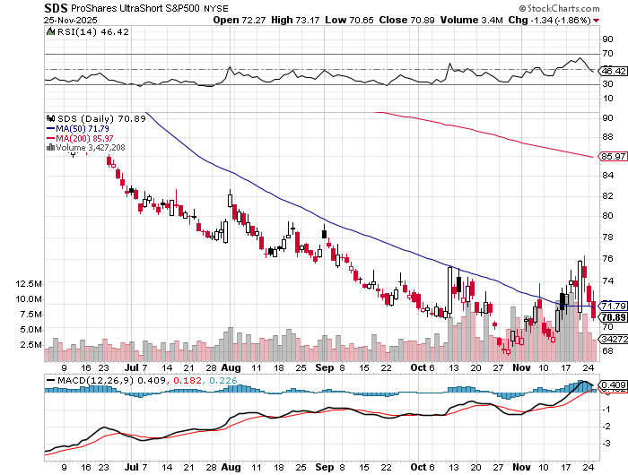
ProShares -2X Short S&P 500 (SDS) - a great 2X hedge for falling long stocks

Slide 22
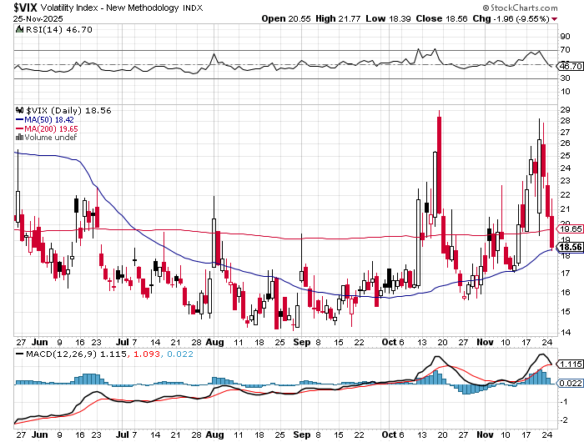
(VIX) – Volatility Index Hits Four Year High at $65, the most since the 2020 pandemic. That implies a 2% move in the S&P 500 (SPX) every day for the next 30 days

Slide 23
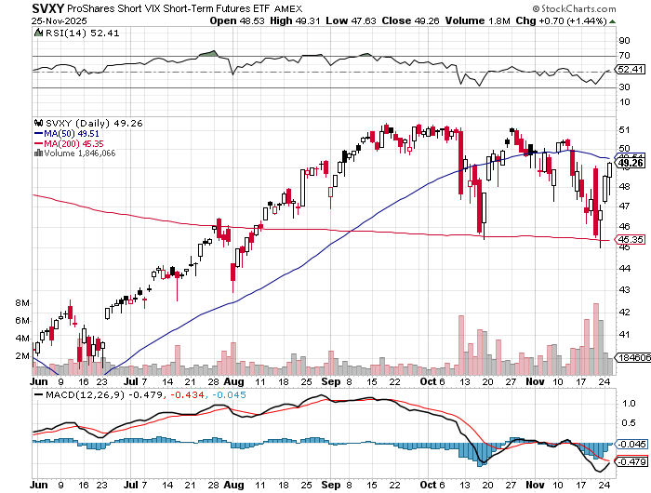
(SVXY) –Short Volatility ETF bought at $36.31 - $32.74 = $3.57

Slide 24
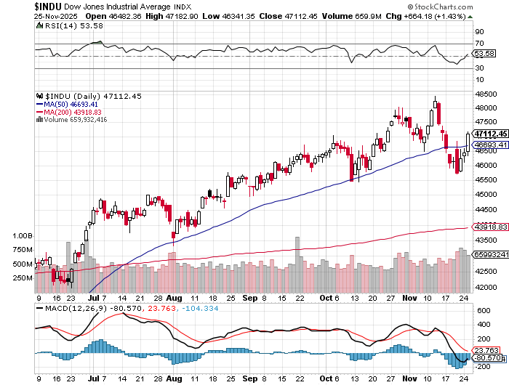
Dow Average ($INDU)-

Slide 25
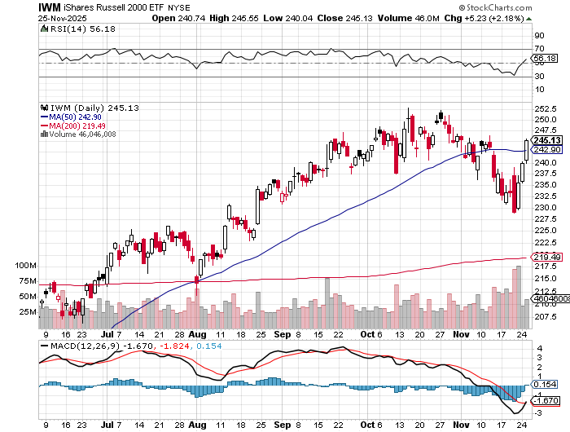
Russell 2000 (IWM)- took profits on Long 10/$137-$142 vertical bull call spread took profits on Long 10/$153-$156 vertical bear put spread

Slide 26
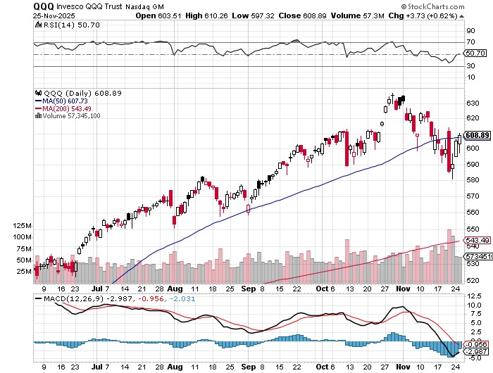
NASDAQ (QQQ) – Down 15% took profits on long 6/$540-$550-$345 put spread, took profits on Long 5/$335-$345 put spread took profits on long (QQQ) /$540-$550 put spread, took profits on long (QQQ) 4/$330-$335 put spread took profits on long (QQQ) 3/$340-$345 put spread, covered long (QQQ) $325-$330 put spread

Slide 27
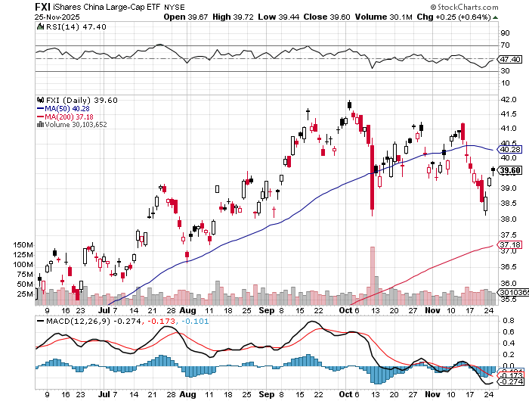
China (FXI) + 36%

Slide 28
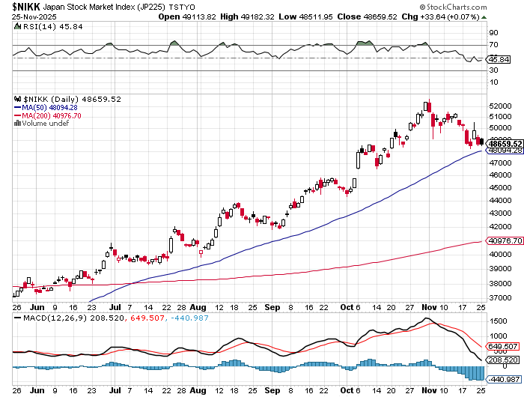
Japan ($NIKK) – down 10% Nikkei Rockets on Japan Trade Deal, which dropped tariffs on Japanese cars to 15%

Slide 29
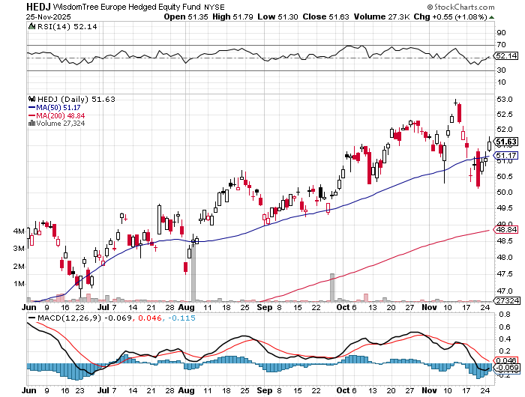
Europe Hedged Equity (HEDJ)- +19%

Slide 30
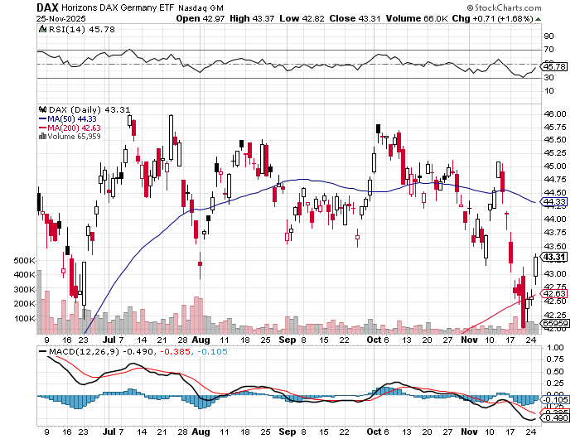
German Dax (DAX)- +30%

Slide 31
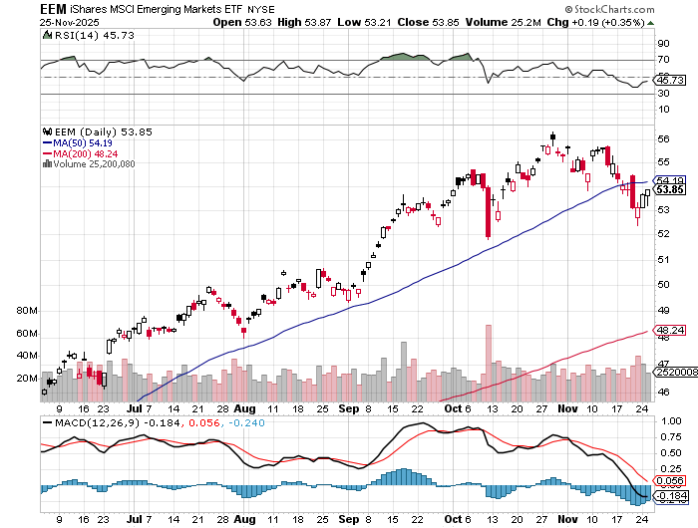
Emerging Markets (EEM) - +8% Weak Dollar, Long Recovery Play

Slide 32



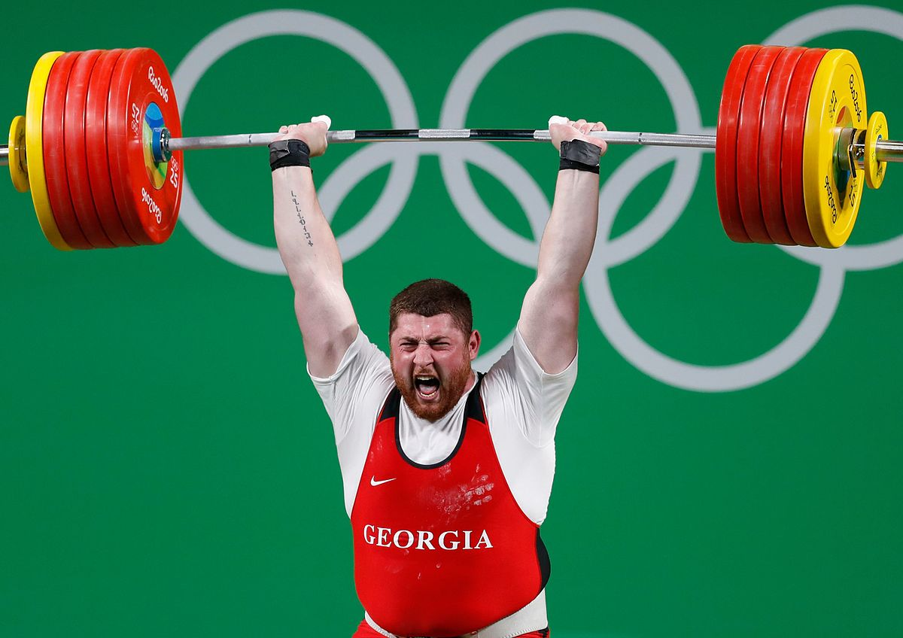
THE MAD HEDGE FUND TRADER
The Barbell Portfolio
*75% Big Tech – 2% of US workforce, 25% of market cap and 25% of US earnings 25% Domestic Recovery, including: Railroads, airlines, cruise lines, Couriers, steel companies Banks, commodities Construction Credit Card Companies Hotels, casinos Online Ticket Sales

Slide 33

NVIDIA (NVDA) – Blackwell Chips @ $70,000 each Nvidia Beats, Forecast Raised stopped out of long 6/$140-$145 puts spread, took profits on long 5/$70-$75 call spread took profits on long 3/$88-$90 call spread, took profits on long 4/$140-$145 puts spread took profits on Long 2/$90-$95 call spread, took profits on Long 12/$117-$120 call spread

Slide 34
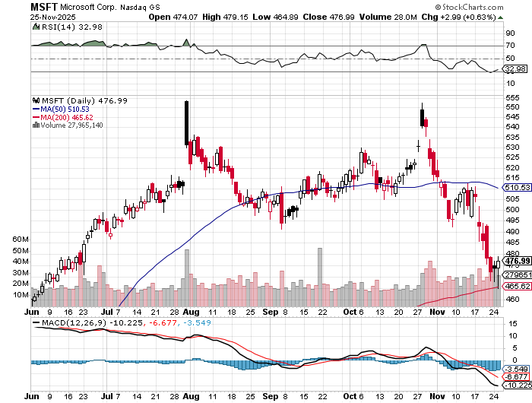

Microsoft (MSFT)- Become the Second $4 trillion Company Microsoft Delivers Blowout Earnings took profits on long 5/$430-$440 put spread Took profits on long 2/$330-$340 call spread, took profits on long 12/$320-$330 call spread took profits on long 9/$235-$245 call spread, took profits on long 7/$220-$210 call spread,

Slide 35
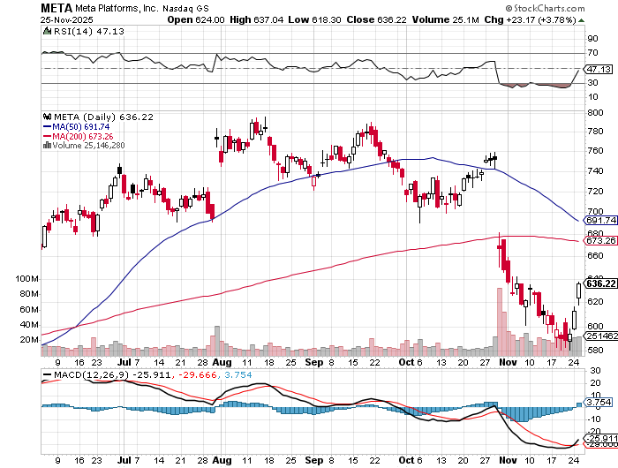

Meta (META) Meta Delays Flagship Behemoth AI Product took profits on Long 8/$420-$430 call spread took profits on Long 5/$360-$370 vertical bull call spread, took profits on Long 9/$290-$300 vertical bear put spread, stopped out of Long 9/$190-$200 vertical bear put spread

Slide 36
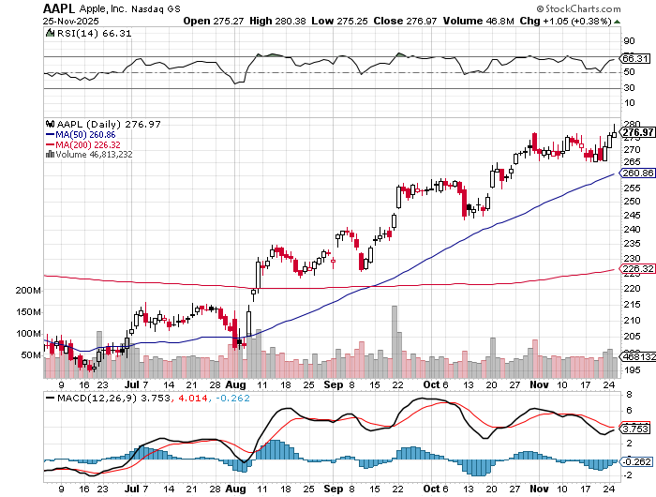

Apple (AAPL) China iPhone Sales Jump 22% took profits on long 6/$220-$230 put spread, profits on Long 5/$225-$235 vertical bear put spread, took profits on Long 8/$160-$170 call spread took profits on Long 6/$200-$210 bear put spread,

Slide 37
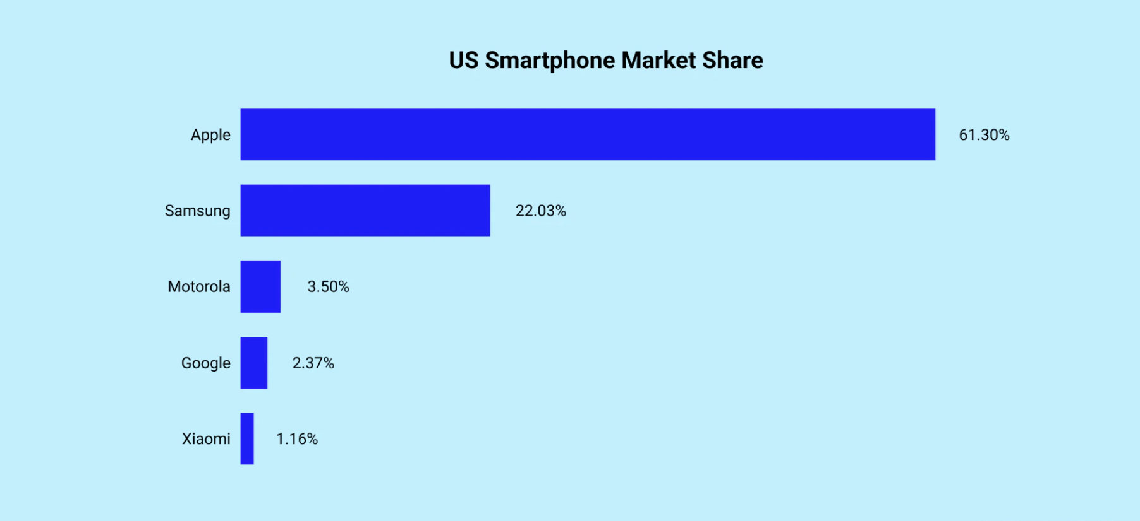

Slide 38
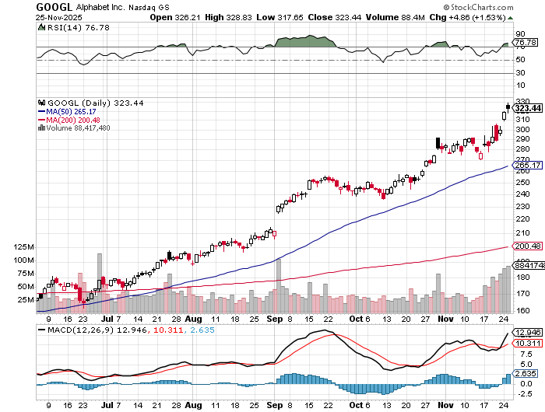
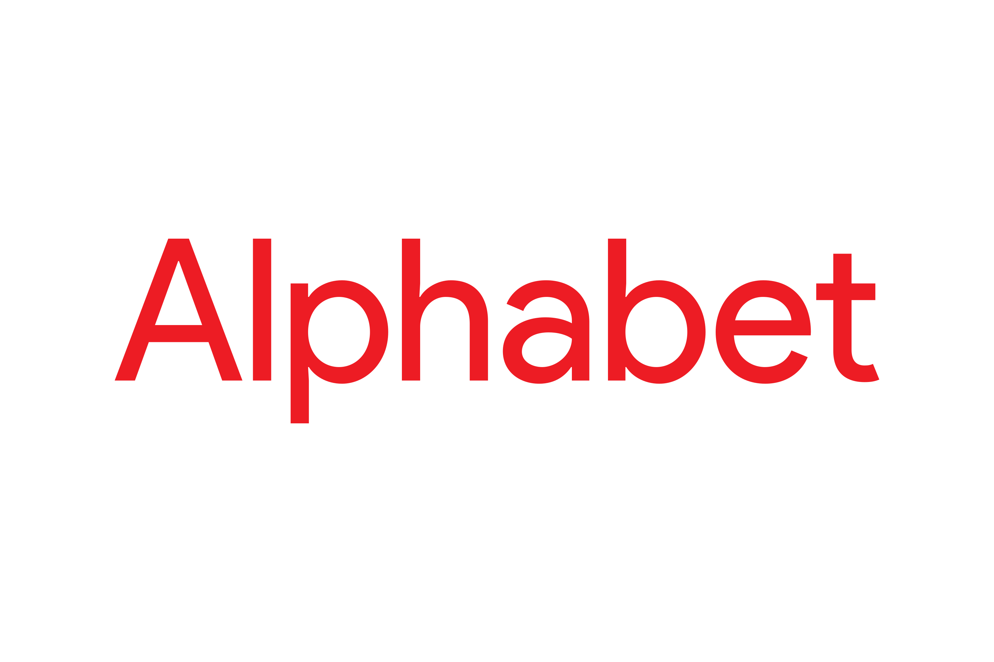
Alphabet (GOOGL) – Google Beats, with Earnings per share up to $2.31 Waymo Robotaxis Expand to Freeway Use in San Francisco took profits on long 12/$110-$120 call spread took profits on long 12/$1,200-$1,230 bull call spread, took profits on long 9/$1,030-$1,080 vertical bull call spread

Slide 39
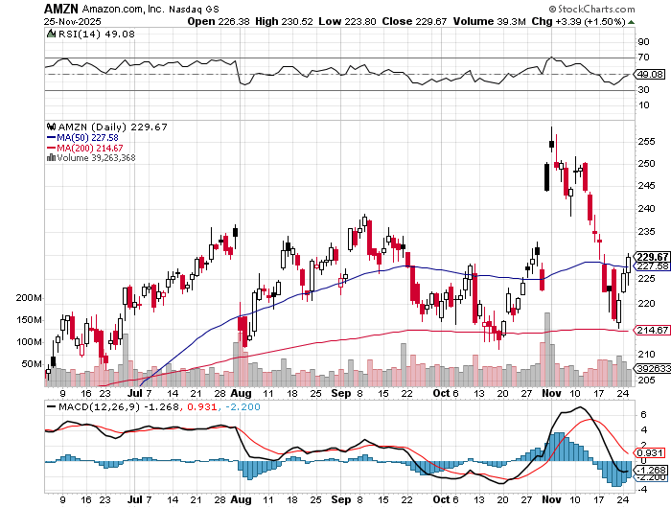

Amazon (AMZN) – Antirust Target Amazon Sells Off on Earnings, Warren Buffet buys major statke took profits on long 3/$155-$160 bull call spread , took profits on long 2/$130-$135 bull call spread

Slide 40
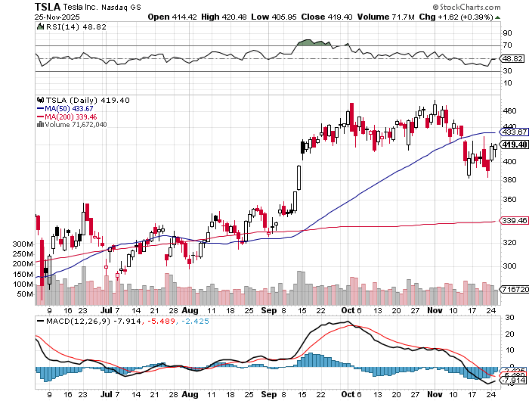

Tesla (TSLA) – Elon Musk Bags $1 Trillion Package, after 75% of shareholders approved European sales crater in October, Tesla Loses One Million EV Sales, over Elon Musk’s extremist political views took profits on long 10/$510-$520 put spread, took profits on 8/$370-$380 put spread took profits on long 7/$420-$430 put spread, took profits on long 7/$360-$370 put spread took profits on long 7/$180-$190 put spread, took profits in long 6/190-$200 call

Slide 41
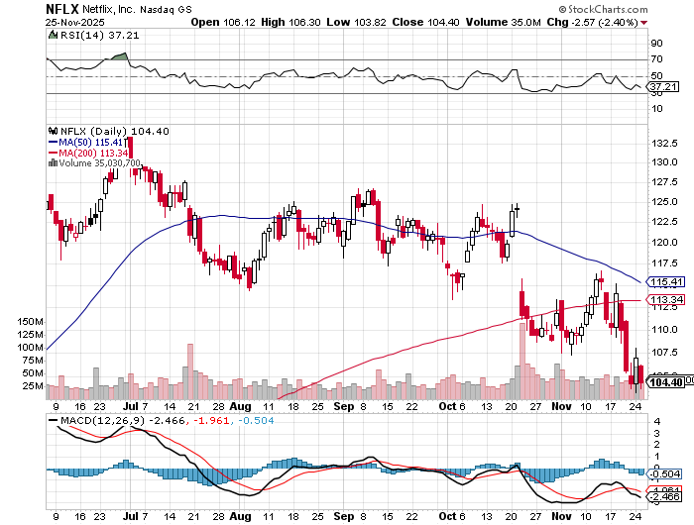

Netflix (NFLX) – Netflix Up Sharply on Warners Brothers Discovery Bid Bernstein Targets $1,34 FOR NETFLIX Took profits on 11/$100-$102 call spread took profits on long $1040-$1060 call spread, took profits on long 4/800-$810 call spread

Slide 42
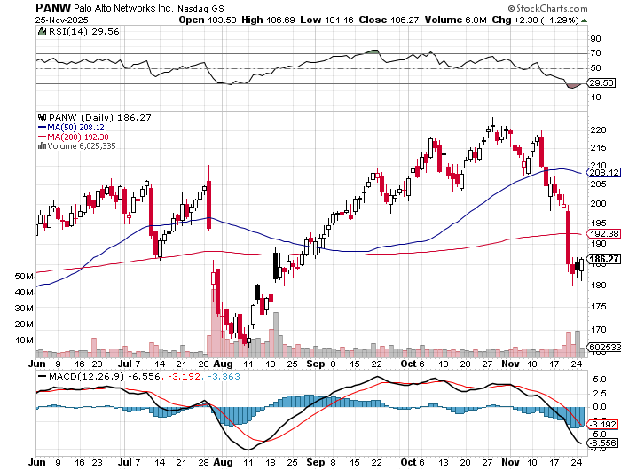

Palo Alto Networks (PANW)- Hacking never goes out of fashion Is AI Putting SaaS Out of Business? took profits on long 2/$260-$270 call spread, took profits on long 10/$130-$140 call spread

Slide 43
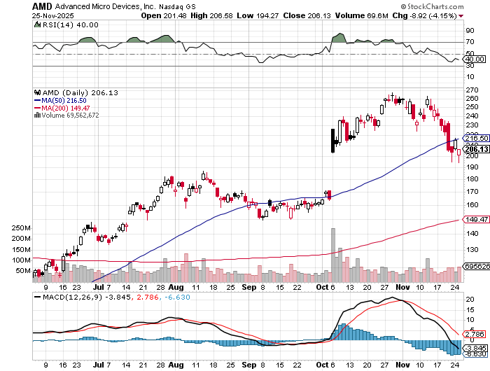

Advanced Micro Devices (AMD)- Recession fears programable logic devices took profits on long 2/$75-$80 call spread

Slide 44
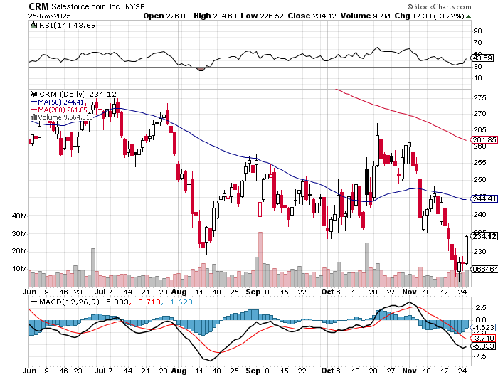

Salesforce (CRM)- Is AI Putting SaaS Out of Business? took profits on long 12/$185-$195 call spread, took profits on long 9/$125-$130 vertical bull call spread took profits on long 8/$125-$130 vertical bull call spread

Slide 45
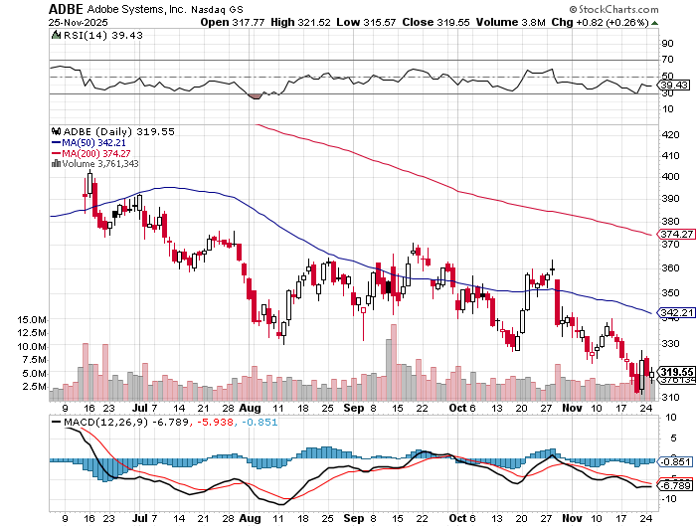

Adobe (ADBE)- Is AI Putting SaaS Out of Business? The Quality Non-China tech play

Slide 46
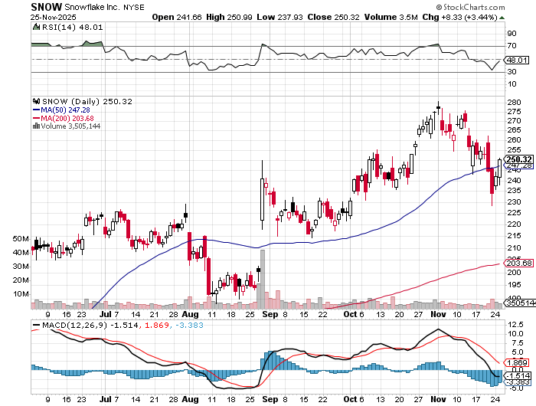

Snowflake (SNOW)- Blockbuster AI Earnings stopped out of long 4/$150-$255 call spread, took profits on long 12/$135-$140 call spread

Slide 47
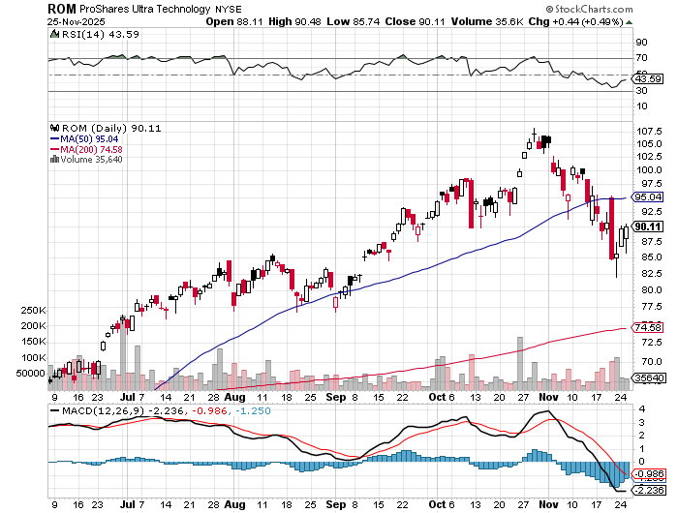
ProShares Ultra Technology ETF (ROM) – 2X Long Technology ETF took profits on long 10/$62-65 call spread

Slide 48
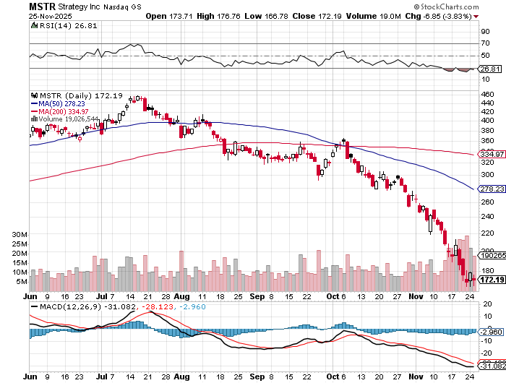

MicroStrategy (MSTR) – Long Bitcoin Play Money is Moving out of Bitcoin Ethereum- Down 63% since July took profits on Long 6/$260-$270 call spread Took profits on long 6/$500-$510 put spread, took profits on long 6/$470-$480 put spread took profits on long 6/$330-$340 call spread, stopped out of long 6/$335-$345 put spread

Slide 49
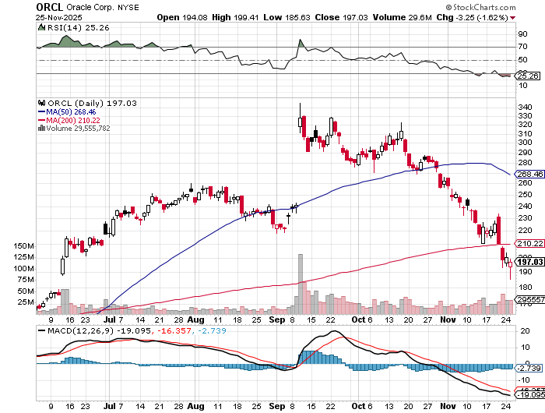

Oracle –(ORCL) – Spectacular Earnings Forecast but $100 billion in debt – down 47% since September high

Slide 50
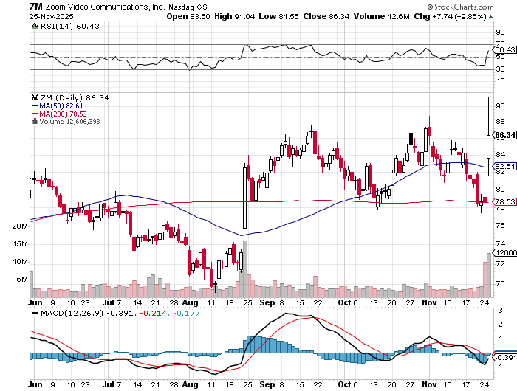

Zoom –(ZM) – Coming Back from the Dead Great Earnings took profits on 11/$72-50-$77.50 call spread

Slide 51
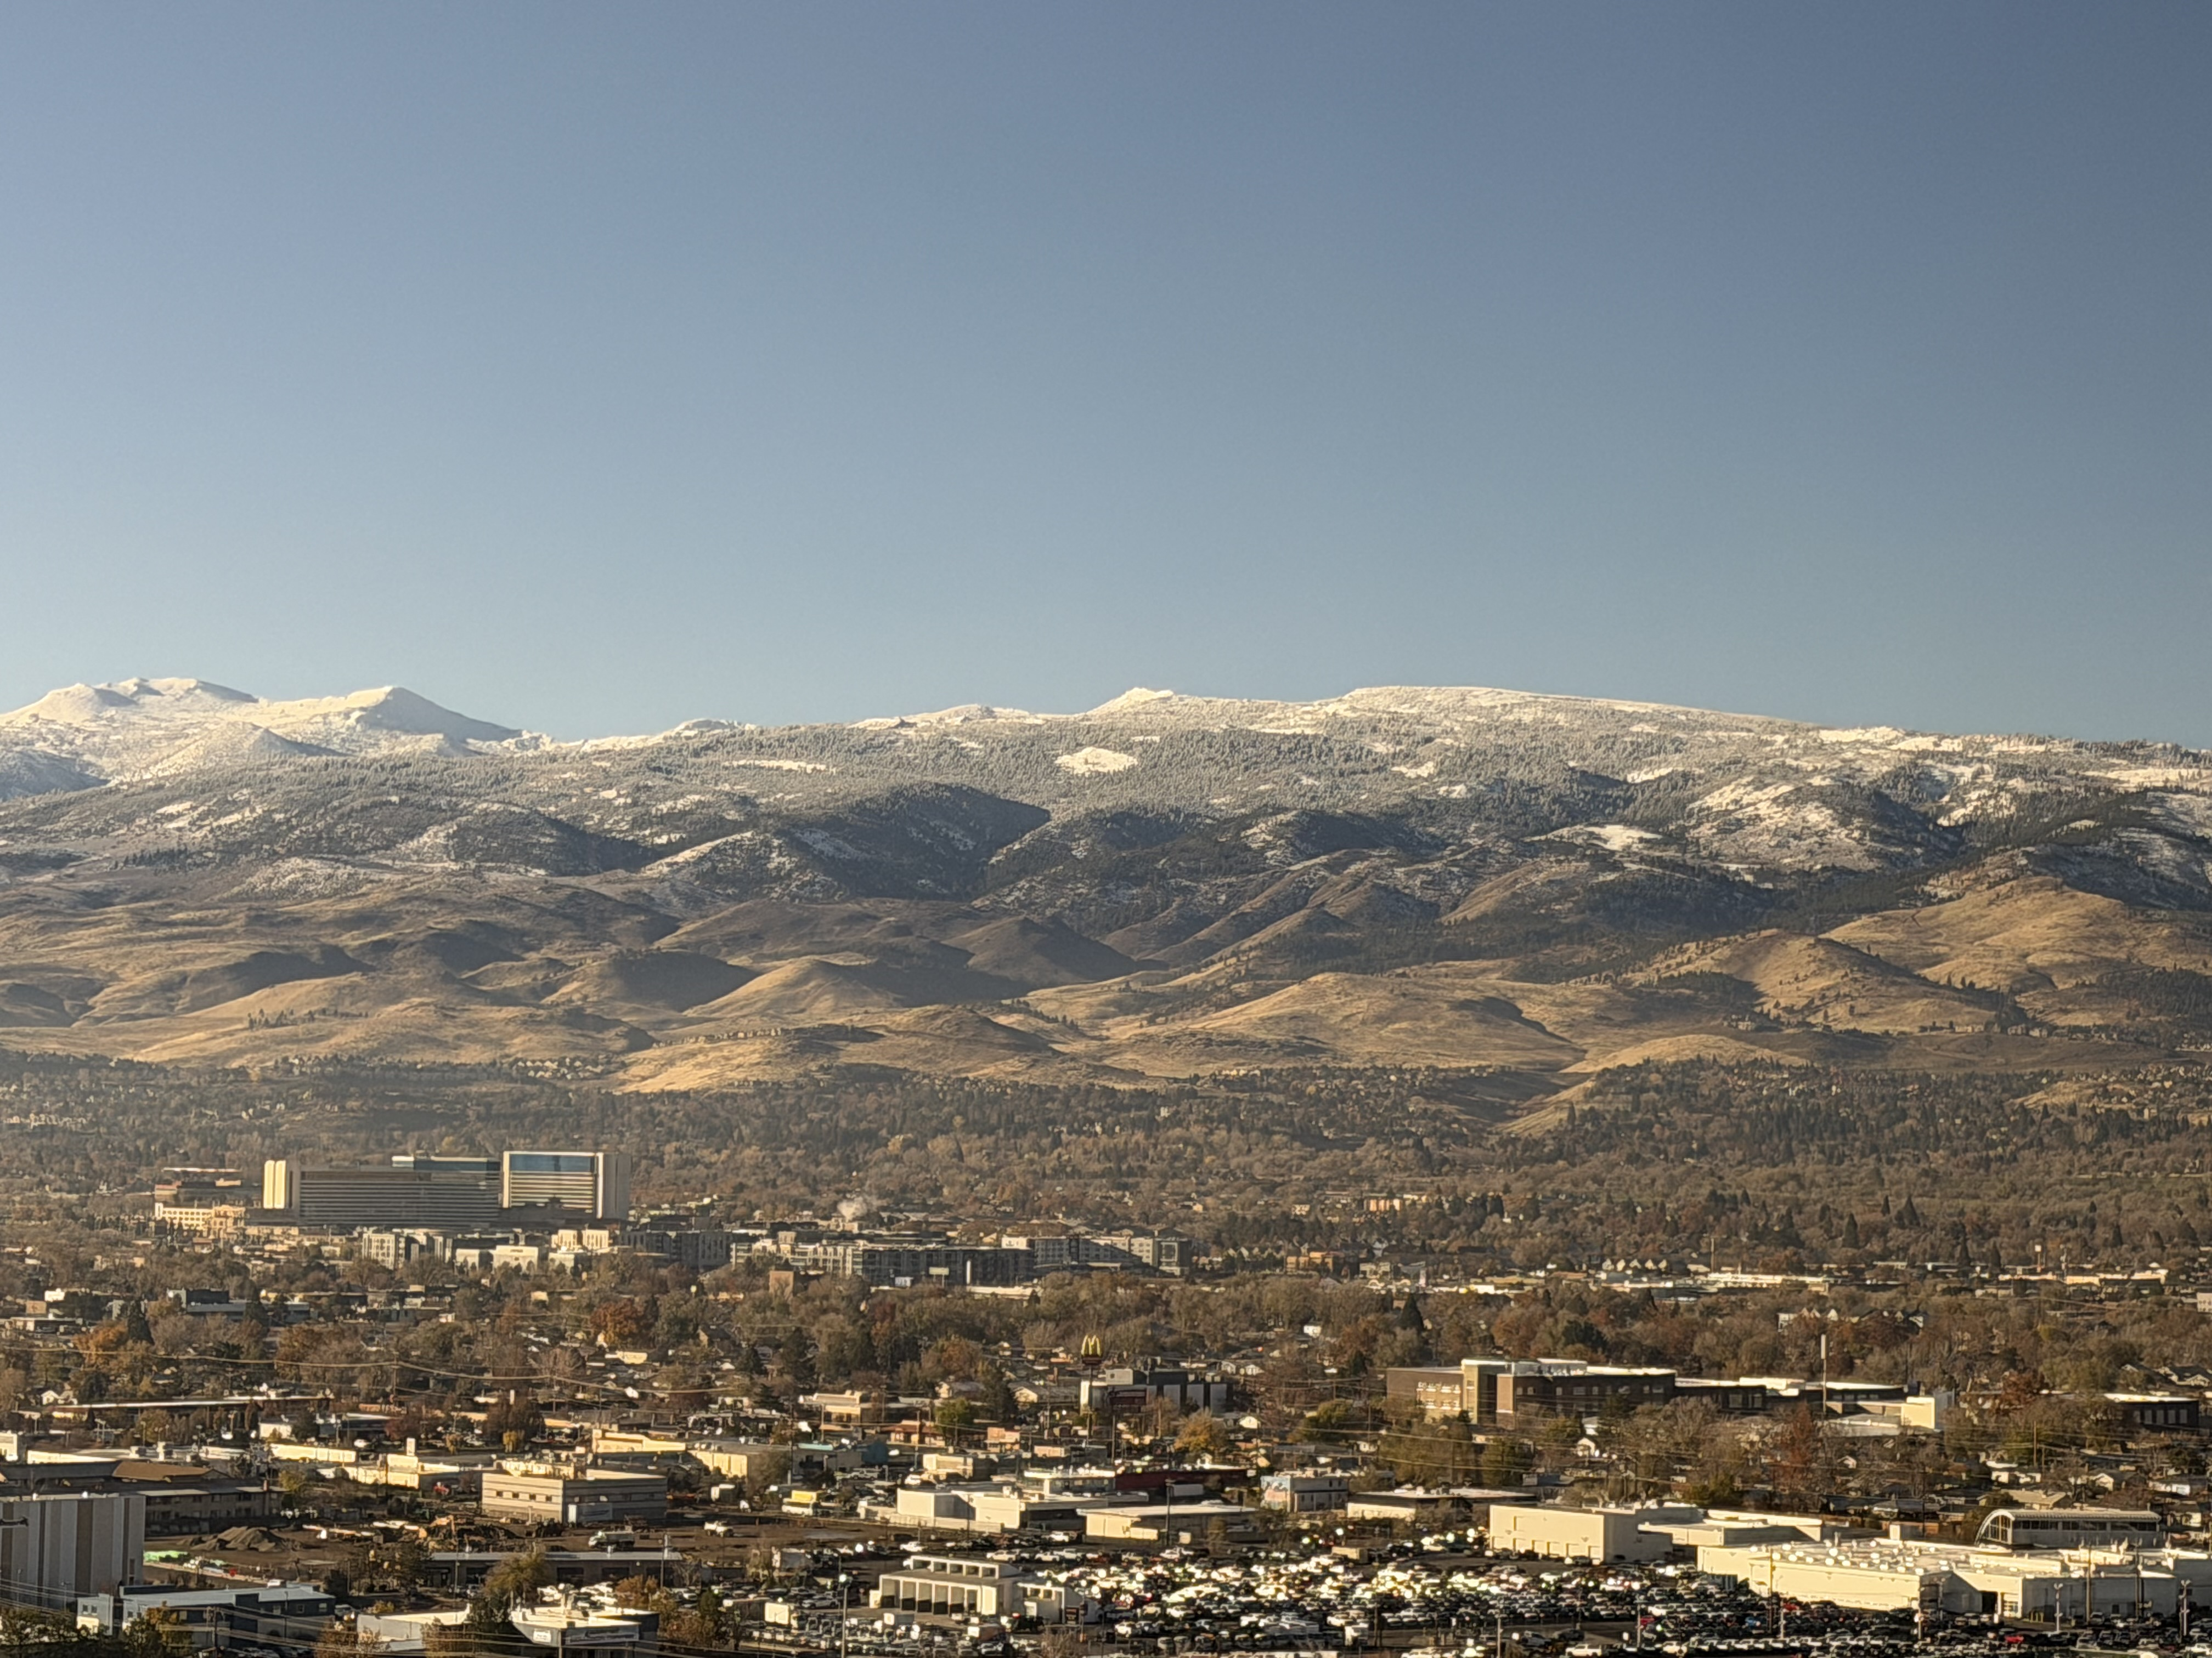

Slide 52
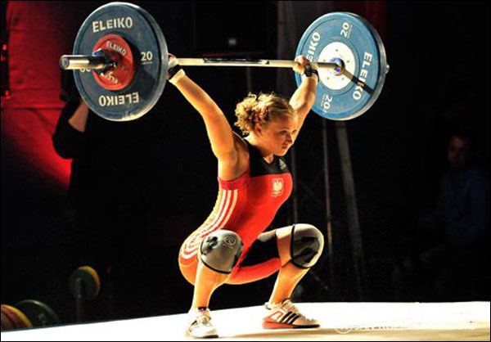
The Second Half of the Barbell
*Bets on a domestic recovery in 2022 Q4 *Upside potential in 2024 far greater than tech *Some of these have not moved for 5 or 10 years *Focuses on economically sensitive cyclical industries *Makes a great counterweight to high-growth technology *We could spend all of next ten years rotating between the two groups

Slide 53
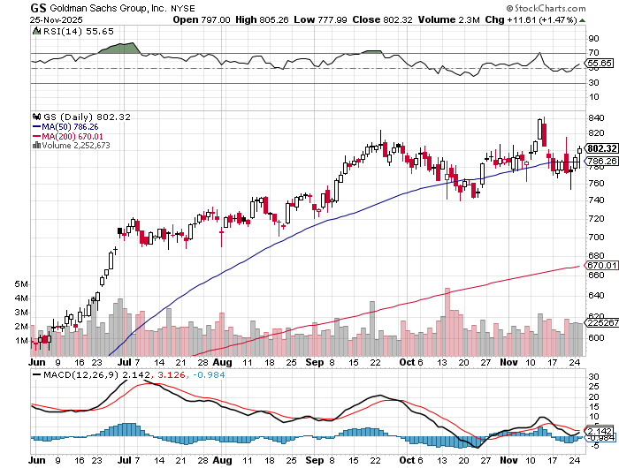

Goldman Sachs (GS) – Upside Breakout! Goldman Sachs Q3 Earnings Rock took profits on long 11/$700-$710 call spread , took profits on long 10/$700-$710 call spread took profits on long 9/$690-$700 call spread, stopped out of 3/$380-$390 call spread, profits on long 12/$330-$350 call spread, took profits on long 11/$330-$350 call spread

Slide 54
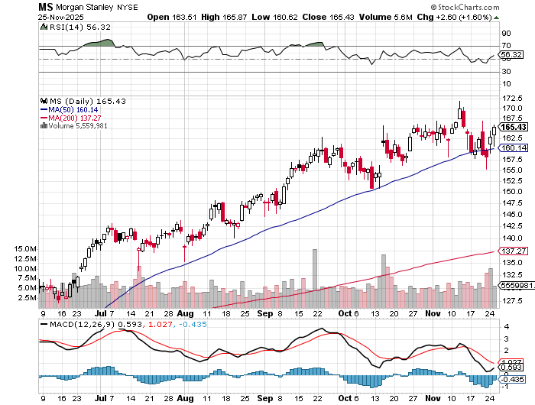

Morgan Stanley (MS) - Upside Breakout! Morgan Stanely Reports Record Profits long $12/150-$155 call spread, took profits on long $12/210-$220 call spread,, took profits on long $12/210-$220 call spread, Took profits on long $195-$205 call spread, took profits on long 4/$65-$70 call spread

Slide 55
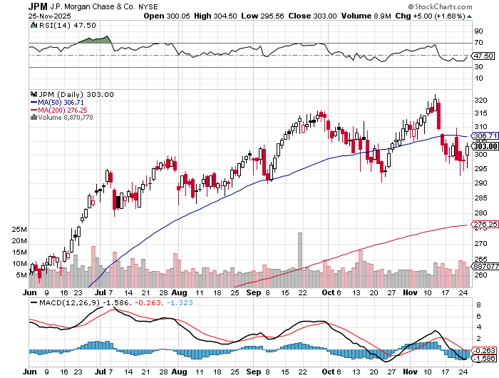

JP Morgan Chase (JPM) – Upside Breakout took profits on long 9/$270-$280 call spread stopped out of 3/$235-$245 calls spread, profits on long 12/$210-$220 call spread, took profits on long 11/$195-$205 call spread, took profits on 4/$215-225 put spread

Slide 56
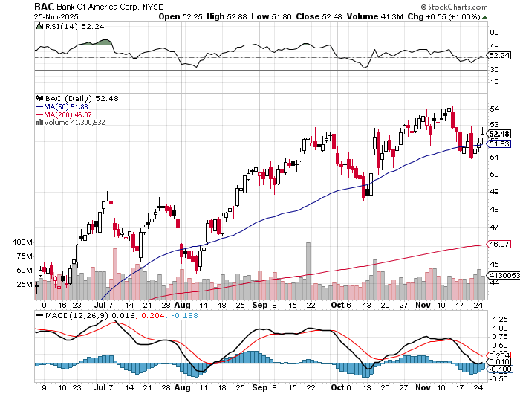

Bank of America (BAC) – Upside Breakout? took profits on long long 12/$41-$44 call spread, took profits on long 4/$20-$23 call spread

Slide 57
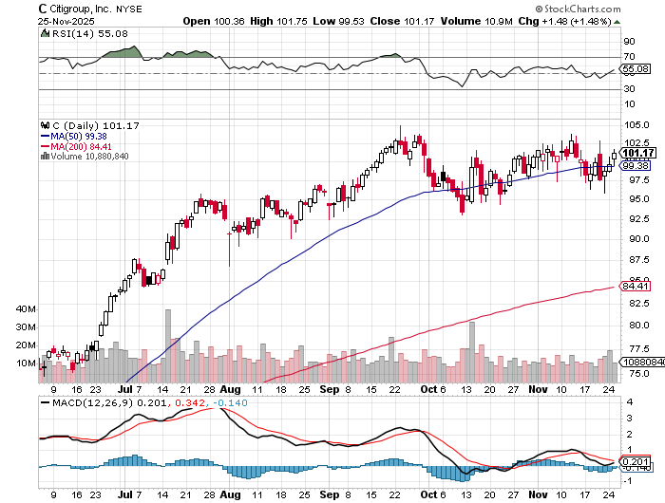

Citigroup (C) – Upside Breakout took profits on long long 12/$60-$65 call spread , took profits on long 4/$30-$35 call spread

Slide 58


Charles Schwab (SCHW) – Upside Breakout took profits on long 4/$30-$35 call spread

Slide 59


Interactive Brokers (IBKR) – Upside Breakout? stopped out of long 3/$160-$170 call spread, out of long 8/$110-$115 call spread , took profits on long 4/$60-$65 call spread

Slide 60


Berkshire Hathaway (BRKB)- Ultimate defensive stock Berkshire Hathaway Builds Record Cash, at $334 billion – Is the new T Bill proxy stopped out of long 12/$405-$415 call spread, took profits on long 12/$320-$330 call spread took profits on long 4/$260-$270 call spread, took profits on long 1/$290-$300 call spread

Slide 61


Blackrock (BLK)-Asset Collection Boom Blackrock Reports Record $12.5 trillion in Assets Under Management stopped out of 12/$1,000-$1,010 call spread, took profits on long 12/$850-$860 call spread took profits on long 3/$770-$790 call spread, took profits on long 3/$310-$340 call spread

Slide 62

SPDR Metals & Mining ETF (XME) – long 2/$28-$30 call spread

Slide 63


Boeing (BA) – Renaissance Boeing Jet Deliveries are Surging. The company delivered 57 commercial aircraft in August, its best performance for the month since 2018

Slide 64


General Motors (GM) – Worst Off Trade War Victim Earnings better than expected plus interest rate beneficiary stopped out of long 4/$52.50-$57.50 put spread at cost, long 3/$53-$56 put spread

Slide 65


Package Delivery- United Parcel Service (UPS) – UPS Deliveries Slow Worldwide, it the wake of the shutdown of its Kentucky hub after a fatal crash took profits on long 11/$130-$140 call spread

Slide 66


Caterpillar (CAT)- Ag + Infrastructure + Housing stopped out of long 8/$310-$320 call spread, took profits on long 12/$220-$230 calls spread took profits on long 12/$145-$150 call spread, took profits on long 11/$125-$135 call spread

Slide 67


Deere & Co. (DE)- Ag + Infrastructure + Housing took profits on long 8/$330-$340 put spread stopped out of long 8/$330-$340 calls spread

Slide 68


Freeport McMoRan - (FCX)- Coming Copper Crisis 50% copper tariff took profits on long 8/$34-$37 call spread took profits on long 4/$37-$40 call spread, took profits on long 5/$42-$45 call spread, stopped out of long $48-$51 put spread, profits on long 6/$32-$35 call spread

Slide 69


Walt Disney (DIS) -Disney Beats Disney Dives on Earnings Bust, although streaming broke even versus an expected loss

Slide 70


Industrials Sector SPDR (XLI)- (GE), (MMM), (UNP), (UTX), (BA), (HON)

Slide 71


Union Pacific RR (UNP)- Big Stuff to Ship The Largest Railroad in History, may be the result of the Union Pacific (UNP)/Norfolk Southern merger worth $200 billion took profits on long 5/$200-$210 call spread took profits on 11/$150-$160 call spread

Slide 72


Walmart (WMT) – Trade War Victim took profit on Long 11/$125-$130 bear put spread, took profit on Long 10/$119-$121 bear put spread took profits on Long 8/$114-$117 bear put spread

Slide 73


Costco (COST) – Trade War Victim took profits on long 4/$840-$850 call spread

Slide 74


Delta Airlines (DAL) – Ticket Price Take Off US Cuts 10% of All Flights, at 40 major airports in response to the government shutdown

Slide 75


Transports Sector SPDR (XTN)- Worst Hit Sector (ALGT), (ALK), (JBLU), (LUV), (CHRW), (DAL)

Slide 76


Health Care Sector (XLV) – Defensive Play and Cheap (JNJ), (PFE), (MRK), (GILD), (ACT), (AMGN)

Slide 77


Amgen (AMGN) long 7/$260-$270 bull call spread, took profits on long 11/$185-$200 bull call spread

Slide 78


Visa (V) – Stablecoin Competition took profits on long 2/$240-$250 bull call spread took profits on long 10/$160-$170 bull call spread, took profits on long 6/$150-$160 bull call spread

Slide 79


Consumer Discretionary SPDR (XLY) (DIS), (AMZN), (HD), (CMCSA), (MCD), (SBUX)

Slide 80


Slide 81

Bonds – Dead Money
*The Bond Market May Cap AI Spending *The major cloud computing and AI platform companies known as "hyperscalers" have borrowed nearly $90 billion *Google owner Alphabet (GOOGL) selling $25 billion in bonds, Meta (META) $30 billion, Oracle (ORCL)$18 billion, and Amazon (AMZN) the most recent, $15 billion *Only Microsoft (MSFT) , the fifth one, has not tapped the debt market in recent weeks *This is on top of $10 trillion in US Government financing needs in 2026 *Will they crowd out the US government or visa versa *No trade here, no volatility, but high risk *Avoid (TLT), (JNK), (NLY), (SLRN) and REITS

Slide 82

Treasury ETF (TLT) – took profits on long 6/$88-$91 put spread stopped out of long 6/$80-$83 call spread, took profits on long 4/$84-$87 call spread stopped out of long 1/$82-$85 call spread, took profits on long 10/$103-$106 put spread took profits on long 6/$$94-$97 put spread, took profits on long 5/$82-$85 calls spread

Slide 83

Ten Year Treasury Yield ($TNX) – 4.02%

Slide 84

Junk Bonds (JNK) 6.54% Yield

Slide 85

Municipal Bonds (MUB) 4.21% Yield-

Slide 86

Emerging Market Debt (ELD) 5.62% Yield-

Slide 87

2X Short Treasuries (TBT)-Out of Favor

Slide 88

Anally Capital Management (NLY) – Leveraged REIT Play Yield 13.25% took profits on long 12/$15-$16 call spread

Slide 89

Foreign Currencies – Dollar Strength Going into Fed Meeting
*US Dollar Faces a Prolonged Decline, off the back of coming Fed interest rate cuts *Foreign currencies trade off of interest rate differentials and Fed rate cut futures at 30% supported the buck *The US dollar strength last week is from a flight to safety bid from the stock market selloff *We may see another 20% move down as more Fed interest rates cuts loom *Next dollar weakness will come with evidence of more rate cuts *Buy (FXA), (FXE), (FXB), (FXC), and (FXY)

Slide 90


THE MAD HEDGE FUND TRADER
Australian Dollar (FXA) - Major Long-Term Bottom is In Targeting Parity – A call option on a global synchronized recovery

Slide 91


Japanese Yen (FXY)

Slide 92


Euro (FXE)-

Slide 93


British Pound (FXB)-

Slide 94


Emerging Market Currencies (CEW)

Slide 95

Energy & Commodities – Worst Asset Class
*Proposed new peace treaty for Ukraine prompts another oil selloff *Cold winter has sent natural gas soaring *Chile’s (SQM) Expects 25% Lithium Demand Increase in 2026 *US to Stop Minting Pennies *Avoid all conventional energy plays in oil and gas *Crude oil is down 20% YTD, the worst performing asset class

Slide 96

Oil-($WTIC)

Slide 97

United States Oil Fund (USO)

Slide 98

Energy Select Sector SPDR (XLE)-No Performance! (XOM), (CVX), (SLB), (KMI), (EOG), (COP)

Slide 99

ExxonMobil (XOM)- Exxon Moves Big into Lithium, with the construction of a major mining operation in Arkansas took profits on Long 4/$100-$105 call spread, took profits on long 12/$120-$125 put spread

Slide 100

Occidental Petroleum (OXY)- Buffet’s a Buyer took profits on long 4/$59-$62 call spread took profits on long 2/$55-$60 call spread, took profits on long 12/$77.50-$82.50 put spread

Slide 101

Natural Gas (UNG) – Rally on Cold Winter took profits on Long January 2025 $7-8 Call Spread LEAPS

Slide 102

Cameco (CCJ) – Global Uranium Renaissance Microsoft to Reopen Three Mile Island to power AI data centers took profits on long 12/$41-$44 call spread, took profits on long 12/$35-$38 call spread, took profits on long 5/$20-$23 bull call spread

Slide 103

Vistra Corp. (VST) – Global Uranium Renaissance took profits on long 2/$100-$110 call spread

Slide 104

Precious Metals –
*BHP Takes a Run at Agnico Eagle (AEM), a producer of 3.5 million ounces of gold a year *Barrack Gold (B) may break up, as costs are rising faster than gold prices *Randgold Resources merger in 2018 failed because cost rose faster than the price of gold *Precious metals and related mining stocks are digesting gold correction *The charts suggest that gold and gold miners are due for a more prolonged period of consolidation to reset their bullish long-term trends. *There is gap-based support near $3,927/oz *If it is breached, it would increase near-term downside risk to the 50-day moving average (MA), currently $3,766/oz. and rising over time *The long-term gold and silver plays are still on *

Slide 105


THE MAD HEDGE FUND TRADER
Gold (GLD) – Headed for $5,000....or $10,000? profits on long 6/$275-$285 call spread, took profits on long 5/$275-$285 call spread stopped out of long 6/$275-$285 call spread, took profits on profits on long 10/$230-$235 call spread
$360 -14.3% 1st support
$344 -18.1% 1st support
BUY

Slide 106

Market Vectors Gold Miners ETF- (GDX) – took profit on long 6/$207.50-$212.50 call spread, took profit on long 7/$200-$205 call spread

Slide 107


Barrick Mining (B) took profit on long 1/$15.50-$16.50 call spread

Slide 108


Newmont Mining- (NEM)- Sometimes you Just Get Lucky took profits on long 10/$47-$50 call spread, took profits on long $55-60 call spread

Slide 109


THE MAD HEDGE FUND TRADER
iShares Silver Trust (SLV) - The Better Play Industrial demand, solar panels, electric cars
2025 Target $50 +50%
BUY

Slide 110


Silver Miners - (SIL)-

Slide 111


Wheaton Precious Metals - (WPM)- LEAPS Approaching Max Profit took profits on long 4/$39-$42 call spread long 6/$75-$80 call spread-expires in 7 trading days , took profits on long 1/$36-$39 call spread

Slide 112


Platinum- (PPLT)- 556,000-ounce shortage this year took profits on long 1/$36-$39 call spread

Slide 113

Real Estate – Going Nowhere
*Home Foreclosure Jump 20% in October *Existing Home Sales Rise 1.2% in October, and up 1.7% year over year *Sales of previously owned homes in October rose to 4.1 million units on a seasonally adjusted, annualized basis, according to the National Association of Realtors *The inventory of homes for sale fell to 1.52 million units, down 0.7% from September, although still nearly 11% higher than a year earlier *At the current sales pace, there is a 4.4-month supply, still considered lean *Homebuilder Sentiment Comes in Flat *Construction Spending is Up 0.2%, the best reading of the year.

Slide 114

S&P Case Shiller Slows S&P Case Shiller Rises to +1.60% YOY in August, with its National Home Price Index New York gained +6.1%, Chicago +5.9%, and Cleveland +4.7%. Tamps and Dallas down -2.2%

Slide 115


Crown Castle International (CCI) – 6.62% yielding 5G cell phone tower REIT Eliot Management Pushes up stock with activist bid took profits on Long 8/$90-$95 call spread,

Slide 116



US Home Construction Index (ITB) (DHI), (LEN), (PHM), (TOL), (NVR)

Slide 117


DH Horton (DHI) Earnings Hit on free upgrades eating into margins took profits on long 11/$165-$175

Slide 118

Trade Sheet- The Recession Trade So What Do We Do About All This?
*Stocks –buy interest rate sensitives and tech *Bonds – stand aside *Commodities – buy dips *Currencies – buy dips *Precious Metals – buy dips *Energy – stand aside *Volatility – sell over $30 *Real estate – buy dips

Slide 119

Next Strategy Webinar 12:00 EST Wednesday, December 10, 2025 from Incline Village, NV Last Webinar of the Year email me questions at https://www.madhedgefundtrader.com/jp-ms-0925
Good Luck and Good Trading!
Notes:
*

Slide 120


Slide 121


