Slide 1
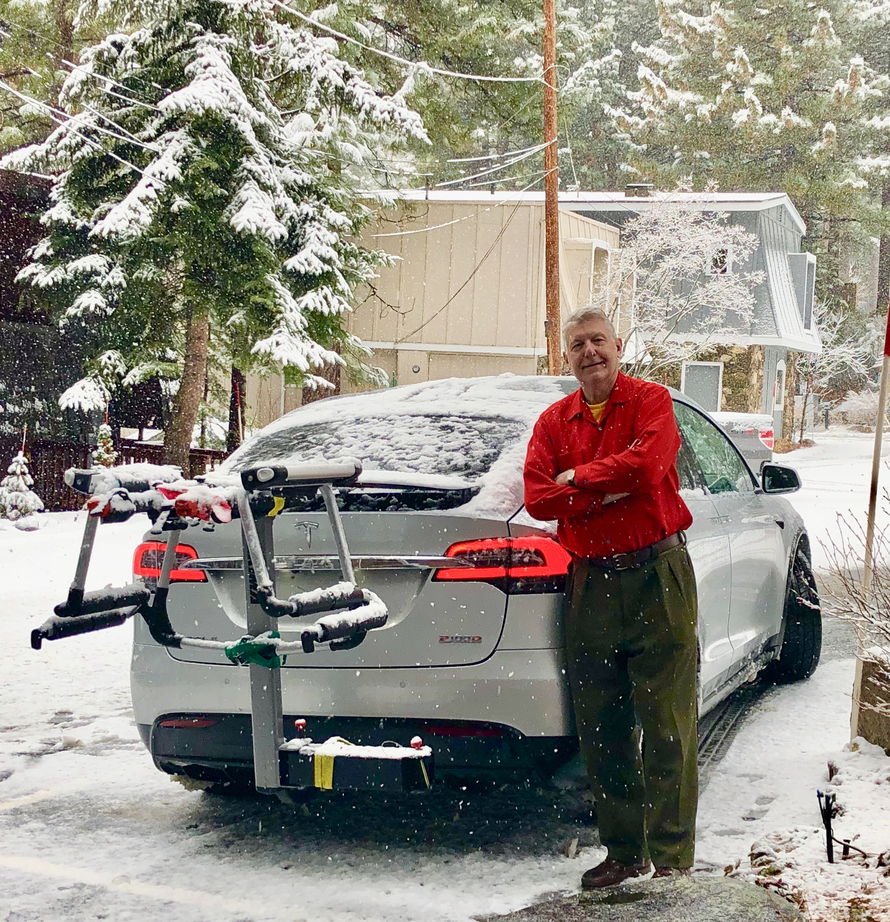
The Mad Hedge Fund Trader
“Special Christmas Issue”
With John Thomas
Incline Village, NV December 10, 2025
www.madhedgefundtrader.com
Notes:
*

Slide 2
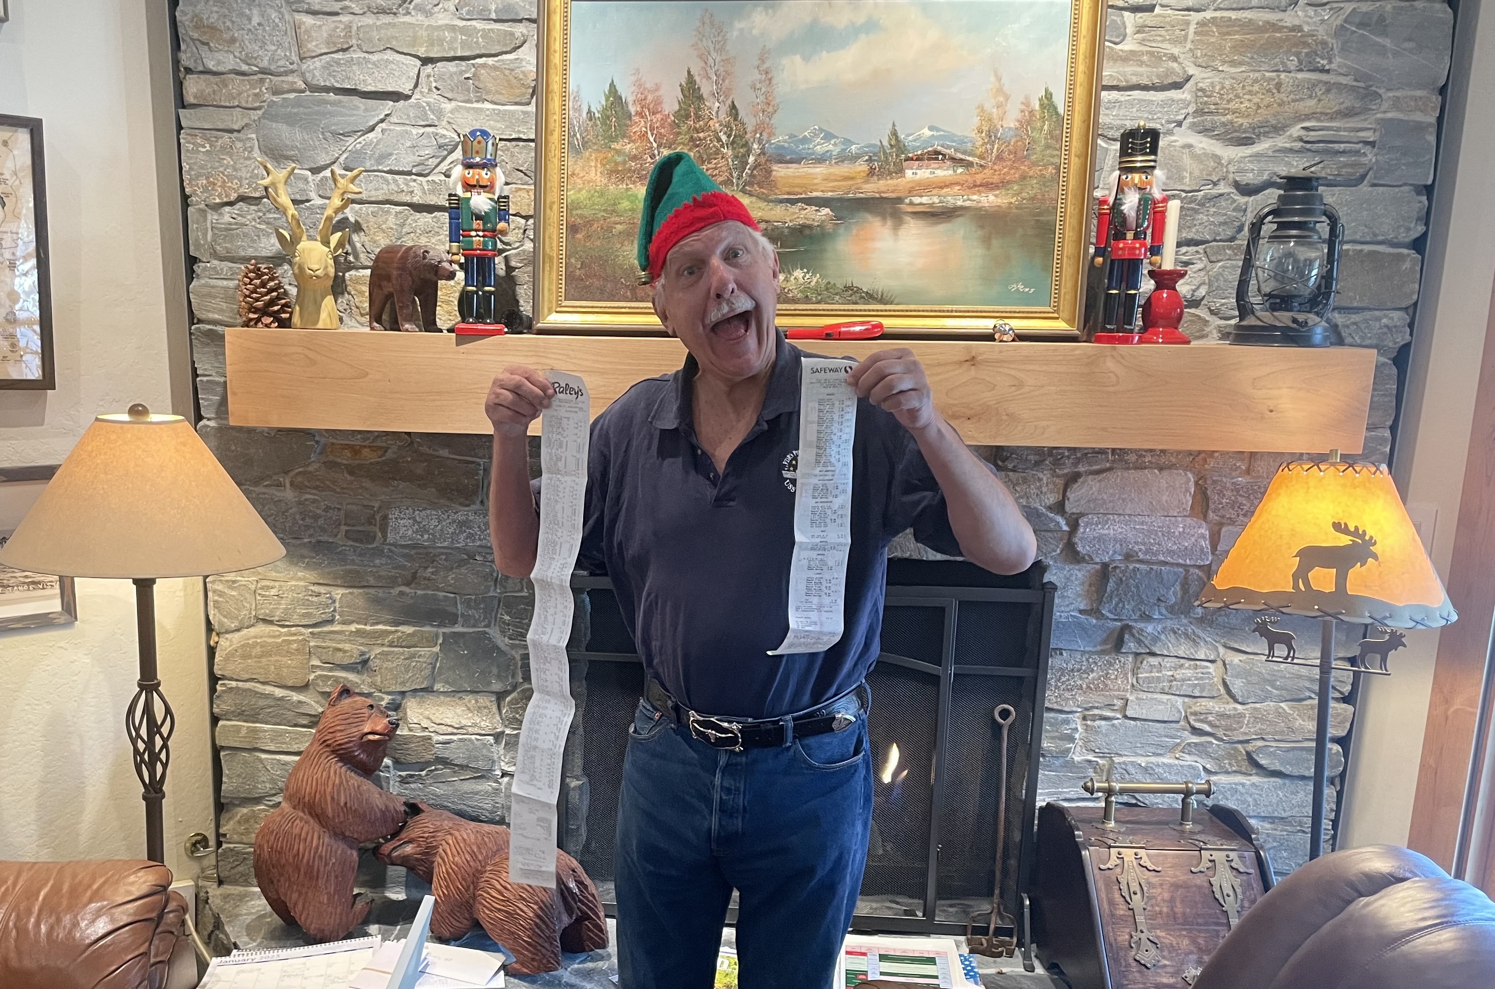

Slide 3

Trade Alert Performance
New All-Time Highs-17 Consecutive Positive Months
*January +5.80% Final *July +5.21% Final
*February +3.66% Final. *August +1.37% Final
*March +4.36% Final *September +2.21% Final
*April +0.95% Final *October +3.11% Final
*May +2.51% Final *November +2.33 MTD
*June +15.48% Final *December +2.66% Final
*2025 Year To Date +62.02%
+813.59% since inception
*Versus 84.63% for all of 2022
*Versus 79.79% for all of 2023
*Versus 75.29% for all of 2024

Slide 4
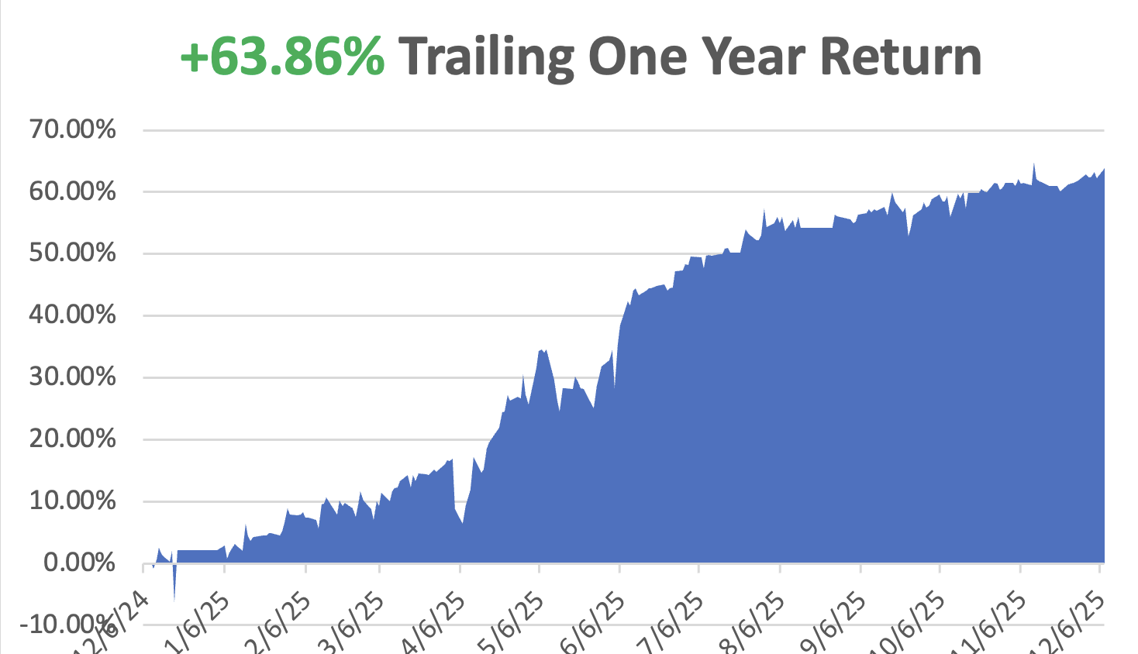

Slide 5
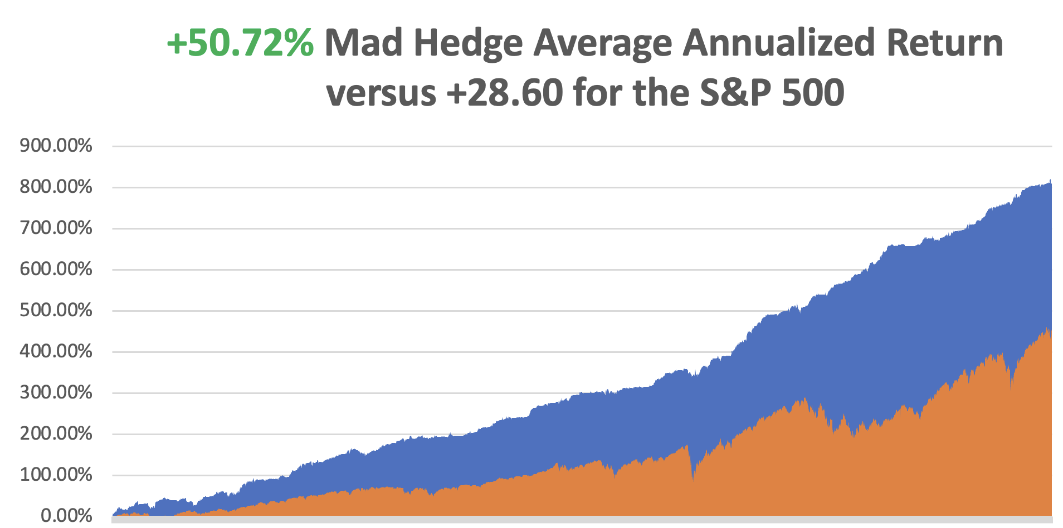

Slide 6


Slide 7
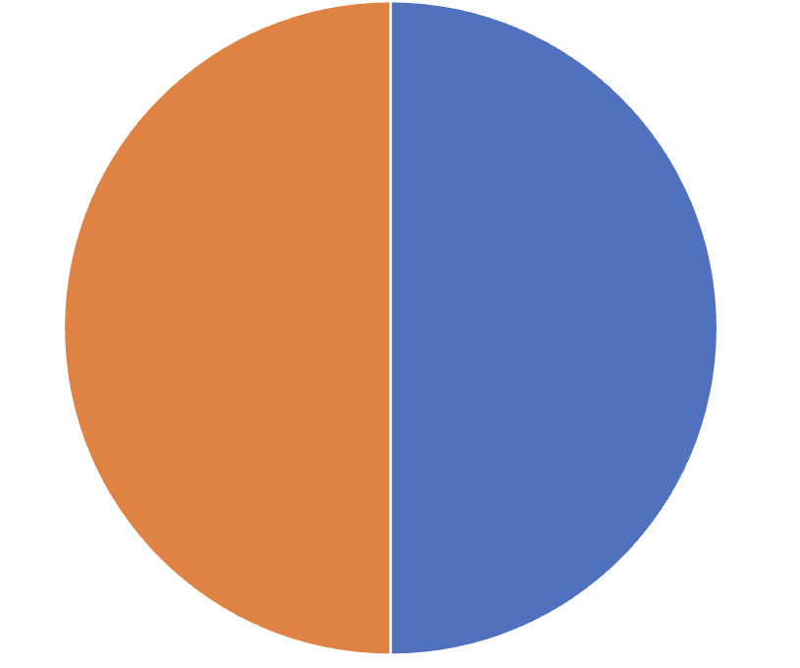
Portfolio Review – High Risk Market Require Maximum Cash
20% risk on, 0% risk off, 80% cash
Entering a very high-risk market
Current Capital at Risk
(MS) 12/$150-$150 call spread | 10.00%
(GLD) 12/$355-$360 call spread | 10.00%
Risk Off
No Positions | 0.00%
Total Net Position | 20.00%
Expiration Value
+62.32%

Slide 8

The Method to My Madness
*The Yearend rally is done, with crypto hitting a short-term bottom for now
*The market still have two big overhangs: Fed interest rate decision on December 10 and the Supreme Court Tariff decision
*Bonds are dead in the water on $42 trillion National Debt overhang, and $42 trillion if the tariffs fail
*The long-term bull arguments of super liquidity, AI, falling interest rates are still the market drivers
*Jobs data remains dire
*Silver hit new high and gold is just behind
*Huge oil oversupply weighs heavily on prices in 2026
*US Dollar hits new multi month lows in line with rate cuts
*Bitcoin plumbs year lows

Slide 9

The Global Economy – Sliding
*Fed Decision in one hour could go either way. Government has held back inflation data. Buy the rumor sell the news?
*ADP Loses 32,000 Jobs in November, almost entirely by small business, which are getting wiped out by tariffs. They lost 120,000 jobs.
*Consumer Sentiment Improves. The University of Michigan's Surveys of
Consumers said its Consumer Sentiment Index increased to 53.3 this month
from a final reading of 51.0 in November.
*Core PCE Decelerates for the first Time Since April
*Layoffs Continue Unabated, planned job cuts
declined to 71,321 last month from October.
*US Services PMI Comes in Flat, little changed at
52.6 last month from 52.4 in October
*ISM Manufacturing PMI Comes in at 48.5, a five-month low.
The economy is clearly slowing

Slide 10
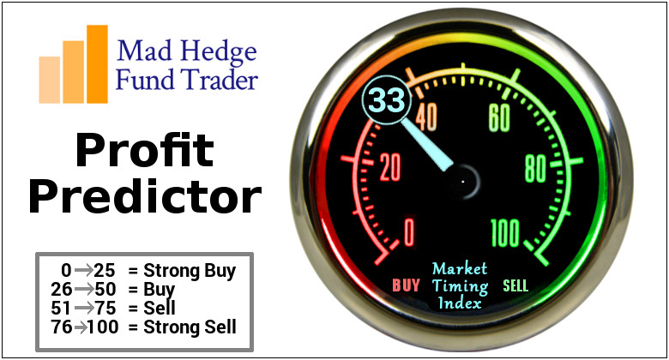

Slide 11
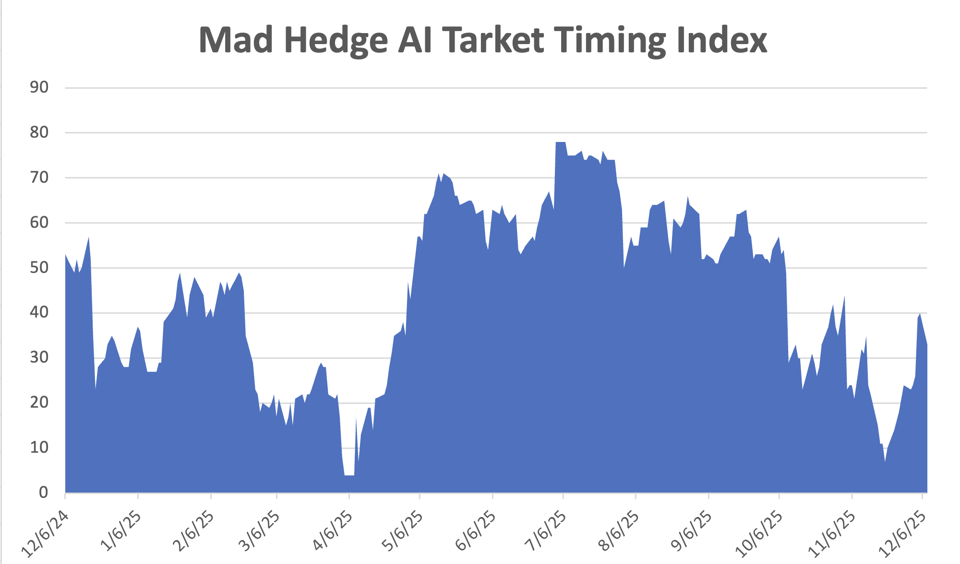
The Mad Hedge Profit Predictor
Market Timing Index – Hits Seven month Low at 6,
An artificial intelligence driven algorithm that analyzes 30 different economic, technical, and momentum driven indicators
SELL
BUY

Slide 12
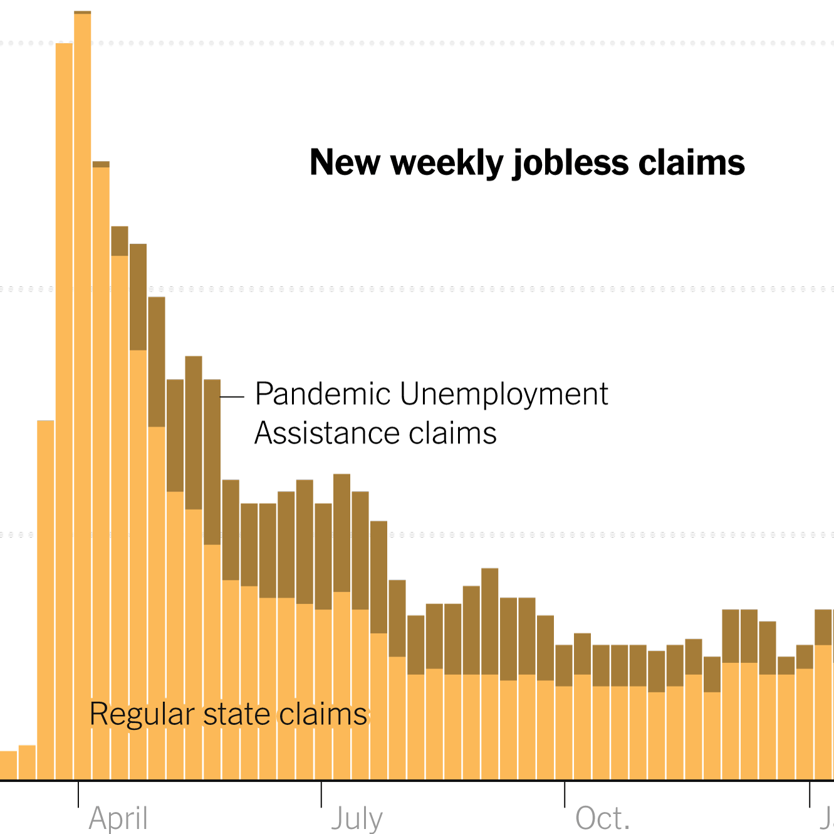
Weekly Jobless Claims –
-27,000 to 191,000 – biggest drop in 3 years

Slide 13
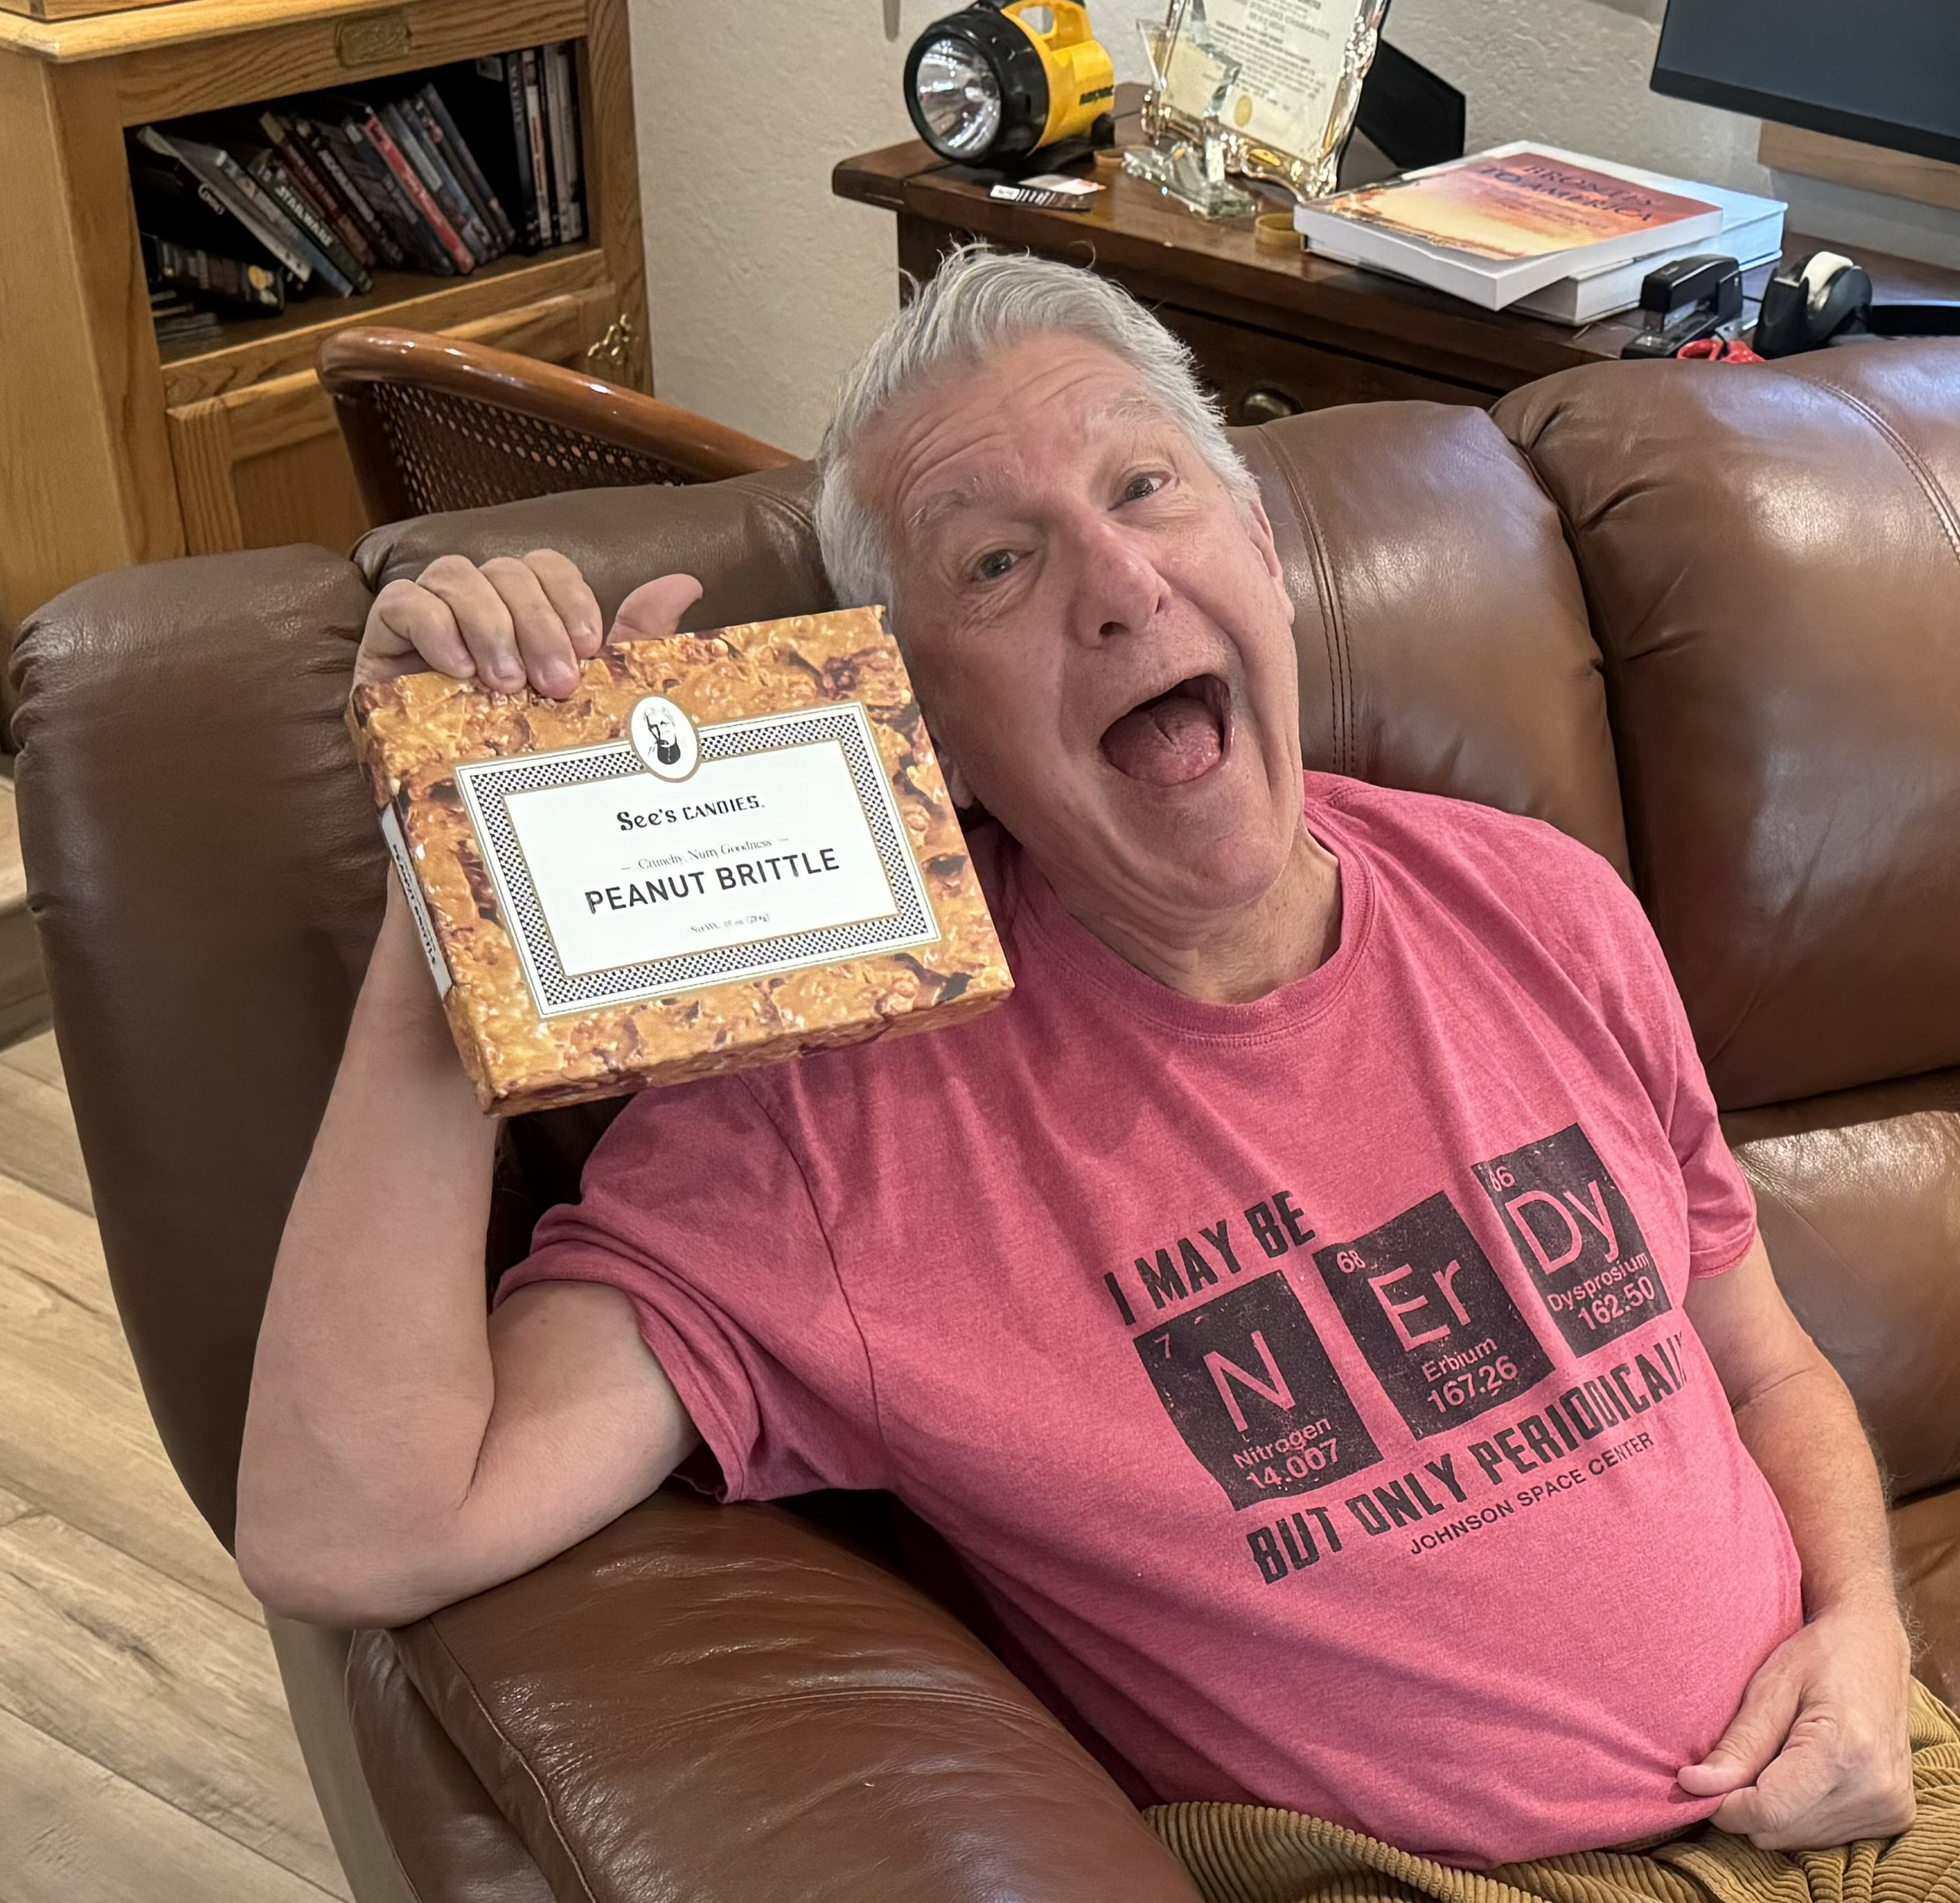

Slide 14
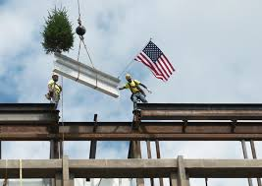
Stocks – Topping Out?
*Stocks catch fire on on Fed comments on Friday November 28
*A massive short cover is ignited
*Interest sensitive financials become the overwhelming leaders clocking gains of 10%-20%
*Bitcoin struggles to forge a bottom
*Bitcoin treasury stock Strategy (MSTR) was down 65% at the bottom
*CrowdStrike (CRWD) gets trashed on weak guidance
*Nvidia (NVDA) can sell H20 chips to China with 25%
export tax payable to the US
*Is US national security for sale with China the highest bidder?
*Technical programs have the (SPY) and Dow Average
topping out from here
*Expect volume and volatility to spring from here as the
“A” teams takes off on Friday for the year

Slide 15
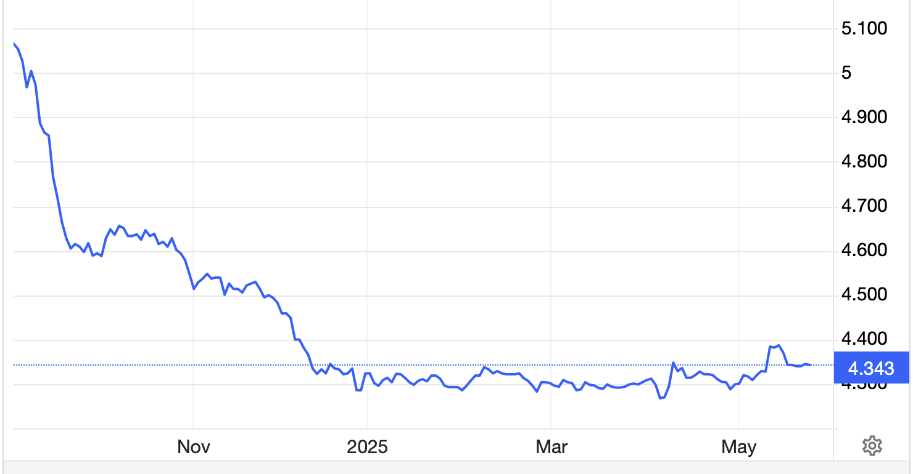
The Ultimate Hedge – Defensive stocks only go down at a slower rate
90 - day US Treasury Bills (Warren Buffet owns $340 billion)
Extend to One Year!
*Government Guaranteed principal
*Endless liquidity,
trade like water
*100% collateral value for margin
*Lock in guaranteed income
*Can be sold at any time to earn
full interest
*Will survive any bear market
*Ask your broker how to buy
3.70% Yield

Slide 16
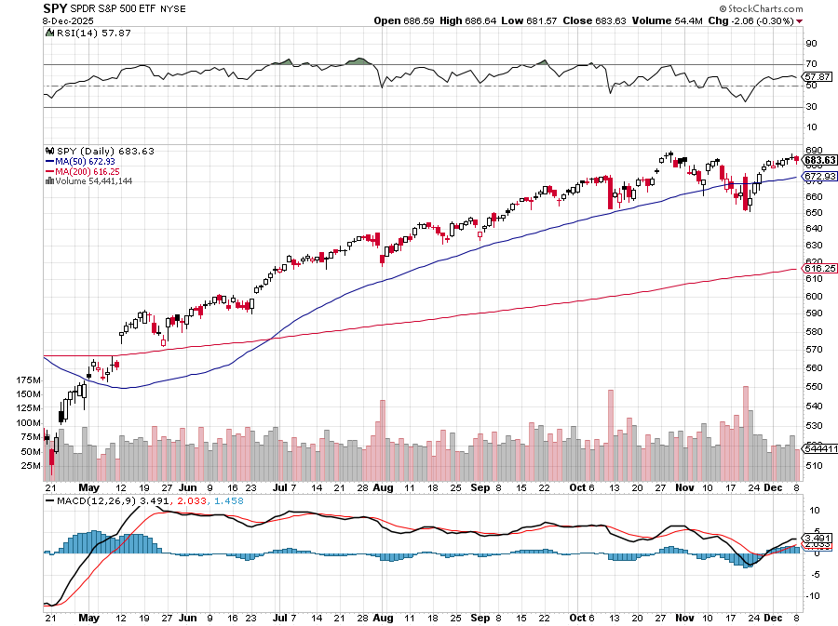
S&P 500 – Breakout! stopped out of $445-$450 put spread took profits on long 6/$660-$640 put spread took profits on 6/$610-$620 put spread
$650
-4.34%
1st support
$630
-6.60%
1st support

Slide 17
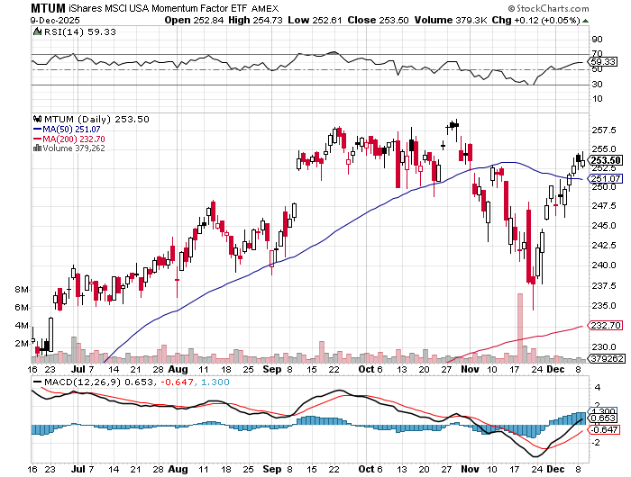
Momentum (MTUM)

Slide 18
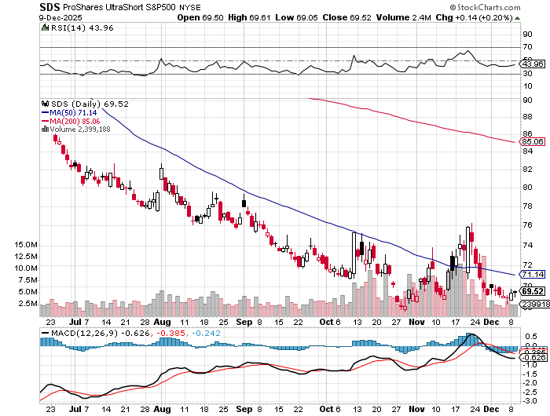
ProShares -2X Short S&P 500 (SDS) - a great 2X hedge for falling long stocks

Slide 19
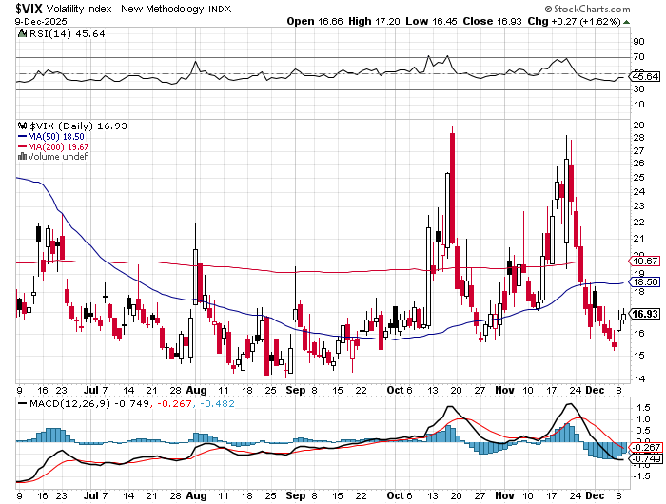
(VIX) –
Volatility Index Hits Four Year High at $65, the most since the 2020 pandemic. That implies a 2% move in the S&P 500 (SPX) every day for the next 30 days

Slide 20
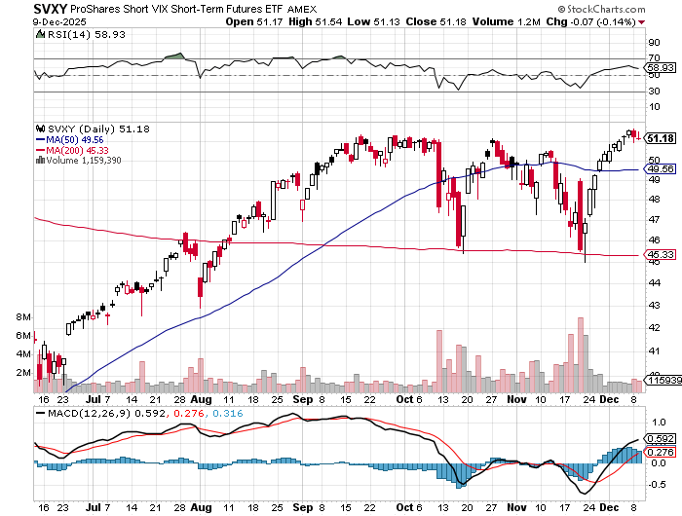
(SVXY) –Short Volatility ETF bought at $36.31 - $32.74 = $3.57

Slide 21
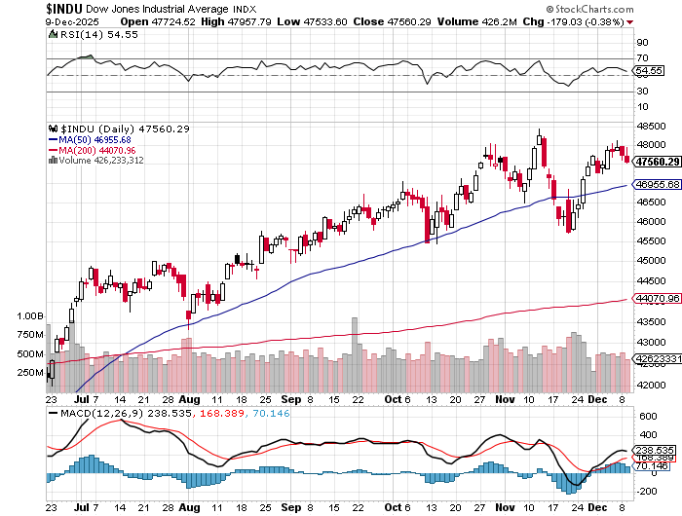
Dow Average ($INDU)-

Slide 22
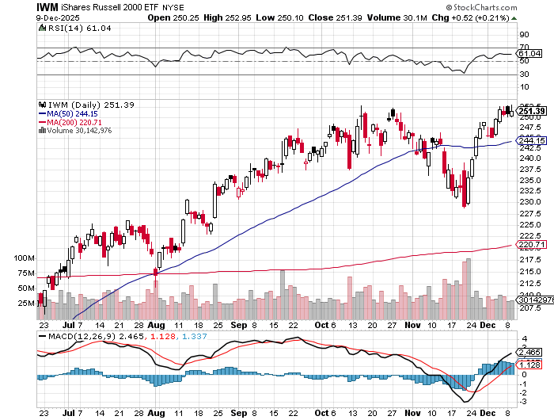
Russell 2000 (IWM)- took profits on Long 10/$137-$142 vertical bull call spread took profits on Long 10/$153-$156 vertical bear put spread

Slide 23
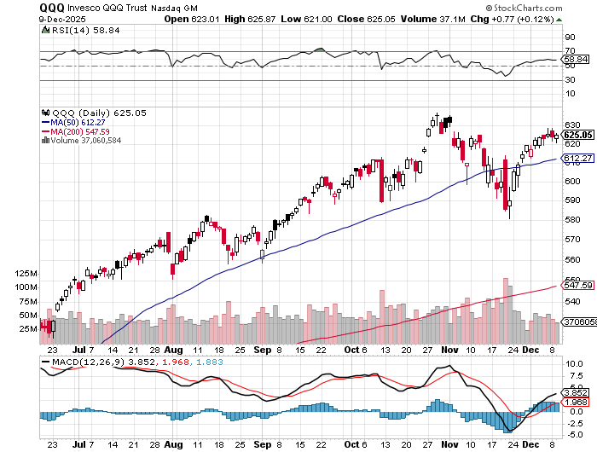
NASDAQ (QQQ) – Down 15% took profits on long 6/$540-$550-$345 put spread, took profits on Long 5/$335-$345 put spread took profits on long (QQQ) /$540-$550 put spread, took profits on long (QQQ) 4/$330-$335 put spread took profits on long (QQQ) 3/$340-$345 put spread, covered long (QQQ) $325-$330 put spread

Slide 24
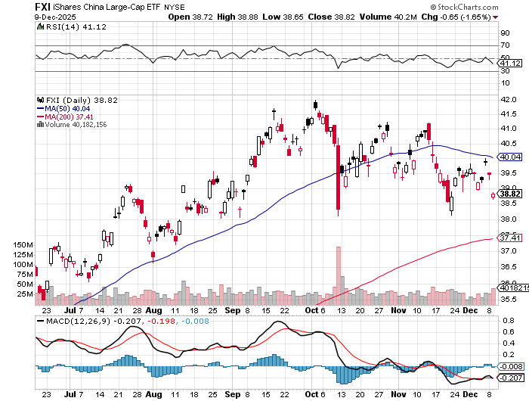
China (FXI) + 36%

Slide 25
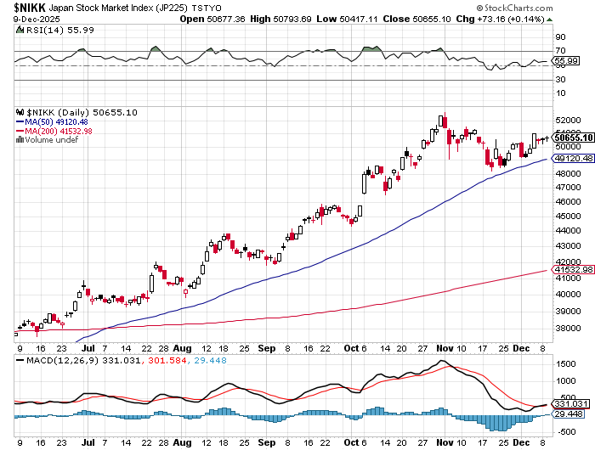
Japan ($NIKK) – down 10%
Nikkei Rockets on Japan Trade Deal, which dropped tariffs on Japanese cars to 15%

Slide 26
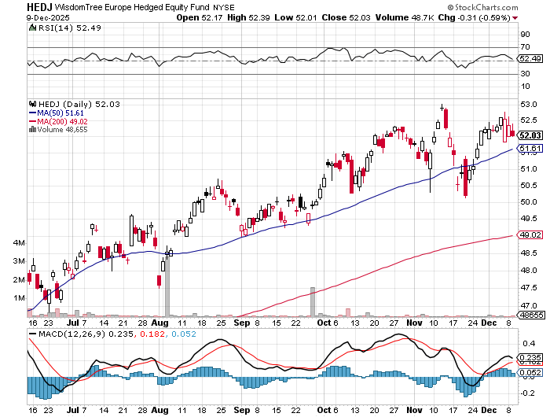
Europe Hedged Equity (HEDJ)- +19%

Slide 27
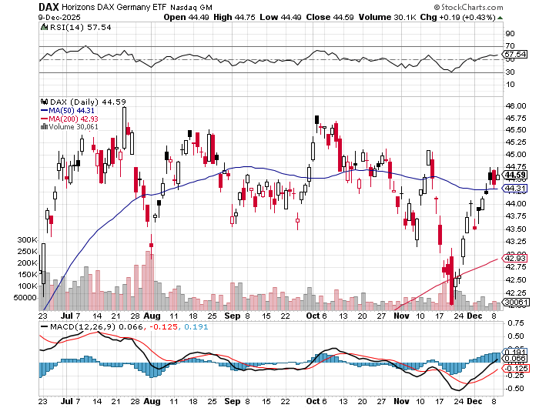
German Dax (DAX)- +30%

Slide 28
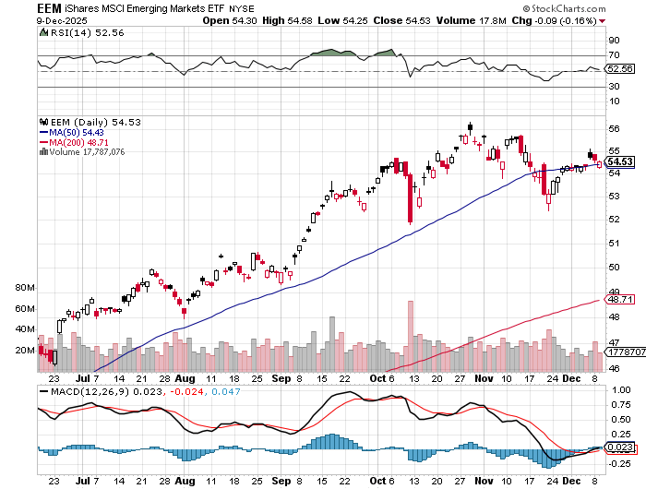
Emerging Markets (EEM) - +8%
Weak Dollar, Long Recovery Play

Slide 29


Slide 30



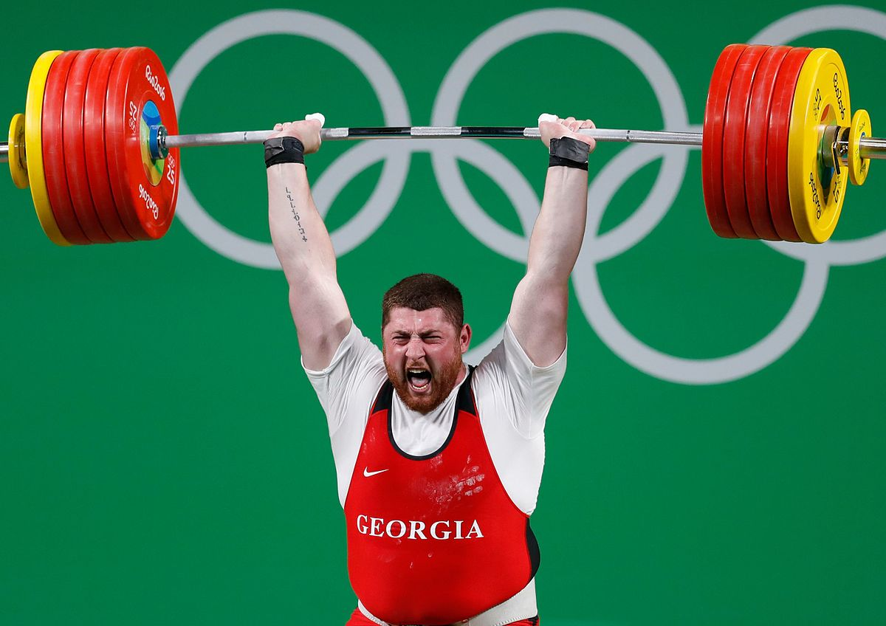
THE MAD HEDGE FUND TRADER
The Barbell Portfolio
*75% Big Tech – 2% of US workforce, 25% of market cap and 25% of US earnings
25% Domestic Recovery, including:
Railroads, airlines, cruise lines,
Couriers, steel companies
Banks, commodities
Construction
Credit Card Companies
Hotels, casinos
Online Ticket Sales

Slide 31
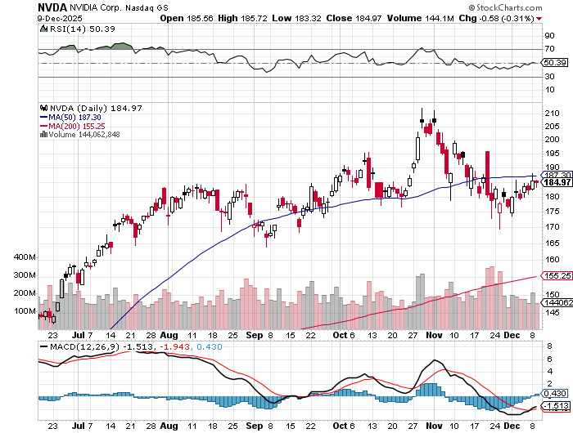

NVIDIA (NVDA) – Blackwell Chips @ $70,000 each
Meta to Buy Google Chips, to replace Nvida (NVDA) Blackwell chips it can’t get. stopped out of long 6/$140-$145 puts spread, took profits on long 5/$70-$75 call spread took profits on long 3/$88-$90 call spread, took profits on long 4/$140-$145 puts spread took profits on Long 2/$90-$95 call spread, took profits on Long 12/$117-$120 call spread

Slide 32
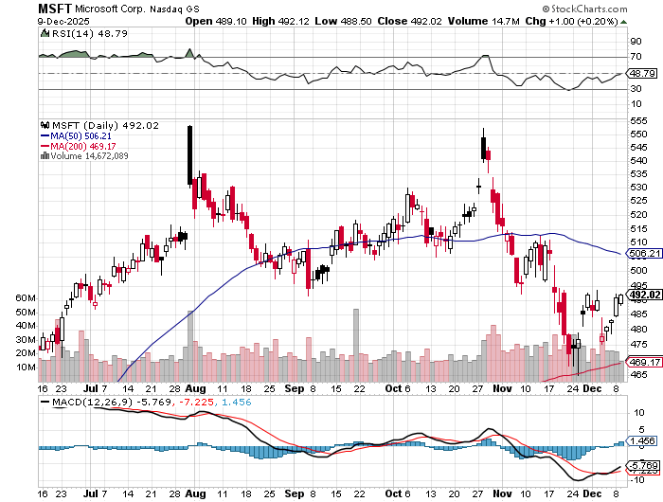

Microsoft (MSFT)- Become the Second $4 trillion Company
Microsoft Delivers Blowout Earnings took profits on long 5/$430-$440 put spread
Took profits on long 2/$330-$340 call spread, took profits on long 12/$320-$330 call spread took profits on long 9/$235-$245 call spread, took profits on long 7/$220-$210 call spread,

Slide 33
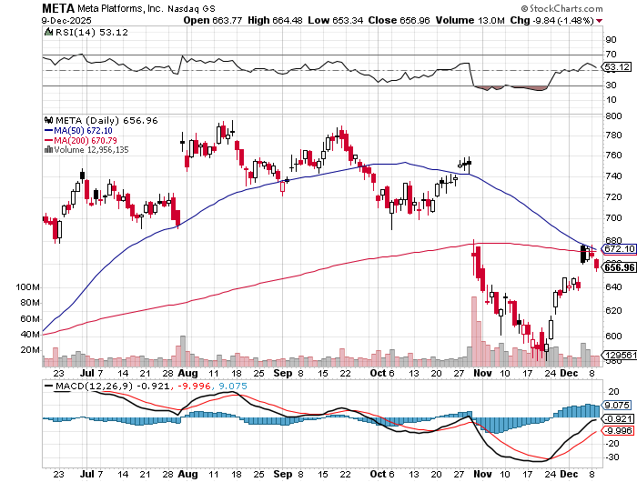

Meta (META)
Meta Delays Flagship Behemoth AI Product took profits on Long 8/$420-$430 call spread took profits on Long 5/$360-$370 vertical bull call spread, took profits on Long 9/$290-$300 vertical bear put spread, stopped out of Long 9/$190-$200 vertical bear put spread

Slide 34
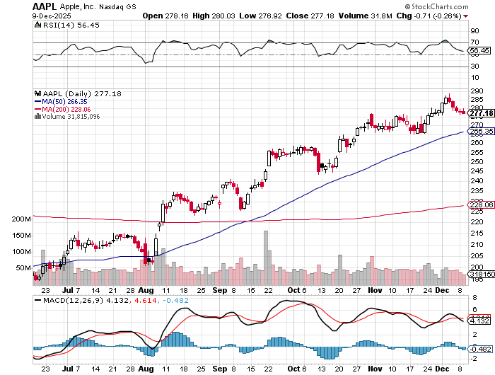

Apple (AAPL)
China iPhone Sales Jump 22% took profits on long 6/$220-$230 put spread, profits on Long 5/$225-$235 vertical bear put spread, took profits on Long 8/$160-$170 call spread took profits on Long 6/$200-$210 bear put spread,

Slide 35
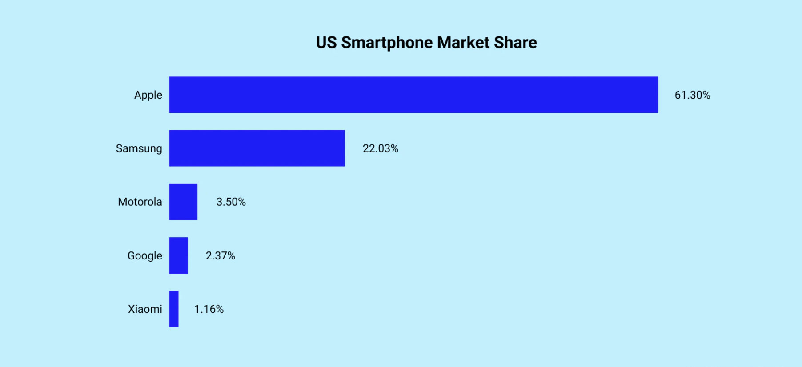

Slide 36
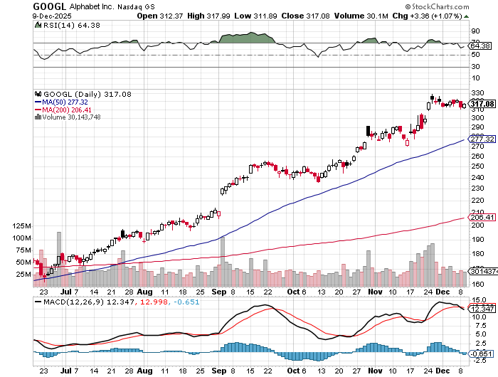
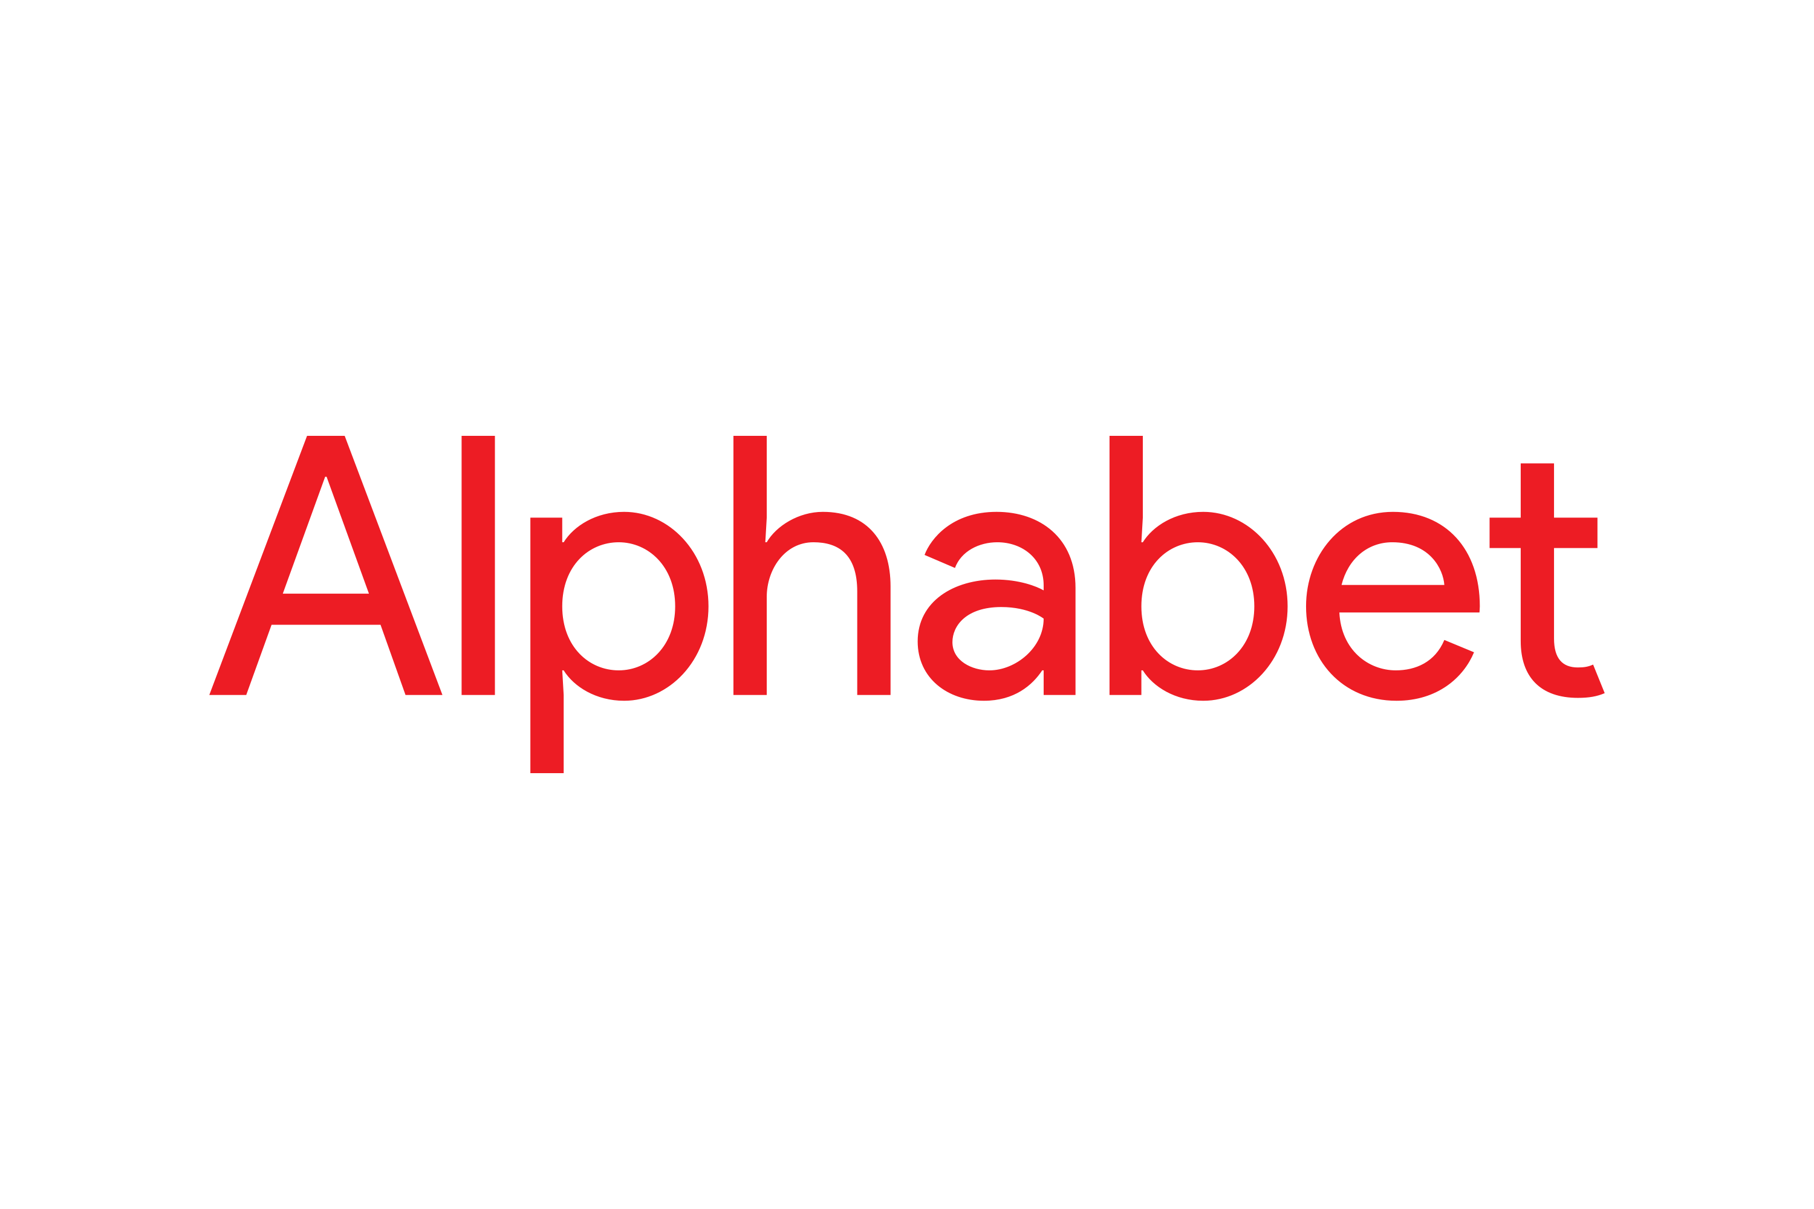
Alphabet (GOOGL) – Google Beats, with Earnings per share up to $2.31
Waymo Robotaxis Expand to Freeway Use in San Francisco took profits on long 12/$110-$120 call spread took profits on long 12/$1,200-$1,230 bull call spread, took profits on long 9/$1,030-$1,080 vertical bull call spread

Slide 37
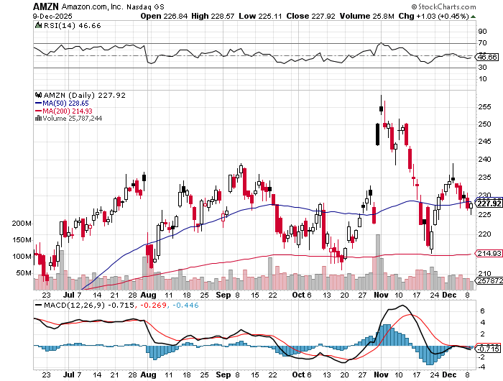

Amazon (AMZN) – Antirust Target
Amazon Sells Off on Earnings, Warren Buffet buys major statke took profits on long 3/$155-$160 bull call spread , took profits on long 2/$130-$135 bull call spread

Slide 38
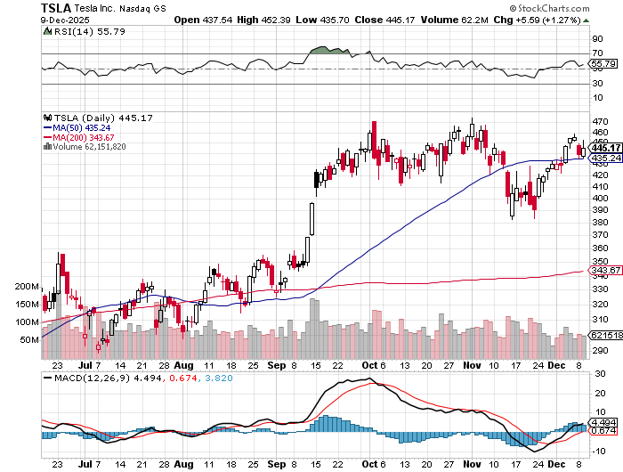

Tesla (TSLA) –
Elon Musk Fined $140 Million by Europe, stock downgraded by Morgan Stanley
took profits on long 10/$510-$520 put spread, took profits on 8/$370-$380 put spread
took profits on long 7/$420-$430 put spread, took profits on long 7/$360-$370 put spread
took profits on long 7/$180-$190 put spread, took profits in long 6/190-$200 call

Slide 39
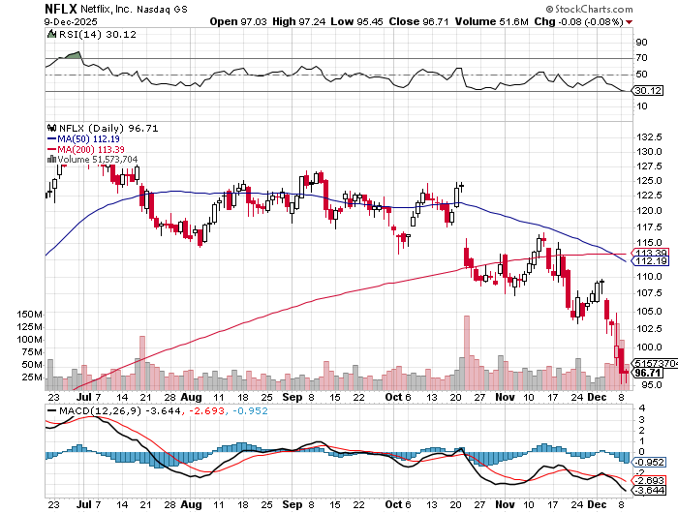

Netflix (NFLX) –
Bidding war against Paramount for Warner Bros Discovery
$108 billion bid by Paramount incurs $72 billion in debt
Took profits on 11/$100-$102 call spread took profits on long $1040-$1060 call spread, took profits on long 4/800-$810 call spread

Slide 40
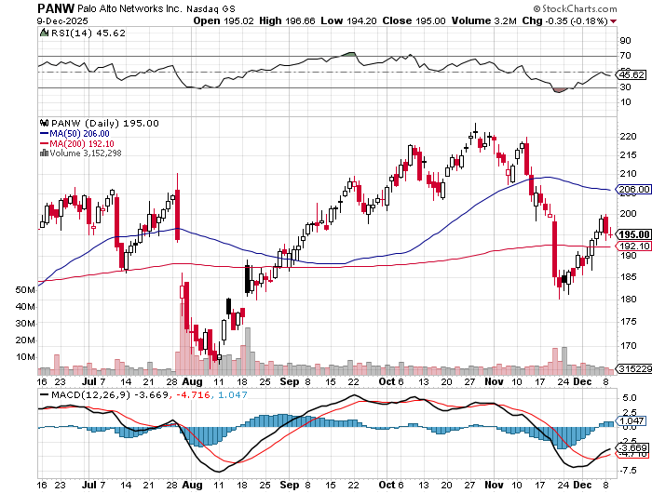

Palo Alto Networks (PANW)- Hacking never goes out of fashion
Is AI Putting SaaS Out of Business? took profits on long 2/$260-$270 call spread, took profits on long 10/$130-$140 call spread

Slide 41
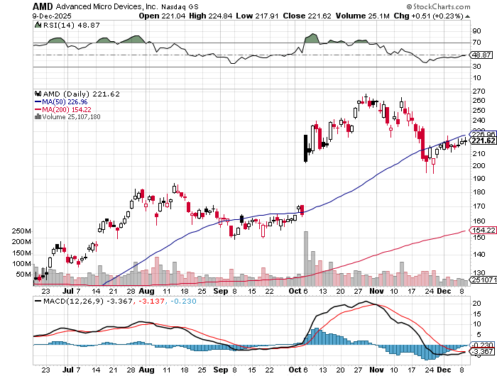

Advanced Micro Devices (AMD)- Recession fears programable logic devices took profits on long 2/$75-$80 call spread

Slide 42
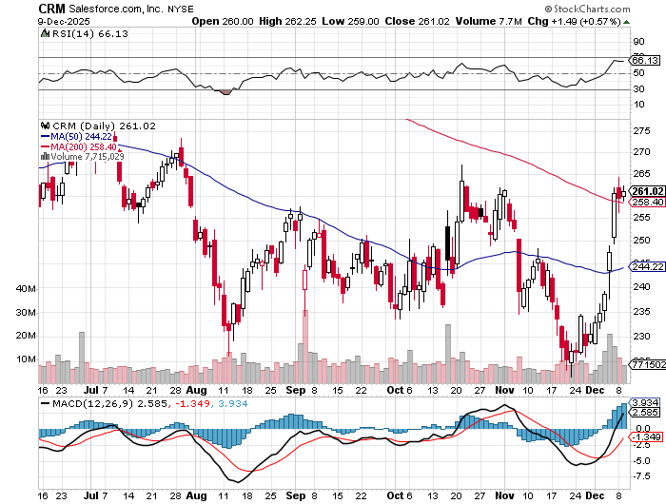

Salesforce (CRM)- Is AI Putting SaaS Out of Business? took profits on long 12/$185-$195 call spread, took profits on long 9/$125-$130 vertical bull call spread took profits on long 8/$125-$130 vertical bull call spread

Slide 43
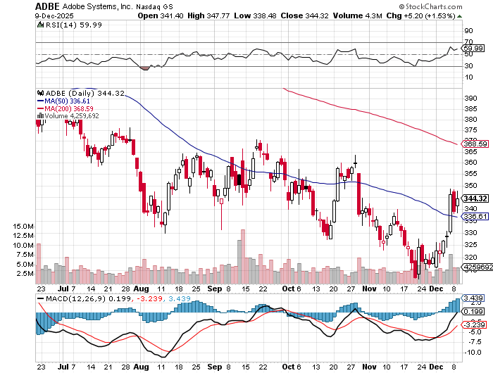

Adobe (ADBE)- Is AI Putting SaaS Out of Business?
The Quality Non-China tech play

Slide 44
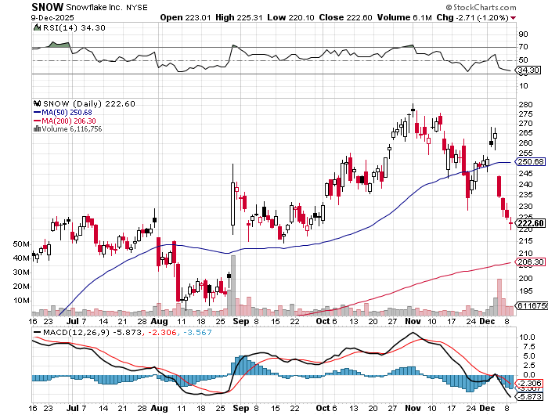

Snowflake (SNOW)- Blockbuster AI Earnings stopped out of long 4/$150-$255 call spread, took profits on long 12/$135-$140 call spread

Slide 45
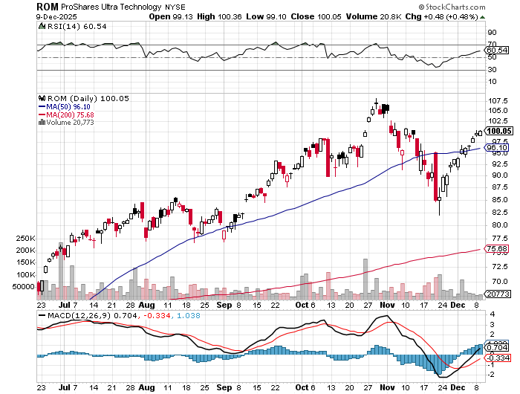
ProShares Ultra Technology ETF (ROM) – 2X Long Technology ETF took profits on long 10/$62-65 call spread

Slide 46
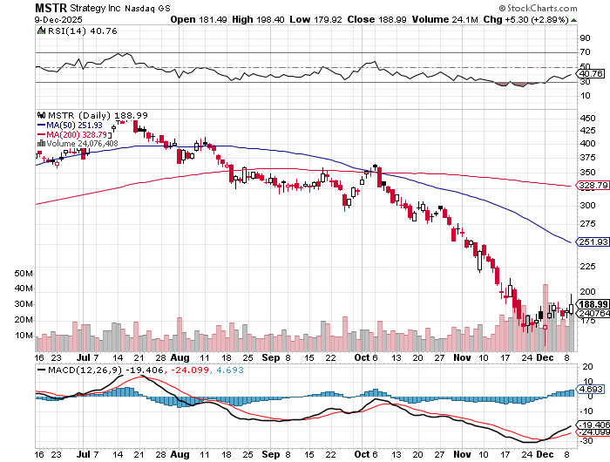

MicroStrategy (MSTR) – Long Bitcoin Play
Money is Moving out of Bitcoin Ethereum took profits on Long 6/$260-$270 call spread
Took profits on long 6/$500-$510 put spread, took profits on long 6/$470-$480 put spread took profits on long 6/$330-$340 call spread, stopped out of long 6/$335-$345 put spread

Slide 47
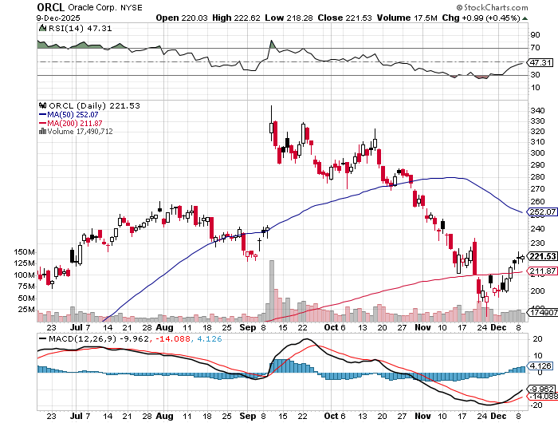

Oracle –(ORCL) – Spectacular Earnings Forecast but $100 billion in debt

Slide 48
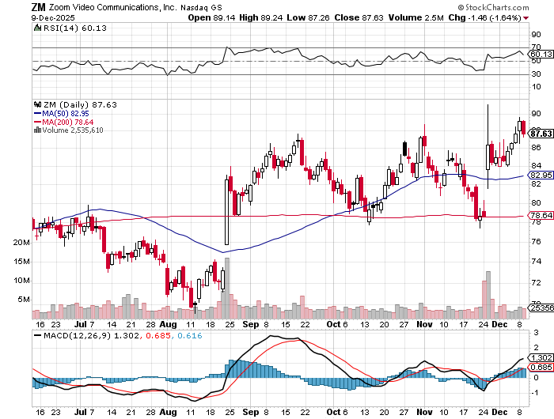

Zoom –(ZM) – Coming Back from the Dead took profits on 11/$72-50-$77.50 call spread

Slide 49


Slide 50
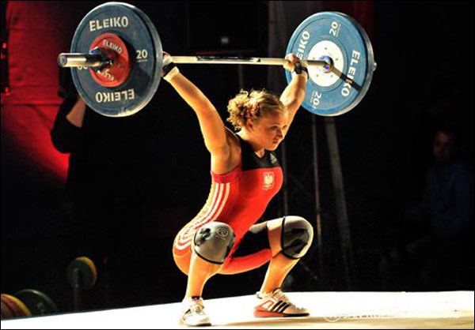
The Second Half of the Barbell
*Bets on a domestic recovery in 2022 Q4
*Upside potential in 2024 far greater than tech
*Some of these have not moved for 5 or 10 years
*Focuses on economically sensitive cyclical industries
*Makes a great counterweight to
high-growth technology
*We could spend all of next ten years rotating
between the two groups

Slide 51
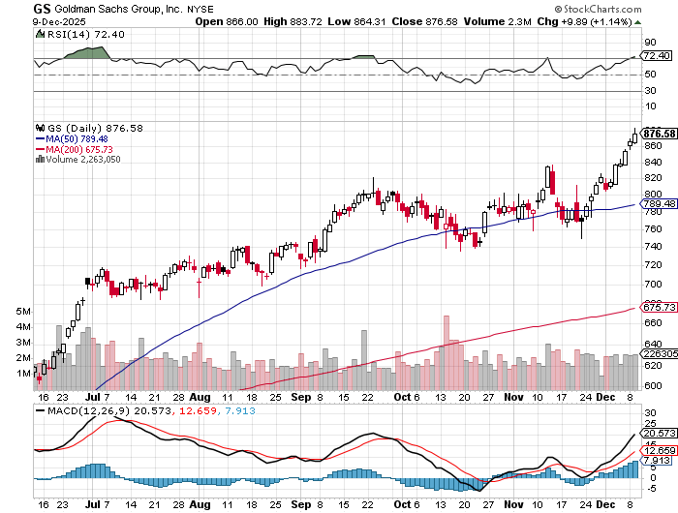

Goldman Sachs (GS) – Upside Breakout!
Goldman Sachs Q3 Earnings Rock took profits on long 11/$700-$710 call spread , took profits on long 10/$700-$710 call spread took profits on long 9/$690-$700 call spread, stopped out of 3/$380-$390 call spread, profits on long 12/$330-$350 call spread, took profits on long 11/$330-$350 call spread

Slide 52
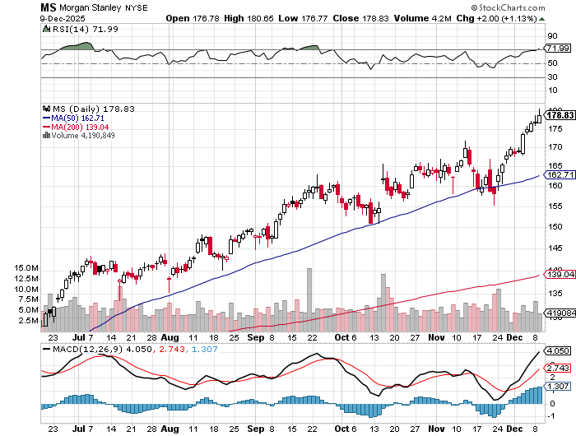

Morgan Stanley (MS) - Upside Breakout!
Morgan Stanely Reports Record Profits long $12/150-$155 call spread – Expires in 7 days took profits on long $12/210-$220 call spread,, took profits on long $12/210-$220 call spread,
Took profits on long $195-$205 call spread, took profits on long 4/$65-$70 call spread

Slide 53
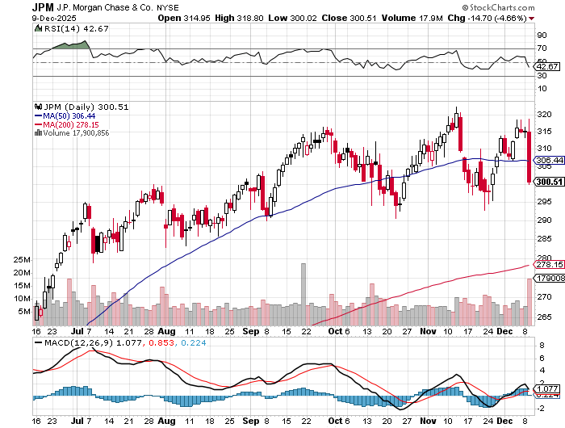

JP Morgan Chase (JPM) – Upside Breakout took profits on long 9/$270-$280 call spread stopped out of 3/$235-$245 calls spread, profits on long 12/$210-$220 call spread, took profits on long 11/$195-$205 call spread, took profits on 4/$215-225 put spread

Slide 54
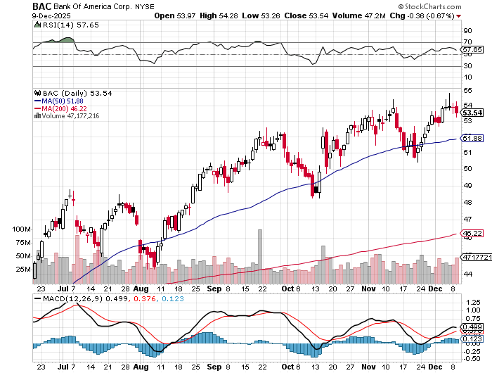

Bank of America (BAC) – Upside Breakout? took profits on long long 12/$41-$44 call spread, took profits on long 4/$20-$23 call spread

Slide 55
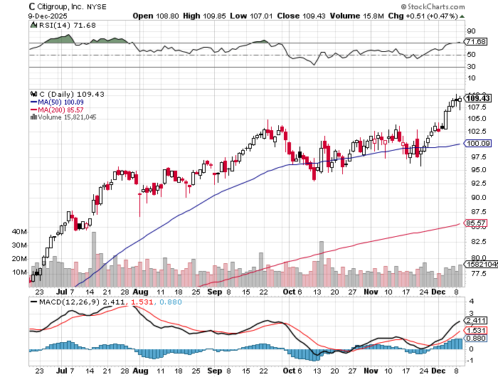

Citigroup (C) – Upside Breakout took profits on long long 12/$60-$65 call spread , took profits on long 4/$30-$35 call spread

Slide 56


Charles Schwab (SCHW) – Upside Breakout took profits on long 4/$30-$35 call spread

Slide 57


Interactive Brokers (IBKR) – Upside Breakout? stopped out of long 3/$160-$170 call spread, out of long 8/$110-$115 call spread , took profits on long 4/$60-$65 call spread

Slide 58


Berkshire Hathaway (BRKB)- Ultimate defensive stock
Berkshire Hathaway Builds Record Cash, at $334 billion – Is the new T Bill proxy stopped out of long 12/$405-$415 call spread, took profits on long 12/$320-$330 call spread took profits on long 4/$260-$270 call spread, took profits on long 1/$290-$300 call spread

Slide 59


Blackrock (BLK)-Asset Collection Boom
Blackrock Reports Record $12.5 trillion in Assets Under Management stopped out of 12/$1,000-$1,010 call spread, took profits on long 12/$850-$860 call spread took profits on long 3/$770-$790 call spread, took profits on long 3/$310-$340 call spread

Slide 60

SPDR Metals & Mining ETF (XME) – long 2/$28-$30 call spread

Slide 61


Boeing (BA) – Renaissance
Boeing Jet Deliveries are Surging. The company delivered 57 commercial aircraft in August, its best performance for the month since 2018

Slide 62


General Motors (GM) – Worst Off Trade War Victim
Earnings better than expected plus interest rate beneficiary stopped out of long 4/$52.50-$57.50 put spread at cost, long 3/$53-$56 put spread

Slide 63


Package Delivery- United Parcel Service (UPS) –
UPS Deliveries Slow Worldwide, it the wake of the shutdown of its Kentucky hub after a fatal crash took profits on long 11/$130-$140 call spread

Slide 64


Caterpillar (CAT)- Ag + Infrastructure + Housing stopped out of long 8/$310-$320 call spread, took profits on long 12/$220-$230 calls spread took profits on long 12/$145-$150 call spread, took profits on long 11/$125-$135 call spread

Slide 65


Deere & Co. (DE)- Ag + Infrastructure + Housing took profits on long 8/$330-$340 put spread stopped out of long 8/$330-$340 calls spread

Slide 66


Freeport McMoRan - (FCX)- Coming Copper Crisis
50% copper tariff took profits on long 8/$34-$37 call spread took profits on long 4/$37-$40 call spread, took profits on long 5/$42-$45 call spread, stopped out of long $48-$51 put spread, profits on long 6/$32-$35 call spread

Slide 67


Walt Disney (DIS) -Disney Beats
Disney Dives on Earnings Bust, although streaming broke even versus an expected loss

Slide 68


Industrials Sector SPDR (XLI)-
(GE), (MMM), (UNP), (UTX), (BA), (HON)

Slide 69


Union Pacific RR (UNP)- Big Stuff to Ship
The Largest Railroad in History, may be the result of the Union Pacific (UNP)/Norfolk Southern merger worth $200 billion took profits on long 5/$200-$210 call spread took profits on 11/$150-$160 call spread

Slide 70


Walmart (WMT) – Trade War Victim took profit on Long 11/$125-$130 bear put spread, took profit on Long 10/$119-$121 bear put spread took profits on Long 8/$114-$117 bear put spread

Slide 71


Costco (COST) – Trade War Victim suing Trump administration over tariffs, one third of sales from imports took profits on long 4/$840-$850 call spread

Slide 72


Delta Airlines (DAL) – Ticket Price Take Off lost $200 million on government shutdown

Slide 73


Transports Sector SPDR (XTN)- Worst Hit Sector
(ALGT), (ALK), (JBLU), (LUV), (CHRW), (DAL)

Slide 74


Health Care Sector (XLV) – Defensive Play and Cheap
(JNJ), (PFE), (MRK), (GILD), (ACT), (AMGN)

Slide 75


Amgen (AMGN) long 7/$260-$270 bull call spread, took profits on long 11/$185-$200 bull call spread

Slide 76


Visa (V) – Stablecoin Competition took profits on long 2/$240-$250 bull call spread took profits on long 10/$160-$170 bull call spread, took profits on long 6/$150-$160 bull call spread

Slide 77


Consumer Discretionary SPDR (XLY)
(DIS), (AMZN), (HD), (CMCSA), (MCD), (SBUX)

Slide 78


Slide 79

Bonds – Collapse!
*Bonds See Worst Week in Six Months, discounting record borrowings
*Ten-year US Treasury yields hit 4.18%
and could be headed to 4.40%
*”Crowding out” will become the most overused
term of 2026 as the government, AI, and M&A
compete for increasingly scarce funds
*The Warner Brothers deal alone is demanding
$100 billion in debt
*The real estate recovery is forestalled once
again, and will be the big loser

Slide 80

Treasury ETF (TLT) – took profits on long 6/$88-$91 put spread stopped out of long 6/$80-$83 call spread, took profits on long 4/$84-$87 call spread stopped out of long 1/$82-$85 call spread, took profits on long 10/$103-$106 put spread took profits on long 6/$$94-$97 put spread, took profits on long 5/$82-$85 calls spread

Slide 81

Ten Year Treasury Yield ($TNX) – 4.18%

Slide 82

Junk Bonds (JNK) 6.54% Yield

Slide 83

Municipal Bonds (MUB) 4.21% Yield-

Slide 84

Emerging Market Debt (ELD) 5.62% Yield-

Slide 85

2X Short Treasuries (TBT)-Out of Favor

Slide 86

Anally Capital Management (NLY) – Leveraged REIT Play
Yield 13.25% took profits on long 12/$15-$16 call spread

Slide 87


Slide 88
Foreign Currencies –
*US Dollar Down for 10th Straight Day, as Fed interest rates cuts loom thanks to the continuing dire jobs data.
*US Dollar Faces a Prolonged Decline, off the back of coming Fed interest rate cuts
*We may see another 20% move down as more
Fed interest rates cuts loom
*Next dollar weakness will come with
evidence of more rate cuts
*Emerging markets (EEM) have been
the best currency play of 2025, up 40% at high
*Buy (FXA), (FXE), (FXB), (FXC), and (FXY)

Slide 89


THE MAD HEDGE FUND TRADER
Australian Dollar (FXA) - Major Long-Term Bottom is In Targeting Parity – A call option on a global synchronized recovery

Slide 90


Japanese Yen (FXY)

Slide 91


Euro (FXE)-

Slide 92


British Pound (FXB)-

Slide 93


Emerging Market Currencies (CEW)

Slide 94


Slide 95


Energy & Commodities –
*Traders have been ramping up copper shipments to the US in recent weeks to once again capitalize on a big premium for the red metal on New York’s Comex exchange, fueled by ongoing uncertainty about the potential for future tariffs
*US Oil Rigs Count Hit Four Year Low
*The oil and gas rig count, an early indicator
of future output, fell by 10 to 544 in the week
to November 26, the lowest since September.
*2026 will be a Blowout Year for Copper.
*A rush to ship metal to the US risks draining
the rest of the world’s inventories
*Buy (FCX) on dips.

Slide 96

Oil-($WTIC)

Slide 97

United States Oil Fund (USO)

Slide 98

Energy Select Sector SPDR (XLE)-No Performance!
(XOM), (CVX), (SLB), (KMI), (EOG), (COP)

Slide 99

ExxonMobil (XOM)-
Exxon Moves Big into Lithium, with the construction of a major mining operation in Arkansas took profits on Long 4/$100-$105 call spread, took profits on long 12/$120-$125 put spread

Slide 100

Occidental Petroleum (OXY)- Buffet’s a Buyer took profits on long 4/$59-$62 call spread took profits on long 2/$55-$60 call spread, took profits on long 12/$77.50-$82.50 put spread

Slide 101

Natural Gas (UNG) – Free Fall on Warm Winter took profits on Long January 2025 $7-8 Call Spread LEAPS

Slide 102

Cameco (CCJ) – Global Uranium Renaissance
Microsoft to Reopen Three Mile Island to power AI data centers took profits on long 12/$41-$44 call spread, took profits on long 12/$35-$38 call spread, took profits on long 5/$20-$23 bull call spread

Slide 103

Vistra Corp. (VST) – Global Uranium Renaissance took profits on long 2/$100-$110 call spread

Slide 104


Slide 105

Precious Metals –
*Silver Hits Yet Another New High, at an incredible $58.65 an ounce
*The white gold has doubled in 2025
*Barack Gold Discussing Breakup
*Despite the run-up in gold prices this year, Barrick's share price
has lagged its rivals due to setbacks at its mine in Mali, three fatal
accidents, falling gold production, and rising costs
*(B) Became the world’s largest gold miner in 2018 when it took
over Randgold Resources
*But the cost of mining has risen faster than the price, squeezing margins.

Slide 106

THE MAD HEDGE FUND TRADER
Gold (GLD) – Headed for $5,000....or $10,000?
long 12/$355-$360 call spread – expires in 7 trading days
profits on long 6/$275-$285 call spread, took profits on long 5/$275-$285 call spread
stopped out of long 6/$275-$285 call spread, took profits on profits on long 10/$230-$235 call spread
$360
-14.3%
1st support
$344
-18.1%
1st support
BUY

Slide 107

Market Vectors Gold Miners ETF- (GDX) – took profit on long 6/$207.50-$212.50 call spread, took profit on long 7/$200-$205 call spread

Slide 108


Barrick Mining (B) took profit on long 1/$15.50-$16.50 call spread

Slide 109


Newmont Mining- (NEM)- Sometimes you Just Get Lucky took profits on long 10/$47-$50 call spread, took profits on long $55-60 call spread

Slide 110


THE MAD HEDGE FUND TRADER
iShares Silver Trust (SLV) - The Better Play Industrial demand, solar panels, electric cars
2025
Target
$50
+50%
BUY

Slide 111


Silver Miners - (SIL)-

Slide 112


Wheaton Precious Metals - (WPM)- LEAPS Approaching Max Profit took profits on long 4/$39-$42 call spread long 6/$75-$80 call spread-expires in 7 trading days , took profits on long 1/$36-$39 call spread

Slide 113


Platinum- (PPLT)- 556,000-ounce shortage this year took profits on long 1/$36-$39 call spread

Slide 114


Slide 115

Real Estate – Out of Season
*Pending Home Sales Rise by 1.9% in October
*Apartment Rents are Falling, as vacancies hit record highs
*It’s due to an oversupply of new units and a slowdown
in demand, especially from younger renters
*This has led to record high vacancy rates and
the fourth consecutive month-over-month rent decline nationally
*Median rents hit $1,367 in November 2025, according
to Apartment List
*The steepest declines have been seen in markets
with high levels of new construction, such as some
cities in the Sun Belt, while other areas with more
limited supply have performed better.

Slide 116

S&P Case Shiller Slows
S&P Case Shiller Rises to +1.60% YOY in August, with its National Home Price Index
New York gained +6.1%, Chicago +5.9%, and Cleveland +4.7%.
Tamps and Dallas down -2.2%

Slide 117


Crown Castle International (CCI) – 4.68% yielding 5G cell phone tower REIT
Eliot Management Pushes up stock with activist bid took profits on Long 8/$90-$95 call spread,

Slide 118



US Home Construction Index (ITB)
(DHI), (LEN), (PHM), (TOL), (NVR)

Slide 119


DH Horton (DHI)
Earnings Hit on free upgrades eating into margins took profits on long 11/$165-$175

Slide 120

Trade Sheet- The Recession Trade
So What Do We Do About All This?
*Stocks –buy interest rate sensitives
*Bonds – stand aside
*Commodities – buy dips
*Currencies – buy dips
*Precious Metals – buy dips
*Energy – stand aside
*Volatility – sell over $30
*Real estate – buy dips

Slide 121

Next Strategy Webinar
12:00 EST Wednesday, January 7, 2026 from Incline Village, NV
Last Webinar of the Year email me questions at https://www.madhedgefundtrader.com/jp-ms-0925
Good Luck and Good Trading!
Notes:
*

Slide 122


Slide 123


