Slide 1
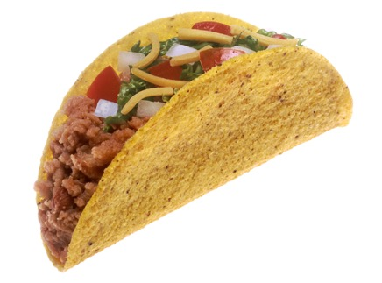
The Mad Hedge Fund Trader
“TACO is Back”
With John Thomas
Miami Beach, Florida January 28, 2026
www.madhedgefundtrader.com
Notes:
*

Slide 2


Slide 3
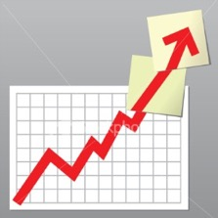
Trade Alert Performance
New All-Time Highs-17 Consecutive Positive Months
*January +0.72% MTD *July +5.21% Final
*February +3.66% Final. *August +1.37% Final
*March +4.36% Final *September +2.21% Final
*April +0.95% Final *October +3.11% Final
*May +2.51% Final *November +2.33 Final
*June +15.48% Final *December +2.66% Final
*2025 Year To Date +0.72%
+814.84% since inception
*Versus 79.79% for all of 2023
*Versus 75.29% for all of 2024
*Versus 62.02% for all of 2025

Slide 4
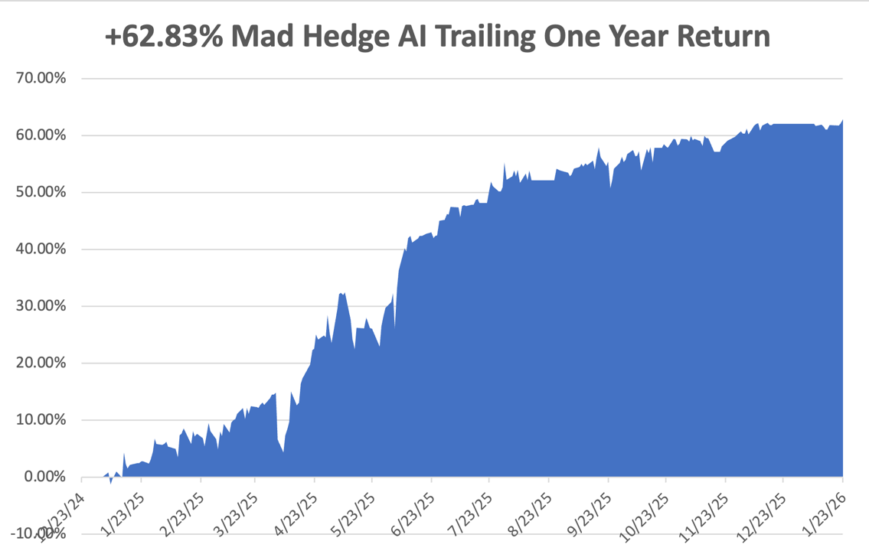

Slide 5
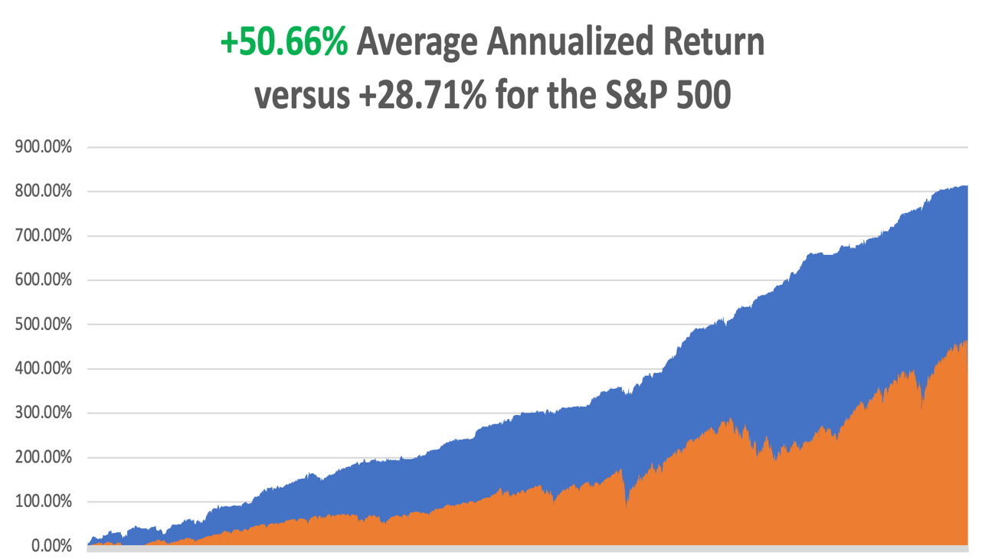

Slide 6
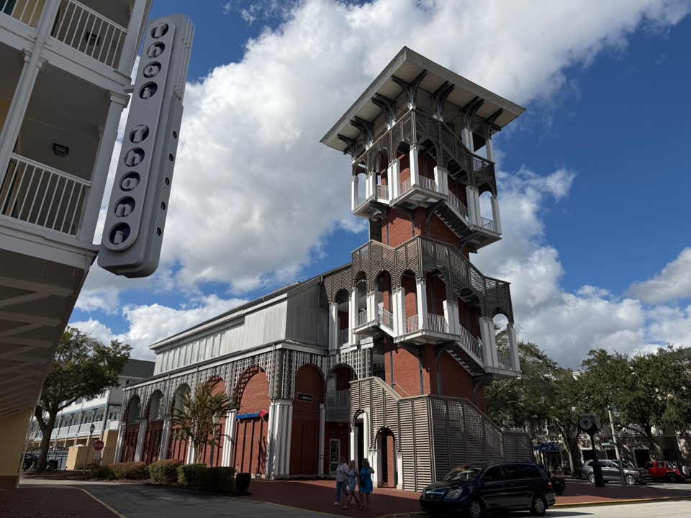

Slide 7
Portfolio Review – High Risk Market Require Maximum Cash
0% risk on, 0% risk off, 100% cash
There are no low risk high return trades
Expiration Value
-0.72%
NO POSITIONS

Slide 8

BIG RISKS FOR THE MARKET
*All the good news for the market in 2026 may already be in the price
*The recent feeble performance of the S&P 500 is the “Tell” here
*What is known: Tax cuts, Coming ultra dovish Fed governor, falling interest rates,
massive government spending financed by record borrowing, AI improvements to
cost cutting and profitability for big companies
*What isn’t known:
The next dozen black swans, the next government interreference
with the stock market
Problem: markets move on what is unknown, not what is known

Slide 9

The Method to My Madness
*With a government shutdown, Supreme Court decision, and Fed rate decision imminent, it is not a great time for risk taking
*Flight to safety inflations protection assets like gold, silver, copper, and platinum are all at extreme all-time highs
*Bonds are dead in the water on $42 trillion National Debt overhang, and $45 trillion if the tariffs fail
*The long-term bull arguments of super liquidity, AI, falling interest rates are still the market drivers
but much is already in the price
*Jobs data remains dire
*Huge oil oversupply weighs heavily on prices in 2026
*US Dollar approaches new multi year lows in line with coming rate cuts
*Bitcoin trying to hold at cost of production at $85,000,
and may bounce hard once gold and silver turn

Slide 10
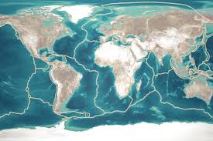
The Global Economy – Breaking UP
*The Fed Meets this Week to Discuss Interest Rates, decision out 2:00 PM EST, no action expected
*A Government Shutdown is on for Friday
*US GDP Growth set to rise by 2.5% in 2025, down from 3.0% in 2024.
*Core PCE Rises, from 2.7% to 2.8%,
*Consumer Spending Rose 0.50% in October
*S&P US PMI Comes in Flat.
*U.S. Consumer Sentiment collapses
*US Retails Sales Beat in November
*Core Capital Goods Rose 0.7% in November

Slide 11
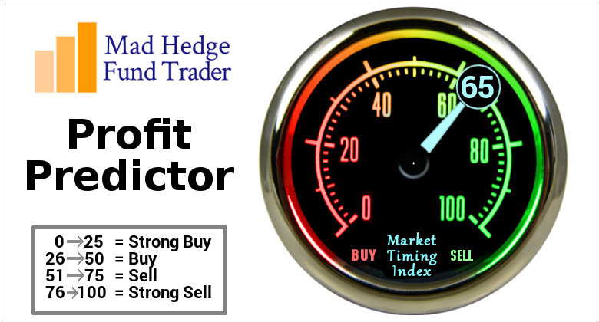

Slide 12
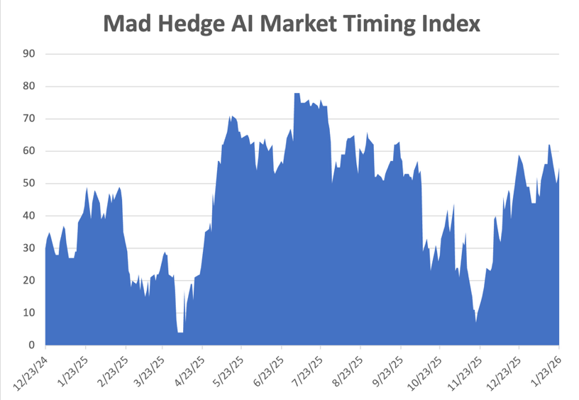
The Mad Hedge Profit Predictor
Market Timing Index – Hits Seven month Low at 6,
An artificial intelligence driven algorithm that analyzes 30 different economic, technical, and momentum driven indicators
SELL
BUY

Slide 13
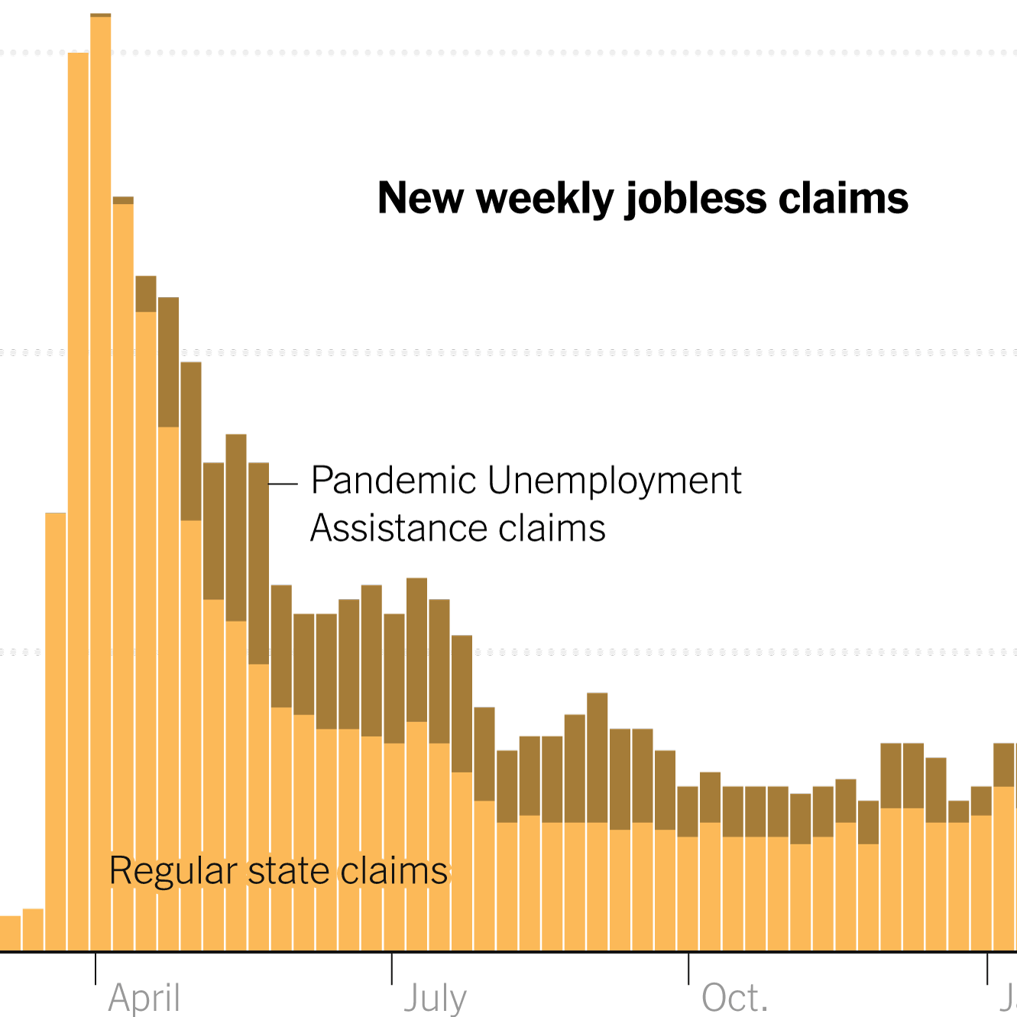
Weekly Jobless Claims –
+1,000 to 200,000

Slide 14
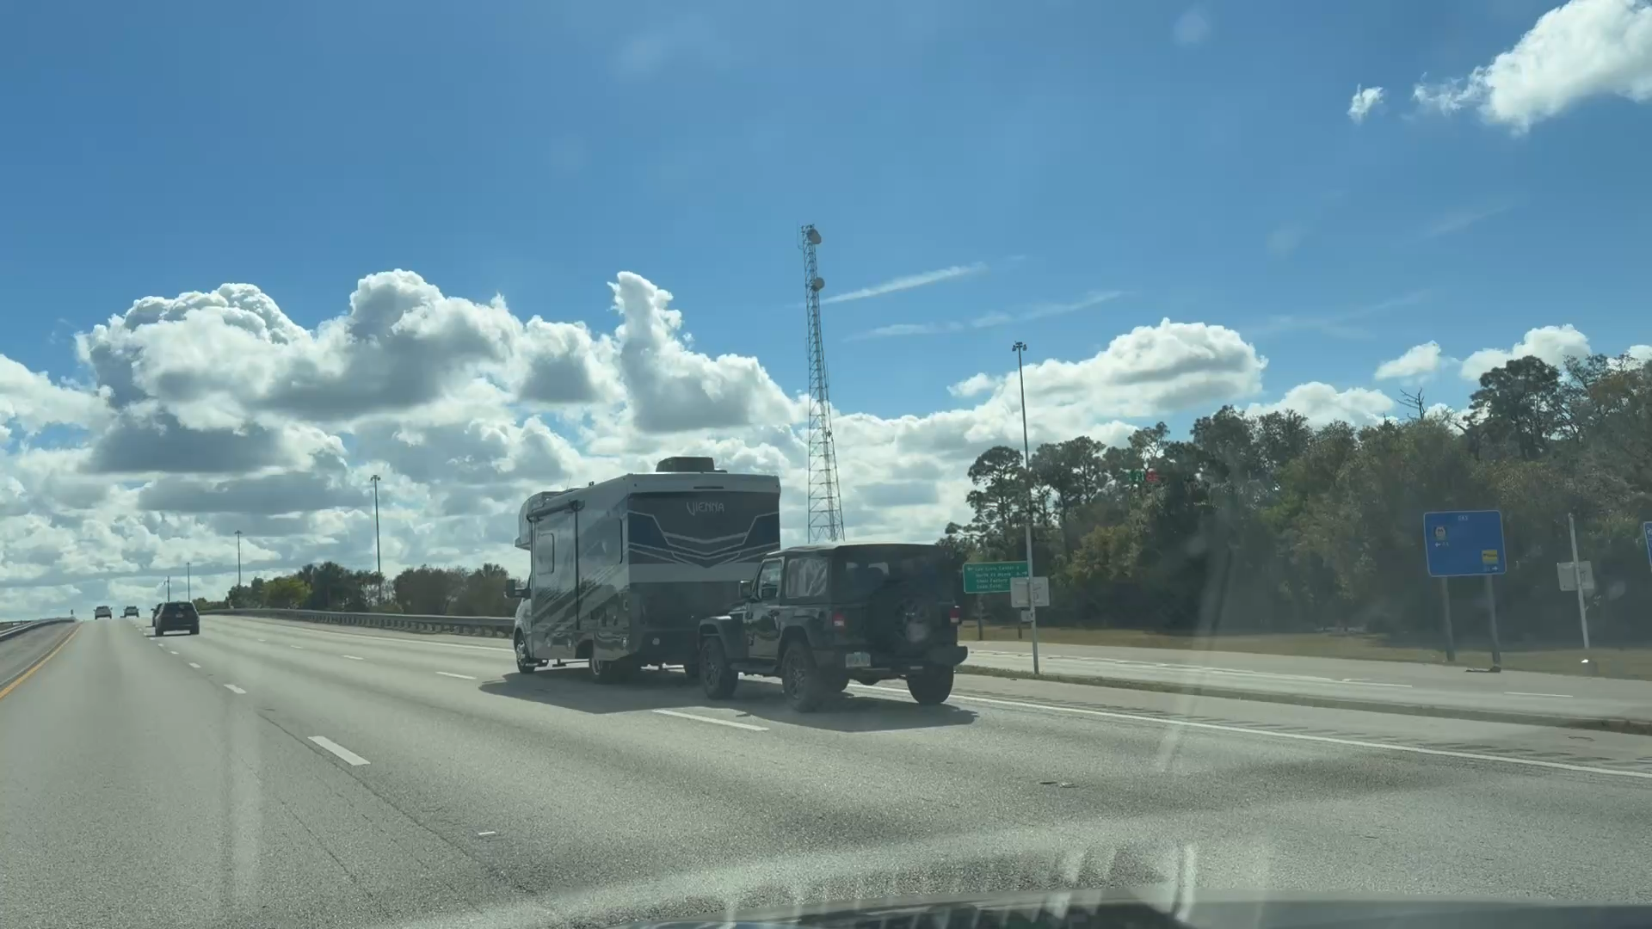

Slide 15
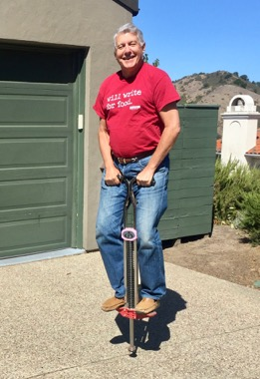
Stocks – Volatility
*Trade War 2.0 Destroys Stocks, taking the Dow Average down 1,200 points, the. Most in four months
*The “Sell American” Trade is Back on, with Europeans discussing dumping all their US stocks and bonds, some $8 trillion worth.
*Banks Continue to Fall on 10% Credit Card Cap
*Saks Fifth Avenue Files for Bankruptcy.
*Weak Japanese Yen is Pushing Nikkei Upward
*CrowdStrike (CRWD) Wins Lawsuit, over the
massive software outage last summer
*Microsoft Jumps 7% on Second Generation AI Chips.

Slide 16
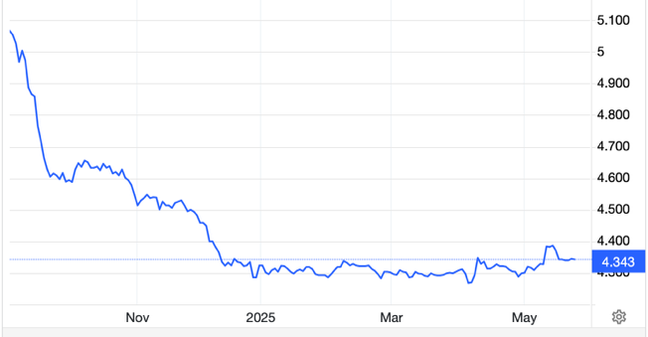
The Ultimate Hedge – Defensive stocks only go down at a slower rate
90 - day US Treasury Bills (Warren Buffet owns $340 billion)
Extend to One Year!
*Government Guaranteed principal
*Endless liquidity,
trade like water
*100% collateral value for margin
*Lock in guaranteed income
*Can be sold at any time to earn
full interest
*Will survive any bear market
*Ask your broker how to buy
3.68% Yield

Slide 17
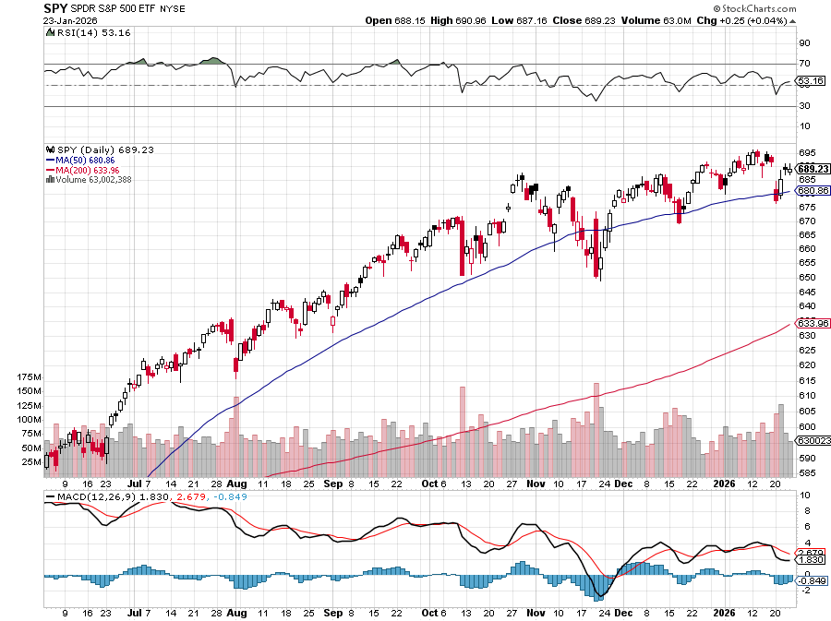
S&P 500 – Breakout!
$650
-3.30%
1st support
$630
-6.20%
1st support

Slide 18
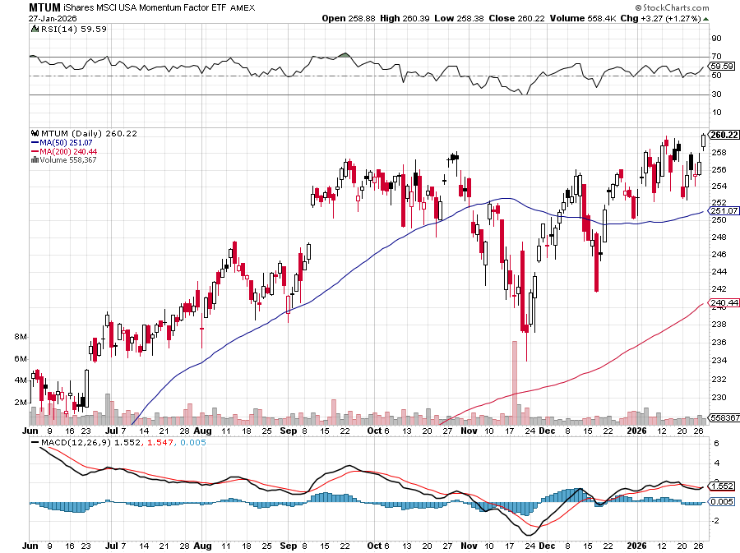
Momentum (MTUM)

Slide 19
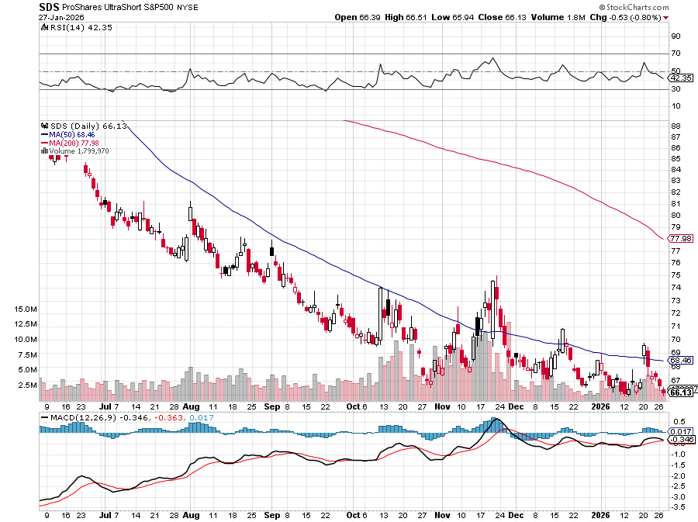
ProShares -2X Short S&P 500 (SDS) - a great 2X hedge for falling long stocks

Slide 20
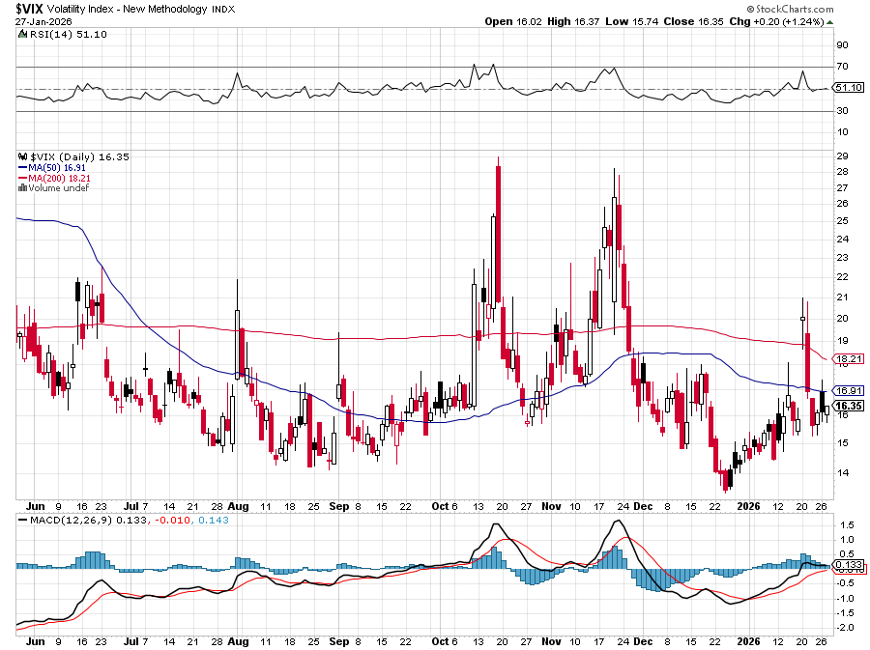
(VIX) –
Volatility Index Hits Four Year High at $65, the most since the 2020 pandemic. That implies a 2% move in the S&P 500 (SPX) every day for the next 30 days

Slide 21
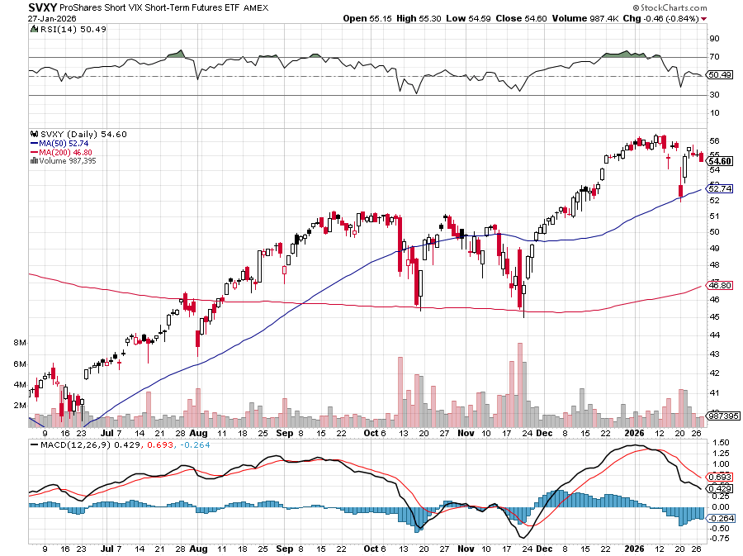
(SVXY) –Short Volatility ETF bought at $36.31 - $32.74 = $3.57

Slide 22
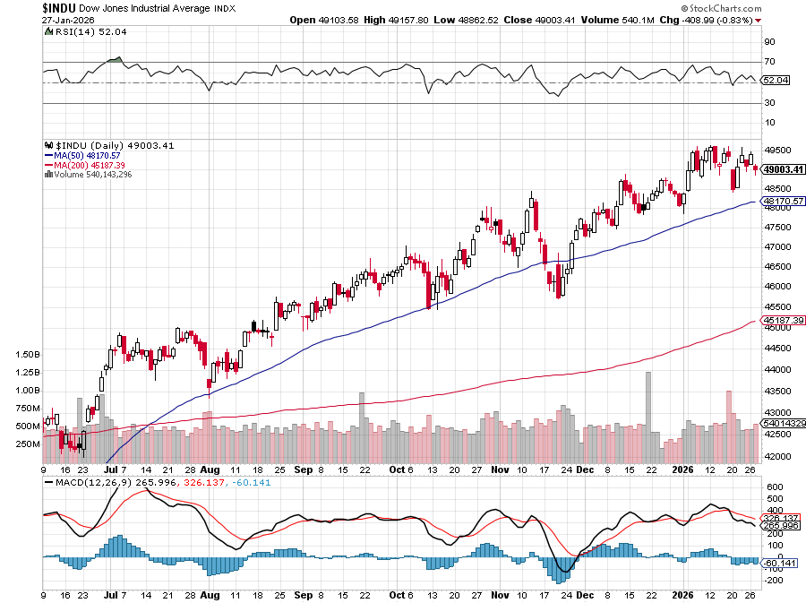
Dow Average ($INDU)-

Slide 23
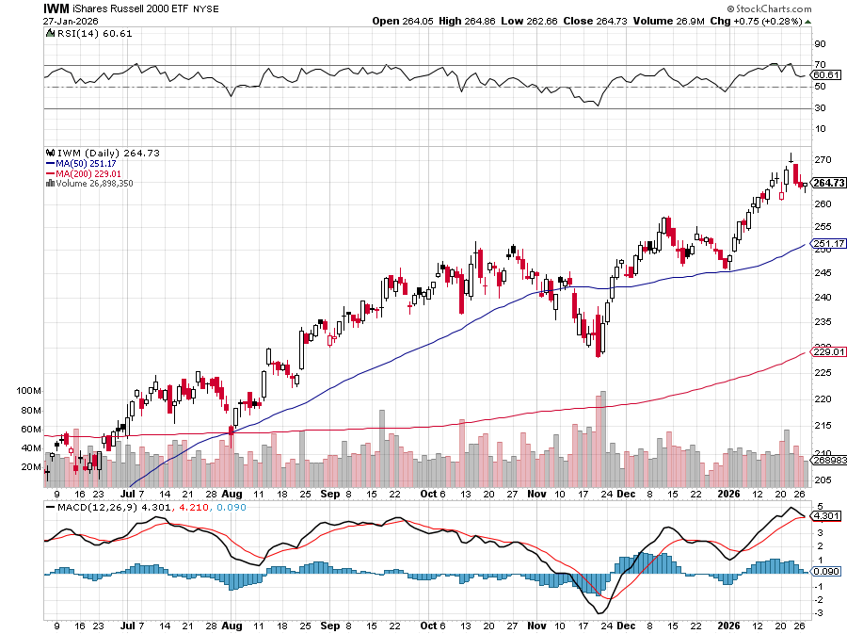
Russell 2000 (IWM)- took profits on Long 10/$137-$142 vertical bull call spread took profits on Long 10/$153-$156 vertical bear put spread

Slide 24
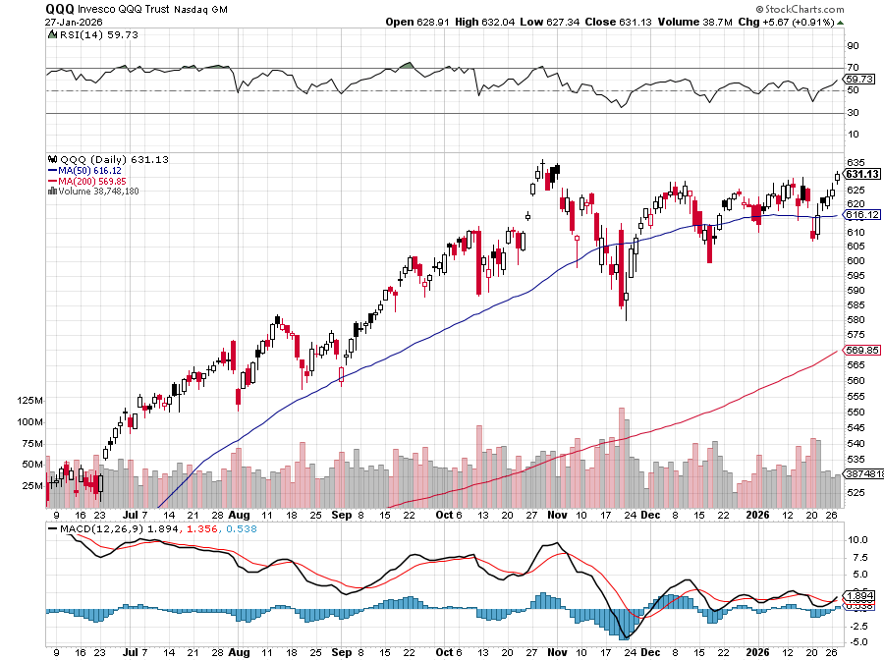
NASDAQ (QQQ) – Down 15% took profits on long 6/$540-$550-$345 put spread, took profits on Long 5/$335-$345 put spread took profits on long (QQQ) /$540-$550 put spread, took profits on long (QQQ) 4/$330-$335 put spread took profits on long (QQQ) 3/$340-$345 put spread, covered long (QQQ) $325-$330 put spread

Slide 25
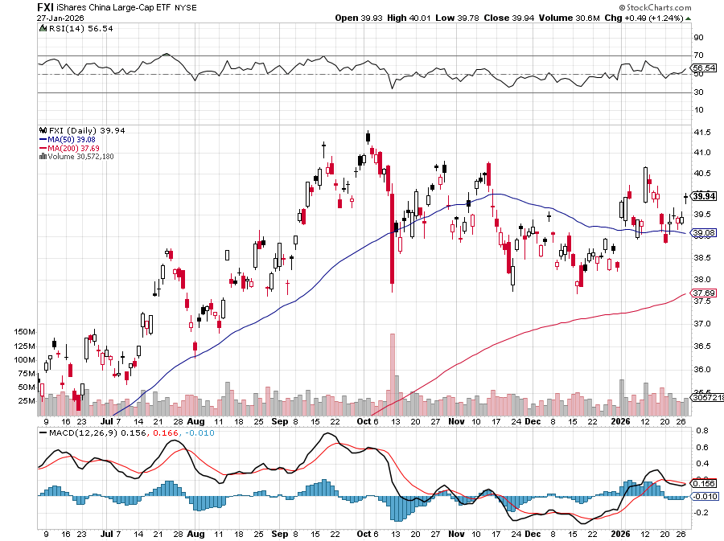
China (FXI) + 36%

Slide 26
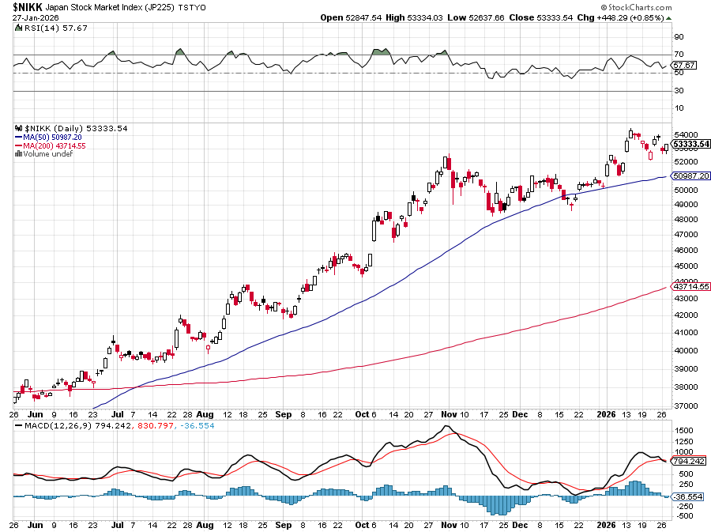
Japan ($NIKK) – down 10%
Nikkei Rockets on Japan Trade Deal, which dropped tariffs on Japanese cars to 15%

Slide 27
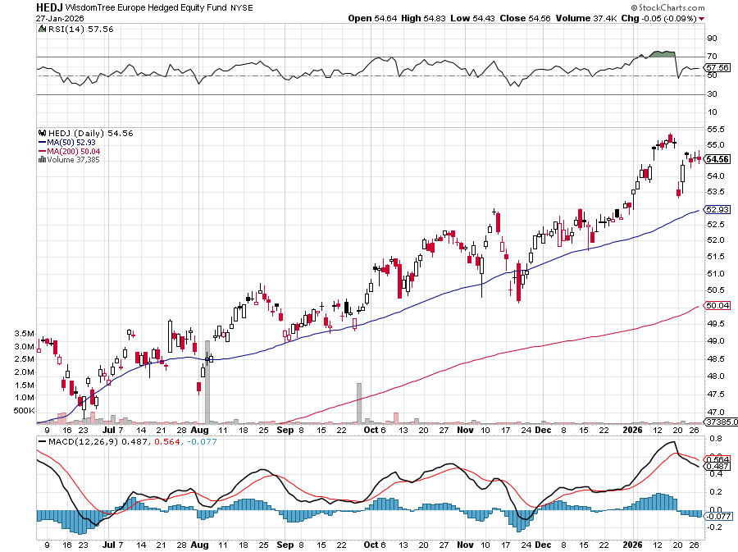
Europe Hedged Equity (HEDJ)- +19%

Slide 28
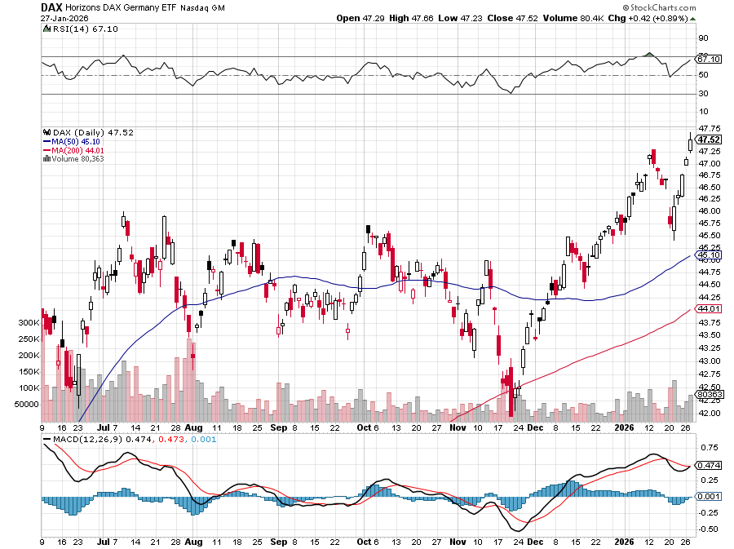
German Dax (DAX)- +30%

Slide 29
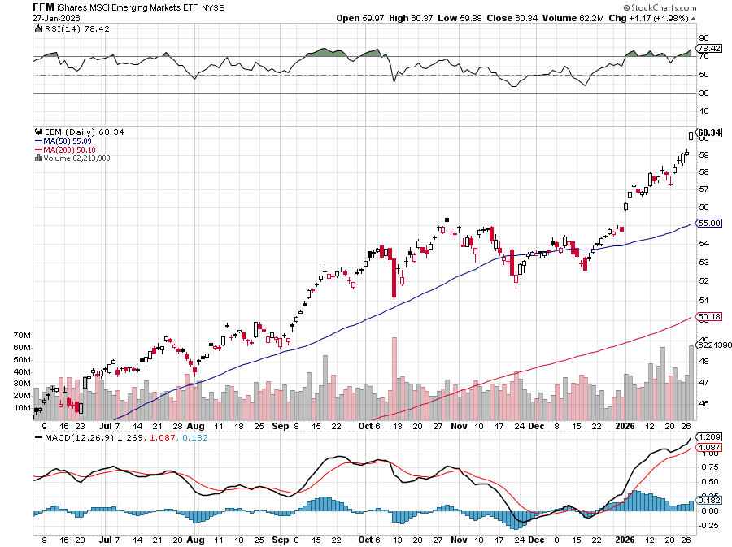
Emerging Markets (EEM) - +8%
Weak Dollar, Long Recovery Play

Slide 30
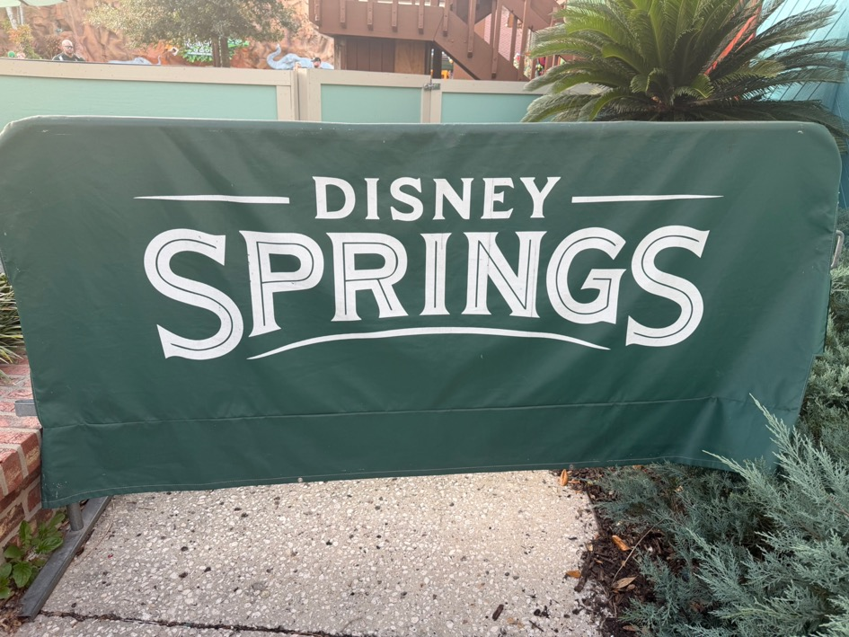

Slide 31



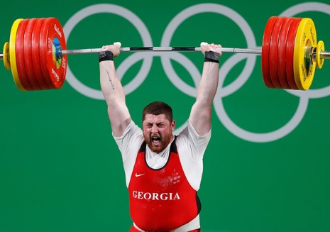
THE MAD HEDGE FUND TRADER
The Barbell Portfolio
*75% Big Tech – 2% of US workforce, 25% of market cap and 25% of US earnings
25% Domestic Recovery, including:
Railroads, airlines, cruise lines,
Couriers, steel companies
Banks, commodities
Construction
Credit Card Companies
Hotels, casinos
Online Ticket Sales

Slide 32
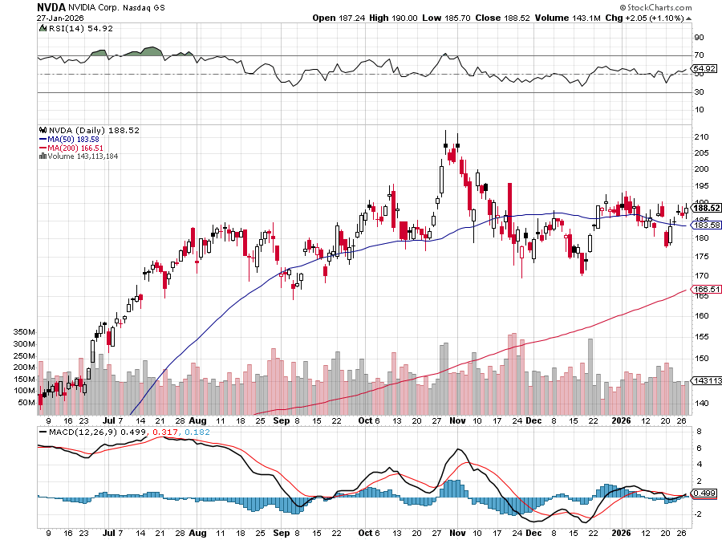

NVIDIA (NVDA) – Blackwell Chips @ $70,000 each
Meta to Buy Google Chips, to replace Nvida (NVDA) Blackwell chips it can’t get. stopped out of long 6/$140-$145 puts spread, took profits on long 5/$70-$75 call spread took profits on long 3/$88-$90 call spread, took profits on long 4/$140-$145 puts spread took profits on Long 2/$90-$95 call spread, took profits on Long 12/$117-$120 call spread

Slide 33
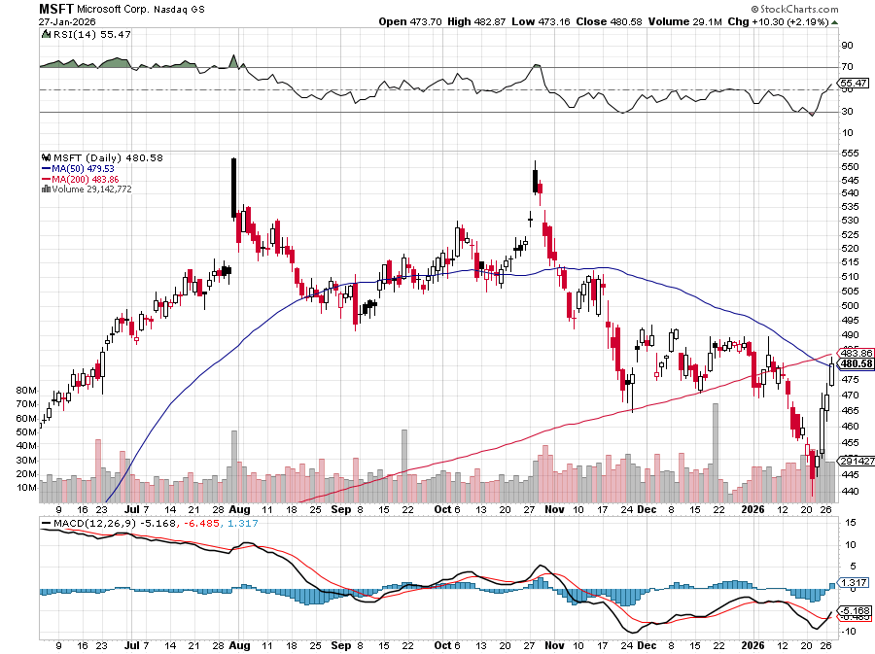

Microsoft (MSFT)- Become the Second $4 trillion Company
Microsoft Delivers Blowout Earnings took profits on long 5/$430-$440 put spread
Took profits on long 2/$330-$340 call spread, took profits on long 12/$320-$330 call spread took profits on long 9/$235-$245 call spread, took profits on long 7/$220-$210 call spread,

Slide 34
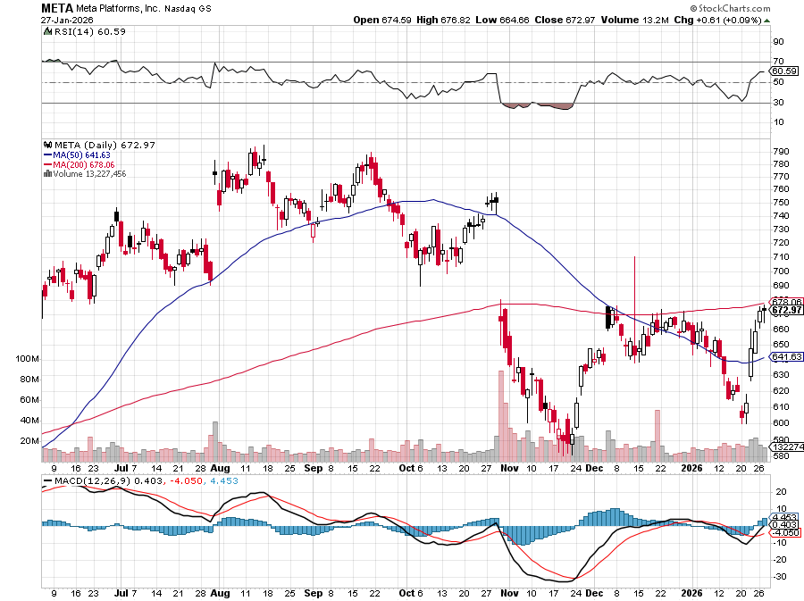

Meta (META)
Meta Delays Flagship Behemoth AI Product took profits on Long 8/$420-$430 call spread took profits on Long 5/$360-$370 vertical bull call spread, took profits on Long 9/$290-$300 vertical bear put spread, stopped out of Long 9/$190-$200 vertical bear put spread

Slide 35
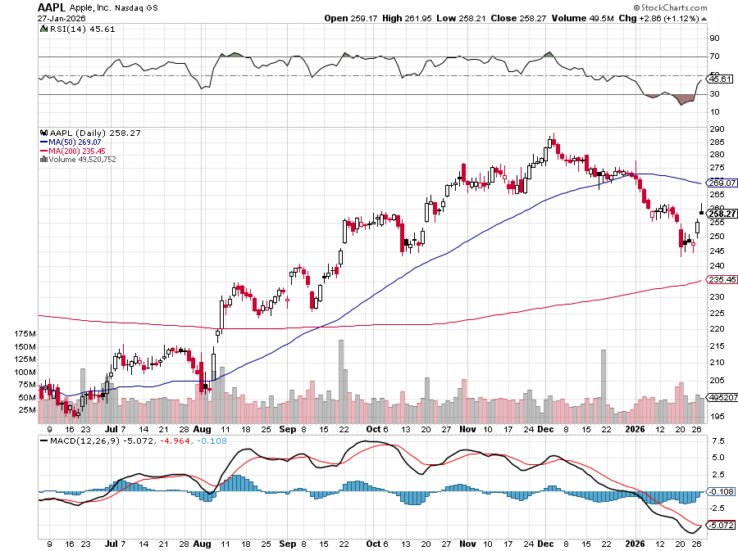

Apple (AAPL)
Is Tim Cook Resigning from Apple? took profits on long 6/$220-$230 put spread, profits on Long 5/$225-$235 vertical bear put spread, took profits on Long 8/$160-$170 call spread took profits on Long 6/$200-$210 bear put spread,

Slide 36
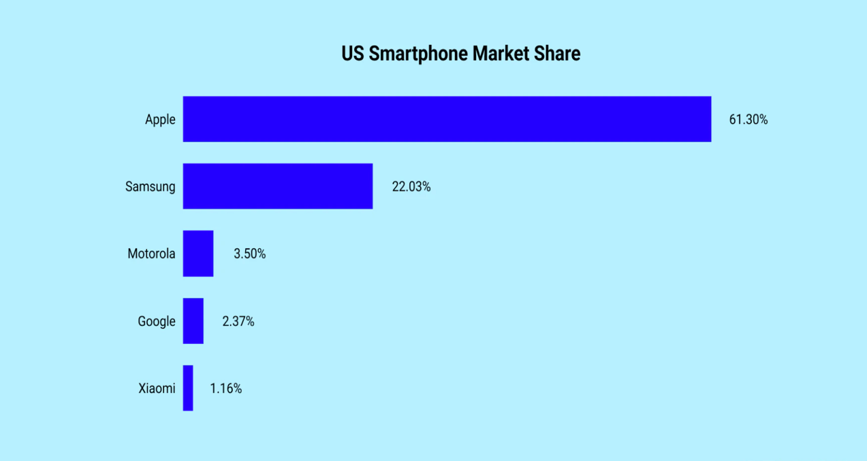

Slide 37
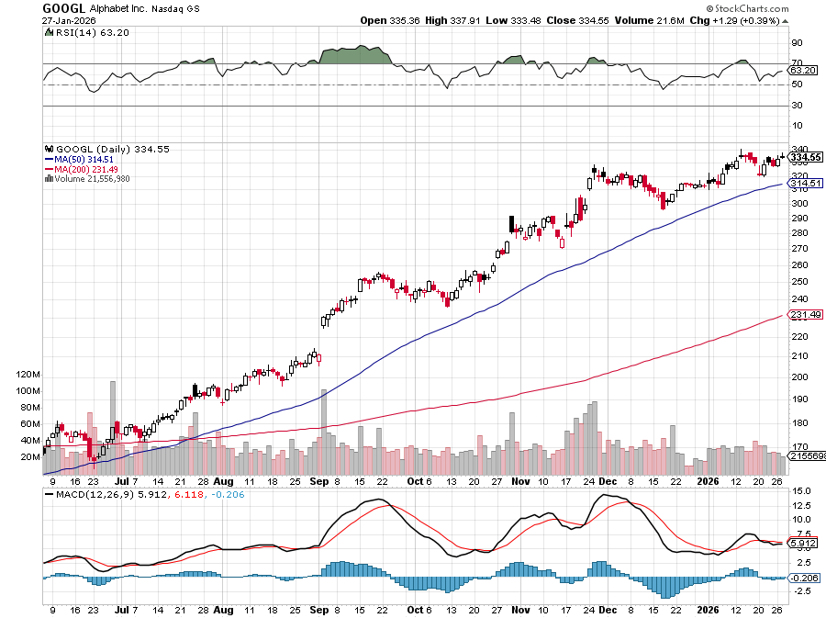
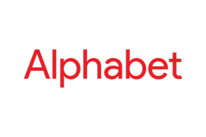
Alphabet (GOOGL) – Google Beats, with Earnings per share up to $2.31
Waymo Robotaxis Expand to Freeway Use in San Francisco took profits on long 12/$110-$120 call spread took profits on long 12/$1,200-$1,230 bull call spread, took profits on long 9/$1,030-$1,080 vertical bull call spread

Slide 38
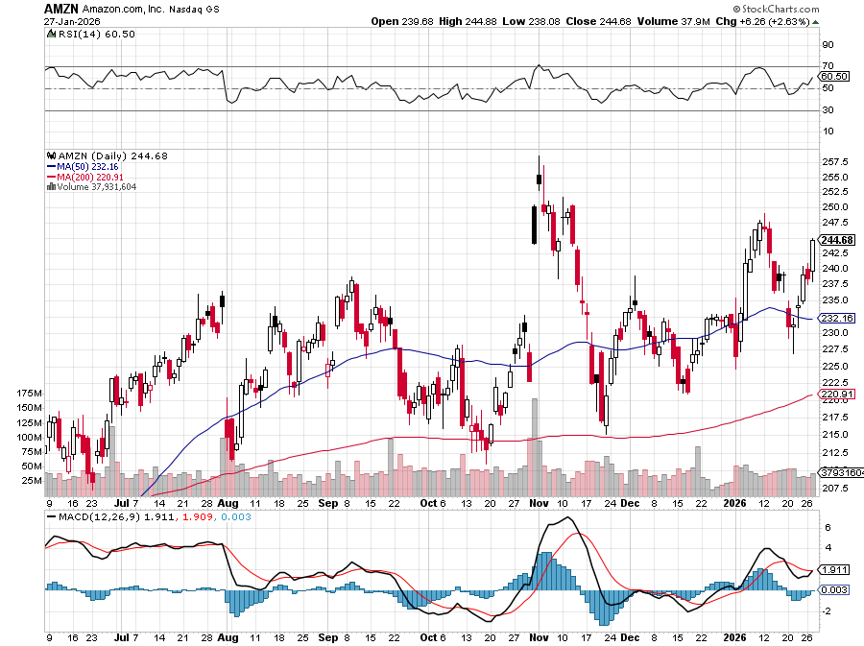

Amazon (AMZN) – Antirust Target
Amazon Cuts 16,000 Jobs took profits on long 3/$155-$160 bull call spread , took profits on long 2/$130-$135 bull call spread

Slide 39
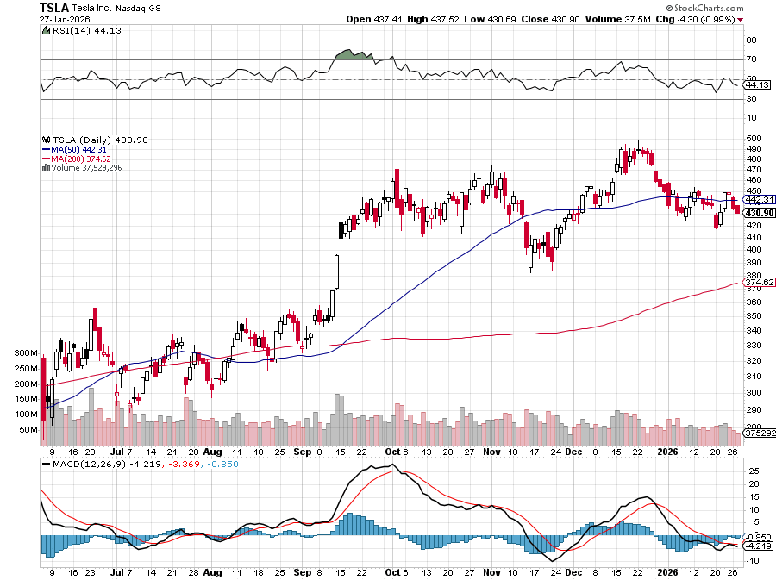

Tesla (TSLA) –
Elon Musk Fined $140 Million by Europe, stock downgraded by Morgan Stanley
took profits on long 10/$510-$520 put spread, took profits on 8/$370-$380 put spread
took profits on long 7/$420-$430 put spread, took profits on long 7/$360-$370 put spread
took profits on long 7/$180-$190 put spread, took profits in long 6/190-$200 call

Slide 40
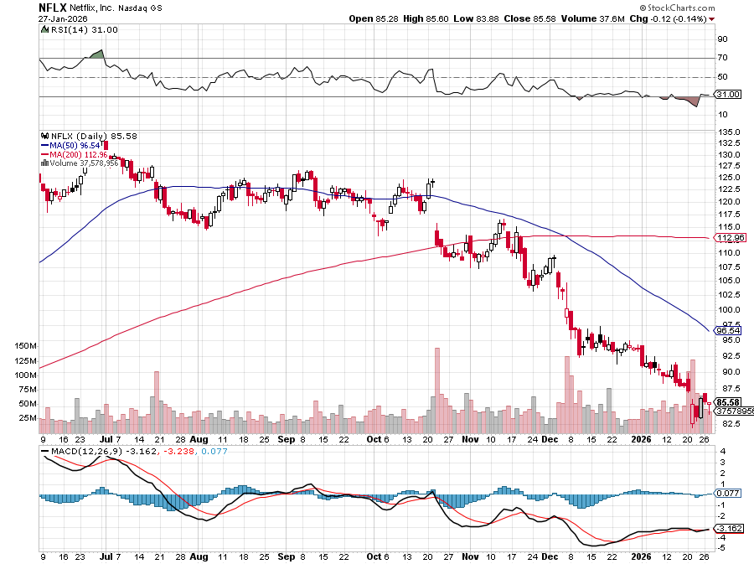

Netflix (NFLX) –
Netflix Tanks 5% on Good Earnings but Weak Guidance
Took profits on 11/$100-$102 call spread took profits on long $1040-$1060 call spread, took profits on long 4/800-$810 call spread

Slide 41
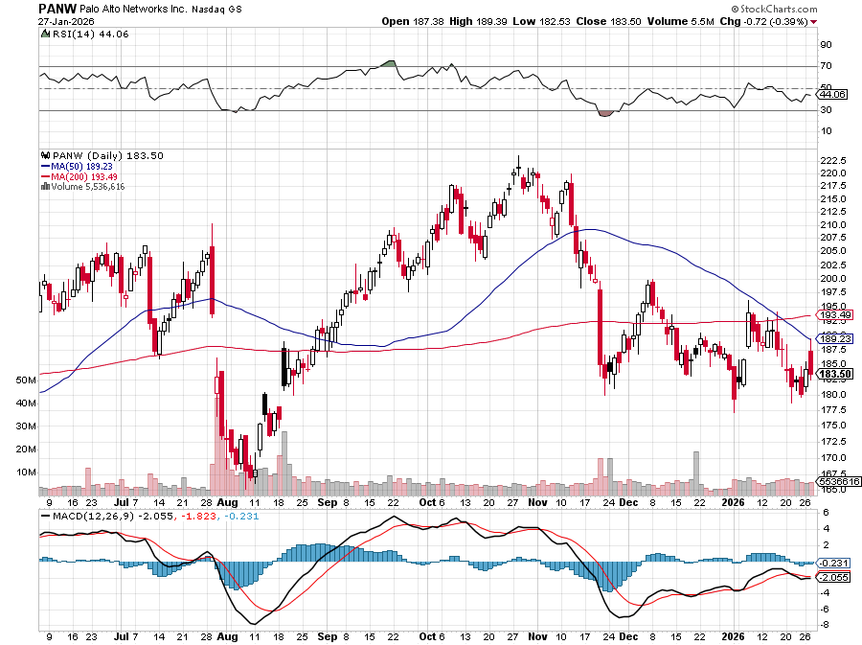

Palo Alto Networks (PANW)- Hacking never goes out of fashion
Is AI Putting SaaS Out of Business? took profits on long 2/$260-$270 call spread, took profits on long 10/$130-$140 call spread

Slide 42
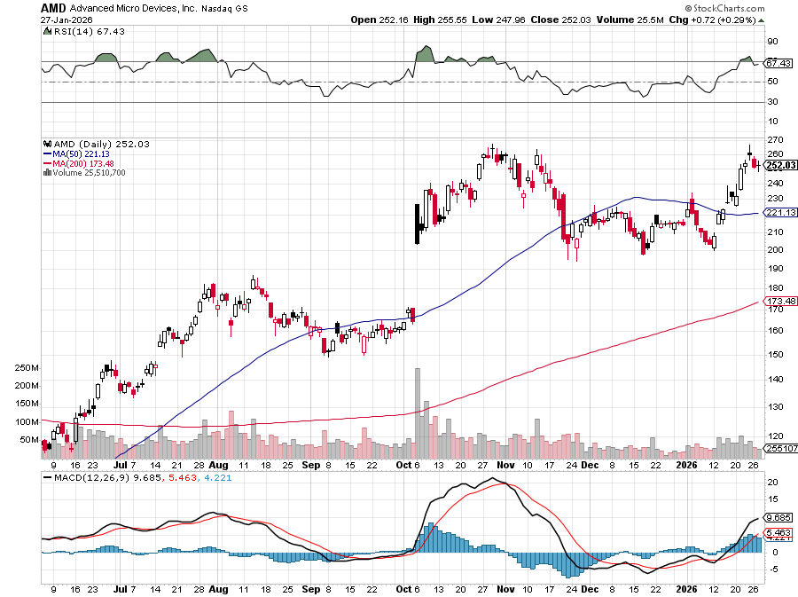

Advanced Micro Devices (AMD)- Recession fears programable logic devices took profits on long 2/$75-$80 call spread

Slide 43
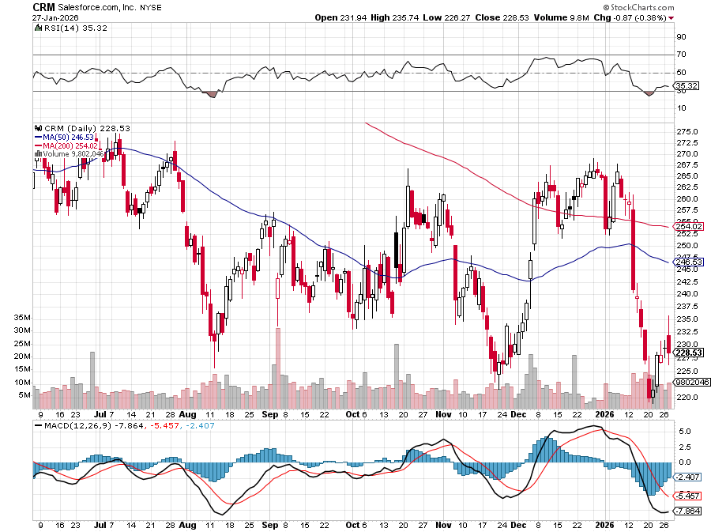

Salesforce (CRM)- Is AI Putting SaaS Out of Business? took profits on long 12/$185-$195 call spread, took profits on long 9/$125-$130 vertical bull call spread took profits on long 8/$125-$130 vertical bull call spread

Slide 44
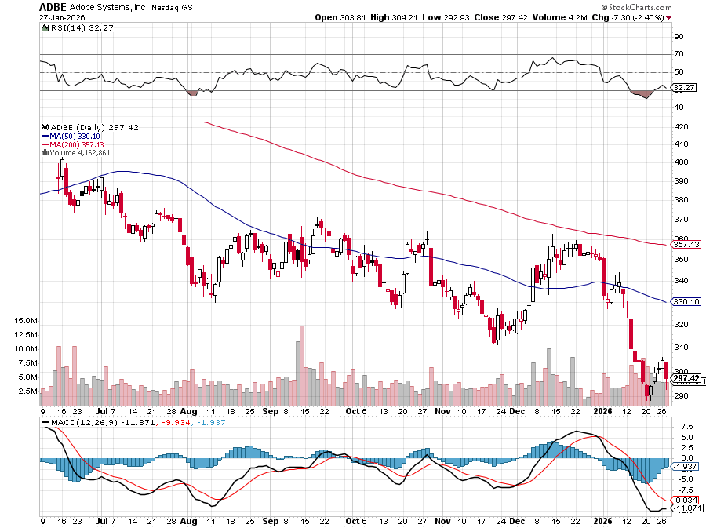

Adobe (ADBE)- Is AI Putting SaaS Out of Business?
The Quality Non-China tech play

Slide 45
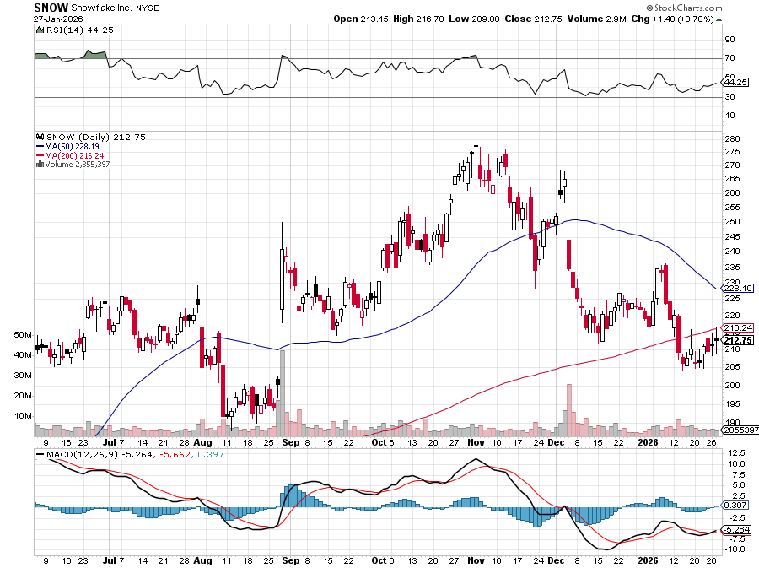

Snowflake (SNOW)- Blockbuster AI Earnings stopped out of long 4/$150-$255 call spread, took profits on long 12/$135-$140 call spread

Slide 46
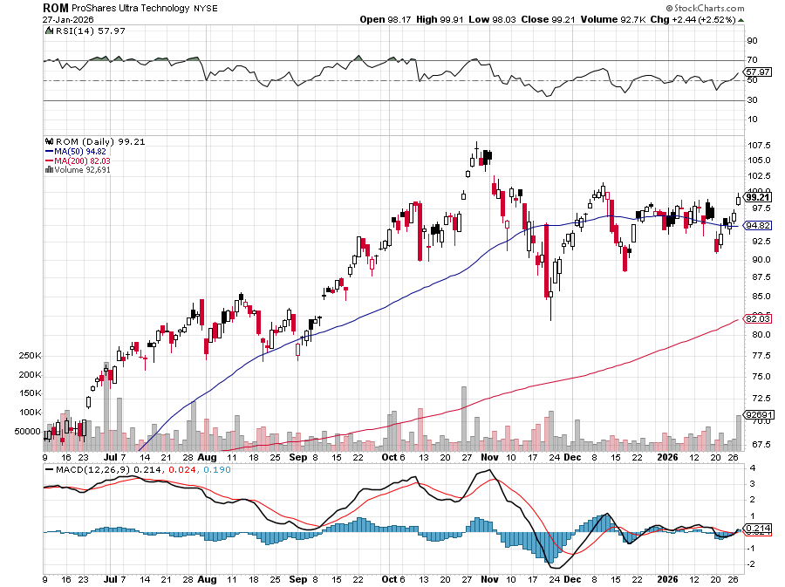
ProShares Ultra Technology ETF (ROM) – 2X Long Technology ETF took profits on long 10/$62-65 call spread

Slide 47
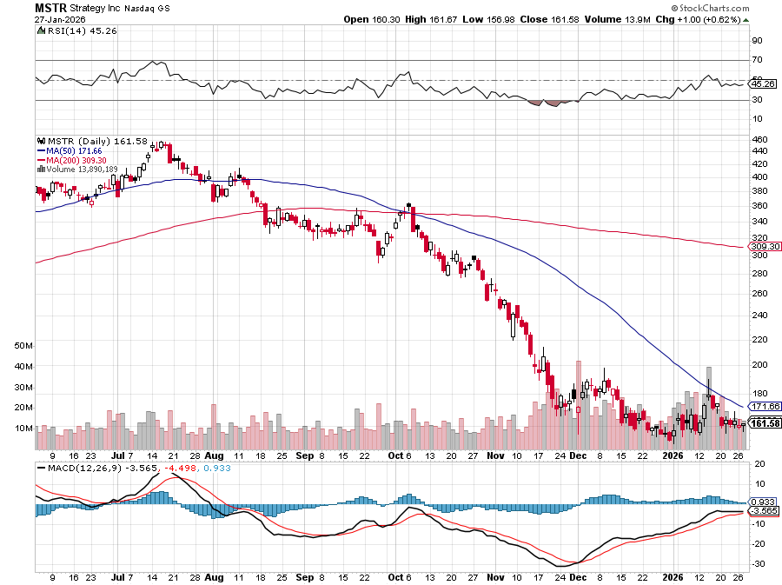

MicroStrategy (MSTR) – Long Bitcoin Play
Money is Moving out of Bitcoin Ethereum took profits on Long 6/$260-$270 call spread
Took profits on long 6/$500-$510 put spread, took profits on long 6/$470-$480 put spread took profits on long 6/$330-$340 call spread, stopped out of long 6/$335-$345 put spread

Slide 48
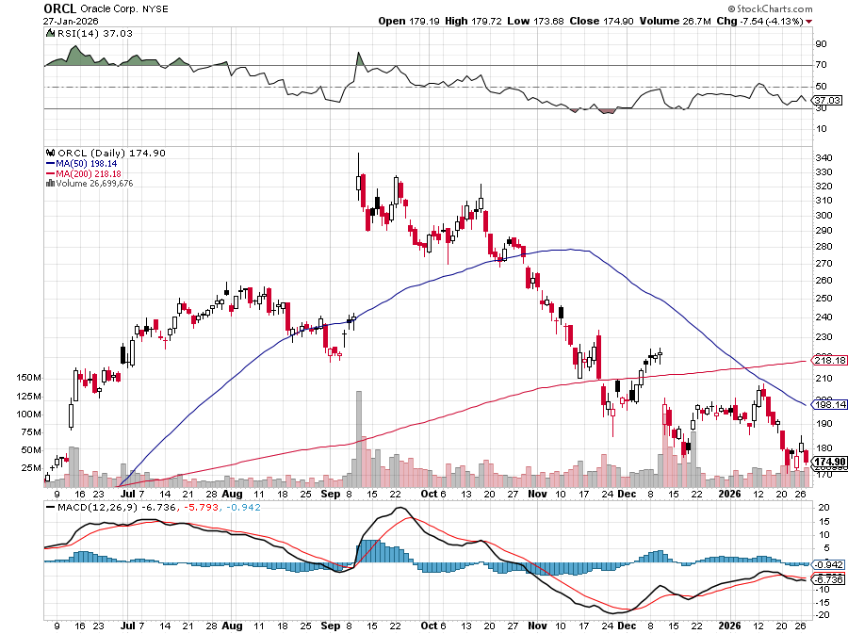

Oracle –(ORCL) – Spectacular Earnings Forecast but $100 billion in debt

Slide 49
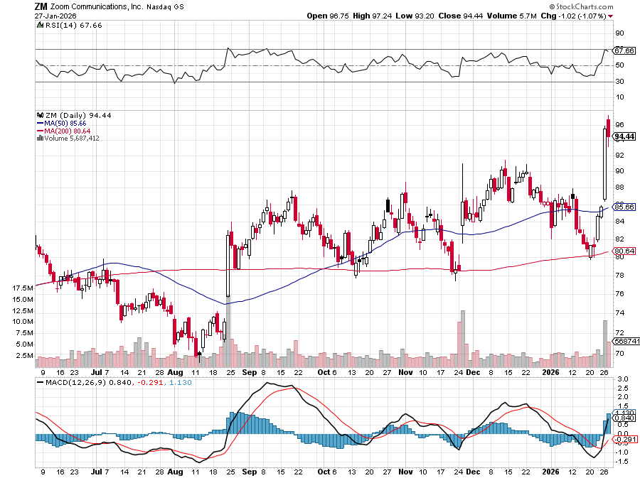

Zoom –(ZM) – Coming Back from the Dead took profits on 11/$72-50-$77.50 call spread

Slide 50


Slide 51
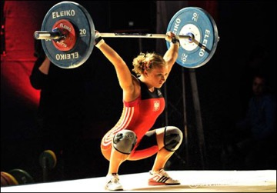
The Second Half of the Barbell
*Bets on a domestic recovery in 2022 Q4
*Upside potential in 2024 far greater than tech
*Some of these have not moved for 5 or 10 years
*Focuses on economically sensitive cyclical industries
*Makes a great counterweight to
high-growth technology
*We could spend all of next ten years rotating
between the two groups

Slide 52
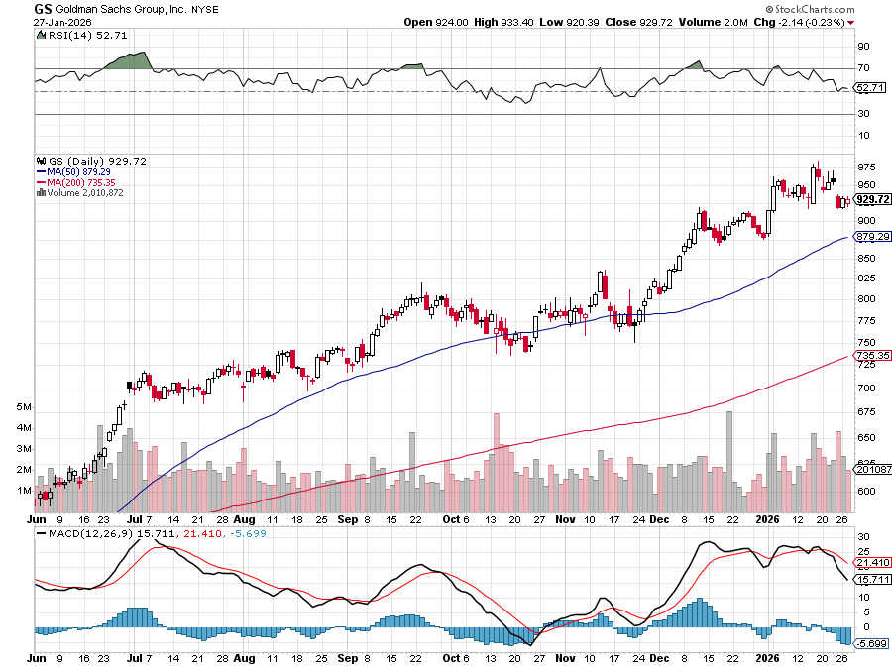

Goldman Sachs (GS) – BALLISTIC
Goldman Sachs (GS) Blows Out Earnings, on record stock trading profits took profits on long 11/$700-$710 call spread , took profits on long 10/$700-$710 call spread took profits on long 9/$690-$700 call spread, stopped out of 3/$380-$390 call spread, profits on long 12/$330-$350 call spread, took profits on long 11/$330-$350 call spread

Slide 53
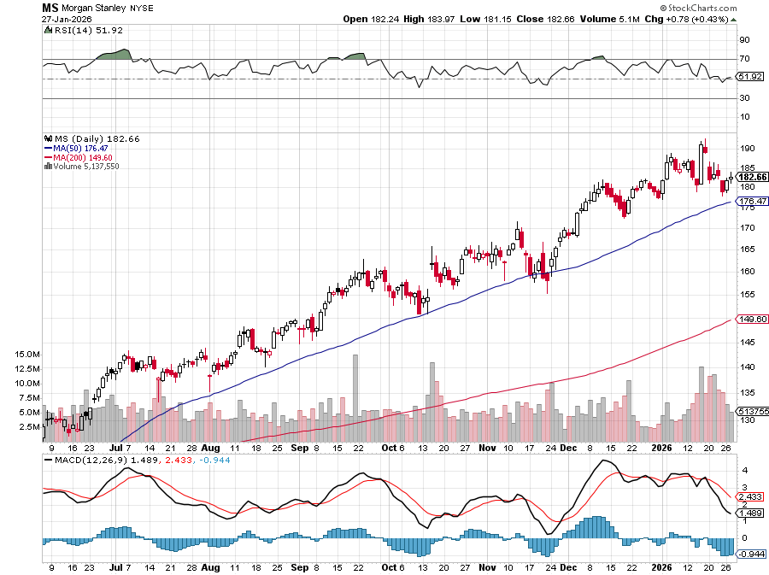

Morgan Stanley (MS) - Upside Breakout!
Morgan Stanley Surges on Investment Banking Windfall took profits on long $12/150-$155 call spread took profits on long $12/210-$220 call spread,, took profits on long $12/210-$220 call spread,
Took profits on long $195-$205 call spread, took profits on long 4/$65-$70 call spread

Slide 54
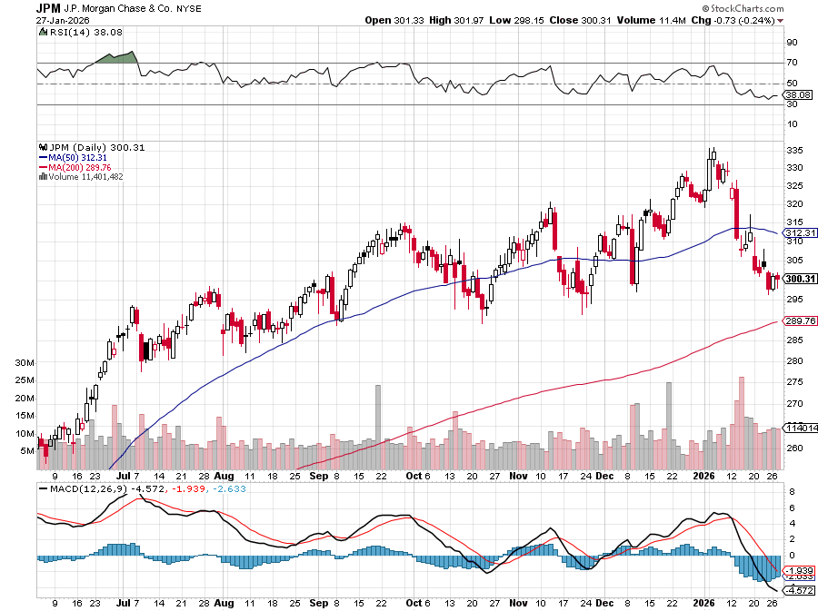

JP Morgan Chase (JPM) –
Trump Sues JP Morgan (JPM) for $5 Billion took profits on long 9/$270-$280 call spread stopped out of 3/$235-$245 calls spread, profits on long 12/$210-$220 call spread, took profits on long 11/$195-$205 call spread, took profits on 4/$215-225 put spread

Slide 55


Bank of America (BAC) – Upside Breakout? took profits on long long 12/$41-$44 call spread, took profits on long 4/$20-$23 call spread

Slide 56


Citigroup (C) – Upside Breakout took profits on long long 12/$60-$65 call spread , took profits on long 4/$30-$35 call spread

Slide 57


Charles Schwab (SCHW) – Upside Breakout took profits on long 4/$30-$35 call spread

Slide 58


Interactive Brokers (IBKR) – Upside Breakout? stopped out of long 3/$160-$170 call spread, out of long 8/$110-$115 call spread , took profits on long 4/$60-$65 call spread

Slide 59


Berkshire Hathaway (BRKB)- Ultimate defensive stock
Berkshire Hathaway Builds Record Cash, at $334 billion – Is the new T Bill proxy stopped out of long 12/$405-$415 call spread, took profits on long 12/$320-$330 call spread took profits on long 4/$260-$270 call spread, took profits on long 1/$290-$300 call spread

Slide 60


Blackrock (BLK)-Asset Collection Boom
Blackrock Reports Record $12.5 trillion in Assets Under Management stopped out of 12/$1,000-$1,010 call spread, took profits on long 12/$850-$860 call spread took profits on long 3/$770-$790 call spread, took profits on long 3/$310-$340 call spread

Slide 61

SPDR Metals & Mining ETF (XME) – long 2/$28-$30 call spread

Slide 62


Boeing (BA) – Renaissance
Boeing Jet Deliveries are Surging. The company delivered 57 commercial aircraft in August, its best performance for the month since 2018

Slide 63


General Motors (GM) – Worst Off Trade War Victim
Earnings better than expected plus interest rate beneficiary stopped out of long 4/$52.50-$57.50 put spread at cost, long 3/$53-$56 put spread

Slide 64


Package Delivery- United Parcel Service (UPS) –
UPS Deliveries Slow Worldwide, it the wake of the shutdown of its Kentucky hub after a fatal crash took profits on long 11/$130-$140 call spread

Slide 65


Caterpillar (CAT)- Ag + Infrastructure + Housing stopped out of long 8/$310-$320 call spread, took profits on long 12/$220-$230 calls spread took profits on long 12/$145-$150 call spread, took profits on long 11/$125-$135 call spread

Slide 66


Deere & Co. (DE)- Ag + Infrastructure + Housing took profits on long 8/$330-$340 put spread stopped out of long 8/$330-$340 calls spread

Slide 67


Freeport McMoRan - (FCX)- Riding on Gold’s Coatails
50% copper tariff took profits on long 8/$34-$37 call spread took profits on long 4/$37-$40 call spread, took profits on long 5/$42-$45 call spread, stopped out of long $48-$51 put spread, profits on long 6/$32-$35 call spread

Slide 68


Walt Disney (DIS) -Disney Beats
Disney Dives on Earnings Bust, although streaming broke even versus an expected loss

Slide 69


Industrials Sector SPDR (XLI)-
(GE), (MMM), (UNP), (UTX), (BA), (HON)

Slide 70


Union Pacific RR (UNP)- Big Stuff to Ship
The Largest Railroad in History, may be the result of the Union Pacific (UNP)/Norfolk Southern merger worth $200 billion took profits on long 5/$200-$210 call spread took profits on 11/$150-$160 call spread

Slide 71


Walmart (WMT) – Trade War Victim took profit on Long 11/$125-$130 bear put spread, took profit on Long 10/$119-$121 bear put spread took profits on Long 8/$114-$117 bear put spread

Slide 72


Costco (COST) – Supreme Court Win in the Price suing Trump administration over tariffs, one third of sales from imports took profits on long 4/$840-$850 call spread

Slide 73


Delta Airlines (DAL) – Ticket Price Take Off lost $200 million on government shutdown

Slide 74


Transports Sector SPDR (XTN)- Worst Hit Sector
(ALGT), (ALK), (JBLU), (LUV), (CHRW), (DAL)

Slide 75


Health Care Sector (XLV) – Defensive Play and Cheap
(JNJ), (PFE), (MRK), (GILD), (ACT), (AMGN)

Slide 76


Amgen (AMGN) long 7/$260-$270 bull call spread, took profits on long 11/$185-$200 bull call spread

Slide 77


Visa (V) – Stablecoin Competition took profits on long 2/$240-$250 bull call spread took profits on long 10/$160-$170 bull call spread, took profits on long 6/$150-$160 bull call spread

Slide 78


Consumer Discretionary SPDR (XLY)
(DIS), (AMZN), (HD), (CMCSA), (MCD), (SBUX)

Slide 79


Slide 80

Bonds – Bond Crash
*Japanese Bond Markets Crash, taking yields up to 4.3%, an all-time high.
*A new stimulatory budget and a weak yen are expected to cause inflation%
*Japan’s debt/GDP is now over 200% compared to 150% for the US.
*It rattles the world because a lot of financing was done
in a formerly low-interest rate world. It all shows how
records debts is a global problem
*It all underlines the global nature of the excessive debt problem
*Denmark Dumps $100 Million of US Treasuries, their entire
holdings, citing the deteriorating finances of the US government

Slide 81

Treasury ETF (TLT) – took profits on long 6/$88-$91 put spread stopped out of long 6/$80-$83 call spread, took profits on long 4/$84-$87 call spread stopped out of long 1/$82-$85 call spread, took profits on long 10/$103-$106 put spread took profits on long 6/$$94-$97 put spread, took profits on long 5/$82-$85 calls spread

Slide 82

Ten Year Treasury Yield ($TNX) – 4.25%

Slide 83

Junk Bonds (JNK) 6.54% Yield

Slide 84

Municipal Bonds (MUB) 4.21% Yield-

Slide 85

Emerging Market Debt (ELD) 5.62% Yield-

Slide 86

2X Short Treasuries (TBT)-Out of Favor

Slide 87

Anally Capital Management (NLY) – Leveraged REIT Play
Yield 13.25% took profits on long 12/$15-$16 call spread

Slide 88


Slide 89

Foreign Currencies – Dollar Crash
*Trump Comments on Currencies Trash the US Dollar
*Returns of “Sell America” trade prompts major crash in US dollar as foreign investments dump US assets
*US Dollar Faces a Prolonged Decline, off the back of coming Fed interest rate cuts
*We may see another 20% move down as more
Fed interest rates cuts loom
*Emerging markets (EEM) have been
the best currency play of 2025, up 40% at high
*Buy (FXA), (FXE), (FXB), (FXC), and (FXY)

Slide 90


THE MAD HEDGE FUND TRADER
Australian Dollar (FXA) - Major Long-Term Bottom is In Targeting Parity – A call option on a global synchronized recovery

Slide 91


Japanese Yen (FXY)

Slide 92


Euro (FXE)-

Slide 93


British Pound (FXB)-

Slide 94


Emerging Market Currencies (CEW)

Slide 95


Slide 96

Energy & Commodities – Venezuela Boost
*Venezuela will need $190 billion in spending to restore its oil fields, and all of that business will go to American companies
*Most on Venezuela's oil infrastructure was built by Schlumberger and Haliburton (HAL)
*It pushed our Schlumberger (SLB) 2026 LEAPS from a total loss to max profits at expiration in weeks
*I saw $2.59 a gallon in Florida.
*If the Ukraine War ends huge Russian inventories will
get dumped on the market crushing pricing
*If any Venezuelan production improve it will crush prices further
*Venezuela is now producing 800,000 barrels a day
*It could produce 4 million barrels a day

Slide 97

Oil-($WTIC)

Slide 98

United States Oil Fund (USO)

Slide 99

Energy Select Sector SPDR (XLE)-No Performance!
(XOM), (CVX), (SLB), (KMI), (EOG), (COP)

Slide 100

ExxonMobil (XOM)-
Exxon Moves Big into Lithium, with the construction of a major mining operation in Arkansas took profits on Long 4/$100-$105 call spread, took profits on long 12/$120-$125 put spread

Slide 101

Occidental Petroleum (OXY)- Buffet’s a Buyer took profits on long 4/$59-$62 call spread took profits on long 2/$55-$60 call spread, took profits on long 12/$77.50-$82.50 put spread

Slide 102

Natural Gas (UNG) – Winter Storm Bost took profits on Long January 2025 $7-8 Call Spread LEAPS

Slide 103

Cameco (CCJ) – Global Uranium Renaissance
Microsoft to Reopen Three Mile Island to power AI data centers took profits on long 12/$41-$44 call spread, took profits on long 12/$35-$38 call spread, took profits on long 5/$20-$23 bull call spread

Slide 104

Vistra Corp. (VST) – Global Uranium Renaissance took profits on long 2/$100-$110 call spread

Slide 105


Slide 106


Slide 107

Precious Metals – All 2026 Targets Reached
*Insanity hits the precious metals markets
*All 2026 targets met with Gold at $5,300 and Silver at $115
*10% intraday swings have become common
*Metals may take a dip in the run up to the Chinese New Year on
February 17, who have been the biggest buyers
*Political instability in the US has become a factor driving gold
*AI build out is creating exponential growth in demand for silver
*I am out of all precious metals positions
*When an investment reaches your target the most dangerous thing
you can do is raise your targe

Slide 108

Watch the Silver/Gold Ratios
*4,000-year range 3:1 to 10:1
*2008 range 40:1 to 100:1
*Now: 50:1
*Conclusion: Silver is vastly overpriced compared
historic gold ration
*Conclusion: Silver is vastly overpriced
*The short of the century may be setting up
*Short silver/long gold has become a major
hedge fund trade

Slide 109

Silver/Gold Ratio to Today

Slide 110


THE MAD HEDGE FUND TRADER
Gold (GLD) – Headed for $5,000....or $10,000?
long 12/$355-$360 call spread – expires in 7 trading days
profits on long 6/$275-$285 call spread, took profits on long 5/$275-$285 call spread
stopped out of long 6/$275-$285 call spread, took profits on profits on long 10/$230-$235 call spread
BUY

Slide 111


Market Vectors Gold Miners ETF- (GDX) – took profit on long 6/$207.50-$212.50 call spread, took profit on long 7/$200-$205 call spread

Slide 112


Barrick Mining (B) took profit on long 1/$15.50-$16.50 call spread

Slide 113


Newmont Mining- (NEM)- Sometimes you Just Get Lucky took profits on long 10/$47-$50 call spread, took profits on long $55-60 call spread

Slide 114


THE MAD HEDGE FUND TRADER
iShares Silver Trust (SLV) - The Better Play Industrial demand, solar panels, electric cars
2026
Target
$100
+50%
BUY

Slide 115


Silver Miners - (SIL)-

Slide 116


Wheaton Precious Metals - (WPM)- LEAPS Approaching Max Profit took profits on long 4/$39-$42 call spread long 6/$75-$80 call spread-expires in 7 trading days , took profits on long 1/$36-$39 call spread

Slide 117


Platinum- (PPLT)- 556,000-ounce shortage this year took profits on long 1/$36-$39 call spread

Slide 118

S&P Case Shiller Slows
S&P Case Shiller Rises to +1.4% YOY in October, with its National Home Price Index
Chicago gained +5.8%, Cleveland +4.1%, and New York +5.0%.
Tampa -4.5% Phoenix -1.5% and Dallas down -1.5%

Slide 119


Slide 120

Real Estate – Rate Push
*DH Horton (DHI) Beats. Incentives helped the company to drive a 3% increase ‌in its net sales
*Existing Home Sales Jump 5.1% from November, to a seasonally adjusted 4.35 million units.
*US Pending Home Sales dive 9.3% in December, according to the National Association of Home Builders
*The Midwwest was hardest hit followed by the Northeast
*The average rate on the popular ⁠30-year fixed-rate mortgage
declined to 6.06%, ‍the lowest level in more than three years
*Mortgage Refinance Demand Soars 40%,

Slide 121


Crown Castle International (CCI) – 4.68% yielding 5G cell phone tower REIT
Eliot Management Pushes up stock with activist bid took profits on Long 8/$90-$95 call spread,

Slide 122



US Home Construction Index (ITB)
(DHI), (LEN), (PHM), (TOL), (NVR)

Slide 123


DH Horton (DHI)
Earnings Hit on free upgrades eating into margins took profits on long 11/$165-$175

Slide 124

Trade Sheet- The Recession Trade
So What Do We Do About All This?
*Stocks –stand aside
*Bonds – stand aside
*Commodities – buy dips
*Currencies – buy dips
*Precious Metals – buy dips
*Energy – buy dips
*Volatility – sell over $30
*Real estate – buy dips

Slide 125

Next Strategy Webinar
12:00 EST Wednesday, February 11, 2026 from Buenos Aires, Argentina
Last Webinar of the Year email me questions at https://www.madhedgefundtrader.com/jp-ms-0925
Good Luck and Good Trading!
Notes:
*

Slide 126


Slide 127


