Slide 1

The Mad Hedge Fund Trader “The View from Above”
With John Thomas Lima, Peru February 25, 2026 www.madhedgefundtrader.com
Notes:
*

Slide 2


Slide 3
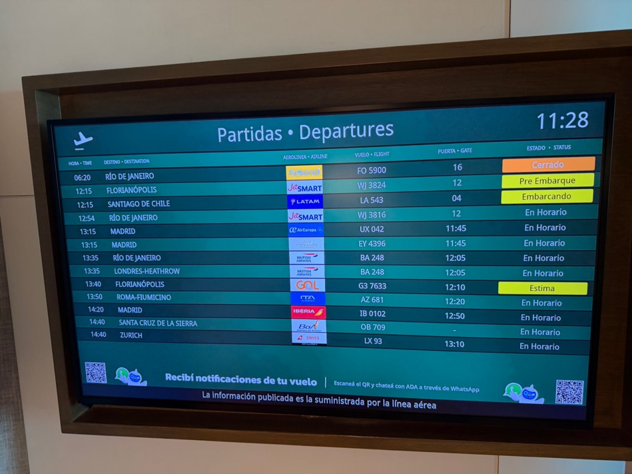

Slide 4


Slide 5
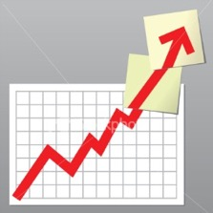
Trade Alert Performance New All-Time Highs-17 Consecutive Positive Months
*January +1.97% MTD *July +5.21% Final *February +3.08% Final. *August +1.37% Final *March +4.36% Final *September +2.21% Final *April +0.95% Final *October +3.11% Final *May +2.51% Final *November +2.33 Final *June +15.48% Final *December +2.66% Final *2026 Year To Date +5.06% +819.02% since inception *Versus 79.79% for all of 2023 *Versus 75.29% for all of 2024 *Versus 62.02% for all of 2025

Slide 6
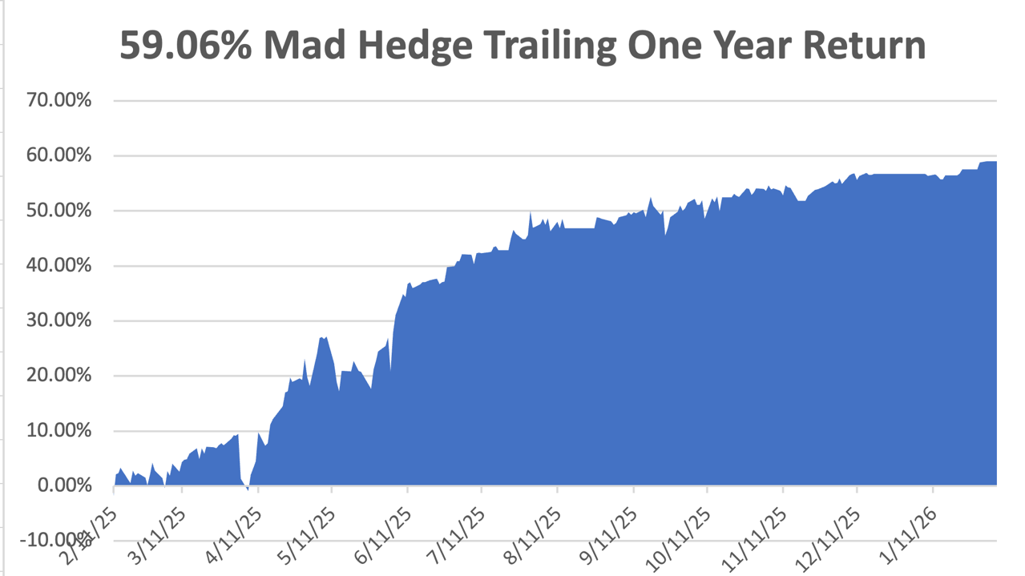

Slide 7
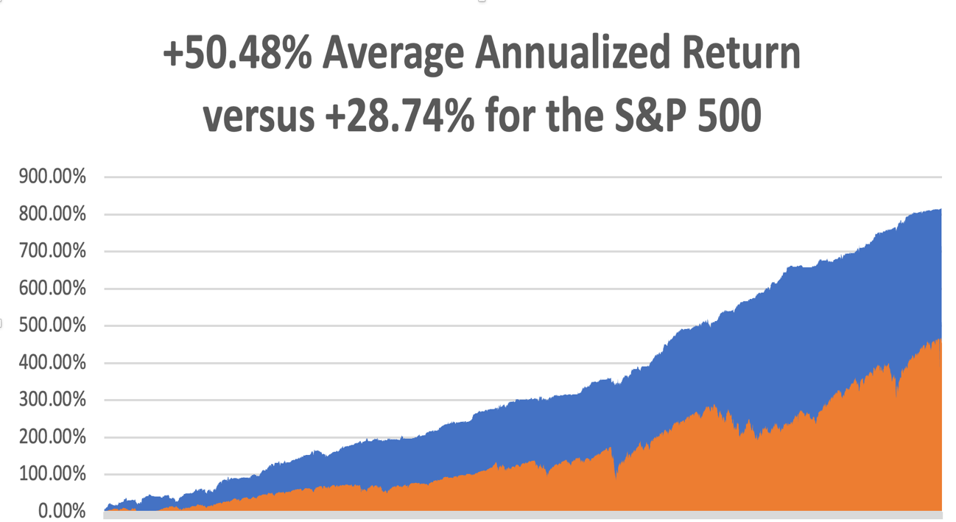

Slide 8


Slide 9


Slide 10
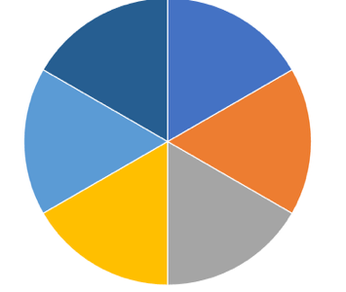
Portfolio Review – High Risk Market Require Maximum Cash 50% risk on, 10% risk off, 40% cash
Asset Class Breakdown
Risk Adjusted Basis
(GLD) 3/$430-$435 call spread | 10.00%
(GLD) 3/$440-$445 call spread | 10.00%
(SPY) 3/$630-$640 call spread | 10.00%
(GS) 3/$790-$800 call spread | 10.00%
(FCX) 3/$55-$58 call spread | 10.00%
Risk Off
(SPY) 3/$710-$720 put spread | -10.00%
Total Net Position | 40.00%
Total Gross Position | 60.00%
cash | 40.00%
Expiration Value +12.07%

Slide 11

What Are HALO Stocks?
*High Asset *Low Obsolescence *Can’t be easily replaced by AI *Are immune to AI shocks are hitting Low Asset High Obsolescence (LAHO) stocks *HALO has massively outperformance LAHO in recent months *HALO examples are: *Texas Pacific Land Corp. (TPL). *FedEx (FDX) *Corning (GLW) *Hershy (HSY) *Southern Co, (SO) *Colgate (CL) *Baker Hughes (BKR) *Apple (AAPL) *Southern Copper (SO) *Any oil company

Slide 12

The Method to My Madness
*Supreme Court decision on tariffs prompts Trump to extend the trade war another year through other means *Economic data show that the US is slowly headed into recession, is why bonds haven’t crashed in the face of impending $45 trillion in national debt *The long-term bull arguments of super liquidity, AI, falling interest rates are still the market drivers, but won’t be enough to support the stock market in the face of a real recession *Jobs data remains bad and getting worse *Iran war fears send oil to six-month highs, negating deflationary effect *US Dollar approaches new multi year lows in line with coming rate cuts *Bitcoin looks ready to fall to new lows with whales bailing

Slide 13
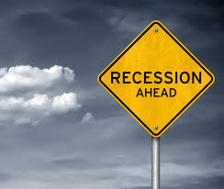
The Global Economy – Recession Risk
*Most recent economic data show the recession risk is rising *ADP Weekly Employment Reports shows a gain of only 12,000 *CBO Raises National Debt Projection rises by $1.4 Trillion, *Factory Orders Plunge *Dallas Fed Manufacturing Index Comes in Flat *US Trade Deficit Explodes *Will Consumers spend or save their $2,000 tax refunds? *Inflation Comes in Soft at 2.4% buy only because the government market October and November at zero because of the government shutdown. The real rate is 3.0%

Slide 14
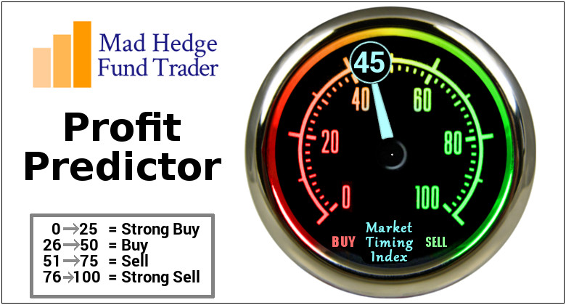

Slide 15
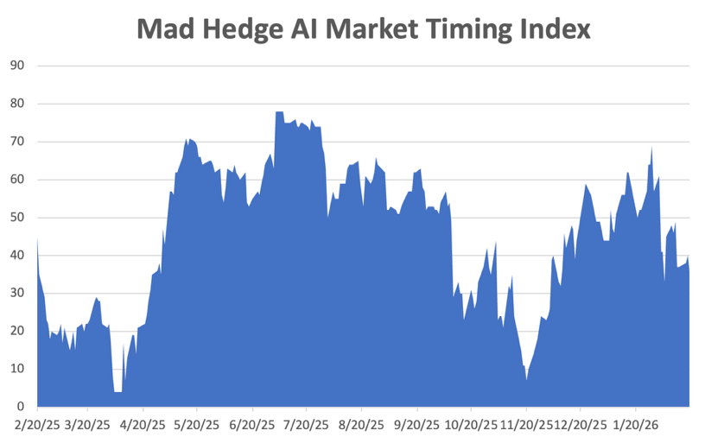
The Mad Hedge Profit Predictor Market Timing Index – Hits Seven month Low at 6, An artificial intelligence driven algorithm that analyzes 30 different economic, technical, and momentum driven indicators
SELL
BUY

Slide 16
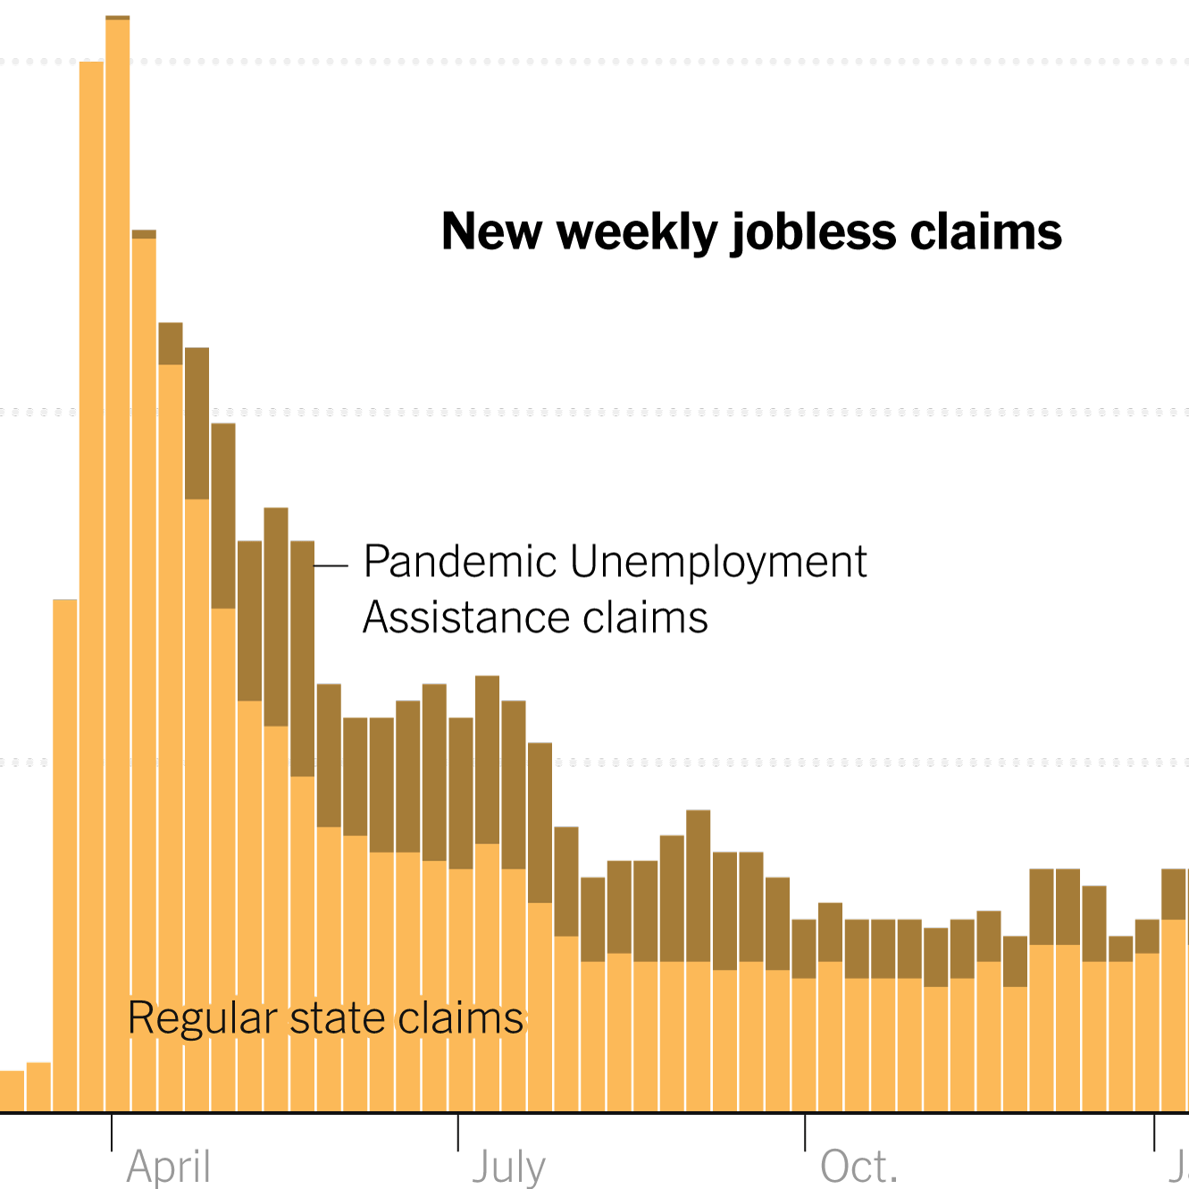
Weekly Jobless Claims – -23,000 to 206,000

Slide 17


Slide 18
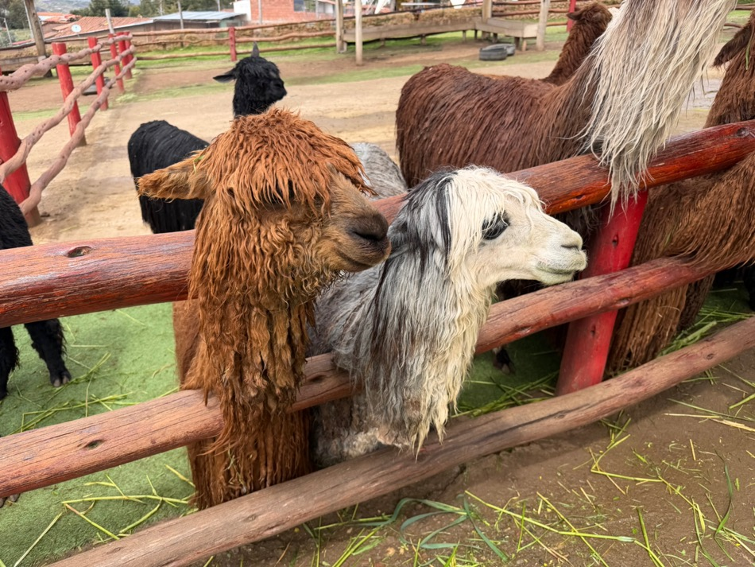

Slide 19

Stocks – Indifferent
*AI May Wipe Out Large Swaths of the White-Collar Industry *IBM Crashes 14%, after the artificial intelligence startup Anthropic said its Claude Code tool can help with modernizing COBOL *Airbnb Jumps 5%, after it became the latest travel company to point to resilient premium demand *Volatility has Suddenly Increased. *About 30% of S&P 500 stocks moved over 20% in three months, double the 15% average, despite low market volatility *Increased inflows into hedge funds, with $3.5 billion in stock purchases this year, are exacerbating extreme stock price movements *Rivian Shares Soar *Software Selloff Spreads to Apollo and Blackstone, Alternative asset managers,

Slide 20
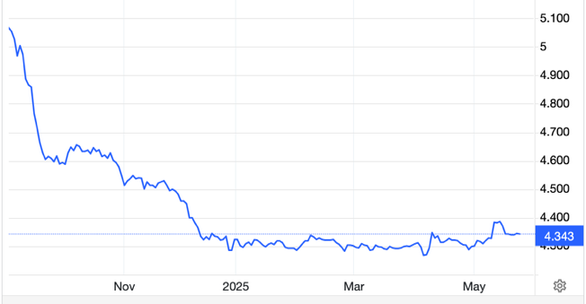
The Ultimate Hedge – Defensive stocks only go down at a slower rate 90 - day US Treasury Bills (Warren Buffet owns $340 billion) Extend to One Year!
*Government Guaranteed principal *Endless liquidity, trade like water *100% collateral value for margin *Lock in guaranteed income *Can be sold at any time to earn full interest *Will survive any bear market *Ask your broker how to buy
3.69% Yield

Slide 21
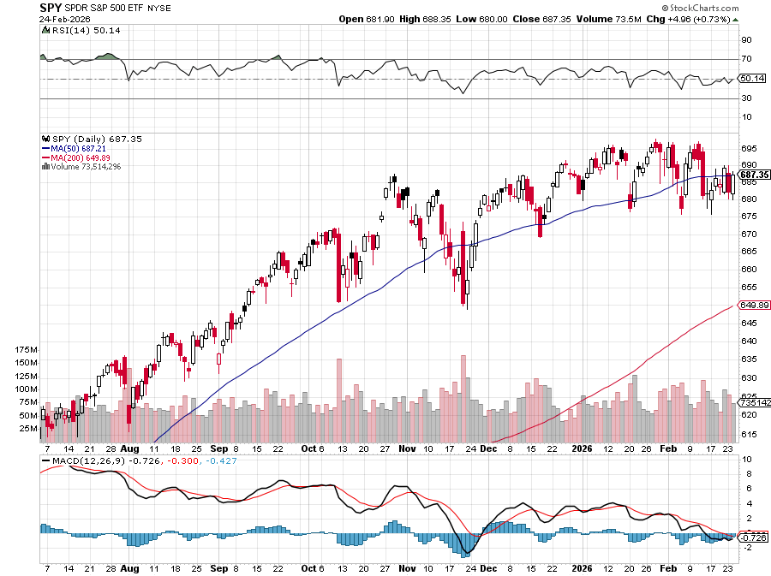
S&P 500 – Stalling
$675 -3.70% 1st support
$660 -5.70% 1st support

Slide 22
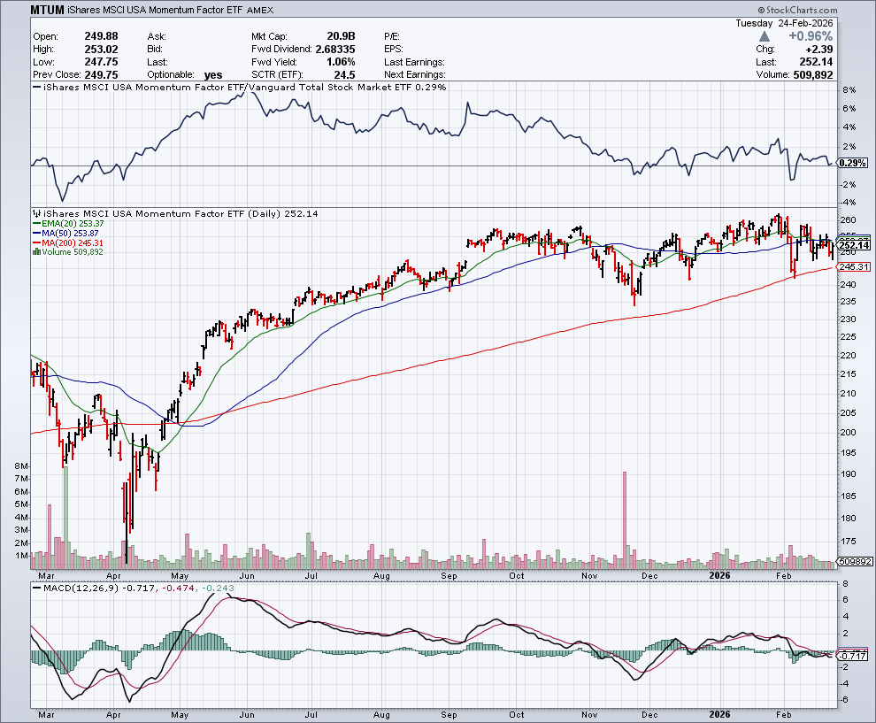
Momentum (MTUM)

Slide 23
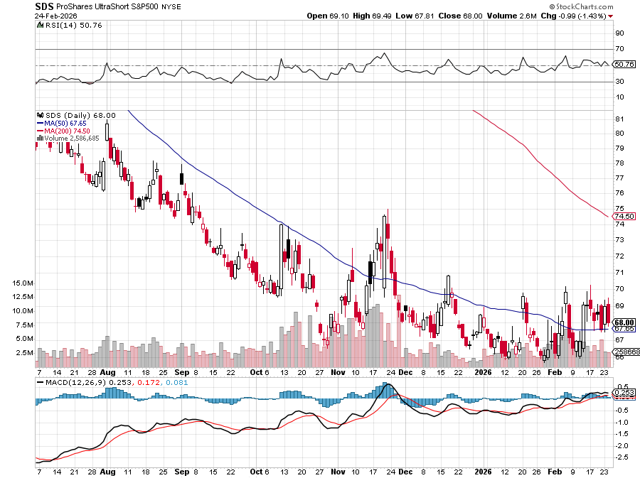
ProShares -2X Short S&P 500 (SDS) - a great 2X hedge for falling long stocks

Slide 24
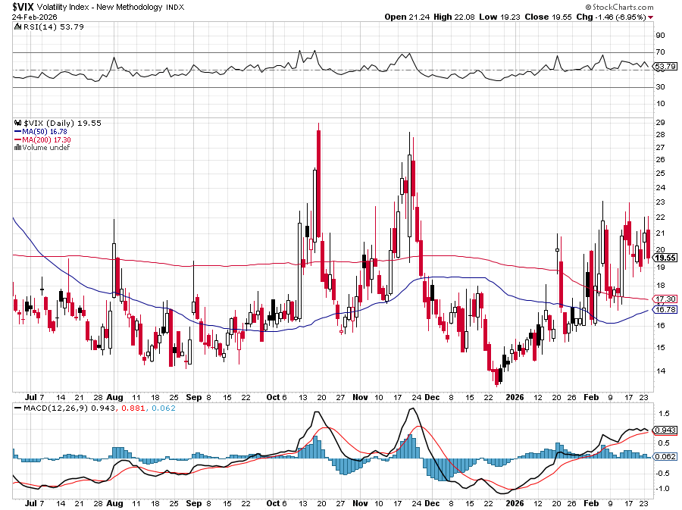
(VIX) – Volatility Index Hits Four Year High at $65, the most since the 2020 pandemic. That implies a 2% move in the S&P 500 (SPX) every day for the next 30 days

Slide 25
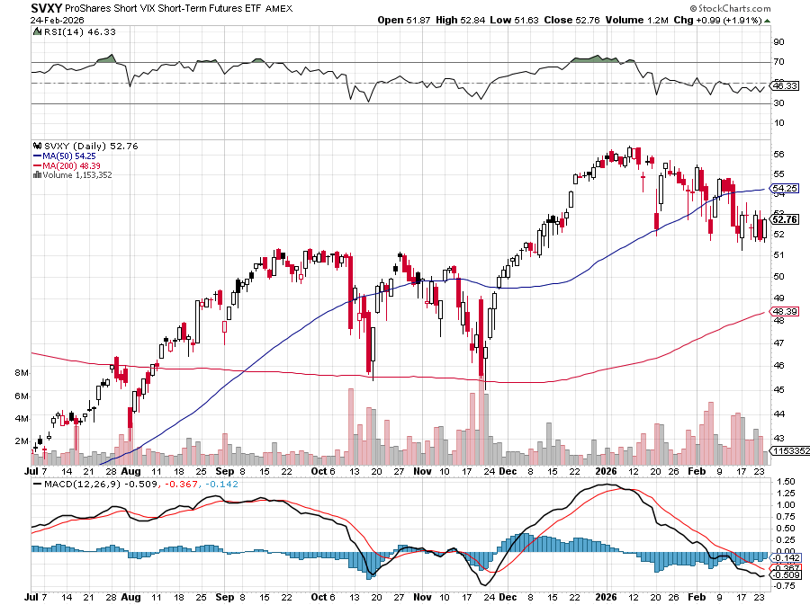
(SVXY) –Short Volatility ETF bought at $36.31 - $32.74 = $3.57

Slide 26
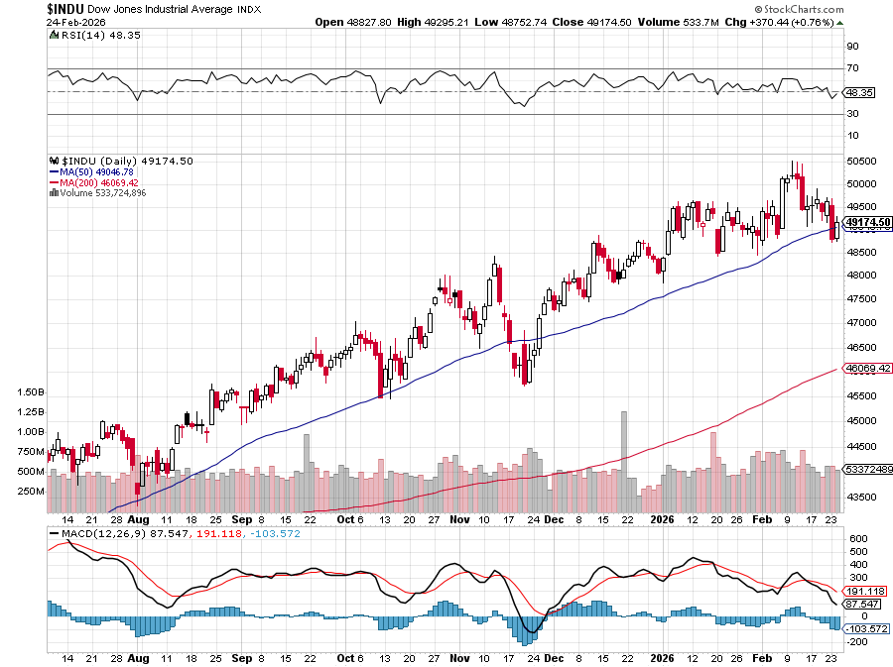
Dow Average ($INDU)-

Slide 27
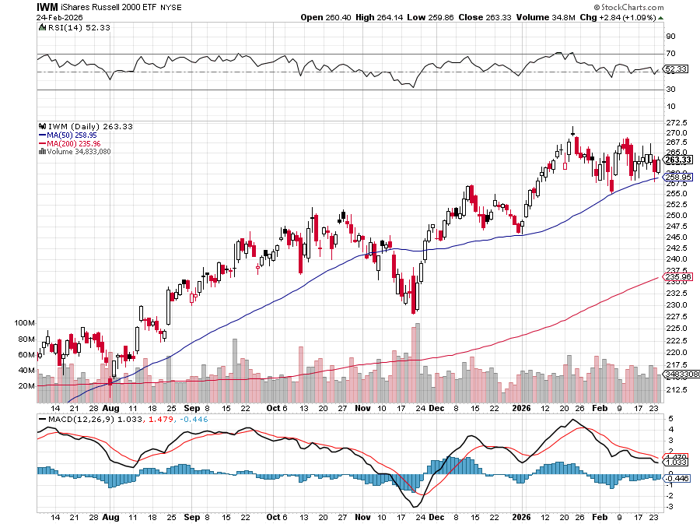
Russell 2000 (IWM)- took profits on Long 10/$137-$142 vertical bull call spread took profits on Long 10/$153-$156 vertical bear put spread

Slide 28
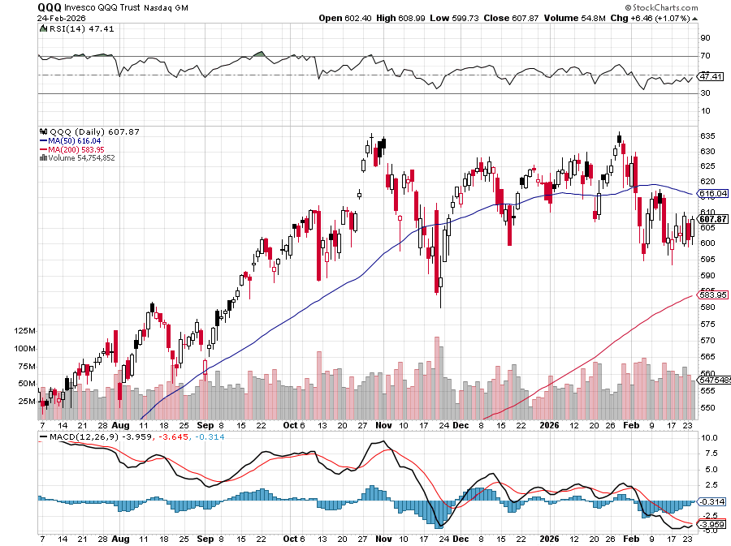
NASDAQ (QQQ) – Down 15% took profits on long 6/$540-$550-$345 put spread, took profits on Long 5/$335-$345 put spread took profits on long (QQQ) /$540-$550 put spread, took profits on long (QQQ) 4/$330-$335 put spread took profits on long (QQQ) 3/$340-$345 put spread, covered long (QQQ) $325-$330 put spread

Slide 29
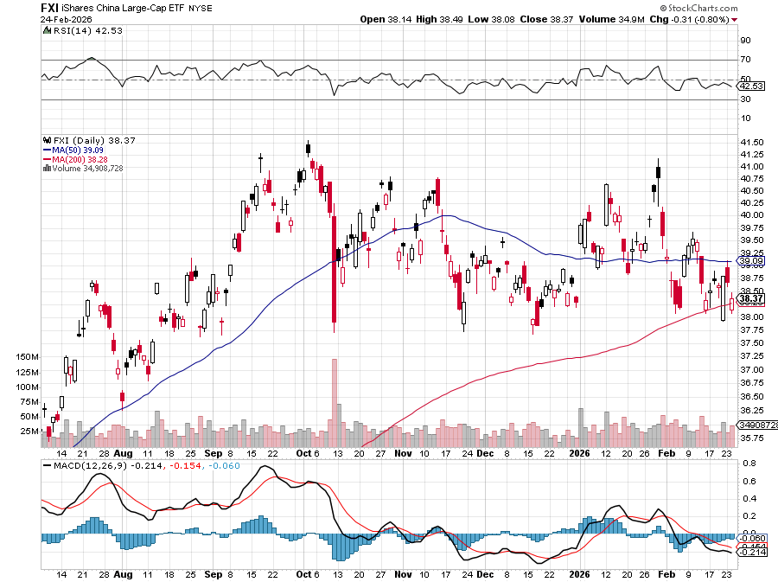
China (FXI) + 36%

Slide 30
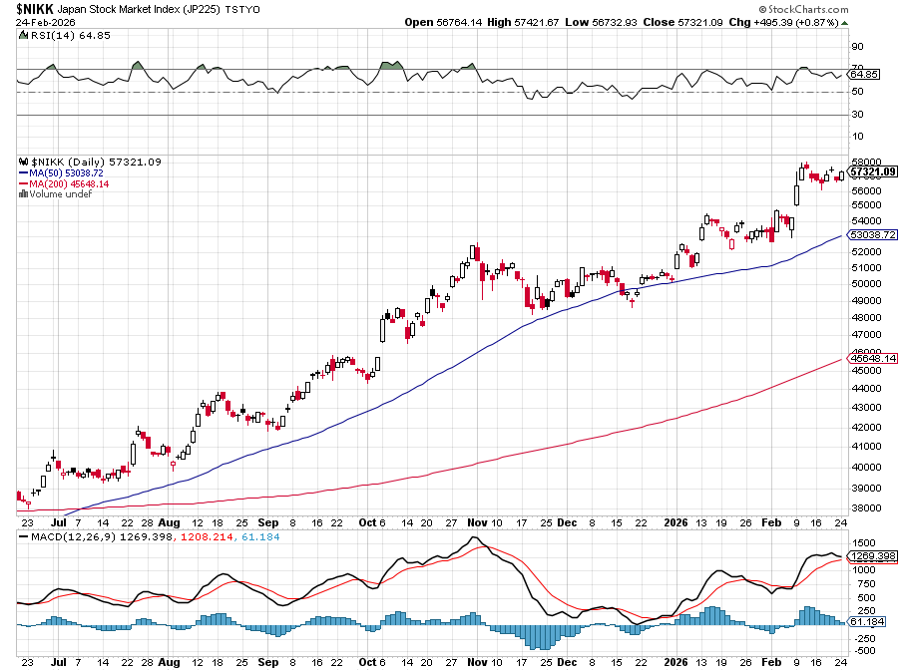
Japan ($NIKK) – down 10% Japanese Conservative Election Win Sends Nikkei Soaring, topping 57,000

Slide 31
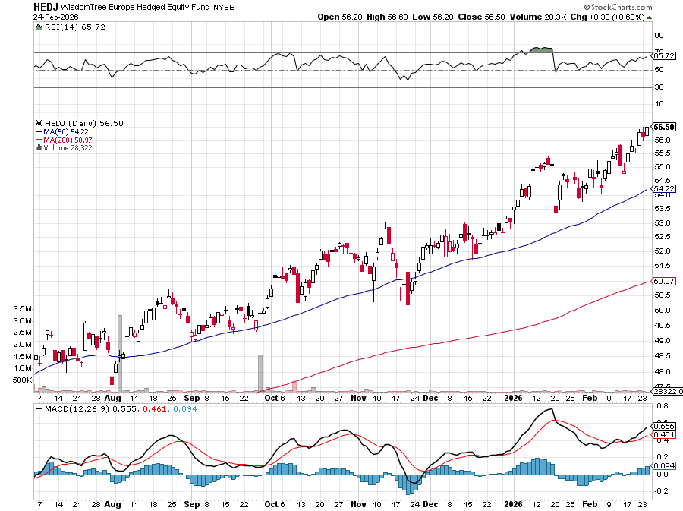
Europe Hedged Equity (HEDJ)- +19%

Slide 32
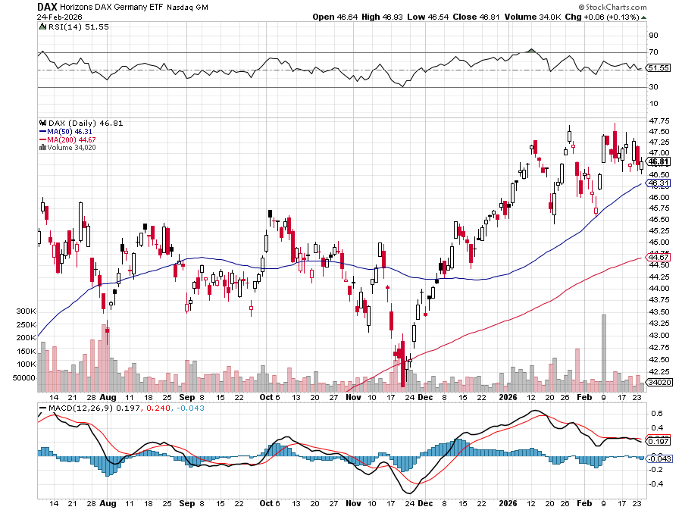
German Dax (DAX)- +30%

Slide 33
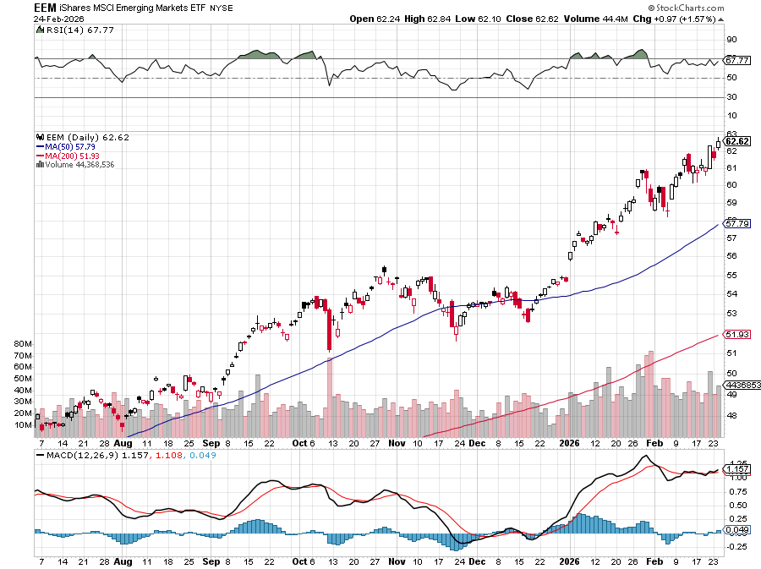
Emerging Markets (EEM) - +8% Weak Dollar, Long Recovery Play

Slide 34


Slide 35


Slide 36



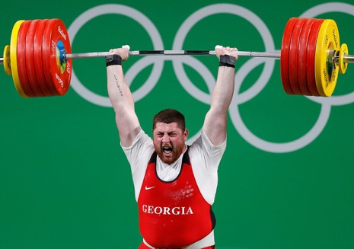
THE MAD HEDGE FUND TRADER
The Barbell Portfolio
*75% Big Tech – 2% of US workforce, 25% of market cap and 25% of US earnings 25% Domestic Recovery, including: Railroads, airlines, cruise lines, Couriers, steel companies Banks, commodities Construction Credit Card Companies Hotels, casinos Online Ticket Sales

Slide 37
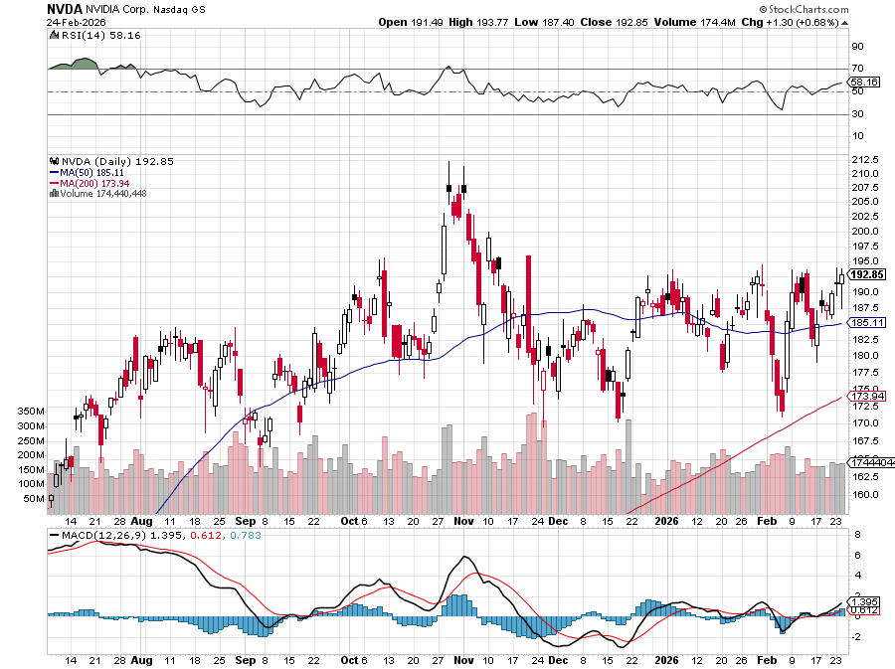

NVIDIA (NVDA) – Blackwell Chips @ $70,000 each Earnings Today After Close stopped out of long 6/$140-$145 puts spread, took profits on long 5/$70-$75 call spread took profits on long 3/$88-$90 call spread, took profits on long 4/$140-$145 puts spread took profits on Long 2/$90-$95 call spread, took profits on Long 12/$117-$120 call spread

Slide 38
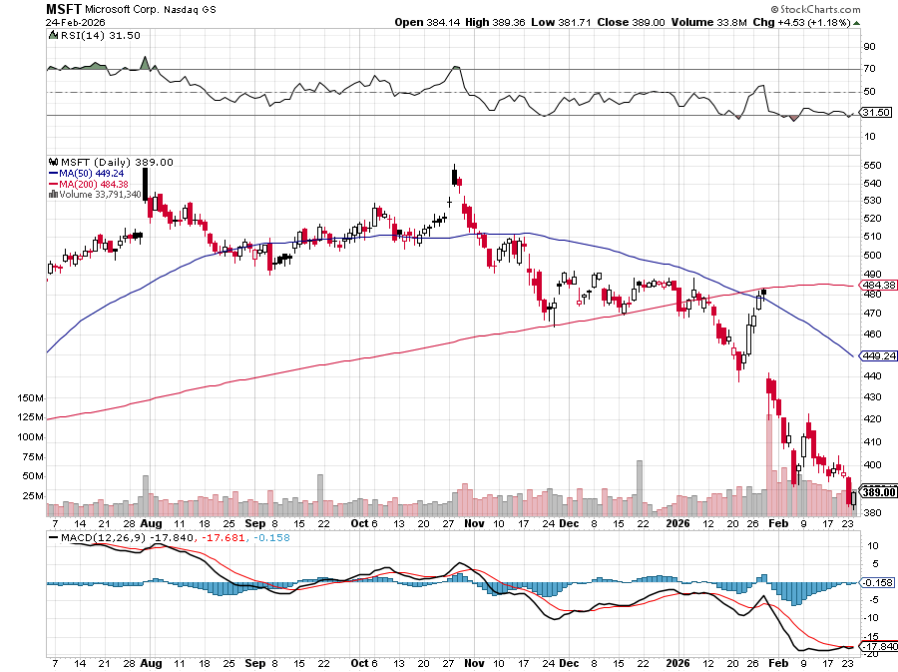

Microsoft (MSFT)- Become the Second $4 trillion Company Microsoft Delivers Blowout Earnings but down 31% in 5 Months took profits on long 5/$430-$440 put spread Took profits on long 2/$330-$340 call spread, took profits on long 12/$320-$330 call spread took profits on long 9/$235-$245 call spread, took profits on long 7/$220-$210 call spread,

Slide 39
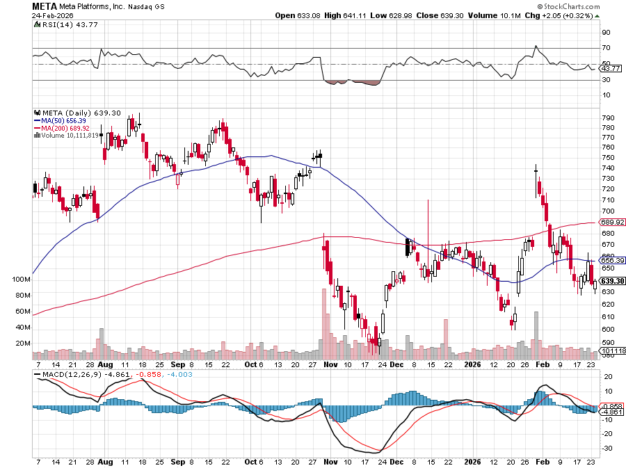

Meta (META) Meta Makes Major Investment in AMD took profits on Long 8/$420-$430 call spread took profits on Long 5/$360-$370 vertical bull call spread, took profits on Long 9/$290-$300 vertical bear put spread, stopped out of Long 9/$190-$200 vertical bear put spread

Slide 40
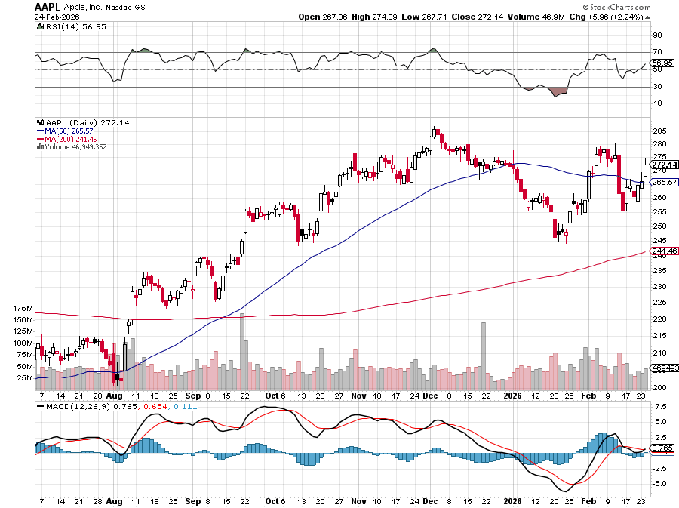

Apple (AAPL) Apple Posted a Big Earnings Beat iPhones are About to Get More Expensive, as the AI build out drives up parts prices took profits on long 6/$220-$230 put spread, profits on Long 5/$225-$235 vertical bear put spread, took profits on Long 8/$160-$170 call spread took profits on Long 6/$200-$210 bear put spread,

Slide 41
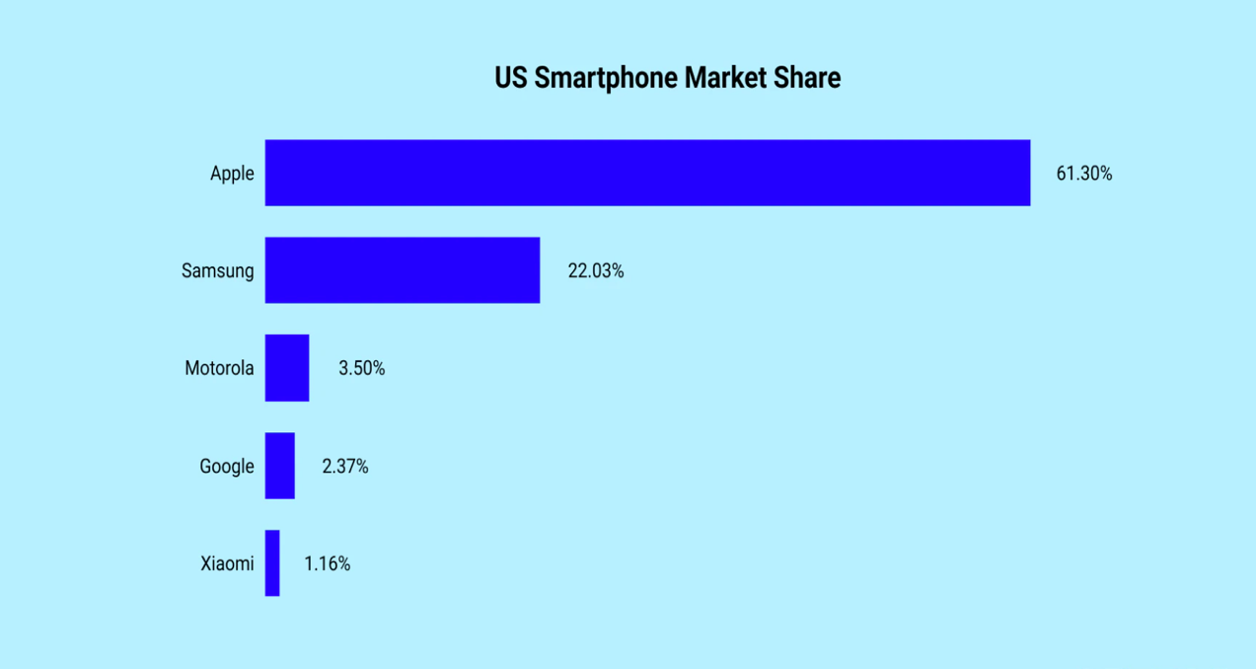

Slide 42
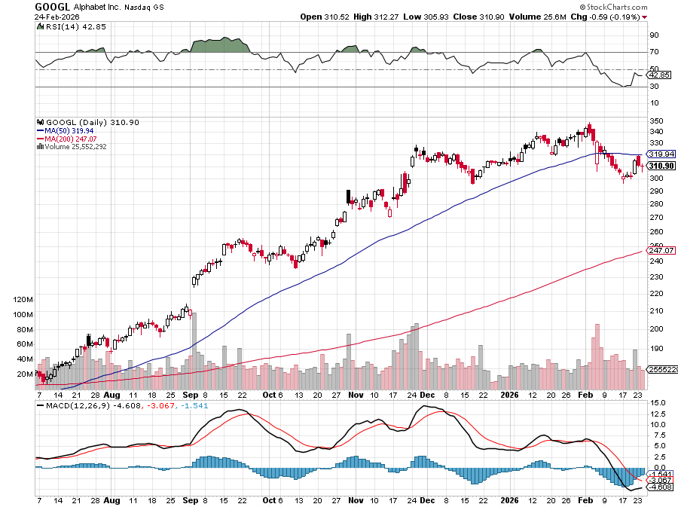
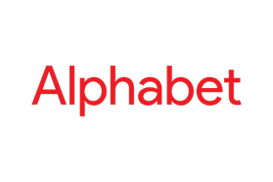
Alphabet (GOOGL) – Alphabet to Issue 100-Year Bond to finance AI build out took profits on long 12/$110-$120 call spread took profits on long 12/$1,200-$1,230 bull call spread, took profits on long 9/$1,030-$1,080 vertical bull call spread

Slide 43
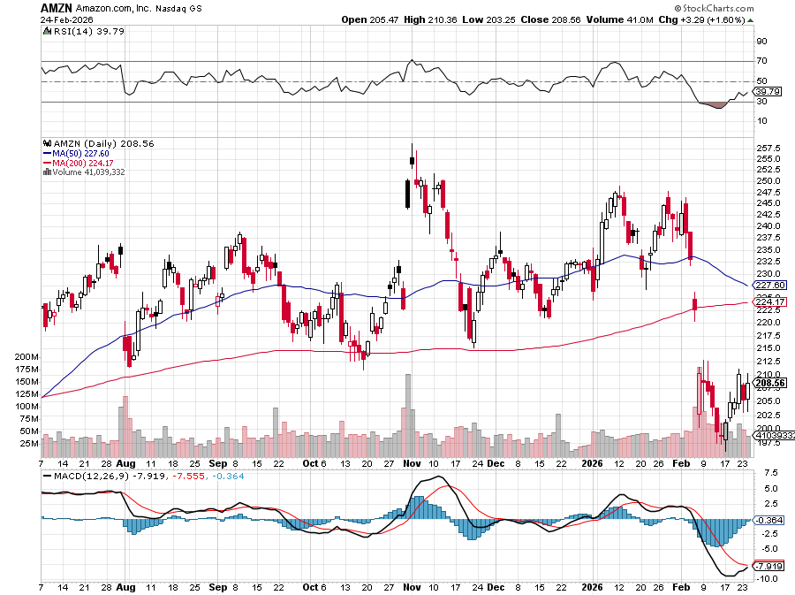

Amazon (AMZN) – Antirust Target Amazon Plunges 12%, after missing its fourth-quarter earnings estimates took profits on long 3/$155-$160 bull call spread , took profits on long 2/$130-$135 bull call spread

Slide 44
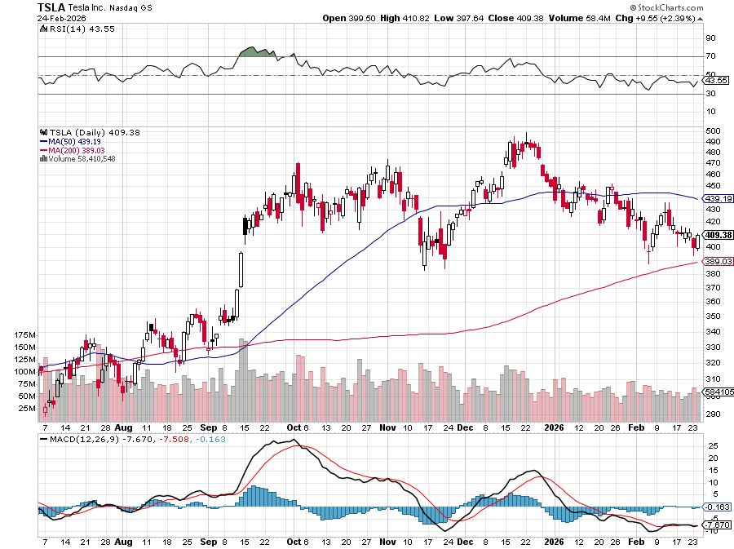

Tesla (TSLA) – Telsa Profits Plunge 16%, off of a 3% drop in YIOY sales took profits on long 10/$510-$520 put spread, took profits on 8/$370-$380 put spread took profits on long 7/$420-$430 put spread, took profits on long 7/$360-$370 put spread took profits on long 7/$180-$190 put spread, took profits in long 6/190-$200 call

Slide 45
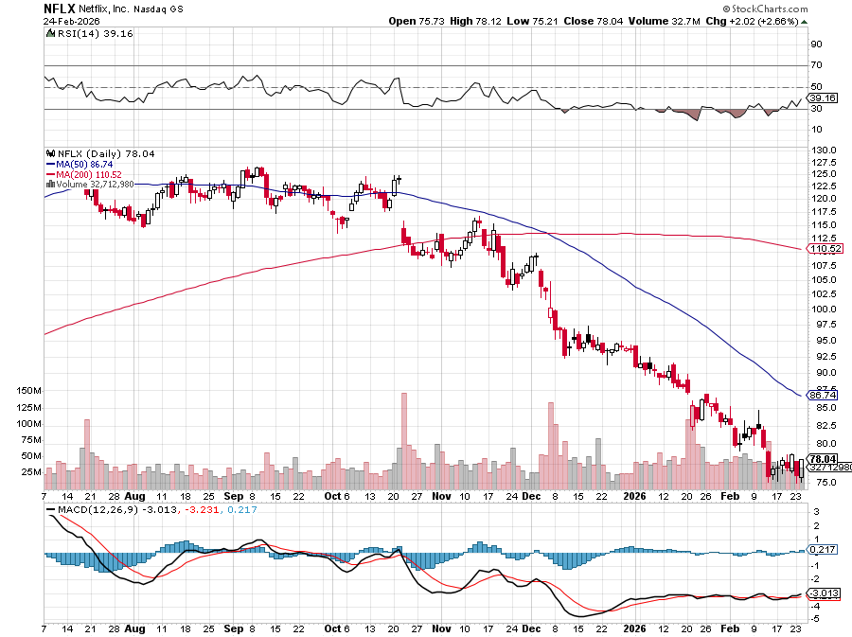

Netflix (NFLX) – Stock down 43% since Warner Bros takeover began Took profits on 11/$100-$102 call spread took profits on long $1040-$1060 call spread, took profits on long 4/800-$810 call spread

Slide 46
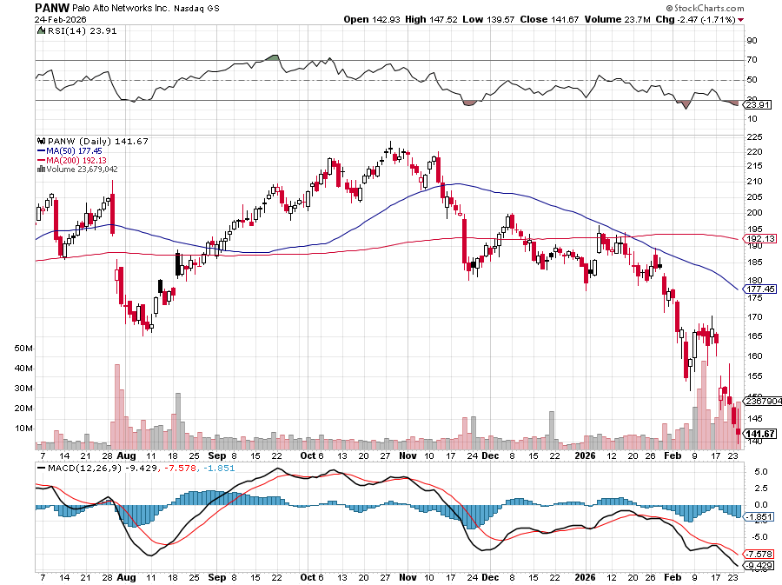

Palo Alto Networks (PANW)- Hacking never goes out of fashion Is AI Putting SaaS Out of Business? took profits on long 2/$260-$270 call spread, took profits on long 10/$130-$140 call spread

Slide 47
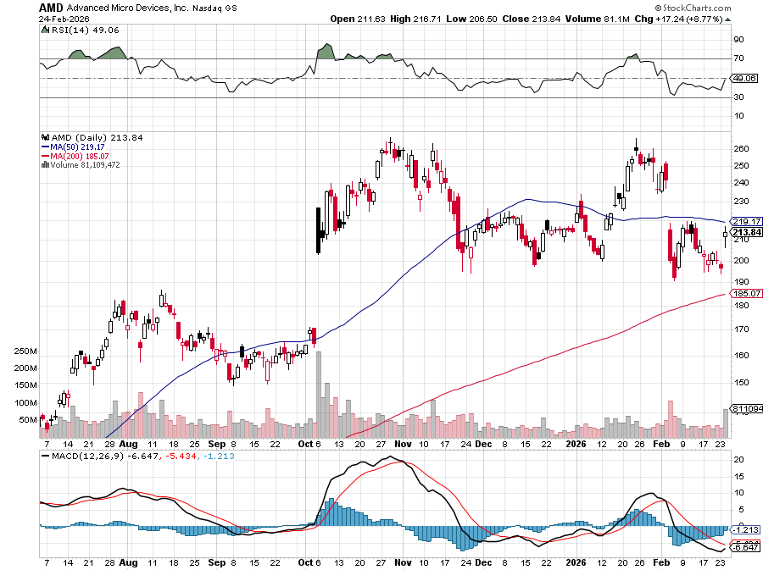

Advanced Micro Devices (AMD)- Recession fears programable logic devices took profits on long 2/$75-$80 call spread

Slide 48
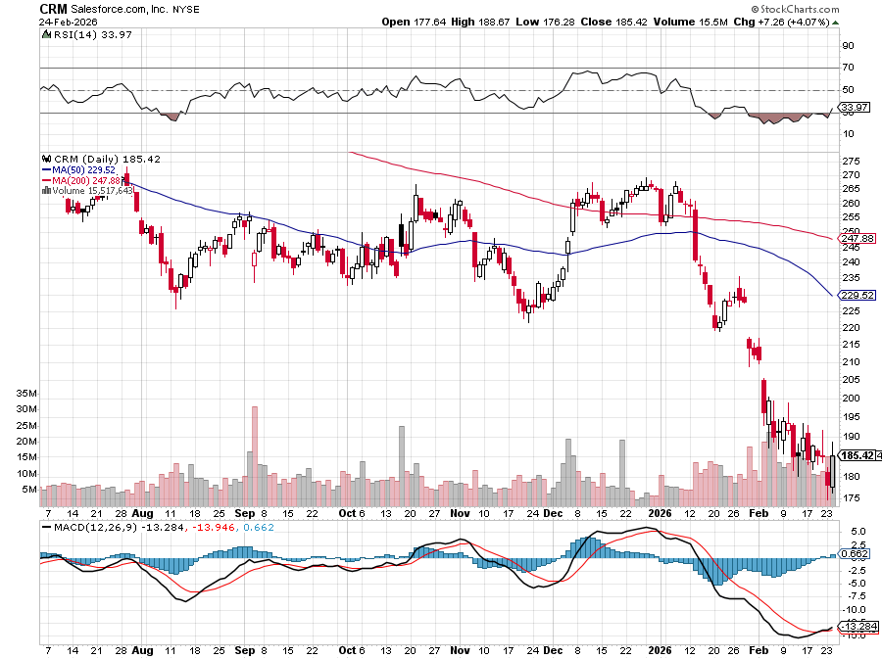

Salesforce (CRM)- Is AI Putting SaaS Out of Business? took profits on long 12/$185-$195 call spread, took profits on long 9/$125-$130 vertical bull call spread took profits on long 8/$125-$130 vertical bull call spread

Slide 49
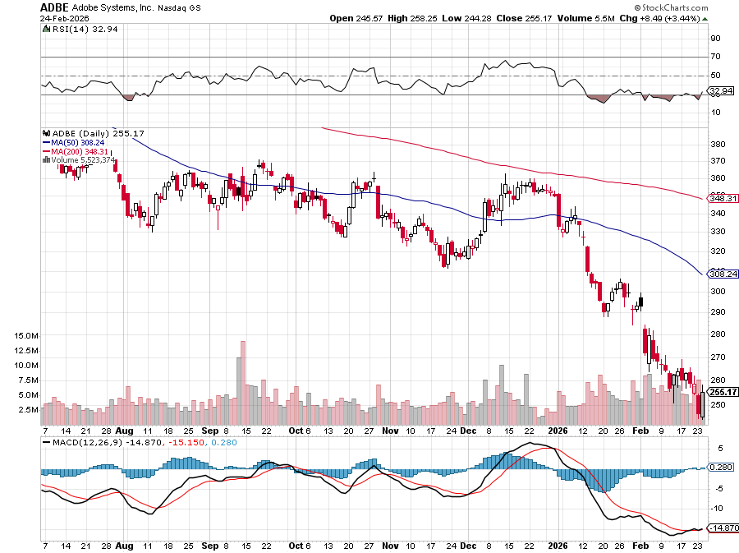

Adobe (ADBE)- Is AI Putting SaaS Out of Business? The Quality Non-China tech play

Slide 50
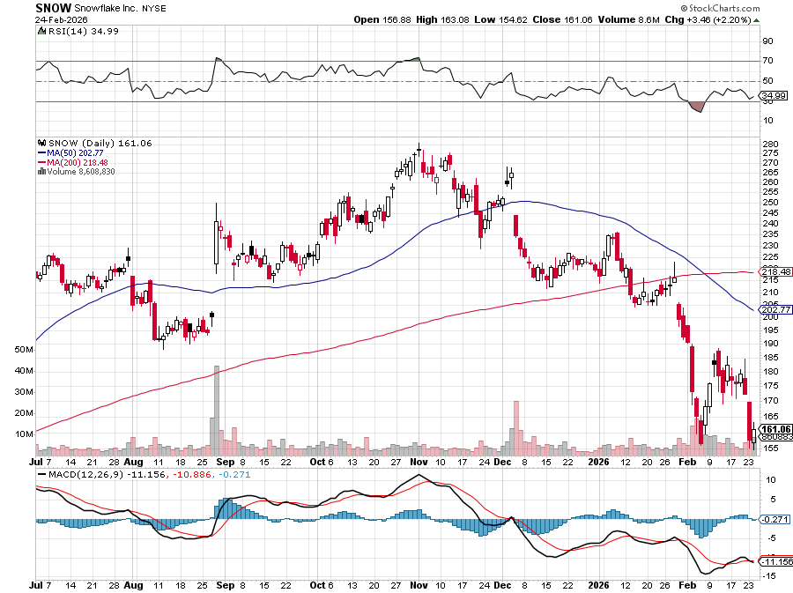

Snowflake (SNOW)- Blockbuster AI Earnings stopped out of long 4/$150-$255 call spread, took profits on long 12/$135-$140 call spread

Slide 51
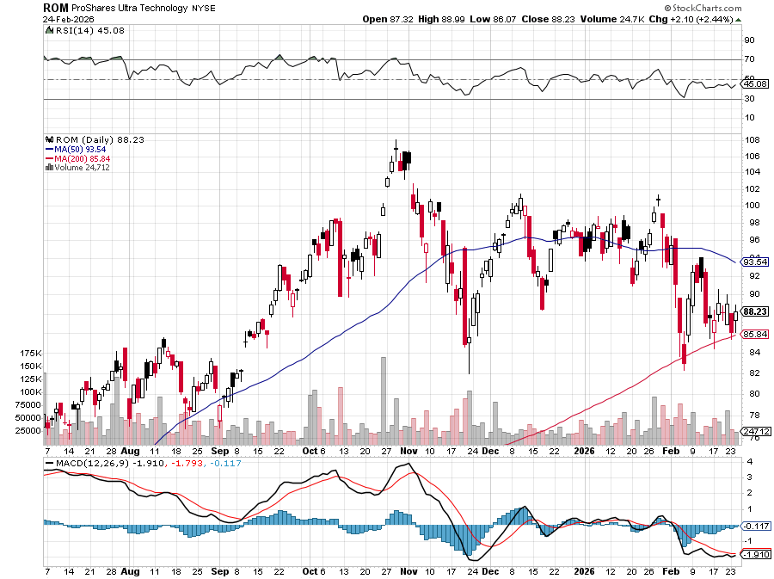
ProShares Ultra Technology ETF (ROM) – 2X Long Technology ETF took profits on long 10/$62-65 call spread

Slide 52
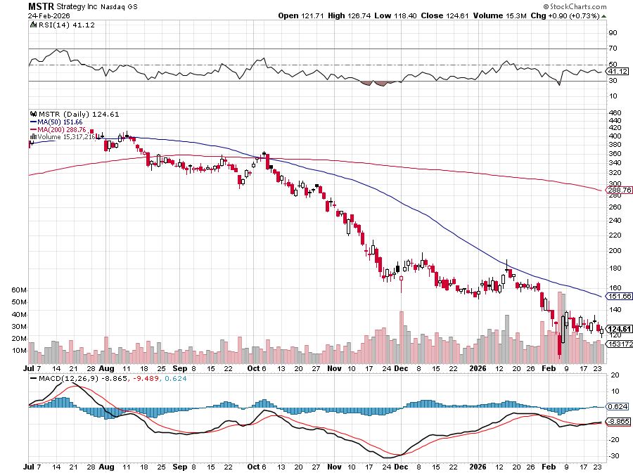

MicroStrategy (MSTR) – Long Bitcoin Play Money is Moving out of Bitcoin into Gold took profits on Long 6/$260-$270 call spread Took profits on long 6/$500-$510 put spread, took profits on long 6/$470-$480 put spread took profits on long 6/$330-$340 call spread, stopped out of long 6/$335-$345 put spread

Slide 53
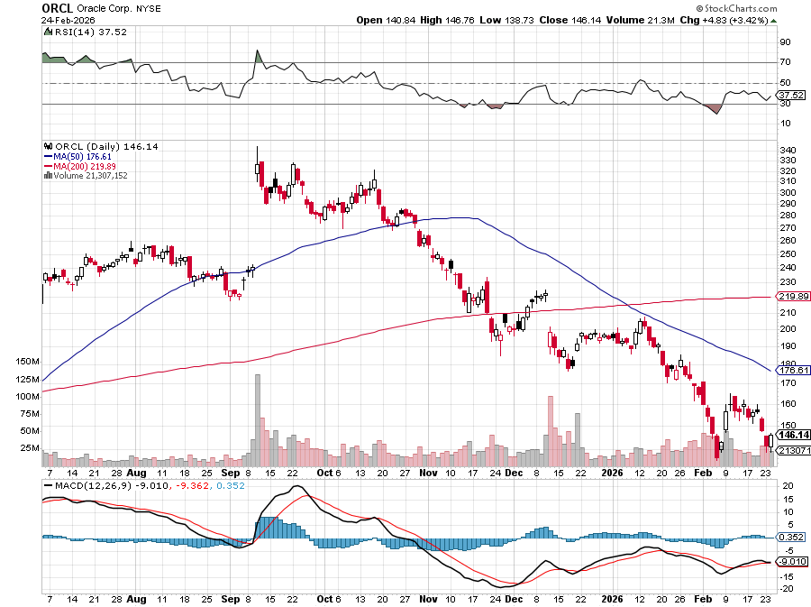

Oracle –(ORCL) – The Price of Over borrowing for AI but $100 billion in debt

Slide 54
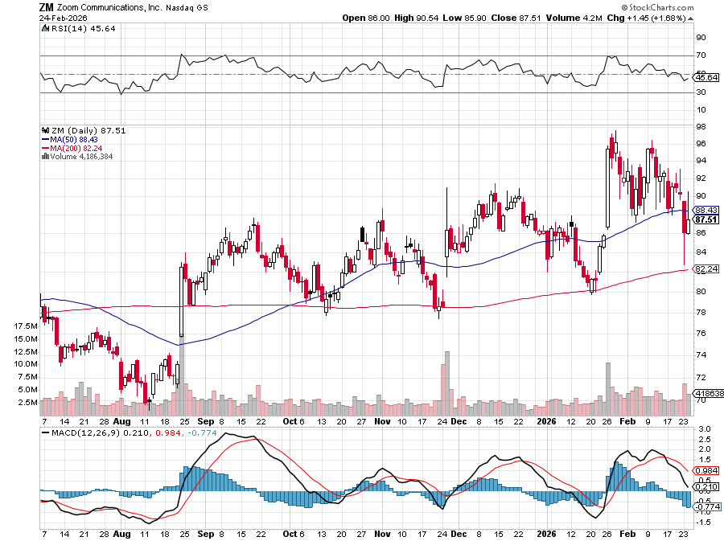

Zoom –(ZM) – Coming Back from the Dead took profits on 11/$72-50-$77.50 call spread

Slide 55
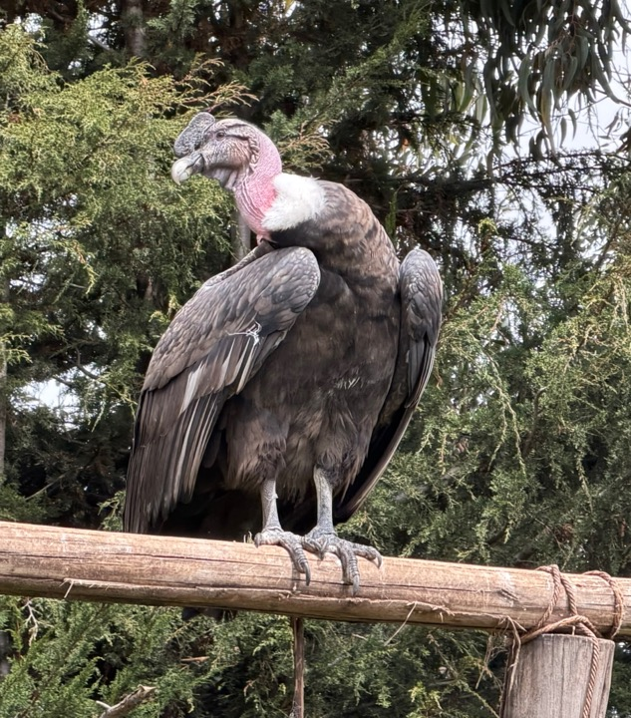

Slide 56


Slide 57
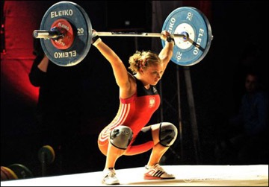
The Second Half of the Barbell
*Bets on a domestic recovery in 2022 Q4 *Upside potential in 2024 far greater than tech *Some of these have not moved for 5 or 10 years *Focuses on economically sensitive cyclical industries *Makes a great counterweight to high-growth technology *We could spend all of next ten years rotating between the two groups

Slide 58
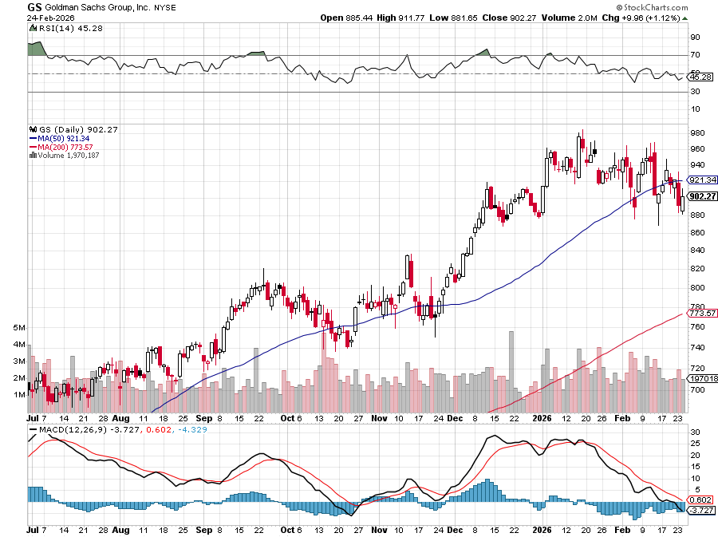

Goldman Sachs (GS) – AI Selloff Goldman Sachs (GS) Blows Out Earnings, on record stock trading profits took profits on long 11/$700-$710 call spread , took profits on long 10/$700-$710 call spread took profits on long 9/$690-$700 call spread, stopped out of 3/$380-$390 call spread, profits on long 12/$330-$350 call spread, took profits on long 11/$330-$350 call spread

Slide 59
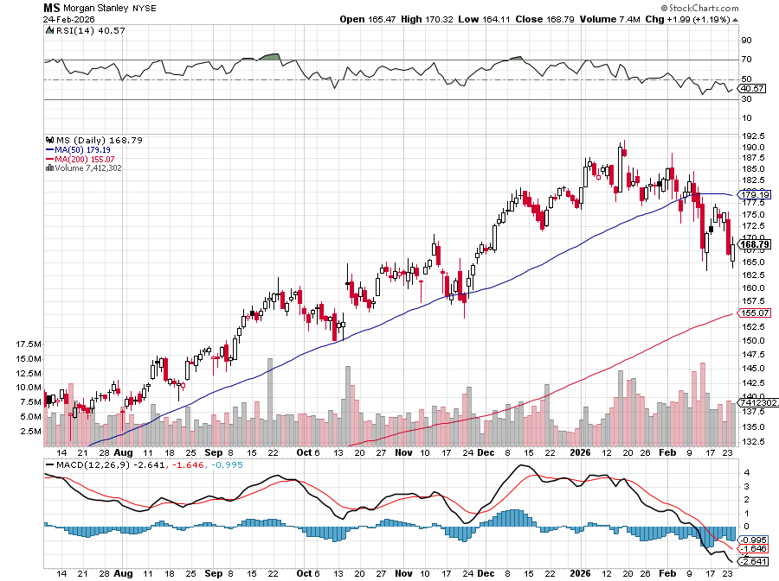

Morgan Stanley (MS) Same Morgan Stanley Surges on Investment Banking Windfall took profits on long $12/150-$155 call spread took profits on long $12/210-$220 call spread,, took profits on long $12/210-$220 call spread, Took profits on long $195-$205 call spread, took profits on long 4/$65-$70 call spread

Slide 60
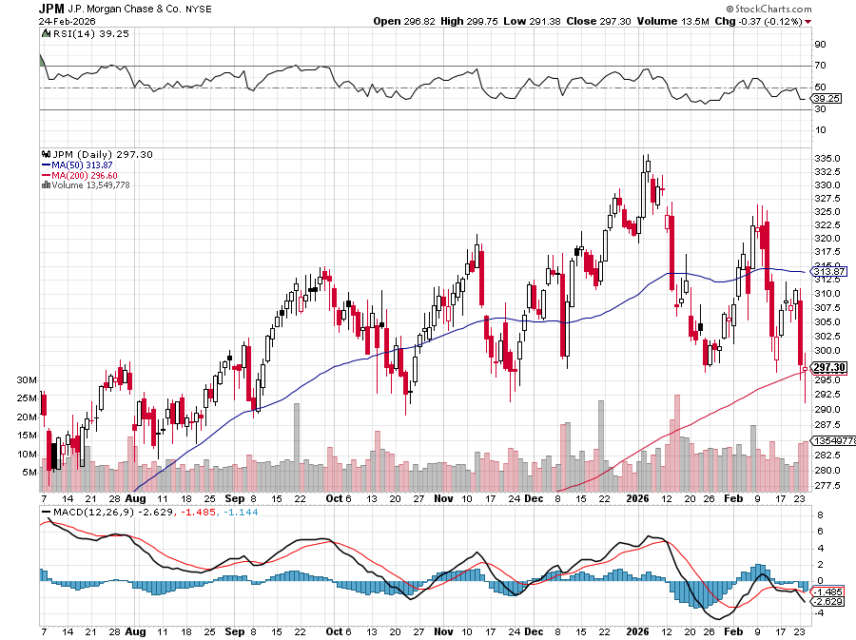

JP Morgan Chase (JPM) – Trump Sues JP Morgan (JPM) for $5 Billion took profits on long 9/$270-$280 call spread stopped out of 3/$235-$245 calls spread, profits on long 12/$210-$220 call spread, took profits on long 11/$195-$205 call spread, took profits on 4/$215-225 put spread

Slide 61
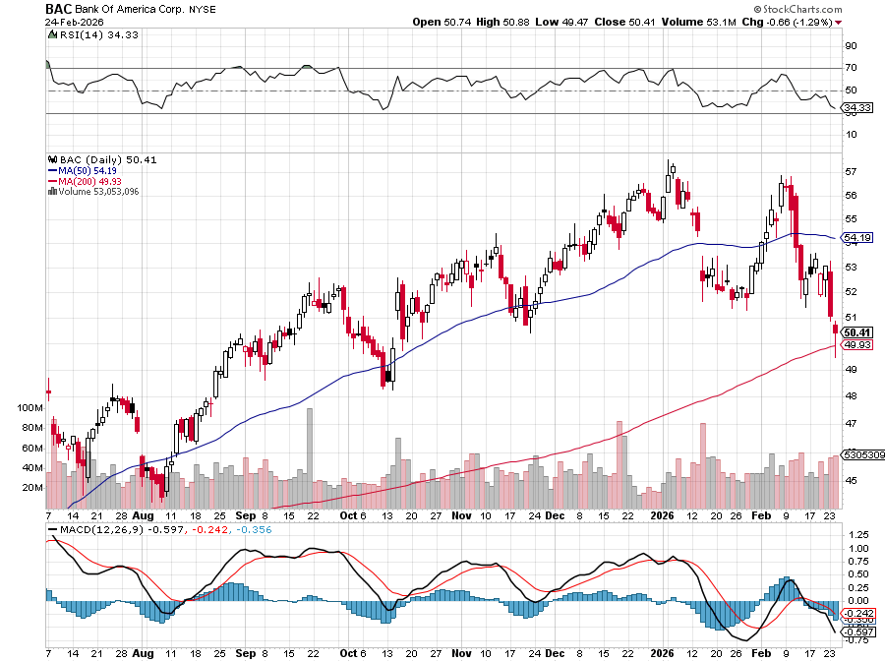

Bank of America (BAC) – Upside Breakout? took profits on long long 12/$41-$44 call spread, took profits on long 4/$20-$23 call spread

Slide 62


Citigroup (C) – Upside Breakout took profits on long long 12/$60-$65 call spread , took profits on long 4/$30-$35 call spread

Slide 63


Charles Schwab (SCHW) – Upside Breakout took profits on long 4/$30-$35 call spread

Slide 64


Interactive Brokers (IBKR) – Upside Breakout? stopped out of long 3/$160-$170 call spread, out of long 8/$110-$115 call spread , took profits on long 4/$60-$65 call spread

Slide 65


Berkshire Hathaway (BRKB)- Ultimate defensive stock Berkshire Hathaway Builds Record Cash, at $334 billion – Is the new T Bill proxy stopped out of long 12/$405-$415 call spread, took profits on long 12/$320-$330 call spread took profits on long 4/$260-$270 call spread, took profits on long 1/$290-$300 call spread

Slide 66


Blackrock (BLK)-Asset Collection Boom Blackrock Reports Record $12.5 trillion in Assets Under Management stopped out of 12/$1,000-$1,010 call spread, took profits on long 12/$850-$860 call spread took profits on long 3/$770-$790 call spread, took profits on long 3/$310-$340 call spread

Slide 67

SPDR Metals & Mining ETF (XME) – long 2/$28-$30 call spread

Slide 68


Boeing (BA) – LEAPS Candidate Boeing is Beating on Deliveries. Boeing begins 2026 with 46 deliveries in January and 103 net new orders

Slide 69


General Motors (GM) – Worst Off Trade War Victim Earnings better than expected plus interest rate beneficiary stopped out of long 4/$52.50-$57.50 put spread at cost, long 3/$53-$56 put spread

Slide 70


Package Delivery- United Parcel Service (UPS) – UPS Deliveries Slow Worldwide, it the wake of the shutdown of its Kentucky hub after a fatal crash took profits on long 11/$130-$140 call spread

Slide 71


Caterpillar (CAT)- Ag + Infrastructure + Housing stopped out of long 8/$310-$320 call spread, took profits on long 12/$220-$230 calls spread took profits on long 12/$145-$150 call spread, took profits on long 11/$125-$135 call spread

Slide 72


Deere & Co. (DE)- Ag + Infrastructure + Housing took profits on long 8/$330-$340 put spread stopped out of long 8/$330-$340 calls spread

Slide 73


Freeport McMoRan - (FCX)- Coming Copper Crisis Upside Breakout took profits on long 8/$34-$37 call spread took profits on long 4/$37-$40 call spread, took profits on long 5/$42-$45 call spread, stopped out of long $48-$51 put spread, profits on long 6/$32-$35 call spread

Slide 74


Walt Disney (DIS) -Disney Beats Disney Dives on Earnings Bust, although streaming broke even versus an expected loss

Slide 75


Industrials Sector SPDR (XLI)- (GE), (MMM), (UNP), (UTX), (BA), (HON)

Slide 76


Union Pacific RR (UNP)- Big Stuff to Ship The Largest Railroad in History, may be the result of the Union Pacific (UNP)/Norfolk Southern merger worth $200 billion took profits on long 5/$200-$210 call spread took profits on 11/$150-$160 call spread

Slide 77


Walmart (WMT) – Trade War Victim Walmart Hits $1 Trillion Market Cap took profit on Long 11/$125-$130 bear put spread, took profit on Long 10/$119-$121 bear put spread took profits on Long 8/$114-$117 bear put spread

Slide 78


Costco (COST) – Trade War Victim suing Trump administration over tariffs, one third of sales from imports took profits on long 4/$840-$850 call spread

Slide 79


Delta Airlines (DAL) – Ticket Price Take Off lost $200 million on government shutdown

Slide 80


Transports Sector SPDR (XTN)- Worst Hit Sector (ALGT), (ALK), (JBLU), (LUV), (CHRW), (DAL)

Slide 81


Health Care Sector (XLV) – Defensive Play and Cheap (JNJ), (PFE), (MRK), (GILD), (ACT), (AMGN)

Slide 82


Amgen (AMGN) long 7/$260-$270 bull call spread, took profits on long 11/$185-$200 bull call spread

Slide 83


Visa (V) – CC default rates rocking plus 10% interest rate cap took profits on long 2/$240-$250 bull call spread took profits on long 10/$160-$170 bull call spread, took profits on long 6/$150-$160 bull call spread

Slide 84


Consumer Discretionary SPDR (XLY) (DIS), (AMZN), (HD), (CMCSA), (MCD), (SBUX)

Slide 85


Slide 86


Slide 87

Bonds – Long Bonds Unloved
*There Will be a Financial Crisis in 2036, or so says the bond market *Longer-term 20-year and 30-year Treasury yields show modest declines, indicating growing concerns about future federal deficits *This is despite three Fed interest rate cuts last year. *The 10y forward rate, now 5.62273%, has risen 0.535 percentage points, signaling increasing long-term fiscal risk and debt concerns *Avoid all government bonds (TLT). *Bonds still trapped in six-month trading range

Slide 88

Treasury ETF (TLT) – took profits on long 6/$88-$91 put spread stopped out of long 6/$80-$83 call spread, took profits on long 4/$84-$87 call spread stopped out of long 1/$82-$85 call spread, took profits on long 10/$103-$106 put spread took profits on long 6/$$94-$97 put spread, took profits on long 5/$82-$85 calls spread

Slide 89

Ten Year Treasury Yield ($TNX) – 4.05%

Slide 90

Junk Bonds (JNK) 6.54% Yield

Slide 91

Municipal Bonds (MUB) 4.21% Yield-

Slide 92

Emerging Market Debt (ELD) 5.62% Yield-

Slide 93

2X Short Treasuries (TBT)-Out of Favor

Slide 94

Anally Capital Management (NLY) – Leveraged REIT Play Yield 13.25% took profits on long 12/$15-$16 call spread

Slide 95


Slide 96


Slide 97

Foreign Currencies – Dollar Wipe Out
*Trump Comments on Currencies Trash the US Dollar *This prompts ballistic moves up in (FXA), (FXE), (FXB), (EEM), and even the long beleaguered (FXY) *These are all Mad Hedge long term long recommendations *The comments signal that there will be no future efforts by the FED to collapsing greenback *Those European vacations are getting more expensive by the day *Sell all dollar rallies. *Buy (FXA), (FXE), (FXB), (FXC), and (FXY)

Slide 98


THE MAD HEDGE FUND TRADER
Australian Dollar (FXA) - Major Long-Term Bottom is In Targeting Parity – A call option on a global synchronized recovery

Slide 99


Japanese Yen (FXY)

Slide 100


Euro (FXE)-

Slide 101


British Pound (FXB)-

Slide 102


Emerging Market Currencies (CEW)

Slide 103


Slide 104

Energy & Commodities – War Fears
*Iran war fears boost oil prices to six-month highs at $67 a barrel *China has sol a large number of anti-ship missiles to Iran *Solar Abandons Silver, as costs soar. Copper is much cheaper *Oil companies are also catching a HALO bid as their have enormous investment in oil infrastructir *If the Ukraine War ends huge Russian inventories will get dumped on the market crushing pricing *If any Venezuelan production improve it will crush prices further *Venezuela is now producing 800,000 barrels a day *It could produce 4 million barrels a day

Slide 105

Oil-($WTIC)

Slide 106

United States Oil Fund (USO)

Slide 107

Energy Select Sector SPDR (XLE)-No Performance! (XOM), (CVX), (SLB), (KMI), (EOG), (COP)

Slide 108

ExxonMobil (XOM)- Exxon Moves Big into Lithium, with the construction of a major mining operation in Arkansas took profits on Long 4/$100-$105 call spread, took profits on long 12/$120-$125 put spread

Slide 109

Occidental Petroleum (OXY)- Buffet’s a Buyer took profits on long 4/$59-$62 call spread took profits on long 2/$55-$60 call spread, took profits on long 12/$77.50-$82.50 put spread

Slide 110

Natural Gas (UNG) – Free Fall on Warm Winter took profits on Long January 2025 $7-8 Call Spread LEAPS

Slide 111

Cameco (CCJ) – Global Uranium Renaissance Microsoft to Reopen Three Mile Island to power AI data centers took profits on long 12/$41-$44 call spread, took profits on long 12/$35-$38 call spread, took profits on long 5/$20-$23 bull call spread

Slide 112

Vistra Corp. (VST) – Global Uranium Renaissance took profits on long 2/$100-$110 call spread

Slide 113


Slide 114

Precious Metals – Digesting
*Gold Surpasses Tech Stock Value for the First Time *All the gold in the world in now worth $42 trillion, while tech stocks are worth only $40 trillion *Which would you rather buy more of as an asset protection strategy? *I vote for the barbarous relic *Potical instability in the US has become a factor driving gold *AI build out is creating exponential growth in demand for silver *When an investment reaches your target the most dangerous thing you can do is raise your targe

Slide 115


THE MAD HEDGE FUND TRADER
Gold (GLD) – Headed for $5,000....or $10,000? long 12/$355-$360 call spread – expires in 7 trading days profits on long 6/$275-$285 call spread, took profits on long 5/$275-$285 call spread stopped out of long 6/$275-$285 call spread, took profits on profits on long 10/$230-$235 call spread
BUY

Slide 116


Market Vectors Gold Miners ETF- (GDX) – took profit on long 6/$207.50-$212.50 call spread, took profit on long 7/$200-$205 call spread

Slide 117


Barrick Mining (B) took profit on long 1/$15.50-$16.50 call spread

Slide 118


Newmont Mining- (NEM)- Sometimes you Just Get Lucky took profits on long 10/$47-$50 call spread, took profits on long $55-60 call spread

Slide 119


THE MAD HEDGE FUND TRADER
iShares Silver Trust (SLV) - The Better Play Industrial demand, solar panels, electric cars
2025 Target $50 +50%
BUY

Slide 120


Silver Miners - (SIL)-

Slide 121


Wheaton Precious Metals - (WPM)- LEAPS Approaching Max Profit took profits on long 4/$39-$42 call spread long 6/$75-$80 call spread-expires in 7 trading days , took profits on long 1/$36-$39 call spread

Slide 122


Platinum- (PPLT)- 556,000-ounce shortage this year took profits on long 1/$36-$39 call spread

Slide 123



Slide 124


Slide 125





Slide 126

Real Estate – Breaking 6.0%!
*Mortgage Rates Finally Fall Below 6.0%, for the traditional 30-year fixed rate loan, the lowest since September 2022 *It was 6.89% a year ago *The near recessionary weak Q3 GDP rate was a major factor *Refi’s are up 130% YOY *Buy homebuilders on dip like (DHI) *Some 5 million extra potential buyers now qualify for loans *Pending Home Sales Dive in January, with realtors blaming low housing inventory *Existing Home Sales Dive 8.4%, in January

Slide 127

S&P Case Shiller Slows S&P Case Shiller Rises to -0.2% YOY in November, with its National Home Price Index Miami gained +3.2%, Tampa +2.0%, and Atlanta +1.5%. Seattle -1.4% San Francisco -1.3%

Slide 128


Crown Castle International (CCI) – 4.80% yielding 5G cell phone tower REIT Eliot Management Pushes up stock with activist bid took profits on Long 8/$90-$95 call spread,

Slide 129



US Home Construction Index (ITB) (DHI), (LEN), (PHM), (TOL), (NVR)

Slide 130


DH Horton (DHI) Earnings Hit on free upgrades eating into margins took profits on long 11/$165-$175

Slide 131

Trade Sheet- The Recession Trade So What Do We Do About All This?
*Stocks –stand aside *Bonds – stand aside *Commodities – buy dips *Currencies – buy dips *Precious Metals – buy dips *Energy – stand aside *Volatility – sell over $30 *Real estate – buy dips

Slide 132

Next Strategy Webinar 12:00 EST Wednesday, March 11, 2026 from Cancun, Mexico Last Webinar of the Year email me questions at https://www.madhedgefundtrader.com/jp-ms-0925
Good Luck and Good Trading!
Notes:
*

Slide 133


Slide 134


