Slide 1
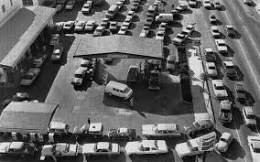
The Mad Hedge Fund Trader
“Oil Shock 3.0”
With John Thomas
Lima, Cancun Mexico 11, 2026
www.madhedgefundtrader.com
Notes:
*

Slide 2
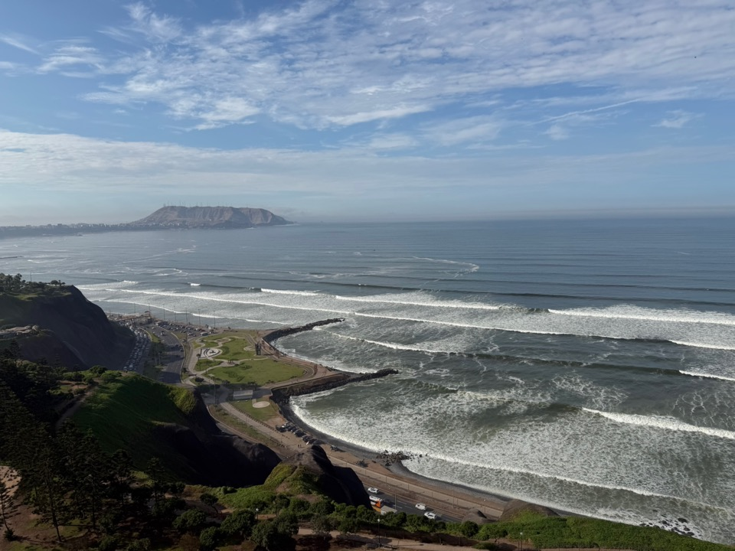

Slide 3
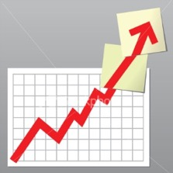
Trade Alert Performance
New All-Time Highs-17 Consecutive Positive Months
*January +1.97% MTD *July +5.21% Final
*February +3.08% Final *August +1.37% Final
*March +0.80% MTD *September +2.21% Final
*April +0.95% Final *October +3.11% Final
*May +2.51% Final *November +2.33 Final
*June +15.48% Final *December +2.66% Final
*2026 Year To Date +1.47%
+813.96% since inception
*Versus 79.79% for all of 2023
*Versus 75.29% for all of 2024
*Versus 62.02% for all of 2025

Slide 4
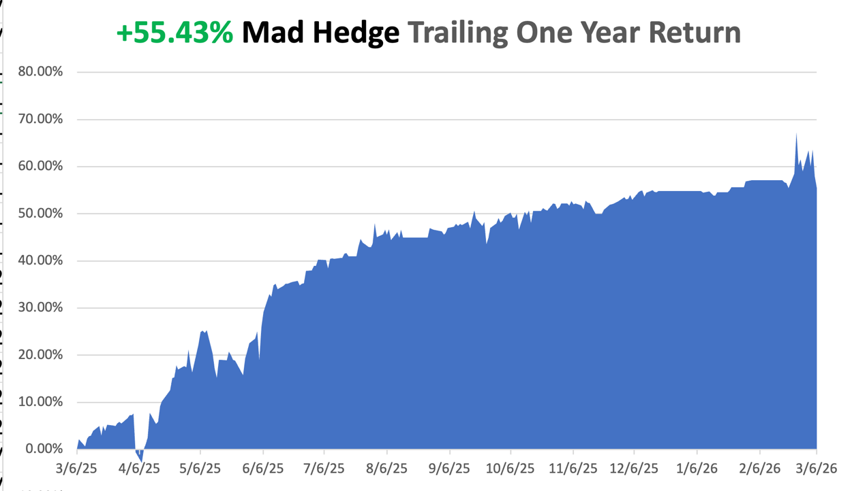

Slide 5
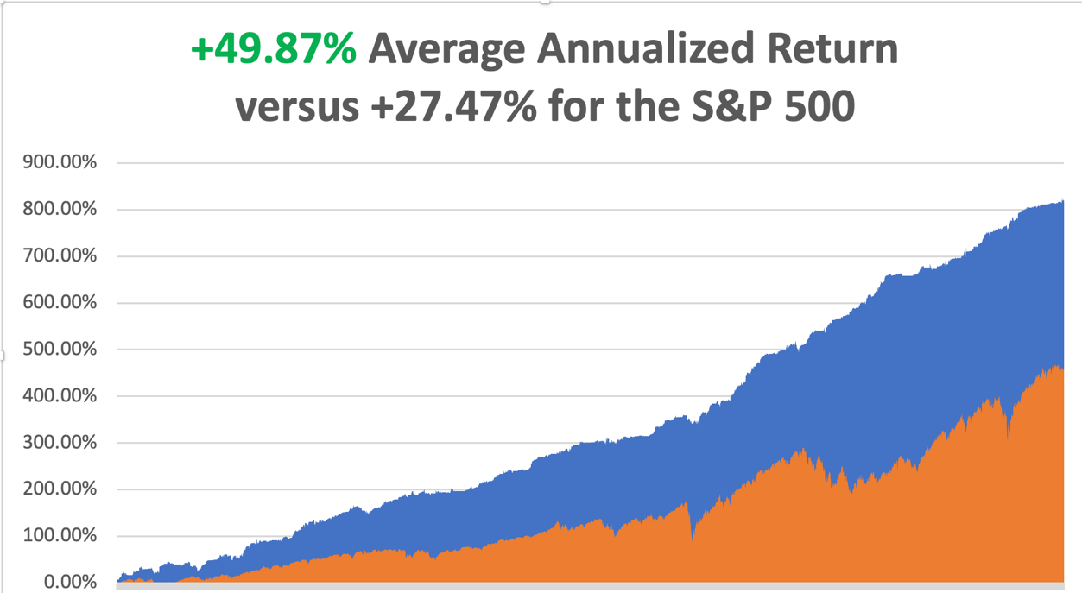

Slide 6


Slide 7
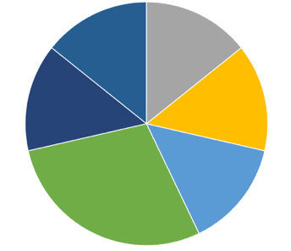
Portfolio Review – High Risk Market Require Maximum Cash
50% risk on, 10% risk off, 40% cash
(SPY) 3/$630-$640 call spread | 10.00%
(GS) 3/$790-$800 call spread | 10.00%
(RTX) 3/$195-$200 call spread | 10.00%
(CAT) $630-$640 call spread | 10.00%
(GLD) 3/$420-$425 call spread | 20.00%
(BA) 3/$195-$200 call spread | 10.00%
Risk Off
(SPY) 3/$710-$720 put spread | -10.00%
Total Net Position | 60.00%
Total Gross Position | 80.00%
cash | 20.00%
Expiration Value
+10.82%

Slide 8

What Are HALO Stocks?
*High Asset
*Low Obsolescence
*Can’t be easily replaced by AI
*Are immune to AI shocks are hitting Low Asset High Obsolescence (LAHO) stocks
*HALO has massively outperformance LAHO in recent months
*HALO examples are:
*Texas Pacific Land Corp. (TPL). *FedEx (FDX)
*Corning (GLW) *Hershy (HSY)
*Southern Co, (SO) *Colgate (CL)
*Baker Hughes (BKR) *Apple (AAPL)
*Southern Copper (SO) *Any oil company

Slide 9

The Method to My Madness
*Expect a Long War. There is no loyal opposition waiting in the wings to take over Iran on US orders. Iran is the one who decides when the Straights of Hormuz open, not the US
*Battle over tariffs rages on, with Trump imposing a 15% global tariffs a week befor the start of the war
*Oil sees sharpest rise in history, from $56 to $120 since Jan 1, up 115%
*Rocketing gasoline costs and new tariff amount to a new
double tax increase for consumers
*Jobs data remains bad and getting worse
*US Dollar takes off on global position unwind
*Bitcoin recovers $70,000 on war fears

Slide 10
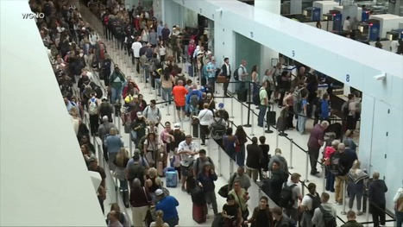
The Global Economy – The Global Recession is Here
*Oil spikes to $119 a barrel, the sharpest move in history
*Volatility Soars, hitting a multiyear high at $35, as markets around the world are thrown into turmoil.
*Nonfarm Payroll loses 92,000 jobs in February
*Headline Unemployment Rate roses to 4.4%
*TSA Waiting Lines Extend Past Hours, as many agents miss their
first paycheck as a result of the Homeland Security Budget Shutdown
*Business Inventories Rose in December, another
recessionary indicator
*Trump Tariffs to Rise 15% this Week
* Producer Price Index Comes in Hot at 0.5%

Slide 11
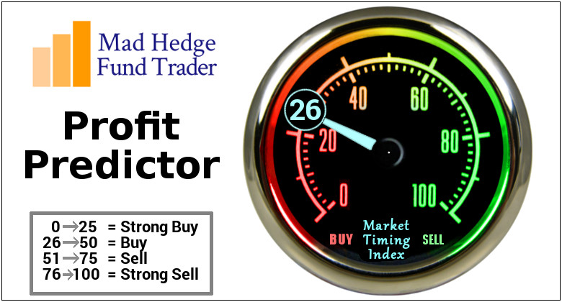

Slide 12
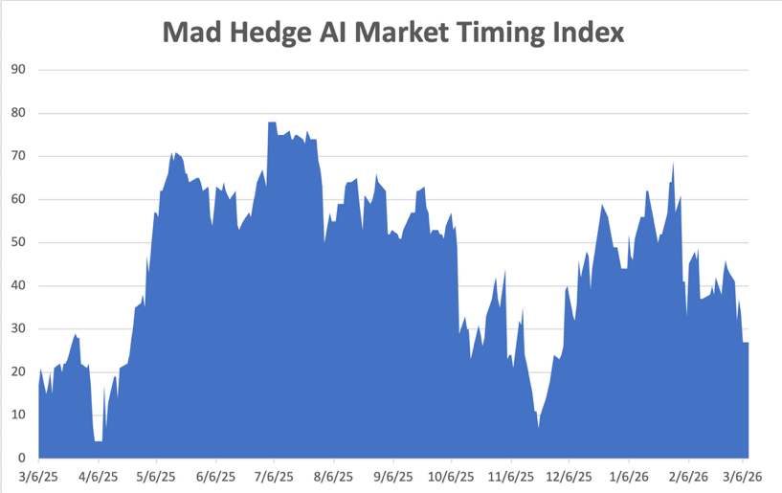
The Mad Hedge Profit Predictor
Market Timing Index – Hits Seven month Low at 6,
An artificial intelligence driven algorithm that analyzes 30 different economic, technical, and momentum driven indicators
SELL
BUY

Slide 13
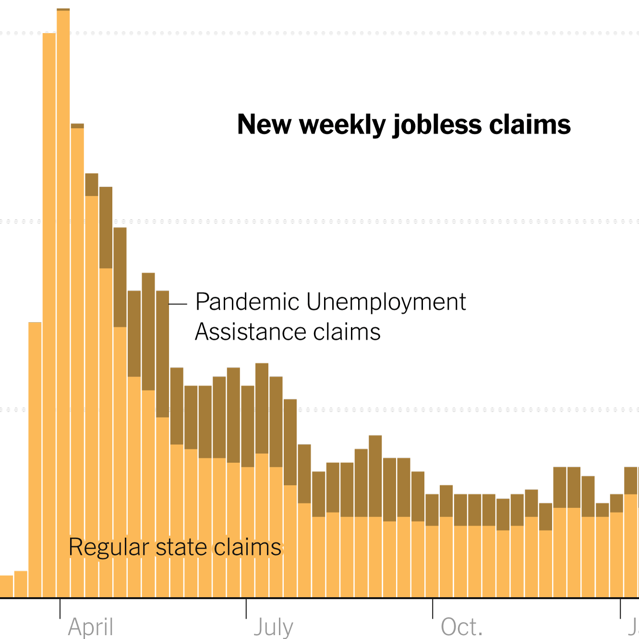
Weekly Jobless Claims –
-1,000 to 213,000

Slide 14
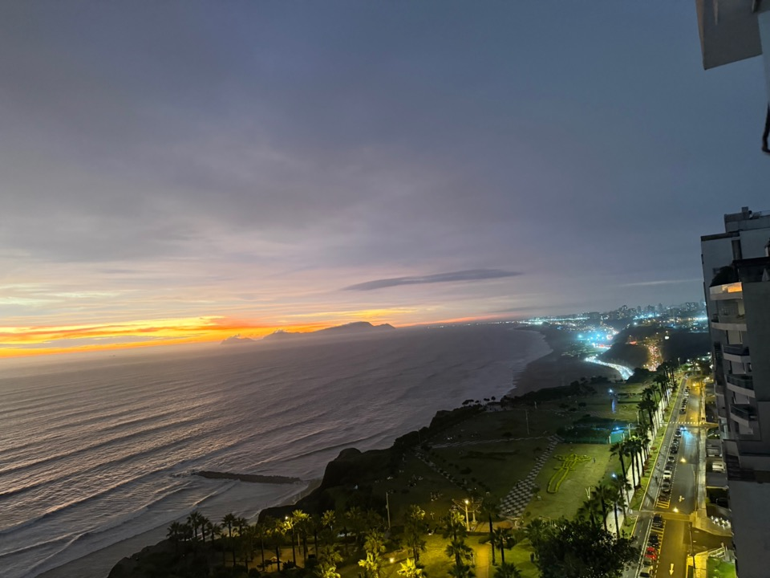

Slide 15
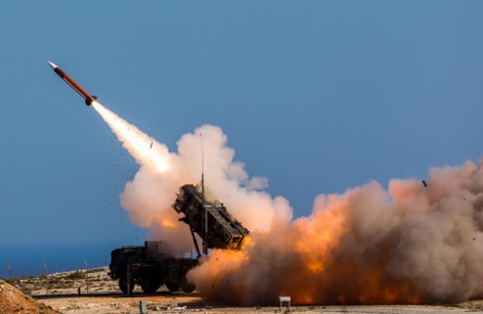
Stocks – Crash!!
*Volatility Soars, hitting a multiyear high at $35, as markets around the world are thrown into turmoil.
*JP Morgan Sees 10% Stock Market Correction, as the Iran War broadens out
*The Mag 7 has become the Lag 7, as investors dump big tech stocks with both hands
*Money is Pouring Out of US Equity Funds. Investors divested a net $21.92 billion of ​U.S. equity funds during the week in their largest ​weekly net sales since January 7
*BYD Sales Plunge, as the world Flees EV’s
*Berkshire Hathaway is Buying Back Own Shares
*South Korean Stock Market Sees Worst Day on Record
*Be Careful Which Airline You Buy, AAL for the rebound
*Netflix Abandon’s Warner Brothers Takeover Attempt
*Dump Coders, Buy Builders, says UBS

Slide 16
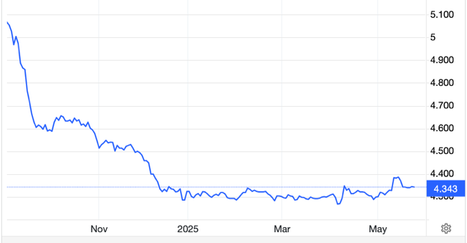
The Ultimate Hedge – Defensive stocks only go down at a slower rate
90 - day US Treasury Bills (Warren Buffet owns $340 billion)
Extend to One Year!
*Government Guaranteed principal
*Endless liquidity,
trade like water
*100% collateral value for margin
*Lock in guaranteed income
*Can be sold at any time to earn
full interest
*Will survive any bear market
*Ask your broker how to buy
3.69% Yield

Slide 17
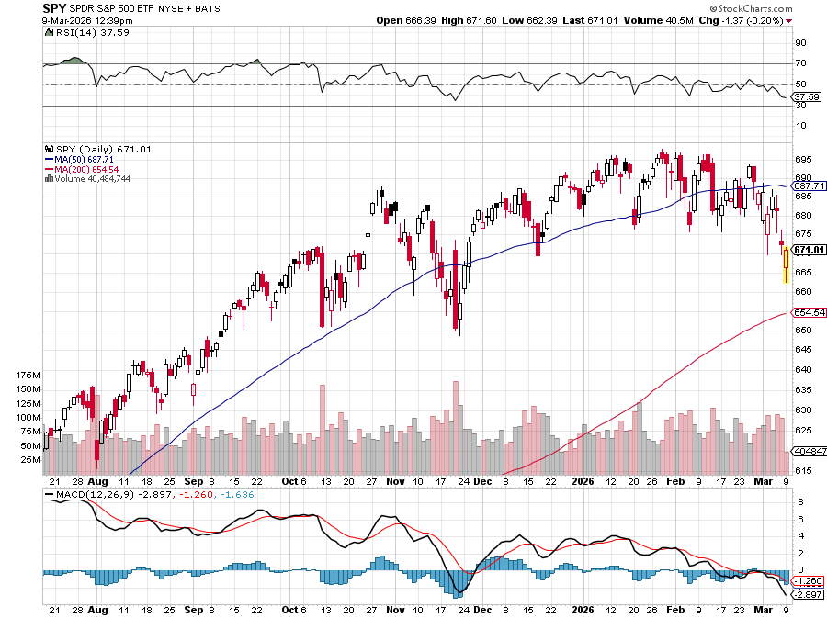
S&P 500 – Stalling
$650
-7.14%
1st support
$615
-12.14%
1st support

Slide 18
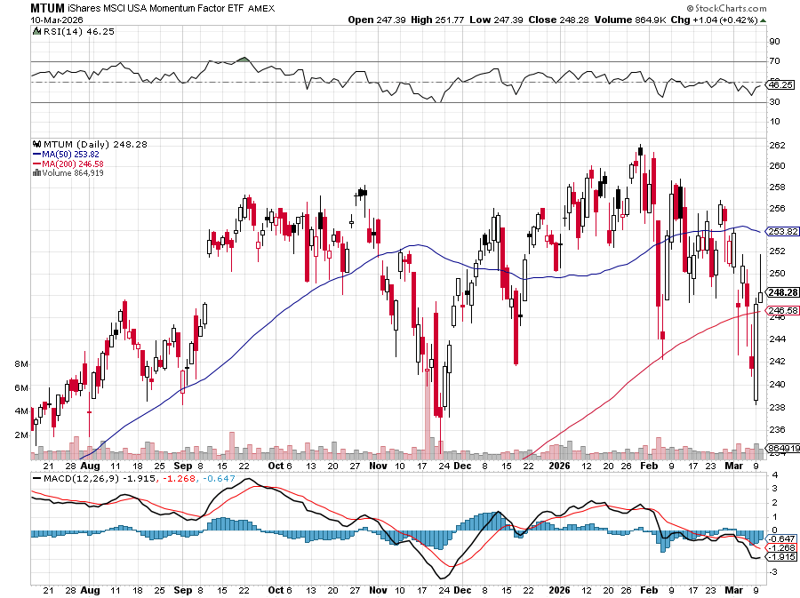
Momentum (MTUM)

Slide 19
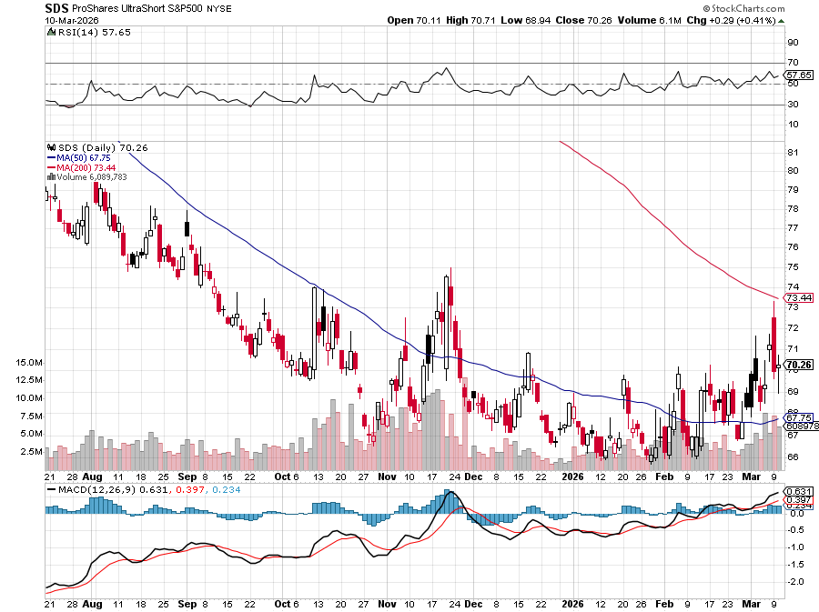
ProShares -2X Short S&P 500 (SDS) - a great 2X hedge for falling long stocks

Slide 20
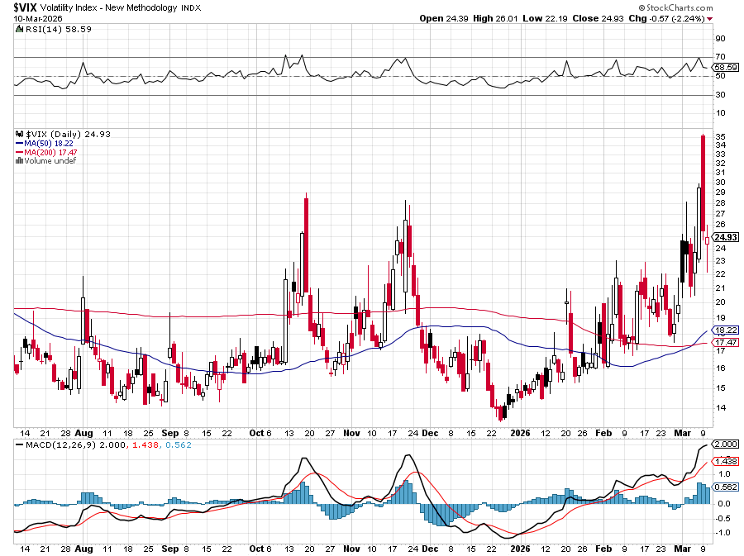
($VIX) – New Highs
Volatility Index Hits Four Year High at $65, the most since the 2020 pandemic. That implies a 2% move in the S&P 500 (SPX) every day for the next 30 days

Slide 21
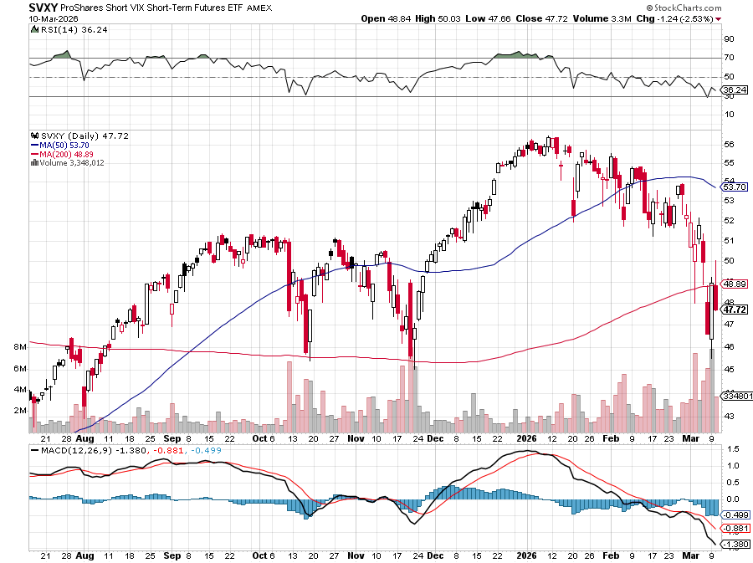
(SVXY) –Short Volatility ETF bought at $36.31 - $32.74 = $3.57

Slide 22
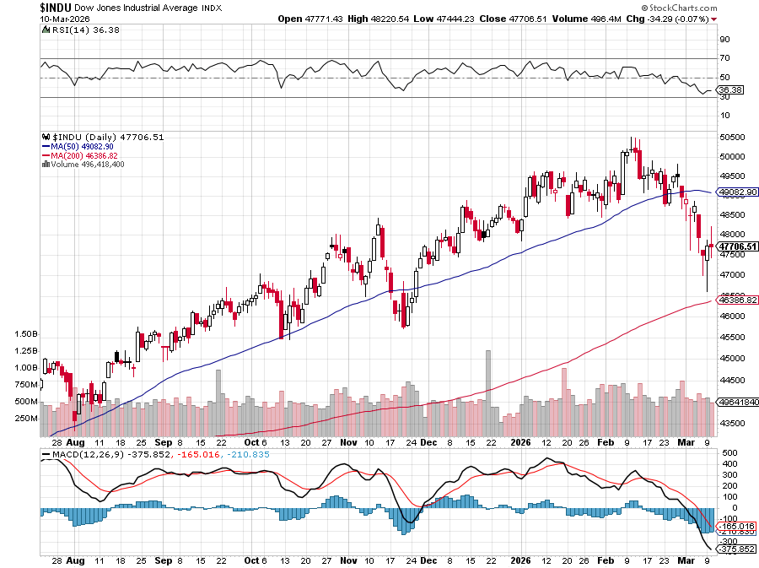
Dow Average ($INDU)-

Slide 23
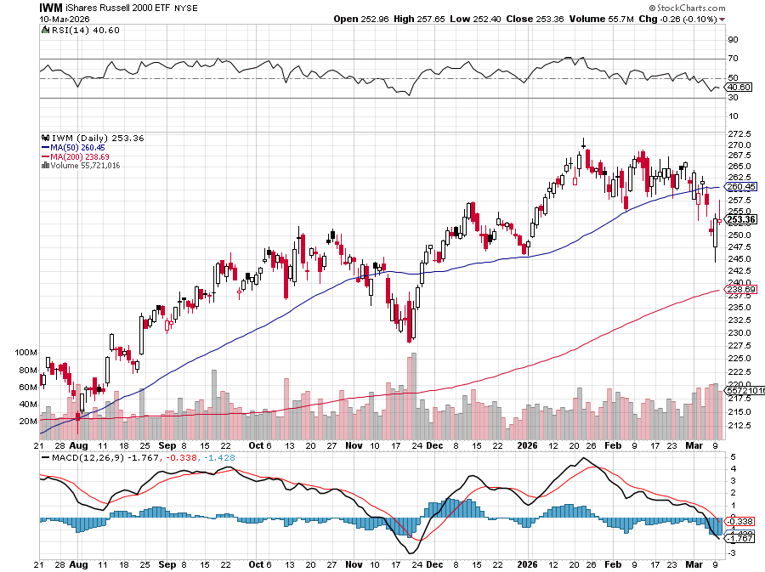
Russell 2000 (IWM)- took profits on Long 10/$137-$142 vertical bull call spread took profits on Long 10/$153-$156 vertical bear put spread

Slide 24
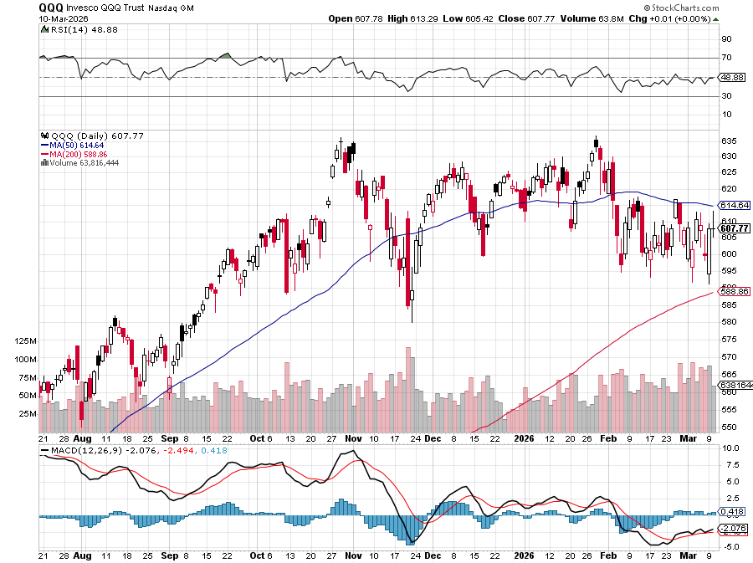
NASDAQ (QQQ) – Down 15% took profits on long 6/$540-$550-$345 put spread, took profits on Long 5/$335-$345 put spread took profits on long (QQQ) /$540-$550 put spread, took profits on long (QQQ) 4/$330-$335 put spread took profits on long (QQQ) 3/$340-$345 put spread, covered long (QQQ) $325-$330 put spread

Slide 25
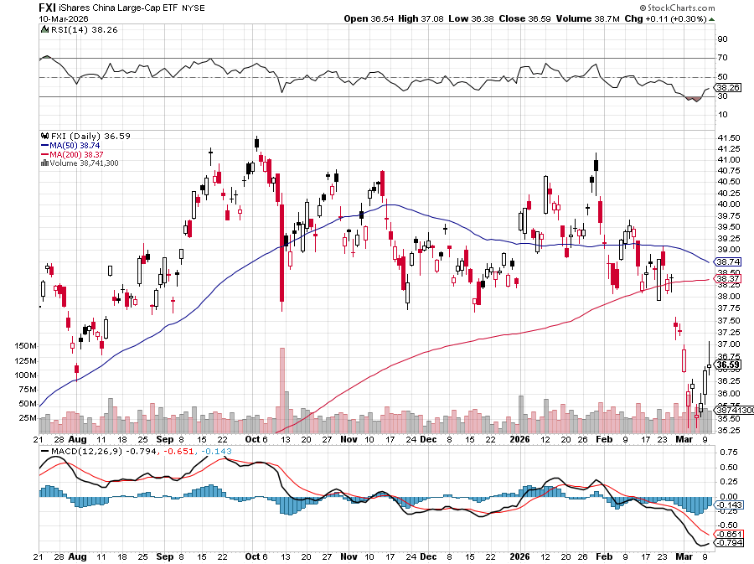
China (FXI) + 36%

Slide 26
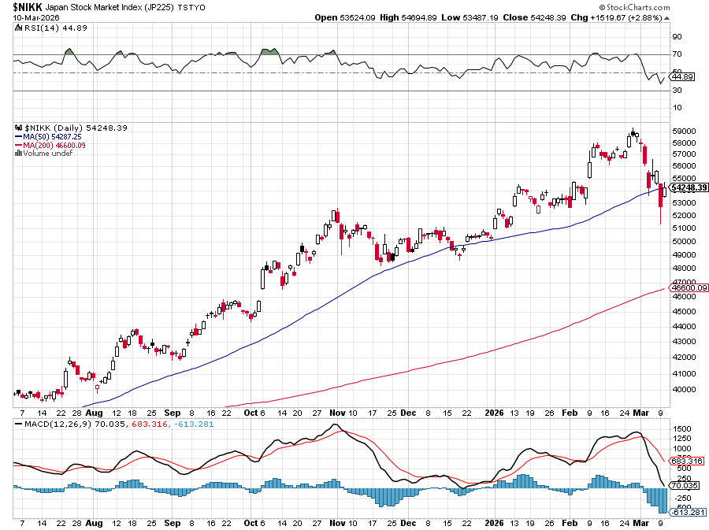
Japan ($NIKK) – down 10%
Japanese Conservative Election Win Sends Nikkei Soaring, topping 57,000

Slide 27
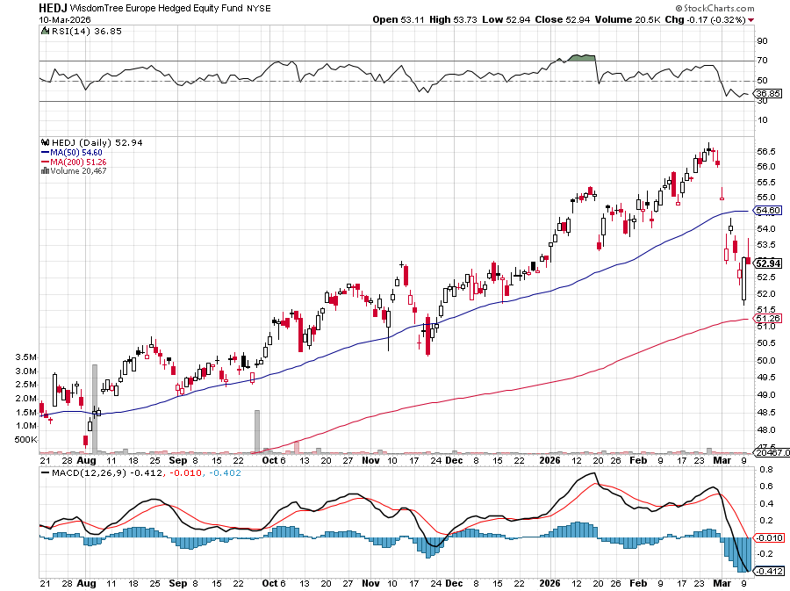
Europe Hedged Equity (HEDJ)- +19%

Slide 28
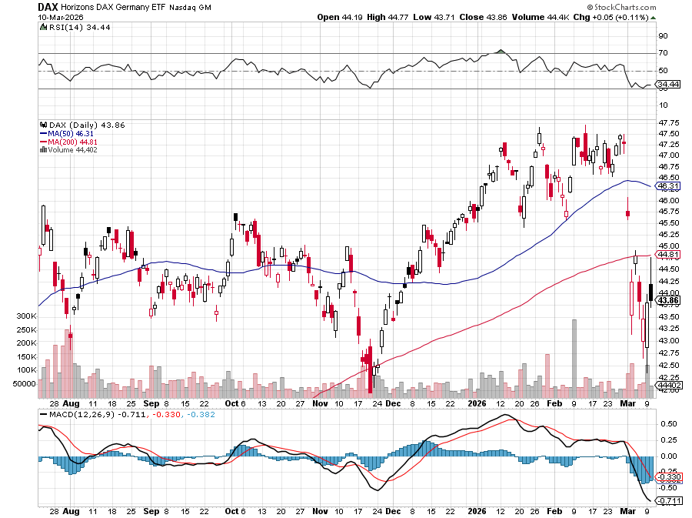
German Dax (DAX)- +30%

Slide 29
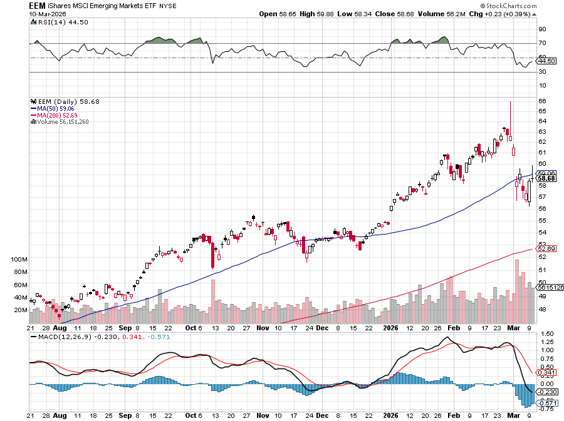
Emerging Markets (EEM) - +8%
Weak Dollar, Long Recovery Play

Slide 30



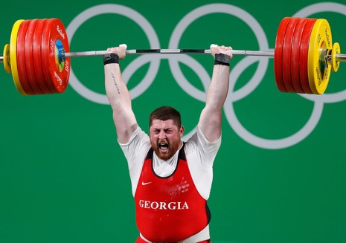
THE MAD HEDGE FUND TRADER
The Barbell Portfolio
*75% Big Tech – 2% of US workforce, 25% of market cap and 25% of US earnings
25% Domestic Recovery, including:
Railroads, airlines, cruise lines,
Couriers, steel companies
Banks, commodities
Construction
Credit Card Companies
Hotels, casinos
Online Ticket Sales

Slide 31
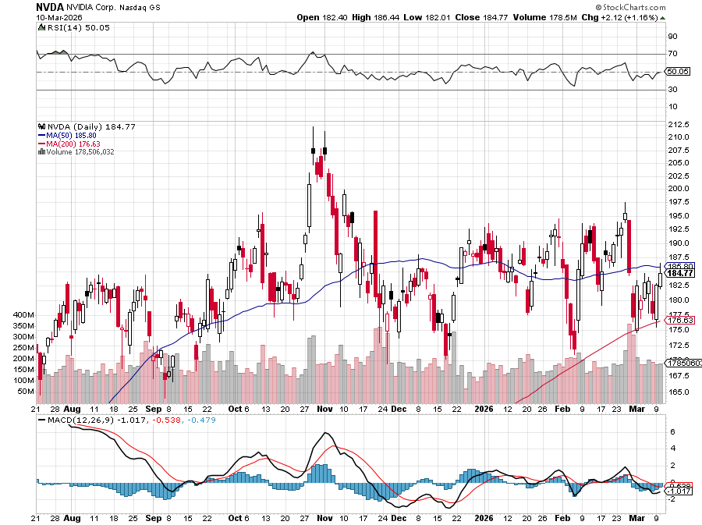

NVIDIA (NVDA) – Blackwell Chips @ $70,000 each
Nvidia Earnings Roar, Stock Whimpers stopped out of long 6/$140-$145 puts spread, took profits on long 5/$70-$75 call spread took profits on long 3/$88-$90 call spread, took profits on long 4/$140-$145 puts spread took profits on Long 2/$90-$95 call spread, took profits on Long 12/$117-$120 call spread

Slide 32
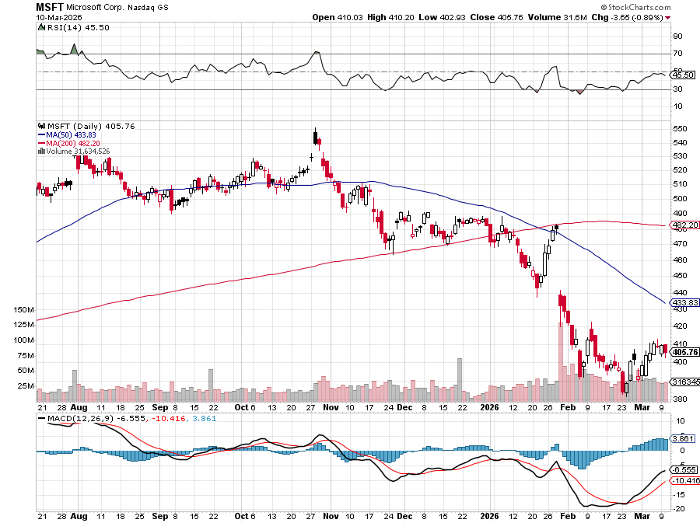

Microsoft (MSFT)- Become the Second $4 trillion Company
Microsoft Delivers Blowout Earnings took profits on long 5/$430-$440 put spread
Took profits on long 2/$330-$340 call spread, took profits on long 12/$320-$330 call spread took profits on long 9/$235-$245 call spread, took profits on long 7/$220-$210 call spread,

Slide 33
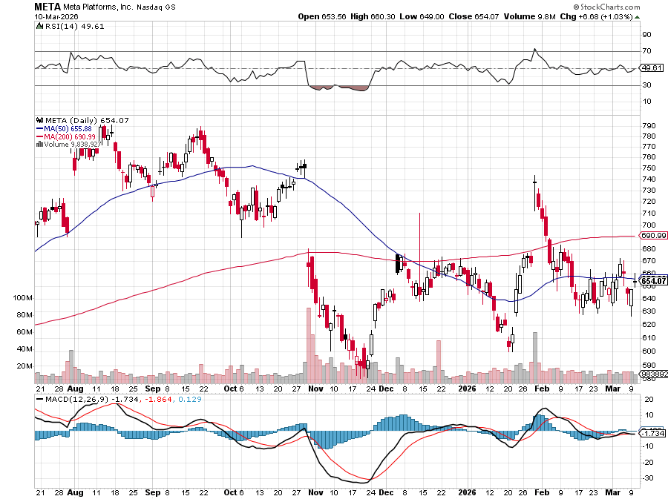

Meta (META)
Meta Makes Major Investment in AMD took profits on Long 8/$420-$430 call spread took profits on Long 5/$360-$370 vertical bull call spread, took profits on Long 9/$290-$300 vertical bear put spread, stopped out of Long 9/$190-$200 vertical bear put spread

Slide 34
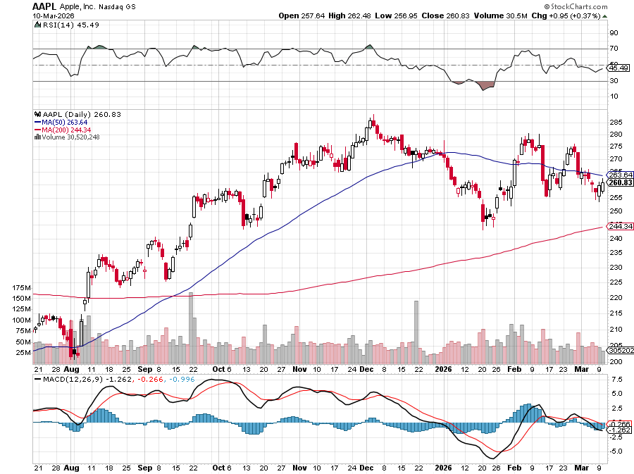

Apple (AAPL)
Apple Launches New MacBook Pro took profits on long 6/$220-$230 put spread, profits on Long 5/$225-$235 vertical bear put spread, took profits on Long 8/$160-$170 call spread took profits on Long 6/$200-$210 bear put spread,

Slide 35
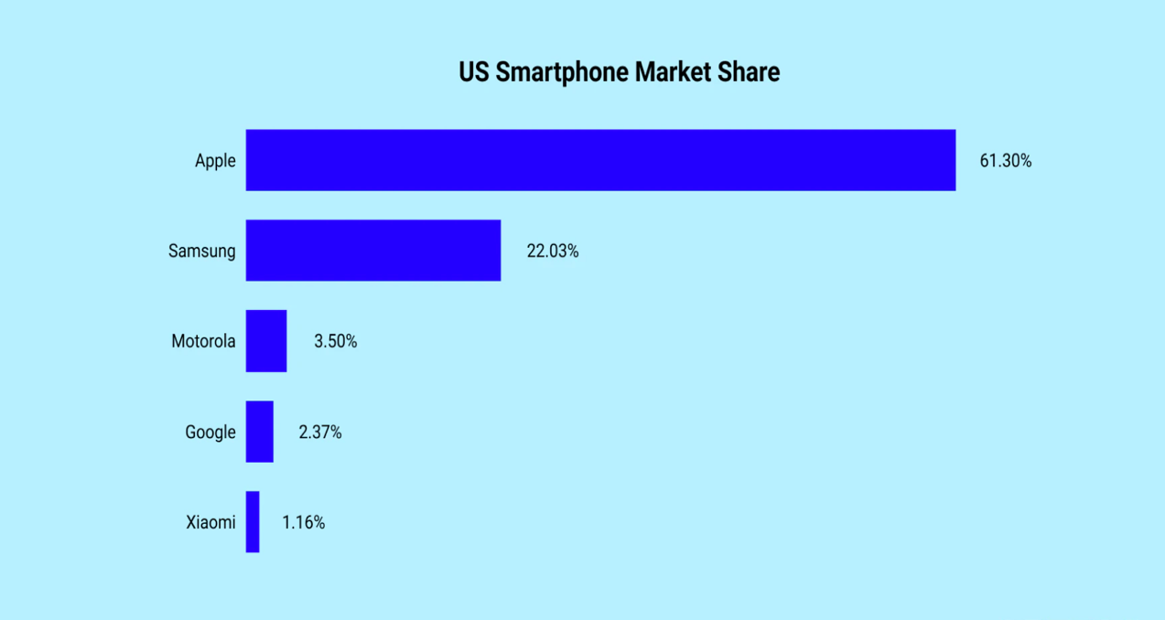

Slide 36
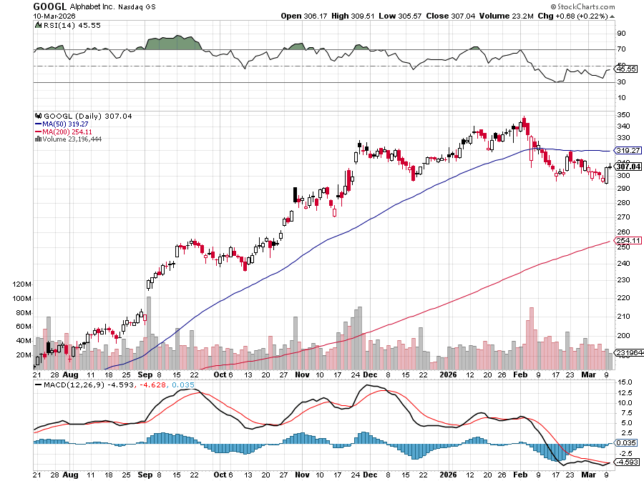
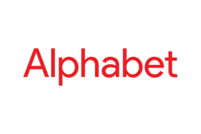
Alphabet (GOOGL) –
Alphabet to Issue 100-Year Bond to finance AI build out took profits on long 12/$110-$120 call spread took profits on long 12/$1,200-$1,230 bull call spread, took profits on long 9/$1,030-$1,080 vertical bull call spread

Slide 37
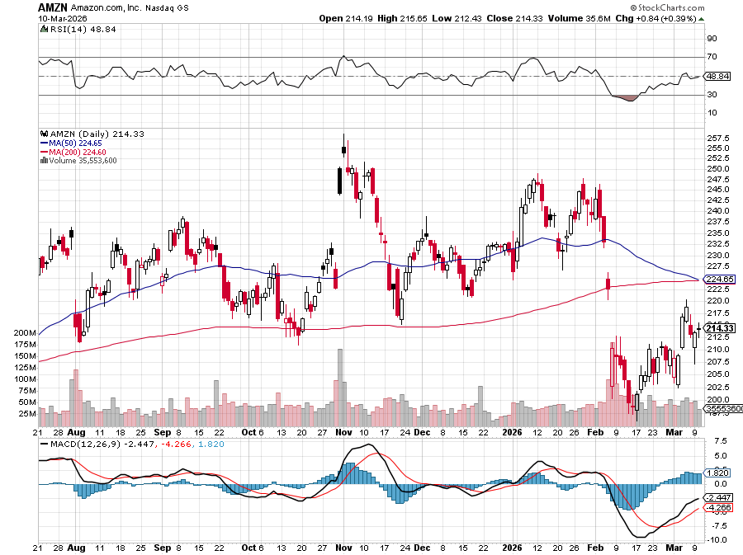

Amazon (AMZN) – Antirust Target
Amazon Plunges 12%, after missing its fourth-quarter earnings estimates took profits on long 3/$155-$160 bull call spread , took profits on long 2/$130-$135 bull call spread

Slide 38
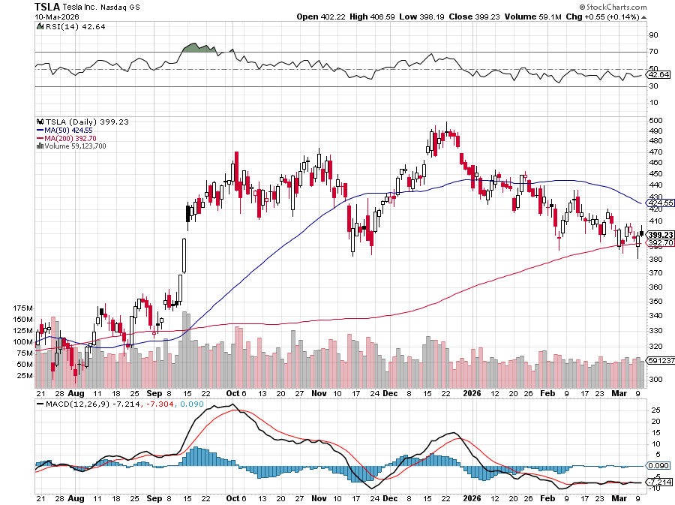

Tesla (TSLA) –
Telsa Profits Plunge 16%, off of a 3% drop in YIOY sales
took profits on long 10/$510-$520 put spread, took profits on 8/$370-$380 put spread
took profits on long 7/$420-$430 put spread, took profits on long 7/$360-$370 put spread
took profits on long 7/$180-$190 put spread, took profits in long 6/190-$200 call

Slide 39
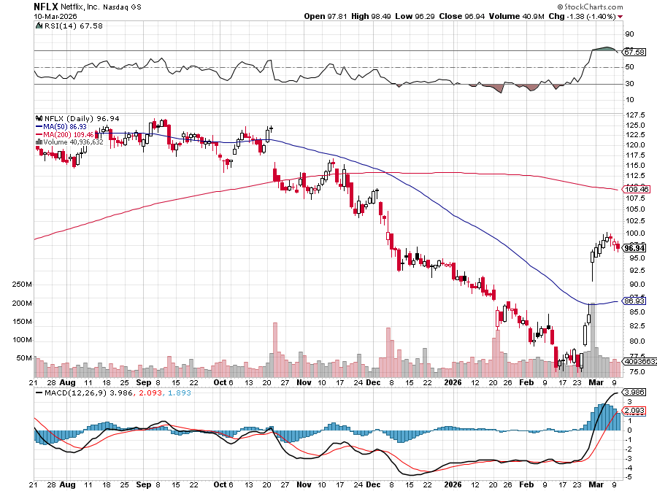

Netflix (NFLX) –
Justic Department Launches Antitrust Investigation of Netflix (NFLX)
Took profits on 11/$100-$102 call spread took profits on long $1040-$1060 call spread, took profits on long 4/800-$810 call spread

Slide 40
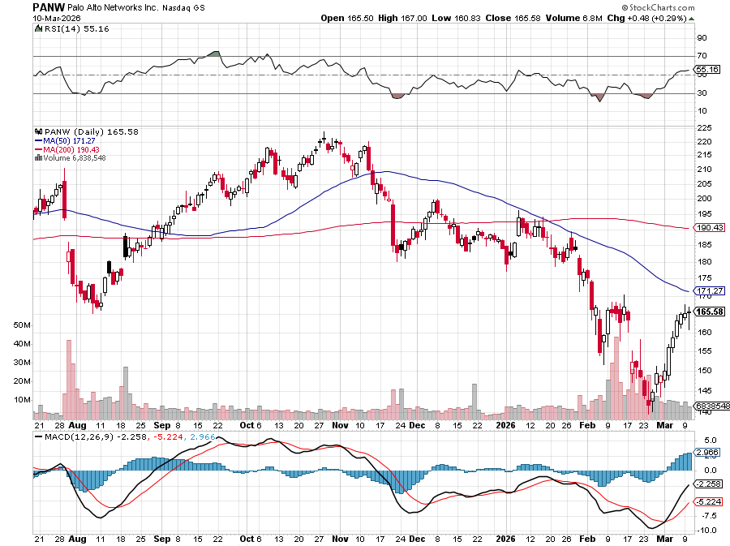

Palo Alto Networks (PANW)- Hacking never goes out of fashion
Is AI Putting SaaS Out of Business? took profits on long 2/$260-$270 call spread, took profits on long 10/$130-$140 call spread

Slide 41
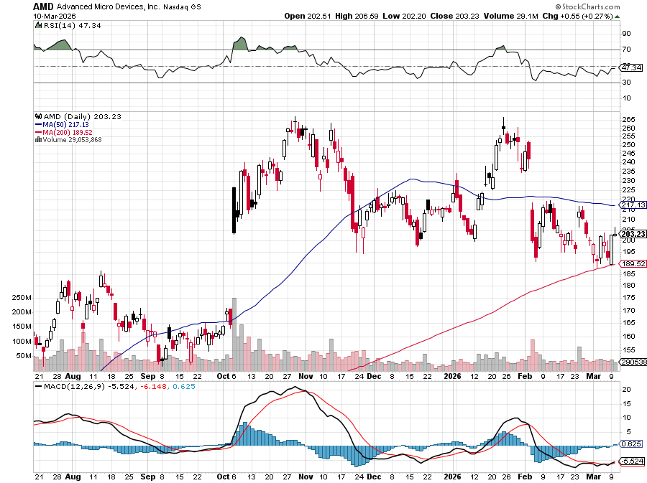

Advanced Micro Devices (AMD)- Recession fears programable logic devices took profits on long 2/$75-$80 call spread

Slide 42
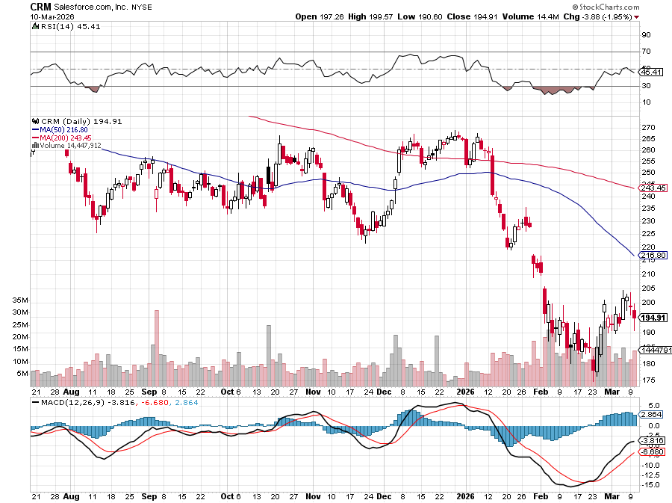

Salesforce (CRM)- Is AI Putting SaaS Out of Business? took profits on long 12/$185-$195 call spread, took profits on long 9/$125-$130 vertical bull call spread took profits on long 8/$125-$130 vertical bull call spread

Slide 43
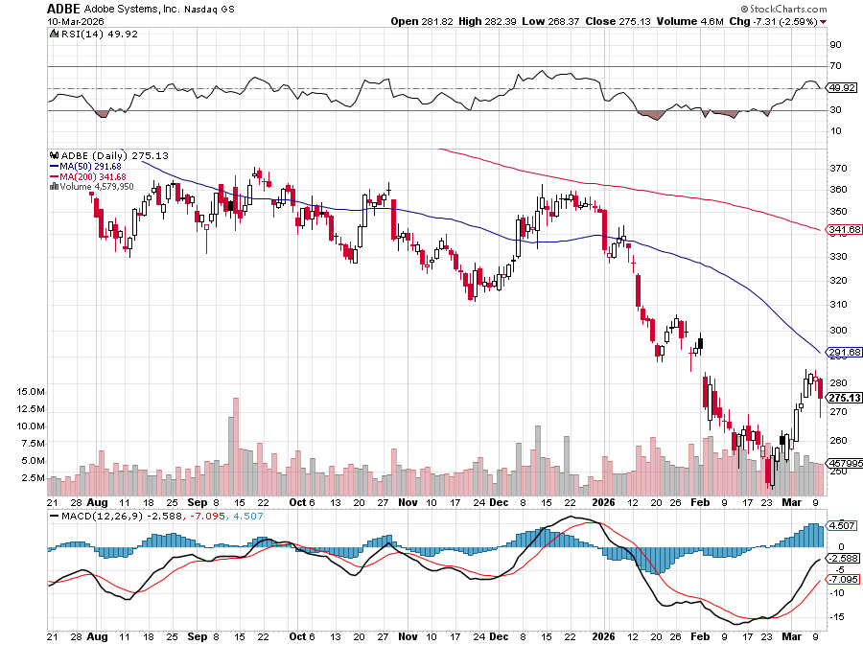

Adobe (ADBE)- Is AI Putting SaaS Out of Business?
The Quality Non-China tech play

Slide 44
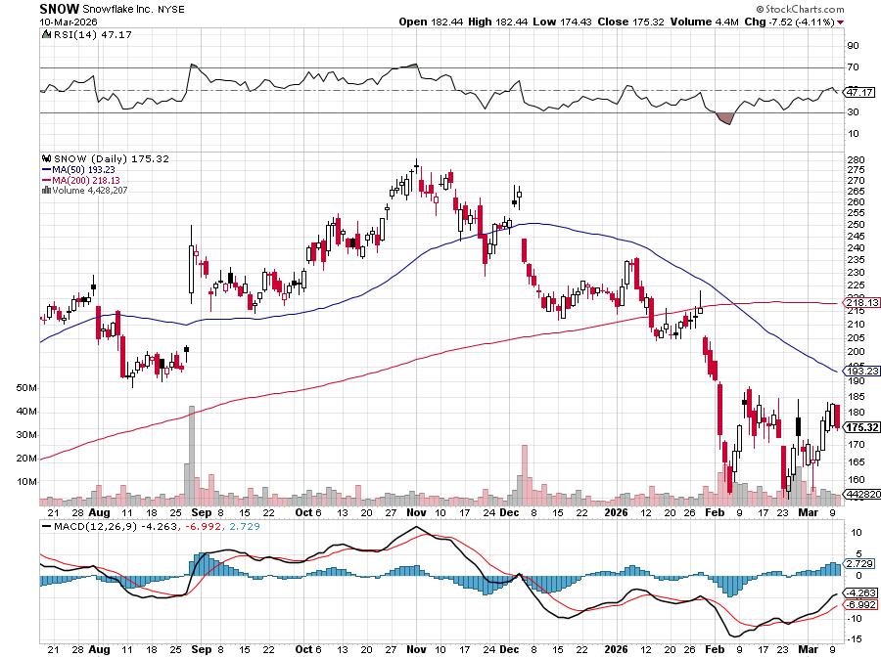

Snowflake (SNOW)- Blockbuster AI Earnings stopped out of long 4/$150-$255 call spread, took profits on long 12/$135-$140 call spread

Slide 45
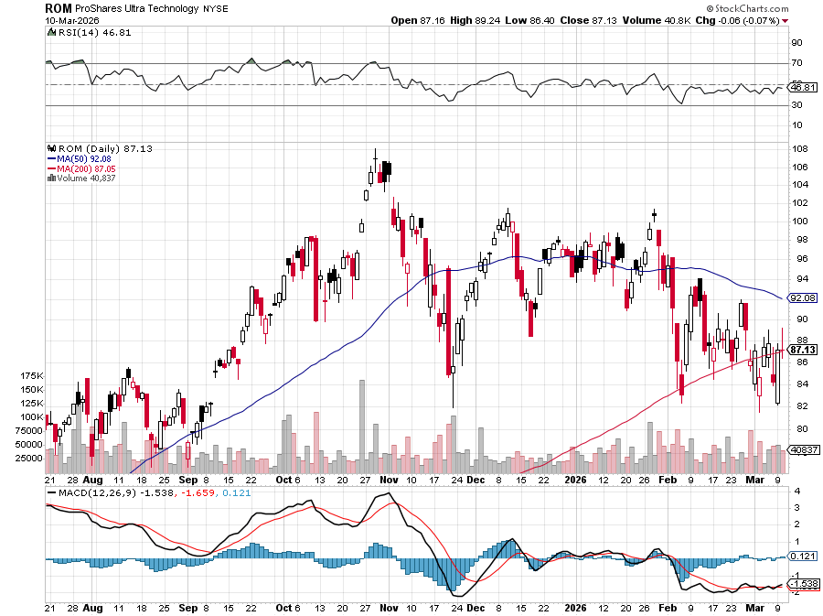
ProShares Ultra Technology ETF (ROM) – 2X Long Technology ETF took profits on long 10/$62-65 call spread

Slide 46
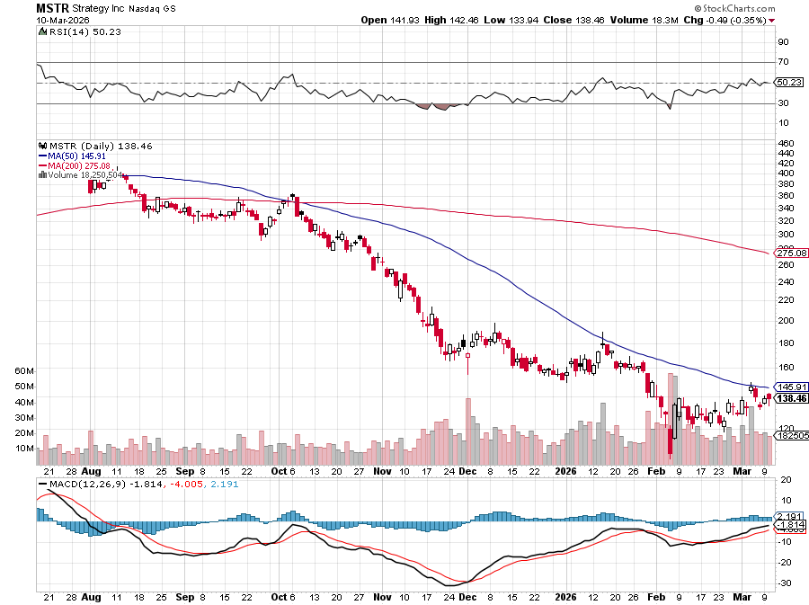

MicroStrategy (MSTR) – Long Bitcoin Play
Money is Moving out of Bitcoin Ethereum took profits on Long 6/$260-$270 call spread
Took profits on long 6/$500-$510 put spread, took profits on long 6/$470-$480 put spread took profits on long 6/$330-$340 call spread, stopped out of long 6/$335-$345 put spread

Slide 47
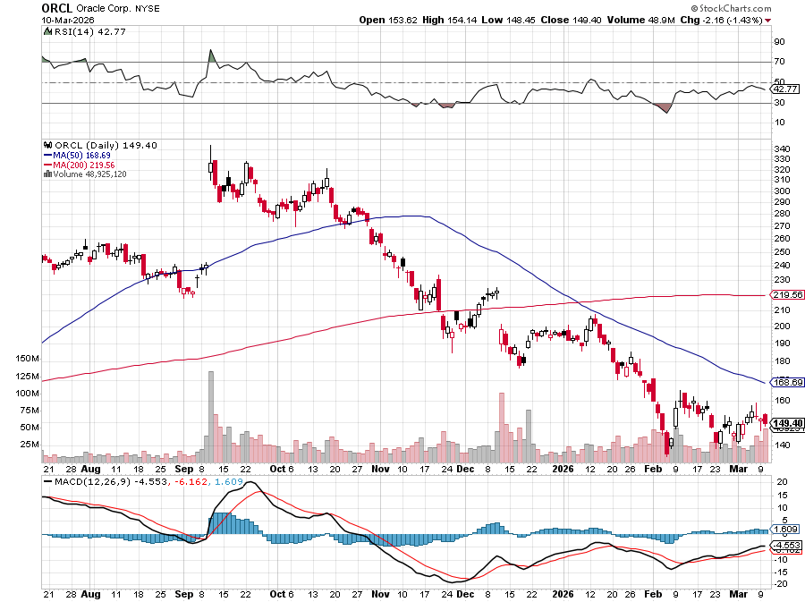

Oracle –(ORCL) – Spectacular Earnings Forecast but $100 billion in debt

Slide 48
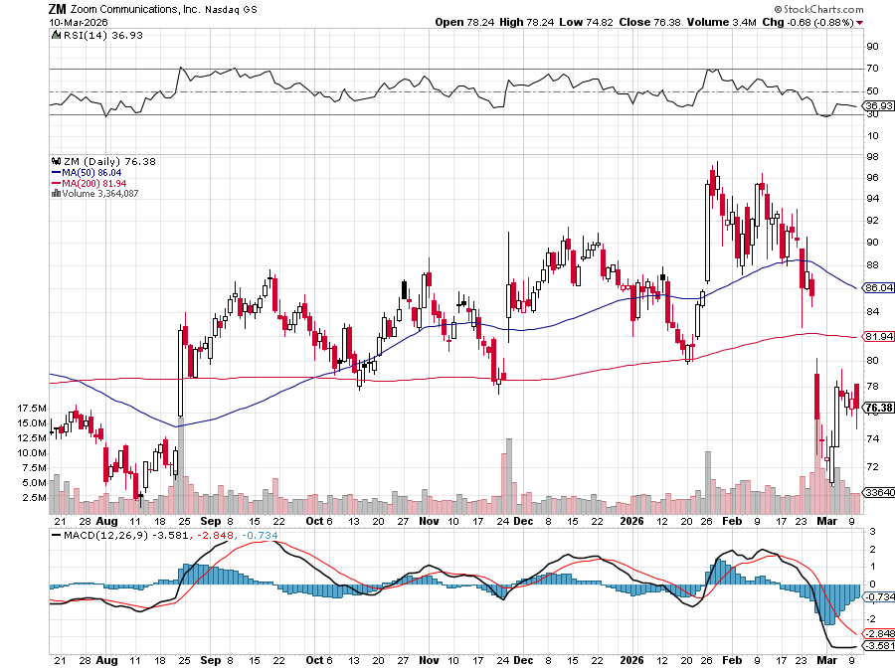

Zoom –(ZM) – Coming Back from the Dead took profits on 11/$72-50-$77.50 call spread

Slide 49
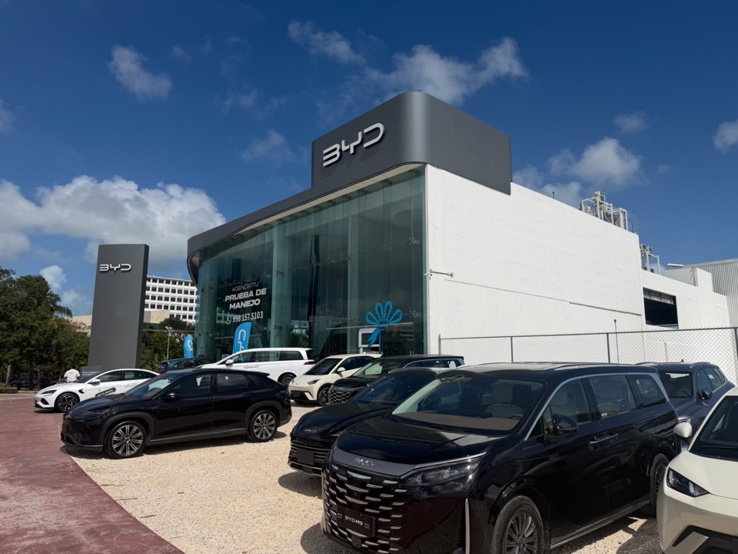

Slide 50
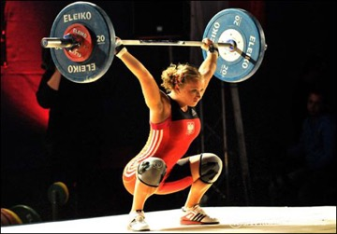
The Second Half of the Barbell
*Bets on a domestic recovery in 2022 Q4
*Upside potential in 2024 far greater than tech
*Some of these have not moved for 5 or 10 years
*Focuses on economically sensitive cyclical industries
*Makes a great counterweight to
high-growth technology
*We could spend all of next ten years rotating
between the two groups

Slide 51
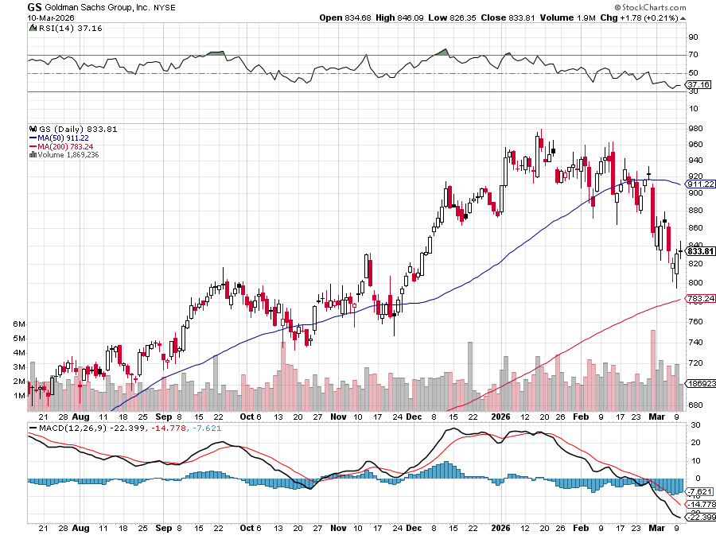

Goldman Sachs (GS) – BALLISTIC
Goldman Sachs (GS) Blows Out Earnings, on record stock trading profits long 3/$790-$800 call spread took profits on long 11/$700-$710 call spread , took profits on long 10/$700-$710 call spread took profits on long 9/$690-$700 call spread, stopped out of 3/$380-$390 call spread, profits on long 12/$330-$350 call spread, took profits on long 11/$330-$350 call spread

Slide 52
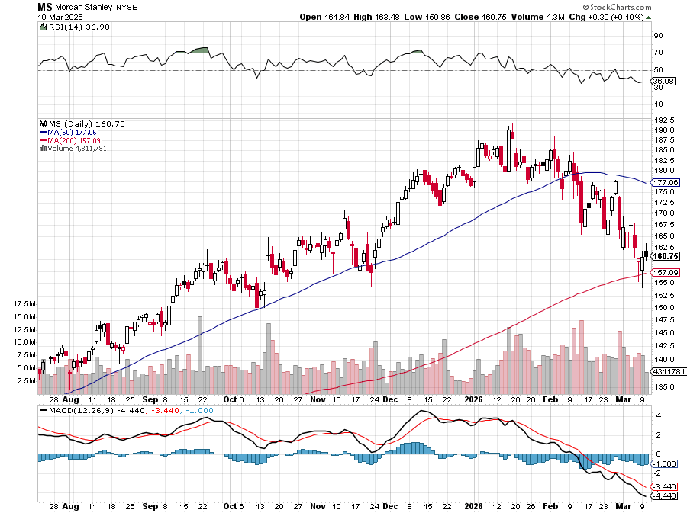

Morgan Stanley (MS) - Upside Breakout!
Morgan Stanley Lays of 2,500, or 3% of their global staff took profits on long $12/150-$155 call spread took profits on long $12/210-$220 call spread,, took profits on long $12/210-$220 call spread,
Took profits on long $195-$205 call spread, took profits on long 4/$65-$70 call spread

Slide 53


JP Morgan Chase (JPM) –
Trump Sues JP Morgan (JPM) for $5 Billion took profits on long 9/$270-$280 call spread stopped out of 3/$235-$245 calls spread, profits on long 12/$210-$220 call spread, took profits on long 11/$195-$205 call spread, took profits on 4/$215-225 put spread

Slide 54


Bank of America (BAC) – Upside Breakout? took profits on long long 12/$41-$44 call spread, took profits on long 4/$20-$23 call spread

Slide 55


Citigroup (C) – Upside Breakout took profits on long long 12/$60-$65 call spread , took profits on long 4/$30-$35 call spread

Slide 56


Charles Schwab (SCHW) – Upside Breakout took profits on long 4/$30-$35 call spread

Slide 57


Interactive Brokers (IBKR) – Upside Breakout? stopped out of long 3/$160-$170 call spread, out of long 8/$110-$115 call spread , took profits on long 4/$60-$65 call spread

Slide 58


Berkshire Hathaway (BRKB)- Ultimate defensive stock
Berkshire Hathaway Builds Record Cash, at $334 billion – Is the new T Bill proxy stopped out of long 12/$405-$415 call spread, took profits on long 12/$320-$330 call spread took profits on long 4/$260-$270 call spread, took profits on long 1/$290-$300 call spread

Slide 59


Blackrock (BLK)-Asset Collection Boom
Blackrock Reports Record $12.5 trillion in Assets Under Management stopped out of 12/$1,000-$1,010 call spread, took profits on long 12/$850-$860 call spread took profits on long 3/$770-$790 call spread, took profits on long 3/$310-$340 call spread

Slide 60

SPDR Metals & Mining ETF (XME) – long 2/$28-$30 call spread

Slide 61


Boeing (BA) – LEAPS Candidate
Boeing is Beating on Deliveries. Boeing begins 2026 with 46 deliveries in January and 103 net new orders long 3/$195-$200 call spread

Slide 62


General Motors (GM) – Worst Off Trade War Victim
Earnings better than expected plus interest rate beneficiary stopped out of long 4/$52.50-$57.50 put spread at cost, long 3/$53-$56 put spread

Slide 63


Package Delivery- United Parcel Service (UPS) –
UPS Deliveries Slow Worldwide, it the wake of the shutdown of its Kentucky hub after a fatal crash took profits on long 11/$130-$140 call spread

Slide 64


Caterpillar (CAT)- Ag + Infrastructure + Housing long $630-$640 call spread stopped out of long 8/$310-$320 call spread, took profits on long 12/$220-$230 calls spread took profits on long 12/$145-$150 call spread, took profits on long 11/$125-$135 call spread

Slide 65


Deere & Co. (DE)- Ag + Infrastructure + Housing took profits on long 8/$330-$340 put spread stopped out of long 8/$330-$340 calls spread

Slide 66


Freeport McMoRan - (FCX)- Coming Copper Crisis
50% copper tariff stopped out of 3/$55-$58 call spread, took profits on long 8/$34-$37 call spread took profits on long 4/$37-$40 call spread, took profits on long 5/$42-$45 call spread, stopped out of long $48-$51 put spread, profits on long 6/$32-$35 call spread

Slide 67


Walt Disney (DIS) -Disney Beats
Disney Dives on Earnings Bust, although streaming broke even versus an expected loss

Slide 68


Industrials Sector SPDR (XLI)-
(GE), (MMM), (UNP), (UTX), (BA), (HON)

Slide 69


Union Pacific RR (UNP)- Big Stuff to Ship
The Largest Railroad in History, may be the result of the Union Pacific (UNP)/Norfolk Southern merger worth $200 billion took profits on long 5/$200-$210 call spread took profits on 11/$150-$160 call spread

Slide 70


Walmart (WMT) – Trade War Victim
Walmart Hits $1 Trillion Market Cap took profit on Long 11/$125-$130 bear put spread, took profit on Long 10/$119-$121 bear put spread took profits on Long 8/$114-$117 bear put spread

Slide 71


Costco (COST) – Trade War Victim suing Trump administration over tariffs, one third of sales from imports took profits on long 4/$840-$850 call spread

Slide 72


Delta Airlines (DAL) – Ticket Price Take Off lost $200 million on government shutdown

Slide 73


Transports Sector SPDR (XTN)- Worst Hit Sector
(ALGT), (ALK), (JBLU), (LUV), (CHRW), (DAL)

Slide 74


Health Care Sector (XLV) – Defensive Play and Cheap
(JNJ), (PFE), (MRK), (GILD), (ACT), (AMGN)

Slide 75


Amgen (AMGN) long 7/$260-$270 bull call spread, took profits on long 11/$185-$200 bull call spread

Slide 76


Visa (V) – Stablecoin Competition took profits on long 2/$240-$250 bull call spread took profits on long 10/$160-$170 bull call spread, took profits on long 6/$150-$160 bull call spread

Slide 77


Consumer Discretionary SPDR (XLY)
(DIS), (AMZN), (HD), (CMCSA), (MCD), (SBUX)

Slide 78

Raytheon (RTX) long $195-$200 call spread

Slide 79

Bonds – Dumped
*There is No Safe Haven in Bonds, with yields climbing worldwide on oil driven inflation fears
*Global government bond markets were headed for one of their worst weekly losses in months
*Ten-year US Treasury yields have backed up 17 basis points since the war started
*Private Credit is Imploding, with Blackstone (BLK) down 8% on record redemptions of its funds.
*Avoid all government bonds (TLT).
*Bonds still trapped in six-month trading range

Slide 80

Treasury ETF (TLT) – took profits on long 6/$88-$91 put spread stopped out of long 6/$80-$83 call spread, took profits on long 4/$84-$87 call spread stopped out of long 1/$82-$85 call spread, took profits on long 10/$103-$106 put spread took profits on long 6/$$94-$97 put spread, took profits on long 5/$82-$85 calls spread

Slide 81

Ten Year Treasury Yield ($TNX) – 4.15%

Slide 82

Junk Bonds (JNK) 6.54% Yield

Slide 83

Municipal Bonds (MUB) 4.21% Yield-

Slide 84

Emerging Market Debt (ELD) 5.62% Yield-

Slide 85

2X Short Treasuries (TBT)-Out of Favor

Slide 86

Anally Capital Management (NLY) – Leveraged REIT Play
Yield 13.25% took profits on long 12/$15-$16 call spread

Slide 87


Slide 88

Foreign Currencies – Dollar Revival
*Iran War triggers massive flight to safety bid for US dollar
*This prompts sharps move down in (FXA), (FXE), (FXB), (EEM), and even the long beleaguered (FXY)
*There is a great trade setting up here in the currencies
*Once the war ends, currencies will rush to new highs
*Sell all dollar rallies.
*Buy (FXA), (FXE), (FXB), (FXC), and (FXY) NOW!

Slide 89


THE MAD HEDGE FUND TRADER
Australian Dollar (FXA) - Major Long-Term Bottom is In Targeting Parity – A call option on a global synchronized recovery

Slide 90


Japanese Yen (FXY)

Slide 91


Euro (FXE)-

Slide 92


British Pound (FXB)-

Slide 93


Emerging Market Currencies (CEW)

Slide 94

Energy & Commodities – War Melt Up!
*Oil Hits $119 Overnight, driven by panic buying by Asian customers which have no alternative
*This this the sharpest rise in oil prices in history and the US oil industry loves it
*America’s Gasoline Bill Rose by $1 Billion This Week and there is more to come
*Israel Attacks Karg Island, crippling Iran’s oil exports for the indefinite future
*It is Iran who decides who opens the Straights of Hormuz, not the US
*Trump allows Russia to sell oil to India, giving it more cash to fight
the Ukraine war
*Rocketing gasoline prices are giving EV’s a second look

Slide 95

Oil-($WTIC)
Sharpes Move in History, up 115%

Slide 96

United States Oil Fund (USO)

Slide 97

Energy Select Sector SPDR (XLE)-No Performance!
(XOM), (CVX), (SLB), (KMI), (EOG), (COP)

Slide 98

ExxonMobil (XOM)-
Exxon Moves Big into Lithium, with the construction of a major mining operation in Arkansas took profits on Long 4/$100-$105 call spread, took profits on long 12/$120-$125 put spread

Slide 99

Occidental Petroleum (OXY)- Buffet’s a Buyer took profits on long 4/$59-$62 call spread took profits on long 2/$55-$60 call spread, took profits on long 12/$77.50-$82.50 put spread

Slide 100

Natural Gas (UNG) – Free Fall on Warm Winter took profits on Long January 2025 $7-8 Call Spread LEAPS

Slide 101

Cameco (CCJ) – Global Uranium Renaissance
Microsoft to Reopen Three Mile Island to power AI data centers took profits on long 12/$41-$44 call spread, took profits on long 12/$35-$38 call spread, took profits on long 5/$20-$23 bull call spread

Slide 102

Vistra Corp. (VST) – Global Uranium Renaissance took profits on long 2/$100-$110 call spread

Slide 103

Precious Metals – Going Flat
*Gold sells off on Iran War, then goes flat
*Gold still digesting recent huge gains by moving sideway
*If we get a sudden dip in gold buy it
*Political instability in the US has become a factor driving gold
*AI build out is creating exponential growth in demand for silver
*But high prices are forcing engineers to design out
silver in many applications

Slide 104


THE MAD HEDGE FUND TRADER
Gold (GLD) – Headed for $5,000....or $10,000?
long 12/$355-$360 call spread – expires in 7 trading days
profits on long 6/$275-$285 call spread, took profits on long 5/$275-$285 call spread
stopped out of long 6/$275-$285 call spread, took profits on profits on long 10/$230-$235 call spread
BUY

Slide 105


Market Vectors Gold Miners ETF- (GDX) – took profit on long 6/$207.50-$212.50 call spread, took profit on long 7/$200-$205 call spread

Slide 106


Barrick Mining (B) took profit on long 1/$15.50-$16.50 call spread

Slide 107


Newmont Mining- (NEM)- Sometimes you Just Get Lucky took profits on long 10/$47-$50 call spread, took profits on long $55-60 call spread

Slide 108


THE MAD HEDGE FUND TRADER
iShares Silver Trust (SLV) - The Better Play Industrial demand, solar panels, electric cars
2025
Target
$50
+50%
BUY

Slide 109


Silver Miners - (SIL)-

Slide 110


Wheaton Precious Metals - (WPM)- LEAPS Approaching Max Profit took profits on long 4/$39-$42 call spread long 6/$75-$80 call spread-expires in 7 trading days , took profits on long 1/$36-$39 call spread

Slide 111


Platinum- (PPLT)- 556,000-ounce shortage this year took profits on long 1/$36-$39 call spread

Slide 112

S&P Case Shiller Slows
S&P Case Shiller Rises to +1.4% YOY in October, with its National Home Price Index
Chicago gained +5.8%, Cleveland +4.1%, and New York +5.0%.
Tampa -4.5% Phoenix -1.5% and Dallas down -1.5%

Slide 113


Slide 114

Real Estate – Nipped in the Bud
*Nascent real estate recovery has been killed off by the Iran War
*Consumers are not in a mood to undertake a major expenditure at the onset of a new war
*Mortgage Applications are Flat at 0.4%.
*Ten-year US Treasury yields rocketing back up to 4.15% won’t help
*Existing Home Sales Rise 1.7%, in February, to a seasonally
adjusted 4.09 million units.
*There were 1.29 million units for sale in January, up 4.9% YOY
*Mortgage rates at 6.0% back then were a big help
*Inventories are at 3.8 months
*The median sale price was $398,000, up 0.3% YOY

Slide 115
S&P Case Shiller Slows
S&P Case Shiller Rises to -0.2% YOY in November, with its National Home Price Index
Miami gained +3.2%, Tampa +2.0%, and Atlanta +1.5%.
Seattle -1.4% San Francisco -1.3%

Slide 116


Crown Castle International (CCI) – 4.68% yielding 5G cell phone tower REIT
Eliot Management Pushes up stock with activist bid took profits on Long 8/$90-$95 call spread,

Slide 117



US Home Construction Index (ITB)
(DHI), (LEN), (PHM), (TOL), (NVR)

Slide 118


DH Horton (DHI)
Earnings Hit on free upgrades eating into margins took profits on long 11/$165-$175

Slide 119

Trade Sheet- The Recession Trade
So What Do We Do About All This?
*Stocks –stand aside
*Bonds – stand aside
*Commodities – buy dips
*Currencies – buy dips
*Precious Metals – buy dips
*Energy – stand aside
*Volatility – sell over $30
*Real estate – buy dips

Slide 120

Next Strategy Webinar
12:00 EST Wednesday, March 25, 2026 from Honolulu Hawaii email me questions at https://www.madhedgefundtrader.com/jp-ms-0925
Good Luck and Good Trading!
Notes:
*

Slide 121


