Slide 1
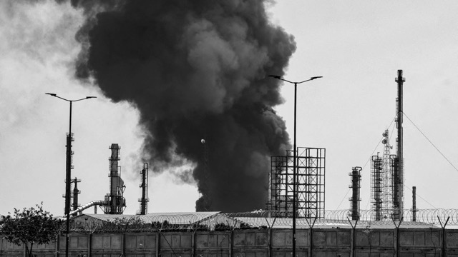
The Mad Hedge Fund Trader
“The Worst-Case Scenario”
With John Thomas
Dubai, United Arab Emirates, April 8, 2026
www.madhedgefundtrader.com
Notes:
*

Slide 2
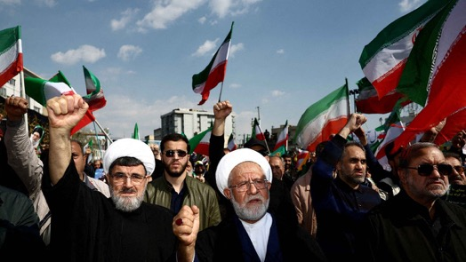
2 Week Cease Fire – An Iran win
*Conclusion: Buy oil (USO), oil companies (XOM), (CVX), and service companies (SLB) on dip
*There appears to ne no Iran participation in this deal, it was all set up by Pakistan
*Itan will only stop firing missiles if the US does
*Straits of Hormuz remain closed
*No handover of enriched uranium
*Time to buy more drones and missiles from Russia
and China and reposition troops to Straits
*Time to rebuild infrastructure
*gasoline prices will keep rising
*Short covering rally of $1,000 points IS TEMPORARY

Slide 3


Slide 4
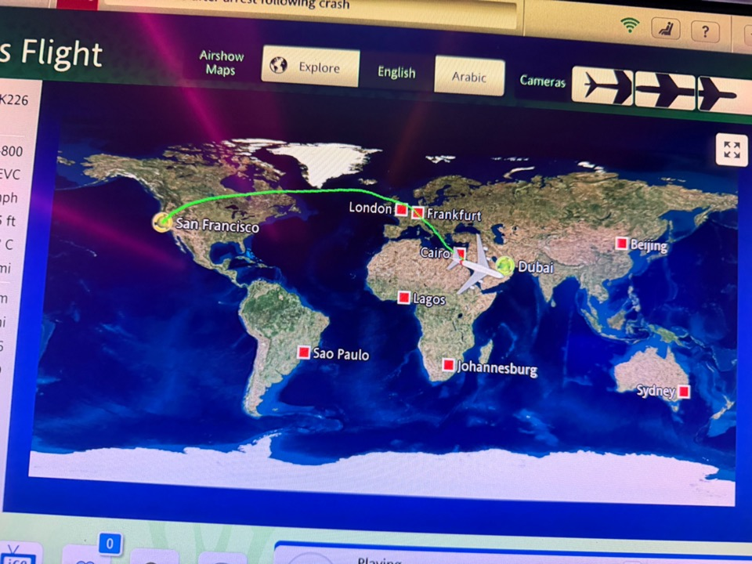

Slide 5

Conclusion from 10 Days in a War Zone
*Closure of the Straits of Hormuz has cut off 20% of the world’s oil supply, 30% of fertilizer, 10% of aluminum, and 35% of helium for chip making
*The Iran War may never end, but continue at a slow burn, taking oil to $200 a barrel
*It may never reopen unrestricted again, with Iran wanting to charge $2 million per ship
*That creates $75 billion a year in new revenues for the Islamic state while doubling the value of its oil exports
*The war gave Iran a switch to turn on and off the global
economy which it alone controls
*The US has created the most unfriendly investment
environment in a century
*Risk Control is the order of the day

Slide 6
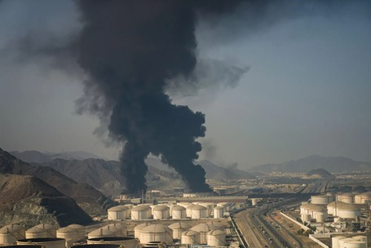
THE NEW ENERGY REALITY
*Many Persian Gulf oil fields were destroyed by mandatory shut-ins and are never coming back
*Middle Eastern oil sources have been proven unreliable and will not attract new investment
*Many damaged oil facilities will take five years and cost $5 billion to rebuild EACH
*Even if the war ended tomorrow, it would take 4 months for new oil supplies to reach the US
*The US is energy independent only on paper
*The reality is that the US needs to import 3 million
barrels a day from the Persian Gulf to keep gas prices
at $4.50 a gallon
*In the meantime, US hoarding and stockpiling has
increased demand by 3 million barrels a day

Slide 7

WHAT TRUMP GOT WRONG ABOUT IRAN
*Iran would surrender in 3 days
*The US went into this war with ammunition and oil stockpiles at decades lows
*Anybody can be bought at the right price. This doesn’t work in theocratic autocracies
*Firing 80% of your intelligence staff gets you terrible intelligence
*Iran’s military capability was wildly underestimated,
attacking a dozen countries at once up to 2,500 miles away
*There is no Iran opposition willing to step in and take control
*Iran is willing to sacrifice its own people to stay in
control
*Iran is getting resupplied by Russia with anti aircraft missiles

Slide 8
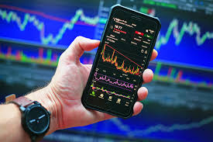
THE CASE AGAINST STOCKS
*US stocks topped in January with price earnings multiples at a very expensive 23X
*They have since dropped to a more reasonable 19X, but the 2009 bottom was at 9X, half current level
*The current energy crisis is much worse than the 2009 subprime loan crisis, so lower lows beckon
*Current earnings forecasts are based on a world that
no longer exists, one with energy at half the current levels
*We’ve just had a great 17-year run in stocks, which is now
over
*However, there’s a new game in town

Slide 9
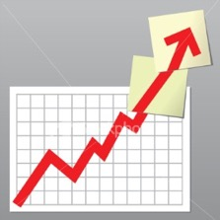
Trade Alert Performance
New All-Time Highs-17 Consecutive Positive Months
*January +1.97% MTD *July +5.21% Final
*February +3.08% Final *August +1.37% Final
*March -5.76% MTD *September +2.21% Final
*April +0.00% Final *October +3.11% Final
*May +2.51% Final *November +2.33 Final
*June +15.48% Final *December +2.66% Final
*2026 Year To Date -1.76%
+812.28% since inception
*Versus 79.79% for all of 2023
*Versus 75.29% for all of 2024
*Versus 62.02% for all of 2025

Slide 10
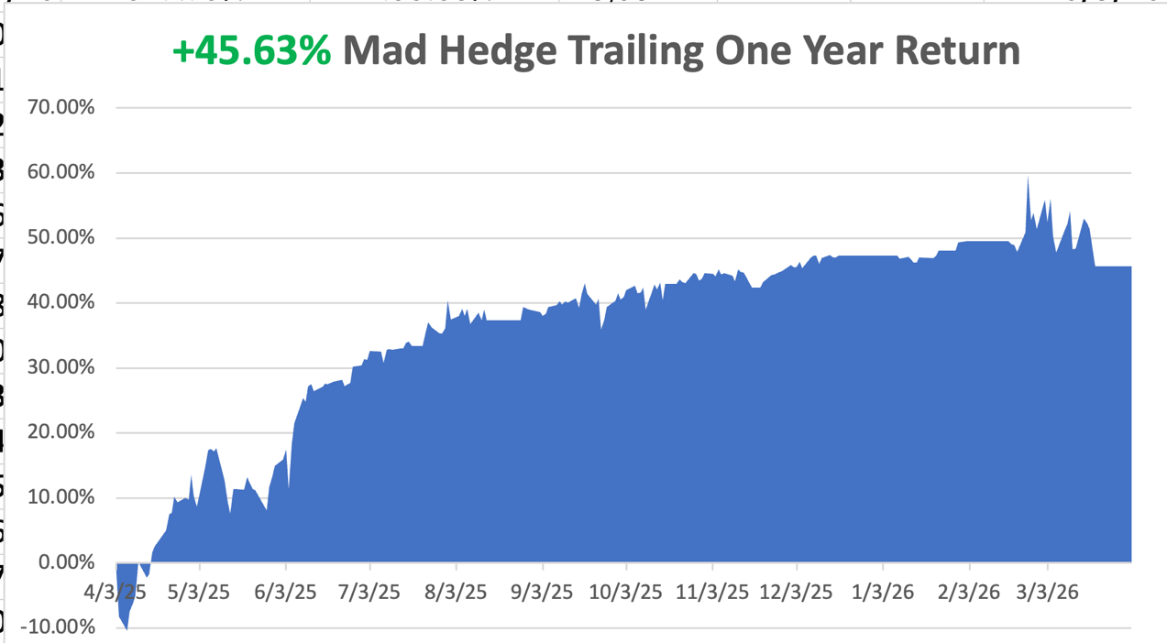

Slide 11
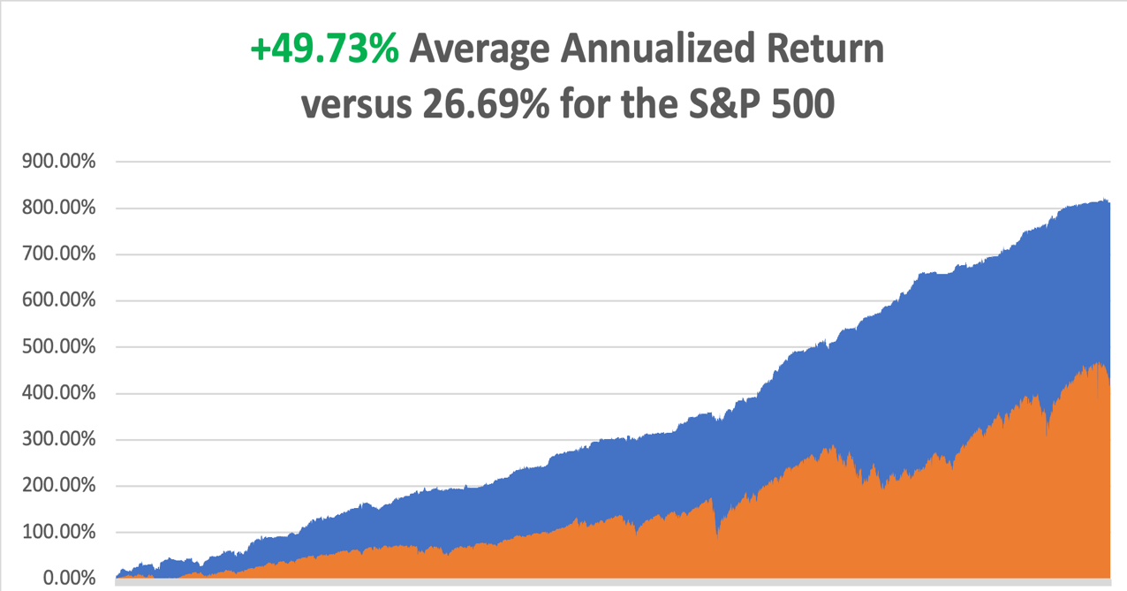

Slide 12
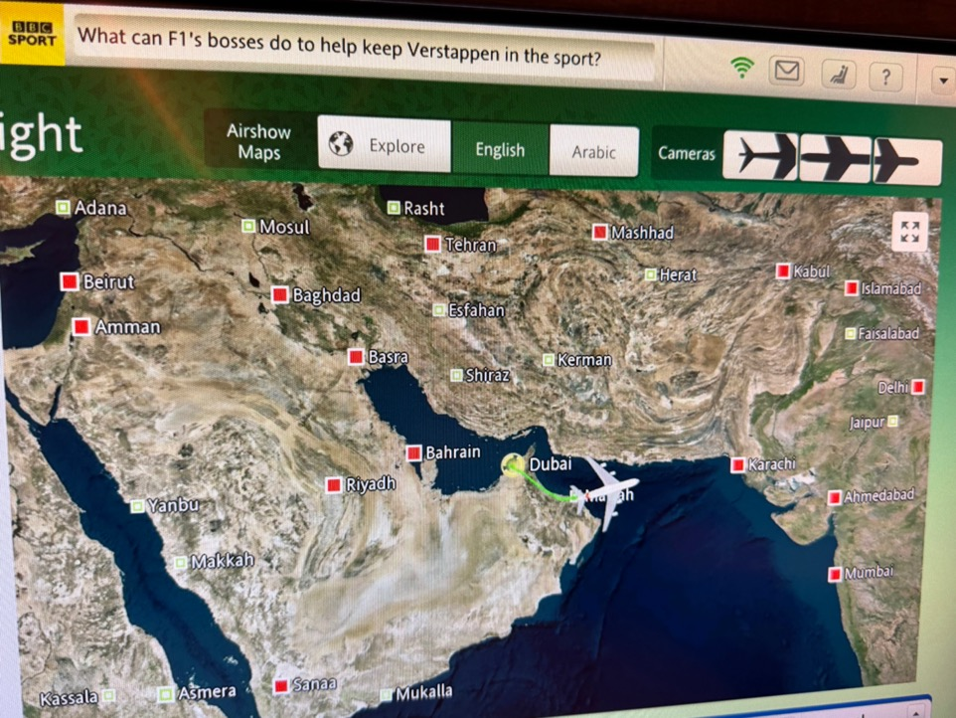

Slide 13
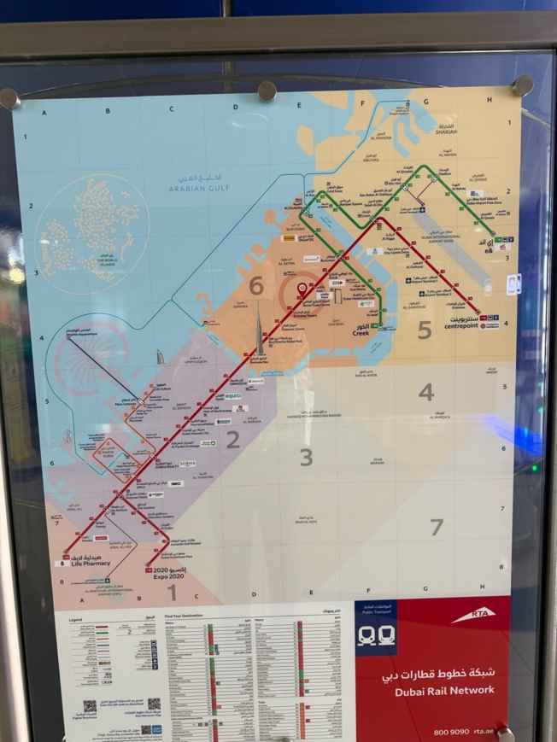

Slide 14
Portfolio Review – High Risk Market Require Maximum Cash
50% risk on, 10% risk off, 40% cash
NO POSITIONS
Expiration Value
+0%

Slide 15

The Method to My Madness
*The Straits of Hormuz are still closed for the rest of 2026
*It cuts off 20% of the world’s oil, 30% of fertilizer, 10% of aluminum, and 33% of helium for computer chips
*The destroyed oil isn’t coming back, some 1 billion barrels, or 70% of the gasoline uses per year
*The 200-day moving average for the (SPY) is now an upside ceiling for the market
*Permanently higher gasoline prices will wipe out the benefits
of any tax cuts
*Jobs data remains bad and getting worse
*US Dollar at one-year highs on position unwind
*Bitcoin stalls at $70,000 on war fears

Slide 16

The Global Economy – The Global Recession is Here
*Nonfarm payrolls rose by 178,000 in March, a reversal from the 133,000 decline in February
*The headline Unemployment Rate edged lower to 4.3%,
*Inflation is Heating Up. With Input prices index surging to 70.7
*Europe is Headed into Recession, as LNG supplies dry up.
*Alaska Air Reports Record Loss, Delta reports today
*Consumer Sentiment Crashes, index falls to 53.3
* US Population is Plunging. Four in ten US counties
shrank last year as the immigration
crackdown continued to stifle the nation’s
main source of population growth

Slide 17
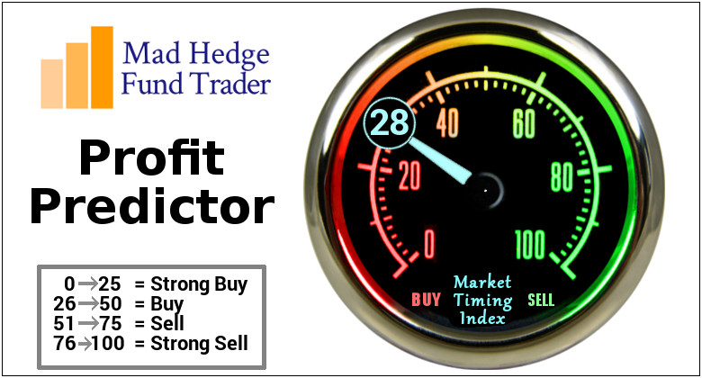

Slide 18
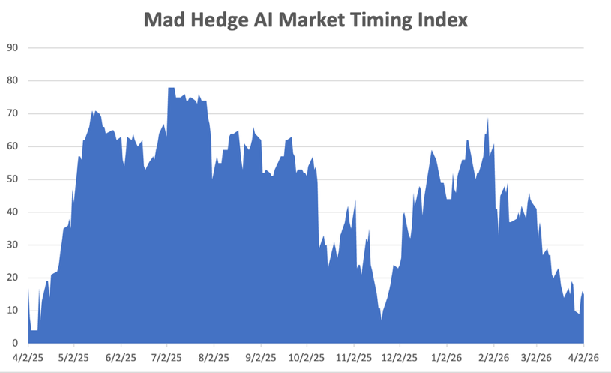
The Mad Hedge Profit Predictor
Market Timing Index – Hits Seven month Low at 6,
An artificial intelligence driven algorithm that analyzes 30 different economic, technical, and momentum driven indicators
SELL
BUY

Slide 19
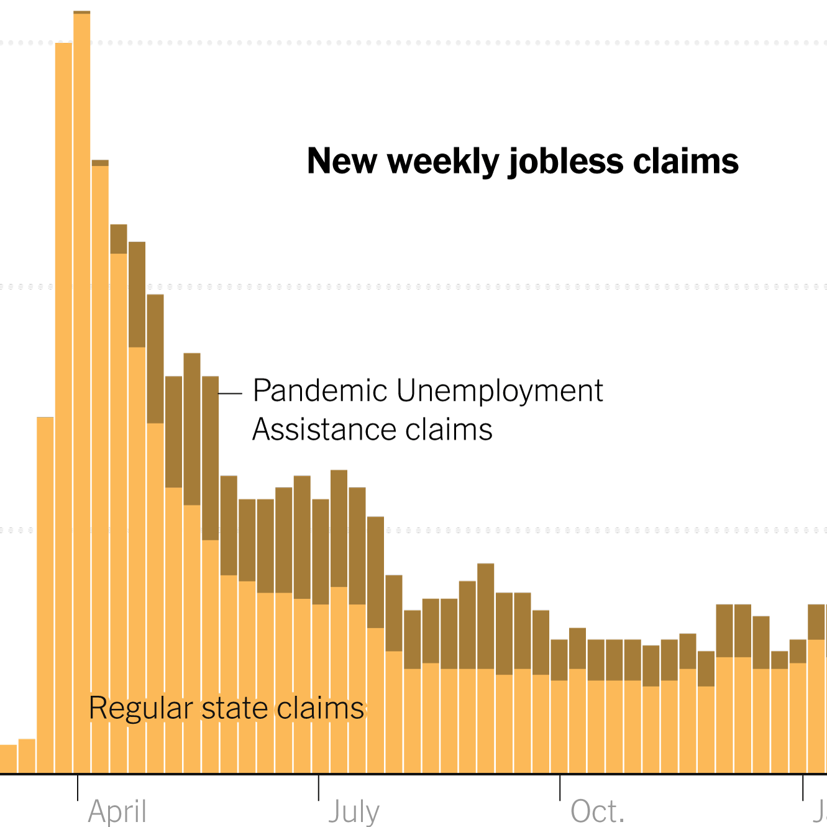
Weekly Jobless Claims –
-1,000 to 213,000

Slide 20
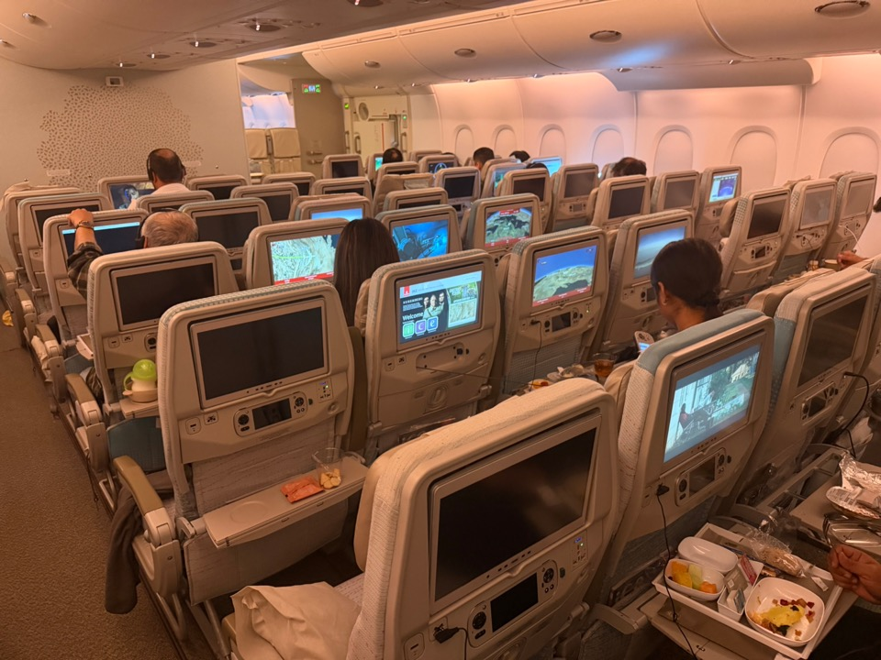

Slide 21
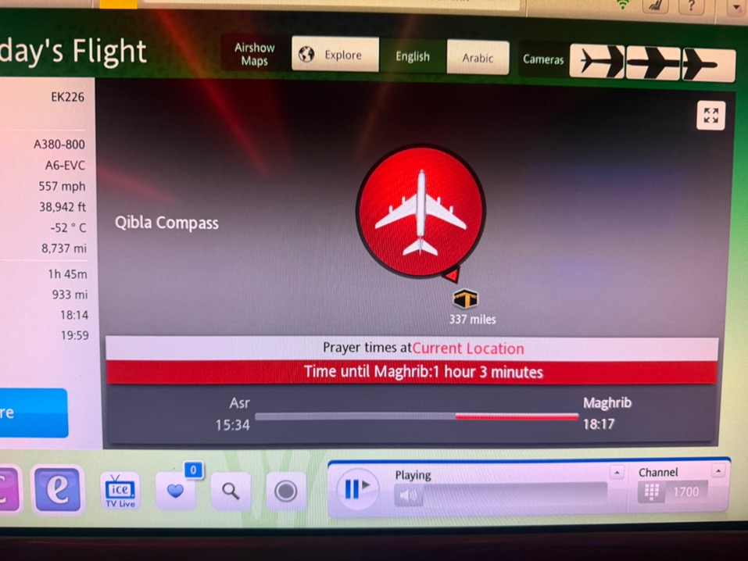

Slide 22
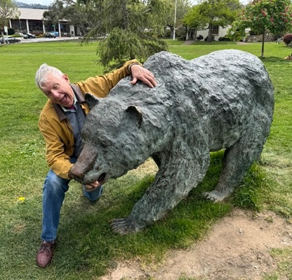
Stocks – The Bear is Coming
*Markets Tank on Trump Speech, with the Dow down $400 and oil up $18.00
*Hedge Funds Get Destroyed by War Turmoil
*Avoid SpaceX, as the company is likely to go public at a peak valuation
*Netflix Raises Prices, making the stock a strong “BUY.”
*Open AI Valued at $852 Billion After Completing $122 Billion Round
*Will Semiconductors Get Hit Next?
*Alaska Air Reports Record Loss, Delta reported this morning
*Nvidia PE Hits Seven-Year Low
*Meta (META) Loses $375 Million Suit, over child protections
*Used EV Sales Rocket in Europe
*Apple is Expected to Make an Important AI Announcement,
at the Worldwide Developers Conference on June 8.

Slide 23

What Are HALO Stocks?
*High Asset
*Low Obsolescence
*Can’t be easily replaced by AI
*Are immune to AI shocks are hitting Low Asset High Obsolescence (LAHO) stocks
*HALO has massively outperformance LAHO in recent months
*HALO examples are:
*Texas Pacific Land Corp. (TPL). *FedEx (FDX)
*Corning (GLW) *Hershy (HSY)
*Southern Co, (SO) *Colgate (CL)
*Baker Hughes (BKR) *Apple (AAPL)
*Southern Copper (SO) *Any oil company

Slide 24
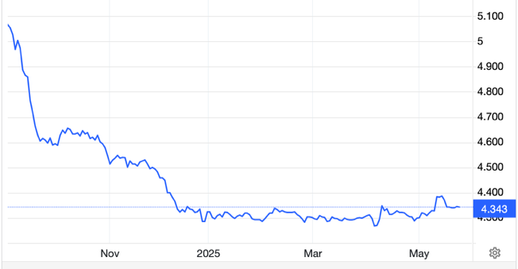
The Ultimate Hedge – Defensive stocks only go down at a slower rate
90 - day US Treasury Bills (Warren Buffet owns $340 billion)
Extend to One Year!
*Government Guaranteed principal
*Endless liquidity,
trade like water
*100% collateral value for margin
*Lock in guaranteed income
*Can be sold at any time to earn
full interest
*Will survive any bear market
*Ask your broker how to buy
3.73% Yield

Slide 25
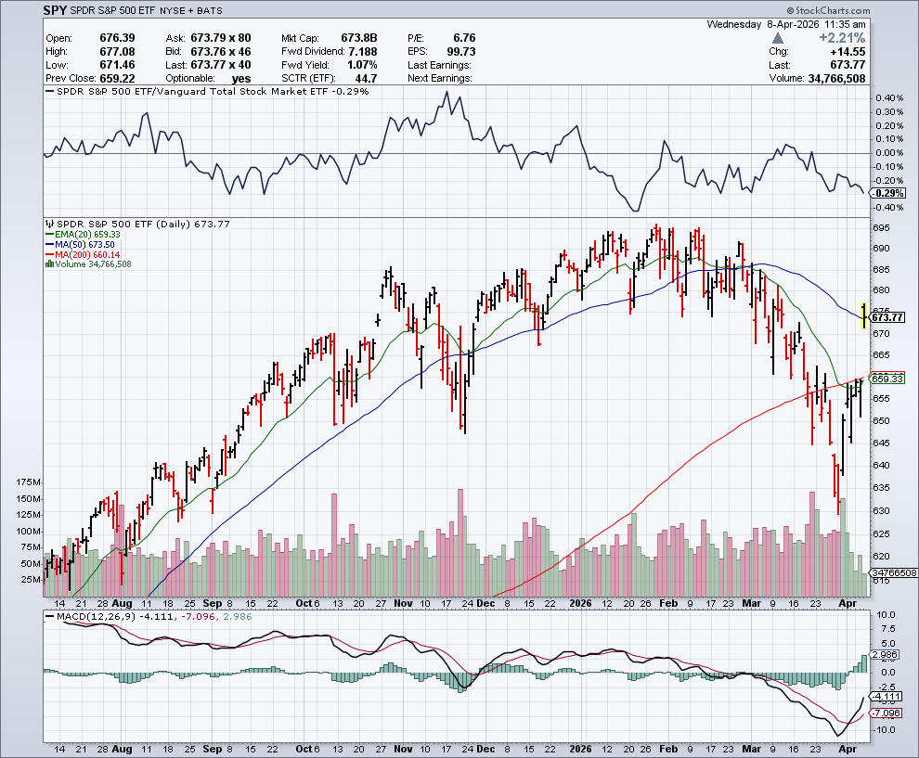
S&P 500 – Battle of the 200 Day MA
$630
-10.00%
1st support
$615
-13.00%
1st support

Slide 26
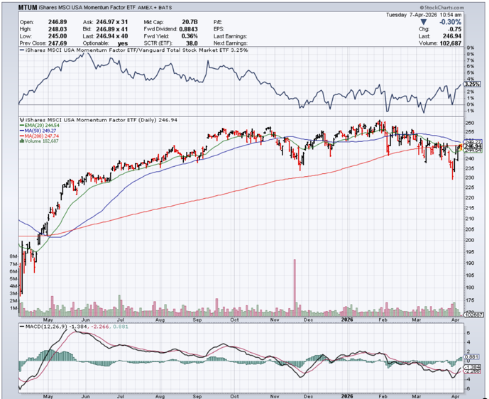
Momentum (MTUM)

Slide 27
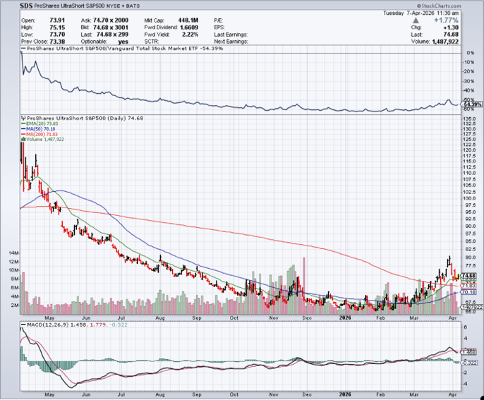
ProShares -2X Short S&P 500 (SDS) - a great 2X hedge for falling long stocks

Slide 28
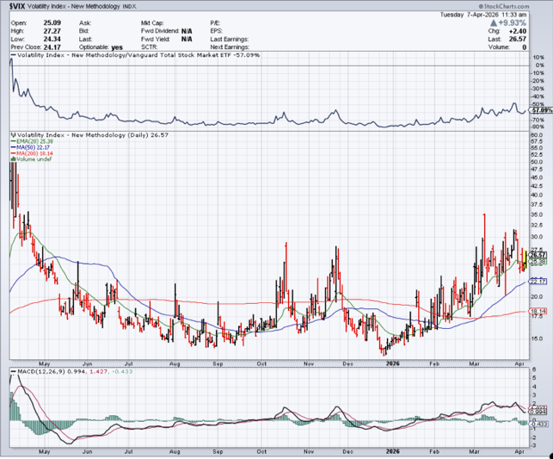
($VIX) – New Highs
Volatility Index Hits Four-Year High at $65, the most since the 2020 pandemic. That implies a 2% move in the S&P 500 (SPX) every day for the next 30 days

Slide 29
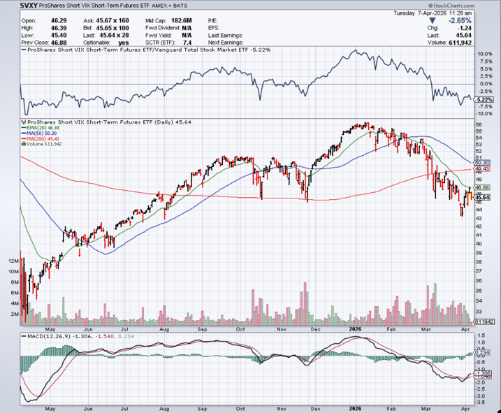
(SVXY) –Short Volatility ETF bought at $36.31 - $32.74 = $3.57

Slide 30
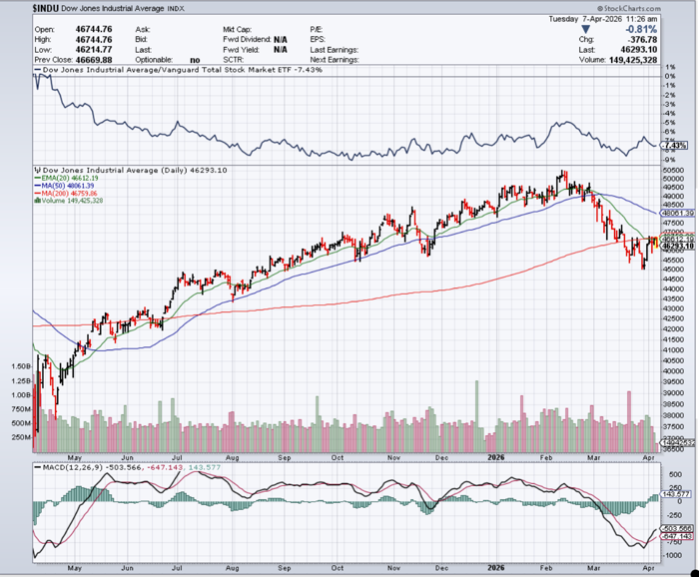
Dow Average ($INDU)-

Slide 31
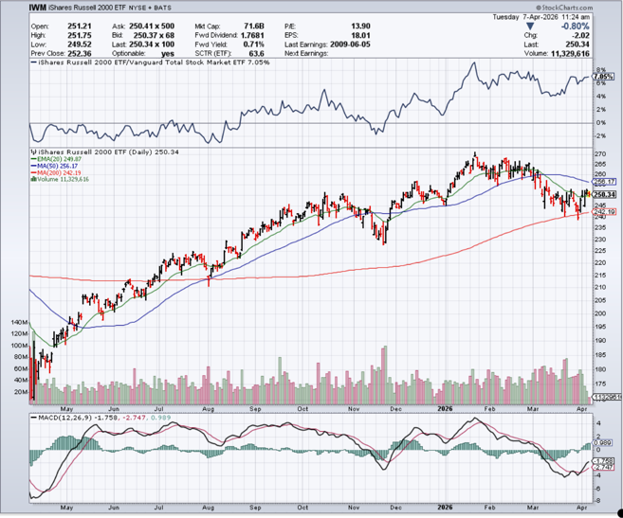
Russell 2000 (IWM)- took profits on Long 10/$137-$142 vertical bull call spread took profits on Long 10/$153-$156 vertical bear put spread

Slide 32
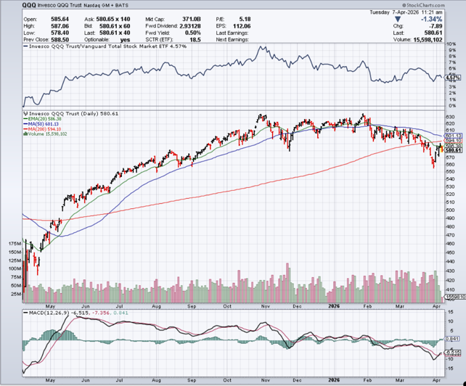
NASDAQ (QQQ) – Down 15% took profits on long 6/$540-$550-$345 put spread, took profits on Long 5/$335-$345 put spread took profits on long (QQQ) /$540-$550 put spread, took profits on long (QQQ) 4/$330-$335 put spread took profits on long (QQQ) 3/$340-$345 put spread, covered long (QQQ) $325-$330 put spread

Slide 33
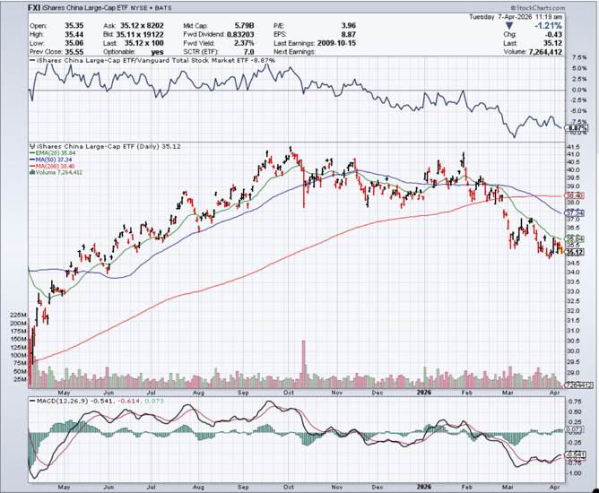
China (FXI) + 36%

Slide 34
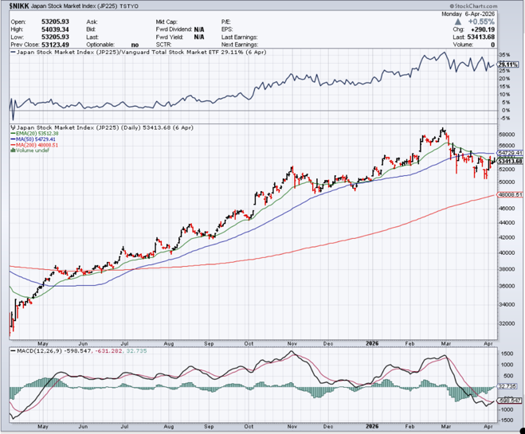
Japan ($NIKK) – down 10%
Japanese Conservative Election Win Sends Nikkei Soaring, topping 57,000

Slide 35
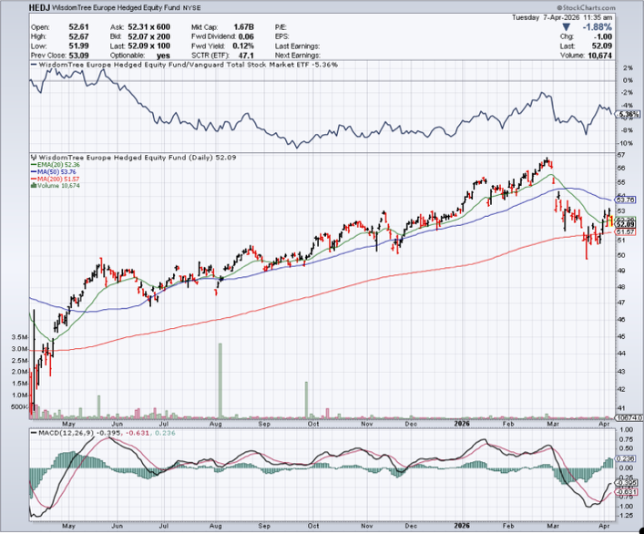
Europe Hedged Equity (HEDJ)- +19%

Slide 36
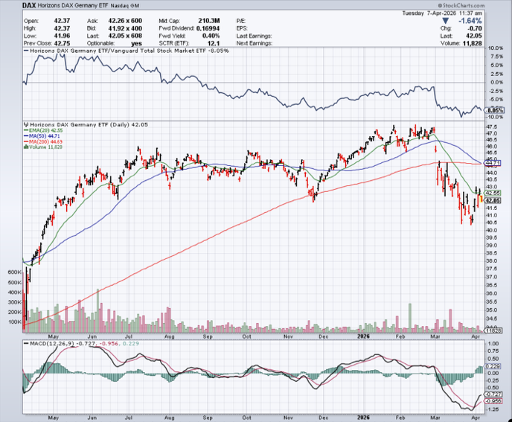
German Dax (DAX)- +30%

Slide 37
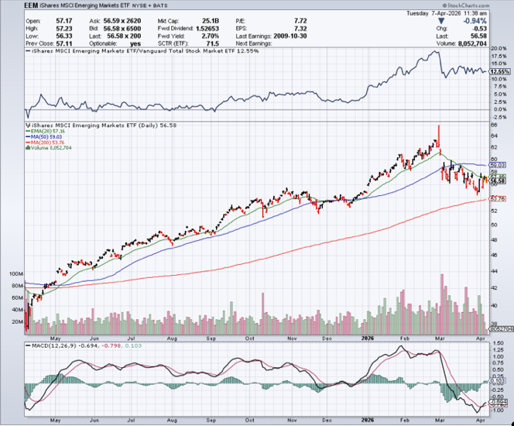
Emerging Markets (EEM) - +8%
Weak Dollar, Long Recovery Play

Slide 38



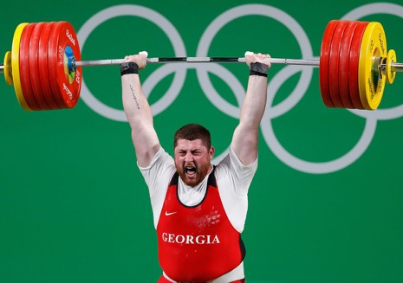
THE MAD HEDGE FUND TRADER
The Barbell Portfolio
*75% Big Tech – 2% of US workforce, 25% of market cap and 25% of US earnings
25% Domestic Recovery, including:
Railroads, airlines, cruise lines,
Couriers, steel companies
Banks, commodities
Construction
Credit Card Companies
Hotels, casinos
Online Ticket Sales

Slide 39
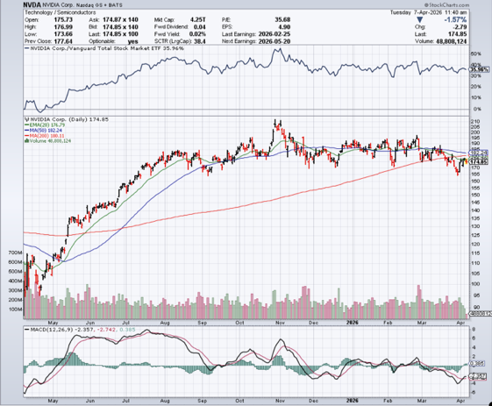

NVIDIA (NVDA) – Blackwell Chips @ $70,000 each
Nvidia Earnings Roar, Stock Whimpers stopped out of long 6/$140-$145 puts spread, took profits on long 5/$70-$75 call spread took profits on long 3/$88-$90 call spread, took profits on long 4/$140-$145 puts spread took profits on Long 2/$90-$95 call spread, took profits on Long 12/$117-$120 call spread

Slide 40
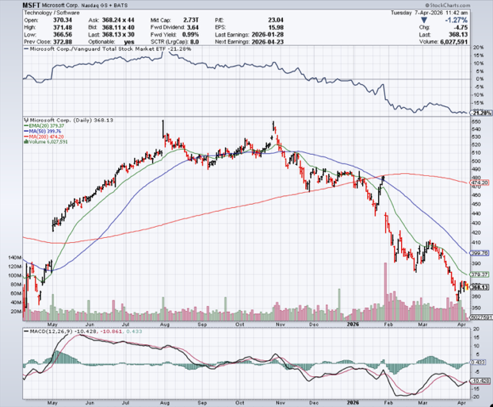

Microsoft (MSFT)- Become the Second $4 trillion Company
Microsoft Delivers Blowout Earnings took profits on long 5/$430-$440 put spread
Took profits on long 2/$330-$340 call spread, took profits on long 12/$320-$330 call spread took profits on long 9/$235-$245 call spread, took profits on long 7/$220-$210 call spread,

Slide 41
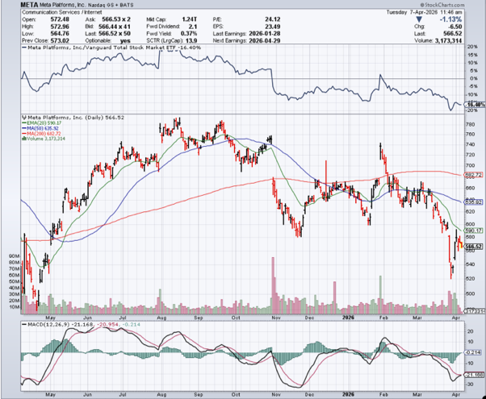

Meta (META)
Meta Makes Major Investment in AMD took profits on Long 8/$420-$430 call spread took profits on Long 5/$360-$370 vertical bull call spread, took profits on Long 9/$290-$300 vertical bear put spread, stopped out of Long 9/$190-$200 vertical bear put spread

Slide 42
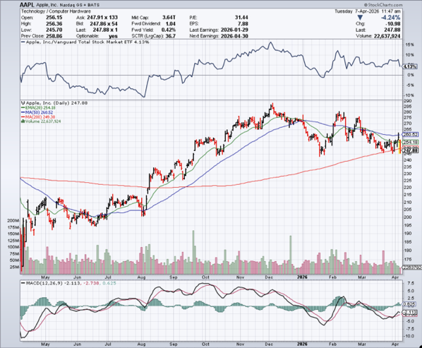

Apple (AAPL)
Delay on Foldable Phone took profits on long 6/$220-$230 put spread, profits on Long 5/$225-$235 vertical bear put spread, took profits on Long 8/$160-$170 call spread took profits on Long 6/$200-$210 bear put spread,

Slide 43
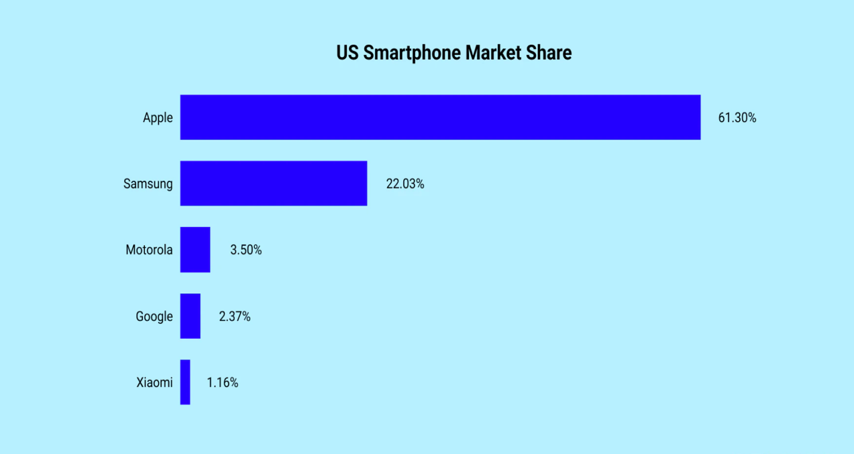

Slide 44
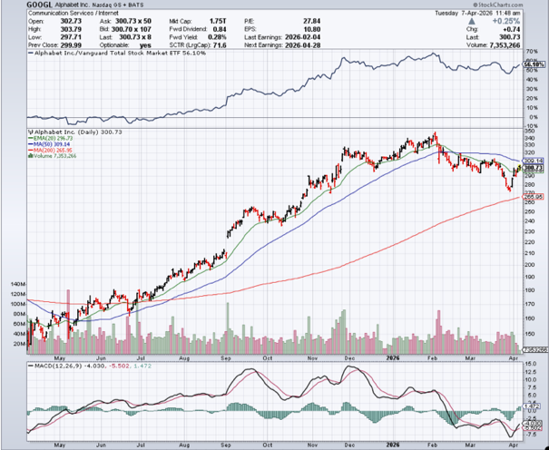
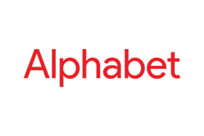
Alphabet (GOOGL) –
Alphabet to Issue 100-Year Bond to finance AI build out took profits on long 12/$110-$120 call spread took profits on long 12/$1,200-$1,230 bull call spread, took profits on long 9/$1,030-$1,080 vertical bull call spread

Slide 45
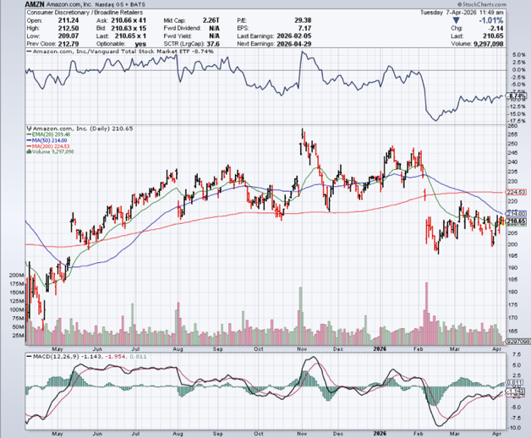

Amazon (AMZN) – Antirust Target
Amazon Plunges 12%, after missing its fourth-quarter earnings estimates took profits on long 3/$155-$160 bull call spread , took profits on long 2/$130-$135 bull call spread

Slide 46
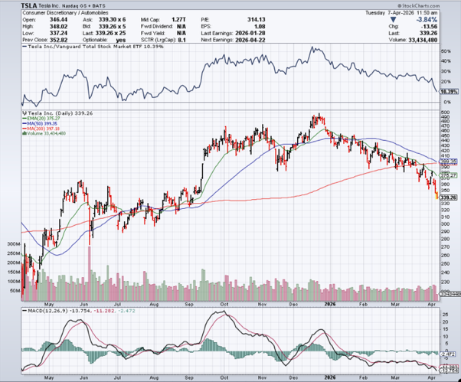

Tesla (TSLA) – Morgan cuts its downside target to only $85
The EV Business is in free fall and profits from robots are years off
Investors are also selling Tesla to buy Space X and its coming $2 trillion valuation
took profits on long 10/$510-$520 put spread, took profits on 8/$370-$380 put spread

Slide 47
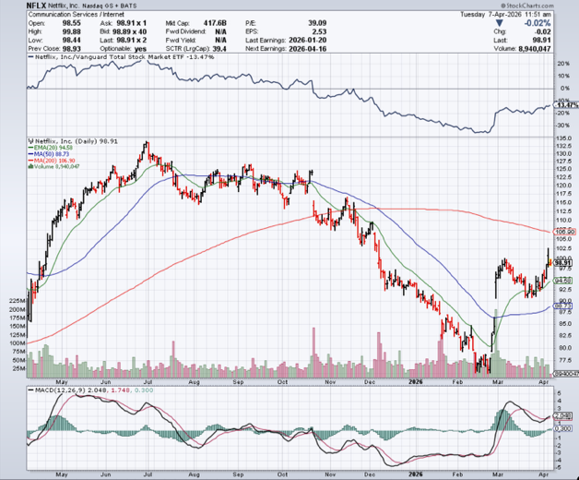

Netflix (NFLX) –
Justic Department Launches Antitrust Investigation of Netflix (NFLX)
Took profits on 11/$100-$102 call spread took profits on long $1040-$1060 call spread, took profits on long 4/800-$810 call spread

Slide 48
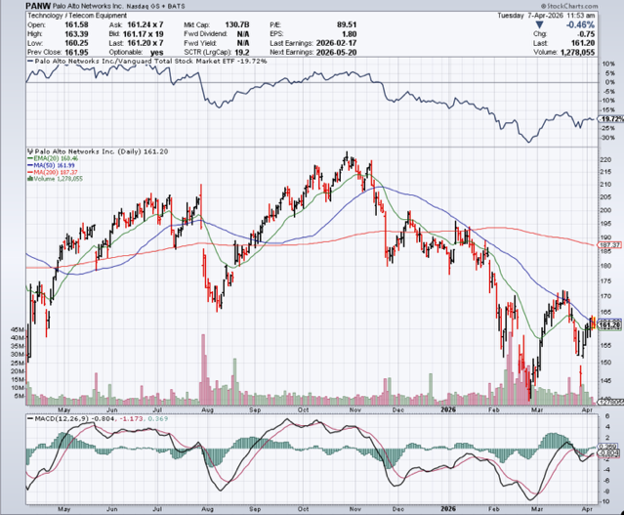

Palo Alto Networks (PANW)- Hacking never goes out of fashion
Is AI Putting SaaS Out of Business? took profits on long 2/$260-$270 call spread, took profits on long 10/$130-$140 call spread

Slide 49
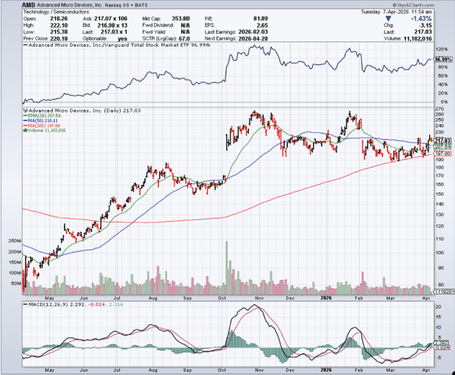

Advanced Micro Devices (AMD)- Recession fears programable logic devices took profits on long 2/$75-$80 call spread

Slide 50
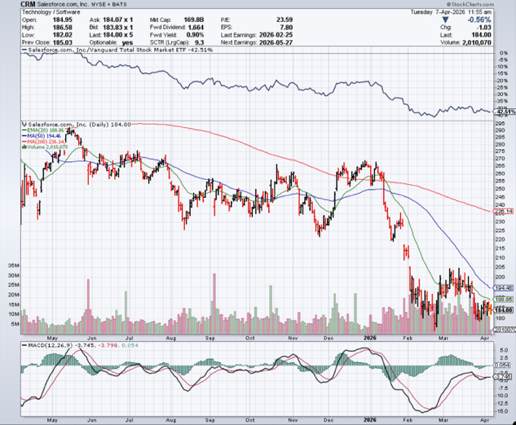

Salesforce (CRM)- Is AI Putting SaaS Out of Business? took profits on long 12/$185-$195 call spread, took profits on long 9/$125-$130 vertical bull call spread took profits on long 8/$125-$130 vertical bull call spread

Slide 51
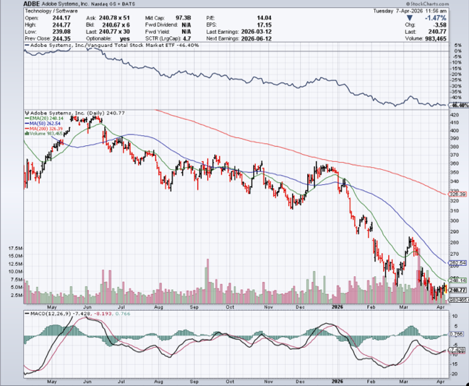

Adobe (ADBE)- Is AI Putting SaaS Out of Business?
The Quality Non-China tech play

Slide 52
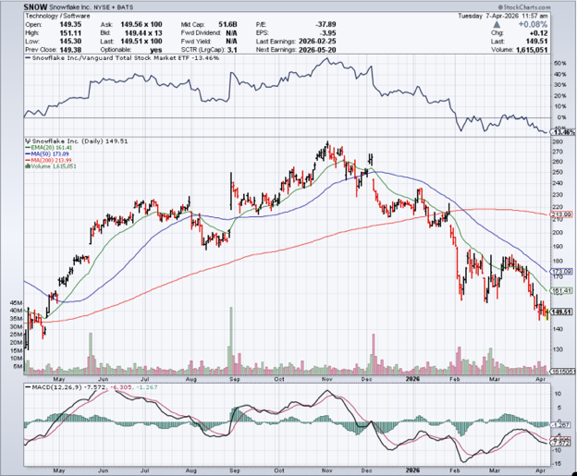

Snowflake (SNOW)- Blockbuster AI Earnings stopped out of long 4/$150-$255 call spread, took profits on long 12/$135-$140 call spread

Slide 53
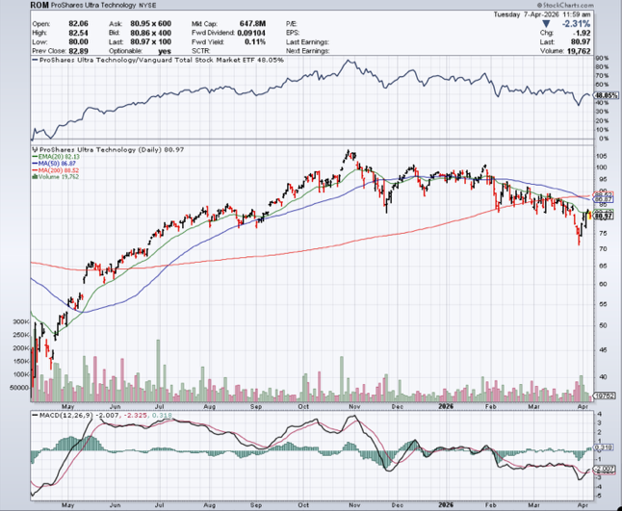
ProShares Ultra Technology ETF (ROM) – 2X Long Technology ETF took profits on long 10/$62-65 call spread

Slide 54
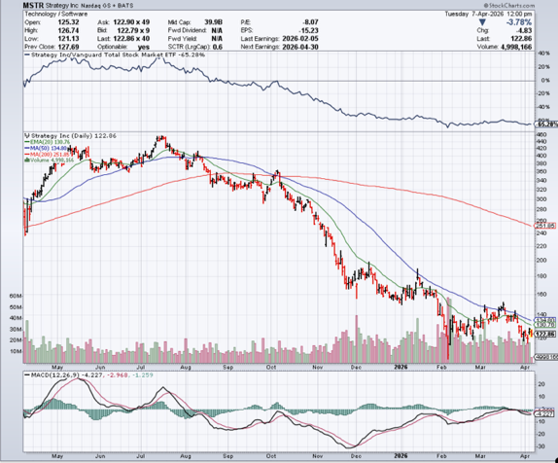

MicroStrategy (MSTR) – Long Bitcoin Play
Money is Moving out of Bitcoin Ethereum took profits on Long 6/$260-$270 call spread
Took profits on long 6/$500-$510 put spread, took profits on long 6/$470-$480 put spread took profits on long 6/$330-$340 call spread, stopped out of long 6/$335-$345 put spread

Slide 55
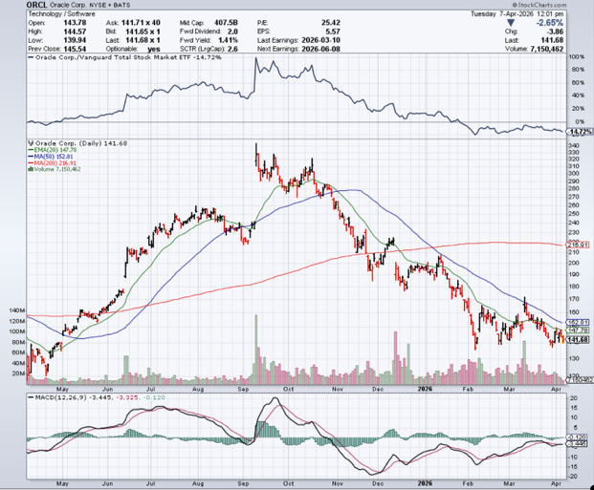

Oracle –(ORCL) – Spectacular Earnings Forecast but $100 billion in debt

Slide 56
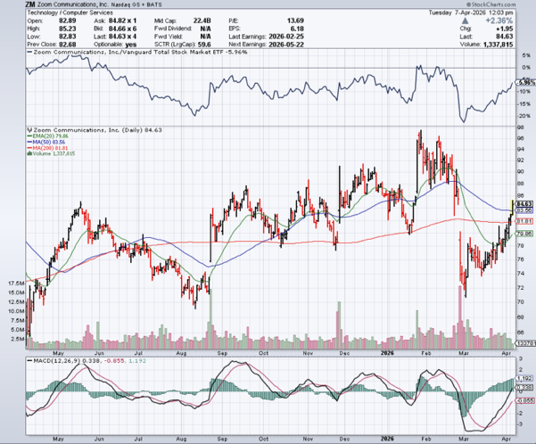

Zoom (ZM) – Coming Back from the Dead took profits on 11/$72-50-$77.50 call spread

Slide 57


Slide 58


Slide 59

The Second Half of the Barbell
*Bets on a domestic recovery in 2022 Q4
*Upside potential in 2024 far greater than tech
*Some of these have not moved for 5 or 10 years
*Focuses on economically sensitive cyclical industries
*Makes a great counterweight to
high-growth technology
*We could spend all of next ten years rotating
between the two groups

Slide 60


Goldman Sachs (GS) – 200 – Day Holds
Goldman Sachs (GS) Blows Out Earnings, on record stock trading profits long 3/$790-$800 call spread took profits on long 11/$700-$710 call spread , took profits on long 10/$700-$710 call spread took profits on long 9/$690-$700 call spread, stopped out of 3/$380-$390 call spread, profits on long 12/$330-$350 call spread, took profits on long 11/$330-$350 call spread

Slide 61


Morgan Stanley (MS) - Upside Breakout!
Morgan Stanley Lays of 2,500, or 3% of their global staff took profits on long $12/150-$155 call spread took profits on long $12/210-$220 call spread,, took profits on long $12/210-$220 call spread,
Took profits on long $195-$205 call spread, took profits on long 4/$65-$70 call spread

Slide 62


JP Morgan Chase (JPM) –
Trump Sues JP Morgan (JPM) for $5 Billion took profits on long 9/$270-$280 call spread stopped out of 3/$235-$245 calls spread, profits on long 12/$210-$220 call spread, took profits on long 11/$195-$205 call spread, took profits on 4/$215-225 put spread

Slide 63


Bank of America (BAC) – Upside Breakout? took profits on long long 12/$41-$44 call spread, took profits on long 4/$20-$23 call spread

Slide 64


Citigroup (C) – Upside Breakout took profits on long long 12/$60-$65 call spread , took profits on long 4/$30-$35 call spread

Slide 65


Charles Schwab (SCHW) – Upside Breakout took profits on long 4/$30-$35 call spread

Slide 66


Interactive Brokers (IBKR) – Upside Breakout? stopped out of long 3/$160-$170 call spread, out of long 8/$110-$115 call spread , took profits on long 4/$60-$65 call spread

Slide 67


Berkshire Hathaway (BRKB)- Ultimate defensive stock
Berkshire Hathaway Builds Record Cash, at $334 billion – Is the new T Bill proxy stopped out of long 12/$405-$415 call spread, took profits on long 12/$320-$330 call spread took profits on long 4/$260-$270 call spread, took profits on long 1/$290-$300 call spread

Slide 68


Blackrock (BLK) – Private Equity Crisis
Blackrock Reports Record $12.5 trillion in Assets Under Management stopped out of 12/$1,000-$1,010 call spread, took profits on long 12/$850-$860 call spread took profits on long 3/$770-$790 call spread, took profits on long 3/$310-$340 call spread

Slide 69

SPDR Metals & Mining ETF (XME) – long 2/$28-$30 call spread

Slide 70


Boeing (BA) – LEAPS Candidate
Boeing is Beating on Deliveries. Boeing begins 2026 with 46 deliveries in January and 103 net new orders long 3/$195-$200 call spread

Slide 71


General Motors (GM) – Worst Off Trade War Victim
Earnings better than expected plus interest rate beneficiary stopped out of long 4/$52.50-$57.50 put spread at cost, long 3/$53-$56 put spread

Slide 72


Package Delivery- United Parcel Service (UPS) –
UPS Deliveries Slow Worldwide, it the wake of the shutdown of its Kentucky hub after a fatal crash took profits on long 11/$130-$140 call spread

Slide 73


Caterpillar (CAT)- Ag + Infrastructure + Housing long $630-$640 call spread stopped out of long 8/$310-$320 call spread, took profits on long 12/$220-$230 calls spread took profits on long 12/$145-$150 call spread, took profits on long 11/$125-$135 call spread

Slide 74


Deere & Co. (DE)- Ag + Infrastructure + Housing took profits on long 8/$330-$340 put spread stopped out of long 8/$330-$340 calls spread

Slide 75


Freeport McMoRan - (FCX)- Coming Copper Crisis
50% copper tariff stopped out of 3/$55-$58 call spread, took profits on long 8/$34-$37 call spread took profits on long 4/$37-$40 call spread, took profits on long 5/$42-$45 call spread, stopped out of long $48-$51 put spread, profits on long 6/$32-$35 call spread

Slide 76


Walt Disney (DIS) - Disney Beats
Disney Dives on Earnings Bust, although streaming broke even versus an expected loss

Slide 77


Industrials Sector SPDR (XLI)-
(GE), (MMM), (UNP), (UTX), (BA), (HON)

Slide 78


Union Pacific RR (UNP)- Big Stuff to Ship
The Largest Railroad in History, may be the result of the Union Pacific (UNP)/Norfolk Southern merger worth $200 billion took profits on long 5/$200-$210 call spread took profits on 11/$150-$160 call spread

Slide 79


Walmart (WMT) – Trade War Victim
Walmart Hits $1 Trillion Market Cap took profit on Long 11/$125-$130 bear put spread, took profit on Long 10/$119-$121 bear put spread took profits on Long 8/$114-$117 bear put spread

Slide 80


Costco (COST) – Trade War Victim suing Trump administration over tariffs, one third of sales from imports took profits on long 4/$840-$850 call spread

Slide 81


Delta Airlines (DAL) – Ticket Price Take Off lost $200 million on government shutdown

Slide 82


Transports Sector SPDR (XTN)- Worst Hit Sector
(ALGT), (ALK), (JBLU), (LUV), (CHRW), (DAL)

Slide 83


Health Care Sector (XLV) – Defensive Play and Cheap
(JNJ), (PFE), (MRK), (GILD), (ACT), (AMGN)

Slide 84


Amgen (AMGN) long 7/$260-$270 bull call spread, took profits on long 11/$185-$200 bull call spread

Slide 85


Visa (V) – Stablecoin Competition took profits on long 2/$240-$250 bull call spread took profits on long 10/$160-$170 bull call spread, took profits on long 6/$150-$160 bull call spread

Slide 86


Consumer Discretionary SPDR (XLY)
(DIS), (AMZN), (HD), (CMCSA), (MCD), (SBUX)

Slide 87


Raytheon (RTX) long $195-$200 call spread

Slide 88


Slide 89


Slide 90

Bonds – Dead on Arrival
*Iran War Kills Off Low-Interest Rate prospects
*Traders in the futures market shifted the probability the Federal Reserve will raise interest rates by the end of 2026 to 52%
*It will boost the Treasury’s borrowing needs from $11 trillion to $13 trillion in 2026
*This is four times the previous all-time high at $3 trillion
*Ten-year US Treasury bonds are poised to mark their biggest monthly tumble since Trump returned to the White House, casting a shadow over the economic outlook
*10-year yields up on the month to 4.58%, reflecting inflation risks from higher
energy costs and diminished likelihood of Federal Reserve interest-rate cuts
*Economists are warning of a potential tipping point where the effect shifts
from being inflationary to sending the economy into a downturn
*Avoid (TLT)

Slide 91

Treasury ETF (TLT) – took profits on long 6/$88-$91 put spread stopped out of long 6/$80-$83 call spread, took profits on long 4/$84-$87 call spread stopped out of long 1/$82-$85 call spread, took profits on long 10/$103-$106 put spread took profits on long 6/$$94-$97 put spread, took profits on long 5/$82-$85 calls spread

Slide 92

Ten Year Treasury Yield ($TNX) – 4.43%

Slide 93

Junk Bonds (JNK) 6.57% Yield

Slide 94

Municipal Bonds (MUB) 3.10% Yield-

Slide 95

Emerging Market Debt (ELD) 5.41% Yield-

Slide 96

2X Short Treasuries (TBT)-Out of Favor

Slide 97

Anally Capital Management (NLY) – Leveraged REIT Play
Yield 13.19% took profits on long 12/$15-$16 call spread

Slide 98


Slide 99


Slide 100

Foreign Currencies – In the Dumps
*Iran War triggers massive flight to safety bid for US dollar as global hedge fund unwind positions and return to cash
*This prompts sharp moves down in (FXA), (FXE), (FXB), (EEM), and even the long beleaguered (FXY)
*There is a great trade setting up here in the currencies
*Once the war ends, currencies will rush to new highs
*Sell all dollar rallies.
*Buy (FXA), (FXE), (FXB), (FXC), and (FXY) NOW!

Slide 101


THE MAD HEDGE FUND TRADER
Australian Dollar (FXA) - Major Long-Term Bottom is In Targeting Parity – A call option on a global synchronized recovery

Slide 102


Japanese Yen (FXY)

Slide 103


Euro (FXE)-

Slide 104


British Pound (FXB)-

Slide 105


Emerging Market Currencies (CEW)

Slide 106


Slide 107


Slide 108

Energy & Commodities – Higher for Longer!
*Oil Breaks Out to the Upside, with the (USO) hitting a 20-year high at $139,
*There is no sign of a reopening of the Straits this year
*Even if they do eventually reopen, much of the Persian Gulf’s export facilities are now scrap metal, requiring five-year rebuilds
*Iran is demanding repayment of damage incurred by
US bombing, or more than $1 trillion
*I’m not holding my breath on that one
*Look for much higher highs in crude (USO), gasoline,
and diesel

Slide 109


Slide 110


Slide 111

Oil-($WTIC)
Sharpest Move in History, up 115%

Slide 112

Chevron-(CVX)

Slide 113

Schlumberger-(SLB)

Slide 114

Energy Select Sector SPDR (XLE)-No Performance!
(XOM), (CVX), (SLB), (KMI), (EOG), (COP)

Slide 115

ExxonMobil (XOM)-
Exxon Moves Big into Lithium, with the construction of a major mining operation in Arkansas took profits on Long 4/$100-$105 call spread, took profits on long 12/$120-$125 put spread

Slide 116

Occidental Petroleum (OXY)- Buffet’s a Buyer took profits on long 4/$59-$62 call spread took profits on long 2/$55-$60 call spread, took profits on long 12/$77.50-$82.50 put spread

Slide 117

Natural Gas (UNG) – Free Fall on Warm Winter took profits on Long January 2025 $7-8 Call Spread LEAPS

Slide 118

Cameco (CCJ) – Global Uranium Renaissance
Microsoft to Reopen Three Mile Island to power AI data centers took profits on long 12/$41-$44 call spread, took profits on long 12/$35-$38 call spread, took profits on long 5/$20-$23 bull call spread

Slide 119

Vistra Corp. (VST) – Global Uranium Renaissance took profits on long 2/$100-$110 call spread

Slide 120


Slide 121


Slide 122

Precious Metals – Demolished
*Turkey Dumps $8 Billion in Gold
*Will The Gulf countries follow with more gold sales to finance reconstruction?
*Iran will also sell gold to rebuild
*Rising interest rates prompted by new massive government borrowing the
war has brought provides more yield competition for the non-yielding
yellow metal
*The central banks are going to step in soon along
with a new round of speculative buyers
*Gold will be a huge buy once the war ends and interest rates fall

Slide 123


THE MAD HEDGE FUND TRADER
Gold (GLD) – Headed for $5,000....or $10,000?
long 12/$355-$360 call spread – expires in 7 trading days
profits on long 6/$275-$285 call spread, took profits on long 5/$275-$285 call spread
stopped out of long 6/$275-$285 call spread, took profits on profits on long 10/$230-$235 call spread
BUY

Slide 124


Market Vectors Gold Miners ETF- (GDX) – took profit on long 6/$207.50-$212.50 call spread, took profit on long 7/$200-$205 call spread

Slide 125


Barrick Mining (B) took profit on long 1/$15.50-$16.50 call spread

Slide 126


Newmont Mining- (NEM)- Sometimes you Just Get Lucky took profits on long 10/$47-$50 call spread, took profits on long $55-60 call spread

Slide 127


THE MAD HEDGE FUND TRADER
iShares Silver Trust (SLV) - The Better Play Industrial demand, solar panels, electric cars
2025
Target
$50
+50%
BUY

Slide 128


Silver Miners - (SIL)-

Slide 129


Wheaton Precious Metals - (WPM)- LEAPS Approaching Max Profit took profits on long 4/$39-$42 call spread long 6/$75-$80 call spread-expires in 7 trading days , took profits on long 1/$36-$39 call spread

Slide 130


Platinum- (PPLT)- 556,000-ounce shortage this year took profits on long 1/$36-$39 call spread

Slide 131

S&P Case Shiller Slows
S&P Case Shiller Rises to +1.4% YOY in October, with its National Home Price Index
Chicago gained +5.8%, Cleveland +4.1%, and New York +5.0%.
Tampa -4.5% Phoenix -1.5% and Dallas down -1.5%

Slide 132


Slide 133


Slide 134

Real Estate – Killed by High Interest Rates
*Home Flipping at Six-Year Low, defined as homes that were bought and sold in the same year, is down 4% YOY
*It was 7% of all homes sold in 2025
*The return on investment has fallen from 32% to 25%, the lowest since the Great Recession in 2008. The peak was 50%
*Tariffs were a major problem, raising prices on everything.
No more Chinese cabinets
*US Construction Spending Dives in January
*The Commerce Department's Census Bureau said that ​construction
spending dropped 0.3% after an upwardly revised 0.8% jump in ‌December
*It was the largest increase since April 2024

Slide 135
S&P Case Shiller Slows
S&P Case Shiller Rises to -0.2% YOY in November, with its National Home Price Index
Miami gained +3.2%, Tampa +2.0%, and Atlanta +1.5%.
Seattle -1.4% San Francisco -1.3%

Slide 136


Crown Castle International (CCI) – 4.68% yielding 5G cell phone tower REIT
Eliot Management Pushes up stock with activist bid took profits on Long 8/$90-$95 call spread,

Slide 137



US Home Construction Index (ITB)
(DHI), (LEN), (PHM), (TOL), (NVR)

Slide 138


DH Horton (DHI)
Earnings Hit on free upgrades eating into margins took profits on long 11/$165-$175

Slide 139


Slide 140


Slide 141

Trade Sheet- The Recession Trade
So What Do We Do About All This?
*Stocks –stand aside
*Bonds – stand aside
*Commodities – buy dips
*Currencies – buy dips
*Precious Metals – buy dips
*Energy – buy dips
*Volatility – sell over $30
*Real estate – buy dips

Slide 142

Next Strategy Webinar
12:00 PM EST Wednesday, April 22, 2026 from Lake Tahoe
Email me questions at madhedgefundtrader@yahoo.com
Good Luck and Good Trading!
Notes:
*

Slide 143


Slide 144


