Slide 1

The Mad Hedge Fund Trader “It’s All About AI”
With John Thomas Silicon Valley, May 6, 2026 www.madhedgefundtrader.com
Notes:
*

Slide 2
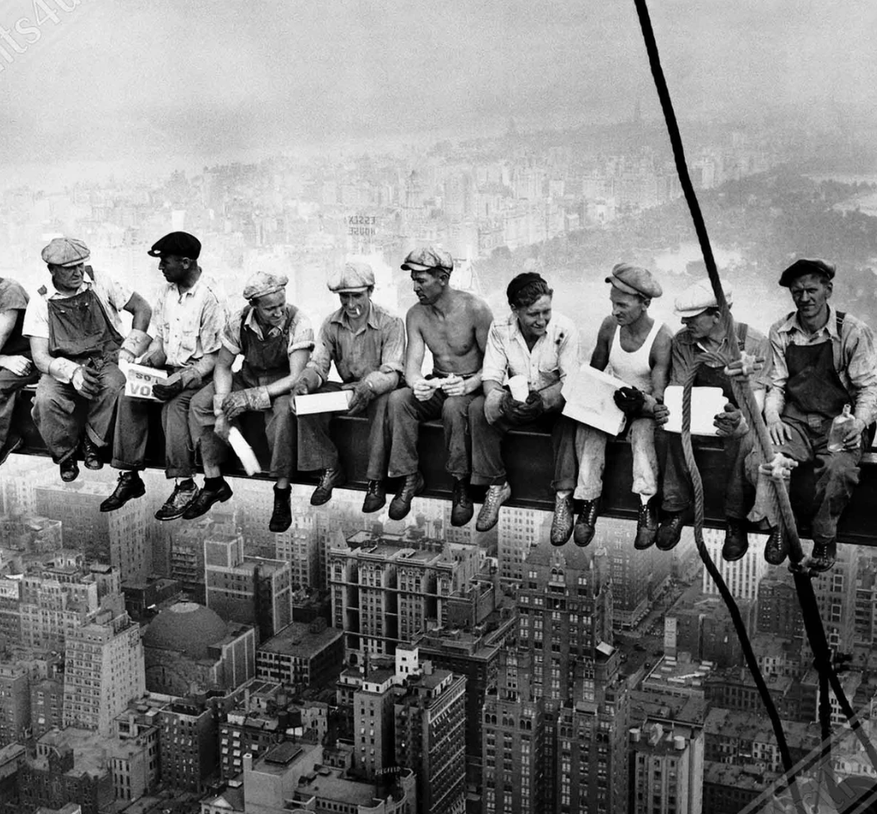

Slide 3

Trade Alert Performance New All-Time Highs-17 Consecutive Positive Months
*January +1.97% MTD *July +5.21% Final *February +3.08% Final *August +1.37% Final *March -5.76% MTD *September +2.21% Final *April +1.81% Final *October +3.11% Final *May +1.70% Final *November +2.33 Final *June +15.48% Final *December +2.66% Final *2026 Year To Date +4.38% +818.34% since inception *Versus 79.79% for all of 2023 *Versus 75.29% for all of 2024 *Versus 62.02% for all of 2025

Slide 4
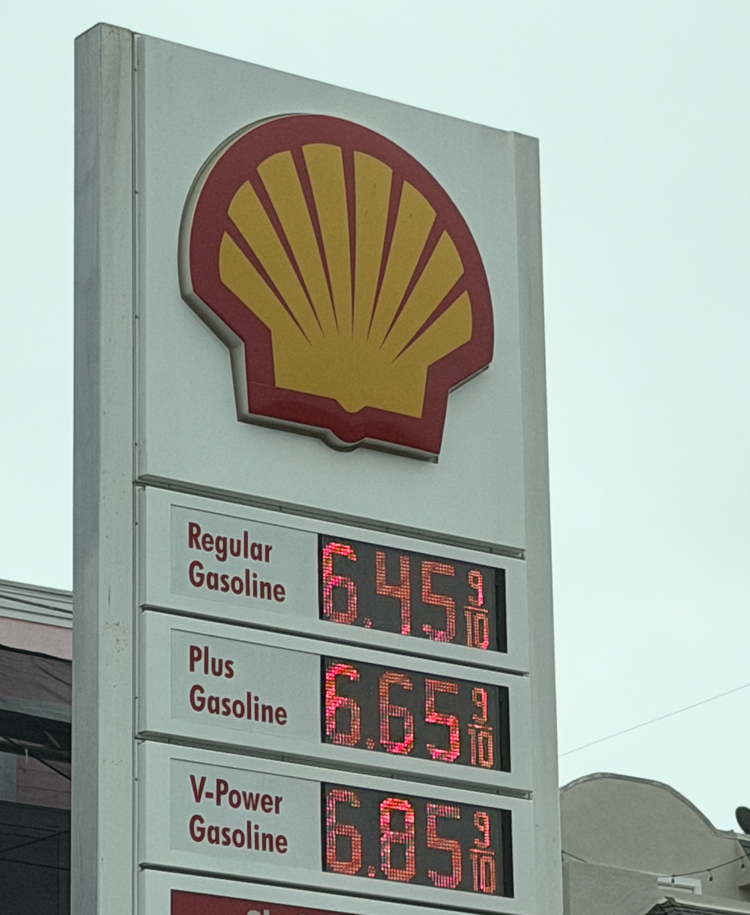

Slide 5
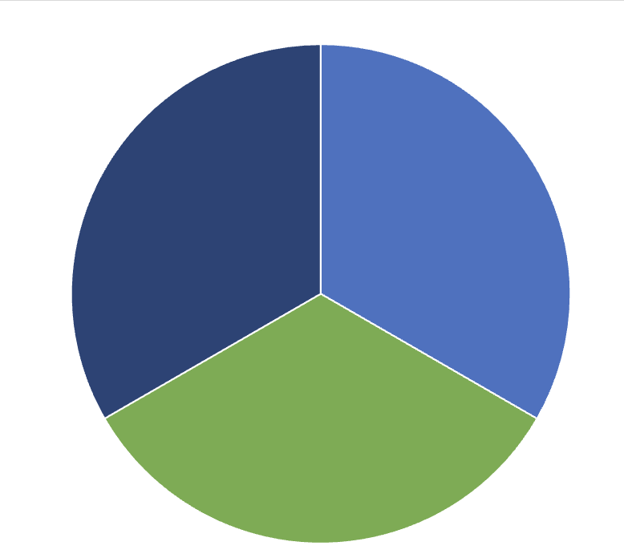
Portfolio Review – High Risk Market Require High Cash 20% risk on, 10% risk off, 70% cash
Expiration Value +4.38%
RISK ON
(SLB) 5/$43-$48 call spread | 10.00%
Risk Off
(USO) 5/8/$175-$170 put spread | -10.00%
(SPY) 6/$760-$755 put spread | -10.00%
Total Net Position | -10.00%
Total Gross Position | 30.00%
cash | 70.00%

Slide 6

The Method to My Madness
*The Straits of Hormuz remain closed so Look for a Longer Iran War, and much higher gasoline prices *Stock market has turned into all AI all the time generating best one month move inn 5 years *Stocks are rising against soaring gas prices, rising interest rates, inflation, and unemployment. This can’t go on forever *Permanently higher gasoline prices and the trade war will wipe out the benefits of any tax cuts, and slow the economy *Bonds are rolling over and dying, sending rates up to year highs *Jobs data remains bad, the age of the large layoff is here *US Dollar giving up gains despite rising rates *Bitcoin breaks out to the upside

Slide 7

The Global Economy – Confused
*JOLTS Come in Weak *US Q1 GDP Growth Shrinks to 2% Annualized *US Factory Orders Rise amid the artificial intelligence ‌investment boom. *Most Small Businesses Will Not Get Tariffs Refunds. About 35 million small businesses will be affected. *US Raises Import Duty on European Cars by 25%, *Personal Core Expenditures Price Index Leaps, to a seasonally adjusted 0.3% * US Trade Deficit Rises, thanks to soaring imports. The goods trade gap increased 5.3% to $87.9 billion last month * World Bank Sees Inflation at Four Year High

Slide 8
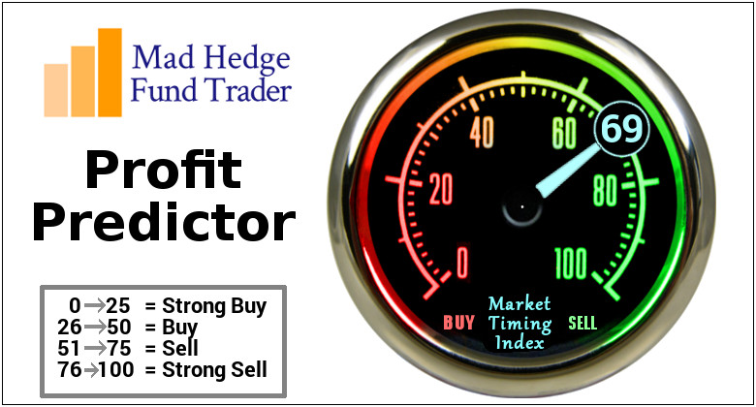

Slide 9
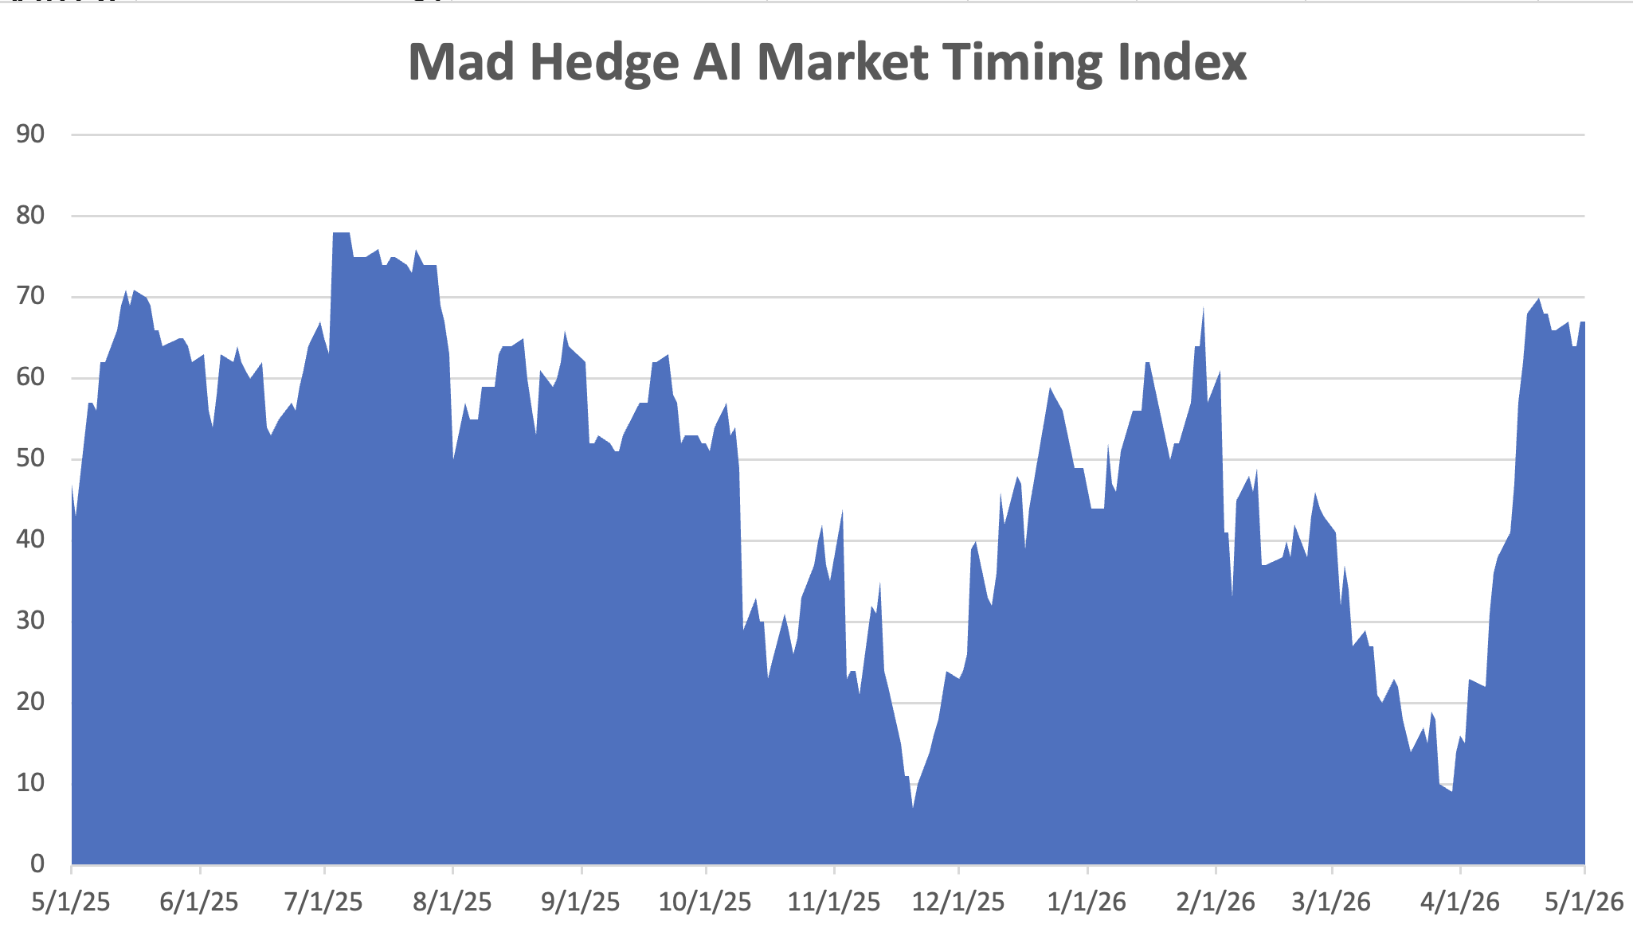
The Mad Hedge Profit Predictor Market Timing Index – Sharpest rise in history An artificial intelligence driven algorithm that analyzes 30 different economic, technical, and momentum driven indicators
SELL
BUY

Slide 10
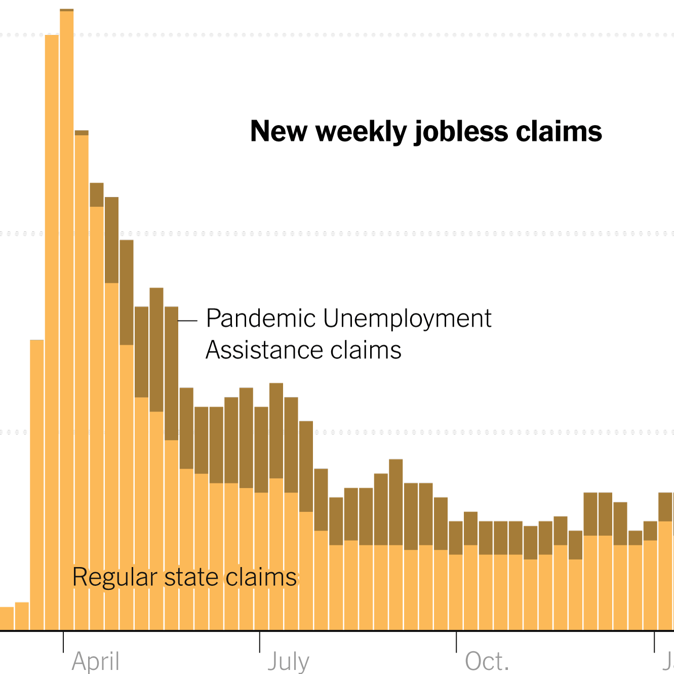
Weekly Jobless Claims – +1,000 to 214,000

Slide 11
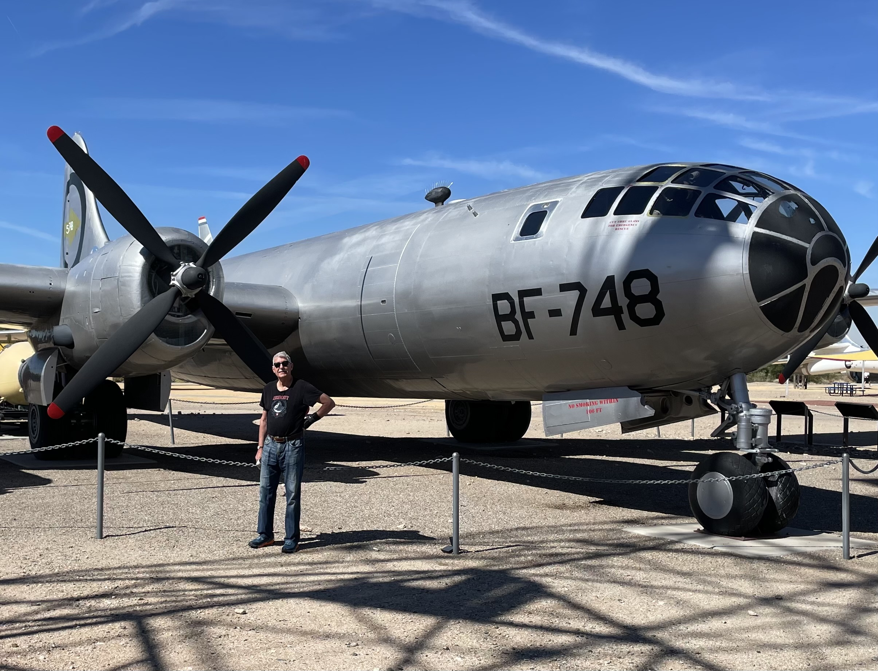

Slide 12

Stocks – Melt Up
*The S&P 500 Just Had Its Best April Since 2020 — Now Comes the Hard Part * Tech has Discounted Great Earnings, and they delivered *Intel Rockets 22%, on a spectacular earnings report, *Schlumberger (SLB) Jumps on Business Realignment *Defense Stocks Buy the Rumor but Sell the News *Tesla Lease Returns Set Up Burgeoning Used EV market *Baker Hughs (BKR) Sees Booming Business as tighter global supplies driven by ‌the Middle East conflict highlight the need for investment *Alphabet (GOOGL) to Invest $40 Billion in Anthropic, popping (GOOGL) shares. *The Avis (CAR) Short Squeeze Ends. The car-rental company Avis Budget Group Inc.’s (CAR) stock cratered, wiping out all but a sliver of its 600% meme gains

Slide 13

What Are HALO Stocks?
*High Asset *Low Obsolescence *Can’t be easily replaced by AI *Are immune to AI shocks are hitting Low Asset High Obsolescence (LAHO) stocks *HALO has massively outperformance LAHO in recent months *HALO examples are: *Texas Pacific Land Corp. (TPL). *FedEx (FDX) *Corning (GLW) *Hershy (HSY) *Southern Co, (SO) *Colgate (CL) *Baker Hughes (BKR) *Apple (AAPL) *Southern Copper (SO) *Any oil company

Slide 14
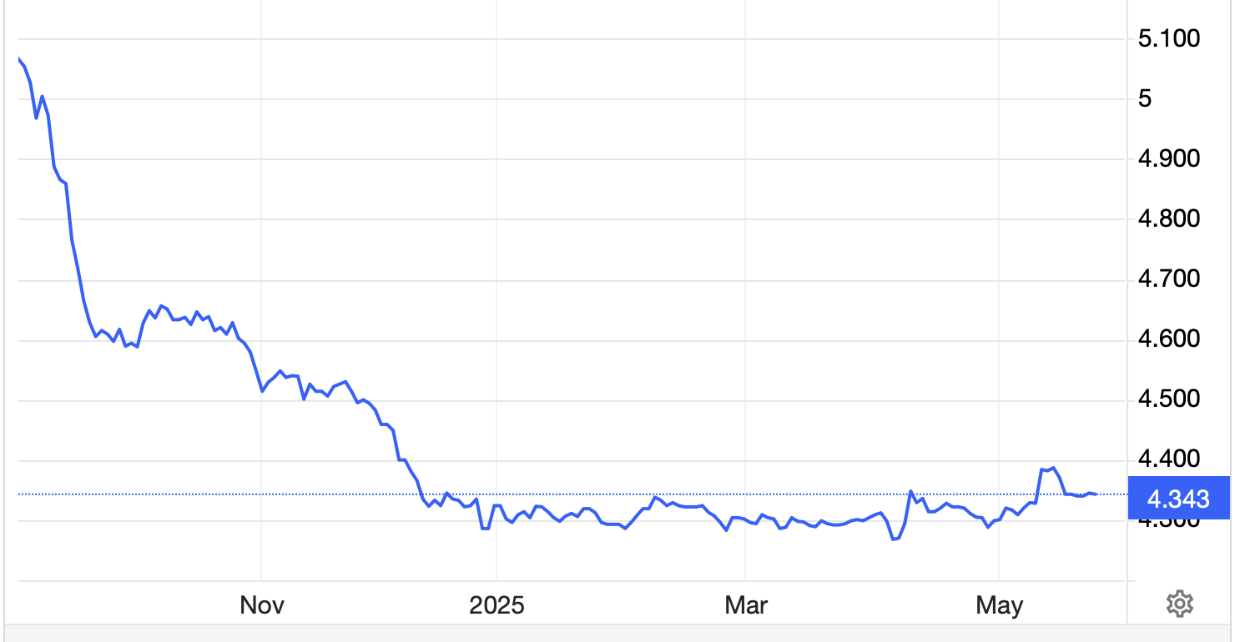
The Ultimate Hedge – Defensive stocks only go down at a slower rate 90 - day US Treasury Bills (Warren Buffet owns $340 billion) Extend to One Year!
*Government Guaranteed principal *Endless liquidity, trade like water *100% collateral value for margin *Lock in guaranteed income *Can be sold at any time to earn full interest *Will survive any bear market *Ask your broker how to buy
3.54% Yield

Slide 15
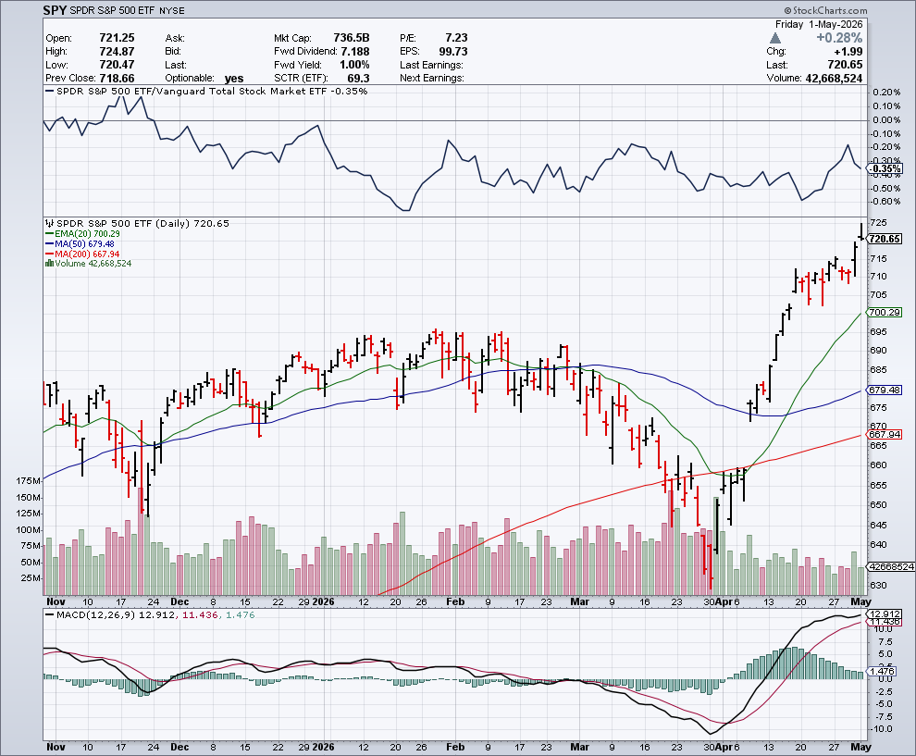
S&P 500 – Battle of the 200 Day MA long 6-18/$755-$760-$120 put spread
$630 all-time high
$664 -6.74% 1st support

Slide 16
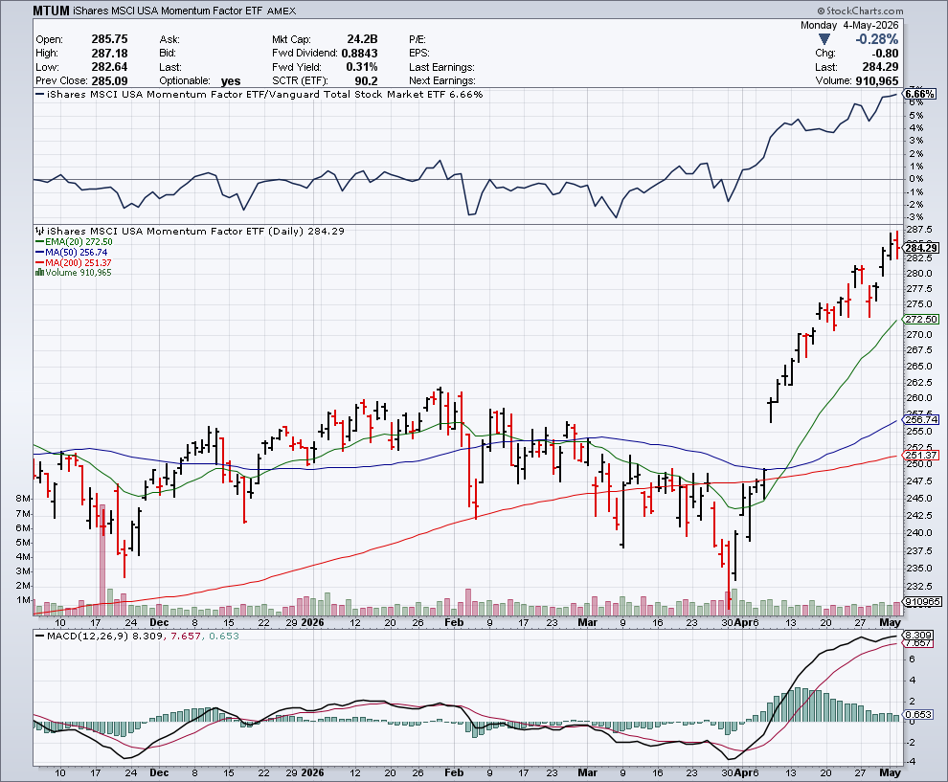
Momentum (MTUM)

Slide 17
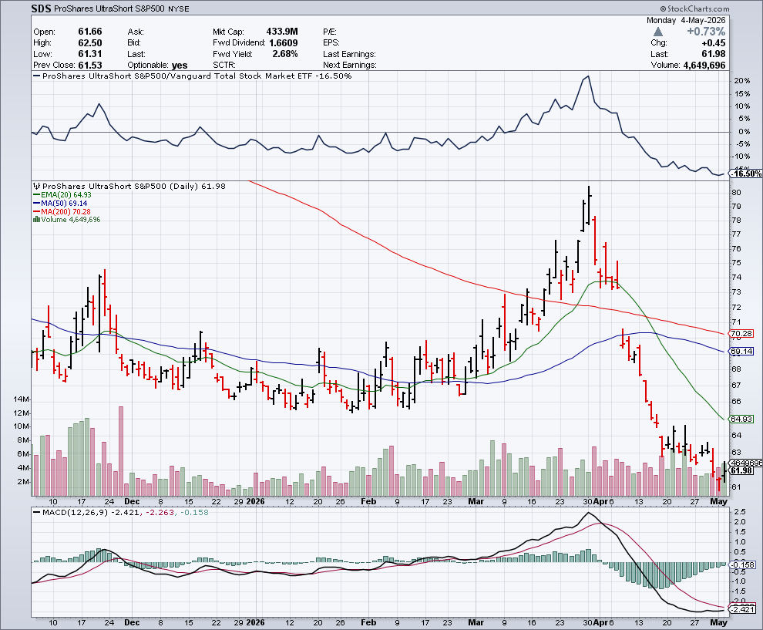
ProShares -2X Short S&P 500 (SDS) - a great 2X hedge for falling long stocks

Slide 18
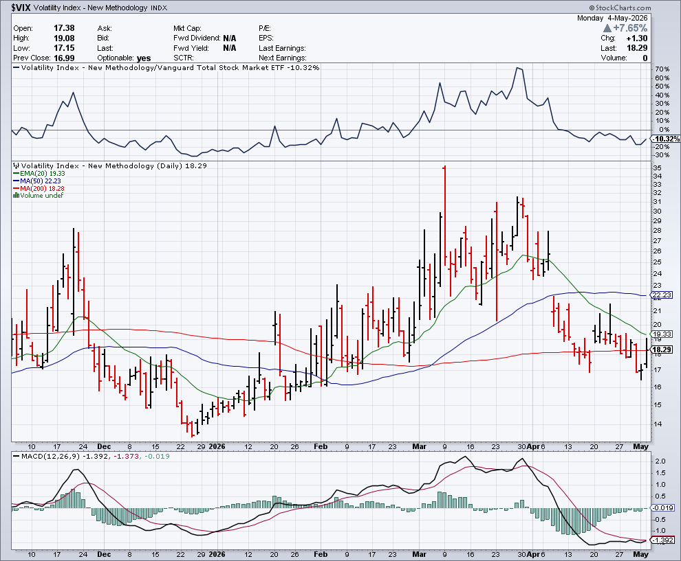
($VIX) – New Highs Volatility Index Hits Four Year High at $65, the most since the 2020 pandemic. That implies a 2% move in the S&P 500 (SPX) every day for the next 30 days

Slide 19
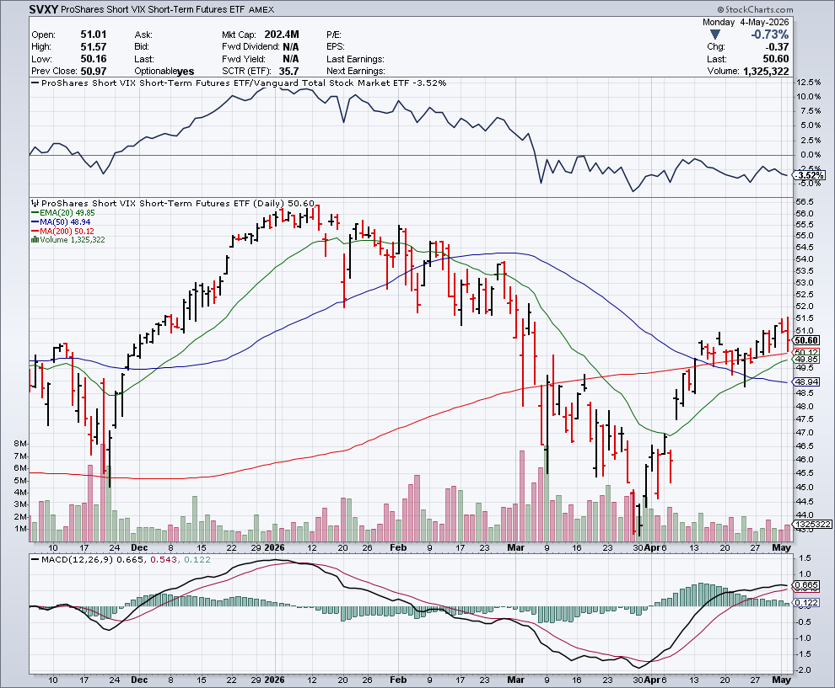
(SVXY) –Short Volatility ETF bought at $36.31 - $32.74 = $3.57

Slide 20
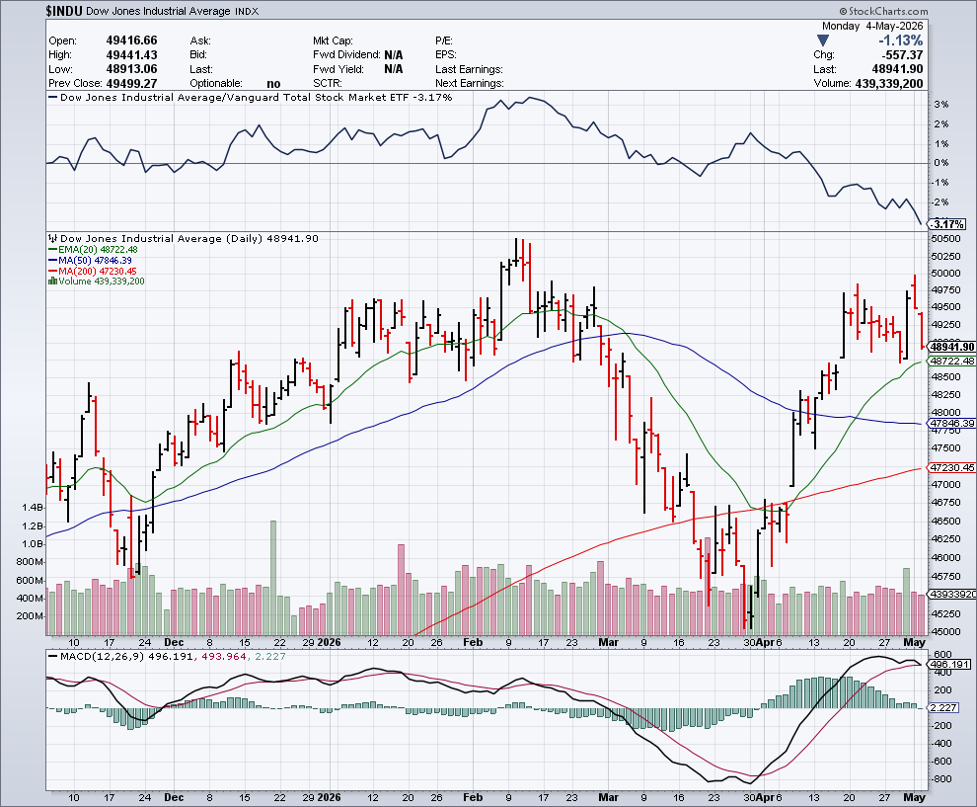
Dow Average ($INDU)-

Slide 21
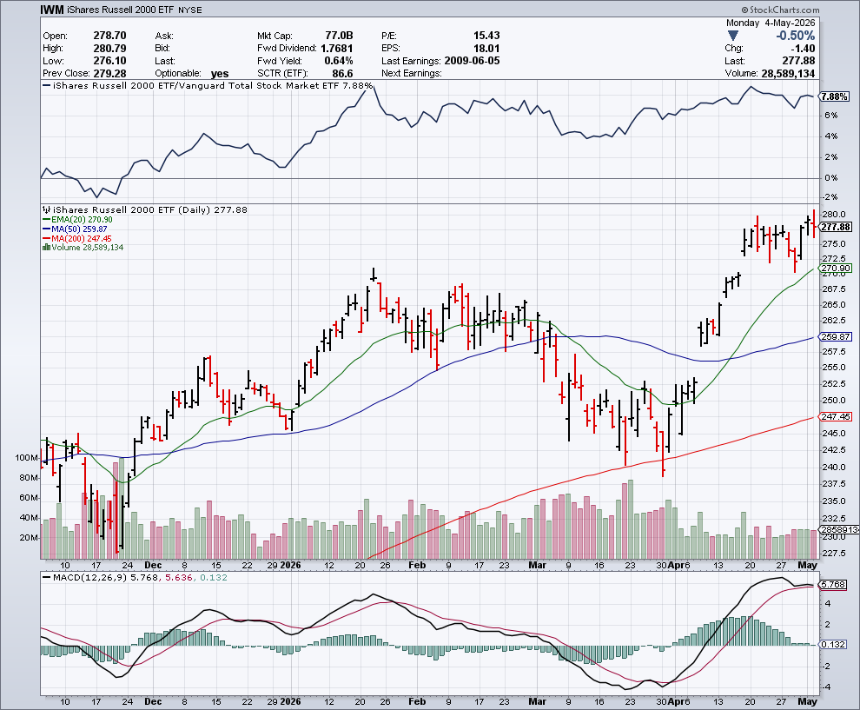
Russell 2000 (IWM)- took profits on Long 10/$137-$142 vertical bull call spread took profits on Long 10/$153-$156 vertical bear put spread

Slide 22
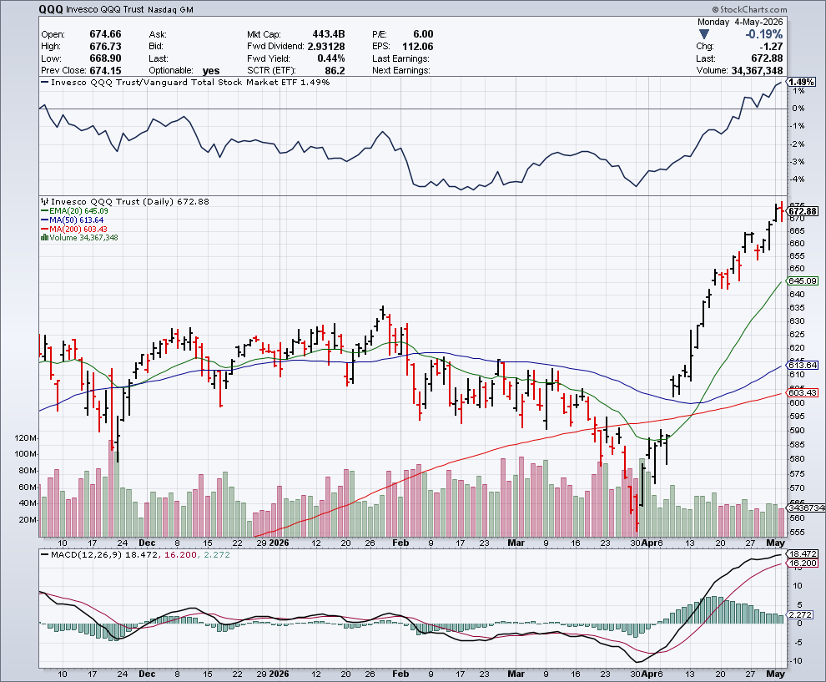
NASDAQ (QQQ) – Down 15% took profits on long 6/$540-$550-$345 put spread, took profits on Long 5/$335-$345 put spread took profits on long (QQQ) /$540-$550 put spread, took profits on long (QQQ) 4/$330-$335 put spread took profits on long (QQQ) 3/$340-$345 put spread, covered long (QQQ) $325-$330 put spread

Slide 23
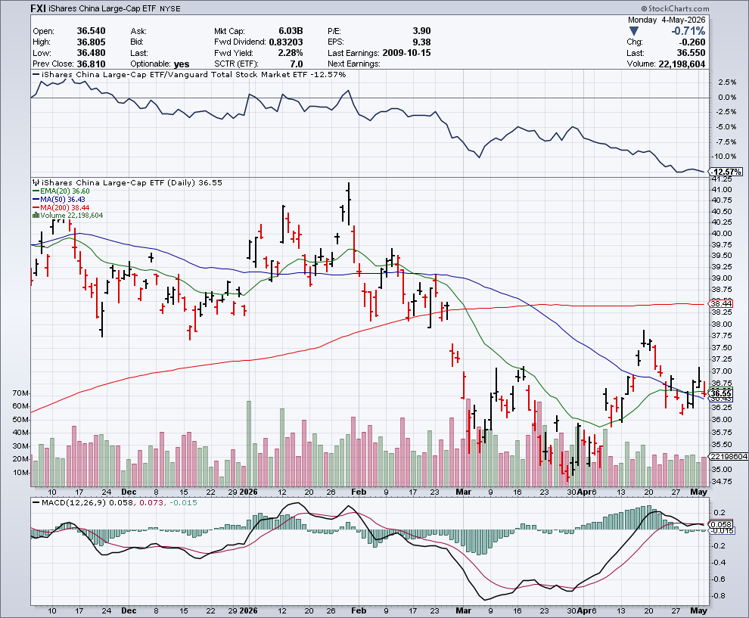
China (FXI)

Slide 24
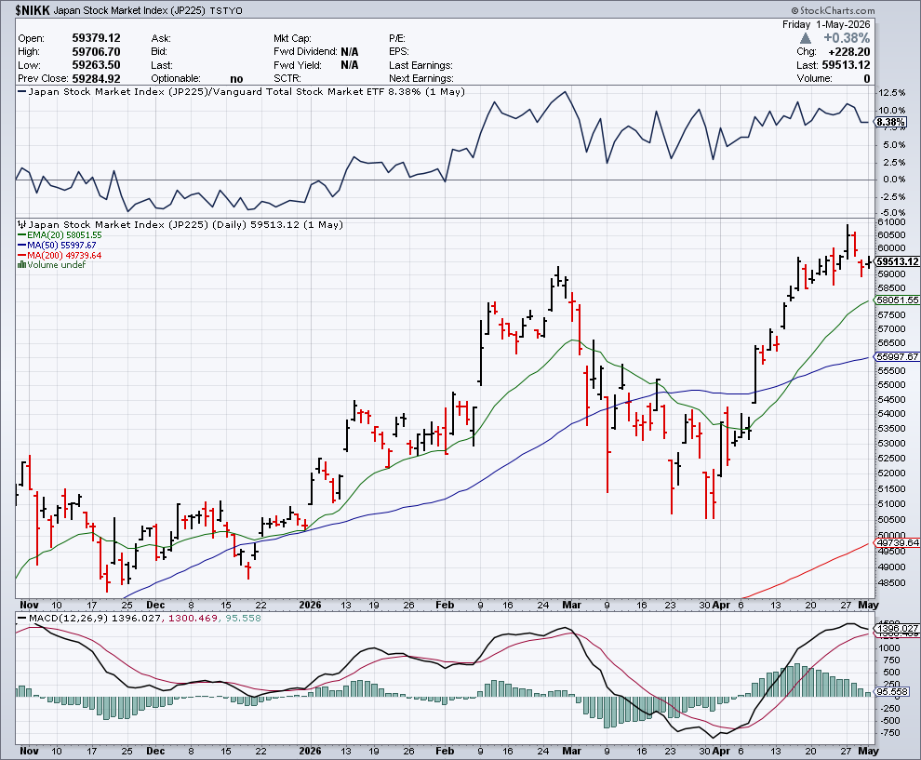
Japan ($NIKK) – Japanese Conservative Election Win Sends Nikkei Soaring, topping 57,000

Slide 25
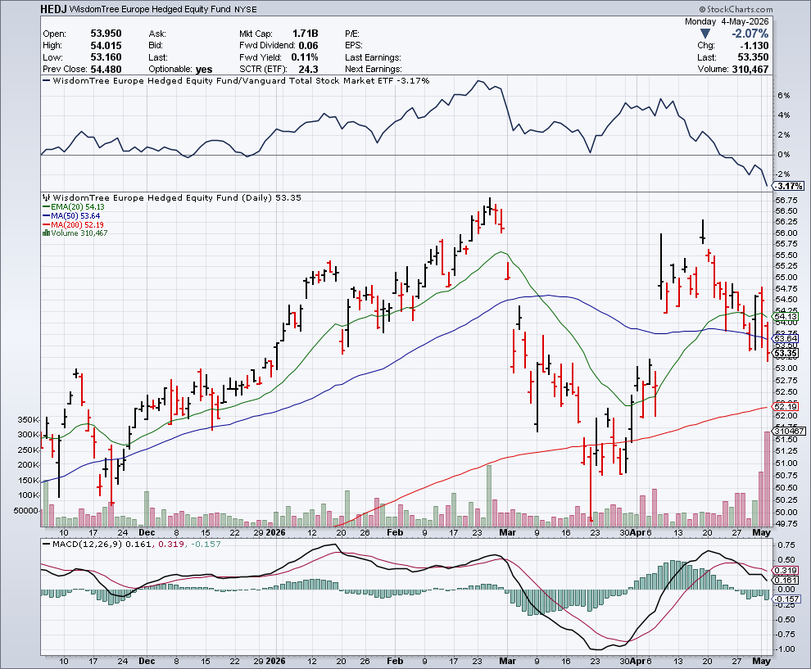
Europe Hedged Equity (HEDJ) -

Slide 26
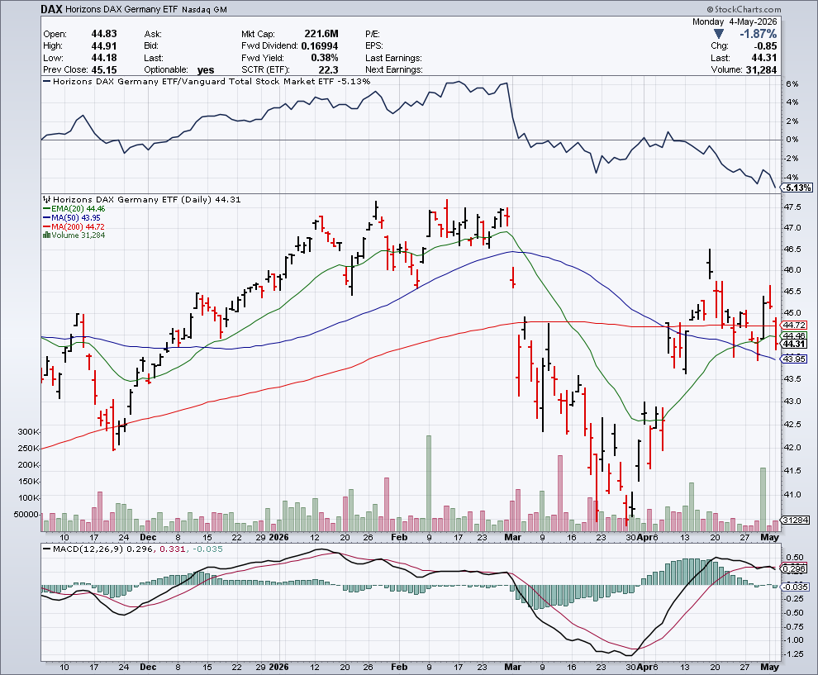
German Dax (DAX) -

Slide 27
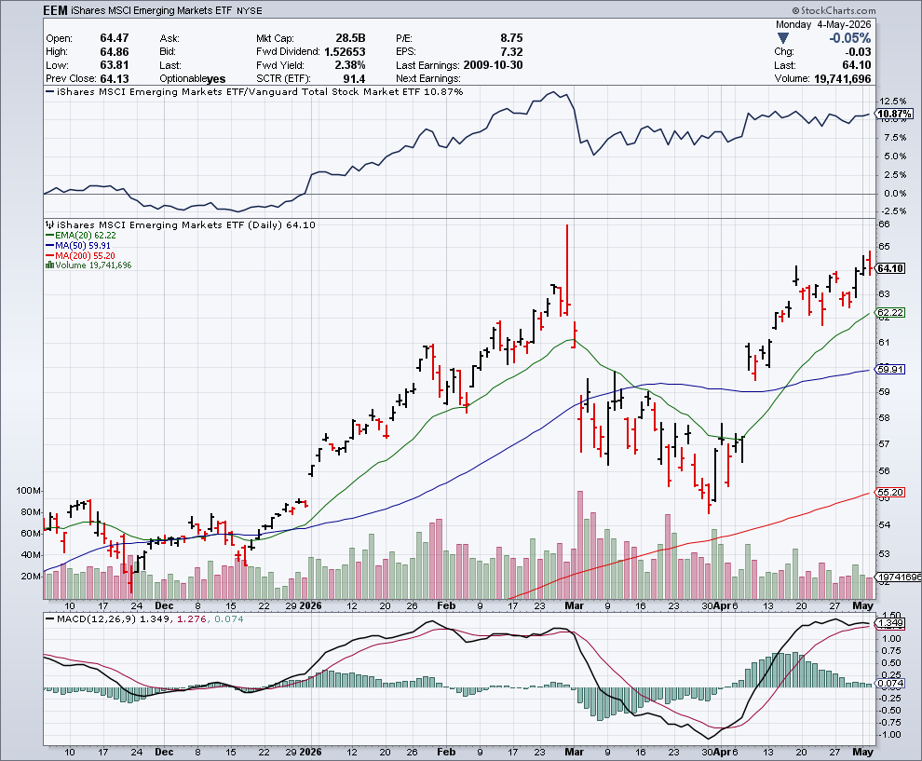
Emerging Markets (EEM) - Weak Dollar, Long Recovery Play

Slide 28

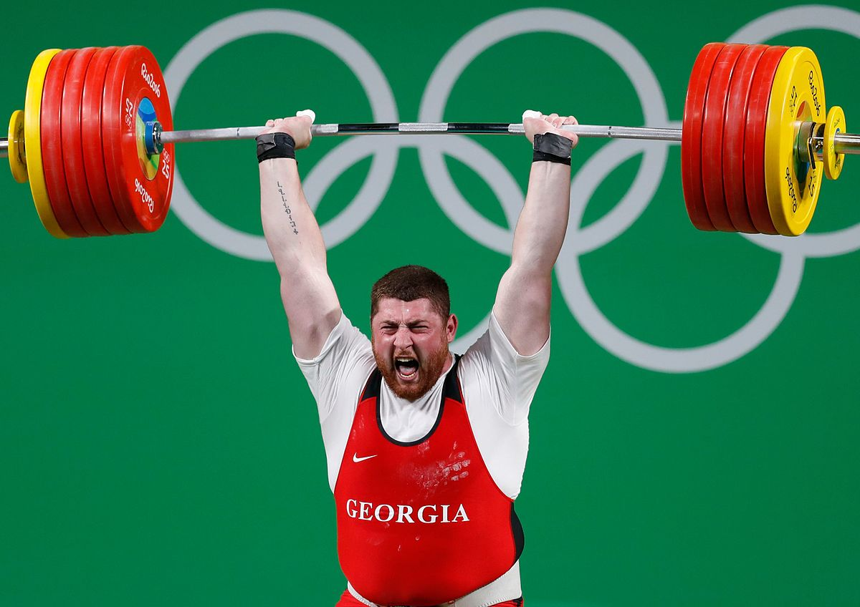
THE MAD HEDGE FUND TRADER
The Barbell Portfolio
*75% Big Tech – 2% of US workforce, 25% of market cap and 25% of US earnings 25% Domestic Recovery, including: Railroads, airlines, cruise lines, Couriers, steel companies Banks, commodities Construction Credit Card Companies Hotels, casinos Online Ticket Sales

Slide 29
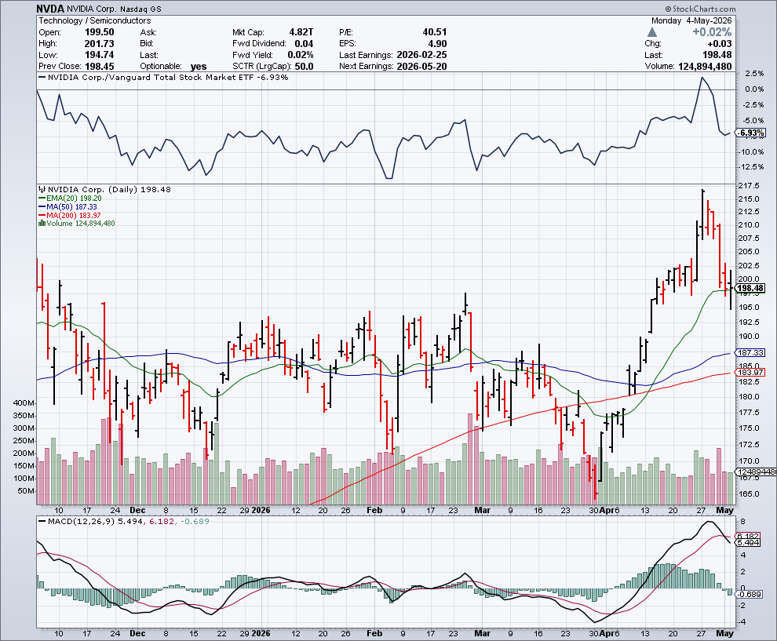

NVIDIA (NVDA) – Blackwell Chips @ $70,000 each Nvidia is Coming for Your Electricity, as GPU rental rates sored from $3.00 to $4.12 in two months stopped out of long 6/$140-$145 puts spread, took profits on long 5/$70-$75 call spread took profits on long 3/$88-$90 call spread, took profits on long 4/$140-$145 puts spread took profits on Long 2/$90-$95 call spread, took profits on Long 12/$117-$120 call spread

Slide 30
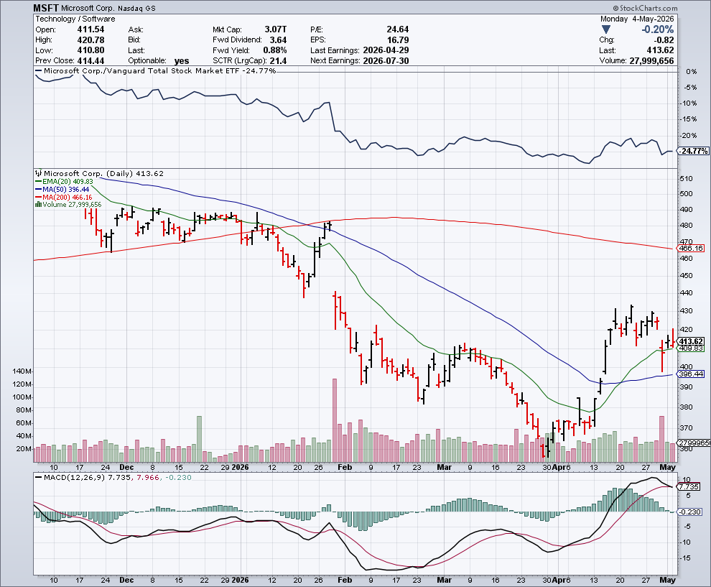

Microsoft (MSFT)- Become the Second $4 trillion Company Microsoft Delivers Blowout Earnings took profits on long 5/$430-$440 put spread Took profits on long 2/$330-$340 call spread, took profits on long 12/$320-$330 call spread took profits on long 9/$235-$245 call spread, took profits on long 7/$220-$210 call spread,

Slide 31
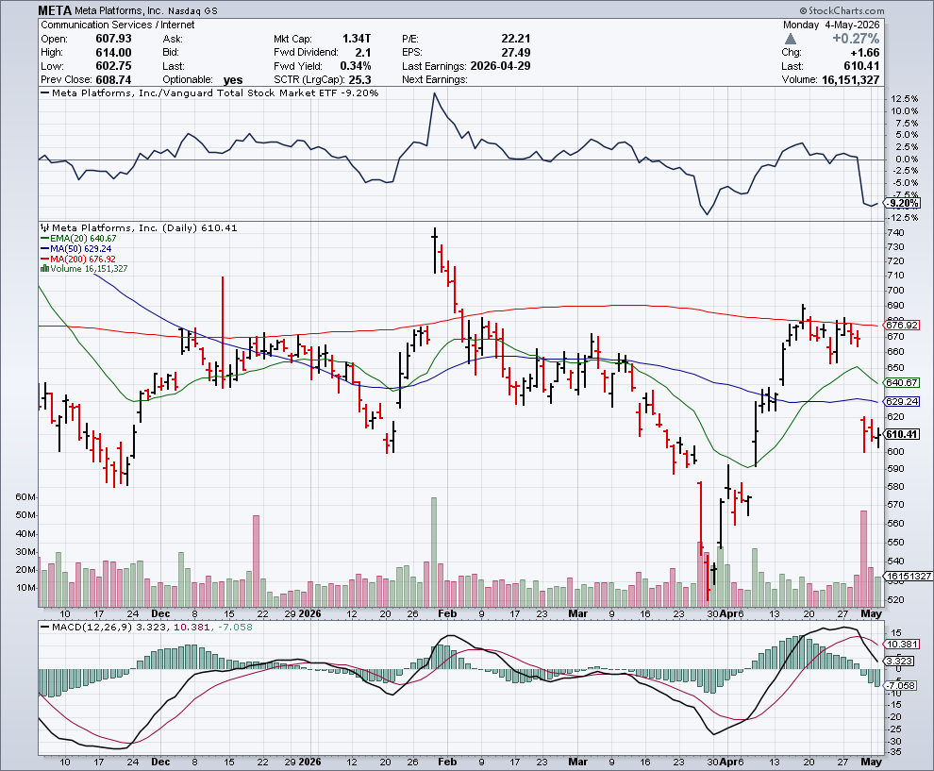

Meta (META) Overspending Concerns took profits on Long 8/$420-$430 call spread took profits on Long 5/$360-$370 vertical bull call spread, took profits on Long 9/$290-$300 vertical bear put spread, stopped out of Long 9/$190-$200 vertical bear put spread

Slide 32
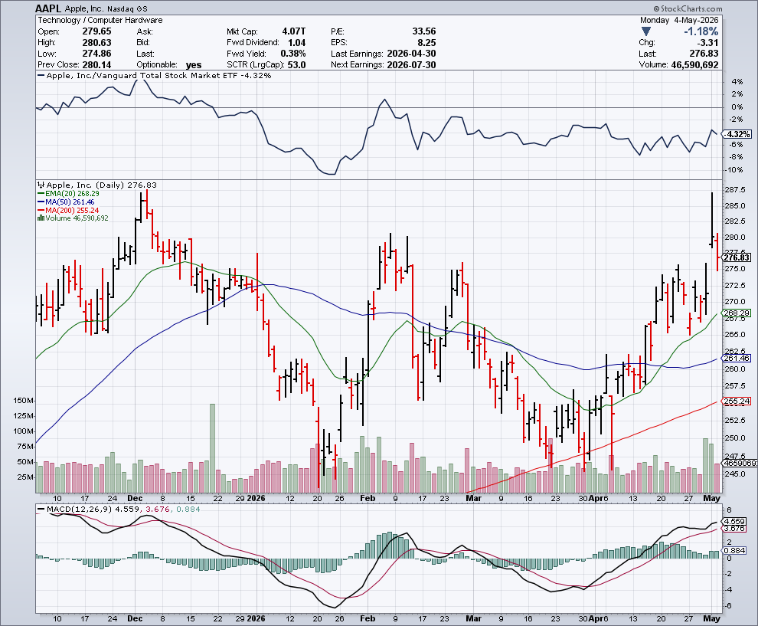

Apple (AAPL) Apple Posts Its Best Quarter in History and the Ternus Era Begins took profits on long 6/$220-$230 put spread, profits on Long 5/$225-$235 vertical bear put spread, took profits on Long 8/$160-$170 call spread took profits on Long 6/$200-$210 bear put spread,

Slide 33
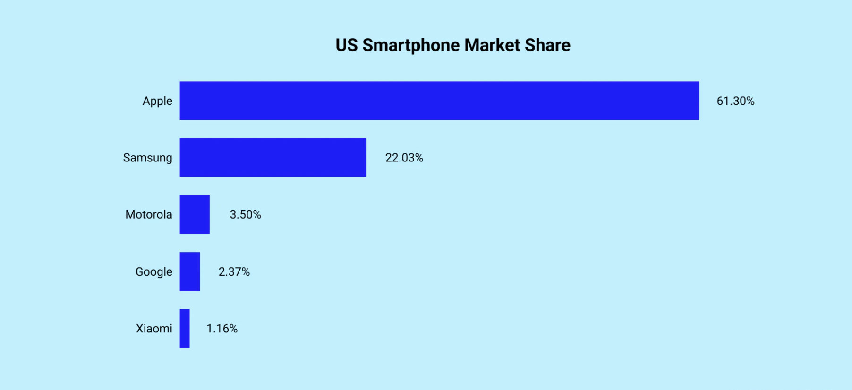

Slide 34
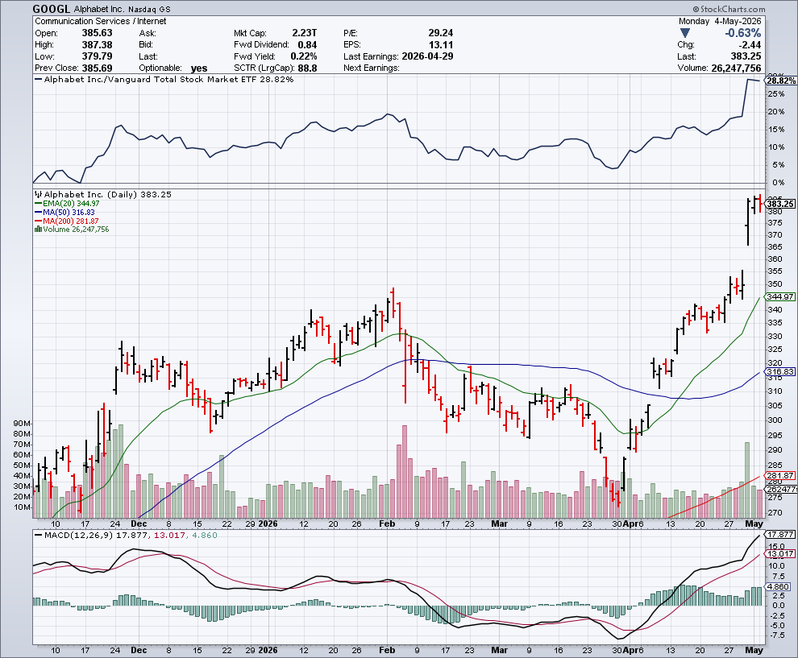
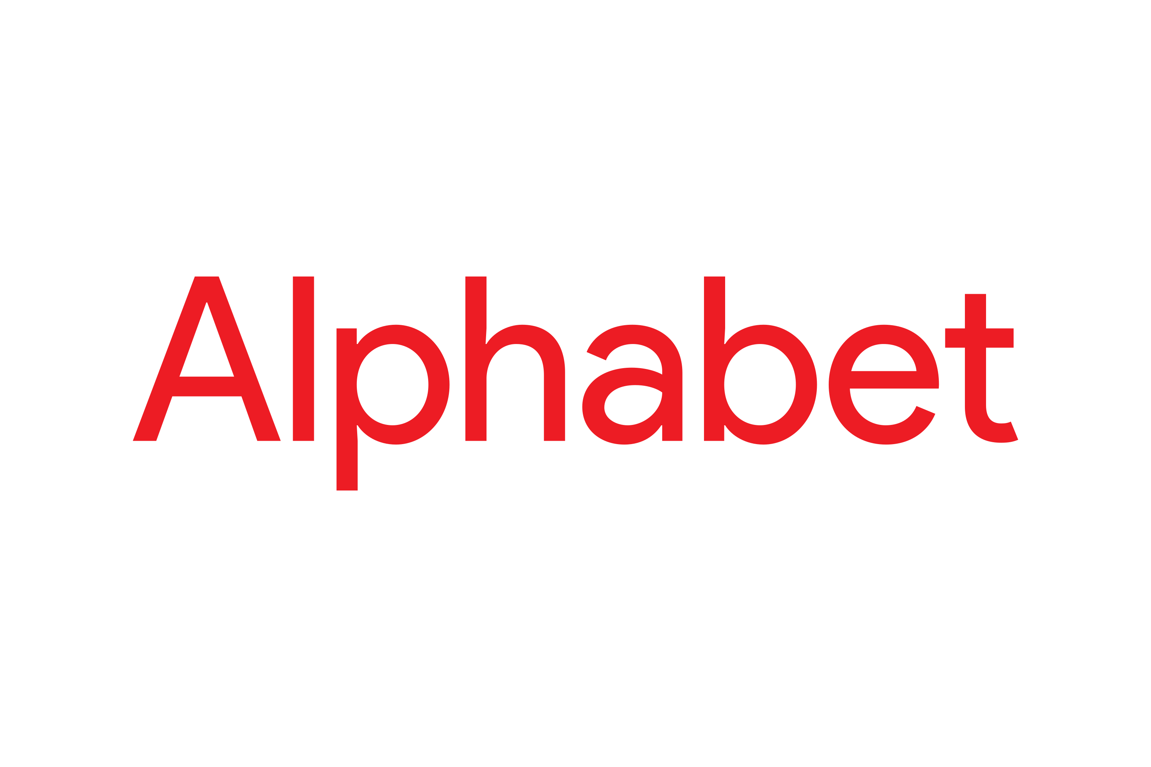
Alphabet (GOOGL) – Ballistic Alphabet Earnings Rock, with quarterly revenues up $109.9 billion took profits on long 12/$110-$120 call spread took profits on long 12/$1,200-$1,230 bull call spread, took profits on long 9/$1,030-$1,080 vertical bull call spread

Slide 35
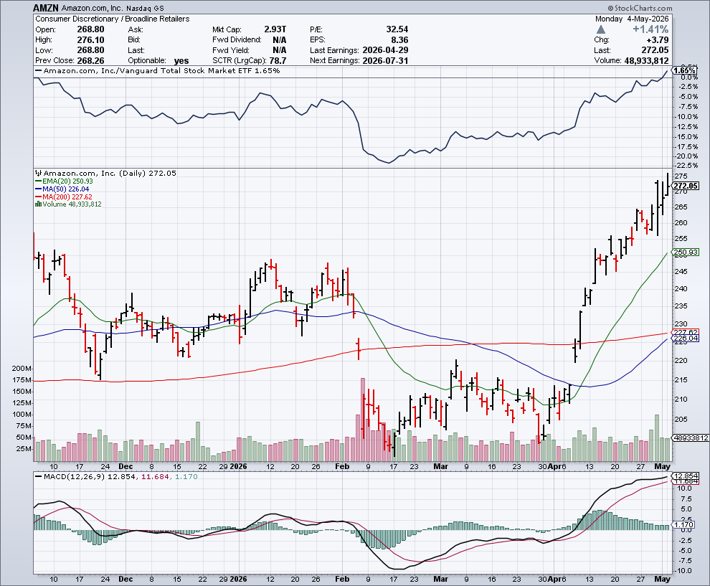

Amazon (AMZN) – Amazon Opens up Delivery System to Third Parties took profits on long 3/$155-$160 bull call spread , took profits on long 2/$130-$135 bull call spread

Slide 36
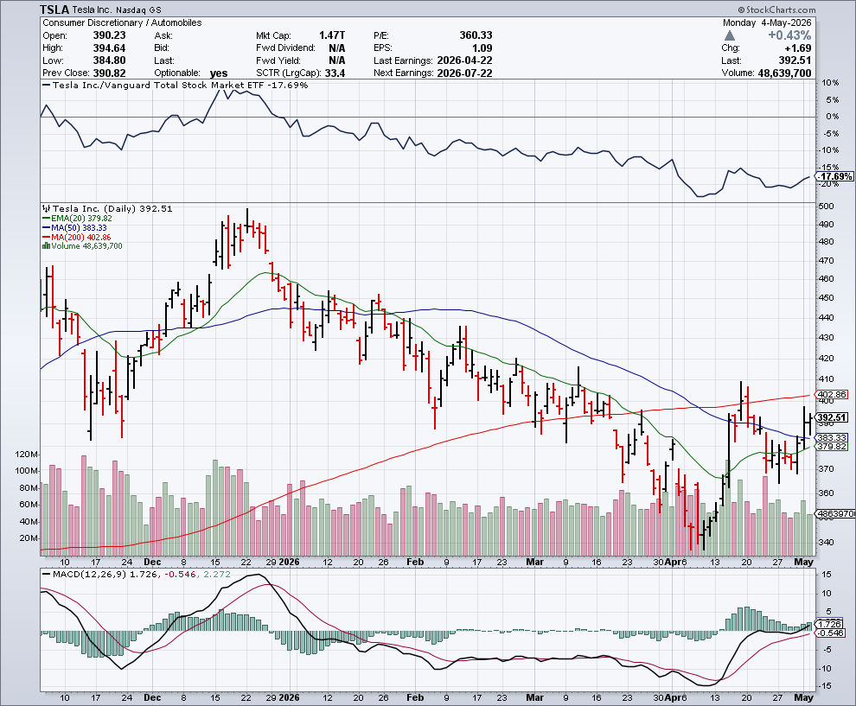

Tesla (TSLA) – EV’s are Back! Tesla sales come in flat Investors are also selling Tesla to buy Space X and its coming $2 trillion valuation took profits on long 10/$510-$520 put spread, took profits on 8/$370-$380 put spread

Slide 37
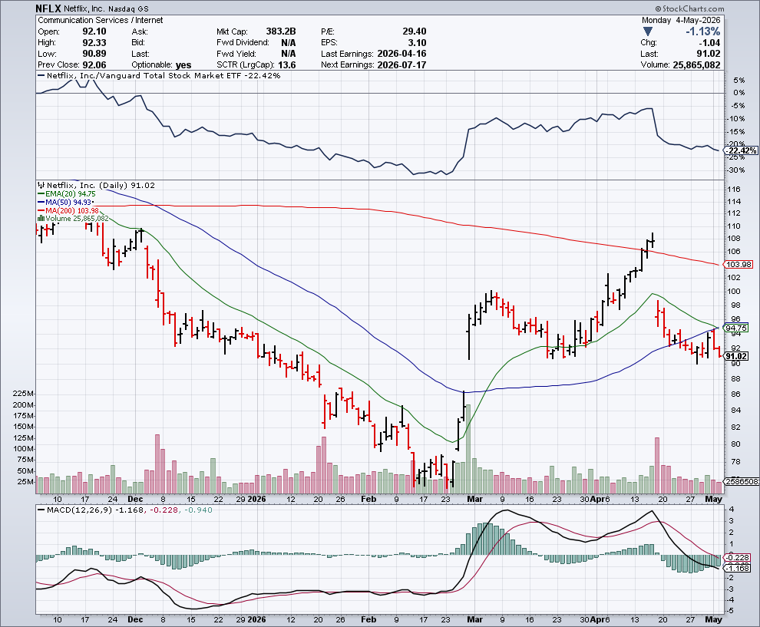

Netflix (NFLX) – Head & Shoulders Top Justic Department Launches Antitrust Investigation of Netflix (NFLX) stopped out of long 5/$84-$89 call spread, Took profits on 11/$100-$102 call spread took profits on long $1040-$1060 call spread, took profits on long 4/800-$810 call spread

Slide 38
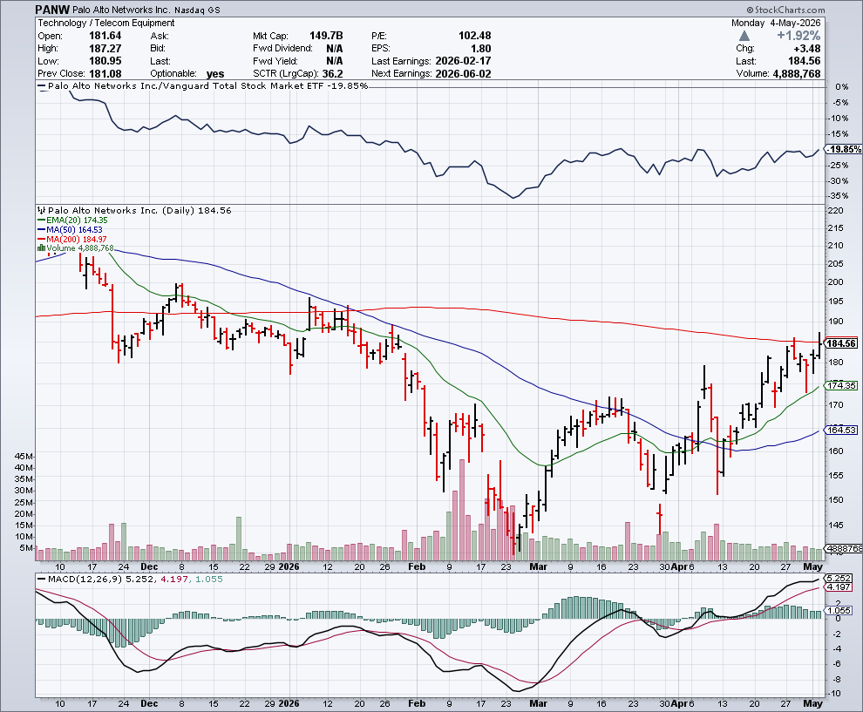

Palo Alto Networks (PANW)- Hacking never goes out of fashion Is AI Putting SaaS Out of Business? took profits on long 2/$260-$270 call spread, took profits on long 10/$130-$140 call spread

Slide 39
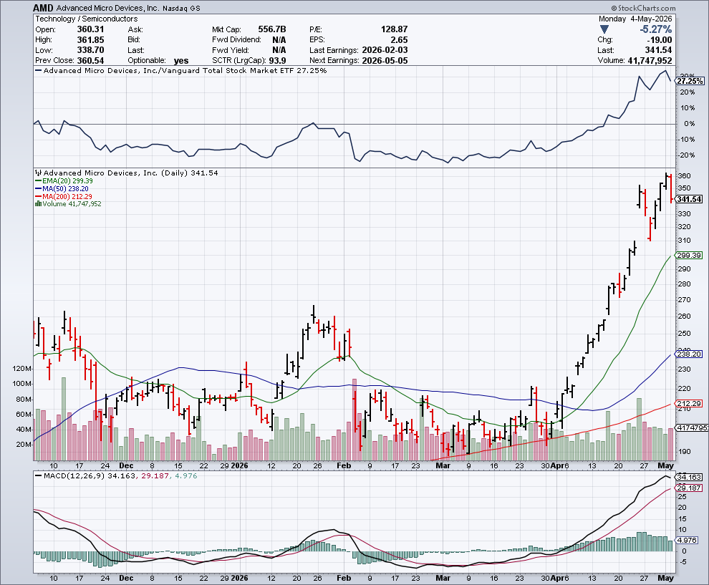

Advanced Micro Devices (AMD)- Melt Up programable logic devices took profits on long 2/$75-$80 call spread

Slide 40
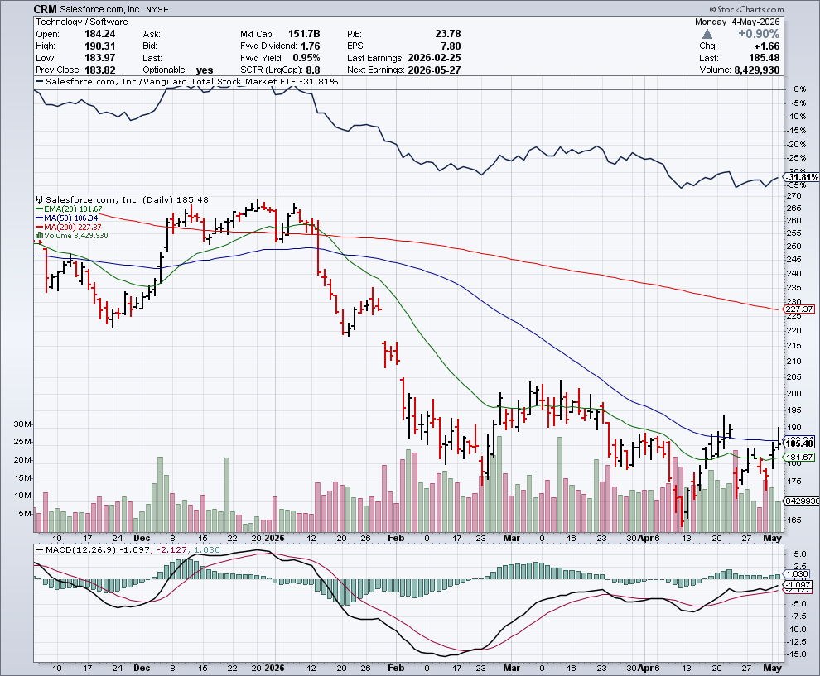

Salesforce (CRM)- Is AI Putting SaaS Out of Business? took profits on long 12/$185-$195 call spread, took profits on long 9/$125-$130 vertical bull call spread took profits on long 8/$125-$130 vertical bull call spread

Slide 41
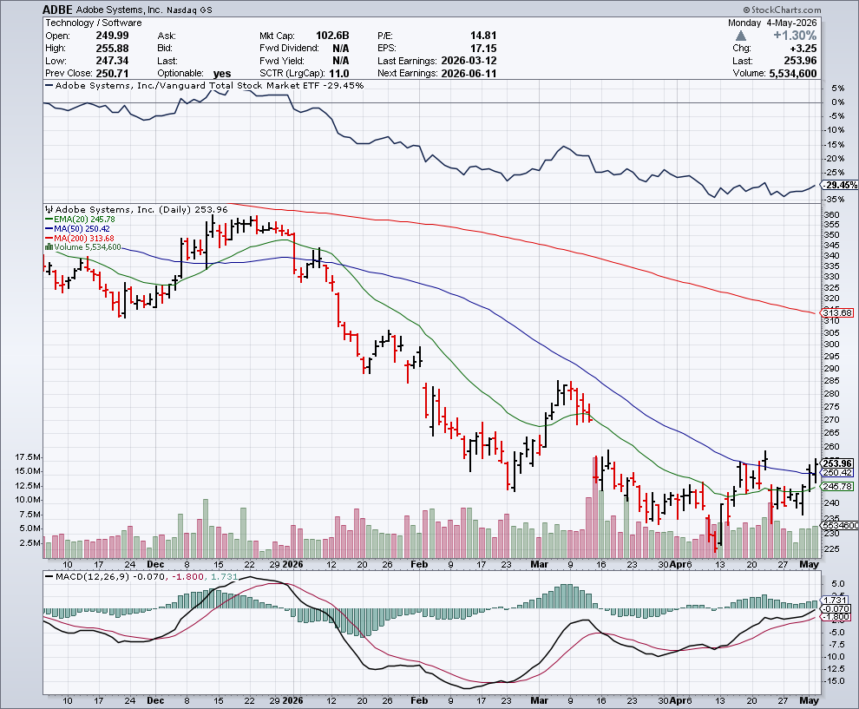

Adobe (ADBE)- Is AI Putting SaaS Out of Business? The Quality Non-China tech play

Slide 42
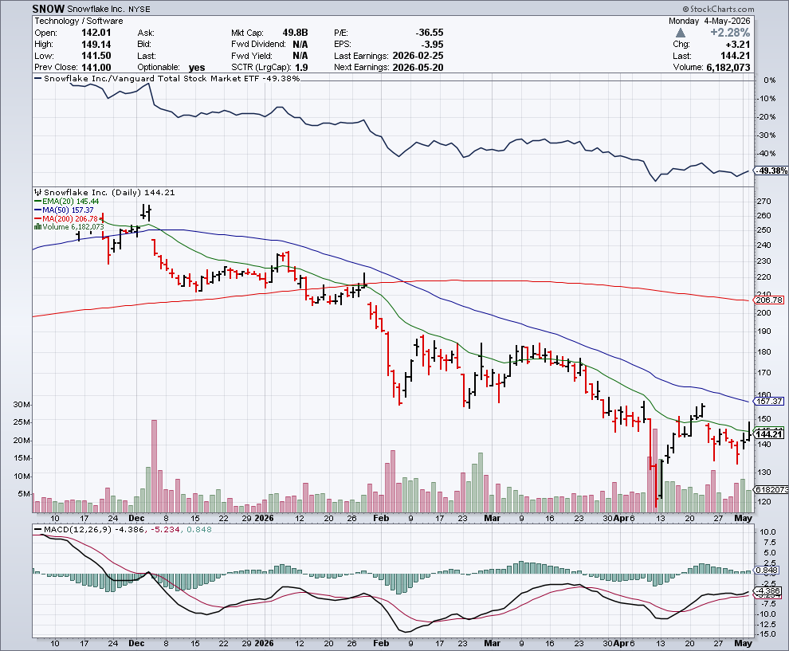

Snowflake (SNOW)- Blockbuster AI Earnings stopped out of long 4/$150-$255 call spread, took profits on long 12/$135-$140 call spread

Slide 43
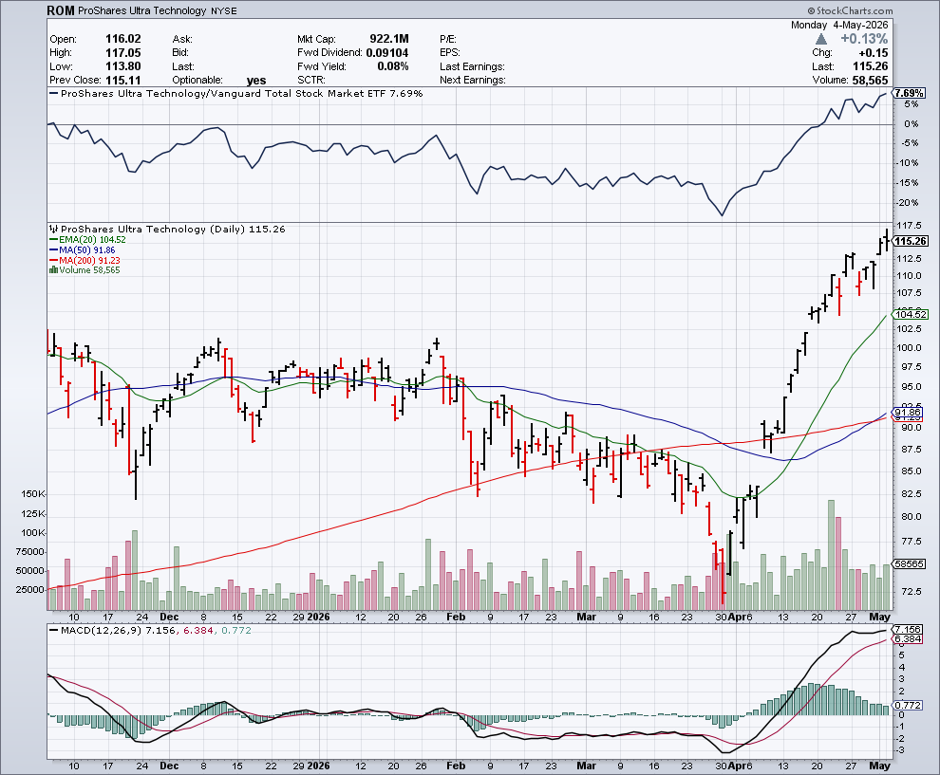
ProShares Ultra Technology ETF (ROM) – 2X Long Technology ETF took profits on long 10/$62-65 call spread

Slide 44
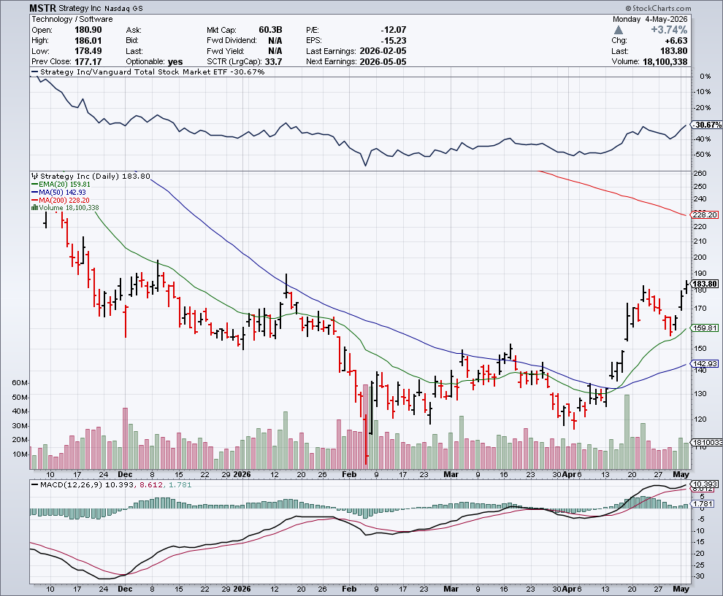

MicroStrategy (MSTR) – Long Bitcoin Play Money is Moving out of Bitcoin Ethereum took profits on Long 6/$260-$270 call spread Took profits on long 6/$500-$510 put spread, took profits on long 6/$470-$480 put spread took profits on long 6/$330-$340 call spread, stopped out of long 6/$335-$345 put spread

Slide 45
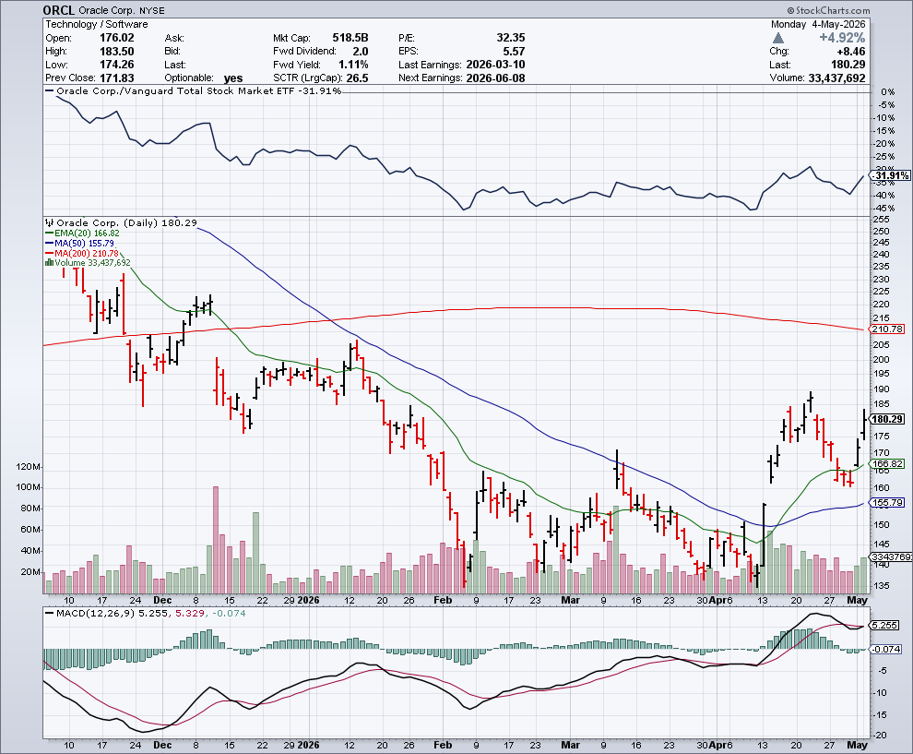

Oracle –(ORCL) – Overborrowing $100 billion in debt

Slide 46
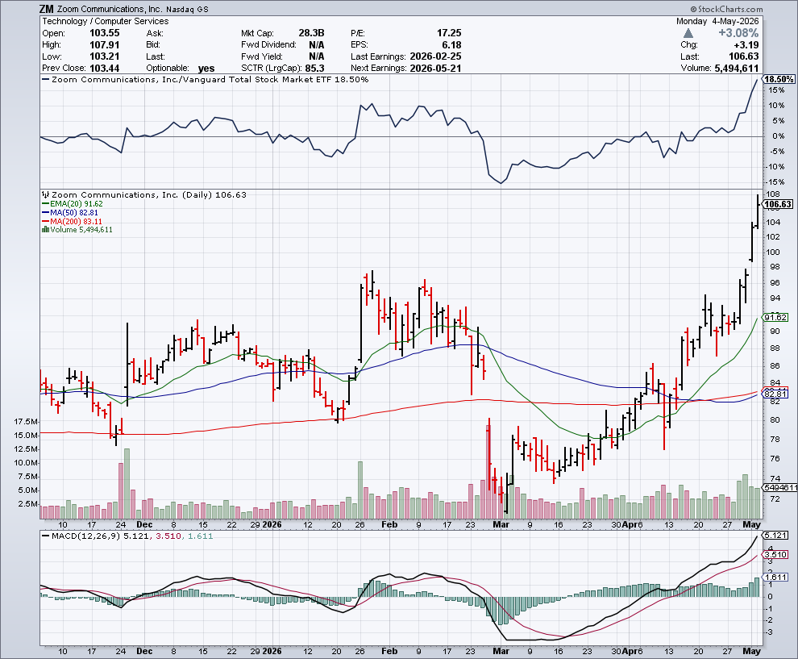

Zoom –(ZM) – Coming Back from the Dead took profits on 11/$72-50-$77.50 call spread

Slide 47
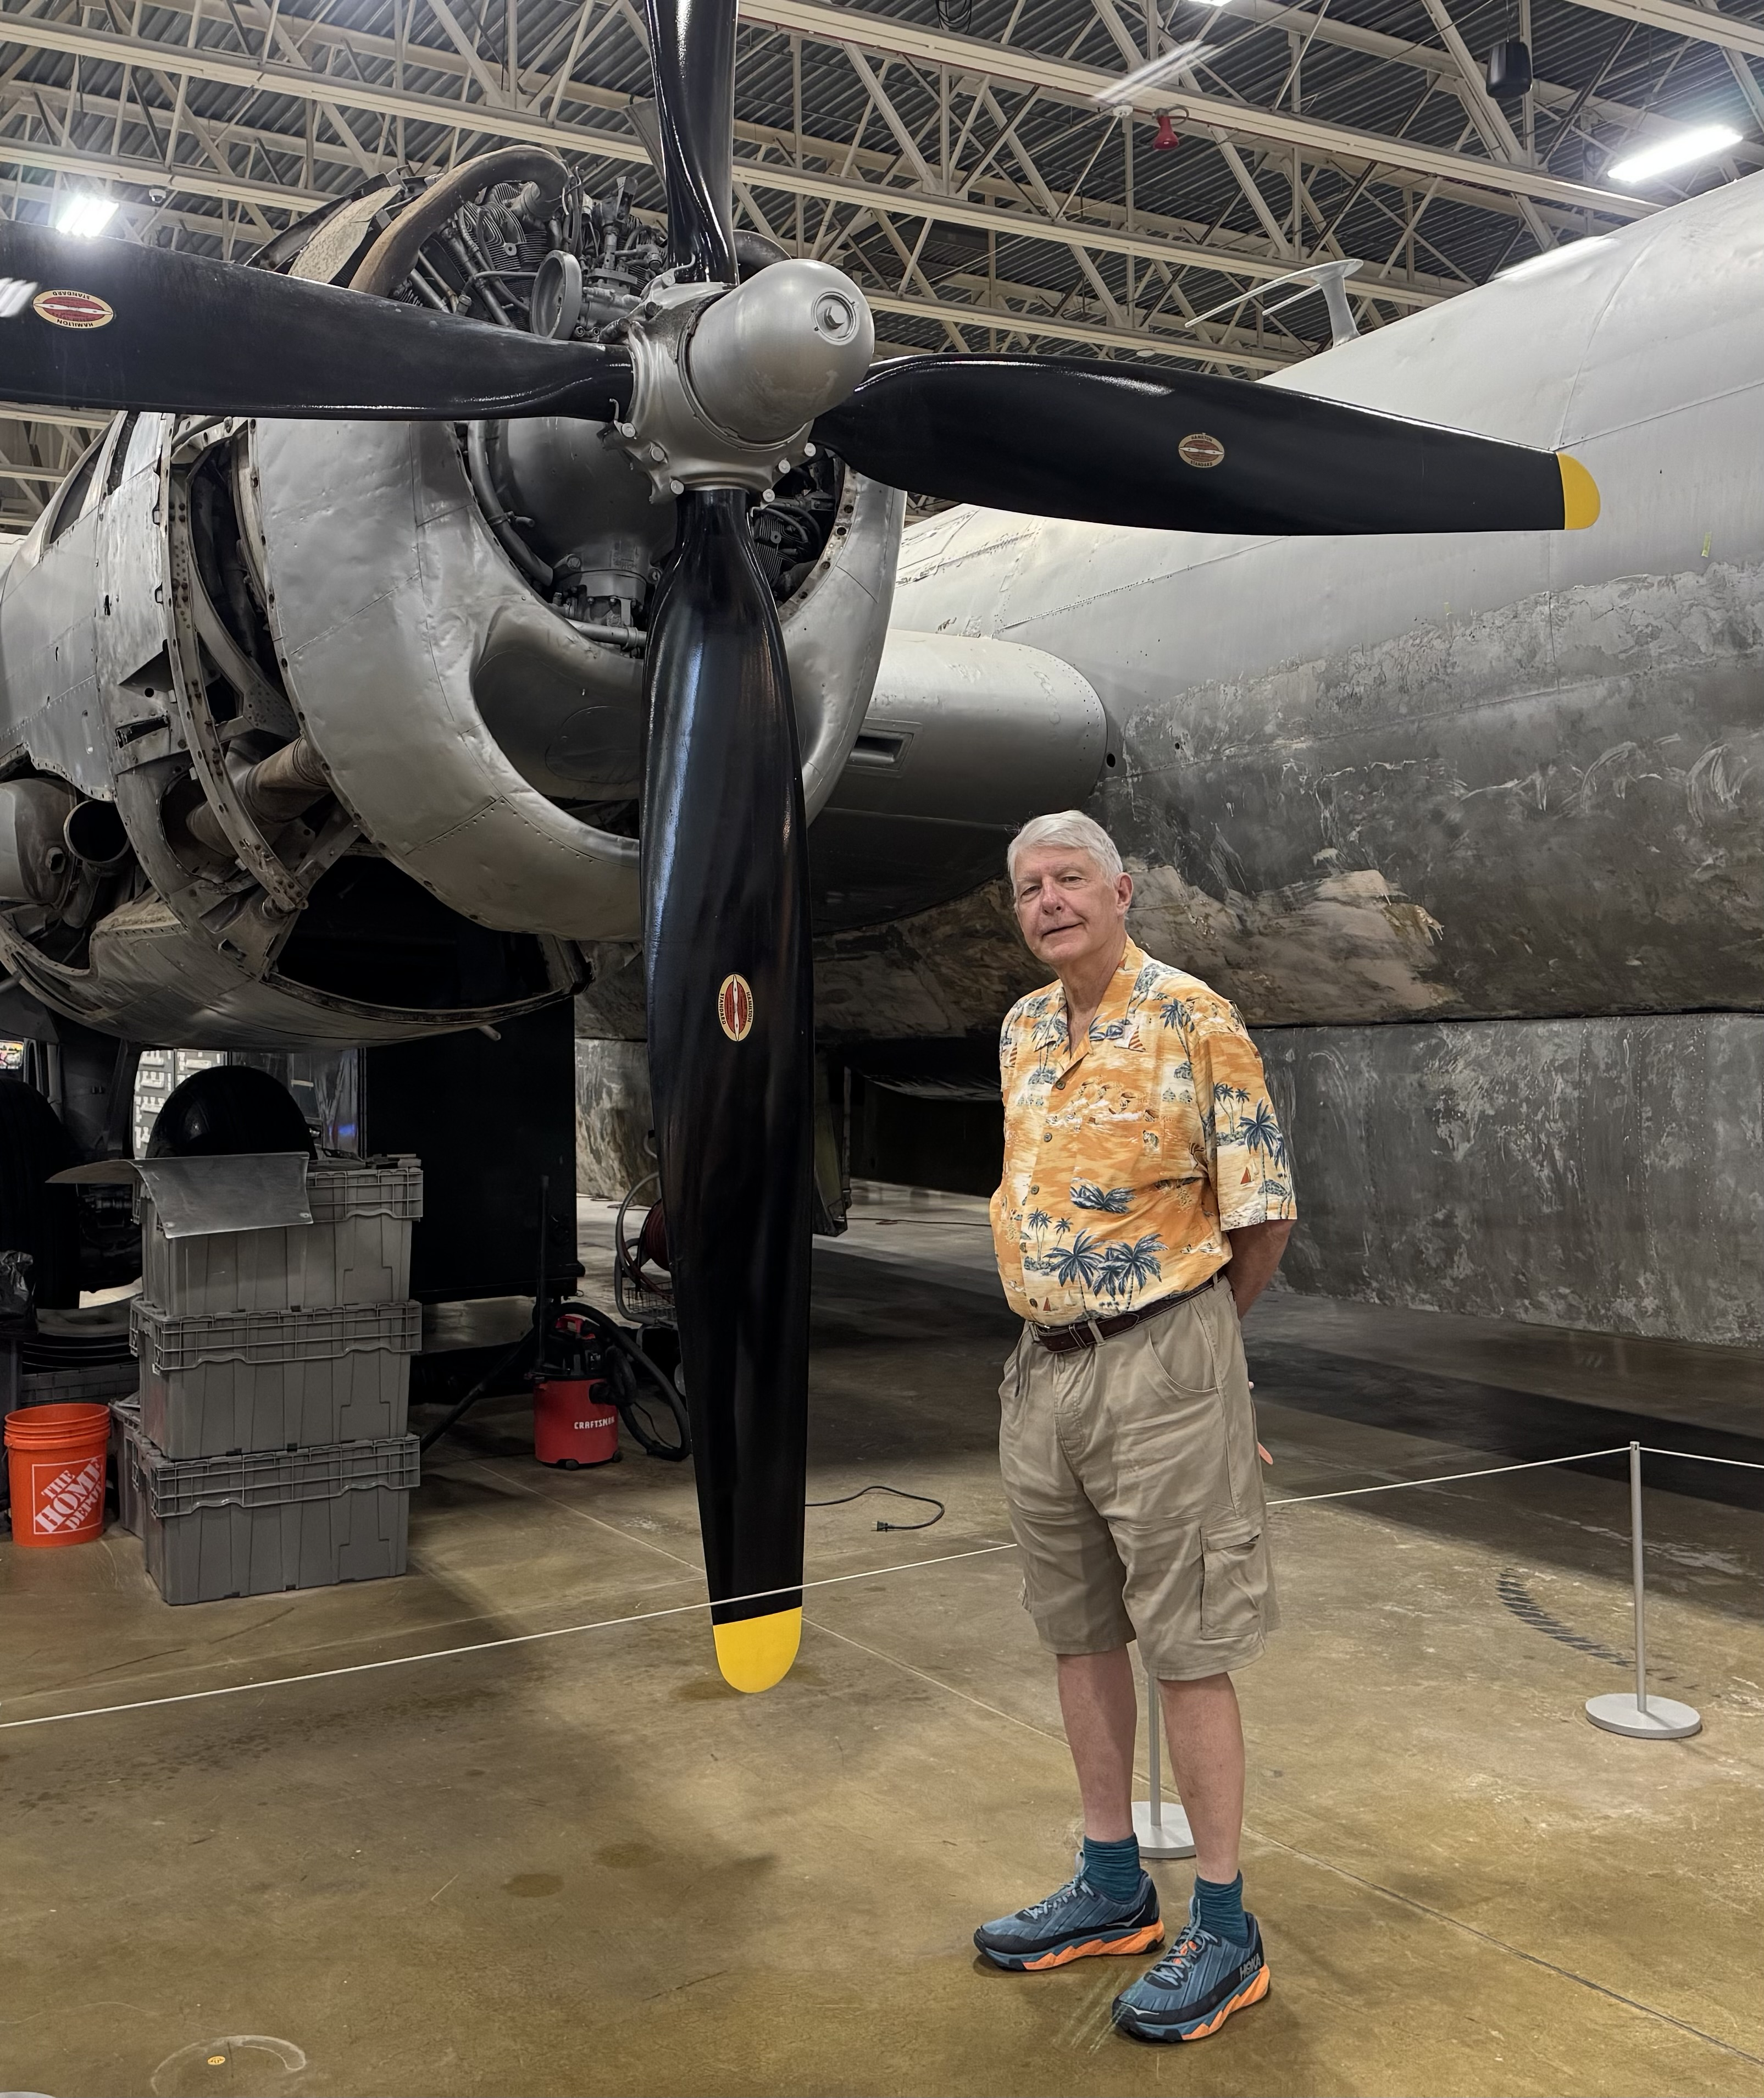

Slide 48
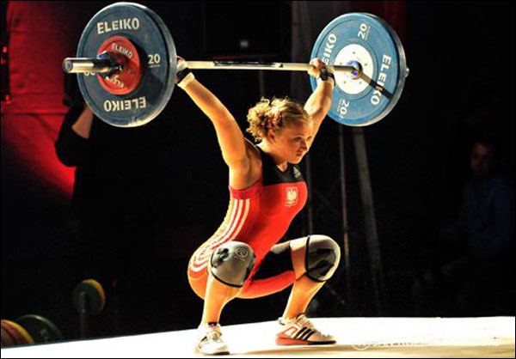
The Second Half of the Barbell
*Bets on a domestic recovery in 2022 Q4 *Upside potential in 2024 far greater than tech *Some of these have not moved for 5 or 10 years *Focuses on economically sensitive cyclical industries *Makes a great counterweight to high-growth technology *We could spend all of next ten years rotating between the two groups

Slide 49
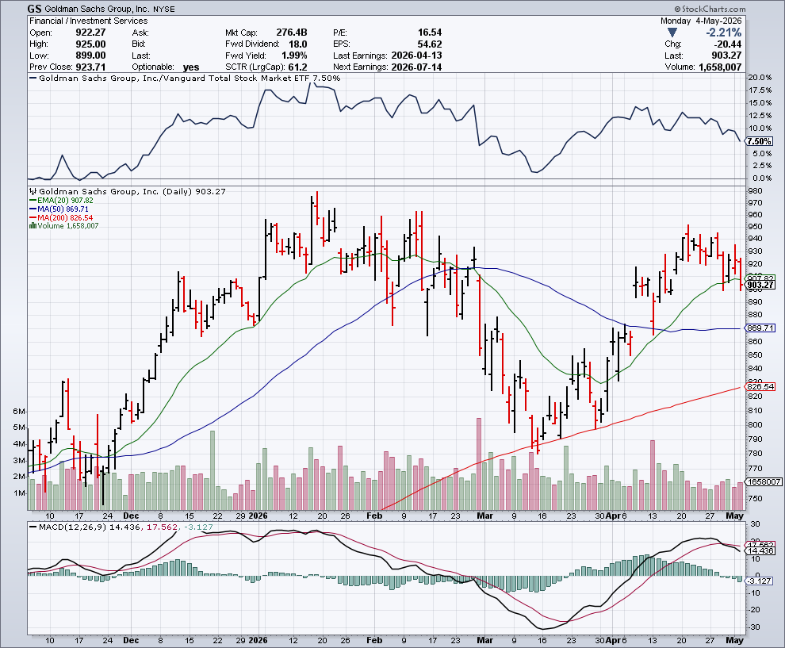

Goldman Sachs (GS) – BALLISTIC Goldman Sachs Beats, on record stock trading profits took profits on long 3/$790-$800 call spread took profits on long 11/$700-$710 call spread , took profits on long 10/$700-$710 call spread took profits on long 9/$690-$700 call spread, stopped out of 3/$380-$390 call spread, profits on long 12/$330-$350 call spread, took profits on long 11/$330-$350 call spread

Slide 50
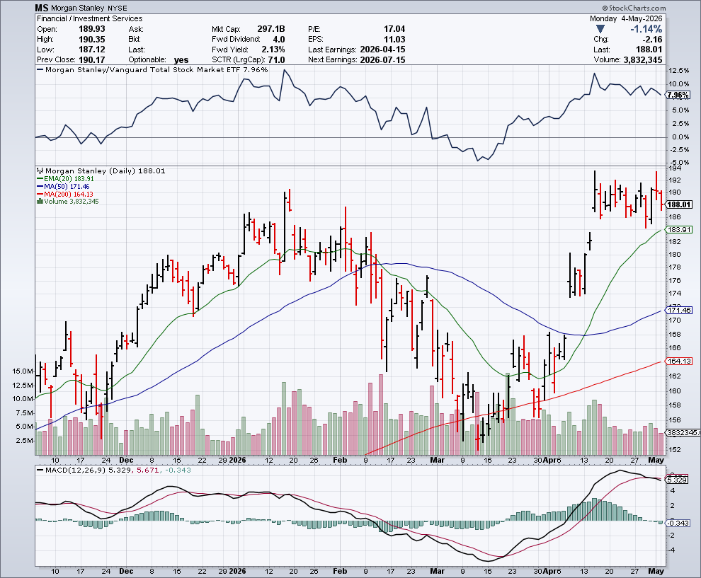

Morgan Stanley (MS) - Upside Breakout! Morgan Stanley Rocks! The company’s stock traders had a record-breaking first quarter took profits on long $12/150-$155 call spread took profits on long $12/210-$220 call spread,, took profits on long $12/210-$220 call spread, Took profits on long $195-$205 call spread, took profits on long 4/$65-$70 call spread

Slide 51
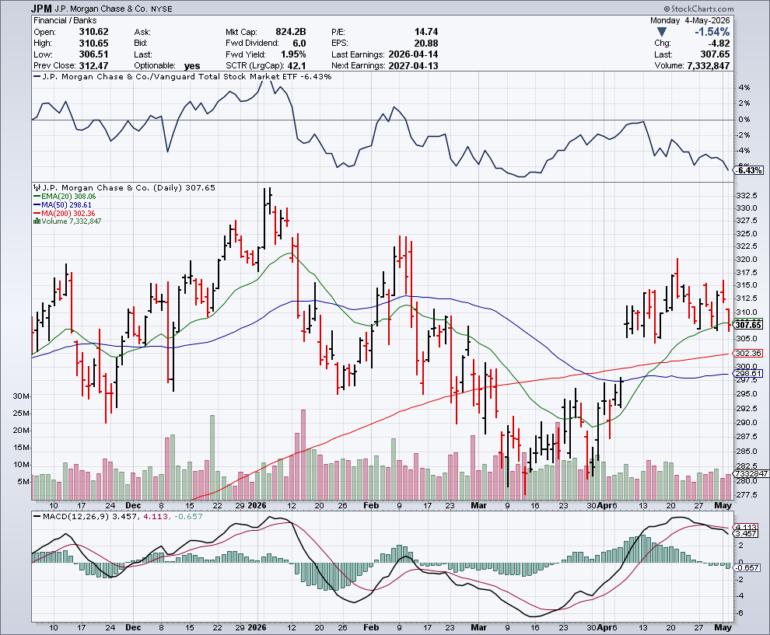
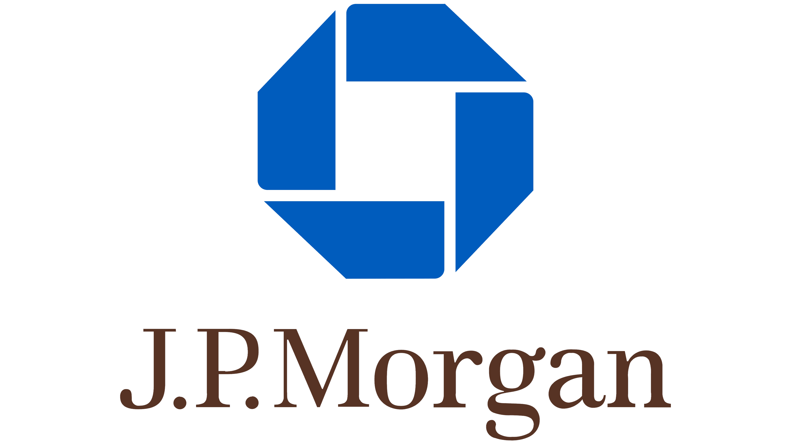
JP Morgan Chase (JPM) – Trump Sues JP Morgan (JPM) for $5 Billion took profits on long 9/$270-$280 call spread stopped out of 3/$235-$245 calls spread, profits on long 12/$210-$220 call spread, took profits on long 11/$195-$205 call spread, took profits on 4/$215-225 put spread

Slide 52
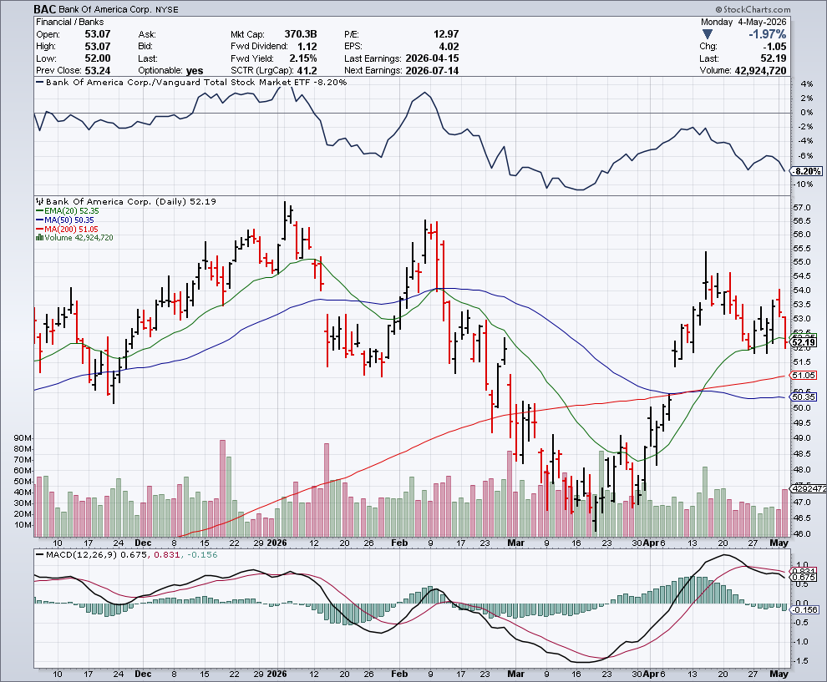

Bank of America (BAC) – Upside Breakout? took profits on long long 12/$41-$44 call spread, took profits on long 4/$20-$23 call spread

Slide 53
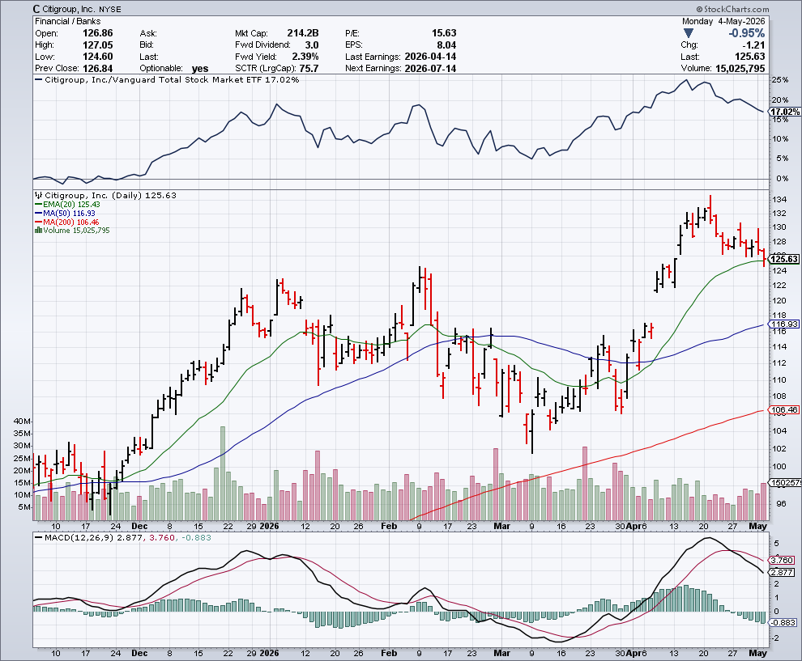

Citigroup (C) – Upside Breakout took profits on long long 12/$60-$65 call spread , took profits on long 4/$30-$35 call spread

Slide 54
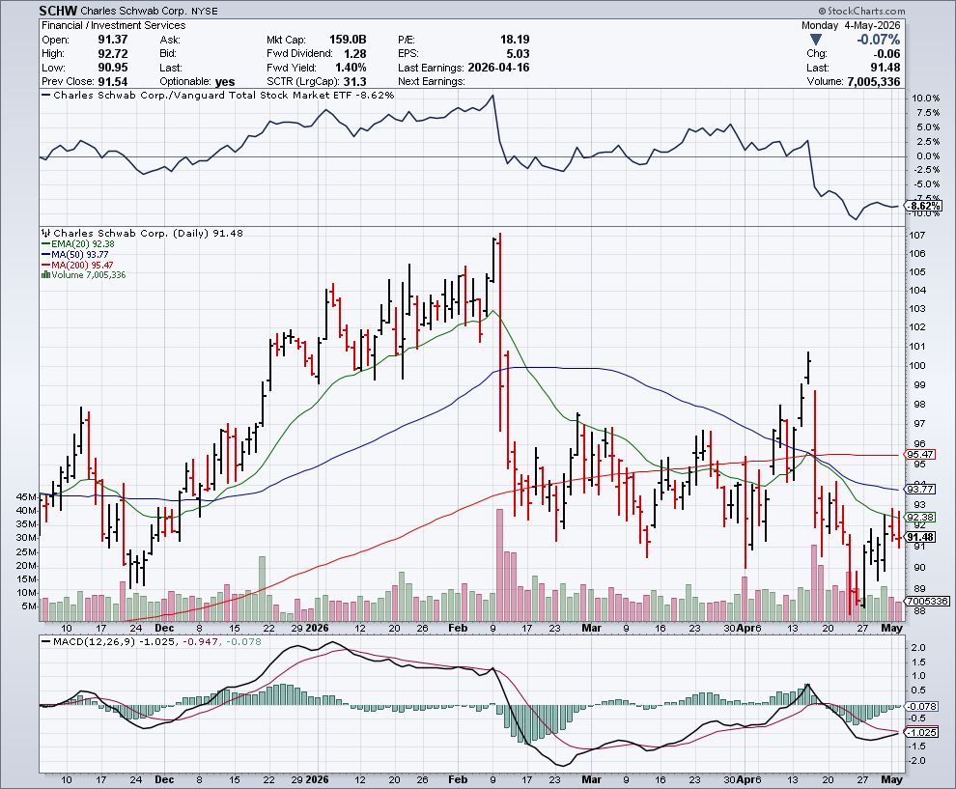

Charles Schwab (SCHW) – Upside Breakout took profits on long 4/$30-$35 call spread

Slide 55


Interactive Brokers (IBKR) – Upside Breakout? stopped out of long 3/$160-$170 call spread, out of long 8/$110-$115 call spread , took profits on long 4/$60-$65 call spread

Slide 56


Berkshire Hathaway (BRKB) – Digesting Buffet Retirement Berkshire Hathaway Builds Record Cash, at $334 billion – Is the new T Bill proxy stopped out of long 12/$405-$415 call spread, took profits on long 12/$320-$330 call spread took profits on long 4/$260-$270 call spread, took profits on long 1/$290-$300 call spread

Slide 57


Blackrock (BLK)-Asset Collection Boom Blackrock Reports Record $12.5 trillion in Assets Under Management stopped out of 12/$1,000-$1,010 call spread, took profits on long 12/$850-$860 call spread took profits on long 3/$770-$790 call spread, took profits on long 3/$310-$340 call spread

Slide 58

SPDR Metals & Mining ETF (XME) – long 2/$28-$30 call spread

Slide 59


Boeing (BA) – LEAPS Candidate Boeing is Beating on Deliveries. Boeing begins 2026 with 46 deliveries in January and 103 net new orders took profits on long 3/$195-$200 call spread

Slide 60


General Motors (GM) – Worst Off Trade War Victim Earnings better than expected plus interest rate beneficiary stopped out of long 4/$52.50-$57.50 put spread at cost, long 3/$53-$56 put spread

Slide 61


Package Delivery- United Parcel Service (UPS) – S&P Case Shiller took profits on long 11/$130-$140 call spread

Slide 62


Caterpillar (CAT)- Data Center Buildout took profits on ong $630-$640 call spread stopped out of long 8/$310-$320 call spread, took profits on long 12/$220-$230 calls spread took profits on long 12/$145-$150 call spread, took profits on long 11/$125-$135 call spread

Slide 63


Deere & Co. (DE)- Ag + Infrastructure + Housing took profits on long 8/$330-$340 put spread stopped out of long 8/$330-$340 calls spread

Slide 64


Freeport McMoRan - (FCX)- Coming Copper Crisis 50% copper tariff stopped out of 3/$55-$58 call spread, took profits on long 8/$34-$37 call spread took profits on long 4/$37-$40 call spread, took profits on long 5/$42-$45 call spread, stopped out of long $48-$51 put spread, profits on long 6/$32-$35 call spread

Slide 65


Walt Disney (DIS) -

Slide 66


Industrials Sector SPDR (XLI)- (GE), (MMM), (UNP), (UTX), (BA), (HON)

Slide 67


Union Pacific RR (UNP)- Big Stuff to Ship The Largest Railroad in History, may be the result of the Union Pacific (UNP)/Norfolk Southern merger worth $200 billion took profits on long 5/$200-$210 call spread took profits on 11/$150-$160 call spread

Slide 68


Walmart (WMT) – AI Consumer Walmart Hits $1 Trillion Market Cap took profit on Long 11/$125-$130 bear put spread, took profit on Long 10/$119-$121 bear put spread took profits on Long 8/$114-$117 bear put spread

Slide 69


Costco (COST) – Trade War Recovery suing Trump administration over tariffs, one third of sales from imports took profits on long 4/$840-$850 call spread

Slide 70


Delta Airlines (DAL) – Quality holds up The only airline with a refinery

Slide 71


Transports Sector SPDR (XTN)- Worst Hit Sector (ALGT), (ALK), (JBLU), (LUV), (CHRW), (DAL)

Slide 72


Health Care Sector (XLV) – Defensive Play and Cheap (JNJ), (PFE), (MRK), (GILD), (ACT), (AMGN)

Slide 73


Amgen (AMGN) took profits on long 7/$260-$270 bull call spread, took profits on long 11/$185-$200 bull call spread

Slide 74


Visa (V) – Stablecoin Competition took profits on long 2/$240-$250 bull call spread took profits on long 10/$160-$170 bull call spread, took profits on long 6/$150-$160 bull call spread

Slide 75


Consumer Discretionary SPDR (XLY) (DIS), (AMZN), (HD), (CMCSA), (MCD), (SBUX)

Slide 76

Raytheon (RTX) stopped out of long $195-$200 call spread

Slide 78

Bonds – Breakdown
*Fed Keeps Interest Rates Unchanged, citing inflation risks as the main reason for not cutting *Four members dissented for the first time since 1992 *Inflation is elevated, in part reflecting the recent increase in global energy prices *This is a shift from previous language saying that inflation was just somewhat" elevated. *Developments ​in the Middle East are contributing to a high level of uncertainty about the economic outlook. *Jay Powell stays on the board until January 2028 to prevent runaway interest rate cuts by new Trump appointed Fed governor and to stonewall criminal prosecution by DOJ

Slide 79

Treasury ETF (TLT) – took profits on long 6/$88-$91 put spread stopped out of long 6/$80-$83 call spread, took profits on long 4/$84-$87 call spread stopped out of long 1/$82-$85 call spread, took profits on long 10/$103-$106 put spread took profits on long 6/$$94-$97 put spread, took profits on long 5/$82-$85 calls spread

Slide 80

Ten Year Treasury Yield ($TNX) – 4.45%

Slide 81

Junk Bonds (JNK) 6.57% Yield

Slide 82

Municipal Bonds (MUB) 3.10% Yield-

Slide 83

Emerging Market Debt (ELD) 5.41% Yield-

Slide 84

2X Short Treasuries (TBT)-Out of Favor

Slide 85

Anally Capital Management (NLY) – Leveraged REIT Play Yield 13.19% took profits on long 12/$15-$16 call spread

Slide 86


Slide 87

Foreign Currencies – Picking Up Steam
*Japanese yen is getting crushed on Mid East oil dependence. The same thing happened in 1973 *US Dollar Loses Iran War Gains, as a tentative ceasefire revived ​appetite for riskier currencies *Collapsing oil trade cuts dollar trade by $2 billion a day, weakening the greenback *Rising interest rates isn’t helping buck showing how weak it really is *Sell all dollar rallies. *Buy (FXA), (FXE), (FXB), (FXC), and (FXY) NOW!

Slide 88


THE MAD HEDGE FUND TRADER
Australian Dollar (FXA) - Major Long-Term Bottom is In Targeting Parity – A call option on a global synchronized recovery

Slide 89


Japanese Yen (FXY)

Slide 90


Euro (FXE)-

Slide 91


British Pound (FXB)-

Slide 92


Emerging Market Currencies (CEW)

Slide 93


Slide 94

Energy & Commodities – Windfall Profits
*Oil Soars $9 on Return to Iran Shooting War *Iran exchanged fire in the Persian Gulf in a flareup of violence on Monday that also drew in the United Arab Emirates *USO Crude ETF Borrows Top 100 *US Crude Oil Exports Soar, as tankers flock to the Texas Gulf Coast. *U.S. oil exports have jumped to 5.2 million barrels per day (bpd) in April, a more than 30% *Exxon beat on revenue at $85.14 billion versus an $82.18 billion estimate, and delivered a one-year total shareholder return of 42% *United Arab Emirates Quits OPEC

Slide 95


Slide 96

Oil-($WTIC) Sharpes Move in History, up 115%

Slide 97

United States Oil Fund (USO)

Slide 98

Schlumberger (SLB) long 5/$43-$48 call spread

Slide 99

Energy Select Sector SPDR (XLE)-No Performance! (XOM), (CVX), (SLB), (KMI), (EOG), (COP)

Slide 100

ExxonMobil (XOM) - Windfall profits for rest of 2026 took profits on 5/$130-$140 call spread took profits on Long 4/$100-$105 call spread, took profits on long 12/$120-$125 put spread

Slide 101

Occidental Petroleum (OXY) - Windfall profits for rest of 2026 took profits on 5/$45-$50 call spread, took profits on long 4/$59-$62 call spread took profits on long 2/$55-$60 call spread, took profits on long 12/$77.50-$82.50 put spread

Slide 102

Natural Gas (UNG) – Oversupply took profits on Long January 2025 $7-8 Call Spread LEAPS

Slide 103

Cameco (CCJ) – Global Uranium Renaissance Microsoft to Reopen Three Mile Island to power AI data centers took profits on long 12/$41-$44 call spread, took profits on long 12/$35-$38 call spread, took profits on long 5/$20-$23 bull call spread

Slide 104

Vistra Corp. (VST) – Global Uranium Renaissance took profits on long 2/$100-$110 call spread

Slide 105


Slide 106

Precious Metals – Reaffirmed as “Risk On”
*Precious metals get crushed on US dollar interest rate spike *Gold is viewed as a “safe asset” avoiding overvaluations of stocks and the uncertainty of crypto *Falling interest rates give gold a boost with less yield competition *The central banks are going to step in soon along with a new round of speculative buyers *Gold will be a huge buy once the war ends and interest rates fall

Slide 107


THE MAD HEDGE FUND TRADER
Gold (GLD) – Headed for $5,000....or $10,000? long 12/$355-$360 call spread – expires in 7 trading days profits on long 6/$275-$285 call spread, took profits on long 5/$275-$285 call spread stopped out of long 6/$275-$285 call spread, took profits on profits on long 10/$230-$235 call spread
BUY

Slide 108


Market Vectors Gold Miners ETF- (GDX) – took profit on long 6/$207.50-$212.50 call spread, took profit on long 7/$200-$205 call spread

Slide 109


Barrick Mining (B) took profit on long 1/$15.50-$16.50 call spread

Slide 110


Newmont Mining- (NEM)- Sometimes you Just Get Lucky took profits on long 10/$47-$50 call spread, took profits on long $55-60 call spread

Slide 111


THE MAD HEDGE FUND TRADER
iShares Silver Trust (SLV) - The Better Play Industrial demand, solar panels, electric cars
2025 Target $50 +50%
BUY

Slide 112


Silver Miners - (SIL)-

Slide 113


Wheaton Precious Metals - (WPM)- LEAPS Approaching Max Profit took profits on long 4/$39-$42 call spread long 6/$75-$80 call spread-expires in 7 trading days , took profits on long 1/$36-$39 call spread

Slide 114


Platinum- (PPLT)- 556,000-ounce shortage this year took profits on long 1/$36-$39 call spread

Slide 115


Slide 116

Real Estate – Stuck in the Mud
*New Home Sales Jump in February and March as the drag from harsh weather faded, *But higher ​mortgage rates and the impact of the Iran War could limit further gains. *New home sales surged 7.4% to a seasonally adjusted annualized rate of 682,000 units in March *Sales ​increased to a rate of 635,000 units in February from 583,000 ​units in January, when they were weighed down by winter ⁠storms. *U.S. Single Family Homebuilding Increased to a 13-Month High in March *But the improvement was likely a blip as permits for future construction fell sharply and confidence among builder remained subdued *Pending Home Sales Rise 0.5% last month to 73.7

Slide 117

S&P Cotality Case Shiller Slows S&P Cotality Rises to -0.2% YOY in November, with its National Home Price Index Miami gained +3.2%, Tampa +2.0%, and Atlanta +1.5%. Seattle -1.4% San Francisco -1.3%

Slide 118


Crown Castle International (CCI) – 4.68% yielding 5G cell phone tower REIT Eliot Management Pushes up stock with activist bid took profits on Long 8/$90-$95 call spread,

Slide 119



US Home Construction Index (ITB) (DHI), (LEN), (PHM), (TOL), (NVR)

Slide 120


DH Horton (DHI) Earnings Hit on free upgrades eating into margins took profits on long 11/$165-$175

Slide 121

Trade Sheet- The Recession Trade So What Do We Do About All This?
*Stocks –buy only big dips *Bonds – stand aside *Commodities – buy dips *Currencies – buy dips *Precious Metals – buy dips *Energy – buy dips *Volatility – sell over $30 *Real estate – buy dips

Slide 122

Next Strategy Webinar 12:00 PM EST Wednesday, May 20, 2026 from Lake Tahoe email me questions at madhedgefundtrader@yahoo.com
Good Luck and Good Trading!
Notes:
*

Slide 123


